Slide 1
Whose Will? 谁的心意？
Dr. Rick Griffith 顾力凯博士

Slide 2
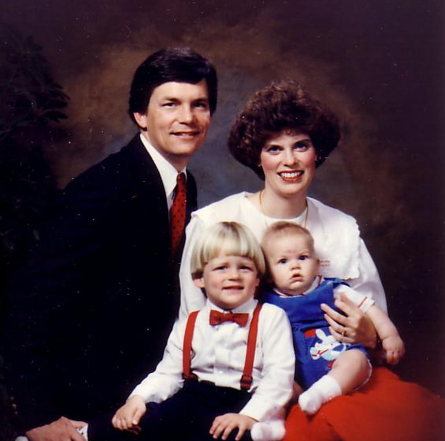
1991: Move to Singapore
Rick, 33
Susan, 30 something
Kurt, 4
Stephen, 1
1991:搬迁到新加坡
Notes:
So 10 years after our first move to Asia as singles, we arrived as a family of four.

Slide 3
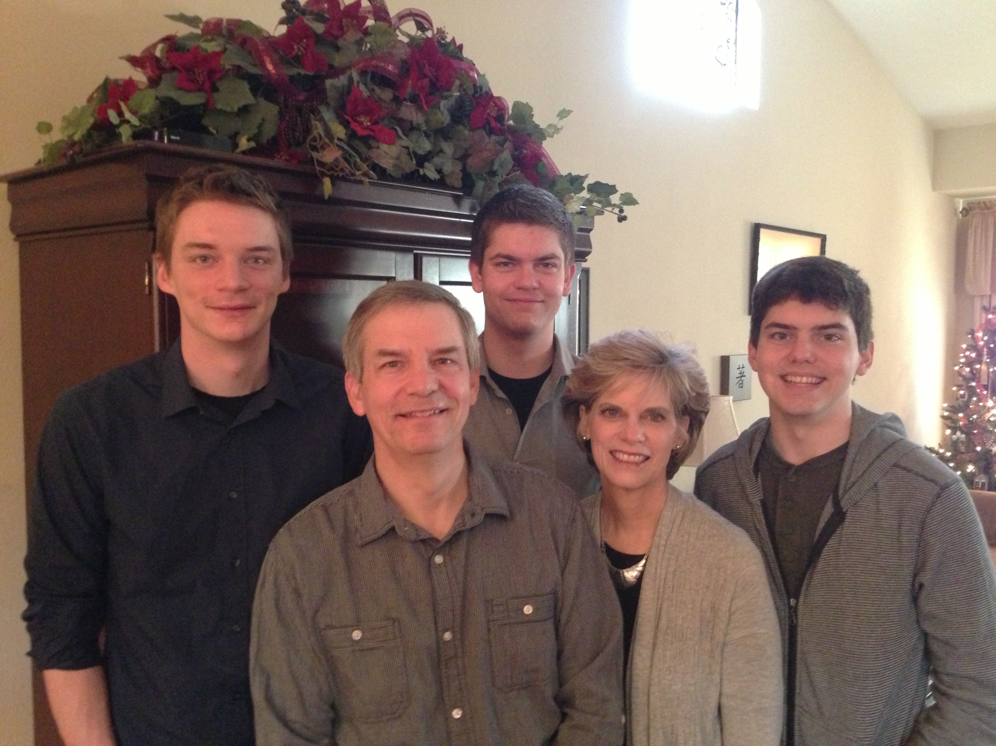
2012年十二月 顾家合照
Kurt 26
Stephen 23
John 20
The Griffith Family Dec 2012
Rick
Susan
Notes:
SUSAN: God continues working in our family as we see Him work in our three sons. Our two older ones work in Seattle and our youngest (John) is in his first year at Biola University in Southern CA. We lived in the USA his first semester, pretending that he needed us until we returned to Singapore on January 5.

Slide 4
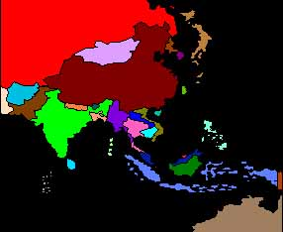
Singapore's Strategic Location
新加坡位居策略性的地点
10/40 Window 10/40之窗
Poorest Area 最贫穷的区域
97% of Unreached 97％未得之民

Slide 5
God's Will?
Marriage
Ministry
?
Job
婚姻
服事
?
工作
神的心意为何？

Slide 6
How can you do God's will rather than your own?
你如何方能按神的心意而行而非凭己意行呢？

Slide 7
Two Kings
二个王

Slide 8
I. Don't say you want God's will when you've already made up your mind (1 Kings 22:1-4)
一、当你已经按自己的意思作了决定时，你不要说你愿按著神的心意而行(王上22:1-4)

Slide 9
Black

Slide 10
The Aramean Threat
亚兰人的威胁
Mesopotamia
Aram 亚兰
Ben-Hadad 便哈达
美索波大米亚
The Great Sea
Israel 以色列
Ahab 亞哈
大海
Judah 犹大
Jehoshaphat 约沙法
Persian Gulf
Egypt 埃及
波斯湾

Slide 11
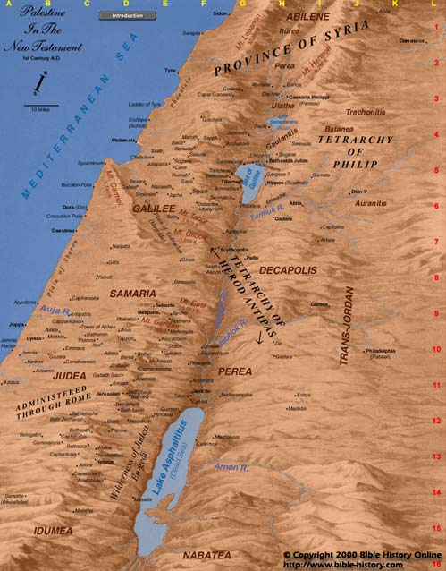
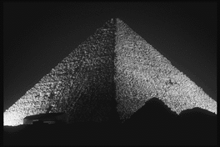
The Way of the Sea 沿海通道
Aram 亚兰
Israel 以色列
Ramoth-Gilead 基列的 拉末
Megiddo 米吉多
Judah 犹大
Egypt

Slide 12
Black

Slide 13
Are you asking for God’s will but your decision is already made?
你是否在寻求神的意旨的当儿，自己又已经作了决定呢?

Slide 14
“Oh, Lord, use me as You will —especially as an advisor!”
“神啊！求你按著祢的意旨使用我 —特别是成为我生命中的谘询者!”

Slide 15
Black

Slide 16
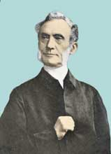
“I seek at the beginning to get my heart into such a state that it has no will of its own in regard to a given matter”
“當我尋求神心意一開始的時候，我就求神預備我的心對於該特定事項，保持完全沒有任何既定方向的狀態。”喬治﹒慕勒
—George Mueller (1805-1898)

Slide 17
Black

Slide 18
II. Don't seek counsel only from those “on your side” (1 Kings 22:5-28)
二、不要單單 諮詢 那些與你站“同一陣線”的人之 意見 (王上 22:5-28)

Slide 19
Black

Slide 20
Are we seeking godly advice in our pursuit of God’s will?
當我們在追尋明白神的旨意的時候， 我們是否尋求一些虔敬的意見?

Slide 21
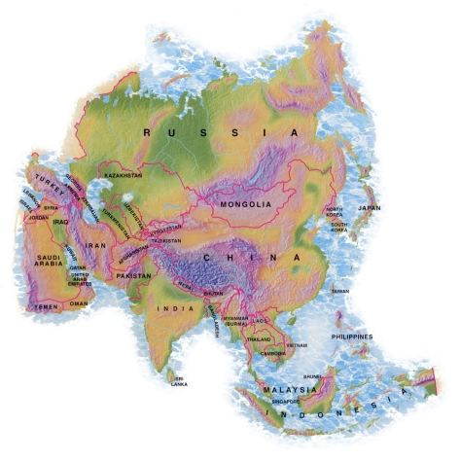
Mongolia? 蒙古？

Slide 22
三、當你漠視神清楚的意旨時，你將會招致大禍！ (王上 22:29-40)
III. Ignoring God's clear will is disastrous (1 Kings 22:29-40)

Slide 23
Black

Slide 24
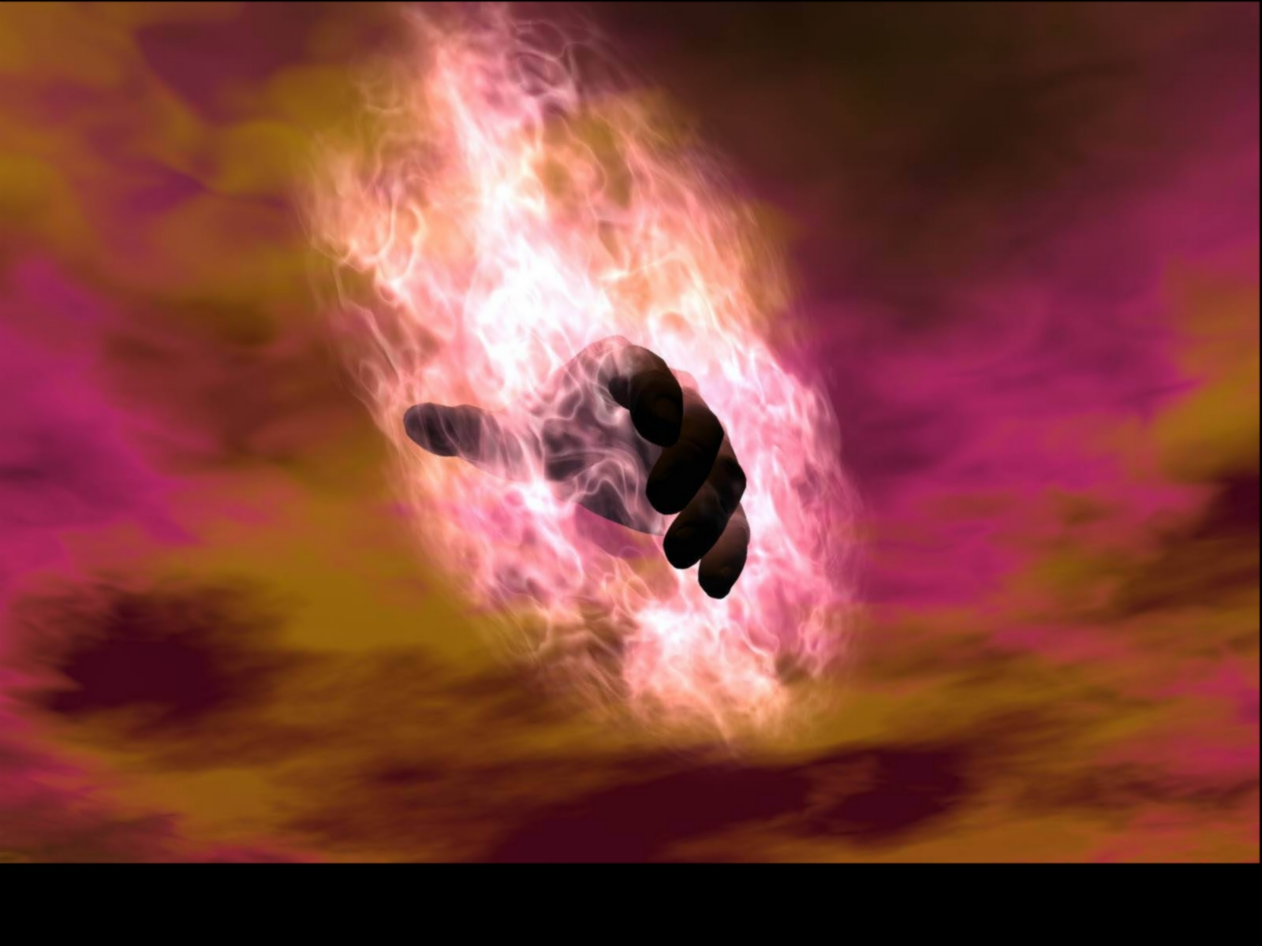
What may result from seeking your will rather than God’s will?
當你尋求自己的意思而非神的旨意時，會為你帶來什麼後果呢？

Slide 25
What results from seeking God's will?
當你尋求 神的 意旨時，又會有什麼 後果呢?

Slide 26
I. Don't say you want God's will when you've already made up your mind (1 Kings 22:1-4)
一、当你已经按自己的意思作了决定时，你不要说你愿按著神的心意而行(王上22:1-4)

Slide 27
II. Don't seek counsel only from those “on your side” (1 Kings 22:5-28)
二、不要單單 諮詢 那些與你站“同一陣線”的人之 意見 (王上 22:5-28)

Slide 28
三、當你漠視神清楚的意旨時，你將會招致大禍！ (王上 22:29-40)
III. Ignoring God's clear will is disastrous (1 Kings 22:29-40)

Slide 29
—Main Idea— Seek the Lord sincerely because ignoring God's clear will has serious results
—中心思想— 誠心地 尋求主，因為漠視神清楚的意旨將導致嚴重的後果

Slide 30
Black

Slide 31
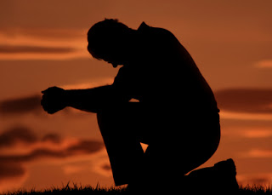
Take time out
歇下腳步

Slide 32
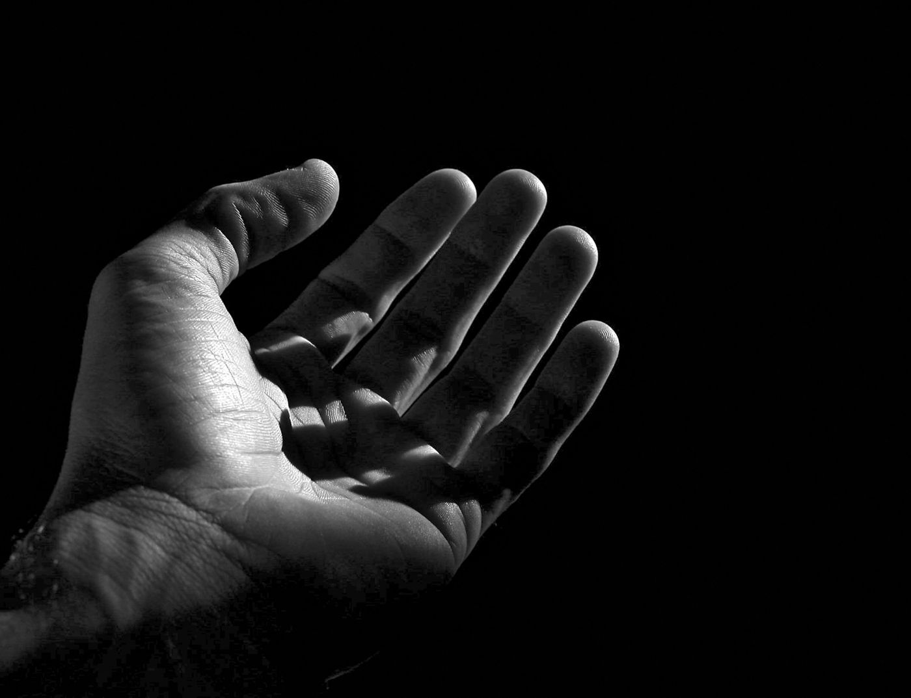
Open your hand 張開你的手
When your will is God's will, you will have your will.
當你的意念就是 上帝的心意之際, 你就會擁有 你的意念。
––Charles Spurgeon 司布真

Slide 33
Black

