Slide 1
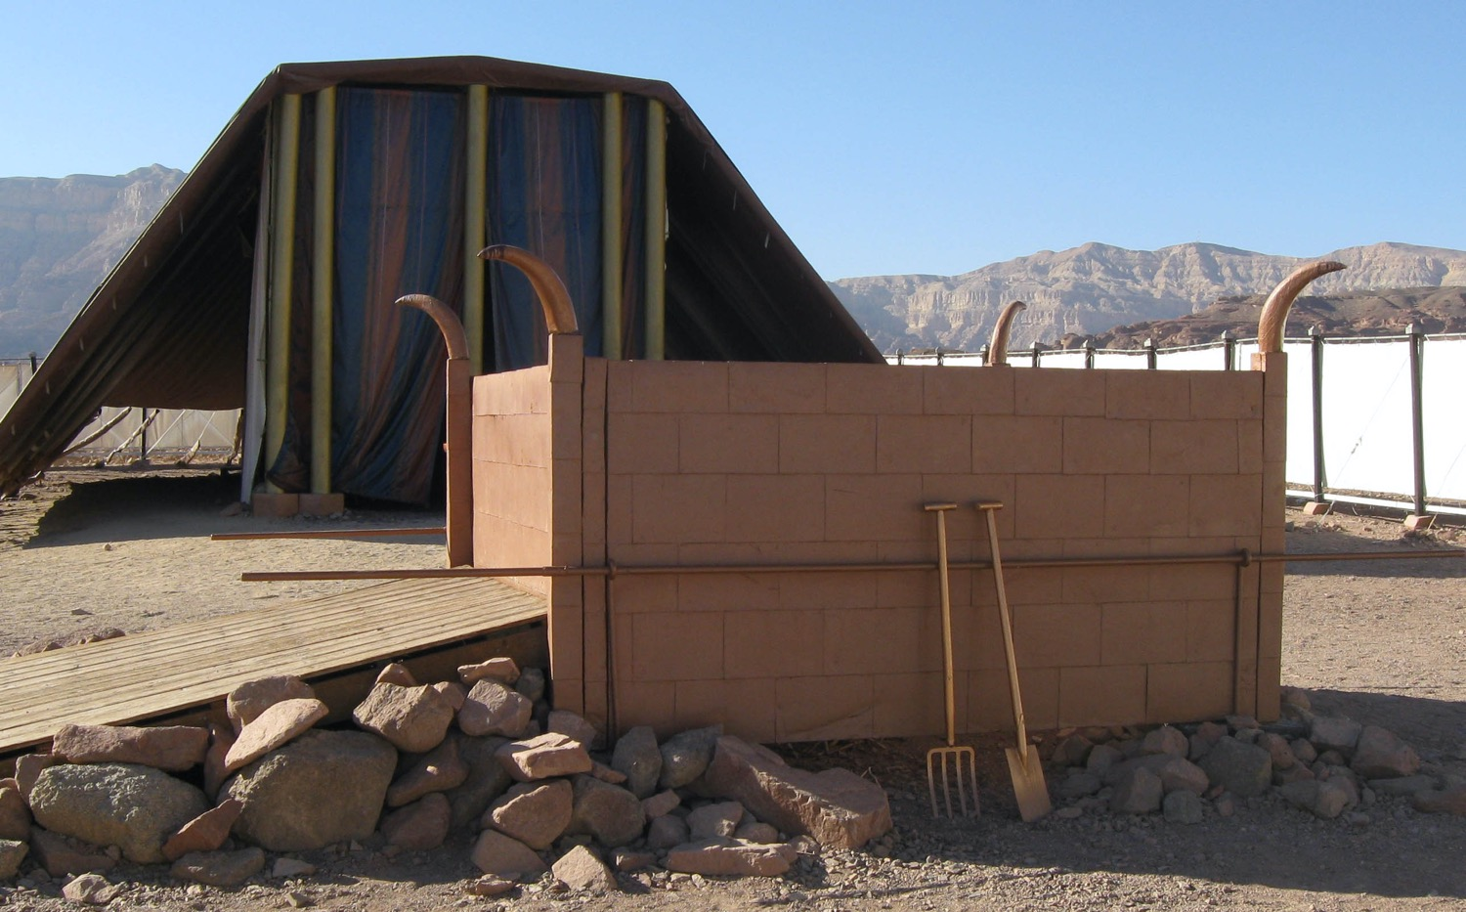
献上的五项祭物
利未记第 1:1–6:7
Dr. Rick Griffith • Crossroads International Church Singapore
新加坡神学院 • CICFamily.com • BibleStudyDownloads.org

Slide 2
基督徒都这么做吗?
Notes:
Tell your answer to this question to the person next to you.

Slide 3
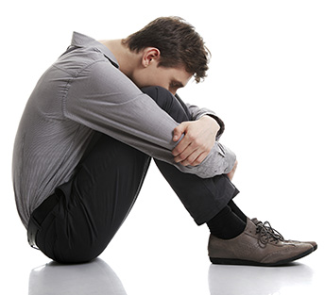
虽然我们身为领袖已被神洁净可是我们仍然还是会离弃神
那我们该如何做呢？

Slide 4

新约中的罪得赦免
OB 175p
OS 121b
管道 = 与神的关系（永不改变）
罪
堵塞 =与神的团契（被罪阻碍）
Notes:
Do we still have a relationship with God when we sin? Yes!
Sin does not hinder our relationship with God but our fellowship with Him.
OT sacrifices did not establish a relationship with God but rather they restored their fellowship with God
OB-38-Salvation-11
OS-03-Leviticus-130

Slide 5

你如何持续的与神同行?
承诺？
读经？
祷告？
其他方法？
Notes:
• Some people make promises to God that they will go wherever he wants them to go.
• Others vow that they will never miss a day of Bible reading the rest of their life.
• Still others promise daily prayer.
• How do you sustain your walk with God? What should you do?

Slide 6

你如何持续与神的交通？

Slide 7
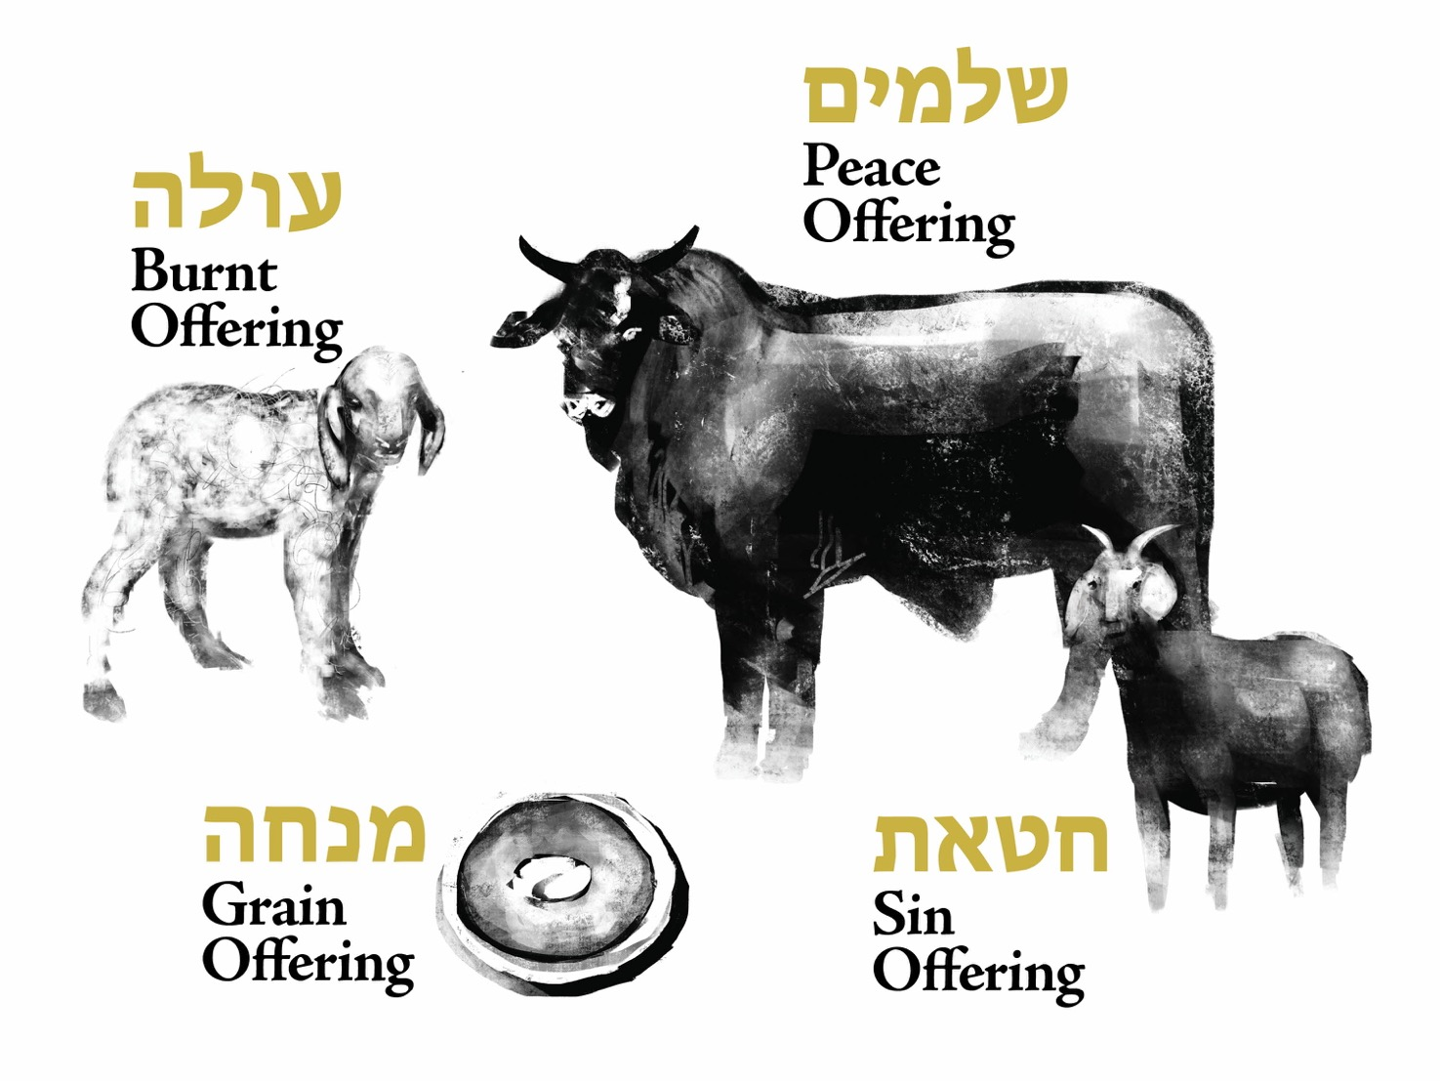
利未记第 1-7 章中的献祭
平安祭
全牲的燔祭
素祭
赎罪祭 & 赎愆祭
Notes:
We can gain insight today from studying the various offerings in the OT book of Leviticus.
How?
OT sacrifices did not establish a relationship with God but rather they restored fellowship with God for Israelites .

Slide 8
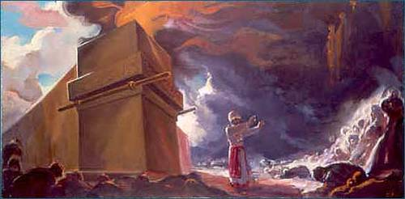
背景
Notes:
Israel already had a relationship with God—the new nation just needed to know how to sustain their fellowship with God.

Slide 9



逾越节的羔羊
Notes:
A year earlier, each Israelite had been saved from death by faith in an innocent lamb.

Slide 10

逾越节的保护
涂在门上的血是一个记号，我经过的时候，见到这血就会越过。我击打埃及的时候，那灾祸不会落到你们身上。
出埃及记 12:13
Notes:
They shed the Passover lamb’s blood and put it on their doorposts.

Slide 11
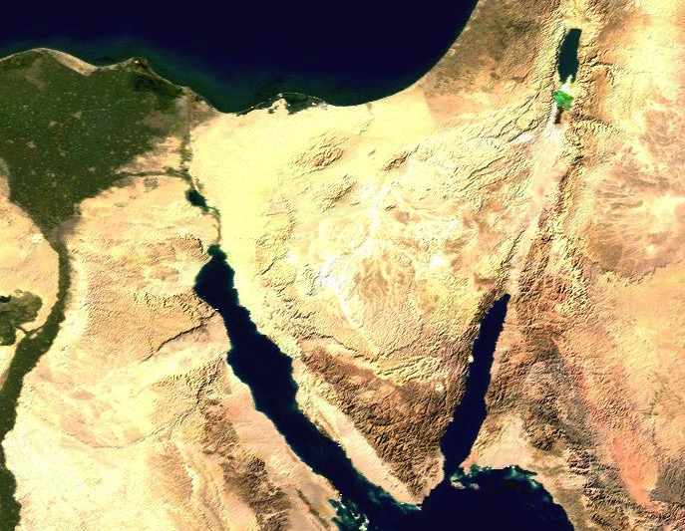
出埃及的路线
107
111a
123
迦南
歌珊
汛的旷野
玛拉
以琳
米甸
西奈山
Notes:
Then God miraculously parted the Sea and led his people out of Egypt—a picture of salvation for the believers since each of those redeemed had been saved from death by the Passover lamb’s blood. In other words, they had a personal relationship with God.

Slide 12
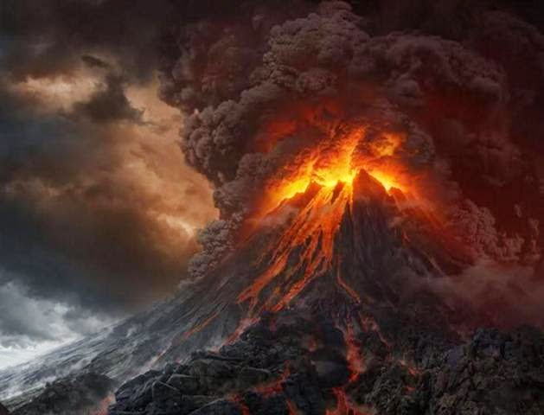
西奈山
Notes:
Israel invited God’s presence at Mt. Sinai and God was pleased to dwell with them (Exodus 39:34).
Despite God’s awesome holiness at Sinai, they had come into a relationship with God though the Passover lamb at the Exodus.

Slide 13
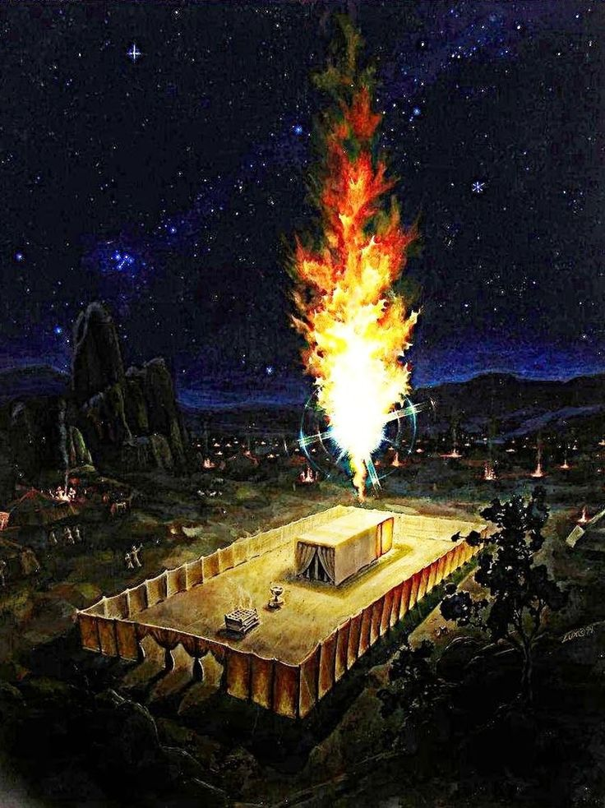
Background
Notes:
Now they stand there at the tabernacle wondering how long this will last. How could they experience God’s blessing, guidance and reality continually?

Slide 14
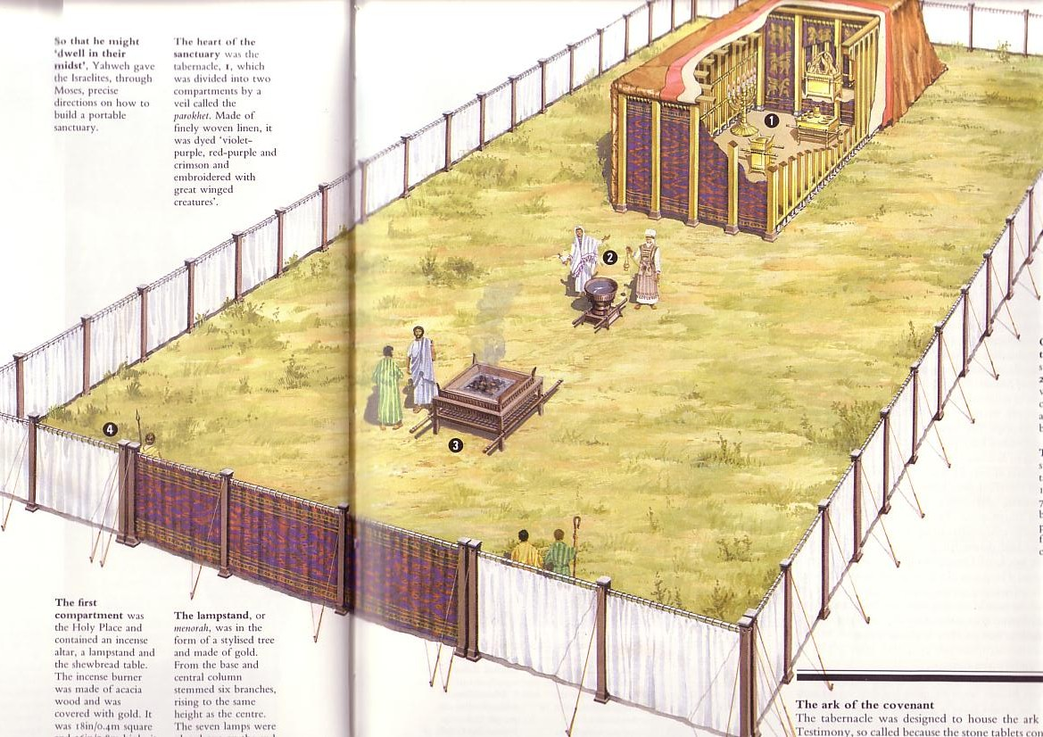
利未记写作的处境
123
以色列人在出埃及记刚建好会幕
但是他们不晓得如何使用它
摩西写了利未记来解释在新国度里的敬拜和生活
Notes:
The tabernacle was finished but now they needed to know what to do with it!

Slide 15
你如何持续与神的交通？
两条进路
利未记第 1:1–6:7
Notes:
(So what is the first way to maintain fellowship with your holy God?)

Slide 16

I. 做你不必做的
—在敬拜中的额外行动
Notes:
Do things that are voluntary to honor the Lord—especially when life is so busy that we don’t do anything optional.

Slide 17
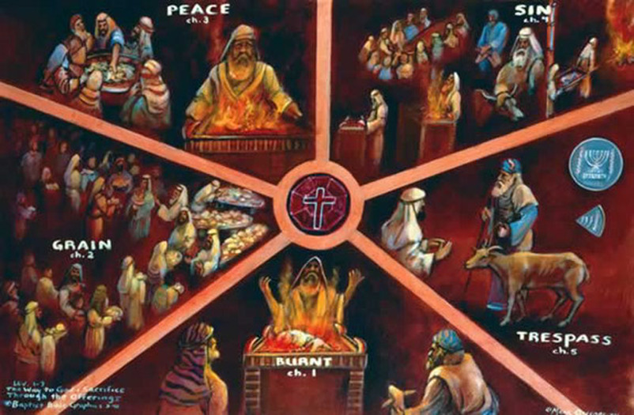
利未记第 1-7 章中的献祭
平安祭
赎罪祭
I. 做你不必做的
—在敬拜中的额外行动
素祭
赎愆祭
全牲的燔祭
Notes:
Israel could continue to enjoy God’s presence by three sacrifices for consecration when in fellowship (Lev 1–3).
We also should express our love to God in new ways.

Slide 18
利未记 1

Slide 19
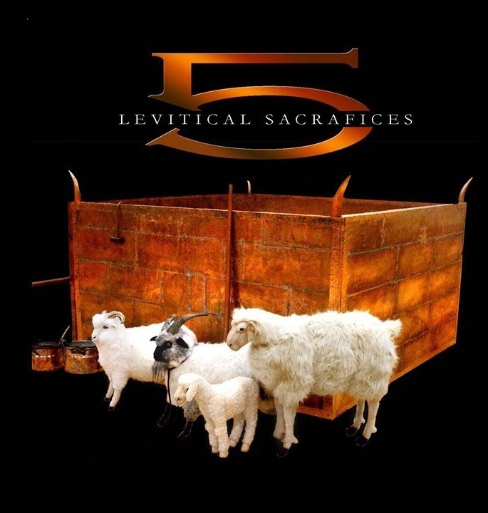
全牲的燔祭
凡我所有都属神
利未记第 1:3-17
Notes:
The burnt offering was a voluntary sacrifice that totally consumed the animal to draw near to God in total dedication (Lev 1).

Slide 20
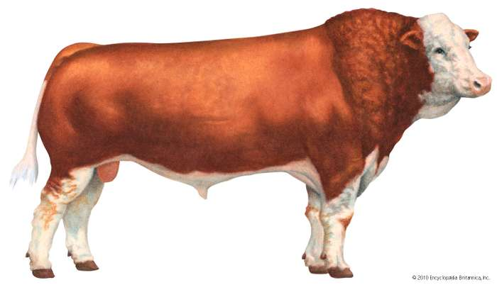
利未记第 1-7 章中的献祭
全牲的燔祭
Notes:
The burnt offering begins with instructions to offer a bull. Wow, what an expensive gift to God! This would be several months or even a year or more wages for people!

Slide 21
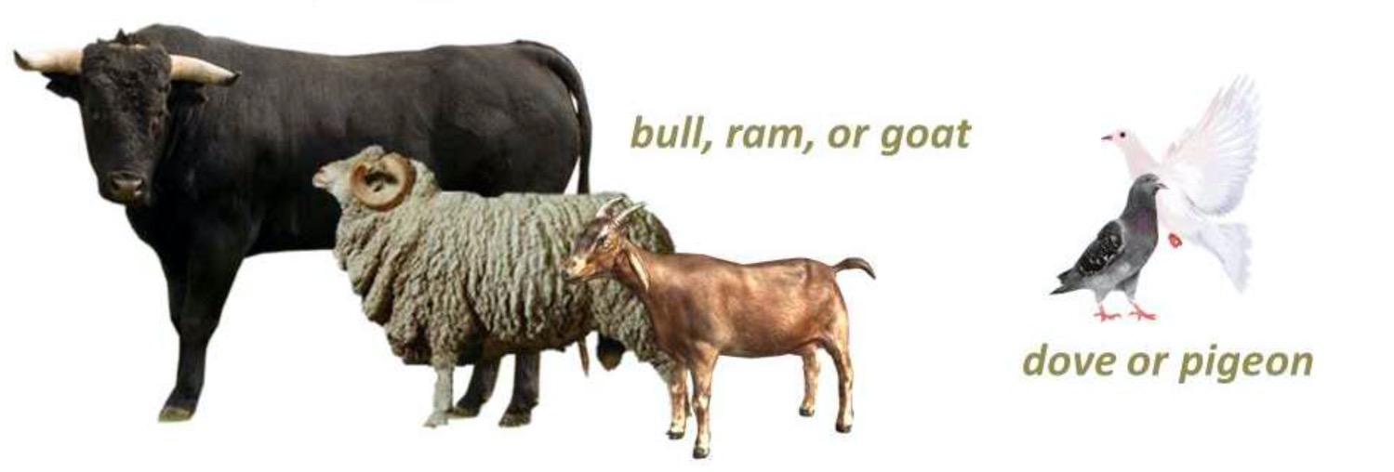
利未记第 1-7 章中的献祭
全牲的燔祭
公牛，公绵羊，公山羊
鸽子
Notes:
But notice that God allowed various types of animals for the same offering.
“1:2. This verse forms a transition to the law of the burnt offering by referring to an offering (NA;b√r∂q, “that which is brought” to God—a general term covering all sacrifice) from either the herd (i.e., a bull, vv. 3-9) or the flock (i.e., a sheep or goat, vv. 10-13). With the addition of birds (vv. 14-17), this provides the formal outline of the law of burnt offering (see also 6:8-13), the animals of the offering being listed in a descending order of value” (BKC).
God allowed expensive offerings (bulls) for the wealthy, moderate animals for the middle class (lambs, goats), and the poor could offer as simple an animal as a bird. Likewise, he instituted the tithe because he made sure that even the poorest person could live on 90% of his income.

Slide 22
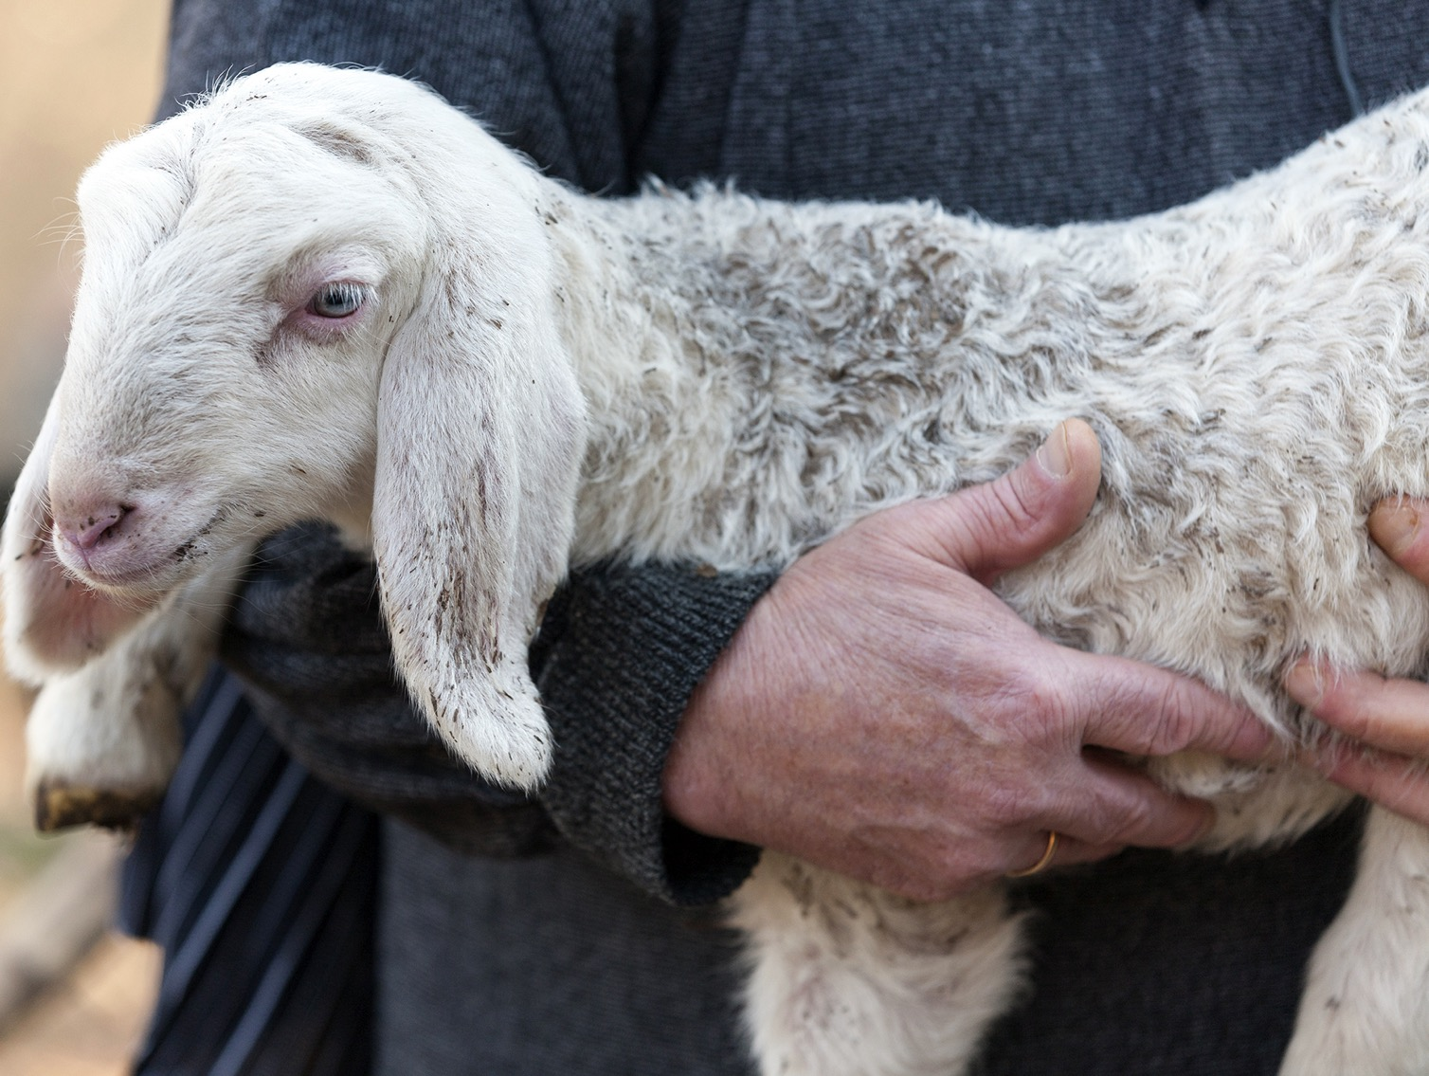
无瑕疵的祭物
Notes:
But one thing that characterized all of these offerings is that they must be perfect animals without defect—just like our Lord Jesus Christ.

Slide 23
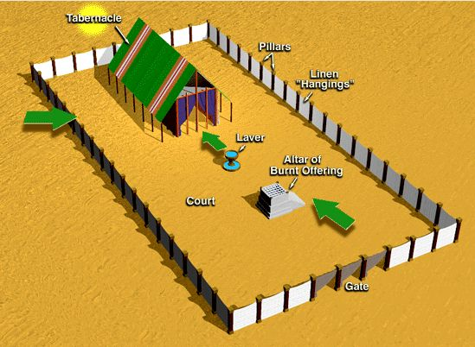
会幕 及 院子
会幕
柱子
细麻帷子
洗濯盆
燔祭坛
院子
门
Notes:
The process was also clearly given.

Slide 24
利未记第 1–5 中的献祭礼仪
128
敬拜者奉上自己的献祭。
他按手在要被宰杀的牺牲物上，大约同 时认罪。
3. 敬拜者宰杀牺牲物。

Slide 25
利未记第 1–5 中的献祭礼仪
128
4. 祭司将血接在盆里，并抹在燔祭坛的东北和西南角，让祭坛的四边都溅上血。剩下的血则全倒在燔祭坛脚。

Slide 26
利未记第 1–5 中的献祭礼仪
128
5. 一部分献祭用来烧在坛上
R. T. Beckwith, New Bible Dictionary, 1962
Notes:
But for a burnt offering, the ENTIRE sacrifice was burned.

Slide 27
利未记第 1–5 中的献祭礼仪
128
6. 所有剩余的献祭则在献祭餐中由祭司或敬拜者（平安祭中）、或是祭司及其家人、或是祭司自己吃掉。
R. T. Beckwith, New Bible Dictionary, 1962

Slide 28
利未记 2

Slide 29

素祭 (利未记第 2)
Notes:
The staple of our diet comes from grain.

Slide 30
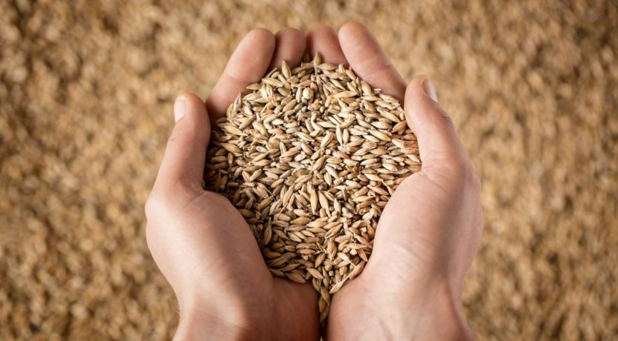
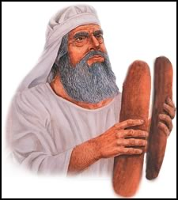
素祭 (利未记第 2)
Notes:
When God provided grain, Israelites could offer some back to God to say thank you.

Slide 31
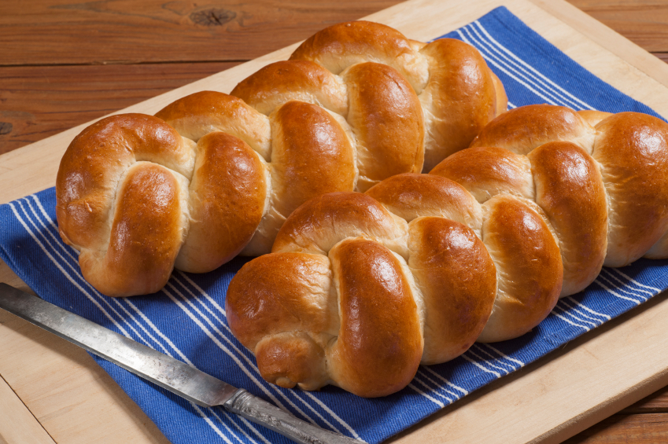
素祭 (利未记第 2)
Notes:
Sometimes grain could be in the form of baked loaves.

Slide 32
旧约里的献祭
128
献祭名
旧约经文
献祭物
意图
燔祭
利 1
6:8-13
8:18-21
16:24
没有残疾的公牛、公羊、或雄鸟 (若是穷人则献斑鸠或雏鸽); 完全烧尽
自愿的敬拜; 为赎普通的无心之失; 表达对神的降伏
素祭
利 2
6:14-23
谷粒，细面，油，乳香，无酵细面饼，用盐调和，与
燔祭和平安祭
同献
自愿的崇拜; 感激神的良善与供应; 表达对神的忠心
圣经资料图书, 29

Slide 33
利未记 3

Slide 34
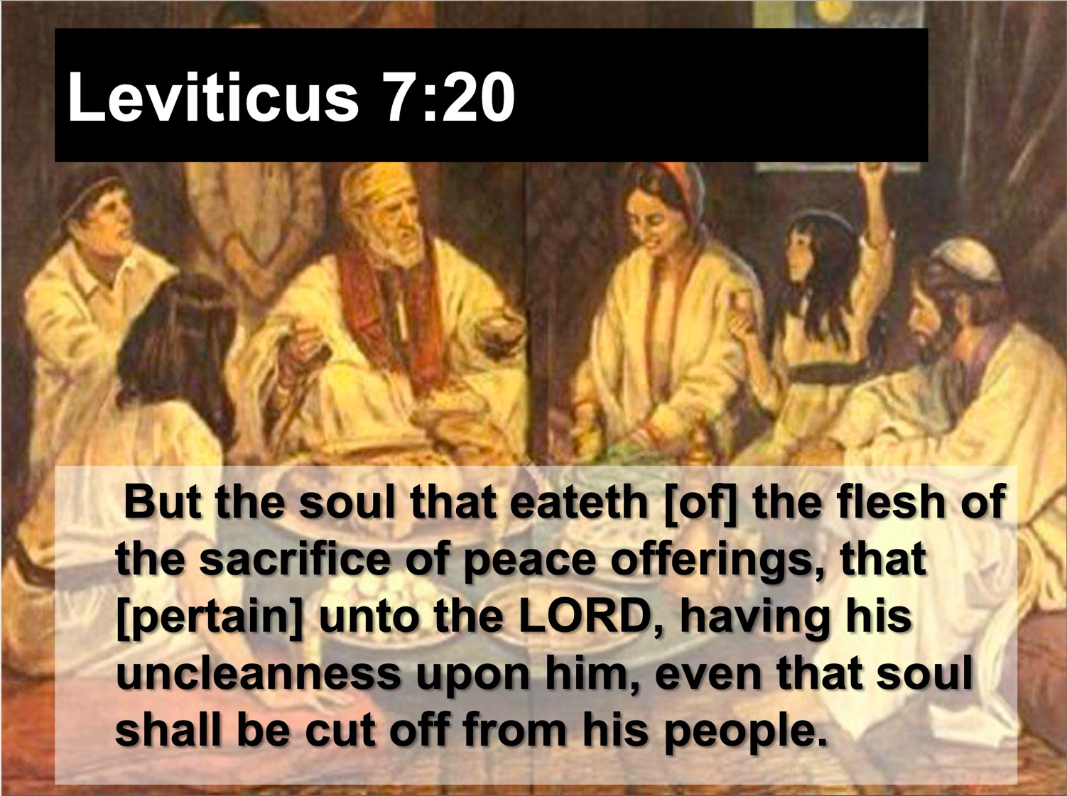
平安祭 (利未记第 3)
“为感恩而献的平安祭的肉，只能在献祭那日吃，一点也不可留到早晨”
(利未记第 7:15 CNV)
Notes:
“The distinctiveness of the fellowship offering was in the communal meal which the worshiper and his family ate before the Lord (cf. 7:15). It was essentially a voluntary act in which the worshiper accepted the meat from God as a token of His covenant faithfulness and gave God acknowledgment or thankful praise for His past blessings bestowed, whether in answer to prayer, or granted unexpectedly, or the normal blessings [1:180] such as a good harvest” )” (Lindsey, BKC, 1:179-80).

Slide 35
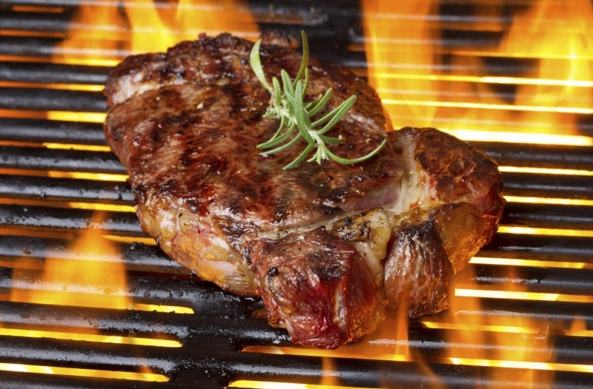
为什么神喜悦馨香之气
(1:9, 17; 2:2, 9, 12; 3:5, 16; 4:31)?
Notes:
Why are these offerings called “an aroma pleasing to the LORD” (Lev. 1:9, 17; 2:2, 9, 12; 3:5, 16; 4:31)?
• Simply put, God likes BBQ!
More seriously, the Lord is pleased to see his people follow his ways. All obedience is like a sweet fragrance to God—especially sacrifices that express our love for him or restore our fellowship with him

Slide 36
我们应该以他所指定以外的方式来爱神
Notes:
Do things that are voluntary to honor the Lord—especially when life is so busy that we don’t do anything optional.

Slide 37
罗马书十二章
154e
义应用在更新的生活

Slide 38

罗马书里的义
145
主题 | 需要 | 供应 | 传授 | 证实 | 应用 | 传播
序言 1:1-17 | 定罪 1:18– 3:20 | 称义 3:21– 5:21 | 成圣 6–8 | 拣选 9–11 | 更新 12:1– 15:13 | 宣教 15:14– 16:27
开始 | 犯罪 | 救恩 | 分别为圣 | 主权 | 服事 | 差遣

Slide 39

罗马书
154e
“。。。要把身体献上，作圣洁而蒙神悦纳的活祭（持续不断地）。。。”
Notes:
Offering our bodies continually is our counterpart to the whole burnt offering (Rom 12:1)—but staying alive on the altar is challenging.

Slide 40


罗马书 12:2
轉化
藉着心意更新

Slide 41


不 要 效 法 这 个 世 界 ， 只 要 心 意 更 新 而 变 化 ， 叫 你 们 察 验 何 为 神 的 善 良 、 纯 全 、 可 喜 悦 的 旨 意 。
罗馬12:2

Slide 42
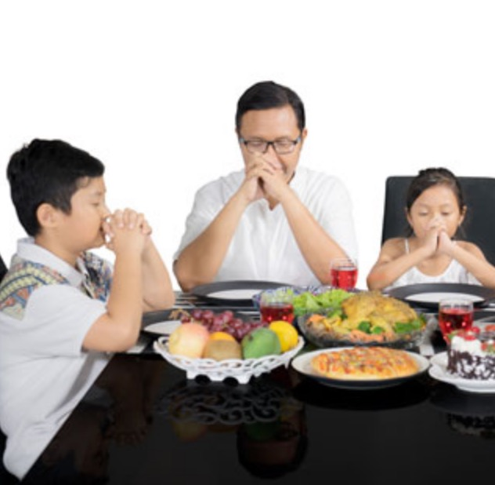
素祭 = 感恩
Notes:
Thanking God for our food parallels the grain offering.

Slide 43

身体及生命（罗12）
154e
Notes:
Community worship is also a fantastic privilege! Don’t look at church as a burden but as a blessing. That’s why the fellowship offering is also called the peace offering. “The typology of the fellowship offering pictures the fellowship that the New Testament believer has with God and with other believers on the basis of Christ’s death on the cross (1 John 1:3). This is one phase of Christ’s ‘making peace through His blood, shed on the cross’ (Col. 1:20). In fact, ‘He Himself is our peace’ (Eph. 2:14)” (Lindsey, BKC, 1:180).

Slide 44
旧约里的献祭
128
献祭名
旧约经文
献祭物
意图
平安祭
利 3
7:11-34
没有残疾的
山羊或绵羊;
各种面
自愿的; 通过共餐表达感恩
赎罪祭
利 4:1-5:13
6:24-30
8:14-17
16:3-22
没有残疾的公牛、公羊或母羊; 斑鸠或雏鸽 (穷人); 每个穷人1/10伊法的细面
义务的;
为赎误犯之罪; 为认罪、得赦免、得洁净
赎愆祭
利 5:14-6:7
7:1-6
没有残疾的公羊或羊羔
义务的，为赎误犯之罪；偿还亏欠的加 20%
圣经资料图书, 29
Notes:
Peace and fellowship were experienced in a group meal.

Slide 45
I. 做你不必做的
—在敬拜中的额外行动
Notes:
Do things that are voluntary to honor the Lord—especially when life is so busy that we don’t do anything optional.

Slide 46
利未记第 1-7 章中的献祭
平安祭
赎罪祭
I. 做你不必做的
—在敬拜中的额外行动
素祭
赎愆祭
全牲的燔祭
Notes:
Israel could continue to enjoy God’s presence by three sacrifices for consecration when in fellowship (Lev 1–3).
We also should express our love to God in new ways.

Slide 47
利未记第 1-7 章中的献祭
128
全牲的燔祭
素祭
平安祭
赎罪祭
赎愆祭
成圣
自愿的
洁净
义务的
Notes:
• So the first group of three offerings tell us to do what is not required—
• extra acts of worship from consecration to God.
• But now we will see another group, so what is the difference between this group of sacrifices? Why have two different groups of offerings? The first three simply expressed thanks and worship of God.
• But now the last two enabled worshippers to confess their sin in a very tangible way.
• Sacrifices of consecration were voluntary.
• But sacrifices of cleansing were obligatory.
So what is the second way to maintain fellowship with your holy God? These last two offerings teach us to…

Slide 48

II. 做我们应当做的—认罪
Notes:
Do things that are compulsory to restore our walk the Lord.

Slide 49
利未记第 1-7 章中的献祭
平安祭
赎罪祭
II. 做我们应当做的—认罪
素祭
赎愆祭
全牲的燔祭
Notes:
Do things that are compulsory to restore our walk the Lord (Lev 4:1-6:7).
Israel could continue to enjoy God’s presence by sacrifices for cleansing when out of fellowship (4:1–6:7).
Give priority to take time to agree with God about your own sin.

Slide 50
利未记 4

Slide 51
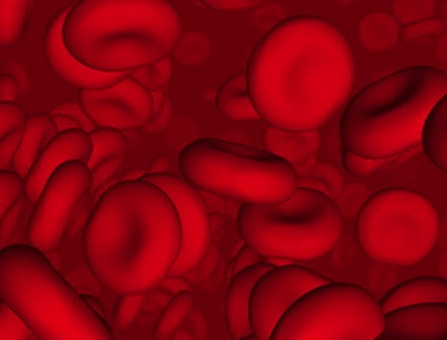
神为什么建立献祭
的体制？
（动物的）血真的饶恕
了罪吗？
Notes:
Did these sacrifices forgive sin in the sense that they established a relationship with God?

Slide 52
血祭能否拯救人于律法之下?
血
Notes:
The answer is NO, for Israel was already a saved community.

Slide 53
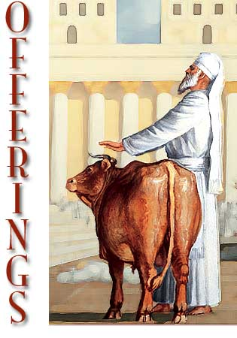
牺牲宽恕罪过
“收 拾 这 牛 ， 与 那 赎 罪 祭 的 牛 一 样 。 祭 司 要 为 他 们 赎 罪 ， 他 们 必 蒙 赦 免 。”
(利 4:20 和合本; 对比4:26, 31, 35).
Notes:
They only needed to know how to maintain their fellowship with a holy God.

Slide 54
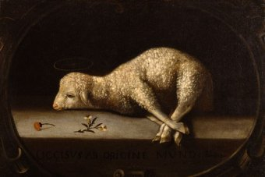
神借奉献的血赦免了以色列人
(利未记 4:1 - 5：13; 6:24 - 30)。
Notes:
Jews restored their fellowship with the Lord through sin and guilt sacrifices.

Slide 55
利未记 5

Slide 56
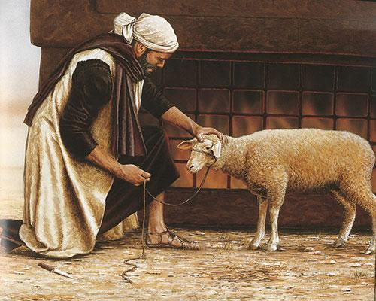
通常是加罰金五分之一
(5:14–6:7; 7:1-10).
+20%
Notes:
The guilt (trespass) offering was an obligatory sacrifice to make restitution for withholding proper due from God or man (5:14–6:7).
• It required an additional 20% restitution for doing wrong to someone else.

Slide 57
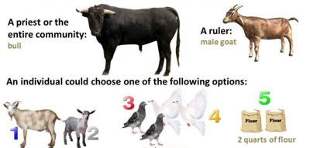
Guilt Offerings (赎愆祭)
用意：赎无意中犯的罪
取决于犯罪者的身份
为官长
为大祭司，为全会众
bull 公牛
male goat
公山羊
为其他居民
母山羊或母羊
两只鸽子
细面伊法十分之一
Notes:
God made covering one’s guilt possible no matter his social status!

Slide 58
旧约中的罪得赦免
121b
管道 = 与神的关系（永不改变）
罪
堵塞 =与神的交通（被罪阻碍）
献祭 = 承认罪 (罪得赦免恢复与神的交通，但与神的关系不受到威胁）
Notes:
当我们犯罪时我们与神仍然有关系吗？是的！Do we still have a relationship with God when we sin? Yes!
罪不阻碍我们与神的关系但会阻碍我们与神的交通。Sin does not hinder our relationship with God but our fellowship with Him.
旧约中的献祭并不能帮助人与神建立关系，而是帮助人恢复与神的交通。OT sacrifices did not establish a relationship with God but rather they restored their fellowship with God

Slide 59
新约中的罪得赦免
OB 175p
OS 121b
管道 = 与神的关系（永不改变）
“我 们 若 认 自 己 的 罪 ， 神 是 信 实 的 ， 是 公 义 的 ， 必 要 赦 免 我 们 的 罪 ， 洗 净 我 们 一 切 的 不 义 。”
(约翰一书 1:9 简体和合本)
罪
堵塞 =与神的团契（被罪阻碍）
基督的牺牲 = 认罪的基础（罪孽被原谅恢复团契，但是从未威胁过与神的关系）
Notes:
Do we still have a relationship with God when we sin? Yes!
Sin does not hinder our relationship with God but our fellowship with Him.
OT sacrifices did not establish a relationship with God but rather they restored their fellowship with God
OB-38-Salvation-11
OS-03-Leviticus-130

Slide 60
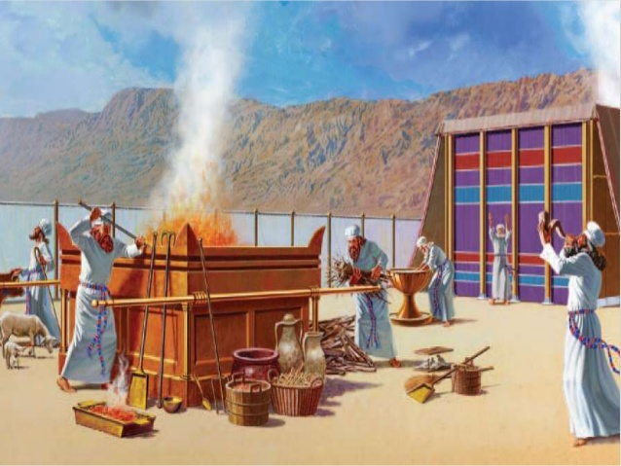
III. Main Point
Notes:
Imagine every sin costing you a month’s pay—would you sin less?

Slide 61
你如何持续与神的交通？
两条进路
利未记第 1:1–6:7
Notes:
(So what is the first way to maintain fellowship with your holy God?)

Slide 62

中心思想
敬拜神和承认你的罪
Notes:
Reverence Him and agree when you fail [restatement].

Slide 63
I. 做你不必做的
—在敬拜中的额外行动
Notes:
Do things that are voluntary to honor the Lord—especially when life is so busy that we don’t do anything optional.

Slide 64
II. 做我们应当做的—认罪
Notes:
Do things that are compulsory to restore our walk the Lord.

Slide 65
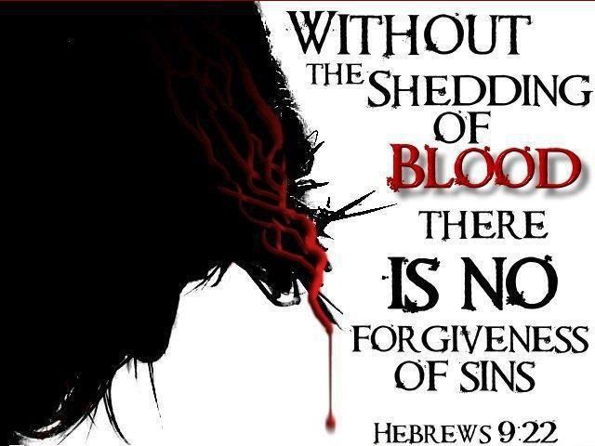
“按着律法，几乎所有都是用血洁净的，如果没有流血，
就没有赦免”
(来 9:22)
Notes:
Christ made the way for us.
Without the shedding of blood there is no forgiveness.

Slide 66

“这是我的身体”
Notes:
We celebrate forgiveness at the Lord’s Supper.

Slide 67
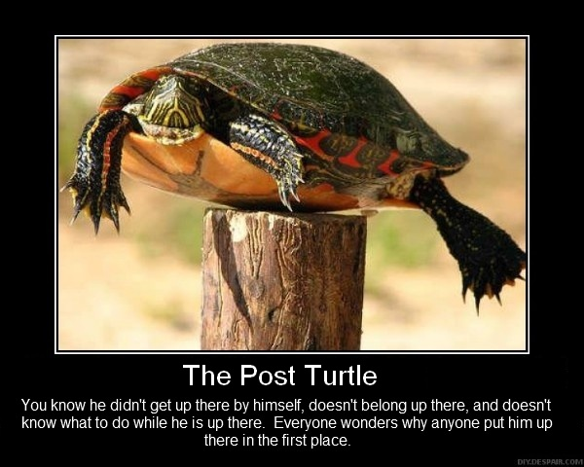
我不是靠自己来到这里的
Notes:
Admit, like a turtle on a fencepost, “I didn’t get here by myself.”

Slide 68

你的生活中有哪些行为需要认罪并除去？
你们要追求与众人和睦，并要追求圣洁；非圣洁没有人能见主。
希伯来书12:14 和合本
Notes:
What issue do you need to address with God now?
Telling the Lord that you love him?
Neglecting community?
Resisting his promptings?

Slide 69
Black

Slide 70


旧约全书讲章 • BibleStudyDownloads.org
免费获得该讲解!
圣经学习下载
Notes:
The explanation for free
OT Preaching link address

