Slide 1
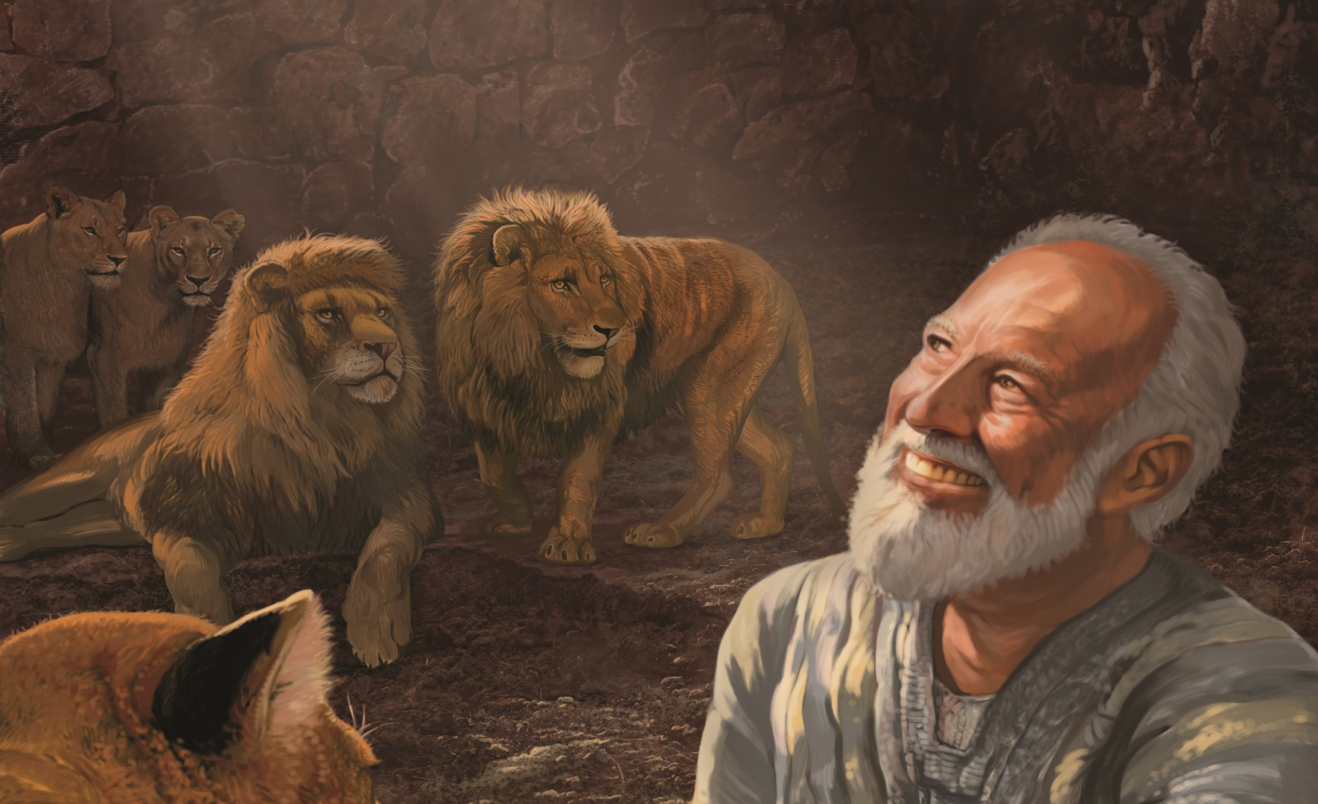
《但以理书》的作者归属
公元前六世纪还是二世纪？
Dr. Rick Griffith • Jordan Evangelical Theological Seminary
BibleStudyDownloads.org

Slide 2
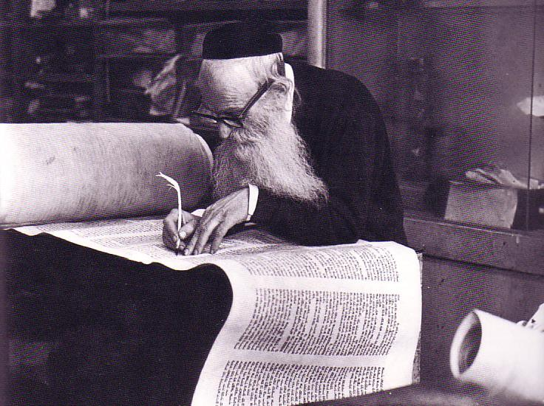
但以理书是谁写的?
533
内部证据: 7:2-12:13 (第一人称); 8:1; 9:2; 12:4
但以理书以外的证据: 以西结书 14:14, 20; 马太福音24:15

Slide 3
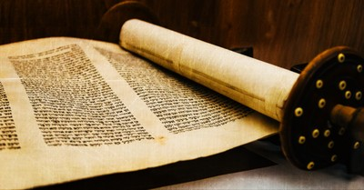
Support for Daniel's Authorship
Internal

Slide 4
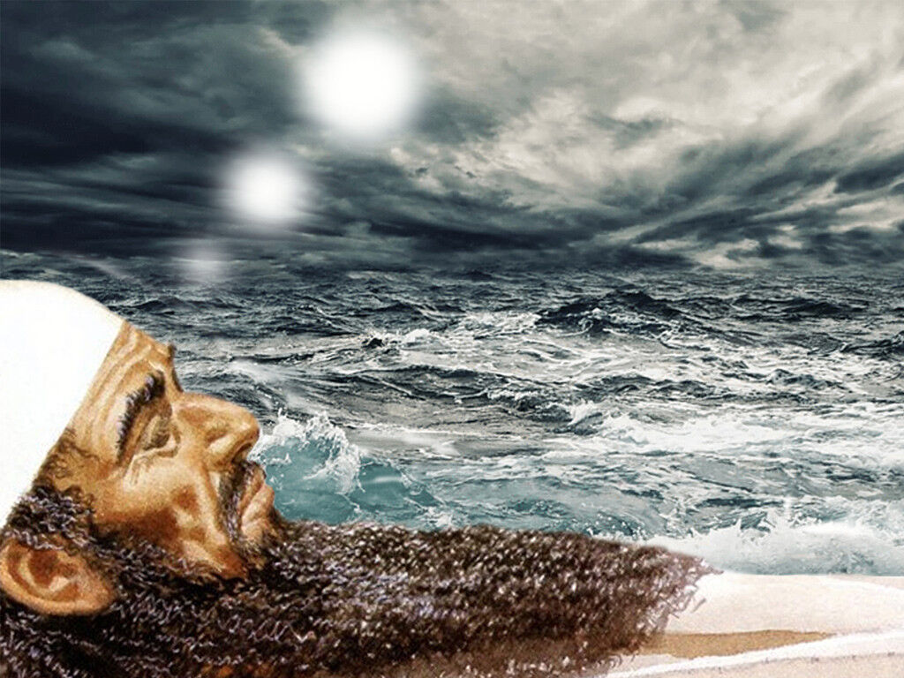
Daniel 7:2 is 1st Person
"Earlier, during the first year of King Belshazzar’s reign in Babylon, Daniel had a dream and saw visions as he lay in his bed. He wrote down the dream, and this is what he saw.
² In my vision that night,
I, Daniel, saw a great storm churning the surface of a great sea, with strong winds blowing from every direction"
(NLT).

Slide 5


放逐与回归之旅
阿勒坡
巴比伦
巴比伦尼亚
耶路撒冷

Slide 6
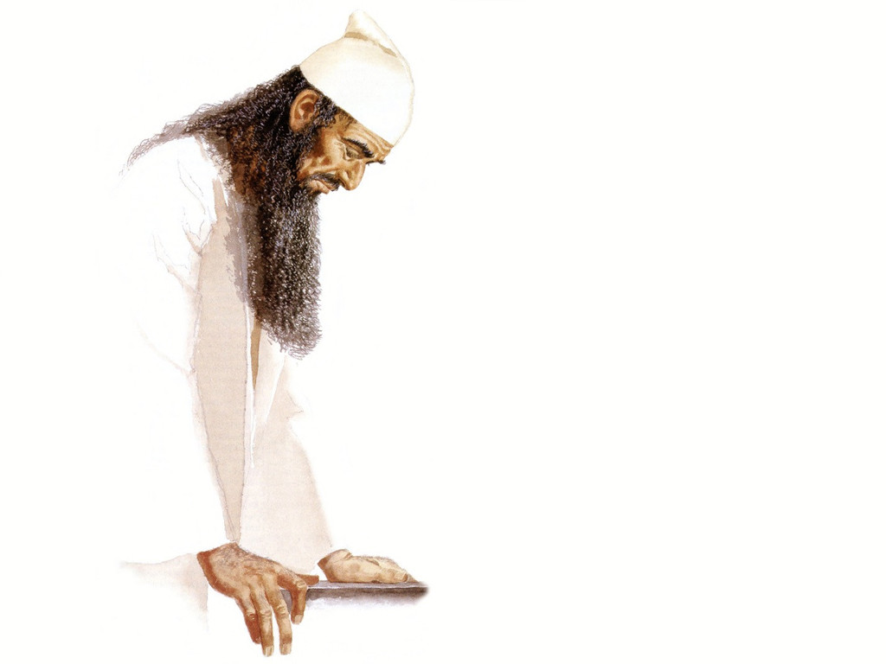
Daniel 8:1 is 1st Person
"During the third year of King Belshazzar’s reign,
I, Daniel, saw another vision, following the one that had already appeared to me"
(NLT).

Slide 7
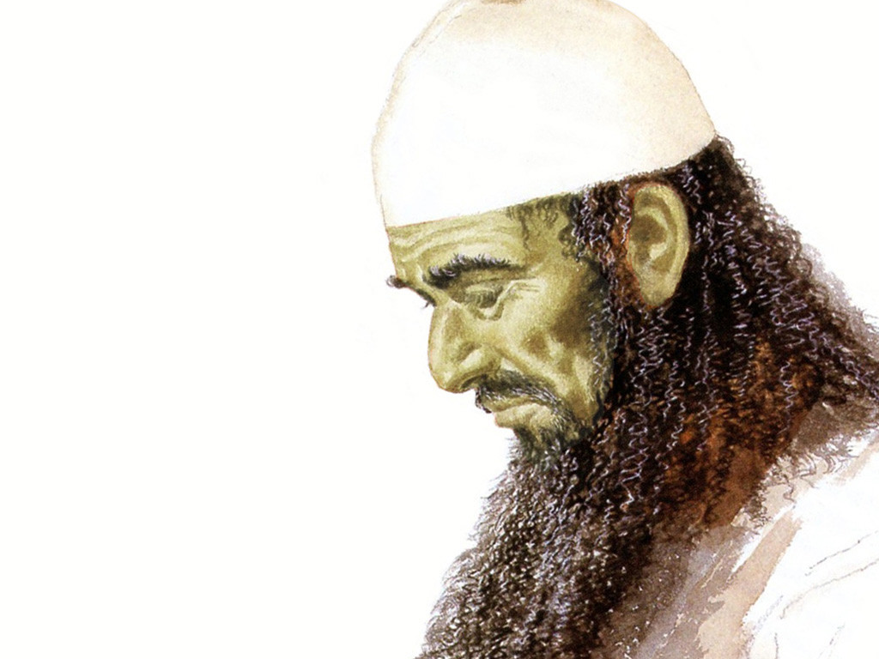
Daniel 9:2 is 1st Person
"During the first year of [Darius’s] reign,
I, Daniel, learned from reading the word of the LORD, as revealed to Jeremiah the prophet, that Jerusalem must lie desolate for 70 years" (NLT).

Slide 8
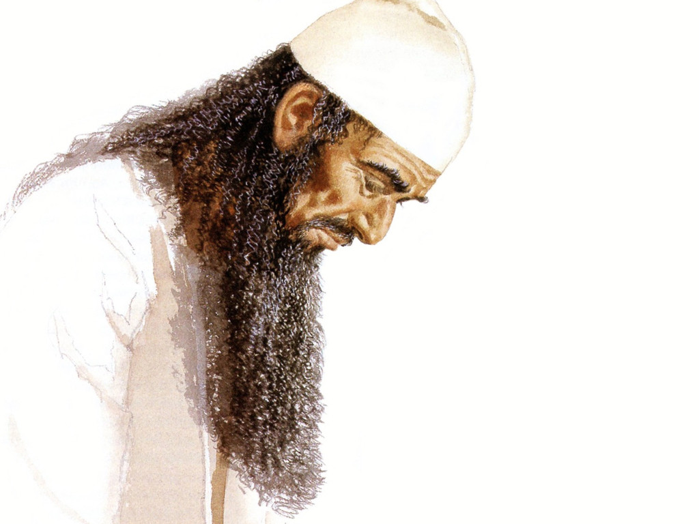
Daniel 12:5 is 1st Person
"Then I, Daniel, looked and saw two others standing on opposite banks of the river" (NLT).

Slide 9

但以理书主要日期
但以理的事奉
(1:1; 10:1)
605-536
但以理的预言
(2-11章)
605-AD 70
安提阿哥
亵渎圣殿
167-164
600
550
500
450
400
350
300
2 5 0
2 0 0
150
100
50
BC/AD
50
评论家认为历史事件
被记录为‘预言’
评论家认为但以理书
写作日期为BC164之后

Slide 10
流放时间表
605
70 年
536
以西结 592-572 (20)
但以理 605-537 (68)
耶利米 626-586 (40)
伯沙撒 550-539 (11)
巴比伦诸王
拿波尼德 555-539 (16)
先知
尼里格力沙 559-555 (4)
以未米罗达 561-560 (1)
尼布甲尼撒 605-561 (44)
尼布甲尼撒 630-605 (25)
650
600
550
500 主前

Slide 11
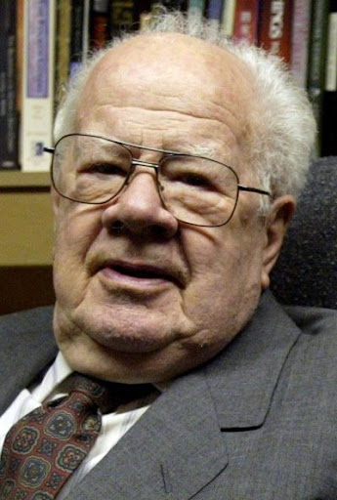
Dwight J. Pentecost, "Daniel,” in The Bible Knowledge Commentary; ed. John F. Walvoord and Roy B. Zuck; Accordance electronic ed. 2 vols.; Wheaton: Victor Books, 1985), 1:1324.
“Daniel’s familiarity with the individuals spoken of in the book and with the historical events and customs mentioned in the book necessitates a sixth-century date for the book. The minute details included in the book could hardly have been retained accurately by oral tradition for some 400 years, as suggested by those who postulate a late date for the book.”
Notes:
Seminary professor J. Dwight Pentecost taught until age 98
Dr. J. Dwight Pentecost (MONA REEDER - 87389)By dallasnews Administrator https://www.dallasnews.com/news/obituaries/2014/05/06/seminary-professor-j-dwight-pentecost-taught-until-age-98/
11:11 PM on May 5, 2014 CDT
The Rev. J. Dwight Pentecost taught more than 10,000 students during his decades at the Dallas Theological Seminary. He taught like he preached, without notes and from the Bible.
The distinguished professor emeritus of Bible exposition taught his last class in December, when he was 98.
Featured on Dallas News
Texas Gov. Greg Abbott scolds Austin for overly ‘stringent’ COVID-19 rules that nix veterans’ parade Gov. Greg Abbott on Tuesday blasted Austin officials for imposing overly restrictive COVID-19…
Pentecost, 99, died April 28 of natural causes at the Forum at Park Lane in Dallas.
A celebration of his life will be at 3 p.m. Wednesday on the seminary campus. Private graveside services were at Restland Memorial Park.
“Dr. ‘P’ — as we affectionately called him — was an inspiration to so many and an institution in his own time,” said seminary president Mark L. Bailey.
“We who have had the privilege to sit under him or teach beside him have all come to know and appreciate the whole of the Bible that our beloved friend believed so thoroughly and taught so faithfully for so many years — all centered in the words and works of Jesus Christ,” Bailey said.
Born in Chester, Pa., Pentecost was 10 when he realized God intended for him to become a minister, he said. His ancestors changed the family name to Pentecost after fleeing the persecutions of French Protestants in 1573. The family arrived in England on Pentecost, the seventh Sunday after Easter, when Christians celebrate the descent of the Holy Spirit on the apostles.
Pentecost attended Hampden-Sydney College in Virginia. He came to Dallas after a summer youth conference where he met a man who had an impressive knowledge of the Bible.
“I wanted to be able to handle the Bible like he did,” Pentecost said in 2005. “So I asked him where he learned how to do that, and he told me he studied at the Dallas seminary.”
In the fall of 1937, Pentecost became the 100th student to enroll at Dallas Theological Seminary, which had been open 12 years then. He earned his master’s degree in 1941 and returned to Pennsylvania, where he was a pastor and taught for eight years at the Philadelphia Bible Institute.
The young pastor devoted two hours each morning to studying Greek, theology and the Bible. He decided he should become a professor.
“While I loved my involvement with people as their shepherd, I felt that I could multiply that effect through teaching,” he said.
Pentecost returned to Dallas and earned his doctorate at the seminary in 1956. While a student, he taught theology, Greek and Bible exposition.
In 1958, he joined the seminary faculty. He was also senior pastor at Grace Bible Church in Dallas from the mid-1950s to 1973.
In 2012, Pentecost missed class for the first time after he fell and broke his leg. Three months later, he was back in the classroom, seminary officials said.
Pentecost authored or co-authored more than 20 books.
His wife of 62 years, Dorothy Pentecost, died in 2000, and a daughter, Gwen Arnold, died in 2011.
Pentecost is survived by a daughter, Jane Fenby of Florida, and two grandchildren.
Memorials may be made to the Dallas Theological Seminary, 3909 Swiss Ave., Dallas, Texas 75204.

Slide 12
"Some critics hold that since God’s name Yahweh is not used by Daniel and since the name was commonly used in Daniel’s day by others, the book must have been written at a later time."
"However, this objection fails to note that in chapter 9 this name is used eight times (Dan. 9:2, 4, 8, 10, 13-14 [thrice], 20). The name for God an author used in a given passage was determined by his content, not by popular custom."
—Pentecost, BKC, 1:1325
Notes:
Some have objected to Daniel’s sixth-century date on the grounds that the book is included in the Writings, the third section of the Hebrew Bible, rather than among the Prophets, the second division. The last prophetic book (Malachi) was written in the fifth century B.C. Those arguing for a late date for Daniel allege that if his book were written in the sixth century, it would have been included in the second division (the Prophets) rather than relegated to the third (the Writings). However, as previously noted, the prophets were set apart by God as His messengers with a special ministry to the nation Israel. Since Daniel was counted by his contemporaries as a governmental leader rather than a prophet, his writings were included in the third division rather than in the second. Thus the status of the author rather than the date of his book determined the division in which his book was included in the Hebrew Bible.
Some critics hold that since God’s name Yahweh is not used by Daniel and since the name was commonly used in Daniel’s day by others, the book must have been written at a later time. However, this objection fails to note that in chapter 9 this name is used eight times (Dan. 9:2, 4, 8, 10, 13-14 [thrice], 20). The name for God an author used in a given passage was determined by his content, not by popular custom.
Some have objected to Daniel’s authorship because of supposed historical errors found in the book. Some have asserted, for instance, that Nebuchadnezzar was not the father of Belshazzar, as indicated in Daniel 5:2, 11, 13, 18 (cf. v. 22). They argue that if Daniel had written the book, he would not have made such an error. However, it has been demonstrated that a royal successor to the throne was called a “son” (5:22) even if he had no blood relationship to an earlier king. (See the chart “Kings of the Neo-Babylonian Empire.”)
Again objection is made to Daniel’s authorship because the writer refers in 1:21 to the time of Daniel’s death. However, 1:21 does not state when Daniel died; it states that he “remained there” (in Babylon) till Cyrus’ first year. Cyrus’ decree liberated the Jews from their exile in Babylon, thus bringing the 70-year Captivity to a near end. Daniel 1:21 is simply pointing out that Daniel lived through the span of the Captivity. The verse does not specify the time of his death. In fact he lived on into at least Cyrus’ third year (10:1).

Slide 13
"Again objection is made to Daniel’s authorship because the writer refers in 1:21 to the time of Daniel’s death."
"However, 1:21 does not state when Daniel died; it states that he 'remained there' (in Babylon) till Cyrus’ first year. Cyrus’ decree liberated the Jews from their exile in Babylon, thus bringing the 70-year Captivity to a near end. Daniel 1:21 is simply pointing out that Daniel lived through the span of the Captivity. The verse does not specify the time of his death. In fact he lived on into at least Cyrus’ third year (10:1)."
—Pentecost, BKC, 1:1325
Notes:
Some have objected to Daniel’s sixth-century date on the grounds that the book is included in the Writings, the third section of the Hebrew Bible, rather than among the Prophets, the second division. The last prophetic book (Malachi) was written in the fifth century B.C. Those arguing for a late date for Daniel allege that if his book were written in the sixth century, it would have been included in the second division (the Prophets) rather than relegated to the third (the Writings). However, as previously noted, the prophets were set apart by God as His messengers with a special ministry to the nation Israel. Since Daniel was counted by his contemporaries as a governmental leader rather than a prophet, his writings were included in the third division rather than in the second. Thus the status of the author rather than the date of his book determined the division in which his book was included in the Hebrew Bible.
Some critics hold that since God’s name Yahweh is not used by Daniel and since the name was commonly used in Daniel’s day by others, the book must have been written at a later time. However, this objection fails to note that in chapter 9 this name is used eight times (Dan. 9:2, 4, 8, 10, 13-14 [thrice], 20). The name for God an author used in a given passage was determined by his content, not by popular custom.
Some have objected to Daniel’s authorship because of supposed historical errors found in the book. Some have asserted, for instance, that Nebuchadnezzar was not the father of Belshazzar, as indicated in Daniel 5:2, 11, 13, 18 (cf. v. 22). They argue that if Daniel had written the book, he would not have made such an error. However, it has been demonstrated that a royal successor to the throne was called a “son” (5:22) even if he had no blood relationship to an earlier king. (See the chart “Kings of the Neo-Babylonian Empire.”)
Again objection is made to Daniel’s authorship because the writer refers in 1:21 to the time of Daniel’s death. However, 1:21 does not state when Daniel died; it states that he “remained there” (in Babylon) till Cyrus’ first year. Cyrus’ decree liberated the Jews from their exile in Babylon, thus bringing the 70-year Captivity to a near end. Daniel 1:21 is simply pointing out that Daniel lived through the span of the Captivity. The verse does not specify the time of his death. In fact he lived on into at least Cyrus’ third year (10:1).

Slide 14
Support for Daniel's Authorship
External
External
External
External
External

Slide 15
流放时间表
605
70 年
536
以西结 592-572 (20)
但以理 605-537 (68)
耶利米 626-586 (40)
Ezekiel notes Daniel as his contemporary on par with Job in the 580s BC (four centuries before 164 BC), so Daniel was well-known—not a myth!
Ezek. 14:14 Even if Noah, Daniel, and Job were there, their righteousness would save no one but themselves, says the Sovereign LORD.
Ezek. 14:20 As surely as I live, says the Sovereign LORD, even if Noah, Daniel, and Job were there, they wouldn’t be able to save their own sons or daughters. They alone would be saved by their righteousness.
伯沙撒 550-539 (11)
巴比伦诸王
拿波尼德 555-539 (16)
先知
尼里格力沙 559-555 (4)
以未米罗达 561-560 (1)
尼布甲尼撒 605-561 (44)
尼布甲尼撒 630-605 (25)
650
600
550
500 主前

Slide 16
但以理 9:25-27 (CNV)
86b-d
²⁵ 你要知道，也要明白，从发出命令恢复和重建耶路撒冷，直到受膏君的时候，必有七个七；又有六十二个七，耶路撒冷连广场和濠沟，都必重新建造起来；那是一段困苦的时期。 ²⁶ 六十二个七以后，受膏者必被剪除，一无所有；那将要来的领袖的人民必毁灭这城和圣所。结局必像洪水而来；必有争战直到末了；荒凉的事已经定了。 ²⁷ 一七之内，他必和许多人坚立盟约；一七之半，他必使献祭和供物终止；他必在殿里；设立那使地荒凉的可憎的像，直到指定的结局倾倒在那造成荒凉的人身上。"

Slide 17

1. 批判性观点
555
耶利米书 25:11-12
主前605/586年
古列
诏令
主前538年
俄尼亚被谋杀
主前171年
安提阿古褻瀆圣殿
主前167年
圣殿重献
主前164年
批判性
7 周
62 周
1 周
批判性观点的评论
接近成就在安提阿古
拒绝命运注定论
不是所有都成就在安提阿古四世
预言如同一个富于想象的预报

Slide 18
但以理书中七十周
551
被膏的那一位
颁令
六十九个七 = 483年
七个七 六十二个七
一个七= 七年
公元前444
–公元前395
公元前395
–公元后33

Slide 19
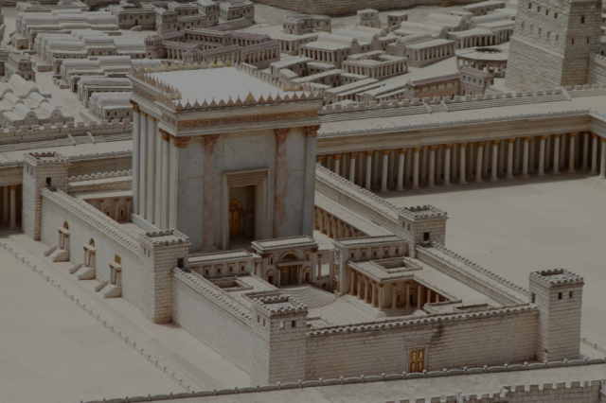
Matthew 24:15 (NLT)
"'The day is coming when you will see what Daniel the prophet spoke about—the sacrilegious object that causes desecration standing in the Holy Place.' (Reader, pay attention!)."
Jesus says that Daniel 9:27 was written by Daniel
Notes:
Some critics say Antiochus IV fulfilled Dan 9:27 in 167 BC when he desecrated the temple by offering a pig on the altar. Yet Jesus noted that the fulfillment was still future. I will take the word of Jesus over the critics.

Slide 20
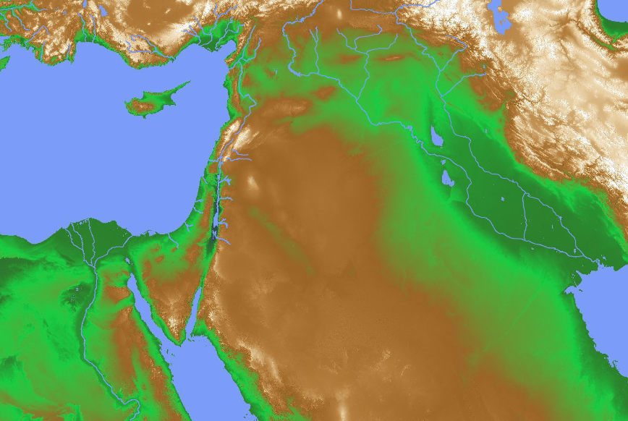
Confirmed ANE Chronologies
“…The Hebrew writers in Kings, etc., have their Assyrian and Babylonian monarchs impeccably in the right order…” (Kitchen, 23)
Mesopotamia:
• Old Babylon (1432-1180)
• Assyria (912-609)
• Neo-Babylon (626-539)
Israel
(dates confirmed)
“…﻿Taharqa reigned from 690 to 664, Necho II from 610 to 595, and Hophra from 589 to 570, all in sequence alongside their Hebrew contemporaries…” (Kitchen, 23)
Egypt
(1550/1540-525)
Notes:
“﻿The framework of ancient Near Eastern history in this epoch is provided by the two major hearths of complex civilization of that day, namely, Mesopotamia (Assyria and Babylonia) on the east and Egypt to the southwest. Before Alexander the Great (336-323) we have the Persian Empire, which ended the independence of Babylon in 539 (by Cyrus) and (for a time) of Egypt in 525 (by Cambyses). All these dates are firm and universally accepted. In Mesopotamia the Neo-Babylonian kings ruled Babylonia from 626 to 539. Overlapping at the end and preceding them, the kings of Assyria are dated to the year from 912 down to 648 (eponym lists, 911/910ff., plus king lists), and to the final end of Assyria in 609. Before 912 Assyrian dates are closely correct back to 1180, before which a dispute over three or thirteen years for Ninurta-apil-ekur gives a maximum ten-year variation back to 1432/1422 for the accession of Enlil-nasir II. Thus from 1180 (and quite closely from the late fifteenth century) Assyrian dates provide a firm backbone of dating other, less securely fixed regions in the Near East.61
On the other side of the area, Egypt also makes a valuable contribution, essentially independent of Mesopotamia. Thus, before the Persian conquest in 525, the Twenty-Sixth (Saite) Dynasty reigned to the year during 664 to 525. The reign of Tanutamun was contemporary with the Twenty-Sixth Dynasty, and the Twenty-Third and Twenty-Fourth Dynasties were wholly contemporary with the Twenty-Second and with each other; so none of these affect the flow of successive dates. Before the Twenty-Sixth Dynasty, Taharqa of the Twenty-Fifth (Kushite/Nubian) Dynasty reigned from 690 to 664. Before this date, it is now clear that Shebitku reigned from at least 702 (and perhaps 706), and his predecessor Shabaka for fourteen years, thirteen over Egypt, maximally 719/minimally 715 to 702. Before him in Egypt, but not ending before 716 (Osorkon IV = Shilkanni of an Assyrian text in 716), the Twenty-Second (Libyan) Dynasty reigned an absolute minimum of close to 230 years, beginning with Shoshenq I (“Shishak”) from 945 (or extremely close to it). Note that this Egyptian chronology stands independently of both the Assyrian and Hebrew data.
Before 945, the Twenty-First Dynasty goes back to 1070 within a year or so. Earlier still, the Ramesside Nineteenth and Twentieth Dynasties (New Kingdom) go back to firm dates of 1279-1213 (not 1212!) for Ramesses II, and for the preceding Eighteenth Dynasty and start of the New Kingdom to either 1550 or 1540 (again, varying because of a king [Tuthmosis II] who reigned either three or thirteen years).62”
Kenneth A. Kitchen, On the Reliability of the Old Testament (Grand Rapids, MI: Eerdmans, 2003), 22-23 (Kindle Edition Loc 780-796 of 14432)
Loc 804 in the black boxes above

Slide 21
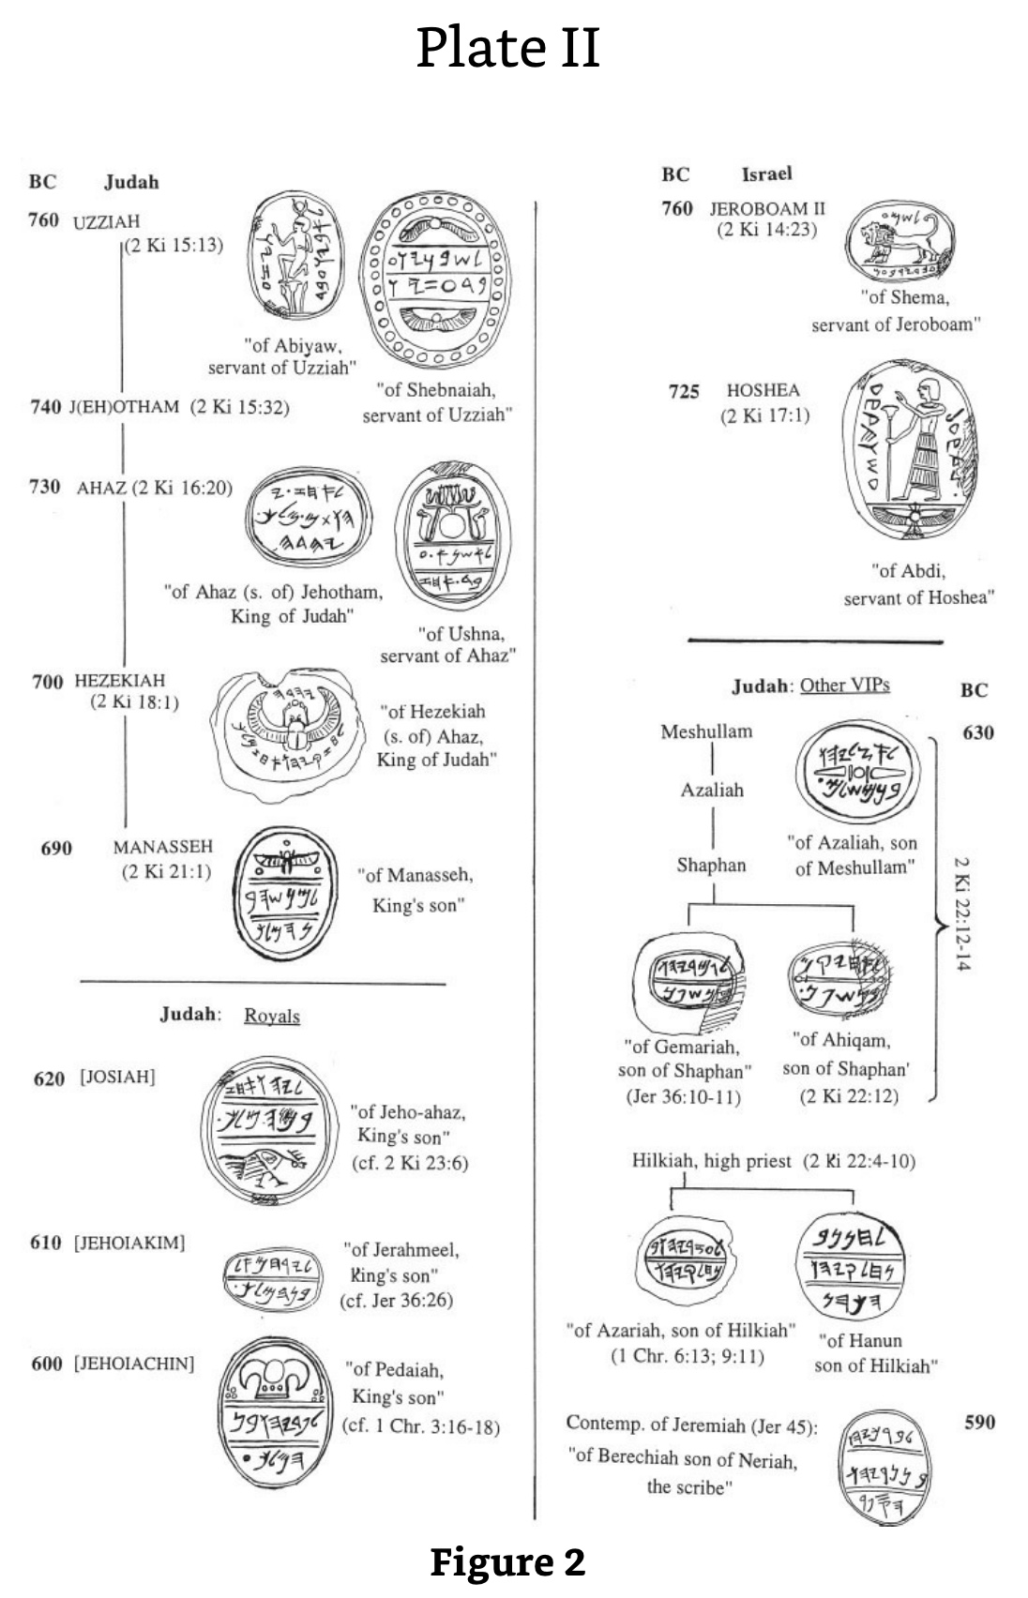
17 Seals Attesting to Jewish Kings
These seals with many close-ups in the following slides show ample archaeological support for the monarchies of Israel and Judah. The same is true for the kings of Babylon noted in Daniel’s prophecy.
Kenneth A. Kitchen,
On the Reliability of the Old Testament (Grand Rapids, MI: Eerdmans, 2003), 16-21, 604
Notes:
﻿”3. KINGS OF ISRAEL AND JUDAH IN LOCAL RECORDS (LR) A. KINGS OF ISRAEL The famous seal of “Shema servant [= minister of state] of Jeroboam” is almost universally recognized to belong to the reign of Jeroboam II of Israel (cf. fig. 2); attempts to date it to Jeroboam I are unconvincing. The Samaria ostraca (main lot) belong also to this period, and maybe to this particular reign.44 To Shallum (I) (or much less likely, his Judean namesake, Jehoahaz III/Shallum II) may just possibly be attributed an eighth-century cylindrical seal stone of royal style (kingly figure, winged discs, etc.).45 As for Hoshea, to his reign belongs the seal of one “Abdi, servant of Hoshea” (fig. 2).46 B. KINGS OF JUDAH (i) Azariah/Uzziah, Jotham, Ahaz To the reign of Azariah/Uzziah belong two seals, of the state ministers (“servants”) Shebaniah (Shebanyau) and Abiah (Abiyau).47 Jotham is attested as Jehotham and father of Ahaz on a recently discovered seal impression (“bulla”) that bears the text “Belonging to Ahaz (son of) Jehotham [= long form of Jotham], King of Judah.”48 A seal of this reign is known, of Ushna servant of Ahaz (for these, cf. fig. 2).49 For Ahaz as father of Hezekiah, see under Hezekiah. (ii) Hezekiah (Fig. 2) His name is mentioned on another recently discovered bulla, which reads: “Belonging to Hezekiah (son of) Ahaz, King of Judah,” and with it can now be matched a damaged bulla that bore the same text.50 To these royal stamps can be added no less than three bullae of “servants” of Hezekiah: of Jehozarah son of Hilkiah, of Azariah son of Jeho’abi, and of one on which the name has been lost.51 Among inscriptions without the royal name but belonging to this time should certainly belong the famous Siloam tunnel inscription (cf. 2 Kings 20:20; 2 Chron. 32:30), and likewise the tomb inscription of the royal steward (“he who is over the house”), […]iah, highly likely to have been [Shebna]iah — and the same as Shebna (abbreviated form of this name), the royal steward of Hezekiah’s day, condemned by the prophet Isaiah (Isa. 22:15-25).52 (iii) Manasseh As a young prince he may have had his own personal seal for official purposes. Such a seal may be seen in a known seal inscribed “belonging to Manasseh, son of the king” (fig. 2), the latter being Hezekiah.53 (iv) Josiah Several items may well belong to this reign, although they are without certainty and do not rank as firm evidence. But they can be conveniently set out here as a good example of items that (in almost every case) clearly belong to the later seventh (to early sixth) century in Judah. In this short period the choice of reigns is sometimes limited by year dates, too high to be anyone but either Manasseh or Josiah in practice. These are: (a) Ostracon Mousaieff 1, which required payment of three shekels of silver to “the House [= temple] of the LORD [YHWH]” in the name of ’Ashiah/’Oshiah the king, via a man [Z]echariah. The script is either eighth (so, Cross) or seventh century (so, Yardeni). In the former case, ’Ashiah/’Oshiah is a variant of Joash, king of Judah; in the latter case, of Josiah, which is the latest date possible. In Josiah’s time a Levite named Zechariah was concerned with repairs to the Jerusalem temple (cf. 2 Chron. 34:12), so the later dating might well allow of our two Zechariahs being the same man.54 (b) Seal stones and impressions. These include both fiscal and personal seals. One fiscal seal is dated to a royal “Year 26” in late seventh-/early sixth-century script. Therefore its editors date it to Josiah, the only king who reigned that long, then. (However, it should be said that as Manasseh supposedly reigned fifty-five years, he cannot be ruled out absolutely.) Exactly similar fiscal stamps include dates in Years 13, 14, and 20 (another in a Year 3 is different).55 The personal seals include (fig. 2): one of a king’s son Jeho-ahaz, probably Josiah’s eventual successor; one of Azaliah son of Meshullam (father of Shaphan) (cf. 2 Kings 22:3); one of Ahikam son of Shaphan, this reign or Jehoiakim’s (cf. 2 Kings 22:12-14; Jer. 26:24); a seal stone in ring, of Hanan son of Hilkiah, (high) priest in Jerusalem (cf. 2 Kings 22:8, 10).56 (v) Jehoiakim and Jehoiachin Attributable to Jehoiakim’s reign (fig. 2) may be the seal of the king’s son Jerahmeel and a bulla from a second seal of the same man. Such a man was son of King Jehoiakim and involved with the prophet Jeremiah (Jer. 36:26). An impression or bulla of “Gemariah son of Shaphan” recalls the man of this name and filiation under Jehoiakim in Jer. 36:10-11.57 For the seal of Gemariah’s brother Ahikam, see above under Josiah. For Baruch in this reign and the next two, see under Zedekiah, below. We have also the seal of the king’s son Pedaiah, readily identifiable as one of the sons of Jehoiachin, named in 1 Chron. 3:16-18.58 Cf. fig. 2. (vi) Zedekiah Here a series of personal seals belong to people who bear the names of characters active in this reign. Most famous are two bullae from seals of “Berechiah [= Baruch], son of Neriah the scribe,” well known as the prophet Jeremiah’s faithful secretary (Jer. 32:12; 36; 43:1-7; 45). Cf. Fig. 2. Malkijah the king’s son (Jer. 38:6) may be the same man as the owner of CWSS, 55, no. 15. Seraiah son of Neriah appears to be Baruch’s brother; Azariah son of Hilkiah would be brother of Hanan (cf. under Josiah); cf. 1 Chron. 6:13; 9:11. Gedaliah “who is over the house” may have been the Gedaliah who briefly governed Judah after the Babylonian conquest in 586 (cf. 2 Kings 25:22-25). One or another of four seal owners Jaazaniah, one being “servant of the king,” may again have been the army officer active in 586 (2 Kings 25:23). A king’s son, Elishama, had descendants active at the fall of Jerusalem (2 Kings 25:25; Jer. 41:1); his probable seal would then date anytime from Josiah onward.59 A major inscriptional source at this time is the collection of ostraca found in the ruins of Lachish, known as the “Lachish Letters.” Archaeologically they date from the last days of Lachish before it was destroyed by Nebuchadrezzar’s troops.60
Kenneth A. Kitchen, On the Reliability of the Old Testament (Grand Rapids, MI: Eerdmans, 2003), 16-21, 604 (Kindle Edition Loc 716-772 of 14432)

Slide 22
Seals of Uzziah & Jotham
“quote”
BC
Judah
760
UZZIAH (2 Ki 15:13)
“of Abiyaw,
servant of Uzziah”
“of Shebnaiah,
servant of Uzziah”
740
J(EH)OTHAM (2 Ki 15:32)
Notes:
﻿”3. KINGS OF ISRAEL AND JUDAH IN LOCAL RECORDS (LR) A. KINGS OF ISRAEL The famous seal of “Shema servant [= minister of state] of Jeroboam” is almost universally recognized to belong to the reign of Jeroboam II of Israel (cf. fig. 2); attempts to date it to Jeroboam I are unconvincing. The Samaria ostraca (main lot) belong also to this period, and maybe to this particular reign.44 To Shallum (I) (or much less likely, his Judean namesake, Jehoahaz III/Shallum II) may just possibly be attributed an eighth-century cylindrical seal stone of royal style (kingly figure, winged discs, etc.).45 As for Hoshea, to his reign belongs the seal of one “Abdi, servant of Hoshea” (fig. 2).46 B. KINGS OF JUDAH (i) Azariah/Uzziah, Jotham, Ahaz To the reign of Azariah/Uzziah belong two seals, of the state ministers (“servants”) Shebaniah (Shebanyau) and Abiah (Abiyau).47 Jotham is attested as Jehotham and father of Ahaz on a recently discovered seal impression (“bulla”) that bears the text “Belonging to Ahaz (son of) Jehotham [= long form of Jotham], King of Judah.”48 A seal of this reign is known, of Ushna servant of Ahaz (for these, cf. fig. 2).49 For Ahaz as father of Hezekiah, see under Hezekiah. (ii) Hezekiah (Fig. 2) His name is mentioned on another recently discovered bulla, which reads: “Belonging to Hezekiah (son of) Ahaz, King of Judah,” and with it can now be matched a damaged bulla that bore the same text.50 To these royal stamps can be added no less than three bullae of “servants” of Hezekiah: of Jehozarah son of Hilkiah, of Azariah son of Jeho’abi, and of one on which the name has been lost.51 Among inscriptions without the royal name but belonging to this time should certainly belong the famous Siloam tunnel inscription (cf. 2 Kings 20:20; 2 Chron. 32:30), and likewise the tomb inscription of the royal steward (“he who is over the house”), […]iah, highly likely to have been [Shebna]iah — and the same as Shebna (abbreviated form of this name), the royal steward of Hezekiah’s day, condemned by the prophet Isaiah (Isa. 22:15-25).52 (iii) Manasseh As a young prince he may have had his own personal seal for official purposes. Such a seal may be seen in a known seal inscribed “belonging to Manasseh, son of the king” (fig. 2), the latter being Hezekiah.53 (iv) Josiah Several items may well belong to this reign, although they are without certainty and do not rank as firm evidence. But they can be conveniently set out here as a good example of items that (in almost every case) clearly belong to the later seventh (to early sixth) century in Judah. In this short period the choice of reigns is sometimes limited by year dates, too high to be anyone but either Manasseh or Josiah in practice. These are: (a) Ostracon Mousaieff 1, which required payment of three shekels of silver to “the House [= temple] of the LORD [YHWH]” in the name of ’Ashiah/’Oshiah the king, via a man [Z]echariah. The script is either eighth (so, Cross) or seventh century (so, Yardeni). In the former case, ’Ashiah/’Oshiah is a variant of Joash, king of Judah; in the latter case, of Josiah, which is the latest date possible. In Josiah’s time a Levite named Zechariah was concerned with repairs to the Jerusalem temple (cf. 2 Chron. 34:12), so the later dating might well allow of our two Zechariahs being the same man.54 (b) Seal stones and impressions. These include both fiscal and personal seals. One fiscal seal is dated to a royal “Year 26” in late seventh-/early sixth-century script. Therefore its editors date it to Josiah, the only king who reigned that long, then. (However, it should be said that as Manasseh supposedly reigned fifty-five years, he cannot be ruled out absolutely.) Exactly similar fiscal stamps include dates in Years 13, 14, and 20 (another in a Year 3 is different).55 The personal seals include (fig. 2): one of a king’s son Jeho-ahaz, probably Josiah’s eventual successor; one of Azaliah son of Meshullam (father of Shaphan) (cf. 2 Kings 22:3); one of Ahikam son of Shaphan, this reign or Jehoiakim’s (cf. 2 Kings 22:12-14; Jer. 26:24); a seal stone in ring, of Hanan son of Hilkiah, (high) priest in Jerusalem (cf. 2 Kings 22:8, 10).56 (v) Jehoiakim and Jehoiachin Attributable to Jehoiakim’s reign (fig. 2) may be the seal of the king’s son Jerahmeel and a bulla from a second seal of the same man. Such a man was son of King Jehoiakim and involved with the prophet Jeremiah (Jer. 36:26). An impression or bulla of “Gemariah son of Shaphan” recalls the man of this name and filiation under Jehoiakim in Jer. 36:10-11.57 For the seal of Gemariah’s brother Ahikam, see above under Josiah. For Baruch in this reign and the next two, see under Zedekiah, below. We have also the seal of the king’s son Pedaiah, readily identifiable as one of the sons of Jehoiachin, named in 1 Chron. 3:16-18.58 Cf. fig. 2. (vi) Zedekiah Here a series of personal seals belong to people who bear the names of characters active in this reign. Most famous are two bullae from seals of “Berechiah [= Baruch], son of Neriah the scribe,” well known as the prophet Jeremiah’s faithful secretary (Jer. 32:12; 36; 43:1-7; 45). Cf. Fig. 2. Malkijah the king’s son (Jer. 38:6) may be the same man as the owner of CWSS, 55, no. 15. Seraiah son of Neriah appears to be Baruch’s brother; Azariah son of Hilkiah would be brother of Hanan (cf. under Josiah); cf. 1 Chron. 6:13; 9:11. Gedaliah “who is over the house” may have been the Gedaliah who briefly governed Judah after the Babylonian conquest in 586 (cf. 2 Kings 25:22-25). One or another of four seal owners Jaazaniah, one being “servant of the king,” may again have been the army officer active in 586 (2 Kings 25:23). A king’s son, Elishama, had descendants active at the fall of Jerusalem (2 Kings 25:25; Jer. 41:1); his probable seal would then date anytime from Josiah onward.59 A major inscriptional source at this time is the collection of ostraca found in the ruins of Lachish, known as the “Lachish Letters.” Archaeologically they date from the last days of Lachish before it was destroyed by Nebuchadrezzar’s troops.60
Kenneth A. Kitchen, On the Reliability of the Old Testament (Grand Rapids, MI: Eerdmans, 2003), 16-21, 604 (Kindle Edition Loc 716-772 of 14432)

Slide 23
Seals of Jeroboam II & Hoshea
BC
Israel
760
JEROBOAM II
(2 Ki 14:23)
“of Shema,
servant of Jeroboam”
725
HOSHEA
(2 Ki 17:1)
“of Abdi,
servant of Hoshea”
Notes:
﻿”3. KINGS OF ISRAEL AND JUDAH IN LOCAL RECORDS (LR) A. KINGS OF ISRAEL The famous seal of “Shema servant [= minister of state] of Jeroboam” is almost universally recognized to belong to the reign of Jeroboam II of Israel (cf. fig. 2); attempts to date it to Jeroboam I are unconvincing. The Samaria ostraca (main lot) belong also to this period, and maybe to this particular reign.44 To Shallum (I) (or much less likely, his Judean namesake, Jehoahaz III/Shallum II) may just possibly be attributed an eighth-century cylindrical seal stone of royal style (kingly figure, winged discs, etc.).45 As for Hoshea, to his reign belongs the seal of one “Abdi, servant of Hoshea” (fig. 2).46 B. KINGS OF JUDAH (i) Azariah/Uzziah, Jotham, Ahaz To the reign of Azariah/Uzziah belong two seals, of the state ministers (“servants”) Shebaniah (Shebanyau) and Abiah (Abiyau).47 Jotham is attested as Jehotham and father of Ahaz on a recently discovered seal impression (“bulla”) that bears the text “Belonging to Ahaz (son of) Jehotham [= long form of Jotham], King of Judah.”48 A seal of this reign is known, of Ushna servant of Ahaz (for these, cf. fig. 2).49 For Ahaz as father of Hezekiah, see under Hezekiah. (ii) Hezekiah (Fig. 2) His name is mentioned on another recently discovered bulla, which reads: “Belonging to Hezekiah (son of) Ahaz, King of Judah,” and with it can now be matched a damaged bulla that bore the same text.50 To these royal stamps can be added no less than three bullae of “servants” of Hezekiah: of Jehozarah son of Hilkiah, of Azariah son of Jeho’abi, and of one on which the name has been lost.51 Among inscriptions without the royal name but belonging to this time should certainly belong the famous Siloam tunnel inscription (cf. 2 Kings 20:20; 2 Chron. 32:30), and likewise the tomb inscription of the royal steward (“he who is over the house”), […]iah, highly likely to have been [Shebna]iah — and the same as Shebna (abbreviated form of this name), the royal steward of Hezekiah’s day, condemned by the prophet Isaiah (Isa. 22:15-25).52 (iii) Manasseh As a young prince he may have had his own personal seal for official purposes. Such a seal may be seen in a known seal inscribed “belonging to Manasseh, son of the king” (fig. 2), the latter being Hezekiah.53 (iv) Josiah Several items may well belong to this reign, although they are without certainty and do not rank as firm evidence. But they can be conveniently set out here as a good example of items that (in almost every case) clearly belong to the later seventh (to early sixth) century in Judah. In this short period the choice of reigns is sometimes limited by year dates, too high to be anyone but either Manasseh or Josiah in practice. These are: (a) Ostracon Mousaieff 1, which required payment of three shekels of silver to “the House [= temple] of the LORD [YHWH]” in the name of ’Ashiah/’Oshiah the king, via a man [Z]echariah. The script is either eighth (so, Cross) or seventh century (so, Yardeni). In the former case, ’Ashiah/’Oshiah is a variant of Joash, king of Judah; in the latter case, of Josiah, which is the latest date possible. In Josiah’s time a Levite named Zechariah was concerned with repairs to the Jerusalem temple (cf. 2 Chron. 34:12), so the later dating might well allow of our two Zechariahs being the same man.54 (b) Seal stones and impressions. These include both fiscal and personal seals. One fiscal seal is dated to a royal “Year 26” in late seventh-/early sixth-century script. Therefore its editors date it to Josiah, the only king who reigned that long, then. (However, it should be said that as Manasseh supposedly reigned fifty-five years, he cannot be ruled out absolutely.) Exactly similar fiscal stamps include dates in Years 13, 14, and 20 (another in a Year 3 is different).55 The personal seals include (fig. 2): one of a king’s son Jeho-ahaz, probably Josiah’s eventual successor; one of Azaliah son of Meshullam (father of Shaphan) (cf. 2 Kings 22:3); one of Ahikam son of Shaphan, this reign or Jehoiakim’s (cf. 2 Kings 22:12-14; Jer. 26:24); a seal stone in ring, of Hanan son of Hilkiah, (high) priest in Jerusalem (cf. 2 Kings 22:8, 10).56 (v) Jehoiakim and Jehoiachin Attributable to Jehoiakim’s reign (fig. 2) may be the seal of the king’s son Jerahmeel and a bulla from a second seal of the same man. Such a man was son of King Jehoiakim and involved with the prophet Jeremiah (Jer. 36:26). An impression or bulla of “Gemariah son of Shaphan” recalls the man of this name and filiation under Jehoiakim in Jer. 36:10-11.57 For the seal of Gemariah’s brother Ahikam, see above under Josiah. For Baruch in this reign and the next two, see under Zedekiah, below. We have also the seal of the king’s son Pedaiah, readily identifiable as one of the sons of Jehoiachin, named in 1 Chron. 3:16-18.58 Cf. fig. 2. (vi) Zedekiah Here a series of personal seals belong to people who bear the names of characters active in this reign. Most famous are two bullae from seals of “Berechiah [= Baruch], son of Neriah the scribe,” well known as the prophet Jeremiah’s faithful secretary (Jer. 32:12; 36; 43:1-7; 45). Cf. Fig. 2. Malkijah the king’s son (Jer. 38:6) may be the same man as the owner of CWSS, 55, no. 15. Seraiah son of Neriah appears to be Baruch’s brother; Azariah son of Hilkiah would be brother of Hanan (cf. under Josiah); cf. 1 Chron. 6:13; 9:11. Gedaliah “who is over the house” may have been the Gedaliah who briefly governed Judah after the Babylonian conquest in 586 (cf. 2 Kings 25:22-25). One or another of four seal owners Jaazaniah, one being “servant of the king,” may again have been the army officer active in 586 (2 Kings 25:23). A king’s son, Elishama, had descendants active at the fall of Jerusalem (2 Kings 25:25; Jer. 41:1); his probable seal would then date anytime from Josiah onward.59 A major inscriptional source at this time is the collection of ostraca found in the ruins of Lachish, known as the “Lachish Letters.” Archaeologically they date from the last days of Lachish before it was destroyed by Nebuchadrezzar’s troops.60
Kenneth A. Kitchen, On the Reliability of the Old Testament (Grand Rapids, MI: Eerdmans, 2003), 16-21, 604 (Kindle Edition Loc 716-772 of 14432)

Slide 24
Seals of Ahaz & Hezekiah
730
AHAZ
(2 Ki 16:20)
“of Ahaz (s. of) Jehotham,
King of Judah”
“of Ushna,
servant of Ahaz”
700
HEZEKIAH
(2 Ki 18:1)
“of Hezekiah,
(s. of) Ahaz,
King of Judah”
Notes:
﻿”3. KINGS OF ISRAEL AND JUDAH IN LOCAL RECORDS (LR) A. KINGS OF ISRAEL The famous seal of “Shema servant [= minister of state] of Jeroboam” is almost universally recognized to belong to the reign of Jeroboam II of Israel (cf. fig. 2); attempts to date it to Jeroboam I are unconvincing. The Samaria ostraca (main lot) belong also to this period, and maybe to this particular reign.44 To Shallum (I) (or much less likely, his Judean namesake, Jehoahaz III/Shallum II) may just possibly be attributed an eighth-century cylindrical seal stone of royal style (kingly figure, winged discs, etc.).45 As for Hoshea, to his reign belongs the seal of one “Abdi, servant of Hoshea” (fig. 2).46 B. KINGS OF JUDAH (i) Azariah/Uzziah, Jotham, Ahaz To the reign of Azariah/Uzziah belong two seals, of the state ministers (“servants”) Shebaniah (Shebanyau) and Abiah (Abiyau).47 Jotham is attested as Jehotham and father of Ahaz on a recently discovered seal impression (“bulla”) that bears the text “Belonging to Ahaz (son of) Jehotham [= long form of Jotham], King of Judah.”48 A seal of this reign is known, of Ushna servant of Ahaz (for these, cf. fig. 2).49 For Ahaz as father of Hezekiah, see under Hezekiah. (ii) Hezekiah (Fig. 2) His name is mentioned on another recently discovered bulla, which reads: “Belonging to Hezekiah (son of) Ahaz, King of Judah,” and with it can now be matched a damaged bulla that bore the same text.50 To these royal stamps can be added no less than three bullae of “servants” of Hezekiah: of Jehozarah son of Hilkiah, of Azariah son of Jeho’abi, and of one on which the name has been lost.51 Among inscriptions without the royal name but belonging to this time should certainly belong the famous Siloam tunnel inscription (cf. 2 Kings 20:20; 2 Chron. 32:30), and likewise the tomb inscription of the royal steward (“he who is over the house”), […]iah, highly likely to have been [Shebna]iah — and the same as Shebna (abbreviated form of this name), the royal steward of Hezekiah’s day, condemned by the prophet Isaiah (Isa. 22:15-25).52 (iii) Manasseh As a young prince he may have had his own personal seal for official purposes. Such a seal may be seen in a known seal inscribed “belonging to Manasseh, son of the king” (fig. 2), the latter being Hezekiah.53 (iv) Josiah Several items may well belong to this reign, although they are without certainty and do not rank as firm evidence. But they can be conveniently set out here as a good example of items that (in almost every case) clearly belong to the later seventh (to early sixth) century in Judah. In this short period the choice of reigns is sometimes limited by year dates, too high to be anyone but either Manasseh or Josiah in practice. These are: (a) Ostracon Mousaieff 1, which required payment of three shekels of silver to “the House [= temple] of the LORD [YHWH]” in the name of ’Ashiah/’Oshiah the king, via a man [Z]echariah. The script is either eighth (so, Cross) or seventh century (so, Yardeni). In the former case, ’Ashiah/’Oshiah is a variant of Joash, king of Judah; in the latter case, of Josiah, which is the latest date possible. In Josiah’s time a Levite named Zechariah was concerned with repairs to the Jerusalem temple (cf. 2 Chron. 34:12), so the later dating might well allow of our two Zechariahs being the same man.54 (b) Seal stones and impressions. These include both fiscal and personal seals. One fiscal seal is dated to a royal “Year 26” in late seventh-/early sixth-century script. Therefore its editors date it to Josiah, the only king who reigned that long, then. (However, it should be said that as Manasseh supposedly reigned fifty-five years, he cannot be ruled out absolutely.) Exactly similar fiscal stamps include dates in Years 13, 14, and 20 (another in a Year 3 is different).55 The personal seals include (fig. 2): one of a king’s son Jeho-ahaz, probably Josiah’s eventual successor; one of Azaliah son of Meshullam (father of Shaphan) (cf. 2 Kings 22:3); one of Ahikam son of Shaphan, this reign or Jehoiakim’s (cf. 2 Kings 22:12-14; Jer. 26:24); a seal stone in ring, of Hanan son of Hilkiah, (high) priest in Jerusalem (cf. 2 Kings 22:8, 10).56 (v) Jehoiakim and Jehoiachin Attributable to Jehoiakim’s reign (fig. 2) may be the seal of the king’s son Jerahmeel and a bulla from a second seal of the same man. Such a man was son of King Jehoiakim and involved with the prophet Jeremiah (Jer. 36:26). An impression or bulla of “Gemariah son of Shaphan” recalls the man of this name and filiation under Jehoiakim in Jer. 36:10-11.57 For the seal of Gemariah’s brother Ahikam, see above under Josiah. For Baruch in this reign and the next two, see under Zedekiah, below. We have also the seal of the king’s son Pedaiah, readily identifiable as one of the sons of Jehoiachin, named in 1 Chron. 3:16-18.58 Cf. fig. 2. (vi) Zedekiah Here a series of personal seals belong to people who bear the names of characters active in this reign. Most famous are two bullae from seals of “Berechiah [= Baruch], son of Neriah the scribe,” well known as the prophet Jeremiah’s faithful secretary (Jer. 32:12; 36; 43:1-7; 45). Cf. Fig. 2. Malkijah the king’s son (Jer. 38:6) may be the same man as the owner of CWSS, 55, no. 15. Seraiah son of Neriah appears to be Baruch’s brother; Azariah son of Hilkiah would be brother of Hanan (cf. under Josiah); cf. 1 Chron. 6:13; 9:11. Gedaliah “who is over the house” may have been the Gedaliah who briefly governed Judah after the Babylonian conquest in 586 (cf. 2 Kings 25:22-25). One or another of four seal owners Jaazaniah, one being “servant of the king,” may again have been the army officer active in 586 (2 Kings 25:23). A king’s son, Elishama, had descendants active at the fall of Jerusalem (2 Kings 25:25; Jer. 41:1); his probable seal would then date anytime from Josiah onward.59 A major inscriptional source at this time is the collection of ostraca found in the ruins of Lachish, known as the “Lachish Letters.” Archaeologically they date from the last days of Lachish before it was destroyed by Nebuchadrezzar’s troops.60
Kenneth A. Kitchen, On the Reliability of the Old Testament (Grand Rapids, MI: Eerdmans, 2003), 16-21, 604 (Kindle Edition Loc 716-772 of 14432)

Slide 25
Seals of Other Judah VIPS
Meshullam
630
Azaliah
“of Azaliah, son
of Meshullam”
Shaphan
2 Ki 22:12-14
“of Gemariah,
son of Shaphan”
(Jer 36:10-11)
“of Ahiqam,
son of Shaphan”
(2 Ki 22:12)
Notes:
﻿”3. KINGS OF ISRAEL AND JUDAH IN LOCAL RECORDS (LR) A. KINGS OF ISRAEL The famous seal of “Shema servant [= minister of state] of Jeroboam” is almost universally recognized to belong to the reign of Jeroboam II of Israel (cf. fig. 2); attempts to date it to Jeroboam I are unconvincing. The Samaria ostraca (main lot) belong also to this period, and maybe to this particular reign.44 To Shallum (I) (or much less likely, his Judean namesake, Jehoahaz III/Shallum II) may just possibly be attributed an eighth-century cylindrical seal stone of royal style (kingly figure, winged discs, etc.).45 As for Hoshea, to his reign belongs the seal of one “Abdi, servant of Hoshea” (fig. 2).46 B. KINGS OF JUDAH (i) Azariah/Uzziah, Jotham, Ahaz To the reign of Azariah/Uzziah belong two seals, of the state ministers (“servants”) Shebaniah (Shebanyau) and Abiah (Abiyau).47 Jotham is attested as Jehotham and father of Ahaz on a recently discovered seal impression (“bulla”) that bears the text “Belonging to Ahaz (son of) Jehotham [= long form of Jotham], King of Judah.”48 A seal of this reign is known, of Ushna servant of Ahaz (for these, cf. fig. 2).49 For Ahaz as father of Hezekiah, see under Hezekiah. (ii) Hezekiah (Fig. 2) His name is mentioned on another recently discovered bulla, which reads: “Belonging to Hezekiah (son of) Ahaz, King of Judah,” and with it can now be matched a damaged bulla that bore the same text.50 To these royal stamps can be added no less than three bullae of “servants” of Hezekiah: of Jehozarah son of Hilkiah, of Azariah son of Jeho’abi, and of one on which the name has been lost.51 Among inscriptions without the royal name but belonging to this time should certainly belong the famous Siloam tunnel inscription (cf. 2 Kings 20:20; 2 Chron. 32:30), and likewise the tomb inscription of the royal steward (“he who is over the house”), […]iah, highly likely to have been [Shebna]iah — and the same as Shebna (abbreviated form of this name), the royal steward of Hezekiah’s day, condemned by the prophet Isaiah (Isa. 22:15-25).52 (iii) Manasseh As a young prince he may have had his own personal seal for official purposes. Such a seal may be seen in a known seal inscribed “belonging to Manasseh, son of the king” (fig. 2), the latter being Hezekiah.53 (iv) Josiah Several items may well belong to this reign, although they are without certainty and do not rank as firm evidence. But they can be conveniently set out here as a good example of items that (in almost every case) clearly belong to the later seventh (to early sixth) century in Judah. In this short period the choice of reigns is sometimes limited by year dates, too high to be anyone but either Manasseh or Josiah in practice. These are: (a) Ostracon Mousaieff 1, which required payment of three shekels of silver to “the House [= temple] of the LORD [YHWH]” in the name of ’Ashiah/’Oshiah the king, via a man [Z]echariah. The script is either eighth (so, Cross) or seventh century (so, Yardeni). In the former case, ’Ashiah/’Oshiah is a variant of Joash, king of Judah; in the latter case, of Josiah, which is the latest date possible. In Josiah’s time a Levite named Zechariah was concerned with repairs to the Jerusalem temple (cf. 2 Chron. 34:12), so the later dating might well allow of our two Zechariahs being the same man.54 (b) Seal stones and impressions. These include both fiscal and personal seals. One fiscal seal is dated to a royal “Year 26” in late seventh-/early sixth-century script. Therefore its editors date it to Josiah, the only king who reigned that long, then. (However, it should be said that as Manasseh supposedly reigned fifty-five years, he cannot be ruled out absolutely.) Exactly similar fiscal stamps include dates in Years 13, 14, and 20 (another in a Year 3 is different).55 The personal seals include (fig. 2): one of a king’s son Jeho-ahaz, probably Josiah’s eventual successor; one of Azaliah son of Meshullam (father of Shaphan) (cf. 2 Kings 22:3); one of Ahikam son of Shaphan, this reign or Jehoiakim’s (cf. 2 Kings 22:12-14; Jer. 26:24); a seal stone in ring, of Hanan son of Hilkiah, (high) priest in Jerusalem (cf. 2 Kings 22:8, 10).56 (v) Jehoiakim and Jehoiachin Attributable to Jehoiakim’s reign (fig. 2) may be the seal of the king’s son Jerahmeel and a bulla from a second seal of the same man. Such a man was son of King Jehoiakim and involved with the prophet Jeremiah (Jer. 36:26). An impression or bulla of “Gemariah son of Shaphan” recalls the man of this name and filiation under Jehoiakim in Jer. 36:10-11.57 For the seal of Gemariah’s brother Ahikam, see above under Josiah. For Baruch in this reign and the next two, see under Zedekiah, below. We have also the seal of the king’s son Pedaiah, readily identifiable as one of the sons of Jehoiachin, named in 1 Chron. 3:16-18.58 Cf. fig. 2. (vi) Zedekiah Here a series of personal seals belong to people who bear the names of characters active in this reign. Most famous are two bullae from seals of “Berechiah [= Baruch], son of Neriah the scribe,” well known as the prophet Jeremiah’s faithful secretary (Jer. 32:12; 36; 43:1-7; 45). Cf. Fig. 2. Malkijah the king’s son (Jer. 38:6) may be the same man as the owner of CWSS, 55, no. 15. Seraiah son of Neriah appears to be Baruch’s brother; Azariah son of Hilkiah would be brother of Hanan (cf. under Josiah); cf. 1 Chron. 6:13; 9:11. Gedaliah “who is over the house” may have been the Gedaliah who briefly governed Judah after the Babylonian conquest in 586 (cf. 2 Kings 25:22-25). One or another of four seal owners Jaazaniah, one being “servant of the king,” may again have been the army officer active in 586 (2 Kings 25:23). A king’s son, Elishama, had descendants active at the fall of Jerusalem (2 Kings 25:25; Jer. 41:1); his probable seal would then date anytime from Josiah onward.59 A major inscriptional source at this time is the collection of ostraca found in the ruins of Lachish, known as the “Lachish Letters.” Archaeologically they date from the last days of Lachish before it was destroyed by Nebuchadrezzar’s troops.60
Kenneth A. Kitchen, On the Reliability of the Old Testament (Grand Rapids, MI: Eerdmans, 2003), 16-21, 604 (Kindle Edition Loc 716-772 of 14432)

Slide 26
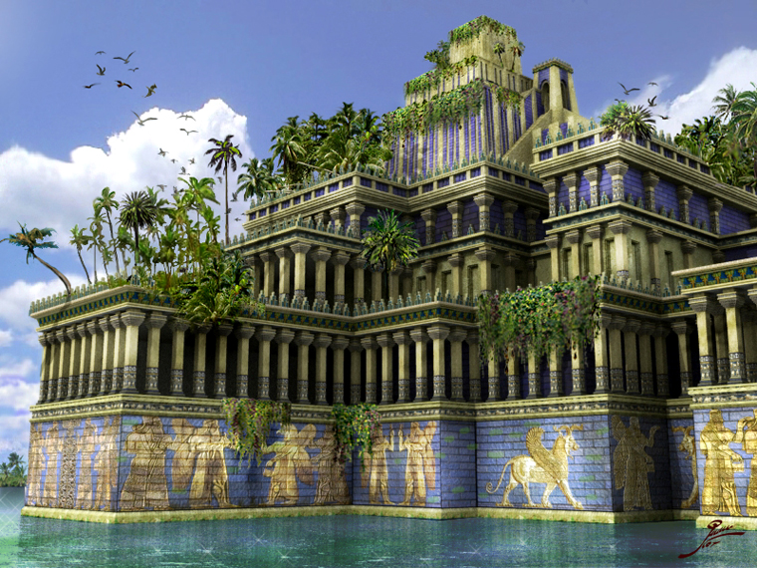
حدائق بابل المعلقة
Notes:
OS-12-2Kings-232
OS-13-1 Chron-232
OS-14-2 Chron-298

Slide 27
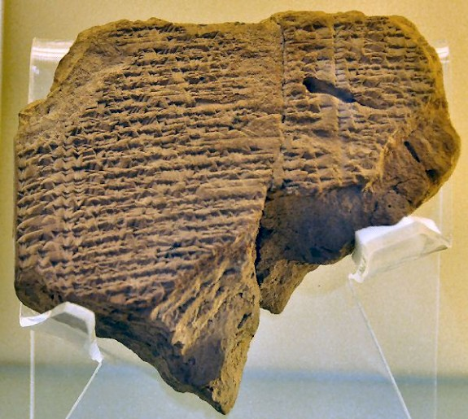
اللطف نحو يهوياكين في السبي
وفي السنة السابعة والثلاثين لسبي يهوياكين ملك يهوذا في الشهر الثاني عشر في السابع والعشرين من الشهر رفع أويل مردوخ ملك بابل في سنة تملكه رأس يهوياكين ملك يهوذا من السجن وكلمه بخير وجعل كرسيه فوق كراسي الملوك الذين معه في بابل وغيّر ثياب سجنه وكان يأكل دائماً الخبز أمامه كل أيام حياته ووظيفته وظيفة دائمة تعطى له من عند الملك أمر كل يوم بيومه كل أيام حياته
2 ملوك 25: 27-30
لوح المؤن
متحف برلين
Chap. 21
Notes:
OS-12-2Kings-233
OS-13-1 Chron-233
OS-14-2 Chron-299

Slide 28
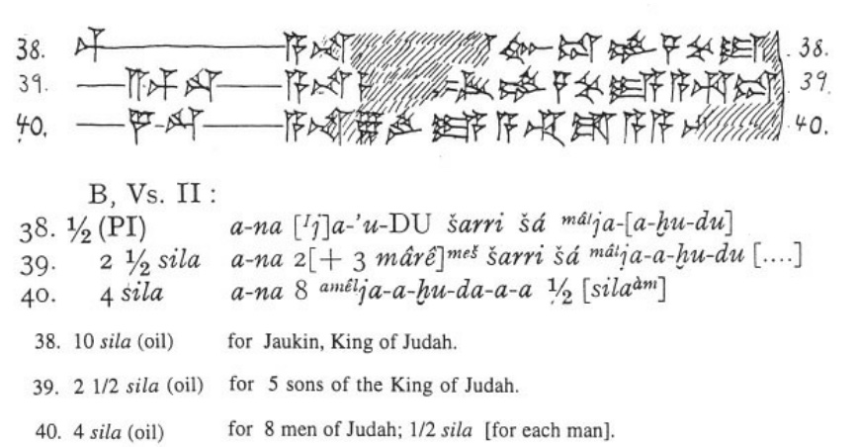
لوح مؤن
يهوياكين
في السبي
الحفريات
البابلية
1899-1917
38) 10سيلا (زيت) ليهوياكين ملك يهوذا
39) 2 ونصف سيلا (زيت) لخمسة من ابناء ملك يهوذا
40) 4 سيلا (زيت) لثمانية من رجال يهوذا، نص سيلا لكل رجل
Notes:
أعلاه صورة اللوح من:
"يهوياكين في بابل
يهوياكين (حكم من 598 إلى 597 ق. م)، آحد آخر ملوك يهوذا تم أسره من قبل البابليين (2 ملوك 24: 15؛ ABC 5) وعاش في المنفى في بلد الغزاة. ومع ذلك، فقد أطلق سراحه ويخبرنا زوجان من الألواح المسمارية من بابل عن مصيره.
أن قصة إطلاق سراح يهوياكين المذكورة في اللوح المسماري، يمكن العثور عليها في نهاية سفر الملوك الثاني من الكتاب المقدس: وفي السنة السابعة والثلاثين لسبي يهوياكين ملك يهوذا في الشهر الثاني عشر في السابع والعشرين من الشهر رفع أويل مرودخ ملك بابل في سنة تملكه رأس يهوياكين ملك يهوذا من السجن وكلمه بخير وجعل كرسيه فوق كراسي الملوك الذين معه في بابل. وغيّر ثياب سجنه وكان يأكل دائمًا الخبز أمامه كل أيام حياته. ووظيفته وظيفة دائمة تعطى له من عند الملك أمر كل يوم بيومه كل أيام حياته.
ملحوظة: كان هناك العديد من أنظمة التاريخ المحتملة، لكن سنة تولي أويل مرودخ (أو مرودخ الشرير) كانت سنة 562/ 561، وهذا مطابق أقل أو أكثر إلى حد ما للسنة السابعة والثلاثين لسبي يهوياكين، الذي بدأ عام 596 (ABC 5 مع الملاحظة)؛ فاليوم السابع والعشرون من السنة السابعة والثلاثين يجب أن تكون في مكان ما من ربيع العام 560. هناك خطأ صغير، لكنه ليس كارثيًا. يمكننا التأكد من أن يهوياكين قد أطلق سراحه عندما أصبح أويل مرودخ ملكًا، بعد وفاة والده نبوخدنصر.
لا يُعرف لماذا أطلق أويل مرودخ سراح ملك يهوذا السابق، لكن ثمة نظرية حديثة تشير إلى أن ولي العهد البابلي، وقع ضحية مؤامرة المحكمة وتم إرساله إلى السجن. وربما التقى بيهوياكين هناك.
حسب التقاليد التلمودية، أن يهوياكين عاش في نهارديا، ليس بعيدًا عن سيبار، في شمال بابل. بشكل عام، هذا مؤكد من حوالي خمسة وثلاثين نصًا مسماريًا، تشير إلى قرية تسمى "اليهودا" al-jahuda (مدينة يهودا) بالقرب من سيبار. ويذكر النبي حزقيال اسم مستوطنة تدعى تل أبيب بالقريب من نيبور.
هناك العديد من النصوص المسمارية التي توضح موقف يهوياكين بعد إطلاق سراحه، أكتشفت في بابل من قبل روبرت كولدوي، وتعرف مجتمعة باسم ANET3 308. لاحظ، أن هذه الوثائق موجودة حاليًا برلين، وهي قوائم تسليمات الطعام والزيت، للأشخاص المهمين، وتثبت أن ملم يهوذا (الذي كان يُدعى Ia-'-u-kin, Ia-'-kin, and Ia-ku-ú-ki-nu) أستلم حصصًا كبيرة. وفيما يلي سطورًا ذات العلاقة:
1
إلى Ia-'-u-kin ملك... إلى بيت qîpûtu من ... لشلاميامو Shalamiamu، ولـ 126 رجلاً في صور Tyre ... لـ لزبيروام Zabiruam من ليديا.
2
10 سيلا من الزيت إلى [Ia]-'-kin ملك Ia-[a-hu-du (يهوياكين ملك يهوذا). 2.5 سيلا من الزيت لخمسة من أبناء ملك يهوذا. 4 سيلا زيت لثمانية من رجال يهوذا.
3
1.5 سيلا لثلاثة نجارين من أرواد. نصف سيلا لكل واحد منهم. 11.5 سيلا لثمانية سبق ذكرهم من جبيل، 1 سيلا لكل من... 3.5 سيلا لسبعة سبق ذكرهم... نصف سيلا لكل منهم. نصف سيلا للنجار نبو-أيتر. 10 سيلا لـ Ia-ku-ú-ki-nu ابن ملك Ia-ku-du. 2.5 سيلا لخمسة من أبناء الملك Ia-ku-du عبر قانا.
تعليق
القائمة الثالثة هي الأكثر إثارة للاهتمام، لأنها تقترح أنه كان ليهوياكين خمسة أبناء، بينما يقول الكتاب المقدس أنه كان هناك سبعة أبناء.
ملاحظة:
وأبناء يهوياكين، في الأسر، أبنه شألتئيل وملكيرام وفدايا وشناصر، ويقميا، وهوشاما، وندبيا. ربما مات أثنان منهم، أو لم يبلغا سن الرشد بعد. ومن المحتمل أن يكون أحدهم أخطأ عند نسخ هذه الآية، لأن هذا اللفظ غريب بعض الشيء، وثمة قراءة مختلفة. فالنص الذي لدينا الآن، إلى أن شآلتئيل فقط هو ابن يهوياكين، والأسماء الأخرى هي بدون مؤهلات. ولعلهم من نسل ملكيرام ابن شآلتئيل، وربما ينبغي أن تُقرأ:
وبنو يهوياكين، الأسير، شآلتئيل ولده، وولده ملكيرام، وفدايا، وشناصر، ويقميا، وهوشاما، وندبيا، أبناء ملكيرام.
بالطبع، هذا يعني أن الأبناء الخمسة في السطر الثالث، هم في اخمسة أحفاد، وهذا بالتأكيد ممكن، لأن كلمة "ابن" كاننت تستخدم بشكل متكرر بمعنى واسع للغاية. وهذا مشكلة أخرى، لماذا لم يُذكر شآلتئيل وملكيرام في النص الثالث؟ ربما أصبحوا ضمن حاشية أحد ملوك بابل، لكن هذه مجرد فرضيات.
ملاحظة أخيرة:
لأن يهوياكين كان ملكًا لمدة ثلاثة أشهر، فيمكن وصفه في النص الثالث بأنه "ابن ملك يهوذا."
أدبيات:
ANET = جيمس ك. بريتشارد، نصوص الشرق الأدنى القديمة المتعلقة بالعهد القديم (الطبعة الثالثة 1969).
ديانا أيدلمان، أصول الهيكل "الثاني." السياسة الإمبراطورية الفارسية وإعادة بناء أورشليم (2005) الصفحات 21- 22.
إرفينغ فينكل، "رثاء نابو شوما أوكين" في بابل. محور تاريخ بلاد ما بين النهرين، معهد الدراسات المبكرة، الأسطورة في العصر الحديث (ساربروكن 1999) 323-341 المحرر ج رينجر. تم إنشاء هذه الصفحات عام 2007، آخر تعديل 12 أكتوبر 2020. https://www.livius.org/articles/person/jehoiachin-in-babylonia/
اللوحة المسمارية البيضاء في الأعلى من ك. أ. كيتشن:
"من مبنى مقبب مجاور للقصر الملكي، ظهرت مجموعة من الألواح المسمارية يعود تاريخها إلى السنوات من العاشرة إلى الخامسة والثلاثين من حكم نبوخدنصر الثاني (595-570) وهي "الألواح التموينية" للأشخاص الذين تم الاحتفاظ بهم أو تشغيلهم في بابل وقصرها. من ضمن المستفيدين الحصول على الزيت، كان "يهوياكين ملك يهوذا" و "أبناء ملك يهوذا الخمسة في رعاية (ولي أمرهم؟) قنايا" (راجع الشكل 10 ت). هكذا كان الملك المنفي الشاب وأطفاله الصغار يحصلون بالفعل على حصص منتظمة في زمن نبوخدنصر (أحد الألواح تاريخة 13، 592)، لكن في ظل ما يعادل الإقامة الجبرية في القصر.
ك. أ. كيتشن، حول مصداقية العهد القديم. شركة إيردمان للنشر. الكيندل. اللوحة X الشكل 10 ت.
_____________
OS-12-2Kings-234
OS-13-1 Chron-234
OS-14-2 Chron-300

Slide 29
النعمة في السبي
256
يهوياكين
(يكنيا/كنيا)
597 (حكم 3 شهور)
شألتئيل
فدايا
يقميا
ندبيا
ملكيرام
شنأصر
هوشاماع
زربابل
1 أخ 3 : 17-19
Notes:
1 أخبار الأيام 3: 16 وكان خلفاء يهوياقيم ابنه يهوياكين وأخوه صدقيا.
من نسل يهوياكين
1 أخبار الأيام 3: 17 وبنو يهوياكين الذي أسره البابليون، شآلتئيل، 18 ملكيرام وفدايا وشناصر ويقميا وهوشاماع وندبيا.
1 أخبار الأيام 3: 19 وابنا فدايا زربابل وشمعي.
وبنو زربابل مشلام وحننيا (,اختهم شلومية) 20 وبنوه الخمسة الآخرون حشوبة، وأوهل، وبرخيا، وحسديا ويوشب حسد.
1 أخبار الأيام 3: 21 وبنو حننيا فلطيا ويشعيا. ورفايا ابن يشعيا. وأبن رفايا هو أرنان. وابن أرنان هو عوبديا وشكنيا ابن عوبديا.
1 أخبار الأيام 3: 22 وكان بنو شكنيا شمعيا وبنوه حطوش ويجآل وباريح ونعريا وشافاط. وهم ستة.
1 أخبار الأيام 3: 23 وبنو نعريا اليوعيني وحزقيا وعزيقام. ثلاثة.
1 أخبار الأيام 3: 24 وبنو اليوعيني هوداياهو وألياشيب وفلايا وعقوب ويوحانان ودلايا وعناني، وهم سبعة.
____________
OS-12-2 Kings-235
OS-13-1 Chron-234
OS-14-2 Chron-301

Slide 30
但以理 605-536 B. C.
联合
王国
1050-930
分裂
王国
930-722
独一
王国
722-586
放逐期后
536-425
1100
1050
1000
950
900
850
800
7 5 0
7 0 0
650
600
550
500
450
放逐期 586-536

Slide 31
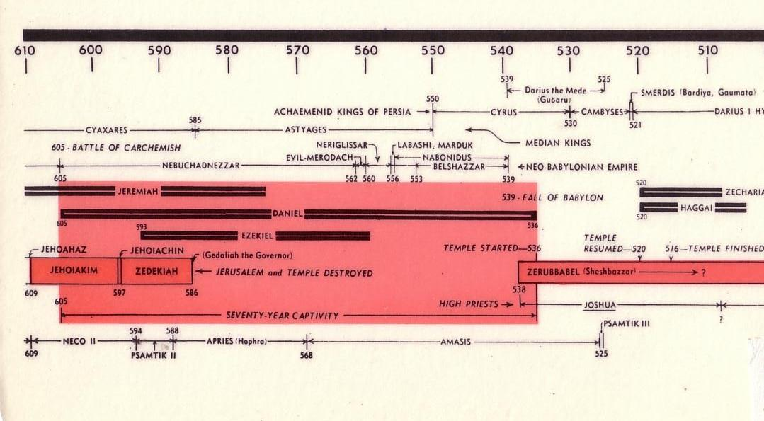
流放表
232 & 342
The Babylonian Exile
John C. Whitcomb, 4th rev. ed., Winona Lake, IN: BMH Books, 1962, 1968

Slide 32
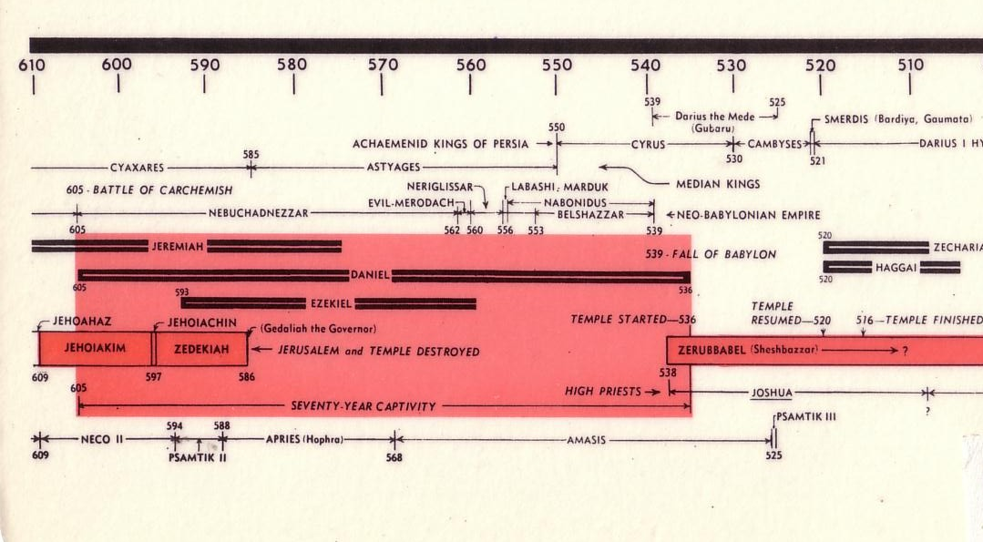
流放表
232 & 342
大流士
马代人
斯麦尔地（巴迪亚，高玛塔）
波 斯 国 王
塞勒斯
纲比西斯
基亚克萨雷斯
亚格斯
米提亚的王
迦基米斯战役
尼力里沙
拉巴斯。马杜克
尼布甲尼撒二世
以莫米罗达
拿波尼杜
伯沙撒
新巴比伦帝国
耶利米
撒迦利亚
巴比伦沦陷
但以理
哈该
以西结
重新开始
建圣殿
约哈斯
约雅斤
建圣殿
圣殿完成
统治者 基大力
约沙法王
西底家
耶路撒冷和圣殿被毁
所罗巴伯（设巴萨）
大祭司
约书亚
七十年俘虏
撒玛提克三世
尼古二世
沙姆提克
（舍弗拉）
亚玛西士
撒玛提克二世
巴比伦放逐者
John C. Whitcomb, 4th rev. ed., Winona Lake, IN: BMH Books, 1962, 1968

Slide 33
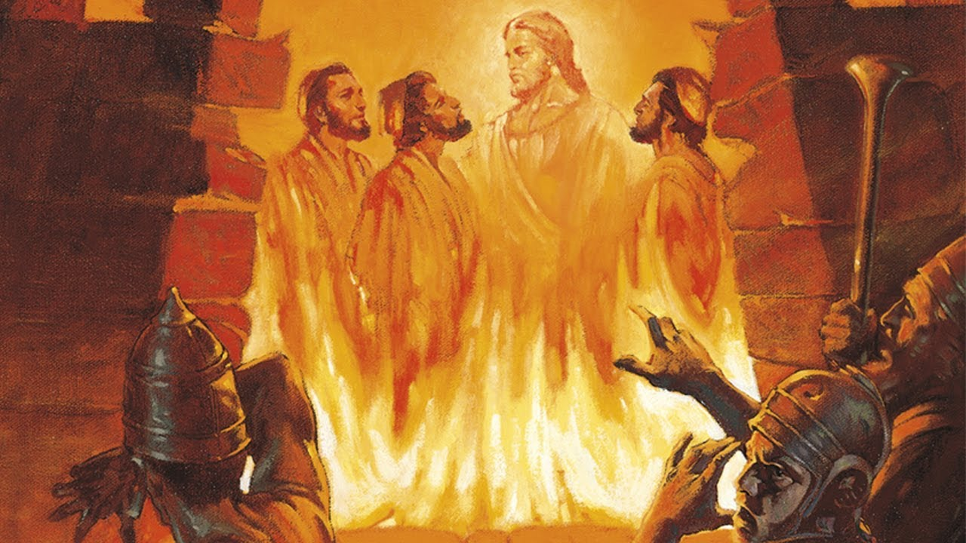
燃烧的火炉

Slide 34
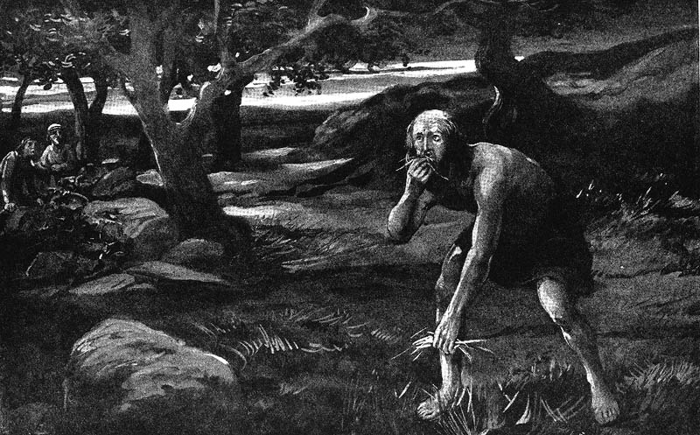
尼布甲尼撒非自愿地成为素食者

Slide 35
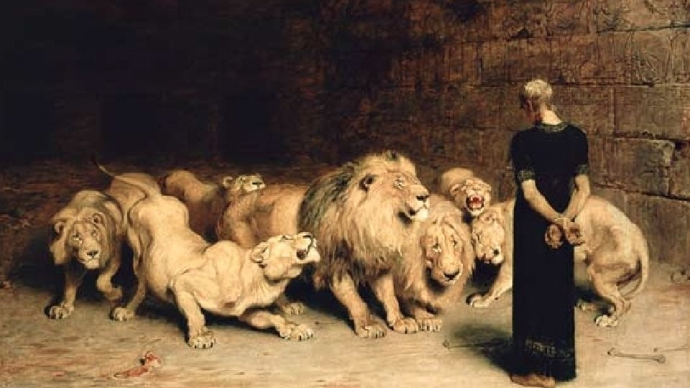
Are these tales?
"The observation that the book contains many historical inaccuracies is the most important clue for the fact that the book originated in the second century. These inaccuracies are explained once it is realized that the writer wrote about the events of her own period, the second century."
M. Nel, “A Literary-Historical Analysis of Daniel 2: Two Powers in Opposition,” Acta Theologica 22 (2002): 78; cited by Tanner, Daniel, 2

Slide 36
但以理书主要日期
但以理的事奉
(1:1; 10:1)
605-536
但以理的预言
(2-11章)
605-AD 70
安提阿哥
亵渎圣殿
167-164
600
550
500
450
400
350
300
2 5 0
2 0 0
150
100
50
BC/AD
50
评论家认为历史事件
被记录为‘预言’
评论家认为但以理书
写作日期为BC164之后

Slide 37
"Some have objected to Daniel’s authorship because of supposed historical errors found in the book. Some have asserted, for instance, that Nebuchadnezzar was not the father of Belshazzar, as indicated in Daniel 5:2, 11, 13, 18 (cf. v. 22). They argue that if Daniel had written the book, he would not have made such an error."
"However, it has been demonstrated that a royal successor to the throne was called a 'son' (5:22) even if he had no blood relationship to an earlier king."
—Pentecost, BKC, 1:1325
Notes:
Some have objected to Daniel’s sixth-century date on the grounds that the book is included in the Writings, the third section of the Hebrew Bible, rather than among the Prophets, the second division. The last prophetic book (Malachi) was written in the fifth century B.C. Those arguing for a late date for Daniel allege that if his book were written in the sixth century, it would have been included in the second division (the Prophets) rather than relegated to the third (the Writings). However, as previously noted, the prophets were set apart by God as His messengers with a special ministry to the nation Israel. Since Daniel was counted by his contemporaries as a governmental leader rather than a prophet, his writings were included in the third division rather than in the second. Thus the status of the author rather than the date of his book determined the division in which his book was included in the Hebrew Bible.
Some critics hold that since God’s name Yahweh is not used by Daniel and since the name was commonly used in Daniel’s day by others, the book must have been written at a later time. However, this objection fails to note that in chapter 9 this name is used eight times (Dan. 9:2, 4, 8, 10, 13-14 [thrice], 20). The name for God an author used in a given passage was determined by his content, not by popular custom.
Some have objected to Daniel’s authorship because of supposed historical errors found in the book. Some have asserted, for instance, that Nebuchadnezzar was not the father of Belshazzar, as indicated in Daniel 5:2, 11, 13, 18 (cf. v. 22). They argue that if Daniel had written the book, he would not have made such an error. However, it has been demonstrated that a royal successor to the throne was called a “son” (5:22) even if he had no blood relationship to an earlier king. (See the chart “Kings of the Neo-Babylonian Empire.”)
Again objection is made to Daniel’s authorship because the writer refers in 1:21 to the time of Daniel’s death. However, 1:21 does not state when Daniel died; it states that he “remained there” (in Babylon) till Cyrus’ first year. Cyrus’ decree liberated the Jews from their exile in Babylon, thus bringing the 70-year Captivity to a near end. Daniel 1:21 is simply pointing out that Daniel lived through the span of the Captivity. The verse does not specify the time of his death. In fact he lived on into at least Cyrus’ third year (10:1).

Slide 38
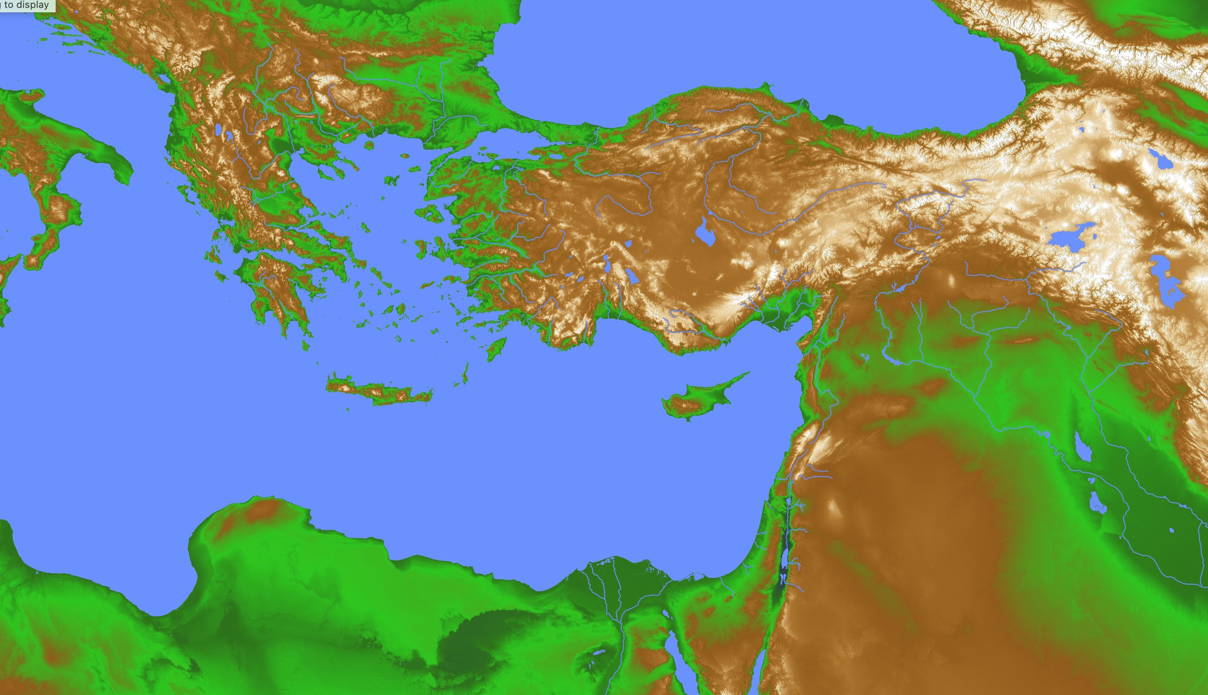
Greek & Persian Loan Words in Daniel
28
Greece
Persia
"Then a herald shouted out, 'People of all races and nations and languages, listen to the king’s command! ⁵ When you hear the sound of the horn, flute, zither, lyre, harp, pipes, and other musical instruments, bow to the ground to worship King Nebuchadnezzar’s gold statue. ⁶ Anyone who refuses to obey will immediately be thrown into a blazing furnace'" (Daniel 3:4-6 NLT).
—How do we explain these many Greek and Persian words in 600 BC before the Greek and Roman empires were established?
Babylon

Slide 39

Greek & Persian Loan Words in Daniel
28
Greece
Persia
"A number of other objections have been raised against the early date for the book. For example, some argue that the several Persian and Greek words in the book indicate that it must have been written much later than the sixth century B.C. However, archeology has revealed that commerce existed between Greece and Babylon even before Daniel’s day. This would explain the presence of Greek words. And the Persian words in the book were from an official or literary form of the Persian language which was in wide use throughout the Near East. (Cf. D.J. Wiseman et al., Notes on Some Problems in the Book of Daniel, pp. 23-7, 35-50.)"
Babylon
Pentecost, BKC, 1:1325
Notes:
Dwight J. Pentecost, "Daniel,” in The Bible Knowledge Commentary; ed. John F. Walvoord and Roy B. Zuck; Accordance electronic ed. 2 vols.; Wheaton: Victor Books, 1985), 1:1325.

Slide 40
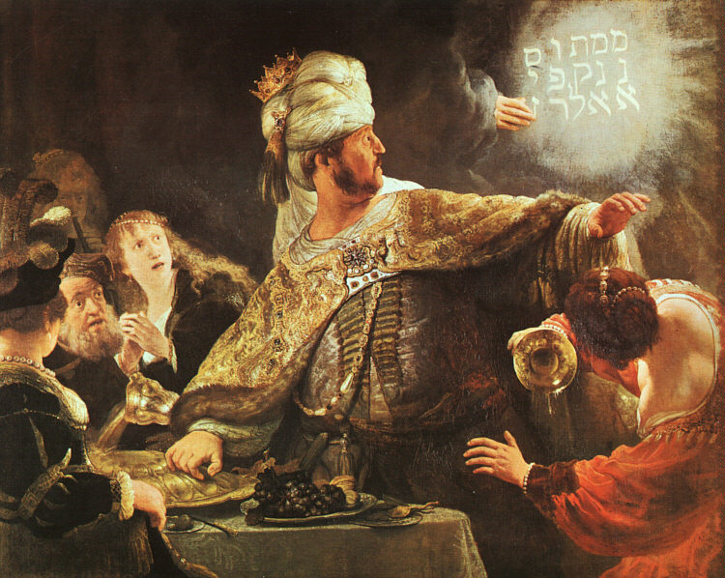
伯沙撒王的谦卑
名画家伦勃朗

Slide 41
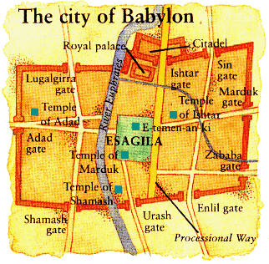
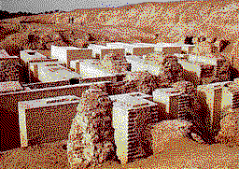

巴比伦的沉沦
144
巴比伦的沉沦 (539 BC)
波斯人由水门底入城
但以理 5章
(伯沙撒王设摆盛筵)

Slide 42
巴比伦的失败（希罗多德）
544b
波斯战争历史1.191 (公元前430 )
“[古列] 安置一部分的军队在进入城市的河流位置， 另一部分在出城的位置, 按照顺序在水域最浅的时候用最快的速度向溪床长驱直入: 然后他撤去他自己指挥的不善战的部分，向着尼托克里斯之前预先挖池的地方:他以运河将幼发拉底河引入原本是沼泽的水池，以使河流的天然的溪水河床成为可以淌水而过的地方。
“随即那些留下来在河边等候攻取巴比伦的波斯人，就进入那水位已经下降到人的腿部一半部位的溪流，沿河涉水前行，进入城里。”

Slide 43
巴比伦的失败（希罗多德）
544b
“如果巴比伦人预先已经知道古列的所做的事，或他们已经预测到危险将至，他们将永远不会让波斯人进城，他们可以将敌军完全消灭; 因为他们可以关紧那些面向河流的街道关口和爬上沿着溪水两旁的墙，就像瓮里捉鳖一般抓住敌人，那似乎就像是一个陷阱。但是事实上，波斯人出其不意地上到他们那里，攻取整个城。由于场地之大，中心领域的居民（在巴比伦的居民）在外城被夺取很久之后还不知道发生了什么改变, 他们仍然还沉浸在节庆的欢乐中， 继续的跳舞和狂欢直到他们在毫无预备中被掳获。这就是巴比伦如何首次被攻取。”
波斯战争历史1.191 (430 BC)

Slide 44
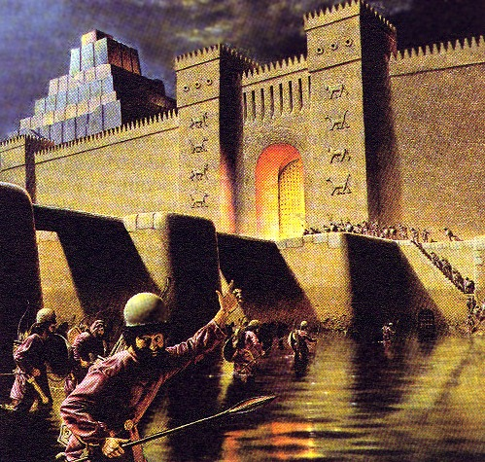
Daniel 5:30-31
“That same night Belshazzar the Chaldean king was slain. So Darius the Mede received the kingdom”
Daniel 5:30-31

Slide 45
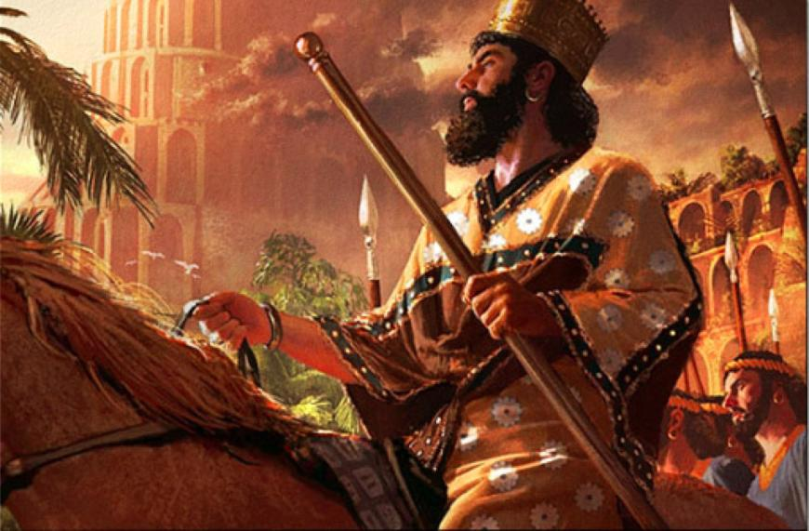
古列征服巴比伦
539 BC

Slide 46
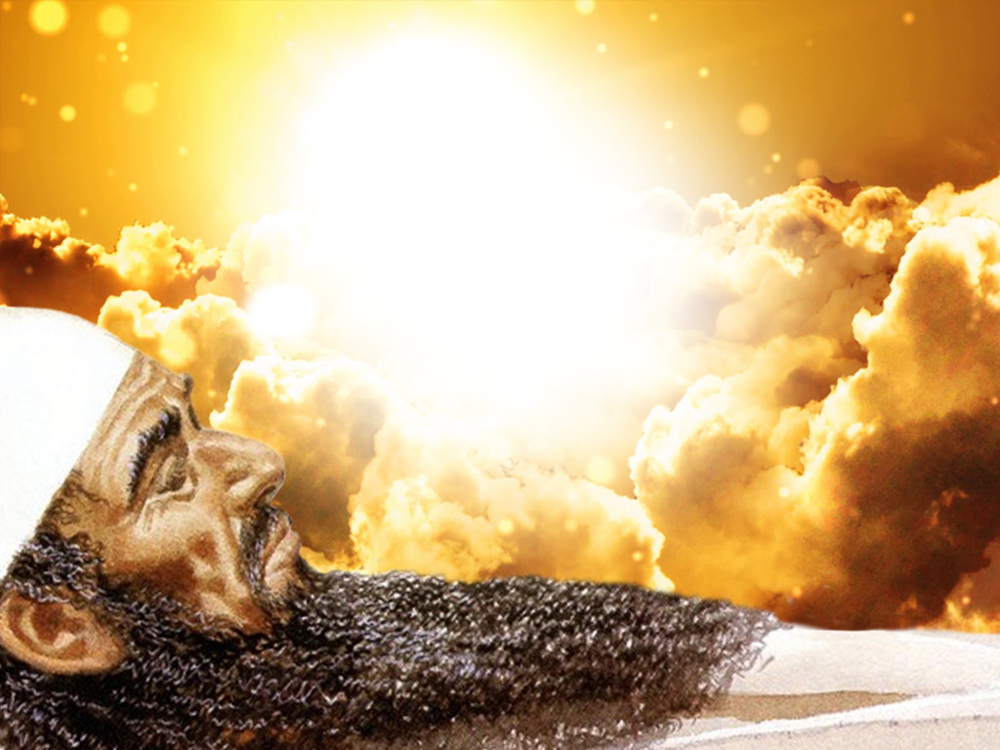
Critics Especially Doubt Visions of Daniel 7–12 (apocalyptic denied for 600 BC)
—Your response?

Slide 47
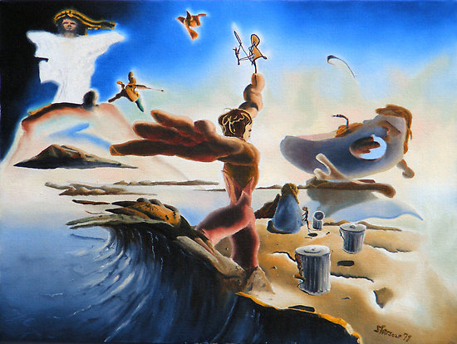
启示录是
唯一预示世界
末日的新约书
结束时间
p. 320
Point D
警告
（不悔改）
悲观主义
神的胜利
保密
宿命论

Slide 48
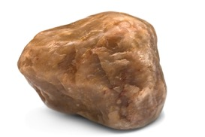
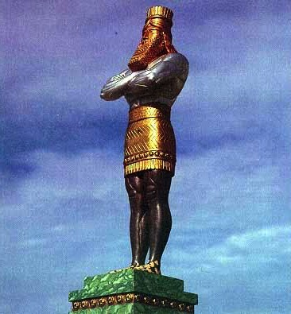
但以理书第二章里的大像
黄金
巴比伦
银
波斯
铜
希腊
钢铁
罗马
钢铁与粘土
敌基督
石头
王国

Slide 49
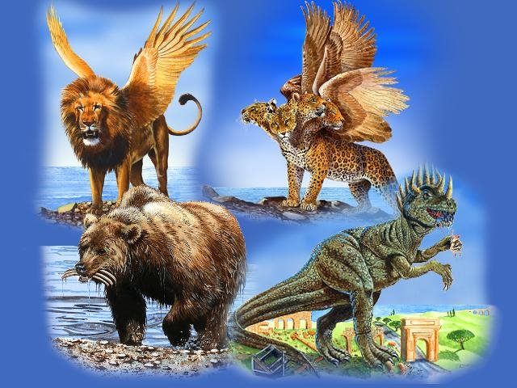
但以理书 7章中的国家
巴比伦
希腊
罗马
玛代-波斯

Slide 50
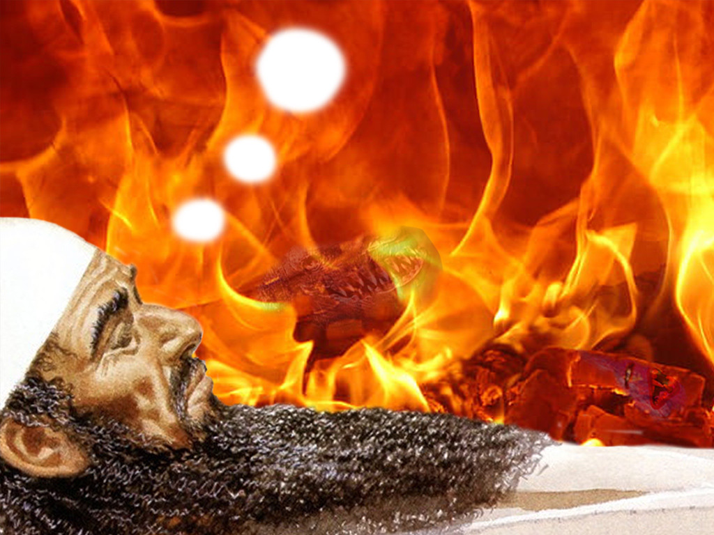
How is it legitimate to accept the Daniel 2 prediction of the four future nations but doubt the same in Daniel 7?

Slide 51
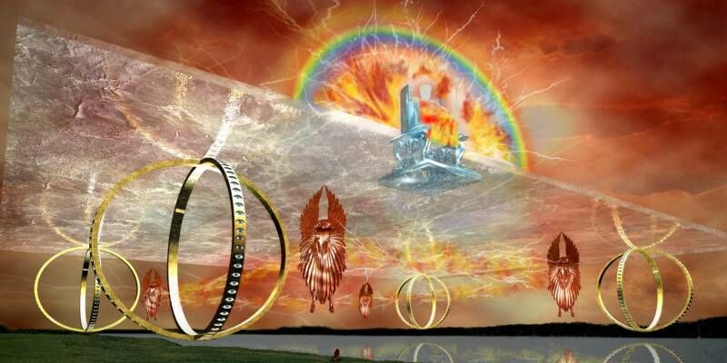
牠们的翅膀互相接触，走动的时候，
不必转身，都是朝着脸孔的方向行賀.
以西结 1:1-12

Slide 52
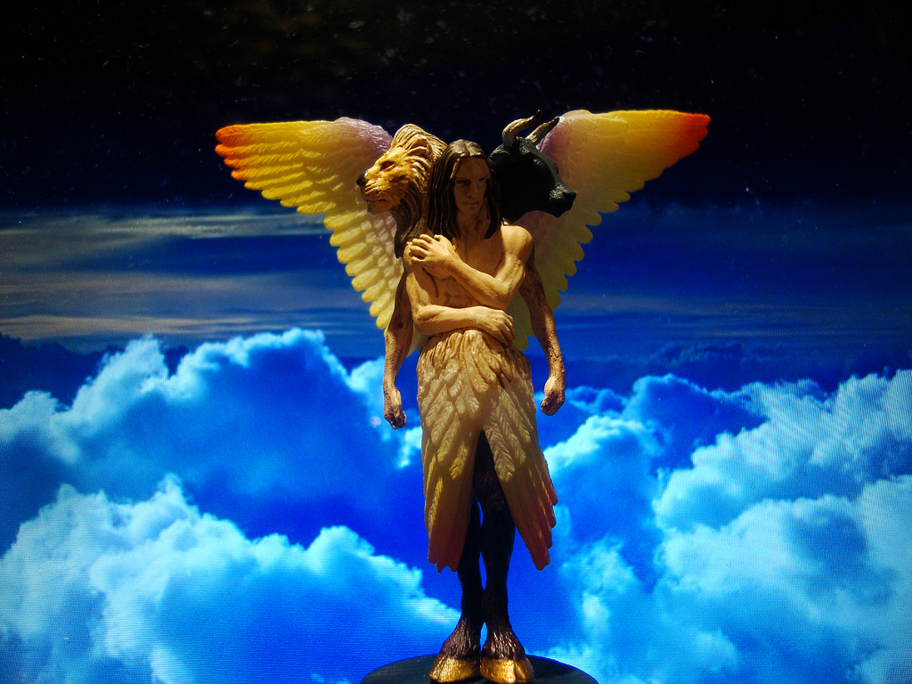
有四个脸的活物（结 1：10 )
367
至于脸的形像、前面各有人的脸、右面各有狮子的脸、左面各有牛的脸、后面各有鹰的脸。
象征上帝的四种创造：人、
野兽、驯兽、飞禽。
Notes:
"I believe that these special creatures symbolize God's creation and are related to God's covenant with Noah (Gen. 9:8–17). The faces of the living creatures parallel God's statement in Genesis 9:10—His covenant is with Noah (the face of the man), the fowl (the face of the eagle), the cattle (the face of the calf), and the beasts of the earth (the face of the lion)" (Wiersbe on Revelation 4:7).
“我相信这些特殊的活物象征着神的创造，并且与神和挪亚立的约有关（创世记 9:8-17）。这些活物的面貌与创世记 9:10 中神的话相对应——祂的约是与挪亚（人脸）、飞鸟（鹰脸）、牲畜（牛犊脸）和地上的野兽（狮子脸）立的。”（韦尔斯比关于启示录 4:7 的注释）

Slide 53
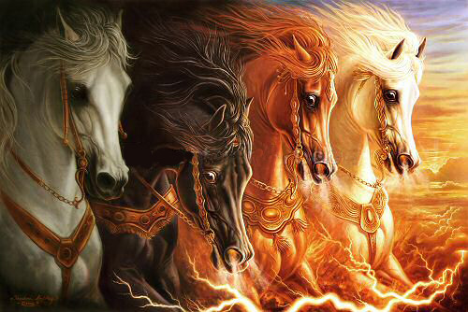
四匹马 (6:1-8)

Slide 54
"Some have objected to Daniel’s sixth-century date on the grounds that the book is included in the Writings, the third section of the Hebrew Bible, rather than among the Prophets, the second division. The last prophetic book (Malachi) was written in the fifth century B.C. Those arguing for a late date for Daniel allege that if his book were written in the sixth century, it would have been included in the second division (the Prophets) rather than relegated to the third (the Writings)."
Your response?
—Pentecost, BKC, 1:1325
Notes:
Some have objected to Daniel’s sixth-century date on the grounds that the book is included in the Writings, the third section of the Hebrew Bible, rather than among the Prophets, the second division. The last prophetic book (Malachi) was written in the fifth century B.C. Those arguing for a late date for Daniel allege that if his book were written in the sixth century, it would have been included in the second division (the Prophets) rather than relegated to the third (the Writings). However, as previously noted, the prophets were set apart by God as His messengers with a special ministry to the nation Israel. Since Daniel was counted by his contemporaries as a governmental leader rather than a prophet, his writings were included in the third division rather than in the second. Thus the status of the author rather than the date of his book determined the division in which his book was included in the Hebrew Bible.
Some critics hold that since God’s name Yahweh is not used by Daniel and since the name was commonly used in Daniel’s day by others, the book must have been written at a later time. However, this objection fails to note that in chapter 9 this name is used eight times (Dan. 9:2, 4, 8, 10, 13-14 [thrice], 20). The name for God an author used in a given passage was determined by his content, not by popular custom.
Some have objected to Daniel’s authorship because of supposed historical errors found in the book. Some have asserted, for instance, that Nebuchadnezzar was not the father of Belshazzar, as indicated in Daniel 5:2, 11, 13, 18 (cf. v. 22). They argue that if Daniel had written the book, he would not have made such an error. However, it has been demonstrated that a royal successor to the throne was called a “son” (5:22) even if he had no blood relationship to an earlier king. (See the chart “Kings of the Neo-Babylonian Empire.”)
Again objection is made to Daniel’s authorship because the writer refers in 1:21 to the time of Daniel’s death. However, 1:21 does not state when Daniel died; it states that he “remained there” (in Babylon) till Cyrus’ first year. Cyrus’ decree liberated the Jews from their exile in Babylon, thus bringing the 70-year Captivity to a near end. Daniel 1:21 is simply pointing out that Daniel lived through the span of the Captivity. The verse does not specify the time of his death. In fact he lived on into at least Cyrus’ third year (10:1).

Slide 55
"However, as previously noted, the prophets were set apart by God as His messengers with a special ministry to the nation Israel. Since Daniel was counted by his contemporaries as a governmental leader rather than a prophet, his writings were included in the third division rather than in the second. Thus the status of the author rather than the date of his book determined the division in which his book was included in the Hebrew Bible."
—Pentecost, BKC, 1:1325
Notes:
Some have objected to Daniel’s sixth-century date on the grounds that the book is included in the Writings, the third section of the Hebrew Bible, rather than among the Prophets, the second division. The last prophetic book (Malachi) was written in the fifth century B.C. Those arguing for a late date for Daniel allege that if his book were written in the sixth century, it would have been included in the second division (the Prophets) rather than relegated to the third (the Writings). However, as previously noted, the prophets were set apart by God as His messengers with a special ministry to the nation Israel. Since Daniel was counted by his contemporaries as a governmental leader rather than a prophet, his writings were included in the third division rather than in the second. Thus the status of the author rather than the date of his book determined the division in which his book was included in the Hebrew Bible.
Some critics hold that since God’s name Yahweh is not used by Daniel and since the name was commonly used in Daniel’s day by others, the book must have been written at a later time. However, this objection fails to note that in chapter 9 this name is used eight times (Dan. 9:2, 4, 8, 10, 13-14 [thrice], 20). The name for God an author used in a given passage was determined by his content, not by popular custom.
Some have objected to Daniel’s authorship because of supposed historical errors found in the book. Some have asserted, for instance, that Nebuchadnezzar was not the father of Belshazzar, as indicated in Daniel 5:2, 11, 13, 18 (cf. v. 22). They argue that if Daniel had written the book, he would not have made such an error. However, it has been demonstrated that a royal successor to the throne was called a “son” (5:22) even if he had no blood relationship to an earlier king. (See the chart “Kings of the Neo-Babylonian Empire.”)
Again objection is made to Daniel’s authorship because the writer refers in 1:21 to the time of Daniel’s death. However, 1:21 does not state when Daniel died; it states that he “remained there” (in Babylon) till Cyrus’ first year. Cyrus’ decree liberated the Jews from their exile in Babylon, thus bringing the 70-year Captivity to a near end. Daniel 1:21 is simply pointing out that Daniel lived through the span of the Captivity. The verse does not specify the time of his death. In fact he lived on into at least Cyrus’ third year (10:1).

Slide 56
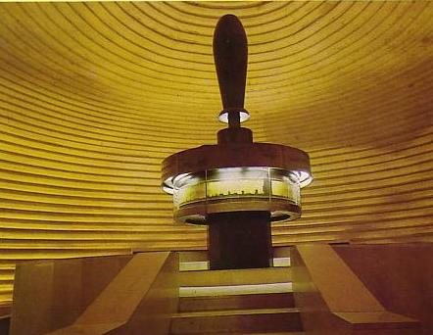
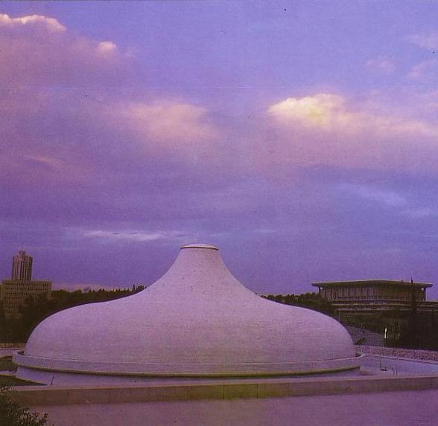
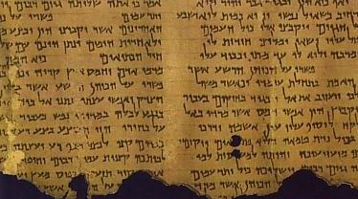
圣殿的书
“死海古卷”的重要性
534
“死海古卷”证明旧约书卷
成书的保守日期
但以理书何时被写成?
保守派
公元前 560
“死海古卷”但以理书文本约公元前200-100 年
自由派
公元前 164

Slide 57
But could Daniel have had an advanced theology of angels and the resurrection?
—Another argument of the critics
Notes:
Further objection is made to an early date because of the advanced theology in the book. Critics claim that frequent references to angels and a reference to the resurrection of the dead (12:2) necessitates a late postexilic date for the book. This, however, overlooks the fact that angels are frequently referred to throughout Israel’s long history and that resurrection is mentioned in passages such as Psalm 16:10 and Isaiah 26:19, which certainly predate the time of Daniel”
Dwight J. Pentecost, "Daniel,” in The Bible Knowledge Commentary; ed. John F. Walvoord and Roy B. Zuck; Accordance electronic ed. 2 vols.; Wheaton: Victor Books, 1985), 1:1325.

Slide 58
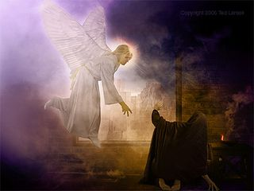
Michael will arise (Daniel 12:1)
Notes:
These prophecies will bless Israel in the Tribulation and reveal judgment for unbelievers to encourage Israel with God's rule (12:4-14).

Slide 59
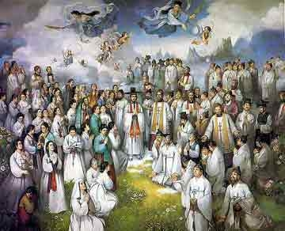
旧约圣徒的审判
160
"那时保护你同胞的伟大护卫天使米迦勒必站起来；并且必有患难的时期，是立国以来直到那时未曾有过的。那时你的同胞中名字记录在册上的，都必得拯救。 ² 必有许多睡在尘土中的人醒过来，有的要得永生，有的要受羞辱，
永远被憎恶。 ³ 那些有智慧的必发光，好象穹苍的光体；那些使许多人归义的必发光，如同星星，直到永永远远。"
(但以理 12:1-3 CNV).

Slide 60
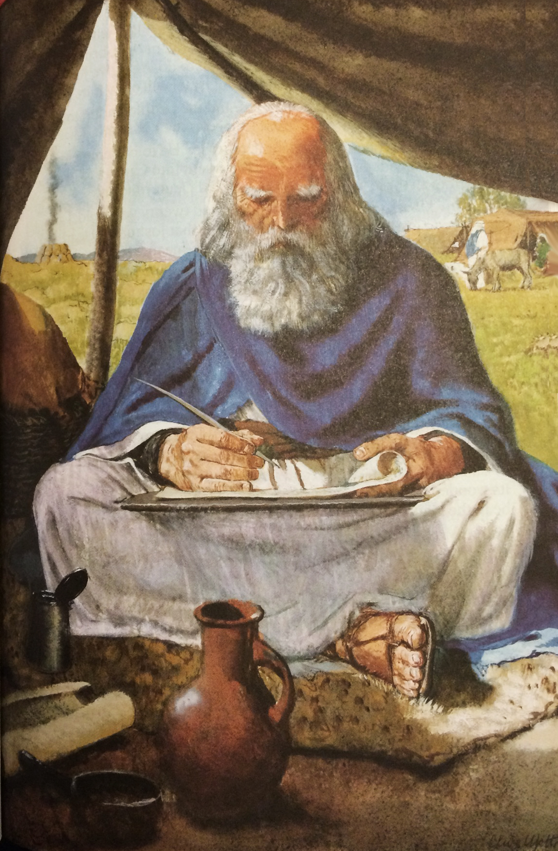
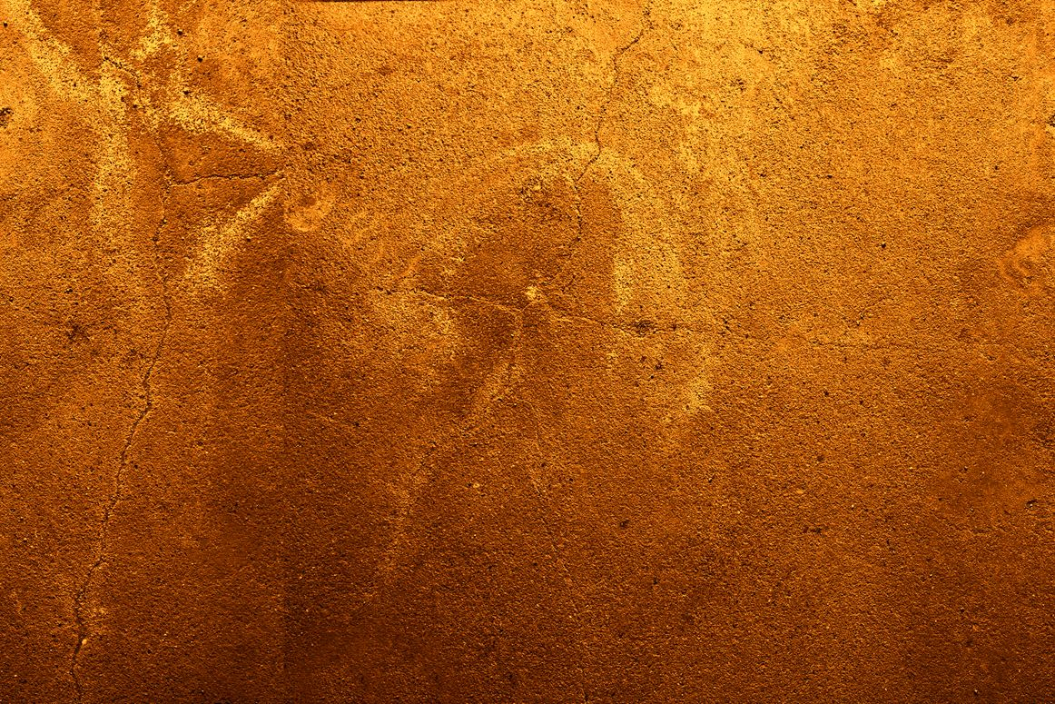
“Your dead will live; Their corpses will rise. You who lie in the dust, awake and shout for joy, for your dew is as the dew of the dawn, and the earth will give birth to the departed spirits.”
Isaiah 26:19

Slide 61

"For you will not leave my soul among the dead or allow your holy one to rot in the grave" (Psalm 16:10 NLT).
Peter noted this as predictive prophecy of the resurrection of Christ (Acts 2)

Slide 62
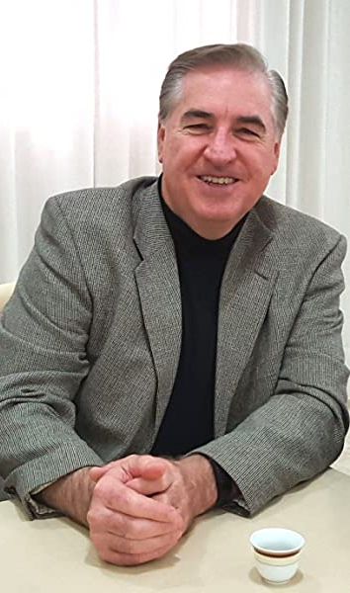
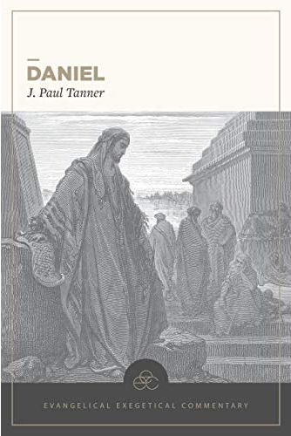
J. Paul Tanner
—Finally, a substantial evangelical commentary on Daniel
Daniel, Evangelical Exegetical Commentary (Bellingham, WA: Lexham Press, 2020)

Slide 63
Conclusion
Do you have any doubts that Daniel wrote the book bearing his name?

Slide 64
Black

Slide 65


Critical Studies of the OT link at BibleStudyDownloads.org
Get this presentation and script for free!

