Slide 1
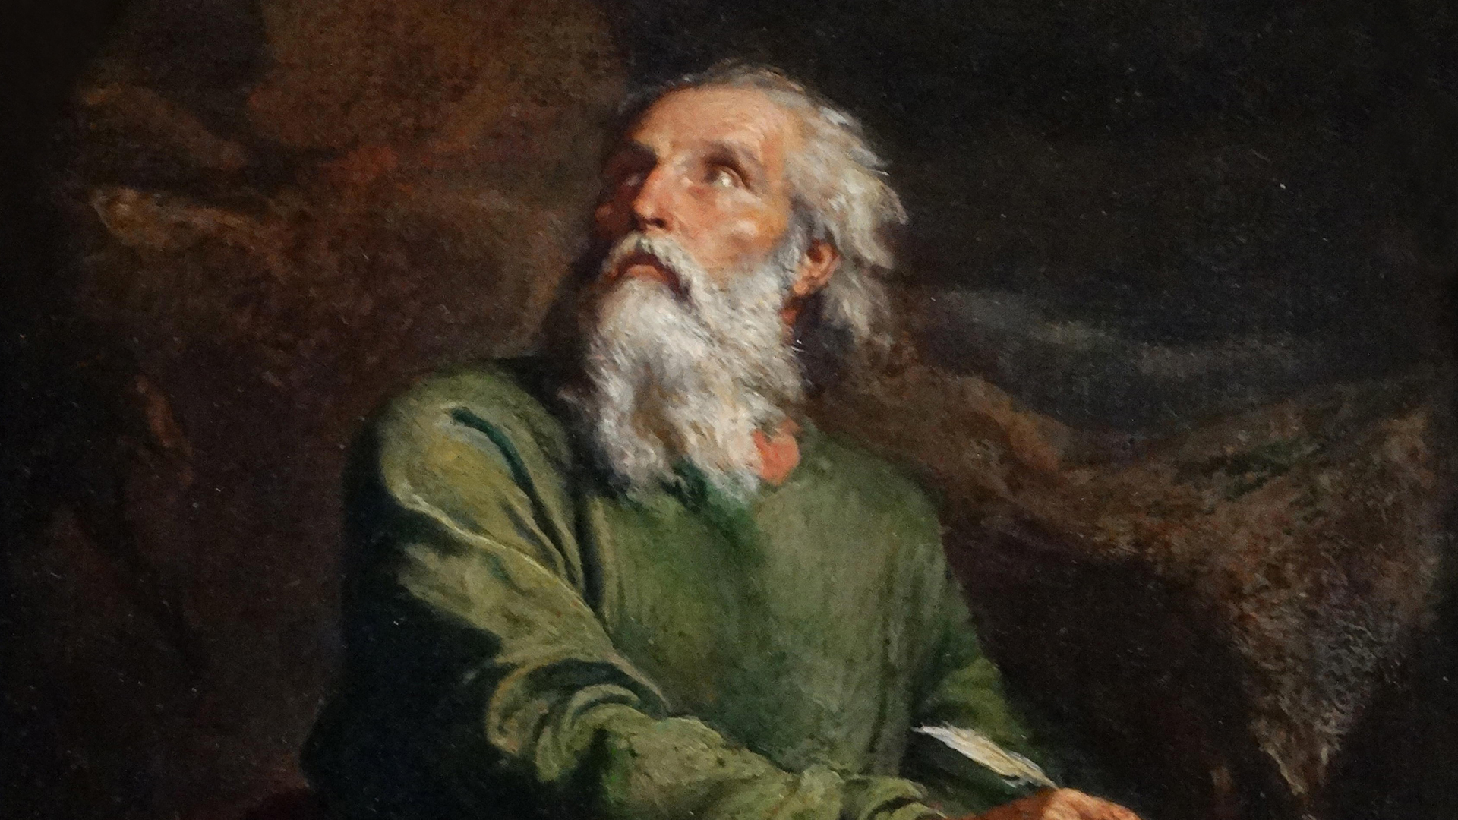
以赛亚书的作者身份
Who wrote Isaiah?
Dr. Rick Griffith • 新加坡神学院 • BibleStudyDownloads.org

Slide 2
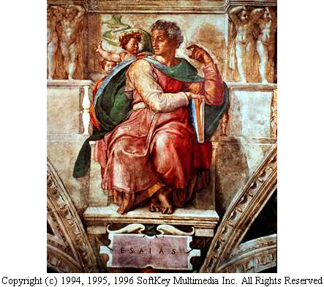
以赛亚
西斯廷教堂
Notes:
2

Slide 3
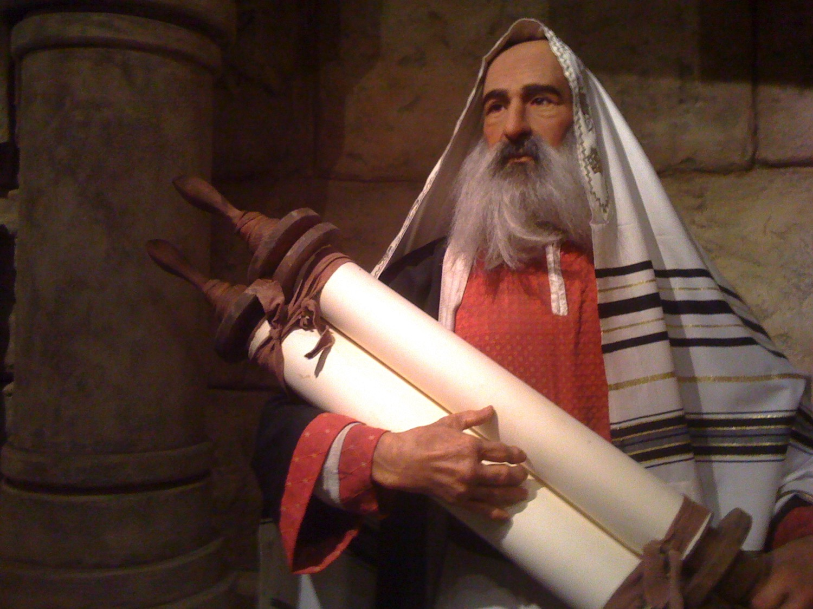
以赛亚是谁?

Slide 4

谁是以赛亚?
他的名字的意思是 “耶和华是救恩” 或“ 耶和华拯救”。
亚摩斯的儿子和传统认为的表弟王乌西雅, 并可能已进入宫廷。
传统的记录，他是烈士被锯成两半。
版权所有 © 一九九四至一九九六年软键多媒体公司。保留所有权利。

Slide 5
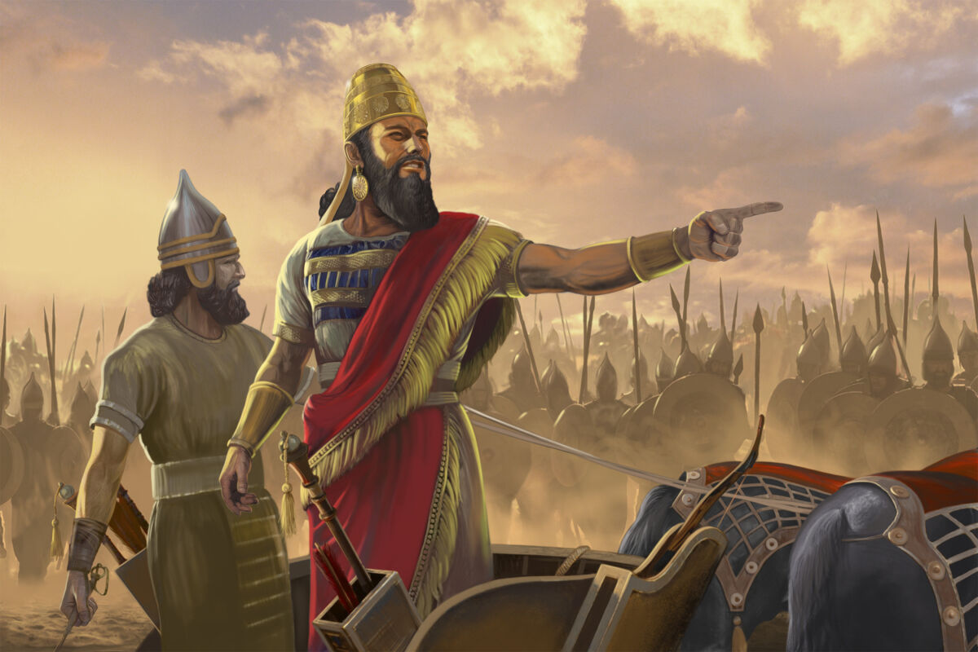
Isaiah wrote during the Assyrian invasions about 700 BC

Slide 6
Placing the Prophets
342
先知的位置
关键日期
931
俄巴底亚
722
约拿
阿摩司
何西阿
以赛亚
弥迦
那鸿
西番雅
耶利米
耶利米哀歌
约珥
但以理
哈该
哈巴谷
以西结
撒加利亚
玛拉基
586

Slide 7
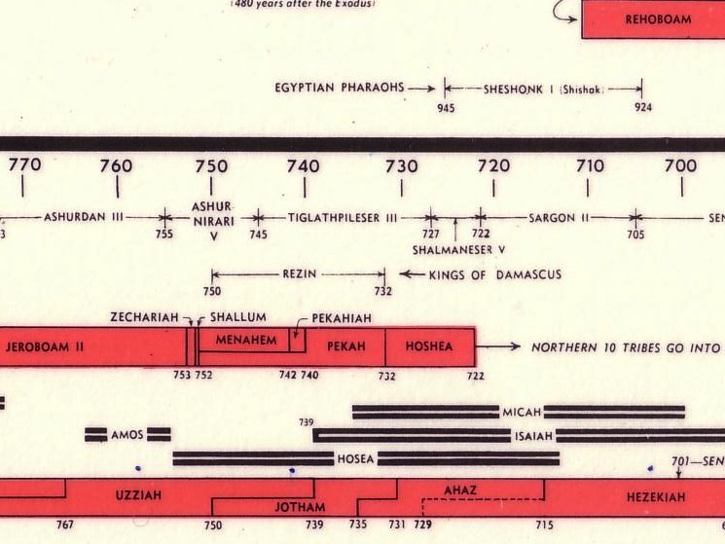

旧约列王及先知的图表
232 & 342

Slide 8
亚述威胁
亚述膨胀
尼尼微
地中海
亚兰
以色列
犹太
波斯湾
埃及

Slide 9
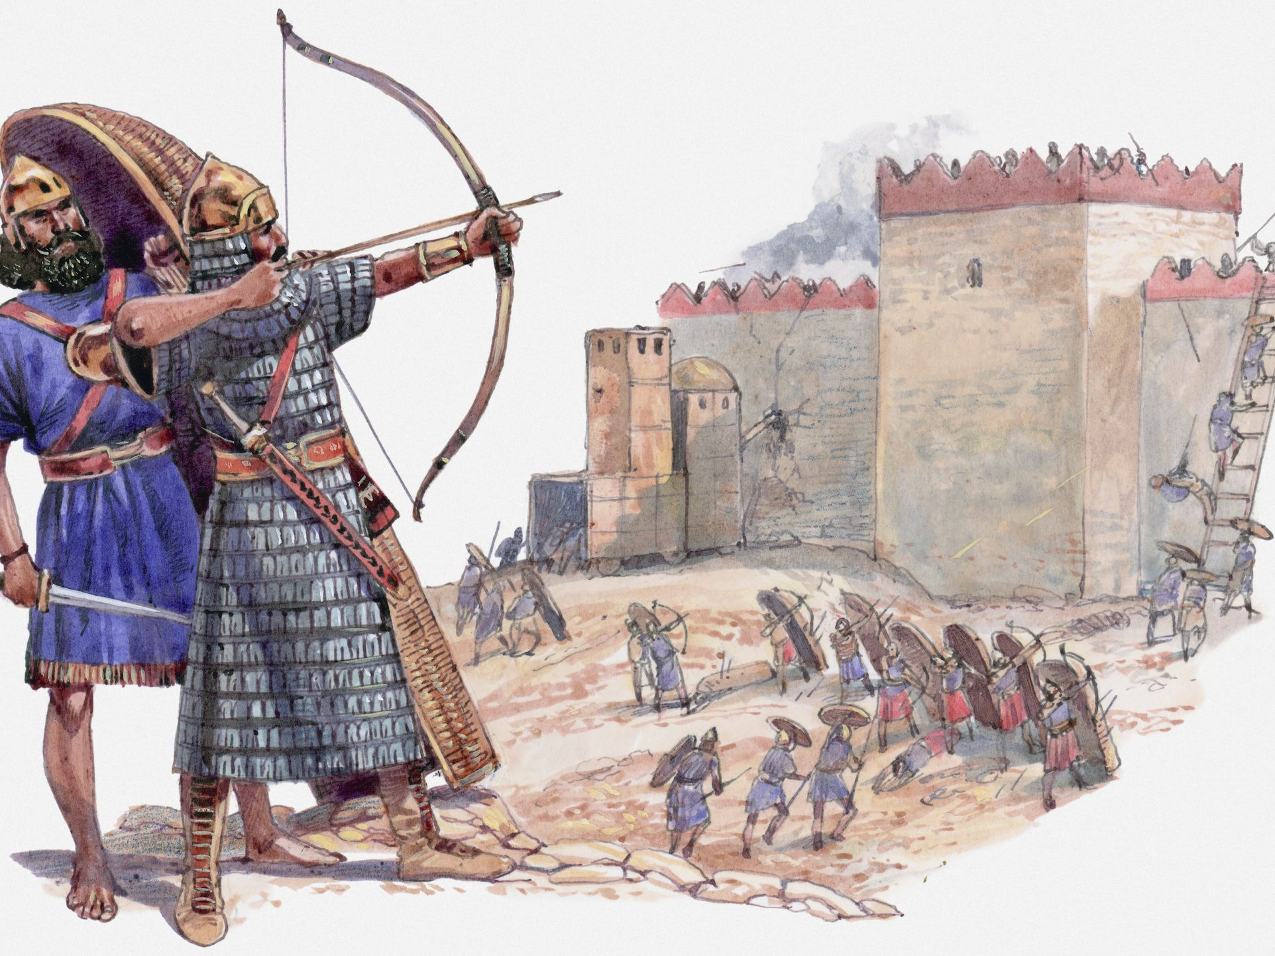
Assyrians ruined 46 cities of Judah
Notes:
As Isaiah served the LORD in Jerusalem, every other city in Judah was conquered one by one.

Slide 10

以赛亚六十五年的先知部
(公元前 745 至 680)
结束以色列的国王
比加
何细亚
犹太的国王
乌西雅
约坦
亚哈斯
希西家

Slide 11
453
谁写以赛亚书?
指控：
1. 背景
2. 风格与神学
以赛亚书
3.弥赛亚
4. 被掳与古列
Notes:
11

Slide 12
453
露德路 - 以赛亚书?
1–39章 40–66章
以赛亚书
Notes:
12

Slide 13
453
露德路 - 以赛亚书?
1–39章 40–66章
三一 - 以赛亚书?
1–39章 40–55章 56–66章
以赛亚书
Notes:
13

Slide 14
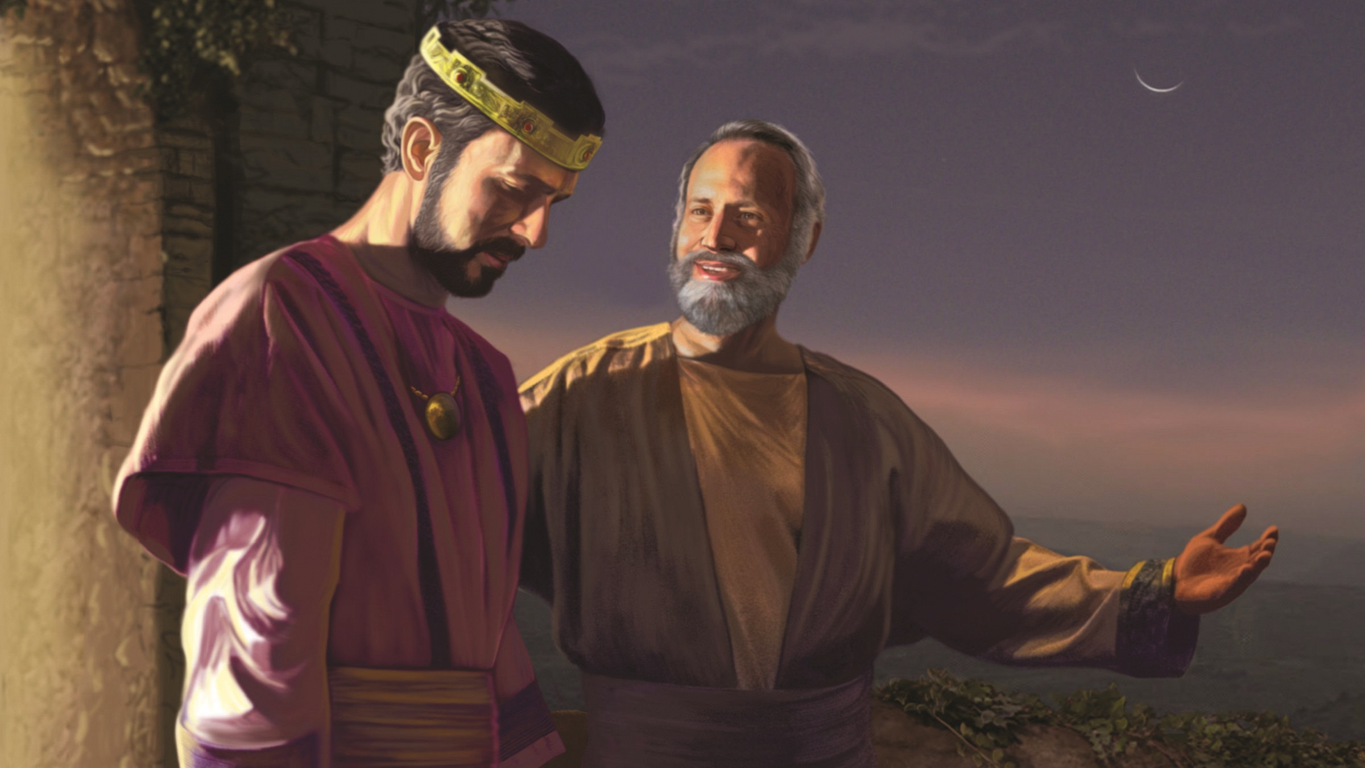
What arguments support Isaiah as author of the whole book?

Slide 15
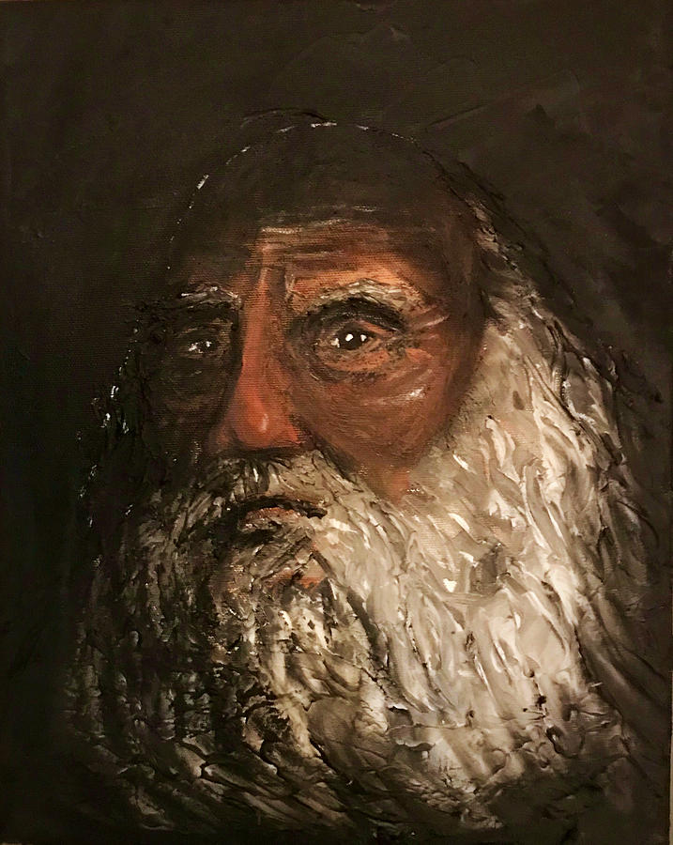
Literary
Arguments
Evidence for Isaiah’s Authorship

Slide 16
453
Deutero-Isaiah?
1–39 40–66
Trito-Isaiah?
1–39 40–55 56–66
"Uno" Isaiah?
1–66
Responses:
1. Background
Isaiah
Notes:
16

Slide 17
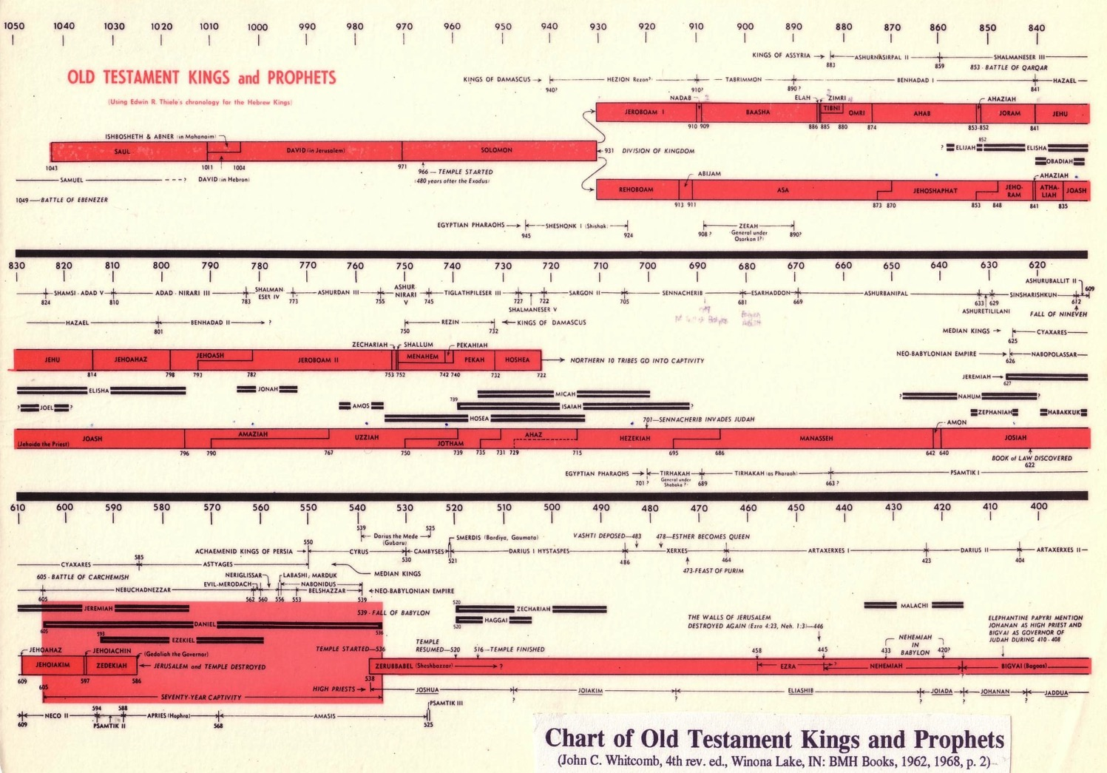
Chart of OT Kings & Prophets
232 & 342
Assyria Strong
Babylon Strong
Chart of Old Testament Kings & Prophets
John C. Whitcomb, 4th ed. (Winona Lake, IN: BMH Books, 1968), 2

Slide 18
453
Deutero-Isaiah?
1–39 40–66
Accusation:
Assyrian Background
(Isa 1–39)
Babylonian Background
(Isa 40–66)
Responses:
1. Background
Isaiah
Rebuttal:
Babylon Noted 9 Times in
1–39
Babylon Noted Only 4 Times in
40–66
Keep due to animation bug!
Notes:
18
1. Accusation: Chapters 1–39 have an Assyrian background but chapters 40–66 have a Babylonian background.
Response: Babylon is mentioned more than twice as often in chapters 1–39 than in 40–66. The only shift is one of perspective from a present to a future time. Besides, Isaiah may have prophesied chapters 1–39 before Assyria conquered Israel and then preached chapters 40–66 afterwards concerning Babylon.

Slide 19
453
Deutero-Isaiah?
1–39 40–66
Trito-Isaiah?
1–39 40–55 56–66
"Uno" Isaiah?
1–66
Responses:
1. Background
2. Style & theology
Isaiah
Notes:
19
2. Accusation: The language, style, and theology of the two sections differ radically.
Response: The differences are exaggerated by critics and can be explained by different emphases (condemnation verses consolation). Critics often will not admit that content, time of writing, and circumstances normally affect an author's style.

Slide 20
Isaiah:
Restoration of the Created Order
Judgment (and Salvation) |  |  |  | Salvation (and Judgment)
Chapters 1–39 |  |  |  | Chapters 40–66
Assyrian Invasion |  |  |  | Babylonian Captivity
Prophecy |  |  | History | Prophecy
Mostly Condemnation |  |  | Inter-lude | Mostly Consolation
Violations & deliverance 1–12 | Judgment on the nations 13–23 | Worldwide judgment & blessing 24–35 | Salvation sickness & sin 36–39 | Shepherd of Israel 40–48 | Suffering Servant 49–57 | God's Initiative 58–59 | Restoration under Messiah 60–66
Judah
739-681 BC (Before, during and after Israel's fall to Assyria in 722 BC)
452
"The Holy One of Israel" (12x)
"The Holy One of Israel" (13x)
"Truly the mouth of the LORD has spoken"
"Truly the mouth of the LORD has spoken” also here
40-50 other phrases
Same 40-50 other phrases
Notes:
20
Critics lead us to believe that the same author could not write both of judgment and salvation. Yet:
Many authors do this today.
The differences between the sections are over-emphasized when in reality Isaiah 1–39 speaks of condemnation but also includes a deliverance section (chapters 7–12), and Isaiah 40–66 emphasizes salvation but even ends with judgment in the final verses.
—————
Paul Tanner Notes:
Notice the use of the title "The Holy One of Israel" in Isaiah. This occurs 12x in ch 1—39 and 13x in 40—66. Given that the title only occurs six other times in the rest of the OT, this even distribution within Isaiah strongly argues for one author.
There are 40-50 other phrases that appear in both sections (e.g., "Truly the mouth of the LORD has spoken").

Slide 21
﻿“The supposed three ‘books’ of 1–39, 40–55, and 56–66 have often been alleged to show traces of different periods of composition. There can be little doubt of 1–39 belonging to the later eighth century, having numerous links with that epoch. But that 40–55 is based in Babylon is simply not true. As scholars of various stripes have been compelled to observe, those chapters betray no firsthand knowledge of the metropolis of Babylon (mentioned only four times in these chapters, and only once actually implying a Hebrew exile, 48:20 — contrasted with nine times in 1–39!), but belong in the milieu of the Levant, not least Palestine.”
—K. A. Kitchen, On the Reliability of the Old Testament
(Eerdmans, 2003), location 8294 of 14432, Kindle Edition.
Notes:
21

Slide 22
453
Deutero-Isaiah in the DSS scroll?
1–33 34–66
Isaiah
Notes:
22

Slide 23
﻿“In tussles over unity and multiplicity in Isaiah, and supposed divisions at chapters 39/40, 55/56, etc., almost nobody has bothered to look for tangible textual evidence.”
K. Kitchen, On the Reliability of the OT, chapter 8, location 8279 of 14432, Kindle ed.
1–33
34–66
Isaiah
Notes:
23

Slide 24
﻿“In the Dead Sea Scrolls there is just one positive indication, in the great, intact scroll of Isaiah, one of the first scrolls published. In this scroll, when he came to the end of what we today call chapter 33 (at 33:24), the ancient scribe deliberately left a blank space (equal to three lines’ depth)”
K. Kitchen, On the Reliability of the OT, chapter 8, location 8279 of 14432, Kindle ed.
1–33
34–66
Isaiah
Notes:
24

Slide 25
﻿“…marking a break at the end of his column, before beginning a new column with what is now 34:1. This is very close to the midpoint of the entire book as he had it, and as we have it. The early scribe had some reason to divide here — but saw no reason to divide at either what is now 39/40 or 55/56, we may note.”
K. Kitchen, On the Reliability of the OT, chapter 8, location 8279 of 14432, Kindle ed.
1–33
34–66
Isaiah
Notes:
25

Slide 26
453
Deutero-Isaiah?
1–39 40–66
Trito-Isaiah?
1–39 40–55 56–66
"Uno" Isaiah?
1–66
Responses:
1. Background
2. Style & theology
Isaiah
3. Messiah
Notes:
26
3. Accusation: Messiah is presented as King in chapters 1–39 but as Suffering Servant in chapters 40–66.
Response: These two concepts are not contradictory and both depict each section.

Slide 27
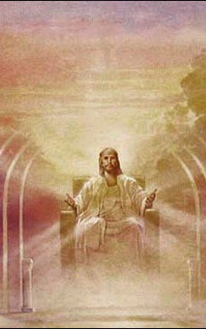
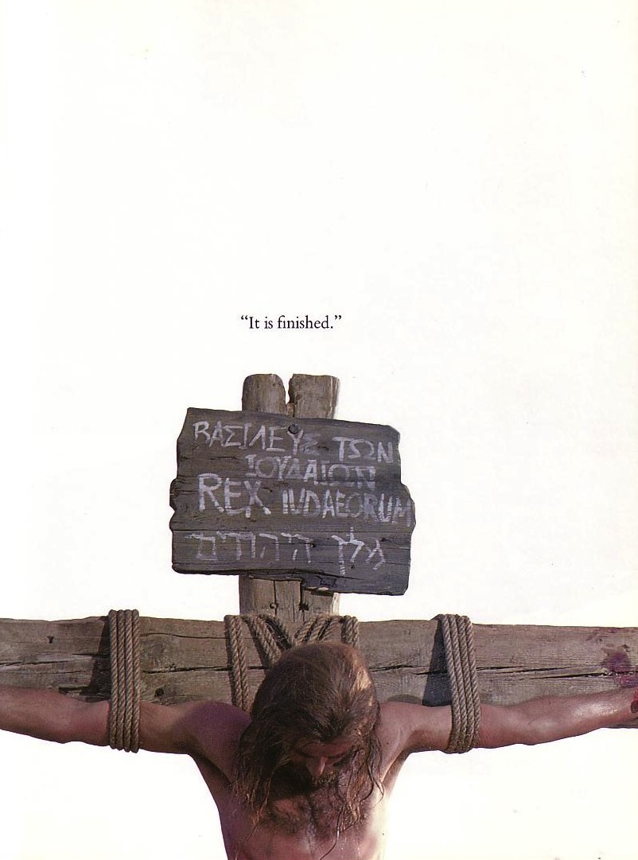

同一位弥赛亚？
"他被藐视，被人拒绝，
是个多受痛苦，熟悉病患的人。…"
(53:3)
"他的政权与平安必无穷无尽地增加，他在大卫的宝座上治理他的国，以公平和公义使国坚立稳固，从现在直到永远。万军之耶和华的热心必成全这事。
"
(9:7)
Notes:
27
Jewish scholars of the intertestamental period could not reconcile 以赛亚's two seemingly contradictory depictions of the Messiah. Therefore, some thought there existed two Messiahs—one to rule and one to suffer. Others said 以赛亚 53 depicted not the Messiah but the suffering Jewish people.
在新旧约中间时期的犹太学者无法调和以赛亚对弥赛亚的两种看似矛盾的描述。因此，有些人认为存在两位弥赛亚——一位掌权，一位受苦。另一些人则认为以赛亚书第53章描述的不是弥赛亚，而是受苦的犹太人民。

Slide 28
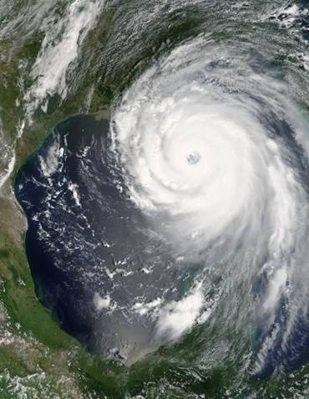
诺查丹玛斯是预言家吗？
这是否预言了卡特里娜飓风？
图尔、奥尔良、布卢瓦、昂热、兰斯和南特等城市因突然的变化而动荡。外邦人会在这些地方搭起帐篷；雷恩的河流中箭矢纷飞，陆地和海洋震动不安。
（《世纪 1》，四行诗 50）
<http://www.nostradamus101.com/prophecies/part3/P1/>
Notes:
28

Slide 29
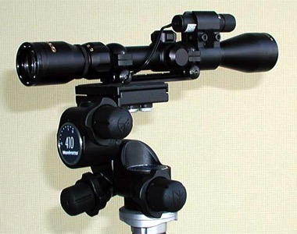
以赛亚预言的准确性
“所以耶和华这样论到亚述王，说：‘他必不会来到这城，也不会在这里射箭；不会拿着盾牌来到城前，也不会筑土垒攻城。 ³⁴ 他从哪条路来，也必从哪条路回去；他必不得进入这城；这是耶和华的宣告。” (赛37:33-34).
Notes:
29

Slide 30
以赛亚预言的准确性
“于是耶和华的使者出去，在亚述营中击杀了十八万五千人；到了早晨，有人起来，所见的都是死尸。 ³⁷ 亚述王西拿基立就拔营离去” (赛37:36-7).
Notes:
30

Slide 31
453
露德路 - 以赛亚书?
1–39章 40–66
三一 - 以赛亚书?
1–39章 40–55章 56–66章
‘uno’乌诺 - 以赛亚书?
1–66章
响应 :
1. 背景
2. 风格与神学
以赛亚书
3.弥赛亚
4.被掳与古列
Notes:
31

Slide 32
Chart of OT Kings & Prophets
232 & 342
Isaiah lived about 700 BC
So how did he know of the 600 BC captivity?
And the 539 BC return under Cyrus?
Chart of Old Testament Kings & Prophets
John C. Whitcomb, 4th ed. (Winona Lake, IN: BMH Books, 1968), 2

Slide 33
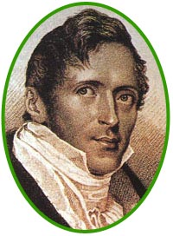
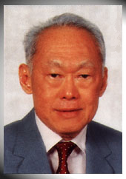
奇妙的预言
460
??
史丹福莱佛士（1819）
李光耀
(1959)
您听说过吗？莱佛士在李光耀之前 140 年写下了“看哪，一位名叫李的人将崛起，把新加坡变成一个国家……”？

Slide 34
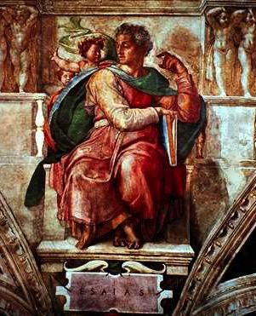
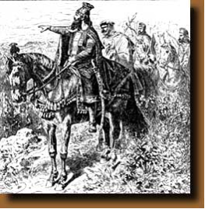
奇妙的预言
460
An Amazing Prophecy
41:25
44:28
45:1
45:13
以赛亚 (700 BC)
古列（公元前 539 年）
“我对古列说：‘我的牧人；他必成就我所喜悦的一切。’他要对耶路撒冷说：‘你必被重建起来！’他必对圣殿说：‘你的根基要奠定！’

Slide 35
Archaeological Arguments
Evidence for Isaiah’s Authorship

Slide 36
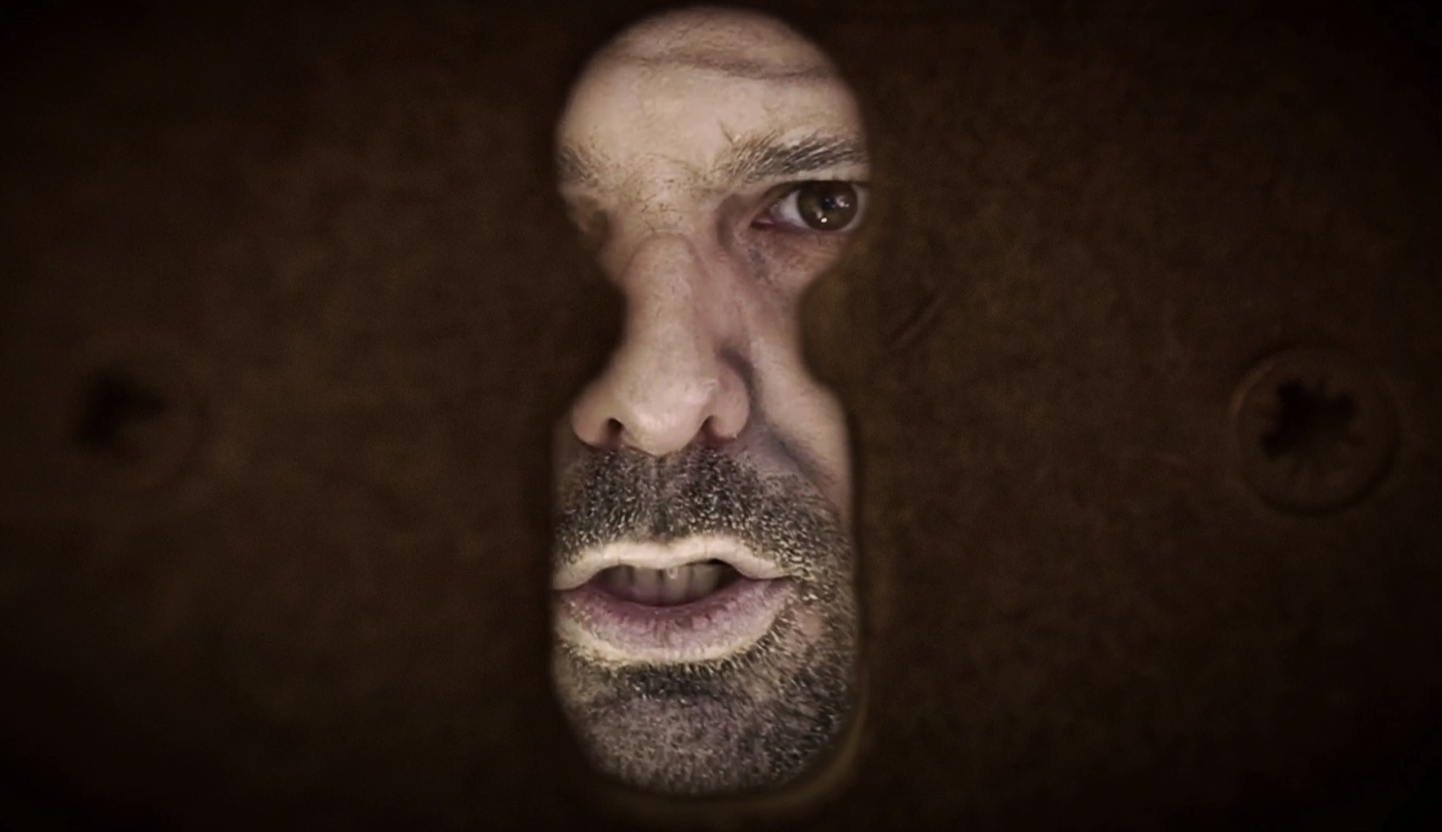
Evidence for Isaiah’s Authorship
• Assyrian records show their king Sennacherib threatening Hezekiah (701 BC)

Slide 37
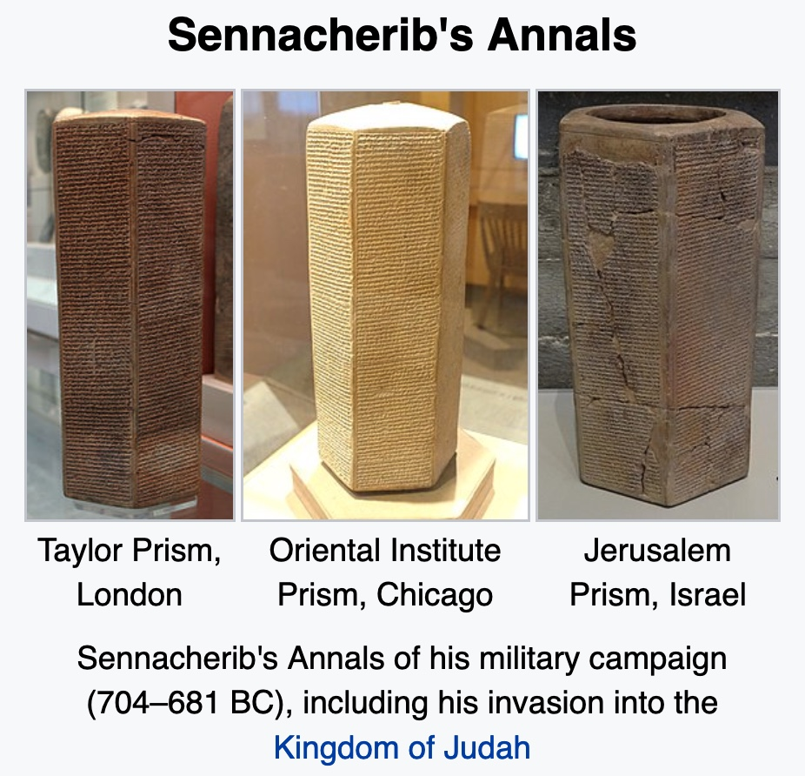
Evidence for Isaiah’s Authorship
Three Copies of Sennacherib’s Annals
Taylor Prism,
London
Oriental Institute Prism, Chicago
Jerusalem Prism,
Israel
Sennacherib’s Annals record his military campaign (704-681 BC), including his invasion into the Kingdom of Judah

Slide 38
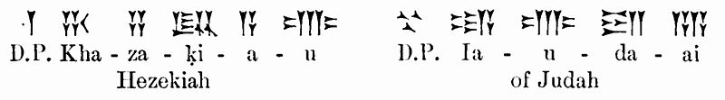
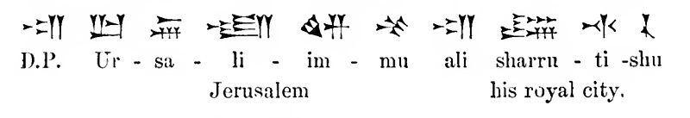
Evidence for Isaiah’s Authorship
Three Copies of Sennacherib’s Annals
Hezekiah
of Judah
Jerusalem
his royal city.

Slide 39
Evidence for Isaiah’s Authorship
"As for the king of Judah, Hezekiah, who had not submitted to my authority, I besieged and captured forty-six of his fortified cities, along with many smaller towns, taken in battle with my battering rams.... I took as plunder 200,150 people, both small and great, male and female, along with a great number of animals including horses, mules, donkeys, camels, oxen, and sheep. As for Hezekiah, I shut him up like a caged bird in his royal city of Jerusalem. I then constructed a series of fortresses around him, and I did not allow anyone to come out of the city gates. His towns which I captured I gave to the kings of Ashod, Ekron, and Gaza.”
—Sennacherib’s Annals—
i.e., Sennacherib could not conquer Jerusalem!
—See Isa 37:36-38;
2 Kings 19—

Slide 40
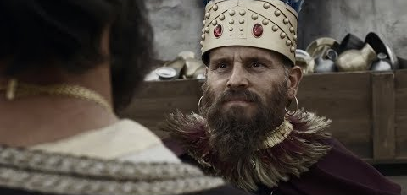
Evidence for Isaiah’s Authorship
• Hezekiah and Isaiah lived at the same time (701 BC)

Slide 41
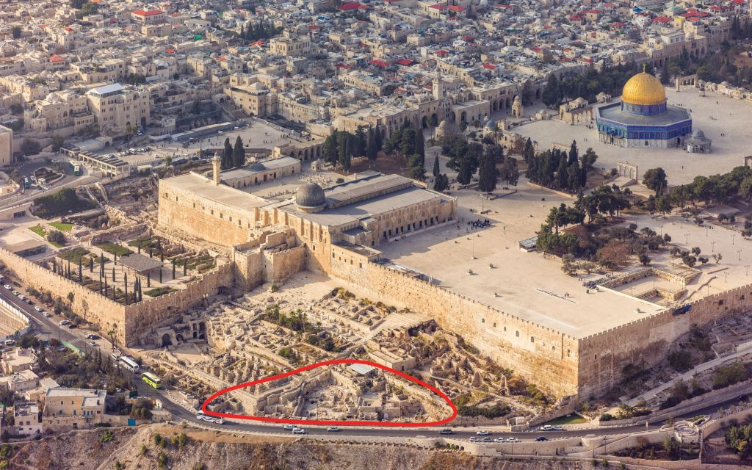
Evidence for Isaiah’s Authorship
• Hezekiah and Isaiah artefacts are found in the same strata
The Ophel excavations at the foot of the southern wall of the Temple Mount in Jerusalem (courtesy of Andrew Shiva)

Slide 42
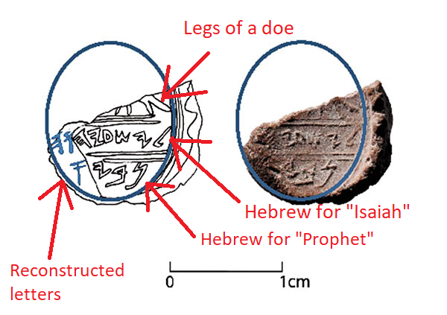
“In find of biblical proportions, seal of Prophet Isaiah said found in Jerusalem”
Legs of a doe
Hebrew for “Isaiah”
Hebrew for “Prophet”
Reconstructed letters
Chanced upon near a seal identified with King Hezekiah, a tiny clay piece may be the first-ever proof of the prophet, though a missing letter leaves room for doubt
By Amanda Borschel-Dan • 22 February 2018, 7:00 am
Notes:
Image Credit: https://theresurgent.com/2018/03/14/did-archeologists-discover-isaiah-the-prophets-personal-seal/
Article:
In find of biblical proportions, seal of Prophet Isaiah said found in Jerusalem
Chanced upon near a seal identified with King Hezekiah, a tiny clay piece may be the first-ever proof of the prophet, though a missing letter leaves room for doubt
By Amanda Borschel-Dan • 22 February 2018, 7:00 am
https://www.timesofisrael.com/in-find-of-biblical-proportions-proof-of-prophet-isaiah-believed-unearthed/
Accessed 1 Nov 2021
The hand of the Prophet Isaiah himself may have created an 8th century BCE seal impression discovered in First Temple remains near Jerusalem’s Temple Mount, according to Hebrew University archaeologist Dr. Eilat Mazar.
“We appear to have discovered a seal impression, which may have belonged to the prophet Isaiah, in a scientific, archaeological excavation,” said Mazar this week in a press release announcing the breathtaking discovery.
Mazar’s team uncovered the minuscule bulla, or seal impression, during renewed excavations at the Ophel, located at the foot of the southern wall of the Temple Mount in Jerusalem. The discovery was published on Wednesday in an article, “Is This the Prophet Isaiah’s Signature?” as part of a massive March-June issue of the Biblical Archaeology Review dedicated to its recently retired founding editor, Hershel Shanks.
The clay impression is inscribed with letters and what appears to be a grazing doe, “a motif of blessing and protection found in Judah, particularly in Jerusalem,” according to the BAR article.
Isaiah Bulla, a 2,700-year-old clay seal impression which potentially belonged to the biblical prophet Isaiah. (Ouria Tadmor/© Eilat Mazar)
The oval-shaped bulla, however, is not intact. On its legible portion, there is an inscription with First Temple Hebrew letters that seem to spell out the name l’Yesha’yah[u] (Belonging to Isaiah). On a line below, there is the partial word nvy, which presumably spells out “prophet.”
“Because the bulla has been slightly damaged at the end of the word nvy, it is not known if it originally ended with the Hebrew letter aleph, which would have resulted in the Hebrew word for ‘prophet’ and would have definitively identified the seal as the signature of the prophet Isaiah,” Mazar said.
Archaeologist Eilat Mazar in the 2018 winter Ophel Excavations in Jerusalem. (YouTube screenshot)
In the BAR article, Mazar leaves room for the possibility that the inscription on the Isaiah bulla does not refer to the biblical prophet. “Without an aleph at the end, the word nvy is most likely just a personal name. Although it does not appear in the Bible, it does appear on seals and a seal impression on a jar handle, all from unprovenanced, private collections.”
“The name of Isaiah, however, is clear,” she said.
Millennia-old connections between a prophet and his king
The most well-known of the biblical prophets, Isaiah is thought by scholars to have been active circa in the late 8th century and early 7th century BCE.
The Isaiah bulla was discovered in wet-sifted material that was taken from an Iron Age layer close to bedrock that was near a foundation trench cut for a wall of a Herodian vault. The material was found close to a structure that was first discovered in 1986-87 and is today thought to have been a “royal bakery.”
Picture: The Ophel excavations at the foot of the southern wall of the Temple Mount in Jerusalem (courtesy of Andrew Shiva)
It was found only 10 feet away from where in 2015 Mazar’s team discovered an important, intact bulla with the inscription “of King Hezekiah of Judah.” The 12th king of the Kingdom of Judah, King Hezekiah ruled from circa 727 BCE-698 BCE, during the period in which the northern Kingdom of Israel fell to the Assyrians in 721 BCE. Some 20 years later, Hezekiah successfully fought off the Assyrian siege of Jerusalem, in part due to fortifications and a water channel which can still be seen today.
A seal impression of King Hezekiah unearthed in the Ophel excavations at the foot of the southern wall of the Temple Mount, conducted by the Hebrew University of Jerusalem’s Institute of Archaeology (ourtesy of Eilat Mazar; photo by Ouria Tadmor)
Upon the discovery of the Hezekiah bulla in 2015, Mazar called the artifact “the closest as ever that we can get to something that was most likely held by King Hezekiah himself.”
This week Mazar said in a press release released by BAR that it is logical that the Isaiah and Hezekiah bullae would be discovered in such close proximity.
“If it is the case that this bulla is indeed that of the prophet Isaiah, then it should not come as a surprise to discover this bulla next to one bearing King Hezekiah’s name given the symbiotic relationship of the prophet Isaiah and King Hezekiah described in the Bible,” said Mazar.
There are several biblical instances of interactions between Isaiah and Hezekiah which indicate the prophet was a spiritual advisor to the king. He consoled the ruler that the Israelites would survive the siege. In the BAR article, Mazar writes, “The names of King Hezekiah and the prophet Isaiah are mentioned in one breath 14 of the 29 times the name of Isaiah is recalled (2 Kings 19–20; Isaiah 37–39). No other figure was closer to King Hezekiah than the prophet Isaiah.”
Picture: Dara Horn walking through Hezekiah’s Tunnel in Jerusalem, August 2017. (Brendan Schulman)
The Hezekiah and Isaiah bullae join other similar finds from previous excavations. Digging in 2005-2008 at the summit of the City of David in a large structure which may have been the palace of biblical King David, she discovered a clay impression with a First Temple Hebrew inscription bearing the name of a high-ranking Israelite official who is recorded by the biblical Jeremiah, “Jehucal, son of Shelemiah, son of Shovi.” Years later, a few meters from the Jehucal bulla, she found a seal impression belonging to a second high-ranking official, “Gedaliah, son of Pashur,” who is also found in Jeremiah. Dozens more bullae have been discovered.
Mazar recently reopened the Ophel excavation and is currently digging in the House of the Medallion, which she excavated in 2013, and a rare untouched Second Temple-period cave.
The find has not been peer reviewed and some have already begun to push back against Mazar’s hypothesis, noting that the lack of an aleph after the nvy leaves room for doubt.
“The critically important letter that would be needed to confirm that the second word is the title ‘prophet’ is an aleph. But no aleph is legible on this bulla, and so that reading cannot be confirmed at all,” Semitic languages professor Christopher Rollston told National Geographic.
Picture: Isaiah, in an illustration from the Providence Lithograph Company (Wikipedia)
“The assumption that this is a [seal] of Isaiah the prophet is scintillating, but it is certainly not something that we should assume is at all certain,” he added. “It’s not.”
Israeli epigrapher Dr. Haggai Misgav took to Facebook to express his skepticism over the possibility of this bulla having belonged to the Prophet Isaiah. Echoing Rollston’s concerns over the missing “aleph,” the Hebrew University lecturer wrote that since the impression would have been tied to a sack of goods, it is highly unlikely the title “prophet” would have been used at all.
“But as always there is no shortage of those who jump on the finds with cries of, ‘Hurray, we have proven the Bible,'” writes Misgav.
While Mazar herself admits that the missing aleph can be problematic, she says the discovery is important nonetheless.
“Whether or not the bulla we found in the Ophel excavations is the bulla of the prophet Isaiah, it remains, nevertheless, a unique and fantastic discovery,” writes Mazar in the BAR article.
“Finding this bulla leads us to consider the personality and the proximity of the prophet Isaiah as one of the closest advisers to King Hezekiah — not only with regard to the events of his time, but also in assessing them from an informed perspective and foreseeing their influence over future events,” she writes.
A gift fit for a true friend to archaeologists
On his way to catch a plane, the new editor of the Biblical Archaeology Review, Dr. Robert Cargill, told The Times of Israel that the publication of the exciting new find in his magazine “came about by very fortunate timing.”
Picture: Dr. Robert Cargill, editor of the Biblical Archaeology Review. (courtesy)
As Cargill was preparing the double issue of BAR in honor of founding editor Shanks, he approached Mazar to ask her for a contribution.
“She said, ‘Your timing couldn’t be better,'” related Cargill. Mazar was getting ready to publish this new discovery. “She allowed us to publish it as a gift to Hershel [Shanks] to say thank you for his support of archaeology and Israel,” said Cargill.
The magazine was first published in 1975 and has focused, sometimes controversially, on finds that claim to offer insights into the ancient workings of the Holy Land — often in approachable articles written by top scholars.
Shanks, not an archaeologist himself, is a lawyer by training. But in the past four decades, he has written innumerable articles and several books about ancient Israel and biblical archaeology.
Standing in front of the Ophel excavation are (from left) Suzanne Singer, the former BAR Managing Editor; Israeli archaeologist Dr. Gabriel Barkay; Hershel Shanks, BAR Editor Emeritus who recently retired as Editor; and Israeli archaeologist Dr. Eilat Mazar. (Eilat Mazar)
In part of her “gift” to Shanks, Mazar wrote: “Like the prophet Isaiah, Hershel is very caring and enthusiastic about current events pertaining to Israel and the greater Near East, in this case those relating to excavations, discoveries, and studies of Biblical archaeology… Creating this valuable link between scholars and the public in the sphere of Biblical archaeology was his ‘prophetic’ vision.”
Cargill, a religious studies assistant professor at University of Iowa, said he respected Mazar’s “careful, responsible treatment” of the bulla in the BAR article.
“She didn’t rush to conclusively say she had found the seal of Isaiah… In our article she gives the possible alternatives,” said Cargill, who called himself “a natural skeptic.”
Drawing by Reut Livyatan Ben-Arie of the Isaiah Bulla, a 2,700-year-old clay seal impression which potentially belonged to the biblical prophet Isaiah. (Illustration: Reut Livyatan Ben-Arie/© Eilat Mazar; Photo by Ouria Tadmor/© Eilat Mazar)
“But if you’re asking me, I think she’s got it. You’re looking at the first archaeological reference of the prophet Isaiah outside of the Bible,” said Cargill. “It’s amazing.”

Slide 43
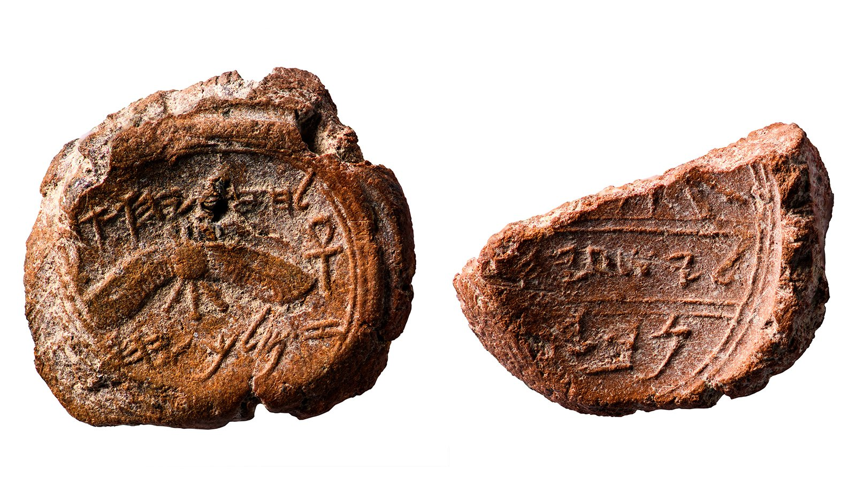

Isaiah’s seal
Hezekiah’s seal
Same strata
•
10 feet apart!
“It was found only 10 feet away from where in 2015 Mazar’s team discovered an important, intact bulla with the inscription ‘of King Hezekiah of Judah.’ The 12th king of the Kingdom of Judah, King Hezekiah, ruled from circa 727 BCE-698 BCE, during the period in which the northern Kingdom of Israel fell to the Assyrians in 721 BCE. Some 20 years later, Hezekiah successfully fought off the Assyrian siege of Jerusalem, in part due to fortifications and a water channel which can still be seen today.”
(https://www.timesofisrael.com/in-find-of-biblical-proportions-proof-of-prophet-isaiah-believed-unearthed/)

Slide 44
New Testament Quotations
Evidence for Isaiah’s Authorship

Slide 45
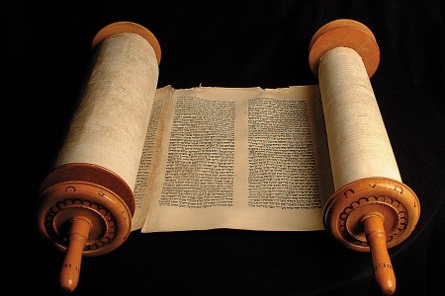
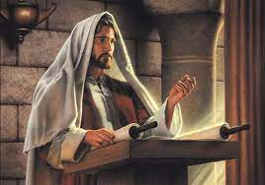
Isaiah Identified by Name in the NT
Isaiah
Jesus & NT Writers

Slide 46
Matthew:
"The prophet Isaiah was speaking about John when he said…"
(Matt 3:3a NLT).
"He is a voice shouting in the wilderness,
'Prepare the way for the LORD’s coming!
Clear the road for him!'"
(Matt 3:3b;
cf. Isaiah 40:3 NLT).

Slide 47
Luke:
"Isaiah had spoken of John when he said…"
(Luke 3:4a NLT).
"He is a voice shouting in the wilderness,
‘Prepare the way for the LORD’s coming!
Clear the road for him!’"
(Luke 3:4b;
cf. Isaiah 40:3 NLT).

Slide 48
John:
"But despite all the miraculous signs Jesus had done, most of the people still did not believe in him. ³⁸This is exactly what Isaiah the prophet had predicted…"
(John 12:37-38a NLT).
"LORD, who has believed our message?
To whom has the LORD revealed his powerful arm?" (John 12:38b; cf. Isaiah 53:1 NLT).
John attributes
Isaiah 53 to Isaiah
Notes:
From Paul Tanner Notes:
“The New Testament authors (including Jesus!) make frequent reference to Isaiah and attribute the quotation to the prophet Isaiah. Note that Jn 12:38-41 quotes Isa 53:1 and 6:9, and attributes them both to Isaiah (cf. Mt 3:3; 12:17; Lk 3:4; Acts 8:28; Rom 9:27-33; 10:16-21).”

Slide 49
John:
"But the people couldn’t believe, for as Isaiah also said…"
(John 12:39 NLT).
"The Lord has blinded their eyes
and hardened their hearts—
so that their eyes cannot see,
and their hearts cannot understand,
and they cannot turn to me
and have me heal them" (John 12:40; cf. Isaiah 6:10 NLT).
John attributes
Isaiah 6 to Isaiah

Slide 50
Paul:
"And concerning Israel, Isaiah the prophet cried out…"
(Rom 9:27a NLT).
"Though the people of Israel are as numerous as the sand of the seashore,
only a remnant will be saved"
(Rom 9:27b;
cf. Isaiah 10:22 NLT).

Slide 51
Jesus:
"This fulfills the prophecy of Isaiah that says…"
(Matt 13:14a NLT).
"When you hear what I say,
you will not understand.
When you see what I do,
you will not comprehend"
(Matt 13:14b;
cf. Isaiah 6:9 NLT).

Slide 52
Conclusion on
Isaiah’s Authorship
There exists no legitimate reason to doubt that Isaiah wrote the prophecy bearing his name—whether linguistic or archaeological or in NT quotations attributed to him.

Slide 53
Black

Slide 54


旧约批判研究 - BibleStudyDownloads.org
免费获得该讲解!
圣经学习下载
Notes:
The explanation for free!
OT Critical Studies link address

