Slide 1
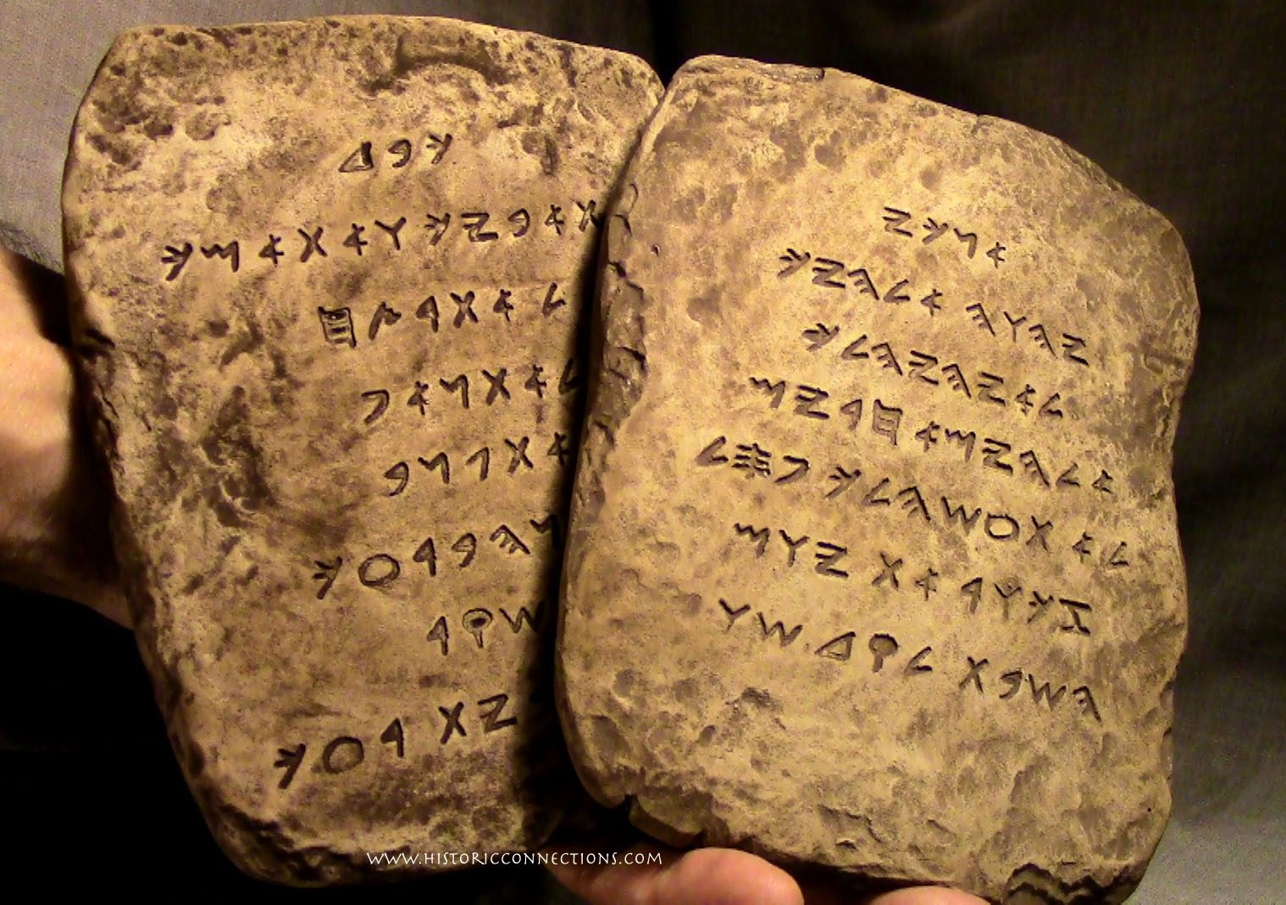
《创世记》的作者归属
谁撰写了《摩西五经》？
Dr. Rick Griffith • Jordan Evangelical Theological Seminary
BibleStudyDownloads.org

Slide 2
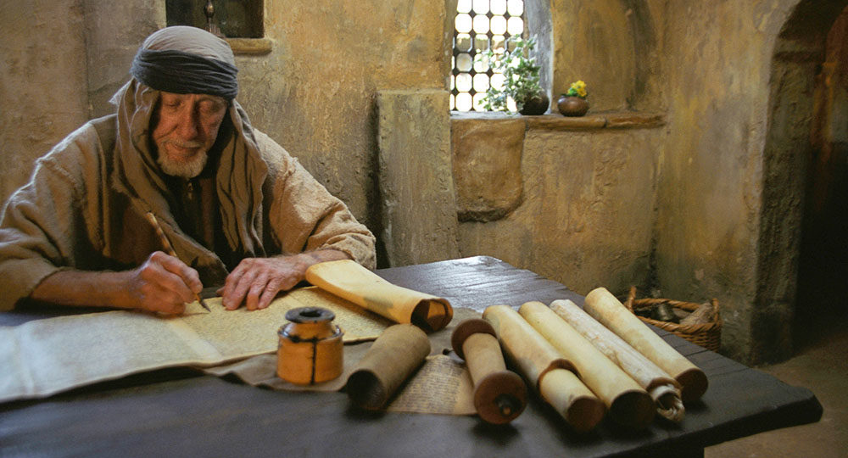
Did Moses wrote Genesis— and the entire Pentateuch?
Critical OT scholarship says no.
Notes:
If we say that the Jewish tradition has argued for Mosaic authorship over the centuries, how would we respond?
Is tradition a fool-proof response?
Are there any Jewish traditions that we do NOT follow? (Most of us do not think as they did that Song of Songs depicts God’s love for Israel.)

Slide 3
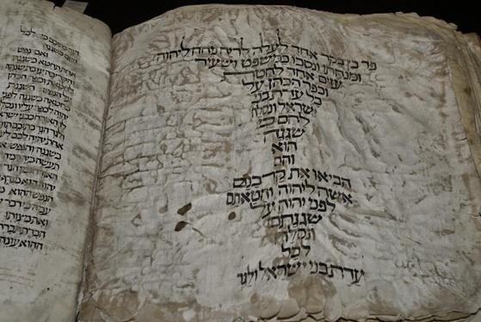
Why do they attack Genesis?
Answer:
It teaches many vital truths!

Slide 4
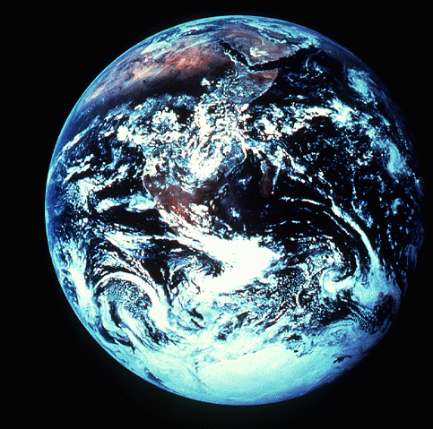
“起初”
创世纪 1:1

Slide 5
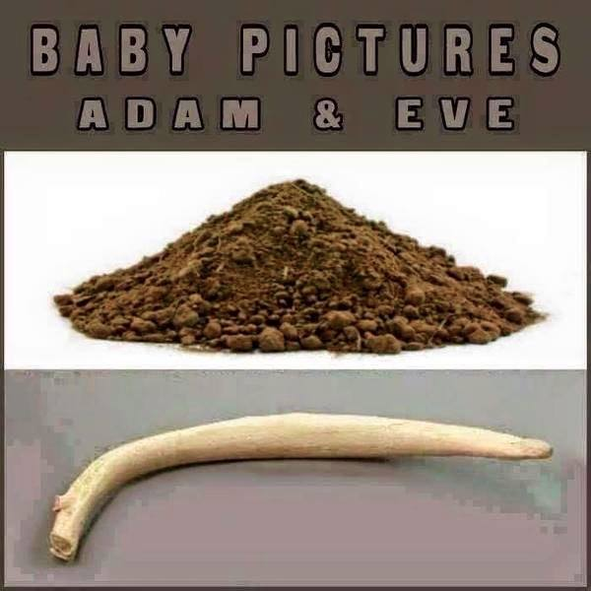
这些是什么？
Notes:
你认得这些吗？你知道这些是什么吗？它们是婴儿照片！
一位女士说：“上帝当然先创造了男人，然后才创造了女人，但话又说回来，在创作最终杰作之前，你总是会打个草稿。”
(http://cher-homespun.blogspot.sg/2011/06/firewater-friday-sure-god-created-man.html 于 2015 年 8 月 15 日访问)
Do you recognize these? Do you know what these are? They are baby pictures!
One woman noted, "Sure God created man before woman, but then again you always make a rough draft before creating the final masterpiece."
(http://cher-homespun.blogspot.sg/2011/06/firewater-friday-sure-god-created-man.html accessed 15 August 2015)

Slide 6
亚当和夏娃婴儿时的图片
Notes:
你认得这些吗？你知道这些是什么吗？它们是婴儿照片！
一位女士说：“上帝当然先创造了男人，然后才创造了女人，但话又说回来，在创作最终杰作之前，你总是会打个草稿。”
(http://cher-homespun.blogspot.sg/2011/06/firewater-friday-sure-god-created-man.html 于 2015 年 8 月 15 日访问)
Do you recognize these? Do you know what these are? They are baby pictures!
One woman noted, "Sure God created man before woman, but then again you always make a rough draft before creating the final masterpiece."
(http://cher-homespun.blogspot.sg/2011/06/firewater-friday-sure-god-created-man.html accessed 15 August 2015)

Slide 7
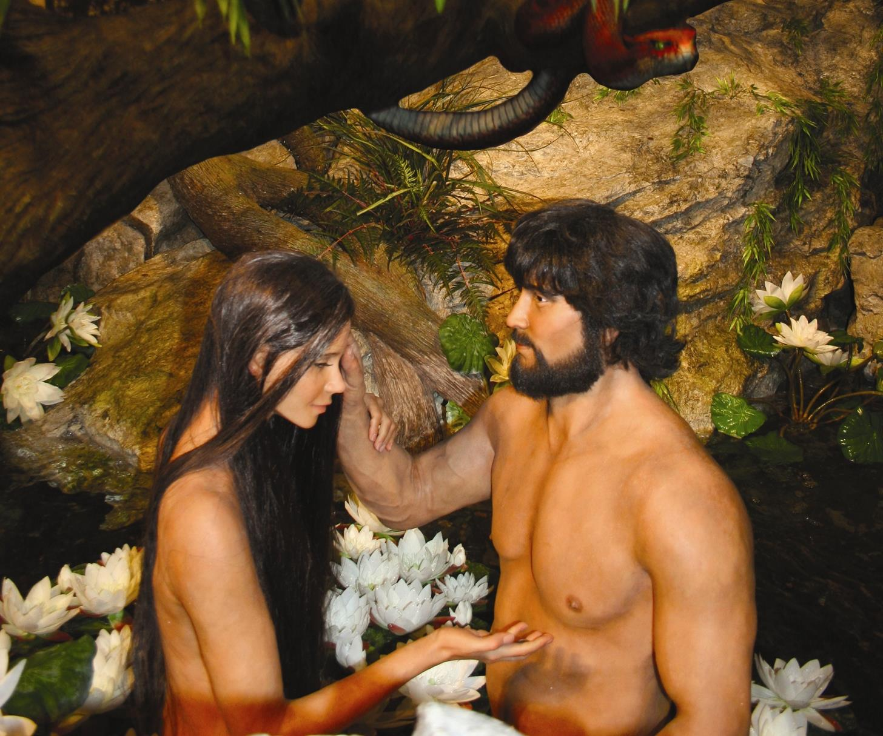
亚当、夏娃和蛇
Notes:
7
7

Slide 8

创世纪1－11是真实的历史吗?
58
相对历史来说，神话是不太可能被用来教导“真理”；
一个没有历史根据的方法是很主观的
其中包含很多别处找不到的重要资料
这段叙述符合创世纪“拣选”的主题
故事的呈现运用了历史的写法
科学研究也印证了创世纪1－11是历史事实
耶稣基督也肯定了这段叙述的历史性
Dr. Rick Griffith • 博士 • 新加坡神学院 • www.biblestudydownloads.org

Slide 9
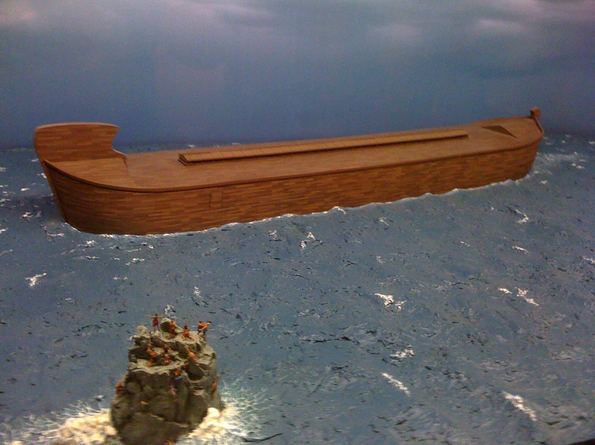
The Ark
Notes:
Noah’s descendants led to his grandson Canaan after the Flood to affirm both God's righteous judgment due to man's sin and his gracious redemption in electing people with whom he can fellowship (6:9–9:29).

Slide 10
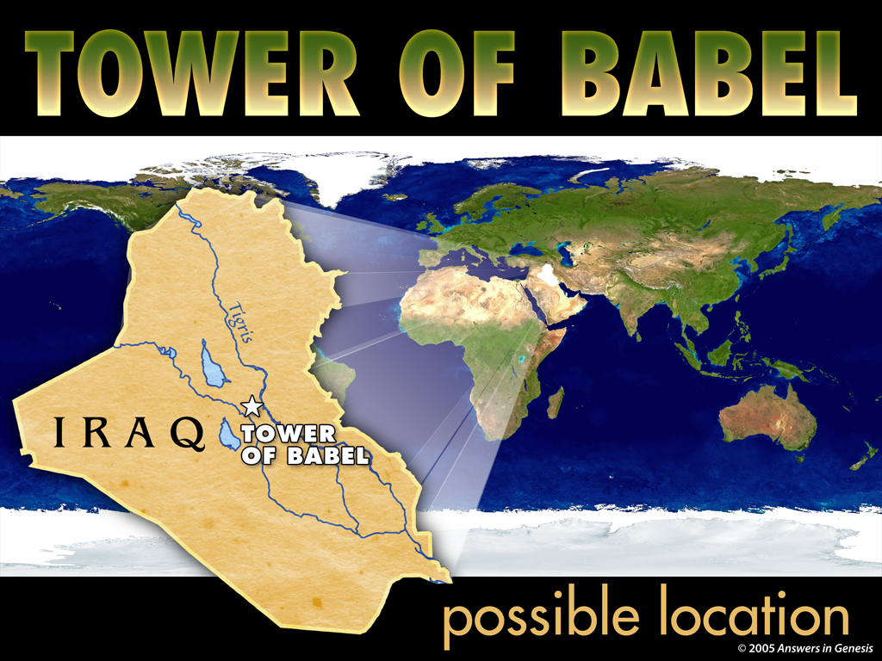
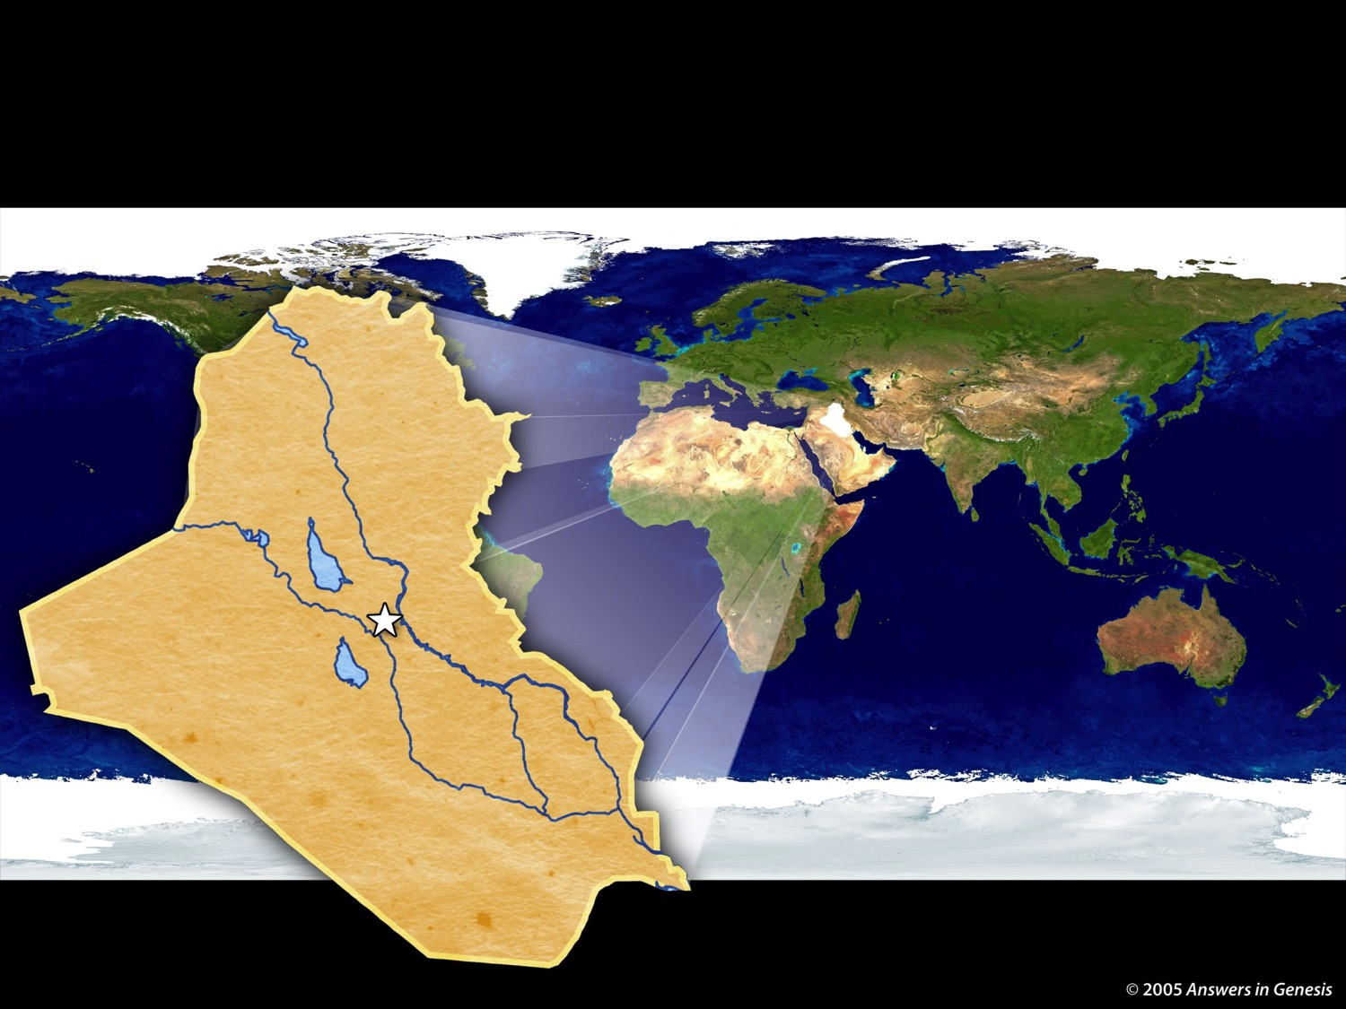
4-07 Tower of Babel Map 02277
TOWER OF BABEL
IRAQ
Tower
of Babel
possible location
Notes:
10
10
Our confusion of languages stems from the city of Babylon where people proudly sought to reach God by their own efforts. God judged them by giving them different languages.

Slide 11
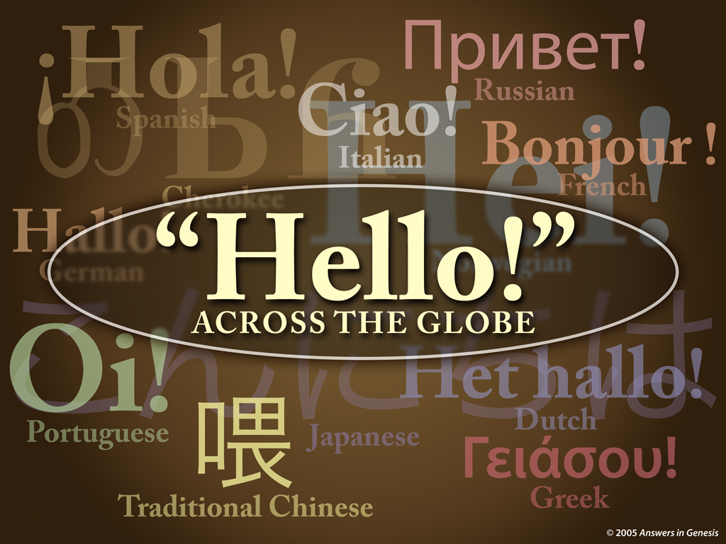
Hello
أهلا
Arabic
Notes:
11
Why do we have so many ways that we greet people today?

Slide 12
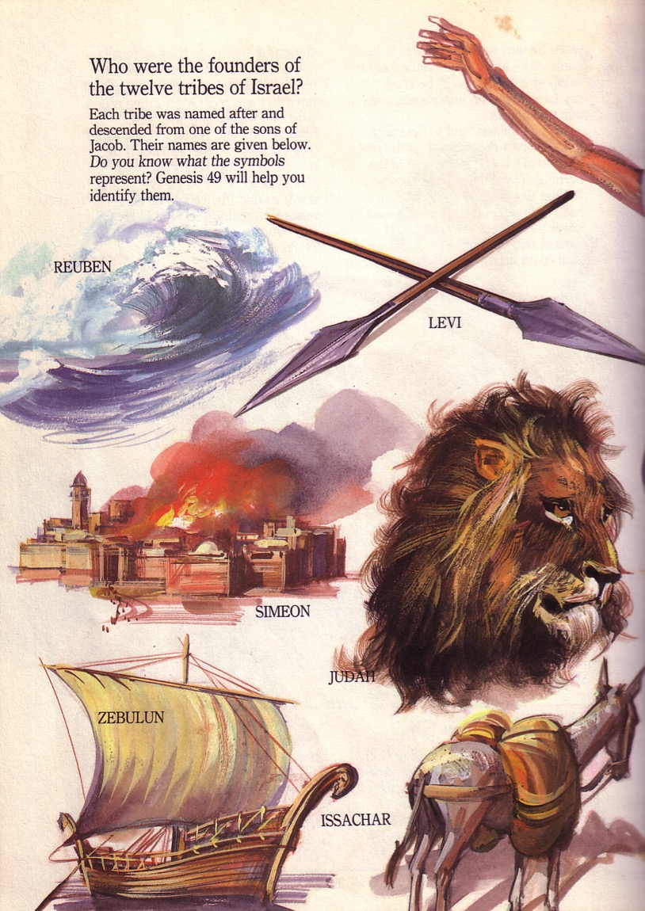
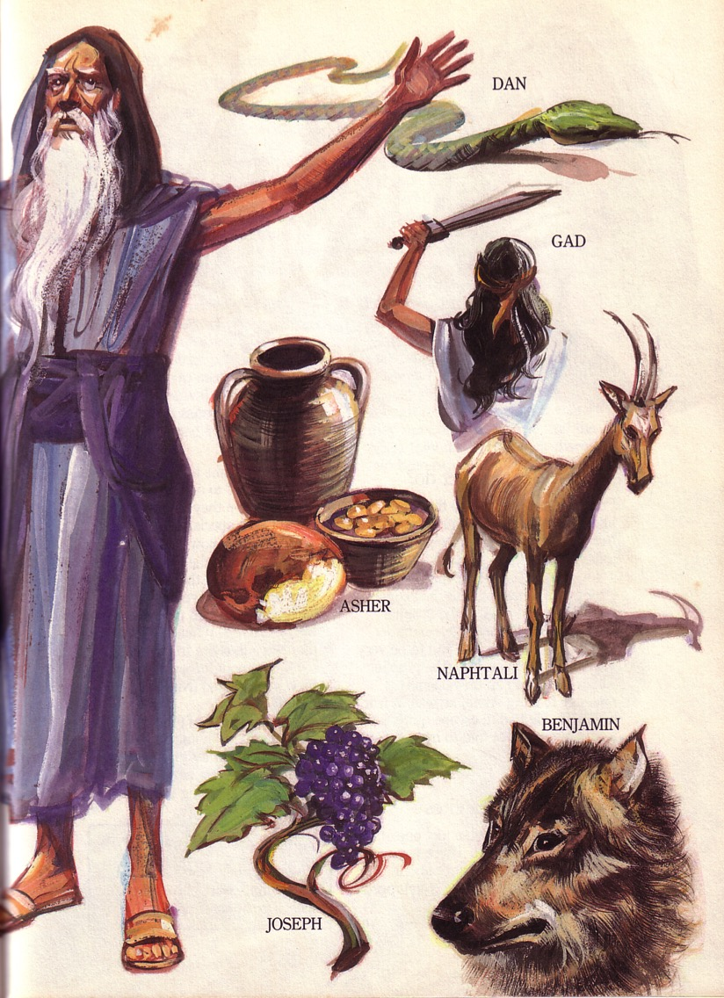
بركة يعقوب لأولاده الإثني عشر كانت نبوية (تك 49)
Notes:
Jacob was brutally honest about the character of his sons before he died.
____________
Common-175
OS-01-Gen37-50-slide 318

Slide 13
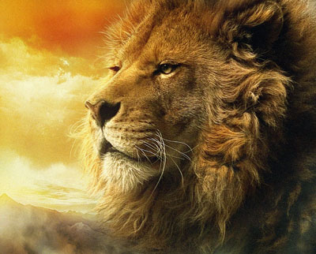
马太福音:基督是君王
犹大是个小狮子。我儿阿, 你抓了食便上去。你屈下身去、卧如公狮、蹲如母狮、谁敢惹你？
¹⁰主必不离犹大, 杖必不离他两脚之间, 直等细罗(就是赐平安者) 来到, 万民必归顺。(中文和合本)
在创世记中,雅各布对犹大的祝福49:9-10,狮子被描绘为君王…
Notes:
God showed Jacob nearly 2000 years before the birth of Jesus that the Messiah would come from Judah in the south of Israel. Royalty in the image of a lion, a scepter, and a ruler's staff all point to Jesus, who will receive worldwide honor and worship.
____________
Common-177
OS-01-Gen37-50-slide 275
OS-10-2Sam-98
NS-01-Matt1-14-slide 71

Slide 14
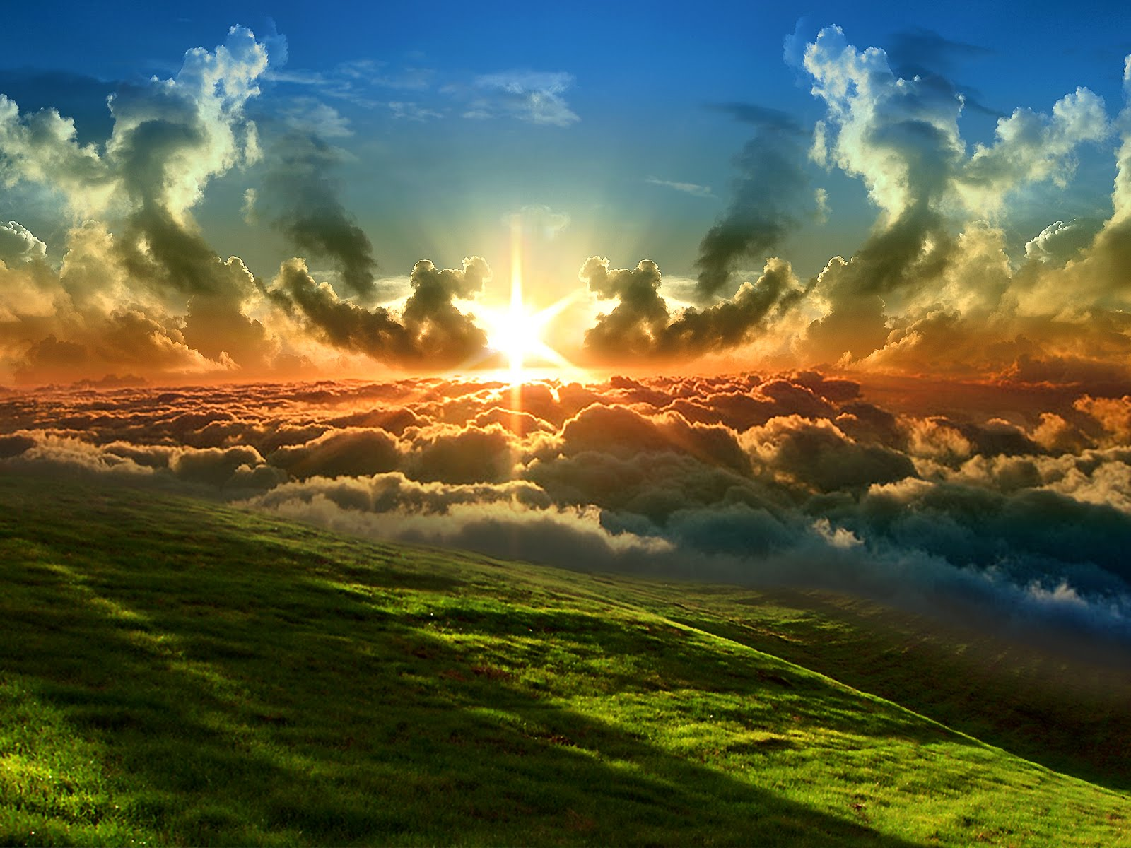
God promised believers like us blessings of the Abrahamic Covenant.

Slide 15
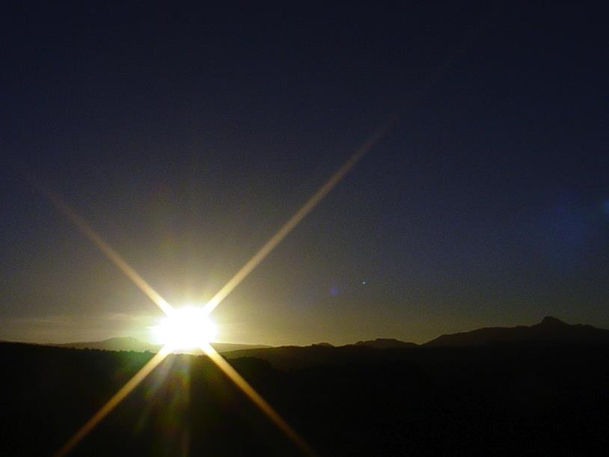

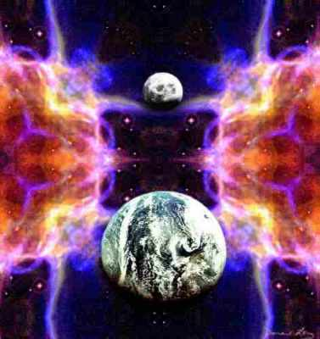

“圣经”的视交叉
446
以相反的顺序重复模式
基督的规则
基督的救赎
在千年恢复男人的规则
男人的规则失去在秋季
创造
新创造
Notes:
We need to know who we are—more accurately, who God says we are—our future identity.
This is shown in the overall structure of the Bible in a chiasm—a literary pattern where earlier content is repeated in reverse order:
• Creation in Genesis 1–2 • is repeated In the Restored, New Creation in Rev 21–22
• Man was created to rule over the fish, birds, and land animals (Gen. 1:28) but he gave over his rule over to the god of this world, Satan (2 Cor. 4:4)
• But this rule will be restored during the 1000-year reign of the saints (Rev. 20:4-6)
• Christ is the central Person of history, • both as Lamb (Redeemer) • and as Lion (Ruler of all creation in the line of David)
________________
Common-487
OC-17-Genesis Authorship-14
OS-01-Genesis1-3-slide 254
OS-17-Esther-145
NS-27-Rev20-22-slide 209

Slide 16
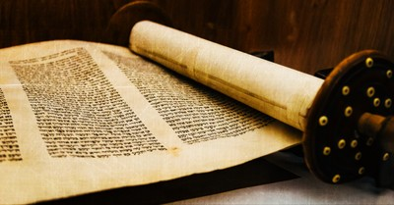
Support for Mosaic Authorship
External
External
Internal
External
External
External

Slide 17
Support for Mosaic Authorship
External
External
External
External
External

Slide 18
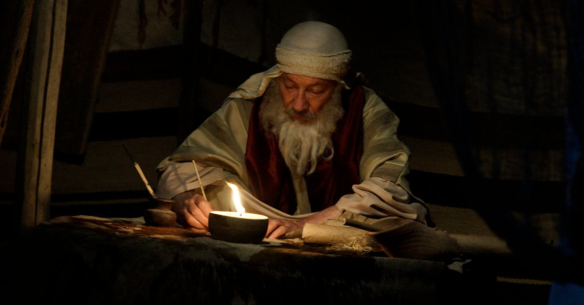
"After the victory, the LORD instructed Moses, 'Write this down on a scroll as a permanent reminder, and read it aloud to Joshua: I will erase the memory of Amalek from under heaven'"
(Exodus 17:14 NLT).
Notes:
Although Genesis does not directly specify its author, the other four books of the Pentateuch affirm Mosaic authorship (cf. Exod. 17:14; 24:4, 7; 34:27; Lev. 1:1-2; Num. 33:2; Deut. 1:1; 31:9).

Slide 19
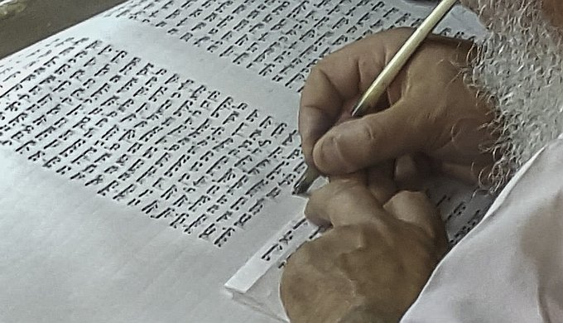
Tradition Supports Moses
Early church
Jerusalem Talmud
Josephus
Except some early Christian theologians

Slide 20
Support for Mosaic Authorship
Internal

Slide 21
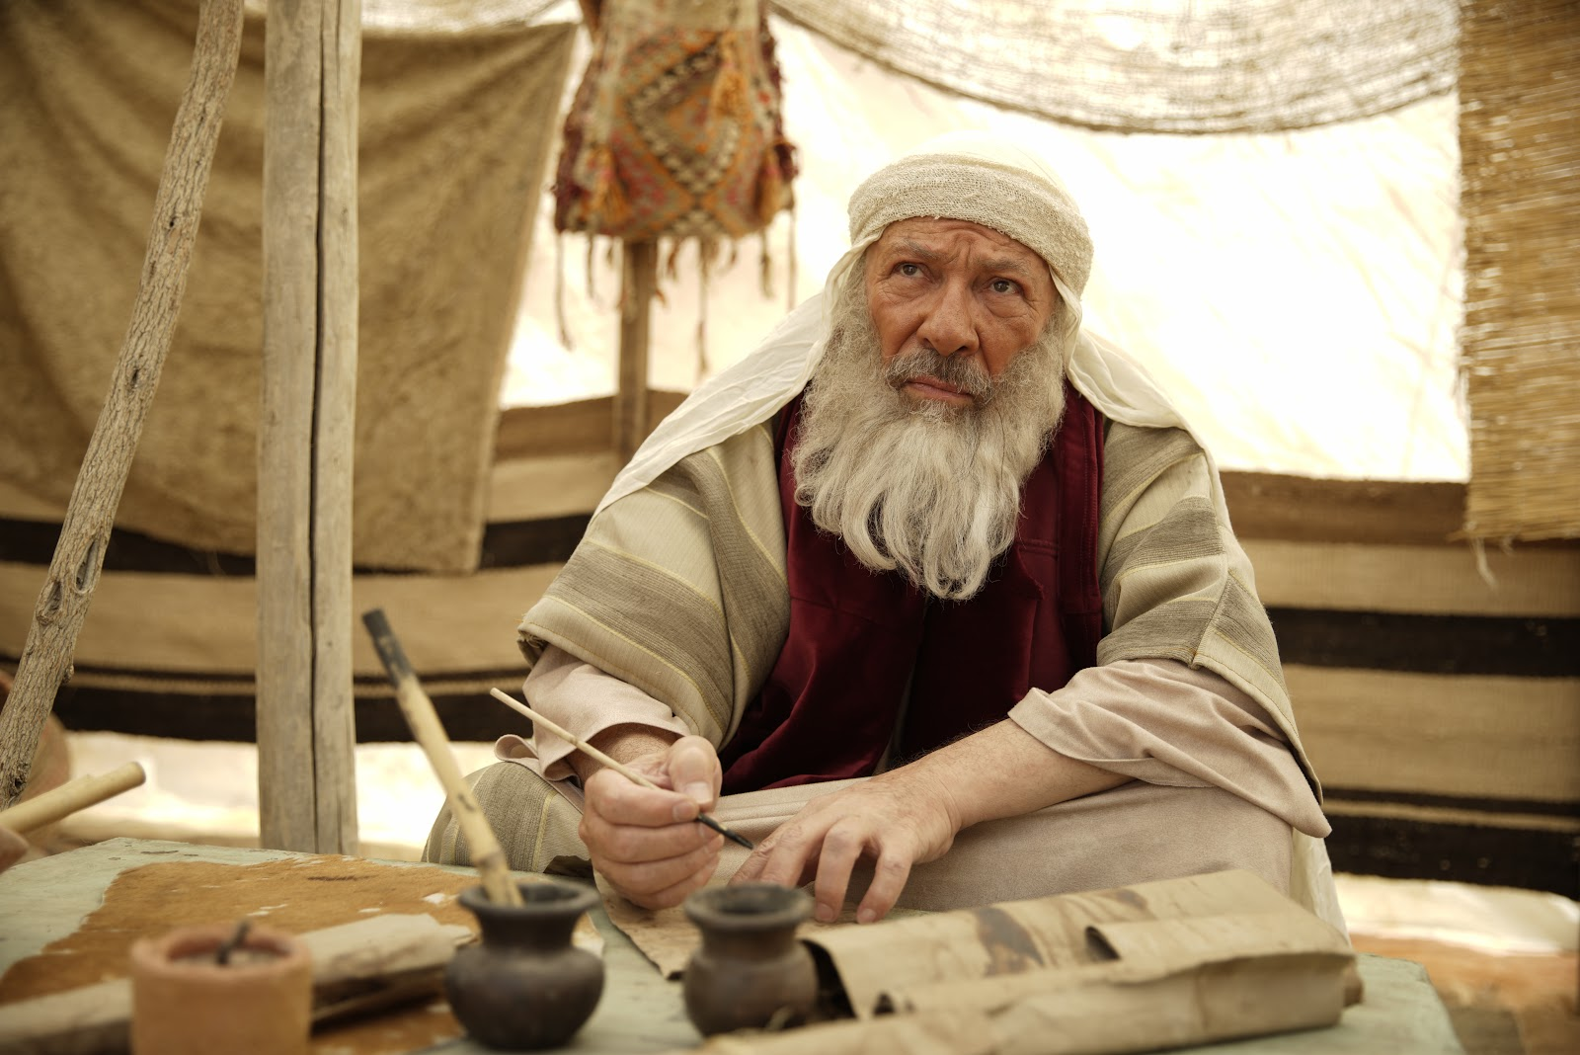
Qualifications of Moses

Slide 22
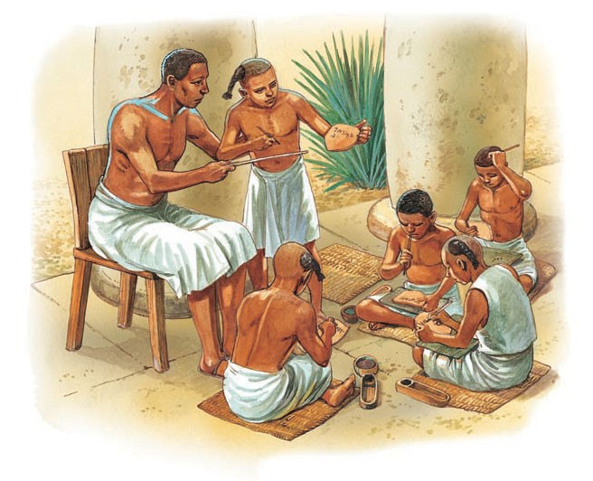
"Moses was educated in all the wisdom of the Egyptians" (Acts 7:22 NLT).

Slide 23

2.摩西到埃及王国前
155
158
使徒行传 7:22 “摩西学会了埃及人一切的学问，成为一个说话办事很有能力的人。
古埃及的教育
1.祭司的学校与寺庙有关，教授魔法，医学和宗教
2.王室为年轻人提供了权力的职位（包括摩西）
3. 由皇家法院赞助的学校培训人们顺利运作政府。
4. 教授的科目包括算术，地理，诗歌和天文学。

Slide 24
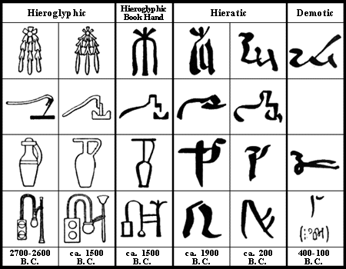
在摩西时代的教育
155
摩西在受训期间学习了埃及的象形文字和迦南文字。
他能够为以色列人记录上帝的律法和诫命。
在荒野游荡期间，没有正式的教育系统。
家庭负责传递他们的生计和技能以及法律的教学。

Slide 25
埃及象形文字

Slide 26
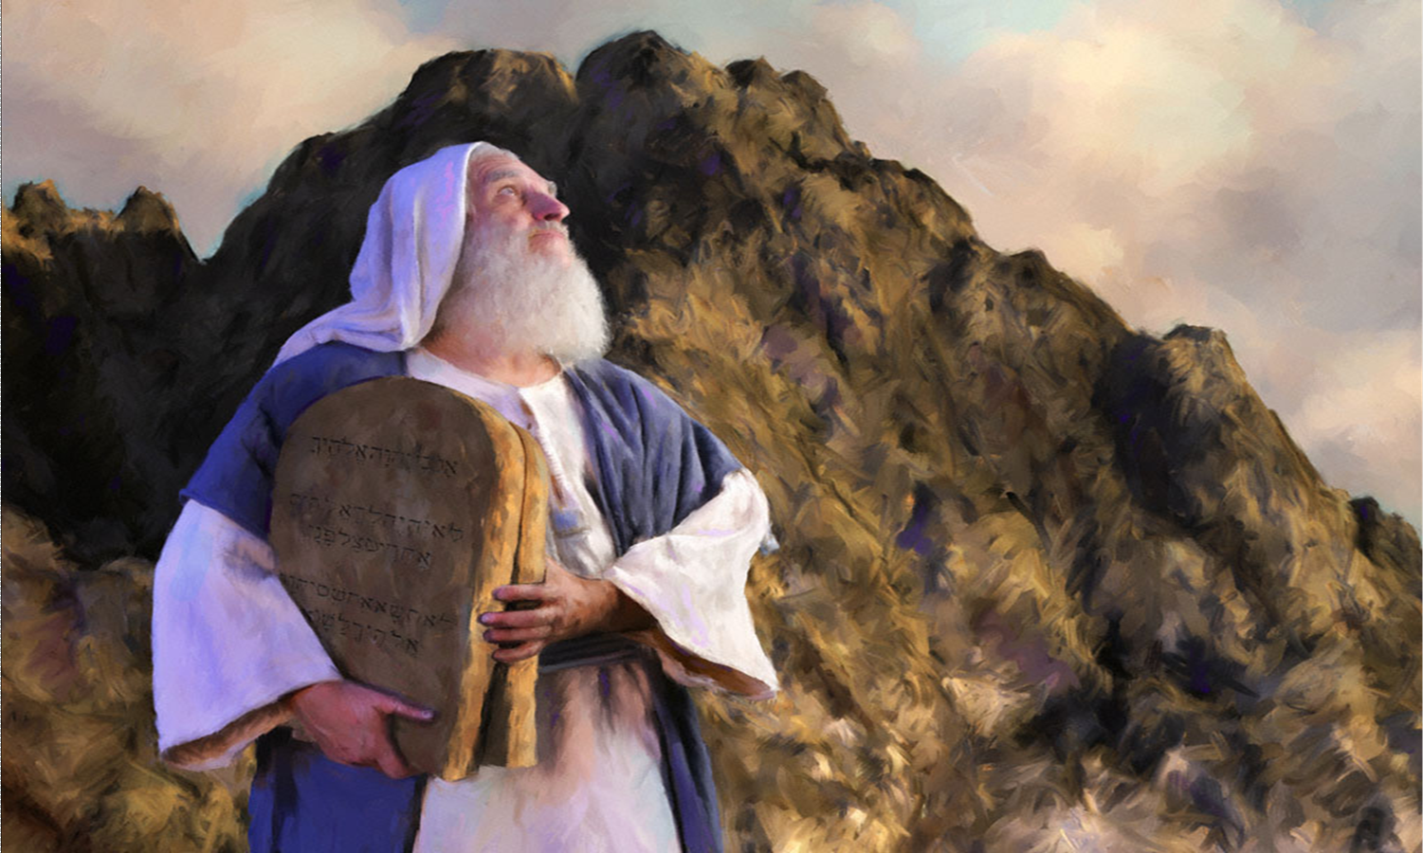
Qualifications of Moses
"We have the witness of the incidental allusions to contemporary events or current issues, to social or political conditions, or to matters of climate or geography. When all such factors are fairly and properly weighed, they lead to this conclusion: the author of these books and his readers must originally have lived in Egypt.”
Gleason Archer, Encyclopedia of Bible Difficulties, 46

Slide 27
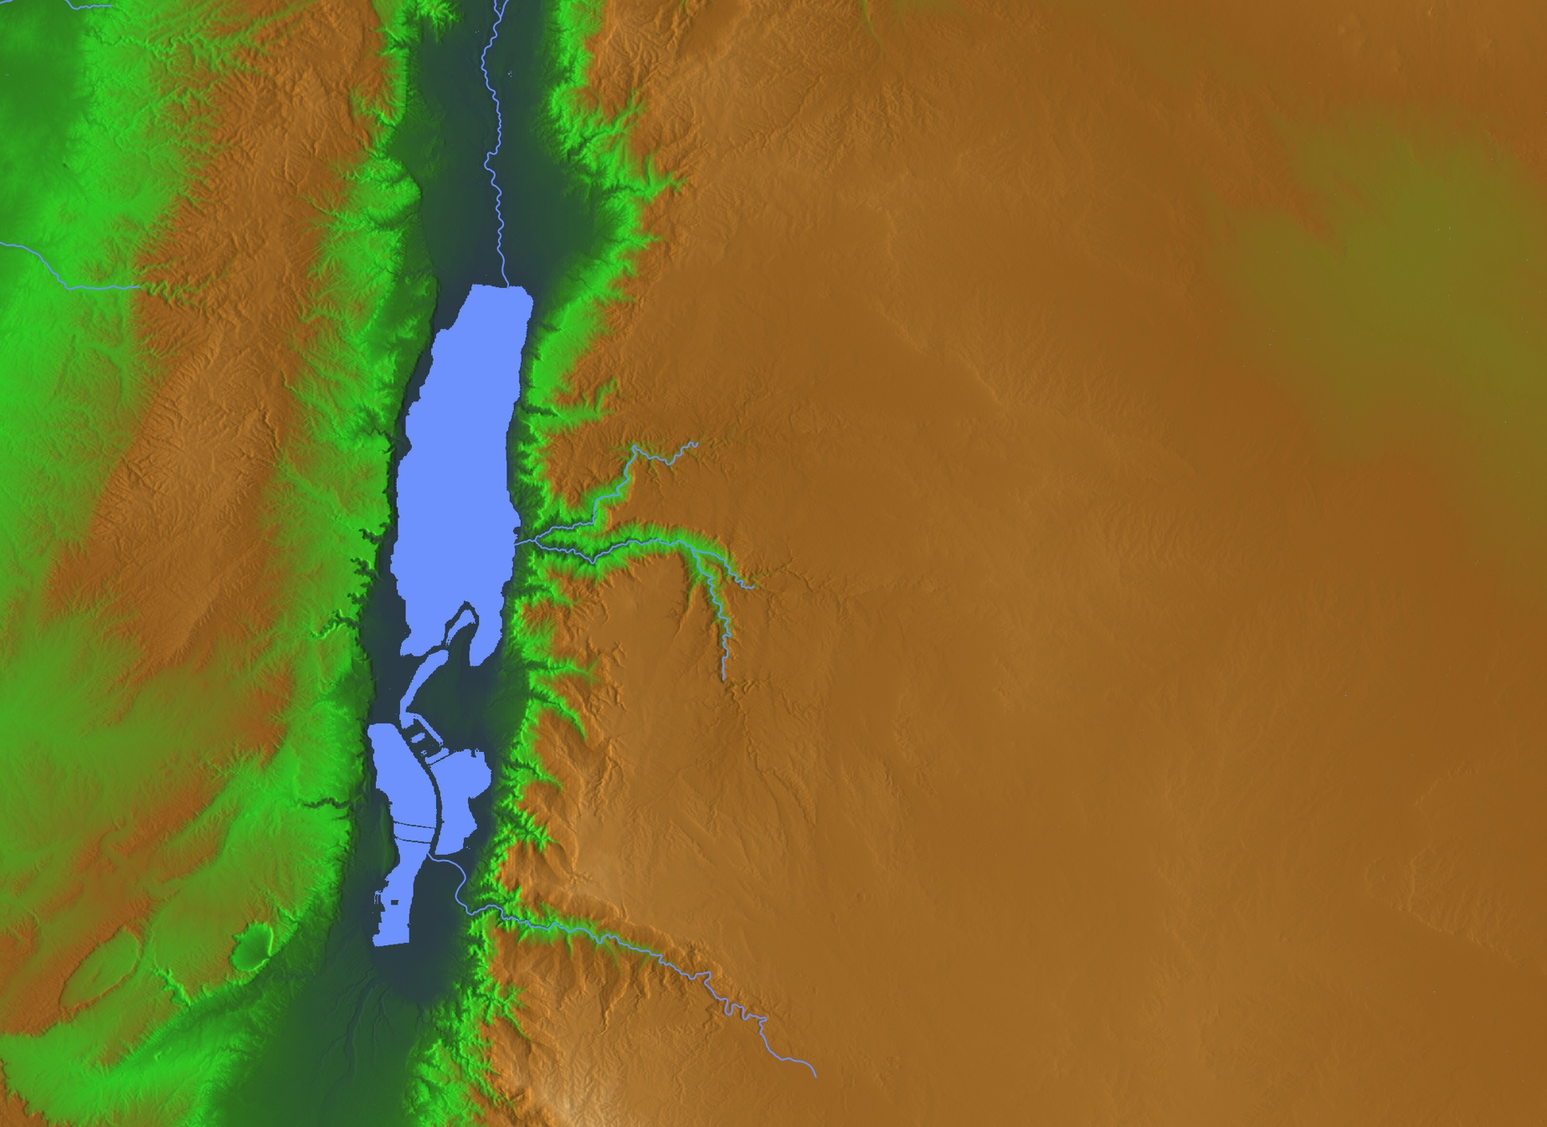
The Choice
Abram & Lot
"Lot took a long look at the fertile plains of the Jordan Valley in the direction of Zoar. The whole area was well watered everywhere, like the garden of the LORD or the beautiful land of Egypt. (This was before the LORD destroyed Sodom and Gomorrah.)"
(Gen 13:10 NLT).
• Gomorrah?
• Sodom?
• Zoar
Notes:
Abram gave Lot the choice where to live. As godless people today take the most beautiful places, so it was then.
• From his northly position, Lot looked south all the way to Zoar and saw lush land.
• He chose to live in Sodom—the city from which he could manage his rural flocks.
• Gomorrah lay close by as well—another godless city of sexual perversion.
• For Lot, the choice was easy—so he moved into the fertile plain—though his should was vexed on how he could impact them:
2Pet. 2:7 But God also rescued Lot out of Sodom because he was a righteous man who was sick of the shameful immorality of the wicked people around him. ⁸ Yes, Lot was a righteous man who was tormented in his soul by the wickedness he saw and heard day after day.
• Abram, on the other hand, chose the rocky hill country.

Slide 28
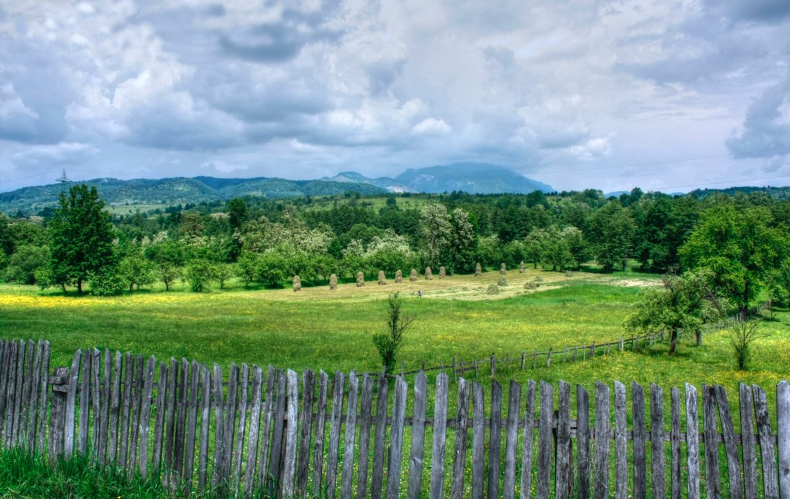
"Lot took a long look at the fertile plains of the Jordan Valley in the direction of Zoar. The whole area was well watered everywhere, like the garden of the LORD or the beautiful land of Egypt. (This was before the LORD destroyed Sodom and Gomorrah.)" (Gen 13:10 NLT).
Notes:
The above description of the Jordan Valley makes sense only to those familiar with Egypt, which limits the original audience to the Exodus generation. This, then, strongly argues for Moses as the author of Genesis.
Similarly, Genesis 41:45 uses the Egyptian spelling (John Davis, A Survey of OT Introduction, 102).

Slide 29
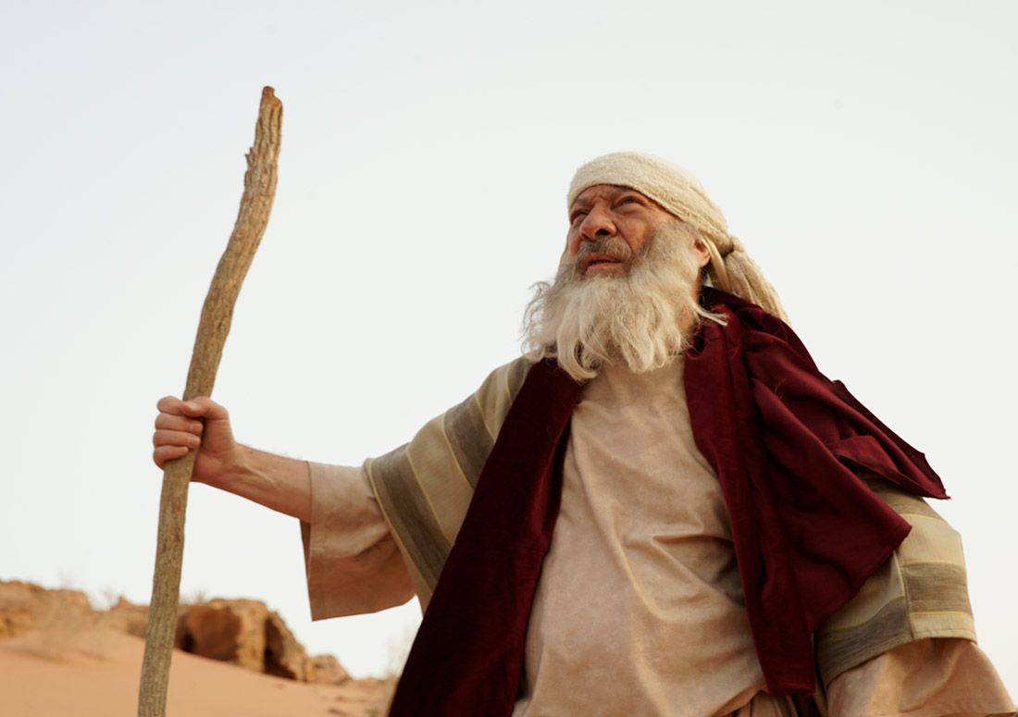
The JEDP Attack on Mosaic Authorship

Slide 30

创世记的作者
57
传统观点 : 摩西
批判性观点 : JEDP
耶典（J）
耶和华
[Jehovah]
(主)
850 BC
伊典（E）
伊罗欣
[Elohim]
(神)
750 BC
申典（D）
申命记学派
[Deuteronomistic
School]
550 BC
祭典（P）
祭司法典
[Priestly Code]
450 BC

Slide 31
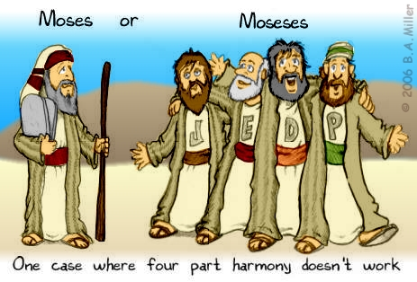
Moses? or Moseses?
One case where four part harmony doesn’t work

Slide 32

JEDP
定型化
OTS 57
Pent 23
南方传统
北方传统
J
主前 850
E
主前 750
JE
主前 650
约西亚
改革手稿
D
主前 621
JED
主前 550
被掳期祭司资料
P
主前 450
JEDP
主前 400
Encountering the OT, 70

Slide 33
JEDP 的问题
OTS 57
Pent 23
违反了摩西五经的自我宣称
忽略了 ANE 考古证据
基于不准确的十九世记的演变
过于主观
拒绝新约圣经的证据
Encountering the OT, 70

Slide 34

谁是摩西五经的作者?
仍有人认为是…
《底本说》的论据

Slide 35
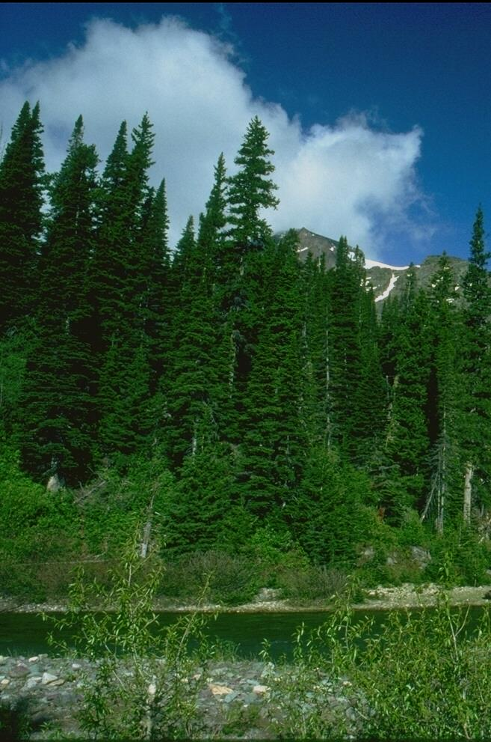
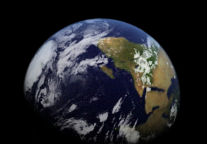
创世的两番描述
创世纪1
创世纪2
用“神”这个字 (Elohim)
第一到第六日
一切被造物的起源
“起初…”
用“主”这个字 (Yahweh 耶和华)
只包含第六日的内容
创造亚当和夏娃
“这是……的后代(toledot)” (在创世纪中共出现11次)

Slide 36
定义
文体
J
E
J-E
D
P
耶和华/雅巍［Jehovah/Yahweh］
伊罗欣［Elohim］
综合编辑［Combined edition］
申命记学派［Deuteronomic］
祭司法典［Priestly］

Slide 37
内容
文体
J
E
J-E
D
P
创世记第二章
创世记 第一章
创世记-民数记
申命记-列王记
创世记-民数记

Slide 38
日期
文体
J
E
J-E
D
P
主前 850
主前 750
主前 650
主前 621
主前 570-445

Slide 39
来源
文体
J
E
J-E
D
P
南国
北国
未知主编
希勒家大祭司
以斯拉

Slide 40
主题
文体
J
E
J-E
D
P
个人传记，生动地描绘人物，以人的角度来描写神

Slide 41
主题
文体
J
E
J-E
D
P
客观，涉及具体的细节，如仪式和献祭

Slide 42
主题
文体
J
E
J-E
D
P
反映约西亚的改革，为在耶路撒冷圣殿的集体敬拜而设立的

Slide 43
主题
文体
J
E
J-E
D
P
神权政治，族谱，仪式和献祭的起源和设立

Slide 44

创世记 六–九的“来源”
六 5-8
六 9-22
七 1-5
七 6
七 7-8
七 9
J
P
J
P
J
P
七 10
七 11
七 12
七 13-16上
七 16下-17
七 18-21
J
P
J
P
J
P

Slide 45
创世记 六–九 的“来源”
七 22-23
七 24-8:2上
八 2b-3上
八 3b-5
八 6-12
八 13上
J
P
J
P
J
P
八 13下
八 14-19
八 20-22
八 1-17
J
P
J
P

Slide 46
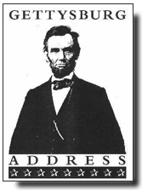
The "Documents" of the Gettysburg Address
THE STIFF-COLLAR COMMENTARY
林肯总统于1863年11月19日，在献战场墓地时运用“较高的批评”在葛底斯堡演讲。
Rev. LeRoy Koopman, Christianity Today, 1965

Slide 47
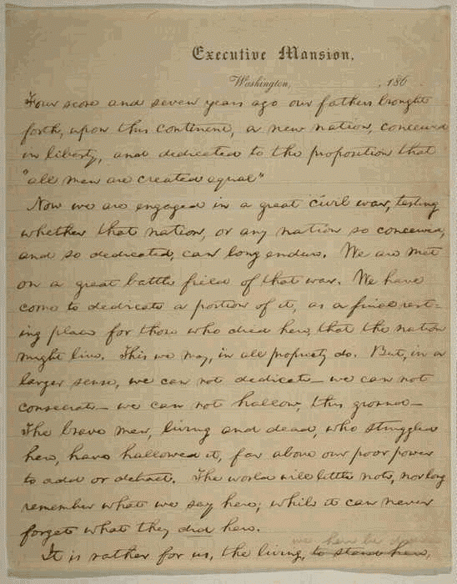
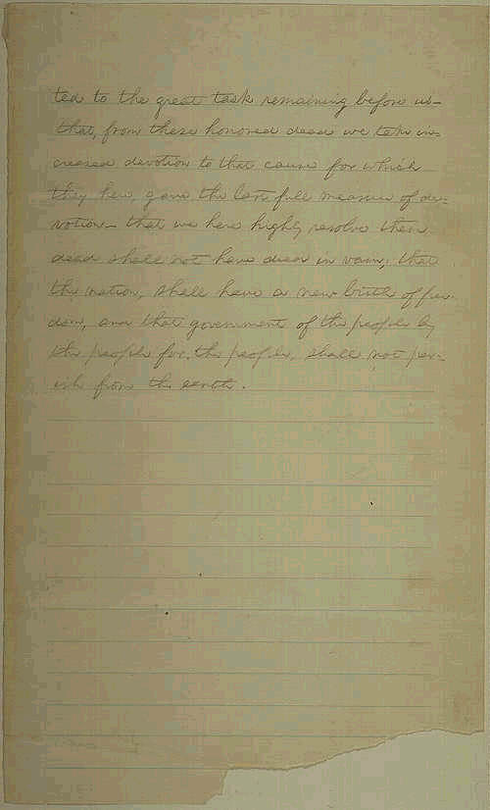
The "Documents" of Gettysburg 2
四分和七年前
这句话是出自林肯的一位英文教授朋友，E。这位朋友善于使用华丽的语言。简单和没受过教育的林肯会直截了当地说“八十七”

Slide 48
The "Documents" of Gettysburg 3
我们的父亲们在这个大陆上创立了一个新国家，它孕育于自由中
“父亲们”，原文是“先辈们”，这是翻译时的错误。 使用“孕育”一词指向主编 M，想必是林肯夫人玛丽，在校对这篇演讲稿时，加入了她女性的偏见。

Slide 49
The "Documents" of Gettysburg 4
奉行“人生来就平等”的议案
“议案” – 来自M。使用“生来” 表明有第三位作者, p¹, 一个陪伴林肯乘搭火车前往葛底斯堡的牧师。林肯是一个外行人，很自然地寻求使用神学术语的帮助。第二位牧师, p², 也给予些许语言上的色彩。

Slide 50
The "Documents" of Gettysburg 5
我们正从事一场伟大的内战，以考验那个国家
“那个国家” — 有些学者认为这是出自一个外国人(C?)。 若是美国人，就会说“这个国家”。

Slide 51
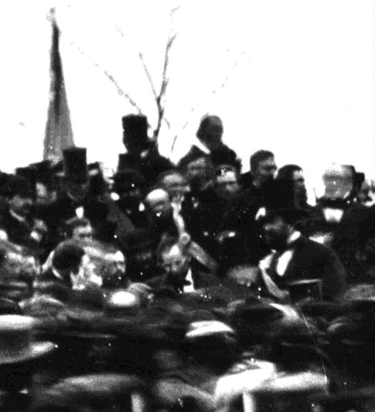
The "Documents" of Gettysburg 6
或者任何一个孕育于自由和奉行上述原则的国家是否能长久存在下来。
“孕育” – M 喜爱用的感叹词

Slide 52
JEDP Problems
OTS 57
Pent 23
Violates internal self-claims of Pentateuch
Anti-supernatural bias
Based on inaccurate 19th century evolution
Lack of unanimity among scholars
Subjective with circular reasoning
No manuscript evidence
Ignores ANE archaeological evidence
Rejects NT evidence
Encountering the OT, 70

Slide 53

Editorial Activity
Notes:
The NT affirms that the Pentateuch was written by Moses. But this does not mean that there existed no updating of the text to make it more understandable to those who read it later.

Slide 54
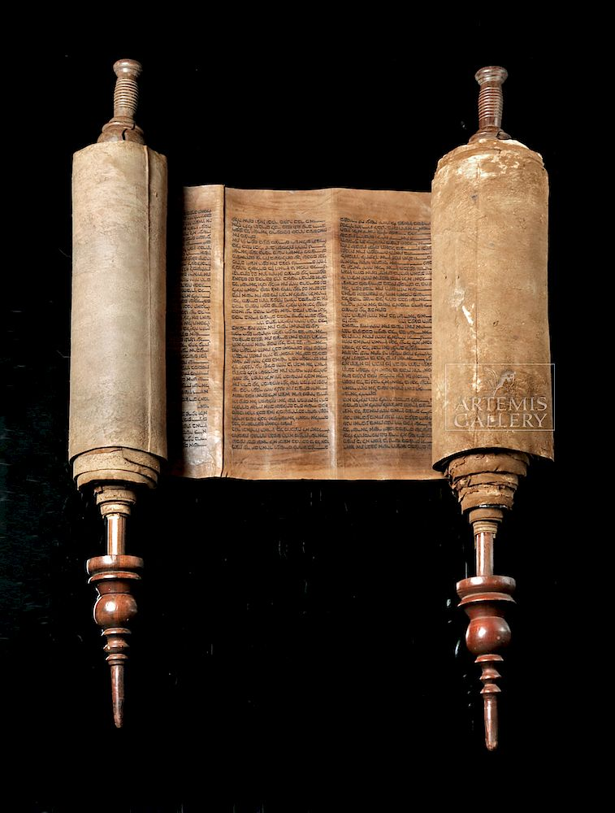
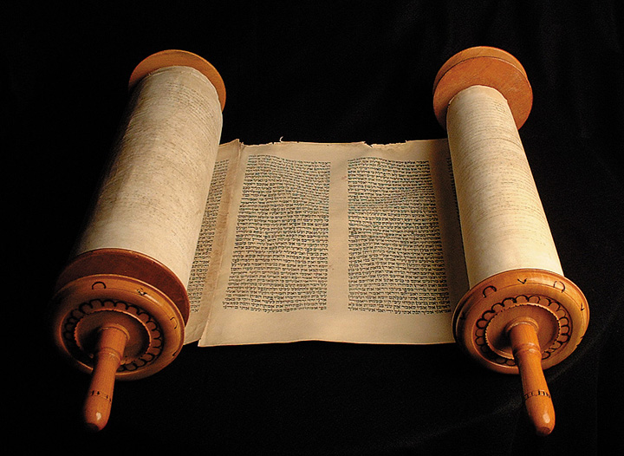
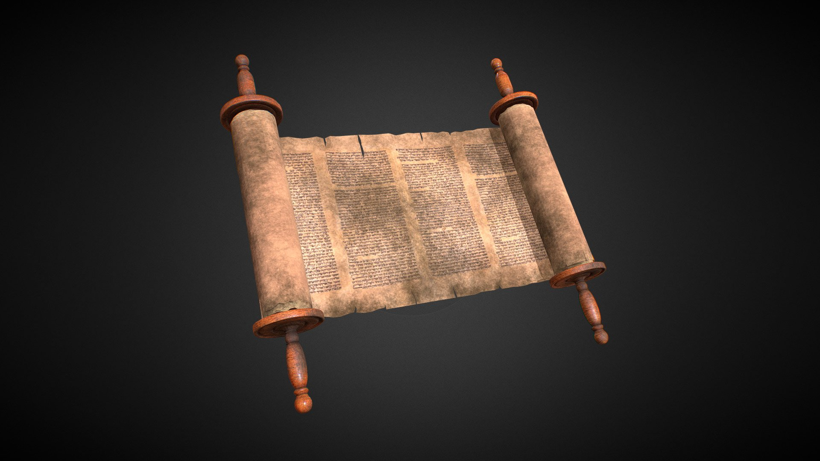
Hebrew Consistency
Why does the whole OT show a consistent use of Hebrew so that the Pentateuch does not look like it was written 1000 years before Malachi?
Pentateuch
1400 BC
Poetics
1000 BC
Malachi
400 BC
Notes:
The OT does have vocabulary development, such as the use of the term “the Jews” only used in the post-exilic era—where also “Yahweh” is not used.
But there still appears to be a smoothing of language?

Slide 55
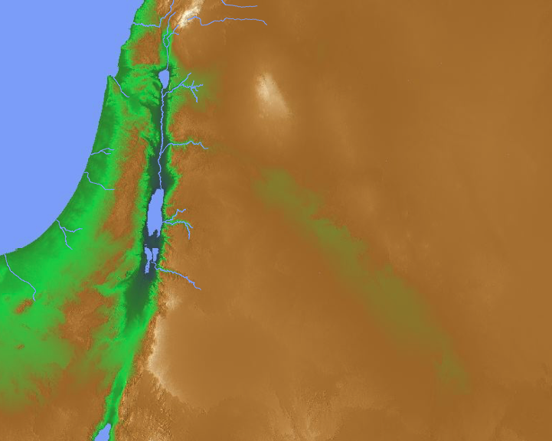
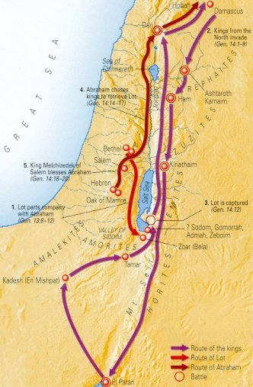
但
迦南地
(主前2000年)
五王
亚伯拉罕
撒冷
幔利
所多玛
“When Abram heard that his relative had been taken captive, he called out the 318 trained men born in his household and went in pursuit as far as Dan”
(Genesis 14:14 NIV).
加低斯
伊勒巴兰
Notes:
Basically, we have four eastern kings against five Jordanian kings (1-7).
They fought at the south end of the Dead Sea, near Sodom where Lot lived.
The five Jordanian kings lost the battle and Lot was carried far north (8-12).
Then Abraham rescued Lot, the goods, women and captives at Dan and Hobah (13-16).
How could Abraham defeat these four powerful kings with only 318 men (14-16)?
Humanly speaking, he had his allies Aner, Eshcol, and Mamre (14:13, 24)—plus he had the advantage of a surprise night attack. However, Abraham was quick to give God the full credit as he agreed with Melchizedek's praise to God for granting him the victory (14:20)
基本上，我们看到四个东方王对抗五个约旦王（1-7）。 他们在死海南端的所多玛附近作战，罗得就住在那里。 五个约旦王战败，罗得被带到很远的北方（8-12）。 然后亚伯拉罕在但和荷巴救回了罗得、财物、妇女和俘虏（13-16）。
亚伯拉罕如何用只有318人的队伍击败这四个强大的王（14-16）？从人的角度来看，他有盟友亚乃、以实各和幔利（14:13, 24），加上他有夜袭的优势。然而，亚伯拉罕迅速将全功归于上帝，因为他同意麦基洗德对上帝赐予胜利的赞美（14:20）。

Slide 56
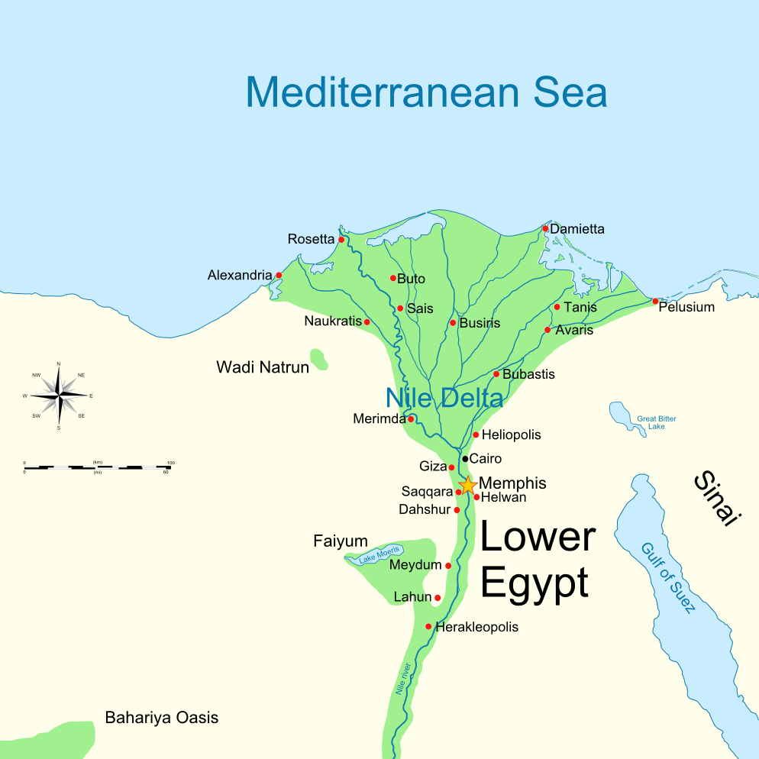
City of Avaris
“Egyptians… forced them to build the cities of Pithom and Rameses as supply centers for the king” (Exod 1:11).
Notes:
The enslaved Israelites built the city of Rameses (Exod 1:11), but Rameses did not live until more than a century later. Probably the best explanation of this is that they built the city of Avaris, upon which the city of Rameses was later built. This is akin to someone in 200 BC writing that the Greeks lived in the Hellenistic city Philadelphia but a later hand changing it to Amman to prevent confusion by those who do not know that the modern Amman used to be called Philadelphia.
__________________
OC-17-Genesis Authorship-55
02-Exodus-137 on Exodus 12

Slide 57
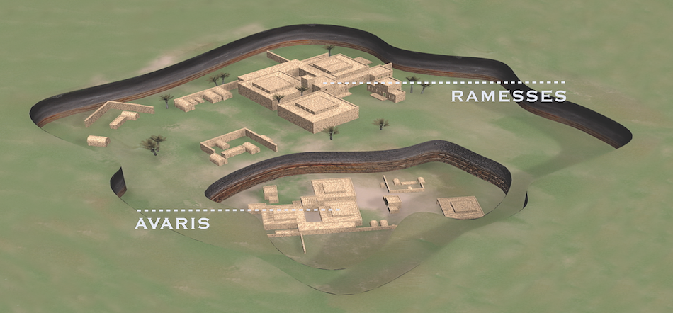
City of Avaris
Beneath Rameses
"Patterns of Evidence" is a film by Timothy Mahoney (Thinking Man Films, 2015) that presents amazing archaeological evidence for the Early Exodus discovered by Dr. David Rohl, an agnostic Egyptologist.
Notes:
In reality, Israelites built Avaris. However, someone under the inspiration of the Holy Spirit changed Avaris to Rameses in order to prevent confusion about the name of the city.
__________________
OC-17-Genesis Authorship-56
02-Exodus-138 on Exodus 12

Slide 58
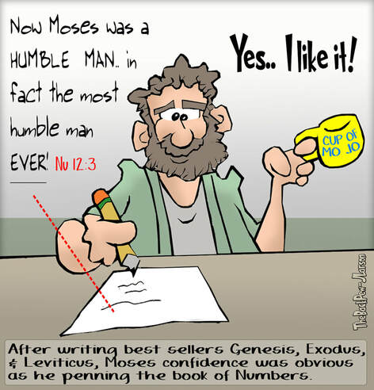
Now Moses was very humble— more humble than any other person on earth.
—Numbers 12:3
Yes… I like it!
After writing best sellers Genesis, Exodus, & Leviticus, Moses’s confidence was obvious as he penned the book of Numbers.

Slide 59
Unlikely Statements
Numbers 12:3 has an interesting parenthesis:
“(Now Moses was very humble—
more humble than any other person on earth.)”
How would you explain this as written by Moses?
This seems to be an addition since
for Moses to say it would be self-contradictory.

Slide 60
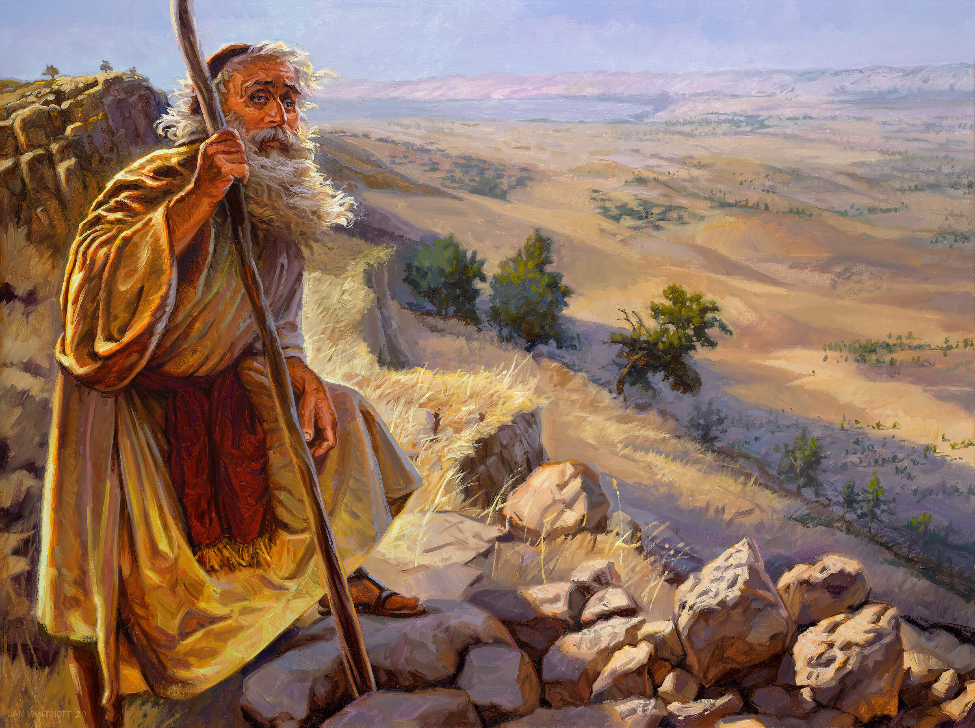
The Death of Moses (Deut 34:1, 5)
"Then Moses went up to Mount Nebo from the plains of Moab and climbed Pisgah Peak, which is across from Jericho. And the LORD showed him the whole land… So Moses, the servant of the LORD, died there in the land of Moab, just as the LORD had said."
Notes:
Who wrote this—did Moses? Not unless he wrote it prophetically and the ink on Deuteronomy was hardly dry before his final mountain climbing!
The Hebrew tradition is that Joshua penned this final chapter of Deuteronomy.

Slide 61
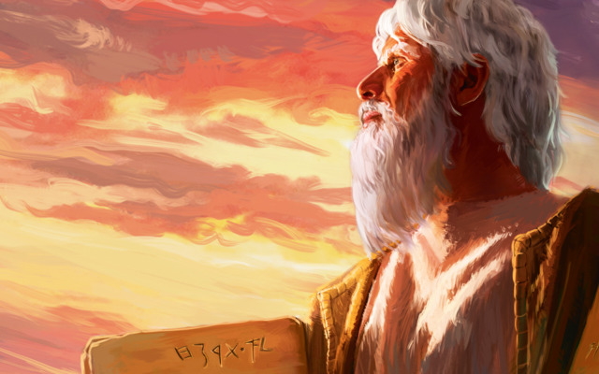
Conclusion
While others may have done some editorial work under the inspiration of the Holy Spirit, no substantial evidence exists that Moses did not compose the Pentateuch. To think otherwise is to contradict the clear testimony of both tradition and Scripture.

Slide 62

Supplements

Slide 63
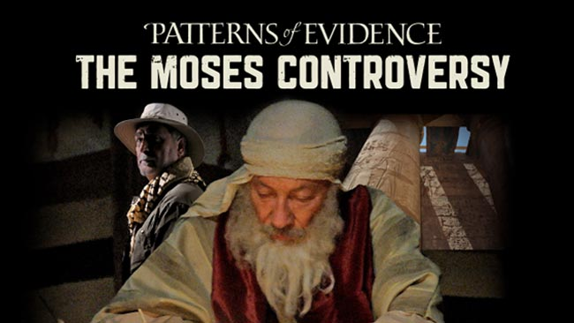
A recent movie supporting authorship by Moses…

Slide 64
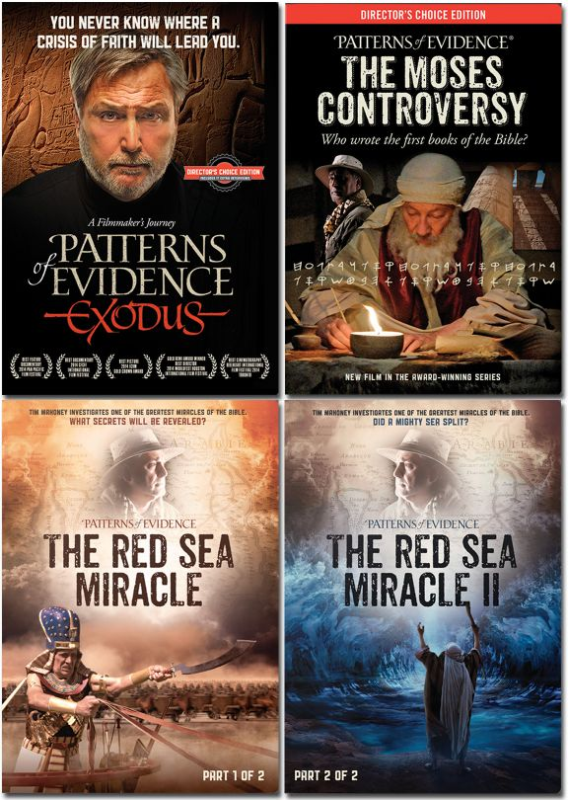
Recent Movies Supporting Moses

Slide 65
《底本说》论据的问题
57
1. 反超自然主义的偏见
2. 循环论证：假定其结论
“不可能有超自然的启示； 因此，圣经不是一个超自然的启示。”

Slide 66
《底本说》论据的问题
57
3. 在运用理论时，导至相互矛盾的解释
4. 忽略了作者在写作风格上的变化

Slide 67
摩西是作者的证据
57
创世记和出埃及记的作者显示了一个对埃及有全面的认识。
目击者的细节都记录在出埃及的事件里。
整部的摩西五经有统一完整的安排。
Gleason Archer, A Survey of Old Testament Introduction

Slide 68
摩西是作者的证据
57
摩西五经证明作者是摩西(出埃及记 十七14; 廿四4; 申命记 卅一9).
其他旧约书都指向摩西为作者(约书亚记 一 7-8)
新约圣经标识摩西为作者(约翰福音 五46-47; 罗马书 十5)
Gleason Archer, A Survey of Old Testament Introduction

Slide 69
Black

Slide 70


Critical Studies of the OT link at BibleStudyDownloads.org
Get this presentation and script for free!

