Slide 1

约书亚记与士师记年代学
Dr. Rick Griffith • Jordan Evangelical Theological Seminary • BibleStudyDownloads.org

Slide 2
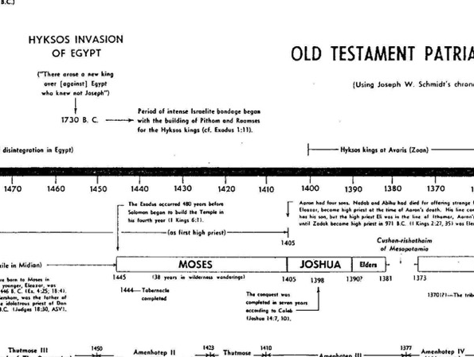
Old Testament Patriarchs & Judges
65a
Josh. 14:7 I was 40 years old when Moses, the servant of the LORD, sent me from Kadesh-barnea to explore the land of Canaan. I returned and gave an honest report.
Josh. 14:10 Now, as you can see, the LORD has kept me alive and well as he promised for all these forty-five years since Moses made this promise—even while Israel wandered in the wilderness. Today I am 85 years old.
40 Age when spied the land
+38 Years of wanderings
=78 Age at start of conquest
- 85 Age at end of conquest
=7 Number of conquest years
1445
1405
1398
7
Caleb said the conquest took 7 years (Joshua 14:7, 10).
Notes:
“Caleb’s remarks provide information for determining the length of the conquest of Canaan by the Israelites. Caleb stated (v. 7) that he was 40 years old when he went to spy out the land. The wilderness wanderings lasted 38 years, thus bringing Caleb’s age to 78 at the beginning of the Conquest. Caleb then said he was 85 at the end of the Conquest. So the Conquest lasted 7 years. This is confirmed by Caleb’s reference (v. 10) to God’s sustaining grace for 45 years since Kadesh Barnea (38 years of the wanderings plus 7 years of the Conquest).”
Donald K. Campbell, “Joshua,” in The Bible Knowledge Commentary, ed. John F. Walvoord and Roy B. Zuck; Accordance electronic ed. 2 vols. (Wheaton: Victor Books, 1985), 1:357.

Slide 3
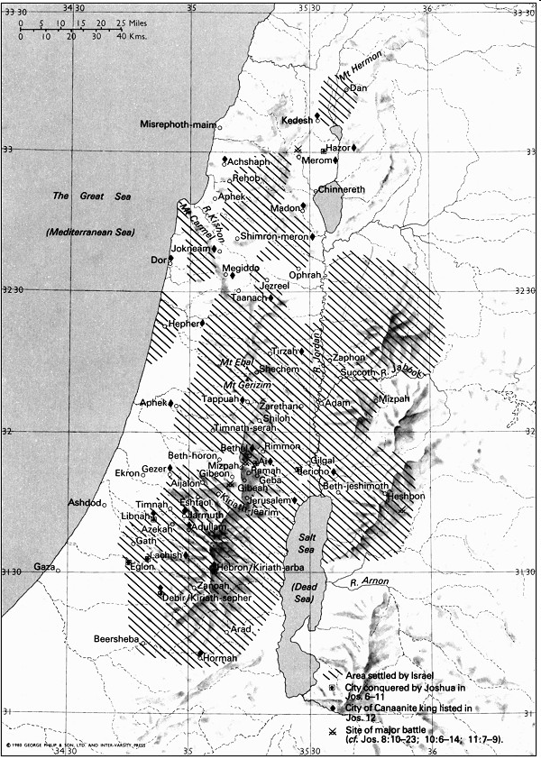
土地在
约书亚的领导下
被征服
181
New Bible Atlas

Slide 4
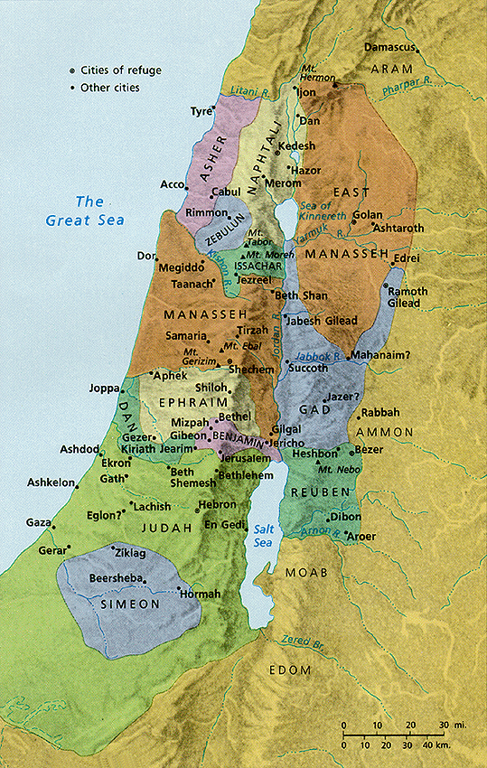
以色列占领地和
土地的分配
171
New Bible Atlas
The Conquest
and
settlement
under 约书亚

Slide 5
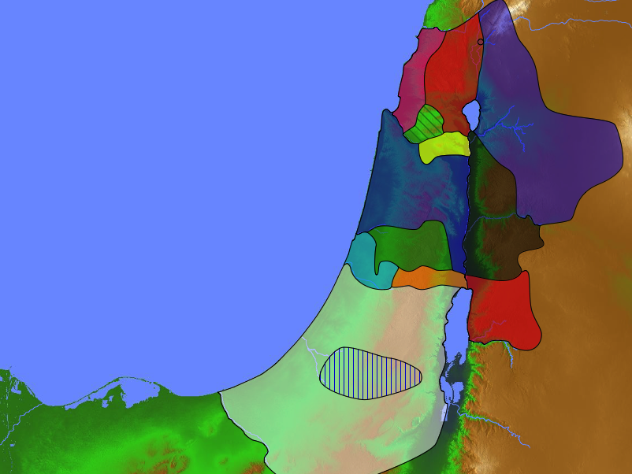
部落的人口
171
亚设
53,400
拿弗他利
45,400
民数记 26
约书亚 13:1–19:48
西布伦
60,500
玛拿西
以萨迦
64,300
玛拿西
52,700
利未
23,000
Spread Throughout Israel
迦得
40,500
以法莲
32,500
但
64,400
便雅悯
45,600
流本
43,730
犹大
76,500
西缅
22,200

Slide 6
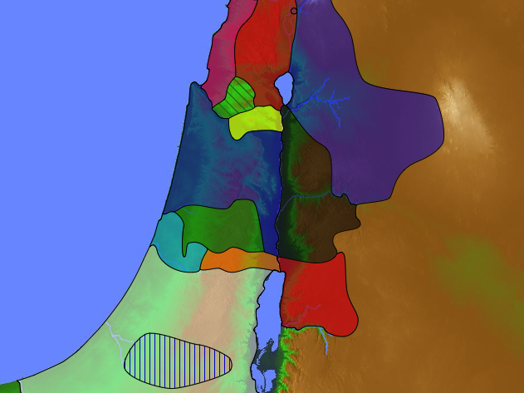
48 利未人的城邑
171a
6 逃城
约书亚 21

Slide 7
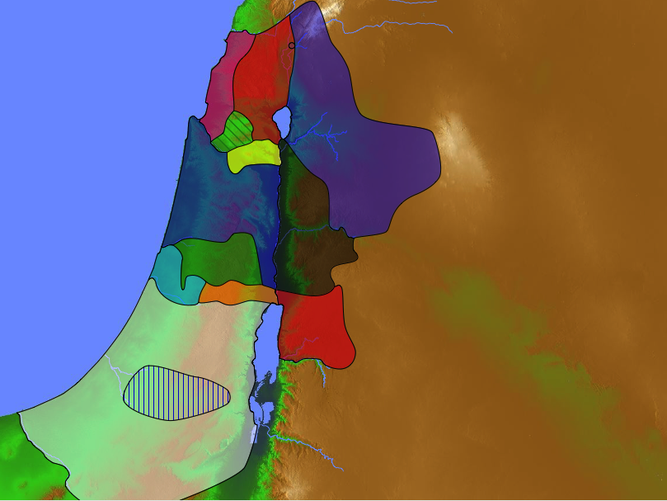
How much land did Joshua conquer?
Naphtali
180a
Asher
But Kenneth Kitchen says that only the central area was occupied.
Zebulun
Manasseh
Issachar
Manasseh
All
Israel
Shechem
Gad
He assumes that the 31 conquered cities of Joshua 13 were not inhabited soon after.
Ephraim
Dan
Benjamin
Hebron
Reuben
Judah
Simeon
Notes:
﻿”Thus, to sum up, the book of Joshua in reality simply records the Hebrew entry into Canaan, their base camp at Gilgal by the Jordan, their initial raids (without occupation!) against local rulers and subjects in south and north Canaan, followed by localized occupation (a) north from Gilgal as far as Shechem and Tirzah and (b) south to Hebron/Debir, and very little more. This is not the sweeping, instant conquest-with-occupation that some hasty ﻿scholars would foist upon the text of Joshua, without any factual justification. Insofar as only Jericho, Ai, and Hazor were explicitly allowed to have been burned into nonoccupation, it is also pointless going looking for extensive conflagration levels at any other Late Bronze sites (of any phase) to identify them with any Israelite impact. Onto this initial picture Judges follows directly and easily, with no inherent contradiction: it contradicts only the bogus and superficial construction that some modern commentators have willfully thrust upon the biblical text of Joshua without adequate reason. The fact is that biblical scholars have allowed themselves to be swept away by the upbeat, rhetorical element present in Joshua, a persistent feature of most war reports in ancient Near Eastern sources that they are not accustomed to understand and properly handle. See next section.”
K. A. Kitchen, On the Reliability of the Old Testament –Eerdmans, Kindle Edition. Loc 3691-3699 of 14432

Slide 8

士师记中的循环
174
1 罪
2 奴役
5 静默
3 代求
4 救恩

Slide 9
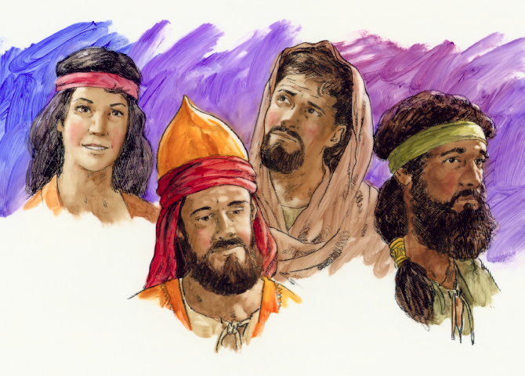
士师记
士师记
Dr. Rick Griffith, 新加坡神学院
BibleStudyDownloads.org

Slide 10

Book Chart
172
神权统治之下的失败
王国体制的需要
未完成的占领
士师的拯救
1:1-2:5
2:6-16:31
17-21
恶化
管教
败坏
循环的起因
循环的咒诅
循环的条件
与迦南人共处
与迦南人开战
生活似迦南人
迦南
c. 341 年(主前1390-1049 )

Slide 11
士师记之秘
70h
我们规定士师记的时代是由摩西时至到扫罗被立为王
  480年 (从出埃及到所罗门圣殿；王上6:1)
  - 40年 (扫罗的统治)
  - 40年 (大卫的统治；王上2:11) = 400年
当我们把士师们及以色列的敌人统治的年时加起来，很明显的超过400年：510+年

Slide 12

我们如何安置士师们呢？
480 年
1446
360 年
966
410 年
荒野 40 年
大卫 40 年
扫罗 40 年
?
1700
1600
1500
1400
1300
1200
1100
1000
900

Slide 13
士师统治之年
65c
公元前1381年米所波大米开始统治
压迫
安宁
114
296
总计
总计
332
410
公元前1049年参孙去世

Slide 14
有可能性的答案
70i
士师们领导的期间包挂了以色列被敌人压迫之年。
几位士师们同时间领导。

Slide 15
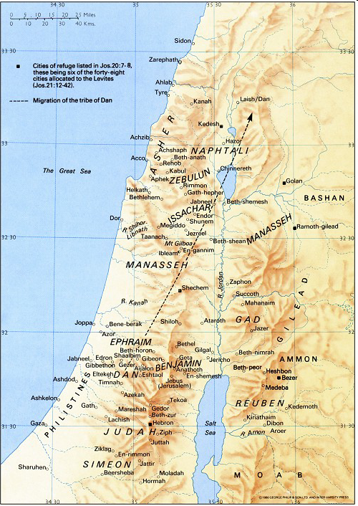
珊迦
New Bible Atlas
参孙
以伦
睚珥
巴拉
基甸
耶弗他
陀拉
亚比米勒
以笏
底波拉
以比赞
俄陀聂
押顿
The Moody Atlas of Bible Lands, map 34

Slide 16
我们认为呢？
70i
圣经很明显记载士师的时期是400年
切地查经透露一些相叠。例如在40年的非利斯坦压迫期间里，耶弗他，参孙，以利及撒母耳都列于当中

Slide 17
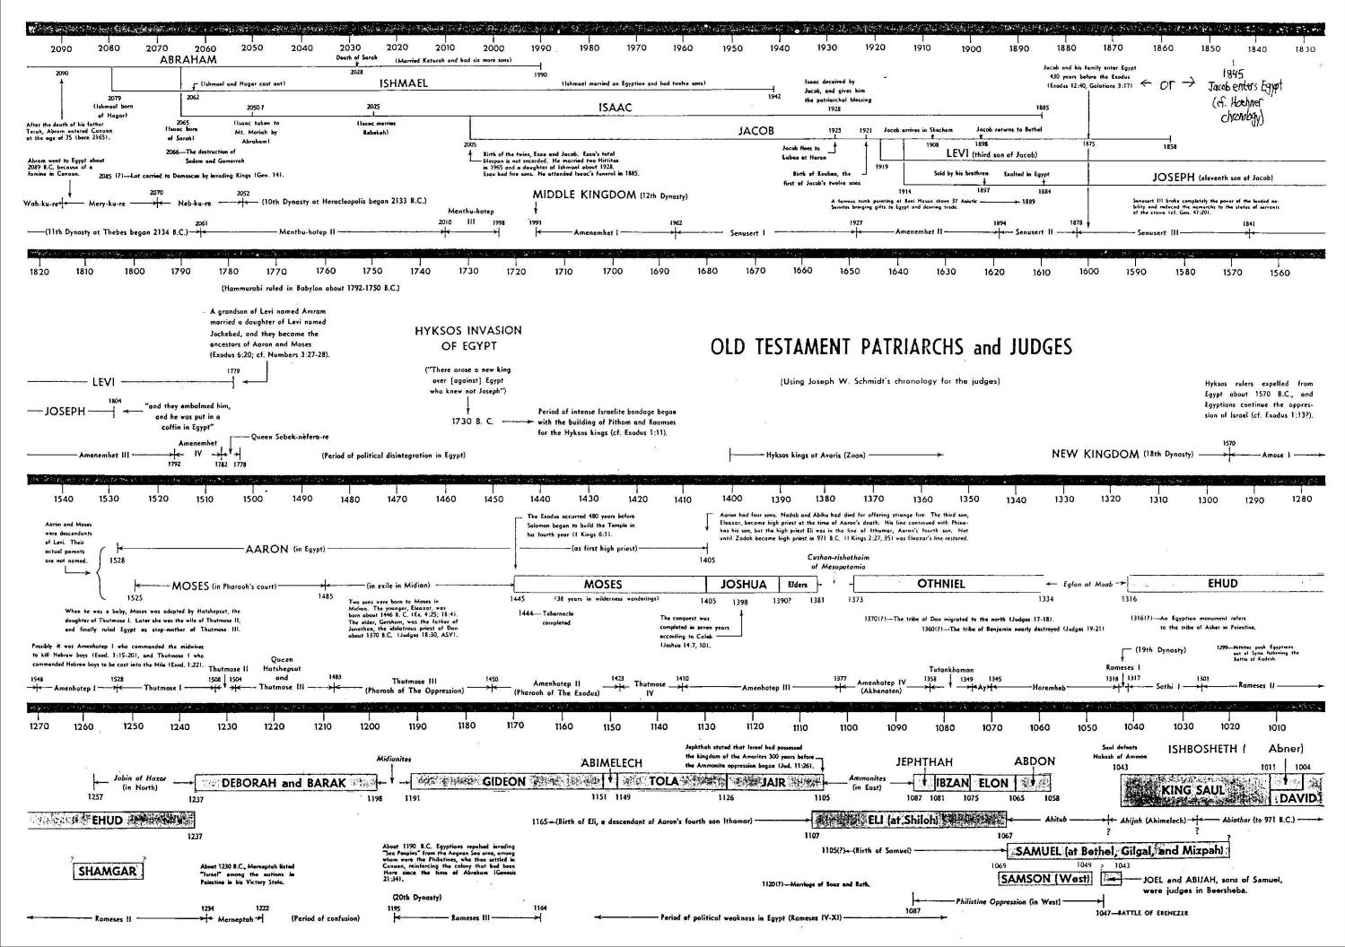
旧约先祖及士师们
65b
注意相叠！

Slide 18
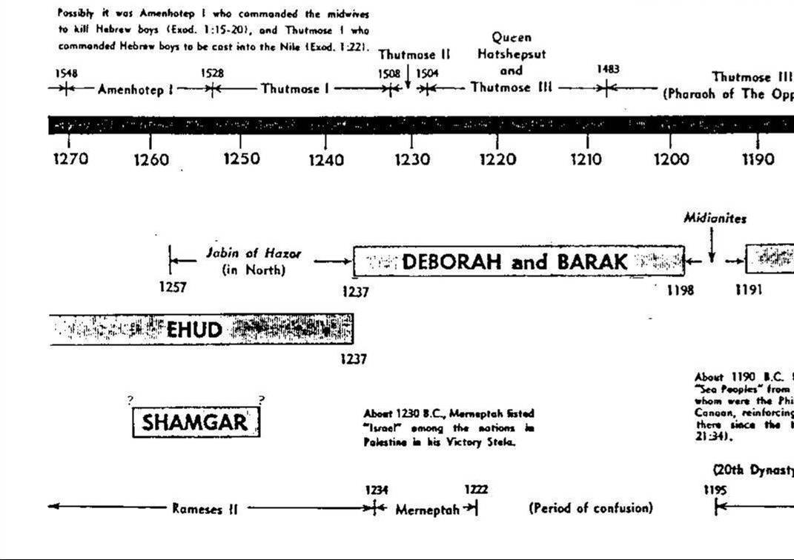
旧约先祖及士师们
65b
注意相叠！

Slide 19
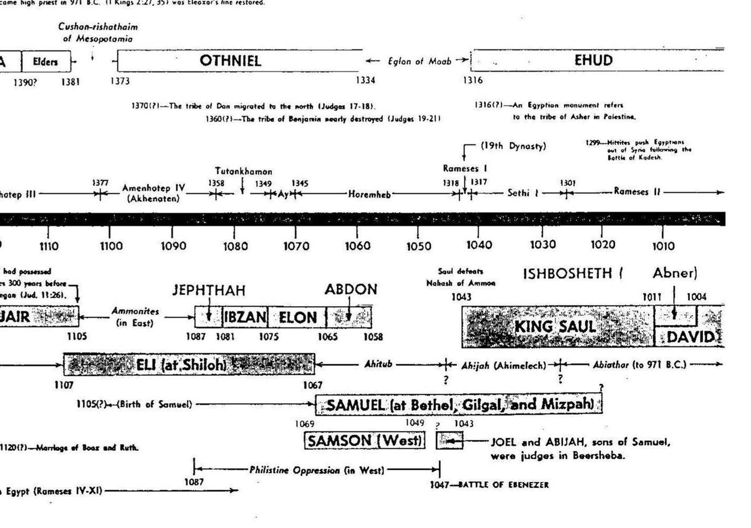
旧约先祖及士师们
65b
注意相叠！

Slide 20
从发现中得到的结论
70i
圣经没有足够的纪录说明每个士师统治的期间有多少年
不是每次都有提到那一年以色列被敌人征服
不过，圣经的历史记载还是很准确

Slide 21
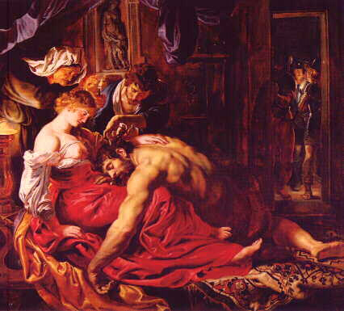
参孙的故事
他的弱点是什么？
她？
头发？
心？
“参孙…
一个有女人为弱点的男人”
-查尔斯 (Chuck Swindoll)

Slide 22
Black

Slide 23


旧约批判研究 - BibleStudyDownloads.org
免费获得该讲解!
圣经学习下载
Notes:
The explanation for free!
OT Critical Studies link address

