Slide 1
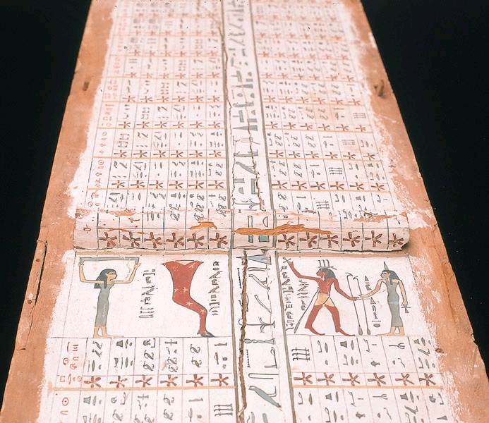
埃及的历史
A New View
Dr. Rick Griffith • Jordan Evangelical Theological Seminary • BibleStudyDownloads.org
Notes:
Adapted: 6, 43, 57, 82, 131

Slide 2

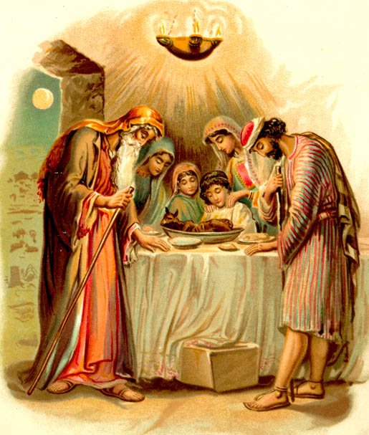

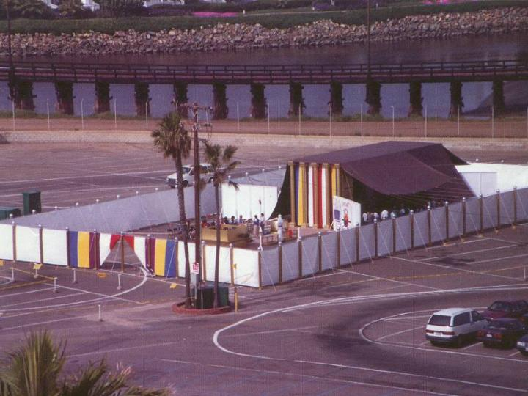
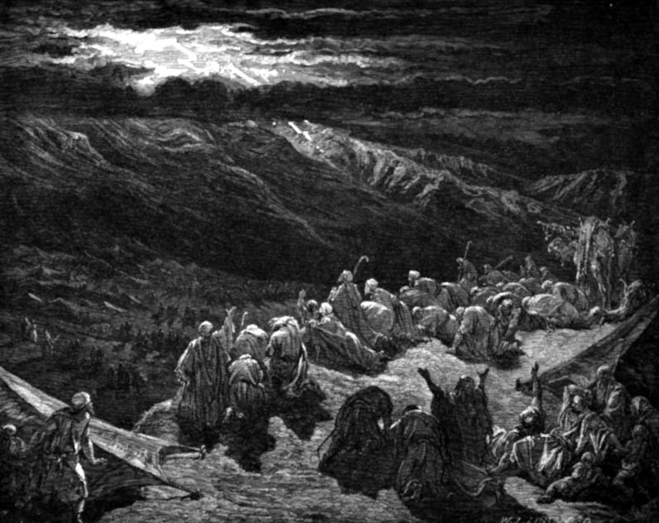
埃及历史
OTB 73
3100-2686 原始王朝时期
2686-2181 古王国
2181-1991 第一王国
1991-1786 中王国
1786-1558 第二王国
1558-1085 新王国
1098- 333 晚期王国
333- 亚历山大大帝
金字塔
亚伯拉罕
约瑟
摩西
Notes:
https://portal.tiu.edu/uportal/teds/otdept/jhoffmeier

Slide 3
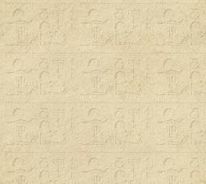
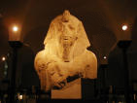
新王朝的帝王
87

Slide 4

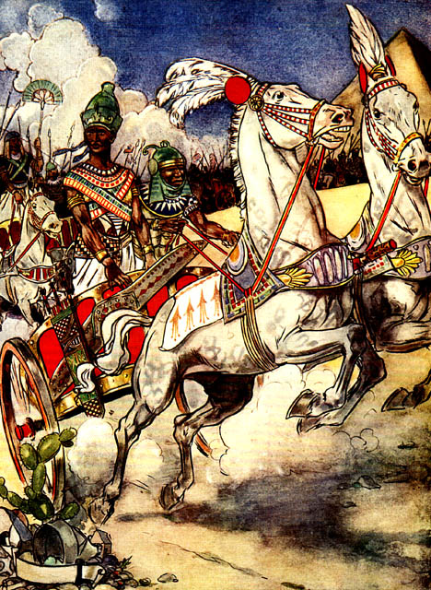
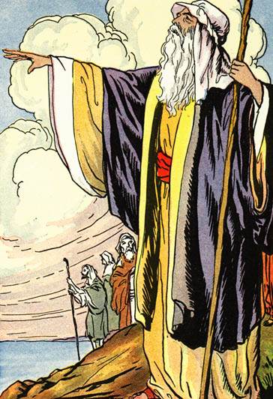
Amenophis II

Slide 5

新王朝的帝王
87
* 一些埃及历史家认为Rameses 在1304 or 1292-1290 开始他的统治. 确定的日期不容易定论。
Notes:
“Egyptian chronology is in a constant state of transition, with much of the terminology and dating in dispute. Professor E.J. Bickerman, Chronology of the ancient world (1980: 83-84 and 106), has properly called it "the rather fluid chronology of the Pharaohs and the Hittites," adding that Ramses II's accession is dated by various Egyptologists to 1304, 1290-92, or 1279 BCE. Reliable absolute dates, astronomical or other, are lacking, as Professor Heinrich Otten had noted. It is a "rubber chronology" that you can stretch or shrink anywhere, by arbitrarily established lengths of co-regencies between rulers and even overlapping dynasties. The possibility of a calendar reform called Menophres Era may radically modify the prevailing modern Egyptian chronology, so the previous "firm" dates cannot be supported astronomically.”
http://en.wikipedia.org/wiki/Egyptian_chronology
埃及编年史处于不断变化的状态，许多术语和日期存在争议。E.J. Bickerman教授在《古代世界的编年史》（1980: 83-84 和 106页）中，恰当地称其为“法老和赫梯人的相当流动的编年史”，并补充说，拉美西斯二世的登基日期被不同的埃及学家定为公元前1304年、1290-92年或1279年。可靠的绝对日期，无论是天文的还是其他的，都是缺乏的，正如Heinrich Otten教授所指出的那样。这是一种“橡皮编年史”，可以任意拉伸或收缩，通过任意确定的统治者之间的共同统治期甚至重叠的王朝长度。被称为“Menophres纪元”的历法改革的可能性可能会从根本上修改现代流行的埃及编年史，因此以前的“确定”日期无法通过天文学支持。
http://en.wikipedia.org/wiki/Egyptian_chronology

Slide 6
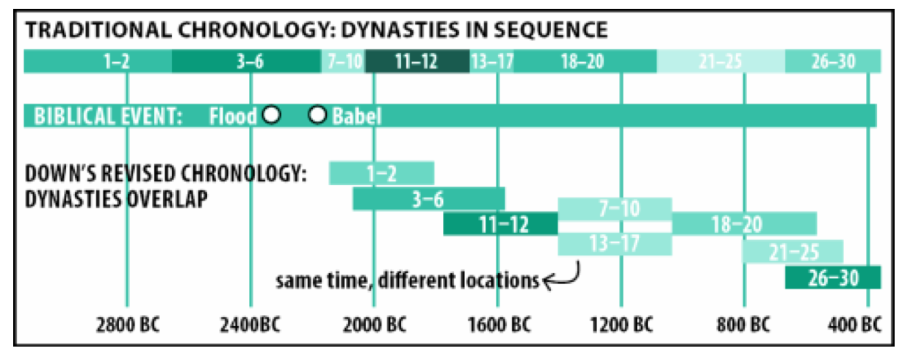
埃及矛盾的历史
OTB 73
传统的编年史：以朝代为时间轴线
圣经历史事件
洪水
巴比塔
没落的王朝编年史 重叠部分
相同的时间不同的地点
公元
公元
公元
公元
公元
公元
公元
The New Answers Book 2, Chapter 24, "Doesn't Egyptian Chronology Prove That the Bible Is Unreliable?" by Dr. Elizabeth Mitchell on July 22, 2010 • https://answersingenesis.org/archaeology/ancient-egypt/doesnt-egyptian-chronology-prove-bible-unreliable
Notes:
The Traditional Chronology places the dynasties in sequence from 1 to 30, but why? This is due to the Greek ruler over Egypt called Ptolemy around
Obviously, the Flood around 2400 BC could not occur 700 years after the first dynasty began.
See also John F. Ashton and David Down, Unwrapping the Pharaohs: How Egyptian Archaeology Confirms the Biblical Timeline (Green Forest, AR: Master Books, 2006). ISBN 0890514682
See also "Egyptian Chronology," at http://creationwiki.org/Egyptian_chronology#cite_note-Jaroncyk-1 (accessed 6 August 2015)
传统编年史将王朝按顺序排列从第1到第30王朝，但为什么呢？这是由于希腊统治者托勒密（Ptolemy）在埃及统治时期。
显然，约公元前2400年的大洪水不可能发生在第一个王朝开始后的700年。
另见 John F. Ashton 和 David Down 的《解开法老之谜：埃及考古如何证实圣经时间线》（绿森林，AR：大师图书，2006年）。ISBN 0890514682
另见“埃及编年史”，网址：http://creationwiki.org/Egyptian_chronology#cite_note-Jaroncyk-1（访问时间：2015年8月6日）

Slide 7


新的编年史
OTB 73
“Patterns of Evidence” 该电影由 Timothy Mahoney (Thinking Man Films, 2015显示了一系列出埃及记中，由Dr. David Rohl发掘出来的考古证据
Notes:
See the film review by Dr. Elizabeth Mitchell at https://answersingenesis.org/reviews/movies/movie-review-patterns-of-evidence-出埃及记/
请参阅伊丽莎白·米切尔博士的电影评论：https://answersingenesis.org/reviews/movies/movie-review-patterns-of-evidence-Exodus/

Slide 8
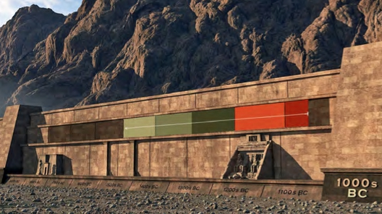
时间墙
Notes:
The 2015 film "Patterns of Evidence" envisions Egyptian chronology as a wall with the timeline on it from 1000 BC on the right tower back to 2000 BC on the left tower. The various eras are indicated in different colors.
2015年的电影《证据的模式》将埃及年代学想象成一堵墙，上面有一条时间线，从右边塔楼的公元前1000年延伸到左边塔楼的公元前2000年。不同的时代以不同的颜色表示。

Slide 9
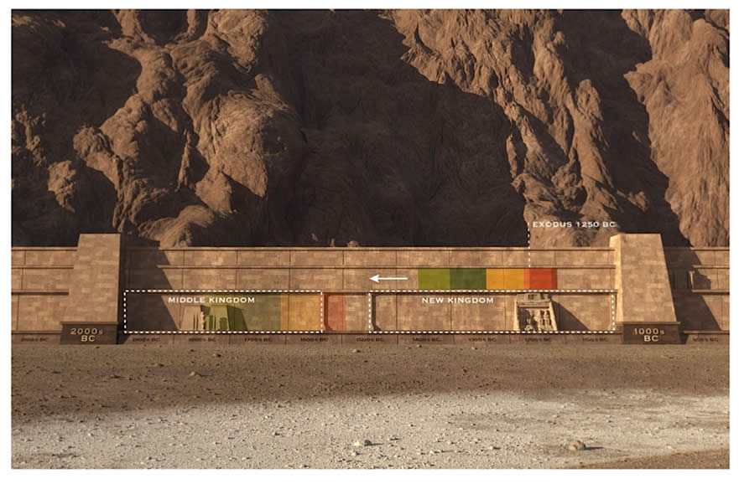
出埃及记晚期 (1250 BC)
出埃及记晚期 (公元前1250)
中期国度
新的国度
2000s
公元前
1000s
公元前
Notes:
These colored eras followed one another, and the date of the 出埃及记 fits in somewhere. The question is, where? In this depiction held by most liberal scholars, it is in the middle of the 13th century around 1250 BC. This would be in the 19th dynasty according to the traditional dating of the dynasties. Such scholars interpret archaeology and the Bible as supporting this late date. But is 1250 BC the best attested date in both archaeology and the Bible? Some do not think so, so they follow an earlier date as depicted in the arrow pointing to the left.
这些不同颜色的时代一个接一个地出现，《出埃及记》的日期适合放在其中的某个位置。问题是，在哪里呢？在大多数自由派学者的描述中，它是在公元前13世纪中期，大约公元前1250年。这将根据传统的王朝编年法处于第19王朝。这些学者解释考古学和圣经，认为支持这个较晚的日期。但公元前1250年是考古学和圣经中最好证明的日期吗？有些人不这么认为，所以他们遵循箭头指向左边所描述的更早的日期。

Slide 10
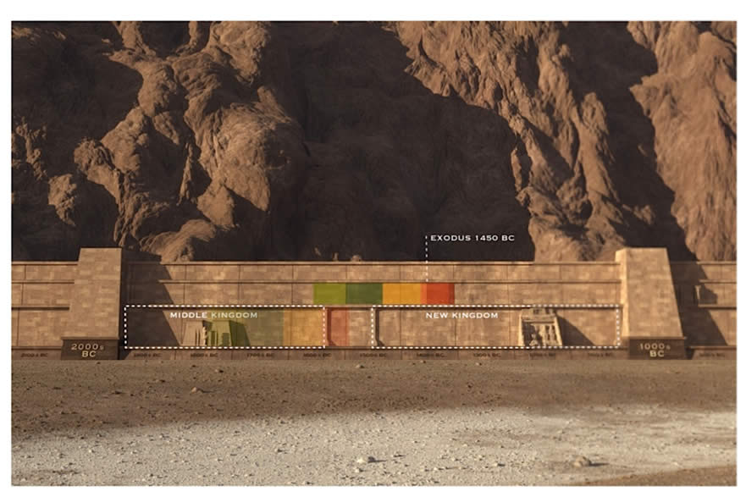
出埃及记早期 (1450 BC)
出埃及记早期 (公元前1450 BC)
中期国度
新的国度
2000s
公元前
1000s
公元前
Notes:
Advocates of the Early Exodus also see it occurring in the New Kingdom, but in the 18th rather than the 19th dynasty.
早期《出埃及记》的支持者也认为它出现在新王国时期，但发生在第十八王朝，而不是第十九王朝。

Slide 11
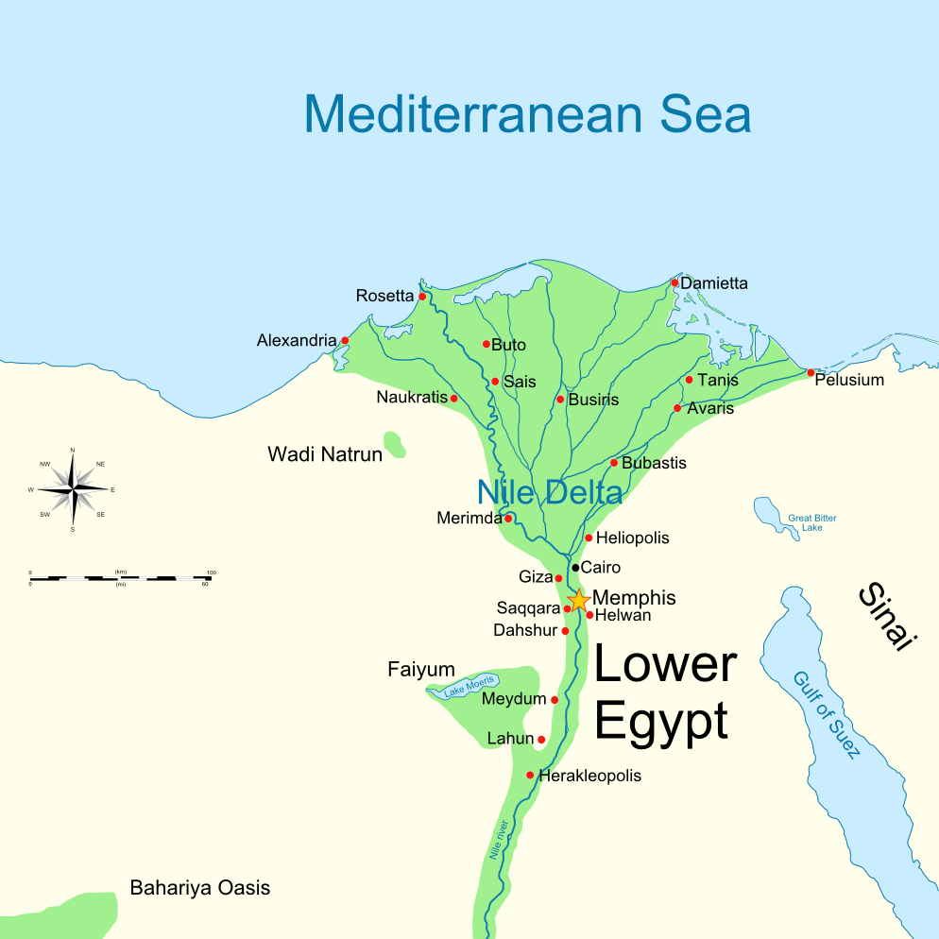
City of Avaris
Notes:
01-Genesis
02-Exodus-137 on Exodus 12

Slide 12
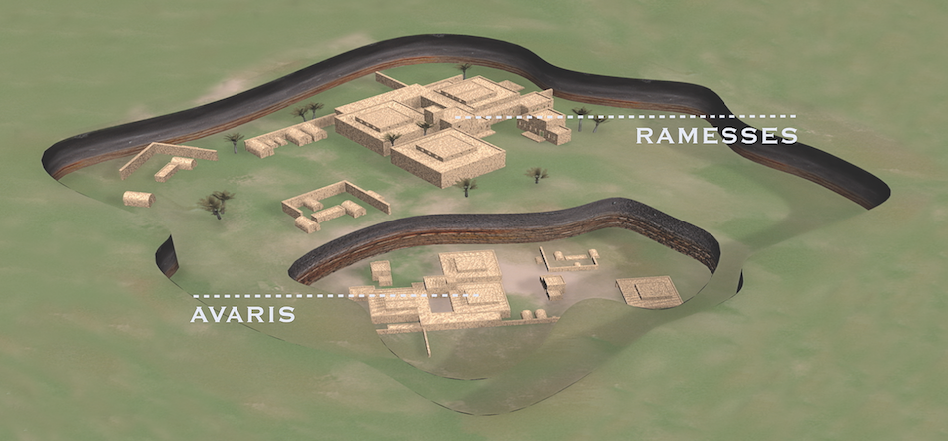
City of Avaris
Beneath Rameses
"Patterns of Evidence" is a film by Timothy Mahoney (Thinking Man Films, 2015) that presents amazing archaeological evidence for the Early Exodus discovered by Dr. David Rohl, an agnostic Egyptologist.

Slide 13
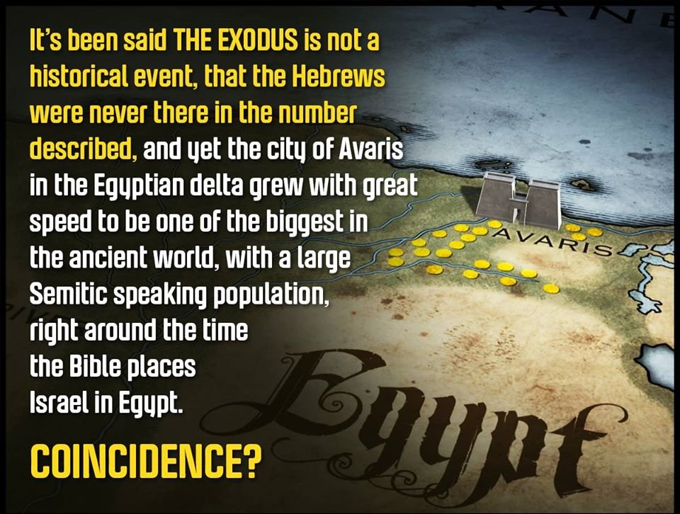
阿瓦里斯市
有人说《出埃及记》不是历史性事件，希伯来人从来没有出现过，但埃及三角洲的阿瓦里斯城却迅速发展成为古代世界上最大的城市之一，闪族人，大约在圣经将以色列安置在埃及的时候
难道是巧合吗？

Slide 14
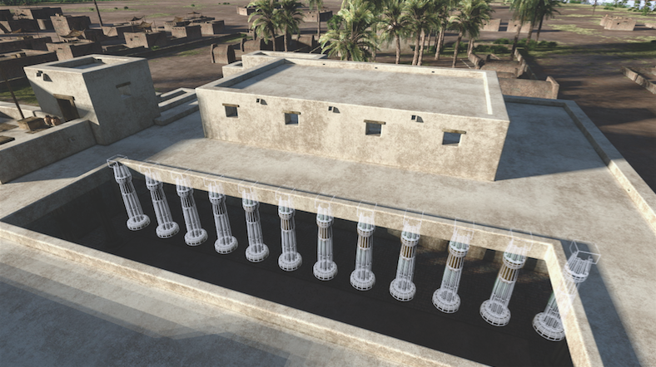
This palace with 12 columns lay directly before 12 tombs behind it
Notes:
The 12 pillars in front of the heart of the palace (Copyright 2014, Patterns of Evidence, LLC.)
“The palace had other interesting aspects; it initially contained 12 pillars at its entrance and had 12 primary tombs behind it. These fit the 12 sons of Jacob (who was also named Israel) who were the heads of the 12 tribes of Israel. The primary tomb of the Semitic official was in the shape of pyramid, something unique at this time for a foreigner – again fitting the great rewards and honor given by Pharaoh to Joseph.”
From the article:
12 Tribes Of Israel on a Seal From Egypt?
Steve Law
September 14, 2018
https://patternsofevidence.com/2018/09/14/12-tribes-of-israel-on-a-seal-from-egypt/
Accessed 30 Jan 2021

Slide 15
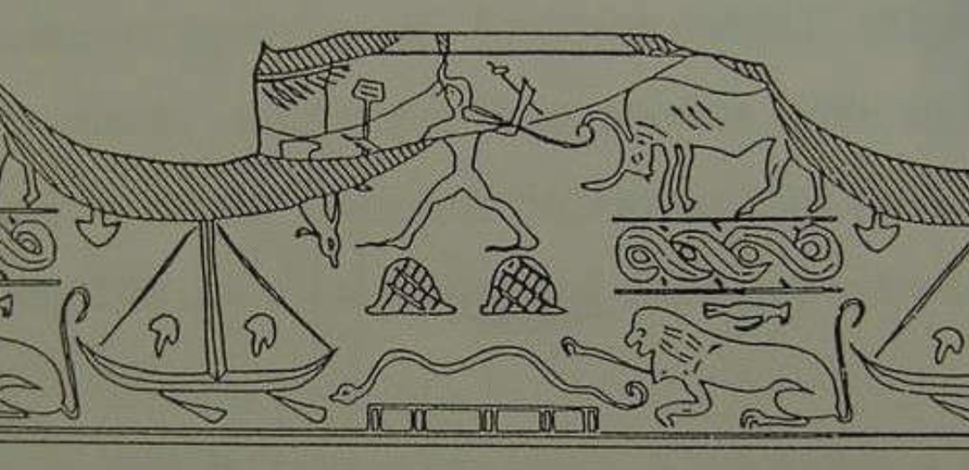
12 Tribes of Israel on a Seal from Avaris, Egypt?
Notes:
The 12 pillars in front of the heart of the palace (Copyright 2014, Patterns of Evidence, LLC.)
“The palace had other interesting aspects; it initially contained 12 pillars at its entrance and had 12 primary tombs behind it. These fit the 12 sons of Jacob (who was also named Israel) who were the heads of the 12 tribes of Israel. The primary tomb of the Semitic official was in the shape of pyramid, something unique at this time for a foreigner – again fitting the great rewards and honor given by Pharaoh to Joseph.”
From the article:
12 Tribes Of Israel on a Seal From Egypt?
Steve Law
September 14, 2018
https://patternsofevidence.com/2018/09/14/12-tribes-of-israel-on-a-seal-from-egypt/
Accessed 30 Jan 2021

Slide 16
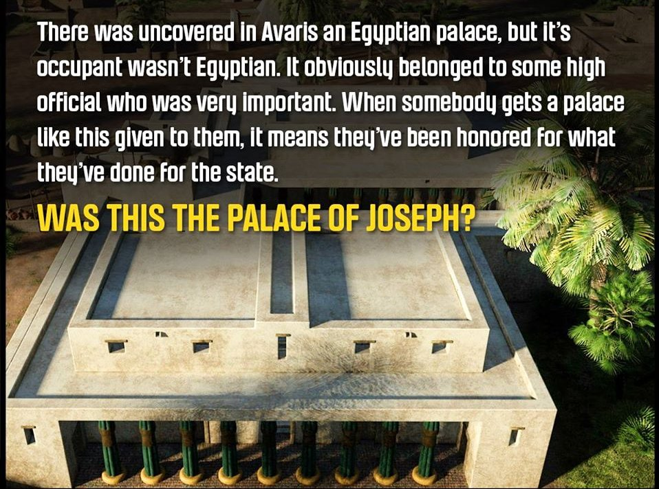
这是约瑟夫的宫殿吗？
在阿瓦里斯发现了一座埃及宫殿，但它的居住者不是埃及人。它显然属于非常重要的高级官员。当有人得到像这样给他们的宫殿时，这意味着他们因为国家所做的贡献而感到荣幸。

Slide 17
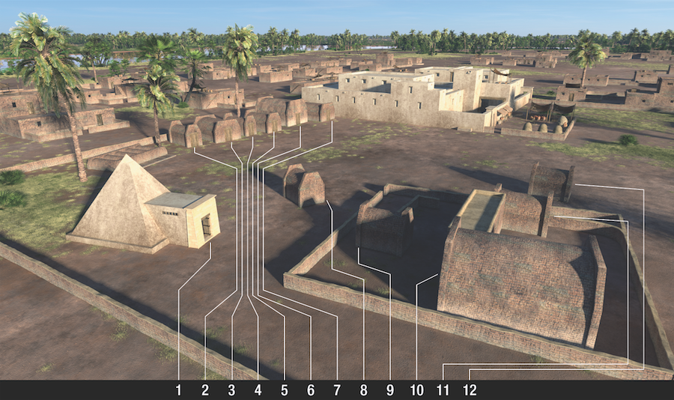
12 Tombs Found Together

Slide 18
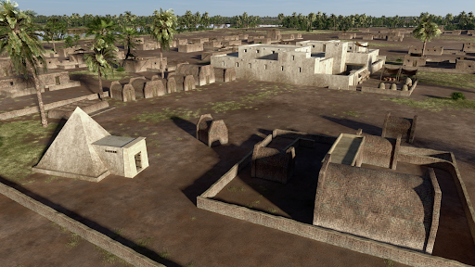
Is the pyramid Joseph's tomb?
Under the city of Rameses (Exod. 1:11) was a tomb occupant with a coat of many colors
It was a pyramid with 11 other tombs
No bones are left

Slide 19
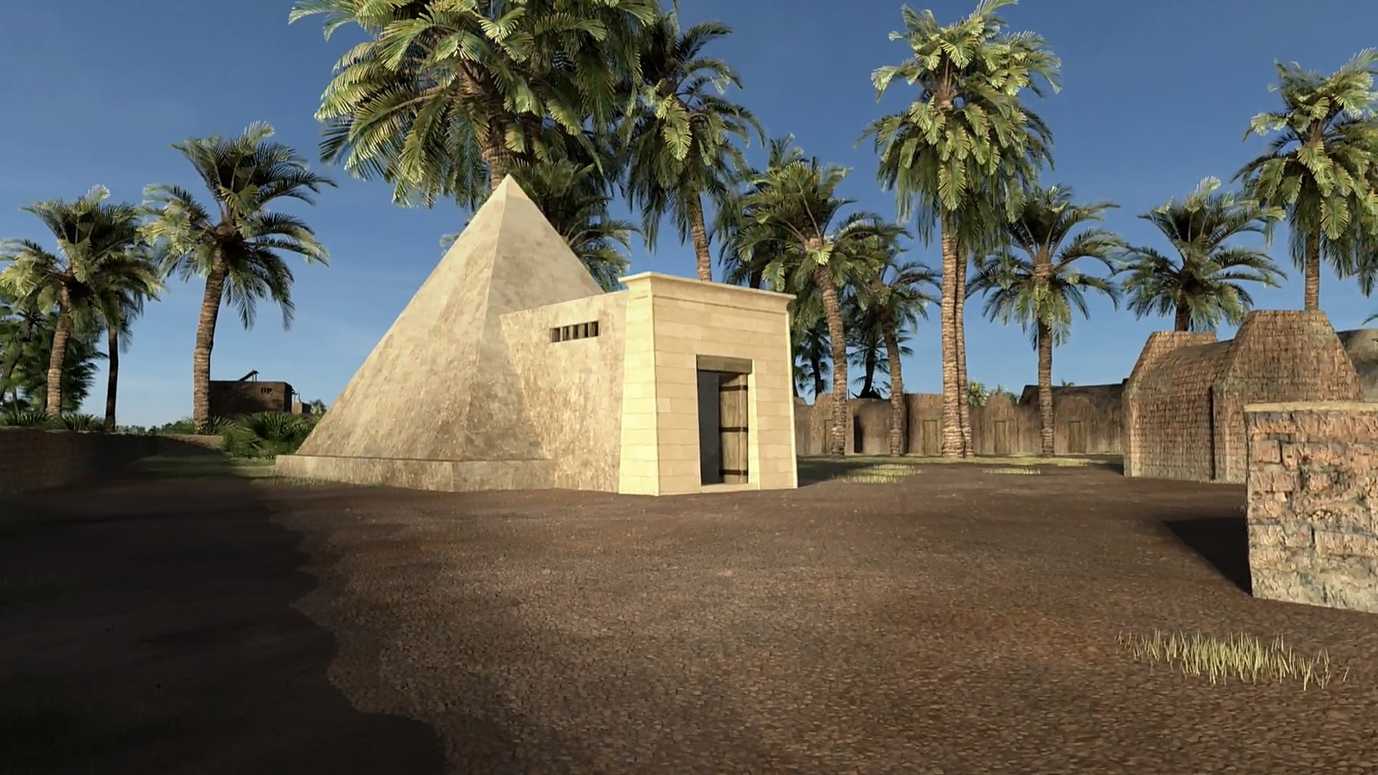
Is the pyramid Joseph's tomb?
Under the city of Rameses (Exod. 1:11) was a tomb occupant with a coat of many colors
It was a pyramid with 11 other tombs
No bones are left

Slide 20
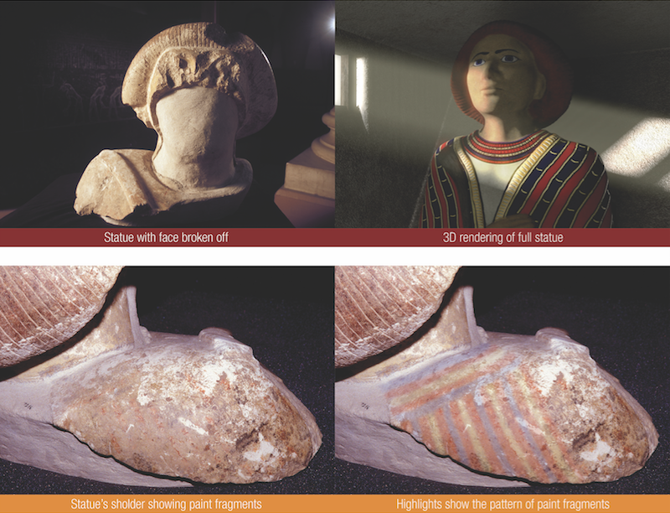
Statue of Joseph?
Statue with face broken off
3D rendering of full statue
Statue’s shoulder showing paint fragments
Highlights show the pattern of paint fragments
Notes:
Statue of the high Semitic official found in the shrine of the pyramid tomb and a digital reconstruction. (Copyright 2014, Patterns of Evidence, LLC.)
“In a shrine in front of the pyramid tomb, the remains of a colossal statue of the Semitic ruler were found – and he was depicted as wearing a multi-color coat. The bones of the person buried here were found to be missing. This again fits the promise made by Joseph’s family that they would take his bones with them when the left Egypt to return to the Promised Land..”
From the article:
12 Tribes Of Israel on a Seal From Egypt?
Steve Law
September 14, 2018
https://patternsofevidence.com/2018/09/14/12-tribes-of-israel-on-a-seal-from-egypt/
Accessed 30 Jan 2021

Slide 21
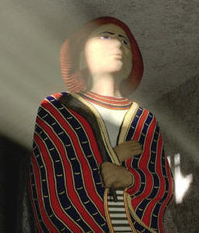
这是约瑟的墓吗？
拉美西斯一世时期的城市 (出埃及记1：11) 有一个很多颜色的坟墓，坟墓的主人穿着彩色的外套。
这是一个金字塔和11个坟墓。
没有任何发现任何骨头。

Slide 22
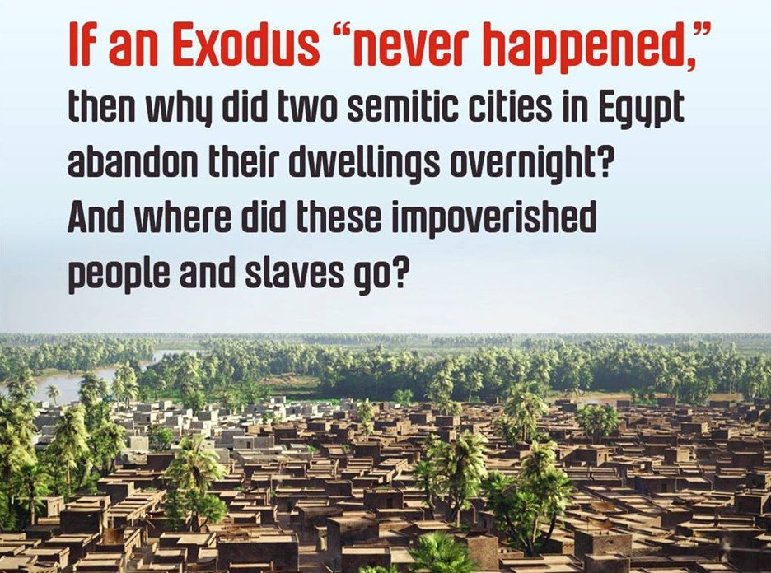
为什么阿瓦里斯市一夜之间被遗弃？它的人口如何在两代人时间内从30,000增长到古代世界上最大的城市之一？
如果出埃及记“从未发生过”，那么为什么埃及的两个闪族人的城市在一夜之间放弃了他们的住所？这些贫穷的人和奴隶去了哪里？

Slide 23
埃及的a历史
OTB 73
传统
圣经
3100-2686 Proto-Dynastic
2686-2181 Old Kingdom
2181-1991 First Intermediate
1991-1786 Middle Kingdom
1786-1558 Second Intermediate
1558-1085 New Kingdom
1098- 332 Late Dynastic
332- 323 Alexander the Great
2400-2200 王朝原型 (没有王朝)
2200-1600 旧的国度 (王朝1-6)
1800-1000 第一中间状态 (7-11)
1600-1000 中间王国 (12-13)
1400-1000第一中间状态 (14-17)
1000- 600 新的国度 (18-20)
800- 后王朝时代 (21-31)
332- 323 亚历山大大帝
亚伯拉罕
金字塔
金字塔
亚伯拉罕
约瑟
约瑟
摩西
摩西
所罗门
耶利米
Notes:
So we really have two major views on the chronology of Egypt. The traditional view puts the pyramids before Abraham and goes all the way back three millennia.
• However, there is another view which I believe is more biblical in the column on the right. This takes the years of Genesis 5 and 11 in their normal sense, going all the way back to the creation of Adam and Eve (see the Genesis PPT). Note the shift of 700 years in using this biblical chronology (see support also in OT Survey notes, 85-90).
https://portal.tiu.edu/uportal/teds/otdept/jhoffmeier for first column
https://answersingenesis.org/archaeology/ancient-egypt/doesnt-egyptian-chronology-prove-bible-unreliable/ for second column in The New Answers Book 2, Chapter 24
"Doesn't Egyptian Chronology Prove That the Bible Is Unreliable?" by Dr. Elizabeth Mitchell on July 22, 2010
因此，我们对埃及的年代顺序实际上有两种主要观点。传统观点认为金字塔建于亚伯拉罕之前，并一直追溯到三千年前。
• 然而，右边一栏中还有另一种观点，我认为这种观点更符合圣经。这种观点以创世纪 5 和 11 的年份作为其正常意义，一直追溯到亚当和夏娃的创造（参见创世纪 PPT）。请注意，使用这个圣经年代顺序时，700 年的时间发生了变化（参见旧约调查注释 85-90 中的支持）。
https://portal.tiu.edu/uportal/teds/otdept/jhoffmeier 为第一栏
https://answersingenesis.org/archaeology/ancient-egypt/doesnt-egyptian-chronology-prove-bible-unreliable/ 为《新答案》第二卷第 24 章的第二栏
“埃及年表难道不能证明圣经不可靠吗？”作者：Elizabeth Mitchell 博士，2010 年 7 月 22 日

Slide 24
Black

Slide 25


旧约批判研究 - BibleStudyDownloads.org
免费获得该讲解!
圣经学习下载
Notes:
The explanation for free!
OT Critical Studies link address

