Slide 1


Template Suite 1-Title 01359
Dr. Terry Mortenson
诺亚的洪水:
洗去数百万年的历程
创世记答案机构
Designed by Dr. Terry Mortenson
Dr. Rick Griffith • 博士 • 新加坡神学院 • BibleStudyDownloads.org
Notes:
This template is intended for talk titles. Although it can be used for significant section titles, its “cover page” feel makes it best used once at the beginning of a presentation. Subtitle can be as its name suggests or the speaker's name. Presentation Team recommends title text size as 50–72 and subtitle size as 30–48 with optimal sizes already used in this example. This also contains a floating AiG logo that can be repositioned or removed as appropriate for the overhead's content.

Slide 2

AiG web site #1

Slide 3
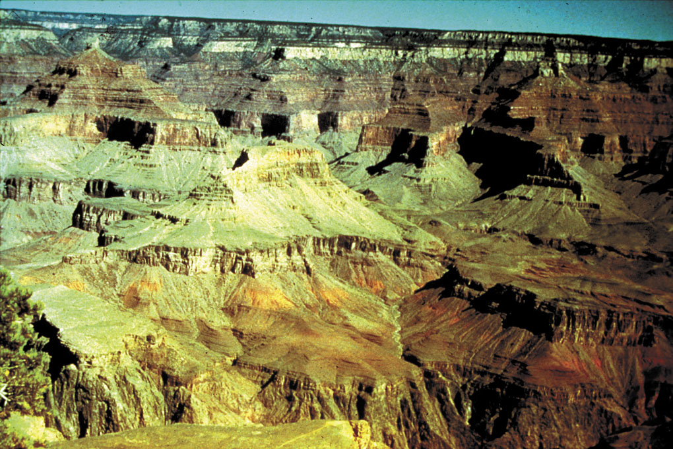
大峡谷
何时及如何形成的呢?

Slide 4
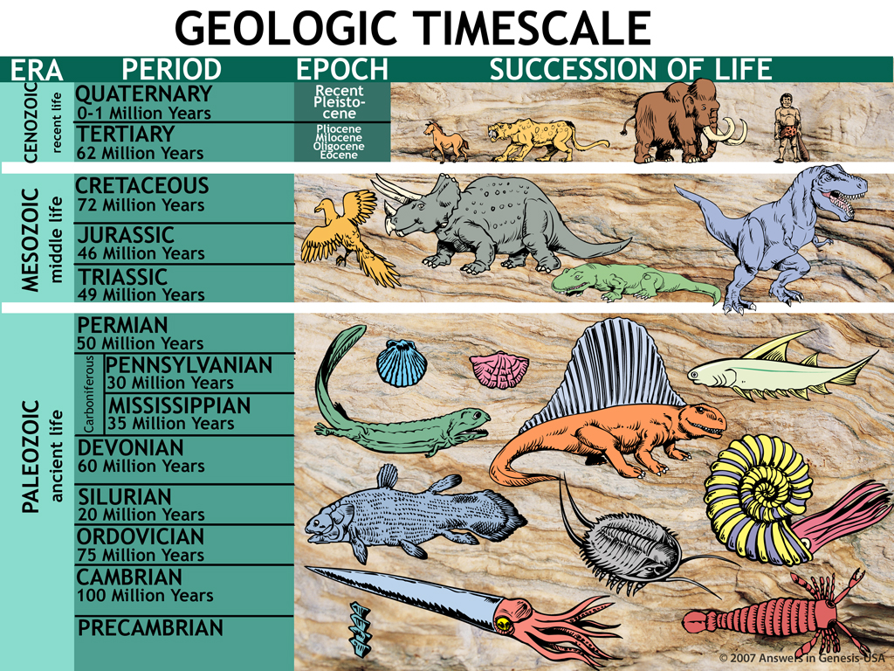
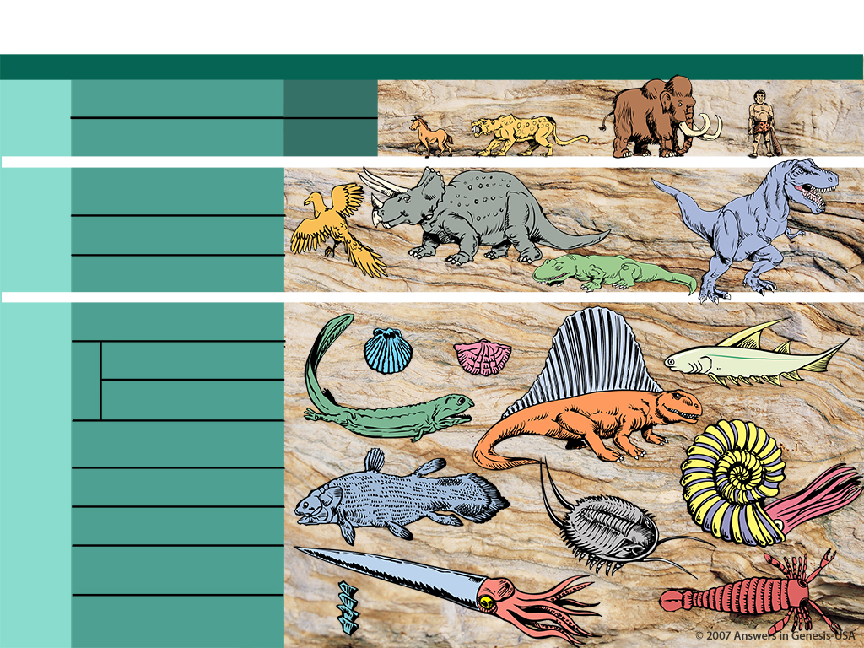
Geologic Timescale 00089
地质时间尺度
时代 时期 时代 一连串的生活
1.9—3.8亿年：
从单细胞到人类
新生代
（近代的生活）
第四纪 （0至一百万年）
更新世
第三纪 （62百万年）
上新世
中新世
渐新世
始新世
中生代
（中代的生活）
早白垩世 （72百万年）
侏罗纪 （46百万年）
三叠纪 （49百万年）
古生
（古代的生活）
二叠纪 （50百万年）
宾夕法尼亚纪 （50百万年）
石炭系
密西西比纪 （35百万年）
泥盆系 （60百万年）
志留纪 （20百万年）
按照进化论
奥陶系 （75百万年）
寒武纪 （100百万年）
寒武纪前

Slide 5
洪水的四个构面
1. 全球性的历史灾难
2. 当地性的历史灾难
3. 全球性的平静洪水历史
4. 神话

Slide 6
洪水的目的
洪水
的
目的

Slide 7

Gen. 6:7, 13 NAS
創 世 記 6:7, 13
7. 耶 和 华 说 ： 我 要 将 所 造 的 人 和 走 兽 ， 并 昆 虫 ， 以 及 空 中 的 飞 鸟 ， 都 从 地 上 除 灭 ， 因 为 我 造 他 们 後 悔 了 。
13. 神 就 对 挪 亚 说 ： 凡 有 血 气 的 人 ， 他 的 尽 头 已 经 来 到 我 面 前 ； 因 为 地 上 满 了 他 们 的 强 暴 ， 我 要 把 他 们 和 地 一 并 毁 灭 。
Notes:
The underlined word is eretz, the same word translated earth in Gen. 1:1 and 2:1 and 2:4. Eretz is used 45 times in the Flood account in Gen. 6:5-9:17. The circled word is adamah, which in modern translations is rendered more accurately as “ground” or “land.” It is used only 9 times in the Flood account. In his rejection of the global Flood, OT scholar Dr. Walter Kaiser said in the Feb. 2006 John Ankerberg debates on creation that eretz is never used in the flood account, but that only adamah is used. He was seriously in error.

Slide 8
Purpose of the Ark
洪水
的
目的

Slide 9
Gen. 7:1-3 NAS
創 世 記 7:1-3
耶 和 华 对 挪 亚 说 ： 你 和 你 的 全 家 都 要 进 入 方 舟 ； 因 为 在 这 世 代 中 ， 我 见 你 在 我 面 前 是 义 人 。
凡 洁 净 的 畜 类 ， 你 要 带 七 公 七 母 ； 不 洁 净 的 畜 类 ， 你 要 带 一 公 一 母 ；
空 中 的 飞 鸟 也 要 带 七 公 七 母 ， 可 以 留 种 ， 活 在 全 地 上 ；

Slide 10

Noah's Ark (kids) & wave

Slide 11
Noah's Ark (kids) & wave
X

Slide 12
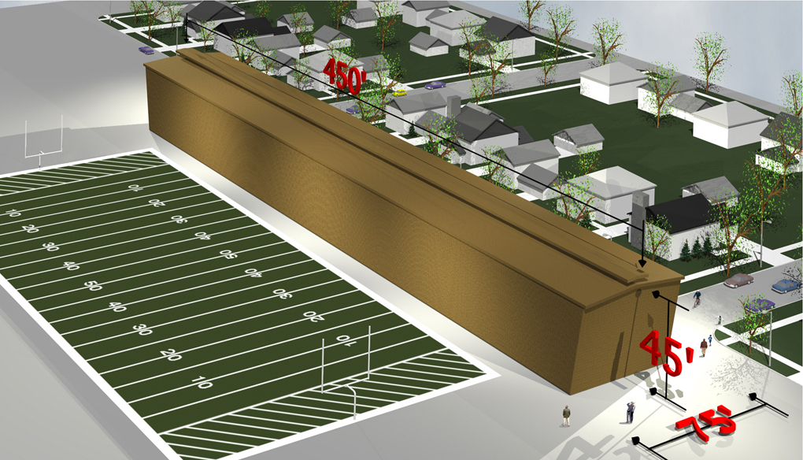
Noah's Ark w/football field & city block

Slide 13
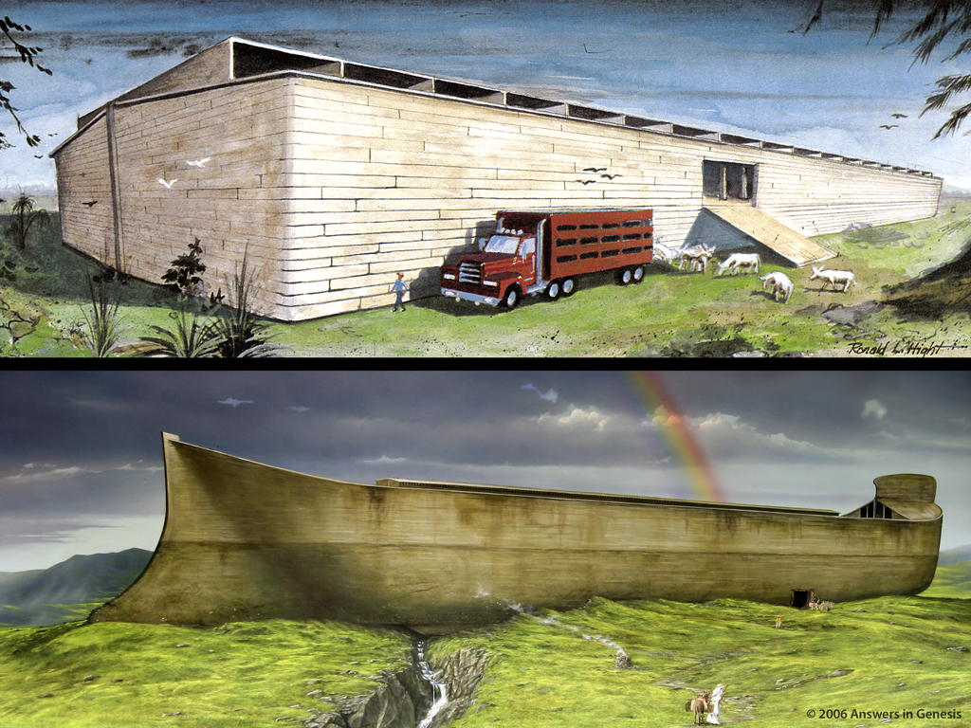
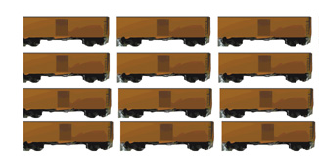
Two Arks Comparison 1 01810
560

Slide 14
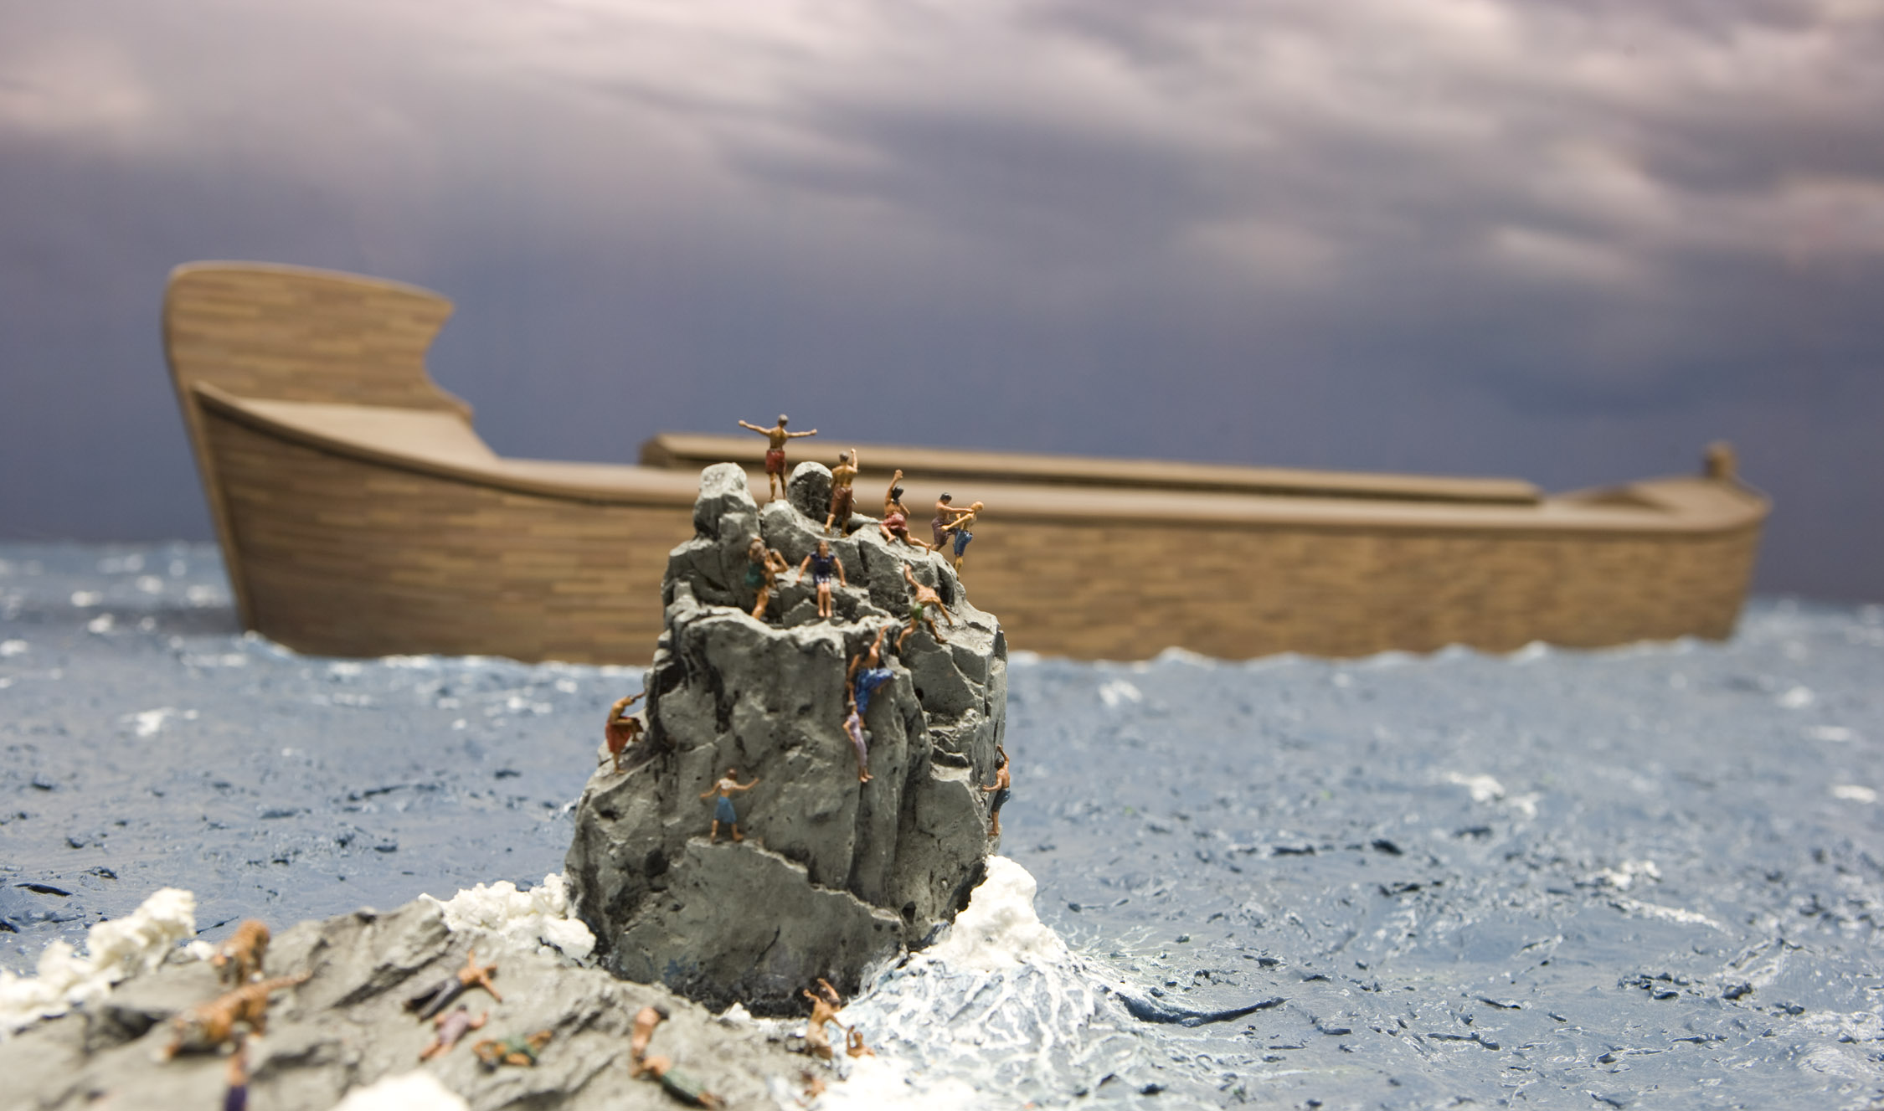
Ark & people perishing
Notes:
The Flood was a real event that can help us understand how God is working in the world today

Slide 15
洪水的性质
洪水
的
性质

Slide 16
Gen. 7:11 NAS
創 世 記 7:11
当 挪 亚 六 百 岁 ， 二 月 十 七 日 那 一 天 ， 大 渊 的 泉 源 都 裂 开 了 ， 天 上 的 窗 户 也 敞 开 了
Notes:
Tsunamis caused by seaquakes can travel at speeds up to 500 mph for thousands of miles.

Slide 17
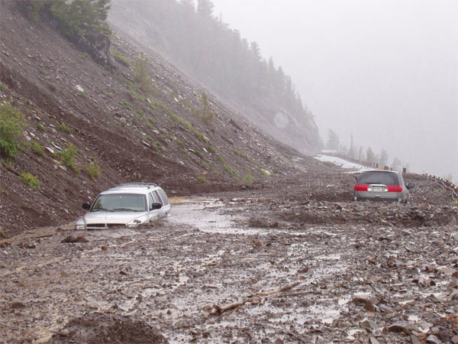
Notes:
Mudslide in southern California, 2008: http://edstacy.blogspot.com/, accessed 22 Sept 2008

Slide 18
Gen. 7:11 NAS
創 世 記 7:11
当 挪 亚 六 百 岁 ， 二 月 十 七 日 那 一 天 ， 大 渊 的 泉 源 都 裂 开 了 ， 天 上 的 窗 户 也 敞 开 了
Notes:
Tsunamis caused by seaquakes can travel at speeds up to 500 mph for thousands of miles.

Slide 19
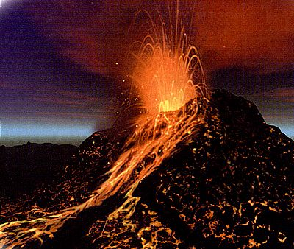
Earthquake—Turkey 2000
Notes:
Volcano from http://images.google.com/imgres?imgurl=http://www.rocks-and-minerals.com/more-about-rocks/images/volcano.jpg&imgrefurl=http://www.rocks-and-minerals.com/more-about-rocks/rocks-that-erupt.htm&h=338&w=400&sz=43&tbnid=Ny5TIZJt3b0J:&tbnh=101&tbnw=119&start=18&prev=/images%3Fq%3Dvolcano%26hl%3Den%26lr%3D%26sa%3DN, downloaded 12 Oct. 2004
Nicaragua flood, National Geographic 196:5 (Sept. 1999), p. 110

Slide 20
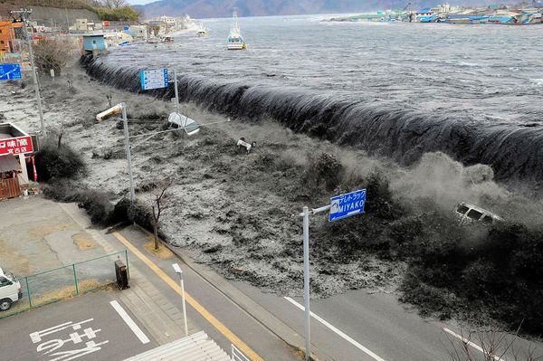
blank
2011年3月在日本的海啸
Notes:
http://news.nationalgeographic.com/news/2011/03/pictures/110315-nuclear-reactor-japan-tsunami-earthquake-world-photos-meltdown/#/japan-earthquake-tsunami-nuclear-unforgettable-pictures-wave_33291_600x450.jpg, accessed 2011 Mar 26

Slide 21
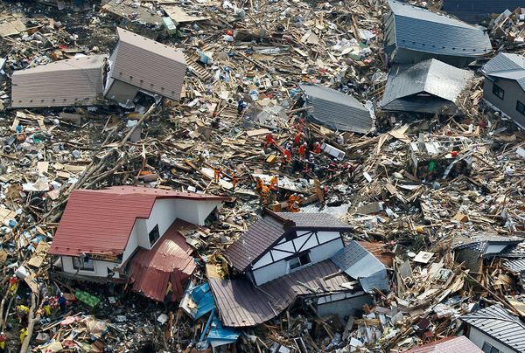
2011年3月在日本的海啸
Notes:
http://news.nationalgeographic.com/news/2011/03/pictures/110315-nuclear-reactor-japan-tsunami-earthquake-world-photos-meltdown/#/japan-earthquake-tsunami-nuclear-unforgettable-pictures-wave_33291_600x450.jpg, accessed 2011 Mar 26

Slide 22
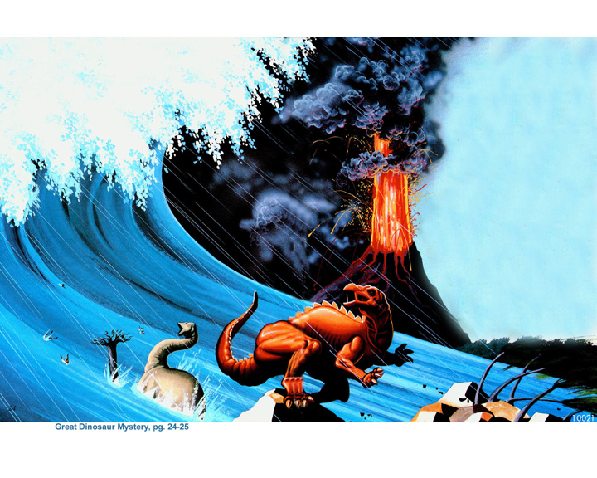
Dinosaurs in Flood

Slide 23
洪水的深度
洪水
的
深度

Slide 24
Gen. 7:19-20 NAS
創 世 記 7:19-20
19。水 势 在 地 上 极 其 浩 大 ， 天 下 的 高 山 都 淹 没 了 。
20。 水 势 比 山 高 过 十 五 肘 ， 山 岭 都 淹 没 了 。
Notes:
Where did the water come from? Fountains of the deep==under the ground and ocean floor. Lou Bergeron, “Deep waters,” New Scientist, 2097 (30 Aug. 1997), p. 22, reports that studies suggest that there is at least 10 times as much water in the mantle of the earth (400 km deep) as in all the oceans. Some of this water is brought to the surface in volcanic eruptions today.
Where did all water go? Into late-flood ocean basins and underground reservoirs, as we have today. Present mountains were raised in the latter part of the flood (Ps. 104:6-9 is describing the flood, not the creation of dry land on Day 3, if you study the text carefully). There are marine fossils on the tops of all the high mountains which is part of the evidence that shows that they were once horizontal sediments under the sea that were hardened into stone and later broke and tilted in the process of mountain-building.

Slide 25

Local flood miracle wall

Slide 26
Local flood miracle wall
X

Slide 27

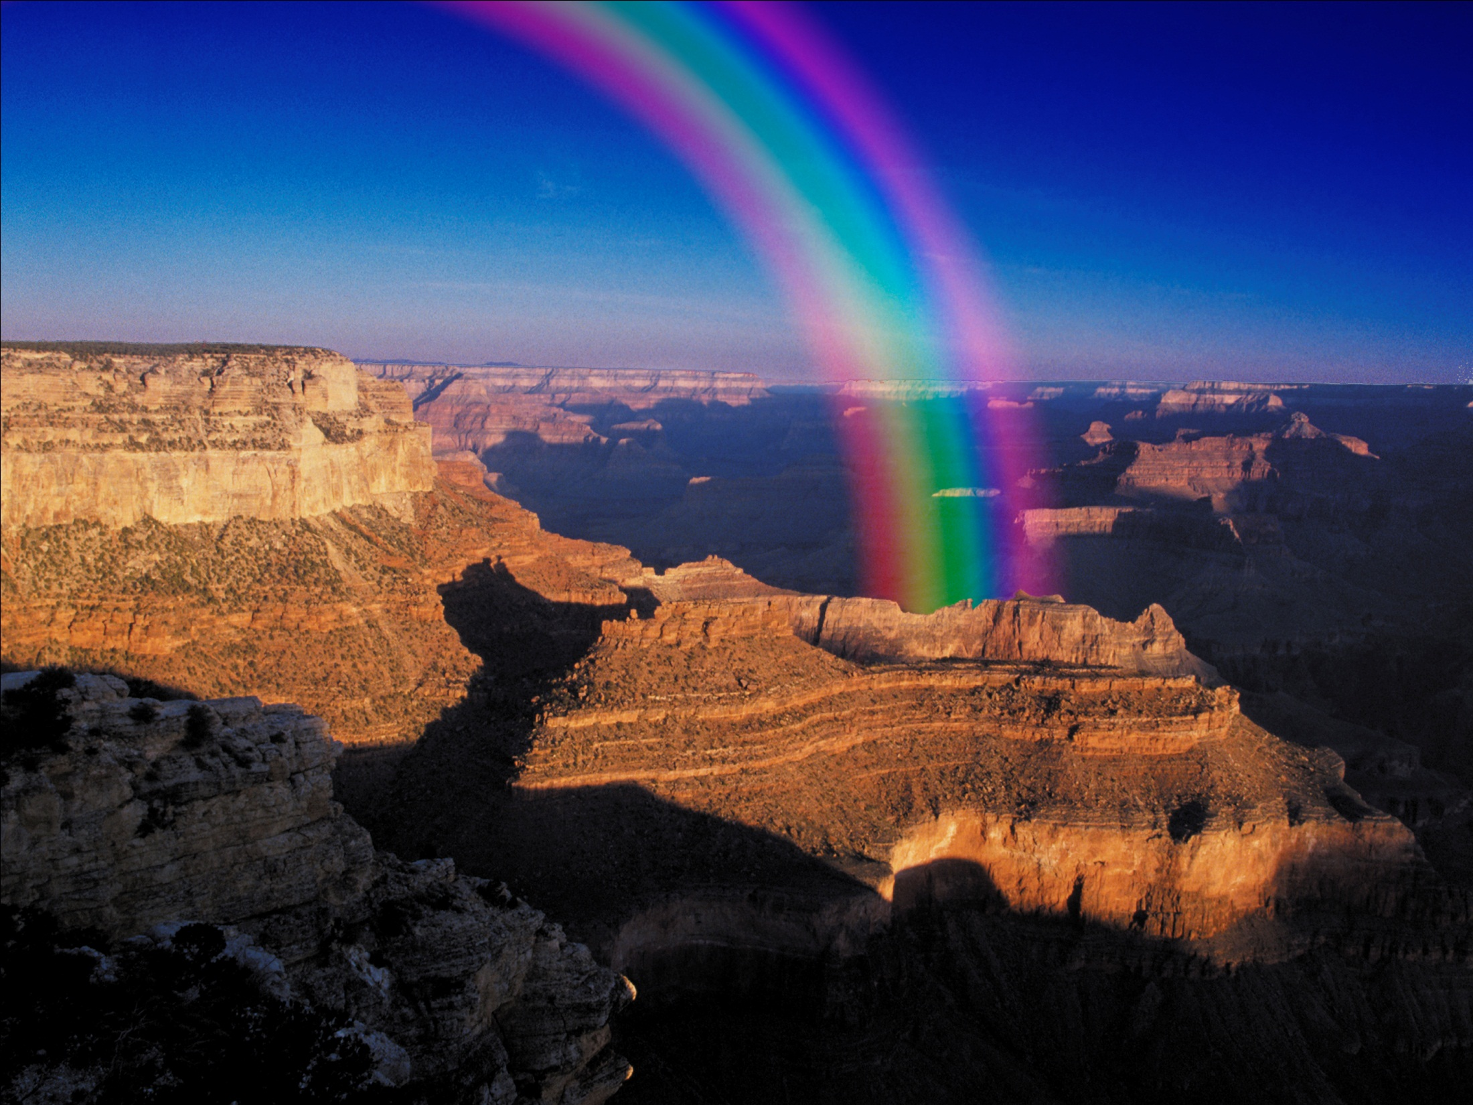
Rainbow promise
彩虹约定
Notes:
27

Slide 28
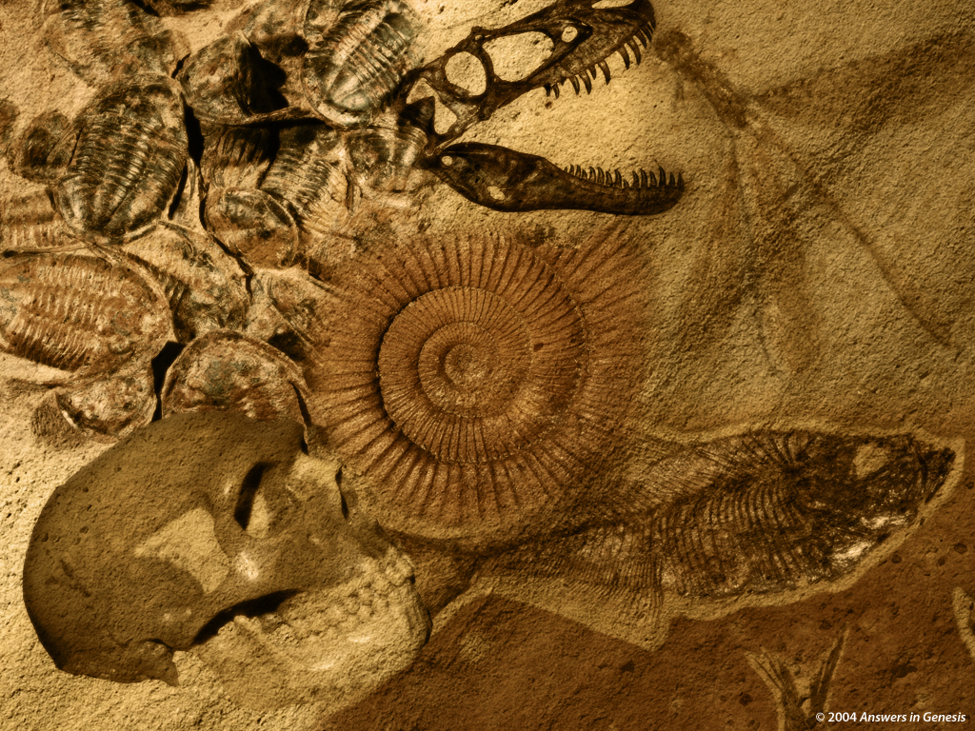
Billions of Dead Things 00058
以有数亿死了的东西
被埋在岩石层里
由洪水造成
偏满全地

Slide 29


化石记录
痛苦
死亡
杀戮
数百万年
=
疫病
挣扎
受苦
灭绝

Slide 30
化石记录
痛苦
X
死亡
杀戮
数百万年
=
疫病
挣扎
受苦
灭绝

Slide 31
19世纪初地球历史的意见
19世纪初地球历史的意见
圣经观点（圣经地质学家）
SCW
F
P
（约6000年）
灾异视图（例如，居维叶，史密斯）
SB
C
C
C
C
P
（百万年）
均变视图（例如，赫顿，莱尔）
SB?
P
（百万年）

Slide 32
19世纪初地球历史的意见
19世纪初地球历史的意见
圣经观点（圣经地质学家）
X
SCW
F
P
（约6000年）
灾异视图（例如，居维叶，史密斯）
X
SB
C
C
C
C
P
（百万年）
均变视图（例如，赫顿，莱尔）
SB?
P
（百万年）

Slide 33

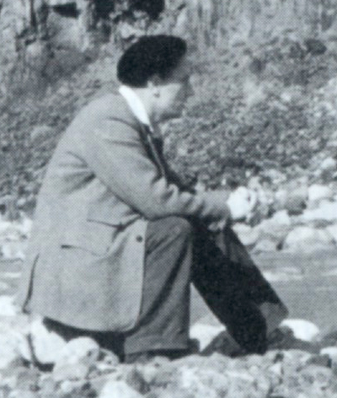
Ager 1981—brainwashing pt. 1
“我这漫长的和业余的题外话，历史是我一直想展现我认为地质了手中的理论家谁受到了当时社会和政治历史的比在实地的观察。”
Notes:
Derek Ager (1923-1993), Professor and Head of the Geology Dept. at University College of Swansea (Wales) from 1969-1988 and president of the British Geological Association 1988-1990, continued in “retirement” as Emeritus Professor till his death in 1993. In his life he visited over 57 countries to look at rocks and wrote 200 papers and four books, as well as many short articles for New Scientist.
Warning to YEC not to use information from his book: Derek Ager, The New Catastrophism (Cambridge, UK: Cambridge Univ. Press, 1993), p. xi. Ager says (bold in the original): “On that side too were the obviously untenable views of bible-oriented fanatics, obsessed with myths such as Noah's flood, and of classicists thinking of Nemesis. That is why I think it necessary to include the following 'disclaimer': in view of the misuse that my words have been put to in the past, I wish to say that nothing in this book should be taken out of context and thought in any way to support the views of the 'creationists' (who I refuse to call 'scientific').”
In The Nature of the Stratigraphic Record, p. 20, he says:
“This is heady wine and has intoxicated palaeontologists since the days when they could blame it all on Noah's flood. In fact, books are still being published by the lunatic fringe with the same explanation. In case this book should be read by some fundamentalist searching for straws to prop up his prejudices, let me state categorically that all my experience (such as it is) has led me to an unqualified acceptance of evolution by natural selection as a sufficient explanation for what I have seen in the fossil record. I find divine creation, or several such creations, a completely unnecessary hypothesis. Nevertheless this is not to deny that there are some very curious features about the fossil record.”

Slide 34
Ager 1981—brainwashing pt. 1
“换句话说，我们
已允许自己是
被洗脑，
避免任何过去的解释，
涉及极端，
可能被称之为“灾难性”
的进程.”
Derek Ager, The Nature of the Stratigraphical Record (London: Macmillan, 1981), pp. 46-47.
Notes:
Derek Ager (1923-1993), Professor and Head of the Geology Dept. at University College of Swansea (Wales) from 1969-1988 and president of the British Geological Association 1988-1990, continued in “retirement” as Emeritus Professor till his death in 1993.

Slide 35
缺少了什么?
它最初是什么?

Slide 36
What's missing? answers
A
B
C
D

Slide 37
没有缺少什么!
它本来就是这样

Slide 38
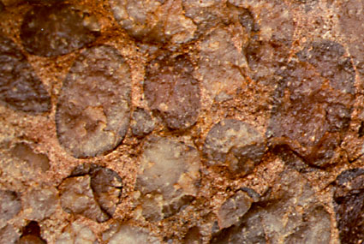
Ager 1993—rapid deposition, Sutton Stone
关于“萨顿石”附近埃杰斯旺西，威尔士的家中标记为“早侏罗世”，企业集团:
“这通常被解释为底砾岩的，历时海侵海。有人建议，用很少的化石证据，这种企业集团跨越的四点五十七菊区和因此上升至500万年的时间。我认为这是存放在短短的几小时或几分钟.”
Derek Ager, The New Catastrophism (Cambridge: Cambridge Univ. Press, 1993), p. 120.
Notes:
He then gives his reasons for this conclusion, attributing the deposit to a hurricane or tsunami.
This is near his home, so he was well acquainted with it.
Ager was Emeritus Professor of Geology, University College of Swansea.
Conglomerate is a clastic sedimentary rock that forms from the cementing of rounded cobble and pebble sized rock fragments. Conglomerate is formed by river movement or ocean wave action. The cementing agents that fill the spaces to form the solid rock conglomerate are silica, calcite, or iron oxides.
Notice in the photo above the rounded rock particles in the conglomerate. These rounded particles make conglomerate different from breccia.
Photo: http://www.indiana.edu/~geol105/1425chap5.htm, accessed 22 April 2008
Definition of conglomerate: http://volcano.und.edu/vwdocs/vwlessons/lessons/Slideshow/Serocks/Sedrock2.html, accessed 22 April 2008

Slide 39
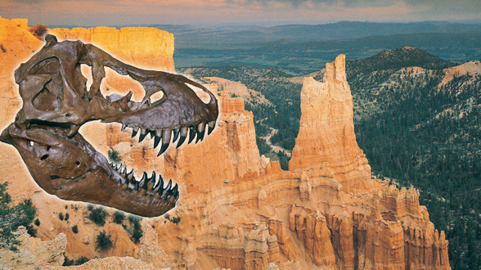
Assumptions Facts-Interpretations Geology
反圣经
的假设
圣经
的假设
古老的地球
没有全球性的洪水
年轻的地球
全球性的洪水

Slide 40


Template Suite 1-Content 01360
多长的时间才能制造化石?
Notes:
As a content template, this is best suited for standard content such as outlines, quotations, Scriptures, and maybe illustrations or photos. Presentation Team recommends 48–60 pt. font for headings and 28–40 pt. for body text. Because of eye flow and visual psychology, the top line may be a little closer than all other sides. This also contains a floating AiG logo that can be repositioned or removed as appropriate for the overhead's content.

Slide 41

Labeled Bone 02014
65
百万
岁
Notes:
Revised: July 2005.

Slide 42
Q655 on fossilization rapid
“僵化现象是一个过程，可以采取任何东西，从几个小时到几百万年。 ...
骨骼变得完全渗矿化需要的时间是高度可变的. 如果地下水沉重装载​​矿物质的化学溶液，这个过程可能会发生迅速. 现代的骨头若陷入矿泉，可以在一个星期内成为渗矿化.”
Philip J. Currie & Eva B. Koppelhus, 101 Questions about Dinosaurs (Mineola, NY: Dover Publications, 1996), p. 11.

Slide 43
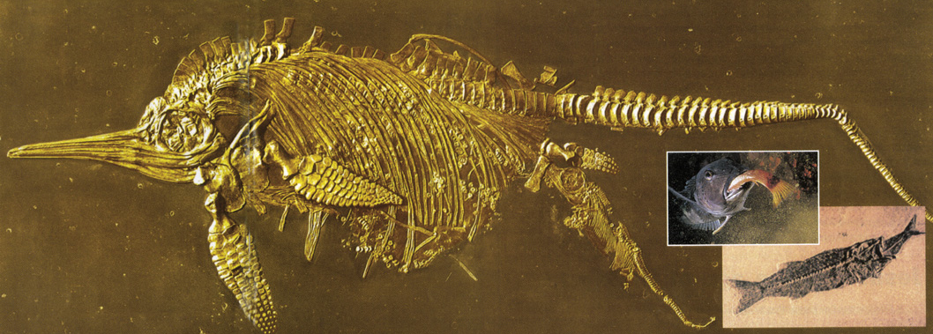
鱼龙分娩时
鱼在饮食
Notes:
Creation, Vol. 23, No. 1 (Dec. 2000-Feb 2001), pp. 10-11.

Slide 44
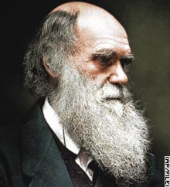
Darwin—soft creature preservation
“无机体，可以保存全软” [在化石记录].
Charles Darwin, On the Origin of Species (London: Penguin Books, 1968 reprint of 1859 first edition), p. 298.

Slide 45
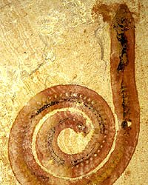
化石蠕虫, 在中国发现
Notes:
http://www.abc.net.au/science/articles/2004/10/27/1228791.htm, accessed 12 April 2008. The article stated that the worm was fossilized before bacteria could eat the worm.

Slide 46
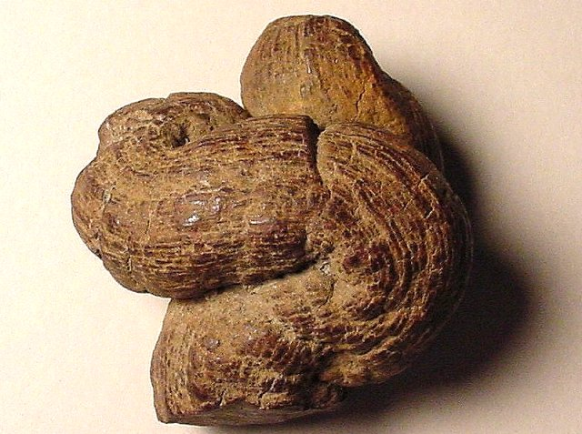
畜禽粪便化石
(粪化石)
Notes:
“A Coprolite is the fossil that results when human or animal dung is fossilized. They are classified as trace fossils as opposed to body fossils, as they give evidence for the animal's behaviour (in this case, diet) rather than morphology. The name is derived from the Greek words κοπρος (kopros) meaning 'dung' and λιθος (lithos) meaning 'stone'. They were first described by William Buckland in 1829. … Coprolites may range in size from a few millimetres to over 60 centimetres.” Info from: http://en.wikipedia.org/wiki/Coprolite, accessed 12 April 2008
Photo: http://skywalker.cochise.edu/wellerr/fossil/coprolite/coprolite02.htm, accessed 12 April 2008. Site says that the picture is copyright free for non-commercial educational purposes.

Slide 47
Template Suite 1-Content 01360
形成岩石及侵蚀岩石需要多久的时间?
Notes:
As a content template, this is best suited for standard content such as outlines, quotations, Scriptures, and maybe illustrations or photos. Presentation Team recommends 48–60 pt. font for headings and 28–40 pt. for body text. Because of eye flow and visual psychology, the top line may be a little closer than all other sides. This also contains a floating AiG logo that can be repositioned or removed as appropriate for the overhead's content.

Slide 48
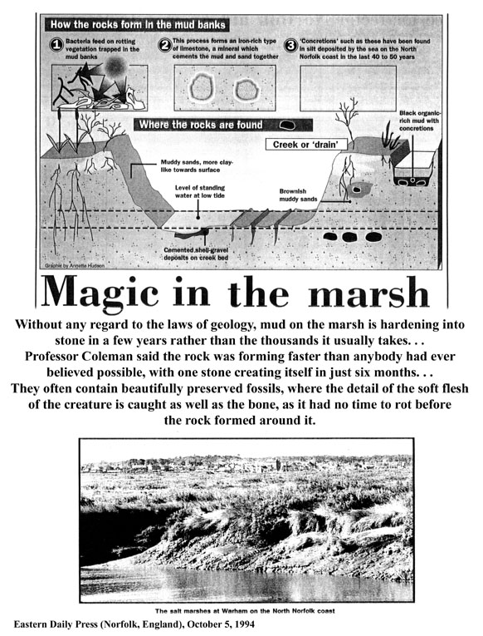
Magic in the Marsh #1
“在没有任何方面的法律地质上的沼泽，泥硬化成石头，是在未来几年内，而不在通常需要的成千上万年. ...
Eastern Daily Press (Norfolk, UK), 5 Oct. 1994, p. 7

Slide 49
Magic in the Marsh #2
科尔曼教授说，岩石形成的速度比任何人都曾经认为可能，一石在短短半年内创建。 ...他们往往含有保存完好的化石，其中的软肉的动物被捕获的细节，以及为骨，因为它没有腐烂前，它周围的岩石形成的时间。“

Slide 50
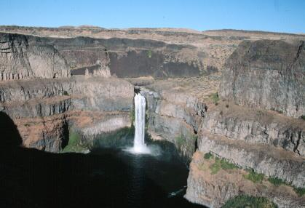
Scablands scene
疤地，东华盛顿
15,000 平方英里 (39,000 平方公里)
帕卢斯瀑布
在1-2天雕刻而成，不是经过数百万年的洪水
Notes:
Originally thought by evolutionary geologists to have formed by stream erosion over millions of years.
Now many evolutionists believe the erosion was the result of 40-100 floods over the course of 1500-3000 years from glacial Lake Missoula to the east.
But other geologists who have carefully investigated the evidence believe most of it was eroded in 1-2 DAYS. It is estimated that 500 cubic miles of water rampaged westward at 60 mph in a torrent flowing with ten times the volume of all the rivers on earth and carrying boulders the size of houses from Montana to Oregon.
See http://www.smithsonianmag.com/smithsonian/issues95/apr95/missoula.html and this report from a NOVA (PBS-TV) report in Mar. 2007: http://www.pbs.org/wgbh/nova/megaflood/scablands.html
Mike Oard (The Missoula Flood Controversy, Creation Research Society, 2004) believes the evidence points to 1 big flood and maybe a few smaller ones, but most of the erosional damage was done by the big one in the post-Flood glacial period.
See also this 2005 report by a YEC geologist teaching in Oregon: http://www.answersingenesis.org/docs2005/0928megaflood.asp, which argues for one major flood and that the basalt layers were deposited under water during the Genesis Flood.
Picture source--http://www.ndsu.nodak.edu/instruct/schwert/geosci/g496_columbia_plateau/g495link.htm

Slide 51
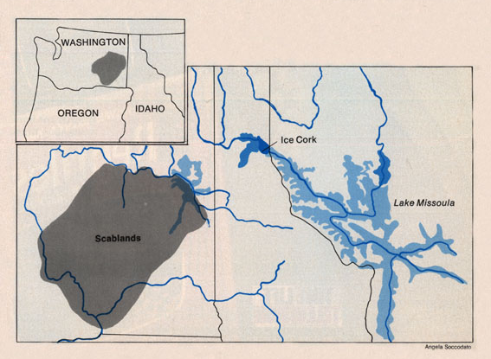
Scablands map
由美国地质协会表示的“建立”，在反对党团结。. … 而不是测试布雷茨的洪水在其本身的优点，他们拒绝了它的一般原则 …”
Notes:
Bretz's first geological paper was in 1923. His “Spokane Flood” flowed from the north at 400 ft deep. His fellow uniformitarian opponents called it an “outrageous hypothesis” and assaulted him verbally. But he continued to amass evidence of the flood and published another paper in 1932, but now attributing the flood to the bursting of glacial Lake Missoula to the east in Montana.
Bretz's catastrophist theory was accepted finally by the geological establishment in 1965.
The evidence for Lake Missoula had been known since the late 1800s, but the uniformitarian geologist, Joseph Pardee, said in his published papers that it had drained slowly. Evidence suggests that he privately believed (even in 1922 before Bretz's first paper) that the lake had burst producing a catastrophic flood, but the peer pressure of the establishment prevented him from saying so publicly.
Bretz believed that he saw evidence for 7 floods.
Glacial Lake Missoula was perched at 4,200 feet above sea level. When ice dam failed, water hundreds of meters (yards) deep swept across an area twice the size of New Jersey at freeway speed, carving giant channels through the basalt that are now dry “coulees”), depositing gravel-boulder bars over 100 meters (300 feet) high and leaving dried waterfalls that make Niagara Falls look small.

Slide 52
Scablands--Gould quote
“布雷茨靠着坚定的，严格的教条，没有任何意义：皇帝曾赤裸裸的一个世纪. 查尔斯•莱尔，地质渐进主义教父，耍了一个建立难以察觉的变化的学说.”
Stephen Jay Gould, “The Great Scablands Debate,” Natural History, Vol. 87:7 (Aug./Sept. 1978), pp. 12, 14.
Notes:
Bretz's catastrophist theory was proposed in 1923. It was accepted finally by the geological establishment in 1965.

Slide 53

上帝的话语
是真理
“圣经”眼镜
人决定
“真理”
数百
万年
数百
万年
“进化论”眼镜
Notes:
We all have a philosophy about how evidence should be interpreted. “Oh no, not me!”
Neutrality is a non-neutral position – because it makes a positive assertion.

Slide 54
Template Suite 1-Content 01360
广泛的
快速
连续
沉积证据
Notes:
As a content template, this is best suited for standard content such as outlines, quotations, Scriptures, and maybe illustrations or photos. Presentation Team recommends 48–60 pt. font for headings and 28–40 pt. for body text. Because of eye flow and visual psychology, the top line may be a little closer than all other sides. This also contains a floating AiG logo that can be repositioned or removed as appropriate for the overhead's content.

Slide 55
快速沉积
缺乏侵蚀特征

Slide 56
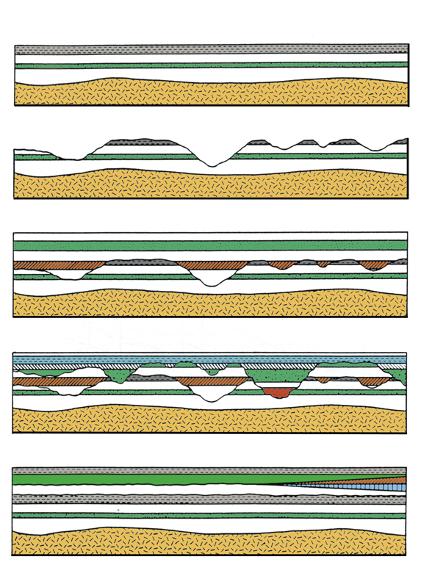
Multiple catastrophism--animated
Notes:
From CENTJ 9(2):1995, p. 226

Slide 57
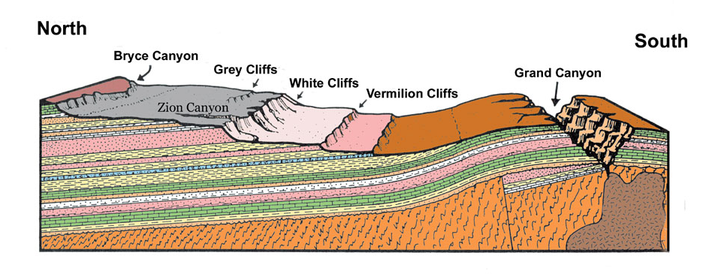
Grand Canyon cutaway
大规模侵蚀特征
300万年?
北
南
布莱斯峡谷
灰色悬崖
白崖
大峡谷
红崖
锡安峡谷
层与层之间
几乎没有侵蚀特征
Notes:
Picture: Steven A. Austin, ed., Grand Canyon: Monument to Catastrophe (Santee, CA: Institute for Creation Research, 1994), p. 58.

Slide 58
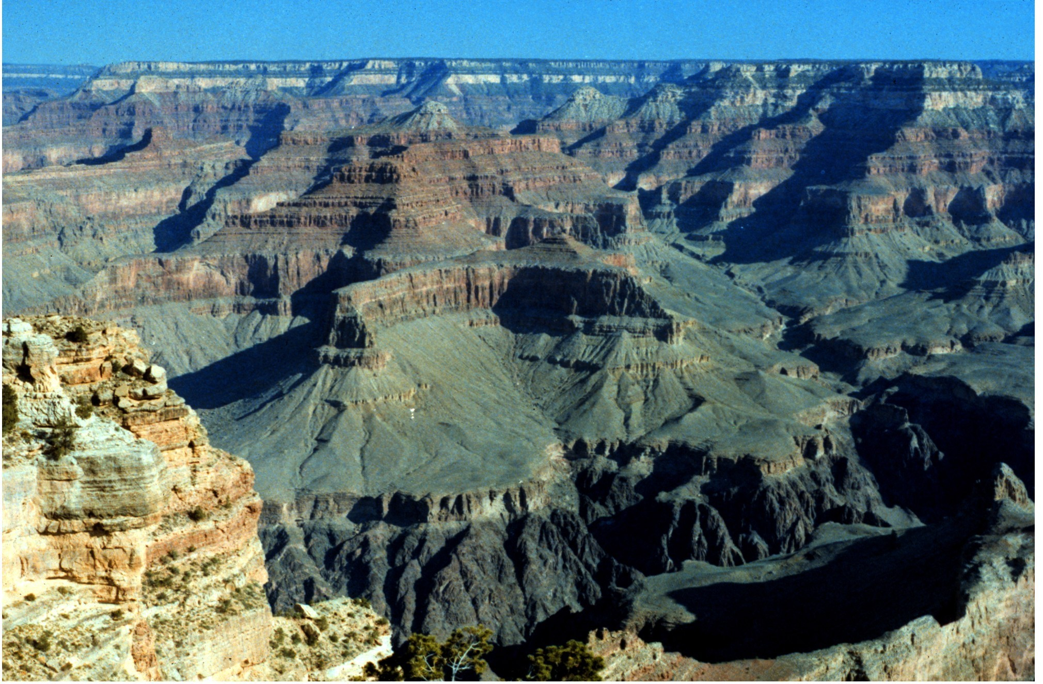
Grand Canyon—dating layers and canyon
沉降: 300百万年
侵蚀: 5百万年还不到一英里
Notes:
Evolutionary geologists knowledgeable about Grand Canyon say it was carved in about 1 million years
Conventional reasoning based on current erosion rates say about 15 million.
The layers were deposited, according to evolutionists, over the course of about 300 million years.
Tapeats Sandstone at Great Unconformity (550 mya) to Kaibab Limestone at the top (250 mya).

Slide 59
快速沉积
缺乏侵蚀特征
软沉积物变形

Slide 60
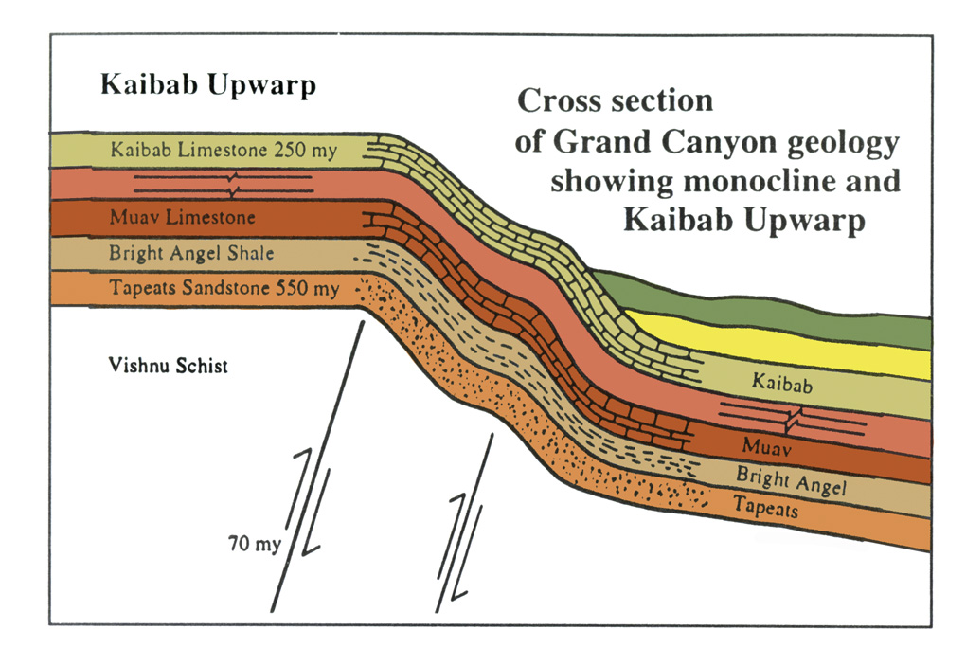
Grand Canyon—strata deformation
向上弯曲的凯巴布
横截面
大峡谷的地质
呈现单斜及
向上弯曲的凯巴布
Notes:
North rim (highest point is 8500 ft) is on average 1000 ft higher in elevation than the south rim.
70 million years ago is when evolutionists say the upwarp occurred, 480 million years after the Tapeats Sandstone formed!
Source: John Morris, The Young Earth (Master Books, 1994), pp. 107-8.

Slide 61
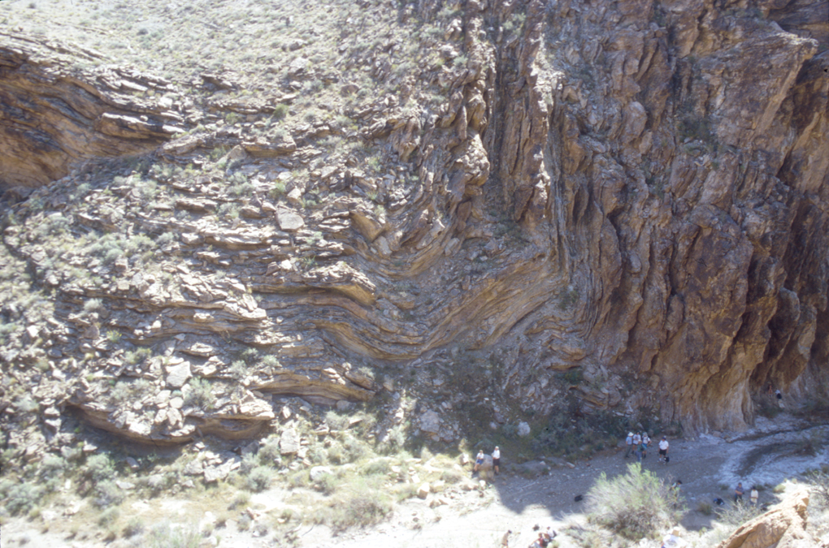
Grand Canyon—90 degree bend
Notes:
Grand Canyon deformation—my slide *** add notes on why these could be rocks bent slowly under pressure after they had hardened, but were deformed while still relatively soft. ??? No elongation of the sand grains? No cracking of the crystals?

Slide 62
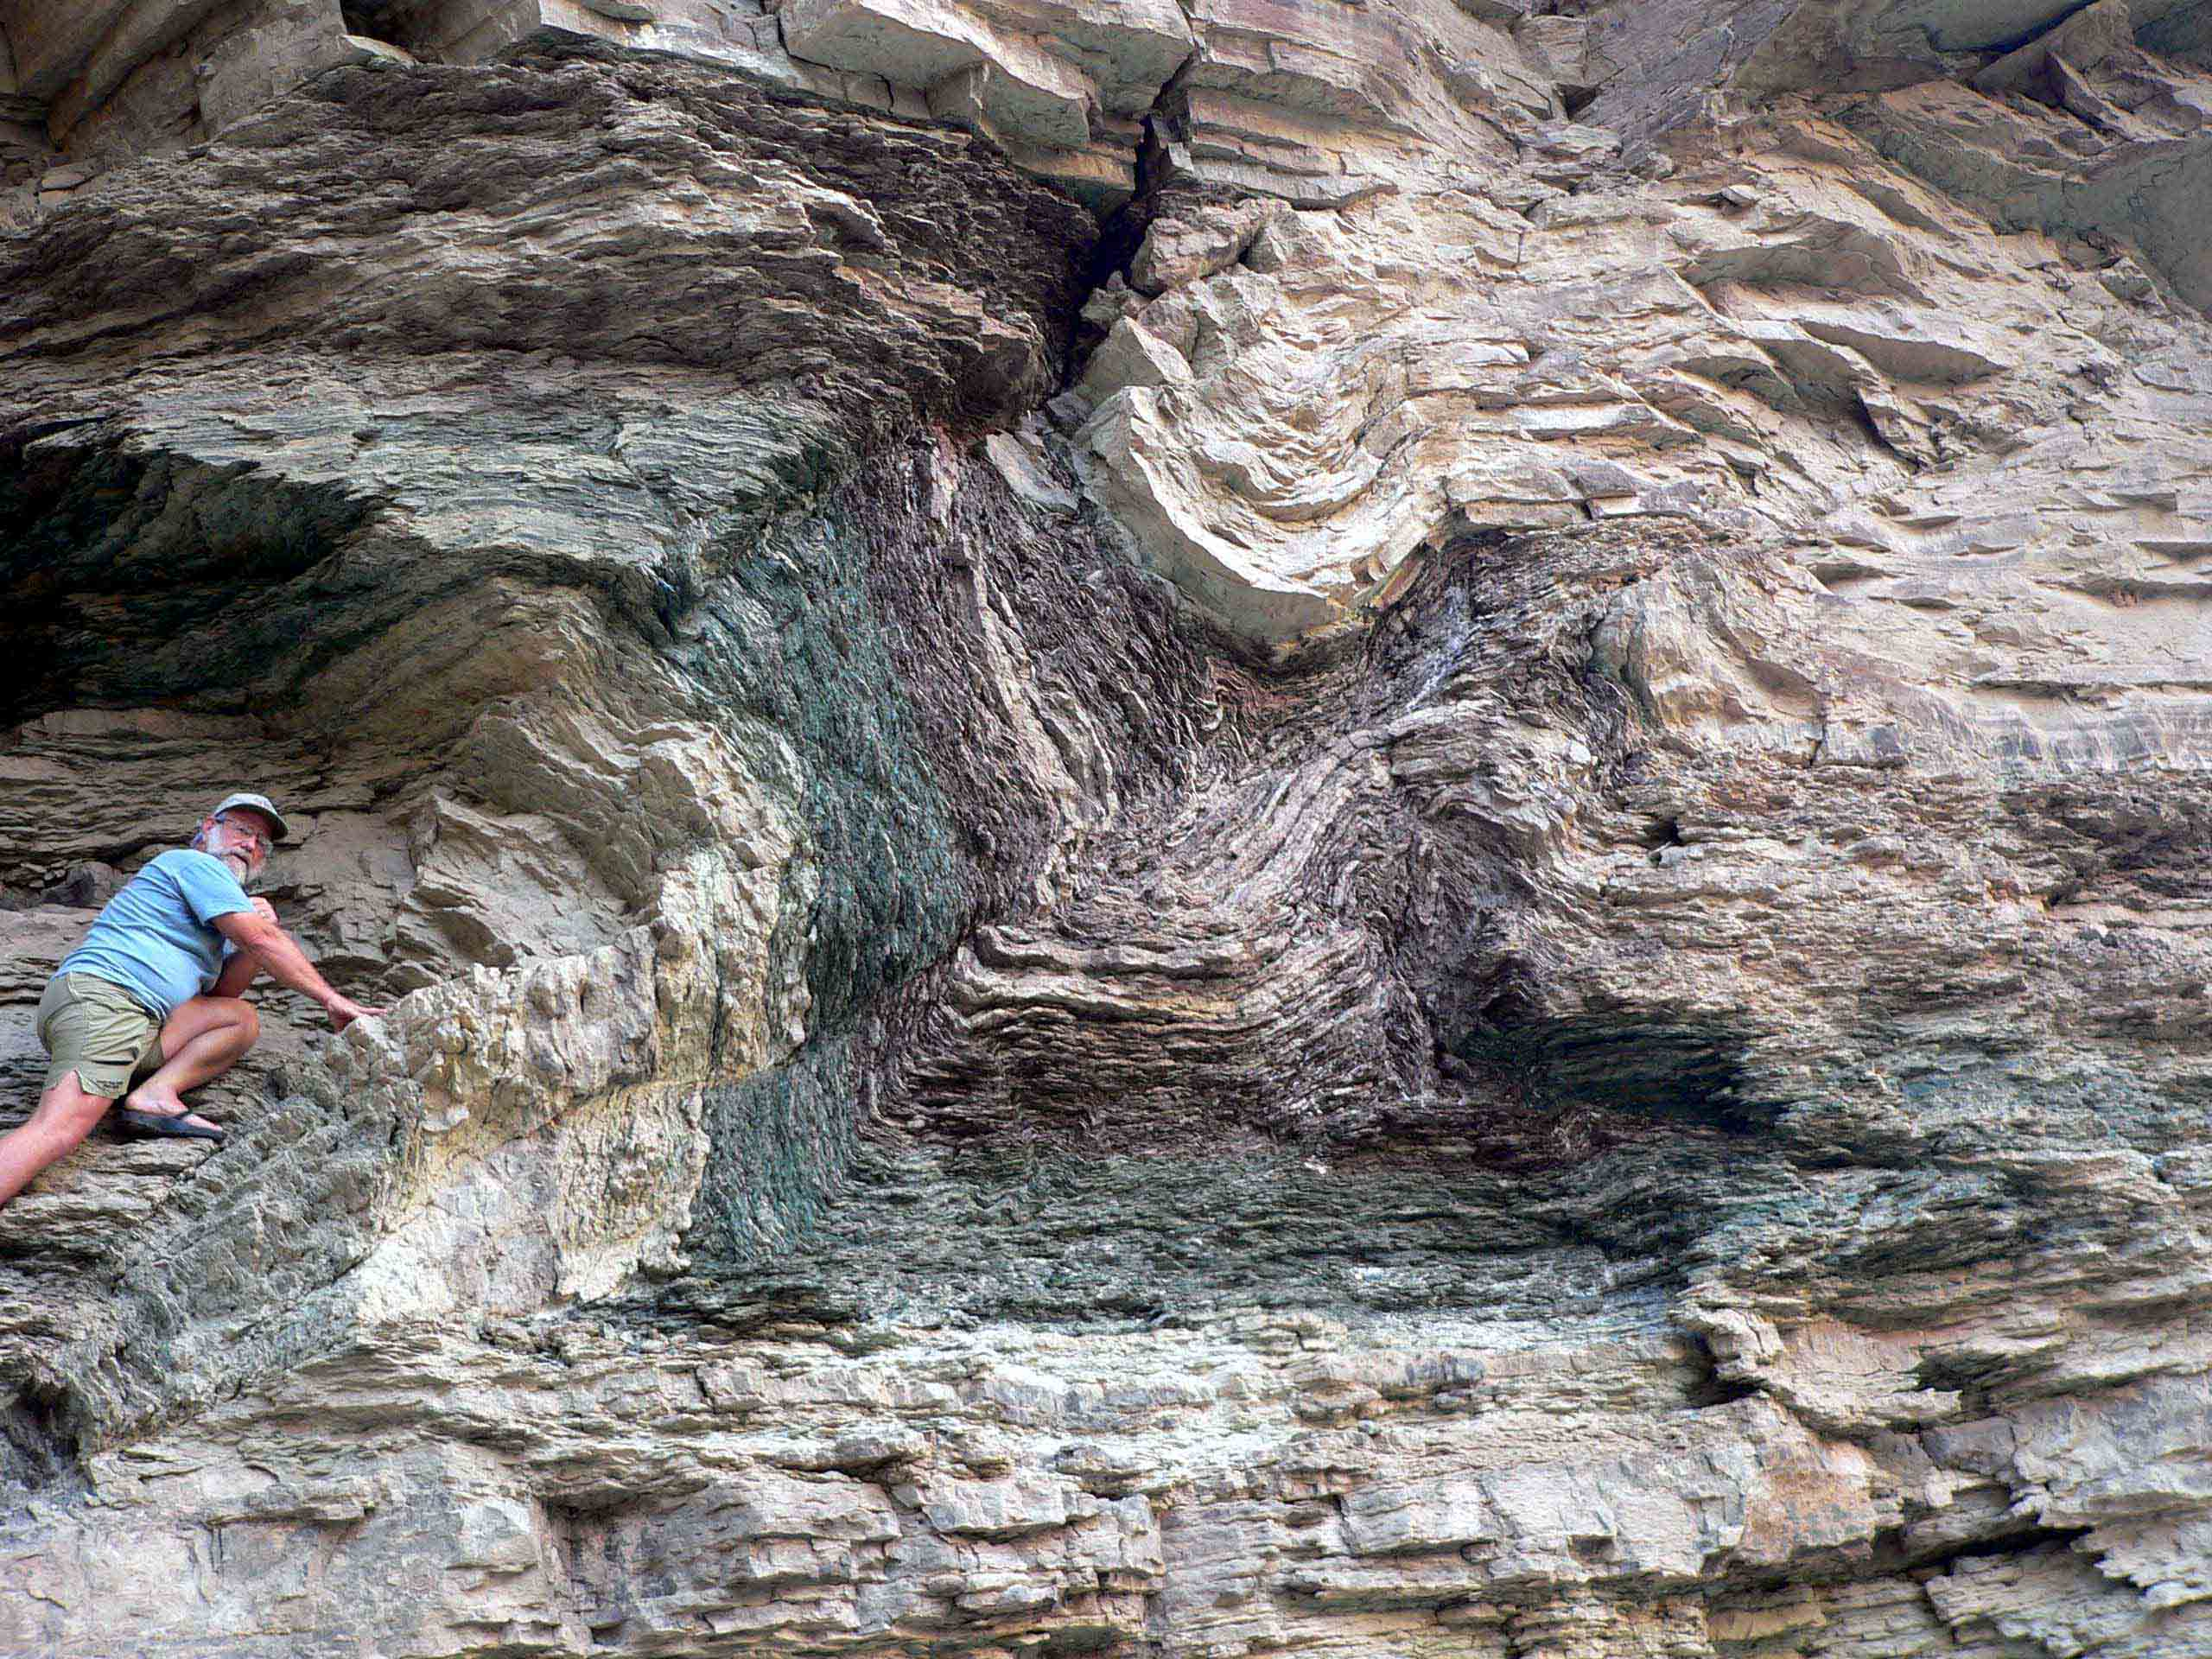
Notes:
Folding in the Bright Angel Shale (dated at 530 MYA by conventional geology) that is right at the Whitmore helicopter pad where we fly out of Grand Canyon. Evolutionists tell us that under heat and pressure solid rocks will bend. But in this case the rock gets metamorphosed, which this shale is not. The evidence says this was wet and relatively soft and plastic when it was bent.

Slide 63
快速沉积
缺乏侵蚀特征
软沉积物变形
缺乏生物扰动界面

Slide 64

Bioturbation illustrated
生长的植物
蛤蜊
蠕虫
活跃海底生态学
Notes:
John Morris, The Young Earth. This is very rarely seen or where it is, it is reasonable to imagine that the evidence in the particular rock formation could have been caused by animal life in a matter or hours, days or weeks during the alternating periods of calm and violence at this location, rather than being evidence of thousands or millions of years.

Slide 65
快速沉积
缺乏侵蚀特征
软沉积物变形
缺乏生物扰动界面
波痕，动物踪迹和雨滴的痕迹

Slide 66
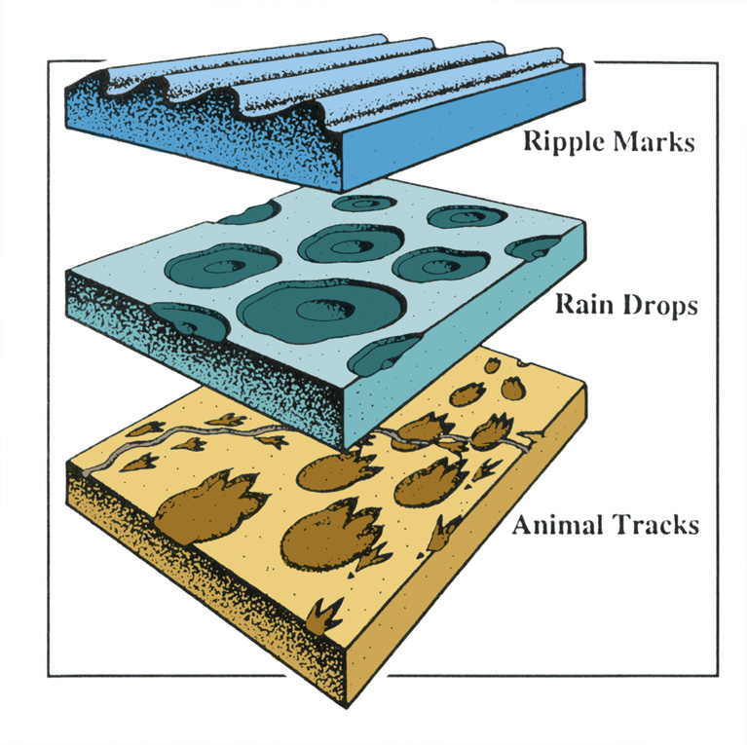
Marks and tracks illustrated
波痕
雨滴
动物踪迹
Notes:
Grand Canyon deformation—my slide
Evidence that animal tracks were made under water, not air (as previously thought), in Grand Canyon, Coconino Sandstone: http://www.answersingenesis.org/home/area/magazines/docs/v15n1_grandcanyon.asp

Slide 67
快速沉积
缺乏侵蚀特征
软沉积物变形
缺乏生物扰动界面
波痕，动物踪迹和雨滴的痕迹
多层岩中的化石

Slide 68
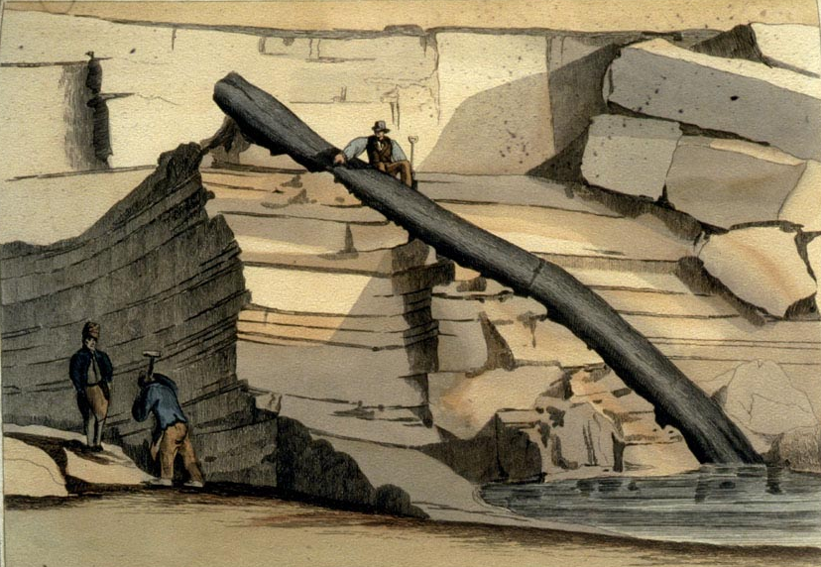
Craigleith polystrate tree
Notes:
My slide
This tree was found in 1826 in Craigleith quarry near Edinburgh, Scotland, in a 200-ft thick mass of alternation sandstone and shale.
The in-situ (autochthonous) and transport (allochthonous) theories were much debated from the 1820s to the early 1840s, though even Buckland said in 1840 that he only knew of a few trees that looked in-situ.

Slide 69
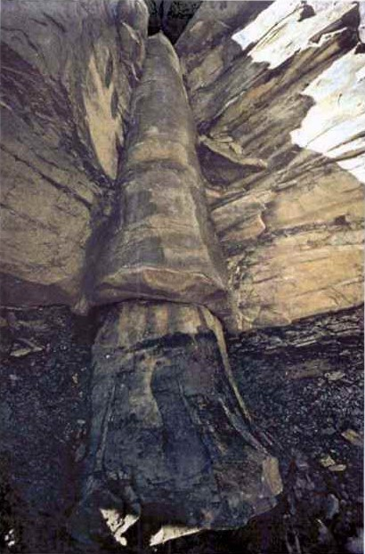
煤层
灰岩
水壶煤矿
库克斯维尔
煤层
Photo: D.Patton

Slide 70
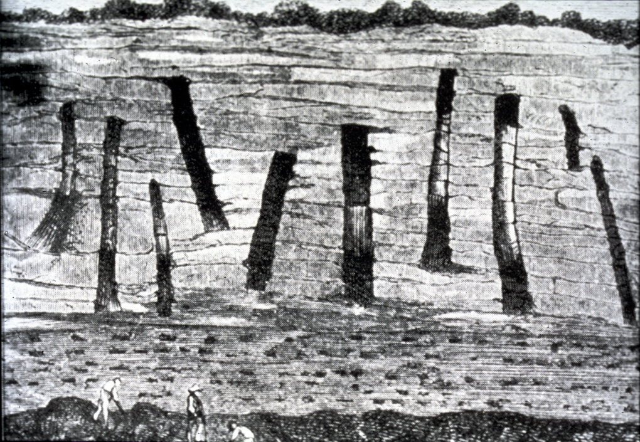
French cliff polystrates
Notes:
My slide
This tree was found in 200 ft thick mass of alternation sandstone and shale

Slide 71
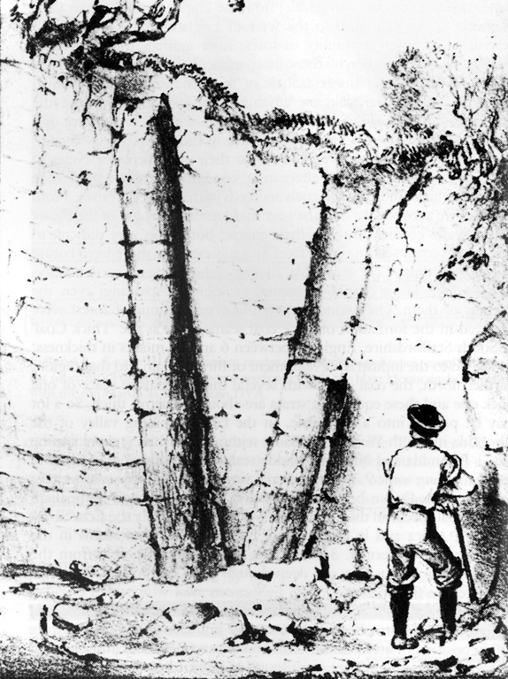
Polystrate tree--Ager
“很显然，沉淀了非常迅速埋葬腐烂的树前站立姿势摔了下来
… 我们无法逃避的结论，沉积在非常迅速确实，在其他时间有长的的休息在沉积物款，虽然它看起来均匀而连续的。”
“在增长的的位置”
Derek Ager, The New Catastrophism (Cambridge: Cambridge U Press, 1993), 48-49.
Notes:
Note the text under the picture (both appear on p. 48). Those trees are not in position of growth for they were not buried gradually as they grew and a catastrophe that laid down that much sediment would not leave the trees standing. Furthermore such polystrate trees never have any branches or roots. What kind of trees grow like that?

Slide 72
What about radiometric dating methods
有关辐射测年方法呢?
Notes:
As a content template, this is best suited for standard content such as outlines, quotations, Scriptures, and maybe illustrations or photos. Presentation Team recommends 48–60 pt. font for headings and 28–40 pt. for body text. Because of eye flow and visual psychology, the top line may be a little closer than all other sides. This also contains a floating AiG logo that can be repositioned or removed as appropriate for the overhead's content.

Slide 73
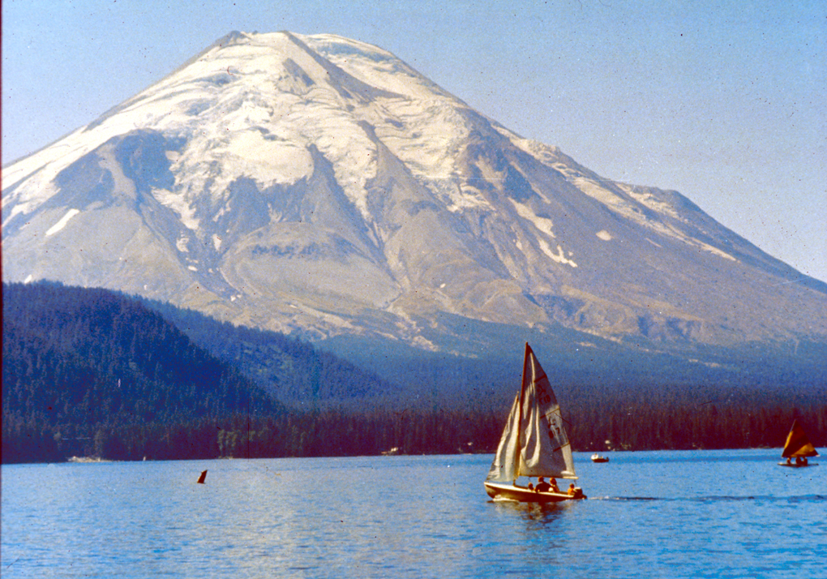
圣海伦斯山爆发之前

Slide 74
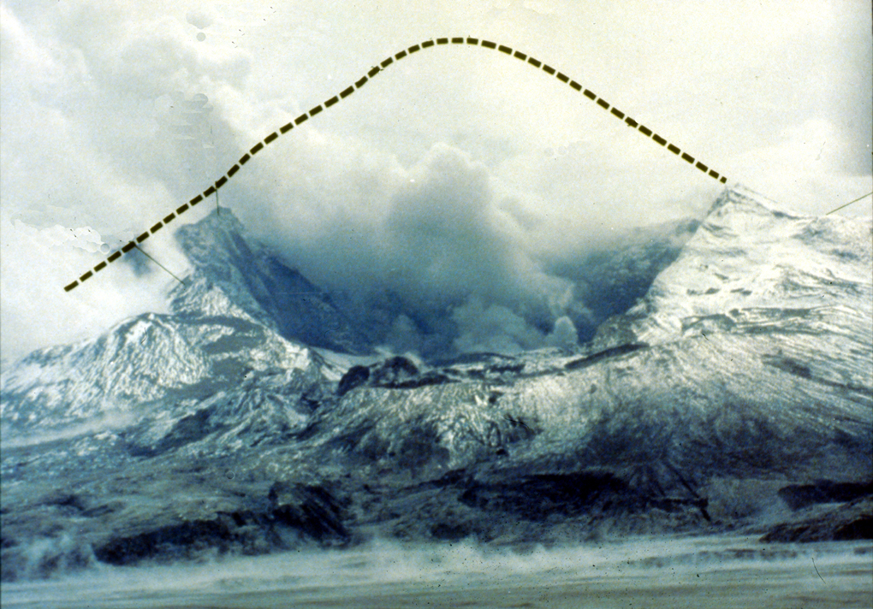
圣海伦斯山顶端被炸飞
熔岩穹丘
Notes:
A lava dome started forming soon after the eruption. The first two domes were blown away by subsequent smaller eruptions in 1980. The present dome started forming in late October 1980 and continues growing to this day, though at faster rate than in the first 6 years (see below).
During 17 so-called dome-building eruptions, from 18 October 1980 to 26 October 1986, thick pasty lava oozed out of the volcanic vent like toothpaste from a tube. Dacite lava is too thick to flow very far, so it simply piled up around the vent, forming the mountain-like dome, which now plugs the volcanic orifice.
Mountain rapidly rebuilding in 2005!
Sept 25, 2005 article: http://www.billingsgazette.com/index.php?tl=1&display=rednews/2005/09/25/build/nation/52-st-helens.inc
“Although things could change at any time, scientists are not expecting any big changes at Mount St. Helens in the near future. The new lava dome is growing about six times faster than it did during the six years of dome building between 1980 and 1986. The extrusion rate is about 1.3 to 9.2 cubic yards per second, averaging 3 cubic yards - enough to fill up the back of a pickup truck every second.
The new Mount St. Helens dome was about 10 feet below the rim of the crater in July, although it has crumbled a little since then. The growth has been in a series of six big upward thrusts or "whalebacks" as the scientists like to call them because of their shape. At the rate it is growing, Mount St. Helens could regain its conical top within decades.“

Slide 75
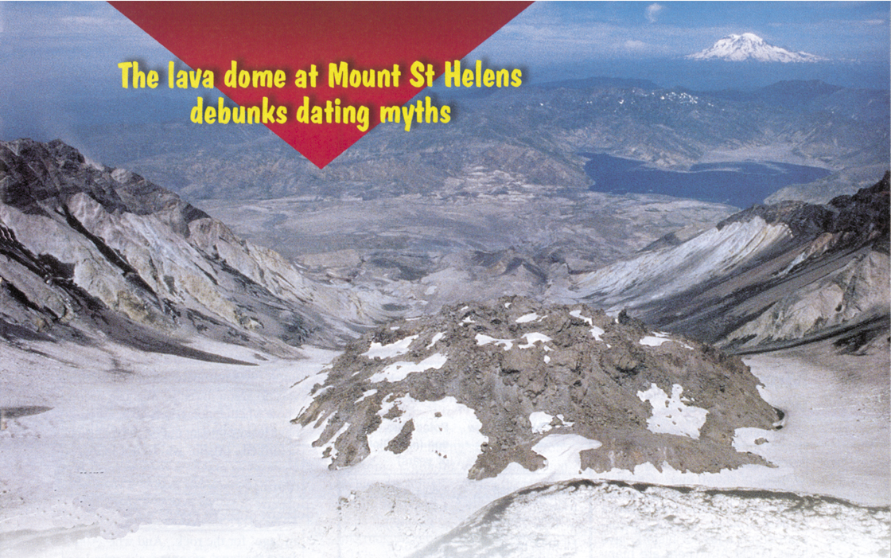
Mt. St. Helens—dome dating
圣海伦火山的熔岩穹丘破除了辐射测年方法
辐射测年: 340,000 – 2.8 百万年
实际年纪: 不到12年!!
Notes:
Samples were collected and dated in 1992 from the dome that started forming in late Oct. 1980.
The highly respected lab (Geochron Laboratories of Cambridge, MA) was not told where the samples were collected, only that they were from dacite rock and low levels of argon were expected. The lab dated a “whole rock” sample and 4 different mineral samples.
Photo: Creation Magazine 23:3 (June-Aug. 2001), pp. 23-25. Other examples of erroneous dating from various places in the world are in this article.

Slide 76
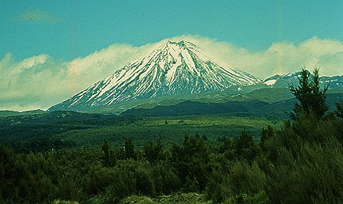
Dating Mt. Ngauruhoe
瑙鲁赫伊山, 新西兰
1949年至1975年的5爆发
辐射测年: 270,000 – 3.5百万年
岩石确实<50 年歳 测年!!!
Notes:
Source of picture and text below: http://volcano.und.edu/vwdocs/volc_images/img_ngauruhoe.html
Mt. Ngauruhoe is a beautifully shaped volcano on the edge of the Tongariro massif. Ngauruhoe is New Zealand's most active volcano with 61 eruptions since 1839 (most recent eruption in 1977). Photograph of Ngauruhue by W.B. Hamilton, U.S. Geological Survey, November 1965.
My statement summarizes the research by Andrew Snelling, “The cause of anomalous Potassium-Argon 'ages' for recent andesite flows at Mt. Ngauruhoe, New Zealand, and the implications for Potassium-Argon 'dating',” Proceedings of the Fourth International Conference on Creationism (Pittsburgh: Creation Science Fellowship, 1998), pp. 503-525. Andrew collected the samples and sent them to a top US lab for dating. He did not tell the lab where the samples were collected but suggested that they could be “young,” so as to ensure that the lab took extra care in their analysis. Andrew reports in this paper 24 other published examples of similarly erroneous dates (by millions of years) for rocks that are only a few decades or centuries old. The implication is that the lavas already had the argon in them from the mantle and there is no way to distinguish primordial AR-40 from the AR-40 that results from decay of K-40 after the lava crystalizes.

Slide 77
岩石：已知或未知的年龄？
已知年龄的
岩石
未知年龄的
岩石
辐射测年方法显然是行不通的。
辐射测年方法假设行得通.

Slide 78
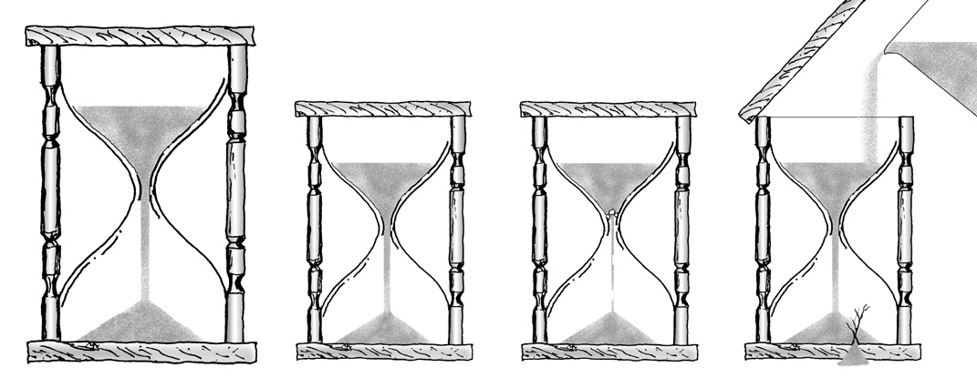
Radiometric dating--hourglasses
放射性定年法的假设
源头
?
?
?
?
终止
?
Daughter
原始比例？
衰减率？
添加或删除吗？
Notes:
From The Answers Book, p. 81.
Article summarizing the 2003 RATE research on helium in zircons and C-14 both showing accelerated decay rates in the past and pointing an earth of only a few thousands of years: Carl Wieland, “RATE group reveals exciting breakthroughs!”, <www.answersingenesis.org/docs2003/0821rate.asp>, 21 Aug. 2003.
Why are these decay processes believed to date with the lava crystallized? Andrew Snelling explains:
The minerals in the volcanic rocks which contain the radioisotopes don't form until the lava cools and crystallizes. This means that the radioisotopes aren't locked into those minerals until the lavas crystallize. And until the radioisotopes are locked into the minerals the clock hasn't been set to age zero. While the lava is still molten the radioisotopes are free to move around. That's why the ages obtained on the volcanic rocks are said to date when the lavas crystallized. However, this doesn't take into account the possibility that the radioisotopes locked into the minerals could have been inherited from the lavas formed as magmas deep inside the earth. But their assumption of dating when the lava crystallized is also based on knowledge that some minerals only preferentially lock in parent radioisotopes and reject the daughter isotopes because the latter are chemically different. This is presumed then to set the clocks at zero, so that all the daughter isotopes measured today have resulted from radioactive decay of the parent isotopes locked in when the minerals and the lavas crystallized.

Slide 79
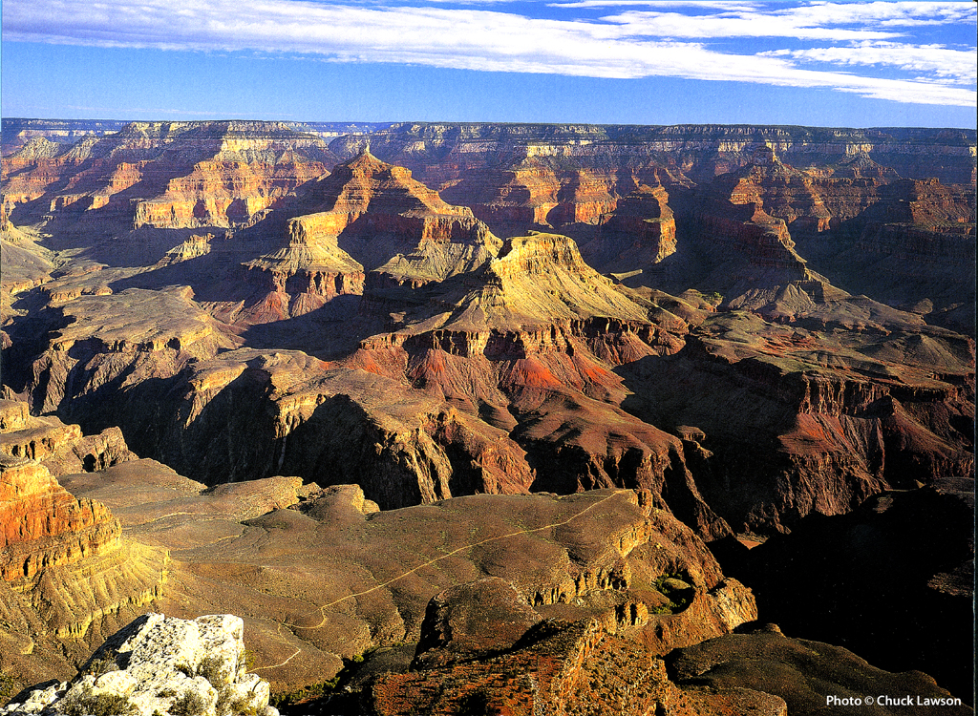
Grand Canyon – calendar 2004 Aug.
几百万年？
诺亚洪水！
Notes:
Photo from “Grand Canyon 2004 Engagement Calendar” (August) produced by Smith-Southwestern, Inc., P.O. box 20100, Mesa, AZ 85277-100.

Slide 80


A&E on bones
痛苦
几百万年
死亡
杀戮
疫病
挣扎
受苦
灭绝
Notes:
80

Slide 81
A&E on bones
痛苦
死亡
杀戮
疫病
痛苦
挣扎
几百万年
受苦
死亡
杀戮
灭绝
疫病
挣扎
受苦
灭绝
Notes:
81

Slide 82
A&E on bones
痛苦
死亡
X
杀戮
诺亚的洪水
疫病
痛苦
挣扎
几百万年
受苦
死亡
杀戮
灭绝
疫病
挣扎
受苦
灭绝
Notes:
82

Slide 83
Geologic Timescale 00089
地质时间尺度
时代 时期 时代 一连串的生活
新生代
最近的生活
第四纪
0-1百万年
第三纪
62百万年
早白垩世
72百万年
中生代
中年生活
侏罗纪
46百万年
三叠纪
49百万年
二叠纪
50百万年
宾夕法尼亚纪
30百万年
洪水存款
石炭系
密西西比纪
35百万年
泥盆世
60百万年
古生代
古代生活
志留纪
20百万年
奥陶世
20百万年
寒武世
100百万年
前寒武纪

Slide 84
Geologic Timescale 00089
地质时间尺度
时代 时期 时代 一连串的生活
新生代
最近的生活
第四纪
0-1百万年
第三纪
62百万年
早白垩世
72百万年
中生代
中年生活
侏罗纪
46百万年
三叠纪
49百万年
二叠纪
50百万年
宾夕法尼亚纪
30百万年
洪水存款
石炭系
密西西比纪
35百万年
泥盆世
60百万年
古生代
古代生活
志留纪
20百万年
奥陶世
20百万年
寒武世
100百万年
前寒武纪
洪水前的存款

Slide 85
Geologic Timescale 00089
地质时间尺度
时代 时期 时代 一连串的生活
新生代
最近的生活
第四纪
0-1百万年
洪水后存款
第三纪
62百万年
早白垩世
72百万年
中生代
中年生活
侏罗纪
46百万年
三叠纪
49百万年
二叠纪
50百万年
宾夕法尼亚纪
30百万年
洪水存款
石炭系
密西西比纪
35百万年
泥盆世
60百万年
古生代
古代生活
志留纪
20百万年
奥陶世
20百万年
寒武世
100百万年
前寒武纪
洪水前的存款

Slide 86
Flood on Mars Q501
““圣经”的比例 - 足以填满的地中海 - 涌出洪水从火星高地的一个十亿年左右，从探路者的最新图片周一证实。.”
Robert S. Boyd, “Ancient gullies suggest 'key ingredient for life',” Cincinnati Enquirer, July 8, 1997.

Slide 87
Noachian Epoch on Mars Q853
“从塔尔西斯岩浆的气体总排放量的全球近400英尺深的水层可能会产生相当于... 在最后的挪亚时代，火山活动消散...”
Roger Phillips (Dir., Washington U.'s McDonnell Center for Space Sciences), “Mars Calamity May Have Created Conditions for Life,” New York Times, Mar. 16, 2001.
Notes:
There are other possible explanations for the geological features on Mars that are interpreted as flood deposits, for similar features appear on the Moon, where noone believes there ever was water and on lava flows on dry land on earth. They could be the result of repeated volcanic eruptions or even surges in one eruption. See Creation, 26:1 (Dec. 2003-Feb. 2004), pp. 10-13.

Slide 88

Noah's Flood on Mars 00342
在火星上的诺亚洪水？

Slide 89
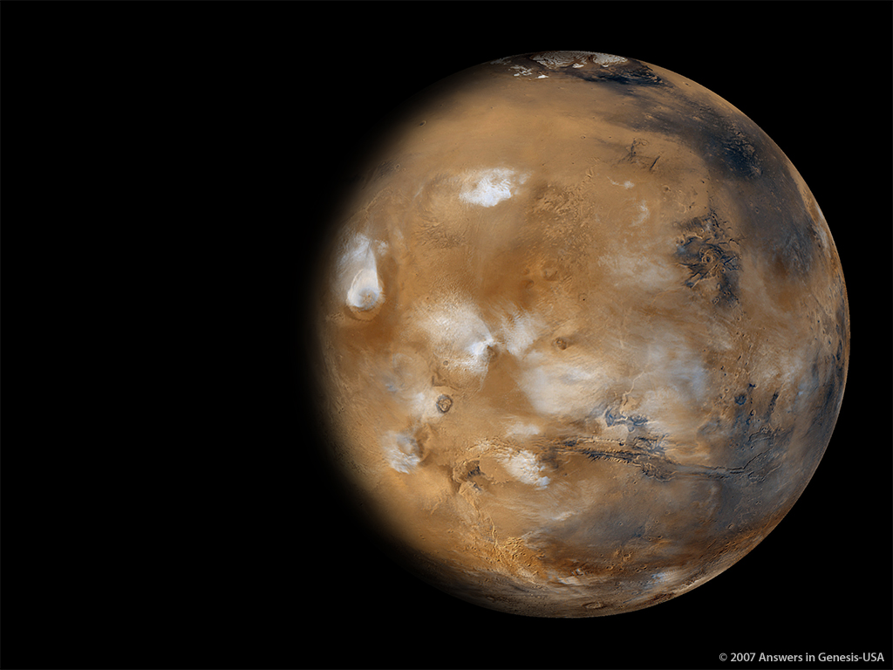
Mars + Water 01428
火星
有寒冰在极地上。
没有水!
从没发现有液体资的水

Slide 90
Rom. 1:21-22 NAS
羅 馬 書1:21-22
21. 因 为 ， 他 们 虽 然 知 道 神 ， 却 不 当 作 神 荣 耀 他 ， 也 不 感 谢 他 。 他 们 的 思 念 变 为 虚 妄 ， 无 知 的 心 就 昏 暗 了 。
22.自 称 为 聪 明 ， 反 成 了 愚 拙 .

Slide 91
Ager: We've been brainwashed
德里克·埃杰:
“我们以允许自己被洗脑了…”

Slide 92

Q 706 Archer
“从表面读创世记第一章，给人的印象似乎是，在整个创作过程发生在6个24小时。如果这是希伯来文的作者的真正意图...
这似乎是背道而驰现代科学的研究，这表明，数十亿年前地球上...”
Gleason Archer, A Survey Of Old Testament Introduction (Chicago: Moody, 1985), 187.

Slide 93
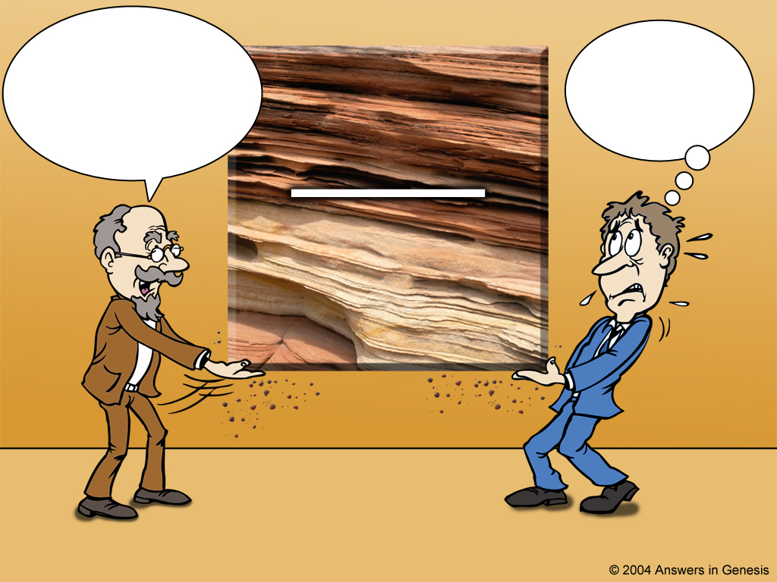
Scientist and theologian
“圣经”是不正确的! 这些岩石已有几百万年的历史. 你一定要相信我，因为我是一个科学家.
我就接受这数百万年的理论，在把它们添加到“圣经”里!
岩石层
数百万年
科学家
神学家
Notes:
However, instead of accepting the history of God's Word, theologians have compromised with the ideas of fallible men. You say:
But, wait a minute! Hasn't science PROVED the earth is millions of years old? And what about the Gap Theory, and Theistic Evolution, and the Day Age Theory and Progressive Creation and didn't dinosaurs die out 65 million years ago? However, all of these questions start with ideas OUTSIDE the Bible

Slide 94

Science is not the issue
真正的问题是不
科学!

Slide 95
上帝的话语
是真理
“圣经”眼镜
人决定
“真理”
数百
万年
数百
万年
“进化论”眼镜
Notes:
We all have a philosophy about how evidence should be interpreted. “Oh no, not me!”
Neutrality is a non-neutral position – because it makes a positive assertion.

Slide 96
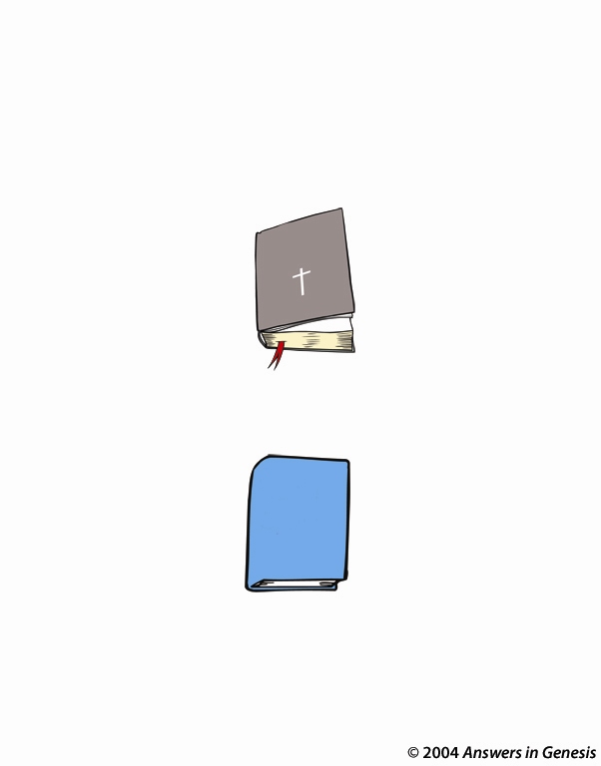
Which authority?
哪个主权?
万无一失神的话语
圣经
科学理论
易犯错误有罪的人的意见

Slide 97





Scientist & Bible—layered new
The
earth is billions of years old & Noah's Flood never happened. Take my word for it!
我在6000年前创造了世界，并发出了一个全球性的大洪水.
相信我的话!
格里森阿切尔博士及其他的旧约学者，以相信世俗的地质学家
圣经

Slide 98
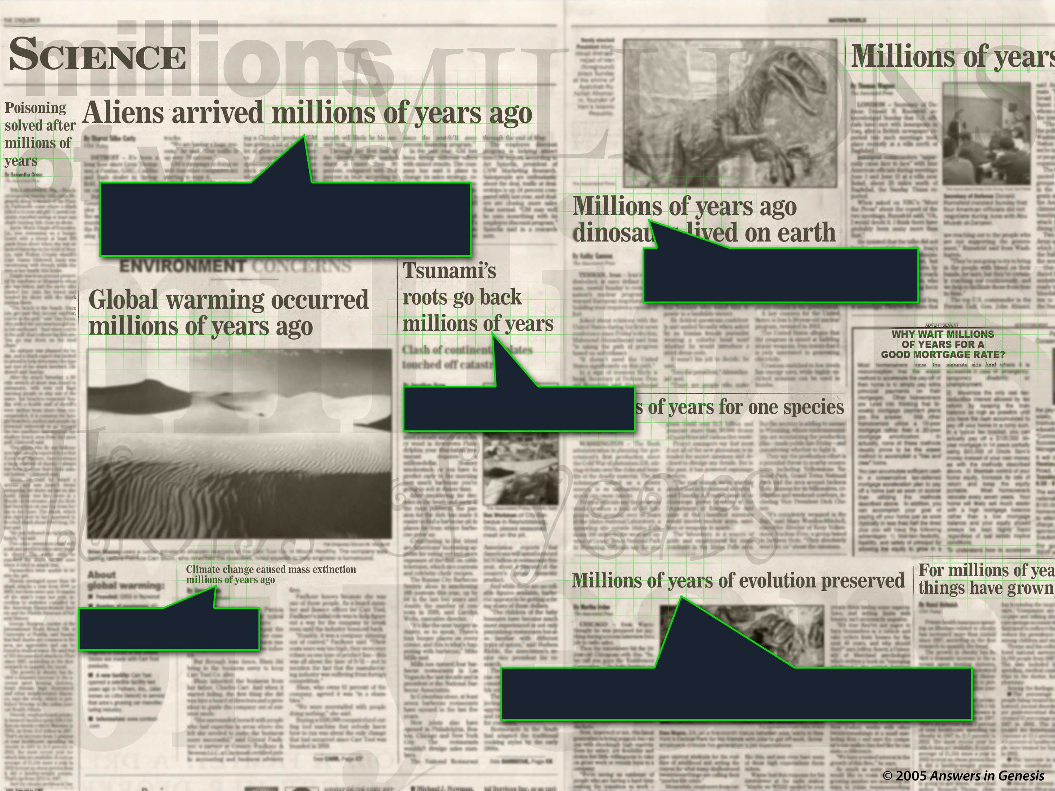
Mil of Yrs Headlines 02011
数百万年
数百万年
数百万年
数百万年
数百万年

Slide 99
I Peter 3:15 NAS
彼 得 前 書 3:15
只 要 心 里 尊 主 基 督 为 圣 。 有 人 问 你 们 心 中 盼 望 的 缘 由 ，就 要 常 作 准 备， 以 温 柔 、 敬 畏 的 心 回 答 各 人。

Slide 100
AiG web site #1

Slide 101
Matt. 24:37-39 NAS
馬 太 福 音 24:37-39
37.挪 亚 的 日 子 怎 样， 人 子 降 临 也 要 怎 样.
38.当 洪 水 以 前 的 日 子 ， 人 照 常 吃 喝 嫁 娶 ， 直 到 挪 亚 进 方 舟 的 那 日,
39.不 知 不 觉 洪 水 来 了 ， 把 他 们 全 都 冲 去 。人 子 降 临 也 要 这 样.
Notes:
Also Lk 17:26-29—Jesus mentions Noah and judgment of Flood (from Gen. 1-11) and Lot and judgment of Sodom and Gomorrah and Lot's wife (Gen. 12-50)—Jesus took both accounts as literal history. In fact, all the accounts that modern man finds so unbelievable (Noah, Lot, Jonah, serpents in the wilderness, etc.) Jesus took as historical fact.

Slide 102
Blank
END

Slide 103

Noah's Ark - Invitation

Slide 104

060 N'sA Door-John10.9
"我就是门， 如果有人藉着我进来， 就必定得救， 并且可以出、 可以入， 也可以找到草场"
(约翰 10:9 CNV).

Slide 105
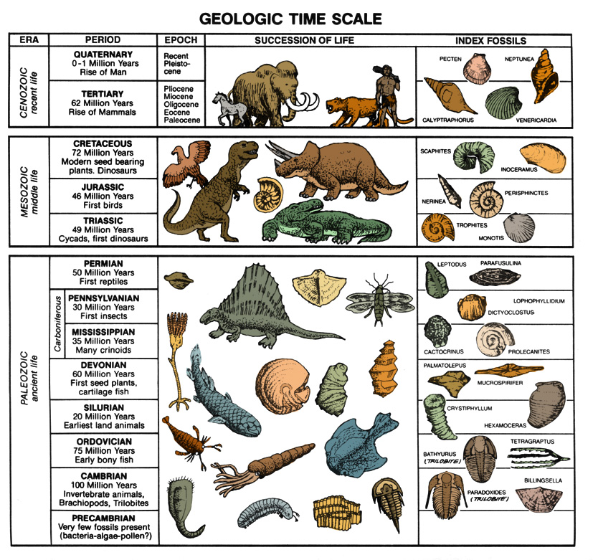
Coal dated by C-14
始新世
36-57万年前
白垩纪
66-144万年前
古生代
286-320万年前
所有的样品在本质上是相同
¹⁴碳 年龄—不超过70,000岁!
Notes:
C-14 is found in organic samples throughout the phanerozoic (Cambrian to Quarternary)—all but the youngest organic material shows C-14 evidence of being buried contemporaneously, much less that 250,000 years ago. There is also evidence that some C-14 is primordial—that is, it was not produced by cosmic ray bombardment of nitrogen in the upper atmosphere, but was part of the original creation.

Slide 106
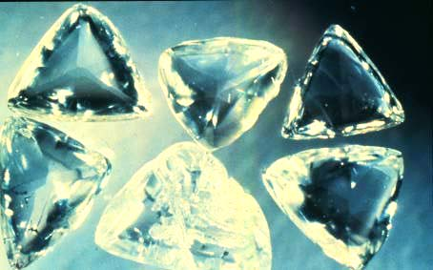
碳14的的钻石！
“年龄”的基础上长半衰期同位素年龄（例如，K/ AR）含有钻石的岩石:
1-2亿年
¹⁴碳测年的12颗钻石 (钻石晶体结构防止了最近与碳的污染 ¹⁴C): “年龄” 58000年.
www.icr.org/research/AGUC-14_Poster_Baumgardner.pdf (American Geophysical Union Conference, Dec 2003 poster session)
Notes:
Photo of Macles diamonds from the Argyle pipe, Western Australia (these are not the ones dated) from: http://volcano.und.nodak.edu/vwdocs/minerals/diamonds.html 'courtesy of Grand Boxer'.
While the poster presentation at the AGU conference documents five diamonds dated by 14C, seven more have since been C-dated, according to March 2005 personal communication between Dr. Don Batten (AiG) and Dr. Russ Humphreys (an ICR co-researcher with Dr. Baumgardner).

Slide 107
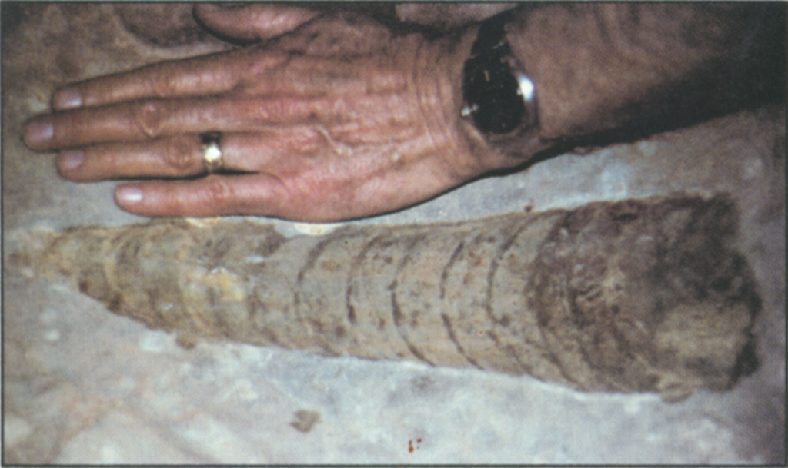
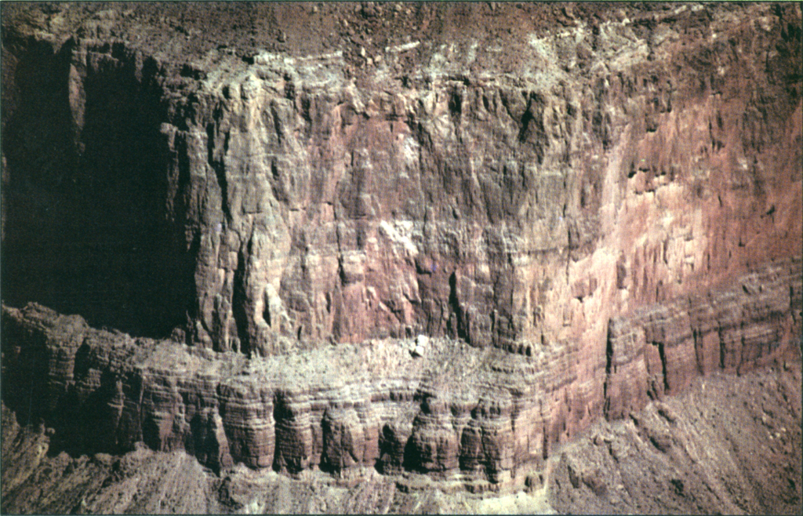

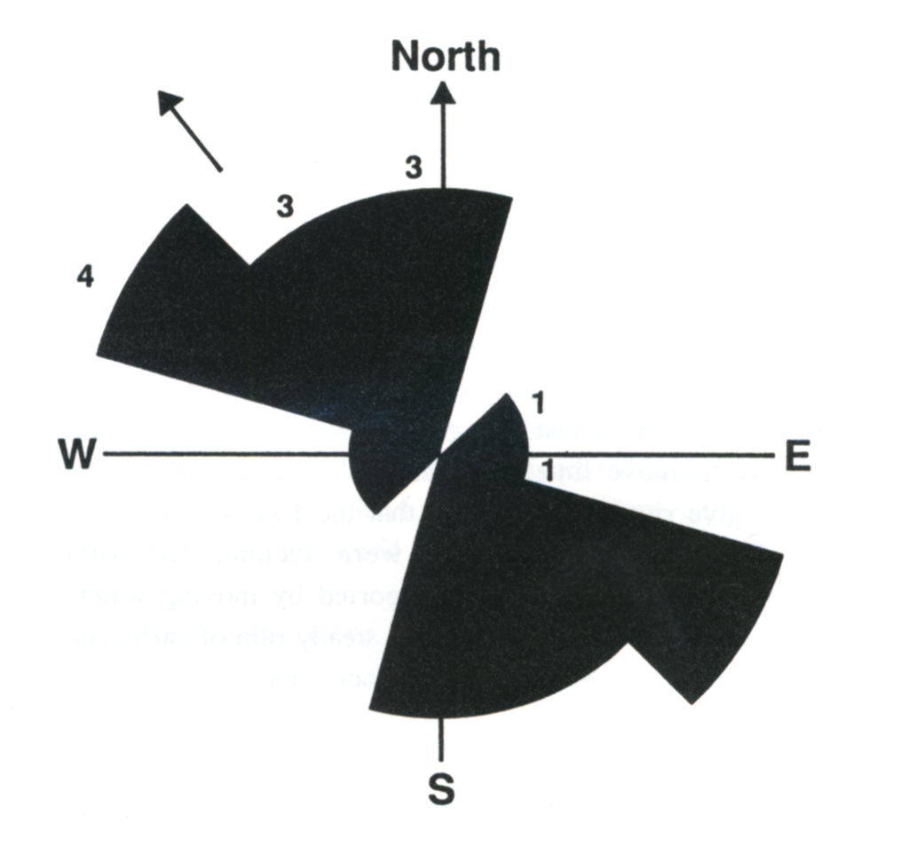
Nautiloid mass kill
大规模杀灭事件
400 ft
11,500 mi.²
鹦鹉螺化石
红墙石灰石
15% 埋直立
鹦鹉螺目软体动物
流动方向
Notes:
Redwall Limestone (fine-grained lime mud deposit, red from iron oxide impurities):
400 ft thick covering 30,000 km2 (11,538 miles2) in N. Arizona and Nevada from Marble Canyon to Las Vegas.
Some of the lime (calcium carbonate) was precipitated from sea water, but Dr. Austin believes most of it was transported from a NW source(s)
Billions of nautiloids (similar to living spiral nautilus shell creatures in Indian Ocean) in 2 meter (7ft) thick bed (120 mi E/W x 30 mi N/S area) in Redwall (first found in 1966—Nautiloid Canyon)
nautiloid size range 2-7 ft (0.6-2.0 meters)
25% buried upright (point down), indicates rapid burial
A continental-wide sheet of water moving on a relatively level surface at an estimated speed of 5 m/s (18 km/hr or 11 mi/hr) did this (which is faster than any river rapids and is like water at the end of a water fall)!
Similar fossil beds have been found in other parts of the world, all pointing to a large body of rapidly moving water.
See Steve Austin's research in his ICC 2003 paper, “Nautiloid mass kill and burial event…” Artist rendition of living nautiloid is from my.erinet.com/ ~jwoolf/nautiloi.gif, downloaded 4 Nov 2004. Other three pictures are from Steve Austin, ed., Grand Canyon: Monument to Catastrophe (Santee, CA: ICR, 1994), p. 25 & 27.

Slide 108

Age of ocean--salt
海洋中的盐
大气和火山尘埃
河流，冰川
侵蚀
喷雾
岩盐沉积
渗漏
离子交换
海洋
沉积物
发行
大洲
海底玄武岩
在海洋中积累的盐
最多在6200万年。.
Notes:
Only 27% of the 45 million tons of salt going into the oceans each year is being removed. So 3-4 times as much is going in as is going out. (ICR Impact article #384, June 2005, p. iii.)
Diagram: John Morris, The Young Earth (Master Books, 1994), 87.
Technical study: Steven A. Austin & D. Russell Humphreys, “The Sea's Missing Salt: A Dilemma for Evolutionists,” in Robert Walsh, ed., Proceedings of the Second International Conference on Creationism (Pittsburgh: Creation Science Fellowship, 1990), II:17-33.

Slide 109
A&E on bones
痛苦
数百万年
死亡
杀戮
疫病
挣扎
受苦
灭绝
Notes:
109

Slide 110
A&E on bones
痛苦
死亡
杀戮
疫病
痛苦
挣扎
数百万年
受苦
死亡
杀戮
灭绝
疫病
挣扎
受苦
灭绝
Notes:
110

Slide 111
A&E on bones
痛苦
死亡
杀戮
诺亚的洪水
疫病
痛苦
挣扎
数百万年
受苦
死亡
杀戮
灭绝
疫病
挣扎
受苦
灭绝
Notes:
111

Slide 112
A&E on bones
痛苦
死亡
X
杀戮
X
诺亚的洪水
疫病
痛苦
挣扎
数百万年
受苦
死亡
杀戮
灭绝
疫病
挣扎
受苦
灭绝
Notes:
112

Slide 113

Noah and Family in Ark 02987

Slide 114

Evolutionized Worldview 00826
进化论的世界观
死亡流血苦难
疾病
数百万年
人的存在
世界

Slide 115

部分
圣经
的世界观
完善
灾难
十字架
混乱
创造
基督
败坏
X
X
X
X
世界
Notes:
When Christians don't have the first four lenses (either denying them or ignoring some of the truths of Gen. 1-11), they too don't see (understand) things in the world clearly. They can see some things reasonably clearly (e.g., Jesus died for the sin problem caused by Adam, men are to be the loving heads of their homes and in the church, man is distinct from the animals and made in the image of God), but some things are distorted (e.g. age of the earth, death before the fall) and so they only have a partially biblical worldview, not a truly Christian worldview.

Slide 116
Black blank------------extras
终结

Slide 117


創造链接地址 BibleStudyDownloads.org
免费获得该讲解!
圣经学习下载
Notes:
The explanation for free!
Creation link address

