Slide 1

家谱与旧约年代学
创世记 第5章与第11章
Dr. Rick Griffith • 新加坡神学院 • BibleStudyDownloads.org
Notes:
CR-30-Gen_5_and_11_Genealogies-52_eng_cr_9230_v10-slide 1
OB-20-Chronology-124_eng_ob_7633_v7-Slide 5
OC-10-Gen_5_and_11_Genealogies-52_eng_oc_9230_v10-slide 1

Slide 2
什么是旧约年代学？
70d
旧业时间的排列，包括日期及与世界历史的关联。
目的：确定旧业里的日期及人物—越准越好。

Slide 3
为何旧约年代学如此重要？
70e
它描述以色列国家的建立，一个超越时代重要的国家。
它符合旧约与近东圣经额外的纪录。
它加强对圣经历史性及可靠性的信赖。
它建立对神及对祂话语的信心。

Slide 4
历史家如何确定旧业的年代学？
70e
资料来源
圣经（家谱，年龄，统治期间，时距，同时与其他国家的发生的事）。
古近东(ANE)的历史纪录。
天文学的资料。
剩余物及考古的发现。
当代历史家的纪录。

Slide 5
历史家如何确定旧业的年代学？
70e
方法
一般的：调查当时的周边环境之后再与其他记录对照看有没有共存点。
根据圣经列出按时间顺序排列的事物。
对照圣经与另外可靠的资料来源同时发生的事件。
与其他资料来源证实。
由已制定的日期做起。

Slide 6

创世纪1－11是真实的历史吗?
58
相对历史来说，神话是不太可能被用来教导“真理”；
一个没有历史根据的方法是很主观的
其中包含很多别处找不到的重要资料
这段叙述符合创世纪“拣选”的主题
故事的呈现运用了历史的写法
科学研究也印证了创世纪1－11是历史事实
耶稣基督也肯定了这段叙述的历史性
Dr. Rick Griffith • 博士 • 新加坡神学院 • www.biblestudydownloads.org
Notes:
I believe we have a genuine history in the first 11 chapters of the Bible. Why? Seven reasons…
_______
See “What does the original Hebrew text reveal about Genesis 1-11? - Dr. Steve Boyd”
https://www.youtube.com/watch?v=3txmpHQJ520
———————
Common-156
OC-17-Genesis Authorship-7
OS-01-Gen4-20-slide 23

Slide 7
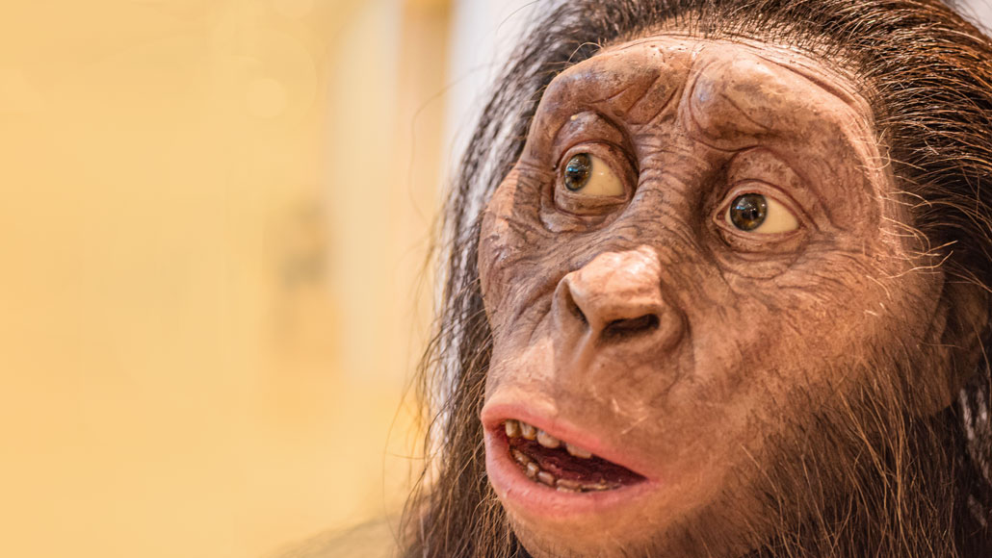
Hominids? Really?
﻿But before [10,000 BC], the “human” story tails back into multimillennia of which we know less, and of which one may well ask which (and what) are humans proper and which (or what) are simply humanlike “hominids.”
Kenneth Kitchen, On the Reliability of the Old Testament
(Grand Rapids: Eerdmans, 2003), loc. 9197 of 14432, Kindle ed.; picture of Australopithecus afarensis (https://www.sciencenews.org/article/lucy-species-brain-skull-heralded-rise-long-childhoods-hominids)
Notes:
Picture from:
Lucy’s species heralded the rise of long childhoods in hominids
Prolonged brain growth was already a feature for hominids before Homo genus members appeared
A more than 3-million-year-old hominid species called Australopithecus afarensis, represented here by an adult’s reconstructed skull, foreshadowed the long period of childhood brain growth typical of people today, a new study suggests.
Lorenza photography / Alamy Stock Photo
Share this:
By Bruce Bower
April 1, 2020 at 2:02 pm
Lucy’s kind had small, chimplike brains that, nevertheless, grew at a slow, humanlike pace.
This discovery, reported April 1 in Science Advances, shows for the first time that prolonged brain growth in hominid youngsters wasn’t a by-product of having unusually large brains. An influential idea over the last 20 years has held that extended brain development after birth originated in the Homo genus around 2.5 million years ago, so that mothers — whose pelvic bones and birth canal had narrowed to enable efficient upright walking — could safely deliver babies.
But Australopithecus afarensis, an East African hominid species best known for Lucy’s partial skeleton, also had slow-developing brains that reached only about one-third the volume of present-day human brains, say paleoanthropologist Philipp Gunz of the Max Planck Institute for Evolutionary Anthropology in Leipzig, Germany, and his colleagues. And A. afarensis is roughly 3 million to 4 million years old, meaning slow brain growth after birth developed before members of the Homo genus appeared, perhaps as early as 2.8 million years ago (SN: 3/4/15).
Too few A. afarensis infants have been studied to calculate the age at which this species attained adult-sized brains, Gunz cautions. The brains of human infants today reach adult sizes by close to age 5, versus an age of around 2 or 3 for both chimps and gorillas.
In the new study, Gunz and colleagues estimated brain volumes for six A. afarensis adults and two children, estimated to have been about 2 years and 5 months old. The kids had brains that were smaller than adult A. afarensis brain sizes in a proportion similar to human children’s brains at the same age relative to adult humans.
The new data suggest that, for Lucy’s species, “infant brain size [relative to that of an average adult] may have been proportionally even smaller than in human infants,” says biological anthropologist Zachary Cofran of Vassar College in Poughkeepsie, N.Y., who did not participate in the new study. If so, that pattern would strongly point to an extended period of brain growth for A. afarensis.
A roughly 3.3-million-year-old A. afarensis child’s skull, shown here, has revealed signs of prolonged growth of a brain that nonetheless had a chimplike structure.@ Zeresenay Alemseged Gunz suggests the extended post-birth brain growth among A. afarensis may have eased the physical and nutritional burden on mothers caring for infants, especially if food was scarce. It also “likely provided a foundation for the evolution of long childhoods in the human lineage,” he says.
His group used high-resolution CT scans to study fossilized braincases from an infant A. afarensis and six adults, including Lucy, all found at Ethiopia’s Hadar site. A second A. afarensis infant braincase came from Ethiopia’s Dikika site (SN: 9/20/06). The scans helped the researchers create 3-D digital reconstructions, or endocasts, of impressions made by the brain on the skull’s inner surface. Endocasts display signature folds and creases in brain tissue typical of humans or chimps, although preservation of these neural landmarks varies.
CT scans also let the researchers determine the infants’ ages by revealing microscopic layers of dental enamel that form daily during childhood, which can be counted like tree rings.
The Dikika child’s well-preserved endocast retained a crease and a set of grooves toward the back of the brain that are found in chimps, but not in humans. These impressions mark a prominent neural area involved in vision. Human brain surfaces lack these markings due to expanded neural tissue that integrates visual and sensory information. A South African Australopithecus skull was previously revealed to have signs of a chimplike visual area in the brain (SN: 1/10/19).
Neither of the A. afarensis infants showed evidence of humanlike frontal brain organization, as has been reported for an approximately 300,000-year-old South African hominid, Homo naledi (SN: 4/25/17).
Anthropologist and neuroscientist Todd Preuss of Emory University in Atlanta agrees. Endocasts of the Hadar A. afarensis skulls contain many preserved features from the brain’s visual area that resemble those on an Australopithecus child’s skull from South Africa that dates to about 2.8 million years ago, says Preuss, who was not part of Gunz’s team.
Much remains to be learned about the pace of brain growth in A. afarensis, says paleoanthropologist Aida Gomez-Robles of University College London. Researchers can’t track brain sizes of A. afarensis individuals from infancy into adulthood, so the new results don’t conclusively determine growth rates, she notes. And earlier interpretations of hominid brain organization based on endocasts have sparked frequent debate, leading Gomez-Robles to withhold judgment on the brains of Lucy’s kind.
Questions or comments on this article? E-mail us at feedback@sciencenews.org
A version of this article appears in the May 9, 2020 issue of Science News.
Citations
P. Gunz et al. Australopithecus afarensis endocasts suggest ape-like brain organization and prolonged brain growth. Science Advances. Published online April 1, 2020. doi: 10.1126/sciadv.aaz4729.
About Bruce Bower
E-mail
Twitter
Bruce Bower has written about the behavioral sciences for Science News since 1984. He writes about psychology, anthropology, archaeology and mental health issues.
Related Stories
Humans Year in review: Early human kin could shake up family tree
By Bruce BowerDecember 15, 2015
Humans Ancient jaw may hold clues to origins of human genus
By Bruce BowerMarch 4, 2015
Anthropology Fossil Skull Diversifies Family Tree
By Bruce BowerMarch 21, 2001

Slide 8
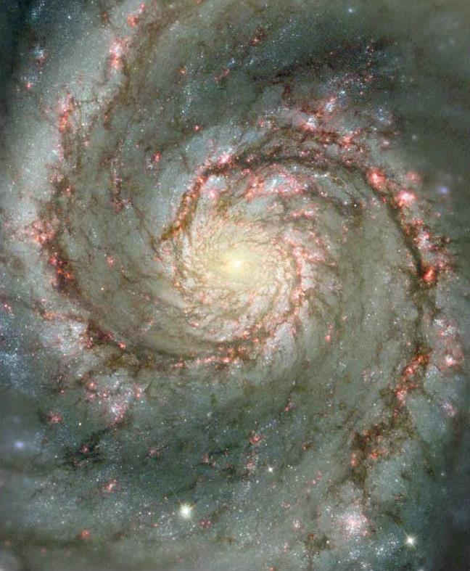
创世纪的问题
开始
创造是何时发生的？
那些先祖真的活这么久吗？
18
©2003 TBBMI
7.5.03a.

Slide 9

哦哦，不……我在我的通读圣经计划中
又遇到了族谱……

Slide 10

重点是什么？
族谱

Slide 11

这有什么意义？
这是补充睡眠的好方法吗？

Slide 12

我们能从创世纪5及11章找出创造的日期吗？
不能
圣经里其他的家谱都有间断（例子：马1:1-17）。
因此创世纪也会有差额
有“差额”的看法把洪水定在公元前2487年但根据埃及的历史是公元前3300年。
能
其他家谱在孩子出世之后没有供应父亲的年龄。
神要我们“定节令，日子，年岁”（创1:14）。
神还有什么原因让我们知道这些人的年龄？

Slide 13
创世纪的谜
5及11章的家谱
70e
创世纪5章把家谱从亚当持续到洪水。
创世纪11章把家谱从闪（挪亚的孩子）带到他拉（亚伯兰的父亲）。
创世纪5及11章的家谱资料可以用来确定一些历史事件的日期吗？

Slide 14
创世纪家谱之谜
亚当
创世纪5章
挪亚
闪
创世纪11章
他拉
这些家谱资料可以用来确定一些历史事件的日期吗？

Slide 15

创世纪5章的家谱
60
亚当
赛特
以挪士
该南
玛勒列
雅列
以诺
玛士撒拉
拉麦
挪亚

Slide 16

为何创世纪5及11章有间断？
60
亚当
陈述时距
赛特
以挪士
该南
玛勒列
雅列
以诺
玛士撒拉
拉麦
挪亚

Slide 17
父亲在孩子出世的年龄
60
亚当-130
赛特-105
以挪士-90
该南-70
玛勒列-65
雅列-162
以诺-65
玛士撒拉-187
拉麦-122
挪亚-500

Slide 18

Genesis 5 Age at Death
38
Adam
930
Seth
912
Enosh
905
Kenan
910
Mahalalel
895
Jared
962
Enoch
365
God took him without death
Methuselah
969
Lamech
777
Noah
950

Slide 19
为何创世纪5及11章有间断？
60
亚当
陈述时距
时距短了
赛特
以挪士
该南
玛勒列
雅列
以诺
玛士撒拉
拉麦
挪亚

Slide 20
创世纪5章短过路加福音3章
60
亚当
亚当
2006
年
挪亚
4138
年
基督

Slide 21
为何创世纪5及11章有间断？
60
亚当
陈述时距
时距短了
平常的
表示父亲-孩子
犹大书14章
赛特
以挪士
7
该南
玛勒列
雅列
以诺
“亚当的七世孙以诺，
曾预言这些人说。。。”
（犹14a 和合本）
玛士撒拉
拉麦
挪亚

Slide 22
两种看法
直接的年代学
  圣经有必要的资料制订旧业的基本历史时间表。
家谱的间断
  圣经没有提到有些家谱的间断。
  家谱资料不是唯一能够断定日期的方法。

Slide 23
间断所提出的论点
圣经—跨越了长久的时光及拥有少许/没有意见是正常的
遗漏不重要的名字不是偶然的而是规律。
在古代，“宗谱”（begat）代表“某某人的祖宗”，不管有几代。
旧业时代的纪录及当代周围国家的纪录一定有不合。

Slide 24
直接年代学的支持
虽然分散于不同的地方，圣经仍然充满许多年代学的资料。
当这些年代学的资料完全系统化，一个直接的年代学就能被证明。

Slide 25
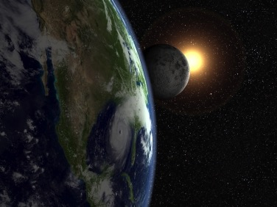

如何确定地球的年龄？
只需问唯一目击者！

Slide 26

" 只需算一算。 "
"上帝, 地球什么年龄了？"

Slide 27

族长年表 (创世记. 5, 11)
38-44
事件
参考
人类被创造
公元前
世界创造
"上帝完成了 "
-6 天
4143
亚当创造了
"上帝创造了人"
0
4143
塞特出生
“ 亚当是 130 岁 …"
130
4013
以挪士出生
“ 塞特是 105 岁…"
235
3908
雅各和家人去了埃及
"雅各布年龄130岁， 是在公元前1445年出埃及前400年 "
2298
1845

Slide 28
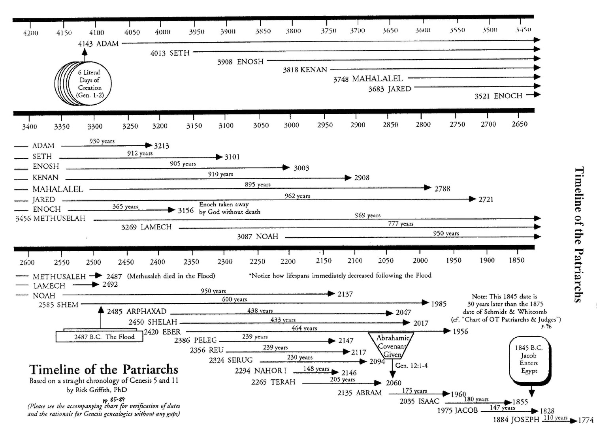
Methuselah's Death
44
亚当和玛土
撒拉是同时代人
大概是亚当告诉玛土撒拉创造记事，玛土撒拉告诉闪，闪告诉亚伯拉罕—只有复述3次!
2487
按时间顺序计算确切表明玛土撒拉在大洪水之年去世了！
2487
玛土撒拉和闪是同时代人
闪和亚伯拉罕是同时代人

Slide 29
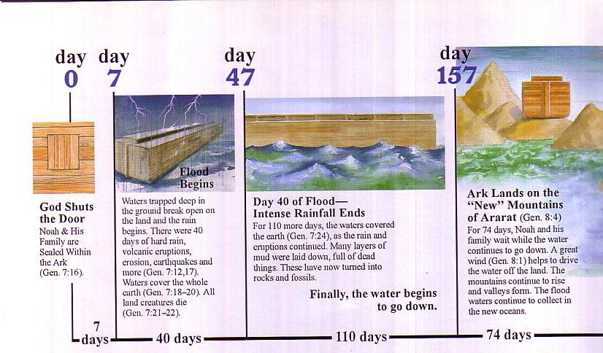
洪水年表
第0天
第7天
第47天
第157天
洪水开始
方舟落在亚 拉 腊 的“新”山上（创世记 8:4）
上帝关上了门
被困在地下深处的水涌到陆地上，雨开始了。有40天的大雨，火山爆发，地震等等(创世记 7:12,17)。水覆盖整个地球 (创世记 7:18-20)。所有陆地生物都死了(创世记 7:21-22) 。
洪水第40天 - 强降雨结束
挪亚和他的家人被密封在方舟内 (创世记 7:16)
再过110天，随着雨水和火山喷发的持续，水继续覆盖地球 (创世记 7:24). 许多含有死去东西的泥层被铺设. 这些现在变成了岩石和化石。
挪亚和他的家人等待74天期间, 水继续消退。 一阵大风(创世记 8:1）有助于将水驱离陆地。 山脉继续上升，山谷继续形成。
最后水开始消退
7
天
40 天
110 天
74 天

Slide 30
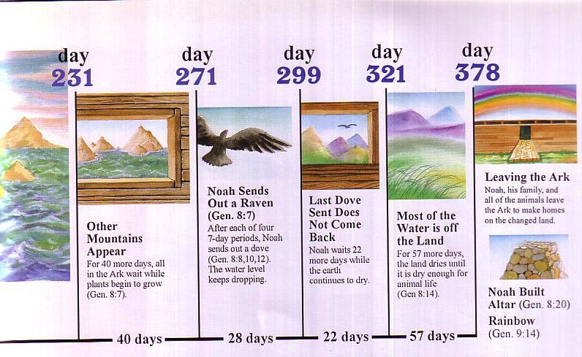
Flood Chronology
洪水年表
第
321天
第
378天
第
231天
第
271天
第
299天
离开方舟
挪亚发出一只乌鸦(创世记 8:7)
挪亚，他的家人和所有动物离开方舟，在改变了的土地上建造家园。
最后发出的鸽子不归
大部分的水已从陆地退去
其他山脉出现
在每四个7天的时间段之后, 挪亚会发出一只鸽子 (创世记 8:8,10,12) 。水继续消退。
挪亚再等22天, 同时地球继续干涸。
再过57天，土地干涸直至足以让动物生活 (创世记 8:14).
再过40天，方舟里的所有人都继续等待。 同时植物开始生 (创世记 8:7)
挪亚建造了祭坛 (创世记 8:20)
彩虹(创世记 9:14)
40 天
28 天
22 天
57 天

Slide 31


Patriarch's long lives
90
他们去世时的年龄
亚当
930 岁
玛土撒拉
969 岁
挪亚
950 岁
闪
600 岁
洪水解释了为什么寿命缩短了
亚伯拉罕
175 岁
摩西
120 岁
大卫
70 岁
To translate, please move the above black box over
Notes:
从 John Morris,挪 亚方舟和亚拉腊探险 (Noah's Ark and the Ararat Adventure), p. 10.

Slide 32

苏美尔国王的名单
大约刻于公元前1800年（大约洪水后的六百年）
据说这十位王在洪水之前各活21,000至43,200年之间
(对照创5)
Notes:
See Clifford Wilson, “The Stones Sill Shout p. 25 and Arnold/Beyer, “Readings from the ANE,” 150

Slide 33
苏美尔国王的名单
“当王权从天降下。。。
亚路林成王然后统治了28,800年。。。
八位王统治了241,000年。然后洪水掩盖了全世界。”
国王及总统治年
亚路林(Alulim) 28,800
亚拉甲(Alalgar) 36,000
安门鲁亚拿(Enmenluanna) 43,200
安门加蓝拿(Enmengalanna) 28,800
督姆洗(Dumuzi) 36,000
安西巴洗亚拿(Ensipazianna) 28,800
安门督兰拿(Enmeduranna) 21,000
吾珥巴土土(Urbatutu) 18,600
总计 241,200
Notes:
See Clifford Wilson, “The Stones Sill Shout p. 25 and Arnold/Beyer, “Readings from the ANE,” 150

Slide 34
苏美尔国王名单
没有人相信28,800年统治的国王，但它确实表现出对长寿和全球洪水的信念。
Arnold & Beyer,来自古代近东的读物, 150
Notes:
看 Clifford Wilson, 石头会呐喊 (The Stones Still Shout), 25 和 Arnold/Beyer,来自古代近东的读物 (Readings from the ANE), 150.

Slide 35
Sumerian King List
Kitchen, Reliability of the OT
How long did they really reign?
King & Years of Reign
Alulim 28,800
Alalgar 36,000
Enmenluanna 43,200
Enmengalanna 28,800
Dumuzi 36,000
Ensipazianna 28,800
Enmeduranna 21,000
Urbatutu 18,600
Total 241,000
The Math Kitchen
÷ 600 48
÷ 600 60
÷ 600 72
÷ 600 48
÷ 600 60
÷ 600 48
÷ 600 35
÷ 600 31
Total 402
Notes:
Kitchen proposes that each reign should actually be divided by 600 since the Sumerians invented the numbering system based on the number 6—as in our system of time that has the hour divided into 12 units, the 24-hour day, etc.”
““﻿That process can perhaps be reversed. Our scribes in 2000 B.C., faced with few kings and long periods, may have bumped up the numbers by using sexagesimal multipliers. So, at Hamazi and Uruk, reversing the process, we might take the 36,000 years of Alalgar or of Dumuzi and divide it by the factor 10 × 60 (600), which would give them each a reign of 60 years. Applied to Alulim’s (and others’) 28,800 years, he (and they) would have reigned 48 years; then Enmenduranna of Sippar at 21,000 years would have reigned 35 years. The mighty Enmenluanna at 43,200 years (the local Methuselah) would come out at 72 years — high but not impossible, even if it left Ramesses II (66 years) and Queen Victoria (64 years) just slightly jealous — but more modest than the 94 years of Pepi II, often granted. The more modest Ubartutu at 18,600 years comes out at 31 years, eminently reasonable. The principal works for all the preflood rulers, and no awkward fractions, etc., are left over. After the flood, reigns are still high, until suddenly Gilgamesh’s son Ur-nungal (no longer heroic?) reigns only 30 years, and all his successors are modest too, except in Kish (a special center of Sumerian kingship). Most of the “heroic” postflood kings may thus have been upped by only 60 years (not by 60 × 10). Thus Lugal-banda’s 1,200 years would then have been 20 years, and Enmebaragisi’s 900 years would have been 15 years. Those with 200 years down to 100 years may have had a factor of only 10 × years; but that is a baseless guess for now.”
—Kenneth A. Kitchen, On the Reliability of the OT (Grand Rapids, MI: Eerdmans, 2003), location 9647 of 14432 Kindle Ed.

Slide 36
父亲在孩子出世的年龄
60
亚当-130
赛特-105
以挪士-90
该南-70
玛勒列-65
雅列-162
以诺-65
玛士撒拉-187
拉麦-122
挪亚-500

Slide 37
Kitchen on Age at Son's Birth
Adam
130
÷ 5 =
26
Seth
105
÷ 5 =
21
Enosh
90
÷ 5 =
18
Kenan
70
÷ 5 =
14
Mahalalel
65
÷ 5 =
13
Jared
162
÷ 5 =
32
Enoch
65
÷ 5 =
13
Methuselah
187
÷ 5 =
37
Lamech
122
÷ 5 =
24
Noah
500
÷ 5 =
100
Notes:
“﻿So much for Sumer. What about Gen. 1–11? There was no sexagesimal system in Hebrew usage, and we are dealing with parents and children (direct or indirect), not reigns. The genealogies in Gen. 5 and 11 differ in the time of life at which children are born to the principal members: after long spans in the preflood one, and virtually normal after the flood. Therefore, as no single formula will apply to both lots, any more than to the preflood and postflood kings in Sumer, let us look at each group separately. Is there a “differential factor” as in Sumer? Overall, in Gen. 5, dividing the biblical number by five produces viable results for the age of the protopatriarchs at the birth of a firstborn from Adam to Lamech, running from 26 (for Adam) down to 16 for Kenan and 13 for Enoch; up to 37+ and 36+ for Methuselah and Lamech.”
—Kenneth A. Kitchen, On the Reliability of the OT (Grand Rapids, MI: Eerdmans, 2003), location 9647 of 14432 Kindle Ed.

Slide 38
Kitchen on Age at Death
Adam
930
÷ 5 =
186
Seth
912
÷ 5 =
182
Enosh
905
÷ 5 =
181
Kenan
910
÷ 5 =
182
Mahalalel
895
÷ 5 =
179
Jared
962
÷ 5 =
192
Enoch
365
÷ 5 =
73
Methuselah
969
÷ 5 =
193
Lamech
777
÷ 5 =
155
Noah
950
÷ 5 =
190
Notes:
“﻿﻿But it gives a consistently high average at death of 180/190 years (except Enoch, who was “translated” at 73), ﻿not unlike the later patriarchs from Abraham to Jacob.”
—Kenneth A. Kitchen, On the Reliability of the OT (Grand Rapids, MI: Eerdmans, 2003), location 9656 of 14432 Kindle Ed.

Slide 39
Alternate Kitchen View
Adam
930
Seth
912
Years Later When Clan Died Out
Enosh
905
Kenan
910
Mahalalel
895
Jared
962
Enoch
365
Methuselah
969
Lamech
777
Noah
950
Notes:
“﻿﻿The large postbirth figures might refer to the supposed life span of the clan, not just the men themselves, if one wished to pursue such paths. Only dear old Noah (having his firstborn at 500 = 100; living, even as “clan,” to 950 = 190 years) is the odd man out.”
—Kenneth A. Kitchen, On the Reliability of the OT (Grand Rapids, MI: Eerdmans, 2003), location 9656 of 14432 Kindle Ed.

Slide 40
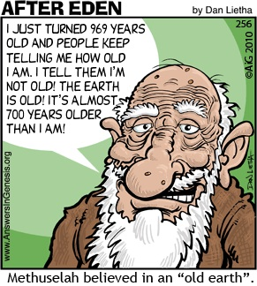
Methuselah
90
I JUST TURNED 969 YEARS OLD AND PEOPLE KEEP TELLING ME HOW OLD I AM. I TELL THEM I'M NOT OLD! THE
EARTH IS OLD! IT'S ALMOST 700 YEARS OLDER THAN
I AM!
Methuselah believed in an "Old Earth."
Notes:
How old is the earth? Let’s ask the oldest man!

Slide 41
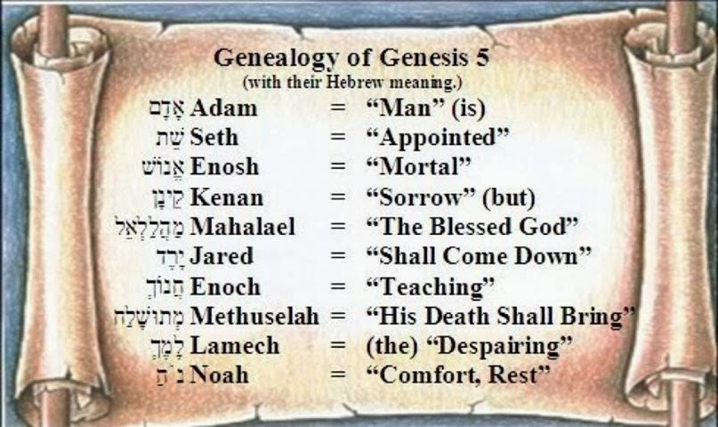
The Meaning of Each Patriarch's Name in the 10 Generations
Notes:
Reading downward with the meanings above, we see that death reigned on the earth. However, their names teach us that at the time of the death of Methuselah in the year of the Flood, through Noah (“comfort, rest”) the world that was renewed through the Flood.

Slide 42
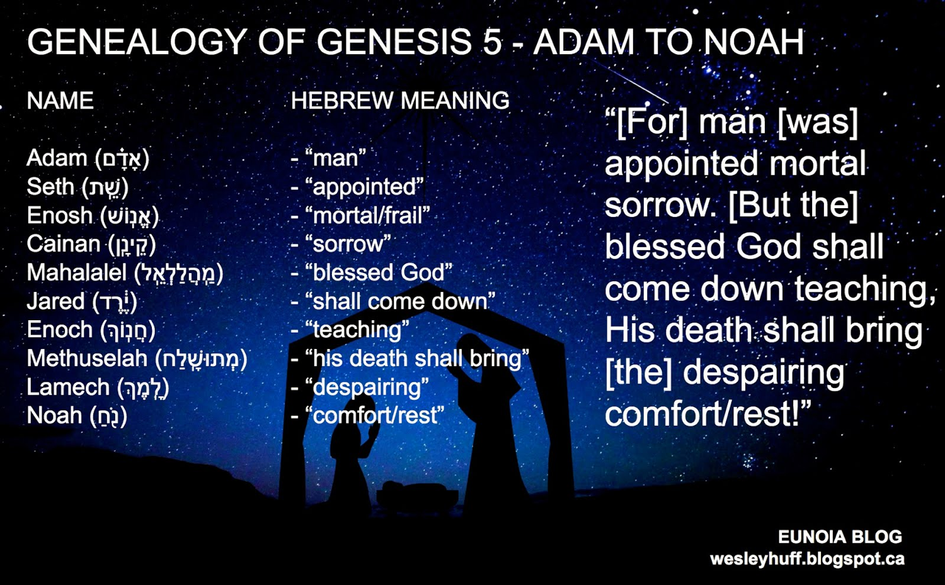
The Meaning of Each Patriarch's Name in the 10 Generations
Notes:
Reading downward with the meanings above, we see that death reigned on the earth. However, their names teach us that at the time of the death of Methuselah in the year of the Flood, through Noah (“comfort, rest”) the world that was renewed through the Flood.

Slide 43

OK, so what's the point?
Notes:
Restatement

Slide 44

Will you take God's Word at face value—even when it is uncomfortable?
Notes:
Restatement

Slide 45

你怎么能分辨地球的年龄？
相信目击者
所写的圣经

Slide 46
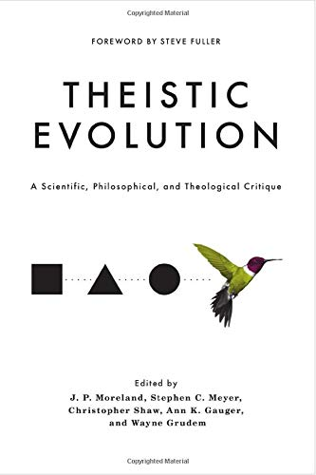
Theistic Evolution: A Scientific, Philosophical, and Theological Critique
J P Moreland,
Wayne Grudem, editors
Nov 2017
—Argues against theistic evolution but still maintains millions of years theory
—Includes NO articles by Biblical Creationists who hold to a Young Earth

Slide 47

AiG Web Address 00439

Slide 48

Unformed and Unfilled 04093
Unformed and Unfilled
  by Weston Fields
A thorough refutation of the gap theory
(2005)
Notes:
Master Books, 2005
245 pages
Amazon: https://www.amazon.com/Unformed-Unfilled-Critique-Gap-Theory/dp/0890514232
Everyone’s heard of it. Many believe it. Is there a “gap in time” between the first two verses in Genesis? Does this alleged gap really represent a vast amount of time? Weston Field’s classic treatment of this subject is now being published by Master Books, and promoted by such important organizations as Answers in Genesis. In this book, Fields makes a detailed study of the gap theory, paying particular attention to the original Hebrew language of Genesis. His conclusion - that this theory is not a reasonable compromise with modern evolutionary theory, but a dangerous diversion from biblical truth - helps readers who struggle with the question of the time taken during the creation week. Was it really six days? Can Christians find a workable solution to the debate about creation and time?
An important book.
A presentation of a variety of views espoused by Christians of all denominations
A professional, scholarly look that can be easily understood by laymen
A fascinating study of the original Hebrew text
A classic work still relevant today
“A brilliant, scholarly refutation of the famed gap theory” - Ken Ham, President, Answers in Genesis

Slide 49
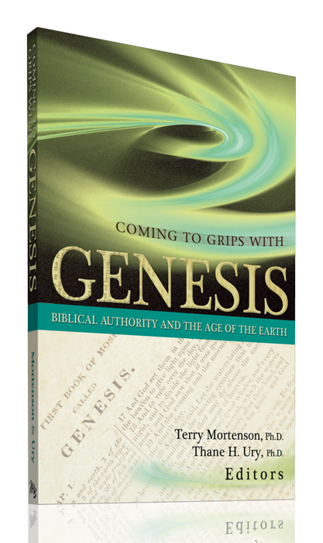
Coming to Grips with Genesis 04702
Coming to Grips with Genesis
  edited by Dr. Terry Mortenson
  and Dr. Thane Ury
14 scholars give a careful biblical & historical defense of
young-earth creationism (2008)
© 2008 Answers in Genesis-USA
Notes:
New Leaf Publishing Group, 2008
450 pages
Fourteen theological scholars address key topics related to the age of the earth, which is the crucial issue of debate in the church today regarding origins. Bringing to bear rigorous biblical, theological, and historical arguments in favor of a six-day creation, the global Flood, and a young earth, they also provide much-needed critiques of a number of contemporary old-earth interpretations of the book of Genesis.
This fresh defense of the literal history of Genesis 1-11 nicely complements other studies which focus more on the scientific evidence of young-earth creationism. As such, this book can serve as a versatile supplement to other works, but is also designed to be used as a standalone text for seminary and Bible college professors and students, pastors, missionaries, and others who want in-depth apologetic resources.
Coming to Grips with Genesis: Biblical Authority and the Age of the Earth includes:
Forewords by Dr. John MacArthur, President of the Master's Seminary and Senior Pastor of Grace Community Church, Sun Valley, CA; and the late Dr. Henry Morris, Founder and President Emeritus, Institute for Creation Research
Detailed analysis of the verbs of Genesis 1
A defense of the Genesis 5 & 11 genealogies as strict chronologies
Reasons for rejecting millions of years of death and natural evil before Adam's sin
Careful reflection on Jesus' teachings regarding a young earth

Slide 50
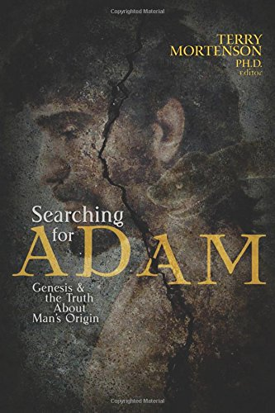
Coming to Grips with Genesis 04702
Searching for Adam: Genesis & the Truth About Man’s Origin
  edited by Dr. Terry Mortenson
16 chapters by scholars upholding the literal Adam and Eve (2016)
© 2008 Answers in Genesis-USA
Notes:
October 30, 2016
528 pages
From Amazon website at https://www.amazon.com/Searching-Adam-Genesis-Truth-Origin/dp/0890519757
Accessed 22 Sep 2021
You can believe with great intellectual integrity what the Bible says about Adam and the origin and history of man. Though there are a growing number of books out on Adam, this one is unique in its multi-author combination of biblical, historical theological, scientific, archaeological and ethical arguments in support of believing in a literal Adam and the Fall. A growing number of professing evangelical leaders and scholars are doubting or denying a literal Adam and a literal Fall, which thereby undermines the gospel of Jesus Christ, the Last Adam, who came to undo the damaging consequences of Adam’s sin and restore us to a right relationship with our Creator. This book will increase your confidence in the truth of Genesis 1-11 and the gospel:
Enhance your understanding pertaining to the biblical evidence for taking Genesis as literal history
Discover the scientific evidence from genetics, fossils, and human anatomy for the Bible’s teaching about Adam
Understand the moral, spiritual, and gospel reasons why belief in a literal Adam and Fall are essential for Christian orthodoxy.

Slide 52


OT Criticism link at BibleStudyDownloads.org
Get this presentation for free!
Notes:
OC Criticism (oc)

