Slide 1
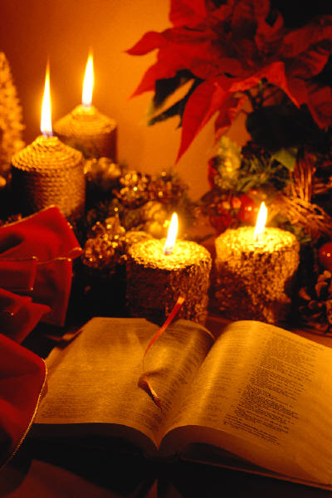
OT Biblical Theology
舊約聖經神學

Slide 2
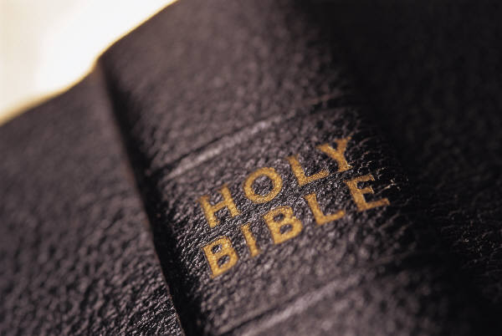
What’s the Theme of the OT?
舊約的主題是什麼？
54
Write this out in a single sentence.
用一個句子寫出來。

Slide 3
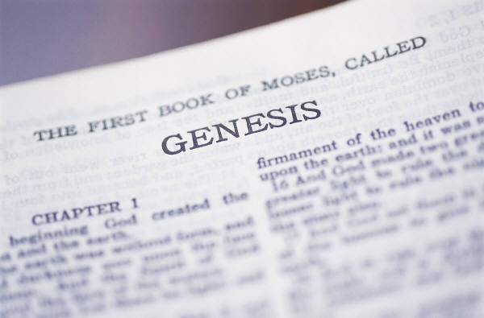
Criteria to Discern the Key OT Theme
辨別主要的 OT 主題的標準。
54
Yes
No
Text-based
基於文章內容
Covers whole Bible
包括整夲聖經
Narrow enough to be helpful
縮小範圍是有幫助的
Focuses on God as He is the Subject
著重於上帝由於他是主題
Not from systematics
不是從系統神學而來
Not piecemeal
不是零散的
“Life” is too general a theme to help us
「生活」是一般幫助我們的一個主題
Man is not the subject of the
Bible
男人不是聖經主題
Notes:
What principles will assure that our theme for the OT and NT is accurate?
The theme should come out of the text rather be imposed on the text from systematic theology.
It should be comprehensive enough to cover all of Scripture from Genesis 1 to Revelation 22.
It should be narrow enough and specific enough to be helpful (e.g., it is not helpful to say that the Bible talks about “life”).
Since God is the main subject of the Word, it should focus more on God than man.

Slide 4

Opinions on the Key OT Theme
對主要的 OT 主題之見解
54-57
Redemption of Man
人類的救贖

Slide 5

Redemption means “to release from ransom”
救贖即「用贖價贖回」

Slide 6

Redemption in the Media
在媒體中的救贖
People have an inherent sense that they need redemption
人們有一種固有的意識他們需要贖回

Slide 7


The Focus of History is the Redemption Provided by Christ
歷史的焦點:救贖是從基督而來

Slide 8

The Centrality of the Cross
十字架的中心
WHAT? 什 麼
2nd
A d a m
第
二
亞
當
1st
Adam
第
一
亞
當
NATION
國
家
TRIBE
族
群
FAMI LY
家
庭
5 0 0 0
1 2 0
11
Notes:
Human history narrowed down to Jesus Christ and expanded from there

Slide 9
The Centrality of the Cross
十字架的中心
ETERNITY
永
恆
WHAT? 什麼
ETERNITY
永
恆
Notes:
The person of Christ bridges the OT and the NT

Slide 10
Opinions on the Key OT Theme
對主要的 OT 主題之見解
54-57
Redemption of Man
人類的救贖
B. Glory of God
神的榮耀

Slide 11
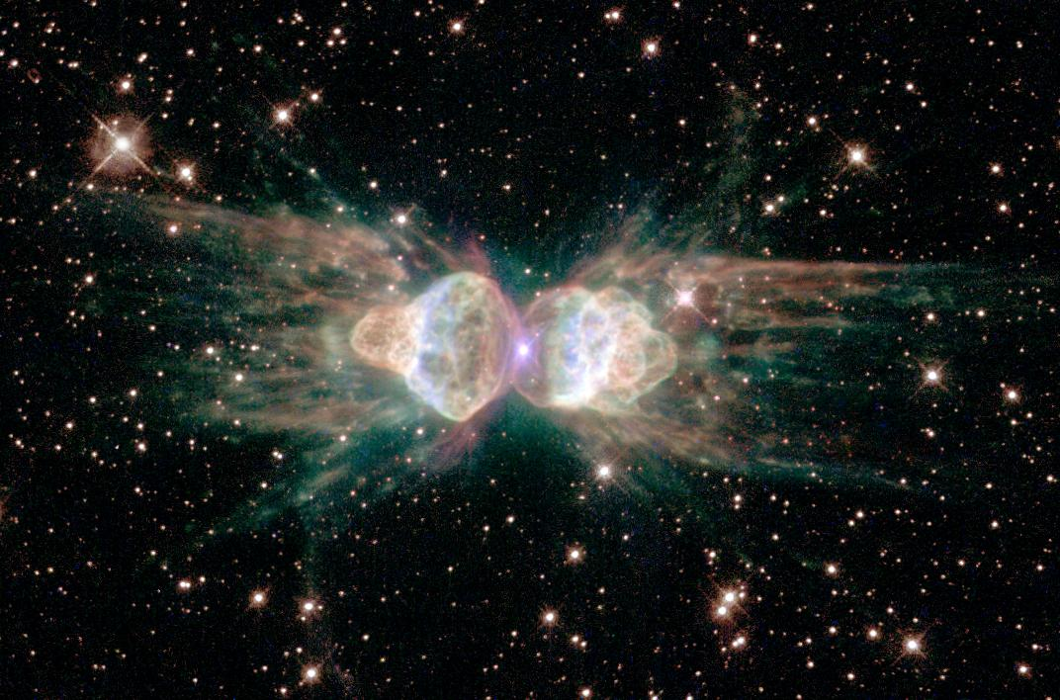
The Glory of God
The Glory of God
神的榮耀

Slide 12
The Glory of God
神的榮耀
LINE C
1600 years (1600 年)
40 authors (40 位作家)
ONE THEME:(一個主題)
the glory of God (神的榮耀)
4
3
5
GOSPELS
6
2
PROPHECIES
ACTS
WRITINGS
7
HISTORIES
EPISTLES
1
LAW
8
REVELATION
7.5.06.
2
©2003 TBBMI
15
Notes:
Remarks:1.法律, 2.歷史,3.著作,4.預言,5.福音,6.使徒行傳,7.書信,8.啟示録.

Slide 13
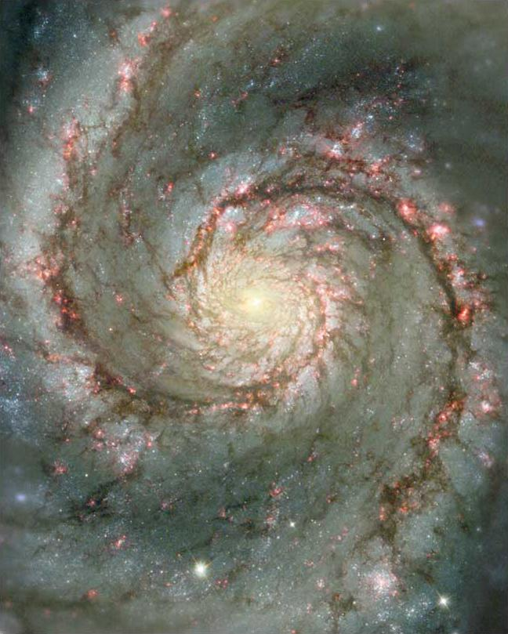
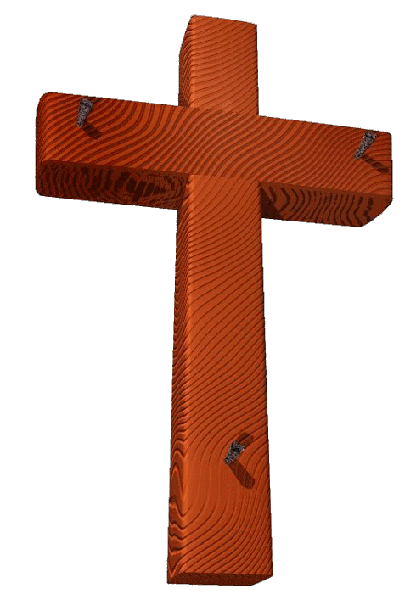
Glory and the Cross
The Glory of God
神的榮耀
1
06-31
40
©2003 TBBMI
7.5.06.
Notes:
Remarks: The glory of God 神的榮耀

Slide 14
Opinions on the Key OT Theme
對主要的 OT 主題之見解
54-57
A Redemption of Man
人類的贖回
B Glory of God
神的榮耀
C Sovereignty of God
神的主權
D God
神
E Creation Faith
創造的信心
F Deuteronomistic Theology of
History
神學中的歷史:申命记
G Worship
敬拜神
H Promise (Covenant)
約的應許
I No Overall Theme
沒有全面的主題
J Rule of God
神的法則
K Kingdom & Covenants
国度與約

Slide 15

The Lord Reigns 1
The Lord reigns, the Lord reigns,
the Lord reigns let the earth rejoice
let the earth rejoice let the earth rejoice
Let the people be glad;
that our God reigns.
(repeat)
耶 和 華 作 王,耶 和 華 作 王,
耶 和 華 作 王 , 願 地 快 樂 。
願 地 快 樂 ,願 地 快 樂 ,
耶 和 華 作 王,
願民快 樂 。

Slide 16
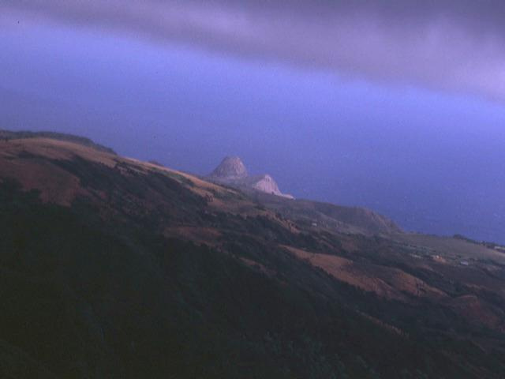
The Lord Reigns 2
The heavens declare His righteousness.
The people see His glory
For You, O Lord, are exalted
over all the earth
over all the earth.
諸 天 表 明 他 的 公 義、
萬 民 看 見 他 的 榮 耀 。
因 為 你 耶 和 華 至 高 ． 超 乎 全 地 ．
你 被 尊 崇。

Slide 17
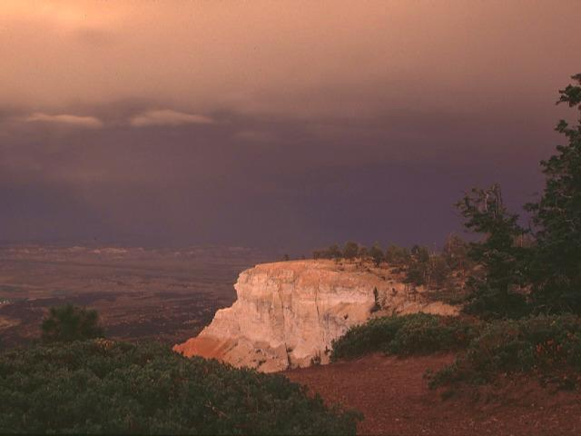
The Lord Reigns 3
The Lord reigns, the Lord reigns,
the Lord reigns let the earth rejoice
let the earth rejoice let the earth rejoice
Let the people be glad;
that our God reigns,
our God reigns,
our God reigns,
our God reigns.
耶和華作王，耶和華作王，
耶和華作王，願全地唱歌。
願全地快樂，願全地快樂。
願人們歡欣，神作王，
神作王，神作王，神作王。

Slide 18
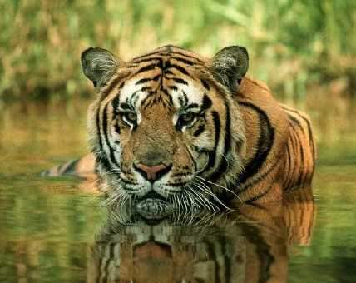
動物
Animals
Creation
創造
God’s Creation…Day 6
第六天神的創造
Then God said, “Let the earth bring forth living creatures after their kind: cattle and creeping things and beasts of the earth after their kind”; and it was so. God made the beasts of the earth after their kind, and the cattle after their kind, and everything that creeps on the ground after its kind; and God saw that it was good (24-25).
神說:「地上要生出活物來，各從其類; 牲畜ヽ昆蟲和地上的野獸，各從其類!」事就這樣成了。於是，神造了地上的野獸，各從其類;牲畜，各從其類; 地上的各樣昆蟲，各從其類。神看這是好的 (創 1:24-25)。

Slide 19
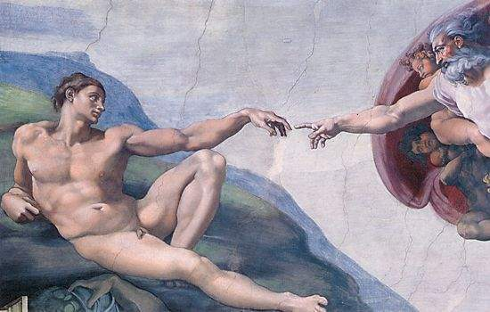
男人
Man
Creation
創造
God’s Creation…Day 6
第六天神的創造
Then God said, “Let Us make man in Our image, according to Our likeness; and let them rule over the fish of the sea and over the birds of the sky and over the cattle and over all the earth, and over every creeping thing that creeps on the earth” (26).
神說:「我們要照著我們的形象，按著我們的樣式造人; 使他們管理海裏的魚ヽ空中的鳥ヽ地上的牲畜，以及全地，和地上所有爬行的生物!」(創 1:26)。

Slide 20
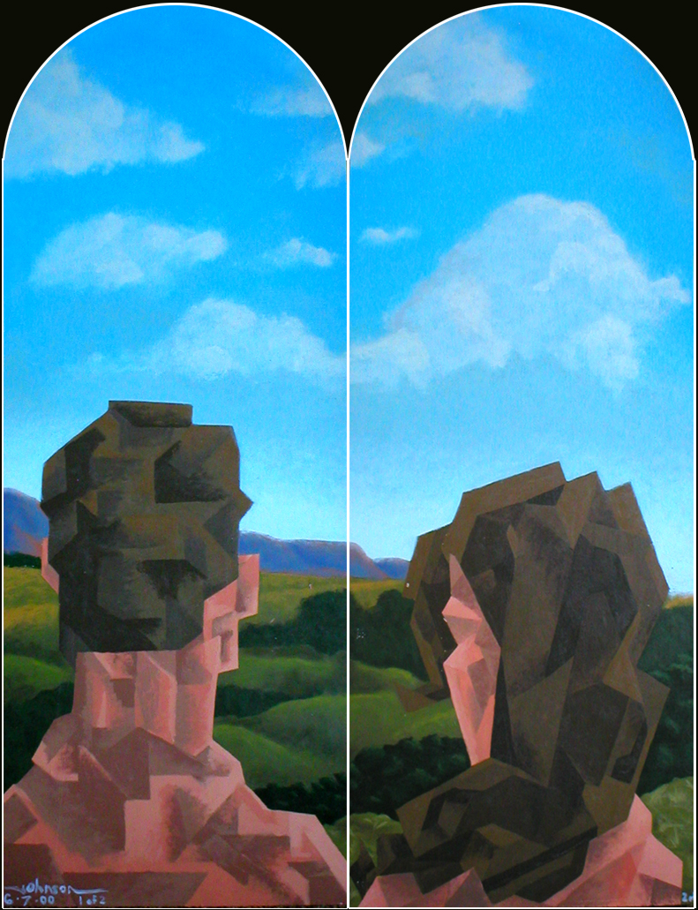
女人
Woman
Creation
創造
God’s Creation…Day 6
第六天神的創造
So God created man in his own image
於是，神照著自已的形象創造了人;
in the image of God he created him
就是照著祂的形象創造了人;
male and female he created them (27).
祂所創造的有男有女(創 1:27)。

Slide 21
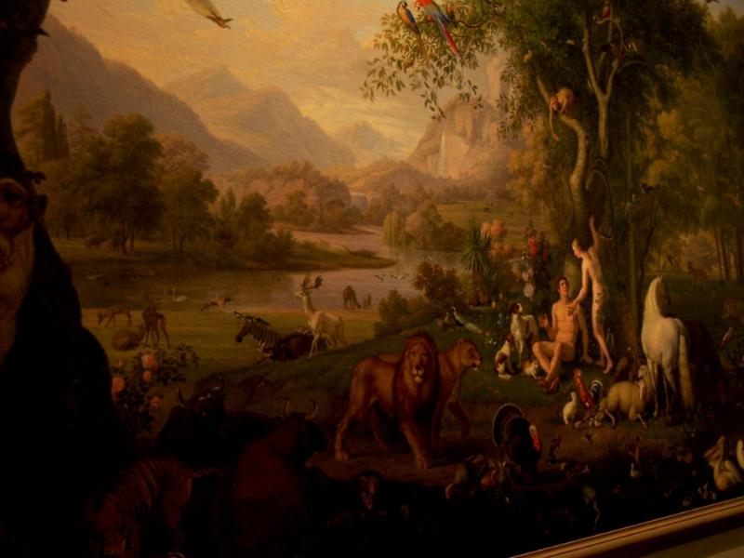
授權
Mandate
Creation
創造
and over the birds of the air 空中的鳥
And God blessed them, and God said to them, “Be fruitful and multiply, and fill the earth and subdue it;神就是賜福給他們，對他們說:「要繁殖增多，充滿這地，征服它;
and have dominion over the fish of the sea 也要管理海裏的魚，
and over every living thing that moves upon the earth” (28). 和地上所有爬行的生物。」 (創 1:28)

Slide 22
An All-Encompassing Theme
全面性的主題
58
Genesis 1:26-28
“Then God said, ‘Let us make man in our image, in our likeness, and let them rule over the fish … birds … livestock … all the earth, and over all the creatures that move along the ground…’ God blessed them and said to them, ‘Be fruitful and increase in number; fill the earth and subdue it. Rule over the fish of the sea and the birds of the air and over every living creature that moves on the ground.’”
創世記 1:26-28
神說:「我們要照著我們的形象，按著我們的樣式造人; 使他們管理海裏的魚ヽ空中的鳥ヽ地上的牲畜，以及全地，和地上所有爬行的生物!」(創 1:26)。
於是，神照著自已的形象創造了人; 就是照著祂的形象創造了人;祂所創造的有男有女(創 1:27)。
神就是賜福給他們，對他們說:「要繁殖增多，充滿這地，征服它;也要管理海裏的魚，空中的鳥和地上所有爬行的生物。」 (創 1:28)
Revelation 22:5
“There will be no more night. They will not need the light of a lamp or the light of the sun, for the Lord God will give them light. And they will reign for ever and ever.”
啟示錄 22:5
「不再有黑夜。他們也不用燈光
日光。因為主神要光照他們。他
們要作王ヽ直到永永遠遠。」
The Bible’s Theme: God extends His rule to man
聖經主題:神擴展對人管理的律例
Command
命令
Covenants
約
Fulfillment
完成

Slide 23
Kingdom & Covenants Timeline
國度與約的時間順序
50
Kingdom Teaching..王國教導.
Adam rules with God (Gen. 1:26, 28; 2:19)
Satan rules as god of this world (Gen. 3:15;
2 Cor. 4:4)
God covenants with Abraham to reestablish man's rule via Israel as a "kingdom of priests" (Gen. 12:1-3; Exod. 19:6)
Israel’s failure to witness to nations as a kingdom of priests is judged via exile under foreign rule
Israel rejects Messiah’s offer of kingdom (Matt. 12:41-42; 23:37-39)
Jesus extends His kingdom in mystery form to the Church (Matt. 13)
Christ subdues Israel’s enemies and nation believes (Rom. 11:26-27)
Christ rules over everything with saints (Eph. 1:9-10; Rev. 20:1-6; 22:5b)
Fall of Man (Gen. 3)
Noahic Covenant 挪亞之約
Genesis 6:18; 9:8-17
ISRAEL
CHURCH
MESSIANIC KINGDOM
Palestinian Covenant
(National Focus)
The “New Man” (Eph. 2:15)
Millennial Eternal
land
Genesis 15:18 (cf. Deut. 30:1-10) promises:
Land from Wadi of Egypt to Euphrates River (Isa. 27:12)
Eternal possession of land (Gen. 17:8) after exile/restoration
Whole world blessed via the land (Isa. 14:1-2)
Israel judged for rejecting Messiah by dispersion away from land for 19 centuries
(AD 70–AD 1948) but now partially restored (Ezek. 37:1-7)
Full restoration (Ezek. 37:8-28) Jerusalem world capital
(Isa. 2:1-5)
New Jerusalem
(Rev. 21)
Davidic Covenant
Christ is Head over His Church, which is a spiritual temple (Eph. 2:19-22;
2 Cor. 6:16)
Christ reigns over the world
(Isa. 11)
with saints (Rev. 5:10)
Christ hands kingdom over to Father (1
Cor. 15:24)
Genesis 12:1-3
seed
2 Samuel 7:12-16 promises perpetual:
Sons (“house” never wiped out)
Kingdom (political dynasty)
Throne (right to rule by descendants)
Temple (son to build it)
Abrahamic Covenant
New Covenant
All 5 elements fulfilled in national restoration (Zech. 8)
All
things made new!
(Rev. 21:5)
blessing
Jeremiah 31:31-34 promises:
Forgiveness
Indwelling Spirit
New heart, nature, mind
Reunification of Israel and Judah
No need for evangelism
Mosaic Law replaced with first three elements of the New Covenant (Luke 22:20; 2 Cor. 3:6)
Mosaic Covenant
Law abolished, fulfilled, and replaced at the cross (Rom. 7:1-6;1 Cor. 9:19-21; Heb. 8:13)
Second Edition
2 January 1998
Temporary (Gal. 3:19) and conditional (Deut. 28) to reveal sin (Rom. 7:7) and regulate Israel (Gal. 3:23-25)
Scripture contains a dual kingdom-covenant emphasis. Israel’s role from Abraham to Christ is expanded to include the Church (continuity) yet the Church
never replaces the nation as the “new Israel” (discontinuity). Israel will again enjoy world prominence after trusting in Christ at His second coming.

Slide 24
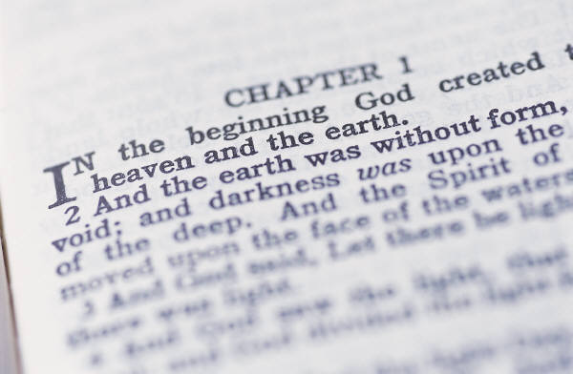
My View of the OT’s Theme
我的舊約主題觀點
58
The Old Testament narrates
舊約的敘述
God’s restoring man to participate in His kingdom rule for His own glory
神為了祂的榮耀恢復人類參與國度與管理
mandated in Eden but lost in the Fall
授權在伊甸園，但是在人類墮落後失去參與權
and accomplished by redeeming man
由得蒙救贖人類來完成
through Israel as a kingdom of priests
透過以色列來做國度的祭司
and ultimately through the Messiah,
最終透過彌塞亞
who will reign as Saviour and King
祂作王和拯救，並來掌權
to fulfill the Abrahamic Covenant
成就了亞伯拉罕的約。

Slide 25

Another View on the Bible’s Theme
另一個對聖經主題的見解
Principle:
定律
The glory of God
神的榮耀
The kingdom of God
神的国度
Premise:
前提
Purpose:
目的
Redemption in Christ
基督的救贖

