Slide 1
Slides on
启示录 3
Dr. Rick Griffith • 博士 • 新加坡神学院 • BibleStudyDownloads.org

Slide 2
撒 狄
启示录 3:1-6

Slide 3
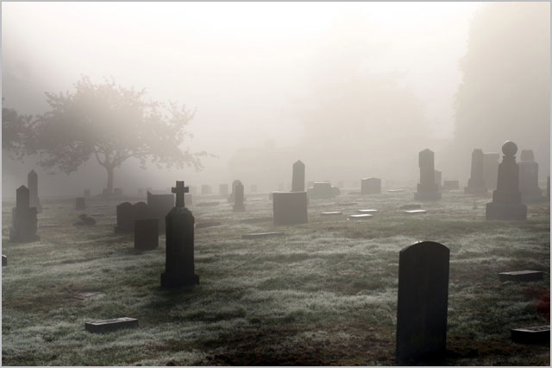
与众不同 却死亡
撒 狄
(启示录 3:1-6)

Slide 4
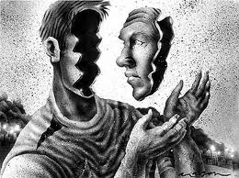
你对自已认识多深？

Slide 5
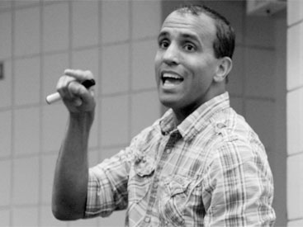
几米•料恩案
Notes:
Jim Keenan is a motivational speaker who runs a website called asalesguy.com. I ran across it this week and found this observation of his very insightful. He writes,
One of our biggest challenges in life is self-assessment. We think we know ourselves pretty well, however the science says different.
As a leader, personal self-assessment is critical to success. We have to be able accurately assess our abilities.
We all have blind spots. Our blind spots are those things that others know about us, that we are unaware of. Our blind spots are those things others see in us, that we can’t see in ourselves.

Slide 6
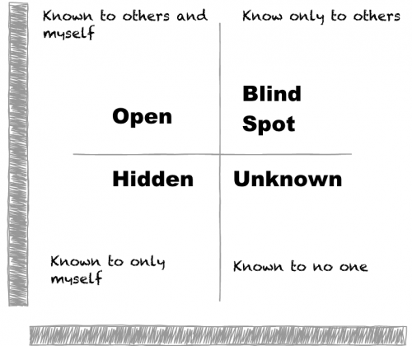
http://asalesguy.com/2012/12/11/how-well-do-you-know-you/
自己与他人知道的
別人知道的
公开
盲点
隐秘
未知的
自己知道的
无人知道的
Notes:
Johari‘s window sums it up nicely like this:
The Open – what others know about us and what we openly share with others
The Hidden – what we know about ourselves that others don’t know. (What we keep hidden from site)
The Unknown – what we don’t know about ourselves and what others don’t know
The Blind Spot – what others know about us, that we don’t know about ourselves
The blind spot is where we get tripped up. It’s the reason we fail and seem perplexed because we thought we did everything right. It’s the date that we thought went awesome yet they don’t want to go out with us again. It’s the co-worker feeling belittled after you thought you had a super productive meeting. The blind spot is the part of us we just don’t see that the rest of the world does that screws everything up.
Do you know your blind spot(s)? Ask around, everyone else does.

Slide 7
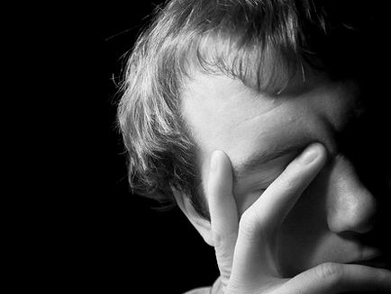
你对自已认识多深？

Slide 8
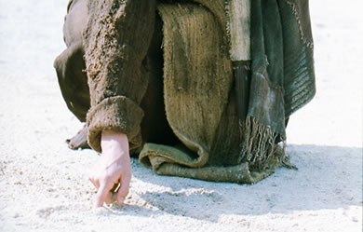
耶稣对你有何想法？
Notes:
We have NO actual accounts of Jesus writing anything except what he wrote in the sand in John 8—and we have no idea what he wrote!

Slide 9

如果耶稣对你写了一封信，
内容会是如何呢？
R
启示录

Slide 10
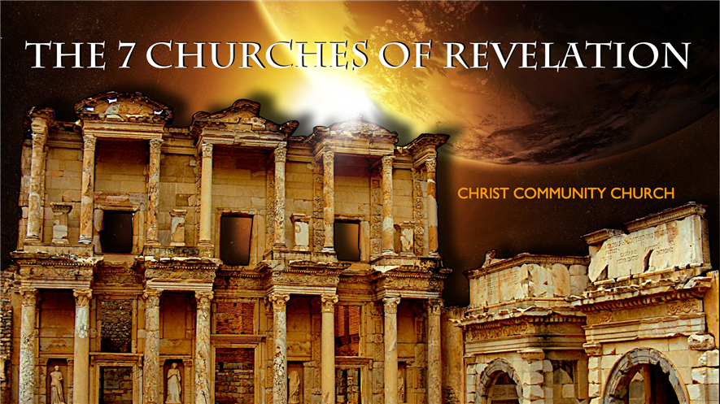
Revelation
耶稣对你有何想法？
耶稣的书写事奉
我们的系列即将完成...

Slide 11
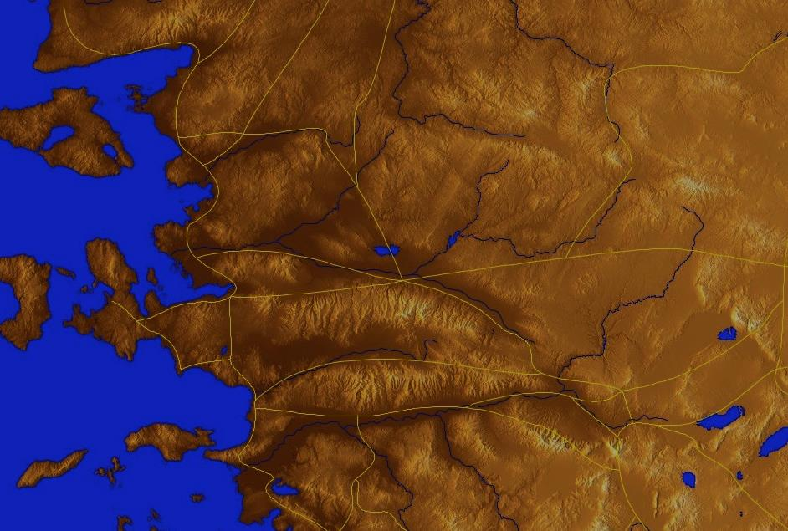
七 个 教 会 (启示录 2–3)
335
Adramyttium
Aezani
别 迦 摩
推 雅 推 喇 城
Cyme
希俄斯
撒 狄
士 每 拿
Eumenia
非 拉 铁 非
勒柏杜斯
Colophon
以 弗 所
尼斯
老 底 嘉
希拉波里斯
Trailes
Heraclea
艾芙洛狄西亚
歌罗西
阿拉班达
拔 摩
米利都
Notes:
Jesus designed a brilliant strategy by having his revelation sent to capital of the province, Ephesus. It included an individual letter to Ephesus, as well as letters to 6 other key churches. The Ephesians copied the entire book of Revelation, though, and sent the original to the next city, Smyrna. Smyrna then made their own copy and sent the original to Pergamum, which lay on the main road to the north. This city then sent the prophecy to Thyatira, which sent it to Sardis, then Philadelphia, and finally to Laodicea.

Slide 12
七 个 教 会 (启示录 2–3)
335
别 迦 摩
推 雅 推 喇 城
撒 狄
士 每 拿
非 拉 铁 非
以 弗 所
老 底 嘉
Notes:
These 7 churches were neither the largest, nor the most influential cities in Asia Minor. However, they were strategically located on a key highway that linked them all.
[Animate} From their own locations we understand that they also copied the prophecy and sent these copies to other churches near them.

Slide 13
七 个 教 会阶段?
324
虐待 却传教使命
痛苦 却坚定
继续 却 妥协
与众不同 却死
忙碌却倒退
I成员 却 不道德
豪华 却 微温
现代的传教使命时代
Constantine
君士坦丁堡
改革
教会 先族
中间的时代
唯物主义
使徒 时代
33
100
313
476
1453
1795
1900
非 拉 铁 非
以 弗 所
士 每 拿
别 迦 摩
推 雅 推 喇 城
撒 狄
老 底 嘉
Notes:
33—The Apostles of Christ pass on the gospel, but by AD 95 the love at Ephesus had grown cold
100—Last Apostle died (John) with the message passed on to their disciples, called the "Church Fathers"
313—Constantine began to merge Christianity and paganism. With paganism illegal, it took on a "Christianized" form.
476—Rome's Fall ushered in 1000 years of deviation from classical learning called the "Middle Ages" with Rome's influence through the RCC
1453—The conquest of Constantinople by the Turks began the Renaissance, followed by the Reformation
1793—William Carey left England for India, sparking the movement of the gospel from the West to the Two-Thirds World
1900—The decline of Christianity in Europe began to be replaced with humanism, materialism, modernism, and post-modernism

Slide 14
启示录2-3章的四个观点
345
别 迦 摩
"过去派"
"历史派"-
"将来派"
"将来派"
推 雅 推 喇 城
撒 狄
士 每 拿
非 拉 铁 非
以 弗 所
老 底 嘉
代表派
Notes:
Four Views:
Historic Churches: The 7 churches were actual churches at John’s time. All actually hold to this view except Bulllinger, who in 1935 taught seven churches are seven Jewish congregations in the future Tribulation period. Almost all see these as depicting seven churches that can be found in any age.
Prophetic: The chapters deal purely with stages of church history without identifying any first century church, shown by remarkable resemblance to successive eras of church history (taught by Cohen, Understanding Revelation, 48-49; and J. A. Seiss, The Apocalypse [London: Marshall, Morgan, and Scott, n.d.], 76-86).
Historico-Prophetical: The churches depict BOTH historic churches of the first century and stages of church history. "This approach is commonly taken in dispensational commentaries; see e.g., Herman A. Hoyt, The Revelation of the Lord Jesus Christ (Winona Lake, IN: BMH, 1966) 17,25-29, and John F. Walvoord, The Revelation of Jesus Christ (Chicago: Moody, 1966) 52, who holds the view cautiously. See also Menno J. Brunk, "The Seven Churches in Revelation 2-3," BSac 126 (1969) 240-46, and Gary G. Cohen, Understanding Revelation (Collingswood, NJ: Christian Beacon, 1968) 44-65, who presents a more impressive argument. Of course, the prophetic view is held by non-dispensationalists as well (e.g., J. P. Lange, Commentary on the Holy Scriptures- Revelation [reprint; Grand Rapids: Zondervan, n.d.] 139). See also the survey of R. C. Trench, Commentary on the Epistles to the Seven Churches in Asia (6th ed., rev.; reprint; Minneapolis: Klock and Klock, 1978) 237-45" (James L. Boyer, "Are the Churches of Revelation 2–3 Prophetic?" Grace Theological Journal 6.2 [1985] 267-273). He answers YES.
Typical (Representative): They were real churches, but also represent types of churches found throughout church history. Therefore, this view is also called the typical or representative view.
Critique:
Historic Churches: The doubt about whether all of the churches existed is flawed—just because we don’t know about each of them does not mean they did not exist (argument from silence)
Historico-Prophetical: Church history had not 7, but 3, stages: Ancient (to 590), Medieval (590-1517), and Modern (1517-present); designations are arbitrary (e.g., is Sardis pre-Reformation or the Reformation itself?)
Prophetic: (a) Any prophetic element would destroy the doctrine of imminency, so the chapters must relate only to actual first century churches since the 4th and 6th letters refer to Christ’s imminent coming, and Philadelphia would be given a false hope of deliverance from wrath (3:10) if the church had to wait until the "Laodicean age." (b) Nothing in these chapters or elsewhere in the NT hint at these being stages of church history. (c) These letters differ from the prophetic portions of the book (Rev. 4–22) in that they are simply epistles similar to those written by Paul.
Typical (Representative): (a) Imminency would be ruined only "if it stated explicitly there would be a period of at least two thousand years before the second advent, or even if it had stated explicitly that there would be ‘seven periods of church history’ (Boyer, 269-70. (b) These seven churches do not represent all types of churches of the first century or any other, for other types exist besides these (e.g., Galatian or Corinthian), and "seven" better pictures the whole of the church age than would the 3 stages proposed above.

Slide 15
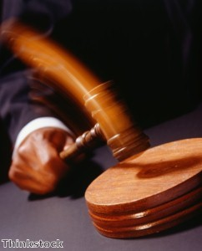
耶稣持有着 对个大教会的 权威

Slide 16
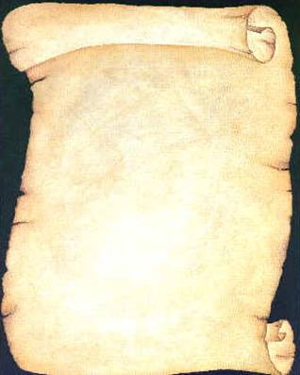
耶稣写信给了七间教会
(启示录 2–3)
以 弗 所
士 每 拿
别 迦 摩
推 雅 推 喇 城
撒 狄
非 拉 铁 非
老 底 嘉

Slide 17
启示录
基督的主权在未来的胜利
主权是属于基督 |  |  | 主权在教会 | 主权在末日的事件
第 1 章 |  |  | 第 2–3 章 | 第 4–22 章
"你看到什么" (1:19a) |  |  | "现在是什么" (1:19b) | "以后会发生什么" (1:19c)
过去 |  |  | 现在 | 未来
基督揭露 |  |  | 教会揭露 | 完成揭露
上帝在地上 |  |  | 上帝的使者 在地上 | 从地狱在地上到天堂地上
审判官 |  |  | 任务 | 判决和奖励
主题 1:1-3 | 敬拜三位一体神 1:4-8 | 荣耀耶稣基督 1:9- 20 | 小亚细亚七教会: 以弗所、士每拿、别迦摩、推雅推喇、撒狄、非拉铁非、 老底嘉 | 苦难 4:1– 19:10 | 第二次来 19:11-21 | 千禧年 20 | 永恒的状态 21:1–22:5 | 终结的迫切性 22:6-21
A.D. 95
318

Slide 18
七 个 教 会 (启2–3)
335
许诺
别 迦 摩
警告
推 雅 推 喇 城
告诫
训斥
表扬
士 每 拿
撒 狄
不适用
监督
不适用
不适用
不适用
以 弗 所
非 拉 铁 非
不适用
老 底 嘉
Notes:
Though some exceptions exist (noted with "N/A" above), the basic pattern of the seven letters is a sevenfold outline:
Church name
Christ Described in a Unique Way for that Church
Commendation of Good Deeds among the Believers
Rebuke of Sin within the Church
Exhortation or Encouragement to Repent
Warning if the Exhortation is Disobeyed
Promise for Faithfulness
Notice also that each letter not only begins with a reference to Christ but ends with an appeal from the Spirit.

Slide 19

克林特·
伊斯特
伍德
1966
好的
恶的
丑陋的

Slide 20
耶稣全
知道
撒狄教会
(启示录 3:1-6)

Slide 21

I. 耶稣知道那美好的。

Slide 22
耶稣以好消息鼓励撒狄，牠是至高统治者並知道他们的信实 (3:1-2a)
335
Adramyttium
Aezani
别 迦 摩
推 雅 推 喇 城
Cyme
希俄斯
撒 狄
士 每 拿
Eumenia
非 拉 铁 非
勒柏杜斯
Colophon
以 弗 所
尼斯
老 底 嘉
希拉波里斯
Trailes
Heraclea
艾芙洛狄西亚
歌罗西
阿拉班达
拔 摩
米利都
Notes:
Jesus designed a brilliant strategy by having his revelation sent to capital of the province, Ephesus. It included an individual letter to Ephesus, as well as letters to 6 other key churches. The Ephesians copied the entire book of Revelation, though, and sent the original to the next city, Smyrna. Smyrna then made their own copy and sent the original to Pergamum, which lay on the main road to the north. This city then sent the prophecy to Thyatira, which sent it to Sardis, then Philadelphia, and finally to Laodicea.

Slide 23
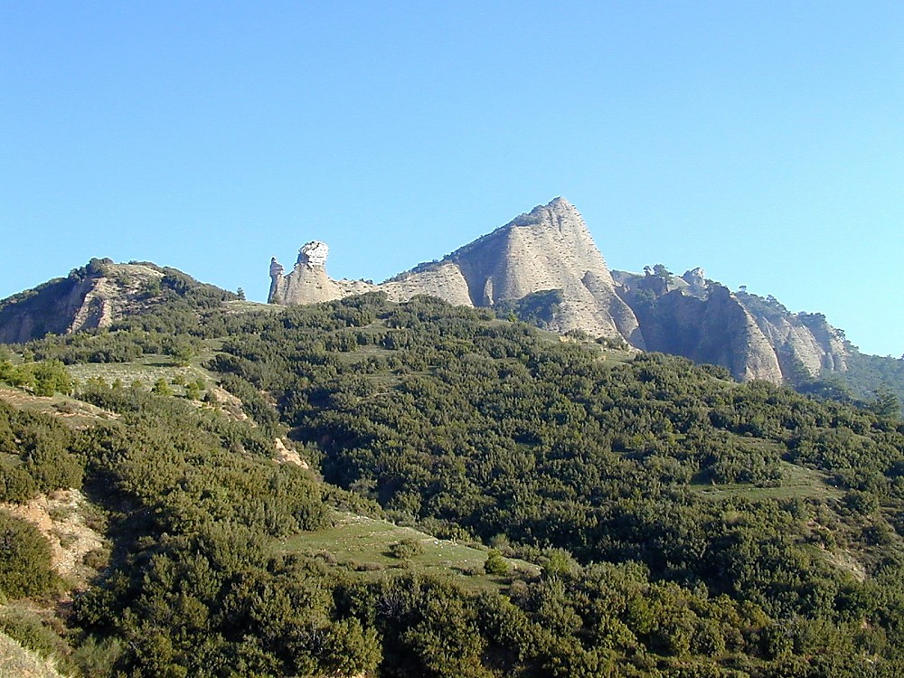

Sardis acropolis from below
撒狄雅典卫城往上观望
Notes:
Historical Background
Sardis was a city of Roman Asia, located in western modern-day Turkey. The acropolis of Sardis, large and imposing, is part of the edge of the mountain range Tmolus, forming a natural fortress difficult to penetrate. Unfortunately, few ruins have been found upon it.
Lydia—Founded in 1200 B.C., Sardis was the capital of the Lydian kingdom under King Gyges. It was a prosperous city, especially under Croesus; its wealth was thought to come from the Pactolis River, which ran through the ancient city. According to mythology, this was the river of the great Phrygian King Midas, in which he washed to cleanse himself of his "golden touch," which even turned his food to gold. Gold found on the banks of the Pactolis was used for the production of gold coins during this time.
Persia—When Kings Cyrus of the Persians besieged and took the city (then called Pers Sparda) in 546 B.C., Lydian control came to an end. Cyrus took the citadel by means of scaling the cliffs in the dark of night, a method repeated years later (214 B.C.) by Antiochus the Great.
Greece—Alexander the Great gave Sardis its independence in 333 B.C. Sardis was under Seleucid control from 270-190 B.C.
Rome—In 188 B.C. the Romans defeated Antiochus III and gave Sardis to King Eumenes II of Pergamos, who held control until 133 B.C. when it came back to Roman power. Sardis honored various Roman Caesars and remained a prominent city until ca. 26 A.D., when it lost out to Smyrna for the privilege of building the imperial temple.

Slide 24
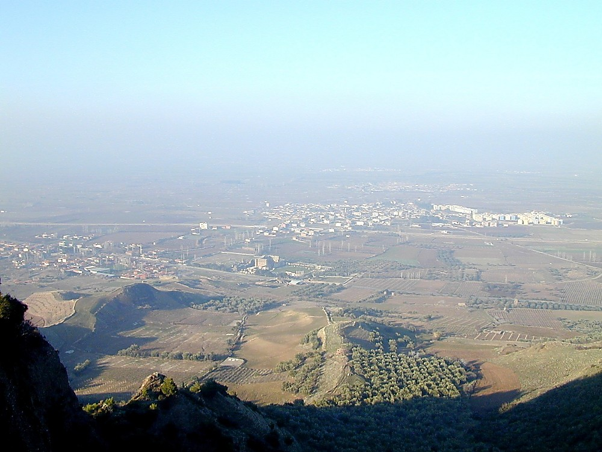
Sardis from acropolis
撒狄从雅典卫城观望
Notes:
Biblical Significance
Sardis became an important center for Christianity during Roman times. In fact, it is one of the seven churches to whom the John wrote the letters mentioned in Revelation 1:11. However, John’s letter to Sardis (Revelation 3:1-6) reveals that the attitude of the believers in the city reflected that of the city as a whole, resting on past reputation and not being faithful. In fact, Sardis was more completely rebuked than any city, aside from Laodicea. Sardis remained a center for Christianity well into the 14th century A.D.

Slide 25
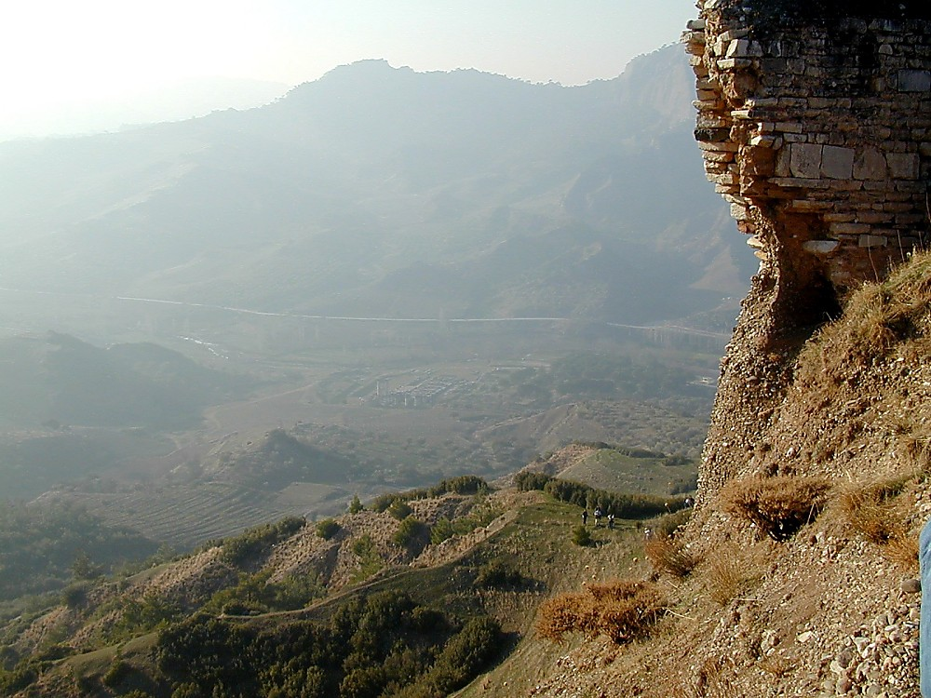
Sardis Temple of Artemis from above
撒狄的阿耳忒弥斯神庙往下观望
Notes:
Artemis was held to be one of the patron deities of Sardis, along with Cybele. A temple dedicated to Artemis lies at the foot of the steep acropolis.

Slide 26
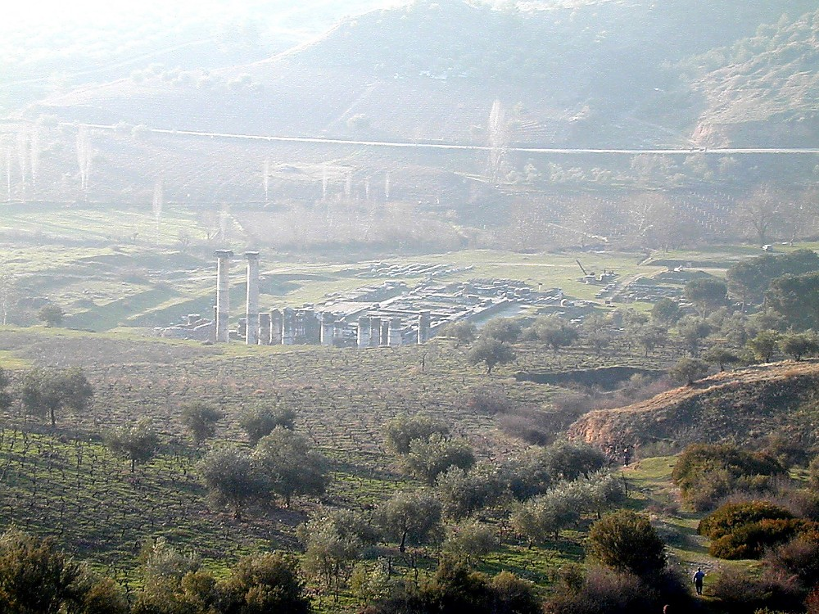
Sardis Temple of Artemis from above
撒狄的阿耳忒弥斯神庙往下观望
Notes:
This temple to Artemis was built by Croesus in the 6th century B.C. but was then destroyed in the Ionian Revolt of 499 B.C. It was a magnificent structure, the fourth-largest Ionic-style temple existing in the ancient world. Alexander the Great began to rebuild this temple in 334 B.C. but never finished. Its remains were covered over by landslides from an earthquake in 17 A.D.

Slide 27
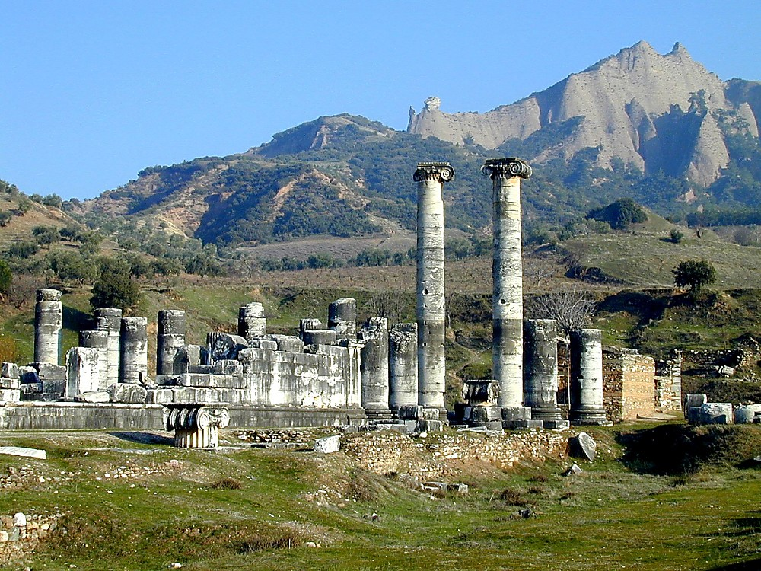
Sardis Temple of Artemis
撒狄的阿耳忒弥斯神庙

Slide 28
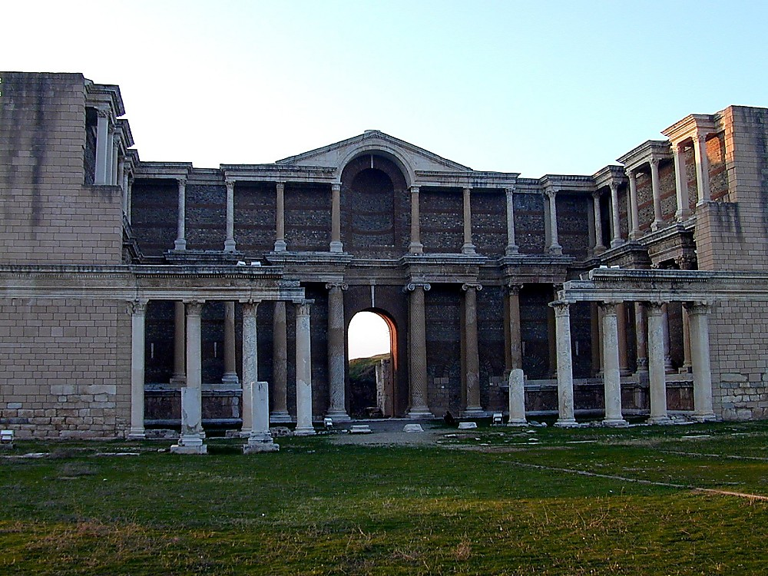
Sardis gymnasium
撒狄体育馆

Slide 29
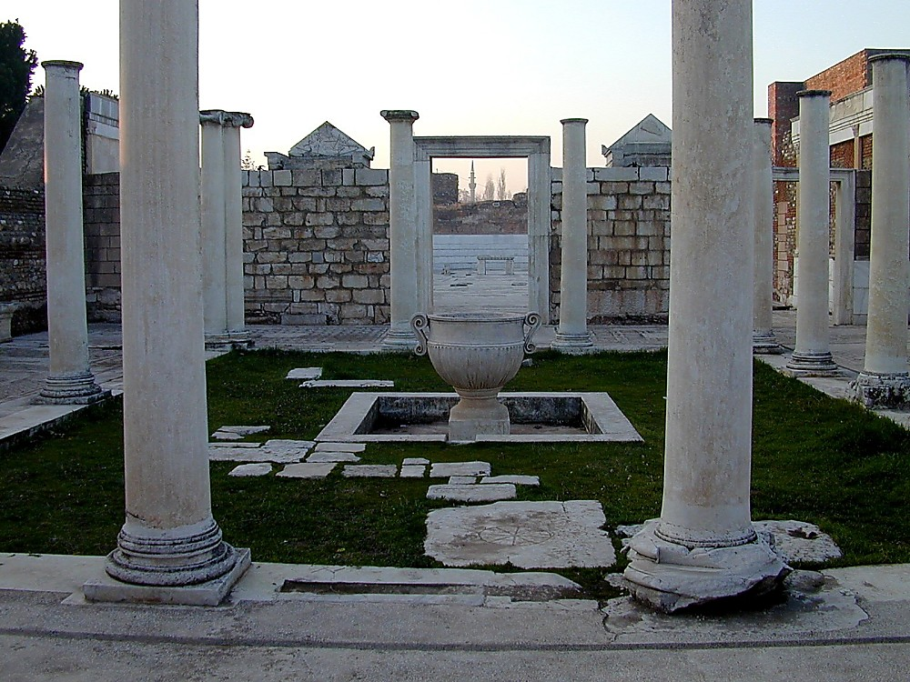
Sardis synagogue, 4th c AD
撒狄犹太教堂, 公元四年
Notes:
Jews in Sardis
There was a large Jewish Diaspora community in Sardis during Roman times, which may have existed for centuries before. The Sepharad (Aramaic name for Sardis) mentioned in Obadiah 20 (these being exiles from Jerusalem ca. 586 B.C.) may refer to Sardis. Seleucid King Antiochus III (late third century B.C.) expanded the Jewish community by means of transferring Jews from Mesopotamia to Lydia.
According to Josephus, Jews of Sardis were granted various privileges during the time of Julius Caesar, including the right to send temple tax to Jerusalem, to have a communal life and conduct suits among themselves, and to receive provisions of ritually clean food.
The approximately eighty inscriptions found in this ostentatious structure reveal that many Jews held high positions, serving on the city council or as wealthy citizens of Sardis. This synagogue (called Beth Alpha) found next to the Marble Hall attests this, since it is the largest synagogue ever found. These remains date to the 4th century A.D., but the three other levels found show that a structure existed here since the 2nd century A.D., although it may have served a different purpose (possibly a basilica).

Slide 30
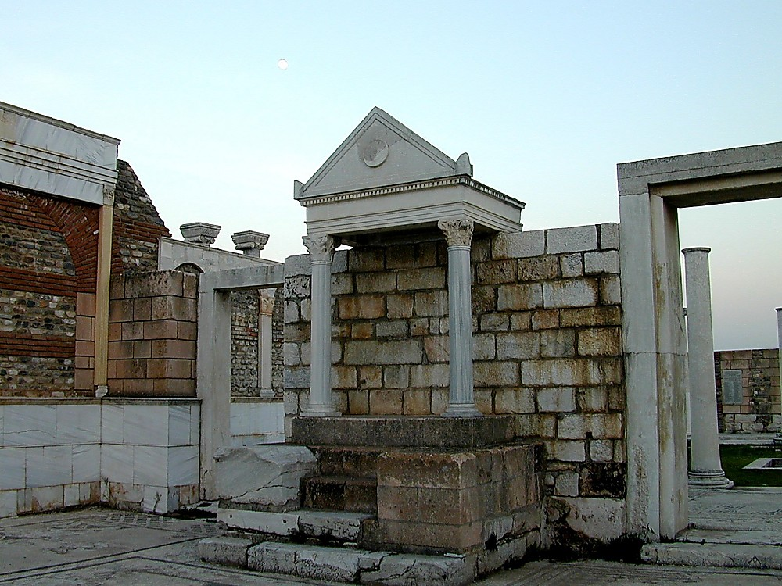
Sardis synagogue bema
撒狄犹太教堂讲坛

Slide 31
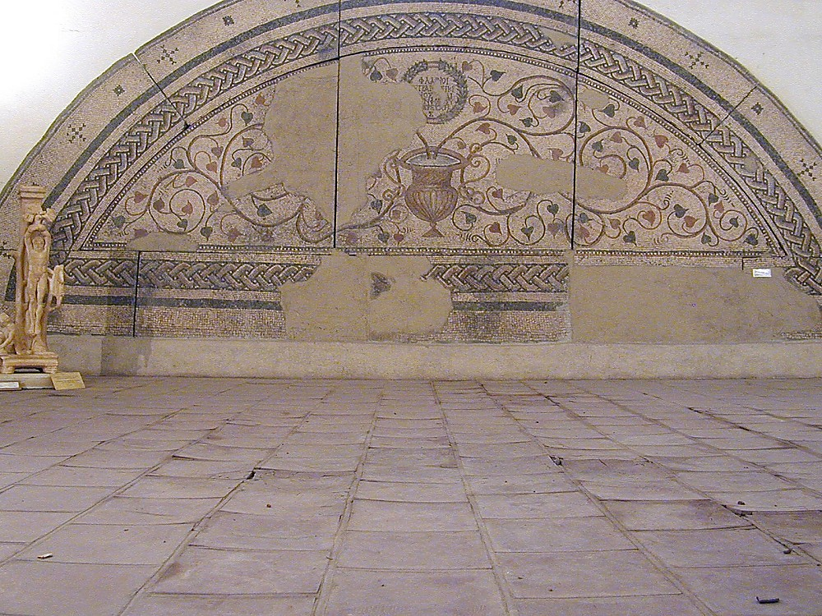
Sardis synagogue mosaic, 400 AD
撒狄犹太教堂镶嵌图案, 公元四百年

Slide 32
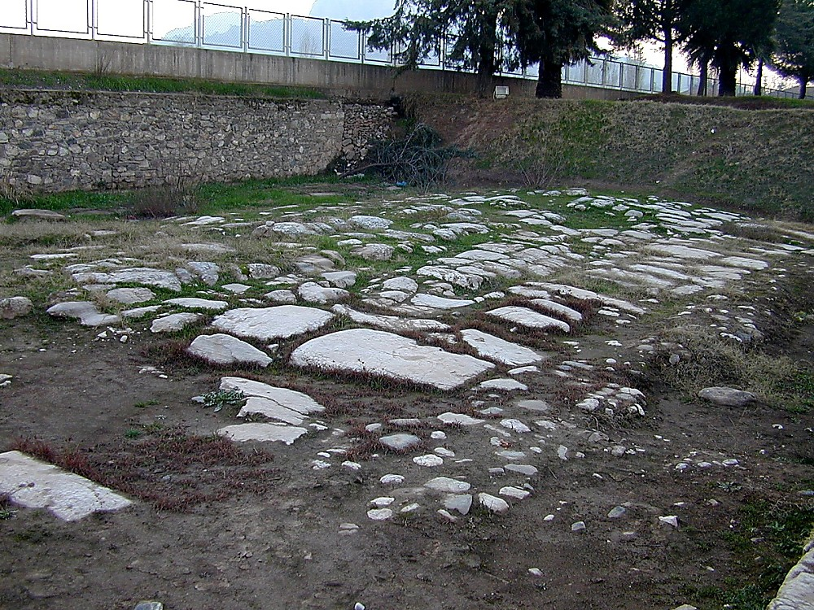
Sardis paved Roman street leading to Persia
撒狄到波斯的罗马式铺面道路
Notes:
Part of Sardis’s prosperity was based upon its location, which was at the crossroads of several major trade routes.

Slide 33
撒 狄 (启3：1-6)
324
别 迦 摩
推 雅 推 喇 城
撒 狄
基督:
那 有 神 的 七 灵 和 七 星 的
士 每 拿
以 弗 所
非 拉 铁 非
老 底 嘉

Slide 34
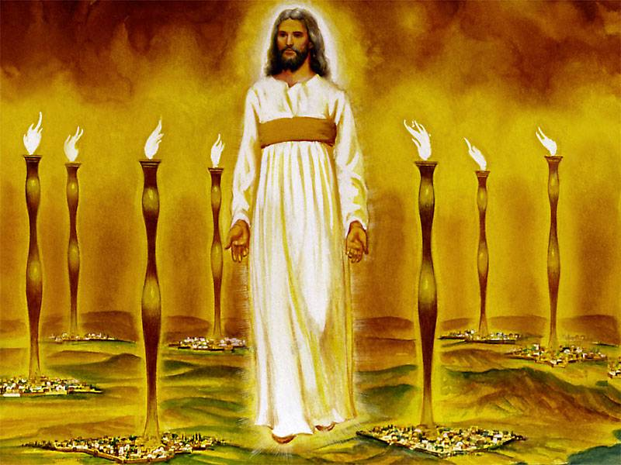
约翰预言那位荣耀的耶稣已见证了祂能处理教会内的问题
(1:12-16)
343
Notes:
"Christ's garments are those of a Judge-King, One with honor and authority. The white hair symbolizes His eternality, "the Ancient of Days" (Dan. 7:9, 13, 22). His eyes see all (Rev. 19:12; Heb. 4:12), enabling Him to judge righteously. His feet of burning brass also suggest judgment, since the brazen altar was the place where the fire consumed the sin offering. The Lord had come to judge the churches, and He would also judge the evil world system.
The "sound of many waters" (Rev. 1:15) makes me think of Niagara Falls! Perhaps two ideas are suggested here: (1) Christ gathers together all the "streams of revelation" and is the Father's "last Word" to man (Heb. 1:1–3); (2) He speaks with power and authority and must be heard. The sword from His mouth certainly represents the living Word of God (Heb. 4:12; Eph. 6:17). He fights His enemies by using His Word (Rev. 2:16; 19:19–21)" (Wiersbe).

Slide 35

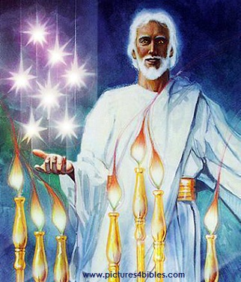
那七星和七个金灯台的奥秘是什么(1:20 新译本)?
你所看见在我右手中的七星和七个金灯台的奥祕就是这样： 七星是七个教会的使者， 七灯台是七个教会。"

Slide 36
撒 狄 (启3：1-6)
324
别 迦 摩
推 雅 推 喇 城
表扬:
我 知 道
你 的 行 为 ，
按 名 你 是 活 的
撒 狄
基督:
那 有 神 的 七 灵 和 七 星 的
士 每 拿
以 弗 所
非 拉 铁 非
老 底 嘉

Slide 37

耶稣知道你的好行为和名声

Slide 38

你有多在意？

Slide 39
I. 耶稣知道那美好的。

Slide 40
II. 耶稣知道那恶的。

Slide 41
撒 狄 (启3：1-6)
324
别 迦 摩
推 雅 推 喇 城
训斥
其 实 是 死 的
表扬:
我 知 道
你 的 行 为 ，
按 名 你 是 活 的
撒 狄
基督:
那 有 神 的 七 灵 和 七 星 的
士 每 拿
以 弗 所
非 拉 铁 非
老 底 嘉

Slide 42
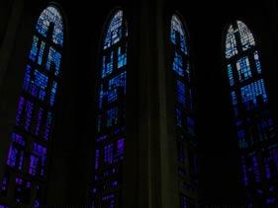
撒 狄: 与众不同却死亡
"按 名 你 是 活 的 ， 其 实 是 死 的 。" (3:1)

Slide 43
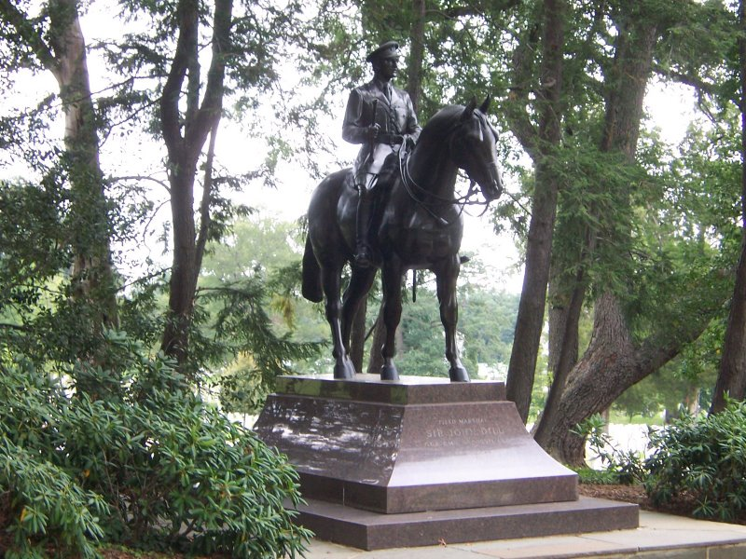
撒 狄: 与众不同却死亡

Slide 44
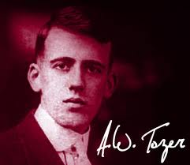
A. W. Tozer
"假设圣灵退出了现今的教会,百分之95我们所行的会继续並且没人知道那差异。假设圣灵从退出了新约教会，百分之95他们所行的将会停止，並每个人会知道其差异。"
Notes:
http://www.patheos.com/blogs/robertcrosby/2012/05/a-w-tozer-on-the-holy-spirit-todays-church/

Slide 45
撒 狄 (启3：1-6)
324
别 迦 摩
推 雅 推 喇 城
劝告：
遵 守 我 ，
忍 耐 的 道
训斥
无
表扬:
你 略 有 一 点 力 量 ， 也 曾 遵 守 我 的 道 ， 没 有 弃 绝
我 的 名
撒 狄
基督:
那 圣 洁 、 真 实 、 拿 着 大 卫 的 钥 匙
士 每 拿
以 弗 所
非 拉 铁 非
老 底 嘉

Slide 46
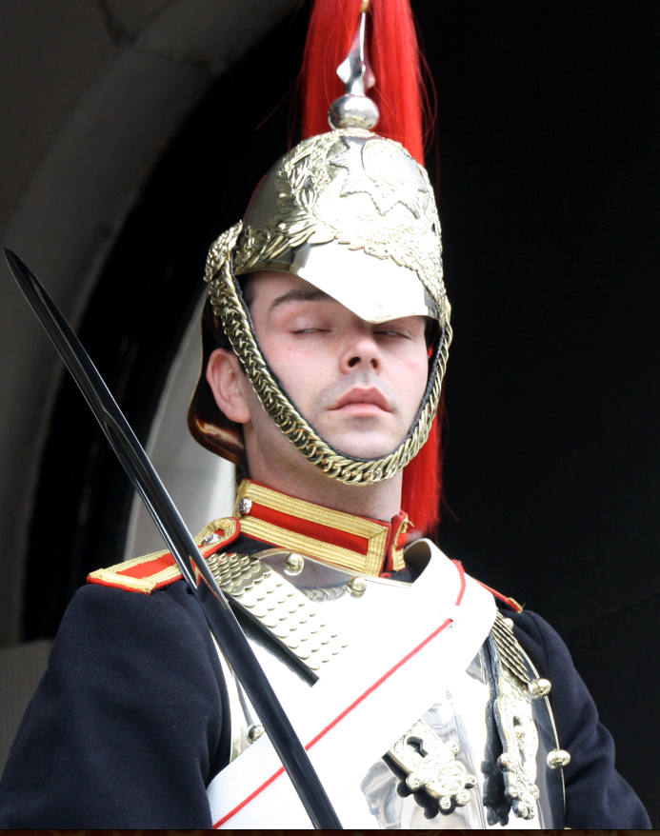
撒 狄
358
你 要 儆 醒 ， 坚 固 那 剩 下 将 要 衰 微 （ 原 文 是 死 ） 的 (3:2)

Slide 47
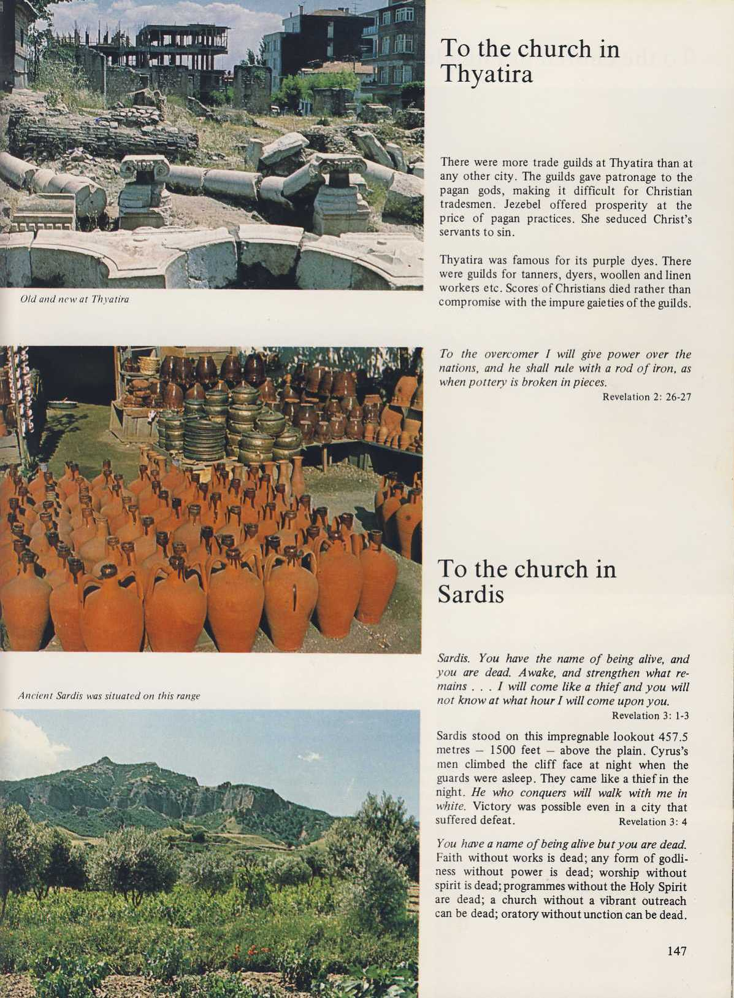
撒 狄
358
撒 狄 城就处在这狭长陡峭的高原上（ 457.5 米 或1500 尺高) ，犹如一个坚不可摧的瞭望台。公元前549年波斯王古列 （居鲁士）的士兵趁它的卫兵晚上熟睡时，成功的攀上北崖, 侵占撒狄城。三个世纪后 (公元前214年), 叙利亚西流古王朝的安提阿哥大帝再以同样的策略进攻获胜。

Slide 48
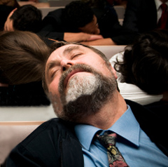
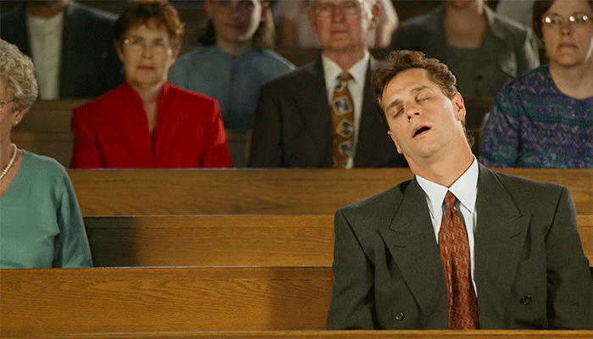
在教堂睡觉

Slide 49
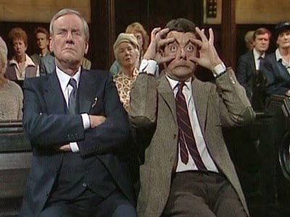
不在教堂睡觉

Slide 50
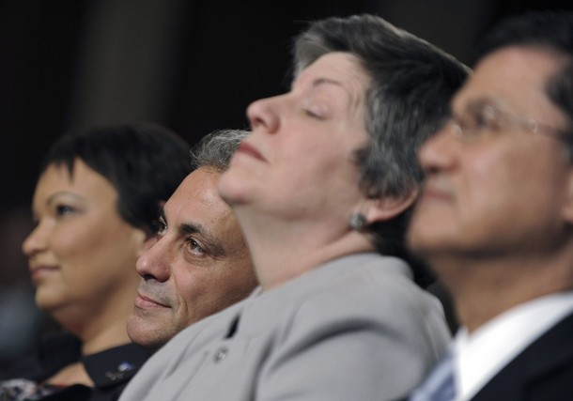
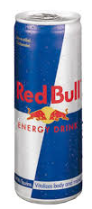
当牧师看到你在崇拜中打盹的迹象:
他为你在崇拜中提供红牛维他命饮料
Notes:
http://sacredsandwich.com/archives/8371

Slide 51
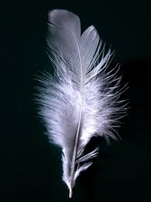
当牧师看到你在崇拜中打盹的迹象:
他中断他的讲道， 他将剃须膏放至你手心里，再用羽毛挠你的鼻子。

Slide 52
当牧师看到你在崇拜中打盹的迹象:
因为你无法聚精会神，他开始𠆤怀疑他的呼唤, 然后停职，开始酗酒，孤单的死在旅馆里。
Notes:
http://sacredsandwich.com/archives/8371

Slide 53
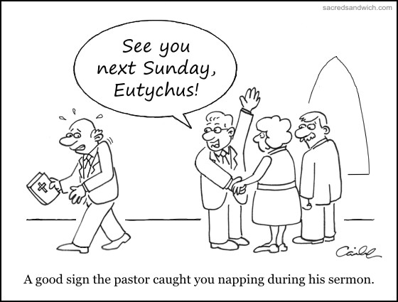
Sleeping in Church
下星期天见,犹推古!
牧教认出你在崇拜中打盹的迹象。
Notes:
http://sacredsandwich.com/archives/8371

Slide 54
撒 狄 (启3：1-6)
324
警告：
无
别 迦 摩
推 雅 推 喇 城
劝告：
遵 守 我 ，
忍 耐 的 道
训斥
无
表扬:
你 略 有 一 点 力 量 ， 也 曾 遵 守 我 的 道 ， 没 有 弃 绝
我 的 名
撒 狄
基督:
那 圣 洁 、 真 实 、 拿 着 大 卫 的 钥 匙
士 每 拿
以 弗 所
非 拉 铁 非
老 底 嘉

Slide 55
撒 狄
358
你 要 儆 醒 ， 坚 固 那 剩 下 将 要 衰 微 （ 原 文 是 死 ） 的 ；. . .
若 不 儆 醒 ， 我 必 临 到 你 那 里 ， 如 同 贼 一 样 。 我 几 时 临 到 ， 你 也 决 不 能 知 道 。(3:2-3)

Slide 56
醒来吧
自己与他人知道的
別人知道的
• 家人
• 灵命缺养
公开
盲点
隐秘
未知的
http://asalesguy.com/2012/12/11/how-well-do-you-know-you/
自己知道的
无人知道的
Notes:
Johari‘s window sums it up nicely like this:
The Open – what others know about us and what we openly share with others
The Hidden – what we know about ourselves that others don’t know. (What we keep hidden from site)
The Unknown – what we don’t know about ourselves and what others don’t know
The Blind Spot – what others know about us, that we don’t know about ourselves
The blind spot is where we get tripped up. It’s the reason we fail and seem perplexed because we thought we did everything right. It’s the date that we thought went awesome yet they don’t want to go out with us again. It’s the co-worker feeling belittled after you thought you had a super productive meeting. The blind spot is the part of us we just don’t see that the rest of the world does that screws everything up.
Do you know your blind spot(s)? Ask around, everyone else does.

Slide 57
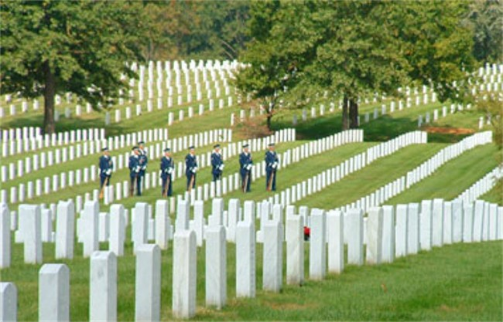
耶稣提醒教会也要警醒
祂擁有我们所有一切
关心他人也意味着关心他们的孩子

Slide 58
I. 耶稣知道那美好的。

Slide 59
II. 耶稣知道那恶的。

Slide 60
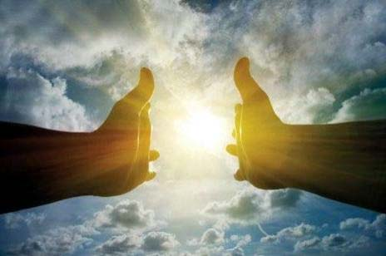
III. 耶稣知道未来。

Slide 61
撒 狄 (启3：1-6)
324
警告：
无
别 迦 摩
许诺
得 胜 的 ， 我 要 叫 他 在 我 神 殿 中 作 柱 子 ， 他 也 必 不 再 从 那 里 出 去 。 我 又 要 将 我 神 的 名 和 我 神 城 的 名 （ 这 城 就 是 从 天 上 、 从 我 神 那 里 降 下 来 的 新 耶 路 撒 冷 ） ， 并 我 的 新 名 ， 都 写 在 他 上 面
推 雅 推 喇 城
劝告：
遵 守 我 ，
忍 耐 的 道
训斥
无
表扬:
你 略 有 一 点 力 量 ， 也 曾 遵 守 我 的 道 ， 没 有 弃 绝
我 的 名
撒 狄
基督:
那 圣 洁 、 真 实 、 拿 着 大 卫 的 钥 匙
士 每 拿
以 弗 所
非 拉 铁 非
老 底 嘉

Slide 62
得胜者 (启示录 2–3)
325
别迦摩
推雅推喇
2:17
2:26
凡得胜
的必这样
穿白衣，我也必不从生命册上涂抹他的名；且要在我父
面前，和我父众使者面前 ，
认他的名
（3:5）
士每拿
撒狄
2:11
3:5
以弗所
非拉铁非
2:7
老底嘉

Slide 63
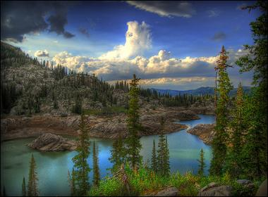
耶稣为你预備了美好的未来!
"圣灵向众教会所说的话，凡有耳的，就应当听。 " (3:6 新译本)

Slide 64
如果耶稣对你写了一封信，
内容会是如何呢？
R
启示录

Slide 65
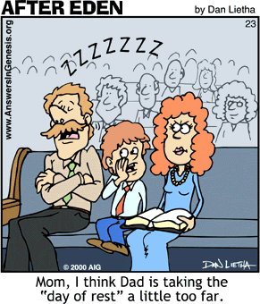
重点？
伊甸园之后
別在
教堂
睡觉!
妈妈,爸爸休息日的实践太过火了。

Slide 66

重点:
耶稣知道你的善，恶与
未来!

Slide 67

Will you wake up?
新年
新年
去起作用

Slide 68

你会醒悟吗?
会
不会

Slide 69
非 拉 铁 非
启示录 3:7-13

Slide 70

饱受折磨却传教使命
非 拉 铁 非
(3:7-13)
Dr. Rick Griffith • Singapore Bible College • biblestudydownloads.com

Slide 71
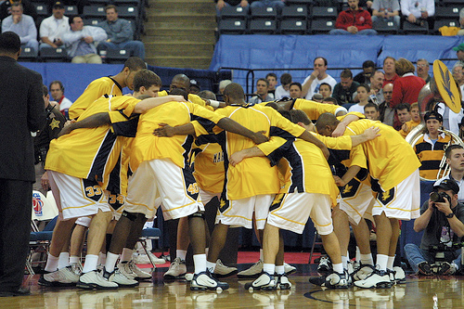
聚集

Slide 72

谁讨厌合一呢？
没一人

Slide 73
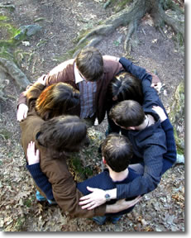
我们团结
感谢上帝让我们团结虽然我们来自16个国家!

Slide 74
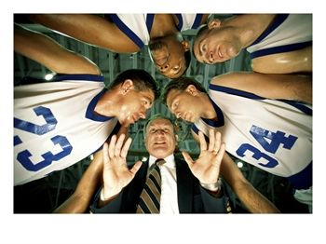
挤作一团

Slide 75

The Holy Huddle
圣洁的合一
敬拜 • 合一 • 专注

Slide 76

圣洁的合一
每个人如同我们看•行•唱•闻！

Slide 77
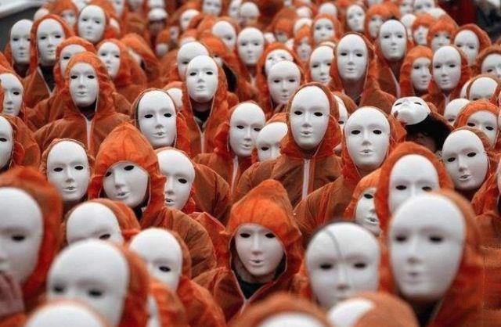
圣洁的聚集
一致—
不是合一

Slide 78

你为何喜欢中国人民保险公司 ?

Slide 79

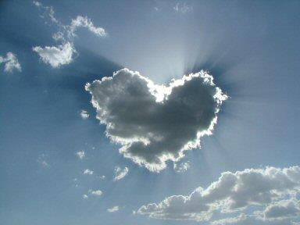

我们的异像是 …
爱神
十字路口的
国际礼拜堂
爱教会
一个身体，许多肢体
Notes:
• Love God
Where it starts—and ends—is in our call to LOVE. As Paul noted, "The greatest of these is love" (1 Cor. 13:13).
What is the most important thing we do as a church? It begins with loving the God who loves us.
• Love Church
Do you genuinely love him? If you don’t, then nothing else you do counts, really.
The second thing He said right after this: to love your neighbor as yourself.
• Love Nations
But who is your neighbor? It starts right here in the body—to love the church—but then it extends from this "close neighbor" to those who are out of the reach of this fellowship where we love the nations. Our leadership is committed to make all that we do revolve around one of these three priorities.
79

Slide 80

你要我们一直是
小孩吗?
Where everyone looks like you
Notes:
But do you want our church to remain small?
Do you fear us getting big where we lose our family atmosphere?
Do you fight growth?
Or do you enfold new people?
Do you invite others to church?

Slide 81
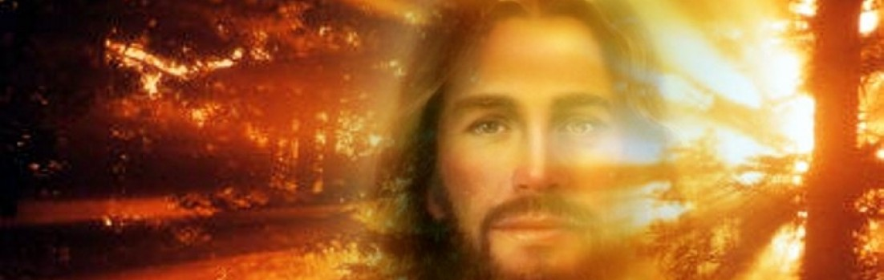
耶稣要我们做什么?
祂不是要我们传福音吗?
祂如何鼓励我们传福音?

Slide 82
Revelation
启示录中的七教会
耶稣的文字事工
我们的系列即将完成
Notes:
Slide 80

Slide 83
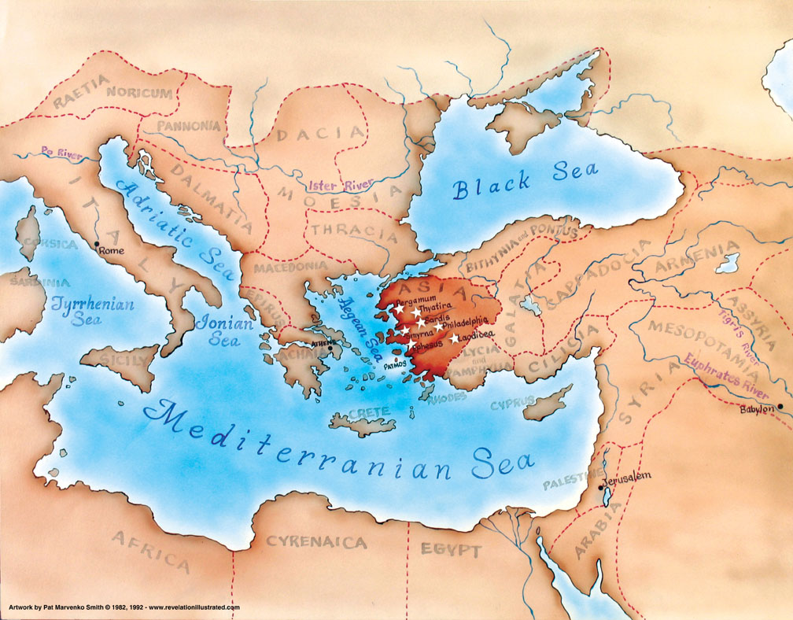
小亚细亚 公元95年
321

Slide 84
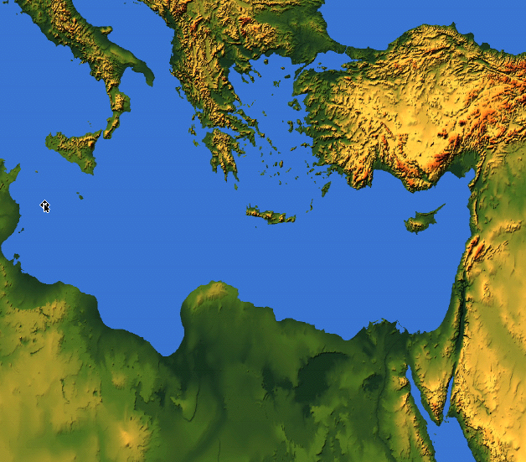
约翰看见了什么？
亚洲的教会
罗马
外部的迫害
来自罗马
(1:9; 2:9-10; 3:10)
教会 内部挣扎
(2:4, 14-15, 21-24;
3:1, 15-17)

Slide 85
交叉体 (启示录 2–3)
335
以弗所
生存被受威胁
士每拿
迫害时
仍然信实
别迦摩
情况参杂
推雅推喇
撒狄
非拉铁非
老底嘉

Slide 86
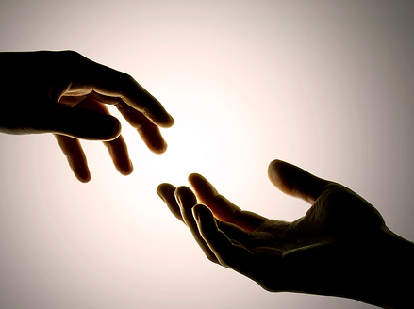
耶稣如何鼓励我们
走出去?
两方面…
启. 3:7-13

Slide 87
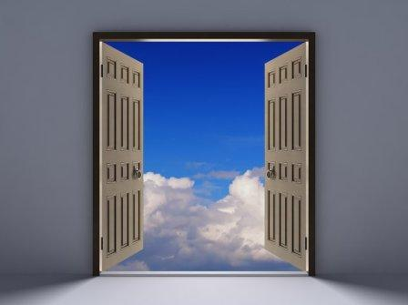
I. 耶稣开门见证(3:7-8) 。

Slide 88
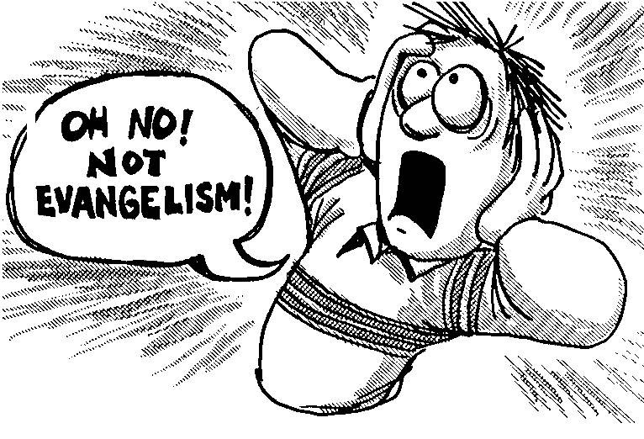
不，不要传福音!

Slide 89
  耶稣给非拉铁非教会做见证(3:7-8).

Slide 90
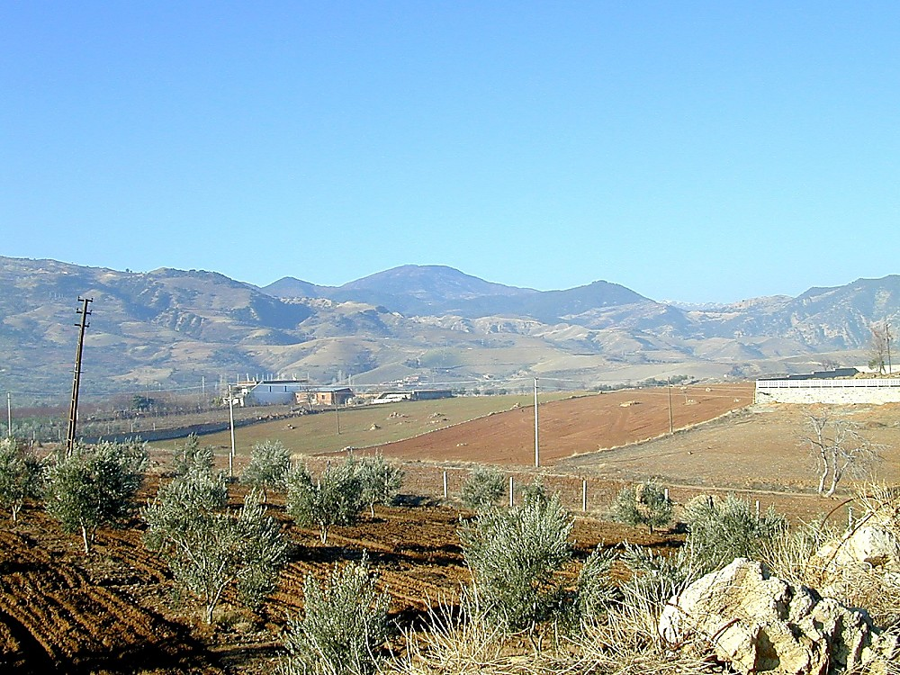
Philadelphia view to south from acropolis
Eumenes II, king of Pergamum所建立,
或兄弟, Attalus II Philadelphus
(统治,公元前159-138),
意思是"兄弟的爱人"
从雅典卫城观望费城南部
Notes:
Historical Background (BiblePlaces.com)
Philadelphia was founded either by Eumenes II, king of Pergamum, or his younger brother Attalus II, who reigned from 159-138 B.C. Founded in honor of Attalus II, the name of the city means "lover of his brother." This refers to Attalus’ loyalty to his brother in refusing to overthrow him, even amidst encouragement from advisors to do so.
At the edge of the Katakekaumene (the "burned land") was a fertile volcanic plain suitable for agriculture, especially grapes; Philadelphia came to be known for its grape production. It was located in a region plagued by many earthquakes, which severely damaged the city in 17 and 23 A.D. Out of gratitude to Emperor Tiberius for his help in rebuilding it, the city took on the name Neo Caesarea. Emperor Rasmanianus changed this name to Plabia, after his wife, but this name also quickly went out of use.

Slide 91
七 个 教 会 (启示录 2–3)
335
Adramyttium
Aezani
别 迦 摩
推 雅 推 喇 城
Cyme
Erythrae
撒 狄
士 每 拿
Eumenia
非 拉 铁 非
Lebedus
Colophon
以 弗 所
Nysa
老 底 嘉
Hierapolis
Trailes
Heraclea
Aphrodisias
Colossae
Alabanda
拔 摩
Miletus
Notes:
Jesus designed a brilliant strategy by having his revelation sent to capital of the province, Ephesus. It included an individual letter to Ephesus, as well as letters to 6 other key churches. The Ephesians copied the entire book of Revelation, though, and sent the original to the next city, Smyrna. Smyrna then made their own copy and sent the original to Pergamum, which lay on the main road to the north. This city then sent the prophecy to Thyatira, which sent it to Sardis, then Philadelphia, and finally to Laodicea.

Slide 92
撒 狄 (Rev. 3：7-13)
324
别 迦 摩
推 雅 推 喇 城
撒 狄
基督:
那 圣 洁 、 真 实 、 拿 着 大 卫 的 钥 匙
士 每 拿
以 弗 所
非 拉 铁 非
老 底 嘉

Slide 93

"那圣洁的、 真实的，
拿着大卫的钥匙"
(3:7b 新译本)
Notes:
"Holy" means Christ is worthy to judge the spiritual life of the Philadelphia church.

Slide 94


"我必把大卫家的钥匙放在他肩头上； 他开了， 就没有人能关；
他关了， 就没有人能开"
(以赛亚书 22:22 新译本)
"钥匙" =通往大卫的
财富
= 握着圣灵的宝藏（事奉的机会）

Slide 95

"开了就没有人能关，
关了就没有人能开的， 这样说"
(3:7c 新译本)

Slide 96

"我知道你的行为， 看哪！ 我已经在你面前给你一道开着的门， 是没有人能关的； 因为你有一点点力量， 也遵守我的道， 没有否认我的名" (3:8 新译本).
赞扬: 祂按照他们的信心赐予机会(3:8).

Slide 97
撒 狄 (Rev. 3：7-13)
324
别 迦 摩
推 雅 推 喇 城
表扬:
你 略 有 一 点 力 量 ， 也 曾 遵 守 我 的 道 ， 没 有 弃 绝
我 的 名
撒 狄
基督:
那 圣 洁 、 真 实 、 拿 着 大 卫 的 钥 匙
士 每 拿
以 弗 所
非 拉 铁 非
老 底 嘉

Slide 98

耶稣也给我们的教会开门见证!
"…我已经在你面前给你一道开着的门…"
(3:8 新译本)
Notes:
So Christ gave them an open door for ministry—and you know what? Christian testimony continues in this city even to today!

Slide 99

52 教导之旅 (1997-2014)
波兰
俄罗斯
法国
荷兰
蒙古
约旦
韩国
中国
尼泊尔
缅甸
印度
泰国
越南
马来西亚
斯里兰卡
新加坡
新神
印度尼西亚
Notes:
From 1997-July 2014 God has seen fit to grant me the privilege to train pastors in 12 other countries on 52 trips the past 17 years.

Slide 100





让我们传福音给更多新加坡居民!
Crossroads International Church

Slide 101

我们的异像…
爱神
十字路口的
国际礼拜堂
爱教会
爱国
Notes:
• Love God
Where it starts—and ends—is in our call to LOVE. As Paul noted, "The greatest of these is love" (1 Cor. 13:13).
What is the most important thing we do as a church? It begins with loving the God who loves us.
• Love Church
Do you genuinely love him? If you don’t, then nothing else you do counts, really.
The second thing He said right after this: to love your neighbor as yourself.
• Love Nations
But who is your neighbor? It starts right here in the body—to love the church—but then it extends from this "close neighbor" to those who are out of the reach of this fellowship where we love the nations. Our leadership is committed to make all that we do revolve around one of these three priorities.
101

Slide 102

我们的使命
十字路口的
国际礼拜堂
• 泰国
• 越南
• 印度
• 蒙古
• 菲律宾
• 缅甸
• 巴基斯坦
• 孟加拉
• 阿富汗
• 尼泊尔
• 加拿大 (印度尼西亚的训练)

Slide 103

使命呼召
20%
使命
新加坡

Slide 104
打开门外出传福音
"…我已经在你面前给你一道开着的门…"
(3:8 新译本)

Slide 105
52 教导之旅 (1997-2014)
蒙古
约旦
韩国
中国
尼泊尔
缅甸
印度
泰国
越南
马来西亚
斯里兰卡
新加坡
新神
印度尼西亚
Notes:
From 1997-July 2014 God has seen fit to grant me the privilege to train pastors in 12 other countries on 52 trips the past 17 years.

Slide 106



2010 福音之旅？
什么地点？外蒙古
什么时间？ 9月 4-12, 2010
什么活动？教导

Slide 107

2012缅甸福音之旅
人物？ Lewis & Barbara Winkler
曼德勒
地方? 仰光省
掸邦
时间？ 11月30日-12月3日
仰光
活动？裁判和教导工作

Slide 108

2014的邀请：走出新加坡传福音
缅甸:
Jonathan Stone
泰国:
Manik Corea

Slide 109

缅甸2014?
Jonathan Stone
曼德勒
掸邦
仰光

Slide 110

Coreas 家人从2008年7月开始在泰国的曼谷

Slide 111

Manik's 建设囯際教会

Slide 112


湖岸家庭中心
湖岸
家庭
中心
Albina Chan

Slide 113

监狱
"I have given you an open door that no one can shut" (3:8)
布道

Slide 114

反应不佳的布道

Slide 115

来，包裹我们的信仰。
能保证我有大大的座位
公交车站
聊聊耶稣

Slide 116

你的职场也是一个宣教工场
"…我已经在你面前给你一道开着的门…" (3:8 新译本)

Slide 117

只管向人宣讲!
" …我已经在你面前给你一道开着的门…"
(3:8 新译本)

Slide 118
耶稣如何鼓励我们
走出去?
两方面…
启. 3:7-13

Slide 119
I. 基督为见证人敞开门(3:7-8).

Slide 120

II. 基督应许服侍的赏赐(3:9-13).

Slide 121
撒 狄 (启. 3：7-13)
324
警告：
无
别 迦 摩
许诺
得 胜 的 ， 我 要 叫 他 在 我 神 殿 中 作 柱 子 ， 他 也 必 不 再 从 那 里 出 去 。 我 又 要 将 我 神 的 名 和 我 神 城 的 名 （ 这 城 就 是 从 天 上 、 从 我 神 那 里 降 下 来 的 新 耶 路 撒 冷 ） ， 并 我 的 新 名 ， 都 写 在 他 上 面
推 雅 推 喇 城
劝告：
遵 守 我 ，
忍 耐 的 道
训斥
无
表扬:
你 略 有 一 点 力 量 ， 也 曾 遵 守 我 的 道 ， 没 有 弃 绝
我 的 名
撒 狄
基督:
那 圣 洁 、 真 实 、 拿 着 大 卫 的 钥 匙
士 每 拿
以 弗 所
非 拉 铁 非
老 底 嘉

Slide 122

基督应许在你敌人面前的荣耀(3:9).
"I have given you an open door that no one can shut" (3:8)
"看哪！ 从撒但的一党， 就是自称是犹太人， 其实不是犹太人， 而是说谎的人中， 我要使他们一些人来在你脚前下拜， 并且知道我已经爱了你"

Slide 123
时代派
208
339e
主再来
以色列
教会时代
磨难
千禧年
永远的国度
7 年
1000 年
审判

Slide 124

何时升天会发生？

Slide 125
希腊的介词
209
"从, 外面, 别处"
ek
peri
dia
"附近"
"经过"
eis
"进入"
Notes:
"Frequently, but not always, ek means from within, while apo means from in a more general way (e.g., from the outside of, from the vicinity of)" (Eugene Van Ness Goetchius, The Language of the New Testament [New York: Charles Schribner's Sons, 1965], 151).

Slide 126
"大灾难之前"被提
208
339e
主再来 =
第二降临
教会时代
磨难
千禧年
永远的国度
7 年
1000 年
5个 升天论全是
大灾难之前
审判

Slide 127
"磨难前" - 升天
208
主再来
升天
磨难
千禧年
教会时代
永远的国度
7 年
1000 年
千禧年

Slide 128
为何我是"磨难前 - 升天" 派
209
保守信徒 在这此刻 (evk) 免 去 你 的 试 炼 (启 示 录. 3:10)

Slide 129
"磨难前" - 升天
208
主再来
你 既 遵 守 我 忍 耐 的 道 ，
我 必 在 普 天 下 人 受 试 炼 的 时 候 ，
保 守 你 免 去 你 的 试 炼
(启 示 录. 3:10)
升天
磨难
千禧年
教会时代
永远的国度
7 年
1000 年
千禧年

Slide 130
"磨难前" - 升天
209
升天
主再来
"从, 外面,
别处"
e,k ek
1. 你 既 遵 守 我 忍 耐 的 道 ，
我 必 在 普 天 下 人 受 试 炼 的 时 候 ，
保 守 你 免 去 你 的 试 炼
(启 示 录. 3:10)
dia, dia
磨难
千禧年
教会时代
"经过"
永远的国度
7 年
1000 年
ei;j eis
"进入"
千禧年
Notes:
"Frequently, but not always, e,k means from within, while e,k means from in a more general way (e.g., from he outside of, form the vicinity of)" (Eugene Van Ness Goetchius, The Language of the New Testament [New York: Charles Schribner's Sons, 1965], 151).

Slide 131
唯一新约出现 "远离" (thre,w e,k)
209
离 开 世 界和
从世 界消除有关联
我 不 求 你 叫 他 们 离 开 世 界 ， 只 求 你 保 守 他 们 脱 离 那 恶 者
(約 翰 福 音 17:15)
"恶者"
领域
e,k ek
别在恶者领域
跟不锁在磨难期
是平行的
"从, 外面, 远离"
Notes:
"Frequently, but not always, e,k means from within, while e,k means from in a more general way (e.g., from he outside of, form the vicinity of)" (Eugene Van Ness Goetchius, The Language of the New Testament [New York: Charles Schribner's Sons, 1965], 151).

Slide 132
"磨难前" - 升天
208
2. 我 必 在 普 天 下 人 受 试 炼 的 时 候 ， 保 守 你 免 去 你 的 试 炼 (启 示 录 3:10)
主再来
升天
磨难
千禧年
教会时代
永远的国度
7 年
1000 年
每次这短语
"教堂的敌人一直在我脑海"
- Mounce, 120
千禧年

Slide 133



为何我是"磨难前 - 升天" 派
209
保守信徒 在这此刻 (evk) 免 去 你 的 试 炼 (启 示 录. 3:10)
非信徒将在磨难期 (3:10) 接受 神的忿 怒 (6:16-17)
圣灵的拦 阻 被 除 去 (帖 撒 羅 尼 迦 後 書 2:6-7).
to. kate,con ("什么拦 阻" = 中性名词 （neuter）, 2:6 = 传福音)
o` kate,cwn ("他抑制" = 男性的, 2:7 = 人)
pnue/ma ("灵" = 中性名词， 用在于人)

Slide 134
为何我是"磨难前 - 升天" 派
209
4. 教会没有在磨难(tribulation), (启 示 录4–19) 被提到，除了 "神 殿 中"在天上 (13:6; cf. 以 弗 所 書. 2:21-22)
5. 教会免去神的忿 怒 (約翰福音 5:24, 罗马. 5:9; 8:1; 帖撒羅尼迦前書 1:10; 5:9). 迫害和忿怒是截然不同。

Slide 135
"磨难前" - 升天
208
5. 教会免去神的忿 怒 :
• 約翰福音 5:24
• 罗马. 5:9; 8:1
• 帖撒羅尼迦前書 1:10; 5:9
• 启示录 6:15-17
• 启示录11:18
• 启示录 14:10, 19
2. 我 必 在 普 天 下 人 受 试 炼 的 时 候 ， 保 守 你 免 去 你 的 试 炼 (启 示 录. 3:10)
主再来
升天
磨难
千禧年
教会时代
永远的国度
7 年
1000 年
千禧年

Slide 136
为何我是"磨难前 - 升天" 派
209
6. 升天将逼近 ("随时都会发生"), 当然磨难前也将来即。
a. "…主 的 日 子 来 到 ， 好 像 夜 间 的 贼 一 样 (帖撒羅尼迦前書 5:2)
b. "我 若 去 为 你 们 预 备 了 地 方 ， 就 必 再 来 接 你 们 到 我 那 里 去 ， 我 在 那 里 ， 叫 你 们 也 在 那 里" (約翰福音 14:3) = "我要来临" 可没迹象
c. 雅 各 書 5:8-9; 提 多 書 2:13; 希伯來書 9:28; 彼得前書 11:6-7; 約翰一書 12:28; 3:2-3; 启示录. 22:10, 12
Notes:
136

Slide 137
耶稣第二来临的步骤
210
 | 升天 | 启示
1 | 磨难前 (启示录 3:10) | 磨难后(启示录19:11-21)
2 | 主 必 亲 自 从 天 降 临(帖 撒 羅 尼 迦 前 書 4:16） | 基督的 脚 必 站 在 耶 路 撒 冷 前 面 朝 东 的 橄 榄 山 上 (撒迦利亞 14:4)
3 | 我 来是为了你们(約翰福音 14:1-2; 帖撒羅尼迦前書 4:15-17) | 主 耶 稣 同 他 众 圣 徒 (馬 太 福 音25:31; 帖 撒 羅 尼 迦 前 書 3:13; 启示录19:14)
4 | 圣徒 (死了的人必先复活) 被提到 云里 ("升天") 从地球提到 在 空 中 与主相遇我 们 就 要 和 主 永 远 同 在 (帖 撒 羅 尼 迦 前 書4:16-17) | 圣 徒 如已经在世上， 将会呆在世上 (不会升天) 迎来 千禧年 (使徒行傳 15:16; 启示录 5:10; cf. 馬 太 福 音 6:10; chap. 24)
5 | 产生 劝 慰， 希望 (帖 撒 羅 尼 迦 前 書4:18) | 产生 惧怕和审判 (馬 太 福 音 24:27-31; 路 加 福 音 21:20-28; 启示录 6:15-17)

Slide 138
第二来临的阶段
210
 | 升天 | 启示
6 | 奥秘只在新约时代被透露 (哥前. 15:51) | 旧约预言的关键在新约澄清 (耶利米 30:7; 撒迦利亚 14:1-3; 马太福音 24:30; 歌羅西 3:4)
7 | 圣民会得到不朽坏的身体(哥前. 15:51-58; 腓利比书 3:20-21) 被带回天堂七年 (帖前 4:17) | 灾祸时圣民的身体会以终有一死的状态在千禧年继续生存 (马太福音 25:31-34)
8 | 逼近的, 不需要神迹 (帖前 4:16) | 不逼近，但会先有在天与地的神迹 (马太福音 24:29-31; 路加福音 21:25-28; 使徒行传2:19-21; 启示录 1:7; chs. 6-19)
9 | 首要目的：救圣民脱离将来忿怒 (帖前 1:10) | 首要目的：判断不信者 (马太福音 25:31-46)

Slide 139
第二来临的阶段
210
 | 升天 | 启示
10 | 只有信徒们才能体会和看得见，因为神会以敌基督张开错觉 (帖后2:11) | 众人都能看得见，因为"众目要看见他" (启示录 1:7)
11 | 对于没有切分犹太和非犹太人的教会实现诺言 (帖前 4:15; cf. 约翰福音 14:1-3; 以弗所书 2:11-16) | 实现在旧约和以色列所下定的约 (创世记 12:1-3; 诗篇 89; 义赛亚 11:11-14; cf. 罗马书 11:26-27)
12 | 罪恶开始增加 (帖后 2:1-12) | 恶毒被抑制 (帖后 1:7; 诗篇 37:9-10)
13 | 教会被拆除 (帖前 4:13-18) | 撒旦被拆除 (启示录 20:1-3)

Slide 140
第二来临的阶段
210
 | 升天 | 启示
14 | 基督显为教会的头，也是各样执政掌权者的元首 (以弗所书 1:10, 22; 4:15; 歌罗西书 1:18; 2:10) | 基督证明为以色列的弥赛亚 (撒加利亚 14:3-4; cf. 使徒行传1:6 和 v. 11)
15 | 信徒们在基督的座位前得到审判 (歌后 5:10; 歌前 3:13) | 以色列和非犹太人的审判 (以西结书 20:34-38; 马太福音 25;撒加利亚 14:4; cf. p. 160)
16 | 主已经近了 (腓立比书 4:5) | 天国已经近了 (马太福音 24:14)
17 | 大自然被消灭 (启示录 6–16) | 大自然被复原 (罗马书 8:19-22; 义赛亚 11:6-9; 35:9; 65:25)

Slide 141
“灾前被提阐”理论述了千禧年如何有新生儿和死亡
435
第二次再来
基督徒
被提
这些再来
教会时代
永恒国度
大灾难
千禧年
7 年
1000 年
审判
在被提的时候, 信徒们相信自己将会去到天堂，而非信徒将会留存在地上—大灾难0% 可能性发生在基督徒身上
大灾难之后, 在地上的基督徒相信可以进入到千禧年，以凡人的身体进入千禧年 – 千禧年会100%的发生在基督徒身上

Slide 142
"患难中" 被提
208
被提
第二来临
患难
千禧年
教会时代
永远的国
7 年
1000 年
审判

Slide 143
"患难后" 被提
208
被提
第二来临
患难
千禧年
教会时代
永远的国
7 年
1000 年
审判

Slide 144
为什么我不跟随"患难后"的看法呢？
209
8. 如果如此，那绵羊和山羊因该已被分别。 (马泰福音 25:31-46).
9. 有的人会在千禧年死亡(以赛亚 65:20), 但是患难后被提时每个信徒都会收到荣耀的身体; 所以一些人必须会在患难时信主，而且以终有一死的身体进入千禧年。

Slide 145
"部分" 被提
208
被提
第二来临
患难
千禧年
教会时代
永远的国
7 年
1000 年
审判

Slide 146

愤怒前的被提
208
主再来
愤怒前的被提
神的愤怒（主的日子）
伤痛的开始
大灾难
千禧年
教会时代
永远的国度
因为你遵守了我忍耐的话
我会在小时保护你
被提与主的日子后续测试
1000年
审判
7年
Notes:
146

Slide 147

灾前被提的前千禧年論
被提
第二降临
白色大
宝座
教会时代
灾 难
千禧年
大 决 战
歌革和玛各
的战斗
"哀哉、那日为大、无日可比、这是雅各遭难的时候、但他必被救出来。 " (耶 30:7)
Notes:
147

Slide 148

祂应许持守的赏赐(3:11b).
"我必快来！ 你要持守你所有的， 不要让人拿走你的冠冕。" (新译本)

Slide 149

赏赐有可能丢失!
"你们要小心， 不要拆毁我们已经完成的工作， 却要得着美满的赏赐" (约翰二书 8 新译本 )

Slide 150
得胜者 (启示录 2–3)
326
别迦摩
推雅推喇
2:17
2:26
得胜的，
我要叫他在我神殿中作柱子，也必不再从那里出去。我又要将我神的名和我神城的名（这城就是从天上、从我神那里降下来的新耶路撒冷），并我的新名，都写在他上面。
(3:12)
士每拿
撒狄
2:11
3:5
以弗所
非拉铁非
2:7
3:12
老底嘉

Slide 151

Philadelphia city from acropolis
非拉铁非柱子在多次地震中塌毁
Notes:
Biblical Significance
Philadelphia is only mentioned in the book of Revelation. It was one of the two churches to whom the apostle John wrote during his exile on Patmos not receiving condemnation. Philadelphia was also the most recently founded city among the seven churches.
Revelation 3:9 (KJV) "Behold, I will make them of the synagogue of Satan, which say they are Jews, and are not, but do lie; behold, I will make them to come and worship before thy feet, and to know that I have loved thee." This is a reference to the opposition of believers in Philadelphia, the unbelieving Jewish population of the city. Many Jews lived in the city of Philadelphia.
Revelation 3:12 (KJV) "Him that overcometh will I make a pillar in the temple of my God, and he shall go no more out: and I will write upon him the name of my God, and the name of the city of my God, which is new Jerusalem, which cometh down out of heaven from my God: and I will write upon him my new name." The word picture of the pillar would have had special significance for the inhabitants of a city plagued with earthquakes. Pillars were support for buildings; this is a picture of God’s solid nature and holy temple, compared with the fallen pillars of the pagan gods. The name mentioned in the verse would have had significance in light of the city’s numerous name changes over the years. Naming is one way to claim possession; just as each emperor tried to claim dominion from the city by re-naming it, so God establishes His eternal dominion over the believers by giving them an eternal, unchanging name.

Slide 152

Philadelphia Church of St John columns
非拉铁非教会的圣约翰圆柱

Slide 153
得胜者 (启示录 2–3)
326
Philadelphus
别迦摩
新该撒利亚
推雅推喇
2:17
2:26
Plabia
阿拉谢希尔 (现在)
得胜的，
我要叫他在我神殿中作柱子，也必不再从那里出去。我又要将我神的名和我神城的名（这城就是从天上、从我神那里降下来的新耶路撒冷），并我的新名，都写在他上面。
(3:12)
士每拿
撒狄
2:11
3:5
以弗所
非拉铁非
2:7
3:12
老底嘉

Slide 154

阿尔伯特•爱因斯坦
"如果人类只是因为害怕审判和期盼赏赐而行善，那么我们就太悲哀了。"
"I have given you an open door that no one can shut" (3:8)

Slide 155

赏赐没有错

Slide 156


君尊义仆的末后统治
最终的命运
君尊义仆的末后统治
约瑟•迪洛

Slide 157
耶稣如何鼓励我们走出去?

Slide 158
I. 基督为见证人敞开门(3:7-8).

Slide 159
II. 基督应许服侍的赏赐(3:9-13).

Slide 160


主旨
耶稣给予我们见证的机会和赏赐

Slide 161


耶稣也会赏赐我们的服侍!

Slide 162
The Holy Huddle
基督里的聚集
崇拜 • 合一 • 聚焦

Slide 163


今年基督为你开了哪些门?
请写下来.
"I have given you an open door that no one can shut" (3:8)
Notes:
Did any of the mission trips seem like a fit for you?
How about local ministry to youth or prisoners?
God is bringing more young professionals here. Can you help gather them together?
Some love kids and babies, so there are open doors there too.

Slide 164
启示录
启示录 3:14-33

Slide 165

既奢侈又不冷不热
老底嘉
(3:14-22)
Rick Griffith • Crossroads International Church • biblestudydownloads.com
Dr. Rick Griffith • Singapore Bible College • biblestudydownloads.com

Slide 166

主祷文
Notes:
DON'T INTERRUPT ME LORD, I'M PRAYING (a 2-person skit reflecting on the Lord's Prayer by Clyde Lee Herring, adapted from Bread magazine, Nazarene Publishing House (http://www.murraymoerman.com/3downloads/don%27t_interrupt_me_lord_i%27m_praying.pdf)

Slide 167

Ah, comfort...
Notes:
Great to see you here at church this morning! But why are you here? A key motivation that I hear for people coming to a specific church is, “I tried several churches until I found one that made me feel comfortable.”

Slide 168

What's wrong with comfort?
Notes:
I can sympathize with that since I try to wear comfortable shoes and put my body in a comfortable position. I didn’t look for a job where I could be miserable long-term, did you? Like you, I tried to get into a place where I am appreciated and it’s a good fit—comfortable, if you will.
But, of course, we need more than comfort. We need for God to challenge our comfortable way of thinking because the comfortable way can lead us to apathy and even death.

Slide 169

When on the beautiful road, seek no other road.
Notes:
I read this week, “When on the beautiful road, seek no other road.” Doesn’t that sound nice? But what if the beautiful road leads us to destruction? We need the discipline to stay on the right road, even if it is not so comfortable or beautiful.

Slide 170

“I seek to comfort the disturbed and disturb the comforted.”
Notes:
One preacher expressed his goal for speaking this way: “I seek to comfort the disturbed and to disturb the comforted.” I suspect we need both—but just at different time—don’t we?

Slide 171

"我们对神不冷不热."
两个极端

Slide 172

难道只有两个选择吗?
两个极端

Slide 173

老底嘉： 既奢侈又不冷不热
363
热
冷
"我知道你的行为，你也不冷也不热；我巴不得你或冷或热。" (3:15 新译本)

Slide 174
老底嘉： 既奢侈又不冷不热
363
热
冷
"你既如温水,也不冷也不热,所以我必从我口中把你吐出去" (3:16 新译本)

Slide 175

基督徒可能就处于中间的位置
光谱

Slide 176

你是不冷不热的现状吗?

Slide 177

你如何胜过属灵的冷淡?

Slide 178
耶稣是如何看待你的?
Notes:
We have NO actual accounts of Jesus writing anything except what he wrote in the sand in John 8—and we have no idea what he wrote!

Slide 179
如果耶稣对你写了一封信，
内容会是什么呢？
R
启示录

Slide 180
Revelation
启示录中的七教会
耶稣的文字事工
这是启示录2-3章中七封信的最后一封
Notes:
Slide 80

Slide 181

当时的老底嘉是怎么样的?

Slide 182

Laodicea Video
Notes:
https://www.youtube.com/watch?v=ZnMfdcMOPqo
Accesssed 22 May 2020

Slide 183
七 个 教 会 (启示录 2–3)
335
Adramyttium
Aezani
别 迦 摩
推 雅 推 喇 城
Cyme
Erythrae
撒 狄
士 每 拿
Eumenia
非 拉 铁 非
Lebedus
Colophon
以 弗 所
Nysa
老 底 嘉
Hierapolis
Trailes
Heraclea
Aphrodisias
Colossae
Alabanda
拔 摩
Miletus
Notes:
Jesus designed a brilliant strategy by having his revelation sent to capital of the province, Ephesus. It included an individual letter to Ephesus, as well as letters to 6 other key churches. The Ephesians copied the entire book of Revelation, though, and sent the original to the next city, Smyrna. Smyrna then made their own copy and sent the original to Pergamum, which lay on the main road to the north. This city then sent the prophecy to Thyatira, which sent it to Sardis, then Philadelphia, and finally to Laodicea.

Slide 184

莱卡思河谷流域
曲流河
希拉波里斯
莱克斯河
老底嘉
歌罗西
老底嘉的战略位置

Slide 185

Laodicea tell from southwest
老底嘉的西南面
Notes:
Historical Background
Antiochus the Great (261-246 B.C.), Seleucid king of Syria after the death of Alexander the Great, fortified Diospolis/Rhoas (in modern Turkey) between 261 and 253 B.C. This he made into a Seleucid outpost, naming it "Laodicea" after his wife, Laodice, whom he later divorced. Laodicea's formal name was "Laodicea on the Lycus" (Laodicea ad Lycum), or "Laodicea of Asia," to distinguish it from six other Seleucid cities with the same name.
Situated on a plateau of the Lycus River Valley at the junction of the north-south road from Pergamum to the Mediterranean and east-west road from Ephesus to the interior of an Asia Minor, Laodicea was an important commercial city. Ephesus lay about one hundred miles to its west and Philadelphia about forty miles to its northwest. Laodicea was one of a triad in this valley: six miles to the north was Hierapolis, noted for its wool industry, and eleven miles to the east was Colossae.
In 133 B.C. the city came under the Pax Romana and greatly prospered. First century B.C. Roman statesman and philosopher Cicero, proconsul of Cilicia, lived in Laodicea in 50 B.C. and cashed his letters of credit here, for it was a strategic banking center and prosperous city. Even the Talmud spoke scornfully of the life of ease and laxity lived by the Laodicean Jews.
In 26 A.D. Laodicea was among several cities in Asia competing for the honor of erecting a temple to emperor Tiberias, but it lost out to Smyrna. Only later, during the reigns of Commodus and Carcalla (180-217 A.D.), was it granted the coveted title of "Temple-Warden."
In the 4th century A.D., Laodicea, called at the time the "Metropolis of Asia," was the capital of West Phrygia. Its prosperity continued into the 5th century, when an earthquake devastated it (494 A.D.). As nearby Denizli grew, many natives there immigrated into Laodicea and under Turkish rule named it "Ladik," but they could not revive its former greatness. Laodicea was finally abandoned in the 13th century A.D.
(Todd Bolen, "Laodicea," in The Pictorial Library of Bible Lands, slide 2)

Slide 186

Laodicea tell from south
只有7500名犹太男性!
老底嘉的南面
Notes:
Jewish Influence and the Church
Laodicea's original settlers were mostly from Syria, but Antiochus also settled a significant number of Jewish families here and in nearby Hierapolis and Colossae. At its height the city had about 7500 Jewish men alone, calculated by a shipment of temple tax seized by governor Flaccus on his way to Jerusalem. This large Jewish population of Laodicea probably formed the nucleus of the early Christian community.
(Todd Bolen, "Laodicea," in The Pictorial Library of Bible Lands, slide 3)

Slide 187

热水管和冷水管

Slide 188

Laodicea aqueduct south of tell
老底嘉南面的输水管
Notes:
(Todd Bolen, "Laodicea," in The Pictorial Library of Bible Lands, slide 8)

Slide 189

Laodicea pipe with calcium
老底嘉的输水管含大量钙杂质
Notes:
Interpreting "Hot" and "Cold": One View (cont.)
Laodicea was located six miles from Hierapolis (Pamukkale today) which has hot springs which are valuable for medicinal purposes (in ancient times and today). Laodicea is located not far away from Colossae (supported by the sharing of the letter to the Colossians; Col 4:13, 16), which is home to springs that form a cold, pure source of water. Laodicea did not have its own water supply, but instead imported it from a town to the south of the city by means of an aqueduct. This water supply was not only warm but emetic (caused vomiting). The vomiting was/is not necessarily caused by the temperature of the water, but by its quality. The latter is attested by the heavy deposits visible on the aqueduct pipes. Ancient and modern sources speak of the poor quality of the water. The point seems to be that Jesus is unhappy with the deeds of the Laodiceans and he uses a metaphor to make his point clear: their deeds were not satisfying to Jesus; if they had been hot like Hierapolis, they would have served an important purpose. If they had been cold like Colossae, they also would have had a value. But their deeds were like the untasty water that flowed into their city.
(Todd Bolen, "Laodicea," in The Pictorial Library of Bible Lands, slide 10)

Slide 190

Laodicea graveyard with bathhouse remains
遍地是大理石 (十分富有!)
两个剧院，一个体育馆等.
墓地的山上有澡堂
Notes:
Excavations
A Canadian team led by Jean des Gagniers in 1961-1963 carried out a small-scale excavation of Laodicea, focusing on the nymphaeum (dated to the early third century A.D.). Very little archaeological work has actually been done at Laodicea, and most of the remains lie in ruins. Nonetheless, it is a large, impressive tell, marble remains everywhere showing wealth of the city. Some archaeological points of interest in the ruins today include inscriptions, two theatres, a stadium, a gate, and a large visible building thought to be a bathhouse.
(Todd Bolen, "Laodicea," in The Pictorial Library of Bible Lands, slide 6)

Slide 191

Laodicea bathhouse arches
老底嘉澡堂的拱形造型
Notes:
(Todd Bolen, "Laodicea," in The Pictorial Library of Bible Lands, slide 14)

Slide 192

Laodicea Greek theater
老底嘉的罗马剧院
Notes:
(Todd Bolen, "Laodicea," in The Pictorial Library of Bible Lands, slide 28)

Slide 193

Laodicea Greek theater
老底嘉的希腊剧院
Notes:
(Todd Bolen, "Laodicea," in The Pictorial Library of Bible Lands, slide 29)

Slide 194

Laodicea stadium seating northern side
老底嘉的体育馆座位
Notes:
(Todd Bolen, "Laodicea," in The Pictorial Library of Bible Lands, slide 20)

Slide 195

Laodicea walls still standing
老底嘉的城墙依然保留着
Notes:
(Todd Bolen, "Laodicea," in The Pictorial Library of Bible Lands, slide 31)

Slide 196

变热!
三种"关系"治疗冷漠…
启. 3:14-22

Slide 197

I. 关系:我们的骄傲降服在
基督的权威里
第一种属灵冷漠的治疗是对以下经文作对比…
启. 3:14

Slide 198

奢侈的老底嘉
363
公元17 年地震后重建城市
Notes:
"The city was very rich. They had also experienced damage from the AD 17 earthquake that decimated Philadelphia. But unlike Philadelphia, Laodicea was well capable of funding the city's rebuild on its own. In fact, the city also supplied funds to help rebuild several smaller cities in the area." http://www.truthwhys.com/news/revelation-part-15-chapter-3-sardis-philadelphia-and-laodicea/
Coin of Julia Domna, AD 197, mother of Caracalla, AR (Silver) Denarius,
3.12 gm, minted in Laodicea, SearM-6614
obv.: "[IVLIA] AVGVSTA"
Bare-headed and draped bust right
rev.: "VESTAE SANCTAE"
Vesta standing left,
http://ettuantiquities.com/roman_coins_page_21.htm holding patera and scepter.

Slide 199

老底嘉的服装工业
363
Notes:
The church is "naked," a local allusion which relates to the major industry of the entire region: the manufacture and preparation of textiles. Laodicea's glossy, black wool earned her a grand reputation, and her citizens wore black garments with pride, contrasting John's advice to the Christians of the city to buy "white raiment, that thou mayest be clothed."
(Todd Bolen, "Laodicea," in The Pictorial Library of Bible Lands, slide 7)

Slide 200

老底嘉的医科学校
363
出口的眼药膏遍布罗马帝国各地

Slide 201
老底嘉(启示录. 3:14-22)
统治者: 耶稣是至高君王，信实的创造者 (3:14b)
326
别迦摩
推雅推喇
基督：
那为阿们的,为诚信真实见证 的,在神创造万物之上为元首的
士每拿
撒狄
以弗所
非拉铁非
老 底 嘉
Notes:
http://www.truthwhys.com/news/revelation-part-15-chapter-3-sardis-philadelphia-and-laodicea/ has many good historical notes

Slide 202

耶稣就是我们的确信和坚定(比较1：6）!
"阿门"

Slide 203

"忠信真实的见证人"
耶稣启示末后(比较1:5)

Slide 204

"统治者是创始的, 是头, 是万有的根源" (比较21:6)

Slide 205
I. 关系:我们的骄傲降服在
基督的权威里
第一种属灵冷漠的治疗是对以下经文作对比…
启. 3:14

Slide 206

II. 责备: 基督对属灵冷淡进行管教
第二种属灵冷淡的治疗是留意基督的教导
启. 3:15-16

Slide 207

现实: 我们在做,却是妥协的态度(3:15-16a).

Slide 208
老底嘉(启示录. 3:14-22)
326
别迦摩
推雅推喇
指责
既如温水,
也不冷也不热
困苦，可怜，贫穷，瞎眼，赤身
基督：
那为阿们的,为诚信真实见证 的,在神创造万物之上为元首的
称赞:
没有!
士每拿
撒狄
以弗所
非拉铁非
老 底 嘉
Notes:
http://www.truthwhys.com/news/revelation-part-15-chapter-3-sardis-philadelphia-and-laodicea/ has many good historical notes

Slide 209
老底嘉： 既奢侈又不冷不热
363
热
冷
"我知道你的行为，你也不冷也不热；我巴不得你或冷或热。" (3:15)

Slide 210
老底嘉： 既奢侈又不冷不热
363
热
冷
"你既如温水,也不冷也不热,所以我必从我口中把你吐出去" (3:16)

Slide 211


老底嘉的输水道

Slide 212
莱卡思河谷流域
曲流河
希拉波里斯
热水泉
莱克斯河
老底嘉
温水
歌罗西
冷水泉
老底嘉有钱但是没有水源

Slide 213

大部分人喜欢其中之一
热饮& 冷饮

Slide 214

为基督复兴!
属灵热忱
热
温水
冷
伪装者
拒绝基督

Slide 215
为基督复兴!
"我巴不得你或冷或热"
(3:15b). 是吗? 为什么?
热
温水
冷
伪装者
拒绝基督

Slide 216

"冷"
拒绝基督

Slide 217

"温水"
冷淡的状况

Slide 218

结果: 基督终止妥协 (3:16b).
"所以我要把你从我口中吐出去" (3:16 新译本)

Slide 219

老 底 嘉 的 供 水
363
老底嘉的水由双管道系统输送,但由于管内含有钙杂质,加上不冷不热的水温, 使访客喝了会呕吐。

Slide 220


耶稣吐出温水
意味着什么?
Like
Vomit
失去得救的机会?
失去做门徒的特权?

Slide 221
交叉体 (启示录 2–3)
335
以弗所
生存被受威胁
士每拿
迫害时
仍然信实
别迦摩
情况参杂
推雅推喇
撒狄
非拉铁非
老底嘉

Slide 222

今日的老底嘉
363
"所以我要把你从我口中吐出去" (3:16 新译本)
在莱卡思地区的老底嘉

Slide 223

"Super Trees" at Marina Bay

Slide 224

Marina Barrage
Desalination Plant

Slide 225

结果…

Slide 226

耶稣:
"不,是你让我不舒服了!"
363
不冷不热的信徒: "耶稣, 你让我生病了!"

Slide 227
I. 关系:我们的骄傲降服在
基督的权威里
第一种属灵冷漠的治疗是对以下经文作对比…
启. 3:14

Slide 228
II. 责备: 基督对属灵冷淡进行管教
第二种属灵冷淡的治疗是留意基督的教导
启. 3:15-16

Slide 229


III. 依靠: 接受基督的富足和掌管取代自我的依靠
第三种属灵冷漠的治疗是改变我们的
启. 3:17-22

Slide 230
老底嘉(启示录. 3:14-22)
意识到属灵自我满足所带来的可悲现状 (3:17)
326
别迦摩
推雅推喇
指责
既如温水,
也不冷也不热
困苦，可怜，贫穷，瞎眼，赤身
基督：
那为阿们的,为诚信真实见证 的,在神创造万物之上为元首的
称赞:
没有!
士每拿
撒狄
以弗所
非拉铁非
老 底 嘉
Notes:
http://www.truthwhys.com/news/revelation-part-15-chapter-3-sardis-philadelphia-and-laodicea/ has many good historical notes

Slide 231
老底嘉(启示录. 3:14-22)
悔改信靠在基督里的富足(3:18-19).
326
别迦摩
箴言
向主买火炼的金子，买白衣穿上，买眼药。
要发热心，
要悔改。
推雅推喇
指责
既如温水,
也不冷也不热
困苦，可怜，贫穷，瞎眼，赤身
基督：
那为阿们的,为诚信真实见证 的,在神创造万物之上为元首的
称赞:
没有!
士每拿
撒狄
以弗所
非拉铁非
老 底 嘉
Notes:
http://www.truthwhys.com/news/revelation-part-15-chapter-3-sardis-philadelphia-and-laodicea/ has many good historical notes

Slide 232
奢侈的老底嘉
公元17年 地震过后重建城市
"我 劝 你 向 我 买 精 炼 的 金 子 ，
使 你 富 足" (3:18a 新译本)
Notes:
"The city was very rich. They had also experienced damage from the AD 17 earthquake that decimated Philadelphia. But unlike Philadelphia, Laodicea was well capable of funding the city's rebuild on its own. In fact, the city also supplied funds to help rebuild several smaller cities in the area." http://www.truthwhys.com/news/revelation-part-15-chapter-3-sardis-philadelphia-and-laodicea/
Coin of Julia Domna, AD 197, mother of Caracalla, AR (Silver) Denarius,
3.12 gm, minted in Laodicea, SearM-6614
obv.: "[IVLIA] AVGVSTA"
Bare-headed and draped bust right
rev.: "VESTAE SANCTAE"
Vesta standing left,
http://ettuantiquities.com/roman_coins_page_21.htm holding patera and scepter.

Slide 233

奢侈的老底嘉
363
公元17年 地震过后重建城市
"我劝你向我买精炼的金子，使你富足" (3:18a 新译本)
Notes:
"The city was very rich. They h
also experienced damage from the AD 17 earthquake that decimated Philadelphia. But unlike Philadelphia, Laodicea was well capable of funding the city's rebuild on its own. In fact, the city also supplied funds to help rebuild several smaller cities in the area." http://www.truthwhys.com/news/revelation-part-15-chapter-3-sardis-philadelphia-and-laodicea/
Coin of Julia Domna, AD 197, mother of Caracalla, AR (Silver) Denarius,
3.12 gm, minted in Laodicea, SearM-6614
obv.: "[IVLIA] AVGVSTA"
Bare-headed and draped bust right
rev.: "VESTAE SANCTAE"
Vesta standing left,
http://ettuantiquities.com/roman_coins_page_21.htm holding patera and scepter.

Slide 234



老底嘉的服装工业
制作了一种特别的黑毛
Notes:
EGYPTIAN GENERAL JOHN DOUCETTE "ACHILLAS" COSTUME FROM CLEOPATRA. (TCF,1963) Designed by Vittorio Nino Novorese for John Doucette, who portrays Egyptian General Achillas, head of Pharaoh Ptolemy XIII's army in Cleopatra. Worn during Caesar's royal visit to Egypt to order the end of discord between Ptolemy and his sister Cleopatra. Constructed authentically by "Casa D'Arte Firenze" of heavy leather with numerous pressed, cast, and stamped metallic ornaments and medallions. Label inside is inscribed for re-purposing of "Ammiraglio Egiziano" as is the black and gold thread under-tunic which is from the same re- purposed screen-use. Excellent condition overall, with only a few of the smallest ornaments missing. $1,500 – $2,000 at http://beingcleopatra.blogspot.com/2011/12/cleopatra-up-for-auction.html

Slide 235

老底嘉的服装工业
"又买白衣穿上，叫你赤身的羞耻不露出来" (3:18b 新译本)

Slide 236

老底嘉的医科学校
出口的眼药膏遍布罗马帝国各地
"瞎眼的…" (3:17)

Slide 237

老底嘉的医科学校
出口的眼药膏遍布罗马帝国各地
"买眼药膏抹你的眼睛，使你可以看见" (3:18c)
Notes:
Coin of Julia Domna, AD 197, mother of Caracalla, AR (Silver) Denarius,
3.12 gm, minted in Laodicea, SearM-6614
obv.: "[IVLIA] AVGVSTA"
Bare-headed and draped bust right
rev.: "VESTAE SANCTAE"
Vesta standing left,
http://ettuantiquities.com/roman_coins_page_21.htm holding patera and scepter.

Slide 238
老底嘉(启示录. 3:14-22)
326
警告
没有!
但是这里有一个邀请!
别迦摩
箴言
向主买火炼的金子，买白衣穿上，买眼药。
要发热心，
要悔改。
推雅推喇
指责
既如温水,
也不冷也不热
困苦，可怜，贫穷，瞎眼，赤身
基督：
那为阿们的,为诚信真实见证 的,在神创造万物之上为元首的
称赞:
没有!
士每拿
撒狄
以弗所
非拉铁非
老 底 嘉
Notes:
http://www.truthwhys.com/news/revelation-part-15-chapter-3-sardis-philadelphia-and-laodicea/ has many good historical notes

Slide 239
耶稣对非拉铁非教会
"…我已经在你面前给你一道开着的门…"
(3:8 新译本)
Notes:
So Christ gave them an open door for ministry—and you know what? Christian testimony continues in this city even to today!

Slide 240

"看哪，我站在门外敲门…"
(3:20 新译本)
接受耶稣进入你的生命

Slide 241

"看哪! 我站在门外敲门. 如果有人听见…"
(3:20a 新译本)
这份邀请是对信徒还是非信徒?
Notes:
This was an appeal to Christians rather than to non-Christians, but does it really matter? Neither the believer nor the unbeliever were experiencing genuine fellowship with Christ! He says, "…if anyone hears my voice…"
The letter is written to believers who were living like unbelievers.

Slide 242

"…我要跟他在一起，他也要跟我在一起吃饭" (3:20b 新译本)
接受耶稣进入你的生命
Notes:
The word' for "dine" here refers to the main meal of the day—the evening dinner. "This mealtime was set aside for relaxation, enjoyment, and fellowship" (Swindoll, Letters to Churches…Then and Now, 53).
Isn't it true today too? Your most personal place is your home. Invite him in!

Slide 243
我们会与主一同作王！

Slide 244
老底嘉(启示录. 3:14-22)
326
承诺
得胜的,我必将神乐园中生命树的果子赐 给他吃。
警告
没有!
别迦摩
箴言
向主买火炼的金子，买白衣穿上，买眼药。
要发热心，
要悔改。
推雅推喇
指责
既如温水,
也不冷也不热
困苦，可怜，贫穷，瞎眼，赤身
基督：
那为阿们的,为诚信真实见证 的,在神创造万物之上为元首的
称赞:
没有!
士每拿
撒狄
以弗所
非拉铁非
老 底 嘉
Notes:
http://www.truthwhys.com/news/revelation-part-15-chapter-3-sardis-philadelphia-and-laodicea/ has many good historical notes

Slide 245

The Overcomers (Rev. 2–3)
365
“For everyone born of God overcomes the world. This is the victory that has overcome the world, even our faith. ⁵Who is it that overcomes the world? Only he who believes that Jesus is the Son of God”
(1 John 5:4-5 NIV)
The overcomer has “kept my command to endure patiently” (Rev 3:10 NIV) and “does my will to the end” (Rev 2:26 NIV)
Every believer overcomes
Faithful believers overcome

Slide 246
The Overcomers (Rev. 2–3)
365
“…whoever hates his brother
is in the darkness and walks around in the darkness… because the darkness has blinded him” (1 John 2:11)
“Only the crowned and rewarded church in heaven will rule” (Dillow, 664)
Are all Christians overcomers?
“You have made them to be a kingdom and priests to serve our God,
and they will reign on the earth” (5:10).
All believers overcome in 1 John 5:4-5, yet some will still “shrink away in shame”
(1 John 2:28)
No. Only faithful ones.

Slide 247
The Overcomers (Rev. 2–3)
365
Unbelievers: “But the cowardly, the unbelieving, the vile, the murderers, the sexually immoral, those who practice magic arts, the idolaters and all liars—their place will be in the fiery lake of burning sulphur. This is the second death” (21:8).
The context of Rev 21:6-8 presents three types of people:
All Saints: “He said to me: “It is done. I am the Alpha and the Omega, the Beginning and the End. To him who is thirsty I will give to drink without cost from the spring of the water of life” (21:6).
He who overcomes will inherit these things, and I will be his God and he will be My son (21:7)

Slide 248
The Overcomers (Rev. 2–3)
365
If all overcome, then none could lose their crown: “I am coming soon. Hold on to what you have, so that no one will take your crown” (3:11).
“The seven letters deal with Christian works, not salvation (2:2, 9, 13, 19; 3:1, 8, 15)” —Yates, BibSac (2006): 227
Are all Christians overcomers?
If we all overcome, then why all the warnings and promises?
No. Only faithful ones.
His name will not be removed from the book of life (3:5)

Slide 249
得胜者 (启示录 2–3)
别迦摩
推雅推喇
士每拿
"得胜者"在每间教会的身上都有被提起；
加上21:7一共出现了八次
撒狄
以弗所
非拉铁非
老底嘉

Slide 250
得胜者 (启示录 2–3)
324
别迦摩
推雅推喇
得胜的，我必将神乐园生命树的果子赐给他吃。 (2:7)
士每拿
撒狄
以弗所
非拉铁非
2:7
老底嘉

Slide 251
得胜者 (启示录 2–3)
324
别迦摩
推雅推喇
得胜的，必不受第二次死的害。 (2:11)
士每拿
撒狄
2:11
以弗所
非拉铁非
2:7
老底嘉

Slide 252
得胜者 (启示录 2–3)
325
别迦摩
推雅推喇
得胜的，
我必将
那隐藏的
吗哪赐给他，并赐
他一块白石，石上写着
新名；除了那领受的以外，没有人能认识
(2:17)
2:17
士每拿
撒狄
2:11
以弗所
非拉铁非
2:7
老底嘉

Slide 253
得胜者 (启示录 2–3)
325
别迦摩
推雅推喇
2:17
2:26
那得胜又遵守我命令到底的，我要赐给他权柄
制伏列国
(2:26)
士每拿
撒狄
2:11
以弗所
非拉铁非
2:7
老底嘉

Slide 254
得胜者 (启示录 2–3)
325
别迦摩
推雅推喇
2:17
2:26
凡得胜
的必这样
穿白衣，我也必不从生命册上涂抹他的名；且要在我父
面前，和我父众使者面前 ，
认他的名
（3:5）
士每拿
撒狄
2:11
3:5
以弗所
非拉铁非
2:7
老底嘉

Slide 255
得胜者 (启示录 2–3)
326
别迦摩
推雅推喇
2:17
2:26
得胜的，
我要叫他在我神殿中作柱子，也必不再从那里出去。我又要将我神的名和我神城的名（这城就是从天上、从我神那里降下来的新耶路撒冷），并我的新名，都写在他上面。
(3:12)
士每拿
撒狄
2:11
3:5
以弗所
非拉铁非
2:7
3:12
老底嘉

Slide 256
得胜者 (启示录 2–3)
326
别迦摩
推雅推喇
2:17
2:26
得胜的，我要赐他在我宝座上与我同坐，就如我得了胜，在我父的宝座上与他同坐一般.
(3:21)
士每拿
撒狄
2:11
3:5
以弗所
非拉铁非
2:7
3:21
3:12
老底嘉

Slide 257
得胜者 (启示录 2–3)
别迦摩
推雅推喇
2:17
2:26
得胜的，必承受这些为业：我要作他的神，他要作我的儿子。
(21:7)
士每拿
撒狄
2:11
3:5
以弗所
非拉铁非
2:7
3:21
3:12
老底嘉

Slide 258
你如何胜过属灵的冷淡?

Slide 259

仰望基督取代自我依靠
主旨

Slide 260
变热!
三种"关系"治疗冷漠…
启. 3:14-22

Slide 261
I. 关系:我们的骄傲降服在
基督的权威里
第一种属灵冷漠的治疗是对以下经文作对比…
启. 3:14

Slide 262
II. 责备: 基督对属灵冷淡进行管教
第二种属灵冷淡的治疗是留意基督的教导
启. 3:15-16

Slide 263
III. 依靠: 接受基督的富足和掌管取代自我的依靠
第三种属灵冷漠的治疗是改变我们的
启. 3:17-22

Slide 264

你和奢侈却不冷不热的老底嘉相似吗?
微温的…
很喜欢

Slide 265

不冷不热是怎样的光景呢?
属灵热忱的流逝

Slide 266

不冷不热是怎样的光景呢?
听不进去

Slide 267
你的属灵光景在光谱的哪个位置?
不要自我满足!
"对属灵光景的自我满足等于属灵的自杀"
—丽莎•希文
Notes:
"The problem wasn't that they needed their physical needs met. The problem was that they were utterly satisfied with where they stood with the Lord spiritually. They were living spiritually unhealthy lives and in my opinion committing spiritual suicide.
'To be satisfied with where you are spiritually is to commit spiritual suicide!'
If you are not moving towards God, then you are moving away from him. There is no in-between. Its either one or the other"
("The Church God Spit Out of His Mouth" by Lisa Haven in BIBLICAL ANSWERS, END TIMES http://vineoflife.wordpress.com/2013/04/08/the-church-god-spit-out-of-his-mouth/ accessed 18 Jan 2014)

Slide 268
耶稣对完全委身的呼召
(太. 10:32-39 新译本)
"凡在人面前承认我的，我在我天父面前也要承认他. ³³ 在人面前不认我的，我在我天父面前也要不认他."
³⁴ "你们不要以为我来了，是要给地上带来和平； 我并没有带来和平，却带来刀剑."

Slide 269
耶稣对完全委身的呼召(太. 10:32-39 新译本)
³⁵ "因为我来了是要叫人分裂：人与父亲作对，女儿与母亲作对， 媳妇与婆婆作对，³⁶ 人的仇敌就是自己的家人!"

Slide 270
耶稣对完全委身的呼召(太. 10:32-39 新译本)
³⁷ "爱父母过于爱我的， 不配作属我的； 爱儿女过于爱我的， 不配作属我的； ³⁸ 凡不背起自己的十字架来跟从我的， 也不配作属我的。 ³⁹ 顾惜自己生命的，必要丧掉生命； 但为我牺牲生命的， 必要得着生命."

Slide 271
"看哪! 我站在门外敲门. 如果有人听见我的声音就开门的, 我要进到…"
(3:20a 新译本 )
接受耶稣进入你的生命

Slide 272



Will you answer Jesus?
耶稣的
来电
拒听
接听
你会接听吗?
Notes:
Slide 260

Slide 273

"圣灵向众教会所说的话，有耳的就应当听"
(3:22 新译本)

Slide 274
老 底 嘉 的 供 水
363
老底嘉附近乡村里的温水对眼睛有帮助。
注意在废墟上的钙层

Slide 275

Complacency
摇头摆尾

Slide 276

基督的主权高于所有教会
345
II. 耶稣通过七封信揭示七个教会内部妥协和外来敌对的光景，宣告祂审判所有教会的主权 (启. 2–3)

Slide 278


新约全书链接地址 BibleStudyDownloads.org
免费获得该讲解!
圣经学习下载
Notes:
NT Survey link

