Slide 1
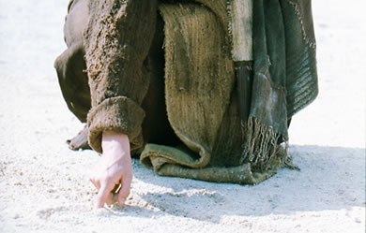
基督作为作家
Dr. Rick Griffith • 博士 • 新加坡神学院 • www.BibleStudyDownloads.org
Notes:
We have NO actual accounts of Jesus writing anything except what he wrote in the sand in John 8—and we have no idea what he wrote!
我们没有任何确切的记载表明耶稣写过任何东西，唯一的一次是在约翰福音 8 章中他在地上写字——但我们完全不知道他写了什么！

Slide 2
我们若要得胜，就必须看到耶稣在以下的事中掌权…
死亡
(1)
诸教会
(2–3)
启示录大纲
Notes:
Death (1): Christ is sovereign over our ultimate enemy that no one else has defeated.
Churches (2-3): Christ is the boss over the seven Asian churches and every local church.
Our Future (4-22): Christ is both Judge and Saviour of the End Times and our Eternal State.
死亡（1）： 基督掌管我们最终的敌人——死亡，这是无人能战胜的。
教会（2-3）： 基督是七间亚洲教会以及每一间地方教会的主。
我们的未来（4-22）： 基督是末世和我们永恒归宿的审判者与救主。

Slide 3
Slides on
启示录 2

Slide 4

如果耶稣对你写了一封信，
内容会是如何呢？
R
启示录

Slide 5
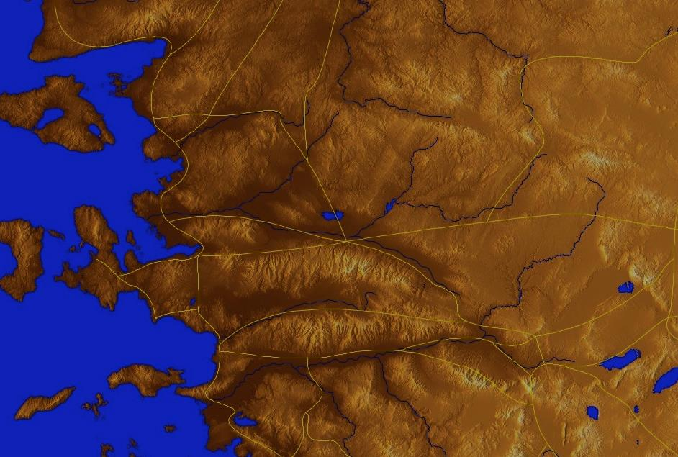
小亚细亚 AD 95
335
亚 西 亚
Aezani
Cyme库麦
Erythra 厄立特利亚
Eumenia
Lebedus
Colophon
Hierapolis
希拉波里斯
Nysa
Trailes
Heraclea
Aphrodisias
Colossae歌罗西
Alabanda 阿拉班达
拔 摩
米 利 都
Notes:
In AD 95 John was exiled to the lonely island of Patmos out in the Adriatic Sea. Jesus Christ had a revelation of comfort to the suffering believers of Asia Minor, but how could this message reach them?
公元 95 年，使徒约翰被流放到亚得里亚海上的荒凉小岛——拔摩岛。
耶稣基督向小亚细亚受苦的信徒启示了安慰的信息，
但这个信息要如何传递给他们呢？

Slide 6
七 个 教 会 (启示录 2–3)
335
Adramyttium
Aezani
别 迦 摩
推 雅 推 喇 城
Cyme
Erythrae
撒 狄
士 每 拿
Eumenia
非 拉 铁 非
Lebedus
Colophon
以 弗 所
Nysa
老 底 嘉
Hierapolis
Trailes
Heraclea
Aphrodisias
Colossae
Alabanda
拔 摩
Miletus
Notes:
Jesus designed a brilliant strategy by having his revelation sent to capital of the province, Ephesus. It included an individual letter to Ephesus, as well as letters to 6 other key churches. The Ephesians copied the entire book of Revelation, though, and sent the original to the next city, Smyrna. Smyrna then made their own copy and sent the original to Pergamum, which lay on the main road to the north. This city then sent the prophecy to Thyatira, which sent it to Sardis, then Philadelphia, and finally to Laodicea.
耶稣设计了一个精妙的策略，使他的启示首先被送往该省的首府——以弗所。
其中包括一封写给以弗所的个人书信，以及写给另外六个关键教会的书信。
以弗所的信徒抄写了整本启示录，然后将原件送往下一座城市——士每拿。
士每拿又制作了一份副本，并将原件送往北方主干道上的别迦摩。
随后，别迦摩将这份预言送往推雅推喇，
推雅推喇再送至撒狄，
撒狄送至非拉铁非，
最终传至老底嘉。

Slide 7
七 个 教 会 (启示录 2–3)
335
别 迦 摩
推 雅 推 喇 城
撒 狄
士 每 拿
非 拉 铁 非
以 弗 所
老 底 嘉
Notes:
These 7 churches were neither the largest, nor the most influential cities in Asia Minor. However, they were strategically located on a key highway that linked them all.
[Animate} From their own locations we understand that they also copied the prophecy and sent these copies to other churches near them.
这七个教会既不是亚细亚（小亚细亚）最大的城市，也不是最具影响力的城市。
然而，它们都位于一条关键的主干道上，这条道路将它们紧密相连。
【动画】从它们各自的地理位置来看，我们可以推测它们也抄写了这份预言，并将这些副本传送给附近的其他教会。

Slide 8
七 个 教 会阶段?
324
虐待 却传教使命
痛苦 却坚定
继续 却 妥协
与众不同 却死
忙碌却倒退
I成员 却 不道德
豪华 却 微温
现代的传教使命时代
Constantine
君士坦丁堡
改革
教会 先族
中间的时代
唯物主义
使徒 时代
33
100
313
476
1453
1795
1900
非 拉 铁 非
以 弗 所
士 每 拿
别 迦 摩
推 雅 推 喇 城
撒 狄
老 底 嘉
Notes:
33—The Apostles of Christ pass on the gospel, but by AD 95 the love at Ephesus had grown cold
100—Last Apostle died (John) with the message passed on to their disciples, called the "Church Fathers"
313—Constantine began to merge Christianity and paganism. With paganism illegal, it took on a "Christianized" form.
476—Rome's Fall ushered in 1000 years of deviation from classical learning called the "Middle Ages" with Rome's influence through the RCC
1453—The conquest of Constantinople by the Turks began the Renaissance, followed by the Reformation
1793—William Carey left England for India, sparking the movement of the gospel from the West to the Two-Thirds World
1900—The decline of Christianity in Europe began to be replaced with humanism, materialism, modernism, and post-modernism
33年——基督的使徒们传扬福音，但到公元95年，以弗所的爱心已经冷淡。
100年——最后一位使徒（约翰）去世，使徒们的信息传递给他们的门徒，被称为“教会教父”。
313年——君士坦丁大帝开始融合基督教和异教。随着异教被宣布为非法，它逐渐呈现出**“基督教化”的形式。
476年——罗马帝国的沦陷，开启了千年的中世纪**，人们偏离了古典学习，罗马天主教会（RCC）成为主要影响力量。
1453年——奥斯曼土耳其攻占君士坦丁堡，开启了文艺复兴，随后迎来了宗教改革。
1793年——威廉·克里（William Carey）离开英国前往印度，掀起了福音从西方传播到全球三分之二地区的运动。
1900年——欧洲基督教的衰落，逐渐被人文主义、物质主义、现代主义和后现代主义所取代。

Slide 9
启示录2-3章的四个观点
345
别 迦 摩
“过去派”
“历史派”-
“将来派”
“将来派”
推 雅 推 喇 城
撒 狄
士 每 拿
非 拉 铁 非
以 弗 所
老 底 嘉
代表派
Notes:
Four Views:
Historic Churches: The 7 churches were actual churches at John’s time. All actually hold to this view except Bulllinger, who in 1935 taught seven churches are seven Jewish congregations in the future Tribulation period. Almost all see these as depicting seven churches that can be found in any age.
Prophetic: The chapters deal purely with stages of church history without identifying any first century church, shown by remarkable resemblance to successive eras of church history (taught by Cohen, Understanding Revelation, 48-49; and J. A. Seiss, The Apocalypse [London: Marshall, Morgan, and Scott, n.d.], 76-86).
Historico-Prophetical: The churches depict BOTH historic churches of the first century and stages of church history. “This approach is commonly taken in dispensational commentaries; see e.g., Herman A. Hoyt, The Revelation of the Lord Jesus Christ (Winona Lake, IN: BMH, 1966) 17,25-29, and John F. Walvoord, The Revelation of Jesus Christ (Chicago: Moody, 1966) 52, who holds the view cautiously. See also Menno J. Brunk, "The Seven Churches in Revelation 2-3," BSac 126 (1969) 240-46, and Gary G. Cohen, Understanding Revelation (Collingswood, NJ: Christian Beacon, 1968) 44-65, who presents a more impressive argument. Of course, the prophetic view is held by non-dispensationalists as well (e.g., J. P. Lange, Commentary on the Holy Scriptures- Revelation [reprint; Grand Rapids: Zondervan, n.d.] 139). See also the survey of R. C. Trench, Commentary on the Epistles to the Seven Churches in Asia (6th ed., rev.; reprint; Minneapolis: Klock and Klock, 1978) 237-45” (James L. Boyer, “Are the Churches of Revelation 2–3 Prophetic?” Grace Theological Journal 6.2 [1985] 267-273). He answers YES.
Typical (Representative): They were real churches, but also represent types of churches found throughout church history. Therefore, this view is also called the typical or representative view.
Critique:
Historic Churches: The doubt about whether all of the churches existed is flawed—just because we don’t know about each of them does not mean they did not exist (argument from silence)
Historico-Prophetical: Church history had not 7, but 3, stages: Ancient (to 590), Medieval (590-1517), and Modern (1517-present); designations are arbitrary (e.g., is Sardis pre-Reformation or the Reformation itself?)
Prophetic: (a) Any prophetic element would destroy the doctrine of imminency, so the chapters must relate only to actual first century churches since the 4th and 6th letters refer to Christ’s imminent coming, and Philadelphia would be given a false hope of deliverance from wrath (3:10) if the church had to wait until the “Laodicean age.” (b) Nothing in these chapters or elsewhere in the NT hint at these being stages of church history. (c) These letters differ from the prophetic portions of the book (Rev. 4–22) in that they are simply epistles similar to those written by Paul.
Typical (Representative): (a) Imminency would be ruined only “if it stated explicitly there would be a period of at least two thousand years before the second advent, or even if it had stated explicitly that there would be ‘seven periods of church history’ (Boyer, 269-70. (b) These seven churches do not represent all types of churches of the first century or any other, for other types exist besides these (e.g., Galatian or Corinthian), and “seven” better pictures the whole of the church age than would the 3 stages proposed above.
四种观点：
历史教会（Historic Churches）：
这七间教会是约翰时代真实存在的教会。所有人基本上都认同这一观点，除了布林格（Bullinger），他在1935年提出，这七间教会是未来大灾难时期的七间犹太会众。几乎所有学者都认为，这些教会代表着任何时代都可以找到的七种教会类型。
预言性（Prophetic）：
启示录的这些章节纯粹是关于教会历史的不同阶段，而不涉及任何第一世纪的教会。这一观点是基于这些教会与教会历史上连续时期的惊人相似性，这一观点由**科恩（Cohen）在《理解启示录》（Understanding Revelation, 48-49）以及J.A. 赛斯（J. A. Seiss）**在《启示录》（The Apocalypse, 76-86）中提出。
历史—预言性（Historico-Prophetical）：
这些教会既代表第一世纪真实存在的教会，也代表教会历史的各个阶段。这种观点普遍被时代论注释家接受，例如：
赫尔曼·霍伊特（Herman A. Hoyt），《主耶稣基督的启示》（The Revelation of the Lord Jesus Christ, 1966, 17, 25-29）
约翰·沃尔伍德（John F. Walvoord），《耶稣基督的启示》（The Revelation of Jesus Christ, 1966, 52），虽然他对此观点持谨慎态度
布朗克（Menno J. Brunk），《启示录2-3章中的七间教会》（The Seven Churches in Revelation 2-3, 1969, 240-246）
科恩（Gary G. Cohen），《理解启示录》（Understanding Revelation, 1968, 44-65）
当然，非时代论学者也有人持有此观点，例如：
J.P. 朗格（J. P. Lange），《圣经评注：启示录》（Commentary on the Holy Scriptures - Revelation, 139）
R.C. 特伦奇（R. C. Trench），《小亚细亚七教会书信评注》（Commentary on the Epistles to the Seven Churches in Asia, 237-245）
**詹姆斯·博耶（James L. Boyer）**在《启示录2-3章的教会是否是预言性的？》（Are the Churches of Revelation 2–3 Prophetic?，1985, 267-273）中回答：“是的。”
典型（代表性）观点（Typical/Representative）：
这些教会是真实存在的，但同时代表整个教会历史中各种类型的教会。因此，这一观点也被称为“典型”或“代表性”的观点。
批评与反驳：
历史教会（Historic Churches）：
质疑这些教会是否全部存在的说法是站不住脚的——仅仅因为我们没有所有的历史资料，并不意味着这些教会不存在（这是“沉默论证”的逻辑错误）。
历史—预言性（Historico-Prophetical）：
教会历史并非只有七个阶段，而是通常划分为三个阶段：
古代教会（至590年）
中世纪教会（590-1517年）
现代教会（1517年至今）
这些划分都是人为的，例如：“撒狄教会（Sardis）”到底代表宗教改革之前的教会，还是宗教改革本身？这一点存疑。
预言性（Prophetic）：
（a） 任何预言性的元素都会破坏基督随时再来的教义（imminency），因此这些章节只能与第一世纪的教会有关，因为第四封信（推雅推喇）和第六封信（非拉铁非）都提到基督的“即将到来”。如果非拉铁非教会（Philadelphia）必须等到“老底嘉时代（Laodicean age）”才能被拯救脱离灾难（3:10），那么这对他们来说就是一个虚假的希望**。
（b） 这些章节或新约的其他部分都没有任何暗示这七间教会代表教会历史的七个阶段。
（c） 这些书信的风格不同于启示录4-22章的预言性内容，更类似于保罗的书信。
典型（代表性）观点（Typical/Representative）：
（a） 只有在启示录明确提到“基督再来前会有至少2000年的教会历史”，或者明确说有“七个教会历史阶段”，才会破坏基督随时再来的教义（詹姆斯·博耶，269-270）。
（b） 这七间教会并不能代表第一世纪所有的教会类型，也无法囊括整个教会历史。例如，“加拉太教会（Galatian）”和“哥林多教会（Corinthian）”就不在其中。因此，“七”这个数字比起历史—预言性观点所提出的三个阶段，更能够象征整个教会时代。

Slide 10

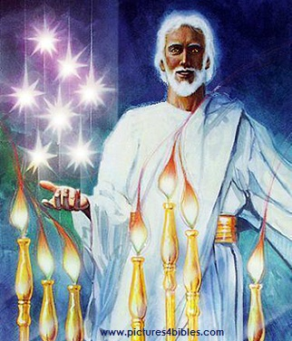
七星和七个金灯台指什么(1:20 ）?
你所看见在我右手中的七星和七个金灯台的奥祕就是这样： 七星是七个教会的使者， 七灯台是七个教会。”

Slide 11
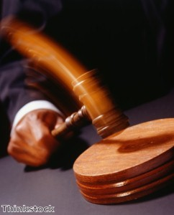
耶稣持有对各大教会的 权威

Slide 12
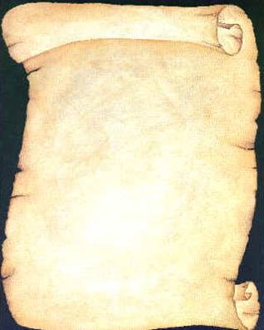
耶稣写信给了七间教会
(启示录 2–3)
以 弗 所
士 每 拿
别 迦 摩
推 雅 推 喇 城
撒 狄
非 拉 铁 非
老 底 嘉

Slide 13
启示录
基督的主权在未来的胜利
主权是属于基督 |  |  | 主权在教会 | 主权在末日的事件
第 1 章 |  |  | 第 2–3 章 | 第 4–22 章
“你看到什么” (1:19a) |  |  | “现在是什么” (1:19b) | “以后会发生什么” (1:19c)
过去 |  |  | 现在 | 未来
基督揭露 |  |  | 教会揭露 | 完成揭露
上帝在地上 |  |  | 上帝的使者 在地上 | 从地狱在地上到天堂地上
审判官 |  |  | 任务 | 判决和奖励
主题 1:1-3 | 敬拜三位一体神 1:4-8 | 荣耀耶稣基督 1:9- 20 | 小亚细亚七教会: 以弗所、士每拿、别迦摩、推雅推喇、撒狄、非拉铁非、 老底嘉 | 苦难 4:1– 19:10 | 第二次来 19:11-21 | 千禧年 20 | 永恒的状态 21:1–22:5 | 终结的迫切性 22:6-21
A.D. 95
318

Slide 14
七 个 教 会 (启2–3)
335
许诺
别 迦 摩
警告
推 雅 推 喇 城
告诫
训斥
表扬
士 每 拿
撒 狄
N/A
监督
N/A
N/A
N/A
以 弗 所
非 拉 铁 非
N/A
老 底 嘉
Notes:
Though some exceptions exist (noted with “N/A” above), the basic pattern of the seven letters is a sevenfold outline:
Church name
Christ Described in a Unique Way for that Church
Commendation of Good Deeds among the Believers
Rebuke of Sin within the Church
Exhortation or Encouragement to Repent
Warning if the Exhortation is Disobeyed
Promise for Faithfulness
Notice also that each letter not only begins with a reference to Christ but ends with an appeal from the Spirit.
虽然存在一些例外（上方以“N/A”标注），但七封书信的基本模式遵循七个要点：
教会名称
基督以该教会独特的方式描述
对信徒善行的称赞
对教会罪恶的责备
劝勉或鼓励悔改
若不听从劝勉的警告
对忠心者的应许
此外，每封信不仅以对基督的描述开头，还以圣灵的呼吁作为结尾。

Slide 15
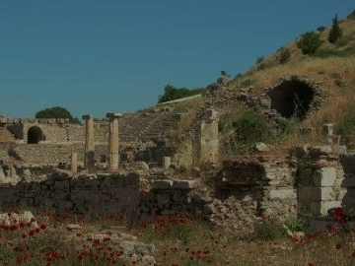
以 弗 所
忙碌却倒退
启示录 2:1-7

Slide 16
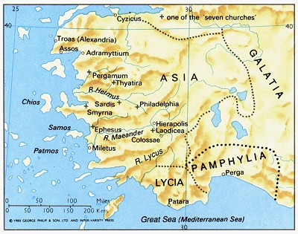
以弗所是亚洲的首都
176

Slide 17
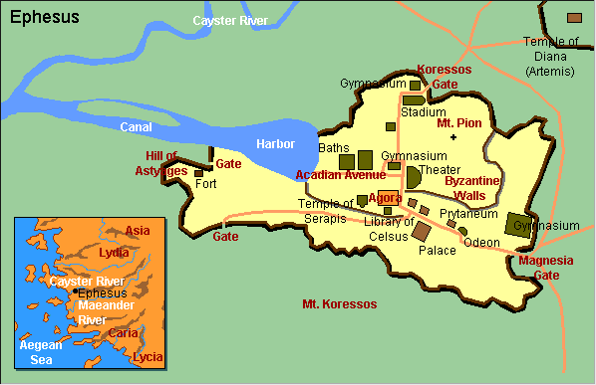
以弗所城的蓝图

Slide 18
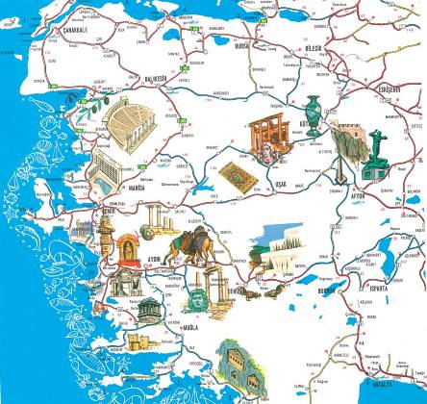
文化的中心

Slide 19

相册

Slide 20
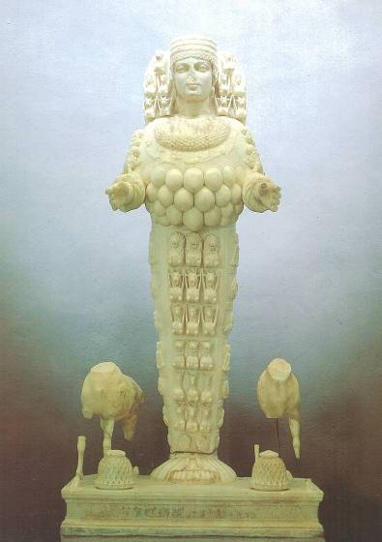
亚底米 , 大女神之肥沃

Slide 21
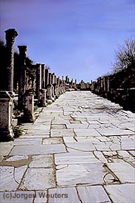
大理石马路
Notes:
Marble city, chariot ruts, speed humps, after earthquake columns put back up again.
大理石之城，战车车辙，减速坡，地震后重新竖立的柱子。

Slide 22
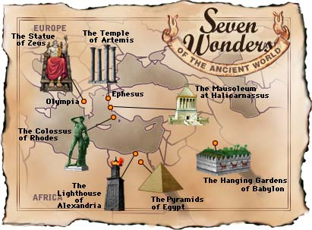
世界七大奇观-古代的世界
奥林匹亚
的宙斯神像
以弗所的
阿耳特弥斯神庙
哈利卡纳苏斯的
摩索拉斯陵墓
罗得岛
的巨像
巴比伦
空中花园
亚历山大
的灯塔
埃及金字塔

Slide 23
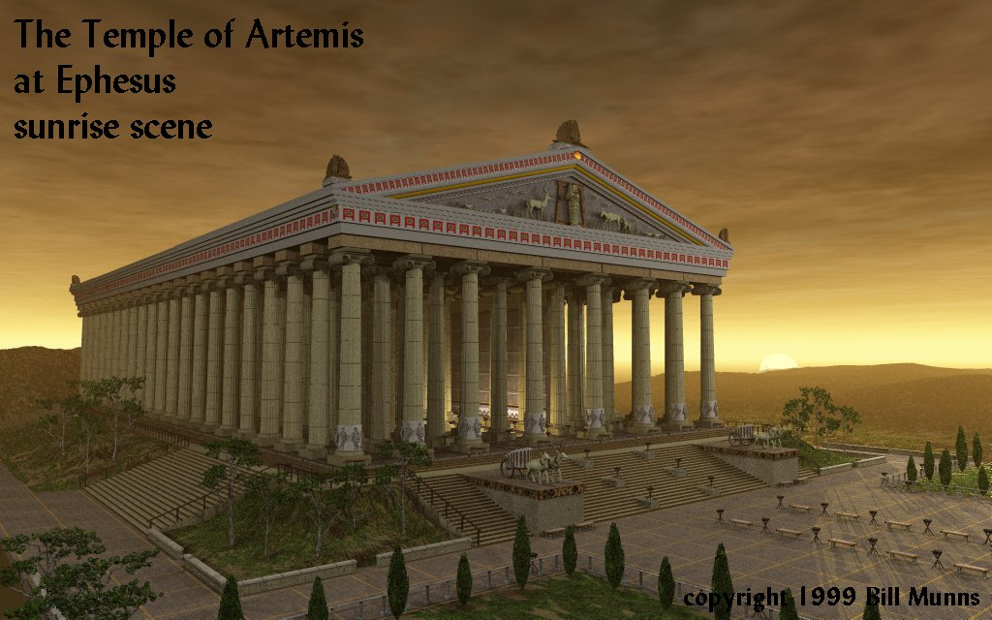
以弗所的
阿耳特弥斯神庙
日出
Notes:
Marble city, chariot ruts, speed humps, after earthquake, columns put back up again. Diana-the goddess mother of e/t, 127 Marble pillars, Artemis (Gk), Diana (Latin)
Sid Caesar, Venerate: Bow to Caesar or die
大理石之城，战车车辙，减速坡，地震后重新竖立的柱子。
戴安娜——万物之母女神，127根大理石柱，阿耳忒弥斯（希腊文），戴安娜（拉丁文）。
西德·凯撒，崇拜：向凯撒跪拜，否则就得死。

Slide 24
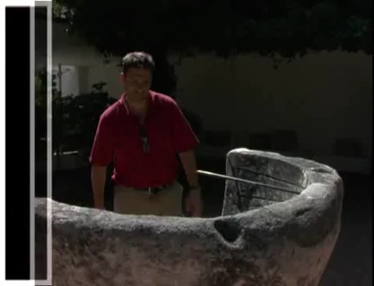
Artemis (Diana) Video (cf. Acts 19)
180c
Notes:
"In Roman mythology, Diana (lt. "heavenly" or "divine") was the goddess of the hunt and moon and birthing, being associated with wild animals and woodland, and having the power to talk to and control animals. She was equated with the Greek goddess Artemis, though she had an independent origin in Italy." (http://en.wikipedia.org/wiki/Diana_%28mythology%29)
Temple had 127 Marble pillars, Artemis (Gk), Diana (Latin)
"在罗马神话中，戴安娜（拉丁文意为‘天上的’或‘神圣的’）是狩猎、月亮和生育的女神，与野生动物和森林有关，并拥有与动物交谈和控制它们的能力。她与希腊女神阿耳忒弥斯（Artemis）相对应，尽管她在意大利有独立的起源。" （来源：维基百科）
这座神庙有127根大理石柱，阿耳忒弥斯（希腊文），戴安娜（拉丁文）。

Slide 25
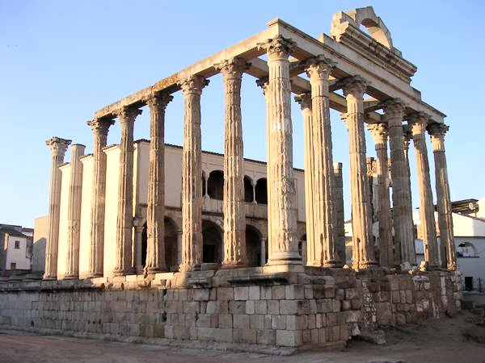
阿耳特弥斯神庙-现照
Diana (Artemis)
Notes:
“In Roman mythology, Diana (lt. "heavenly" or "divine") was the goddess of the hunt and moon and birthing, being associated with wild animals and woodland, and having the power to talk to and control animals. She was equated with the Greek goddess Artemis, though she had an independent origin in Italy.” (http://en.wikipedia.org/wiki/Diana_%28mythology%29)
Temple had 127 Marble pillars, Artemis (Gk), Diana (Latin)
“在罗马神话中，戴安娜（拉丁文意为‘天上的’或‘神圣的’）是狩猎、月亮和生育的女神，与野生动物和森林有关，并拥有与动物交谈和控制它们的能力。她与希腊女神阿耳忒弥斯（Artemis）相对应，尽管她在意大利有独立的起源。” （来源：维基百科）
这座神庙有127根大理石柱，阿耳忒弥斯（希腊文），戴安娜（拉丁文）。

Slide 26

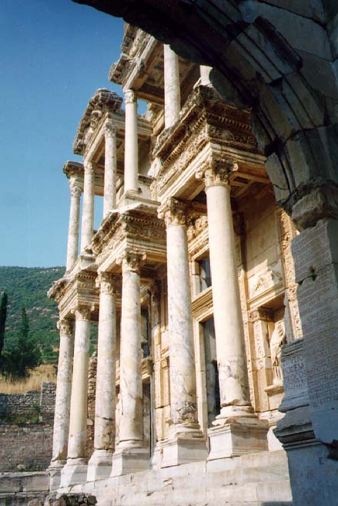
凯撒的图书馆
凯撒
Notes:
Marble city, chariot ruts, speed humps, after earthquake, columns put back up again. Diana-the goddess mother of e/t, 127 Marble pillars, Artemis (Gk), Diana (Latin)
Sid Caesar, Venerate: Bow to Caesar or die
大理石之城，战车车辙，减速带；地震后，柱子被重新竖立。
戴安娜——万物之母女神，神庙有127根大理石柱，阿耳忒弥斯（希腊文），戴安娜（拉丁文）。
西德·凯撒（Sid Caesar），崇敬：向凯撒跪拜，否则就得死。

Slide 27
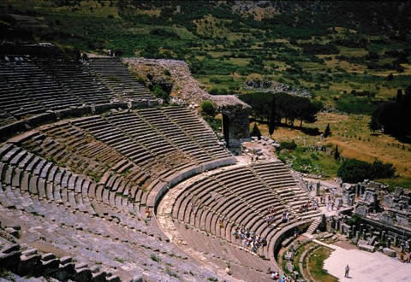
剧院座席- 25,000
theh'-at-ron
使 徒 行 傳 19:29
Notes:
The place where the Ephesian clerk averted a riot in Acts 19:29
以弗所书记在使徒行传19:29中平息骚乱的地方。

Slide 28
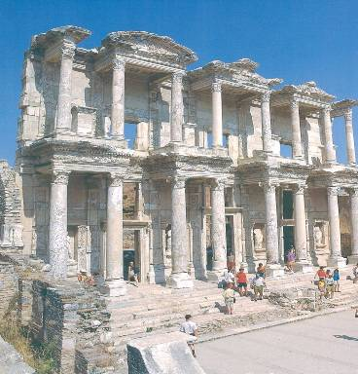
图书馆

Slide 29
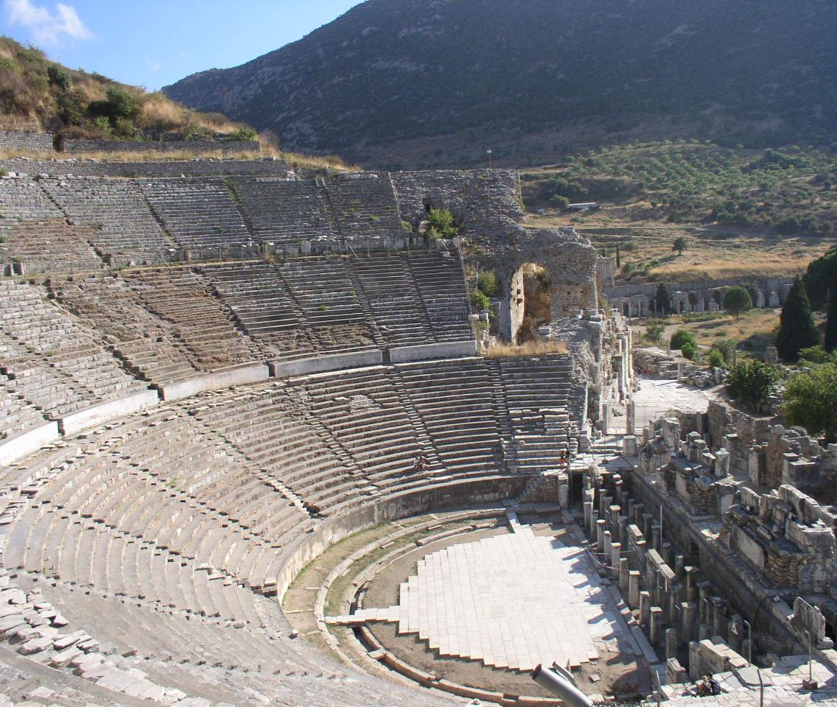
圆形剧场

Slide 30
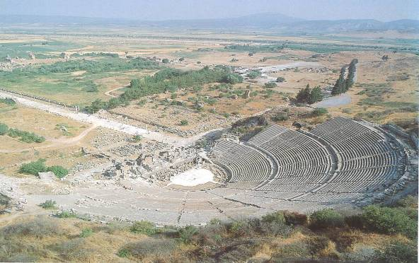
阿卡迪亚林阴道

Slide 31
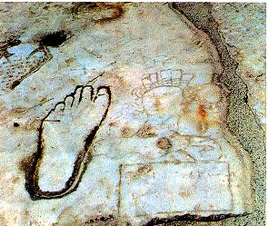
指路说明：
不道德的 & 文盲

Slide 32
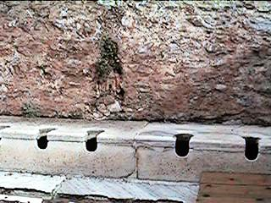
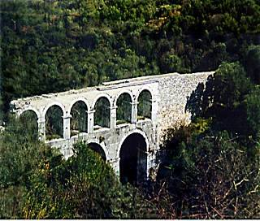
厕所和输水道

Slide 33
以 弗 所 (启2:1-7)
324
许落
赐生 命 树 的 果 子
别 迦 摩
警告
如果你不忏悔，
我将会把你的灯台移走
推 雅 推 喇 城
告诫
回想起
忏悔
返回 行 起 初 所 行 的 事
训斥
你 把 起 初 的 爱 心 离 弃 了
劳 碌 、 忍 耐 ，劳 苦 ， 并 不 乏 倦 也 知 道 你 不 能 容 忍 恶 人， 恨 恶 尼 哥 拉
撒 狄
基督:
那 右 手 拿 着 七 星 、 在 七 个 金 灯 ，中 间 行 走 的
士 每 拿
以 弗 所
非 拉 铁 非
老 底 嘉

Slide 34
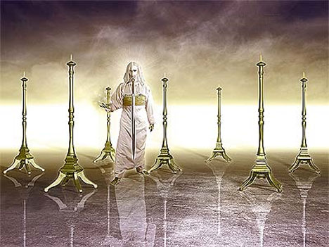
‘那右手拿着七星， 在七个金灯台中间行走的， 这样说： (2:1b)
349

Slide 35

以弗所書大綱
175
猶太人和外邦人合一的愛
合一平等 |  |  |  | 愛的見証
1-3章 |  |  |  | 4-6章
教條 |  |  |  | 應用
地位 |  |  |  | 實踐
信念 |  |  |  | 行為
特權 |  |  |  | 責任
問候 1:1-2 | 地位 1:1-3-23 | 復和 2 | 獨一性 3 | 合一 4：1-16 | 聖潔 4:1-5：20 | 順服 5:21-6:9 | 倚靠 6:10-20 | 愛 6:21-24
羅馬
公元60年秋 (第一次於羅馬被監禁)
Notes:
章
與主的關係不斷增長並意識到他們在基督裡所站的新地位，與猶太歸主者的後嗣的身份等同。 (1-3)
2. 每日與主同行的經歷顯出合一的愛。
(4-6)

Slide 36
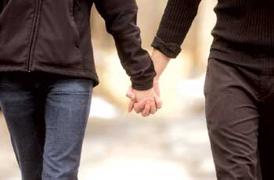
Revelation 2:4 (NIV)
还记得你的初恋吗？
Yet I hold this against you:
You have forsaken
your first love.

Slide 37
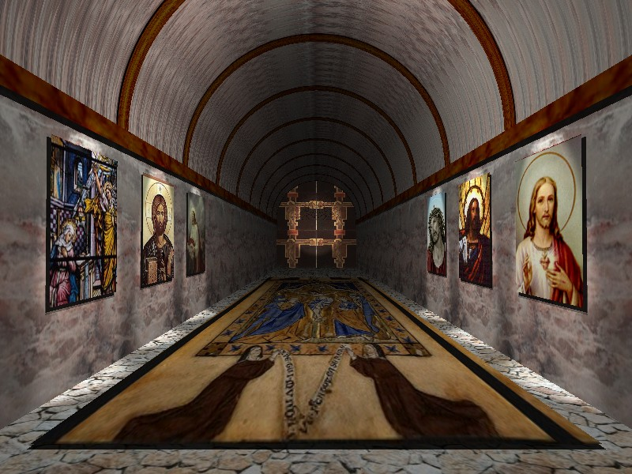
启 示 录 2:4
然而有一件事我要责备你、就是你把起初的爱心离弃了。

Slide 38
士 每 拿
启 示 录 2:8-11

Slide 39
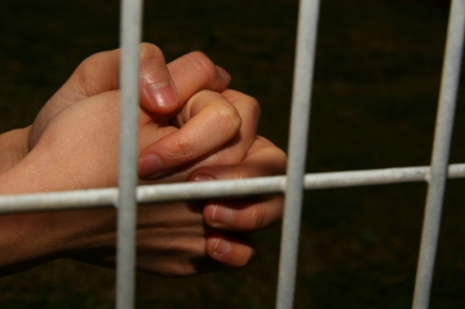
痛苦 却坚定
士 每 拿
(启示录. 2:8-11)
Rick Griffith • Crossroads International Church • biblestudydownloads.com

Slide 40
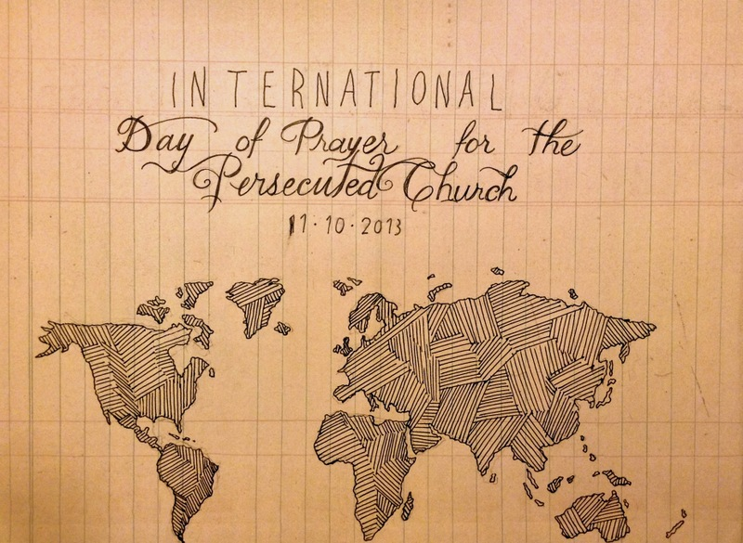
国际祷告日
国际祷告日：为受逼迫的教会11-10-2013
Notes:
Today and last Sunday, over one half million churches around the globe commemorate the International Day of Prayer for the Persecuted Church. We stand with them and have designed our entire service to remember our suffering brothers and sisters who lose property, livelihood, and loved ones—yes, who lose even life itself—simply due to their faith in our Lord Jesus Christ.
今天和上个主日，全球超过五十万间教会共同纪念国际受逼迫教会祷告日。我们与他们站在一起，并特别设计了整个敬拜仪式，以纪念那些因对主耶稣基督的信仰而失去财产、生计、亲人，甚至生命的受逼迫的弟兄姐妹们。

Slide 41
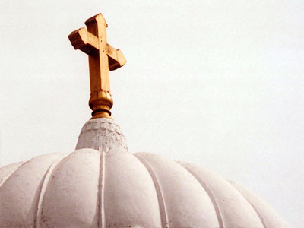
全体圣徒的教会
2013年9月22日
Notes:
Our thoughts today turn to seven weeks ago from this day to All-Saints Church.
今天，我们的思绪回到了七周前的这一天，追忆众圣徒教堂。

Slide 42
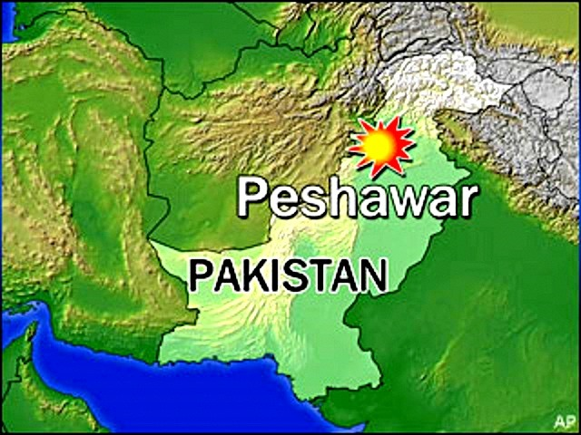
All-Saints Church
22 Sep 2013
白沙瓦
巴基斯坦
Notes:
The church is located in the northern region of Pakistan in the city of Peshawar, close to the border with Afghanistan.
这座教堂位于巴基斯坦北部的白沙瓦市，靠近阿富汗边境。

Slide 43
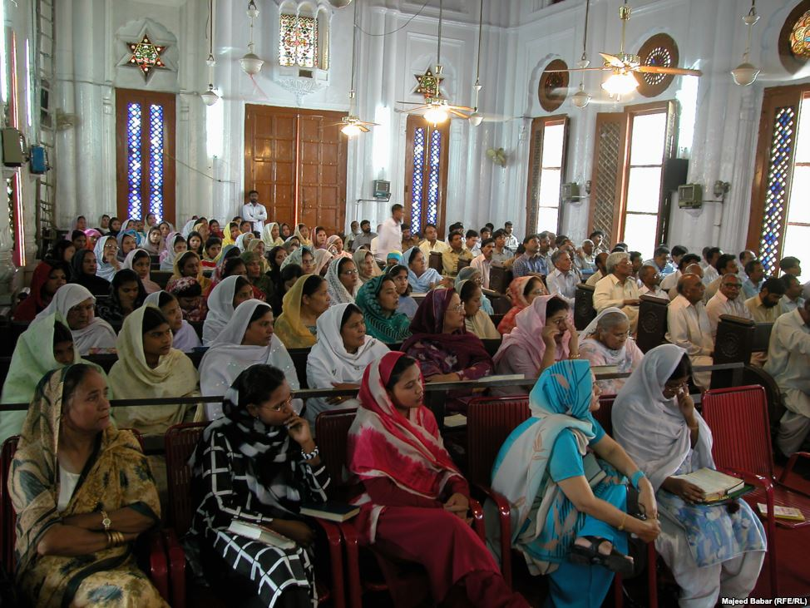
All-Saints Church
22 Sep 2013
Notes:
Inside the church it looks much like many others in that region where the men and the women sit on opposite sides.
在教会内部，其布局与该地区的许多其他教会相似，男性和女性分坐在不同的区域。

Slide 44
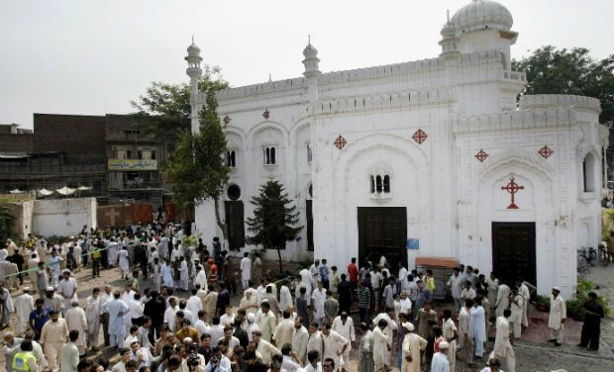
全体圣徒的教会
22 Sep 2013
Notes:
On 22 September 2013 after the service the believers gathered outside the building in the courtyard to talk, to eat—over 200 men, women, and children.
2013年9月22日，礼拜结束后，信徒们聚集在教堂外的庭院里交谈、用餐——共有200多名男女老少。

Slide 45
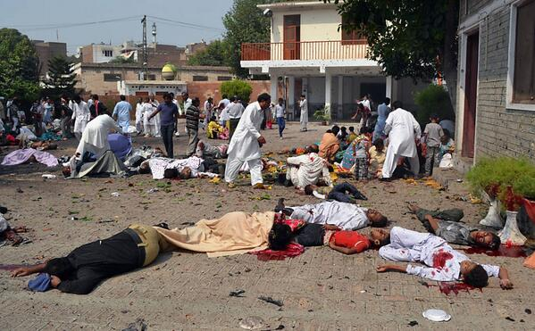
全体圣徒的教会
22 Sep 2013
Notes:
Infiltrating the crowd were two suicide bombers, who struck the All Saints Church members after their service that Sunday, killing more more than 90 people and wounding more than 150. The victims included many children.
混入人群中的两名自杀式袭击者在那个星期日的礼拜结束后袭击了万圣堂教会的会众，造成90多人死亡，150多人受伤。受害者中包括许多儿童。

Slide 46
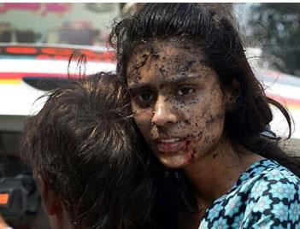
All-Saints Church
22 Sep 2013
Notes:
None of us can imagine the horror of that moment.
我们无法想象那一刻的恐怖。

Slide 47
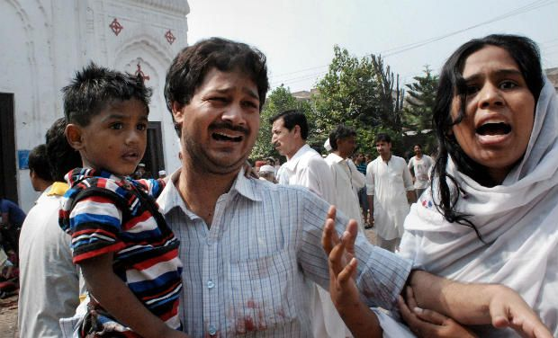
All-Saints Church
万圣堂教会
22 Sep 2013
Notes:
None of us can.

Slide 48
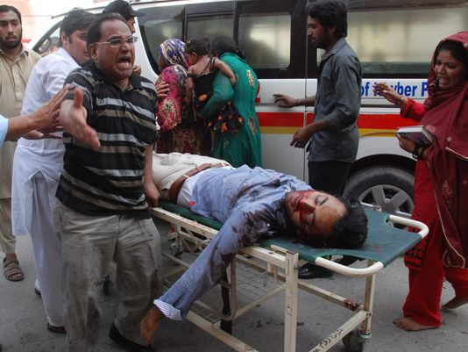
All-Saints Church
22 Sep 2013
Notes:
A wing of the Pakistani Taliban claimed responsibility for the bombing, saying it would continue to target non-Muslims until the United States stopped drone attacks in the country's remote tribal region.
巴基斯坦塔利班的一个分支声称对这次爆炸负责，并表示将继续针对非穆斯林发动袭击，直到美国停止在该国偏远部落地区的无人机袭击。

Slide 49
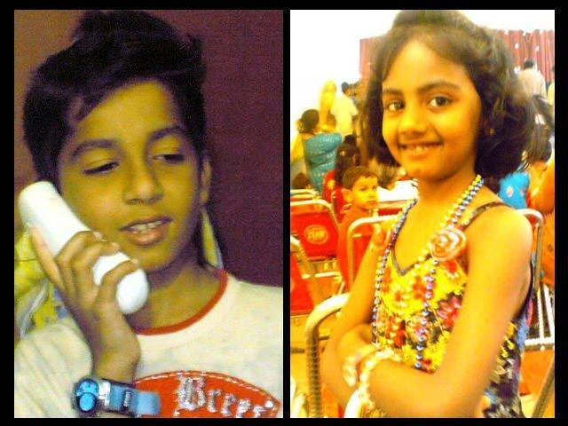
艾尚和妮哈
Notes:
The saddest part of the story concerns the children. The father of Eshaan and Neha was on business in the US at the time, but later wrote, "As he did after every Sunday mass, Eshaan was playing near the church gate with his friends. Little was he to know that this was the last time he would pray in church, play with his friends, tease his sister or hug his mother. His head was ripped off by the blast and his sister Neha, who was running after him at the time, was so traumatised by the sight that her little heart gave in and she collapsed next to Eshaan’s torn body."
Full article:
"The twin bombs that exploded on Sunday at All Saints Church, Peshawar, killed more than 90 people, injured nearly 150 others, and emotionally scarred thousands more.
Investigations are under way while recovery and treatment has begun for the injured and their families. For some, healing will be swift while others may take small steps over months, maybe even years. Many more might never fully recover from this tragedy.
The most heartbreaking of this and such tragedies is the number of young lives lost in these attacks. Since the blast took place on Sunday, the All Saints Church was packed to the brim with Christians from the locality; many of them students, volunteers, youth leaders, activists and Sunday school children. These were children we all knew, if not in person, at least by face. Even now as I close my eyes, I can visualise the happy little angels skipping through the church doors.
It is therefore, with great sorrow and a heavy heart that I share my memories of Neha and Eshaan.
Since the blast, I have not had a moment’s peace as I keep remembering how they used to make me laugh at their playful antics. Today I realised that the only way to alleviate my pain, even if a little bit, is by sharing their story.
These little victims of the senseless violence that rocked Peshawar in general and the Christian community in particular, were gems treasured by their parents, family, friends and teachers alike.
As he did after every Sunday mass, Eshaan was playing near the church gate with his friends. Little was he to know that this was the last time he would pray in church, play with his friends, tease his sister or hug his mother. His head was ripped off by the blast and his sister Neha, who was running after him at the time, was so traumatised by the sight that her little heart gave in and she collapsed next to Eshaan’s torn body.
I cannot even begin to imagine what Eshaan and Neha’s parents must be feeling right now. I can’t imagine the horror that any parent would feel upon hearing such news – that their two young children, the apples of their eyes, the stars in their life – are no more. There can be nothing more traumatic than raising your children, caring for them, loving them and already dreaming of their future only to have them ripped away from you.
In Eshaan and Neha’s case, the situation was worsened because their father, Insar, was in the United States at the time of the blast. In a cracked voice, he said over the phone,
“They were little angels sent down to me to love and protect. Like most fathers, I was often over-protective and sometimes downright clingy. After all, my children were my treasure.”
His voice completely broke then, and all we heard for a few minutes was the heart-wrenching weeping of a man in physical and emotional trauma. Mustering up his strength, he said,
“No parent should ever have to encounter a day like today; no parent should ever have to hear the words that your child is no more. Parents are never prepared to lose their children, not even children who have a terminal illness. Then how do I deal with something I did not even have an inkling of?”
After every few minutes of crying and talking about his children, he repeated, almost like a mantra,
“If only I was in Pakistan.”
While their father is in the US and has not been able to catch a flight back home yet, their mother, Uzma, is in the Intensive Care Unit (ICU). She still has no idea of what happened to her children.
Remembering his children, Insar says,
“Children change our life. They show us new ways to love, new things to find joy in, and new ways to look at the world.”
However, for Insar and Uzma the world has become dark and empty. This one incident has taken the light of their lives away and every room, every toy, every scribble will bring back painful memories. Their only wish will be to turn back time and see their children one last time, hold them tight and kiss their glowing faces. There will be times when getting through the day will feel like torture.
All we can do is pray that with time, these memories will become less painful and that one day, Insar and Uzma will begin to re-build their lives. We hope that they will learn to carry with them, happy memories of the love they shared with their precious children, even if it was for such a short time.
http://blogs.tribune.com.pk/story/18971/they-were-just-children-not-christian-children/
故事中最令人心碎的部分涉及孩子们。
艾尚（Eshaan）和妮哈（Neha）的父亲当时正在美国出差，后来他写道：
“像往常每个主日弥撒后那样，艾尚在教堂门口附近和朋友们一起玩耍。他根本不会知道，这将是他最后一次在教堂祷告，最后一次与朋友玩耍，最后一次戏弄妹妹，最后一次拥抱母亲。爆炸的冲击撕裂了他的头颅，而他的妹妹妮哈当时正在追着他跑，目睹这一幕的她受到了极大的惊吓，小小的心脏再也无法承受，她倒在了艾尚残破的身体旁。”
完整文章：
“2013年9月22日，星期日，在白沙瓦的万圣教堂（All Saints Church）发生的连环爆炸，造成90多人死亡，近150人受伤，并让成千上万人在情感上留下了无法愈合的伤痕。”
调查仍在进行，而伤者及其家人的康复和治疗已经开始。对于一些人来说，伤痛或许会很快平复，而对于另一些人，这可能需要数月，甚至数年的时间。更多的人可能永远都无法从这场悲剧中恢复过来。
在这场灾难中，最令人痛心的莫过于无辜孩子的生命被夺走。
由于爆炸发生在主日礼拜期间，万圣教堂当时挤满了当地的基督徒——其中许多是学生、志愿者、青年领袖、社会活动家和主日学的孩子们。这些孩子是我们所熟悉的，即使不是直接认识，至少也见过他们的面孔。即便现在，当我闭上眼睛时，脑海中仍浮现出他们欢快地跳跃着进入教堂的大门的画面。
因此，我怀着沉痛的心情分享我对妮哈（Neha）和艾尚（Eshaan）的回忆。
自爆炸发生以来，我的内心就没有片刻安宁，脑海中不断浮现他们嬉戏打闹时的模样，让我忍不住微笑。然而今天，我意识到，唯一能稍微缓解痛苦的方法，就是分享他们的故事。
这起毫无意义的暴力事件，不仅震撼了白沙瓦，更重创了基督教群体。而这些小小的受害者，本是他们父母、家人、朋友和老师的珍宝。
像往常一样，艾尚在主日弥撒结束后，和朋友们一起在教堂门口玩耍。他万万没有想到，这竟是他最后一次在教堂祷告，最后一次与朋友们嬉戏，最后一次调皮地戏弄妹妹，最后一次依偎在母亲怀里。爆炸的冲击瞬间撕裂了他的头颅，而他的妹妹妮哈，正追着他跑，亲眼目睹了这一可怕的一幕，惊吓过度的小小心脏再也无法承受，她在哥哥残破的身体旁倒下了。
我无法想象艾尚和妮哈的父母此刻的心情。我无法想象任何一位父母在听到这样的噩耗时会有多么崩溃——他们心中的挚爱、生命中的明星，竟然就这样永远地离开了。
没有什么比养育孩子、照顾他们、爱他们，并怀揣着对他们未来的美好期望，却最终被残酷地夺走更让人痛苦的事情了。
对于艾尚和妮哈来说，情况更加悲惨，因为他们的父亲英萨尔（Insar）事发时正在美国。他在电话中用颤抖的声音说道：
“他们是上帝赐给我的小天使，让我去爱护、去保护。像大多数父亲一样，我时常对他们过于保护，有时候甚至有些过于依恋。毕竟，他们是我人生中最宝贵的财富。”
他的声音在这里完全崩溃了，电话里只剩下令人心碎的哭泣声。几分钟后，他努力平复自己的情绪，说道：
“没有父母应该经历这样的日子；没有父母应该听到那样的话——‘你的孩子不在了’。父母永远不会为失去孩子做好准备，即使孩子身患绝症，他们仍旧抱有希望。而我，又该如何面对这突如其来的噩耗？”
每隔几分钟，在哭泣和回忆中，他都会不断重复着那句仿佛咒语般的话：
“如果我当时在巴基斯坦……”
与此同时，孩子们的母亲乌兹玛（Uzma）目前正在重症监护病房（ICU），她还不知道自己的孩子已经离世。
回忆起自己的孩子们，英萨尔说道：
“孩子改变了我们的生活。他们教会我们如何去爱，如何发现生活中的喜悦，如何用全新的眼光看待世界。”
然而，对于英萨尔和乌兹玛来说，世界已变得黑暗和空虚。这场灾难夺走了他们生命中的光芒，每一个房间、每一件玩具、每一道涂鸦，都会勾起无尽的痛苦回忆。他们唯一的愿望，就是能让时光倒流，再次看到他们的孩子，紧紧地拥抱他们，亲吻他们天真的笑脸。对于他们而言，每一天的度过都会是一种折磨。
我们唯一能做的，就是祷告，祈求时间能抚平他们的伤痛，祈求有一天，他们能重新振作，继续前行。我们希望，他们能带着对孩子们的美好回忆继续生活，即使这段记忆是如此短暂。
原文链接：
他们只是孩子，而不仅仅是基督徒的孩子

Slide 50
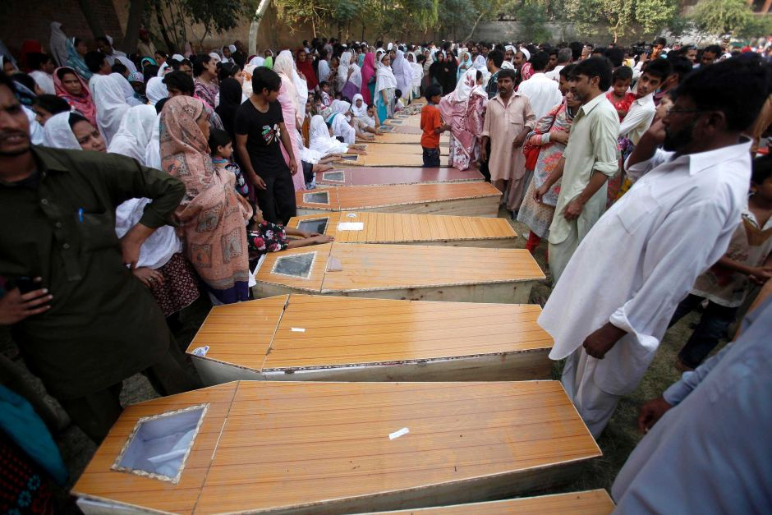
全体圣徒教会
90 被杀
150 受伤
13 寡妇
36 孤儿
53 个家庭失去主要劳力
Notes:
The toll on a single assembly is staggering!
对一个聚会造成的伤亡是惊人的！

Slide 51
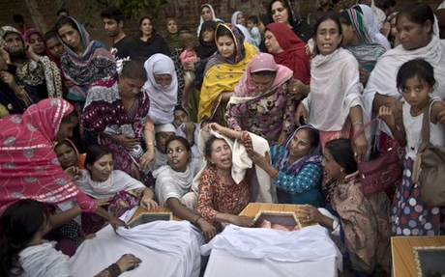
All-Saints Church
22 Sep 2013
Notes:
The grief is unimaginable.
其悲痛难以想象。

Slide 52
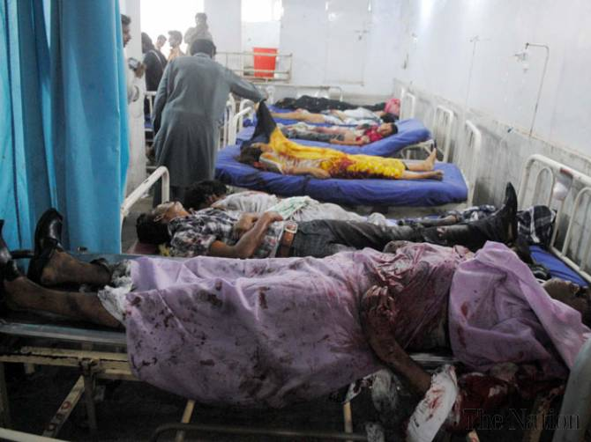
全体圣徒教会
没有医生
Notes:
The tragedy was compounded by the fact that the local hospital could not handle the crisis primarily because local doctors and paramedics refused to come to the hospital to treat the Christians—not until the local political leader ordered them to come or their jobs would be on the line.
Full article:
PESHAWAR - Death toll from Sunday’s twin bombings at All Saints Church was horrendous and Lady Reading Hospital was running out of caskets, beds and medicine for the wounded; and on top of that doctors and paramedics were absent.
To give vent to their anger over sorry state of affairs at the public health centre, attendants of the injured ransacked the hospital and chanted slogans against Khyber Pakhtunkhwa government for its inability to ensure every sort of health facility during the emergency situation.
Insufficient number of doctors and nurses was present at the hospital that could hardly provide first aid treatment to over 100 injured ferried from the blast site. Despite the fact that an emergency was declared, most of the doctors remained absent from their duties.
It came as a shock to learn that a provincial government so willing to provide free of cost treatment and medicines slipped on ensuring hassle-free health services. As a result, most of the injured could not get medical aid in a timely manner, while many of the injured had to lie down across the floor due to shortage of beds.
Nevertheless, when Pakistan Tehreek-e-Insaf chief Imran Khan came in, most of the doctors had to pull up their socks in order to save their skin.
People from different walks of life criticised PTI-led provincial government for its poor performance and asked it to provide all sort of health facilities to the injured. They also demanded stern action against the negligent doctors.
http://www.nation.com.pk/pakistan-news-newspaper-daily-english-online/national/23-Sep-2013/peshawar-hospital-ransacked-for-absence-of-docs-facilities
这场悲剧因当地医院无法应对危机而雪上加霜，主要原因是当地医生和医护人员拒绝前往医院救治基督徒——直到当地政治领导人下令，威胁他们若不前往就会丢掉工作。
完整文章：
白沙瓦（PESHAWAR）——
星期日在万圣教堂（All Saints Church）发生的双重爆炸导致的死亡人数令人震惊，而Lady Reading 医院不仅缺少棺木、病床，还缺乏足够的药物来治疗伤者；更糟糕的是，医生和医护人员竟然缺席。
由于对公立医院的糟糕状况感到愤怒，受害者家属和陪同者砸毁了医院设施，并高呼口号，谴责开伯尔-普赫图赫瓦省（Khyber Pakhtunkhwa）政府在紧急情况下未能提供必要的医疗保障。
医院内仅有极少数的医生和护士在岗，他们勉强能够为从爆炸现场送来的100多名伤者提供基本的急救治疗。尽管医院已宣布进入紧急状态，但大多数医生仍然没有到岗。
令人震惊的是，尽管省政府宣称要提供免费医疗和药品，却在最关键的时刻未能确保医疗服务的正常运行。
因此，大部分伤者无法及时获得医疗救助，许多伤者由于病床短缺，不得不直接躺在地板上。
然而，当巴基斯坦正义运动党（PTI）领袖伊姆兰·汗（Imran Khan）到达医院后，许多医生才被迫投入工作，以避免遭受惩罚。
来自社会各界的人士纷纷批评由PTI领导的省政府，指责其在危机中的糟糕表现，并要求其向所有伤者提供全面的医疗援助。他们还要求对失职的医生采取严厉的惩处措施。
原文链接：
白沙瓦医院因医生缺席和医疗设施不足被砸

Slide 53
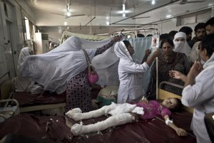
全体圣徒教会
22 Sep 2013
Notes:
So they did, but it was too late for some of the victims who needed immediate care to save their lives.
他们确实这样做了，但对于一些需要紧急救治以挽救生命的受害者来说，已经太迟了。

Slide 54
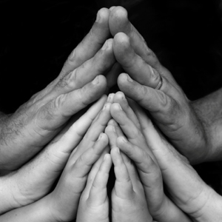
你在 哪方面为信仰受苦？
Notes:
You workplace passes you up for promotion.
Your motives are misunderstood.
You are lumped with fanatics.
Your faith is ridiculed in your family.
Some other area?
你的工作场所跳过你进行晋升。
你的动机被误解。
你被归为极端分子。
你的信仰在家庭中受到嘲笑。
还有其他方面吗？

Slide 55
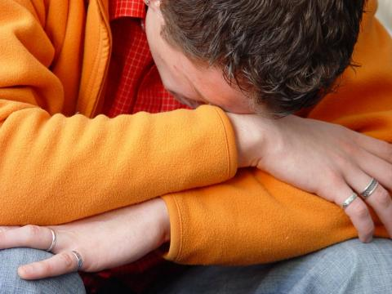
耶稣希望你如何应对苦难？
Notes:
What is most important is Christ's view of suffering—how he wants us to address it!
最重要的是基督对苦难的看法——他希望我们如何面对它！

Slide 56
基督作为作家
Dr. Rick Griffith • Singapore Bible College • biblestudydownloads.com
Notes:
We have NO actual accounts of Jesus writing anything except what he wrote in the sand in John 8—and we have no idea what he wrote!
Still needs translation into Chinese: 8, 116
Notes section of slide 10 updated on 28 Dec 2012 but not translated into Chinese yet
我们没有任何确切的记载表明耶稣曾经写下过任何东西，唯一的例外是在约翰福音第8章中，他曾在地上写字——但我们完全不知道他写了什么！
仍需翻译成中文的部分：8, 116
第10张幻灯片的备注部分已于2012年12月28日更新，但尚未翻译成中文。

Slide 57
如果耶稣对你写了一封信，
内容会是如何呢？
R
启示录

Slide 58
小亚细亚 AD 95
335
亚 西 亚
Aezani
Cyme库麦
Erythra 厄立特利亚
Eumenia
Lebedus
Colophon
Hierapolis
希拉波里斯
Nysa
Trailes
Heraclea
Aphrodisias
Colossae歌罗西
Alabanda 阿拉班达
拔 摩
米 利 都
Notes:
In AD 95 John was exiled to the lonely island of Patmos out in the Adriatic Sea. Jesus Christ had a revelation of comfort to the suffering believers of Asia Minor, but how could this message reach them?
公元95年，使徒约翰被流放到孤寂的拔摩岛（Patmos），该岛位于亚得里亚海。耶稣基督向小亚细亚受苦的信徒启示安慰的信息，但这个信息要如何传达给他们呢？

Slide 59
七 个 教 会 (启示录 2–3)
335
Adramyttium
Aezani
别 迦 摩
推 雅 推 喇 城
Cyme
Erythrae
撒 狄
士 每 拿
Eumenia
非 拉 铁 非
Lebedus
Colophon
以 弗 所
Nysa
老 底 嘉
Hierapolis
Trailes
Heraclea
Aphrodisias
Colossae
Alabanda
拔 摩
Miletus
Notes:
Jesus designed a brilliant strategy by having his revelation sent to capital of the province, Ephesus. It included an individual letter to Ephesus, as well as letters to 6 other key churches. The Ephesians copied the entire book of Revelation, though, and sent the original to the next city, Smyrna. Smyrna then made their own copy and sent the original to Pergamum, which lay on the main road to the north. This city then sent the prophecy to
a, which sent it to Sardis, then Philadelphia, and finally to Laodicea.
耶稣设计了一个精妙的策略，将他的启示发送到该省的首府以弗所。这封信包括一封专门写给以弗所的信，以及写给另外六个关键教会的信。然而，以弗所的信徒抄录了整本《启示录》，然后将原件送到下一个城市士每拿。士每拿随后制作了自己的副本，并将原件送到北方主干道上的别迦摩。然后，这座城市将这封预言书送往推雅推喇，推雅推喇再传至撒狄，然后是非拉铁非，最后到老底嘉。

Slide 60
七 个 教 会 (启示录 2–3)
335
别 迦 摩
推 雅 推 喇 城
撒 狄
士 每 拿
非 拉 铁 非
以 弗 所
老 底 嘉
Notes:
These 7 churches were neither the largest, nor the most influential cities in Asia Minor. However, they were strategically located on a key highway that linked them all.
[Animate} From their own locations we understand that they also copied the prophecy and sent these copies to other churches near them.
这七间教会既不是小亚细亚最大的城市，也不是最有影响力的城市。然而，它们都位于一条关键的交通要道上，将彼此连接起来。
[动画] 从它们各自的地理位置来看，我们可以推测，它们也抄写了这启示的信息，并将这些副本送往附近的其他教会。

Slide 61
七星和七个金灯台指什么 (1:20)?
你所看见在我右手中的七星和七个金灯台的奥祕就是这样： 七星是七个教会的使者， 七灯台是七个教会。”

Slide 62
耶稣持有着 对个大教会的 权威

Slide 63
耶稣写信给了七间教会
(启示录 2–3)
以 弗 所
士 每 拿
别 迦 摩
推 雅 推 喇 城
撒 狄
非 拉 铁 非
老 底 嘉

Slide 64
启示录
基督的主权在未来的胜利
主权是属于基督 |  |  | 主权在教会 | 主权在末日的事件
第 1 章 |  |  | 第 2–3 章 | 第 4–22 章
“你看到什么” (1:19a) |  |  | “现在是什么” (1:19b) | “以后会发生什么” (1:19c)
过去 |  |  | 现在 | 未来
基督揭露 |  |  | 教会揭露 | 完成揭露
上帝在地上 |  |  | 上帝的使者 在地上 | 从地狱在地上到天堂地上
审判官 |  |  | 任务 | 判决和奖励
主题 1:1-3 | 敬拜三位一体神 1:4-8 | 荣耀耶稣基督 1:9- 20 | 小亚细亚七教会: 以弗所、士每拿、别迦摩、推雅推喇、撒狄、非拉铁非、 老底嘉 | 苦难 4:1– 19:10 | 第二次来 19:11-21 | 千禧年 20 | 永恒的状态 21:1–22:5 | 终结的迫切性 22:6-21
A.D. 95
318

Slide 65
七 个 教 会 (启2–3)
335
许诺
别 迦 摩
警告
推 雅 推 喇 城
告诫
训斥
表扬
士 每 拿
撒 狄
N/A
监督
N/A
N/A
N/A
以 弗 所
非 拉 铁 非
N/A
老 底 嘉
Notes:
Though some exceptions exist (noted with “N/A” above), the basic pattern of the seven letters is a sevenfold outline:
Church name
Christ Described in a Unique Way for that Church
Commendation of Good Deeds among the Believers
Rebuke of Sin within the Church
Exhortation or Encouragement to Repent
Warning if the Exhortation is Disobeyed
Promise for Faithfulness
Notice also that each letter not only begins with a reference to Christ but ends with an appeal from the Spirit.
虽然存在一些例外（上方以“N/A”标注），但七封书信的基本模式遵循七个要点：
教会名称
基督以该教会独特的方式描述
对信徒善行的称赞
对教会罪恶的责备
劝勉或鼓励悔改
若不听从劝勉的警告
对忠心者的应许
此外，每封信不仅以对基督的描述开头，还以圣灵的呼吁作为结尾。

Slide 66
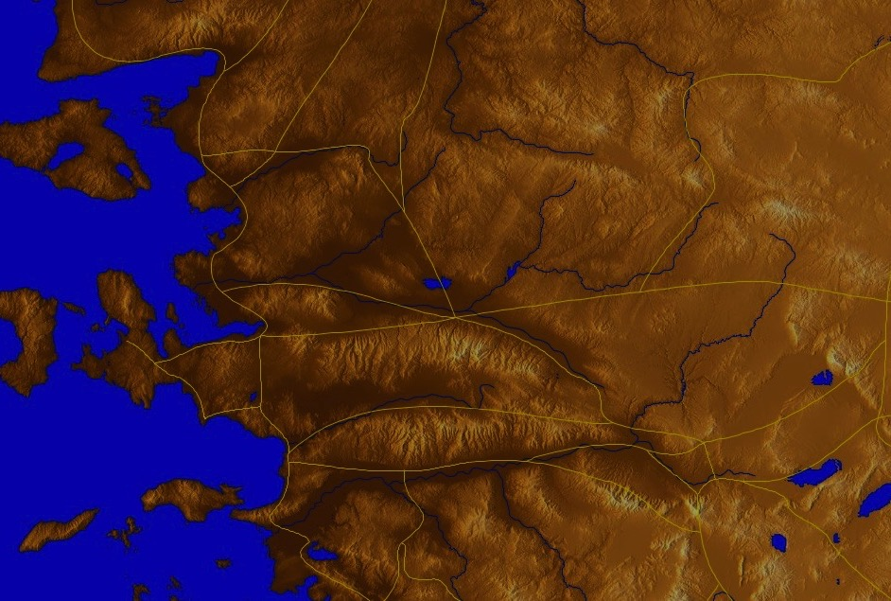
以弗所是
亚洲的首都
176
Notes:
The first letter was sent to Ephesus, which we covered last week.
第一封信是寄往以弗所的，我们在上周已经讨论过。

Slide 67
启 示 录 2:4
然而有一件事我要责备你、就是你把起初的爱心离弃了。

Slide 68
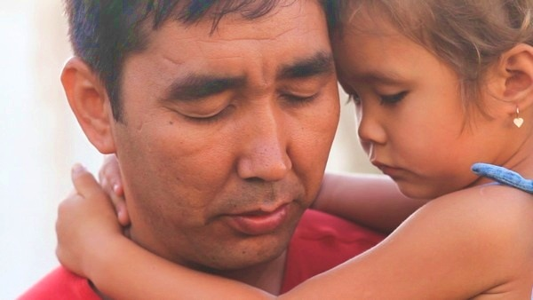
如何应对苦难？
耶稣给士每拿教会3个方法
Notes:
So today we come to the second letter, written to believers in Smyrna. This letter addresses this question…
所以今天，我们来到第二封信，这封信是写给士每拿的信徒的。这封信探讨了这样一个问题……

Slide 69
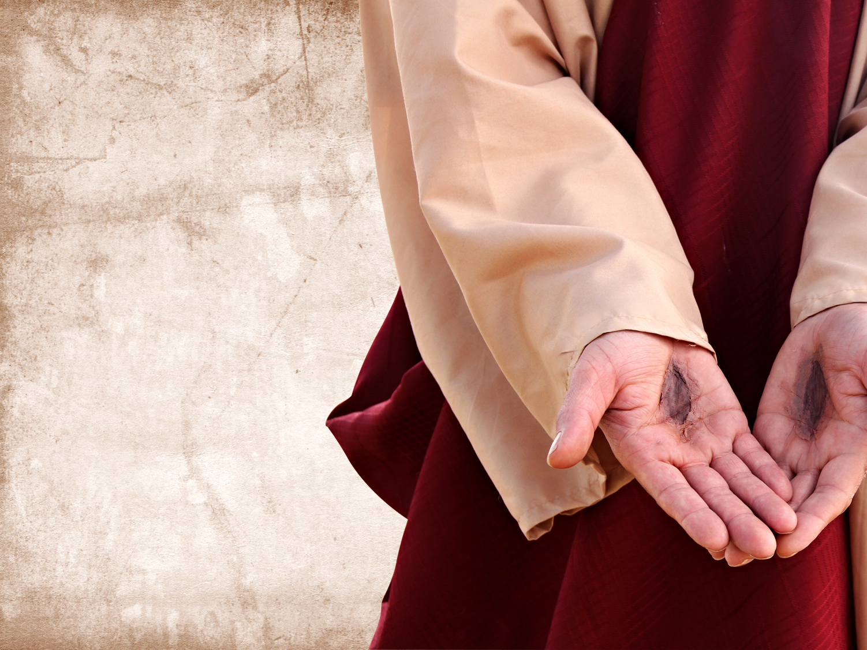
I. 要知道
耶稣
懂得/知晓
你的苦难 (2:8-9)
Notes:
Know that Jesus has "been there, done that.”
要知道，耶稣曾经经历过一切，并已得胜。

Slide 70
七 个 教 会 (启示录 2–3)
335
Adramyttium
Aezani
别 迦 摩
推 雅 推 喇 城
Cyme
Erythrae
撒 狄
士 每 拿
Eumenia
非 拉 铁 非
Lebedus
Colophon
以 弗 所
Nysa
老 底 嘉
Hierapolis
Trailes
Heraclea
Aphrodisias
Colossae
Alabanda
拔 摩
Miletus
Notes:
Jesus designed a brilliant strategy by having his revelation sent to capital of the province, Ephesus. It included an individual letter to Ephesus, as well as letters to 6 other key churches. The Ephesians copied the entire book of Revelation, though, and sent the original to the next city, Smyrna. Smyrna then made their own copy and sent the original to Pergamum, which lay on the main road to the north. This city then sent the prophecy to Thyatira, which sent it to Sardis, then Philadelphia, and finally to Laodicea.
耶稣设计了一个绝妙的策略，让他的启示首先传到该省的首都——以弗所。
这不仅包括一封写给以弗所的书信，还包括写给另外六间重要教会的书信。
以弗所的信徒抄写了整本《启示录》，然后将原稿送往下一座城市——士每拿。
士每拿再抄写自己的副本，并将原稿送往北方主干道上的别迦摩。
别迦摩随后将这卷预言书送往推雅推喇，推雅推喇再传递给撒狄，然后是非拉铁非，最后到达老底嘉。

Slide 71
士 每 拿 (启2:8-11)
324
别 迦 摩
推 雅 推 喇 城
训斥
无！
表扬:
患 难
迫害和 贫 穷
撒 狄
基督:
那 首 先 的 、 末 後 的 、 死 过 又 活 的
士 每 拿
以 弗 所
非 拉 铁 非
老 底 嘉

Slide 72
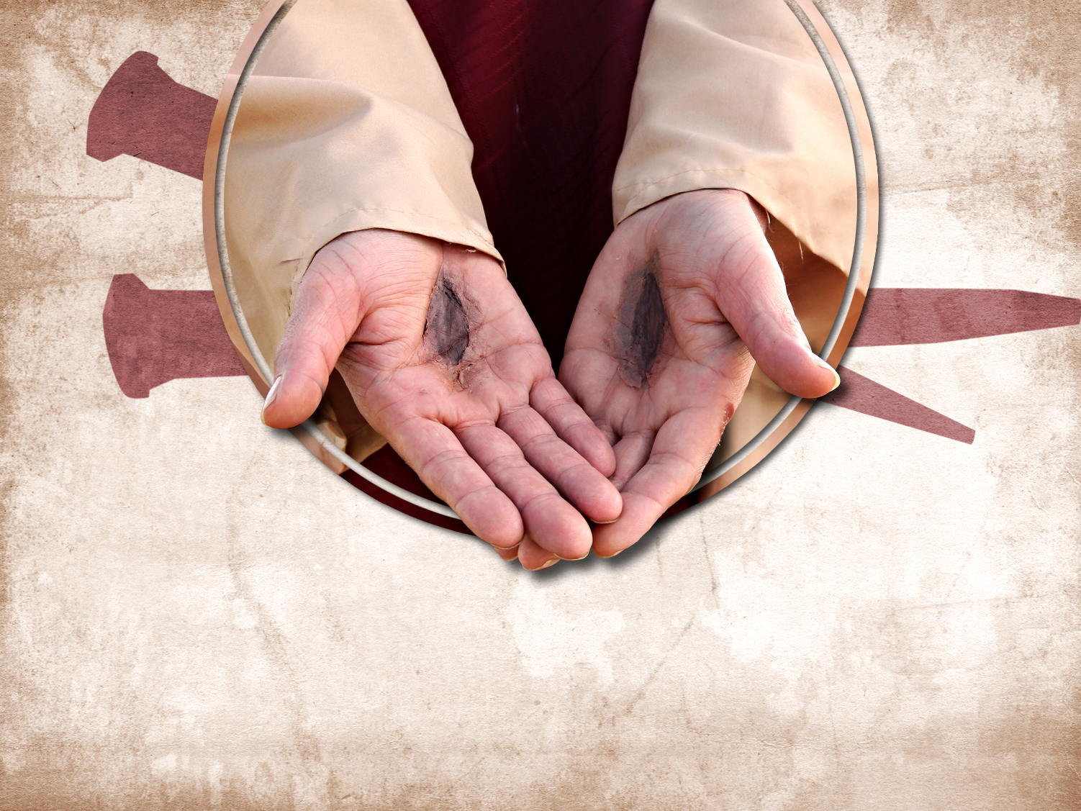
感谢耶稣
祂知道你正在受何种苦

Slide 73
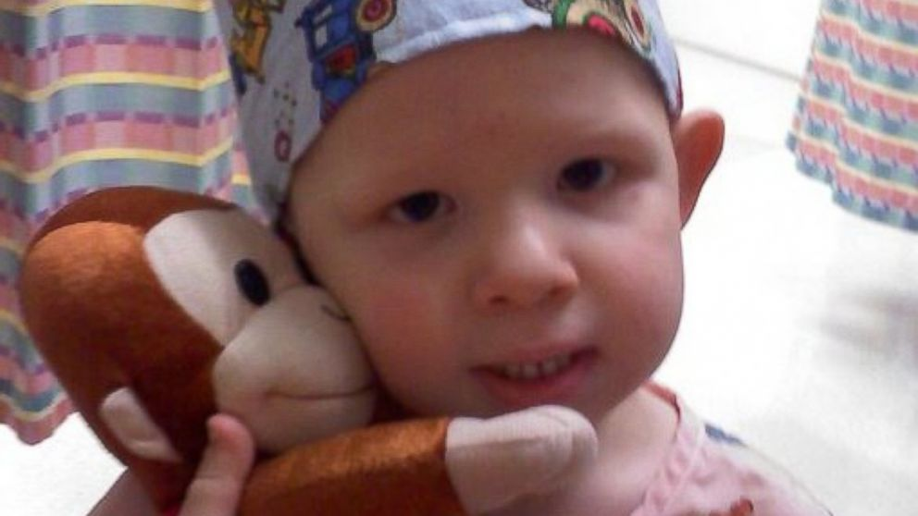
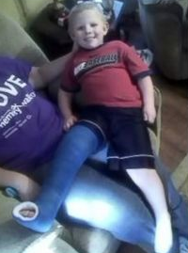
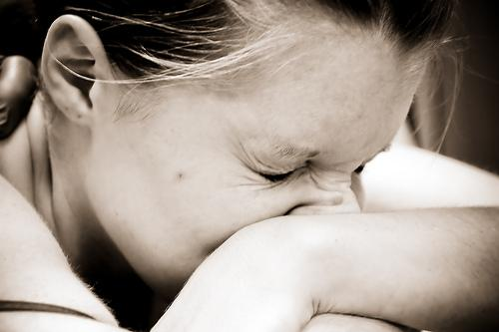
以撒 布朗
感受不到痛的男孩
http://abcnews.go.com/Health/meet-toddler-feels-pain/story?id=20658484
Notes:
Is pain good? Most of us do not think so!
• Isaac
Little Isaac Brown is five years old. Like other kids his age, he's learning to read and write his ABCs and to calculate simple addition and subtraction. But there is one thing Isaac is learning that rare few other children will ever have to learn. Isaac is learning about pain.
"We're doing the best we can to just teach him; he knows blood is bad," said Brown. "We taught him even when he was little to say 'ow.' You don't have to tell normal kids to say 'ow.'"
• Baby
Isaac was born with an extremely rare genetic insensitivity to pain. Like a modern day leper, Isaac doesn't know when he's touching a hot stove, when he's stepped on broken glass, or when he's broken a bone. For example, he broke his pelvis and felt no pain at all.
• Leg
Because he doesn't feel injuries, Isaac's parents, Carrie and Randy Brown, are teaching him how to identify them to stay healthy.
痛苦是好的吗？ 大多数人都不会这么认为！
以撒（Isaac）
小以撒·布朗（Isaac Brown）今年五岁，和同龄的孩子一样，他正在学习识字、写字母，以及简单的加减运算。但有一件事，是极少数孩子需要学习的，那就是——痛苦。
“我们尽最大努力教他，他知道流血是不好的。” 布朗（Brown）说道，“当他还很小的时候，我们就教他要说‘哎哟’，而普通的孩子根本不需要被教才能喊‘哎哟’。”
婴儿时期
以撒出生时患有极其罕见的遗传性疼痛不敏感症。
就像现代的麻风病人一样，以撒不会察觉自己正在接触灼热的炉子、踩到碎玻璃，甚至骨折时都毫无感觉。例如，他曾经骨盆骨折，却完全没有痛感。
腿部受伤
由于无法察觉受伤，以撒的父母凯莉（Carrie）和兰迪·布朗（Randy Brown） 不得不教导他如何识别身体的伤害，以便保护自己的健康。

Slide 74

Isaac Brown
The Boy Who Feels NO Pain
“当初医生得出诊断，他们说他们也不能做什么，至少当时是这样” 母亲凯莉回忆说。“不过他们可以利用以撒突变的基因，来帮助长期病痛的患者减轻痛苦！这想法真是不可思议……上帝赐给我们以撒，也许是为了这个目的.”
http://www.medicaldaily.com/can-boy-who-feels-no-pain-help-chronic-pain-sufferers-261005
Notes:
Family
"The toddler years were an absolute nightmare," said Isaac's mother, Carrie Brown. "He would just drop to the ground and smack his face on the table. He thought the fall was fun."
Isaac has dunked his hand in hot coffee without flinching. He once placed his palm on a working oven burner without shedding a tear.
His parents are believers. His mother noted..
Read quote
家庭
“蹒跚学步的那些年简直是一场噩梦，”艾萨克的母亲凯莉·布朗说道。“他会直接倒在地上，把脸撞到桌子上。他觉得摔倒很好玩。”
艾萨克曾把手伸进热咖啡里，却毫无反应。他还曾把手掌放在正在工作的烤炉上，却没有流下一滴眼泪。
他的父母是信徒。他的母亲提到……
阅读引用内容

Slide 75
受苦的原因
      “对于不虔不义的，受苦不足为怪。但是为什么义人受苦？圣经给出一些答案。受苦可能是因为：
        管教 (林前，11:30-32; 希伯来书，12:3-13),
        预防，警戒 (保罗身上的刺, 林后12:7),
        学习顺服 (基督受苦，希伯来书. 5:8; 罗马书. 5:3-5), or
        为基督作更好的见证 (使徒行传 9:16).”
约翰 . 沃尔伍德John Walvoord, “启示录,” 选自《圣经知识注释书》, 第2卷935页

Slide 76

耶稣感觉得到你的痛苦.

Slide 77
I. I. 要知道
耶稣
懂得/知晓
你的苦难 (2:8-9)

Slide 78

II. 不要害怕为基督受苦 (2:10a)
Notes:
During Nero's persecutions Christians refused to stop worshipping Christ, so they held their services underground in the tombs beneath Rome.
在尼禄的逼迫时期，基督徒拒绝停止敬拜基督，因此他们在罗马地下墓穴中举行聚会。

Slide 79
士 每 拿 (启2:8-11)
324
别 迦 摩
推 雅 推 喇 城
劝告：
不要害怕，
你 务 要
至 死 忠 心
训斥
无！
表扬:
患 难
迫害和 贫 穷
撒 狄
基督:
那 首 先 的 、 末 後 的 、 死 过 又 活 的
士 每 拿
以 弗 所
非 拉 铁 非
老 底 嘉

Slide 80

谁更惧怕?
迫害者?
受害者?
“不要怕人的威吓，也不要惊慌”
（彼得前书 3:14b)

Slide 81

给予的
“…如果身体被烧毁却没有爱，
算 不 得 什么
“烈士的鲜血是教会的种子”
-特塔利安-

Slide 82

All-Saints Church
回应
献身在白沙瓦（巴基斯坦城市）冲突
中牺牲的“全体圣徒教会”的烈士们
没人能动摇他们，他们也不惧怕颤抖。

Slide 83

All-Saints Church
反应可能源自惧怕

Slide 84

印度基督徒呼吁终止
与巴基斯坦的关系
政治反应
Notes:
Indian Christians burn Pakistan’s flag to protest church attack in Peshawar - See more at: http://post.jagran.com/christians-burn-pakistans-flag-to-protest-church-attack-in-peshawar-1380097718#sthash.drVPwCB0.dpuf
印度基督徒焚烧巴基斯坦国旗，以抗议白沙瓦教堂遭袭事件
查看更多详情：链接

Slide 85

All-Saints Church
愤怒的反应

Slide 86

All-Saints Church
22 Sep 2013
Notes:
Note the large words in English that the people of All Saints read prior to their martyrdom or suffering in the courtyard
请注意，万圣教堂的信徒在殉道或受苦之前，在庭院中所阅读的那些醒目的英文词句。

Slide 87

我们的反应
如果一个肢体受苦…
Notes:
We have committed S$3000 to help 6 families who lost their bread winners for three months.
我们已承诺提供 新加坡币 3000 元，帮助 6 个失去家庭支柱的家庭，为期 三个月。

Slide 88

现在你愿意承认对受苦的畏惧吗？

Slide 89
I. 要知道
耶稣
懂得/知晓
你的苦难 (2:8-9)

Slide 90
II. 不要害怕为基督受苦 (2:10a)
Notes:
During Nero's persecutions Christians refused to stop worshipping Christ, so they held their services underground in the tombs beneath Rome.
在尼禄的逼迫时期，基督徒拒绝停止敬拜基督，因此他们在罗马地下墓穴中举行聚会。

Slide 91

III. 苦难中要忠心 (2:10b-11).
Notes:
Commit now not to waver or give up your faith due to persecution.
现在就立志，不因逼迫而动摇或放弃你的信仰。

Slide 92
士 每 拿 (启2:8-11)
324
别 迦 摩
警告：
魔 鬼 要 把 你 们 中 间 几 个 人 下 在 监 里 ， 叫 你 们 被 试 炼 ， 你 们 必 受 患 难 十 日
推 雅 推 喇 城
劝告：
不要害怕，
你 务 要
至 死 忠 心
训斥
无！
表扬:
患 难
迫害和 贫 穷
撒 狄
基督:
那 首 先 的 、 末 後 的 、 死 过 又 活 的
士 每 拿
以 弗 所
非 拉 铁 非
老 底 嘉

Slide 93

启示录 : 痛苦 却坚定
"看哪！ 魔鬼将要把你们中间几个人下在监里， 叫你们受试炼， 你们要受患难十天" (2:10c)

Slide 94
士 每 拿 (启2:8-11)
324
别 迦 摩
推 雅 推 喇 城
劝告：
不要害怕，
你 务 要
至 死 忠 心
训斥
无！
表扬:
患 难
迫害和 贫 穷
撒 狄
基督:
那 首 先 的 、 末 後 的 、 死 过 又 活 的
士 每 拿
以 弗 所
非 拉 铁 非
老 底 嘉

Slide 95

士 每 拿 : 痛苦却坚定
“魔 鬼 要 把 你 们 中 间 几 个 人 下 在 监 里 ， 叫 你 们 被 试 炼 ， 你 们 必 受 患 难 十 日” (2:10b)

Slide 96

佩尔佩图阿-殉教 (AD 203)
Notes:
She refused to offer incense to Diana's image and thus was killed for it.
她拒绝向黛安娜（Diana）的像献香，因此被杀害。

Slide 97
士 每 拿 (启2:8-11)
324
别 迦 摩
警告：
魔 鬼 要 把 你 们 中 间 几 个 人 下 在 监 里 ， 叫 你 们 被 试 炼 ， 你 们 必 受 患 难 十 日
许诺
赐 给 你 那
生 命 的 冠 冕
推 雅 推 喇 城
劝告：
不要害怕，
你 务 要
至 死 忠 心
训斥
无！
表扬:
患 难
迫害和 贫 穷
撒 狄
基督:
那 首 先 的 、 末 後 的 、 死 过 又 活 的
士 每 拿
以 弗 所
非 拉 铁 非
老 底 嘉

Slide 98

ENDA（非歧视就业法案）
这个问题是如何被炒作的…
捍卫平等
Employment（就业）
Non-
Discrimination （不受歧视）
Act （法案）

Slide 99

ENDA
这个问题是如何被炒作的…
结束(一个)合法歧视！

Slide 100

ENDA
这个问题是如何被炒作的…
我淋浴时，旁边就是一个同性恋者。你工作时，身旁也可能就有这样的人。
通过 ENDA 法案.

Slide 101

大部分保守的基督徒反对此法案
停止
“非歧视就业法案”

Slide 102

从前不适用该法案
这个问题是如何被炒作的…
http://www.washingtonblade.com/2013/10/30/enda-heats/
华盛顿刀锋报—美国同性恋新闻领头报纸
“目前（2013年10月30日），ENDA法案有一个宗教除外条款，此条款允许宗教组织，比如教会或者教会学校，在用工方面对同性恋，双性恋，变性者有不同对待。然而，类似规定在1964年的《民权法案》第七条中找不到（甚至有抵触）；第七条禁止宗教组织基于种族，性别，国籍的歧视。
Notes:
Supporters have convinced people that homosexuality is not only OK, but it MUST be supported as it is as unchangeable as one’s race, gender, or national origin.
支持者已经让人们相信，同性恋不仅是可以接受的，而且必须被支持，因为它和**种族、性别或国籍一样是不可改变的。
http://www.washingtonblade.com/2013/10/30/enda-heats/

Slide 103

ENDA 法案的遣词造句
“用人单位因着个人（求职者，受雇人）实际的或者被认定的性别取向或性别身份而拒绝雇用任何人，或开除任何人，或在工资，工期，工作条件，就业权利方面歧视任何个人，都是非法的。

Slide 104

ENDA 参议院投票 (2013年11月5日)
“以61票赞成--30票反对, 参议院清除了《非歧视用工法案》在最终提交众议院决定之前的一大障碍。 不象其他诸多版本，这个法案将“性别身份”作为一个受法律保护的类别，从而将议题大大推进了一步。根据61位参议员的意见，美国的学校，组织，公司，慈善机构将不得不收起他们在安全，利润，未来业务方面的考虑，不仅鼓励男人在工作时着装为女人（反之亦然），而且还要为他们提供为此所需的场所。“
宗教自由X
政治正确√
托尼（Tony Perkins）“今日华盛顿” 家庭研究协会 2013年11月6日

Slide 105

众议院发言人约翰（ John Boehner）
"发言人认为这个法案将会增加许多本不必要的诉讼，进而影响就业，特别是小公司的就业。发言人始终认为，现有法律其实已经对（同性恋）有保护。
托尼（Tony Perkins）“今日华盛顿” 家庭研究协会 2013年11月7日

Slide 106

要点
在苦难中，以忠心替代畏惧，因为耶稣确切知道你的感受！
准备好了吗?

Slide 107

你现在如何
受苦？
      耶稣知晓你在受苦.
      不要害怕为基督受苦。
      不论结果如何，要忠心.

Slide 108
印度
“…如果身体被烧毁却没有爱，
算 不 得 什么
“烈士的鲜血是教会的种子”
-特塔利安-

Slide 109

被烧毁的教堂

Slide 110

火灾毀损教堂

Slide 111

有些
基督徒幸存

Slide 112

有些归天国

Slide 113
别 迦 摩
别 迦 摩 2:12-17

Slide 114
亲爱的别 迦 摩 教会…
妥协但继续的教会

Slide 115
别 迦 摩 (启2:12-17)
324
别 迦 摩
推 雅 推 喇 城
警告：
若 不 悔 改 ，
我 就 快 临 到
你 那 里 ，
用 我 口 中 的 剑
攻 击 他 们
许诺
我 必 将 那 隐 藏 的 吗 哪 赐 给 他 ，
并 赐 他 一 块 白 石 ，
石 上 写 着 新 名
劝告：
忏悔
训斥
你 那 里 有 人 服 从 了 巴 兰 和
尼 哥 拉的 教 训
表扬:
你 还 坚 守
我 的 名 ，
没 有 弃 绝
我 的 道
撒 狄
基督:
有 两 刃
利 剑
士 每 拿
以 弗 所
非 拉 铁 非
老 底 嘉

Slide 116
别 迦 摩 (启2:12-17)
“你要写信给在别迦摩教会的使者， 说： ‘那有一把两刃利剑的， 这样说： 13 我知道你居住的地方， 就是撒但王座所在的地方。 当我忠心的见证人安提帕在你们那里， 就是在撒但居住的地方被杀的那些日子， 你还持守我的名， 没有否认对我的信仰。 14 然而有几件事我要责备你， 因为在你那里有些人持守巴兰的教训。 这巴兰曾经教导巴勒把绊脚石放在以色列人面前， 叫他们吃祭过偶像的食物， 并且行淫乱。 15 同样， 你也有些人持守尼哥拉党的教训。 16 所以， 你应当悔改； 如果不悔改， 我就很快地来到你们那里， 用我口中的剑跟他们作战。 17 圣灵向众教会所说的话， 有耳的就应当听。 得胜的， 我必定把那隐藏的吗哪赐给他， 并且赐他一块白石， 石上写着新的名字， 这名字除了那领受的人以外， 是没有人能知道的。’

Slide 117
基督的命令
耶稣告诉约翰：
"你要写信给在别迦摩教会的使者" (2:12)

Slide 118
基督的赞扬
2:13 "我知道你居住的地方， 就是撒但王座所在的地方。 当我忠心的见证人安提帕在你们那里， 就是在撒但居住的地方被杀的那些日子， 你还持守我的名， 没有否认对我的信仰。"

Slide 119

别迦摩模型:
继续却妥协
Notes:
It has long been assumed that the temple was dedicated to Zeus. The altar is mentioned in the Book of Revelation, 2:11-12: "To the angel of the church in Pergamum [sic], write this: . . . 'I know that you live where Satan's throne is . . . . '" This is a scale model of the altar.
人们长期以来一直认为这座神庙是献给宙斯（Zeus）的。
启示录 2:11-12 提到了这座祭坛：
“你要写信给在别迦摩教会的使者，说：……‘我知道你的居所，就是有撒但座位之处……’”
这是这座祭坛的等比例模型。

Slide 120

撒 但 座 位 (2:11-13)
"我知道你居住的地方， 就是撒但王座所在的地方" (2:13)
Notes:
It has long been assumed that the temple was dedicated to Zeus. The altar is mentioned in the Book of Revelation, 2:11-12: "To the angel of the church in Pergamum [sic], write this: . . . 'I know that you live where Satan's throne is . . . . '" This is a scale model of the altar.
人们长期以来一直认为这座神庙是献给**宙斯（Zeus）**的。
启示录 2:12-13 提到了这座祭坛：
“你要写信给在别迦摩教会的使者，说：……‘我知道你的居所，就是有撒但座位之处……’”
这是这座祭坛的等比例模型。

Slide 121

巴比伦宗教向西转移
罗马
帕加马
巴比伦
Notes:
"After the Persians took over Babylon in 539 B.C., they discouraged the continuation of the mystery religions of Babylon. Subsequently the Babylonian cultists moved to Pergamum (or Pergamos) where one of the seven churches of Asia Minor was located (cf. Rev. 2:12-17)… When the teachers of the Babylonian mystery religions later moved from Pergamum to Rome, they were influential in paganizing Christianity and were the source of many so-called religious rites which have crept into ritualistic churches" (Walvoord, BKC).
“公元前 539 年，波斯人占领巴比伦后，他们阻止了巴比伦神秘宗教的延续。随后，巴比伦的祭司们迁往别迦摩（Pergamum 或 Pergamos），即小亚细亚七间教会之一所在地（参启示录 2:12-17）。……后来，巴比伦神秘宗教的教师们又从别迦摩迁往罗马，他们对基督教的异教化产生了深远的影响，并成为许多所谓宗教仪式的根源，这些仪式后来渗透到礼仪性教会之中。”（沃尔沃德，《圣经知识注释》）

Slide 122

巴比伦宗教向西转移
Pontifex Maximus
“桥梁的主要守护者"
人与撒旦之间的桥梁的守护者
罗马
Pergamum
巴比伦
Notes:
"Crowns in the shape of a fish head were worn by the chief priests of the Babylonian cult to honor the fish god. The crowns bore the words "Keeper of the Bridge," symbolic of the "bridge" between man and Satan. This handle was adopted by the Roman emperors, who used the Latin title Pontifex Maximus, which means "Major Keeper of the Bridge." And the same title was later used by the bishop of Rome. The pope today is often called the pontiff, which comes from pontifex. " (Walvoord, BKC).
“巴比伦教派的大祭司们佩戴着鱼头形状的冠冕，以此来敬拜鱼神。这些冠冕上刻有‘桥梁的守护者’（Keeper of the Bridge）这一称号，象征着人与撒但之间的‘桥梁’。这一称号后来被罗马皇帝采用，他们使用拉丁语称号 Pontifex Maximus，意思是‘至高桥梁守护者’。随后，这一称号又被罗马的主教沿用。今天，教皇经常被称为 pontiff，这个词正是来源于 pontifex。”（沃尔沃德，《圣经知识注释》（BKC））

Slide 123
基督的责备
    2:14 "然而有几件事我要责备你， 因为在你那里有些人持守巴兰的教训。 这巴兰曾经教导巴勒把绊脚石放在以色列人面前， 叫他们吃祭过偶像的食物， 并且行淫乱。 ¹⁵ 同样， 你也有些人持守尼哥拉党的教训。"

Slide 124
一些会众听从巴兰的教训
2:14 "然而有几件事我要责备你， 因为在你那里有些人持守巴兰的教训。 这巴兰曾经教导巴勒把绊脚石放在以色列人面前， 叫他们吃祭过偶像的食物， 并且行淫乱。"

Slide 125

民 数 记
135
准备占用 领土
准备
老一代
不信
延期
准备
下一代
1:1–10:10
10:11–25:18
26–36
神的信实
以色列背信弃义
神的信实
神赐福
神惩处
神赐福
以色列献身
以色列抱怨
以色列 献身
常规
动乱
重新常规
西 乃 山
旷野
摩 押
20 天
38 年, 3 个月, 10 天
ca. 5 个月
组织
(1-4)
洗涤 (5:1-10:10)
去
低 斯(10:11-
12:16)
低 斯罪
(13-14)
旷野
(15-19)
去
摩 押 (20-21)
摩 押
罪
(22-25)
土地
供应
(26-27)
奉献 & 誓言 (28-30)
最后准备
(31-36)

Slide 126

约旦河东事件
140
战胜西 宏 和 住 希 (民 数 记 . 21)
巴 勒没能让神针对以色列-巴 兰赐福 （民 数 记 22 – 24）

Slide 127


Balaam
巴 兰
民 数 记 22-24

Slide 128
启 示 录 2:14-15
14 然 而 ， 有 几 件 事 我 要 责 备 你 ： 因 为 在 你 那 里 有 人 服 从 了 巴 兰 的 教 训 ； 这 巴 兰 曾 教 导 巴 勒 将 绊 脚 石 放 在 以 色 列 人 面 前 ， 叫 他 们 吃 祭 偶 像 之 物 ， 行 奸 淫 的 事 。
15 你 那 里 也 有 人 照 样 服 从 了 尼 哥 拉 一 党 人 的 教 训 。

Slide 129
彼 得 后书 2:15-16
15 他 们 离 弃 正 路 ， 就 走 差 了 ， 随 从 比 珥 之 子 巴 兰 的 路 。 巴 兰 就 是 那 贪 爱 不 义 之 工 价 的 先 知 ，
16 他 却 为 自 己 的 过 犯 受 了 责 备 ； 那 不 能 说 话 的 驴 以 人 言 拦 阻 先 知 的 狂 妄 。

Slide 130
猶 大 书 11 (NIV)
11 他 们 有 祸 了 ！ 因 为 走 了 该 隐 的 道 路 ， 又 为 利 往 巴 兰 的 错 谬 里 直 奔 ， 并 在 可 拉 的 背 叛 中 灭 亡 了 。

Slide 131
约旦河东事件
140
战胜西 宏 和 住 希 (民 数 记 . 21)
巴 勒没能让神针对以色列-巴 兰赐福 （民 数 记 22 – 24）
巴 勒成功的让以色列百 姓 与 摩 押 女 子 行 起 淫 乱
(民 数 记. 25)

Slide 132
一些会众听从尼哥拉党的教训
2:15 "同样， 你也有些人持守尼哥拉党的教训."

Slide 133
基督的纠正
2:16-17 "所以， 你应当悔改； 如果不悔改， 我就很快地来到你们那里， 用我口中的剑跟他们作战。 ¹⁷圣灵向众教会所说的话， 有耳的就应当听。 得胜的， 我必定把那隐藏的吗哪赐给他， 并且赐他一块白石， 石上写着新的名字， 这名字除了那领受的人以外， 是没有人能知道的。’ "

Slide 134
悔改...
2:16 "所以， 你应当悔改； 如果不悔改， 我就很快地来到你们那里， 用我口中的剑跟他们作战。"

Slide 135
接受训诲
2:17 "圣灵向众教会所说的话， 有耳的就应当听。 得胜的， 我必定把那隐藏的吗哪赐给他， 并且赐他一块白石， 石上写着新的名字， 这名字除了那领受的人以外， 是没有人能知道的。"

Slide 136
领受…生命的粮
"得胜的， 我必定把那隐藏的吗哪赐给他"
(2:17a)

Slide 137
    约翰福音 6:30-35
于是他们就说： “你要行甚么神蹟， 让我们看了就信你呢？ 你到底能作甚么呢？ 31 我们的祖宗在旷野吃过吗哪， 正如经上所记： ‘他把从天上来的食物赐给他们吃。’” 32 耶稣对他们说： “我实实在在告诉你们， 不是摩西把那从天上来的食物赐给你们， 而是我父把天上来的真食物赐给你们； 33 因为 神的食物就是从天上降下来， 把生命赐给世人的那一位。” 34 他们对耶稣说： “主啊， 求你常把这食物赐给我们。” 35 耶稣说： “我就是生命的食物， 到我这里来的， 必定不饿； 信我的， 永远不渴。

Slide 138
承受… 永生
"并且赐他一块白石， 石上写着新的名字， 这名字除了那领受的人以外， 是没有人能知道的。"
(2:17b)

Slide 139
推雅推喇城
启示录 2:18-29

Slide 140

推 雅 推 喇 城 :
I成员 却 不道德
Rick Griffith • Crossroads International Church • biblestudydownloads.com

Slide 141

Right way, wrong way
正确的路
错误的路

Slide 142

色情

Slide 143


色情
美国沉迷于
色情
卖淫是世界上最古老的行业之一，而如今，这个行业比以往任何时候都更加兴旺。然而，对色情的彻底沉迷正以惊人的速度从计算机和电视屏幕蔓延到整个美国的家庭、亲情关系以及婚姻之中，带来了严重的危机。

Slide 144







色情
每30分钟： 美国就会制作一部色情影片。
每秒钟： 30,000 人正在观看色情内容。
美国生产了全球 89% 的色情网站。
42.7% 的互联网用户观看色情内容（即 102,434,567 人）。

Slide 145


色情
色情产业约为
它的收入比所有顶级科技公司的总收入还要高。
的行业
色情
（微软、谷歌、亚马逊、eBay、雅虎、苹果、Netflix、EarthLink）

Slide 146




色情
每天有：
🔍 6800万次
色情相关的搜索引擎请求
📌 占所有搜索请求的 25%
色情
占所有搜索请求的 25%
是互联网搜索的
头号主题
每天发送 25 亿封色情邮件
📌 占所有邮件的 8%
📨 普通互联网用户每天平均收到 4.5 封色情邮件

Slide 147



色情
首次接触色情内容的平均年龄仅为 11 岁。
访问色情网站的男女比例：
28% 女性 72% 男性
男性比女性观看色情内容的可能性高 6 倍，并且更容易花费更多时间观看。
17%
的女性表示她们在与色情成瘾作斗争。

Slide 148




色情
大约 200,000 名美国人是“色情成瘾者”：指的是每周在网上观看色情内容超过 11 小时的人。
反复观看色情内容会对你的
性欲产生负面影响：
三分之一的伴侣也同样失去了兴趣。
超过 50% 的人在参与“网络性互动”后，对性生活失去了兴趣。

Slide 149

色情
色情成瘾导致：
• 40% 的“性瘾者”失去了配偶
58% 的人遭受严重的经济损失
三分之一的人失去了工作
色情内容的使用使婚姻不忠的发生率增加超过 300%

Slide 150

色情
56% 的离婚案例涉及其中一方对色情网站有强迫性兴趣。
严重的临床抑郁症在互联网色情内容使用者中的报告频率是普通人的两倍。
性强迫症患者和成瘾者比普通人高出 23 倍的可能性认为：
接触网络色情内容是他们人生中发生过的最糟糕的事情。”

Slide 151


色情
的 18-24 岁男性 在一个典型的月份内会访问色情网站。

Slide 152




色情
平均每次访问色情网站的时长为 6 分 29 秒。
一年中观看色情内容最少的一天是感恩节（Thanksgiving）。
一周中观看色情内容最多的一天是星期天（Sunday）。
最低
观看率
最高
观看率
感恩节
星期天

Slide 153

色情

Slide 154

教会里的色情

Slide 155

耶稣对信徒不道德行为的反应如何?

Slide 156
如果耶稣对你写了一封信，
内容会是如何呢？
R
启示录

Slide 157
七 个 教 会 (启示录 2–3)
335
Adramyttium
Aezani
别 迦 摩
推 雅 推 喇 城
Cyme
Erythrae
撒 狄
士 每 拿
Eumenia
非 拉 铁 非
Lebedus
Colophon
以 弗 所
Nysa
老 底 嘉
Hierapolis
Trailes
Heraclea
Aphrodisias
Colossae
Alabanda
拔 摩
Miletus
Notes:
Jesus designed a brilliant strategy by having his revelation sent to capital of the province, Ephesus. It included an individual letter to Ephesus, as well as letters to 6 other key churches. The Ephesians copied the entire book of Revelation, though, and sent the original to the next city, Smyrna. Smyrna then made their own copy and sent the original to Pergamum, which lay on the main road to the north. This city then sent the prophecy to Thyatira, which sent it to Sardis, then Philadelphia, and finally to Laodicea.
耶稣设计了一个绝妙的策略，让他的启示首先传到该省的首都——以弗所。
这不仅包括一封写给以弗所的书信，还包括写给另外六间重要教会的书信。
以弗所的信徒抄写了整本《启示录》，然后将原稿送往下一座城市——士每拿。
士每拿再抄写自己的副本，并将原稿送往北方主干道上的别迦摩。
别迦摩随后将这卷预言书送往推雅推喇，推雅推喇再传递给撒狄，然后是非拉铁非，最后到达老底嘉。

Slide 158
耶稣写信给了七间教会
(启示录 2–3)
以 弗 所
士 每 拿
别 迦 摩
推 雅 推 喇 城
撒 狄
非 拉 铁 非
老 底 嘉

Slide 159

《启示录》2:18-29 结构
负面
正面
负面
正面

Slide 160
耶稣对信徒 不道德行为，如何反应?

Slide 161
I. 耶稣审判 信徒的罪 (2:18).

Slide 162
七 个 教 会 (启示录 2–3)
335
Adramyttium
Aezani
别 迦 摩
推 雅 推 喇 城
Cyme
Erythrae
撒 狄
士 每 拿
Eumenia
非 拉 铁 非
Lebedus
Colophon
以 弗 所
Nysa
老 底 嘉
Hierapolis
Trailes
Heraclea
Aphrodisias
Colossae
Alabanda
拔 摩
Miletus
Notes:
Jesus designed a brilliant strategy by having his revelation sent to capital of the province, Ephesus. It included an individual letter to Ephesus, as well as letters to 6 other key churches. The Ephesians copied the entire book of Revelation, though, and sent the original to the next city, Smyrna. Smyrna then made their own copy and sent the original to Pergamum, which lay on the main road to the north. This city then sent the prophecy to Thyatira, which sent it to Sardis, then Philadelphia, and finally to Laodicea.
耶稣设计了一个绝妙的策略，让他的启示首先传到该省的首都——以弗所。
这不仅包括一封写给以弗所的书信，还包括写给另外六间重要教会的书信。
以弗所的信徒抄写了整本《启示录》，然后将原稿送往下一座城市——士每拿。
士每拿再抄写自己的副本，并将原稿送往北方主干道上的别迦摩。
别迦摩随后将这卷预言书送往推雅推喇，推雅推喇再传递给撒狄，然后是非拉铁非，最后到达老底嘉。

Slide 163

推 雅 推 喇
355
推 雅 推 喇以紫色染料以及制革、染色、羊毛和亚麻纺织工人协会出名，因此广泛使用陶罐, 也经常有异教庆典活动。许多基督徒宁死也不愿妥协，不愿参与协会庆典活动。

Slide 164
推 雅 推 喇
355
推 雅 推 喇的贸易行业协会比其他城市还要多，这些协会都供奉行业神。基督徒因不拜偶像而遇到生计上的困难。

Slide 165
推 雅 推 喇 城 (启2:18-29)
324
别 迦 摩
推 雅 推 喇 城
撒 狄
基督:
眼 目 如 火 焰 、 脚 像 光 明 铜
士 每 拿
以 弗 所
非 拉 铁 非
老 底 嘉

Slide 166

对耶稣的描述
"神的儿子， 那眼睛像火燄、 两脚像光铜的， 这样说" (2:18 )

Slide 167
耶稣对信徒 不道德行为，如何反应?

Slide 168

II. 耶稣 称赞 他们的服侍(2:19).

Slide 169
推 雅 推 喇 城 (启2:18-29)
324
别 迦 摩
推 雅 推 喇 城
表扬:
行 为 、爱 心 、 信 心 、 勤 劳 、 忍 耐 ， 又 知 道 你 末 後 所 行 的 善 事 ， 比 起 初 所 行 的 更 多
撒 狄
基督:
眼 目 如 火 焰 、 脚 像 光 明 铜
士 每 拿
以 弗 所
非 拉 铁 非
老 底 嘉

Slide 170

"我知道你的行为， 你的爱心、 信心、 服侍和忍耐， 也知道你后来所作的比先前的还要多" (2:19 CNV)

Slide 171

我们当中谁是应当受称赞的?

Slide 172

米利暗（Miriam Burnett）

Slide 173

Lewis, Barbara & Christine Winkler

Slide 174

Lewis Winkler

Slide 175

Lewis Winkler

Slide 176

Lewis Winkler

Slide 177

Lewis Winkler

Slide 178

Lewis Winkler

Slide 179

Susan Griffith

Slide 180

耶稣
知道!
优秀
很好
好
一般
差

Slide 181
耶稣对信徒 不道德行为，作何反应?

Slide 182

III. 耶稣鉴察不忠心和忠心的信徒 (2:20-25)

Slide 183
推 雅 推 喇 城 (启2:18-29)
324
别 迦 摩
推 雅 推 喇 城
训斥
容 让 那 自 称 是 先 知 的 妇 人 耶 洗 别 教 导 我 的 仆 人 ， 引 诱 他 们 行 奸 淫 ， 吃 祭 偶 像 之 物
表扬:
行 为 、爱 心 、 信 心 、 勤 劳 、 忍 耐 ， 又 知 道 你 末 後 所 行 的 善 事 ， 比 起 初 所 行 的 更 多
撒 狄
基督:
眼 目 如 火 焰 、 脚 像 光 明 铜
士 每 拿
以 弗 所
非 拉 铁 非
老 底 嘉

Slide 184

"然而有一件事我要责备你， 就是你容让那自称是先知的妇人耶洗别， 教导和引诱我的众仆人行淫乱， 吃祭过偶像的食物。 21 我曾给她时间， 让她悔改， 她却不肯为她的淫行悔改"
(2:20-21 CNV)

Slide 185

谁是耶洗别?

Slide 186

但
巴力
3.5 年的干旱快结束的时候，在侍奉“雷神”“雨神”的这块土地上，以利亚直面耶洗别的850个先知。
伯特利
耶路撒冷
列王记上16:31-33

Slide 187

“当时社会能接受的却是基督所憎恨的。他们偏离正道已有时日 (21节).推 雅 推 喇教会可能最初从吕底亚那里听到福音。吕底亚通过保罗的传道而信主 (使徒行传 16:14-15).有趣的是，如今一个妇人，自称’女先知‘ 正影响教会。其名’耶洗别‘表明她正腐蚀推 雅 推 喇教会，正如当年亚哈王的妻子耶洗别腐蚀以色列国。 (列王记上 16:31-33)”
(沃尔伍德 Walvoord, BKC)

Slide 188
推 雅 推 喇 城 (启2:18-29)
324
别 迦 摩
警告：
看 哪 ， 我 要 叫 他 （耶 洗 别） 病 卧 在 床 。 那 些 与 他 行 淫 的 人 ， 若 不 悔 改 所 行 的 ， 我 也 要 叫 他 们 同 受 大 患 难 。
23 我 又 要 杀 死 他 的 党 类 （ 原 文 是 儿 女 ） ， 叫 众 教 会 知 道 ， 我 是 那 察 看 人 肺 腑 心 肠 的 ， 并 要 照 你 们 的 行 为
报 应 你 们 各 人
推 雅 推 喇 城
劝告：
忏悔
你 们 已 经 有 的 ， 总 要 持 守
训斥
容 让 那 自 称 是 先 知 的 妇 人 耶 洗 别 教 导 我 的 仆 人 ， 引 诱 他 们 行 奸 淫 ， 吃 祭 偶 像 之 物
表扬:
行 为 、爱 心 、 信 心 、 勤 劳 、 忍 耐 ， 又 知 道 你 末 後 所 行 的 善 事 ， 比 起 初 所 行 的 更 多
撒 狄
基督:
眼 目 如 火 焰 、 脚 像 光 明 铜
士 每 拿
以 弗 所
非 拉 铁 非
老 底 嘉

Slide 189

HIV病毒 • 艾滋病

Slide 190

HIV 病毒及艾滋病全球一览
南亚和东南亚

Slide 191

"看哪， 我要把她抛在大患难的床上； 那些跟她行淫乱的人， 如果不为她的行为悔改， 我也要把他们抛在大患难中。
²³我必以死亡击杀她的儿女…"
(2:22-23a CNV)

Slide 192
推 雅 推 喇 城 (启2:18-29)
324
别 迦 摩
警告：
看 哪 ， 我 要 叫 他 （耶 洗 别） 病 卧 在 床 。 那 些 与 他 行 淫 的 人 ， 若 不 悔 改 所 行 的 ， 我 也 要 叫 他 们 同 受 大 患 难 。
23 我 又 要 杀 死 他 的 党 类 （ 原 文 是 儿 女 ） ， 叫 众 教 会 知 道 ， 我 是 那 察 看 人 肺 腑 心 肠 的 ， 并 要 照 你 们 的 行 为
报 应 你 们 各 人
推 雅 推 喇 城
劝告：
忏悔
你 们 已 经 有 的 ， 总 要 持 守
训斥
容 让 那 自 称 是 先 知 的 妇 人 耶 洗 别 教 导 我 的 仆 人 ， 引 诱 他 们 行 奸 淫 ， 吃 祭 偶 像 之 物
表扬:
行 为 、爱 心 、 信 心 、 勤 劳 、 忍 耐 ， 又 知 道 你 末 後 所 行 的 善 事 ， 比 起 初 所 行 的 更 多
撒 狄
基督:
眼 目 如 火 焰 、 脚 像 光 明 铜
士 每 拿
以 弗 所
非 拉 铁 非
老 底 嘉

Slide 193


艾滋病
的治疗

Slide 194

忠心的信徒必须坚持到底
（启 2:24-25）
Notes:
"To all who have not learned the so-called "deep secrets of Satan," I do not burden you further; however, hold what you have until I come."
Does Jesus really just expect some of us simply to remain faithful to the truth we have been taught (24-25)?
Yes, he expects perseverance, since growth and blessing are his responsibility.
Since the church was so small, Jesus did not ask them to leave it but to remain until he purged it of false teachers.
We often think we need to do great things for Christ. Actually, it is HE who does the great things! He only asks us to remain faithful.
Obviously, those caught up in immorality were not faithful!
24至于你们其余在推雅推拉的人，就是不跟从那教训，不认识所谓撒但深奥的事的人，我告诉你们，我不会把别的重担放在你们身上。25不过，你们要持守已经得着的，直到我来。（启示录 2:24-25）
耶稣真的只是期望我们中一些人简单地持守所学的真理吗？
是的，祂期望我们持守到底，因为成长和祝福是祂的责任。
由于当时的教会人数很少，耶稣并没有要求他们离开，而是要他们留在其中，直到祂洁净教会、除去假教师。
我们常常认为自己需要为基督做伟大的事，但实际上，是祂在成就伟大的事！ 祂只要求我们忠心持守。
很显然，那些陷入淫乱的人并不忠心！

Slide 195
耶稣对信徒 不道德行为，作何反应?

Slide 196

四、耶稣
奖赏
忠心的人
（启示录 2:26-29）。

Slide 197
推 雅 推 喇 城 (启2:18-29)
324
别 迦 摩
警告：
看 哪 ， 我 要 叫 他 （耶 洗 别） 病 卧 在 床 。 那 些 与 他 行 淫 的 人 ， 若 不 悔 改 所 行 的 ， 我 也 要 叫 他 们 同 受 大 患 难 。
23 我 又 要 杀 死 他 的 党 类 （ 原 文 是 儿 女 ） ， 叫 众 教 会 知 道 ， 我 是 那 察 看 人 肺 腑 心 肠 的 ， 并 要 照 你 们 的 行 为
报 应 你 们 各 人
推 雅 推 喇 城
许诺
我 要 赐 给 他 权 柄
制 伏 列 国，
晨 星 赐 给 他
劝告：
忏悔
你 们 已 经 有 的 ， 总 要 持 守
训斥
容 让 那 自 称 是 先 知 的 妇 人 耶 洗 别 教 导 我 的 仆 人 ， 引 诱 他 们 行 奸 淫 ， 吃 祭 偶 像 之 物
表扬:
行 为 、爱 心 、 信 心 、 勤 劳 、 忍 耐 ， 又 知 道 你 末 後 所 行 的 善 事 ， 比 起 初 所 行 的 更 多
撒 狄
基督:
眼 目 如 火 焰 、 脚 像 光 明 铜
士 每 拿
以 弗 所
非 拉 铁 非
老 底 嘉

Slide 198


推 雅 推 喇
355
²⁶ 那 得 胜 又 遵 守 我 命 令 到 底 的 ， 我 要 赐 给 他 权 柄 制 伏 列 国 ；
²⁷ 他 必 用 铁 杖 辖 管 （ 辖 管 ： 原 文 是 牧 ） 他 们 ， 将 他 们 如 同 窑 户 的 瓦 器 打 得 粉 碎 ， 像 我 从 我 父 领 受 的 权 柄 一 样 。
启示录 2:26-27

Slide 199
得胜者 (启示录 2–3)
别迦摩
推雅推喇
士每拿
“得胜者”在每间教会的身上都有被提起；
加上21:7一共出现了八次
撒狄
以弗所
非拉铁非
老底嘉

Slide 200
得胜者 (启示录 2–3)
324
别迦摩
推雅推喇
士每拿
得胜的，我必将神乐园生命树的果子赐给他吃。 (2:7)
撒狄
以弗所
非拉铁非
2:7
老底嘉

Slide 201
得胜者 (启示录 2–3)
324
别迦摩
推雅推喇
士每拿
撒狄
得胜的，必不受第二次死的害。 (2:11)
2:11
以弗所
非拉铁非
2:7
老底嘉

Slide 202
得胜者 (启示录 2–3)
325
别迦摩
推雅推喇
得胜的，
我必将
那隐藏的
吗哪赐给他，并赐
他一块白石，石上写着
新名；除了那领受的以外，没有人能认识
(2:17)
2:17
士每拿
撒狄
2:11
以弗所
非拉铁非
2:7
老底嘉

Slide 203
得胜者 (启示录 2–3)
325
别迦摩
推雅推喇
2:17
2:26
士每拿
撒狄
那得胜又遵守我命令到底的，我要赐给他权柄
制伏列国
(2:26)
2:11
以弗所
非拉铁非
2:7
老底嘉

Slide 204

你准备好去统治世界吗?

Slide 205

耶稣的法则
启示录2:27引用诗篇2:8-9

Slide 206




将 来 的 恩 惠 (19-20章)
天 堂
(21-22 章)
千 禧 年
(20 章)
再 來
(19 章)
Notes:
These 2 slides translated into Chinese using Google translator: 36, 149

Slide 207

预备好去统治吗？
服侍
君王的統治
学习永生的保证和人类重大的意义

Slide 208
启 示 录 20:4
4 我又看见几个宝座、也有坐在上面的、并有审判的权柄赐给他们．我又看见那些因为给耶稣作见证、并为 神之道被斩者的灵魂、和那没有拜过兽与兽像、也没有在额上和手上受过他印记之人的灵魂．他们都复活了、与基督一同作王一千年。

Slide 209
“岂不知圣徒要审判世界么?”
(林前六2上)

Slide 210

"我们若与基督同死"
(提摩太前书 2:12 新译本 )

Slide 211

"得胜的， 我必定赐他和我一同坐在我的宝座上， 正像我得了胜和我父一同坐在他的宝座上一样"
(启示录3:21
新译本 ).

Slide 212
耶稣如何回应信徒中的不贞？

Slide 213

服务是无法以一尘不所取代的
重点:
Notes:
Activities can't replace adoration.
Good works can't replace godliness.
Perseverance can't replace purity.
行为不能取代敬拜。
善行不能取代敬虔。
忍耐不能取代圣洁。

Slide 214

耶稣如何回应信徒中的不贞?
断定
表扬
识辨
将赏

Slide 215
Porn-Again Christian
又是色情作品 基督徒
又是色情作品
基督徒
上网阅读 下载打印和共享 购买书籍

Slide 216

不再看黄色网站 :
严格过瀘
负责

Slide 217


Title
网络责任和过滤
网络责任和过滤
你的
脑袋
色情

Slide 218
Notes:
Singles might need to change roommates to live with someone who holds God's standards.
Married couples need to guard your sexual relationship so that sex is never a reward, or a punishment, or a right.
单身人士或许需要更换室友，与持守神的标准的人同住。
已婚夫妇需要谨守彼此的婚姻关系，使性关系既不是奖励，也不是惩罚，更不是权利。

Slide 219


新约全书链接地址 BibleStudyDownloads.org
免费获取该讲解!
圣经学习下载
你需要更好地了解圣经吗？谁不需要呢？BibleStudyDownloads （圣经学习下载）为神学生和教师们提供了从 创世纪 到 启示录的 30万份 可编辑的免费PowerPoint和Word文件。
本网站的大部分资料由Dr. Rick Griffith 博士设计，他从1991年到2021年在新加坡神学院教授圣经、神学和讲道学，现在是约旦福音神学院的圣经释经教授。
圣经学习下载

