Slide 1
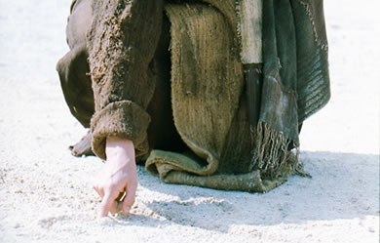
基督作为作家
Dr. Rick Griffith • 博士 • 新加坡神学院 • www.BibleStudyDownloads.org
Notes:
We have NO actual accounts of Jesus writing anything except what he wrote in the sand in John 8—and we have no idea what he wrote!

Slide 2
我们若要得胜，就必须看到耶稣在以下的事中掌权…
死亡
(1)
诸教会
(2–3)
启示录大纲
Notes:
Death (1): Christ is sovereign over our ultimate enemy that no one else has defeated.
Churches (2-3): Christ is the boss over the seven Asian churches and every local church.
Our Future (4-22): Christ is both Judge and Saviour of the End Times and our Eternal State.

Slide 3
Slides on
启示录 2

Slide 4

如果耶稣对你写了一封信，
内容会是如何呢？
R
启示录

Slide 5
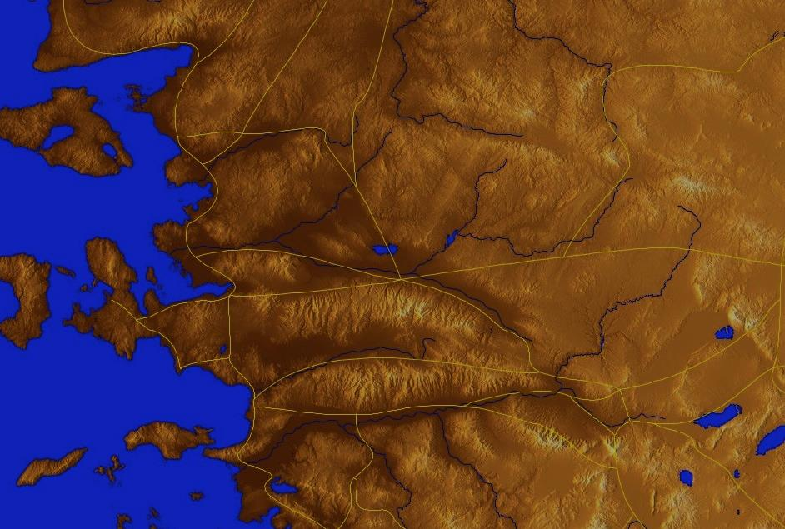
小亚细亚 AD 95
335
亚 西 亚
Aezani
Cyme库麦
Erythra 厄立特利亚
Eumenia
Lebedus
Colophon
Hierapolis
希拉波里斯
Nysa
Trailes
Heraclea
Aphrodisias
Colossae歌罗西
Alabanda 阿拉班达
拔 摩
米 利 都
Notes:
In AD 95 John was exiled to the lonely island of Patmos out in the Adriatic Sea. Jesus Christ had a revelation of comfort to the suffering believers of Asia Minor, but how could this message reach them?

Slide 6
七 个 教 会 (启示录 2–3)
335
Adramyttium
Aezani
别 迦 摩
推 雅 推 喇 城
Cyme
Erythrae
撒 狄
士 每 拿
Eumenia
非 拉 铁 非
Lebedus
Colophon
以 弗 所
Nysa
老 底 嘉
Hierapolis
Trailes
Heraclea
Aphrodisias
Colossae
Alabanda
拔 摩
Miletus
Notes:
Jesus designed a brilliant strategy by having his revelation sent to capital of the province, Ephesus. It included an individual letter to Ephesus, as well as letters to 6 other key churches. The Ephesians copied the entire book of Revelation, though, and sent the original to the next city, Smyrna. Smyrna then made their own copy and sent the original to Pergamum, which lay on the main road to the north. This city then sent the prophecy to Thyatira, which sent it to Sardis, then Philadelphia, and finally to Laodicea.

Slide 7
七 个 教 会 (启示录 2–3)
335
别 迦 摩
推 雅 推 喇 城
撒 狄
士 每 拿
非 拉 铁 非
以 弗 所
老 底 嘉
Notes:
These 7 churches were neither the largest, nor the most influential cities in Asia Minor. However, they were strategically located on a key highway that linked them all.
[Animate} From their own locations we understand that they also copied the prophecy and sent these copies to other churches near them.

Slide 8
七 个 教 会阶段?
324
虐待 却传教使命
痛苦 却坚定
继续 却 妥协
与众不同 却死
忙碌却倒退
I成员 却 不道德
豪华 却 微温
现代的传教使命时代
Constantine
君士坦丁堡
改革
教会 先族
中间的时代
唯物主义
使徒 时代
33
100
313
476
1453
1795
1900
非 拉 铁 非
以 弗 所
士 每 拿
别 迦 摩
推 雅 推 喇 城
撒 狄
老 底 嘉
Notes:
33—The Apostles of Christ pass on the gospel, but by AD 95 the love at Ephesus had grown cold
100—Last Apostle died (John) with the message passed on to their disciples, called the "Church Fathers"
313—Constantine began to merge Christianity and paganism. With paganism illegal, it took on a "Christianized" form.
476—Rome's Fall ushered in 1000 years of deviation from classical learning called the "Middle Ages" with Rome's influence through the RCC
1453—The conquest of Constantinople by the Turks began the Renaissance, followed by the Reformation
1793—William Carey left England for India, sparking the movement of the gospel from the West to the Two-Thirds World
1900—The decline of Christianity in Europe began to be replaced with humanism, materialism, modernism, and post-modernism

Slide 9
启示录2-3章的四个观点
345
别 迦 摩
“过去派”
“历史派”-
“将来派”
“将来派”
推 雅 推 喇 城
撒 狄
士 每 拿
非 拉 铁 非
以 弗 所
老 底 嘉
代表派
Notes:
Four Views:
Historic Churches: The 7 churches were actual churches at John’s time. All actually hold to this view except Bulllinger, who in 1935 taught seven churches are seven Jewish congregations in the future Tribulation period. Almost all see these as depicting seven churches that can be found in any age.
Prophetic: The chapters deal purely with stages of church history without identifying any first century church, shown by remarkable resemblance to successive eras of church history (taught by Cohen, Understanding Revelation, 48-49; and J. A. Seiss, The Apocalypse [London: Marshall, Morgan, and Scott, n.d.], 76-86).
Historico-Prophetical: The churches depict BOTH historic churches of the first century and stages of church history. “This approach is commonly taken in dispensational commentaries; see e.g., Herman A. Hoyt, The Revelation of the Lord Jesus Christ (Winona Lake, IN: BMH, 1966) 17,25-29, and John F. Walvoord, The Revelation of Jesus Christ (Chicago: Moody, 1966) 52, who holds the view cautiously. See also Menno J. Brunk, "The Seven Churches in Revelation 2-3," BSac 126 (1969) 240-46, and Gary G. Cohen, Understanding Revelation (Collingswood, NJ: Christian Beacon, 1968) 44-65, who presents a more impressive argument. Of course, the prophetic view is held by non-dispensationalists as well (e.g., J. P. Lange, Commentary on the Holy Scriptures- Revelation [reprint; Grand Rapids: Zondervan, n.d.] 139). See also the survey of R. C. Trench, Commentary on the Epistles to the Seven Churches in Asia (6th ed., rev.; reprint; Minneapolis: Klock and Klock, 1978) 237-45” (James L. Boyer, “Are the Churches of Revelation 2–3 Prophetic?” Grace Theological Journal 6.2 [1985] 267-273). He answers YES.
Typical (Representative): They were real churches, but also represent types of churches found throughout church history. Therefore, this view is also called the typical or representative view.
Critique:
Historic Churches: The doubt about whether all of the churches existed is flawed—just because we don’t know about each of them does not mean they did not exist (argument from silence)
Historico-Prophetical: Church history had not 7, but 3, stages: Ancient (to 590), Medieval (590-1517), and Modern (1517-present); designations are arbitrary (e.g., is Sardis pre-Reformation or the Reformation itself?)
Prophetic: (a) Any prophetic element would destroy the doctrine of imminency, so the chapters must relate only to actual first century churches since the 4th and 6th letters refer to Christ’s imminent coming, and Philadelphia would be given a false hope of deliverance from wrath (3:10) if the church had to wait until the “Laodicean age.” (b) Nothing in these chapters or elsewhere in the NT hint at these being stages of church history. (c) These letters differ from the prophetic portions of the book (Rev. 4–22) in that they are simply epistles similar to those written by Paul.
Typical (Representative): (a) Imminency would be ruined only “if it stated explicitly there would be a period of at least two thousand years before the second advent, or even if it had stated explicitly that there would be ‘seven periods of church history’ (Boyer, 269-70. (b) These seven churches do not represent all types of churches of the first century or any other, for other types exist besides these (e.g., Galatian or Corinthian), and “seven” better pictures the whole of the church age than would the 3 stages proposed above.

Slide 10

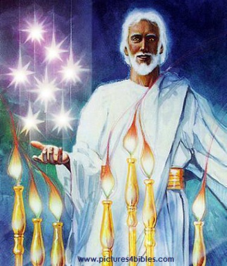
七星和七个金灯台指什么(1:20 ）?
你所看见在我右手中的七星和七个金灯台的奥祕就是这样： 七星是七个教会的使者， 七灯台是七个教会。”

Slide 11
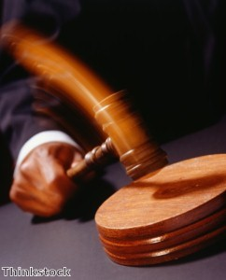
耶稣持有对各大教会的 权威

Slide 12
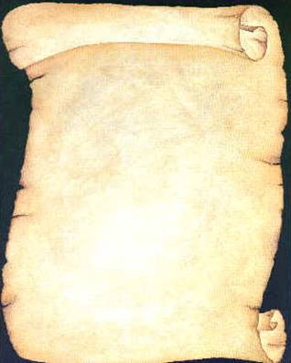
耶稣写信给了七间教会
(启示录 2–3)
以 弗 所
士 每 拿
别 迦 摩
推 雅 推 喇 城
撒 狄
非 拉 铁 非
老 底 嘉

Slide 13
启示录
基督的主权在未来的胜利
主权是属于基督 |  |  | 主权在教会 | 主权在末日的事件
第 1 章 |  |  | 第 2–3 章 | 第 4–22 章
“你看到什么” (1:19a) |  |  | “现在是什么” (1:19b) | “以后会发生什么” (1:19c)
过去 |  |  | 现在 | 未来
基督揭露 |  |  | 教会揭露 | 完成揭露
上帝在地上 |  |  | 上帝的使者 在地上 | 从地狱在地上到天堂地上
审判官 |  |  | 任务 | 判决和奖励
主题 1:1-3 | 敬拜三位一体神 1:4-8 | 荣耀耶稣基督 1:9- 20 | 小亚细亚七教会: 以弗所、士每拿、别迦摩、推雅推喇、撒狄、非拉铁非、 老底嘉 | 苦难 4:1– 19:10 | 第二次来 19:11-21 | 千禧年 20 | 永恒的状态 21:1–22:5 | 终结的迫切性 22:6-21
A.D. 95
318

Slide 14
七 个 教 会 (启2–3)
335
许诺
别 迦 摩
警告
推 雅 推 喇 城
告诫
训斥
表扬
士 每 拿
撒 狄
N/A
监督
N/A
N/A
N/A
以 弗 所
非 拉 铁 非
N/A
老 底 嘉
Notes:
Though some exceptions exist (noted with “N/A” above), the basic pattern of the seven letters is a sevenfold outline:
Church name
Christ Described in a Unique Way for that Church
Commendation of Good Deeds among the Believers
Rebuke of Sin within the Church
Exhortation or Encouragement to Repent
Warning if the Exhortation is Disobeyed
Promise for Faithfulness
Notice also that each letter not only begins with a reference to Christ but ends with an appeal from the Spirit.

Slide 15
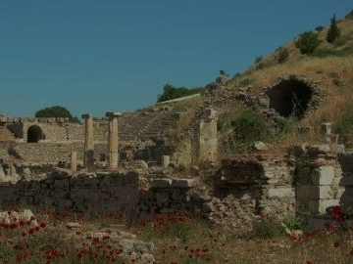
以 弗 所
忙碌却倒退
启示录 2:1-7

Slide 16
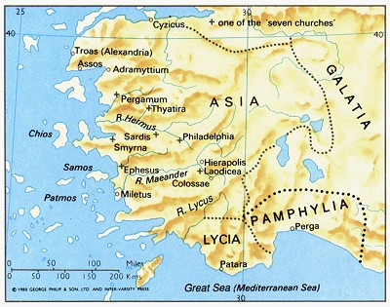
以弗所是亚洲的首都
176

Slide 17
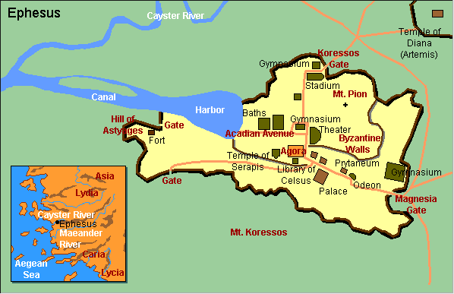
以弗所城的蓝图

Slide 18
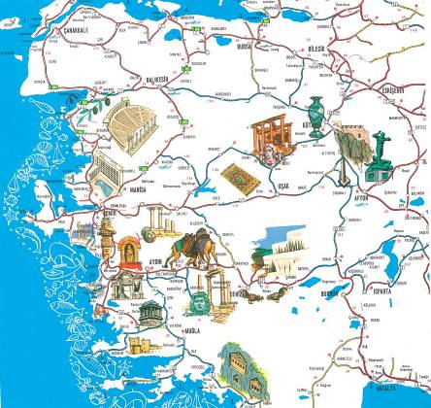
文化的中心

Slide 19

相册

Slide 20
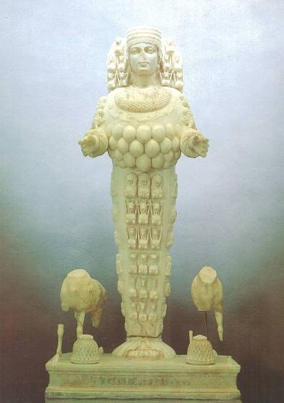
亚底米 , 大女神之肥沃

Slide 21
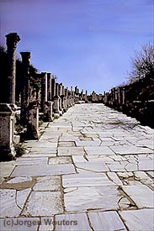
大理石马路
Notes:
Marble city, chariot ruts, speed humps, after earthquake columns put back up again.

Slide 22
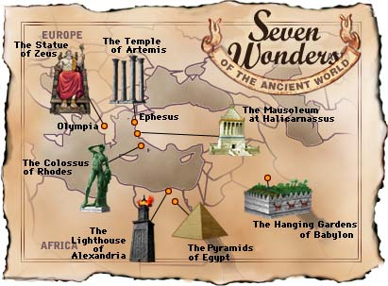
世界七大奇观-古代的世界
奥林匹亚
的宙斯神像
以弗所的
阿耳特弥斯神庙
哈利卡纳苏斯的
摩索拉斯陵墓
罗得岛
的巨像
巴比伦
空中花园
亚历山大
的灯塔
埃及金字塔

Slide 23
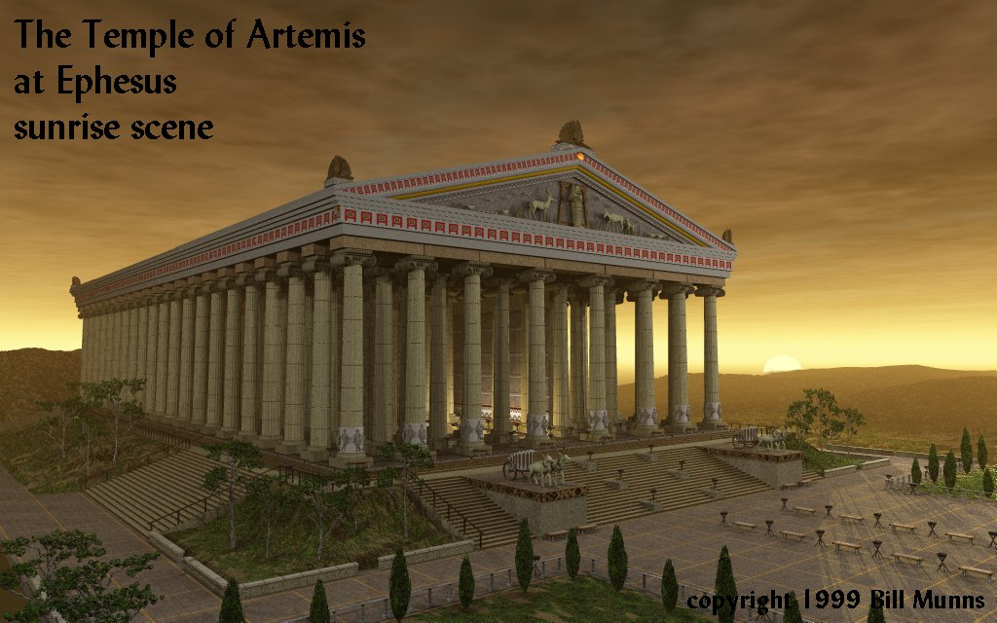
以弗所的
阿耳特弥斯神庙
日出
Notes:
Marble city, chariot ruts, speed humps, after earthquake, columns put back up again. Diana-the goddess mother of e/t, 127 Marble pillars, Artemis (Gk), Diana (Latin)
Sid Caesar, Venerate: Bow to Caesar or die

Slide 24
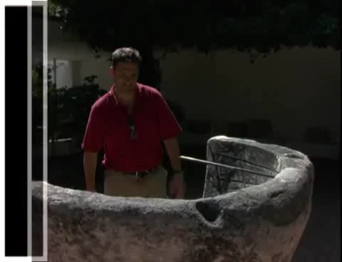
Artemis (Diana) Video (cf. Acts 19)
180c
Notes:
"In Roman mythology, Diana (lt. "heavenly" or "divine") was the goddess of the hunt and moon and birthing, being associated with wild animals and woodland, and having the power to talk to and control animals. She was equated with the Greek goddess Artemis, though she had an independent origin in Italy." (http://en.wikipedia.org/wiki/Diana_%28mythology%29)
Temple had 127 Marble pillars, Artemis (Gk), Diana (Latin)

Slide 25
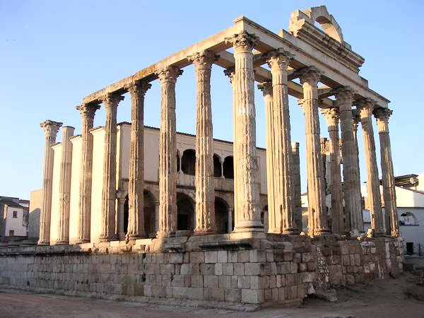
阿耳特弥斯神庙-现照
Diana (Artemis)
Notes:
“In Roman mythology, Diana (lt. "heavenly" or "divine") was the goddess of the hunt and moon and birthing, being associated with wild animals and woodland, and having the power to talk to and control animals. She was equated with the Greek goddess Artemis, though she had an independent origin in Italy.” (http://en.wikipedia.org/wiki/Diana_%28mythology%29)
Temple had 127 Marble pillars, Artemis (Gk), Diana (Latin)

Slide 26

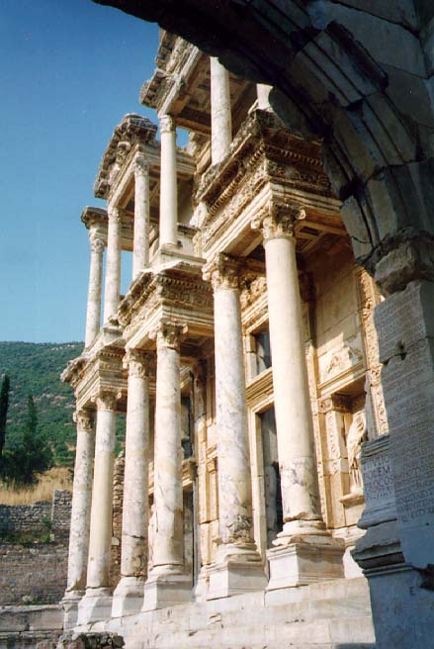
凯撒的图书馆
凯撒
Notes:
Marble city, chariot ruts, speed humps, after earthquake, columns put back up again. Diana-the goddess mother of e/t, 127 Marble pillars, Artemis (Gk), Diana (Latin)
Sid Caesar, Venerate: Bow to Caesar or die

Slide 27
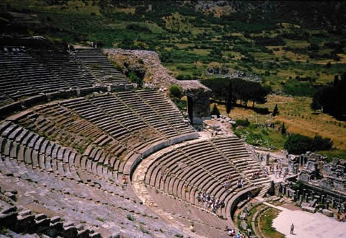
剧院座席- 25,000
theh'-at-ron
使 徒 行 傳 19:29
Notes:
The place where the Ephesian clerk averted a riot in Acts 19:29

Slide 28
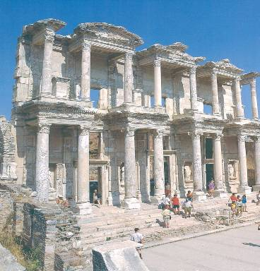
图书馆

Slide 29
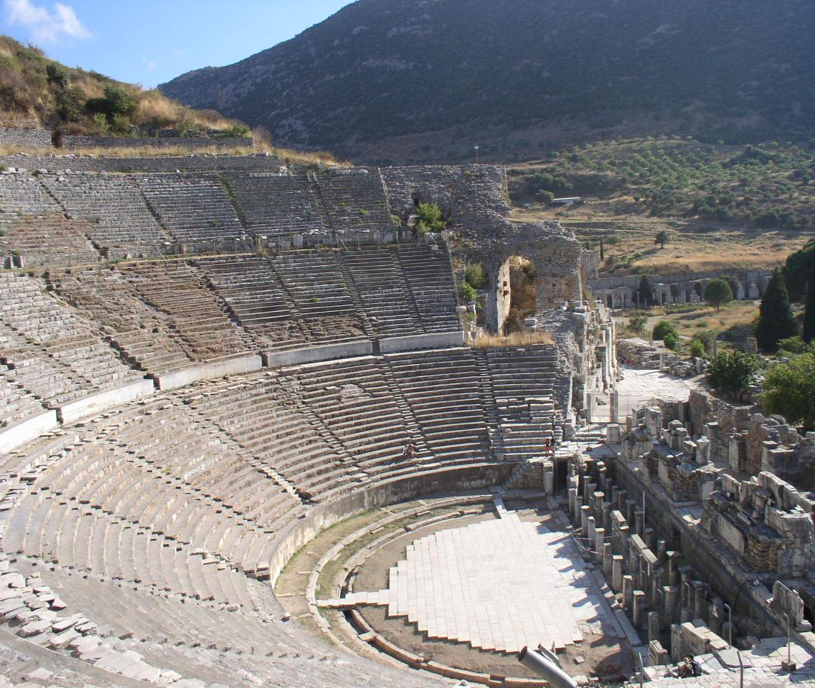
圆形剧场

Slide 30
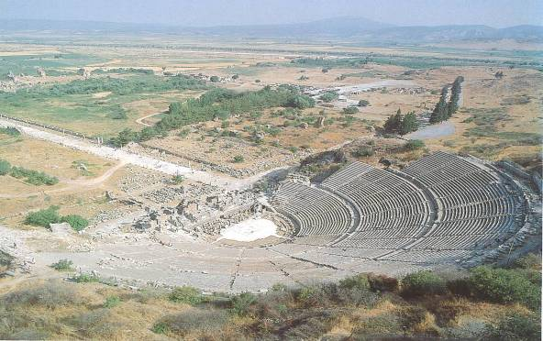
阿卡迪亚林阴道

Slide 31
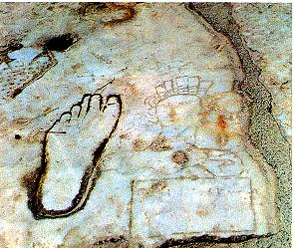
指路说明：
不道德的 & 文盲

Slide 32
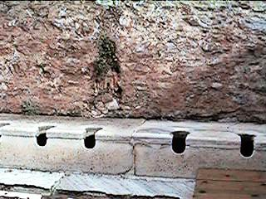
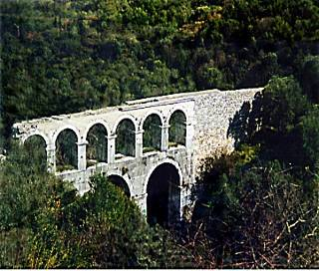
厕所和输水道

Slide 33
以 弗 所 (启2:1-7)
324
许落
赐生 命 树 的 果 子
别 迦 摩
警告
如果你不忏悔，
我将会把你的灯台移走
推 雅 推 喇 城
告诫
回想起
忏悔
返回 行 起 初 所 行 的 事
训斥
你 把 起 初 的 爱 心 离 弃 了
劳 碌 、 忍 耐 ，劳 苦 ， 并 不 乏 倦 也 知 道 你 不 能 容 忍 恶 人， 恨 恶 尼 哥 拉
撒 狄
基督:
那 右 手 拿 着 七 星 、 在 七 个 金 灯 ，中 间 行 走 的
士 每 拿
以 弗 所
非 拉 铁 非
老 底 嘉

Slide 34
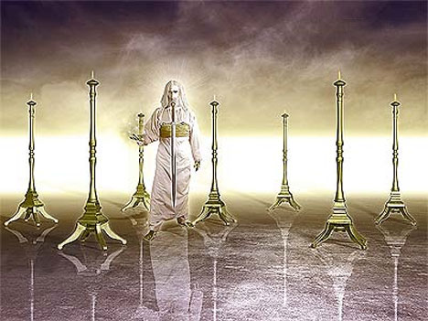
‘那右手拿着七星， 在七个金灯台中间行走的， 这样说： (2:1b)
349

Slide 35

以弗所書大綱
175
猶太人和外邦人合一的愛
合一平等 |  |  |  | 愛的見証
1-3章 |  |  |  | 4-6章
教條 |  |  |  | 應用
地位 |  |  |  | 實踐
信念 |  |  |  | 行為
特權 |  |  |  | 責任
問候 1:1-2 | 地位 1:1-3-23 | 復和 2 | 獨一性 3 | 合一 4：1-16 | 聖潔 4:1-5：20 | 順服 5:21-6:9 | 倚靠 6:10-20 | 愛 6:21-24
羅馬
公元60年秋 (第一次於羅馬被監禁)
Notes:
章
與主的關係不斷增長並意識到他們在基督裡所站的新地位，與猶太歸主者的後嗣的身份等同。 (1-3)
2. 每日與主同行的經歷顯出合一的愛。
(4-6)

Slide 36
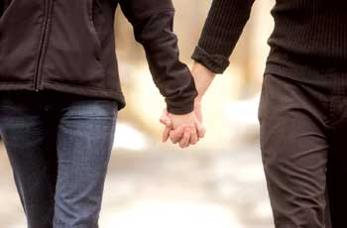
Revelation 2:4 (NIV)
还记得你的初恋吗？
Yet I hold this against you:
You have forsaken
your first love.

Slide 37
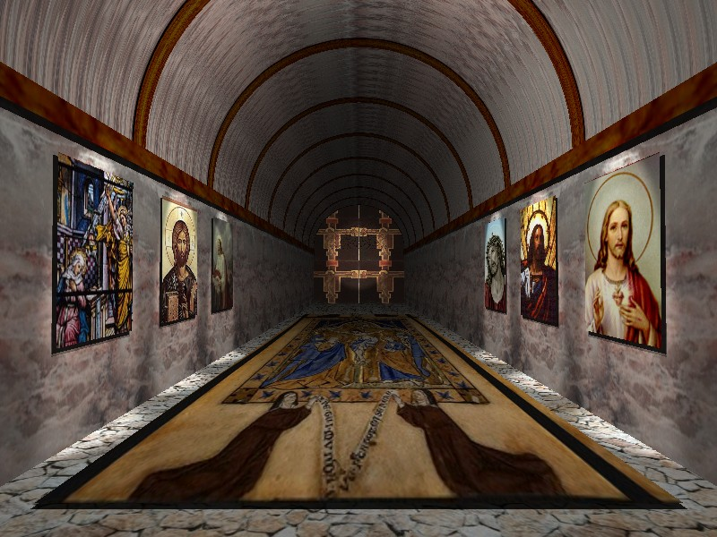
启 示 录 2:4
然而有一件事我要责备你、就是你把起初的爱心离弃了。

Slide 38
士 每 拿
启 示 录 2:8-11

Slide 39
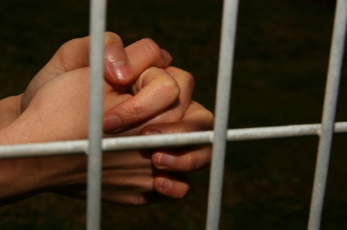
痛苦 却坚定
士 每 拿
(启示录. 2:8-11)
Rick Griffith • Crossroads International Church • biblestudydownloads.com

Slide 40
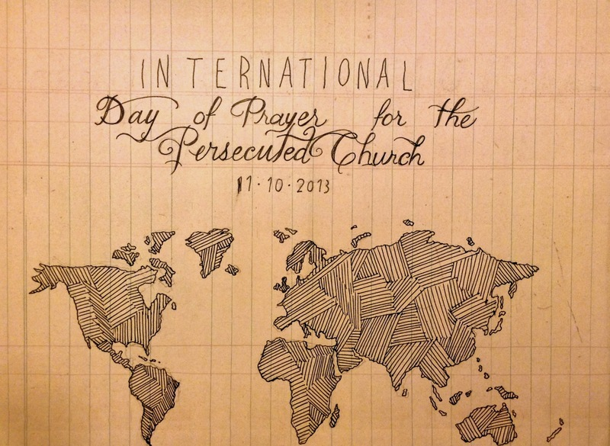
国际祷告日
国际祷告日：为受逼迫的教会11-10-2013
Notes:
Today and last Sunday, over one half million churches around the globe commemorate the International Day of Prayer for the Persecuted Church. We stand with them and have designed our entire service to remember our suffering brothers and sisters who lose property, livelihood, and loved ones—yes, who lose even life itself—simply due to their faith in our Lord Jesus Christ.

Slide 41
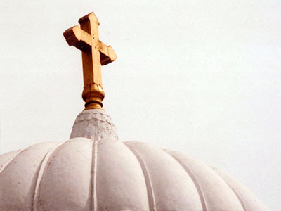
全体圣徒的教会
2013年9月22日
Notes:
Our thoughts today turn to seven weeks ago from this day to All-Saints Church.

Slide 42
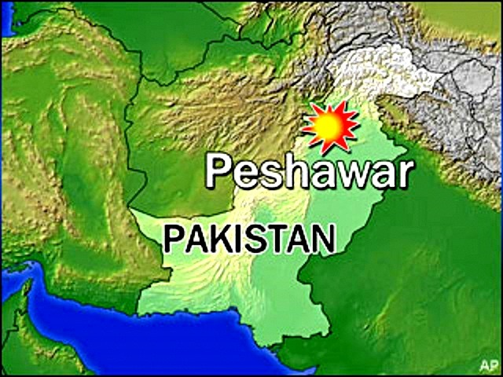
All-Saints Church
22 Sep 2013
白沙瓦
巴基斯坦
Notes:
The church is located in the northern region of Pakistan in the city of Peshawar, close to the border with Afghanistan.

Slide 43
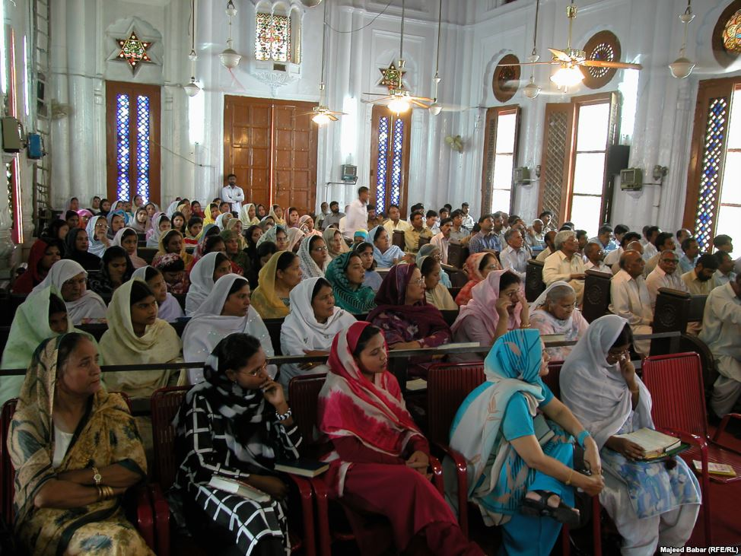
All-Saints Church
22 Sep 2013
Notes:
Inside the church it looks much like many others in that region where the men and the women sit on opposite sides.

Slide 44
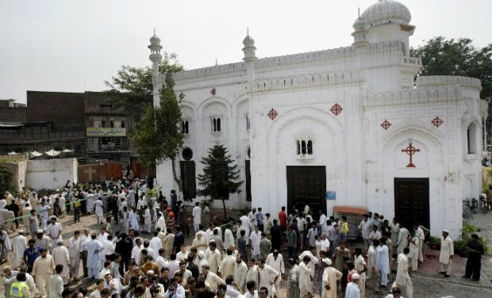
全体圣徒的教会
22 Sep 2013
Notes:
On 22 September 2013 after the service the believers gathered outside the building in the courtyard to talk, to eat—over 200 men, women, and children.

Slide 45
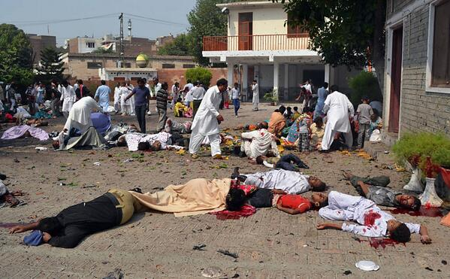
全体圣徒的教会
22 Sep 2013
Notes:
Infiltrating the crowd were two suicide bombers, who struck the All Saints Church members after their service that Sunday, killing more more than 90 people and wounding more than 150. The victims included many children.

Slide 46
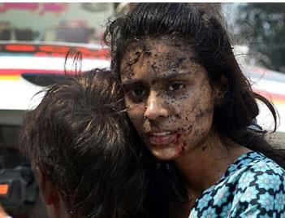
All-Saints Church
22 Sep 2013
Notes:
None of us can imagine the horror of that moment.

Slide 47
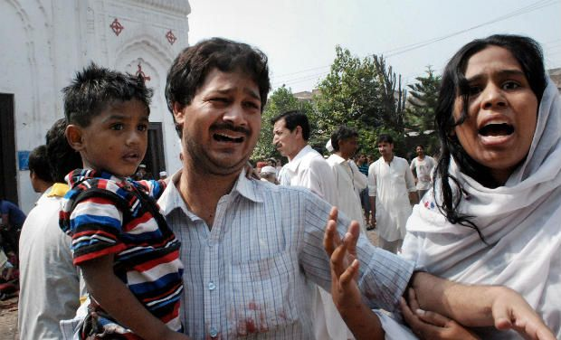
All-Saints Church
22 Sep 2013
Notes:
None of us can.

Slide 48
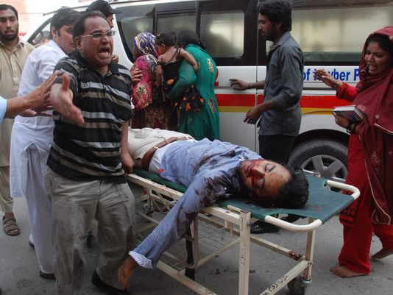
All-Saints Church
22 Sep 2013
Notes:
A wing of the Pakistani Taliban claimed responsibility for the bombing, saying it would continue to target non-Muslims until the United States stopped drone attacks in the country's remote tribal region.

Slide 49
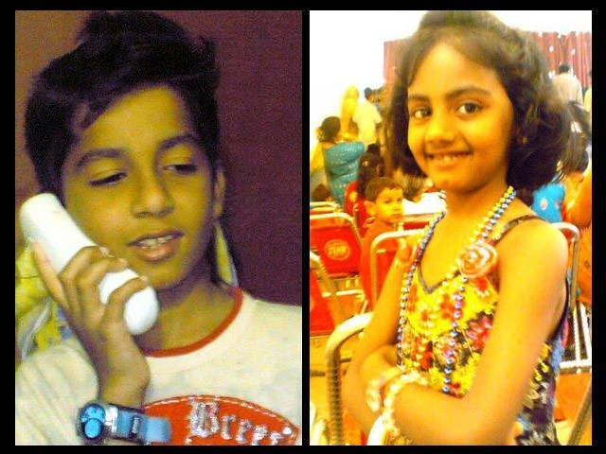
Eshaan & Neha
Notes:
The saddest part of the story concerns the children. The father of Eshaan and Neha was on business in the US at the time, but later wrote, "As he did after every Sunday mass, Eshaan was playing near the church gate with his friends. Little was he to know that this was the last time he would pray in church, play with his friends, tease his sister or hug his mother. His head was ripped off by the blast and his sister Neha, who was running after him at the time, was so traumatised by the sight that her little heart gave in and she collapsed next to Eshaan’s torn body."
Full article:
"The twin bombs that exploded on Sunday at All Saints Church, Peshawar, killed more than 90 people, injured nearly 150 others, and emotionally scarred thousands more.
Investigations are under way while recovery and treatment has begun for the injured and their families. For some, healing will be swift while others may take small steps over months, maybe even years. Many more might never fully recover from this tragedy.
The most heartbreaking of this and such tragedies is the number of young lives lost in these attacks. Since the blast took place on Sunday, the All Saints Church was packed to the brim with Christians from the locality; many of them students, volunteers, youth leaders, activists and Sunday school children. These were children we all knew, if not in person, at least by face. Even now as I close my eyes, I can visualise the happy little angels skipping through the church doors.
It is therefore, with great sorrow and a heavy heart that I share my memories of Neha and Eshaan.
Since the blast, I have not had a moment’s peace as I keep remembering how they used to make me laugh at their playful antics. Today I realised that the only way to alleviate my pain, even if a little bit, is by sharing their story.
These little victims of the senseless violence that rocked Peshawar in general and the Christian community in particular, were gems treasured by their parents, family, friends and teachers alike.
As he did after every Sunday mass, Eshaan was playing near the church gate with his friends. Little was he to know that this was the last time he would pray in church, play with his friends, tease his sister or hug his mother. His head was ripped off by the blast and his sister Neha, who was running after him at the time, was so traumatised by the sight that her little heart gave in and she collapsed next to Eshaan’s torn body.
I cannot even begin to imagine what Eshaan and Neha’s parents must be feeling right now. I can’t imagine the horror that any parent would feel upon hearing such news – that their two young children, the apples of their eyes, the stars in their life – are no more. There can be nothing more traumatic than raising your children, caring for them, loving them and already dreaming of their future only to have them ripped away from you.
In Eshaan and Neha’s case, the situation was worsened because their father, Insar, was in the United States at the time of the blast. In a cracked voice, he said over the phone,
“They were little angels sent down to me to love and protect. Like most fathers, I was often over-protective and sometimes downright clingy. After all, my children were my treasure.”
His voice completely broke then, and all we heard for a few minutes was the heart-wrenching weeping of a man in physical and emotional trauma. Mustering up his strength, he said,
“No parent should ever have to encounter a day like today; no parent should ever have to hear the words that your child is no more. Parents are never prepared to lose their children, not even children who have a terminal illness. Then how do I deal with something I did not even have an inkling of?”
After every few minutes of crying and talking about his children, he repeated, almost like a mantra,
“If only I was in Pakistan.”
While their father is in the US and has not been able to catch a flight back home yet, their mother, Uzma, is in the Intensive Care Unit (ICU). She still has no idea of what happened to her children.
Remembering his children, Insar says,
“Children change our life. They show us new ways to love, new things to find joy in, and new ways to look at the world.”
However, for Insar and Uzma the world has become dark and empty. This one incident has taken the light of their lives away and every room, every toy, every scribble will bring back painful memories. Their only wish will be to turn back time and see their children one last time, hold them tight and kiss their glowing faces. There will be times when getting through the day will feel like torture.
All we can do is pray that with time, these memories will become less painful and that one day, Insar and Uzma will begin to re-build their lives. We hope that they will learn to carry with them, happy memories of the love they shared with their precious children, even if it was for such a short time.
http://blogs.tribune.com.pk/story/18971/they-were-just-children-not-christian-children/

Slide 50
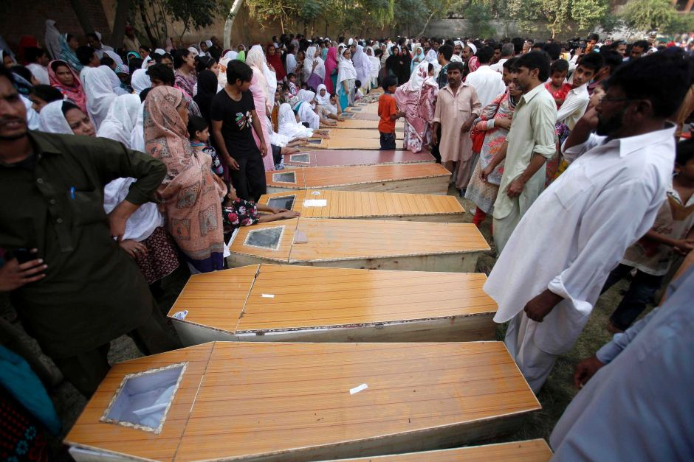
全体圣徒教会
90 被杀
150 受伤
13 寡妇
36 孤儿
53 个家庭失去主要劳力
Notes:
The toll on a single assembly is staggering!

Slide 51
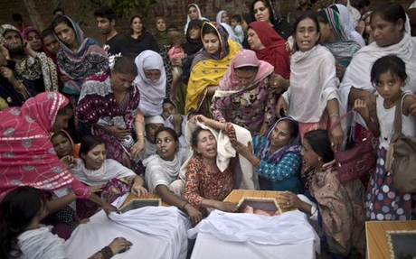
All-Saints Church
22 Sep 2013
Notes:
The grief is unimaginable.

Slide 52
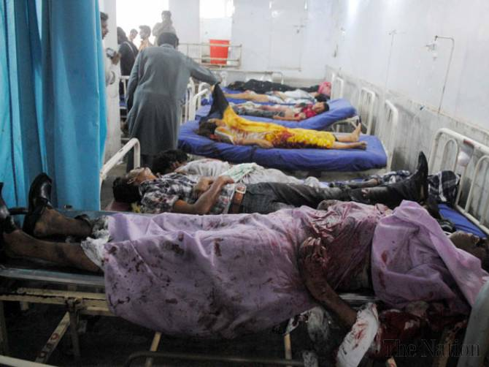
全体圣徒教会
没有医生
Notes:
The tragedy was compounded by the fact that the local hospital could not handle the crisis primarily because local doctors and paramedics refused to come to the hospital to treat the Christians—not until the local political leader ordered them to come or their jobs would be on the line.
Full article:
PESHAWAR - Death toll from Sunday’s twin bombings at All Saints Church was horrendous and Lady Reading Hospital was running out of caskets, beds and medicine for the wounded; and on top of that doctors and paramedics were absent.
To give vent to their anger over sorry state of affairs at the public health centre, attendants of the injured ransacked the hospital and chanted slogans against Khyber Pakhtunkhwa government for its inability to ensure every sort of health facility during the emergency situation.
Insufficient number of doctors and nurses was present at the hospital that could hardly provide first aid treatment to over 100 injured ferried from the blast site. Despite the fact that an emergency was declared, most of the doctors remained absent from their duties.
It came as a shock to learn that a provincial government so willing to provide free of cost treatment and medicines slipped on ensuring hassle-free health services. As a result, most of the injured could not get medical aid in a timely manner, while many of the injured had to lie down across the floor due to shortage of beds.
Nevertheless, when Pakistan Tehreek-e-Insaf chief Imran Khan came in, most of the doctors had to pull up their socks in order to save their skin.
People from different walks of life criticised PTI-led provincial government for its poor performance and asked it to provide all sort of health facilities to the injured. They also demanded stern action against the negligent doctors.
http://www.nation.com.pk/pakistan-news-newspaper-daily-english-online/national/23-Sep-2013/peshawar-hospital-ransacked-for-absence-of-docs-facilities

Slide 53
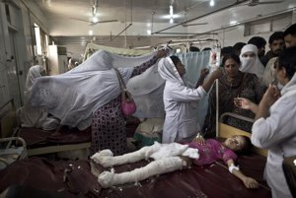
全体圣徒教会
22 Sep 2013
Notes:
So they did, but it was too late for some of the victims who needed immediate care to save their lives.

Slide 54
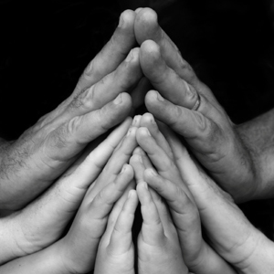
你在 哪方面为信仰受苦？
Notes:
You workplace passes you up for promotion.
Your motives are misunderstood.
You are lumped with fanatics.
Your faith is ridiculed in your family.
Some other area?

Slide 55
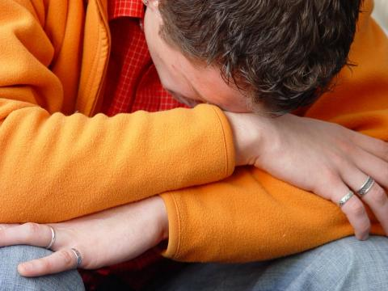
耶稣希望你如何应对苦难？
Notes:
What is most important is Christ's view of suffering—how he wants us to address it!

Slide 56
基督作为作家
Dr. Rick Griffith • Singapore Bible College • biblestudydownloads.com
Notes:
We have NO actual accounts of Jesus writing anything except what he wrote in the sand in John 8—and we have no idea what he wrote!
Still needs translation into Chinese: 8, 116
Notes section of slide 10 updated on 28 Dec 2012 but not translated into Chinese yet

Slide 57
如果耶稣对你写了一封信，
内容会是如何呢？
R
启示录

Slide 58
小亚细亚 AD 95
335
亚 西 亚
Aezani
Cyme库麦
Erythra 厄立特利亚
Eumenia
Lebedus
Colophon
Hierapolis
希拉波里斯
Nysa
Trailes
Heraclea
Aphrodisias
Colossae歌罗西
Alabanda 阿拉班达
拔 摩
米 利 都
Notes:
In AD 95 John was exiled to the lonely island of Patmos out in the Adriatic Sea. Jesus Christ had a revelation of comfort to the suffering believers of Asia Minor, but how could this message reach them?

Slide 59
七 个 教 会 (启示录 2–3)
335
Adramyttium
Aezani
别 迦 摩
推 雅 推 喇 城
Cyme
Erythrae
撒 狄
士 每 拿
Eumenia
非 拉 铁 非
Lebedus
Colophon
以 弗 所
Nysa
老 底 嘉
Hierapolis
Trailes
Heraclea
Aphrodisias
Colossae
Alabanda
拔 摩
Miletus
Notes:
Jesus designed a brilliant strategy by having his revelation sent to capital of the province, Ephesus. It included an individual letter to Ephesus, as well as letters to 6 other key churches. The Ephesians copied the entire book of Revelation, though, and sent the original to the next city, Smyrna. Smyrna then made their own copy and sent the original to Pergamum, which lay on the main road to the north. This city then sent the prophecy to
a, which sent it to Sardis, then Philadelphia, and finally to Laodicea.

Slide 60
七 个 教 会 (启示录 2–3)
335
别 迦 摩
推 雅 推 喇 城
撒 狄
士 每 拿
非 拉 铁 非
以 弗 所
老 底 嘉
Notes:
These 7 churches were neither the largest, nor the most influential cities in Asia Minor. However, they were strategically located on a key highway that linked them all.
[Animate} From their own locations we understand that they also copied the prophecy and sent these copies to other churches near them.

Slide 61
七星和七个金灯台指什么 (1:20)?
你所看见在我右手中的七星和七个金灯台的奥祕就是这样： 七星是七个教会的使者， 七灯台是七个教会。”

Slide 62
耶稣持有着 对个大教会的 权威

Slide 63
耶稣写信给了七间教会
(启示录 2–3)
以 弗 所
士 每 拿
别 迦 摩
推 雅 推 喇 城
撒 狄
非 拉 铁 非
老 底 嘉

Slide 64
启示录
基督的主权在未来的胜利
主权是属于基督 |  |  | 主权在教会 | 主权在末日的事件
第 1 章 |  |  | 第 2–3 章 | 第 4–22 章
“你看到什么” (1:19a) |  |  | “现在是什么” (1:19b) | “以后会发生什么” (1:19c)
过去 |  |  | 现在 | 未来
基督揭露 |  |  | 教会揭露 | 完成揭露
上帝在地上 |  |  | 上帝的使者 在地上 | 从地狱在地上到天堂地上
审判官 |  |  | 任务 | 判决和奖励
主题 1:1-3 | 敬拜三位一体神 1:4-8 | 荣耀耶稣基督 1:9- 20 | 小亚细亚七教会: 以弗所、士每拿、别迦摩、推雅推喇、撒狄、非拉铁非、 老底嘉 | 苦难 4:1– 19:10 | 第二次来 19:11-21 | 千禧年 20 | 永恒的状态 21:1–22:5 | 终结的迫切性 22:6-21
A.D. 95
318

Slide 65
七 个 教 会 (启2–3)
335
许诺
别 迦 摩
警告
推 雅 推 喇 城
告诫
训斥
表扬
士 每 拿
撒 狄
N/A
监督
N/A
N/A
N/A
以 弗 所
非 拉 铁 非
N/A
老 底 嘉
Notes:
Though some exceptions exist (noted with “N/A” above), the basic pattern of the seven letters is a sevenfold outline:
Church name
Christ Described in a Unique Way for that Church
Commendation of Good Deeds among the Believers
Rebuke of Sin within the Church
Exhortation or Encouragement to Repent
Warning if the Exhortation is Disobeyed
Promise for Faithfulness
Notice also that each letter not only begins with a reference to Christ but ends with an appeal from the Spirit.

Slide 66
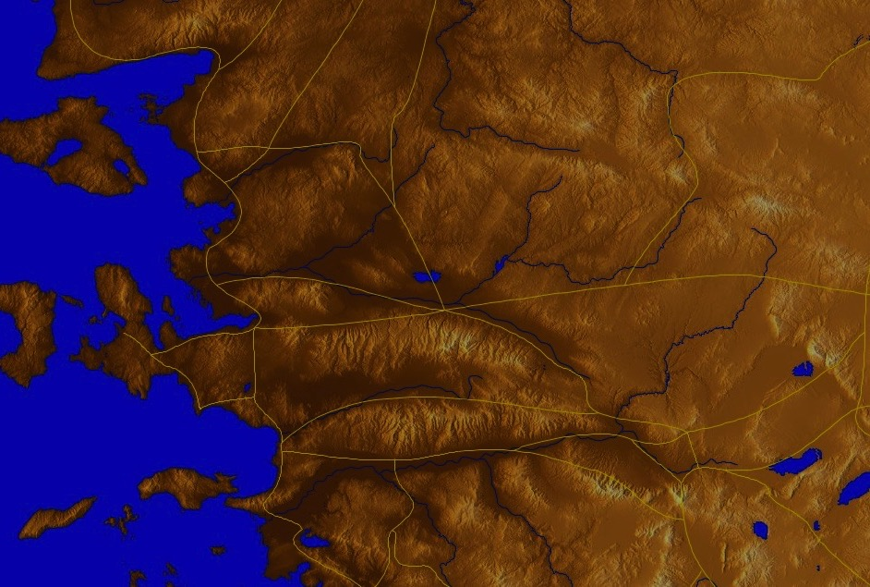
以弗所是
亚洲的首都
176
Notes:
The first letter was sent to Ephesus, which we covered last week.

Slide 67
启 示 录 2:4
然而有一件事我要责备你、就是你把起初的爱心离弃了。

Slide 68
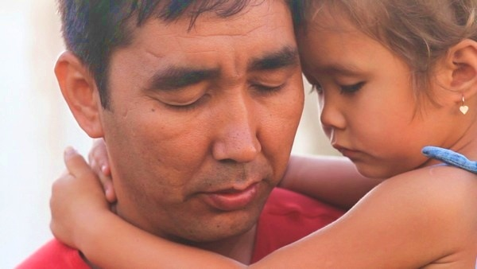
如何应对苦难？
耶稣给士每拿教会3个方法
Notes:
So today we come to the second letter, written to believers in Smyrna. This letter addresses this question…

Slide 69
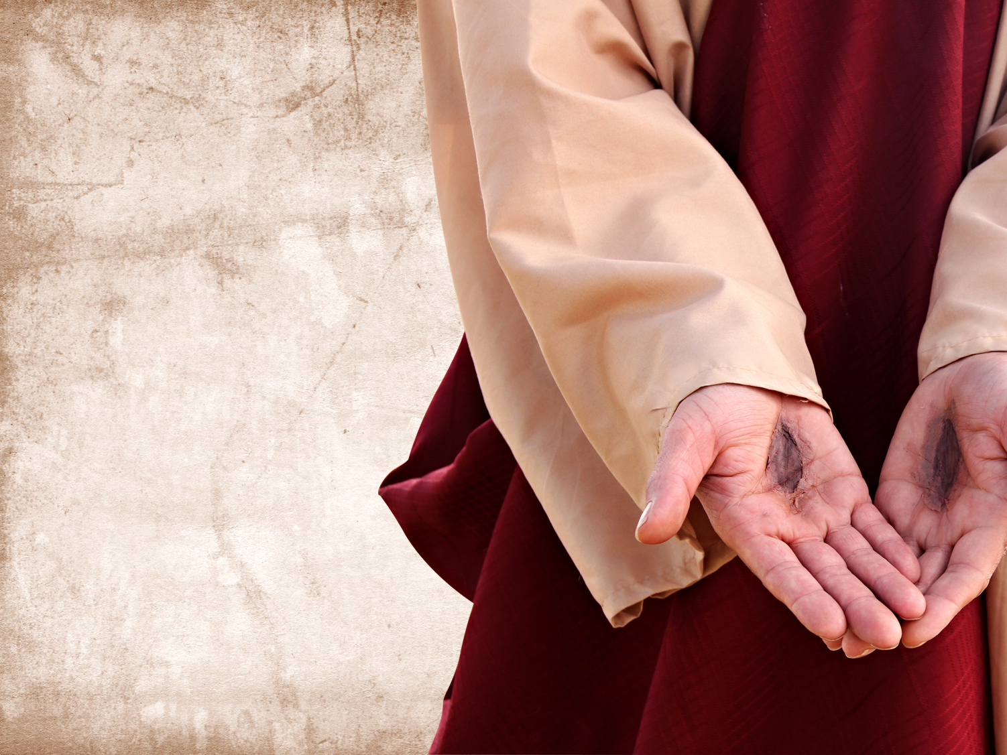
I. 要知道
耶稣
懂得/知晓
你的苦难 (2:8-9)
Notes:
Know that Jesus has "been there, done that."

Slide 70
七 个 教 会 (启示录 2–3)
335
Adramyttium
Aezani
别 迦 摩
推 雅 推 喇 城
Cyme
Erythrae
撒 狄
士 每 拿
Eumenia
非 拉 铁 非
Lebedus
Colophon
以 弗 所
Nysa
老 底 嘉
Hierapolis
Trailes
Heraclea
Aphrodisias
Colossae
Alabanda
拔 摩
Miletus
Notes:
Jesus designed a brilliant strategy by having his revelation sent to capital of the province, Ephesus. It included an individual letter to Ephesus, as well as letters to 6 other key churches. The Ephesians copied the entire book of Revelation, though, and sent the original to the next city, Smyrna. Smyrna then made their own copy and sent the original to Pergamum, which lay on the main road to the north. This city then sent the prophecy to Thyatira, which sent it to Sardis, then Philadelphia, and finally to Laodicea.

Slide 71
士 每 拿 (启2:8-11)
324
别 迦 摩
推 雅 推 喇 城
训斥
无！
表扬:
患 难
迫害和 贫 穷
撒 狄
基督:
那 首 先 的 、 末 後 的 、 死 过 又 活 的
士 每 拿
以 弗 所
非 拉 铁 非
老 底 嘉

Slide 72
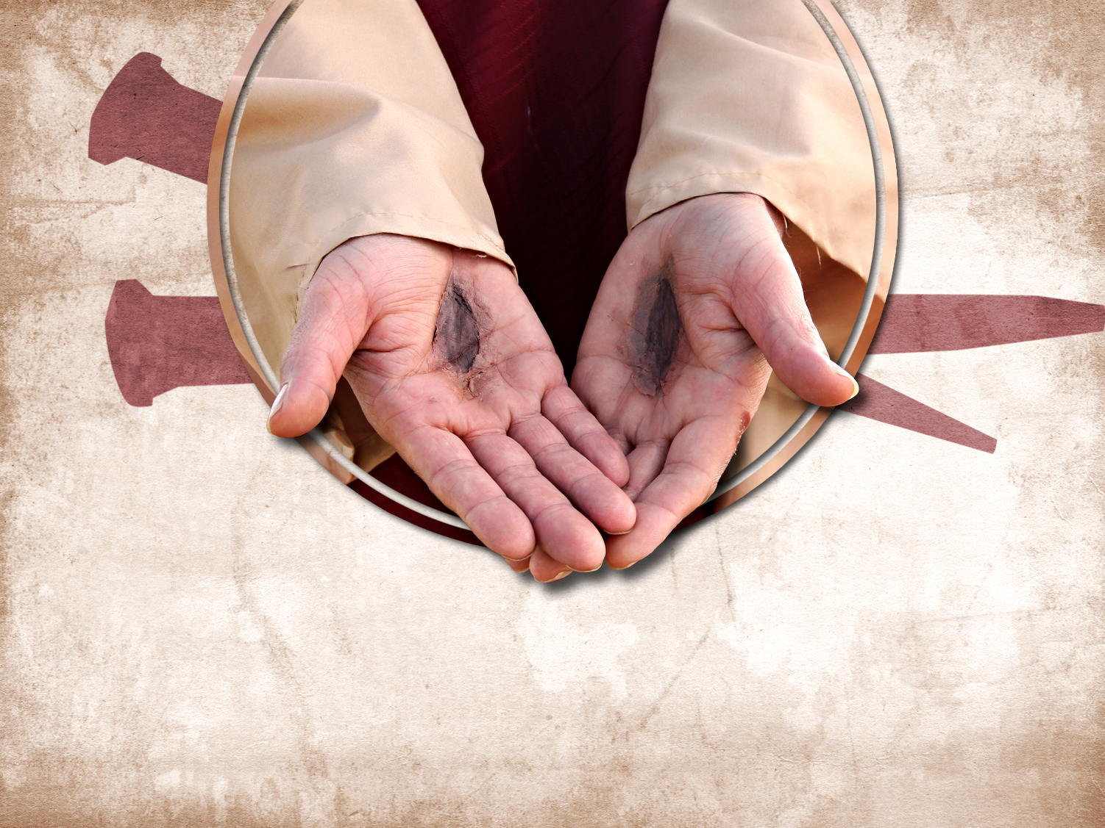
感谢耶稣
祂知道你正在受何种苦

Slide 73
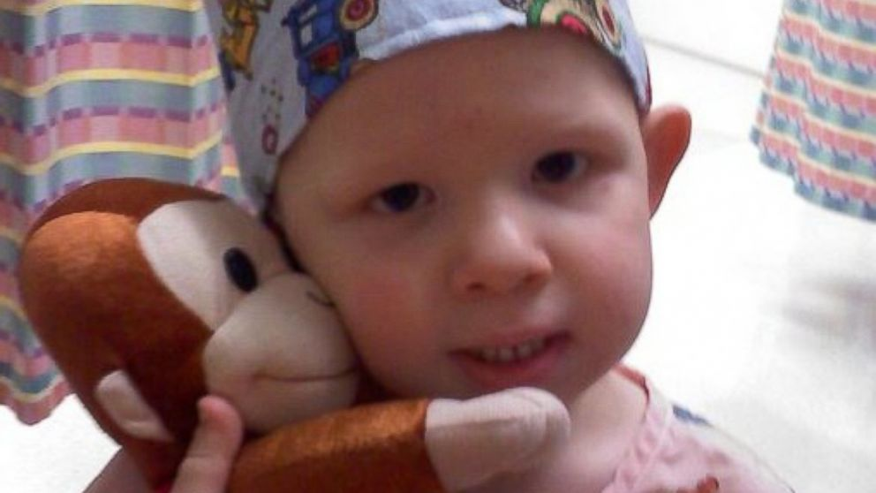
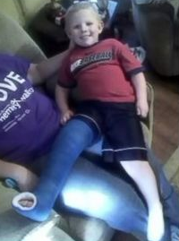
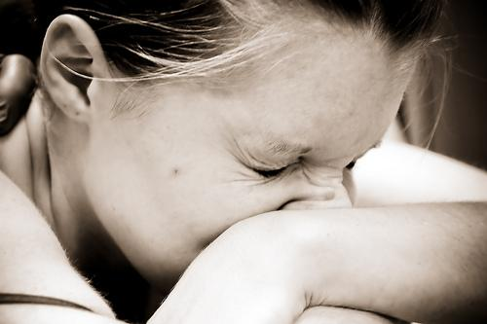
以撒 布朗
感受不到痛的男孩
http://abcnews.go.com/Health/meet-toddler-feels-pain/story?id=20658484
Notes:
Is pain good? Most of us do not think so!
• Isaac
Little Isaac Brown is five years old. Like other kids his age, he's learning to read and write his ABCs and to calculate simple addition and subtraction. But there is one thing Isaac is learning that rare few other children will ever have to learn. Isaac is learning about pain.
"We're doing the best we can to just teach him; he knows blood is bad," said Brown. "We taught him even when he was little to say 'ow.' You don't have to tell normal kids to say 'ow.'"
• Baby
Isaac was born with an extremely rare genetic insensitivity to pain. Like a modern day leper, Isaac doesn't know when he's touching a hot stove, when he's stepped on broken glass, or when he's broken a bone. For example, he broke his pelvis and felt no pain at all.
• Leg
Because he doesn't feel injuries, Isaac's parents, Carrie and Randy Brown, are teaching him how to identify them to stay healthy.

Slide 74

Isaac Brown
The Boy Who Feels NO Pain
“当初医生得出诊断，他们说他们也不能做什么，至少当时是这样” 母亲凯莉回忆说。“不过他们可以利用以撒突变的基因，来帮助长期病痛的患者减轻痛苦！这想法真是不可思议……上帝赐给我们以撒，也许是为了这个目的.”
http://www.medicaldaily.com/can-boy-who-feels-no-pain-help-chronic-pain-sufferers-261005
Notes:
Family
"The toddler years were an absolute nightmare," said Isaac's mother, Carrie Brown. "He would just drop to the ground and smack his face on the table. He thought the fall was fun."
Isaac has dunked his hand in hot coffee without flinching. He once placed his palm on a working oven burner without shedding a tear.
His parents are believers. His mother noted..
Read quote

Slide 75
受苦的原因
      “对于不虔不义的，受苦不足为怪。但是为什么义人受苦？圣经给出一些答案。受苦可能是因为：
        管教 (林前，11:30-32; 希伯来书，12:3-13),
        预防，警戒 (保罗身上的刺, 林后12:7),
        学习顺服 (基督受苦，希伯来书. 5:8; 罗马书. 5:3-5), or
        为基督作更好的见证 (使徒行传 9:16).”
约翰 . 沃尔伍德John Walvoord, “启示录,” 选自《圣经知识注释书》, 第2卷935页

Slide 76

耶稣感觉得到你的痛苦.

Slide 77
I. I. 要知道
耶稣
懂得/知晓
你的苦难 (2:8-9)

Slide 78

II. 不要害怕为基督受苦 (2:10a)
Notes:
During Nero's persecutions Christians refused to stop worshipping Christ, so they held their services underground in the tombs beneath Rome.

Slide 79
士 每 拿 (启2:8-11)
324
别 迦 摩
推 雅 推 喇 城
劝告：
不要害怕，
你 务 要
至 死 忠 心
训斥
无！
表扬:
患 难
迫害和 贫 穷
撒 狄
基督:
那 首 先 的 、 末 後 的 、 死 过 又 活 的
士 每 拿
以 弗 所
非 拉 铁 非
老 底 嘉

Slide 80

谁更惧怕?
迫害者?
受害者?
“不要怕人的威吓，也不要惊慌”
（彼得前书 3:14b)

Slide 81

给予的
“…如果身体被烧毁却没有爱，
算 不 得 什么
“烈士的鲜血是教会的种子”
-特塔利安-

Slide 82

All-Saints Church
回应
献身在白沙瓦（巴基斯坦城市）冲突
中牺牲的“全体圣徒教会”的烈士们
没人能动摇他们，他们也不惧怕颤抖。

Slide 83

All-Saints Church
反应可能源自惧怕

Slide 84

印度基督徒呼吁终止
与巴基斯坦的关系
政治反应
Notes:
Indian Christians burn Pakistan’s flag to protest church attack in Peshawar - See more at: http://post.jagran.com/christians-burn-pakistans-flag-to-protest-church-attack-in-peshawar-1380097718#sthash.drVPwCB0.dpuf

Slide 85

All-Saints Church
愤怒的反应

Slide 86

All-Saints Church
22 Sep 2013
Notes:
Note the large words in English that the people of All Saints read prior to their martyrdom or suffering in the courtyard

Slide 87

我们的反应
如果一个肢体受苦…
Notes:
We have committed S$3000 to help 6 families who lost their bread winners for three months.

Slide 88

现在你愿意承认对受苦的畏惧吗？

Slide 89
I. 要知道
耶稣
懂得/知晓
你的苦难 (2:8-9)

Slide 90
II. 不要害怕为基督受苦 (2:10a)
Notes:
During Nero's persecutions Christians refused to stop worshipping Christ, so they held their services underground in the tombs beneath Rome.

Slide 91

III. 苦难中要忠心 (2:10b-11).
Notes:
Commit now not to waver or give up your faith due to persecution.

Slide 92
士 每 拿 (启2:8-11)
324
别 迦 摩
警告：
魔 鬼 要 把 你 们 中 间 几 个 人 下 在 监 里 ， 叫 你 们 被 试 炼 ， 你 们 必 受 患 难 十 日
推 雅 推 喇 城
劝告：
不要害怕，
你 务 要
至 死 忠 心
训斥
无！
表扬:
患 难
迫害和 贫 穷
撒 狄
基督:
那 首 先 的 、 末 後 的 、 死 过 又 活 的
士 每 拿
以 弗 所
非 拉 铁 非
老 底 嘉

Slide 93

启示录 : 痛苦 却坚定
"看哪！ 魔鬼将要把你们中间几个人下在监里， 叫你们受试炼， 你们要受患难十天" (2:10c)

Slide 94
士 每 拿 (启2:8-11)
324
别 迦 摩
推 雅 推 喇 城
劝告：
不要害怕，
你 务 要
至 死 忠 心
训斥
无！
表扬:
患 难
迫害和 贫 穷
撒 狄
基督:
那 首 先 的 、 末 後 的 、 死 过 又 活 的
士 每 拿
以 弗 所
非 拉 铁 非
老 底 嘉

Slide 95

士 每 拿 : 痛苦却坚定
“魔 鬼 要 把 你 们 中 间 几 个 人 下 在 监 里 ， 叫 你 们 被 试 炼 ， 你 们 必 受 患 难 十 日” (2:10b)

Slide 96

佩尔佩图阿-殉教 (AD 203)
Notes:
She refused to offer incense to Diana's image and thus was killed for it.

Slide 97
士 每 拿 (启2:8-11)
324
别 迦 摩
警告：
魔 鬼 要 把 你 们 中 间 几 个 人 下 在 监 里 ， 叫 你 们 被 试 炼 ， 你 们 必 受 患 难 十 日
许诺
赐 给 你 那
生 命 的 冠 冕
推 雅 推 喇 城
劝告：
不要害怕，
你 务 要
至 死 忠 心
训斥
无！
表扬:
患 难
迫害和 贫 穷
撒 狄
基督:
那 首 先 的 、 末 後 的 、 死 过 又 活 的
士 每 拿
以 弗 所
非 拉 铁 非
老 底 嘉

Slide 98

ENDA（非歧视就业法案）
这个问题是如何被炒作的…
捍卫平等
Employment（就业）
Non-
Discrimination （不受歧视）
Act （法案）

Slide 99

ENDA
这个问题是如何被炒作的…
结束(一个)合法歧视！

Slide 100

ENDA
这个问题是如何被炒作的…
我淋浴时，旁边就是一个同性恋者。你工作时，身旁也可能就有这样的人。
通过 ENDA 法案.

Slide 101

大部分保守的基督徒反对此法案
停止
“非歧视就业法案”

Slide 102

从前不适用该法案
这个问题是如何被炒作的…
http://www.washingtonblade.com/2013/10/30/enda-heats/
华盛顿刀锋报—美国同性恋新闻领头报纸
“目前（2013年10月30日），ENDA法案有一个宗教除外条款，此条款允许宗教组织，比如教会或者教会学校，在用工方面对同性恋，双性恋，变性者有不同对待。然而，类似规定在1964年的《民权法案》第七条中找不到（甚至有抵触）；第七条禁止宗教组织基于种族，性别，国籍的歧视。
Notes:
Supporters have convinced people that homosexuality is not only OK, but it MUST be supported as it is as unchangeable as one’s race, gender, or national origin.
http://www.washingtonblade.com/2013/10/30/enda-heats/

Slide 103

ENDA 法案的遣词造句
“用人单位因着个人（求职者，受雇人）实际的或者被认定的性别取向或性别身份而拒绝雇用任何人，或开除任何人，或在工资，工期，工作条件，就业权利方面歧视任何个人，都是非法的。

Slide 104

ENDA 参议院投票 (2013年11月5日)
“以61票赞成--30票反对, 参议院清除了《非歧视用工法案》在最终提交众议院决定之前的一大障碍。 不象其他诸多版本，这个法案将“性别身份”作为一个受法律保护的类别，从而将议题大大推进了一步。根据61位参议员的意见，美国的学校，组织，公司，慈善机构将不得不收起他们在安全，利润，未来业务方面的考虑，不仅鼓励男人在工作时着装为女人（反之亦然），而且还要为他们提供为此所需的场所。“
宗教自由X
政治正确√
托尼（Tony Perkins）“今日华盛顿” 家庭研究协会 2013年11月6日

Slide 105

众议院发言人约翰（ John Boehner）
"发言人认为这个法案将会增加许多本不必要的诉讼，进而影响就业，特别是小公司的就业。发言人始终认为，现有法律其实已经对（同性恋）有保护。
托尼（Tony Perkins）“今日华盛顿” 家庭研究协会 2013年11月7日

Slide 106

要点
在苦难中，以忠心替代畏惧，因为耶稣确切知道你的感受！
准备好了吗?

Slide 107

你现在如何
受苦？
      耶稣知晓你在受苦.
      不要害怕为基督受苦。
      不论结果如何，要忠心.

Slide 108
印度
“…如果身体被烧毁却没有爱，
算 不 得 什么
“烈士的鲜血是教会的种子”
-特塔利安-

Slide 109

被烧毁的教堂

Slide 110

火灾毀损教堂

Slide 111

有些
基督徒幸存

Slide 112

有些归天国

Slide 113
别 迦 摩
别 迦 摩 2:12-17

Slide 114
亲爱的别 迦 摩 教会…
妥协但继续的教会

Slide 115
别 迦 摩 (启2:12-17)
324
别 迦 摩
推 雅 推 喇 城
警告：
若 不 悔 改 ，
我 就 快 临 到
你 那 里 ，
用 我 口 中 的 剑
攻 击 他 们
许诺
我 必 将 那 隐 藏 的 吗 哪 赐 给 他 ，
并 赐 他 一 块 白 石 ，
石 上 写 着 新 名
劝告：
忏悔
训斥
你 那 里 有 人 服 从 了 巴 兰 和
尼 哥 拉的 教 训
表扬:
你 还 坚 守
我 的 名 ，
没 有 弃 绝
我 的 道
撒 狄
基督:
有 两 刃
利 剑
士 每 拿
以 弗 所
非 拉 铁 非
老 底 嘉

Slide 116
别 迦 摩 (启2:12-17)
“你要写信给在别迦摩教会的使者， 说： ‘那有一把两刃利剑的， 这样说： 13 我知道你居住的地方， 就是撒但王座所在的地方。 当我忠心的见证人安提帕在你们那里， 就是在撒但居住的地方被杀的那些日子， 你还持守我的名， 没有否认对我的信仰。 14 然而有几件事我要责备你， 因为在你那里有些人持守巴兰的教训。 这巴兰曾经教导巴勒把绊脚石放在以色列人面前， 叫他们吃祭过偶像的食物， 并且行淫乱。 15 同样， 你也有些人持守尼哥拉党的教训。 16 所以， 你应当悔改； 如果不悔改， 我就很快地来到你们那里， 用我口中的剑跟他们作战。 17 圣灵向众教会所说的话， 有耳的就应当听。 得胜的， 我必定把那隐藏的吗哪赐给他， 并且赐他一块白石， 石上写着新的名字， 这名字除了那领受的人以外， 是没有人能知道的。’

Slide 117
基督的命令
耶稣告诉约翰：
"你要写信给在别迦摩教会的使者" (2:12)

Slide 118
基督的赞扬
2:13 "我知道你居住的地方， 就是撒但王座所在的地方。 当我忠心的见证人安提帕在你们那里， 就是在撒但居住的地方被杀的那些日子， 你还持守我的名， 没有否认对我的信仰。"

Slide 119

别迦摩模型:
继续却妥协
Notes:
It has long been assumed that the temple was dedicated to Zeus. The altar is mentioned in the Book of Revelation, 2:11-12: "To the angel of the church in Pergamum [sic], write this: . . . 'I know that you live where Satan's throne is . . . . '" This is a scale model of the altar.

Slide 120

撒 但 座 位 (2:11-13)
"我知道你居住的地方， 就是撒但王座所在的地方" (2:13)
Notes:
It has long been assumed that the temple was dedicated to Zeus. The altar is mentioned in the Book of Revelation, 2:11-12: "To the angel of the church in Pergamum [sic], write this: . . . 'I know that you live where Satan's throne is . . . . '" This is a scale model of the altar.

Slide 121

巴比伦宗教向西转移
罗马
帕加马
巴比伦
Notes:
"After the Persians took over Babylon in 539 B.C., they discouraged the continuation of the mystery religions of Babylon. Subsequently the Babylonian cultists moved to Pergamum (or Pergamos) where one of the seven churches of Asia Minor was located (cf. Rev. 2:12-17)… When the teachers of the Babylonian mystery religions later moved from Pergamum to Rome, they were influential in paganizing Christianity and were the source of many so-called religious rites which have crept into ritualistic churches" (Walvoord, BKC).

Slide 122

巴比伦宗教向西转移
Pontifex Maximus
“桥梁的主要守护者"
人与撒旦之间的桥梁的守护者
罗马
Pergamum
巴比伦
Notes:
"Crowns in the shape of a fish head were worn by the chief priests of the Babylonian cult to honor the fish god. The crowns bore the words "Keeper of the Bridge," symbolic of the "bridge" between man and Satan. This handle was adopted by the Roman emperors, who used the Latin title Pontifex Maximus, which means "Major Keeper of the Bridge." And the same title was later used by the bishop of Rome. The pope today is often called the pontiff, which comes from pontifex. " (Walvoord, BKC).

Slide 123
基督的责备
    2:14 "然而有几件事我要责备你， 因为在你那里有些人持守巴兰的教训。 这巴兰曾经教导巴勒把绊脚石放在以色列人面前， 叫他们吃祭过偶像的食物， 并且行淫乱。 ¹⁵ 同样， 你也有些人持守尼哥拉党的教训。"

Slide 124
一些会众听从巴兰的教训
2:14 "然而有几件事我要责备你， 因为在你那里有些人持守巴兰的教训。 这巴兰曾经教导巴勒把绊脚石放在以色列人面前， 叫他们吃祭过偶像的食物， 并且行淫乱。"

Slide 125

民 数 记
135
准备占用 领土
准备
老一代
不信
延期
准备
下一代
1:1–10:10
10:11–25:18
26–36
神的信实
以色列背信弃义
神的信实
神赐福
神惩处
神赐福
以色列献身
以色列抱怨
以色列 献身
常规
动乱
重新常规
西 乃 山
旷野
摩 押
20 天
38 年, 3 个月, 10 天
ca. 5 个月
组织
(1-4)
洗涤 (5:1-10:10)
去
低 斯(10:11-
12:16)
低 斯罪
(13-14)
旷野
(15-19)
去
摩 押 (20-21)
摩 押
罪
(22-25)
土地
供应
(26-27)
奉献 & 誓言 (28-30)
最后准备
(31-36)

Slide 126

约旦河东事件
140
战胜西 宏 和 住 希 (民 数 记 . 21)
巴 勒没能让神针对以色列-巴 兰赐福 （民 数 记 22 – 24）

Slide 127


Balaam
巴 兰
民 数 记 22-24

Slide 128
启 示 录 2:14-15
14 然 而 ， 有 几 件 事 我 要 责 备 你 ： 因 为 在 你 那 里 有 人 服 从 了 巴 兰 的 教 训 ； 这 巴 兰 曾 教 导 巴 勒 将 绊 脚 石 放 在 以 色 列 人 面 前 ， 叫 他 们 吃 祭 偶 像 之 物 ， 行 奸 淫 的 事 。
15 你 那 里 也 有 人 照 样 服 从 了 尼 哥 拉 一 党 人 的 教 训 。

Slide 129
彼 得 后书 2:15-16
15 他 们 离 弃 正 路 ， 就 走 差 了 ， 随 从 比 珥 之 子 巴 兰 的 路 。 巴 兰 就 是 那 贪 爱 不 义 之 工 价 的 先 知 ，
16 他 却 为 自 己 的 过 犯 受 了 责 备 ； 那 不 能 说 话 的 驴 以 人 言 拦 阻 先 知 的 狂 妄 。

Slide 130
猶 大 书 11 (NIV)
11 他 们 有 祸 了 ！ 因 为 走 了 该 隐 的 道 路 ， 又 为 利 往 巴 兰 的 错 谬 里 直 奔 ， 并 在 可 拉 的 背 叛 中 灭 亡 了 。

Slide 131
约旦河东事件
140
战胜西 宏 和 住 希 (民 数 记 . 21)
巴 勒没能让神针对以色列-巴 兰赐福 （民 数 记 22 – 24）
巴 勒成功的让以色列百 姓 与 摩 押 女 子 行 起 淫 乱
(民 数 记. 25)

Slide 132
一些会众听从尼哥拉党的教训
2:15 "同样， 你也有些人持守尼哥拉党的教训."

Slide 133
基督的纠正
2:16-17 "所以， 你应当悔改； 如果不悔改， 我就很快地来到你们那里， 用我口中的剑跟他们作战。 ¹⁷圣灵向众教会所说的话， 有耳的就应当听。 得胜的， 我必定把那隐藏的吗哪赐给他， 并且赐他一块白石， 石上写着新的名字， 这名字除了那领受的人以外， 是没有人能知道的。’ "

Slide 134
悔改...
2:16 "所以， 你应当悔改； 如果不悔改， 我就很快地来到你们那里， 用我口中的剑跟他们作战。"

Slide 135
接受训诲
2:17 "圣灵向众教会所说的话， 有耳的就应当听。 得胜的， 我必定把那隐藏的吗哪赐给他， 并且赐他一块白石， 石上写着新的名字， 这名字除了那领受的人以外， 是没有人能知道的。"

Slide 136
领受…生命的粮
"得胜的， 我必定把那隐藏的吗哪赐给他"
(2:17a)

Slide 137
    约翰福音 6:30-35
于是他们就说： “你要行甚么神蹟， 让我们看了就信你呢？ 你到底能作甚么呢？ 31 我们的祖宗在旷野吃过吗哪， 正如经上所记： ‘他把从天上来的食物赐给他们吃。’” 32 耶稣对他们说： “我实实在在告诉你们， 不是摩西把那从天上来的食物赐给你们， 而是我父把天上来的真食物赐给你们； 33 因为 神的食物就是从天上降下来， 把生命赐给世人的那一位。” 34 他们对耶稣说： “主啊， 求你常把这食物赐给我们。” 35 耶稣说： “我就是生命的食物， 到我这里来的， 必定不饿； 信我的， 永远不渴。

Slide 138
承受… 永生
"并且赐他一块白石， 石上写着新的名字， 这名字除了那领受的人以外， 是没有人能知道的。"
(2:17b)

Slide 139
推雅推喇城
启示录 2:18-29

Slide 140

推 雅 推 喇 城 :
I成员 却 不道德
Rick Griffith • Crossroads International Church • biblestudydownloads.com

Slide 141

Right way, wrong way
正确的路
错误的路

Slide 142

色情

Slide 143


色情
AMERICA IS
ADDICTED TO
PORN
Selling sex is one of the oldest businesses in the world, and right now, business has never been better. But this full-blown addiction to porn is spreading from computer and TV screens across America to homes, families, and marriages across the country at a dangerous pace.

Slide 144







色情
Every 30 minutes: A porn film is made in the USA.
Every second:
30.000 people are viewing porn.
The United States produces 89% of all pornographic websites.
42.7% of internet users view porn (that’s 102,434,567 people)

Slide 145


色情
Porn is roughly a
It’s larger than the revenues of the top technology companies combined.
industry

Slide 146




色情
There are:
68 MILLION daily pornographic search engine requests
25%
of all search requests
IS THE #1 TOPIC
FOR INTERNET SEARCHES
2.5 billion daily pornographic emails
(8% of total emails)
The average Internet user receives
4.5 pornographic emails per day.

Slide 147



色情
The average age of initial pornography is just 11.
Breakdown of male/female
visitors to pornography sites:
28% FEMALE 72% MEN
17% of women say they struggle with pornography addiction.
Men are more than 6X as likely to view porn than woman, and more likely to spend more time viewing it.

Slide 148




色情
About 200,000 Americans are “porn addicts”: defined as spending 11 hours or more per week online looking at porn.
Repeatedly viewing porn can
negatively effect your sex drive:
More than 50% of those engaged in “sexual internet interactions” had lost interest in sexual intercourse.
One-third of their partners had lost interest as well.

Slide 149

色情
Addiction to porn has led to:
40% “sex addicts” lose their spouses
58% suffer considerable financial losses
One-third lose their jobs
Pornography use increases the marital infidelity
rate by more than
300%

Slide 150

色情
56% of divorce cases involved one person having an obsessive interest in pornographic websites.
Severe clinical depression was reported twice as frequently among Internet pornography users compared.
Sexual compulsives & addicts are 23 times more likely than those without a problem to state that:
“Discovering online sexual material was the worst thing that had ever happened in their life.”

Slide 151


色情
of men aged 18-24 visit porn sites in a typical month.

Slide 152




色情
THE AVE PORN SITE VISIT LASTS 6 MINUTES & 29 SECONDS.
THE LEAST POPULAR DAY OF THE YEAR TO VIEW PORN IS THANKSGIVING.
THE MOST POPULAR DAY OF THE WEEK TO VIEW PORN IS SUNDAY.
LOWEST
HIGHEST
THANKSGIVING
SUNDAY

Slide 153

色情

Slide 154

教会里的色情

Slide 155

耶稣对信徒不道德行为的反应如何?

Slide 156
如果耶稣对你写了一封信，
内容会是如何呢？
R
启示录

Slide 157
七 个 教 会 (启示录 2–3)
335
Adramyttium
Aezani
别 迦 摩
推 雅 推 喇 城
Cyme
Erythrae
撒 狄
士 每 拿
Eumenia
非 拉 铁 非
Lebedus
Colophon
以 弗 所
Nysa
老 底 嘉
Hierapolis
Trailes
Heraclea
Aphrodisias
Colossae
Alabanda
拔 摩
Miletus
Notes:
Jesus designed a brilliant strategy by having his revelation sent to capital of the province, Ephesus. It included an individual letter to Ephesus, as well as letters to 6 other key churches. The Ephesians copied the entire book of Revelation, though, and sent the original to the next city, Smyrna. Smyrna then made their own copy and sent the original to Pergamum, which lay on the main road to the north. This city then sent the prophecy to Thyatira, which sent it to Sardis, then Philadelphia, and finally to Laodicea.

Slide 158
耶稣写信给了七间教会
(启示录 2–3)
以 弗 所
士 每 拿
别 迦 摩
推 雅 推 喇 城
撒 狄
非 拉 铁 非
老 底 嘉

Slide 159

《启示录》2:18-29 结构
负面
正面
负面
正面

Slide 160
耶稣对信徒 不道德行为，如何反应?

Slide 161
I. 耶稣审判 信徒的罪 (2:18).

Slide 162
七 个 教 会 (启示录 2–3)
335
Adramyttium
Aezani
别 迦 摩
推 雅 推 喇 城
Cyme
Erythrae
撒 狄
士 每 拿
Eumenia
非 拉 铁 非
Lebedus
Colophon
以 弗 所
Nysa
老 底 嘉
Hierapolis
Trailes
Heraclea
Aphrodisias
Colossae
Alabanda
拔 摩
Miletus
Notes:
Jesus designed a brilliant strategy by having his revelation sent to capital of the province, Ephesus. It included an individual letter to Ephesus, as well as letters to 6 other key churches. The Ephesians copied the entire book of Revelation, though, and sent the original to the next city, Smyrna. Smyrna then made their own copy and sent the original to Pergamum, which lay on the main road to the north. This city then sent the prophecy to Thyatira, which sent it to Sardis, then Philadelphia, and finally to Laodicea.

Slide 163

推 雅 推 喇
355
推 雅 推 喇以紫色染料以及制革、染色、羊毛和亚麻纺织工人协会出名，因此广泛使用陶罐, 也经常有异教庆典活动。许多基督徒宁死也不愿妥协，不愿参与协会庆典活动。

Slide 164
推 雅 推 喇
355
推 雅 推 喇的贸易行业协会比其他城市还要多，这些协会都供奉行业神。基督徒因不拜偶像而遇到生计上的困难。

Slide 165
推 雅 推 喇 城 (启2:18-29)
324
别 迦 摩
推 雅 推 喇 城
撒 狄
基督:
眼 目 如 火 焰 、 脚 像 光 明 铜
士 每 拿
以 弗 所
非 拉 铁 非
老 底 嘉

Slide 166

对耶稣的描述
"神的儿子， 那眼睛像火燄、 两脚像光铜的， 这样说" (2:18 )

Slide 167
耶稣对信徒 不道德行为，如何反应?

Slide 168

II. 耶稣 称赞 他们的服侍(2:19).

Slide 169
推 雅 推 喇 城 (启2:18-29)
324
别 迦 摩
推 雅 推 喇 城
表扬:
行 为 、爱 心 、 信 心 、 勤 劳 、 忍 耐 ， 又 知 道 你 末 後 所 行 的 善 事 ， 比 起 初 所 行 的 更 多
撒 狄
基督:
眼 目 如 火 焰 、 脚 像 光 明 铜
士 每 拿
以 弗 所
非 拉 铁 非
老 底 嘉

Slide 170

"我知道你的行为， 你的爱心、 信心、 服侍和忍耐， 也知道你后来所作的比先前的还要多" (2:19 CNV)

Slide 171

我们当中谁是应当受称赞的?

Slide 172

米利暗（Miriam Burnett）

Slide 173

Lewis, Barbara & Christine Winkler

Slide 174

Lewis Winkler

Slide 175

Lewis Winkler

Slide 176

Lewis Winkler

Slide 177

Lewis Winkler

Slide 178

Lewis Winkler

Slide 179

Susan Griffith

Slide 180

耶稣
知道!
优秀
很好
好
一般
差

Slide 181
耶稣对信徒 不道德行为，作何反应?

Slide 182

III. 耶稣鉴察不忠心和忠心的信徒 (2:20-25)

Slide 183
推 雅 推 喇 城 (启2:18-29)
324
别 迦 摩
推 雅 推 喇 城
训斥
容 让 那 自 称 是 先 知 的 妇 人 耶 洗 别 教 导 我 的 仆 人 ， 引 诱 他 们 行 奸 淫 ， 吃 祭 偶 像 之 物
表扬:
行 为 、爱 心 、 信 心 、 勤 劳 、 忍 耐 ， 又 知 道 你 末 後 所 行 的 善 事 ， 比 起 初 所 行 的 更 多
撒 狄
基督:
眼 目 如 火 焰 、 脚 像 光 明 铜
士 每 拿
以 弗 所
非 拉 铁 非
老 底 嘉

Slide 184

"然而有一件事我要责备你， 就是你容让那自称是先知的妇人耶洗别， 教导和引诱我的众仆人行淫乱， 吃祭过偶像的食物。 21 我曾给她时间， 让她悔改， 她却不肯为她的淫行悔改"
(2:20-21 CNV)

Slide 185

谁是耶洗别?

Slide 186

但
巴力
3.5 年的干旱快结束的时候，在侍奉“雷神”“雨神”的这块土地上，以利亚直面耶洗别的850个先知。
伯特利
耶路撒冷
列王记上16:31-33

Slide 187

“当时社会能接受的却是基督所憎恨的。他们偏离正道已有时日 (21节).推 雅 推 喇教会可能最初从吕底亚那里听到福音。吕底亚通过保罗的传道而信主 (使徒行传 16:14-15).有趣的是，如今一个妇人，自称’女先知‘ 正影响教会。其名’耶洗别‘表明她正腐蚀推 雅 推 喇教会，正如当年亚哈王的妻子耶洗别腐蚀以色列国。 (列王记上 16:31-33)”
(沃尔伍德 Walvoord, BKC)

Slide 188
推 雅 推 喇 城 (启2:18-29)
324
别 迦 摩
警告：
看 哪 ， 我 要 叫 他 （耶 洗 别） 病 卧 在 床 。 那 些 与 他 行 淫 的 人 ， 若 不 悔 改 所 行 的 ， 我 也 要 叫 他 们 同 受 大 患 难 。
23 我 又 要 杀 死 他 的 党 类 （ 原 文 是 儿 女 ） ， 叫 众 教 会 知 道 ， 我 是 那 察 看 人 肺 腑 心 肠 的 ， 并 要 照 你 们 的 行 为
报 应 你 们 各 人
推 雅 推 喇 城
劝告：
忏悔
你 们 已 经 有 的 ， 总 要 持 守
训斥
容 让 那 自 称 是 先 知 的 妇 人 耶 洗 别 教 导 我 的 仆 人 ， 引 诱 他 们 行 奸 淫 ， 吃 祭 偶 像 之 物
表扬:
行 为 、爱 心 、 信 心 、 勤 劳 、 忍 耐 ， 又 知 道 你 末 後 所 行 的 善 事 ， 比 起 初 所 行 的 更 多
撒 狄
基督:
眼 目 如 火 焰 、 脚 像 光 明 铜
士 每 拿
以 弗 所
非 拉 铁 非
老 底 嘉

Slide 189

HIV病毒 • 艾滋病

Slide 190

HIV 病毒及艾滋病全球一览
南亚和东南亚

Slide 191

"看哪， 我要把她抛在大患难的床上； 那些跟她行淫乱的人， 如果不为她的行为悔改， 我也要把他们抛在大患难中。
²³我必以死亡击杀她的儿女…"
(2:22-23a CNV)

Slide 192
推 雅 推 喇 城 (启2:18-29)
324
别 迦 摩
警告：
看 哪 ， 我 要 叫 他 （耶 洗 别） 病 卧 在 床 。 那 些 与 他 行 淫 的 人 ， 若 不 悔 改 所 行 的 ， 我 也 要 叫 他 们 同 受 大 患 难 。
23 我 又 要 杀 死 他 的 党 类 （ 原 文 是 儿 女 ） ， 叫 众 教 会 知 道 ， 我 是 那 察 看 人 肺 腑 心 肠 的 ， 并 要 照 你 们 的 行 为
报 应 你 们 各 人
推 雅 推 喇 城
劝告：
忏悔
你 们 已 经 有 的 ， 总 要 持 守
训斥
容 让 那 自 称 是 先 知 的 妇 人 耶 洗 别 教 导 我 的 仆 人 ， 引 诱 他 们 行 奸 淫 ， 吃 祭 偶 像 之 物
表扬:
行 为 、爱 心 、 信 心 、 勤 劳 、 忍 耐 ， 又 知 道 你 末 後 所 行 的 善 事 ， 比 起 初 所 行 的 更 多
撒 狄
基督:
眼 目 如 火 焰 、 脚 像 光 明 铜
士 每 拿
以 弗 所
非 拉 铁 非
老 底 嘉

Slide 193


艾滋病
的治疗

Slide 194

Faithful believers must persevere (2:24-25)
Notes:
"To all who have not learned the so-called "deep secrets of Satan," I do not burden you further; however, hold what you have until I come."
Does Jesus really just expect some of us simply to remain faithful to the truth we have been taught (24-25)?
Yes, he expects perseverance, since growth and blessing are his responsibility.
Since the church was so small, Jesus did not ask them to leave it but to remain until he purged it of false teachers.
We often think we need to do great things for Christ. Actually, it is HE who does the great things! He only asks us to remain faithful.
Obviously, those caught up in immorality were not faithful!

Slide 195
How does Jesus respond to immorality among believers?

Slide 196

IV. Jesus rewards faithfulness (2:26-29).

Slide 197
推 雅 推 喇 城 (启2:18-29)
324
别 迦 摩
警告：
看 哪 ， 我 要 叫 他 （耶 洗 别） 病 卧 在 床 。 那 些 与 他 行 淫 的 人 ， 若 不 悔 改 所 行 的 ， 我 也 要 叫 他 们 同 受 大 患 难 。
23 我 又 要 杀 死 他 的 党 类 （ 原 文 是 儿 女 ） ， 叫 众 教 会 知 道 ， 我 是 那 察 看 人 肺 腑 心 肠 的 ， 并 要 照 你 们 的 行 为
报 应 你 们 各 人
推 雅 推 喇 城
许诺
我 要 赐 给 他 权 柄
制 伏 列 国，
晨 星 赐 给 他
劝告：
忏悔
你 们 已 经 有 的 ， 总 要 持 守
训斥
容 让 那 自 称 是 先 知 的 妇 人 耶 洗 别 教 导 我 的 仆 人 ， 引 诱 他 们 行 奸 淫 ， 吃 祭 偶 像 之 物
表扬:
行 为 、爱 心 、 信 心 、 勤 劳 、 忍 耐 ， 又 知 道 你 末 後 所 行 的 善 事 ， 比 起 初 所 行 的 更 多
撒 狄
基督:
眼 目 如 火 焰 、 脚 像 光 明 铜
士 每 拿
以 弗 所
非 拉 铁 非
老 底 嘉

Slide 198


推 雅 推 喇
355
²⁶ 那 得 胜 又 遵 守 我 命 令 到 底 的 ， 我 要 赐 给 他 权 柄 制 伏 列 国 ；
²⁷ 他 必 用 铁 杖 辖 管 （ 辖 管 ： 原 文 是 牧 ） 他 们 ， 将 他 们 如 同 窑 户 的 瓦 器 打 得 粉 碎 ， 像 我 从 我 父 领 受 的 权 柄 一 样 。
启示录 2:26-27

Slide 199
得胜者 (启示录 2–3)
别迦摩
推雅推喇
士每拿
“得胜者”在每间教会的身上都有被提起；
加上21:7一共出现了八次
撒狄
以弗所
非拉铁非
老底嘉

Slide 200
得胜者 (启示录 2–3)
324
别迦摩
推雅推喇
士每拿
得胜的，我必将神乐园生命树的果子赐给他吃。 (2:7)
撒狄
以弗所
非拉铁非
2:7
老底嘉

Slide 201
得胜者 (启示录 2–3)
324
别迦摩
推雅推喇
士每拿
撒狄
得胜的，必不受第二次死的害。 (2:11)
2:11
以弗所
非拉铁非
2:7
老底嘉

Slide 202
得胜者 (启示录 2–3)
325
别迦摩
推雅推喇
得胜的，
我必将
那隐藏的
吗哪赐给他，并赐
他一块白石，石上写着
新名；除了那领受的以外，没有人能认识
(2:17)
2:17
士每拿
撒狄
2:11
以弗所
非拉铁非
2:7
老底嘉

Slide 203
得胜者 (启示录 2–3)
325
别迦摩
推雅推喇
2:17
2:26
士每拿
撒狄
那得胜又遵守我命令到底的，我要赐给他权柄
制伏列国
(2:26)
2:11
以弗所
非拉铁非
2:7
老底嘉

Slide 204

你准备好去统治世界吗?

Slide 205

耶稣的法则
启示录2:27引用诗篇2:8-9

Slide 206




将 来 的 恩 惠 (19-20章)
天 堂
(21-22 章)
千 禧 年
(20 章)
再 來
(19 章)
Notes:
These 2 slides translated into Chinese using Google translator: 36, 149

Slide 207

预备好去统治吗？
服侍
君王的統治
学习永生的保证和人类重大的意义

Slide 208
启 示 录 20:4
4 我又看见几个宝座、也有坐在上面的、并有审判的权柄赐给他们．我又看见那些因为给耶稣作见证、并为 神之道被斩者的灵魂、和那没有拜过兽与兽像、也没有在额上和手上受过他印记之人的灵魂．他们都复活了、与基督一同作王一千年。

Slide 209
“岂不知圣徒要审判世界么?”
(林前六2上)

Slide 210

"我们若与基督同死"
(提摩太前书 2:12 新译本 )

Slide 211

"得胜的， 我必定赐他和我一同坐在我的宝座上， 正像我得了胜和我父一同坐在他的宝座上一样"
(启示录3:21
新译本 ).

Slide 212
耶稣如何回应信徒中的不贞？

Slide 213

服务是无法以一尘不所取代的
重点:
Notes:
Activities can't replace adoration.
Good works can't replace godliness.
Perseverance can't replace purity.

Slide 214

耶稣如何回应信徒中的不贞?
断定
表扬
识辨
将赏

Slide 215
Porn-Again Christian
又是色情作品 基督徒
又是色情作品
基督徒
上网阅读 下载打印和共享 购买书籍

Slide 216

不再看黄色网站 :
严格过瀘
负责

Slide 217


Title
网络责任和过滤
网络责任和过滤
你的
脑袋
色情

Slide 218
Notes:
Singles might need to change roommates to live with someone who holds God's standards.
Married couples need to guard your sexual relationship so that sex is never a reward, or a punishment, or a right.

Slide 219


新约全书链接地址 BibleStudyDownloads.org
免费获得该讲解!
圣经学习下载
Notes:
NT Survey link

