Slide 1

约翰三书
对传教士的支持
Rick Griffith 博士 • 新加坡神学院 • BibleStudyDownloads.org

Slide 2
关键字
305
传教士
约翰三书

Slide 3
主题
23
对传教士的支持
约翰三书

Slide 4
关键节
305
“所以我们应当接待这样的人，
好让我们为了真理成为同工。”
(8)。
约翰三书

Slide 5
总结概要
307
约翰鼓励该犹继续支持宣教士，如底米丢传教士，忽略丢特腓（一个反对支持宣教士的不敬虔领袖）的反对，并帮助教会看到其在资助上帝工作上的责任。
约翰三书

Slide 6

国度陈述
27f
305
身为基督国度的一份子，
我们 “应该接待[传道士]、
叫我们与他们一同为真理作工”
(v. 8 NLT)。
约翰三书

Slide 7

圣约陈述
27f
家庭教会是传扬神新约真理的主要制度
(第三至第四节)。
约翰三书

Slide 8

救赎陈述
27f
信徒要以如低米丢的行善（第十一节上至十二节）
取代如丢特腓反对耶稣的行为（第九至第十一节）
约翰三书

Slide 9
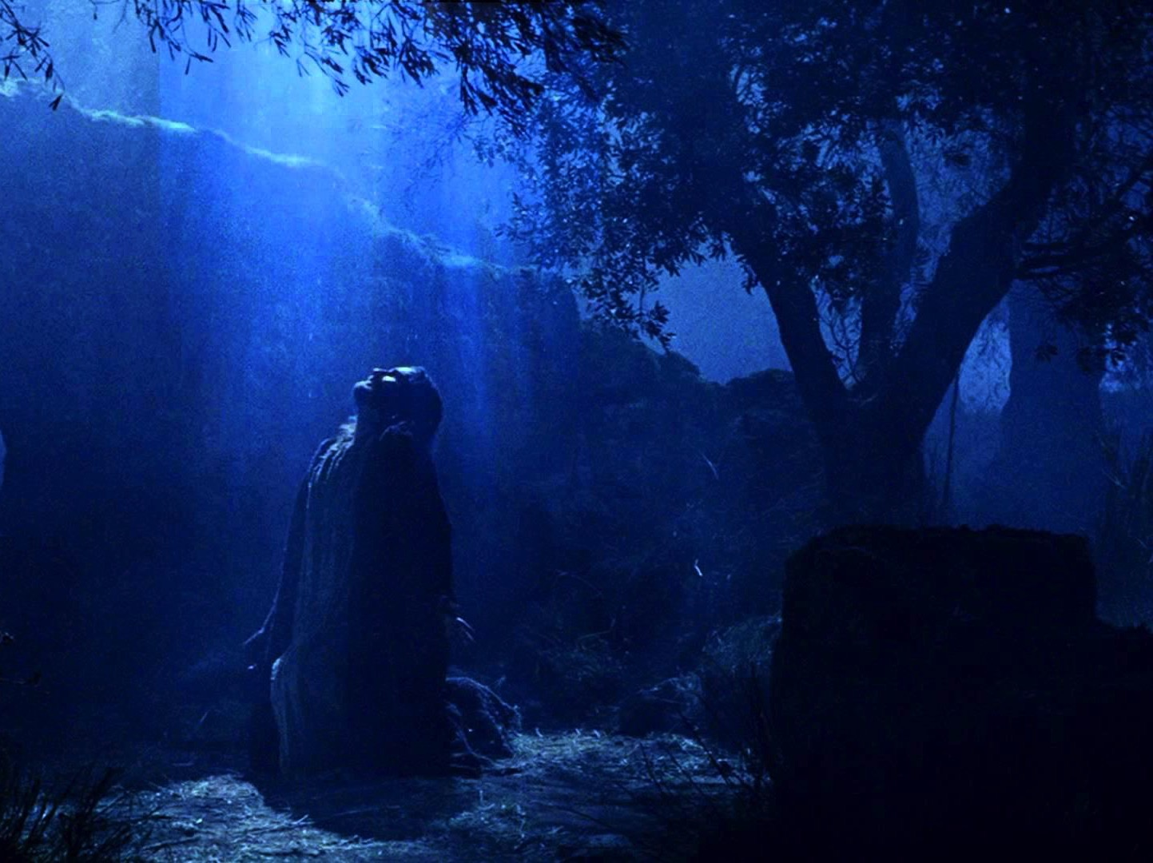
预言
(主, 神性)
27f
旅行的传道士“为主的名出外” (第七节) ，
因为他们所要传的信息不是非信徒会支持的。
约翰三书

Slide 10
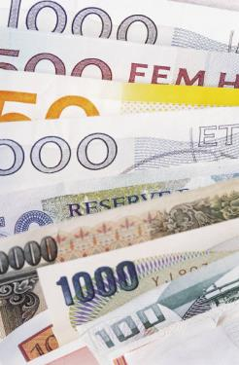
约翰三书大纲
305
对传教士的支持
1-8
9-11
12-14
该犹
丢特腓
低米丢
称赞
谴责
推荐
支持传教士
反对传教士
是个传教士
问候与 祷告
1-2
因神圣而喜悦
3-4
支持证实了
5-8
为了拒绝约翰
9
为了反对的传教士
10
为了做罪恶
11
好名誉
12
期望中的探访
13-14.a
富感情的问候
14b-d
亞西亞
公元90年间

Slide 11
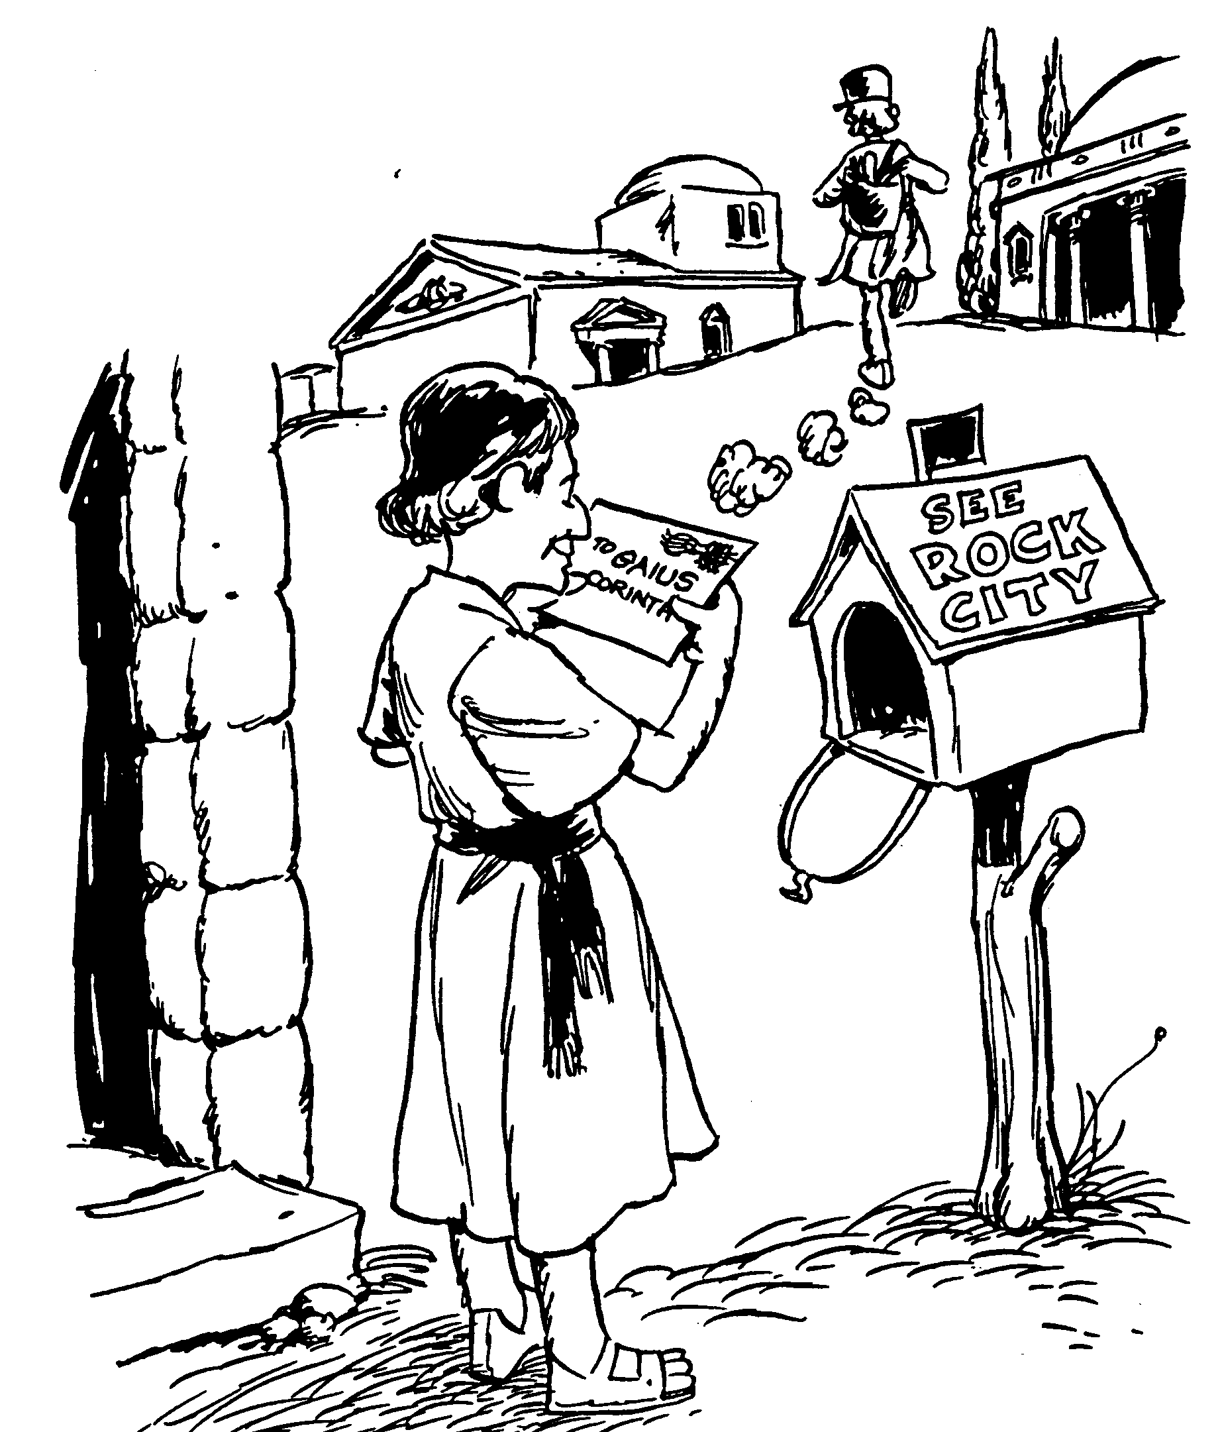
Acrostic Bible – 3 John
约翰三书
经节
1-4 向该犹问侯
5-6 接纳异客和弟兄们
7-8 投资于神的工
9-10 投资上帝的工作
11-14 推崇低米丢
巴里 赫德尔斯顿 《藏头诗圣经》

Slide 12
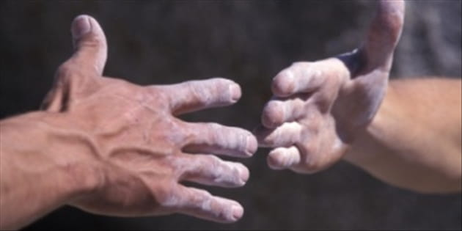
要施舍
约翰三书
Rick Griffith 博士 • Crossroads International Church Singapore
BibleStudyDownloads.org

Slide 13

“当每个人所看到的真理是不同的， 我要怎么样持守真理?"
约翰三书
USA Weekend Report on Religion (1996)的记者
Notes:
Do you see the subtle lie that “there is no objective truth”?

Slide 14

真理是真理
即使无人相信，
真理仍是真理。
即使万人相信，
谎言仍是谎言。
约翰三书
Notes:
Truth is truth, even if no one believes it. A lie is still a lie, even if everyone believes it. Gravity is true, so you WILL fall off the cliff even if you SINCERELY believe you won’t fall!

Slide 15
新约二十七本书信
28
十九本是关乎回应异端!
Notes:
Did you know that, of the 27 NT books, 19 of them responded to heresy afflicting the church? Talk about the need to know and obey God’s truth! Defending truth is a huge theme in the New Testament!

Slide 16

你需要服从神的真理吗?
约翰三书
Notes:
How many of you feel a need to obey God’s truth? Raise your hand if you feel the need to be obedient to the Bible.
Obviously there are numerous ways to obey God’s truth—prayer, reading the Bible, etc. but today we will focus on three ways noted in one of these 19 letters.

Slide 17
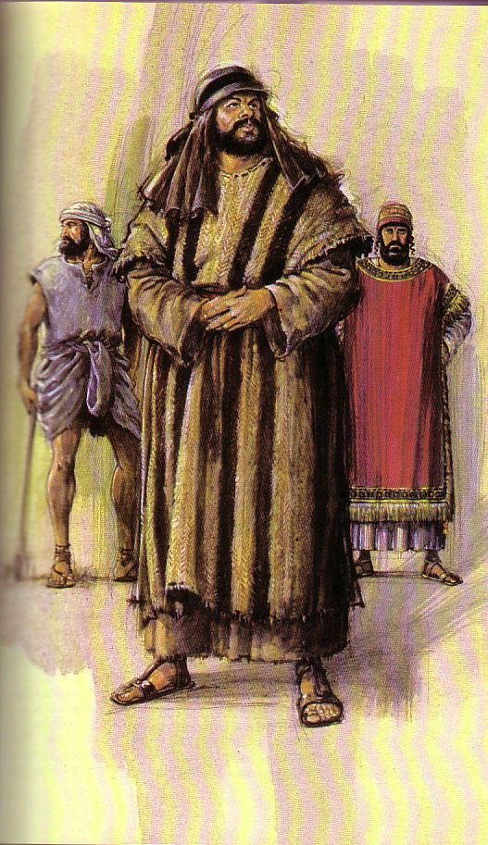
我们要怎么服从神的真理?
306
III.
如
低米丢
一般成为
传道士
(12)
II.
不要如
丢特腓
一般阻拦
宣教事工
(9-11)
I. 如该犹一般帮助
他人传真理 (5-8)
约翰三书
Notes:
So how can we obey God’s truth?
• We’re to be people who propagate the truth. How? Support missionaries like Gaius
• and don’t hinder the gospel like Diotrephes. But it would be amiss not to share the final way to obey the truth, and that is to…
• Spread God’s truth by being a witness yourself in the footsteps of Demetrius.

Slide 18

借着上帝为你安排的方式支持传教事工 来活出神的真理。
约翰三书主要思想
Notes:
The Lord has a specific place in his vineyard for you to share his truth—find it and go for it!

Slide 19


那么您又如何呢?
305
您是否有通过你的好客和财务来支持传教士以便促进福音
的传播吗?
约翰三书

Slide 21
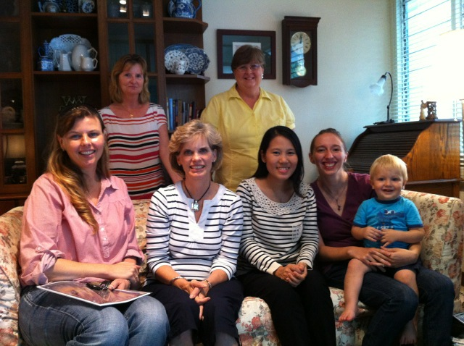

Our People
苏珊教导教会的妇女
Notes:
I also lead the woman's Precept Bible study at our church

Slide 22
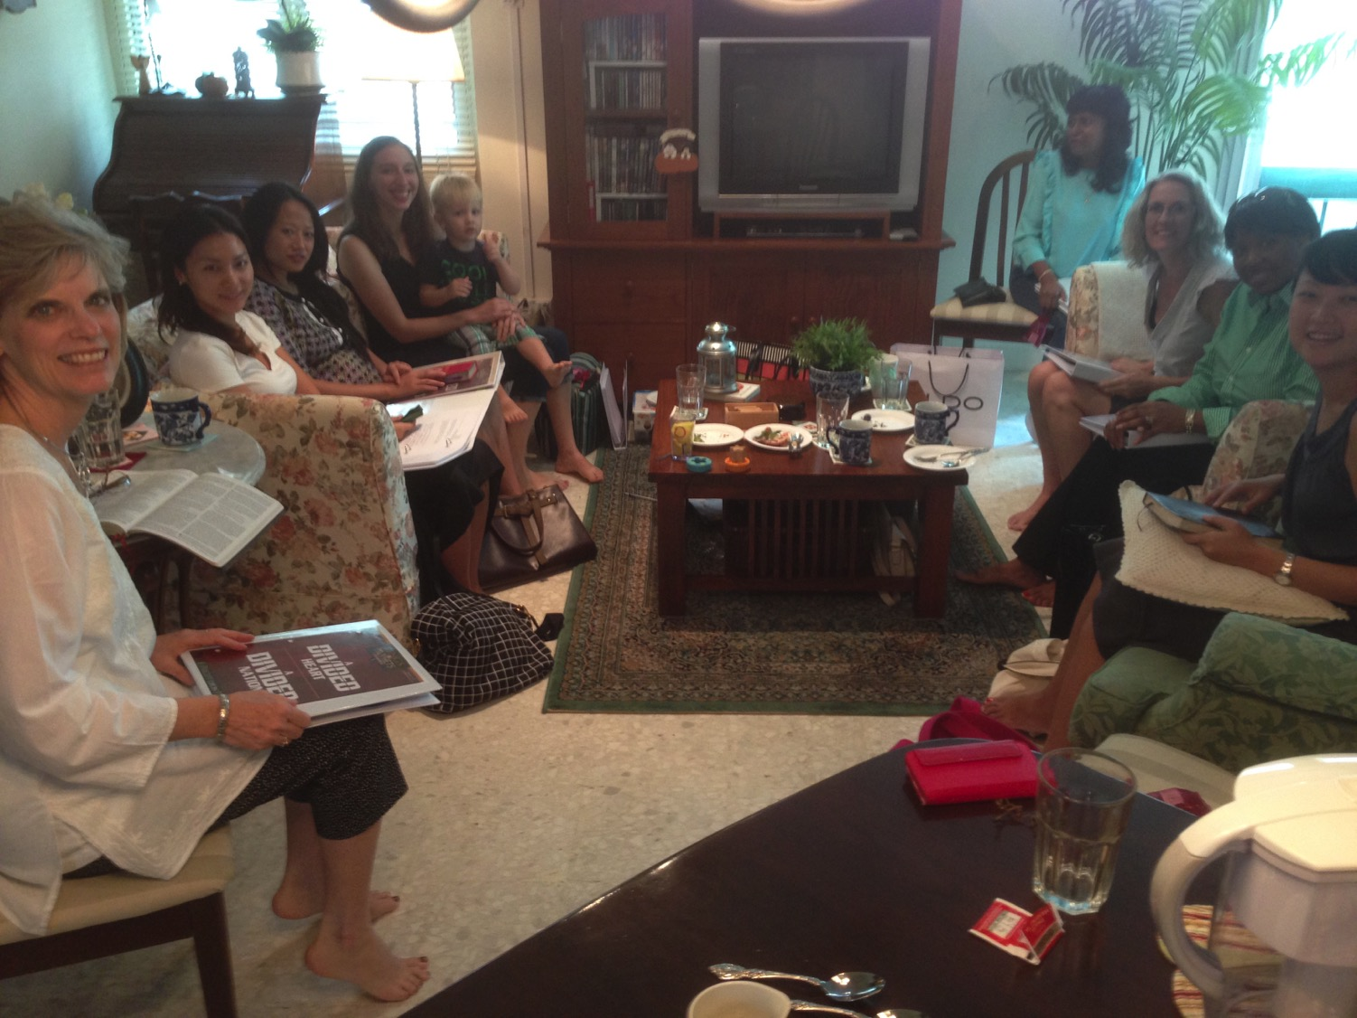
妇女查经班在研读列王记上下
美国•印度•新加坡•新西兰•津巴布韦•荷兰

Slide 23
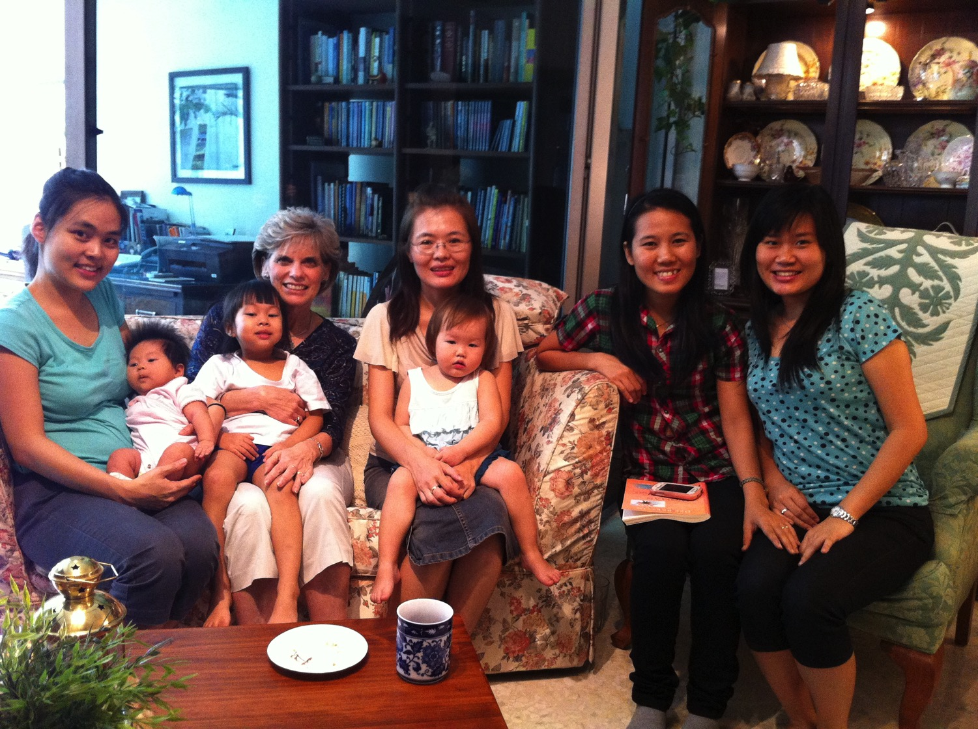
泰国• 蒙古• 缅甸• 印尼
Notes:
INTERVIEWER: And Susan, what ministries has the Lord granted you?
SUSAN: I have been teaching the wives of leaders at SBC. These 5 women come from 5 different nations!
SUSAN: I also lead the woman's Bible study at our church

Slide 24
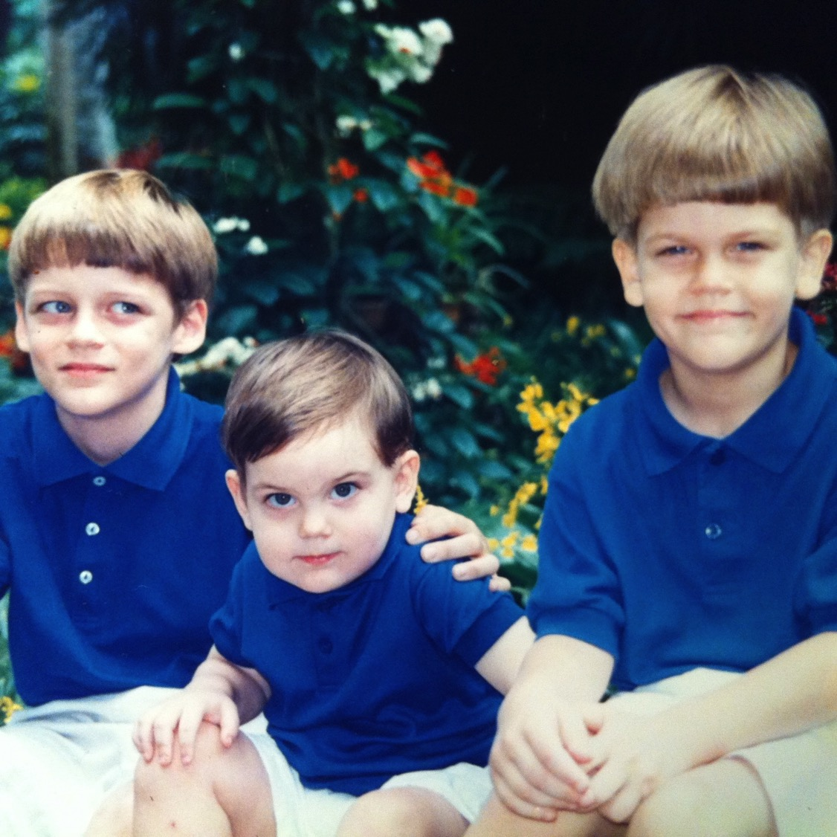
我们的三个儿子

Slide 25
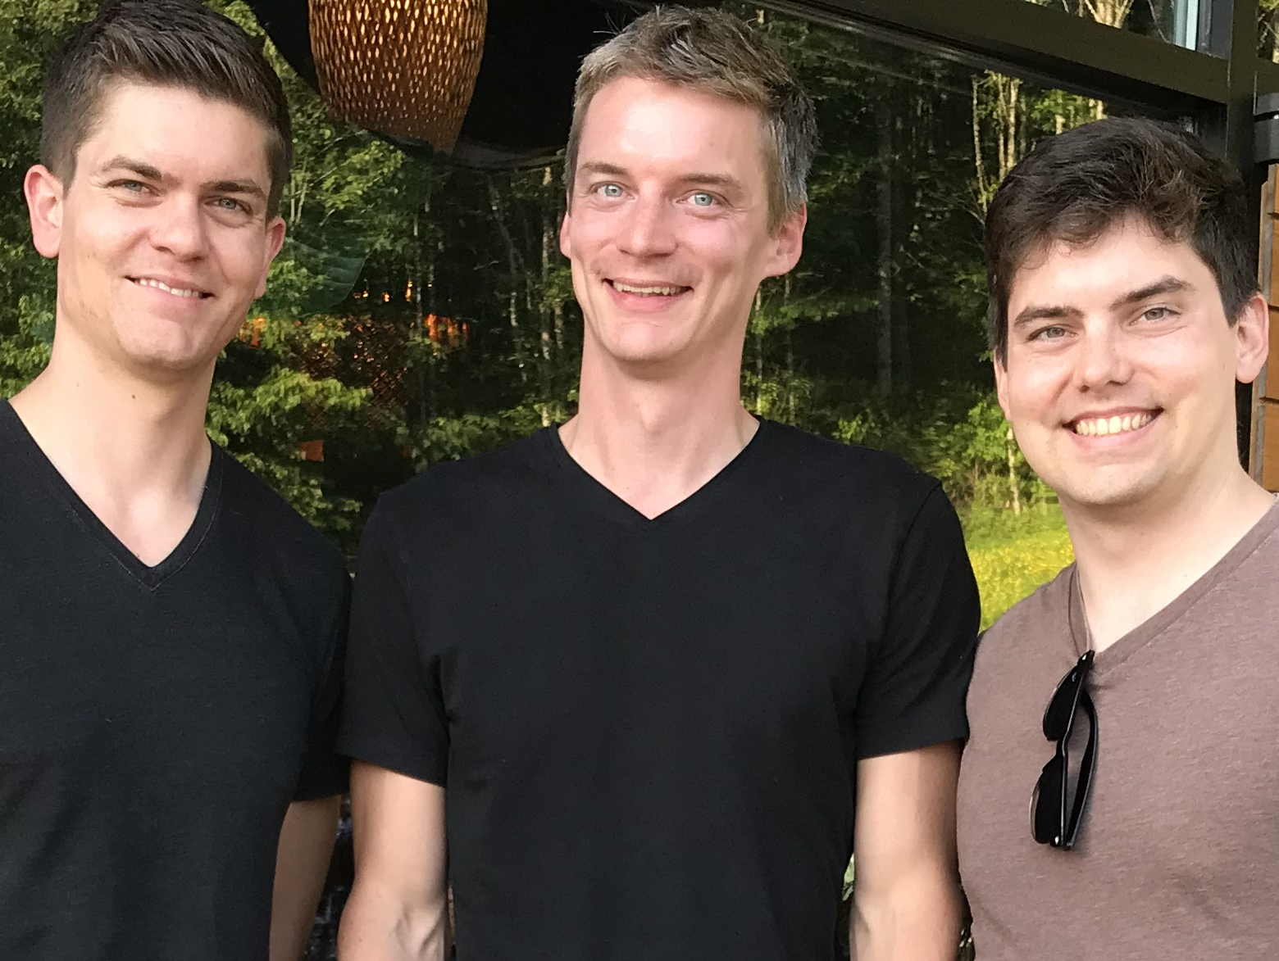
我们的3个儿子

Slide 26
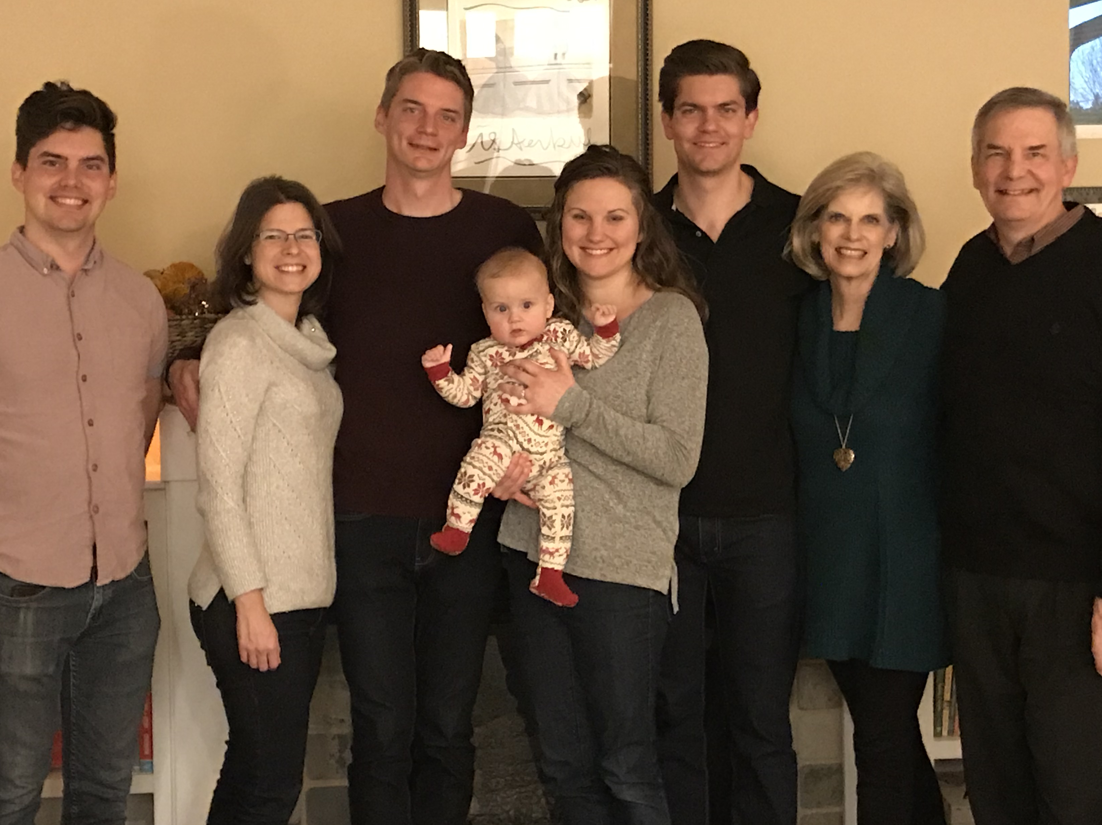
The Griffiths
31 May 2019
2019
约翰
(27)
克尔和 卡拉
(33)
史帝文
和卡蒂 杰西(30)
力克和苏珊

Slide 27
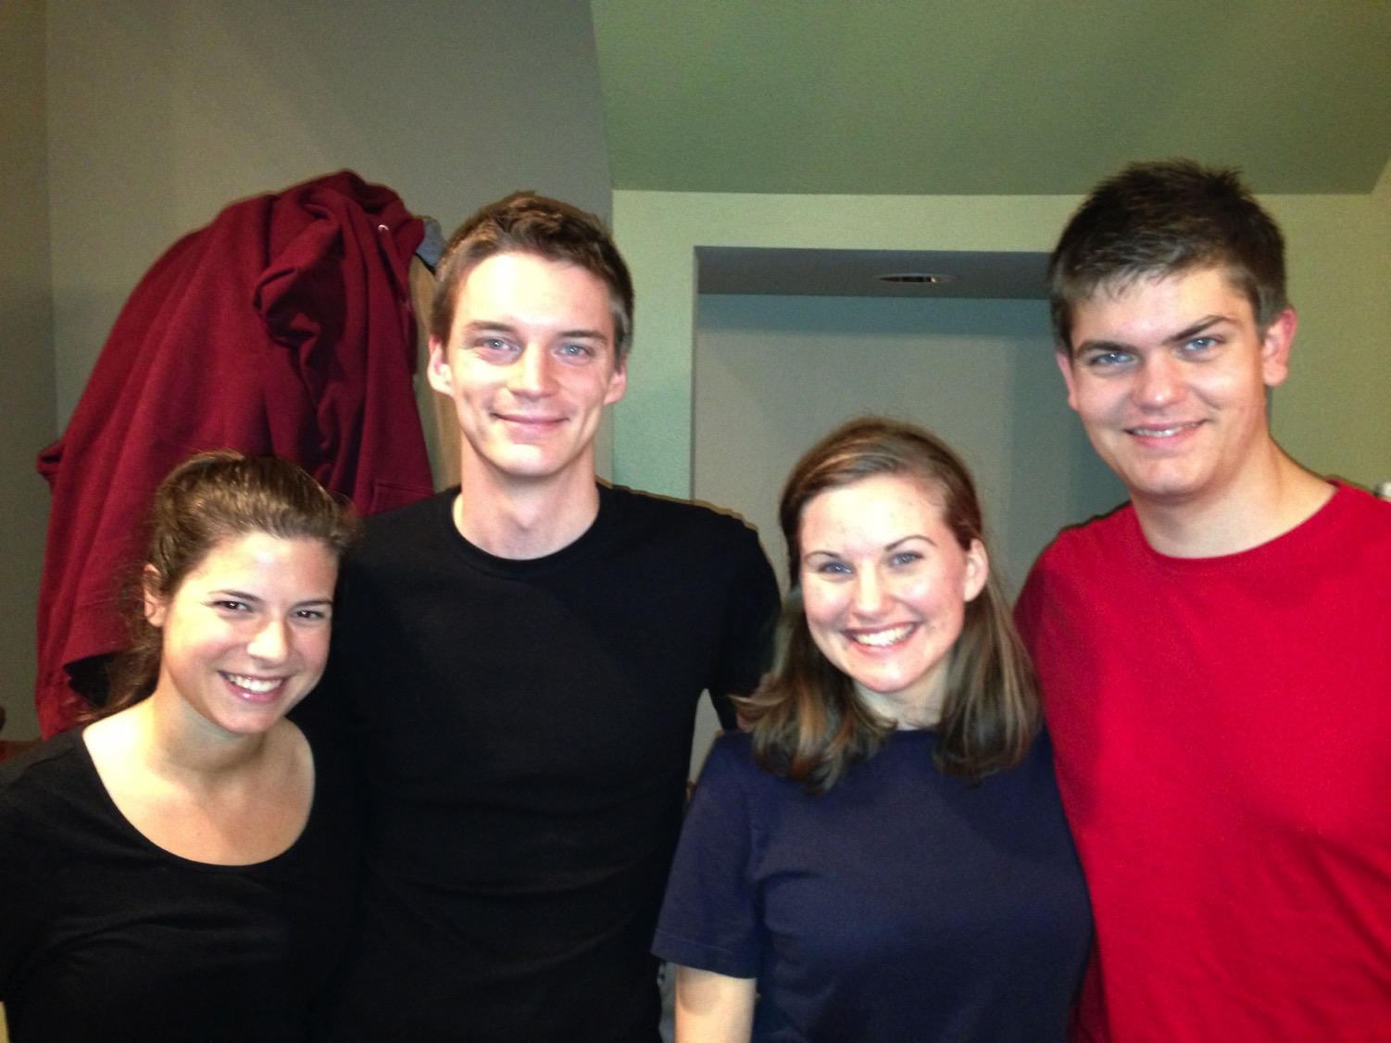
克尔和卡拉 史帝文和卡蒂
8

Slide 28
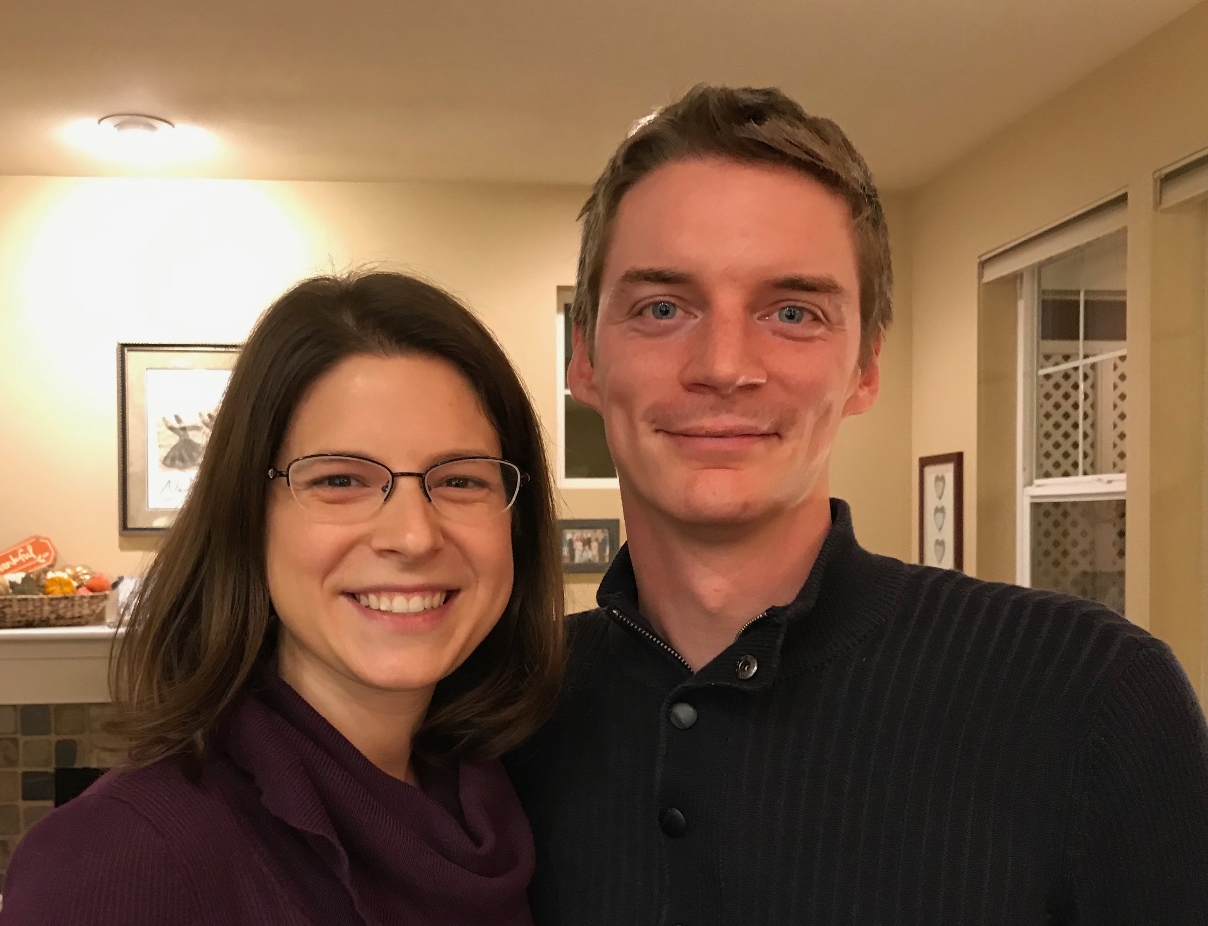
克尔是一位 信息技术人员
Notes:
Kurt and his wife Cara are in Seattle

Slide 29
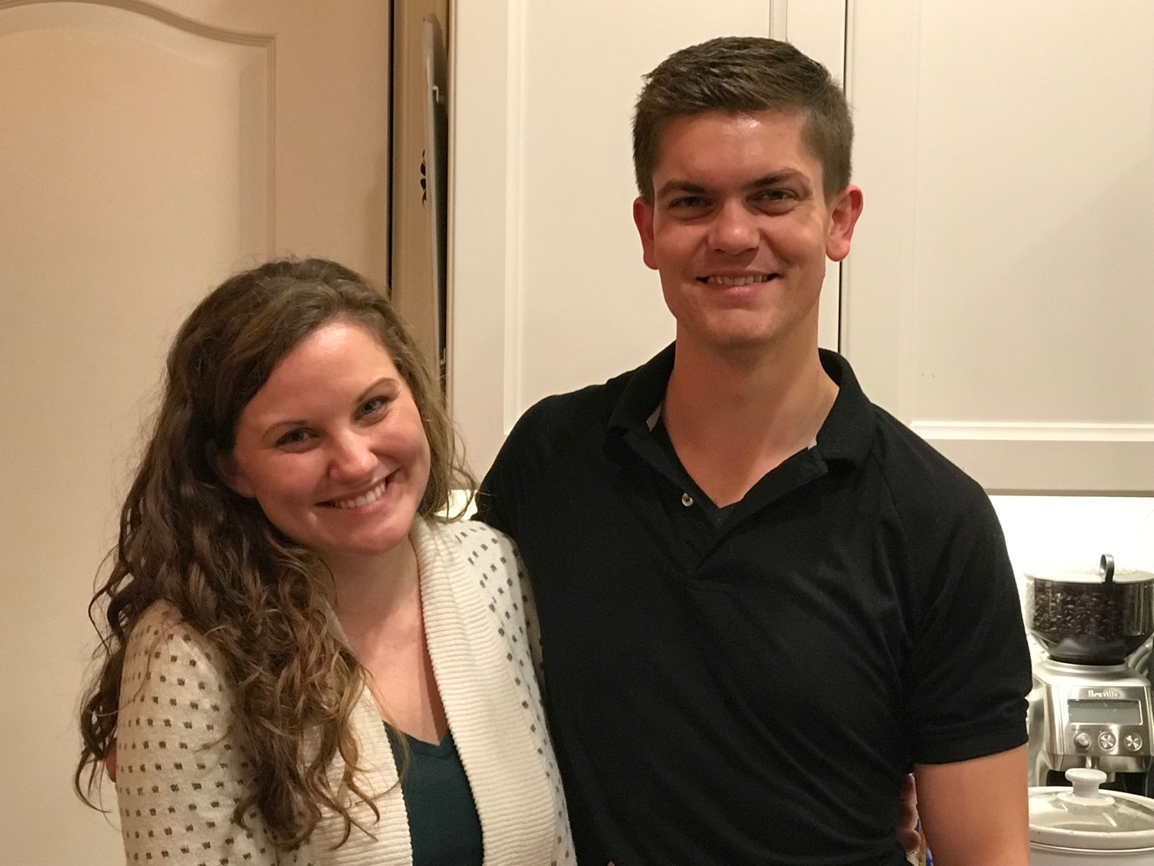
史帝文和卡蒂
6
Notes:
Stephen and his wife Katie in Boise

Slide 30
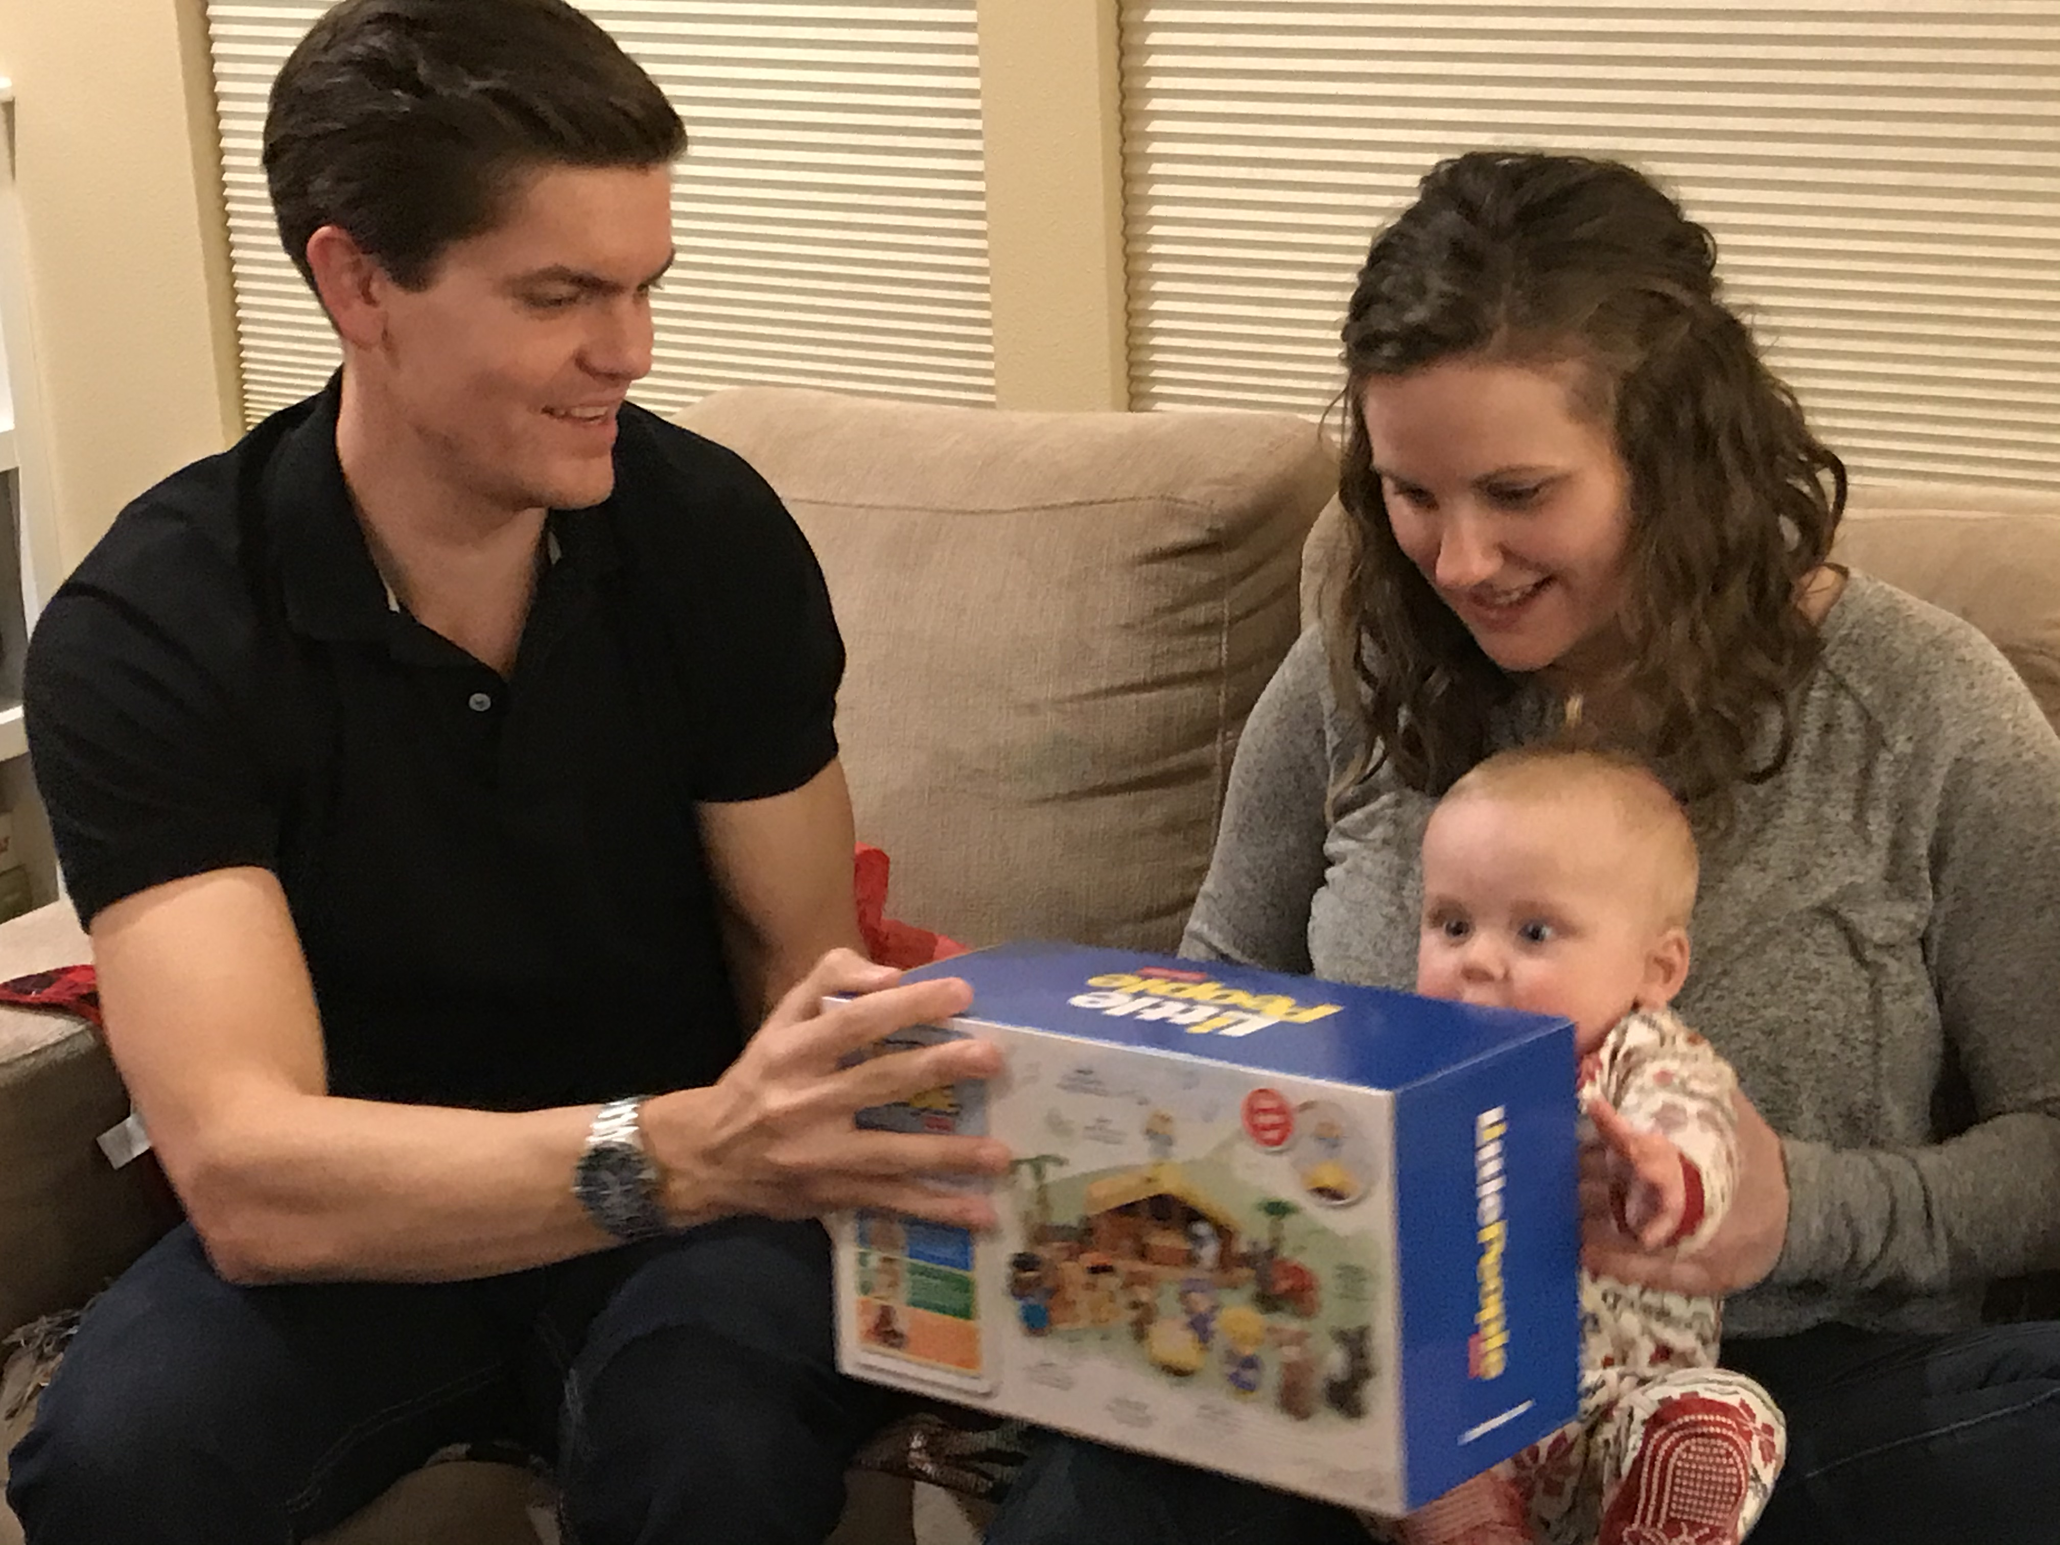
在 2019，五月， 史帝文 & 凯媞
给我们第一个儿孙叫耶西
6
Notes:
Stephen and his wife Katie in Seattle
史帝文 & 凯媞 – 耶西

Slide 31
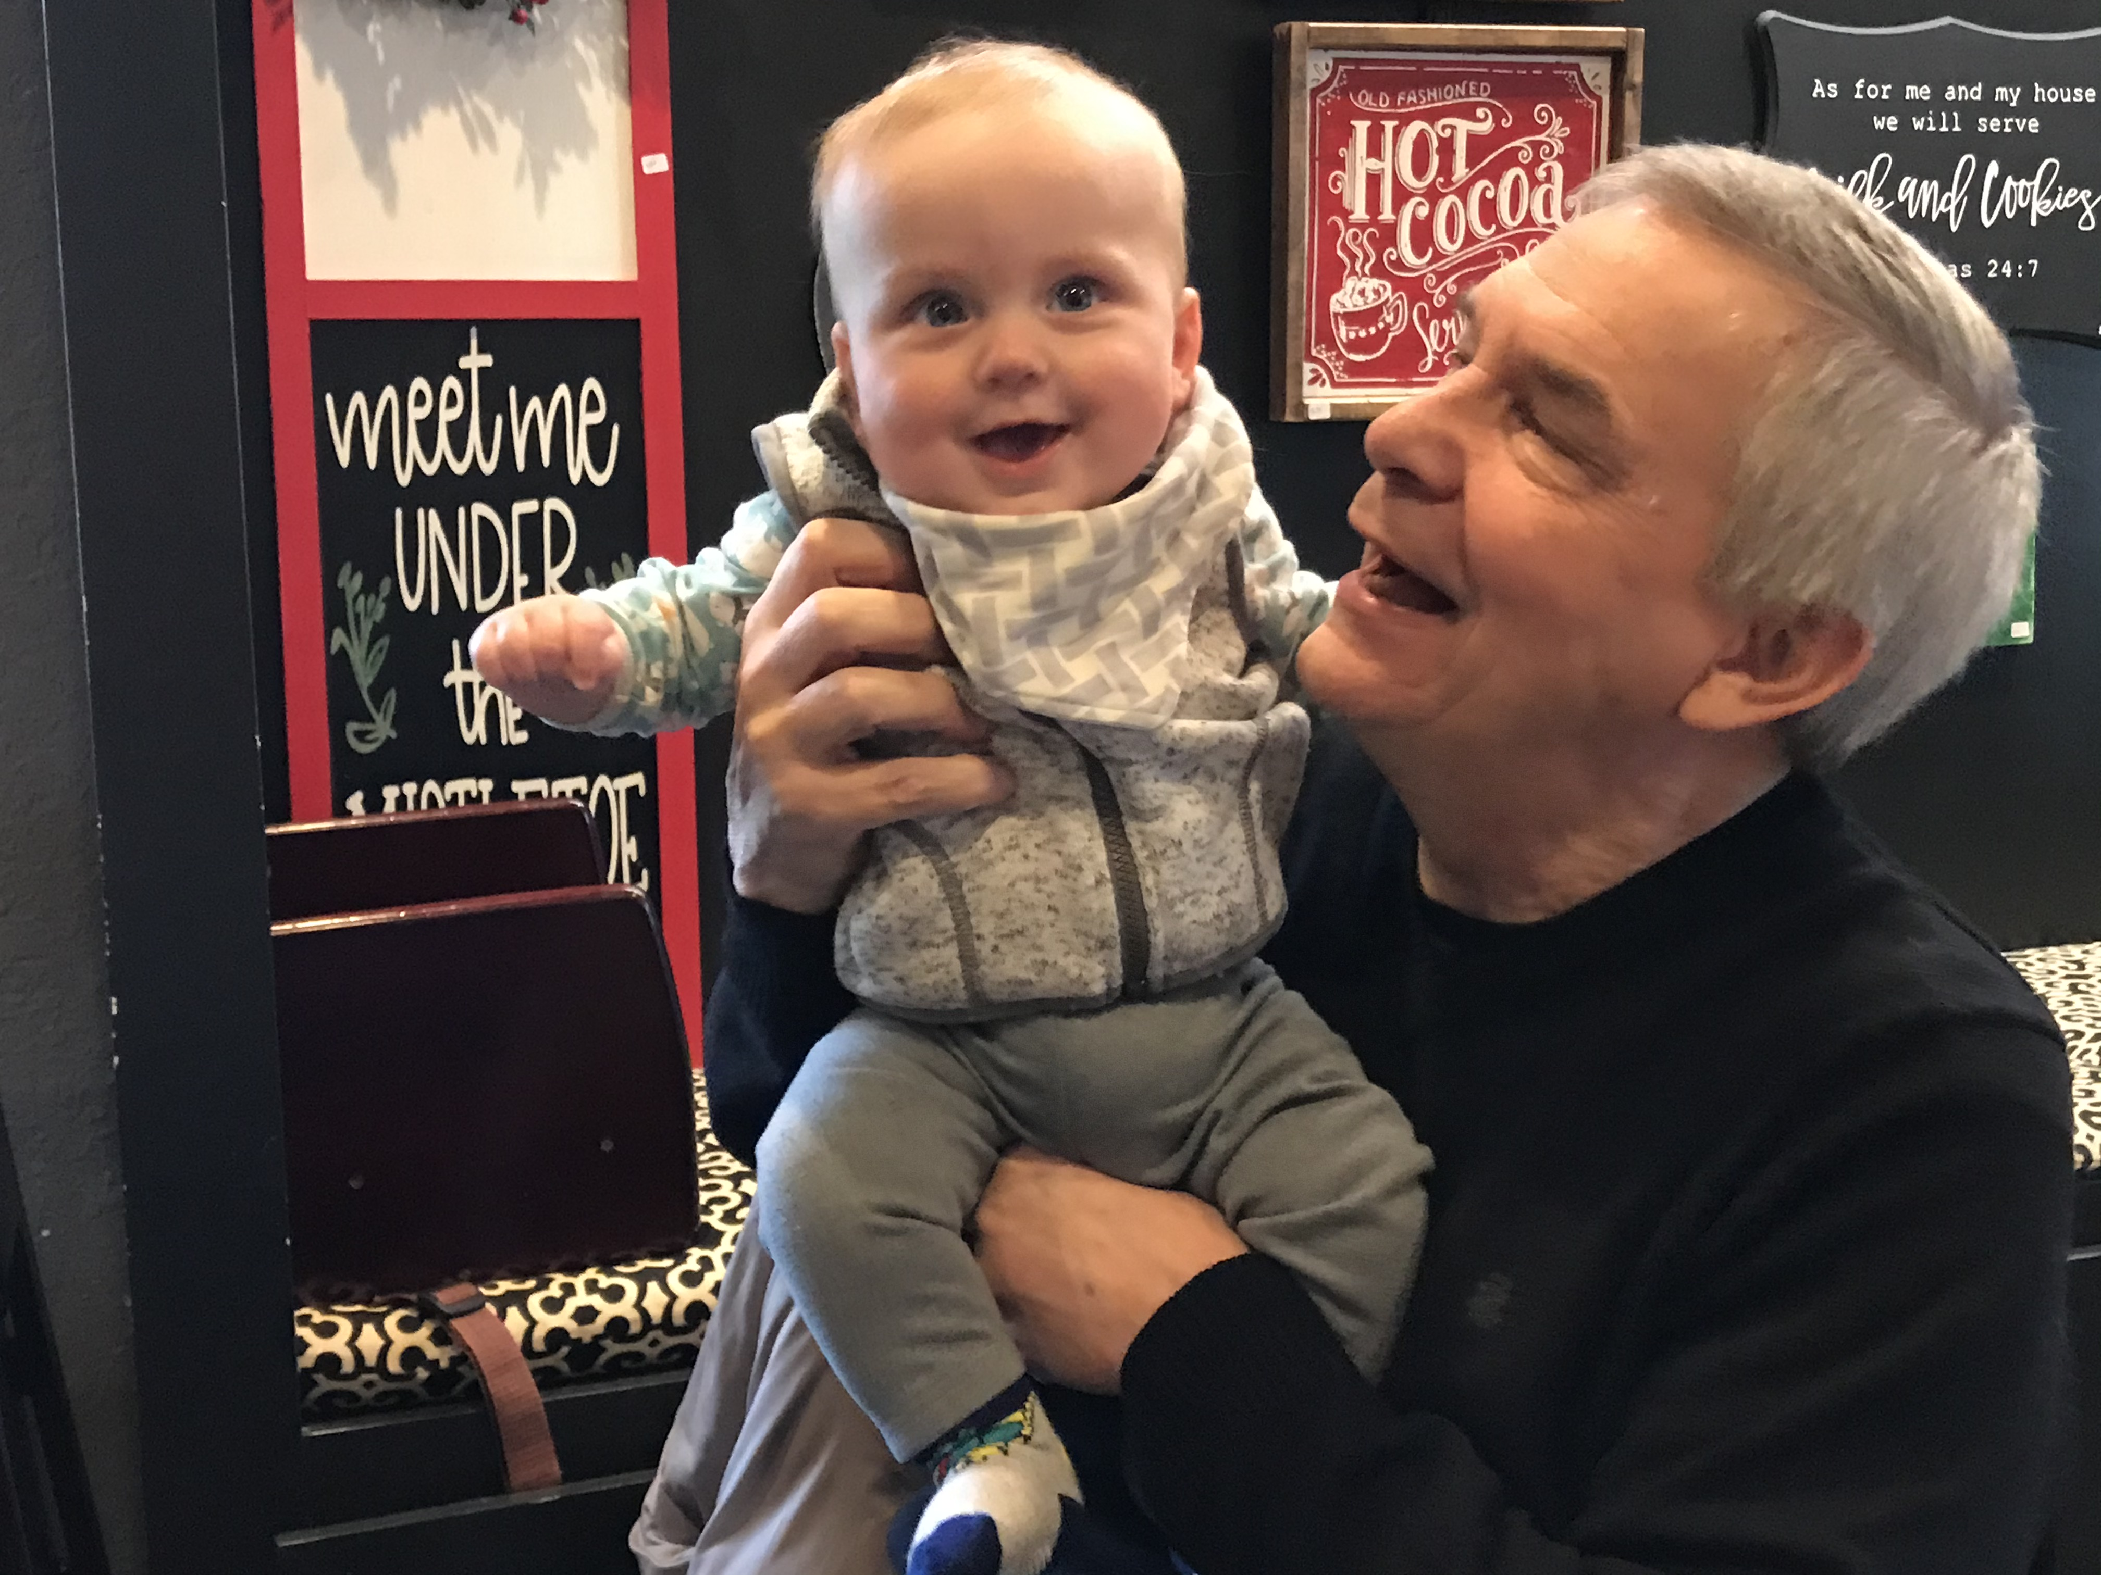
儿孙耶西

Slide 32
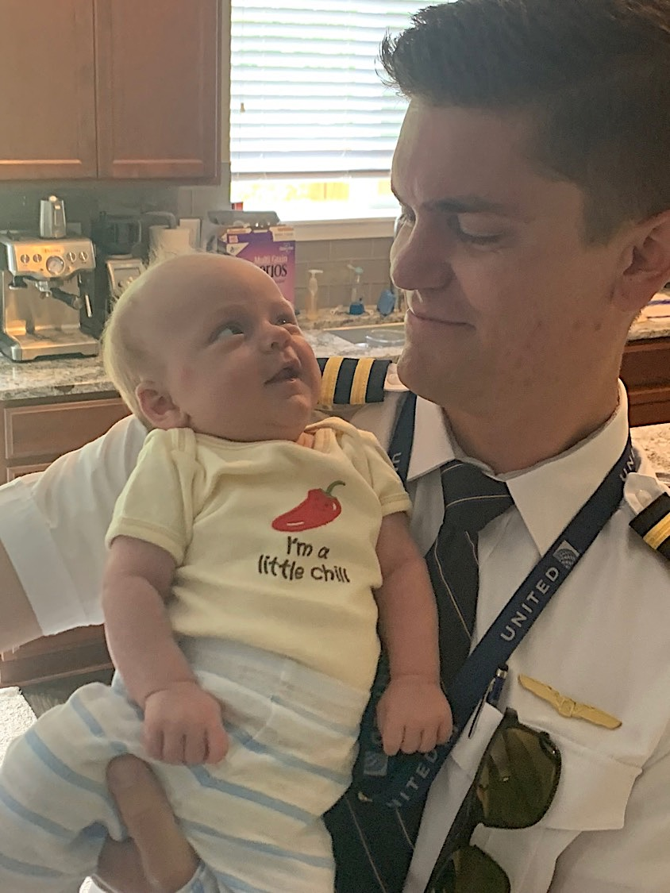
史帝文是一位
United航空公司
机师

Slide 33
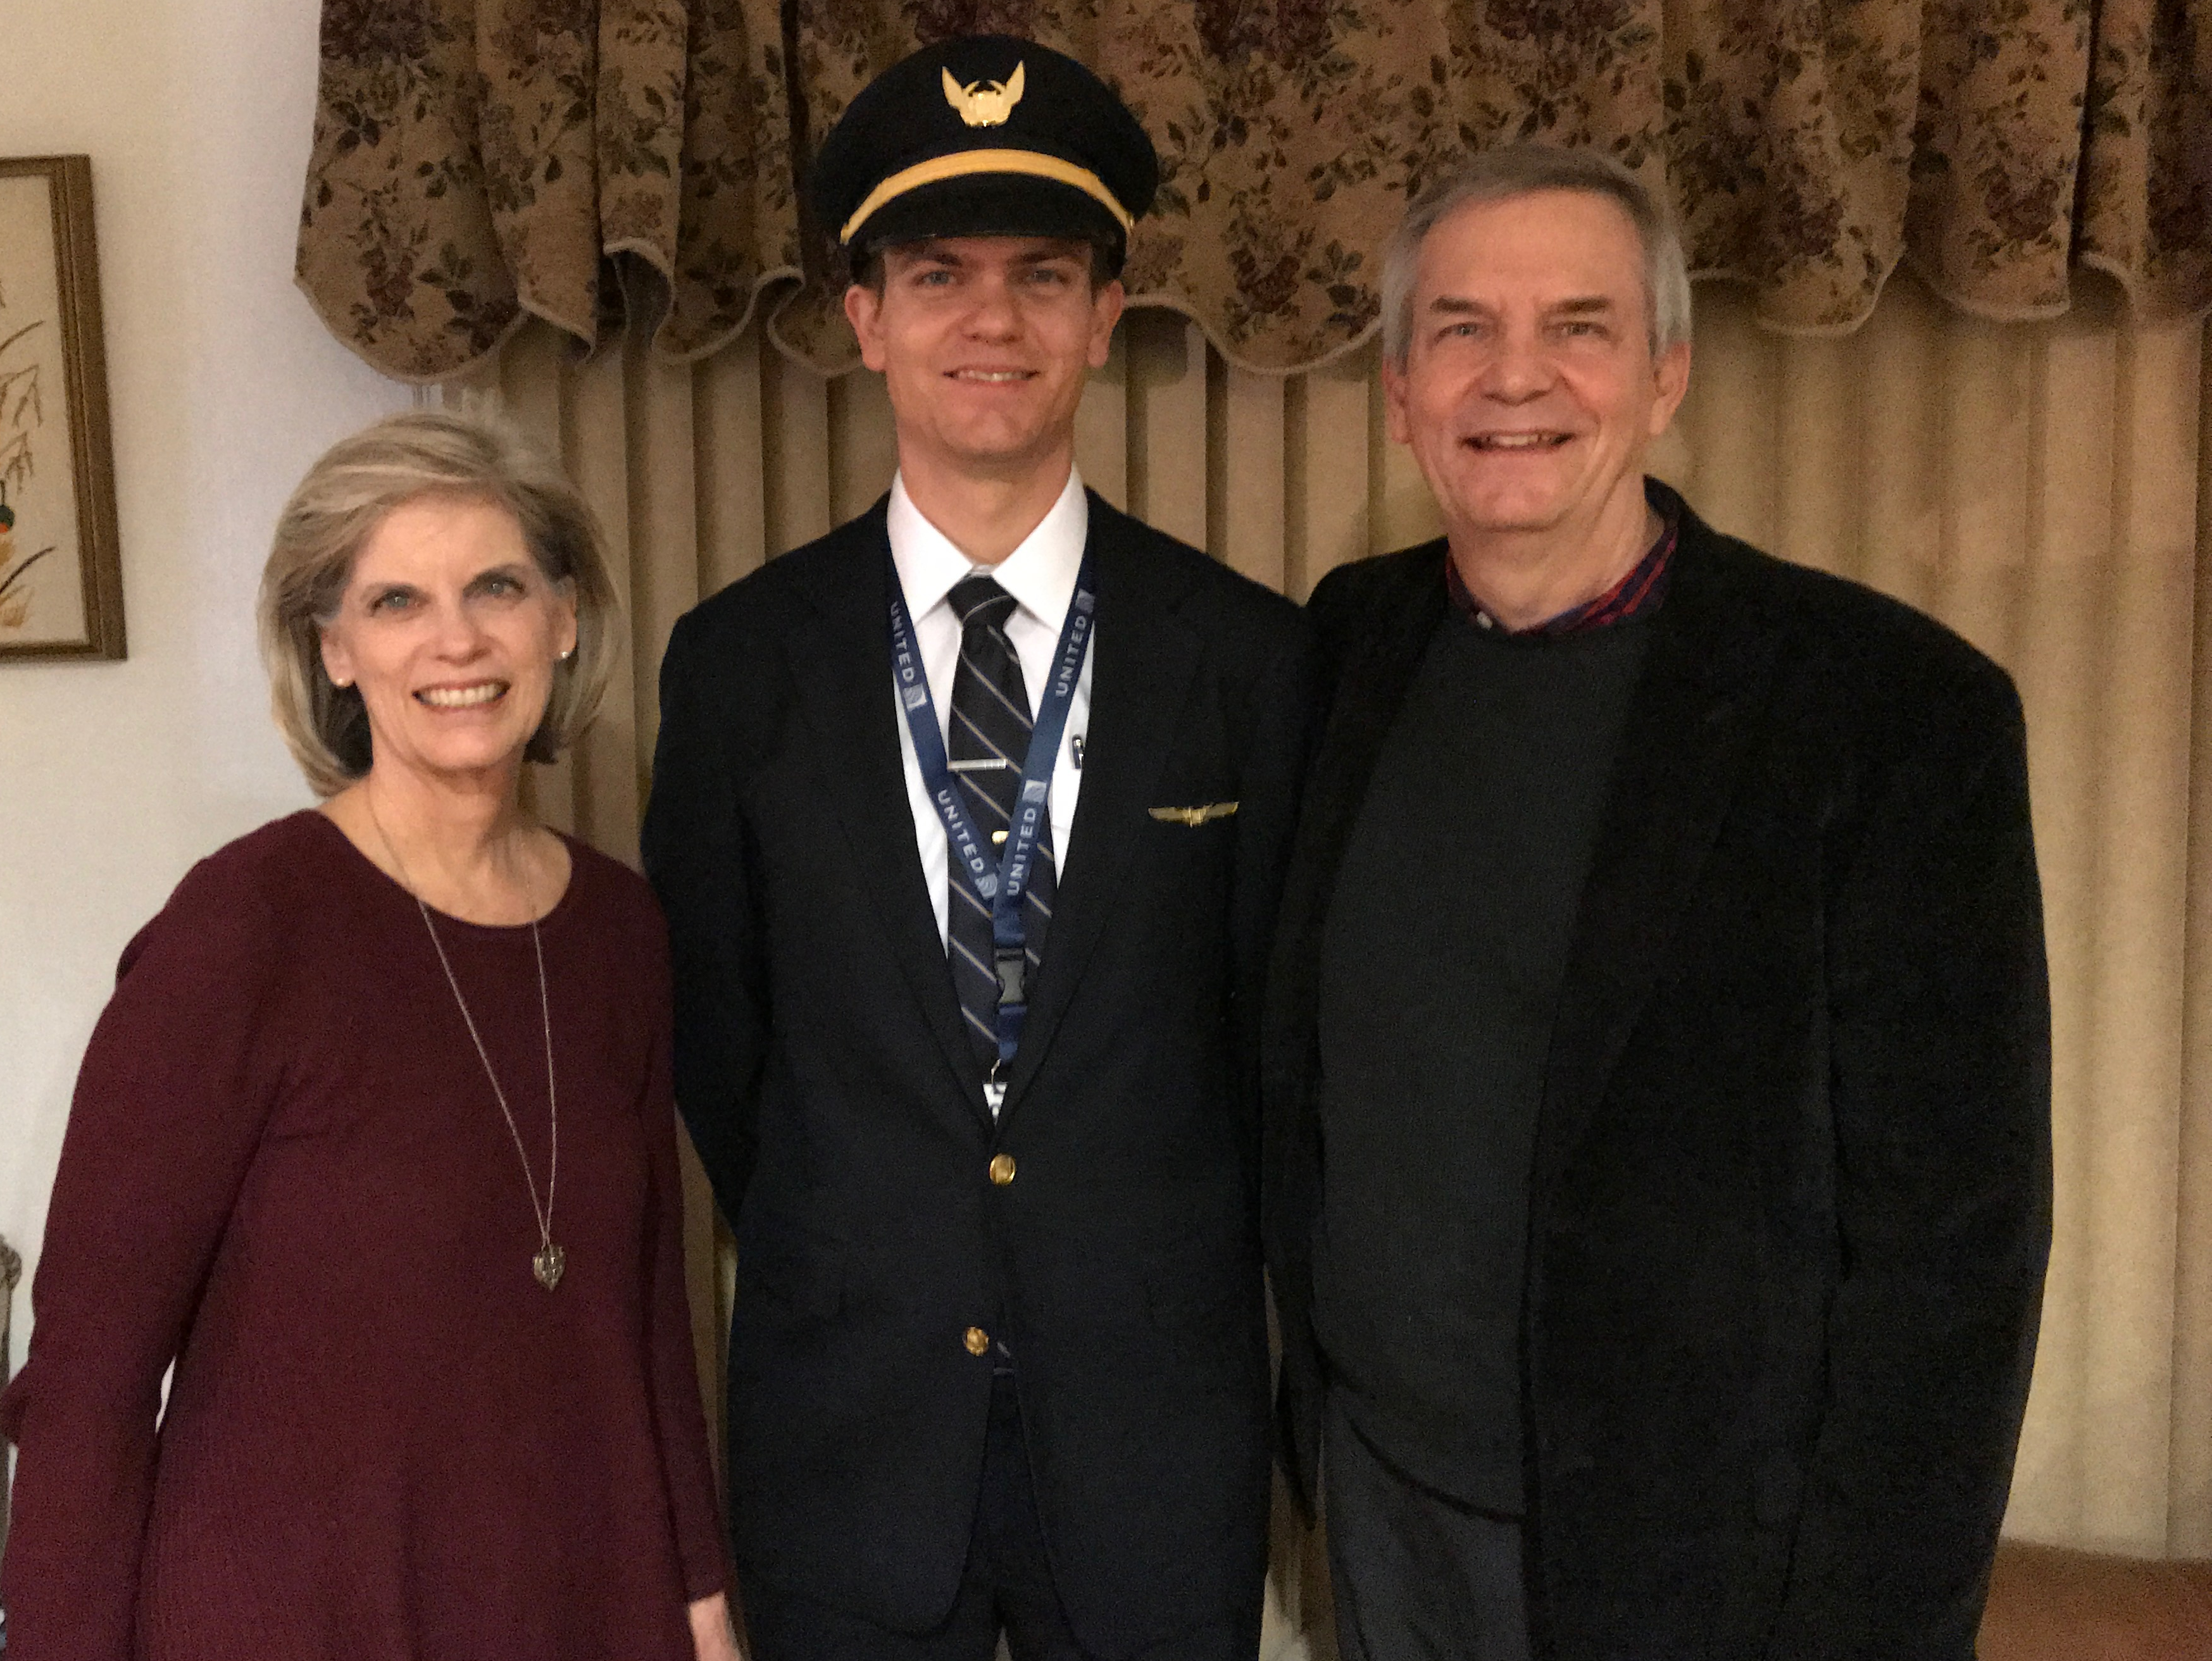
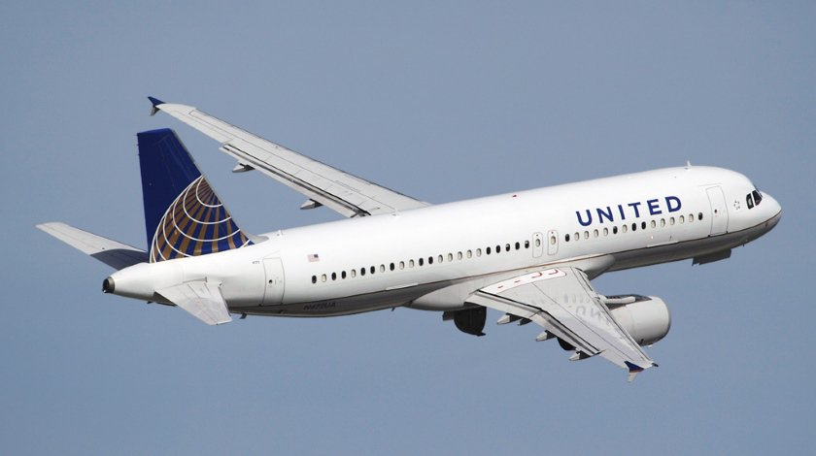
史帝文是一位
United航空公司
机师
6
Notes:
Stephen and his wife Katie in Boise

Slide 34
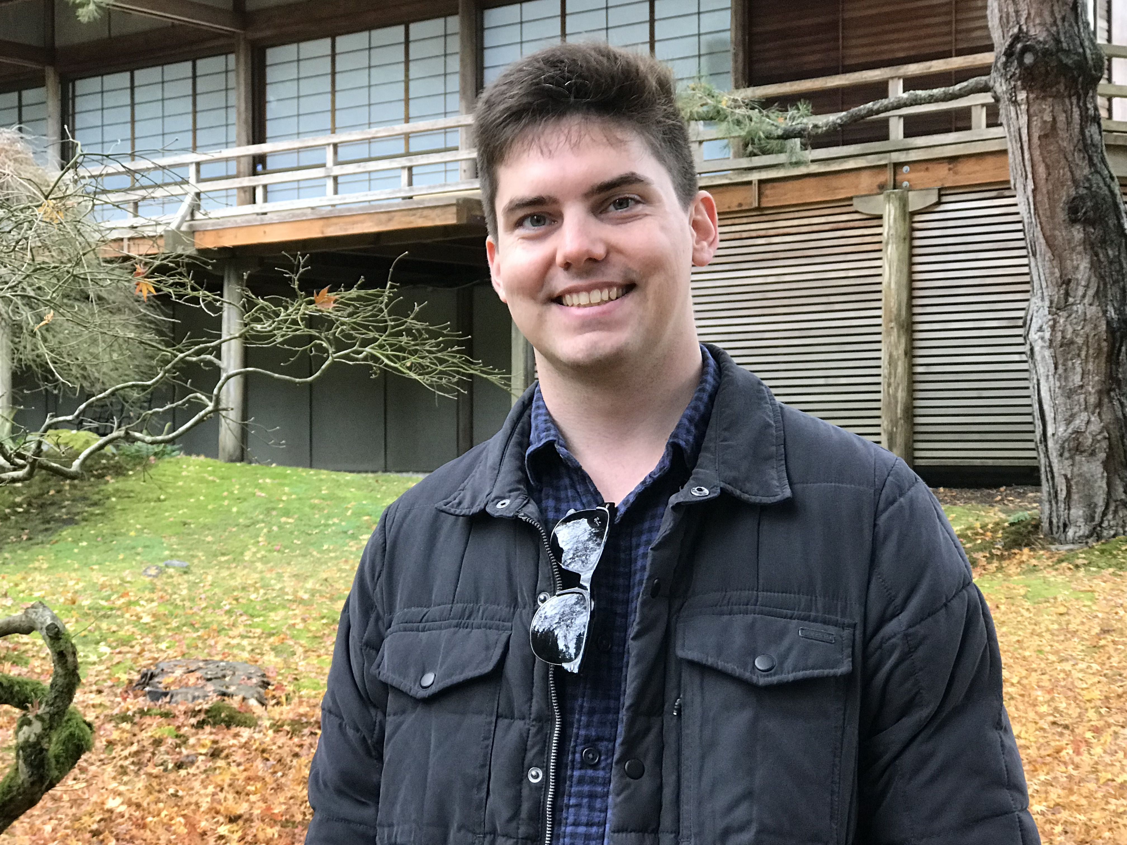

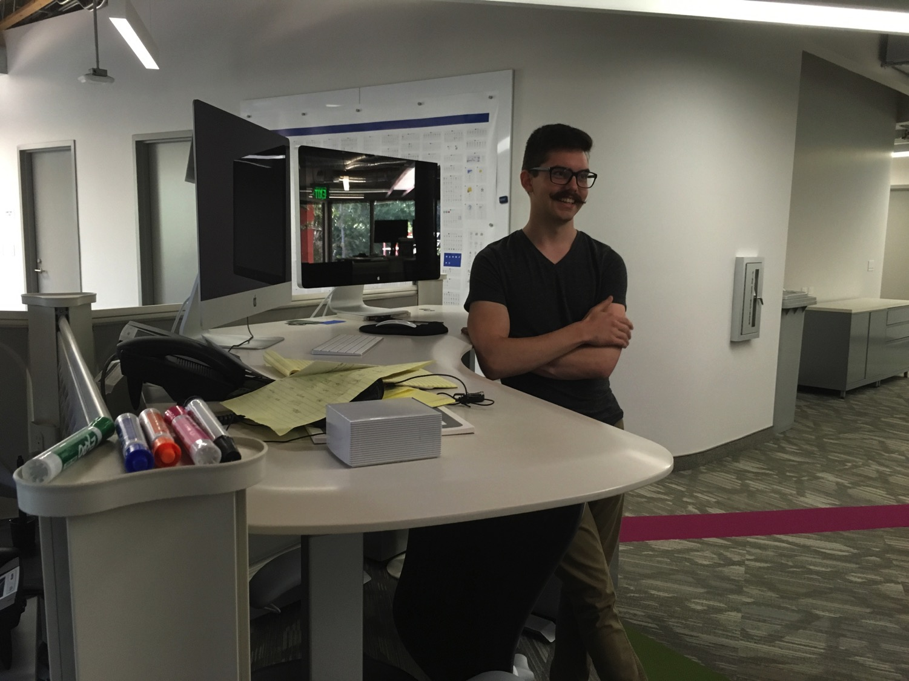
我们的小儿子，约翰(23)是 加利福尼亚的一个图形艺术家
8
Notes:
John just graduated from Biola and works for ESRI

Slide 35
要施舍
约翰三书
Rick Griffith 博士 • Crossroads International Church Singapore
BibleStudyDownloads.org

Slide 36


Ability or Integrity?
What is more important to you?
Notes:
A recent poll during an election year asked respondents what they considered more important in a presidential candidate: ability or integrity. Is it more important to have a candidate with expertise or high moral standards—for example, one who tells the truth? The results were sad as most preferred a candidate’s ability over his truthfulness. Obviously, both ability and integrity are needed in any job—especially the presidency! But how little attention is given to truth in today’s society! Anything goes!

Slide 37
“当每个人所看到的真理是不同的， 我要怎么样持守真理?"
约翰三书
USA Weekend Report on Religion (1996)的记者
Notes:
Do you see the subtle lie that “there is no objective truth”?

Slide 38
真理是真理
即使无人相信，
真理仍是真理。
即使万人相信，
谎言仍是谎言。
约翰三书
Notes:
Truth is truth, even if no one believes it. A lie is still a lie, even if everyone believes it. Gravity is true, so you WILL fall off the cliff even if you SINCERELY believe you won’t fall!

Slide 39
我在新神教授的课程
概览
旧约 新约
背景
旧约 新约
神学
教会论 圣灵论 末世论
讲道
讲道学 1 讲道学 2

Slide 40
新约二十七本书信
28
十九本是关乎回应异端!
Notes:
Did you know that, of the 27 NT books, 19 of them responded to heresy afflicting the church? Talk about the need to know and obey God’s truth! Defending truth is a huge theme in the New Testament!

Slide 41
你需要服从神的真理吗?
约翰三书
Notes:
How many of you feel a need to obey God’s truth? Raise your hand if you feel the need to be obedient to the Bible.
Obviously there are numerous ways to obey God’s truth—prayer, reading the Bible, etc. but today we will focus on three ways noted in one of these 19 letters.

Slide 42
新约综览(普通书信 ＋ 关键字)
38
124
39-41
“直 到 地 极” (使 徒 行 传 1:8)
使 徒 9 13 14 15 16 18 21 27 28
五月57-
八月59
大 马 色
安 提 阿
四月 48-
九月 49
1
加 拉 太
四月 50-
九月 52
2
爱琴海
春季 53-
五月 57
3
亚洲
五月 57-
八月 59
试验
二月 60-
三月 62
1
罗马
春季 62-
秋季 67
4
西班牙
秋季 67-
春季 68
2
罗马
秋季 49
理事会
春季68
教会扩长
35 48 49 50 52 53 57 60 62 67 68 95
天国
主权1
主权2
门徒
相 信
合一
秩序
教 义
提后
犹大
因信称义
被提
成圣
伪装者
雅各
行为
大患难
使 徒
神性
行事为人
希伯来
优秀
约 1
爱
彼 前
受苦
约 2
称义
饶恕
极限
福音书以及使徒行传
态度
彼后
知识
约 3
传教士
保罗书信
普通书信
普通书信 ＋关键节

Slide 43

场合
306
在新约还没完成和在早期信徒之中完全流通之前，教会必须依靠旅行的传教者和老师来教导真理。
因为当时的旅店不安全，数量也很少, 所以这些老师就和基督徒住在一起。

Slide 44
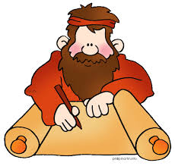
场合
306
一个名叫该犹的人忠实好客地对这样人(vv. 5-8), 尽管在教会里的另一位名叫丢特腓的人反对 (vv. 9-10) 。
约翰鼓励该犹继续对传教士好客和实际的支持。

Slide 45
新约书中的章节
新约的四本“书”只有一章

Slide 46

新约的电子邮件
15
13
腓利门 约贰 约叁 犹大
话
245
219
Notes:
I call these "New Testament Emails" as they are about the length one puts in an email.

Slide 47
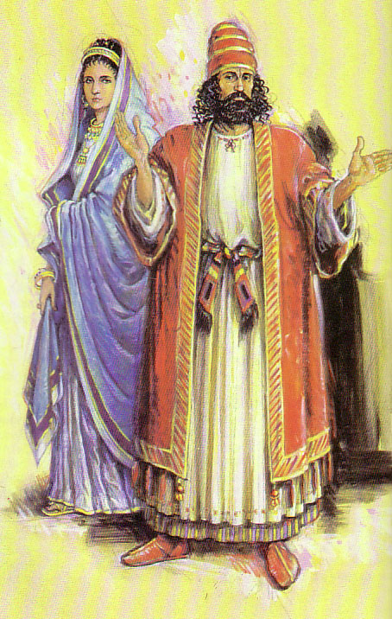
约翰二书对垒约翰三书
306
对比
虽然使徒约翰在约翰二书对支持假的老师发出警告
但是约翰三书却事情的“反面”也提出来: 信徒应该支持真正的传教士老师。

Slide 48
约翰二书对垒约翰三书
306
对比
 | 约翰二书 | 约翰三书
接收者 | 一个妇女 | 一个男人
姓名 | 匿名 | 该犹,丢特腓,低米丢
语气 | 谴责 | 称赞
转教士 | 假的 | 真的
好客／支持 | 错放了 | 失遗 了(丢特腓) 维护了(该犹)
章节 | 13 | 15
字数（希腊文本） | 245 | 219

Slide 49
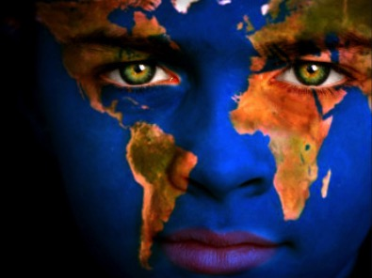
问安 (1-4 ＣＮＶＳ)
306
我这作长老的写信给亲爱的该犹，就是我在真理中所爱的。 ² 亲爱的，我祝你凡事亨通，身体健壮，正如你的灵魂安泰一样。
³有些弟兄来到，证实你心中存有真理，就是你按真理行事，我就非常欣慰。 ⁴ 我听见我的儿女按真理行事，我的喜乐没有比这更大的了。.

Slide 50

这封温暖, 亲切的信件围旋在三个人之间

Slide 51
这封温暖, 亲切的信件围旋在三个人之间:
306
丢特腓是个世俗的信徒,他反对该犹和其它信徒的好客来接待传教士
(vv. 9-11)
低米丢是教会应该支持的传教士
(v. 12) 。
该犹是真心诚意地支持传教士的一个虔诚人的人(vv. 1-8)

Slide 52
我们要怎么服从神的真理?
306
III.
如
低米丢
一般成为
传道士
(12)
Notes:
So how can we obey God’s truth?
• We’re to be people who propagate the truth. How? Support missionaries like Gaius
• and don’t hinder the gospel like Diotrephes. But it would be amiss not to share the final way to obey the truth, and that is to…
• Spread God’s truth by being a witness yourself in the footsteps of Demetrius.

Slide 53
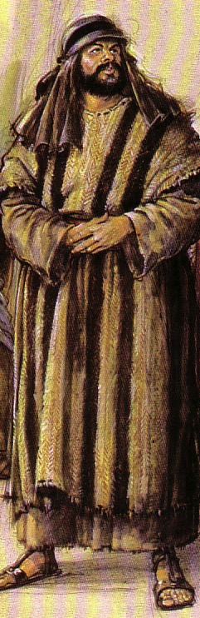
Gaius
306
"Dear friend, you are being faithful to God when you care for the traveling teachers who pass through, even though they are strangers to you. ⁶They have told the church here of your loving friendship."
"Please continue providing for such teachers in a manner that pleases God. ⁷For they are traveling for the Lord, and they accept nothing from people who are not believers."

Slide 54

明信片的主要内容
305
关键词: 传教士
关键经文:
“所以我们应该接待这样的人，叫我们与他们一同为真理做工。”
(约翰三书第8节)

Slide 55

Will you pray?
Notes:
The absolutely best way to support your missionaries is through prayer. This weekend begins the 30 days of prayer for the followers of Islam, who desperately need the gospel. Pick up a prayer guide and join the many doing this for the next month.

Slide 56

我们的宣教机构

Slide 57
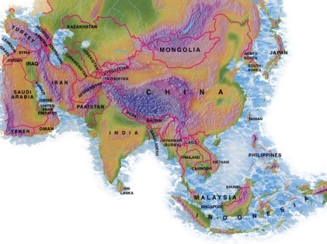

新加坡神学院的学生
美国
蒙古
日本
韩国
中国
尼泊尔
香港
缅甸
印度
泰国
越南
菲律宾
马来西亚
新加坡
新神
印尼

Slide 58
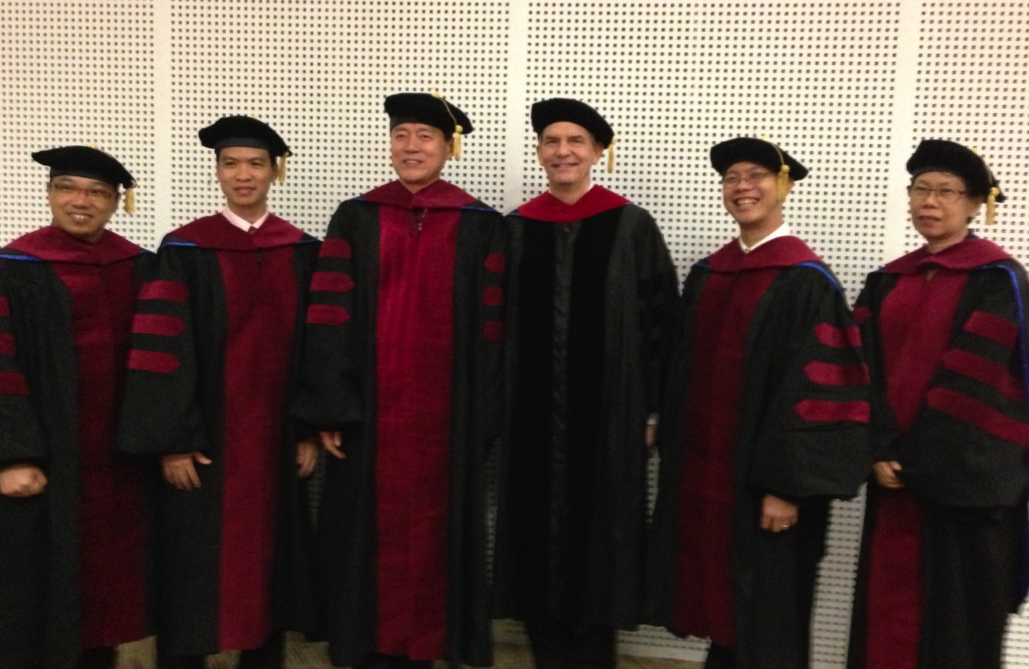
我负责指导新神博士研究生（DMin）
Notes:
I'm also the director of the doctoral program at SBC that trains about 80 seminary professors and pastors throughout Asia in English and Chinese. Generallly each year about 5 of them received their Doctor of Ministry degree.

Slide 59
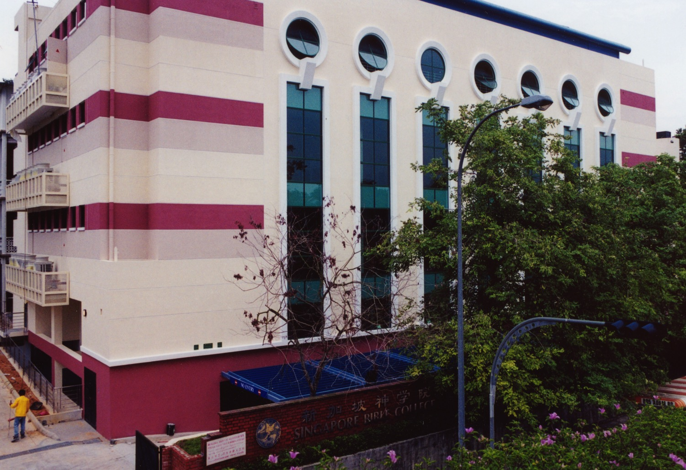
新加坡神学院
9
Notes:
I've served as a seminary professor with 30 other faculty at Singapore's largest training school: Singapore Bible College

Slide 60
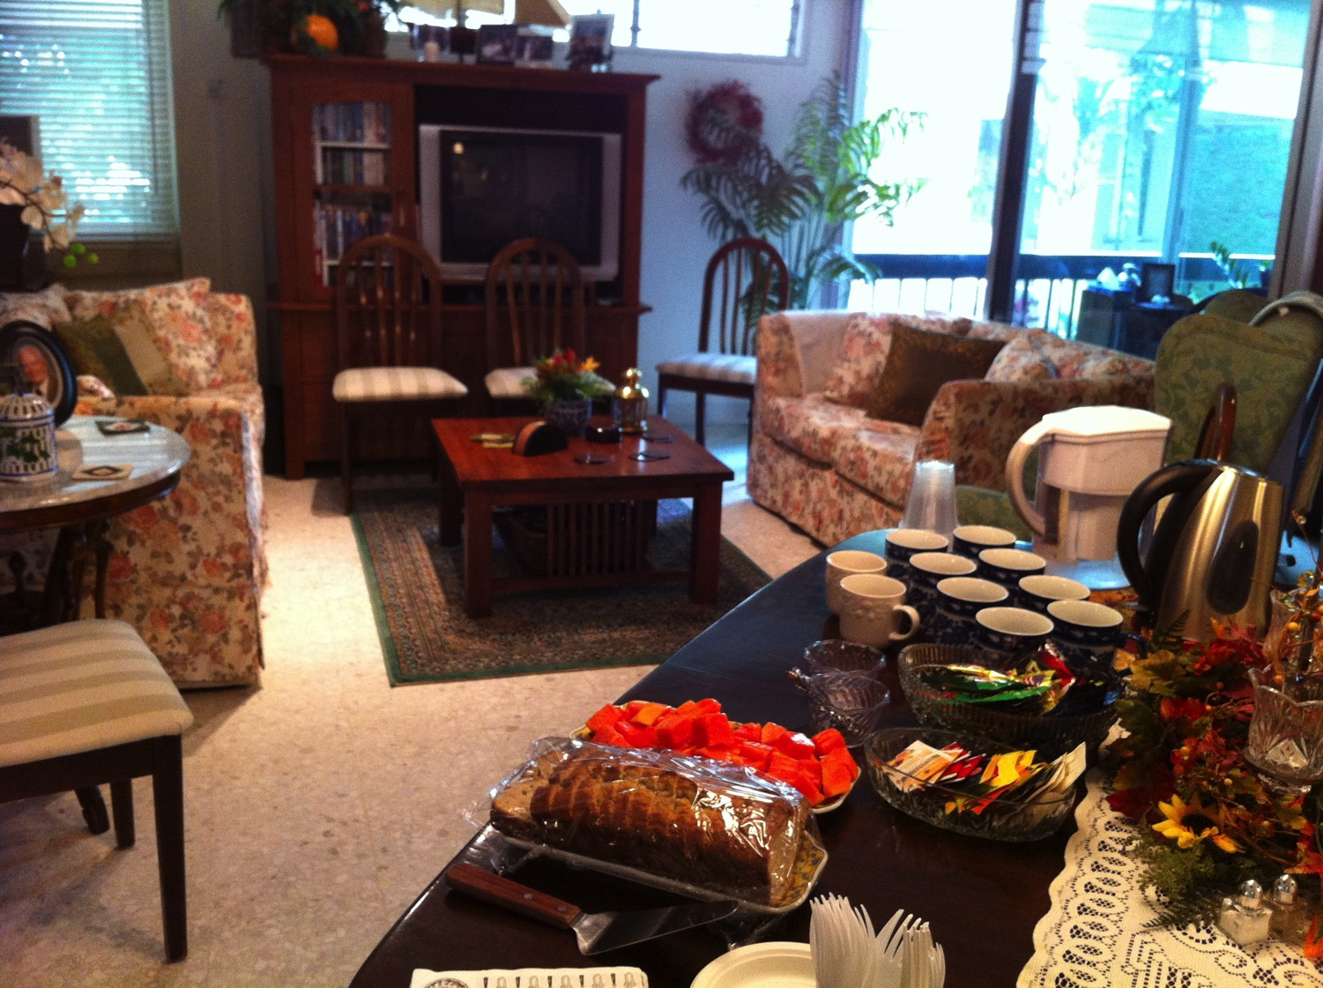
我们在新神的公寓
9
Notes:
Our Wednesday pattern to set up the table for our Pastoral Care Group that comes up to our apartment on campus.

Slide 61
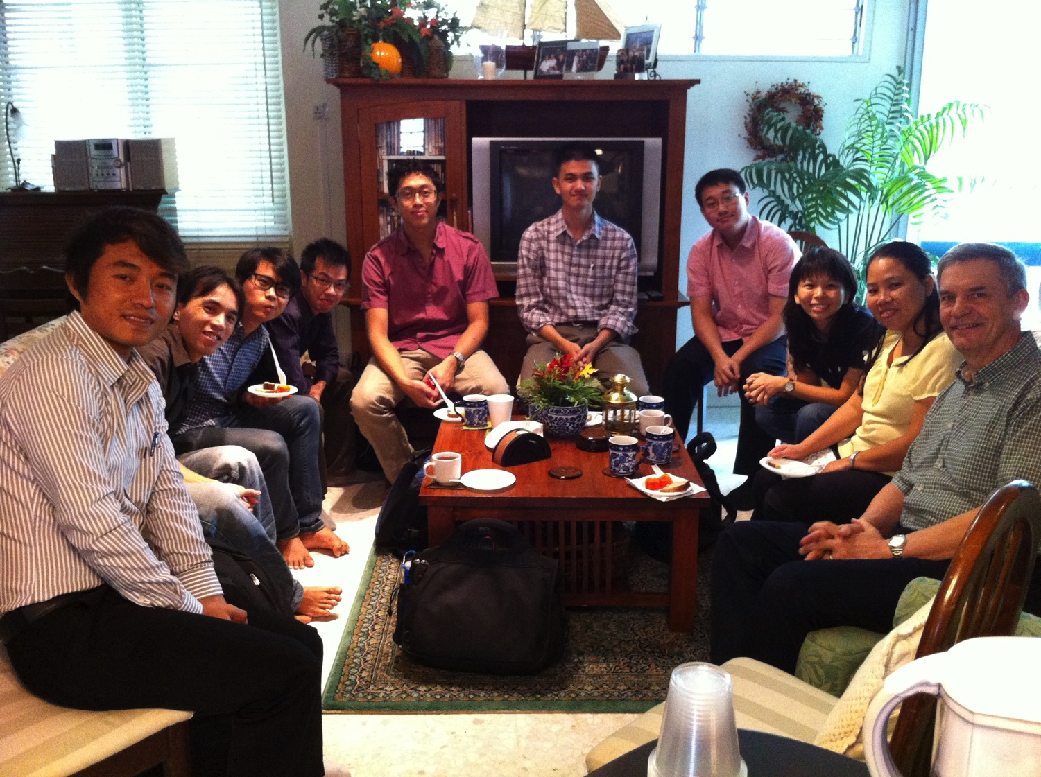
新加坡神学院的学生
9
Notes:
Our Pastoral Care Group has 9 students from Myanmar, Vietnam, Singapore, and Hong Kong.

Slide 62
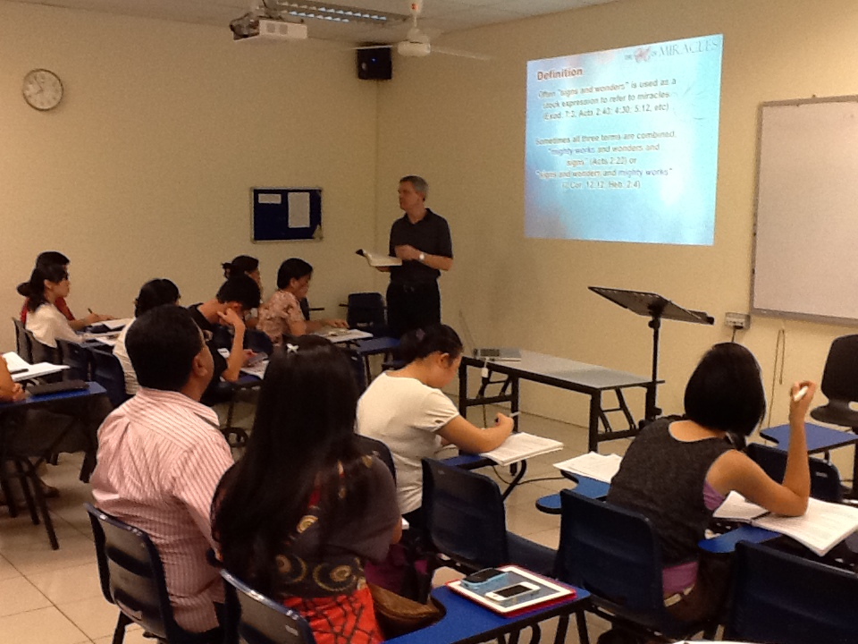
新加坡神学院的学生
Notes:
James & Sue Feng (China), Eva (Germany), Valentin (France), Samuel & Cynthia (India), Jieun (Korea), Singpu (Myanmar), Bagary (UK), Winkler (USA)

Slide 63


新约全书链接地址 BibleStudyDownloads.org
免费获得该讲解!
圣经学习下载
Notes:
NT Survey link: http://biblestudydownloads.org/resource/%e6%96%b0%e7%ba%a6%e5%85%a8%e4%b9%a6/

Slide 64
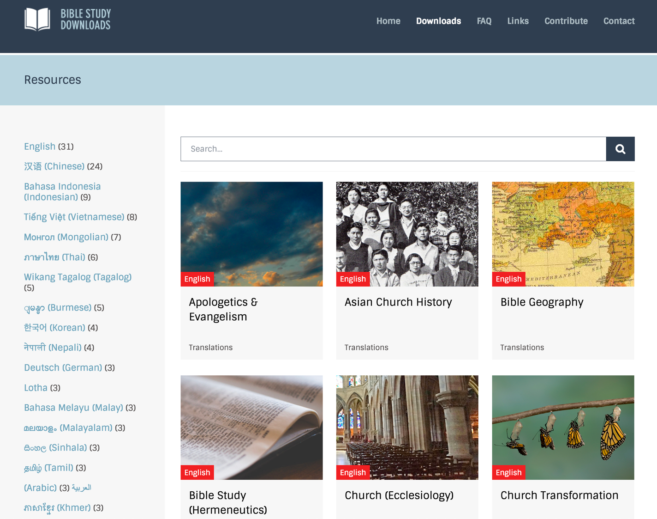
BibleStudyDownloads.org
7
Notes:
Currently we have 33 courses on the website.

Slide 65
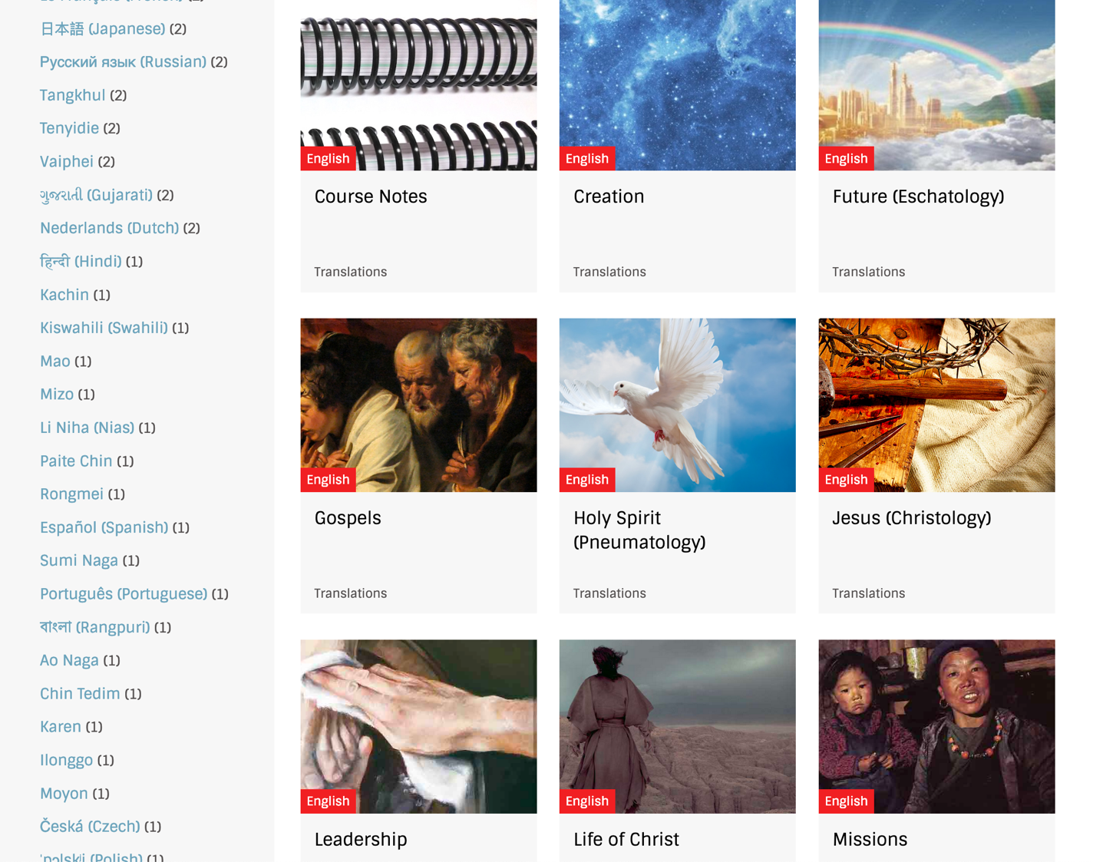
BibleStudyDownloads.org
7
Notes:
These include Bible, theology, church history, and practical ministry

Slide 66
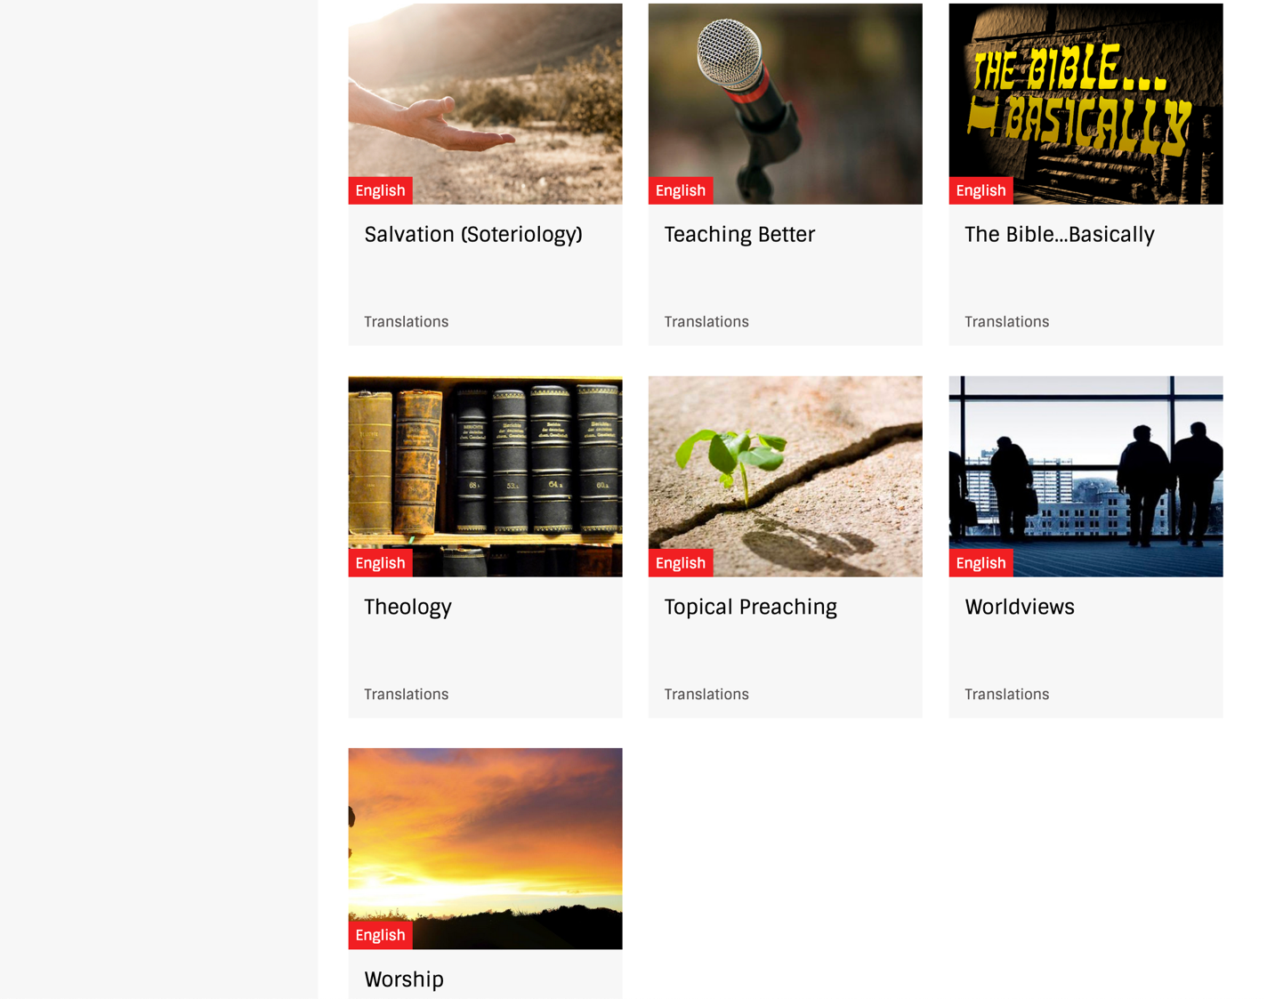
BibleStudyDownloads.org
7
Notes:
Most of these courses are mine, but others have also shared their courses with me.

Slide 67
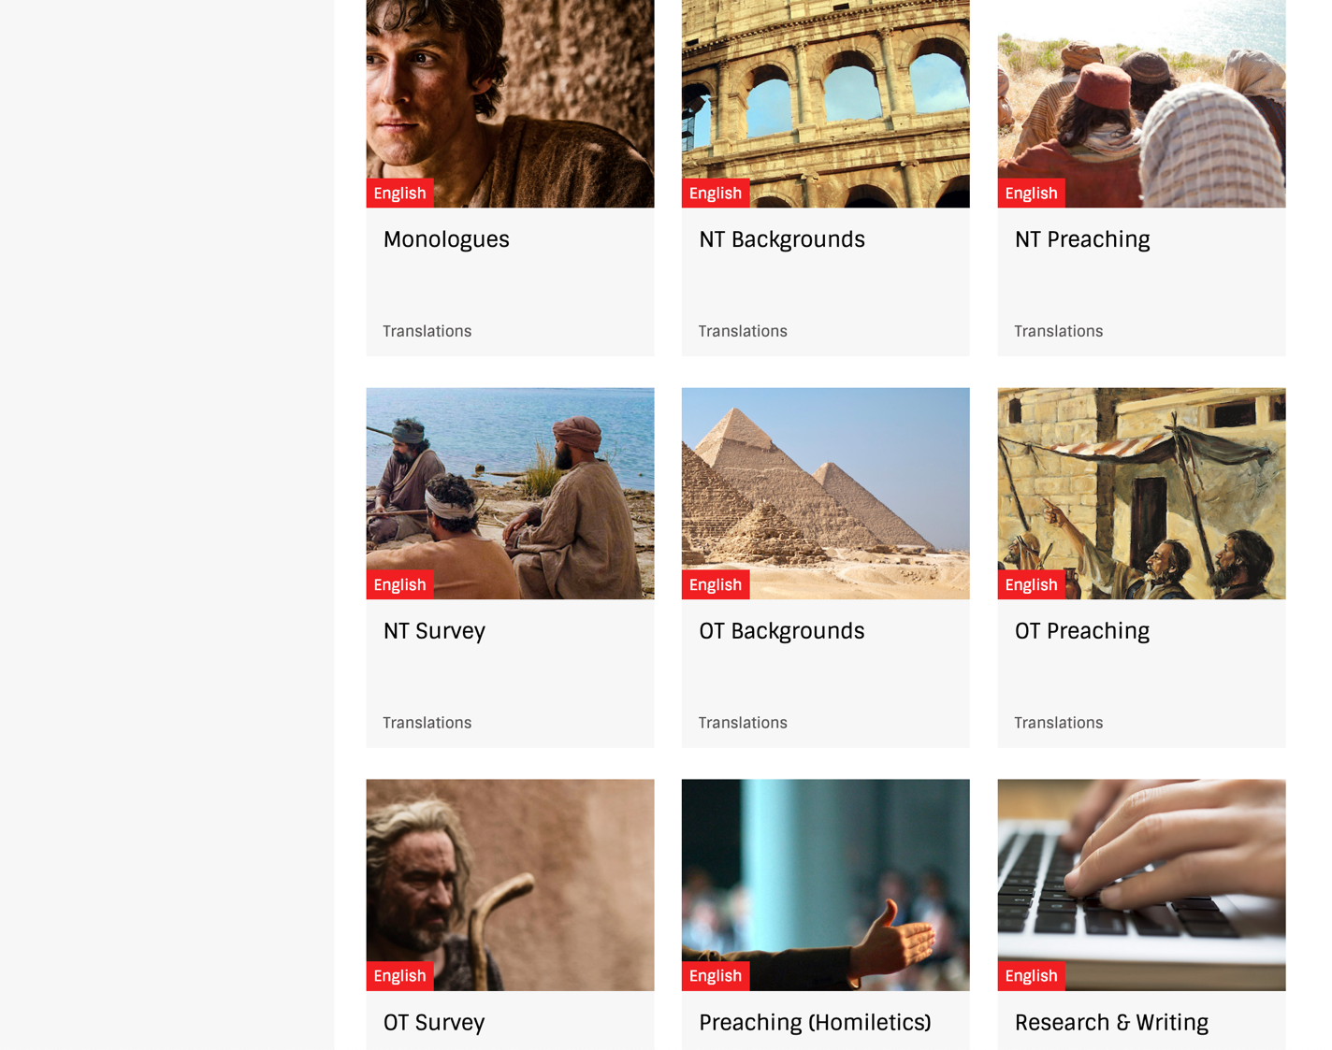
BibleStudyDownloads.org
7
Notes:
So all you need to do is to click on a course as there are no passwords. For example, select New Testament Survey to get NT materials.

Slide 68
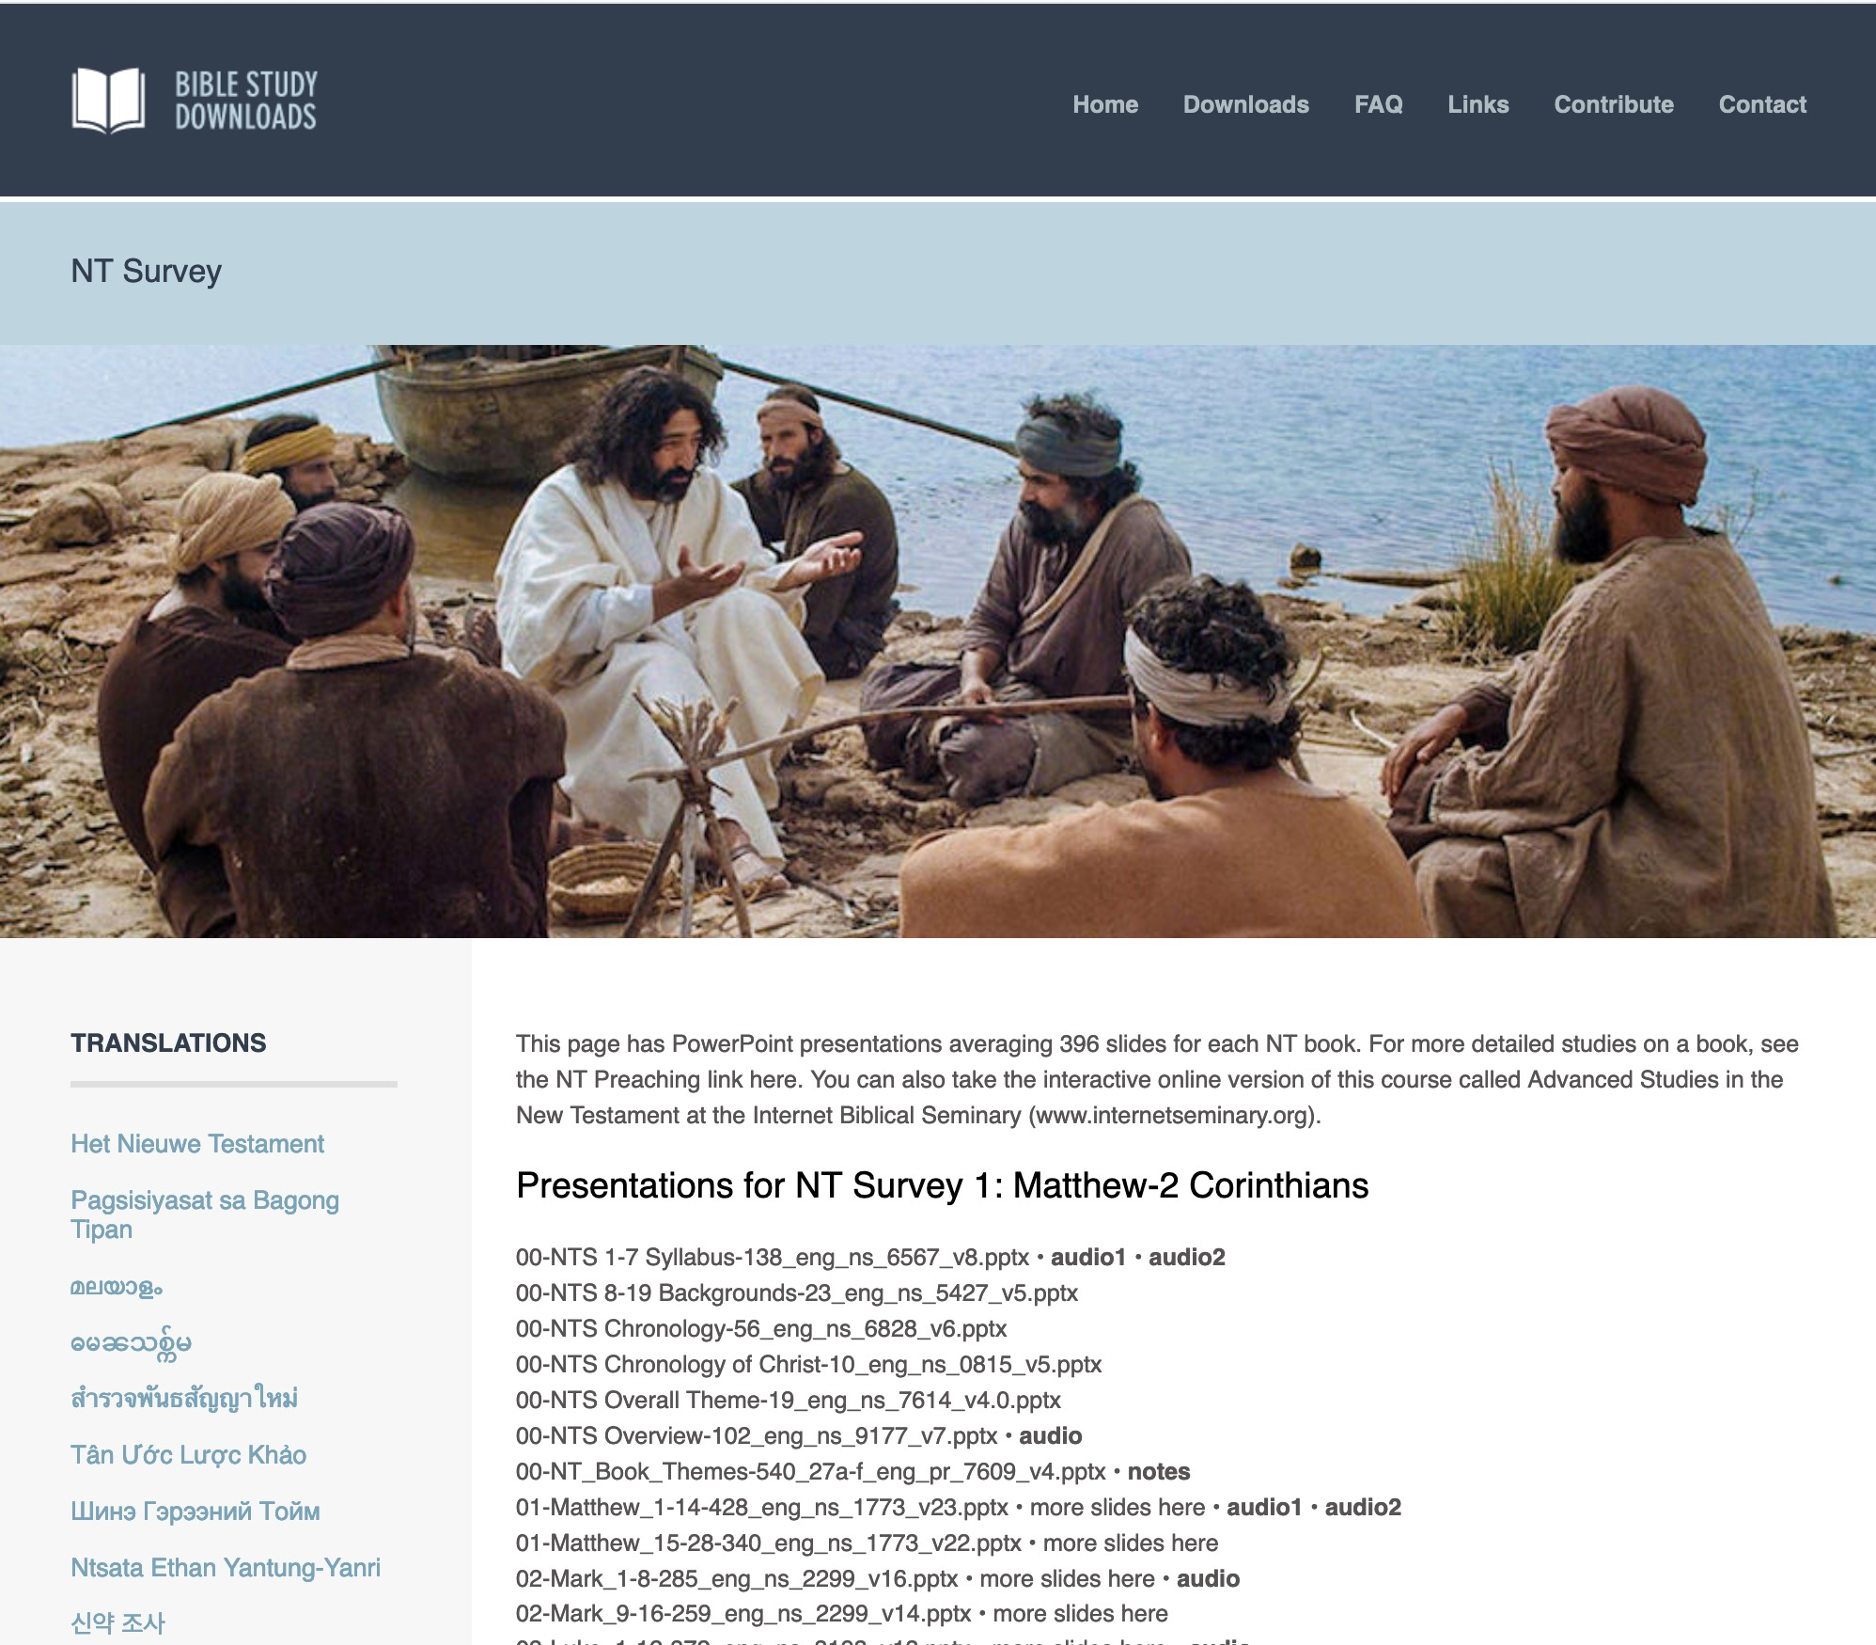
BibleStudyDownloads.org
7
English
Notes:
This brings you to the English page where some of the 66,000 PPT slides in English are accessed.

Slide 69
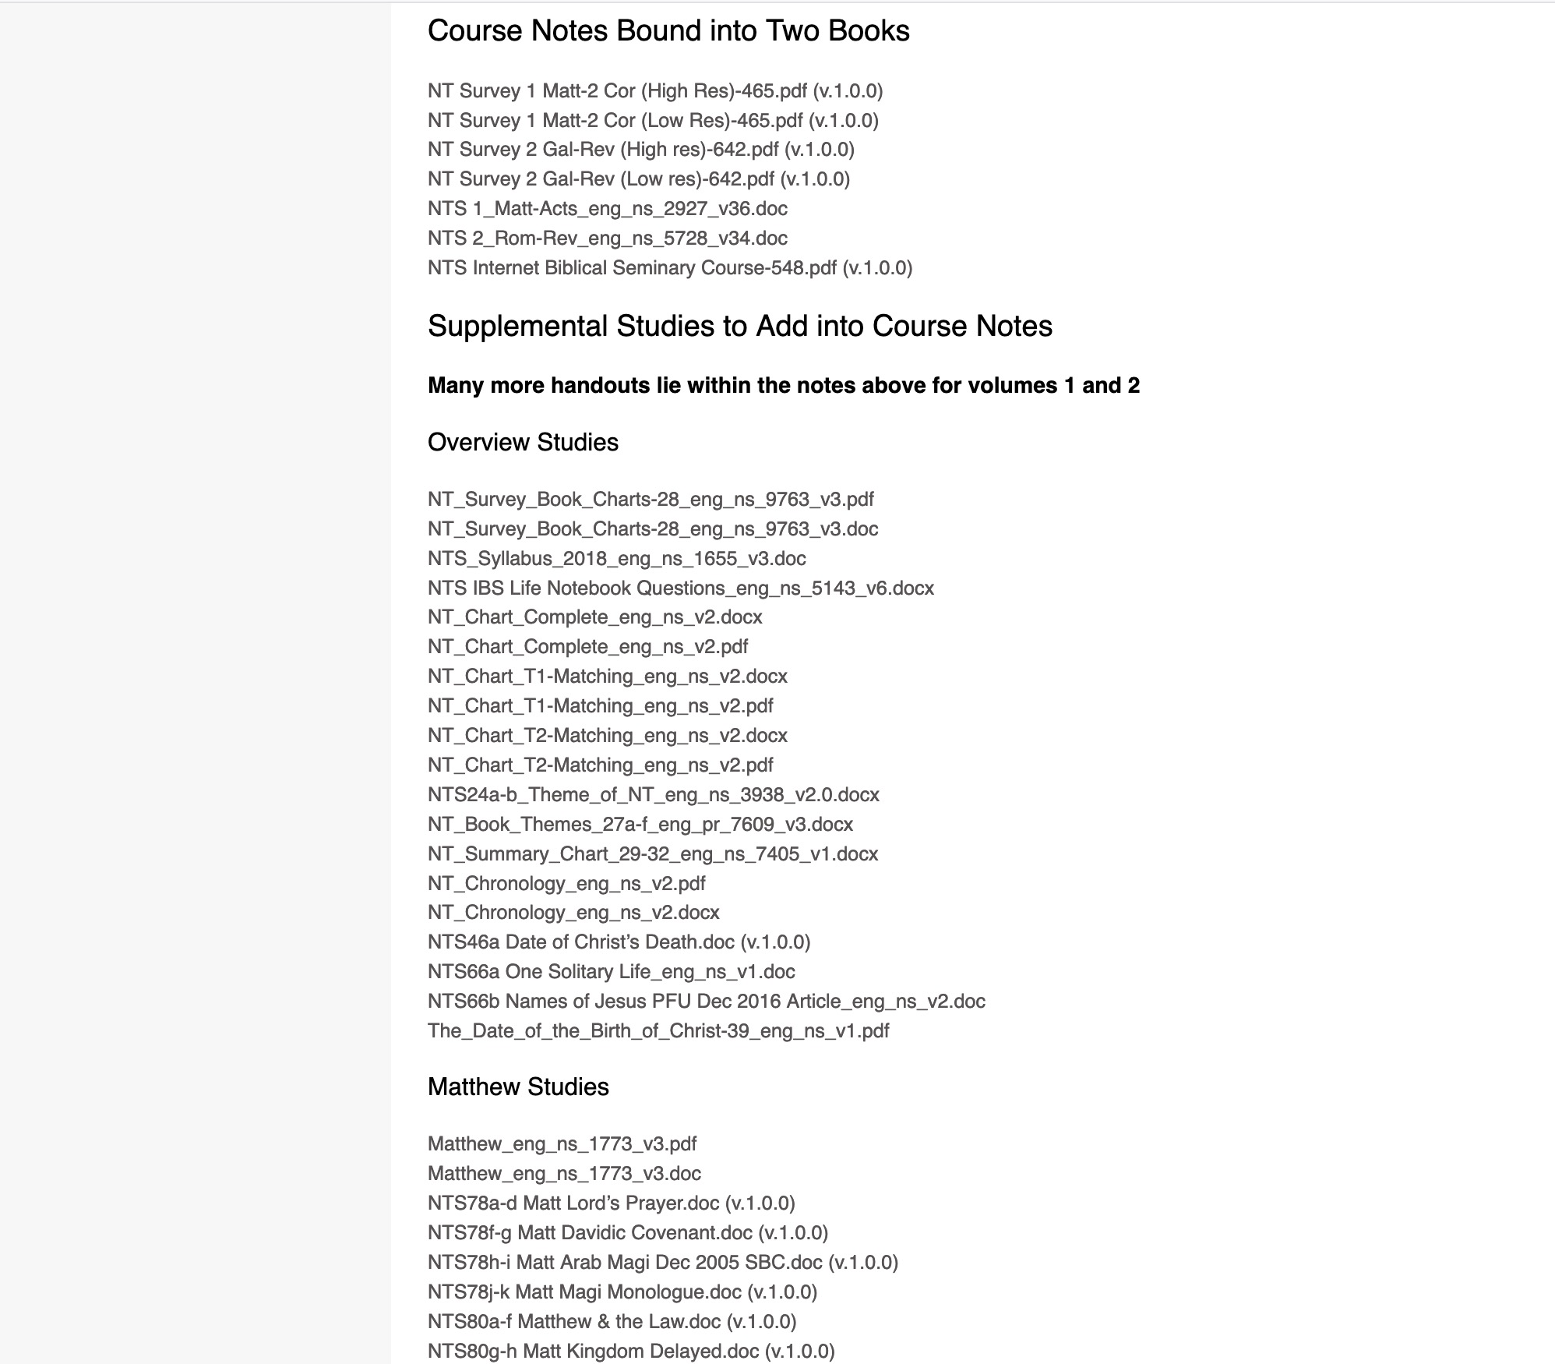
BibleStudyDownloads.org
7
NT Survey
Class Notes
Notes:
About 20,000 pages of notes are also available for free download.

Slide 70
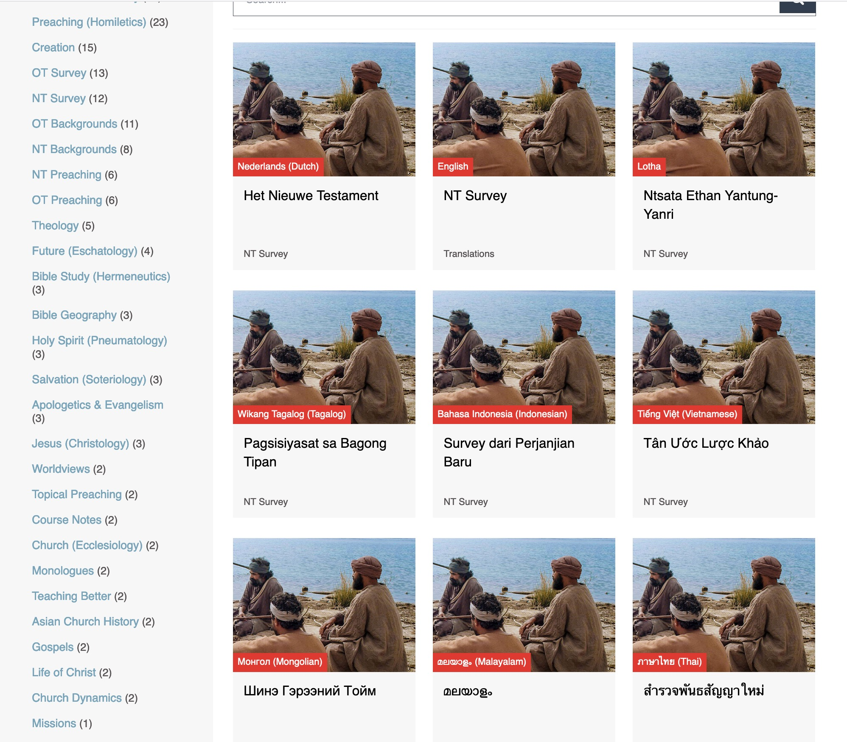
BibleStudyDownloads.org
7
Translations
Notes:
ON the left column are the present translations of each course. Here are 9 languages featured for NT Survey.

Slide 71
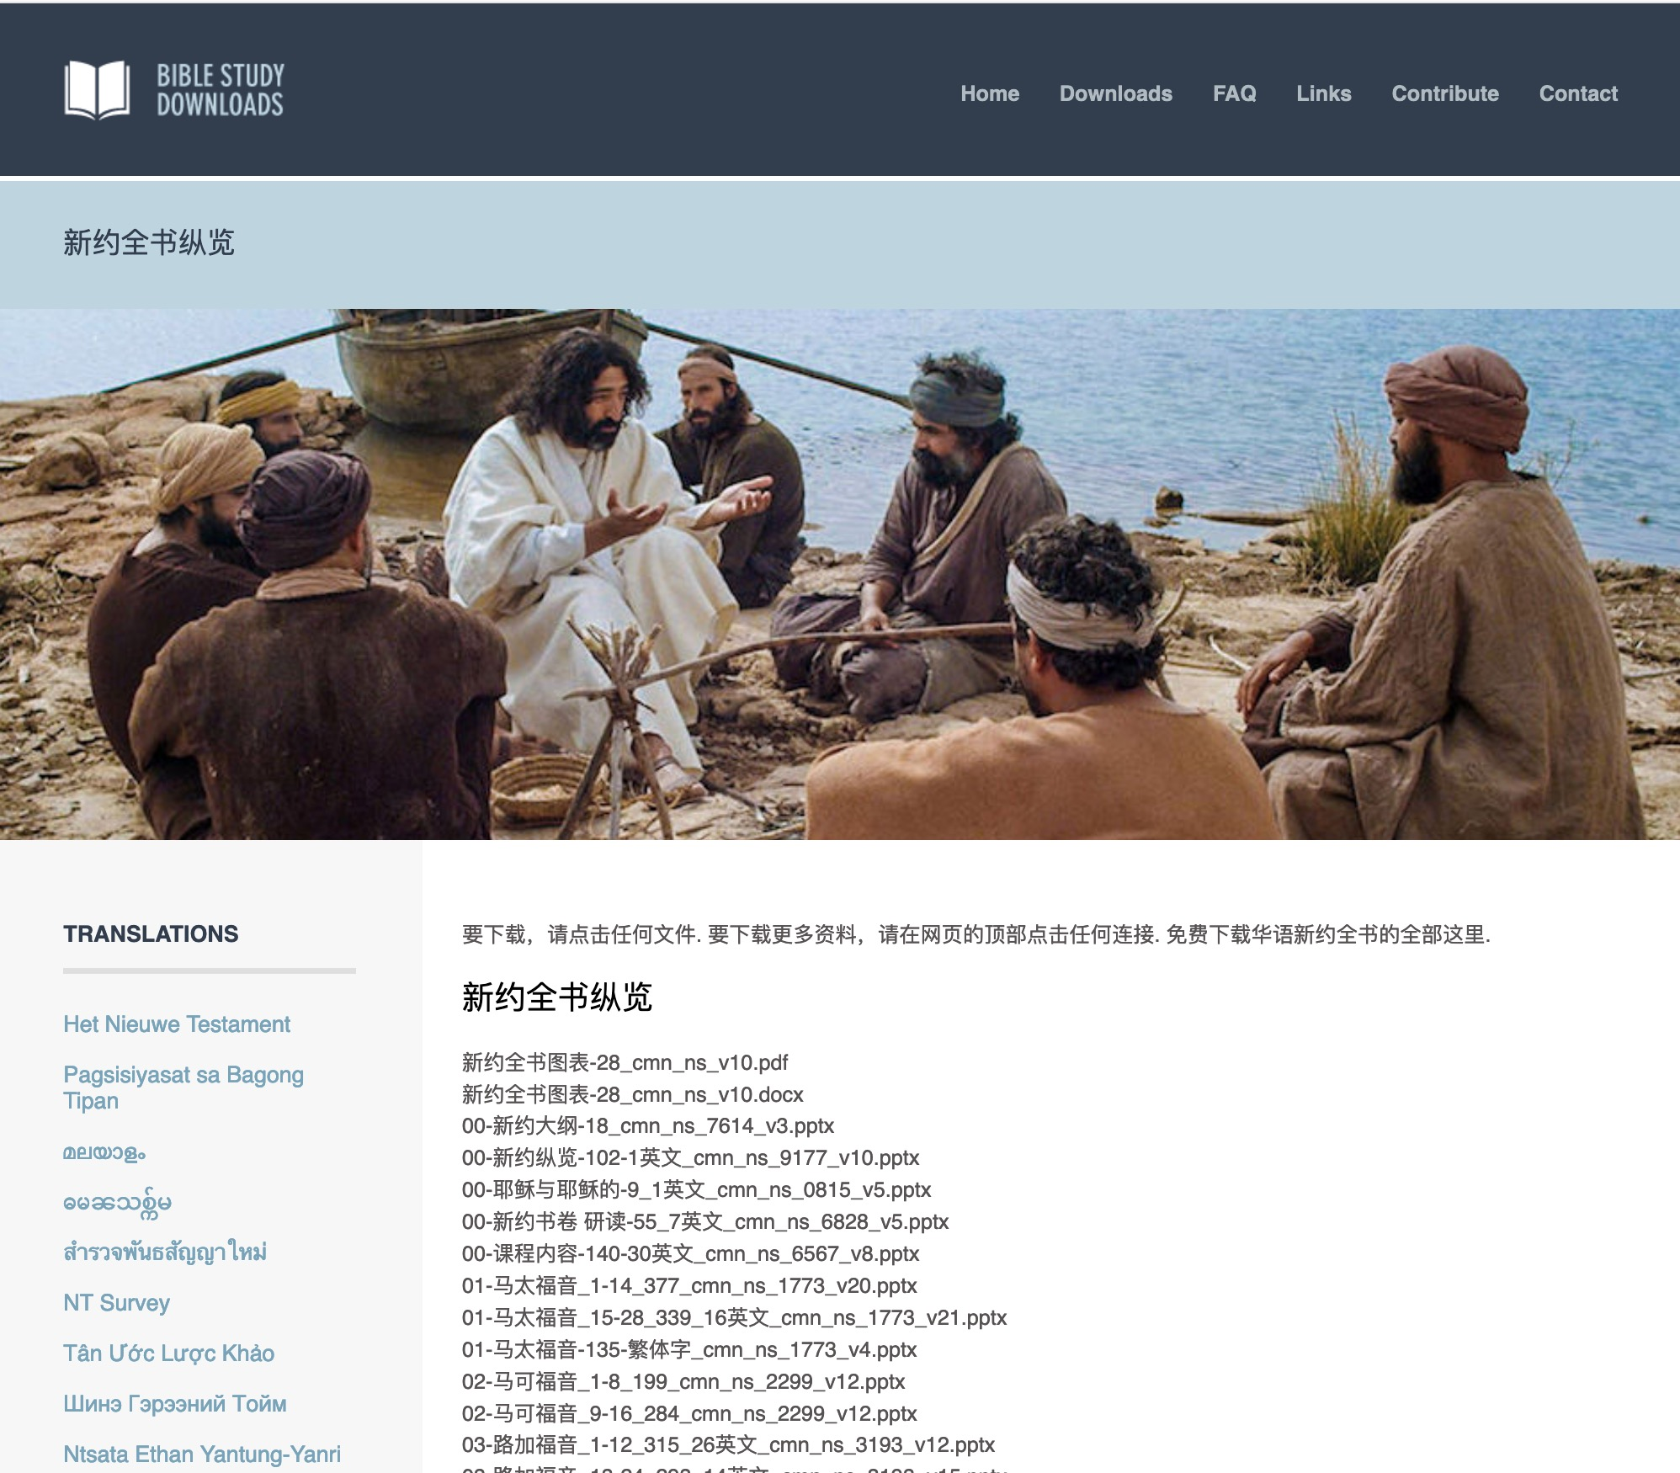
Chinese
7
01-马太福音_1-14_377_cmn_ns_1773_v20.pptx
Notes:
Chinese downloads include more than 37,000 slides as of Jan 2020. The file names are also in the various languages. This file on Matthew 1-14 means it has 377 slides in Chinese in the NT Survey course with file number 1773. The last part shows that this is version 20 of this PPT file.

Slide 72
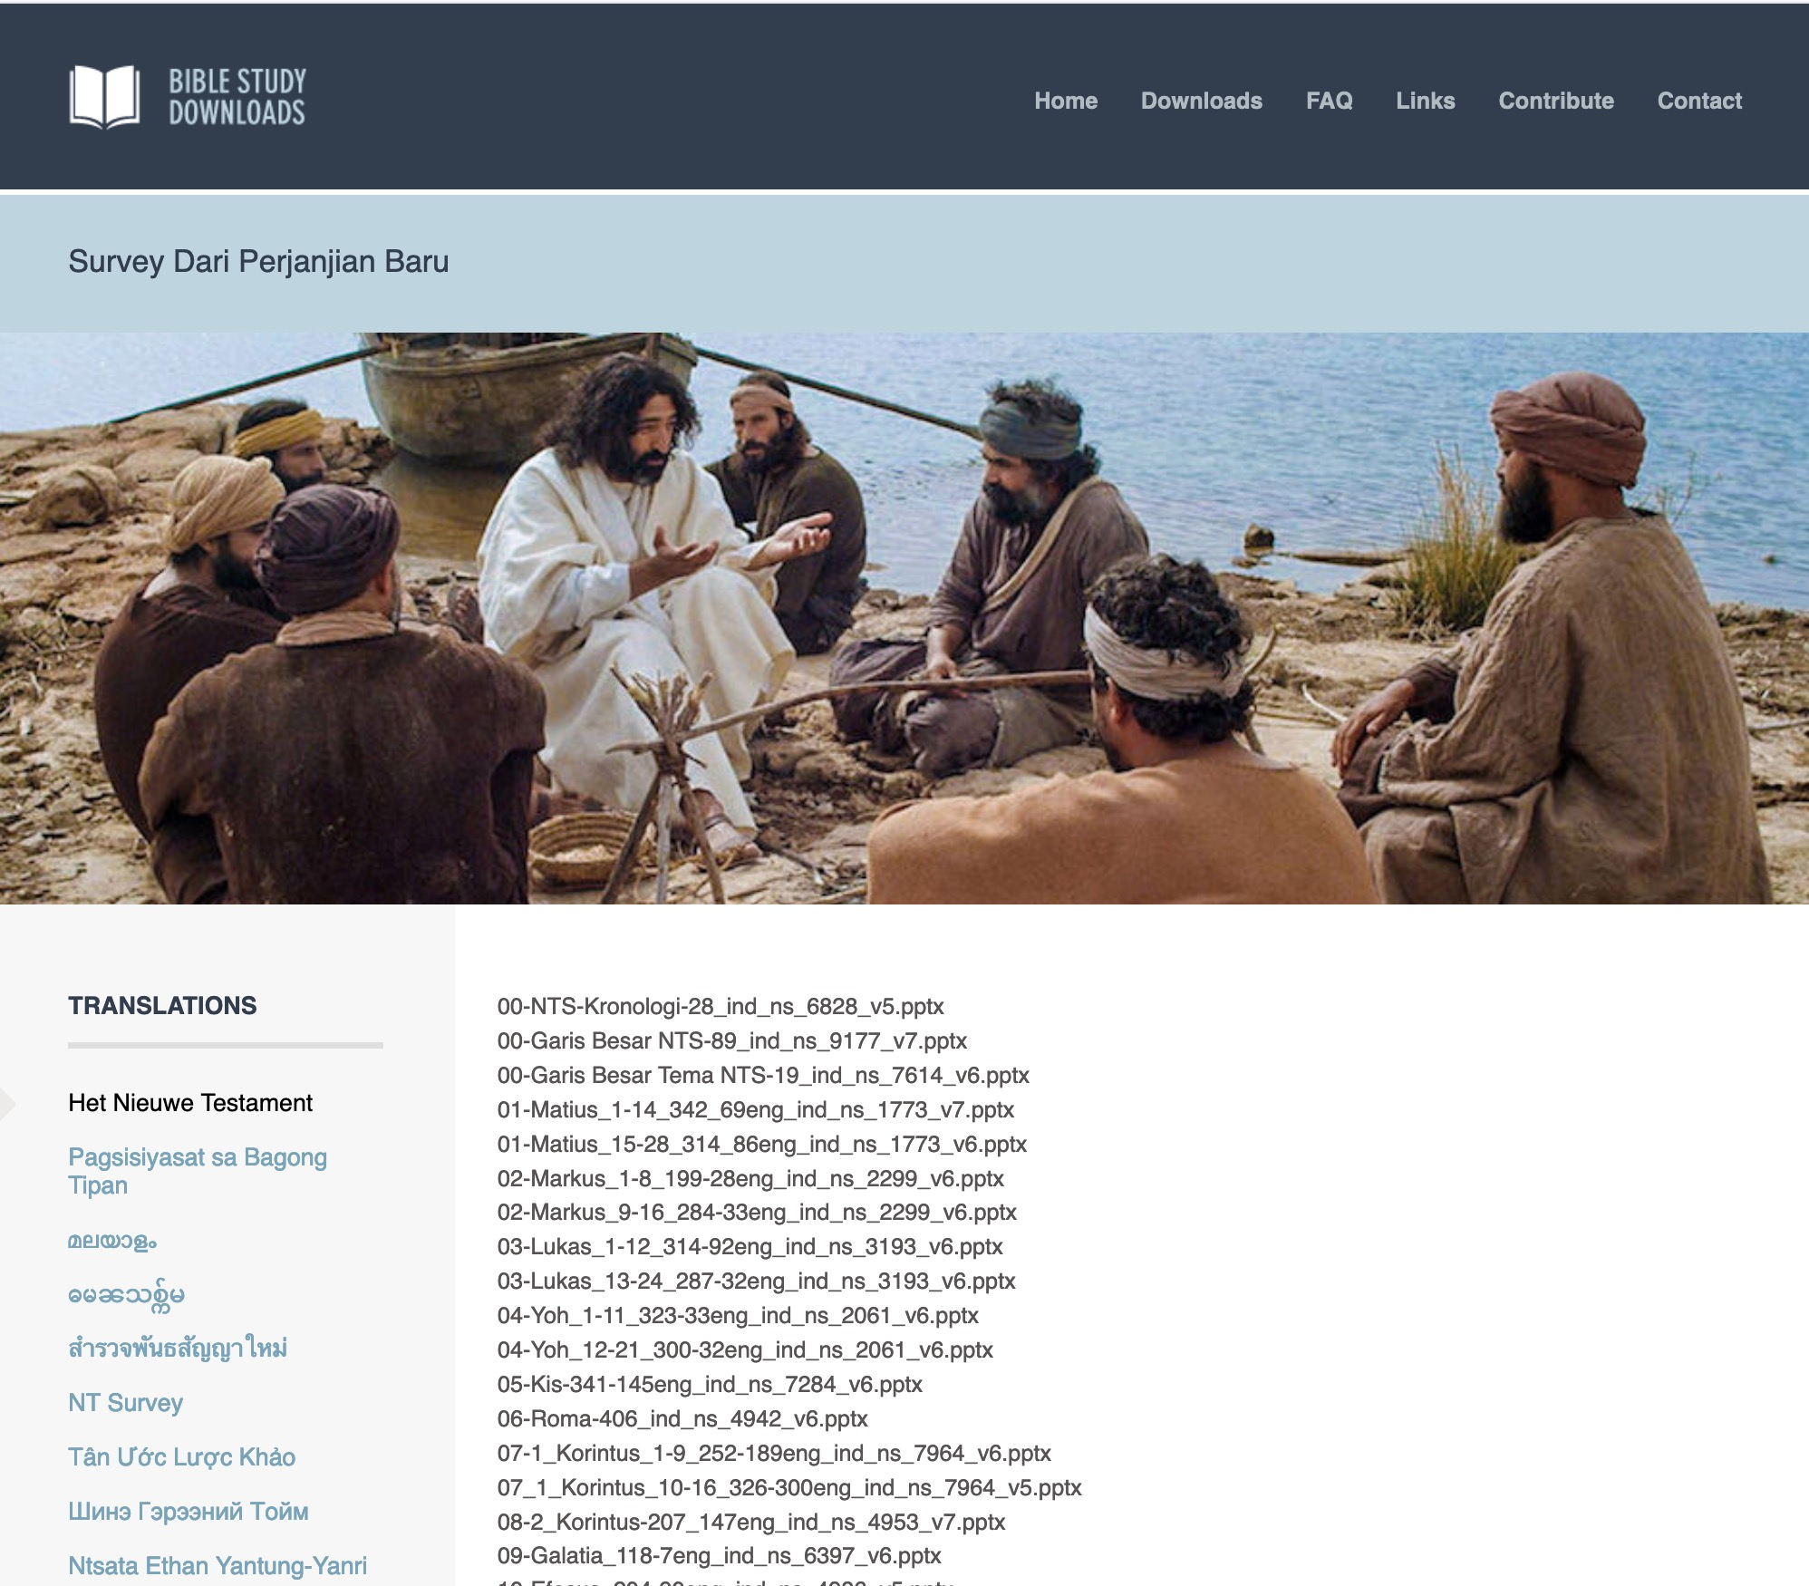
Indonesian
7
Notes:
Indonesian downloads include more than 14,000 slides as of Jan 2020.

Slide 73
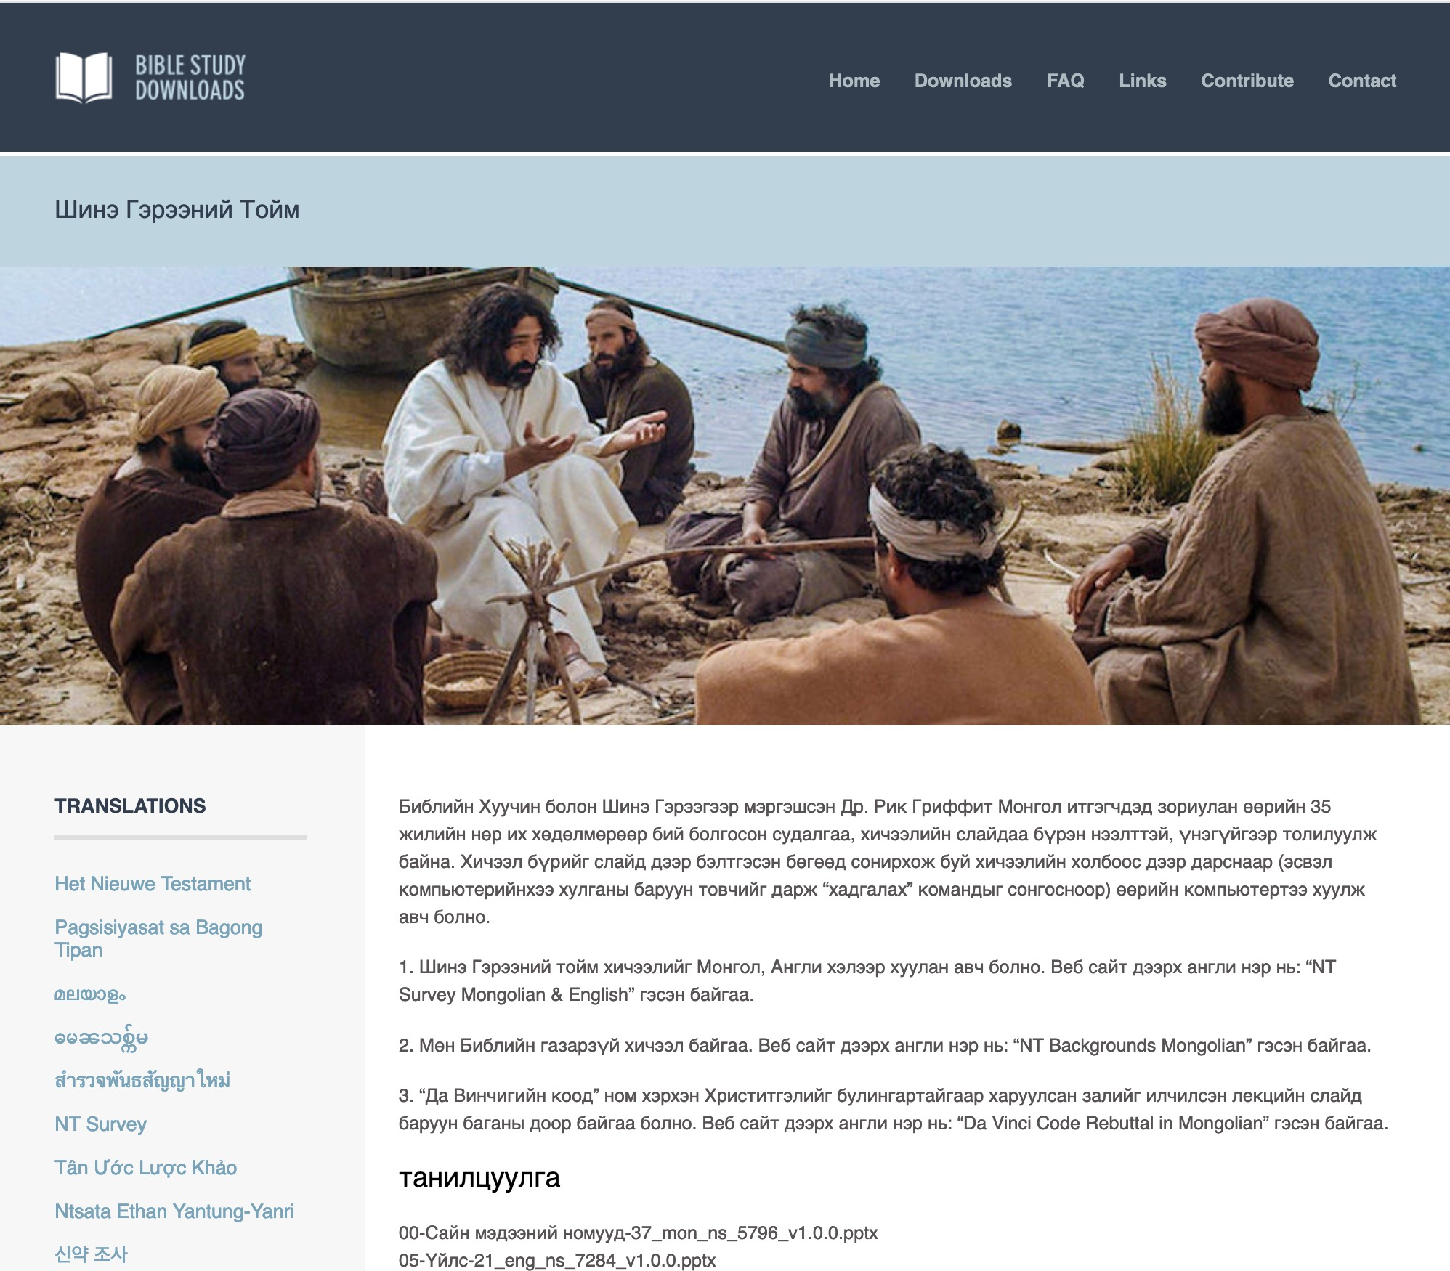
Mongolian
7
Notes:
Mongolian downloads include more than 3,000 slides as of Jan 2020.

Slide 74
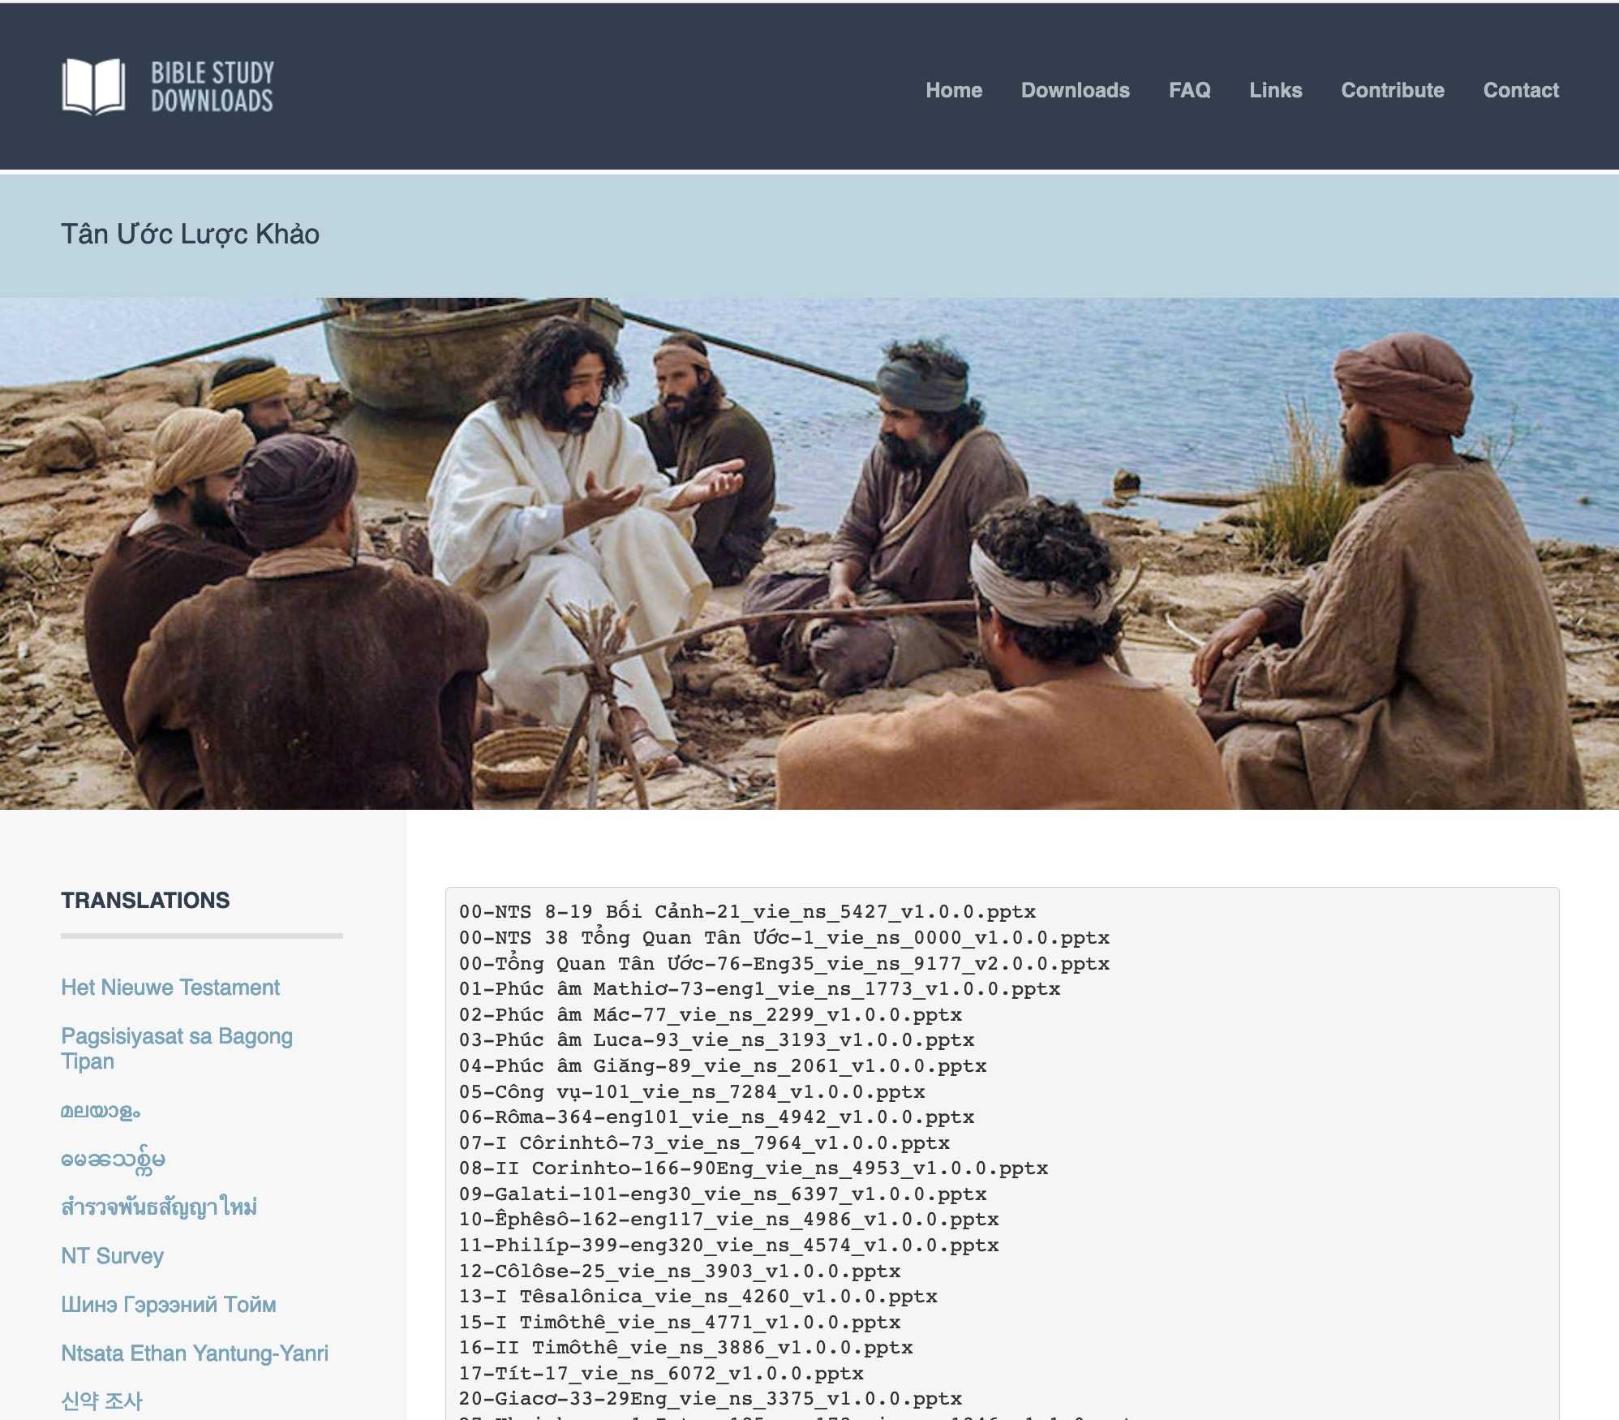
Vietnamese
7
Notes:
Vietnamese downloads include more than 8,000 slides as of Jan 2020.

Slide 75
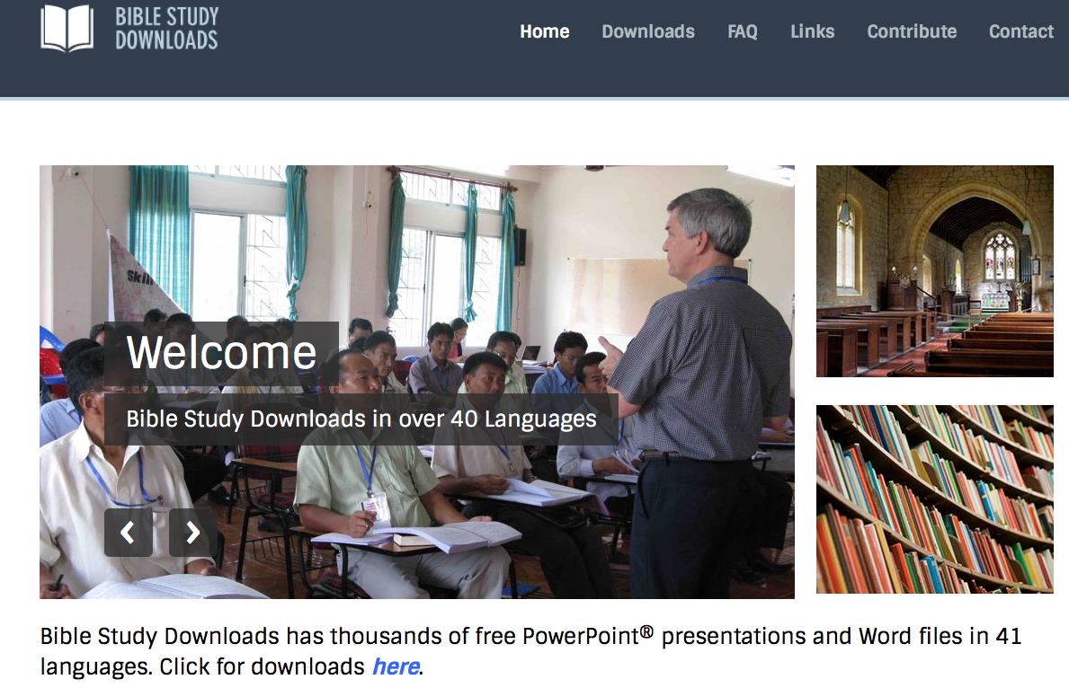
BibleStudyDownloads.org
7
Notes:
Partnering together with 700 translators has resulted in Bible teaching and study materials—mostly PowerPoint—in 49 languages! All a teacher needs to do is to click on a file and it downloads for free to teach any book of the Bible and many other subjects.

Slide 76
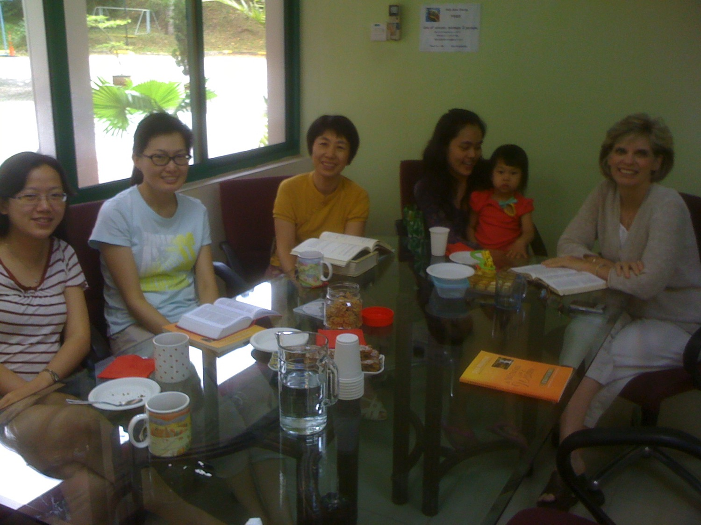
新加坡神学院的学生的妻子
Notes:
I have a great privilege of encouraging new believers at Singapore Bible College. Diotrephes was near-sighted, but most of my students are first generation believers excited about God and missions. Susan joins me in this by mentoring their wives…

Slide 77
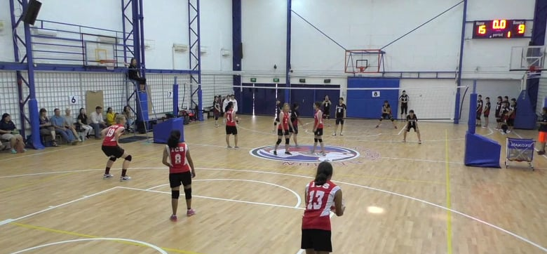
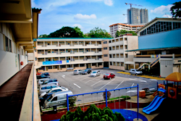
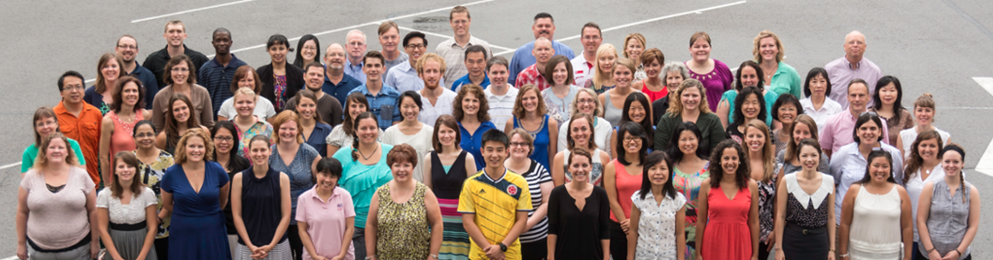
国际社区学校
(International Community School) 创立于1993年

Slide 78




ICS 现在有480个学生!
瑞典
英国
韩国
瑞士
日本
意大利
美国
泰国
印度
墨西哥
ICS
委内瑞拉
印尼
巴西
南非
澳大利亚
Notes:
With nearly 500 students

Slide 79

Christian Hospitality

Slide 80

约翰三书- 概略图
305
对传教士的支持
1-8
9-11
12-14
该犹
丢特腓
低米丢
称赞
谴责
推荐
支持传教士
反对传教士
是个传教士
问候与 祷告
1-2
因神圣而喜悦
3-4
支持证实了
5-8
为了拒绝约翰
9
为了反对的传教士
10
为了做罪恶
11
好名誉
12
期望中的探访
13-14.a
富感情的问候
14b-d
亞西亞
公元90年间

Slide 81
我们要怎么服从神的真理?
306
III.
如
低米丢
一般成为
传道士
(12)
I. 如该犹一般帮助
他人传真理 (5-8)
Notes:
So how can we obey God’s truth?
• We’re to be people who propagate the truth. How? Support missionaries like Gaius
• and don’t hinder the gospel like Diotrephes. But it would be amiss not to share the final way to obey the truth, and that is to…
• Spread God’s truth by being a witness yourself in the footsteps of Demetrius.

Slide 82
“ 我曾经略略写信给你那里的教会，但他们中间那好作领袖的丢特腓不接待我们。 ¹⁰ 因此，我来的时候，必要提起他所作的事，就是他用恶言中伤我们；这还不够，他不但不接待弟兄，还要阻止那些想要接待的人，甚至把他们赶出教会。”
(vv. 9-10 ＣＮＶＳ).

Slide 83
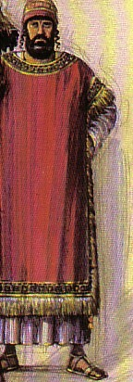
306
Diotrephes
"nourished by Zeus"
Gossiped about John
Refused missionaries
Threw out supporters
Notes:
It’s interesting to note that Diotrephes means "nourished by Zeus."
But what’s so unusual about a Gentile Christian with a pagan name?
Most of my SBC students are saved out of Buddhism and ancestor worship. Some are even named after Chinese deities—but after salvation they take on new names: Grace, Timothy, etc. One student from Hong Kong was named Wing Ming, but since salvation has gone by the name “Cross” to testify how Christ changed his life.
Although the common first century practice for Gentiles saved from idolatry was to change their names after embracing Christianity, Diotrephes’ pagan name was not changed after his conversion. Neither did he change his conduct.
But what did Diotrephes do that made him so bad?
• He gossiped about John and the missionaries John sent to the church. Imagine slandering the last remaining apostle who walked with Christ!
• What arrogance! Verse 10 says that he refused to welcome missionaries sent to his church.
• He even opposed missionary support to the extent of kicking people out who gave to missionaries! Can you imagine your pastor or chairman of the board excommunicating you for inviting my family over for lunch?

Slide 84

Hindrances
Hindrances
Notes:
Perhaps we don’t throw people out of this church who support missions, but…
• We can hinder the gospel through very subtle ways.
For example, sometimes we let false teaching go without a comment!

Slide 85
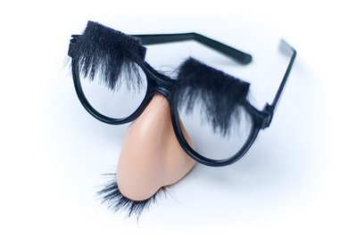
Should we name false teachers by name?
John did.
Notes:
So should we name false teachers by name? John did!

Slide 86
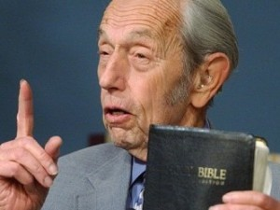
Harold Camping
"Jesus will come in 1994"
"Jesus will come 21 May 2011"
"Jesus will come 21 Oct 2011"
Notes:
When someone like Harold Camping give false prophecies about the return of Jesus, we should call it what it is.

Slide 87
Harold Camping
Camping admitted in a private interview that he no longer believed that anybody could know the time of the Rapture or the end of the world, in stark contrast to his previously staunch position on the subject. In March 2012, he stated that his attempt to predict a date was "sinful", and that his critics had been right in emphasizing the words of Matthew 24:36: "of that day and hour knoweth no man". He added that he was now searching the Bible "even more fervently...not to find dates, but to be more faithful in [his] understanding."
http://en.wikipedia.org/wiki/Harold_Camping
Notes:
Fortunately, he repented of it before he died.
http://en.wikipedia.org/wiki/Harold_Camping

Slide 88

最古老和最强大的传统之一是在公元52年（在保罗第二次和第三次传教之旅之间）使徒多马将福音带到了印度甚至中国。
印度马德拉斯圣多马·巴西里卡

Slide 89

多马行传

Slide 90
“1。那时我们这群们徒在耶路撒冷……我们将世界划分为不同的部分，以便每人都前往主差遣他的国家。”

Slide 91
“抽签结果，印度落入也是双胞胎的犹大多马身上。但他不愿，以肉体虚弱，不能旅行推辞。并道：【我是希伯来人，怎能够向印度人传福音？】”

Slide 92
“当他如此推理和说话时，救主在夜间向他显现并对他说：【多马，不要害怕，往印度去吧，我的恩典与你同在。】”

Slide 93
“可是多马仍不听从，并说：【差我到别的地方，我不会往印度的。】”

Slide 94
“2 当他如此讲话和思考时，有一位由印度王京达菲派的商人使者，名叫阿斑。”

Slide 95


Slide 96
“2 有一个来自印度的商人，名叫阿斑，是国王京达菲派的使者，要买木匠带回印度。”

Slide 97
“中午时刻，主看见他在在市场并走向他说：【你是否需要买一个木匠？】他回答：【是。】主说：【我有一个奴隶，他是一个木匠。。。】”

Slide 98
“更着，他指向多马的身影，用三枚未加盖印章的白银利特拉银成交，并写了一份销售契据，说：”

Slide 99
“我，耶稣，木匠约瑟之子，已将我的奴隶犹大卖给印度王京达菲的商人阿斑。”

Slide 100
“事成后，主将犹大多马带到商人阿斑前。阿斑问多马：【他是你的主人吗？】 多马答：【是。】”

Slide 101
“阿斑说：【我从你主人买了你。】 多马沉默不语。”

Slide 102
“3 第二天早上，多马祷告。。。【主耶稣，你要我往那里，我就往那里，愿你的旨意成就。】 接者多马前去商人阿斑那儿，除了他的身价外，他无其它钱财。

Slide 103
“因为耶和华把钱给了他说：【无论你到哪儿，你的代价同我的恩典同在。】 接着，多马发现阿斑将行李搬上船。他就跟着上船。”

Slide 104
“在船上，阿斑问多马：【你的手工艺如何？】 多马答说：【我会做木犁，叉架和螺旋钻，船，船桨，船桅杆和滑轮。石制品如：”

Slide 105
“皇殿的柱子，庙宇和法院。商人阿斑说：【对，你是是我们需要的木匠。】接着他们开始航行。他们顺风顺水，直达皇家城市阿查波尼（又称山打掘）。

Slide 106

泛亚贸易路线（公元一世纪）
在第一世纪，每隔三日便有一艘从埃及驶往印度的船
锡西
秦尼
非洲
大夏
阿拉伯
印度

Slide 107


Slide 108


克什米尔主权争议地区 - 印度、巴基斯坦和中华人民共和国各持己见。
印度

Slide 109

Our People
9
13个国家的70名会友
来自2020
Notes:
…and our own Andrew Spurgeon here at this church, who is one of our key speakers.

Slide 110

Crossroads教会会友2015年7月
意大利
法国
日本
荷兰
香港
韩国
黎巴嫩
台湾
中国
缅甸
印度
美国
菲律宾
津巴布韦
马来西亚
新加坡
CIC
新西兰
印尼
Notes:
我们2015年3月的源自世界上12个不同的国家。

Slide 111

Our People
用经文讲道
Notes:
RICK: Yes, we helped start Crossroads International Church in 2006 and I serve as the pastor-teacher.

Slide 112

Our People
9
2016: 65 个人来自20 个国家
Notes:
That’s why when we helped start Crossroads International Church in 2006 where I serve as the pastor-teacher.

Slide 113

Our People
9
新神的学生在CIC服侍
Notes:
Often when we have mission myopia we can throw cold water on new believers—those who are often the most eager ones to share their faith! I remember when I went out as a missionary to Asia the first time, some “Diotrepheses” came along: my church which discouraged me from going, my sister who said I was doing the wrong thing, and my Mom who said, “I can’t believe my son can graduate from business school with honors and then go out and beg for money!”

Slide 114

Missions Giving
宣教奉献
20%
Notes:
from the start we committed to invest in other countries 20% of our offerings!

Slide 115

“亲爱的，不要效法恶，应该效法善。行善的属于 神，作恶的没有见过 神。“
(v. 11 ＣＮＶＳ).

Slide 116
我们要怎么服从神的真理?
306
III.
如
低米丢
一般成为
传道士
(12)
II.
不要如
丢特腓
一般阻拦
宣教事工
(9-11)
I. 如该犹一般帮助
他人传真理 (5-8)
Notes:
So how can we obey God’s truth?
• We’re to be people who propagate the truth. How? Support missionaries like Gaius
• and don’t hinder the gospel like Diotrephes. But it would be amiss not to share the final way to obey the truth, and that is to…
• Spread God’s truth by being a witness yourself in the footsteps of Demetrius.

Slide 117

306
低米丢
¹²低米丢行善，有众人为他作证，真理本身也为他作证。我们也为他作证，你知道我们的见证是真的。
Notes:
Demetrius was almost assuredly the missionary who carried the letter from John to Gaius.
He had a good reputation so he was sent out—a guy whom the whole church would vouch for. And even if the truth could speak, it would agree: “Here’s a quality guy!”
Notice John didn’t say, “Hey, Gaius, we still have needs over here in Ephesus. Sorry we can’t send any quality people your way, but you know how it is, the home church needs them.”

Slide 118



把自己投资在可靠的人身上！
「从前你在许多见证人面前听过我的教导，你要把这些教导传给忠信可靠、能够教导他人的人。」（提后2:2当代译本）
门徒训练
保罗
提摩太
忠信可靠
他人

Slide 119


亚洲国家之中的差传活动
309

Slide 120

Missions in Singapore 2009
= 200 Believers per Missionary
309
Missions in Singapore 2014
= 350 Believers per Missionary
Notes:
Singapore improved in its missions commitment from 1990 to 2009, where the 549 believers to send out one missionary reduced to 200 Christians. However, five years later it crept up to 350 believers needed to send out one missionary. We need this to go back down!

Slide 121

About one third of churches haven’t sent out even one career missionary
309
Our church is one of the 9 that has sent out four missionaries.
Notes:
We need to heed the teaching of 3 John!

Slide 122

我们的愿景
爱列国
爱教会
爱神
Notes:
Repentance will bring restoration in a church: God wants our church to really trust him.
We still don’t see our need for him as we don’t see our need to pray.
We also need to be involved in his work: missions, teaching, accountability groups, finances, etc.
_______________
OS-29-Joel-128
NS-13-1 Thess-111

Slide 123


Crossroads in Missions
Notes:
Missions has always been a priority here—perhaps partly due to all three of your elders being missionaries!

Slide 124

Missions Giving
24%
20%
Notes:
We commit to give one fifth of offerings to ministry outside Singapore. Last year we hit 24%. This includes missionaries such as these…

Slide 125

The Coreas in Bangkok
$1500 quarterly through March
Notes:
They will return to Singapore next month, so our support will be reallocated outside Singapore.

Slide 126


Athan & Chanchan in India/USA
$1500 quarterly through 2020
Notes:
Likewise, Athan and Chanchan have an evangelistic ministry to reach the poor in Manipur, India. We commit to support nationals for their training until they return home, when we feel their own people should support them. Athan will get his doctorate in Dec 2020 so our support will continue only until then.

Slide 127

Family in Central Asia
$1200 annually
Notes:
Some minister in high security zones, so we do not reveal their names of locations.

Slide 128


Myanmar 2014?
Jonathan Stone in Myanmar
$900 quarterly
Notes:
Jonathan disciples leaders who reach kids for Jesus.

Slide 129

莎拉 和 挪亚
Former Young Adult Coordinator(s)
Notes:
129
129
It’s exciting to see how God continues to send out His best. Our member Noah is one of the few trained Chiru believers in the world, but served right among our church until he and Sarah returned to NE India in 2018.

Slide 130

挪亚 (Chiru 族, 曼尼普尔)

Slide 131

挪亚 (Chiru 族, 曼尼普尔)

Slide 132
Balance relationships with tasks (13-15).
" 我还有许多话要写给你，可是我不愿借用笔墨。 ¹⁴ 我盼望很快就见到你，当面谈谈。 ¹⁵ 愿你平安。这里的朋友都问候你。请你一一提名问候你那里的朋友。"
(vv. 13-15 ＣＮＶＳ).

Slide 133
这封温暖, 亲切的信件围旋在三个人之间

Slide 134
借着上帝为你安排的方式支持传教事工 来活出神的真理。
约翰三书主要思想
Notes:
The Lord has a specific place in his vineyard for you to share his truth—find it and go for it!

Slide 135
总结概要
307
约翰鼓励该犹继续支持宣教士，如底米丢传教士，忽略丢特腓（一个反对支持宣教士的不敬虔领袖）的反对，并帮助教会看到其在资助上帝工作上的责任。
约翰三书

Slide 136
我们要怎么服从神的真理?
306
III.
如
低米丢
一般成为
传道士
(12)
II.
不要如
丢特腓
一般阻拦
宣教事工
(9-11)
I. 如该犹一般帮助
他人传真理 (5-8)
约翰三书
Notes:
So how can we obey God’s truth?
• We’re to be people who propagate the truth. How? Support missionaries like Gaius
• and don’t hinder the gospel like Diotrephes. But it would be amiss not to share the final way to obey the truth, and that is to…
• Spread God’s truth by being a witness yourself in the footsteps of Demetrius.

Slide 137
那么您又如何呢?
305
您是否有通过你的好客和财务来支持传教士以便促进福音
的传播吗?

Slide 139
新约全书讲章 • BibleStudyDownloads.org
免费获得该讲解!
圣经学习下载
Notes:
The explanation for free
NT Preaching link address

Slide 140

Nepal Teaching Trip

Slide 141

We lived with a Nepali Family

Slide 142

We taught at the Himalayan Graduate School of Theology

Slide 143

Name

Slide 144

We had many small groups

Slide 145

Name

Slide 146

Name

Slide 147

Assignments & More Assignments!

Slide 148

Assignments & More Assignments!

Slide 149

Name

Slide 150

刚受洗的信徒

Slide 151

Ananda Tamang 牧师

Slide 152

Pastor Ananda Runs a Training School

Slide 153


Thank God for the growth of the Nepali Church!

Slide 154
Black

Slide 155

People Need the Lord
Greg Nelson, Phill McHugh
CCLI Song #18084
© 1983 River Oaks Music Company (Admin. by Capitol CMG Pub.)
Shepherd's Fold Music (Admin. by Capitol CMG Publishing)
CIC CCLI Licence # 277507

Slide 156

Everyday they pass me by,
I can see it in their eyes.
Empty people filled with care,
Headed who knows where?

Slide 157

On they go through private pain,
Living fear to fear.
Laughter hides their silent cries,
Only Jesus hears.

Slide 158

People need the Lord,
people need the Lord.
At the end of broken dreams,
He's the open door.
People need the Lord,
people need the Lord.
When will we realize,
people need the Lord?

Slide 159

We are called to take His light
To a world where wrong seems right.
What could be too great a cost
For sharing Life with one who's lost?

Slide 160

Through His love our hearts can feel
All the grief they bear.
They must hear the Words of Life
Only we can share.

Slide 161
People need the Lord,
people need the Lord.
At the end of broken dreams,
He's the open door.
People need the Lord,
people need the Lord.
When will we realize,
people need the Lord?

Slide 162
Song – “People need the Lord” 1

Slide 163
Song – “People need the Lord” 2

Slide 164
Song – “People need the Lord” 3

Slide 165


综合
307
对传教士的支持
1-8 该犹被证实
9-11 丢特腓被谴责
12 低米丢被推荐
13-14 结论

Slide 166

标题
306
希腊原文的标题
(vIwavnnou g 约翰的第三部)
是跟普通书信的命名方式为标准, 先以作者的名字然后与其他约翰的书信作区别。

Slide 167

作者
306
外在证据
使徒约翰是以亞西亞的以弗所教会的领导身份而写了这圣经里最短的的信件,而且他也是约翰福音, 约翰一书, 约翰二书和启示录的作者。
内在证据
“长老”的称呼(v. 1)一直被认为是使徒约翰的另一种称呼直到自由主义学者的出现。
爱、喜悦、真理, 和反基督者的题材, 约翰一书和 约翰福音有非常相似对重点。

Slide 168

当时的情况
306
日期
多数的学者相信, 约翰记录这封书信时是大概公元90年间, 虽然没有什么证据可以排除一个较早的日期。
起源地/接收者
约翰这封书信是写给他亲爱的朋友该犹的, 他应该是一位经常让旅行的传教士住在他家的亞西亞人,也许约翰就居住在他那里。

Slide 169
论据
307
约翰三书教信徒显示好客本性与支持那些被教会差遣而来的真实的老师使他们可以自由地传扬福音。
约翰写给该犹的这张“明信片” 称赞他为这好客的人。约翰首先称赞该犹为他忠实的支持这些人(vv. 1-8), 然后谴责该犹的反对者,丢特腓, 因为他拒绝了传教士和那些他们支持的人(vv. 9-11), 在结束前他介绍了低米丢为一个值得的支持的人(v. 12) 和一些私事(vv. 13-14) 。

Slide 170

概述
307-309
约翰肯定了该犹对神虔诚和传教士的支持以便他会继续的支持传教工作尽管有丢特腓的反对 (1-8)。
II. 约翰谴责丢特腓因为他拒绝了他的教导和反对给传教士的支持以便他邪恶的行动不会被仿效 (9-11)。
III. 约翰大力推荐低米丢, 也许是因为他就是运载信件的一位旅行的传教士, 还夹有三份正面的推荐以便该犹不会犹豫提供他和其它传教士的同样支持 (12)。
IV. 约翰表现出盼望能亲自的看见该犹, 并且祝愿他平安, 给他问候, 也要求该犹代表他问候他的朋友以表达他对丢特腓的强烈不满和他对该犹的喜爱 (13-15)。

