Slide 1
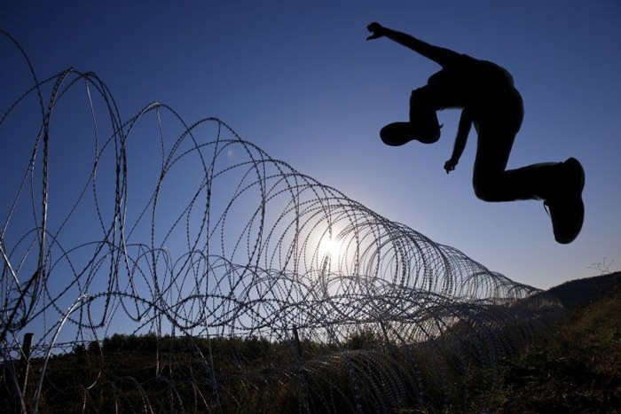
约翰二书
对爱的极限
Rick Griffith 博士 • 新加坡神学院 • BibleStudyDownloads.org

Slide 2
关键字
297
界限
约翰二书

Slide 3
Theme
23
对爱的极限
约翰二书

Slide 4
关键节
297
“凡越过基督的教训又不持守的，就没有 神；持守这教训的，就有父和子了。如果有人到你们那里，不传这教训，你们就不要接待他到家里，也不要问候他”
(9-10)。
约翰二书

Slide 5
总结概要
297
约翰劝勉一位接待宣教士的女基督徒和她的儿女们，爱是有界限的，需要小心不要像接待真教师一样对待假教师，以免助长他们异端教导的蔓延。
约翰二书

Slide 6

国度陈述
27f
国度的生活在爱与真理之间取得平衡
(vv. 1-6)，因此两者不会互相废止
约翰二书

Slide 7

圣约陈述
27f
收信人是一个匿名的妇女和她的孩子 (第一节), 这妇女大有可能经常为了教会崇拜或接待传教士而开放家庭。
约翰二书

Slide 8

救赎陈述
27f
我们救恩的一个证明是要相信基督成了肉身为我们死 (第七节), 而否认这事实的 “就没有神” (第九节), 可能就是说他们会失去赏赐 (第八节)。
约翰二书

Slide 9
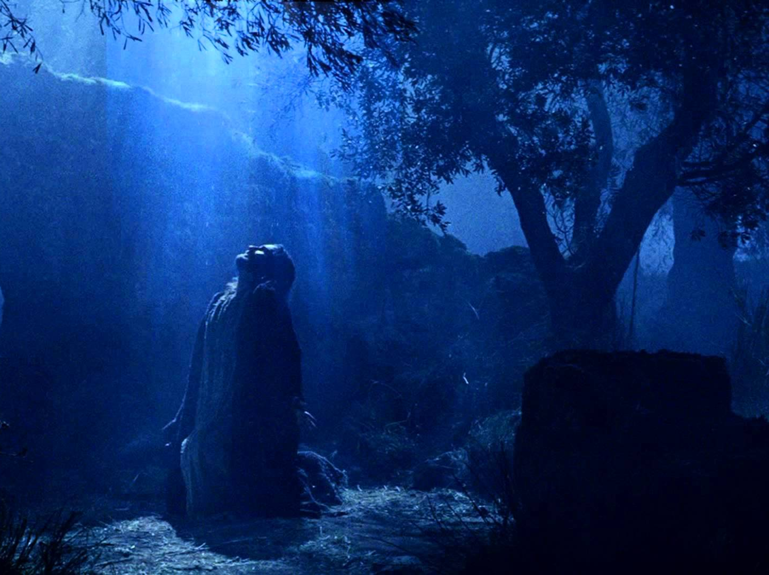
预言
(主, 神性)
27f
耶稣虽然成了肉身，但仍然是主，因为“有许多迷惑人的出来、他们不认耶稣基督是成了肉身来的。这就是那迷惑人、敌基督的。” (第七节)。
约翰二书

Slide 10
约翰二书大纲
297
对爱的极限
援助真实的老师
避免假的老师
第1至6节
第7至13节
活在戒律中
以防伪造者
正面
反面
真理的展示
真理的保卫
以真理和爱的问安(1-3)
赞扬儿童的守纪 (4)
对爱的叮嘱(5-6)
禁止帮助假的老师(7-11)
期待的探望与问候(12-13)
以弗所
公元 85-95

Slide 11
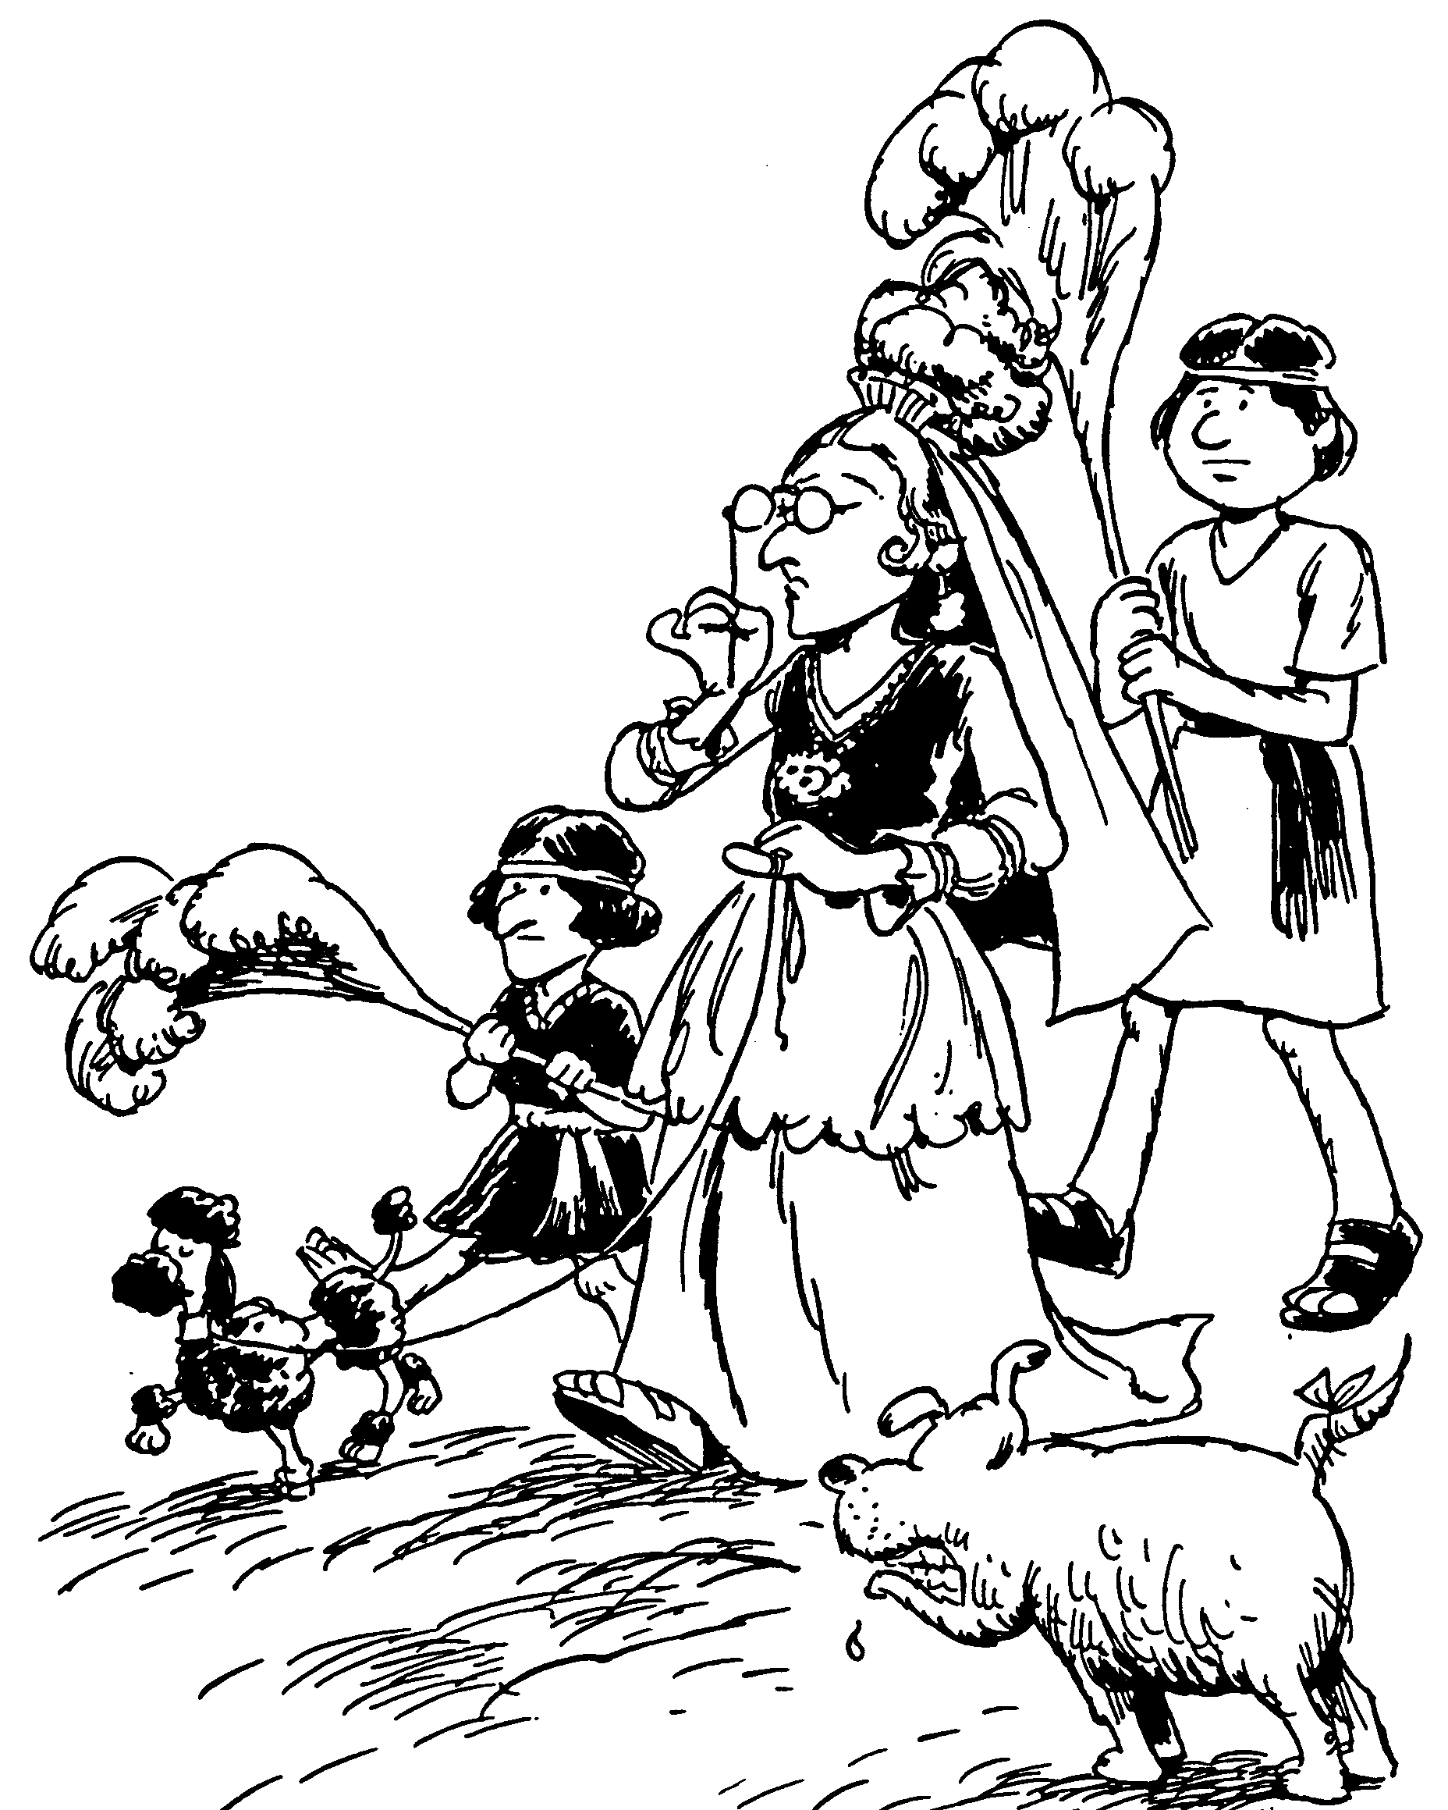
Acrostic Bible – 2 John
约翰二书
1－3 对姐妹的爱待
4－6 劝勉彼此相爱
7－11 提防那些反对基督
12－13 盼望探访
对爱
的极限
巴里 赫德尔斯顿 《藏头诗圣经》

Slide 12

要有辨识能力
约翰二书
Rick Griffith 博士 • Crossroads International Church Singapore
BibleStudyDownloads.org

Slide 13
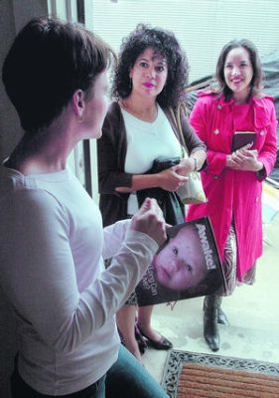
专题研究时刻…
假设二个耶和华见证的教徒来到您的门前。您将邀请他们进入您的家里面吗? 为什么呢?
请进入你所选择的小组...
约翰二书
指挥台
不让他们进来
让他们进来
看情形
Notes:
It’s a lazy Saturday afternoon and you’re catching up on a few projects around the house. Then a knock comes at the door. You open it to discover two Jehovah's Witnesses. After talking a few minutes, they say to you, “It sounds like you have a keen interest in spiritual things. Can we hear more from you and tell us our understanding?”
• In such a situation, would you invite them inside your home? Why or why not?
• We often vote with our hands, but today I want you to vote with your feet, walking to a certain part of the room.
• Please get into the right group. • Those who would keep them out move left • those who would let them in move to the right side of the room • and those who need more information or feel it depends on certain factors move to the back. Ready, vote!
Why are you in that group? Tell those around you for the next minute.
Each group will now have 1-2 people tell the rest why they came to that group: first letting them in, second keeping them out and then the "it depends" group.
Please take your seats now.

Slide 14

福音
真的有改变我们的生命吗?
约翰二书
Notes:
The gospel is supposed to change lives, showing us how to respond in a difficult situation such as dealing with false teaching.
In such a situation, how does the gospel tell us to respond?

Slide 15
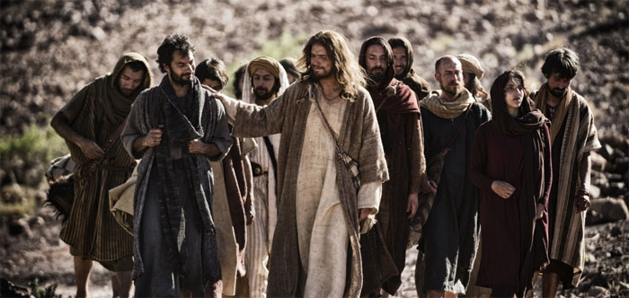
你要怎么样活出福音?
两个方法…
约翰二书
Notes:
What ways can you apply the Good News of Jesus?

Slide 16
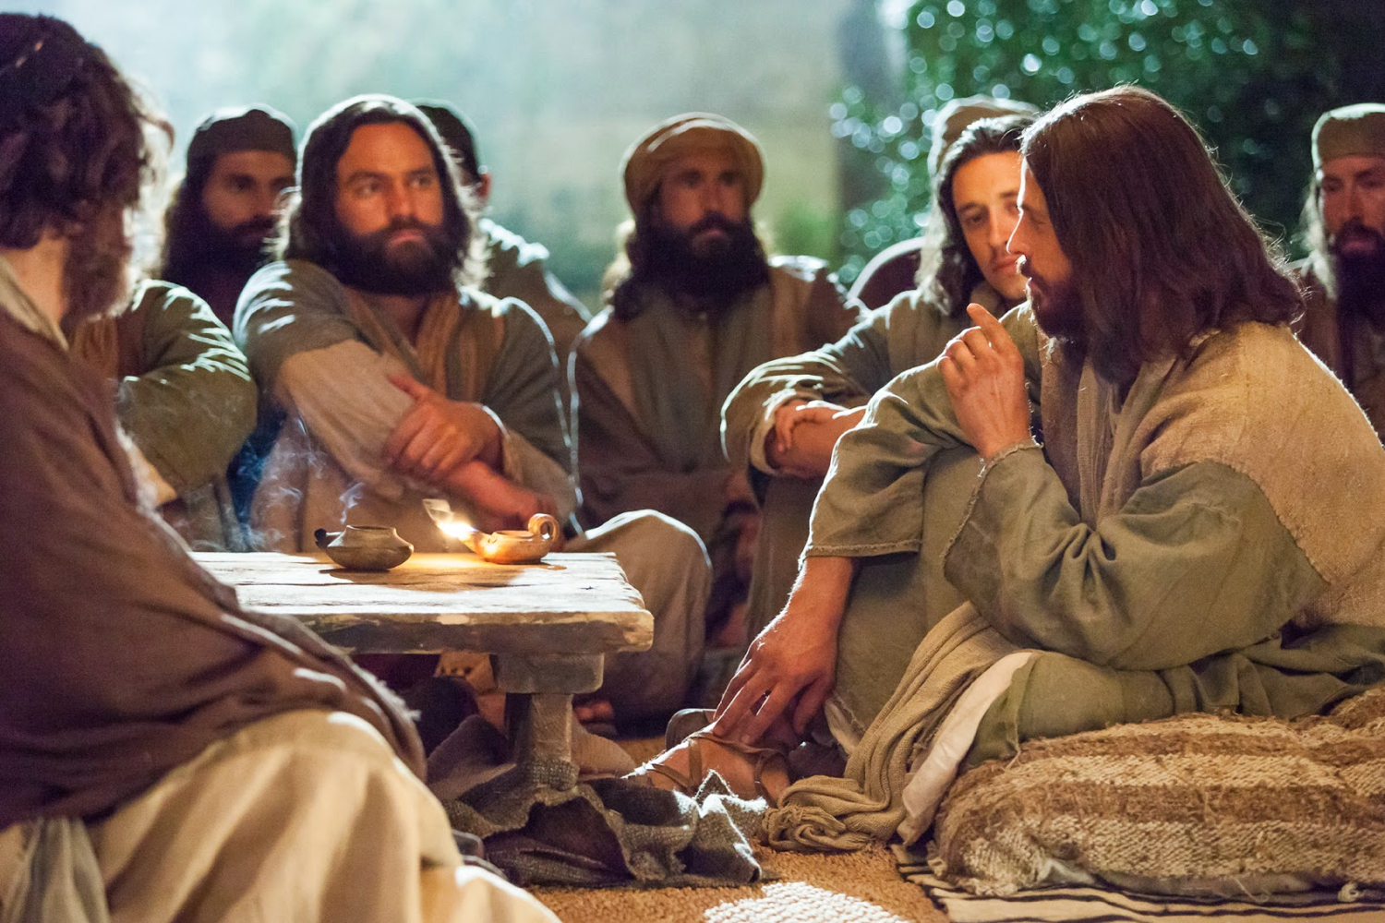
I. 帮助传真道的人(1-6)。
约翰二书
Notes:
Support those preaching the right message about Christ (1-6).

Slide 17

II. 避开传假道的人(7-13)。
约翰二书
Notes:
Do not support preachers of heresy (7-13).

Slide 18
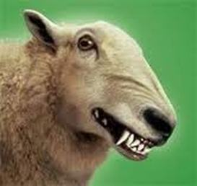
主要思想
借着不帮助
阻碍福音的人
活出福音
约翰二书
Notes:
In 2 John 10 we see the teaching in a nutshell: Do not encourage false teaching in any way so you can live out the Good News!

Slide 19

信徒怎么帮助异端?
297
鼓励迭代异端
把钱交给邪教 (视频传道士等)
买异端的书籍
观看违背圣经的电影
从假传道士接收文献
约翰二书

Slide 20
Black

Slide 21
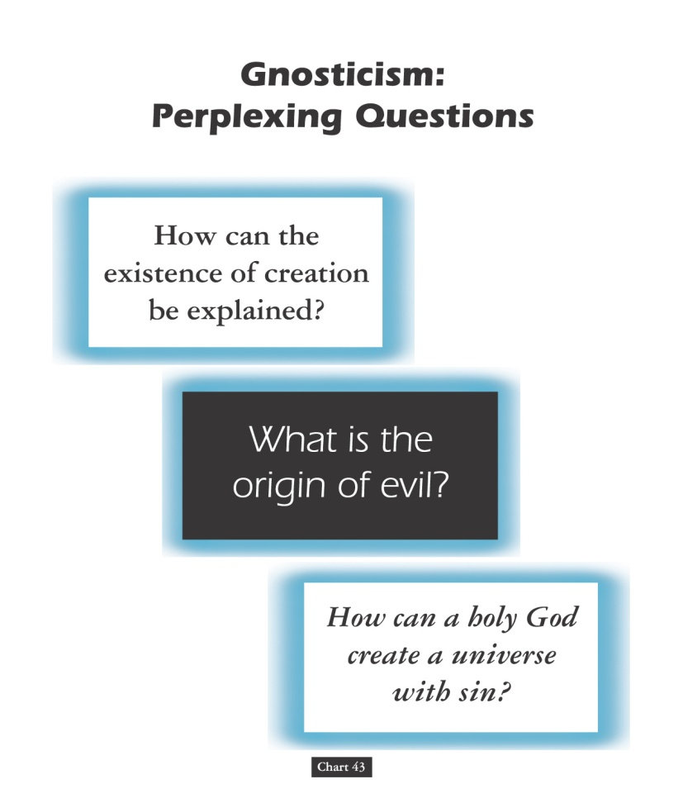
诺斯底主义：
令人困惑的问题
153a
要如何解释创造
的存在？
什么是罪恶的起源？
圣洁的神怎么能创造有罪恶的宇宙？
图 43
John D. Hannah, Charts of Ancient & Medieval Church History (Grand Rapids: Zondervan, 2001)
Notes:
Text from Hannah for this chart:
"The Christian faith was opposed by numerous adversaries––threats from the state, ominous false religions, and heretics within its own borders. The most imposing religious threat came from Gnosticism, which was particularly dangerous because of its intellectual coherency. While Gnosticism seemed to provide answers to perplexing questions, it succeeded only in mixing a snippet of biblical truth with error."

Slide 22
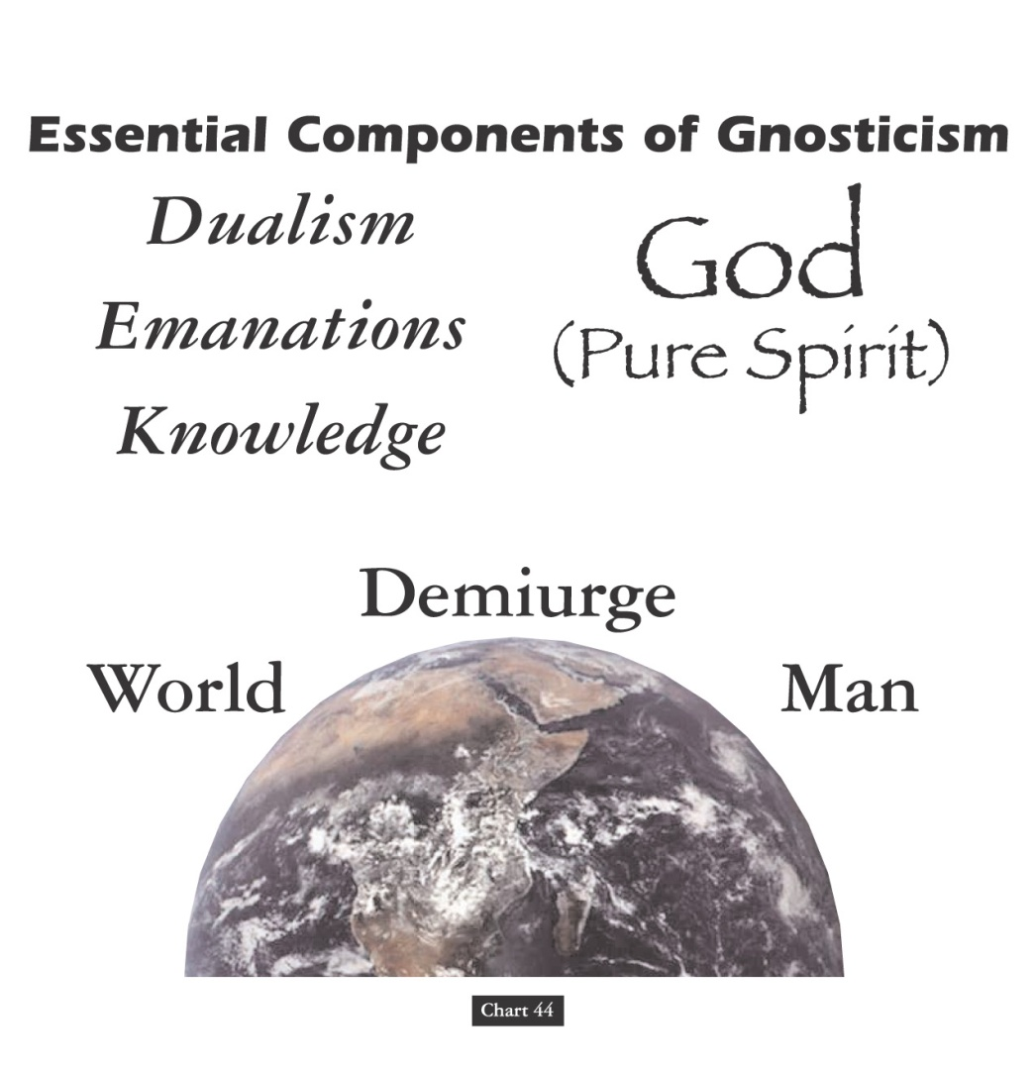

诺斯底主义的重要组成部分
153b
神
（纯洁的灵）
(1) 二元论
(2) 放射物
(3) 知识
造物主
世界
人
图 44
John D. Hannah, Charts of Ancient & Medieval Church History (Grand Rapids: Zondervan, 2001)
Notes:
Text from Hannah for this chart:
"Gnosticism taught (1) that there is a radical dualism of the spiritual in opposition to the material (God, who is Spirit, is the supreme good, while matter is evil); (2) that God could not have created matter because it is contrary to his nature; rather, the world, which is material and evil, was created by the Demiurge (an emanation from God), and man is a material being with an entrapped spirit; and (3) that through a "secret knowledge," salvation becomes the life of escape from the material confines of the body."

Slide 23

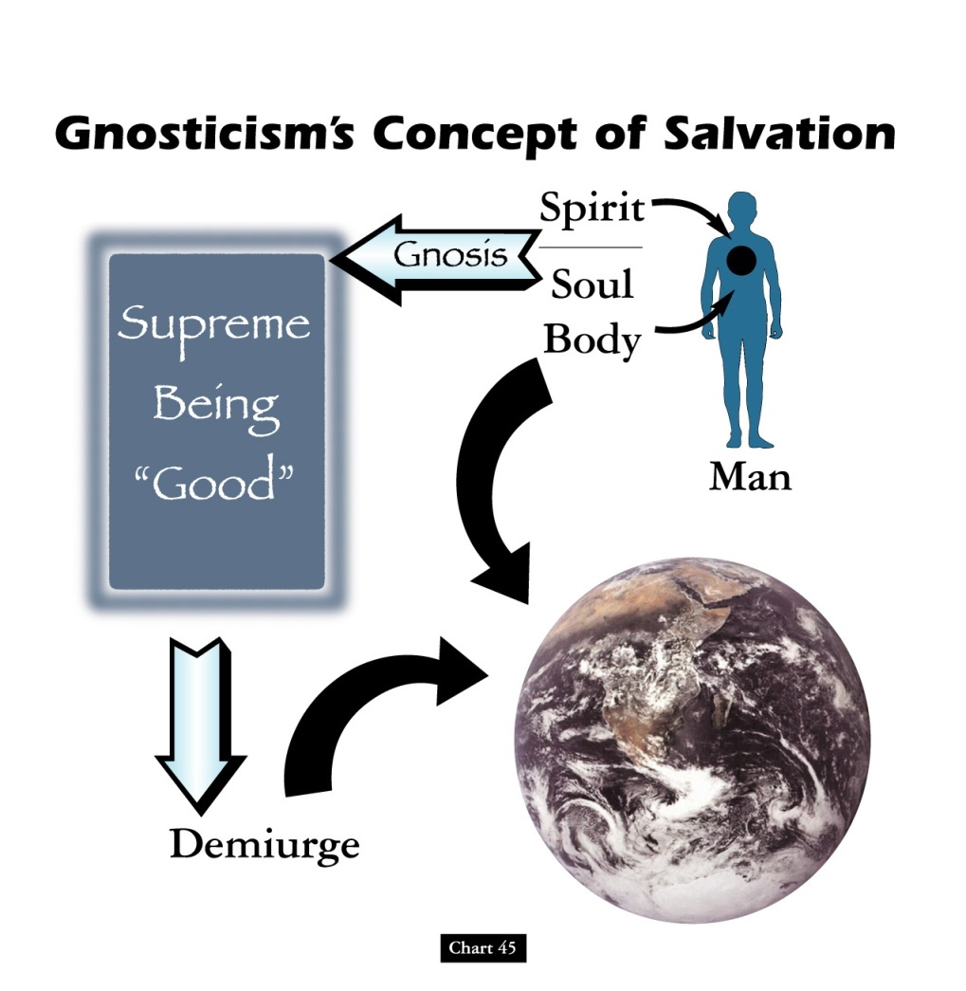

诺斯底主义对于救赎的概念
153c
灵
灵知
至高的神
“好的”
魂
肌体
人
造物主
图 45
John D. Hannah, Charts of Ancient & Medieval Church History (Grand Rapids: Zondervan, 2001)
Notes:
Text from Hannah for this chart [animation brackets mine]:
"Gnosticism's concept of salvation is as follows: God did not create the world, [1] but a lesser yet powerful being (the Demiurge) made this evil world and [2] mankind––though within man is a spark of good. [3] Salvation results from enlarging the capacity of that nature while minimizing the hold of materialism, [4] and it is accomplished by means of the secret teachings of Gnostic teachers. In resisting this teaching, Christian writers adopted a worldview that embraced the God of the Bible as the divine creator, affirmed the creation as good though marred by a subsequent devastation, and espoused the salvation of the body as well as the soul."

Slide 24
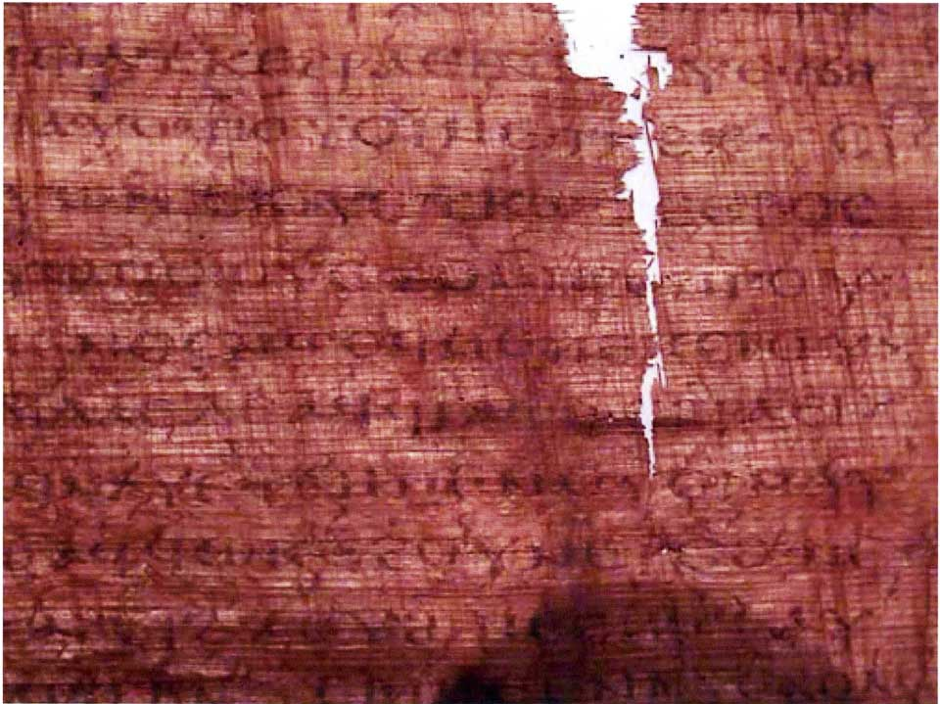
The Gospel of Judas
186a
Judas said, "Master, could it be that my seed is under the control of the rulers?" Jesus answered and said to him, "… you will grieve much when you see the kingdom and all its generation." When he heard this, Judas said to him, "What good is it that I have received it? For you have set me apart for that generation." Jesus answered and said, "You will become the thirteenth, and you will be cursed by the other generations—and you will come to rule over them. In the last days they will curse your ascent [47] to the holy [generation]."
Notes:
Another work that appeared in the early church—probably in the second century—is called the Gospel of Judas. It says that Judas would rule over the disciples—even though he was actually an unbeliever!

Slide 25
The Gospel of Judas
186a
Judas said to Jesus, "Look, what will those who have been baptized in your name do?" Jesus said, "… Truly [I] say to you, Judas, [those who] offer sacrifices to Saklas [...]God [—three lines missing—] everything that is evil. But you will exceed all of them. For you will sacrifice the man that clothes me."
Notes:
It even says that Jesus was a spirit that was "clothed" with Christ, and Judas will be part of the plan to exalt Jesus.

Slide 26
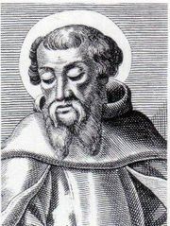
Irenaeus (AD 180)
186b
1. Others again declare that Cain derived his being from the Power above, and acknowledge that Esau, Korah, the Sodomites, and all such persons, are related to themselves. On this account, they add, they have been assailed by the Creator, yet no one of them has suffered injury. For Sophia was in the habit of carrying off that which belonged to her from them to herself. They declare that Judas the traitor was thoroughly acquainted with these things, and that he alone, knowing the truth as no others did, accomplished the mystery of the betrayal; by him all things, both earthly and heavenly, were thus thrown into confusion. They produce a fictitious history of this kind, which they style the Gospel of Judas.
Against Heresies 1.31.1
Notes:
The later second century church father Irenaeus spoke of this book as a heresy where Judas had a special knowledge (gnosis) that the other disciples lacked.
_______________
http://www.ccel.org/fathers2/ANF-01/anf01-60.htm#P7477_2003920

Slide 27
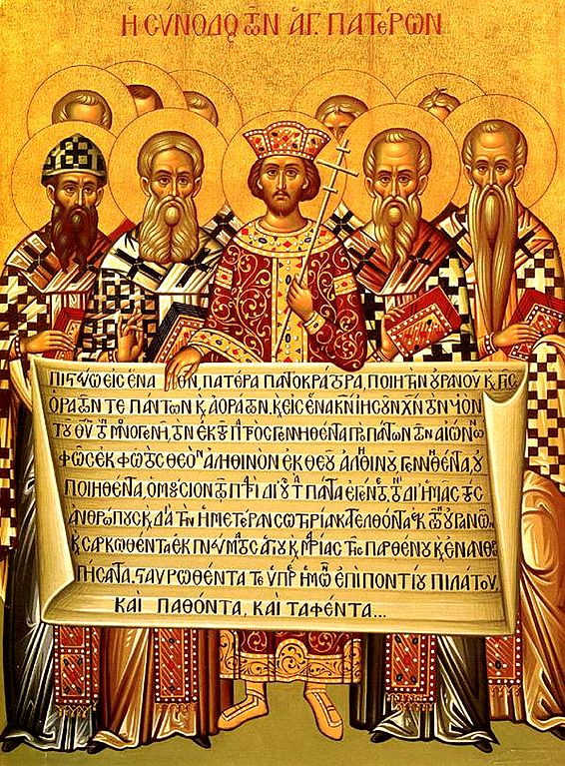
尼西亚信经
(公元 325)
153e
Dr. Rick Griffith, Crossroads International Church Singapore
CICFamily.com & BibleStudyDownloads.org
Notes:
The Nicene Creed (AD 325) was the second oldest creedal statement of the Early Church, preceded only by The Apostle’s Creed of 1^{st to} 3rd centuries. But why do we have it in the first place?

Slide 28
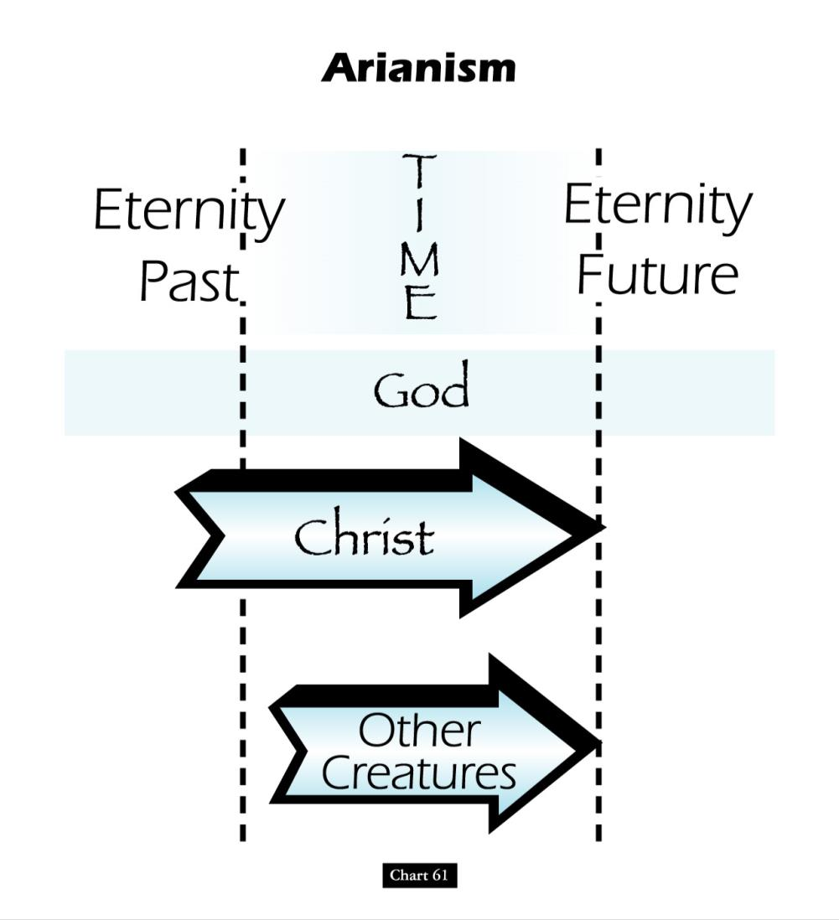
阿里乌斯的异端教义
时间
过去到现在
（永恒）
现在到未来
（永恒）
神
基督
被造的
万物
John D. Hannah, Charts of Ancient & Medieval Church History (Grand Rapids: Zondervan, 2001)
Notes:
异教者当中有一位叫阿里乌斯。他否认基督象天父也是永恒的。阿里乌斯的教义说明基督在过去的永恒里有个起点。

Slide 29
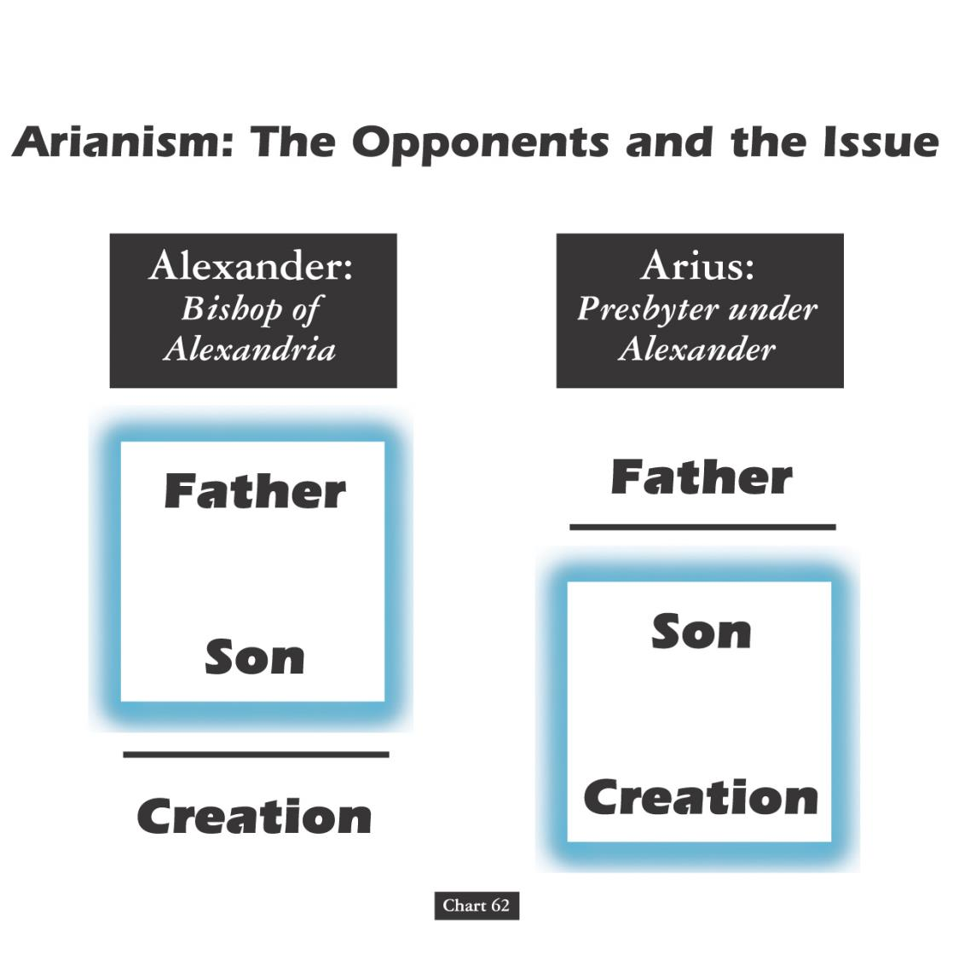
阿里乌斯教∶反对者与争论点
亚历山大∶
亚历山太的主教
阿里乌∶
亚历山大之下的长老
天父
天父
上帝之子
上帝之子
万物
万物
John D. Hannah, Charts of Ancient & Medieval Church History (Grand Rapids: Zondervan, 2001)
Notes:
阿里乌斯的上司亚历山大的看法是规范的。他相信天父和耶稣都不是被创造的。反而，阿里乌斯却相信耶稣也是被创造的。他的教义是天父创造了耶稣，过后耶稣创造了万物。

Slide 30
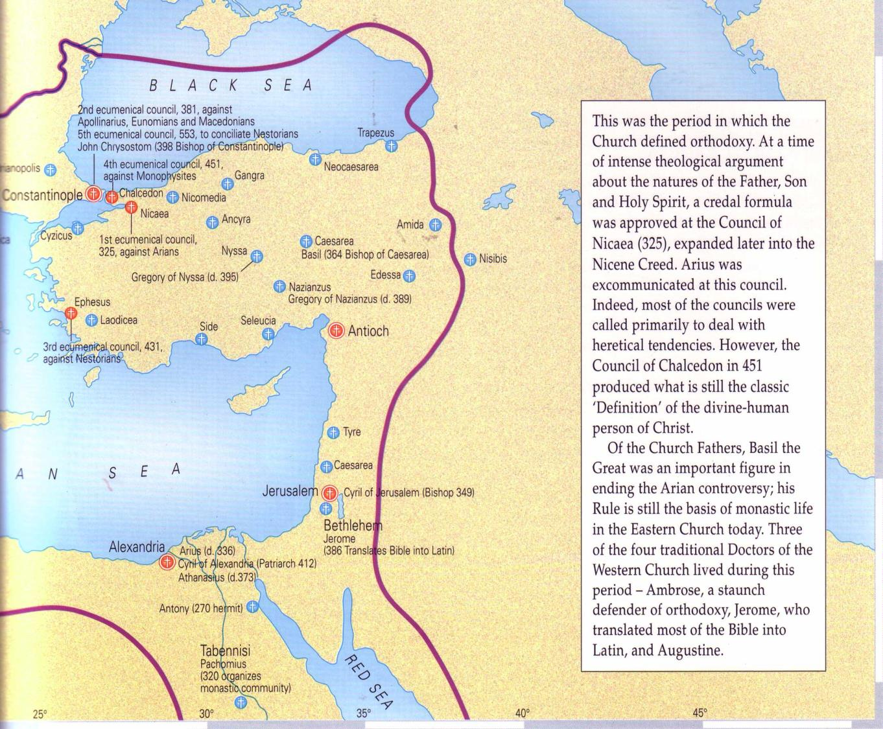
在尼西亚会议发生了什么事
(公元 325)?
尼西亚
当时在东方帝国的主教聚集与把亚历山太的阿里乌斯逐出教外。
亚历山太
The Atlas of the Bible and the History of Christianity, ed. Tim Dowley (London: Three’s Company, 1997), 77
Notes:
让我们看看最早的会议对于耶稣的想法。在尼西亚（今土耳其）的焦点是两位在亚历山太，埃及，的教会领袖的反面信念。

Slide 31
在尼西亚会议到底发生了什么？
票数∶300
虚构
事实
票数∶2
阿里乌斯门徒∶
“耶稣不是神”
传统型的∶
“耶稣是神”
阿里乌斯门徒∶
“耶稣不是神”
传统型的∶
“耶稣是神”
公元 325
尼西亚会议

Slide 32
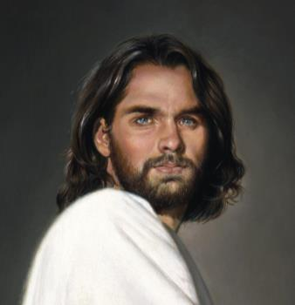
第一世纪门徒对于神的信仰
保罗:
“基督也是从他们出来的，他是在万有之上，永远可称颂的神。”
罗 9:5
彼得:
“救主耶稣基督之义”彼后 1:1
神:
“论到子却说，神阿，你的宝座。。。’”
来 1:8
耶稣:
“我与父原为一。”
约10:30
Notes:
早期的基督教徒都坚信耶稣的却是神！希伯来书1∶8 给我们最可靠的见证，那时天父本身的见证。

Slide 33
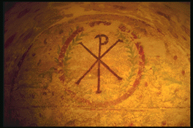
尼西亚会议之前已经有门徒坚信基督是神
伊格内修斯:“神已成人的形式”(公元 105)
克莱门:“你认为耶稣为神是恰当的”(公元 150)
艾雷尼厄斯:“他是神，因他的名以马内利已表明他的确是神”(公元 180)
特土良:“… 基督我们的神”(公元 200)
俄利根:“我们坚信救主是神,是应该不会冒犯到任何人”(公元 225)
拉克坦提乌斯:“我们坚信基督为神”
(公元 304)
Bercot, 93-100 in Garlow & Jones, 94
Notes:
尼西亚会议之前已经有许多门徒坚信基督是神

Slide 34
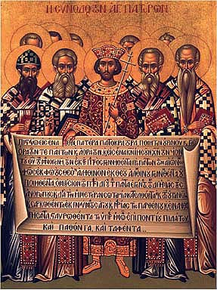
尼西亚信经 (公元 325)
我等信独一之神，
即全能之圣父，创造天地，及一切有形无形之万物之主。
我等信独一之主耶稣基督，
上帝独生之圣子，
是圣父在万世之先所生，
是从神所出之神，
从光所出之光，
从真神所出之真神，是生非，是与圣父同体
John D. Hannah, Charts of Ancient & Medieval Church History (Grand Rapids: Zondervan, 2001)
Notes:
正统的看法已坚持， 表扬在尼西亚信经里。
The orthodox view won out and was expressed in the Nicene Creed. Let’s remind ourselves of this important teaching as we affirm aloud this great summary of Christian teaching. Reading together…(recite text)

Slide 35
尼西亚信经 (公元 325)
万物皆借圣子而造；圣子为要拯救我等世人，从天降临，为圣灵感动之童贞女马利亚所生，成为人身，在本丢彼拉多手下，为我等钉十字架，被害而葬，照圣经之言，第三日复活，升天，坐在圣父之右；将来复必有荣耀而降临，审判生人死人，其国无穷无尽。
John D. Hannah, Charts of Ancient & Medieval Church History (Grand Rapids: Zondervan, 2001)
Notes:
正统的看法已坚持， 表扬在尼西亚信经里。

Slide 36
尼西亚信经 (公元 325)
我等信圣灵即是主，
是赐生命者，是从圣父、圣子所出，与圣父、圣子，同是当拜，当称颂者，众先知说预言，皆是被圣灵感动；我等信使徒所立独一圣而公之教会；我等信因为赦罪设立之独一洗礼；我等望死后复活，又望来世之永生。阿们。
John D. Hannah, Charts of Ancient & Medieval Church History (Grand Rapids: Zondervan, 2001)
Notes:
正统的看法已坚持， 表扬在尼西亚信经里。

Slide 37
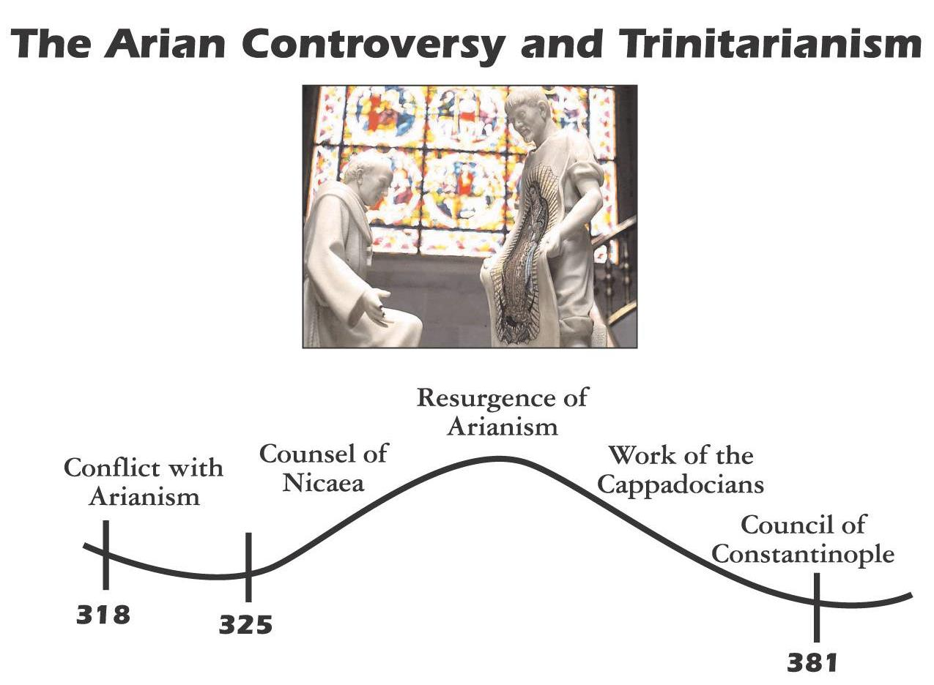

阿里乌斯教义的争议与三位一体论
阿里乌斯教
的复甦
尼西亚
会议
卡帕多西亚族(Cappadocians)之工作
阿里乌斯
教义的争议
君士坦丁
堡会议
反对阿里乌斯
教的初期
反对阿里乌斯
教的後期
John D. Hannah, Charts of Ancient & Medieval Church History (Grand Rapids: Zondervan, 2001)
Notes:
Unfortunately, Nicea did not end the Arian controversy, which later resurged until its final rejection almost 60 years later.

Slide 38
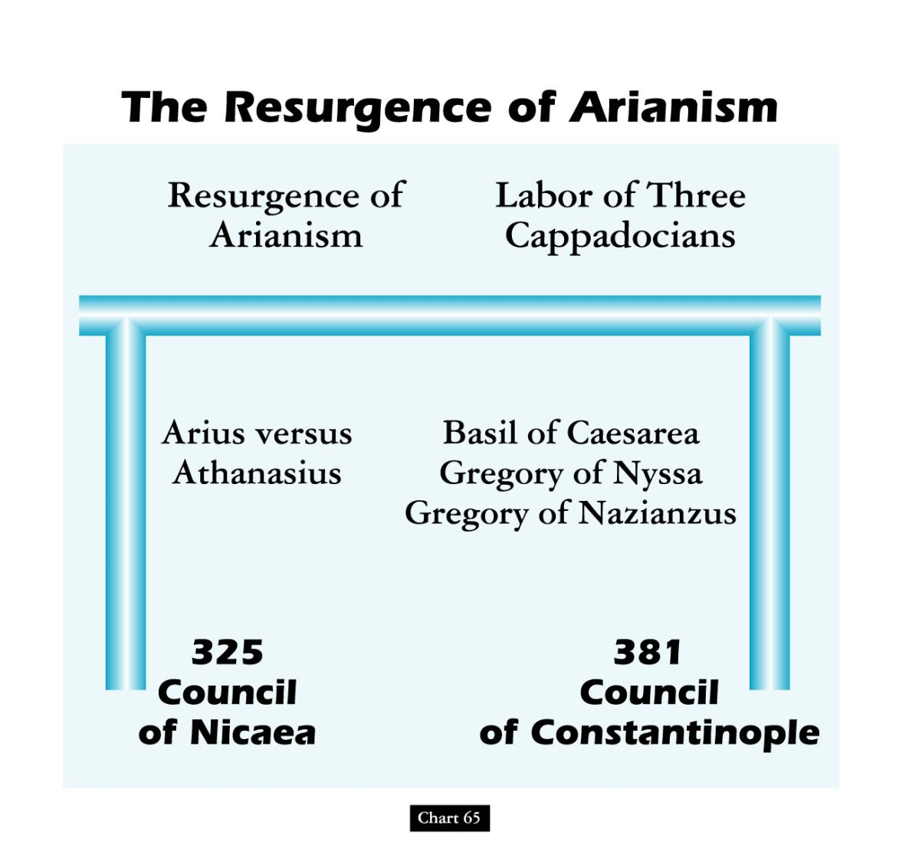
阿里乌斯教的复甦
阿里乌斯教
的复甦
卡帕多西亚族(Cappadocians)之工作
尼西亚会议
君士坦丁堡会议
John D. Hannah, Charts of Ancient & Medieval Church History (Grand Rapids: Zondervan, 2001)
Notes:
God raised up Basil and the “Two Gregorys” to finally nail the coffin in Arianism. (However, this same heresy came back in the 1800s in a cult called Jehovah’s Witnesses which teaches that Jesus was created by the Father.)

Slide 39
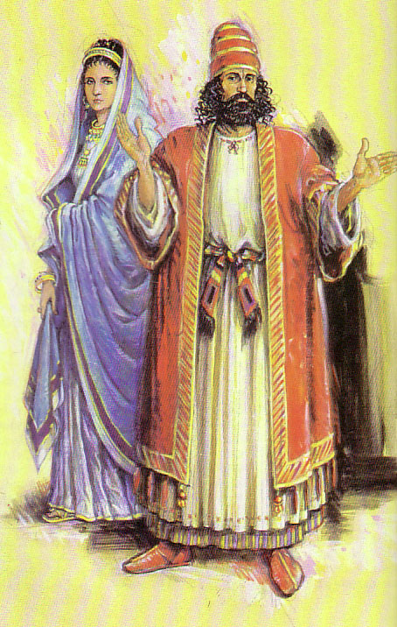
约翰二书对垒约翰三书
306
对比
虽然使徒约翰在约翰二书对支持假的老师发出警告
但是约翰三书却事情的“反面”也提出来: 信徒应该支持真正的传教士老师。

Slide 40
约翰二书对垒约翰三书
306
对比
 | 约翰二书 | 约翰三书
接收者 | 一个妇女 | 一个男人
姓名 | 匿名 | 该犹,丢特腓,低米丢
语气 | 谴责 | 称赞
转教士 | 假的 | 真的
好客／支持 | 错放了 | 失遗 了(丢特腓) 维护了(该犹)
章节 | 13 | 15
字数（希腊文本） | 245 | 219

Slide 41
要有辨识能力
约翰二书
Rick Griffith 博士 • Crossroads International Church Singapore
BibleStudyDownloads.org

Slide 42

Lunar New Year Blessing
Radio Bible Class

Slide 43
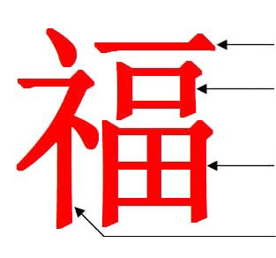
“Blessing”
One
Mouth (=Man)
Garden/Field
Divine Prefix
Notes:
Last week we were introduced to the amazing Chinese word for “blessing.”
It literally means one mouth (or man) in a garden in God’s presence!
Seriously! What an indication of Adam in the Garden of Eden with God’s blessing!

Slide 44

Genesis in Chinese Characters
See Dave Stewart, “The Story of Genesis in the Chinese Characters,” ShareShare presentation, https://www.slideshare.net/DaveSinNM/the-story-of-genesis-in-the-chinese-characters?qid=e6e52686-6545-4def-8537-2444d576b004&v=&b=&from_search=1, accessed 20 Jan 2020
Notes:
Many have noted that the story of Genesis is actually within the traditional Chinese characters.

Slide 45

“Create”
Create means to speak to dust to give life to a man so he can walk
to create
Speak = dust, life, man + walk/mud
Notes:
For example, the Chinese character for “create” has four components: dust, life, man and walk.

Slide 46


“Devil” & “Tempter”
Devil
Secret
Life
Man
Garden
Tempter
Devil
Cover
Forest/
Two Trees
Notes:
Chinese also has an insightful character for “devil” that shows a “secret” (or whisperer) for “life” told to a “man” in a “garden.”
That “devil” character forms the basis for the word “tempter,” which adds to devil words for “cover” among “two trees.”

Slide 47

“Boat”
The boat was a vessel of eight people
Boat
Vessel + Eight + People
Notes:
In Chinese, a large “boat” is formed with words for “vessel” and “eight people.” Doesn’t that sound like Noah, his wife, his three sons and their wives? There are actually over 270 Global Flood stories, but the Chinese one specifies the number of those saved as 8!

Slide 48
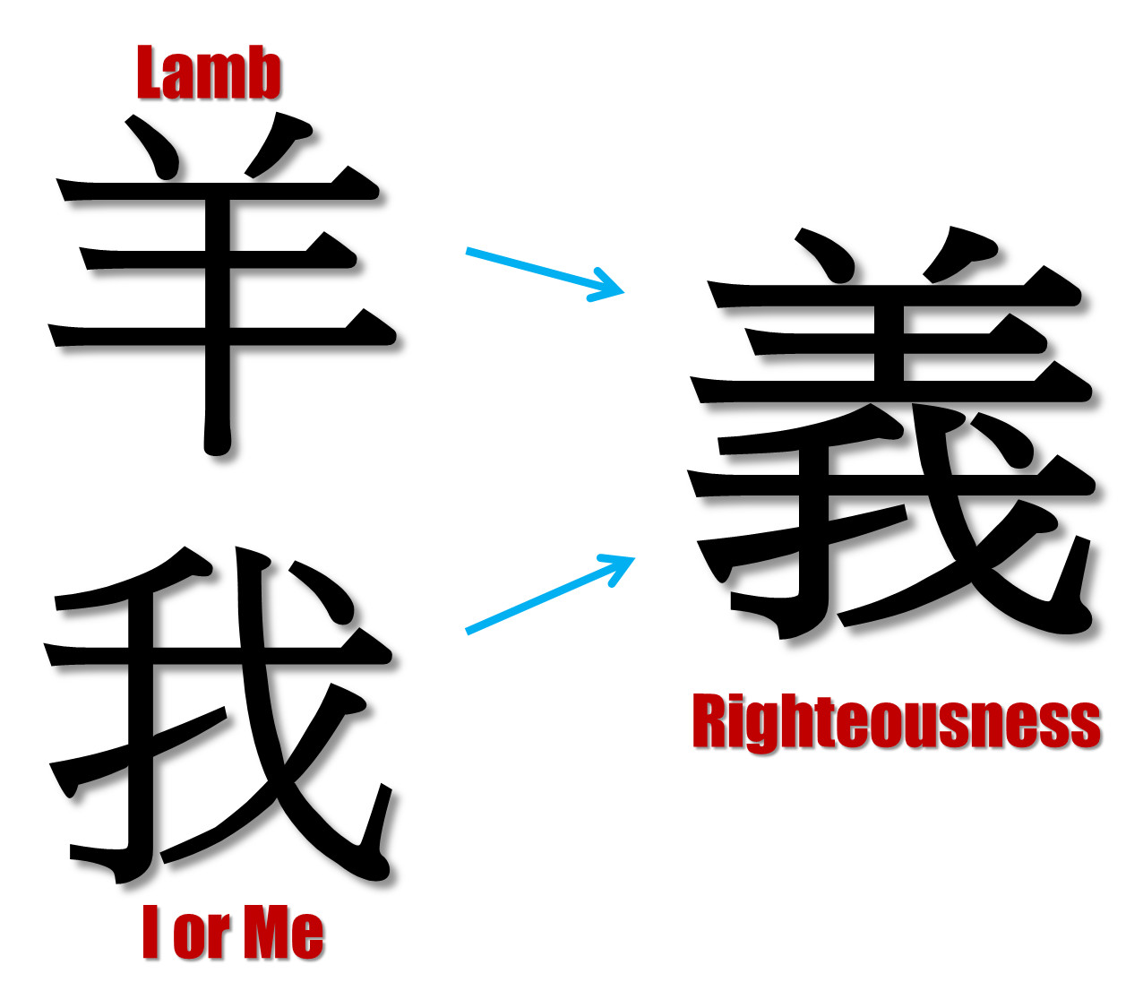
“Righteousness”
Lamb
I or Me
Notes:
As in most languages, the word for “me” is quite common. But Chinese puts the character for “lamb” over “me” to designate righteousness. We become righteous in God’s sight when overshadowed by the Lamb of God!

Slide 49
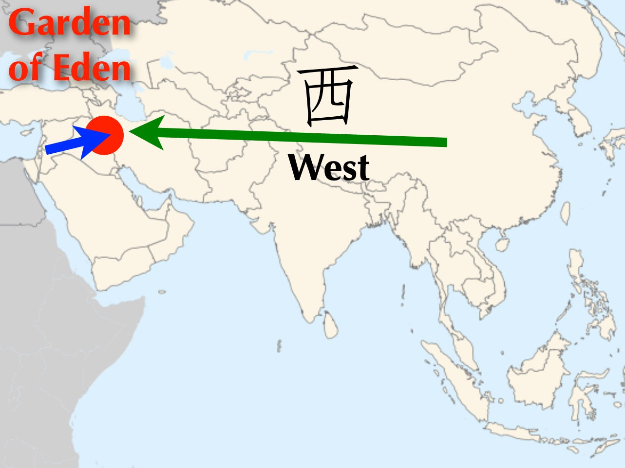
Garden of Eden
West
Notes:
Chinese has a very interesting word for “west.” Of course, the Garden of Eden was west of China.

Slide 50
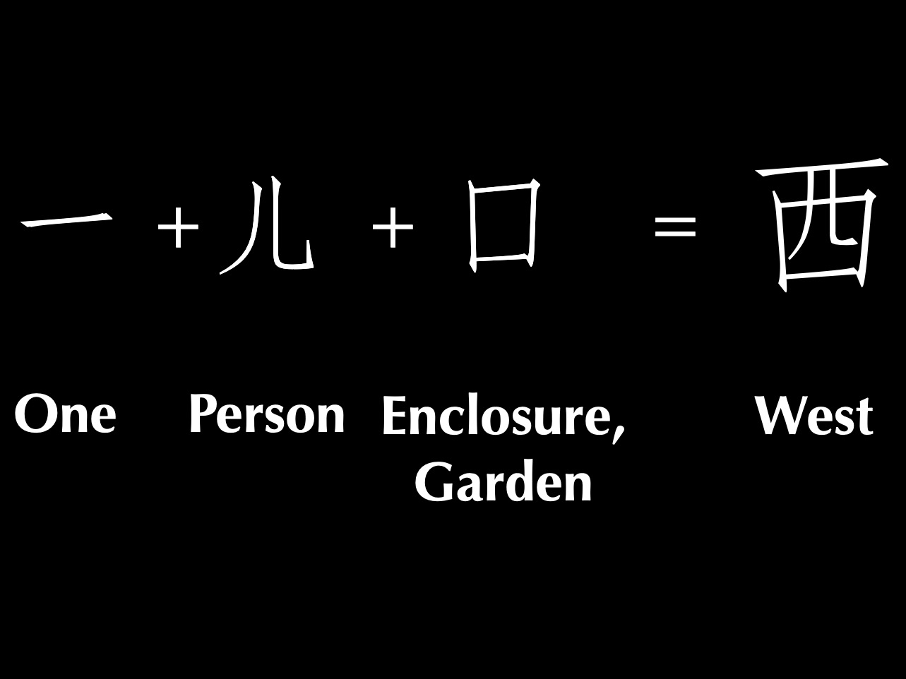
One man in a garden = West
One
Person
Enclosure,
Garden
West
Notes:
In Chinese, “west” literally means “one person in a garden” which took place west of China in the Middle East depiction of the Garden of Eden where God placed one man in a garden.

Slide 51

Title
One
Notes:
Many more Chinese examples are cited by authors such as C. H. Kang.

Slide 52

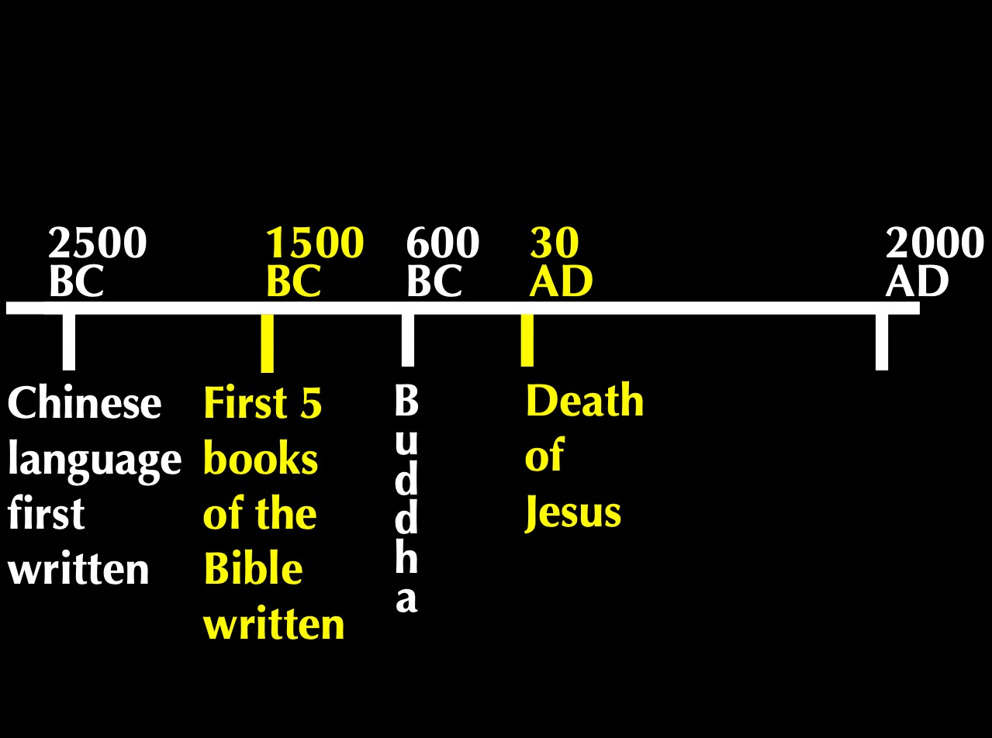
Timeline
2500
1500
400
33
2000
BC
AD
Chinese Language First Written
First 5 Books
of Bible Written
B
u
d
d
h
a
Death of Jesus
Notes:
So what’s the point? These Chinese words were basic to the language thousands of years before the Bible was translated into Chinese! We find them even 1000 years before Genesis was written, confirming their accuracy.
• In fact, the Chinese worshipped a single God, Shang Di, for thousands of years before Buddha lived.
But true teaching about God is always under attack.

Slide 53
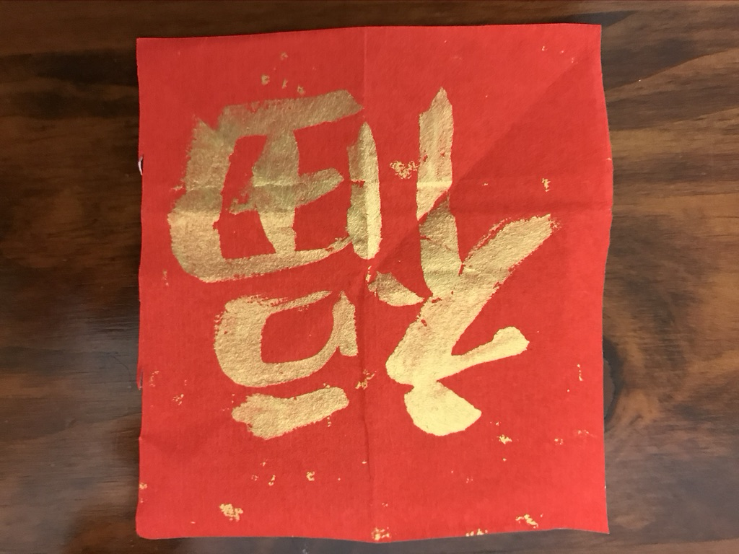

“Lucky”?
“Blessing”?
Notes:
I showed this Chinese character for “blessing” to my non-Christian Chinese friend Jeffrey. He immediately looked at it and said, “Ah, lucky!” God’s blessings are reduced to luck in Satan’s relentless attack against the truth.

Slide 54
专题研究时刻…
假设二个耶和华见证的教徒来到您的门前。您将邀请他们进入您的家里面吗? 为什么呢?
请进入你所选择的小组...
约翰二书
指挥台
不让他们进来
让他们进来
看情形
Notes:
It’s a lazy Saturday afternoon and you’re catching up on a few projects around the house. Then a knock comes at the door. You open it to discover two Jehovah's Witnesses. After talking a few minutes, they say to you, “It sounds like you have a keen interest in spiritual things. Can we hear more from you and tell us our understanding?”
• In such a situation, would you invite them inside your home? Why or why not?
• We often vote with our hands, but today I want you to vote with your feet, walking to a certain part of the room.
• Please get into the right group. • Those who would keep them out move left • those who would let them in move to the right side of the room • and those who need more information or feel it depends on certain factors move to the back. Ready, vote!
Why are you in that group? Tell those around you for the next minute.
Each group will now have 1-2 people tell the rest why they came to that group: first letting them in, second keeping them out and then the "it depends" group.
Please take your seats now.

Slide 55
关键节
297
“凡越过基督的教训又不持守的，就没有 神；持守这教训的，就有父和子了。如果有人到你们那里，不传这教训，你们就不要接待他到家里，也不要问候他”
(约翰二 9-10).
约翰二

Slide 56

什么是全备的福音?

Slide 57
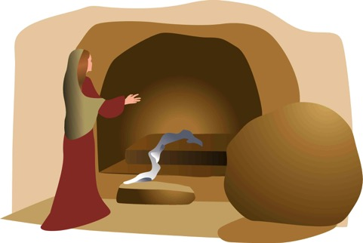
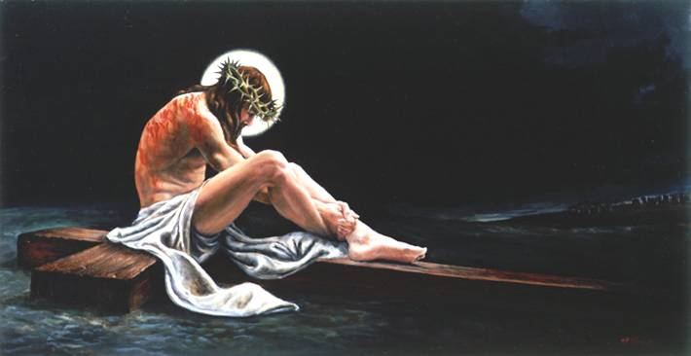
全备的福音
“我 如 今 把 先 前 所 传 给 你 们 的 福 音 告 诉 你 们 知 道。。”
埋葬
复活
死亡
“基督为了我们的罪死…”
“第三天，他从死里复活…”
“他被埋葬…”
林前15:3-4

Slide 58
福音
真的有改变我们的生命吗?
约翰二书
Notes:
The gospel is supposed to change lives, showing us how to respond in a difficult situation such as dealing with false teaching.
In such a situation, how does the gospel tell us to respond?

Slide 59
你要怎么样活出福音?
Notes:
What ways can you apply the Good News of Jesus?

Slide 60
新约综览(普通书信 ＋ 关键字)
38
124
39-41
“直 到 地 极” (使 徒 行 传 1:8)
使 徒 9 13 14 15 16 18 21 27 28
五月57-
八月59
大 马 色
安 提 阿
四月 48-
九月 49
1
加 拉 太
四月 50-
九月 52
2
爱琴海
春季 53-
五月 57
3
亚洲
五月 57-
八月 59
试验
二月 60-
三月 62
1
罗马
春季 62-
秋季 67
4
西班牙
秋季 67-
春季 68
2
罗马
秋季 49
理事会
春季68
教会扩长
35 48 49 50 52 53 57 60 62 67 68 95
天国
主权1
主权2
门徒
相 信
合一
秩序
教 义
提后
犹大
因信称义
被提
成圣
伪装者
雅各
行为
大患难
使 徒
神性
行事为人
希伯来
优秀
约 1
爱
彼 前
受苦
约 2
称义
饶恕
极限
福音书以及使徒行传
态度
彼后
知识
保罗书信
普通书信
普通书信 ＋ 关键字

Slide 61
新约书中的章节
新约的四本“书”只有一章

Slide 62

新约的电子邮件
腓利门 约贰 约叁 犹大
Notes:
I call these "New Testament Emails" as they are about the length one puts in an email.

Slide 63

日期
298
多数的学者相信, 约翰记录这封书信时是大概公元90年间, 虽然没有什么证据可以排除一个较早的日期。
因此它应该是大约在公元85-95 年间完成的。

Slide 64
布朗的主要来源是相信神秘直觉
153
二个类型在約翰一書
Docetic诺斯替教从dokeo， “似乎” (基督只似乎是一个人)问题是罪恶贬值的唯物主义否认了基督的人类被接触的耶稣(1 ：1)导致禁欲主义淫邪提升
Cerinthian 诺斯替教
从Cerinthus，创建者在亚洲(基督只似乎是上帝)精神上是好高尚的知识(gnosis)
否认 基督 神
水 与 血 (5:6)
带领骄傲教育提升
Notes:
Many Gnostics did the opposite of Brown’s thesis--they denied Jesus was a real man. Others exalted the spirit so much that they denied his deity. Brown supposes that this latter heretical group was normative Christianity!

Slide 65
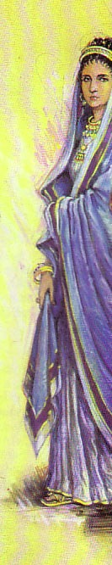
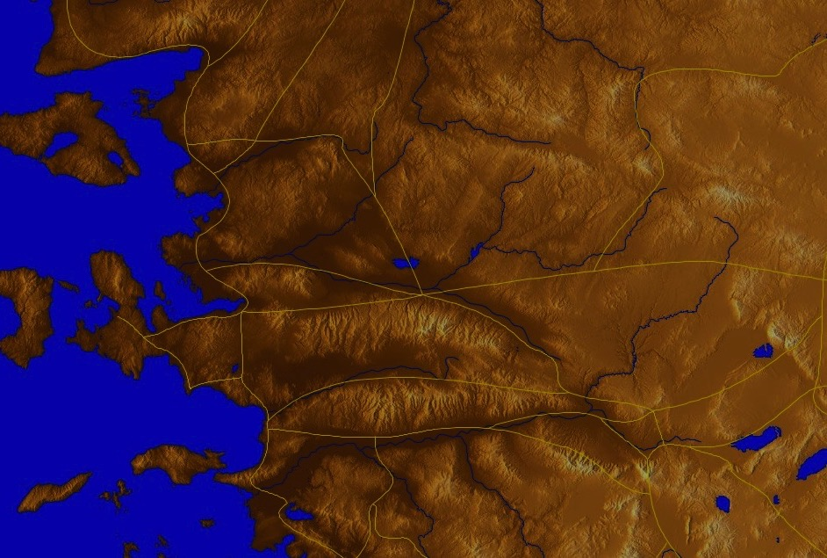
起源地/接收者
298-299
别 迦 摩
“被检选的夫人与
她的孩子" (v. 1)
推 雅 推 喇 城
撒 狄
士 每 拿
非 拉 铁 非
以 弗 所
老 底 嘉
Notes:
John wrote a woman to help her see how to live out the gospel in this difficult context.

Slide 66

谁是那“被检选的夫人与她的孩子"?
298-299
一个拟人化的形式为一个地方教会
居住在加利利的圣女玛丽亚
或许是一名匿名妇女与她的孩子, 曾打开他们的家做礼拜和安置旅行中的传教者。

Slide 67
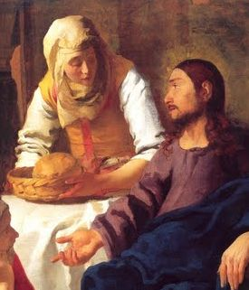
场合
299
在新约还没完成和在早期信徒之中完全流通之前，教会必须依靠旅行的传教者和老师来教导真理。
因为当时的旅店不安全，数量也很少, 所以这些老师就和基督徒住在一起。

Slide 68
场合
299
一个难以回答的问题是, “要怎么知道哪位老师可被允许进入他/她的家呢?"
约翰这封书信里针对这个问题作了个回应， 他命令一名好客的妇女，以“她的爱所设个极限” 来拒绝在安置假的老师或给他们任何鼓励。

Slide 69
你要怎么样活出福音?
两个方法…
约翰二书
Notes:
What ways can you apply the Good News of Jesus?

Slide 70
约翰二 1-6

Slide 71
I. 帮助传真道的人(1-6)。
约翰二书
Notes:
Support those preaching the right message about Christ (1-6).

Slide 72

平衡爱和真理
297
补充
“您所需要的只是爱...” (西皮四)
您同意这说法吗?为什么呢?
爱
真理
肉麻
平衡
严厉
爱
真理
爱
真理

Slide 73
“ 我这作长老的，写信给蒙拣选的夫人和她的儿女。你们是我在真理中所爱的；不单是我，凡认识真理的， ² 也因为真理的缘故爱你们。这真理在我们里面，也必与我们同在，直到永远。” (约贰1-2 CNVS).

Slide 74
“愿恩惠、怜悯、平安，从父 神和他儿子耶稣基督在真理和爱中与我们同在。
⁴ 我看见你的儿女中，有人照着我们从父领受的命令在真理中行事，我就非常欣慰。”
(约贰 3-4 CNVS).

Slide 75
“ 夫人哪，我现在请求你，我们要彼此相爱。我写给你的，不是一条新命令，而是我们从起初就有的。 ⁶ 我们要照着他的命令行事，这就是爱。你们从起初所听见的那命令，就是要你们凭着爱心行事。”
(约贰 5-6 CNVS).

Slide 76

"Share with God's people who are in need. Practice hospitality." Romans 12:13 (NIV)
"Now the overseer must be . . . hospitable" 1 Timothy 3:2 (NIV)
"Offer hospitality to one another without grumbling." 1 Peter 4:9 (NIV)

Slide 77
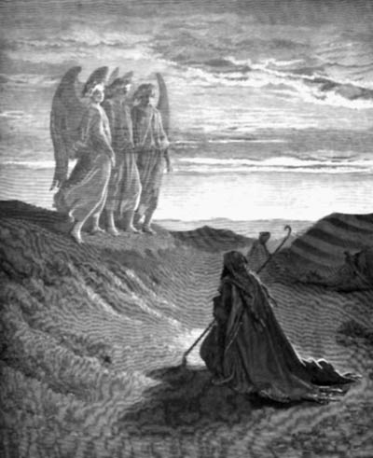
"不要忘了用爱心接待人，
有人就是这样作，
在无意中就款待了天使。"
希伯来 13:2 (CNV)

Slide 78
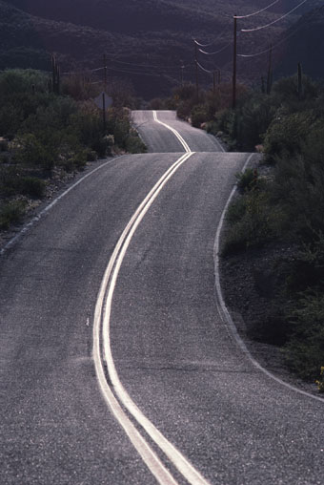
" 所以，无论我甚么时候到西班牙去，都希望趁我路过时和你们见面，先稍微满足我的心愿，然后由你们给我送行到那里去。"
罗马15:24 (CNV)

Slide 79
"我也许会和你们同住一些时候，甚至和你们一同过冬；这样，我无论要到哪里去，你们都可以
给我送行。"
林前 16:6

Slide 80
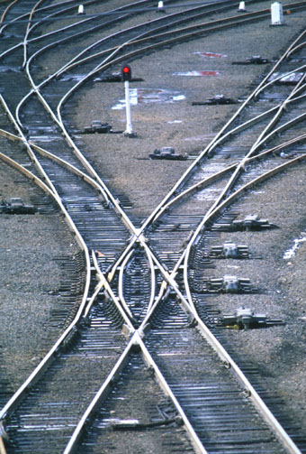
"你要尽力资助西纳律师和亚波罗的旅程，使他们不致缺乏。"
提多 3:13 (CNVS)

Slide 81
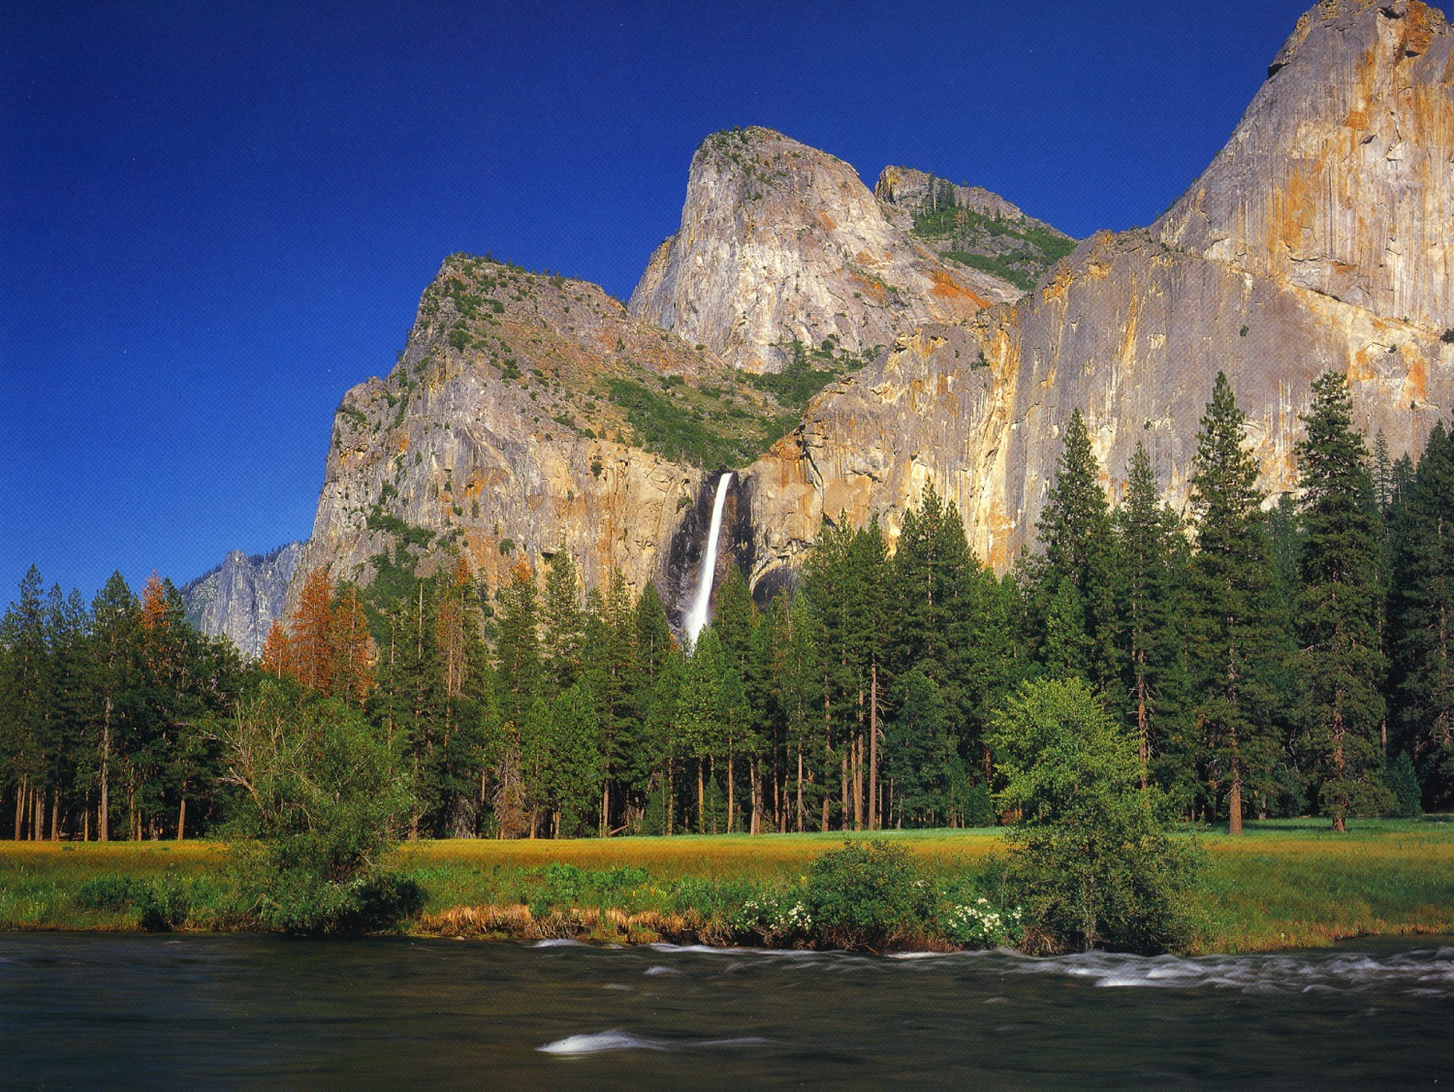
Didache 11:4 "Let every apostle, when he comes to you, be received as the Lord;"

Slide 82
Didache 11:5 "but he shall not abide more than a single day, or if there be need, a second likewise; but if he abide three days, he is a false prophet."

Slide 83
Didache 11:6 "And when he departs let the apostle receive nothing except bread, until he finds shelter; but if he asks for money, he is a false prophet."

Slide 84
Didache 12:1 "But let every one that comes in the name of the Lord be received; and then when you have tested him you shall know him"

Slide 85
Didache 12:2 "If the comer is a traveler, assist him, so far as you are able; but he shall not stay with you more than two or three days, if it be necessary."

Slide 86

"你们白白地得来，
也应当白白地给人。"
马太10:8 (CNVS)

Slide 87
"主为我们舍命，这样，我们就知道甚么是爱；我们也应当为弟兄舍命。"
约壹 3:16 (CNVS)

Slide 88
你要怎么样活出福音?
两个方法…
约翰二书
Notes:
What ways can you apply the Good News of Jesus?

Slide 89
I. 帮助传真道的人(1-6)。
约翰二书
Notes:
Support those preaching the right message about Christ (1-6).

Slide 90
约翰二 7-13

Slide 91
II. 避开传假道的人(7-13)。
约翰二书
Notes:
Do not support preachers of heresy (7-13).

Slide 92

“有许多欺骗人的已经在世上出现，他们否认耶稣基督是成了肉身来的；这就是那骗人的和敌基督的。”
(约贰 7 CNVS).

Slide 93
“你们要小心，不要拆毁我们已经完成的工作，却要得着美满的赏赐。 ⁹ 凡越过基督的教训又不持守的，就没有 神；持守这教训的，就有父和子了。”
(约贰 8-9 ＣＮＶＳ).

Slide 94
“如果有人到你们那里，不传这教训，你们就不要接待他到家里，也不要问候他； ¹¹ 因为问候他的，就在他的恶事上有分了。”
(约贰10-11 ＣＮＶＳ).

Slide 95
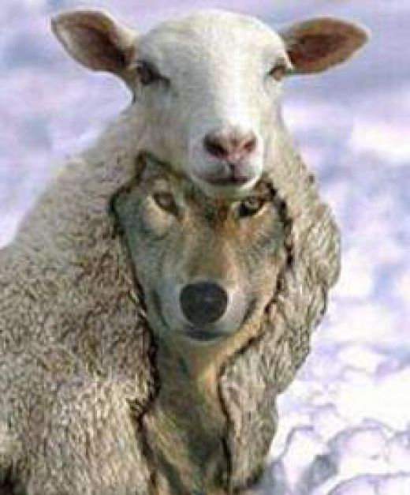
The Meaning of 2 John 10
Summary of Differing Views
304
Can False Teachers. . .
View Stay in Believers Homes? Enter Believers' Homes? Adherents
1 Yes Yes John R. Stott
F. F. Bruce
2 No Yes Stanley Toussaint
3 No ? I. Howard Marshall
B. F. Westcott
Robert Weldon Wilson
4 No No Rick Griffith

Slide 96

关键词/经文
297
关键词
极限
关键经文
凡越过基督的教训、不常守著的，就没有神；常守这教训的，就有父又有子。
若有人到你们那里，不是传这教训，不要接他到家里，也不要问他的安
(约翰二书第9至10节).

Slide 97
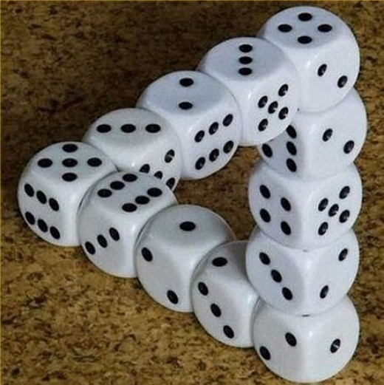
Too good to be true the-ology

Slide 98
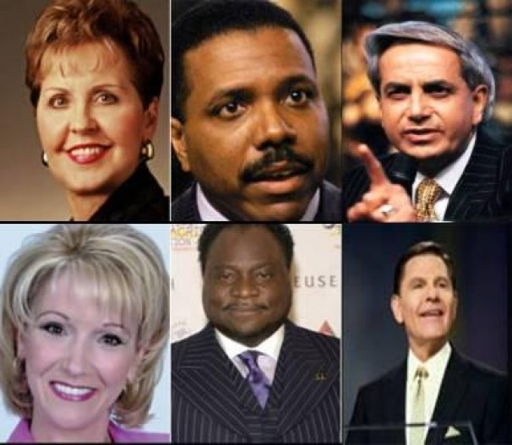
Joyce Meyers in her
$2 million jet, etc.

Slide 99

Oprah Winfrey

Slide 100
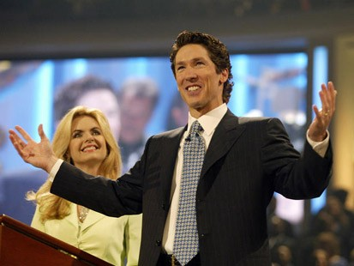
Joel Osteen
No preaching on sin
Led in prayer at gay "wedding"

Slide 101

Motivational Speaking
Magical prayers, feel good messages, have it your way theology; surely this is too awesome to be what Paul warned us about
http://www.conservativecut.com/blog/?tag=false-teacher
Notes:
http://www.conservativecut.com/blog/?tag=false-teacher

Slide 102
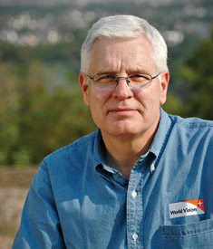
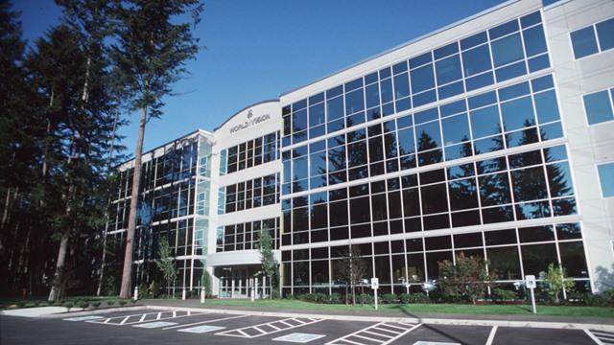
World Vision Controversy
CEO Richard Stearns
Notes:
World Vision Reverses Decision To Hire Christians in Same-Sex Marriages
(UPDATED) President Richard Stearns: 'Certain beliefs are so core to our Trinitarian faith that we must take a strong stand on those beliefs.'
Celeste Gracey and Jeremy Weber/ March 26, 2014
Only two days after announcing it would hire Christians in same-sex marriages, World Vision U.S. has reversed its ground-breaking decision after weathering intense criticism from evangelical leaders.
"The last couple of days have been painful," president Richard Stearns told reporters this evening. "We feel pain and a broken heart for the confusion we caused for many friends who saw this policy change as a strong reversal of World Vision's commitment to biblical authority, which it was not intended to be."
"Rather than creating more unity [among Christians], we created more division, and that was not the intent," said Stearns. "Our board acknowledged that the policy change we made was a mistake … and we believe that [World Vision supporters] helped us to see that with more clarity … and we're asking you to forgive us for that mistake."
http://www.christianitytoday.com/ct/2014/march-web-only/world-vision-reverses-decision-gay-same-sex-marriage.html accessed 8 April 2014

Slide 103
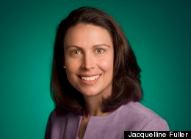
World Vision Controversy
Jacqueline Fuller
Notes:
World Vision board member quits over gay marriage hiring ban
Google's Jacqueline Fuller leaves Christian charity's board after it reverses decision to hire workers in same-sex marriages
Share 113
inShare0
Email
Associated Press in Seattle
theguardian.com, Thursday 3 April 2014 01.31 BST
Jump to comments (12)
A World Vision board member has resigned in protest after the Christian aid group quickly reversed its decision to hire employees in same-sex marriages.
Jacquelline Fuller, director of corporate giving for Google, said in an email to the Associated Press on Wednesday she remained a "huge fan" of the group's work on behalf of the poor, but she had resigned on Friday "as I disagreed with the decision to exclude gay employees who marry".
She declined to comment further.
http://www.theguardian.com/society/2014/apr/03/world-vision-board-member-quits-gay-marriage-hiring

Slide 104
约翰二书- 概略图
297
对爱的极限
援助真实的老师
避免假的老师
第1至6节
第7至13节
活在戒律中
以防伪造者
正面
反面
真理的展示
真理的保卫
以真理和爱的问安(1-3)
赞扬儿童的守纪 (4)
对爱的叮嘱(5-6)
禁止帮助假的老师(7-11)
期待的探望与问候(12-13)
以弗所
公元 85-95

Slide 105
Follow Up Relationally (12-13)
“我还有许多话要写给你们，可是我不想借用纸墨，只是盼望到你们那里当面谈谈，好让我们的喜乐充足。 ¹³ 你那蒙拣选的姊妹的儿女都问候你。”
(约贰 12-13 ＣＮＶＳ).

Slide 106
你要怎么样活出福音?
约翰二书
Notes:
What ways can you apply the Good News of Jesus?

Slide 107
主要思想
借着不帮助
阻碍福音的人
活出福音
约翰二书
Notes:
In 2 John 10 we see the teaching in a nutshell: Do not encourage false teaching in any way so you can live out the Good News!

Slide 108
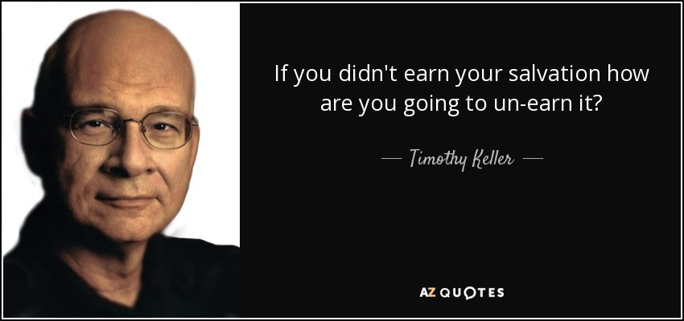
Salvation by Grace Cannot be Lost
"If you didn't earn your salvation, how are you going to un-earn it?"
—Timothy Keller—

Slide 109

祂应许持守的赏赐 (启示录 3:11b).
"我必快来！ 你要持守你所有的， 不要让人拿走你的冠冕。" (新译本)

Slide 110
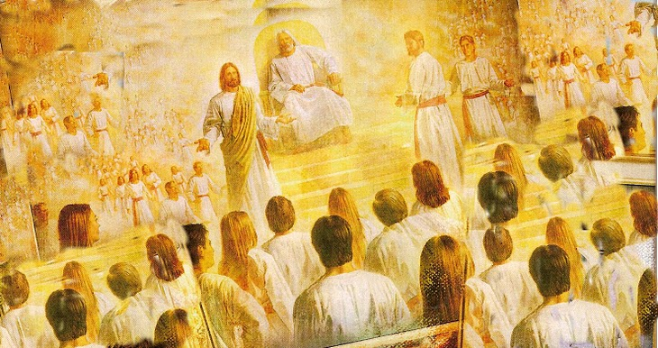
奖励可以丢失！
“请注意，你不要失去我们所努力的工，要勤奋，使你收到满足的赏赐。”（约翰二书第8节NLT）
"I have given you an open door that no one can shut" (3:8)

Slide 111
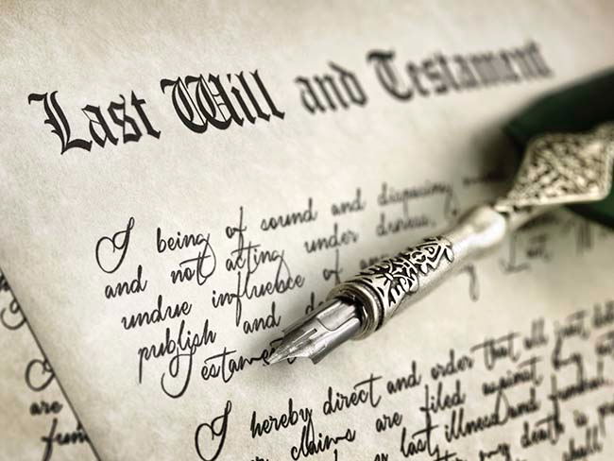
今日的产业

Slide 112

在基督里得着的产业

Slide 113

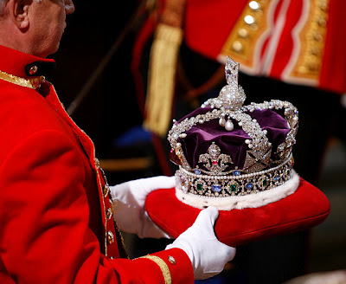
君尊义仆的末后统治
最终的命运
君尊义仆的末后统治
约瑟•迪洛

Slide 114
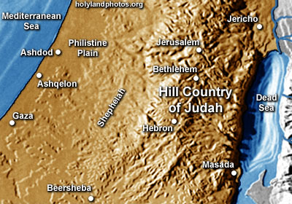
旧约中的产业
地中海
耶利哥
非利士
平原
耶路撒冷
伯利恒
阿士昆兰
犹大
山区
死海
加沙
希布伦
别士巴

Slide 115
旧约中的产业
1. 继承迦南地和居住在那里之间存在差异。 前者是指所有权，后者则指居所。
2. 虽然以色列作为一个国家被应许了产业，然而维护他们对迦南地的继承权的条件是信心，顺服和完成任务。 应许虽然是给整个国家的，但是只适用于有信心和顺服的余数人。
Joseph Dillow, Final Destiny, 56

Slide 116
Inheritance in the OT
旧约中的产业
产业不等同于天堂，而是天堂之外附加的东西，应许给那些忠实地顺服上帝的信徒。
4. 就如旧约里的信徒因为不顺服丧失了他们的地上的产业，我们也可能由于类似的原因丧失我们的未来的奖励（产业）。 但是，丧失产业并不意味着丧失拯救。
Joseph Dillow, Final Destiny, 56

Slide 117
Inheritance in the OT
旧约中的产业
5. 在旧约中两种产业可供享用。 所有相信的以色列人因信重生得了神作他们的产业，但不都继承土地。 这为一个概念铺平了道路，就是新约也教导两种产业的概念。 我们都是上帝的子嗣，但我们不是都与基督一同作联合继承人，除非我们坚忍到生命终了。 前者指的是我们的救恩，后者是对我们的奖赏。
Joseph Dillow, Final Destiny, 56

Slide 118
Inheritance in the OT
旧约中的产业
6. 一个以色列孩子凭借对上帝的信心而重生，即是上帝的继承人，也是迦南地的继承人。 然而只有那些以色列中忠实的信徒才能保持自己长子的地位，得到应许给他们的产业。
Joseph Dillow, Final Destiny, 56

Slide 119

新约中的产业

Slide 120
两种类型的产业
“即是儿女，就是继承人 – 是上帝的继承人和基督的联合继承者，如果我们真的分享他的痛苦，我们也必分享他的荣耀”（罗8:17）。
= 救恩
= 奖赏

Slide 121


在新约里的皇冠
不可朽坏
历代志上 9:25
希望
帖撒罗尼迦书2:19
公义
提摩太后书. 4:8
生命
雅各书 1:12;
启示录 2:10
荣耀
彼得前书5:4
Notes:
Rick Griffith, Eschatology notes, 189
2. What is the nature of the heavenly rewards? What will these rewards be like?
a. Rewards of Possession
1) Five crowns (stephanos) are noted as personal possessions in heaven (cf. p. 76). These crowns are not kingly crowns (diadems) but victor’s wreaths made of vines or leaves (or even gold and silver in the form of a garland or wreath):
An incorruptible crown is for those who master their flesh (1 Cor. 9:25).
A crown of hope or joy is for those who bore fruit in others’ lives for Christ (1 Thess. 2:19). This is sometimes called the soul-winner’s crown.
A crown of life is for believers who patiently endure trials and suffering (James 1:12; Rev. 2:10).
A crown of glory rewards spiritual shepherds who feed the flock (1 Pet. 5:4).
A crown of righteousness is for one longing for Christ’s return (2 Tim. 4:8).
b. Rewards of Responsibility (cf. W. A. Criswell and Paige Patterson, Heaven, 208-14)
1) In Luke 19:11-27 (Parable of the Ten Minas) Jesus taught that before going on a journey, a nobleman gave each of his ten servants the same amount of money—one mina each. Upon returning, the master rewarded each accordingly with differing degrees of responsibility based on their faithfulness.
2) Matthew 25:14-30 (Parable of the Talents) records a similar story, except each man received a different amount of money to invest for his master (the one who buried his master’s money depicts an unsaved man, v. 30). This parable also depicts varying degrees of reward: “His master replied, ‘Well done, good and faithful servant! You have been faithful with a few things; I will put you in charge of many things. Come and share your master’s happiness’” (v. 21).
2) We too often view ownership as sinful, though this is not scriptural.
a) As joint-heirs with Christ (Rom. 8:17; Heb. 1:2), we own what He owns! This is joint-ownership in a communal sense but “to deny private property inevitably ends in denying privacy” (Gilmore, 302) much like the mystical idea of blending into the “Total One.” Ownership in heaven will not include the sinful possessiveness of earth.
b) We have a heavenly inheritance which is “imperishable and undefiled, and will not fade away, reserved in heaven for you” (1 Pet. 1:4 NASB).
3. However, a recent article argues against levels of reward (Craig L. Blomberg, “Degrees of Reward in the Kingdom of Heaven?” Journal of the Evangelical Theological Society 35 [June 1992]: 159-72). He provides some interesting thoughts:
a. The vineyard worker parable teaches that each worker received the same pay no matter how long he worked (Matt. 20:1-16). This teaches that all believers are rewarded equally since all receive pay by grace. The ending, “the last shall be first, and the first, last” (v. 16), means that all positions in heaven are interchangeable.
Response: Do they indeed receive pay by grace? In each case the pay was for work, not faith. The main point that “the last shall be first, and the first, last” (v. 16) may better indicate that God’s system of ranking people in heaven differs from that which man uses on earth.
b. Scholars do not agree on the form these differing heavenly rewards will take. Suggestions include capacity for service, added responsibilities, degree of bliss, possessions, and an enriched relationship with God.
Response: Our ignorance of the type of reward does not deny its existence (see preceding discussion for more details on types of reward).
c. If heaven is perfection, how can there be varying degrees of perfection?
Response: This may seem inappropriate from our vantage point since we are not God, but he has made many perfect things which differ in quality even in our present world. For example, plants are perfectly made yet less durable than jewels.
d. Blomberg considers passages generally used to teach rewards not convincing.
1) The crown passages speak of the reward of eternal life itself, not something in addition to it (1 Cor. 9:25; 1 Thess. 2:19; 2 Tim. 4:8; Jas. 1:12; 1 Pet. 5:4). [But this does not seem to be the normal reading of each passage.]
2) The texts about those who are the “least” or “greatest” relate only to the “present aspects of the kingdom” (Matt. 5:19; 11:11; 18:4; Mark 9:34-35; Luke 9:48). [No, for people here are compared with the least of the people there.]
3) The quality of each man’s works and their rewards (1 Cor. 3:11-15) relates to degree of shame or satisfaction at the judgment (cf. 1 John 2:28), not the lasting results of it which persist for all time in an everlasting hierarchy. [Even this is not correct, since verse 14 declares that “if what he has built survives, he will receive his reward.” It is true that the nature of the reward is not stated, so the belief that it is merely momentary satisfaction may be true or false—no one knows. However, 2 Corinthians 5:10 does indicate that each will be judged for his deeds and “will receive what is due him.”]
Other arguments of Blomberg should be considered. This article is worth reading. Perhaps we need to re-evaluate long-held views in this area.

Slide 122
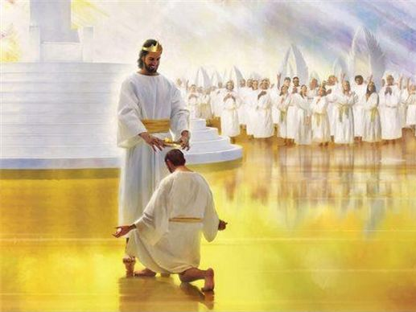
"不再有黑夜了，他们也不需要灯光或日光了，因为主 神要光照他们。他们要作王，
直到永永远远。"
(22:5 CNV).

Slide 123

神施加的管教

Slide 124

得胜者 (启示录 2–3)
326
别迦摩
推雅推喇
2:17
2:26
得胜的，
我要叫他在我神殿中作柱子，也必不再从那里出去。我又要将我神的名和我神城的名（这城就是从天上、从我神那里降下来的新耶路撒冷），并我的新名，都写在他上面。
(3:12)
士每拿
撒狄
2:11
3:5
以弗所
非拉铁非
2:7
3:12
老底嘉

Slide 125

我们会与主一同作王！

Slide 126
老底嘉(启示录. 3:14-22)
326
承诺
得胜的,我必将神乐园中生命树的果子赐 给他吃。
警告
没有!
别迦摩
箴言
向主买火炼的金子，买白衣穿上，买眼药。
要发热心，
要悔改。
推雅推喇
指责
既如温水,
也不冷也不热
困苦，可怜，贫穷，瞎眼，赤身
基督：
那为阿们的,为诚信真实见证 的,在神创造万物之上为元首的
称赞:
没有!
士每拿
撒狄
以弗所
非拉铁非
老 底 嘉
Notes:
http://www.truthwhys.com/news/revelation-part-15-chapter-3-sardis-philadelphia-and-laodicea/ has many good historical notes

Slide 127
得胜者 (启示录 2–3)
326
别迦摩
推雅推喇
2:17
2:26
得胜的，
我要叫他在我神殿中作柱子，也必不再从那里出去。我又要将我神的名和我神城的名（这城就是从天上、从我神那里降下来的新耶路撒冷），并我的新名，都写在他上面。
(3:12)
士每拿
撒狄
2:11
3:5
以弗所
非拉铁非
2:7
3:12
老底嘉

Slide 128

你准备好统治世界了吗？

Slide 129

基督的通知
诗篇 2:8-9 被引用在 启示录 2:27

Slide 130




将 来 的 恩 惠 (19-20章)
天 堂
(21-22 章)
千 禧 年
(20 章)
再 來
(19 章)
Dr. Rick Griffith • 博士 • 新加坡神学院 • BibleStudyDownloads.org
Notes:
These 2 slides translated into Chinese using Google translator: 36, 149

Slide 131
启 示 录 20:4
⁴ 我又看见几个宝座、也有坐在上面的、并有审判的权柄赐给他们．我又看见那些因为给耶稣作见证、并为 神之道被斩者的灵魂、和那没有拜过兽与兽像、也没有在额上和手上受过他印记之人的灵魂．他们都复活了、与基督一同作王一千年。

Slide 132
“岂不知圣徒要审判世界么?”
(林前六2上)

Slide 133

“我们若能坚忍，
就必与他一同作王”
(提后2:12 ＣＮＶＳ)

Slide 134

"得胜的， 我必定赐他和我一同坐在我的宝座上， 正像我得了胜和我父一同坐在他的宝座上
一样"
(启示录3:21
新译本 ).

Slide 135
然而，仍然有神的管教。。。

Slide 136


亚拿尼亚与撒非拉
使徒 5

Slide 137

信徒可以被“取消资格”
"难道你们不知道，在场上赛跑的人，虽然大家都跑，但得奖的只有一个人吗？你们都应当这样跑，好叫你们可以得奖。 ²⁵ 凡参加运动比赛的，在一切事上都有节制；他们这样作，不过要得到能坏的冠冕，我们却是要得不朽的冠冕。
²⁶ 所以我奔跑，不是没有目标的；我斗拳，不是打空气的。 ²⁷ 我要克制自己的身体，叫身体服我，免得我传了给别人，自己反而落选了。“
(林前 9:24-27 CNV).

Slide 138

格林多前11:27-29 (ＣＮＶＳ)
因此，无论甚么人若用不合适的态度吃主的饼，喝主的杯，就是得罪主的身体、主的血
了。 ²⁸ 所以人应当省察自己，然后才吃这饼，喝这杯。 ²⁹ 因为那吃喝的人，如果不辨明是主的身体，就是吃喝定在自己的身上的罪了。
Notes:
138

Slide 139
格林多前11:30-32 (ＣＮＶＳ)
³⁰ 因此，你们中间有许多人是软弱的，患病的，而且死了（“死了”直译作“睡了”）的也不少。 ³¹ 我们若仔细省察自己，就不会受审判了。 ³² 然而我们被主审判的时候，是受他的管教，免得和世人一同被定罪。
Notes:
139

Slide 140

有至于死的罪 (约壹 5:16-17 CNVS)
“如果有人看见弟兄犯了不至于死的罪，他就要祈求， 神必因他的缘故，把生命赐给那些犯了不至于死的罪的人；有至于死的罪，我不说他应当为那罪祈求。 一切不义都是罪，但也有不至于死的罪。”

Slide 141

所有的信徒都要穿上基督的公义。

Slide 142

所有的信徒都会享受天堂。

Slide 143

耶稣会审判世界。

Slide 144

耶稣会奖励忠实的信徒。

Slide 145

活出你的未来！

Slide 146
你要怎么样活出福音?
两个方法…
约翰二书
Notes:
What ways can you apply the Good News of Jesus?

Slide 147
主要思想
借着不帮助
阻碍福音的人
活出福音
约翰二书
Notes:
In 2 John 10 we see the teaching in a nutshell: Do not encourage false teaching in any way so you can live out the Good News!

Slide 148
概述
300-301
I. (1-6) 约翰用真理和爱来鼓励一名妇女,为了他对她后来的谴责作准备。
II. (7-13) 约翰警告妇女不要帮助假的老师,并且帮助她认清她的爱是有极限的。

Slide 149
I. 帮助传真道的人(1-6)。
约翰二书
Notes:
Support those preaching the right message about Christ (1-6).

Slide 150

Well, Charles, when I baptize you…

Slide 151

Everything that goes under belongs to God.

Slide 152


Slide 153

"接待你们的，就是接待我；接待我的，就是接待那差我来的。"
马太 10:40 (ＣＮＶＳ)
"无论谁因门徒的名，只把一杯凉水给这些微不足道的人中的一个喝，
我实在告诉你们，他决不会得不到他的赏赐。
"
马太10:42 (ＣＮＶＳ)

Slide 154

主也曾这样吩咐，叫传福音的人靠福音为生。
林前 9:14 (ＣＮＶＳ)

Slide 155
在圣道上受教的，应该和施教的人分享自己的一切美物。
加拉太 6:6 (ＣＮＶＳ)

Slide 156

弟兄们，你们应该记得我们的辛苦和劳碌；我们把 神的福音传给你们的时候，怎样昼夜作工，免得你们有人受累。
贴前 2:9 (ＣＮＶＳ)

Slide 157

下战场的得多少，留守武器的也得多少，应当大家平分。
撒母耳记上 30:24
(ＣＮＶＳ)

Slide 158

我并不求礼物，只求你们的果子不断增加，归在你们的帐上。
腓立比 4:17 (ＣＮＶＳ)

Slide 159

因为 神并不是不公义，以致忘记了你们的工作，和你们为他的名所表现的爱心，就是你们以前服事圣徒，现在还是服事他们。
希伯来 6:10 (ＣＮＶＳ)

Slide 160
II. 避开传假道的人(7-13)。
约翰二书
Notes:
Do not support preachers of heresy (7-13).

Slide 161
关键词/经文
297
关键词
极限
关键经文
凡越过基督的教训、不常守著的，就没有神；常守这教训的，就有父又有子。
若有人到你们那里，不是传这教训，不要接他到家里，也不要问他的安
(约翰二书第9至10节).

Slide 162

总结报告
300
约翰劝勉以有限的爱来招待传教士的那位好客的基督徒妇女和她的孩子,但也警告她不要以同样热诚来招待假的老师以便援助传播具有破坏性的异端邪说。

Slide 163


Noah
Shadowed

Slide 164


Noah
因为人们没有保护好环境，所以地球必须被毁灭

Slide 165

自无神论的制片人 达伦 阿罗诺夫斯基
“最不符合圣经的圣经题材电影”
Notes:
"Russell Crowe hits 'Noah' critics: 'Bordering on absolute stupidity'". The Washington Times. March 27, 2014. Retrieved March 27, 2014; cited at Wikipedia, "Noah (movie)."

Slide 166

Noah
基督徒因该看吗?

Slide 167

对电影“诺亚”的赞美
“聚焦在家庭” 主席吉姆 达利 说道:
“[诺亚] 是对于经文具有创意的诠释使得我们可以 想象诺亚深深的挣扎 对于诺亚回应上帝对他在他生命中的呼召. 这部电影版本的诺亚的故事给了我们基督徒一个很好的机会给我们的这个世代的文化来展现一个符合圣经经文的诺亚 并且和我们的朋友还有家庭吗来讨论关于永恒的意义。”
https://en.wikipedia.org/wiki/Noah_%282014_film%29#Test_screenings
Notes:
http://www.refiningtruth.com/noah-genesis-6-facts/

Slide 168

对电影“诺亚”的批评
肯 哈姆(创世纪的解答者):
“除了一些名字的记载…我们很难发现有关圣经创世纪第6章至第9章的内容出现在电影中。 是的, 电影里出现了方舟，并且在圣经中出现了很多次, 但是电影里的方舟看起来不可以航行. 有很多的动物进入方舟, 但是有太多的动物挤进去了, 确实比所需的还要多。”
http://time.com/42274/ken-ham-the-unbiblical-noah-is-a-fable-of-a-film/

Slide 169
信徒怎么帮助异端?
297
鼓励迭代异端
把钱交给邪教 (视频传道士等)
买异端的书籍
观看违背圣经的电影
从假传道士接收文献
约翰二书

Slide 170

What Does All This Mean?
297
You are a watchtower!
Don't contribute to or encourage in any way Buddhism, Islam, Hinduism, Mormonism, Jehovah's Witnesses or any other false religion.

Slide 171
Black

Slide 172


新约全书讲章 • BibleStudyDownloads.org
免费获得该讲解!
圣经学习下载
Notes:
The explanation for free
NT Preaching link address

Slide 173

标题
298
希腊原文的标题(vIwavnnou b 约翰的第二部)
是跟普通书信的命名方式为标准, 先以作者的名字然后与其他约翰的书信作区别。

Slide 174
作者
298
外在证据
教会传统长期视这封书信是出自于使徒约翰的手笔。他是亞西亞的以弗所教会的领导也是约翰福音, 约翰一书,约翰三书和启示录的作者。
内在证据
“长老”的称呼(v. 1)一直被认为是使徒约翰的另一种称呼直到自由主义学者 的出现。
爱、喜悦、真理, 和反基督者的题材, 约翰一书和 约翰福音有非常相似对重点。

Slide 175


特征
299
这封信件在圣经里是最短第二的本书
这是唯一针对妇女的新约信件。
第10节是这封短的信件里最有争议性的。所争议的事包括是否应该允许假的老师:
  (1) 留居在信徒的家中,
  (2) 只是进入他们的家, 或
  (3) 两者都不。
  第三种的看法是普遍的看法,以便信徒在最轻微的程度上也不会被介入促进假的教学的工作上。

Slide 176

论据
299
约翰的第二封书信警告妇女不要过于热忱的好客反而提供寄宿给假的老师,这样才不会帮助传播他们具有破坏性的教意。
他那平衡了真理和爱的问候说明了这点, 他也随着称扬妇女平衡了爱与真理的重要性。
其次在信件随着而来的主要教导是要警告当她展示她的爱时要有辩明的极限,这样才能拒绝假的老师。

Slide 177

综合
300
对爱的极限
1-6 援助真实的老师
7-13 避免假的老师

Slide 179
新约全书链接地址 BibleStudyDownloads.org
免费获得该讲解!
圣经学习下载
Notes:
NT Survey link: http://biblestudydownloads.org/resource/%e6%96%b0%e7%ba%a6%e5%85%a8%e4%b9%a6/

