Slide 1

约翰一书
以爱守纪来与早期的诺斯底主义交战
Rick Griffith 博士 • 新加坡神学院 • BibleStudyDownloads.org

Slide 2
关键字
290
爱
约翰一书

Slide 3
主题
23
在爱中顺服可抵抗
早期诺斯替教主意
约翰一书

Slide 4
关键节
290
“我把这些事写给你们，是指着那些欺骗你们的人说的… 孩子们，你们要住在主里面。这样，他若显现，我们就可以坦然无惧；他来的时候，我们也不至惭愧地躲避他了。”
(2:26, 28)。
约翰一书

Slide 5
总结概要
290
约翰写了一封笼统的书信，鼓励他的读者通过爱他人来顺从上帝的命令，以保护他们免受早期的诺斯底主义的影响，诺斯底主义否认基督的神性或人性。
约翰一书

Slide 6

国度陈述
27e
290
约翰一书双重的主题，顺服(1:1–2:29; 5:4-21) 及爱(3:1–5:3) 最好体现出基督的国度在我们生命中正面的影响。
约翰一书

Slide 7

圣约陈述
27e
新约的真理在我们的言行举止中最能够体现出来 (4:7-21)。
约翰一书

Slide 8

救赎陈述
27e
耶稣是“为我们的罪、也是为普天下人的罪”的挽回祭 (2:2), 使我们的救赎有保障与确据 (5:13-15)。
约翰一书

Slide 9
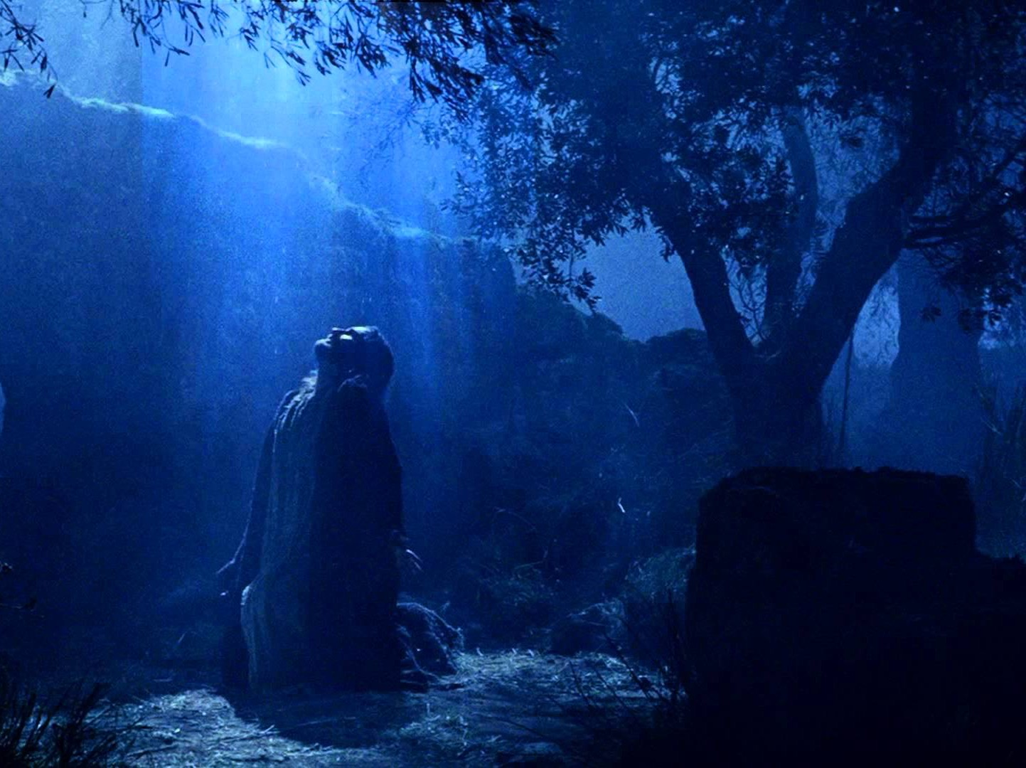
预言
(主, 神性)
27e
信靠基督是主会使人服从神与彼此相爱，便能抵挡早期诺斯替教主意与任何否认耶稣是主的异端 (2:26)。
约翰一书

Slide 10
约翰一书大纲
290
以爱守纪来与早期的诺斯底主义交战
守纪的必要
爱的特征
守纪的好处
1–2 章
3:1–5:3
5:4-21
基督的人性
守纪的前提
守纪的妨碍
不犯罪
不恨信徒
有慈心
对上帝有信心
服从使徒所教
关心信徒
服从上帝的命令
对世界的胜利
得救的保证
祷告的教导
从罪孽中解放
对上帝的保真
以弗所对小亞西亞的教会
公元85至95年间

Slide 11
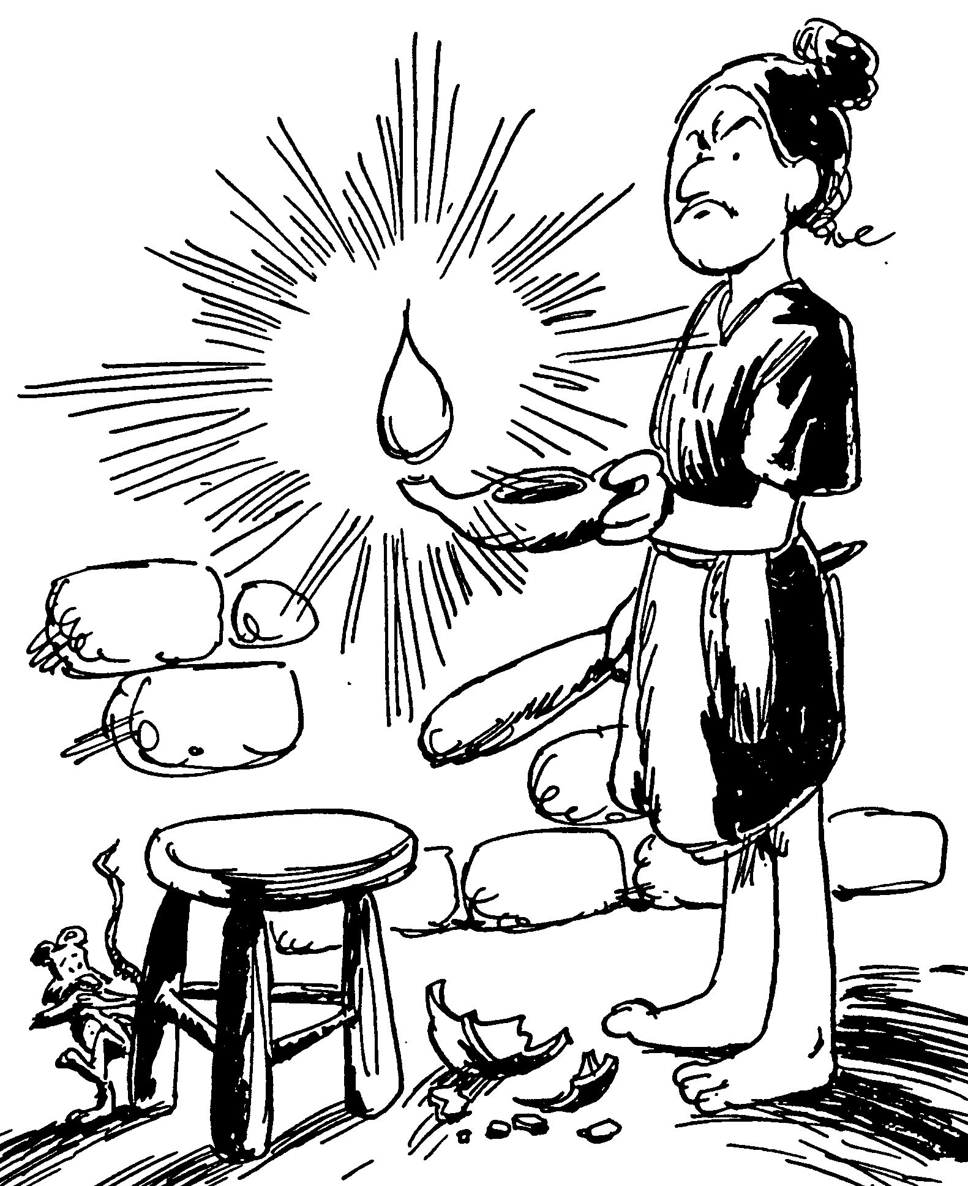
Acrostic Bible – 1 John
活在光中
保惠师的重要性
上帝的儿女远里罪恶
基督徒如何相爱
信徒的见证
约翰一书
巴里 赫德尔斯顿 《藏头诗圣经》

Slide 12
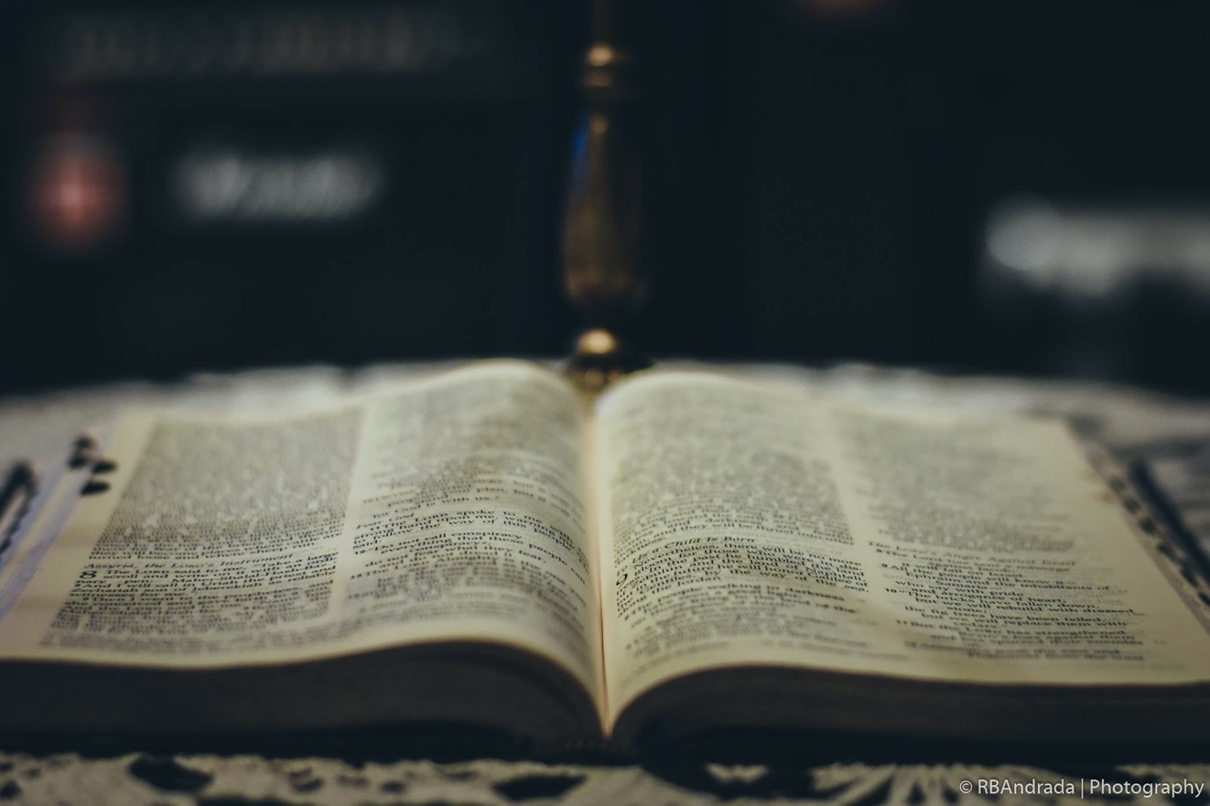
要互相服从
约翰一书
Rick Griffith 博士 • Crossroads International Church Singapore
BibleStudyDownloads.org

Slide 13
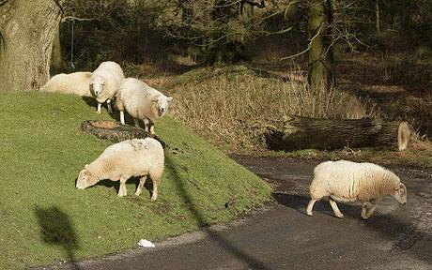
羊趋向迷失方向
约翰一书
Notes:
ARIAL

Slide 14
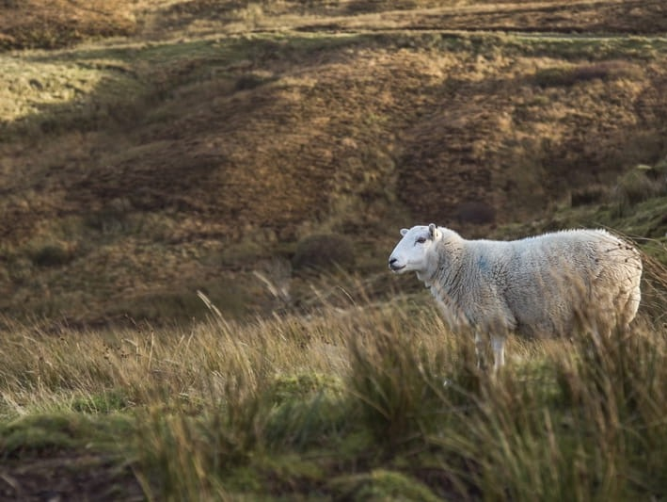
怎么不因为假教诲而
迷失方向?
约翰一书
Notes:
• The first letter from the Apostle John tells us • three key ways that we can stop losing our way—wandering off, drifting—like sheep.

Slide 15

I. 遵守 神的命令(1–2).
  相信基督是全人，得着团契与喜乐
  (1:1-4)。
  依靠耶稣 (1:5–2:14)。
  避开顺服的两个障碍，
  抵挡早期的诺斯底主义
  (2:15-29)。
约翰一书
Notes:
Follow what the Lord says so you won’t stray away (1 John 1–2 restated).

Slide 16

II. 爱 他人(3:1–5:3)。
  不要犯罪 (3:1-10)
  不要恨恶信徒 (3:11-15)
  要有恻隐之心 (3:16-20)
  要在神的面前有信心 (3:21-24)
  要顺从使徒的教导 (4:1-6)
  要关心照顾信徒 (4:7-21)
  要遵守神的命令 (5:1-3)
约翰一书
Notes:
Live for other people instead of for yourself, which is a key trait of false teaching (3:1–5:3 restated).

Slide 17

服从的好处:
III. 要明白只有借着服从才能得到你真正需要的东西(5:4-21)。
胜过世界(5:4-5)
得救的确据(5:6-13)
祷告受指导 (5:14-17)
从惯常的罪中得释放 (5:18-20)
避开偶像忠于神 (5:21)
约翰一书
Notes:
When you do what God says, you get your true needs met (5:4-21 restated).

Slide 18

主要思想
若是你服从神与彼此相爱，
你就会拥有你真正所需要的，
就不会听信家教诲。
约翰一书
Notes:
We stay on track spiritually and benefit greatly by obeying God and loving each other (commands restated).

Slide 19
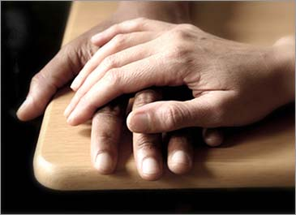
应用
290
您应该怎样对其它信徒显示爱以便异端邪说无法盾形?
您知道谁需要看见基督徒的爱被显示才会从假的教学中回头?
约翰一书

Slide 20
Black

Slide 21
标题
291
希腊原文的标题
(vIwavnnou av 约翰的第一部)
是跟普通书信的命名方式为标准, 先以作者的名字然后与其他约翰的书信作区别。

Slide 22
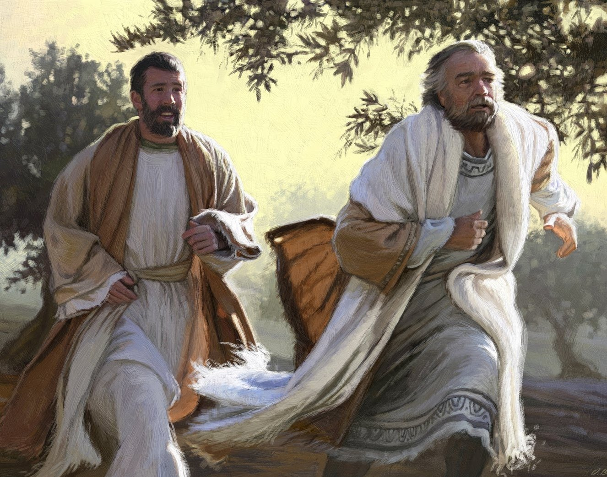
"彼得和那门徒就动身，到坟墓那里去。 ⁴ 两个人一齐跑，那门徒比彼得跑得快，先到了坟墓"
(使徒 20:3-4 CNV).
使徒约翰

Slide 23
作者
291
外在证据
约翰一书这信件在所有普通书信中最被证实的
证据显示约翰为作者在这边书信形成的初期就被接受了，从约翰同时期的20 年左右，泊李克布(Polycarp) 。伊仍尼亞司(Irenaeus) 曾经引述约翰的这封书信也相信那是约翰所作的。许多其它早期教会的教父也接受了约翰为作者,比如: 亚历山大的革利免Clement (公元 155-215) ，特拖伦(Tertullian) (公元 150-222) ，欧李根Origen (公元 185-253) ，司皮来恩Cyprian (公元 200-258) 并且所有拉丁和希腊教父。磨拉敦的经文系列Muratonian Canon和敘利亞(Syriac)的早期版本都认定为约翰为约翰一书的作者。

Slide 24
作者
291
外在证据
约翰一书这信件在所有普通书信中最被证实的
主要反对的看法是:
  或许是另外一位叫约翰的长老所写
  也或许是约翰的门徒所写的。这是因为袙皮亞司（Papias） 似乎把长老约翰和使徒约翰做了分别; 但是,他也在别处使用长老这个词汇来代表使徒,因此这两者也应该被解释为同一人。

Slide 25
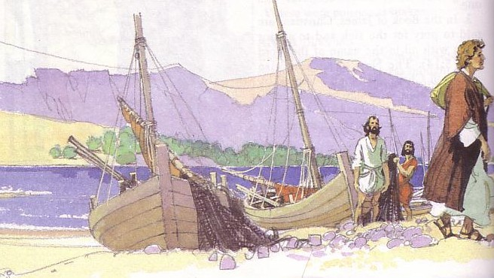
作者
291
内在证据
书信的内容强烈的支持约翰为作者的传统。
他的名字虽然不被提及,但是他以目击者(1:1-4)的权威显示于他那断言他话语 (2:19; 4:6 ,14) 。
这书信的手法和第四本福音书非常相似。
论到从起初原有的生命之道，就是我们所听见、所看见、亲眼看过、亲手摸过的。
(约翰一书第1章第1节)

Slide 26
日期
291
多数保守的学者把约翰一书的著作日期定为公元80-97 年间,而自由主义者把作日期定位公元90-110 年以后。
书信不提及任何在多米天(Domitian)的王朝(公元81-96 期间)的迫害。
这也许建议一个在公元81年之前或在公元96 年之后的著作日期。无论如何，约翰在他写这树信时, 他已是一位八十多岁或更老的老人了。
这课程所使用的日期是公元85-95年间因为它应该是在启示录之前写的(公元95-96)。

Slide 27
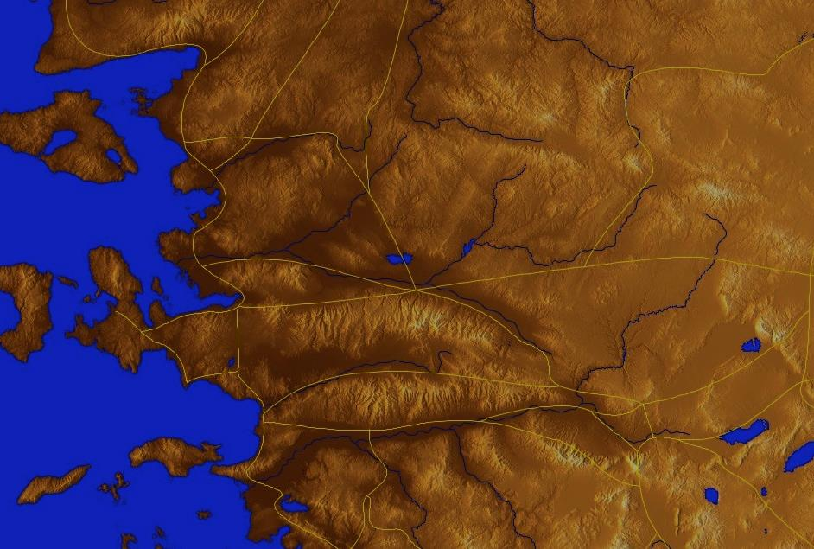
起源地/接收者
335
保留自己,远离偶像的箴言(5:21)证实这传统因为偶像在异教的西腊-罗马文化是著名,但在巴勒斯坦却
是罕见的。
别 迦 摩
推 雅 推 喇 城
撒 狄
士 每 拿
非 拉 铁 非
以 弗 所
老 底 嘉
Notes:
These 7 churches were neither the largest, nor the most influential cities in Asia Minor. However, they were strategically located on a key highway that linked them all.
[Animate} From their own locations we understand that they also copied the prophecy and sent these copies to other churches near them.

Slide 28
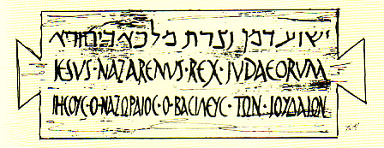
场合
291
虽然诺斯底主义还没有发展到它的最糟糕的形式直到第二世纪，而诺斯底主义的一个早期的形式就显现在这封信件里。
诺斯底主义有二个基本的异端元素:
智力(灵知的) 的极端启发, 和
它的信仰是万物都是邪恶的。

Slide 29
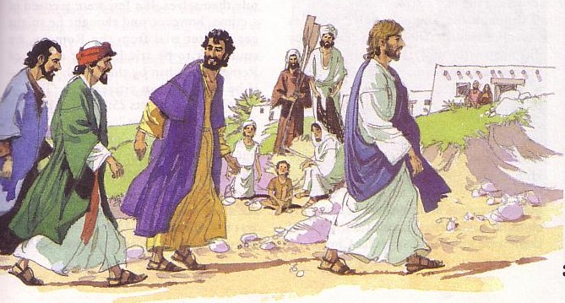
场合
291
约翰与相信神秘直觉论的交战以二种形式在他的信件里显现:
多司底(Docetic)的诺斯底主义否认了基督的任性(4:2-3) ，说他只似乎是个人，因此约翰写道，他实际上接触了耶稣(1:1) 。
司林多的(Cerinthian)诺斯底主义否认了基督是神。司林多Cerinthus他居住在约翰所居住的亞西亞附近, 他所教的是, 耶稣是一个凡人,唯有在他的洗礼时“基督” 下降于他,但在他的被钉死在十字架上之前离开了他。约翰的回复是, 耶稣基督是为着水(他的洗礼) 和血(他的死亡)而来的, 如此并反驳了司林多Cerinthus。

Slide 30

场合
291
诺斯底主义的实际外在表现也分成为二个阵营。
某些诺斯底主义者认为万物都是邪恶的, 应该不惜一切代价来避免它, 造成禁欲主义。在他的信件约翰试图击败禁欲主义,以鼓励信徒之间的团契关系 (1:7) 。
其它的诺斯底主义者是宿命的。他们认为因为既然无法改变万物皆邪恶的事实, 所以任合一种不道德的变型都是可接受的。约翰具体地回应了这后者的哲学。他的信件显示了那尊守上帝的命令, 特别是通过爱其他人, 是最佳的反击相诺斯底主义的实际行动。他也并且以赞扬守纪和正义来寻求击败淫邪。

Slide 31
特征
292
绝对声明(如, 3:6) 。
遵守在基督里可从服从上帝的命令和对兄弟的爱看得清楚(2:28-4:16) 。
有丰富的相对教学法(相反平行性), 因为约翰看一切事物不是黑色就是白色。
手法非常简单却有深奥的意思。概念频繁被重覆但却不单调。
它惊奇的没有一个旧约的引文,最多也只是引用了一个事件(该隐, 3:12) 。

Slide 32

总结报告
293
约翰写这封普通信件来鼓励他的读者服从上帝的命令去爱其他人是为了保护他们免受早期的诺斯底主义的教导而否认基督的神性或人类的。

Slide 33
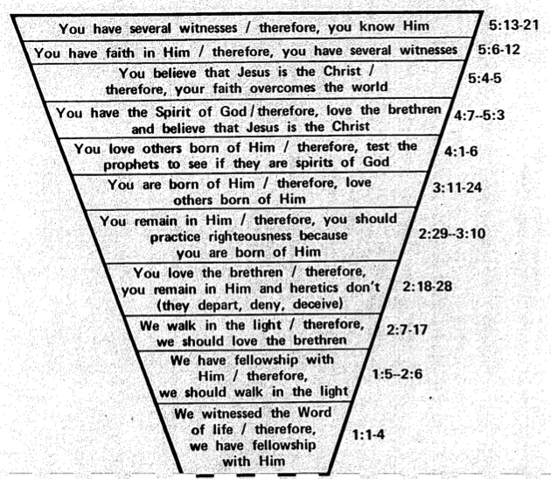
Ascending Spiral Structure in 1 John
295
Therefore, you know Him
5:13-21
Therefore, you have several witnesses
5:6-12
Therefore, your faith overcomes the world
Therefore, since you have the Spirit of God, love the
brothers and believe that Jesus is the Christ
5:4-5
4:7–5:3
Therefore, test the spirits to see if they are
spirits of God
4:1-6
Therefore, you love others born of Him
3:11-24
Therefore, you should practice righteousness
because you are born of Him
2:29–3:10
Therefore, you remain in Him
while heretics depart, deny & deceive
2:18-28
Therefore, we should
love the brothers
2:7-17
Therefore, we should
walk in the light
1:5–2:6
Therefore, we have
fellowship with Him
Edited from Roy Zuck's Adaptation of Lenski
1:3-4
We witnessed
the Word of life
1:1-2

Slide 34
概述
293-294
I. (第1-2章) 约翰嘱咐他的读者在守纪生活的前提下,他们不会容易地被早期的诺斯底主义的教学和实践误入歧途。
II. (第3章第1节-第5章第3节) 约翰肯定充满爱的生活的特征让他的读者真正地爱可以作为防御诺斯底主义的教学和实践。
III. (第5章第4节-第21节) 约翰许诺守纪生活的后果激发了他的读者以服从地生活来面对早期的诺斯底主义。

Slide 35

论据
约翰的信件有至少以下五个目的:
促进团契关系(1:3),
使喜悦充足(1:4),
保护神圣性(2:1),
防止异端邪说(2:26),
293

Slide 36
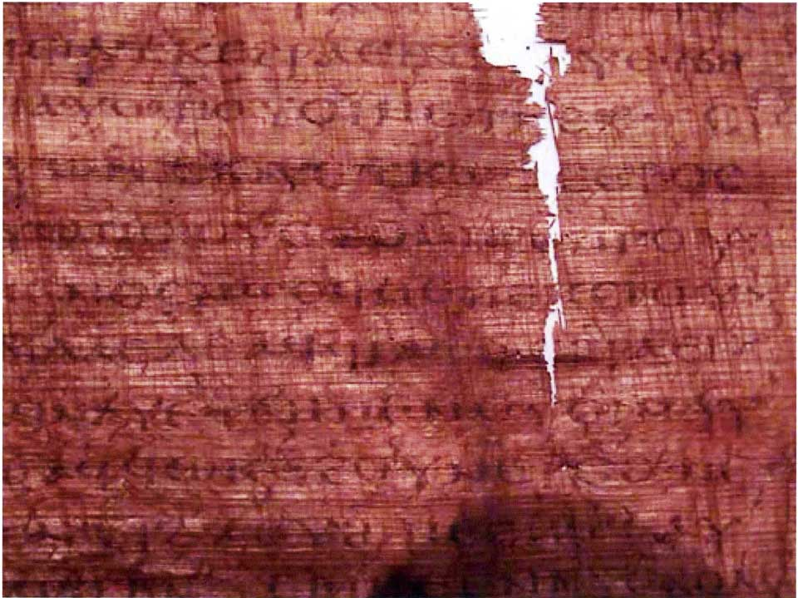
犹大的福音书
犹大说, “师傅，我的子孙是在统治者的控制下吗?” 耶稣回答道, “当你看到天国和所有它的后代时，你会很伤心….” 当他听到这，耶稣对他说, “好的是：我已经接收到它，因为你让我分开那后代.”,耶稣回答道“你将成为第十三位, 你将被其他后代诅咒—你将来控制他们. 最后他们将诅咒你向圣堂的攀爬 [47] [后代].”

Slide 37
犹大的福音书
犹大对耶稣说, “看, 那些名义上被洗礼的人将要做什么?”耶稣说, “… 告诉你实话,犹大, 他们提供祭品给 Saklas [...]上帝 [—三行丢失—] 每样东西都是邪恶的. 但你更胜一筹.因为你将献上为我提供衣服的人为祭品.”

Slide 38

爱任纽
(公元 180)
186b
1. 此外，另一些人宣称该隐的存在来自天上的大能者，有说以扫、可拉、所有玛人和所有这样的人都与他们自己有关。 他们又说：因此他们受到创造者攻击，但是他们之中没有一个受伤。 苏菲亚从他们当中拿走属于她自己的，拿到自己那里。 他们宣称叛徒犹大彻底知悉这些事，而他比任何人都知道真理 ，只有他成就了背叛耶稣这个奥秘。 这样，地上和天上的一切事情都被他搞乱了。 他们按着这种说法捏造出一本虚构的历史书，他们叫做《犹大福音》。
《 反驳异端》
1.31.1
Notes:
http://www.ccel.org/fathers2/ANF-01/anf01-60.htm#P7477_2003920

Slide 39
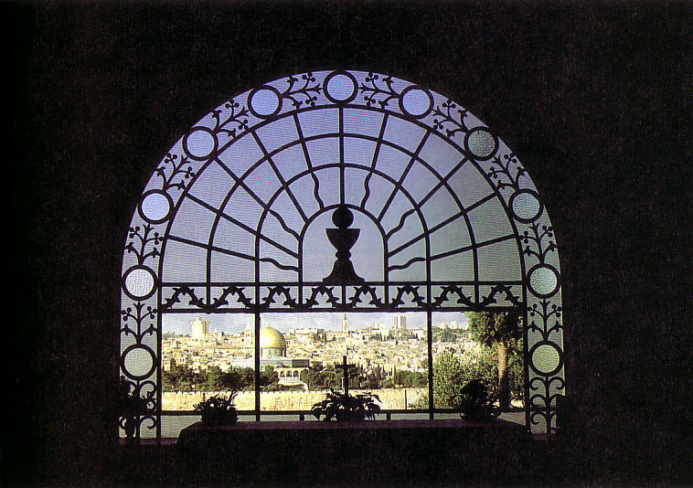
综合
293
以爱守纪与早期的诺斯底主义交战
1—2 守纪的必要
3:1—5:3 爱的特征
5:4-21 守纪的好处

Slide 40
论据
约翰的信件有至少以下五个目的:
促进团契关系(1:3),
使喜悦充足(1:4),
保护神圣性(2:1),
防止异端邪说(2:26),
和提供救世的保证(5:13)
293

Slide 41

约翰一书5：11-13 中的保证
62 b) (2)
63
63
我们应该
怀疑吗？
我们应该
怀疑吗？
“这是神所证明的：
他已经给了我们永生，这生命在他的儿子身上。12凡有儿子有生命，没有神的儿子，就没有生命。13我已经写给你们 相信神的儿子的名，使你们知道你有永生
我们应该
怀疑吗？

Slide 42

Key Word
290
关键词
爱

Slide 43
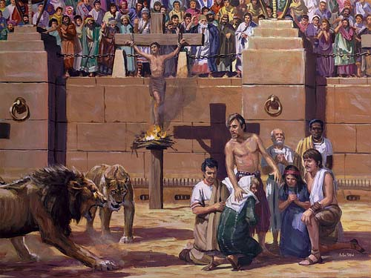
Key Word
290
Both Nero (AD 60s) and Domitian (AD 90s) tested love for God

Slide 44
Song – “I Love You, Lord”

Slide 45
要互相服从
约翰一书
Rick Griffith 博士 • Crossroads International Church Singapore
BibleStudyDownloads.org

Slide 46
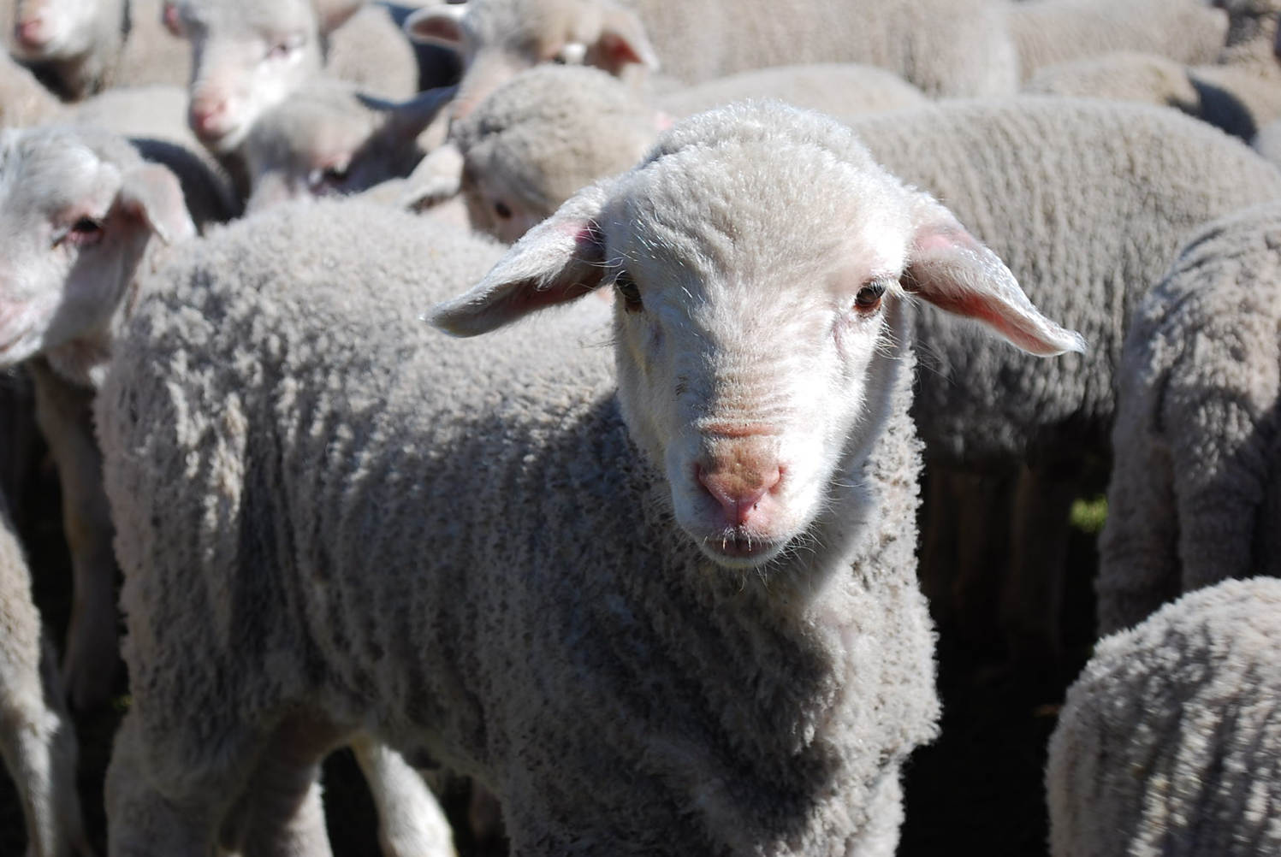
你是一只羊
Notes:
The animal that the Bible compares us to most is the sheep. Why do you think that is so?

Slide 47
羊趋向迷失方向
约翰一书
Notes:
ARIAL

Slide 48
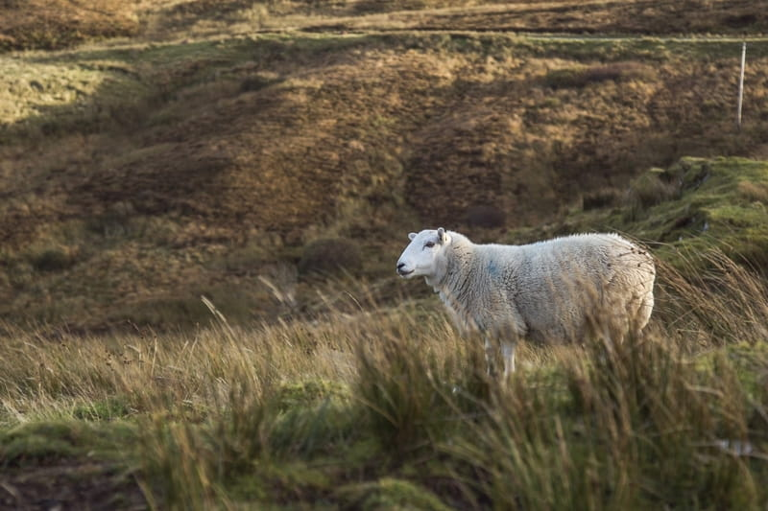
Lost sheep get lonely.
Notes:
Sheep are relational animals, so being away from the flock is lonely.

Slide 49
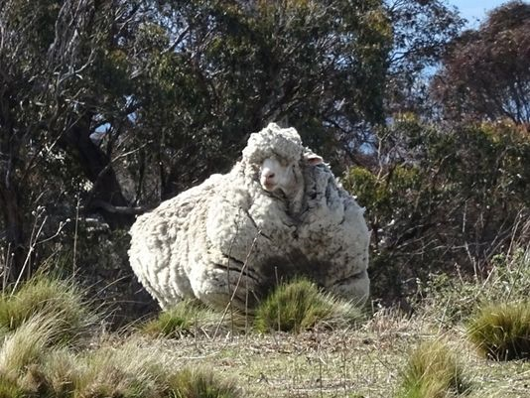
Sheep tend to return.
Notes:
Here is one sheep named Chris who was lost in Australia. He was found in 2015 by bush walkers after about 6 years of wandering. As you can see from the heavy coat of 90 pounds…

Slide 50
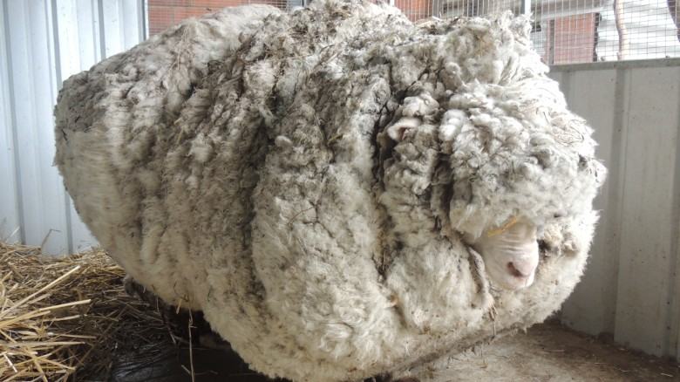
But straying has a price.
Notes:
The baggage from being away is quite a burden—for sheep as well as for people!
————————
Chris, the famously woolly sheep, has died
By Elizabeth Wolfe and Saeed Ahmed, CNN
Updated 1623 GMT (0023 HKT) October 22, 2019
Chris the sheep died in his home at the Little Oak Sanctuary.
(CNN)Chris the sheep lived a, shall we say, full and fluffy life, beloved by fans worldwide for his singular woolliness.
He died at his home at the Little Oak Sanctuary, where he had been living since his rise to fame in 2015.
While Chris should be appreciated for his many lovable qualities -- consider his kind eyes and gently sloping nose -- he became internationally celebrated after becoming the unofficial world record holder for having grown the heaviest fleece.
He was found outside of Australia's capital, Canberra, so overgrown with fleece that he could barely walk. Almost 90 lbs!
When he was found, Chris was carrying years worth of wool on his body, making it difficult for him to walk.
Little Oak Sanctuary, announced the legendary sheep's death on Tuesday in a Facebook post.
"We are heartbroken at the loss of this sweet, wise, friendly soul," said the post.
Little Oak Sanctuary made a point of looking at Chris as more than a spectacle and respecting him as a companion.
"He was so much more than this, so very much more," it said in the post. "And we will remember him for all that he was - someone, not something - here with us, not for us. RIP dear Chris."
Those wishing to mourn Chris's passing may visit his famous fleece on display at the National Museum of Australia.

Slide 51
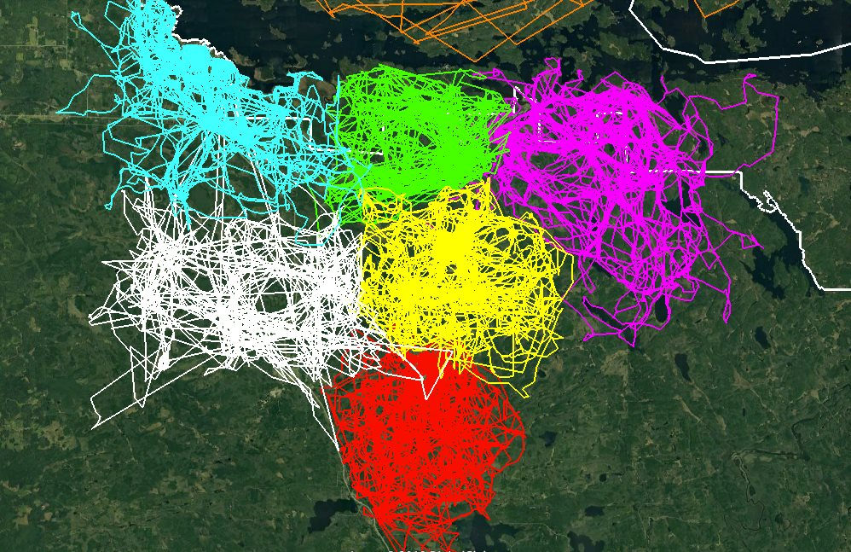
GPS Tracking Shows How Much Wolf Packs Avoid Each Other’s Range
Notes:
Instead of being like sheep, we should be more like wolves! “What?” You say.
Well, wolves have been recently shown to be masters at staying together. A study since 2015 in Minnesota has shown that wolf packs avoid each other’s range. Each wolf pack was tracked via GPS by colour and the results show that they all stay within their own domain—too bad Christians cannot stay with the good teaching that we have received. Instead, we tend to be like sheep who veer away.
So this leads to our question for today…
————————
GPS Tracking Shows How Much Wolf Packs Avoid Each Other’s Range
This image of GPS tracking of multiple wolves in six different packs around Voyageurs National Park was created in the framework of the Voyageurs Wolf Project. It is an excellent illustration of how much wolf packs in general avoid each other’s range.
In Voyageurs National Park a typical wolf pack territory is somewhere around 50-70 square miles but that can vary from year to year. So that’s about the size of the areas marked with the different colors. The white line marks the boundary of the national park.
As beautifully demonstrated by the animation, wolf packs generally avoid being around each other unless they are fighting for food that may be in short supply. When that occurs, they may engage in battles with other packs in order to continue have their claim on a given location as well as the food found within it.
Wolves may need to shift their territory due to human activity as well. When people clear out part of their natural habitat they may have to find a new route to get to their food sources. This can also create conflicts among the various wolf packs due to overstepping their bounds.
———————
https://earthlymission.com/gps-tracking-shows-how-much-wolf-packs-avoid-each-others-range/
Accessed 8 Jan 2020
About (Facebook page started in 2015)
The Voyageurs Wolf Project studies wolves and their prey (moose, deer, and beavers) during the summer in and around Voyageurs National Park, Minnesota.

Slide 52
Have you strayed?
Buying?
Porn?
Law v. Grace?
Imbalanced?
Notes:
How about you? Have you ever been deceived to follow teachings against the Bible?
• Have you fallen into the lie that buying something would make you happy? Did it? This is false teaching about material things.
• Have you ever seen porn? This teaches falsely about sex.
• Have you gotten out of balance too much towards grace or law?
• What about now? Are you out of balance in your understanding of God at all right now or do you completely understand God and fully obey him in every way?
So you are susceptible to false teaching, aren’t you?

Slide 53
怎么不因为假教诲而
迷失方向?
约翰一书
Notes:
• The first letter from the Apostle John tells us • three key ways that we can stop losing our way—wandering off, drifting—like sheep.

Slide 54
主题
23
在爱中顺服可抵抗
早期诺斯替教主意
约翰一书

Slide 55
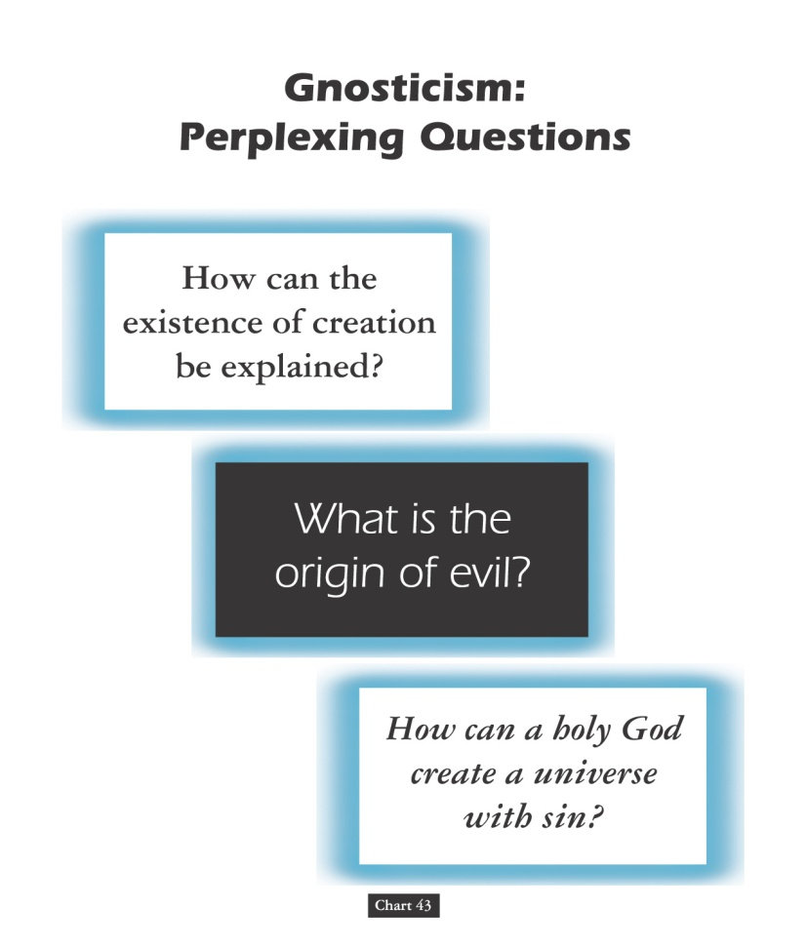
诺斯底主义：
令人困惑的问题
153a
要如何解释创造
的存在？
什么是罪恶的起源？
圣洁的神怎么能创造有罪恶的宇宙？
图 43
John D. Hannah, Charts of Ancient & Medieval Church History (Grand Rapids: Zondervan, 2001)
Notes:
Text from Hannah for this chart:
"The Christian faith was opposed by numerous adversaries––threats from the state, ominous false religions, and heretics within its own borders. The most imposing religious threat came from Gnosticism, which was particularly dangerous because of its intellectual coherency. While Gnosticism seemed to provide answers to perplexing questions, it succeeded only in mixing a snippet of biblical truth with error."

Slide 56
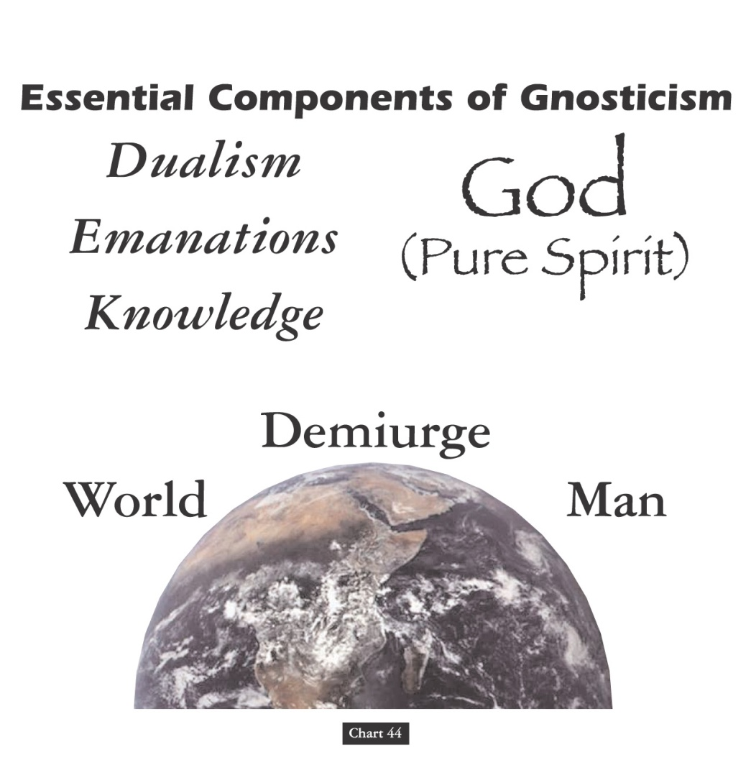
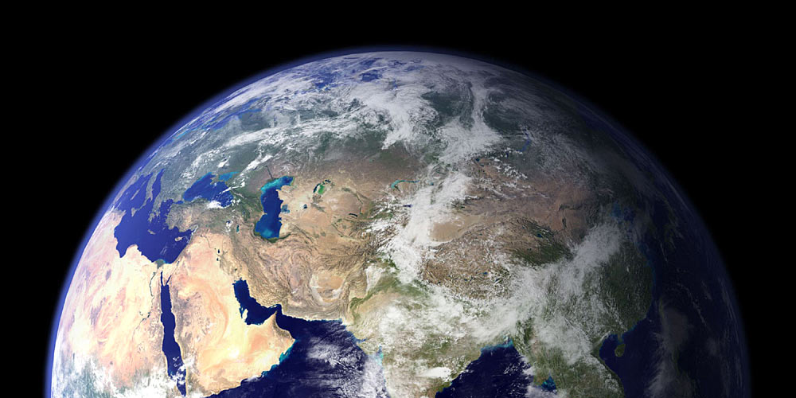
诺斯底主义的重要组成部分
153b
神
（纯洁的灵）
(1) 二元论
(2) 放射物
(3) 知识
造物主
世界
人
图 44
John D. Hannah, Charts of Ancient & Medieval Church History (Grand Rapids: Zondervan, 2001)
Notes:
Text from Hannah for this chart:
"Gnosticism taught (1) that there is a radical dualism of the spiritual in opposition to the material (God, who is Spirit, is the supreme good, while matter is evil); (2) that God could not have created matter because it is contrary to his nature; rather, the world, which is material and evil, was created by the Demiurge (an emanation from God), and man is a material being with an entrapped spirit; and (3) that through a "secret knowledge," salvation becomes the life of escape from the material confines of the body."

Slide 57

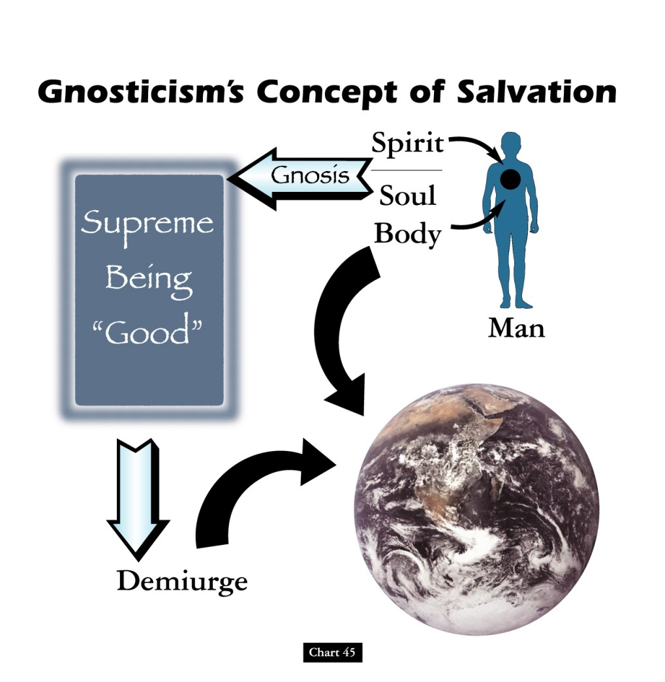
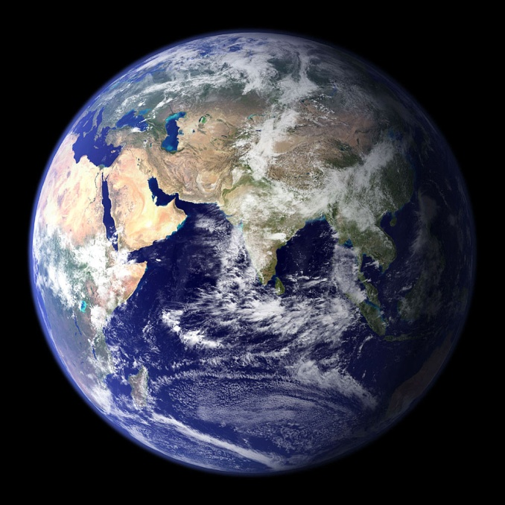
诺斯底主义对于救赎的概念
153c
灵
灵知
至高的神
“好的”
魂
肌体
人
造物主
图 45
John D. Hannah, Charts of Ancient & Medieval Church History (Grand Rapids: Zondervan, 2001)
Notes:
Text from Hannah for this chart [animation brackets mine]:
"Gnosticism's concept of salvation is as follows: God did not create the world, [1] but a lesser yet powerful being (the Demiurge) made this evil world and [2] mankind––though within man is a spark of good. [3] Salvation results from enlarging the capacity of that nature while minimizing the hold of materialism, [4] and it is accomplished by means of the secret teachings of Gnostic teachers. In resisting this teaching, Christian writers adopted a worldview that embraced the God of the Bible as the divine creator, affirmed the creation as good though marred by a subsequent devastation, and espoused the salvation of the body as well as the soul."

Slide 58

Origin/Destination
291
A general letter sent from the aged John in Ephesus
Pergamum
Thyatira
Sardis
Smyrna
Philadelphia
Ephesus
Laodicea

Slide 59
新约综览(普通书信 + 关键字)
38
124
39-41
“直 到 地 极” (使 徒 行 传 1:8)
使 徒 9 13 14 15 16 18 21 27 28
五月57-
八月59
大 马 色
安 提 阿
四月 48-
九月 49
1
加 拉 太
四月 50-
九月 52
2
爱琴海
春季 53-
五月 57
3
亚洲
五月 57-
八月 59
试验
二月 60-
三月 62
1
罗马
春季 62-
秋季 67
4
西班牙
秋季 67-
春季 68
2
罗马
秋季 49
理事会
春季68
教会扩长
35 48 49 50 52 53 57 60 62 67 68 95
天国
主权1
主权2
门徒
相 信
合一
秩序
教 义
提后
犹大
因信称义
被提
成圣
伪装者
雅各
行为
大患难
使 徒
神性
行事为人
希伯来
优秀
约 1
爱
彼 前
称义
饶恕
受苦
福音书以及使徒行传
态度
彼后
知识
保罗书信
普通书信
保罗书信, 类别,关键字

Slide 60
论据
约翰的信件有至少以下五个目的:
促进团契关系(1:3),
使喜悦充足(1:4),
保护神圣性(2:1),
防止异端邪说(2:26),
和提供救世的保证(5:13)
这个五重目的使这本书不容易以一个主材或目的,也难以概述, 特别是主题的重叠性。
但是, 看起来守纪是最笼统的一个主题, 特别是被展示在爱其他人方面, 它包含了所有上述目的。
守纪的好处有许多, 但最直接的好处是爱可以保护和免受早期的相信神秘直觉论。
293

Slide 61
约翰一书大纲
290
以爱守纪来与早期的诺斯底主义交战
守纪的必要
爱的特征
守纪的好处
1–2 章
3:1–5:3
5:4-21
基督的人性
守纪的前提
守纪的妨碍
不犯罪
不恨信徒
有慈心
对上帝有信心
服从使徒所教
关心信徒
服从上帝的命令
对世界的胜利
得救的保证
祷告的教导
从罪孽中解放
对上帝的保真
以弗所对小亞西亞的教会
公元85至95年间

Slide 62
怎么不因为假教诲而
迷失方向?
约翰一书
Notes:
• The first letter from the Apostle John tells us • three key ways that we can stop losing our way—wandering off, drifting—like sheep.

Slide 63
怎么不因为假教诲而…
约翰一书
遵守 神的命令(1–2)
迷失方向?
Notes:
What should you do to keep consistent amidst so many lies about God?

Slide 64
Slides on
约壹 1

Slide 65
I. 遵守 神的命令(1–2).
  相信基督是全人，得着团契与喜乐
  (1:1-4)。
约翰一书
Notes:
Follow what the Lord says so you won’t stray away (1 John 1–2 restated).

Slide 66
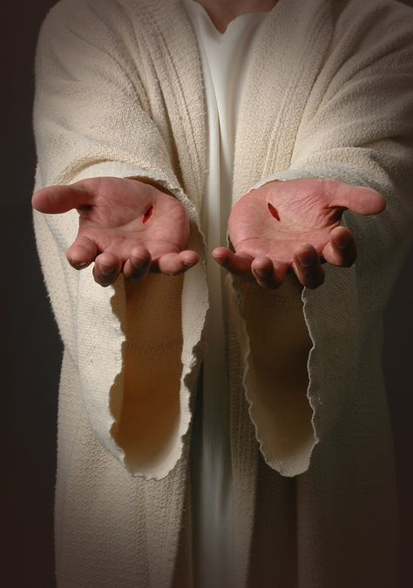
"We proclaim to you the one who existed from the beginning, whom we have heard and seen. We saw him with our own eyes and touched him with our own hands. He is the Word of life"
(1 John 1:1 NLT).

Slide 67
约翰（一）中的早期的诺斯替教
186
两种类型
幻影说诺斯替教
物质是恶魔
贬低唯物主义
不承认基督的博爱
涉及耶稣 (1:1)
禁欲主义
道德败坏
Cerinthian诺斯替教
精神是好的
知识丰富 (诺斯)
不承认基督的神的身份
水和血 (5:6)
骄傲自大
教育

Slide 68
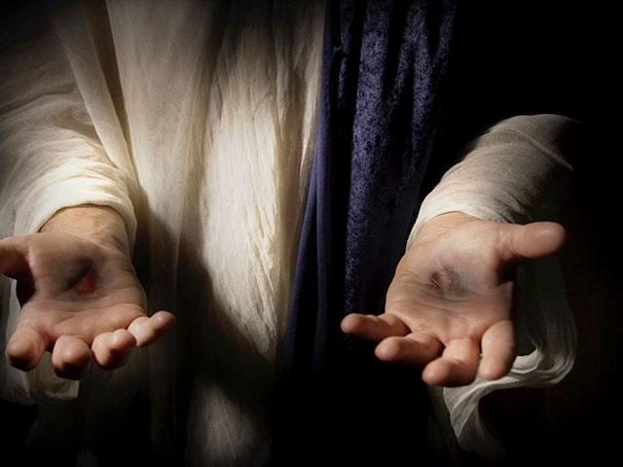
"This one who is life itself was revealed to us, and we have seen him. And now we testify and proclaim to you that he is the one who is eternal life. He was with the Father, and then he was revealed to us"
(1 John 1:2 NLT).

Slide 69
"We proclaim to you what we ourselves have actually seen and heard so that you may have fellowship with us. And our fellowship is with the Father and with his Son, Jesus Christ. ⁴ We are writing these things so that you may fully share our joy"
(1 John 1:3-4 NLT).

Slide 70
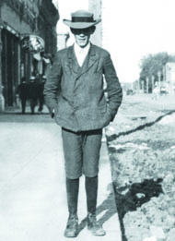
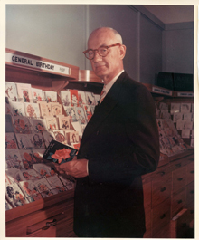
John taught that God showcased Jesus
291
-292
God did the same thing when He sent Jesus Christ into the world. That's when the Word of Life was moved from behind the counters, out of the drawers and placed in a display case for all the world to see, handle and admire.
"That which was from the beginning, which we have heard, which we have seen with our eyes, which we have looked at and our hands have touched––this we proclaim concerning the Word of life. The life appeared; we have seen it and testify to it, and we proclaim to you the eternal life, which was with the Father and has appeared to us" (1 John 1:1-2).
JC Hall
Illustration Exchange 26 June 2013
Notes:
The life of J.C. Hall, founder of Hallmark Cards, is a true rags-to-riches story. Born to poor parents, J.C. was quickly put to work, mostly in sales, to help keep himself and his family afloat. Along with his brothers, he began selling postcards in Norfolk, Nebraska. But the postcard business wasn't thriving there. So, with little else than a couple of shoe boxes of postcards, he moved to Missouri to start afresh. Full of innovative ideas, he moved on from postcards to greeting cards. When the store from which he operated burned down in 1915, he and his brothers invested in an engraving business and began printing their own cards.
But it wasn't just the quality of the cards that burgeoned the business. It was Hall's groundbreaking idea to move the cards from behind the counters, where clerks would pick an "appropriate" card for the customer, out into display cases where customers could see them, handle them, and admire them.
By the time he died in 1982, Hall had turned two shoe boxes of postcards into a multi-billion dollar company.
Says the Hallmark corporate website, "J.C. Hall took greeting cards out of drawers in retail stores, and into displays that let shoppers see all their choices, dramatically changing the way cards were merchandised."
Application:
God did the same thing when He sent Jesus Christ into the world. That's when the Word of Life was moved from behind the counters, out of the drawers and placed in a display case for all the world to see, handle and admire.
"That which was from the beginning, which we have heard, which we have seen with our eyes, which we have looked at and our hands have touched--this we proclaim concerning the Word of life. The life appeared; we have seen it and testify to it, and we proclaim to you the eternal life, which was with the Father and has appeared to us" (1 John 1:1-2).

Slide 71
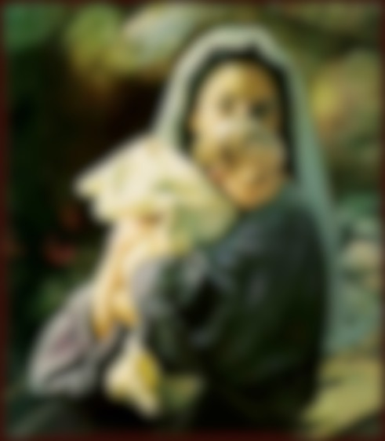
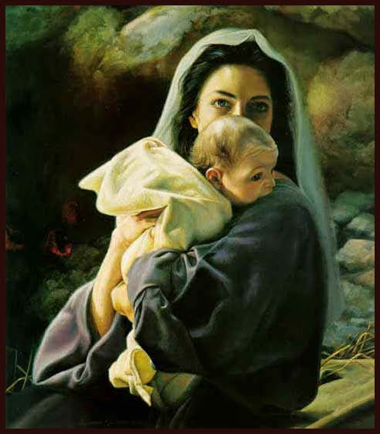
God Became Man

Slide 72
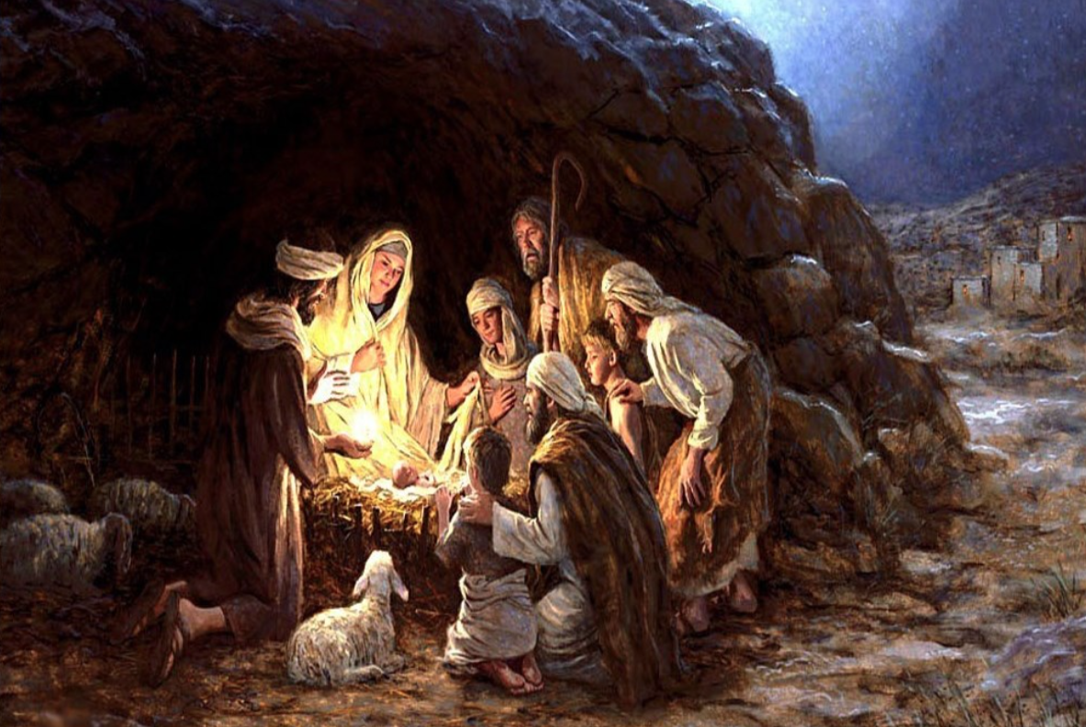
The Nativity
Notes:
In 1994, two Americans answered an invitation from the Russian Department of Education to teach morals and ethics (based on biblical principles) in the public schools. They were invited to teach at prisons, businesses, the fire and police departments and a large orphanage. About 100 boys and girls who had been abandoned, abused, and left in the care of a government-run program were in the orphanage. They relate the following story in their own words:
"It was nearing the holiday season, 1994, time for our orphans to hear—for the first time—the traditional story of Christmas. We told them about Mary and Joseph arriving in Bethlehem. Finding no room in the inn, the couple went to a stable, where the baby Jesus was born and placed in a manger. Throughout the story, the children and orphanage staff sat in amazement as they listened. Some sat on the edges of their stools, trying to grasp every word.
Completing the story, we gave the children three small pieces of cardboard [for each] to make a crude manger. Each child was given a small paper square, cut from yellow napkins I had brought with me. No colored paper was available in the city. Following instructions, the children tore the paper and carefully laid strips in the manger for straw. Small squares of flannel, cut from a worn-out nightgown an American lady was throwing away as she left Russia, were used for the baby's blanket. A doll-like baby was cut from tan felt we had brought from the United States.
The orphans were busy assembling their manger as I walked among them to see if they needed any help. All went well until I got to one table where little Misha sat—he looked to be about 6 years old and had finished his project. As I looked at the little boy's manger, I was startled to see not one, but two babies in the manger. Quickly, I called for the translator to ask the lad why there were two babies in the manger. Crossing his arms in front of him and looking at his completed manger scene, the child began to repeat the story very seriously. For such a young boy, who had only heard the Christmas story once, he related the happenings accurately—until he came to the part where Mary put the baby Jesus in the manger.
Then Misha started to ad lib. He made up his own ending to the story as he said, "And when Maria laid the baby in the manger, Jesus looked at me and asked me if I had a place to stay. I told him I have no mamma and I have no papa, so I don't have any place to stay. Then Jesus told me I could stay with him. But I told him I couldn't, because I didn't have a gift to give him like everybody else did. But I wanted to stay with Jesus so much, so I thought about what I had that maybe I could use for a gift. I thought maybe if I kept him warm, that would be a good gift. So I asked Jesus, ‘If I keep you warm, will that be a good enough gift?' And Jesus told me, ‘If you keep me warm, that will be the best gift anybody ever gave me.’ So I got into the manger, and then Jesus looked at me and he told me I could stay with him—for always."
As little Misha finished his story, his eyes brimmed full of tears that splashed down his little cheeks. Putting his hand over his face, his head dropped to the table and his shoulders shook as he sobbed and sobbed. The little orphan had found someone who would never abandon nor abuse him, someone who would stay with him — FOR ALWAYS.
Few of us would fault little Misha for doing all he could to help save little Jesus. Yet the reality is that Jesus is the one who did all he could to save little you and me.
The makeshift crib of Christmas is incomplete without the cross of Calvary.

Slide 73
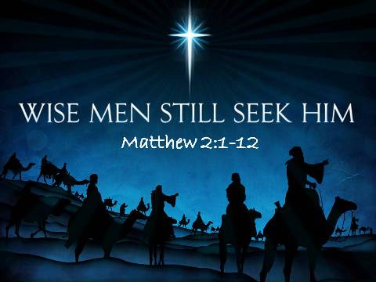
Wise Men Still Seek Him
Notes:
I would love for you to tell me about it on the guest cards that are coming around to you now if you are our guest. I would love to share with you some other life-changing truths.

Slide 74
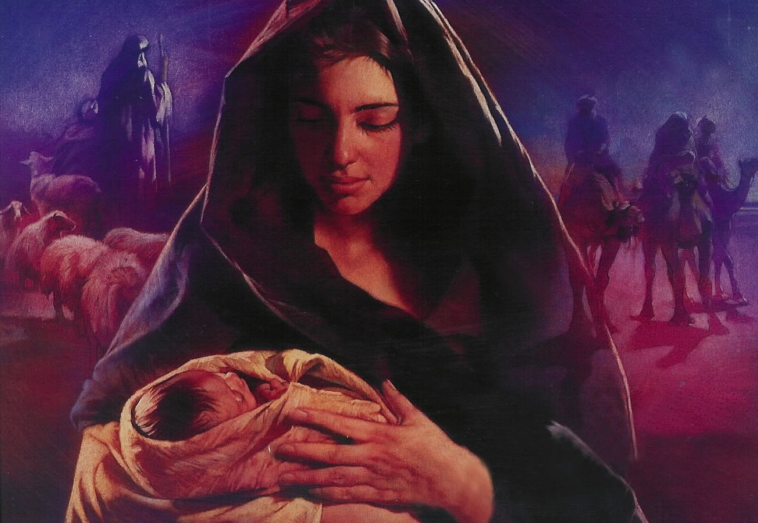
希伯来 2:14 (CNVS)
孩子们既然同有血肉之体，他自己也照样成为血肉之体，
为要借着死，消灭那掌握死权的魔鬼.
Notes:
Do you know why Jesus became a man? Why did God have to take on human flesh? Hebrews 2:14 tells us clearly…
We rightfully think of God becoming man this season—a concept the theologians call the “incarnation.” This comes from the Latin in carne that literally means in flesh.
But how long will Jesus be a man “in flesh”? I’ll tell you—FOR ALWAYS!

Slide 75
I. 遵守 神的命令(1–2).
  相信基督是全人，得着团契与喜乐
  (1:1-4)。
  依靠耶稣 (1:5–2:14)。
约翰一书
Notes:
Follow what the Lord says so you won’t stray away (1 John 1–2 restated).

Slide 76

"This is the message we heard from Jesus and now declare to you:
God is light, and there is no darkness in him at all" (1 John 1:5 NLT).

Slide 77

"So we are lying if we say we have fellowship with God but go on living in spiritual darkness; we are not practicing the truth.
⁷ But if we are living in the light, as God is in the light, then we have fellowship with each other, and the blood of Jesus, his Son, cleanses us from all sin"
(1 John 1:6-7 NLT).

Slide 78
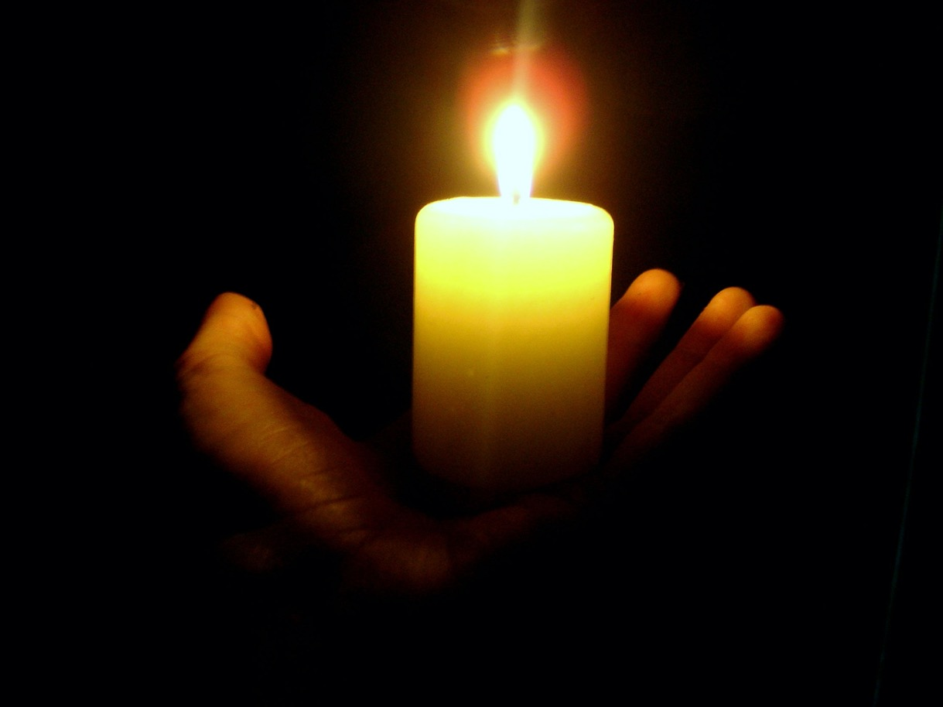
"If we claim we have no sin, we are only fooling ourselves and not living in the truth"
(1 John 1:8 NLT).
"If we claim we have not sinned, we are calling God a liar and showing that his word has no place in our hearts"
(1 John 1:10 NLT).

Slide 79

旧约中的罪得赦免
121b
管道 = 与神的关系（永不改变）
罪
堵塞 =与神的交通（被罪阻碍）
献祭 = 承认罪 (罪得赦免恢复与神的交通，但与神的关系不受到威胁）
Notes:
当我们犯罪时我们与神仍然有关系吗？是的！Do we still have a relationship with God when we sin? Yes!
罪不阻碍我们与神的关系但会阻碍我们与神的交通。Sin does not hinder our relationship with God but our fellowship with Him.
旧约中的献祭并不能帮助人与神建立关系，而是帮助人恢复与神的交通。OT sacrifices did not establish a relationship with God but rather they restored their fellowship with God
Do we still have a relationship with God when we sin? Yes!
Sin does not hinder our relationship with God but our fellowship with Him.
OT sacrifices did not establish a relationship with God but rather they restored their fellowship with God
OB-38-Salvation-11
OS-03-Leviticus-130
NS-23-1Jn-79

Slide 80
新约中的罪得赦免
OB 175p
OS 121b
管道 = 与神的关系（永不改变）
“我 们 若 认 自 己 的 罪 ， 神 是 信 实 的 ， 是 公 义 的 ， 必 要 赦 免 我 们 的 罪 ， 洗 净 我 们 一 切 的 不 义 。”
(约翰一书 1:9 简体和合本)
罪
堵塞 =与神的团契（被罪阻碍）
基督的牺牲 = 认罪的基础（罪孽被原谅恢复团契，但是从未威胁过与神的关系）
Notes:
Do we still have a relationship with God when we sin? Yes!
Sin does not hinder our relationship with God but our fellowship with Him.
OT sacrifices did not establish a relationship with God but rather they restored their fellowship with God
OB-38-Salvation-11
OS-03-Leviticus-130
NS-23-1Jn-79

Slide 81
Slides on
约壹 2

Slide 82

"My dear children, I am writing this to you so that you will not sin. But if anyone does sin, we have an advocate who pleads our case before the Father. He is Jesus Christ, the one who is truly righteous" (1 John 2:1 NLT).

Slide 83
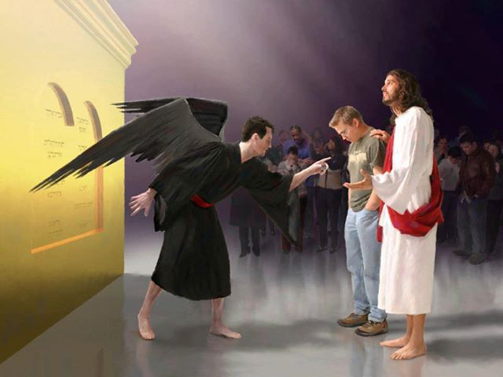
谁能定我们的罪呢．有基督耶稣已经死了、而且从死里复活、现今在 神的右边、也替我们祈求
罗马书 8:34

Slide 84

"He himself is the sacrifice that atones for our sins—and not only our sins but the sins of all the world"
(1 John 2:2 NLT).

Slide 85
I. 遵守 神的命令(1–2).
  相信基督是全人，得着团契与喜乐
  (1:1-4)。
  依靠耶稣 (1:5–2:14)。
  避开顺服的两个障碍，
  抵挡早期的诺斯底主义
  (2:15-29)。
约翰一书
Notes:
Follow what the Lord says so you won’t stray away (1 John 1–2 restated).

Slide 86

“不要爱世界和世上的东西” (约壹2:15)

Slide 87
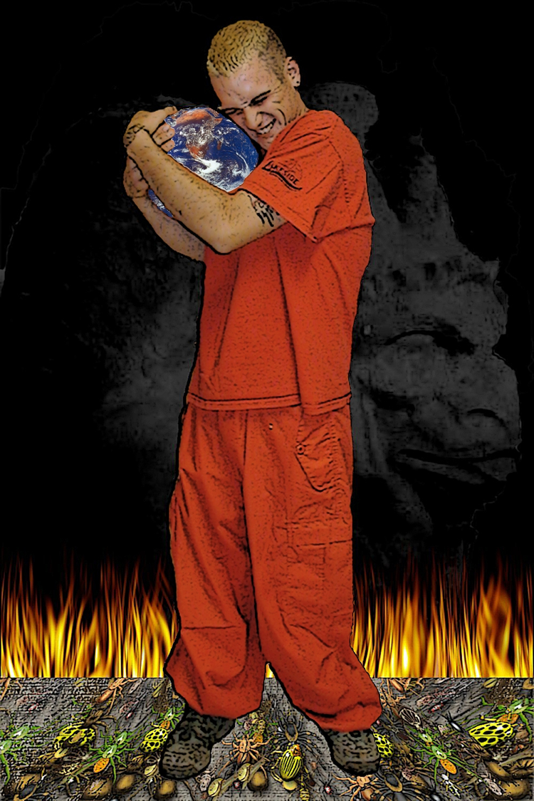
约壹 2:15 (CNVS)
“不要爱世界和世上的东西。人若爱世界，爱父的心就不在他里面了。”

Slide 88
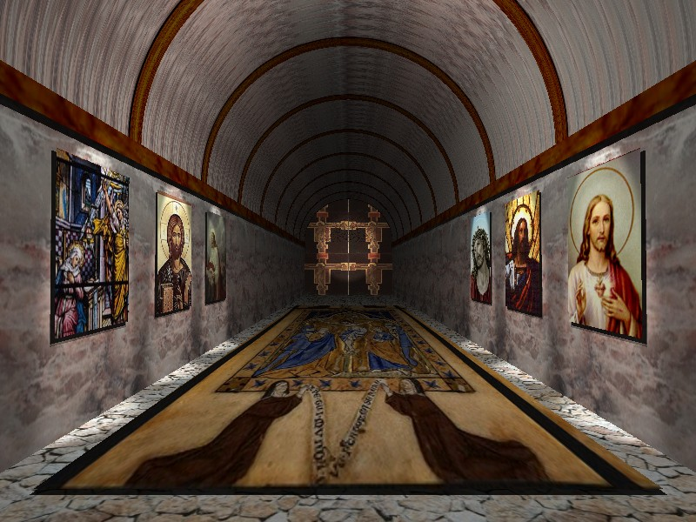
约翰一书 二章十六－十七节
因 为 凡 世 界 上 的 事 ， 就 像 肉 体 的 情 欲 ， 眼 目 的 情 欲 ， 并 今 生 的 骄 傲 ， 都 不 是 从 父 来 的 ， 乃 是 从 世 界 来 的 。 这 世 界 和 其 上 的 情 欲 都 要 过 去 ， 惟 独 遵 行 神 旨 意 的 ， 是 永 远 常 存 。
跳 下 去

Slide 89
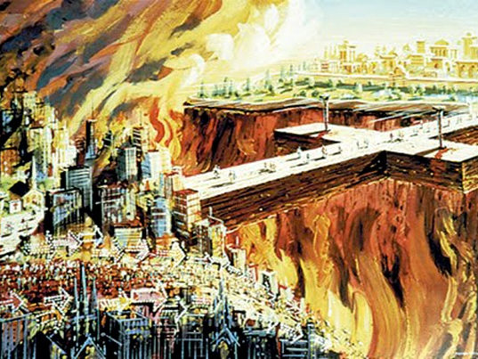
“…这世界和世上的私欲都要渐渐过去”
(约壹 2:17a)

Slide 90

属世的事物
（各列经文的对比）
296
属世
约翰一书二章十五十六节
试探的来源
夏娃
(创 3)
基督
(马太 4)
“肉 体 的 情 欲”
不讨神喜悦的肉体私欲 (如婚外的性交，暴食）
“那 棵 树 的 果 子 好 作 食 物”
石 头 变 成 食 物
“眼 目 的 情 欲”
贪心， 贪恋 (第十条律 法：不 可 贪恋)
“悦 人 的 眼 目”
拥有世 上的 万 国 与 万 国 的 荣 华
“今 生 的 骄 傲”
骄 傲与夸耀:
• 事业
• 地位
• 属世得优势
• 等等。。。。
“使 人 有 智 慧”
人所段定
(“从殿 顶跳下去”)

Slide 91
Avoid two hindrances to obedience to fight early Gnosticism (2:15-29).
Worldliness
(2:15-17)
Deception
(2:18-29)
Notes:
How are we deceived? That which is against Jesus deceives us into thinking it is real and helpful.

Slide 92

"Dear children, the last hour is here. You have heard that the Antichrist is coming, and already many such antichrists have appeared. From this we know that the last hour has come. ¹⁹ These people left our churches, but they never really belonged with us; otherwise they would have stayed with us. When they left, it proved that they did not belong with us" (1 John 2:18-19 NLT).
Notes:
Does this mean that every person who leaves his church is antichrist? No, as some us sheep just go astray. He simply says that people opposing Jesus typically cannot last within the church. They eventually leave, especially if the church teaches the truth.

Slide 93
那么圣灵的内住和膏抹有何分别呢?
关于圣灵内住的一些争议性议题
Notes:
What is the relationship of the anointing of the Spirit to indwelling?

Slide 94
圣灵的恩膏
Xvi
H
"那在基督里坚定我们和你们，又膏抹我们的，就是 神。 ²² 他在我们身上盖了印，就是赐圣灵在我们心里
作凭据。"
(林后 1:21 CUV)

Slide 95
圣灵的恩膏
Xvi
H
"你们从那圣者得着膏抹，这是你们都知道的。…²⁷你们既然在你们里面有从主领受的膏抹，就不需要别人教导你们了，因为在一切事上有主的膏抹教导你们；这膏抹是真的，不是假的，你们应该按着他所教导的住在他里面。" (1 John 2:20, 27, CUV)

Slide 96
雷历论恩膏
xvi
H
“恩膏和内住的分别在于它们不同的目的。 内住 带来神的 同在 在信徒的生命里. 恩膏, 对于信徒来说, 就是可能可以被教导的意思(约前 2:20, 27). 事实上,这也是唯一清楚列明会发生在信徒身上的例子.”

Slide 97
雷历论恩膏
xvi
H
“但是, 如果人们采用耶稣被恩膏为例证if [路 4:18; 徒 4:27; 10:38; 来. 1:9] 和旧约里祭师们 [出. 30:32-33; 附. 列王 撒上. 10:1; 番 4:14], 那么就会出现另外一个目的—即 service服侍. 但是…完全的经历恩膏关键在于被圣灵充满。”
(雷历博士, The Holy Spirit, 73).

Slide 98

关键节
290
约翰写此书的主要目的
我将这些话写给你们，是指著那引诱你们的人说的… 小子们哪，你们要住在主里面。这样，他若显现，我们就可以坦然无惧；当他来的时候，在他面前也不至於惭愧。
(约翰一书第二章第二十六至二十八节)

Slide 99
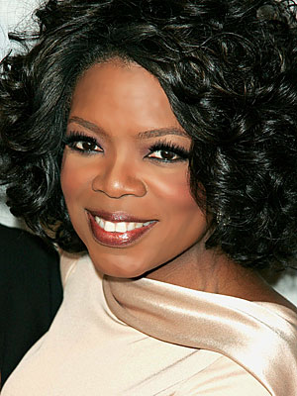
Oprah Winfrey’s Influence
22 million viewers each day!
Named most influential celebrity two years in a row (2012-2013)

Slide 100
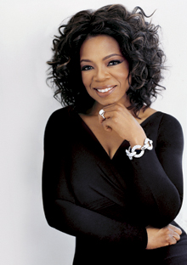
Oprah Leads Millions Astray
"All that is divine, my heart is open to you..."
"The universe is not interested in your struggles and your pain and your sorrow..."
"My heart is open to find the flow, the flow, the flow, the flow that is my life."
Notes:
See 2:25 on the timer at https://www.youtube.com/watch?v=oq6ejJqpOTs
See also http://www.jesus-is-savior.com/Wolves/oprah-fool.htm where she dies Christ as the only way to God.

Slide 101

Oprah Leads Millions Astray
“I am not talking about religion. I am a Christian. That is my faith. I'm not asking you to be a Christian. If you want to be one I can show you how. But it is not required. I have respect for all faiths. All faiths. But what I'm talking about is not faith or religion. I'm talking about spirituality,” Winfrey said.
Notes:
Oprah Winfrey: ‘I Am a Christian’
2:20PM EDT 4/26/2012 Jennifer LeClaire
http://www.charismanews.com/us/33290-oprah-winfrey-i-am-a-christian

Slide 102
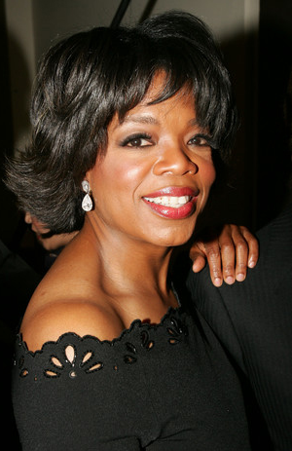
Oprah Leads Millions Astray
One commented on her…
“Take a few moments and imagine a religion where Jesus did not come to die on the cross, where there is no heaven, no hell, no sin, no salvation, no doctrine, where all spiritual paths in the world are equally valid and where ‘god’ is in you and in everything else you see.
That is the religion of Oprah Winfrey.
It is also the New Age ‘one world religion’ that many other spiritual gurus throughout the world have been trying to bring to fruition.”
Notes:
Oprah Winfrey: Jesus Did Not Come To Die On The Cross
http://www.curezone.com/forums/am.asp?i=1862458

Slide 103
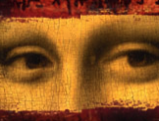
破解
达芬奇密码
Dr. Rick Griffith • 博士 • 新加坡神学院 • BibleStudyDownloads.org

Slide 104

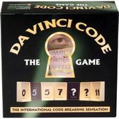



44 种语言!

Slide 105
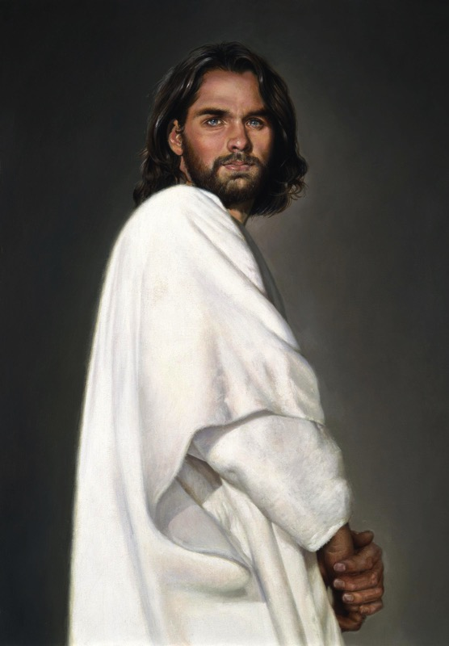
到底耶稣基督是怎样的人？
作者：
圣经：
仅是人
乃是成为人的神

Slide 106
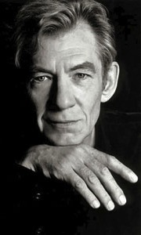
Is the Bible reliable?
Brown 藉着“历史学家” Leigh Teabing的口来控告…
“亲爱的，
圣经是出自人的手。
不是神…
[它]经过无数的翻译、
添加和修改的进化。
历史上从未有最终版本。”
DVC, 195

Slide 107
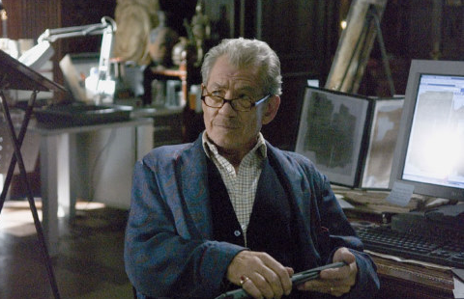
Is the Bible reliable?
295f
Brown accuses via the mouth of "historian" Leigh Teabing…
"The Bible is a product of man, my dear. Not of God… [It] has evolved through countless translations, additions, and revisions. History has never had a definitive version of the book."
DVC, 195
Notes:
We are led to believe that some versions of the Bible have differing numbers of books--and that the fact that the Bible has been translated into more languages than any other book makes it suspect. No, this is a sign of worldwide recognition of it as the Word of God.

Slide 108

"Saying that Dan Brown's book is about Christianity is like saying 'Finding Nemo' is about marine biology."
"We have just as much evidence to suggest that Jesus was married to Mary Magdalene as we have that clown fish talk."
Kenneth Boa & John Alan Turner, The Gospel According to the Da Vinci Code
Notes:
Well said. Biblical biologists will agree.

Slide 109
怎么不因为假教诲而…
约翰一书
遵守 神的命令(1–2)
爱 他人(3:1–5:3)
迷失方向?
Notes:
What should you do to keep consistent amidst so many lies about God?

Slide 110
Slides on
约壹 3

Slide 111
II. Love others (3:1–5:3).
  Don’t sin (3:1-10)
Notes:
RESTATE

Slide 112

¹ See what great love the Father has lavished on us, that we should be called children of God! And that is what we are! The reason the world does not know us is that it did not know him. ² Dear friends, now we are children of God, and what we will be has not yet been made known. But we know that when Christ appears, we shall be like him, for we shall see him as he is. ³ All who have this hope in him purify themselves, just as he is pure.
1 John 3:1-3 NIV

Slide 113
How much can a believer sin
(1 John 3:4)?
NLT (cf. NIV)
"Everyone who sins is breaking God’s law, for all sin is contrary to the law of God.”
Absolute
NAU (cf. NET)
"Everyone who practices sin also practices lawlessness; and sin is lawlessness.”
Habitual
Both translations are possible in the Greek text.
However, wouldn't it be lawless to sin even once?

Slide 114
How much can a believer sin
(1 John 3:6)?
NLT (cf. NIV)
" Anyone who continues to live in him will not sin. But anyone who keeps on sinning does not know him or understand who he is.”
Habitual
NAU (cf. NET)
"No one who abides in Him sins; no one who sins has seen Him or knows Him.”
Absolute

Slide 115
Each of the preceding four translations are inconsistent in rendering verses 4 and 6.
But NLT, NAU, and NET all give the habitual sense to verse 6—all but the NIV, that reads, “He who does what is sinful is of the devil…”
BOTTOM LINE:
We sin when we follow Satan rather than God!

Slide 116
II. Love others (3:1–5:3).
  Don’t sin (3:1-10)
  Don’t hate believers (3:11-15)
Notes:
RESTATE

Slide 117
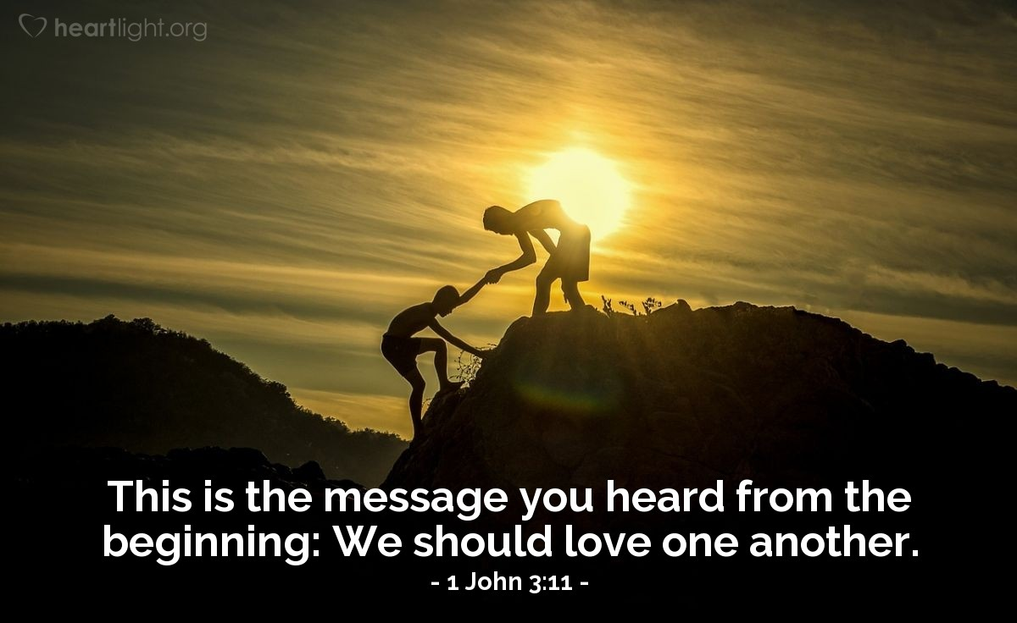
"This is the message you have heard from the beginning: We should love one another"
(1 John 3:11 NLT).

Slide 118
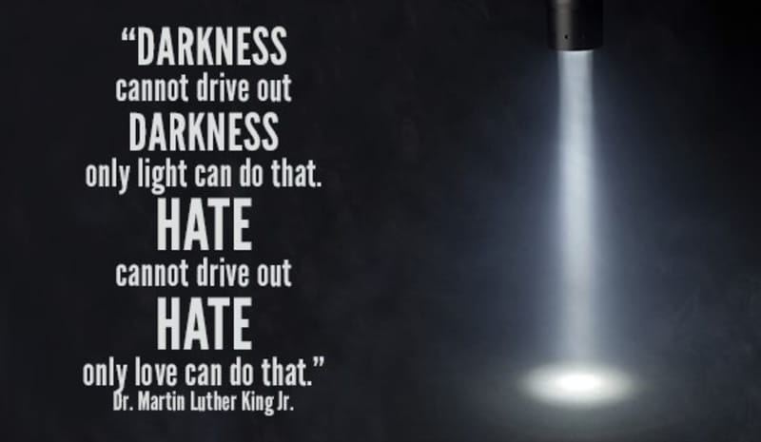
Hatred of people is from Satan.

Slide 119
II. Love others (3:1–5:3).
  Don’t sin (3:1-10)
  Don’t hate believers (3:11-15)
  Show compassion (3:16-20)
Notes:
RESTATE

Slide 120
"We know what real love is because Jesus gave up his life for us. So we also ought to give up our lives for our brothers and sisters. ¹⁷ If someone has enough money to live well and sees a brother or sister in need but shows no compassion—how can God’s love be in that person?" (1 John 3:16-17 NLT).

Slide 121
"Dear children, let’s not merely say that we love each other; let us show the truth by our actions. ¹⁹ Our actions will show that we belong to the truth, so we will be confident when we stand before God.
²⁰ Even if we feel guilty, God is greater than our feelings, and he knows everything" (1 John 3:18-20 NLT).

Slide 122
II. Love others (3:1–5:3).
  Don’t sin (3:1-10)
  Don’t hate believers (3:11-15)
  Show compassion (3:16-20)
  Be confident before God (3:21-24)
Notes:
RESTATE

Slide 123

"Dear friends, if we don’t feel guilty, we can come to God with bold confidence"
(1 John 3:21 NLT).

Slide 124
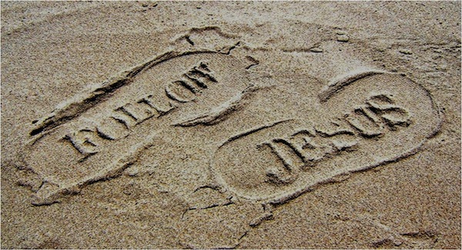
And we will receive from him whatever we ask because we obey him and do the things that please him"
(1 John 3:22 NLT)."

Slide 125
"And this is his commandment: We must believe in the name of his Son, Jesus Christ, and love one another, just as he commanded us. ²⁴ Those who obey God’s commandments remain in fellowship with him, and he with them. And we know he lives in us because the Spirit he gave us lives in us"
(1 John 3:23-24 NLT).

Slide 126
Slides on
约壹 4

Slide 127
II. Love others (3:1–5:3).
  Don’t sin (3:1-10)
  Don’t hate believers (3:11-15)
  Show compassion (3:16-20)
  Be confident before God (3:21-24)
  Obey apostolic teaching (4:1-6)
Notes:
RESTATE

Slide 128

Test the spirits (4:1)

Slide 129
“亲爱的，不要每个灵都信，总要试验那些灵是否出于 神，因为有许多假先知已经来到世上了。 ² 你们可以这样认出 神的灵：凡是承认耶稣基督是成了肉身来的，那灵就是出于 神。”
(约翰一 4:1-2 CNV).

Slide 130
“凡是不承认耶稣基督是成了肉身来的，那灵就不是出于 神，而是敌基督者的灵；你们听过他要来，现在他已经在世上了。”
(约翰一 4:3 CNV).

Slide 131
"But you belong to God, my dear children. You have already won a victory over those people, because the Spirit who lives in you is greater than the spirit who lives in the world.
⁵ Those people belong to this world, so they speak from the world’s viewpoint, and the world listens to them"
(1 John 4:4-5 NLT).

Slide 132
"But we belong to God, and those who know God listen to us. If they do not belong to God, they do not listen to us. That is how we know if someone has the Spirit of truth or the spirit of deception"
(1 John 4:6 NLT).

Slide 133
II. Love others (3:1–5:3).
  Don’t sin (3:1-10)
  Don’t hate believers (3:11-15)
  Show compassion (3:16-20)
  Be confident before God (3:21-24)
  Obey apostolic teaching (4:1-6)
  Care for believers (4:7-21)
Notes:
RESTATE

Slide 134

"Dear friends, let us continue to love one another, for love comes from God. Anyone who loves is a child of God and knows God. ⁸ But anyone who does not love does not know God, for God is love" (1 John 4:7-8 NLT).

Slide 135
Slides on
约壹 5

Slide 136
II. Love others (3:1–5:3).
  Don’t sin (3:1-10)
  Don’t hate believers (3:11-15)
  Show compassion (3:16-20)
  Be confident before God (3:21-24)
  Obey apostolic teaching (4:1-6)
  Care for believers (4:7-21)
  Obey God’s commands (5:1-3)
Notes:
RESTATE

Slide 137

"Everyone who believes that Jesus is the Christ has become a child of God. And everyone who loves the Father loves his children, too. ² We know we love God’s children if we love God and obey his commandments. ³ Loving God means keeping his commandments, and his commandments are not burdensome"
(1 John 5:1-3 NLT).

Slide 138
怎么不因为假教诲而…
约翰一书
遵守 神的命令(1–2)
爱 他人(3:1–5:3)
迷失方向?
要明白只有借着服从才能得到你真正需要的东西(5:4-21)
Notes:
What should you do to keep consistent amidst so many lies about God?

Slide 139

— Francis Chan —
The Bible says that when we obey God’s commands, we benefit. I think we naturally assume that if we look out for our own interests and concerns, we will be happy. But people who sacrifice for others will tell you that seasons of giving are the most rewarding of their lives.

Slide 140
Benefits of Obedience:
III. Realize that obedience produces what you really need (5:4-21).
Victory over the world system (5:4-5)
Notes:
Rather than living a defeated life, you will conquer the world—literally!

Slide 141
"For every child of God defeats this evil world, and we achieve this victory through our faith. ⁵ And who can win this battle against the world? Only those who believe that Jesus is the Son of God"
(1 John 5:4-5 NLT).

Slide 142
Benefits of Obedience:
III. Realize that obedience produces what you really need (5:4-21).
Victory over the world system (5:4-5)
Assurance of salvation (5:6-13)
Notes:
Rather than doubt your state (now and forever), you will know that you have eternal life!

Slide 143

Jesus Will Return to Earth
Notes:
That’s also how long we can stay with him. He will come back for us, as 1 Thessalonians 4 says

Slide 144

被提
"因为主必亲自从天降临，那时，有发令的声音，有天使长的呼声，还有 神的号声，那些在基督里死了的人必先复
活； ¹⁷ 然后，我们还活着存留的人，必和他们一同被提到云里，在空中与主相会。这样，我们就要和主常常同在。
¹⁸ 所以，你们应该用这些话彼此劝慰。“
(贴前 4:16-18 CNVS).

Slide 145

Notes:
Would you like be assured that you have the gift of eternal life and will be with Jesus “for always”? John, the last surviving friend of Jesus, gave us this promise…

Slide 146

上帝的礼物 (约翰一书5)
"这见证就是 神已经把永远的生命赐给我们，这生命是在他儿子里面的。 ¹² 凡有 神儿子的，就有生命；没有 神儿子的，就没有生命。
¹³ 我把这些事写给你们信 神的儿子之名的人，是要你们知道自己有永生。 "
Notes:
Do you have the Son? Then what else do you have? Life! Eternal life!
Have you believed in the Son? Then you can know that you have eternal life—not wish for eternal life, not hope for eternal life, not work for eternal life, but know that you have eternal life.
So the question this Christmas is whether you have the Son. He invites you into his manger, as it were, to trust him so that you can be with him “for always.”

Slide 147

A Prayer
“Jesus, thank you for the promise of eternal life by simple trust in you.
I trust you now that you are indeed who you said you were—God’s Son—and I thank you by faith for giving me eternal life. Amen.”
Notes:
If you haven’t done this before, pray with me now…
PRAY
If you trusted Jesus by praying that prayer, God says that you now have eternal life! You have begun the most amazing adventure you will ever know.

Slide 148

永恒的
保障
61

Slide 149

Eternal Security
61
永恒
保障
“一旦得救，永远得救”

Slide 150
保障与确据的对比
155o
 | 永远的保障 | 得救的确据
基本意思 | 从罪的永远刑罚中被拯救出来（一次得救，永远得救 | 知道我们是从罪的永远刑罚中获得拯救
定义 | “神的工作保证救恩的恩典，一旦得着，就永远不会失去 ” (Ryrie, Basic Theology, 328) | “认识永远保障或信者蒙保守的真理” (Ryrie, Basic Theology, 328)

Slide 151
保障与确据的对比
155o
 | 永远的保障 | 得救的确据
圣灵的工作 | 印记 (弗 1:13-14) | 同证 (罗8:15-17)
信徒的… | 神儿女的地位 (罗8:16b) | 信心的操练 (罗8:16a)
领受者 | 所有基督徒都能得到 | 一些基督徒怀疑
永恒 | 不会失去(约6:39-40; 10:27-29; 罗8:30, 38-39; 希7:25) | 可能会失去(因此约翰写了约壹 5:11-13)
赞美诗 | “我知我所信的是谁 ” | “有福的确据 ” (#367)

Slide 152

神学
支持
永恒的保障
61

Slide 153
三一神的工作，支持保障
61
圣父
是
不是
不是
神
是
是
圣子
圣灵
不是
H. Wayne House, Charts of Christian Theology and Doctrine, 45

Slide 154

父神的工作
61

Slide 155

拣选
61

Slide 156

永久?
61
“凡是父赐给我的人，必到我这里来；到我这里来的，我决不丢弃他”
(约翰 6:37 CNV)

Slide 157

基督圣子的工作
61

Slide 158

“我的羊听我的声音，我也认识他们，他们也跟随我。 ²⁸ 我赐给他们永生，他们永不灭亡，谁也不能把他们从我手里夺去。 ²⁹ 那位把羊群赐给我的父比一切都大，也没有人能把他们从我父的手里夺去。” (约翰 10:27-29 CNV)
61

Slide 159



Subject
相信与否！
61
我们怎么知道耶稣给了我们永生？
我们能知道吗？

Slide 160

一个惊人的宣告！
61
“我实实在在告诉你们，那听见我的话又信那差我来的，就有永生，不被定罪，而是已经出死入生了。”
–– 约翰 5:24
Notes:
Verse 26
Why did the crowd search for Jesus?
The crowd wants follow a prophet who will provide free food and political deliverance.

Slide 161
永久?
61
“凡是父赐给我的人，必到我这里来；到我这里来的，我决不丢弃他”
(约翰 6:37 CNV)

Slide 162

圣灵的封印工作
62

Slide 163

一个保证安全
和提供确据的封印
Notes:
在保罗的时期，蜡封的信件的意思：（1）发件人加盖印章，表示其拥有权在蜡封之內（2）保隌內容保密。结果是，收件人可以肯定内容是受保障和安全的。

Slide 164

“ 你们既然听了真理的道，就是使你们得救的福音，也信了基督，就在他里面受了所应许的圣灵作为印记。 ¹⁴ 这圣灵是我们得基业的凭据，直到 神的产业得赎，使他的荣耀得着颂赞。”
(弗 1:13-14 CNVS).

Slide 165

得救
的
确据
Notes:
Paul used this background to assure his readers their salvation by noting that the Holy Spirit HIMSELF was the seal of their salvation (Eph. 1:13-14).
保罗用这样的背景下，以保证他的读者们的救赎是单靠圣灵确保的（弗1:13-14）。

Slide 166

罗马10:9-10 CNVS
"你若口里认耶稣为主，心里信 神使他从死人中复活，就必得救；
¹⁰ 因为心里相信就必称义，用口承认就必得救。”

Slide 167

救恩的本质
62
b)
我们从罪恶中得解救
证明了我们的保障

Slide 168

信徒站立在
上帝面前证明了 保障
62
c)

Slide 169
圣经支持永恒保障
63

Slide 170
约翰一书5：11-13 中的保证
62 b) (2)
63
63
我们应该
怀疑吗？
我们应该
怀疑吗？
“这是神所证明的：
他已经给了我们永生，这生命在他的儿子身上。12凡有儿子有生命，没有神的儿子，就没有生命。13我已经写给你们 相信神的儿子的名，使你们知道你有永生
我们应该
怀疑吗？

Slide 171

我们需要得到神的义
-- 但应该怎么做？

Slide 172

145
罗马书中的公义
神的公义，藉着在基督里因信称义–非借着律法
1–11章 | 12–16章
称义的解释 | 称义的应用
神学性 | 实用性
信什么 | 怎样表现
直向 | 橫向
与神的关系 | 与人的关系

Slide 173


“成了”
155h
称义 (3:24)
神宣告我们“无罪”，并使我们与
他和好
合法
公义(3:25-26)
神的公平—他照个人的行为惩罚或归罪于无罪的代替者(耶稣基督)
完全
偿还

Slide 174

恩典是…
God‘s
Riches
At
Christ's
Expense
神借基督的犠牲而来的财富

Slide 175

不再定罪 (8:1)!
154b

Slide 176

罗马书 8章中的保障
154b
我们不再定罪了 (8:1)
我们脱离罪和死的律了 (8:2)
我们拥有基督的灵了 (8:9)
圣灵将赐我们荣耀的身体 (8:11)
我们被接纳进入神的家 (8:14, 16, 17, 21, 23)
我们的身体将要得赎 (8:23)
我们所盼望的将会成就 (8:24-25)
我们预先定下效法基督的模样 (8:29)
所有预先定下得救的人将得荣耀 (8:30)
没有什么能使我们与神的爱隔绝 (8:35-39)
我们已经得胜有余 (8:37)
Notes:
176

Slide 177

救恩的三个阶段
155a
阶段
从罪中释放出来
时间
教义 . . .
过去
我已经 得救了
当我接受基督耶稣时
公义
审判—借着他的死 (3:21-24)
基督掌权—借着我的死(6:3-7)
现在
我现在已得救
当我与圣灵同行时
成圣
能力—借着圣灵内住
(8:2-14)
同在— 借着身体得赎
(8:22-25)
当我得到新身体时
将来
我将得救
荣耀

Slide 178

Blessed Assurance 1/7
有福的确据
Fanny Crosby

Slide 179

Blessed Assurance 2/7
有福的确据,耶稣属我!
先尝主荣耀,何等喜乐!
得救的后嗣,救赎功成
由圣灵重生, 宝血洗净。

Slide 180
Blessed Assurance 3/7
这是我信息 我的诗歌
赞美我救主 昼夜唱和
这是我信息 我的诗歌
赞美我救主 昼夜唱和

Slide 181

Blessed Assurance 4/7
完全顺服主 万事安宁
我在救主里喜乐满心怀
时刻仰望主 儆醒等待
满得主恩惠 浸于主爱

Slide 182
Blessed Assurance 5/7
这是我信息 我的诗歌
赞美我救主 昼夜唱和
这是我信息 我的诗歌
赞美我救主 昼夜唱和

Slide 183

Blessed Assurance 6/7
完全的顺服 快乐无比
有福的异象显在我心里
天使带信息 由天而来
报明主怜悯 述说主爱

Slide 184
Blessed Assurance 5/7
这是我信息 我的诗歌
赞美我救主 昼夜唱和
这是我信息 我的诗歌
赞美我救主 昼夜唱和

Slide 185

罗马书 8:28-30的一个比喻
155p
有一天一个非常
有智慧且技能精湛的雕刻家 想要制作一座美丽的大理石雕像…

Slide 186

预知
155p
在一个大理石采石场，在有许多可能性的选择面前他挑选了一块粗糙的顽石, 他自由打算.

Slide 187

预定
155p
他给它画上标记，并由此 注定将把它制作成为他心目中所设想的佳作。 那个记号保护了它不被丢弃或者毁灭。

Slide 188


呼召与称义
155p
一段时间过后 他差遣他的助理 把石头拿回来放在他自己的工作台上.

Slide 189

逐渐成圣以及永恒的保障
155p
于是，雕塑家开始用
凿子凿 , 用粗锉打磨，将
那块粗糙的石头锉光滑整形
以至于浮现他心目中理想
的样式。
然而至始至终，
他未曾想要毁坏这块石头，
也不许可任何人来破坏它。

Slide 190

被提
155p
终于有一天，他的工作完成了。 石雕像成功地在石头上雕刻出精美的轮廓，样式与他的模型完全符合。
现在是把它从杂乱的工作台上挪移出来的时候了，将它运到展览馆等候揭幕，以便向大众展示。

Slide 191


得荣耀
155p
所有经过的人面带
微笑以表赞赏，
并向聪明智慧、
技艺精湛的雕刻家
献上高度的
赞许和颂扬。

Slide 192

“万事互相效力，叫爱神的人得益处…” (8:28-30)
155p
荣耀
称义
被召
预定
预知
Notes:
192

Slide 193
Benefits of Obedience:
III. Realize that obedience produces what you really need (5:4-21).
Victory over the world system (5:4-5)
Assurance of salvation (5:6-13)
Guidance in prayer (5:14-17)
Notes:
Rather than live aimlessly, you will have God lead you as you talk to him.

Slide 194

"And we are confident that he hears us whenever we ask for anything that pleases him. ¹⁵ And since we know he hears us when we make our requests, we also know that he will give us what we ask for" (1 John 5:14-15 NLT).

Slide 195

"If you see a Christian brother or sister sinning in a way that does not lead to death, you should pray, and God will give that person life.
But there is a sin that leads to death, and I am not saying you should pray for those who commit it. ¹⁷ All wicked actions are sin, but not every sin leads to death" (1 John 5:16-17 NLT).

Slide 196

有至于死的罪 (约壹 5:16-17 CNVS)
“如果有人看见弟兄犯了不至于死的罪，他就要祈求， 神必因他的缘故，把生命赐给那些犯了不至于死的罪的人；有至于死的罪，我不说他应当为那罪祈求。 一切不义都是罪，但也有不至于死的罪。”

Slide 197
Benefits of Obedience:
III. Realize that obedience produces what you really need (5:4-21).
Victory over the world system (5:4-5)
Assurance of salvation (5:6-13)
Guidance in prayer (5:14-17)
Freedom from habitual sin (5:18-20)
Notes:
Rather than be a slave to your passions, you will be liberated.

Slide 198
How much can a believer sin
(1 John 5:18)?
NLT (cf. NIV)
" We know that God’s children do not make a practice of sinning, for God’s Son holds them securely, and the evil one cannot touch them.”
Habitual
NAU (cf. NET)
"We know that no one who is born of God sins; but He who was born of God keeps him, and the evil one does not touch him.”
Absolute

Slide 199
Benefits of Obedience:
III. Realize that obedience produces what you really need (5:4-21).
Victory over the world system (5:4-5)
Assurance of salvation (5:6-13)
Guidance in prayer (5:14-17)
Freedom from habitual sin (5:18-20)
Fidelity to God by avoiding idolatry (5:21)
Notes:
Rather than other things having a grip on you, you’ll have trust God like a little child.

Slide 200




1 John 5:21 (NIV)
"Keep yourself from idols"

Slide 201

"Dear children, keep away from anything that might take God’s place in your hearts" (1 John 5:21 NLT).

Slide 202

"Dear children, keep away from anything that might take God’s place in your hearts" (1 John 5:21 NLT).
Notes:
https://visual.ly/community/infographic/lifestyle/idols
Accessed 10 Jan 2020
Source: https://blacksunsetart.wixsite.com/blacksunset

Slide 203
怎么不因为假教诲而
迷失方向?
约翰一书
Notes:
• The first letter from the Apostle John tells us • three key ways that we can stop losing our way—wandering off, drifting—like sheep.

Slide 204
怎么不因为假教诲而…
约翰一书
遵守 神的命令(1–2)
爱 他人(3:1–5:3)
迷失方向?
要明白只有借着服从才能得到你真正需要的东西(5:4-21)
Notes:
What should you do to keep consistent amidst so many lies about God?

Slide 205
I. 遵守 神的命令(1–2).
  相信基督是全人，得着团契与喜乐
  (1:1-4)。
  依靠耶稣 (1:5–2:14)。
  避开顺服的两个障碍，
  抵挡早期的诺斯底主义
  (2:15-29)。
约翰一书
Notes:
Follow what the Lord says so you won’t stray away (1 John 1–2 restated).

Slide 206
II. 爱 他人(3:1–5:3)。
  不要犯罪 (3:1-10)
  不要恨恶信徒 (3:11-15)
  要有恻隐之心 (3:16-20)
  要在神的面前有信心 (3:21-24)
  要顺从使徒的教导 (4:1-6)
  要关心照顾信徒 (4:7-21)
  要遵守神的命令 (5:1-3)
约翰一书
Notes:
Live for other people instead of for yourself, which is a key trait of false teaching (3:1–5:3 restated).

Slide 207
服从的好处:
III. 要明白只有借着服从才能得到你真正需要的东西(5:4-21)。
胜过世界(5:4-5)
得救的确据(5:6-13)
祷告受指导 (5:14-17)
从惯常的罪中得释放 (5:18-20)
避开偶像忠于神 (5:21)
约翰一书
Notes:
When you do what God says, you get your true needs met (5:4-21 restated).

Slide 208
主要思想
若是你服从神与彼此相爱，
你就会拥有你真正所需要的，
就不会听信家教诲。
约翰一书
Notes:
We stay on track spiritually and benefit greatly by obeying God and loving each other (commands restated).

Slide 209
应用
290
您应该怎样对其它信徒显示爱以便异端邪说无法盾形?
您知道谁需要看见基督徒的爱被显示才会从假的教学中回头?

Slide 210
Black

Slide 211


新约全书讲章 • BibleStudyDownloads.org
免费获得该讲解!
圣经学习下载
Notes:
The explanation for free
NT Preaching link address

Slide 212
Black

Slide 213
新约全书链接地址 BibleStudyDownloads.org
免费获得该讲解!
圣经学习下载
Notes:
NT Survey link: http://biblestudydownloads.org/resource/%e6%96%b0%e7%ba%a6%e5%85%a8%e4%b9%a6/

