Slide 1
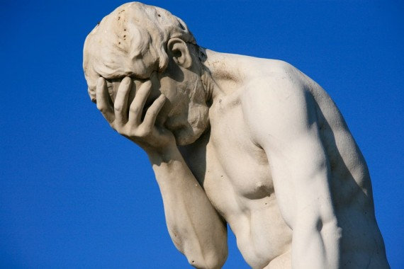
提多书
241
Rick Griffith 博士 • 新加坡神学院 • BibleStudyDownloads.org

Slide 2
关键字
241
行事为人
提多书

Slide 3
主题
23
以纯正的言行举止对付敌人
提多书

Slide 4
关键节
241
“这话是可信的，我愿你确实地强调这些事，
使信 神的人常常留心作善工；这些都是美事，
并且是对人有益的。” (3:8)。
提多书

Slide 5
提多书
241
保罗劝勉提多通过按立合格的长老，教导可敬的行为，即靠恩典得救的自然结果，来组织克里特教会，以话语和行动（行为）来抵挡反对者。

Slide 6

国度陈述
27d
241
耶稣是基督 (1:4) “我们的救主” (3:6) 是我们在 “等候所盼望的福、并等候至大的
神、和我们救主耶稣基督的荣耀显现” (2:13)时事奉的主。
提多书

Slide 7

圣约陈述
27d
教会的行事为人是福音真理关键的见证 (2:11–3:15)。
提多书

Slide 8

救赎陈述
27d
“因为 神救众人的恩典、已经显明出来” (2:11) 教导我们怎么样才是虔诚。
提多书

Slide 9
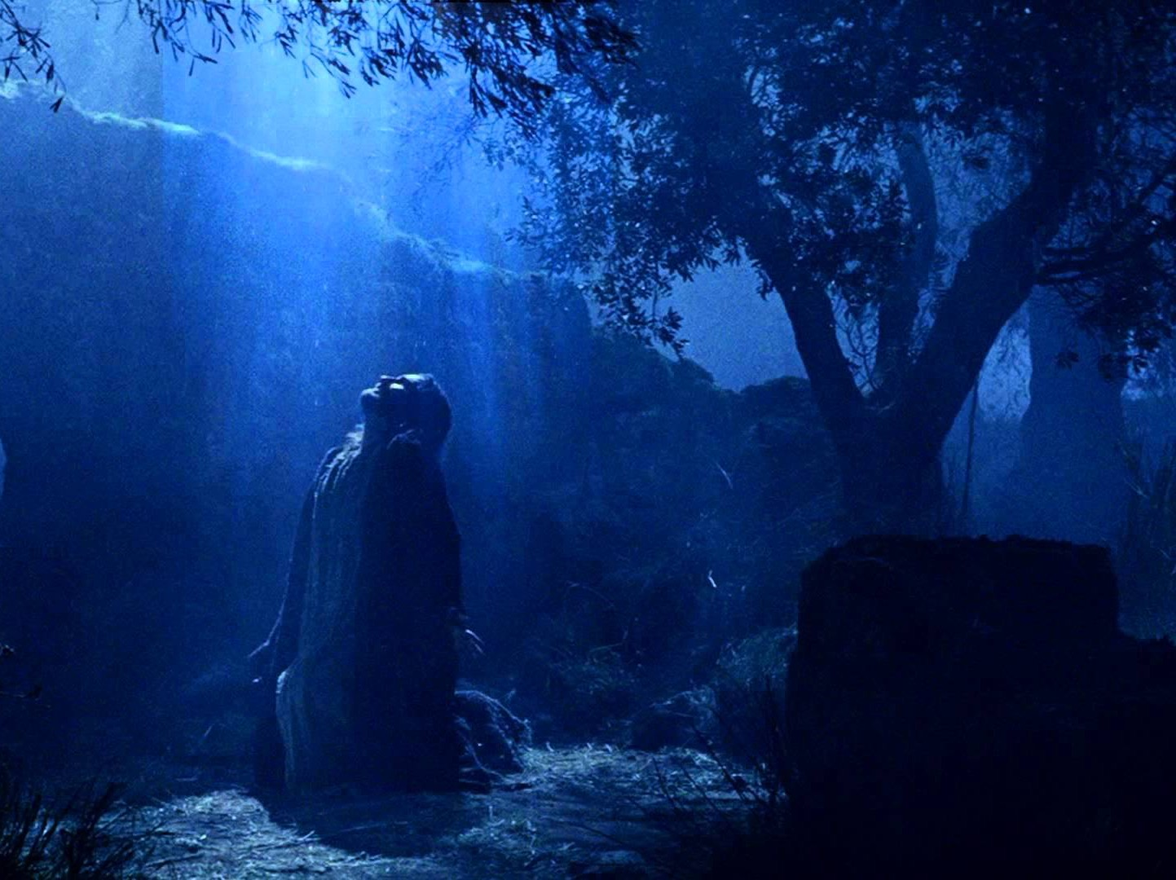
预言
(主, 神性)
27d
神在万古之先所应许的永生(1:2)。
提多书

Slide 10
提多书
241
Sound Conduct Against Opposition
好的行为
Summary Chart
Appoint Elders
委派长老
Set Things in Order
安排事情的秩序
Prevent False Doctrine
防止假教义
Practice True Doctrine
实际行出真的教义
Elders vs. False Teachers
长老对抗假教师
Conduct
for Various Groups
教会各群体的行为
Grace
Leads to Godliness
恩典带来敬虔
Chapter 1
1
2:1-10
2:1-10
2:11—3:15
2:11—3:15
Organize
处理
Teach
教导
Grace
恩典
Truth leads to godliness
1:1-4
2:4-5
老年女人
1:1-4
真理带来敬虔
1:5-16
长老
Elders
1:5-16
2:1-2
老年男人
Older Men
2:1-2
Older Women
2:4-5
Younger Women
2:4-5
2:4-5
年青女人
Younger
Men
2:6-8
2:6-8
年青男人
Slaves
2:9-10
2:9-10
奴隶
Educates
2:11-15
2:11-15
教育
Empowers
3:1-2
3:1-2
授权
Motivates
3:3-8
3:3-8
推动
Protects
3:9-11
3:9-11
保罗
Concl.
3:12-15
3:12-15
结论
Asia Minor to Crete
小亚细亚到克罗尼
Summer AD 66
西元66年暑

Slide 11
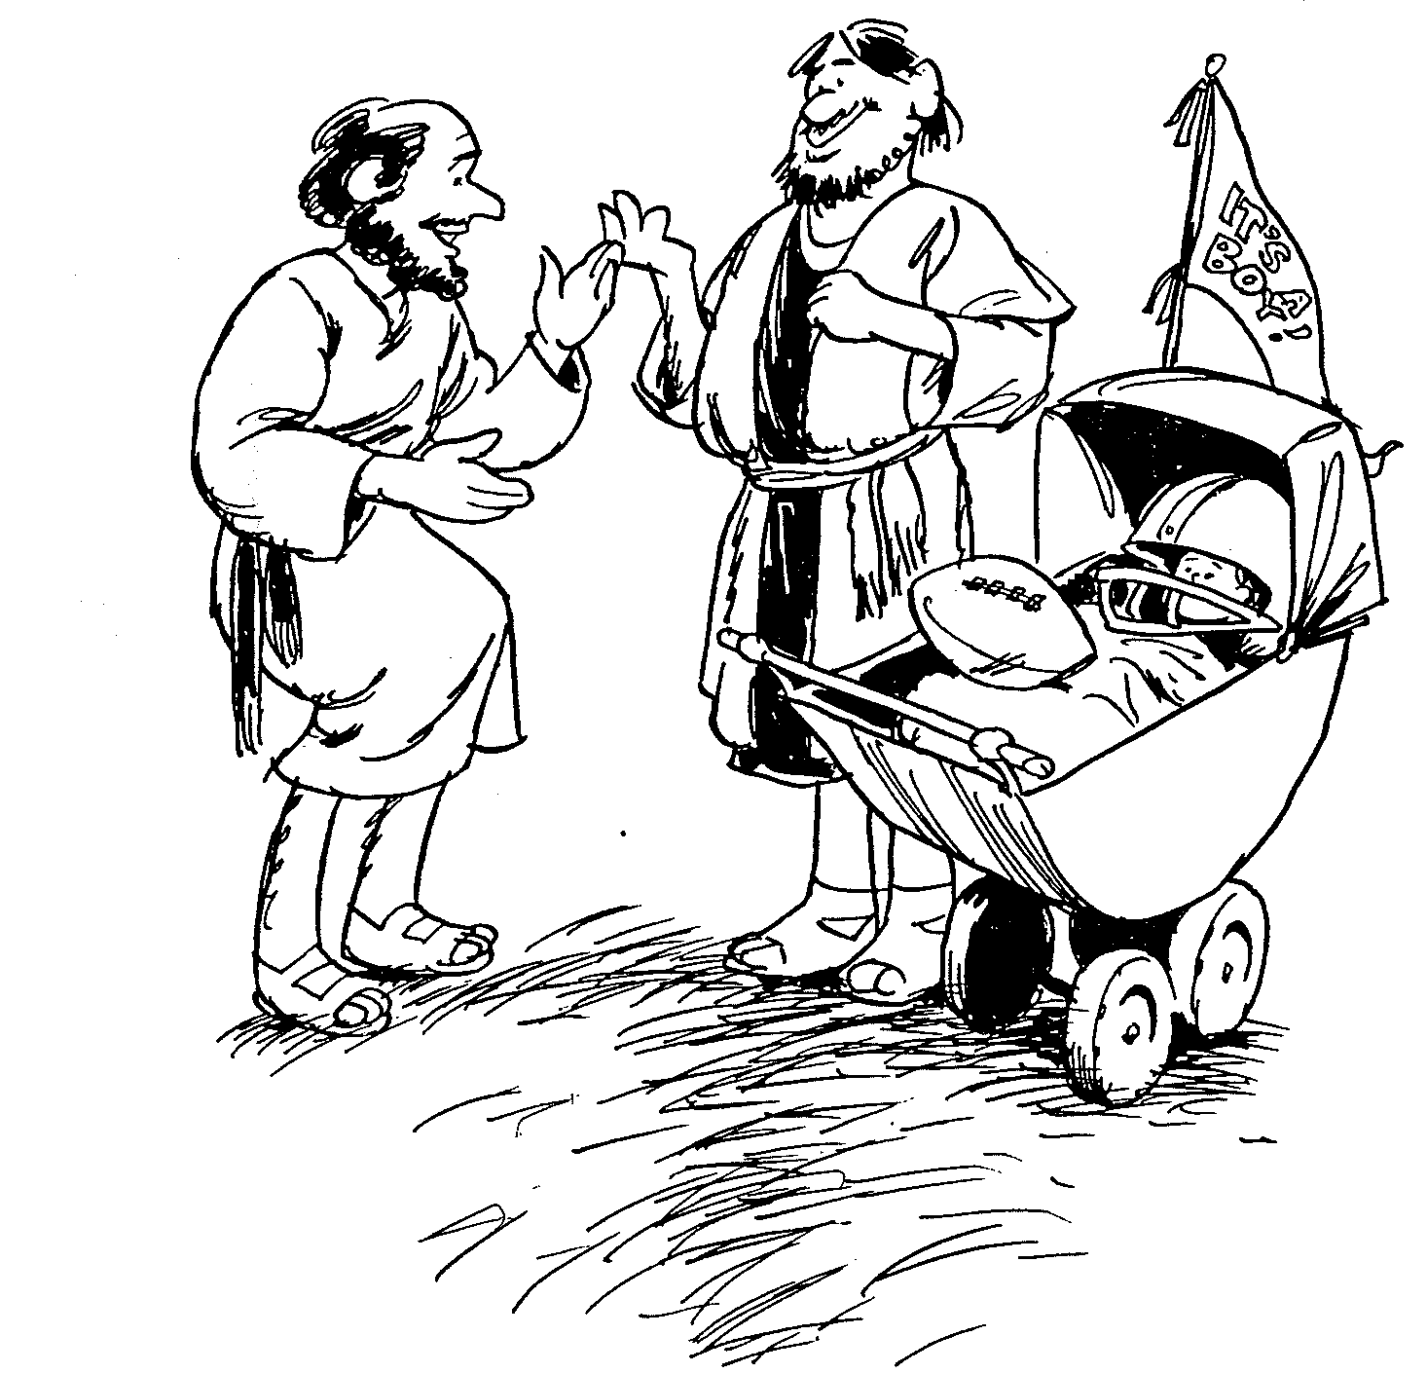
提多书
1
2
3
正确的教义压制错误
有条理的生命带来教义
永不避开好的行为
巴里 赫德尔斯顿 《藏头诗圣经》

Slide 12

要信誉良好
提多书
Rick Griffith 博士 • Crossroads International Church Singapore
BibleStudyDownloads.org

Slide 13

现代假福音
若是有真信心，上帝就会医治?
世上财宝是我们神圣的权柄?
主的圣餐能治百病?
提多书

Slide 14
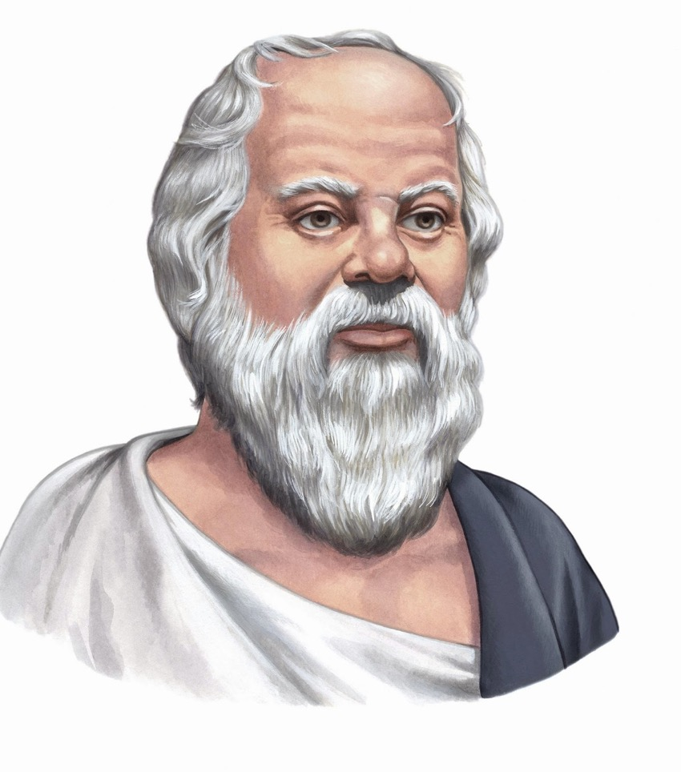
信誉
这世上获得荣誉的最佳方式是我们将伪装成的样子。
— 苏格拉底
写给提多的书信

Slide 15

我们怎么能在诸多假教导中保持 信誉良好?
提多书的三个方法
Notes:
How can we stand true to the Lord with so many heresies plaguing the church?

Slide 16

I. 有虔诚的 长老 教导真理。
提多书第一章
Notes:
Sound doctrine silences error.

Slide 17

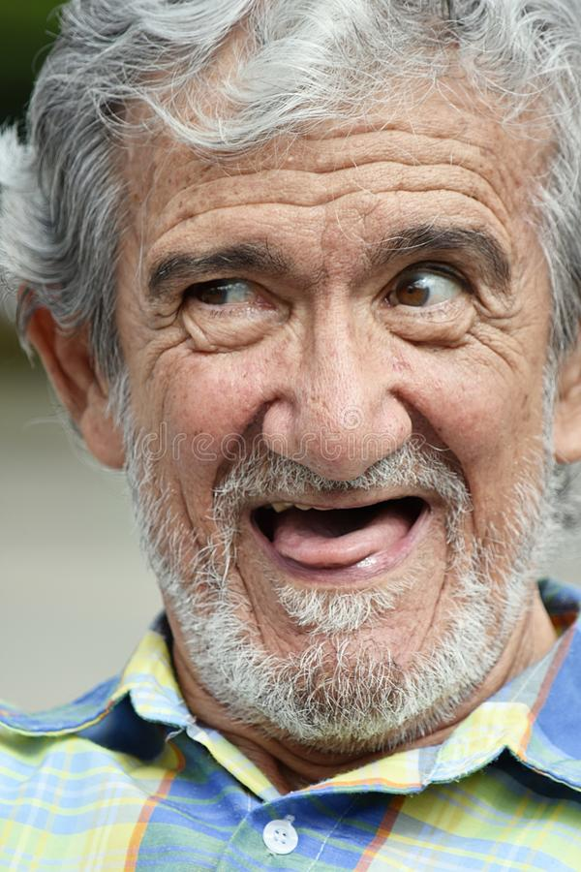
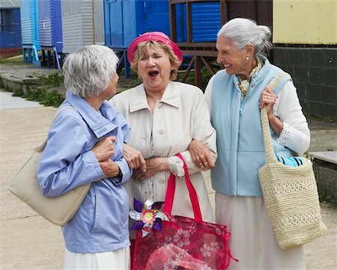

II. 按着你的岁数行事为人。
提多书 2:1-10
Notes:
Order life to doctrine.

Slide 18

III. 让恩典带来 虔诚的心。
提多书 2:11–3:15
Notes:
Never shun good deeds

Slide 19
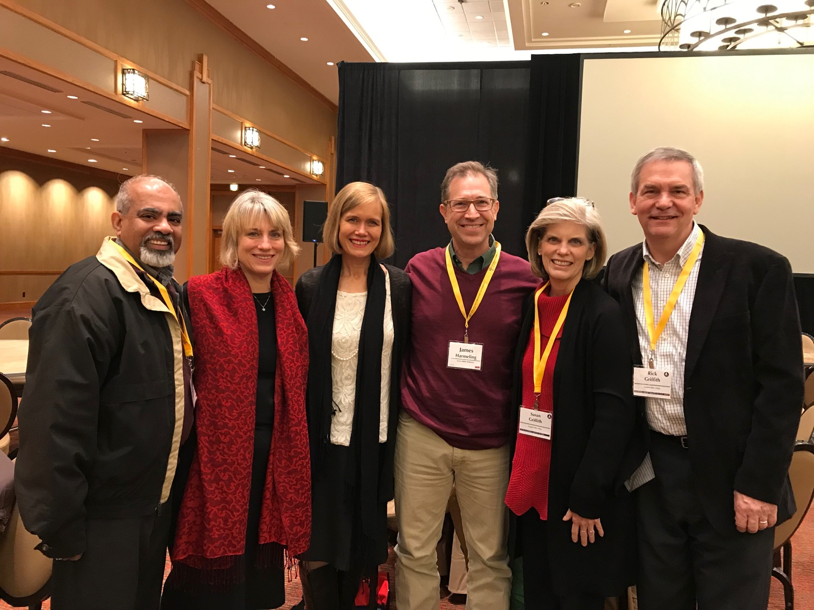
主要是想
提多书
我们的长老要教导
借着神的恩典所得来的
可尊敬的言行举止。

Slide 20
Black

Slide 21
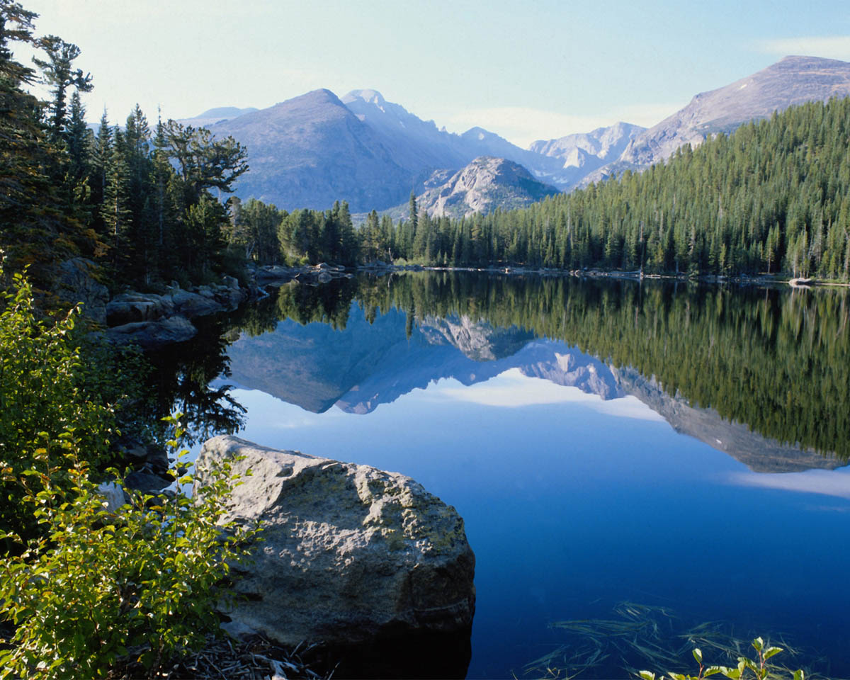
We Are an Offering 1/4
We lift our voices, we lift our hands,
we lift our lives up to You,
we are an offering.
Lord, use our voices,
Lord, use our hands,
Lord, use our lives, they are Yours,
we are an offering.

Slide 22
We Are an Offering 2/4
All that we have, all that we are,
all that we hope to be,
we give to You, we give to You!
We lift our voices, we lift our hands,
we lift our lives up to You,
we are an offering,
we are an offering.

Slide 23
We Are an Offering 3/4
We lift our voices, we lift our hands,
we lift our lives up to You,
we are an offering.
Lord, use our voices,
Lord, use our hands,
Lord, use our lives, they are Yours,
we are an offering.

Slide 24
We Are an Offering 4/4
All that we have, all that we are,
all that we hope to be,
we give to You, we give to You!
We lift our voices, we lift our hands,
we lift our lives up to You,
we are an offering,
we are an offering.

Slide 25


什麼推動你的正確的行為?
简单测验时间
恩典? 或是
律法?
支持你的答案!

Slide 26
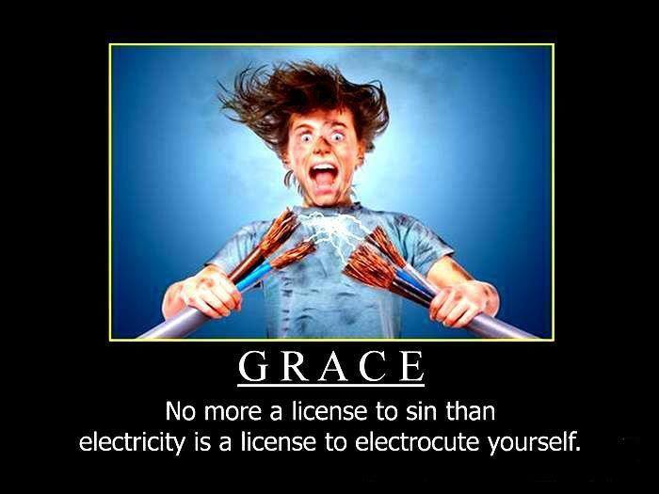
GRACE
No more a license to sin than
electricity is a license to electrocute yourself

Slide 27
新约新约书卷的关键词关键字
24
日期 | 书卷 | 关键字 | 保罗的生平 | 关键信条
40s | 马太福音 | 国度 |  | 教会论
44-47 | 雅各布书 | 行为 |  | 救赎论
49 | 加拉太书 | 称义 | 第一次行程 | 救赎论
51 | 帖撒罗尼迦前书 | 被提 | 第二次行程 | 末世论
51 | 帖撒罗尼迦后书 | 大灾难 | 第二次行程 | 末世论
56 | 哥林多前书 | 成圣 | 第三次行程 | 教会论
56 | 哥林多后书 | 使徒的权柄 | 第三次行程 | 教会论
56-57 | 罗马书 | 神的义 | 第三次行程 | 救赎论
57-59 | 路加福音 | 神的掌权 |  | 宣教论

Slide 28
新约新约书卷的关键词关键字
24
日期 | 书卷 | 关键字 | 保罗的生平 | 关键信条
60 | 以弗所书 | 合一 | 第一次入狱 | 基督伦 (主管)
61 | 歌罗西书 | 神性 | 第一次入狱 | 基督伦 (神)
61 | 腓利门书 | 饶恕 | 第一次入狱 | 基督伦 (和解人)
62 | 腓利比书 | 态度 | 第一次入狱 | 基督伦 (榜样)
62 | 使徒行传 | 主权2 |  | 宣教论
62 | 提前书 | 秩序 | 第四次行程 | 教会论
64 | 彼前书 | 受苦 |  | 末世论
64 | 彼后书 | 知识 |  | 末世论
64-68 | 马可书 | 门徒 |  | 末世论

Slide 29
新约新约书卷的关键词关键字
24
日期 | 书卷 | 关键字 | 保罗的生平 | 关键信条
66 | 提多 | 行事为人 | 第四次行程 | 教会论
67 | 提后 | 教 义 | 第二次入狱 | 教会论
67-68 | 希伯来 | 优秀 |  | 基督伦
c. 69 | 约翰 | 相 信 |  | 救赎论
75 | 犹大 | 伪装者 |  | 末世论
85-95 | 约 1 | 爱 |  | 救赎论
85-95 | 约 2 | 极限 |  | 宣教论
85-95 | 约 3 | 传教士 |  | 宣教论
95-96 | 启示录 | 胜利 |  | 末世论

Slide 30

38
124
39-41
新约综览(保罗书信＋关键字)
“直到地极” (徒 1:8)
徒9 13 14 15 16 18 21 27 28
五月57-
八月59
大 马 色
安 提 阿
四月 48-
九月 49
1
加 拉 太
四月 50-
九月 52
2
爱琴海
春季 53-
五月 57
3
亚洲
五月 57-
八月 59
试验
二月 60-
三月 62
1
罗马
春季 62-
秋季 67
4
西班牙
秋季 67-
春季 68
2
罗马
秋季 49
理事会
春季68
教会扩长
35 48 49 50 52 53 57 60 62 67 68 95
天国
主权1
主权2
门徒
相 信
以弗所
合一
提 前
秩序
提后
加拉太
帖 前
歌前
教 义
因信称义
被提
成圣
大患难
帖后
使 徒
歌罗西
神性
提 多
歌后
行事为人
称义
腓利门
罗马
饶恕
福音书以及使徒行传
腓立比
态度
保罗书信
1234
旅程
罗马
收监
保罗书信 +关键节

Slide 31
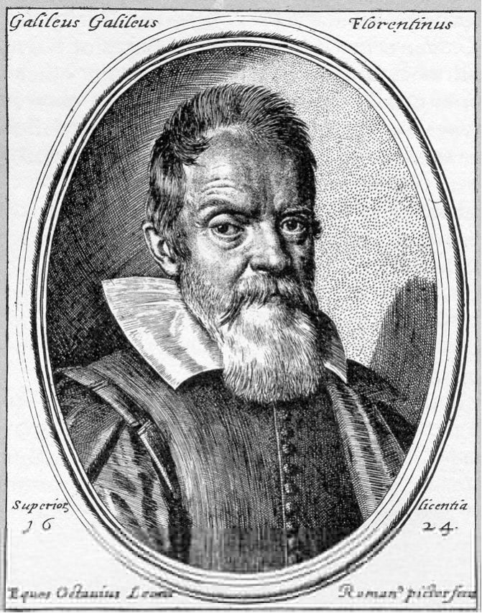
我們如何打擊異端?
迦利略被認為是異端的份子，由於非正統的觀念與傳統的觀念，在原子和地球旋轉不同。
情形可能更壞…
Notes:
･ Galileo, HereticPietro Redondi, translated by Raymond Rosenthal - Allen Lane, Penguin Press, 1987 ﾐ 356 + x pp - ｣17.95 The story of Galileo's quarrel with the Roman Catholic Church and of the events leading to his trial in 1633 is well-known, yet although the case against him has been explored many times, there remains a suspicion that our knowledge is incomplete and that there were hidden factors. Wide-ranging and revolutionary as the implications of the Copernican system were, it seems unlikely that their theological challenge would have been insuperable. Even Pope Urban VIII himself had earlier befriended Galileo and had shown interest in his Copernican studies. It appears therefore, that the problems raised by Galileo's work stemmed from a deeper meta-physical level and in this book Pietro Redondi seeks to show that the charge of heresy brought against Galileo in 1633 arose less from his Copernicanism than from his unorthodox physical ideas, especially his support for an atomist theory of heat, light and matter. This theory was opposed to Aristotelian ideas of matter and substantial forms which had long supported the fundamental Roman Catholic doctrine of transubstantiation. An atomist theory was incompatible with the miraculous transformation of the Host.” http://www.historytoday.com
迦利略與羅馬天主教會發生爭論，導致1633年著名的審訊。他也遇到困難的處境，包括人們的語言上的攻擊和人們的懷疑等等。這些都是在當時人們有限的認知所造成的結果。同時，也是原子理論與神蹟的改變所帶來不同的變化。

Slide 32
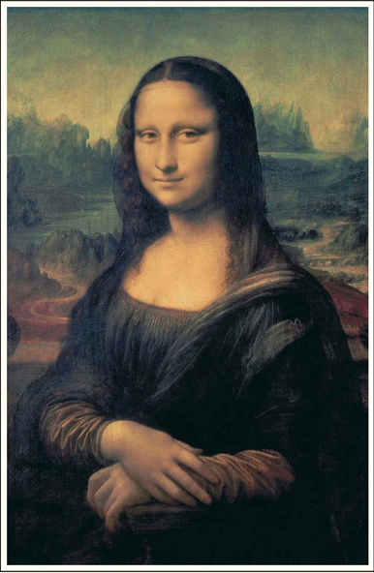

How should we fight heresy?
Notes:
The Da Vinci Code=達文西密碼, Dan Brown= 布朗．但著。

Slide 33
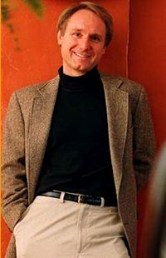
含笑中錢就進到銀行
$二億六仟萬
銷售一千二百萬本

Slide 34
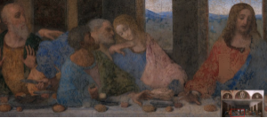
在這裏的是誰?
約翰?
或馬利亞?
布朗說”約翰”實際上是抹大拉的馬利亞，是耶穌的妻子!
不論如何，達文西只是在畫中描繪約翰是一位很英俊的男人。

Slide 35
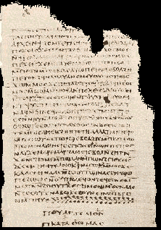
抹大拉的馬利亞作為基督的伴侣(妻子)
{…}伴侣，抹大拉。{…}愛她甚於所有的門徒，常常親吻她的嘴。{…}其他的門徒。他們對他說”為什麼愛她甚於我們?"
菲利福音(諾斯底新約伪經)
http://www.gnosis.org/naghamm/gop.html
Notes:
http://www.gnosis.org/naghamm/gop.html
Image is of the Gospel of Thomas on the same site.

Slide 36
提多
主題
242
Title
給提多的信是三巻書的其中之一巻，通稱為牧養之書信。他是保羅最後寫的，也是唯一對個人寫而不是對教會所寫的。

Slide 37
提多
作者身分
242
Authorship
外在證據
證實保羅是原作者，可從保羅其他書信中找到証據。(除了羅馬書和哥林多前書)
內在證據
這書信保羅宣稱，他是原作者(提前1:1)，及在書信中充滿保羅的風格。

Slide 38

提多
日期
242
Date 1
保羅在人生的下半塲的年歲，是鮮為人知的。從協調外在與裏面的資料，得著一個設想:
.第一在羅馬入獄 (徒28:30-31)
.保羅寫以弗所，歌羅西書，腓利門書，
和腓立比書
.主的弟弟，雅各的殉道。

Slide 39
提多
日期
242
Date 2
.從獄中得到釋放。 62年春—67年冬
.保羅在以弗所和歌羅西(提摩太離開以弗所)62 年春—夏
.彼得到達羅馬。 62 年
.保羅在馬其頓。 62年晚夏—62/63年冬
.在馬其頓寫提前，在以弗所寄給提 摩太。 62 年冬
.保羅在亞細亞。 63年春—64年春
.保羅在西班牙(羅15:24，預期到羅馬) 64 年春—66年春
.尼禄逼害基徒和彼得的殉道。 64 年夏

Slide 40
242
提多
日期
Date 3
保羅在革哩底 (提多離開那裏; 提多書1:5) 66年 初夏
保羅在亞細亞 66年夏-冬
從小亞細亞寫提多書給在革哩底的提多 66年 夏
保羅在尼哥波立(提多書3:12) 66/67年 冬
保羅在特羅亞(提後4:13)馬其頓和希臘 67年 春
從小亞細亞寫提多書給在革哩底的提多 66夏
第二次入獄 67年冬-68春
保羅被逮捕和帶到羅馬 67年冬
在羅馬安提阿之後，再給在後弗所的提摩太。 67年冬
保羅被殺 68年春
耶路撒冷被毀 70年9月2日

Slide 41
提多
環境
242
Circumstances
起源/接受者
保羅給提多的書信(提多書1:4)是從小亞細不知名的地點寄到在革哩底的提多(提多書1:5)。以弗所，馬其頓和哥林多前也被考慮為可能的書寫的地點，但不會改變它的解釋。
特別的事情
在保羅的第一次與第二次入獄之間，他與提多曾住在一起並到革哩底。由於在福音事工大有進展，保羅離開時提出幫助新的信徒進到當地的教會，然後他做其它的事工。其後，保羅寫信給提多供他管理教會的智慧和信徒的行為規範。

Slide 42
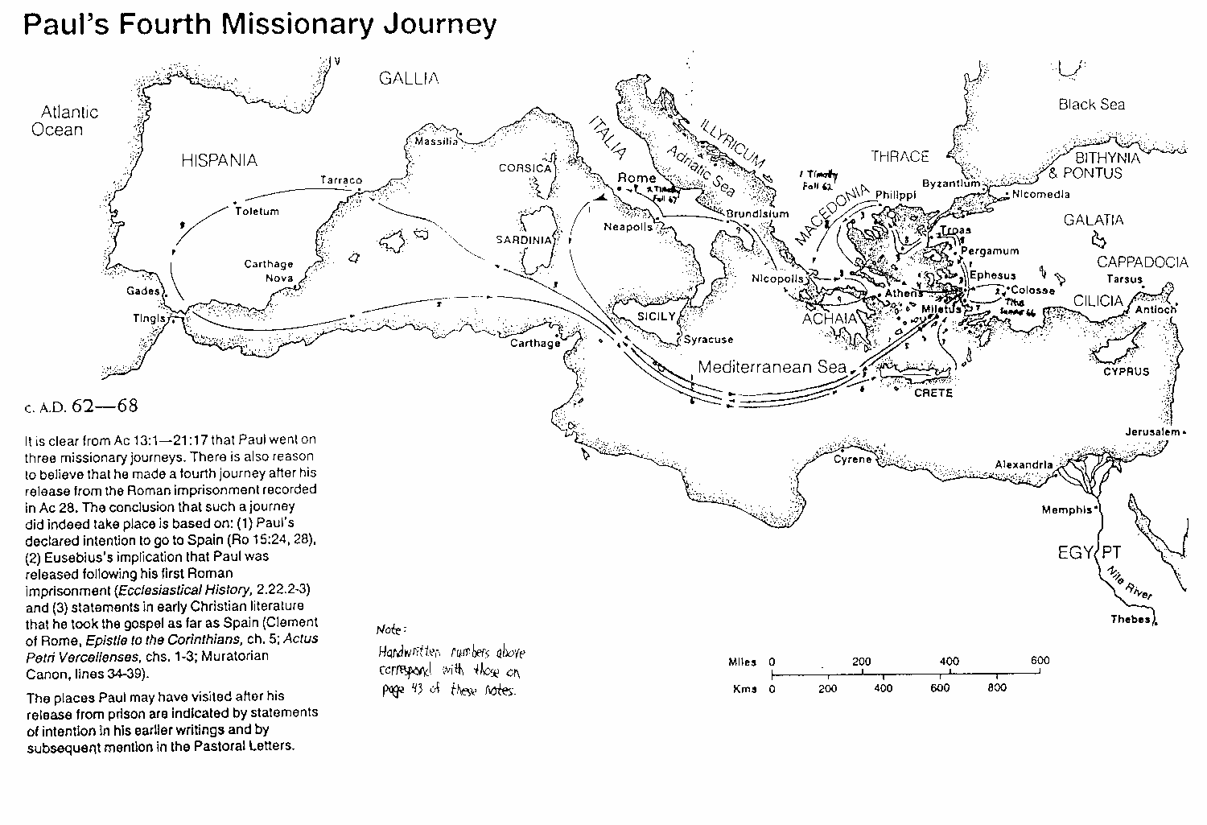
保羅的第四次行程
168
保羅得到忍耐的奬賞, 他曾七次被囚，被強迫逃亡他處，和被石頭打。曾經在東西方都宣傳，由於他的信心，使他得著好名稱。他又曾經向全界教導如何稱義，並且他到達西方的極限。最後，他為義而殉道。如此，他離開世界進到聖地，這些都是他忍耐的證明。
1 Clement 5
克林門前書5章
Notes:
http://www.earlychristianwritings.com/text/1clement-roberts.html

Slide 43
提多
提 多 書 & 提 後
243
Similarities of Titus & 2 Tim
提多書
提後
西元67年被囚在羅馬時所寫的
西元66年在小亞細亞自由的時寫的
比較長 (共四章83章)
比較簡短 (共3章46節)
非正式，友善(寫了20個名字)
比較正式，很少寫到個人的事 (只寫6個人的名字)
教導如何帶領教會
教導如何組織教會
強調好的行為
強調好的教義。

Slide 44
提多
論點
Argument
243
保羅寫這信給提多的目地是給他實際的建議，這些建議能夠幫助使徒，並代表知道如何組織，在克里亞的新信徒。他的書信提出三方面的忠告:
1。如何委任適當的長老們，這才能在話語和行為上反駁假教師(第一章)
2。 如何教導信徒們有好的行為，使教會不致為反對者誹謗(2:1-10)
3。規誡聖徒們活出與假教師不同的生活，由於神的恩典，他們會活出敬虔的行 為。 (2:11-3:15)
保羅強調基督行為多於教義; 無論如何，提多要教導人們正確的行為來，表達出教義與行為是不能分離。

Slide 45

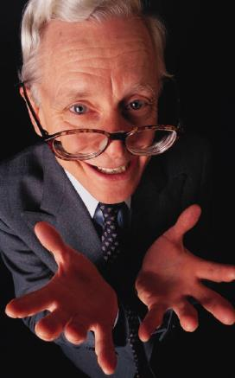

提多
綜合
243
Synthesis
用好行為對抗反對者
1 長老反對假教師
2:1-10 不同團體的行為
2:11—3:15 恩典帶來虔敬

Slide 46
提多
Summary Statement
241
總結
保羅勸勉提多到克里底人所組織的教會，並委派在當中有合宜品格的長老群們並教導信徒們能活出有好的行為見證來。因為這是救恩的結果，靠著主的恩典，能打敗反對者的言語和行為。(好的行為見證)

Slide 47
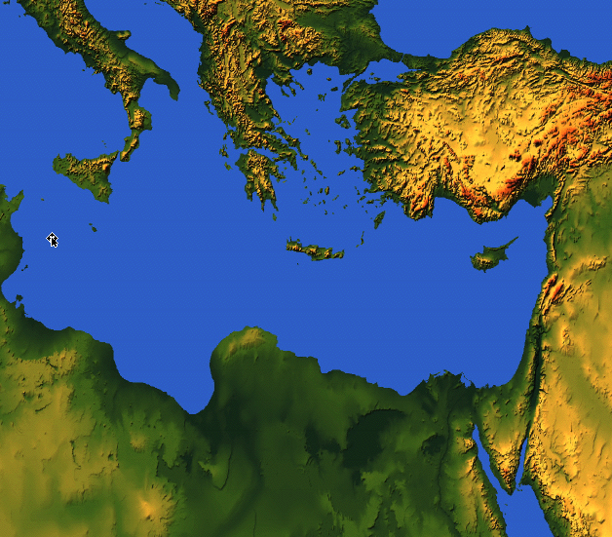

保罗与提多
在哪里?
242
以弗所
克里特

Slide 48
要信誉良好
提多书
Rick Griffith 博士 • Crossroads International Church Singapore
BibleStudyDownloads.org

Slide 49
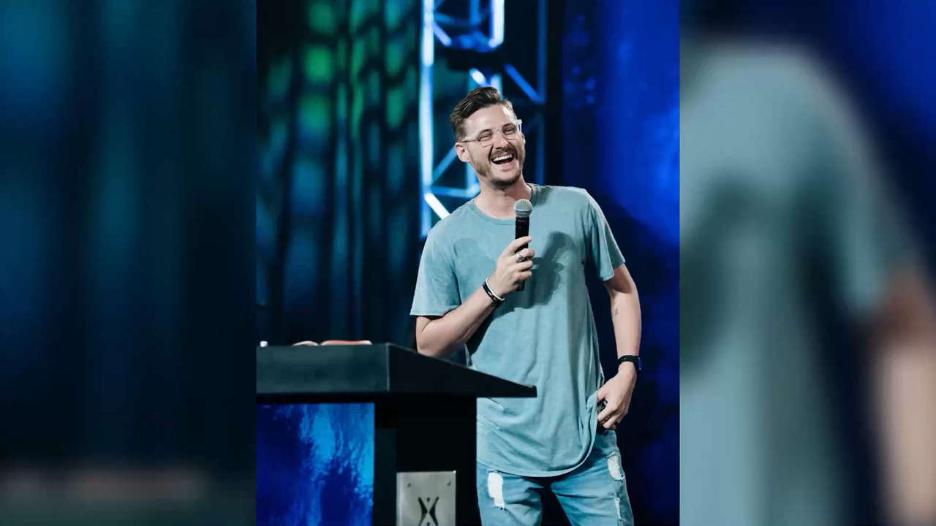
Pastor Jarrid Wilson
Harvest Christian Fellowship Riverside, Calif

Slide 50
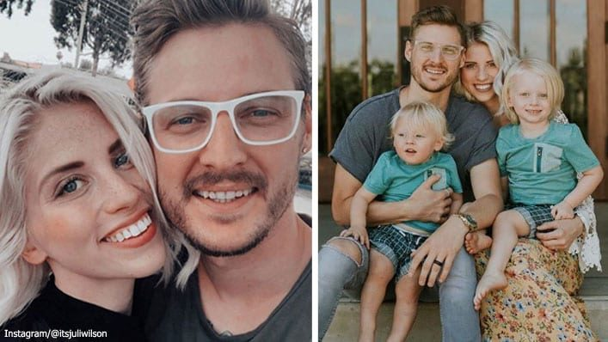
Another Pastor…
Notes:
To add to the many US pastors who have already taken their own lives in recent years, megachurch pastor and mental health advocate Jarrid Wilson died by suicide on Monday (9 Sep 2019). He served at Harvest Christian Fellowship in California with Greg Laurie, a popular evangelical leader.

Slide 51
Struggles are Real
It's been said that 1 in every 4 pastors struggles with depression. Lifeway Research reveals that the number of pastors diagnosed with clinical depression was double the national average. Forty five percent sought advice from their family doctor regarding stress and anxiety issues. Nearly one-fourth of all pastors (23 percent) acknowledge having "personally struggled with mental illness," and half of those pastors say the illness has been diagnosed.
—Charisma News 29 Aug 2018—
Notes:
YEAR IN REVIEW: Wife of Beloved Pastor Who Committed Suicide Speaks Out
1:00PM EDT 8/29/2018 Jessilyn Lancaster
https://www.charismanews.com/us/72893-wife-of-beloved-pastor-who-committed-suicide-speaks-out

Slide 52

Are Christians any better off?
Notes:
It makes one wonder if Christianity really works, doesn’t it? Of course, we know Jesus truly changes lives, but it makes me sad to see so many who don’t see that reality in their lives. So what the problem, then? Pastor Wilson got caught up in false teaching—the lie that he and his family would be better off if he was dead instead of alive.

Slide 53
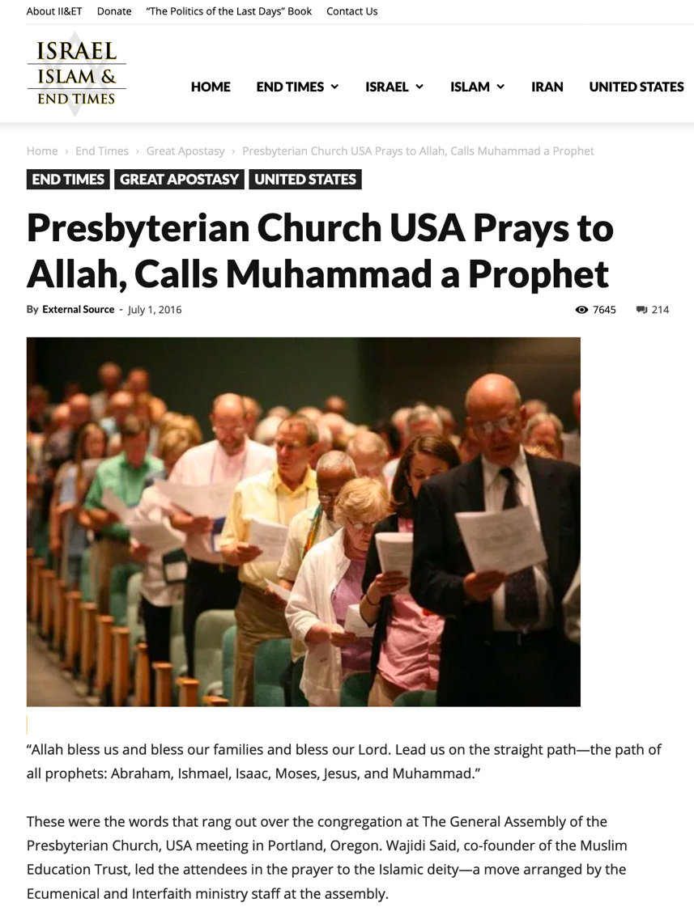
False Teaching
“Allah, bless us and bless our families and bless our Lord. Lead us on the straight path—the path of all the prophets: Abraham, Ishmael, Isaac, Moses, Jesus and Muhammad.”
Notes:
One key problem is the false teaching all around us. In 2016, the Presbyterian Church USA even prayed to Allah…
—————————
https://israelislamandendtimes.com/presbyterian-church-usa-prays-to-allah-calls-muhammad-a-prophet/?utm_campaign=shareaholic&utm_medium=facebook&utm_source=socialnetwork&fbclid=IwAR2mraG6FYMzzkflfKLhp5eHjvzjgyYMNRTYjuSwVgOV6CD9xLqtETAsXao
Accessed 14 July 2019

Slide 54
现代假福音
若是有真信心，上帝就会医治?
世上财宝是我们神圣的权柄?
主的圣餐能治百病?
提多书

Slide 55
关键字
241
行事为人
提多书

Slide 56
主题
23
以纯正的言行举止对付敌人
提多书

Slide 57
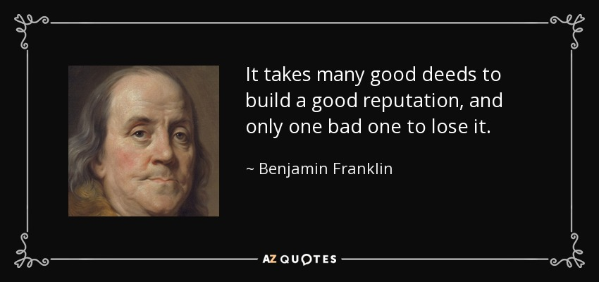
Be Reputable
It takes many good deeds to build a good reputation, and only one bad one to lose it.
—Benjamin Franklin
Notes:
In short, as my message title indicates, “Be Reputable.” Ben Franklin noted aptly…

Slide 58
信誉
这世上获得荣誉的最佳方式是我们将伪装成的样子。
— 苏格拉底
写给提多的书信

Slide 59
Results of Reputable Conduct
“that the word of God may not be reviled”
(Titus 2:5)
“that an opponent may be put to shame, having nothing evil to say about us”
(Titus 2:8)
“adorn the doctrine of God our Savior”
(Titus 2:10)
Notes:
In Paul’s letter to Titus, we see many results of reputable conduct…

Slide 60
提多
241
鑰字
行為
Key Word / Verse
鑰詞
“這話是可信的，我也願你把這些事切切實實的講明，使那些已信神的人，留心作正經事業。這都是美事，並且與人有益。(提多書3:8)

Slide 61
Character is who you really are. Reputation is who others think you are.
How’s your reputation? Are you known by unbelievers as a follower of Jesus?
Do you wish everyone in this church had the same reputation that you have?
How well does your reputation show the love of the Lord Jesus?
Notes:
So how are you doing at this?

Slide 62
我们怎么能在诸多假教导中保持 信誉良好?
提多书的三个方法
Notes:
How can we stand true to the Lord with so many heresies plaguing the church?

Slide 63
38
124
39-41
新约综览(保罗书信＋关键字)
“直到地极” (徒 1:8)
徒9 13 14 15 16 18 21 27 28
五月57-
八月59
大 马 色
安 提 阿
四月 48-
九月 49
1
加 拉 太
四月 50-
九月 52
2
爱琴海
春季 53-
五月 57
3
亚洲
五月 57-
八月 59
试验
二月 60-
三月 62
1
罗马
春季 62-
秋季 67
4
西班牙
秋季 67-
春季 68
2
罗马
秋季 49
理事会
春季68
教会扩长
35 48 49 50 52 53 57 60 62 67 68 95
天国
主权1
主权2
门徒
相 信
以弗所
合一
提 前
秩序
提后
加拉太
帖 前
歌前
教 义
因信称义
被提
成圣
大患难
帖后
使 徒
歌罗西
神性
提 多
歌后
行事为人
称义
腓利门
罗马
饶恕
福音书以及使徒行传
腓立比
态度
保罗书信
1234
旅程
罗马
收监
保罗书信 +关键节

Slide 64

Pastoral Epistles
1 Timothy
Titus
2 Timothy
1 Timothy = personal, urgent, doctrinal emphasis
Titus = less urgent, practical emphasis
2 Timothy = personal, urgent, focus on the Word
Notes:
These last three letters of Paul are called the Pastoral Epistles.
They show the most advanced theology of local church life and shepherding the flock—but this makes sense since Paul and the church had learned much in the previous 30 years since the church had begun.
Sadly, most NT scholars today do not believe that Paul wrote these letters and many date them in the second century. I guess they think that Paul was a slow learner!

Slide 65
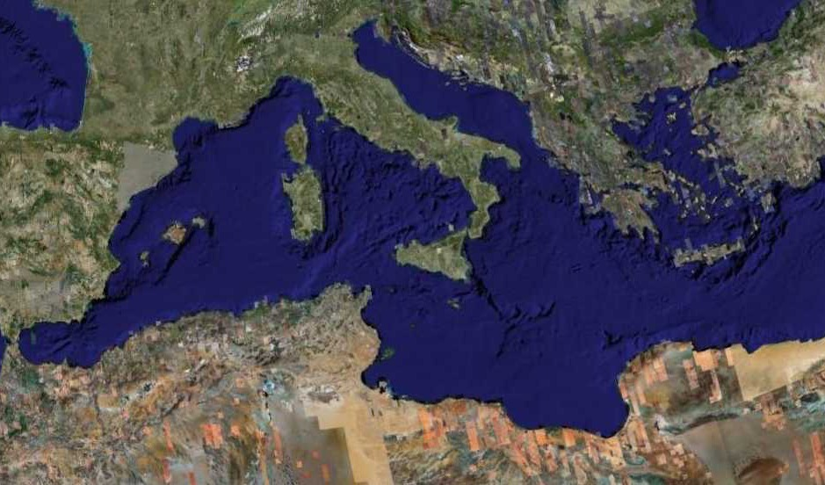
Fourth Missions Trip
1-2 Timothy & Titus After Acts
Spring 62 – Fall 67
Notes:
Paul had finished reaching the Eastern Roman Empire by the time he wrote Titus—and even had just returned from Spain.
—————
Freedom from Imprisonment Spring 62–Fall 67
Paul in Ephesus and Colosse (Timothy left at Ephesus) Spring–Summer 62
Peter travels to Rome 62
Paul in Macedonia late summer 62-winter 62/63
1 Timothy written from Macedonia to Timothy in Ephesus Fall 62
Paul in Asia Minor Spring 63-Spring 64
Paul in Spain (anticipated in Rom. 15:24) Spring 64-Spring 66
Christians persecuted by Nero; Peter martyred Summer 64
Paul in Crete (Titus left there; Tit 1:5) early Summer 66
Paul in Asia Minor Summer- Fall 66
Titus written from Asia Minor to Titus in Crete Summer 66
Paul in Nicopolis (Tit 3:12) Winter 66/67
Paul in Troas (2 Tim 4:13), Macedonia and Greece Spring– Fall 67
Second Roman Imprisonment Fall 67–Spring 68
Paul arrested and brought to Rome Fall 67
2 Timothy written from Rome to Timothy in Ephesus Fall 67
Paul beheaded Spring 68

Slide 66
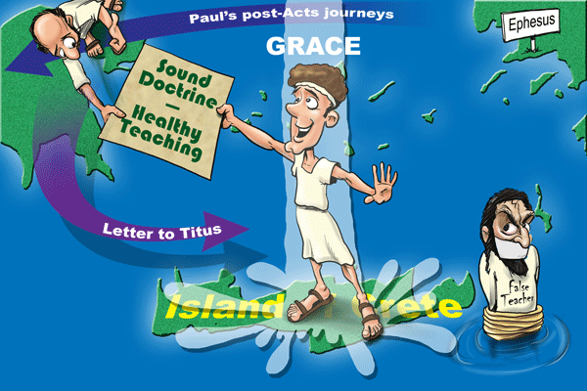
恩惠
Paul’s post-Acts journeys
以弗所
Sound Doctrine
––––––
Healthy Teaching
"我从前留你在克里特岛，是要你办好没有办完的事，并且照我所吩咐的，在各城设立长老。"
(提多1:5 CNV).
写给提多的信
False Teacher
克里特岛

Slide 67
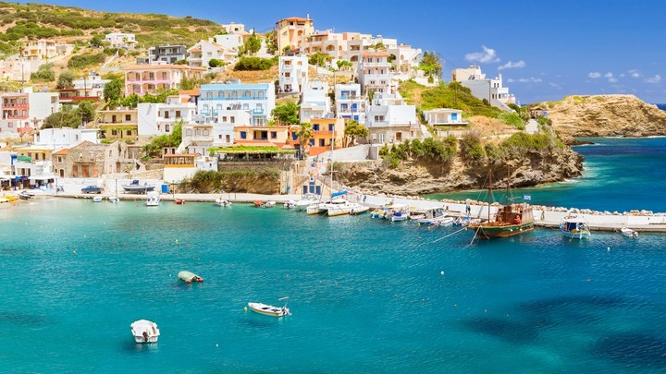
Crete was beautiful but had a poor reputation
Notes:
So how could the believers there live out the Christian life in such a pagan place?

Slide 68
我们怎么能在诸多假教导中保持 信誉良好?
提多书的三个方法
Notes:
How can we stand true to the Lord with so many heresies plaguing the church?

Slide 69
提多书
241
Sound Conduct Against Opposition
好的行为
Summary Chart
Appoint Elders
委派长老
Set Things in Order
安排事情的秩序
Prevent False Doctrine
防止假教义
Practice True Doctrine
实际行出真的教义
Elders vs. False Teachers
长老对抗假教师
Conduct
for Various Groups
教会各群体的行为
Grace
Leads to Godliness
恩典带来敬虔
Chapter 1
1
2:1-10
2:1-10
2:11—3:15
2:11—3:15
Organize
处理
Teach
教导
Grace
恩典
Truth leads to godliness
1:1-4
2:4-5
老年女人
1:1-4
真理带来敬虔
1:5-16
长老
Elders
1:5-16
2:1-2
老年男人
Older Men
2:1-2
Older Women
2:4-5
Younger Women
2:4-5
2:4-5
年青女人
Younger
Men
2:6-8
2:6-8
年青男人
Slaves
2:9-10
2:9-10
奴隶
Educates
2:11-15
2:11-15
教育
Empowers
3:1-2
3:1-2
授权
Motivates
3:3-8
3:3-8
推动
Protects
3:9-11
3:9-11
保罗
Concl.
3:12-15
3:12-15
结论
Asia Minor to Crete
小亚细亚到克罗尼
Summer AD 66
西元66年暑

Slide 70
I. 有虔诚的 长老 教导真理。
提多书第一章
Notes:
Sound doctrine silences error.

Slide 71
提多书
1
2
3
正确的教义压制错误
有条理的生命带来教义
永不避开好的行为
巴里 赫德尔斯顿 《藏头诗圣经》

Slide 72
Slides on
提多 1

Slide 73
提多
大綱
244
Outline
1. (第一章) 保羅勸勉提多委派有好品格的長老群，熟悉聖經並能用神的話語去斥責那些的假教師來保護新成立的革里底的教會。
2. (2:1-10) 保羅勸勉提多教導不同的年齡曾的信徒，活出好的品格及信仰的生活。因此革里底的敵人不能誹謗教會和神的道。
3.(2:11-3:15)保羅申明神的恩典能使人有敬的行為。他提醒提多，他在信中所吩咐的是每一個基督徒所必須行的。歸因於我們的得救在於神的恩典。

Slide 74

PURITY
Titus 1:1-4 (NLT)

Slide 75

¹ This letter is from Paul, a slave of God and an apostle of Jesus Christ. I have been sent to proclaim faith to those God has chosen and to teach them to know the truth that shows them how to live godly lives.
Titus 1:1 (NLT)
Notes:
Paul greets Titus that truth leads to godliness amidst pagans (1:1-4).

Slide 76
² This truth gives them confidence that they have eternal life, which God—who does not lie—promised them before the world began.
Titus 1:2 (NLT)

Slide 77

Adorning the Gospel
Building Healthy Churches that Display God’s Power
S t u d i e s i n T i t u s
Preached by Dr. Jim Harmeling on Titus 1:1-2
at Crossroads International Church Singapore • cicfamily.com
Uploaded by Dr. Rick Griffith • Singapore Bible College
Thousands of files in 49 languages for free at BibleStudyDownloads.org

Slide 78
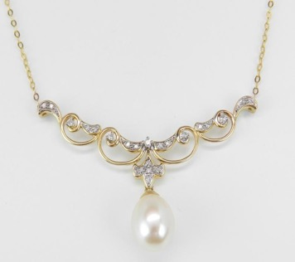
Why is the health of a church important?
Titus 1:1-4
Healthy churches are part of God’s mission (vs. 1-2a)
The mission of sound conversion
Jude 3
³ Beloved, although I was very eager to write to you about our common salvation, I found it necessary to write appealing to you to contend for the faith that was once for all delivered to the saints.

Slide 79
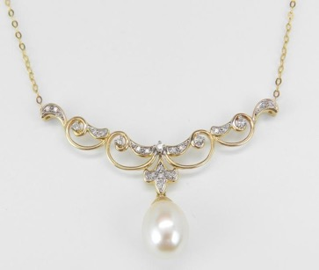
Why is the health of a church important?
Titus 1:1-4
Healthy churches are part of God’s mission (vs. 1-2a)
The mission of sound conversion
The mission in growth in knowledge of the truth
The mission of developing godly living

Slide 80
“Any doctrine which does not promote godliness is manifestly bogus.”
—John Stott—
“But real truth never deviates from the path of piety.
A profession of the truth which allows an individual to live in ungodliness is a spurious profession.”
—Donald Hiebert—

Slide 81

Why is the health of a church important?
Titus 1:1-4
Healthy churches are part of God’s mission (vs. 1-2a)
The mission of sound conversion
The mission in growth in knowledge of the truth
The mission of developing godly living
The mission of living for another world

Slide 82
³ And now at just the right time he has revealed this message, which we announce to everyone. It is by the command of God our Savior that I have been entrusted with this work for him.
Titus 1:3 (NLT)

Slide 83
⁴ I am writing to Titus,
my true son in the faith that we share.
May God the Father and Christ Jesus our Savior give you grace and peace.
Titus 1:4 (NLT)

Slide 84
Adorning the Gospel
Building Healthy Churches that Display God’s Power
S t u d i e s i n T i t u s
Preached by Dr. Jim Harmeling on Titus 1:3-4
at Crossroads International Church Singapore • cicfamily.com
Uploaded by Dr. Rick Griffith • Singapore Bible College
Thousands of files in 49 languages for free at BibleStudyDownloads.org

Slide 85
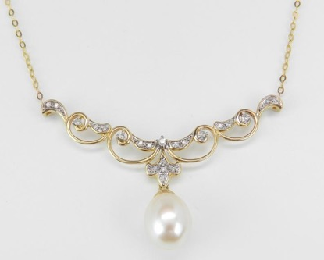
Why is the health of a church important?
Titus 1:1-4
Healthy churches are part of God’s mission (vs. 1-2a)
The mission of sound conversion
The mission of growth in knowledge of the truth
The mission of developing godly living
The mission of living for another world

Slide 86
Why is the health of a church important?
Titus 1:1-4
Healthy churches are part of God’s mission (vs. 1-2a)
Healthy churches reflect the glory of God’s character (vs. 2b-3)
His sovereignty: He designed His plan of salvation from eternity

Slide 87
Ephesians 1:4
“. . . even as he chose us in him before the foundation of the world, that we should be holy and blameless before him.”
2 Timothy 1:9
“. . . who saved us and called us to a holy calling, not because of our works but because of his own purpose and grace, which he gave us in Christ Jesus before the ages began.”
1 Corinthians 2:7
God’s hidden wisdom was “decreed before the ages for our glory.”

Slide 88
Why is the health of a church important?
Titus 1:1-4
Healthy churches are part of God’s mission (1-2a)
Healthy churches reflect the glory of God’s character (2b-3)
His sovereignty: He designed His plan of salvation from eternity
His providence: He guides history to fulfill His plan

Slide 89
Romans 5:6 – “at the right time”
Galatians 4:4 – “the fullness of time”
Ephesians 1:10 – “the fullness of time”
Acts 17:26 – “determined allotted periods and the boundaries . . .”

Slide 90
“It was no accident that Christianity came when it did. It came in God’s own time; all history had been a preparation for it; and the circumstances were such that the way was open for the good news to spread.”
—William Barclay—

Slide 91

5 Reasons for the “proper time” to manifest Christ
Unified language
More convenient travel
Safer travel
Political stability
Philosophical openness

Slide 92
Why is the health of a church important?
Titus 1:1-4
Healthy churches are part of God’s mission (1-2a)
Healthy churches reflect the glory of God’s character (2b-3)
His sovereignty: He designed His plan of salvation from eternity
His providence: He guides history to fulfill His plan
His wisdom: He chooses human proclamation as His means of transforming lives

Slide 93
Why is the health of a church important?
Titus 1:1-4
Healthy churches are part of God’s mission (vs. 1-2a)
Healthy churches reflect the glory of God’s character (vs. 2b-3)
Healthy churches reveal God’s continual leading (v. 4)

Slide 94
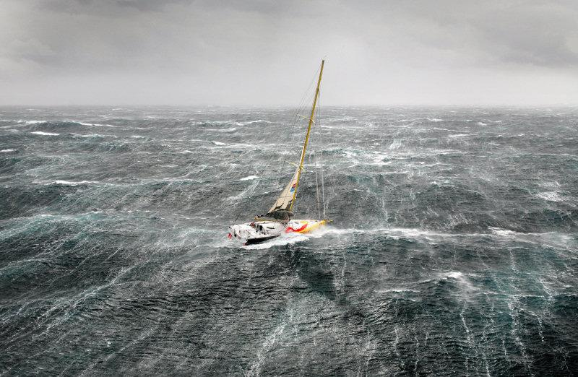
Leadership Challenges in the Life of Titus
Church leadership challenge 1: Clarify and defend the gospel (Gal 2:1-10)
Church leadership challenge 2: Confront sin (2 Cor 2:12-13; 7:5-16)
Church leadership challenge 3: Collect money (2 Cor 8:6-24)
Church leadership challenge 4: Strengthen young churches in a difficult location

Slide 95
Why is the health of a church important?
Titus 1:1-4
Healthy churches are part of God’s mission (vs. 1-2a)
Healthy churches reflect the glory of God’s character (vs. 2b-3)
Healthy churches reveal God’s continual leading (v. 4)

Slide 96

SCRIPTURE READING
Titus 1:5-9 (NLT)

Slide 97

⁵ I left you on the island of Crete so you could complete our work there and appoint elders in each town as I instructed you.
⁶ An elder must live a blameless life. He must be faithful to his wife, and his children must be believers who don’t have a reputation for being wild or rebellious.
Titus 1:5-6 (NLT)

Slide 98
⁷ A church leader is a manager of God’s household, so he must live a blameless life. He must not be arrogant or quick-tempered; he must not be a heavy drinker, violent, or dishonest with money.
Titus 1:7 (NLT)

Slide 99
⁸ Rather, he must enjoy having guests in his home, and he must love what is good. He must live wisely and be just. He must live a devout and disciplined life.
Titus 1:8 (NLT)

Slide 100
⁹ He must have a strong belief in the trustworthy message he was taught; then he will be able to encourage others with wholesome teaching and show those who oppose it where they are wrong.
Titus 1:9 (NLT)

Slide 101
Adorning the Gospel
Building Healthy Churches that Display God’s Power
S t u d i e s i n T i t u s
Preached by Dr. Jim Harmeling on Titus 1:5-9
at Crossroads International Church Singapore • cicfamily.com
Uploaded by Dr. Rick Griffith • Singapore Bible College
Thousands of files in 49 languages for free at BibleStudyDownloads.org

Slide 102
Healthy churches develop godly leaders
T i t u s 1 : 5 - 9
Godly leaders strengthen the church (v. 5)

Slide 103
Acts 20:28-32
²⁸ Pay careful attention to yourselves and to all the flock, in which the Holy Spirit has made you overseers, to care for the church of God, which he obtained with his own blood. ²⁹ I know that after my departure fierce wolves will come in among you, not sparing the flock;³⁰ and from among your own selves will arise men speaking twisted things, to draw away the disciples after them. ³¹ Therefore be alert, remembering that for three years I did not cease night or day to admonish every one with tears. ³² And now I commend you to God and to the word of his grace, which is able to build you up and to give you the inheritance among all those who are sanctified.

Slide 104
1 Peter 5:1-5
¹ So I exhort the elders among you, as a fellow elder and a witness of the sufferings of Christ, as well as a partaker in the glory that is going to be revealed: ² shepherd the flock of God that is among you, exercising oversight, not under compulsion, but willingly, as God would have you; not for shameful gain, but eagerly; ³ not domineering over those in your charge, but being examples to the flock. ⁴ And when the chief Shepherd appears, you will receive the unfading crown of glory. ⁵ Likewise, you who are younger, be subject to the elders. Clothe yourselves, all of you, with humility toward one another, for “God opposes the proud but gives grace to the humble.”

Slide 105
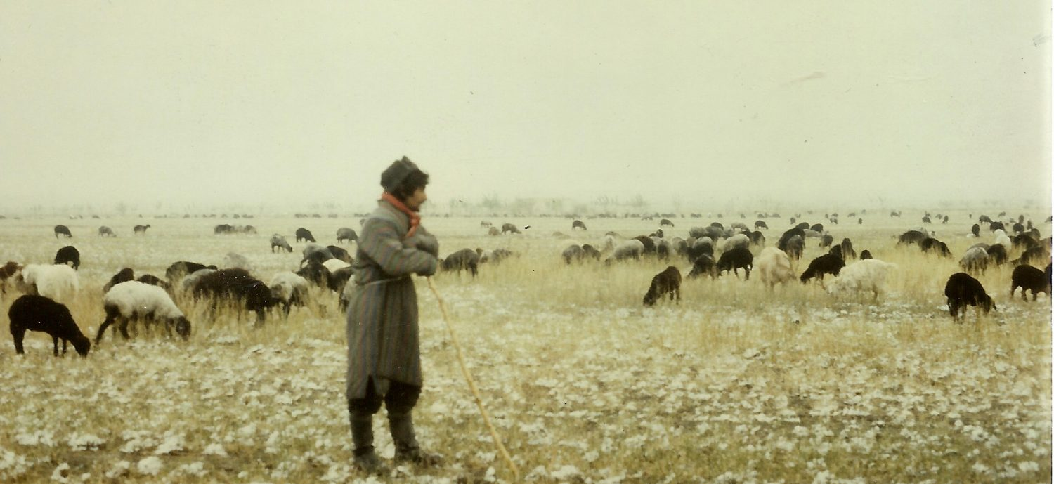
Church Leaders
Presbuteros = elderly person; wiser person
Episkopos = overseer; manager; director
Notes:
Two key concepts come together in two terms for church leaders. They are called presbuteros or elders because they are typically among the oldest and most mature members. They are also deemed episkopos or overseers as they manage or direct the affairs of the church.

Slide 106
Healthy churches develop godly leaders
T i t u s 1 : 5 - 9
Godly leaders strengthen the church (v. 5)
Godly leaders set a standard for transformed living (vs. 6-9)
A standard for living at home (6)
A standard for living in public (7-8)

Slide 107
NOT THIS
arrogant
quick-tempered
drunkard
violent
greedy for gain
THIS INSTEAD
hospitable
lover of good
self-controlled
upright
holy
disciplined

Slide 108
Healthy churches develop godly leaders
T i t u s 1 : 5 - 9
Godly leaders strengthen the church (v. 5)
Godly leaders set a standard for transformed living (vs. 6-9)
A standard for living at home (6)
A standard for living in public (7-8)
A standard for teaching and doctrine (9)

Slide 109

Scripture Reading
Titus 1:10-16 (ESV)

Slide 110
¹⁰ For there are many who are insubordinate, empty talkers and deceivers, especially those of the circumcision party. ¹¹They must be silenced, since they are upsetting whole families by teaching for shameful gain what they ought not to teach.
Titus 1:10-11 (ESV)

Slide 111
¹² One of the Cretans, a prophet of their own, said, “Cretans are always liars, evil beasts, lazy gluttons.” ¹³ This testimony is true. Therefore rebuke them sharply, that they may be sound in the faith,
Titus 1:12-13 (ESV)

Slide 112
¹⁴ not devoting themselves to Jewish myths and the commands of people who turn away from the truth. ¹⁵ To the pure, all things are pure, but to the defiled and unbelieving, nothing is pure; but both their minds and their consciences are defiled.
Titus 1:14-15 (ESV)

Slide 113
¹⁶ They profess to know God, but they deny him by their works. They are detestable, disobedient, unfit for any good work.
Titus 1:16 (ESV)

Slide 114
Adorning the Gospel
Building Healthy Churches that Display God’s Power
S t u d i e s i n T i t u s
Preached by Dr. Jim Harmeling on Titus 1:10-16
at Crossroads International Church Singapore • cicfamily.com
Uploaded by Dr. Rick Griffith • Singapore Bible College
Thousands of files in 49 languages for free at BibleStudyDownloads.org

Slide 115

What is wrong with this picture?

Slide 116
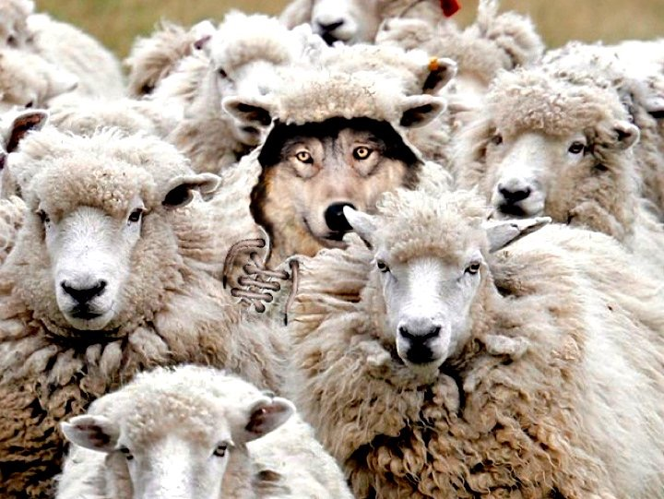
Healthy churches confront false doctrine
Notes:
These godly elders must refute legalistic and greedy Jewish heretics (1:10-16).

Slide 117
How Do We Confront False Teachers?
Reveal sinful character traits of false teachers (v. 10)
Carefully distance the church from false teachers (vs. 11-13)
Stop the damage (11, 13a)
Reveal the habits of the sinful flesh (12)

Slide 118
Philippians 1:9-10
⁹ And it is my prayer that your love may abound more and more, with knowledge and all discernment, ¹⁰ so that you may approve what is excellent, and so be pure and blameless for the day of Christ,

Slide 119
How Do We Confront False Teachers?
Reveal sinful character traits of false teachers (v. 10)
Carefully distance the church from false teachers (vs. 11-13)
Stop the damage (11, 13a)
Reveal the habits of the sinful flesh (12)
Redirect people to the truth (13b)

Slide 120
How Do We Confront False Teachers?
Reveal sinful character traits of false teachers (v. 10)
Carefully distance the church from false teachers (vs. 11-13)
Train the church to detect false doctrine (vs. 14-16)
Is their source of authority human wisdom
or divine revelation? (14)
Is their focus internal or external? (15)

Slide 121
Mark 7:14-23
¹⁴ And he called the people to him again and said to them, “Hear me, all of you, and understand: ¹⁵ There is nothing outside a person that by going into him can defile him, but the things that come out of a person are what defile him.” ¹⁷ And when he had entered the house and left the people, his disciples asked him about the parable. ¹⁸ And he said to them, “Then are you also without understanding? Do you not see that whatever goes into a person from outside cannot defile him, ¹⁹ since it enters not his heart but his stomach, and is expelled?” (Thus he declared all foods clean.) ²⁰ And he said, “What comes out of a person is what defiles him. ²¹ For from within, out of the heart of man, come evil thoughts, sexual immorality, theft, murder, adultery, ²² coveting, wickedness, deceit, sensuality, envy, slander, pride, foolishness. ²³ All these evil things come from within, and they defile a person.”

Slide 122
How Do We Confront False Teachers?
Reveal sinful character traits of false teachers (v. 10)
Carefully distance the church from false teachers (vs. 11-13)
Train the church to detect false doctrine (vs. 14-16)
Is their source of authority human wisdom
or divine revelation? (14)
Is their focus internal or external? (15)
Is their practice in life or only in words? (16)

Slide 123
“The ultimate test in life is usefulness, and those who are a bad influence and have a contaminating effect are of no use to God or to other people. Instead of helping God’s work in the world, they hinder it; and uselessness always invites disaster.”
—William Barclay—

Slide 124
How Do We Confront False Teachers?
Reveal sinful character traits of false teachers (v. 10)
Carefully distance the church from false teachers (vs. 11-13)
Train the church to detect false doctrine (vs. 14-16)
Is their source of authority human wisdom
or divine revelation? (14)
Is their focus internal or external? (15)
Is their practice in life or only in words? (16)

Slide 125



如何在教会里挑选领袖？
好名声
背景
精明
皮夹子
专业
125

Slide 126
教会当如何挑选领袖？
圣经例子：
会众决定/推举
INTRODUCTION
身体
a. 使徒
徒1:12-26——会众选出，使徒指派
b. 执事
徒6:3——会众选出，使徒指派

Slide 127
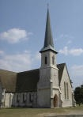
教会同工的指派
INTRODUCTION
使徒（例：保罗）或他的助手按立长老
a. 徒14:23
b. 多1:5
身体
127

Slide 128

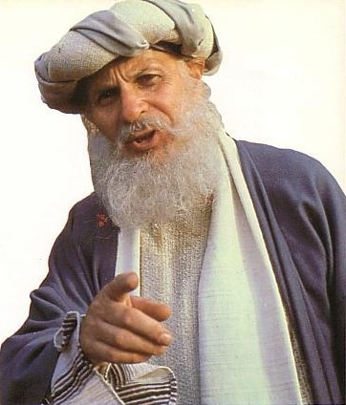
长老的资格是什么？
128

Slide 129
监督(O) 与执事(d) 的品质
224
一般的名誉
    (察觉品格)
  无可指摘 (O)
  教外有好名誉 (O)
  庄重 (O & D)

Slide 130

监督(o)与执事(d)的品质
225
II. 家庭生活 (如有接婚)
  一个妻子的丈夫 (O & D)
  妻子是被庄重的，不说谗言，有节制，凡事忠心。 (D)
  儿女凡事敬重顺服 (O & D)

Slide 131

监督(o)与执事(d)的品质
225
III. 反面的特征
  不轻易发怒 (O)
  不暴力 (O)
  与人无争 (O)
  不是初信主的 (O)
  不贪不义之财 (O & D)
  不好酒；有节制的 (O & D)

Slide 132

监督(o)与执事(d)的品质
226
IV. 正面的特征
  乐意接待客旅 (O)
  切合实际 (O)
  先受考验 (D)
  真诚 (D)
善于教导 (O)

Slide 133
领袖的品质
223
他们是谁？监督 (长老，主教，牧师) 和执事
品质是指领袖现在的生活
如果领袖失败，他必须离职。
所有的品质是必需和相等重要得
品格是比才干重要 （只有两种特性有关才干）
管理自己的家重于工作
应该要合格才可以
  1. 给于敬虔方向
  2. 教会可以避免不好或不熟练的领袖带来的不必要问题

Slide 134
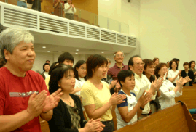
I. 会众在教会里拥有最终极的权利
134

Slide 135
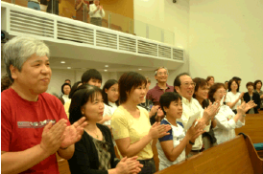
会众权利
执行教会纪律（太18:17）
「就告诉教会……」
挑选领袖（徒6:3）
「当从你们中间选出……」
传授正统的教义：
「我当日传给你们的，原是从主领受的……」（林前11:23）
「亲爱的弟兄啊……总要试验那些灵」（约一4:1）
「为……真道竭力的争辩。」（犹3）
135

Slide 136

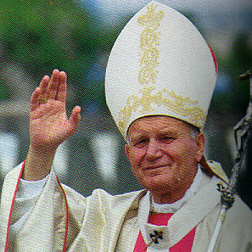
主教级
教会结构图
（简化）
244a
会督
圣公会
信义会
卫理公会
东正教
天主教
教堂牧师
教堂牧师
教堂牧师
会吏
会吏
会吏
会友
会友
会友
136

Slide 137

基本长老会结构图
244a
长老会
主任牧师
主任牧师
主任牧师
长老
（议会）
长老
（议会）
长老
（议会）
会友
会友
会友
137

Slide 138

区域长老会结构图
教区
长老群
长老群
主任牧师
主任牧师
主任牧师
主任牧师
主任牧师
主任牧师
长老
（议会）
长老
（议会）
长老
（议会）
长老
（议会）
长老
（议会）
长老
（议会）
会友
会友
会友
会友
会友
会友
138

Slide 139

最高层长老会结构图
长老大会
教区
教区
长老群
长老群
长老群
长老群
长老（议会）
长老（议会）
长老（议会）
长老（议会）
长老（议会）
长老（议会）
长老（议会）
长老（议会）
长老（议会）
长老（议会）
长老（议会）
长老（议会）
会友
会友
会友
会友
会友
会友
会友
会友
会友
139
会友
会友
会友

Slide 140

浸信会又如何？
教会的自治权
140

Slide 141

两个问题：
谁拥有教会最后的发言权？
圣经如何论到教会领袖的模式？
141

Slide 142
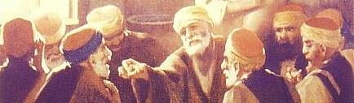
II. 圣经里的教会领袖模式是由长老组成.
142

Slide 143
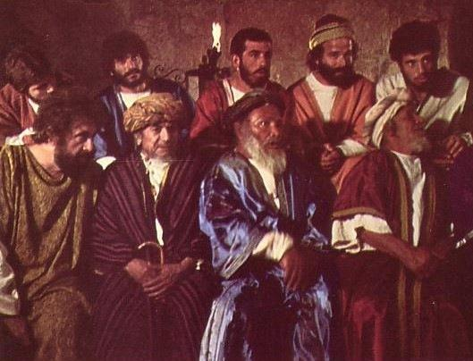
由长老领导的摩西时代
与摩西一起
领导的长老
主前1400年
「你去招聚以色列的长老，对他说……」（出3:16）
143

Slide 144
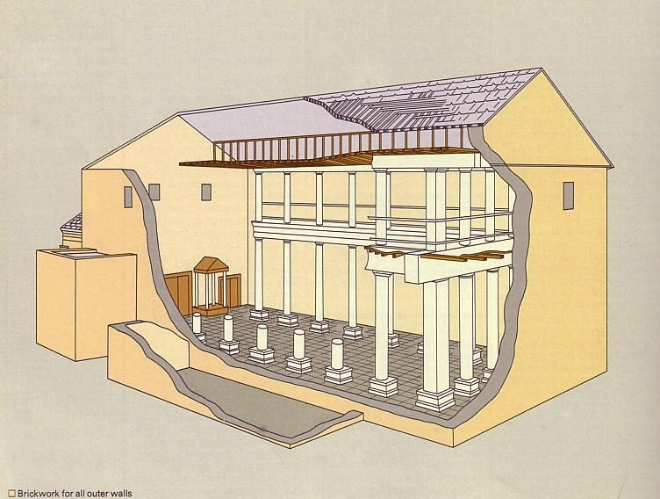
谁领导犹太会堂？
长老领导
的犹太会堂
主前600年
与摩西一起
领导的长老
主前1400年
144

Slide 145
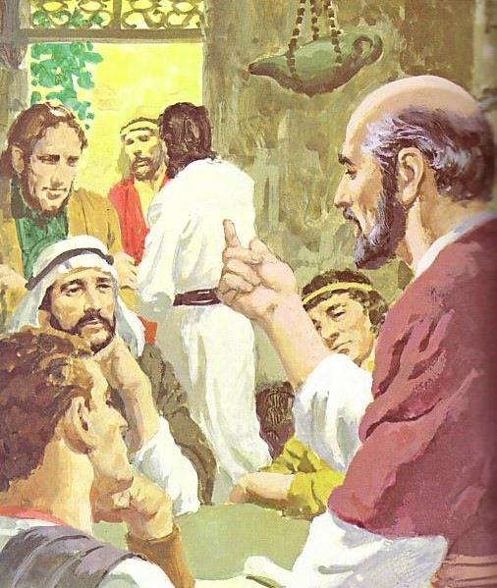
神在各个的时代里都主张团体领袖
长老领导
的犹太会堂
主前600年
新约
长老
与摩西一起
领导的长老
主前1400年
145

Slide 146
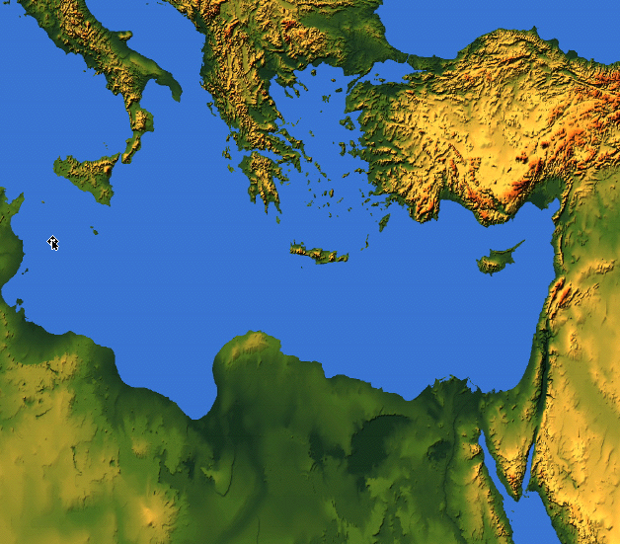
各处所提及的长老
长老 = 监督 = 会督 = 牧师
55
耶路撒冷（主后47）
CNV Acts 11:30 他们就这样行了， 由巴拿巴和扫罗经手送到长老们那里。
以弗所（主后57)
CNV Acts 20:17他从米利都派人去以弗所， 请教会的长老来。
加拉太（主后48）
NIV Acts 14:23 两人在各教会为他们指派了长老； 禁食祈祷之后， 就把他们交讬给所信的主。
革哩底（主后66）
NIV Titus 1:5我从前留你在克里特岛， 是要你办好没有办完的事， 并且照我所吩咐的， 在各城设立长老。
腓立比（主后62）
NIV Philippians 1:1 基督耶稣的仆人保罗和提摩太， 写信给所有住在腓立比， 在基督耶稣里的圣徒、 监督和执事:
旁非利亚、加拉太、加帕多家、亚洲及庇推尼（主后64）
彼5:1「我这作长老……劝你们中间与我同作长老的人。」
（参1:1）

Slide 147
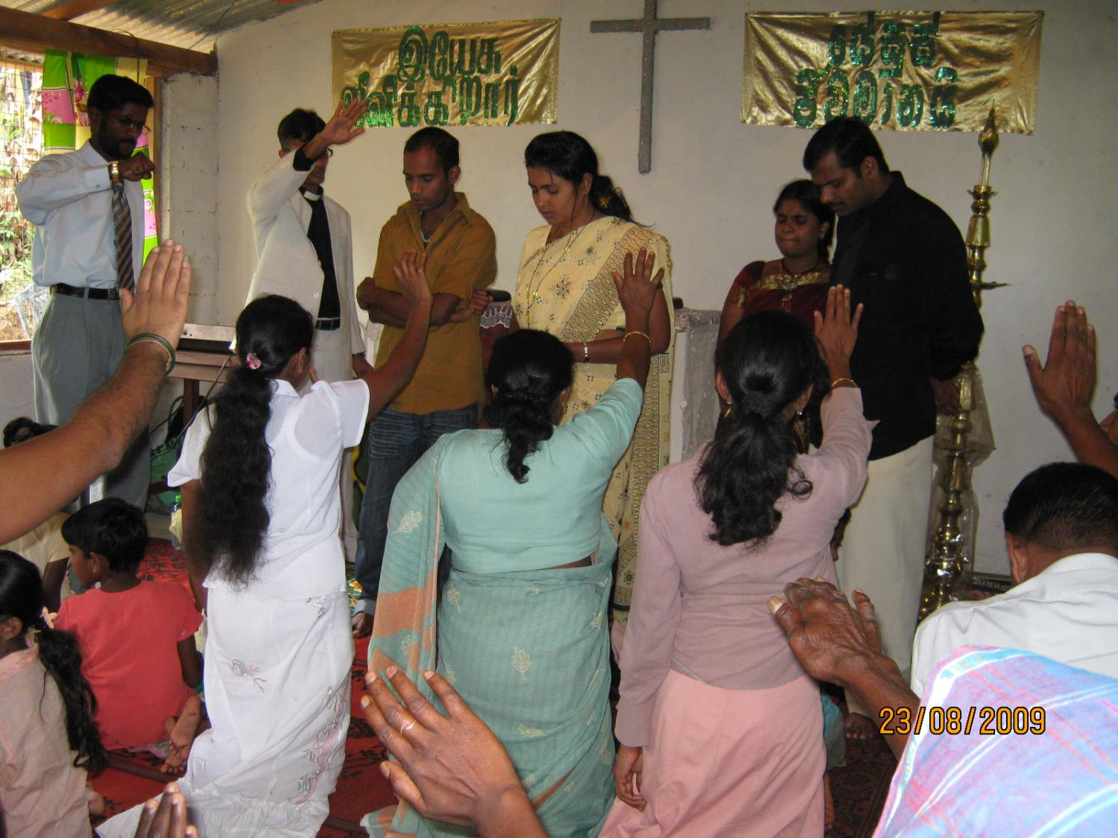
长老当作什么？
147

Slide 148
长老的牧养职分
(a) 教导的长老：
INTRODUCTION
「作全群的监督」（徒20:28）
「善于教导」（帖前5:12；提前3:2；多1:9b）
良好的圣经基础（多1:9a）
教导神的计划（徒20:20,27）
受薪制的教导（提前5:17）
BODY
148

Slide 149

三种类型的长老
236b
「那善于管理教会的长老，当以为配受加倍的敬奉，那劳苦传道教导人的，更当如此。」（提前5:17）
所有长老
教导、保护、领导、服事、见证
无领薪或 $
若有需要
领薪的经理
$
传道人及老师
$$

Slide 150
长老的牧养职分
(a) 教导的长老：
INTRODUCTION
「作全群的监督」（徒20:28）
「善于教导」（帖前5:12；提前3:2；多1:9b）
良好的圣经基础（多1:9a）
教导神的计划（徒20:20,27）
受薪制的教导（提前5:17）
最高职位：教导（徒6:1-7）
长老领导执事（腓1:1）
BODY
150

Slide 151
长老的三个牧养工作
236c1
教导
提前3:2；5:17

Slide 152
236a 6b
长老和执事的关系
模式一：主任牧师带领执事会
主任牧师
执事会
不符合圣经
152

Slide 153
236a 6b
长老和执事的关系
模式二：主任牧师与执事会平起平坐
执事会
主任牧师
不符合圣经
153

Slide 154
236a 6b
长老和执事的关系
模式三：执事带领长老/牧者
执事会
主任牧师
不符合圣经
154

Slide 155
236a 6b
长老和执事的关系
模式四：长老团带领执事会
主任牧师
执事会
155

Slide 156
236a 6b
长老和执事的关系
使徒带领「七个执事」
使徒
DDDDDDD
DDDD
DDDDD
「七位执事」
（徒21:8）
156

Slide 157
236a 6b
长老和执事的关系
模式五：长老与执事的委员会
长老
DDDDDDD
DDDD
DDDDD
157

Slide 158

236c1
长老的三个牧养工作
教导
提前3:2；5:17
牧师—教师
弗4:11
牧养
（保护与领导）
彼前5:1-4; 徒20:29,35; 帖前5:12
158

Slide 159
长老的三个牧养工作
236c1
行政管理
「服事、关顾及见证」
提前3:1，4-5；5:17
Episkopos =Epi「在上面」+skopos「看」= 「守望」
教导
提前3:2；5:17
牧师—教师
弗4:11
牧养
（保护与领导）
彼前5:1-4; 徒20:29,35; 帖前5:12
159

Slide 160
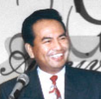







分担领导
圣经支持
长老群
而是多个长老
不是一个长老……
160

Slide 161

总结
INTRODUCTION
因此，新约呈现的长老功能是
教导、牧养及行政管理
BODY
161

Slide 162
231
执事的主要功能
INTRODUCTION
服事
a. 徒6:1-6
b. 提前3:8-13
BODY
162

Slide 163
注意：
执事不是统治者，他们是附属在长老的治理之下。
执事辅助长老，尤其是减轻长老身负教会繁重的事工。
INTRODUCTION
BODY
163

Slide 164
注意：
新约里并没有记载执事如同长老一样拥有治理教会的权利，也并没记载执事被吩咐去作教导圣经或正统的教义。
INTRODUCTION
BODY
164

Slide 165

236a
设立教会管理的型式
INTRODUCTION
长老（管理/作抉择）
BODY
执事（服事）
会众（委任）
165

Slide 166
长老－会众动力
INTRODUCTION
长老
看自己如同仆人
爱
BODY
看他们如同领袖
会众
166

Slide 167

假教师与教导
提前1:3-20; 4:1-16; 6:3-5, 20, 21
221
提摩太留在以弗所教会的其中一个理由是要嘱咐假教师 (1:3)
异端的来源：虚妄的邪灵和鬼摩 (4:1)

Slide 168

假教师的特征
221
“虚伪的骗子" (1:7)
不胜任: 他们 “不明白自己讲的是什么，主张的又是什么" (1:7)
骄傲(6:4)
属灵瞎: “心术败坏，丧失真理的人" (6:5)
利用 “虔诚”为了得利 (6:5)

Slide 169
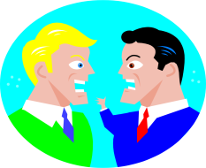
假教义的特征
教导不接受“主耶稣基督纯正的话语” (6:3)
传假的教义: “他们禁止嫁娶，禁戒食物” (4:3)
注重世俗以及老妇的无稽之谈和无穷的家谱
专好问难争辩 (6:4)

Slide 170
I. 有虔诚的 长老 教导真理。
提多书第一章
Notes:
Sound doctrine silences error.

Slide 171
我们怎么能在诸多假教导中保持 信誉良好?
提多书的三个方法
Notes:
How can we stand true to the Lord with so many heresies plaguing the church?

Slide 172
Slides on
提多 2

Slide 173
II. 按着你的岁数行事为人。
提多书 2:1-10
Notes:
Order life to doctrine.

Slide 174
提多书
1
2
3
正确的教义压制错误
有条理的生命带来教义
永不避开好的行为
巴里 赫德尔斯顿 《藏头诗圣经》

Slide 175
提多
大綱
244
Outline
1. (第一章) 保羅勸勉提多委派有好品格的長老群，熟悉聖經並能用神的話語去斥責那些的假教師來保護新成立的革里底的教會。
2. (2:1-10) 保羅勸勉提多教導不同的年齡曾的信徒，活出好的品格及信仰的生活。因此革里底的敵人不能誹謗教會和神的道。

Slide 176

Scripture Reading
Titus 2:1-10 (ESV)

Slide 177
Older Men
Sober-minded
Dignified
Self-controlled
Sound in faith, love, steadfastness

Slide 178
¹ But as for you, teach what accords with sound doctrine. ² Older men are to be sober-minded, dignified, self-controlled, sound in faith, in love, and in steadfastness.
Titus 2:1-2 (ESV)

Slide 179
Older Men
Sober-minded
Dignified
Self-controlled
Sound in faith, love, steadfastness
Older Women
Reverent
Not slanderers
Not addicted to wine
Train younger women

Slide 180
³ Older women likewise are to be reverent in behavior, not slanderers or slaves to much wine. They are to teach what is good
Titus 2:3 (ESV)

Slide 181
Older Men
Sober-minded
Dignified
Self-controlled
Sound in faith, love, steadfastness
Older Women
Reverent
Not slanderers
Not addicted to wine
Train younger women
Younger Women
Love husbands & children
Self-controlled
Pure
Working at home
Submissive to husbands

Slide 182
and so train the young women to love their husbands and children, ⁵ to be self-controlled, pure, working at home, kind, and submissive to their own husbands, that the word of God may not be reviled.
Titus 2:4-5 (ESV)

Slide 183
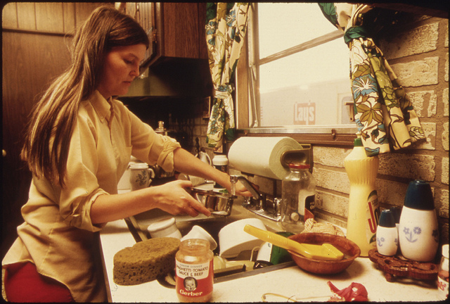
“理家” (提多 2:4-5 CNVS)
"好提醒年轻的妇女爱丈夫爱儿女， 并且自律、贞洁、理家、善良、顺从自己的丈夫，免得 神的道受毁
谤。"

Slide 184
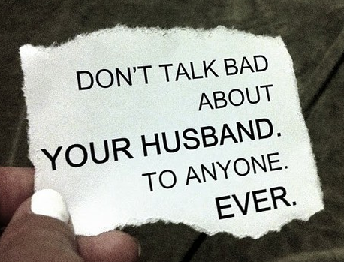
“顺从丈夫” (提多 2:4-5 CNV)
好提醒年轻的妇女爱丈夫爱儿女， ⁵ 并且自律、贞洁、
理家、善良、顺从自己的丈夫，免得 神的道受毁谤。
从来别跟任何人
说你丈夫
的坏话
丈夫也不该
说妻子的坏话!
从来
Notes:
Translators use the text boxes and then drag them over.

Slide 185
Older Men
Sober-minded
Dignified
Self-controlled
Sound in faith, love, steadfastness
Older Women
Reverent
Not slanderers
Not addicted to wine
Train younger women
Younger Men
Self-controlled
Good works
Integrity
Dignity
Sound speech
Younger Women
Love husbands & children
Self-controlled
Pure
Working at home
Submissive to husbands

Slide 186
⁶ Likewise, urge the younger men to be self-controlled. ⁷ Show yourself in all respects to be a model of good works, and in your teaching show integrity, dignity, ⁸ and sound speech that cannot be condemned, so that an opponent may be put to shame, having nothing evil to say about us.
Titus 2:6-8 (ESV)

Slide 187
⁹ Bondservants are to be submissive to their own masters in everything; they are to be well-pleasing, not argumentative, ¹⁰ not pilfering, but showing all good faith, so that in everything they may adorn the doctrine of God our Savior.
Titus 2:9-10 (ESV)

Slide 188
Adorning the Gospel
Building Healthy Churches that Display God’s Power
S t u d i e s i n T i t u s
Preached by Dr. Jim Harmeling on Titus 2:1-10
at Crossroads International Church Singapore • cicfamily.com
Uploaded by Dr. Rick Griffith • Singapore Bible College
Thousands of files in 49 languages for free at BibleStudyDownloads.org

Slide 189
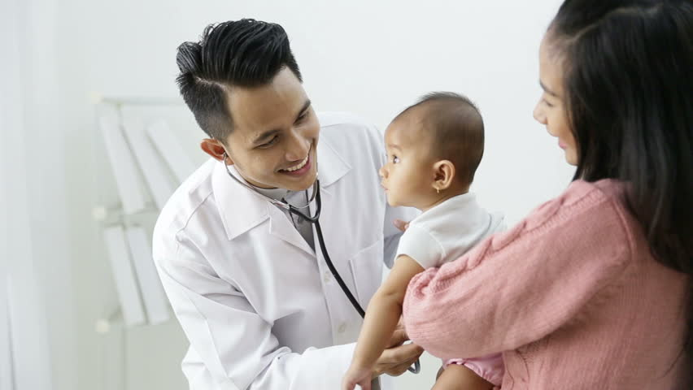
Healthy churches encourage godly living
(Titus 2:1-10)

Slide 190
Sound truth must lead to godly living (v. 1)
“accords” = resemble, fitting, suit
Ephesians 5:3
“But sexual immorality and all impurity or covetousness must not even be named among you, as is proper among saints.”

Slide 191
Sound truth must lead to godly living (v. 1)
Sound truth impacts everyone (vs. 2-10)
Older men
Older women
Younger women
Younger men

Slide 192
Older Men
Sober-minded
Dignified
Self-controlled
Sound in faith, love, steadfastness
Older Women
Reverent
Not slanderers
Not addicted to wine
Train younger women
Younger Men
Self-controlled
Good works
Integrity
Dignity
Sound speech
Younger Women
Love husbands & children
Self-controlled
Pure
Working at home
Submissive to husbands

Slide 193
Sound truth must lead to godly living (v. 1)
Sound truth impacts everyone (vs. 2-10)
Older men
Older women
Younger women
Younger men
Employees

Slide 194
Results of Reputable Conduct
“that the word of God may not be reviled”
(Titus 2:5)
“that an opponent may be put to shame, having nothing evil to say about us”
(Titus 2:8)
“adorn the doctrine of God our Savior”
(Titus 2:10)

Slide 195
我们怎么能在诸多假教导中保持 信誉良好?
提多书的三个方法
Notes:
How can we stand true to the Lord with so many heresies plaguing the church?

Slide 196
I. 有虔诚的 长老 教导真理。
提多书第一章
Notes:
Sound doctrine silences error.

Slide 197
II. 按着你的岁数行事为人。
提多书 2:1-10
Notes:
Order life to doctrine.

Slide 198
III. 让恩典带来 虔诚的心。
提多书 2:11–3:15
Notes:
Never shun good deeds

Slide 199
提多书
1
2
3
正确的教义压制错误
有条理的生命带来教义
永不避开好的行为
巴里 赫德尔斯顿 《藏头诗圣经》

Slide 200
III. 让恩典带来 虔诚的心。
God's grace educates believers how to choose godliness over ungodliness (2:11-15).
提多书 2:11–3:15
Notes:
Never shun good deeds

Slide 201
提多
大綱
244
Outline
1. (第一章) 保羅勸勉提多委派有好品格的長老群，熟悉聖經並能用神的話語去斥責那些的假教師來保護新成立的革里底的教會。
2. (2:1-10) 保羅勸勉提多教導不同的年齡曾的信徒，活出好的品格及信仰的生活。因此革里底的敵人不能誹謗教會和神的道。
3.(2:11-3:15)保羅申明神的恩典能使人有敬的行為。他提醒提多，他在信中所吩咐的是每一個基督徒所必須行的。歸因於我們的得救在於神的恩典。

Slide 202

Scripture Reading
Titus 2:11-15 (ESV)

Slide 203

¹¹ For the grace of God has appeared, bringing salvation for all people, ¹² training us to renounce ungodliness and worldly passions, and to live self-controlled, upright, and godly lives in the present age,
Titus 2:11-12 (ESV)

Slide 204
¹³ waiting for our blessed hope, the appearing of the glory of our great God and Savior Jesus Christ,
Titus 2:13 (ESV)

Slide 205
¹⁴ who gave himself for us to redeem us from all lawlessness and to purify for himself a people for his own possession who are zealous for good works.
Titus 2:14 (ESV)

Slide 206
¹⁵ Declare these things; exhort and rebuke with all authority. Let no one disregard you.
Titus 2:15 (ESV)

Slide 207
Adorning the Gospel
Building Healthy Churches that Display God’s Power
S t u d i e s i n T i t u s
Preached by Dr. Jim Harmeling on Titus 2:11-16
at Crossroads International Church Singapore • cicfamily.com
Uploaded by Dr. Rick Griffith • Singapore Bible College
Thousands of files in 49 languages for free at BibleStudyDownloads.org

Slide 208
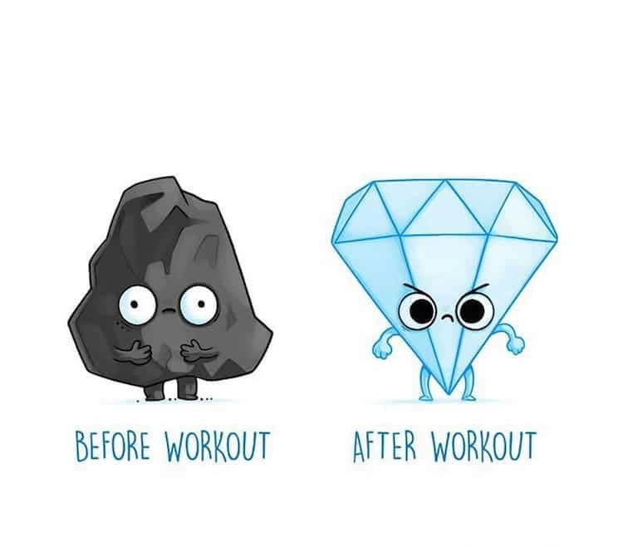
BEFORE WORKOUT
AFTER WORKOUT

Slide 209
Healthy churches focus on Christ as the source of their transformation
(Titus 2:11-15)
Before Christ
After Christ
Deceptive
Pleasure loving
Godly
Self-controlled
Pure

Slide 210
How Does God’s Grace Bring
Life Transformation?
God’s past grace: He brings salvation (2:11)
God’s present grace: He trains us in righteousness (2:12)

Slide 211

paideuo

Slide 212
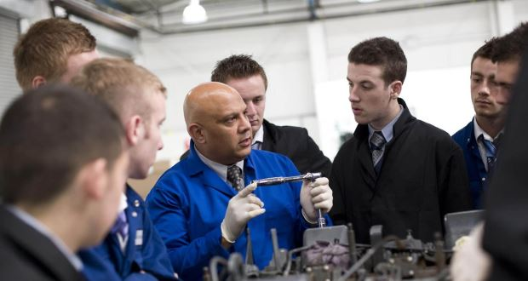
paideuo

Slide 213
How Does God’s Grace Bring
Life Transformation?
God’s past grace: He brings salvation (v. 11)
God’s present grace: He trains us in righteousness (v. 12)
Out with the bad (“ungodliness and worldly passions”)
Galatians 5:24
“And those who belong to Christ Jesus
have crucified the flesh with its passions and desires.”

Slide 214
1 John 2:15-17
¹⁵ Do not love the world or the things in the world. If anyone loves the world, the love of the Father is not in him. ¹⁶ For all that is in the world—the desires of the flesh and the desires of the eyes and pride of life—is not from the Father but is from the world. ¹⁷ And the world is passing away along with its desires, but whoever does the will of God abides forever.

Slide 215
How Does God’s Grace Bring
Life Transformation?
God’s past grace: He brings salvation (v. 11)
God’s present grace: He trains us in righteousness (v. 12)
Out with the bad (“ungodliness and worldly passions”)
In with the good (“live self-controlled, upright, and godly lives in the present age”)

Slide 216
2 Timothy 2:22
“So flee youthful passions and pursue righteousness, faith, love, and peace, along with those who call on the Lord from a pure heart.”

Slide 217
Before TRAINING After
Selfish -God’s grace- Love others
Lustful -God’s grace- Pure thoughts
Easily angered -God’s grace- Patient
Rebellious -God’s grace- Submissive
Envy others -God’s grace- Contentment
Uncontrolled tongue -God’s grace- Self-control
Resentment -God’s grace- Forgiveness

Slide 218
How Does God’s Grace Bring
Life Transformation?
God’s past grace brings salvation (2:11)
God’s present grace trains us in righteousness (2:12)
God’s future grace motivates us for the future (2:13-15)
His glorious return motivates us
Jude 24
“Now to him who is able to keep you from stumbling and to present you blameless before the presence of his glory with great joy”

Slide 219
How Does God’s Grace Bring
Life Transformation?
God’s past grace brings salvation (2:11)
God’s present grace trains us in righteousness (2:12)
God’s future grace motivates us for the future (2:13-15)
His glorious return motivates us
His redemptive work motivates us
His ownership motivates us

Slide 220
Slides on
提多 3

Slide 221
III. 让恩典带来 虔诚的心。
God's grace educates believers how to choose godliness over ungodliness (2:11-15).
God's grace empowers gracious behavior before all people (3:1-2).
提多书 2:11–3:15
Notes:
Never shun good deeds

Slide 222

Scripture Reading
Titus 3:1-15 (ESV)

Slide 223

¹ Remind them to be submissive to rulers and authorities, to be obedient, to be ready for every good work, ² to speak evil of no one, to avoid quarreling, to be gentle, and to show perfect courtesy toward all people.
Titus 3:1-2 (ESV)

Slide 224
III. 让恩典带来 虔诚的心。
God's grace educates believers how to choose godliness over ungodliness (2:11-15).
God's grace empowers gracious behavior before all people (3:1-2).
God's grace motivates good works in response to God’s mercy (3:3-8).
提多书 2:11–3:15
Notes:
Never shun good deeds

Slide 225
³ For we ourselves were once foolish, disobedient, led astray, slaves to various passions and pleasures, passing our days in malice and envy, hated by others and hating one another. ⁴ But when the goodness and loving kindness of God our Savior appeared,
Titus 3:-3-4 (ESV)

Slide 226
⁵ he saved us, not because of works done by us in righteousness, but according to his own mercy, by the washing of regeneration and renewal of the Holy Spirit, ⁶ whom he poured out on us richly through Jesus Christ our Savior, ⁷ so that being justified by his grace we might become heirs according to the hope of eternal life.
Titus 3:5-7 (ESV)

Slide 227
⁸ The saying is trustworthy, and I want you to insist on these things, so that those who have believed in God may be careful to devote themselves to good works. These things are excellent and profitable for people.
Titus 3:8 (ESV)

Slide 228
III. 让恩典带来 虔诚的心。
God's grace educates believers how to choose godliness over ungodliness (2:11-15).
God's grace empowers gracious behavior before all people (3:1-2).
God's grace motivates good works in response to God’s mercy (3:3-8).
God's grace protects from division where argumentative saints are disciplined (3:9-11).
提多书 2:11–3:15
Notes:
Never shun good deeds

Slide 229
⁹ But avoid foolish controversies, genealogies, dissensions, and quarrels about the law, for they are unprofitable and worthless.
Titus 3:9 (ESV)

Slide 230
¹⁰ As for a person who stirs up division, after warning him once and then twice, have nothing more to do with him, ¹¹ knowing that such a person is warped and sinful; he is self-condemned.
Titus 3:10-11 (ESV)

Slide 231
III. 让恩典带来 虔诚的心。
God's grace educates believers how to choose godliness over ungodliness (2:11-15).
God's grace empowers gracious behavior before all people (3:1-2).
God's grace motivates good works in response to God’s mercy (3:3-8).
God's grace protects from division where argumentative saints are disciplined (3:9-11).
God’s grace relates to people with warmth and diligence (3:12-15).
提多书 2:11–3:15
Notes:
Never shun good deeds

Slide 232
¹² When I send Artemas or Tychicus to you, do your best to come to me at Nicopolis, for I have decided to spend the winter there. ¹³ Do your best to speed Zenas the lawyer and Apollos on their way; see that they lack nothing.
Titus 3:12-13 (ESV)

Slide 233
¹⁴ And let our people learn to devote themselves to good works, so as to help cases of urgent need, and not be unfruitful.
¹⁵ All who are with me send greetings to you. Greet those who love us in the faith.
Grace be with you all.
Titus 3:14-15 (ESV)

Slide 234
Adorning the Gospel
Building Healthy Churches that Display God’s Power
S t u d i e s i n T i t u s
Preached by Dr. Jim Harmeling on Titus 3:1-15
at Crossroads International Church Singapore • cicfamily.com
Uploaded by Dr. Rick Griffith • Singapore Bible College
Thousands of files in 49 languages for free at BibleStudyDownloads.org

Slide 235

Healthy churches Promote peace
(Titus 3:1-15)

Slide 236

How Do We Promote Peace in an Unbelieving World?
Believers promote peace with their words and actions (vs. 1-2)
They respect the law
They are proactive in good deeds
They are considerate of others

Slide 237
How Do We Promote Peace in an Unbelieving World?
Believers promote peace with their words and actions (vs. 1-2)
Believers promote peace by humbly recalling God’s peace with them (vs. 3-8)
Recall our natural unclean state

Slide 238
John 8:44
“You are of your father the devil, and your will is to do your father's desires. He was a murderer from the beginning, and does not stand in the truth, because there is no truth in him. When he lies, he speaks out of his own character, for he is a liar and the father of lies.”

Slide 239
2 Corinthians 4:4
“In their case the god of this world has blinded the minds of the unbelievers, to keep them from seeing the light of the gospel of the glory of Christ, who is the image of God.”

Slide 240
How Do We Promote Peace in an Unbelieving World?
Believers promote peace with their words and actions (vs. 1-2)
Believers promote peace by humbly recalling God’s peace with them (vs. 3-8)
Recall our natural unclean state
Recall God’s goodness to cleanse us

Slide 241
Ephesians 5:25-27
²⁵ Husbands, love your wives, as Christ loved the church and gave himself up for her, ²⁶ that he might sanctify her, having cleansed her by the washing of water with the word, ²⁷ so that he might present the church to himself in splendor, without spot or wrinkle or any such thing, that she might be holy and without blemish.

Slide 242
How Do We Promote Peace in an Unbelieving World?
Believers promote peace with their words and actions (vs. 1-2)
Believers promote peace by humbly recalling God’s peace with them (vs. 3-8)
Recall our natural unclean state
Recall God’s goodness to cleanse us
Resolve to live for good works

Slide 243
“Persons who have put their faith in our Savior God are expected to take the lead in good works.
. . . They should be in the forefront in good works, not dragging their feet while others take the lead.”
—Homer Kent—

Slide 244
How Do We Promote Peace in an Unbelieving World?
Believers promote peace with their words and actions (vs. 1-2)
Believers promote peace by humbly recalling God’s peace with them (vs. 3-8)
Believers promote peace by protecting peace in church leadership (vs. 9-15)

Slide 245

Protect peace by confronting false leaders who threaten peace
Protect peace by building leadership teams devoted to the health of the congregation
Protect peace by congregation assistance to church leadership

Slide 246
我们怎么能在诸多假教导中保持 信誉良好?
提多书的三个方法
Notes:
How can we stand true to the Lord with so many heresies plaguing the church?

Slide 247
I. 有虔诚的 长老 教导真理。
提多书第一章
Notes:
Sound doctrine silences error.

Slide 248
II. 按着你的岁数行事为人。
提多书 2:1-10
Notes:
Order life to doctrine.

Slide 249
III. 让恩典带来 虔诚的心。
提多书 2:11–3:15
Notes:
Never shun good deeds

Slide 250
主要是想
提多书
我们的长老要教导
借着神的恩典所得来的
可尊敬的言行举止。

Slide 251
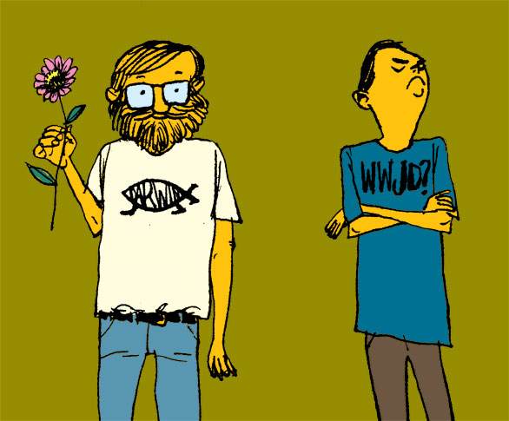
The Central Issue in Titus:
Should your life look any better than the life of a non-Christian?
提多
241
YES!

Slide 252
The Central Issue in Titus:
Does your life look any better than the life of a non-Christian?
提多
241

Slide 253
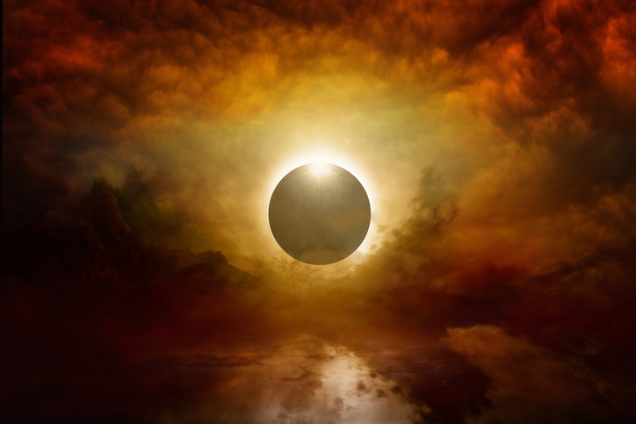
How to live?
Charles R. Swindoll, Contagious Christiantiy, 47
Notes:
What difference should this make in our lives?

Slide 254

Make sure that you have received the salvation God freely offers you (Titus 2:11 NLT).
"For the grace of God has been revealed, bringing salvation to all people."
Charles R. Swindoll, Contagious Christiantiy, 47

Slide 255

Continue to resist a corrupt lifestyle (Titus 2:12a NLT).
"And we are instructed to turn from godless living and sinful pleasures."
Charles R. Swindoll, Contagious Christiantiy, 47

Slide 256
Older Men
Sober-minded
Dignified
Self-controlled
Sound in faith, love, steadfastness
Older Women
Reverent
Not slanderers
Not addicted to wine
Train younger women
Younger Men
Self-controlled
Good works
Integrity
Dignity
Sound speech
Younger Women
Love husbands & children
Self-controlled
Pure
Working at home
Submissive to husbands

Slide 257

Live in a sensible, godly manner (Titus 2:12b-13 NLT).
"We should live in this evil world with wisdom, righteousness, and devotion to God, ¹³while we look forward with hope to that wonderful day when the glory of our great God and Savior, Jesus Christ, will be revealed."
Charles R. Swindoll, Contagious Christiantiy, 47

Slide 258


Do you need to read a good book on grace?
241

Slide 259
Black

Slide 260


新约全书讲章 • BibleStudyDownloads.org
免费获得该讲解!
圣经学习下载
Notes:
The explanation for free
NT Preaching link address

Slide 261

提多
應用
241
Application
神的恩典導致你有好行為
你會行善:
•由於你怕神的誡罰 (內在機動, 律法) 或
•由於你愛神回應他的恩典?

Slide 262

受洗是什么?
对比了两个不同的看法…
Notes:
Let's begin our search of the NT teaching on baptism by asking this simple question: What is baptism?

Slide 263
教會體制之總結
Church Government Summary 1
244a
主教制
長老制
會眾制
長老/會眾制
定義
主教管理几間教堂
當地的長老順從更高的體制
個別地方教堂會眾作最後的決定
個別教會會眾與選出長老保持平衡
結構
主教，最高執事，代理人，祭司，理事，領袖，會眾。
大會，總會，中會，會期，地方教會
會眾， 執事，
牧師
長老/牧師,
執事，會眾
獨特性
各階層的神職人員，最多等級與制度
神職人員有階級之分別，特別是長老的教導和管理的能力
神職人員有階級之分別，民主制度，地方教會的自治，通常是一個教會，一位牧師
神職人員有階級之
分別，民主制度，
地方教會與自治

Slide 264
Church Government Summary 2
教會體制之總結
244a
主教制
長老制
會眾制
長老/會眾
宗教和團體
聖公會/主教制，路德會，衛理公會，東正教，天主教
長老會，改革宗
會眾制，浸信會，聖經長老會，福音自治會，五旬節教派
聖經公會，獨立制
列舉聖經之根據
舊約單一領袖之實例，太16:18，18:18，28:18-20，(使徒之繼承)，徒6:3，6(主教之按立)，多1;5(提多之職權)
舊約長老管制之實例，徒11:30(長老管理財政)，徒14:23(每一個教會的長老團)，徒15(大會高於地方教會)，徒20:17(長老是教會最高之職權
太18:17，徒1，6:3-5，11:22，15:25，林前5:12，林後2:6-7，帖後3:14(集體做決定)，長老，主教，牧師，監督(例:提前3:1，對提多1:5)，彼前2:9(祭司之職份)，新約很多經文都以地方教會為焦點。
長老制(除了徒15並不表示大會高於地方教會+會眾之經文

Slide 265
教會體制之總結
244b
Church Government Summary 3
主教制
長老制
會眾制
長老制/會眾制
聖經的否認
沒有明確的証據，這結構在地方教會之上(雅各只是領導不是管治)，按立之權力並不是單給一個主教，使徒之繼承沒有被證明，主教/長老分別不恰當
沒有明確之証據，這結構高於地方教會(徒15，耶路撒冷教會無權管治安提亞教會，由教會自已做決定)，信徒祭司無法維持長老之職權。長老照顧羊群
單一牧師(=長老)，的觀念，不合聖經。由於長老是以團體來運作
存在的優點
有效率，合一(較少教會分裂)
集體作決定
集體作決定，會眾之投入
平衡的力量，長老和信徒
存在的缺點
太多權力集中於主教一人身上，沒有給教會的人有一些空間並提出意見
太多權力集於長老團，沒有給教會及會眾提供意見
沒有效率重大決定常常要一致決定。不合一(常致教會分裂)，牧師常被看作僱工多於領袖
長老會的權力過大是一項危險，很難介定那些是長老的問題，或是會眾的問題

Slide 266

孩子呢?
(Paedobaptism)

Slide 267

第一世纪教会的受洗礼
244c
受洗礼只为相信者，
且只用浸水礼

Slide 268

Recipients
(Paedobaptism)
The baptism of infants is recorded no earlier than the 3rd century A.D.

Slide 269

Recipients
244c
Two additional points:
Infant baptism advocates believe Col. 2:11-12 says that baptism is a sign of the new covenant that corresponds to circumcision in the Old Testament.
Jews were circumcised at 8 days old, sooo….

Slide 270

However, recipients should not be infants because…
244d
Circumcision doesn't parallel baptism
Males
All
Physical life
Spiritual life
Any age
Conscious faith
8th day of life
Right after belief
NT parallel = heart circumcision
New covenant sign = Lord's supper

Slide 271

Recipients
244d
(Paedobaptism)
Proponents claim that the "household baptisms" mentioned in Scripture included infants

Slide 272

Believers baptism advocates say that the recipients should not be infants because…
244e
Baptism testifies to what has already taken place in the life of the believer

Slide 273

Why is immersion the proper mode?

Slide 274

"Believed…then Baptized" Pattern in Acts
244e-f
Peter: "Repent…3000 baptized" (2:38, 41)
Samaritans "believed…baptized" (8:12)
Eunuch "believed…baptized" (8:36-38)
Paul believed…baptized (9:18)
Cornelius "believed…baptized" (10:47)
Jailer "believed…baptized" (16:14-15, 33)
Crispus "believed…baptized" (18:8)
John's disciples "believed…baptized" (19:5)

Slide 275

“baptize” 是什么意思?
141
语言学: bapti,zw 的意思是”浸，浸泡，洗，下落，湿透，淹没…浸泡” (BAGD 131c)

Slide 276
浸禮總論
Baptism Summary 1
244c
嬰兒
信徒
擁護者
天主教，路德宗，長老會，改革宗，聖公會，衛理公會，及一些福音自傳教會
浸信會，聖經會，弟兄會，五旬宗，福音自傳會(部份)，大部份為獨立教會。
目的
三個觀點:
1。天主教:得救與恩典的方法，與接受浸禮的信心不同。(浸禮)
2。路德宗:得救的恩典的方法，假設接受者有信心的領受。
3。其它，不是得救的恩典，但是有約的印證和記號。
聯合觀點:受浸是得救的象徵，外在的徵兆，裏面因信耶穌之真實的表現。
支持以上所說的目的
浸禮在下列的經文都有談論，(可16:16，約3:5，徒2:38，多3:5，彼前3:21)
(浸禮被Ronald K.Y.Fung)否定，在加拉太書， NICNT, 173-74
浸禮與得蒙救贖是連在一起的，但受浸並不會帶來救贖。得蒙救贖是由於信心(約3:16，羅10:9-10，弗2:8-9)，新約的受浸常常是在決志之後。但得救與受浸是獨立的事件，由於受浸並不是常常由決志來決定的(徒3:19，16:31)

Slide 277
受浸結論
Baptism Summary 2
244c-d
目的
(繼續)
受浸是約的記號(西2:12)，這表明受浸者加入神的社區
新約的證明，不是受浸，而是領受主的聖餐。(林前11:25)
西2:11-12與受浸有關的不是肉身的割禮，而是”屬靈”上的割禮，或得救。同樣，在新約那裏表明受浸如何與約有關呢?例如:(亞伯拉罕的約)，在左邊所引起的辯論，在歌羅西書中沒有一句與受浸有關的。
受浸是約的印記。(徒15:1，21:21，加2:3-5)
左邊的經文所說的割禮與現在所必需無關，也沒有說到受浸，而是聖靈(弗1:13-14)

Slide 278
受浸的結論
244c-d
Baptism Summary 3
目的(繼續)
浸禮的中心思想是從罪中得潔淨(西2:11-12)
受浸表明罪赦免，更表明與耶穌同死同復活(羅6:1-7)
接受浸禮只是一個低指標的象徵，它是按照新約的規定。
只是基督徒接受浸禮，這高層次的浸禮與得救有關。左邊的說明認為不是重要的證明，但這是與領聖餐有關的。
這賊無受浸不是一個好的例子。由於主引用這例外的。
天主教和路得宗認為必須受浸才得救，但他沒有受浸(路23:40-3)

Slide 279
受浸的結論
Baptism Summary 4
244d
主題
嬰兒在基督裏沒有個人的信心可以受浸。
信徒們可受浸(嬰兒和未得救除外)
支持以上所說的主題
受浸與割禮是相對應的，嬰兒可行割禮，因些也可以受浸禮。
左邊的思考方式是錯誤的。同時，只有兒童才能行割禮。
嬰兒浸洗大能力，它代表神的恩典。新約怎能取代老人，排除兒童，況且神也拯救動物(創9:10)兒童對衪是寶貴。
神的恩典如何臨到嬰兒?他無法意識到罪的權勢，如一個常常犯罪的人。恩典臨到成人時，是如何的奇妙。兒童在舊約的得救不是因為割禮，而是由於信心(創15:6)。同樣，在新約也是因為信心的接受，而不是因為受浸，(羅4:1-25)。另外，怎樣將拒絕嬰兒浸禮，而說到動物。動物不需受浸，二者有不存在的比較。

Slide 280
浸禮結論
244d
Baptism Summary 5
主題
在新約整個家庭受浸是包括嬰兒的(徒10:47-48，16:15，18:8，林前1:16)
每一個家庭全部受浸的經文都是假設。全部的人包括嬰兒都相信受浸
支持以上所說的主題
從早期教會的歷史中嬰兒受浸已經存在
從早期非經典浸禮指示，(二世紀時)，成人受洗需要1-2天的禁食。(J.B.Lightfoot之使徒之父親們)
基督祝福兒童，是包括嬰兒(可10:13-16)，是表明衪贊同嬰兒浸禮。
祝福與受浸是二件事情。在左方是表示新約基督祝福兒重，並非贊同受浸。

Slide 281
浸禮的結論
244e
Baptism Summary 6
在新約並沒有禁止為嬰兒受浸，就是容許去行。
沉默不代表贊同(如我們不能為死人受浸禮，簡單而言，新約沒有禁止)，新約支持信徒受浸，就是自動禁止嬰兒受浸，因為嬰兒不能相信。
主題(繼續)
大使命的第一順序是産生門徒，然後為他們受浸，(太28:19-20)，這樣，只是門徒受浸，不包括嬰兒。
受浸是指信徒與主的死連合(羅6:11)，這是嬰兒所不能明白的。

Slide 282
浸禮的結論
Baptism Summary 7
244e-f
樣式
所有新約受浸主題都淸楚說明是相信者。必須有充分理由才不接受這標準。徒 2:38, 41; 8:12, 36-38; 9:18; 10:47; 16:14-15，33，18:8，19:5。顯示悔改在受浸之前。”聽道…相信…受浸。”
支持以上所說的模式
經文沒有具體說明受浸的特別方式。這樣容許，點水禮和灑水禮。不是方法的問題，是受水禮者之誠實的心。
經文唯一題到是浸禮，因為誰的樣式不重要?也不表示樣式無關重要。
在早期教會歷史普遍流行的灑水禮。
灑水禮是在第二世紀，當浸禮在流水或冷水不能同時的一種方式。

Slide 283
浸禮的結論
Baptism Summary 8
244e-f
Mode樣式
灑水禮在新約常常被提及(林前6:11，弗5:26，希9:10，10:22，多3:5)
這些經文沒有一個與浸禮和澆灌有關，他們只是在基督裡靠著信心，從罪中得著屬靈的潔淨或在猶太儀式中多次的潔淨(希9:10)，希伯來書10:22中不是與浸禮有關，是從我們心中得著，罪惡感的除去和身子用水潔淨。
支持以上所說的樣式
澆灌最好的代表是聖靈的澆灌在信徒的身上。(太3:11，徒1:5，2:3)
在新約浸禮代表著信徒對舊生命死去和得著新生命。這是與澆灌浸禮和聖靈澆灌有關，(羅6:1)，這樣的浸禮是明顯的樣式。

Slide 284
浸禮的結論
Baptism Summary 9
244f
樣式
(繼續)
灑水禮在聖經中常常提到。(出24:6-8，民8:7，以36:24-26，希9:13-14，10:22)
沒有任何一句經文與浸禮有關，他們只與用灑水禮來潔淨，祭司有關(民8:7)，用水來灑水容器或聖靈的拯救工作。(以36:24-26，希10:22)
實際上，彼得不可能在五旬節當天為3000人受浸(徒2:41)，這浸禮必是灑水禮或澆灌禮。
經文沒有說到灑水禮或澆灌禮。若一人在1小時為100人受浸，那麼120位門徒(徒1:15)，能為12000人在1 小時受浸。若是只是12門徒領浸禮，也只需3小時，3000x(12x100=1200/hr)
腓立比獄卒不可能離開崗位去浸禮，但可以用灑水禮或澆灌禮。(徒16:33b)
獄卒聽了保羅的講道(v32)，並幫保羅和希拉清洗傷口。他要請保羅和希拉到他的家享用凌晨晚餐(v34)，浸禮的時間比用餐的時間要短。在左邊只假設獄卒只有一位所以不能離開崗位。

Slide 285
浸禮的結論
Baptism Summary 10
244f
樣式
(繼續)
字典意思不能建造神學
在新約的浸水禮的意思:是澆，浸，洗等的意思(BAGD 131c)，其他的意思包括去澆。(路16:24)，CF LXX 猶太書2:14，書3:15，利4:6，11:32，和啟19:13。從字典之意的馬丁路德和加爾文都相信浸禮是聖經之樣式。
施洗約翰是用灑水禮，特別他是利未人，所以灑水禮是舊約所用的。
施洗約翰是在約旦河施浸，若是灑水禮那需要人們來到河中?另外，他所用的浸禮在當時是猶太人所使用的方式。

Slide 286
浸禮的結論
244g
Baptism Summary 11
浸水禮先於基督教，並不表示基督教的浸禮是跟隨此種方式。
新約的浸禮，不單是浸禮，更是猶太人的儀式(可7:4，路11:38)，異教和猶太改教禮都是先於基督教的浸禮。
樣式
(繼續)
新舊約的灑水禮和澆灌禮是很相似的。
浸禮的意思:
*証明與主同死和復活(羅6:3-5，西2:12)。
*順服主的權柄(太28:18-19，徒19:3-5，22:16)。
*順從和在神面前有好的良心。(彼前3:21)

Slide 287
Baptism Summary 12
244g
浸禮的結論
浸禮前於羅馬書，因此浸禮在羅馬書中提到並非是新的。(沒有証據證明浸禮與基督同死和復活有關)
在新約中只有6 巻書中，安插在羅馬書之前。所以羅馬書是列在最先安插的書信中。其中以加拉太書和林前比羅馬書先早寫了7年多。
樣式
(繼續)
在右邊之後的段落辯論說中浸禮只在水中發生，但也可以站在水中行灑水禮和澆灌禮。
所有新約的浸禮:”很多水”(約3:23)，”從水中起來”(可1:10)，”進到水中”(徒8:38)。這最後的例子是有關衣索比亞的太監可以很容易用灑水禮，但他沒有採用灑水禮而用的浸禮。

Slide 288
Black

Slide 289
新约全书链接地址 BibleStudyDownloads.org
免费获得该讲解!
圣经学习下载
Notes:
NT Survey link: http://biblestudydownloads.org/resource/%e6%96%b0%e7%ba%a6%e5%85%a8%e4%b9%a6/

