Slide 1
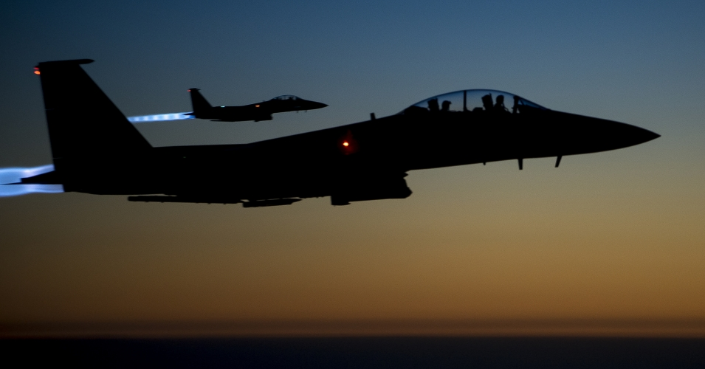
提摩太后书
纯正
教义
对抗
异端
Rick Griffith 博士 • 新加坡神学院 • BibleStudyDownloads.org

Slide 2
关键字
237
教义
提摩太后书

Slide 3
主题
23
纯正
教义
对抗
异端
提摩太后书

Slide 4
关键节
237
“全部圣经都是 神所默示的，在教训、
责备、矫正和公义的训练各方面，都是有益的，为要使属 神的人装备好，可以完成各样的善工。… 务要传道”
(3:16-17; 4:2)。
提摩太后书

Slide 5
237
总结概要
保罗劝勉提摩太，即使面对困难，也要忠心地实践和传讲真理，以鼓励他坚持对抗错误教导和离经叛教。
提摩太后书

Slide 6

国度陈述
237
27d
237
“他的显现和他的国度” (4:1) 的提起把基督的再来与他千年的主宰连接起来 而 “救我进他的天国” (4:18) 显示祂永恒的属性。
提摩太后书

Slide 7

圣约陈述
27d
保罗是“奉 神旨意、照着在基督耶稣里生命的应许、作基督耶稣使徒” (1:1)。
提摩太后书

Slide 8

救赎陈述
27d
圣经能使我们 “因信基督耶稣有得救的智慧” (3:15; 对比 2:10)。
提摩太后书

Slide 9
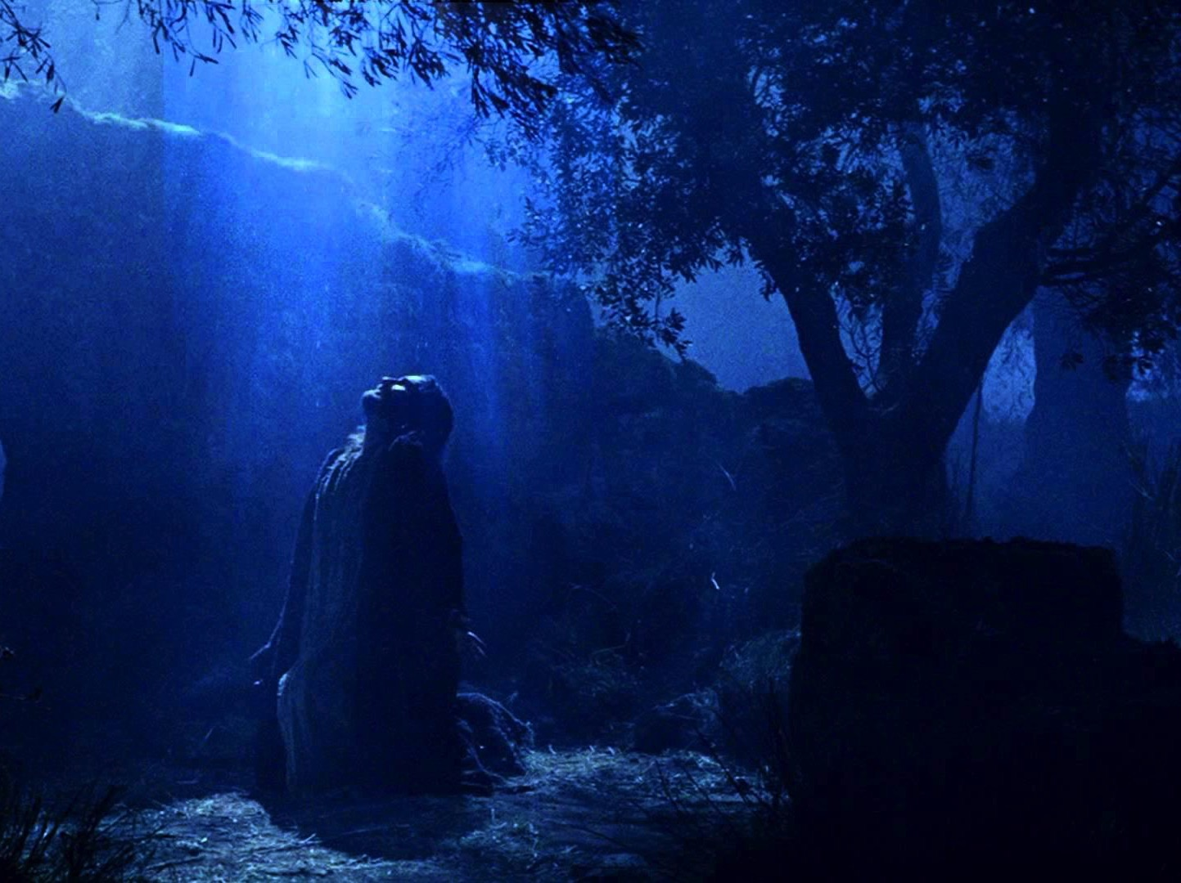
预言
(主, 神性)
27d
在短短的四章里，耶稣被称为主十六次 (e.g., 1:8; 2:19; 4:8), 因为保罗正因为宣讲基督的神性而面临死亡。
提摩太后书

Slide 10
提摩太后书
大纲
237
纯正的教义对抗异端
在现今的困苦中持守 |  | 在未来的困苦中持守
第 1–2 章 |  | 第 3–4 章
忠心的例子 1 | 忠心的特征 2 | 问题： 离弃真道 3:1-9 | 解决方式： 传主道 3:10–4:5 | 保罗的希望 4:6-22
友尼基 罗以 保罗 阿尼色弗 | 门训 一心一意 顺服 努力 合乎 圣经 圣洁 温柔 | 无神 假冒伪善 | 讲道 持守 责备 激励 传福音 | 殉道 背叛 问安 祝福
罗马至以弗所
主后 67年 秋 (第二次罗马监禁)

Slide 11
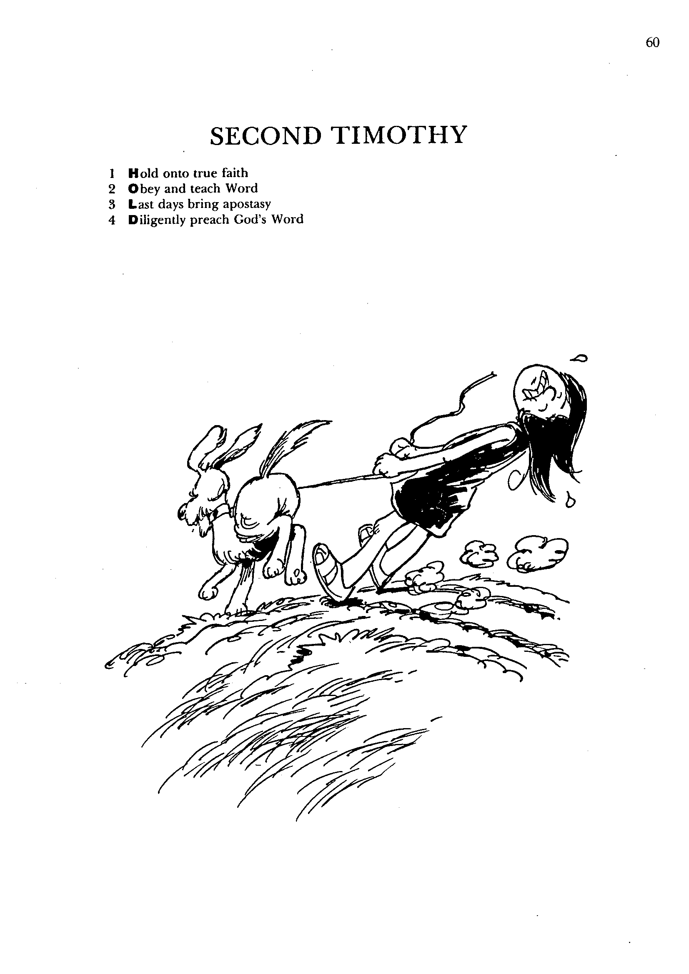
提摩太后书
1
2
3
4
持守真信仰
遵守与教导圣言
末日带来的叛教主义
勤奋传扬圣道
巴里 赫德尔斯顿 《藏头诗圣经》

Slide 12
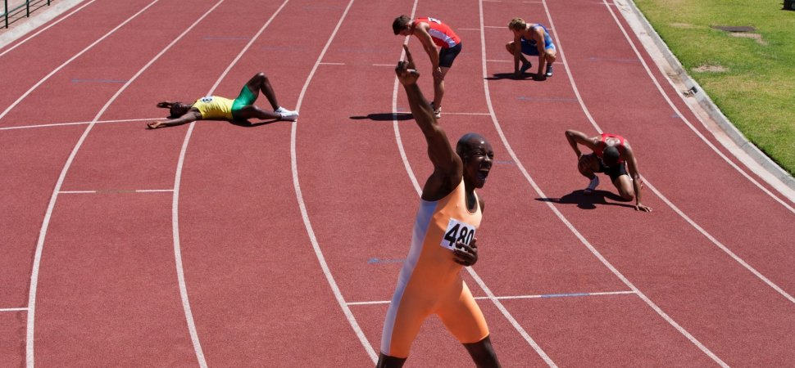
要坚持不懈
提摩太后书
Rick Griffith 博士 • Crossroads International Church Singapore
BibleStudyDownloads.org

Slide 13

叛教。
“转身地拒绝”
提摩太后书
Notes:
This is called “apostasy.” It literally means a turning away by rejecting.
Sometimes this means that the person no longer claims to be a Christian—but in other cases, the person still claims the name of Jesus (professes Christ) but has turned away from a key doctrine of the faith.

Slide 14

你怎么能在叛教主义中
坚持不懈?
提摩太后书
Notes:
What can you do now to make sure you are following the Lord faithfully in the future?

Slide 15

38
124
39-41
新约综览(保罗书信)
“直 到 地 极” (使 徒 行 传 1:8)
使 徒 9 13 14 15 16 18 21 27 28
五月57-
八月59
大 马 色
安 提 阿
四月 48-
九月 49
1
加 拉 太
四月 50-
九月 52
2
爱琴海
春季 53-
五月 57
3
亚洲
五月 57-
八月 59
试验
二月 60-
三月 62
1
罗马
春季 62-
秋季 67
4
西班牙
秋季 67-
春季 68
2
罗马
秋季 49
理事会
春季68
教会扩长
35 48 49 50 52 53 57 60 62 67 68 95
天国
主权1
主权2
门徒
相 信
以弗所
合一
提 前
秩序
提后
加拉太
帖 前
歌前
教 义
因信称义
被提
成圣
大患难
帖后
使 徒
歌罗西
神性
提 多
歌后
行事为人
称义
腓利门
罗马
饶恕
福音书以及使徒行传
腓立比
态度
保罗书信
保罗书信 +关键节

Slide 16
怎么能坚持不懈:
忠实地...
遵守
神的话
传扬
神的话
&
提摩太后书第一至二章
提摩太后书第三至四章
Notes:
Consistently follow what God says (1-2)
Consistently tell others what God says (3-4)

Slide 17

主要思想
忠实地 遵守 与 传扬
神的话。
提摩太后书

Slide 18

"因为时候要到、人必厌烦纯正的道理。耳朵发痒、就随从自己的情欲、增添好些师傅。 ⁴ 并且掩耳不听真道、偏向荒渺的言语" (4:3-4)。
提摩太后书
他们将“掩耳不听 (apostrepho) 真道"
(4:4)。

Slide 19

请问你的阅读，新闻，交友，电影，电视，尤其是互联网上所接触的, 是否是坚定还是削弱你的信仰？
提摩太后书

Slide 20
Black

Slide 21
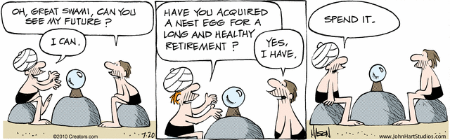
您的未来
伟大的斯瓦米, 您能告诉我关于我的未来吗?
您有没有为自己将来积蓄了退休金?
把它花掉吧!
Nephew
我能.
我有.
Notes:
伟大的斯瓦米, 您能告诉我关于我的未来吗? 我能.
您有没有为自己将来积蓄了退休金？ 我有.
把它花掉吧!

Slide 22

身为基督徒,你应该对
未来的前景感到乐观?

Slide 23
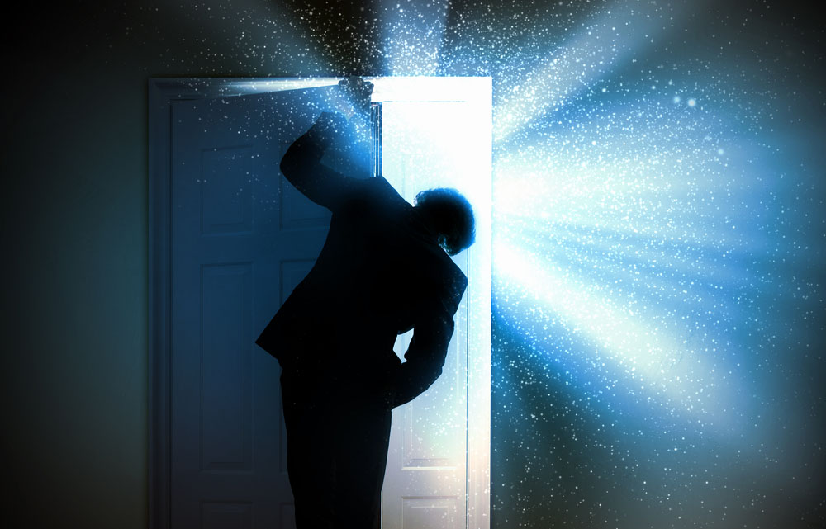
未来

Slide 24

未来
Notes:
毕竟有谁能保证他的罪被赦免和拥有天上的家？有谁拥有一个引导者是能知道一切，无条件地爱我们，并什么都可以做得的呢？信徒是不是似乎应该是对未来最有信心的人？

Slide 25

未来是属于我们的
Notes:
你呢？你是不是一个乐观主义者？

Slide 26

未来的新加坡
Notes:
新加坡独立后目前已进入第50年，她从一个小渔村演变成为一个在全球舞台上扮演重要角色的参与者。

Slide 27

未来的新加坡
Notes:
经济前景乐观-就业率高，房地产价格稳定或上升

Slide 28

新加坡水上农场
Notes:
新加坡将来会发展的水上农场...

Slide 29

新加坡水上农场
Notes:
毗邻滨海湾的水上农场

Slide 30

我们是不是应该感到鼓舞?
Notes:
即使在永恒或属灵这一方面，基督徒人数在新加坡总人口的比例继续上升.同样的,一些教堂增长的速度甚至超过了新加坡总人口增长的速度。基督徒是不是应该因此感到鼓舞？

Slide 31

你不应该对未来感到乐观.
身为基督徒,
你对未来抱着
乐观的态度吗？

Slide 32
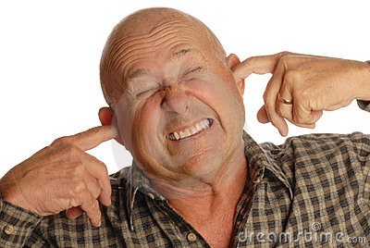
未来的日子会更艰苦.
Notes:
圣经上说，这个世界在基督再来之前，是最艰难的日子.事实上，它在公元一世纪时, 对基督徒已开始变得更艰难了。为什么这么说呢？

Slide 33

APOSTASY
“They will be fooled by evil spirits and by teachings that come from demons”
(1 Timothy 4:1)
Notes:
“During the last days there will be a great "Falling Away", a major apostasy, and a great abandoning of all obedience to God's word. Elements in the world that once promoted or greatly favored Christianity will now viciously turn against it. What is right will be called wrong, and what is wrong will be called right. This is apparent all over the planet as church after church is falling to homosexual sin, perversions, lies, the prosperity gospel and other heresies even worse than that, and embracing them with reckless abandon.”
__________________
The Great Apostasy
Posted On January 5th, 2015
AKA: The Great Falling Away
https://www.prophecyindex.org/prophecies/view/the_great_apostasy/

Slide 34
APOSTASY
Proofs and Fulfillments: (185)
First Lesbian Bishop Replaces Crosses with Islamic Symbols to Make Muslims Feel at Ease
Christian and Jewish Clergy Bless Abortion Clinic, Claim "God is Present in This Space"
Ohio School To Remove Ten Commandments Plaque For Almost 100 Years After Atheist Group
Evangelical denomination expels entire congregation over LGBT policy
Newly Consecrated Gay Bishop Declares God Is A Woman - The Daily Caller
Largest US Presbyterian Denomination to Ordain First Non-Binary Person as
Joel Osteen Celebrates LGBTQ Pride at Lady Gaga Event
United Church of Christ clergy hold service of blessing at Planned Parenthood
Hillsong Church Affirms Full Pro-LGBTQ Position in Their One World Religion Alpha Conference
Methodist University Offers Students Course on 'Queer Bible Hermeneutics’
Chrislam Founder Rick Warren Partnering With Mosques To Equate God Of The Bible And Allah
Durham Church offers to cover crosses while hosting Muslim prayers - Anglican
Investigation Shows Televangelists Living Lavish Lifestyles
Prosperity Gospel Plantation Owner, Paula White, Claims God Told Her to Accept Title of 'Apostle’
Spain: 10 Million Live in Towns Without Evangelical Presence
“They will be fooled by evil spirits and by teachings that come from demons” (1 Timothy 4:1)
Notes:
Examples of this turning away from the truth are legion, so I will highlight only a few.
__________________
The Great Apostasy
Posted On January 5th, 2015
AKA: The Great Falling Away
https://www.prophecyindex.org/prophecies/view/the_great_apostasy/

Slide 35
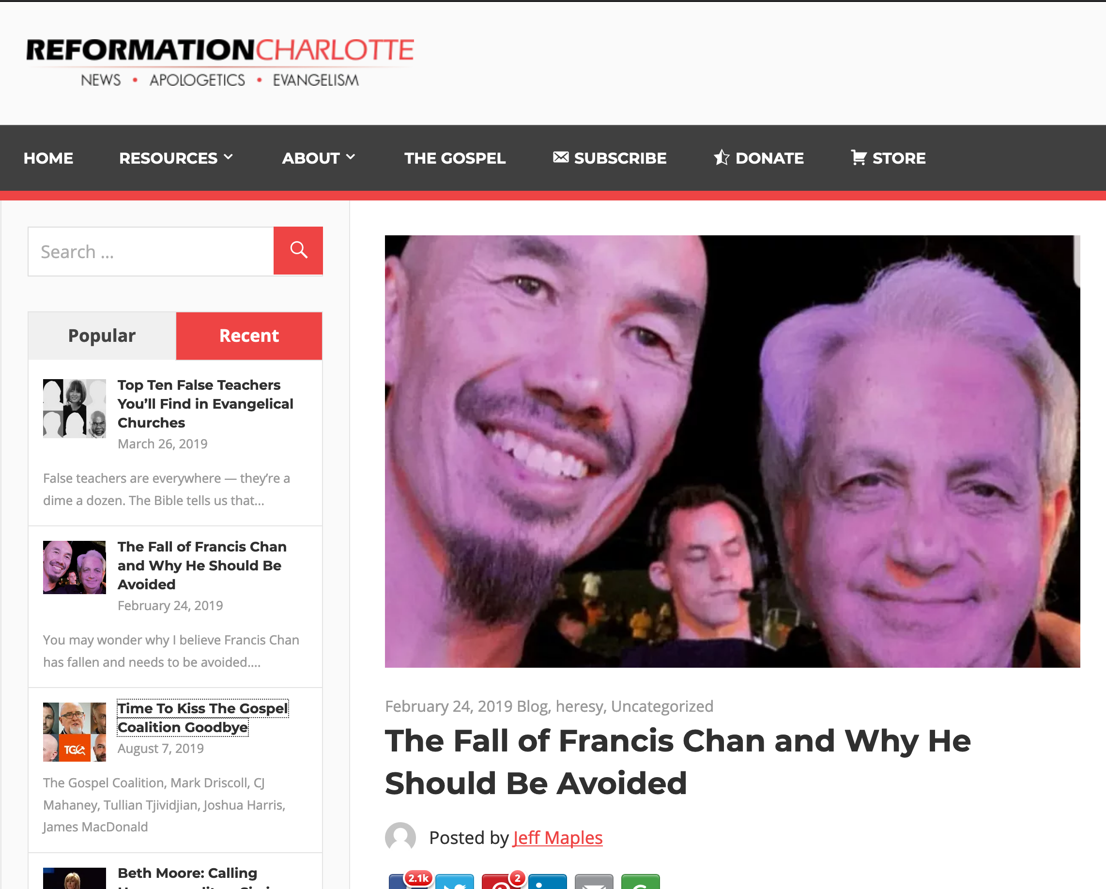
The Fall of Francis Chan and Why He Should Be Avoided
Notes:
You may wonder why I believe Francis Chan has fallen and needs to be avoided. Isn’t he orthodox? Doesn’t he preach the true gospel? Isn’t he, well, doctrinally sound?
Well, Chan is a graduate of both John MacArthur’s Master’s University and Seminary, an unusually solid, seminary that teaches rightly on such important doctrines as the sovereignty of God, the inerrancy of Scripture, and the cessation of the apostolic sign gifts. He was the founder and former pastor of Cornerstone Community Church in Simi Valley, California. Chan is now a well-known conference speaker, regularly preaching alongside questionable, at best charismatics such as Mike Bickle of IHOPKC and many others.
Chan, despite his solid theological educational background, is highly compromised in many ways, and not just because he regularly shares the stage with heretics. While that, in and of itself, is problematic, Chan’s compromises are much deeper and stem from a serious lack of discernment.
Chan aims to be a people-pleaser. It’s understandable that a man in the flesh would desire the praise of other men, but God dislikes this attitude and the Apostle Paul warns against it (Galatians 1:10).
When Chan decided to leave his church several years ago to begin his charismatic crusade, he announced to his congregation “God was leading him elsewhere.” Then, two years ago, while speaking at a gathering, speaking of his former church, he told the audience that they were all a “bunch of losers” who didn’t exercise their spiritual gifts.
Francis Chan, for several years, has been on the speaker circuit for several heretical crusades. On of the most popular crusades he’s frequented has been IHOPKC’s annual One Thing conference alongside such heretics as Todd White, Michael Brown, Joyce Meyer, and Seventh Day Adventist, Ben Carson. This conference is not only heretical due to it’s theological grounding steeped in New Apostolic Reformation ideology, it’s also ecumenical, and holds a Catholic track.
But Chan is no stranger to ecumenism. In 2003, Mike Gendron, a Christian apologist best known for his polemics and evangelistic resources for Catholics, was invited to speak at Chan’s church. Gendron, a man who knows and loves Catholics enough to speak truthfully about the serious and damning theological errors they hold to, spoke to Chan’s audience truthfully about the errors of purgatory, Mary, the Eucharist, and the biblical way of salvation. This prompted Chan to rebuke Mike Gendron in front of the entire gathering, stating that it “was a mistake” to host Gendron.
Chan’s obvious discontent with biblical truth shows that he is not only theologically inept and lacks serious discernment, but that he also seeks to not offend man, effectively offending God much worse.
PICTURES:
Francis Chan with Heretic, Mike Bickle
Francis Chan with charlatan, Benny Hinn
Francis Chan with faux faith-healer, Todd White
In his never-ending crusade to please the world, Chan continues to praise well-known, well-liked heretics while throwing solid men of God under the bus. Chan knows that men like Gendron are less popular with the world and the culture because they see the truth of Scripture as black and white — without compromise.
This weekend, Chan, at Lou Engle’s 2019 Send Conference, Chan was noted praising arch-heretics, Todd White and Daniel Kolenda. Todd White is a fraudulent “faith-healer” who claims to have healed hundreds of people of various ailments without a shred of evidence. Todd White holds to the Word of Faith heresy, “little God” theology, and is largely into the heretical New Apostolic Reformation movement that teaches that the office of Apostle — like the original 12 — has been reinstated and Apostles and Prophets exist today. Besides the fact that every single “Apostle” and “Prophet” in this movement is morally compromised in some way, not a single one has ever prophesied the way the biblical prophets have done. You can see Chan praising these men in the video below, toward the end.
Francis Chan, though he may occasionally speak things that sound right and biblical, is a wolf in sheep’s clothing to be avoided at all costs. Because of his associations with heretics and false teachers — and his considerable lack of discernment — Chan leads his people astray. He is not a shepherd to be followed, as he feeds his sheep directly to the wolves.
____________
https://reformationcharlotte.org/2019/02/24/francis-chan-why-you-should-avoid-him/

Slide 36

Time to Kiss the Gospel Coalition Goodbye
Notes:
In the wake of Joshua Harris’ apostasy — the Purity Culture pastor who divorced his wife, denounced Christianity, and embraced homosexuality — many people are wondering just exactly what went wrong. The apostasy follows a string of The Gospel Coalition contributors who have either been disqualified or have completely turned from their faith altogether.
From Tullian Tjividjian and Mark Driscoll to James MacDonald and C.J. Mahaney, many men that had been warned about by those “pesky discernment blogs” ultimately showed their true colors and were caught up in scams ranging from sex abuse cover-ups to bullying their staff at church.
The entire paradigm exemplifying The Gospel Coalition gave rise to a new breed of professing Christian — New Calvinism. While some, like Kevin DeYoung, ponder the reasoning behind the rampant apostasy at The Gospel Coalition, speculating that it is because they are too quick to “elevate gifted men,” I suspect the problem is much deeper than that. DeYoung writes,
What is worth exploring in this instance [Harris’ apostasy]—and, we can tell you, has already for years generated a great deal of soul searching—is why a number of young men who were at one time closely associated with The Gospel Coalition have been forced to leave the ministry. Our primary takeaway is that in years past our tribe was too quick to elevate gifted men who may not have had enough time to prove themselves faithful for the long haul. But even here, we would note that the public crises always get more attention than scores of young men who have quietly continued to serve the Lord with growing maturity.
The problem, you see, isn’t being “too quick” to “elevate gifted men.” The problem is elevating men who have a primary cause that fits the theme and narrative of The Gospel Coalition. The problem is, The Gospel Coalition isn’t really about the gospel — it’s about other things, like social justice, egalitarianism, LGBTQ activism, open borders and mass illegal immigration, theological liberalism, self-advancement, etc. The Gospel Coalition merely cloaks these causes in Christian-themed language, slaps the phrase “gospel-centered” on it, and brings aboard anyone who is willing to advance their cause — or at least act as a cloak for the gospel while The Gospel Coalition advances their own cause.
And the problem isn’t that just a few men have been officially disqualified — The Gospel Coalition continues to be wrought with unqualified, disqualified, and outright dangerous men and women. At The Gospel Coalition, the bad far outweigh the good. The Gospel Coalition still employs a massive number of homosexuals and LGBTQ activists, social justice warriors, and egalitarians. The Gospel Coalition employs people who are funded by leftist billionaires like George Soros, James Riady, and Zack Exley. The problem is The Gospel Coalition isn’t guided by the gospel, the Scriptures, or even basic Christian principles. It is guided by a leftist agenda whose primary purpose is to turn the Evangelical Church to the left politically and theologically.
Mark Driscoll wasn’t the problem. Tullian Tjividjian wasn’t the problem. C.J. Mahaney wasn’t the problem. James MacDonald wasn’t the problem. And no, Joshua Harris wasn’t the problem. All of these fallen men are merely symptoms of the problem. The problem is that The Gospel Coalition — and the (very few) good men who may be left — continue to give a platform to leftists, use complicit men like these to disguise their agenda, and allow the leftists at the organization to promote their agenda unfettered.
It’s time to kiss The Gospel Coalition goodbye.
_______
https://reformationcharlotte.org/2019/08/07/time-to-kiss-the-gospel-coalition-goodbye/

Slide 37

Apostasy

Slide 38
题目
提摩太后书
238
提摩太后书是三封教牧书信的其中一卷，特征是写给个人的（不是教会的），是保罗最后的写作。
(Pro.j Timo.qeon b Second to Timothy

Slide 39
引言
238
其中的一卷教牧书信 ( 提摩太前后书和提多书)
保罗写给个人的书信 （就像写给教会书信）

Slide 40
作者
238
使徒保罗
(在第一和第二节明显地看到 ： “作 基 督 耶 稣 使 徒 的 保 罗。。。。 写 信 给 我 亲 爱 的 儿 子 提 摩 太 ”。)
Notes:
Need to not only talk about Paul authorship, other opinions about others view of authorship

Slide 41

提摩太后书
作者
238
外在的证据
证明保罗是作者和其他保罗书信是一样的，除了罗马书和哥林多前书
内在的证据
书信宣称保罗是作者（提后 1:1) 和有保罗一贯的写信特征

Slide 42
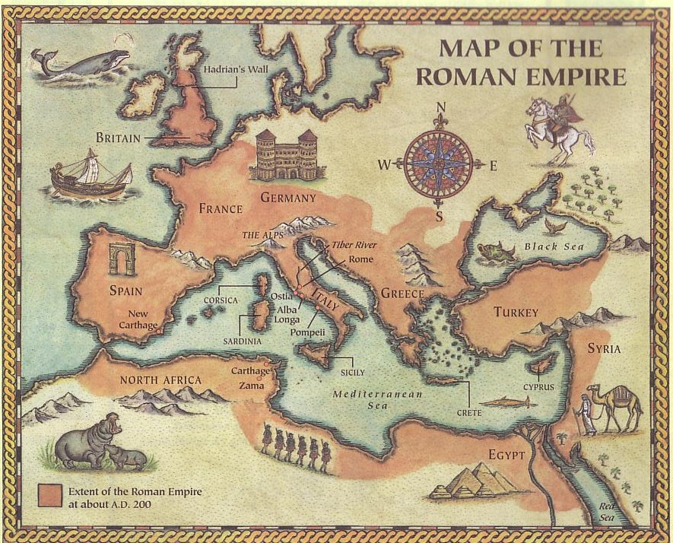
Origins / Recipients
提摩太后书
收信人
238
保罗写提摩太后书给他的同工，提摩太。这书信是写了提摩太前书五年之后 (提后1:2)。
假定提摩太还在以弗所 (提前1:3b), 提摩太后书也是写去同样地点 (提后 1:16-18; 4:19)。
罗马
以弗所
书信是从罗马写的(1:17; 2:9) ，在保罗第二次罗马监禁和第一次申辨之后写的 (4:16-17)。

Slide 43
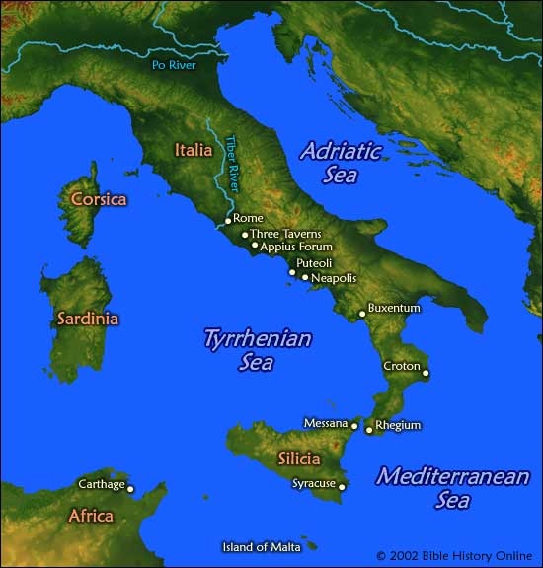
地点
238
保罗第二
次监禁
罗马

Slide 44
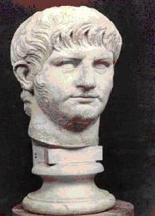
日期
238
在尼罗皇帝（Emperor Nero) 的朝代
(主后 67)

Slide 45


Date 1
提摩太后书
日期
238
保罗书信按时间顺序是不明确的，但是从内证和外证来看，符合以下的情况。
第一次罗马监禁 主后60年二月- 62年三月
(使 28:30-31)
保罗写以弗所书，哥罗西书， 主后60年秋—62年早春
腓利门书和腓立比书
雅各，主的兄弟，殉道, 主后62年春

Slide 46

Date 2
提摩太后书
日期
238
监禁被释放 主后62年春—67 年秋
保罗在以弗所和歌罗西 春—62年夏
(提摩太离开以弗所)
彼得去罗马 主后62年
保罗在马其顿 主后62年夏末-62/63年冬
在马其顿写提摩太前书给在 主后62年秋
以弗所的提摩太
保罗在小亚西亚 63春-64春
保罗在西班牙 64春-66春
(参考罗 15:24)
基督徒被尼禄王逼迫和彼得殉道 64夏

Slide 47


Date 3
提摩太后书
日期
238
保罗在克里特 主后66 早夏
(提多离开那里; 提多书 1:5)
保罗在小亚西亚 66年夏-秋
提多书 在小亚西亚写成， 66年夏
给在克里特的提多
保罗在尼哥波立 (提多 3:12) 66/67年冬
保罗在特罗亚(提后 4:13), 67年春—秋
马其顿和雅典
提多书 在小亚西亚写成， 66年夏
给在克里特的提多
第二次在罗马被监禁 67年秋—68年春
保罗被捕，带到罗马 67年秋
在罗马写提摩太后书给在以弗所的提摩太 67年秋
保罗被杀 68年春
在罗马写提摩太后书给 67年秋
在以弗所的提摩太
耶路撒冷被毁 70年9月2日

Slide 48

收信人
提摩太后书
238
提摩太 – 保罗长时间旅行布道的同工
书信类别
个人化以及富有情感

Slide 49

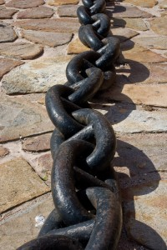
写作目的
238
在提摩太前书五年以后写成
保罗第二次罗马监禁 (4: 6-8)
保罗被杀之前(4: 9, 21)
尼禄王嫁祸于基督徒

Slide 50


Occasion
提摩太后书
写作目的
238
主后 67年当保罗在写提摩太后书时，他已经在几个城市被囚过：
耶路撒冷: 10 年前 (5月29日-6月9日, 57年)
叙利亚: 8-10年 前 (6月57年-8月 59年)
罗马: 5-7 年前(2月 60年-3月62年)
在过去十年中几乎有五年时间是在狱中度过，所以他知道监狱和政治的情况。他知道他第二次被囚将会被处死 (提后 4:6-8)。
保罗知道他不会在罗马监狱里太久，所以叫提摩太尽快在冬天之前到他那里去。(提后 4:9, 21).

Slide 51
提摩太后书
特征
239
这封书信是保罗写的最后一封书信
这封书信提供了新约所需要的清楚的解释 (4:2):
需要保守所交托的善道 (1:14)
强调真理的中心 (2:15)
需要如何持守善道(3:14)
需要为福音受磨难(1:8; 2:3)
解释圣经的默示(3:16-17)

Slide 52

提摩太后书
238
关键词
教义
钥节
“全部圣经都是神所默示，在教训，责备，矫正和共义的训练各方面，都是有益的，为要使属神的人装备好，可以完成各样的善工…务要传道”
(提后3:16-17; 4:2).

Slide 53


争论
238
-要告诉提摩太什么是最重要的
鼓励他要持守他的信仰生活和传道的信念。
- 鼓励他在面对困难和假教师的时候，要忠心传上帝的话。

Slide 54
提摩太后书
1
2
3
4
持守真信仰
遵守与教导圣言
末日带来的叛教主义
勤奋传扬圣道
巴里 赫德尔斯顿 《藏头诗圣经》

Slide 55
提摩太后书
争论
239
这封书信主要是写给提摩太 （好像提摩太前书）
在保罗殉道之前，许多人跌倒了，他非常谨慎地用词，也许是最后的信，帮助提摩太守住真理的信仰，直到他死。
因为在将来会面对更大的困难( 3-4章).
，使徒保罗激励提摩太要在患难中持守虔诚的品性(1-2章)
他忠心传扬主道，特别需要对抗离弃真道的人。 (3:10—4:5).

Slide 56

综合
提摩太后书
239
纯正的教义对抗异端
综合
1–2 在现今的困苦中持守
3–4 在未来的困苦中持守

Slide 57

大纲
237
1 & 2 章
3 & 4 章
在困苦中持守
在未来的困苦中持守
忠心的例子
问题：离弃真道
保罗的希望
忠心的特征
答案：
传主道

Slide 58
When to hang in there…
Persevere Now
Persevere in the Future
&

Slide 59
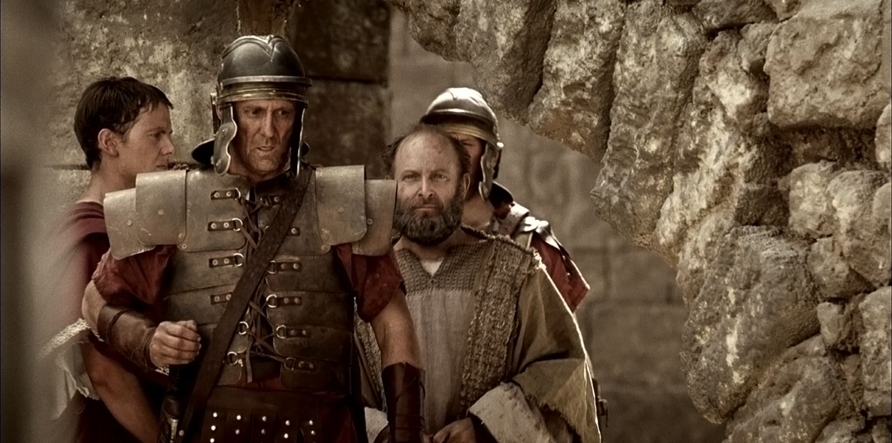
Paul led to Prison

Slide 60
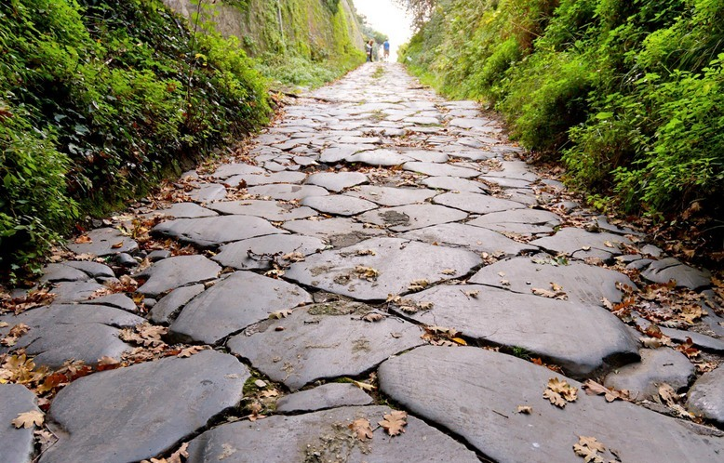
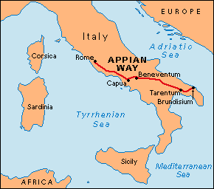
保罗第一次在罗马被监禁 (公元60-62年)
(使徒行传 28:15)
那里的弟兄们， 一听见我们的信息，就出来到亚比乌市，和三馆地方迎 接我们。保罗见了他们，就感谢神，放心壮胆 。
Notes:
在公元60年,保罗第一次来到罗马时,受到了信徒的欢迎.

Slide 61
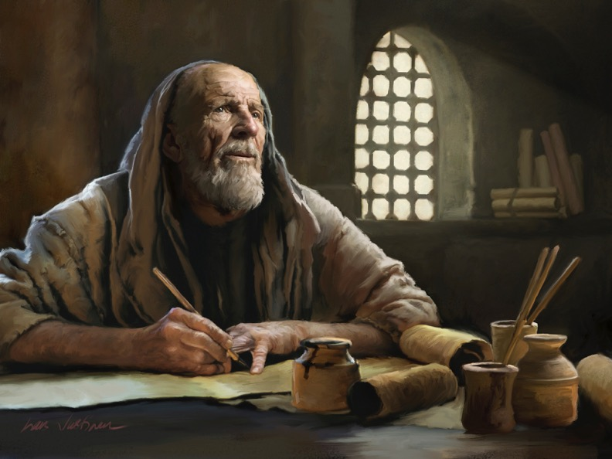
教牧书信

Slide 62

Pastoral Epistles
1 Timothy
Titus
2 Timothy
1-2 Timothy = personal, urgent, doctrinal emphasis
Titus = less urgent, practical emphasis
Notes:
These last three letters of Paul are called the Pastoral Epistles.

Slide 63

保罗在罗马被监禁的第二次 (公元67年-68年)
“我现在被浇奠，我离世的时候到了。那美好的仗我已经打了。当跑的路我已经跑尽了。所信的道我已经守住了。”
(提摩太后书 4:6-7)

Slide 64
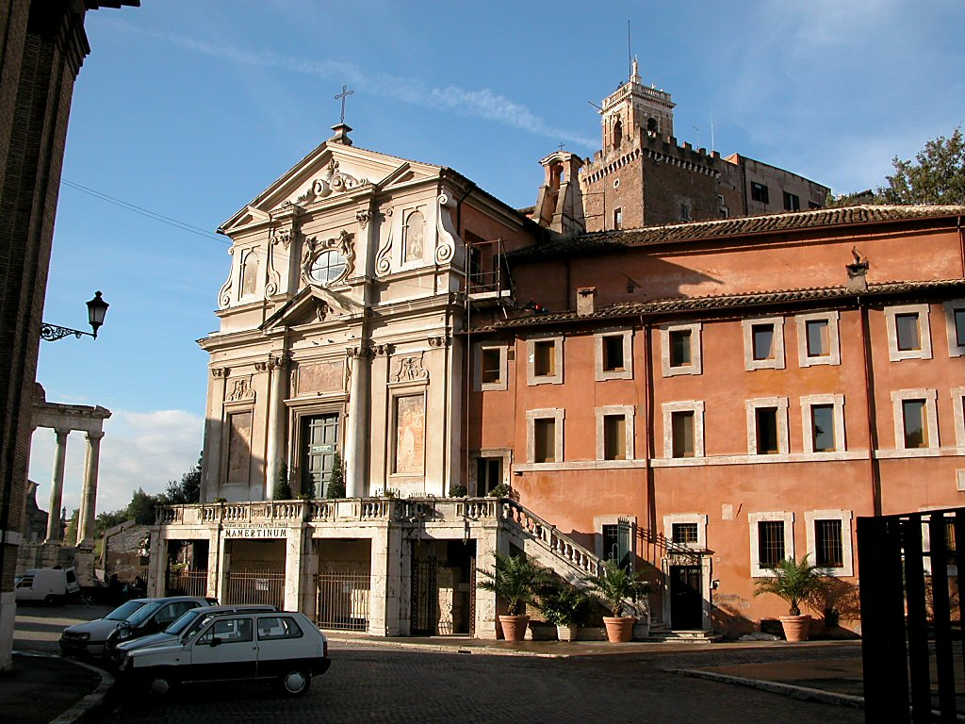
马梅尔定(Mamertine)监狱
Notes:
使徒保罗和使徒彼得在罗马被监禁的传统监狱.这个监狱在保罗的时代被简称为“卡尔塞尔监狱”。 中世纪时期, 它被称为”马梅尔定”(Mamertine)监狱。 -Todd Bolen，BiblePlaces.com

Slide 65
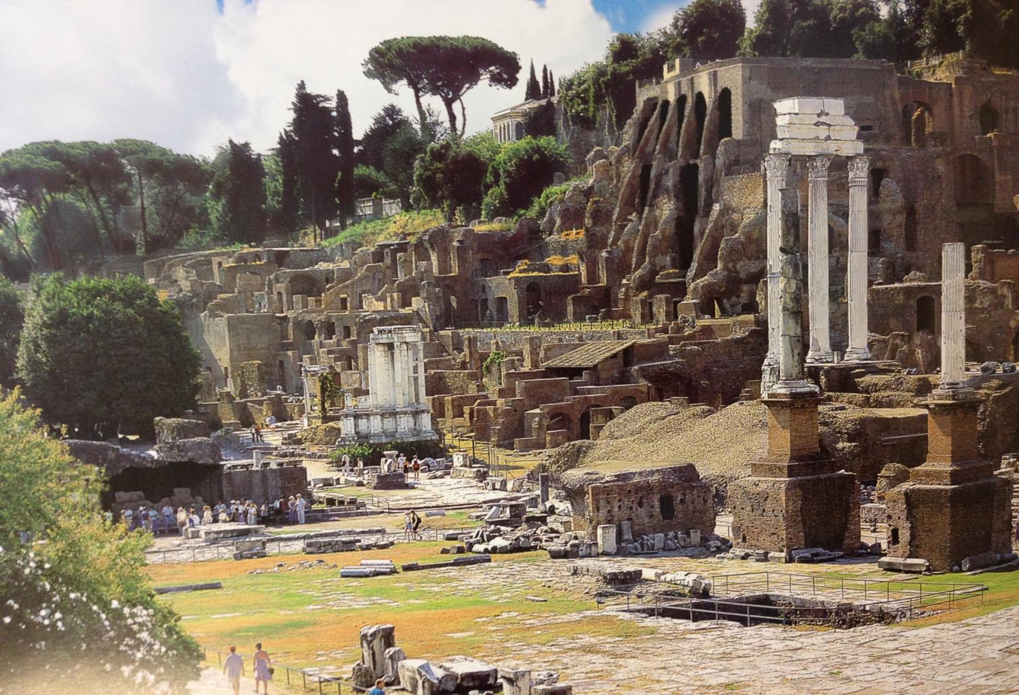
罗马时代中央广场（现代遗址）

Slide 66
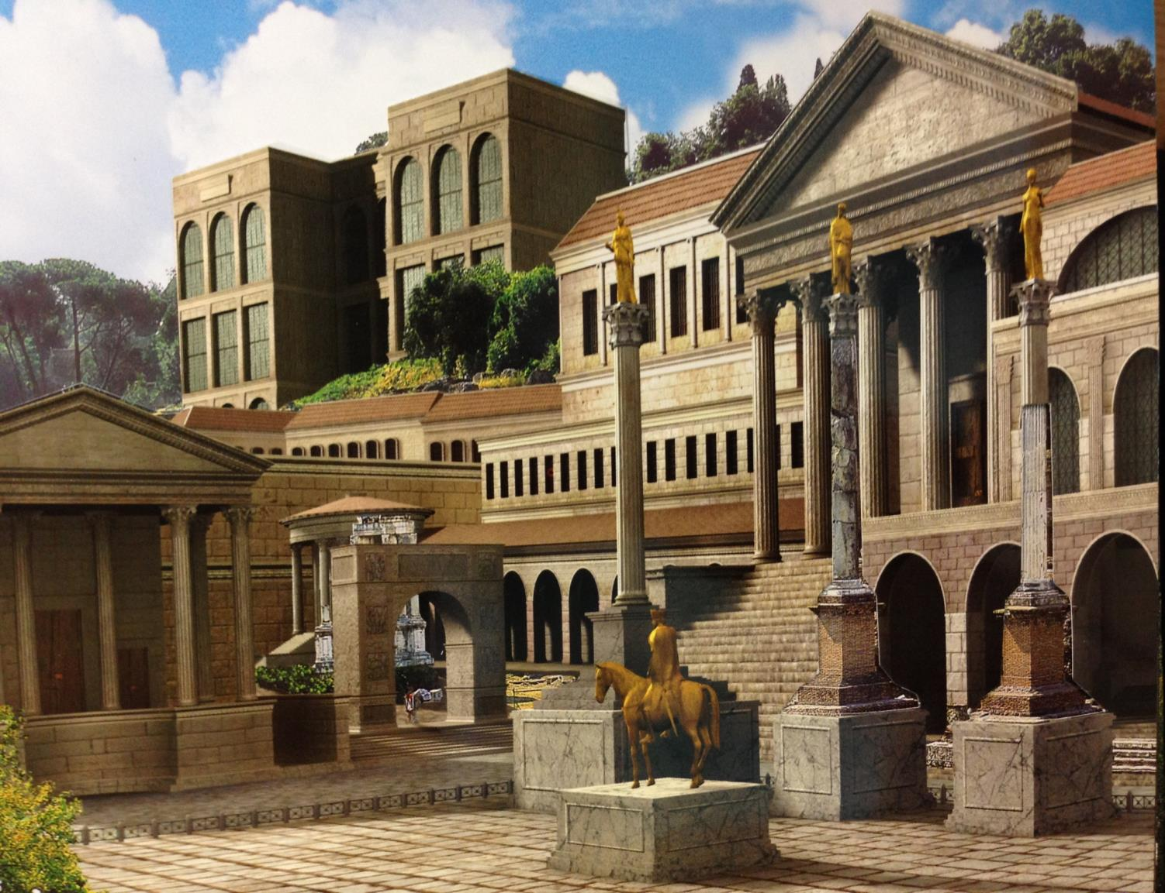
罗马时代中央广场公元4世纪
罗马时代中央广场公元4世纪

Slide 67
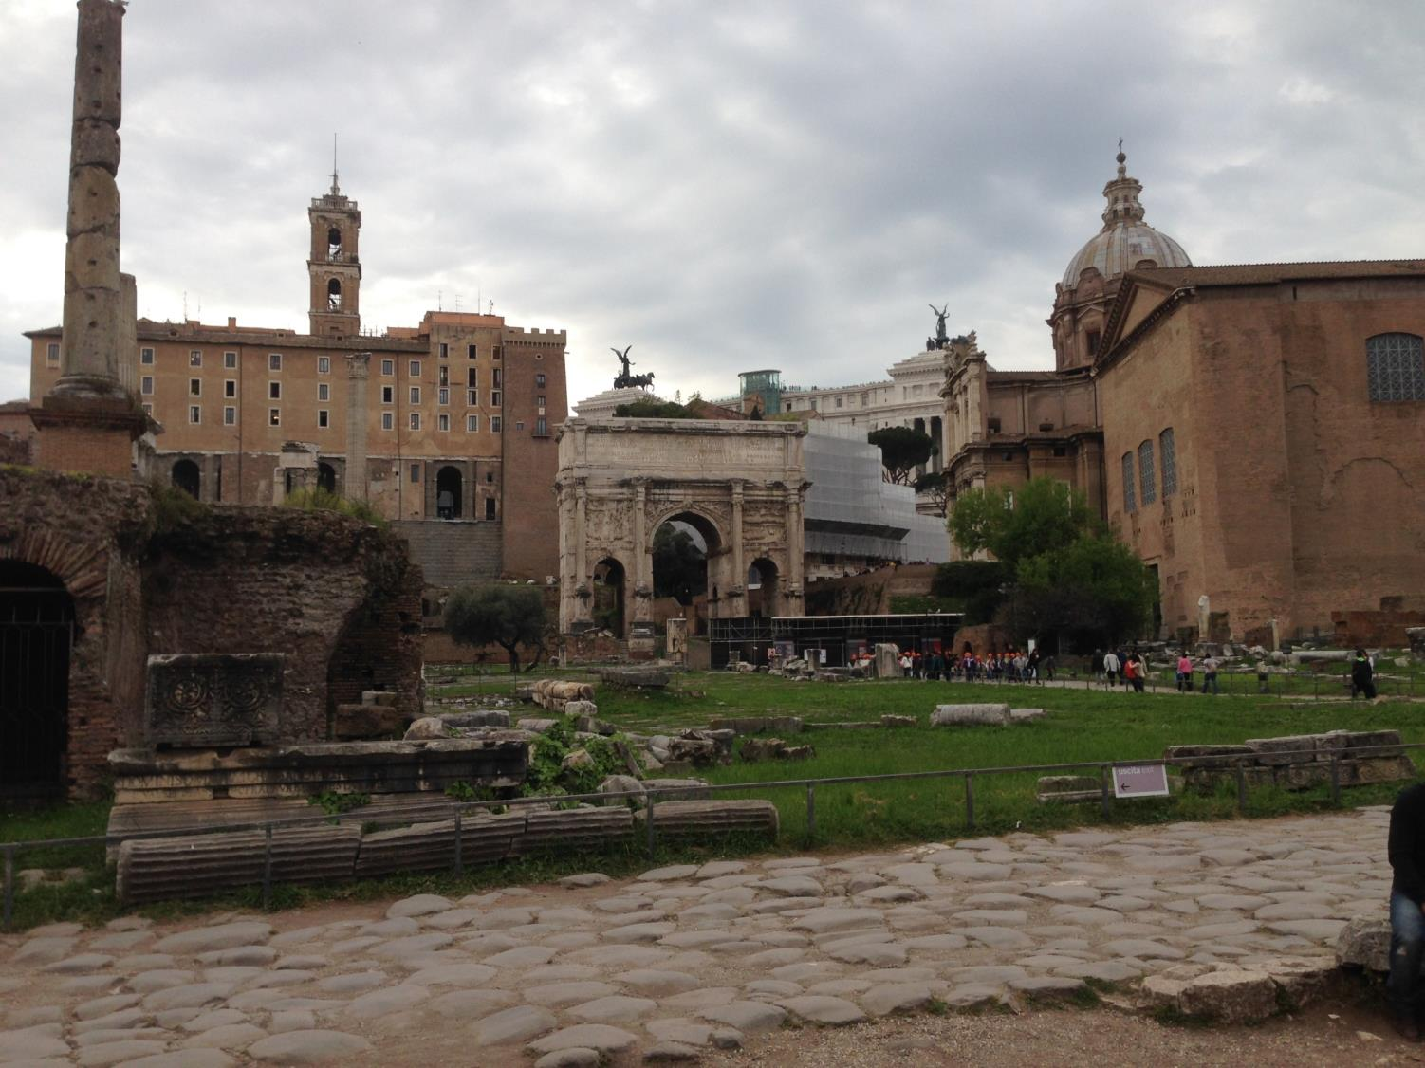
东面广场 (从上空的景观)
马梅尔定(Mamertine) 监狱
教廷参院

Slide 68
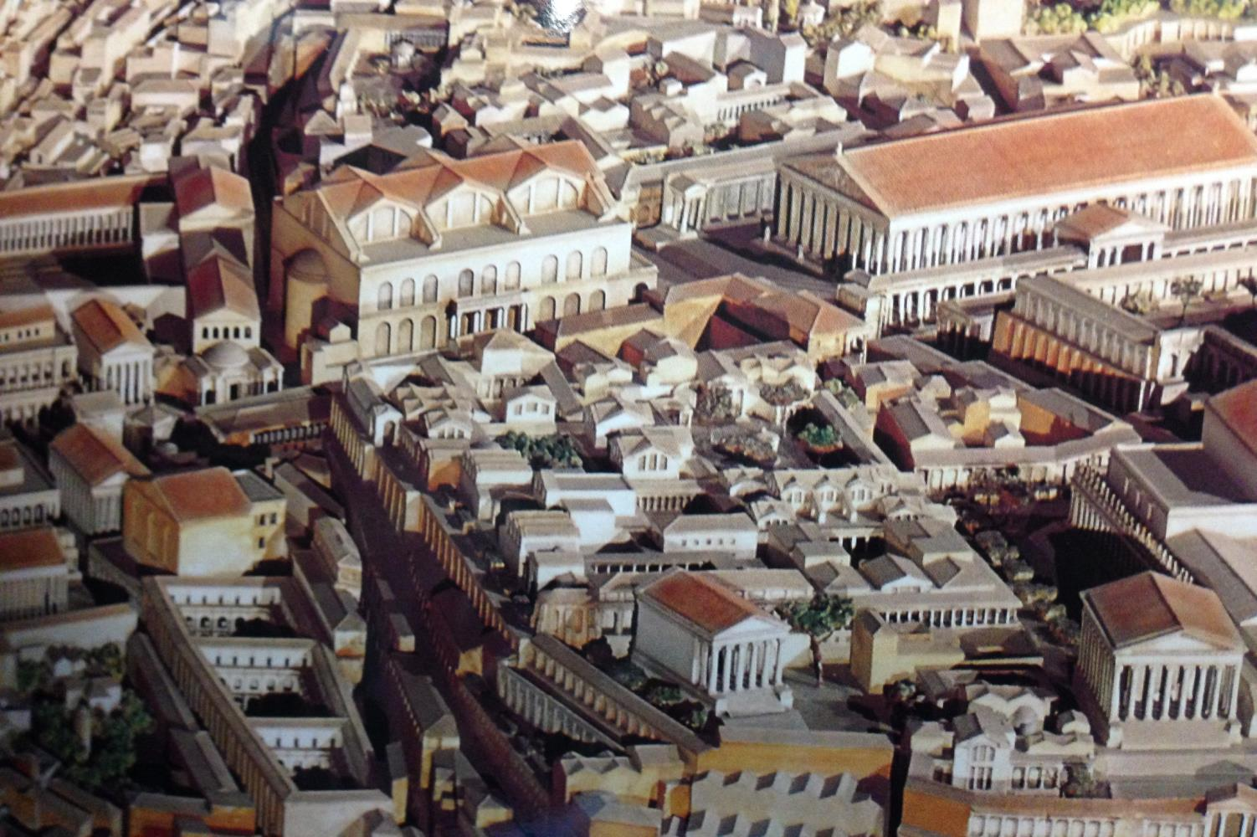
中央广场从上空的景观

Slide 69
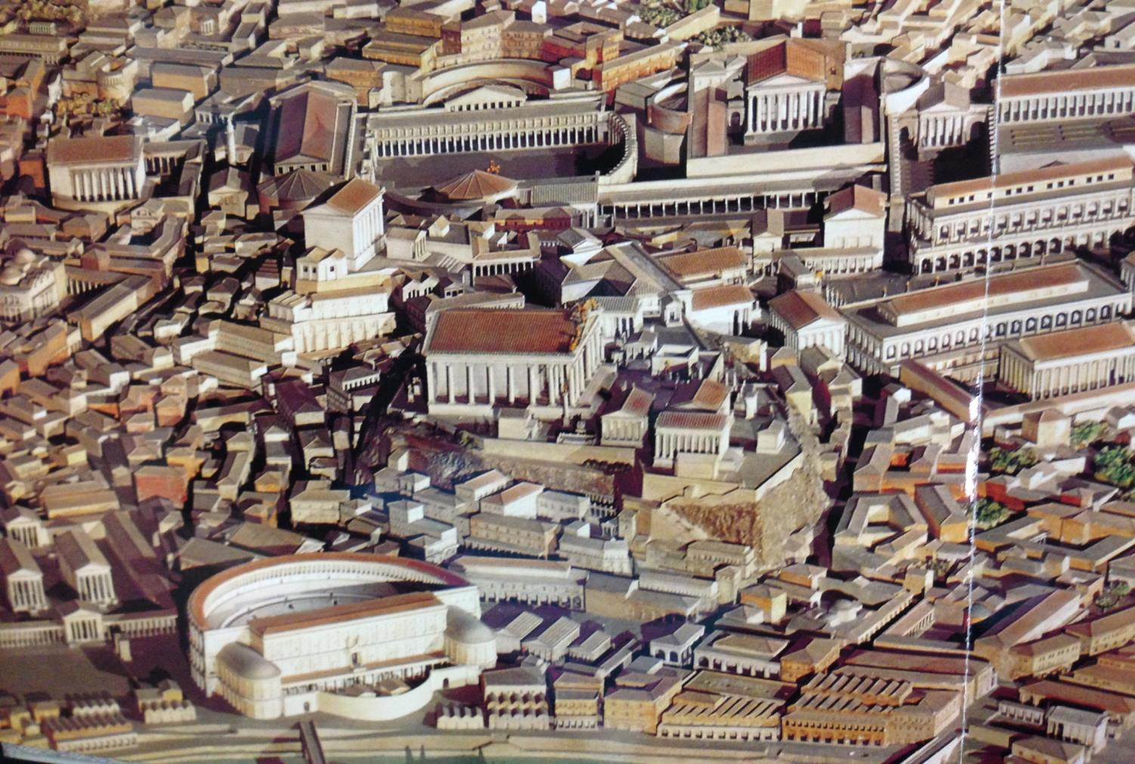
西面广场从上空的景观

Slide 70
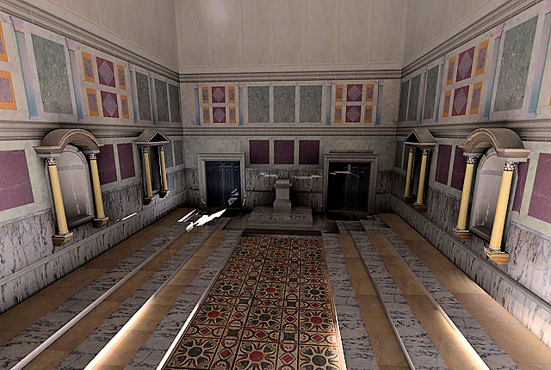
教廷内部
由加州大学体验技术中心重建的教廷朱莉娅的内部

Slide 71
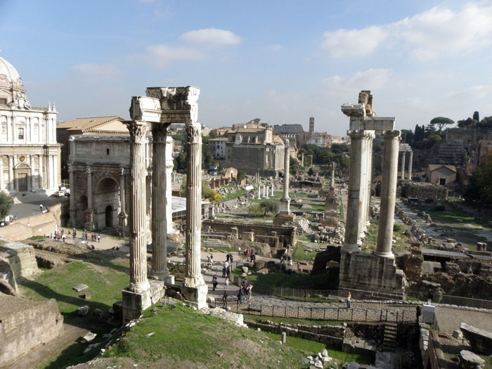
从马梅尔定(Marmatine)监狱罗马时代广场的景观（公元2014）

Slide 72
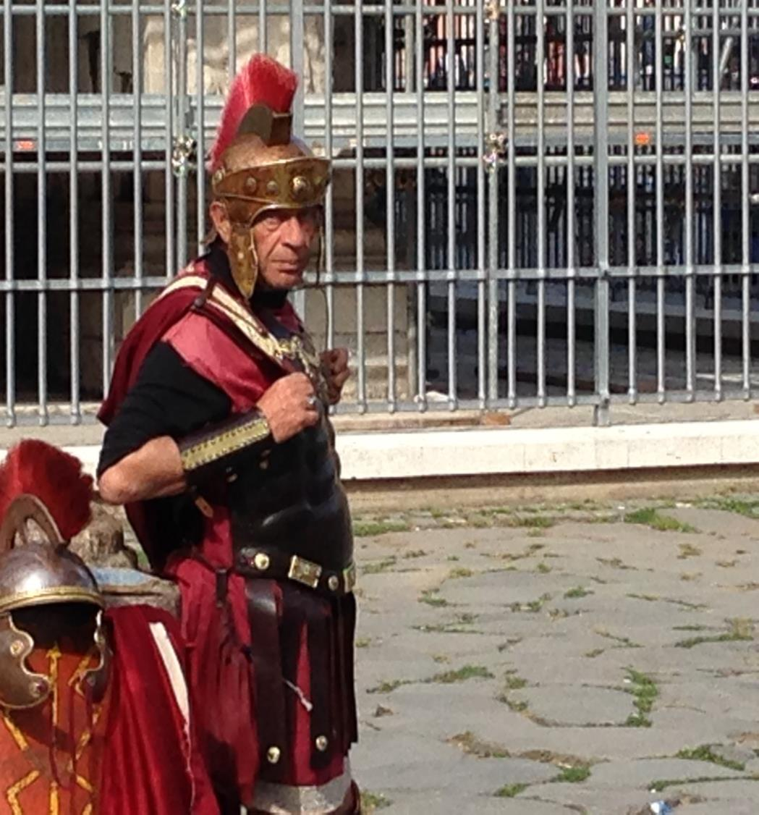
告诉你的邻居：如果你被
处死前写的最后一封信，
你会
写给谁,你会
写什么？
提摩太后书

Slide 73


Summary Chart
提摩太后书
提摩太后书
237
纯正的教义对抗异端
Sound Doctrine Against Opposition
在现今的困苦中持守
Persevere in Present Hardship
在未来的困苦中持守
Persevere in Future Hardship
1–2 章
Chapters 1—2
3–4 章
Chapters 3—4
Examples
of Faithfulness
1
Problem:
Apostasy
3:1-9
Solution:
Preach the Word
3:10—4:5
Characteristics
of Faithfulness
2
问题：离弃真道
3:1-9
答案：传主道
3:10—4:5
忠心的例子
1
忠心的特征
2
保罗的希望
4:6-22
Paul’s Hope
4:6-22
Preaching
Persevering
Rebuking
Encouraging
Evangelism
Eunice
Lois
Paul
Onesiphorus
讲道
持守
责备
激励
传福音
友尼基
罗以
保罗
阿尼色弗
无神
假冒伪善
Martyrdom
Betrayals
Greetings
Benediction
Discipling * Single-minded * Obedient * Hardworking * Biblical
* Holy * Gentle
Godlessness
Hypocrisy
殉道
背叛
问安
祝福
门训 * 专一 * 顺服 * 努力 * 合乎圣经
* 圣洁 * 温柔
罗马到以弗所
Rome to Ephesus
主后 67年秋 (第二次罗马监禁)
Autumn AD 67 (second Roman imprisonment)

Slide 74
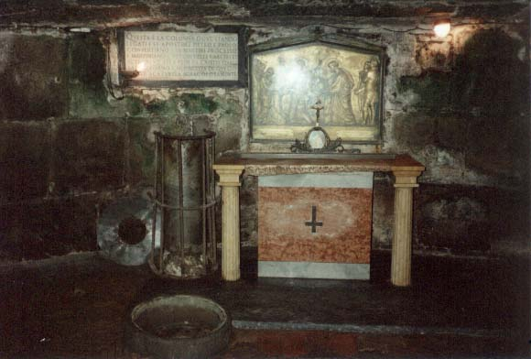
主要主题
忠心
离弃真道
神默示的话语

Slide 75
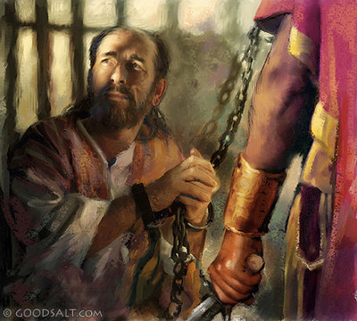
总结
提摩太后书
237
保罗激励提摩太尽管在困苦中也要忠心活出真理和传扬神的道，坚持对抗假教师和离弃真道的人。

Slide 76
要坚持不懈
提摩太后书
Rick Griffith 博士 • Crossroads International Church Singapore
BibleStudyDownloads.org

Slide 77

Many who followed Jesus…

Slide 78

…don’t follow him today.

Slide 79
叛教。
“转身地拒绝”
提摩太后书
Notes:
This is called “apostasy.” It literally means a turning away by rejecting.
Sometimes this means that the person no longer claims to be a Christian—but in other cases, the person still claims the name of Jesus (professes Christ) but has turned away from a key doctrine of the faith.

Slide 80
"因为时候要到、人必厌烦纯正的道理。耳朵发痒、就随从自己的情欲、增添好些师傅。 ⁴ 并且掩耳不听真道、偏向荒渺的言语" (4:3-4)。
提摩太后书
他们将“掩耳不听 (apostrepho) 真道"
(4:4)。

Slide 81
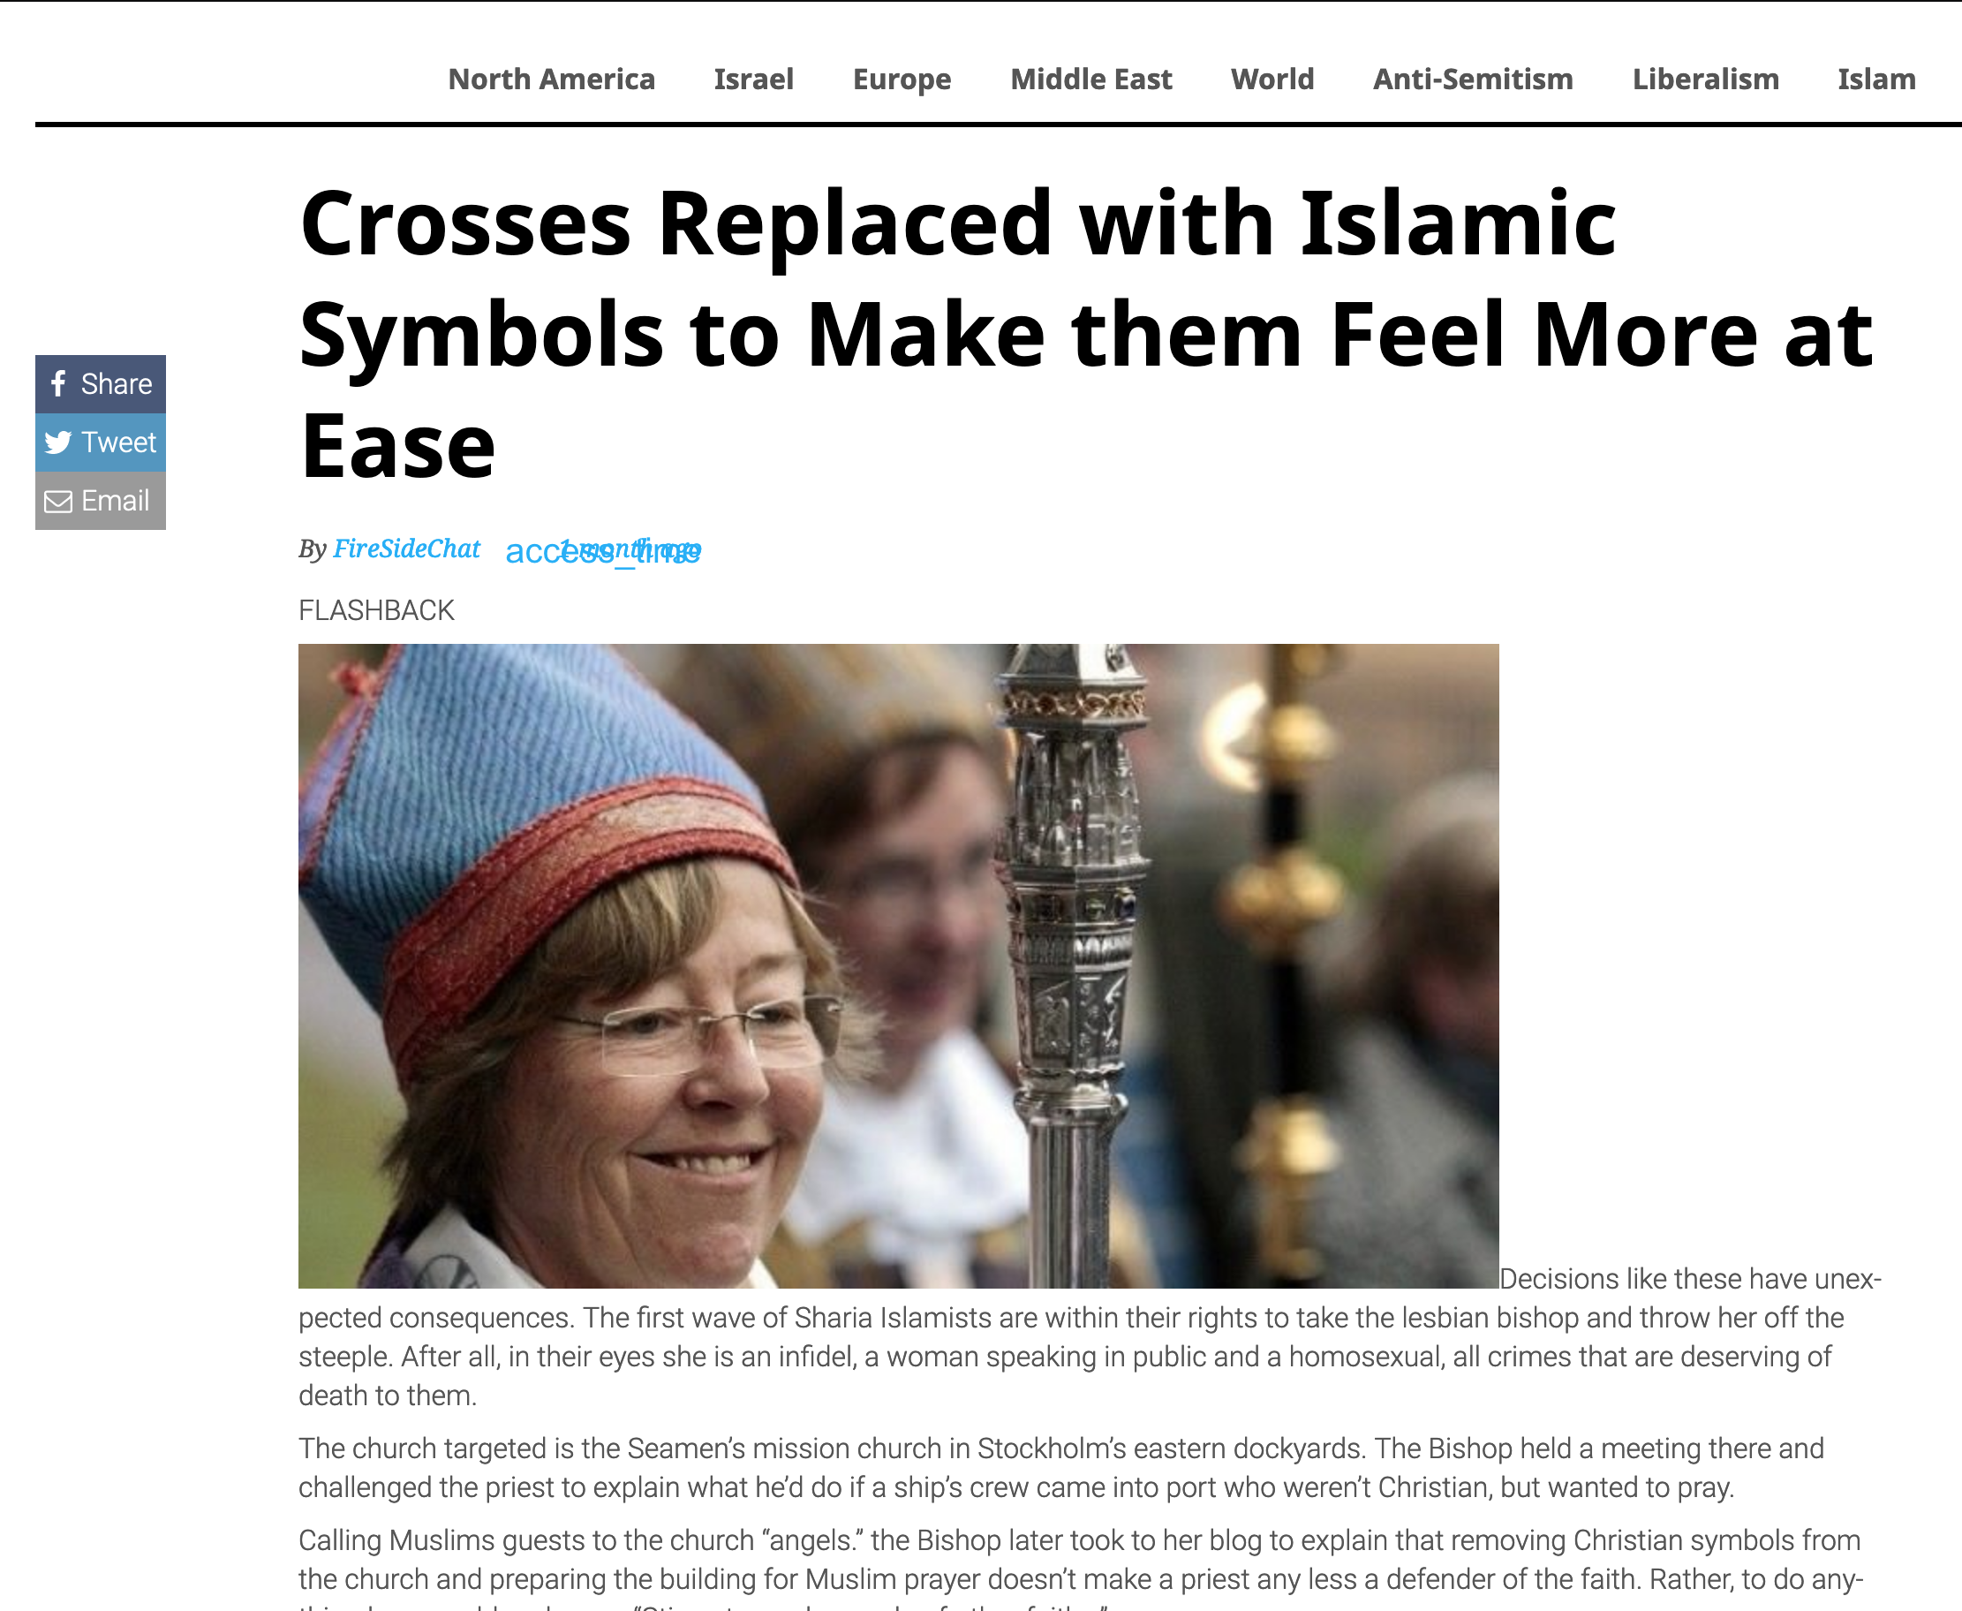
Crosses Replaced with Islamic Symbols to Make them Feel More at Ease
22 August 2019
Notes:
First Lesbian Bishop Orders Crosses Replaced with Islamic Symbols to Make them Feel More at Ease
________
https://www.firesidechat.news/2019/08/22/first-lesbian-bishop-orders-church-crosses-replaced-with-islamic-symbols-to-make-them-feel-more-at-ease.html
__________________
The Great Apostasy
Posted On January 5th, 2015
AKA: The Great Falling Away
https://www.prophecyindex.org/prophecies/view/the_great_apostasy/

Slide 82
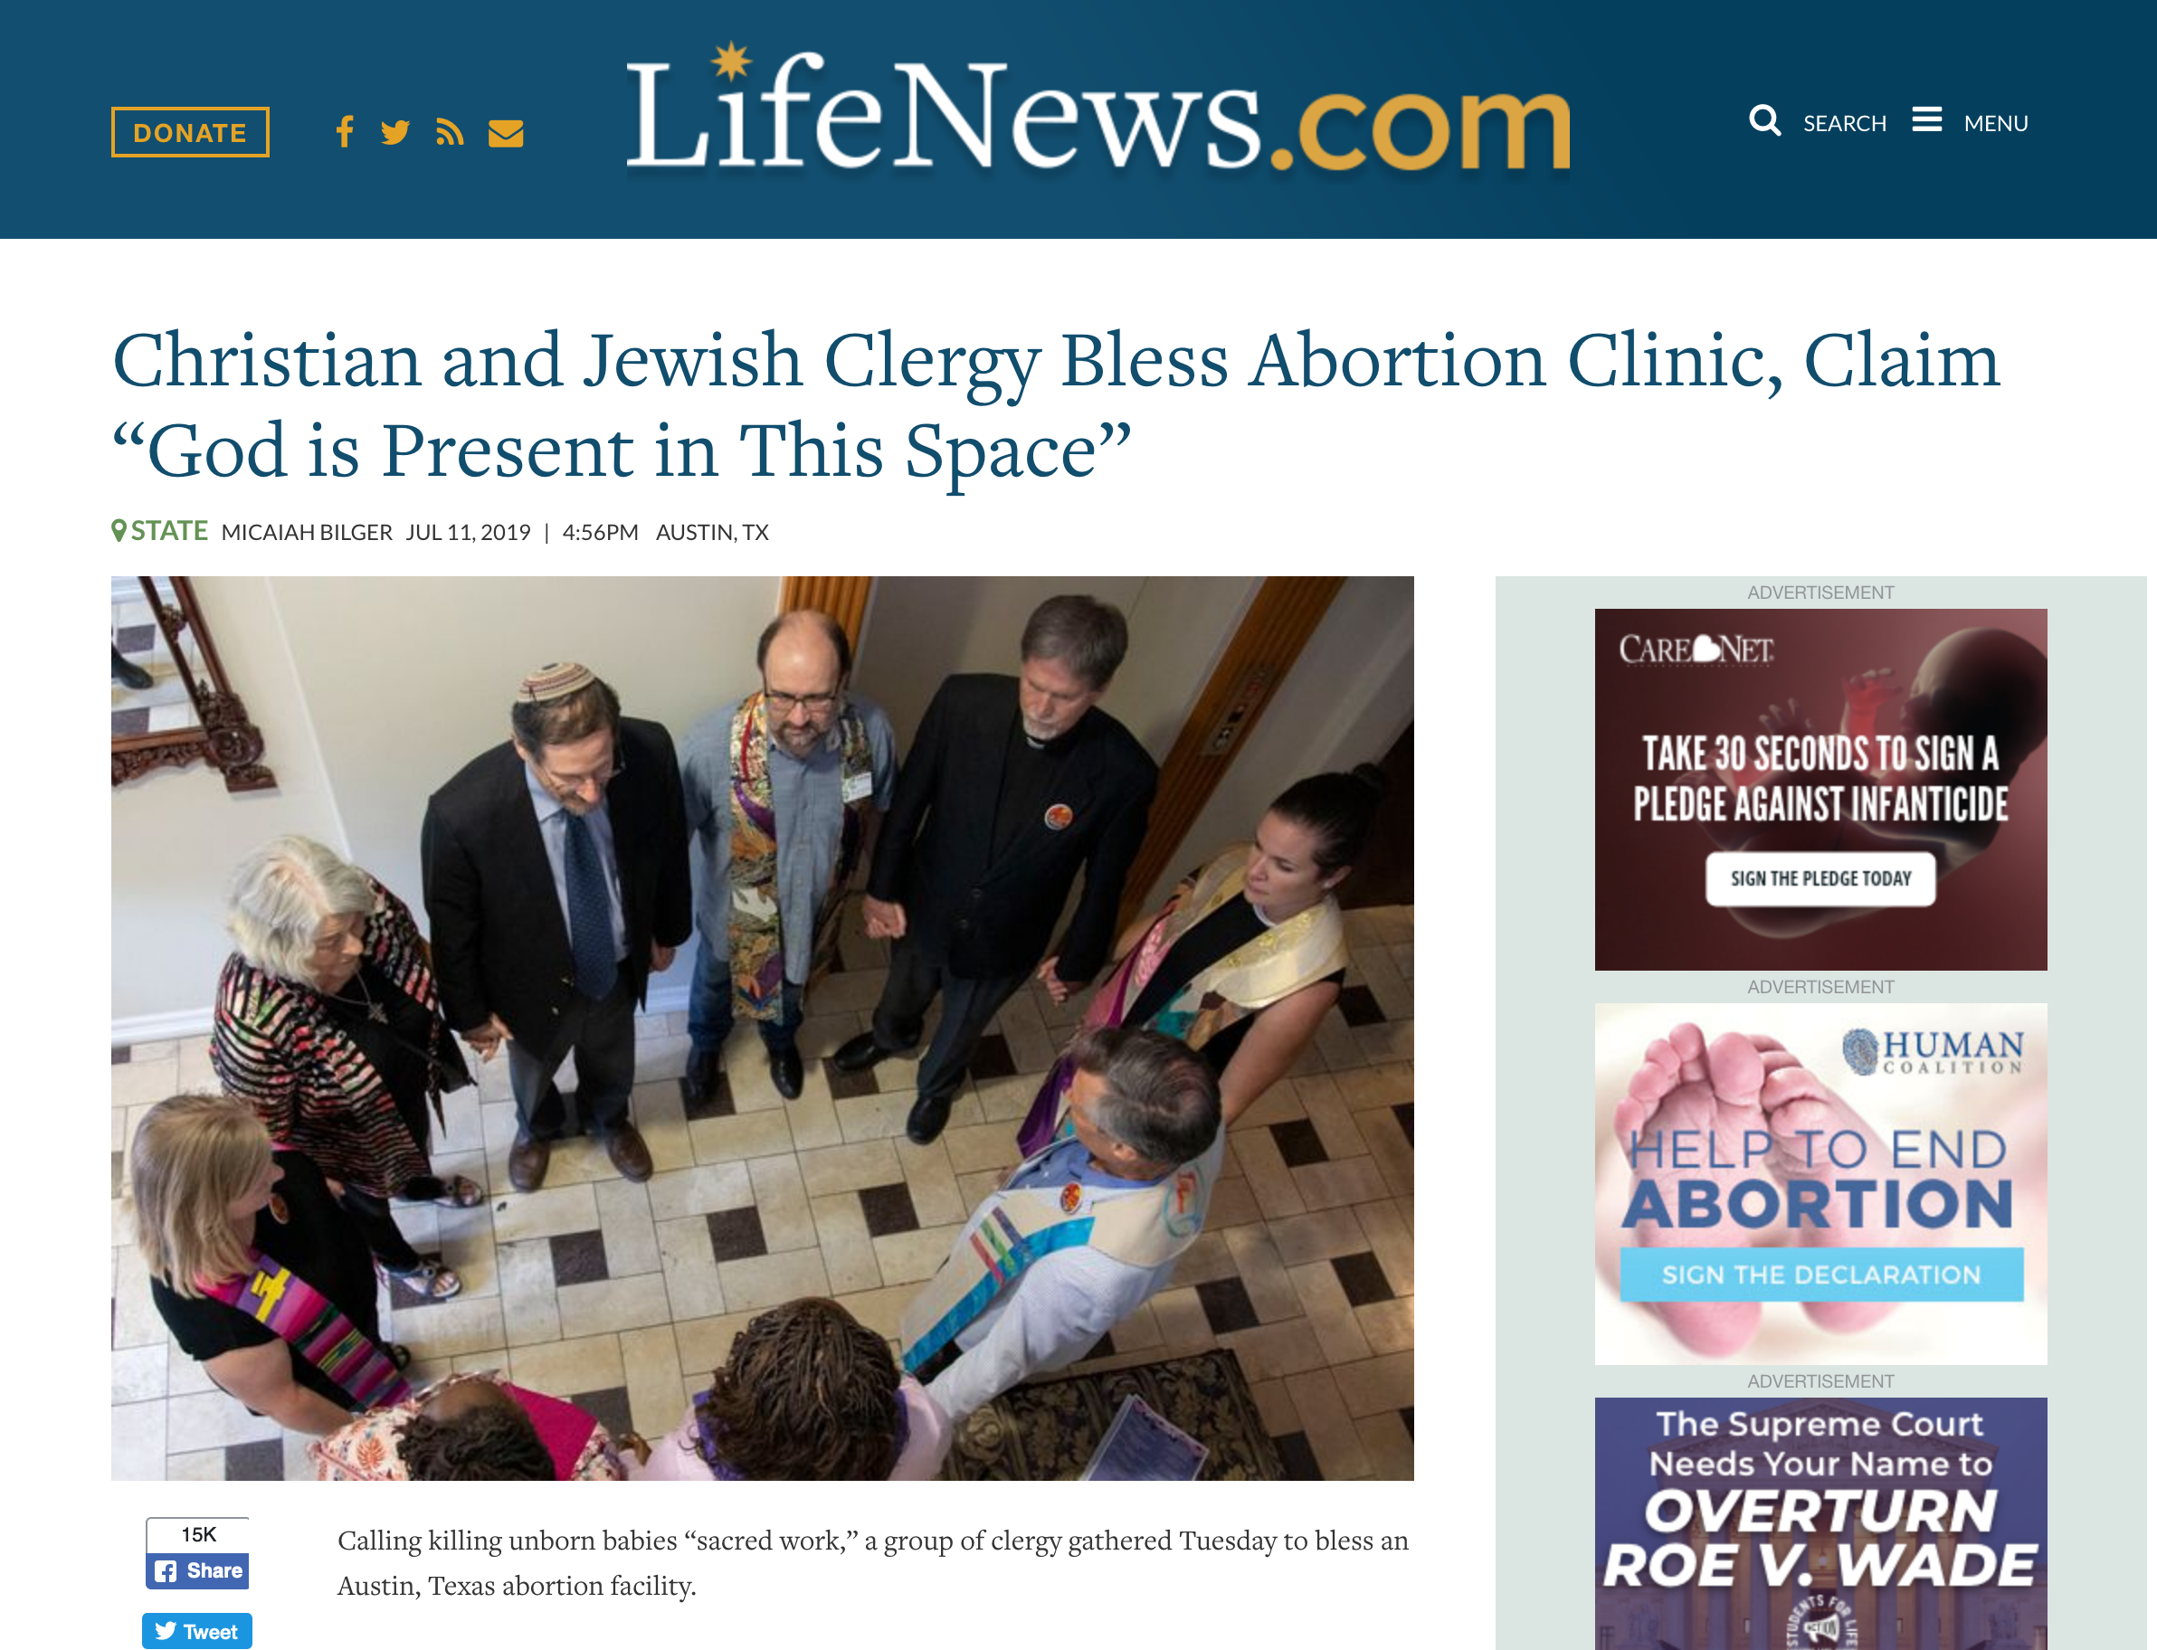
Christian and Jewish Clergy Bless Abortion Clinic,
Claim “God is Present in This Space”
Notes:
https://www.lifenews.com/2019/07/11/christian-and-jewish-clergy-bless-abortion-clinic-claim-god-is-present-in-this-space/

Slide 83
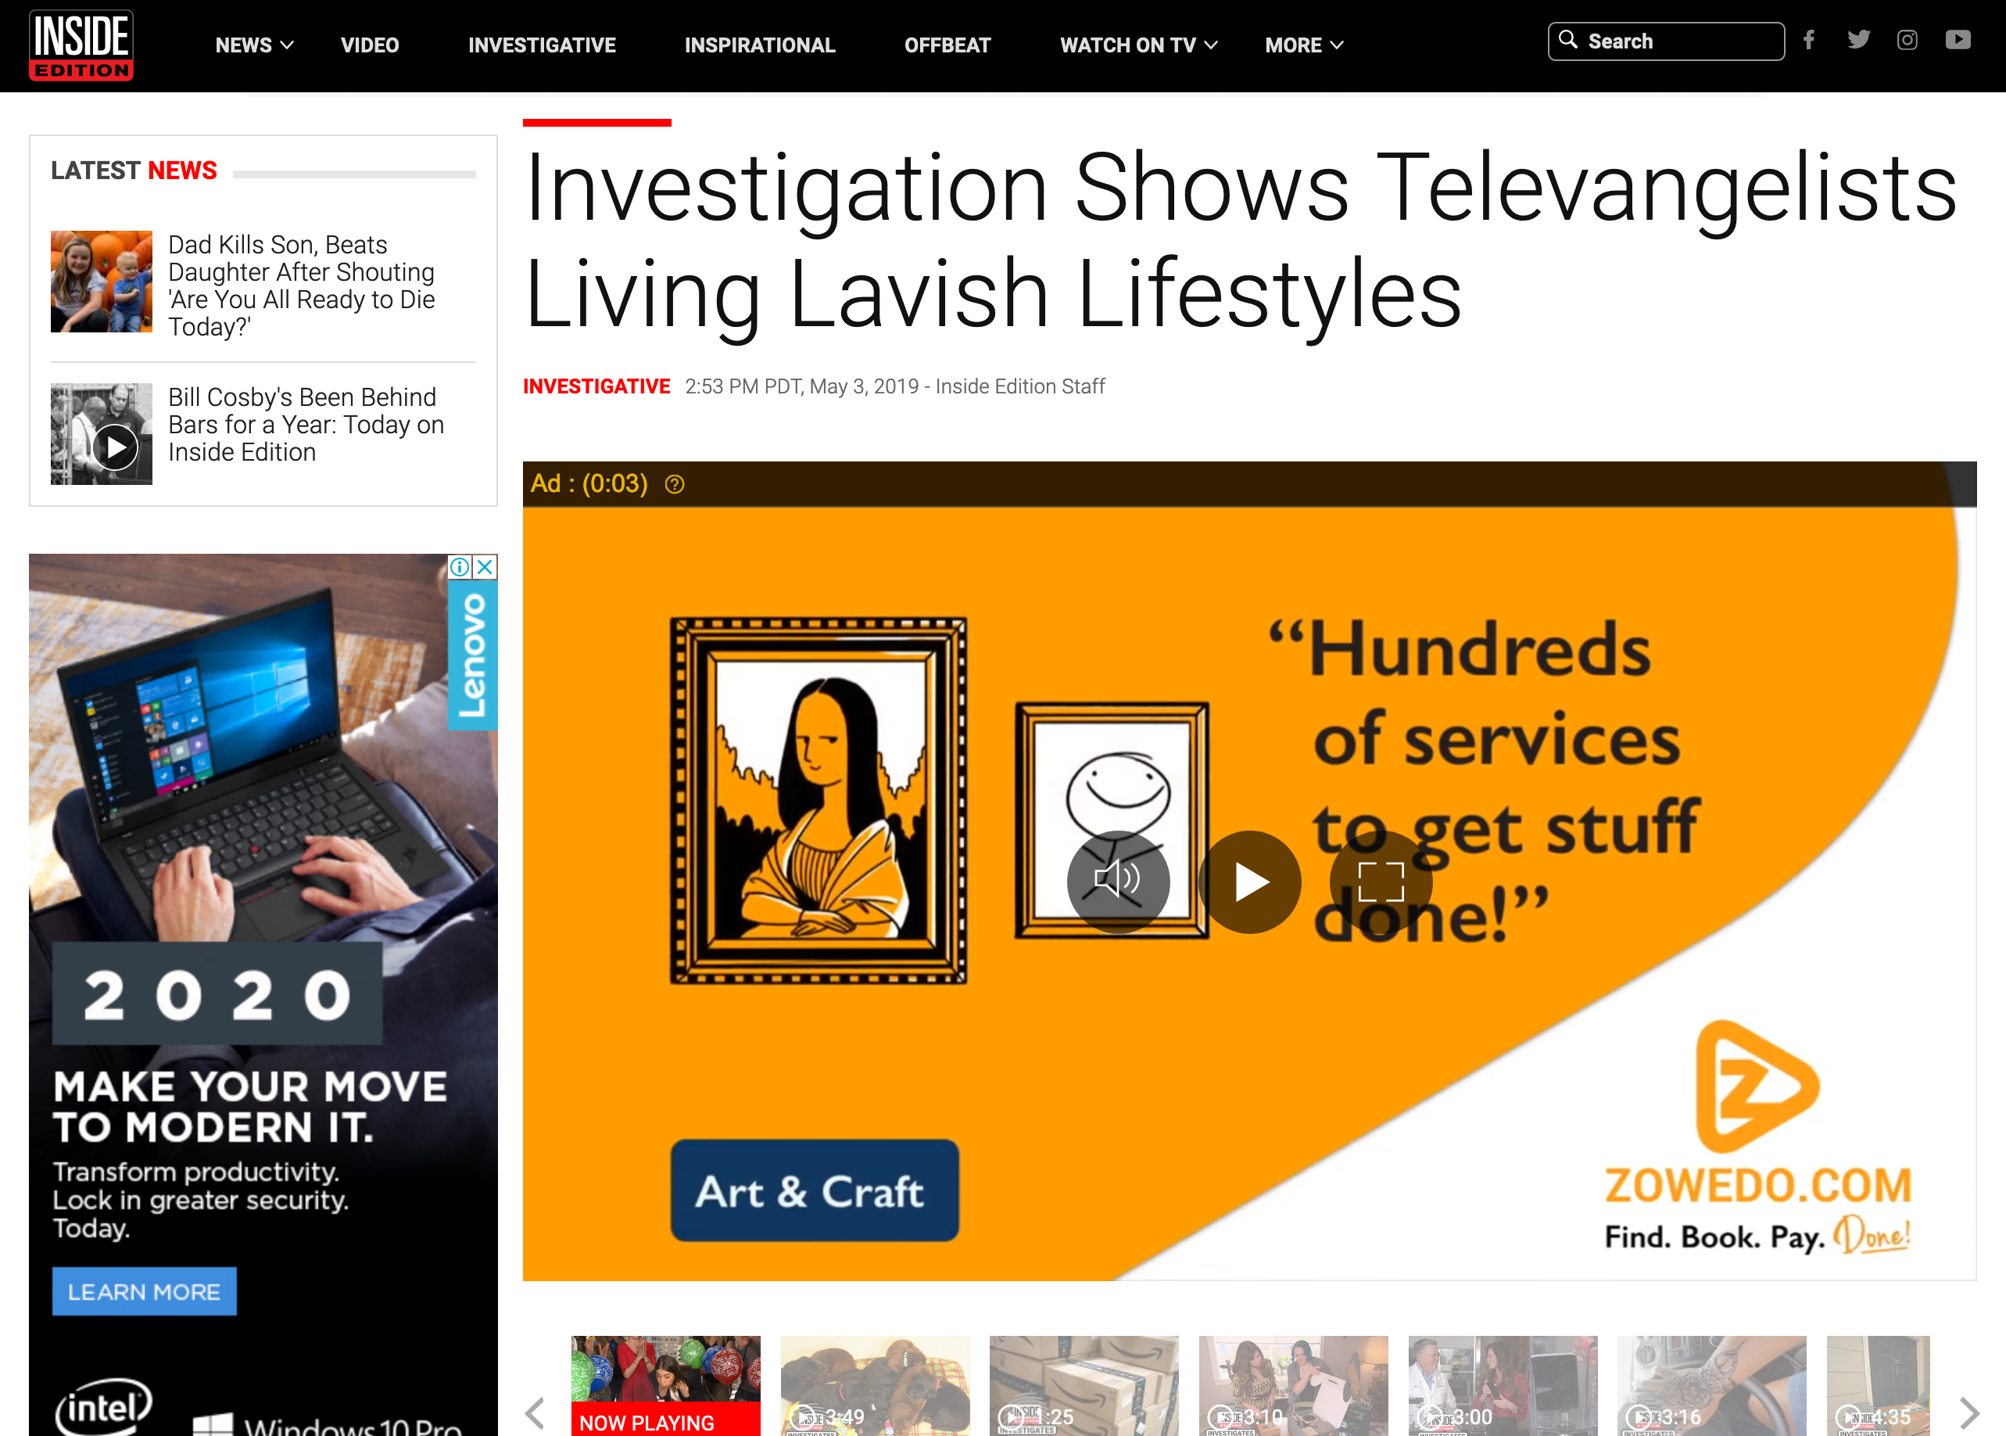

Investigation Shows Televangelists Living Lavish Lifestyle
Notes:
Kenneth Copeland owns TWO private jets and has his own airport at his home in Texas!
Watch the 4-minute clip below
______
https://www.insideedition.com/investigation-shows-televangelists-living-lavish-lifestyles-52662

Slide 84
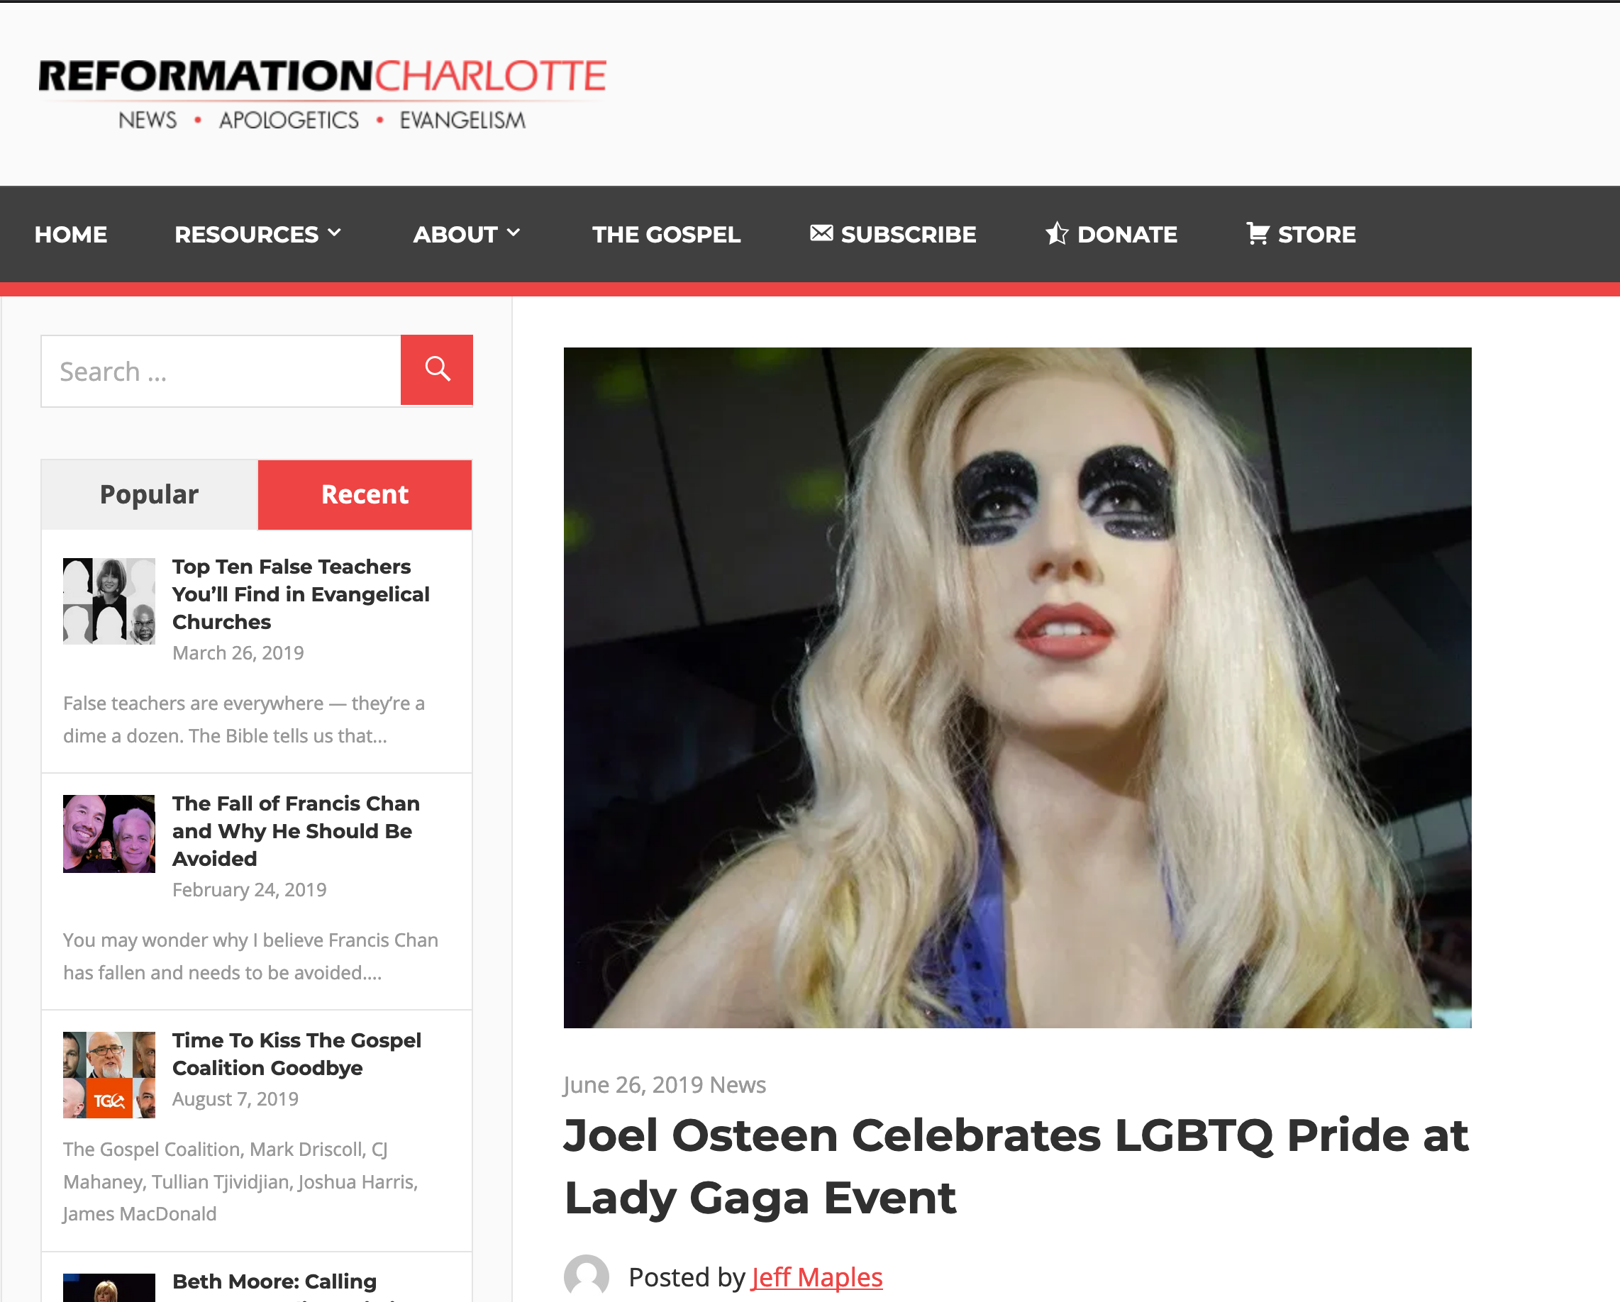

Joel Osteen Celebrates LGBTQ Pride at Lady Gaga Event
Notes:
Therefore go out from their midst, and be separate from them, says the Lord, and touch no unclean thing; then I will welcome you…
2 Corinthians 6:17
This is not satire, this really happened. Joel Osteen, one of the modern-day princes of the Word of Faith prosperity gospel movement, was seen at Lady Gaga’s pride celebration at Apollo Theater on Monday night. The New York Daily News reports,
Poehler wasn’t the only heavy hitter in the crowd. From Alaska Thunderf–k, a drag performer who won Season 2 of “RuPaul’s Drag Race All Stars” to the controversial televangelist and anti-LGBTQ pastor Joel Osteen, the event drew an eclectic mix of fans, industry insiders and celebrities, from the movies (Catherine Zeta-Jones, Michael Douglas), the music universe (Clive Davis, Adam Lambert), the fashion world (Alexander Wang), television (John Oliver, Camila Mendes) and the America’s gay Royal couple and Harlem residents Neil Patrick Harris and husband David Burtka.
Osteen’s presence was curious, because Gaga has championed LGBTQ causes.
Lady Gaga is known for her risque performances and lack of modest attire. Being that Osteen is a charlatan who has been given over to the lusts of this world and bilks millions of people for every dime they have, it comes as no surprise that he and his wife, Victoria, would immerse themselves in the culture of demonic influence, sex, and greed. It was reported that Osteen was wearing a blue blazer while his wife was wearing a long, black dress. A picture of the two can be seen here.
Interestingly, Osteen asserted a few years ago that he believes that the Scriptures are clear that homosexuality is a sin. Yet, he has continuously softened his tone and downplayed the significance toward homosexuality since then. In an effort to remain culturally relevant and inclusive, Osteen generally avoids the topic altogether.
Osteen’s ministry has produced a number of look-alike worldly money-hungry pastors, including his very own apprentice, John Gray, who was caught cheating on his wife and made amends to her by buying her a $200 thousand Lamborghini while living in a $1.8 million home paid for by his church.
________________
https://reformationcharlotte.org/2019/06/26/joel-osteen-celebrates-lgbtq-pride-at-lady-gaga-event/

Slide 85
你怎么能在叛教主义中
坚持不懈?
提摩太后书
Notes:
What can you do now to make sure you are following the Lord faithfully in the future?

Slide 86
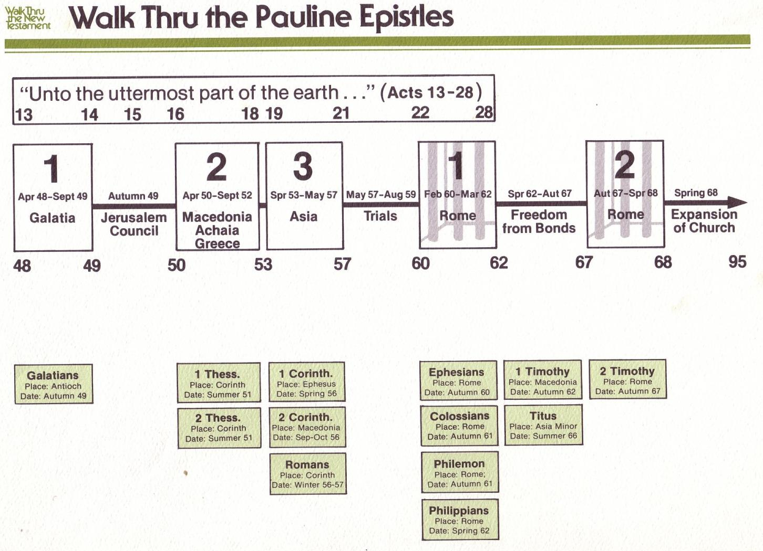
Walk Thru the Pauline Epistles
143
新约综览 (保罗书信)
143
38
124
39-41
保罗书信综览
「直到世界最偏僻的地方」 (徒 1:8)
徒 9 13 14 15 16 18 21 27 28
罗马书是保罗宣教书信的最后一卷书，但却是新约书信
中的第一本
夏 35-
37
大马士革
安提阿
四月 48-
九月 49
1
加拉太
四月 50-
九月 52
2
爱琴海
春 53-
五月 57
3
亚细亚
五月 57-
八月 59
试验
二月 60-
三月 62
1
罗马
春62-
冬 67
4
西班牙
秋 67-
春68
2
罗马
冬 49
公会
春 68
教会扩展
35 48 49 50 52 53 57 60 62 67 68 95
马太
宣教
路加
使徒行传
马可
约翰
监狱
教牧
加
帖上
林前
弗
提前
提後
東方宣教
帖下
林後
西
多
宣教
罗马
門
教牧
腓
福音和使徒行传
1234
旅程
监狱
保罗书信
罗马
收监
Pauline
Notes:
NS-25-1 Tim-83

Slide 87
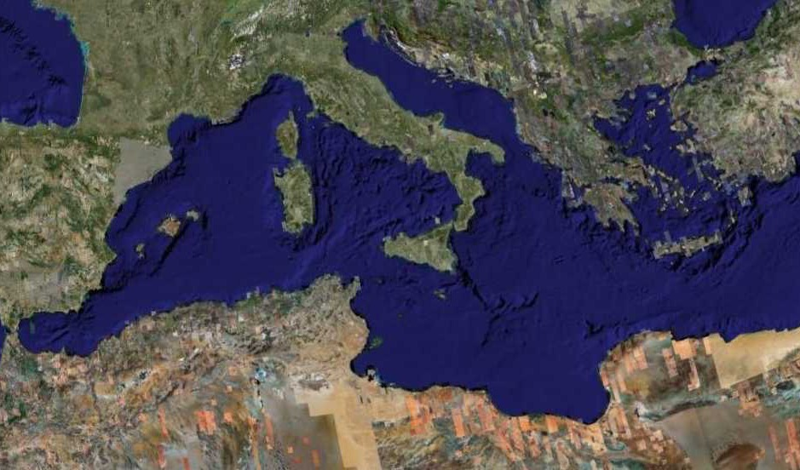
Fourth Missions Trip
1-2 Timothy & Titus After Acts
Spring 62 – Fall 67
Notes:
Paul had finished reaching the Eastern Roman Empire by the time he wrote Titus—and even had just returned from Spain. Yet he soon was captured and brought to Rome a second time, where he wrote 2 Timothy.
—————
Freedom from Imprisonment Spring 62–Fall 67
Paul in Ephesus and Colosse (Timothy left at Ephesus) Spring–Summer 62
Peter travels to Rome 62
Paul in Macedonia late summer 62-winter 62/63
1 Timothy written from Macedonia to Timothy in Ephesus Fall 62
Paul in Asia Minor Spring 63-Spring 64
Paul in Spain (anticipated in Rom. 15:24) Spring 64-Spring 66
Christians persecuted by Nero; Peter martyred Summer 64
Paul in Crete (Titus left there; Tit 1:5) early Summer 66
Paul in Asia Minor Summer- Fall 66
Titus written from Asia Minor to Titus in Crete Summer 66
Paul in Nicopolis (Tit 3:12) Winter 66/67
Paul in Troas (2 Tim 4:13), Macedonia and Greece Spring– Fall 67
Second Roman Imprisonment Fall 67–Spring 68
Paul arrested and brought to Rome Fall 67
2 Timothy written from Rome to Timothy in Ephesus Fall 67
Paul beheaded Spring 68

Slide 88

保罗在罗马被监禁的对照
38
124
39-41
公元60年2月-公元62年3月
1
罗马
公元62年春季--
公元67年秋季
4
西班牙
公元67年秋季-公元68年春季
2
罗马
60 62 67 68
以弗所书
提摩太后书
歌罗西书
腓利门书
腓立比书
保罗书信
1234
旅程
罗马
监禁

Slide 89
保罗在罗马被监禁的对照(公元67年-68年)
罗马皇帝尼禄心理健康
38
124
39-41
公元60年2月-公元62年3月
1
罗马
公元62年春季-公元67年秋季
4
西班牙
公元67年秋季-公元68年春季
2
罗马
60 62 67 68
罗马皇帝尼罗心理健康
稳定 发疯
公元64年罗马大火
大火前 大火后
基督徒的意见
犹太教派 大多是外邦人
罗马政府对基督徒的态度
保护 无约束的迫害
罗马政府对基督徒的迫害
罕见 广泛普及
保罗的下场
被释放 斩首

Slide 90
保罗在罗马被监禁的第二次 (公元67年-68年)
"凡在亚西亚的人都离弃我，这是你知道的。其中有腓吉路和黑摩其尼”
(提摩太后书 1:15)
"不但如此，凡立志在基督耶稣里敬虔度日的，也都要受逼迫。只是作恶的，和迷惑人的，必越久越恶，他欺哄人也被人欺哄。”
(提摩太后书 3:12-13)
Notes:
然而，七年后的情景是完全不同的。罗马皇帝尼禄发起对信徒的迫害，基督徒是非常不受欢迎的。许多基督徒因此否认了信仰, 那些坚持信仰的信徒，都进入地下墓穴聚集.

Slide 91
保罗在罗马被监禁的第二次 (公元67年-68年)
你要赶紧的到我这里来。因为底马贪爱现今的世界，离弃我往帖撒罗尼迦去了。革勒士往加拉太去。提多往挞马太去。
独有路加在我这里。你来的时候要把马可带来。因为他在传道的事上于我有益处。我已经打发推基古往以弗所去。我在特罗亚留于加布的那件外衣，你来的时候可以带来。那些书也要带来。更要紧的是那些皮卷。铜匠亚力山大多多的害我。主必照他所行的报应他。你也要防备他。因为他极力敌挡了我们的话。
(提摩太后书 4:9-15)

Slide 92
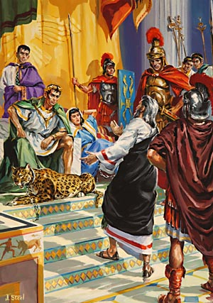
Paul's Second Imprisonment (AD 67-68)
我初次申诉，没有人前来帮助我，大家竟都离弃我。但愿这罪不归与他们。惟有主站在我旁边，给我力量，使福音被我尽都传明，叫外邦人都听见。我也从狮子口里被救出来.
(提摩太后书 4:16-17)

Slide 93
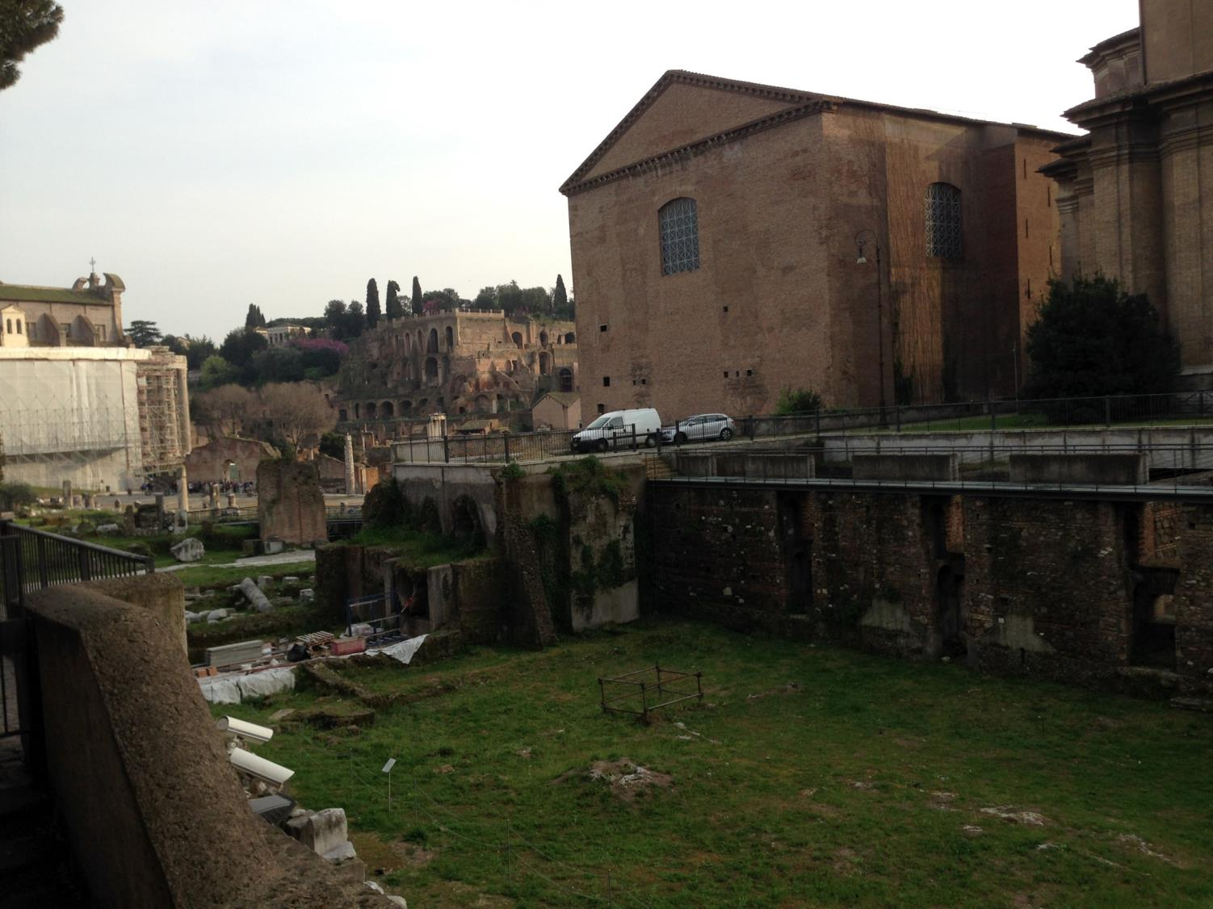
邻近地点
马梅尔定(Mamertine) 监狱
教廷参院

Slide 94
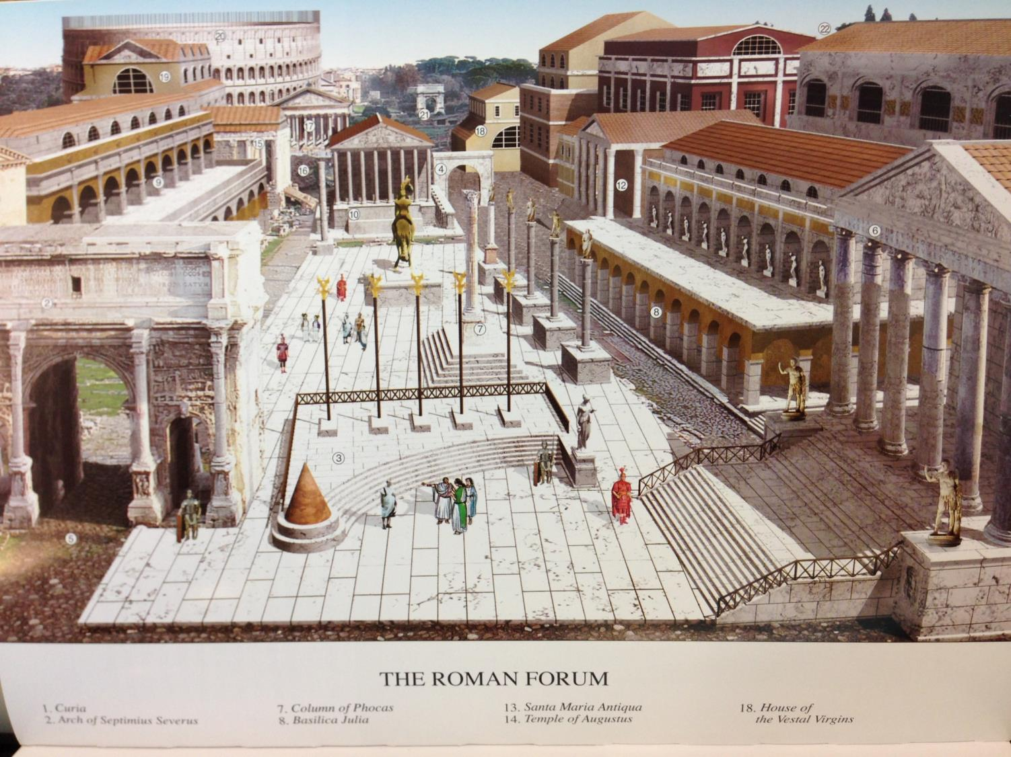
从从马梅尔定(Marmatine)监狱罗马时代广场的景观（公元4世纪）

Slide 95
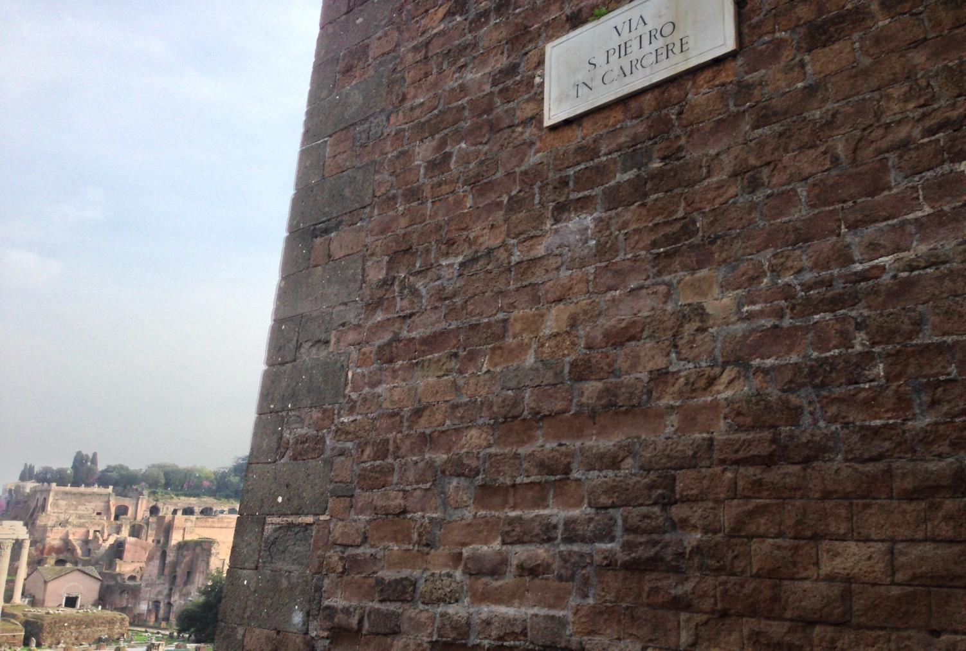
“彼得在监狱街”

Slide 96
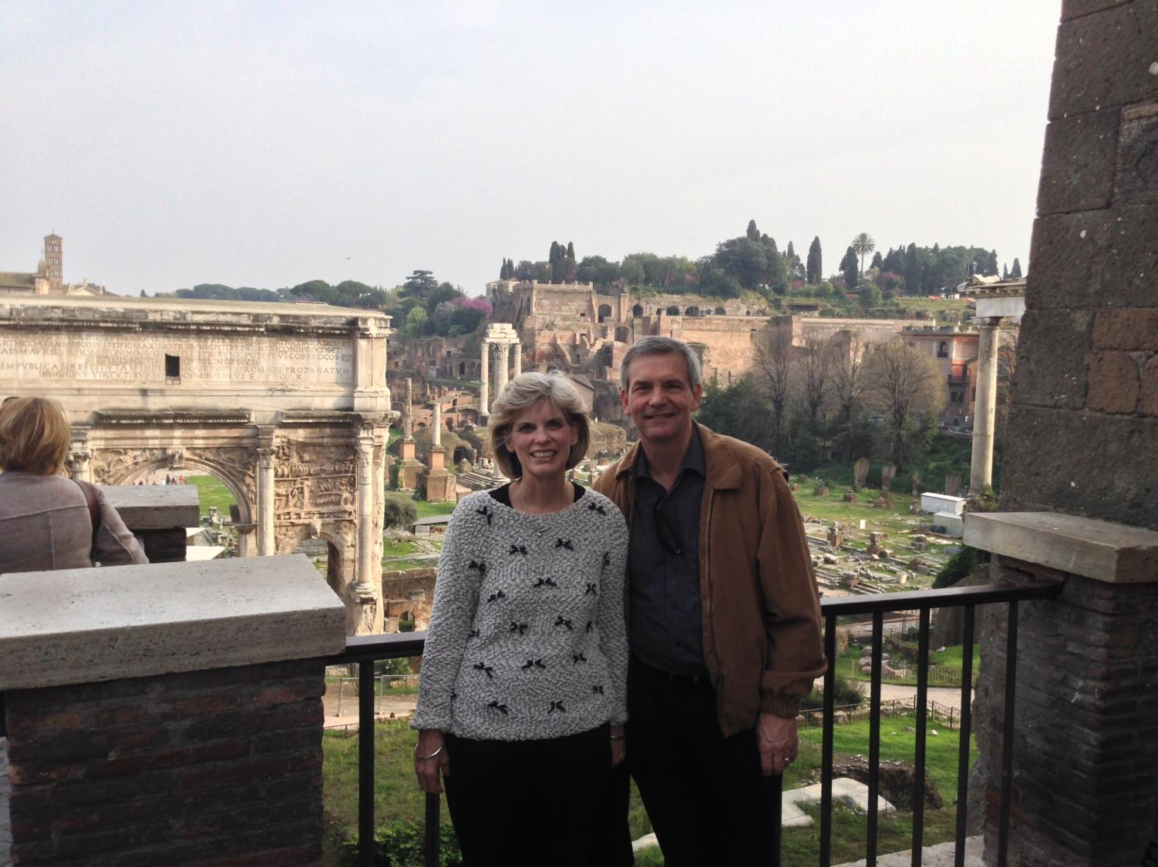
苏珊和里克因为彼得和
保罗的监禁获得自由.

Slide 97
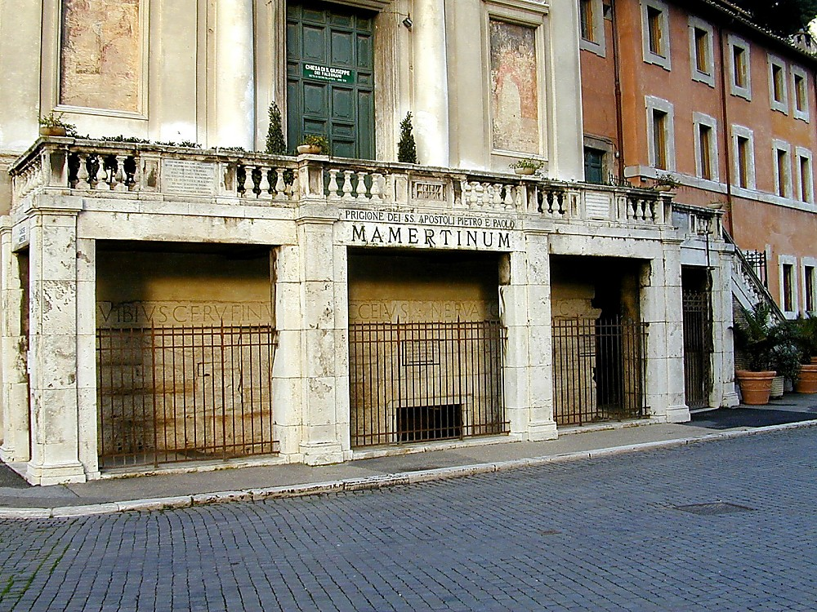
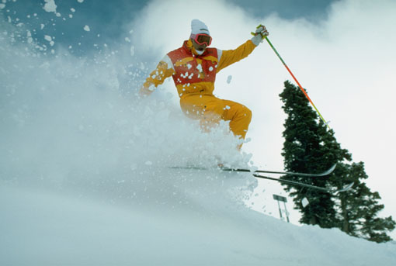
“使徒彼得和保罗”的
马梅尔定(Marmertine)监狱
Notes:
—Todd Bolen, BiblePlaces.com

Slide 98
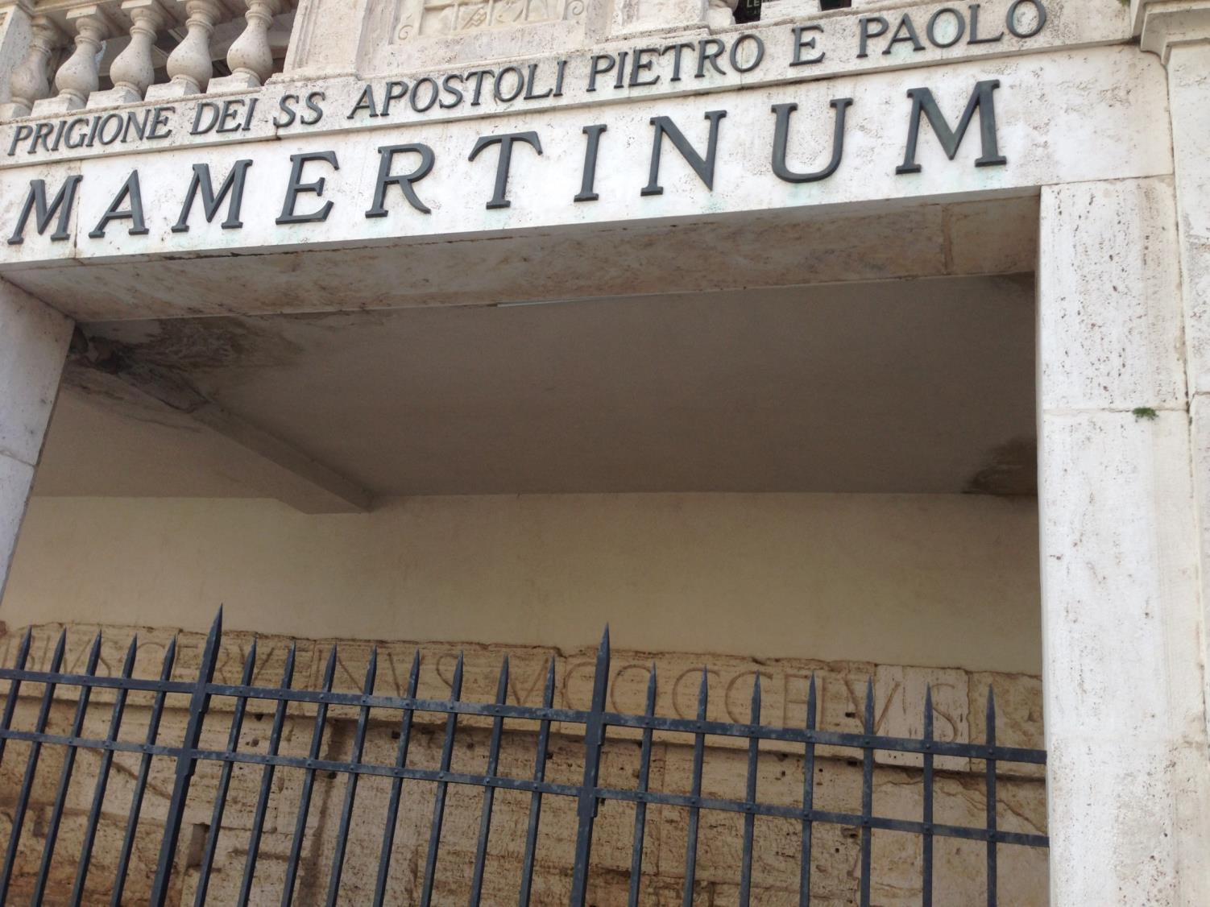
“使徒彼得和保罗”的
马梅尔定(Marmertine)监狱

Slide 99
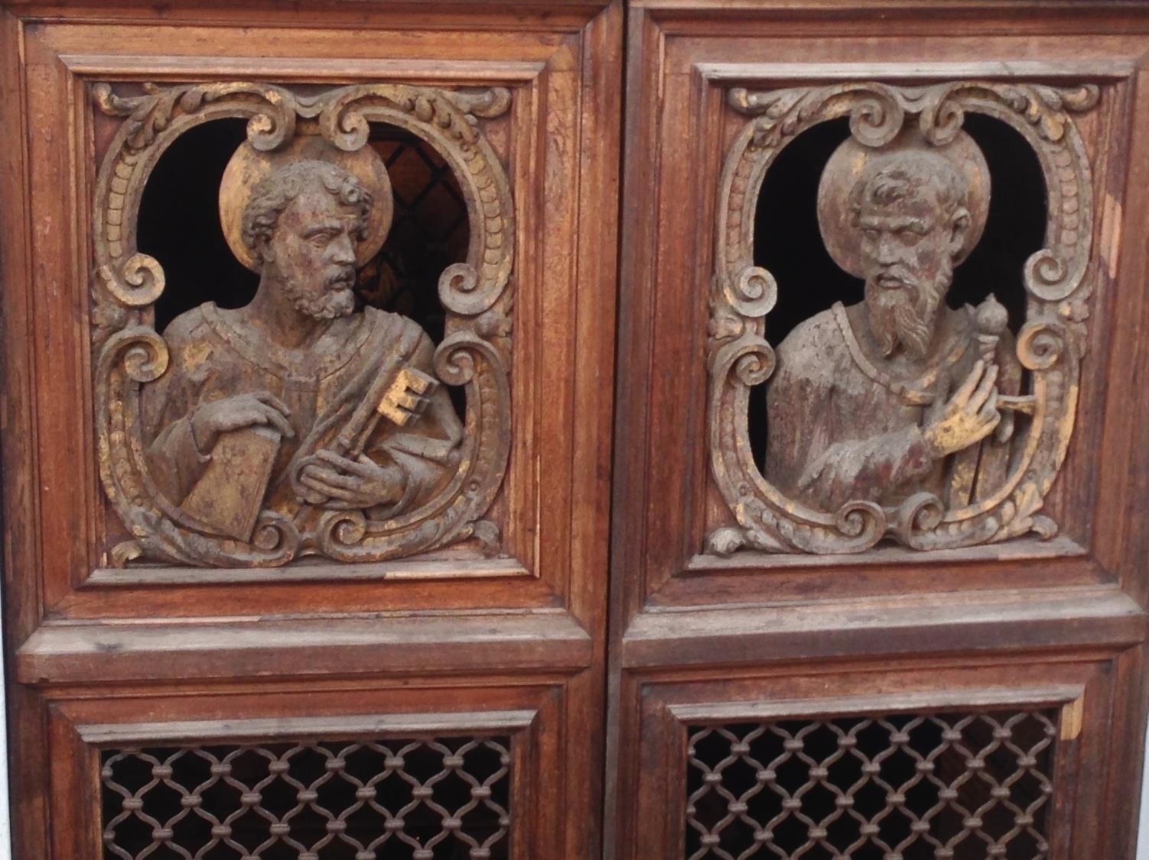
马梅尔定(Mamertine) 的门有彼得与保罗的刻画

Slide 100
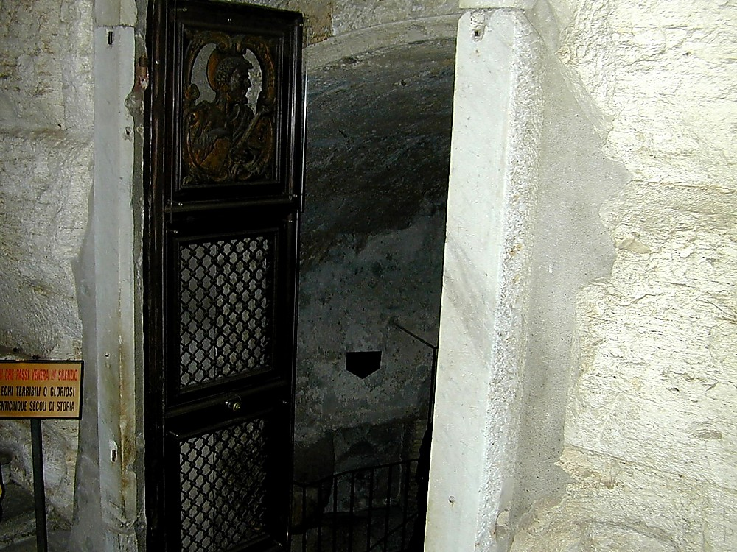
马梅尔定(Marmertine)监狱入口

Slide 101

马梅尔定(Mamertine)游览

Slide 102
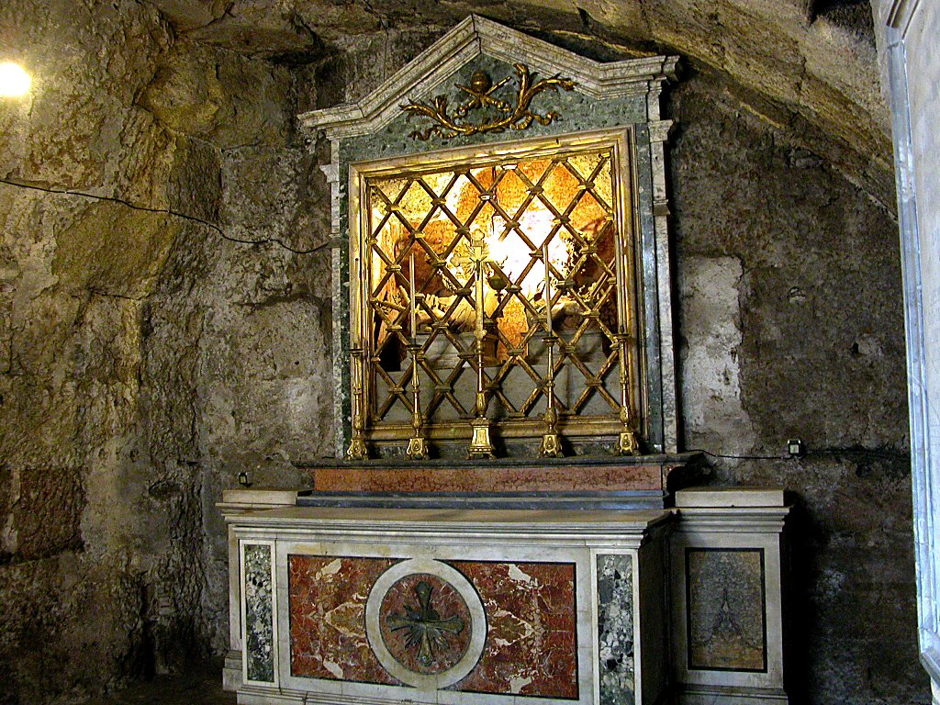
马梅尔定(Mamertine) 监狱里彼得和保罗的半身像

Slide 103
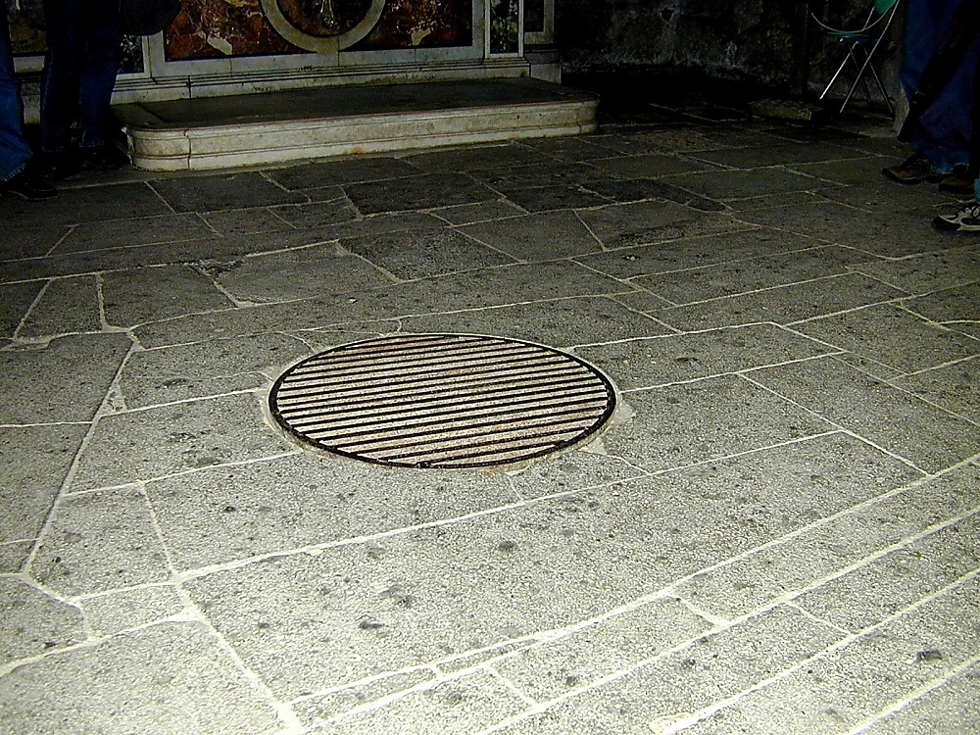
囚犯通过井盖进入地下沟渠
Notes:
该卡尔塞尔是古罗马唯一的监狱。它有两部分，一个上部和一个下部; 监狱上部被称为“卡尔塞尔”，而较低的下（原本以为是一个沟渠）被称为“Tullianum。”那些从卡尔塞尔进入 Tullianum 的囚犯是通过卡尔塞尔地板上的洞进入的。该名“Tullianum”可能是来自拉丁词为泉水，很巧合的是，这部分监狱里有一个井。根据传说，使徒彼得促使井水涌现，使他能为他的狱卒-圣突和圣Martinianus施洗。有些争论彼得是否曾经在这里被关押。 -Todd博伦，BiblePlaces.com

Slide 104
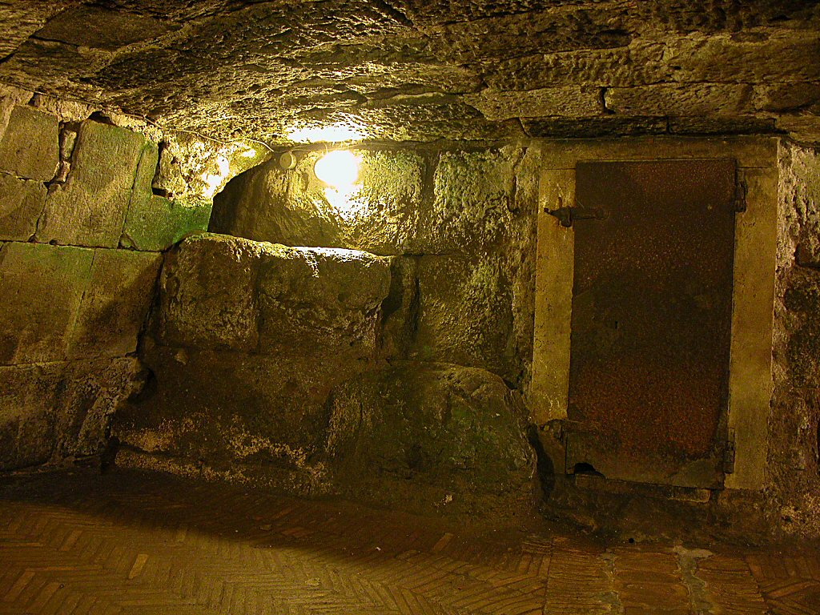
Mamertine Prison writing area and door
马梅尔定(Marmertine)监狱
写信的部分和门
Notes:
罗马帝国很少关押普通犯人，但保留了马梅尔定(Marmertine)监狱来关押政治犯。罗马帝国的敌人，如朱古达和韦辛格托里克斯，往往在Tullianum被扼杀。罗马作家,萨卢斯特，在公元前40年描述Tullianum为一个“十二英尺深，全面被强硬的墙壁关闭和一个石头拱顶”的监狱。它是一个令人厌恶, 被忽视得可怕，黑暗和恶臭的地方。“-Todd博伦，BiblePlaces.com
罗马帝国很少关押普通犯人，但保留了马梅尔定(Marmertine)监狱来关押政治犯。罗马帝国的敌人，如朱古达和韦辛格托里克斯，往往在Tullianum被扼杀。罗马作家,萨卢斯特，在公元前40年描述Tullianum为一个“十二英尺深，全面被强硬的墙壁关闭和一个石头拱顶”的监狱。它是一个令人厌恶, 被忽视得可怕，黑暗和恶臭的地方。“-Todd博伦，BiblePlaces.com

Slide 105
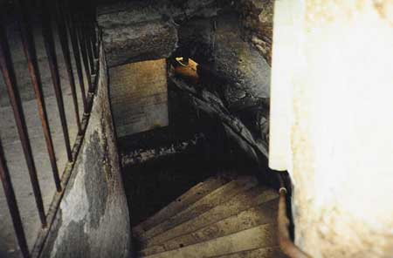
下楼梯

Slide 106
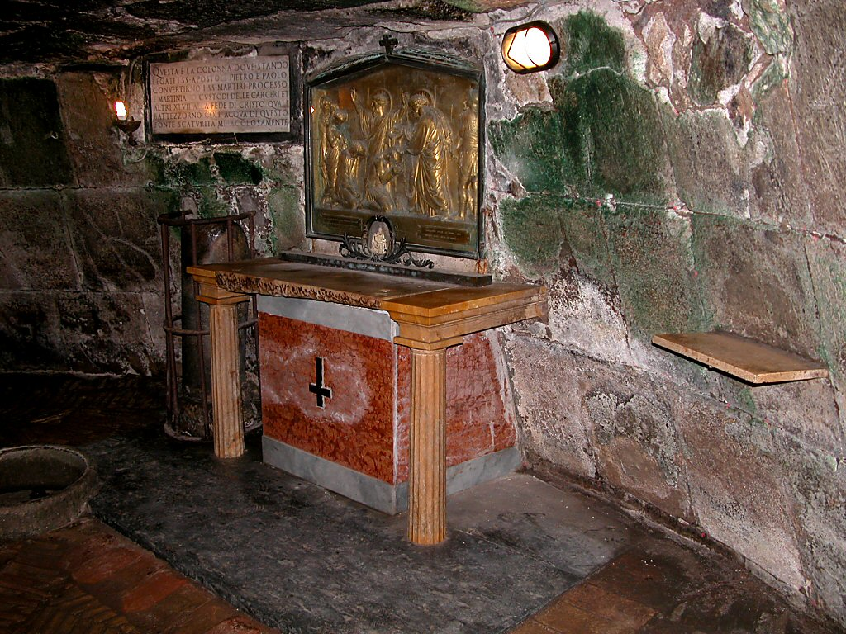
彼得（公元64年）和保罗（公元67-68)的地下监狱

Slide 107
你怎么能在叛教主义中
坚持不懈?
提摩太后书
Notes:
What can you do now to make sure you are following the Lord faithfully in the future?

Slide 108
怎么能坚持不懈:
忠实地...
遵守
神的话
提摩太后书第一至二章
Notes:
Consistently follow what God says (1-2)

Slide 109
Slides on
提摩太后 1

Slide 110
提摩太后
大纲
237
纯正的教义对抗异端
在现今的困苦中持守 |  | 在未来的困苦中持守
第 1–2 章 |  | 第 3–4 章
忠心的例子 1 | 忠心的特征 2 | 问题：离弃真道 3:1-9 | 解决方式：传主道 3:10–4:5 | 保罗的希望 4:6-22
友尼基 罗以 保罗 阿尼色弗 | 门训 一心一意 顺服 努力 合乎 圣经 圣洁 温柔 | 无神 假冒伪善 | 讲道 持守 责备 激励 传福音 | 殉道 背叛 问安 祝福
罗马至以弗所
主后 67年 秋 (第二次罗马监禁)

Slide 111
Paul greeted Timothy with his own persevering attitude in the face of death (1:1-2).

Slide 112
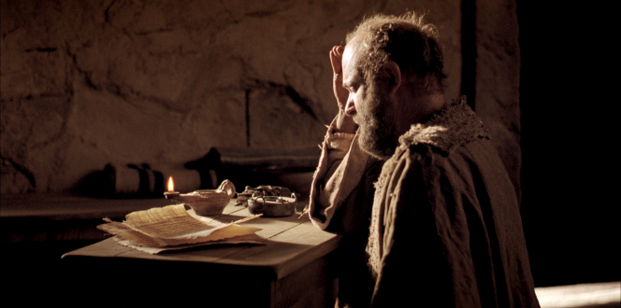
"This letter is from Paul, chosen by the will of God to be an apostle of Christ Jesus. I have been sent out to tell others about the life he has promised through faith in Christ Jesus"
(2 Timothy 1:1 NLT).

Slide 113
"I am writing to Timothy, my dear son. May God the Father and Christ Jesus our Lord give you grace, mercy, and peace"
(2 Timothy 1:2 NLT).

Slide 114
Timothy should imitate others’ faithfulness despite many who fell away (1:3-18).

Slide 115
He learned faithfulness from his mother and grandmother shown at his ordination (1:3-7).

Slide 116
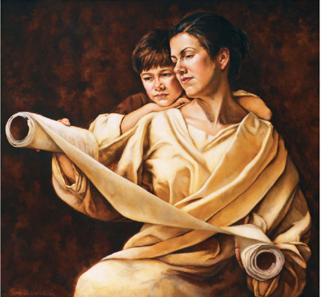
主要主题 1: 忠心
忠心的例子:
a. 从母亲友尼基和祖母罗以学习 (1:3-7)
在家学习，日常生活中父母信心的榜样。

Slide 117

主要主题 1: 忠心
b. 从保罗学习
(1:8-14)
保罗在患难中还是忠心，因为他深信上帝必保守他直到那日 (1:11-12).

Slide 118
He should bravely suffer Nero’s tortures like Paul through the gospel’s power (1:8-14).

Slide 119
"So never be ashamed to tell others about our Lord. And don’t be ashamed of me, either, even though I’m in prison for him. With the strength God gives you, be ready to suffer with me for the sake of the Good News.
⁹ For God saved us and called us to live a holy life. He did this, not because we deserved it, but because that was his plan from before the beginning of time—to show us his grace through Christ Jesus"
(2 Timothy 1:8-9 NLT).

Slide 120
"And now he has made all of this plain to us by the appearing of Christ Jesus, our Savior. He broke the power of death and illuminated the way to life and immortality through the Good News. ¹¹And God chose me to be a preacher, an apostle, and a teacher of this Good News"
(2 Timothy 1:10-11 NLT).

Slide 121

"That is why I am suffering here in prison. But I am not ashamed of it, for I know the one in whom I trust, and I am sure that he is able to guard what I have entrusted to him until the day of his return" (2 Timothy 1:12 NLT).

Slide 122

我知道我所信的
CCLI Song # 31762
© Words: Public Domain | Music: Public Domain
For use solely with the SongSelect®. Terms of Use. All rights reserved. www.ccli.com
CCLI License # 277507

Slide 123
I know not why God’s wondrous grace
To me He hath made known,
Nor why, unworthy, Christ in love
Redeemed me for His own.

Slide 124
But “I know whom I have believed,
And am persuaded that He is able
To keep that which I’ve committed
Unto Him against that day.”

Slide 125
I know not what of good or ill
May be reserved for me,
Of weary ways or golden days,
Before His face I see.

Slide 126
But “I know whom I have believed,
And am persuaded that He is able
To keep that which I’ve committed
Unto Him against that day.”

Slide 127
I know not when my Lord may come,
At night or noonday fair,
Nor if I’ll walk the vale with Him,
Or “meet Him in the air.”

Slide 128
But “I know whom I have believed,
And am persuaded that He is able
To keep that which I’ve committed
Unto Him against that day.”

Slide 129
I know not what of good or ill
May be reserved for me,
Of weary ways or golden days,
Before his face I see.

Slide 130
But “I know whom I have believed,
And am persuaded that He is able
To keep that which I’ve committed
Unto Him against that day.”

Slide 131
I know not when my Lord may come,
At night or noonday fair,
Nor if I’ll walk the vale with Him,
Or “meet Him in the air.”

Slide 132
But “I know whom I have believed,
And am persuaded that He is able
To keep that which I’ve committed
Unto Him against that day.”

Slide 133

我知道我所信的
我不知道为什么上帝赐我祂奇妙恩典，
也不知道为什么虽我不配，基督的爱却救赎了我
副歌 :
但我知道我所信的
也深信他能保全我所交托祂的一切, 直到那一天
我不知道将来的日子
对我来说是好还是坏，
无论我疲惫或渡过流金岁月
都要瞻望祂的脸孔 。

Slide 134

"Hold on to the pattern of wholesome teaching you learned from me—a pattern shaped by the faith and love that you have in Christ Jesus.
¹⁴Through the power of the Holy Spirit who lives within us, carefully guard the precious truth that has been entrusted to you"
(2 Timothy 1:13-14 NLT).

Slide 135
Asian believers deserted Jesus but Onesiphorus set a faithful example (1:15-18).

Slide 136
保罗在罗马被监禁的第二次 (公元67年-68年)
"凡在亚西亚的人都离弃我，这是你知道的。其中有腓吉路和黑摩其尼”
(提摩太后书 1:15)
Notes:
然而，七年后的情景是完全不同的。罗马皇帝尼禄发起对信徒的迫害，基督徒是非常不受欢迎的。许多基督徒因此否认了信仰, 那些坚持信仰的信徒，都进入地下墓穴聚集.

Slide 137

主要主题 1：忠心
提摩太后
  c. 从阿尼色弗学习 (1:15-18)
  阿尼色弗不以保罗的锁链为耻。他很努力的寻找保罗，终于找到了。

Slide 138
Slides on
提摩太后 2

Slide 139
Knowing what faithfulness looks like helps us persevere under trial (2 Tim 2).

Slide 140
Like a discipling teacher, invest in others the teaching you received (2:1-2).

Slide 141

"Timothy, my dear son, be strong through the grace that God gives you in Christ Jesus"
(2 Timothy 2:1 NLT).

Slide 142

门徒训练
"…make disciples of all nations…" (Matt. 28:19)
But how?
Notes:
我们都知道，我们的基本使命是在列国中训练门徒

Slide 143



把自己投资在可靠的人身上！
「从前你在许多见证人面前听过我的教导，你要把这些教导传给忠信可靠、能够教导他人的人。」（提后2:2当代译本）
门徒训练
保罗
提摩太
忠信可靠
他人

Slide 144


门徒训练
层次
导师 (保罗)
同辈
同辈
(提摩太)
辅导 (他人)
Notes:
Each of us should be like Timothy to learn from someone more mature than us, and also be a "Paul" to someone less mature to help that person grow in Christ.

Slide 145

生命改变小组
委身：和一两位同样性别的人每星期一个小时见面一次，在三方面负责：
认罪：10个问题
读经：每天三章经文
祷告：为失丧者
Church Multiplication Associates––www.CMAResources.org
Notes:
An LTG has 2-3 persons committed to growing spiritually. They meet in a home, restaurant, church, business, or wherever they can have a 60-minute accountability session each week.

Slide 146


生命改变小组
Church Multiplication Associates––www.CMAResources.org
Notes:
No LTG should be larger than 3 people. Once a member invites a 4th person and it is shown that this 4th person will be committed to the LTG concept, the group of 4 multiplies into 2 groups of 2 persons. The additional members can be believers or unbelievers, as long as they are committed to confession, Bible reading, and prayer.

Slide 147




生命改变小组
Church Multiplication Associates––www.CMAResources.org
Notes:
Ideally, the church is then composed of many LTG groups at different stages, growing to multiply more groups so that accountability remains intact in a small group for each person.

Slide 148


新加坡神学院学生
美国
蒙古
日本
韩国
中国
香港
缅甸
印度
泰国
越南
菲律宾
马来亚
新加坡
新神
印度尼西亚

Slide 149
Like a good soldier, show unswerving commitment to please your superior, Jesus
(2:3-4).

Slide 150

忠心的特征
提摩太后书
  精兵(2: 3-4) – 当兵的人不让世务缠身，为要使那招兵的人欢喜。

Slide 151

"Endure suffering along with me, as a good soldier of Christ Jesus. ⁴ Soldiers don’t get tied up in the affairs of civilian life, for then they cannot please the officer who enlisted them"
(2 Timothy 2:3-4 NLT).

Slide 152

Unity in battle
Notes:
When we all wear the armor, we can both attack enemy strongholds and also defend from Satan’s attacks.

Slide 153

“The Turtle”
= advancing together
Notes:
Believers who are united in direction can advance the gospel where they otherwise would be unprotected.

Slide 154

Protecting
one another
Notes:
When we all wear the armor, we defend not only ourselves from attack—we defend one another.

Slide 155


Slide 156

Roman Soldiers

Slide 157

Roman Soldiers

Slide 158
简明新闻
简明新闻

Slide 159


李显龙总理在总统府被绑架了…

Slide 160

但是，有一队突击队去救总统了。

Slide 161

工作很难。你可以应付吗？

Slide 162
不幸的，我们不能够战胜青春的诱惑.…

Slide 163

Bailing out…
我们也不能够战胜试练

Slide 164
Like a successful athlete, obey the rules in God's Word (2:5).

Slide 165


  2. 竟赛的人(2:5) –竟赛的人若不尊守规则，就不能得冠冕。

Slide 166
Like a diligent farmer, have the joy of spiritual fruit like Jesus after he was raised (2:6-13).

Slide 167



  3. 农夫 (2:6-13) – 一个农夫一定要努力才会有好收成。
忠心= 忠诚于基督，我们的元帅，服从神的律法和努力

Slide 168
"Always remember that Jesus Christ, a descendant of King David, was raised from the dead. This is the Good News I preach.
⁹And because I preach this Good News, I am suffering and have been chained like a criminal. But the word of God cannot be chained. ¹⁰So I am willing to endure anything if it will bring salvation and eternal glory in Christ Jesus to those God has chosen"
(2 Timothy 2:8-10 NLT).

Slide 169

我们若能坚忍，
就必与他一同作王；
我们若不认他，
他必不认我们；
我们纵然不信，
他仍然是信实的，
因为他不能否定自己。”
这话是可信的。
提莫太后 2:12-13
他仍然是
信实的

Slide 170

我们若能坚忍， 就必与他一同作王； 我们若不认他， 他必不认我们
(2:12 CNV)

Slide 171

你应当竭力在
神
面前作一个
蒙称许、无愧的
工人，
正确地讲解
真理的道
提莫太后 2:15

Slide 172
Like an unashamed workman, fight heresy with Scripture—not human words (2:14-19).

Slide 173

1 TIMOTHY 2:15
Do your best to present yourself to God as one
APPROVED
a worker who has no need to be ashamed
rightly handling the word of truth.

Slide 174
Protection from False Teachers (2 Tim 2:14-26)
Protect the Flock
(14-19)
Protect the Shepherd
(20-26)

Slide 175

"Avoid worthless, foolish talk that only leads to more godless behavior. ¹⁷This kind of talk spreads like cancer, as in the case of Hymenaeus and Philetus.
¹⁸They have left the path of truth, claiming that the resurrection of the dead has already occurred; in this way, they have turned some people away from the faith"
(2 Timothy 2:16-18 NLT).

Slide 176

But God’s truth stands firm like a foundation stone with this inscription: "The Lord knows those who are his," and "All who belong to the Lord must turn away from evil"
(2 Timothy 2:19 NLT).

Slide 177
Like a noble instead of ignoble container, be pure to avoid false teachers (2:20-22).

Slide 178
Like a gentle servant, gently teach false teachers instead of arguing with them (2:23-26).

Slide 179

新加坡人口宗教信仰的分布
佛教
佛教
回教
基督教
没有宗教
基督教
没有宗教
道教
印度教
其他宗教
回教
The Straits Times 14 Jan 2013 - 10:37am
Notes:
新加坡可能已经看到教会增长，但它只是世界整体的一个缩影而已。即使在新加坡，没有宗教信仰的“无神论者”人数不断增加

Slide 180
你怎么能在叛教主义中
坚持不懈?
提摩太后书
Notes:
What can you do now to make sure you are following the Lord faithfully in the future?

Slide 181
怎么能坚持不懈:
忠实地...
遵守
神的话
传扬
神的话
&
提摩太后书第一至二章
提摩太后书第三至四章
Notes:
Consistently follow what God says (1-2)
Consistently tell others what God says (3-4)

Slide 182
Slides on
提摩太后 3

Slide 183
Before Jesus returns, avoid false teachers who are smooth-tongued but godless (3:1-9).

Slide 184

如何应对世俗主义?
提摩太后书第3章
Dr. Rick Griffith, Crossroads International Church
BibleStudyDownloads.org

Slide 185

"神不存在."
你应该如何处理世俗主义？
提摩太后书提供2种方式
Notes:
你应该如何处理世俗主义？信徒应该如何应对我们这个日益无神的时代

Slide 186

1. 避免不敬虔的教牧 (3:1-5)
Notes:
拒绝任何不符合圣经内容的教导.

Slide 187

“提摩太,你应该知道，在末日的日子里，将会有非常困苦的时期.”
(3:1)
Notes:
我们保证会有困难的日子（3：1）。保罗在他写提摩太书信时,正经历巨大的考验.

Slide 188
主要主题 2: 离弃真道
保罗列举18项末日抵档真理的特征。
末日人会拒绝纯真的教义 (4:3-4)
- 劝提摩太要离开这些人(3:5-8)

Slide 189
“提摩太,你应该知道，在末日的日子里，将会有非常困苦的时期.”
(3:1)
Notes:
我们保证会有困难的日子（3：1）。保罗在他写提摩太书信时,正经历巨大的考验.

Slide 190

(3:2-5a)
“末日生活会很艰难，因为不信神的人会欺骗他人.”

Slide 191

18项末日抵档真理的特征
专爱自己
贪爱钱财
自夸
高傲
亵渎
悖逆父母
忘恩负义
不圣洁
没有亲情
不肯和解
恶言中伤
不能自律
横蛮凶暴
不爱良善
卖主卖友
容易冲动
傲慢自大
爱享乐过于爱神

Slide 192

我们该怎么办?
危险
Notes:
我应该如何对待这样的人？我们应该应对这些？我们应该和他们争论吗？保罗说’不’....

Slide 193

避開不敬虔的教会领袖
“這樣的人你要避開.”
(提摩太後書3:5b)
“避開不敬虔的教会领袖.”
(提摩太後書3:5b)
Notes:
今天别人给我们的建议，往往是与教导假教义者进行公开讨论。但是，保罗在这里的意思是“故意以及避免与别人联系，远离，避开”（BDAG）。

Slide 194

避開不敬虔的教会领袖
Notes:
但提摩太如何能避免这些在他周围不敬虔的教会领袖?（5B）？ “毫无疑问的，保罗在这里是指提摩太在教会事奉的同工，因为他已经指示提摩太要善待每个人（参见提摩太后书。2:24）”（BKC）

Slide 195

‘那偷進人家，牢籠無知婦女的，正是這等人。這些婦女擔負罪惡，被各樣的私慾引誘，常常學習，終久不能明白真道.’ 提摩太后书 3:6-7
Notes:
异教徒尽管他们多受欢迎, 注定会受到神的审判（提摩太后书3：6-9）。轻 信的女性喜爱听最新的异端教导 (提摩太后书3：6-7）。

Slide 196

People-Pleasing Preaching

Slide 197

“從前雅尼和佯庇怎樣敵擋摩西，這等人也怎樣敵擋真道。他們心地壞，在真道上是可廢棄的。然而他們不能再這樣敵擋真道；因為他們的愚昧必在眾人 面前顯露出來，像那两人
一樣.”
(3:8-9)
Notes:
教导假教义者由于他们反对真理和堕落的心灵,注定会受到神的审判.(提摩太后书 3:8-9)
"The reference to Jannes and Jambres and their opposition to Moses draws not on the Old Testament but on a widespread Jewish legend about two of Pharaoh's magicians who competed against Moses and lost (cf. Ex. 7:11; 9:11). The comparison between the false teachers and the Egyptians, and implicitly therefore Timothy and Moses, must have encouraged the young minister" (BKC).
————————
Common Core State Standards in Mathematics, Grades 3–8
In this timely and practical course, Dr. Kanold and Dr. Briars explain both the whys and the how-tos for implementing the CCSS
http://www.solution-tree.com/authors/tim-kanold/ccss-math-3-8-online-course.html

Slide 198

谢谢你没有在你的脑里乱抛垃圾.
我们的价值观是从我们认为是毫无价值的的事物上显示出来。今天上帝希望我们把精力投入在有永恒价值的事物上.

Slide 199
1. 避免不敬虔的教牧 (3:1-5)
Notes:
拒绝任何不符合圣经内容的教导.

Slide 200
Accept and preach the Word of God as well as fulfill all ministry duties (3:10–4:5).

Slide 201

2.接受真理(3:10-17)
Notes:
Feed yourself reality from God's servants and God's Word.

Slide 202

2 Tim 3:10-17 (NIV)
¹⁰ You, however, know all about my teaching, my way of life, my purpose, faith, patience, love, endurance, ¹¹ persecutions, sufferings—what kinds of things happened to me in Antioch, Iconium and Lystra, the persecutions I endured. Yet the Lord rescued me from all of them.

Slide 203
2 Tim 3:10-17 (NIV)
¹² In fact, everyone who wants to live a godly life in Christ Jesus will be persecuted, ¹³ while evildoers and impostors will go from bad to worse, deceiving and being deceived.

Slide 204
2 Tim 3:10-17 (NIV)
¹⁴ But as for you, continue in what you have learned and have become convinced of, because you know those from whom you learned it, ¹⁵ and how from infancy you have known the Holy Scriptures, which are able to make you wise for salvation through faith in Christ Jesus.

Slide 205
2 Tim 3:10-17 (NIV)
¹⁶ All Scripture is God-breathed and is useful for teaching, rebuking, correcting and training in righteousness, ¹⁷ so that the servant of God may be thoroughly equipped for every good work.

Slide 206

跟随神的仆人 (3:10-13)

Slide 207

“但你已經服從了我的教訓、品行、志向、信心、寬容、愛心、忍耐， 以及我在安提阿、以哥念、路司得所遭遇的逼迫,苦難 。我所忍受是何等的逼迫；但從這一切苦難中，主都把我救出來了 。”
(提摩太后书 3:10-11)
Notes:
跟随保罗受苦的例子（提摩太后书3：10-11）。
我们常说，”不要跟随我。跟随基督。”这听起来好像很谦虚，但人们需要看到耶稣的现代化例子。保罗说跟随基督，但他也鼓励他的读者跟随他。 “跟随我，正如我跟随基督”（以弗所书 5：1）

Slide 208

我们要期待像保罗一样受苦难.

Slide 209

¹² In fact, everyone who wants to live a godly life in Christ Jesus will be persecuted, ¹³ while evildoers and impostors will go from bad to worse, deceiving and being deceived. ¹⁴ But as for you, continue in what you have learned and have become convinced of, because you know those from whom you learned it, ¹⁵ and how from infancy you have known the Holy Scriptures, which are able to make you wise for salvation through faith in Christ Jesus.
2 Timothy 3:12-17

Slide 210
¹⁶ All Scripture is God-breathed and is useful for teaching, rebuking, correcting and training in righteousness, ¹⁷ so that the servant of God may be thoroughly equipped for every good work.
2 Timothy 3:12-17

Slide 211

“不但如此，凡立志在基督耶穌裡敬虔度日的也都要受逼迫。只是作惡的和迷 惑人的，必越久越惡，他欺哄人，也被人欺哄.”
(3:12-13)

Slide 212

“凡立志在基督耶穌裡敬虔度日的
也都要受逼迫.” (3:12)

Slide 213

基督教儿童的迫害
Notes:
我们不必看得太远来找基督徒受迫害的例子。在2014年我们听到在伊拉克基督教孩子因拒绝否认基督而被钉死在十字架上或被斩杀的新闻。
也许现在我们意识到这节经文不是那么令人费解。更令人费解的是我们还是要尝试理顺的解释这节经文。

Slide 214

“只是作惡的和迷惑人的，必越久越惡，他欺哄人，也被人欺哄。”
(3:13)
Notes:
这是为什么我们需要虔诚信徒的例子：作恶的人肯定会增加。
最可怕的是, 当一个人被人欺骗时，他甚至不知道自己被受骗了。这就是因为他已经上当了！你呢？

Slide 215
我们如何能接受真理，
而不是谎言?
真理
谎言
Notes:
我们如何能接受真理，而不是谎言？

Slide 216
遵循神的仆人(3:10-13)
Notes:
虔诚的例子能帮助，但必须有一个绝对的标准，所以保罗也说…

Slide 217

遵循神的话语(3:14-17)

Slide 218

“你应当遵守所学
和确信的；
你知道是跟谁学的，
并且知道自己从小
就明白圣经，…”
(3:14-15a)
Notes:
忠心地守住神的真理（3：14-15a）。
我们必须继续遵守，并忠实于事实真相（3：14A）。
保罗给了我们保持真相的原因有两个（3：14B-15A）。
（1）我们的老师是值得信赖的（3：14A）。
提摩太首先从他信主的母亲和祖母学习（参见2添1：5;徒16：1）。
保罗后来称他为他的属灵“儿子”（提前1：2;2添1：2）。
（但教师如何才能成为值得我们信赖的呢？）
（2）因为他们教教导我们圣经的真理（3：15A）。
当你查看任何基督教聚会，你会发现大部分教会领袖在18岁前信主.
我们不能过分强调教导孩子神的话语是多么重要。
（但是，为什么教导圣经如此重要？）

Slide 219

神的话语的祝福
(3:15b-17)
Notes:
为什么教导圣经如此重要？因为当你不断研读神的话语时,你会得到神多方面的祝福（提摩太后书3：15b-17）

Slide 220

“這圣经能使你因信基督耶穌，
有得救的智慧.” (3:15b)
Notes:
圣经给我们智慧来接受基督.（提摩太后书3：15b).真正的智慧是专注在最重要的事情上。

Slide 221

“圣经都是神所默示的.” (3:16a)
Notes:
圣经是来自上帝自己的“嘴”（3：16a）。

Slide 222

“圣经是上帝所默示的.”(3:16a)
Notes:
希腊语中的“灵感”的意思是“神所默示的”。

Slide 223

“圣经是上帝所默示的.”(3:16a)
Notes:
诚然，神是通过人写圣经，但圣经是神的灵启示他们写的,所以圣经是没有错误的。

Slide 224

为何神的话至关重要？
「圣经都是神所默示的，于教训、督责、使人归正、教导人学义，都是有益的。
叫属神的人得以完全，预备行各样的善事。」
提后3:16-17

Slide 225

神话语所带来的四个结果
2
督责
责备
教导
训练（学义）
提后3:16-17
Notes:
If you preach sequentially through the Bible, you will have the divine balance in these four areas:
Teaching tells people how to walk God's road
Rebuking tells them when they get off the path
Correcting shows how to get back to the right way
Training in righteousness is the result of the cycle of teaching, rebuking and correcting over and over.

Slide 226

主要主题 3：圣经
保罗对圣经的看法
  a. 神默示 (3:16; 彼后 1:21)
  b. 有用的(3:16)
  - 教训
  责备
  矫正
  公义的训练
为要使属神的人装备好，可以抵挡假教义和完成各样善工

Slide 227

我们要如何
世俗化?
Notes:
我们生活的世界是越来越世俗化。

Slide 228

“所有的宗教都一样.”
Notes:
我们被告知的谎言如世界上所有的宗教都是相同的。

Slide 229

“所有的宗教都一样.”
Notes:
许多人把所有的宗教都结合起来, 因为他们没有找到真理.

Slide 230
"神不存在."
你应该如何处理世俗主义？
Notes:
所以，你应该如何应对这种世俗主义，一种经常表现自己有敬虔的外貌却心里没有神的存在？

Slide 231

用真理来替代谎言
主要的想法
Notes:
不要被卷入世俗的思想，而是要信靠圣经的价值观，真理。

Slide 232
1.避免不敬虔的教牧 (3:1-5)
Notes:
除了避免他们, 我们还能如何应对异端分子？什么事奉是能持久的？在第10节保罗说“但是你......”教导我们如何应对不敬虔的教师。当我们..., 我们可以处理世俗主义…

Slide 233
2.接受真理(3:10-17)
Notes:
Feed yourself reality from God's servants and God's Word.

Slide 234

Garbage in, Garbage out
Notes:
但是’垃圾进垃圾出’也是针对成年人的忠告

Slide 235

主要主题 2: 离弃真道
你的教会有这样的人吗？
听顺耳的话，转离不听真理，
反倒趋向无稽之谈。

Slide 236
大纲
提摩太后书
239-240
I. (1-2章) 使徒保罗激励提摩太要在患难中持守虔诚的品性来对抗假教师和离弃真道的人。
II. (3-4章) 因为在将来会面对更大的困难，使徒保罗以自己对死正确的态度来激励提摩太要忠心传扬主道，特别需要对抗离弃真道的教导和做法。

Slide 237

关键
提摩太后书
237
关键词: 教义
关键 节:
“圣 经 都 是 神 所 默 示 的 （ 或 作 ： 凡 神 所 默 示 的 圣 经 ） ， 於 教 训 、 督 责 、 使 人 归 正 、 教 导 人 学 义 都 是 有 益 的 ， 叫 属 神 的 人 得 以 完 全 ， 预 备 行 各 样 的 善 事 …务 要 传 道.”
提 摩 太 后书 三章十六节-十七节， 四章二节

Slide 238


简介词
237
传扬上帝的道

Slide 239
应用
你是阿尼色弗吗,在患难和逼迫中持守基督信仰？你拥有什么信心的特征？是士兵吗？是运动员吗？是勤劳的农夫吗？
2. 在你的事奉中，你有经历离弃真道吗？你是这么存活的？
3. 思想你在走完人生道路的见证。你会如何激励和挑战下一代？

Slide 240
Slides on
提摩太后 4

Slide 241
Preach and live the truth by hardship, rebuking, encouraging, and evangelizing (4:1-5).

Slide 242

"I solemnly urge you in the presence of God and Christ Jesus, who will someday judge the living and the dead when he appears to set up his Kingdom: ²Preach the word of God. Be prepared, whether the time is favorable or not. Patiently correct, rebuke, and encourage your people with good teaching"
(2 Timothy 4:1-2 NLT).

Slide 243
"因为时候要到、人必厌烦纯正的道理。耳朵发痒、就随从自己的情欲、增添好些师傅。 ⁴ 并且掩耳不听真道、偏向荒渺的言语" (4:3-4)。
提摩太后书
他们将“掩耳不听 (apostrepho) 真道"
(4:4)。

Slide 244

"But you should keep a clear mind in every situation. Don’t be afraid of suffering for the Lord. Work at telling others the Good News, and fully carry out the ministry God has given you" (2 Timothy 4:5 NLT).

Slide 245
Hope in God until death despite betrayals by friends (4:6-18).

Slide 246
保罗在罗马被监禁的第二次 (公元67年-68年)
“我现在被浇奠，我离世的时候到了。那美好的仗我已经打了。当跑的路我已经跑尽了。所信的道我已经守住了。”
(提摩太后书 4:6-7)

Slide 247

"And now the prize awaits me—the crown of righteousness, which the Lord, the righteous Judge, will give me on the day of his return. And the prize is not just for me but for all who eagerly look forward to his appearing" (2 Timothy 4:8 NLT).

Slide 248
保罗在罗马被监禁的第二次 (公元67年-68年)
你要赶紧的到我这里来。因为底马贪爱现今的世界，离弃我往帖撒罗尼迦去了。革勒士往加拉太去。提多往挞马太去。
独有路加在我这里。你来的时候要把马可带来。因为他在传道的事上于我有益处。我已经打发推基古往以弗所去。我在特罗亚留于加布的那件外衣，你来的时候可以带来。那些书也要带来。更要紧的是那些皮卷。铜匠亚力山大多多的害我。主必照他所行的报应他。你也要防备他。因为他极力敌挡了我们的话。
(提摩太后书 4:9-15)

Slide 249
Paul's Second Imprisonment (AD 67-68)
我初次申诉，没有人前来帮助我，大家竟都离弃我。但愿这罪不归与他们。惟有主站在我旁边，给我力量，使福音被我尽都传明，叫外邦人都听见。我也从狮子口里被救出来.
(提摩太后书 4:16-17)

Slide 250
"Yes, and the Lord will deliver me from every evil attack and will bring me safely into his heavenly Kingdom. All glory to God forever and ever! Amen" (2 Timothy 4:18 NLT).

Slide 251
Do not be conquered by death, but victorious in it and relational through every trial (4:19-22).

Slide 252

"Give my greetings to Priscilla and Aquila and those living in the household of Onesiphorus. ²⁰Erastus stayed at Corinth, and I left Trophimus sick at Miletus" (2 Timothy 4:19-20 NLT).

Slide 253

"Do your best to get here before winter. Eubulus sends you greetings, and so do Pudens, Linus, Claudia, and all the brothers and sisters.
²²May the Lord be with your spirit. And may his grace be with all of you."
(2 Timothy 4:21-22 NLT).

Slide 254

当我们见到耶稣
有时日子漫长，难于承受试炼，
我们经常投诉，又抱怨又无助；
但基督就快来，迎接祂的新娘，
在永恒的那日，眼泪全将抹去。
副歌
当我们见到耶稣，一切都值回票价，
当我们见到耶稣，试炼就微不足道；
只要瞥见祂一面，忧愁就全都消失，
勇敢奔走十架路，直到见我主荣面。

Slide 255

有时天气阴霾，毫无亮光可言，
我们颠簸行走，无人伸手援助；
但天上的那位，深知人的需要，
借着祷告交托，问题全被解决。
副歌
当我们见到耶稣，一切都值回票价，
当我们见到耶稣，试炼就微不足道；
只要瞥见祂一面，忧愁就全都消失，
勇敢奔走十架路，直到见我主荣面。

Slide 256
日子终会逝去，风暴终会过去，
我们最后跨入，荣耀得救那日；
享受天上喜乐：竖琴、天家、冠冕，
魔鬼终被除去，全然卸下重担。
副歌
当我们见到耶稣，一切都值回票价，
当我们见到耶稣，试炼就微不足道；
只要瞥见祂一面，忧愁就全都消失，
勇敢奔走十架路，直到见我主荣面。

Slide 257
你怎么能在叛教主义中
坚持不懈?
提摩太后书
Notes:
What can you do now to make sure you are following the Lord faithfully in the future?

Slide 258
主要思想
忠实地 遵守 与 传扬
神的话。
提摩太后书

Slide 259
怎么能坚持不懈:
忠实地...
遵守
神的话
传扬
神的话
&
提摩太后书第一至二章
提摩太后书第三至四章
Notes:
Consistently follow what God says (1-2)
Consistently tell others what God says (3-4)

Slide 260

Are you spiritually tired?

Slide 261

Max Lucado

Slide 262

Perseverance

Slide 263
"因为时候要到、人必厌烦纯正的道理。耳朵发痒、就随从自己的情欲、增添好些师傅。 ⁴ 并且掩耳不听真道、偏向荒渺的言语" (4:3-4)。
提摩太后书
他们将“掩耳不听 (apostrepho) 真道"
(4:4)。

Slide 264

当我们用真理来替代谎言时,将会
是什么情况?

Slide 265

Garbage in, Garbage out
垃圾进 ⬅
垃圾出 ➔
垃圾进 垃圾出
进入我们脑海的一切,
会影响我们的思考和行动.
不要让垃圾进入你的脑海里.
Notes:
小心进入您脑海的一切: 阅读，新闻，交友，电影，电视，尤其是互联网。
我们经常这样教孩子，这是正确的。

Slide 266
请问你的阅读，新闻，交友，电影，电视，尤其是互联网上所接触的, 是否是坚定还是削弱你的信仰？
提摩太后书

Slide 267

应用
应用
提摩太后书
237
有什么比神的话更有能力对抗异端？方法，逻辑思维，不理会假教义。。。？
最重要的是合适的教导。

Slide 268
Black

Slide 269


新约全书讲章 • BibleStudyDownloads.org
免费获得该讲解!
圣经学习下载
Notes:
The explanation for free
NT Preaching link address

Slide 270
特征
238
圣经最重要的解释 (3:16-17)
新约最清楚的解释(4:2)
  -需要保守所交托的善道 (1:14)
  -强调真理的中心 (2:15)
  -需要如何持守善道(3:14)
  -需要为福音受磨难(1:8; 2:3)

Slide 271

Original Group Presentation Team Members
2 Timothy
Lee Siew Boon, Vincent
Mary Magdalene
Tong Hang Fong, Connie
Akshay Rajkumar
Ang Jing Chai
Lau Geoffrey
Lee May Sze, Astrid
Oh, Dennis
Low Eng Hoon, Casurine

Slide 272
Black

Slide 273
新约全书链接地址 BibleStudyDownloads.org
免费获得该讲解!
圣经学习下载
Notes:
NT Survey link: http://biblestudydownloads.org/resource/%e6%96%b0%e7%ba%a6%e5%85%a8%e4%b9%a6/

