Slide 1
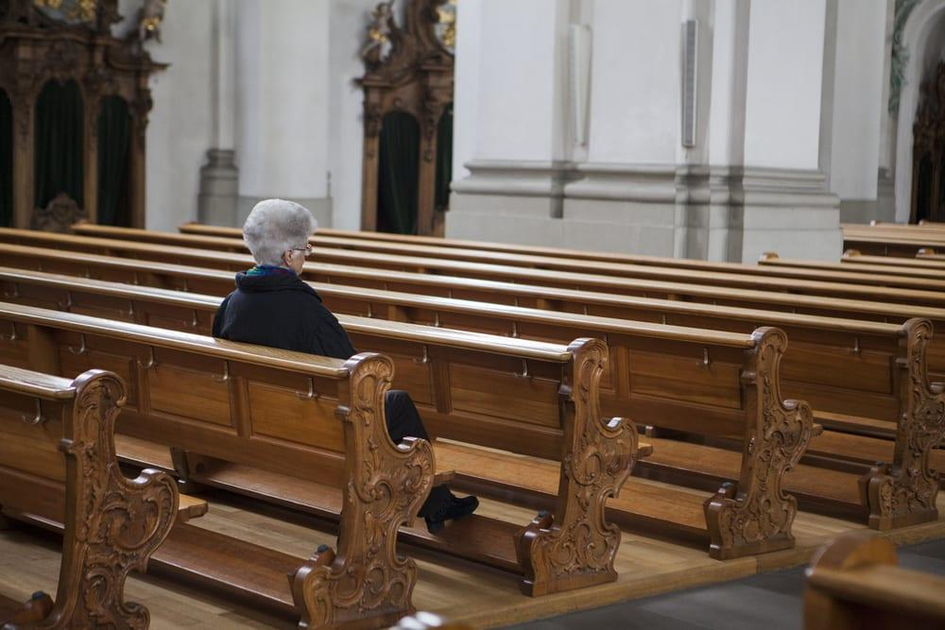
提摩太前书
教会次序
Rick Griffith 博士 • 新加坡神学院 • BibleStudyDownloads.org

Slide 2
关键字
217
次序
提摩太前书

Slide 3
主题
23
教会的先后次序
提摩太前书

Slide 4
关键节
217
“… 我把这些事写给你，希望不久可以到你那里去； 假如我来迟了，你也可以知道在 神的家里应该怎样行。这家就是永活 神的教会、真理的柱石和根基。”
(3:14-15)。
提摩太前书

Slide 5
总结概要
217
保罗劝勉提摩太要勇敢地守住他的个人生活、教义和当地教会秩序，以保护以弗所教会的事工，不受禁欲主义和投机性假教师的影响。
提摩太前书

Slide 6

国度陈述
27d
“但愿尊贵荣耀归与那不能朽坏不能看见永世的君王、独一的神、直到永永远远。阿们” (1:17)。 这“万王之王” 是指耶稣，因为祂是 “独一的神” (6:14-15)。
提摩太前书

Slide 7

圣约陈述
27d
新约群体是“神的家”， 是 “永生神的教会、真理的柱石和根基” (3:14-15)。
在行政管理上是自治的 (3:5, 15; 5:16)。
提摩太前书

Slide 8

救赎陈述
27d
“基督耶稣降世、为要拯救罪人。这话是可信的、是十分可佩服的。在罪人中我是个罪魁。” (1:15)。
提摩太前书

Slide 9
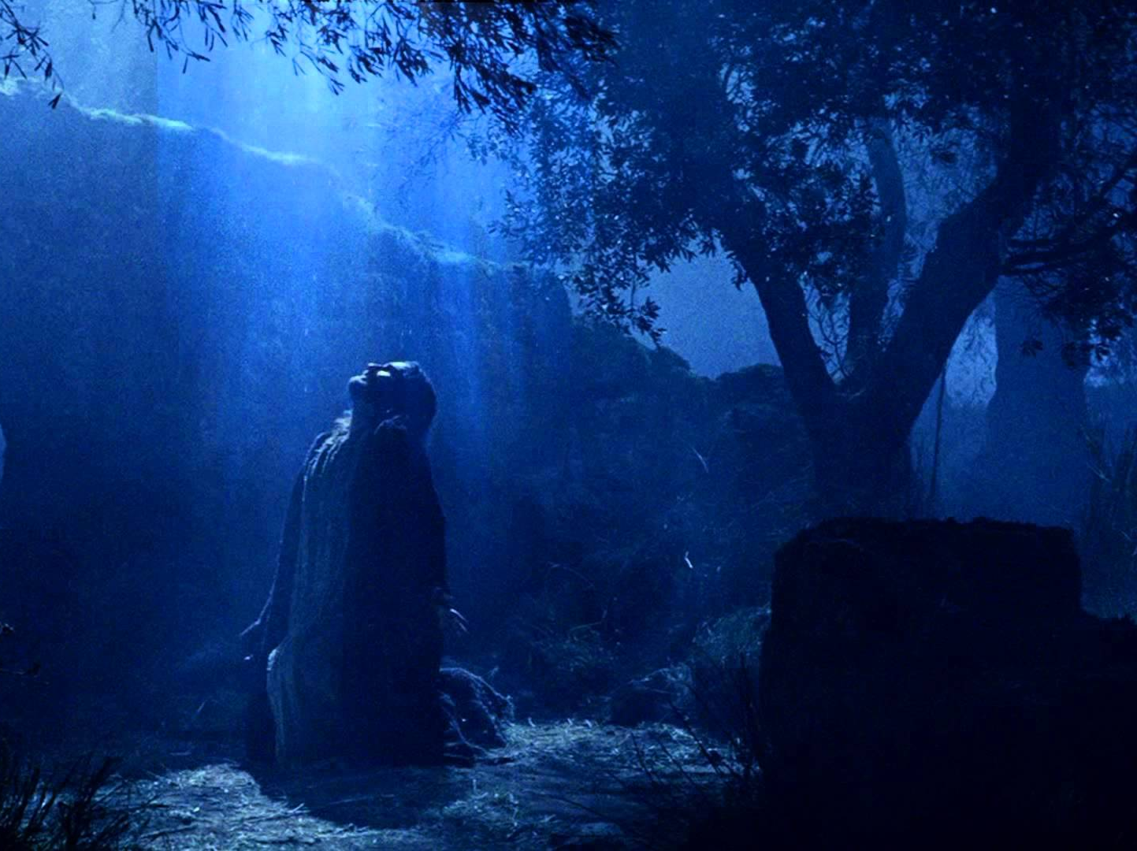
预言
(主, 神性)
27d
耶稣常被称为“主”(1:2, 12, 14; 6:3)
甚至也被称为 “万主之主” (6:14-15)。
提摩太前书

Slide 10
提摩太前 教会次序
(通过将优先次序给予…)
与假教师辩论 | 教会生活 | 个人生活/教义 | 不同教会群体 | 警惕物质主义
第 1 章 | 第 2–3 章 | 第 4 章 | 5:1–6:10 | 6:11-21
教义 | 敬拜 | 例证 | 尊敬 | 优先次序
警告 | 众人 | 警告 | 众人 | 警告
问安 反驳异端 上帝恩典 吩咐 | 祷告 性别角色 领袖特质 书信目的 | 将来的异端 关注生命 关注教义 | 尊重个人 寡妇 老人 奴隶 假教师 | 属灵目标 富足人必须奉献 结束的吩咐
实用劝勉贯穿全书信
从马其顿到以弗所
主后 62年秋
提摩太前书
217

Slide 11
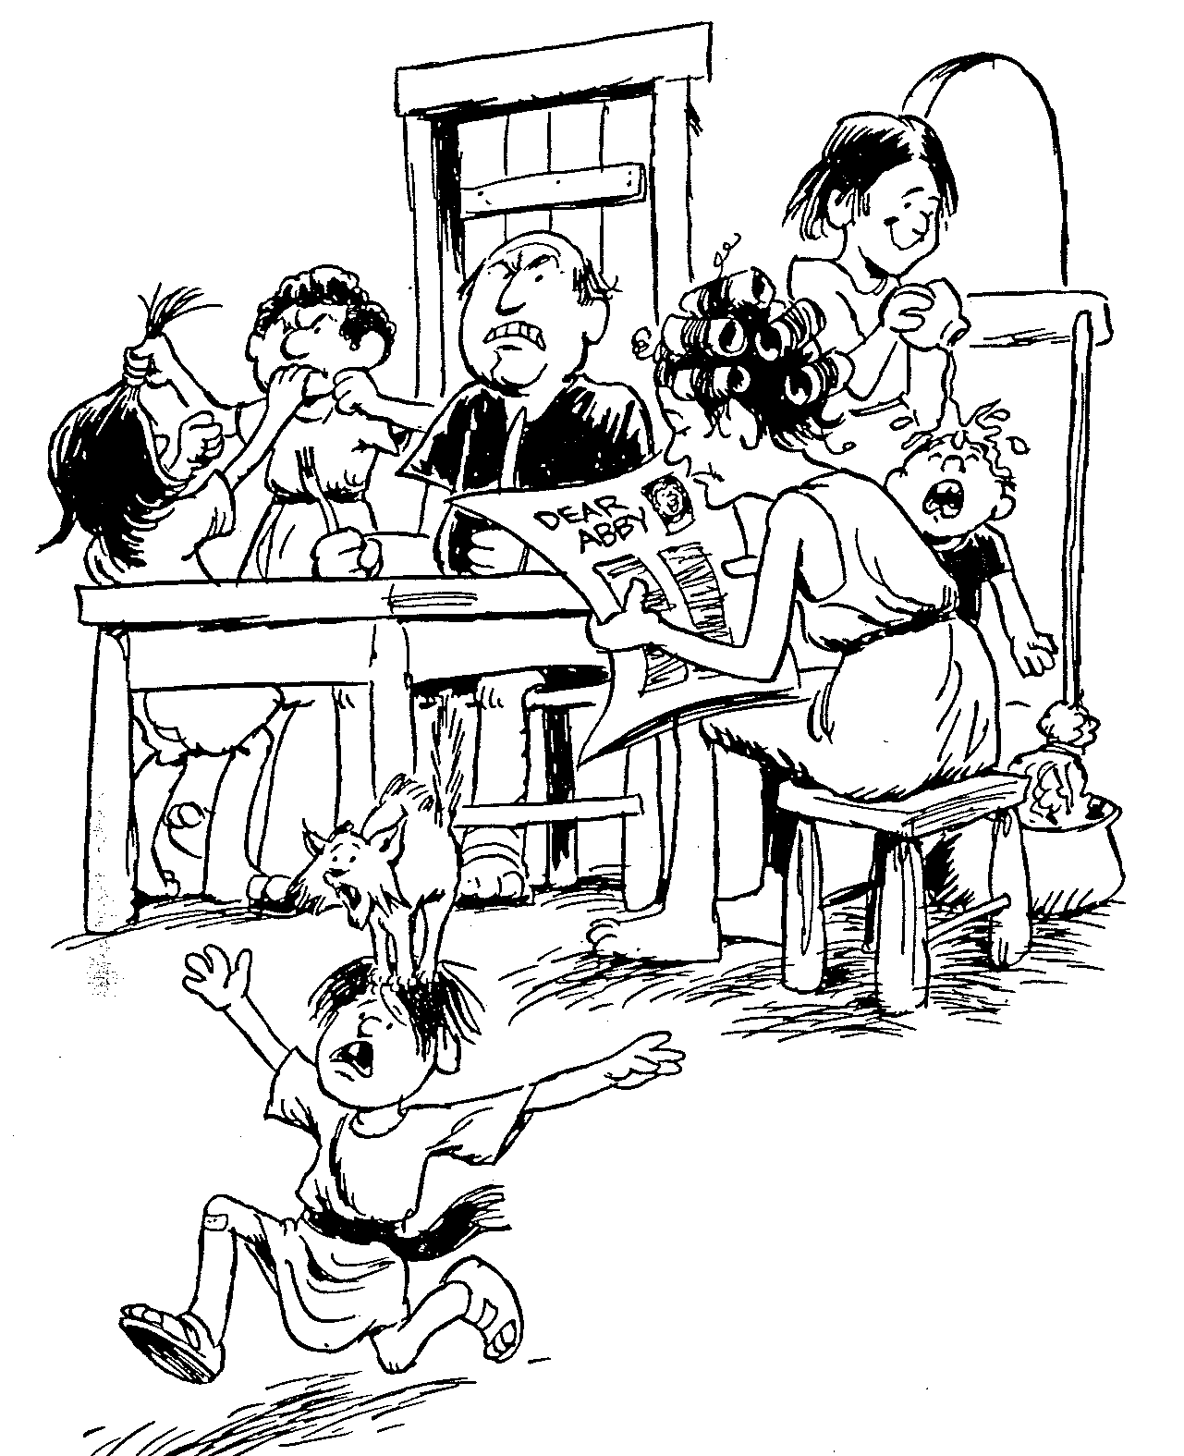
提摩太前书
1
2
3
4
5
6
关于假教导的教诲
关于圣洁妇人的教诲
基督教长老该有的美德
圣洁生活的教诲
关于圣洁妇人的教诲
世俗生活的果效
巴里 赫德尔斯顿 《藏头诗圣经》

Slide 12
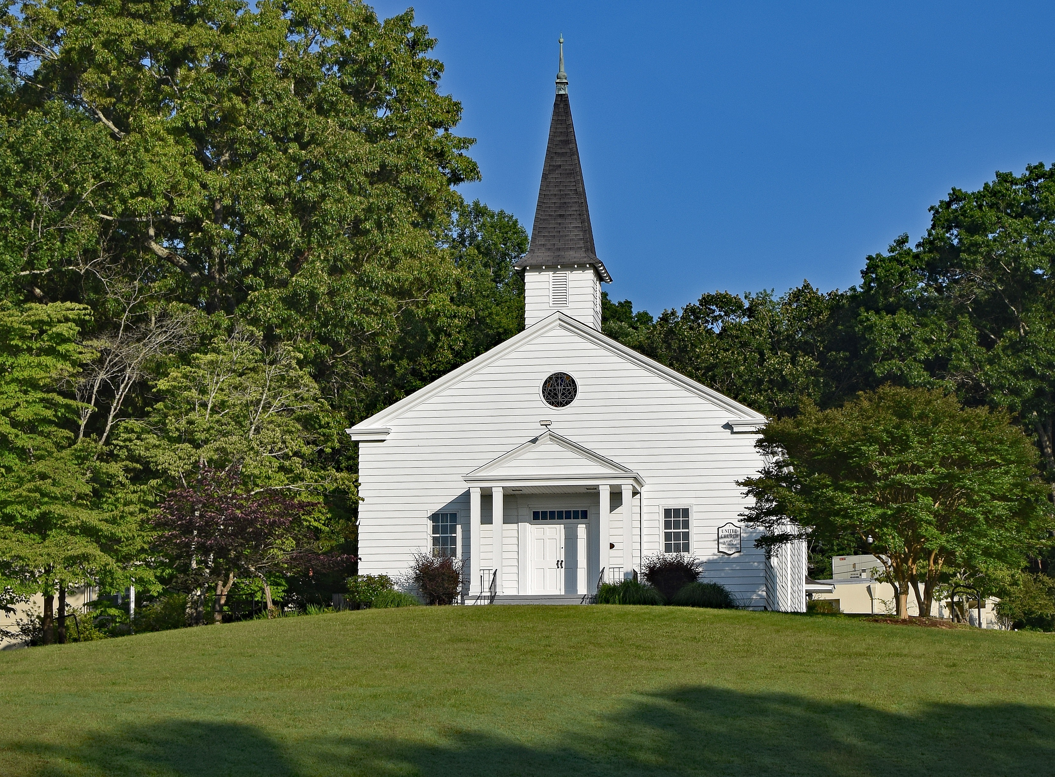
要有次序
提摩太前书
Rick Griffith 博士 • Crossroads International Church Singapore
BibleStudyDownloads.org

Slide 13

神对教会次序的优先重点
是什么？
提摩太前书

Slide 14

I. 你的生命要在律法与 恩典 中取得平衡
(第一章)。
提摩太前书
Notes:
Avoid the extremes of too many rules and too few rules.
避免过多的规则或过少的规则这两种极端。

Slide 15

II. 需要在虔诚领袖的带领下有公共的敬拜生活 (第二至三章)。
提摩太前书
Notes:
Our church services must main order by not just letting anyone lead.
我们的教会聚会必须保持秩序，不能让任何人随意带领。

Slide 16

III. 谨守私生活与教义 (第四章)。
提摩太前书
Notes:
Your beliefs affect everything about you—privately and publicly. Watch them!
你的信念会影响你的一切——无论是私下还是公开场合。要谨慎对待它们！

Slide 17

IV. 满足各教会群体的需要
(5:1–6:10)。
提摩太前书
Notes:
Our church’s different subgroups must not be vulnerable to enemy attack.
“我们教会中的各群组务要警醒，免得给仇敌留下攻击的机会。”

Slide 18

V. 不要因为爱钱而毁了属灵生命
(6:11-21)
提摩太前书
Notes:
Resist materialism that replaces godliness with apostasy.
要抵挡那以背道取代敬虔的物质主义。

Slide 19

主要思想
借着遵守上帝对教会次序的优先重点，
我们能够抵挡假教师。
提摩太前书

Slide 20
Black

Slide 21
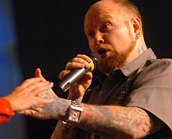
橱窗里的传道人值多少？
Notes:
How Much Is That Preacher in the Window?
By Jean Shaw
Editor’s note: A recent editorial by editor-in-chief Bob Dasal, which asked whether churches should hire or call their ministerial staff, generated a good deal of response. Obviously, the subject is of great interest to preachers! Therefore, we thought you would enjoy this tongue-in-cheek treatment of the question.
This is the introductory slide for the class skit available at http://www.pulpithelps.com/www/docs/1095-7174. The skit is a takeoff on the 1950s “How Much is That Doggie in the Window?” song by Patti Page at http://www.youtube.com/watch?v=2AkLE4X-bbU
The text is below for each slide.
________________
Good morning, madam. May I help you?
Yes, please, I’d like to buy a minister.
Did you have a particular model in mind?
I’ve got a description from the Candidate Committee right here. We want a man about 30, well educated, with some experience. Good preacher and teacher. Balanced personality. Serious, but with a sense of humor. Efficient, but not rigid. Good health. Able to identify with all age groups. And, if possible, sings tenor.
Sings tenor?
We’re short of tenors in the choir.
I see. Well, that’s quite a list. How much money did you want to spend?
The committee says $15,000-$15,500 tops.
Hmm. Well, perhaps we’d better start in the bargain basement.
橱窗里的那位传道人值多少钱？
作者：Jean Shaw
编者按：最近，主编Bob Dasal的一篇社论引发了广泛反响，文中探讨了教会是否应该雇佣或呼召其牧职团队。显然，这个话题引起了传道人们的极大兴趣！因此，我们认为你会喜欢这篇略带幽默的文章。
这是课堂短剧的引言幻灯片，短剧可在以下网址获取：http://www.pulpithelps.com/www/docs/1095-7174。短剧改编自20世纪50年代Patti Page的歌曲《橱窗里的小狗多少钱？》，歌曲链接：http://www.youtube.com/watch?v=2AkLE4X-bbU。
以下是每张幻灯片的文本内容。
早上好，女士。请问有什么可以帮您的？
是的，我想买一位传道人。
您有特别想要的型号吗？
我这里有一份候选人委员会提供的描述。我们想要一位大约30岁、受过良好教育、有一定经验的男士。他需要擅长讲道和教导，性格平衡，既严肃又有幽默感，办事高效但不死板，身体健康，能与各个年龄段的人打成一片。如果可能的话，最好能唱男高音。
唱男高音？
我们诗班缺男高音。
我明白了。嗯，这个要求可不简单。您打算花多少钱呢？
委员会说最多1.5万到1.55万美元。
嗯，那我们可能得从特价区开始找了。
（注：以上翻译尽量贴近中文圣经的语言风格，同时保留了原文的幽默感。如果需要进一步调整，请告诉我！）

Slide 22
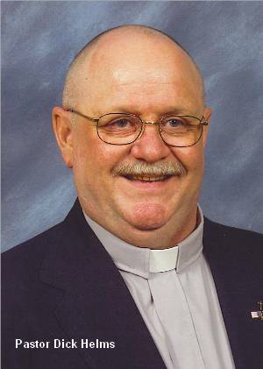
普林斯顿 467
Notes:
Tell me, how much is that model in the window?
You mean the one in the Pendleton plaid suit and the grey suede dune boots?
Yes, that one. He’s a real dream.
That’s our Princeton #467. Has a Ph.D. and AKC papers.
AKC?
American Koinonia Council. He sells for $36,000 plus house.
Wow! That’s too rich for our blood…
But he’s …an exceptional buy… He’s a little older than 30, but has excellent experience. Aggressive. Good heart. Has a backing of sermons, two of which have been printed in Christianity Today.
He’s not too bad. Can you do something about his bald head? Mrs. Fulton especially insists that our minister have some hair.
Madam, all our ministers come in a variety of hair styles.
I’ll keep him in mind.
告诉我，橱窗里的那位型号多少钱？
你是说那位穿着Pendleton格子西装和灰色麂皮沙地靴的？
对，就是他。他真是个理想人选。
那是我们的普林斯顿#467型号。拥有博士学位和AKC认证。
AKC？
美国团契理事会认证。他的售价是3.6万美元，外加一套房子。
哇！这价格对我们来说太高了……
但他可是……物超所值……虽然比30岁稍大一些，但经验丰富。充满干劲，心地善良。还有一系列讲道稿，其中两篇已经发表在《今日基督教》上。
他确实不错。不过，你能处理一下他的秃头问题吗？Fulton太太特别强调，我们的传道人必须有点头发。
女士，我们的传道人都有各种发型可选。
我会把他列入考虑名单的。

Slide 23
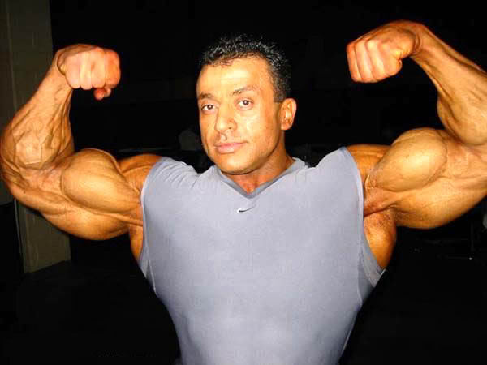
奥林匹亚 222
Notes:
Now let me show you Olympia #222. Four years of varsity sports at Southern Cal. Plays football, basketball, volleyball, and ping-pong. Comes complete with sports equipment.
What a physique! He must weigh 200 pounds!
Yes, indeed. You get a lot for your money with this one. And think what he can do for your young people.
Great! But how is he at preaching?
I must admit he’s not St. Peter. But you can’t expect good sermons and a church-wide athletic program too!
I suppose not. Still…
现在让我为您介绍奥林匹亚#222型号。他在南加州大学打了四年校队比赛，擅长足球、篮球、排球和乒乓球，还附带全套运动装备。
多么健壮的体格！他肯定有200磅重吧！
是的，确实如此。这位可是物超所值。想想他能为你们的年轻人做多少事。
太棒了！但他的讲道水平如何？
我得承认，他不是圣彼得那样的讲道高手。但您总不能指望他既擅长讲道，又能带领全教会的体育活动吧！
我想也是。不过……

Slide 24
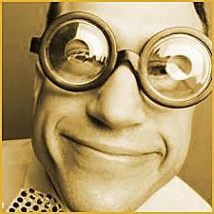
IBM 400
Notes:
Let me show you our IBM 400. Now here’s a preacher. All his sermons are superb—well-researched, copious anecdotes, and they always have three points. And—he comes with a full set of Calvin’s Commentaries at no extra charge! You get the whole package for $18,300.
He’s wearing awfully thick glasses.
For $220 more we put in contact lenses.
I don’t know. He might study too much. We don’t want a man who’s in his office all the time.
Of course… [But he] comes from a management background. Trained in business operations. Adept with committees. Gets his work done by 11:30 every morning.
His tag says he’s an IBM 486sx.
Madam, you have a discerning eye. Innovative Biblical Methods. This man will positively revitalize your church.
I’m not sure our church wants to be revitalized. Haven’t you got something less revolutionary?
让我给你展示一下我们的IBM 400。这是一个讲道者。他的每一篇讲道都非常出色——研究充分，充满故事，而且总是有三个要点。而且——他附赠了一整套加尔文的《圣经注释》，没有额外收费！你可以用18,300美元得到整个套餐。他戴着一副非常厚的眼镜。
如果再加220美元，我们可以给他换成隐形眼镜。
我不知道。他可能研究得太多了。我们可不希望有一个整天待在办公室的人。
当然……[不过他]来自管理背景。接受过商业操作训练。擅长处理委员会事务。每天早上11:30之前就能完成工作。
他的标签上写着他是IBM 486sx。
女士，您眼光独到。创新的圣经方法。这位讲道者肯定能让您的教会焕发新生。
我不确定我们教会需要复兴。你们有没有什么不那么革命性的选项？

Slide 25
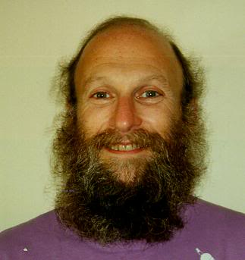
共情 41C
Notes:
Well, would you like someone of the social worker type? We have this Ghetto #130.
The man with the beard. Good gracious, no. Mrs. Fulton would never go for that.
How about our Empathy #41C? His forte is counseling. Very sympathetic. Patient. Good with people who have problems.
Everyone in our church has problems. But he might not get out and visit new people. We really need a man who does a lot of visitation. You see, all our people are very busy and…
Yes, yes. I understand. You want a minister who can do everything well.
That’s it! Haven’t you got somebody like that?
那么，您想要一个像社会工作者那样的人吗？我们有这个“贫民区#130”。
那个有胡子的男人。天哪，不行。富尔顿夫人绝对不接受那种人。
那我们有“共情#41C”怎么样？他的专长是辅导。非常有同情心，耐心，擅长处理有问题的人。
我们教会里每个人都有问题。可是他可能不会去探访新的人。我们真的需要一个做大量探访的牧师。您看，我们教会的人都非常忙碌，而且……
是的，是的。我明白了。您需要一个什么都能做得很好的牧师。
没错！难道你们没有这样的人吗？

Slide 26
Black
Notes:
I’m thinking. In our back room we have a minister who was traded in last week. Excellent man, but he broke down after three years. If you don’t mind a used model, we can sell him at a reduced price.
Well, we had hoped for someone brand-new. We just redecorated the sanctuary, and we wanted a new minister to go with it.
Of course. But with a little exterior work, and a fresh suit, this man will look like he just came out of the box. No one will ever know. Let me bring him out and you can look him over.
All right. Honestly, this minister shopping is exhausting. It’s so hard to get your money’s worth. Tell me, do you accept coupons, and do you double them? What about rebates?
Uh, no. But if there’s any dissatisfaction after six months, we send a new congregation for the balance of the year. That usually takes care of most problems.
©Jean Shaw. From the book, Please Don’t Stand up in My Canoe, Zondervan, 1976, Via Contact.
Reprinted by permission at http://www.pulpithelps.com/www/docs/1095-7174
我在想。在我们后面的房间里，有一位上周刚被调换来的牧师。是个优秀的人，不过他在三年后崩溃了。如果您不介意购买二手的，我们可以以折扣价卖给您。
嗯，我们原本希望能找个全新的。我们刚刚重新装修了圣殿，想找一个新牧师来搭配。
当然。不过只要稍微做点外部修整，再换一套新西装，这位牧师看起来就像是刚从盒子里拿出来的一样。没人会知道的。我去把他带出来，您可以看看他。
好吧。老实说，买牧师真是累人。很难找到物有所值的。告诉我，你们接受优惠券吗？而且是双倍优惠吗？退还现金的政策如何？
呃，不接受。不过如果六个月后有任何不满，我们会派来一个新会众，替您服务到年底。通常这样可以解决大多数问题。
©Jean Shaw。摘自《Please Don’t Stand up in My Canoe》，Zondervan，1976年，Via Contact。
经允许转载，网址：http://www.pulpithelps.com/www/docs/1095-7174

Slide 27
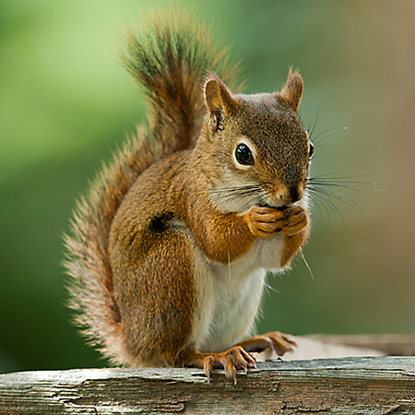
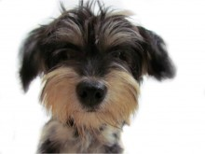
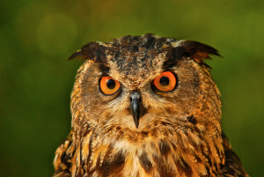

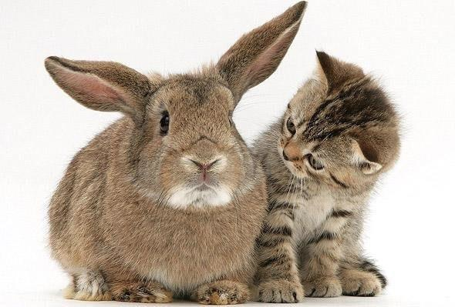
你是什么样的动物？
Notes:
If you could describe yourself as an animal, which one would you pick?
Now, biblically speaking, what animal are you?
“如果你可以把自己描述为一种动物，你会选择哪种？
那么，从圣经角度来说，你是哪种动物？”

Slide 28
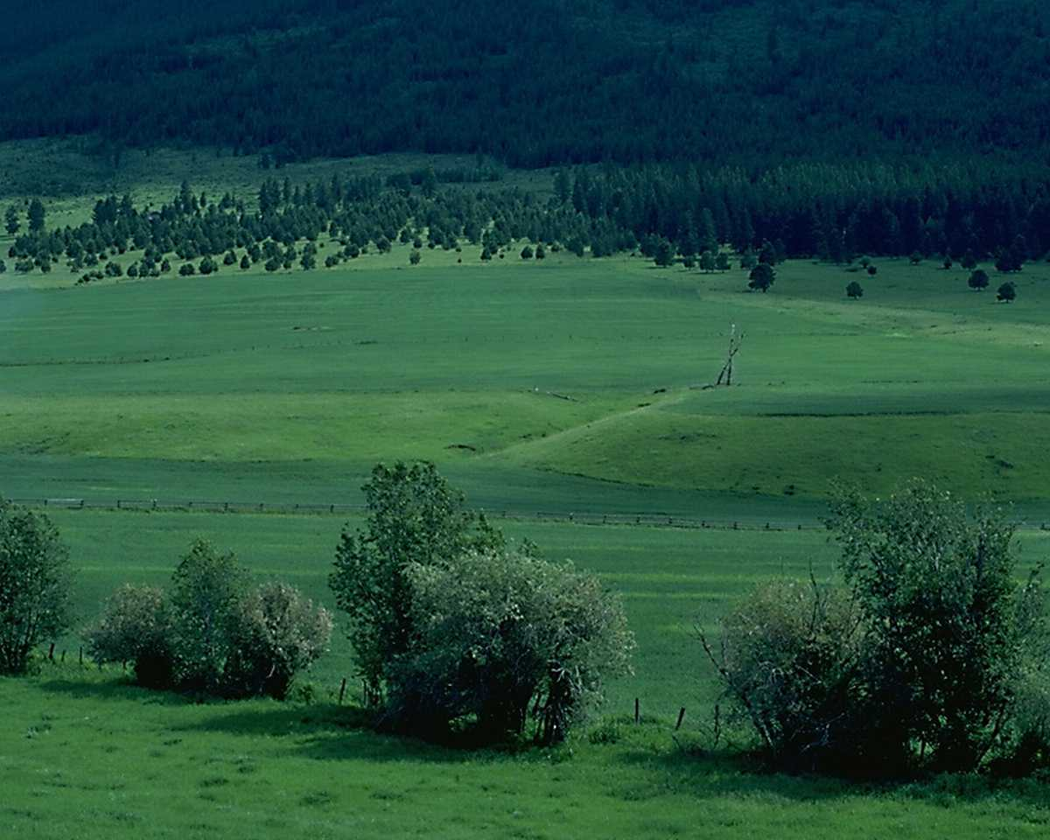
诗篇 23 篇
¹ 耶和华是我的牧者，我必不致缺乏。 ² 他使我躺卧在青草地上，领我在可安歇的水边。³ 他使我的灵魂苏醒，为自己的名引导我走义路。⁴ 我虽然行过死荫的幽谷，也不怕遭害，因为你与我同在；你的杖，你的竿，都安慰我。⁵ 在我敌人面前，你为我摆设筵席；你用油膏了我的头，使我的福杯满溢。⁶ 我一生一世必有恩惠慈爱随着我；我且要住在耶和华的殿中，直到永远。

Slide 29
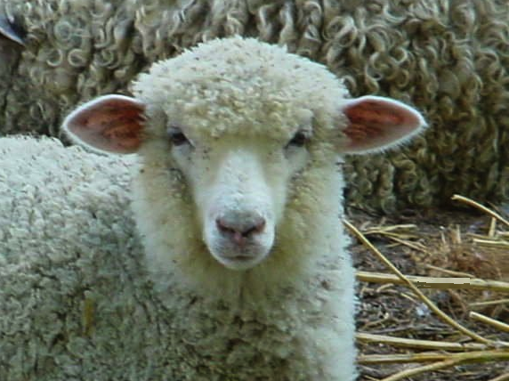
你是一只羊

Slide 30
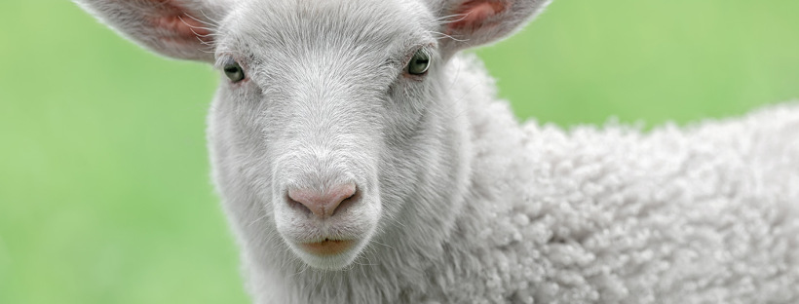
做一只‘羊’
意味着什么？
Notes:
Does being a sheep mean you are cute and easy to get along with? Not quite.
做一只羊意味着你很可爱，容易相处吗？并不完全是。

Slide 31
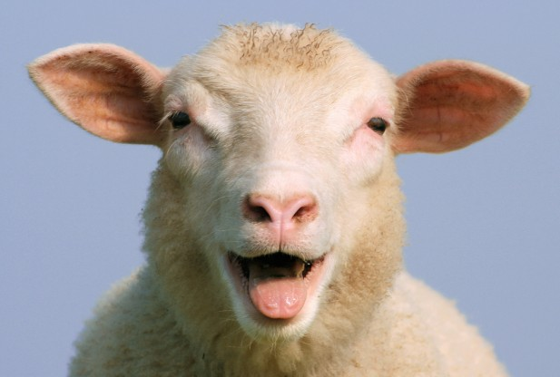
愚笨、迷茫、无助
Tim Challies, http://www.challies.com/christian-living/dumb-directionless-defenseless posted 26 Aug 2013, accessed 7 Aug 2016
Notes:
One bogger puts it this way: "Why sheep? Why not cheetahs or wolves or tigers or another animal with a bit of flair, a bit of class? But the Bible tells us often that we are sheep. We are sheep and God is a shepherd. That sheep/shepherd word picture is at the heart of the best-loved Psalm—Psalm 23. I spent some time with that psalm lately and tried to gain a better appreciation of why God saw fit to tell us we are sheep.
I will admit I am not the world's foremost expert on sheep. I grew up in the city and even now live in an area of town that explicitly forbids owning livestock. In place of first-hand knowledge, I spent some time reading about sheep. It was funny. And kind of humbling.
Do a little bit of reading about sheep and you'll soon see they are not survivors. They are not strong and independent creatures, not proud hunters or fierce predators. They're actually kind of pathetic, entirely dependent upon a shepherd for at least three reasons. Two of these reasons are related to the brain of a sheep and the other is related to its body."
Dumb, Directionless, Defenseless
Tim Challies, http://www.challies.com/christian-living/dumb-directionless-defenseless posted 26 Aug 2013, accessed 7 Aug 2016
一位博客写道：“为什么是羊？为什么不是猎豹、狼、老虎或其他有些风采、有些格调的动物呢？但是圣经经常告诉我们我们是羊。我们是羊，上帝是牧羊人。羊和牧羊人的比喻是最受喜爱的诗篇——诗篇23篇的核心。我最近花了一些时间研究这篇诗篇，并尝试更好地理解为什么上帝认为我们是羊。”
我承认，我不是世界上最权威的羊专家。我在城市里长大，现在住在一个明确禁止养牲畜的区域。没有直接的经验，我花了一些时间阅读关于羊的资料。结果很有趣，也有点让人谦卑。
稍微读一些关于羊的资料，你很快就会发现它们并不是很能自理的动物。它们不是强壮和独立的生物，不是骄傲的猎人或凶猛的掠食者。实际上，它们有些可怜，完全依赖牧羊人，至少有三个原因。两个原因与羊的大脑有关，另一个原因与它的身体有关。”
愚笨、迷茫、无助
Tim Challies，网址：http://www.challies.com/christian-living/dumb-directionless-defenseless，发布于2013年8月26日，最后访问于2016年8月7日。

Slide 32
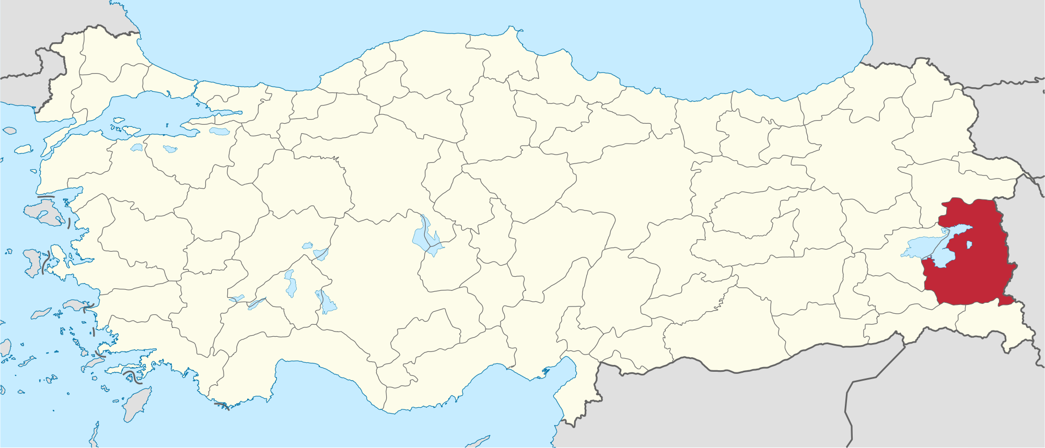
来自土耳其凡省的新闻故事
Tim Challies, http://www.challies.com/christian-living/dumb-directionless-defenseless posted 26 Aug 2013, accessed 7 Aug 2016
Notes:
"This is a real news story that aptly tells us the first reason sheep need a shepherd: because sheep are dumb.
'Hundreds of sheep followed their leader off a cliff in eastern Turkey, plunging to their deaths this week while shepherds looked on in dismay.'"
Dumb, Directionless, Defenseless
Tim Challies, http://www.challies.com/christian-living/dumb-directionless-defenseless posted 26 Aug 2013, accessed 7 Aug 2016
图中的英文翻译如下：
“来自土耳其凡省的新闻故事”
“这是一个真实的新闻故事，恰如其分地告诉我们羊需要牧羊人的第一个原因：因为羊是愚笨的。‘成百上千只羊跟随它们的领袖，从土耳其东部的一悬崖上掉下去，牧羊人看着这一切，感到惊愕。’”
愚笨、迷茫、无助
Tim Challies，网址：http://www.challies.com/christian-living/dumb-directionless-defenseless，发布于2013年8月26日，最后访问于2016年8月7日。

Slide 33
“愚笨、迷茫、无助”
“成百上千只羊跟随它们的领袖，从土耳其东部的一悬崖上掉下去，牧羊人看着这一切，感到惊愕。四百只羊从凡省一个峡谷中掉下去，摔死了，但却缓解了另一千一百只存活下来的动物的摔落。来自附近村庄的牧羊人在吃早餐时疏忽了羊群，让它们自由活动。当地农民的损失估计为74,000美元。”
—实际新闻故事
Tim Challies, http://www.challies.com/christian-living/dumb-directionless-defenseless posted 26 Aug 2013, accessed 7 Aug 2016
Notes:
Dumb, Directionless, Defenseless
Tim Challies, http://www.challies.com/christian-living/dumb-directionless-defenseless posted 26 Aug 2013, accessed 7 Aug 2016

Slide 34
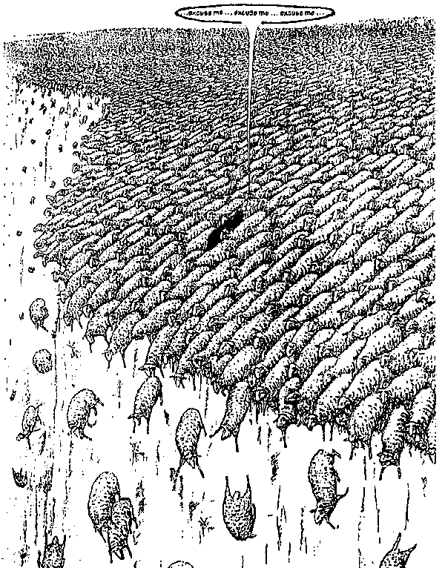
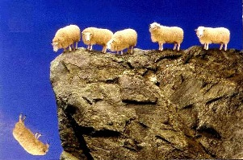
"Dumb, Directionless, Defenseless"
Notes:
"One sheep wandered off a cliff and 1,499 others just followed along. Can you picture it? 1,500 sheep, each walking off a cliff, one after the other.”
“一只羊走失了，其他1,499只羊跟着它走下悬崖。你能想象吗？1,500只羊，一个接一个地走下悬崖。”
Dumb, Directionless, Defenseless
Tim Challies, http://www.challies.com/christian-living/dumb-directionless-defenseless posted 26 Aug 2013, accessed 7 Aug 2016
See also https://factualfacts.com/animals/in-2005-in-turkey-a-suicide-sheep-jumped-off-a-cliff-and-1500-sheep-followed-the-first-one/

Slide 35
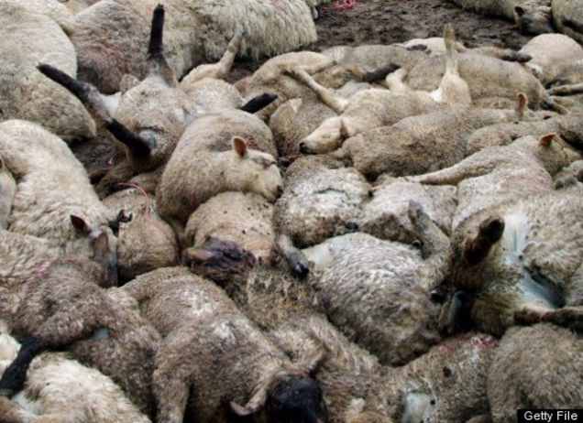
“愚笨、迷茫、无助”
Tim Challies, http://www.challies.com/christian-living/dumb-directionless-defenseless posted 26 Aug 2013, accessed 7 Aug 2016
Notes:
"Soon they were piled so deep that the ones at the bottom were crushed to death and the ones on top were lying on a big downy-soft pillow. It is completely absurd and tells us one important fact about sheep and the first reason sheep absolutely need a shepherd: they are not the smartest animals in the world. In fact, they may well be just about the dumbest animals in the world.”
“很快它们堆积得如此深，以至于底部的羊被压死，而顶部的羊则躺在一个柔软的羽毛枕头上。这完全是荒谬的，告诉我们一个关于羊的重要事实，以及羊绝对需要牧羊人的第一个原因：它们不是世界上最聪明的动物。事实上，它们很可能是世界上最愚笨的动物。”
Dumb, Directionless, Defenseless
Tim Challies, http://www.challies.com/christian-living/dumb-directionless-defenseless posted 26 Aug 2013, accessed 7 Aug 2016
See also https://factualfacts.com/animals/in-2005-in-turkey-a-suicide-sheep-jumped-off-a-cliff-and-1500-sheep-followed-the-first-one/

Slide 36
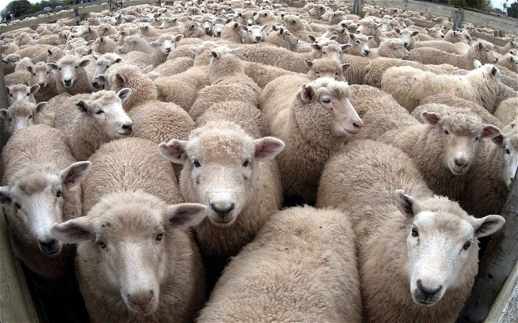
“愚笨、迷茫、无助”
Tim Challies, http://www.challies.com/christian-living/dumb-directionless-defenseless posted 26 Aug 2013, accessed 7 Aug 2016
Notes:
"And here's a second reason sheep need a shepherd: they are directionless. Sheep are prone to wander. Even if you put them in an absolutely perfect environment with everything they need (things like green pastures and still waters), sooner or later they will just wander off. If a shepherd doesn't manage them, if he doesn't micromanage them and keep them under constant surveillance, they'll wander off and be lost.
Left to themselves, sheep will not and cannot last very long.”
“这里是羊需要牧羊人的第二个原因：它们没有方向感。羊容易迷失方向。即使你把它们放在一个完美的环境中，提供它们所需的一切（比如绿草如茵的牧场和宁静的水源），它们迟早会迷失方向。如果牧羊人不管理它们，如果他不微观管理它们并保持对它们的持续监控，它们就会迷路并且失去方向。
如果让它们自生自灭，羊是无法、也不能长时间生存的。”
Dumb, Directionless, Defenseless
Tim Challies, http://www.challies.com/christian-living/dumb-directionless-defenseless posted 26 Aug 2013, accessed 7 Aug 2016

Slide 37
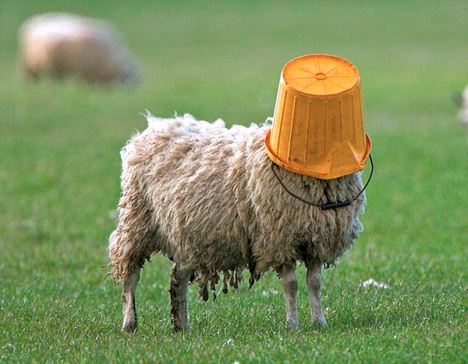
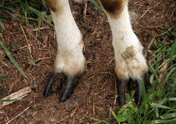
“愚笨、迷茫、无助”
Tim Challies, http://www.challies.com/christian-living/dumb-directionless-defenseless posted 26 Aug 2013, accessed 7 Aug 2016
Notes:
"Sheep are dumb and directionless. They are also defenseless. Left to themselves, sheep will not and cannot last very long. Just about any other domesticated animal can be returned to the wild and will stand a fighting chance of survival. But not sheep. Put a sheep in the wild and you've just given nature a snack.
Think about it: there are different ways animals react when they perceive some kind of danger. Here are three common ones: fight, flight, and posture.
Let's thinking about fight. A sheep gets frightened or sees that he is in danger. Maybe he sees a bear rambling toward him. What is he going to do? He doesn't have claws, he doesn't have fangs, he doesn't have venom, he doesn't have spines or quills or large talons. He's got nothing to protect himself. Fighting is definitely out. But that's okay—there are lots of other animals that don't fight it out."
Dumb, Directionless, Defenseless
Tim Challies, http://www.challies.com/christian-living/dumb-directionless-defenseless posted 26 Aug 2013, accessed 7 Aug 2016
“羊愚笨、迷茫、无助。它们也是无防备的。如果让它们自生自灭，羊无法，也不能长时间生存。几乎所有其他的驯养动物，如果被放回野外，都有一定的生存机会。但羊不行。把羊放到野外，你就把它送给了自然当零食。
想一想：动物在感知到某种危险时，有不同的反应方式。这里有三种常见的反应：战斗、逃跑和姿态。
我们来谈谈战斗。羊如果感到害怕或看到自己处于危险之中，可能它看到一只熊向它走来。它会怎么办？它没有爪子，没有獠牙，没有毒液，没有刺或羽毛钩爪。它没有任何能保护自己的东西。显然，战斗是不可能的。但这没关系——有很多其他动物也不会选择战斗。”
愚笨、迷茫、无助
Tim Challies，网址：http://www.challies.com/christian-living/dumb-directionless-defenseless，发布于2013年8月26日，最后访问于2016年8月7日。

Slide 38
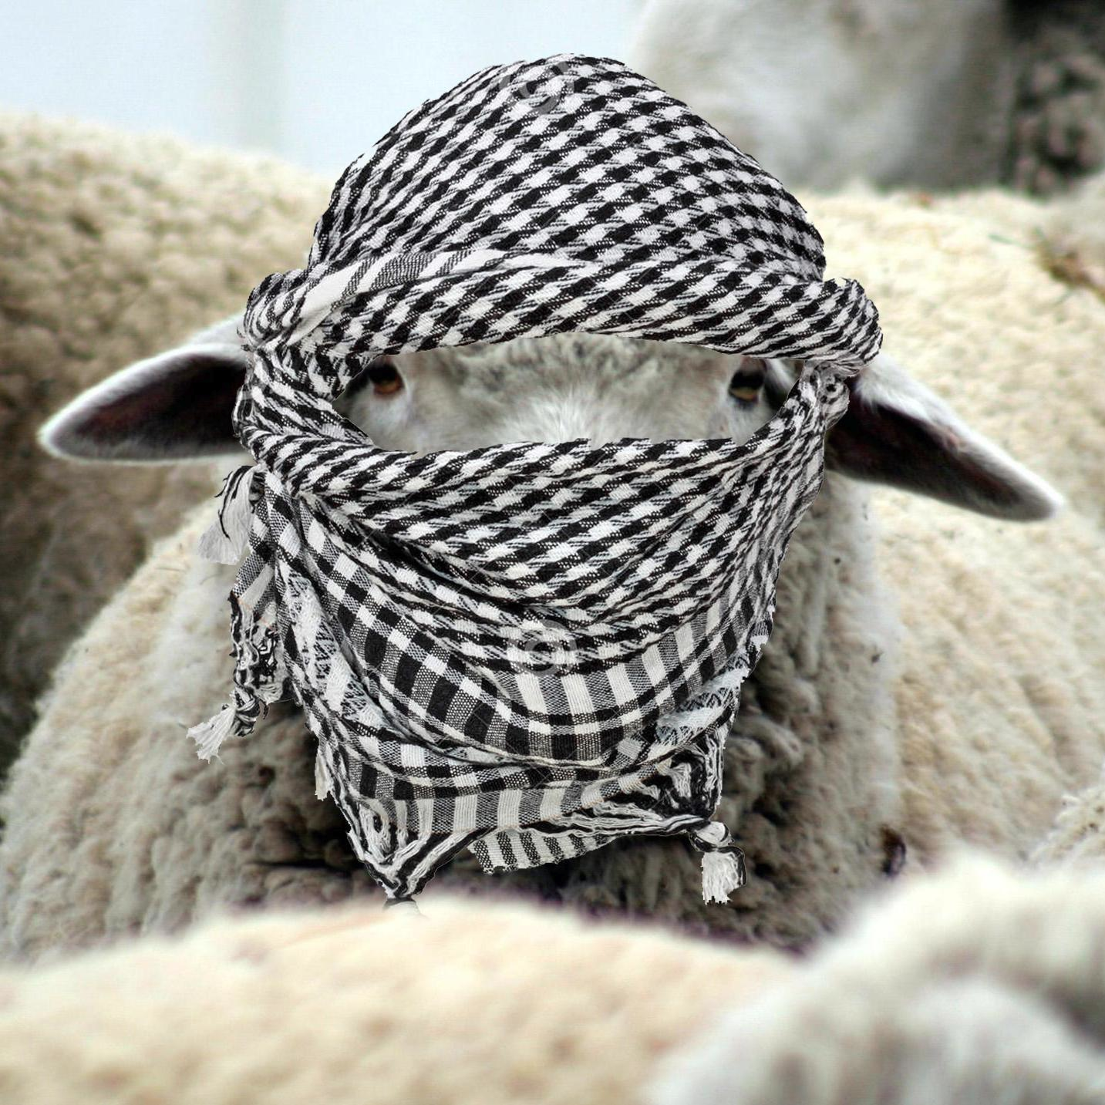
“愚笨、迷茫、无助”
Tim Challies, http://www.challies.com/christian-living/dumb-directionless-defenseless posted 26 Aug 2013, accessed 7 Aug 2016
Notes:
"How about flight, just turning tail and running away? That's a good defense mechanism. Unfortunately sheep aren't fast; they certainly aren't agile, especially when their wool is long, and even more so when their wool is long and wet. Last I checked they don't have wings. A sheep is not going to outrun or outfly a bear. The sheep will not fight and it cannot take flight. So far it is looking pretty good for the bear."
Dumb, Directionless, Defenseless
Tim Challies, http://www.challies.com/christian-living/dumb-directionless-defenseless posted 26 Aug 2013, accessed 7 Aug 2016
“那么逃跑呢，转身跑掉呢？那是一个很好的防御机制。不幸的是，羊不快；它们肯定不灵活，尤其是当它们的毛发很长的时候，尤其是当它们的毛发既长又湿的时候。根据我最后的了解，它们没有翅膀。羊是跑不过或者飞不过熊的。羊不能战斗，也不能逃跑。到目前为止，熊看起来占据了优势。”
愚笨、迷茫、无助
Tim Challies，网址：http://www.challies.com/christian-living/dumb-directionless-defenseless，发布于2013年8月26日，最后访问于2016年8月7日。

Slide 39
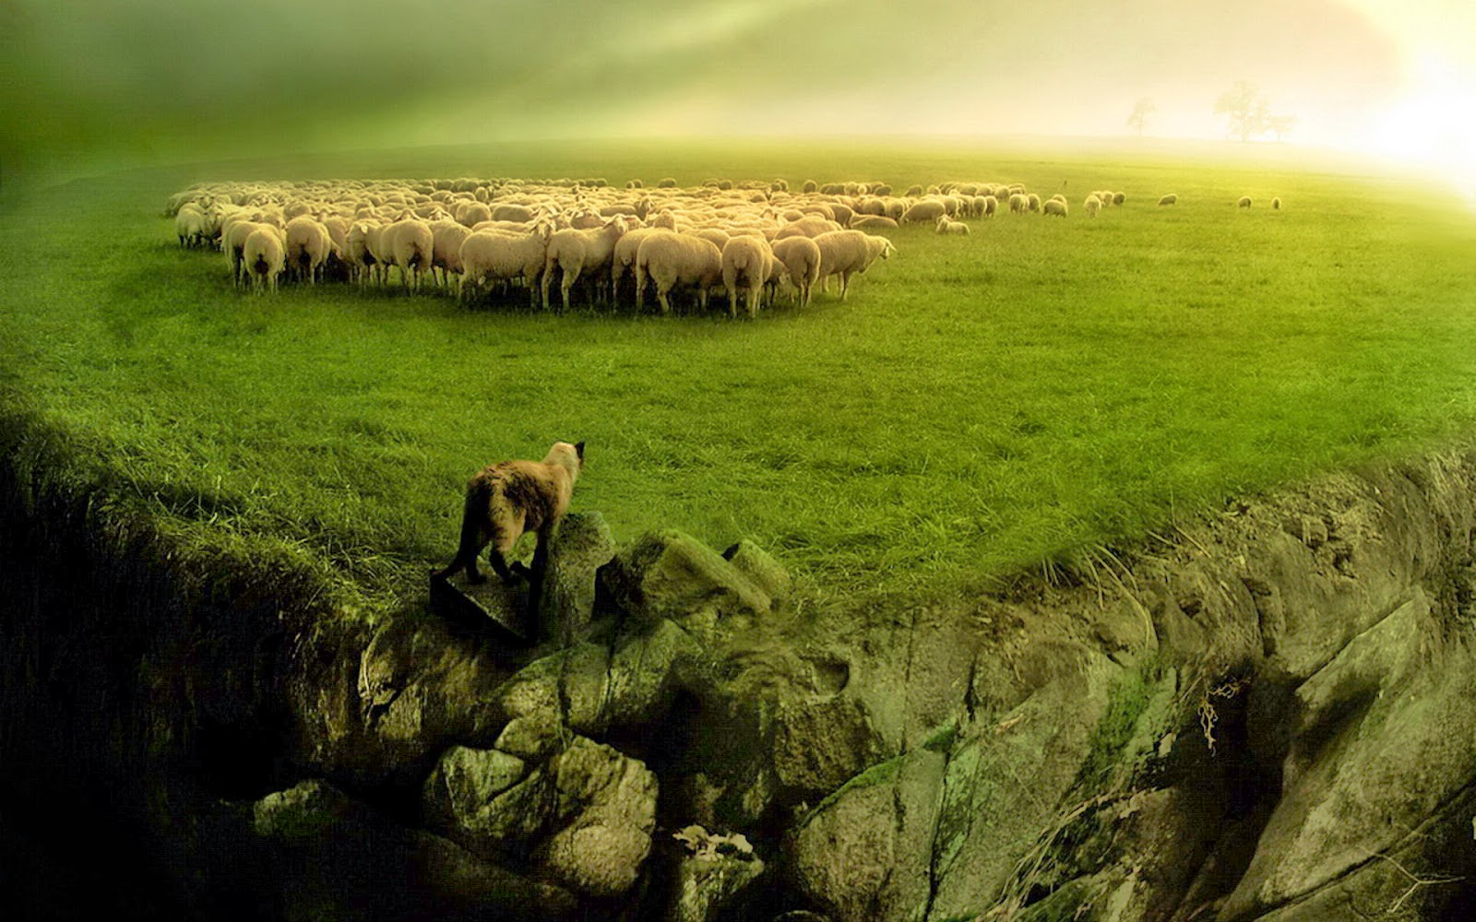
“愚笨、迷茫、无助”
Tim Challies, http://www.challies.com/christian-living/dumb-directionless-defenseless posted 26 Aug 2013, accessed 7 Aug 2016
Notes:
"How about posture? A dog will bark and growl and show his teeth to warn you away. A lion will roar. A rattlesnake will shake his rattle. A cat will arch his back and hiss. The best a sheep can do is baaa. I don't think that bear is going be too intimidated. It is for good reason that no one relies on a guard sheep to keep their property secure.
Sheep can't fight, they can't run away, and they can't scare away. Sheep can't fight, they can't run away, and they can't scare away. So what does a sheep do when danger comes? It flocks. When a bear approaches, the sheep will gather with others in a pack and run in circles in complete panic, just hoping that the bear will choose someone else. Without a shepherd to protect them, they'll be picked off and eaten one by one."
Dumb, Directionless, Defenseless
Tim Challies, http://www.challies.com/christian-living/dumb-directionless-defenseless posted 26 Aug 2013, accessed 7 Aug 2016
“那么姿态呢？狗会吠叫、咆哮，露出牙齿来警告你离开。狮子会吼叫。响尾蛇会摇动它的尾巴。猫会弓起背部并发出嘶嘶声。羊能做的最多也就是‘咩’。我想那只熊并不会感到太害怕。也正因为如此，没有人依赖守卫羊来保护他们的财产安全。
羊不能战斗，不能逃跑，不能吓跑敌人。羊不能战斗，不能逃跑，不能吓跑敌人。那么，当危险来临时，羊会怎么做呢？它们聚集在一起。当熊靠近时，羊会与其他羊聚集在一起，形成一群，完全慌乱地围着跑，只希望熊会选择攻击其他羊。在没有牧羊人保护的情况下，它们会一个个被挑选出来，吃掉。”
愚笨、迷茫、无助
Tim Challies，网址：http://www.challies.com/christian-living/dumb-directionless-defenseless，发布于2013年8月26日，最后访问于2016年8月7日。

Slide 40
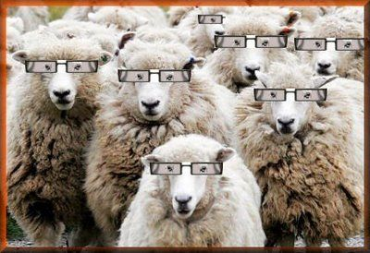
“愚笨、迷茫、无助”
Tim Challies, http://www.challies.com/christian-living/dumb-directionless-defenseless posted 26 Aug 2013, accessed 7 Aug 2016
Notes:
"Sheep are dumb and directionless and defenseless. So I guess when God says that we are sheep who need a shepherd, he doesn't mean it as a compliment to us. It is just a very realistic assessment of who we are and what we need. We are sheep who are completely dependent upon a shepherd.
To say that God is our shepherd and we are sheep, is to humble ourselves, admitting what is true about us, and to elevate God, declaring what is true of him. When you say, 'The Lord is my shepherd,' you are saying something that ought to move your heart in praise and gratitude. To declare that God if your shepherd is to praise and glorify him because God the shepherd stoops down to care for poor, lost, not-so-smart sheep like you and me."
Dumb, Directionless, Defenseless
Tim Challies, http://www.challies.com/christian-living/dumb-directionless-defenseless posted 26 Aug 2013, accessed 7 Aug 2016
“羊愚笨、迷茫、无助。所以我想，当上帝说我们是需要牧羊人的羊时，他并不是在夸奖我们。这只是对我们是谁以及我们需要什么的非常现实的评估。我们是完全依赖牧羊人的羊。
说上帝是我们的牧羊人，而我们是羊，意味着我们要谦卑自己，承认关于我们的真实情况，同时高举上帝，宣告关于他的真实本质。当你说‘耶和华是我的牧羊人’时，你是在说一些应该让你心中充满赞美和感恩的话。宣告上帝是你的牧羊人，就是在赞美和荣耀他，因为上帝作为牧羊人俯身照顾像你和我这样贫穷、迷失、并不聪明的羊。”
愚笨、迷茫、无助
Tim Challies，网址：http://www.challies.com/christian-living/dumb-directionless-defenseless，发布于2013年8月26日，最后访问于2016年8月7日。

Slide 41

“我们怎么像羊呢？”
"耶稣把我们比作羊，这可不是一种恭维。羊是所有生物中最愚笨的动物之一。大多数动物在很多情况下如果被放回野外，都会学会自力更生并存活下去。但是，放羊到野外是无法生存的。羊没有任何生存技能。它们完全依赖牧羊人——就像我们一样。羊会意识到，当牧羊人说话时，它们应该跟随他，因为牧羊人的计划比它们自己的计划更好。
Greg Laurie, http://www.jesus.org/following-jesus/discipleship/how-are-we-like-sheep.html, accessed 7 Aug 2016

Slide 42
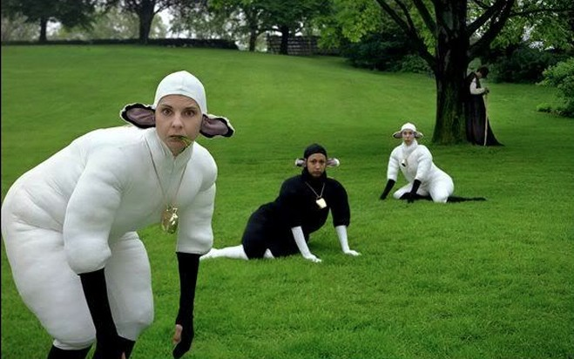
那我们需要什么？

Slide 43


38
124
39-41
新约综览(保罗书信)
“直 到 地 极” (使 徒 行 传 1:8)
使 徒 9 13 14 15 16 18 21 27 28
五月57-
八月59
大 马 色
安 提 阿
四月 48-
九月 49
1
加 拉 太
四月 50-
九月 52
2
爱琴海
春季 53-
五月 57
3
亚洲
五月 57-
八月 59
试验
二月 60-
三月 62
1
罗马
春季 62-
秋季 67
4
西班牙
秋季 67-
春季 68
2
罗马
秋季 49
理事会
春季68
教会扩长
35 48 49 50 52 53 57 60 62 67 68 95
天国
主权1
主权2
门徒
相 信
以弗所
合一
提 前
加拉太
帖 前
歌前
秩序
因信称义
被提
成圣
大患难
帖后
使 徒
歌罗西
歌后
神性
称义
腓利门
罗马
饶恕
福音书以及使徒行传
腓立比
态度
保罗书信
保罗书信 +关键节

Slide 44
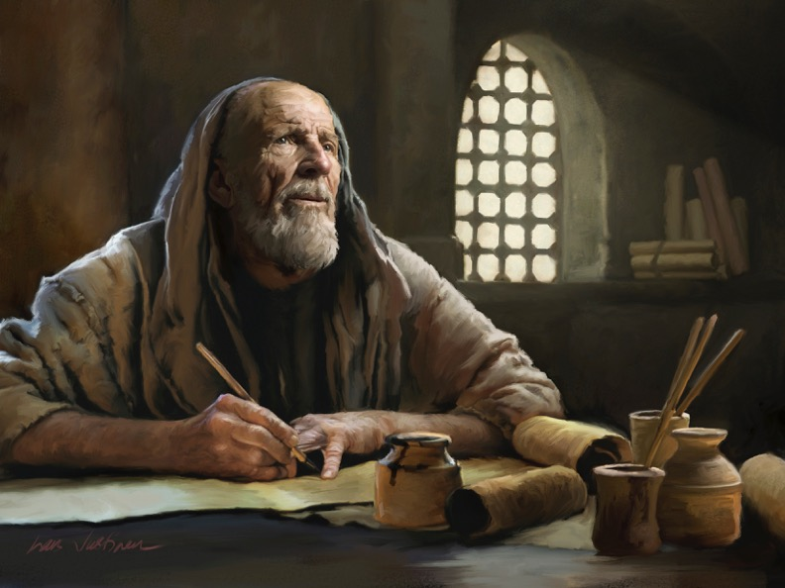
教牧书信

Slide 45

牧养书信
提摩太前书
提多书
提摩太后书
提摩太前书 = 个人、紧急、教义重点
提多书 = 不太紧急、实际重点
提摩太后书 = 个人、紧急、专注于圣言
Notes:
These last three letters of Paul are called the Pastoral Epistles.
They show the most advanced theology of local church life and shepherding the flock—but this makes sense since Paul and the church had learned much in the previous 30 years since the church had begun.
Sadly, most NT scholars today do not believe that Paul wrote these letters and many date them in the second century. I guess they think that Paul was a slow learner!
这三封保罗的最后书信被称为牧养书信。
它们展示了最先进的地方教会生活神学和牧养群羊的教义——但这很有意义，因为保罗和教会在过去的30年里已经学到了很多东西，自教会成立以来。
遗憾的是，今天大多数新约学者认为保罗没有写这些书信，并且将它们的日期定在第二世纪。我猜他们认为保罗是个慢学习者！

Slide 46
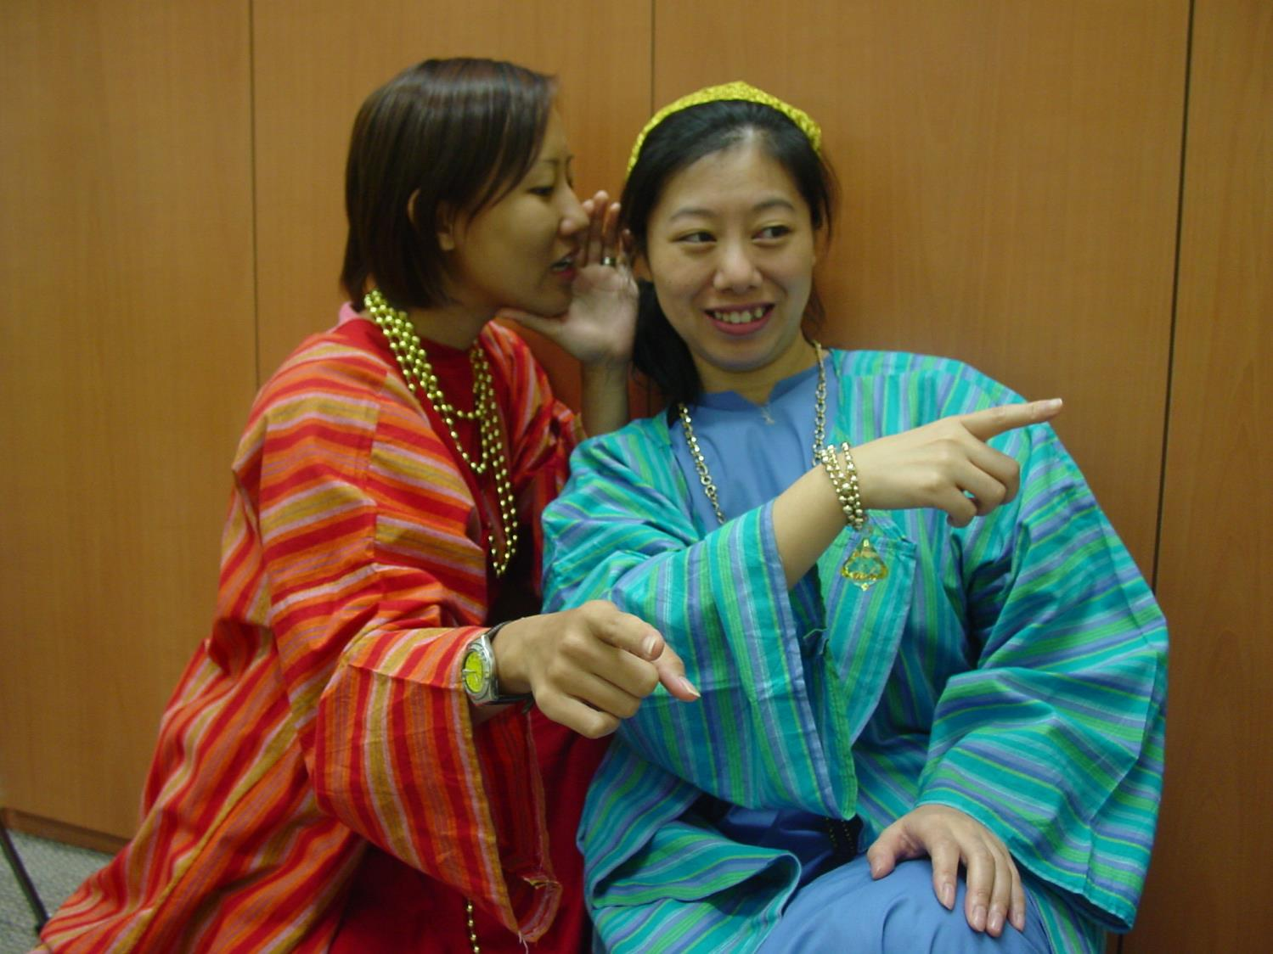
Rich ladies
嗨，你有没有听说。。。
你是说那个人。。。？

Slide 47
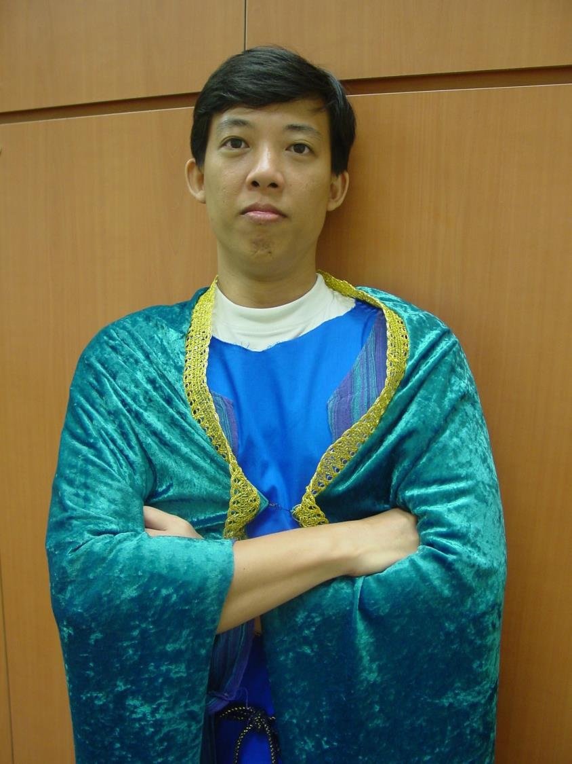
The wealthy
我真有福气。我有钱又英俊。

Slide 48
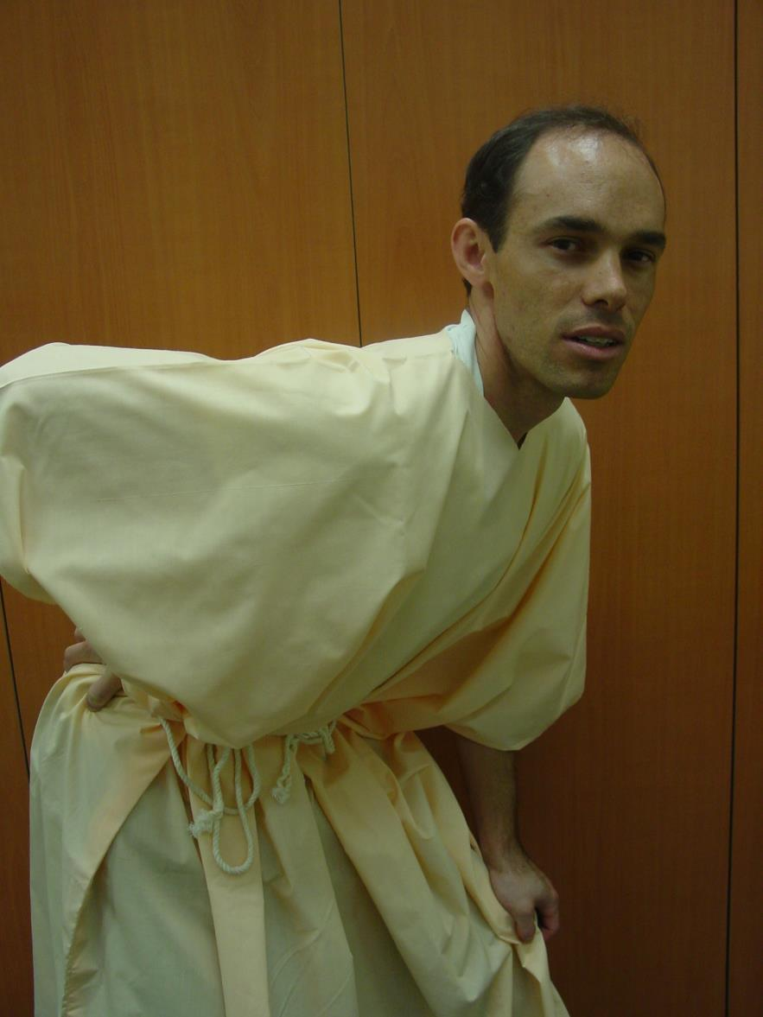
The Poor
我这疼痛的背。。等等。。为什么我的思想从我的耳朵出来？

Slide 49
提摩太前书

Slide 50
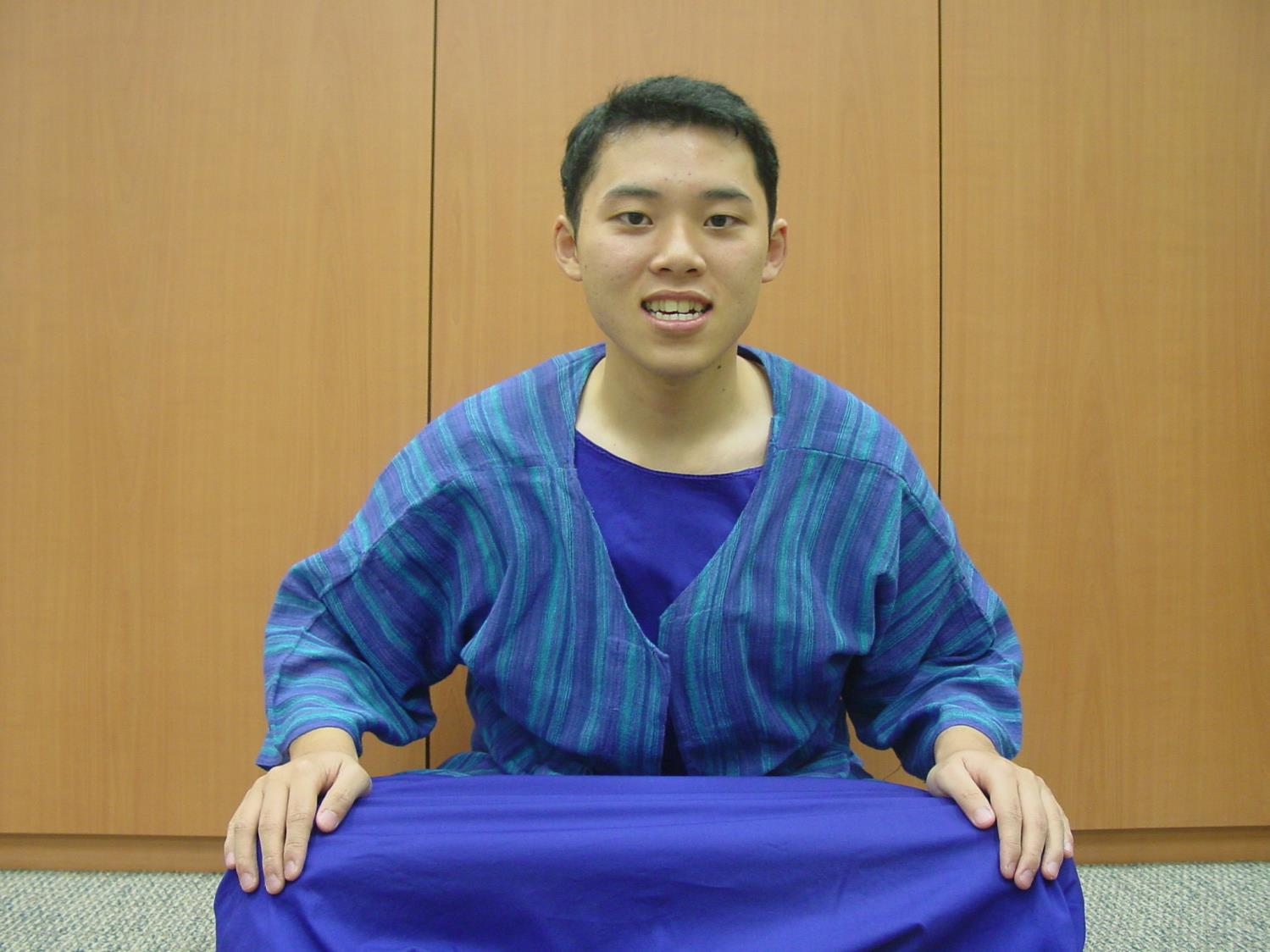
Young Timothy
我这么年轻。。我该怎样对他们说呢？

Slide 51
一个清晨的主日
在以弗所。。。

Slide 52
愿荣耀归给王
(提前1:17)
Now unto the King eternal
Unto the King immortal
Unto the King invisible
The only wise God, the only wise God
(repeat)
Chorus: Oh, unto the King be glory and honor
Unto the King forever
Unto the King be glory and honor
Forever and ever
Amen Amen
（左侧歌词大意）
愿荣耀归给那永恒的君王
愿荣耀归给那不朽的君王
愿荣耀归给那不可见的君王
唯一智慧的上帝，唯一智慧的上帝
（重复）
合唱：哦，愿荣耀与尊荣归给王
愿荣耀归给那永恒的君王
愿荣耀与尊荣归给王
直到永永远远
阿们，阿们

Slide 53

出埃及记背景

Slide 54
提摩太面临什么问题？
219
虚弱的胃
人看不起他
假教师想要因他们的教导而富有
女人想在教会教导信徒
寡妇的问题
心高气傲的富有的人
对领袖的控告

Slide 55

提摩太前书
背景

Slide 56

作者
218
普遍都认为是保罗写的
外在的证据: 初期教会教父普遍认为如此
内在的证据:
  书信宣称保罗是作者 (1:1)
  有保罗一贯的写信特征：神的呼召，用许多个人的名称， 以及保罗的神学重点。

Slide 57

写作日期
219
应该是保罗从罗马第一次监禁被释放之后(主后62年)，接近第二次被囚到最后被囚。
保罗大概主后68年去世。提摩太前书大概在
主后62年 之后写成。.

Slide 58

收信人
219
提摩太 (1:2) – 意思是“尊崇上帝”或“被上帝尊崇”
  路司得居民, 罗马省会加拉太的路司得城(使16:1-3).
  父亲: 希腊人; 母亲: 犹太妇人名称友尼基 （提后 1:5)
  保罗第一次宣教历程在路司得带领信主的 (使14:8-20)
保罗称提摩太为：
  “主里亲爱又忠心的儿子”
    (林前 4:17; 提前1:2; 提后 1:2)
  “同工” (罗 16:21; 帖前 3:2)

Slide 59
写作目的和地点
219
在米利都与以弗所长老开会时，保罗警告教会将来会有假教师起来讲歪曲悖谬的话，引诱门徒跟从他们。(使20:29-30).
保罗从第一次被囚释放后与提摩太到马其顿去。
他们在以弗所停留，保罗就发现假教议正在侵蚀教会。
  保罗把许米乃和亚历山大交给撒旦 (1:19-20).
  保罗将提摩太留在以弗所，作为他的代表，去阻止假教师的影响（1:3)
抵达马其顿时，保罗写了提摩太前书来激励和授权于提摩太来进行任务。

Slide 60
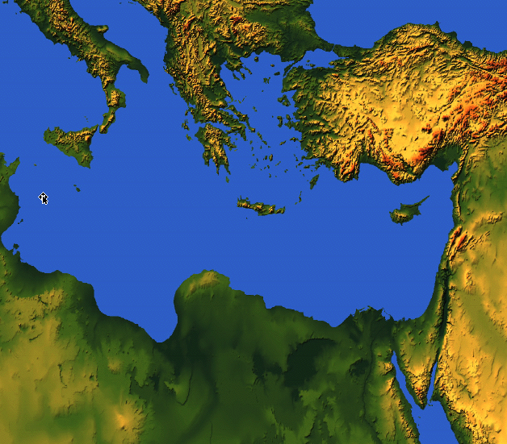

从哪里到哪里?
219
马其顿
以弗所

Slide 61
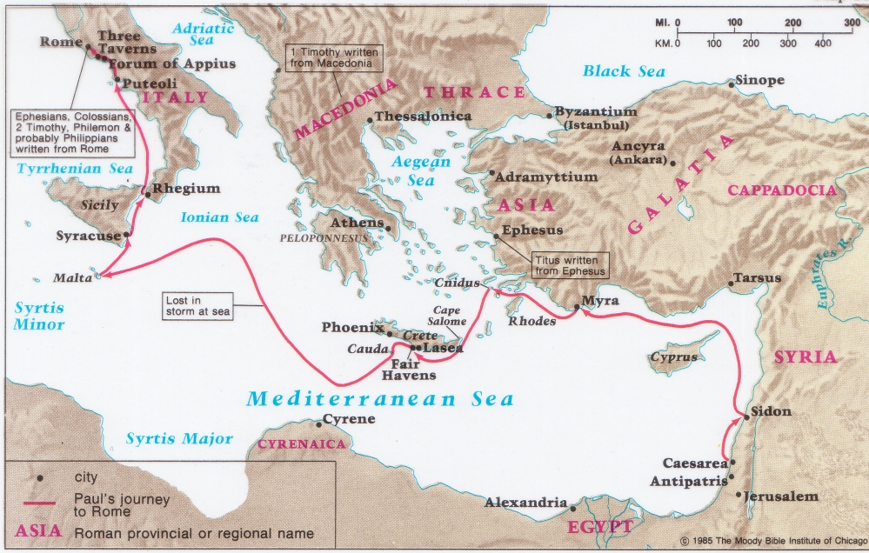
提摩太前书与提多书的来源
141
219
马其顿
以弗所

Slide 62
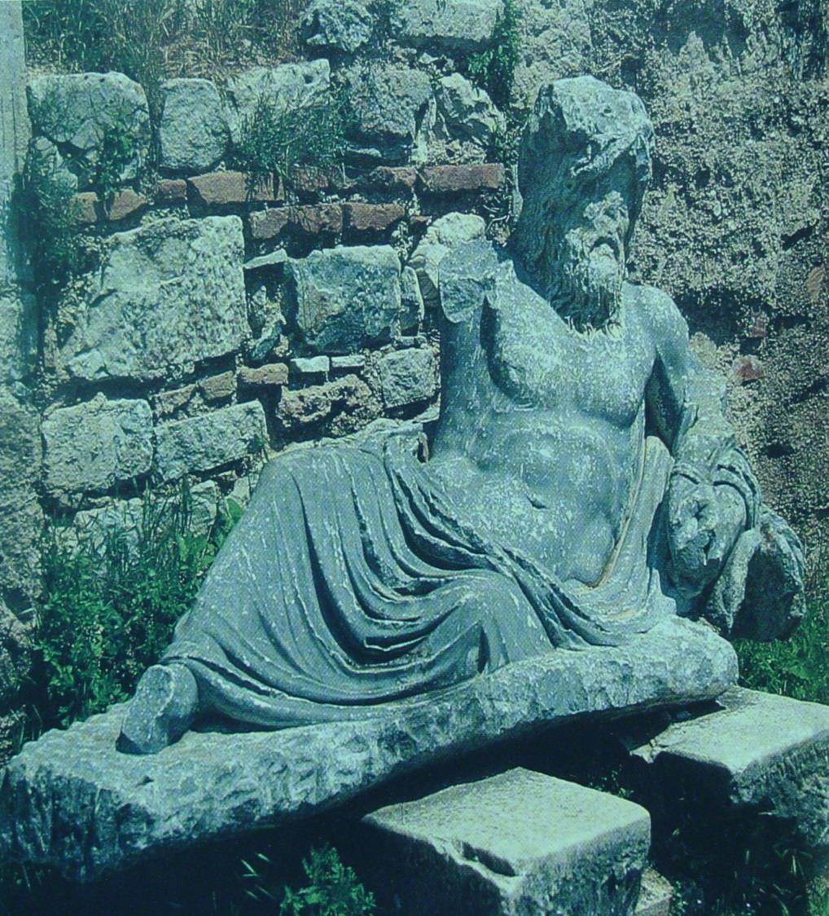
在米利都得神像(River Maeander), 保罗向以弗所教会长老们告别。
(使 20:17)

Slide 63
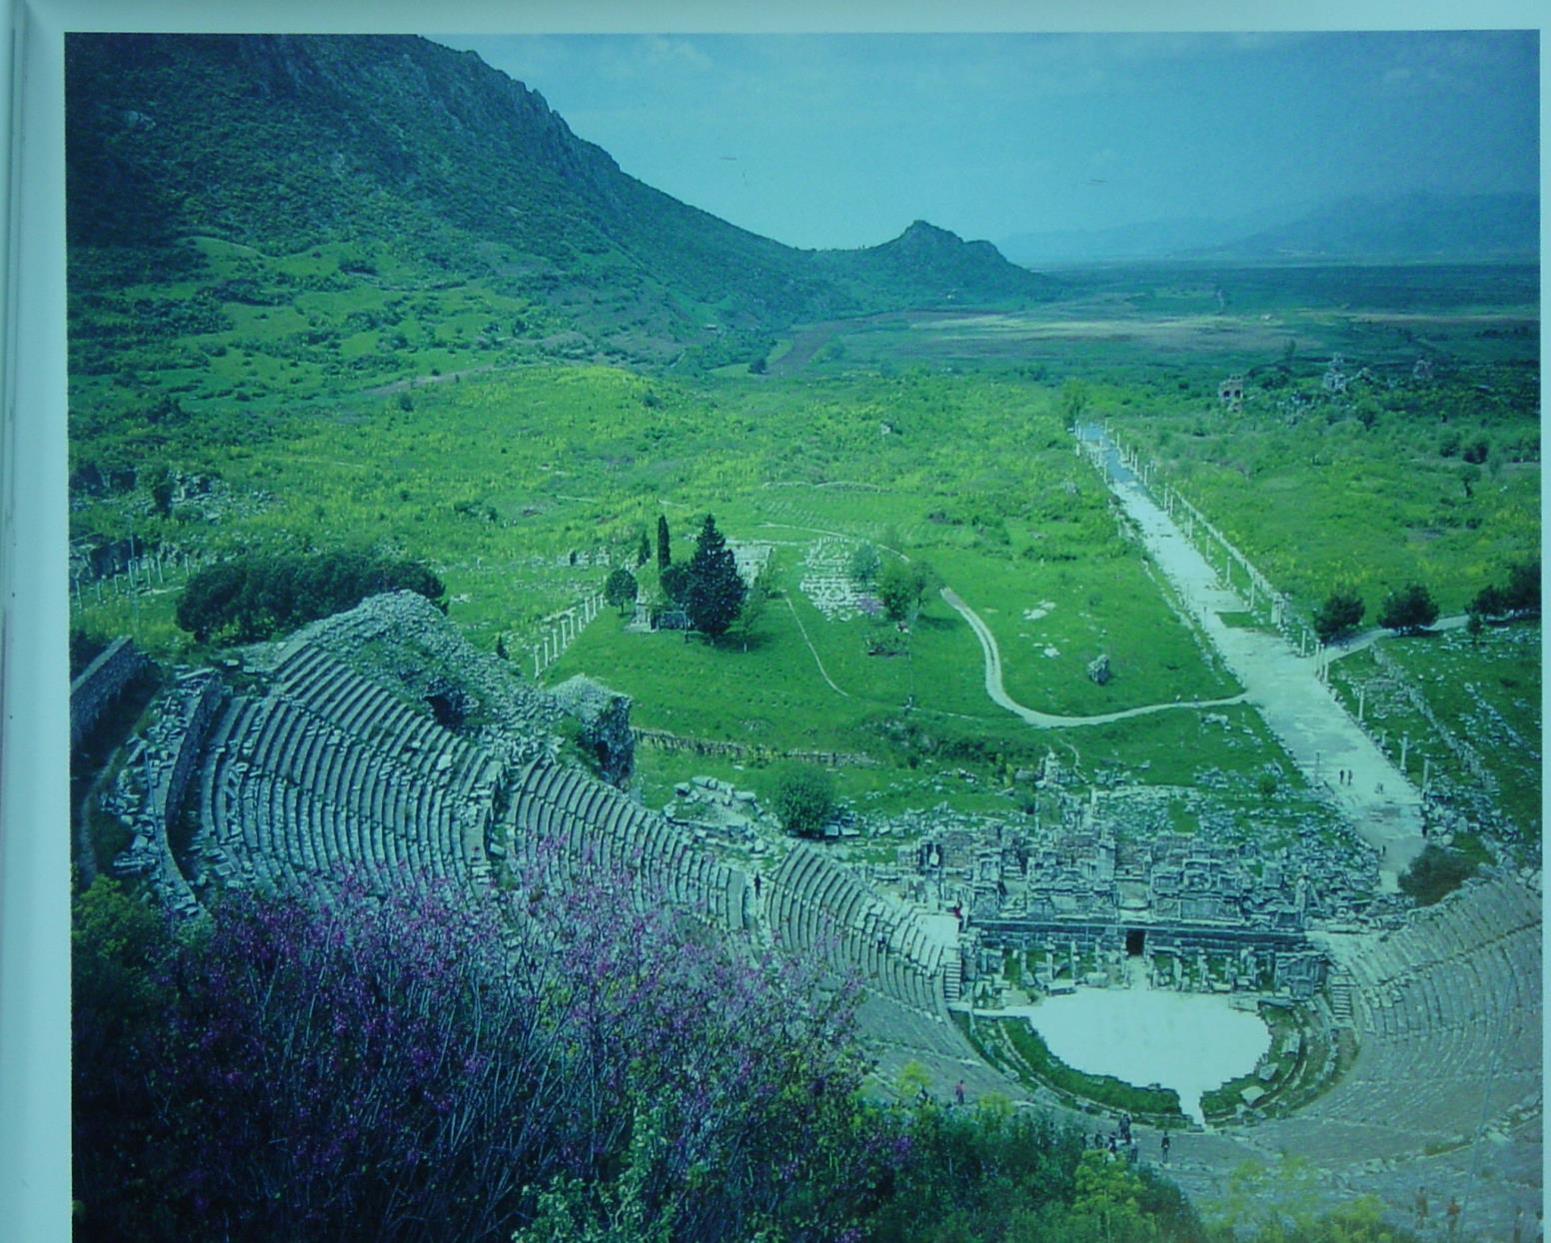
从以弗所剧院的高层往下看
从以弗所大剧院的上层看，远处可以看到通往古港口的长长的、笔直的阿卡迪亚大道，港口早已被淤泥覆盖。
180a

Slide 64
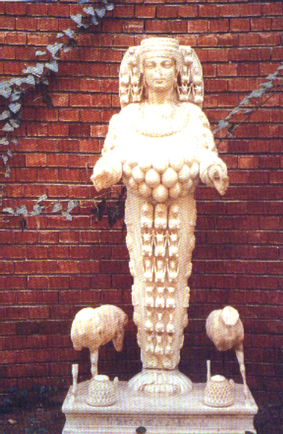
Artemis
阿耳忒弥斯
180d
Artemis 的神像，在以弗所拥有许多乳房的神像

Slide 65
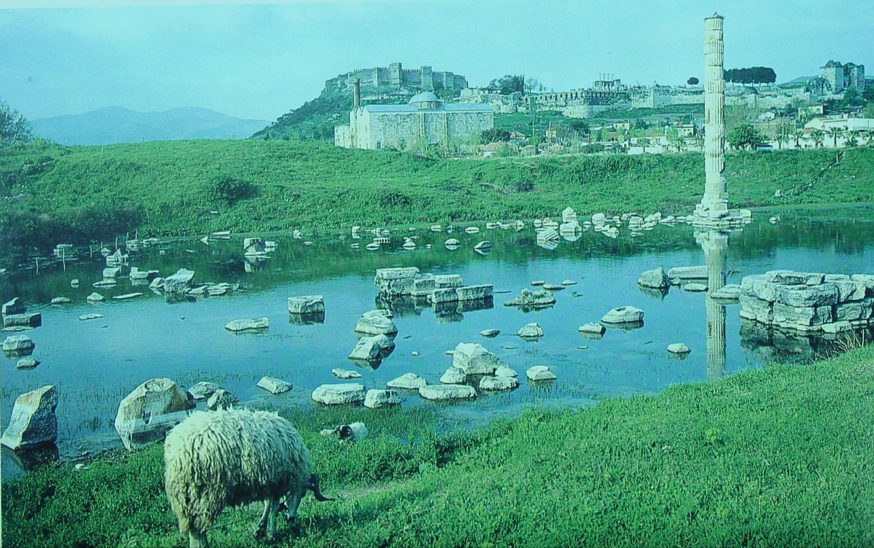
Artemis 阿耳忒弥斯的神殿
Citadel in background
这个池以把著名的Artemis (或戴安娜）
神殿淹没了，在提摩太前书写成时有的。

Slide 66
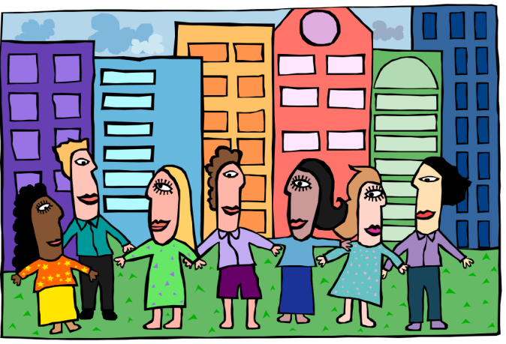
主题
220
教会的次序
“…我把这些事写给你…你也可以知道在神的家里应该这样行, 这家就是永活神的教会，真理的柱石和根基。 ” (提摩太前书 3:14-15)

Slide 67
大纲
220
第一章: 对付假教师
  假教师
  保罗与福音
  给提摩太的分付
第二章: 崇拜
  普遍对崇拜聚会的关切
  弟兄与姐妹在崇拜聚会的角色
第三章: 领袖
  作监督与执事的资格

Slide 68
大纲
220
第四章: 对提摩太的训勉
  假教师的警告
  生活与神学要谨慎
第五章: 对不同人的对待
  寡妇
  长老
  奴仆 (6:1-2)
第六章: 拥有物质
  腐败: 敬虔为得利的门路
  对比的态度：自主的敬虔t
  给提摩太的嘱咐: 操练敬虔为目标
  给富有人的命令: 把盼望放在神而不是财富
  给提摩太的嘱咐： 警戒所被委托的

Slide 69
要有次序
提摩太前书
Rick Griffith 博士 • Crossroads International Church Singapore
BibleStudyDownloads.org

Slide 70

假道
Notes:
False teaching is all around us. Beware!
The world has never had more “isms” than today. They don’t seem to die out. Like a cancer or virus, false teaching just seems to morph and replicate to attack in new ways.

Slide 71
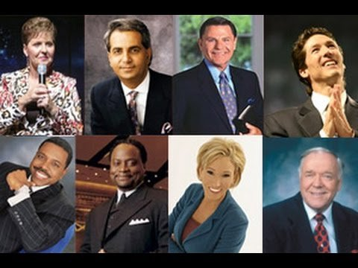
假道
Notes:
Heresies have never been more accessible. You could find me 100 false theologies right there in your seat on your smart phone before you stand up!
异端邪说从未如此触手可及。你只需要在座位上，拿起智能手机，在站起来之前，我就能让你找到100个错误的神学观点！

Slide 72
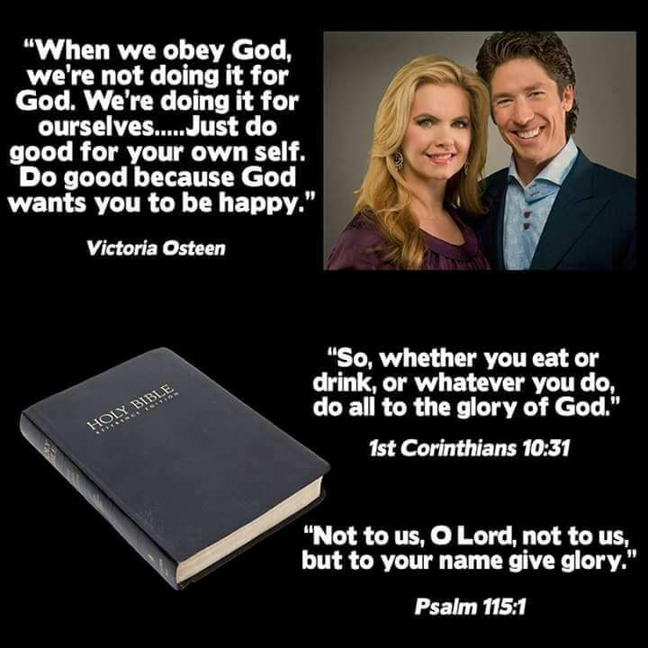
但我们能击败异端吗？
“当我们服从上帝时，我们不是为了上帝而做。我们是为了自己做的……
只为自己做好事。做好事，因为上帝希望你快乐。
”
—Victoria Osteen—
维多利亚·奥斯汀
“所以，你们或吃或喝，无论做什么，都要为荣耀神而行。”
哥林多前书10:31
耶和华啊，荣耀不要归于我们，不要归于我们，要因你的慈爱和诚实归在你的名下！
诗篇115:1
Notes:
But the Bible says, “Do all to the glory of God” (1 Cor 10:31)!
但是圣经说：“无论做什么，都要为荣耀神而行”（哥林多前书 10:31）！

Slide 73

Order
如何通过对基督徒撒谎致富
“通过讲述虚假的福音欺骗基督徒的7个步骤”
乔尔·奥斯汀
Notes:
Should we just buy a book on it?
Or should we just live and let live?
我们是不是应该买一本书来研究一下？
还是应该让其自生自灭，随它去？

Slide 74
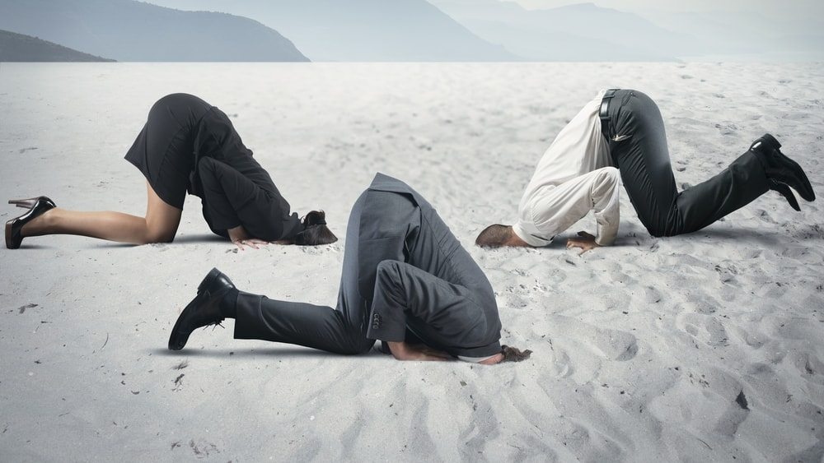
我们应该把头埋在沙子里吗？

Slide 75
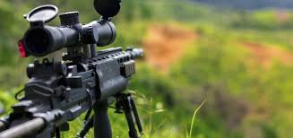
我们应该进行全面攻击吗？

Slide 76
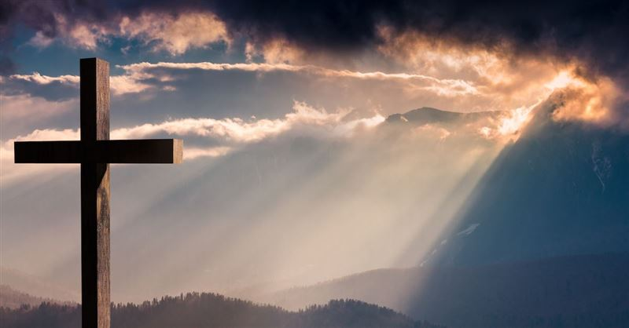
我们应该看看上帝如何说要击败异端吗？
Notes:
This seems the best strategy to me! Here is what he says…
在我看来，这似乎是最好的策略！这是他所说的……

Slide 77
关键节
217
“… 我把这些事写给你，希望不久可以到你那里去； 假如我来迟了，你也可以知道在 神的家里应该怎样行。这家就是永活 神的教会、真理的柱石和根基。”
(3:14-15)。
提摩太前书

Slide 78
主要思想
借着遵守上帝对教会次序的优先重点，
我们能够抵挡假教师。
提摩太前书

Slide 79
神对教会次序的优先重点
是什么？
提摩太前书

Slide 80
主题
23
教会的先后次序
提摩太前书

Slide 81
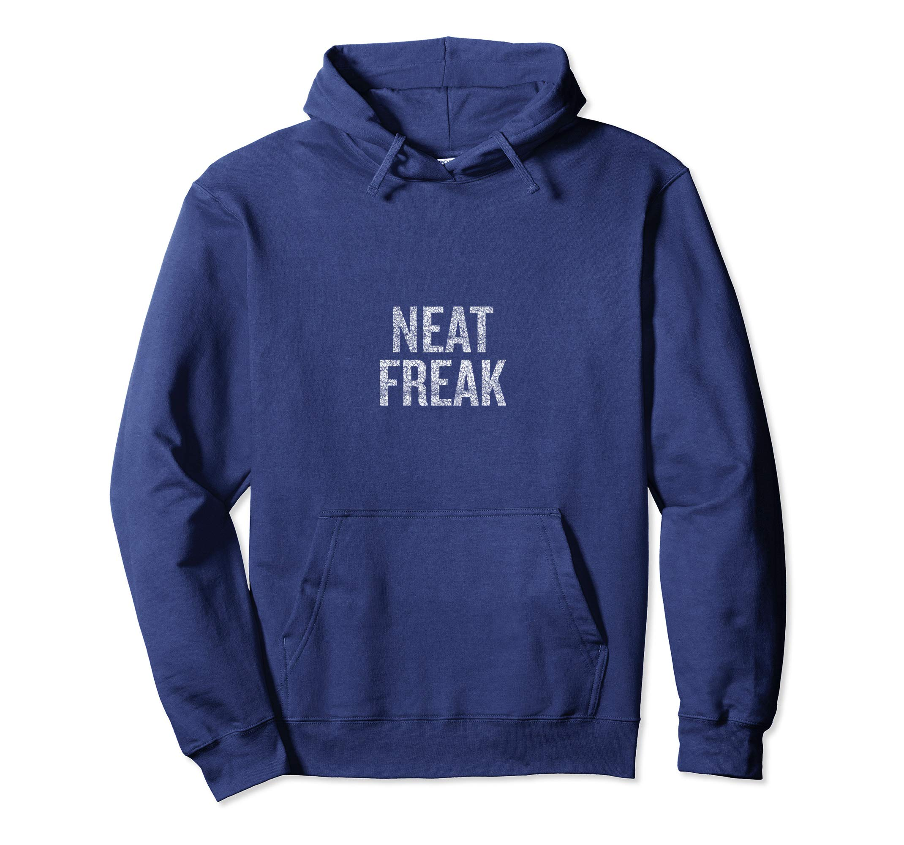
整洁
怪人

Slide 82

有序意味着……
管理，控制，引导，正确行事，得体行事，文明，善良，友善，表现最佳。
有序的其他词是什么？

Slide 83
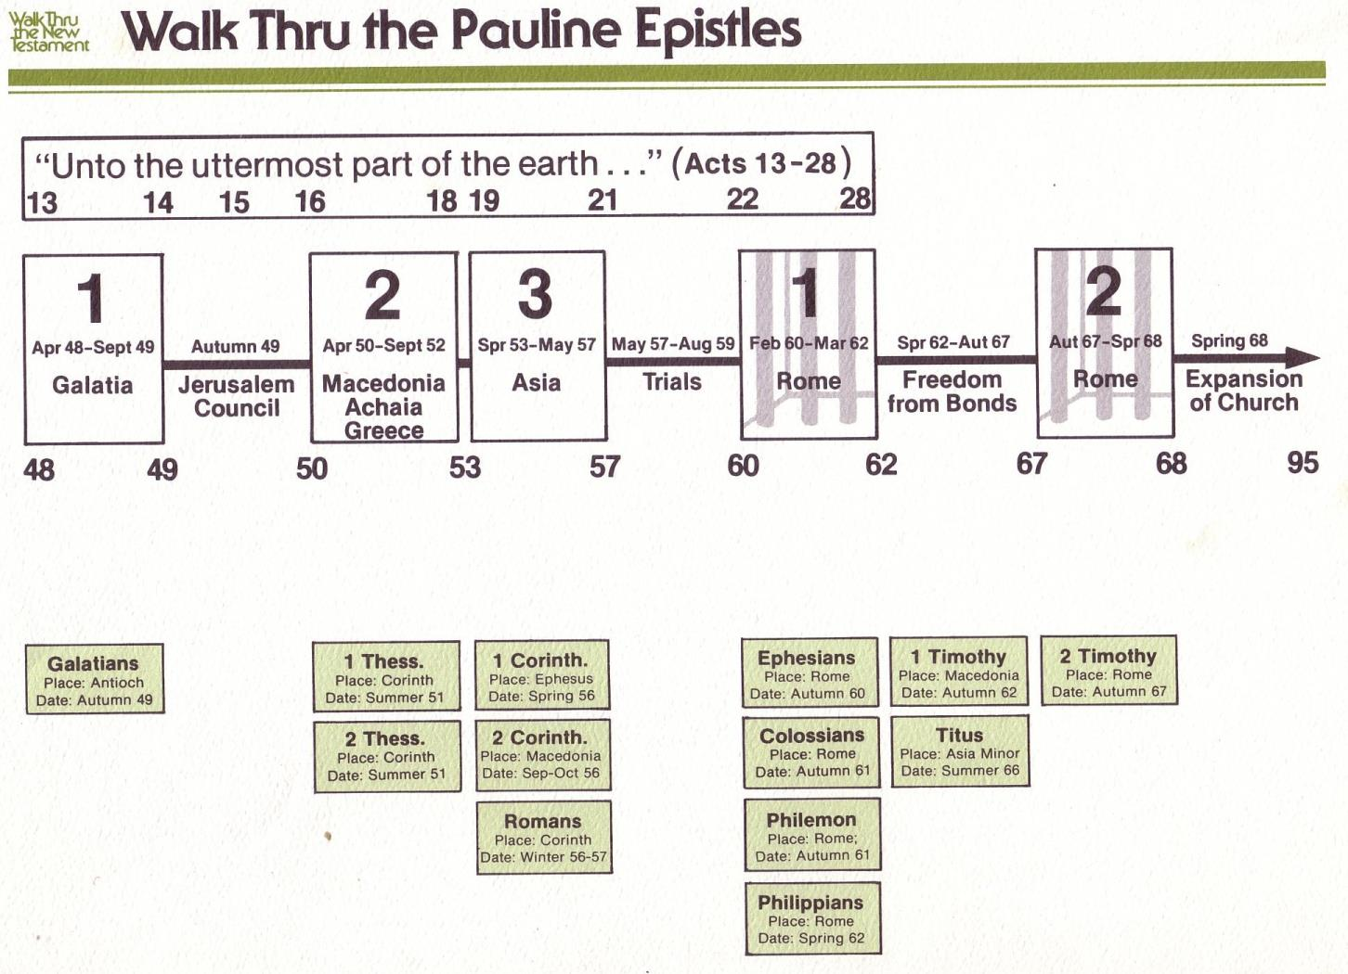
Walk Thru the Pauline Epistles
143
新约综览 (保罗书信)
143
38
124
39-41
保罗书信综览
「直到世界最偏僻的地方」 (徒 1:8)
徒 9 13 14 15 16 18 21 27 28
罗马书是保罗宣教书信的最后一卷书，但却是新约书信
中的第一本
夏 35-
37
大马士革
安提阿
四月 48-
九月 49
1
加拉太
四月 50-
九月 52
2
爱琴海
春 53-
五月 57
3
亚细亚
五月 57-
八月 59
试验
二月 60-
三月 62
1
罗马
春62-
冬 67
4
西班牙
秋 67-
春68
2
罗马
冬 49
公会
春 68
教会扩展
35 48 49 50 52 53 57 60 62 67 68 95
马太
宣教
路加
使徒行传
马可
约翰
监狱
教牧
加
帖上
林前
弗
提前
提後
東方宣教
帖下
林後
西
多
宣教
罗马
門
教牧
腓
福音和使徒行传
1234
旅程
监狱
保罗书信
罗马
收监
Pauline
Notes:
NS-25-1 Tim-83

Slide 84
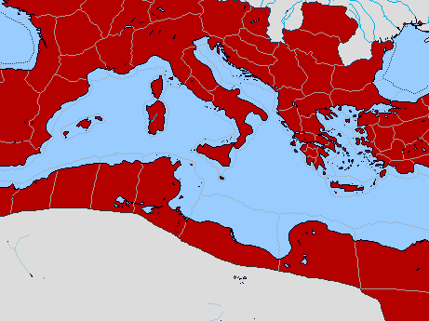
Bible Lands Blank Map
保罗的使徒行传后的旅程
142
罗马
马其顿
西班牙
以弗所
提摩太前书
克里特
© https://www.deviantart.com/sharklord1/art/Alt-Roman-Empire-Provinces-701148110

Slide 85

你不能让一切都成为优先事项。
待办事项清单：
一切
Notes:
Purpose: Why is this letter in the Bible?
It is not enough just to know the importance of combating heresy. We need to know how to do it!
This letter is not the only solution, as other letters also address how to fight false teachers. But it does give us five important handles on to be victorious in maintaining church order in an environment of false teaching.
目的：这封信为什么在圣经中？
仅仅知道打击异端的重要性还不够。我们需要知道如何去做！
这封信不是唯一的解决方案，因为其他信件也提到了如何对抗虚假的教师。但它确实给了我们五个重要的指导原则，帮助我们在错误教义的环境中，胜利地维持教会的秩序。

Slide 86

…秩序
最重要的优先事项
Notes:
Paul gives five priorities to maintain church order so the heretics will be defeated.
保罗给出了五个优先事项来维持教会秩序，以便击败异端。

Slide 87
I. 你的生命要在律法与 恩典 中取得平衡
(第一章)。
提摩太前书
Notes:
Avoid the extremes of too many rules and too few rules.
避免极端，既不要有太多规则，也不要有太少规则。

Slide 88
Slides on
提摩太前 1

Slide 89

1奉我们的救主 神，和我们的盼望基督耶稣的命令，作基督耶稣使徒的保罗，2写信给因信主而作我真儿子的提摩太。愿恩惠、怜悯、平安从父 神和我们的主基督耶稣临到你。
3我往马其顿去的时候，曾经劝你留在以弗所，为要嘱咐某些人，不可传别的教义，4也不可沉迷于无稽之谈和无穷的家谱；这些事只能引起争论，对于 神在信仰上所定的计划是毫无帮助的。
提摩太前书 1

Slide 90
5这嘱咐的目的是出于爱；这爱是发自纯洁的心、无愧的良心和无伪的信心。6有些人偏离了这些，就转向无意义的辩论，7想要作律法教师，却不明白自己讲的是甚么，主张的又是甚么。
8我们知道律法是好的，只要应用得恰当。9要知道律法本来不是为义人设立的，而是为那些无法无天和放荡不羁的、不敬虔和犯罪的、不圣洁和世俗的、弒父母和杀人的、
提摩太前书 1

Slide 91
10淫乱的、亲男色的、拐带人口的、说谎话的、发假誓的，以及为其他抵挡纯正教训的人设立的。11这是照着可称颂之 神所交托我的荣耀福音说的。
12我感谢那赐我能力的、我们的主基督耶稣，因为他认为我有忠心，派我服事他。13我从前是亵渎 神的、迫害人的、凌辱人的，然而我还蒙了怜悯，因为我是在不信的时候，由于无知而作的。14我们主的恩典，随着在基督耶稣里的信心和爱心，在我身上越发增加。
提摩太前书 1

Slide 92
15“基督耶稣降世，为要拯救罪人。”这话是可信的，是值得完全接纳的。在罪人中我是个罪魁。16可是，我竟然蒙了怜悯，好让基督耶稣在我这个罪魁身上，显明他完全的忍耐，给后来信他得永生的人作榜样。17但愿尊贵荣耀归给万世的君王，就是那不朽坏、人不能见、独一的 神，直到永永远远。阿们。
提摩太前书 1

Slide 93
18我儿提摩太啊！我照着从前关于你的预言，把这命令交托你，为的是要叫你借着这些预言打那美好的仗。19常常存着信心和无愧的良心。有些人丢弃良心，就在信仰上失落了。20他们当中有许米乃和亚历山大，我已经把他们交给撒但，使他们受管教不再亵渎。
提摩太前书 1

Slide 94

健康的
教会
保护
福音
《提摩太前书》1:1-11
由Dr. Jim Harmeling吉姆·哈梅林博士在新加坡 十字路国际教会讲道
上传者：瑞克·格里菲斯博士 • 新加坡神学院
成千上万的文件可以在BibleStudyDownloads.org网站免费下载，提供54种语言。

Slide 96
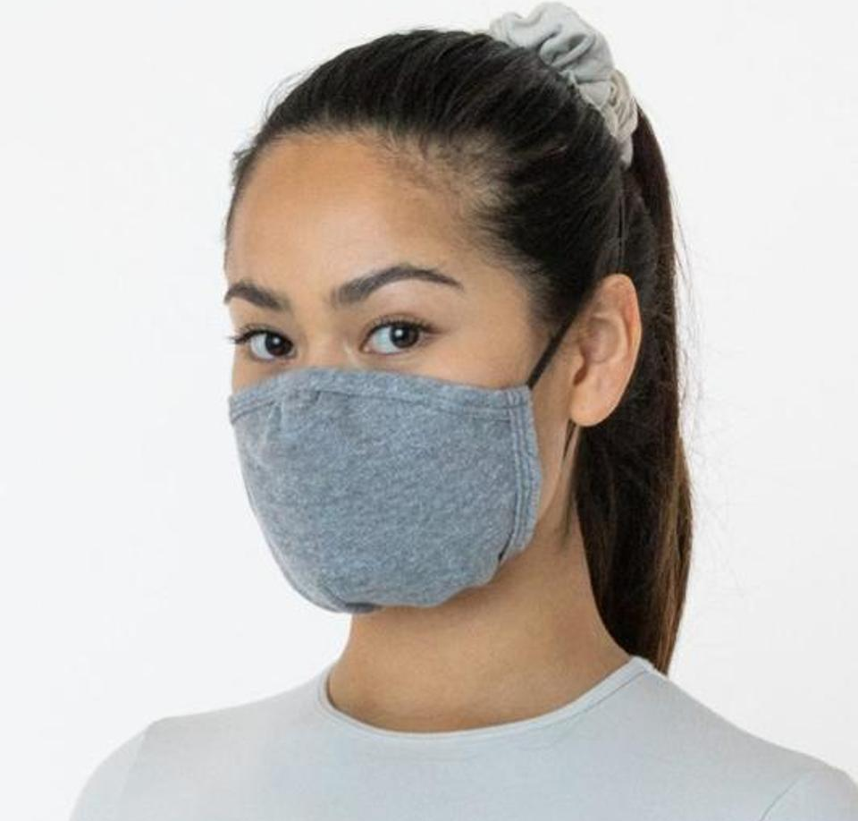
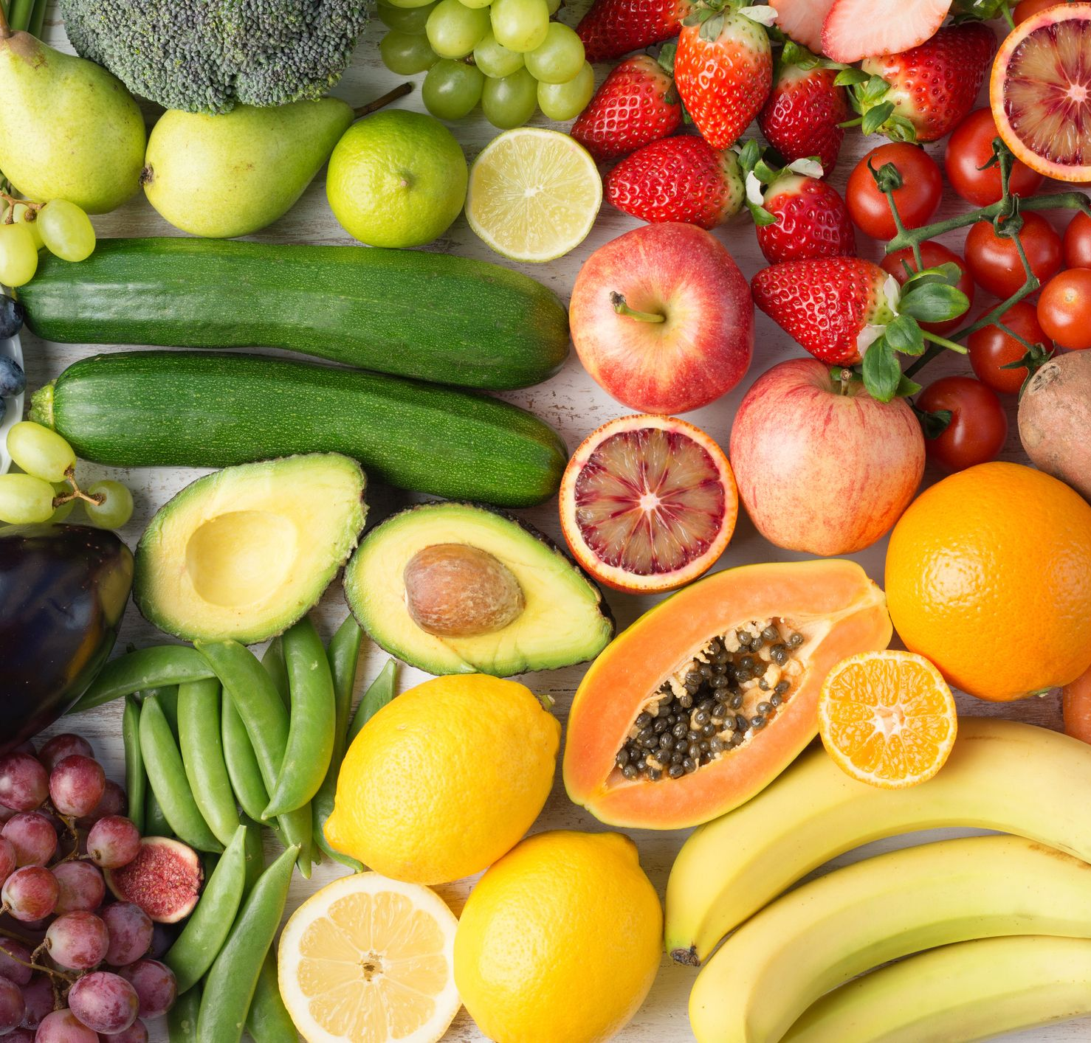


你如何保持健康？

Slide 97
健康的教会生活
提摩太前书研究

Slide 98



为孩子安全做家居防护

Slide 99
    1 – 健康的教会保护福音
    2 – 健康的教会祷告
    3 – 健康的教会培养敬虔的领袖
    4 – 健康的教会有良好的教导
    5 – 健康的教会彼此关爱
    6 – 健康的教会避免世俗化

Slide 100
健康的
教会
保护
福音
《提摩太前书》1:1-11

Slide 101
    使徒行传 20:29-31
    29 我知道我去之后，必有凶暴的豺狼进入你们中间，不爱惜羊群。
    30 就是你们中间也必有人起来，说悖谬的话，要引诱门徒跟从他们。
    31 所以你们应当警醒，记念我三年之久昼夜不住地流泪劝诫你们各人。

Slide 102
承认福音的权威（1-2节）
以弗所书 2:19-20
“19 所以你们不再是外人和客居的，而是与圣徒同国，是上帝家里的人，
20 并且被建造在使徒和先知的根基上，基督耶稣自己是房角石。”

Slide 103
承认福音的权威（1-2节）
哥林多前书 9:1
我不是自由的吗？我不是使徒吗？我不是见过我们的主耶稣吗？你们不是我在主里面所做之工吗？
哥林多后书 12:12
我在你们中间用百般的忍耐，借着神迹、奇事、异能，显出使徒的凭据来。

Slide 104
承认福音的权威（1-2节）
不要偏离福音的目标（3-5节）

Slide 105



洁净的心
健康基督徒爱的特质
良心
真诚的信仰

Slide 106
神的72个名字
Kabbalah.com
这72个名字是72个由希伯来字母组成的三字母组合，每个组合通过字母本身将其独特的能量从上界引导到我们的世界。我们可以通过用意识的意图目光扫过这些字母来与它们连接，从而连接到它们的能量。
在卡巴拉中心，我们教导任何人都可以使用这些名字作为一种灵性工具，与内在的神圣本质之火花连接，并在种子层次——意识的层次上进行转化。

Slide 107
承认福音的权威（1-2节）
不要偏离福音的目标（3-5节）
在福音中保留律法（6-11节）

Slide 108

神的律法
神对圣洁和公义生活的标准（罗马书 7:12）
它要求内外的遵守（马太福音 5:17-30）
它揭示了我们有多么罪恶（罗马书 3:20）
它引领我们到基督面前寻求宽恕（加拉太书 3:23-27）
• 不可杀人。
• 不可奸淫。
• 不可偷盗。
• 不可作假见证陷害人。
• 不可贪恋人的妻子。
• 除我以外，你不可有别的神。
• 不可为自己雕刻偶像。
• 不可妄称耶和华你神的名。
• 记住安息日，将其分别为圣。
• 当孝敬父母。

Slide 109
健康的
教会
保护
福音
提摩太前书 1:12-20
Preached by Dr. Jim Harmeling
at Crossroads International Church Singapore • cicfamily.com
Uploaded by Dr. Rick Griffith • Singapore Bible College
Thousands of files in 49 languages for free at BibleStudyDownloads.org

Slide 110

他们捍卫信息
提摩太前书 1:1-11
• 承认权威
• 不要偏离目标
• 保留律法

Slide 111

他们活出信息
提摩太前书 1:12-20

Slide 112

将福音应用于你自己的生活（1:12-17）
将生命改变归功于神（12节）
回忆得救前的状态（13节）

Slide 113
使徒行传 22:3-5
3 保罗说：“我原是犹太人，生在基利家的大数，长在这城里；在迦玛列门下，按着我们祖宗严紧的律法受教；热心侍奉神，像你们众人今日一样。 4 我也曾逼迫奉这道的人，直到死地，无论男女都锁拿下监。 5 这是大祭司和众长老都可以给我作见证的。我又领了他们达于弟兄的书信，往大马士革去，要把在那里奉这道的人锁拿，带到耶路撒冷受刑。

Slide 114
使徒行传 26:9-11
9 从前我自己以为应当多方攻击拿撒勒人耶稣的名， 10 我在耶路撒冷也曾这样行了。既从祭司长得了权柄，我就把许多圣徒囚在监里；他们被杀，我也出名定案。 11 在各会堂，我屡次用刑强逼他们说亵渎的话，又分外恼恨他们，甚至追逼他们，直到外邦的城邑。

Slide 115
傲慢的对手 - 狂妄（Hubris）
“相应的抽象名词是hubris，亚里士多德将其定义为：‘Hubris’（狂妄）意味着伤害和使人悲痛，以至于受害者感到羞辱和悲伤，而不是施害者因伤害他人而获得任何额外的利益，而只是因为他在自己的残忍和他人的痛苦中找到快感。”
威廉·巴克莱
William Barclay

Slide 116


Slide 117
将福音应用于你的生活（1:12-17）
将生命改变归功于神（12节）
回忆得救前的状态（13节）
解释神如何改变你（14节）

Slide 118
腓立比书 1:29
“因为 神为了基督的缘故赐恩给你们，使你们不单是信基督，也是要为他受苦”
罗马书 2:4
还是你藐视 神丰富的恩慈、宽容和忍耐，不晓得他的恩慈是要领你悔改的吗？

Slide 119
将福音应用于你的生活（1:12-17）
将生命改变归功于神（12节）
回忆得救前的状态（13节）
解释神如何改变你（14节）
宣告福音拯救所有罪人（15节）
确信耶稣是忍耐的（16节）
赞美基督带来的生命改变（17节）

Slide 120
将福音应用于你的生活（1:12-17）
挑战信徒持守信仰（1:18-20）
群体责任帮助我们持守信仰（18节）
我们的良心帮助我们持守信仰（19a节）
失败的例子成为警戒，帮助我们坚定不移
（第19节下-20节）

Slide 121

律法主义

Slide 122
神对教会次序的优先重点
是什么？
提摩太前书

Slide 123
I. 你的生命要在律法与 恩典 中取得平衡
(第一章)。
提摩太前书
Notes:
Avoid the extremes of too many rules and too few rules.
避免极端，既不要有太多规则，也不要有太少规则。

Slide 124
II. 需要在虔诚领袖的带领下有公共的敬拜生活 (第二至三章)。
提摩太前书
Notes:
Our church services must main order by not just letting anyone lead.
我们的教会崇拜必须保持秩序，不可让任何人随意带领。

Slide 125
Slides on
提摩太前 2

Slide 126
健康的教会
祷告
提摩太前书 2:1-7
讲道者： Jim Harmeling 博士
地点： （Crossroads International Church Singapore） 网站： cicfamily.com
上传者： Rick Griffith 博士 • 新加坡圣经学院（Singapore Bible College）
资源： 提供 54 种语言的数千份免费文件，访问 BibleStudyDownloads.org

Slide 127

为福音带来的
悔改祷告

Slide 128

“恳求、祷告、代求和感谢”
祷告涉及对神勤恳且充满情感的恳求和迫切的哀求。
祷告包含清晰、深思熟虑的言辞，这些言辞符合正确的圣经原则。
祷告包括因神和祂回应祷告而喜乐并感恩。

Slide 129

福音包容性的祷告：为每个人的灵魂祷告（2:1-4）
这影响国家领导人（第1节）
这使神喜悦（第3节）
这使人归向真理（第4节）

Slide 130
福音包容性的祷告：为每个人的灵魂祷告（2:1-4）
福音排他性的祷告：为人们接受纯正的福音祷告（2:5-7）
只有一位神（第5节上）
只有一位神与人之间的中保（第5节下）

Slide 131

“保罗论证说，因为只有一位神，所以所有人都必须成为祷告的对象，因为所有人唯有通过这位独一的神和唯一的中保才能得救。”
威廉·芒斯（William Mounce）

Slide 132
13 你们要进窄门；因为引到灭亡，那门是宽的，路是大的，进去的人也多。
^{14 引到永生，那门是窄的，路是小的，找着的人也少。}
^{马太福音7:13-14}

Slide 133
福音包容性的祷告：为每个人的灵魂祷告（2:1-4）
福音排他性的祷告：为人们接受纯正的福音祷告（2:5-7）
只有一位神（第5节上）
只有一位神与人之间的中保（第5节下）
只有一个赎价，使我们得赦免（第6节上）

Slide 134
“因为人子来，并不是要受人的服事，乃是要服事人，并且要舍命作多人的赎价。”
马可福音 10:45（和合本）

Slide 135
福音包容性的祷告：为每个人的灵魂祷告（2:1-4）
福音排他性的祷告：为人们接受纯正的福音祷告（2:5-7）
只有一位神（第5节上）
只有一位神与人之间的中保（第5节下）
只有一个赎价，使我们得赦免（第6节上）
只有一次献上赎价（第6节下）

Slide 136
及至时候满足， 神就差遣他的儿子，为女子所生，且生在律法以下，
加拉太书 4：4

Slide 137
福音包容性的祷告：为每个人的灵魂祷告（2:1-4）
福音排他性的祷告：为人们接受纯正的福音祷告（2:5-7）
只有一位神（第5节上）
只有一位神与人之间的中保（第5节下）
只有一个赎价，使我们得赦免（第6节上）
只有一次献上赎价（第6节下）
有受差遣的使者来宣扬这一真理（第7节）。

Slide 138
提摩太前书
论战：
女人在崇拜聚会的职份

Slide 139
  A. 女性不应该担任牧师或教师的角色，对整个教会行使权威。
222i
  B. 女性不应该担任长老或教会最高领导委员会中的其他职务。
  C. 女性不应该在教会敬拜中担任主要的敬拜领袖。
  D. 女性不应该担任成人基督教教育主任的职位，对男性教师行使权威。
  E. 女性不应该担任儿童主日学主任的职位，对男性教师行使权威。
  F. 女性不应该在教会建筑中教授混合性别的成人主日学课程。
  G. 女性不应该在私人家中教授混合性别的成人小组课程。
  H. 女性不应该在神学院或圣经学院教授混合性别的圣经研究课程。
  I. 女性不应该在神学院或圣经学院教授混合性别的非圣经课程。

Slide 140
避免极端
逐字翻译Literalism
高举 真理+文化
2:8 男人必须举起圣洁的手随处祷告。
2:9-10 女人不可以辫 发或带金饰珠宝。
2:11-12 在任何情况下，女人都不可以教导男人。
自由主义Liberalism
消除真理+文化
所有的教导都过时和不相干的，只是暂时的规则来面对当时的情况。

Slide 141
文化与真理的不同
文化
会变的
圣经的作者和读者是在时间的范围里
提供分析资料
具体和明确
真理
不变的
超越时间
提供构成整体的真理
普遍的

Slide 142

男人的祷告 2:8
男人祷告的责任

Slide 143
男人的祷告 2:8
应用 1 :
文化
祷告的身体姿态：站着，跪着，坐着，拍手 或举手。
真理
男人要随处于圣洁和爱来祷告。

Slide 144

女人的装饰 （2：9-10）
衣裳
头发
金饰珠宝

Slide 145
女人的装饰 （2：9-10）
应用 2:
文化
女人的衣裳，头发和金饰珠宝可随文化而变化。
真理
女人要以端正，娴淑，自律和善行为装饰。

Slide 146

顺服 2:11-12
女人与男人的关系

Slide 147

女人应该作的是什么?
女人在外邦人与敬虔的社会，从前与现在

Slide 148
「女人要沉静学道，一味的顺服，我不许女人讲道，也不许她辖管男人，只要沉静。」—提前2:11-12
148

Slide 149

谁愿意来处理这个问题？
日历
约翰逊
“我来负责感恩节、圣诞节、新年和复活节的讲道。‘教会中女性的角色’、‘今日方言’、‘圣经无误性’以及我们特别的‘筹款主日’，就交给你了。”

Slide 150

彼此平等论
互相补足论
NT Wright
Ben Witherington III
Gordon Fee
Scot McKnight
Ruth A. Tucker
Walter C. Kaiser
Jim Wallis
Rachel Held Evans
Gilbert Bilezikian
J.I. Packer
Tim Keller
John F. MacArthur
C.S. Lewis
John Piper
John Wimber
Mark Driscoll
Elisabeth Elliot
Douglas Wilson
vs
150

Slide 151

共同基础
它不像童女怀孕，基督的神性，靠恩典得救般重要
我们能够在爱里异中求同
我们能在公众场合向别人学习神的话
151

Slide 152


“超越政治的潘朵拉讲台”
152

Slide 153
「女人要沉静学道，一味的顺服，我不许女人讲道，也不许她辖管男人，只要沉静。」—提前2:11-12
153

Slide 154
女人该做什么呢？
161o
注意：以下三个经文的上下文都关于公众敬拜
看来林前11与林前14及提前2有矛盾
哥林多前书11 | 哥林多前书14 | 提摩太前书2
能公众祷告(5,13) |  | 公众祷告只有男人(8)
能公众讲道(5) | 不能说话(34) | 一定要安静(12c)
说话是可以的(含蓄的) | 说话是可耻的(35)
 |  | 不能教男人(12a)
 |  | 不许辖管男人(12b)
蒙着头是一般的(16) | 安静是一般的(33) | 男人祷告是一般的(8)
哪一个经文是一般的规律(普通)和哪一个是例外？
想知道如何解决这些矛盾，请看接下来的八面！

Slide 155
I. 平静的学习
「女人要沉静学道，一味的顺服，我不许女人讲道，也不许她辖管男人，只要沉静。」——提前2:11-12
Hesuchia包含两个意思：
A. 培养内在的安静及专注
B. 安静：搁下其他的关注，允许时间
—「你们要休息，要知道我是神。」（诗46:10）
155

Slide 156
II.敬重的学习，而非纂权
「女人要沉静学道，一味的顺服，我不许女人讲道，也不许她辖管男人，只要沉静。」——提前2:11-12
A. 即使不同意，也要敬重
—讲者要「按正意分解神的道」（提后2:15）
听者要学习
—批判的思想而非批评的态度
156

Slide 157
II.敬重的学习，而非纂权
「女人要沉静学道，一味的顺服，我不许女人讲道，也不许她辖管男人，只要沉静。」——提前2:11-12
B.不可纂夺权位
——要受教；抑制反对精神
——「我口所出的话也必如此，决不徒然返回，
却要成就我所喜悦的，在我发他去成就的事上必然亨通。」（赛55:11）
——神使用「差劲」的讲章！
157

Slide 158

以平静及敬重的心学习
158

Slide 159

Q:但为什么保罗禁止女性在公开崇拜中教导男性？
A:因为她们受教育程度较低吗？

Slide 160


提摩太前书 2:11-15
¹¹女人应该安静而完全顺服地学习。
¹²我不准 女人教训男人，辖制男人；
女人总要安静。
¹³因为先造的是亚当，后造的夏娃。 ¹⁴不是亚当受了引诱，而是女人受了引诱，陷在过犯里面。¹⁵然而女人要是常常存着信心，爱心，圣洁自律，在她生育的事上必定得救。

Slide 161
女人的顺服 2:11-12
应用 3:
文化
安静学习
不可以教导?
真理
完全的顺服
在教会里，不可以教训或辖制男人

Slide 162
文化: 静默与教导
顺服在不同的文化是不一样的，不一定要以静默来表现。
如果女人教导男人，是不是说他们就是在辖制他们？
人教导时，权柄是在神的话语，不是在人身上。

Slide 163
真理：权柄-顺服
女人顺服的基本原则: 堕落2:14
误解: 女人在堕落时就显示她们容易受骗，所以她们不应该教导男人。
反对: 如果女人容易受骗，她们就不应该教导任何人，不只是男人。保罗指的是女人在教导儿女和年轻的夫人所扮演的特别的角色（提多书2：4）。
真理: 夏娃在堕落的罪不只是受骗，而是她篡夺了亚当的权柄，交换了彼此的角色。

Slide 164
提摩太前书 2:11-14
结论：
姐妹可以站讲台吗？
不可以，除非她没有戴权柄

Slide 165
Slides on
提摩太前 3

Slide 166
提摩太前书
教会生活与次序

Slide 167



如何在教会里挑选领袖？
好名声
背景
精明
皮夹子
专业
167

Slide 168
教会当如何挑选领袖？
圣经例子：
会众决定/推举
INTRODUCTION
身体
a. 使徒
徒1:12-26——会众选出，使徒指派
b. 执事
徒6:3——会众选出，使徒指派

Slide 169

教会同工的指派
INTRODUCTION
使徒（例：保罗）或他的助手按立长老
a. 徒14:23
b. 多1:5
身体
169

Slide 170


长老的资格是什么？
170

Slide 171

在前方带领，不要从后面驱赶
《羊群手册》
现代牧羊人的指南
不要专制
要敏感于需求

Slide 172
健康教会
生活
提摩太前书研究

Slide 173
健康教会培养虔诚的领袖
提摩太前书
第3章1-7节

Slide 174

他们培养虔诚的长老
（1-7节）

Slide 175

回顾
1 提摩太后书 2:11-14
男性应领导教会
女性依然可以说话
女性依然可以教导
女性依然可以领导

Slide 176
“人若想要得监督的职分，就是羡慕善工，这话是可信的。”
长老 = 谁？年长的男性
监督 = 做什么？监督
牧师 = 如何？像牧羊人

Slide 177
使徒行传 20:17, 28
^{17 他从米利都派人去以弗所，请教会的长老来。}
28 圣灵既然立你们为全群的监督，牧养 神用自己的血所赎来的教会，你们就应当为自己谨慎，也为全群谨慎。

Slide 178
彼得前书 5:1-2
我这同作长老，也是为基督受苦作见证，又是同享将来所要显现的荣耀的，劝你们当中作长老的：
务要牧养在你们中间的 神的羊群，按着 神的旨意看顾他们。不是出于勉强，而是出于甘心；不是因为贪财，而是出于热诚；

Slide 179
14个教会监督的性格特质：
他们不是轻浮的（“只是一妻之夫”）。
2. 他们个人自律（“谨守自己”）。
3. 他们在心理和情感上平衡（“自我控制”）。
4. 他们不是失控的（“体面的”）。
5. 他们习惯好客（“好客的”）。
6.他们能够教导圣经（“善于教导”）。
7.他们不沉迷于化学品（“不是醉鬼”）。
8.他们能控制自己的脾气（“不暴力”）。
9.他们为人体贴（“温柔的”）。

Slide 180

温氏完全解释性词典
温柔：
“它表达了那种考虑周到的态度，以人道和理性的方式看待一个案件的事实。”

Slide 181
14个教会监督的性格特质：
他们不是轻浮的（“只是一妻之夫”）。
2. 他们个人自律（“谨守自己”）。
3. 他们在心理和情感上平衡（“自我控制”）。
4. 他们不是失控的（“体面的”）。
5. 他们习惯好客（“好客的”）。
6.他们能够教导圣经（“善于教导”）。
7.他们不沉迷于化学品（“不是醉鬼”）。
8.他们能控制自己的脾气（“不暴力”）。
9.他们为人体贴（“温柔的”）。
10.他们是和平制造者（“不争斗”）

Slide 182
14个教会监督的性格特质：
11.他们不贪爱钱财（“不贪财”）
12.他们管理自己的家庭良好（“他必须管理好自己的家庭，端正地使儿女顺服，因为人若不知道管理自己的家，怎能照管神的教会呢？”）
13.他们不是初信者（“他不可是初入教的，恐怕他自高自大，就落在魔鬼所受的刑罚里”）
14.他们在非信徒中有好的名声（“他必须在外人中有好名声，免得被辱骂，落在魔鬼的网罗里”）

Slide 183


Slide 184
监督(O) 与执事(d) 的品质
224
一般的名誉
    (察觉品格)
  无可指摘 (O)
  教外有好名誉 (O)
  庄重 (O & D)

Slide 185

监督(o)与执事(d)的品质
225
II. 家庭生活 (如有接婚)
  一个妻子的丈夫 (O & D)
  妻子是被庄重的，不说谗言，有节制，凡事忠心。 (D)
  儿女凡事敬重顺服 (O & D)

Slide 186

监督(o)与执事(d)的品质
225
III. 反面的特征
  不轻易发怒 (O)
  不暴力 (O)
  与人无争 (O)
  不是初信主的 (O)
  不贪不义之财 (O & D)
  不好酒；有节制的 (O & D)

Slide 187

监督(o)与执事(d)的品质
226
IV. 正面的特征
  乐意接待客旅 (O)
  切合实际 (O)
  先受考验 (D)
  真诚 (D)
善于教导 (O)

Slide 188
领袖的品质
223
他们是谁？监督 (长老，主教，牧师) 和执事
品质是指领袖现在的生活
如果领袖失败，他必须离职。
所有的品质是必需和相等重要得
品格是比才干重要 （只有两种特性有关才干）
管理自己的家重于工作
应该要合格才可以
  1. 给于敬虔方向
  2. 教会可以避免不好或不熟练的领袖带来的不必要问题

Slide 189

I. 会众在教会里拥有最终极的权利
189

Slide 190
会众权利
执行教会纪律（太18:17）
「就告诉教会……」
挑选领袖（徒6:3）
「当从你们中间选出……」
传授正统的教义：
「我当日传给你们的，原是从主领受的……」（林前11:23）
「亲爱的弟兄啊……总要试验那些灵」（约一4:1）
「为……真道竭力的争辩。」（犹3）
190

Slide 191


主教级
教会结构图
（简化）
244a
会督
圣公会
信义会
卫理公会
东正教
天主教
教堂牧师
教堂牧师
教堂牧师
会吏
会吏
会吏
会友
会友
会友
191

Slide 192

基本长老会结构图
244a
长老会
主任牧师
主任牧师
主任牧师
长老
（议会）
长老
（议会）
长老
（议会）
会友
会友
会友
192

Slide 193


区域长老会结构图
教区
长老群
长老群
主任牧师
主任牧师
主任牧师
主任牧师
主任牧师
主任牧师
长老
（议会）
长老
（议会）
长老
（议会）
长老
（议会）
长老
（议会）
长老
（议会）
会友
会友
会友
会友
会友
会友
193

Slide 194

最高层长老会结构图
长老大会
教区
教区
长老群
长老群
长老群
长老群
长老（议会）
长老（议会）
长老（议会）
长老（议会）
长老（议会）
长老（议会）
长老（议会）
长老（议会）
长老（议会）
长老（议会）
长老（议会）
长老（议会）
会友
会友
会友
会友
会友
会友
会友
会友
会友
194
会友
会友
会友

Slide 195

浸信会又如何？
教会的自治权
195

Slide 196

两个问题：
谁拥有教会最后的发言权？
圣经如何论到教会领袖的模式？
196

Slide 197

II. 圣经里的教会领袖模式是由长老组成.
197

Slide 198

由长老领导的摩西时代
与摩西一起
领导的长老
主前1400年
「你去招聚以色列的长老，对他说……」（出3:16）
198

Slide 199

谁领导犹太会堂？
长老领导
的犹太会堂
主前600年
与摩西一起
领导的长老
主前1400年
199

Slide 200

神在各个的时代里都主张团体领袖
长老领导
的犹太会堂
主前600年
新约
长老
与摩西一起
领导的长老
主前1400年
200

Slide 201

各处所提及的长老
长老 = 监督 = 会督 = 牧师
55
耶路撒冷（主后47）
CNV Acts 11:30 他们就这样行了， 由巴拿巴和扫罗经手送到长老们那里。
以弗所（主后57)
CNV Acts 20:17他从米利都派人去以弗所， 请教会的长老来。
加拉太（主后48）
NIV Acts 14:23 两人在各教会为他们指派了长老； 禁食祈祷之后， 就把他们交讬给所信的主。
革哩底（主后66）
NIV Titus 1:5我从前留你在克里特岛， 是要你办好没有办完的事， 并且照我所吩咐的， 在各城设立长老。
腓立比（主后62）
NIV Philippians 1:1 基督耶稣的仆人保罗和提摩太， 写信给所有住在腓立比， 在基督耶稣里的圣徒、 监督和执事:
旁非利亚、加拉太、加帕多家、亚洲及庇推尼（主后64）
彼5:1「我这作长老……劝你们中间与我同作长老的人。」
（参1:1）

Slide 202

长老当作什么？
202

Slide 203
长老的牧养职分
(a) 教导的长老：
INTRODUCTION
「作全群的监督」（徒20:28）
「善于教导」（帖前5:12；提前3:2；多1:9b）
良好的圣经基础（多1:9a）
教导神的计划（徒20:20,27）
受薪制的教导（提前5:17）
BODY
203

Slide 204

三种类型的长老
236b
「那善于管理教会的长老，当以为配受加倍的敬奉，那劳苦传道教导人的，更当如此。」（提前5:17）
所有长老
教导、保护、领导、服事、见证
无领薪或 $
若有需要
领薪的经理
$
传道人及老师
$$

Slide 205
长老的牧养职分
(a) 教导的长老：
INTRODUCTION
「作全群的监督」（徒20:28）
「善于教导」（帖前5:12；提前3:2；多1:9b）
良好的圣经基础（多1:9a）
教导神的计划（徒20:20,27）
受薪制的教导（提前5:17）
最高职位：教导（徒6:1-7）
长老领导执事（腓1:1）
BODY
205

Slide 206
长老的三个牧养工作
236c1
教导
提前3:2；5:17

Slide 207
236a 6b
长老和执事的关系
模式一：主任牧师带领执事会
主任牧师
执事会
不符合圣经
207

Slide 208
236a 6b
长老和执事的关系
模式二：主任牧师与执事会平起平坐
执事会
主任牧师
不符合圣经
208

Slide 209
236a 6b
长老和执事的关系
模式三：执事带领长老/牧者
执事会
主任牧师
不符合圣经
209

Slide 210
236a 6b
长老和执事的关系
模式四：长老团带领执事会
主任牧师
执事会
210

Slide 211
236a 6b
长老和执事的关系
使徒带领「七个执事」
使徒
DDDDDDD
DDDD
DDDDD
「七位执事」
（徒21:8）
211

Slide 212
236a 6b
长老和执事的关系
模式五：长老与执事的委员会
长老
DDDDDDD
DDDD
DDDDD
212

Slide 213

236c1
长老的三个牧养工作
教导
提前3:2；5:17
牧师—教师
弗4:11
牧养
（保护与领导）
彼前5:1-4; 徒20:29,35; 帖前5:12
213

Slide 214
长老的三个牧养工作
236c1
行政管理
「服事、关顾及见证」
提前3:1，4-5；5:17
Episkopos =Epi「在上面」+skopos「看」= 「守望」
教导
提前3:2；5:17
牧师—教师
弗4:11
牧养
（保护与领导）
彼前5:1-4; 徒20:29,35; 帖前5:12
214

Slide 215








分担领导
圣经支持
长老群
而是多个长老
不是一个长老……
215

Slide 216

总结
INTRODUCTION
因此，新约呈现的长老功能是
教导、牧养及行政管理
BODY
216

Slide 217




我们不能把执事改名为“长老”吗？
Deacon
Deacon
长老
长老

Slide 218
不，它们之间有许多不同之处……
执事
长老
资格
品格
品格 + 教导
角色 (恩赐)
行政管理
牧养关怀
所需时间
较多
更加广泛
年龄
比较年轻
比较年长

Slide 219
231
执事的主要功能
INTRODUCTION
服事
a. 徒6:1-6
b. 提前3:8-13
BODY
219

Slide 220
注意：
执事不是统治者，他们是附属在长老的治理之下。
执事辅助长老，尤其是减轻长老身负教会繁重的事工。
INTRODUCTION
BODY
220

Slide 221
注意：
新约里并没有记载执事如同长老一样拥有治理教会的权利，也并没记载执事被吩咐去作教导圣经或正统的教义。
INTRODUCTION
BODY
221

Slide 222

236a
设立教会管理的型式
INTRODUCTION
长老（管理/作抉择）
BODY
执事（服事）
会众（委任）
222

Slide 223
长老－会众动力
INTRODUCTION
长老
看自己如同仆人
爱
BODY
看他们如同领袖
会众
223

Slide 224

假教师与教导
提前1:3-20; 4:1-16; 6:3-5, 20, 21
221
提摩太留在以弗所教会的其中一个理由是要嘱咐假教师 (1:3)
异端的来源：虚妄的邪灵和鬼摩 (4:1)

Slide 225

假教师的特征
221
“虚伪的骗子" (1:7)
不胜任: 他们 “不明白自己讲的是什么，主张的又是什么" (1:7)
骄傲(6:4)
属灵瞎: “心术败坏，丧失真理的人" (6:5)
利用 “虔诚”为了得利 (6:5)

Slide 226

假教义的特征
教导不接受“主耶稣基督纯正的话语” (6:3)
传假的教义: “他们禁止嫁娶，禁戒食物” (4:3)
注重世俗以及老妇的无稽之谈和无穷的家谱
专好问难争辩 (6:4)

Slide 228
健康的教会生活
提摩太前书 3:8-16
Preached by Dr. Jim Harmeling
at Crossroads International Church Singapore • cicfamily.com
Uploaded by Dr. Rick Griffith • Singapore Bible College
Thousands of files in 49 languages for free at BibleStudyDownloads.org

Slide 229


Slide 230



Slide 231
使徒行传 6:1-2
1. 门徒不断增加的时候，讲希腊话的犹太人，埋怨本地的希伯来人，因为在日常的供给上，忽略了他们的寡妇。
2. 于是十二使徒召集了众门徒，说：“要我们放下 神的道，去管理伙食，是不合适的。

Slide 232
健康的教会生活
《提摩太前书研读》

Slide 233
“健康教会培养虔诚的领袖”
提摩太前书 3:1-16

Slide 234
他们培养敬虔的长老（第1-7节）
他们培养敬虔的执事（第8-16节）
腓立比书 1:1
基督耶稣的仆人保罗和提摩太，写信给所有住在腓立比，在基督耶稣里的圣徒、监督和执事。

Slide 235
“人若想要得监督的职分，就是羡慕善工，这话是可信的。”
长老 = 谁？年长的男性
监督 = 做什么？监督
牧师 = 如何？像牧羊人

Slide 236
雅各书 5:14
你们中间有人患病吗？他就应该请教会的长老来，让他们奉主的名为他抹油祈祷。

Slide 237
使徒行传 15:1-2, 6
1. 有几个人从犹太下来，教导弟兄们说：“你们若不照摩西的规例受割礼，就不能得救。”
2. 保罗和巴拿巴，与他们大大地争执辩论起来。大家就派保罗、巴拿巴和他们中间的几个人，为这个问题上耶路撒冷去见使徒和长老。
^{6 使徒和长老聚集在一起，商议这件事。}

Slide 238
执事应具备的品格特质
他们是受人尊敬的（“端庄”）。
他们不说反复无常的话（“不说两舌”）。
他们没有成瘾的恶习（“不嗜酒”）。
4.他们不贪婪或物质化（“不贪不义之财”）。
他们在信仰上持守正道，生活正直（“要存清洁的良心，持守真道的奥秘”）。

Slide 239
执事应具备的品格特质
他们在事工责任上经过考验（“这些人也要先受试验，若无可指责，然后叫他们作执事。”）。
他们管理好自己的家庭（“执事只要作一个妇人的丈夫，好好管理儿女和自己的家。”）。

Slide 240

给妇女的挑战

Slide 241
女性执事？
为什么紧接着又提到“执事”的品格特质？
那为什么又说执事应当是“一个妻子的丈夫”？
为什么在整章中都用相同的词指代女性，而这个词又用于指代妻子？
为什么在使徒行传第六章没有选出女性？
执事的妻子？
为什么长老的妻子没有被提及？
为什么不明确指出这些是执事的妻子，而不是用“女人”这个词，而是用“她们的”妻子？
为什么在罗马书16:1中，非比被称为“仆人”或“执事”？

Slide 242
• 他们是可敬的（“庄重”）。
• 他们能控制自己的舌头（“不说谗言”）。
• 他们对自己的生活有节制（“谨守”）。
• 他们是可靠的（“凡事忠心”）。

Slide 243
为什么教会领袖重要？（第14-16节）
教会有品质：它是有秩序的。
教会有个性：它是一个由人组成的家庭。
教会有神的同在：祂住在其中。
教会有使命：它必须支撑并保护真理。

Slide 244
提摩太前书 3:8-13 (新译本)
232
⁸,照样，执事也必须庄重，不一口两舌，不酗酒，不贪不义之财。 ⁹用清洁的良心持守信仰的奥秘。 ¹⁰他们也必须先受考验，若没有可责之处，然后才让他们作执事。 ¹¹照样，他们的 妻子 {¹¹可解作女执事} 也要庄重 不说？？言，有节制，凡事忠心。¹²执事 只可以作一个妻子的丈夫，善于 管理儿女和自己的家。¹³那善于作执事的，就为自己得了好的位分，也因着相信基督耶稣得到大大的胆量。

Slide 245
对女人的观点- 提摩太前书3:11
232
Gynaikos (gunaiko.j) 可以翻译成 “女人” 或 “妻子”
用词至少有六个观点:
女人
长老和执事的妻子
像执事但在他们以下
执事的妻子
女执事, 或
执事的妻子称为女执事
245

Slide 246
支持“像执事但在他们以下”
232
（4）“她们是一个独立的群体，而不仅仅是执事的妻子，也不是所有属于教会的妇女……另一方面，事实上，在描述她们所需的资格时，并没有使用单独的段落，而是直接插入在执事的规定要求之间，这同样清楚地表明，这些妇女不应被视为教会中的第三个职分，即女执事的职分，与执事同级，并赋予与执事相等的权柄。”
（威廉·亨德里克森，《教牧书信》，新约注释系列，第346页；唐纳德·格思里，《教牧书信》，第85页；参见我的第232页，注释2）。
246

Slide 247
支持“执事的妻子”观点者
232
翻译版本: NIV, KJV, NKJV, GNB, Beck, LB, Phillips
学着:
  Warren Wiersbe, 51-52
  Earle,《释经圣经注释》 Expositors Bible Commentary, 11:368
  Litfin, 《圣经知识注释》 Bible Knowledge Commentary, 2:238 says the view has a slim advantage.

Slide 248
支持“女执事”观点者
232
翻译版本: NIV footnote, Williams trans.
学着:
  James B. Hurley, 《圣经视角中的男人与女人》 Man and Woman in Biblical Perspective, 229-33
  Kelly, 83
  Newport J. D. White, 《释经希腊新约》 in Expositors Greek Testament, 4:115-16
  J. H. Bernard, The Pastoral Epistles, 58-59
  Walter Lock, 《教牧书信的批判性和释经性注释》 , ICC, 40-41

Slide 249

1 Tim 3:16 (NIV)
^{16 敬虔的奥秘真伟大啊，这是众人所公认的，就是：}
^{“他在肉身显现，}
^{在圣灵里称义“在圣灵里称义”或译：“被圣灵称义”，}
^{被天使看见；}
^{被传于列国，}
^{被世人信服，}
^{被接到荣耀里。”}

Slide 250
Slides on
提摩太前 4

Slide 251
III. 谨守私生活与教义 (第四章)。
提摩太前书
Notes:
Your beliefs affect everything about you—privately and publicly. Watch them!
你的信仰影响你的一切——无论是私人生活还是公共生活。留意它们！

Slide 252
对假教师和假教义的回应
惩罚: 把他们交给撒旦，“使他们受教不再亵渎” (1:20)
有帮助的教导： 教导凡上帝所造的，都是好的，只要存感谢的心领受的。(4:4-6)

Slide 253

对假教师和假教义的回应
敬虔生活: 操练自己达到敬虔的地步。(4:7)
忠心事奉: 避免 世俗的空谈和冒称是知识的那种反调 (6:20) 和 促进神的工作 (1:4, 5)

Slide 254
IV. 满足各教会群体的需要
(5:1–6:10)。
提摩太前书
Notes:
Our church’s different subgroups must not be vulnerable to enemy attack.
我们教会的不同小组必须不易受到敌人的攻击。

Slide 255
Slides on
提摩太前 5

Slide 256
三种类型的长老
236b
「那善于管理教会的长老，当以为配受加倍的敬奉，那劳苦传道教导人的，更当如此。」（提前5:17）
所有长老
教导、保护、领导、服事、见证
无领薪或 $
若有需要
领薪的经理
$
传道人及老师
$$

Slide 257

因为经上说：「牛在场上踹谷的时候，不可笼住它的嘴。又说：『工人得工价是应当的』。」（提前5:18）
·马其顿
保罗写提摩太前书
主后62
保罗在五年里称路加福音为
“圣经”
·该撒利亚
路加福音写成
主后57-59
「你们要住在那家，吃喝他们所供给的，因为工人得工价是应当的……」（路10:7）
257

Slide 258
Slides on
提摩太前 6

Slide 259
V. 不要因为爱钱而毁了属灵生命
(6:11-21)
提摩太前书
Notes:
Resist materialism that replaces godliness with apostasy.
抵制以悖道取代敬虔的物质主义。

Slide 260

假教义的结果
起争论和无效果的讨论，对神的工作是毫无帮助的。(1:4-6)
产生妒忌，纷争，毁谤，恶意的猜疑。 (6: 4,5)
偏离了真道(6:21)

Slide 261

$$ 钱 $$
其中的一个假教义：“丧失真理的人，他们视敬虔为得利的门路” (6:5)
他们剥削教会

Slide 262

福音是要传扬的，不是用来贩卖的。

Slide 263

敬虔与知足
对假教师视敬虔为得利的门路的警告 (6:5).
  贪财是万恶之根(6:10).
  那些想要发财的人，就落在试探中和陷阱里(6:9).

Slide 264
敬虔与知足
约伯的比喻 (约伯1:21):
“其实敬虔而又知足，就是得大利途径”
(提摩太前书 6:7)

Slide 265

"Scripture" (6: NLT).
当你拥有金钱买不到的东西时，你才是真正的富有。
—Garth Brooks—

Slide 266

敬虔与知足
保罗的榜样:
  法利赛家族y
  当保罗全时间事奉时，他放弃了财富和安全
“只要有衣有食，就应当知足 (6:8).”
  希腊文“衣裳”的用语也可以指掩蔽
  需要: 食物，水，衣服，掩蔽

Slide 267
主要思想
借着遵守上帝对教会次序的优先重点，
我们能够抵挡假教师。
提摩太前书

Slide 268
神对教会次序的优先重点
是什么？
提摩太前书

Slide 269
I. 你的生命要在律法与 恩典 中取得平衡
(第一章)。
提摩太前书
Notes:
Avoid the extremes of too many rules and too few rules.
避免过多规条和过少规条的极端情况。

Slide 270
II. 需要在虔诚领袖的带领下有公共的敬拜生活 (第二至三章)。
提摩太前书
Notes:
Our church services must main order by not just letting anyone lead.
我们的教会崇拜必须保持秩序，不可让任何人随意带领。

Slide 271
III. 谨守私生活与教义 (第四章)。
提摩太前书
Notes:
Your beliefs affect everything about you—privately and publicly. Watch them!
你的信仰影响你的一切——无论是私下还是公开。谨慎持守！

Slide 272
IV. 满足各教会群体的需要
(5:1–6:10)。
提摩太前书
Notes:
Our church’s different subgroups must not be vulnerable to enemy attack.
我们教会的不同群体不可对敌人的攻击毫无防备。

Slide 273
V. 不要因为爱钱而毁了属灵生命
(6:11-21)
提摩太前书
Notes:
Resist materialism that replaces godliness with apostasy.
抵制以悖道取代敬虔的物质主义。

Slide 274
提摩太前 教会次序
(通过将优先次序给予…)
与假教师辩论 | 教会生活 | 个人生活/教义 | 不同教会群体 | 警惕物质主义
第 1 章 | 第 2–3 章 | 第 4 章 | 5:1–6:10 | 6:11-21
教义 | 敬拜 | 例证 | 尊敬 | 优先次序
警告 | 众人 | 警告 | 众人 | 警告
问安 反驳异端 上帝恩典 吩咐 | 祷告 性别角色 领袖特质 书信目的 | 将来的异端 关注生命 关注教义 | 尊重个人 寡妇 老人 奴隶 假教师 | 属灵目标 富足人必须奉献 结束的吩咐
实用劝勉贯穿全书信
从马其顿到以弗所
主后 62年秋
提摩太前书
217

Slide 275
Black

Slide 276


新约全书讲章链接地址 BibleStudyDownloads.org
免费获取该讲解!
圣经学习下载
你需要更好地了解圣经吗？谁不需要呢？BibleStudyDownloads （圣经学习下载）为神学生和教师们提供了从 创世纪 到 启示录的 30万份 可编辑的免费PowerPoint和Word文件。
本网站的大部分资料由Dr. Rick Griffith 博士设计，他从1991年到2021年在新加坡神学院教授圣经、神学和讲道学，现在是约旦福音神学院的圣经释经教授。
圣经学习下载

Slide 277

领袖要照顾群羊。

Slide 278

The Shack
当悲剧遭遇永恒
《小屋》
Notes:
Should we just live and let live?
我们是否应该采取“各过各的，互不干涉”的生活态度？

Slide 279

The Shack
《小屋》中的十三种异端
1. 上帝父神与耶稣一同被钉十字架。
2. 上帝的爱限制了祂自己，因此祂无法施行公义。
3. 上帝已经宽恕了所有人类，无论他们是否悔改。
4. 所有等级制度都是邪恶的。
5. 上帝永远不会因罪审判人。
6. 三位一体没有层级结构，只是一个合一的圆圈。
7. 上帝屈服于人的愿望和选择。
8. 公义不会因爱而实现。
9. 没有永恒的审判或地狱中的折磨。
10. 通往上帝的道路不止一条，耶稣与所有人同行，走各自不同的旅程。
11. 耶稣不断地随着我们一同改变。
12. 最终所有人都会进入天堂。
13. 圣经并非真实的，因为它将上帝限制在文字之中。

Slide 280

The Shack
《小屋》中的十三种异端
摧毁
1. 上帝父神与耶稣一同被钉十字架。
2. 上帝的爱限制了祂自己，因此祂无法施行公义。
3. 上帝已经宽恕了所有人类，无论他们是否悔改。
4. 所有等级制度都是邪恶的。
5. 上帝永远不会因罪审判人。
6. 三位一体没有层级结构，只是一个合一的圆圈。
7. 上帝屈服于人的愿望和选择。
8. 公义不会因爱而实现。
9. 没有永恒的审判或地狱中的折磨。
10. 通往上帝的道路不止一条，耶稣与所有人同行，走各自不同的旅程。
11. 耶稣不断地随着我们一同改变。
12. 最终所有人都会进入天堂。
13. 圣经并非真实的，因为它将上帝限制在文字之中。

Slide 281
测验
教会领袖的品质是指过去或现在的生活？
什么是作教会领袖最重要的品质？
如果一个牧师没有达到应有的品质时，我们应该这么处理？

Slide 282

怎么样有一个有效的事工？
教会生活 public
  掌握和教导纯正教义
  享有人的尊敬
  有一个平衡的事奉
私人生活 personal
  运用神给的恩赐
  生活与神学要谨慎

Slide 283
愿荣耀归给王
(提前1:17)
Now unto the King eternal
Unto the King immortal
Unto the King invisible
The only wise God, the only wise God
(repeat)
Chorus: Oh, unto the King be glory and honor
Unto the King forever
Unto the King be glory and honor
Forever and ever
Amen Amen
（左侧歌词大意）
愿荣耀归给那永恒的君王
愿荣耀归给那不朽的君王
愿荣耀归给那不可见的君王
唯一智慧的上帝，唯一智慧的上帝
（重复）
合唱：哦，愿荣耀与尊荣归给王
愿荣耀归给那永恒的君王
愿荣耀与尊荣归给王
直到永永远远
阿们，阿们

Slide 284
Black

Slide 285
新约全书链接地址 BibleStudyDownloads.org
免费获取该讲解!
圣经学习下载
你需要更好地了解圣经吗？谁不需要呢？BibleStudyDownloads （圣经学习下载）为神学生和教师们提供了从 创世纪 到 启示录的 30万份 可编辑的免费PowerPoint和Word文件。
本网站的大部分资料由Dr. Rick Griffith 博士设计，他从1991年到2021年在新加坡神学院教授圣经、神学和讲道学，现在是约旦福音神学院的圣经释经教授。
圣经学习下载

