Slide 1
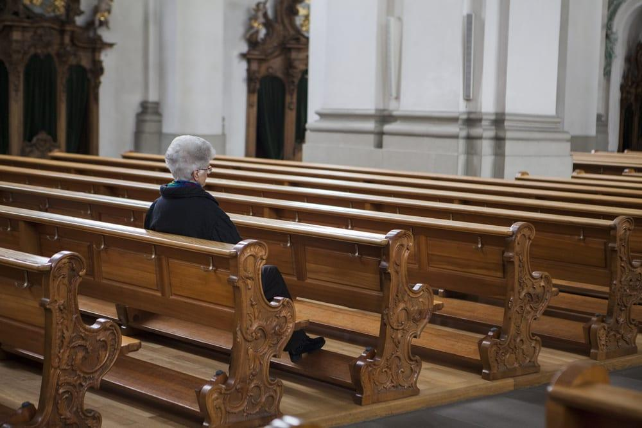
提摩太前书
教会次序
Rick Griffith 博士 • 新加坡神学院 • BibleStudyDownloads.org

Slide 2
关键字
217
次序
提摩太前书

Slide 3
主题
23
教会的先后次序
提摩太前书

Slide 4
关键节
217
“… 我把这些事写给你，希望不久可以到你那里去； 假如我来迟了，你也可以知道在 神的家里应该怎样行。这家就是永活 神的教会、真理的柱石和根基。” (3:14-15)。
提摩太前书

Slide 5
总结概要
217
保罗劝勉提摩太要勇敢地守住他的个人生活、教义和当地教会秩序，以保护以弗所教会的事工，不受禁欲主义和投机性假教师的影响。
提摩太前书

Slide 6
国度陈述
27d
“但愿尊贵荣耀归与那不能朽坏不能看见永世的君王、独一的神、直到永永远远。阿们” (1:17)。 这“万王之王” 是指耶稣，因为祂是 “独一的神” (6:14-15)。
提摩太前书

Slide 7
圣约陈述
27d
新约群体是“神的家”， 是 “永生神的教会、真理的柱石和根基” (3:14-15)。
在行政管理上是自治的 (3:5, 15; 5:16)。
提摩太前书

Slide 8
救赎陈述
27d
“基督耶稣降世、为要拯救罪人。这话是可信的、是十分可佩服的。在罪人中我是个罪魁。” (1:15)。
提摩太前书

Slide 9
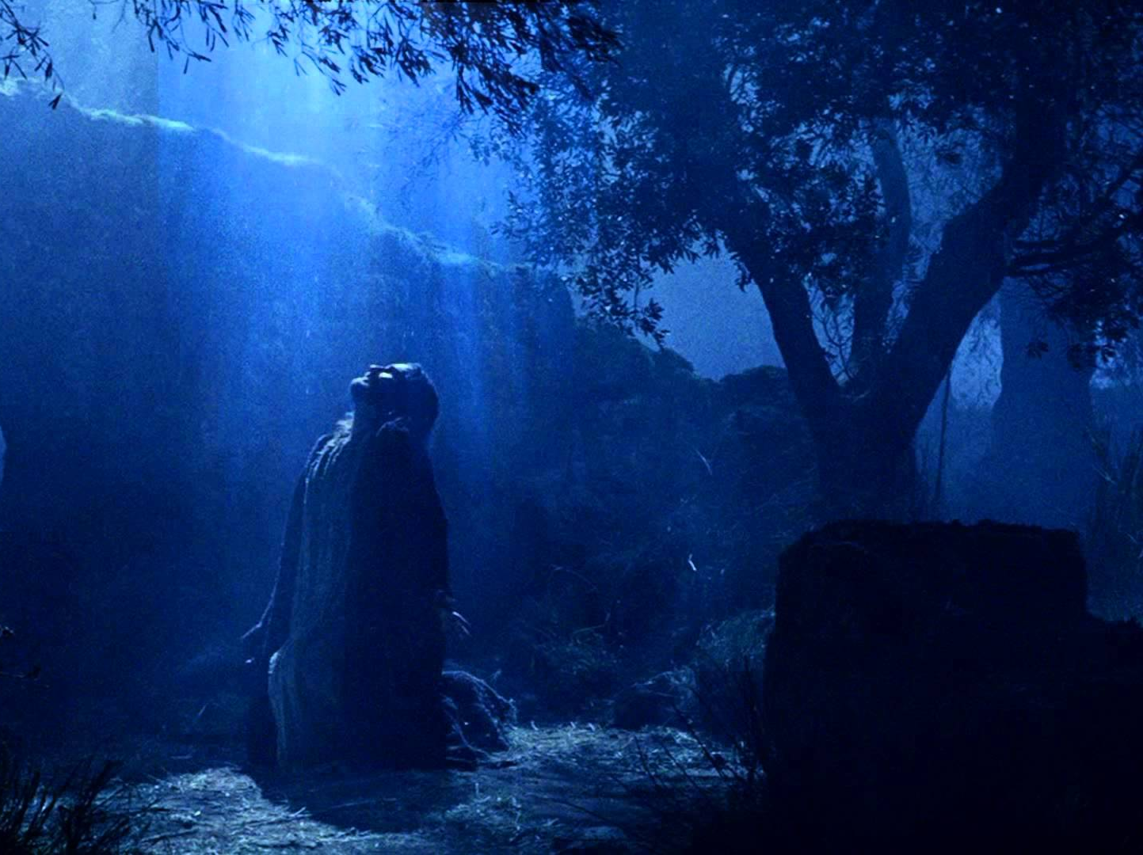
预言 (主, 神性)
27d
耶稣常被称为“主”(1:2, 12, 14; 6:3) 甚至也被称为 “万主之主” (6:14-15)。
提摩太前书

Slide 10
提摩太前 教会次序
(通过将优先次序给予…)
与假教师辩论 | 教会生活 | 个人生活/教义 | 不同教会群体 | 警惕物质主义
第 1 章 | 第 2–3 章 | 第 4 章 | 5:1–6:10 | 6:11-21
教义 | 敬拜 | 例证 | 尊敬 | 优先次序
警告 | 众人 | 警告 | 众人 | 警告
问安 反驳异端 上帝恩典 吩咐 | 祷告 性别角色 领袖特质 书信目的 | 将来的异端 关注生命 关注教义 | 尊重个人 寡妇 老人 奴隶 假教师 | 属灵目标 富足人必须奉献 结束的吩咐
实用劝勉贯穿全书信
从马其顿到以弗所
主后 62年秋
提摩太前书
217

Slide 11
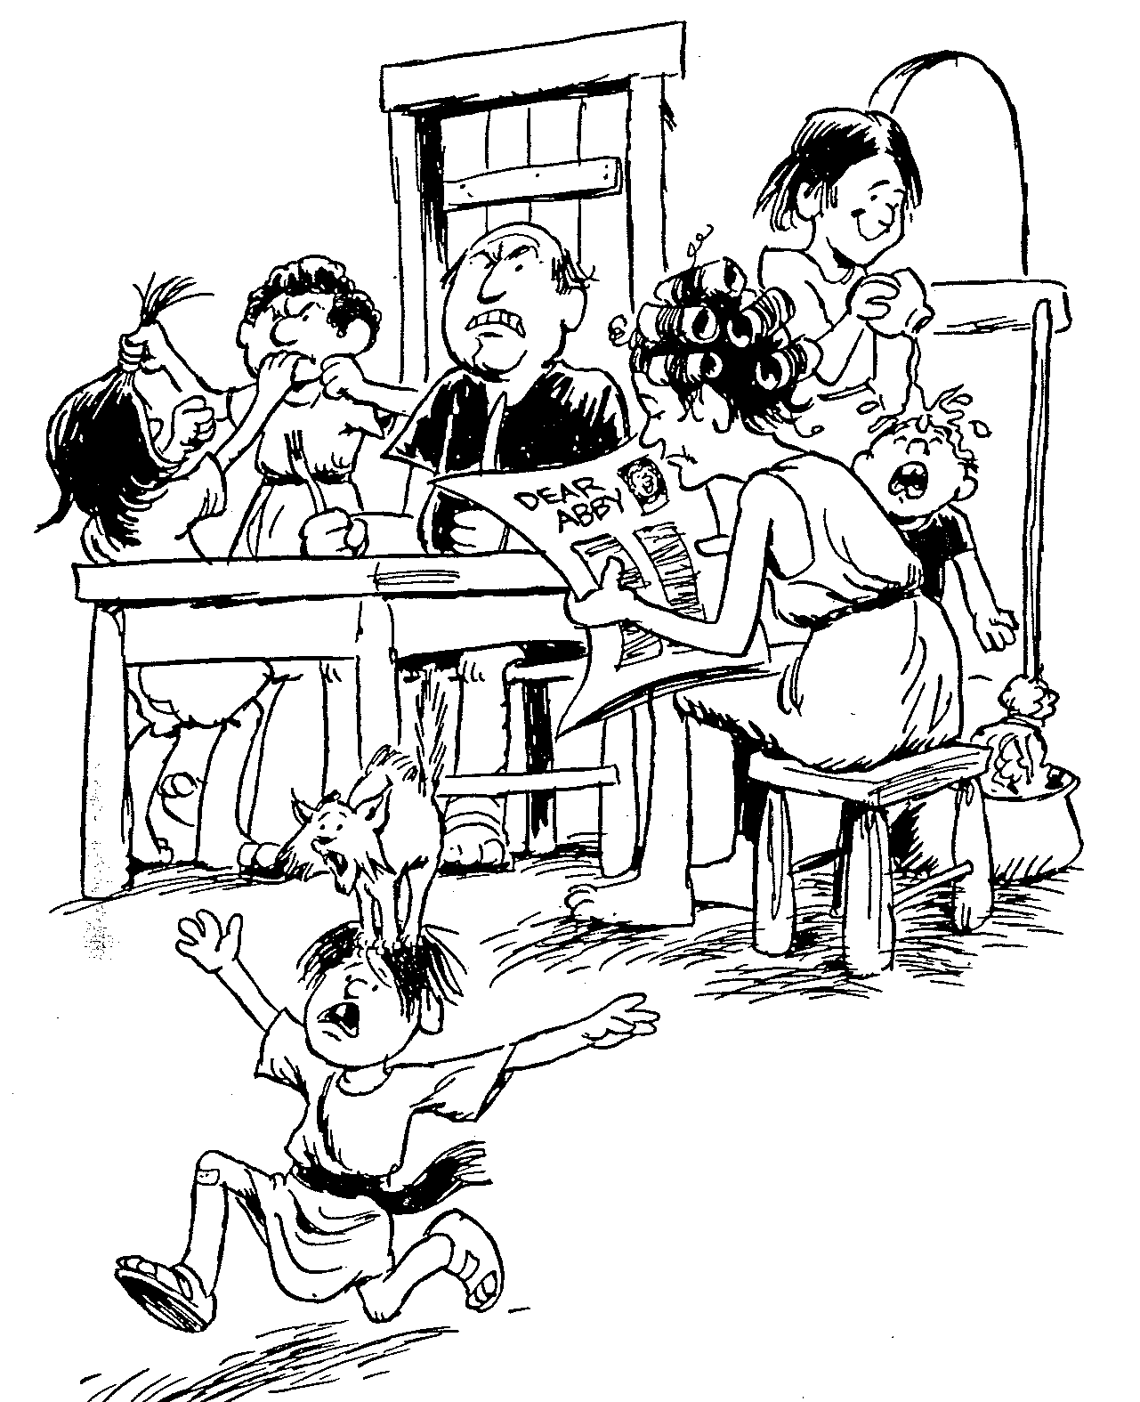
提摩太前书
1
2
3
4
5 6
关于假教导的教诲
关于圣洁妇人的教诲
基督教长老该有的美德
圣洁生活的教诲
关于圣洁妇人的教诲
世俗生活的果效
巴里 赫德尔斯顿 《藏头诗圣经》

Slide 12
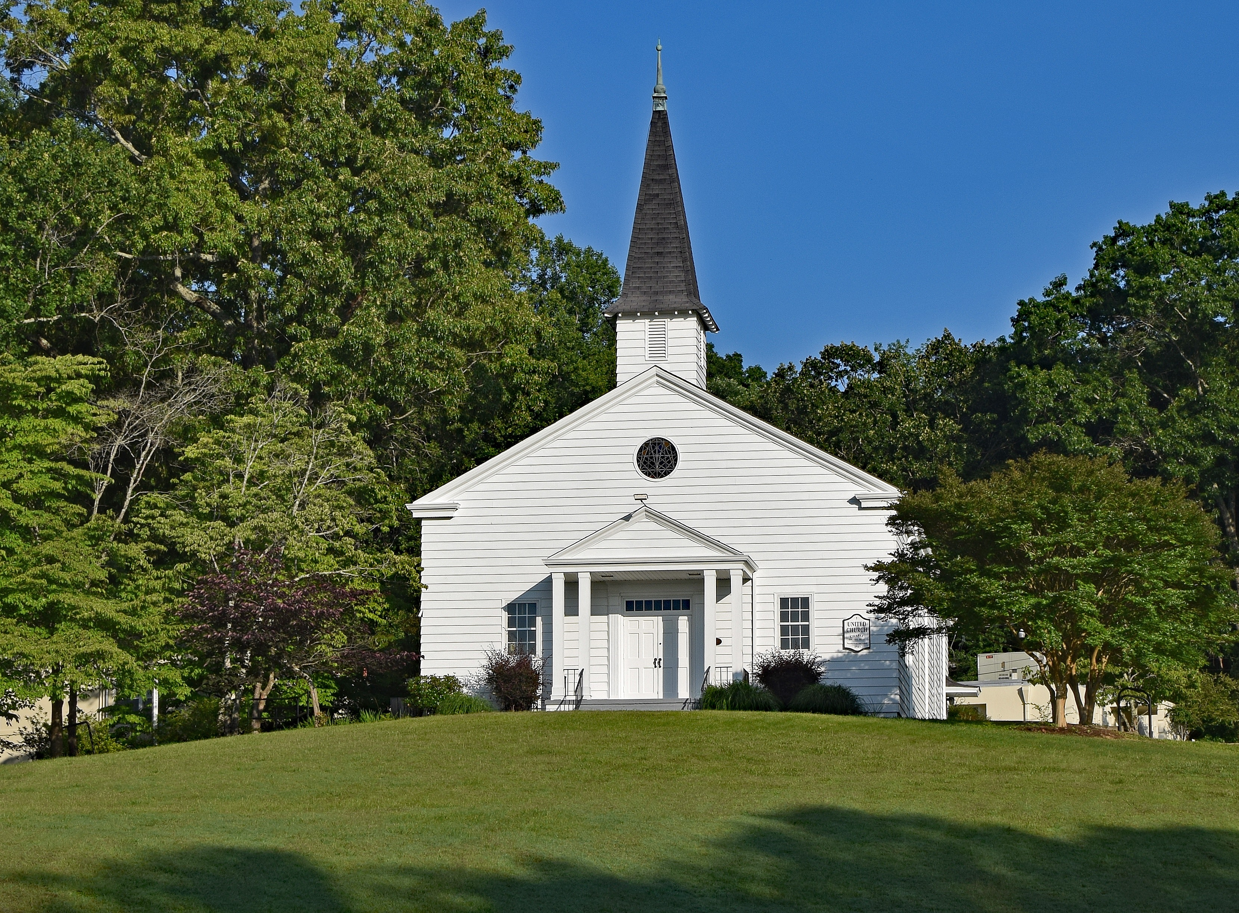
要有次序
提摩太前书
Rick Griffith 博士 • Crossroads International Church Singapore
BibleStudyDownloads.org

Slide 13
神对教会次序的优先重点 是什么？
提摩太前书

Slide 14
I. 你的生命要在律法与 恩典 中取得平衡 (第一章)。
提摩太前书
Notes:
Avoid the extremes of too many rules and too few rules.

Slide 15
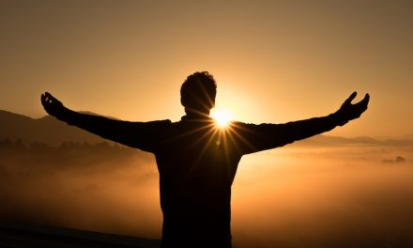
II. 需要在虔诚领袖的带领下有公共的敬拜生活 (第二至三章)。
提摩太前书
Notes:
Our church services must main order by not just letting anyone lead.

Slide 16
III. 谨守私生活与教义 (第四章)。
提摩太前书
Notes:
Your beliefs affect everything about you—privately and publicly. Watch them!

Slide 17
IV. 满足各教会群体的需要 (5:1–6:10)。
提摩太前书
Notes:
Our church’s different subgroups must not be vulnerable to enemy attack.

Slide 18
V. 不要因为爱钱而毁了属灵生命 (6:11-21)
提摩太前书
Notes:
Resist materialism that replaces godliness with apostasy.

Slide 19
主要思想
借着遵守上帝对教会次序的优先重点， 我们能够抵挡假教师。
提摩太前书

Slide 20
Black

Slide 21
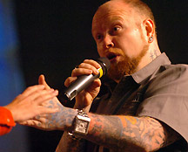
How Much is That Preacher in the Window?
Notes:
How Much Is That Preacher in the Window? By Jean Shaw
Editor’s note: A recent editorial by editor-in-chief Bob Dasal, which asked whether churches should hire or call their ministerial staff, generated a good deal of response. Obviously, the subject is of great interest to preachers! Therefore, we thought you would enjoy this tongue-in-cheek treatment of the question.
This is the introductory slide for the class skit available at http://www.pulpithelps.com/www/docs/1095-7174. The skit is a takeoff on the 1950s “How Much is That Doggie in the Window?” song by Patti Page at http://www.youtube.com/watch?v=2AkLE4X-bbU
The text is below for each slide.
________________
Good morning, madam. May I help you?
Yes, please, I’d like to buy a minister.
Did you have a particular model in mind?
I’ve got a description from the Candidate Committee right here. We want a man about 30, well educated, with some experience. Good preacher and teacher. Balanced personality. Serious, but with a sense of humor. Efficient, but not rigid. Good health. Able to identify with all age groups. And, if possible, sings tenor.
Sings tenor?
We’re short of tenors in the choir.
I see. Well, that’s quite a list. How much money did you want to spend?
The committee says $15,000-$15,500 tops.
Hmm. Well, perhaps we’d better start in the bargain basement.

Slide 22
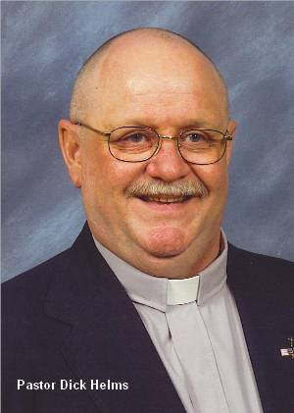
Princeton 467
Notes:
Tell me, how much is that model in the window?
You mean the one in the Pendleton plaid suit and the grey suede dune boots?
Yes, that one. He’s a real dream.
That’s our Princeton #467. Has a Ph.D. and AKC papers.
AKC?
American Koinonia Council. He sells for $36,000 plus house.
Wow! That’s too rich for our blood…
But he’s …an exceptional buy… He’s a little older than 30, but has excellent experience. Aggressive. Good heart. Has a backing of sermons, two of which have been printed in Christianity Today.
He’s not too bad. Can you do something about his bald head? Mrs. Fulton especially insists that our minister have some hair.
Madam, all our ministers come in a variety of hair styles.
I’ll keep him in mind.

Slide 23
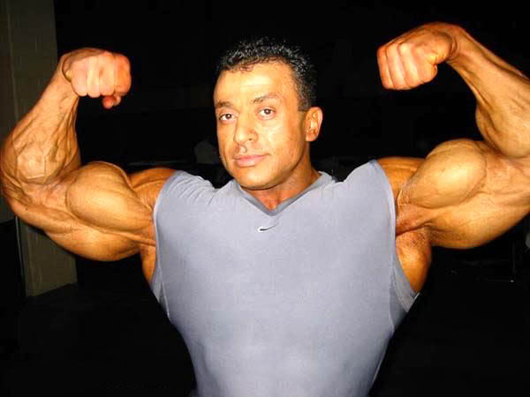
Olympia 222
Notes:
Now let me show you Olympia #222. Four years of varsity sports at Southern Cal. Plays football, basketball, volleyball, and ping-pong. Comes complete with sports equipment.
What a physique! He must weigh 200 pounds!
Yes, indeed. You get a lot for your money with this one. And think what he can do for your young people.
Great! But how is he at preaching?
I must admit he’s not St. Peter. But you can’t expect good sermons and a church-wide athletic program too!
I suppose not. Still…

Slide 24
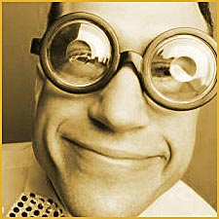
IBM 400
Notes:
Let me show you our IBM 400. Now here’s a preacher. All his sermons are superb—well-researched, copious anecdotes, and they always have three points. And—he comes with a full set of Calvin’s Commentaries at no extra charge! You get the whole package for $18,300.
He’s wearing awfully thick glasses.
For $220 more we put in contact lenses.
I don’t know. He might study too much. We don’t want a man who’s in his office all the time.
Of course… [But he] comes from a management background. Trained in business operations. Adept with committees. Gets his work done by 11:30 every morning.
His tag says he’s an IBM 486sx.
Madam, you have a discerning eye. Innovative Biblical Methods. This man will positively revitalize your church.
I’m not sure our church wants to be revitalized. Haven’t you got something less revolutionary?

Slide 25
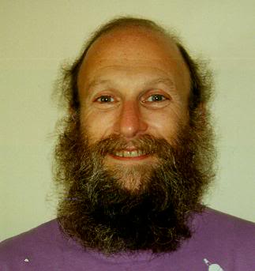
Empathy 41C
Notes:
Well, would you like someone of the social worker type? We have this Ghetto #130.
The man with the beard. Good gracious, no. Mrs. Fulton would never go for that.
How about our Empathy #41C? His forte is counseling. Very sympathetic. Patient. Good with people who have problems.
Everyone in our church has problems. But he might not get out and visit new people. We really need a man who does a lot of visitation. You see, all our people are very busy and…
Yes, yes. I understand. You want a minister who can do everything well.
That’s it! Haven’t you got somebody like that?

Slide 26
Black
Notes:
I’m thinking. In our back room we have a minister who was traded in last week. Excellent man, but he broke down after three years. If you don’t mind a used model, we can sell him at a reduced price.
Well, we had hoped for someone brand-new. We just redecorated the sanctuary, and we wanted a new minister to go with it.
Of course. But with a little exterior work, and a fresh suit, this man will look like he just came out of the box. No one will ever know. Let me bring him out and you can look him over.
All right. Honestly, this minister shopping is exhausting. It’s so hard to get your money’s worth. Tell me, do you accept coupons, and do you double them? What about rebates?
Uh, no. But if there’s any dissatisfaction after six months, we send a new congregation for the balance of the year. That usually takes care of most problems.
©Jean Shaw. From the book, Please Don’t Stand up in My Canoe, Zondervan, 1976, Via Contact. Reprinted by permission at http://www.pulpithelps.com/www/docs/1095-7174

Slide 27
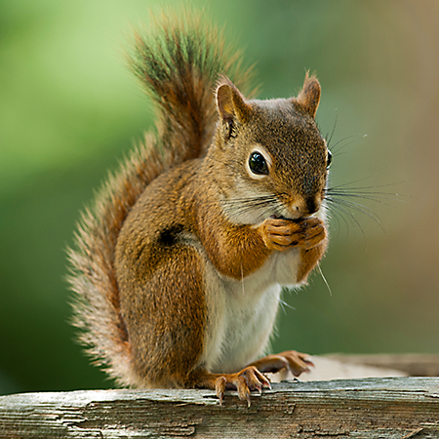
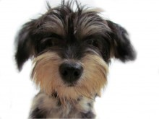
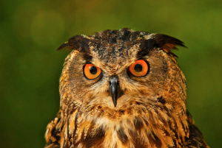
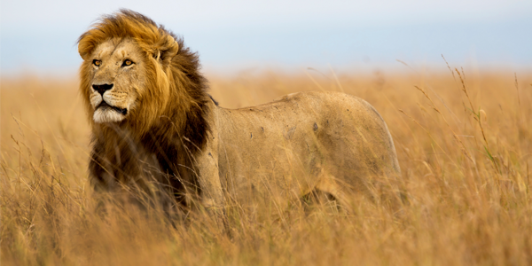
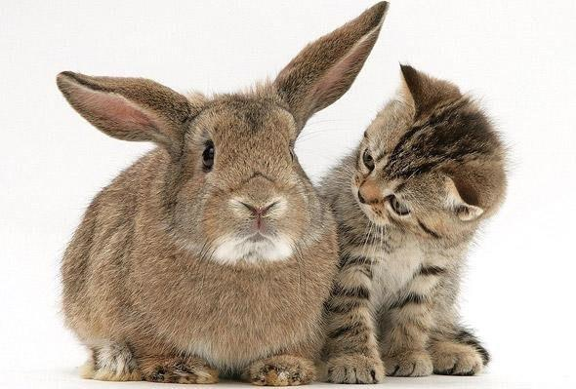
What kind of animal are you?
Notes:
If you could describe yourself as an animal, which one would you pick?
Now, biblically speaking, what animal are you?

Slide 28
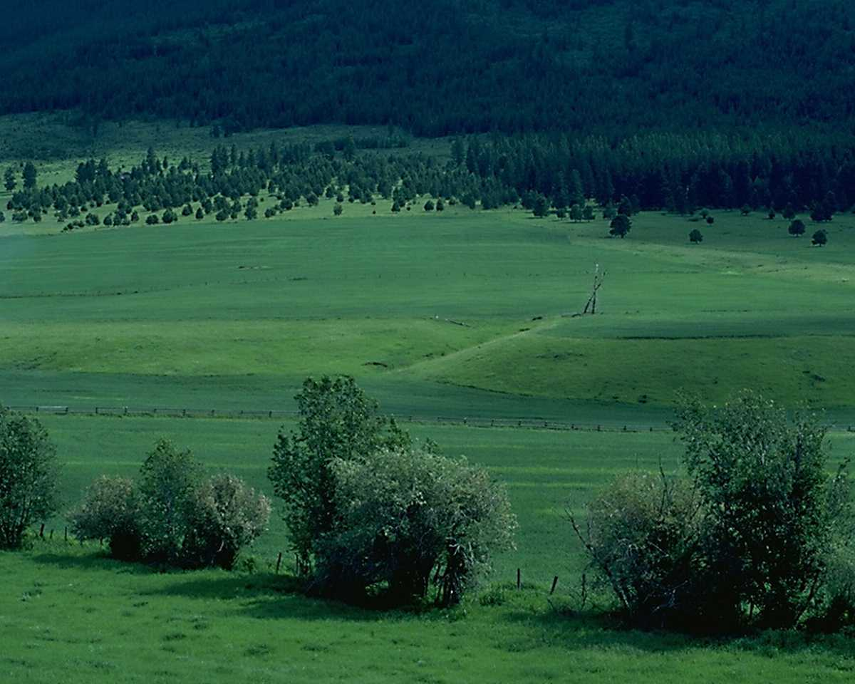
诗篇 23 篇
¹ 耶和华是我的牧者，我必不致缺乏。 ² 他使我躺卧在青草地上，领我在可安歇的水边。³ 他使我的灵魂苏醒，为自己的名引导我走义路。⁴ 我虽然行过死荫的幽谷，也不怕遭害，因为你与我同在；你的杖，你的竿，都安慰我。⁵ 在我敌人面前，你为我摆设筵席；你用油膏了我的头，使我的福杯满溢。⁶ 我一生一世必有恩惠慈爱随着我；我且要住在耶和华的殿中，直到永远。

Slide 29
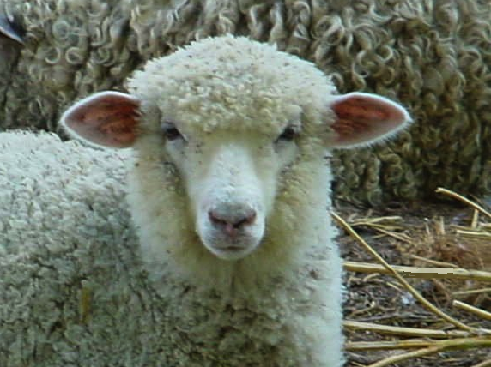
你是一只羊

Slide 30
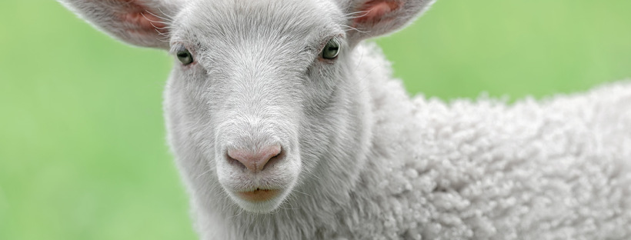
What does it mean to be a "sheep"?
Notes:
Does being a sheep mean you are cute and easy to get along with? Not quite.

Slide 31
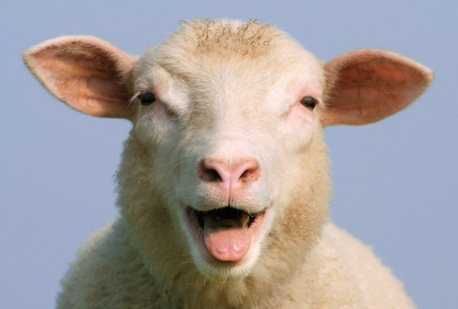
"Dumb, Directionless, Defenseless"
Tim Challies, http://www.challies.com/christian-living/dumb-directionless-defenseless posted 26 Aug 2013, accessed 7 Aug 2016
Notes:
One bogger puts it this way: "Why sheep? Why not cheetahs or wolves or tigers or another animal with a bit of flair, a bit of class? But the Bible tells us often that we are sheep. We are sheep and God is a shepherd. That sheep/shepherd word picture is at the heart of the best-loved Psalm—Psalm 23. I spent some time with that psalm lately and tried to gain a better appreciation of why God saw fit to tell us we are sheep.
I will admit I am not the world's foremost expert on sheep. I grew up in the city and even now live in an area of town that explicitly forbids owning livestock. In place of first-hand knowledge, I spent some time reading about sheep. It was funny. And kind of humbling.
Do a little bit of reading about sheep and you'll soon see they are not survivors. They are not strong and independent creatures, not proud hunters or fierce predators. They're actually kind of pathetic, entirely dependent upon a shepherd for at least three reasons. Two of these reasons are related to the brain of a sheep and the other is related to its body."
Dumb, Directionless, Defenseless
Tim Challies, http://www.challies.com/christian-living/dumb-directionless-defenseless posted 26 Aug 2013, accessed 7 Aug 2016

Slide 32
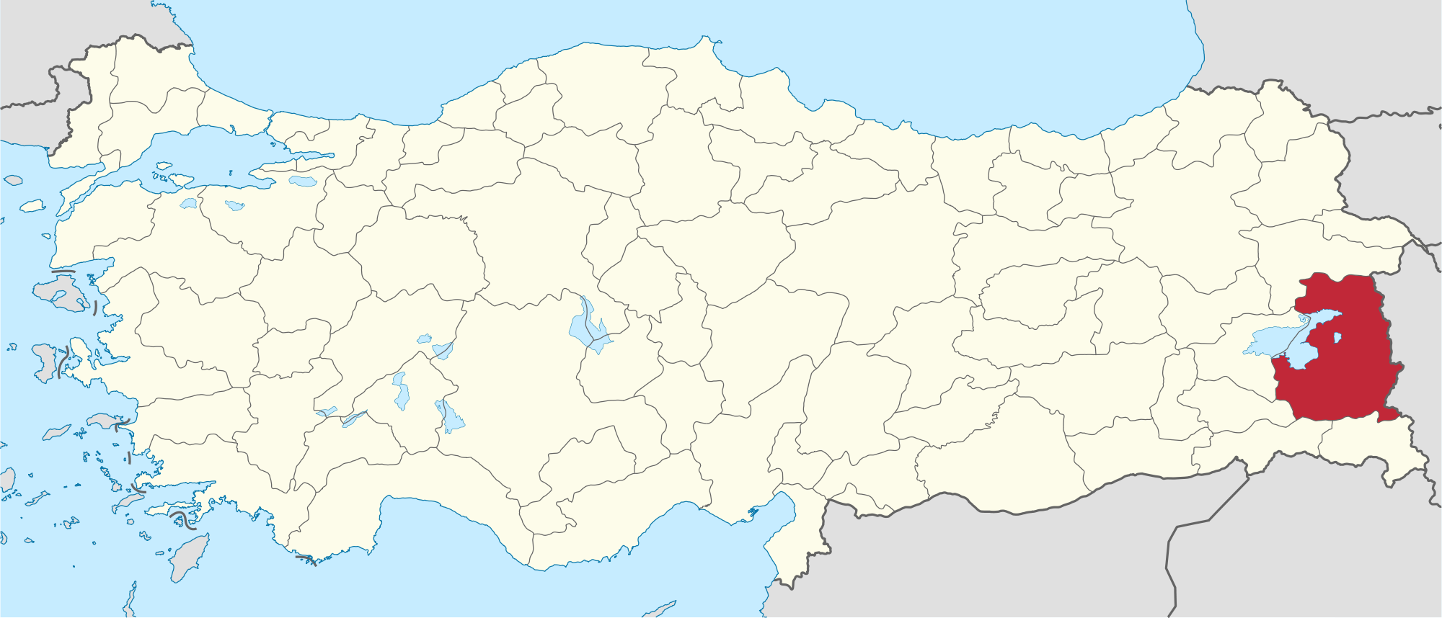
News Story from Van Province, Turkey
Tim Challies, http://www.challies.com/christian-living/dumb-directionless-defenseless posted 26 Aug 2013, accessed 7 Aug 2016
Notes:
"This is a real news story that aptly tells us the first reason sheep need a shepherd: because sheep are dumb.
'Hundreds of sheep followed their leader off a cliff in eastern Turkey, plunging to their deaths this week while shepherds looked on in dismay.'"
Dumb, Directionless, Defenseless
Tim Challies, http://www.challies.com/christian-living/dumb-directionless-defenseless posted 26 Aug 2013, accessed 7 Aug 2016

Slide 33
"Dumb, Directionless, Defenseless"
"Hundreds of sheep followed their leader off a cliff in eastern Turkey, plunging to their deaths this week while shepherds looked on in dismay. Four hundred sheep fell 15 metres to their deaths in a ravine in Van province near Iran but broke the fall of another 1,100 animals who survived. Shepherds from a nearby village neglected the flock while eating breakfast, leaving the sheep to roam free. The loss to local farmers was estimated at $74,000."
—Actual news story
Tim Challies, http://www.challies.com/christian-living/dumb-directionless-defenseless posted 26 Aug 2013, accessed 7 Aug 2016
Notes:
Dumb, Directionless, Defenseless
Tim Challies, http://www.challies.com/christian-living/dumb-directionless-defenseless posted 26 Aug 2013, accessed 7 Aug 2016

Slide 34
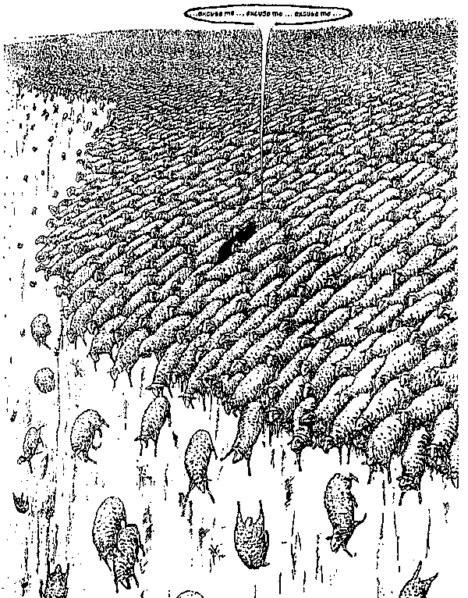
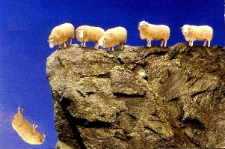
"Dumb, Directionless, Defenseless"
Notes:
"One sheep wandered off a cliff and 1,499 others just followed along. Can you picture it? 1,500 sheep, each walking off a cliff, one after the other."
Dumb, Directionless, Defenseless
Tim Challies, http://www.challies.com/christian-living/dumb-directionless-defenseless posted 26 Aug 2013, accessed 7 Aug 2016
See also https://factualfacts.com/animals/in-2005-in-turkey-a-suicide-sheep-jumped-off-a-cliff-and-1500-sheep-followed-the-first-one/

Slide 35
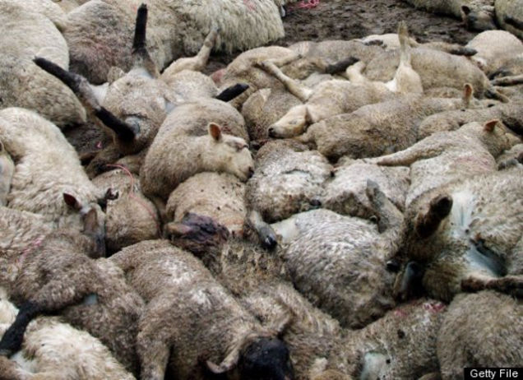
"Dumb, Directionless, Defenseless"
Tim Challies, http://www.challies.com/christian-living/dumb-directionless-defenseless posted 26 Aug 2013, accessed 7 Aug 2016
Notes:
"Soon they were piled so deep that the ones at the bottom were crushed to death and the ones on top were lying on a big downy-soft pillow. It is completely absurd and tells us one important fact about sheep and the first reason sheep absolutely need a shepherd: they are not the smartest animals in the world. In fact, they may well be just about the dumbest animals in the world."
Dumb, Directionless, Defenseless
Tim Challies, http://www.challies.com/christian-living/dumb-directionless-defenseless posted 26 Aug 2013, accessed 7 Aug 2016
See also https://factualfacts.com/animals/in-2005-in-turkey-a-suicide-sheep-jumped-off-a-cliff-and-1500-sheep-followed-the-first-one/

Slide 36
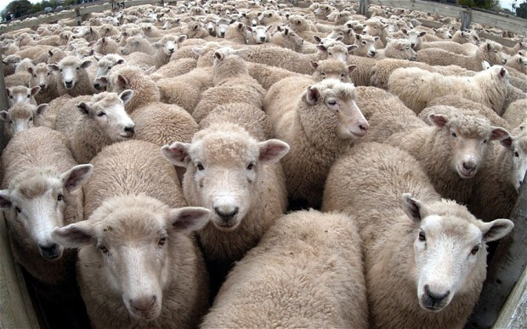
"Dumb, Directionless, Defenseless"
Tim Challies, http://www.challies.com/christian-living/dumb-directionless-defenseless posted 26 Aug 2013, accessed 7 Aug 2016
Notes:
"And here's a second reason sheep need a shepherd: they are directionless. Sheep are prone to wander. Even if you put them in an absolutely perfect environment with everything they need (things like green pastures and still waters), sooner or later they will just wander off. If a shepherd doesn't manage them, if he doesn't micromanage them and keep them under constant surveillance, they'll wander off and be lost.
Left to themselves, sheep will not and cannot last very long."
Dumb, Directionless, Defenseless
Tim Challies, http://www.challies.com/christian-living/dumb-directionless-defenseless posted 26 Aug 2013, accessed 7 Aug 2016

Slide 37
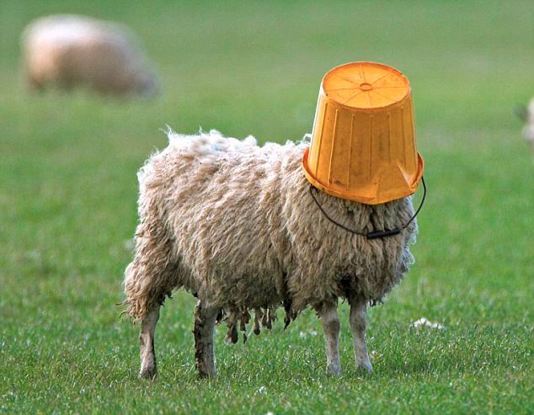
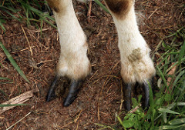
"Dumb, Directionless, Defenseless"
Tim Challies, http://www.challies.com/christian-living/dumb-directionless-defenseless posted 26 Aug 2013, accessed 7 Aug 2016
Notes:
"Sheep are dumb and directionless. They are also defenseless. Left to themselves, sheep will not and cannot last very long. Just about any other domesticated animal can be returned to the wild and will stand a fighting chance of survival. But not sheep. Put a sheep in the wild and you've just given nature a snack.
Think about it: there are different ways animals react when they perceive some kind of danger. Here are three common ones: fight, flight, and posture.
Let's thinking about fight. A sheep gets frightened or sees that he is in danger. Maybe he sees a bear rambling toward him. What is he going to do? He doesn't have claws, he doesn't have fangs, he doesn't have venom, he doesn't have spines or quills or large talons. He's got nothing to protect himself. Fighting is definitely out. But that's okay—there are lots of other animals that don't fight it out."
Dumb, Directionless, Defenseless
Tim Challies, http://www.challies.com/christian-living/dumb-directionless-defenseless posted 26 Aug 2013, accessed 7 Aug 2016

Slide 38
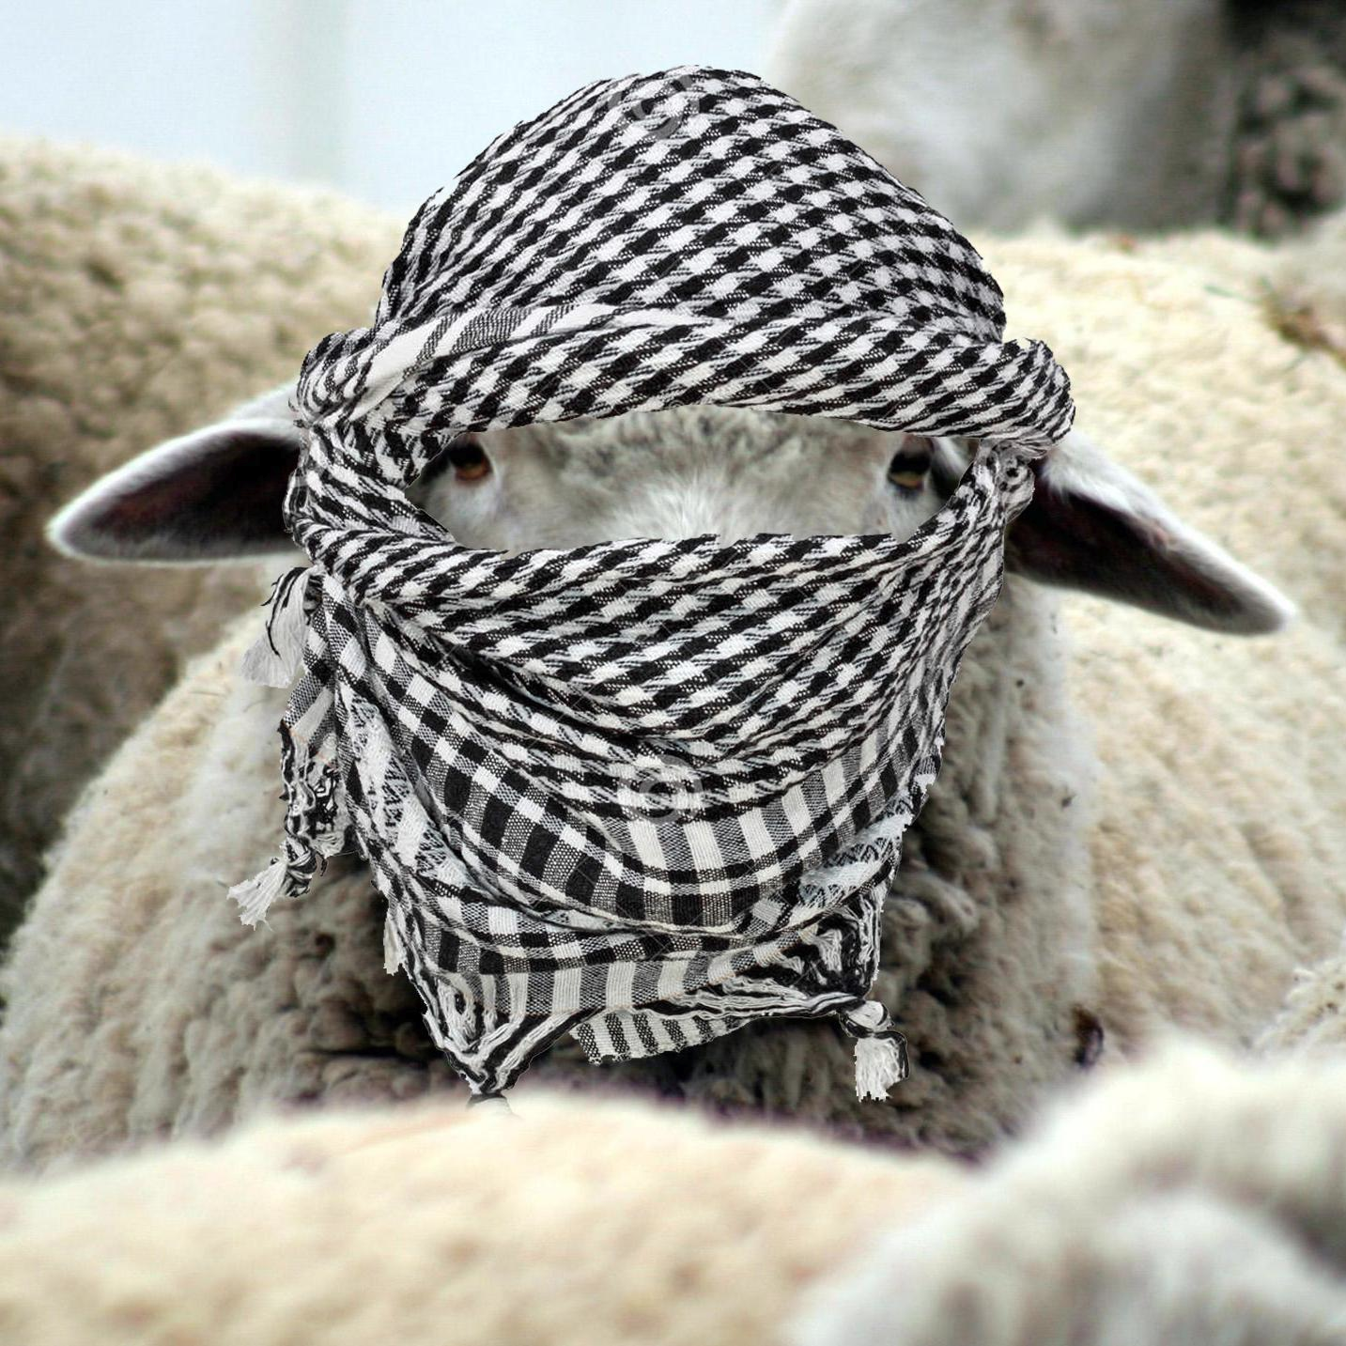
"Dumb, Directionless, Defenseless"
Tim Challies, http://www.challies.com/christian-living/dumb-directionless-defenseless posted 26 Aug 2013, accessed 7 Aug 2016
Notes:
"How about flight, just turning tail and running away? That's a good defense mechanism. Unfortunately sheep aren't fast; they certainly aren't agile, especially when their wool is long, and even more so when their wool is long and wet. Last I checked they don't have wings. A sheep is not going to outrun or outfly a bear. The sheep will not fight and it cannot take flight. So far it is looking pretty good for the bear."
Dumb, Directionless, Defenseless
Tim Challies, http://www.challies.com/christian-living/dumb-directionless-defenseless posted 26 Aug 2013, accessed 7 Aug 2016

Slide 39
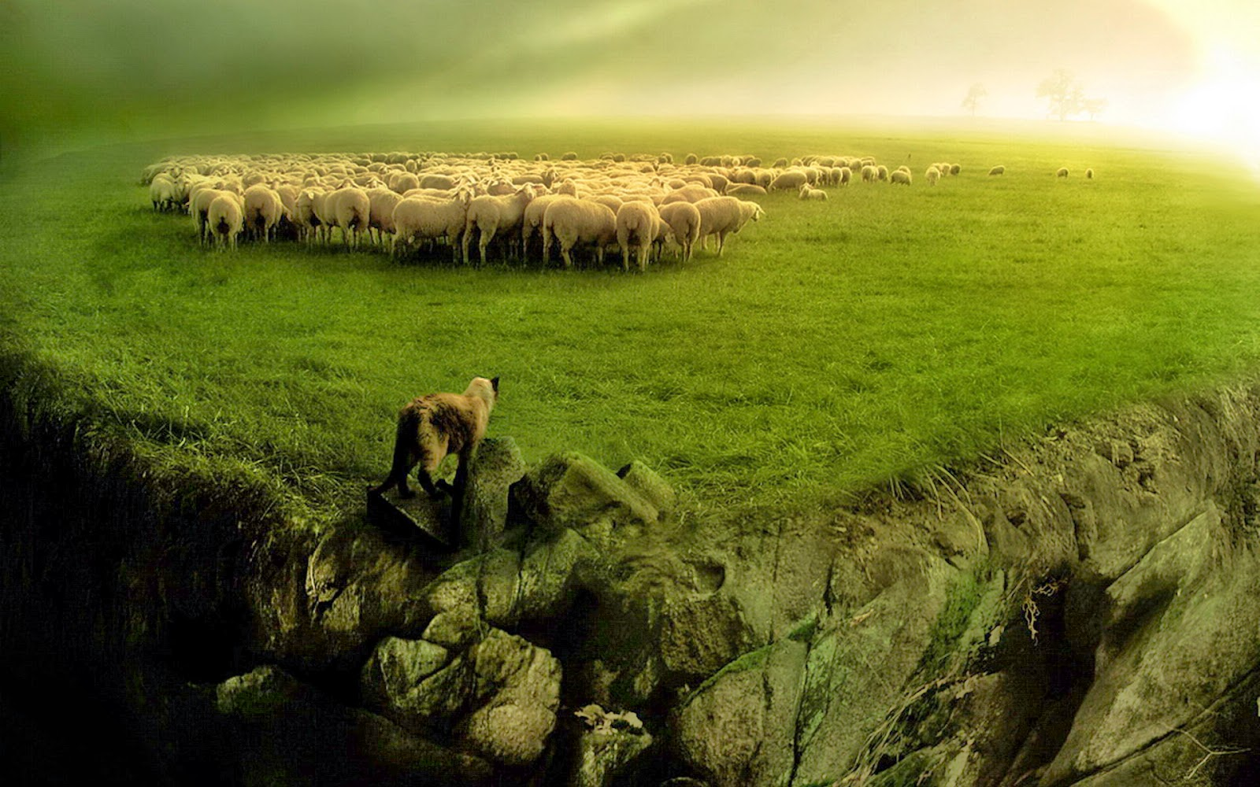
"Dumb, Directionless, Defenseless"
Tim Challies, http://www.challies.com/christian-living/dumb-directionless-defenseless posted 26 Aug 2013, accessed 7 Aug 2016
Notes:
"How about posture? A dog will bark and growl and show his teeth to warn you away. A lion will roar. A rattlesnake will shake his rattle. A cat will arch his back and hiss. The best a sheep can do is baaa. I don't think that bear is going be too intimidated. It is for good reason that no one relies on a guard sheep to keep their property secure.
Sheep can't fight, they can't run away, and they can't scare away. Sheep can't fight, they can't run away, and they can't scare away. So what does a sheep do when danger comes? It flocks. When a bear approaches, the sheep will gather with others in a pack and run in circles in complete panic, just hoping that the bear will choose someone else. Without a shepherd to protect them, they'll be picked off and eaten one by one."
Dumb, Directionless, Defenseless
Tim Challies, http://www.challies.com/christian-living/dumb-directionless-defenseless posted 26 Aug 2013, accessed 7 Aug 2016

Slide 40
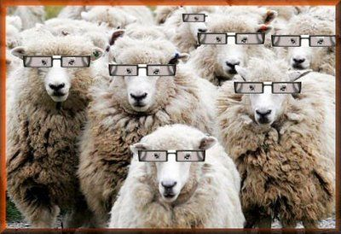
"Dumb, Directionless, Defenseless"
Tim Challies, http://www.challies.com/christian-living/dumb-directionless-defenseless posted 26 Aug 2013, accessed 7 Aug 2016
Notes:
"Sheep are dumb and directionless and defenseless. So I guess when God says that we are sheep who need a shepherd, he doesn't mean it as a compliment to us. It is just a very realistic assessment of who we are and what we need. We are sheep who are completely dependent upon a shepherd.
To say that God is our shepherd and we are sheep, is to humble ourselves, admitting what is true about us, and to elevate God, declaring what is true of him. When you say, 'The Lord is my shepherd,' you are saying something that ought to move your heart in praise and gratitude. To declare that God if your shepherd is to praise and glorify him because God the shepherd stoops down to care for poor, lost, not-so-smart sheep like you and me."
Dumb, Directionless, Defenseless
Tim Challies, http://www.challies.com/christian-living/dumb-directionless-defenseless posted 26 Aug 2013, accessed 7 Aug 2016

Slide 41
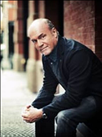
"How Are We Like Sheep?"
"That Jesus compares us to sheep is not a compliment, by the way. Sheep are among the dumbest of all creatures. Most animals, in many cases, will survive if released into the wild. They will learn to fend for themselves and make it. But a sheep released into the wild cannot survive. Sheep have no survival skills whatsoever. They are totally dependent upon the shepherd - just like we are. The sheep come to know that when the shepherd speaks they should follow because his plan for them is better than their plan for themselves."
Greg Laurie, http://www.jesus.org/following-jesus/discipleship/how-are-we-like-sheep.html, accessed 7 Aug 2016

Slide 42
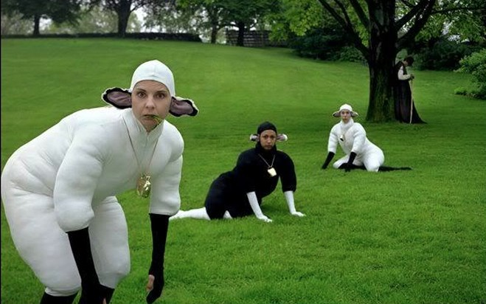
So what do we need?

Slide 43
38 124 39-41
新约综览(保罗书信)
“直 到 地 极” (使 徒 行 传 1:8)
使 徒 9 13 14 15 16 18 21 27 28
五月57- 八月59
大 马 色 安 提 阿
四月 48- 九月 49
1 加 拉 太
四月 50- 九月 52
2 爱琴海
春季 53- 五月 57
3 亚洲
五月 57- 八月 59
试验
二月 60- 三月 62
1 罗马
春季 62- 秋季 67
4 西班牙
秋季 67- 春季 68
2 罗马
秋季 49
理事会
春季68
教会扩长
35 48 49 50 52 53 57 60 62 67 68 95
天国
主权1
主权2
门徒
相 信
以弗所
合一
提 前
加拉太
帖 前
歌前
秩序
因信称义
被提
成圣
大患难
帖后
使 徒
歌罗西
歌后
神性
称义
腓利门
罗马
饶恕
福音书以及使徒行传
腓立比
态度
保罗书信
保罗书信 +关键节

Slide 44
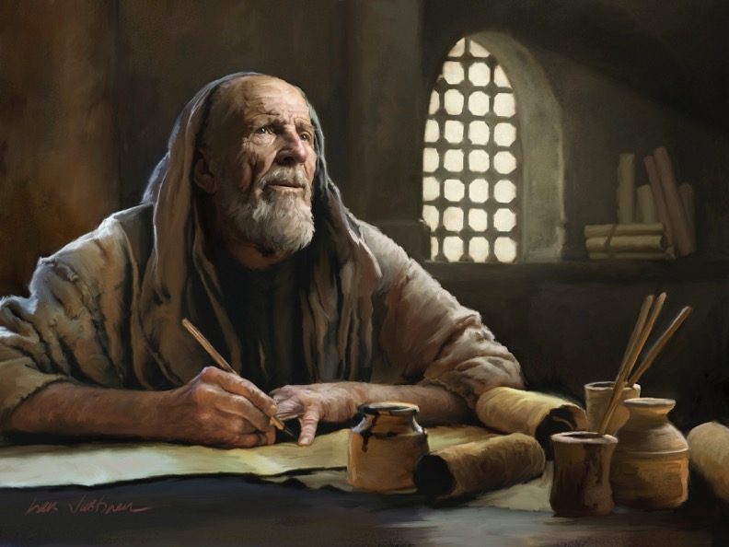
教牧书信

Slide 45
Pastoral Epistles
1 Timothy
Titus
2 Timothy
1 Timothy = personal, urgent, doctrinal emphasis
Titus = less urgent, practical emphasis
2 Timothy = personal, urgent, focus on the Word
Notes:
These last three letters of Paul are called the Pastoral Epistles.
They show the most advanced theology of local church life and shepherding the flock—but this makes sense since Paul and the church had learned much in the previous 30 years since the church had begun.
Sadly, most NT scholars today do not believe that Paul wrote these letters and many date them in the second century. I guess they think that Paul was a slow learner!

Slide 46
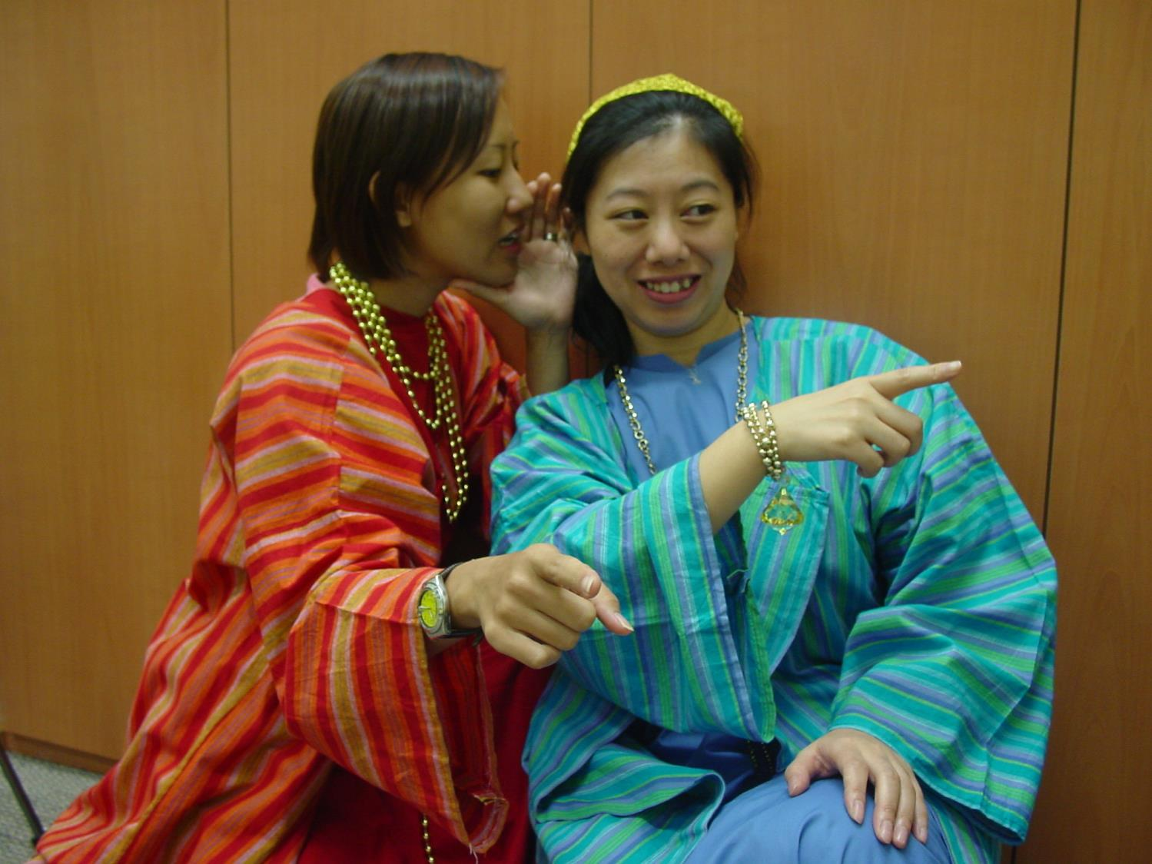
Rich ladies
嗨，你有没有听说。。。
你是说那个人。。。？

Slide 47
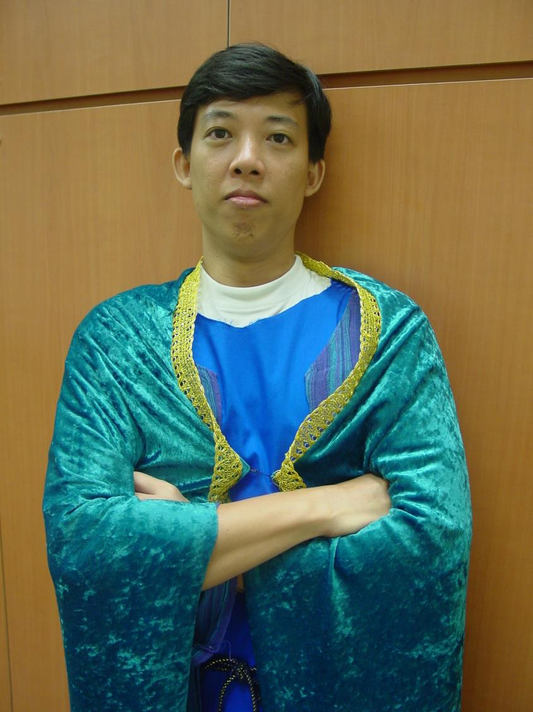
The wealthy
我真有福气。我有钱又英俊。

Slide 48
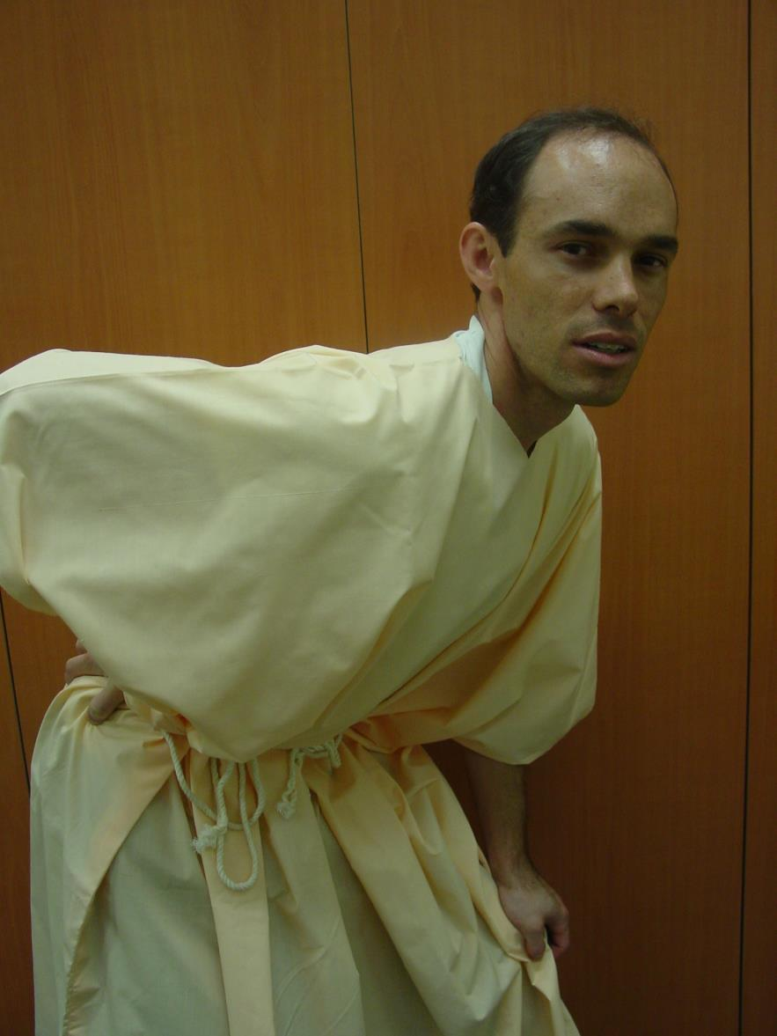
The Poor
我这疼痛的背。。等等。。为什么我的思想从我的耳朵出来？

Slide 49
提摩太前书

Slide 50
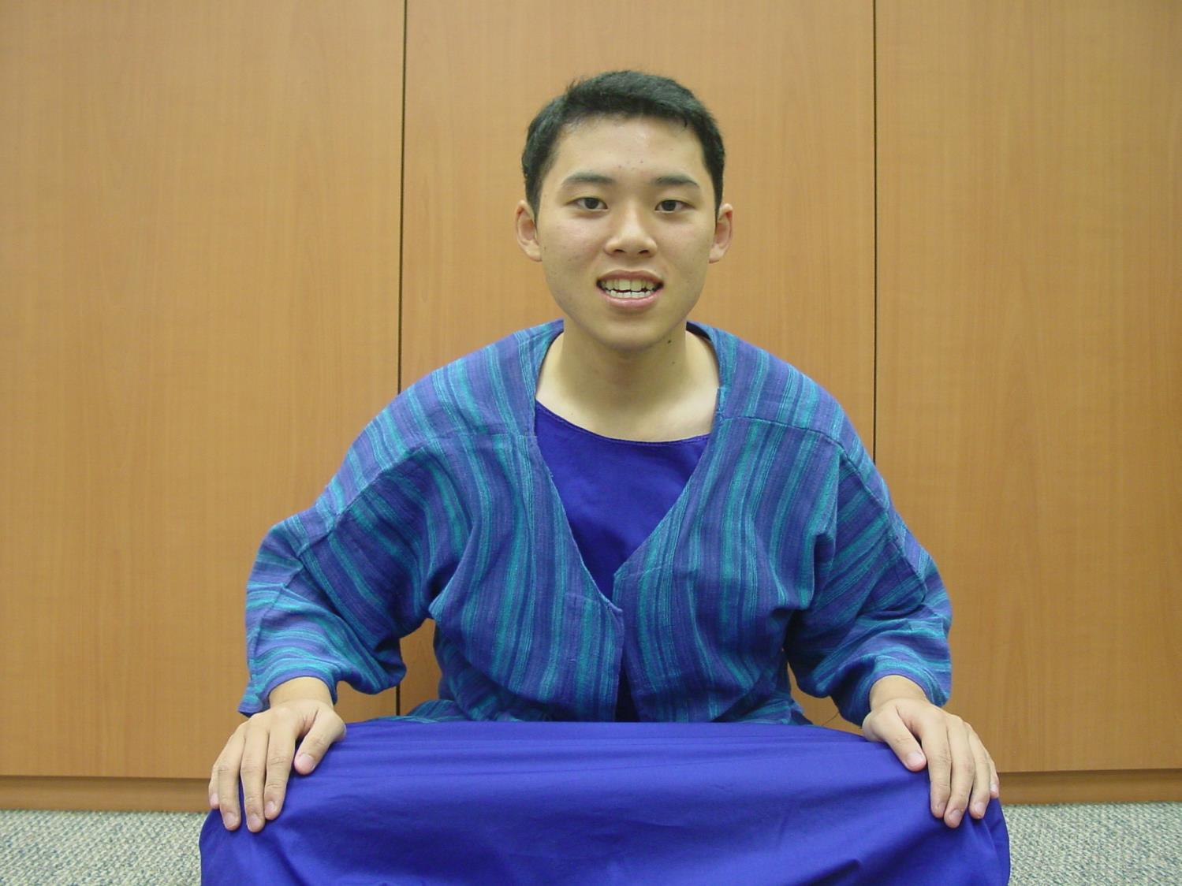
Young Timothy
我这么年轻。。我该怎样对他们说呢？

Slide 51
一个清晨的主日 在以弗所。。。

Slide 52
Now Unto the King (提前1:17)
Now unto the King eternal
Unto the King immortal
Unto the King invisible
The only wise God, the only wise God
(repeat)
Chorus: Oh, unto the King be glory and honor
Unto the King forever
Unto the King be glory and honor
Forever and ever
Amen Amen

Slide 53
出埃及记背景

Slide 54
提摩太面临什么问题？
219
虚弱的胃
人看不起他
假教师想要因他们的教导而富有
女人想在教会教导信徒
寡妇的问题
心高气傲的富有的人
对领袖的控告

Slide 55
提摩太前书
背景

Slide 56
作者
218
普遍都认为是保罗写的
外在的证据: 初期教会教父普遍认为如此
内在的证据:
书信宣称保罗是作者 (1:1)
有保罗一贯的写信特征：神的呼召，用许多个人的名称， 以及保罗的神学重点。

Slide 57
写作日期
219
应该是保罗从罗马第一次监禁被释放之后(主后62年)，接近第二次被囚到最后被囚。
保罗大概主后68年去世。提摩太前书大概在
主后62年 之后写成。.

Slide 58
收信人
219
提摩太 (1:2) – 意思是“尊崇上帝”或“被上帝尊崇”
路司得居民, 罗马省会加拉太的路司得城(使16:1-3).
父亲: 希腊人; 母亲: 犹太妇人名称友尼基 （提后 1:5)
保罗第一次宣教历程在路司得带领信主的 (使14:8-20)
保罗称提摩太为：
“主里亲爱又忠心的儿子”
(林前 4:17; 提前1:2; 提后 1:2)
“同工” (罗 16:21; 帖前 3:2)

Slide 59
写作目的和地点
219
在米利都与以弗所长老开会时，保罗警告教会将来会有假教师起来讲歪曲悖谬的话，引诱门徒跟从他们。(使20:29-30).
保罗从第一次被囚释放后与提摩太到马其顿去。
他们在以弗所停留，保罗就发现假教议正在侵蚀教会。
保罗把许米乃和亚历山大交给撒旦 (1:19-20).
保罗将提摩太留在以弗所，作为他的代表，去阻止假教师的影响（1:3)
抵达马其顿时，保罗写了提摩太前书来激励和授权于提摩太来进行任务。

Slide 60
从哪里到哪里?
219
马其顿
以弗所

Slide 61
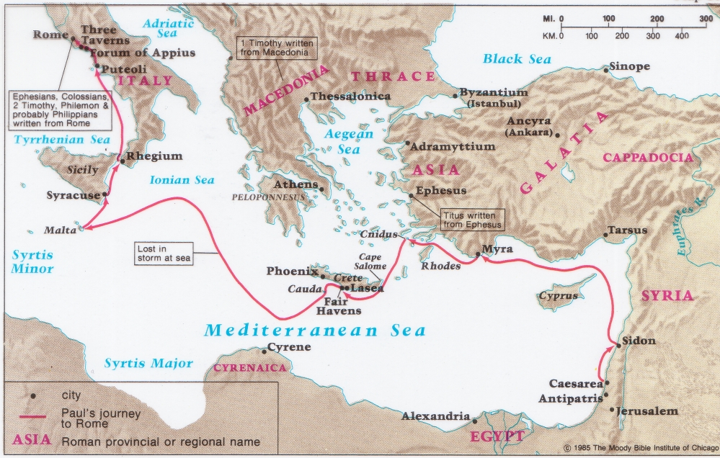
提摩太前书与提多书的来源
141
219
马其顿
以弗所

Slide 62
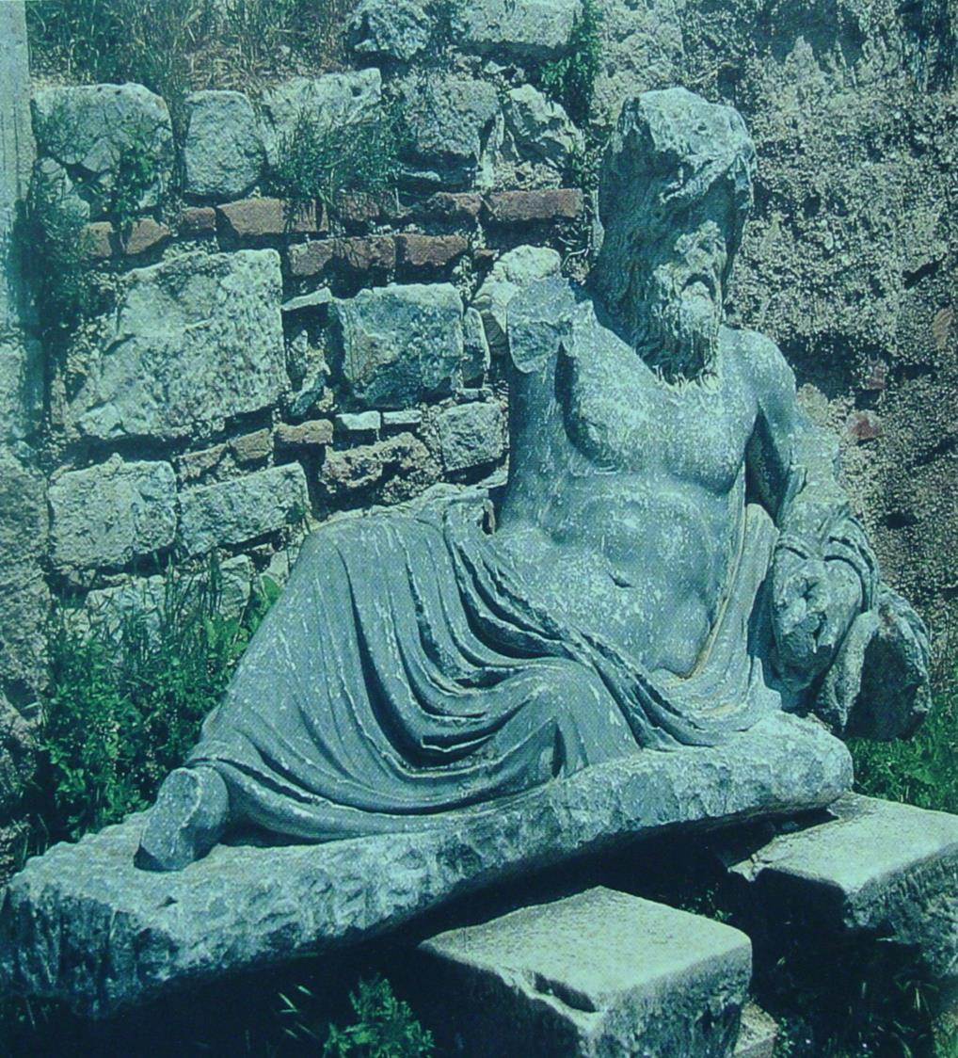
在米利都得神像(River Maeander), 保罗向以弗所教会长老们告别。 (使 20:17)

Slide 63
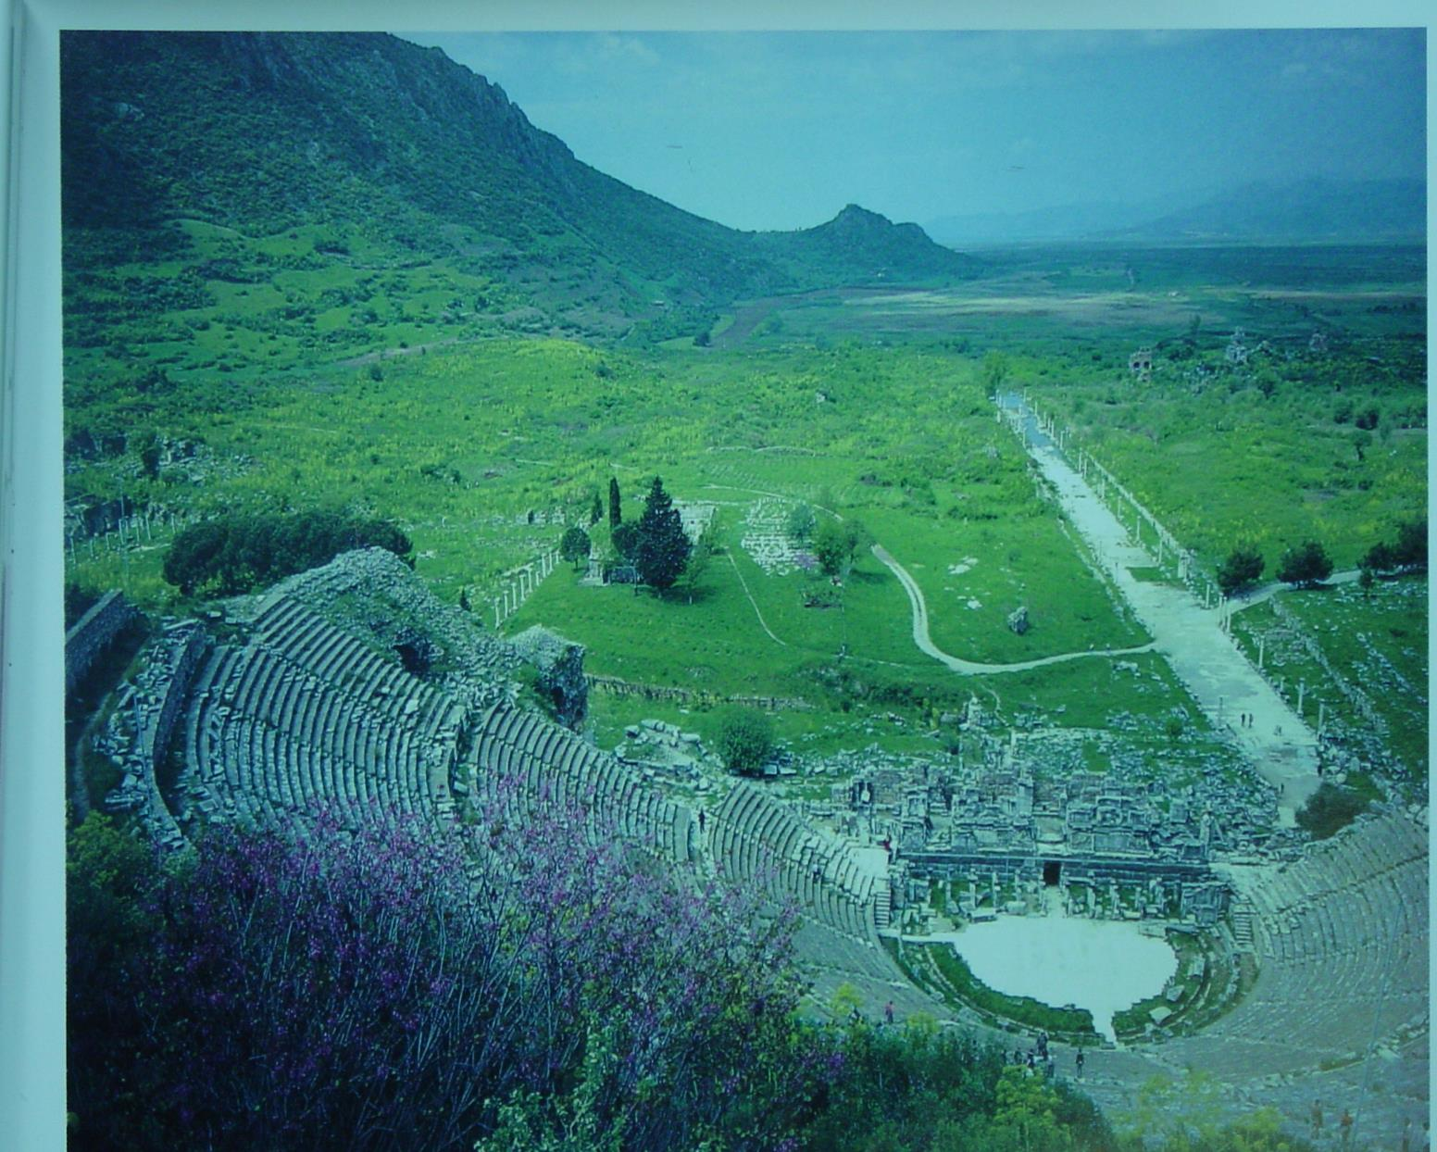
从以弗所剧院的高层往下看 View from top tiers of the great theatre at Ephesus, showing the long, straight Arcadian Way leading in the distance to the ancient harbour, long since silted over.
180a

Slide 64
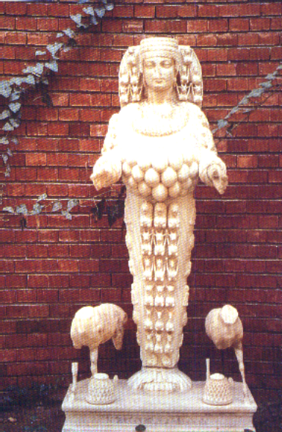
Artemis
180d
Artemis 的神像，在以弗所拥有许多乳房的神像

Slide 65
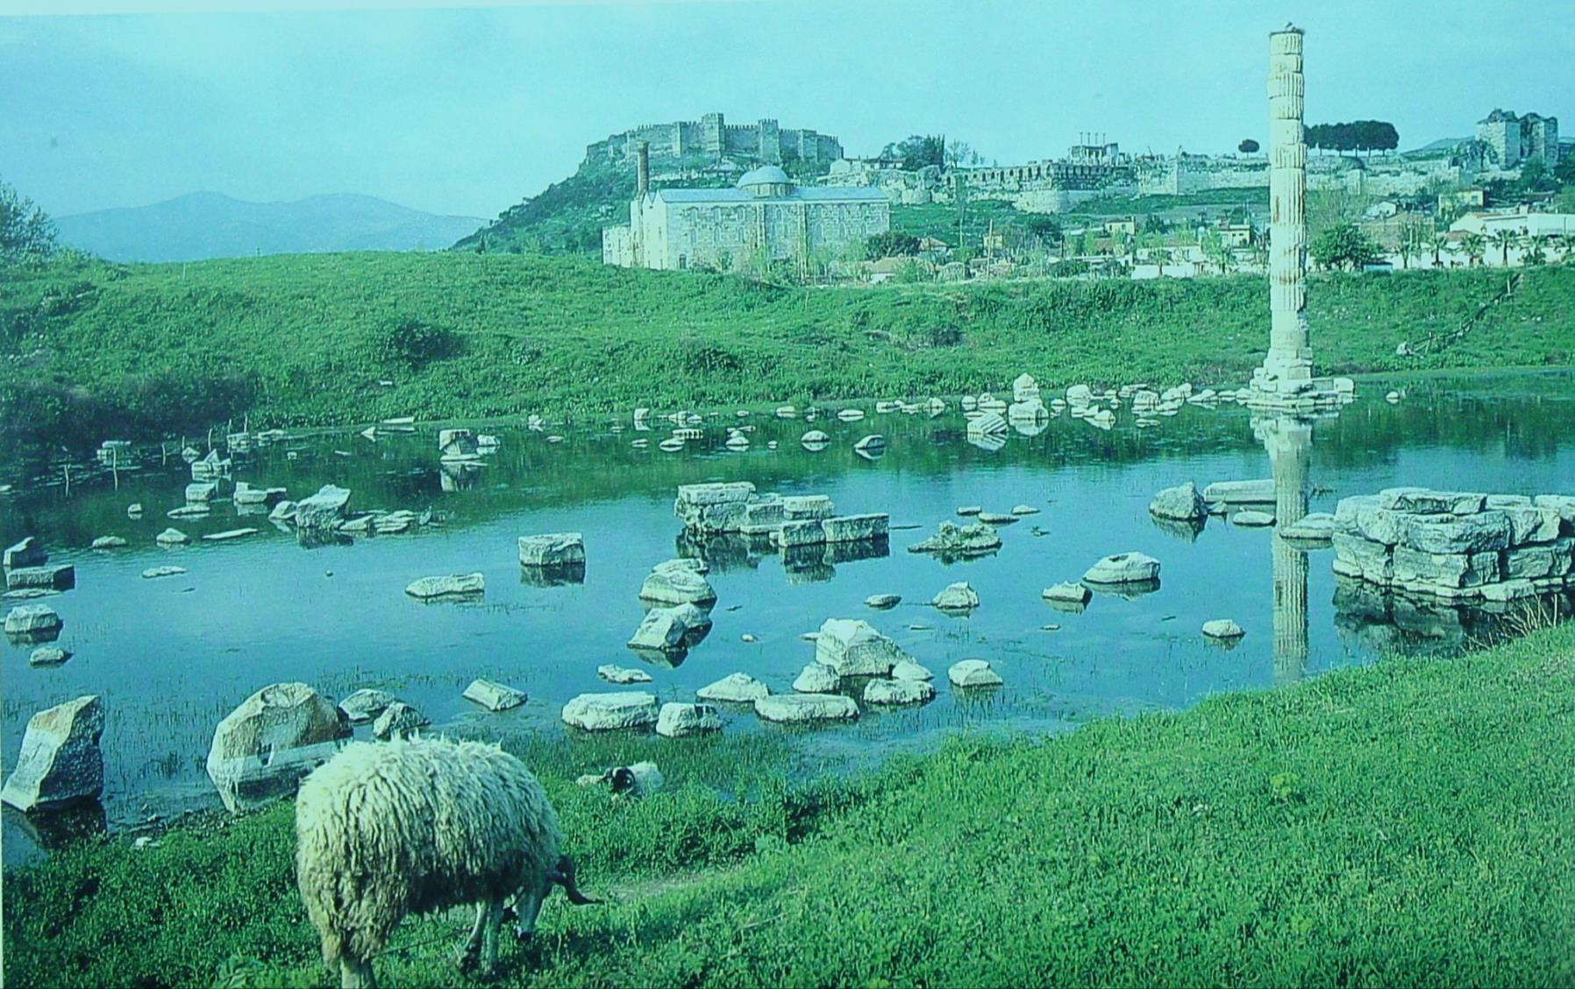
Artemis 的神殿
Citadel in background
这个池以把著名的Artemis (或戴安娜）
神殿淹没了，在提摩太前书写成时有的。

Slide 66
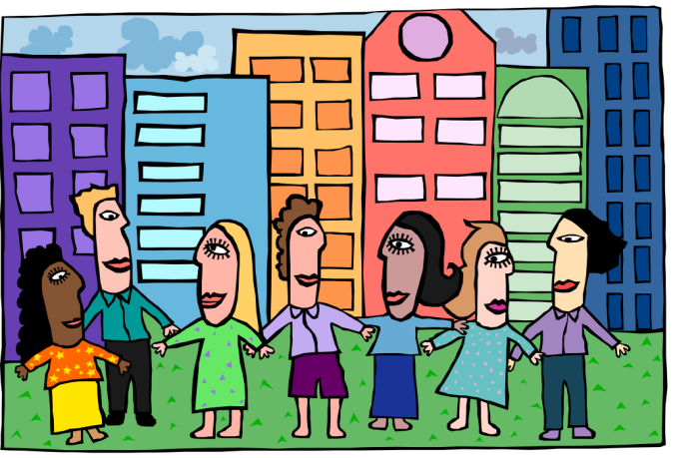
主题
220
教会的次序
“…我把这些事写给你…你也可以知道在神的家里应该这样行, 这家就是永活神的教会，真理的柱石和根基。 ” (提摩太前书 3:14-15)

Slide 67
大纲
220
第一章: 对付假教师
假教师
保罗与福音
给提摩太的分付
第二章: 崇拜
普遍对崇拜聚会的关切
弟兄与姐妹在崇拜聚会的角色
第三章: 领袖
作监督与执事的资格

Slide 68
大纲
220
第四章: 对提摩太的训勉
假教师的警告
生活与神学要谨慎
第五章: 对不同人的对待
寡妇
长老
奴仆 (6:1-2)
第六章: 拥有物质
腐败: 敬虔为得利的门路
对比的态度：自主的敬虔t
给提摩太的嘱咐: 操练敬虔为目标
给富有人的命令: 把盼望放在神而不是财富
给提摩太的嘱咐： 警戒所被委托的

Slide 69
要有次序
提摩太前书
Rick Griffith 博士 • Crossroads International Church Singapore
BibleStudyDownloads.org

Slide 70
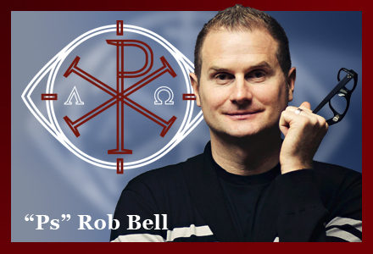
假道
Notes:
False teaching is all around us. Beware!
The world has never had more “isms” than today. They don’t seem to die out. Like a cancer or virus, false teaching just seems to morph and replicate to attack in new ways.

Slide 71
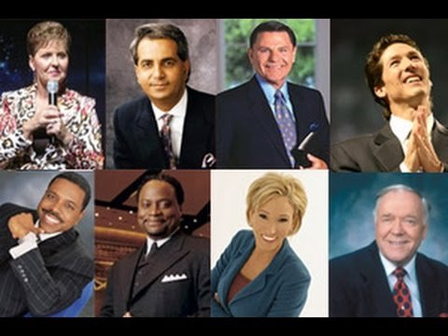
假道
Notes:
Heresies have never been more accessible. You could find me 100 false theologies right there in your seat on your smart phone before you stand up!

Slide 72
But can we defeat heresy?
“When we obey God, we’re not doing it for God. We’re doing it for ourselves…. Just do good for your own self. Do good because God wants you to be happy.”
—Victoria Osteen—
Notes:
But the Bible says, “Do all to the glory of God” (1 Cor 10:31)!

Slide 73
Order
Notes:
Should we just buy a book on it?
Or should we just live and let live?

Slide 74
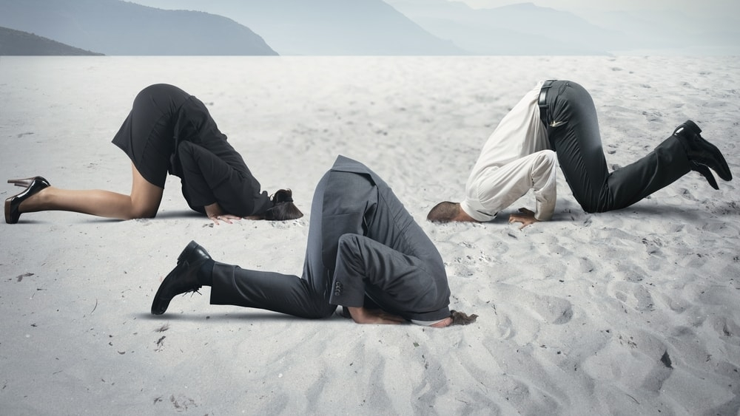
Should we put our heads in the sand?

Slide 75
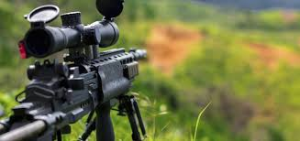
Should we have an all-out assault?

Slide 76
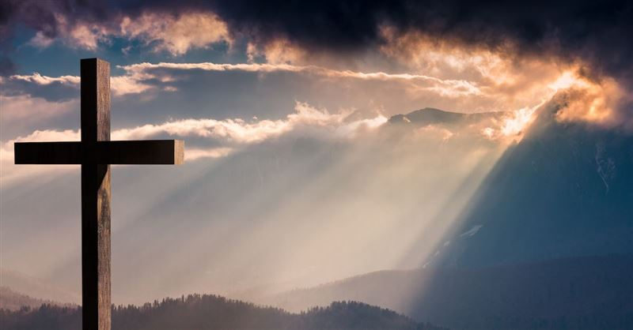
Should we see how God says to defeat heresy?
Notes:
This seems the best strategy to me! Here is what he says…

Slide 77
关键节
217
“… 我把这些事写给你，希望不久可以到你那里去； 假如我来迟了，你也可以知道在 神的家里应该怎样行。这家就是永活 神的教会、真理的柱石和根基。” (3:14-15)。
提摩太前书

Slide 78
主要思想
借着遵守上帝对教会次序的优先重点， 我们能够抵挡假教师。
提摩太前书

Slide 79
神对教会次序的优先重点 是什么？
提摩太前书

Slide 80
主题
23
教会的先后次序
提摩太前书

Slide 81
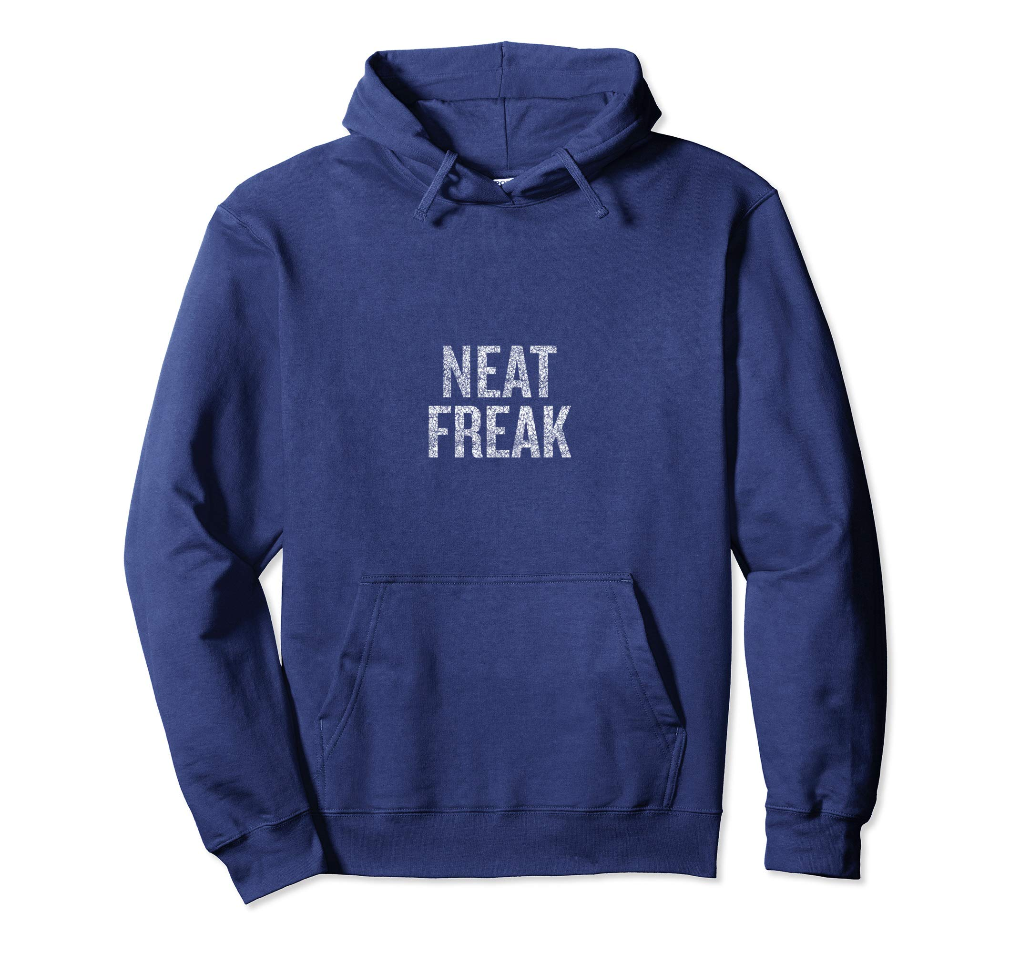
NEAT FREAK

Slide 82
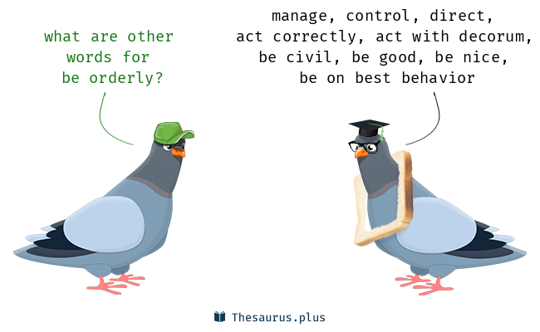
Orderly means…
Manage, control, direct, act correctly, act with decorum, be civil, be good, be nice, be on best behavior
What are other words for be orderly?

Slide 83
Walk Thru the Pauline Epistles
143
新约综览 (保罗书信)
143
38 124 39-41
保罗书信综览
「直到世界最偏僻的地方」 (徒 1:8)
徒 9 13 14 15 16 18 21 27 28
罗马书是保罗宣教书信的最后一卷书，但却是新约书信
中的第一本
夏 35- 37
大马士革 安提阿
四月 48- 九月 49
1 加拉太
四月 50- 九月 52
2 爱琴海
春 53- 五月 57
3 亚细亚
五月 57- 八月 59
试验
二月 60- 三月 62
1 罗马
春62- 冬 67
4 西班牙
秋 67- 春68
2 罗马
冬 49
公会
春 68
教会扩展
35 48 49 50 52 53 57 60 62 67 68 95
马太
宣教
路加
使徒行传
马可
约翰
监狱
教牧
加
帖上
林前
弗
提前
提後
東方宣教
帖下
林後
西
多
宣教
罗马
門
教牧
腓
福音和使徒行传
1234
旅程
监狱
保罗书信
罗马
收监
Pauline
Notes:
NS-25-1 Tim-83

Slide 84
Bible Lands Blank Map
Paul’s Post-Acts Journey
142
Rome
Macedonia
Spain
Ephesus
1 Timothy
Crete
© https://www.deviantart.com/sharklord1/art/Alt-Roman-Empire-Provinces-701148110

Slide 85
You cannot make everything priority
Notes:
Purpose: Why is this letter in the Bible?
It is not enough just to know the importance of combating heresy. We need to know how to do it!
This letter is not the only solution, as other letters also address how to fight false teachers. But it does give us five important handles on to be victorious in maintaining church order in an environment of false teaching.

Slide 86
…for Order
Notes:
Paul gives five priorities to maintain church order so the heretics will be defeated.

Slide 87
I. 你的生命要在律法与 恩典 中取得平衡 (第一章)。
提摩太前书
Notes:
Avoid the extremes of too many rules and too few rules.

Slide 88
Slides on 提摩太前 1

Slide 89
¹ Paul, an apostle of Christ Jesus by the command of God our Savior and of Christ Jesus our hope,
² To Timothy my true son in the faith:
Grace, mercy and peace from God the Father and Christ Jesus our Lord.
³ As I urged you when I went into Macedonia, stay there in Ephesus so that you may command certain people not to teach false doctrines any longer
⁴ or to devote themselves to myths and endless genealogies. Such things promote controversial speculations rather than advancing God’s work—which is by faith.
1 Timothy 1

Slide 90
⁵ The goal of this command is love, which comes from a pure heart and a good conscience and a sincere faith. ⁶ Some have departed from these and have turned to meaningless talk. ⁷ They want to be teachers of the law, but they do not know what they are talking about or what they so confidently affirm.
⁸ We know that the law is good if one uses it properly. ⁹ We also know that the law is made not for the righteous but for lawbreakers and rebels, the ungodly and sinful, the unholy and irreligious, for those who kill their fathers or mothers, for murderers,
1 Timothy 1

Slide 91
¹⁰ for the sexually immoral, for those practicing homosexuality, for slave traders and liars and perjurers—and for whatever else is contrary to the sound doctrine ¹¹ that conforms to the gospel concerning the glory of the blessed God, which he entrusted to me. ¹² I thank Christ Jesus our Lord, who has given me strength, that he considered me trustworthy, appointing me to his service. ¹³ Even though I was once a blasphemer and a persecutor and a violent man, I was shown mercy because I acted in ignorance and unbelief. ¹⁴ The grace of our Lord was poured out on me abundantly, along with the faith and love that are in Christ Jesus.
1 Timothy 1

Slide 92
¹⁵ Here is a trustworthy saying that deserves full acceptance: Christ Jesus came into the world to save sinners—of whom I am the worst. ¹⁶ But for that very reason I was shown mercy so that in me, the worst of sinners, Christ Jesus might display his immense patience as an example for those who would believe in him and receive eternal life. ¹⁷ Now to the King eternal, immortal, invisible, the only God, be honor and glory for ever and ever. Amen.
1 Timothy 1

Slide 93
¹⁸ Timothy, my son, I am giving you this command in keeping with the prophecies once made about you, so that by recalling them you may fight the battle well, ¹⁹ holding on to faith and a good conscience, which some have rejected and so have suffered shipwreck with regard to the faith. ²⁰ Among them are Hymenaeus and Alexander, whom I have handed over to Satan to be taught not to blaspheme.
1 Timothy 1

Slide 94
Healthy Churches guard the gospel
1 Timothy 1:1-11
Preached by Dr. Jim Harmeling at Crossroads International Church Singapore • cicfamily.com Uploaded by Dr. Rick Griffith • Singapore Bible College Thousands of files in 49 languages for free at BibleStudyDownloads.org

Slide 96
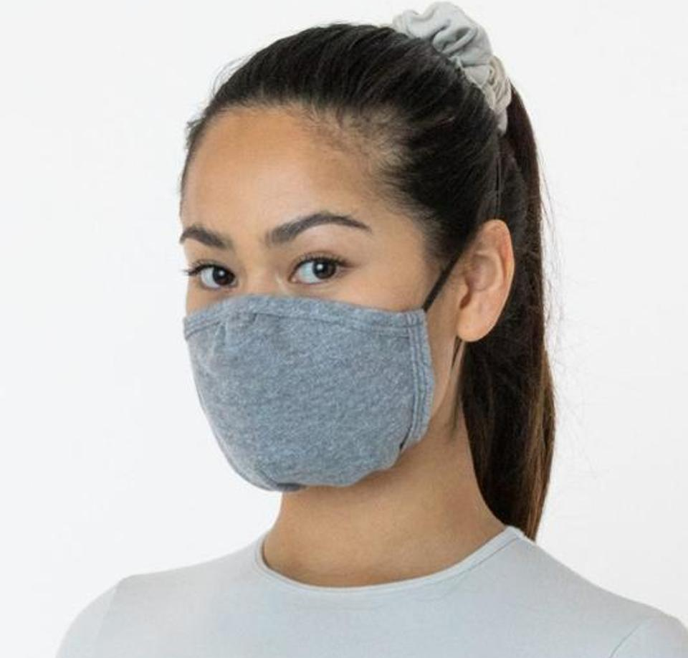
How do you stay healthy?

Slide 97
Healthy Church Life
Studies in 1 Timothy

Slide 98
Kid Proofing the house

Slide 99
1 – Healthy Churches guard the gospel
2 – Healthy Churches pray
3 – Healthy Churches develop godly leaders
4 – Healthy Churches are well taught
5 – Healthy Churches care for each other
6 – Healthy Churches avoid worldliness

Slide 100
Healthy Churches guard the gospel
1 Timothy 1:1-11

Slide 101
Acts 20:29-31
²⁹ I know that after my departure fierce wolves will come in among you, not sparing the flock; ³⁰ and from among your own selves will arise men speaking twisted things,
to draw away the disciples after them.
³¹ Therefore be alert, remembering that for
three years I did not cease night or day to
admonish every one with tears.

Slide 102
Recognize the authority of the gospel (vs. 1-2)
Ephesians 2:19-20
¹⁹ So then you are no longer strangers and aliens, but you are fellow citizens with the saints and members of the household of God, ²⁰ built on the foundation of the apostles and prophets, Christ Jesus himself being the cornerstone

Slide 103
Recognize the authority of the gospel (vs. 1-2)
1 Corinthians 9:1
Am I not free? Am I not an apostle? Have I not seen Jesus our Lord? Are not you my workmanship in the Lord?
2 Corinthians 12:12
The signs of a true apostle were performed among you with utmost patience, with signs and wonders and mighty works.

Slide 104
Recognize the authority of the gospel (vs. 1-2)
Do not get distracted from the goal of the gospel (vs. 3-5)

Slide 105
Clean heart
The qualities of love in a healthy disciple of Christ
Good conscience
Sincere faith

Slide 106
The 72 Names of God
Kabbalah.com
The 72 Names are 72 three-letter combinations of Hebrew letters, each combination channeling its unique energy from the Upper Worlds into our world through the letters themselves. We can connect with these letters simply by passing our eyes over them with the conscious intent of connecting to their energy.
At the Kabbalah Centre, we teach that any person can use these Names as a spiritual tool to connect with the spark of Divine Essence within and to make transformations at the seed level—the level of consciousness.

Slide 107
Recognize the authority of the gospel (vs. 1-2)
Do not get distracted from the goal of the gospel (vs. 3-5)
Retain the Law in the gospel (vs. 6-11)

Slide 108
God’s Law
God’s standard of holiness and righteous living (Rom 7:12)
It requires internal and external adherence (Matt 5:17-30)
It reveals how sinful we are (Rom 3:20)
It leads us to Christ for forgiveness (Galatians 3:23-27)

Slide 109
Healthy Churches guard the gospel
1 Timothy 1:12-20
Preached by Dr. Jim Harmeling at Crossroads International Church Singapore • cicfamily.com Uploaded by Dr. Rick Griffith • Singapore Bible College Thousands of files in 49 languages for free at BibleStudyDownloads.org

Slide 110
They protect the message
1 Timothy 1:1-11
Recognize authority
Don’t get distracted from goal
Retain the Law

Slide 111
They live the message
1 Timothy 1:12-20

Slide 112
Apply the gospel to your own life (1:12-17)
Credit God for life change (v. 12)
Recall pre-conversion state (v. 13)

Slide 113
Acts 22:3-5
³ “I am a Jew, born in Tarsus in Cilicia, but brought up in this city, educated at the feet of Gamaliel according to the strict manner of the law of our fathers, being zealous for God as all of you are this day. ⁴ I persecuted this Way to the death, binding and delivering to prison both men and women, ⁵ as the high priest and the whole council of elders can bear me witness. From them I received letters to the brothers, and I journeyed toward Damascus to take those also who were there and bring them in bonds to Jerusalem to be punished.

Slide 114
Acts 26:9-11
⁹ “I myself was convinced that I ought to do many things in opposing the name of Jesus of Nazareth. ¹⁰ And I did so in Jerusalem. I not only locked up many of the saints in prison after receiving authority from the chief priests, but when they were put to death I cast my vote against them. ¹¹ And I punished them often in all the synagogues and tried to make them blaspheme, and in raging fury against them I persecuted them even to foreign cities.

Slide 115
Insolent opponent - hubris
“The corresponding abstract noun is hubris, which Aristotle defines: ‘Hubris means to hurt and to grieve people, in such a way that shame comes to the man who is hurt and grieved, and not that the person who inflicts the hurt and injury may gain anything else in addition to what he already possesses, but simply that he may find delight in his own cruelty and in the suffering of the other person.’”
William Barclay

Slide 117
Apply the gospel to your own life (1:12-17)
Credit God for life change (v. 12)
Recall pre-conversion state (v. 13)
Explain how God changed you (v. 14)

Slide 118
Philippians 1:29
“For it has been granted to you that for the sake of Christ you should not only believe in him but also suffer for his sake”
Romans 2:4
“Or do you presume on the riches of his kindness and forbearance and patience, not knowing that God's kindness is meant to lead you to repentance?”

Slide 119
Apply the gospel to your own life (1:12-17)
Credit God for life change (v. 12)
Recall pre-conversion state (v. 13)
Explain how God changed you (v. 14)
Declare that the gospel saves all sinners (v. 15)
Reassure that Jesus is patient (v. 16)
Offer praise to Christ for life change (v. 17)

Slide 120
Apply the gospel to your own life (1:12-17)
Challenge believers to remain steadfast in faith (1:18-20)
Corporate accountability helps us remain steadfast (v. 18)
Our conscience helps us remain steadfast (v. 19a)
Fatal examples help us remain steadfast (vs. 19b-20)

Slide 121
Legalism

Slide 122
神对教会次序的优先重点 是什么？
提摩太前书

Slide 123
I. 你的生命要在律法与 恩典 中取得平衡 (第一章)。
提摩太前书
Notes:
Avoid the extremes of too many rules and too few rules.

Slide 124
II. 需要在虔诚领袖的带领下有公共的敬拜生活 (第二至三章)。
提摩太前书
Notes:
Our church services must main order by not just letting anyone lead.

Slide 125
Slides on 提摩太前 2

Slide 126
Healthy Churches Pray
1 Timothy 2:1-7
Preached by Dr. Jim Harmeling at Crossroads International Church Singapore • cicfamily.com Uploaded by Dr. Rick Griffith • Singapore Bible College Thousands of files in 49 languages for free at BibleStudyDownloads.org

Slide 127
Pray for Gospel Conversions

Slide 128
“entreaties and prayers, petitions
and thanksgivings”
Prayer involves diligent and emotional pleading and earnest begging of God
Prayer involves clear, thought out statements that accord with proper biblical precepts
Prayer involves rejoicing and gratitude over God and His answer to requests

Slide 129
Gospel Inclusive Prayer: pray for everyone’s soul (2:1-4)
This impacts national leaders (v. 1)
This pleases God (v. 3)
This brings people to the truth (v. 4)

Slide 130
Gospel Inclusive Prayer: pray for everyone’s soul (2:1-4)
Gospel Exclusive Prayer: pray for people to embrace the narrow gospel (2:5-7)
There is one God (v. 5a)
There is one mediator to God (v. 5b)

Slide 131
“Paul argues that because there is only one God, all people must be the object of prayer since all can be saved only through the one God and the one mediator.”
William Mounce

Slide 132
¹³ Enter by the narrow gate. For the gate is wide and the way is easy that leads to destruction, and those who enter by it are many. ¹⁴ For the gate is narrow and the way is hard that leads to life, and those who find it are few.
Matthew 7:13-14

Slide 133
Gospel Inclusive Prayer: pray for everyone’s soul (2:1-4)
Gospel Exclusive Prayer: pray for people to embrace the narrow gospel (2:5-7)
There is one God (v. 5a)
There is one mediator to God (v. 5b)
There is one payment for our sin (v. 6a)

Slide 134
For even the Son of Man came not to be served but to serve, and to give his life as a ransom for many.
Mark 10:45

Slide 135
Gospel Inclusive Prayer: pray for everyone’s soul (2:1-4)
Gospel Exclusive Prayer: pray for people to embrace the narrow gospel (2:5-7)
There is one God (v. 5a)
There is one mediator to God (v. 5b)
There is one payment for our sin (v. 6a)
There is one time that payment was made (v. 6b)

Slide 136
But when the fullness of time had come, God sent forth his Son, born of woman, born under the law.
Galatians 4:4

Slide 137
Gospel Inclusive Prayer: pray for everyone’s soul (2:1-4)
Gospel Exclusive Prayer: pray for people to embrace the narrow gospel (2:5-7)
There is one God (v. 5a)
There is one mediator to God (v. 5b)
There is one payment for our sin (v. 6a)
There is one time that payment was made (v. 6b)
There are commissioned messengers to proclaim this truth (v. 7)

Slide 138
提摩太前书
论战：
女人在崇拜聚会的职份

Slide 139
A. A woman should not serve as a pastor-teacher with authority over an entire church
222i
B. A woman should not serve as an elder (or other role on the highest ruling council) of a church.
C. A woman should not be the main worship leader in the church worship service.
D. A woman should not be an adult Christian Education director with authority over male teachers.
E. A woman should not be a children’s Sunday school director with authority over male teachers.
F. A woman should not teach a mixed adult Sunday school class at the church building.
G. A woman should not teach a mixed adult cell group at a private home.
H. A woman should not teach a mixed biblical studies course at a seminary or Bible college.
I. A woman should not teach a mixed non-biblical course at a seminary or Bible college.

Slide 140
避免极端
逐字翻译Literalism
高举 真理+文化
2:8 男人必须举起圣洁的手随处祷告。
2:9-10 女人不可以辫 发或带金饰珠宝。
2:11-12 在任何情况下，女人都不可以教导男人。
自由主义Liberalism
消除真理+文化
所有的教导都过时和不相干的，只是暂时的规则来面对当时的情况。

Slide 141
文化与真理的不同
文化
会变的
圣经的作者和读者是在时间的范围里
提供分析资料
具体和明确
真理
不变的
超越时间
提供构成整体的真理
普遍的

Slide 142
男人的祷告 2:8
男人祷告的责任

Slide 143
男人的祷告 2:8
应用 1 :
文化
祷告的身体姿态：站着，跪着，坐着，拍手 或举手。
真理
男人要随处于圣洁和爱来祷告。

Slide 144
女人的装饰 （2：9-10）
衣裳
头发
金饰珠宝

Slide 145
女人的装饰 （2：9-10）
应用 2:
文化
女人的衣裳，头发和金饰珠宝可随文化而变化。
真理
女人要以端正，娴淑，自律和善行为装饰。

Slide 146
顺服 2:11-12
女人与男人的关系

Slide 147
女人应该作的是什么?
女人在外邦人与敬虔的社会，从前与现在

Slide 148
「女人要沉静学道，一味的顺服，我不许女人讲道，也不许她辖管男人，只要沉静。」—提前2:11-12
148

Slide 149
Who wants to address this?
“I’ll preach on Thanksgiving, Christmas, New Year’s and Easter. You can have ‘The Role of Women in the Church,’ ‘Tongues Speaking for Today,’ ‘Biblical Inerrancy,’ and our special ‘Fund Drive Sunday.’”

Slide 150
彼此平等论
互相补足论
NT Wright
Ben Witherington III
Gordon Fee
Scot McKnight
Ruth A. Tucker
Walter C. Kaiser
Jim Wallis
Rachel Held Evans
Gilbert Bilezikian
J.I. Packer
Tim Keller
John F. MacArthur
C.S. Lewis
John Piper
John Wimber
Mark Driscoll
Elisabeth Elliot
Douglas Wilson
vs
150

Slide 151
共同基础
它不像童女怀孕，基督的神性，靠恩典得救般重要
我们能够在爱里异中求同
我们能在公众场合向别人学习神的话
151

Slide 152
“超越政治的潘朵拉讲台”
152

Slide 153
「女人要沉静学道，一味的顺服，我不许女人讲道，也不许她辖管男人，只要沉静。」—提前2:11-12
153

Slide 154
女人该做什么呢？
161o
注意：以下三个经文的上下文都关于公众敬拜
看来林前11与林前14及提前2有矛盾
哥林多前书11 | 哥林多前书14 | 提摩太前书2
能公众祷告(5,13) |  | 公众祷告只有男人(8)
能公众讲道(5) | 不能说话(34) | 一定要安静(12c)
说话是可以的(含蓄的) | 说话是可耻的(35)
 |  | 不能教男人(12a)
 |  | 不许辖管男人(12b)
蒙着头是一般的(16) | 安静是一般的(33) | 男人祷告是一般的(8)
哪一个经文是一般的规律(普通)和哪一个是例外？
想知道如何解决这些矛盾，请看接下来的八面！

Slide 155
I. 平静的学习
「女人要沉静学道，一味的顺服，我不许女人讲道，也不许她辖管男人，只要沉静。」——提前2:11-12
Hesuchia包含两个意思：
A. 培养内在的安静及专注
B. 安静：搁下其他的关注，允许时间
—「你们要休息，要知道我是神。」（诗46:10）
155

Slide 156
II.敬重的学习，而非纂权
「女人要沉静学道，一味的顺服，我不许女人讲道，也不许她辖管男人，只要沉静。」——提前2:11-12
A. 即使不同意，也要敬重
—讲者要「按正意分解神的道」（提后2:15）
听者要学习
—批判的思想而非批评的态度
156

Slide 157
II.敬重的学习，而非纂权
「女人要沉静学道，一味的顺服，我不许女人讲道，也不许她辖管男人，只要沉静。」——提前2:11-12
B.不可纂夺权位
——要受教；抑制反对精神
——「我口所出的话也必如此，决不徒然返回，
却要成就我所喜悦的，在我发他去成就的事上必然亨通。」（赛55:11）
——神使用「差劲」的讲章！
157

Slide 158
以平静及敬重的心学习
158

Slide 159
Q: But why did Paul prohibit women from teaching men in public worship?
A: Because they were less educated?

Slide 160
提摩太前书 2:11-15
¹¹女人应该安静而完全顺服地学习。 ¹²我不准 女人教训男人，辖制男人； 女人总要安静。
¹³因为先造的是亚当，后造的夏娃。 ¹⁴不是亚当受了引诱，而是女人受了引诱，陷在过犯里面。¹⁵然而女人要是常常存着信心，爱心，圣洁自律，在她生育的事上必定得救。

Slide 161
女人的顺服 2:11-12
应用 3:
文化
安静学习
不可以教导?
真理
完全的顺服
在教会里，不可以教训或辖制男人

Slide 162
文化: 静默与教导
顺服在不同的文化是不一样的，不一定要以静默来表现。
如果女人教导男人，是不是说他们就是在辖制他们？
人教导时，权柄是在神的话语，不是在人身上。

Slide 163
真理：权柄-顺服
女人顺服的基本原则: 堕落2:14
误解: 女人在堕落时就显示她们容易受骗，所以她们不应该教导男人。
反对: 如果女人容易受骗，她们就不应该教导任何人，不只是男人。保罗指的是女人在教导儿女和年轻的夫人所扮演的特别的角色（提多书2：4）。
真理: 夏娃在堕落的罪不只是受骗，而是她篡夺了亚当的权柄，交换了彼此的角色。

Slide 164
提摩太前书 2:11-14
结论：
姐妹可以站讲台吗？
不可以，除非她没有戴权柄

Slide 165
Slides on 提摩太前 3

Slide 166
提摩太前书
教会生活与次序

Slide 167
如何在教会里挑选领袖？
好名声
背景
精明
皮夹子
专业
167

Slide 168
教会当如何挑选领袖？
圣经例子：
会众决定/推举
INTRODUCTION
身体
a. 使徒
徒1:12-26——会众选出，使徒指派
b. 执事
徒6:3——会众选出，使徒指派

Slide 169
教会同工的指派
INTRODUCTION
使徒（例：保罗）或他的助手按立长老
a. 徒14:23
b. 多1:5
身体
169

Slide 170
长老的资格是什么？
170

Slide 171
Lead in front,
don’t push from behind
Don’t dominate
Be sensitive to needs

Slide 172
Healthy Church Life
Studies in 1 Timothy

Slide 173
Healthy Churches Develop godly leaders
1 Timothy 3:1-7

Slide 174
They Raise up Godly Elders (vs. 1-7)

Slide 175
Review
1 Timothy 2:11-14
Men are to lead the church
Women can still speak
Women can still teach
Women can still lead

Slide 176
The saying is trustworthy: If anyone aspires to the office of overseer, he desires a noble task.
Elder = Who? Older man
Overseer = What? Oversee
Pastor = How? Like a shepherd

Slide 177
Acts 20:17, 28
¹⁷ Now from Miletus he sent to Ephesus and called the elders of the church to come to him.
²⁸ Pay careful attention to yourselves and to all the flock, in which the Holy Spirit has made you overseers, to care for the church of God, which he obtained with his own blood.

Slide 178
1 Peter 5:1-2
¹ So I exhort the elders among you, as a fellow elder and a witness of the sufferings of Christ, as well as a partaker in the glory that is going to be revealed: ² shepherd the flock of God that is among you, exercising oversight, not under compulsion, but willingly, as God would have you; not for shameful gain, but eagerly;

Slide 179
14 Character Traits For Church Overseers
They are not flirtatious (“the husband of one wife”)
2. They are personally disciplined (“sober-minded”)
3. They are mentally and emotionally balanced (“self-controlled”)
4. They are not out of control (“respectable”)
5. They practice hospitality (“hospitable”)
6. They are able to teach the Bible (“able to teach”)
7. They are not addicted to chemicals (“not a drunkard”)
8. They control their temper (“not violent”)
9. They are considerate of others (“gentle”)

Slide 180
Gentleness:
“It expresses that considerateness that looks humanely and reasonably at the facts of a case.”

Slide 181
14 Character Traits For Church Overseers
They are not flirtatious (“the husband of one wife”)
2. They are personally disciplined (“sober-minded”)
3. They are mentally and emotionally balanced (“self-controlled”)
4. They are not out of control (“respectable”)
5. They practice hospitality (“hospitable”)
6. They are able to teach the Bible (“able to teach”)
7. They are not addicted to chemicals (“not a drunkard”)
8. They control their temper (“not violent”)
9. They are considerate of others (“gentle”)
10. They are peace makers (“not quarrelsome”)

Slide 182
14 Character Traits For Church Overseers
11. They are not materialistic (“not a lover of money”)
12. They manage their homes well (“He must manage his own household well, with all dignity keeping his children submissive, for if someone does not know how to manage his own household, how will he care for God’s church?”)
13. They are not a young Christian (“He must not be a recent convert, or he may become puffed up with conceit and fall into the condemnation of the devil”)
14. They have a favorable testimony among unbelievers (“…he must be well thought of by outsiders, so that he may not fall into disgrace, into a snare of the devil”)

Slide 184
监督(O) 与执事(d) 的品质
224
一般的名誉
(察觉品格)
无可指摘 (O)
教外有好名誉 (O)
庄重 (O & D)

Slide 185
监督(o)与执事(d)的品质
225
II. 家庭生活 (如有接婚)
一个妻子的丈夫 (O & D)
妻子是被庄重的，不说谗言，有节制，凡事忠心。 (D)
儿女凡事敬重顺服 (O & D)

Slide 186
监督(o)与执事(d)的品质
225
III. 反面的特征
不轻易发怒 (O)
不暴力 (O)
与人无争 (O)
不是初信主的 (O)
不贪不义之财 (O & D)
不好酒；有节制的 (O & D)

Slide 187
监督(o)与执事(d)的品质
226
IV. 正面的特征
乐意接待客旅 (O)
切合实际 (O)
先受考验 (D)
真诚 (D)
善于教导 (O)

Slide 188
领袖的品质
223
他们是谁？监督 (长老，主教，牧师) 和执事
品质是指领袖现在的生活
如果领袖失败，他必须离职。
所有的品质是必需和相等重要得
品格是比才干重要 （只有两种特性有关才干）
管理自己的家重于工作
应该要合格才可以
1. 给于敬虔方向
2. 教会可以避免不好或不熟练的领袖带来的不必要问题

Slide 189
I. 会众在教会里拥有最终极的权利
189

Slide 190
会众权利
执行教会纪律（太18:17）
「就告诉教会……」
挑选领袖（徒6:3）
「当从你们中间选出……」
传授正统的教义：
「我当日传给你们的，原是从主领受的……」（林前11:23）
「亲爱的弟兄啊……总要试验那些灵」（约一4:1）
「为……真道竭力的争辩。」（犹3）
190

Slide 191
主教级
教会结构图
（简化）
244a
会督
圣公会
信义会
卫理公会
东正教
天主教
教堂牧师
教堂牧师
教堂牧师
会吏
会吏
会吏
会友
会友
会友
191

Slide 192
基本长老会结构图
244a
长老会
主任牧师
主任牧师
主任牧师
长老
（议会）
长老
（议会）
长老
（议会）
会友
会友
会友
192

Slide 193
区域长老会结构图
教区
长老群
长老群
主任牧师
主任牧师
主任牧师
主任牧师
主任牧师
主任牧师
长老
（议会）
长老
（议会）
长老
（议会）
长老
（议会）
长老
（议会）
长老
（议会）
会友
会友
会友
会友
会友
会友
193

Slide 194
最高层长老会结构图
长老大会
教区
教区
长老群
长老群
长老群
长老群
长老（议会）
长老（议会）
长老（议会）
长老（议会）
长老（议会）
长老（议会）
长老（议会）
长老（议会）
长老（议会）
长老（议会）
长老（议会）
长老（议会）
会友
会友
会友
会友
会友
会友
会友
会友
会友
194
会友
会友
会友

Slide 195
浸信会又如何？
教会的自治权
195

Slide 196
两个问题：
谁拥有教会最后的发言权？
圣经如何论到教会领袖的模式？
196

Slide 197
II. 圣经里的教会领袖模式是由长老组成.
197

Slide 198
由长老领导的摩西时代
与摩西一起
领导的长老
主前1400年
「你去招聚以色列的长老，对他说……」（出3:16）
198

Slide 199
谁领导犹太会堂？
长老领导
的犹太会堂
主前600年
与摩西一起
领导的长老
主前1400年
199

Slide 200
神在各个的时代里都主张团体领袖
长老领导
的犹太会堂
主前600年
新约
长老
与摩西一起
领导的长老
主前1400年
200

Slide 201
各处所提及的长老
长老 = 监督 = 会督 = 牧师
55
耶路撒冷（主后47）
CNV Acts 11:30 他们就这样行了， 由巴拿巴和扫罗经手送到长老们那里。
以弗所（主后57)
CNV Acts 20:17他从米利都派人去以弗所， 请教会的长老来。
加拉太（主后48）
NIV Acts 14:23 两人在各教会为他们指派了长老； 禁食祈祷之后， 就把他们交讬给所信的主。
革哩底（主后66）
NIV Titus 1:5我从前留你在克里特岛， 是要你办好没有办完的事， 并且照我所吩咐的， 在各城设立长老。
腓立比（主后62）
NIV Philippians 1:1 基督耶稣的仆人保罗和提摩太， 写信给所有住在腓立比， 在基督耶稣里的圣徒、 监督和执事:
旁非利亚、加拉太、加帕多家、亚洲及庇推尼（主后64）
彼5:1「我这作长老……劝你们中间与我同作长老的人。」 （参1:1）

Slide 202
长老当作什么？
202

Slide 203
长老的牧养职分
(a) 教导的长老：
INTRODUCTION
「作全群的监督」（徒20:28）
「善于教导」（帖前5:12；提前3:2；多1:9b）
良好的圣经基础（多1:9a）
教导神的计划（徒20:20,27）
受薪制的教导（提前5:17）
BODY
203

Slide 204
三种类型的长老
236b
「那善于管理教会的长老，当以为配受加倍的敬奉，那劳苦传道教导人的，更当如此。」（提前5:17）
所有长老
教导、保护、领导、服事、见证
无领薪或 $ 若有需要
领薪的经理
$
传道人及老师 $$

Slide 205
长老的牧养职分
(a) 教导的长老：
INTRODUCTION
「作全群的监督」（徒20:28）
「善于教导」（帖前5:12；提前3:2；多1:9b）
良好的圣经基础（多1:9a）
教导神的计划（徒20:20,27）
受薪制的教导（提前5:17）
最高职位：教导（徒6:1-7）
长老领导执事（腓1:1）
BODY
205

Slide 206
长老的三个牧养工作
236c1
教导
提前3:2；5:17

Slide 207
236a 6b
长老和执事的关系
模式一：主任牧师带领执事会
主任牧师
执事会
不符合圣经
207

Slide 208
236a 6b
长老和执事的关系
模式二：主任牧师与执事会平起平坐
执事会
主任牧师
不符合圣经
208

Slide 209
236a 6b
长老和执事的关系
模式三：执事带领长老/牧者
执事会
主任牧师
不符合圣经
209

Slide 210
236a 6b
长老和执事的关系
模式四：长老团带领执事会
主任牧师
执事会
210

Slide 211
236a 6b
长老和执事的关系
使徒带领「七个执事」
使徒
DDDDDDD
DDDD
DDDDD
「七位执事」
（徒21:8）
211

Slide 212
236a 6b
长老和执事的关系
模式五：长老与执事的委员会
长老
DDDDDDD
DDDD
DDDDD
212

Slide 213
236c1
长老的三个牧养工作
教导
提前3:2；5:17
牧师—教师
弗4:11
牧养
（保护与领导） 彼前5:1-4; 徒20:29,35; 帖前5:12
213

Slide 214
长老的三个牧养工作
236c1
行政管理
「服事、关顾及见证」 提前3:1，4-5；5:17
Episkopos =Epi「在上面」+skopos「看」= 「守望」
教导
提前3:2；5:17
牧师—教师
弗4:11
牧养
（保护与领导） 彼前5:1-4; 徒20:29,35; 帖前5:12
214

Slide 215
分担领导
圣经支持
长老群
而是多个长老
不是一个长老……
215

Slide 216
总结
INTRODUCTION
因此，新约呈现的长老功能是
教导、牧养及行政管理
BODY
216

Slide 217
Can't we just renamed deacons "elders"?
Deacon
Deacon
Elder
Elder

Slide 218
No. There are many differences between them…
Deacon
Elder
Qualifications
Character
Character + Teaching
Role (Gifting)
Administration
Pastoral
Time Involved
Much
Even more extensive
Age
Younger
Older

Slide 219
231
执事的主要功能
INTRODUCTION
服事
a. 徒6:1-6
b. 提前3:8-13
BODY
219

Slide 220
注意：
执事不是统治者，他们是附属在长老的治理之下。
执事辅助长老，尤其是减轻长老身负教会繁重的事工。
INTRODUCTION
BODY
220

Slide 221
注意：
新约里并没有记载执事如同长老一样拥有治理教会的权利，也并没记载执事被吩咐去作教导圣经或正统的教义。
INTRODUCTION
BODY
221

Slide 222
236a
设立教会管理的型式
INTRODUCTION
长老（管理/作抉择）
BODY
执事（服事）
会众（委任）
222

Slide 223
长老－会众动力
INTRODUCTION
长老
看自己如同仆人
爱
BODY
看他们如同领袖
会众
223

Slide 224
假教师与教导 提前1:3-20; 4:1-16; 6:3-5, 20, 21
221
提摩太留在以弗所教会的其中一个理由是要嘱咐假教师 (1:3)
异端的来源：虚妄的邪灵和鬼摩 (4:1)

Slide 225
假教师的特征
221
“虚伪的骗子" (1:7)
不胜任: 他们 “不明白自己讲的是什么，主张的又是什么" (1:7)
骄傲(6:4)
属灵瞎: “心术败坏，丧失真理的人" (6:5)
利用 “虔诚”为了得利 (6:5)

Slide 226
假教义的特征
教导不接受“主耶稣基督纯正的话语” (6:3)
传假的教义: “他们禁止嫁娶，禁戒食物” (4:3)
注重世俗以及老妇的无稽之谈和无穷的家谱
专好问难争辩 (6:4)

Slide 228
Healthy Church Life
1 Timothy 3:8-16
Preached by Dr. Jim Harmeling at Crossroads International Church Singapore • cicfamily.com Uploaded by Dr. Rick Griffith • Singapore Bible College Thousands of files in 49 languages for free at BibleStudyDownloads.org

Slide 231
Acts 6:1-2
¹ Now in these days when the disciples were increasing in number, a complaint by the Hellenists arose against the Hebrews because their widows were being neglected in the daily distribution. ² And the twelve summoned the full number of the disciples and said, “It is not right that we should give up preaching the word of God to serve tables.”

Slide 232
Healthy Church Life
Studies in 1 Timothy

Slide 233
Healthy Churches Develop godly leaders
1 Timothy 3:1-16

Slide 234
They Raise up Godly Elders (vs. 1-7)
They Develop Godly Deacons (vs. 8-16)
Philippians 1:1
Paul and Timothy, servants of Christ Jesus,
To all the saints in Christ Jesus who are at Philippi, with the overseers and deacons:

Slide 235
The saying is trustworthy: If anyone aspires to the office of overseer, he desires a noble task.
Elder = Who? Older man
Overseer = What? Oversee
Pastor = How? Like a shepherd

Slide 236
James 5:14
Is anyone among you sick? Let him call for the elders of the church, and let them pray over him, anointing him with oil in the name of the Lord.

Slide 237
Acts 15:1-2, 6
¹ But some men came down from Judea and were teaching the brothers, “Unless you are circumcised according to the custom of Moses, you cannot be saved.” ² And after Paul and Barnabas had no small dissension and debate with them, Paul and Barnabas and some of the others were appointed to go up to Jerusalem to the apostles and the elders about this question.
⁶ The apostles and the elders were gathered together to consider this matter.

Slide 238
What qualities are desired in a deacon?
They are respectable (“dignified”)
They do not speak out of both sides of their mouths
(“not double-tongued”)
They do not have addictions (“not addicted to much
wine”)
4. They are not greedy and materialistic (“not greedy for
dishonest gain”)
They are doctrinally sound with a life of integrity
(“They must hold to the mystery of the faith with a
clear conscience”)

Slide 239
What qualities are desired in a deacon?
They have been tested in ministry responsibility (“And
let them all be tested first; then let them serve as
deacons if they prove themselves blameless.”)
They manage their homes well (“Let deacons each be the husband of one wife, managing their children and their own households well.”)

Slide 240
A Challenge to the Women

Slide 241
female deacons?
Why resume character traits of the “deacons” immediately afterwards?
Why then say deacons are husbands of one wife?
Why use the same word for the women throughout this chapter that refers to wives?
Why not select females in Acts 6?
deacon’s wives?
Why are elder’s wives not mentioned?
Why not make it clear these are deacon’s wives by including the personal pronoun, “their” wives, instead of “women”?
Why is Phoebe called a “servant” or “deacon” in Romans 16:1?

Slide 242
They are respectable (“dignified”)
They are self-controlled with their tongue (“not slanderers”)
They have self-control over their life (“sober-minded).
They are reliable (“faithful in all things)

Slide 243
Why are church leaders important?
(vs. 14-16)
The Church has quality: It is ordered
The Church has personality: It is a family of people
The Church has God’s presence: He is living in it
The Church has a mission: It must support and protect the truth

Slide 244
提摩太前书 3:8-13 (新译本)
232
⁸,照样，执事也必须庄重，不一口两舌，不酗酒，不贪不义之财。 ⁹用清洁的良心持守信仰的奥秘。 ¹⁰他们也必须先受考验，若没有可责之处，然后才让他们作执事。 ¹¹照样，他们的 妻子 {¹¹可解作女执事} 也要庄重 不说？？言，有节制，凡事忠心。¹²执事 只可以作一个妻子的丈夫，善于 管理儿女和自己的家。¹³那善于作执事的，就为自己得了好的位分，也因着相信基督耶稣得到大大的胆量。

Slide 245
对女人的观点- 提摩太前书3:11
232
Gynaikos (gunaiko.j) 可以翻译成 “女人” 或 “妻子”
用词至少有六个观点:
女人
长老和执事的妻子
像执事但在他们以下
执事的妻子
女执事, 或
执事的妻子称为女执事
245

Slide 246
支持“像执事但在他们以下”
232
(4) “They are a group by themselves, not just the wives of the deacons nor all the women who belong to the church.…On the other hand, the fact that no special and separate paragraph is used in describing their necessary qualifications, but that these are simply wedged in between the stipulated requirements for deacons, with equal clarity indicates that these women are not to be regarded as constituting a third order in the church, the office of deaconess, on par with and endowed with authority equal to that of deacons” (William Hendricksen, Pastoral Epistles, NTC, 346; Donald Guthrie, The Pastoral Epistles, 85; See my p. 232, note 2).
246

Slide 247
Supporters of “Deacon Wives”
232
Translations: NIV, KJV, NKJV, GNB, Beck, LB, Phillips
Scholars:
Warren Wiersbe, 51-52
Earle, Expositors Bible Commentary, 11:368
Litfin, Bible Knowledge Commentary, 2:238 says the view has a slim advantage.

Slide 248
Supporters of “Deaconesses”
232
Translations: NIV footnote, Williams trans.
Scholars:
James B. Hurley, Man and Woman in Biblical Perspective, 229-33
Kelly, 83
Newport J. D. White, in Expositors Greek Testament, 4:115-16
J. H. Bernard, The Pastoral Epistles, 58-59
Walter Lock, A Critical and Exegetical Commentary on the Pastoral Epistles, ICC, 40-41

Slide 249
1 Tim 3:16 (NIV)
¹⁶ Beyond all question, the mystery from
which true godliness springs is great:
He appeared in the flesh, was vindicated by the Spirit, was seen by angels, was preached among the nations, was believed on in the world, was taken up in glory.

Slide 250
Slides on 提摩太前 4

Slide 251
III. 谨守私生活与教义 (第四章)。
提摩太前书
Notes:
Your beliefs affect everything about you—privately and publicly. Watch them!

Slide 252
对假教师和假教义的回应
惩罚: 把他们交给撒旦，“使他们受教不再亵渎” (1:20)
有帮助的教导： 教导凡上帝所造的，都是好的，只要存感谢的心领受的。(4:4-6)

Slide 253
对假教师和假教义的回应
敬虔生活: 操练自己达到敬虔的地步。(4:7)
忠心事奉: 避免 世俗的空谈和冒称是知识的那种反调 (6:20) 和 促进神的工作 (1:4, 5)

Slide 254
IV. 满足各教会群体的需要 (5:1–6:10)。
提摩太前书
Notes:
Our church’s different subgroups must not be vulnerable to enemy attack.

Slide 255
Slides on 提摩太前 5

Slide 256
三种类型的长老
236b
「那善于管理教会的长老，当以为配受加倍的敬奉，那劳苦传道教导人的，更当如此。」（提前5:17）
所有长老
教导、保护、领导、服事、见证
无领薪或 $ 若有需要
领薪的经理
$
传道人及老师 $$

Slide 257
因为经上说：「牛在场上踹谷的时候，不可笼住它的嘴。又说：『工人得工价是应当的』。」（提前5:18）
·马其顿
保罗写提摩太前书
主后62
保罗在五年里称路加福音为
“圣经”
·该撒利亚
路加福音写成
主后57-59
「你们要住在那家，吃喝他们所供给的，因为工人得工价是应当的……」（路10:7）
257

Slide 258
Slides on 提摩太前 6

Slide 259
V. 不要因为爱钱而毁了属灵生命 (6:11-21)
提摩太前书
Notes:
Resist materialism that replaces godliness with apostasy.

Slide 260
假教义的结果
起争论和无效果的讨论，对神的工作是毫无帮助的。(1:4-6)
产生妒忌，纷争，毁谤，恶意的猜疑。 (6: 4,5)
偏离了真道(6:21)

Slide 261
$$ 钱 $$
其中的一个假教义：“丧失真理的人，他们视敬虔为得利的门路” (6:5)
他们剥削教会

Slide 262
THE GOSPEL IS TO BE TOLD, NOT SOLD

Slide 263
敬虔与知足
对假教师视敬虔为得利的门路的警告 (6:5).
贪财是万恶之根(6:10).
那些想要发财的人，就落在试探中和陷阱里(6:9).

Slide 264
敬虔与知足
约伯的比喻 (约伯1:21):
“其实敬虔而又知足，就是得大利途径”
(提摩太前书 6:7)

Slide 265
"Scripture" (6: NLT).
You aren’t wealthy until you have something money can’t buy.
—Garth Brooks—

Slide 266
敬虔与知足
保罗的榜样:
法利赛家族y
当保罗全时间事奉时，他放弃了财富和安全
“只要有衣有食，就应当知足 (6:8).”
希腊文“衣裳”的用语也可以指掩蔽
需要: 食物，水，衣服，掩蔽

Slide 267
主要思想
借着遵守上帝对教会次序的优先重点， 我们能够抵挡假教师。
提摩太前书

Slide 268
神对教会次序的优先重点 是什么？
提摩太前书

Slide 269
I. 你的生命要在律法与 恩典 中取得平衡 (第一章)。
提摩太前书
Notes:
Avoid the extremes of too many rules and too few rules.

Slide 270
II. 需要在虔诚领袖的带领下有公共的敬拜生活 (第二至三章)。
提摩太前书
Notes:
Our church services must main order by not just letting anyone lead.

Slide 271
III. 谨守私生活与教义 (第四章)。
提摩太前书
Notes:
Your beliefs affect everything about you—privately and publicly. Watch them!

Slide 272
IV. 满足各教会群体的需要 (5:1–6:10)。
提摩太前书
Notes:
Our church’s different subgroups must not be vulnerable to enemy attack.

Slide 273
V. 不要因为爱钱而毁了属灵生命 (6:11-21)
提摩太前书
Notes:
Resist materialism that replaces godliness with apostasy.

Slide 274
提摩太前 教会次序
(通过将优先次序给予…)
与假教师辩论 | 教会生活 | 个人生活/教义 | 不同教会群体 | 警惕物质主义
第 1 章 | 第 2–3 章 | 第 4 章 | 5:1–6:10 | 6:11-21
教义 | 敬拜 | 例证 | 尊敬 | 优先次序
警告 | 众人 | 警告 | 众人 | 警告
问安 反驳异端 上帝恩典 吩咐 | 祷告 性别角色 领袖特质 书信目的 | 将来的异端 关注生命 关注教义 | 尊重个人 寡妇 老人 奴隶 假教师 | 属灵目标 富足人必须奉献 结束的吩咐
实用劝勉贯穿全书信
从马其顿到以弗所
主后 62年秋
提摩太前书
217

Slide 275
Black

Slide 276
新约全书讲章 • BibleStudyDownloads.org
免费获得该讲解!
圣经学习下载
Notes:
The explanation for free
NT Preaching link address

Slide 277
Leaders look out for the flock.

Slide 278
The Shack
Notes:
Should we just live and let live?

Slide 279
The Shack

Slide 280
The Shack

Slide 281
测验
教会领袖的品质是指过去或现在的生活？
什么是作教会领袖最重要的品质？
如果一个牧师没有达到应有的品质时，我们应该这么处理？

Slide 282
怎么样有一个有效的事工？
教会生活 public
掌握和教导纯正教义
享有人的尊敬
有一个平衡的事奉
私人生活 personal
运用神给的恩赐
生活与神学要谨慎

Slide 283
Now Unto the King (提摩太前书1:17)
Now unto the King eternal
Unto the King immortal
Unto the King invisible
The only wise God, the only wise God
(repeat)
Chorus: Oh, unto the King be glory and honor
Unto the King forever
Unto the King be glory and honor
Forever and ever
Amen. Amen.

Slide 284
Black

Slide 285
新约全书链接地址 BibleStudyDownloads.org
免费获得该讲解!
圣经学习下载
Notes:
NT Survey link: http://biblestudydownloads.org/resource/%e6%96%b0%e7%ba%a6%e5%85%a8%e4%b9%a6/

