Slide 1
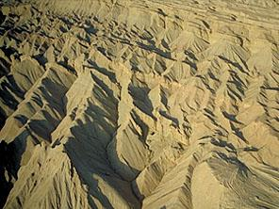
帖撒罗尼迦后书
216
Dr. Rick Griffith • 新加坡神学院• BibleStudyDownloads.org

Slide 2
关键字
211
大灾难
帖撒罗尼迦后书

Slide 3
主题
23
大灾难修正
帖撒罗尼迦后书

Slide 4
关键节
211
“无论有灵、有话、有冒我们的名的书信，说主的日子现在到了，你们都不要轻易动心，也不要惊慌。 3 不要让人用任何方法迷惑了你们，因为主的日子来到以前，必定有背道的事，并且那不法的人，就是那沉沦之子，必定显露出来”
(贴后2:2-3).
帖撒罗尼迦后书

Slide 5
总结和应用
帖撒罗尼迦后书
211
信息声明
保罗在更正那些帖撒罗尼迦被逼迫的信徒有关主再来的日子(受难)的错误观念时，已间接鼓励和鉴定那些沮丧的信徒也激励了那些不守规则的信徒帮助他们在真理上站立的稳即使有假教师。
应用
你读了末世论,相信它会引响你
作为一个基督徒的行为吗？

Slide 6

帖撒罗尼迦后书 国度陈述
2 Thessalonians Kingdom Statement
27a
在描述撒旦的国度反对耶稣时，保罗对敌基督者的最清楚的描述有三个迹象（叛教，敌基督者的启示，以及除去限制者），而这三个迹象将在灾难之前发生。这可能发生在被提 （Rapture）的几天，几周或几个月后 (2:3-7)。
Notes:
2 Thessalonians Kingdom Statement
Describing Satan’s kingdom to oppose Jesus, Paul’s clearest description of the Antichrist has three signs (the apostasy, the revelation of the Antichrist, and the removal of the restrainer) that will take place before the tribulation, which could happen days, weeks, or months after the Rapture (2:3-7).

Slide 7
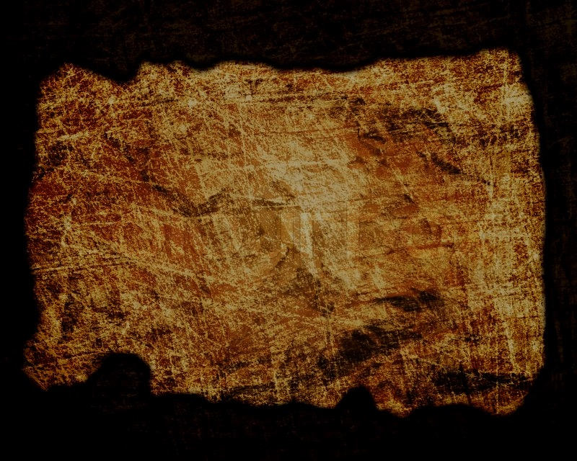
Covenant in 2 Thessalonians
帖撒罗尼迦后书的圣约
27a
耶和华的日子（参照以赛亚书13：6,9; 约珥书1-2; 西番雅书 1：14-16）有着击败以色列的仇敌承。
基于此, 保罗鼓励 他们坚持不懈为了未来在主的日子里的奖赏 （第1章），并纠正他们对主的日子的错误观念 （第2章） ，因为这种观念已导致了游手好闲的态度 （第3章）。
Notes:
Covenant in 2 Thessalonians
The Day of the LORD (cf. Isa. 13:6, 9; Joel 1–2; Zeph. 1:14-16) promised defeat of Israel’s enemies. Based on this, Paul encouraged perseverance based upon their future reward at the day of the Lord (ch. 1) and corrected their false notion of the day of the Lord (ch. 2) that had resulted in idleness (ch. 3).

Slide 8

Redemption in 2 Thessalonians
27a
帖撒罗尼迦后书的救赎论
在三篇短章中仅有47节的经文,救主被称为 “耶稣”13次（Elwell和Yarbrough，《遇见新约》，332）。祂从罪中拯救（1：1,8），也从审判中救出（1：7）。
Notes:
Redemption in 2 Thessalonians
The Savior is called “Jesus” 13 times in three short chapters of only 47 verses (Elwell & Yarbrough, Encountering the New Testament, 332), where his deliverance from sin (1:1, 8) also delivers from judgment (1:7-8; 2:8).

Slide 9
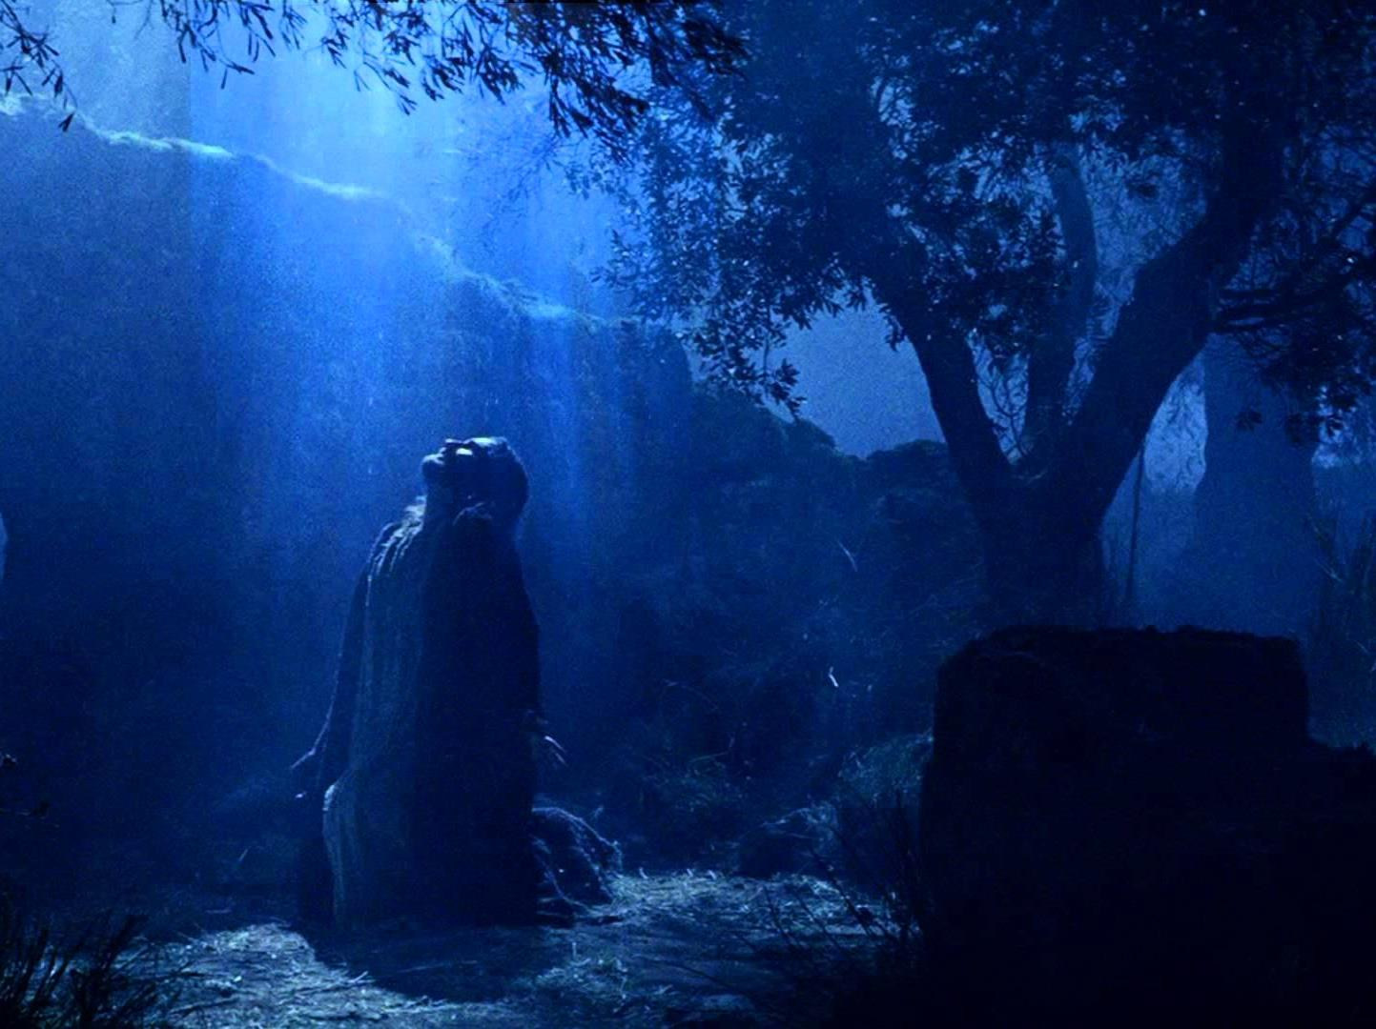
Prophecy in 2 Thessalonians
(Lord, Deity)
帖撒罗尼迦前书的预言
（主, 神性)
27a
我们的主在三篇短章中仅有47节的经文被称为
“主”22次（Elwell和Yarbrough，《遇见新约》，332），强调祂的权威/权力 （1：7; 2：8）
和神性是平等与 父。
Notes:
Prophecy in 2 Thessalonians
(Lord, Deity)

Slide 10
Book Chart
帖撒罗尼迦后书: 受难的更正
逼迫中仍坚信 |  | 关於主的日子 |  |  | 训导慵懒的门徒
第一章 |  | 第二章 |  |  | 第三章
情感 |  | 神学观 |  |  | 实际行为
逼迫中的鼓励 |  | 解释那一天 |  |  | 身上得荣耀
煽胆的信徒 |  | 扰乱的信徒 |  |  | 不守规矩的信徒
更改观念 |  | 更改神学观 |  |  | 更改态度
问安 | 奖赏 与审判 | 受难前 的教导 | 敌基督 的条件 | 站稳：坚守 | 祷告 | 神的管教 | 祝福
1:1-2 | 1:3-12 | 2:1-2 | 2:3-12 | 2:13-17 | 3:1-5 | 3:6-15 | 3:16-18
格林多
后夏 公元 51年
211

Slide 11
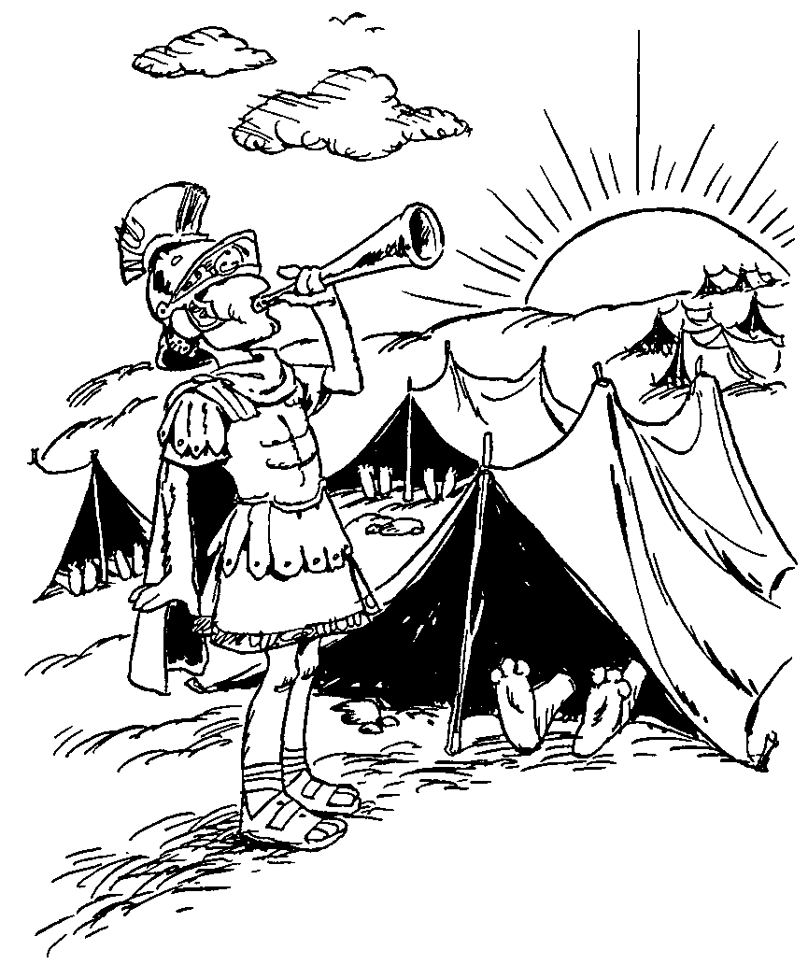
SECOND THESSALONIANS
描述帖撒罗尼迦教会的信仰
最后的日子里叛教
通过作工收获果实
1
2
3
Description of Thessalonians' faith
Apostasy in last days
Yield fruit through work
帖撒罗尼迦前书 (根据赫德尔斯顿)
Barry Huddleston, The Acrostic Bible
巴里 赫德尔斯顿, 《藏头诗圣经》
Notes:
1：Description of Thessalonians' faith
2： Apostasy in last days
3： Yield fruit through work

Slide 12
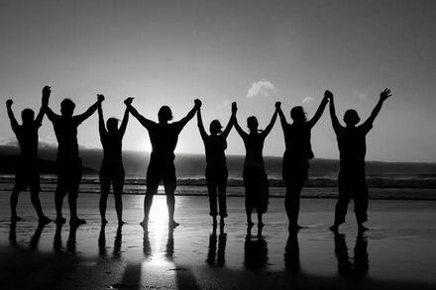
得到肯定
帖撒罗尼迦后书
Dr. Rick Griffith • Crossroads International Church Singapore
BibleStudyDownloads.org

Slide 13


自我肯定是否足够？
今天最棒的人是谁?
我无条件的爱我自己。

Slide 14

神怎么在困难中肯定我们？

Slide 15



神是全方面的肯定我们。
(帖撒罗尼迦后书 的主题)
神如何肯定我 们
情绪
1
神学
2
实践
3
Notes:
Restated: He is not incomplete or piecemeal in his ministry to us.
• He touches the heart (emotionally),
• the mind (theologically),
• and the hands (practically).

Slide 16


（一）情绪：神赐毅力以让我们成熟 （帖撒罗尼迦后书 第1章）
Notes:
The Lord helps us not to lose heart so we will grow.]

Slide 17

（二）神学：神赐真理以带给我们稳定 （帖撒罗尼迦后书 第2章）
Notes:
Theology matters! The Lord corrects our misconceptions to give us firm footing.

Slide 18
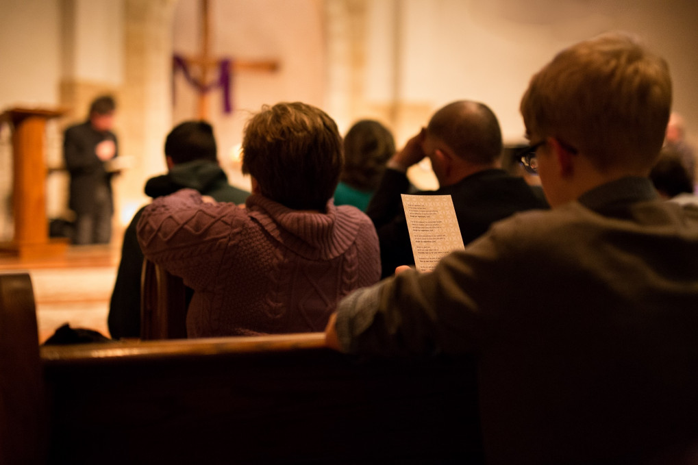
III. Practically: God cultivates discipline in us to build responsibility (2 Thess 3).
（三）实践：神让我们培养纪律以让我们训练出责任感 （帖撒罗尼迦后书 第3章）
Notes:
The Lord helps us hold one another accountable so we will be reliable.
• Rather than living an undisciplined life
• Each of us has had to show discipline to learn certain skills such as playing an instrument
• So we need that same type of discipline to know his Word
• And to be a vital part of his church.

Slide 19
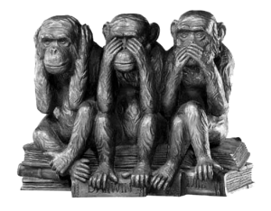
在鼓励别人这方面，你做得如何呢？

Slide 20
Black
Notes:
20

Slide 21

有时享平安如江河平又稳
有时享平安如江河平又稳
有时忧伤来
似浪滚
有时忧伤来
似浪滚
不论何环境，主己教导我说
不论何环境，主己教导我说
我心灵得安宁，得安宁
我心灵得安宁，得安宁
副：我心灵得安宁，我心灵得安宁
副：我心灵得安宁，我心灵得安宁
得安宁，得安宁
得安宁，得安宁

Slide 22
回想我众罪，全钉在十架上
回想我众罪，全钉在十架上
每念此，衷心极欢畅
每念此，衷心极欢畅
主担我重担，何奇妙大恩情
主担我重担，何奇妙大恩情
赞美主！我心灵得安宁
赞美主！我心灵得安宁
副：我心灵得安宁，我心灵得安宁
副：我心灵得安宁，我心灵得安宁
得安宁，得安宁
得安宁，得安宁

Slide 23

求主快再来，使信心得亲见
求主快再来，使信心得亲见
云彩将卷起在主前
云彩将卷起在主前
号筒声吹响，主再临掌权柄
号筒声吹响，主再临掌权柄
愿主来！我心灵必安宁
愿主来！我心灵必安宁
副：我心灵得安宁，我心灵得安宁
副：我心灵得安宁，我心灵得安宁
得安宁，得安宁
得安宁，得安宁

Slide 24
約圣經－ 关键字
24
日期 | 新约书 | 关键 | 保罗的生命 | 关键教义
40s | 马太福音 | 神国 |  | 系统神学
44-47 | 雅各书 | 作工 |  | 信仰神学
49 | 加拉太书 | 因信称义 | 第一次传道旅程 | 信仰神学
51 | 帖撒罗尼迦前书 | 被提 | 第二次传道旅程 | 信仰神学
51 | 帖撒罗尼迦后书 | 受难 | 第二次传道旅程 | 信仰神学
56 | 歌林多前书 | 洁静 | 第三次传道旅程 | 系统神学
56 | 歌林多后书 | 使徒 | 第三次传道旅程 | 系统神学
56-57 | 罗马书 | 正义 | 第三次传道旅程 | 信仰神学
57-59 | 路加福音 | 主权 |  | 科学使命

Slide 25
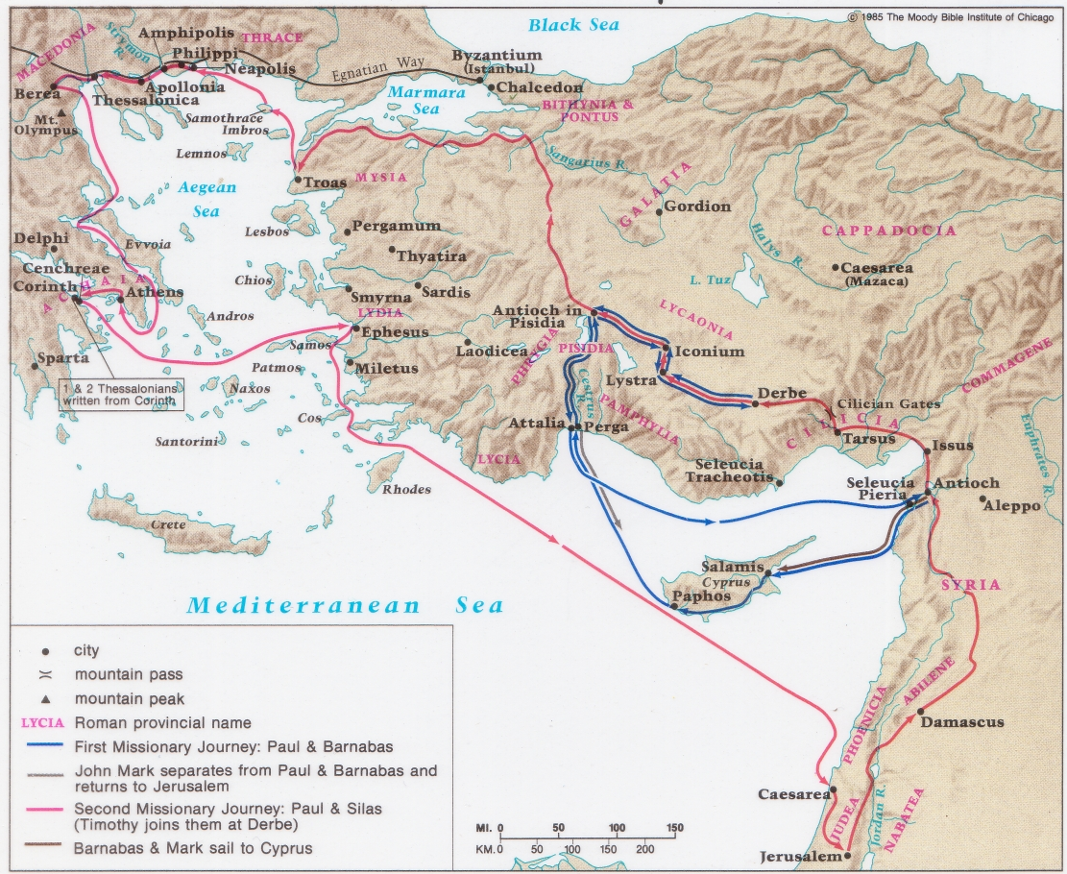
保罗的第一和二次传道旅程
138-39

Slide 26
Paul's Advice to Troubled Thessalonians: Focus on God!
215
Focus on God in the Thessalonian Epistles
Total Verses | "God" | "Jesus" | "Lord" | "Christ" | Total
1 Thess. (89) | 36 | 16 | 24 | 10 | 86
2 Thess. (47) | 18 | 13 | 22 | 10 | 63
Total (136) | 54 | 29 | 46 | 20 | 149
保罗对忧虑的帖撒罗尼迦人的劝告：
专注于上帝！
Focus on God in the Thessalonian Epistles
经文总数 | “神" | “耶稣" | “主" | “极度" | 总数
帖前 (89) | 36 | 16 | 24 | 10 | 86
帖后(47) | 18 | 13 | 22 | 10 | 63
总数(136) | 54 | 29 | 46 | 20 | 149
Number of Greek occurrences from Elwell & Yarbrough,
Encountering the New Testament, 332
希腊文出现的数量-Elwell 和 Yarbrough,
《遇见新约》, 332

Slide 27
神学主题
636
1. 耶和华的日子
这概念几乎在所有的新约的先知书里出现
在西番雅里:
耶和华的日子和其他指引在3章里提及“日子”
耶和华的日子 ~ 3 次 ; ‘日子’~ 9 次
“日子” 是
  a. 逼近了 (1:14)
  b. 恐怖的日子 (1:15)
  c. 罪的审判 (1:17)
  d. 宇宙的审判(1:2-3, 2:4-15; 3:8)
  e. 大自然伟大的惊厥 (1:15)
  f. 残余者被救赎 (3:16-17)

Slide 28
作者:
212
外在的证定
保罗是帖撒罗尼迦后书的作者有以下的证明和维持 ：如坡旅甲和早期的伊格那修。 再加上马吉安律法和穆拉多利经目，还有早期的教父的见证。
圣经内证
书信当中已征定保罗为作者:
圣经记载保罗是写帖撒罗尼迦书的作者(帖1:1; 3:17).
2. 未成熟的结束(3:1-5) 指定保罗为最适合的模范者
3.神学批评者指出和帖撒罗尼迦前书有相似的共同点于可证明保罗是作者。.
4. 如果差别只在于末世论的帖后2:1-12和帖前4:13—5:11被神学批评者所提出的差别只在于耶稣降临，的两句用词不同。
结论
对保罗是否本书信之作者的批评，并不多见；而早期教会有文献证据，说明他们接纳书信是保罗写的。毫无疑问，文题的风格是保罗的。

Slide 29
日期
212
保罗是在公元 51 年夏天时写帖撒罗尼迦后书(是在帖前的几个月后). 以下证明这论点:
保罗，西拉，提摩太 (1:1) 不承有在一起的记录除了在歌林多的时候。
2. 教会的情况和帖撒罗尼迦前书 一样。( cf. 帖撒羅尼迦前書; 帖撒羅尼迦後書 3:6-15).
3. 这些人肯定在歌林多住多一年。第二封的书信是出于保罗探访他们五年后。很肯定的说帖后书所写的日子不会超过帖前多过十二个月。

Slide 30
收信者
写给于帖撒罗尼迦的信徒在马其顿的北面。
212
原地
保罗在歌林多写的。

Slide 31
新约综览
38
124
39-41
“直 到 地 极” (使 徒 行 传 1:8)
使 徒 9 13 14 15 16 18 21 27 28
四月 48-
九月 49
1
加 拉 太
四月 50-
九月 52
2
爱琴海
春季 53-
五月 57
3
亚洲
五月 57-
八月 59
试验
二月 60-
三月 62
1
罗马
春季 62-
秋季 67
4
西班牙
秋季 67-
春季 68
2
罗马
35-37
大 马 色
安 提 阿
秋季 49
理事会
春季68
教会扩长
35 48 49 50 52 53 57 60 62 67 68 95
马太
路加
使徒行传
马可
约翰
加拉太
帖前
雅各
帖后
福音书以及使徒行传
保罗书信
一二三四
旅程
普通书信
罗马
关押
动画

Slide 32
综合性
214
1 情绪论:逼迫中仍坚信
2 神学论:关於主的日子
3 实际论:训导慵懒的门徒

Slide 33
大纲
214-215
(Ch. 1) 保罗鼓励帖撒罗尼的信徒坚守真理来面对逼迫者和等待主再来对这些人的审判,以作为他对那些胆怯的信徒深情的关怀.
(Ch. 2) 保罗改正帖撒罗尼的信徒有关假教师对主再来的日子已到的错误观念而敌基督须先显现才能使教会坚守真理.
(Ch. 3)保罗警告教会要训导那些手无正业”而只等待被提的日子”的慵懒信徒 .为得是要羞辱慵懒信徒对他们的行为负责。. 有如学习保罗和他的同工的榜样。

Slide 34
得到肯定
帖撒罗尼迦后书
Dr. Rick Griffith • Crossroads International Church Singapore
BibleStudyDownloads.org

Slide 35

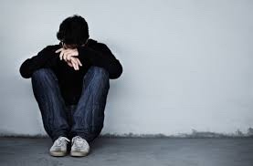
Affirmation
Notes:
Lately I have been thinking a lot about how we all need to be affirmed.
The past two weeks both Susan and I have had the most health issues ever in our 35-year marriage. Last Sunday was the first time we both ever missed church. My voice just wasn’t in shape to preach, I didn’t have the energy, etc. I won’t give you all the details lest it become “an organ recital.”
That’s not what is important. What is more significant is that some of you reached out to us and genuinely affirmed us! Thank you! Susan’s eye operation to correct her double vision did happen and was a success, despite our doubts about it going through with her rapid heartbeat days before the operation. Now, instead of seeing two husbands with her double vision, she is back to having only one husband.

Slide 36

Our Mission
The mission of Crossroads is to reach the nations by reaching internationals residing in Singapore
Notes:
Let’s read this together…

Slide 37
Our Vision
The vision of Crossroads is to lead internationals into a vital relationship with Jesus Christ as disciples who can transform their unique spheres of influence (2 Tim. 2:2). In particular, Crossroads focuses primarily, but not exclusively, on reaching the English-speaking community
Notes:
37
Reading together again…

Slide 38

我们的愿景
爱列国
爱教会
爱神
Notes:
Repentance will bring restoration in a church: God wants our church to really trust him.
We still don’t see our need for him as we don’t see our need to pray.
We also need to be involved in his work: missions, teaching, accountability groups, finances, etc.
_______________
OS-29-Joel-128
NS-13-1 Thess-111

Slide 39

Words can affirm
Notes:
Curious about this concept of affirmation, I began looking up the word “affirmation” on Google to see what I could find.
I was surprised to see that nearly everything I saw related to SELF-affirmation! I wonder if anyone is affirming OTHERS anymore!

Slide 40


Self Affirmation
Notes:
Hmmmm, should we approve of everything we do?

Slide 41

Self Affirmation
Notes:
We are told to recite 1000 self-confidence affirmations!

Slide 42


Self Affirmation
Notes:
Some self affirming claims include “I love me.”
Also, I believe in me.

Slide 43



Self Affirmation
Notes:
How about “I am enough”?
Not to be outdone, another has modified it: “I am MORE THAN enough.”
Or I fill me mind with positive thoughts.

Slide 44
自我肯定是否足够？
今天最棒的人是谁?
我无条件的爱我自己。

Slide 45

I don’t deserve self-esteem
Notes:
What if a person doubts that he or she deserves self-esteem?

Slide 46
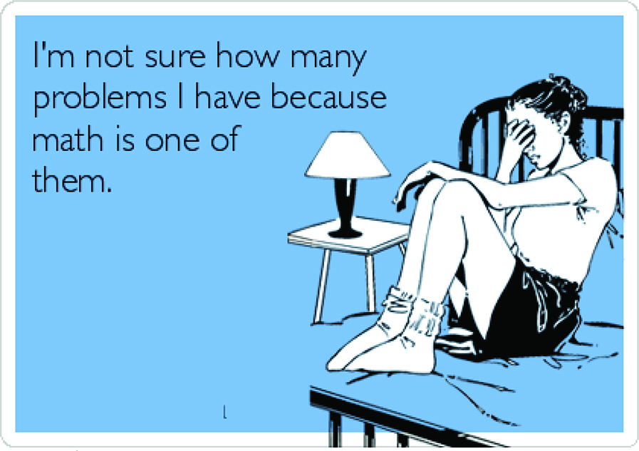
I’m not sure how many problems I have because math is one of them.
Notes:
What do you do if you say, “I am not sure how many problems I have because math is one of them”?
Isn’t it far better for others to praise you than for you to praise yourself?

Slide 47
神怎么在困难中肯定我们？

Slide 48
Background to
2 Thessalonians
Notes:
Today we will look at a church caught in the “winepress of persecution” that had yielded to God, resulting in a fragrant display of God’s grace. The Thessalonians still had “persecutions and trials” about a year after Paul had established the church but they were bearing under it, though crushed.

Slide 49
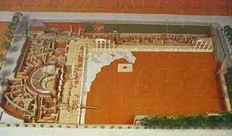
帖撒罗尼迦
(现在叫撒罗尼迦)
由马其顿将军卡山得在公元前315年建立
一个古帖撒罗尼迦的模型
以他的妻子撒罗尼迦命名，她是腓力二世的女儿，也是亚历山大大帝同父异母的姐姐
在公元前167年，成为了马其顿四个邦国其中之一的首都
在公元前146年，成为了一个省以及该省行政部门所在地
从公元前42年起，成为由地方官管辖的自由城市
Notes:
Thessalonica=帖撒羅尼迦。1‧在西元前315年有馬其頓將軍凱撒林達建立。2‧這城市用他的妻子的名字命名為撒羅尼迦。她是腓力二世的女兒，也是亞歴山大帝同父異母的姐姐。3‧在主前167年，帖撒羅尼迦成為馬其頓的四個區之一的首府。4‧在主前146年，帖撒羅尼迦成為一個行省的行政區。5‧從主前42年，帖撒羅尼迦成為自由的城市，及有自已來管理。
，

Slide 50
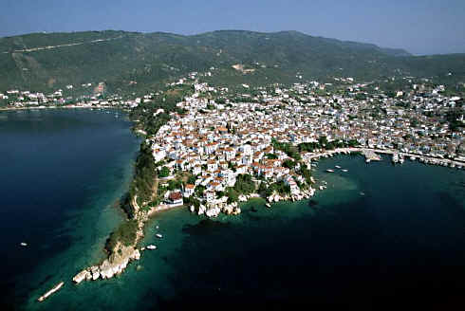
赛尔迈海湾的港口城市
Notes:
The church was located in northern Greece on a peninsula as both a key port city…

Slide 51
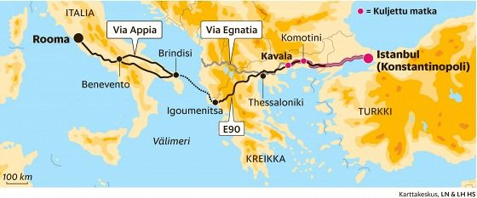
位于特洛亚湾的一个港口城市
它连接26个农村
也是马其顿的主要海港及海军基地
它是从港口和埃格那梯亚进入马其顿的主要通道
埃格那梯亚通道横跨城市的西北和东南
  横跨主要陆路的路线
  绵延493英里（790公里）

Slide 52
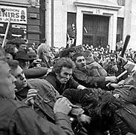
送他进监狱
打倒保罗
未完待续……

Slide 53
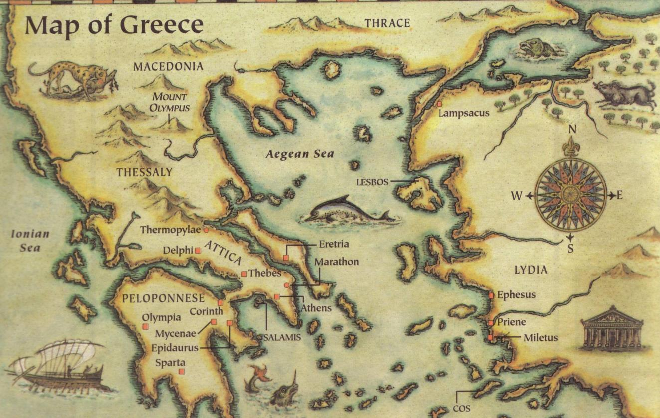
这书信是在主后51年写
帖撒罗尼迦
Berea
雅典
哥林多
三种鼓励人的方式...
听了提摩太的报告后，在哥林多写的
Notes:
Written in Corinth after hearing Tim's report
听了提摩太的报告后，在哥林多写的

Slide 54
时机
212-213
有关历史和编排保罗的第二次传道旅程的剧情在帖撒罗尼迦的时期有如同以下:
1. 保罗建立帖撒罗尼迦教会 十一月 公元50 至一月 51
2. 保罗的传道旅在庇哩亚, 雅典, 和歌林多. 二至三 51
写完帖撒罗尼迦前书后几个月,保罗得知 教会发生一些在帖前书信里所不能解决的问题 .因此保罗决定再写信给教会来帮忙这些信徒如何处理一些难题。
3.西拉，提摩太 回报保罗在歌林多 四月至五月公元 51
4.保罗写帖撒罗尼迦前书从歌林多寄出。早夏公元 51
5.帖前书信的带信者回报保罗。中夏公元 51
6.保罗从歌林多帖撒罗尼迦后书 后夏公元 51
7.保罗离开歌林多 九月一日公元 52

Slide 55
新约综览
38
124
39-41
“直 到 地 极” (使 徒 行 传 1:8)
使 徒 9 13 14 15 16 18 21 27 28
四月 48-
九月 49
1
加 拉 太
四月 50-
九月 52
2
爱琴海
春季 53-
五月 57
3
亚洲
五月 57-
八月 59
试验
二月 60-
三月 62
1
罗马
春季 62-
秋季 67
4
西班牙
秋季 67-
春季 68
2
罗马
35-37
大 马 色
安 提 阿
秋季 49
理事会
春季68
教会扩长
35 48 49 50 52 53 57 60 62 67 68 95
马太
路加
使徒行传
马可
约翰
加拉太
帖前
雅各
帖后
福音书以及使徒行传
保罗书信
一二三四
旅程
普通书信
罗马
关押
动画

Slide 56

做好准备
贴撒罗尼迦前书
Dr. Rick Griffith • Crossroads International Church Singapore
BibleStudyDownloads.org

Slide 57

Our Need
贴撒罗尼迦前书
Notes:
At some point in perhaps the not-too-distant future millions of people will just quickly rise to meet the Lord Jesus Christ.

Slide 58
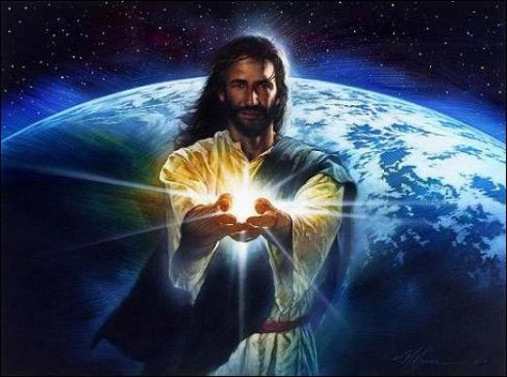
Black

Slide 59
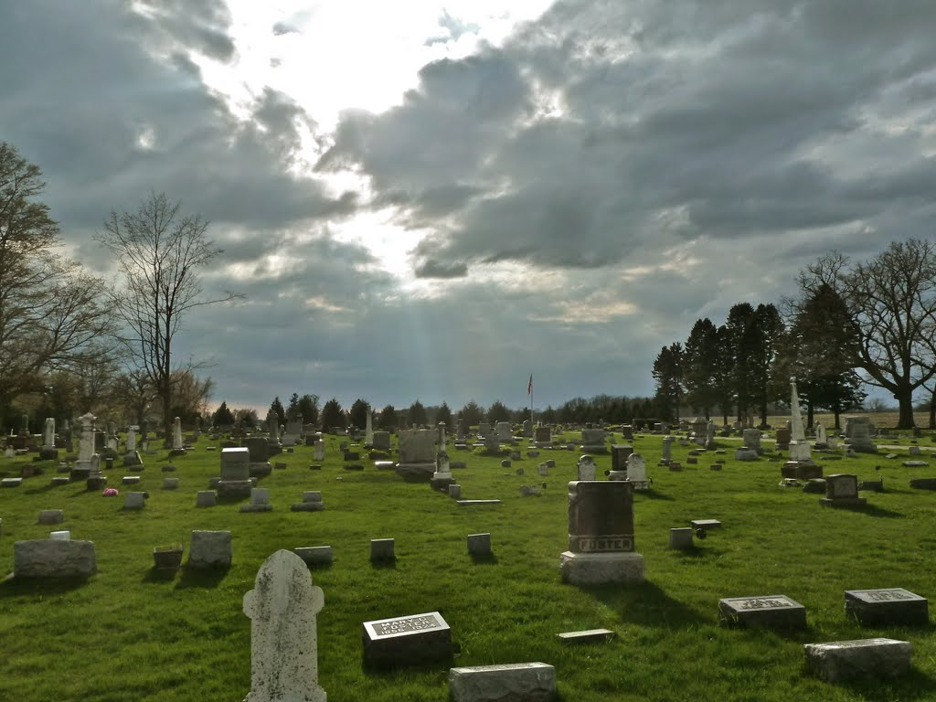
被提
“弟兄们，论到 睡了的人，我们不愿意你们知道， 免得你们忧伤， 像那些没有盼望的人一样。 ¹⁴ 我们若信耶稣死了， 又复活了， 照样， 也应该相信那些靠着耶稣已经睡了的人。” （帖撒罗尼迦前书 3：13-14）
Notes:
Paul speaks clearly of this next event on God’s prophetic calendar in 1 Thess 4:13-18…

Slide 60
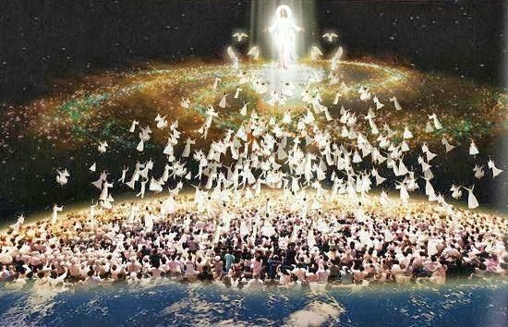
被提
¹⁶“ 因为主必亲自从天降临， 那时， 有法令的声音， 有天使长的呼声， 还有 神 的号声， 那些在基督里死了的人必先复活： ¹⁷然后， 我们还活着存留的人， 必和他们一同被提到云里， 自空中与主相会。 这样， 我们就要和主常常同在。”
（帖撒罗尼迦前书 4： 16 – 17）

Slide 61

要怎么为被提 做准备？
2 种方式。。。
贴撒罗尼迦前书
Notes:
What specific ways can you be ready for Jesus when he come back?

Slide 62
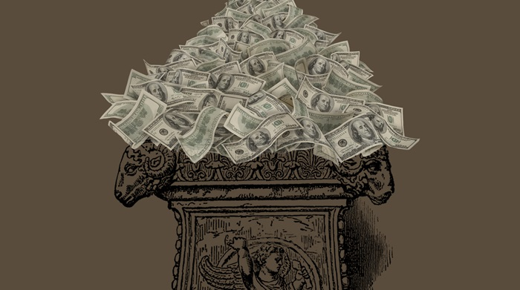
（一）没有贪婪地服侍耶稣
(第1–3章）。
贴撒罗尼迦前书
Notes:
Live for Christ as if money is not a big concern.

Slide 63

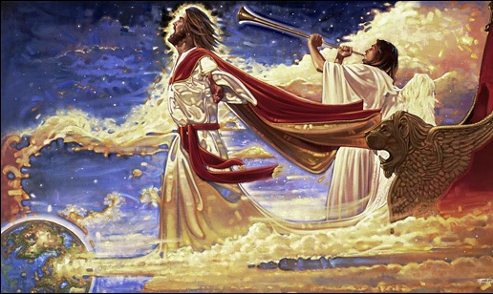
（二） 关心人和神学 (第 4–5章)。
+
贴撒罗尼迦前书
Notes:
Doctrine and relationships should occupy much of our time.
In particular, we need a theology of Christ’s second coming.

Slide 64
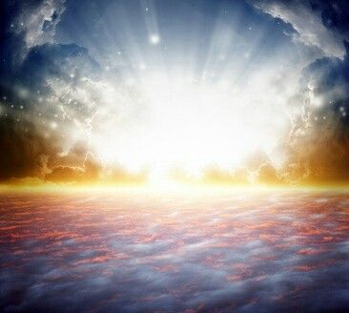
主要概念
以金钱， 朋友 和圣经为耶稣的回归做好准备
贴撒罗尼迦前书

Slide 65

我们都得做交待。
贴撒罗尼迦前书

Slide 66

贴撒罗尼迦前书5:2
“像夜间的贼来到”
Notes:
Do you think your home will be broken into tonight? At his return, Jesus will be as expected as much as you expect a thief to rob your house tonight.
Are you prepared for him to arrive at any time? Is there anything you do that will cause you to be ashamed if he came at that time you do it?

Slide 67
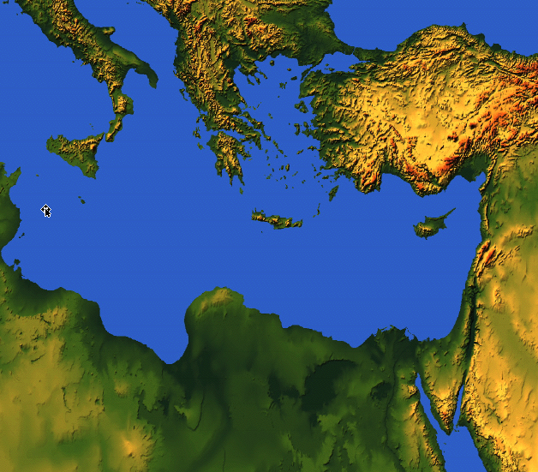

1-2 Thessalonians
Macedonia
212
Thessalonica
Corinth
Notes:
But now, months later, Jesus had not come and the church was wondering if they had already entered the tribulation. So Paul wrote them another letter to show how God continued to affirm them.

Slide 68
论点
214
保罗写信给信徒是来帮忙如何处理教会所面对的三相难题。
招受逼迫 (1:3-10),
不法者说主已经来了 (2:1-12), 和
懒惰的帖撒罗尼迦信徒在 “等待被提” (3:6-15).
保罗鼓励他们鉴定拯救的盼望来得奖赏 (ch. 1)和更正对主再来的日子错误的观念 (ch. 2)导致信徒懒惰 (ch. 3). 主题是关于主再来得日子所引起信徒的反应。

Slide 69
神怎么在困难中肯定我们？
3 ways…

Slide 70
Slides on
帖撒罗尼迦后 1

Slide 71
神如何肯定我 们
情绪
1
Notes:
Restated: He is not incomplete or piecemeal in his ministry to us.
• He touches the heart (emotionally),
• the mind (theologically),
• and the hands (practically).

Slide 72
（一）情绪：神赐毅力以让我们成熟 （帖撒罗尼迦后书 第1章）
Notes:
The Lord helps us not to lose heart so we will grow.]

Slide 73
Paul's Advice to Troubled Thessalonians: Focus on God!
215
Focus on God in the Thessalonian Epistles
Total Verses | "God" | "Jesus" | "Lord" | "Christ" | Total
1 Thess. (89) | 36 | 16 | 24 | 10 | 86
2 Thess. (47) | 18 | 13 | 22 | 10 | 63
Total (136) | 54 | 29 | 46 | 20 | 149
保罗对忧虑的帖撒罗尼迦人的劝告：
专注于上帝！
Focus on God in the Thessalonian Epistles
经文总数 | “神" | “耶稣" | “主" | “极度" | 总数
帖前 (89) | 36 | 16 | 24 | 10 | 86
帖后(47) | 18 | 13 | 22 | 10 | 63
总数(136) | 54 | 29 | 46 | 20 | 149
Number of Greek occurrences from Elwell & Yarbrough,
Encountering the New Testament, 332
希腊文出现的数量-Elwell 和 Yarbrough,
《遇见新约》, 332

Slide 74
马太福音书的主要思想
服事主耶稣基督
上帝
神
王
耶稣
基督
救主
Notes:
Serve Jesus as Savior, God, and King of your life!

Slide 75
A Worthy Name to Repeat
2 Thess 1
2 Thess 2
2 Thess 3
Lord Jesus Christ
(1:1)
Lord Jesus Christ
(2:1)
Lord Jesus Christ
(3:6)
Lord Jesus Christ
(1:2)
Lord Jesus Christ
(2:14)
Lord Jesus Christ
(3:12)
Lord Jesus Christ
(1:12)
Lord Jesus Christ
(2:16)
Lord Jesus Christ
(3:18)
Notes:
The lofty name of the “Lord Jesus Christ” appears 9 times in this book—three times each in all three chapters (NLT):
2Th. 1:1 This letter is from Paul, Silas, and Timothy. We are writing to the church in Thessalonica, to you who belong to God our Father and the Lord Jesus Christ.
2Th. 1:2 May God our Father and the Lord Jesus Christ give you grace and peace.
2Th. 1:12 Then the name of our Lord Jesus will be honored because of the way you live, and you will be honored along with him. This is all made possible because of the grace of our God and Lord, Jesus Christ.
2Th. 2:1 Now, dear brothers and sisters, let us clarify some things about the coming of our Lord Jesus Christ and how we will be gathered to meet him.
2Th. 2:14 He called you to salvation when we told you the Good News; now you can share in the glory of our Lord Jesus Christ.
2Th. 2:16 Now may our Lord Jesus Christ himself and God our Father, who loved us and by his grace gave us eternal comfort and a wonderful hope,
2Th. 3:6 And now, dear brothers and sisters, we give you this command in the name of our Lord Jesus Christ: Stay away from all believers who live idle lives and don’t follow the tradition they received from us.
2Th. 3:12 We command such people and urge them in the name of the Lord Jesus Christ to settle down and work to earn their own living.
2Th. 3:18 May the grace of our Lord Jesus Christ be with you all.

Slide 76

See God's perspective on trials (1:1-2).
Notes:
So these first two verses show that seeing God's perspective helps us to reach out and affirm others. There’s another way to affirm others in verse 3…

Slide 77
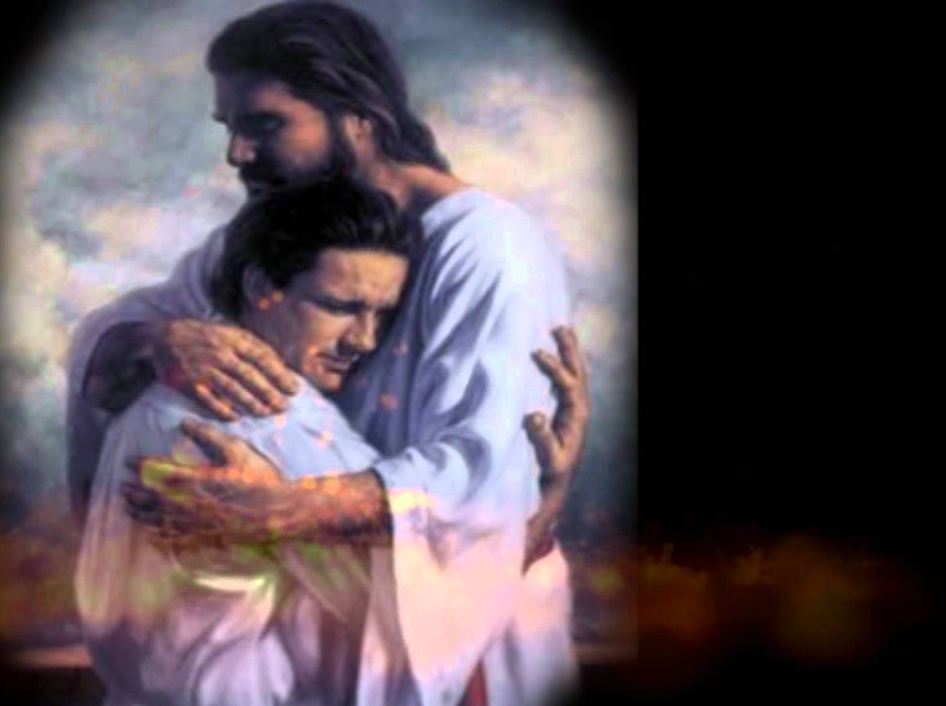
"This letter is from Paul, Silas, and Timothy. We are writing to the church in Thessalonica, to you who belong to God our Father and the Lord Jesus Christ. ²May God our Father and the Lord Jesus Christ give you grace and peace."
2 Thessalonians 1:1-2 NLT
Notes:
You may be wondering why I say that these verses teach us to help afflicted people see God's perspective. Aren't they just the preliminaries to the letter that follows?
Yes, but notice how many times Paul mentions God in this one sentence—four times!
Twice he refers to the Father and twice to Christ, who is placed on equal level with the Father since He, too, is God.

Slide 78
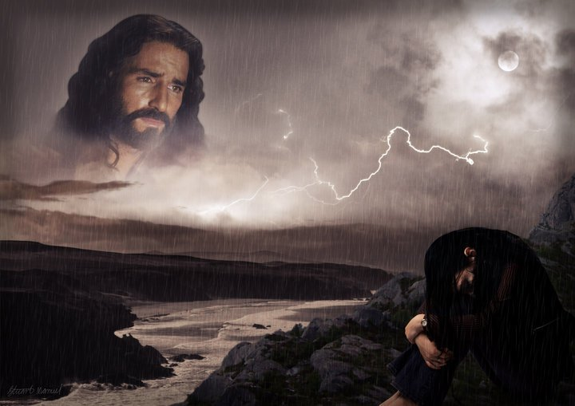
"By looking to our lofty Lord Jesus Christ we realize that He is not looking away from us in complacency but looking down on us in compassion."
—Charles R. Swindoll, Steadfast Christianity, 4—
Notes:
We all have peaks and valleys in our lives—peaks when it's easy to see the Lord and valleys when it's difficult to see Him. Swindoll writes…
• Text above

Slide 79

"I will lift up my eyes to the mountains;
From [where else] shall my help come?
My help comes from the LORD, who made heaven and earth
(Ps. 121:1-2)."
—Charles R. Swindoll, Steadfast Christianity, 4—

Slide 80
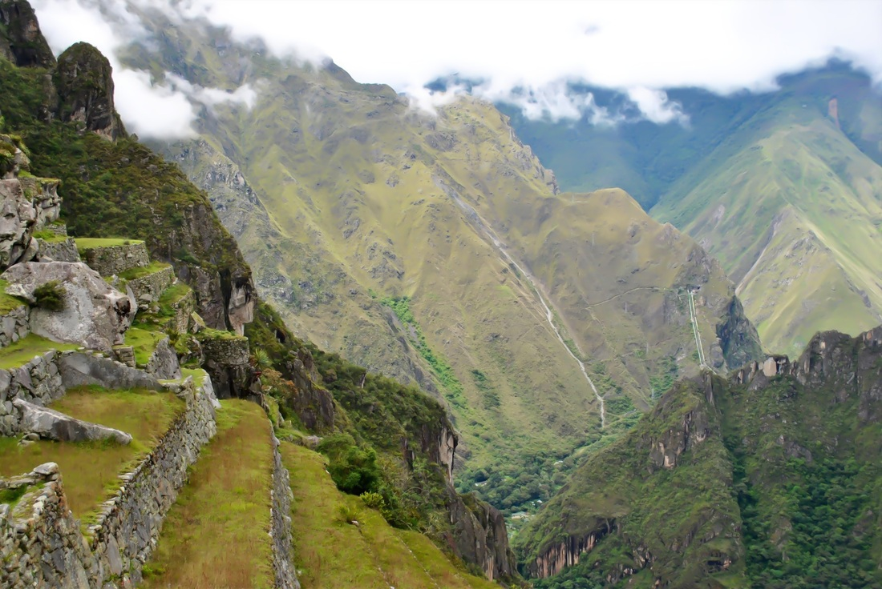
"Do you look to the peaks when you're in the valleys? Or are you so rutted in the valleys that you've forgotten the mountains are even there? People who fail to affirm usually do so because they fail to see the Lord in the midst of it all."
—Charles R. Swindoll, Steadfast Christianity, 4—

Slide 81
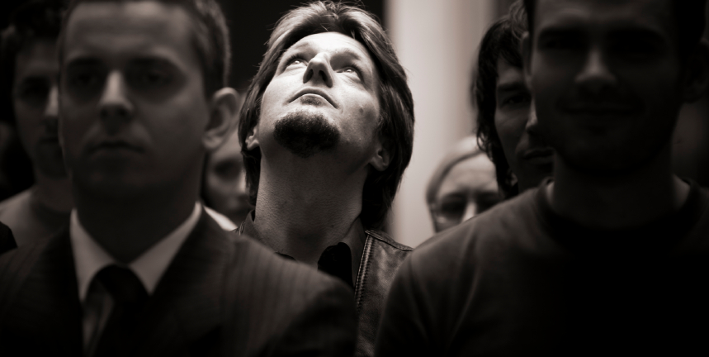
"When we look up, we are reminded that God is not removed… not absent… not out of touch. And then we get a glimpse of the divine perspective on our circumstances—which can only be seen from the peaks, not in the valleys."
—Charles R. Swindoll, Steadfast Christianity, 4—

Slide 82

Seeing from God's Perspective
Notes:
Aren't you encouraged when you're around people who always talk about the Lord?
They see life from God's viewpoint—and there's no more encouraging view!

Slide 83
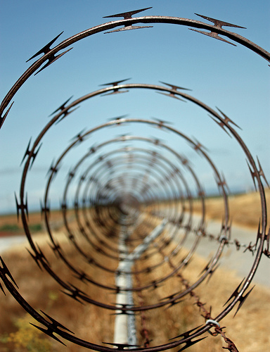
How many of us notice when others are caught in a spiral?
Notes:
Love means seeing needs. I wonder how many of us have eyes to see when others have genuine needs—physical issues are easier to see, but spiritual needs are a greater challenge.
Life goes so fast, often it’s tough to take care of ourselves let alone others. I struggle with this—don’t you? Do you struggle with how to help those who are in tough straits? Do you know anyone afflicted in their relationship with their spouse, in financial woe, struggling with children or work or something else?

Slide 84

How to Affirm Others
2 Thessalonians 1:1-4
Three ways we can affirm others...
Notes:
Today we're going to take a brief look into the first four verses of 2 Thessalonians to see how Paul affirmed the afflicted believers at the ancient city of Thessalonica in order to encourage them to grow in Christ. How did he comfort them to help them grow?

Slide 85
I. See God's perspective on trials (1:1-2).
Notes:
View difficulties from the Lord’s eyes.

Slide 86
"This letter is from Paul, Silas, and Timothy. We are writing to the church in Thessalonica, to you who belong to God our Father and the Lord Jesus Christ. ²May God our Father and the Lord Jesus Christ give you grace and peace."
2 Thessalonians 1:1-2 NLT
Notes:
You may be wondering why I say that these verses teach us to help afflicted people see God's perspective. Aren't they just the preliminaries to the letter that follows?
Yes, but notice how many times Paul mentions God in this one sentence in the Greek text—four times!
Twice he refers to the Father and twice to Christ, who is placed on equal level with the Father since He, too, is God.

Slide 87
Paul's Advice to Troubled Thessalonians: Focus on God!
215
Focus on God in the Thessalonian Epistles
Total Verses | "God" | "Jesus" | "Lord" | "Christ" | Total
1 Thess. (89) | 36 | 16 | 24 | 10 | 86
2 Thess. (47) | 18 | 13 | 22 | 10 | 63
Total (136) | 54 | 29 | 46 | 20 | 149
保罗对忧虑的帖撒罗尼迦人的劝告：
专注于上帝！
Focus on God in the Thessalonian Epistles
经文总数 | “神" | “耶稣" | “主" | “极度" | 总数
帖前 (89) | 36 | 16 | 24 | 10 | 86
帖后(47) | 18 | 13 | 22 | 10 | 63
总数(136) | 54 | 29 | 46 | 20 | 149
Number of Greek occurrences from Elwell & Yarbrough,
Encountering the New Testament, 332
希腊文出现的数量-Elwell 和 Yarbrough,
《遇见新约》, 332

Slide 88
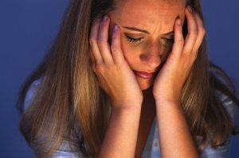
We also need to help others focus on the Lord in their difficulty

Slide 89

Romans 8:28
Notes:
Granted, there's balance here, too. This doesn't mean you go around blabbing all the time, "Well, all things work for the good!"

Slide 90
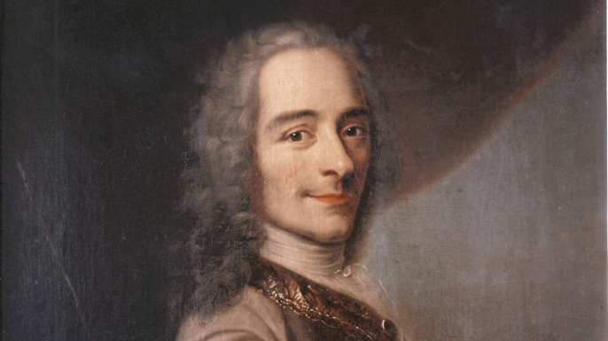

Voltaire (1694-1778)
Notes:
The French atheist, Voltaire, makes fun of such people in his novel Candide.

Slide 91
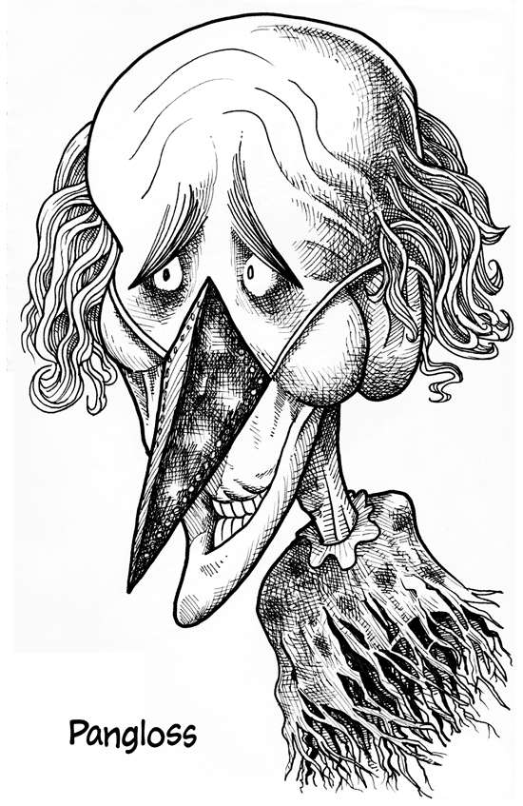
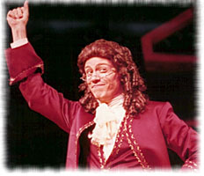
Dr. Pangloss
"Well, all things work for good!"
Notes:
Voltaire constantly belittles the Christian in the story, Dr. Pangloss, every time something awful happens, saying, "Well, all things work for good!"

Slide 92

Romans 8:28
Notes:
Voltaire quotes, of course, only a portion of Romans 8:28, that says this applies to those who love God. Even Christians only quote part of the verse too.

Slide 93
Romans 8:28 NIV
"And we know that in all things
God works for the good
of those who love him,
who have been called
according to his purpose."
Notes:
But Romans 8:28 actually applies this optimism only to those who both love God and are called according to his purpose. We must be "the called ones" who know Him and love Him.

Slide 94
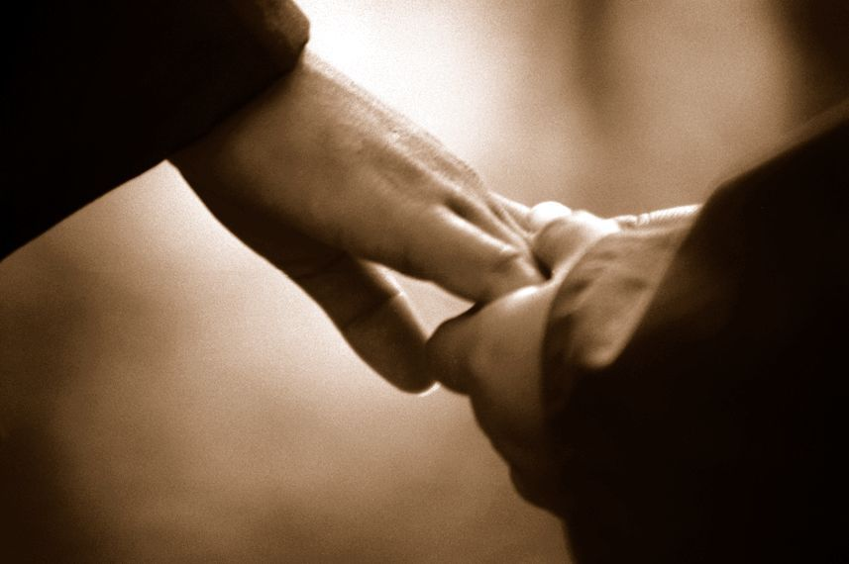
Turn others to the Lord
By saying nothing at all
By sharing a Bible reference
Notes:
There are ways of turning people's sights to the Lord without always quoting Scripture and saying, "Praise Jesus, Praise Jesus…"
• Sometimes we affirm and turn others to God by saying nothing at all.
• Often just writing down a Scripture reference for the person and encouraging him to look it up later is best.

Slide 95
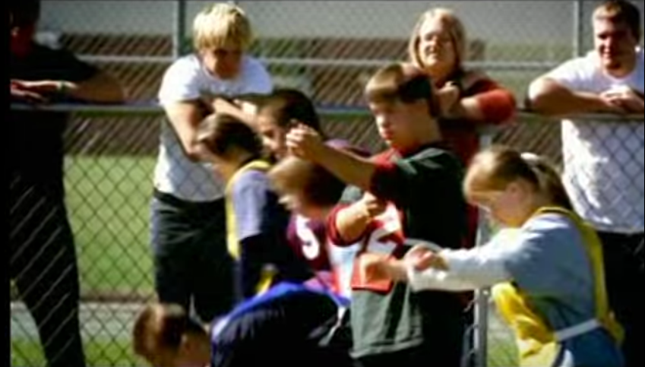
Seattle Special Olympics
Notes:
We need to realign ourselves towards God because his plan is perfect!
A few years ago, at the Seattle Special Olympics, six contestants, all physically or mentally disabled, assembled at the starting line for the 100-yard dash.

Slide 96
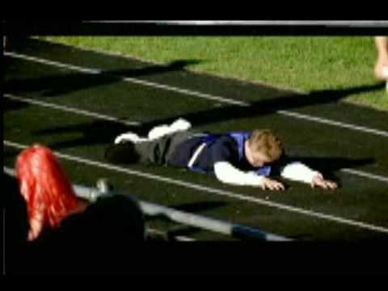
Seattle Special Olympics
Notes:
At the gun, they all started out, not exactly in a dash, but with a relish to run the race to the finish and win. All, that is, except one little boy who stumbled on the asphalt, tumbled over a couple of times, and began to cry. The others heard the boy cry. They slowed down and looked back. Then they all turned around and went back ... every one of them.

Slide 97
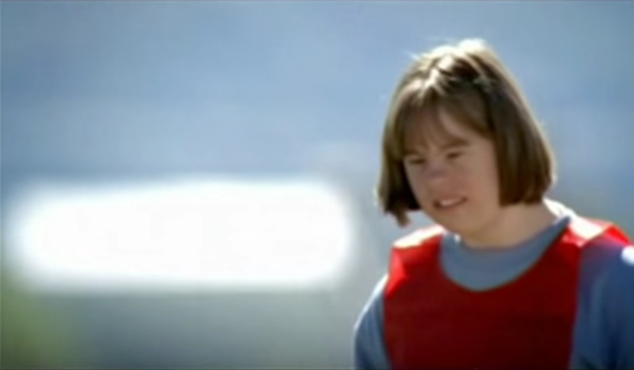
Seattle Special Olympics
Notes:
One girl with Down's Syndrome bent down and kissed him and said, "This will make it better."

Slide 98
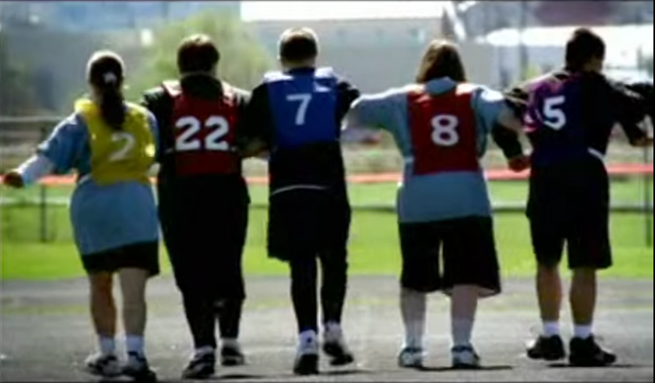
Seattle Special Olympics
Notes:
Then all six linked arms and ran together to the finish line.

Slide 99
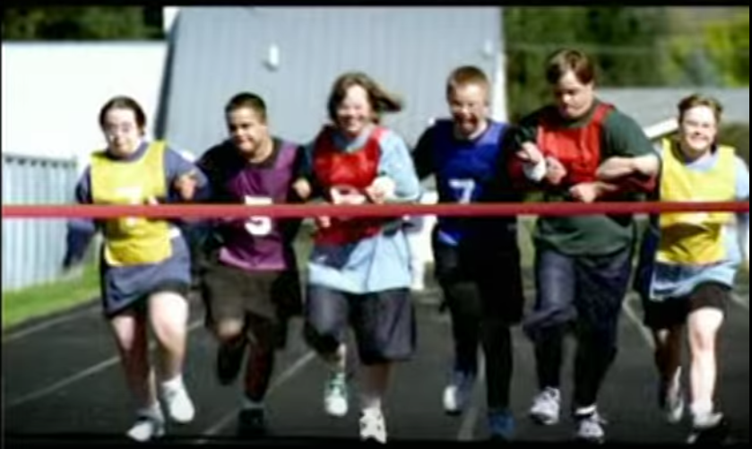
Seattle Special Olympics
Notes:
Everyone in the stadium stood, and the cheering went on for several minutes. People who were there are still telling the story.
Why? Because deep down we know this one thing: What matters in this life is more than winning for ourselves. God’s view on life is helping others win, even if it means slowing down and changing our course.

Slide 100
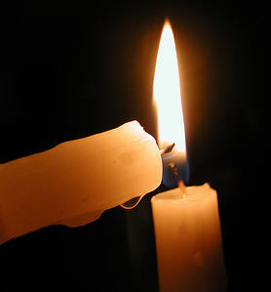
"A candle loses nothing by lighting another candle."
—James Keller
Notes:
"A candle loses nothing by lighting another candle." You can be that candle to share God’s view and bring light to others without in the least diminishing your own light.

Slide 101

Thank God for others' growth (1:3).
Notes:
Others benefit in their spiritual walk when they hear you praise God for them.

Slide 102

"Dear brothers and sisters, we can't help but thank God for you, because your faith is flourishing and your love for one another is growing”
(2 Thessalonians 1:3 NLT).
Notes:
Paul thanked God for two things—their faith and their love (1:3).
I wonder how often you thank God for others’ spiritual growth. When someone is going through trials how do we generally pray?
I hate to admit it, but most of the time we ask God to remove the trials.
Notice the focus of Paul's prayer here—not a request that God take away their trials but thanksgiving!
He affirmed them by praying not for the removal of the trial but for character development through the trial.
Paul doesn't focus on what's going on around them—he looks at what God is doing within them—building qualities like faith, love, and perseverance mentioned in verse 4.

Slide 103
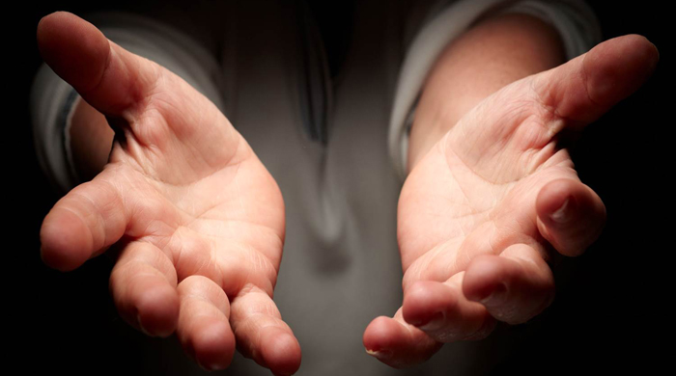
He affirmed them that their love for one another kept increasing—so we see Paul affirming their affirmation!

Slide 104
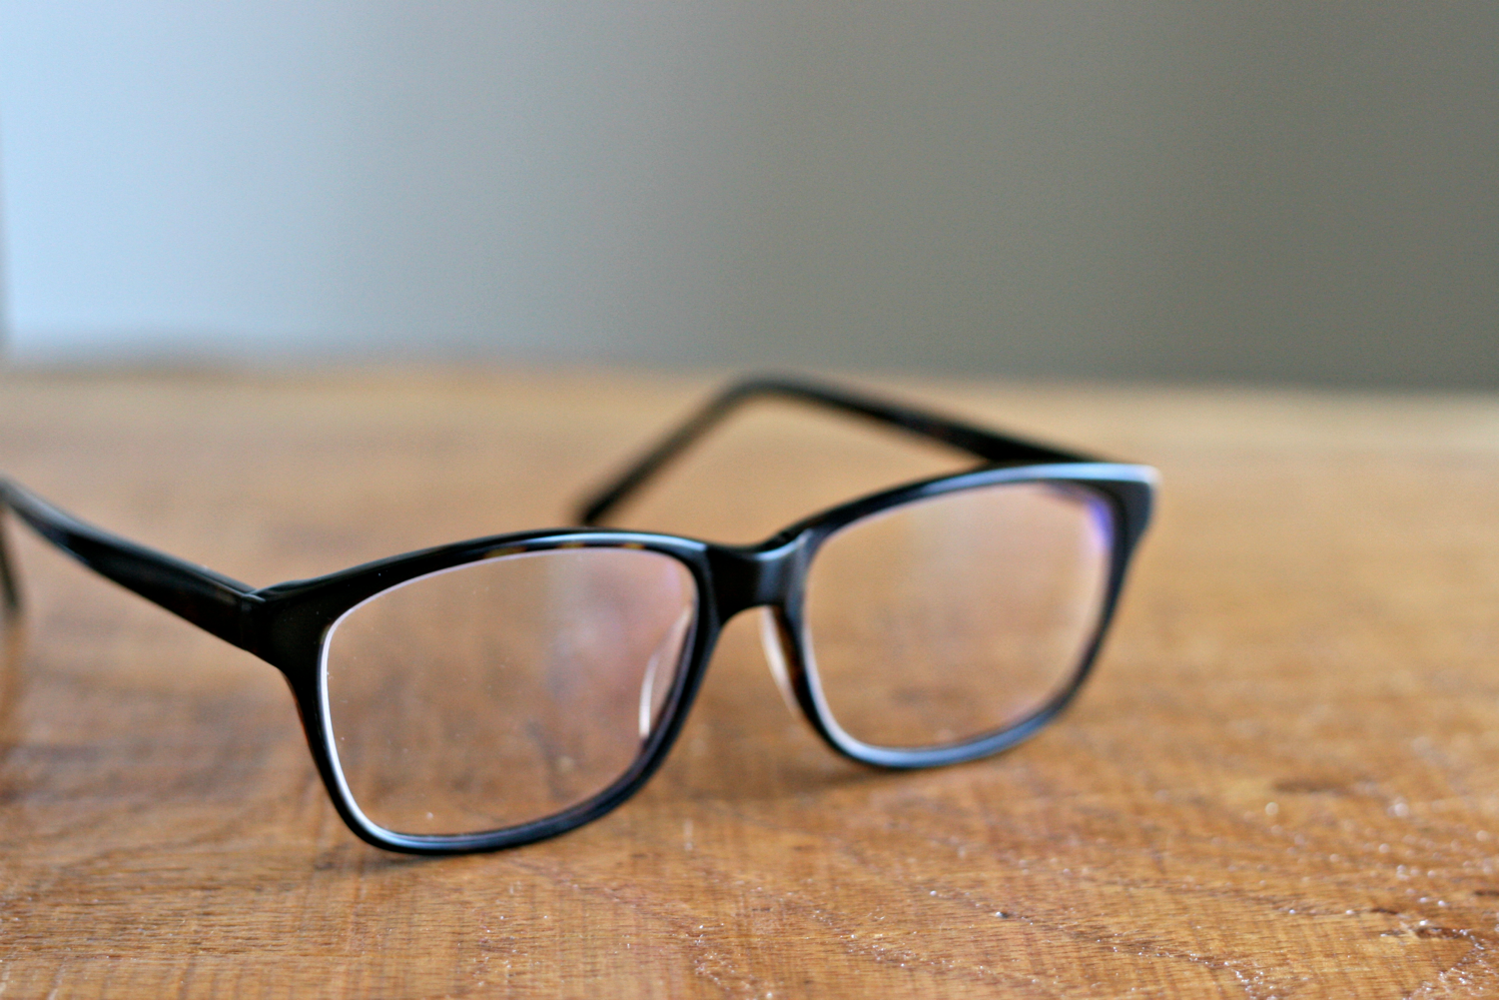
What kind of glasses do you wear?
Notes:
He affirmed them that their love for one another kept increasing—so we see Paul affirming their affirmation! When you look at others, what type of glasses do you wear?

Slide 105

Mercy Glasses
Notes:
We need to see people differently—with mercy glasses—looking at them in light of the death of Jesus for them and for us. However…

Slide 106
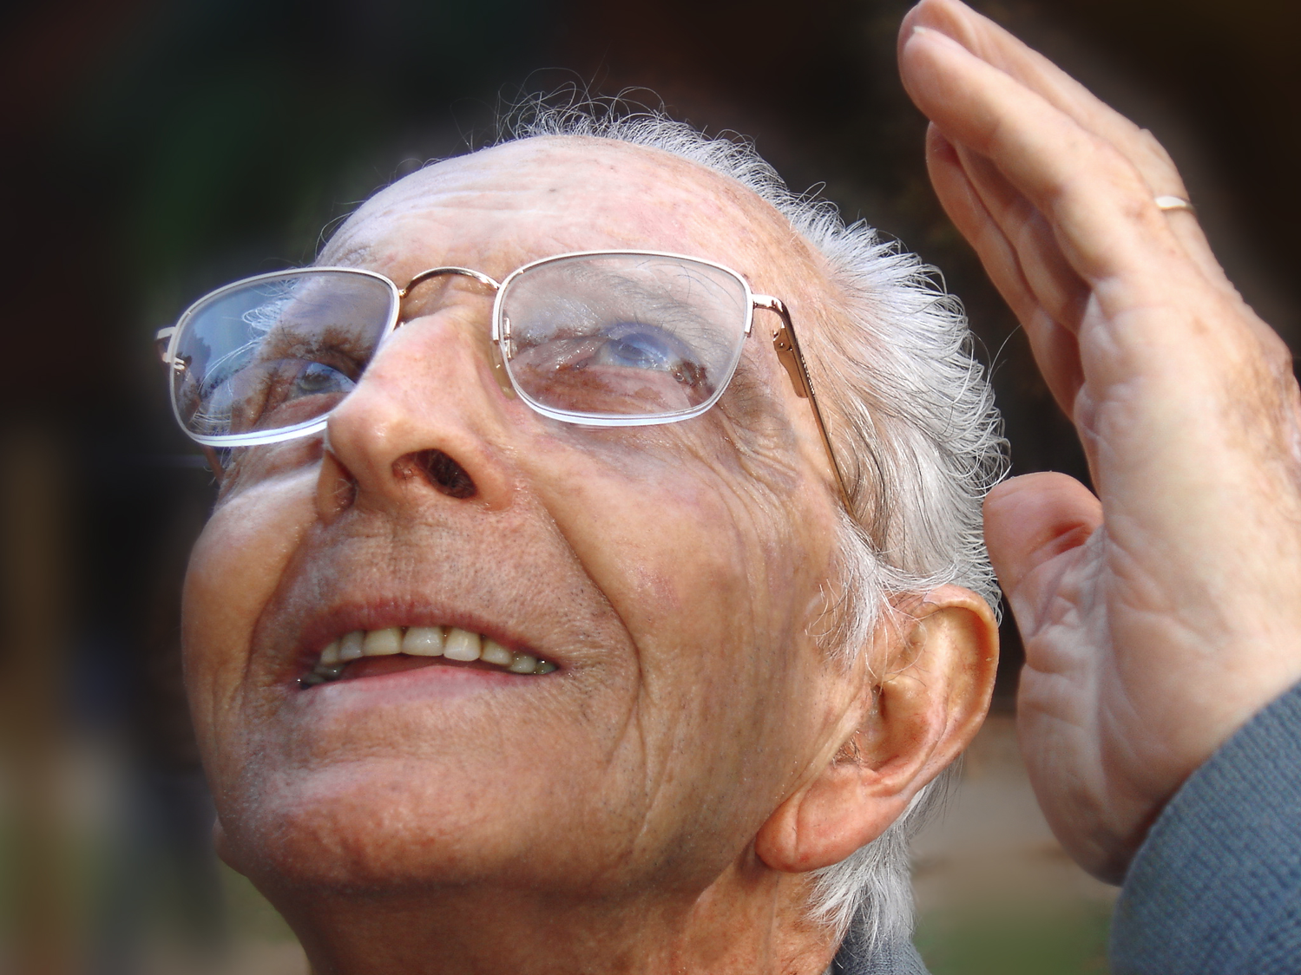
Prayer Affirms
Notes:
Prayer for others is no doubt the best way to affirm others. That's why Paul did it!
I hope as a church we’ll grow to pray beyond a focus on the circumstances and pray that God will use difficulties to build the character of Christ within us.
The three qualities Paul notes are a great starting place—faith, love and perseverance.
MPI
I think our prayer times together as a church would be even better if we make it a point to thank God for others' growth right there in the group.

Slide 107

Publicly brag about others' spiritual growth (1:4).
Notes:
Make your praise common knowledge to help others persevere.

Slide 108
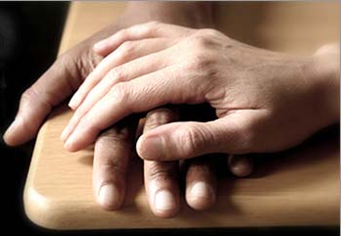
"We proudly tell God's other churches about your endurance and faithfulness in all the persecutions and hardships you are suffering."
2 Thessalonians 1:4 NLT
Notes:
Paul told others how well they hung in there (1:4).
He could have been negative—“Man, you should see those Thessalonians’ hassles. Their theology is messed up so much they think they’re in the Tribulation!”
Not Paul! He said, "Wow! You should see how the church at Thessalonica continues to reach out, deepen in their love, make great strides in trusting God, and endure—despite the most intense persecutions in the Roman Empire. They're doing grrrrrrrreat!"

Slide 109
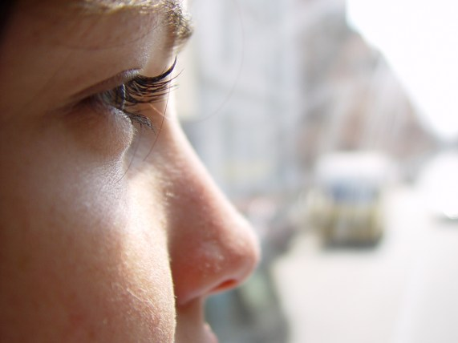
People often become what you tell them they will become.
Notes:
People often become what you tell them they will become.
This is especially true in parenting children.

Slide 110
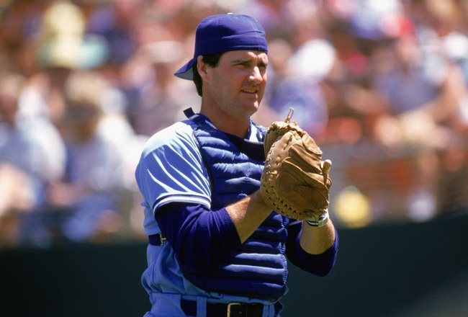
Jim Sundberg
Notes:
Children tend to become what their parents tell them they will become. Major league baseball catcher Jim Sundberg said that his father was always telling Jim, “Jim, one day you’re going to be a great major league catcher.”

Slide 111
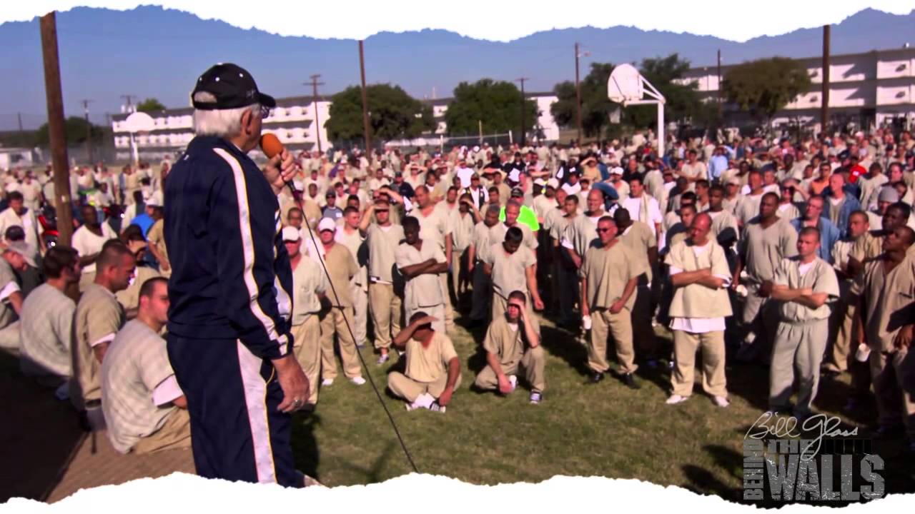
"How many of you had parents that told you that you would end up in prison one day?”
Notes:
Evangelist Bill Glass asked a group of 1000 inmates, “How many of you had parents that told you that you would end up in prison one day?” Almost every one of the inmates raised their hands.

Slide 112
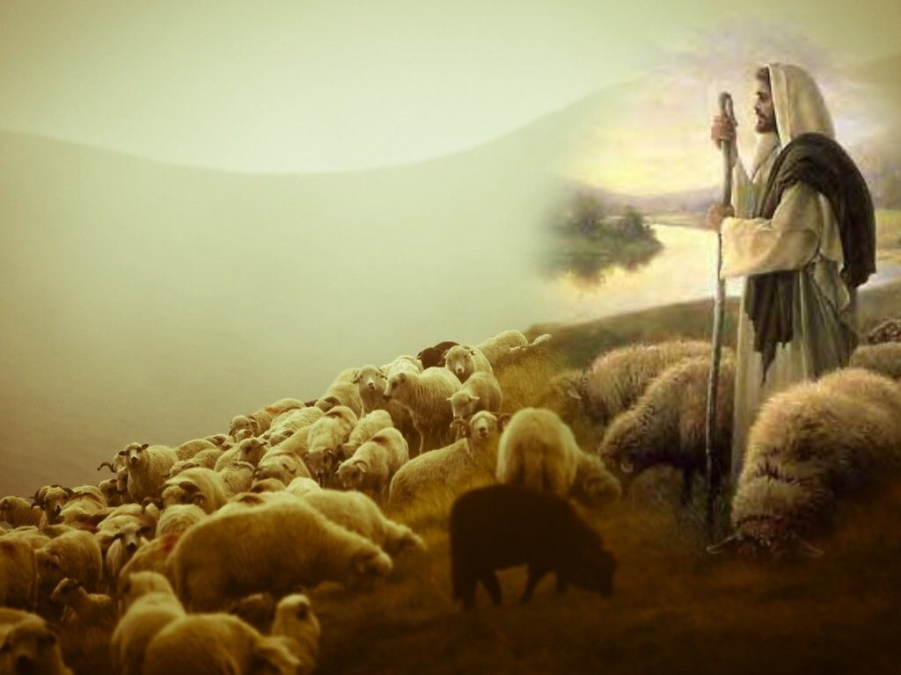
Affirm the afflicted to help them mature in Christ.
Main Idea of 2 Thess 1:1-4
Notes:
Encourge others to grow!

Slide 113
"And God will use this persecution to show his justice and to make you worthy of his Kingdom, for which you are suffering. ⁶In his justice he will pay back those who persecute you"
(2 Thess 1:5-6 NLT).
Notes:
God will reward the church’s perseverance during affliction but punish their persecutors by helping the church become mature (1:3-12).

Slide 114
"And God will provide rest for you who are being persecuted and also for us when the Lord Jesus appears from heaven. He will come with his mighty angels, ⁸in flaming fire, bringing judgment on those who don’t know God and on those who refuse to obey the Good News of our Lord Jesus"
(2 Thess 1:7-8 NLT).

Slide 115
"They will be punished with eternal destruction, forever separated from the Lord and from his glorious power. ¹⁰When he comes on that day, he will receive glory from his holy people—praise from all who believe. And this includes you, for you believed what we told you about him" (2 Thess 1:9-10 NLT).

Slide 116

So we keep on praying for you, asking our God to enable you to live a life worthy of his call. May he give you the power to accomplish all the good things your faith prompts you to do.
2 Thess 1:11

Slide 117
Then the name of our Lord Jesus will be honored because of the way you live, and you will be honored along with him. This is all made possible because of the grace of our God and Lord, Jesus Christ.
2 Thess 1:12

Slide 118

Persevering through affliction develops maturity
Charles R. Swindoll, Steadfast Christianity, 3

Slide 119



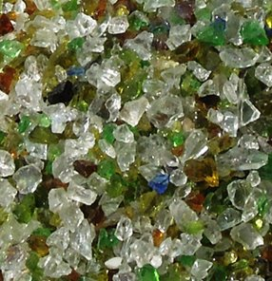
Marbles or Grapes?
Notes:
We decide how difficulties will change us. Do you agree? In his book No Greater Power, Richard C. Halverson, past chaplain of the US Senate, wrote:
“Crush marbles and you get fragmentation, disintegration—hard, sharp pieces. You can get hurt if you’re not careful.
Crush grapes and you get fragrant, refreshing wine.
Some people relate like marbles. The fear of vulnerability hardens them. They protect themselves, allow no one to penetrate. Being vulnerable is high-risk, and they want low-risk. They bump against others and ricochet around, never enjoying a vital relationship. In brittle lovelessness, they shatter when crushed, and hurt others.
Some people relate like grapes. They yield to pressure. They accept their weakness as essential to intimacy. They give love, knowing love is always vulnerable, knowing love is the heart and soul of our faith. When crushed, they bring blessing: fragrant, redemptive blessing.”
Difficulties certainly come our way for every one of us.
But how do you respond to these trials? Are you like a marble or like a grape? In either case, we get crushed, but marbles resist it while grapes welcome the benefits.
Are you angry at God for allowing difficulty into your life? Or do you see him affirming you?
Richard C. Halverson, No Greater Power (Portland, OR: Multnomah, 1986), 67; cited in Charles R. Swindoll, Steadfast Christianity: A Study of Second Thessalonians (Fullerton, CA: Insight for Living, 1986), 1.

Slide 120
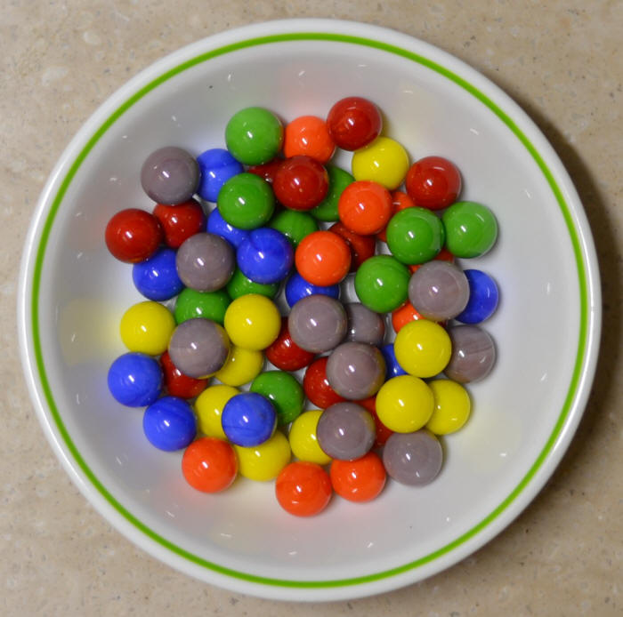
My Defensiveness
Notes:
I have needed affirmation to overcome my own weakness of defensiveness.
As I have recently reflected on my early years as a Christian teenager, I recall one particular weakness. When someone expressed a concern about me, I reacted with defensiveness. This was a problem I had in my early years of marriage too. Susan would observe a weakness in me and I would defend myself as if she was attacking me.
After further consideration and prayer about this, I realized that it went back to my teenage years. My mother married a third time when I was age 13, and my step-father would point out a deficiency in me rather roughly. He had a horrible relationship with his own father—so much that he called him by his first name rather than “Dad” or “Father”—and he lacked an ability to gently tell me how to better sweep the floor or wash the dishes or whatever. I constantly felt attacked, even though that wasn’t his intention.
So I developed this defensive attitude in my other relationships too. I suspect I felt that way about God as well.
God really changed me, though. At least I think he did! I guess you can be the judge whether I defend myself right now. I think he has given me an ability to respond rather than react, to persevere in a way that helps me grow in maturity.

Slide 121
神怎么在困难中肯定我们？

Slide 122
（一）情绪：神赐毅力以让我们成熟 （帖撒罗尼迦后书 第1章）
Notes:
The Lord helps us not to lose heart so we will grow.]

Slide 123
Slides on
帖撒罗尼迦后 2

Slide 124
神如何肯定我 们
情绪
1
神学
2
Notes:
Restated: He is not incomplete or piecemeal in his ministry to us.
• He touches the heart (emotionally),
• the mind (theologically),
• and the hands (practically).

Slide 125
（二）神学：神赐真理以带给我们稳定 （帖撒罗尼迦后书 第2章）
Notes:
Theology matters! The Lord corrects our misconceptions to give us firm footing.

Slide 126
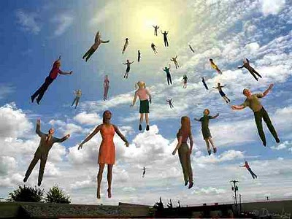
"Now, dear brothers and sisters, let us clarify some things about the coming of our Lord Jesus Christ and how we will be gathered to meet him"
(2 Thess 2:1 NLT).

Slide 127
关键节
211
“无论有灵、有话、有冒我们的名的书信，说主的日子现在到了，你们都不要轻易动心，也不要惊慌。 3 不要让人用任何方法迷惑了你们，因为主的日子来到以前，必定有背道的事，并且那不法的人，就是那沉沦之子，必定显露出来”
(贴后2:2-3).
帖撒罗尼迦后书

Slide 128
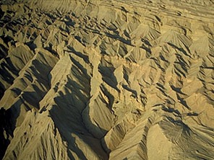
判定
Judgement！
216
followed by…
跟后是。。。
Notes:
Judgment! followed by…

Slide 129

祝福!
216

Slide 130


上帝的日子
216
审判
+
祝福
灾难
千年
启示 6–19
启示 20
7 年
1000 年

Slide 131
一个时代论“时间轴”
437
欢天喜地
第二次降临
（撒迦利亚书14:3-5）
大白
宝座
（启示录20:11-14)
教会时代
苦难
（撒迦利亚书14:1-2）
千年
（撒迦利亚书14:6-21）
歌革和玛（世界末日）
（以西结书38-39）
歌革和玛再访
(启示录20:7-10)
Notes:
131

Slide 132

Antichrist Sets Up Image for Worship
(贴后 2:3-4 CNVS)
80 I
为了被崇拜，敌基督自己设置崇拜i象式
(贴后 2:3-4 CNVS)
"不要让人用任何方法迷惑了你们，因为主的日子来到以前，必定有背道的事，并且那不法的人，就是那沉沦之子，必定显露出来。 4 他抵挡 神，抬举自己，高过一切称为神或受人敬拜的，甚至坐在 神的殿中，自称为 神。"

Slide 133
"That day will not come until…" (2:3a)
213
“因为主的日子来到以前。。。” (2:3a)
1. "the rebellion (apostasy) occurs" (3b)
1. “必定有背道的事” （3b)
= Christendom is completely apostate
= 基督教世界会完全背道的
2. "the man of lawlessness is revealed" (3c)
2. “并且那不法的人”(3c)
= Antichrist signs covenant with Israel (Dan. 9:27)
= 基督的敌人和以色列坚立盟约 (但以里书 9:27)
3. "the one who now holds [lawlessness] back will be taken out of the way" (7b)
3. “只是现在有一个箝制他的在那里，直等到那箝制解除了”
= restraining influence of the Holy Spirit in the Church is taken to heaven
= 圣灵克制教会的势力会被带到天堂

Slide 134
"Don’t you remember that I told you about all this when I was with you? ⁶And you know what is holding him back, for he can be revealed only when his time comes. ⁷For this lawlessness is already at work secretly, and it will remain secret until the one who is holding it back steps out of the way. ⁸Then the man of lawlessness will be revealed, but the Lord Jesus will kill him with the breath of his mouth and destroy him by the splendor of his coming" (2 Thess 2:5-8 NLT).

Slide 135



The Restrainer
209
限制者
圣灵通过教会克制邪恶将会不在。
(帖撒罗尼迦后书 2：6-7
⁶ 现在你们也知道，那箝制他，使他到了时候才可以显露出来的是甚么。 ⁷ 因为那不法的潜力已经发动，只是现在有一个钳制他的有在那里，直等到那箝制解除了， (CNVS).
to. kate,con (“那箝制他” = 中性, 2:6 = 福音传道)
to. kate,con ("what restrains" = neuter, 2:6 = gospel preaching)
o` kate,cwn (“有一个钳制他的” = 阳性, 2:7 = 一个人)
o` kate,cwn ("he who restrains" = masculine, 2:7 = a person)
pnue/ma (“圣灵” =中性 ，但是用于一个人)
pnue/ma ("Spirit" = neuter noun but used of a person)

Slide 136
耶和华的日子
帖撒罗尼迦后书 2:3-7 在主的日子之前的先决条件 （有3件）:
213
1
天堂的审判席位
哥林多后书5:10; 哥林多前书3:10-15
3 阻止者 (2:7b)
1
3 Restrainer (2:7b)
2
1 叛教 (2:3b)
2
1 Apostasy (2:3b)
2 基督的敌人 (2:3c)
2 Antichrist (2:3c)
3
1
The Day of the Lord
3
第二来临
启示录 19:11-21
Second Coming
Rev. 19:11-21
被提
帖撒罗尼迦前书4:13-18
大灾难
千年
永恒
Rapture
1 Thess. 4:13-18
Eternal state
3
1000 年.
(Daniel‘s 70th week)
Matt 24:21
(长期的)
69 周
(但以里书9:24-27)
教会时代
马太福音 16:18
使徒行传 2:1-4
2
3½
3½
启示录20:4-6
(Timeless)
69 Weeks
(Dan. 9:24-27)
Church Age
Matt. 16:18
Acts 2:1-4
7年
(但以理的第70周)
马太福音 24:21
Matt. 27:50
马太福音27:50
短暂的准备时期;
基督的敌人的崛起
（时间长短未知）
《预言》 (达拉斯神学院视频系列， 1980s)
"Prophecy" (Dallas Seminary video series, 1980s)
Short Period of Preparation; Rise of the Antichrist
(length of time unknown)

Slide 137


第七十“礼拜”的排列顺序
336
Adapted from J. Dwight Pentecost, Dallas Theological Seminary, 1988
人子的迹象
马太福音 24:30
基督的到来以完成
礼拜中
3½ 年
1290 天
但以理 12:11
30天
30
天
1260 天
45 天
启示录 11:3; 12:6
但以理 12:12
3½年
3½ 年
当选那兽
启示录 17:13
盟约
但以理 9:27a
违反盟约
但以理 9:27b
第二来临
最激烈的灾祸
灾祸

Slide 138



为什么我相信灾前试炼？
209
信徒会被保守和免去试炼 (启 3:10)
灾难试炼非信徒 (3:10) 在上帝的愠怒之下 (6:16-17)
圣灵不再需要遏制恶魔(帖后 2:6-7).
to. kate,con (“what restrains” = neuter, 2:6 = gospel preaching)
o` kate,cwn (“he who restrains” = masculine, 2:7 = a person)
pnue/ma (“Spirit” = neuter noun but used of a person)

Slide 139
"This man will come to do the work of Satan with counterfeit power and signs and miracles. ¹⁰He will use every kind of evil deception to fool those on their way to destruction, because they refuse to love and accept the truth that would save them. ¹¹So God will cause them to be greatly deceived, and they will believe these lies. ¹²Then they will be condemned for enjoying evil rather than believing the truth" (2 Thess 2:9-12 NLT).

Slide 140
Book Chart
帖撒罗尼迦后书: 受难的更正
逼迫中仍坚信 |  | 关於主的日子 |  |  | 训导慵懒的门徒
第一章 |  | 第二章 |  |  | 第三章
情感 |  | 神学观 |  |  | 实际行为
逼迫中的鼓励 |  | 解释那一天 |  |  | 身上得荣耀
煽胆的信徒 |  | 扰乱的信徒 |  |  | 不守规矩的信徒
更改观念 |  | 更改神学观 |  |  | 更改态度
问安 | 奖赏 与审判 | 受难前 的教导 | 敌基督 的条件 | 站稳：坚守 | 祷告 | 神的管教 | 祝福
1:1-2 | 1:3-12 | 2:1-2 | 2:3-12 | 2:13-17 | 3:1-5 | 3:6-15 | 3:16-18
格林多
后夏 公元 51年
211

Slide 141

Keys
帖撒罗尼迦后书
211
关键字 :
受难
关键词
我劝你们：无论有灵、有言语、有冒我名的书信，说主的日子现在（或作：就）到了，不要轻易动心，也不要惊慌。人不拘用甚麽法子，你们总不要被他诱惑；因为那日子以前，必有离道反教的事，并有那大罪人，就是沉沦之子，显露出来。
(帖撒羅尼迦後書 2:2-3).

Slide 142
Summary & Application
帖撒罗尼迦后
211
总表
保罗在更正那些帖撒罗尼迦被逼迫的信徒有关主再来的日子(受难)的错误观念时，已间接鼓励和鉴定那些沮丧的信徒也激励了那些不守规则的信徒帮助他们在真理上站立的稳即使有假教师。
运用
你读了末世论,相信它会引响你作为一个基督徒的行为吗？

Slide 143

The Future Ministries of the Holy Spirit
HS xlii
REMOVAL
OF SIN
RESTORATION OF ISRAEL
EZEK 36:24-27
RESIDENCE IN THE NEW JERUSALEM
REJUVENATION
OF NATURE
HEB 12:22-24
JOHN 14:16, 26; 16:13
EZEK 36:24-27
RETURN OF CHRIST
ISA 32:15; 34:16
FULNESS OF SALVATION
RESURRECTION OF THE BODY
RAPTURE
REVELATION
EZEK 36:25-31
FOR US
REGENERATION OF THE GENTILES
WITH US
INDWELLING OF EVERY BELIEVER
ROM 8:11
GAL 5:5; 6:8
JOHN 6:63
REV 7:9-17
EZEK 36:27–37:14
JER 31:33
ISA 44:3
POURING OUT OF THE SPIRIT
POWER FOR THE WITNESSES
REMOVAL OF THE RESTRAINER
JOEL 2:28-32
ZECH 12:10
ROM 11:26-27
RULE OF MESSIAH
MATT 10:19-20; 24:14
2 THESS 2:7
ISA 11:2
CHURCH
TRIBULATION
MILLENNIUM
ETERNITY
REMOVAL OF THE RESTRAINER
MINISTRY OF THE WITNESSES
RESTRAINT
OF SIN
SOURCE: Professor Manfred E. Kober, Faith Baptist College and Seminary, Ankeny, Iowa 50021. Used by Permission in Charles Ryrie, The Holy Spirit, 2d ed., 188
2 THESS 2:7
REV 11:3-4
ZECH 4:6
ISA 59:19
Figure 21.1

Slide 144

敌基督与
但以理9章
“他们从我们中间离去，这就表明他们是不属于我们的。” （翰一书 2:19）
第四野兽：敌基督的面具
（唯一的大灾难后期电影 - 2005年发行）
The 4th Beast: Mask of the Antichrist
(the only posttrib film — released 2005)
The Antichrist & Daniel 9
Dr. Rick Griffith • Singapore Bible College • biblestudydownloads.com

Slide 145
巨大的领导空虚
216a
A Huge Leadership Vacuum
困难时期总是会设置适合舞台， 好为独裁者提升到这种场合。
Difficult times always set the stage for dictators to rise to the occasion.

Slide 146

敌基督的不同名称
216a
79
Names for the Antichrist
Bloody & Deceitful Man (Ps 5:6)
凶残诡诈的(诗篇 5:6)
小角(但以理. 7:8)
Man of Sin
(2 Thess. 2:3)
沉沦之子
(帖后2：3)
Beast from the Sea (Rev. 13:1)
海中的兽(启示录. 13:1)
One Causing Desolation (但以理 9:27)
带来毁灭的 (但以理 9:27)

Slide 147
敌基督的行为
216a
79
The Activity of the Antichrist

Slide 148


但以理书第二章里的大像
黄金
巴比伦
银
波斯
铜
希腊
钢铁
罗马
钢铁与粘土
敌基督
石头
王国

Slide 149


但以理书中 世上的帝国
545
四个帝国
但以理书中主要帝国的年代
第八章异象
标识
公元前 626
异象但以理书
第二章
第七章异象
巴比伦
巴比伦
2：48
金的头
公元前 539
狮子
玛代波斯
玛代波斯
8：20
银的胸和臂
熊
公绵羊
公元前 330
希腊
（包括托勒密和塞琉古）
铜的腹和腰
豹
公山羊
希腊
8：21
公元前167年
马加比和哈斯摩
铁的腿
公元前 63
令人恐惧的兽
罗马
罗马
公元后 70 耶路撒冷沦陷
铁泥混杂的脚
Bible Visual Resource Book, 133

Slide 150
第七十“礼拜”的排列顺序
336
Adapted from J. Dwight Pentecost, Dallas Theological Seminary, 1988
人子的迹象
马太福音 24:30
基督的到来以完成
礼拜中
3½ 年
1290 天
但以理 12:11
30天
30
天
1260 天
45 天
启示录 11:3; 12:6
但以理 12:12
3½年
3½ 年
当选那兽
启示录 17:13
盟约
但以理 9:27a
违反盟约
但以理 9:27b
第二来临
最激烈的灾祸
灾祸

Slide 151

但以理书11:40
543
黑海
黎巴嫩
叙利亚和伊拉克
地中海
约旦
以色列的敌人们将侵袭她的领土
利比亚
埃及
沙特阿拉伯
红海
苏丹

Slide 152

但以理书
11:40-45
543
地中海
西奈
在地中海的船只将有一场战役
俄罗斯水陆袭击
西顿
大马士革
大量俄罗斯人从水陆发起攻击和占领领土
埃及
俄罗斯水陆攻击
俄罗斯水陆
加利利海
约旦河
苏丹
伯利恒
耶路撒冷

Slide 153


由东由西而来(但以理书11:44)
543
黑海
复兴的罗马帝国的十个国家
红色的中国和东方的
联盟
地中海
伊朗
霍尔木兹海峡
波斯湾
西奈
利比亚
埃及

Slide 154

启 示 录 13 章 的 兽
龙 =
撒但
陸野兽 =
假先知
海野兽 =
敌基督
Used with permission
Notes:
Slides needing translation as of 12 Sep 2013: slides 90-91, 146

Slide 155

撒旦的三位一体”
“父亲”= 撒旦
“儿子”=
敌基督
“灵”=
假先知

Slide 156



世界将拜兽

Slide 157

右手上
的印记
16 他 又 叫 众 人 ， 无 论 大 小 、 贫 富 、 自 主 的 、 为 奴 的 ， 都 在 右 手 上 或 是 在 额 上 受 一 个 印 记 。
17 除 了 那 受 印 记 、 有 了 兽 名 或 有 兽 名 数 目 的 ， 都 不 得 做 买 卖 。
启示录 13:16-17

Slide 158

右手中的
印记
它 又 叫 众 人 ， 无 论 大 小 贫 富 ， 自 主 的 ， 为 奴 的 ， 都 在 右 手 上 ， 或 是 在 额 上 ， 受 一 个 印 记 。 ¹⁷除 了 那 受 印 记 ， 有 了 兽 名 ， 或 有 兽 名 数 目 的 ， 都 不 得 作 买 卖 。
启示录13:16, 17

Slide 159

敌基督到底是谁呢？

Slide 160
以下的片段会说明某些人怎么把“兽”属灵化。。。
假！
666

Slide 161
大红龙!
撒旦:
神的大敌；凡是真理, 良善, 神的创造他都厌恶; 恨不得能够把自己称为神!

Slide 162

如果把兽给属灵化
兽:
世界的政治制度。除了那些属于羔羊的，这政治要求和得到一切的敬拜与顺从，目的是让撒旦把整个世界给掌握在手中。

Slide 163

把假先知给属灵化
假先知:
所有以伪造的伦理和奇迹把人类带坏的观念形态，信仰，甚至是科技。 他的目的是把人类的敬拜转向那兽。

Slide 164

可是他被列为有人的数目，而他的数目是六百六十六。
(Revelation 13:18)

Slide 165

希腊文的字母号数(Gematria)
希伯来文，希腊文和拉丁文的字母各自都带有号数
http://religion-cults.com/antichrist/666.htm
Notes:
religion-cults.com/ antichrist/666.htm

Slide 166

尼罗= 666?
388
http://religion-cults.com/antichrist/666.htm

Slide 167

希伯来文的字母号数
英文 | 希腊文 | 希伯来文 | 号数
A | Alpha | Aleph | 1
B | Beta | Beth | 2
C | Gamma | Gimmel | 3
D | Delta | Daleth | 4
E | Epsilon | He | 5
F |  | Waw | 6
G |  | Zahyin | 7
H | Eta | Heth | 8
www = 666
http://religion-cults.com/antichrist/666.htm

Slide 168
英文字母号数
388
K | 66
I | 54
S | 114
S | 114
I | 54
N | 84
G | 42
E | 30
R | 108
 | 666
A | 6
B | 12
C | 18
D | 24
E | 30
F | 36
G | 42
H | 48
I | 54
J | 60
K | 66
L | 72
M | 78
N | 84
O | 90
P | 96
Q | 102
R | 108
S | 114
T | 120
U | 126
V | 132
W | 138
X | 144
Kissinger = Antichrist!

Slide 169

通用产品代条形码
388
但是犹太人在下一节经文是否也有个密码？
(启示录 14:1)
http://religion-cults.com/antichrist/mark.htm
Notes:
http://religion-cults.com/antichrist/mark.htm and www.soldierofthelord.4t.com/ photo.html

Slide 170





兽印记：微型芯片
www.soldierofthelord.4t.com/ photo.html

Slide 171



Monster Drink!
388

Slide 172

希伯来文字母的对等数字
388
怪兽增力饮料 =
666

Slide 173

层出不穷！
各类型的计算法就把这些总计成六百六十六：Kissinger 基辛格, Van de Broek 布鲁克, Lustiger 吕斯蒂热, Hitler 希特勒, Deutschland 德意志, Himmler 希姆莱, New York 纽约, US of America 美国, Santa Claus 圣诞老人, Kennedy 肯尼迪, Al Gore 阿尔伯特戈尔。。。 Holy Bible 圣经, SS number 纳粹党标号, witchcraft 魔法, lustful 淫荡, monetary 货币, live 生存, son of sin 罪孽的后代, mark of beast 兽印记, evil 罪恶, bullet 子弹。。。 Internet 因特网, billgates+3 (the III) 比尔盖茨（第三）， computer 电脑, terminal 终端, binary 二进制, windows98 微软的视窗操作系统, teletext 电视杂志, calculation 计算。。。

Slide 174

乔治·沃克·布什?

Slide 175

“他必在列国中施行审判”
"He will judge the nations"

Slide 176

东门

Slide 177
但以理
神万能主权在外邦人统治的时代
主权在但以理之上 |  |  | 主权在外邦人之上 |  |  |  |  |  | 主权在犹太人之上
第一章 |  |  | 第二至七章 |  |  |  |  |  | 第八至十二章
叙述 |  |  | 叙述异象 |  |  |  |  |  | 异象
希伯来文 |  |  | 亚兰文 |  |  |  |  |  | 希伯来文
外邦人名词称呼神 |  |  | 外邦人名词称呼神 |  |  |  |  |  | 犹太人名词称呼神
第三人称 (‘但以理’) |  |  | 第三人称 (‘但以理’) |  |  |  |  |  | 第一人称 (‘我’)
但以理的榜样 |  |  | 但以理讲解 国王的梦 |  |  |  |  |  | 天使讲解但以理的梦
 |  |  | 大像 |  | 众国王
放逐 1:1-7 | 食物 1:8-16 | 尊崇 1:17-21 | 多元 2 升职 | 金 3 火窑 | 尼王 4 放逐 | 伯王 5 筵席 | 大利乌王 6 狮子 | 全 7 大 兽 | 玛代- 波斯 至希腊 8 | 回到 “七十个七” 9 | 两约之间至大灾难 10–12
巴比伦
605-536 BC

Slide 178

但以理
七年盟
1290/1260 天的考验
十角兽
启示录

Slide 179
但以理第九章 大纲
539
但以理的祷告 (9:1-19)
神的回应 - 七十个七 (9:20-27)
七十周的解释被分成4个主要的观点:
But let's first see the text itself and ask
who the "bad guys" are: "the Anointed One" or
the "ruler who will arise"?
七十周的解释被分成4个主要的观点:
但是，让我们先看看本文并提出
“坏人”是谁的问题：“受膏者”或
“将要出现的统治者”？
Notes:
CF Daniel OTS

Slide 180
但以理 9:24-27 (CNVS)
86b-d
“25 你要知道，也要明白，从发出命令恢复和重建耶路撒冷，直到受膏君的时候，必有七个七；又有六十二个七（“必有七个七；又有六十二个七”或译：“必有七个七和六十二个七”），耶路撒冷连广场和濠沟，都必重新建造起来；那是一段困苦的时期。 26 六十二个七以后，受膏者必被剪除，一无所有（“一无所有”或译：“不再存在”）；那将要来的领袖的人民必毁灭这城和圣所。结局必像洪水而来；必有争战直到末了；荒凉的事已经定了。 27 一七之内，他必和许多人坚立盟约；一七之半，他必使献祭和供物终止；他必在殿里（“殿里”原文作“翼上”）；设立那使地荒凉的可憎的像（“可憎的像”原文是复数），直到指定的结局倾倒在那造成荒凉的人身上。”
Notes:
CF Daniel OTS

Slide 181

七十个七的不同观点
554
总结但以理书9:24-27四点主要的看见
提图斯拆毁耶路撒冷 公元后70
耶路撒冷的预言公元前605-586
古列的颁令公元前538
亚达薛西王颁令公元前444
耶路撒冷重建
阿尼亚的谋杀 公元前171
安提阿古颁令 公元前167
再次献上圣殿 公元前164
基督的死公元后33
教会
时代
七年大灾难
千禧年国度
批判性的
7周
62周
1周
象征性的
7周
62周
1周
弥赛亚的
7周
62周
1周
前千禧年的
7周
62周
1周
^{但 9:27} 一七之内，他必和许多人坚立盟约；一七之半，他必使献祭和供物终止；他必在殿里（“殿里”原文作“翼上”）；设立那使地荒凉的可憎的像（“可憎的像”原文是复数），直到指定的结局倾倒在那造成荒凉的人身上。" (CNVS).
Notes:
CF Daniel OTS

Slide 182
1. 批判性观点
555
  7 周：从耶利米的预言到古列
  62 周：从古列到阿尼亚
  1 周：从阿尼亚到圣殿的恢复
  批判性观点的评论
  接近成就在安提阿古
  拒绝命运注定论
  不是所有都成就在安提阿古四世
  预言如同一个富于想象的预报
Notes:
CF Daniel OTS

Slide 183
2. 弥撒亚/历史意义的观点
555
7 周从古列的判决开始
62 周的结束在耶稣的第一次到来 (9:26 在这之后出现)
最后一周–基督的死废除了献祭
公元后70年耶路撒冷被毁
  弥赛亚观点的评论
  拒绝神学缺口
  最后的王子不是被看作敌基督，乃是被看作基督
  把马太福音24:15当作应验在公元后70年(然后马太将他写下)
  约的解释(来8:13)和荒废(来9:25, 26)
  没有对敌基督者(启13:5他将统治42个月)做出解释
  帖后2:4 提到敌基督者(不是基督)将在殿里自称是神
  无论如何，扬(学者)把11:40-44看做是敌基督 (扬, 248, 251)
Notes:
CF Daniel OTS

Slide 184
3. 无千禧年象征观点
555
70 是一个不确定的时期–为着带领人民进入救赎
7是一个神圣工作的标志，象征完全
  第一个七年由古列颁令开始 (公元前538)
  62周 = 福音被传开
  最后一周 = 敌基督者的统治 基督失去影响力
  70年结束在 基督第二次再来
象征观点的评论
  70x7是为着所有人，不是专为以色列
  掩盖预言元素的细节
  古列颁令 - 最接近但以理祷告的时间
Notes:
CF Daniel OTS

Slide 185

詹姆斯 E. 史密斯的弥撒亚观点
但以理书9:24-27中的
七十个七
耶路撒冷的摧毁
7个7
耶路撒冷的恢复
62个7
等待弥赛亚
耶稣受洗 公元前62年
耶路撒冷颁布修复令公元前457
扫罗的对话
问题?
这个停止献祭的(但 9:27) 同样也亵渎了圣殿(参帖后 2:4; 启 13:5)
483年 直到弥赛亚再现
The Major Prophets (Joplin, MO: College Press, 1995), LOGOS electronic version chart 22
Notes:
CF Daniel OTS

Slide 186
4. 前千禧年观点
555
7周 - 从公元前444年亚达薛西王向尼西米颁令开始。
62周 - 结束于基督得胜的进入
缺口 = 教会时代 = 外邦人时代
(注意路加福音中21:24耶稣的预言)
最后一周 = 七年大灾难
Notes:
CF Daniel OTS

Slide 187

但以理书中七十周
551
被膏的那一位
颁令
六十九个七 = 483年
七个七 六十二个七
一个七= 七年
公元前444
–公元前395
公元前395
–公元后33
Notes:
CF Daniel OTS

Slide 188

但以理的七十周
(但 9:24-27)
552
七十周是被决定于人和圣城
带来永远的
公义
千禧年
恢复
教会时期
在圣约中的
四个世纪
公元前70 城毁
大灾难
公元前 538
公元前 424
停止献祭与荒凉可憎的像
但9:27
但12:1
直到最后将是战争
自命令的发布到恢复到建造耶路撒冷（尼2:1-8）
公元前444
直到弥赛亚王子
亚9:9
路19:28-29
公元后33
弥赛亚被剪除在
第69周后
圆满成功
但以理书9:24-27 70个7周
69周
公元前 444
公元后 33
Notes:
CF Daniel OTS

Slide 189

詹姆斯 E. 史密斯的弥撒亚观点
患难时期
但12:4-12
公元后67年3月：
罗马军队开始围困耶路撒冷
公元后70年7月：圣殿停止献祭
公元后70年8月：耶路撒冷烧毁。考验结束
荒凉可憎的像站立在圣所：公元后66年10月罗马军队进军耶路撒冷之后撤离
（太：24:15 路21:20）
城市被毁：反叛者被杀或被征服。在监狱中的狂热的犹太教信徒被释放
1290天（但12：11）
45天
1335天（但12:12）
问题?
在公元后60年，游历和学问没有广泛地增长 (但12:2)
公元后66年没有可憎之像站立在殿里
一载，二载，半载（但12:7）
3+年
The Major Prophets (Joplin, MO: College Press, 1995), LOGOS electronic version chart 24

Slide 190
第七十“礼拜”的排列顺序
336
Adapted from J. Dwight Pentecost, Dallas Theological Seminary, 1988
人子的迹象
马太福音 24:30
基督的到来以完成
礼拜中
3½ 年
1290 天
但以理 12:11
30天
30
天
1260 天
45 天
启示录 11:3; 12:6
但以理 12:12
3½年
3½ 年
当选那兽
启示录 17:13
盟约
但以理 9:27a
违反盟约
但以理 9:27b
第二来临
最激烈的灾祸
灾祸

Slide 191
前千禧年的评论
555
哪个是9：25发出的命令?
  (1) 古列颁令重建殿 (代下36: 22-23; 拉1:1-4; 6:1-5);
  (2) 大利乌颁令确认古列的法令 (拉 6:6-12);
  (3)亚达薛西颁令 #1 (拉 7:11-26);
  (4)亚达薛西颁令 #2 授权于尼西米重建这城 (尼 2:1-8).
为什么我们认为这法令是亚达薛西王在位第二十年（公元前444）所颁布的#2法令? 这是因为尼西米记2:12-17描写耶路撒冷在当时是废墟。

Slide 192

路加福音 21:24 外邦人时期
551
路12:24 外邦人时期
圣约中的四个世纪
主的王权
耶3:17
赛62:6-7
犹大的国度
公元前586
恢复时期
教会时期
徒：15:14-18
罗11:25
巴比伦
波斯
希腊
罗马
公元前 538
公元前333
公元后63
在很多国家之间
她的太阳已经西落
耶15:9
因为他们离弃了耶和华他们神的约
耶22:8-9
王下25:8-12
耶15:4,22:29-30，30:24,
结10:4,18,11:22-25,
14:22-23
结6:8
何3:4-5，8:8
摩9:8-9
弥5:7-8
耶31:35-37,46:27-28
51:5
我必实践我向以色列家和犹大家应许赐福的诺言 耶33:7-14
塞 4:2-6
结43:1-9
亚2:10-13，8:1-8
Raymond Ludwigson, A Survey of Bible Prophecy

Slide 193
553
犹太历
每年360天
69周：483年= 476阳历年
法令的颁布是在公元前444年3月5日，这样推算出弥撒亚于公元后33年4月3日被杀。公元后33年3月30日荣耀入耶路撒冷。
但以理书9:27与启示录13:5, 14-15的比较

Slide 194

70周的计算
553
公元前444年5月5日
尼散月1日 亚达薛西王第二十年
尼2:1-8
公元后33年3月30日，在尼散月凯旋的进入耶路撒冷
路19:28-40
教会时代
第70周
69周
69×7×360=173，880天
公元前444年，3月5日+173,888天公元后33年3月30日
½周
½周
查证
公元前444年至公元后33年=476年
476年×365.24219879天=173,844天
+3月5日&3月30日之间=25天
173,880天
弥赛亚69周之后剪除- 4月3日，公元后33年
360-天 年 的基本原理
½周——但9:27
一载，两载，半载—但7:25,12:7
启12;14
1260天—启12:6,11:3
42个月—启 11:2，13：15
因此：42个月=1260天=一载，两载，半载= ½周
因此：月=30天；年=360天
Harold Hoehner, Chronological Aspects of the Life of Christ

Slide 195

70周的计算
公元前444年至公元后33年=476年
476年
× 365天
——————————
173，,740天
+116天 在闰年里
+24天 3月5日到3月30日
——————————
173,880天
公元前444年至公元后33年=476年
476年
× 365天
——————————
173，,740天
+116天 在闰年里
+24天 3月5日到3月30日
——————————
173,880天
553
483年在犹太历和阳历里
犹太历
每年360天
阳历
每年365天
（7×7）+（62×7）年=483年
483年
× 360天
——————————
173,880天
公元前444年至公元后33年=476年★
476年
× 365天
——————————
173，,740天
+116天 在闰年里▼
+24天 3月5日到3月30日
——————————
173,880天
查看注解：但9:27b 为确认每年360天
★从仅一年期满在公元前1年和公元后一年，一共476，不是477
▼一共476年分为四部分（每四年一次闰年）给了附加的119天。但三天必须从119天众减去因为百的不是闰年，虽然第400年是闰年
Harold Hoehner, Chronological Aspects of the Life of Christ

Slide 196
Daniel's 70th Week
216b
但以里的第七十个“礼拜”
但以理 9：27
第二来临
（马太福音24：29-31）
大灾难
（马太福音24：21）
教会时代
弥赛亚的国度
3 ½ 年
3 ½ 年
一个時期、多个時期、半个時期
立圣约
违背约
敌基督被毁灭
敌基督的权利升起
（中阶）
主权
(但以理 7：27)
（但以理 9：27）
大灾难的日子
权力高峰
(但以理 7：25；启示录 13：5）
（马太福音24：15）
被判定！
(但以理 7：26)

Slide 197
"As for us, we can’t help but thank God for you, dear brothers and sisters loved by the Lord. We are always thankful that God chose you to be among the first to experience salvation—a salvation that came through the Spirit who makes you holy and through your belief in the truth. ¹⁴He called you to salvation when we told you the Good News; now you can share in the glory of our Lord Jesus Christ" (2 Thess 2:13-14 NLT).

Slide 198
"With all these things in mind, dear brothers and sisters, stand firm and keep a strong grip on the teaching we passed on to you both in person and by letter. ¹⁶Now may our Lord Jesus Christ himself and God our Father, who loved us and by his grace gave us eternal comfort and a wonderful hope, ¹⁷comfort you and strengthen you in every good thing you do and say" (2 Thess 2:15-17 NLT).

Slide 199
Trusting amidst confusion produces stability
Charles R. Swindoll, Steadfast Christianity, 3
Notes:
There is an immense amount of theological confusion spouted all over today. The rise of the Internet has allowed YouTube and other avenues to spread heresies. It seems that the more hits or likes, the more bizarre and damaging the teaching. My own YouTube video has just a few hundred views, but the insane stuff has millions of views!
How can we keep trusting the Lord amidst such craziness?
Keep going back to the source—the Word of God.
How are you doing at your goal of reading the Bible each day this year?

Slide 200
神怎么在困难中肯定我们？

Slide 201
（一）情绪：神赐毅力以让我们成熟 （帖撒罗尼迦后书 第1章）
Notes:
The Lord helps us not to lose heart so we will grow.]

Slide 202
（二）神学：神赐真理以带给我们稳定 （帖撒罗尼迦后书 第2章）
Notes:
Theology matters! The Lord corrects our misconceptions to give us firm footing.

Slide 203
Slides on
帖撒罗尼迦后 3

Slide 204
神如何肯定我 们
情绪
1
神学
2
实践
3
Notes:
Restated: He is not incomplete or piecemeal in his ministry to us.
• He touches the heart (emotionally),
• the mind (theologically),
• and the hands (practically).

Slide 205
III. Practically: God cultivates discipline in us to build responsibility (2 Thess 3).
（三）实践：神让我们培养纪律以让我们训练出责任感 （帖撒罗尼迦后书 第3章）
Notes:
The Lord helps us hold one another accountable so we will be reliable.
• Rather than living an undisciplined life
• Each of us has had to show discipline to learn certain skills such as playing an instrument
• So we need that same type of discipline to know his Word
• And to be a vital part of his church.

Slide 206
"Finally, dear brothers and sisters, we ask you to pray for us. Pray that the Lord’s message will spread rapidly and be honored wherever it goes, just as when it came to you. ²Pray, too, that we will be rescued from wicked and evil people, for not everyone is a believer" (2 Thess 3:1-2 NLT).

Slide 207
"But the Lord is faithful; he will strengthen you and guard you from the evil one. ⁴And we are confident in the Lord that you are doing and will continue to do the things we commanded you. ⁵May the Lord lead your hearts into a full understanding and expression of the love of God and the patient endurance that comes from Christ"
(2 Thess 3:3-5 NLT).

Slide 208
"And now, dear brothers and sisters, we give you this command in the name of our Lord Jesus Christ: Stay away from all believers who live idle lives and don’t follow the tradition they received from us. ⁷For you know that you ought to imitate us. We were not idle when we were with you"
(2 Thess 3:6-7 NLT).

Slide 209

Discipline the idle (3:6-15)
教训游手好闲者 (3:6-15)
"…弟兄们，我们奉主耶稣基督的名吩咐你们，凡是游手好闲的弟兄，不按着你们从我们所领受的教训去行，就应当远离他。" (3:6 CNVS)

Slide 210
"We never accepted food from anyone without paying for it. We worked hard day and night so we would not be a burden to any of you. ⁹We certainly had the right to ask you to feed us, but we wanted to give you an example to follow" (2 Thess 3:8-9 NLT).

Slide 211
Discipline the idle (3:6-15)
教训游手好闲者 (3:6-15)
"…弟兄们，我们奉主耶稣基督的名吩咐你们，凡是游手好闲的弟兄，不按着你们从我们所领受的教训去行，就应当远离他。" (3:6 CNVS)
"我们在你们那里的时候，曾经吩咐过你们，如果有人不肯作工，就不可吃饭。" (3:10 CNVS)

Slide 212
"Yet we hear that some of you are living idle lives, refusing to work and meddling in other people’s business. ¹²We command such people and urge them in the name of the Lord Jesus Christ to settle down and work to earn their own living. ¹³As for the rest of you, dear brothers and sisters, never get tired of doing good" (2 Thess 3:11-13 NLT).
“We hear that some among you are idle.
They are not busy; they are busybodies”
(2 Thess 3:11 NIV).

Slide 213
"Take note of those who refuse to obey what we say in this letter. Stay away from them so they will be ashamed. ¹⁵Don’t think of them as enemies, but warn them as you would a brother or sister" (2 Thess 3:14-15 NLT).

Slide 214
Benediction
Now may the Lord of peace himself give you his peace at all times and in every situation. The Lord be with you all.
2 Thess 3:16 (NLT)

Slide 215
"Here is my greeting in my own handwriting: Paul. I do this in all my letters to prove they are from me.
¹⁸May the grace of our Lord Jesus Christ be with you all" (2 Thess 3:17-18 NLT).

Slide 216
Waiting with discipline cultivates responsibility
Charles R. Swindoll, Steadfast Christianity, 3
Notes:
Hard-working Singapore weeds out lazy people. There is no unemployment insurance here that people can take advantage of, and there is no welfare program that can make people dependent.
However, occasionally we still have people go from church to church to try to get money out of each congregation. Like other churches, we try to have a balanced view where we help people in need—but we also expect our people to work for a living.
Would you say you are a disciplined person?
Do you discipline your time? Or do you waste time?
Do you serve others or spend most of your time on yourself?
The general rule in this passage is Paul’s maxim: “Those unwilling to work will not get to eat” (3:10 NLT).

Slide 217
神怎么在困难中肯定我们？

Slide 218
神是全方面的肯定我们。
(帖撒罗尼迦后书 的主题)
神如何肯定我 们
情绪
1
神学
2
实践
3
Notes:
Restated: He is not incomplete or piecemeal in his ministry to us.
• He touches the heart (emotionally),
• the mind (theologically),
• and the hands (practically).

Slide 219
（一）情绪：神赐毅力以让我们成熟 （帖撒罗尼迦后书 第1章）
Notes:
The Lord helps us not to lose heart so we will grow.]

Slide 220
（二）神学：神赐真理以带给我们稳定 （帖撒罗尼迦后书 第2章）
Notes:
Theology matters! The Lord corrects our misconceptions to give us firm footing.

Slide 221
III. Practically: God cultivates discipline in us to build responsibility (2 Thess 3).
（三）实践：神让我们培养纪律以让我们训练出责任感 （帖撒罗尼迦后书 第3章）
Notes:
The Lord helps us hold one another accountable so we will be reliable.
• Rather than living an undisciplined life
• Each of us has had to show discipline to learn certain skills such as playing an instrument
• So we need that same type of discipline to know his Word
• And to be a vital part of his church.

Slide 222

Sister Mrosla's Third Grade Class
St. Mary's School in Morris, Minnesota
Notes:
A Catholic nun named Sister Helen P. Mrosla relates this story about affirmation…
He was in the first third grade class I taught at Saint Mary's School in Morris, Minn. All 34 of my students were dear to me, but Mark Eklund was one in a million. Very neat in appearance, but had that happy-to-be-alive attitude that made even his occasional mischievousness delightful.
___________
Nun's Lesson is Still Viral Decades Later
This story originally appeared in Proteus, A Journal of Ideas, published by Shippensburg University in Pennsylvania. Printed twice a year, each edition of Proteus is devoted to a theme and all its aspects from a number of viewpoints.
In 1991, Sister Helen Mrosla, a former third-grade teacher at our St. Mary's School, responded to the journal's request for stories about education. She submitted the text below. Later that year, Reader's Digest reprinted her submission. About a decade later, the story became a popular email chain letter, which tainted its authenticity. Chain letters are often understood to be hoaxes.
Today, however, this sweet letter has regained its authenticity and is used throughout the world to inspire educators and build students' self-esteem. It's since been republished thousands of times over.
http://assumptionofmorris.org/site/about/ourviralnun/
Accessed 6 Nov 2016

Slide 223


Helen P. Mrosla
Mark Eklund
Notes:
Mark talked incessantly. I had to remind him again and again that talking without permission was not acceptable. What impressed me so much, though, was his sincere response every time I had to correct him for misbehaving: "Thank you for correcting me, Sister!" I didn't know what to make of it at first, but before long I became accustomed to hearing it many times a day.
One morning my patience was growing thin when Mark talked once too often, and then I made a novice teacher's mistake. I looked at him and said, "If you say one more word, I am going to tape your mouth shut!"
It wasn't ten seconds later when Chuck blurted out, "Mark is talking again." I hadn't asked any of the students to help me watch Mark, but since I had stated the punishment in front of the class, I had to act on it.
• I remember the scene as if it had occurred this morning. I walked to my desk, very deliberately opened my drawer and took out a roll of masking tape. Without saying a word, I proceeded to Mark's desk, tore off two pieces of tape and made a big X with them over his mouth. I then returned to the front of the room. As I glanced at Mark to see how he was doing, he winked at me. That did it! I started laughing. The class cheered as I walked back to Mark's desk, removed the tape and shrugged my shoulders. His first words were, "Thank you for correcting me, Sister."
At the end of the year I was asked to teach junior high math. The years flew by, and before I knew it Mark was in my classroom again. He was more handsome than ever and just as polite. Since he had to listen carefully to my instructions in the "new math," he did not talk as much in ninth grade as he had in the third.
One Friday, things just didn't feel right. We had worked hard on a new concept all week, and I sensed that the students were frowning, frustrated with themselves — and edgy with one another. I had to stop this crankiness before it got out of hand. So I asked them to list the names of the other students in the room on two sheets of paper, leaving a space between each name. Then I told them to think of the nicest thing they could say about each of their classmates and write it down. It took the remainder of the class period to finish the assignment, and as the students left the room, each one handed me the papers. Charlie smiled. Mark said, "Thank you for teaching me, Sister. Have a good weekend."
That Saturday, I wrote down the name of each student on a separate sheet of paper, and I listed what everyone else had said about that individual. On Monday I gave each student his or her list. Before long, the entire class was smiling. "Really?" I heard whispered. "I never knew that meant anything to anyone!" "I didn't know others liked me so much!" No one ever mentioned those papers in class again. I never knew if they discussed them after class or with their parents, but it didn't matter. The exercise had accomplished its purpose. The students were happy with themselves and one another again.
That group of students moved on. Several years later, after I returned from vacation, my parents met me at the airport. As we were driving home, Mother asked me the usual questions about the trip — the weather, my experiences in general. There was a light lull in the conversation. Mother gave Dad a sideways glance and simply said, "Dad?"
My father cleared his throat as he usually did before something important. "The Eklunds called last night," he began.
"Really?" I said. "I haven't heard from them in years. I wonder how Mark is."
____
Credit: Sister Helen P. Mrosla. Sister Helen Mrosla, a Franciscan nun, submitted "All the Good Things" to Proteus, A Journal of Ideas in 1991. Her article also appeared in Reader's Digest that same year, was reprinted in the original Chicken Soup for the Soul book in 1993, and was offered yet again in 1996's Stories for the Heart.
All The Good Things
Helen P. Mrosla
http://mylifeyoga.com/2015/01/10/all-the-good-things/
Accessed 6 Nov 2016

Slide 224

Mark Eklund
Notes:
Dad responded quietly. "Mark was killed in Vietnam," he said. "The funeral is tomorrow, and his parents would like if it you could attend." To this day I can still point to the exact spot on I-494 where Dad told me about Mark.
I had never seen a serviceman in a military coffin before. Mark looked so handsome, so mature. All I could think at that moment was, Mark, I would give all the masking tape in the world if only you would talk to me.
The church was packed with Mark's friends. Chuck's sister sang "The Battle Hymn of the Republic." Why did it have to rain on the day of the funeral? It was difficult enough at the graveside. The pastor said the usual prayers, and the bugler played taps. One by one those who loved Mark took a last walk by the coffin and sprinkled it with holy water. I was the last one to bless the coffin. As I stood there, one of the soldiers who had acted as pallbearer came up to me. "Were you Mark's math teacher?" he asked. I nodded as I continued to stare at the coffin. "Mark talked about you a lot," he said.
After the funeral, most of Mark's former classmates headed to Chuck's farmhouse for lunch. Mark's mother and father were there, obviously waiting for me. "We want to show you something," his father said, taking a wallet out of his pocket. "They found this on Mark when he was killed. We thought you might recognize it." Opening the billfold, he carefully removed two worn pieces of notebook paper that had obviously been taped, folded and refolded many times. I knew without looking that the papers were the ones on which I had listed all the good things each of Mark's classmates had said about him.
"Thank you so much for doing that," Mark's mother said. "As you can see, Mark treasured it."
Mark's classmates started to gather around us. Charlie smiled rather sheepishly and said, "I still have my list. It's in the top drawer of my desk at home." Chuck's wife said, "Chuck asked me to put his in our wedding album." "I have mine too," Marilyn said. "It's in my diary." Then Vicki, another classmate, reached into her pocketbook, took out her wallet and showed her worn and frazzled list to the group. "I carry this with me at all times," Vicki said without batting an eyelash. "I think we all saved our lists." That's when I finally sat down and cried. I cried for Mark and for all his friends who would never see him again.
_________
"A Morris native and St. Mary's alumni, Mark Eklund was killed in the Vietnam War. He was just 20 years old."
http://assumptionofmorris.org/site/about/ourviralnun/

Slide 225
How ‘bout you?
Notes:
The affirmation you give this week just might meet a specific need and inspire hope too.
Who needs your affirmation this week, today? Take some moments now to tell the Lord who you are going to encourage and how you're going to do it—
Take that person out for a meal?
Offer a helping hand?
Send a card or note?
Phone him or her to show that you care?
Make it simple—but most of all, make it genuine affirmation.
Maybe you need to receive affirmation today more than to give it.
Even if people fail to affirm you, God doesn’t.
He sent his own Son for you to affirm you—so tell him thanks!
If you need human affirmation, we are up here to talk afterwards.

Slide 226
在鼓励别人这方面，你做得如何呢？

Slide 227

Words of Affirmation

Slide 228
Black

Slide 229


新约全书讲章 • BibleStudyDownloads.org
免费获得该讲解!
圣经学习下载
Notes:
The explanation for free
NT Preaching link address

Slide 230

We will never recognize the true value of our own lives until we affirm the value in the life of others.
—Ronald Reagan—

Slide 231
How to Live
如何生活
Live as though Christ was crucified yesterday,
risen today and
coming tomorrow."
“要活得好像基督
昨天被钉上十字架，
今天复活，
明天就要来了。”
–马丁路德
–Martin Luther

Slide 232

“我们应看他"
歌手：Sandi Patti
Notes:
232
http://fr.musicplayon.com/Sandi-Patty-We-Shall-Behold-Him-Chinese-lyrics-touch-709300.html?translateTo=zh

Slide 233

天空
将
展现…
Notes:
233

Slide 234

…准备他的入口
Notes:
234

Slide 235

星星
应为
他鼓掌
用
雷鸣般的
赞美

Slide 236

他眼中
的
甜美的
光芒
应加强
那些
等待
Notes:
236

Slide 237

我们应看他
然后面对面
Notes:
237

Slide 238

噢，我们应看他
是的，我们应看他
Notes:
238

Slide 239

…在所有的荣耀
面对面
Notes:
239

Slide 240

我们应看他
我们应看他
Notes:
240

Slide 241

…面对我们的救主
和主的脸
Notes:
241

Slide 242

天使将吹响
他的到来的呐喊
Notes:
242

Slide 243

睡眠应从上升
他们沉睡的地方
Notes:
243

Slide 244

那些仍须
我们应在一瞬间改变了
Notes:
244

Slide 245

我们应看他
然后面对面
Notes:
245

Slide 246

我们影看她
我们应看他
Notes:
246

Slide 247

…在所有的荣耀
面对面
Notes:
247

Slide 248

我们应看他
我们应看他
Notes:
248

Slide 249

…面对我的救主
和主的脸
Notes:
249

Slide 250

我们应看他，
我们的救主和主!
Notes:
250

Slide 251

...我们的救主和主!
Notes:
251

Slide 252
新约全书链接地址 BibleStudyDownloads.org
免费获得该讲解!
圣经学习下载
Notes:
NT Survey link: http://biblestudydownloads.org/resource/%e6%96%b0%e7%ba%a6%e5%85%a8%e4%b9%a6/

Slide 253
Black

