Slide 1

新约全书链接地址

Slide 2
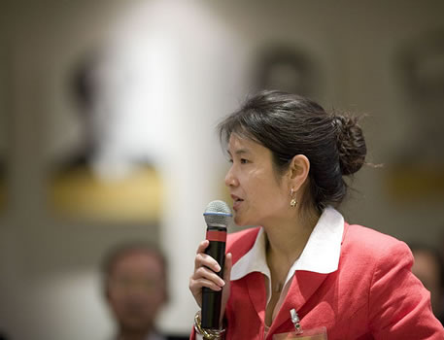
自我介绍!
名称
国家
家庭背景
教会
事奉目标
Name
Country
Programme
Family
Church
Ministry Goal
$20 each for Notes

Slide 3
NTS Sign Up List
Name | HP | Email | Reading |  | Project & Language
 |  |  | A: IBS | B: ENT | 1: NTS | 2: TBB | 3: Teach | 4: Paper
X | X | X | X
X | X | X |  | X | X
X | X | X |  | X |  | X
X | X | X |  | X |  |  | X
X | X | X |  | X |  |  |  | X
Name | Email | Degree | Project

Slide 4


Our People
苏珊教导教会的妇女
Notes:
I also lead the woman's Precept Bible study at our church

Slide 5
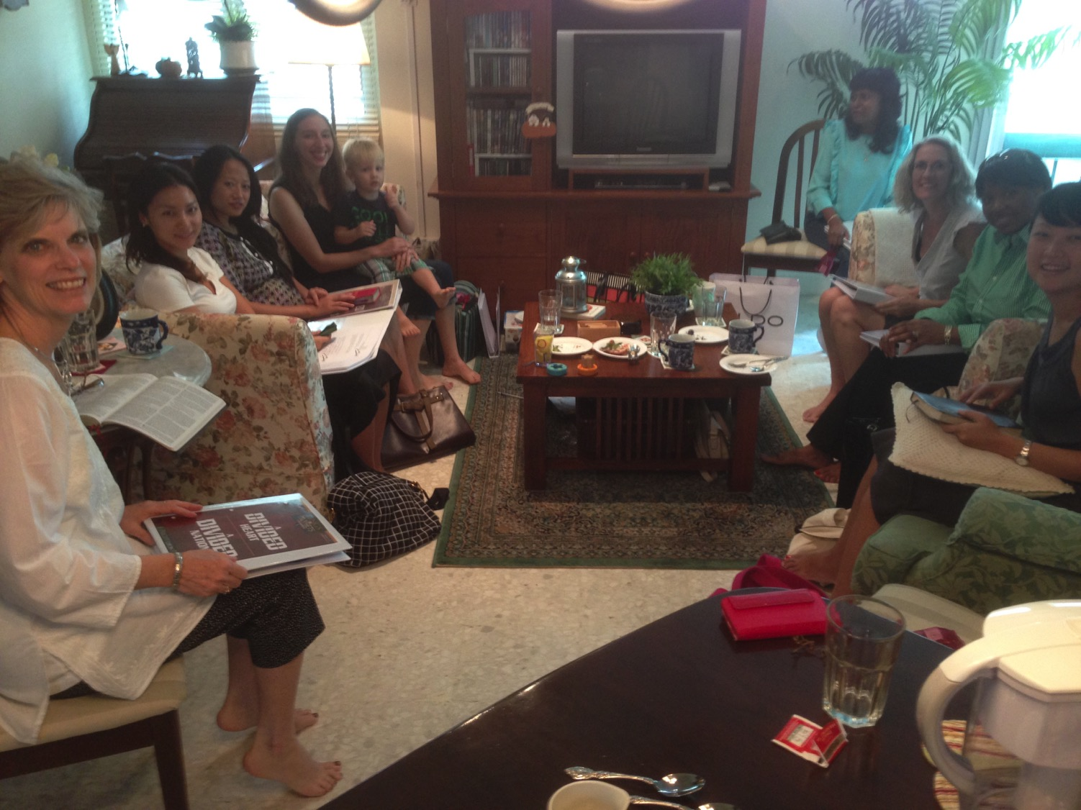
妇女查经班在研读列王记上下
美国•印度•新加坡•新西兰•津巴布韦•荷兰

Slide 6
妇女查经班在研读列王记上下
美国•印度•新加坡•新西兰•津巴布韦•荷兰

Slide 7

泰国•蒙古•缅甸•印度尼西亚
Notes:
INTERVIEWER: And Susan, what ministries has the Lord granted you?
SUSAN: I have been teaching the wives of leaders at SBC. These 5 women come from 5 different nations!
SUSAN: I also lead the woman's Bible study at our church

Slide 8
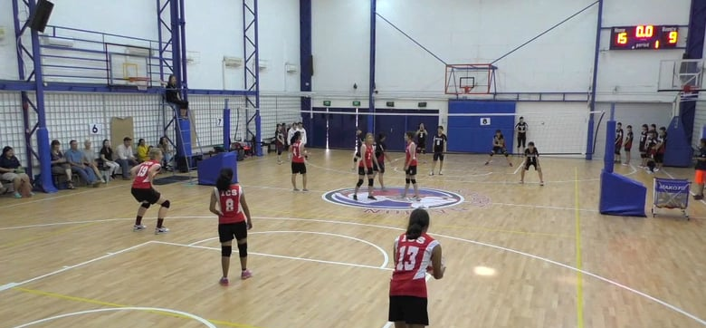
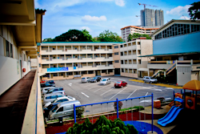
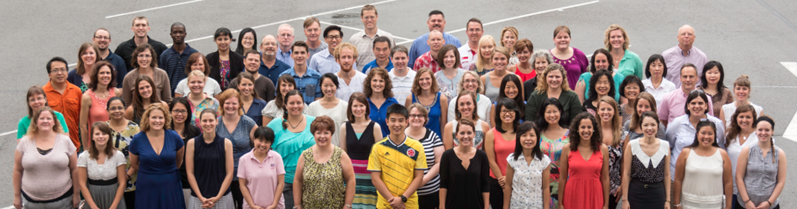
国际社区学校
(International Community School) 创立于1993年

Slide 9




ICS 现在有480个学生!
瑞典
英国
韩国
瑞士
日本
意大利
美国
泰国
印度
墨西哥
ICS
委内瑞拉
印尼
巴西
南非
澳大利亚
Notes:
With nearly 500 students

Slide 10
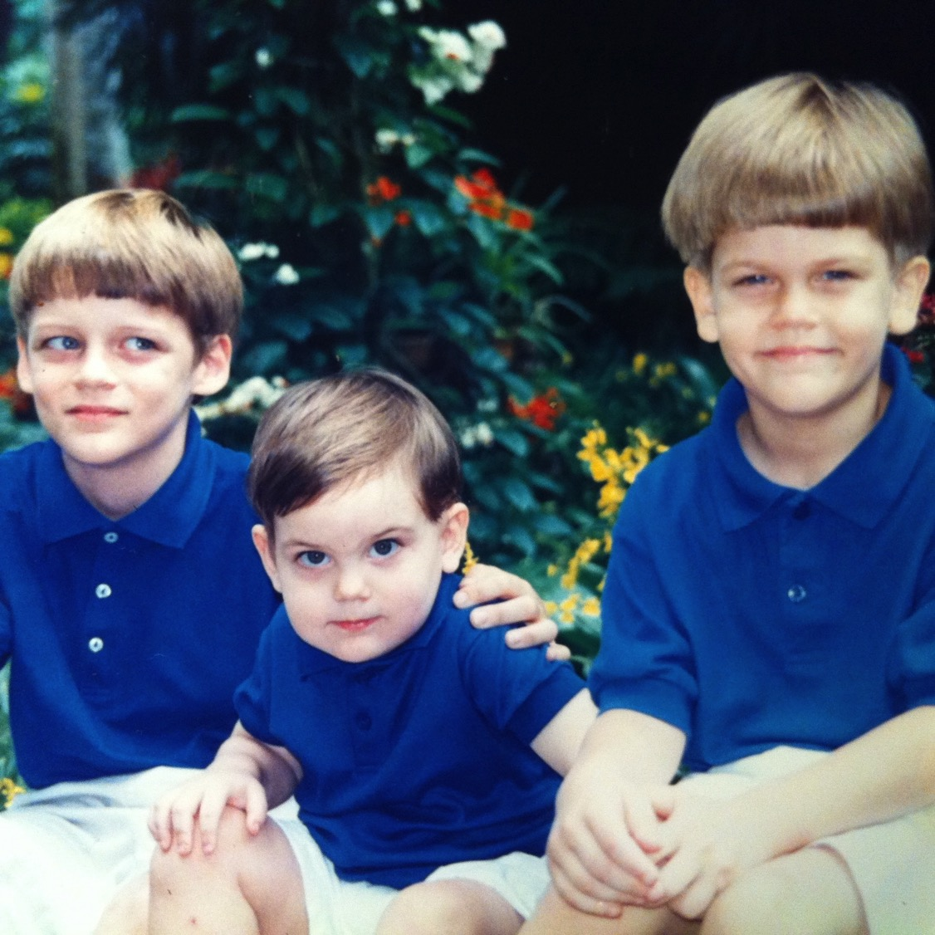
我们的3个儿子

Slide 11

我们的3个儿子

Slide 12
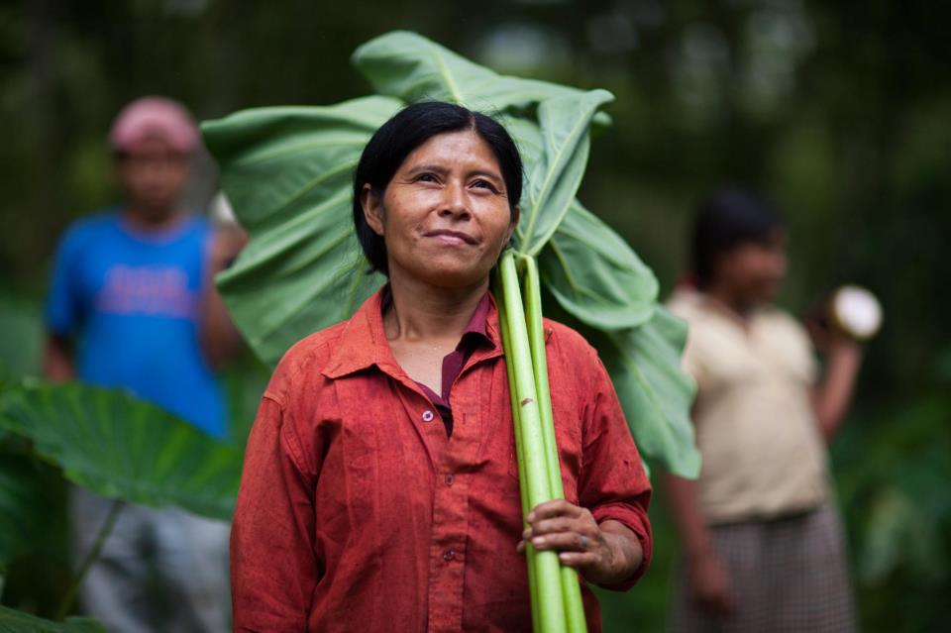

克尔是一位 信息技术人员
9g

Slide 13

Kurt works in IT
9g

Slide 14

The Griffiths
31 May 2019
2019
力克和苏珊
约翰
(26)
克尔和 卡拉
(31)
史帝文
和卡蒂 杰西(29)

Slide 15
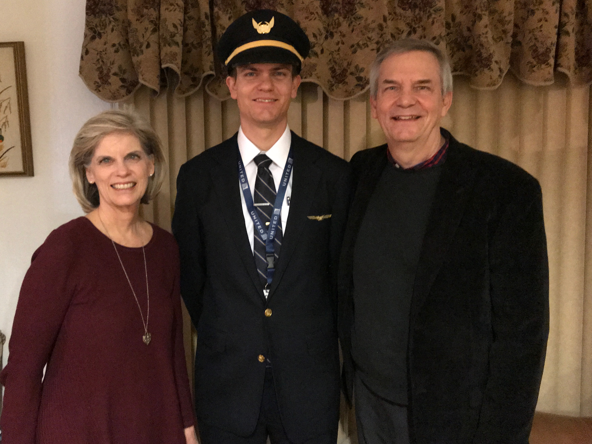
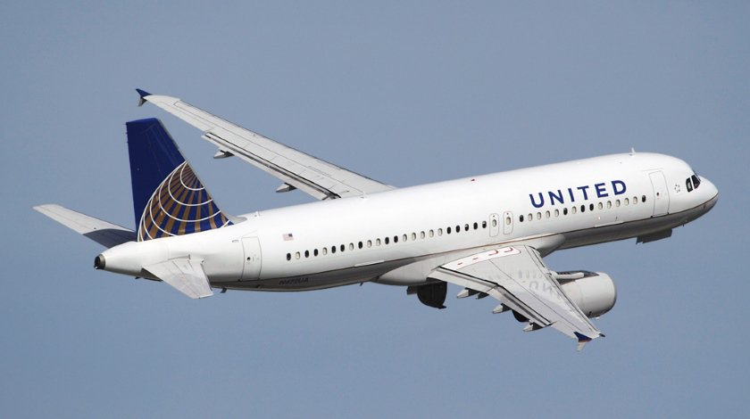
史帝文是一位
United航空公司
机师
6
Notes:
Stephen and his wife Katie in Boise

Slide 16
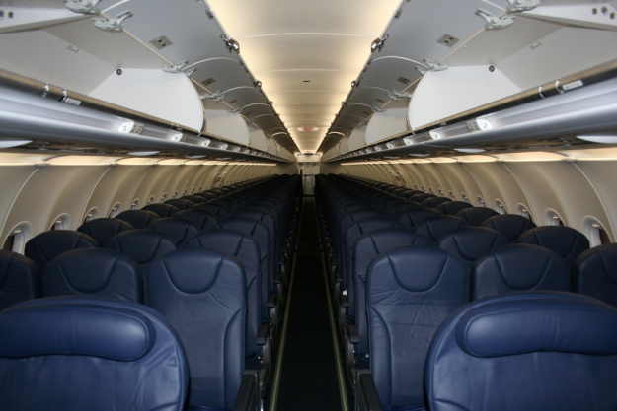
史帝文驾机搭载 170+ 旅客
8

Slide 17
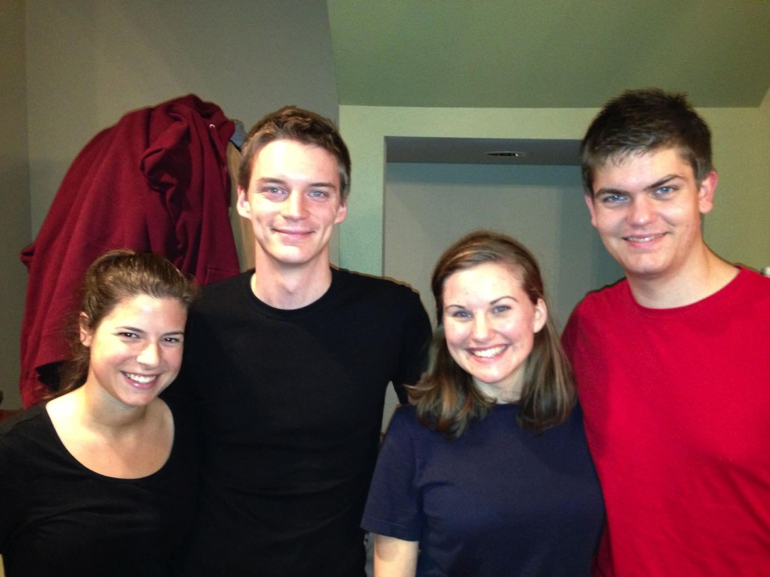
克尔和卡拉 史帝文和卡蒂
8

Slide 18


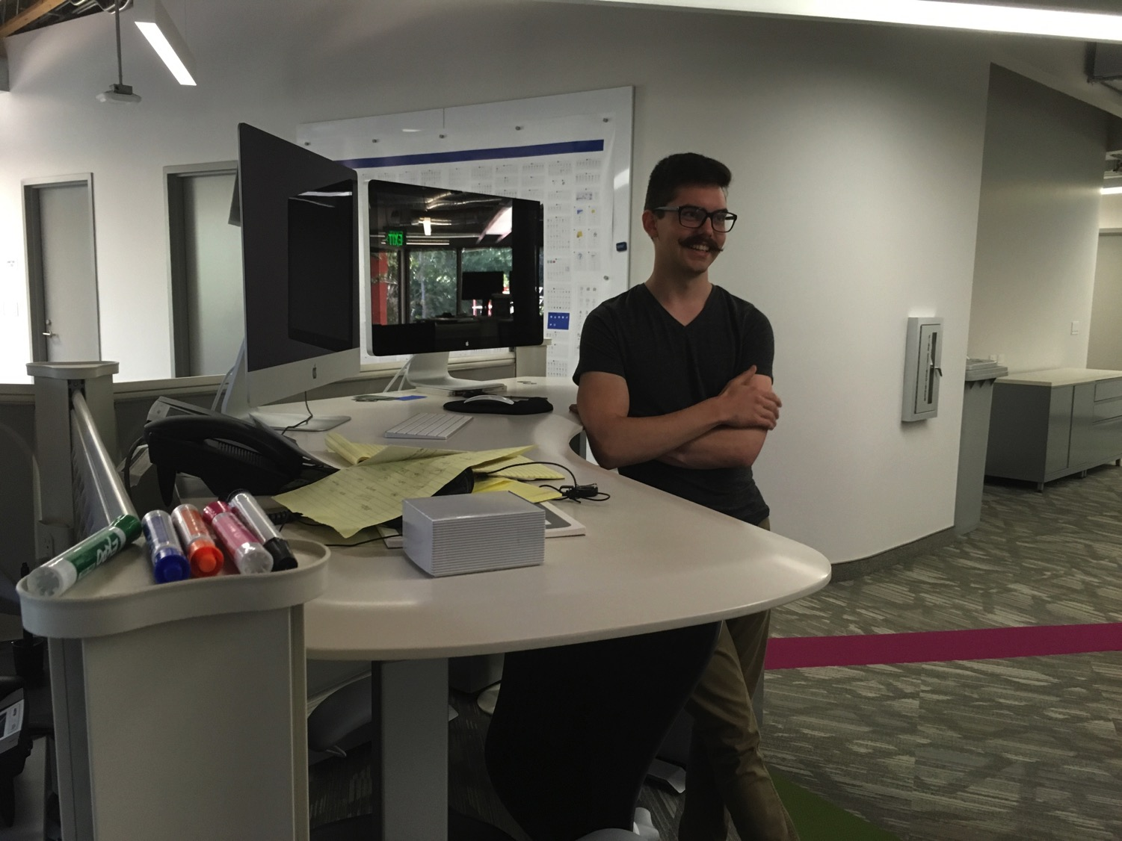
我们的小儿子，约翰(23)是 加利福尼亚的一个图形艺术家
8
Notes:
John just graduated from Biola and works for ESRI

Slide 19
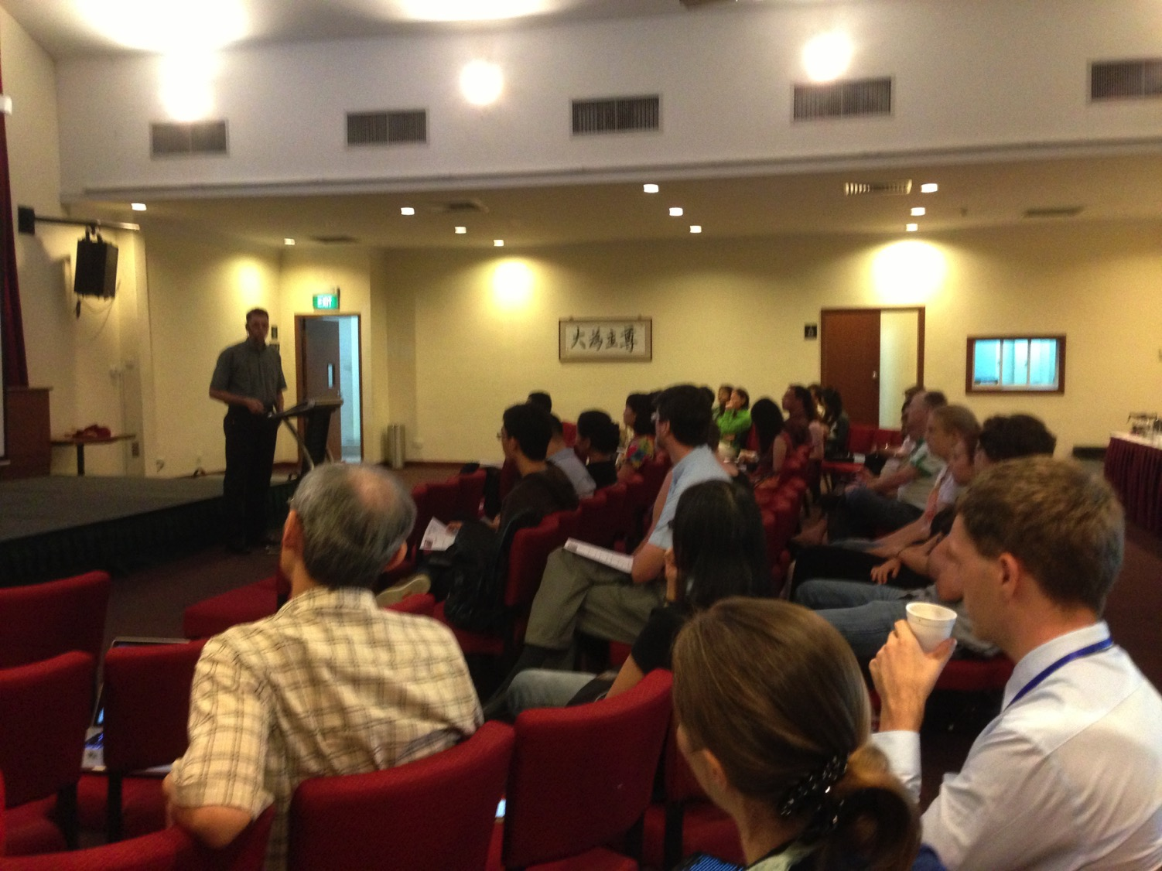
Our People
9
70 people from 12 nations
January 2020

Slide 20
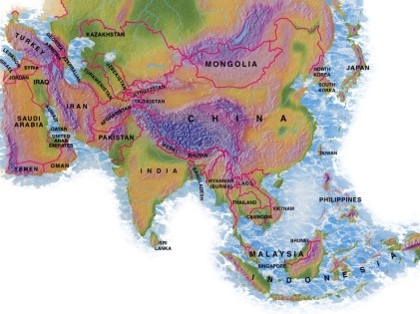

Crossroads教会会友2015年7月
意大利
法国
日本
荷兰
香港
韩国
黎巴嫩
台湾
中国
缅甸
印度
美国
菲律宾
津巴布韦
马来西亚
新加坡
CIC
新西兰
印尼
Notes:
我们2015年3月的源自世界上12个不同的国家。

Slide 21
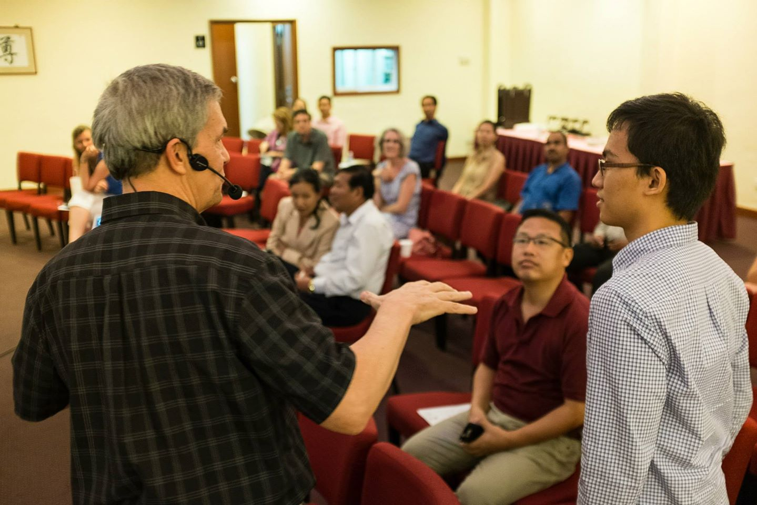
Our People
2015:来自13个国家的50名会友
Notes:
We also helped start Crossroads International Church in 2006 where I serve as the pastor-teacher.

Slide 22
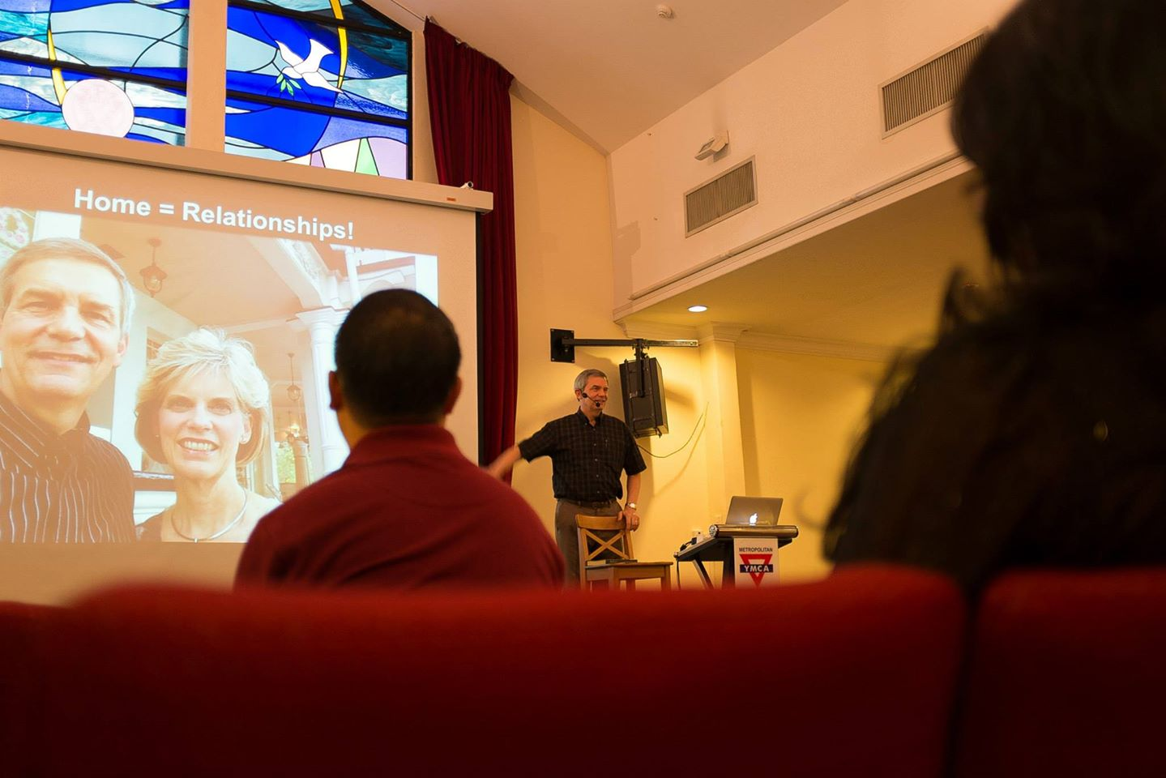
Our People
用经文讲道
Notes:
RICK: Yes, we helped start Crossroads International Church in 2006 and I serve as the pastor-teacher.

Slide 23
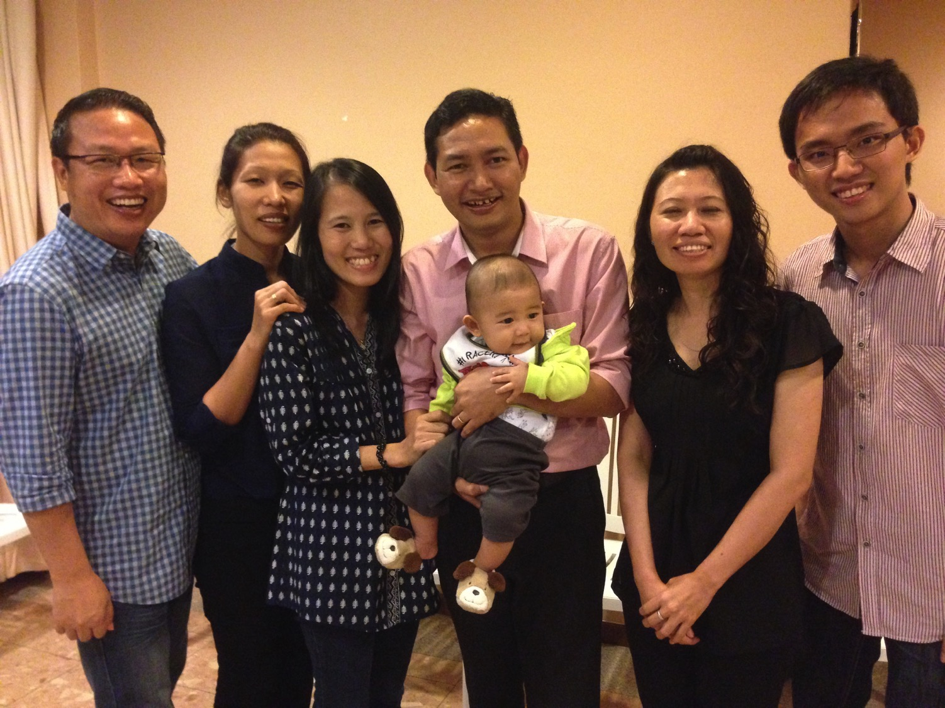
Our People
新加坡神学院学生在教会事奉
Notes:
One special joy is mentoring my students who serve with us at church and led ministries to youth, children, home groups, and the worship team.

Slide 24
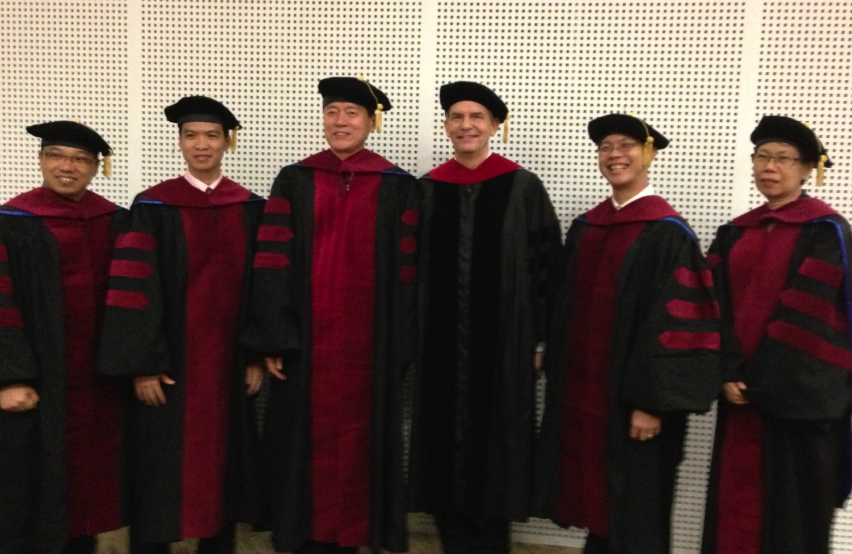
我负责指导新神博士研究生（DMin）
Notes:
I'm also the director of the doctoral program at SBC that trains about 80 seminary professors and pastors throughout Asia in English and Chinese. Generallly each year about 5 of them received their Doctor of Ministry degree.

Slide 25

Leading Change & Conflict Resolution
(Dr. Alan McMahan Oct 2016)

Slide 26
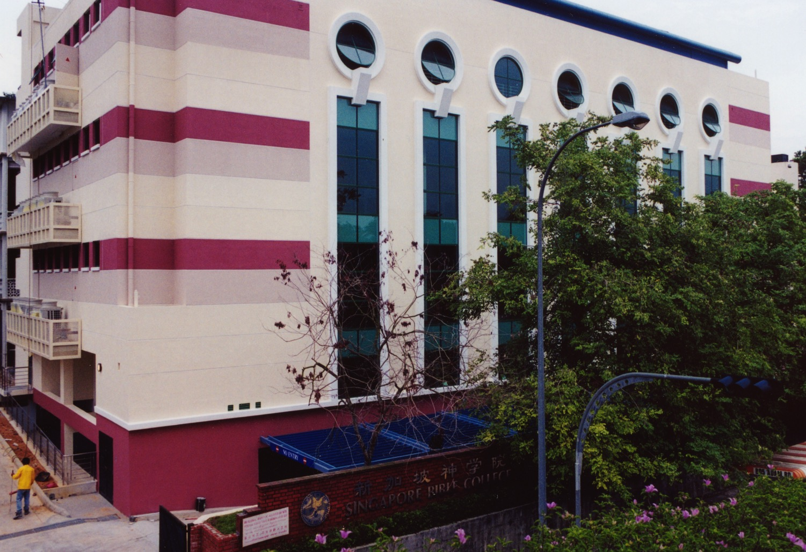
新加坡神学院
Notes:
I've served as a seminary professor with 30 other faculty at Singapore's largest training school: Singapore Bible College

Slide 27

Our Singapore Bible College Apt.
9
Notes:
Our Wednesday pattern to set up the table for our Pastoral Care Group that comes up to our apartment on campus.

Slide 28
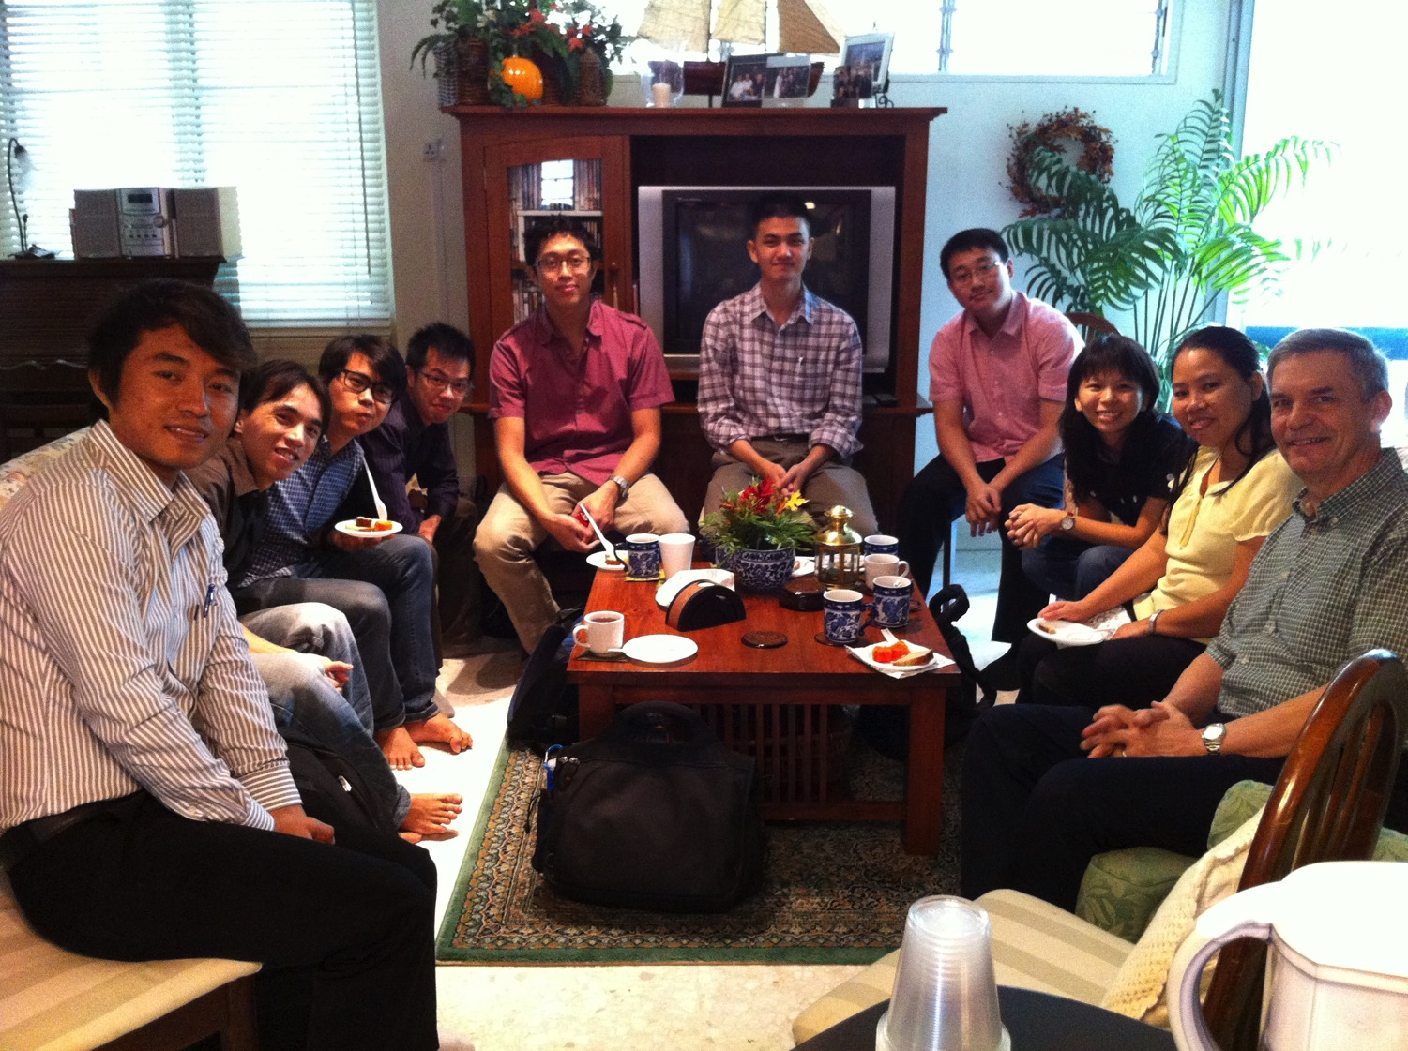
SBC Pastoral Care Group
9
Notes:
Our Pastoral Care Group has 9 students from Myanmar, Vietnam, Singapore, and Hong Kong.

Slide 29
新神 课程 网上教学
(英文 • 印尼文 • 中文)
基础 旧约 新约
背景 旧约的世界 新约的世界
神学 教会 灵命 未来
讲道 讲道研习（上） 讲道研习(下）
Notes:
I get to teach these leaders every book of the Bible in survey courses, plus backgrounds to both the OT and NT, three areas of theology, and how to preach.

Slide 30


宣教机构…

Slide 31
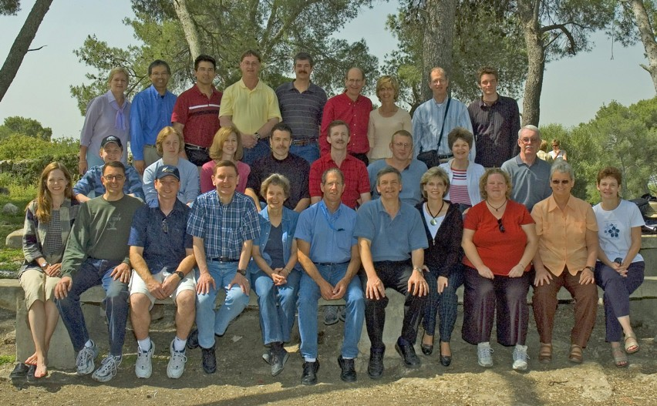
WorldVenture Seminary Professors in Israel

Slide 32

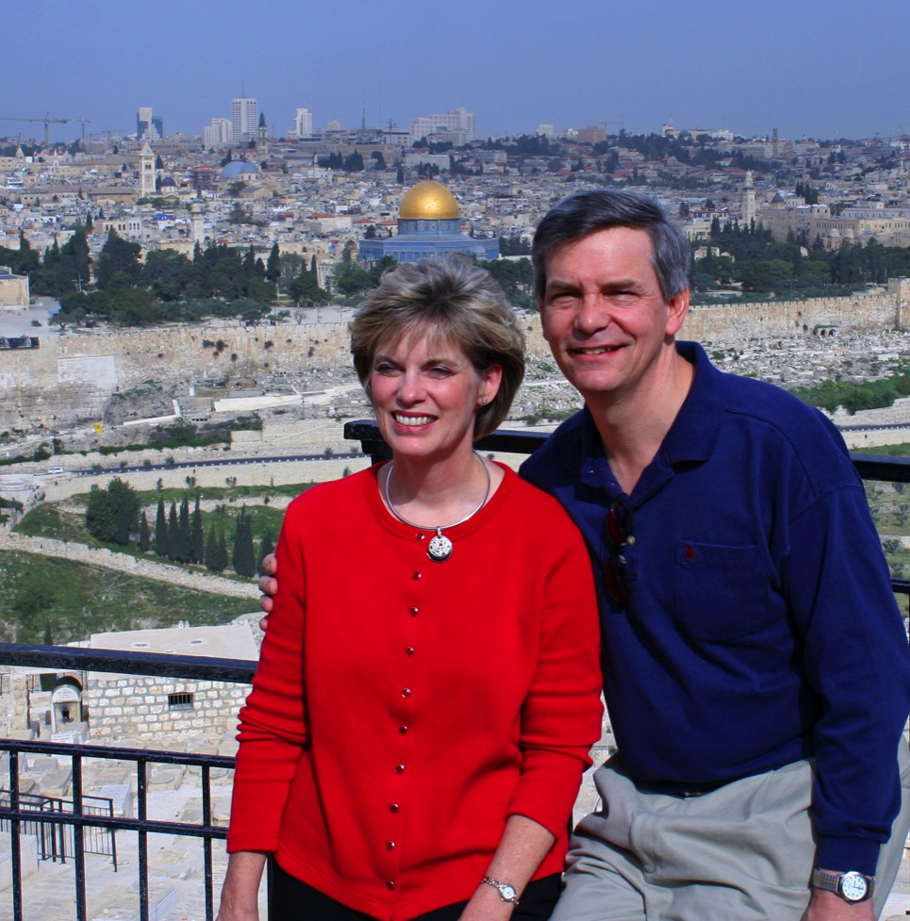
Susan & Rick at Mount of Olives
Kurt in
Hezekiah's Tunnel

Slide 33

Dead Sea Mud

Slide 34
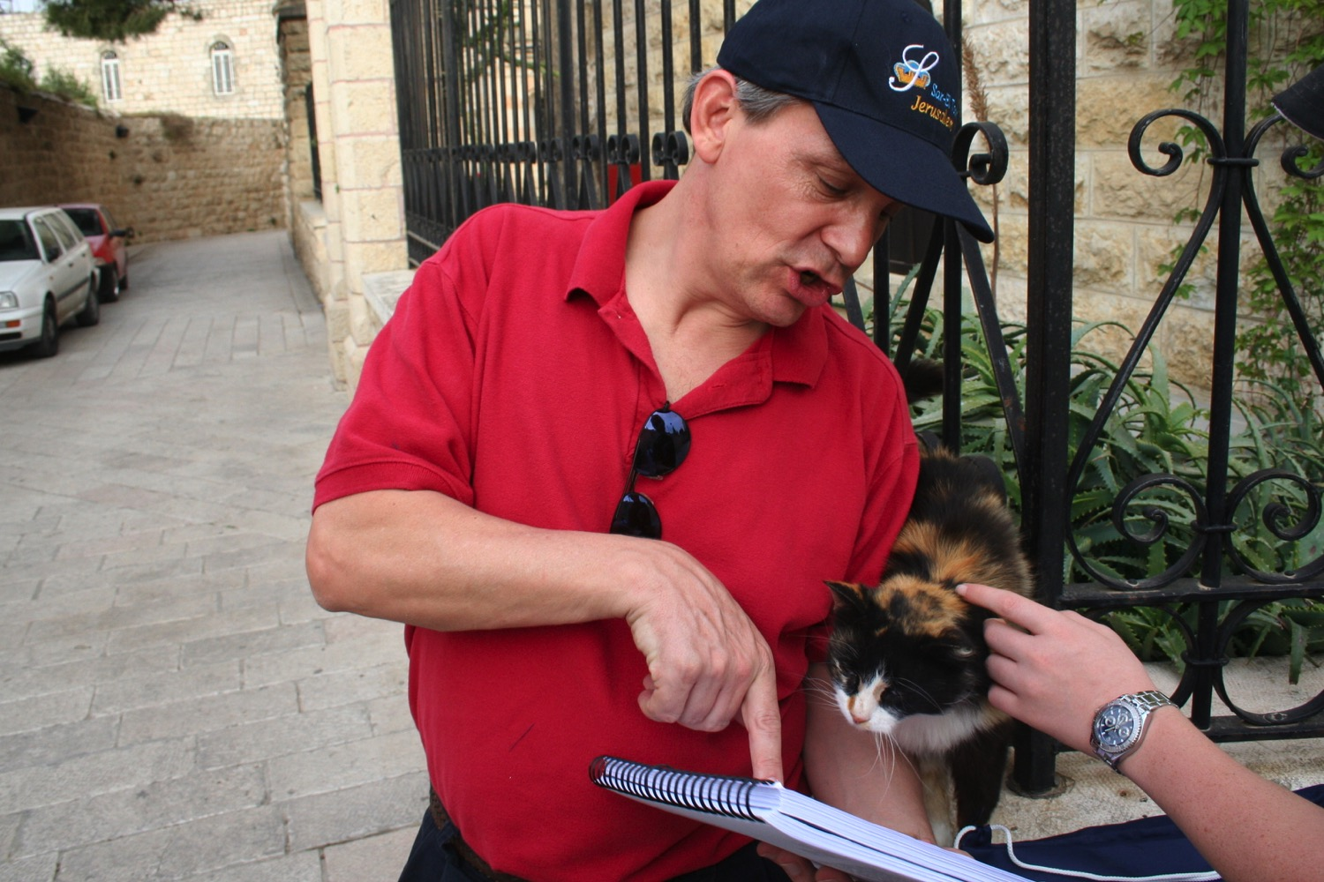
"Preach to every creature" (Mark 16:15)

Slide 35
上帝给我们的事工
世界探索事工 新加坡工场领袖
新加坡神学院 圣经和讲道教授
新加坡神学院 事工博士学位负责人
兼职教授 在12个国家任教

Slide 36

分配文件系统

Slide 37

TBB

Slide 38

TBB Vision

Slide 39

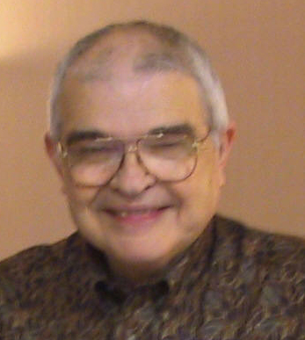
Dr John Fryman
Dr. John Fryman
Author of The Bible…Basically 10-Hour Seminar
Fort Worth, Texas
www.biblebasically.org
©2004 TBBMI
8.0.01.
04

Slide 40

English

Slide 41

Burmese
Lai S
iangtho…Abulpi
A Presentation of The Bible…Basically Ministries International Inc. Fort Worth, Texas
www.biblebasically.com
©2004 TBBMI
8.0.01.
04

Slide 42


French
LA BIBLE…
EN BASE
Une Présentation du Ministère Internationale de La Bible… En Base Inc. Fort Worth, Texas
www.biblebasically.com
©2006 TBBMI
8.0.01.
04
©2004 TBBMI
9.6.01.

Slide 43

Japanese
バイブル ベイシックミニストリーズ
インスティチュート
A Presentation of The Bible…Basically Ministries International Inc. Fort Worth, Texas
www.biblebasically.com
©2004 TBBMI
8.0.01.
04
Notes:
Japanese title slide

Slide 44

Khmer (Cambodian)
mUldæanRKwH>>>
énRBHKm<IIr
karbgðaj[sÁal;nUvRBHKm<Ir>>> EdlCamUldæanRKw³ kñúg B½n§kic©shKmnGnþrCati GayGinsIu.
Fort Worth, Texas
www.biblebasically.com
©2004 TBBMI
8.0.01.
04

Slide 45

Korean
성경은 …
기본적으로
A Presentation of The Bible…Basically Ministries International Inc. Fort Worth, Texas
www.biblebasically.com
7.5.01.
©2003 TBBMI
04

Slide 46

Malay
Alkitab…
Dasar
Presentasi dari The Bible…Basically Ministries International Inc. Fort Worth, Texas
www.biblebasically.com
©2004 TBBMI
8.0.01.
04

Slide 47

Mao (India)
Bible…
Amolo Leino
Bible…Ngashankakhuina Ministries International Inc. pashina semkashok Fort Worth, Texas
www.biblebasically.com
©2004 TBBMI
8.0.01.
04

Slide 48

Malayalam (India)
Æß èÌÌßZ
çÌØßAÜß
¥ÕÄøßMßAáKÄí Æß èÌÌßZ çÌØßAÜß… ÎßÈßØíd¿àØí §aVÈÞ×ÃW çËÞVGíÕVJí, æ¿µíØÞØí
©2004 TBBMI
8.0.01.
04

Slide 49

Mongolian
Библи…
Үндсэндээ
A Presentation of The Bible…Basically Ministries International Inc. Fort Worth, Texas
www.biblebasically.com
©2004 TBBMI
8.0.01.
04

Slide 50

Nepali
afOan======
cfwf/e[\t
A Presentation of The Bible…Basically Ministries International Inc. Fort Worth, Texas
www.biblebasically.com
8.0.01.
©2004 TBBMI
04

Slide 51

Swahili (Kenya)
biblia kwa ujumla
A Presentation of The Bible…Basically Ministries International Inc. Fort Worth, Texas
www.biblebasically.com
8.0.01.
©2003 TBBMI
04

Slide 52

Tagalog (Philippines)
Ang Biblia . . . Pinasimple
A Presentation of The Bible…Basically Ministries International Inc. Fort Worth, Texas
www.biblebasically.com
©2004 TBBMI
8.0.01.
04
Notes:
PLEASE PUT THE TITLE AND SUBTITLES INTO YOUR NATIONAL LANGUAGE AND LEAVE THE WEBSITE UNCHANGED

Slide 53

Tangkhul (India)
Bible…
Ngashankakhui
Bible…Ngashankakhuina Ministries International Inc. pashina semkashok Fort Worth, Texas
www.biblebasically.com
©2004 TBBMI
8.0.01.
04

Slide 54

Tamil (Sri Lanka/India)
jpUkiwapd;…
mbg;gil
A Presentation of The Bible…Basically Ministries International Inc. Fort Worth, Texas
www.biblebasically.com
©2004 TBBMI
8.0.01.
04

Slide 55

Vietnamese
Kinh thánh…
Cơ bản là
A Presentation of The Bible…Basically Ministries International Inc. Fort Worth, Texas
www.biblebasically.com
©2004 TBBMI
8.0.01.
04

Slide 56


Bahasa Indonesia
Presentasi dari The Bible…Basically Ministries International Inc. Fort Worth, Texas
www.biblebasically.com
7.5.01.
©2003 TBBMI
04

Slide 57
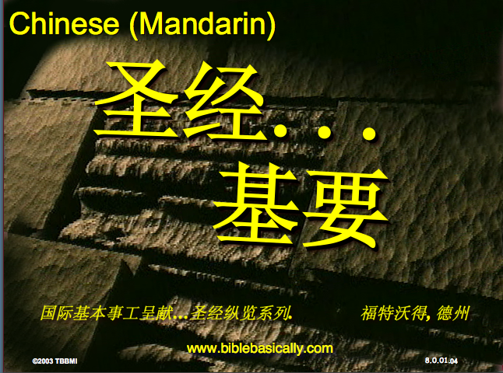
Chinese (Mandarin)
圣经...
基要
国际基本事工呈献…圣经纵览系列. 福特沃得, 德州
www.biblebasically.com
8.0.01.
©2003 TBBMI
04

Slide 58
PowerPoint (945幻灯片)
学生作业簿（100页)
教师课文（400页）
TBB 教材
已被翻译成
英文•中文•印地文•印度尼西亚文•韩文•马来文•蒙古文•俄文•西班牙文
A Presentation of The Bible…Basically Ministries International Inc. Fort Worth, Texas
www.biblebasically.com
©2004 TBBMI
8.0.01.
04

Slide 59
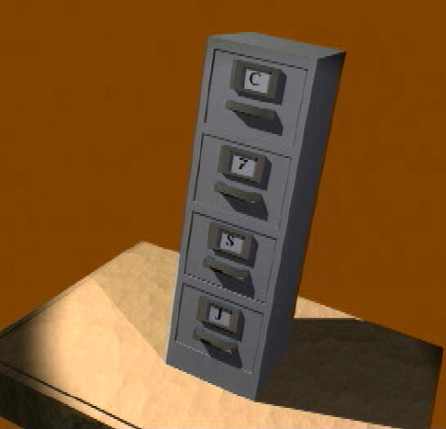
7
造
您的圣经
档案
默
主
学生手册第8-14页
37

Slide 60
7
1
2
3
造
4
5
6
7
8
默
9
10
主
学生手册第8-14页
39

Slide 61
打开
“您的圣经档案”
7
造 默主
造 默主
造 默主
造 默主
7
7
学生手册第8-14页
4
40

Slide 62
打开
“您的圣经档案”
7
7
= 4+3
学生手册第8-14页
2
41

Slide 63
7
打开
“您的圣经档案”
造 4 3 默 主
造 4 3 默 主
学生手册第8-14页
1
42

Slide 64
五个关键字和词组:
7
造 = 创造
4 = 人物
3
= 时期
默 = 静默
主
= 主耶稣
学生手册第8-14页
5
43

Slide 65
五个关键字和词组:
7
造 = 创造
4 = 人物
3
= 时期
默 = 静默
主
= 主耶稣
学生手册第8-14页
6
44

Slide 66
五个关键字和词组:
7
造 = 创造
4 = 人物
3
= 时期
默 = 静默
主
= 主耶稣
学生手册第8-14页
45

Slide 67
4 个人 物 就 是:
7
亚伯拉罕
约瑟
摩西
约书亚
学生手册第8-14页
5
46

Slide 68
7
亚 伯拉罕
的约
摩 西
的 书 !
学生手册第8-14页
47

Slide 69
4 个人 物 就 是:
7
约瑟
亚伯拉罕
亚伯拉罕
摩西
的约
约书亚
摩西
的书
学生手册第8-14页
8
48

Slide 70
7
创造
亚伯拉罕
约瑟
摩西
约书亚
学生手册第8-14页
5
49

Slide 71
五个关键字和词组:
7
造 = 创造
4 = 人物
3
= 时期
默 = 静默
主
= 主耶稣
学生手册第8-14页
50

Slide 72
7
无 王 掳
学生手册第8-14页
2
51

Slide 73
3 个时期就是:
7
无 王
王 朝
被 掳
学生手册第8-14页
6
52

Slide 74
OT Review
7
天地被创造
亚伯拉罕
约瑟夫
摩西
约书亚
无政府状态的国民
被君王统治的国民
被俘虏的国民
Handbook pg. 8-14
55
Notes:
Now we add the 3 SOCIETIES group to the others, and we have:
CREATION
ABRAHAM
JOSEPH
MOSES
JOSHUA
ANARCHY
ROYALTY
CAPTIVITY

Slide 75
To Review…
7
让我们来重复..
C 7 S J
C 4 3 S J
Handbook pg. 8-14
3
56
Notes:
To review the entire sequence so far…
Beginning with the single number
//// 7....
leading to…
//// C 7 S J...
which becomes...
//// C 4 3 S J.
These numbers and letters are then used to develop a mental list of TEN WORDS that will form a dependable mental outline of the entirety of Scripture.

Slide 76
5关键词或短语：
7
C=天地被创造
4 = 人物
3 = 群体
S = 沉默
J = 耶稣
Handbook pg. 8-14
5
45
Notes:
Now, based on C 4 3 S J, we enlarge that idea into five key words or phrases. They will become the foundation of your mental Bible File. Here they are…say them aloud…
//// C = CREATION
//// 4 = 4 PEOPLE
//// 3 = 3 SOCIETIES
//// S = SILENCE
//// J = JESUS.
And that's an organizational plan for the entire Bible! Those five words and phrases create an abbreviated outline map of the entire Bible's basic design.

Slide 77
OT Review
天地被创造
亚伯拉罕
约瑟夫
摩西
约书亚
无政府状态的国民
被君王统治的国民
被俘虏的国民
沉默
耶稣
7
Handbook pg. 8-14
55
Notes:
Now we add the 3 SOCIETIES group to the others, and we have:
CREATION
ABRAHAM
JOSEPH
MOSES
JOSHUA
ANARCHY
ROYALTY
CAPTIVITY

Slide 78
你要牢记的圣经文件
CREATION
CREATION
ABRAHAM
ABRAHAM
ABRAHAM
ABRAHAM
JOSEPH
ABRAHAM
MOSES
JOSEPH
JOSHUA
ANARCHY
MOSES
ROYALTY
CAPTIVITY
JOSHUA
SILENCE
JESUS
ANARCHY
ROYALTY
CAPTIVITY
SILENCE
JESUS
Handbook pg. 8-14
59
11
Notes:
Now it's time mentally to apply those ten words as labels to ten mental folders in your new Bible File –
//// right up there in your head. That mental picture might look something like this. And there they are...
//// CREATION//// ABRAHAM//// JOSEPH//// MOSES//// JOSHUA//// ANARCHY//// ROYALTY//// CAPTIVITY//// SILENCE…and…//// JESUS.
Now it's organized in a neat and orderly package in your mind --- ready for recall and use as you need it. Now just a few more
examples to drive home the point...

Slide 79
Membuka
“Arsip Alkitab Anda”
7
7
7
7
7
7
C S Y
C S Y
C S Y
C S Y
Buku Panduan hlm. 8-14
40
4

Slide 80
Membuka
“Arsip Alkitab Anda”
7
7
= 4+3
Buku Panduan hlm. 8-14
41
2

Slide 81
Membuka
“Arsip Alkitab Anda”
7
C 4 3 S Y
C 4 3 S Y
Buku Panduan hlm. 8-14
42
1

Slide 82
5 Kata Kunci atau Ungkapan:
7
C = CIPTAAN
4 = TOKOH
3 = KOMUNITAS
S = SENYAP
Y = YESUS
Buku Panduan hlm. 8-14
43
5

Slide 83
5 Kata Kunci atau Ungkapan:
7
C = CIPTAAN
4 = TOKOH
3 = KOMUNITAS
S = SENYAP
Y = YESUS
Buku Panduan hlm. 8-14
45

Slide 84
4 TOKOH tsb adalah:
7
A BRAHAM
Y USUF
M USA
Y OSUA
Buku Panduan hlm. 8-14
46
5

Slide 85
AYMY
7
ANUGERAH
YANG
MENAKJUBKAN
YA !
Buku Panduan hlm. 8-14
47

Slide 86
5 Kata Kunci atau Ungkapan:
7
C = CIPTAAN
4 = ORANG
3 = KOMUNITAS
S = SENYAP
Y = YESUS
Buku Panduan hlm. 8-14
50

Slide 87

KAKAP
7
K
A
K
A
P
Buku Panduan hlm. 8-14
53
2
Notes:
Alat pengingat yang lainnya adalah …
//// Ini ikan apa?
//// Benar, ikan “KAKAP”
//// Kita lihat disini ada 2 huruf K, kita mau buang 1 huruf K-nya
//// Huruf A juga ada 2, kita buang lagi huruf A yang double
//// Sekarang yang tersisa adalah A-K-P
//// Ikan KAKAP-nya tidak dibutuhkan lagi, kita kembali ke laut saja..
Sisa tiga huruf ini A-K-P, huruf-huruf ini akan membantu anda mengingatkan huruf pertama pada tiga 3 MACAM KOMUNITAS.

Slide 88
KE 3 KOMUNITAS ADALAH:
7
A NARKI
K ERAJAAN
P EMBUANGAN
Buku Panduan hlm. 8-14
52
6

Slide 89

Singapore Bible College Students
USA
MONGOLIA
JAPAN
KOREA
CHINA
HONG KONG
MYANMAR
INDIA
THAILAND
VIETNAM
PHILIPPINES
MALAYSIA
SINGAPORE
SBC
INDONESIA
Notes:
These faithful leaders are from about 25 countries who come to us in Singapore for masters and doctoral-level training. We train them to build into others back in their home countries.

Slide 90

"in the beginning"
Gen. 1:1
An Introduction to Genesis

Slide 91
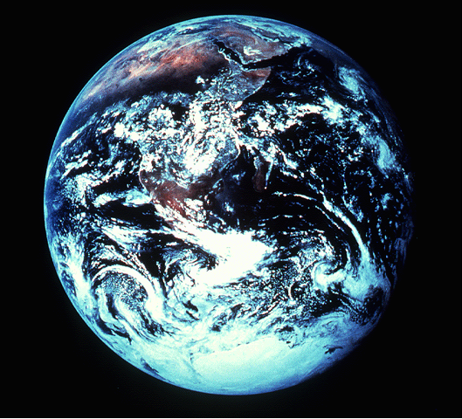
"pada mulanya"
Gen. 1:1
Pengenalan kitab Kejadian

Slide 92
"起初"
Gen. 1:1
创世记导论

Slide 93
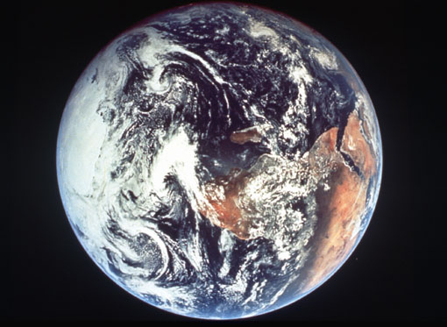
Days of Creation
33
Void
Formless
Forming
Filling
Day 4: Sun, moon & stars arranged
Day 1: Light
Day 2: Water & air separated
Day 5: Fish & fowl
Day 3: Land & sea separated
Day 6: Animals & man
Genesis 1:3-31

Slide 94
Days of Creation in Bahasa Indonesian
Hari-hari penciptaan
64
Kosong
Tidak berbentuk
Dibentuk
Diisi
Hari 4: Matahari, bulan & bintang diatur
Hari 1: Terang
Hari 2: Air &
udara dipisahkan
Hari 5: Ikan & unggas
Hari 3: Darat & laut dipisahkan
Hari 6: Binatang & manusia
Kejadian 1:3-31

Slide 95
六天的创造
空虚
64
充满
混沌
形成
第四天: 太阳，月亮与众星摆列在天
第一天: 光
第二天:
水与空气分开
第五天: 鱼与雀鸟
第三天:
旱地与海分开
第六天: 动物与人
创世记 1:3-31

Slide 96


圣经基本链接地址 BibleStudyDownloads.org
免费获得该讲解!
圣经学习下载
Notes:
The explanation for free!
The Bible…Basically link address

Slide 97
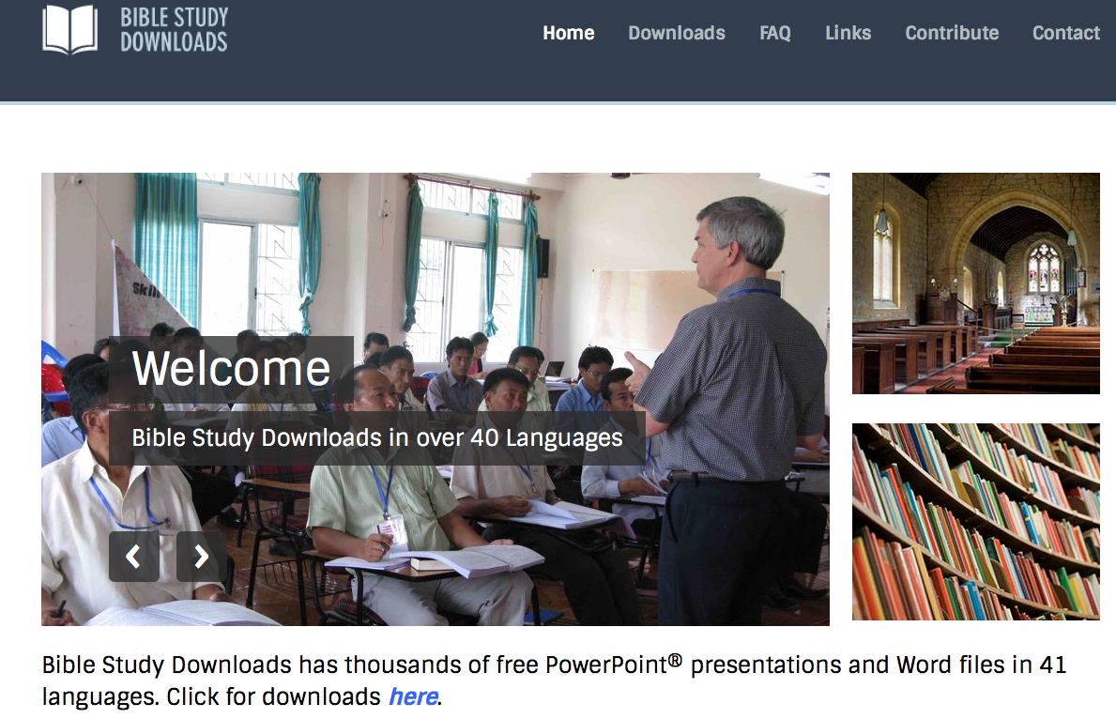
BibleStudyDownloads.org
7
Notes:
This has resulted in Bible teaching and study materials—mostly PowerPoint—in 42 languages! All a teacher needs to do is to click on a file and it downloads for free to teach any book of the Bible and many other subjects.

Slide 98
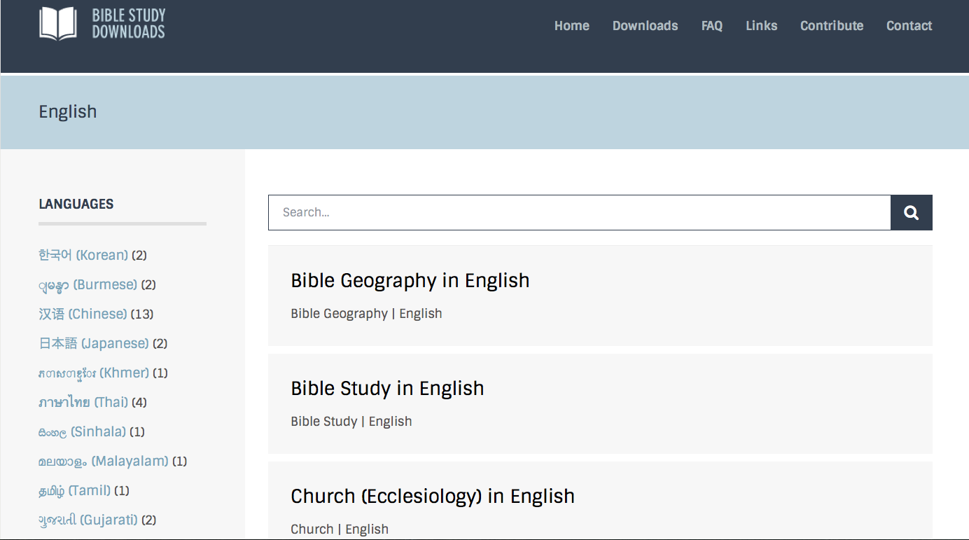
BibleStudyDownloads.org
7
Notes:
This has resulted in Bible teaching and study materials—mostly PowerPoint—in 42 languages! All a teacher needs to do is to click on a file and it downloads for free to teach any book of the Bible and many other subjects.

Slide 99
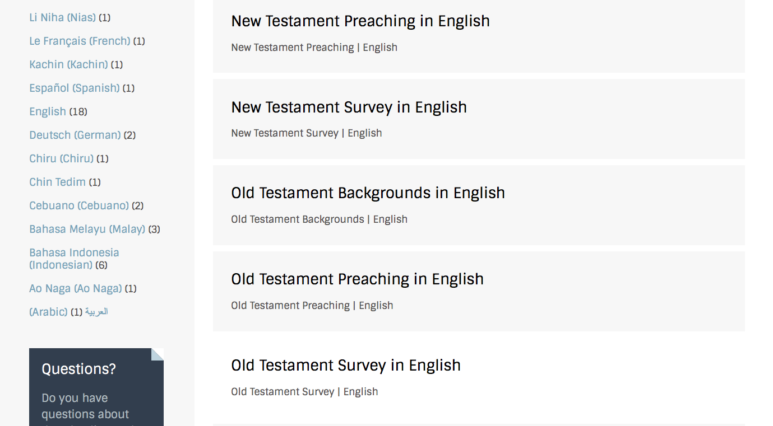
BibleStudyDownloads.org
7
Notes:
This has resulted in Bible teaching and study materials—mostly PowerPoint—in 42 languages! All a teacher needs to do is to click on a file and it downloads for free to teach any book of the Bible and many other subjects.

Slide 100
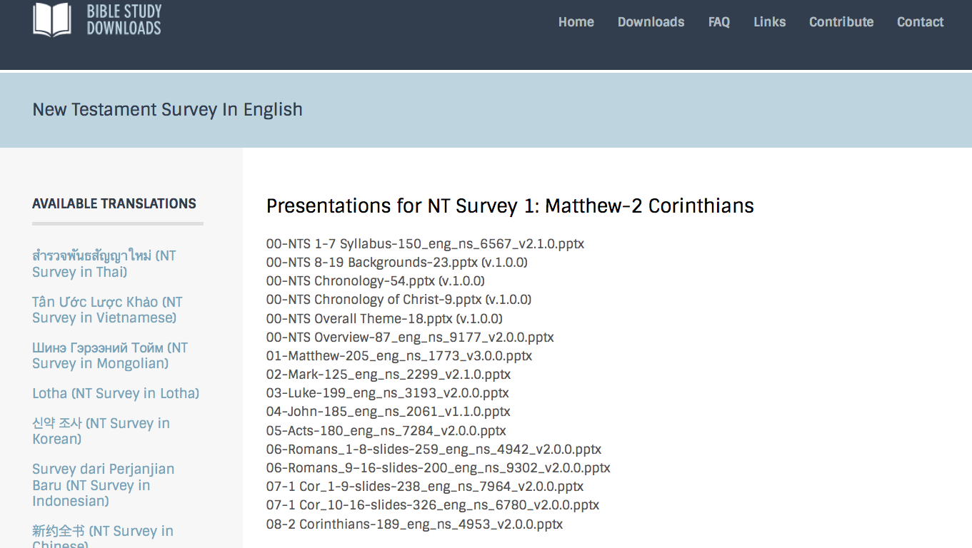
BibleStudyDownloads.org
7
Notes:
This has resulted in Bible teaching and study materials—mostly PowerPoint—in 42 languages! All a teacher needs to do is to click on a file and it downloads for free to teach any book of the Bible and many other subjects.

Slide 101
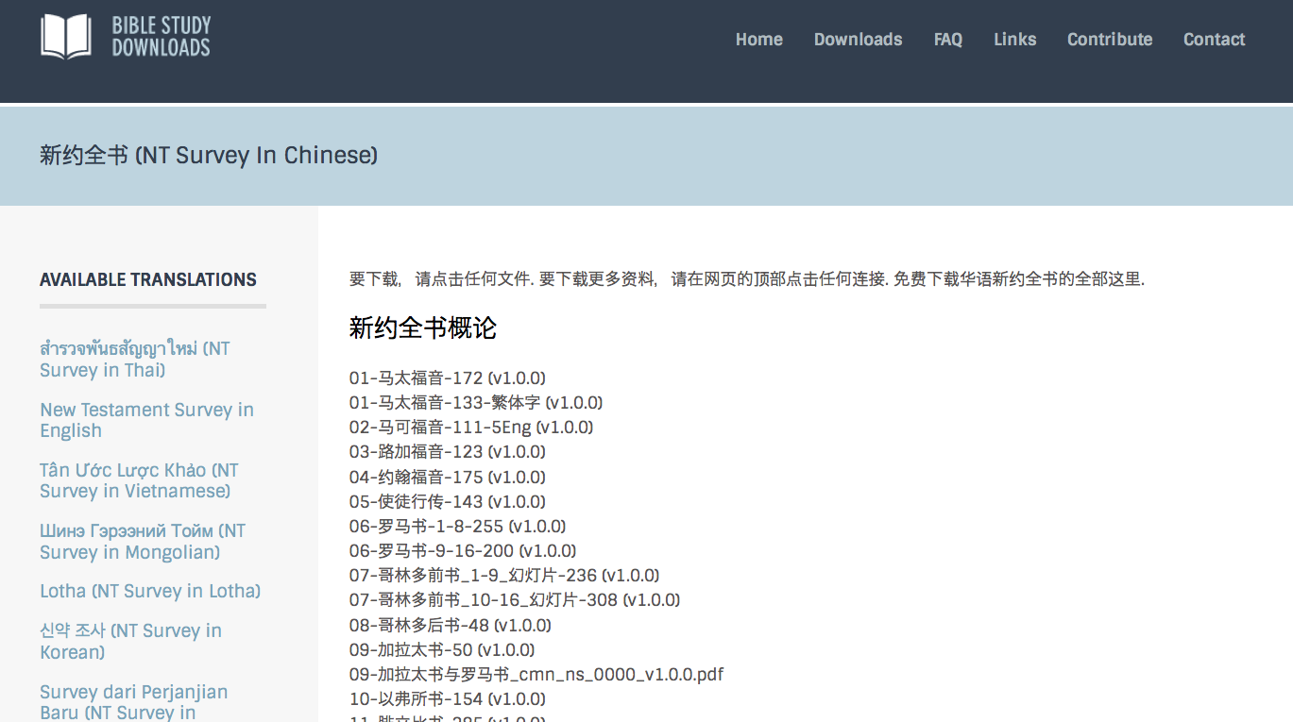
BibleStudyDownloads.org
7
Notes:
This has resulted in Bible teaching and study materials—mostly PowerPoint—in 42 languages! All a teacher needs to do is to click on a file and it downloads for free to teach any book of the Bible and many other subjects.

Slide 102
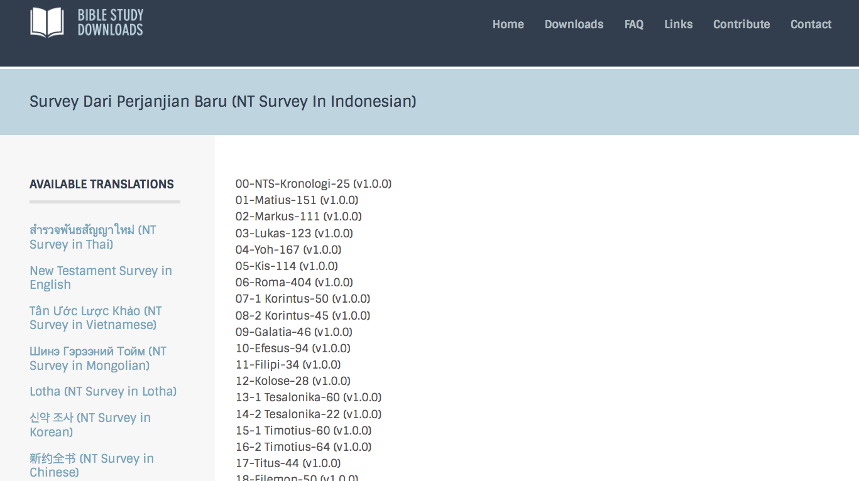
BibleStudyDownloads.org
7
Notes:
This has resulted in Bible teaching and study materials—mostly PowerPoint—in 42 languages! All a teacher needs to do is to click on a file and it downloads for free to teach any book of the Bible and many other subjects.

Slide 103
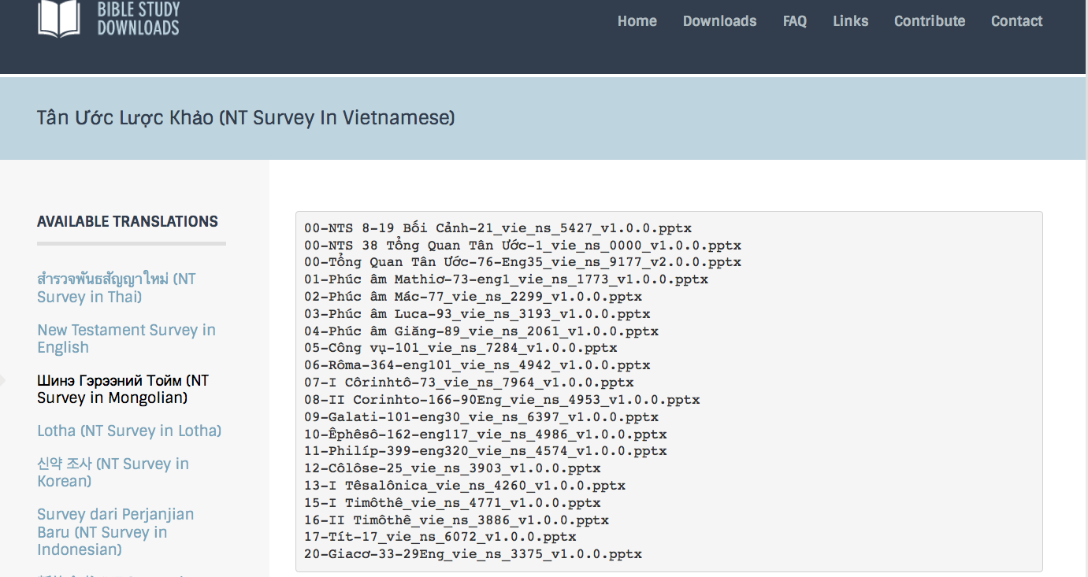
BibleStudyDownloads.org
7
Notes:
This has resulted in Bible teaching and study materials—mostly PowerPoint—in 42 languages! All a teacher needs to do is to click on a file and it downloads for free to teach any book of the Bible and many other subjects.

Slide 104
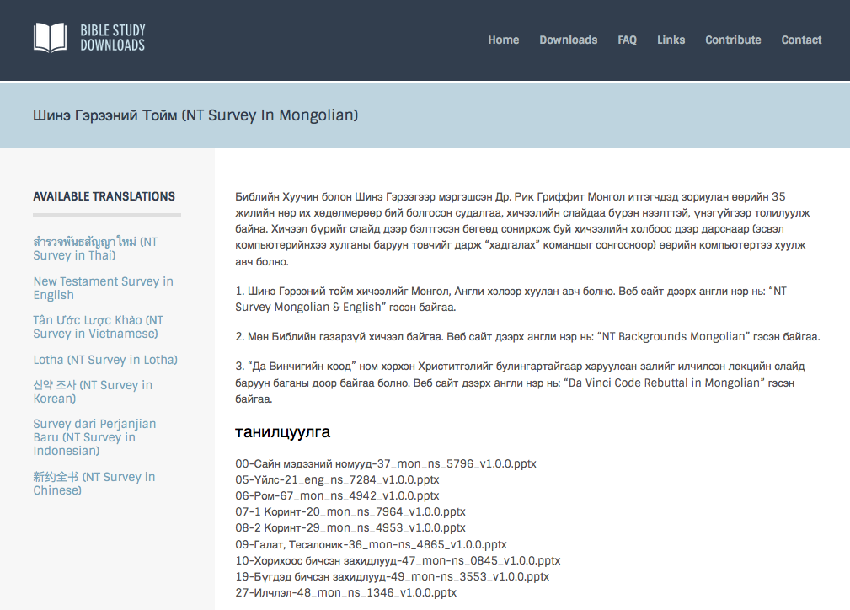
BibleStudyDownloads.org
7
Notes:
This has resulted in Bible teaching and study materials—mostly PowerPoint—in 42 languages! All a teacher needs to do is to click on a file and it downloads for free to teach any book of the Bible and many other subjects.

Slide 105
BibleStudyDownloads.org
7
Notes:
This has resulted in Bible teaching and study materials—mostly PowerPoint—in 42 languages! All a teacher needs to do is to click on a file and it downloads for free to teach any book of the Bible and many other subjects.

Slide 106
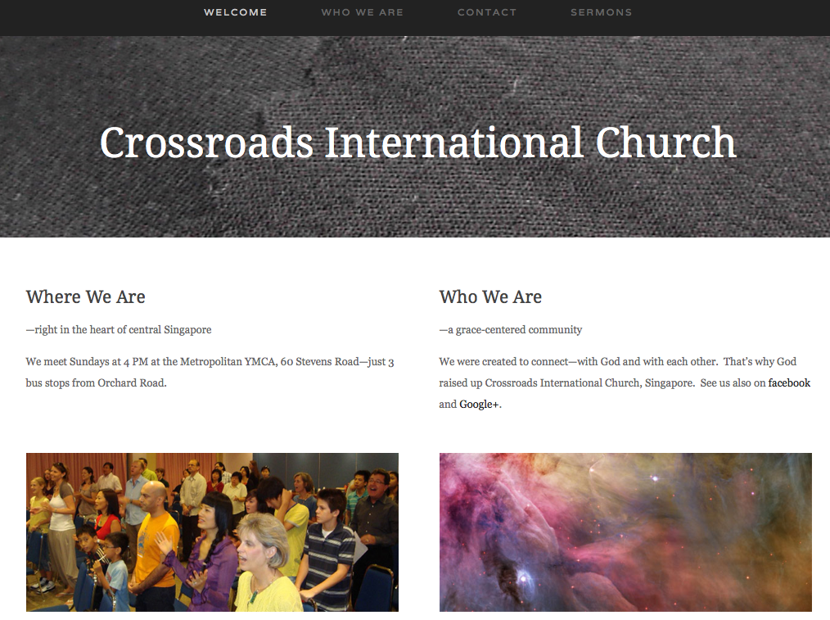
CICFamily.com

Slide 107
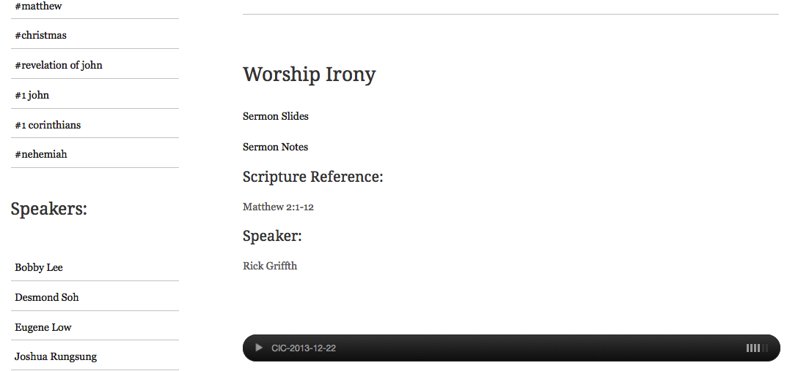
www.cicfamily.com
CICFamily.com

Slide 108
上帝给我们的事工
世界探索事工 新加坡工场领袖
新加坡神学院 圣经和讲道教授
新加坡神学院 事工博士学位负责人
兼职教授 在12个国家任教
圣经基础事工 翻译负责人
Biblestudydownloads.com圣经学习下载网站 网站负责人
十字路口国际教会 牧师-教师

Slide 109
教导事工 1997-2018
红色 = 我曾经在这些国家教授过这课程
蒙古
约旦
韩国
中国
尼泊尔
缅甸
印度
泰国
越南
马来西亚
斯里兰卡
新加坡
印度尼西亚
109
Notes:
From 1997-2018 God has seen fit to grant me the privilege to train pastors in 12 other countries on 65 trips. I have taught Homiletics in 8 of these countries.

Slide 110
Course Description
1
A survey of the message of each of the 27 New Testament books,
their relationships to each other,
introductory issues (author, date, occasion, uniqueness, etc.) and
factors in the first century church (e.g. chronology and history) that influenced the life and ministry of the early church as well as affect the mission of the church today

Slide 111
Course Objectives
1
By the end of this course the student will be able to…
A. State the author, date, origin, recipients, occasion, characteristics, relevance and argument of all 27 NT books.
B. Place each of the NT books in chronological order in conjunction with the Book of Acts, Roman history, and Jewish history.
C. Teach the basic content of the course in English and/or prepare for this in one's native language.
D. Know from experience the value of Internet learning to know how to learn from the net.

Slide 112

通过互联网学习的优势
7
兴趣
更好的学习
装备/训练信徒
节省时间

Slide 113
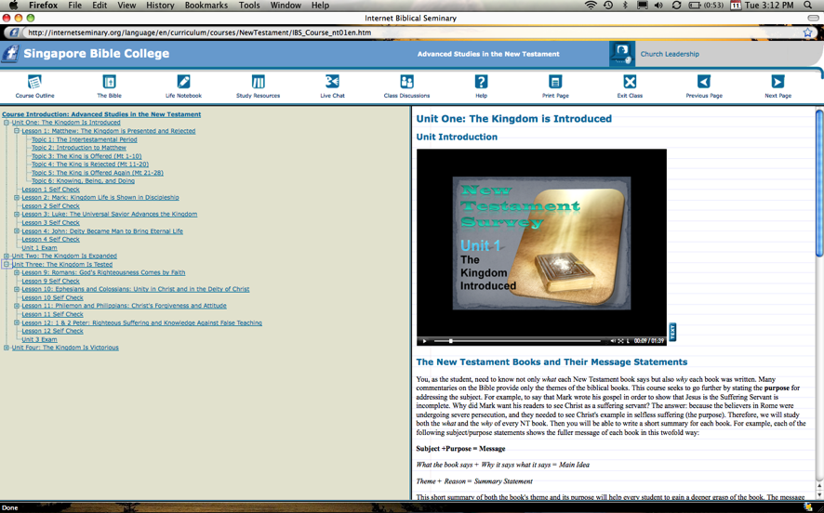
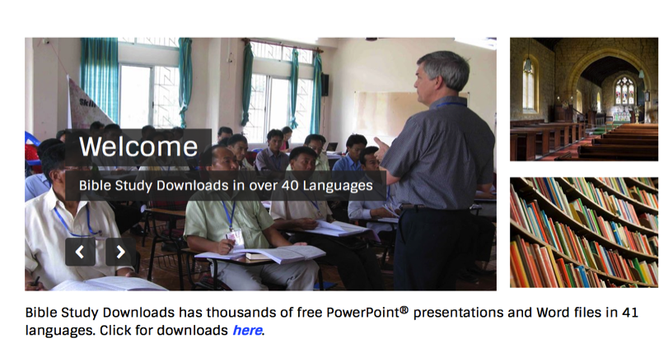
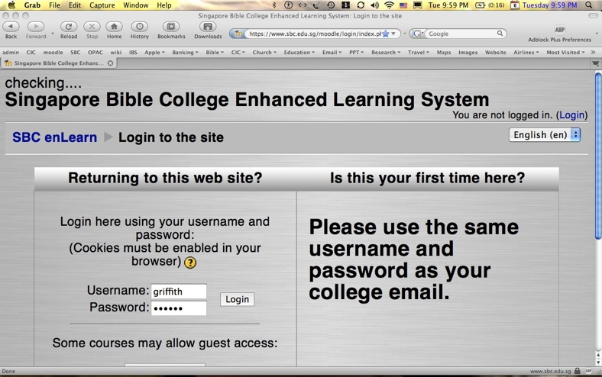
我们的 3个网站
Internet Biblical Seminary
(Reading)
BibleStudyDownloads.org
(Downloads)
SBC Moodle
(Quizzes)

Slide 114
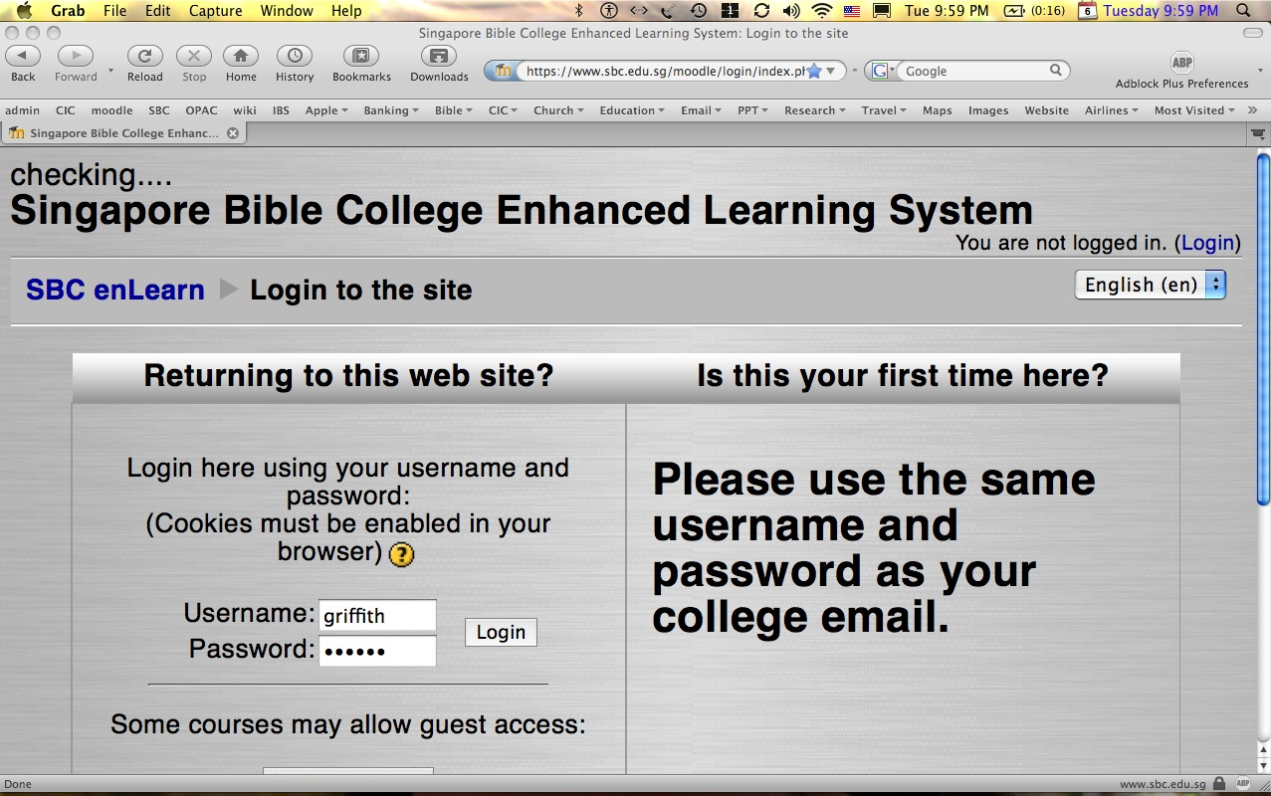
如何使用 moodle…
1
上网到sbc.edu.sg/moodle/login/index.php
键入您的正常SBC用户名和SBC密码
点击OT课程（或CCTE OT CCTE课程）
开始进行测验或发布信息

Slide 115
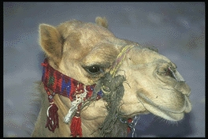
CCTE Course Requirements
1-3
Readings (50%)
Quizzes (50%)

Slide 116


测验，中期和 期末考试都
不可参考书本！

Slide 117
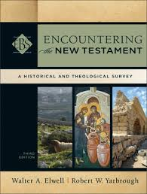
MPrep/BCM/GDC/MAC (3-hour) Requirements
1-3
Readings (25%) 15 hrs.
Quizzes (25%) 5 hrs.
Project (25%) 15 hrs.
Final Exam (25%) 5 hrs.

Slide 118
GDCS
(2-credit hour) Requirements
1-3
Readings (33%) 15 hrs.
Project (33%) 15 hrs.
Final Exam (33%) 5 hrs.

Slide 119

Advantages
1-3
More comprehensive
Interactive
Variety vs. reading books in other courses
IBS
Reading
Decision
Other viewpoints
No wireless needed
More backgrounds in chapter 2
ENT

Slide 120
Project Decision Flowchart
1-3
IBS
Life Notebook
Reading
Decision
Project
Decision
Translate
ENT
Teach
Write Paper

Slide 121
NTS Sign Up List
Name | HP | Email | Reading |  | Project & Language
 |  |  | A: IBS | B: ENT | 1: NTS | 2: TBB | 3: Teach | 4: Paper
X | X | X | X
X | X | X |  | X | X
X | X | X |  | X |  | X
X | X | X |  | X |  |  | X
X | X | X |  | X |  |  |  | X
Name | Email | Degree | Project

Slide 122
Other Matters
7
Copying Class Notes
Contacting Me
At SBC box L19 or office phone (6559-1513)
Home address is Block 2-302
Mobile number: 9113-7090
My office hours are after chapel (Wed, Thur & Fri)
E-mail: griffith@sbc.edu.sg
Let's have lunch too!

Slide 123
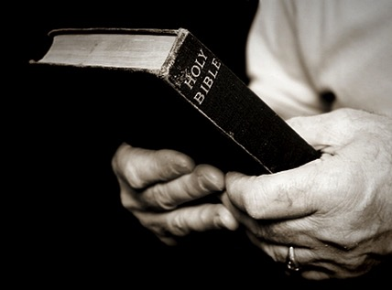
Course Design
7
Sequence (Scriptural)
  used by Jensen, Guthrie, Wilkinson & Boa, class notes

Slide 124
新约书架
22
四福音
新约历史
马
太
福
音
马
可
福
音
路
加
福
音
约
翰
福
音
使徒行传
帖
撒
罗
尼
迦
前
书
帖撒罗尼迦后书
保罗书信
哥林多前书
哥林
多后
书
提
摩
太
前
书
提
摩
太
后
书
加
拉
太
书
以
弗
所
书
腓
立
比
书
歌罗
西书
腓利门书
罗
马
书
提
多
书
使徒书信
给约翰的启示
希
伯
来
书
雅各布
书
彼
得
前
书
彼
得
后
书
约
翰
一
书
约翰二书
约
翰
三
书
犹大
书
启
示
录
Notes:
What overall observations can you make in your small group for the NT?
• There are 5 parts to the NT (grouped by category)
• 4 versions of Christ's life but only one of the church
• Most the NT are letters (especially by Paul)
• 6 of Paul's 13 letters are to people he wrote twice (follow-up for Cor., Thess., & Tim.)
• 2 groupings (general epistles & gospels) named after their authors while Paul's after their recipients

Slide 125

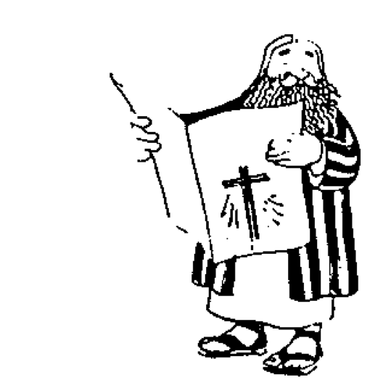




新约“楼”
21
保罗给牧者的书信
 | 提摩太前书 | 提摩太后书 | 提多书 |  | 腓利门书
保罗给教会的书信 | 帖撤罗尼迦后书 |  |  |  | 启示录 | 普通书信
 | 帖撤罗尼迦后书 |  |  |  | 犹大书
 | 歌罗西书 |  |  |  | 约翰三书
 | 腓立比书 |  |  |  | 约翰二书
 | 以弗所书 |  |  |  | 约翰一书
 | 加拉太书 |  |  |  | 彼得前书
 | 哥林多后书 |  |  |  | 彼得彼书
 | 哥林多前书 |  |  |  | 雅各布书
 | 罗马书 |  |  |  | 希伯来书
 | 使徒行传
 | 马太 | 马可 |  | 路加 | 约翰
历史书
Adapted from Walk Thru the Bible
Notes:
What overall observations on the NT can you make from this diagram?
Gospels and Acts form the primary and secondary foundations of the NT.
On the historical foundation are two pillars of 9 books each.
Paul’s letters to churches in the left pillar all fit into Acts.
Paul didn’t write any inspired letters to churches after Acts.
Pauline letters are named after recipients while General after authors (except Hebrews)
The four gospels are named after their authors.
Every book that ends in "ns" is Pauline
All Pastoral Epistles begin with "T"
All General Epistles were written after Acts except James.
Each of the 2 pillars also have a foundational book: Romans & Hebrews (also their longest)
Both pillars also end up in books that primarily deal with eschatology
Instruction to the leaders comprise only 4 books
Only 4 NT books are written to an individual
i.e., the NT is written not to leaders primarily but to the average Christian
Each 1st book of multiple (1-2 Cor, 1-2 Thess, etc.) is longer & more significant

Slide 126
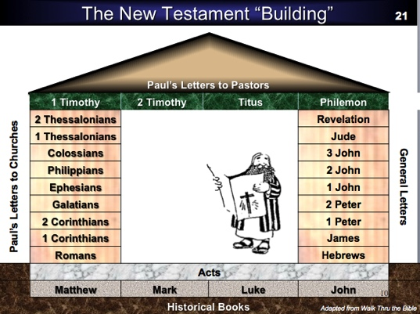
观察新约的结构
21
福音书及使徒行传构成新约的基底层及第二重基础。
四福音书均以作者的名字命名。
历史的基础有两条柱, 每条柱均有九卷书
保罗给众教会的书信在左边的柱子中, 全都与使徒
行传吻合。
保罗在使徒行传后, 再没有写任何书信给教会。
一般情况下书信皆以笔者命名, 但保罗书信则以收
信人命名(希伯来书除外)
每一卷以 “ns”作书信名称字尾的均属保罗书信。
所有教牧书信均以 “T”作书信名称字头。

Slide 127
观察新约的结构
21
所有普通书信均写于使徒行传之后, 除了雅各布书。
每条柱均由一卷基础性的书卷作开端: 罗马书及希伯来书(也是最长的书卷)。
两条柱均以涉及末世信息的书卷作结尾。
给领袖的指引, 只由四卷书信所组成。
只有四卷新约书卷是写给个别人仕的。(此类新约书卷是写给一般信徒而非专门写给领袖) 。
多重书信中(例如:哥林多前后书, 帖撤罗尼迦前后书等…) 的第一卷所写的都较长及重要的。

Slide 128
观察新约的结构
21
结构可以分配三个九本书的部分: 9本历史书/牧者的书信+ 9本教会的书信+9本普通书信
保罗教会的书信有跟多犹太读者过于保罗普通书信的外邦人读者。
保罗的书信都是针对见证耶稣活着时代所写的，但是，普通书信大多数都是为第二代信徒说写的。
新约基础的书都于耶稣基督的生命说写的，也为耶稣为新约的重点。
Notes:
Three sections all have 9 books: 9 Historical/Pastoral + 9 Pauline + 9 General.
Audiences of the Pauline column had more Jews than the Gentile readers of the General column.
Pauline letters addressed early Christians when eyewitnesses to Jesus lived but General letters mostly addressed second generation believers.
The NT foundation rests on books about the life of Christ, as Jesus is the focus of the NT.

Slide 129
Course Design
7
Sequence (Scriptural)
  used by Jensen, Guthrie, Wilkinson & Boa, class notes
Author (Biographical)
  used by Hiebert (vols. 1, 3)

Slide 130
Authors of the New Testament
13
Name | Nationality | Home Town | Occupation | Relation-ships | Chapters Written | Verses Written | Books Written
Matthew | Jew | Capernaum | Tax Collector | Apostle of Jesus Christ | 28 | 1,071 | Gospel of Matthew
Mark | Jew / Roman | Jerusalem | Missionary | Disciple of Peter | 16 | 678 | Gospel of Mark
Luke | Greek | Antioch | Physician | Disciple of Paul | 52 | 2,158 | Gospel of Luke Acts
John | Jew | Bethsaida or Capernaum | Fisherman | Apostle of Jesus Christ | 50 | 1,414 | Gospel of John 1 John 2 John 3 John Revelation

Slide 131
Authors of the New Testament
13
Name | Nationality | Home Town | Occupation | Relation-ships | Chapters Written | Verses Written | Books Written
Paul | Jew | Tarsus | Tentmaker | Apostle of Jesus Christ | 87 (100)* | 2,033 (2,336)* | Romans 1 Corinthians 2 Corinthians Galatians Ephesians Philippians Colossians Philemon 1 Thess. 2 Thess. 1 Timothy 2 Timothy Titus (Hebrews?)
*Indicates total if Hebrews is assigned to Paul.

Slide 132
Authors of the New Testament
13
Name | Nationality | Home Town | Occupation | Relation-ships | Chapters Written | Verses Written | Books Written
James | Jew | Nazareth | Carpenter? | Brother of Jesus Christ | 5 | 108 | James
Peter | Jew | Bethsaida | Fisherman | Apostle of Jesus Christ | 8 | 166 | 1 Peter 2 Peter
Jude | Jew | Nazareth | Carpenter? | Brother of Jesus Christ | 1 | 25 | Jude

Slide 133
Course Design
7
Sequence (Scriptural)
  used by Jensen, Guthrie, Wilkinson & Boa
Author (Biographical)
  used by Hiebert (vols. 1, 3)
Content (Theological)
  used by Hiebert (vol. 2)

Slide 134
新约书卷的关键词
24
日期 | 书卷 | 关键词 | 保罗的生平 | 关键信条
40s | 马太福音 | 国度 |  | 教会论
44-47 | 雅各布书 | 行为 |  | 救赎论
49 | 加拉太书 | 称义 | 第一次行程 | 救赎论
51 | 帖撒罗尼迦前书 | 被提 | 第二次行程 | 末世论
51 | 帖撒罗尼迦后书 | 大灾难 | 第二次行程 | 末世论
56 | 哥林多前书 | 成圣 | 第三次行程 | 教会论
56 | 哥林多后书 | 使徒的权柄 | 第三次行程 | 教会论
56-57 | 罗马书 | 神的义 | 第三次行程 | 救赎论
57-59 | 路加福音 | 神的掌权 |  | 宣教论

Slide 135
新约书卷的关键词
24
日期 | 书卷 | 关键词 | 保罗的生平 | 关键信条
60 | 以弗所书 | 合一 | 第一次入狱 | 基督伦 (主管)
61 | 歌罗西书 | 神性 | 第一次入狱 | 基督伦 (神)
61 | 腓利门书 | 饶恕 | 第一次入狱 | 基督伦 (和解人)
62 | 腓利比书 | 态度 | 第一次入狱 | 基督伦 (榜样)
62 | 使徒行传 | 主权2 |  | 宣教论
62 | 提前书 | 秩序 | 第四次行程 | 教会论
64 | 彼前书 | 受苦 |  | 末世论
64 | 彼后书 | 知识 |  | 末世论
64-68 | 马可书 | 门徒 |  | 末世论

Slide 136
新约书卷的关键词
24
日期 | 书卷 | 关键词 | 保罗的生平 | 关键信条
66 | 提多 | 行事为人 | 第四次行程 | 教会论
67 | 提后 | 教 义 | 第二次入狱 | 教会论
67-68 | 希伯来 | 优秀 |  | 基督伦
c. 69 | 约翰 | 相 信 |  | 救赎论
75 | 犹大 | 伪装者 |  | 末世论
85-95 | 约 1 | 爱 |  | 救赎论
85-95 | 约 2 | 极限 |  | 宣教论
85-95 | 约 3 | 传教士 |  | 宣教论
95-96 | 启示录 | 胜利 |  | 末世论

Slide 137
Course Design
7
Sequence (Scriptural)
  used by Jensen, Guthrie, Wilkinson & Boa
Author (Biographical)
  used by Hiebert (vols. 1, 3)
Content (Theological)
  used by Hiebert (vol. 2)
Time (Chronological)
  used by Tenney
  We will follow this method after studying the gospels and Acts to see the books in their historical context.

Slide 138
新约纵览
38
124
39-41
“直 到 地 极” (使 徒 行 传 1:8)
使 徒 9 13 14 15 16 18 21 27 28
四月 48-
九月 49
1
加 拉 太
四月 50-
九月 52
2
爱琴海
春季 53-
五月 57
3
亚洲
五月 57-
八月 59
试验
二月 60-
三月 62
1
罗马
春季 62-
秋季 67
4
西班牙
秋季 67-
春季 68
2
罗马
35-37
大 马 色
安 提 阿
秋季 49
理事会
春季68
教会扩长
35 48 49 50 52 53 57 60 62 67 68 95
马太
路加
使徒行传
马可
约翰
加拉太
帖前
歌前
以弗所
提前
提后
犹大
雅各
帖后
歌后
歌罗西
提多
希伯来
约 1
罗马
腓利门
彼 前
约 2
福音书以及使徒行传
腓利比
彼后
约 3
保罗书信
一二三四
旅程
启示录
普通书信
罗马
关押
动画

Slide 139
Black
1
4
2
5
3
6

Slide 140
新约全书链接地址 BibleStudyDownloads.org
免费获得该讲解!
圣经学习下载
Notes:
NT Survey link

