Slide 1
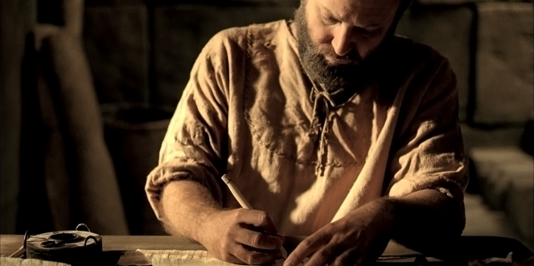
保罗作者身份
Dr. Rick Griffith • 博士 • 新加坡神学院 • BibleStudyDownloads.org

Slide 2
Paul's Epistles in Mostly Scriptural Order
Foundational | Prophetic | Prison | Pastoral
Romans 1 Corinthians 2 Corinthians Galatians | 1 Thessalonians 2 Thessalonians | Ephesians Philippians Colossians Philemon | 1 Timothy 2 Timothy Titus
Christ & the Cross | Christ & the Second Coming | Christ & the Church | Christ & the Congregation
Soteriology | Eschatology | Christology | Ecclesiology
TEXT
Adapted from The Pastoral Epistles © John Stevenson 2010 • https://slideplayer.com/slide/6106093/
Notes:
This chart shows that Paul addressed theology to churches in this order: Soteriology, Eschatology, Christology, and Ecclesiology. This contrasts with how most follow-up today postpones eschatology too late.
This order follows the NT except Philemon is moved from the end of the Pauline Epistles after Titus to complete the Prison Epistles after Colossians.
But one could argue that Philemon is a pastoral letter, since it addresses a situation that required reconciliation.
On the other hand, Paul wrote Philemon in Rome during Paul's first imprisonment, so it is a Prison Epistle in this sense.
In the end, I do not know who has explained the reasoning for the order of Paul's letters.
Note that combining the four Foundational and two Prophetic Epistles gives us the six Missionary Epistles.
___________
Common-440
NS-00-NT Introduction-105
NS-06-Pauline Epistles-4
NS-06-Missionary Epistles-10
NS-10-Prison Epistles-3
NS-15-Pastoral Epistles-15

Slide 3

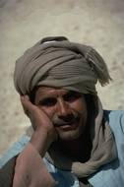
支持保罗说作者
146
书信内证保罗是作者 (1:1).
早期教会对保罗是作者未曾提出任何反对.
书信中的历史记述符合保罗生平事迹
本书的教义与其他保罗所撰写的书信相同是典型的保罗作风

Slide 4

作 者 身 份
内部证明
146
外在证明
获早期教父支持:
罗马之克莱门特 (Clement) （公元95）
伊格纳修斯 (Ignatius) (ca. 公元115)
坡旅甲（Polycarp） (ca. 公元115)
罗马书早在公元200年前就被列入现存新约书集中保罗书信之内，甚至也出现在马西昂（Marcion）异端书中。
所有当代激进批评家，除了鲍尔（Baur）以外，也都赞成同保罗是罗马书的作者。
在下列方面与保罗的其他写作相符合：
用词
文风
逻辑
神学发展
罗马书，哥林多前后书，加拉太书是判断保罗其他书信的标准。
此信很可能是 德提（Tertius） (16:22) 为保罗代笔写的。

Slide 5
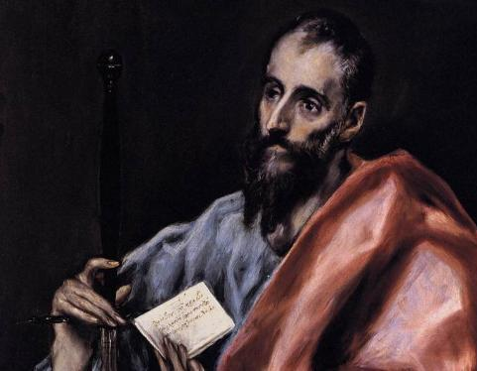
保罗的传记论证 (加拉太书 1–2)
保罗捍卫
使徒

Slide 6
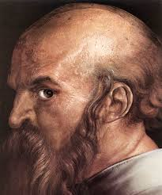
不同类型的称呼 (1:1 和合本)
“作 使 徒 的 保 罗 （ 不 是 由 於 人 ， 也 不 是
藉 着 人 ， 乃 是 藉 着 耶 稣 基 督 ， 与 叫 他 从
死 里 复 活 的 父 神 ）。"

Slide 7
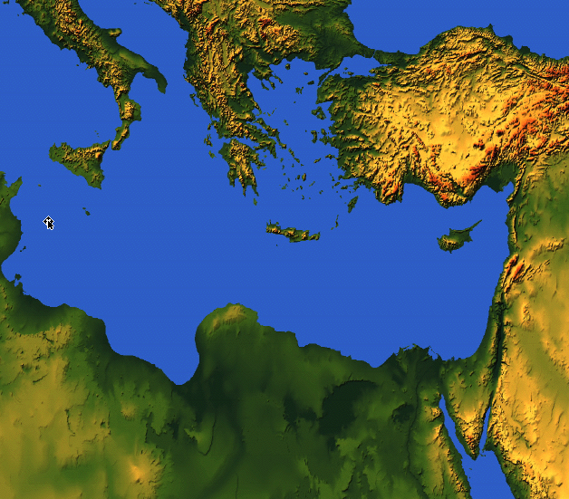

175
罗马
以弗所
以弗所书

Slide 8
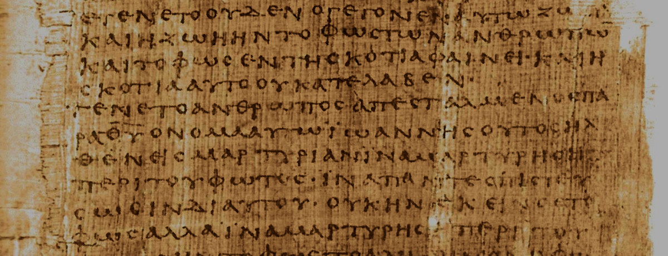
How do the Pastorals differ from Paul's earlier letters?
Pastorals:
Address leaders instead of churches
Focus on church issues from a leader's view
Use different words than the earlier letters
Show a more developed church leadership
Have a different style
Early Letters:
Pastorals:
Doctrine
Practice
Doctrine & Practice
Notes:
Regarding #3 above on the different words in the Pastorals:
Only they give the lists of elder and deacon qualifications (1 Tim 3; Tit 1).
They "describe the heretical threat as both present (1 Tim 1:3, 20; 2 Tim 2:20; Titus 1:10-16) and future (1 Tim 4:1; 2 Tim 3:1)" (Mark Bailey, "A Biblical Theology of Paul's Pastoral Epistles," in A Biblical Theology of the NT eds. Roy B. Zuck and Darrell L. Bock [Chicago: Moody, 1994], 335).
The term kekausteriasmenon for "seared" appears only in 1 Timothy 4:2 in the NT. Likewise, antilytron ("ransom") is used only in 1 Timothy 2:6 in the NT. But note that Colossians has many words used only there as it addresses a unique situation and thus required a unique vocabulary. Its 35 unique words include “visible” (1:16), “supremacy” (1:18), “fill up” (1:24), “philosophy” (2:8), and “deity” (2:9; Kubo, A Reader's Greek-English Lexicon of the New Testament, 193-97).
These epistles lack mention of Jesus as the Son of God or subordinate to the Father—but they still have an exalted view of "Christ Jesus" (used in the Pastorals in 25 of the 32 NT references). See Bailey, 343.

Slide 9

What concerns scholars on the authorship of the Pastorals?
Marcion's Canon (AD 170) had only 10 Pauline letters (but Marcion was a heretic).
They are absent from p⁴⁶—one of the earliest Pauline manuscripts (but we don't know why).
Paul's authorship of the Pastorals wasn't doubted until 1800s (when critics superseded the text).

Slide 10
Black

Slide 11


新约批判研究- BibleStudyDownloads.org
免费获得该讲解!
圣经学习下载
Notes:
The explanation for free!
NT Critical Studies link address

