Slide 1
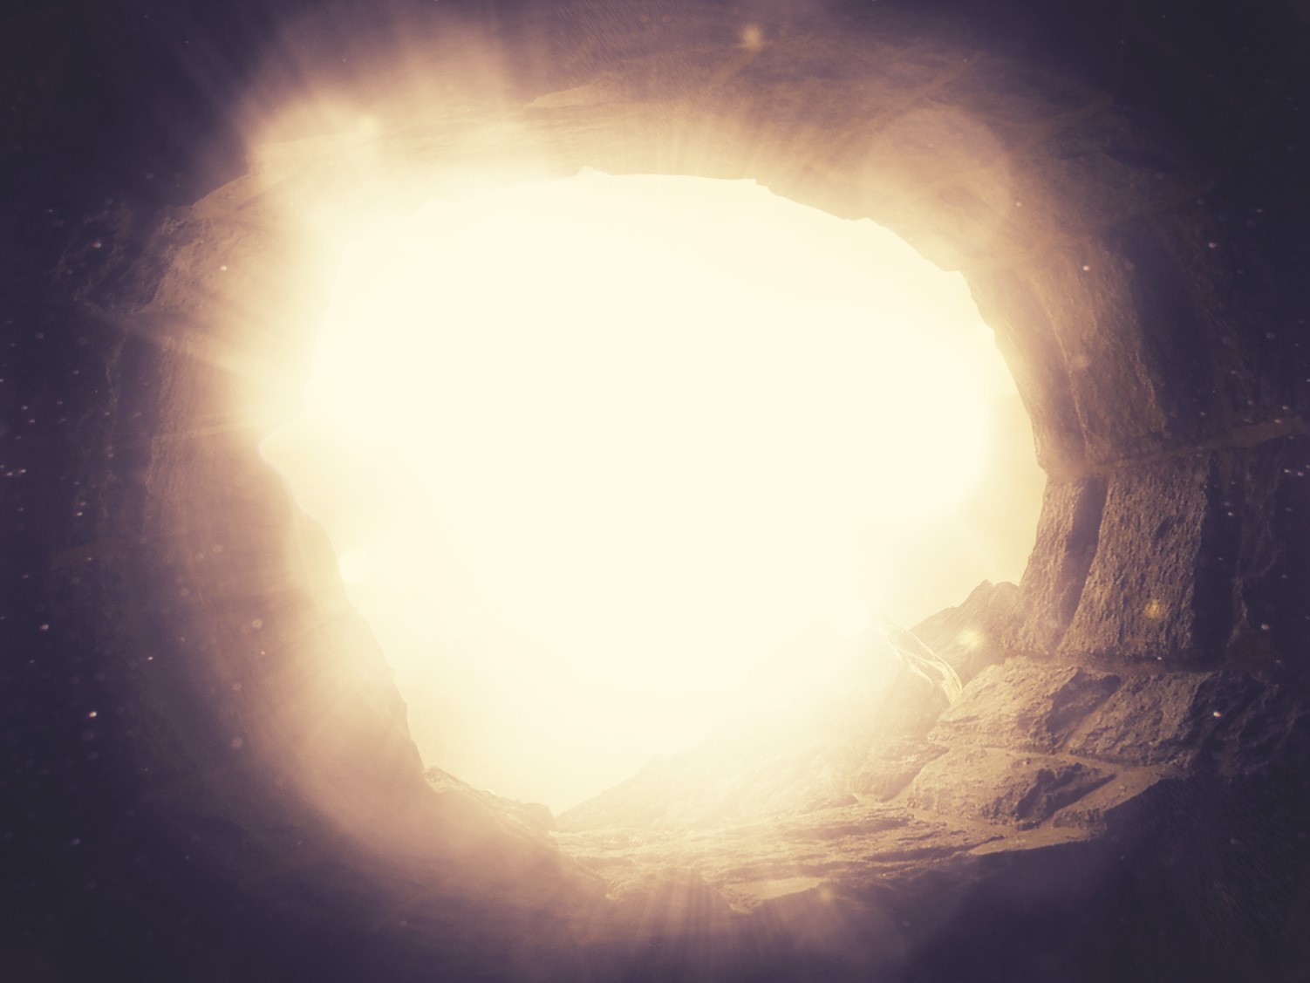
君王的复活
§§ 184-198
Section summaries based on J. Dwight Pentecost, A Harmony of the Words and Works of Jesus Christ (Grand Rapids: Zondervan, 1981)
Dr. Rick Griffith • Singapore Bible College • BibleStudyDownloads.org
The Messiah comes back to life again as Victor over death, which proves His deity and provides proof for the disciples' proclamation of the gospel to all nations

Slide 2
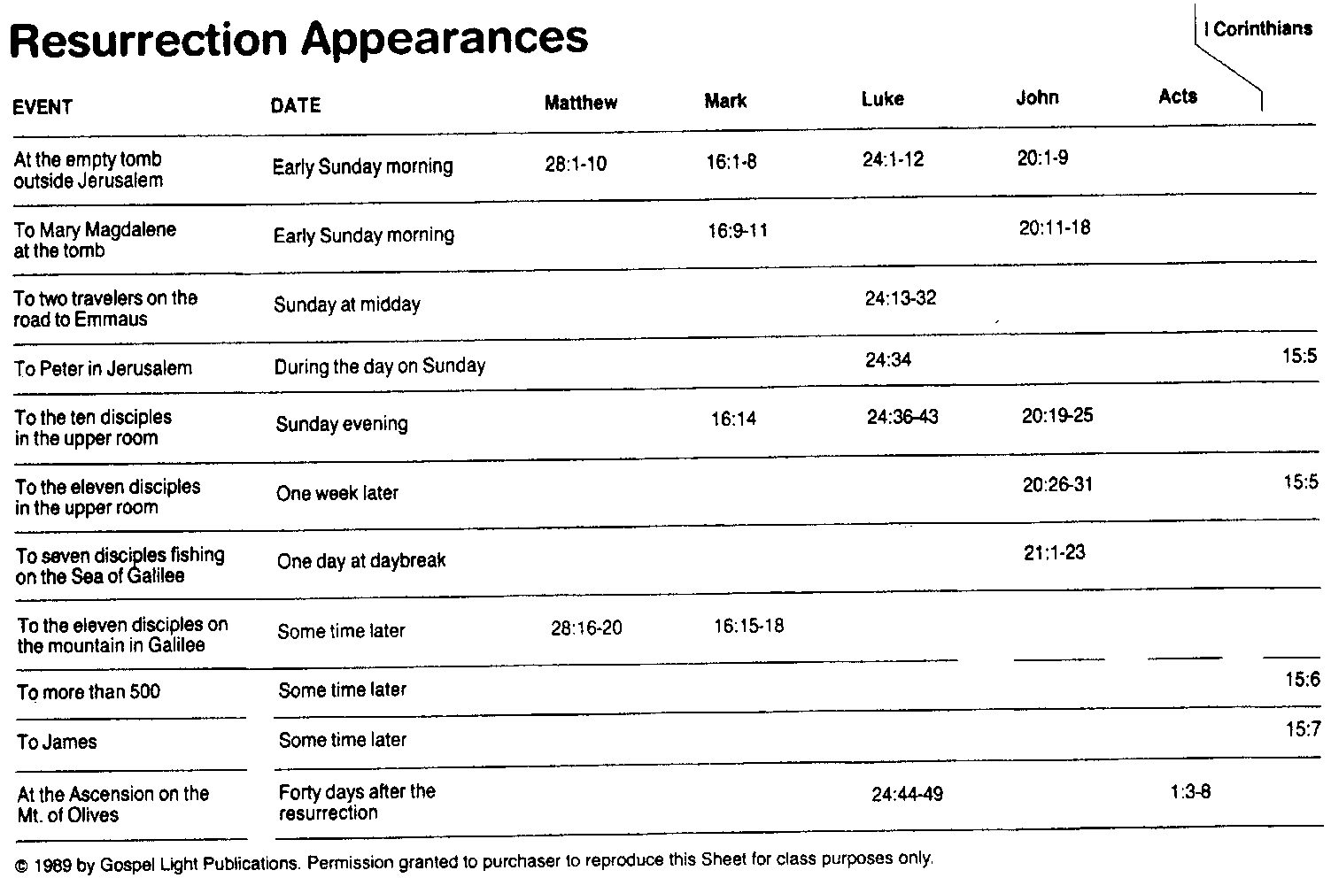
复活显现
105
哥前
目期
马太
马可
路加
约翰
使徒
星期天早晨
星期天早晨
星期天中午
星期天
星期天傍晚
一星期后
一个早晨
过一般时间
过一般时间
过一般时间
复活后40天

Slide 3
A. The Preparation by the Women
§ 184
Matthew 28:1; Mark 16:1
Following the Sabbath early on Sunday morning Mary Magdalene, Mary the mother of James, and Salome proceed to the tomb with spices to show their devotion to Christ by anointing His body

Slide 4
B. The Opening of the Tomb
§ 185
Matthew 28:2-4
Christ resurrects when in a violent earthquake an angel rolls back the stone and sits upon it so that witnesses may see that Christ's body is gone, the angel's glory scaring the Roman guard so that they at first shook, then became as corpses, then left the site

Slide 5
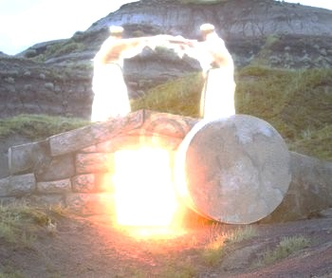
I. The empty tomb shows us that Christ is alive today (20:1-9).

Slide 6
“The Gospel of John” ® Movie
John 20:1-9
Notes:
6

Slide 7
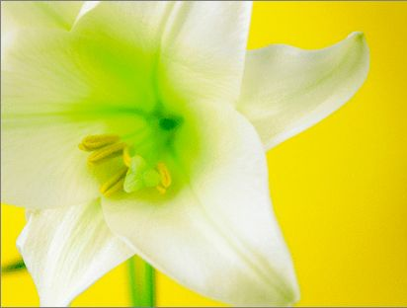
Three Initial Witnesses
Mary (1-2)
John (3-5)
Peter (6-9)

Slide 8
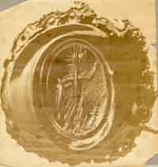
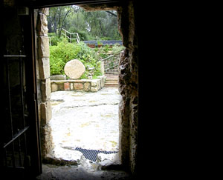
From Inside the Tomb Looking Out
The Roman seal prevented tampering
Notes:
8
8

Slide 9
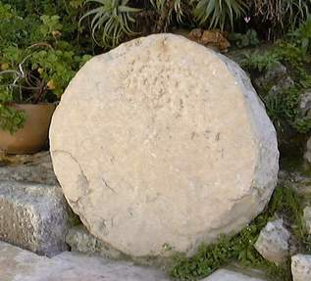
The stone was rolled away…
Notes:
9
9

Slide 10
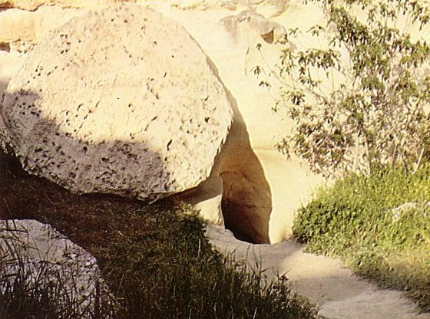
Who moved the stone?
He never died?
Jesus' strength?
Romans?
Jewish Leaders?
Disciples?

Slide 11
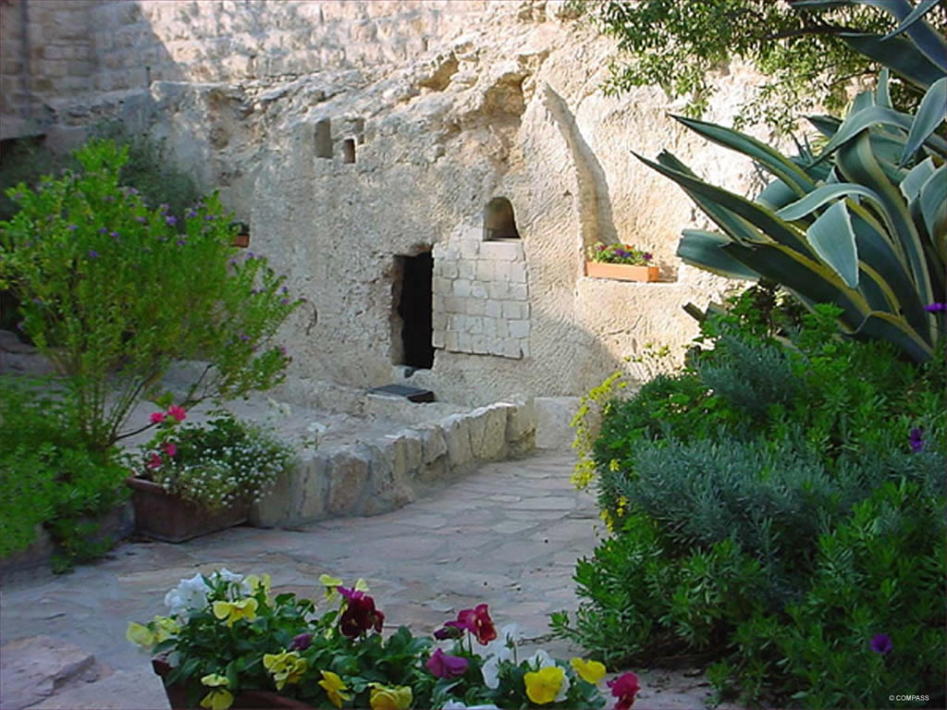
The Garden Tomb
Notes:
11
11

Slide 12
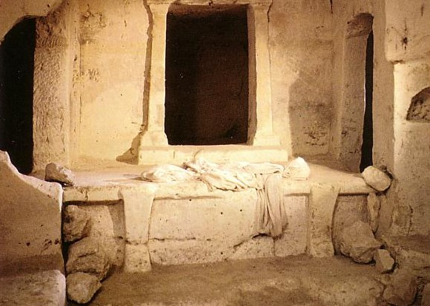
Empty linens

Slide 13
C. The Visit of the Women
§ 186
Matthew 28:5-8; Mark 16:2-8; Luke 24:1-8; John 20:1
As the three women discuss how they might open the tomb they observe that it already is open and upon entering see two angels, one of who announces Christ's resurrection and the women's responsibility to tell Peter and the disciples to meet Christ in Galilee

Slide 14


马太 28:1-15
马可 16:1-20
路加 24:1-47
约翰 20:1-29
免费
圣经
图片
复活及的故事
耶稣复活了

Slide 15


Slide 17


Slide 18


Slide 19


Slide 20


Slide 21


Slide 22


Slide 23


Slide 24


Slide 25


Slide 26


Slide 27


Slide 28


Slide 29


Slide 30


Slide 31


Slide 32
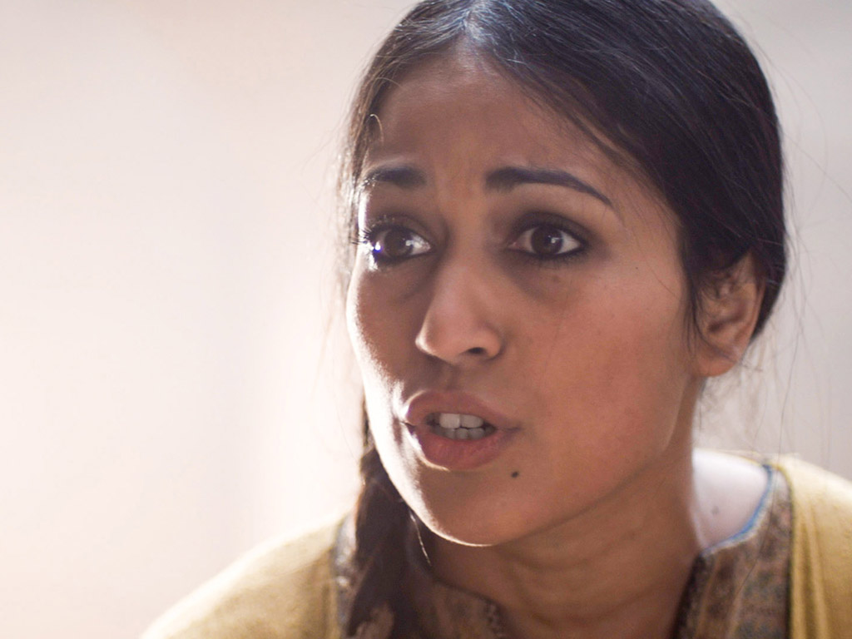

Slide 33
Free Bible Images
授权使用
免费
圣经
图片
图片中的文字

Slide 34

授权使用
马太福音
d
马可福音
o
路加福音
0
约翰福音
0
由Lumo Project出版独家资源，我们特此通知您我们不授权将这些图片发放给除freebibleimages.org客户以外的任何人。
所有图片不授权用于视频制作、epublishing或者其他媒体。所有下载的图片和文件不可通过除freebibleimages.org以外的其他网站传播，亦不可用于任何破坏基督信仰和福音的处境中。
o
图片仅供教育展示、博客和社交媒体使用；所有用途均需注明出处
www.LumoProject.com
图片声明 BBM
© 版权所有
www.bigbookmedia.com

Slide 35
D. The Report to the Disciples
§ 187
Luke 24:9-12; John 20:2-10
The women, despite the angelic announcement, tell the disciples that they do not know where the body is revealing that they do not understand the significance of the resurrection, which prompts Peter and John to run to the tomb to investigate the matter themselves, resulting in John's belief

Slide 36
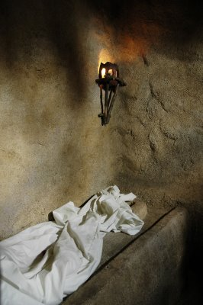
“Seeing” in 20:5-8
John
“looked”
v. 5
John
“saw”
v. 8
“peeped”
“perceived”
Peter
“saw”
v. 6
“beheld attentively”
Notes:
36
36

Slide 37
E. The Appearance to Mary
§ 188
Mark 16:9-11; John 20:11-18
Mary Magdalene returns to the tomb, speaks with Christ, and returns to the disciples with the news that He has resurrected but they do not believe her, indicating that their unbelief prevents them from even believing an eyewitness account

Slide 38
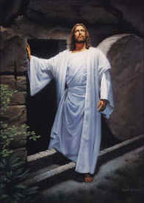
II. Christ's resurrection meets you at your need
(20:10-29)
Comforts the despairing
Mary (10-18)
Notes:
38
38

Slide 39
F. The Appearance to the Women
§ 189
Matthew 28:9-10
The other women return to the tomb and see Christ also, Who tells them to report to the disciples to meet Him in Galilee that He might give them parting instructions and a final commission

Slide 40
G. The Report of the Guard
§ 190
Matthew 28:11-15
The guard return to Jerusalem and report the resurrection to the chief priests, who, in conjunction with the Sanhedrin, bribe them to lie that the disciples stole Christ's body while they were asleep, a futile attempt to discredit the disciples stemming from the stubborn unbelief of the religious leaders

Slide 41
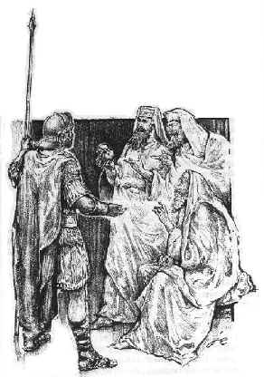
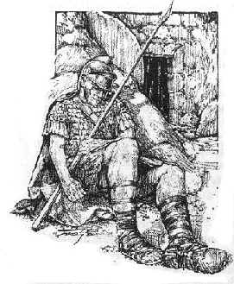
賄賂兵丁 (28:12)

Slide 42
H. The Appearance to the Two on the Emmaus Road
§ 191
Mark 16:12-13; Luke 24:13-32
On the Emmaus Road Christ makes His first appearance to men, one of whom is Cleopas, who do not at first recognize Jesus and have difficulty harmonizing the Messiah's suffering with His glory, but they accept Christ's interpretation relating the cross to the throne and recognize Him at the evening supper

Slide 43
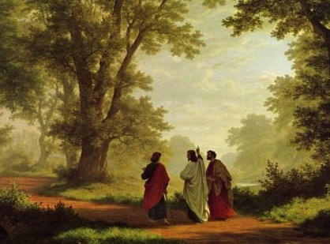
Could mortals and those in glorified bodies really live together?
435
Jesus did this on the Emmaus Road
(Luke 24)

Slide 44
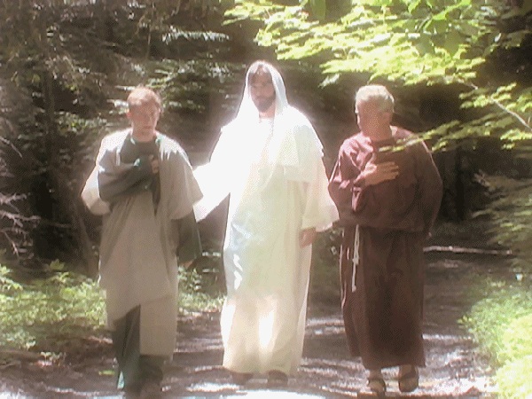
Could mortals and those in glorified bodies really live together?
435
Remember when Jesus glowed?

Slide 45
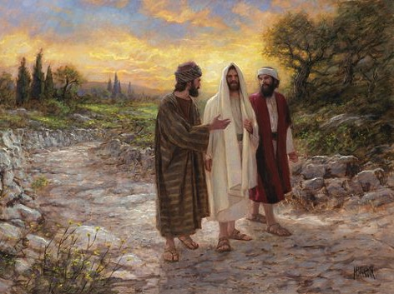
Could mortals and those in glorified bodies really live together?
435
No, he looked like the rest of us!

Slide 46
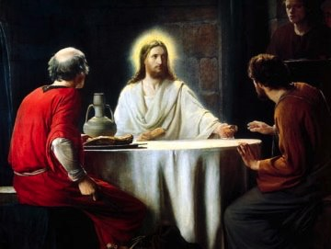
Only at dinner did they recognize Jesus
435

Slide 47
Could mortals and those in glorified bodies really live together?
"And beginning with Moses and all the Prophets, he explained to them what was said in all the Scriptures concerning himself"
(Luke 24:27 NIV)

Slide 48
I. The Report of the Two to the Disciples
§ 192
Luke 24:33-35
These two disciples report to the Eleven that they have seen the Lord, thus verifying the earlier report of the women

Slide 49
J. The Appearance to Several Disciples
§ 193
Mark 16:14; Luke 24:36-43; John 20:19-25
As the two disciples share about Christ's appearance with the Eleven (minus Thomas) and those gathered with them, Jesus appears to all of them, and later the ten disciples relate this to Thomas who remains unconvinced, indicating that faith alone is not sufficient for Him to believe

Slide 50
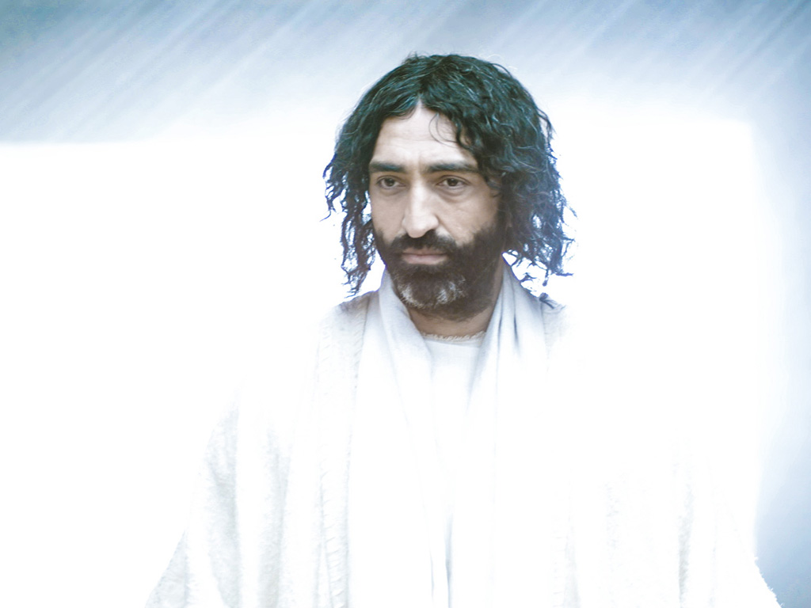
免费
圣经
图片
复活节的故事
耶稣向门徒显现
路加 24:36-49
约翰 20:19-23

Slide 51
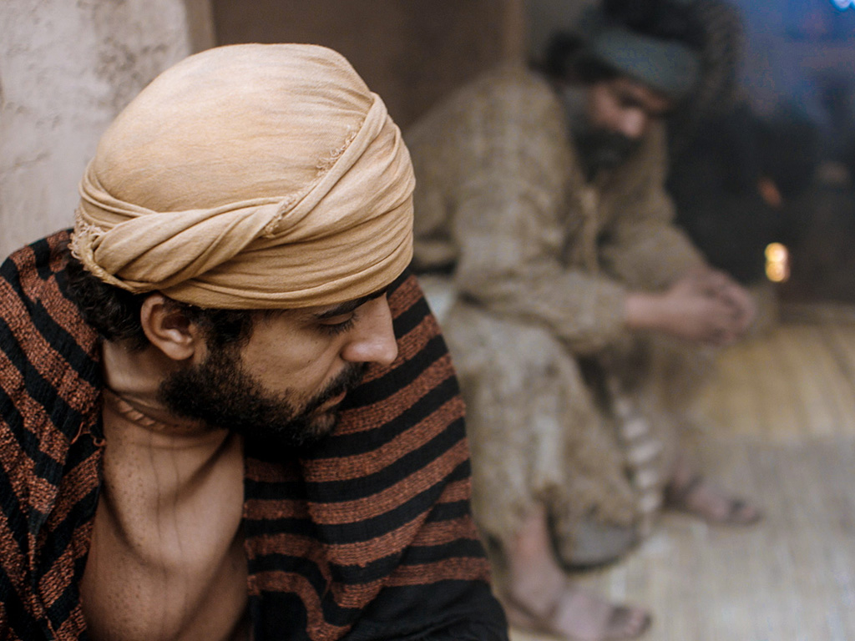

Slide 52
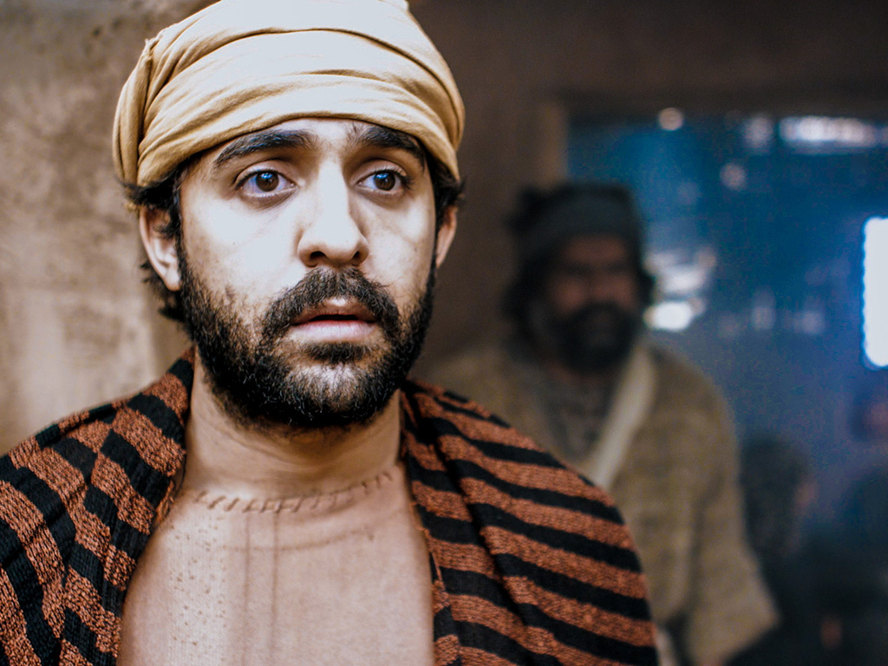

Slide 54
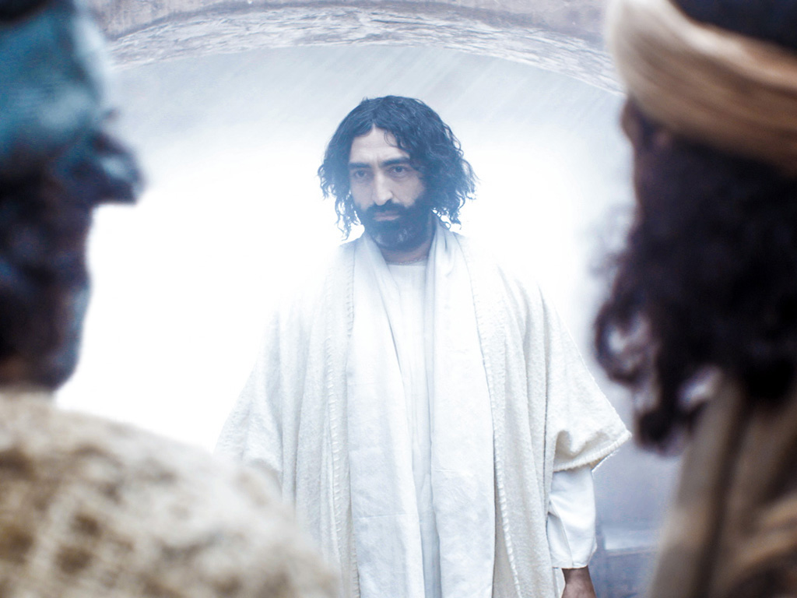

Slide 55
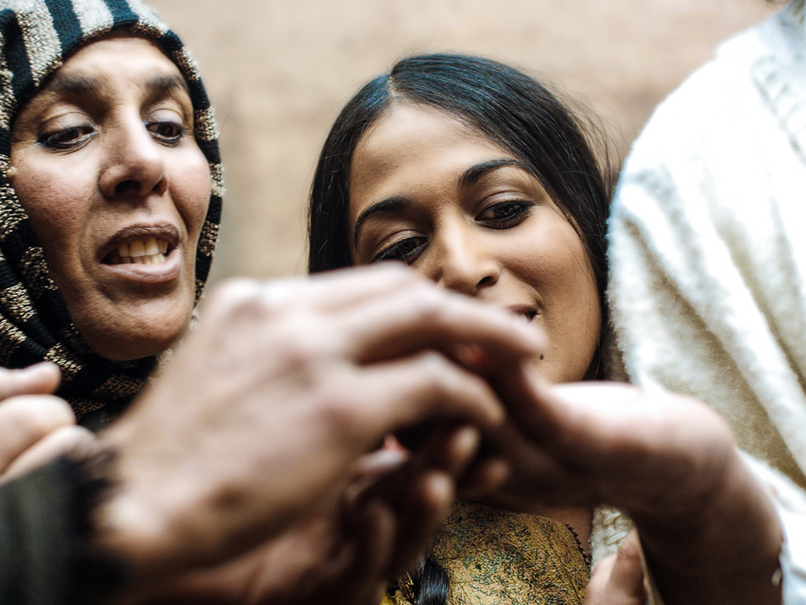

Slide 56
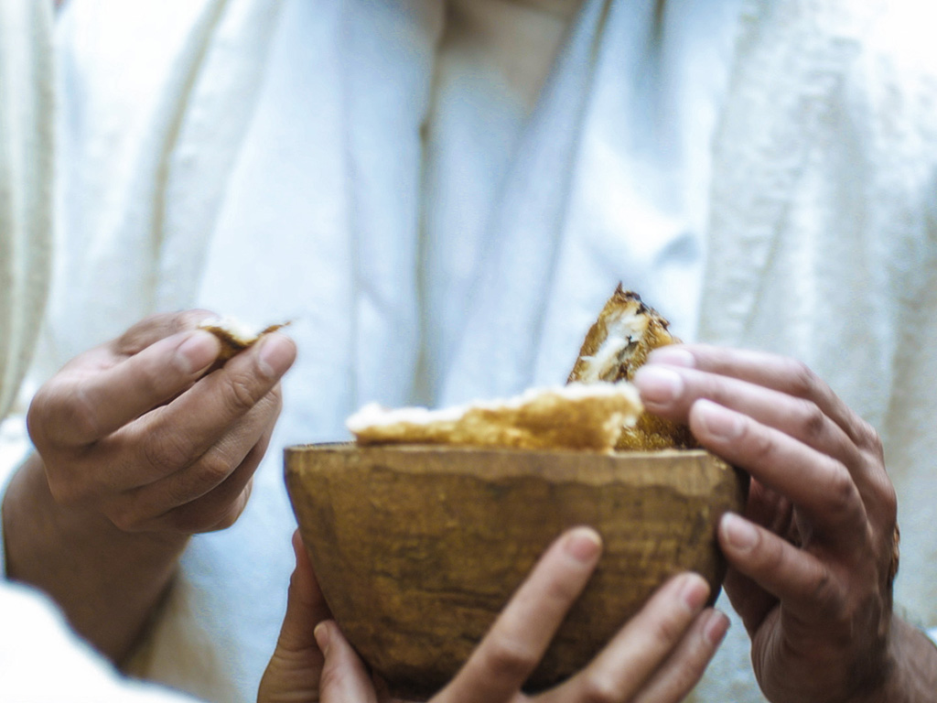

Slide 57
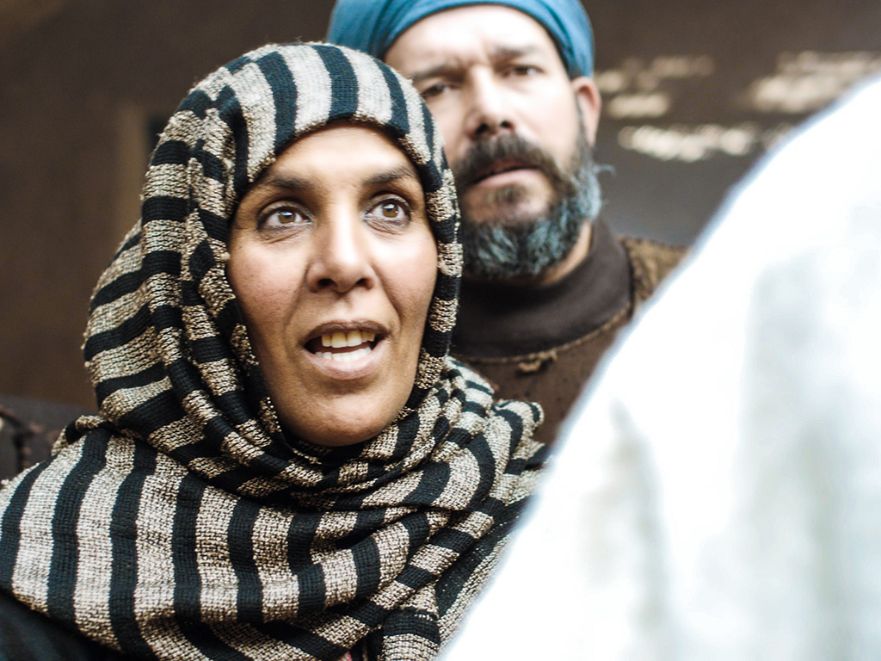

Slide 58
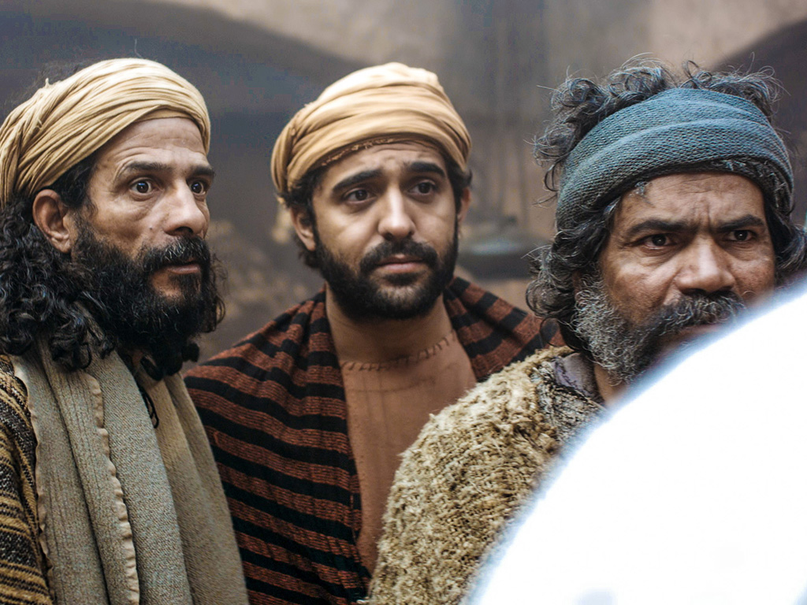

Slide 59
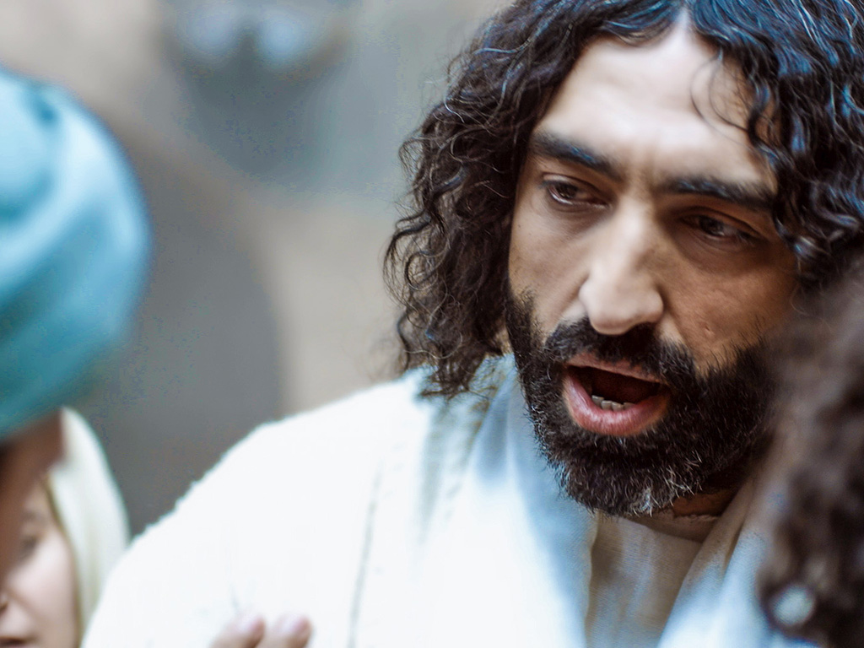

Slide 60
Free Bible Images
授权使用
免费
圣经
图片
图片中的文字

Slide 61
授权使用
马太福音
d
马可福音
o
路加福音
0
约翰福音
0
由Lumo Project出版独家资源，我们特此通知您我们不授权将这些图片发放给除freebibleimages.org客户以外的任何人。
所有图片不授权用于视频制作、epublishing或者其他媒体。所有下载的图片和文件不可通过除freebibleimages.org以外的其他网站传播，亦不可用于任何破坏基督信仰和福音的处境中。
o
图片仅供教育展示、博客和社交媒体使用；所有用途均需注明出处
www.LumoProject.com
图片声明 BBM
© 版权所有
www.bigbookmedia.com

Slide 62
K. The Appearance to the Eleven
§ 194
John 20:26-31
One week later Christ again appears to the ten disciples while Thomas is with them and invites him to touch Him, but Thomas immediately declares his submission to Him as Lord and deity, thus all the disciples are witnesses to the things that they will preach in the coming years

Slide 63
II. Christ's resurrection meets you at your need
(20:10-29)
Comforts the despairing
Mary (10-18)
Encourages the discouraged disciples (19-23)
Gives proof to the doubting Thomas (24-29)
Notes:
63
63

Slide 64
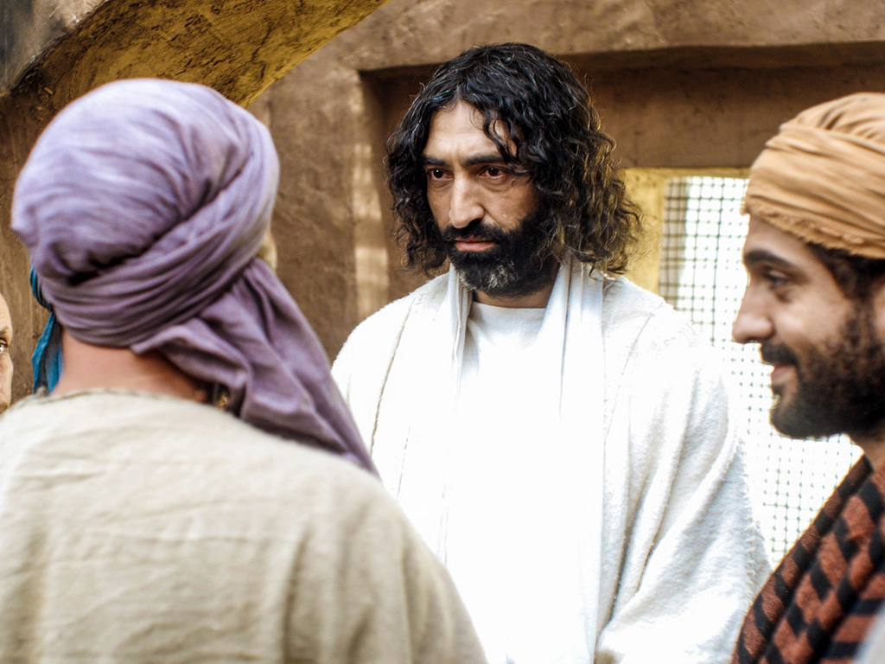

约翰 20:24-29
复活节的故事
耶稣向多马显现

Slide 65
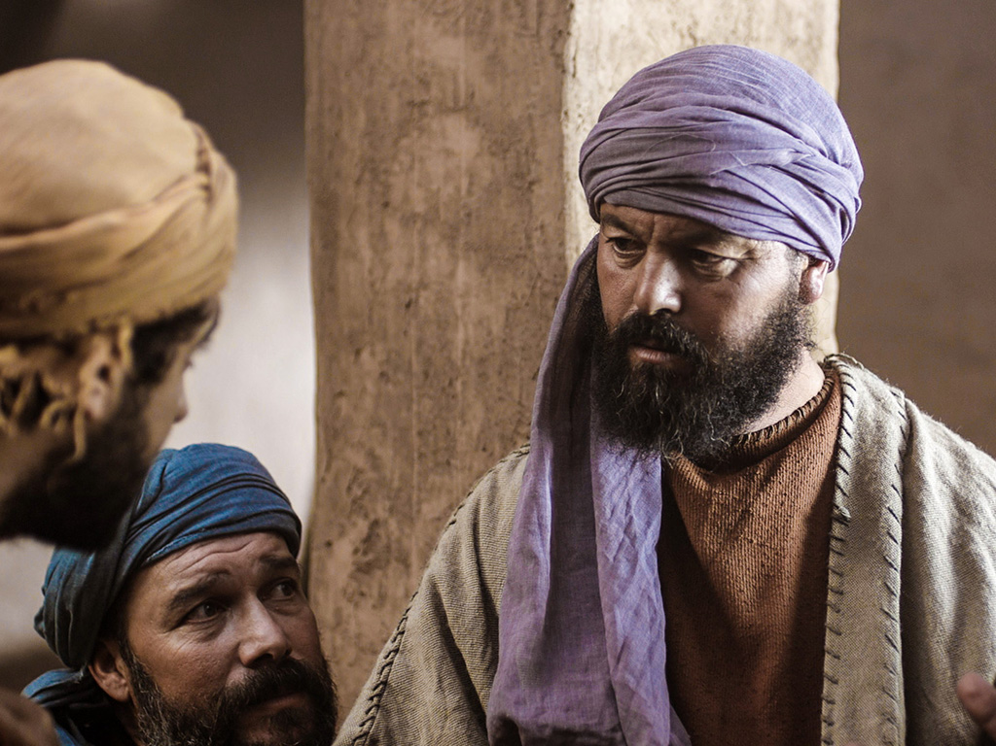

Slide 66
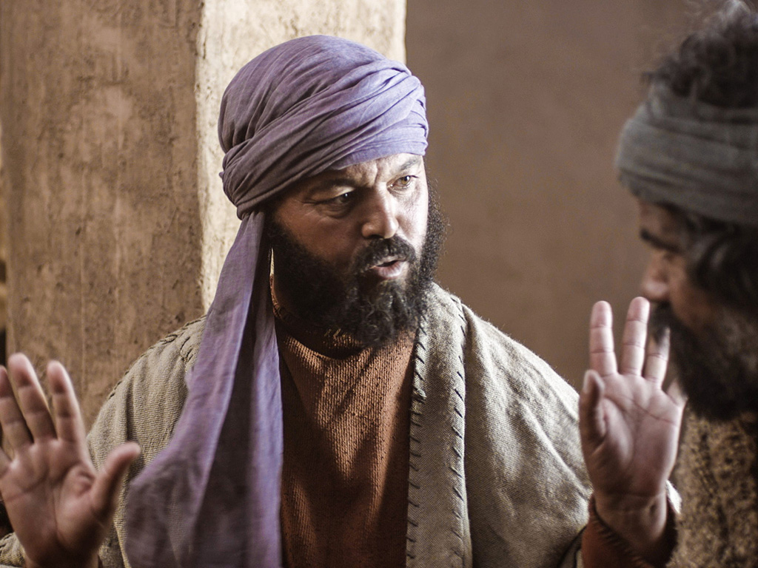

Slide 67
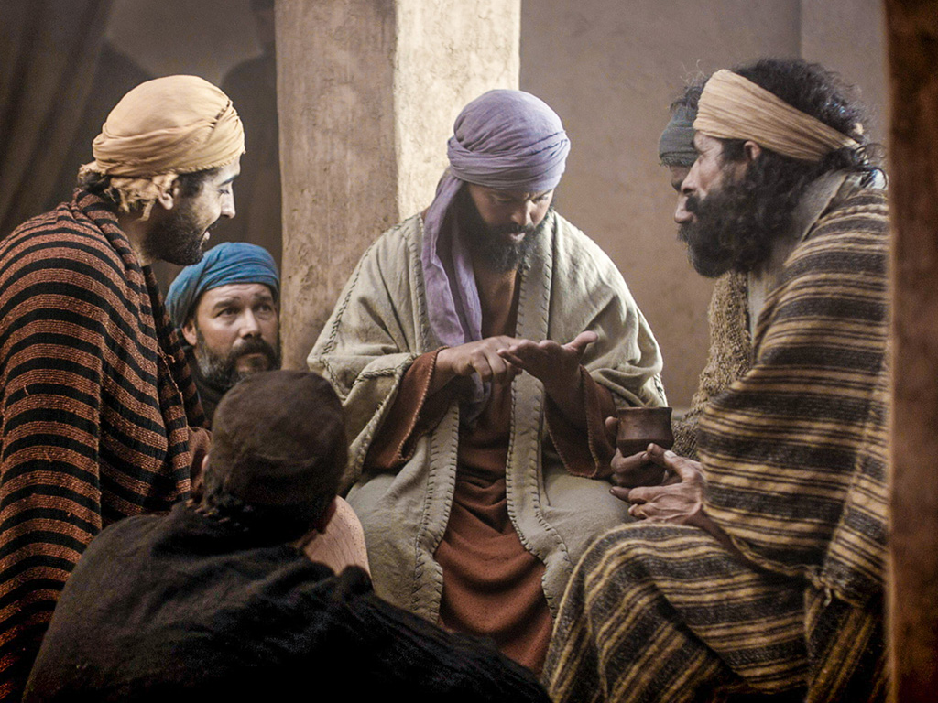

Slide 68
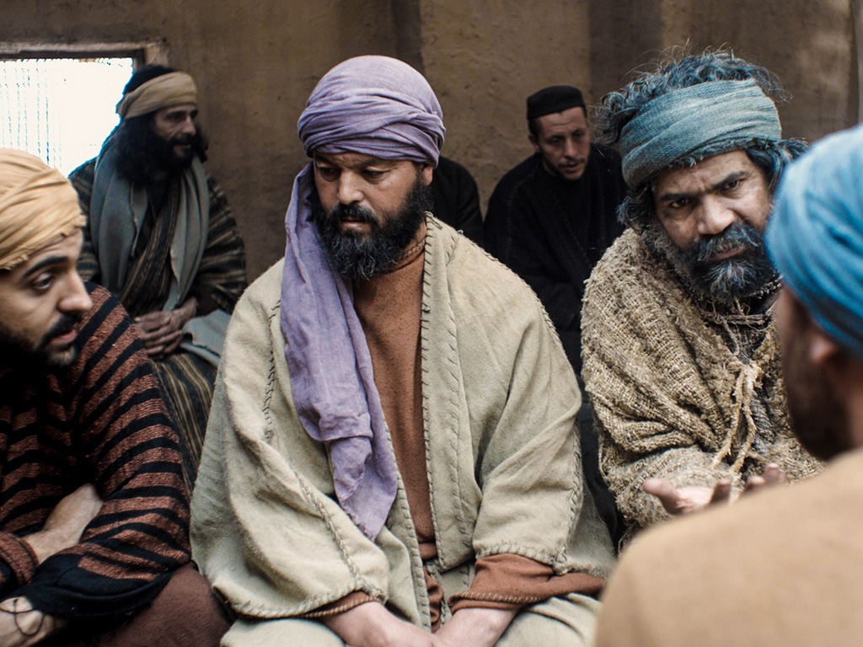

Slide 69
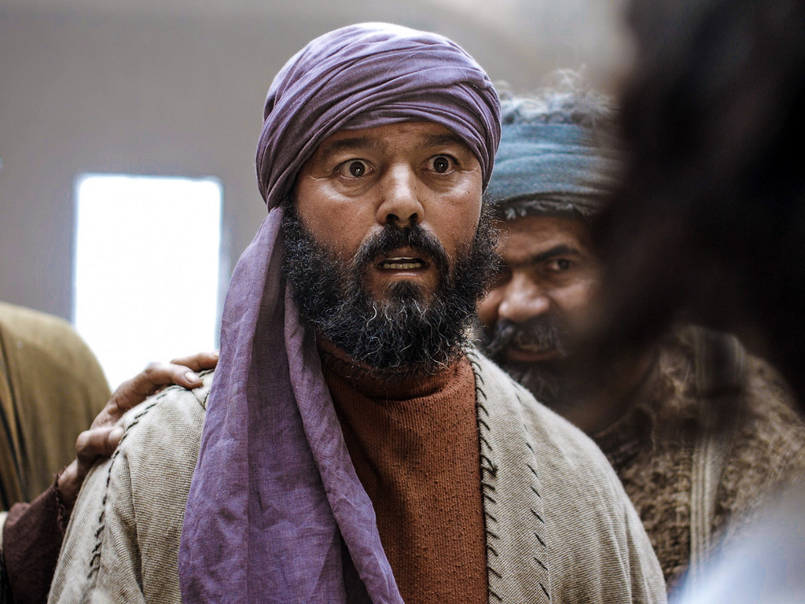

Slide 70
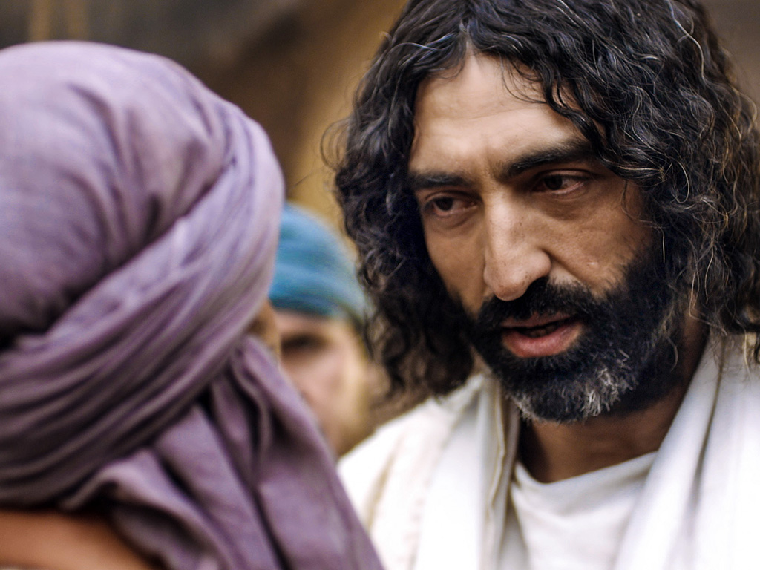

Slide 71
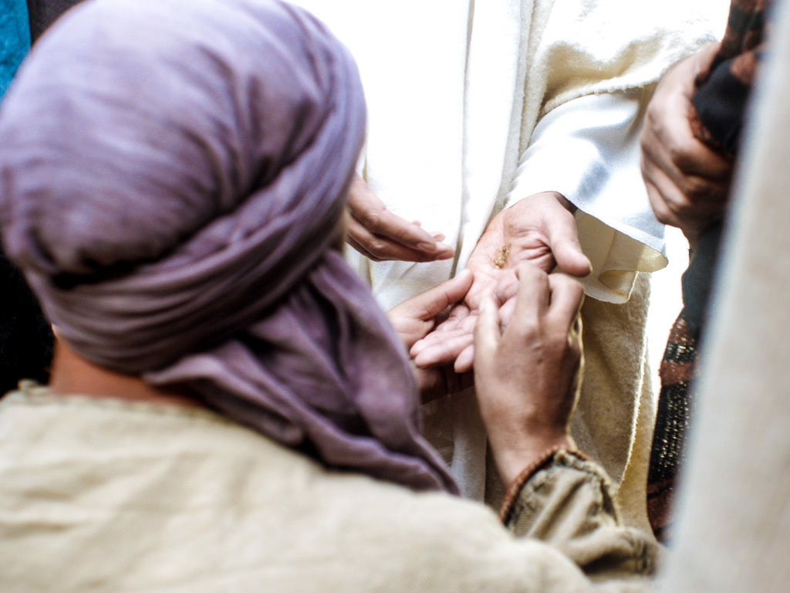

Slide 72
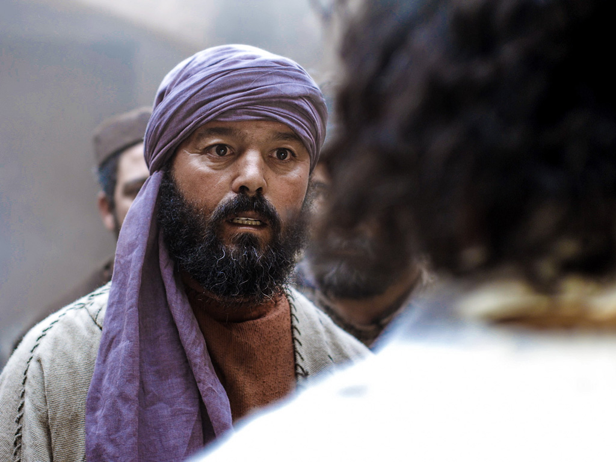

Slide 74
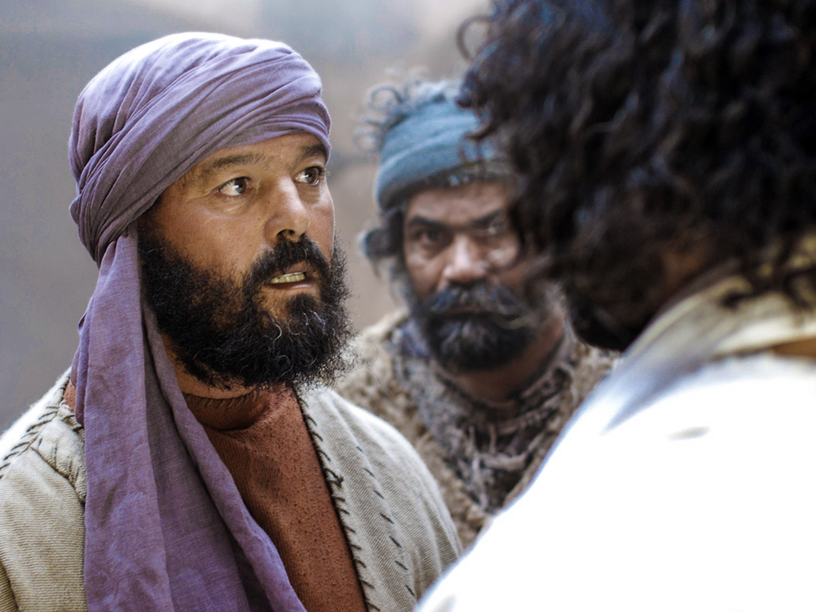

Slide 75
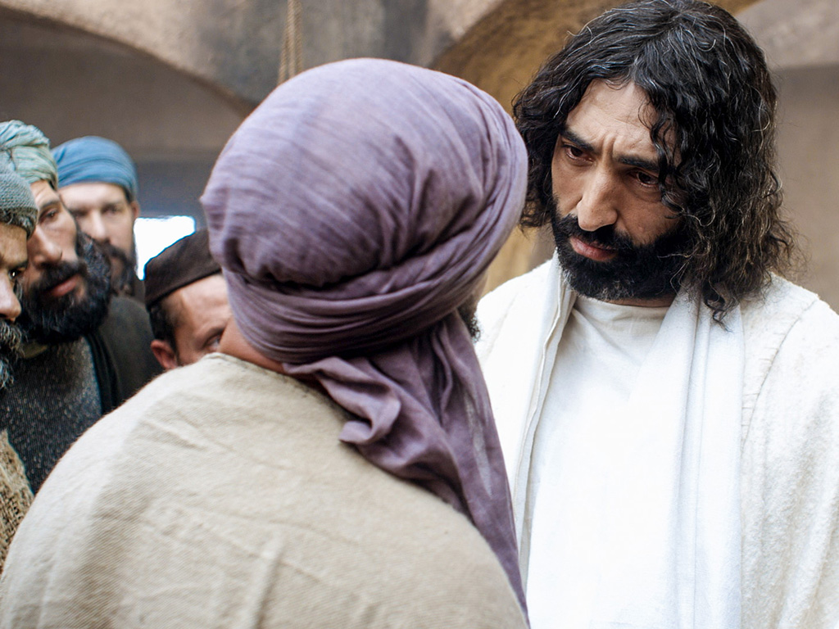

Slide 76
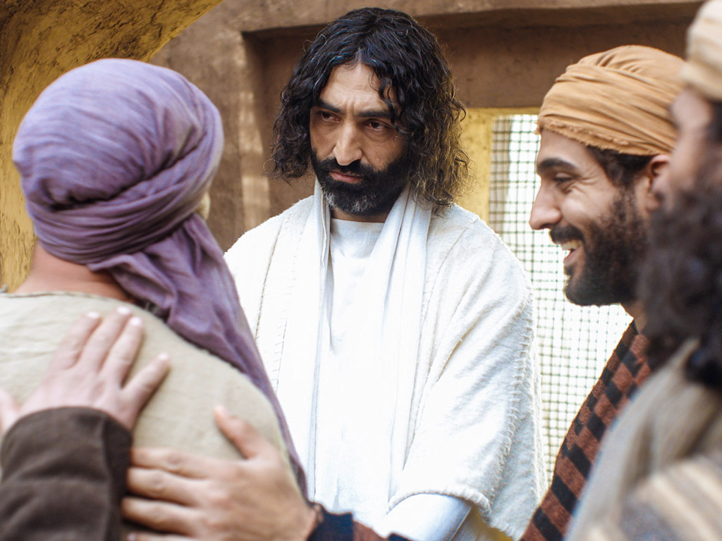

Slide 77
Free Bible Images
授权使用
免费
圣经
图片
图片中的文字

Slide 78
授权使用
马太福音
d
马可福音
o
路加福音
0
约翰福音
0
由Lumo Project出版独家资源，我们特此通知您我们不授权将这些图片发放给除freebibleimages.org客户以外的任何人。
所有图片不授权用于视频制作、epublishing或者其他媒体。所有下载的图片和文件不可通过除freebibleimages.org以外的其他网站传播，亦不可用于任何破坏基督信仰和福音的处境中。
o
图片仅供教育展示、博客和社交媒体使用；所有用途均需注明出处
www.LumoProject.com
图片声明 BBM
© 版权所有
www.bigbookmedia.com

Slide 79
L. The Appearance to Seven Disciples
§ 195
John 21:1-25
Christ appears to seven of the Eleven at the Sea of Galilee to further confirm His resurrection and to reinstate Peter, who thrice had denied Christ, in a threefold declaration of love for Christ and commitment to do His will

Slide 80
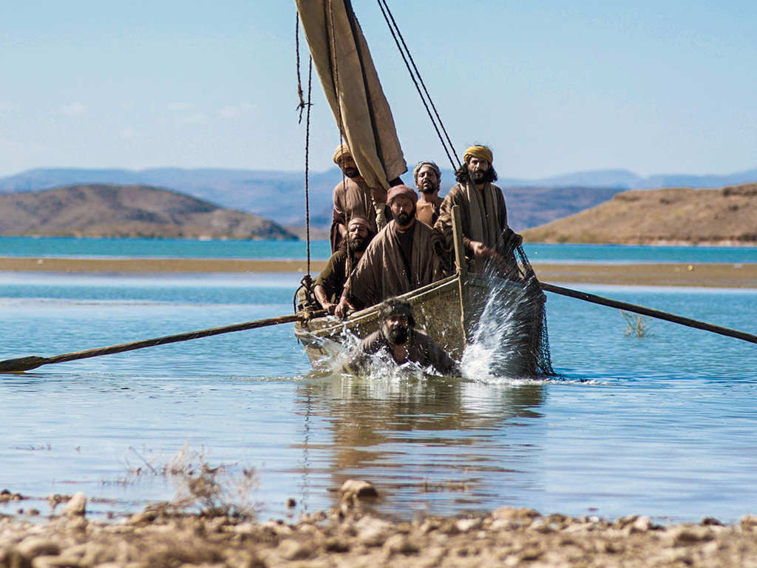
免费
圣经
图片
约翰 21:1-14
复活节的故事
耶稣在加利利
向门徒显现

Slide 81
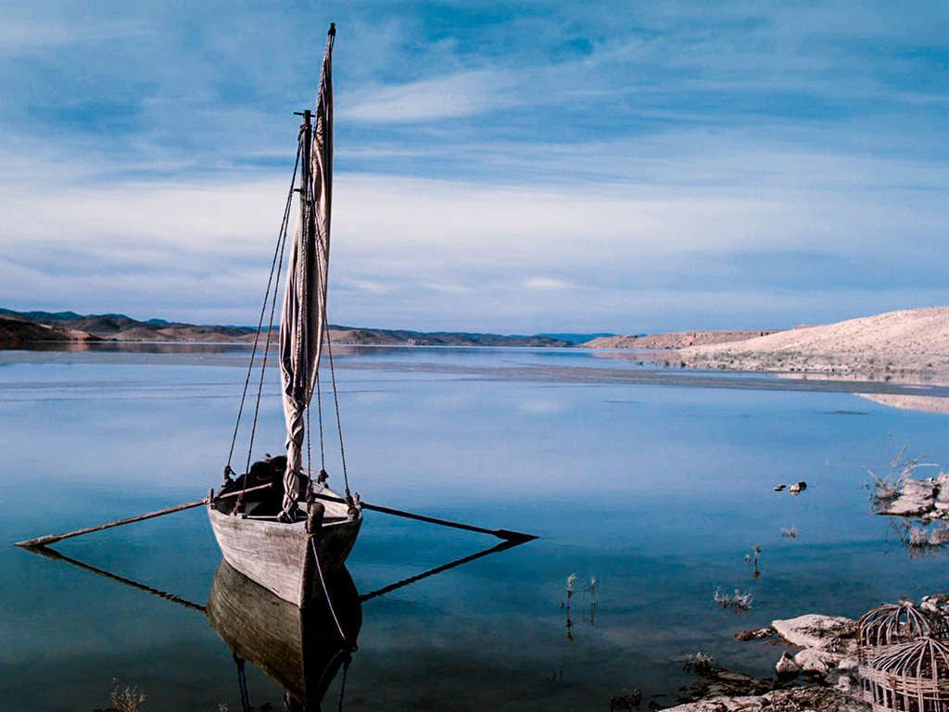

Slide 82
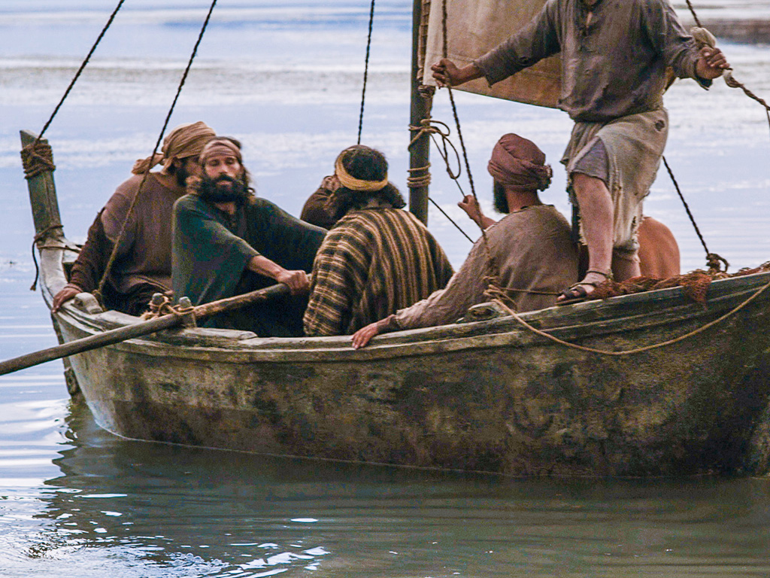

Slide 83
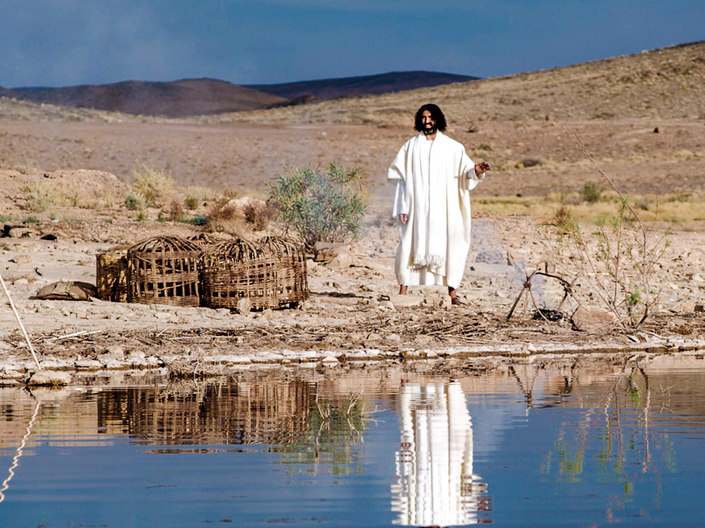

Slide 84
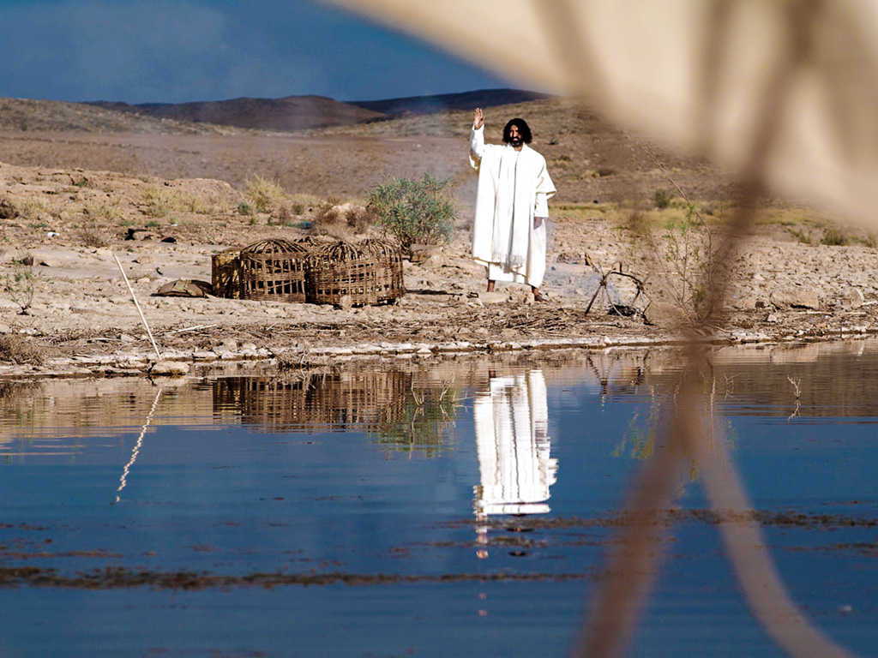

Slide 85
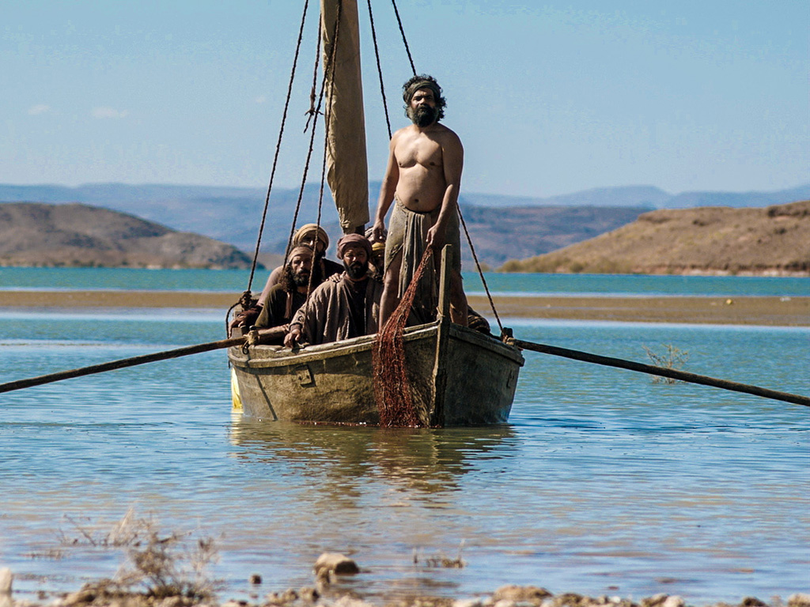

Slide 86
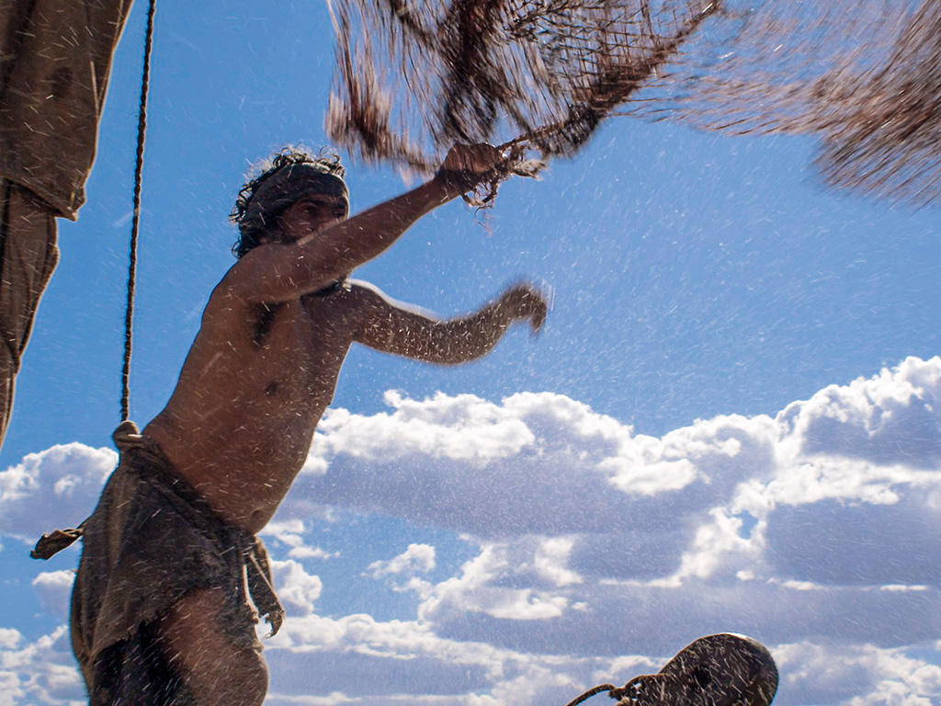

Slide 87
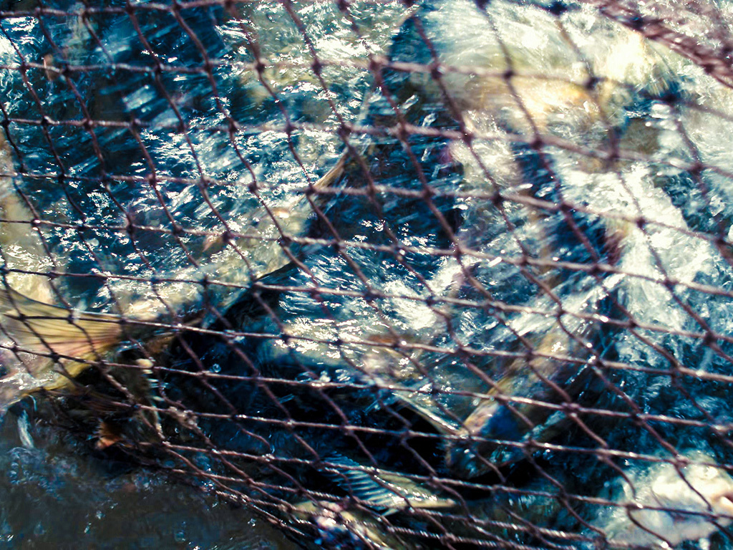

Slide 89
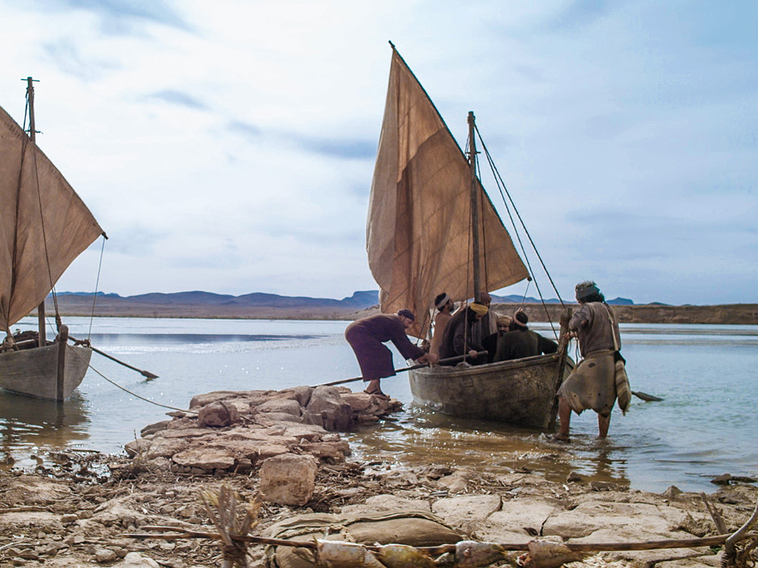

Slide 90
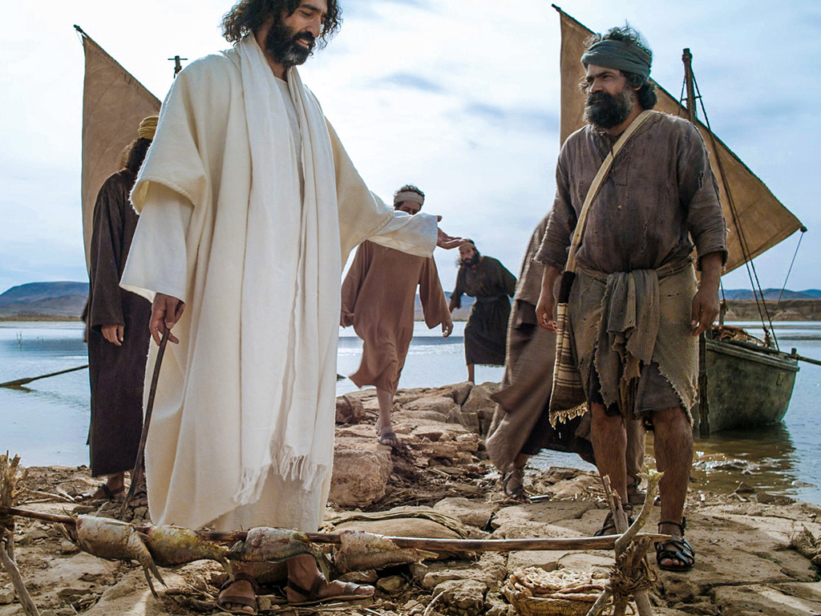

Slide 91


Slide 92


Slide 93


Slide 94


Slide 95
Free Bible Images
授权使用
免费
圣经
图片
图片中的文字

Slide 96
授权使用
马太福音
d
马可福音
o
路加福音
0
约翰福音
0
由Lumo Project出版独家资源，我们特此通知您我们不授权将这些图片发放给除freebibleimages.org客户以外的任何人。
所有图片不授权用于视频制作、epublishing或者其他媒体。所有下载的图片和文件不可通过除freebibleimages.org以外的其他网站传播，亦不可用于任何破坏基督信仰和福音的处境中。
o
图片仅供教育展示、博客和社交媒体使用；所有用途均需注明出处
www.LumoProject.com
图片声明 BBM
© 版权所有
www.bigbookmedia.com

Slide 97
II. Christ's resurrection meets you at your need
(20:10-29)
Comforts the despairing
Mary (10-18)
Encourages the discouraged disciples (19-23)
Notes:
97
97

Slide 98

甚麽使灰心丧气的彼得回头?

Slide 99

免费
圣经
图片
约翰 21:15-25
复活节的故事
耶稣问彼得

Slide 100


Slide 101


Slide 103


Slide 104


Slide 105


Slide 106


Slide 107


Slide 108


Slide 109


Slide 110


Slide 111
Free Bible Images
授权使用
免费
圣经
图片
图片中的文字

Slide 112
授权使用
马太福音
d
马可福音
o
路加福音
0
约翰福音
0
由Lumo Project出版独家资源，我们特此通知您我们不授权将这些图片发放给除freebibleimages.org客户以外的任何人。
所有图片不授权用于视频制作、epublishing或者其他媒体。所有下载的图片和文件不可通过除freebibleimages.org以外的其他网站传播，亦不可用于任何破坏基督信仰和福音的处境中。
o
图片仅供教育展示、博客和社交媒体使用；所有用途均需注明出处
www.LumoProject.com
图片声明 BBM
© 版权所有
www.bigbookmedia.com

Slide 113

How does Jesus restore us after we really mess things up?

Slide 114

A Regretful Peter

Slide 115

A Resurrected Savior

Slide 116

The Sea of Tiberias (John 21)

Slide 117
Movements
3 ways that Christ restores us after failure
Miraculous catch
Peter's Reinstatement
John's Death
Conclusion

Slide 118

I. Admit you need Christ even where you feel competent (21:1-14).

Slide 119

“Have you caught anything?”
Notes:
http://perso.wanadoo.fr/saint.pierre/pagesan/alapparition_au_lac.html

Slide 120

“No.”
“Cast your net on the right side.”
“Whoa!”
Notes:
http://perso.wanadoo.fr/saint.pierre/pagesan/alapparition_au_lac.html

Slide 121

John: “It's the Lord!”
Peter: “Jump!”
Notes:
http://perso.wanadoo.fr/saint.pierre/pagesan/alapparition_au_lac.html

Slide 122

What's the point of this miracle?
Notes:
http://perso.wanadoo.fr/saint.pierre/pagesan/alapparition_au_lac.html

Slide 123

Fish Déjà Vu
Is John alluding to the earlier account?
Luke 5:1-11
John 21:1-14
Calling
Reinstatement
Jesus in boat
Jesus on shore
“Follow me”
“Feed my lambs”
Evangelize
Shepherd
Jesus' Message Repeated: “You need me to be truly competent!”

Slide 124

Do you admit that you need Christ even in your area of competence?
Notes:
http://perso.wanadoo.fr/saint.pierre/pagesan/alapparition_au_lac.html

Slide 125
“Have you sold anything?”
"No, Lord"
Notes:
http://perso.wanadoo.fr/saint.pierre/pagesan/alapparition_au_lac.html

Slide 126

What's your area of competence?

Slide 127
I. Admit you need Christ even where you feel competent (21:1-14).

Slide 128

II. Show your love for Christ by loving people (21:15-17).

Slide 129
“Do you love me more than these?”
What are “these”?
“Do you love me more than you love fishing?”
“Do you love me more than you love these disciples?”
“Do you love me more than the rest of these disciples love me?”
Notes:
John 13:37 “I will lay down my life you” (even if the others fail you)

Slide 130
Three Questions
Do you agape me?
I phileo you.
Do you agape me?
I phileo you.
Do you phileo me?
I phileo you.

Slide 131

Three Reinstatements
Do you agape me?
Feed my lambs
Do you agape me?
Take care of my sheep
Do you phileo me?
Feed my sheep

Slide 132

"Feed my sheep."

Slide 133

Teaching Responsibility

Slide 134

Don’t feed sheep junk food!

Slide 135

Don’t abuse sheep!

Slide 136

"Feed my sheep."

Slide 137

How to get Peter out of his tunnel…
Step 1: Do the same miracle again
Step 2: Reinstate him three times

Slide 138
Do You Agape Others?
Do you agape others?
I phileo them.
Do you agape others?
I phileo them.
Do you agape others?
I phileo them.

Slide 139

Loving people is loving Christ

Slide 140
Categories of Gifts (1 Peter 4:11)
Speaking | Serving
Teaching | Administering
Evangelism | Faith
Pastor-Teacher | Giving
Encouraging | Service
 | Mercy

Slide 141
I. Admit you need Christ even where you feel competent (21:1-14).

Slide 142
II. Show your love for Christ by loving people (21:15-17).

Slide 143

III. Don't worry about Christ’s plan for others (21:18-23).

Slide 144

“…When you are old, you will stretch out your hands, and someone else will dress you and lead you where you do not want to go” (21:18)
Peter's Crucifixion
"Follow me!"

Slide 145

Peter asked Jesus, “What about him, Lord?"
(John 21:21).

Slide 146

Jesus replied, “If I want him to remain alive until I return, what is that to you? As for you, follow me" (John 21:22).

Slide 147
Jesus also commands us not to question his calling for others

Slide 148

How does Jesus restore us?

Slide 149

Jesus restores us to the calling He has for us!
Main Idea

Slide 150

How do you find the calling He has for you?

Slide 151
I. Admit you need Christ even where you feel competent (21:1-14).

Slide 152
II. Show your love for Christ by loving people (21:15-17).

Slide 153
III. Don't worry about Christ’s plan for others (21:18-23).

Slide 154

John's Conclusion (21:24-25)
“I'm an eyewitness!” (21:24)
“I haven't told half the story!” (21:25)

Slide 155

Believe in Jesus
³⁰ The disciples saw Jesus do many other miraculous signs in addition to the ones recorded in this book. ³¹ But these are written so that you may believe that Jesus is the Messiah, the Son of God, and that by believing in him you will have life by the power of his name" (20:30-31).

Slide 156

"Follow me"
"Feed my sheep"

Slide 157
M. The Commission to the Disciples
§ 196
Matthew 28:16-20; Mark 16:15-18
Christ commissions all the apostles on a mountain in Galilee to make disciples throughout the world and promises His own assistance in conjunction with that of the Holy Spirit so that the apostles would have the authority and power to be His witnesses

Slide 158

馬太福音28:18-20
耶穌進前來，對他們說：
「天上地下所有的權柄都賜給我了。所以，你們要去，使萬民作我的門徒，奉父、子、聖靈的名給他們施洗（或譯：給他們施洗，歸於父、子、聖靈的名）。 凡我所吩咐你們的，都教訓他們遵守，我就常與你們同在，直到世界的末了。」

Slide 159

既然耶稣是王，那么信徒
就会与他统治！

Slide 160


信徒会统治地球
(启示. 5:10).
“使他們 成為我們神的國度 和祭司；
他們 將要在地上做王。“

Slide 161

启 示 录 20:4-6 简图
^{4b} 他们都复活了、与基督一同作王一千年。
^{4a} 我又看见几个宝座、也有坐在上面的、并有审判的权柄赐给他们．我又看见那些因为给耶稣作见证、并为 神之道被斩者的灵魂、和那没有拜过兽与兽像、也没有在额上和手上受过他印记之人的灵魂…
1000 年
^{5b} 这是头一次的复活。 ^{6a} 在头一次复活有分的、有福了、圣洁了．第二次的死在他们身上没有权柄…
^{6b} 他们必作 神和基督的祭司、并要与基督一同作王千一年。
^{5a} 其余的死人还没有复活、直等那一千年完了。 .

Slide 162

既然耶稣满足了所有成为
以色列王的条件，代表着我们
会与他统治！
要旨

Slide 163


你现在信任这位君王吗？
在我们祈祷，“主啊，你的国度降临”之前，我们必须愿意祈祷，“让我的王国离我而去。”

Slide 164

你会在此站立吗？

Slide 165

耶稣既是羔羊也是狮子
耶稣基督
神的羔羊
犹太的狮子

Slide 166

“我相信你为我的死。”

Slide 167

你准备好与他一同统治了吗？

Slide 168

现在就决定忠诚

Slide 169

88
这经文是新约其中最困难的经节
可 16:9-20
90-92

Slide 170

Western
西方式的正文
Byzantine
拜占庭式的手稿
Alexandrian
亚历山德里亚的正文
三种正文类型
Notes:
The NT manuscripts of the early centuries of the church were copied in three main regions: Rome gave us the Western text type (or majority text, since they copied so many of them), the city of Constantinople became the capital of the Eastern Orthodox church with its Byzantine manuscripts, and a large community of Christians gathered in Alexandria, Egypt. This Alexandrian texts were the earliest, going back to about AD 200.

Slide 171
怎么处理马可16:9-20呢?
西方
90
拜占庭式的
全部有16:9-20
众多手稿
但第5至7世纪
全部有16:9-20
众多手稿
但第9至15世纪
有些省略16:9-20
仅5手稿
第4世纪，包括它
弟5至9世纪排除
亚历山大
Notes:
The NT manuscripts of the early centuries of the church were copied in three main regions:
Rome gave us the Western text type which has many manuscripts from the 8th-10th centuries, supported by the Roman Catholic church.
The city of Constantinople became the capital of the Eastern Orthodox church with its Byzantine manuscripts (or majority text, since they copied so many of them). While considerably varying, it also underlies the Textus Receptus Greek text used for most Reformation-era translations of the New Testament into vernacular languages, and
A large community of Christians gathered in Alexandria, Egypt. This Alexandrian texts were the earliest, going back to about AD 200. Modern translations mainly use Eclectic editions that conform more often to the Alexandrian text-type.

Slide 172
88
这经文是新约其中最困难的经节
可 16:9-20
90-92

Slide 173
N. The Final Commission
§ 197
Luke 24:44-49
After some time with the apostles in Galilee, Christ returns to Jerusalem with them in order to open their minds that they may comprehend the Scriptures and to encourage them to stay in the city until they receive the baptism of the Spirit to empower them for ministry

Slide 174
O. The Ascension of Christ
§ 198
Mark 16:19-20; Luke 24: 50-53
On the Mount of Olives Jesus blesses His disciples and is received into heaven in their sight to sit at the right hand of God that He might carry on His present ministry for the saints

Slide 175

Jesus ascended to the Father
This means he is alive now!

Slide 176
P. The Parables of Christ
Passages
Summary

Slide 177

GALILEAN MINISTRY
JESUS'
LATER STAGES

Slide 178

Introduction
Jesus’ Galilean Ministry- Later Stages
Parables
Miracles
Withdrawal

Slide 179

Intro to Parable
Parables
Parable is:
- a brief metaphorical narrative
- a narrative of imagined events used to illustrate a
moral or spiritual lesson (Oxford Dictionary)
GREEK
“parabole” comes from two words that mean “to throw along side”

Slide 180

Parables : Views
Each parable makes only one main point and the details within the parables are not to be allegorized.
(Adolf Julicher, 19th Century)
A valuable working hypothesis for interpreting the parables may be to look for one main point associated with each main character or group of characters in the parables.
(Craig L. Blomberg)
Parables are generally lifelike

Slide 181
COMMON PARABLE STRUCTURES
Triadic Parables
Good
Example
Unifier
Bad
Example
Master
Good
Subordinate
Wicked
Subordinate
Samaritan
Man in
ditch
Priest/
Levite
Father
Master
King
Prodigal
Son
Older
Brother
Subordinate
Servant forgiven large debt
Sub-Subordinate
Servant owing small debt
MONARCHIC
NON MONARCHIC
Blomberg, Jesus and the Gospels

Slide 182
COMMON PARABLE STRUCTURES
Dyadic Parables
Master
Farmer
Good
Example
Bad
Example
Servant
Seed Growing
Secretly
Tax
Collector
Pharisee
Monadic Parables
One
Main
Character
Treasure
Hunter
Blomberg, Jesus and the Gospels

Slide 183


MINISTRY OF VARIOUS WOMEN
(Luke 7:36-8:3)
Jesus compared the woman with the forgiven debtor and declared her sins forgiven. The final word of the passage overall is a declaration of the woman’s salvation.
“for she loved much,” was later used by traditional Catholic thought to justify works-righteousness.
Parables

Slide 184

PARABLES
JESUS'

Slide 185


Historicity
form the very
core of the
teaching of Jesus
Parables
illustrate the kingdom of God

Slide 186
Theological Distinctives
Mark
Matthew
Luke
Understanding the parable is the key to discern the gospel’s meaning
Transition from Jesus’ self-disclosure to Israel
How to hear and obey the Word of God

Slide 187
Q. The Miracles of Christ
Passages
Summary

Slide 188

Why did John write about Jesus' miracles?
III. All of Christ's miracles are to bring us to faith in Him (20:30-31)
These [signs] are written so that you may believe that Jesus is the Christ, the Son of God, and that by believing you may have life in his name (John 20:31).

Slide 189
MIRACLES
Background Considerations

Slide 190


MIRACLES
Background Considerations
KINGDOM OF GOD

Slide 191
MIRACLES
JESUS'

Slide 192


Historicity
KINGDOM OF GOD

Slide 193
Each Gospel Has a Theological Distinctive
Matthew
Luke
John
Christological Issues
Magical View & Stress on Satan’s power
Signs to encourage faith
  The primary focus is CHRISTOLOGICAL to demonstrate that Jesus is the divine Messiah and that the kingdom of God is now breaking into human history with new force.
Mark
Suffering Messiah

Slide 194



Withdrawal from Galilee
Third main period of ministry
REJECTION!
Galilee
Jerusalem

Slide 195
Withdrawal from Galilee
Third main period of ministry
REJECTION!
Withdrawal

Slide 196

Withdrawal from Galilee
Third main period of ministry
REJECTION!
Peter’s Confession & Aftermath

Slide 197
Theological Distinctive
Mark
Matthew
Luke
Jesus the Suffering Servant
Ministry among Jews & Gentiles
Jesus as Eschatological prophet and discipleship

Slide 198


Conclusion

Slide 199
Black

Slide 200


基督生命链接地址 BibleStudyDownloads.org
免费获得该讲解!
圣经学习下载
Notes:
Bible Geograhpy (bg)

