Slide 1
拒绝君王
§§ 168-183
Section summaries based on J. Dwight Pentecost, A Harmony of the Words and Works of Jesus Christ (Grand Rapids: Zondervan, 1981)
Dr. Rick Griffith • Singapore Bible College • BibleStudyDownloads.org
The Messiah is rejected by the nation in His arrest, trials, procession to Calvary, crucifixion, burial and sealing of the tomb that He might bear the sins of the world on the cross

Slide 2
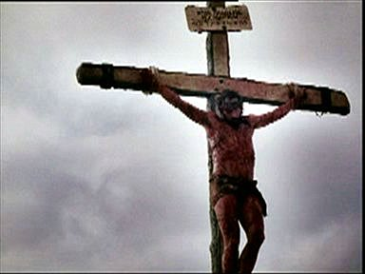
The Suffering Christ

Slide 3
Content
Experience Jesus’ 7 Last Day
Experience Jesus’ 6 Last Trials
Experience Jesus’ 7 Last Tortures
Experience Jesus’ 7 Last Word

Slide 4
Objectives
Experience God’s love
The seriousness of Sin
Grateful for what Christ had done
May follow the example of Christ

Slide 5
Journey with Christ Begins

Slide 6

受难周
星期一
星期二
115
星期三
星期五
星期四
星期日
Fri
星期六
星期六
星期日

Slide 7
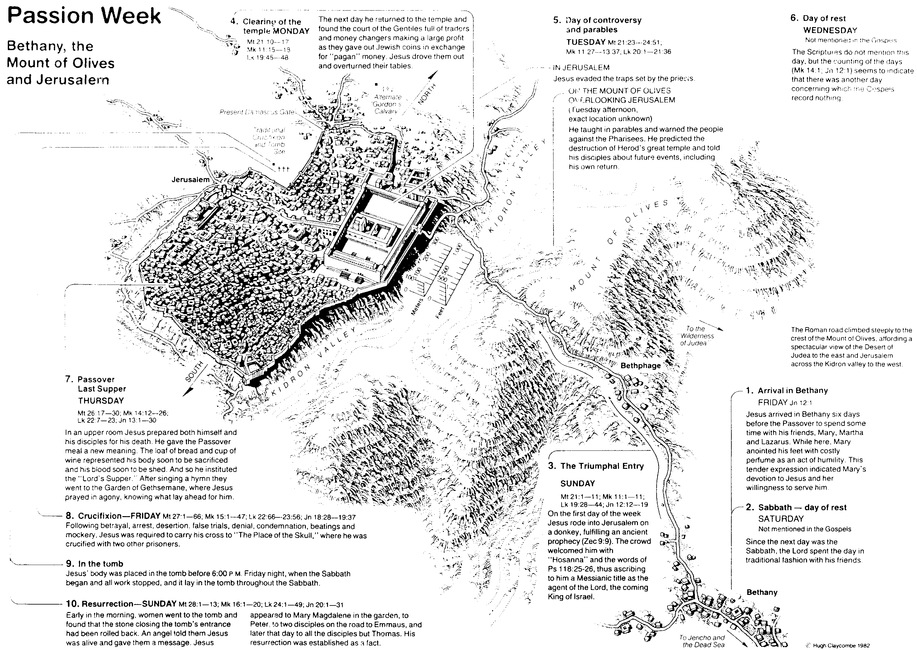
Jesus’ 7 Last Days
Day 1 Friday
Jesus Arrived in Bethany Jn 12:1
Day 2 Saturday
Sabbath
Dr Rick NT Survey p64

Slide 8
Sunday
Day 3 Sunday
The Triumphal Entry
MT 21:1-11; Mk 11:1-11; LK 19:28-44; Jn 12:12-19

Slide 9
Monday
Day 4 Monday
Jesus Clearing the Temple
Mt 21:10-17; Mk 11:15-18 Lk 19:45-48

Slide 10
Tuesday & Wednesday
Day 5 Tuesday
Controversy & Parables
MT 21:23-24:51; Mk 11:27-13:37; Lk 20:1-21:36
Day 6 Wednesday
Day of Rest

Slide 11
Thursday
Day 7 Thursday
Passover Last Supper
Mt 26: 17-30; Mk 14:12-26;Lk 22:7-23; Jn 13:1-30

Slide 12
Friday
Day 8 Friday
Crucifixion/ Tomb
Mt27:1-66; Mk 15:1-47; Lk 22:66-23:56; Jn 18:28-19:37

Slide 13
Jesus’ final week
Sat: Anointing in Bethany
Sun: Triumphal
Mon: Temple cleansing
Tue: Teaching
Wed: ?
Thu: Passover
Fri: Trials & execution
Blomberg p315

Slide 14
Jesus’ Final Hours
Thursday--------------
Aftersun down
Thurs-Friday----------
NightTime
Last supper
Prayer in Garden
Betrayal
Custody
Hearing Before Annas
Trial Before Caiaphas
Peter’s denial
Blomberg p342

Slide 15
Jesus’ Final hours
Friday------------------
Early morning
Late Morning----------
Midafternoon----------
Near Sundown--------
Sanhedrin Completes
Deliberations
Jesus Sent To Pilate
Hearing Before Pilate
Jesus Sent To Herod
Return To Pilate
Jesus Nailed To Cross
Jesus Dies
Jesus Buried
Blomberg p342

Slide 16
Crucifixion
Most Cruelest form of execution
Most Shameful
Roman Citizen exempted
Worst criminal
Tie with a rope or nails through
X-shape or t-shape
Die suffocation

Slide 17
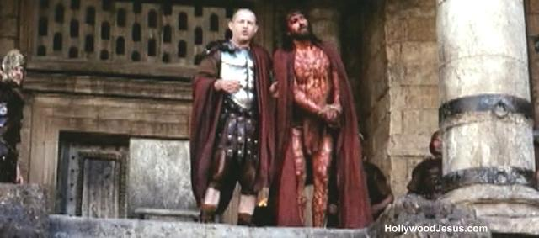
Why Jesus Choose To Die?

Slide 18
A. The Arrest
§ 168
Matthew 26:47-56; Mark 14:43-52; Luke 22:47-53; John 18:2-12a
Christ voluntarily and aggressively allows Himself to be betrayed and arrested in Gethsemane, all the time being in complete control and demonstrating authority over His adversaries

Slide 19


马太 26:36-56
马可 14:32-52
路加 22:39-53
约翰 18:1-12
复活节的故事
耶稣在客西马尼
祷告

Slide 20


Slide 21


Slide 22


Slide 23


Slide 24


Slide 26


Slide 27


Slide 28


Slide 29


Slide 30


Slide 31


Slide 32


Slide 33


Slide 34


Slide 35


Slide 36


Slide 37


Slide 38


Slide 39


Slide 40

Free Bible Images
授权使用
免费
圣经
图片
图片中的文字

Slide 41

授权使用
马太福音
d
马可福音
o
路加福音
0
约翰福音
0
由Lumo Project出版独家资源，我们特此通知您我们不授权将这些图片发放给除freebibleimages.org客户以外的任何人。
所有图片不授权用于视频制作、epublishing或者其他媒体。所有下载的图片和文件不可通过除freebibleimages.org以外的其他网站传播，亦不可用于任何破坏基督信仰和福音的处境中。
o
图片仅供教育展示、博客和社交媒体使用；所有用途均需注明出处
www.LumoProject.com
图片声明 BBM
© 版权所有
www.bigbookmedia.com

Slide 42
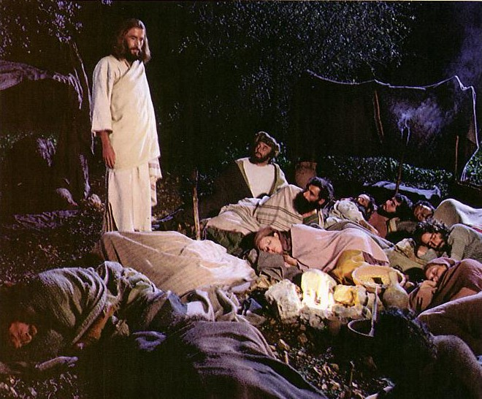
Jesus controlled His own arrest (John 18:1-11).

Slide 43
B. The Religious Trial
§§ 169-173
Christ is illegally tried by religious authorities on religious grounds as to His following, teaching and supposed blasphemy that this unjust treatment might lead Him to the cross as the sacrifice for sin

Slide 44
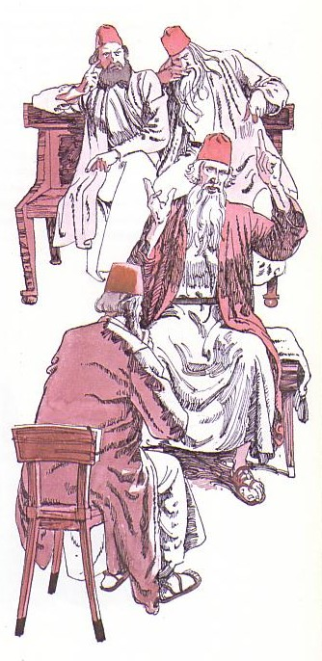
Jesus' illegal trials proved Him innocent (18:12–19:16a).
Notes:
Then his six illegal trials proved him innocent!

Slide 45
Jesus’ 6 Last Trials
Dr Rick, Nt Survey p 65
Annas. ex-high priest
Caiaphas and Sanhedrin
Sanderdrin and 70 ruling leaders of Israel
Pilate, governor of Judea
Herod Antipas of Galilee
Return To Pilate

Slide 46
Jesus’ Unjust Trials
Held at night
No specific charge
No witness
No defense attorney
No proof of guilt
This was not a trial but a planned murdered

Slide 47
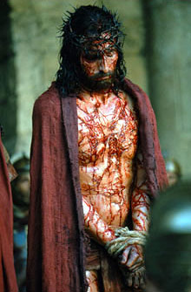
Why Jesus kept silent?

Slide 48
1. The Examination before Annas
§ 169
John 18:12b-14, 19:23
Annas, the deposed high priest who is recognized by the Jews, illegally evaluates Christ's following and teaching and allows the religious trial to continue by sending Christ to Caiaphas

Slide 49
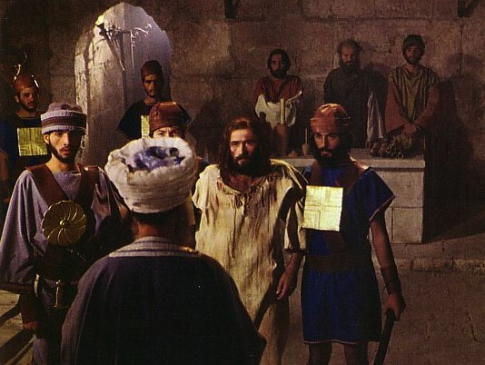
The Jewish Trials: Annas
Illegal
No longer high priest
At night
In a home
No witnesses
No actual charge
Violence
Illegal
Illegal
Illegal
Illegal
Illegal
Notes:
The trial by Annas was illegal.

Slide 50
2. Examination before Caiaphas
§ 170
Matthew 26:57, 59-68; Mark 14:53, 55-65; Luke 22:54a, 63-65; John 18:24
Caiaphas, the unrecognized high priest of the Jews, and the Sanhedrin illegally evaluate Christ's testimony and charge Him with blasphemy based on His own confession, concluding that He is worthy of death

Slide 51

The Illegal Trial by Caiaphas
Closed meeting
At house of Caiaphas
Held at night
No specific charges
Accusations changed
No defense attorney
Verdict already determined
Bribe
No waiting period
Illegal
Notes:
The trial by Caiaphas was also illegal.

Slide 52
3. Denial by Peter
§ 171
Matthew 26:58, 69-75; Mark 14: 54, 66-72; Luke 22:54b-62;
John 18:15-18, 25-27
Peter denies the Lord three times, thus demonstrating the truthfulness of Christ's prediction and his inadequacy apart from Jesus' presence while in the company of His adversaries

Slide 53
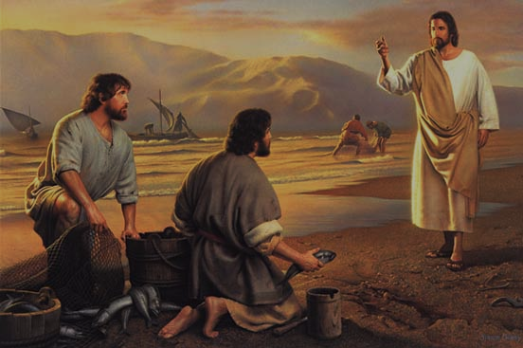
彼得的呼召
（马可福音的来源）

Slide 54
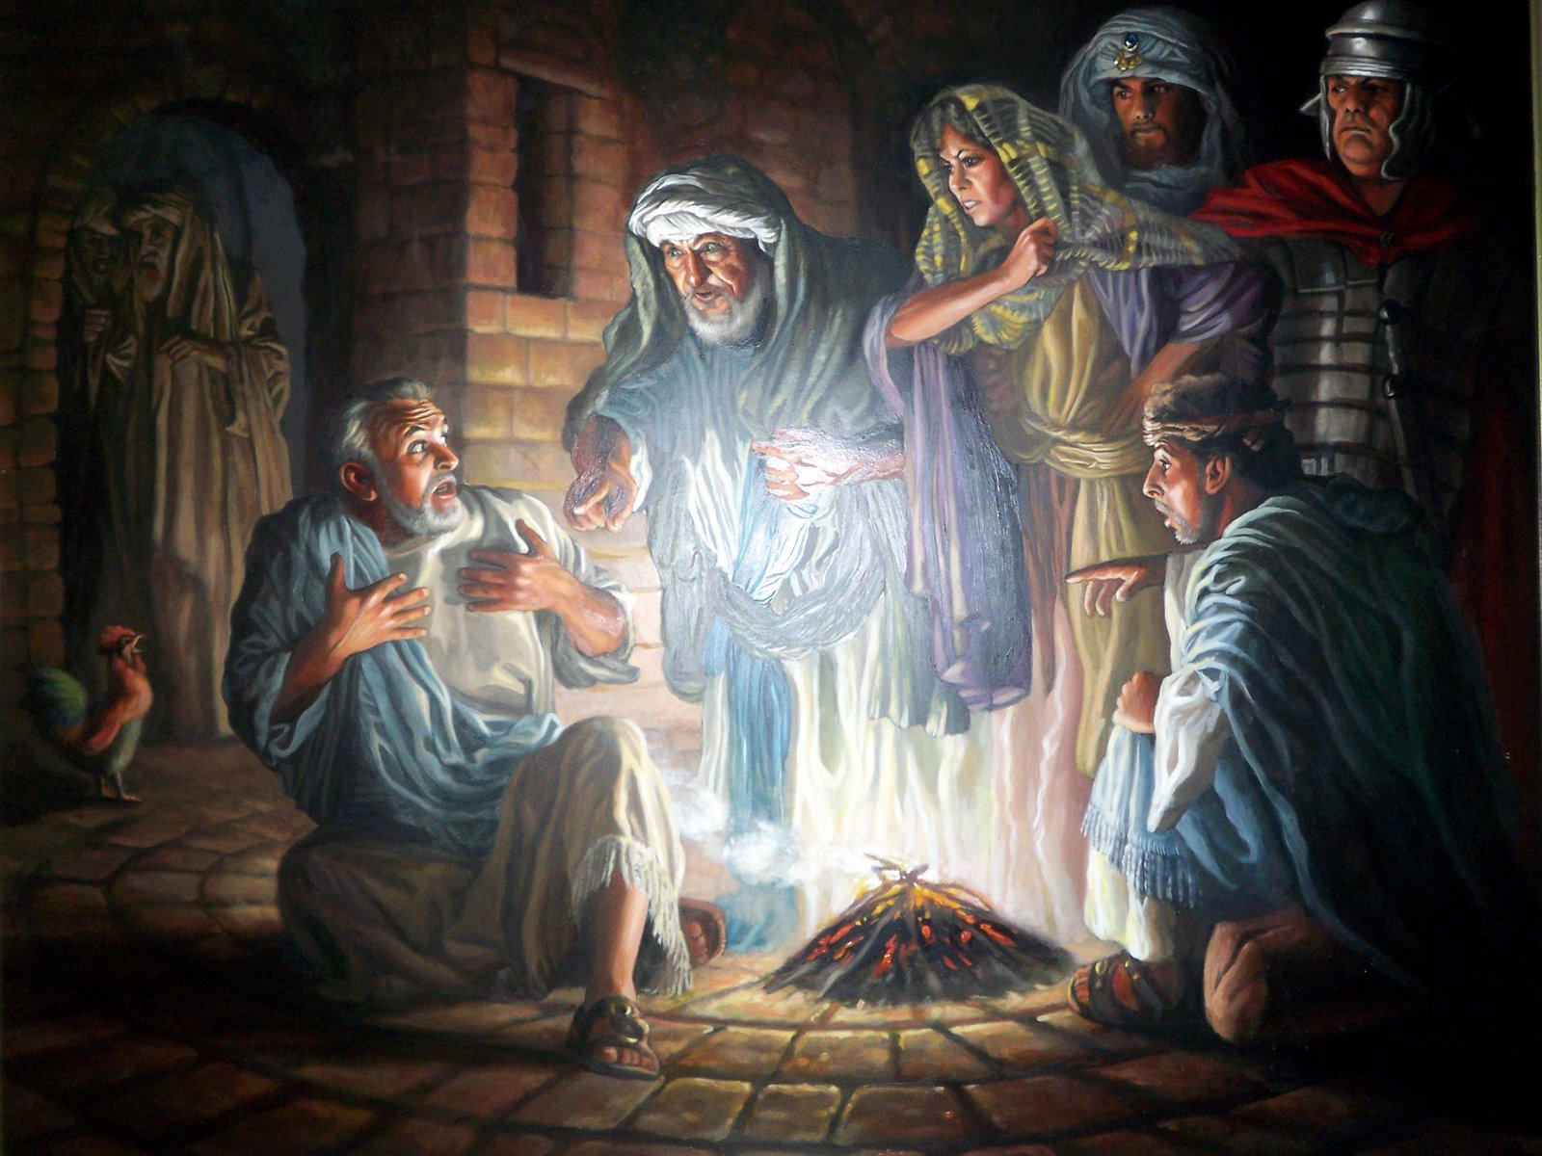
彼得三次不认主

Slide 55



马太 26:69-75
马可 14:66-72
路加 22:54-62
约翰 18:15-27
复活节的故事
彼得不认耶稣

Slide 56


Slide 57


Slide 58


Slide 59


Slide 60


Slide 61


Slide 62


Slide 63


Slide 64


Slide 66

图片声明 Big Book Media
© 版权所有.
授权使用
BIG BOOK MEDIA

Slide 67
Free Bible Images
授权使用
免费
圣经
图片
图片中的文字

Slide 68
4. Condemnation by the Sanhedrin
§ 172
Matthew 27:1; Mark 15:1a; Luke 22:66-71
The entire Sanhedrin illegally tries Jesus before dawn to ratify what had illegally taken place during the night when only a portion of the court had been present at the house of Caiaphas, sentencing Him to death for blasphemy

Slide 69


马太 26:57-67
马可 14:53-65
路加 22:66-71
约翰 18:15-27
复活节的故事
耶稣在公议会面前

Slide 70


Slide 71


Slide 72


Slide 74


Slide 75


Slide 76


Slide 77


Slide 78
Free Bible Images
授权使用
免费
圣经
图片
图片中的文字

Slide 79
授权使用
马太福音
d
马可福音
o
路加福音
0
约翰福音
0
由Lumo Project出版独家资源，我们特此通知您我们不授权将这些图片发放给除freebibleimages.org客户以外的任何人。
所有图片不授权用于视频制作、epublishing或者其他媒体。所有下载的图片和文件不可通过除freebibleimages.org以外的其他网站传播，亦不可用于任何破坏基督信仰和福音的处境中。
o
图片仅供教育展示、博客和社交媒体使用；所有用途均需注明出处
www.LumoProject.com
图片声明 BBM
© 版权所有
www.bigbookmedia.com

Slide 80
5. Death of Judas
§ 173
Matthew 27:3-10
Judas returns the thirty coins to the temple, commits suicide by hanging in unrepentant remorse and the money is used to purchase a burial place for foreigners that the prophecies of Zechariah (11:12-13) and Jeremiah (18:1-4; 19:1-3) might be fulfilled

Slide 81
C. The Civil Trial
§§ 174-177
Since the Jews could not legally execute anyone, the religious leaders bring Jesus before the Romans and change the charge from blasphemy, a religious one, to treason, a political accusation, which, after three trials, succeeds in having Him mocked and lead away for crucifixion

Slide 82

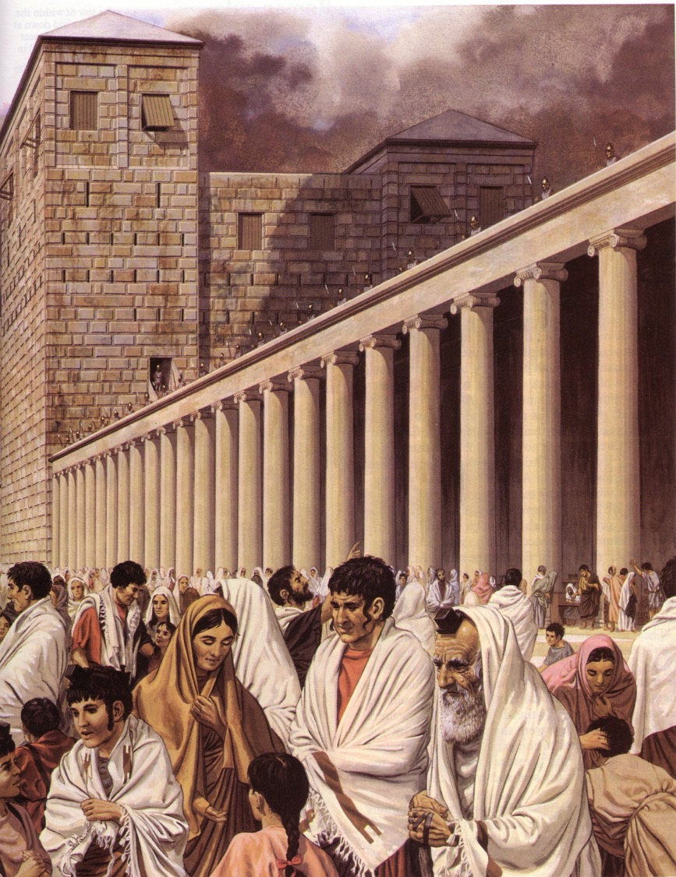
The Roman Trials
Notes:
Then the trials by Romans were illegal.

Slide 83
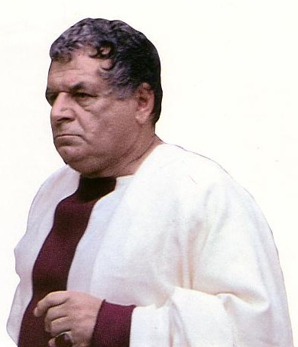
Three Roman Mockeries
Illegal
Pilate
Antipas
Pilate (second time)
Illegal
Illegal
Charge:
Treason
Notes:
Then the trials by Romans were illegal. They also charged Jesus treason but never proved their claim.

Slide 84
1. Trial Before Pilate
§ 174
Matthew 27:2, 11-14; Mark 15:1b-5; Luke 23:1-5; John 18:28-38
Pilate declares Christ innocent of the ambiguous charges laid against Him and makes several attempts to save Him from the cross, concluding that His kingdom was no threat to Rome

Slide 85
2. Trial Before Herod
§ 175
Luke 23:6-12
Pilate, seeking to avoid making a judgment on Christ, sends Him to Herod, who ruled over Galilee, but Herod also declares Christ innocent of treason

Slide 86
3. Trial Before Pilate
§ 176
Matthew 27:15-26; Mark 15:6-15; Luke 23:13-25;
John 18:39-19:1, 4-16a
Pilate thrice again declares Jesus innocent of treason but offers the Jews the option of having Jesus or the murderer Barabbas released and is surprised that the Jews prefer the releasing of Barabbas, so Pilate flogs Jesus, seeks to absolve himself from responsibility by washing his hands and delivers Him over to be crucified from fear of Rome's reprisal, the crowd's displeasure and possible judgment from a deity if Jesus is indeed God

Slide 87
4. Mockery
§ 177
Matthew 27:27-30; Mark 15:16-19; John 19:2-3
Since Christ was condemned for being a king, the Roman soldiers act out a mock coronation but also repeatedly beat Him and spit upon Him before taking Him away for crucifixion

Slide 88
Jesus’ Seven Last Tortures
Sleepless Night
Fists
Scourging
Thorn Crown
Wooden Cross
Nails
Spear

Slide 89
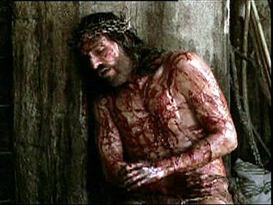
Sleepless night

Slide 90
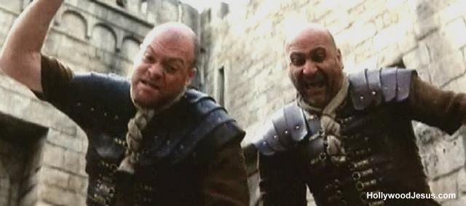
Beaten By Guards

Slide 91
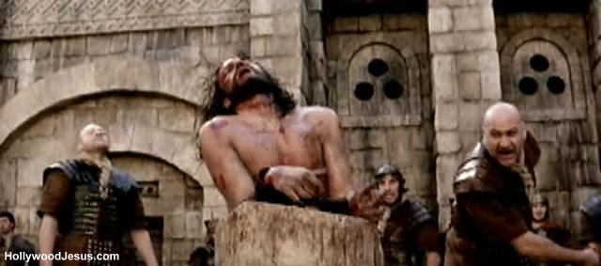
Scourging

Slide 92
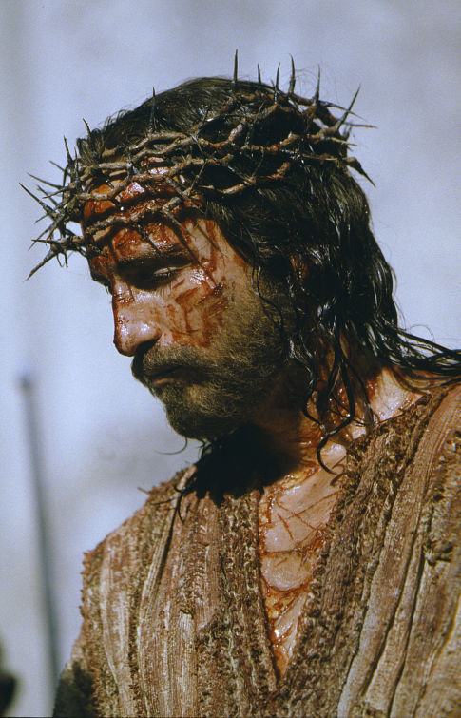
Thorn Crown

Slide 93


马太 27:27-37
马可 15:16-25
路加 23:26-34
约翰 19:16-27
复活节的故事
耶稣被钉十字架

Slide 94


Slide 95


Slide 96


Slide 97


Slide 98


Slide 99


Slide 100


Slide 101


Slide 102


Slide 103


Slide 104


Slide 105


Slide 106


Slide 107


Slide 108


Slide 109


Slide 110
Free Bible Images
授权使用
免费
圣经
图片
图片中的文字

Slide 111
授权使用
马太福音
d
马可福音
o
路加福音
0
约翰福音
0
由Lumo Project出版独家资源，我们特此通知您我们不授权将这些图片发放给除freebibleimages.org客户以外的任何人。
所有图片不授权用于视频制作、epublishing或者其他媒体。所有下载的图片和文件不可通过除freebibleimages.org以外的其他网站传播，亦不可用于任何破坏基督信仰和福音的处境中。
o
图片仅供教育展示、博客和社交媒体使用；所有用途均需注明出处
www.LumoProject.com
图片声明 BBM
© 版权所有
www.bigbookmedia.com

Slide 112
D. Procession to Calvary
§ 178
Matthew 27:31-34; Mark 15:20-23; Luke 23:26-33;
John 19:16b-17
Christ attempts to carry His cross to Calvary but since He is unable to do so Simon of Cyrene is forced to bear it, indicating the severity of the beating Jesus received from the guards

Slide 113

Today: Jesus' death paid for our sin (19:16b-42)
Notes:
Today in John 19:16b-42 we finish the passion account where it shows how Christ voluntarily gave his life for us.

Slide 114

Two Movements
Death
Burial
Notes:
Today we’ll see true love in two movements—Christ’s death and burial—that they support the concept of his atonement.
The first evidence that Jesus genuinely took our sin upon him was that…

Slide 115

I. Christ fulfilled Scripture in his selfless death (19:16b-37).
Selflessness
Fulfillments
Carried cross
Notes:
Jesus paid for our sin by dying to fulfill prophecy and with utmost care for others.
• Jesus showed selflessness by carrying his own cross (19:16b-17).
The typical criminal had to do this—even those crucified on either side of Christ.

Slide 116
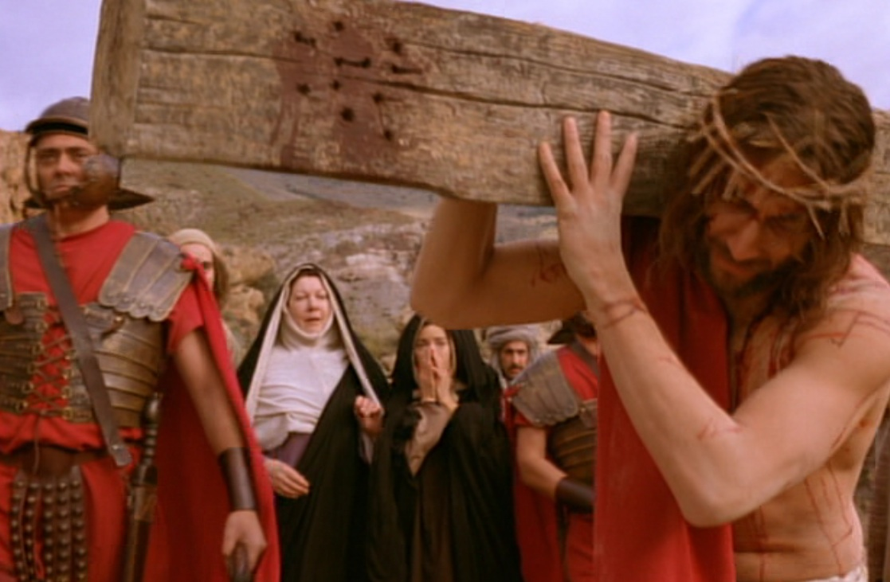
Carrying His Own Cross
Notes:
But Jesus didn’t have to carry his own cross. Matt. 26:53 says had the power to get out of arrest when he could have called 72,000 angels! That’s 12 legions of angels to defend Him. A Roman legion numbered about 6,000 soldiers.

Slide 117
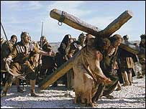
Wooden Cross

Slide 118
E. The Crucifixion
§§ 179-181
Christ is crucified for the sins of the world with signs accompanying His death to indicate that the people had executed the very Messiah Himself

Slide 119


马太 27:38-66
马可 15:25-47
路加 23:35-56
约翰 19:28-42
复活节的故事
耶稣死在十字架上

Slide 120


Slide 121


Slide 122


Slide 123


Slide 124


Slide 125


Slide 126


Slide 128


Slide 129


Slide 131


Slide 132
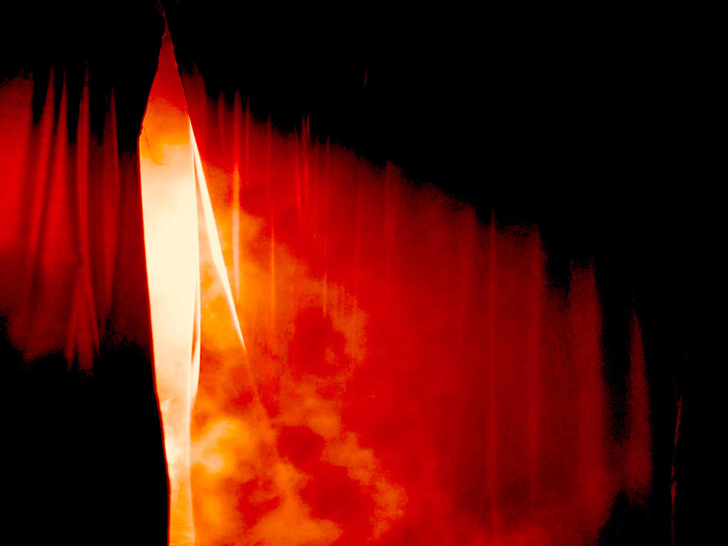

Slide 133


Slide 134


Slide 135


Slide 136


Slide 137


Slide 138
Free Bible Images
授权使用
免费
圣经
图片
图片中的文字

Slide 139
授权使用
马太福音
d
马可福音
o
路加福音
0
约翰福音
0
由Lumo Project出版独家资源，我们特此通知您我们不授权将这些图片发放给除freebibleimages.org客户以外的任何人。
所有图片不授权用于视频制作、epublishing或者其他媒体。所有下载的图片和文件不可通过除freebibleimages.org以外的其他网站传播，亦不可用于任何破坏基督信仰和福音的处境中。
o
图片仅供教育展示、博客和社交媒体使用；所有用途均需注明出处
www.LumoProject.com
图片声明 BBM
© 版权所有
www.bigbookmedia.com

Slide 140
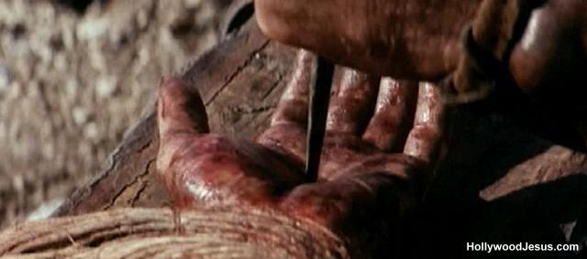
Nailed

Slide 141
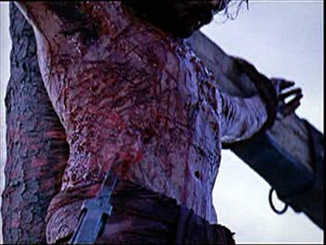
Speared
Spear
Spear

Slide 142
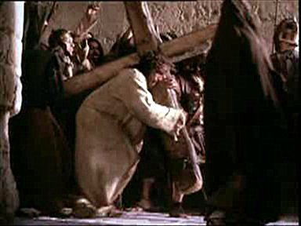
Why He chose to suffer?

Slide 143
I. Christ fulfilled Scripture in his selfless death (19:16b-37).
Selflessness
Fulfillments
Carried cross
Crucifixion
Notes:
Jesus died selflessly in public crucifixion amidst contempt by the Jews (19:18-22).

Slide 144
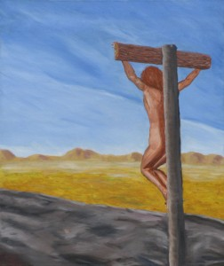
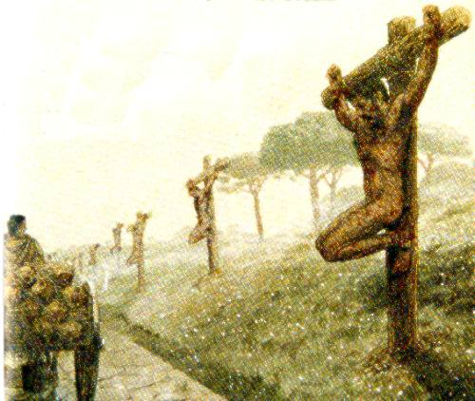
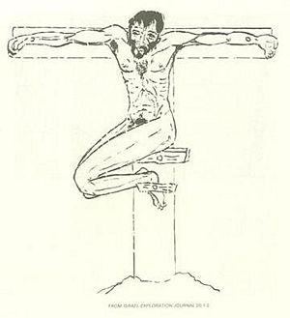
Crucified Naked
Notes:
We can’t really imagine the shame of crucifixion today as we execute criminals clothed. But, despite what the movies show, Jesus was totally naked—no loin cloth!

Slide 145
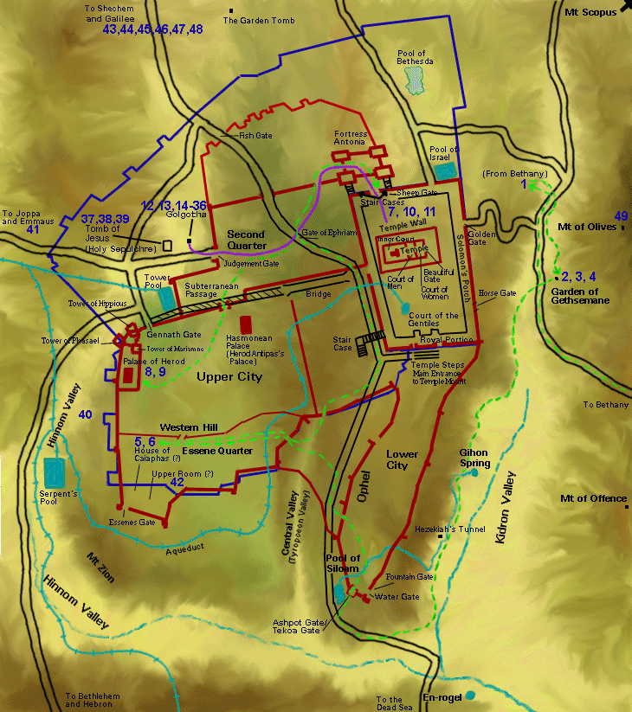
Jesus' Final Movements
Notes:
Jesus’ crucifixion was definitely public—on a main road either at the Garden Tomb or Church of the Holy Sepulcher.

Slide 146
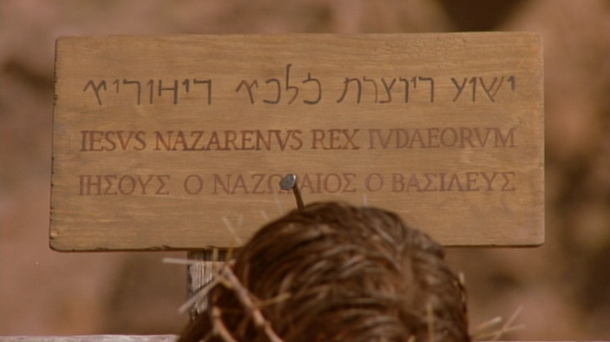
The Placard
Notes:
To intensify the shame, a sign above Jesus was in three languages so the many who passed by on this key road just outside the city could read it. Passover was the biggest holiday of the year with about 90,000 people in Jerusalem.

Slide 147
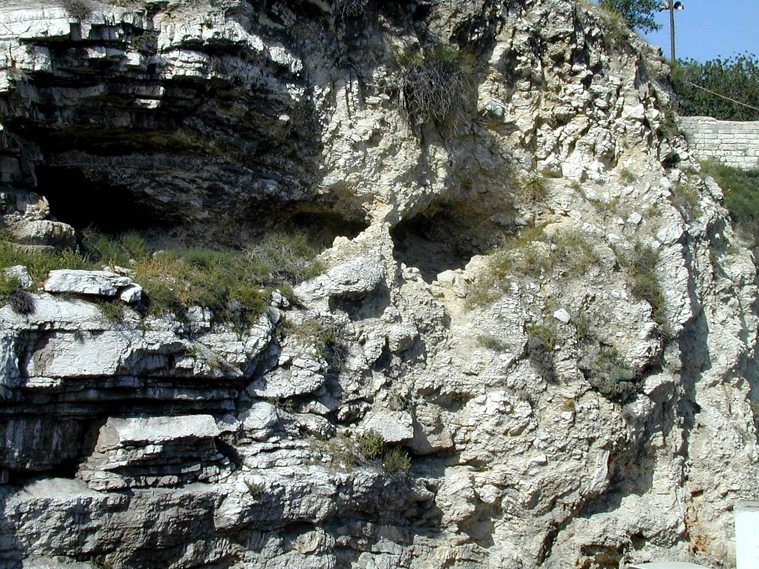
Gordon's Calvary
Notes:
Interestingly, the northern site for the crucifixion of Christ is the outcropping that looks like a skull at Gordon’s Calvary—

Slide 148
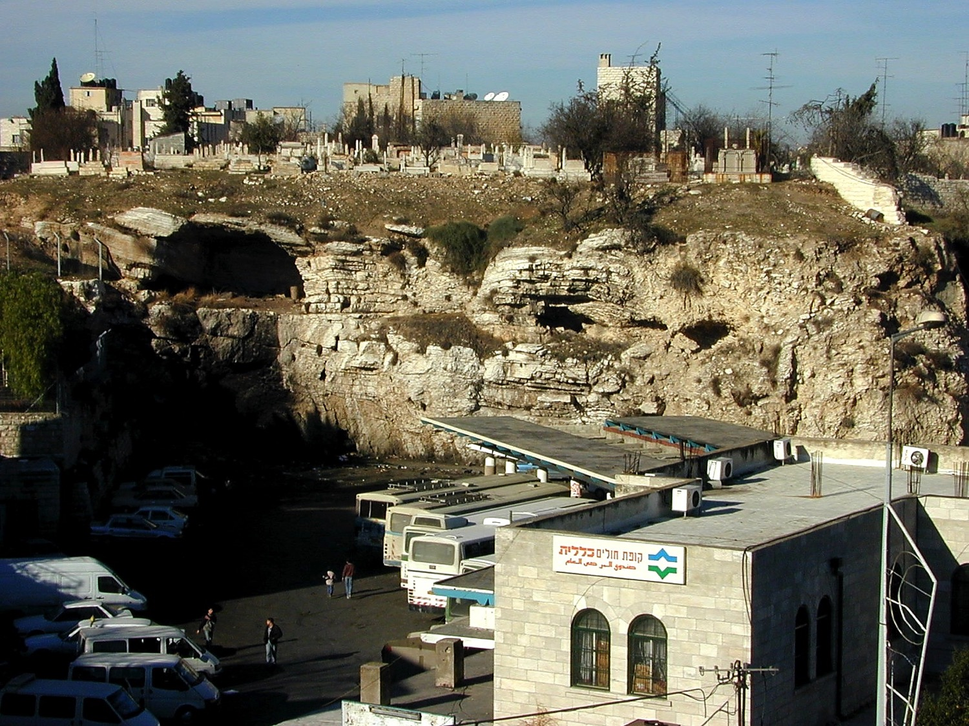
Gordon's Calvary
Notes:
—which is still next to a popular place—a bus station!

Slide 149
I. Christ fulfilled Scripture in his selfless death (19:16b-37).
Selflessness
Fulfillments
Carried cross
Clothes divided
Crucifixion
Notes:
Jesus fulfilled Scripture by allowing His clothes to be divided and bargained for (19:23-24).
One might think that Jesus would, at the least, have his mother take his clothes—but no, he was not spared the indignity of even having his clothes taken from him.

Slide 150
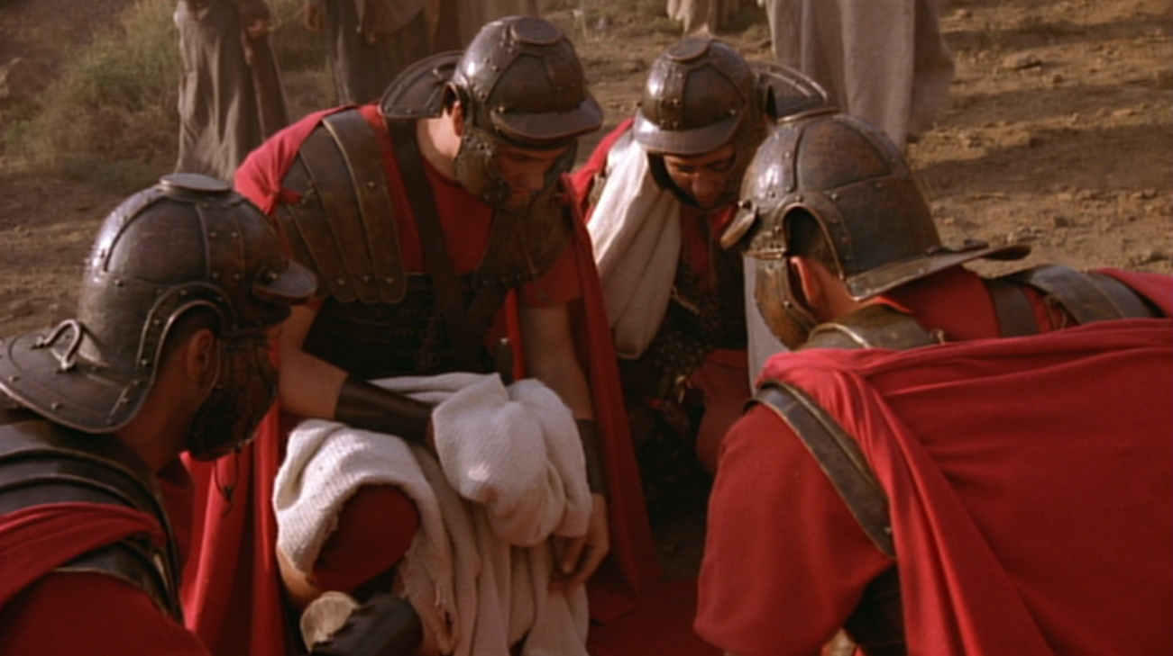
5 Items to Divide
Turban–Sandals–Robe–Outer Garment–Girdle
Notes:
Wiersbe notes, “At most Roman executions, a centurion would be assigned with four soldiers to assist him… It was the privilege of the soldiers to share whatever personal belongings the victims had; so they divided up all that Jesus owned—His personal clothing. He would have had a turban, a pair of sandals, an undergarment (the seamless robe), an outer garment, and a girdle. The four men each took a piece of clothing, and then they gambled for the seamless robe.”
Warren W. Wiersbe, The Bible Exposition Commentary (Wheaton, Ill.: Victor Books, 1996, c1989), Jn 19:17.

Slide 151
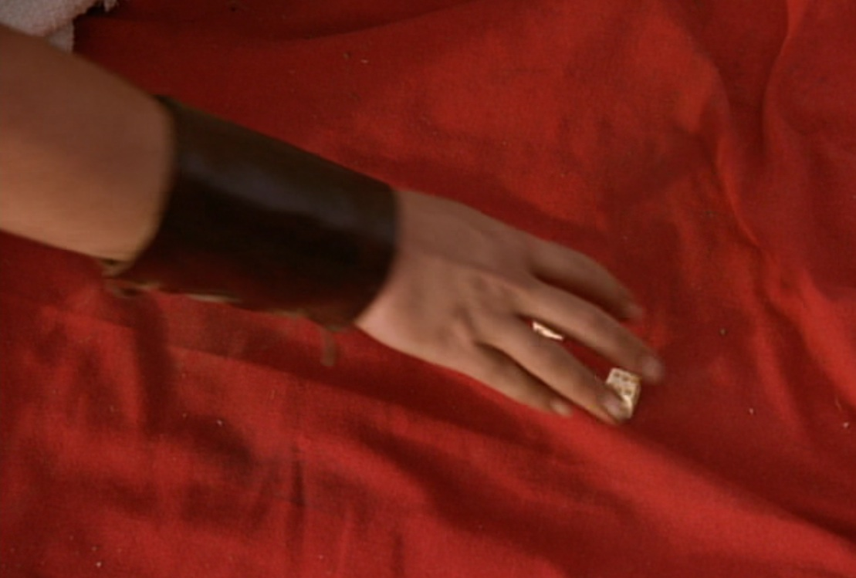
"They divided my garments among themselves and threw dice for my clothing" (Ps. 22:18)
Notes:
Psalm 22:18 was fulfilled in, “They divided my garments among themselves and threw dice for my clothing” (19:24 NLT).

Slide 152
1. First Three Hours
§ 179
Matthew 27:35-44; Mark 15:24-32; Luke 23:34-43; John 19:18-27
While on the cross the first three hours Christ utters three statements indicating His forgiveness of His tormentors, the salvation of one thief beside Him and the entrusting of His mother Mary to John, thus indicating His concern for others even while approaching death

Slide 153
Jesus’ Seven Last Word
“Father, forgive them, for they do not know what they are doing” (Luke 23:34)
“I tell you the truth, today you will be with me in paradise” (Luke 23:43)
“Dear woman, here is your son,” and “Here is your” (John 19:27)
Blomberg p347-348

Slide 154
I. Christ fulfilled Scripture in his selfless death (19:16b-37).
Selflessness
Fulfillments
Carried cross
Clothes divided
Crucifixion
Cared for Mary
Notes:
Jesus died selflessly by committing care for His mother to His disciple John (19:25-27).
Most crucified men could not endure such shame and pain, so they heaped abuse on their tormenters. Instead, Jesus prayed that God would forgive them! Rather than concern for himself, Christ also thought about the future care of his mother.

Slide 155
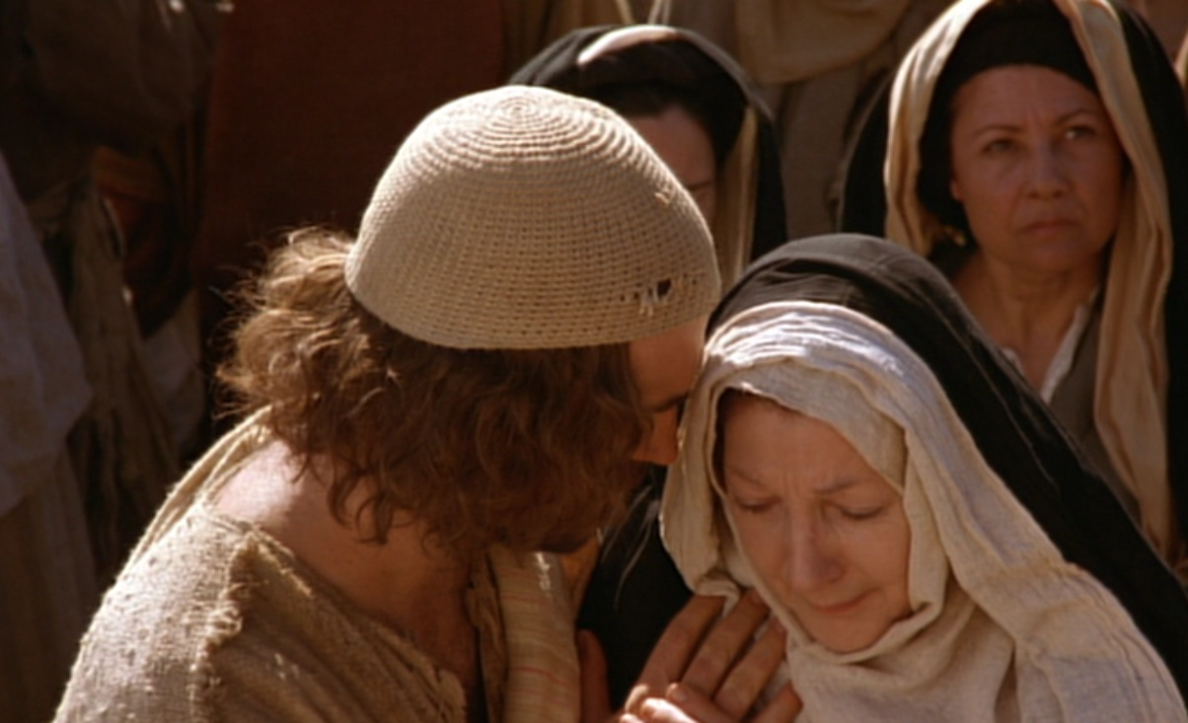
Care for His Mother Mary
Notes:
He cared even after his death through John, to whom he says, “Here is your mother” (19:27).
Why John instead of Jesus’ siblings?
Remember in John 7:5 that his brothers did not even believe in Christ, unlike the beloved disciple John (13:23). But Jesus, as the Good Shepherd (10:4), cares for his own mother as he would the rest of his sheep.

Slide 156
2. Second Three Hours
§ 180
Matthew 27:45-50; Mark 15:33-37; Luke 23:44, 46; John 19:28-30
While on the cross the second three hours Christ utters three statements before He dies, indicating His separation from the Father while bearing man's sin, His thirst in fulfillment of Psalm 22:15, and the declaration that His death paid for the sin of the entire human race as the final sacrifice, thus indicating His sovereignty over His own death in that His life was not taken from Him but voluntarily given

Slide 157
I. Christ fulfilled Scripture in his selfless death (19:16b-37).
Selflessness
Fulfillments
Carried cross
Clothes divided
Crucifixion
Thirsted
Cared for Mary
Notes:
Jesus fulfilled Scripture as the living water who thirsted (19:28-29).

Slide 158
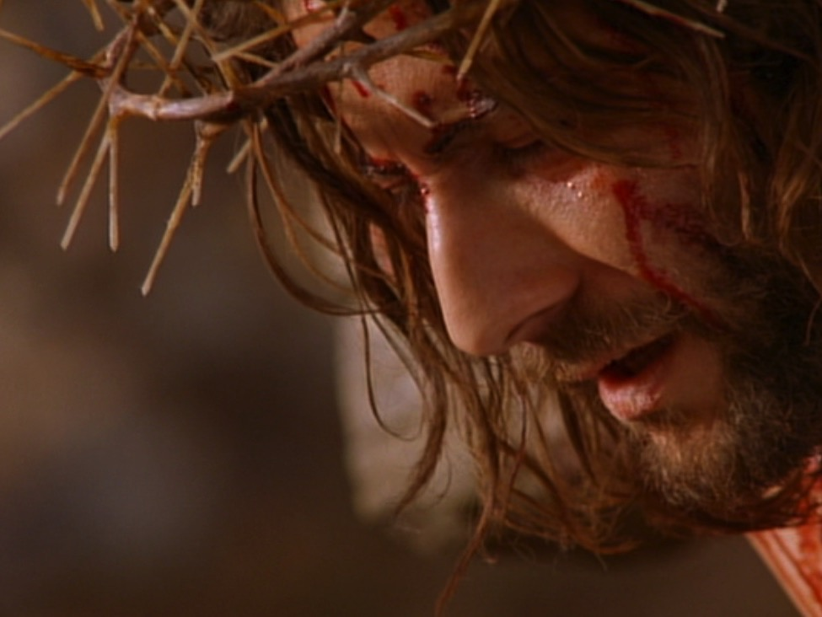
"I am thirsty"
(19:28; cf. Psalm 22:15; 69:21)
Notes:
Psalm 22:15; 69:21 was fulfilled with Christ declaring, “I am thirsty” (John 19:28).
“I am thirsty” (19:28) shows irony, for the One who gives living water (4:14; 7:38-39) willingly allowed himself to thirst. Christ quotes Psalm 69:21 here—a psalm that ends with triumph in his fulfillment of this prophecy.

Slide 159
Jesus’ Seven Last Word
“My God, my God, why have you forsaken me?” (Mark 15:34)
“I am thirsty” (John 19:28)
“It is finished” (John 19:30)
“Father into your hands I commit my spirit” (Luke 23:46)
Blomberg p347-348

Slide 160
Significance of Jesus’ Word
Forgiveness is available for those who repent.
Heaven is available to believers.
Jesus’ model His love by loving His enemies and family.
Jesus experiences pain and separation with God.
Jesus’ Humanity and Divinity.
His mission is accomplished.
Jesus’ authority over His death.

Slide 161
Why Jesus Must Suffer And Die?
For even the Son of Man did not come to be served, but to serve, and to give his life as a ransom for many.
Mark 10:45

Slide 162
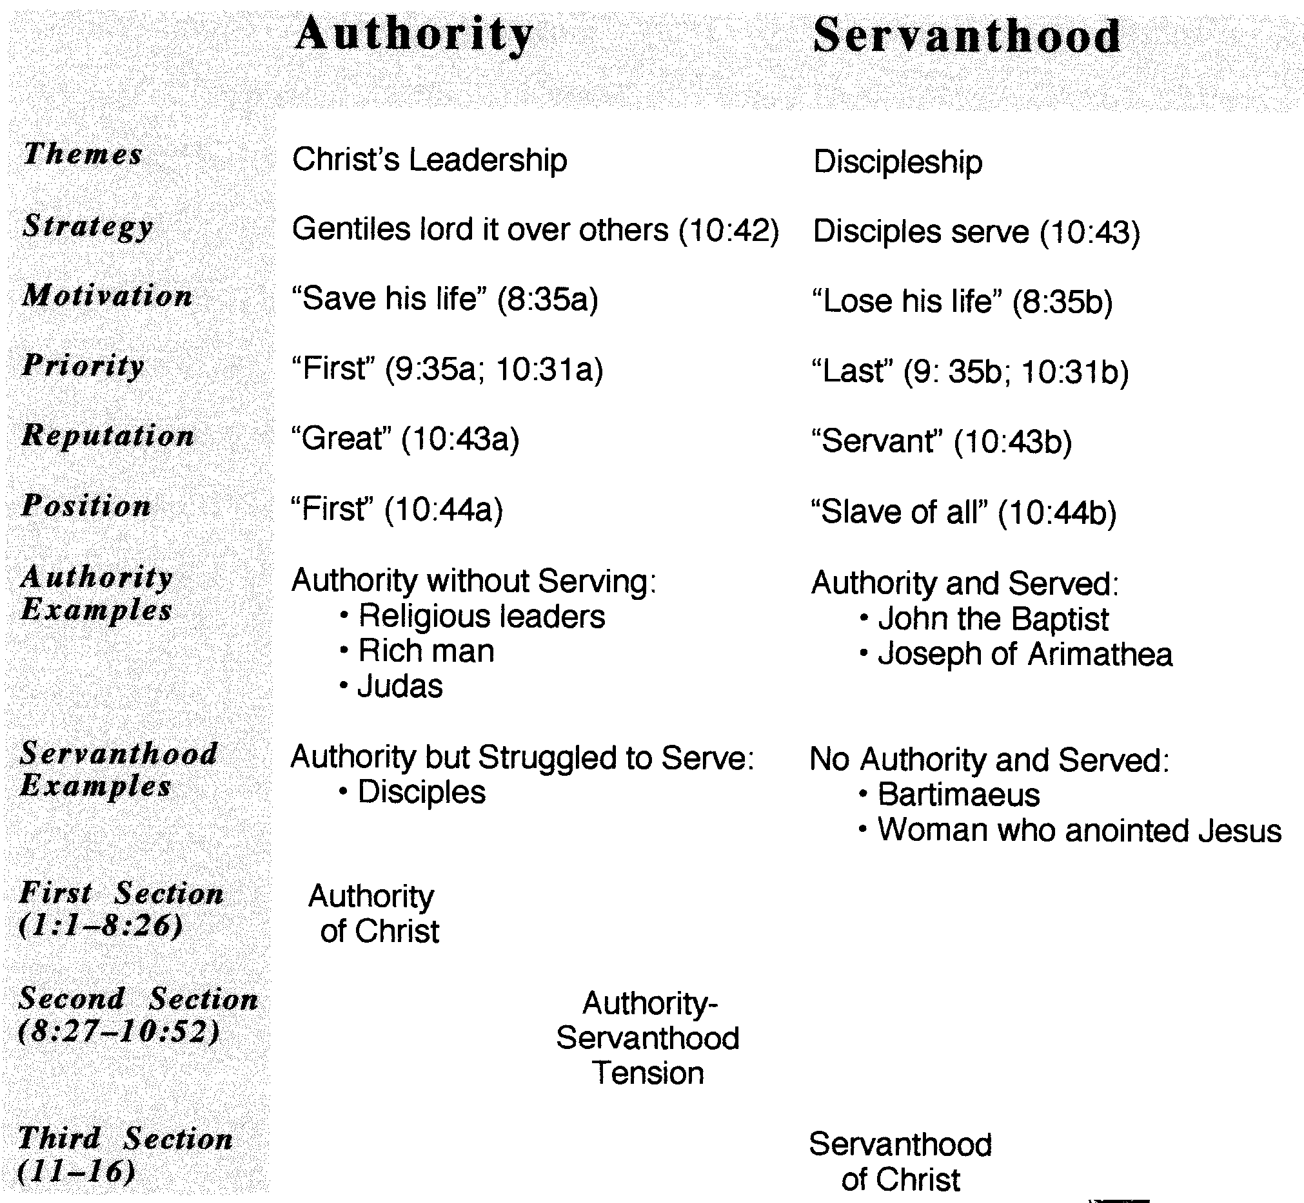
Servanthood in Mark
Dr Rick NT p89a

Slide 163
Philippians 2:5-11
Your attitude should be the same as that of Christ Jesus:
Who being in very nature God,
Did not consider equality with God something to be grasped,
But made himself nothing, taking the very nature of a servant,
Being made in human likeness.
And being found in appearance as a man, he humble himself
And became obedient to death-even death on the cross!
Therefore God exalted him to the highest place
And give him the name that is above every name,
That at the name of Jesus every knee should bow
In heaven and on earth, and every tongue confess that Jesus Christ is Lord, to the glory of God the Father.

Slide 164
I. Christ fulfilled Scripture in his selfless death (19:16b-37).
Selflessness
Fulfillments
Carried cross
Clothes divided
Crucifixion
Thirsted
Cared for Mary
Paid for sin
Notes:
Jesus fulfilled Scripture as the One who paid for all sin (19:30).

Slide 165
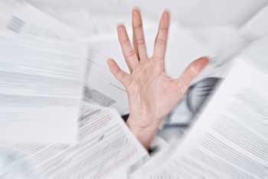
The Heavy Debt of Sin
Notes:
You and I have a tremendous debt to God.
Ray Comfort illustrates it this way: Have you ever broken God’s commandment by lying? What does that make you? Yes, a liar!
Have you ever prioritized something else ahead of God? What does that make you? Yes, an idolater!

Slide 166
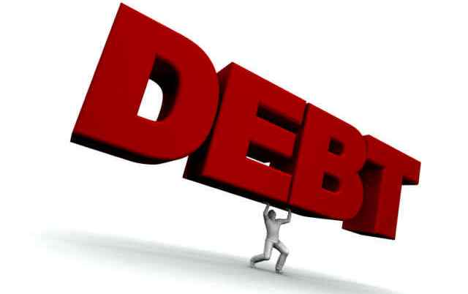
The Debt of Sin
DEBT
Notes:
Suppose you only sinned three times a day—a word, action, or thought less than God—that’s 1000 sins a year! And that’s good year! How many thousands of your sins separate you from God?
We can plead that God is merciful—and he is—but his mercy is balanced with his justice that requires payment for your sin—not just token payment, but death!

Slide 167


"It is finished"
Legal
Paid
in Full
Notes:
When Jesus declared, “It is finished” (19:30), it was a legal term meaning “paid in full.” Our sin on him recalls the many times in John when Christ claimed that his “hour” had not yet come (2:4; 13:1, etc.). Now his “hour” had come to pay the redemption for which He had come.

Slide 168
I. Christ fulfilled Scripture in his selfless death (19:16b-37).
Selflessness
Fulfillments
Carried cross
Clothes divided
Crucifixion
Thirsted
Cared for Mary
Paid for sin
Pierced side
Notes:
Jesus fulfilled Scripture with the piercing of his side instead of breaking his legs (19:31-37).

Slide 169
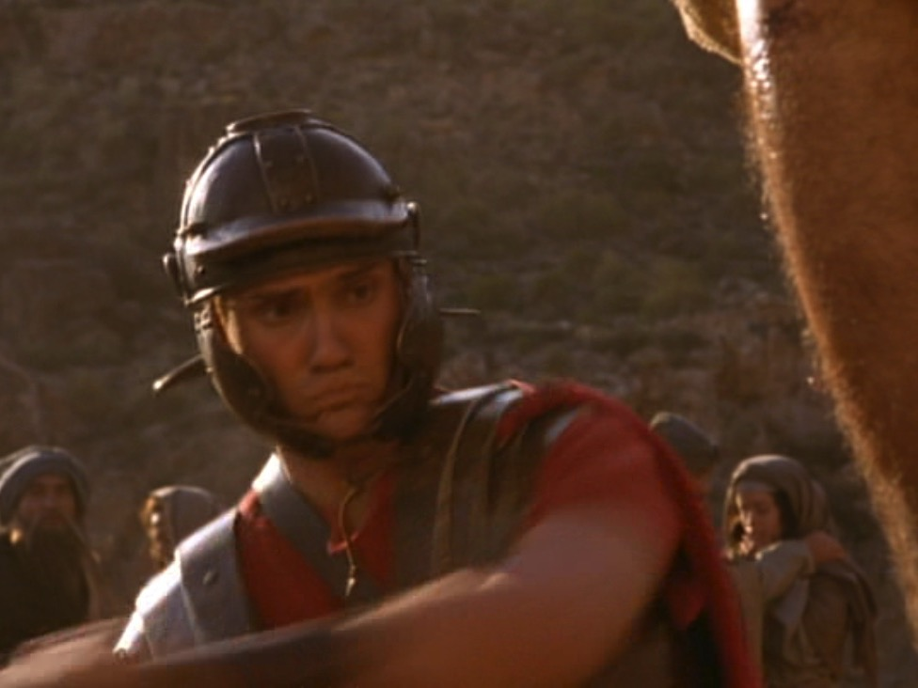
Why break the legs?
Notes:
How would the breaking of a victim’s legs bring death (19:31)? The way to hasten death was to prevent the crucified man from pushing up to take a breath—so breaking the legs prevented breathing. The shock and loss of more blood by having the legs broken with a heavy mallet also hastened death.

Slide 170
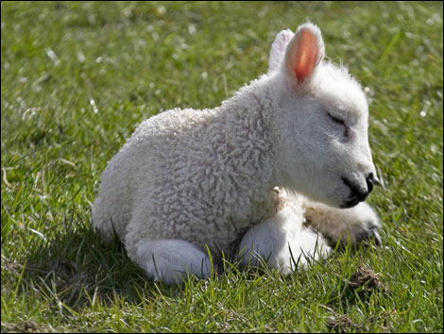
Passover lambs were unblemished
Notes:
The Passover lamb was to be without a defect—including even after death. “Not one of his bones will be broken” (John 19:36 NLT) fulfilled two OT texts:

Slide 171
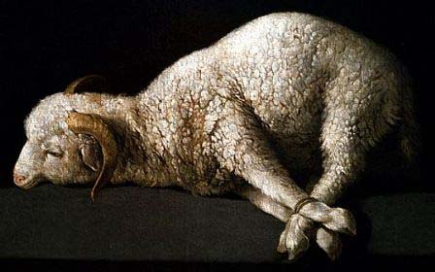
Passover lambs were roasted whole without any legs broken
"Each Passover lamb must be eaten in one house. Do not carry any of its meat outside, and do not break any of its bones"
Exodus 12:46; cf. Num. 9:12
Notes:
Exodus 12:46 commanded, “Each Passover lamb must be eaten in one house. Do not carry any of its meat outside, and do not break any of its bones.”

Slide 172
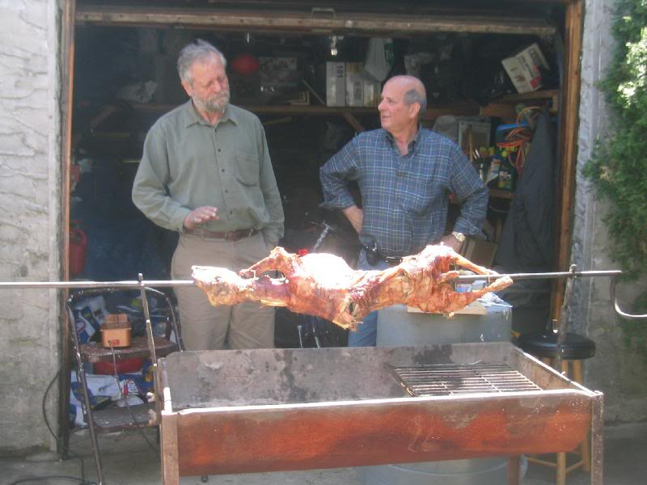
Passover lambs are still roasted whole without any legs broken

Slide 173
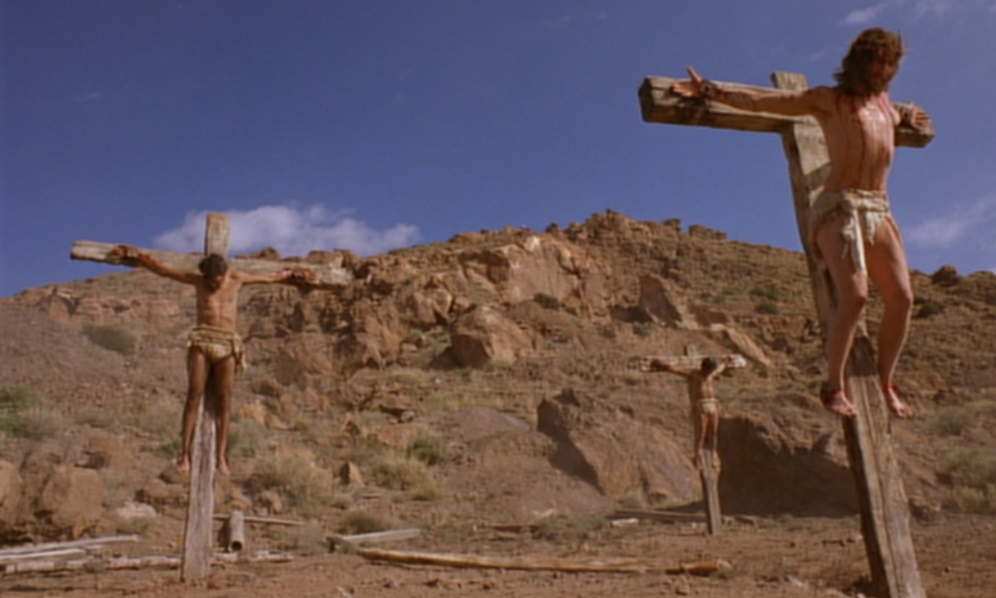
Psalm 34:20 NLT
"For the Lord protects the bones of the righteous;
not one of them is broken!"
Notes:
Ps. 34:20 prophesied, “For the Lord protects the bones of the righteous; not one of them is broken!”

Slide 174
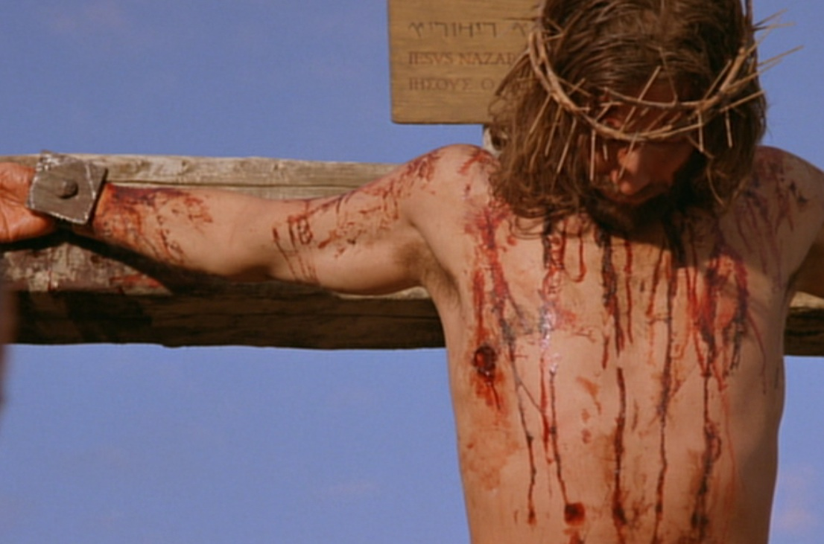
Zech. 12:10 NLT
"Then I will pour out a spirit of grace and prayer on the family of David and on the people of Jerusalem. They will look on me whom they have pierced and mourn for him as for an only son. They will grieve bitterly for him as for a firstborn son who has died."
Notes:
“They will look on the one they pierced” (Zech. 12:10) was fulfilled in John 19:37 with the soldier thrusting a spear into his side.

Slide 175
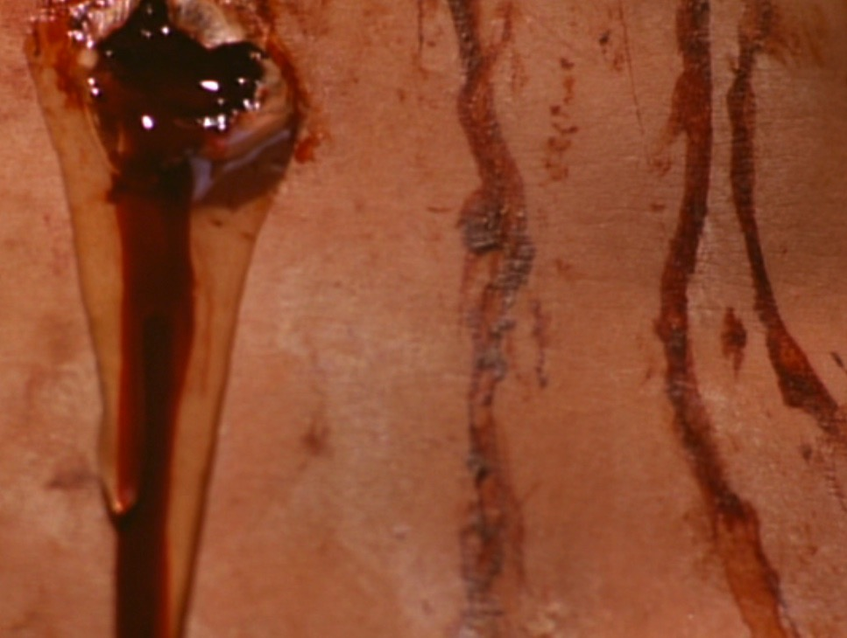
"Blood & Water"
Heart failure?
New temple (2:19)?
Life through his blood (1:13)?
Death (1 John 1:1)?

Slide 176
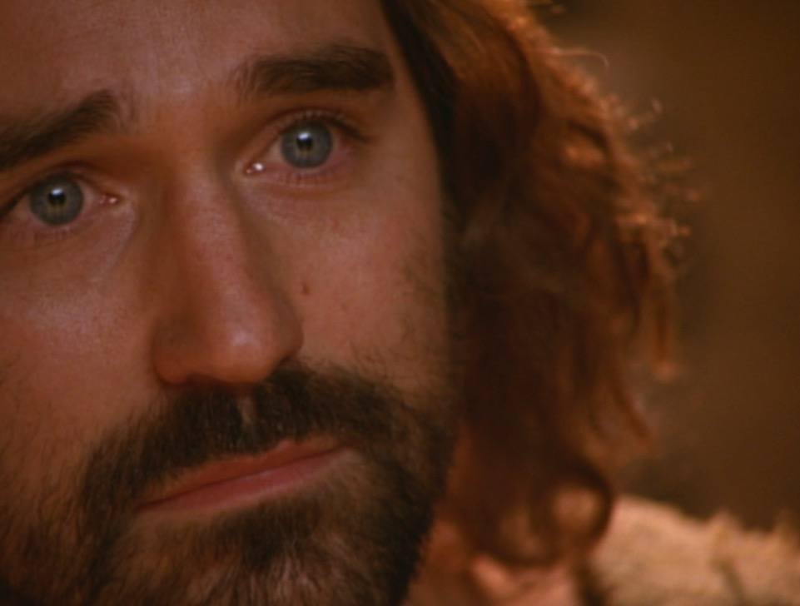
"(This report is from an eyewitness giving an accurate account. He speaks the truth so that you also can believe.)" (19:35 NLT)
Notes:
To sum up, John’s purpose in verse 35 was so you and I can believe in Jesus.

Slide 177
3. Accompanying Signs
§ 181
Matthew 27:51-56; Mark 15:38-41; Luke 23:45, 47-49
At the moment of His death the renting of the temple veil reveals the open access all men have to God through Christ's death, the earthquake indicates the provision for creation's redemption, and the raising of the saints acknowledges Christ's resurrection as not an isolated phenomenon but only the first fruits of His victory over death seen in the resurrection to life of all believers

Slide 178
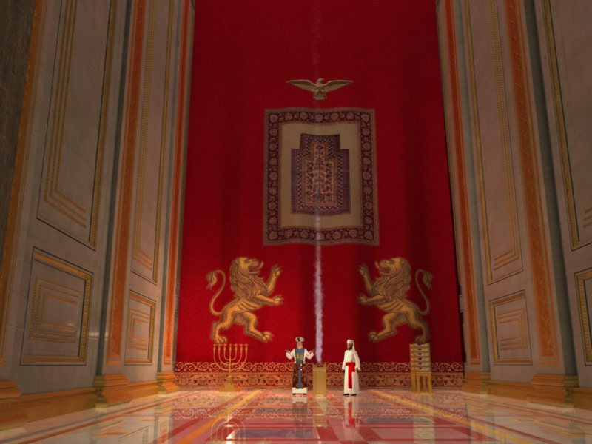
殿 裏 的 幔 子

Slide 179
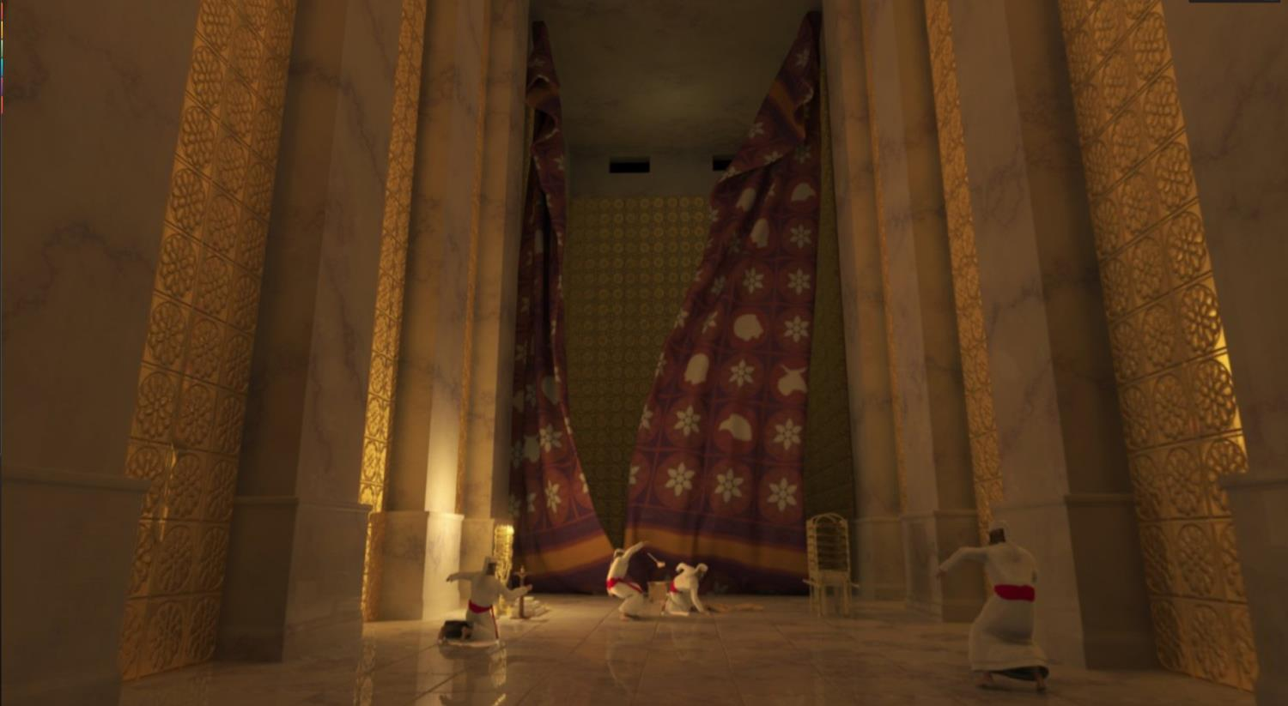
殿 裏 的 幔 子 從 上 到 下 裂 開 為 二 (27:51)

Slide 180
F. The Burial of Christ
§ 183
Matthew 27:57-61; Mark 15: 42-47; Luke 23:50-56;
John 19:31-42
Christ is quickly buried in Joseph of Arimathea's nearby tomb because of the approaching Sabbath and the defilement dead bodies would have brought to the area

Slide 181
I. Christ fulfilled Scripture in his selfless death (19:16b-37).
Selflessness
Fulfillments
Carried cross
Clothes divided
Crucifixion
Thirsted
Cared for Mary
Paid for sin
Pierced side
Notes:
So verses 16b-37 show the twin evidences of both Christ’s selfless nature and the fulfillment of many OT prophecies. These show us that his death was unlike any other in that it was a sacrificial death for our sins. A second way we know he died for us is in verses 38-42 which show that…

Slide 182
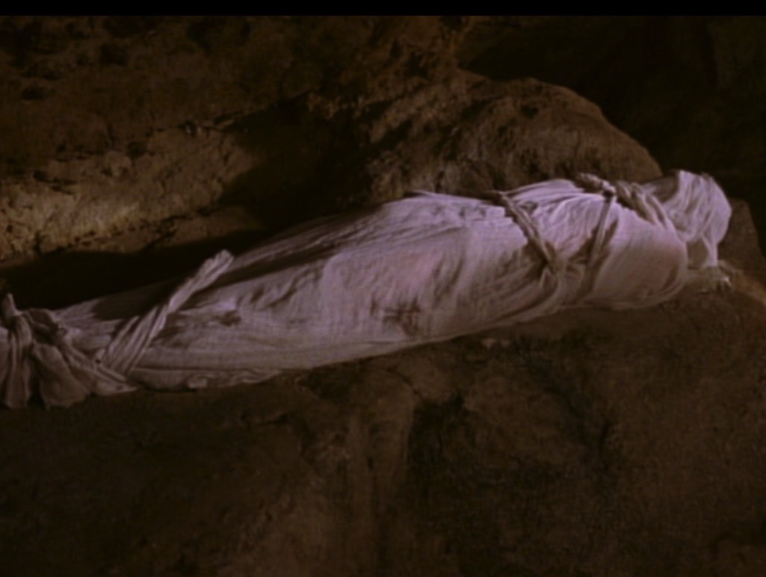
II. Christ's burial proved he was truly dead (19:38-42).
Notes:
We know Jesus really did pay for our sin by the fact that he truly died, which sets the stage for the resurrection in John 20.

Slide 183
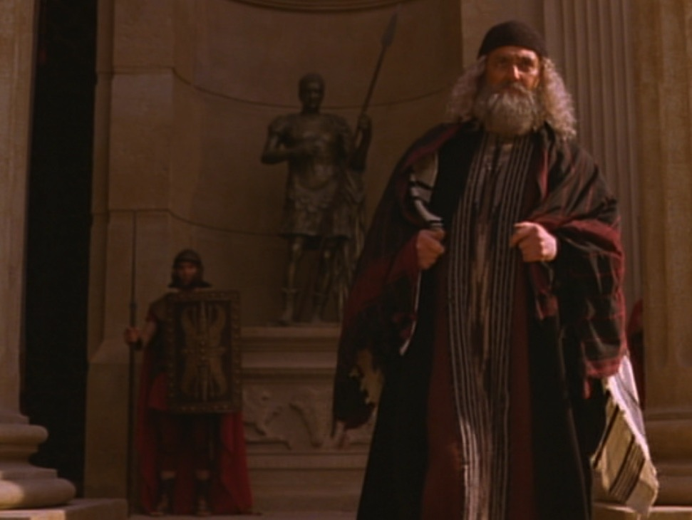
Joseph of Arimathea
Notes:
The previously secret believers, Joseph and Nicodemus, prepared his body for burial in 33 kilos of spices (19:38-40).

Slide 184
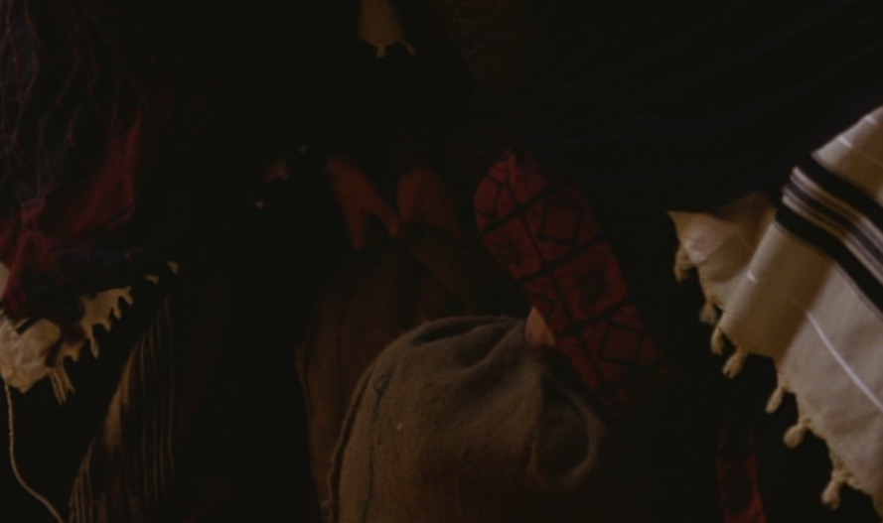
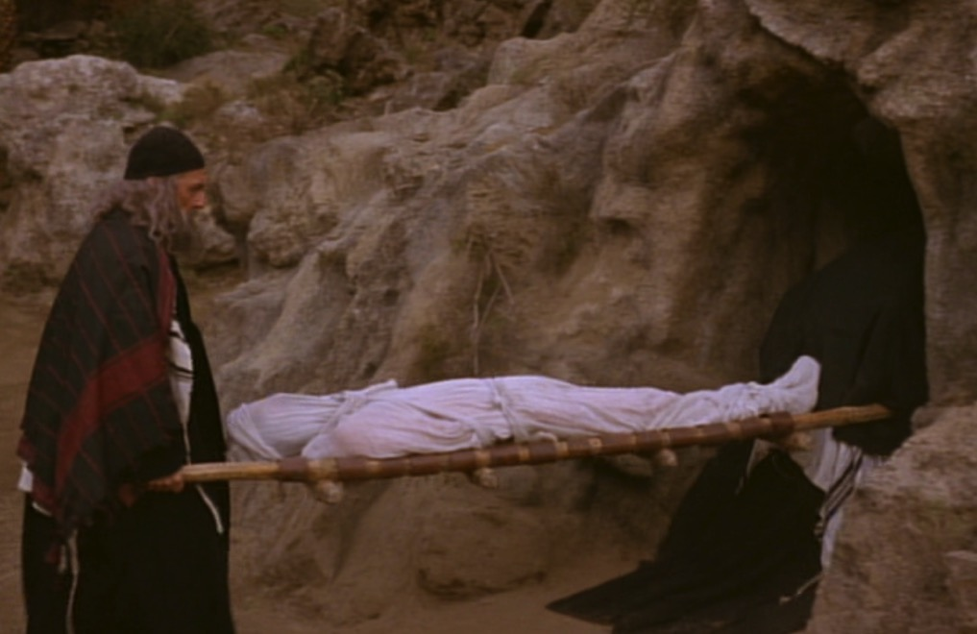
33 Kilos of Spices
Notes:
Where could they get so many spices quickly and a brand new tomb so close by? We don’t know, but what we do know is that…

Slide 185
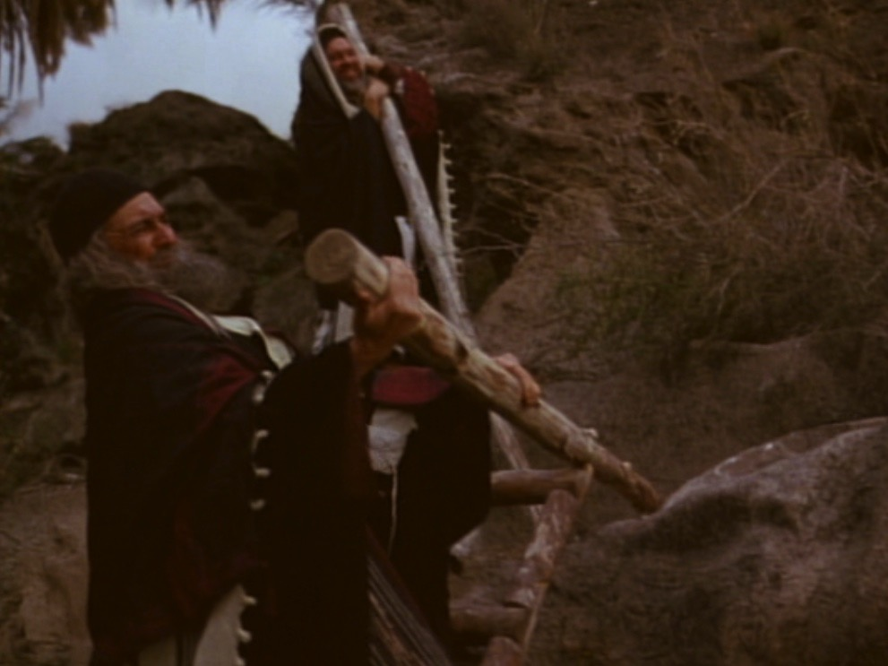
Closing the Tomb
Notes:
The appearance of these men reminds us that there exist many even today who are secret believers—men and women who feel they cannot openly declare Christ.

Slide 186

Why was a tomb burial vital?
Notes:
The body was laid in a brand new, expensive, rock-hewn garden tomb rather than in the Potter’s Field (19:41-42).
Why was it so important that Jesus was buried in a tomb?
The wrapping and burial in 33 kilos of spices proved that he was truly dead.

Slide 187

Hinnom Valley
Notes:
Normally a criminal’s body was thrown into the Valley of Hinnom and burned or eaten by dogs. But if his body was burned there, claim of a resurrection would be absurd. So his enemies actually protected his body for credibility purposes!

Slide 188

Joseph & Nicodemus
Notes:
The tomb burial allowed secret believers Nicodemus and Joseph to come forward.

Slide 189

He was truly dead
Notes:
But what was the main reason the burial of Christ is significant? It proved that Christ was indeed dead. You can’t have a resurrection unless you first have a dead man!

Slide 190

He Died for You!
But how do we know that Christ's death actually paid for our sin?
Notes:
We began with the question, “How do we know that Christ’s death actually paid for our sin?” So how can we be sure his death was unlike any other? I sum up the whole passage in this way…

Slide 191

Main Idea
Christ must have died for our sin since it was so prophetic, selfless and certain.
Notes:
Jesus’ death was a selfless fulfillment of Scripture ending in tomb burial (restated MI).

Slide 192
I. Christ fulfilled Scripture in his selfless death (19:16b-37).
Selflessness
Fulfillments
Carried cross
Clothes divided
Crucifixion
Thirsted
Cared for Mary
Paid for sin
Pierced side
Notes:
How do we know that Christ’s death actually paid for our sin?

Slide 193
II. Christ's burial proved he was truly dead (19:38-42).

Slide 194

To End All Wars

Slide 195

To End All Wars

Slide 196

Golgotha, in The Church of the Holy Sepulcher
Notes:
Visiting the tomb of Jesus can get us all caught up in the gaudy display—

Slide 197

Golgotha, in The Church of the Holy Sepulcher
Notes:
—so that we miss the key point that Christ actually died for our sin.

Slide 198

Golgotha, in The Church of the Holy Sepulcher
Notes:
The rock of Golgotha is barely seen!

Slide 199

Who crucified Jesus?
Notes:
Let me leave you to answer one of two questions…

Slide 200


It is Finished
Notes:
Pre-believers: Will you trust in Christ’s death that paid for your sin?

Slide 201














Cross Too Heavy?
Notes:
Believers: What cost could you pay that is too much for the one who died for you? Please watch this sequence of pictures…

Slide 202
G. The Sealing of the Tomb
§ 183
Matthew 27:62-66
The Sanhedrin succeeds in securing Pilate's permission to guard and seal the tomb for fear of a deception of resurrection initiated by the disciples, which really only increases the number of witnesses to the resurrection

Slide 203
Black

Slide 204


基督生命链接地址 BibleStudyDownloads.org
免费获得该讲解!
圣经学习下载
Notes:
Bible Geograhpy (bg)

