Slide 1
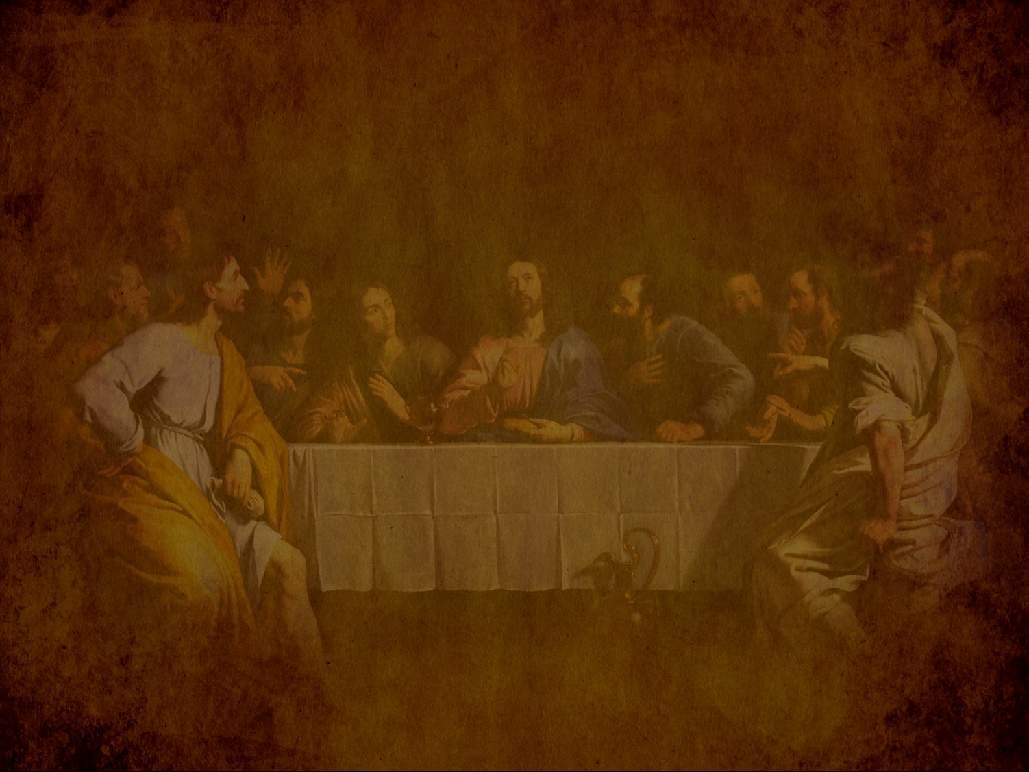
Preparation for the Death of the King
预备君王的死亡
§§ 150-167
Section summaries based on J. Dwight Pentecost, A Harmony of the Words and Works of Jesus Christ (Grand Rapids: Zondervan, 1981)
Christ Himself makes preparations for the Messiah’s death in predictions about Israel's future, by events in the last days of His life, and by precepts and prayers of Christ
Dr. Rick Griffith • Singapore Bible College • BibleStudyDownloads.org

Slide 2
A. Predictions by Christ
§ 150
马太 24:1-25:46; 马可 13:1-37; 路加 21:5-36
Christ foretells the events that will accompany His Second Advent that Israel might know that the Messiah is about to appear as Judge

Slide 3
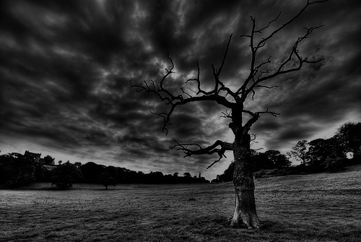
橄欖山的教導(太24–25)
78
Adapted from Mark L. Bailey, DTS class notes, 1986
第二次的再来(27-31):
天上的徵兆 (29-30)
人子的再来 (27, 30)
飛鳥的食物(28)
選民的拯救 (31)
憎惡的蒼凉
(15-20)
假基督與假先知
(23-26)
末世的徵兆
(4-8)
大災難
(9-14, 21-22)
列国的裁判
绵羊
山羊
與啟示錄相關性的經文
12:7-12
13:14
12:8-17
8:1–19:10
(太. 25:31-46)
6:1–8:5
19:11-21

Slide 4
1. The Question
马太 24:1-3; 马可 13:1-4; 路加 21:5-7
Jesus predicts the destruction of the temple and Jerusalem in response to the disciples' questions about His return and Jerusalem's destruction

Slide 5
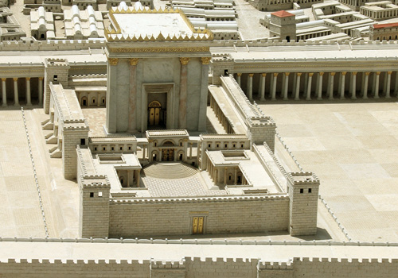
門徒: 多麼雄偉的聖殿! (24:1)
耶稣: “將來在這 裡没有一塊石頭 留在石頭上，不被 拆毁了 。” (24:2)
門徒: 何時? 有甚麼跡象? (24:3)

Slide 6
马可 13: 1-37
yapkimfah Singapore Bible College 23 feb 2006

Slide 7
THE OLIVET DISCOURSE

Slide 8
JESUS’ PROPHECY OF THE DESTRUCTION OF THE TEMPLE
AND HIS RETURN

Slide 9
The Olivet Discourse
Matt. 24-25 | 马可 13 |  | 路加 21:5-38
signs but the end is not yet
the desolating sacrilege (AD70) |  |  |  | Jerusalem surrounded by armies
great tribulation (Church age) |  |  |  | times of Gentiles
second coming of Christ
command to alert faithfulness
Craig L. Blomberg Jesus and the Gospel p.324

Slide 10
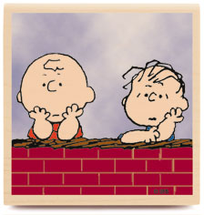


When Will the Temple Be Destroyed
What Will Be the Sign that it is the end

Slide 11
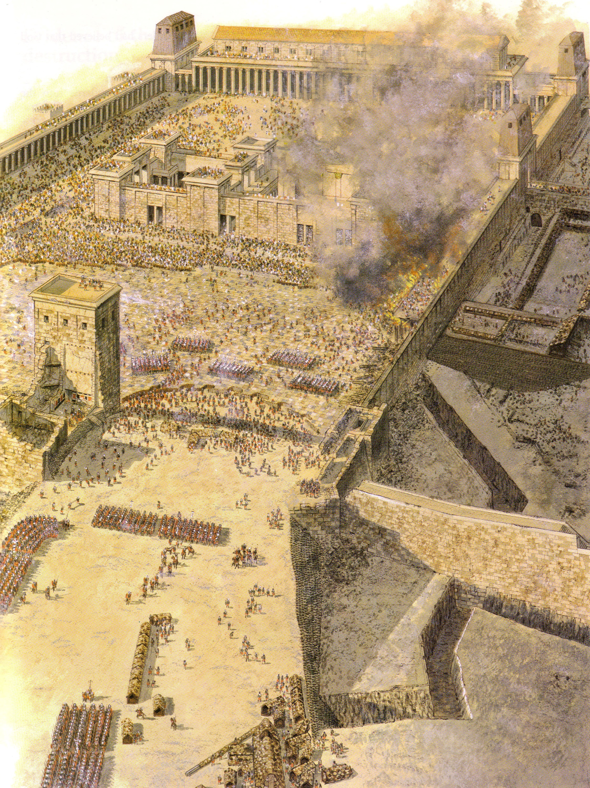
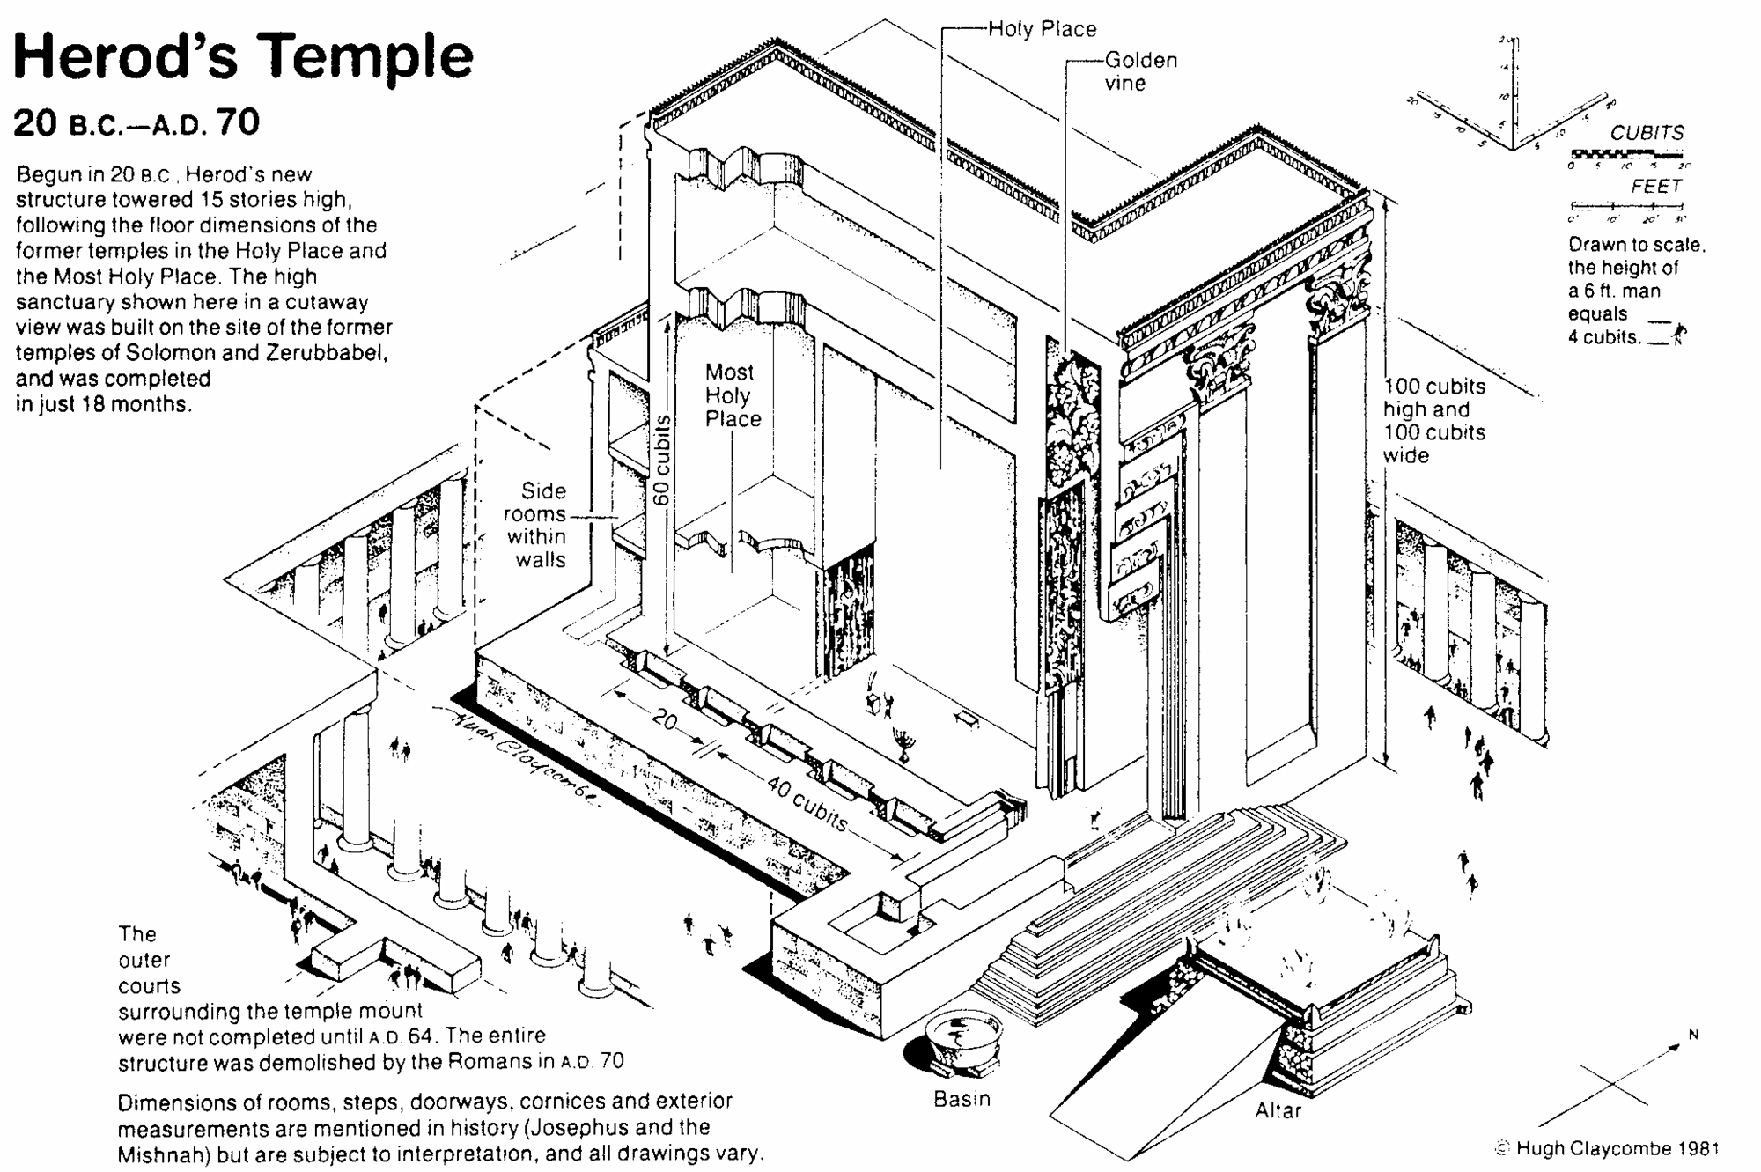
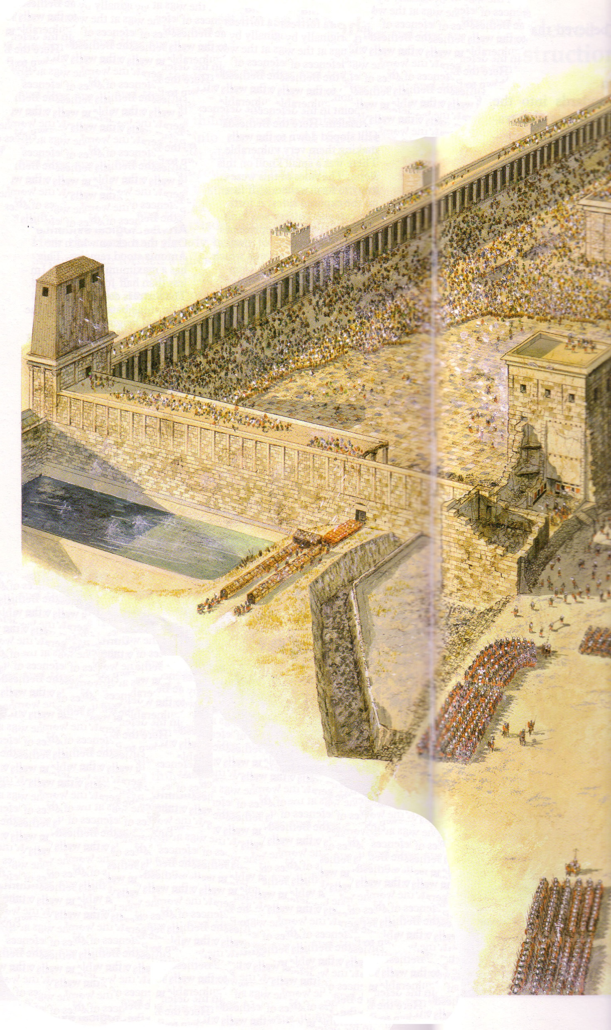

Slide 12
2. The Tribulation
马太 24:4-26; 马可 13:5-23; 路加 21:8-26
Jesus predicts the seventieth week of Daniel 9:27 as a seven year tribulation preceding the Second Advent in order that Israel might know the signs of His coming and the judgments to follow

Slide 13
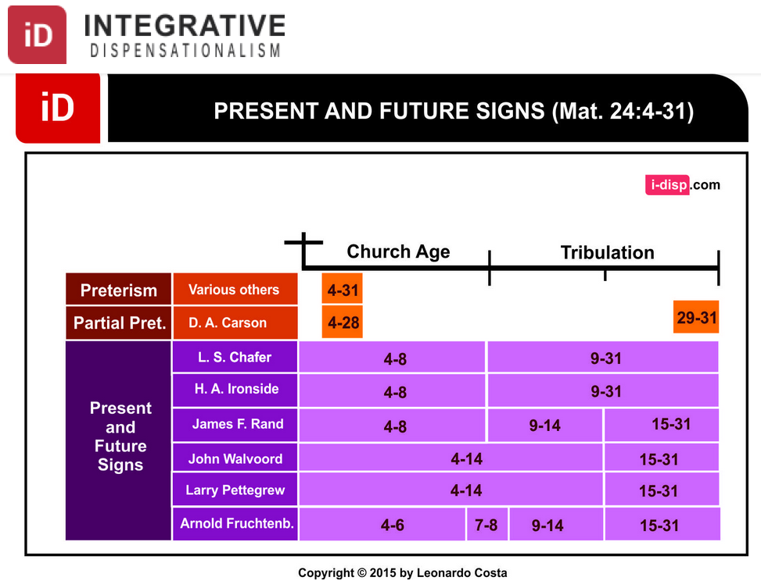
Dispensational Views on Matthew 24
综合
时代主义
目前和未来的迹象 （马太24：4-31）
教会时代
苦难
末世预言
实现论
其他
局部实现论
现在和
将来的年代
Notes:
莱昂纳多科斯塔，“马太福音24：4-31在时代论中实现”，综合解放主义网站
http://i-disp.com/the-fulfillment-of-matthew-244-31-in-dispensational-tradition/ accessed 24 July 2015

Slide 14
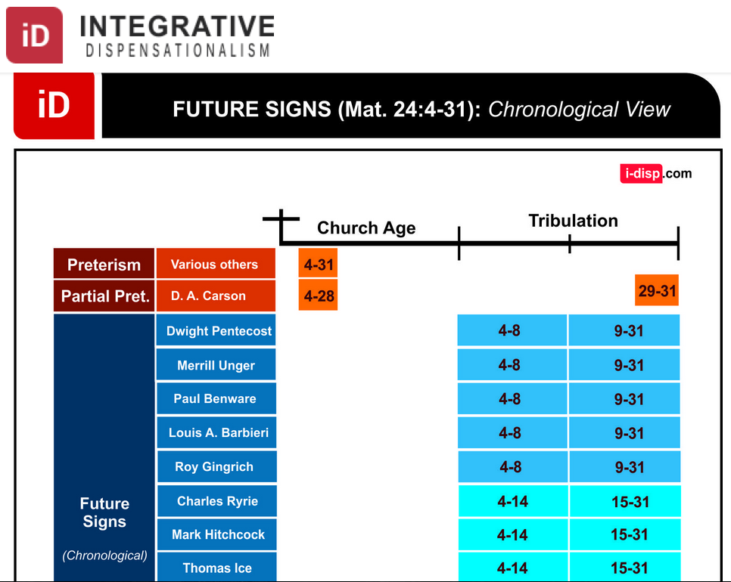
Dispensational Views on Matthew 24
综合
时代主义
未来的迹象 （马太24：4-31）按时间顺序
教会时代
苦难
末世预言
实现论
其他
局部实现论
未来的年代
Notes:
莱昂纳多科斯塔，“马太福音24：4-31在时代论中实现”，综合解放主义网站
http://i-disp.com/the-fulfillment-of-matthew-244-31-in-dispensational-tradition/ accessed 24 July 2015

Slide 15
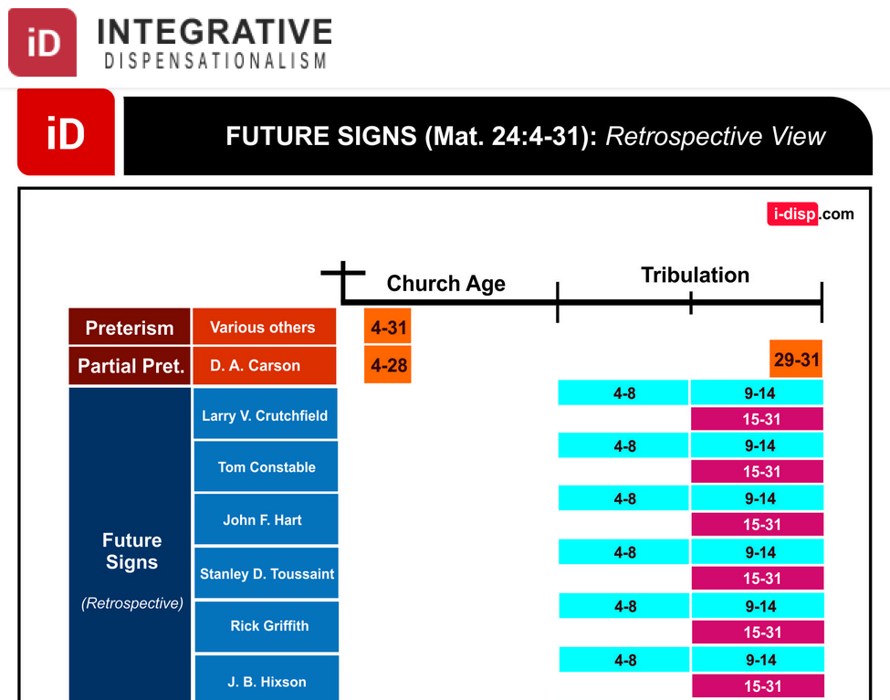
Dispensational Views on Matthew 24
综合
时代主义
未来的迹象 （马太24：4-31）回顾性观点
教会时代
苦难
末世预言
实现论
其他
局部实现论
未来的年代
(回顾性观点)
Notes:
莱昂纳多科斯塔，“马太福音24：4-31在时代论中实现”，综合解放主义网站
http://i-disp.com/the-fulfillment-of-matthew-244-31-in-dispensational-tradition/ accessed 24 July 2015

Slide 16
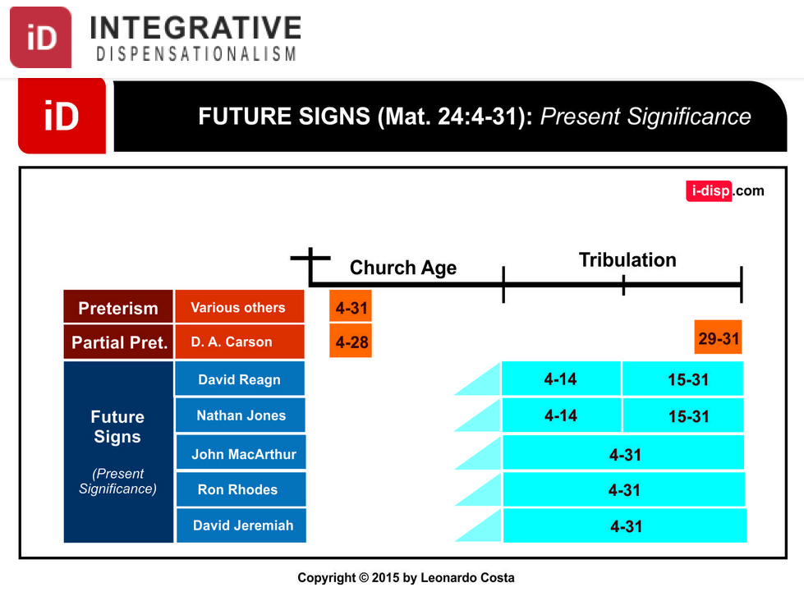
Dispensational Views on Matthew 24
综合
时代主义
未来的迹象 （马太24：4-31）目前的意义
教会时代
苦难
末世预言
实现论
其他
局部实现论
未来的年代
(目前的意义)
Notes:
莱昂纳多科斯塔，“马太福音24：4-31在时代论中实现”，综合解放主义网站
http://i-disp.com/the-fulfillment-of-matthew-244-31-in-dispensational-tradition/ accessed 24 July 2015

Slide 17


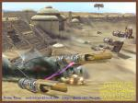





signs (v. 5-8)
deceive many
wars and rumours of wars
not yet the end
famine
persecutions

Slide 18
Keep Alert Do Not Be Alarmed (vv. 1-13)
The Gospel must be preached to all nations (v.10)
Do not worry what to say, Holy Spirit will help (v.11)
Persecution – family members (v.12)
Stand firm (v.13)

Slide 19
“ the abomination that causes desolation” (v.14) (Mt. 24:15)
It is the detestable thing (Dan 9: 24-27)
The Antichrist
Believers flee immediately (v.14b)
Leave belongings (v.15-16)
Dreadful for mothers (v.17)
pray for good weather (v.18)

Slide 20
a. The First Half
马太 24:4-8; 马可 13:5-8; 路加 21:8-11
The signs of the first three and one half years of the Tribulation are given in order to forewarn Israel of the coming judgment at Christ's Second Advent

Slide 21
b. The Second Half
马太 24:9-14; 马可 13:9-13; 路加 21:12-19
The signs of the second three and one half years of the Tribulation are given in order to forewarn Israel of the coming judgment at Christ's Second Advent

Slide 22
c. Repetition and Explanation
马太 24:15-26; 马可 13:14-23; 路加 21:20-26
The terror of the Tribulation is reiterated in respect to the Antichrist in particular to identify this man as the sign that will forewarn Israel of the approaching Second Advent

Slide 23
橄榄山论语概述
Chinese Simplified
English
橄榄山话语概述
27
耶路撒冷
第一次被陷
586 B.C.
耶路撒冷
第二次被陷
A.D 70
被提
帖前
4:14-17
耶路撒冷
第三次被陷
圣徒第二次再来
太 23:39; 24:30
以色列
教会时代
灾难
千禧年
大灾难
但 9:27
太 24:15
以色列被分散
路 21:24
归回应许之地
外邦国的审判
太 25:31-46
606 B.C.
外邦人的时代 路 21:24
取自撒冷。可班
启示录表 (1979), 48

Slide 24
外邦人的时代 (路加福音 21:24)
106
外邦人的时代 (路加福音 21:24)
猶大国
光复时期
两约之间的400年
586 BC
AD 70
教 会 时 期
主 的 宝 座
巴比伦
波斯
希腊
罗马
Acts 15:14-18
Rom. 11:25
Jer. 3:17
Isa. 62:6-7
538 BC
333 BC
63 BC
在 众 多 国 家 中
耶利米书 15:9
Ezekiel 6:8
Hosea 3:4-5
Hosea 8:8
Amos 9:8-9
Jer. 31:35-37
Jer. 46: 27-28
Jer. 51:5
耶利米书 33:7-14
耶利米书 22:8-9
Isa. 4:2-6
Ezek. 43:1-9
Zech. 2:10-13
Zech. 8:1-8
2 Kings 25:8-12
Jer. 15:4, 22:29-30, 30:24
Ezek. 10:4, 28. 11:22-25, 14:22-23
Adapted from Raymond Ludwigson, A Survey of Bible Prophecy

Slide 25
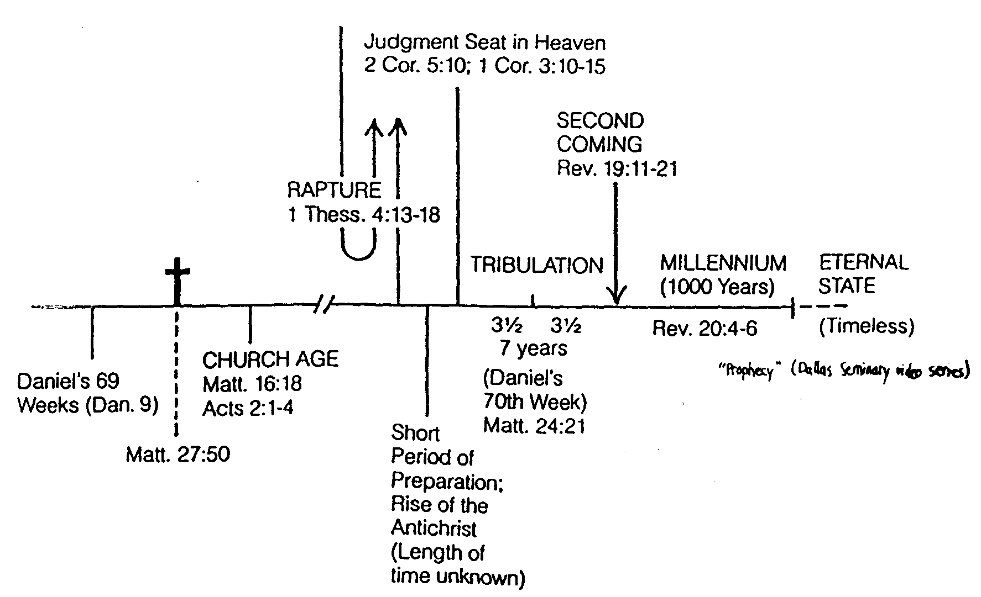
Another Overview
Day of the Lord

Slide 26
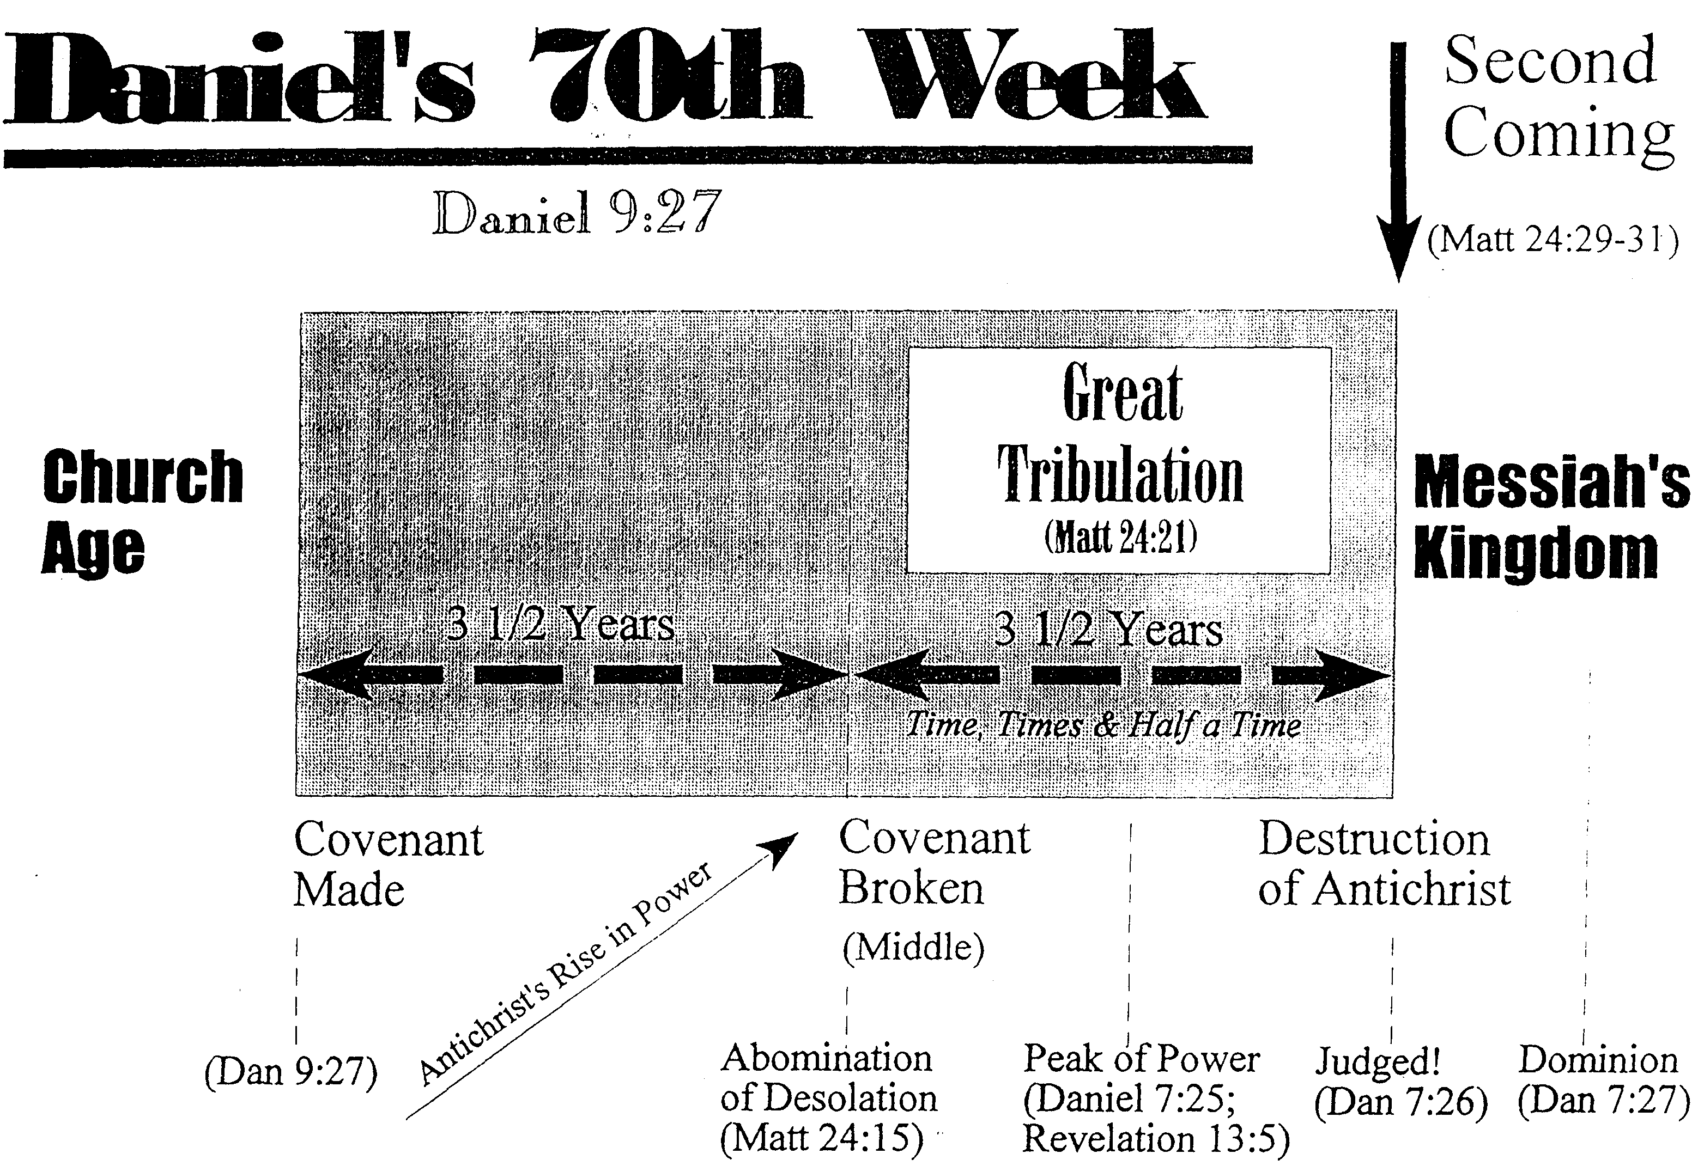

Slide 27
“ the abomination that causes desolation” (v.14)
The great tribulation of unparalleled affliction (v.19)
God shorten the days (v.20)
False messiahs, prophets, signs and miracles (vv.21-22)
The great tribulation sign is so terrible it requires being foretold (v.23)

Slide 28
3. The Second Advent
马太 24:27-30; 马可 13:24-27; 路加 21:27-28
Jesus predicts His return to the earth in power and glory to subject the earth to His authority in order to fulfill man's destiny as authority over the earth

Slide 29
Keep watch, Jesus is coming, time unknown (vv. 24-37)
Jesus will return following that distress [tribulation] (v.24)
When Jesus returns
  The sun will be darkened and the moon will not give its light (v 24)
  The stars will fall from the sky and the heavenly bodies (Isaiah 13:10) will be shaken (v.25)
Men will see Jesus’ return (v.26)

Slide 30
4. The Regathering of Israel
马太 24:31
Jesus predicts Israel's supernatural restoration to its land after having been scattered by military invasions

Slide 31
5. Parenthetical Exhortations
马太 24:32-51; 马可 13:28-37; 路加 21:29-36
Christ provides practical exhortations in light of His coming as Judge to further stress the need to be watchful, prepared and faithful in light of the Second Advent

Slide 32
Keep watch, Jesus is coming, time unknown (vv. 24-37)
He will gather his people (elect) from all over the earth (v 27)
The signs points to the end for his return is not perceive and occur within a generation (vv.28-30)
Jesus returns is sure (v.31)
Heaven and earth will pass away (v.31a)
His word will never pass away (v.31b)

Slide 33
Keep watch, Jesus is coming, time unknown (vv. 24-37)
  No one know the exact time Jesus’ return
  so be on guard and keep watch (vv.32-37)

Slide 34
summary
Disciples asked Jesus, “when will these things happen?” and “What will be the sign of your coming?”
He returns after the great tribulation
Event 1: the outer space happenings
Event 2: Jesus will come in the clouds
Event 3: Jesus will gather the elect

Slide 35
What Can We Do to Prepare

Slide 36
What Can We Do to Prepare
Keep alert and do not be alarmed at the signs of the End Time
The Antichrist that cause the desolation of the holy place
Keep watch for the coming of the Son of Man because the exact time is unknown

Slide 37
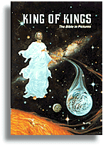
“Come Lord Jesus”

Slide 38
a. The Fig Tree
马太 24:32-44; 马可 13:28-37; 路加 21:29-36
The budding of the fig tree illustrates that signs will be given to Israel that the nation might recognize that Christ's judgment is imminent and be watchful and prepared

Slide 39
b. The Faithful Servant
马太 24:45-51
The illustration of the faithful servant warns Israel to be faithful since the nation will not know when Christ will return

Slide 40
6. Judgment on Israel
马太 25:1-30
Jesus predicts judgment upon living Israel in two parables that indicate that the nation will be judged for its failure to be a light for the Gentiles and that only those prepared by faith in Himself will enter the Millennium

Slide 41
a. The Ten Virgins
马太 25:1-13
The parable of the ten virgins illustrates that only those prepared through faith in Him are taken into the banquet of the millennial feast

Slide 42
b. Talents
马太 25:14-30
The parable of the talents teaches that living Israel will be judged so that the consequences of the nation's faithlessness as a light to the Gentiles might be accomplished

Slide 43
7. Judgment on Gentiles
马太 25:31-46
Jesus predicts that living Gentiles will be judged based upon their treatment of Israel to separate saved from unsaved Gentiles for determining entrance into the millennial kingdom

Slide 44
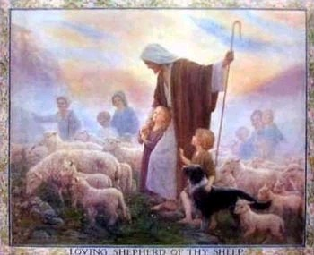
审判列国
(绵羊与山羊)
160
CNV 马太 25:31 "当人子在他的荣耀里，带着所有的使者降临的时候，他要坐在荣耀的宝座上。 32 万族要聚集在他面前，他要把他们彼此分开，好象牧羊人把绵羊和山羊分开一样： 33 把绵羊放在右边，山羊放在左边。 34 那时，王要对右边的说：‘蒙我父赐福的，来承受创世以来为你们预备好的国吧。"

Slide 45
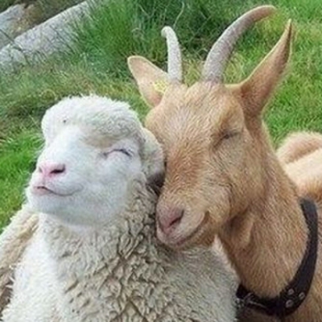
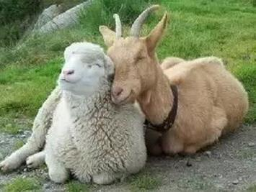
綿羊和山羊不是一樣嗎？

Slide 46
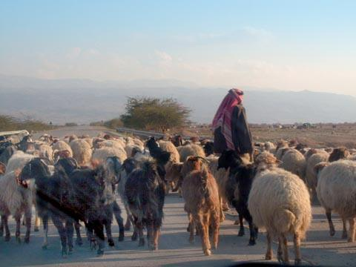
列國的審判
當人子在他榮耀裏、同著眾天使降臨的時候，
要坐在他榮耀的寶座上。
萬民都要聚集在他面前。他要把他們別出來，
好像牧羊的分別綿羊山羊一般
(馬太25:31-32)

Slide 47
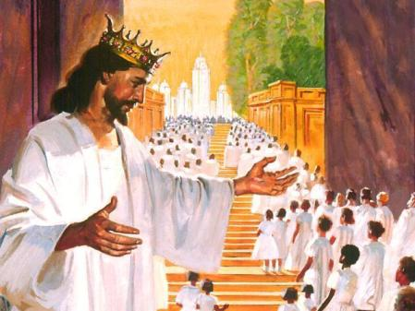
活着的外邦人的审判
³¹ "当人子在他的荣耀里，带着所有的使者降临的时候，他要坐在荣耀的宝座上。
³² 万族要聚集在他面前，他要把他们彼此分开，好象牧羊人把绵羊和山羊分开一样： ³³ 把绵羊放在右边，山羊放在左边。 ³⁴ 那时，王要对右边的说：‘蒙我父赐福的，来承受创世以来为你们预备好的国吧。“
(马太 25:31-34 CNV).

Slide 48
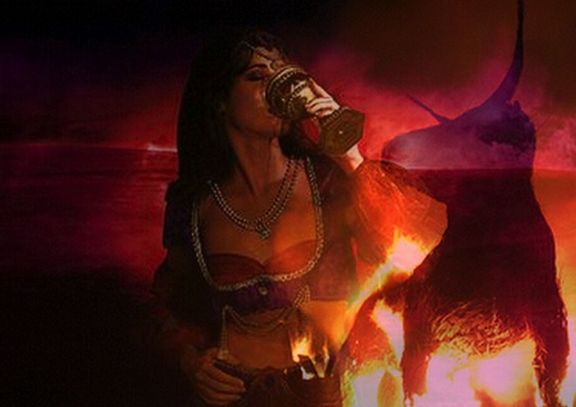
活着的外邦人的审判
⁴¹ "王也要对左边的说：‘你们这被咒诅的，离开我，到为魔鬼和他的使者所预备的永火里去
吧！ ⁴² 因为我饿了，你们没有给我吃；我渴
了，你们没有给我喝；
⁴³ 我作旅客，你们没有接待我；我赤身露体，你们没有给我衣服
穿；我病了，我在监里，你们没有看顾我。’ ⁴⁴ 他们就回答：‘主
啊，我们甚么时候见你饿了、渴了、作旅客、赤身露体、病了，或在监里，却没有服事你呢？’ ⁴⁵ 王要回答他们：‘我实在告诉你们，这些事你们既然没有作在一个最小的身上，就是没有作在我的身上了。’ ⁴⁶ 他们要进入永远的刑罚，义人却要进入永生。"
(马太 25:41-46 CNV).

Slide 49
橄榄山论语概述
Chinese Simplified
English
橄榄山话语概述
27
耶路撒冷
第一次被陷
586 B.C.
耶路撒冷
第二次被陷
A.D 70
被提
帖前
4:14-17
耶路撒冷
第三次被陷
圣徒第二次再来
太 23:39; 24:30
以色列
教会时代
灾难
千禧年
大灾难
但 9:27
太 24:15
以色列被分散
路 21:24
归回应许之地
外邦国的审判
太 25:31-46
606 B.C.
外邦人的时代 路 21:24
取自撒冷。可班
启示录表 (1979), 48

Slide 50
B. Preparation for Christ's Death
§§ 151-160
Various events follow their divinely prescribed order to prepare for the death of the Messiah as a sacrifice for the world's sin

Slide 51
1. The Prediction of His Death
§ 151
马太 26:1-2; 马可 14:1a; 路加 22:1
Christ pinpoints the exact day of His death as the Passover to inform the disciples that He would fulfill prophecy by being God's sacrificial Lamb on that very day

Slide 52
2. The Plan of the Rulers
§ 152
马太 26:3-5; 马可 14:1b-2; 路加 22:2
The Sanhedrin takes Caiaphas' recommendation to put Christ to death by actively planning His execution at some time other than during the feast to prevent a riot

Slide 53
3. The Pouring of the Ointment
§ 153
马太 26:6-13; 马可 14:3-9; 约翰 12:2-8
Mary anoints Christ as King but Jesus states that her anointing actually anticipated His upcoming death

Slide 54
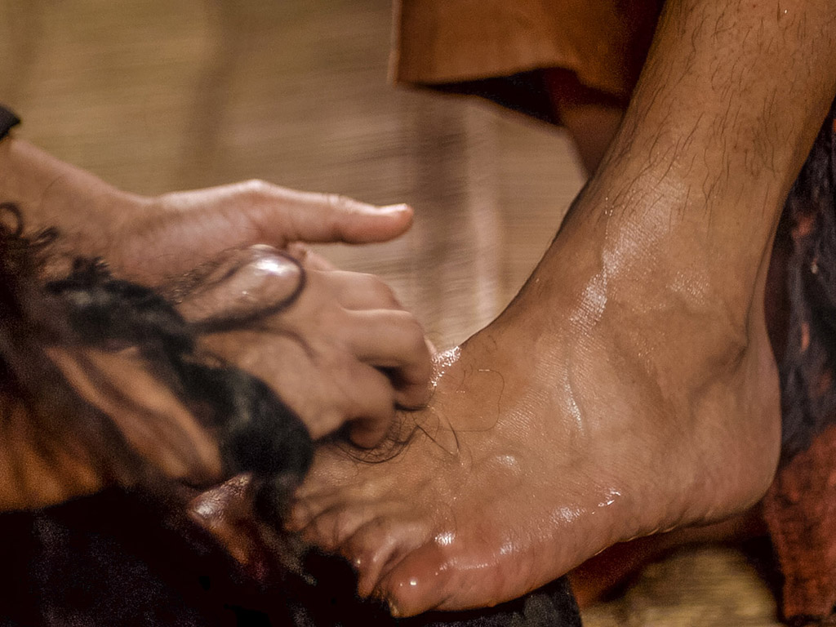
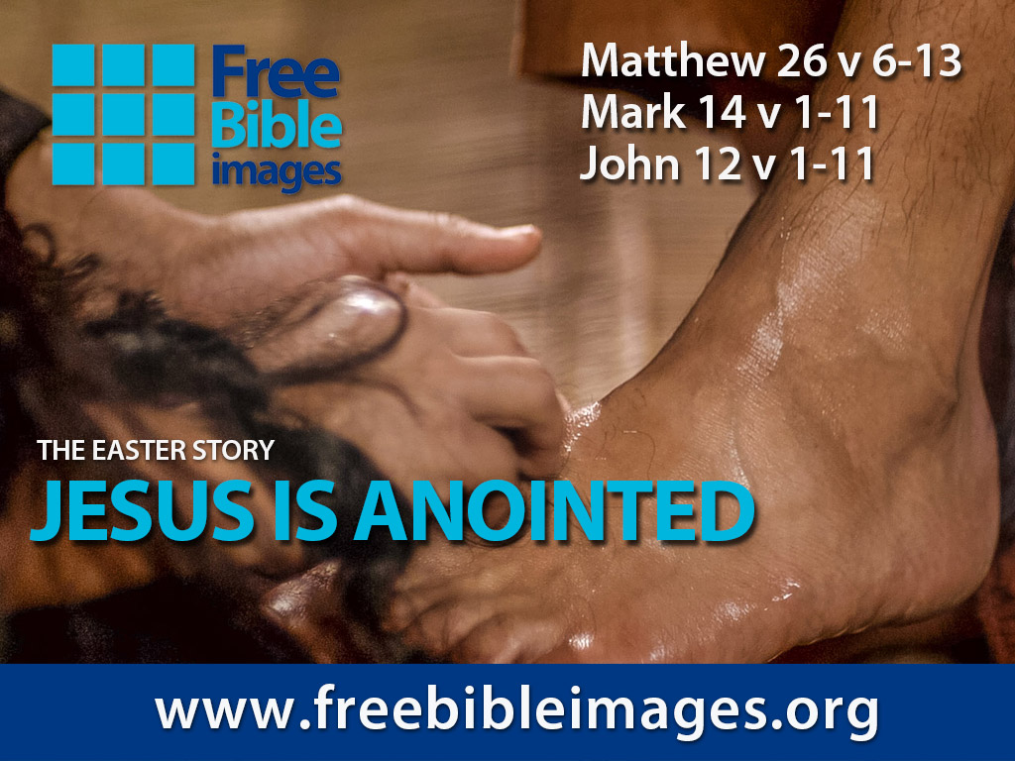

破碎和溢出
免费
圣经
图片
马太 26:6-13
马可 14:1-11
约翰 12:1-11
演出者： Steve Green
耶稣是受膏者

Slide 55
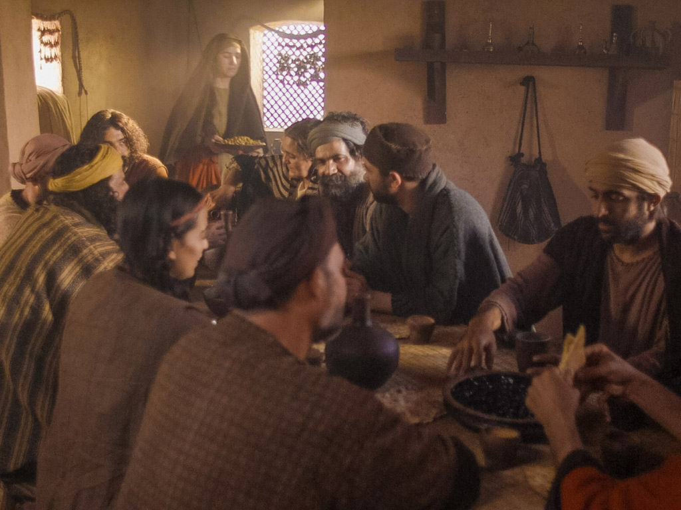
Notes:
Music background 1 of 2

Slide 56
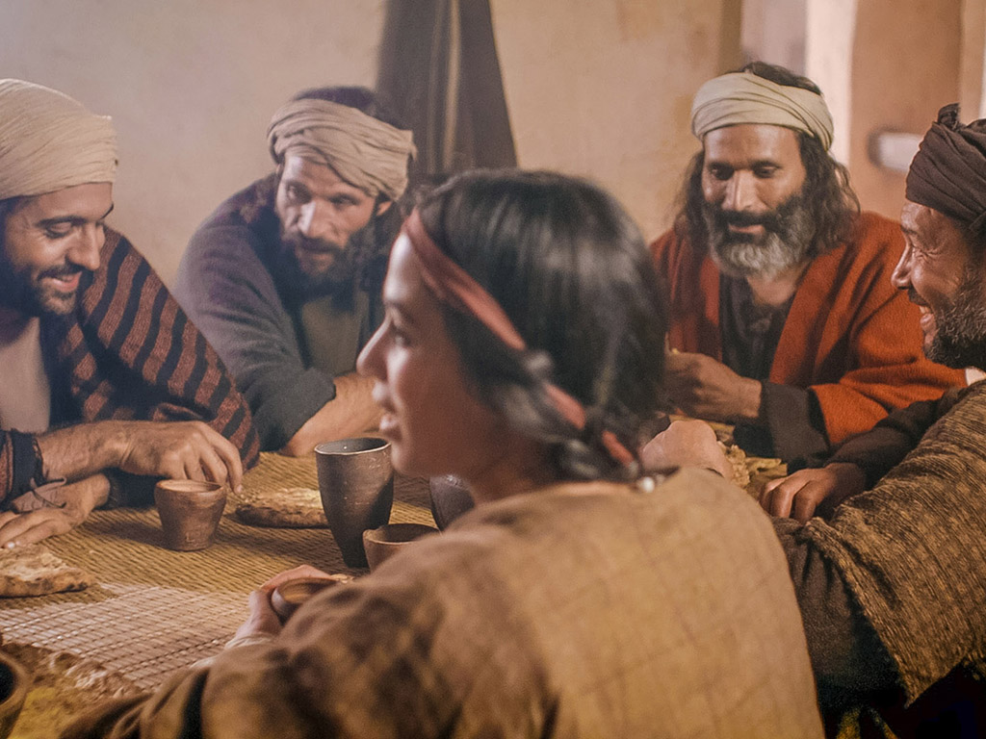
Notes:
Music background 1 of 2

Slide 57

有一天，一位平凡的村女，被她对主热爱的
推动力

Slide 58
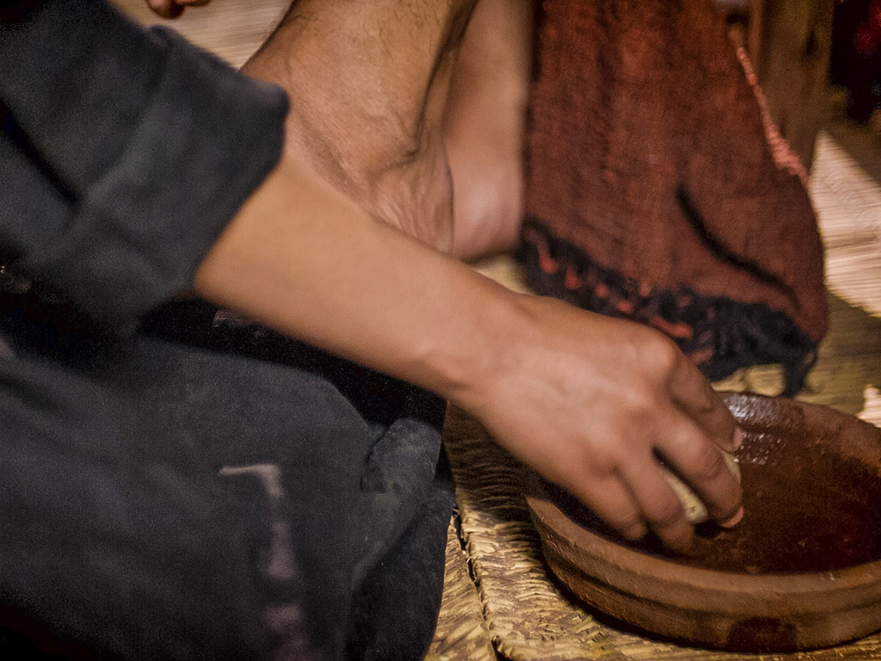
不顾众人嘲笑地肆意倾倒出一瓶价值不菲的精华

Slide 59
一旦它被打破并洒出香气弥漫了整个房间。就像一个囚犯从他的镣铐释放一样，像幽灵被坟墓中释放出来

Slide 60
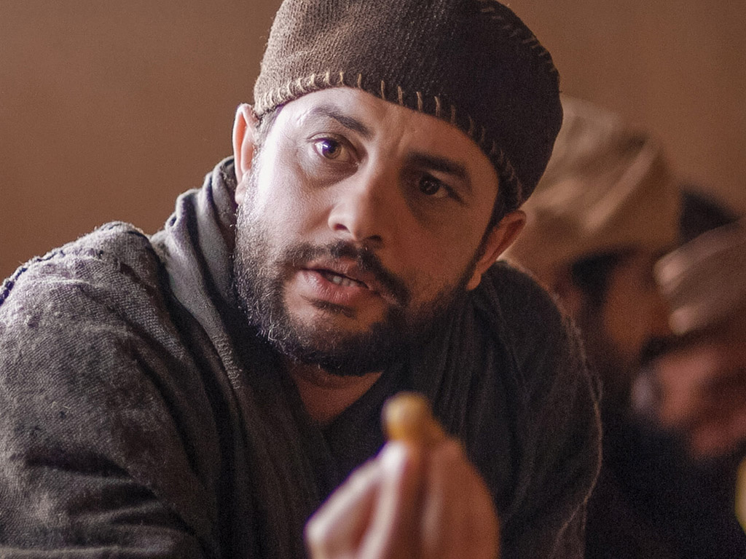
耶稣，为了爱你，破碎而洒落
生命中最宝贵的财富，沉溺于你

Slide 61
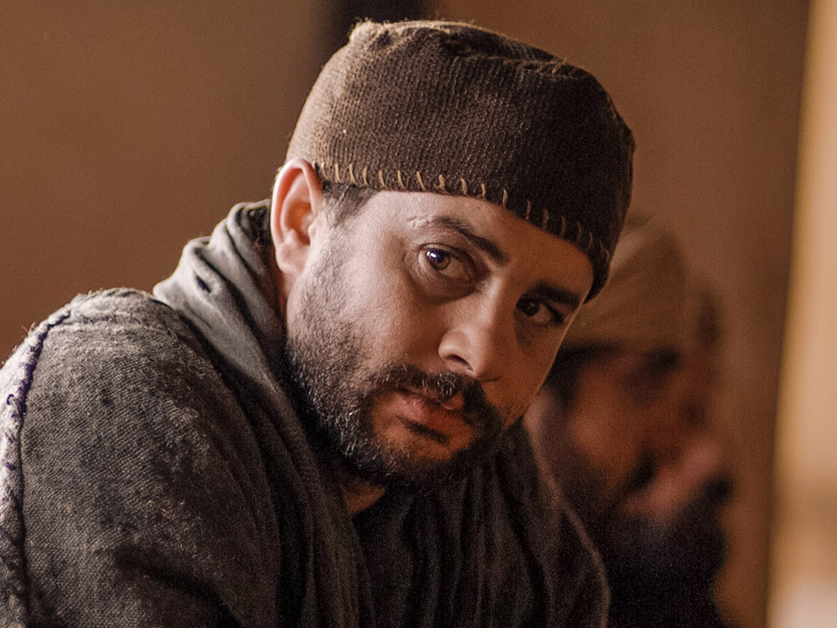
破碎并洒出，倒在你的脚下
在甜蜜的放弃中，让我被洒出来用完于你

Slide 62
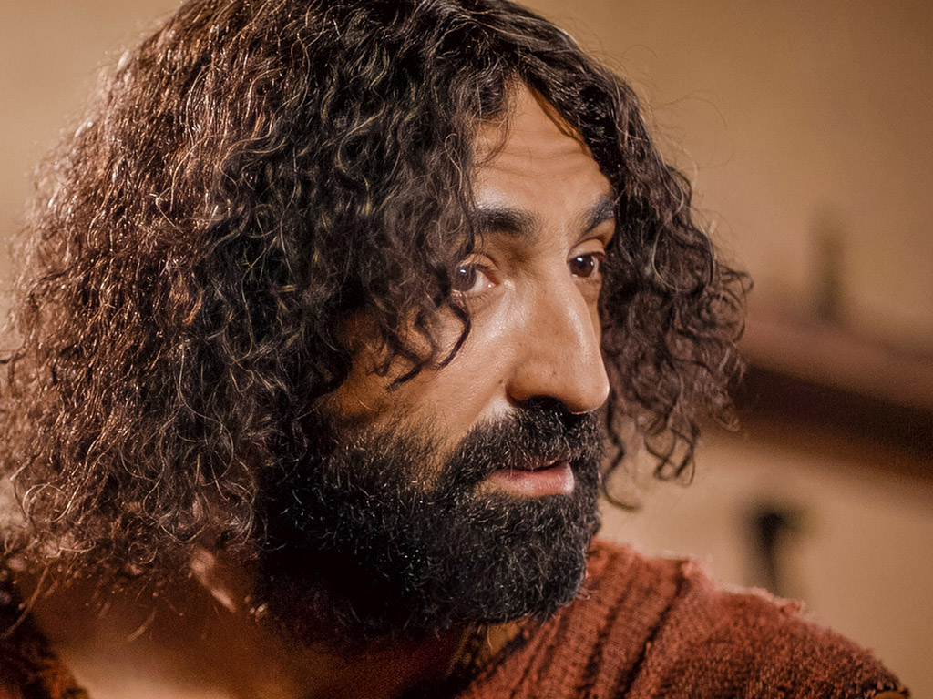
主啊，你是上帝宝贵的宝贝，祂是祂所爱的，祂自己完美的儿子
被差遣到这世间来向我展示天父的爱，只为了爱而实行

Slide 63
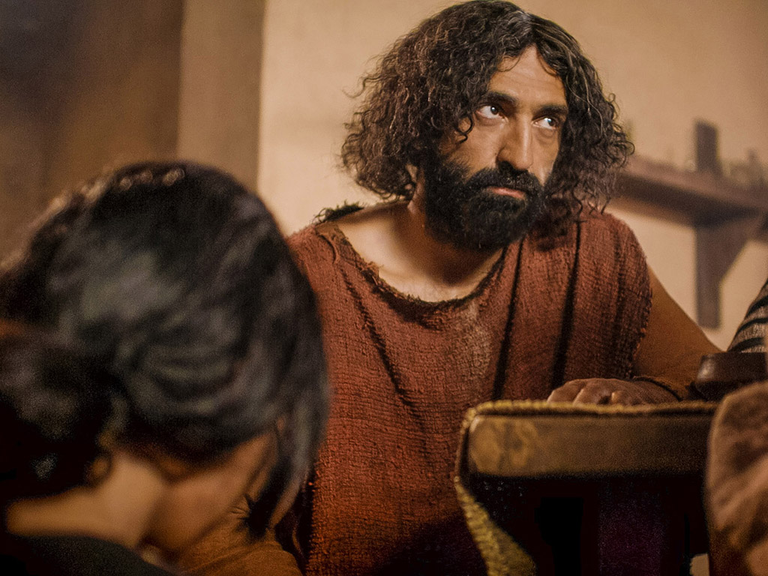
你是完美，圣洁的，但你自愿地放弃了自己尊荣的身份
你为了赦免我的罪犯而不惜代价，你已经耗尽并为我浪费了

Slide 64
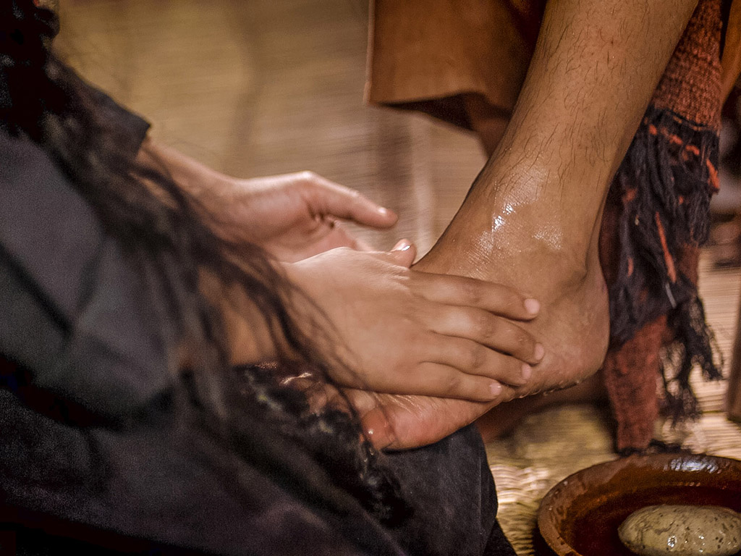
破碎和洒落都为了爱我，耶稣 - 上帝最珍贵的宝藏就在我身上

Slide 65
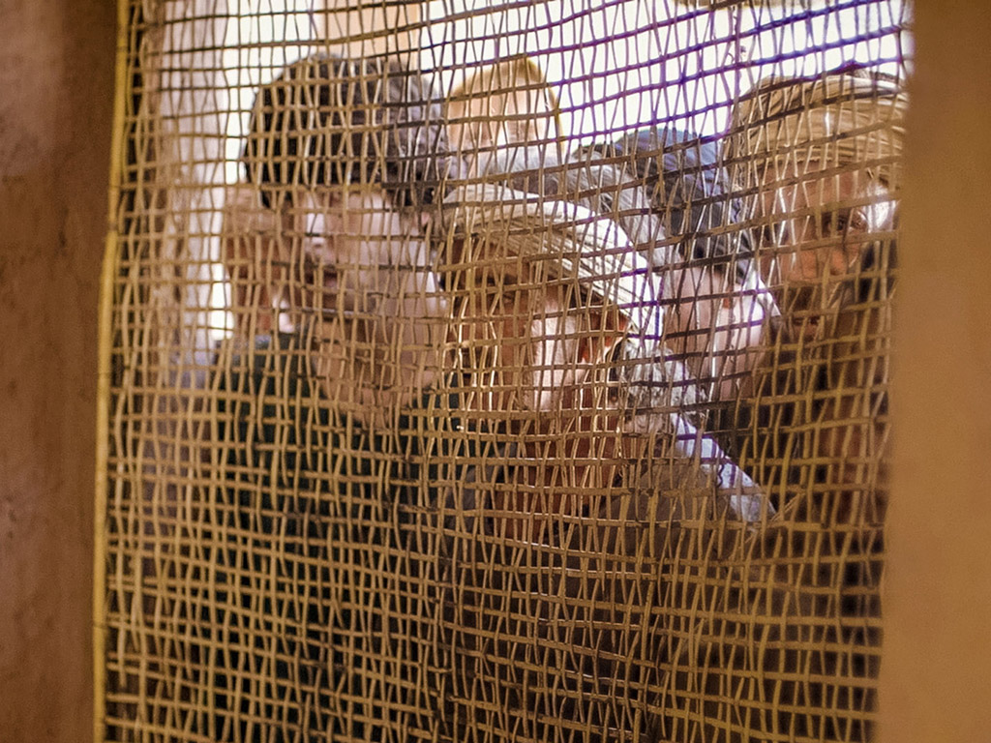
破碎，洒出，倒在我的脚下。
主啊，为了我，你放弃所有尊荣，洒出了，为我而燃尽了

Slide 66
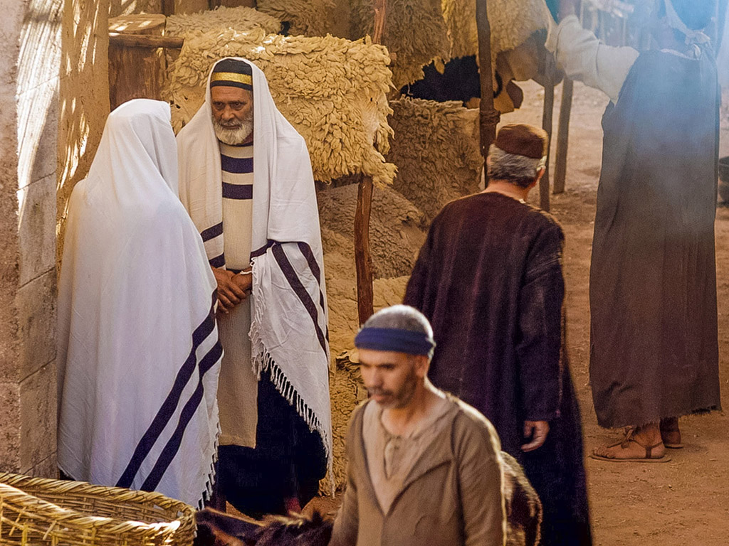
在甜蜜的放弃中，让我被洒出并用尽你

Slide 67

图片声明 Big Book Media
© 版权所有.
授权使用
BIG BOOK MEDIA

Slide 68

Free Bible Images
授权使用
免费
圣经
图片
图片中的文字

Slide 69

带有雪花石膏罐子的妇女是抹大拉的马利亜吗？
不.路加福音没有提他的名,但在其它福音中清楚记说是伯大尼的马利亜

Slide 70
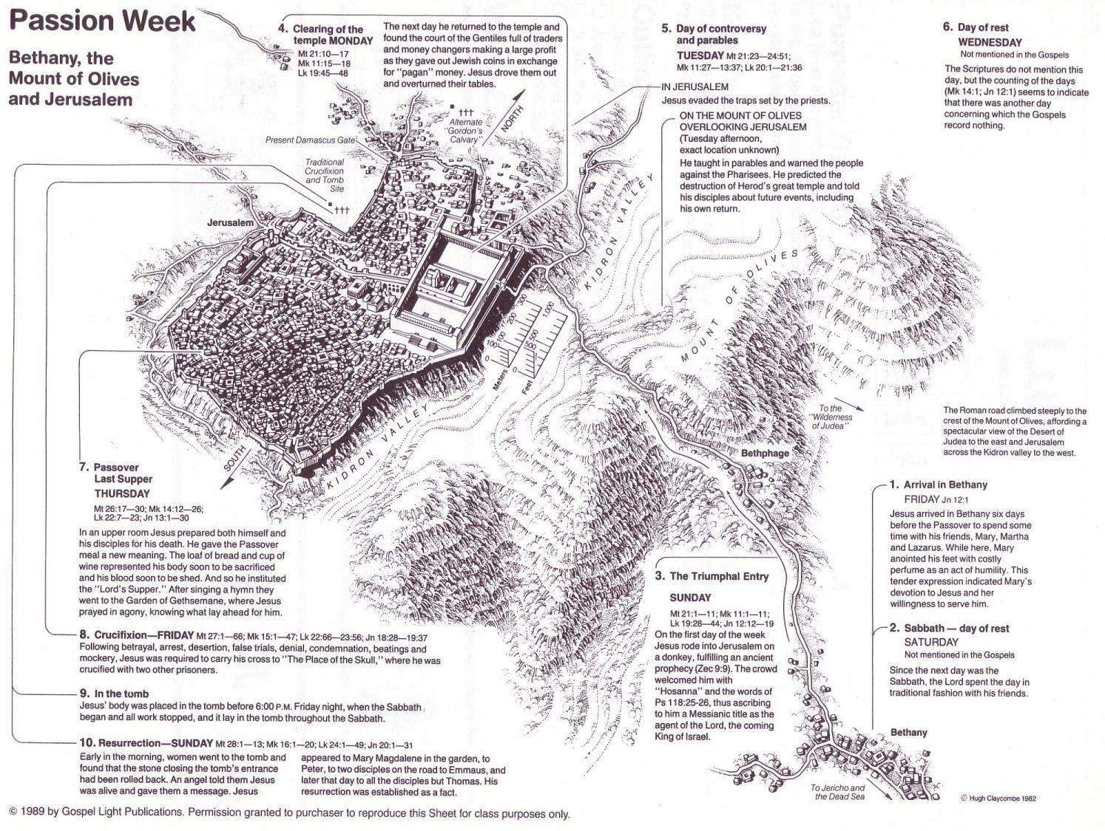
约翰福音12章事件
64
656
不信的摘要
12:37-50
死亡的预表
12:21-36
光荣的进入
12:12-20
伯大尼的受膏
12:1-11

Slide 71
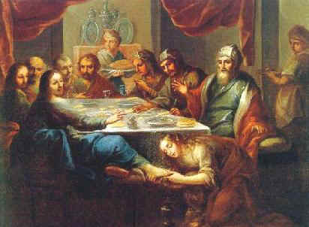
路 7:36-50
耶稣和那有罪的女人

Slide 72
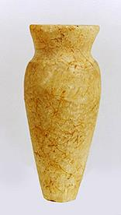
耶稣的恩膏
所有四个福音书记载的共同点：
女子的突然访问
耶稣的头和/或脚被受膏
用她的头发擦他的脚
弟子/犹大对浪费的投诉
耶稣对门徒的斥责
在一个名男人叫西门的家
雪花石膏瓶 （除了约翰书)
Notes:
耶稣的恩膏
共同所有四个福音书的记载：
由女子未宣布拜访
受膏耶稣的头和/或脚
擦他脚用她的头发
浪费投诉
弟子/犹大
门徒耶稣斥责
在一个名叫西门的男人的家
玉瓶（除了约翰）

Slide 73

耶稣的两个恩膏
路加7:36-50
早期的事工
哭泣
对于崇拜，女人的罪
得赦免(路加7:48)
由无名妓女在法利赛人
西门的家里(路加7:40)
约翰12:1-11
马太26:6-13; 马可14:3-9
在受难周
没有哭泣的记载
对于安葬，女人不需要有宽恕
由玛丽，拉撒路的姐姐，在长大麻疯的西门家里(马太26:6;马可14:3)

Slide 74
4. The Promise to Betray
§ 154
马太 26:14-16; 马可 14:10-11; 路加 22:3-6
Judas presents himself to the Sanhedrin as chief witness in an official indictment to testify against Christ in His upcoming trial, thus revealing his bitterness and disappointment with the Lord

Slide 75
5. The Preparation of the Passover
§ 155
马太 26-17-19; 马可 14:12-16; 路加 22:7-13
Jesus sends Peter and 约翰 to prepare the Passover supper for Him and the disciples that they may fully obey the law's demands to observe the feast

Slide 76
6. The Passover Observance
§ 156
马太 26:20; 马可 14:17; 路加 22:14-16, 24-30
At the Passover observance Christ's mention of the Passover finding its fulfillment in the kingdom of God prompts the disciples to dispute over the important positions at the table since they supposed that these positions they held at this feast would determine their positions in the kingdom

Slide 77
7. The Provision of an Example
§ 157
约翰 13:1-20
Christ loves the disciples enough to become their servant by washing their feet to illustrate that the one who rules must become one who serves

Slide 78
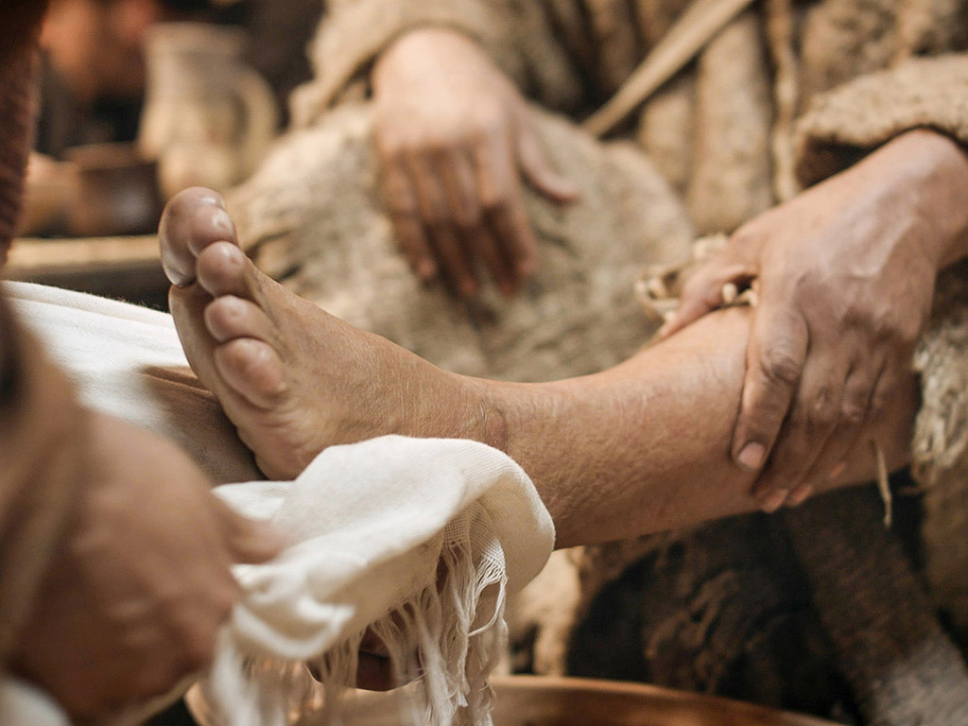
约翰 13:1-17
免费
圣经
图片
复活节的故事
耶稣为门徒洗脚

Slide 79
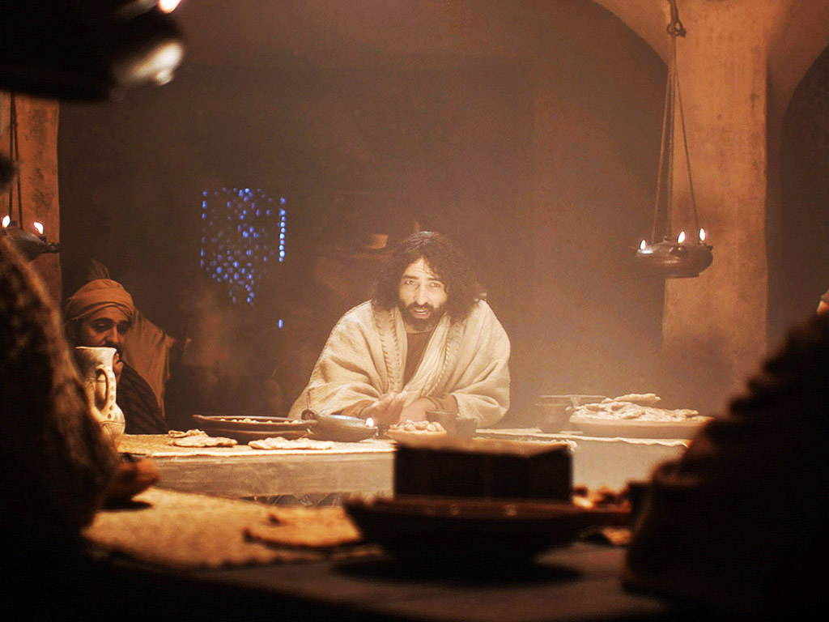

Slide 80
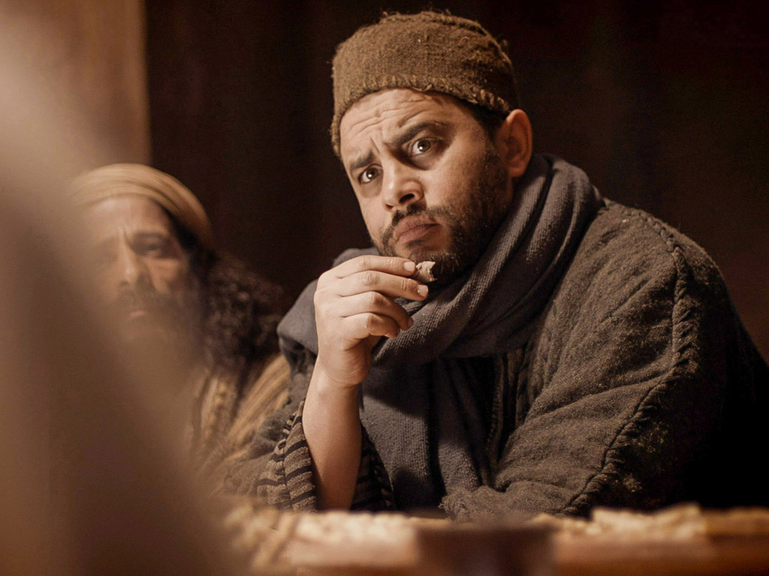

Slide 81
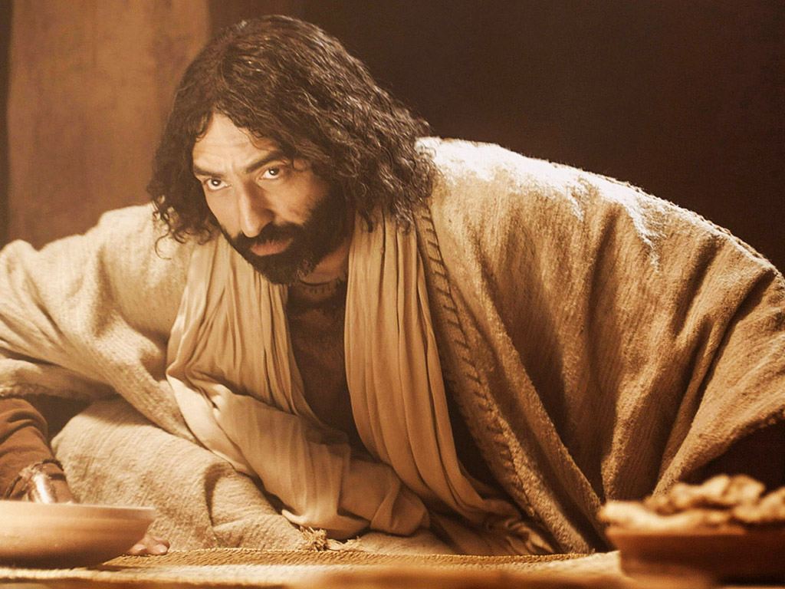

Slide 82
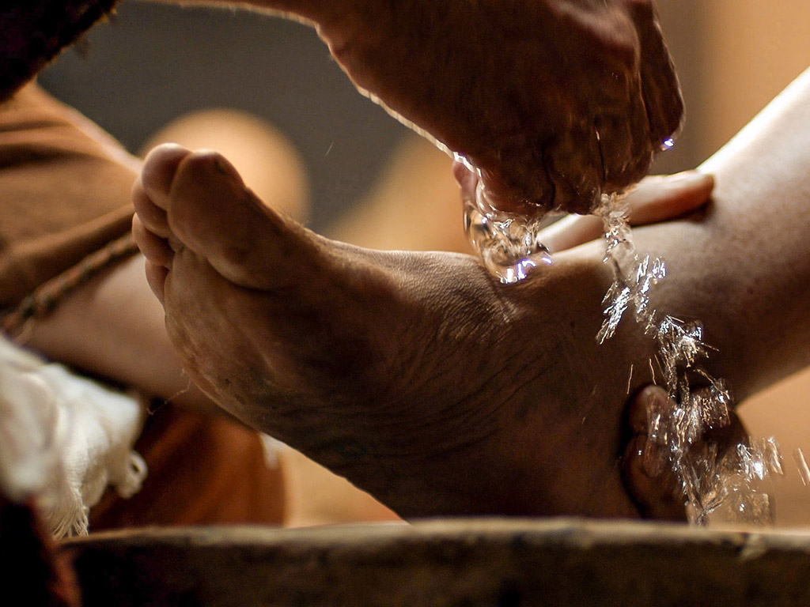

Slide 83
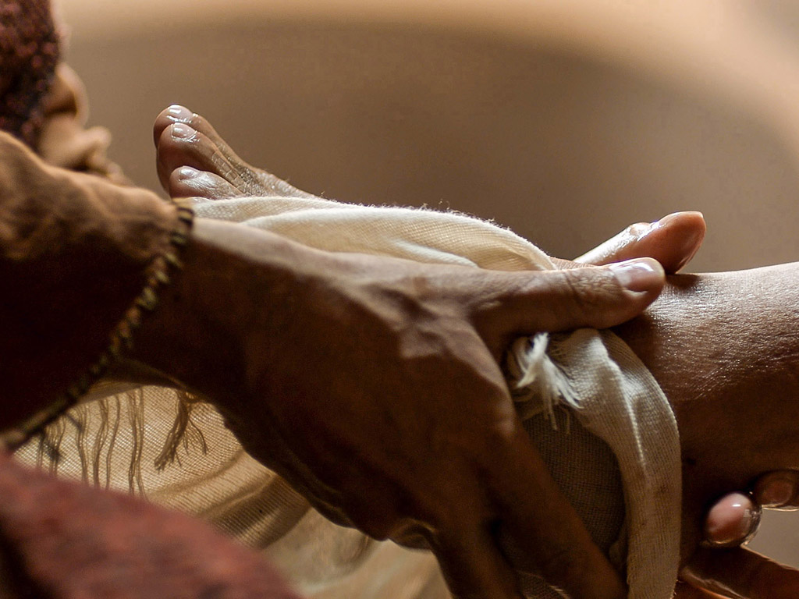

Slide 84
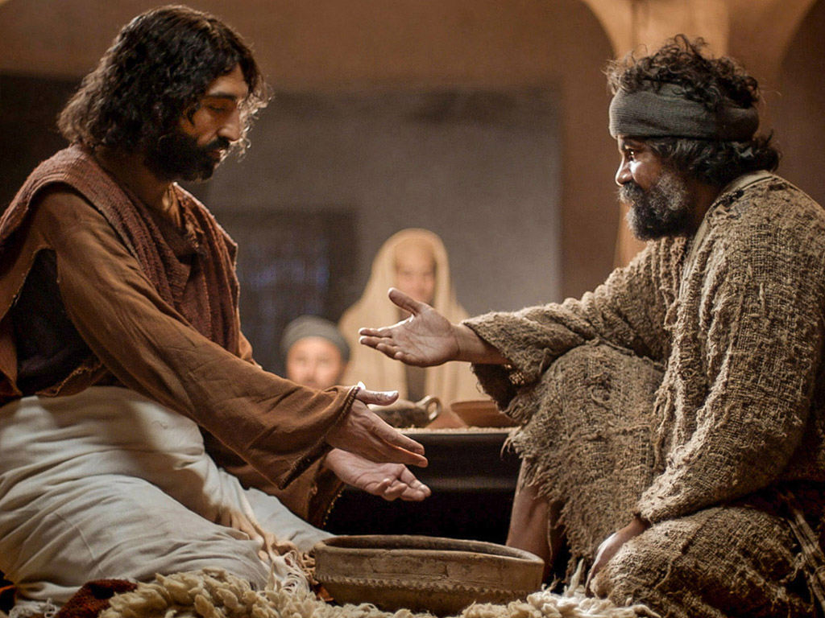

Slide 85
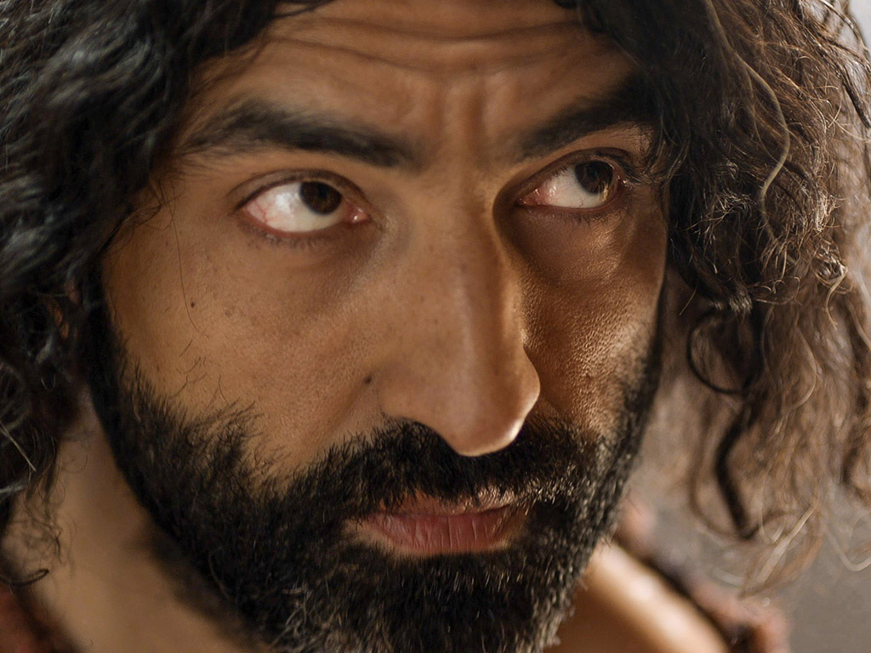

Slide 86
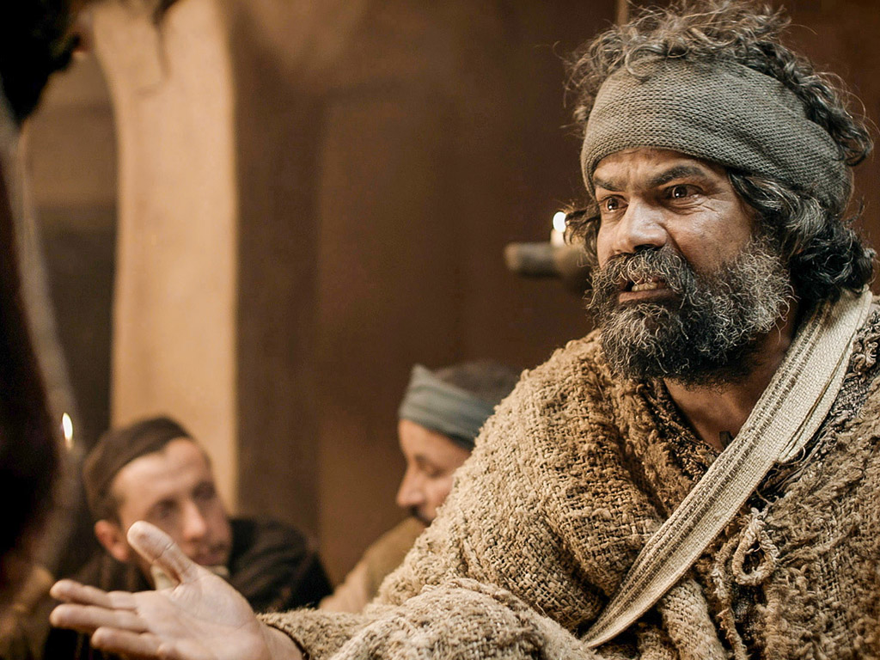

Slide 87
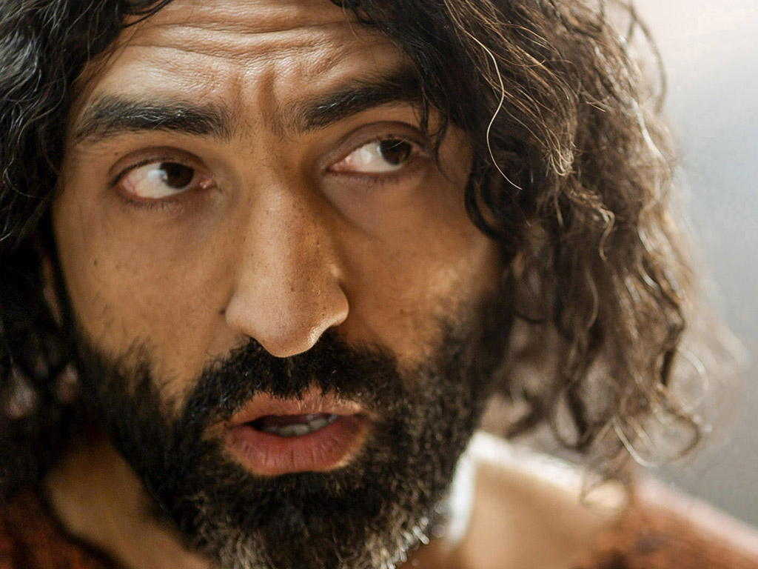

Slide 88
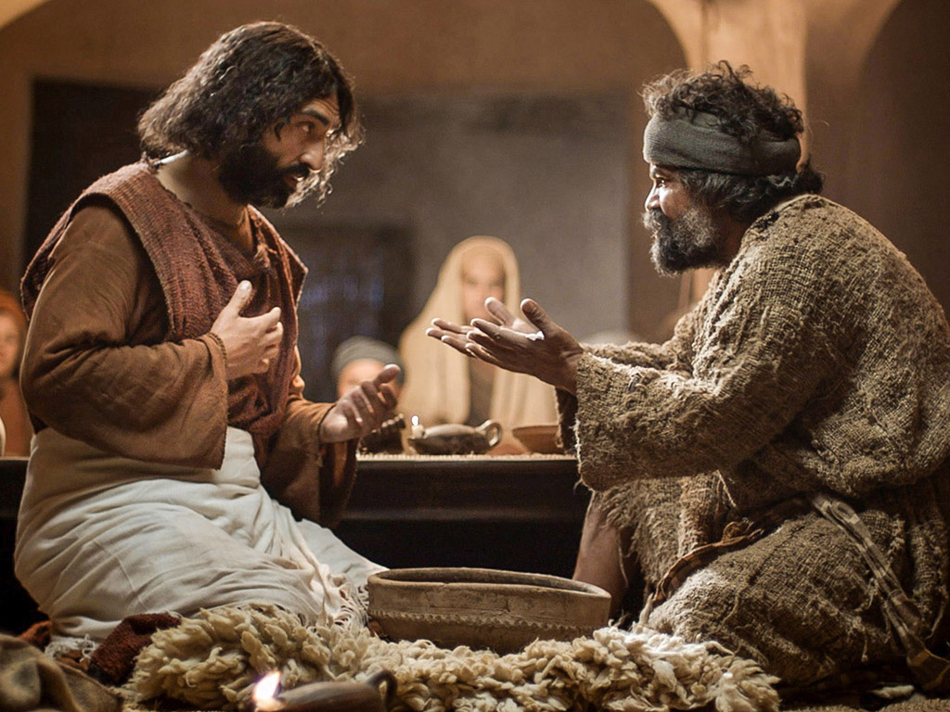

Slide 90
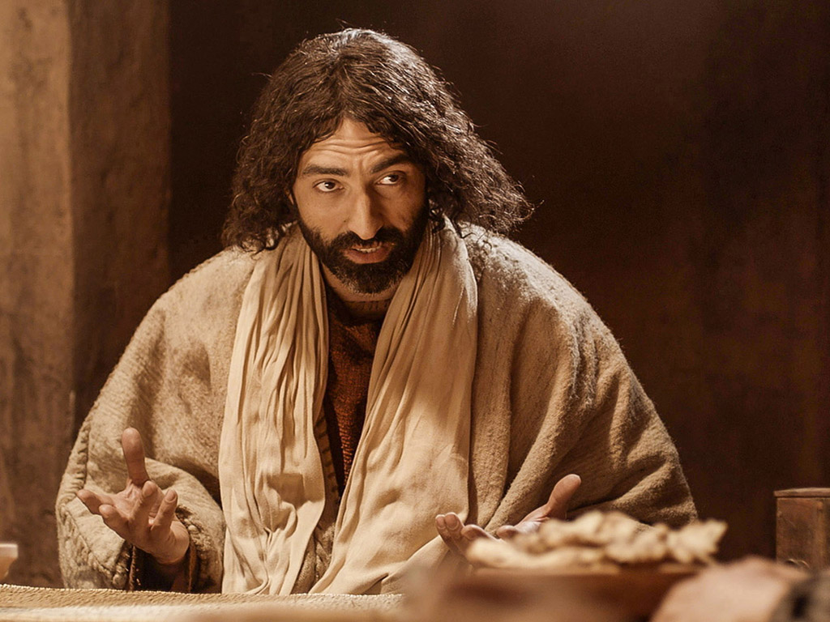

Slide 91
Free Bible Images
授权使用
免费
圣经
图片
图片中的文字

Slide 92
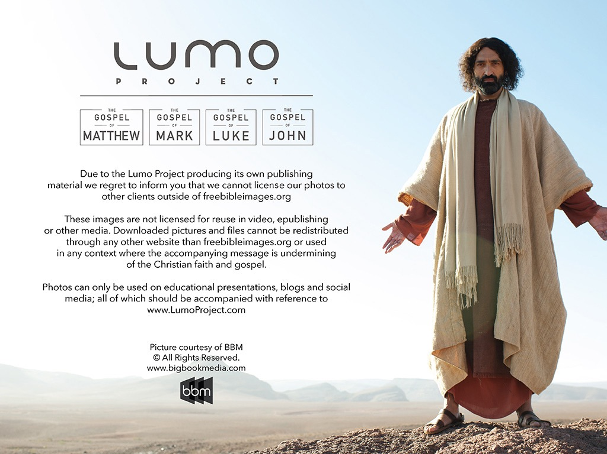
授权使用
马太福音
d
马可福音
o
路加福音
0
约翰福音
0
由Lumo Project出版独家资源，我们特此通知您我们不授权将这些图片发放给除freebibleimages.org客户以外的任何人。
所有图片不授权用于视频制作、epublishing或者其他媒体。所有下载的图片和文件不可通过除freebibleimages.org以外的其他网站传播，亦不可用于任何破坏基督信仰和福音的处境中。
o
图片仅供教育展示、博客和社交媒体使用；所有用途均需注明出处
www.LumoProject.com
图片声明 BBM
© 版权所有
www.bigbookmedia.com

Slide 93

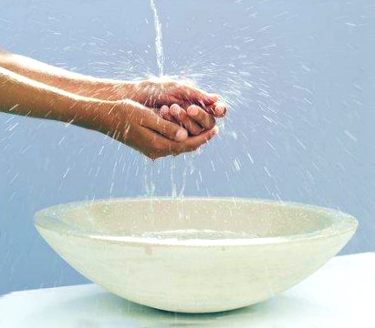
洗手

Slide 94

脚代替手

Slide 95

Upper Room Seating

Slide 96

“U” 型餐卓

Slide 97

在逾越节与耶稣同席

Slide 98

逾越节筵席的位置
头
Notes:
Where did the head of the table sit?

Slide 99

筵席的首位
耶稣
约翰
犹大

Slide 100
Dirty Saints
约翰 13:1-17

Slide 101

Why get dirty for others?
3 reasons

Slide 102

I. Getting dirty shows your love.

Slide 103
Love Exemplified
“... He showed them the full extent of his love” (1).

Slide 104

II. Getting dirty shows your humility.

Slide 105

Jesus showed humility

Slide 106

Jesus washed the feet of Judas too!

Slide 107

Jesus retained his authority but took on a servant’s role

Slide 108

“Lord, are you going to wash my feet?” (13:6)
“Unless I wash you, have no part with me” (13:8)

Slide 109

“Then wash my hands and head as well, not just my feet!” (13:9)
Two washings:
Body = salvation (once)
Feet = confession (repeated)
Notes:
13:9-10. “Peter continued to miss the spiritual lesson, but he was certain of his desire to be joined to Jesus. Therefore he asked Jesus to wash his hands and head as well as his feet. Jesus answered, A person who has had a bath needs only to wash his feet; his whole body is clean. (Some Gr. mss. omit the words “his feet.”) Roman Catholics sometimes have interpreted verse 10 to mean that after infant baptism only penance is needed. A preferable interpretation is that after salvation all one needs is confession of sins, the continual application of Jesus’ death to cleanse one’s daily sins (cf. 1 约翰 1:7; 2:1-2). When Jesus added that not every one of you is clean, He was referring to Judas (cf. 约翰 13:11, 18). This suggests that Judas was not converted” (Ibid).

Slide 110

Humble service curbs pride
1. Voluntary
2. No complaining
3. Unconventional

Slide 111

“When a man forgets himself, he usually does something everybody else remembers.”

Slide 112

III. Getting dirty shows you imitate Christ.

Slide 113

“I have given you an example to follow. Do as I have done to you” (约翰 13:15)

Slide 114

Main Idea
When you love people like Jesus, you don’t mind dirt.

Slide 115

Why Get Dirty?
1. To show love
2. To show humility
3. To imitate Jesus

Slide 116
8. The Prediction of Judas' Betrayal
§ 158
马太 26:21-25; 马可 14:18-21; 路加 22:21-23
Christ predicts Judas' betrayal through the passing of the sop in order to offer forgiveness to Judas if he accepts salvation by placing faith in Christ

Slide 117
9. The Prediction of Peter's Denial
§ 159
马太 26:31-35; 马可 14:27-31; 路加 22:31-38
The Lord foretells Peter's denial and prays that the Twelve's faith would not fail so that they all would be restored after denying Him as Lord

Slide 118

Jesus predicted that Peter would deny him that very night (13:38)
Notes:
Peter would deny him (13:38)…

Slide 119
10. The Provision of a Memorial
§ 160
马太 26:26-30; 马可 14:22-26; 路加 22:17-20
Jesus establishes memorials of His person in the cup and bread in order that in the future whenever they eat bread or drink the cup they would remember His sacrificial death

Slide 120

免费
圣经
图片
马太 26:17-35
马可 14:12-31
路加 22:7-38
约翰 13:18-38
复活节的故事
主的晚餐

Slide 121


Slide 122


Slide 123


Slide 124


Slide 125


Slide 126


Slide 127


Slide 128


Slide 130


Slide 131


Slide 132


Slide 133


Slide 134


Slide 135


Slide 136
Free Bible Images
授权使用
免费
圣经
图片
图片中的文字

Slide 137


PESACH
The Passover Meal
Notes:
Translators, do NOT translate PESACH as this is Hebrew but translate “The Passover Meal”

Slide 138
The Four Cups (Exod. 6:6-7)
145
"Therefore, say to the Israelites:
'I am the Lord, and I will bring you out from under the yoke of the Egyptians.
Sanctification
Plagues
I will free you from being slaves to them,
and I will redeem you with an outstretched arm and with mighty acts of judgment.
Redemption

Slide 139


… This is my body
GIVEN FOR YOU do this in
REMEMBRANCE of me.
路加 22:19

Slide 140
… This cup is the
NEW COVENANT in my blood, which is POURED OUT for you.
The cup (not baptism) is the new covenant sign
路加 22:20

Slide 141
C. Precepts By Christ
§§ 161-165
约翰 13:31-16:33
Christ provides His last precepts for the disciples at the Last Supper in order to prepare them for His departure and for their ministry apart from His bodily presence

Slide 142
1. Prologue
§ 161
约翰 13:31-35
Jesus commands the disciples to love one another with the same love He showed to them--an unconditional, mutual, serving love--as a sign of identification with Himself and a means of provision for one another as Christ had provided for them

Slide 143
2. Problems
§ 162
约翰 13:36, 14:1-24
Jesus addresses problems the disciples had by declaring that He would be gone only temporarily, that He was the only way to the Father, that He would send them a Helper in the person of the Spirit, and that a restoration of intimate fellowship would come to those who believed in Him, all these statements thus promising a new intimacy of fellowship with the Father, Son and Spirit

Slide 144


Confusion
3 ways to replace confusion with comfort
Comfort

Slide 145

I. Life: Realize that Jesus is preparing a wonderful life in heaven for you (14:1-4).

Slide 146

“Don’t let your hearts be troubled. Trust in God, and trust also in me” (约翰 14:1 NLT)

Slide 147

Your Heart
“Trust in the Lord with all your heart; do not depend on your own understanding” (Prov. 3:5)
“Guard your heart above all else, for it determines the course of your life” (Prov. 4:23)

Slide 148

“Don’t let your hearts be troubled. Trust in God, and trust also in me” (约翰 14:1 NLT)

Slide 149

约翰 14:2 Mansions (KJV)
“In my Father’s house are many mansions...” (KJV)
“In my Father’s house are many mansions...” (KJV)

Slide 150

约翰 14:2

Slide 151

Marriage Backgrounds in Jewish Literature
Marriage depicts Christ’s love for the church (Eph. 5)

Slide 152

The First Century Wedding Procession
Groom’s House (in Father’s House)
The procession parallels Christ’s return for His Bride, the Church
Bride’s House

Slide 153

“We will be caught up (“raptured”) in the clouds to meet the Lord in the air”
(1 Thess. 4:17)

Slide 154
I. Life: Realize that Jesus is preparing a wonderful life in heaven for you (14:1-4).

Slide 155

II. Way: Trust Christ as the only way you can reach God (14:5-14).

Slide 156

约翰 14:6

Slide 157

Dr. Steve McSwain
“Therefore, I now know that when Jesus said, ‘I am the way, the truth...no one comes to the Father but by me,’ he was not saying, as Christian history has mistakenly thought, ‘There is no other way to God but by me.’ He was simply saying instead, ‘The way I live is the way to know God--it's also the way to live happily in this world. If you want to know God, follow my way...emulate how I live, how I think, the way I treat myself, others, and the world.’"
http://www.selfgrowth.com/articles/is-jesus-the-only-way-to-god

Slide 158

Other texts say the same...
"Nor is there salvation in any other, for there is no other name under heaven given among men by which we must be saved" (Acts 4:12).
"He who does not believe the Son shall not see life, but the wrath of God abides on him" (约翰 3:36).

Slide 159

Other texts say the same...
"For there is one God and one Mediator between God and men, the Man Christ Jesus" (1 Timothy 2:5).
"And this is the testimony: that God has given us eternal life, and this life is in His Son. He who has the Son has life; he who does not have the Son of God does not have life" (1 约翰 5:11-12)
Notes:
Only Christ can atone for sin, and therefore only Christ can provide salvation.

Slide 160

Is there really only one way?

Slide 161

The ONE Way

Slide 162

Lee Strobel
jesuschristonly.com
Notes:
http://www.jesuschristonly.com/sermons/lee-strobel/jesus-the-only-way-to-god.html

Slide 163
Black

Slide 164
I. Life: Realize that Jesus is preparing a wonderful life in heaven for you (14:1-4).

Slide 165
II. Way: Trust Christ as the only way you can reach God (14:5-14).

Slide 166
3. Promises
§ 163
约翰 14:25-31
Jesus promises that the Holy Spirit's teaching would cause them to understand those aspects of His instruction which still did not make sense to them so that they would be able to proclaim His words and that they would have His peace which would dispel fear

Slide 167
The Holy Spirit!
How could the disciples cope once Jesus left them to return to heaven?

Slide 168

III. Truth: Submit to the Spirit’s teaching (14:15-31).

Slide 169

Spirit Ministries
(约翰 14:15-31)
Counsels & teaches
(15-21)

Slide 170

圣灵保惠师
" 你 们 若 爱 我 ， 就 必 遵 守 我 的 命 令 。
我 要 求 父 ， 父 就 另 外 赐 给 你 们 一 位 保 惠 师 （ 或 作 ： 训 慰 师 ； 下 同 ） ， 叫 他 永 远 与 你 们 同 在。"
约翰福音 14:15-16
Notes:
Jesus promised that the Holy Spirit would be with us forever.
耶稣承诺我们圣灵会永远与我们同在。

Slide 171

保惠师(约翰福音 14:16)
保惠师 = 策士 = 安慰者
希腊语=“与你并肩而行的人”
“‘另一个’的希腊语选项”
Heteros =“另一种不同的”
Allos = “另一种相同的”
圣灵将像耶稣本人一样与我们同在！
Notes:
Jesus called t
he Spirit our advocate or counselor or comforter…
耶稣称圣灵为我们的保惠师、劝慰者或安慰者…

Slide 172


"…those who do not have the Spirit of Christ living in them do not belong to him at all… The Spirit of God, who raised Jesus from the dead, lives in you"
(Romans 8:9, 11)

Slide 173
Spirit Ministries
(约翰 14:15-31)
Counsels & teaches
(15-21)
Enables obedience & grants peace
(22-31)

Slide 174

约翰 14:27

Slide 175
Confusion
Comfort

Slide 176

How can you replace your confusion with Christ’s comfort?
Main Idea
Main Idea
Trust the one way, one truth, and one life!
One Life
(1-4)
One Way
(5-14)
One Truth
(15-31)

Slide 177
4. Instruction Concerning Their Present Experience
§ 164
约翰 15:1-16:4
Jesus instructs the disciples concerning their need to be vitally related to Him through the Holy Spirit in the midst of opposition from the world that they might experience success in ministry and be prepared for spiritual conflict

Slide 178
a. Fruit bearing
约翰 15:1-17
Christ likens Himself to a vine and the disciples to branches connected to the vine that the Father tends to produce the most fruit in order to show that their success in ministry depends upon their future relationship to Him as the Source of life and the Source of fruit

Slide 179

约15:1-6 的诠释
119e
基督徒失去了他们的救恩
所谓的“基督徒”其实是非信徒
曾经被高举并得鼓励的基督徒后来被以死亡作懲罰
基督徒为神所顾念，直至审判临到那些不为神所使用的人身上

Slide 180
b. The Foe of the Disciples
约翰 15:18-16:4
Christ warns the believers of opposition from the world even unto death that they might depend upon the Spirit and be prepared for spiritual conflict

Slide 181
5. Instruction Concerning the Future
§ 165
约翰 16:5-33
Jesus gives the disciples instruction regarding the future ministry of the Spirit, the resurrection and His presence, which will result in power for effective ministry, unlimited access in prayer, and peace

Slide 182
a. The Ministry of the Holy Spirit
约翰 16:5-15
The coming of the Spirit depends upon His departure that the Holy Spirit might indwell them for an effective ministry

Slide 183

约翰 16:5-33
Jesus Continues Preparing the Disciples for His Absence
Last Discourse
Part 3

Slide 184

Preparing the Disciples in Christ's Last Discourse
(约翰 13:31–16:33)

Slide 185
How could the disciples cope without Jesus with them anymore?

Slide 186

The Holy Spirit!
How could the disciples cope without Jesus with them anymore?

Slide 187

Key Ministries of the Spirit (16:5-15)
To Unbelievers
8-11
To Believers
12-15
Conviction
Teaching

Slide 188
How does the Spirit convict unbelievers (16:8-11)?
Conviction summary (8)
Guilt in regard to sin (9)
Guilt in regard to righteousness (10)
Guilt in regard to judgment (11)

Slide 189

The Spirit & the Word
"But when he, the Spirit of truth, comes, he will guide you into all truth…" (16:14)

Slide 190

How does the Spirit teach believers God's Word (16:12-15)?

Slide 191

How can you be more open to the Spirit's teaching ministry in your life?

Slide 192
b. The Result of the Resurrection
约翰 16:16-28
The resurrection will be preceded by great grief but Christ will be restored to them again with great joy that they might have unlimited access to the Father in prayer through Christ

Slide 193
c. Conclusion
约翰 16:29-33
Christ will not abandon the disciples so that they might know His peace as they wait for the fulfillment of His promise to overcome the world

Slide 194
D. Prayer by Christ for Believers
§ 166
约翰 17:1-26
Christ prays for Himself but especially for His disciples and future believers to enable them to minister successfully in His behalf after His departure

Slide 195
约翰福音概览
107
道成肉身赐世人永生
神儿子 的神性 | 神儿子的启示 |  | 神子装备 门徒 | 神子受难 与复活 | 神子的 足够性
1:1-18 | 1:19–12:50 |  | 13–17 | 18–20 | 21
前言 | 公开 |  | 私下 | 公开 | 私下
道成肉身 | 被接受的 2个神迹 1:19–4:54 | 被拒绝的 5个神迹 5–12 | 楼房里 的教导 （无神迹） | 终极的神迹 | 最后的 神迹
亘古 | 主後29年秋天至 33年3月30日, 星期一 |  | 主後33年 4月2日, 星期四 | 主後33年 4月3日,星期五 至33年 4月5日,星期日 | 主後33年 5月
以弗所 (主後65-69年)

Slide 196

Jerusalem from the East, AD 33
约翰 13–14
Passover at 马可’s House
约翰 15–16
Vineyard
约翰 17
Prayer
Kidron Brook
约翰 18 Mt. of Olives
Notes:
Today we finish what has often been called the Upper Room Discourse—the last time Jesus taught his disciples. This actually isn’t a good term to describe all of 约翰 13–17 because at the end of 约翰 14, Jesus noted, “Come, let’s be going.”
So they left the upper room of the Passover and began walking east to the Mt. of Olives where he would be betrayed. This likely brought him through a vineyard where he taught in 约翰 15 that he was the vine and, as branches, they needed connection to him.
In 约翰 18:1, they would cross the Kidron Valley, so they are still on the west side of the Kidron Brook. In this ravine lay a channel that led from the temple—not a waterway like an aqueduct—but rather a channel that led from the temple altar where an estimated 256,000 lambs were slaughtered during the Passover. When Jesus crossed it, no doubt the smell of blood was ominously hanging in the air—a picture of what was to happen the next day with Jesus as our Passover Lamb.

Slide 197

Christ’s Prayer in 约翰 17
“There is no voice which has ever been heard, either in heaven or in earth, more exalted, more holy, more fruitful, more sublime, than the prayer offered up by the Son to God Himself.”
––Philip Melanchthon

Slide 198
















Widening Circle of Christ's Prayer
James
Thaddeus
约翰
Peter
Andrew
For
Himself
Bartholomew
James bar Alphaeus
For
Disciples
Thomas
Simon the Zealot
Philip
马太
For
All Believers

Slide 199

A Pattern for Prayer
Finally pray for those outside your influence
Then pray for those in your closest sphere of influence
First pray that
you are in
God’s will

Slide 200
1. His Prayer for Himself
约翰 17:1-5
Jesus prays for the reunion of His soul and body after death (resurrection) and that He would be brought out of spiritual death (glorification), revealing His complete subjection to God in His approaching death and His absolute confidence in God for the resurrection to follow

Slide 201
A Pattern for Prayer
I. Pray that you will glorify God by fulfilling his calling for you.

Slide 202
Widening Circle of Christ's Prayer
For
Himself

Slide 203

“The time has come. Glorify your Son…” (17:1)
“You granted him authority…
[to] give eternal life” (17:2)
“I have brought you glory by completing the work
you gave me to do” (17:4)

Slide 204

我们在
天上的父

Slide 205
愿人都尊你的名为圣

Slide 206
愿你的国降临

Slide 207

愿你的旨意行在地上

Slide 208
2. His Prayer for His Disciples
约翰 17:6-19
Jesus prays for the disciples' protection, joy, and setting apart for ministry (ordination) that they might make the Father known to the world

Slide 209
A Pattern for Prayer
II. Pray for those you influence to be protected and holy.
联合
I. Pray that you will glorify God by fulfilling his calling for you.
III. 为所有信徒祷告，使他们成为向世界作联合见证的人。

Slide 210
Widening Circle of Christ's Prayer
1. Protect them (6-16)
2. Sanctify them (17-19)
James
Thaddeus
约翰
Peter
Andrew
For
Himself
Bartholomew
James bar Alphaeus
For
Disciples
Thomas
Simon the Zealot
Philip
马太

Slide 211










Widening Circle of Your Prayers
1. Protect them
2. Sanctify them

Slide 212

Good & Evil

Slide 213

Hebrews 5:14

Slide 214

Light overpowers the dark… EVERY TIME.

Slide 215

”I’m not asking you to take them out of the world, but to keep them safe from the evil one”
(约翰 17:15)

Slide 216

Light dispels darkness!

Slide 217
3. His Prayer for the Family of Believers
约翰 17:20-26
Jesus prays in regard to the future believers who would result from the disciples' ministry for their unity, glorification and love for one another to match the love the Father has for the Son

Slide 218












Widening Circle of Christ's Prayer
Thaddeus
James
约翰
Peter
For
Himself
Andrew
Bartholomew
James bar Alphaeus
For
Disciples
Thomas
马太
Simon the Zealot
Philip
For
All Believers
Notes:
Here Jesus prays a threefold prayer for Himself, His disciples, and for all believers.
• In verses 1-5 Christ prays for Himself that God would glorify Him in His completion of His mission through His vicarious death.
• In verses 6-19 Christ prays that His disciples might have God's protection and sanctification while they remain in the world.
• Today's text in verses 20-26 concerns the last section of Christ's prayer that relates to us as a part of all believers.

Slide 219

What was most important to Jesus as he anticipated the cross?
Notes:
What was most important to Jesus as he anticipated the cross?

Slide 220

Jesus prayed for our unity (约翰 17)
Notes:
Today we will focus on the end of his prayer where he prays for our unity.

Slide 221

What is Unity?
Notes:
But what does unity look like?

Slide 222

Uniformity
Notes:
Well, unity is not the same as uniformity. Many of us have worn uniforms at work, in the military, on sports teams, or some other team.
We are too painfully aware that just looking the same doesn't mean unity!

Slide 223

Why Unity?
Three reasons for unity…
Notes:
But why is unity so important that Christ would make it His final prayer for the saints? (Subject).
Today we will see three reasons Jesus gives for us to be united.
Verses 20-23 tell us that first motivation for unity is because…

Slide 224
I. Unity grows the church (20-23).
Unity
Notes:
When believers get along with one another, the church increases.

Slide 225

"My prayer is not for them alone. I pray also for those who will believe in me through their message"
(17:20 NIV)

Slide 226

"that all of them may be one, Father, just as you are in me and I am in you"
(17:21a NIV)

Slide 227
The Trinity
= Three-unity
Father
is
is not
is not
GOD
is
is
Son
Spirit
is not
H. Wayne House, Charts of Christian Theology and Doctrine, p. 45
Notes:
Our model for unity is the first and second members of the Trinity (20-21a).
Can you imagine the Father and the Son arguing over roles and responsibilities?
"Hey Father! I don't like this idea of dying on a cross. Count me out. If you think it's necessary, then you do it yourself!"
The Father replies, "No way!" and the Spirit agrees, adding, "And what this stuff about me having to give everyone gifts? What a hassle! I hate shopping!"
• In fact, "Trinity" really means "three-unity." Three persons of the Godhead have differing roles but work together in complete unity.

Slide 228



"that all of them may be one, Father, just as you are in me and I am in you. May they also be in us so that the world may believe that you have sent me. ²²I have given them the glory that you gave me, that they may be one as we are one: ²³I in them and you in me. May they be brought to complete unity to let the world know that you sent me and have loved them even as you have loved me" (21b-23 NIV).
Notes:
Likewise, our unity shows the world that Christ is from God (21b-23).
In my NIV text verses 20-23 comprise 5 sentences, which makes it hard to tell where the emphasis is in this section. But actually, the Greek text has only 2 sentences—verses 20-21 and verses 22-23, both of which have as their final idea "that the world may believe" and "to let the world know." The result of unity is evangelism!

Slide 229

Interview of a Catholic Leader
Notes:
Some years back [1993], a British reporter asked a Catholic leader on the growth of evangelicals in the UK, "Are you concerned about this incredible growth among the evangelicals?" "No," came the firm reply. "Why not?" the reporter pressed. "I'm not concerned that the evangelicals have growth to 17 million here," the Catholic leader said. "I won't be concerned—that is, unless they decide to unite."

Slide 230


The City-State of Singapore
Notes:
In contrast, where there is unity, the world believes—like verses 21b and 23b say.
I think one reason the church in Singapore has grown in recent years is because it has learned something about unity despite race and language groups. Of the 4 major language groups in Singapore, 3 have been effectively reached: English, Mandarin, and Tamil.

Slide 231


Multi-cultural • Multi-ethnic • Multi-religious
99% of Hindus are Indian
99% of Buddhists are Chinese
99% of Muslims are Malay
Only Christians effectively cross racial lines though Malays are still unreached
Notes:
• Did you know that 99% of Hindus are Indian
• 99% of Buddhists here are Chinese, and
• 99% of Muslims are Malay?
• In contrast, only Christians have reached across ethnic lines with 79% Chinese, 8% Indian, a half percent Malay, and 13% other groups.
Sure, we have a way to go, but I can't help but think that non-Christians have taken a more serious look at Christianity given the unity amidst diversity across racial and language lines.

Slide 232
Unity
Three reasons for unity
Notes:
I said Christ addresses three reasons for unity in today's text.

Slide 233
I. Unity grows the church (20-23).
Unity

Slide 234

II. We'll be united in heaven forever
—so let's start agreeing now (24).
Notes:
We'll be in glory together—so let's show some of that glory now.

Slide 235

"Father, I want those you have given me to be with me where I am, and to see my glory, the glory you have given me because you loved me before the creation of the world" (17:24 NIV).
Notes:
Christ prayed that true Christians would "be with me where I am." What does He mean? He was right there, wasn't He? And weren't the disciples already there? Of course.
Here we see Jesus using the present tense to refer to something actually future. He does the same thing in verse 11 which literally reads, "I am in the world no longer," even though He was still there.
Christ is looking to the future with such certainty that He speaks of it in the present. The disciples hadn't seen His glory yet, in that He was confined to a human body. But they would see it—they'd all see it together.

Slide 236

Finding Directions in Heaven?
Notes:
I think the implication here is that since we'll be united forever in heaven, this should show down here as well.
Can you imagine in heaven trying to find your way around: "Let's see, here we are in the Presbyterian precinct. But where's Assemblies Avenue? Oh, OK, I see it here on the map—after Baptist Boulevard, Lutheran Lane, Reformed Road, Charismatic Crescent, and on the tip of Pentecostal Point!"
No way! We're all one family there. We'll keep our same race—you'll still be Chinese—but we won't be separated by a denominational distinctive!

Slide 237

新加坡神学院
Notes:
One of the best tastes of earthly unity before heavenly bliss is Singapore Bible College. Once I was teaching at SBC on the Book of Job. As I shared how different cultures explained the reasons for suffering, I asked a Pakistani student to share how Pakistani Muslims explain pain, then I asked an Indian student, "How do Indians view suffering?"

Slide 238

SBC Schools
Chinese
Music
Counseling
English
Established 1952
31 Full-time Faculty
500 Students
25 Denominations
25 Countries
29 Languages
Notes:
It suddenly occurred to me that our class not only had students from Pakistan and India, but also from Malaysia, Philippines, Myanmar, Korea, Indonesia, Hong Kong, and Singapore—in one class! SBC has 500 students from 25 nations and 20 denominations and functions as a genuinely diverse but equally genuinely united fellowship.

Slide 239
Church Unity
When should we not work together?
Notes:
But I should give one word of caution.
Genuine spiritual unity is possible only with genuine believers.

Slide 240

What does 2 Cor. 6:14-7:1 mean?
"
136
"Don't team up with those who are unbelievers. How can righteousness be a partner with wickedness? How can light live with darkness? ¹⁵What harmony can there be between Christ and the devil? How can a believer be a partner with an unbeliever? ¹⁶And what union can there be between God's temple and idols? For we are the temple of the living God."

Slide 241
What does 2 Cor. 6:14-7:1 mean?
"
136
"As God said:
'I will live in them
and walk among them.
I will be their God,
and they will be my people.
¹⁷Therefore, come out from among unbelievers, and separate yourselves from them, says the Lord'
(2 Cor. 6:16-17)

Slide 242
What does 2 Cor. 6:14-7:1 mean?
"
136
"Don't touch their filthy things,
and I will welcome you. ¹⁸And I will be your Father, and you will be my sons and daughters, says the Lord Almighty."
¹Because we have these promises, dear friends, let us cleanse ourselves from everything that can defile our body or spirit. And let us work toward complete holiness because we fear God" (2 Cor. 6:17–7:1)

Slide 243

What does 2 Cor. 6:14-7:1 mean?
"
136
"The direct commands to separate from other people are always commands to separate from unbelievers, not from Christians with whom one disagrees… There are no direct New Testament commands to separate from Christians with whom one has doctrinal differences (unless those differences involve such serious heresies that the Christian faith itself is denied)."
Wayne Grudem, Systematic Theology, 877

Slide 244




World Council of Churches
"It is better to be divided by truth than to be united by error"
Notes:
The WCC has over 250 Protestant, Catholic, Anglican, and Eastern Orthodox churches—but does it have biblical unity? No, it has organizational, external unity—but no spiritual, internal unity in the biblical sense. In fact, at the World Parliament of Religions in Chicago in 1993 the WCC encouraged its member denominations to open its arms to African shamans, Hindus, Muslims, Buddhists, and witch doctors!
• Another leader correctly noted, "It is better to be divided by truth than to be united by error."

Slide 245
Unity
Three reasons for unity
Notes:
Christ's prayer up to this point highlighted two reasons He considered unity vital…

Slide 246
I. Unity grows the church (20-23).
Unity

Slide 247
II. We'll be united in heaven forever
—so let's start agreeing now (24).
Notes:
We'll be in glory together—so let's show some of that glory now.

Slide 248

III. Unity shows love that attracts unbelievers (25-26).
Notes:
United Christians draw others into the family through their love.

Slide 249

"Righteous Father, though the world does not know you, I know you, and they know that you have sent me. ²⁶I have made you known to them, and will continue to make you known in order that the love you have for me may be in them and that I myself may be in them" (17:25-26 NIV).

Slide 250


Two Boys
Notes:
A young boy grew up in a family where his mother prayed regularly to various gods, attended the festivals, went to the temple regularly. However, his father was more philosophical. Once the boy asked his father who God was, and his dad took him outside, pointed to the sky and said, "There—that's god. And beyond that is god too!" The mother's ritualistic beliefs and father's philosophical musings caused many arguments between them—so much so that the boy decided to abandon their religion for Christianity because he saw love among believers. Lack of unity ruins one's testimony!
Another young boy grew up in a "free thinker" family. His mother and father divorced when he was four, his mother remarried, and his step father and mother fought continually. They too divorced, and a third marriage began that was equally traumatic. One day the boy visited a school friend's house. The difference was amazing! No one threw things, the parents didn't argue, the father was a spiritual leader in the home, they all prayed together, there was a genuine peace and unity which made this boy want to visit that home time and again. He did. He ended up going to church with the family and soon accepted Christ. He even became a missionary for 28 years. And he's speaking to you right now.
• I have seen what Christian unity can do in my own life. I've also seen the devastating effects of disunity over the simplest issue.

Slide 251
Unity
Why is unity important?
Notes:
So why is unity so important that Christ would make it His final prayer for the saints?

Slide 252
Main Idea
Christian unity is evangelistic!
Thaddeus
James
约翰
Peter
Andrew
Bartholomew
James bar Alphaeus
Thomas
马太
Simon the Zealot
Philip
Notes:
Here is the key idea of what Jesus said: Christian unity is evangelistic (MI). When believers stick together, non-believers want to stick with them. Jesus said people that will come to Christ when they see that believers can get along.

Slide 253

Mahatma Gandhi (1869-1948)
"I would become a Christian
—if it weren't for Christians."
Notes:
Unbelievers are also repulsed by disunity. Mahatma Gandhi was tremendously drawn to Jesus Christ and His teachings, but after seeing how Christians treated each other he said,
• "I would become a Christian
• —if it weren't for Christians."

Slide 254

"In essentials, unity;
In non-essentials, liberty;
In all things, charity."
––Philip Melanchthon
Notes:
The great reformer, Philip Melanchthon, put it this way…

Slide 255

The Great Redwood Sequoias
Notes:
I grew up in Northern California with great redwood sequoia forests, the largest trees in the world. One scholar notes of them, "Redwoods are noted for age, beauty, and fine wood.

Slide 256

The Great Redwood Sequoias
Notes:
But one unusual characteristic of the redwoods is their tendency toward unity. Two redwoods may grow up together several feet apart, and then after 50 or 100 years the trees begin to touch.

Slide 257

The Great Redwood Sequoias
Notes:
Quite often the bark begins to overlap and fill out so that the two trees ultimately become one!

Slide 258

The Great Redwood Sequoias
Notes:
There are cases where a dozen trees have sprung up from the outer roots of a tree that has fallen and have formed a perfect circle. After several centuries these trees have grown together so that outwardly they appear as a single giant tree!"
"In keeping with Christ's prayer, the goal of the body of Christ should be to grow into such a unity that the world will recognize us as one. The display of such unity in our individualistic society will be a testimony to the world of the divine Person and work of Christ."
J. Carl Laney, Marching Orders, 156, emphasis his

Slide 259
E. Prayer in the Garden
§ 167
马太 26:36-46; 马可 14:32-42; 路加 22:39-46;
约翰 18:1
Christ prays that the Father might accept His death as full payment for the sin of the world and that He would be raised to full fellowship with the Father so that He might not be separated from God for eternity

Slide 260

马太 26:36-56
马可 14:32-52
路加 22:39-53
约翰 18:1-12
免费
圣经
图片
复活节的故事
耶稣在客西马尼
祷告

Slide 261


Slide 262


Slide 263


Slide 264


Slide 265


Slide 267


Slide 268


Slide 269


Slide 270


Slide 271


Slide 272


Slide 273


Slide 274


Slide 275


Slide 276


Slide 277


Slide 278


Slide 279


Slide 280


Slide 281
Free Bible Images
授权使用
免费
圣经
图片
图片中的文字

Slide 282
授权使用
马太福音
d
马可福音
o
路加福音
0
约翰福音
0
由Lumo Project出版独家资源，我们特此通知您我们不授权将这些图片发放给除freebibleimages.org客户以外的任何人。
所有图片不授权用于视频制作、epublishing或者其他媒体。所有下载的图片和文件不可通过除freebibleimages.org以外的其他网站传播，亦不可用于任何破坏基督信仰和福音的处境中。
o
图片仅供教育展示、博客和社交媒体使用；所有用途均需注明出处
www.LumoProject.com
图片声明 BBM
© 版权所有
www.bigbookmedia.com

Slide 283
Black

Slide 284


基督生命链接地址 BibleStudyDownloads.org
免费获得该讲解!
圣经学习下载
Notes:
Bible Geograhpy (bg)

