Slide 1
Official Presentation of the King
§§ 138-149
Christ officially presents Himself to Israel as Messiah but is challenged as to His authority, followed by His announcement of impending judgment upon the nation for rejecting Him
Section summaries based on J. Dwight Pentecost, A Harmony of the Words and Works of Jesus Christ (Grand Rapids: Zondervan, 1981)
Dr. Rick Griffith • Singapore Bible College • BibleStudyDownloads.org

Slide 2
A. The Arrival in Bethany
§ 138
约翰 11:55-12:1, 9-11
As people gather and prepare for the Passover and Christ arrives in Bethany, the Jewish leaders seek to kill both Jesus and Lazarus, supposing that this will protect Israel from Roman invasion if Christ sets the kingdom up at that time

Slide 3
B. The Triumphal Entry
§ 139
马太 21:1-11, 14-17; 马可 11:1-11; 路加 19:29-44; 约翰 12:12-19
Christ enters Jerusalem to officially present Himself to the nation Israel as Messiah and Fulfiller of the Messianic prophecies

Slide 4
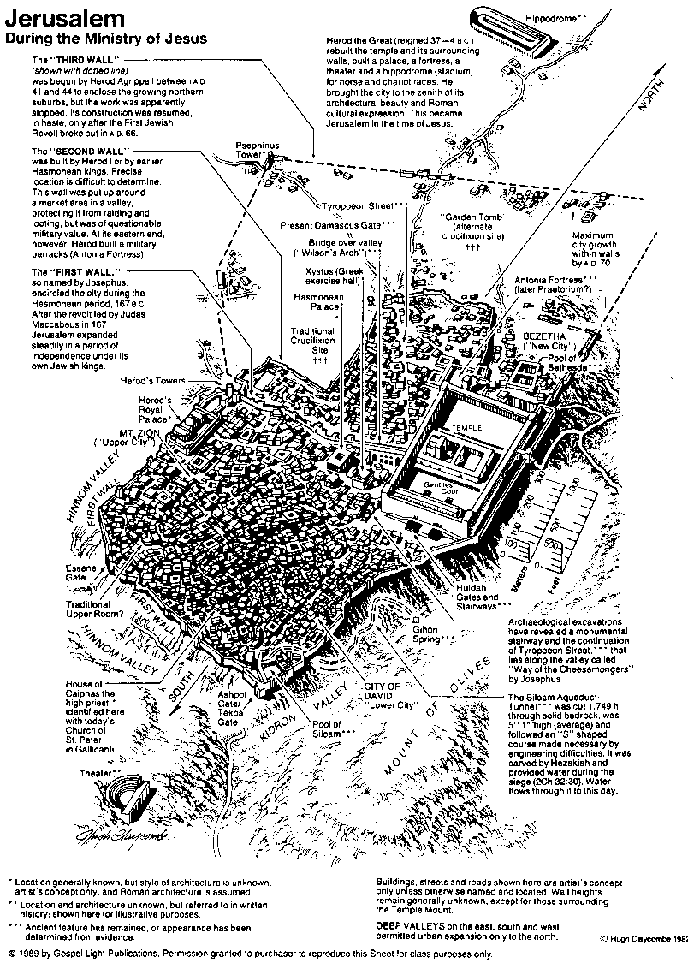
耶穌傳道時期的 耶路撒冷
80

Slide 5
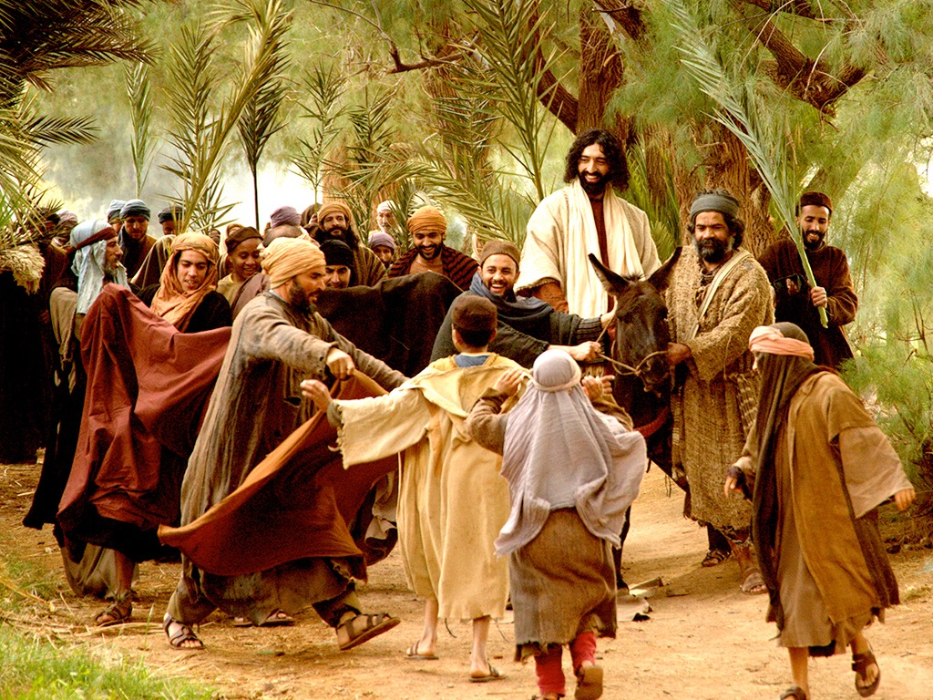
马太 21:1-11
马可 11:1-11
路加 19:28-44
约翰 12:12-19
免费
圣经
图片
复活节的故事
凯旋进
圣城(棕枝全日)

Slide 6
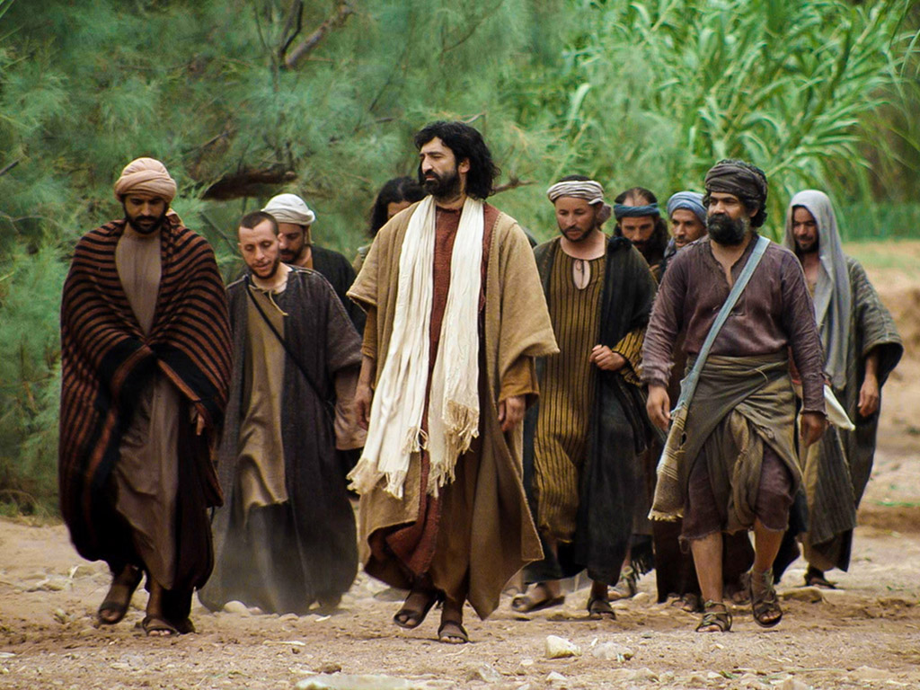

Slide 7
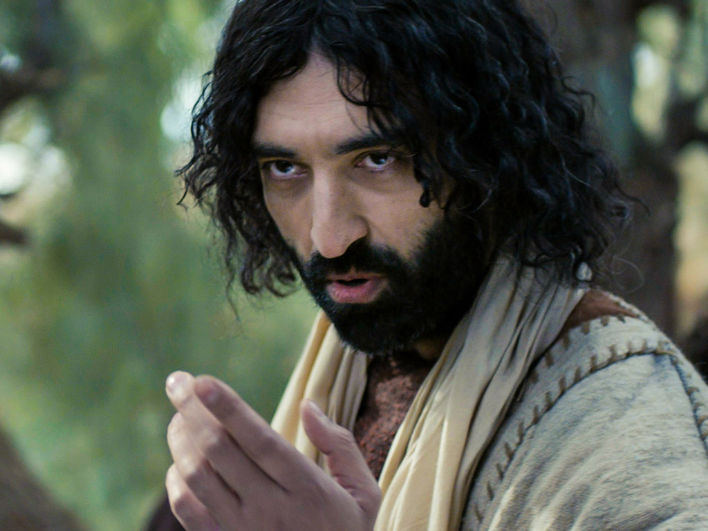

Slide 8
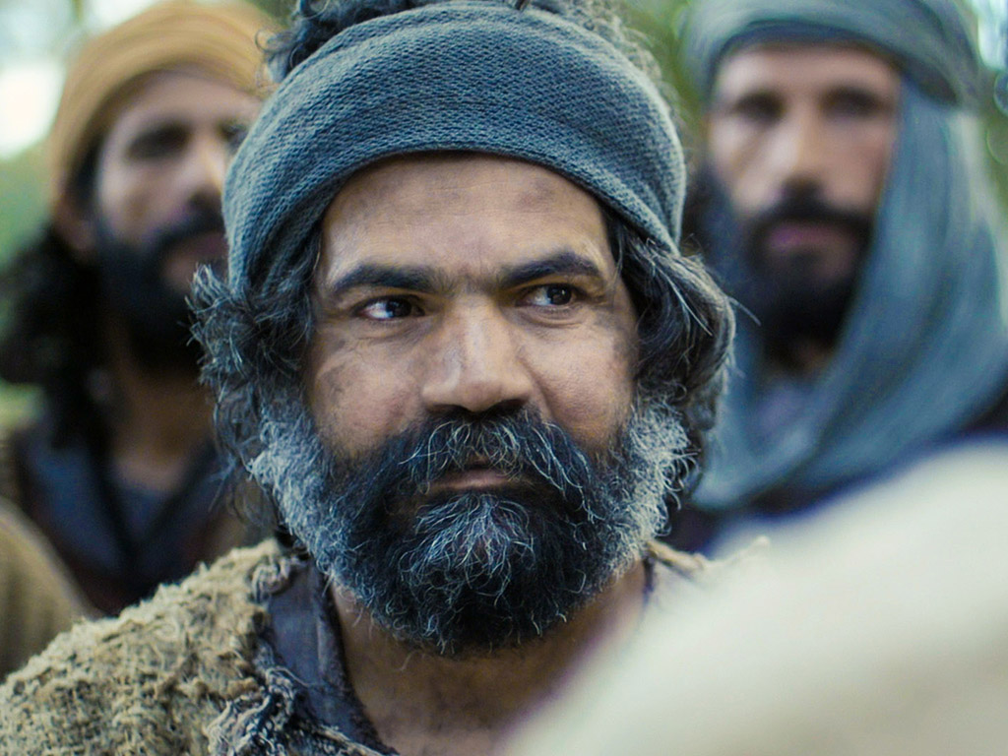

Slide 9
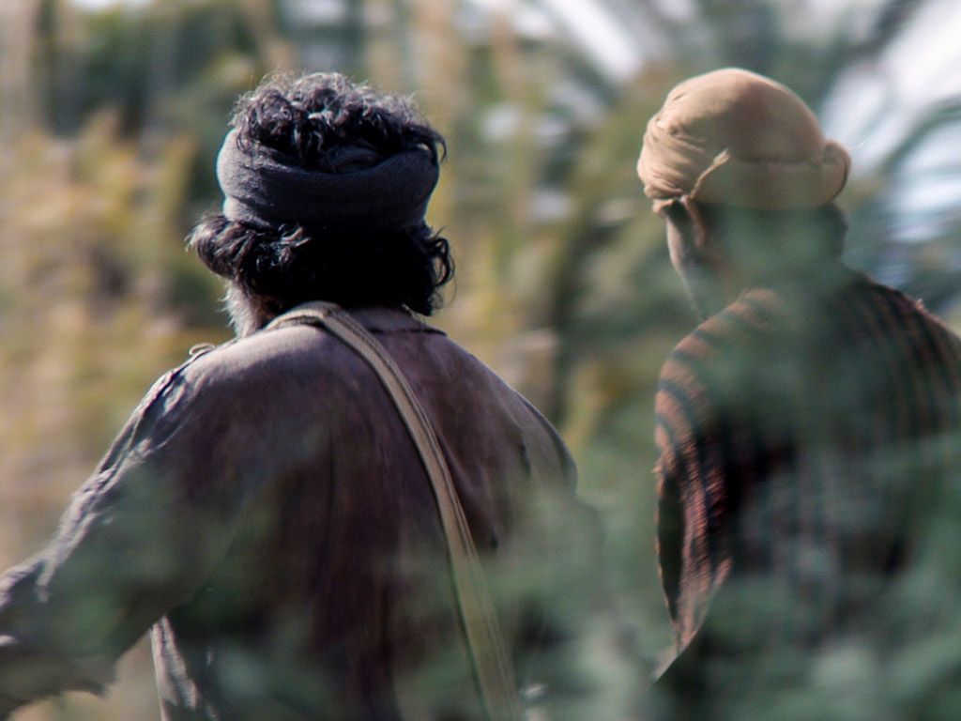

Slide 10
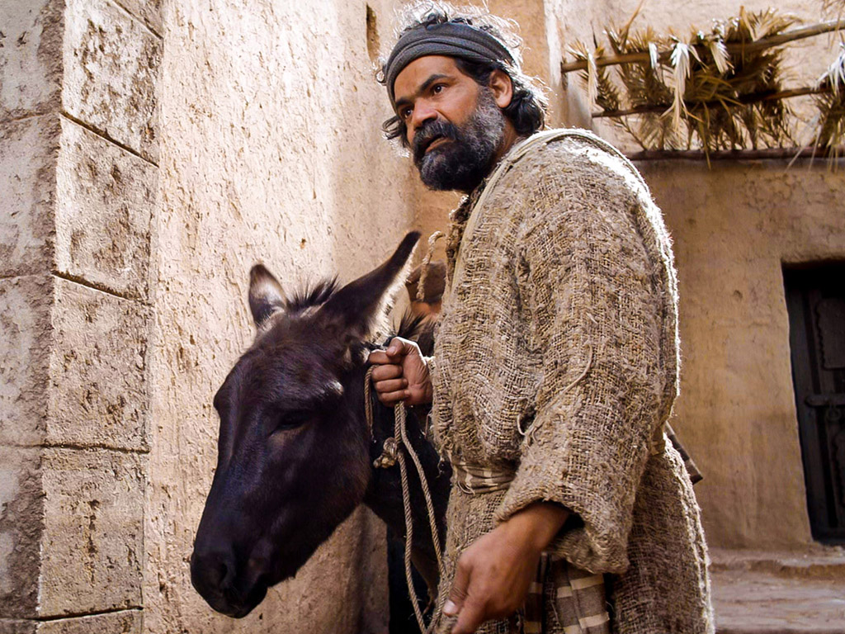

Slide 11
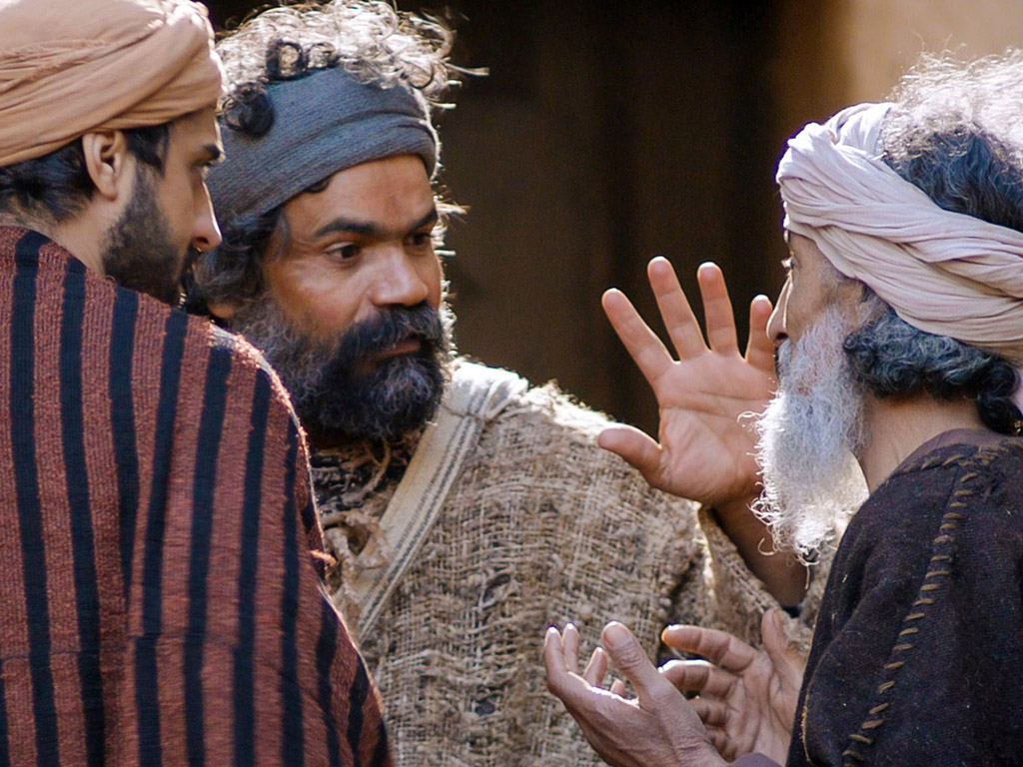

Slide 12
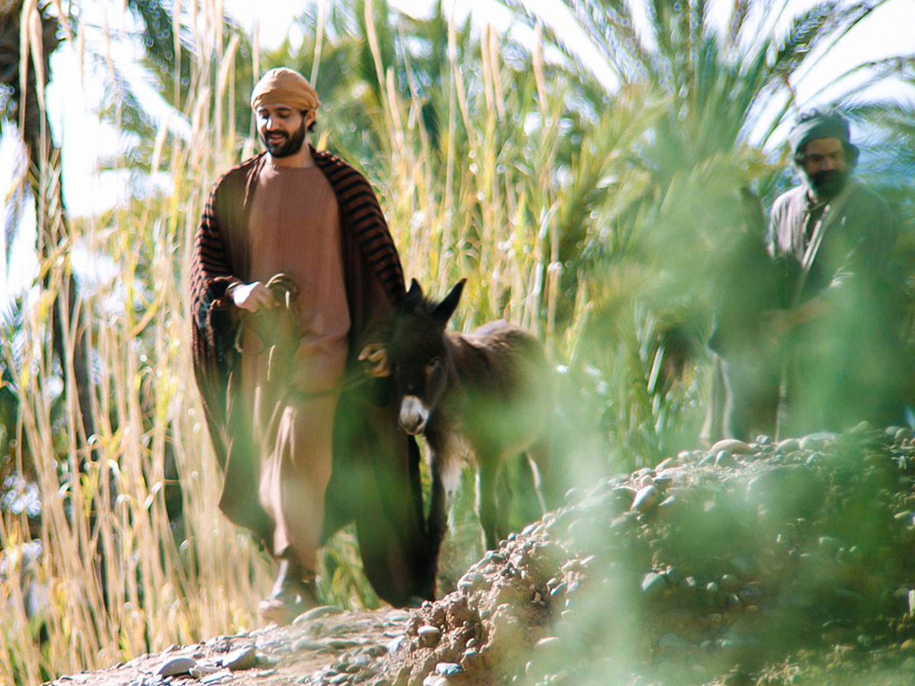

Slide 13
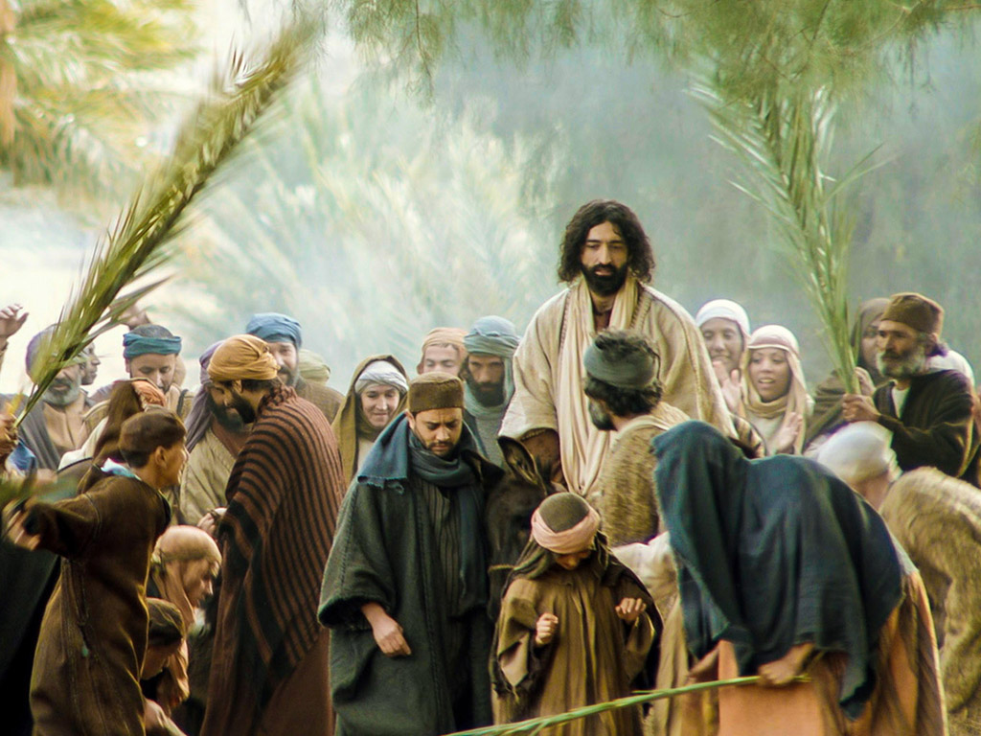

Slide 14
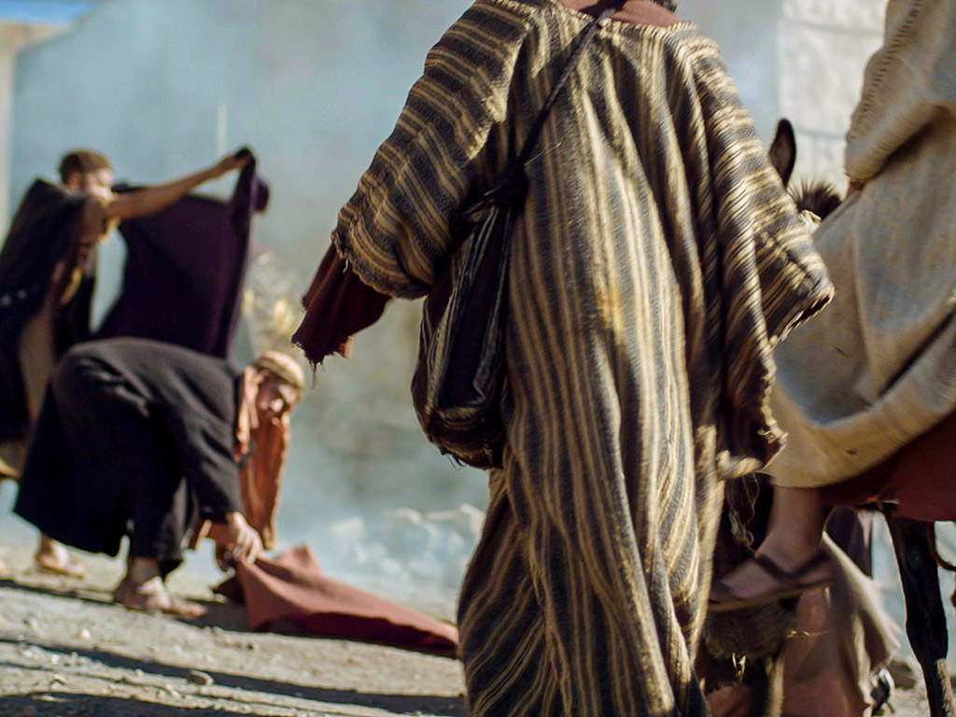

Slide 16
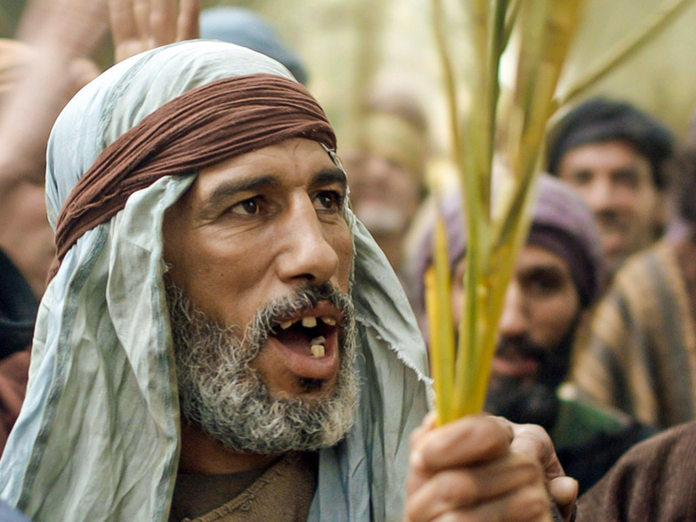

Slide 17
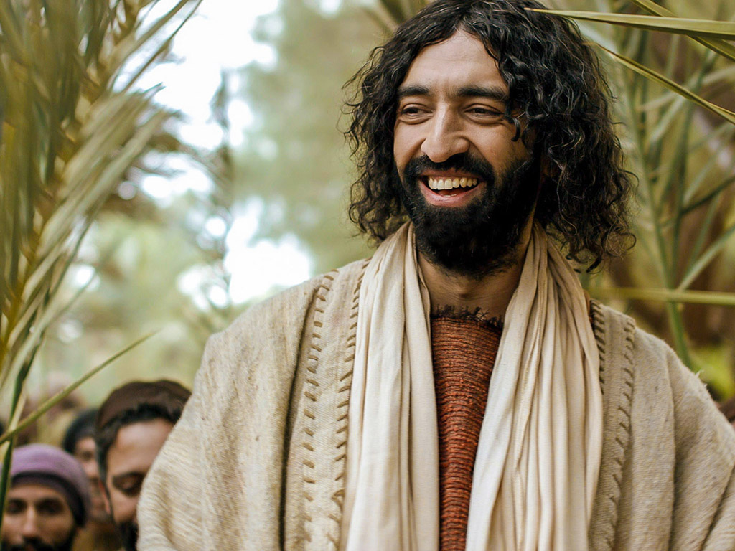

Slide 18
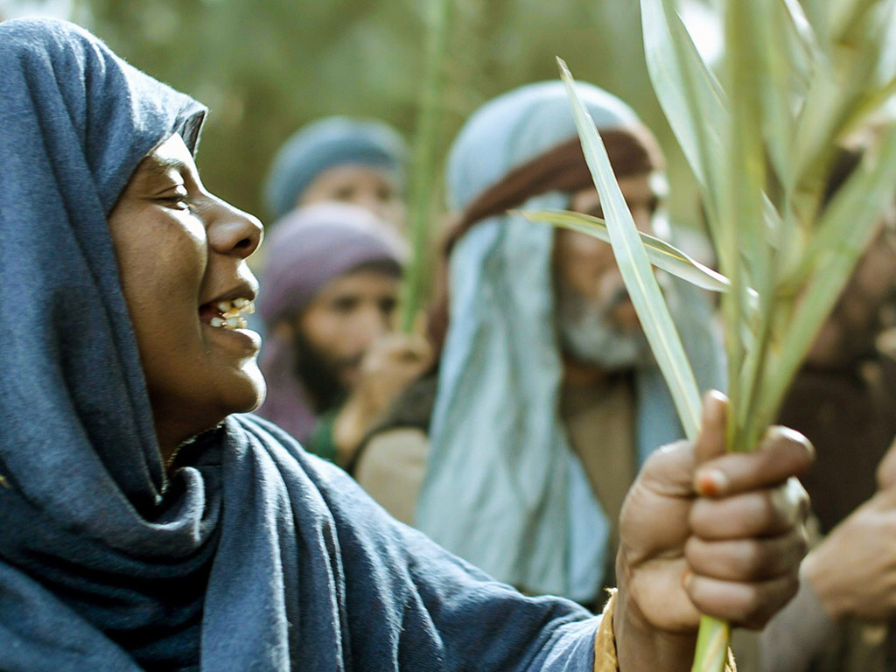

Slide 19
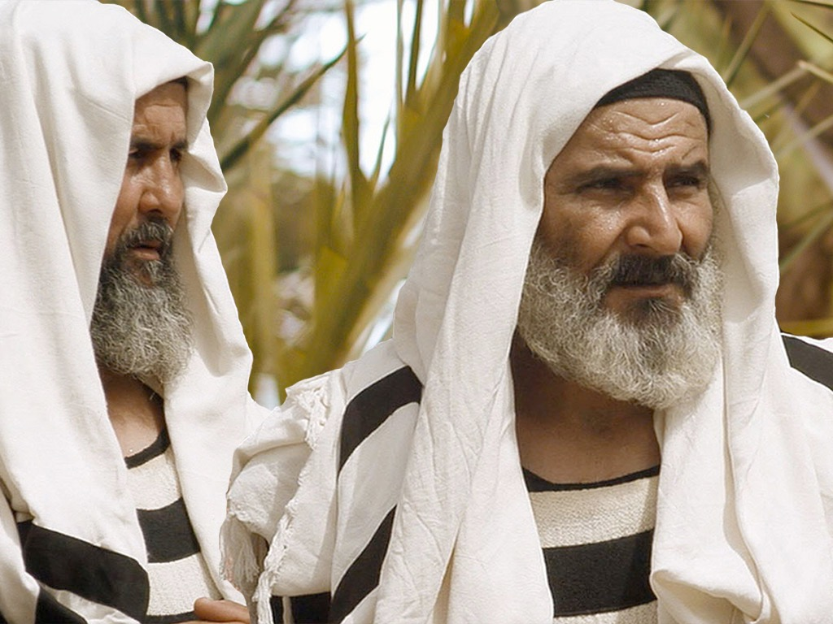

Slide 20
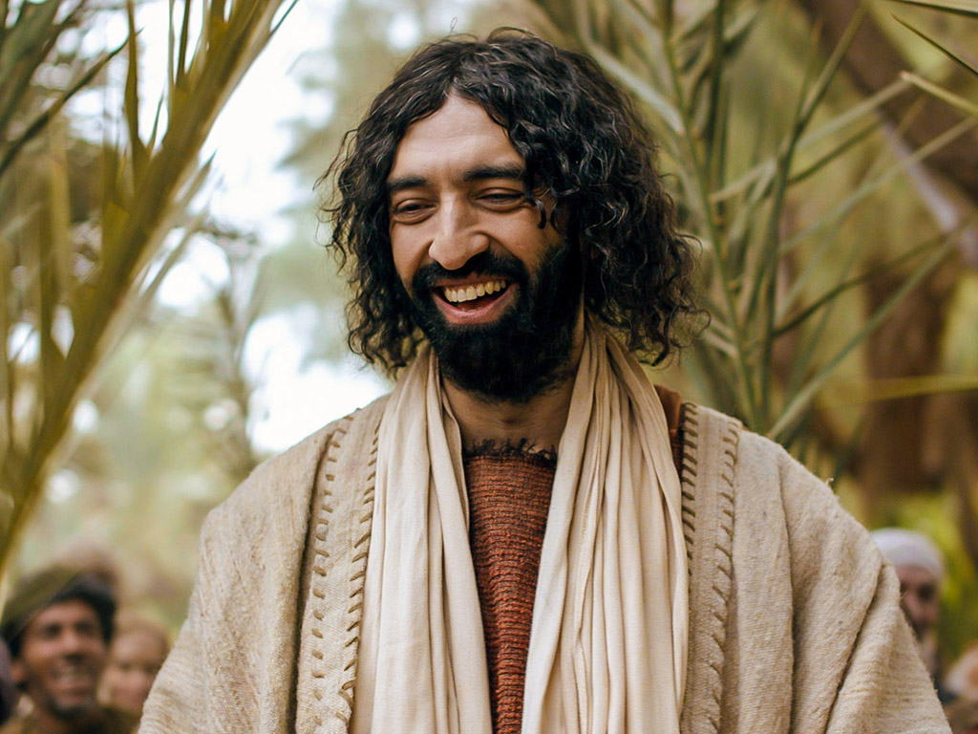

Slide 21
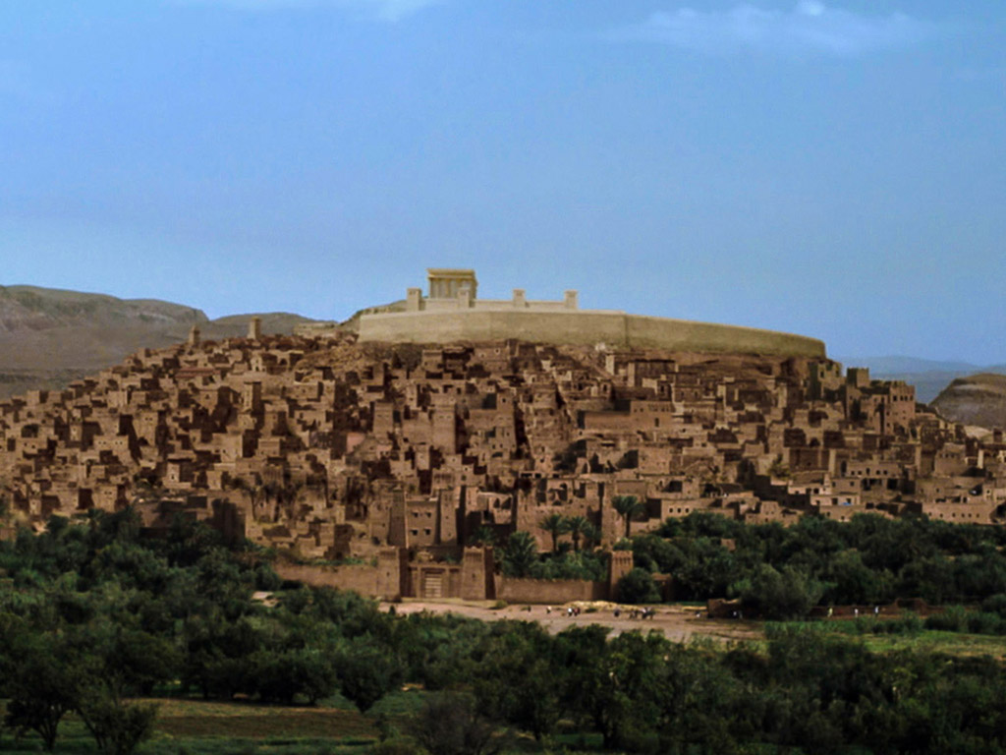

Slide 22
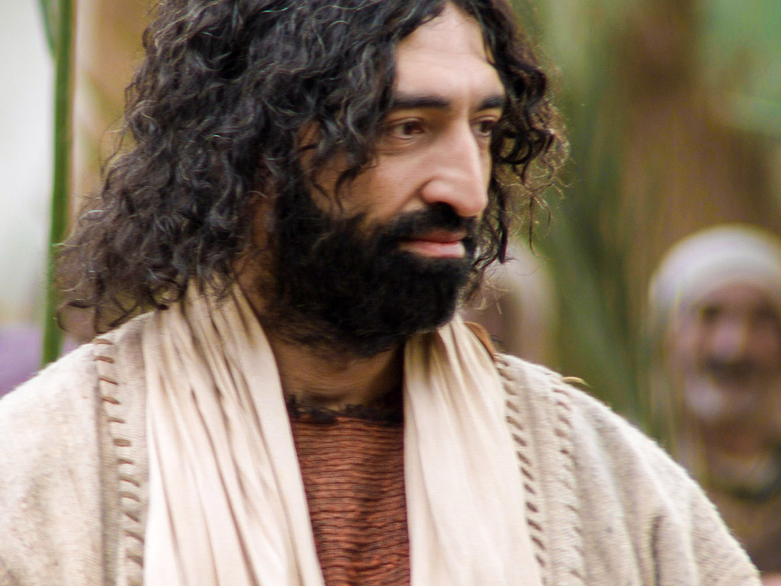

Slide 23
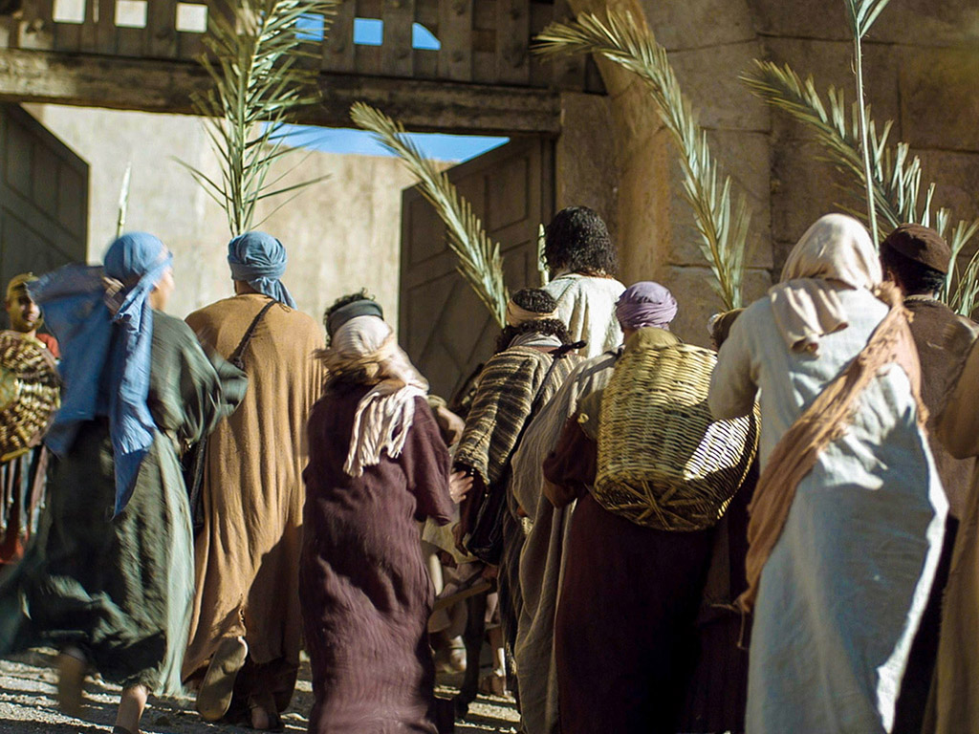

Slide 24
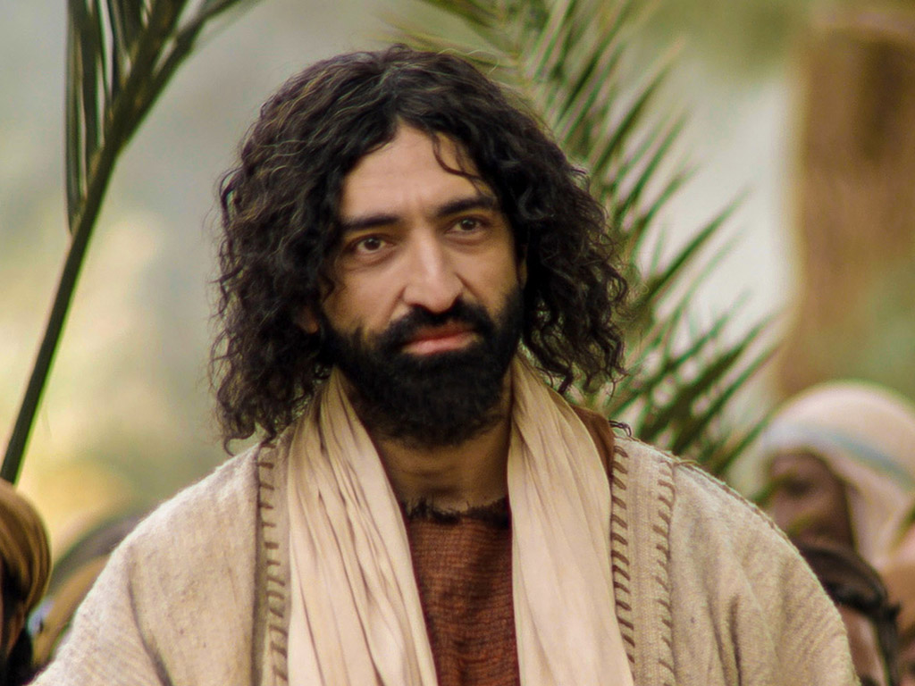

Slide 25
Free Bible Images
授权使用
免费
圣经
图片
图片中的文字

Slide 26
授权使用
马太福音
d
马可福音
o
路加福音
0
约翰福音
0
由Lumo Project出版独家资源，我们特此通知您我们不授权将这些图片发放给除freebibleimages.org客户以外的任何人。
所有图片不授权用于视频制作、epublishing或者其他媒体。所有下载的图片和文件不可通过除freebibleimages.org以外的其他网站传播，亦不可用于任何破坏基督信仰和福音的处境中。
o
图片仅供教育展示、博客和社交媒体使用；所有用途均需注明出处 www.LumoProject.com
图片声明 BBM © 版权所有
www.bigbookmedia.com

Slide 27
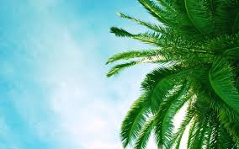
Palm Sunday
圣枝
主日
Notes:
棕榈星期天是一个有趣的名字，不是吗？

Slide 28
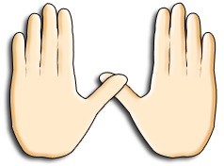
Palm Sunday
Notes:
We know that today recalls the palm branches waved at Jesus as he entered Jerusalem at the beginning of his last week of his life. Yet the focus really isn't the tree palms, but the hand palms of Jesus that would stretch out on a cross but a few days later.

Slide 29
从圣枝到十架
Notes:
树掌不过是十字架的前奏。

Slide 30
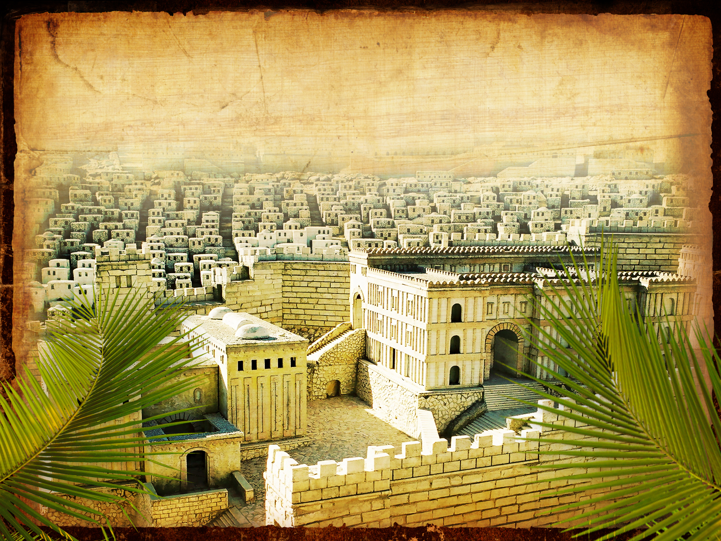
凯旋进圣城
马太 21:9
Notes:
Even the alternate name—Triumphant Entry—is also perplexing.

Slide 31
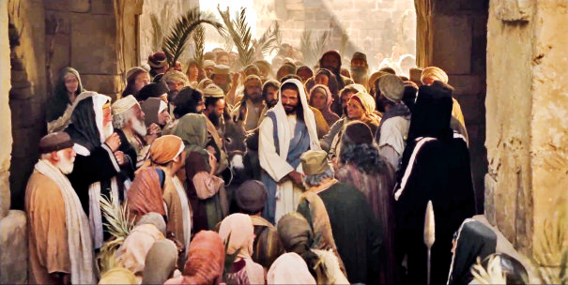
凯旋进圣城
Notes:
True, Jesus rode into Jesus and the crowds cheered his arrival.

Slide 32
Triumphant Entry
马太 21:9
前 行 後 随 的 众 人 喊 着 说 ：
和 散 那
（ 原 有 求 救 的 意 思 ， 在 此 是 称 颂 的 话 ）
归 於 大 卫 的 子 孙 ！
奉 主 名 来 的 是 应 当 称 颂 的 ！
高 高 在 上 和 散 那 ！
马太21:9
Notes:
马太 21:9 says the crowds that went ahead of him and those that followed shouted, “Hosanna to the Song of David!” “Blessed is he who comes in the name of the Lord!” “Hosanna in the highest!”

Slide 33
从圣枝到双掌
Notes:
通常情况下，一个国王骑马进入城市，作为他的敌人的胜利者，而那个星期五将在星期五耶稣的死亡达到高潮，我们称之为耶稣受难日。

Slide 34
耶稣受难日为何是美好的？
Notes:
But that name is equally puzzling. Why is Good Friday called “good”?
Our leader died on that day, so it seems strange to call the day “good.” No other religion refers to the death of their leader as “good.”
We believe that his death was good. How was that?

Slide 35
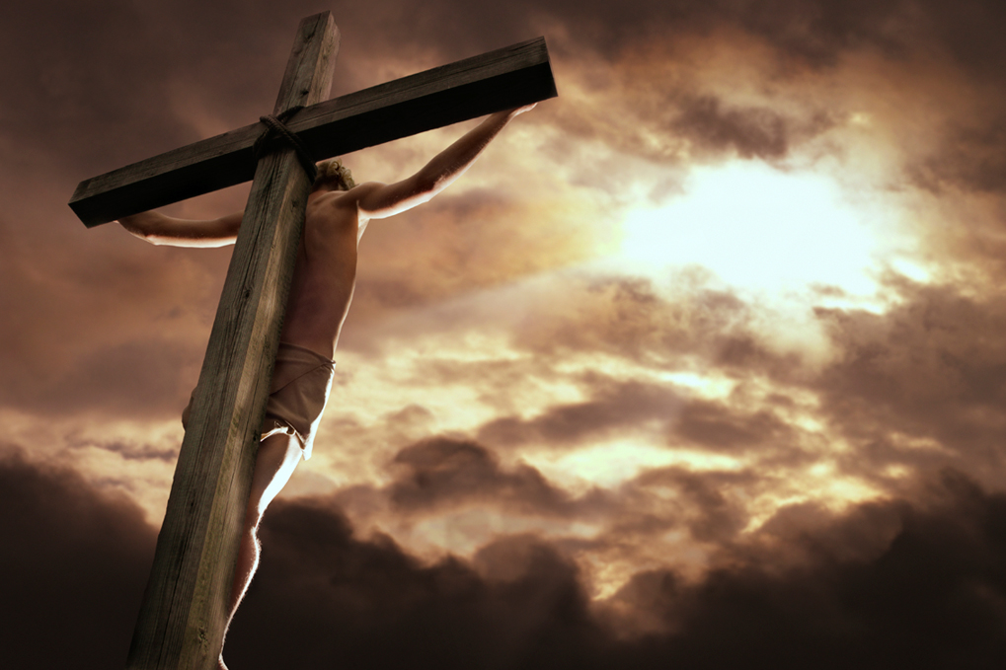
基督的死怎么比 任何牺牲都好？

Slide 36
C. The Authority of the King
§ 140
马太 21:12-13, 18-19; 马可 11:12-18;
路加 19:45-48
Christ curses the fig tree to symbolize the hypocrisy of the nation as falsely professing to bear fruit for God and cleanses the temple a second time to reveal His right to judge as Messiah

Slide 37
D. Invitations by the King
§ 141
约翰 12:20-50
Jesus declares that following His death the Gentiles will not have to approach Him through Israel so that all men might know that they can believe in His death and resurrection for all men

Slide 38
E. Proof of the Authority of the King
§ 142
马太 21:20-22; 马可 11:19-25; 路加 21:37-38
The fig tree that Christ cursed withers to indicate that the judgment pronounced upon the nation would fall quickly and to call for faith in His person

Slide 39
F. The King's Authority Challenged
§§ 143-146
Christ's authority as Messiah is challenged by the various religious and political leaders of His day, thus indicating their rejection of Him and His message

Slide 40
1. By the Priests and Elders
§ 143
马太 21:23-22:14; 马可 11:27-12:12; 路加 20:1-19
Jesus refuses to answer the priests and elders concerning the Source of His authority but instead tells parables of Israel's rejection in order to declare Gentile entrance in response to national rejection despite centuries of preparation by divinely sent prophets

Slide 41
2. By the Pharisees and Herodians
§ 144
马太 22:15-22; 马可 12:13-17; 路加 20:20-26
Jesus declares that people have a dual allegiance to God as supreme and to government as a delegated authority, thus evading the political debate between the Pharisees and Herodians that could have either alienated Himself from Israel or incited the people to rebel against Rome

Slide 42
3. By the Sadducees
§ 146
马太 22:23-33; 马可 12:18-27; 路加 20:27-40
Jesus shows a high regard for the law in His affirmation of the resurrection to the disbelieving and cunning Sadducees by demonstrating that Abraham, Isaac and Jacob must be resurrected to take part in the promises of the Abrahamic Covenant

Slide 43
4. By the Pharisees
§ 147
马太 22:34-40; 马可 12:38-34
Jesus summarizes obedience to the law as completely fulfilling one's responsibilities to both God and man in order to convince the Pharisees that since no one could adequately fulfill these requirements one must turn to Christ to receive the salvation He offered

Slide 44
G. Challenge by the King
§ 147
马太 22:41-46; 马可 12:35-37; 路加 20:41-44
After answering several questions Christ asks a question, revealing from Psalm 110 that the Messiah is not only truly human as the Son of David but deity as well as David's Lord, a question asked both to confront the Pharisees to decide whether to accept His claims concerning His person and to refute their claim that He was a son of hell

Slide 45
H. Judgment by the King
§ 148
马太 21:1-39; 马可 12:38-40; 路加 20:45-47
Christ pronounces a series of woes upon the Pharisees for the purpose of delineating reasons why God's judgment must fall on them and their hypocritical Pharisaic system

Slide 46
I. Instruction at the Treasury
§ 149
马可 12:41-44; 路加 21:1-4
Christ contrasts the hypocrisy of the faithless practices of the Pharisees with the sacrificial commitment of a poor widow in order to show that she was a true disciple who would enter the kingdom

Slide 47
Black

Slide 48
基督生命链接地址 BibleStudyDownloads.org
免费获得该讲解!
圣经学习下载
Notes:
Bible Geograhpy (bg)

