Slide 1
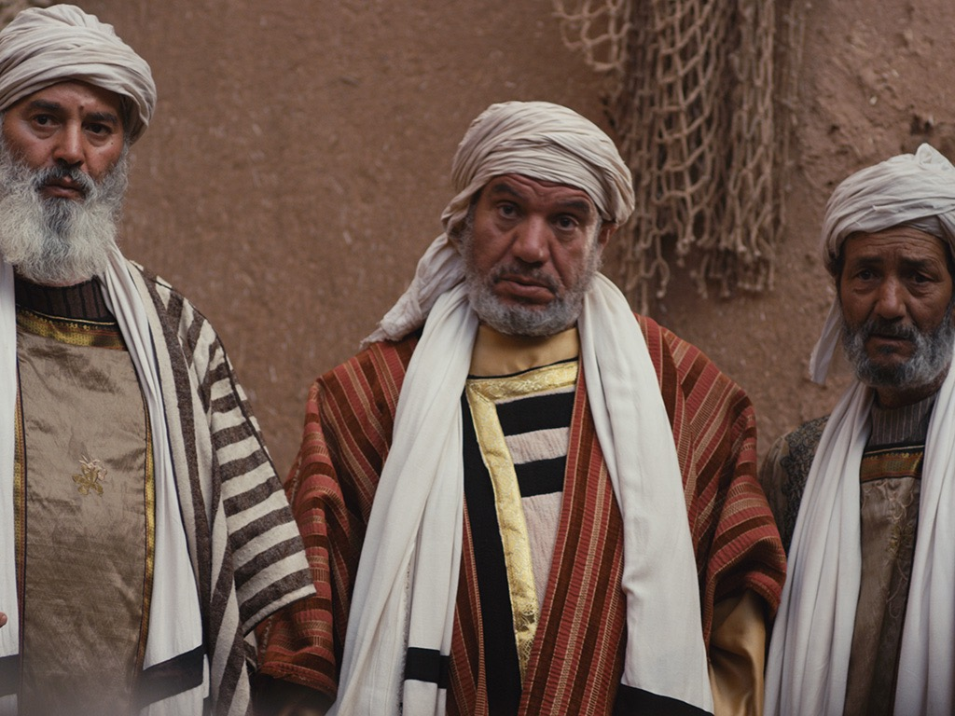

反对君王
§§ 98-119
Section summaries based on J. Dwight Pentecost, A Harmony of the Words and Works of Jesus Christ (Grand Rapids: Zondervan, 1981)
Dr. Rick Griffith • Singapore Bible College • BibleStudyDownloads.org

Slide 2
A. Conflict At the Feast of Tabernacles
§ 98
约翰 7:1-52
Christ's authority and person are questioned and responded to by Him at the Feast of Tabernacles, giving the unbelieving Jews further motivation to put Him to death

Slide 3
1. Christ's Authority Questioned
约翰 7:11-15
The crowds at Jerusalem wonder how Christ could teach with authority apart from rabbinical training, thus setting up the scene for Christ to reveal His true nature

Slide 4
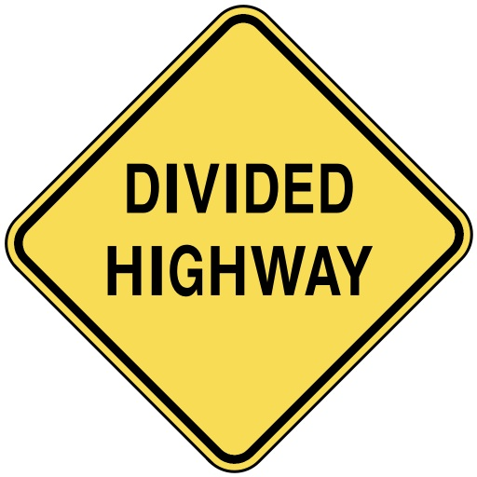
Divided Opinions
约翰 7

Slide 5
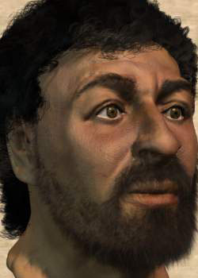
这是谁?

Slide 6
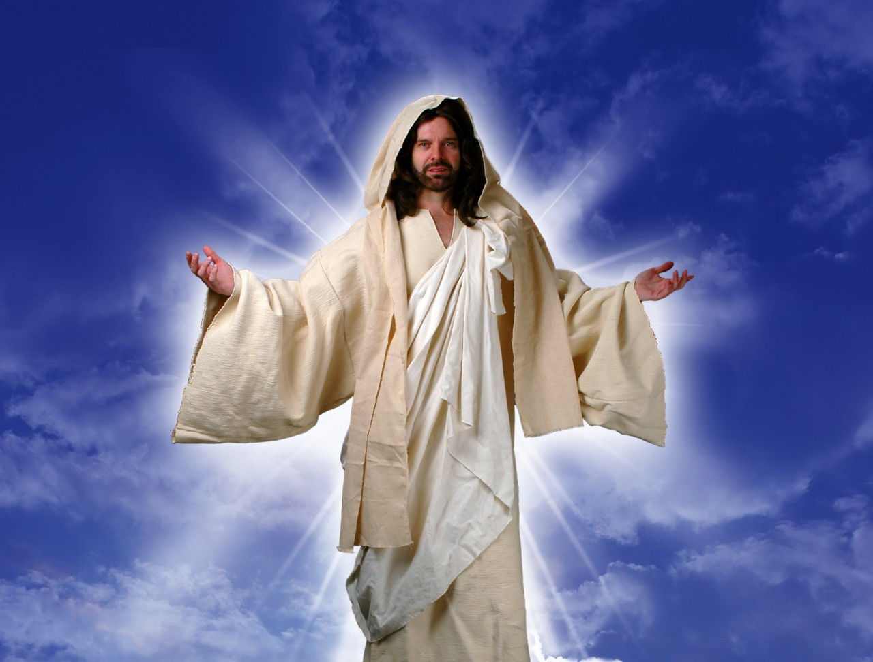
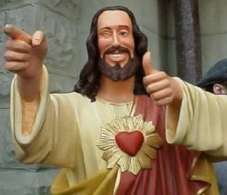
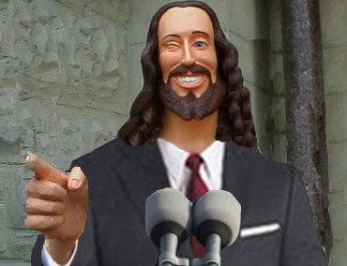
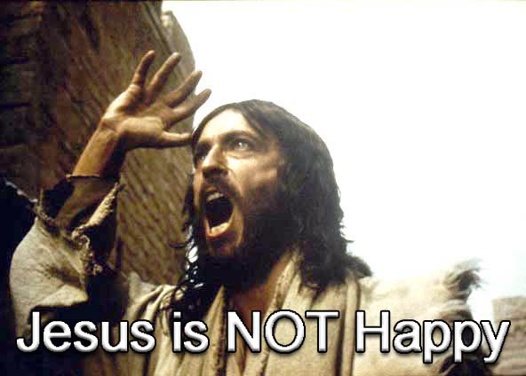
What do you think of Jesus?

Slide 7
Black

Slide 8

Touched by an Angel

Slide 9
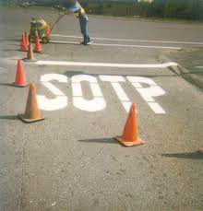
And Christians are considered stupid?!

Slide 10

Four Christmases

Slide 11
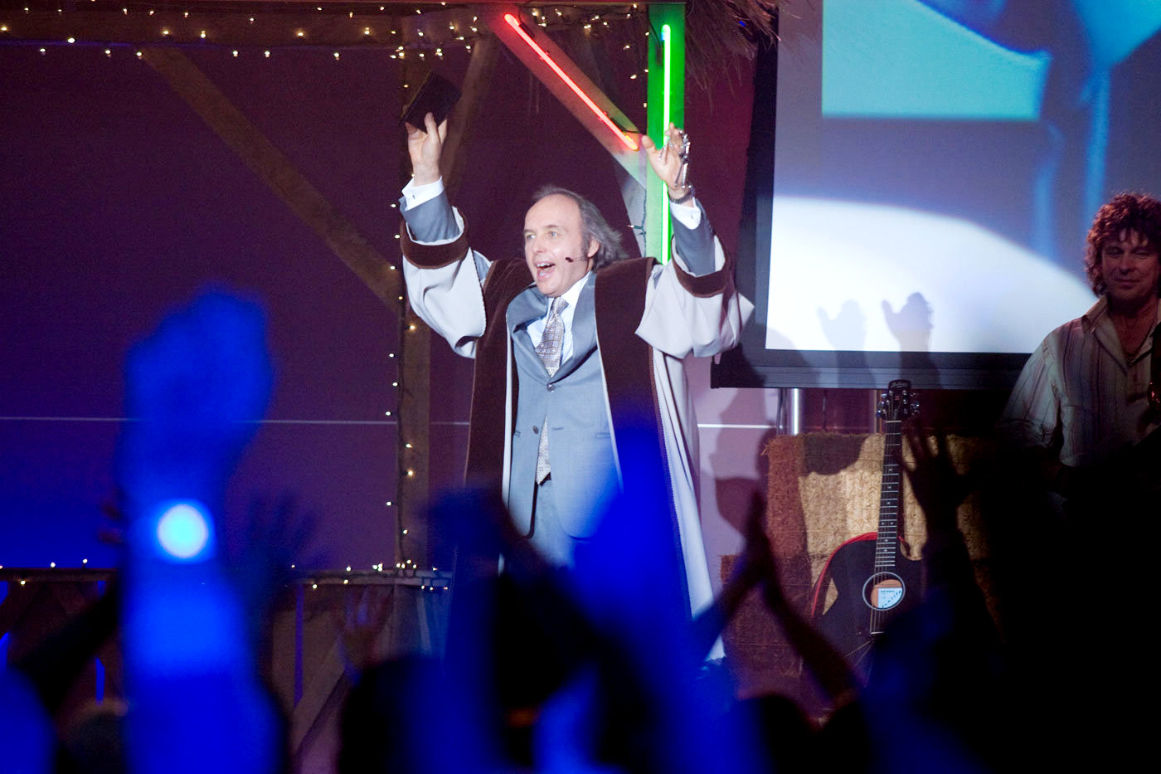
“Four Christmases” Pastor Phil

Slide 12
Black

Slide 13

Our Subject Today
Why do people have such divided opinions about Christ?

Slide 14
A Controversial Figure in 约翰 1–6
Believers in
约翰 1-4:
Galileans
Samaritan Woman
约翰 the Baptist
Nicodemus
Passover Jews
Disciples
The line of faith
Unbelievers in
约翰 5–6:
Jerusalem Leaders
Galilean People
Disciples desert Jesus

Slide 15
Our Subject Today
Why do people have such divided opinions about Christ?
3 reasons!

Slide 16
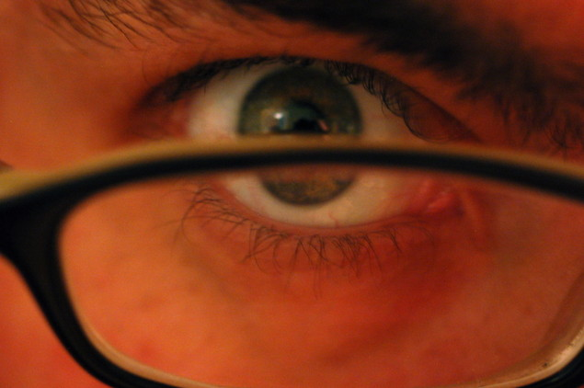
I. Everyone makes his or her own decision about Christ (7:1-13).
Why do people have such divided opinions about Christ?

Slide 17
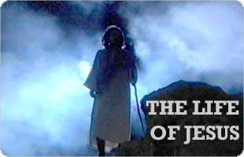
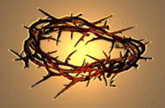
Brothers of Jesus
Transition between Galilean ministry
and Feast of Tabernacles in Jerusalem
“No one who wants to become a public figure acts in secret. Since you are doing these things, show yourself to the world” (7:4).
But when the Jewish Feast of Tabernacles
was near…
(7:2)
My time is not yet come; for you any time is right
...because for me the right time has not yet come.

Slide 18

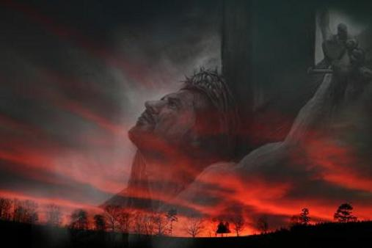
“Hour” in 约翰’s Gospel
NASB Occurrences (Greek are all hora except 7:6, 8):
2:4 “My hour has not yet come”
7:6 “My time (Gr. kairos) is not yet here”
7:8 “My time (Gr. kairos) has not yet fully come”
7:30 “His hour had not yet come”

Slide 19
Black
Notes:
Jerusalem crowds also divided (10-13)

Slide 20
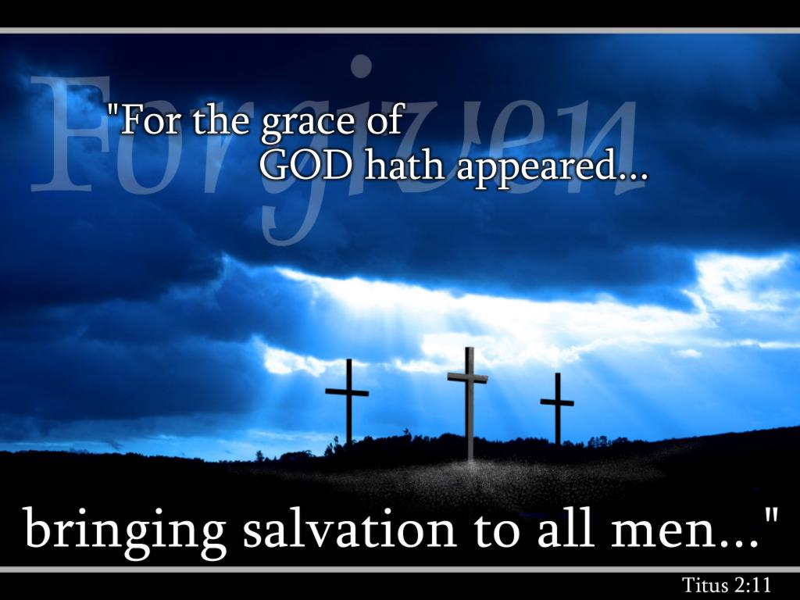
We must each decide who Christ is— and also give that choice to others.

Slide 21
I. Everyone makes his or her own decision about Christ (7:1-13).
Why do people have such divided opinions about Christ?

Slide 22
2. Christ's Explanation
约翰 7:16-24
Christ responds by explaining that God the Father taught Him, not the rabbis, and that as one sent from God they should submit to His teaching as from God just like they were supposed to submit to Moses' teaching as from God

Slide 23
3. Christ's Person Questioned
约翰 7:25-27
The multitude is reluctant to conclude that Jesus is really the Christ since the Pharisees do not arrest Him and since they could trace His residence to Nazareth and His parentage to Joseph, thus excusing themselves for their unbelief rather than investigating the facts

Slide 24
4. Christ's Explanation
约翰 7:28-30
Christ explains that His origin is heaven rather than Nazareth and His Father is God the Father rather than Joseph that they may know His true identity as the Son of God

Slide 25
5. Response
约翰 7:31-36
The response to Christ's explanation is mixed, some believing and the leaders more committed to kill Him for blasphemy even if He tries to escape their clutches

Slide 26
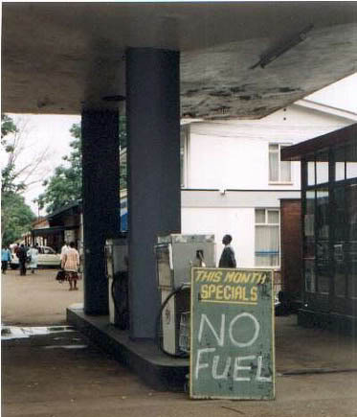

II. People reject Christ’s teaching because they reject God (7:14-36).

Slide 27
Black

Slide 28
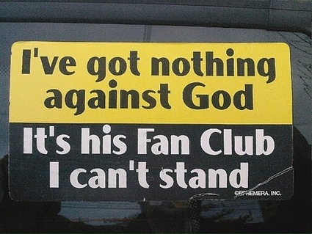
Problems with the Church

Slide 29
I. Everyone makes his or her own decision about Christ (7:1-13).
Why do people have such divided opinions about Christ?

Slide 30

II. People reject Christ’s teaching because they reject God (7:14-36).

Slide 31
6. Christ's Invitation
约翰 7:37-52
Jesus identifies Himself as the fulfillment of the elaborate golden pitcher ceremony at the Feast recalling God's provision of water for Israel and calls all to trust Him to satisfy their spiritual thirst, resulting in a mixed response

Slide 32

III. Jesus’ claim to give eternal life always has a mixed response (7:37-52).
Why do people have such divided opinions about Christ?

Slide 33

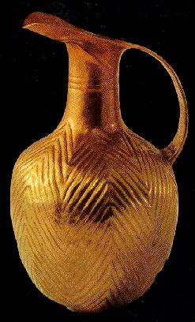
Jerusalem
21
The Feast of Tabernacles

Slide 34
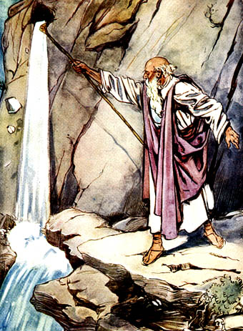
Water from a Rock
Numbers 20:8-11

Slide 35

“Anyone who is thirsty may come to me! ³⁸ Anyone who believes in me may come and drink! For the Scriptures declare, ‘Rivers of living water will flow from his heart.’”
(约翰 7:37-38 NLT)
Notes:
When Jesus added, As the Scripture has said, He did not identify the Old Testament passage(s) He had in mind. But He may have thought of Psalm 78:15-16 and Zechariah 14:8 (cf. Ezek. 47:1-11; Rev. 22:1-2).
约翰 F. Walvoord, Roy B. Zuck and Dallas Theological Seminary., The Bible Knowledge Commentary : An Exposition of the Scriptures (Wheaton, IL: Victor Books, 1983-c1985), 2:301.

Slide 36
Black

Slide 37

Black

Slide 38

Q & A
Curious: “Where did he get all this knowledge?” (14-15).
Jesus’ Answer: “God gave it to me.”
Offended: “You’re demon possessed! Who’s trying to kill you?” (20).
Jesus’ Answer: “Hypocrites are who care more for circumcision than for people.”

Slide 39
Q & A
Uninformed: “Isn’t this the man they are trying to kill? But the Messiah will simply appear…” (25).
Jesus’ Answer: “You know where I’m from—but you don’t know God!”
Believing: “Will the Messiah do more miracles than Jesus?” (31).
Jesus’ Answer: “I will be with you only for a short time more [about 6 months] but you won’t find me and can’t follow me.”

Slide 40
Which are You?
Curious?
Offended?
Uninformed?
Believing?

Slide 41
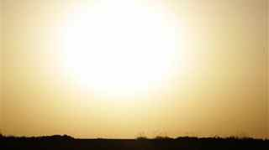
Main Idea
People reject Christ because they don’t accept God’s authority over their lives.

Slide 42

Jesus Paid It All

Slide 43
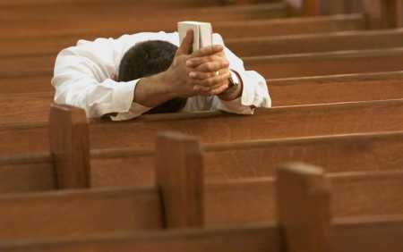
Why not believe today?

Slide 44
B. Conflict Over the Law
§ 99
约翰 7:53-8:11
Through refusing to pass judgment upon the woman caught in adultery Christ foils the Pharisees' trap to make Him acknowledge the Mosaic law as too stringent to be observed and approve of the watered down Pharisaical interpretations of the law

Slide 45
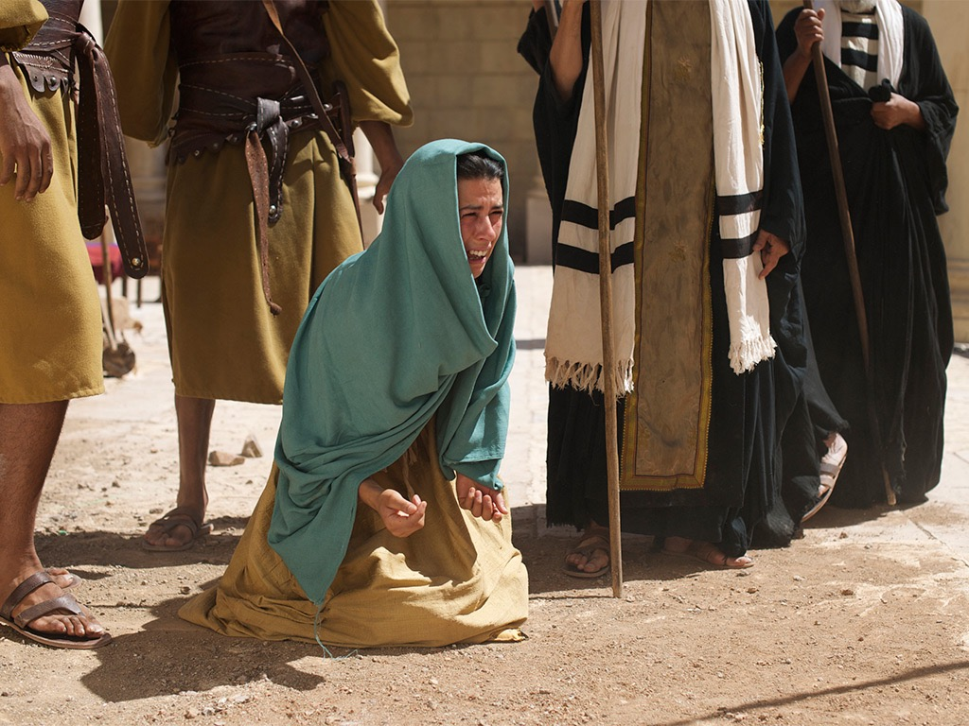

Free
Bible
images
约翰 8:2-11
JESUS AND THE WOMAN ACCUSED OF ADULTERY

Slide 46
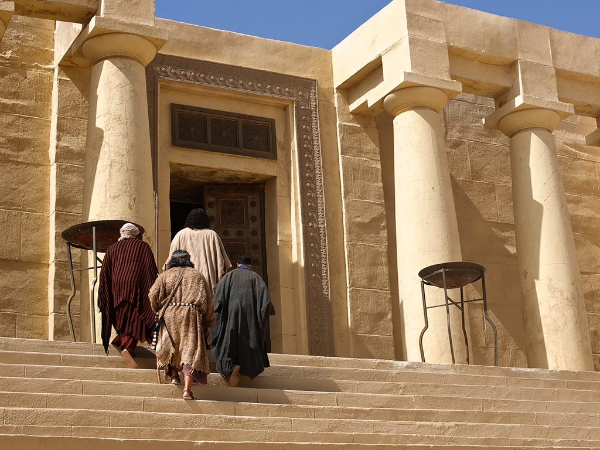

Slide 47
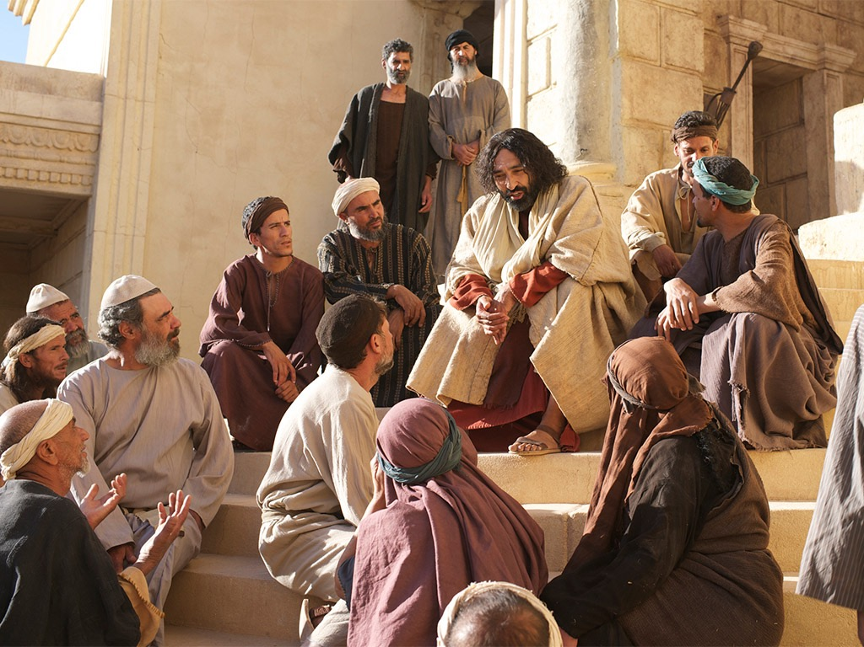

Slide 48
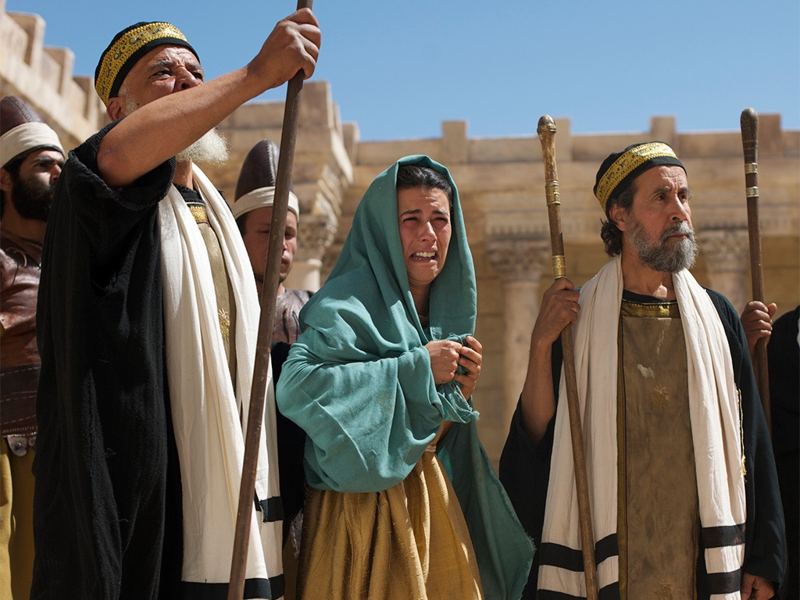

Slide 50
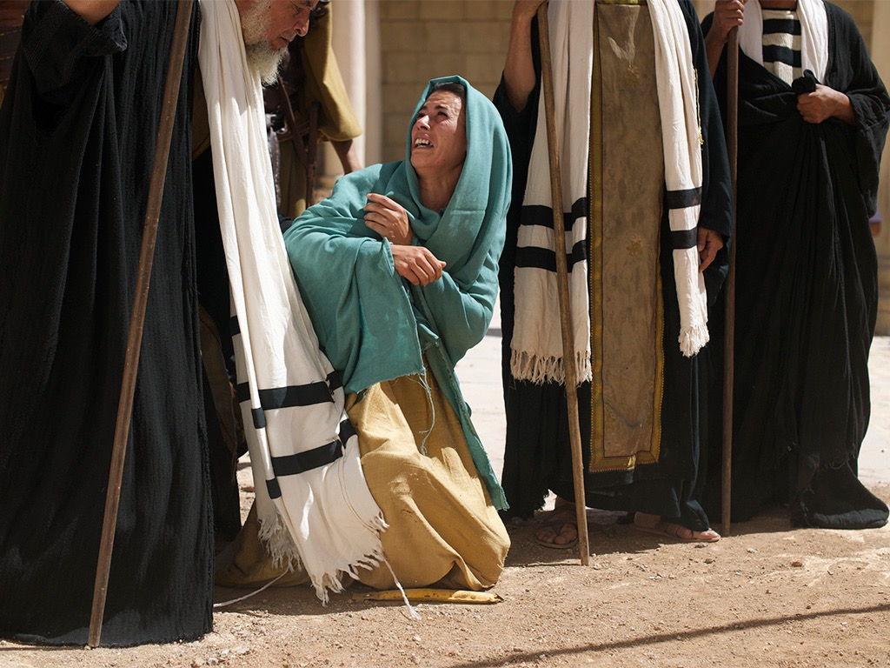

Slide 51
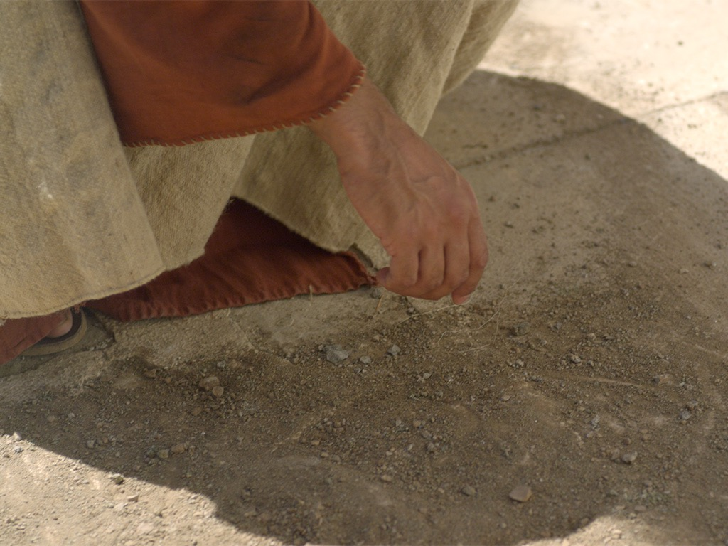

Slide 52
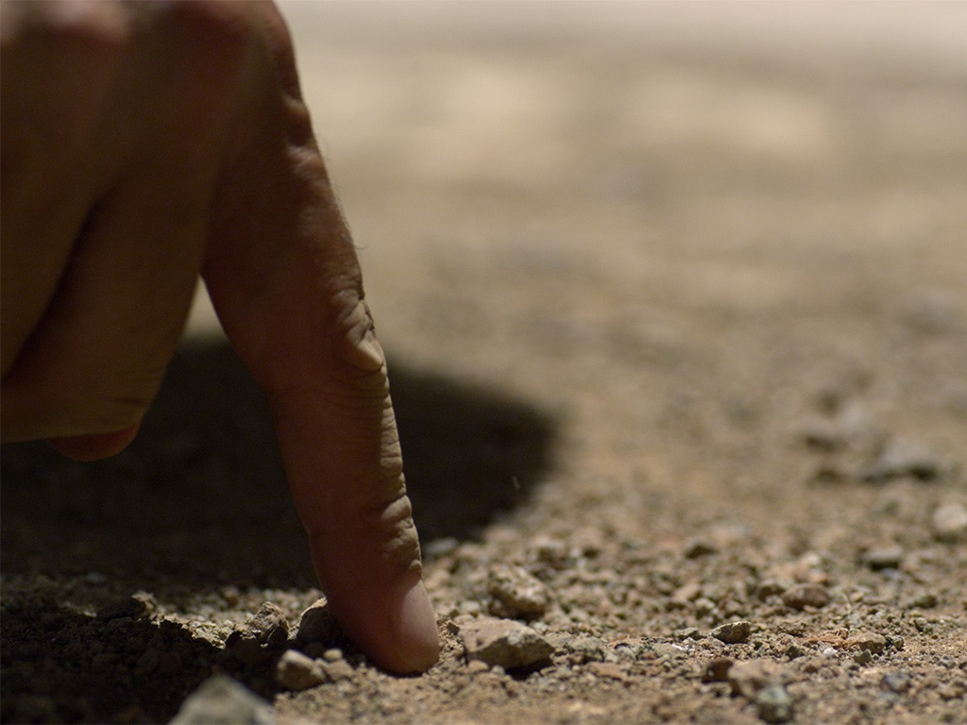

Slide 53
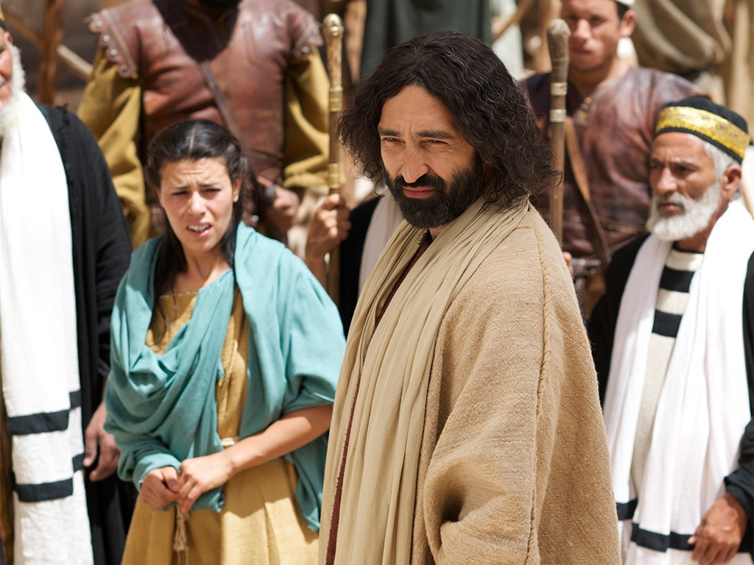

Slide 54
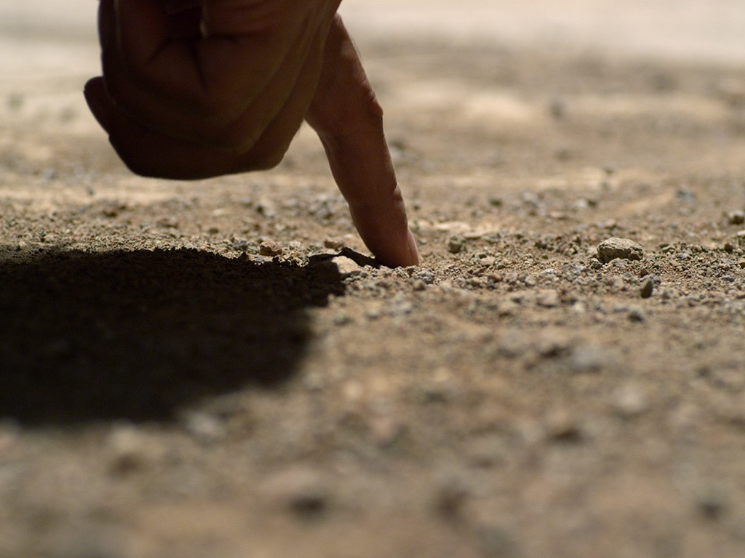

Slide 55
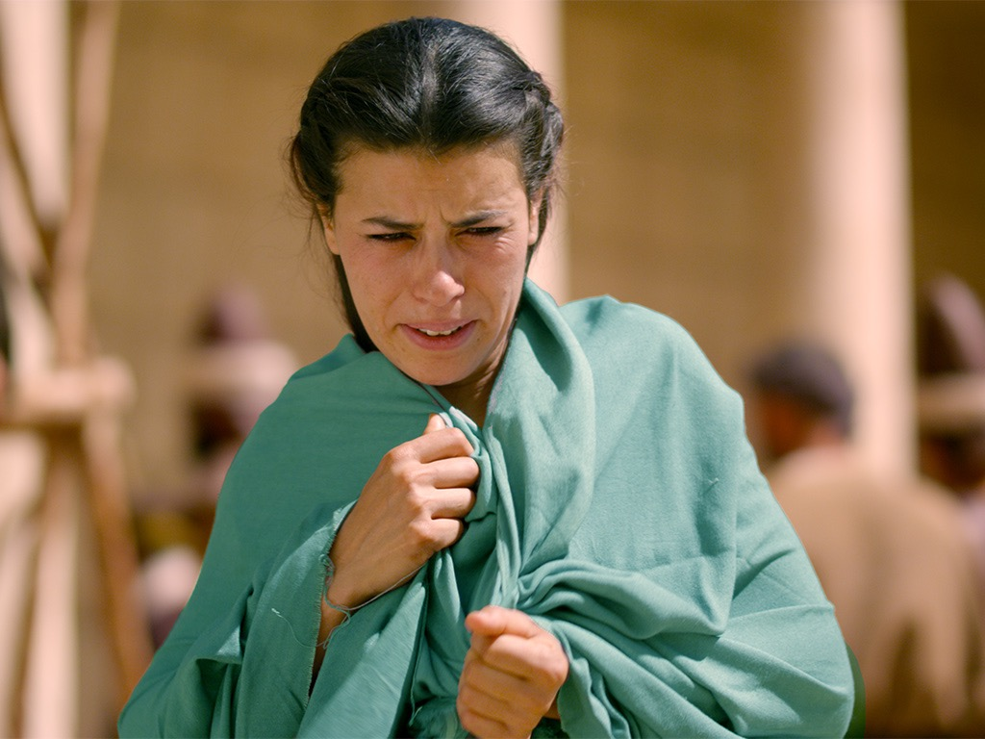

Slide 56
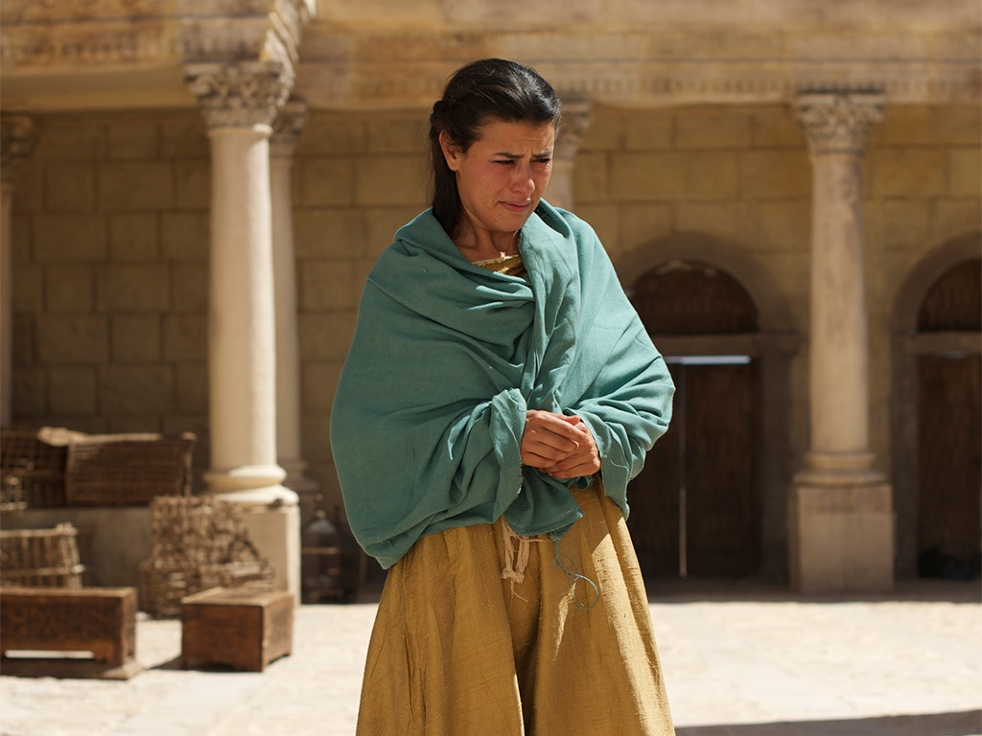

Slide 57
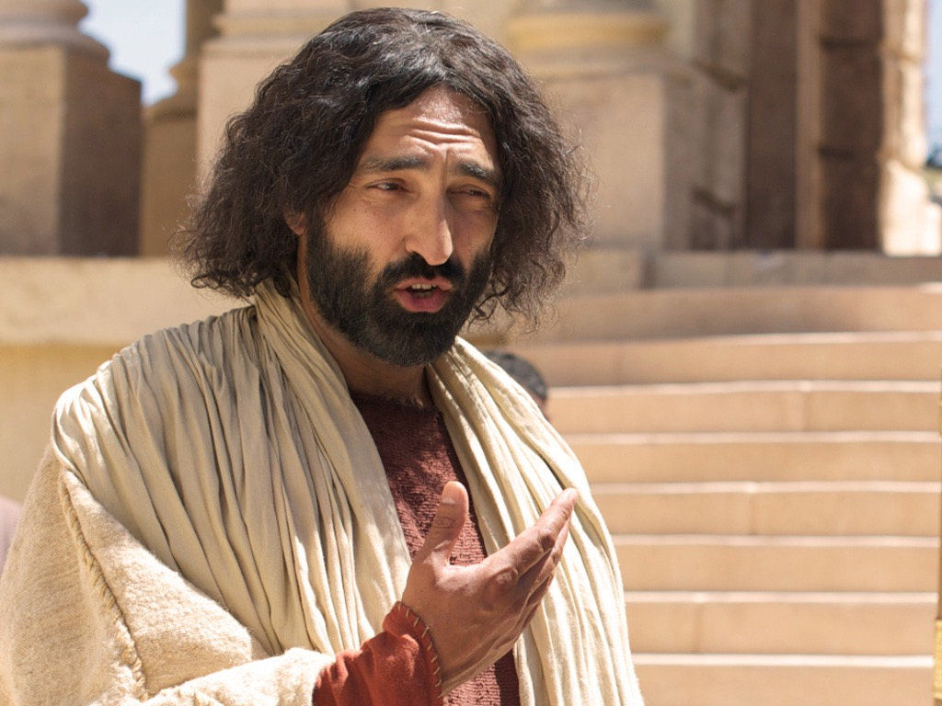

Slide 58

授权使用
马太福音
d
马可福音
o
路加福音
0
约翰福音
0
由Lumo Project出版独家资源，我们特此通知您我们不授权将这些图片发放给除freebibleimages.org客户以外的任何人。
所有图片不授权用于视频制作、epublishing或者其他媒体。所有下载的图片和文件不可通过除freebibleimages.org以外的其他网站传播，亦不可用于任何破坏基督信仰和福音的处境中。
o
图片仅供教育展示、博客和社交媒体使用；所有用途均需注明出处
www.LumoProject.com
图片声明 BBM
© 版权所有
www.bigbookmedia.com

Slide 59

How can we show God’s compassion in a world where people think Christianity only judges us?

Slide 60

The Text of 约翰 7:53–8:11
Inspired or Not?

Slide 61
Divided Opinions
“Most scholars seem to agree that the passage is a part of inspired Scripture [e.g., F.F. Bruce]. In fact, the development of the entire chapter can easily be seen to grow out of this striking event in the temple... The transition from 约翰 7:52 to 8:12 would be too abrupt without a transitional section.”
–Warren Wiersbe, The Bible Exposition Commentary
“Almost all textual scholars agree that these verses were not part of the original... The style and vocabulary of this passage differ from the rest of the Gospel, and the passage interrupts the sequence from 7:52-8:12. It is probably a part of true oral tradition which was added to later Greek manuscripts by copyists.”
–Edwin A. Blum, in The Bible Knowledge Commentary
Notes:
Wiersbe notes, “Is the story of the woman taken in adultery a part of Scripture? If it is, where does it belong in the Gospel record? 约翰 7:53–8:11 is not found in some of the ancient manuscripts; where it is found, it is not always in this location in 约翰’s Gospel. Most scholars seem to agree that the passage is a part of inspired Scripture (“a fragment of authentic Gospel material,” says Dr. F.F. Bruce) regardless of where it is placed.
“To many of us, the story fits right here! In fact, the development of the entire chapter can easily be seen to grow out of this striking event in the temple. Our Lord’s declaration on His being the Light of the world (约翰 8:12) certainly fits, and so do His words about true and false judgment (约翰 8:15–16, 26). The repeated phrase “die in your sins” (约翰 8:21, 24) would clearly relate to the judgment of the woman; and the fact that the chapter ends with an attempt to stone Jesus shows a perfect parallel to the opening story. The transition from 约翰 7:52 to 8:12 would be too abrupt without a transitional section.”
Warren W. Wiersbe, The Bible Exposition Commentary (Wheaton, Ill.: Victor Books, 1996, c1989), Jn 7:37.

Slide 62
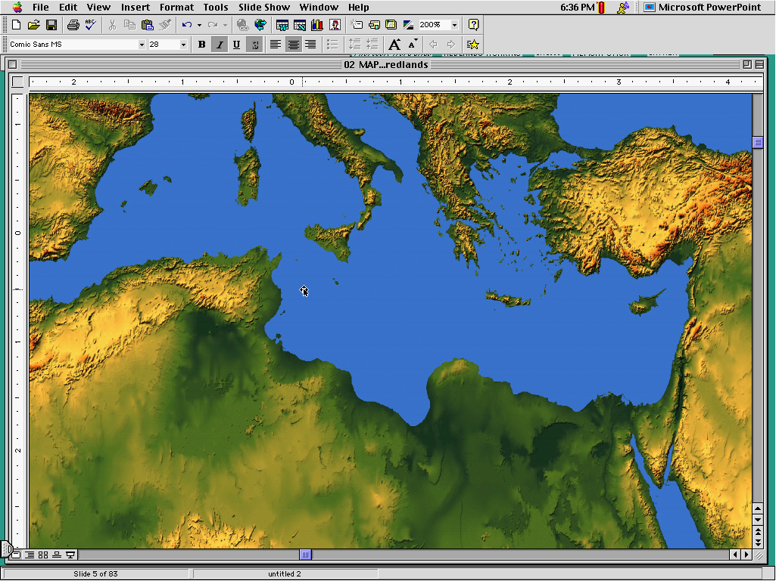
Western
Byzantine
Later (AD 600) manuscripts keep it
Latest (AD 1000) manuscripts keep it
3 Text Types
Alexandrian
Earliest (AD 200-400) manuscripts omit it
Notes:
The NT manuscripts of the early centuries of the church were copied in three main regions: Rome gave us the Western text type (or majority text, since they copied so many of them), the city of Constantinople became the capital of the Eastern Orthodox church with its Byzantine manuscripts, and a large community of Christians gathered in Alexandria, Egypt. This Alexandrian texts were the earliest, going back to about AD 200.

Slide 63
Note the Flow...
Jesus exposes evil intent of the Pharisees (8:10)
Jesus is the Light of the World (8:12)
Pharisees made a false judgment(8:15)
Jesus makes a right judgment (8:16)
Pharisees tried to stone her (8:5)
Pharisees tried to stone Jesus(8:59)

Slide 64

Where we’re going today...
Passage
Applications

Slide 65

What’s the Point?
Show mercy to the repentant!
Don't let people trap you!
Be smarter when you commit adultery so you don’t get caught!
Jesus didn’t really follow the Law.
Forgive people before they repent—that's what Jesus does!
Don’t be too quick to throw stones.
God isn’t serious about sin after all.
Notes:
Show mercy to the repentant—maybe, but we don’t see her repent!
Don't let people trap you!
Be smarter when you commit adultery so you don’t get caught!
Jesus didn’t really follow the Law? Hmmm…
Forgive people before they repent—that's what Jesus does!
Don’t be too quick to throw stones?
God isn’t serious about sin after all?

Slide 66
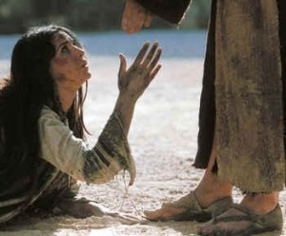
I. Jesus showed the true compassion of the Law by forgiving an adulterous woman (7:53–8:11).

Slide 67
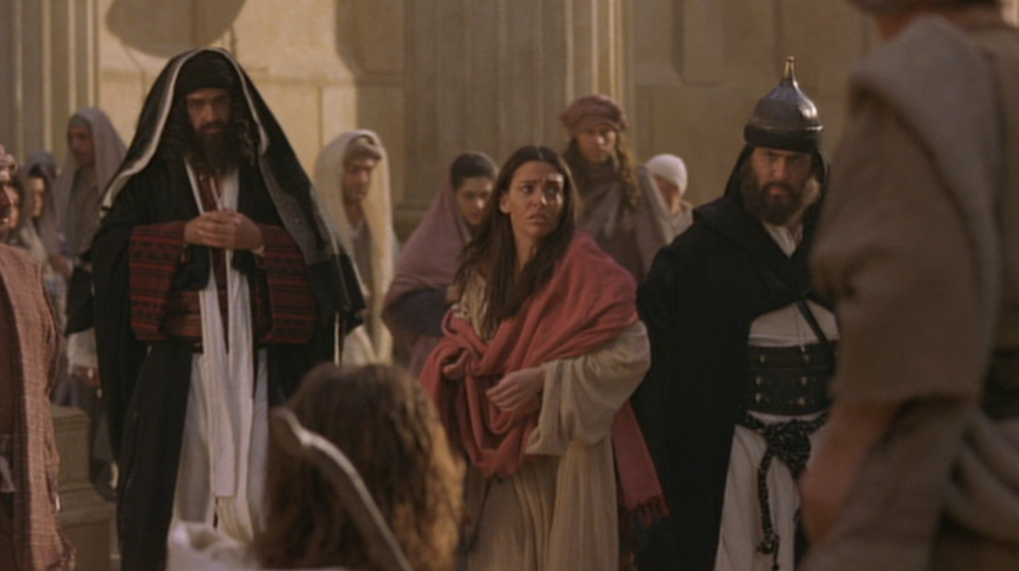
A. Pharisees brought an adulterous woman to Jesus to retain their power by having Jesus condemn Himself (7:53–8:6a).

Slide 68
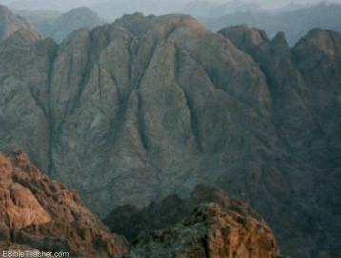
B. Jesus showed the Pharisee’s sin by following the true compassion of the Law to condemn sinners and redeem the repentant (8:6b-11).
Why did God give the Law on Mount Sinai?

Slide 69
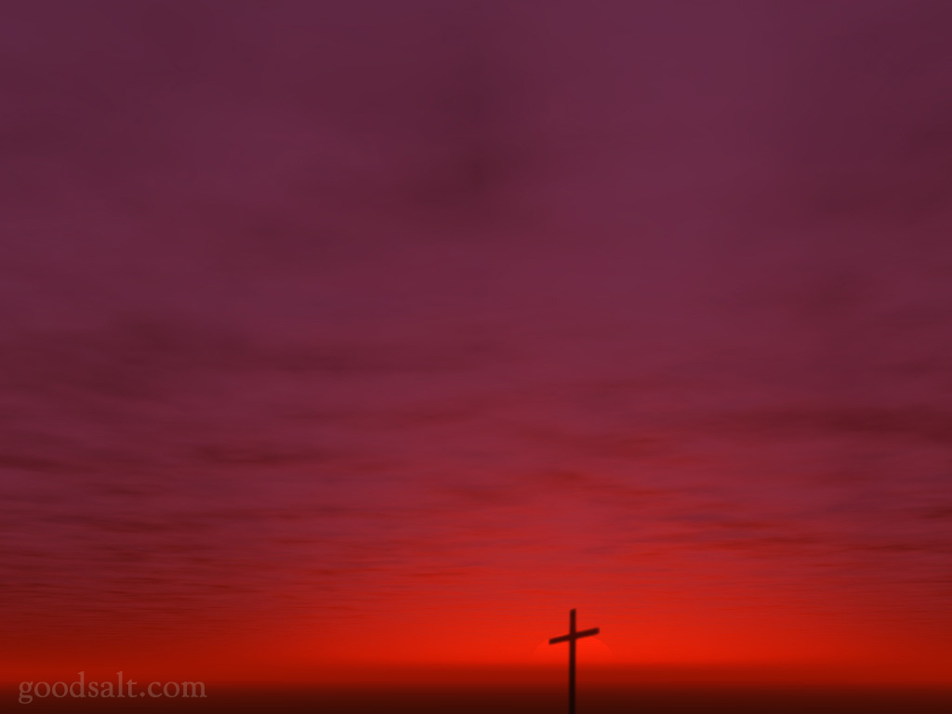
II. Show God’s compassion by helping people repent
(Main Idea).

Slide 70
C. Conflict Over the Light
§ 100
约翰 8:12-20
Christ's declaration to be the Light of the World identifies Himself as the Messiah anticipated in the Feast of Tabernacles, a claim rejected by the Pharisees because He witnessed on His Own behalf and responded to by Christ who points to the Father's additional witness on His behalf

Slide 71

The Light of the World
约翰 8:12-59

Slide 72
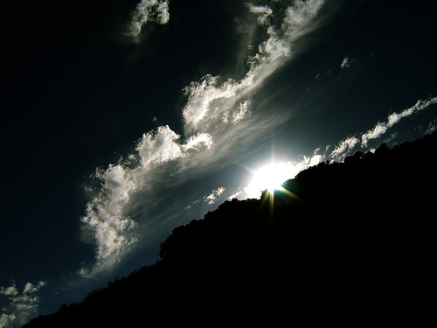
Can people tell the difference
between
and light?
darkness

Slide 73
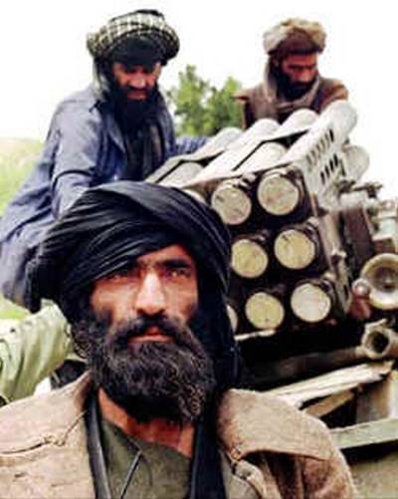
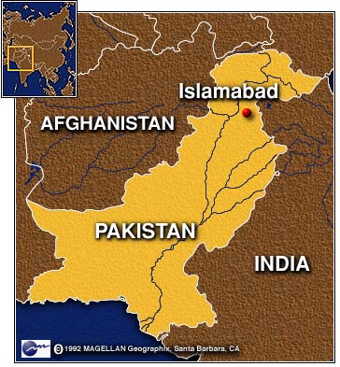
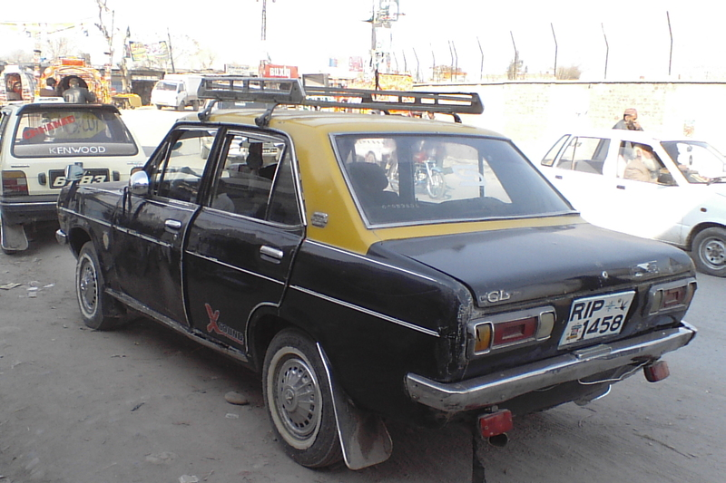
Edwin Paul
28 Sep 2010

Slide 74
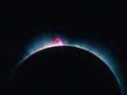
Jesus (logos) was God (1:1c)
“In the beginning
was the Word,
and the Word was with God,
and the Word was God”
(约翰 1:1)
Notes:
Scripture is very clear that Jesus is God. Christians have always believed this key doctrine called the deity of Christ.

Slide 75
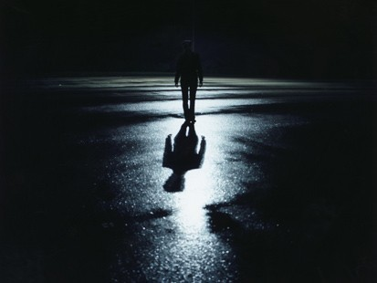
The Great Transfer
For he has rescued us from the kingdom of darkness
and transferred us into the Kingdom of his dear Son
¹⁴ who purchased our freedom and forgave our sins (Col 1:13-14)

Slide 76

How should we expect people to respond to Christ’s claim to be eternal God?

Slide 77


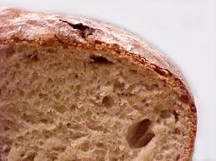
约翰 6–8
Bread
6
Water
7
Light
8

Slide 78
How should we expect people to respond to Christ’s claim to be eternal God?
3 responses...

Slide 79
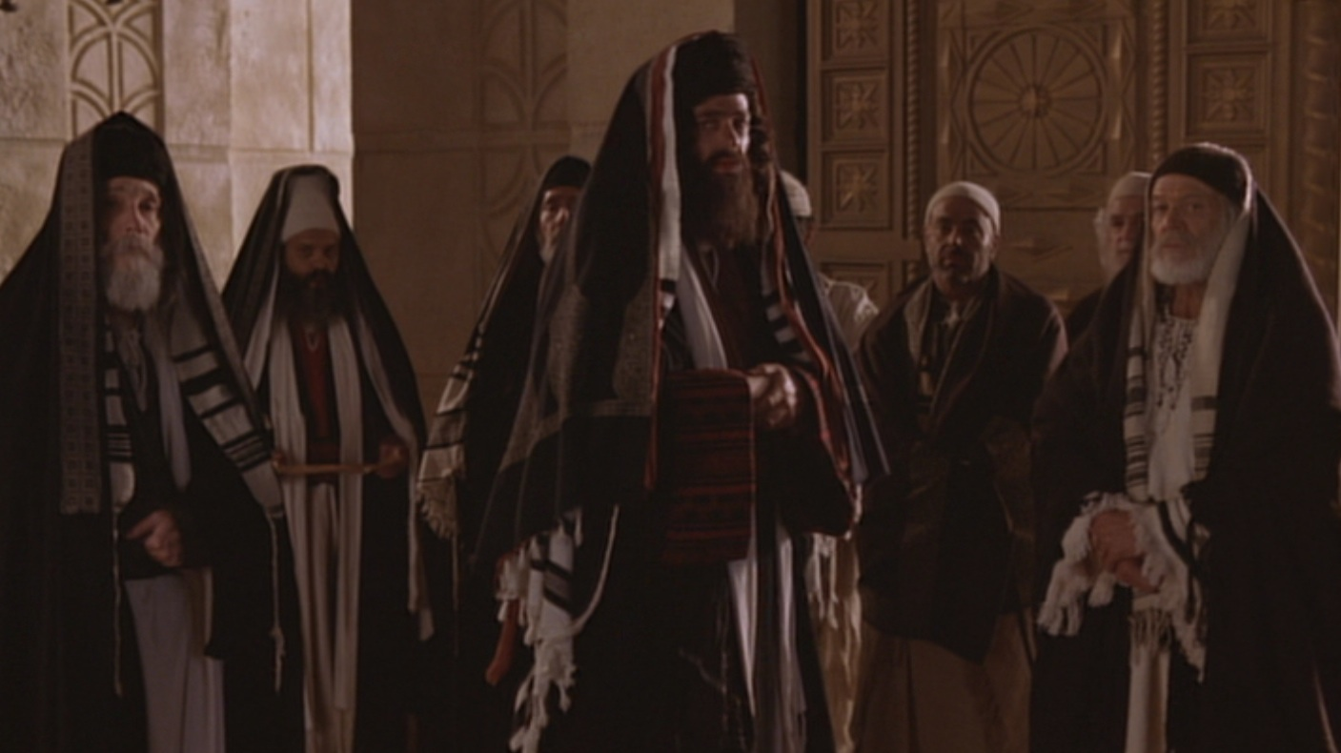
I. Some are hostile to Christ as the way of salvation (12-20).

Slide 80
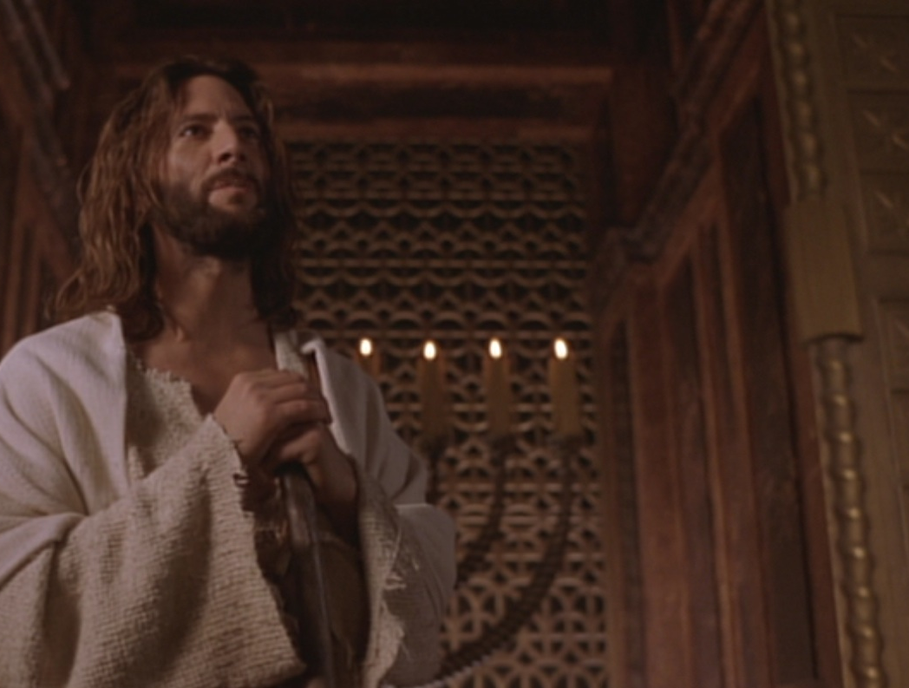
“我是世上的光”
约翰 8:12

Slide 81
“The claim is exclusive, one only God could make. Note that Jesus claimed to the light of the world, not a light. Although the claim is exclusive, the offer is inclusive—an offer any and all could respond to.”
Charles Swindoll, Following Christ…
The Man of God, 33, emphasis his

Slide 82
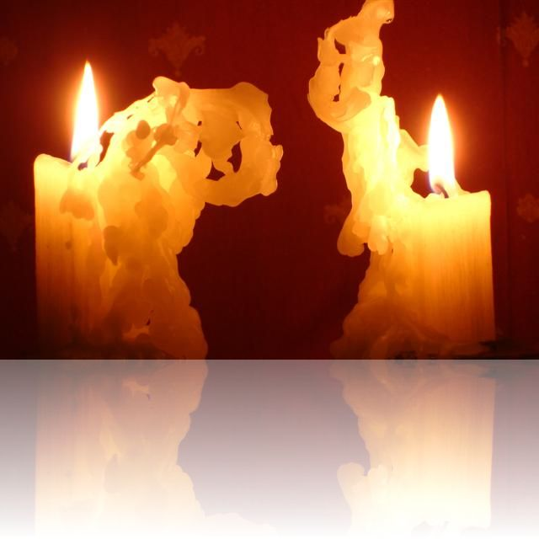
Two Witnesses (Deut 17:6)
“But never put a person to death on the testimony of only one witness. There must always be two or three witnesses.”

Slide 83
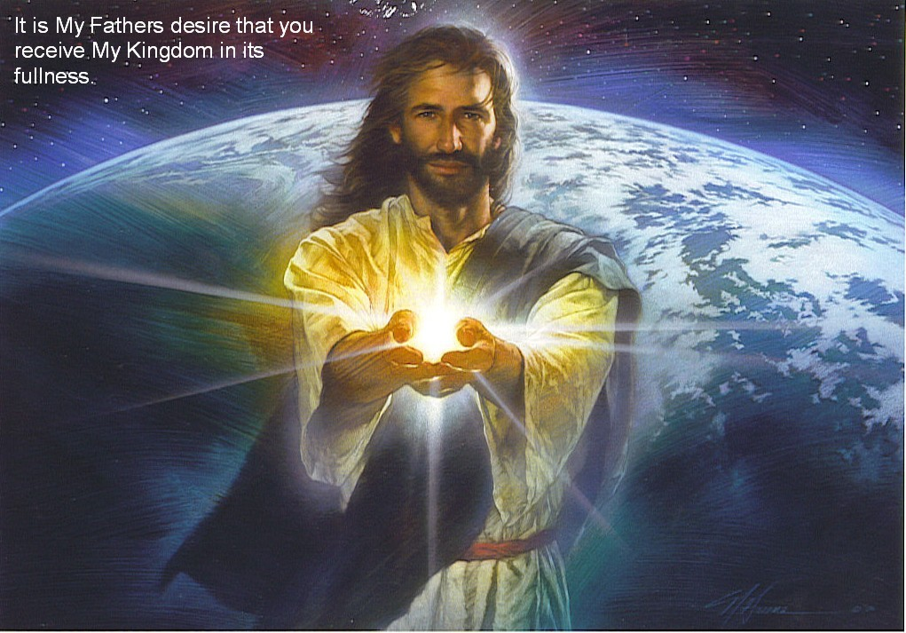
Jesus is the light of life (12-20)
Light
Life
Darkness
Death
Hostility!

Slide 84
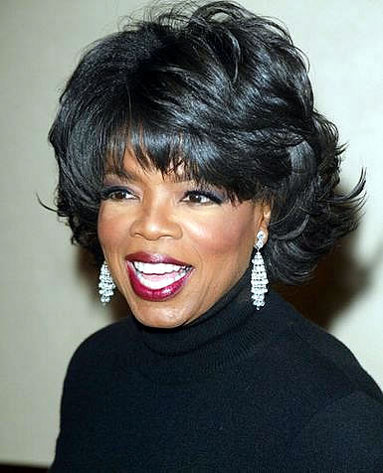
Oprah Winfrey
“Does God care about your heart... Or does God care that you call his son ‘Jesus’?”
Notes:
http://www.youtube.com/watch?v=ETeI6i5oqh4&feature=related

Slide 85
I. Some are hostile to Christ as the way of salvation (12-20).

Slide 86
D. Conflict Over His Person
§ 101
约翰 8:21-59
Christ's declaration of Messianic identity and deity elicit open opposition and attempted but unsuccessful execution by stoning from the Jewish leaders, who become even more determined to kill Him

Slide 87
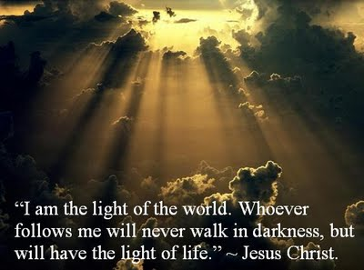
II. Many believe that the Father sent Jesus from heaven (21-30).

Slide 88

Who are you?!
约翰 8:25

Slide 89

“My identity? I am God!” (25-30)
Above
Eternal life
Below
Die in sins
Jesus continued, “You are from below; I am from above. You belong to this world; I do not. ²⁴ That is why I said that you will die in your sins; for unless you believe that I Am who I claim to be, you will die in your sins” (约翰 8:23-24).

Slide 90

Many people there placed their faith in him (30).

Slide 91
I. Some are hostile to Christ as the way of salvation (12-20).

Slide 92
II. Many believe that the Father sent Jesus from heaven (21-30).

Slide 93

III. All are revealed as of God or Satan (31-59).

Slide 94

A. Believers in Jesus are freed from slavery to be the spiritual descendants of Abraham (31-38).
Child of God

Slide 95

“Believe” in 约翰’s Gospel
“Then many who heard him say these things believed in him.
³¹ Jesus said to the people who believed in him, ‘You are truly my disciples if you remain faithful to my teachings. ³² And you will know the truth, and the truth will set you free’” (8:30-32).

Slide 96

约翰 8:34 text

Slide 97

Life’s Journey

Slide 98

Freedom

Slide 99

Freedom (约翰 8:34)

Slide 100

B. Those who reject Jesus identify the devil as their father even to the point of trying to kill the messenger (39-59).

Slide 101

1. Those who reject Jesus identify the devil as their father (39-47).

Slide 102

“You belong to your father, the devil... He was a murderer from the beginning... When he lies, he speaks his native language...” (8:44)

Slide 103

2. Some reject God to the point that they even try to kill the messenger (48-59).

Slide 104

“Before Abraham was born, I Am!”
约翰 8:58

Slide 105

Christ’s “I am…” Claims in 约翰’s Gospel
“Light of the World”
“Before Abraham”
“Good Shepherd”
“Door”
“I & Father are one”
“Resurrection & Life”
“Way, Truth, & Life”
“True Vine”

Slide 106

“They picked up stones to throw at him”
约翰 8:59

Slide 107

Main Idea
How should we expect people to respond to Christ’s claim to be eternal God who saves us from sin?
Christ’s claim to be God elicits the best & worst in us.

Slide 108

Who is Jesus?
Jesus is the Light of life (12-20)
Jesus is sent from heaven by God the Father (21-30)
Jesus can make you God’s child (31-38)
Jesus is God eternal (39-59)

Slide 109

3 responses:
• Some are hostile (12-20).
• Many believe (21-30).
• All are revealed as of God or Satan (31-59).

Slide 110

Walk to the light!

Slide 111


Liar–Lunatic–Lord
Notes:
C.S. Lewis, a popular British theologian, wrote, "I am trying here to prevent anyone saying the really foolish thing that people often say about Him: 'I'm ready to accept Jesus as a great moral teacher, but I don't accept His claim to be God.' That is the one thing we must not say. A man who was merely a man and said the sort of things Jesus said would not be a great moral teacher. He would either be a lunatic - on the level with the man who says he is a poached egg - or else he would be the Devil of Hell. You must make your choice. Either this man was, and is, the Son of God: or else a madman or something worse. You can shut Him up for a fool, you can spit at Him and kill Him as a demon; or you can fall at His feet and call Him Lord and God. But let us not come with any patronising nonsense about His being a great human teacher. He has not left that open to us. He did not intend to." (C.S. Lewis, Mere Christianity, The MacMillan Company, 1960, pp. 40-41.)

Slide 112


D.L. Moody

Slide 113
E. Conflict Over the Healing of the Blind Man
§ 102
约翰 9:1-41
Through the Sabbath healing of the man born blind Christ authenticates His claim as Light to those in darkness and is worshipped as God

Slide 114


Don’t the Blind Know They’re Blind?
约翰 9

Slide 115
Spiritual Blindness

Slide 116



Healing from Spiritual Blindness
satisfying life
eternal life

Slide 117

What must we see to prevent spiritual blindness— in ourselves & others?

Slide 118
约翰 6–8
Bread
6
Water
7
Light
8

Slide 119
What must we see to prevent spiritual blindness— in ourselves & others?
3 views:
miracle
controversy
decision

Slide 120

I. Jesus makes the blind see.

Slide 121

A. Jesus’ healing a blind man proved he gives spiritual sight too (1-7).

Slide 122

1. This man was born blind to show that God empowered Jesus to give eternal life (1-5).

Slide 123

Why this blindness?

Slide 124

Exodus 20:4-5
Sin
“You must not make for yourself an idol.... ⁵ You must not bow down to them or worship them, for ... I lay the sins of the parents upon their children; the entire family is affected—even children in the third and fourth generations of those who reject me.’”
Suffering

Slide 125

2. Jesus proved He was the way for eternal life by miraculously healing the man (6-7).

Slide 126

Why did Christ put mud on the man’s eyes (9:6)?

Slide 127

Jesus formed Adam from the dust (约翰 1:3; Gen. 2:7).

Slide 128
Washing developed his faith

Slide 129

Journey to the Pool of Siloam
Temple
Pool of Siloam

Slide 130

B. Do you believe that God sent Jesus to cure your own blindness?

Slide 131


约翰记载的神迹
111
约翰福音独有的神迹-黄色方格内 (九个神迹中的六个)
变水为酒
2:1-11
医治大臣
的儿子
4:46-54
医治38年的
中风病患
5:1-18
喂饱5000人
6:1-15
行走海面上
6:16-21
医治生来
瞎眼的
9:1-7
叫拉撒路
从死里复活
11:1-45
基督复活
20:1-31
奇妙捕获
21:1-3

Slide 132
I. Jesus makes the blind see.

Slide 133

II. Jesus changes people’s lives(8-34).

Slide 134


A. The blind man increasingly gained spiritual insight...
... while the Pharisees increasingly rejected his testimony and became more spiritually blind (8-34).

Slide 135

Evidence of Spiritual Blindness
Trusting rules over God’s work (8-16)
“This man Jesus is not from God, for he is working on the Sabbath” (16a).
Notes:
Read 13-16a: “¹³ Then they took the man who had been blind to the Pharisees, ¹⁴ because it was on the Sabbath that Jesus had made the mud and healed him. ¹⁵ The Pharisees asked the man all about it. So he told them, “He put the mud over my eyes, and when I washed it away, I could see!”
¹⁶ Some of the Pharisees said, “This man Jesus is not from God, for he is working on the Sabbath.”
Tyndale House Publishers., Holy Bible : New Living Translation., 2nd ed. (Wheaton, Ill.: Tyndale House Publishers, 2004), Jn 9:13-16.

Slide 136

Evidence of Spiritual Blindness
Persecuting God’s witnesses (17-23)

Slide 137

Evidence of Spiritual Blindness
Rejecting Christ despite evidence (24-34)

Slide 138

³² Ever since the world began, no one has been able to open the eyes of someone born blind. ³³ If this man were not from God, he couldn’t have done it” (32-33).
^{No OT sight restored}
^{No disciples healed blindness}
Healing blindness was Christ’s most common miracle!
^{Evidence of being Messiah}

Slide 139

B. Does seeing evidence for Jesus help you gain or lose spiritual insight?

Slide 140

Humility

Slide 141

Did life originate as an accident?
“There are only two possible explanations as to how life arose: Spontaneous generation arising to evolution or a supernatural creative act of God…. There is no other possibility. Spontaneous generation was scientifically disproved 120 years ago by Louis Pasteur and others, but that just leaves us with only one other possibility… that life came as an act of supernatural creation by God, but I can’t accept that philosophy because I do not want to believe in God. Therefore, I choose to believe that which I know is scientifically impossible, spontaneous generation leading to evolution.”
Dr. George Wald
Professor Emeritus of Biology, Harvard
Nobel Prize winner in Biology, 1971
Notes:
The same applies to hearing others testify that Jesus offers eternal life—we must act on the evidence by believing it to prevent spiritual blindness.
George Wald, “Origin, Lie and Evolution,” Scientific American 1978); cited by Joe White and Nicholas Comninellis, Darwin’s Demise (Green Forest, AR: Master Books, 2001), 46.

Slide 142
I. Jesus makes the blind see.

Slide 143
II. Jesus changes people’s lives(8-34).

Slide 144


III. Jesus deserves worship as God (35-41).

Slide 145


Opposite Responses

Slide 146

The former blind man confesses Jesus as God (35-38).

Slide 147

Jesus condemns the Pharisees for rejecting him as God (39-41).

Slide 148

约翰 9:39-41 NLT
³⁹ Then Jesus told him, “I entered this world to render judgment—to give sight to the blind and to show those who think they see (Greek: “those who see”) that they are blind.”
⁴⁰ Some Pharisees who were standing nearby heard him and asked, “Are you saying we’re blind?”
⁴¹ “If you were blind, you wouldn’t be guilty,” Jesus replied. “But you remain guilty because you claim you can see”

Slide 149

How should we respond when we see that Jesus is truly God Himself?

Slide 150
???????
Who’s the real blind man?

Slide 151

The blind man sees!
Who’s the real blind man?
• God: “worshipped Jesus” (38)
• “A man from God” (33)
• “A prophet” (17)
• “A man called Jesus” (7)

Slide 152

The Pharisees are blind!
Who’s the real blind man?
• Jesus is a con man (15, 18)
• Jesus is a Sabbath breaker (16)
• Blind man was deceived (17)
• Parents will discredit him (19)
• Excommunication threat (22)
• Curse in God’s name (24a)

Slide 153
The Pharisees are blind!
Who’s the real blind man?
• Jesus is a sinner (24b)
• Jesus is a deceiver (26)
• Blind man was deceived (26)
• Cursed the blind man (28)
• Lied about Jesus’ origin (29)
• Excommunicated blind man (34)

Slide 154

The Main Idea of 约翰 9
How can you avoid spiritual blindness? Respond in faith to what you know now about Jesus!

Slide 155


Are you color blind?
I. Jesus makes the blind see.
II. Jesus changes people’s lives.
III. Jesus deserves worship as God.

Slide 156


Helen Keller (1880-1968)

Slide 157

Whoever wants healing from spiritual blindness must believe that Jesus is God.

Slide 158
Purpose #1
Jesus Healed the Blind Man
Reveal the Truth
9:1-7

Slide 159
Deity of Christ
9:1 Man born blind
We are blind spiritually at birth thus need rebirth which only God can provide
9:2-4a “Rabbi, who sinned.…? God might be displayed in Him.”
Christ’s ability to cure our spiritual blindness shows him to be God
9:4b-5 Day and Night
He was sent by God to work but his work ceased during His crucifixion-resurrection

Slide 160
Deity of Christ
9:6 Mud and saliva
Irenaeus believed the action was to show Christ is the Creator (cf. Gen. 2:7)
9:7 Siloam means “Sent”
Jesus was “Sent” by God
Water symbolized the Holy Spirit so that the blind man was born of water and the Spirit (cf. 3:5)

Slide 161
What is the Truth of Verses 1-7?
Jesus is the Son of God because He was sent by God to give Spiritual Truth to the blind
“There was the true Light which coming into the world, enlightens every man” (1:9)
“Truly, truly, I say to you, unless one is born again he cannot see the kingdom of God” (3:3)

Slide 162
Purpose #2
Jesus Healed the Blind Man
Reveal the Blind
9:8-34

Slide 163
Black

Slide 164
Black

Slide 165


WHO WAS TRULY BLIND?
Pharisees? or the Blind Man?

Slide 166
Steps in the Blind Man’s Belief
Blind man interrogated
by neighbors (8-12)
Blind man and parents interrogated
by Pharisees (13-23)
Blind man interrogated
by Pharisees again (24-34)
“The man they call Jesus” (11)
“He is a prophet” (17)
“Whether he is a sinner or not, I don’t know. One thing I do know. I was blind but now I see!” (25)
“If this man were
not from God,
He could do
nothing”(33)

Slide 167
Steps in the Pharisees’ Unbelief
“This man is not from God” (17)
“This man is a sinner” (25)
“You are His disciples but we are disciples of Moses” (29)
“You were born entirely in sin, and are you teaching us?” (34)

Slide 168

Contrasts
Blind Man
Had not seen Jesus before being healed
Knew little about the Mosaic Law
Beggar
Received Spiritual Truth
(Spiritual Sight)
Pharisees
Witnessed Jesus’ miracles & teaching
Claimed to know God’s Word
Religious
Rejected Spiritual Truth
(Spiritual Blindness)

Slide 169
What Caused the Blindness?
His parents were afraid of the Jews; for the Jews had already decided that anyone who acknowledged Jesus was the Christ would be put out of the synagogue (22)
“If we let him go on like this, all men will come and take away both our place and our nation” (约翰 11:48)
REPUTATION, PRIDE and WEALTH
caused their spiritual blindness

Slide 170
Pharisees Lived in Darkness
He came to his own but those who were His own did not receive Him.
约翰 1:11
For everyone who does evil hates the Light, and does not come to the Light for fear that his deeds will be exposed.
约翰 3:20

Slide 171
Why Were They Blind?
Pharisees were spiritually blind because they rejected the testimony of the blind man and the Deity of Christ.

Slide 172
THE
OUTCOME
(35-41)

Slide 173
Outcome for the Blind Man (35-38)
The blind man could see the kingdom of God because he became born again.
The blind beggar become a child of God.
The blind man worshiped the Son of God.

Slide 174
Outcome for the Pharisees (39-41)
The Pharisees would be judged and condemned because they willfully rejected Jesus as the Son of God (39a)
The Pharisees’ ability to see spiritual truth degenerated (39b)
The Pharisees continued with their guilt upon them (41b)

Slide 175
约翰 3:17-18
For God did not send the Son into the world to judge the world, but that the world might be saved through Him. He who believes in Him is not judged; he who does not believe has been judged already, because he has not believed in the name of the only begotten Son of God.

Slide 176
约翰’s Message
Jesus is the Truth. Therefore…
Those who believe in Jesus shall know the truth and the truth will set them free.
But those who reject Jesus as the Son of God shall be judged.

Slide 177
Application
Let’s not follow in the footsteps of the Pharisees--blinded by their pride, reputation and wealth.
Let’s follow the example of the blind man--humbly obey and believe His Word.

Slide 178
The Great Transfer
For he has rescued us from the kingdom of darkness
and transferred us into the Kingdom of his dear Son
¹⁴ who purchased our freedom and forgave our sins (Col 1:13-14)

Slide 179
F. Conflict Over the Shepherd
§ 103
约翰 10:1-21
Christ declares that a remnant of Israel followed Him as the true, good, only and obedient Shepherd and called to Him those who followed the Pharisees as false shepherds

Slide 180
G. Witness of the
Seventy-Two
§ 104
路加 10: 1-24
Christ sends out the seventy-two disciples to witness to the crowds that He is Messiah and the kingdom is at hand despite the growing opposition of the leaders to His person, thus revealing that the common people also had begun to debate over His person

Slide 181
H. Conflict Over the Question of Eternal Life
§ 105
路加 10:25-37
Christ teaches the parable of the Good Samaritan to show that a neighbor is a needy person whose need can be met in order to declare the fruits of repentance to a lawyer requesting how good he needed to be to enter the kingdom

Slide 182

好 撒 玛 利 亚 人

Slide 183
奥古斯丁的寓言解释该好撒玛利亚人的比喻（路加福音15）
文本 解读
“某人” ... ... ... ... ... ... 亚当
盗贼 ... ... ... ... ... ... ... 魔鬼和恶魔
剥去他 ... ... ... ... ... ... 把他的不朽
打他 ... ... ... ... ... ... ... 引诱他犯罪
祭司和利未人 ... ... ... ... ... 旧约的职事它什么也
不做的亚当
好撒玛利亚人 ... ... ... ... ... 基督
结合创面用油和酒 ... ... ... ... 抑制了罪了希望和告诫
与合作热切精神
客栈 ... ... ... ... ... ... ... 教会
客栈老板 ... ... ... ... ... ... 使徒保罗
真的吗?!

Slide 184

God's Compassion
路加 10:25-37

Slide 185
I. An Example of Fellowship
§ 106
路加 10:38-42
Christ favors the fellowship of Mary over the service of Martha, thus demonstrating that occupation with Christ is more important than occupation for Christ

Slide 186
J. Instruction in Prayer
§ 107
路加 11:1-13
Jesus identifies areas of need one should present to God and teaches the importance of persistent prayer as one who has need presenting intercessions to One who can meet the need in order to encourage prayer for the coming of the Spirit following His death and resurrection

Slide 187
K. Conflict Over the Healing of the Dumb Man
§ 108
路加 11:14-36
In response to the people's accusation that Christ cast the demon out of a dumb man by Satan's power Jesus teaches that the nation's continued unbelief makes its state worse than before 约翰's ministry and that its spiritual darkness will result in judgment, not for lack of revelation but because the nation refused the revelation it received

Slide 188

Free
Bible
images
马太 9:32-34; 路加 11:14-23
耶稣治愈哑巴

Slide 189


Slide 191


Slide 192


Slide 193


Slide 194


Slide 195


Slide 196


Slide 198


Slide 199


Slide 200
授权使用
马太福音
d
马可福音
o
路加福音
0
约翰福音
0
由Lumo Project出版独家资源，我们特此通知您我们不授权将这些图片发放给除freebibleimages.org客户以外的任何人。
所有图片不授权用于视频制作、epublishing或者其他媒体。所有下载的图片和文件不可通过除freebibleimages.org以外的其他网站传播，亦不可用于任何破坏基督信仰和福音的处境中。
o
图片仅供教育展示、博客和社交媒体使用；所有用途均需注明出处
www.LumoProject.com
图片声明 BBM
© 版权所有
www.bigbookmedia.com

Slide 201
L. Conflict Over Pharisaic Ritualism
§ 109
路加 11:37-54
Christ openly condemns the Pharisees for their traditions that mislead Israel from the true intent of the law, revealing the impossibility of reconciliation between Christ and the Pharisees

Slide 202
M. Instruction of the Disciples
§§ 110-118
Christ addresses the believers among the multitude concerning Pharisaic practices and the program of God in view of Israel's rejection

Slide 203
1. Hypocrisy
§110
路加 12:1-12
Christ warns the disciples and the multitudes that the Pharisees were unrighteous despite their claim to be acceptable to God in order to encourage those weighing the cost of breaking with the Pharisees to secure their eternal destiny by putting their faith in Him

Slide 204
2. Covetousness
§ 111
路加 12:13-34
Jesus warns the disciples that the Pharisaic practice of trusting riches as the basis of their acceptance before God actually stemmed from greed so that His disciples would rely upon Him in faith

Slide 205
3. Watchfulness
§ 112
路加 12:35-41
In light of the postponement of the kingdom Christ warns the disciples to be watching, waiting and prepared for Him to come again because the kingdom had not been withdrawn but postponed until a future date

Slide 206

路加 12:35-38 新译本
³⁵ "你们的腰当束起来，灯也该点着，
³⁶ 像等候自己的主人从婚筵回来一样，好叫你们在主人回来敲门时，立刻给他开门。
³⁷ 主人来到了，看见仆人警醒，这些仆人就有福了。我实在告诉你们，主人必亲自束腰，招待他们吃饭，进前来侍候他们。
³⁸ 主人也许半夜之前，或天亮之前回来，看见他们这样，这些仆人就有福了。
(路加 12:35-38 新译本)

Slide 207
4. Faithfulness
§ 113
路加 12:42-48
Christ teaches His disciples that those who are watchful must also be faithful in order to instruct them that degrees of both rewards and punishments will be determined by one's degree of faithfulness

Slide 208
5. The Effect of His Coming
§ 114
路加 12:49-53
Christ teaches that when He returns there will be a judgment which brings division over the person of Christ in order to encourage the people to separate from Pharisaism and embrace Him

Slide 209
6. The Signs of the Times
§ 115
路加 12: 54-59
Christ rebukes the crowd for being able to interpret the weather but not the signs authenticating His person in order to urge them to seek reconciliation with the Judge

Slide 210
7. Concerning Repentance
§ 116
路加 13:1-9
Christ refutes the common teaching that tragedy happens only to people in sin to warn the crowd that judgment would befall them as well if they refuse to repent since the entire generation was deserving of judgment

Slide 211
8. Concerning Israel's Need
§ 117
路加 13:10-17
Christ heals a crippled woman on the Sabbath to picture Israel's need for Him as Messiah and to show what He was prepared to do if the nation would trust Him in faith

Slide 212
9. Concerning the Kingdom Program
§ 118
路加 13:18-21
In order to help the disciples' discouragement over the lack of response of the crowds Christ encourages them that He knew they would not respond and that the kingdom's small beginning would grow quietly, pervasively and irreversibly to result in a large, new form of the kingdom

Slide 213
N. Conflict at the Feast of Dedication
§ 119
约翰 10:22-39
Christ claims to be Messiah of God as shown in both His words and works in order that the Jews rejecting Him would realize that they disbelieved not because of insufficient evidence but from rejection of the evidence

Slide 214
Black

Slide 215


基督生命链接地址 BibleStudyDownloads.org
免费获得该讲解!
圣经学习下载
Notes:
Bible Geograhpy (bg)

