Slide 1
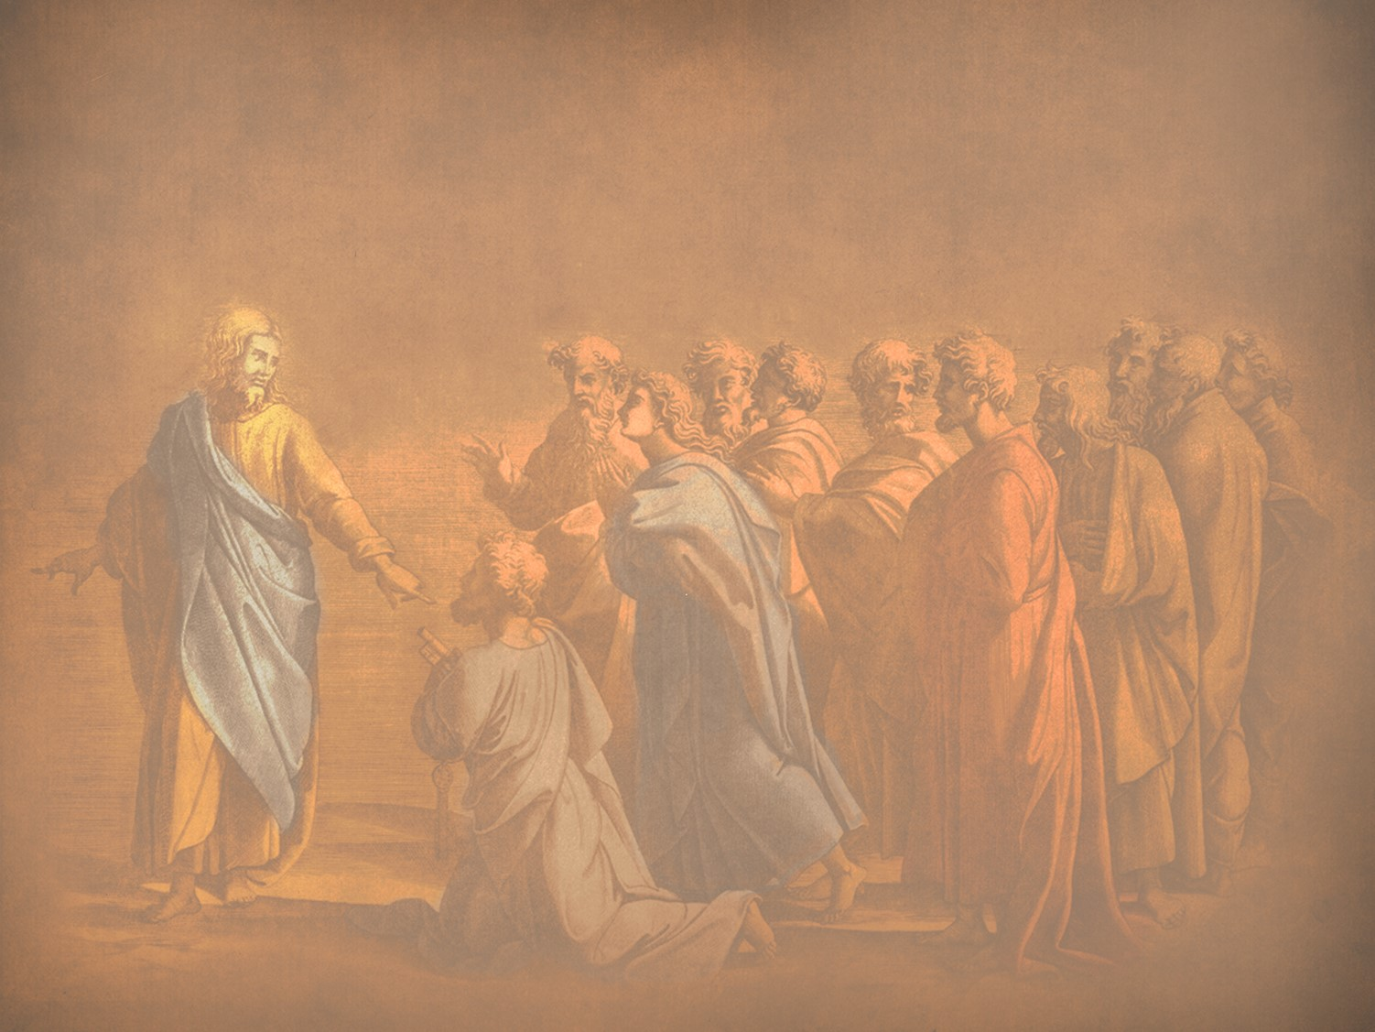
君王教导门徒
§§ 74-97
Section summaries based on J. Dwight Pentecost, A Harmony of the Words and Works of Jesus Christ (Grand Rapids: Zondervan, 1981)
Dr. Rick Griffith • Singapore Bible College • BibleStudyDownloads.org
The Messiah no longer devotes Himself to a public ministry but withdraws to teach the apostles how to continue the ministry the Father had entrusted to Him since His rejection would soon end in death

Slide 2
A. Feeding the Five Thousand
§ 74
Matthew 14:13-21; Mark 6:30-44; Luke 9:10-17; John 6:1-13
In His feeding the five thousand Christ, as the New Moses in fulfillment of Deuteronomy 18:15, (1) teaches His disciples the importance of doing the work of a shepherd as He reveals the nature of the ministry, their inadequacy, and His sufficiency to accomplish the ministry, (2) confirms the believing remnant in their faith, and (3) establishes the unbelieving masses in their spiritual blindness

Slide 3
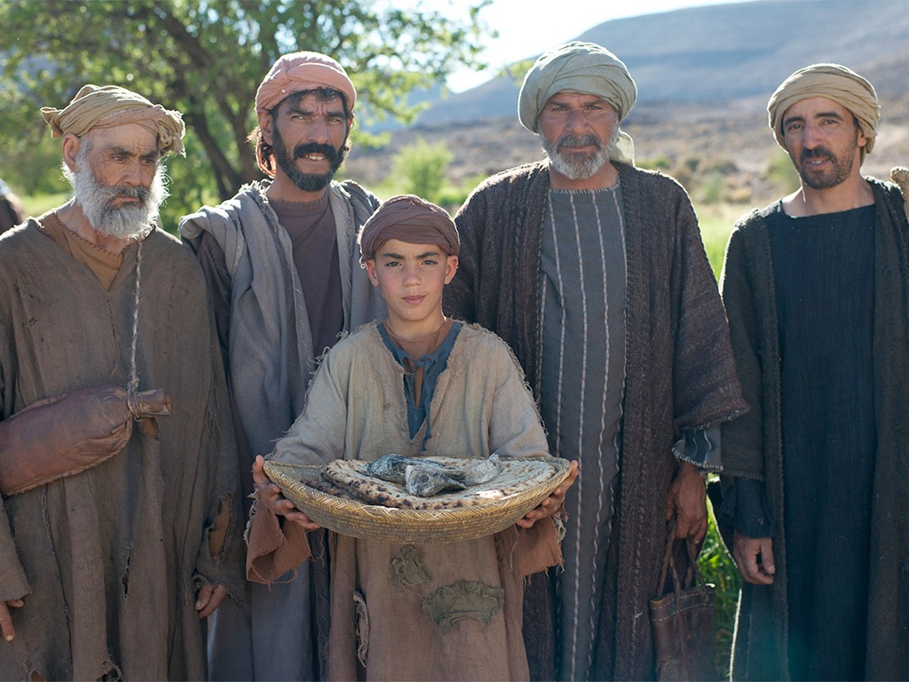
耶稣给五千人吃饱
马太 14:13-22
马可 6:31-46
路加 9:10-17
约翰 6:1-13

Slide 4
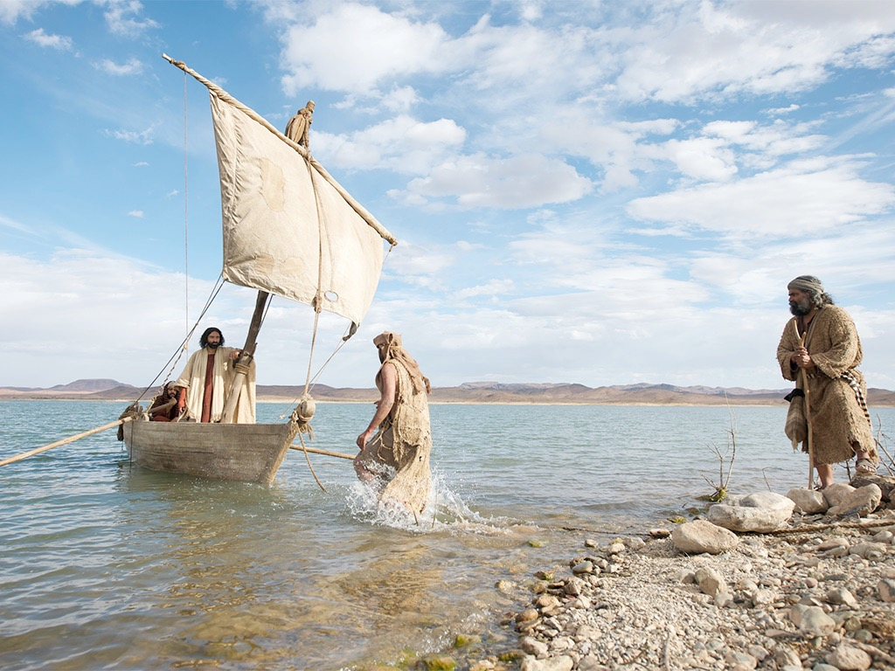

Slide 5
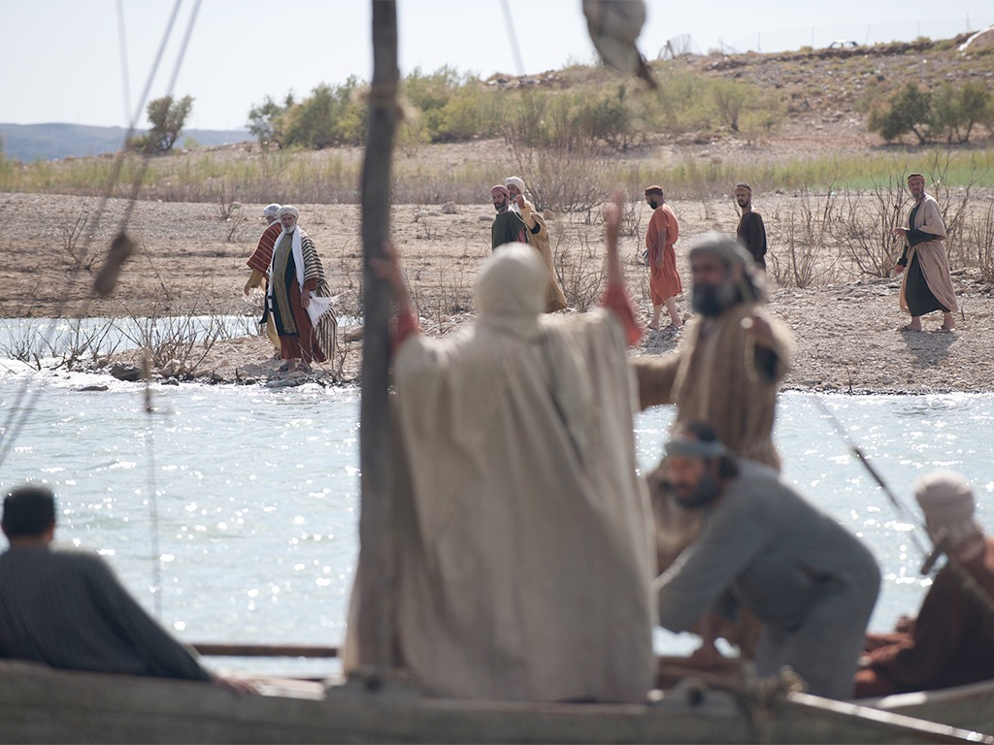

Slide 6
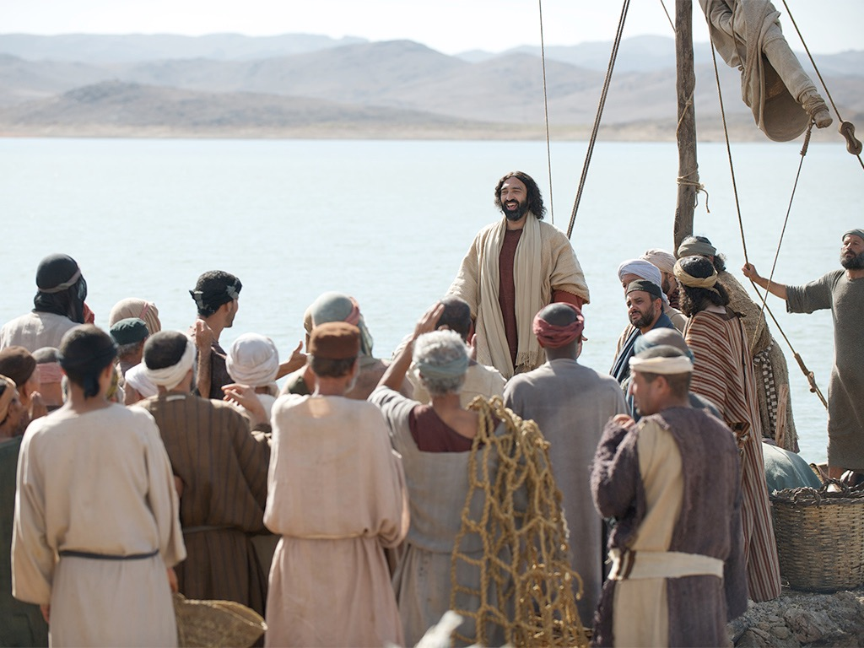

Slide 7
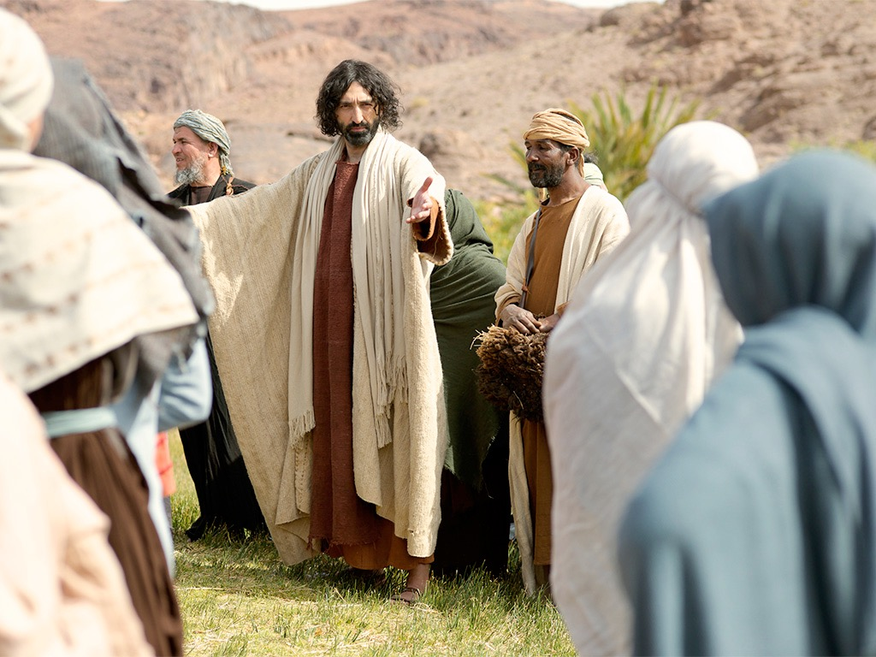

Slide 8
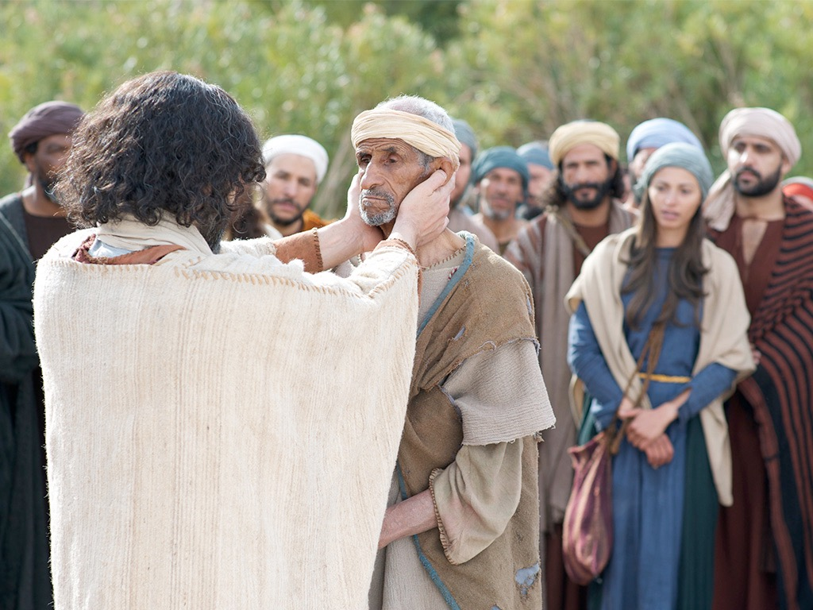

Slide 9
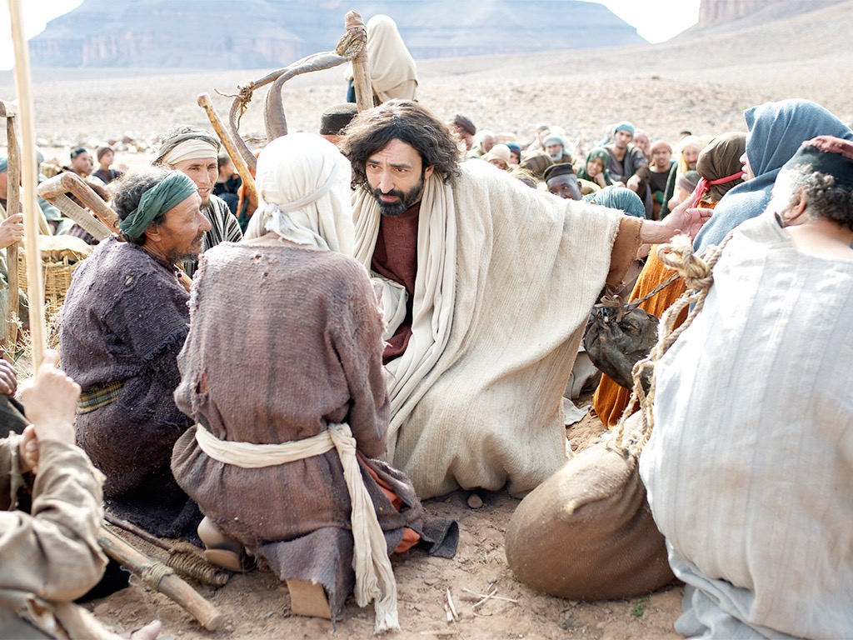

Slide 10
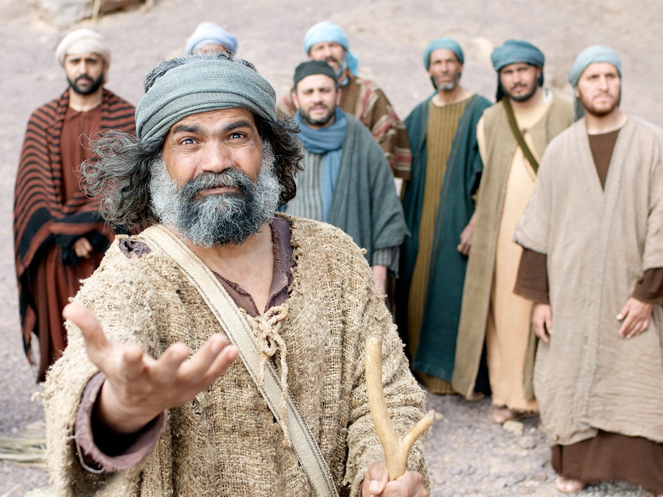

Slide 11
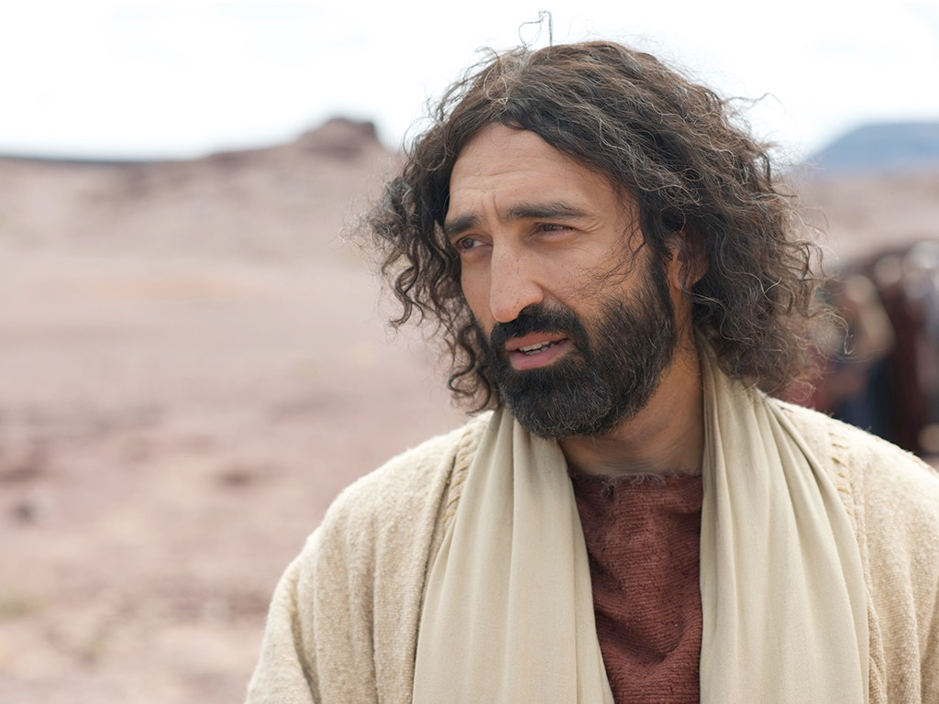

Slide 12
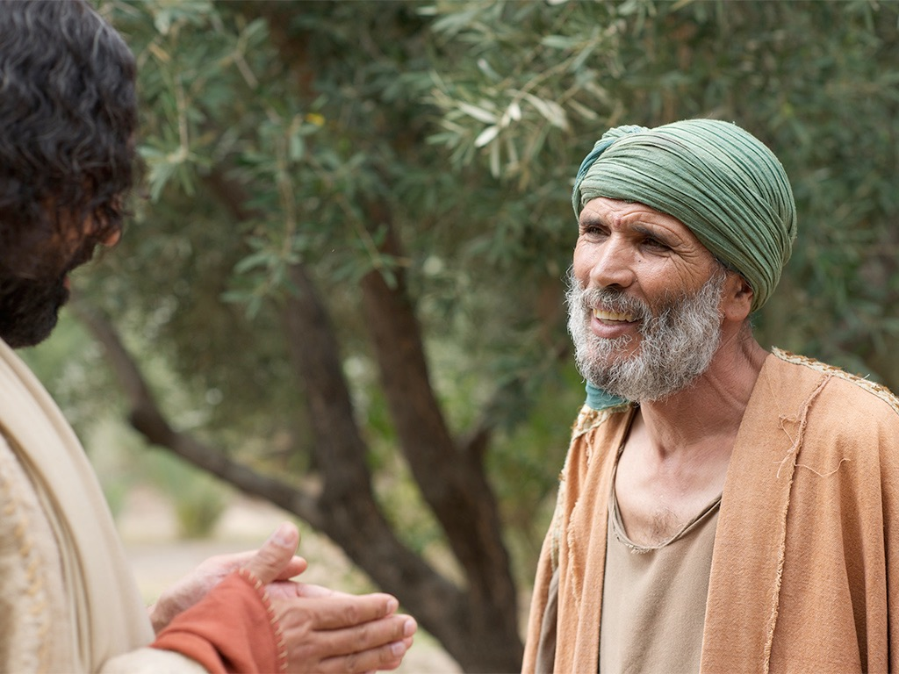

Slide 13
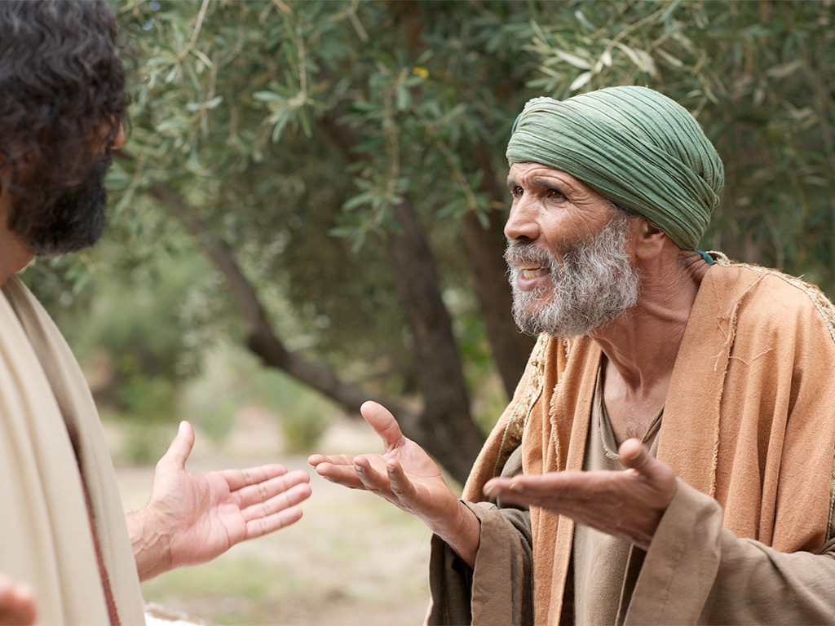

Slide 15
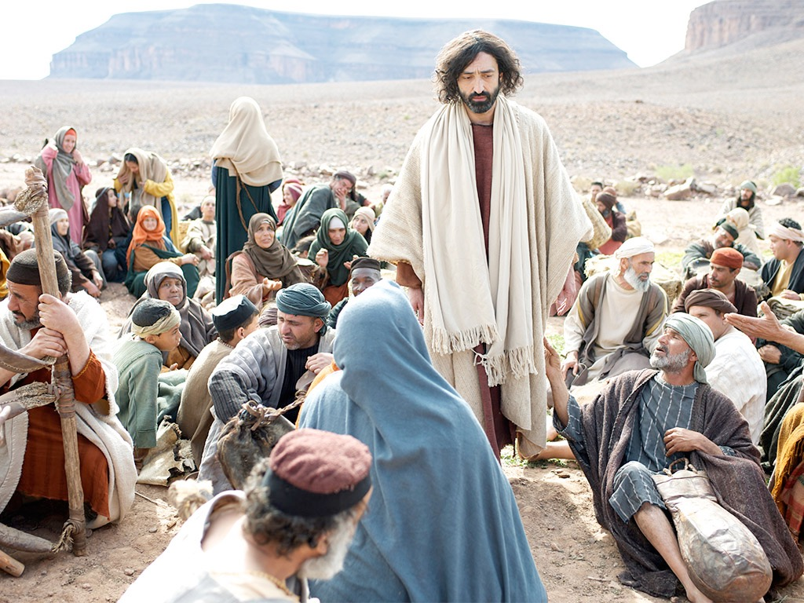

Slide 16
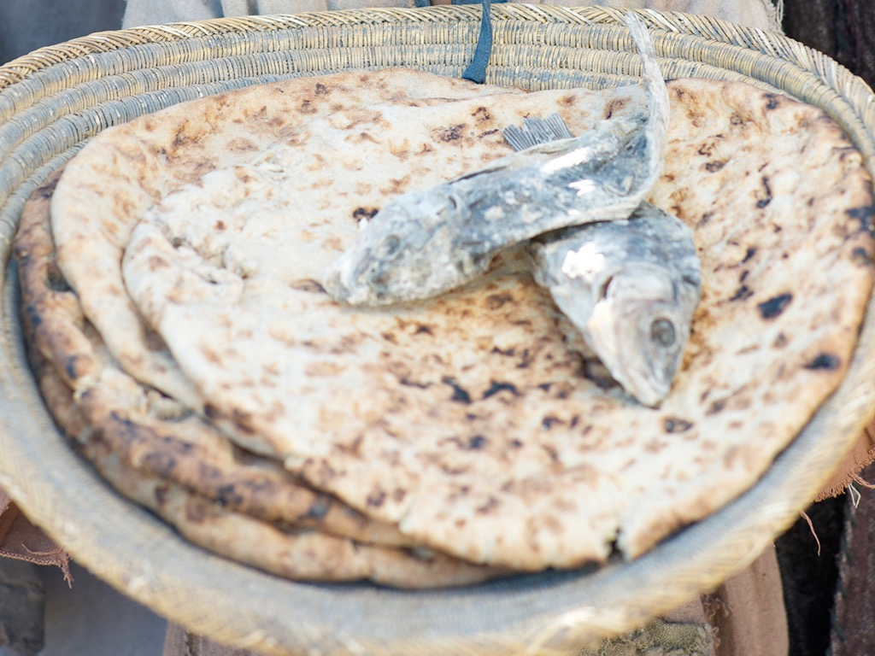

Slide 17
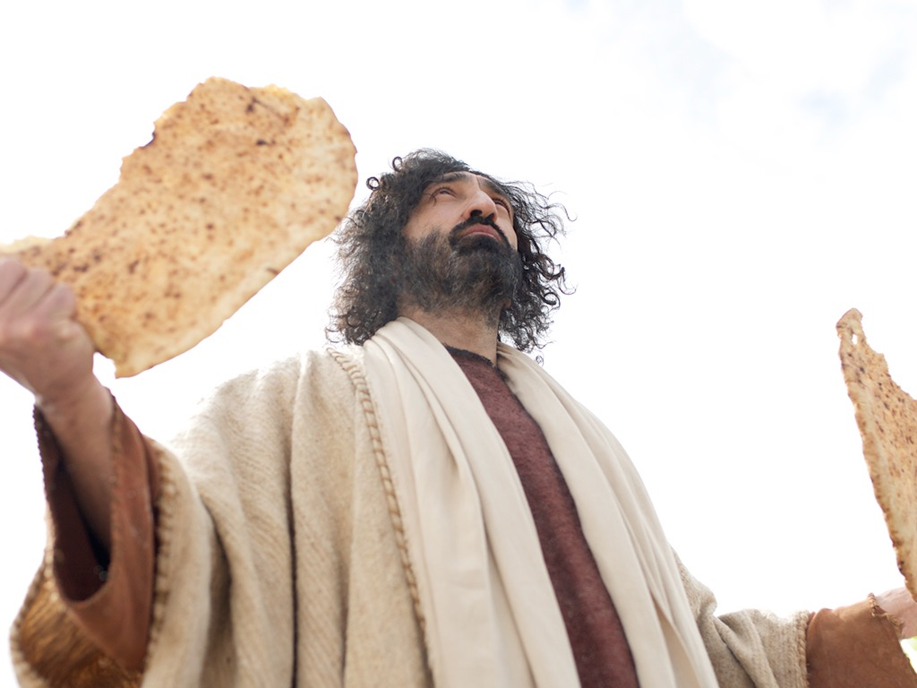

Slide 18
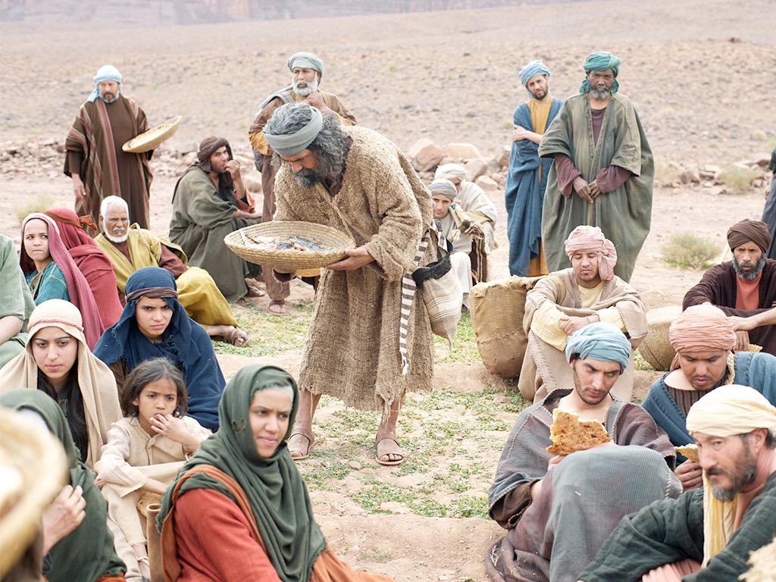

Slide 19
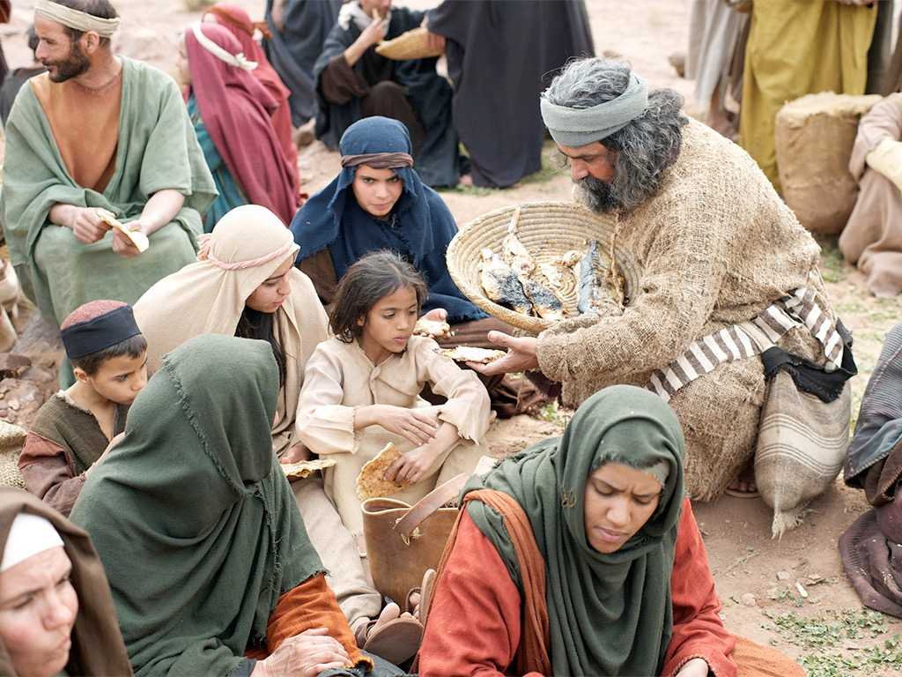

Slide 20
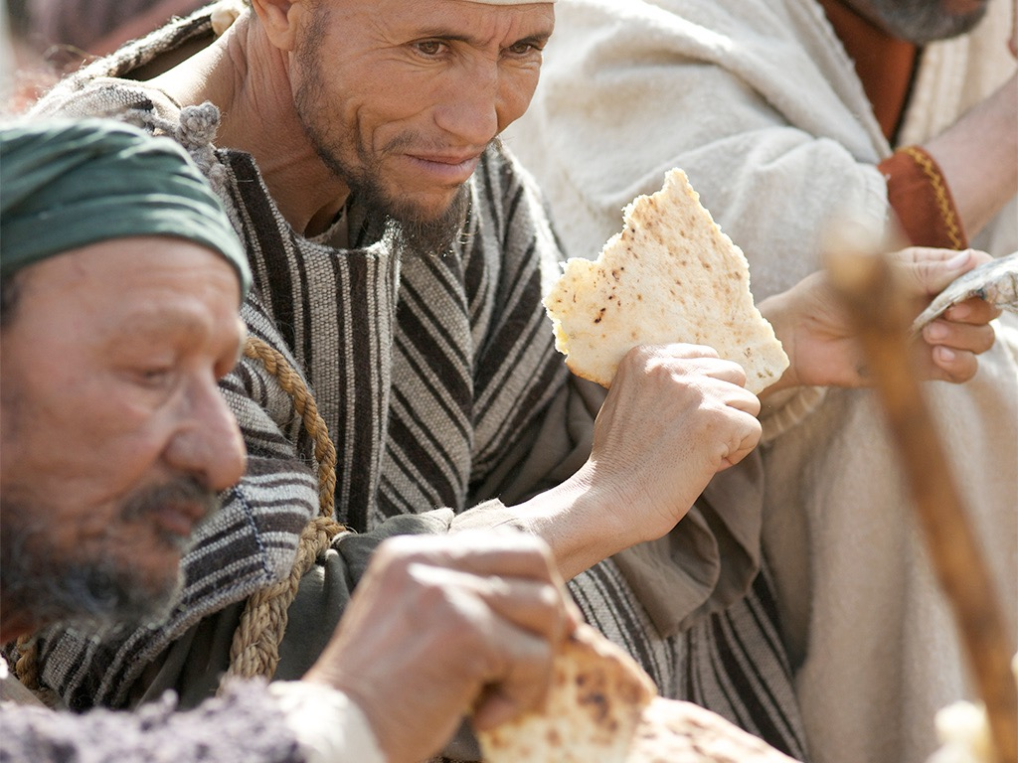

Slide 21
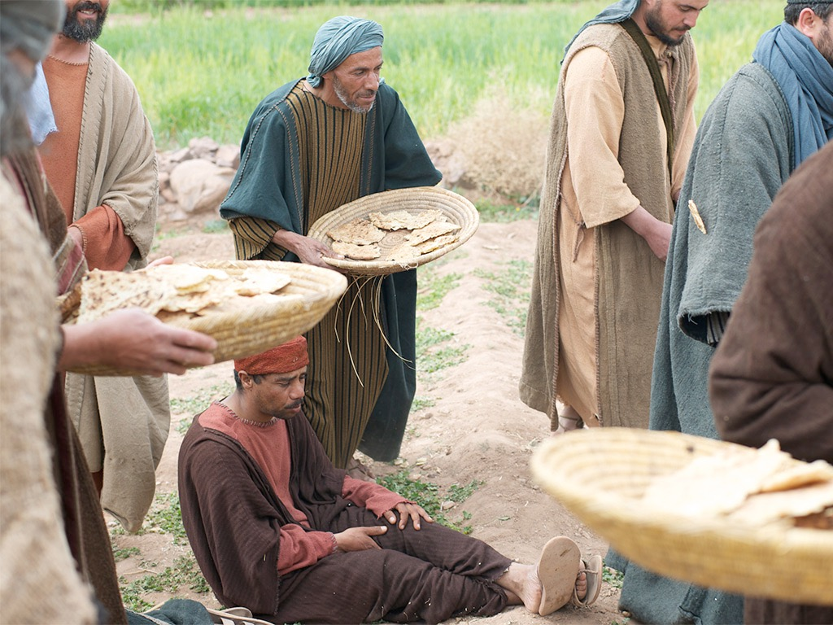

Slide 22
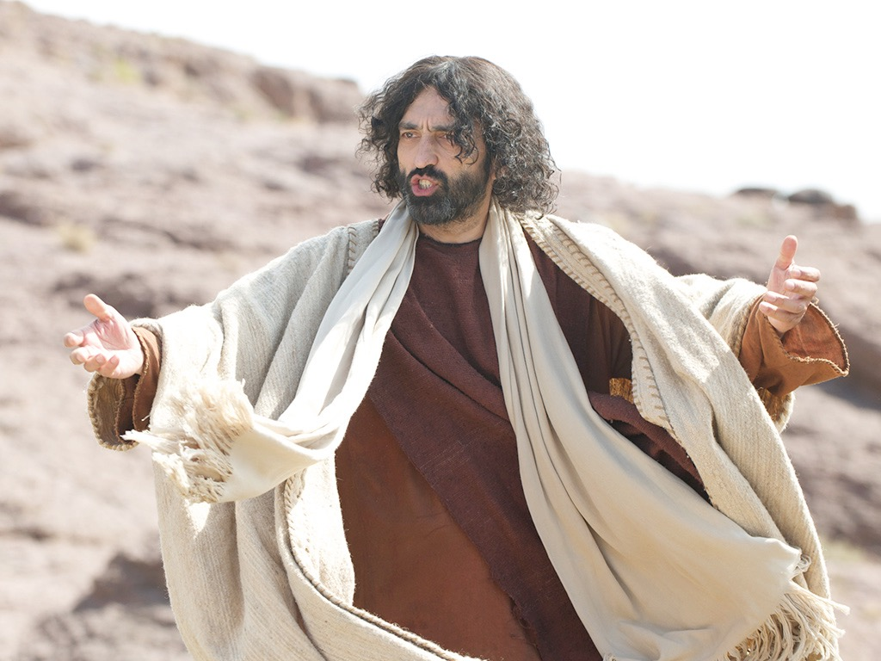

Slide 23
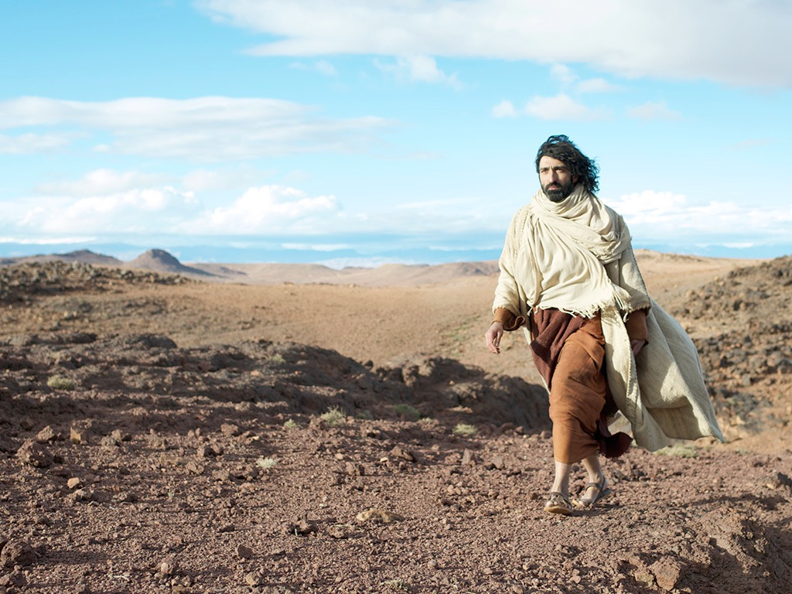

Slide 24
Free Bible Images
授权使用
免费
圣经
图片
图片中的文字

Slide 25
授权使用
马太福音
d
马可福音
o
路加福音
0
约翰福音
0
由Lumo Project出版独家资源，我们特此通知您我们不授权将这些图片发放给除freebibleimages.org客户以外的任何人。
所有图片不授权用于视频制作、epublishing或者其他媒体。所有下载的图片和文件不可通过除freebibleimages.org以外的其他网站传播，亦不可用于任何破坏基督信仰和福音的处境中。
o
图片仅供教育展示、博客和社交媒体使用；所有用途均需注明出处 www.LumoProject.com
图片声明 BBM © 版权所有
www.bigbookmedia.com

Slide 26
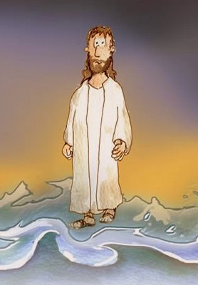
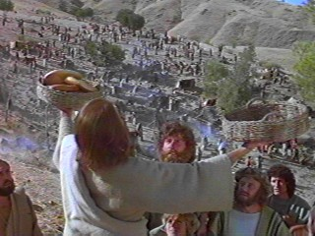
Can Jesus Prove It?
JOHN 6

Slide 27
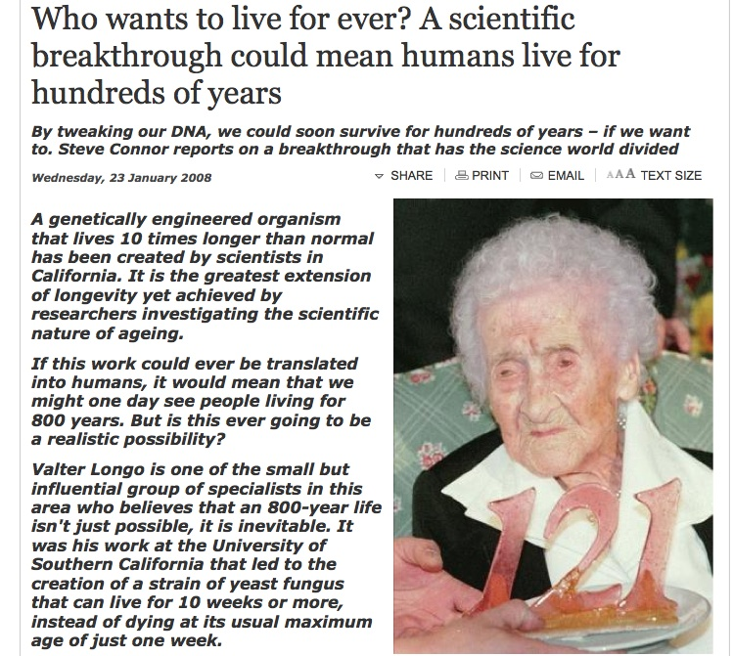
DNA Breakthrough!
Born in 1875, Jeanne Calment died in 1997 aged 122 years and 164 days

Slide 28
Howtoliveforever.net
You can have “youthful looks, improved appearance and attractiveness, and health and vitality well into your 70s, 80s, 90s, 100s, 1,000s . . . as long as you want.”

Slide 29
An Astonishing Claim!
“I tell you the truth, those who listen to my message and believe in God who sent me have eternal life. They will never be condemned for their sins, but they have already passed from death into life”
–– John 5:24
Notes:
Verse 26
Why did the crowd search for Jesus?
The crowd wants follow a prophet who will provide free food and political deliverance.

Slide 30
Subject
How do we know Jesus can give eternal life?
JOHN 6

Slide 31
3 MOVEMENTS:
Showing his Authority (1-21)
The Bread of Life (22-59)
Disciples desert Jesus (60-71)

Slide 32
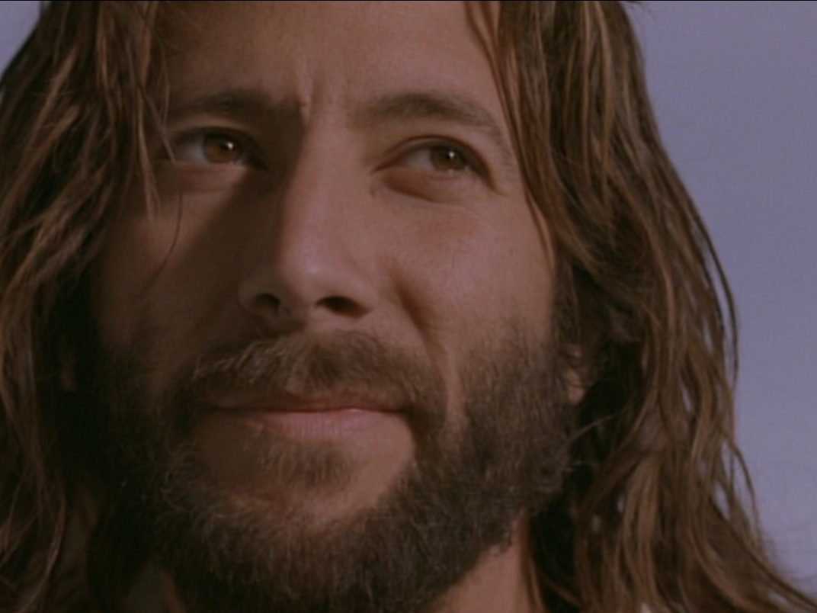
I. Jesus showed His authority over Moses and creation (6:1-21).
1-15
16-21

Slide 33
Feeding the 5000
Feeding the 5000
1-15

Slide 34
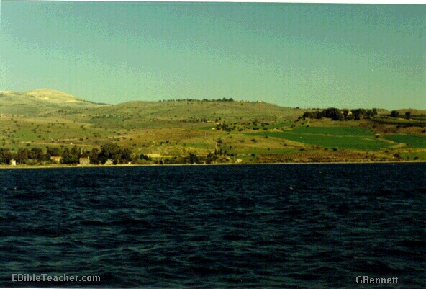
The Setting
Near Sea of Galilee
Notes:
Jesus went up to the mountain & Sat down to teach the disciples

Slide 35
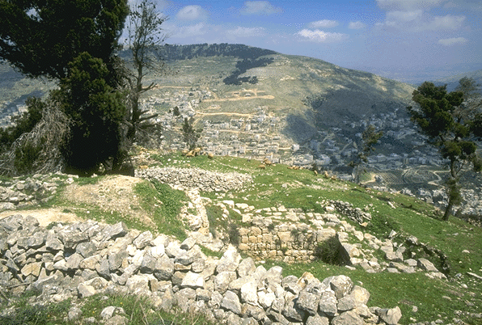
Verse 5-7
Notes:
Verse 5-7
Do you have faith in God?

Slide 36
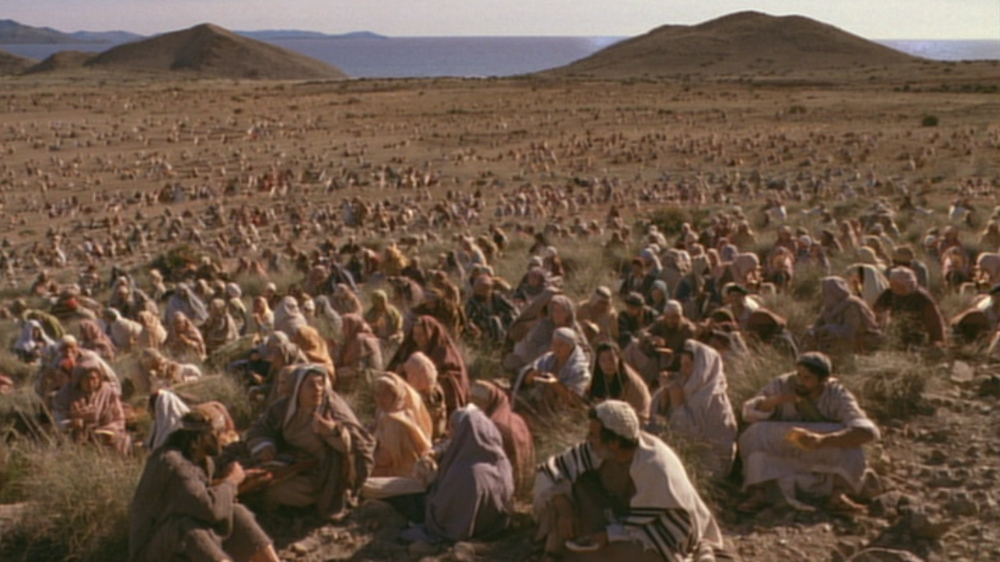
A huge crowd in a remote place
Notes:
Verse 5-7
Do you have faith in God?

Slide 37
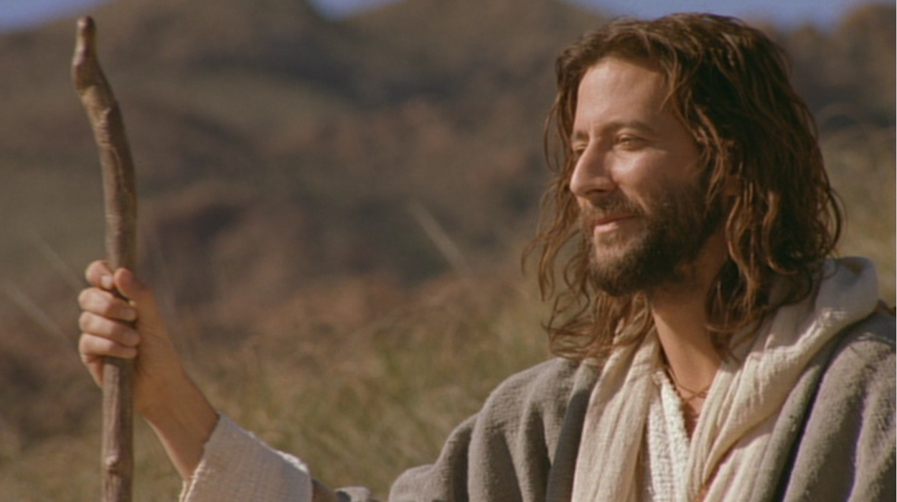
Verse 5-7
Where shall we buy bread for these people to eat?
Notes:
Verse 5-7
Do you have faith in God?

Slide 38
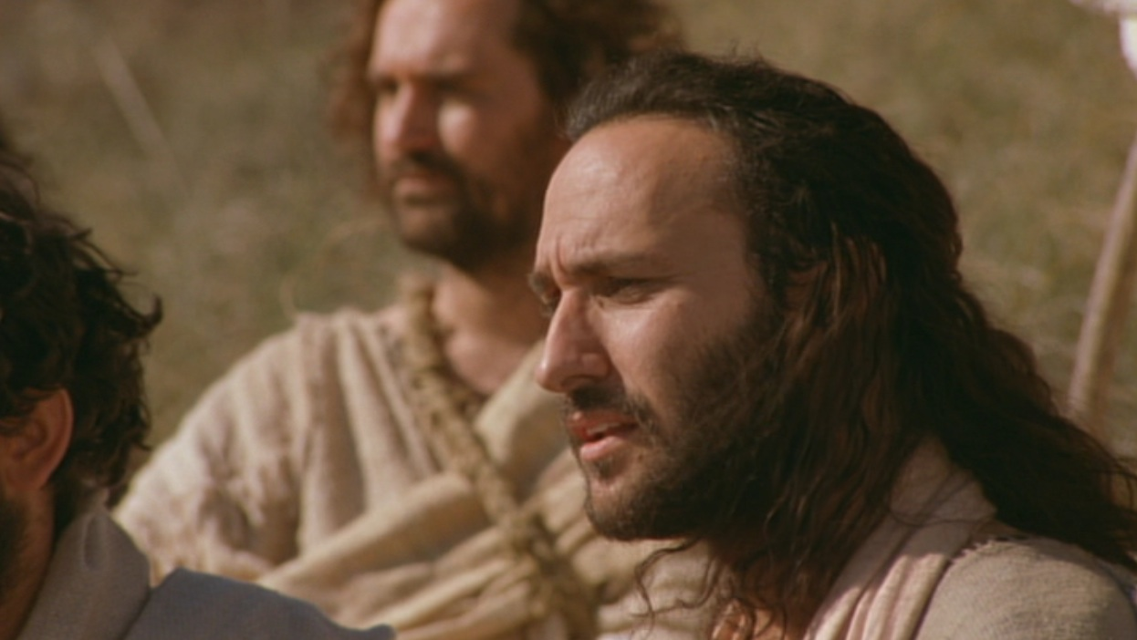
Verse 5-7
8 months’ wages would not buy enough bread for each one to have a bite!!
Notes:
Verse 5-7
Do you have faith in God?

Slide 39
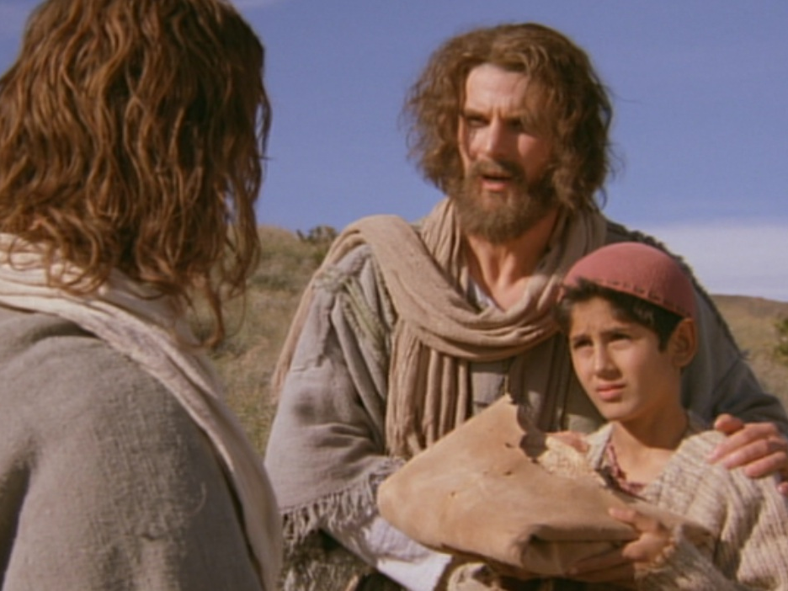
Andrew being helpful
“There’s a young boy here with five barley loaves and two fish. But what good is that with this huge crowd?”

Slide 40
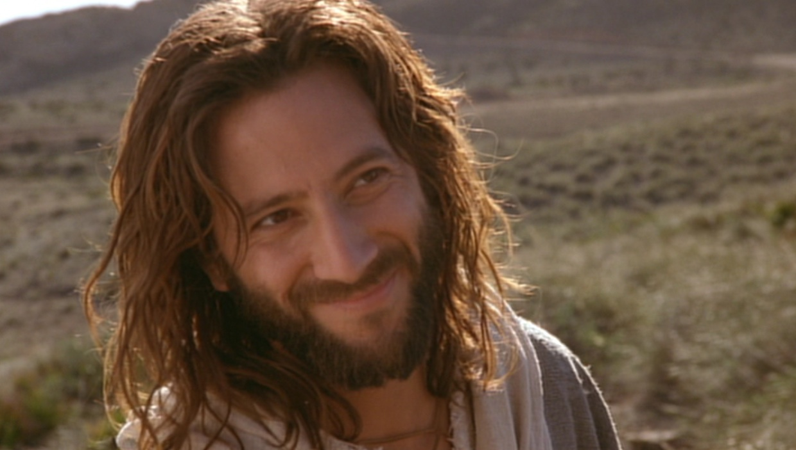
Verse 5-7
Tell everyone to sit down.
Notes:
Verse 5-7
Do you have faith in God?

Slide 41
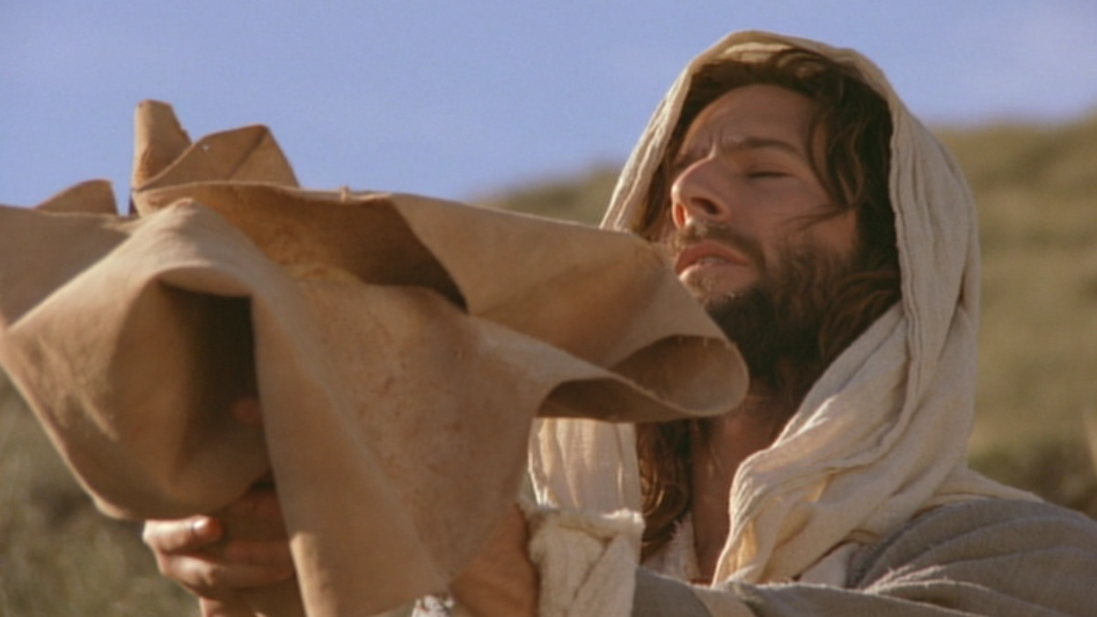
Verse 9-11
Jesus then took the loaves, gave thanks...
Notes:
Do you believe that God can use what you have and multiply it?

Slide 42
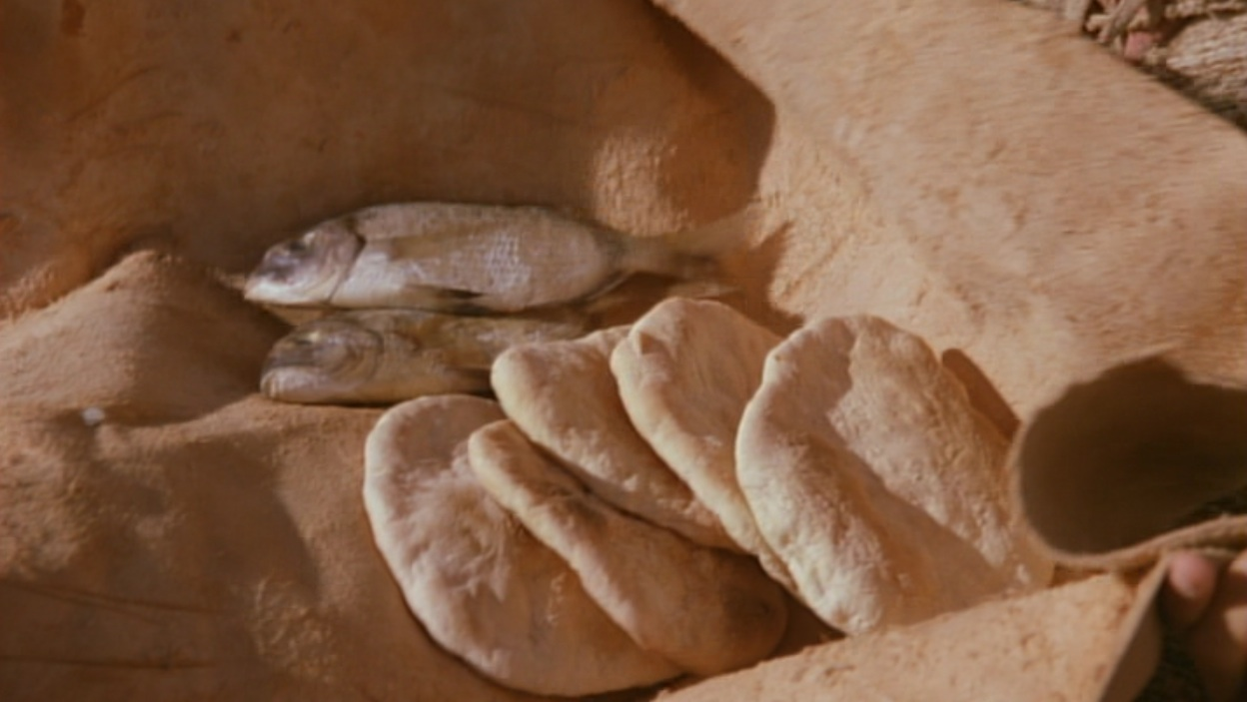
Verse 9-11
Jesus then took the loaves, gave thanks, and distributed to those who were seated as much as they wanted...
Notes:
Do you believe that God can use what you have and multiply it?

Slide 43
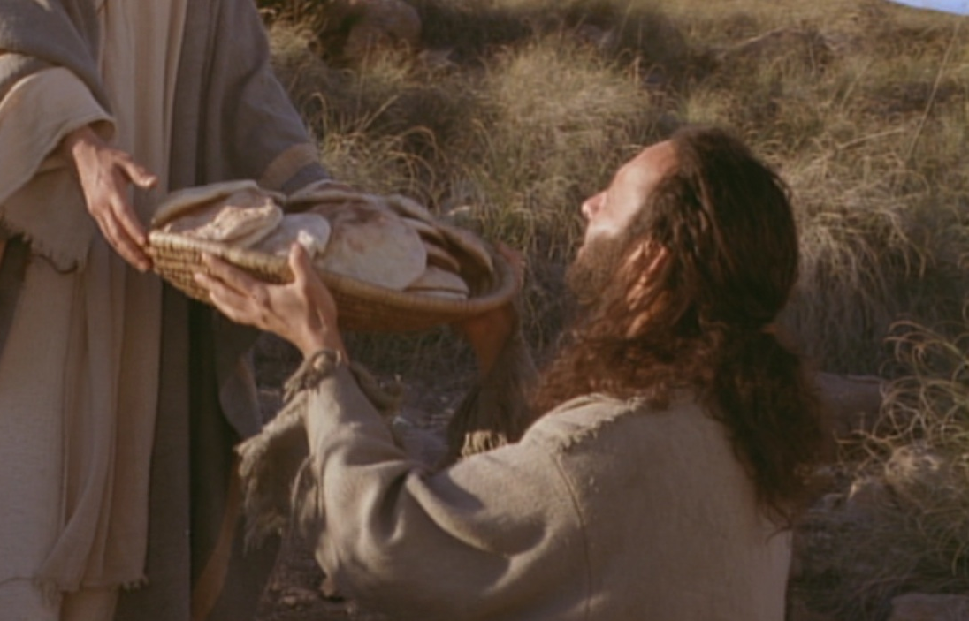
Bread Multiplied!

Slide 44
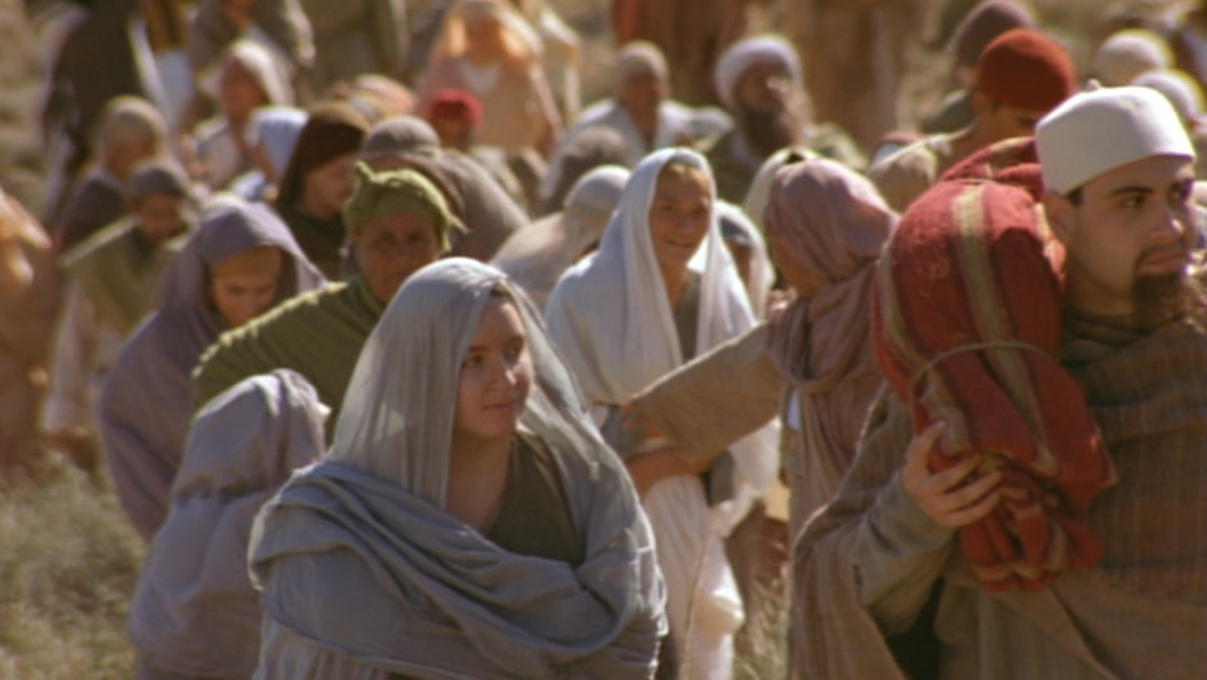
What’s the Point? The crowd is the key!

Slide 45
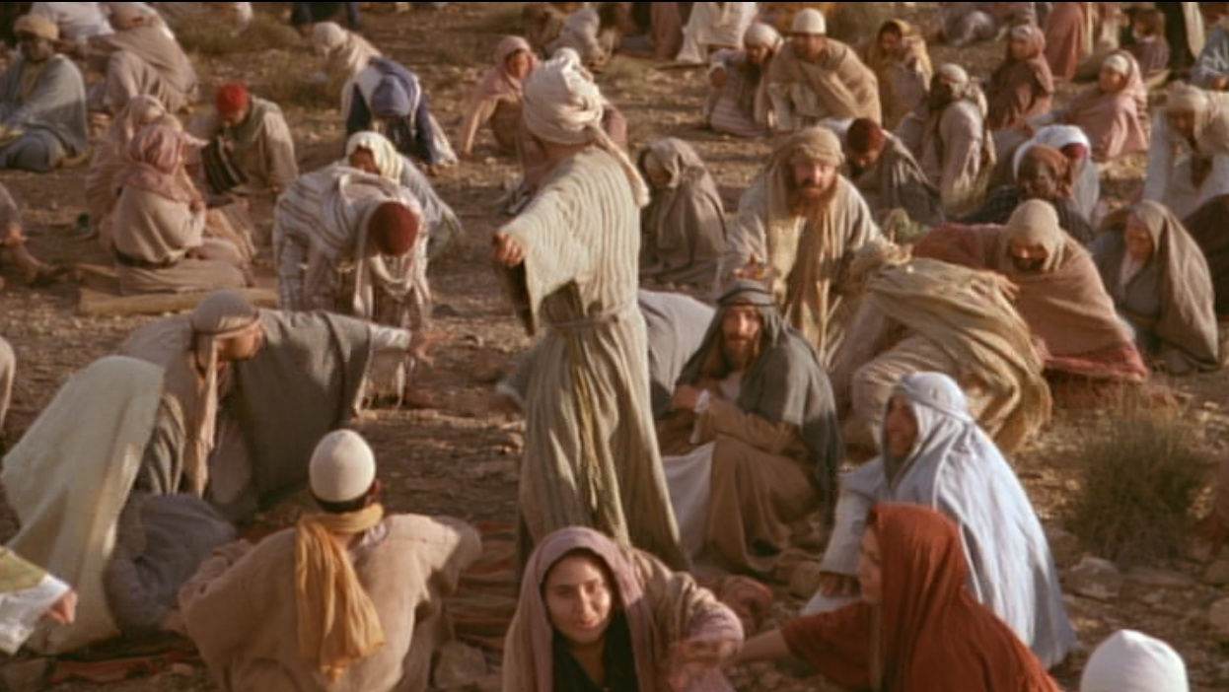
When the people saw him do this miraculous sign, they exclaimed,
“Surely, he is the Prophet we have been expecting!” (6:24 NLT)

Slide 46
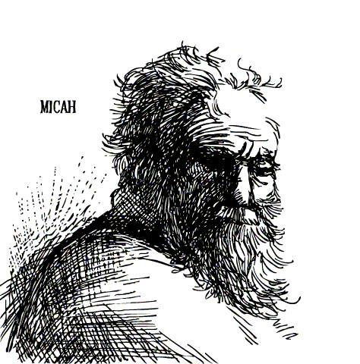
Prophecy of a Prophet given through Moses (Deut. 18:15)
“I will raise up a Prophet like you from among their fellow Israelites. I will put my words in his mouth, and he will tell the people everything I command him.”

Slide 47
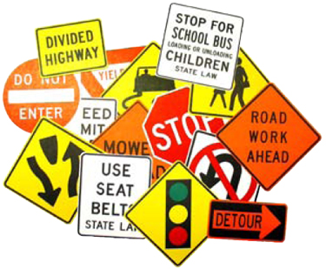
约翰记载的神迹
111
约翰福音独有的神迹-黄色方格内 (九个神迹中的六个)
变水为酒 2:1-11
医治大臣
的儿子 4:46-54
医治38年的
中风病患 5:1-18
喂饱5000人 6:1-15
行走海面上 6:16-21
医治生来
瞎眼的 9:1-7
叫拉撒路
从死里复活 11:1-45
基督复活 20:1-31
奇妙捕获 21:1-3

Slide 48
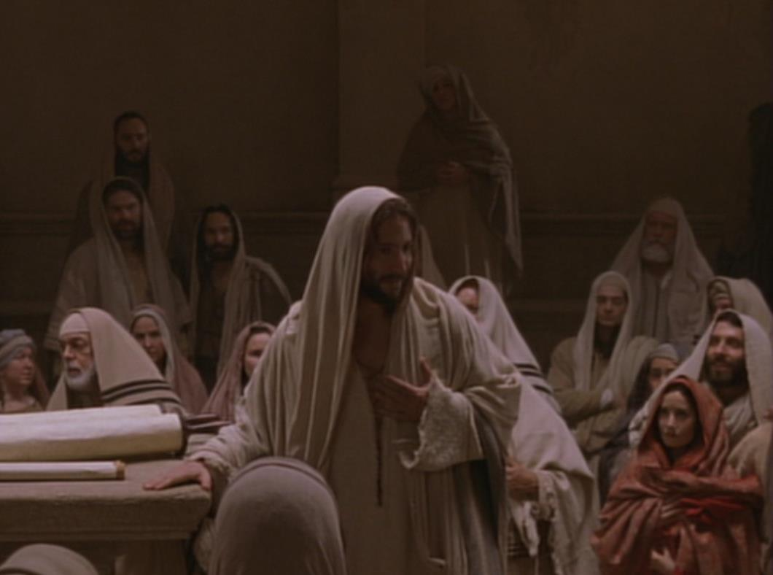
钥字 相信
约翰福音
107
钥节
“耶稣在门徒面前、另外行了许多神迹、没有记在这书上。但記這些事、要叫你們信耶穌是基督、是神的兒子．並且叫你們信了他、就可以因他的名得生命。” (20:30-31).

Slide 49
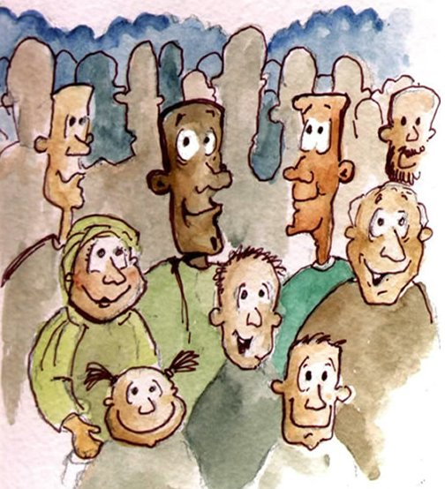
Verse 15
Notes:
Verse 15
who is this ‘prophet’ that the people are referring to?
“The Prophet” is the one prophesied by Moses (Deu 18:15). They acknowledge that Jesus was the Prophet who would come into the world to deliver them from the control of the Roman Empire.
Jesus knew that they want to make him king but he withdrew again to the mountains.

Slide 50
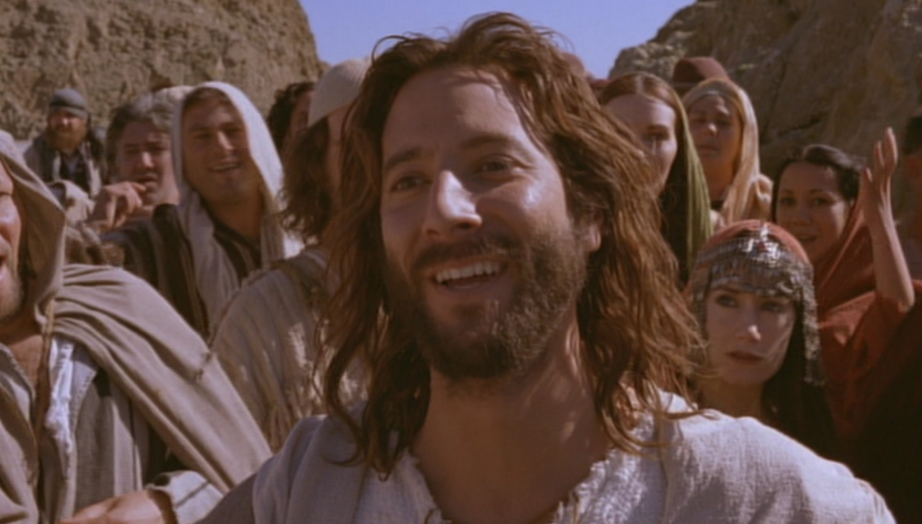
What’s the Point?
Jesus is the New Moses!
Jesus is even better than Moses!
MOSES
Predicted a Prophet
Gave manna from God
Sustained physical life
JESUS
Fulfilled the prediction
Is manna who IS God
Gives eternal life

Slide 51
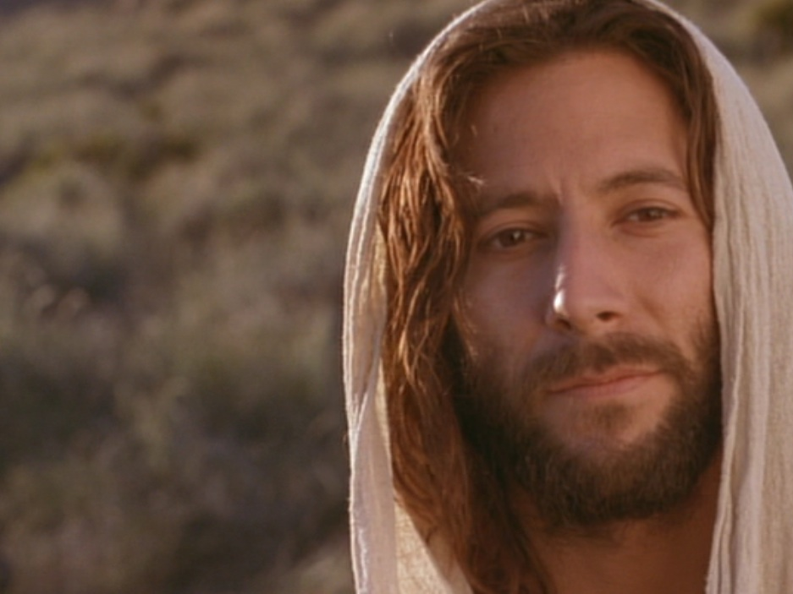
Jesus proved himself greater than Moses as the giver of eternal life by miraculously feeding 5000 Jews (6:1-15).

Slide 52
B. Rejection of an Offer to Make Christ King
§ 75
Matthew 14: 22-23; Mark 6:45-46; John 6:14-15
When those who ate the loaves become convinced that Christ is the New Moses in fulfillment of Deuteronomy 18:15 and desire to make Him King He rejects their offer since it would be premature in that Israel's leaders had not believed in Him and it would be incomplete as His rule would extend only over Galilee

Slide 53
C. Instruction Through the Storm
§ 76
Matthew 14:24-33; Mark 6:47-52; John 6:16-21
Jesus walks on the water to rescue His disciples on the Sea in order to teach them that when obstacles come as they do His will His help is available and must be claimed by faith

Slide 54
Walking on Water (16-24)
WALKING ON WATER
16-21

Slide 55
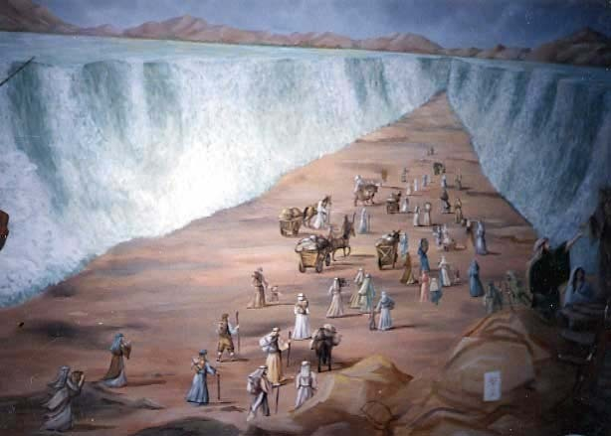
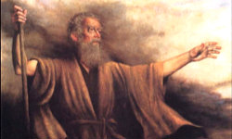
Moses Parting the Sea

Slide 56
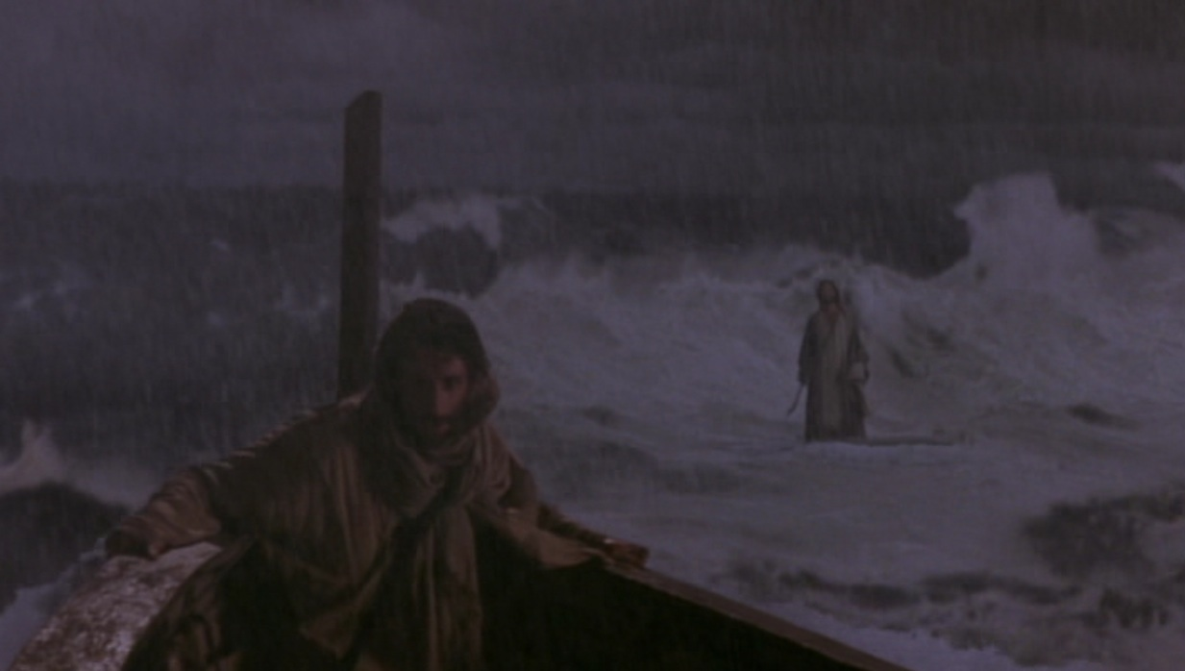
Jesus Walked on the Sea

Slide 57
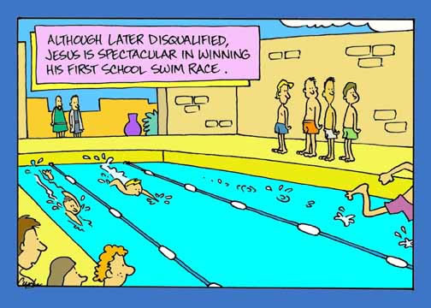
Hey, that’s now fair!

Slide 58
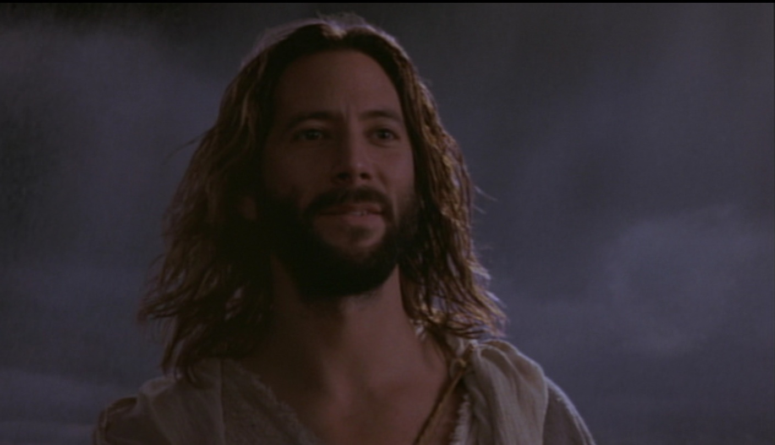
Jesus: “Don’t be afraid! It is I” (6:20)
KJV
NAS
NCV
NET
NIV
NKJV
NRSV

Slide 59
“Don’t be afraid! I am here” (6:20)
NLT

Slide 60
“Don’t be afraid! I Am!” (6:20)
Greek:
﻿ἐγώ εἰμι,

Slide 61
约翰福音里十大“我是”的声明
111
1
MATTHEW
2
MARK
JEWS
ROMANS
“我就是弥赛亚” (4:26)
“是我．不要怕” (6:20)
“我就是生命的粮” (6:35)
“我是世界的光” (8:12)
“还没有亚伯拉罕、就有了我” (8:58)
“我就是羊的门” (10:7)
“我是好牧人” (10:11, 14)
“复活在我、生命也在我” (11:25)
“我就是道路、真理、生命” (14:6)
“我是真葡萄树” (15:1)
TO:
TO:
AS:
KING
AS:
SERVANT
WHAT
HE:
SAID
WHAT
HE:
DID
3
LUKE
TO:
GREEKS
AS:
GOD/MAN
WHAT
HE:
FELT

Slide 62
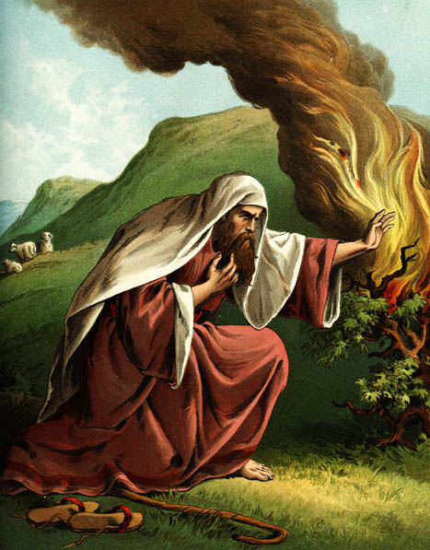
The Burning Bush
Exodus 3:1-4:17

Slide 63
EXCUSES
God replied to Moses, “I Am Who I Am. Say this to the people of Israel: I Am has sent me to you” (Exodus 3:14 NLT).
1. Who am I (3:11)?
2. Who are You (3:13)?
3. What if I fail (4:1)?
4. I’m not gifted (4:10)
5. I don’t want to get involved (4:13)

Slide 64
I. Jesus showed His authority over Moses and creation (6:1-21).
1-15
16-21

Slide 65
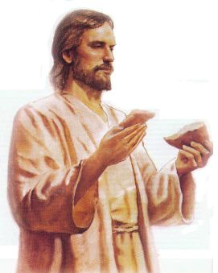
II. Jesus satisfies our spiritual hunger by giving us eternal life (6:22-59).

Slide 66
Two Foods
Unlike food that spoils, Jesus gives eternal life (6:22-27).

Slide 67
Verse 26
Jesus answered, “I tell you the truth, you are looking for me, not because you saw miraculous signs but because you ate the loaves and had your fill” (John 6:26)
Notes:
Verse 26
Why did the crowd search for Jesus?
The crowd wants follow a prophet who will provide free food and political deliverance.

Slide 68
Verse 27
Do not work for food that spoils,
Do not work for food that spoils, but for food that endures to eternal life, which the Son of Man will give you.
Notes:
Verse 27
What is the meaning behind these verses?
The people’s work should have been directed to a food that endures. Jesus explains the meaning of preservation, namely eternal life. The source of eternal life is the Son of Man. He is the one who gives eternal life, the food that does not perish. Jesus turned the concern of the Jews on its head and defined the assuring work not as usual labor but as believing Him. Both believing and obeying are parallel ways one acknowledges dependence on God.

Slide 69
Two Works
Unlike human effort, Jesus enables us to do God’s work by believing in Him (6:28-29).
Notes:
They replied, “We want to perform God’s works, too. What should we do?” Jn 6:28 NLT

Slide 70
Two Breads
Unlike manna God gave via Moses, Jesus is the true “Bread” from heaven that gives eternal life (6:30-33).

Slide 71
Two Results
Unlike bread that only sustains physical life, belief in Christ gives eternal life (6:34-59).

Slide 72
III. Jesus’ claim to be the only source of life forces a decision (6:60-71).

Slide 73
Disciples desert Jesus (60-71)
Disciples desert Jesus (61-71)
“At this point many of his disciples turned away and deserted him” (John 6:66).

Slide 74
The Twelve remained because eleven of them believed He was God’s Son (6:67-71).

Slide 75
The Main Idea of John 6
Since Christ has authority over creation, trust Him to give you eternal life!

Slide 76
Disbelief?

Slide 77
Or Belief? “You are the holy one of God!”

Slide 78
D. Reception in Gennesaret
§ 77
Matthew 14:34-36; Mark 6:53-56
Christ instills in His disciples through continued healings that what He accomplished in the physical realm represents what He desired to perform for people in the spiritual realm if they trust Him in faith

Slide 79
E. Instruction Concerning the Bread of Life
§ 78
John 6:22-71
Through His claim to be the true bread from heaven Christ teaches His disciples that He did not come to give physical bread but new, heavenly bread, which is eternal life

Slide 80
F. Instruction Concerning Defilement
§ 79
Matthew 15:1-20; Mark 7:1-23; John 6:1
Christ trains the disciples in the real, inner source of defilement to reveal how the Pharisees violate the law with their traditions in their uncleanness due to their heart condition

Slide 81
G. Reception in Tyre and Sidon
§ 80
Matthew 15:21-28; Mark 7:24-30
Through the healing of the Canaanite woman's demon-possessed daughter Christ schools His disciples how while it was premature for Gentiles to receive kingdom blessings until Israel repents, personal needs can be met through individual faith in His person

Slide 82
H. Reception in Decapolis
§ 81
Matthew 15:29-38; Mark 7:31-8:9a
By healing the deaf and dumb man and feeding the four thousand Gentiles, Christ instructs His men on the need to minister to Gentiles as well as Jews and, though inadequate for the task, to do this through His power

Slide 83
I. Rejection in Magadan
§ 82
Matthew 15:39-16:4; Mark 8:9b-12
Jesus refuses to give another sign to the unbelieving religious leaders except for His resurrection because they were rejecting Him in unbelief, not because sufficient signs had been lacking

Slide 84
J. Warning Against Rejection
§ 83
Matthew 16:5-12; Mark 8:9b-12
Christ warns His disciples against the hypocritical attitude of the Pharisees and Herod that led them to reject Him so His men would be aware of possible attitudes in themselves

Slide 85
K. Confession of Peter
§ 84
Matthew 16:13-20; Mark 8:27-30; Luke 9:18-21
Upon Peter's affirmation of Christ's deity Jesus reveals for the first time that Peter and all the Twelve will exercise authority to make official pronouncements already made by God in a new organism, the Church

Slide 86
L. Instruction Concerning His Death
§ 85
Matthew 16:21-23; Mark 8:31-33; Luke 9:22
Christ explains to His disciples that He would soon be delivered over to death in Jerusalem at the hands of the religious leaders but would rise the third day, a message which Peter opposed because he did not understand the necessity of Christ's sacrifice for sin

Slide 87
M. Instruction Concerning Discipleship
§ 86
Matthew 6:24-28; Mark 8:34-9:1; Luke 9:23-27
Christ educates the disciples and the multitude that to be a committed, true disciple one must relinquish his own will and submit it completely to Christ so that His hearers would decide to follow Him rather than the Pharisees in light of the impending judgment of the nation and Christ's glorious rule as Messiah

Slide 88
N. Revelation of the Kingdom
§ 87
Matthew 17:1-8; Mark 9:2-8; Luke 9:28-36
In fulfillment of Christ's prophecy about seeing His glory one week earlier Jesus is transfigured before Peter, James, and John to reveal in miniature the essential glory He will reveal to the world when He begins to reign at the Second Advent and to authenticate Christ as One worthy of obedience

Slide 89
O. Instruction Concerning Elijah
§ 88
Matthew 17:9-13; Mark 9:9-13
Jesus instructs the disciples with Him on the mount that although Elijah will come before the institution of the kingdom, Malachi's prophecy concerning his coming was fulfilled in John the Baptist that the disciples might harmonize the necessity of Christ's sacrifice for sin before His glorification

Slide 90
P. Instruction Concerning Dependence
§ 89
Matthew 17:14-21; Mark 9:14-29; Luke 9:37-43a
When the disciples are unable to exorcise the demon from a boy Christ uses this experience to illustrate the deliverance He could provide for Israel if the nation believes and to teach the disciples that their ministry cannot succeed based upon their authority and position received previously but would surely succeed through dependent faith in Christ

Slide 91
Q. Additional Instruction Concerning His Death
§ 90
Matthew 17:22-23; Mark 9:30-32; Luke 9:43b-45
Jesus again predicts His death and resurrection to the disciples to enable them to understand that suffering must precede glory in the same Messiah, not two Messiahs

Slide 92
R. Instruction Concerning Sonship
§ 91
Matthew 17:24-27
Jesus directs Peter in paying their voluntary temple tax to prevent cause for accusation from the authorities even though as the authority over the temple Christ and His disciples were exempt from the tax as related to the One to whom the temple was dedicated

Slide 93
S. Instruction Concerning Humility
§ 92
Matthew 18:1-5; Mark 9:33-37; Luke 9:49-50
Following the disciples' argument regarding which of them would be greatest in the kingdom Christ uses a child to tutor them on humility and dependence necessary for positions of greatness in the kingdom

Slide 94
T. Instruction Concerning Pride
§ 93
Matthew 18:6-14; Mark 9:38-50; Luke 9:49-50
While the disciples expect to be commended for rebuking an exorcist not associated with the Twelve, Jesus rebukes them for their superior attitudes which offended another believer, exhorts them to remove the basic problem which caused the offense, and reminds them that even what is little in the sight of men received the watch-care of God

Slide 95
U. Instruction Concerning Forgiveness
§ 94
Matthew 18:15-35
Christ teaches the disciples that they are to forgive both unconditionally and completely in the same manner in which God has forgiven them

Slide 96
如何修复关系
马太福音 18:15-20
Dr. Rick Griffith • 博士 • 新加坡神学院 • www.BibleStudyDownloads.org
10 December 2006
6 March 2011

Slide 97
I. (15-17) 教会正确的与犯罪的信徒徒重建关系的方法是尽量不公开。
(15) 个人的罪只局限于那些直接参与者因此容易重建犯罪的人。
16) 经过私底下的沟通如对罪不愿悔改的情况下你可多带一两个人一同处理以便重建罪人。
(17上)经过一小组人的沟通与重建如对罪还是不愿悔改的情况下可让全教会知道以制止继续犯罪。
(17下) 不愿悔改的罪人让教会知道后的后果既是对待罪人如同非信徒（这包括取消会籍）。

Slide 98
II. (18-20) 教会有权柄恢复信徒或选择逐出犯罪的信徒的原因是实行上帝的权柄。
(18-19) 教会代天父恢复或者试图恢复犯罪的会友 1. （18）教会判决的依据乃是神早已订立的 2. （19）教会领袖的决定乃是执行神的旨意 B. (20) 教会在耶稣的面前恢复或者试图恢复犯罪的会友

Slide 99
释经思想:教会应该恢复或将犯罪信徒逐出教会的原因是实行上帝的权柄。
(15-17) 教会应正确的与犯罪的信徒徒重建关系的方法是尽量不公开。
(18-20)教会有权柄重建信徒或选择逐出犯罪的信徒的原因是实行上帝的权柄。

Slide 100
The Point of Verses 15-17
1. 尽量在
私底下 进行 (15-17)
Notes:
God’s strategy to bring sinning Christians back is to involve as few people as you can.

Slide 101
神挽回的 四个步骤：
4
3
2
1
…逐步向更多人透露
Notes:
God’s restoring process has four steps that progressively tell more and more people about the sin (15-17).

Slide 102
挽回的第一步： 你亲自向他说
M
M
M
M
M
M
M
M
M
M
M
M
M
M
M
M
S
M
M
M
M
M
M
M
M
M
M
M
S = Sinner 犯罪的人
M = Member 会友
Notes:
What’s our human tendency here?
• It is to tell others about the problem instead of the one involved.
• God commands us to keep the issue as private as possible.

Slide 103
Matthew's Relational Pillars
马太福音的人际关系支柱
5:23-24
18:15-17
你是:
冒犯别人者
被冒犯者
问题:
一般情况
罪
Notes:
This differs from Matthew 5 in that you’re not an offender, but the offended.
• Note also that in Matthew 5 sin may not be in the picture, but Matthew 18 deals specifically with a believer living in sin. This does not refer simply to differences of opinion on debatable matters.

Slide 104
Matthew's Relational Pillars
马太福音的人际关系支柱
5:23-24
18:15-17
你是:
冒犯别人者
被冒犯者
问题:
一般情况
罪
主动者:
你！
你!
Notes:
Earlier we saw from Matthew 5:23-24 that God places the responsibility to reconcile on you if you are the offender. Now whose job is it to initiate if you are the offended?
• Yes, again it is your responsibility again! You say, "That’s not fair! Why is it my job in both situations? Whether I am the offender or the offended I still have to make the first move?" Well, if relationships are not resolved between believers, it has to be through the fault of both—as both have the command of God to resolve it!

Slide 105
挽回的第二步： 带一两个人同去
M
M
M
M
M
M
M
M
M
M
M
M
M
M
M
M
S
M
M
M
M
M
M
M
M
M
M
M
S = Sinner 犯罪的人
M = Member 会友
Notes:
Take one or two others along (16).

Slide 106
挽回的第三步： 告知教会全体
M
M
M
M
M
M
M
M
M
M
M
M
M
M
M
M
S
M
M
M
M
M
M
M
M
M
M
M
S = Sinner 犯罪的人
M = Member 会友
Notes:
The church leadership certainly must be involved at this point before the matter is brought to the congregation. They also must see the issue isn’t just a difference of opinion between two parties; the biblical basis for the offender living in sin must be clearly shown with specific passages.

Slide 107
挽回的第四步： 看他作外邦人
M
M
M
M
M
M
M
M
M
M
M
M
M
M
M
M
S
M
M
M
M
M
M
M
M
M
M
M
S = Sinner 犯罪的人
M = Member 会友
S

Slide 108
Sins Worthy of Discipline
如何执行管教
不要称他/她作基督徒
向他/她传福音
不要让他/她领圣餐
取消他/她的教会会籍
不让他/她在教会里事奉
非信徒
要把犯淫乱的人"交给撒但 "（林前5:5）
不可与他/她吃饭（林前5:11）
禁止他/她参加教会？
更差
Notes:
But Jesus said to "treat him as you would a pagan or a tax collector." Jesus treated pagans with love and kindness, but he didn’t ask them to evangelize the lost as part of his team. You shouldn’t be ugly or ungodly, but…
• Don’t refer to him/her as a Christian. (ILL: I have done this with my former brother-in-law who divorced my sister to marry another woman.)
• Evangelize this person.
• Don’t let him/her take the Lord’s Supper.
• Remove the person from membership.
• Remove this person from church roles (ILL: My friend Paula was asked to leave her church kitchen ministry once her adultery was discovered.)
But in other ways it is more serious than how we treat unbelievers:
• "Deliver over to Satan" one in sex sin (1 Cor. 5:5). Years ago a friend named John left his wife and two small boys for another woman. My church disciplined him, but an elder kept up with him to restore him. After five years, he showed up at church—but he looked 20 years older!
• Don’t eat with him/her (1 Cor. 5:11).
• Should we prohibit the person from attending church? Some say they, like unbelievers, should be welcomed in services without taking the Lord’s Supper; but in most discipline cases this is not even an issue as few disciplined believers seek to return to the assembly until repentant.

Slide 109
第二个问题的答案在第18-20节： 为何要正确地挽回犯罪跌倒的基督徒？
Notes:
But why must we do all this? What right do we have to discipline our members? Why must we restore sinning Christians properly? Because…

Slide 110
第18-20节的重点：
II.教会的行动 是神权柄的延伸！
Notes:
God’s right to judge is actually delegated to us!

Slide 111
为何要执行处分? 当我们尝试挽回…
我们代父 执行 (18-19)
Notes:
We act in the place of the Father when we seek to restore someone (18-19).

Slide 112
V. Instruction Concerning Discipleship
§ 95
Matthew 8:19-22; Luke 9:57-62
Christ trains His disciples in the costly nature of true discipleship through three men who claimed to be disciples yet either wanted only His provision, was unwilling to give up his father's authority, or had love for family which exceeded love for Christ

Slide 113
W. Challenge by His Brothers
§ 96
John 7:2-9
Christ rejects the tainted counsel of His brothers to go to Jerusalem and publicly reveal Himself because He needs to move according to God's timetable not only as King but as the Passover Lamb as well

Slide 114
X. Journey to Jerusalem
§ 97
Luke 9:51-56; John 7:10
Having completed His instruction of the Twelve to carry on His ministry in His absence, Christ passes through unrepentant Samaria to face the opposition of the religious leaders that would culminate in His death and resurrection

Slide 115
Black

Slide 116
基督生命链接地址 BibleStudyDownloads.org
免费获得该讲解!
圣经学习下载
Notes:
Bible Geograhpy (bg)

