Slide 1
对君王的争议
§§ 60-73
Section summaries based on J. Dwight Pentecost, A Harmony of the Words and Works of Jesus Christ (Grand Rapids: Zondervan, 1981)
Dr. Rick Griffith • Singapore Bible College • BibleStudyDownloads.org
The Messianic identity of Jesus Christ is challenged and publicly opposed in preparation for His sacrifice for the nation

Slide 2
A. The Rejection
of the Herald
§ 60
马太 11:2-19; 路加 7:18-35
The rejection of 约翰 by Israel's leaders is paralleled in the rising opposition to Christ and His offer of the kingdom

Slide 3
B. The Curse
of the Cities of Galilee
§ 61
马太 11:20-30
Christ curses the cities of Galilee which had witnessed His miracle yet still remained unbelieving in order to establish how the hearts of the Jewish people exceeded the hardness of the Gentiles

Slide 4
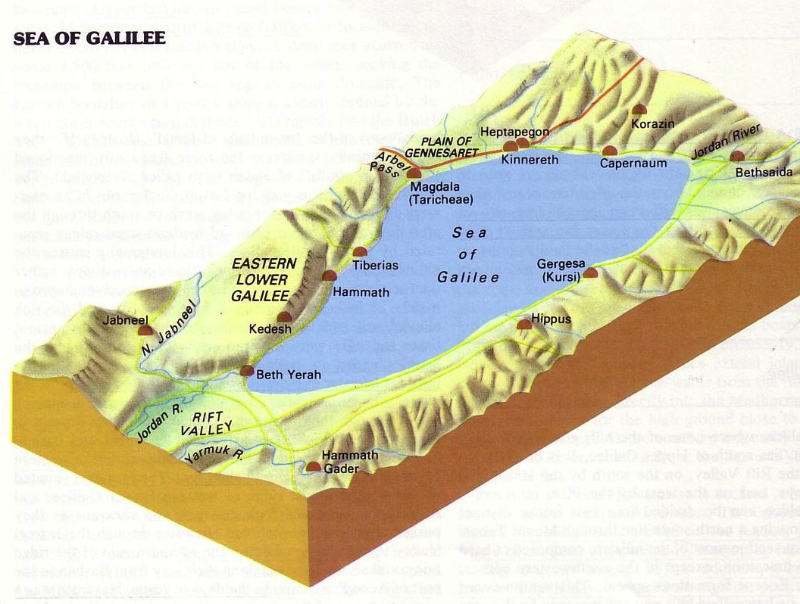
三城地区
172
Point f
那时，耶稣开始责备那些他曾在那里行过许多神迹的城，因为它们不肯悔改：
“哥拉逊啊，你有祸了！伯赛大啊，你有祸了！在你们那里行过的神迹，如果行在推罗和西顿，它们早已披麻蒙灰悔改了。 但我告诉你们，在审判的日子，推罗和西顿所受的，比你们还轻呢。
迦百农啊！你会被高举到天上吗？你必降到阴间。在你那里行过的神迹，如果行在所多玛，那城还会存留到今天。 24 但我告诉你们，在审判的日子，所多玛那地方所受的，比你还轻呢。”
马太福音11:20-24

Slide 5
1. Condemnation for Unbelief
马太 11:20-24
Christ condemns the Jewish region of Galilee for opposing Him in unbelief, stating that they were subject to greater judgment than Gentiles who had not received authenticating signs

Slide 6
2. Explanation of Unbelief
马太 11:25-27
The reason the Galilean cities persist in unbelief is because of Israel's spiritual blindness stemming from a past history of willful rejection of God's revelation

Slide 7
3. Invitation to Belief
马太 11:28-30
Even in His message of condemnation Christ offers rest from the burdensome submission to Pharisaical regulations by trust in His person

Slide 8
C. Reception
by a Sinner
§ 62
路加 7:36-50
Christ reveals the opposition of the Pharisees by their self-righteous response when they hear Him declare forgiveness upon the repentant woman of ill repute at Simon the Pharisee's home

Slide 9
D. Witness to the King
§ 63
路加 8:1-3
Several believing women of financial means acknowledge faith in Christ by their witness and material support for His ministry

Slide 10
E. Rejection of Christ and His Offer by the Leaders
§ 64
马太 12:22-37; 马可 3:20-30
In the most significant turning point in Christ's ministry, Pharisaic opposition mounts by rejecting Christ in attributing His power of exorcism to Satan to which Christ defends Himself since the nation's destiny depended upon what it thought of Him

Slide 11
F. Request for a Sign
by the Leaders
§ 65
马太 12:38-45
When Israel's leaders show their unfaithfulness to God as teachers Christ promises to conquer death itself in His resurrection, a sign which could never be attributed to Satan, and reveals the true nature of Israel as more wicked than before 约翰's ministry because of the nation's rejection

Slide 12
G. Rejection of the Nation
by Christ
§ 66
马太 12:46-50; 马可 3:31-35; 路加 8:19-21
In response to the rejection from Israel's leaders Christ rejects the nation, thus anticipating God's setting aside Israel to prepare for a new form of the kingdom in the interadvent age

Slide 13
H. Revelation in View of Rejection
§§ 67-71
In response to national rejection Christ presents revelation regarding the course of the kingdom in the present age and in conjunction with demonstrations of His power

Slide 14
1. The Course of the Kingdom in the Present Age
§ 67
马太 13:1-53; 马可 4:1-34; 路加 8:4-18
The interadvent age is characterized by coexistence of good and evil while the Word of God is proclaimed, beginning small and imperceptibly but reaching worldwide proportions to include both Jews and Gentiles and ending in judgment before the Millennium

Slide 15
2. Power Over Nature
§ 68
马太 8:18, 23-27; 马可 4:35-41; 路加 8:22-25
Through calming the stormy Sea of Galilee Christ confirms that He is Lord over nature that the disciples might realize that some day all creation will be in subjection to Him so they can trust Him in whatever trials lay ahead

Slide 16
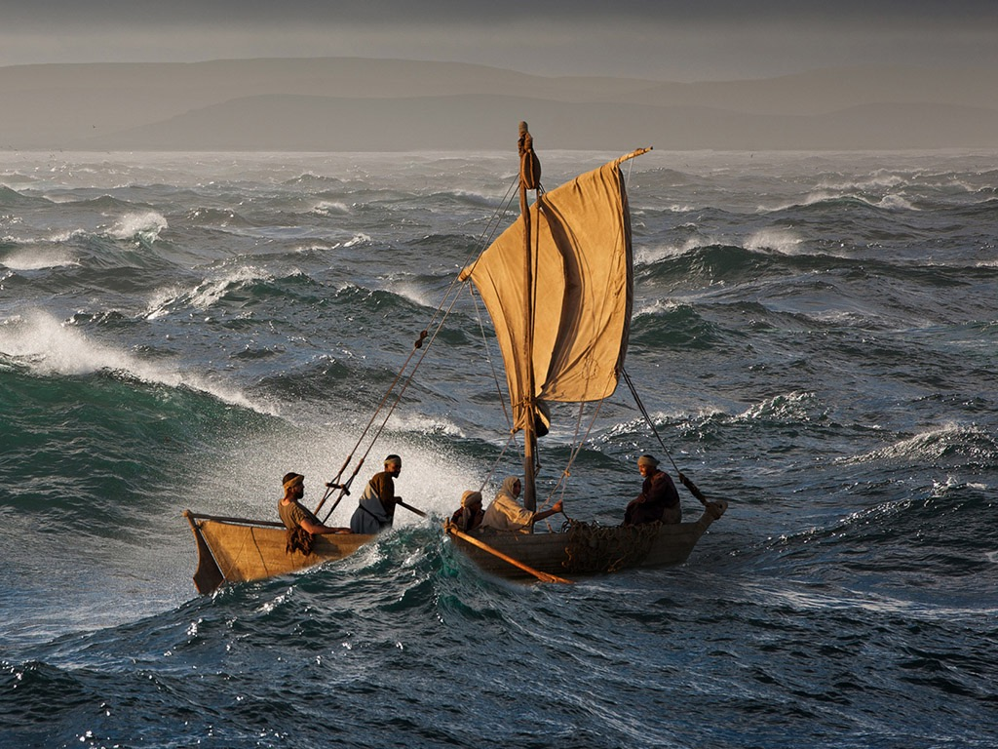
免费
圣经
图片
马太 8:23-27
马可 4:35-41 路加 8:22-25
耶稣平静风浪

Slide 17
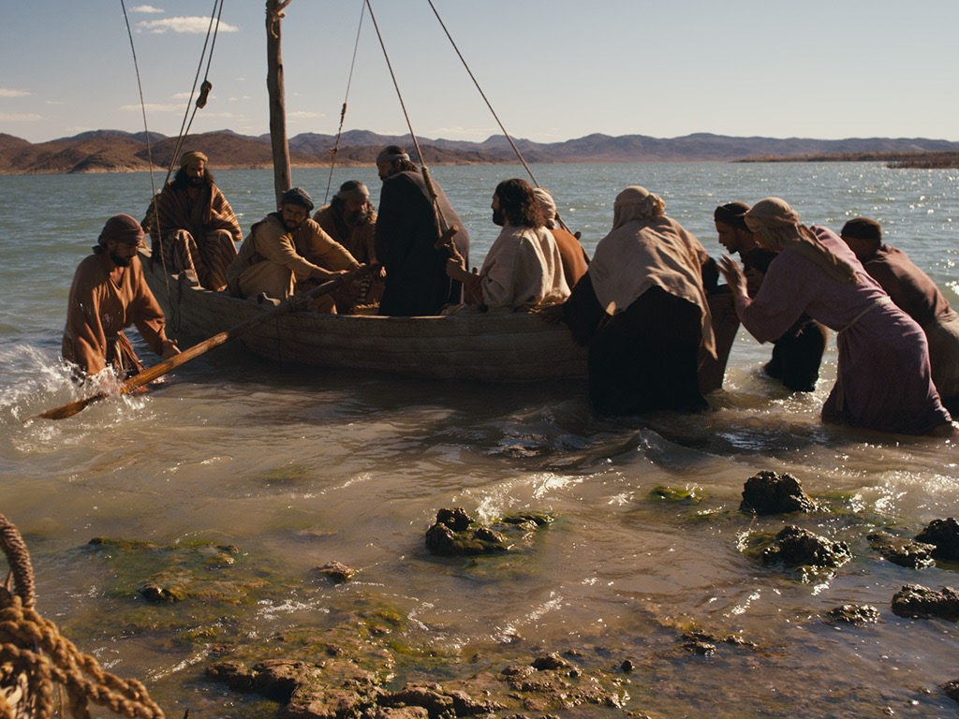

Slide 18
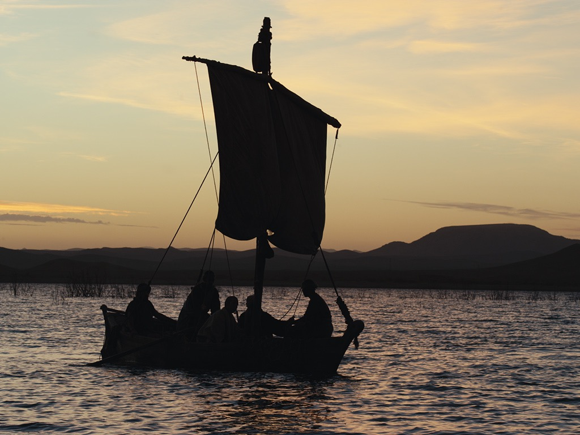

Slide 19
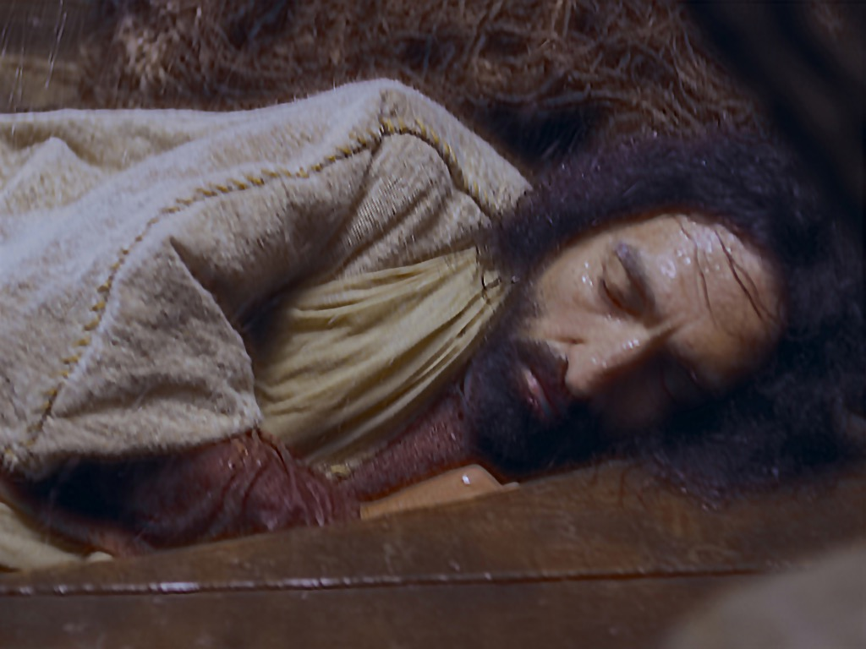

Slide 21
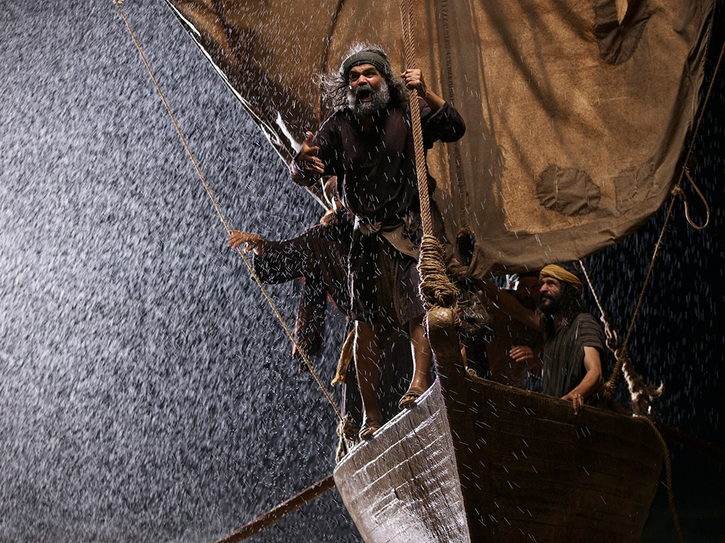

Slide 22
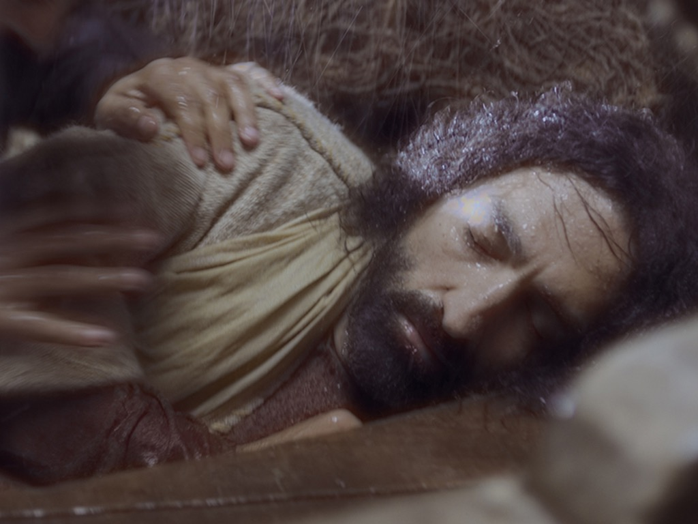

Slide 23
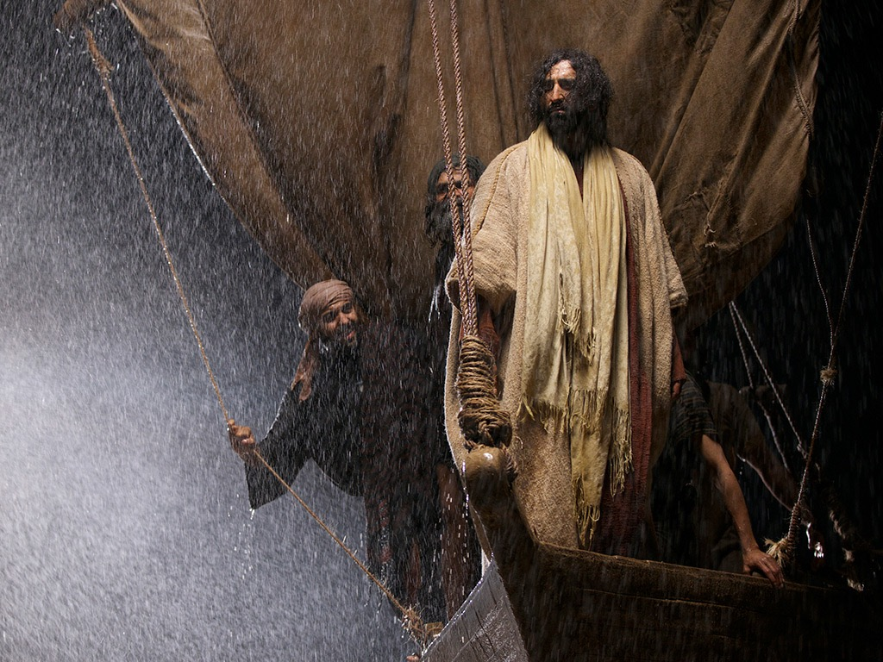

Slide 24
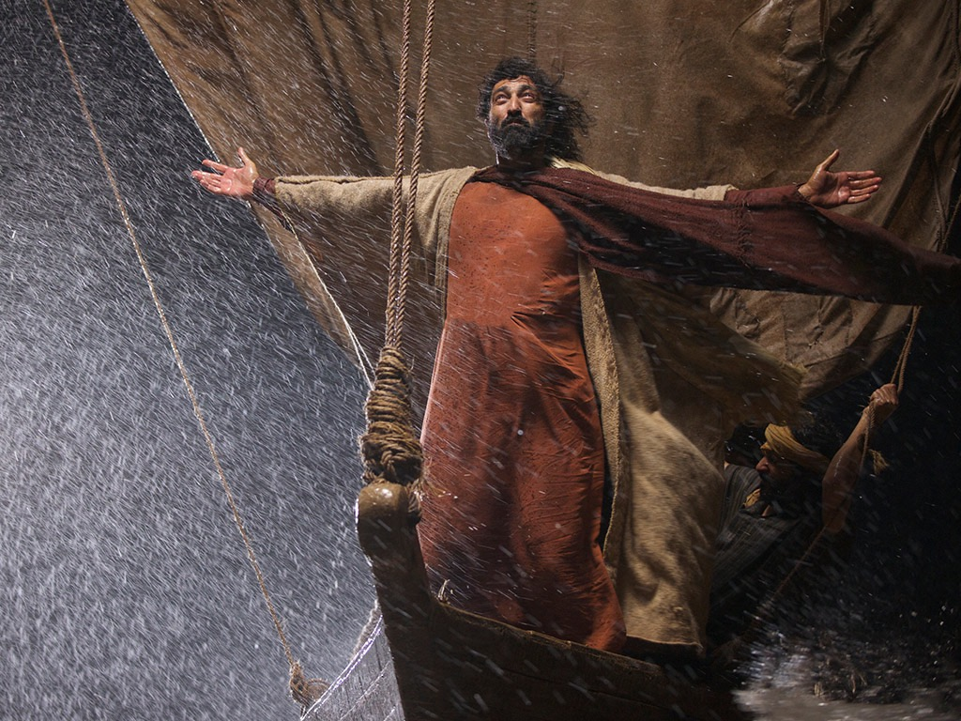

Slide 25
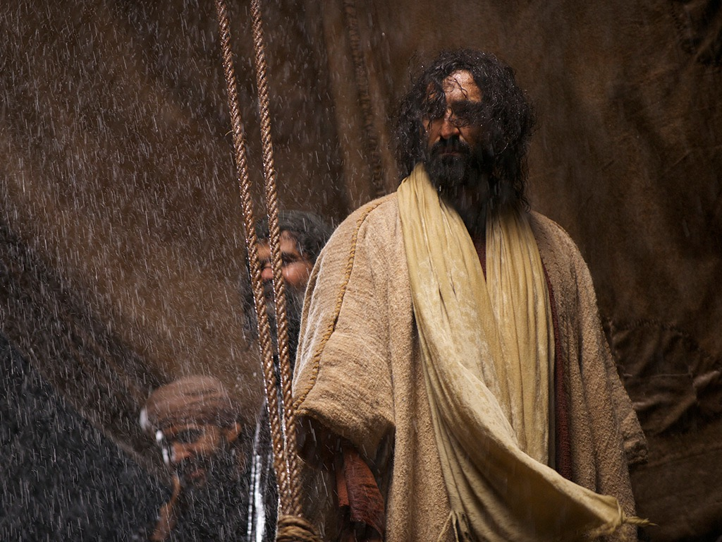

Slide 26
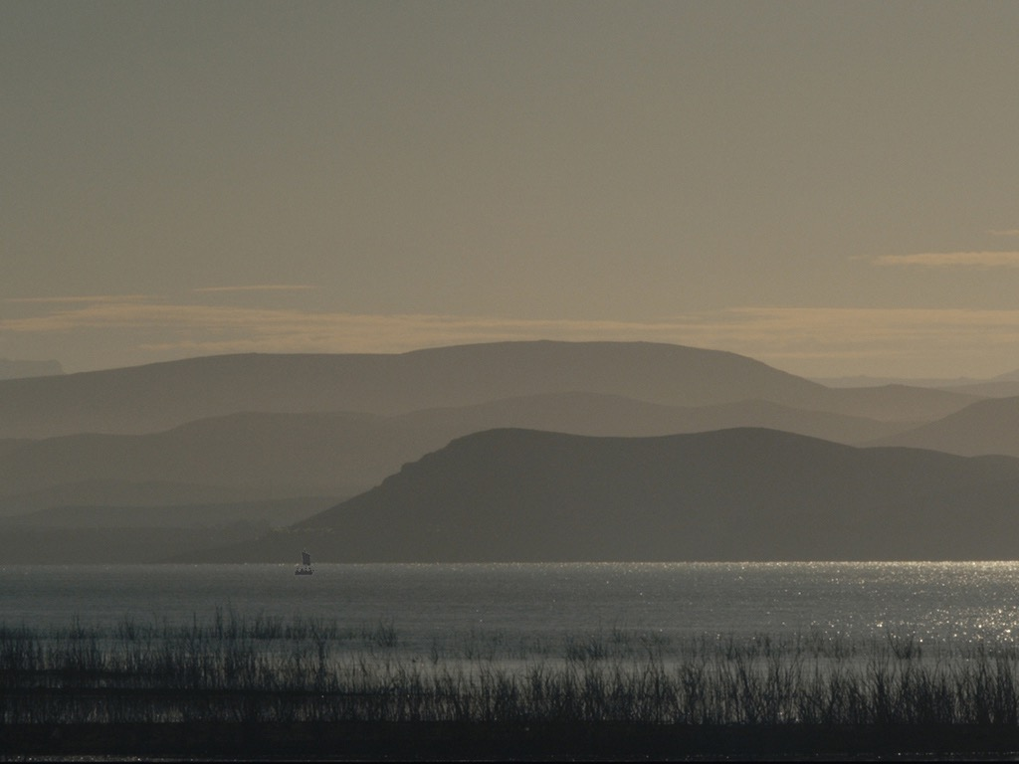

Slide 27
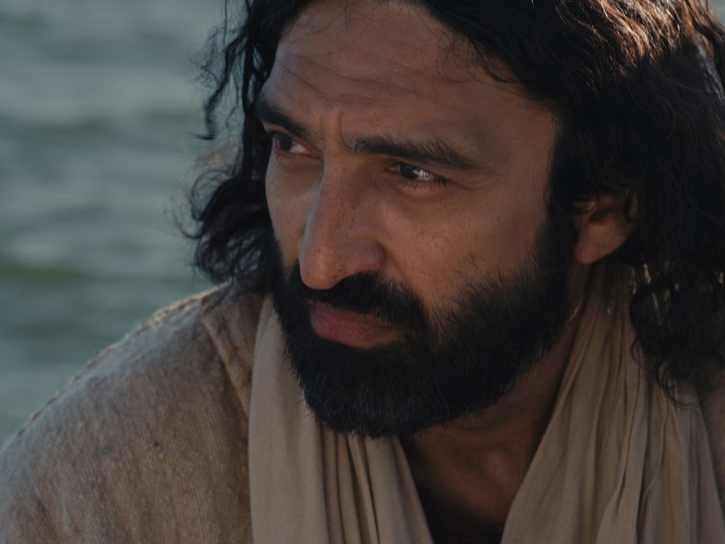

Slide 29
授权使用
马太福音
d
马可福音
o
路加福音
0
约翰福音
0
由Lumo Project出版独家资源，我们特此通知您我们不授权将这些图片发放给除freebibleimages.org客户以外的任何人。
所有图片不授权用于视频制作、epublishing或者其他媒体。所有下载的图片和文件不可通过除freebibleimages.org以外的其他网站传播，亦不可用于任何破坏基督信仰和福音的处境中。
o
图片仅供教育展示、博客和社交媒体使用；所有用途均需注明出处 www.LumoProject.com
图片声明 BBM © 版权所有
www.bigbookmedia.com

Slide 30
3. Power Over Demons
§ 69
马太 8:28-34; 马可 5:1-20; 路加 8:26-39
In the face of opposition from Israel's leaders Christ verifies His authority over a legion of demons which controlled swine to show that He was not controlled by Satan since He controlled Satan's host

Slide 31
4. Power Over Disease and Death
§ 70
马太 9:18-26; 马可 5:21-43; 路加 8:40-56
Christ heals an unclean woman with a flow of blood and raises Jairus' daughter, acknowledging through allowing to be touched and through touching the dead His royal authority as Israel's king even though His people had rejected Him

Slide 32
5. Power Over Blindness
§ 71
马太 9:27-34
Two blind men acknowledge Christ as Messiah and appeal for a messianic miracle, which Christ performs for them when they acknowledge their faith in His person, thus illustrating His willingness to remove Israel's spiritual blindness if the nation responds in faith

Slide 33
I. Rejection in Nazareth
§ 72
马太 13:54-58; 马可 6:1-6a
Christ's rejection in His hometown of Nazareth because He had not been taught by an accredited teacher shows the extent of blindness and inability to receive spiritual light evident in these unbelievers

Slide 34
耶稣的家庭
圣灵
男性着白色 女性着黄色
马利亚
约瑟
耶稣
约西
西门
妹妹2
雅各
犹大
妹妹1
“这不是那木匠吗？不是马利亚的儿子，雅各、约西、犹大、西门的哥哥吗？他的妹妹们不也在我们这里吗？”他们就厌弃耶稣。 (马可 6:3 新译本)

Slide 35
J. Death of the Herald
§ 73
马太 14:1-12; 马可 6:14-29; 路加 9:7-9
Ultimate opposition to Christ and rejection of His offer of the kingdom is foreshadowed in Herod's execution of 约翰 for righteousness' sake

Slide 36
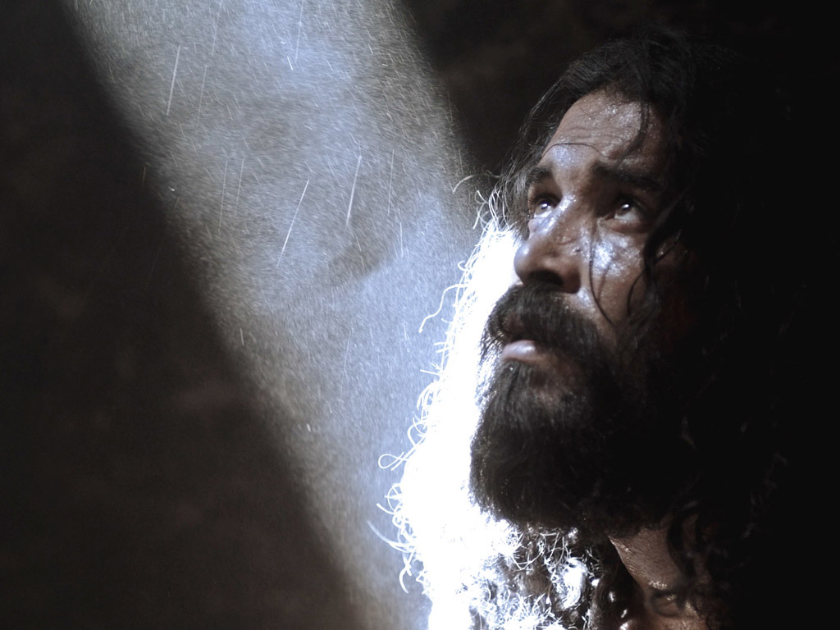
施洗约翰在监狱里
马太 14:1-12
马可 6:14-29

Slide 37
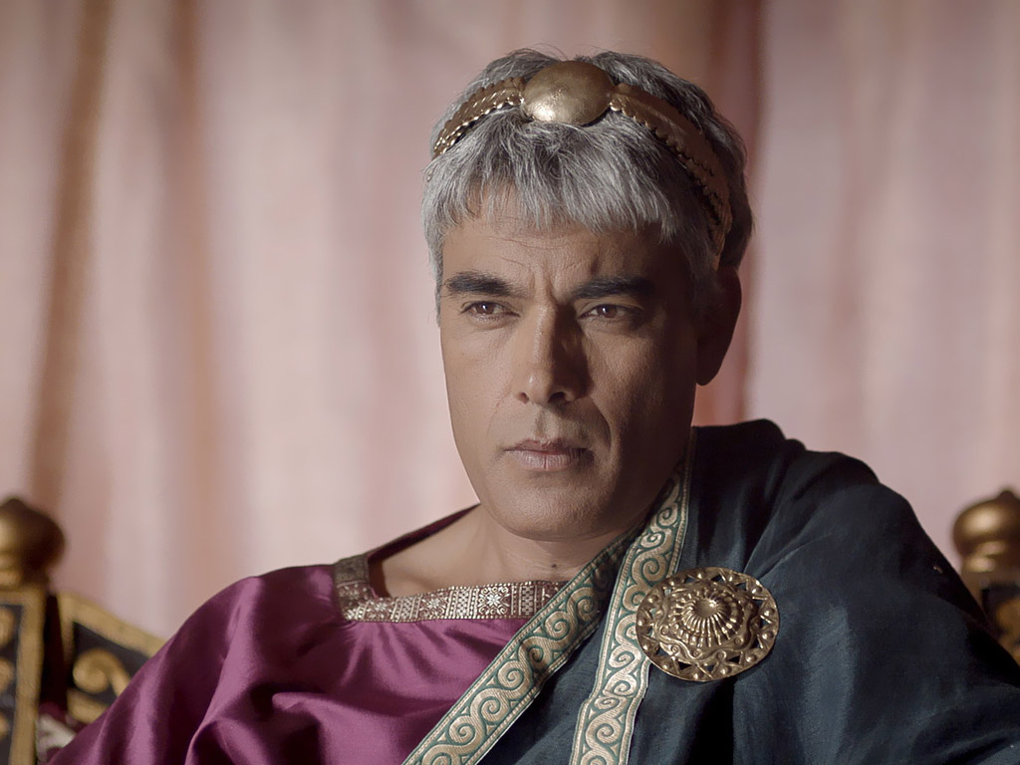

Slide 38
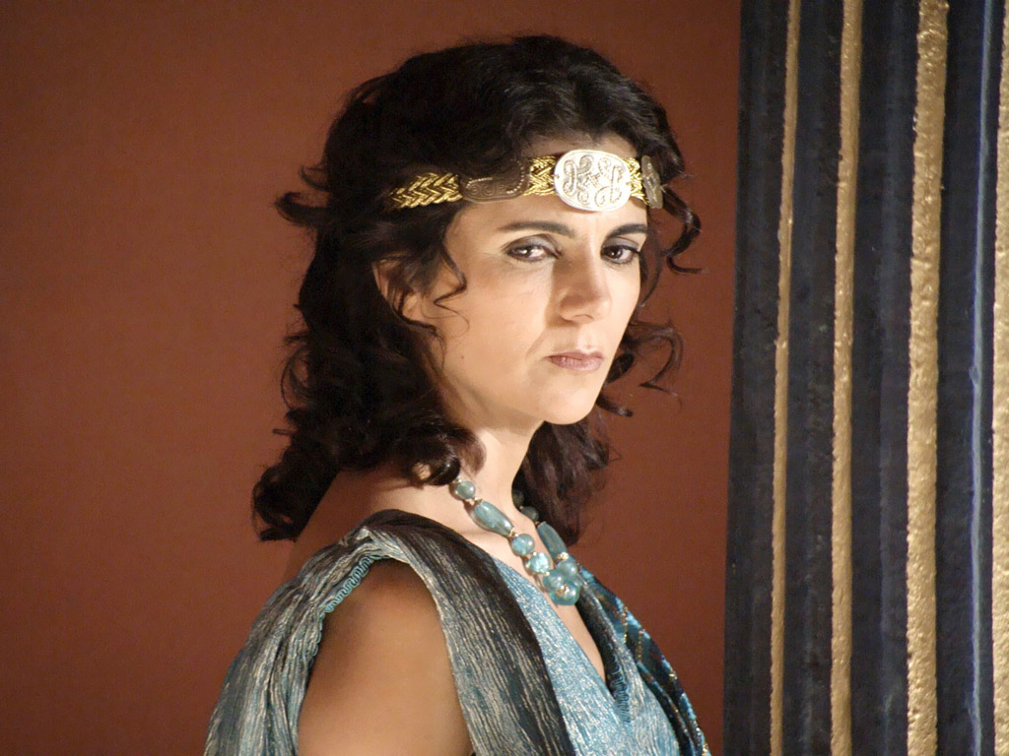

Slide 39
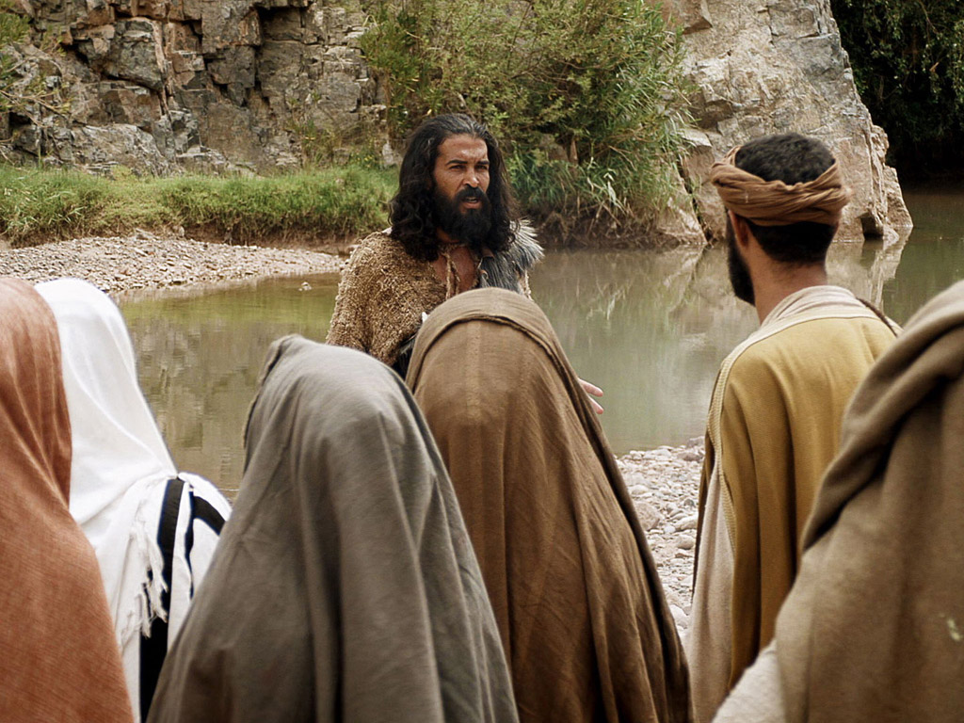

Slide 42
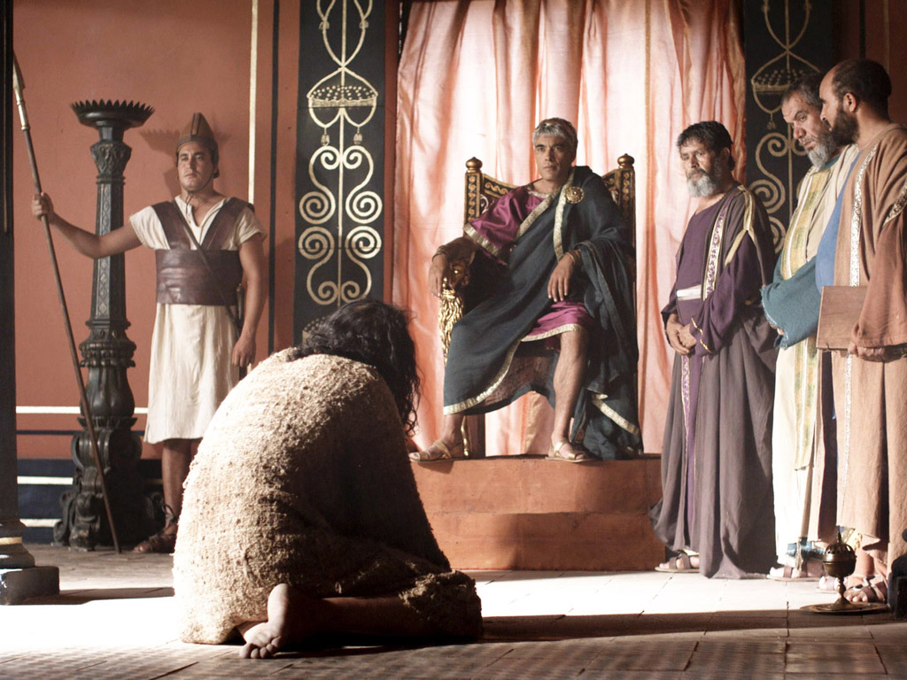

Slide 43
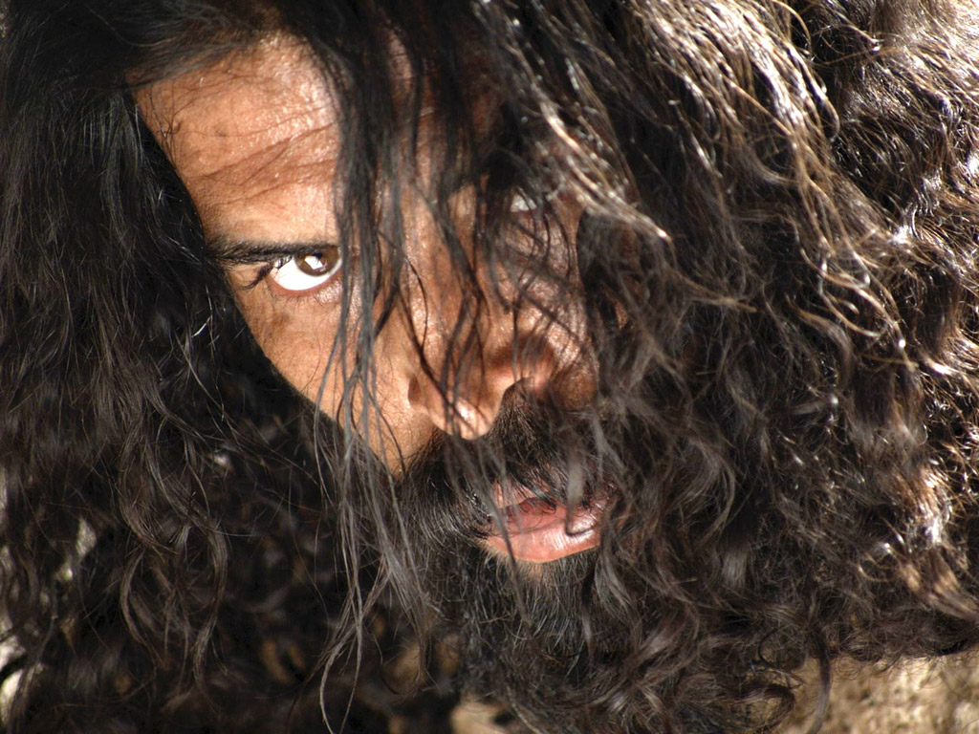

Slide 44
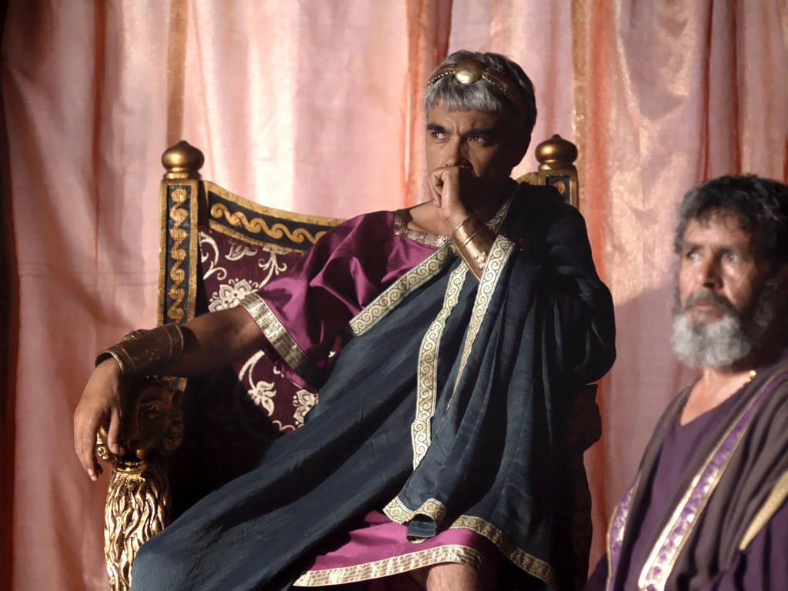

Slide 45
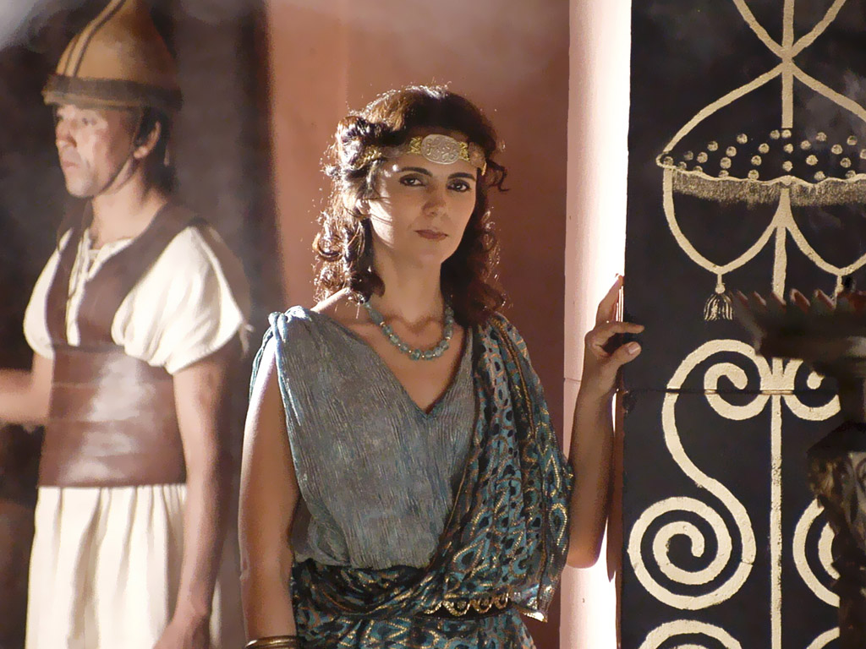

Slide 46
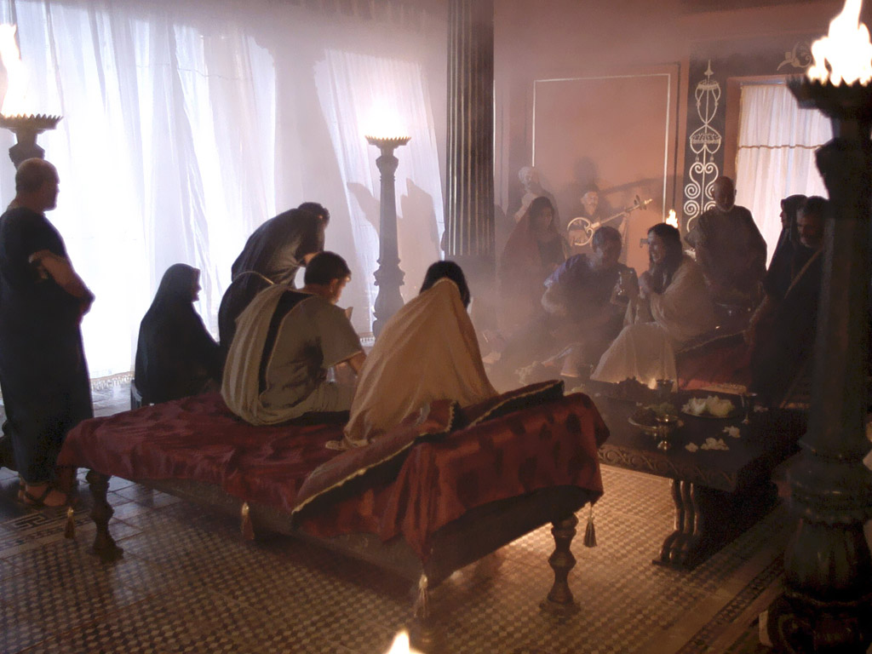

Slide 49
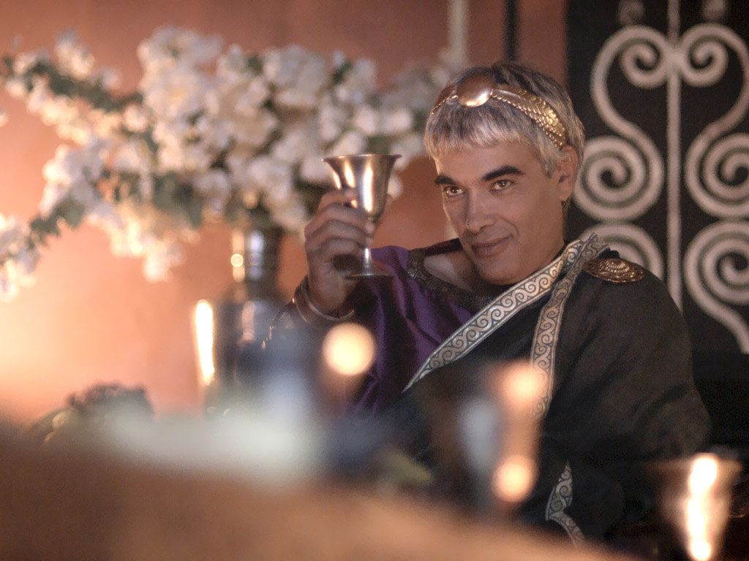

Slide 50
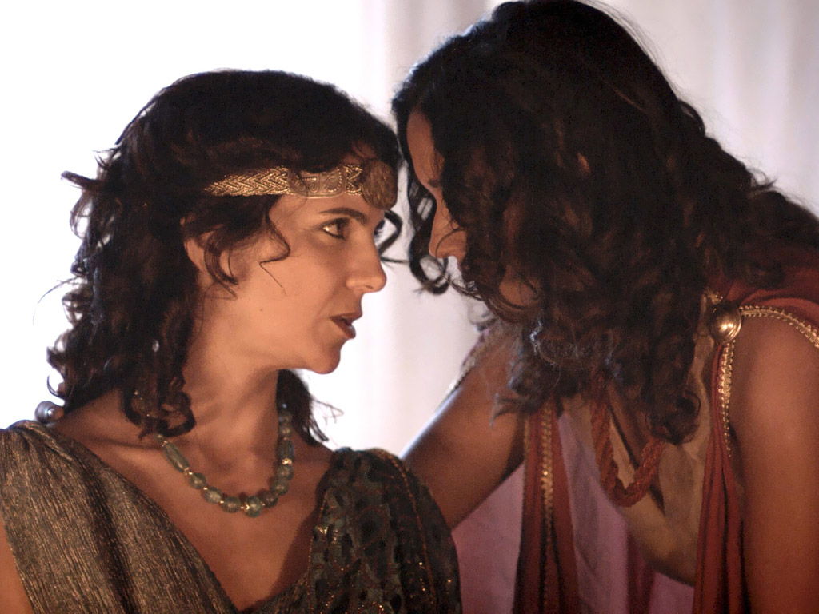

Slide 51
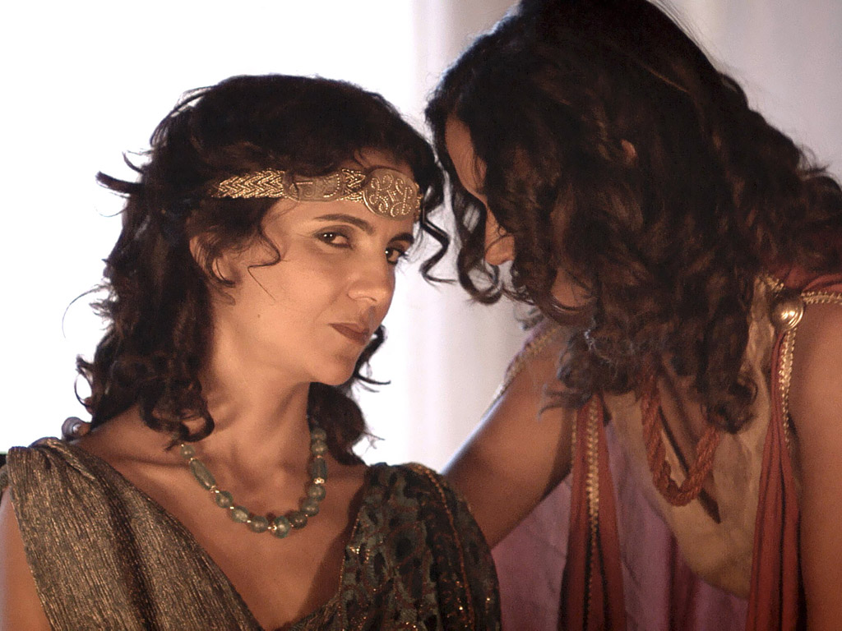

Slide 52
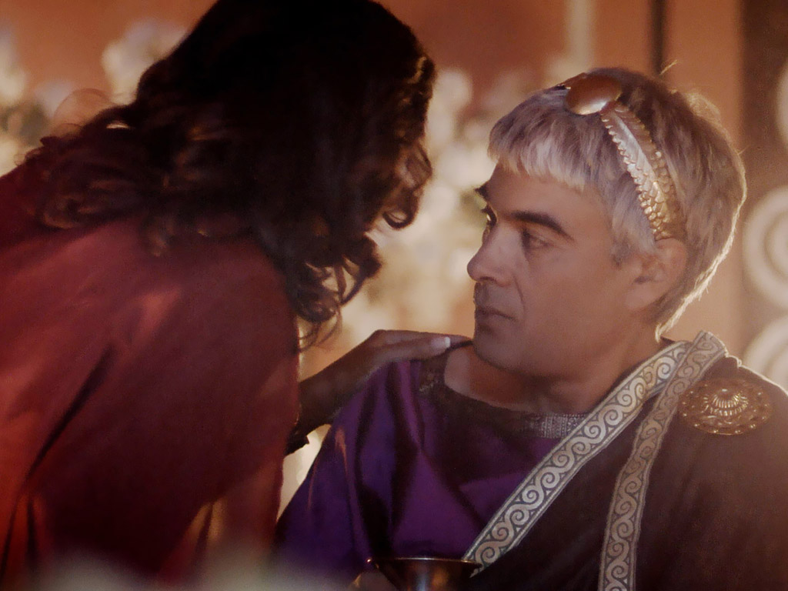

Slide 53
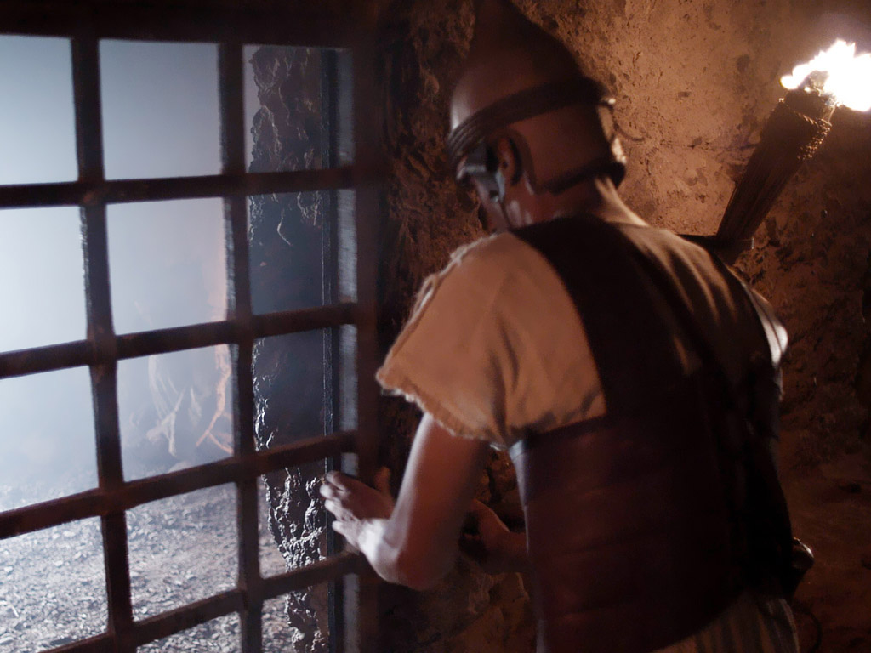

Slide 54
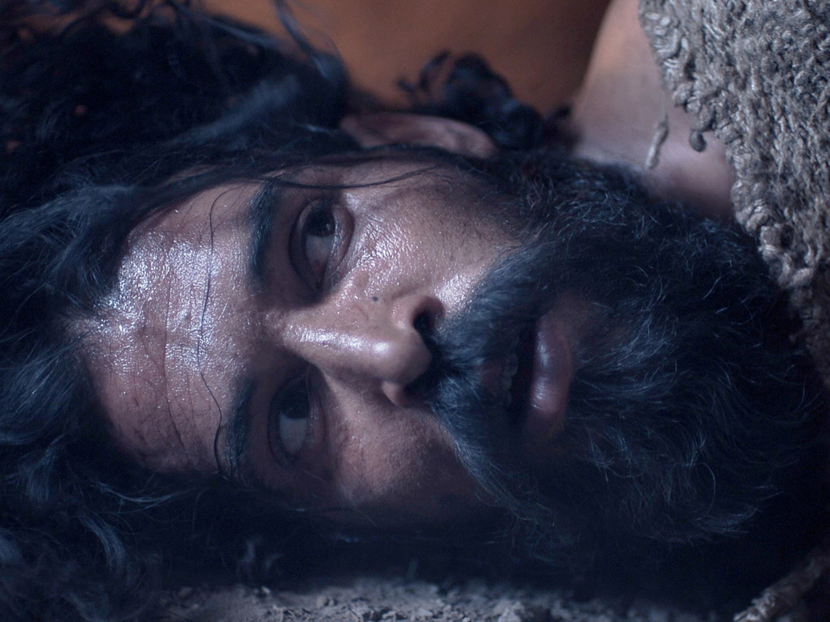

Slide 55
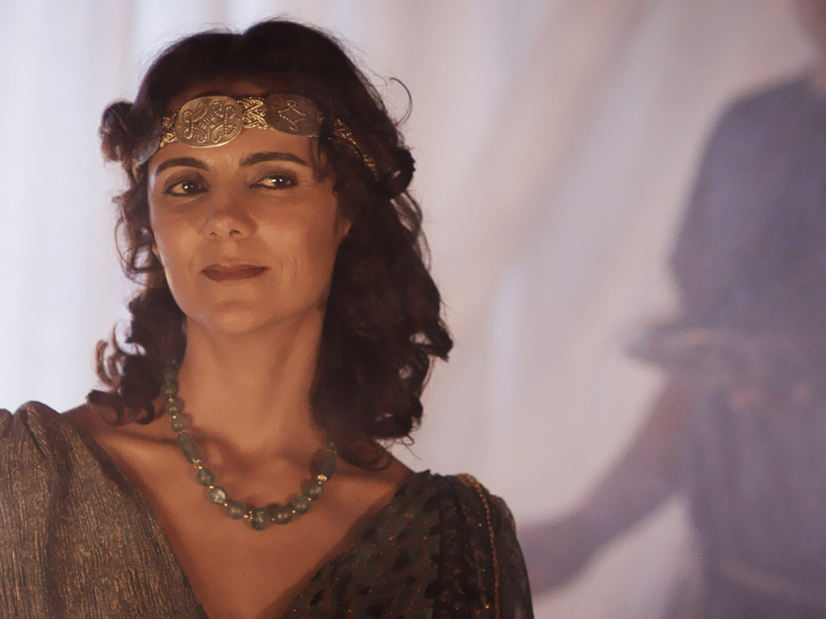

Slide 56
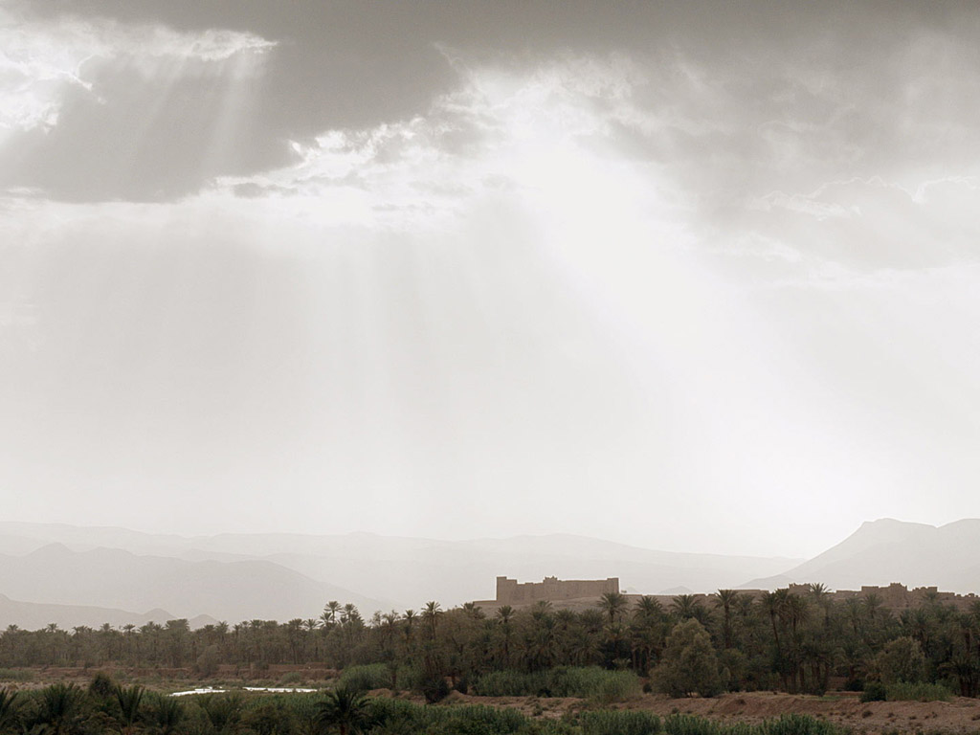

Slide 57
图片声明 Big Book Media © 版权所有.
授权使用
BIG BOOK MEDIA

Slide 58
Free Bible Images
授权使用
免费
圣经
图片
图片中的文字

Slide 59
Black

Slide 60
基督生命链接地址 BibleStudyDownloads.org
免费获得该讲解!
圣经学习下载
Notes:
Bible Geograhpy (bg)

