Slide 1

君王的认证
§§ 28-59
Section summaries based on J. Dwight Pentecost, A Harmony of the Words and Works of Jesus Christ (Grand Rapids: Zondervan, 1981)
Dr. Rick Griffith • Singapore Bible College • BibleStudyDownloads.org
The Messianic identity of Jesus is evident in the initial acceptance of His person and in his authority shown in His works and teaching

Slide 2
The Acceptance
of His Person
§§ 28-36
Christ is initially accepted in Judea, Samaria and Galilee by His new disciples and by the multitudes

Slide 3
1. The Belief of the First Disciples
§ 28
约翰 1:35-51
Simon Peter, Andrew, 约翰, and Nathaniel confess faith in Christ's person, work and office as Messiah of Israel

Slide 4
2. The Belief Through the First Miracle
§ 29
约翰 2:1-11
Jesus confirms the faith of the disciples of 约翰 who had come to him and those who these first disciples brought to Jesus through turning water to wine, which revealed His essential glory as the Son of God and the joy He would bring to those who accepted His message

Slide 5
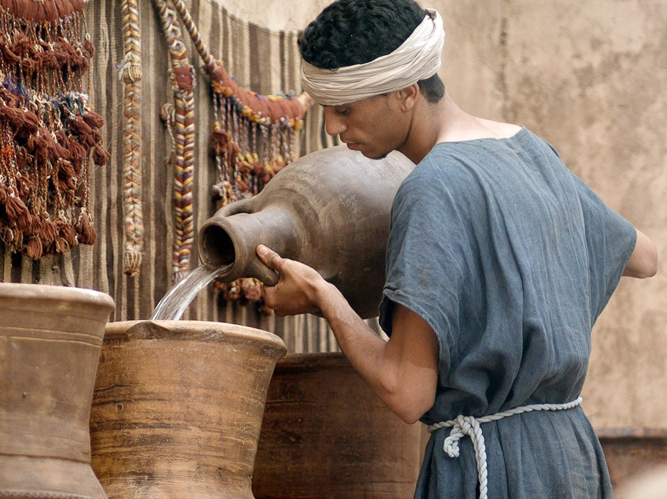

免费
圣经
图片
约翰 2:1-11
在迦拿的婚筵

Slide 6
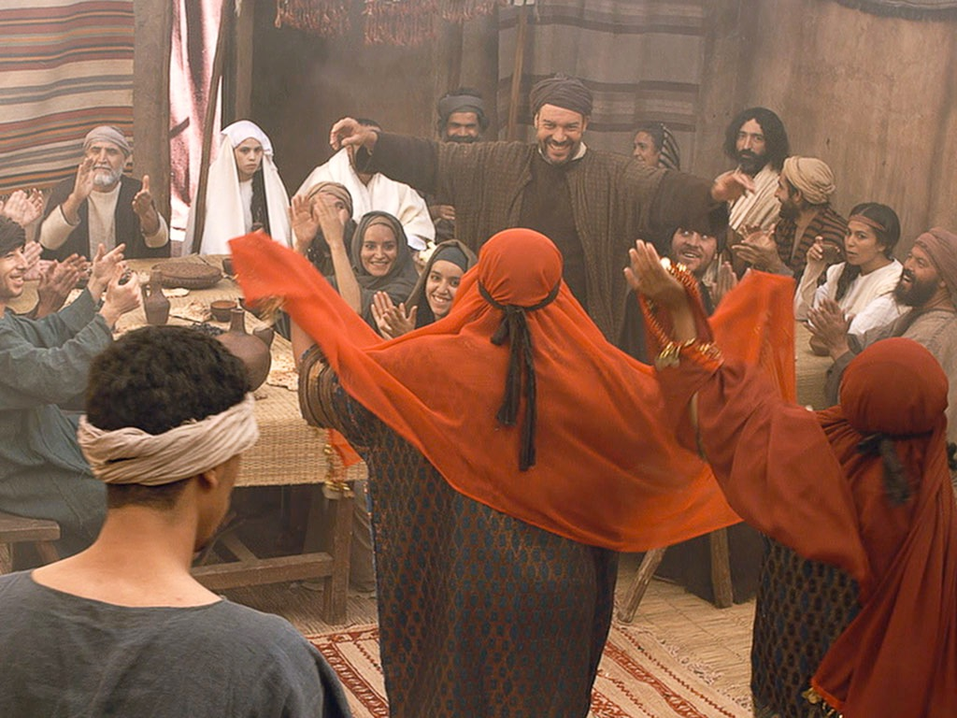

Slide 7
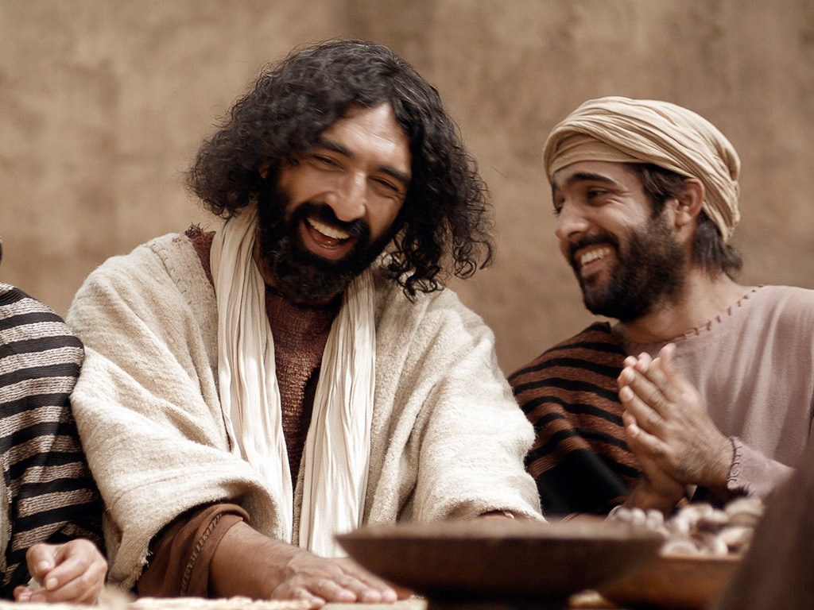

Slide 8
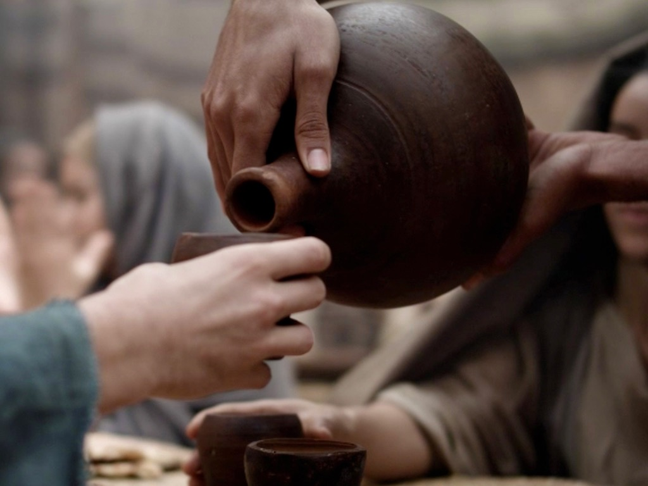

Slide 9
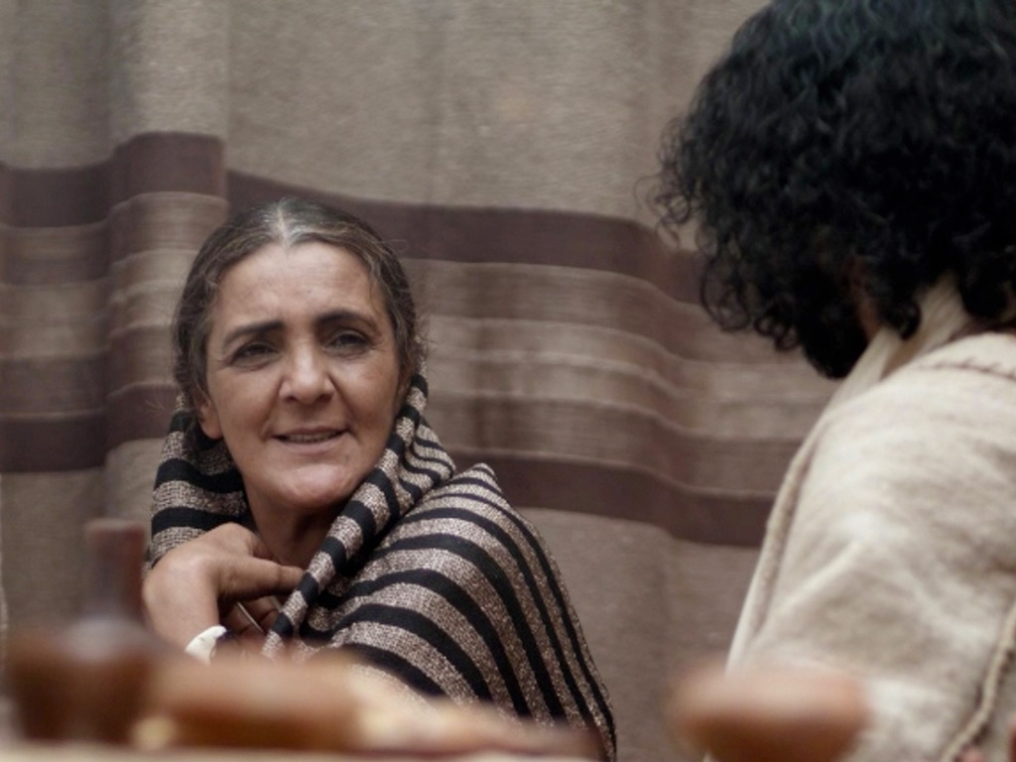

Slide 10
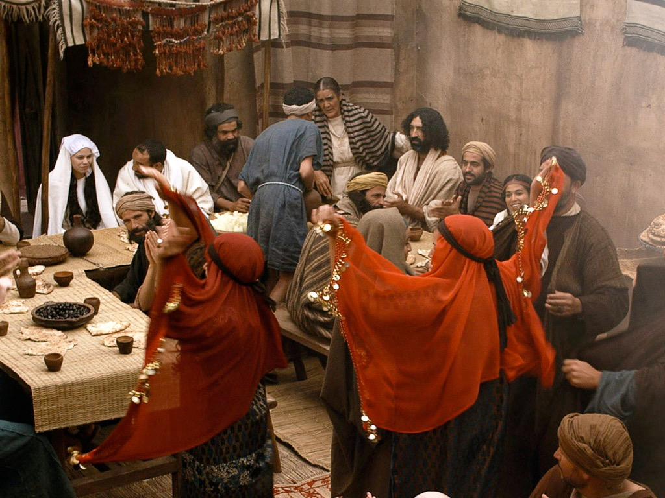

Slide 11
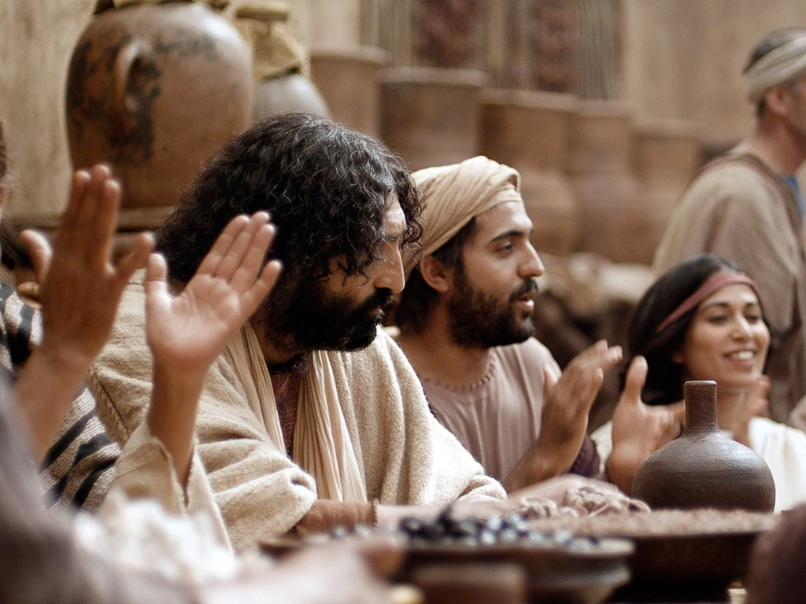

Slide 13
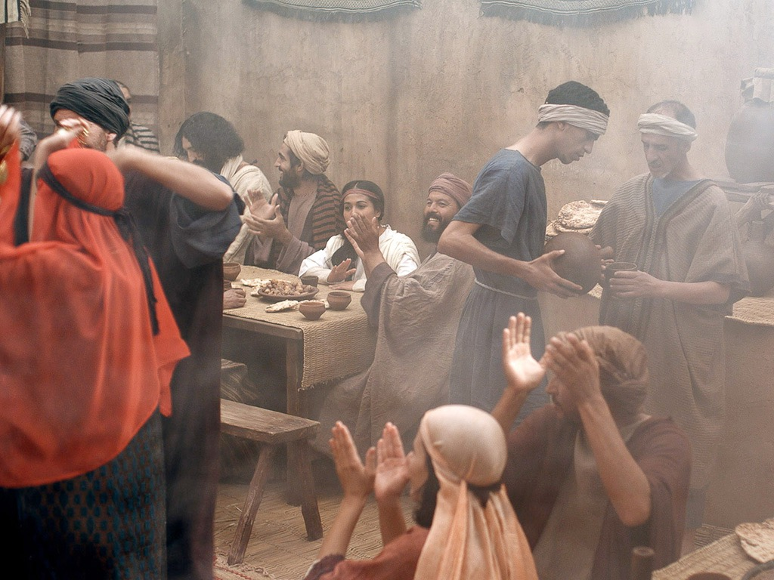

Slide 14
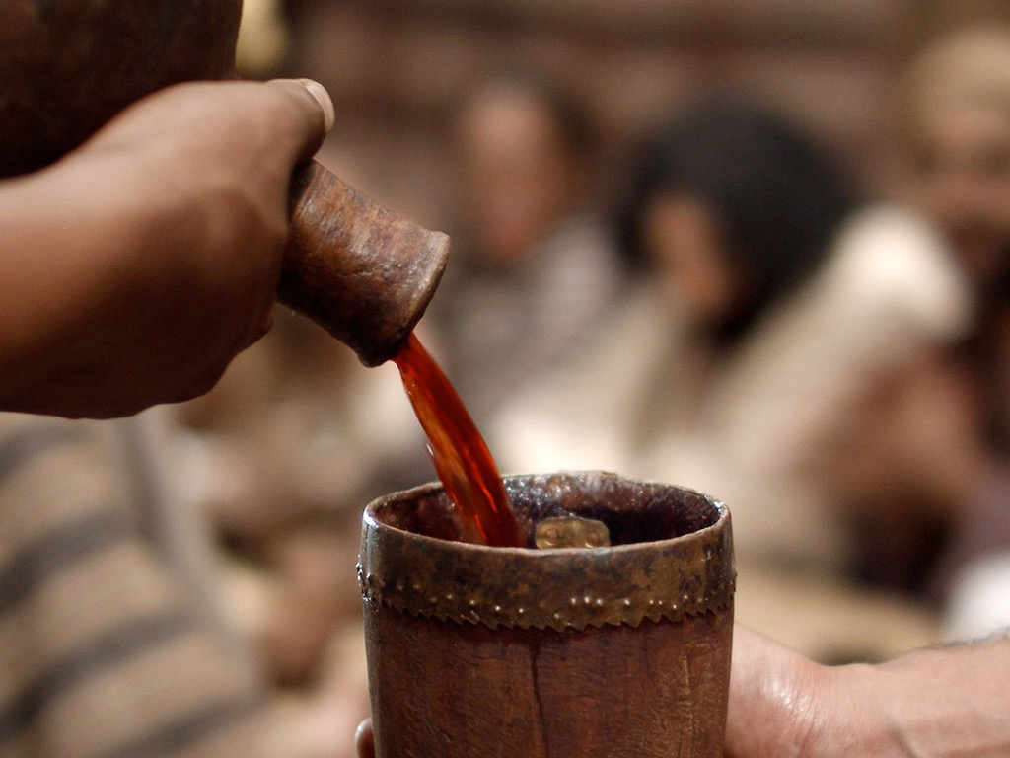

Slide 15
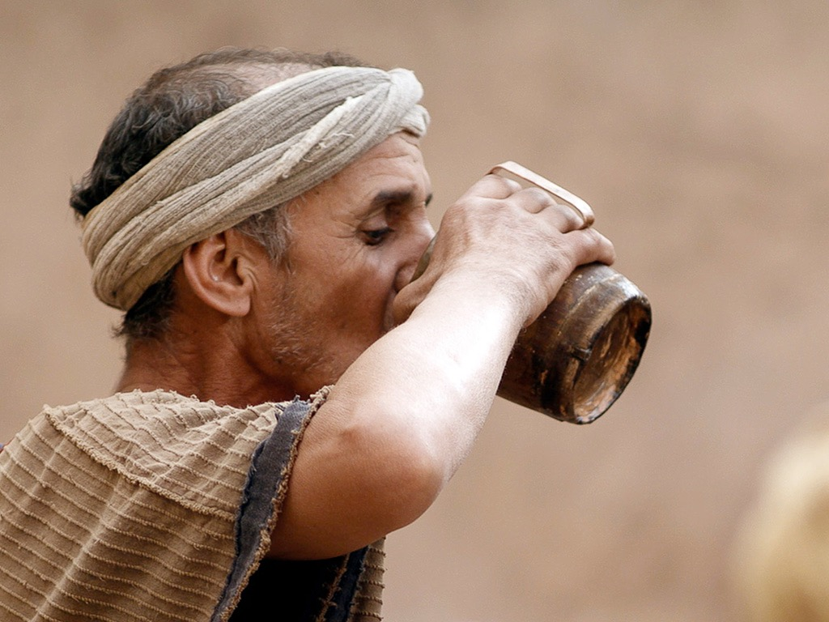

Slide 16
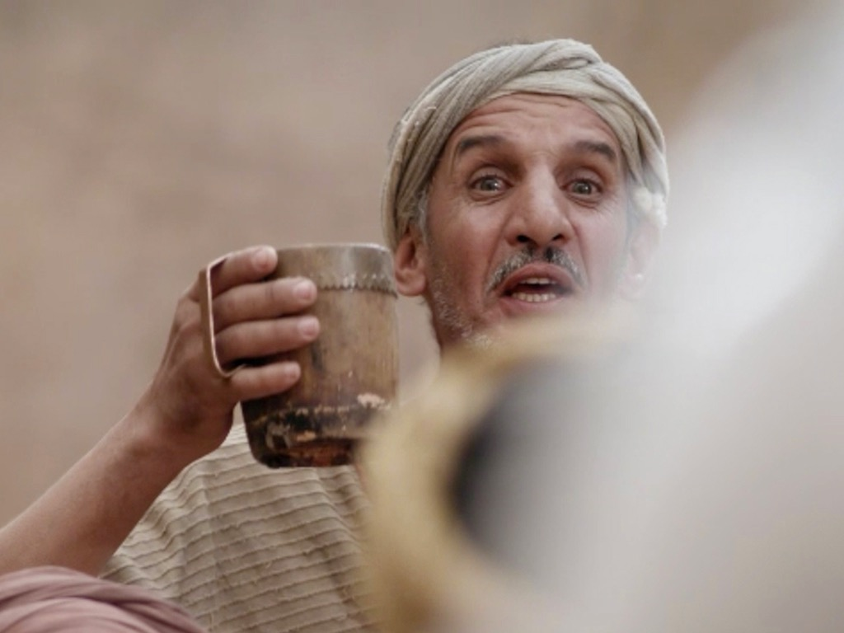

Slide 17
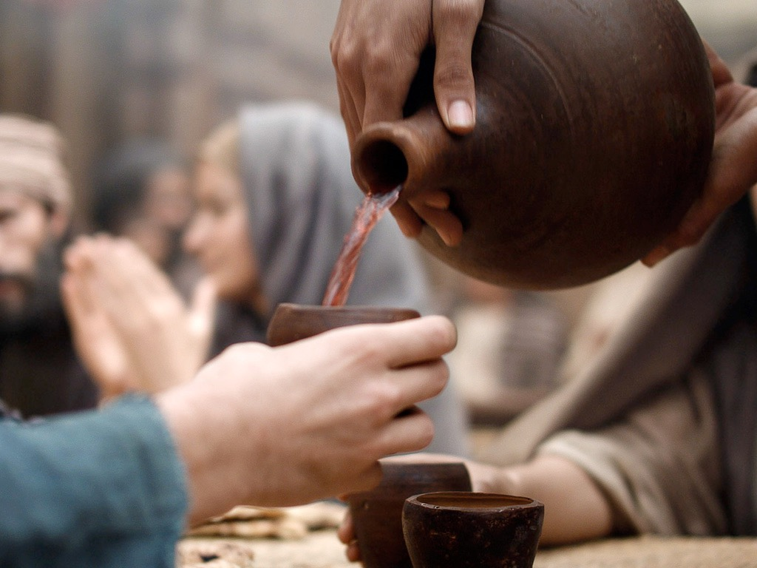

Slide 18
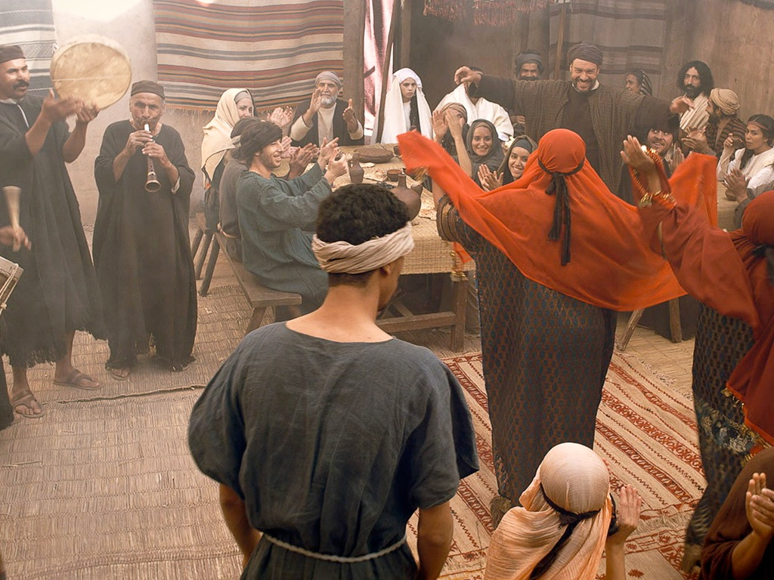

Slide 19
Free Bible Images
授权使用
免费
圣经
图片
图片中的文字

Slide 20

授权使用
马太福音
d
马可福音
o
路加福音
0
约翰福音
0
由Lumo Project出版独家资源，我们特此通知您我们不授权将这些图片发放给除freebibleimages.org客户以外的任何人。
所有图片不授权用于视频制作、epublishing或者其他媒体。所有下载的图片和文件不可通过除freebibleimages.org以外的其他网站传播，亦不可用于任何破坏基督信仰和福音的处境中。
o
图片仅供教育展示、博客和社交媒体使用；所有用途均需注明出处
www.LumoProject.com
图片声明 BBM
© 版权所有
www.bigbookmedia.com

Slide 21
3. The Sojourn in Capernaum
§ 30
约翰 2:12
Christ further establishes the faith of His disciples in His Messianic identity in Capernaum before commencing His first great public ministry in Judea

Slide 22
4. The Possession of the Temple
§ 31
约翰 2:13-22
Christ demonstrates His authority as Messiah in His zeal for the Temple purification which, when challenged by His opponents, He promises to authenticate in His death and resurrection

Slide 23

马太 21:12-17
马可 11:15-19
路加 19:45-48
约翰 2:13-24
复活节的故事
洁净
圣殿
免费
圣经
图片

Slide 24


Slide 25


Slide 26


Slide 27


Slide 28


Slide 30


Slide 31


Slide 32


Slide 33


Slide 34


Slide 35


Slide 36


Slide 37


Slide 38


Slide 39


Slide 40
Free Bible Images
授权使用
免费
圣经
图片
图片中的文字

Slide 41
5. Acceptance in Judea
§ 32
约翰 3:23-3:21
Christ's acceptance by Israelites in Judea is confirmed through miraculous signs and by Nicodemus through Christ's declaration that He was the true Revealer of God and the only means by which man might receive a new birth to enter the kingdom

Slide 42
6. The Witness of 约翰
§ 33
约翰 3:22-36
In response to an attempt of some to provoke 约翰 to jealousy over Christ's ministry success 约翰 demonstrates his allegiance to Christ by testifying of the latter's superiority as a heavenly Revealer of the Father that people might know the Father and have eternal life rather than the wrath of God

Slide 43
7. The Withdrawal from Judea
§ 34
马太 4:12; 马可 1:14; 路加 3:19-20; 约翰 4:14
Christ transfers His base of ministry from Judea to Galilee to avoid possible conflict between His disciples and 约翰's, because of the rejection of His ministry through Herod's imprisoning 约翰, and because the Spirit motivated Him to escape possible death at the hands of the Pharisees

Slide 44
8. The Acceptance in Samaria
§ 35
约翰 4:5-42
Christ is accepted as Messiah by some Samaritans through the witness of the woman at the well who responded to the revelation of His person and the eternal life He came to give

Slide 45
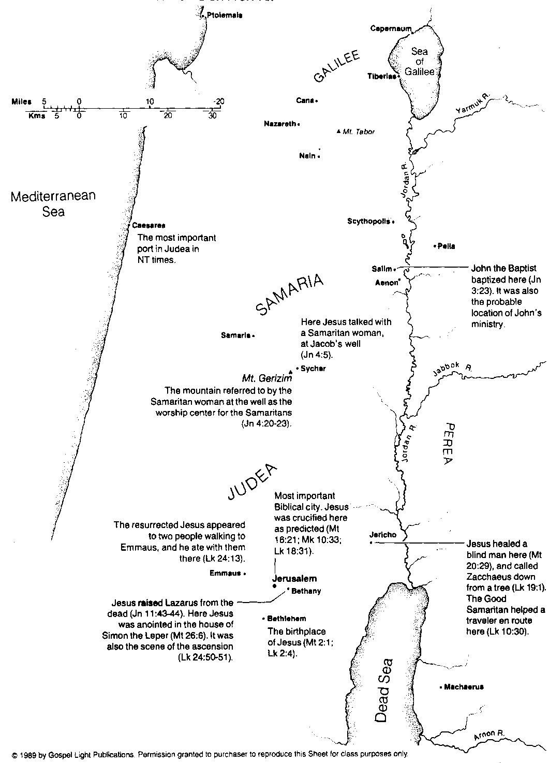
耶稣在犹太全地及撒玛利亚
107

Slide 46
9. The Acceptance in Galilee
§ 36
约翰 4:43-45
Christ is welcomed in Galilee because of what the Galileans had seen Him perform at the Passover in Jerusalem and because they felt honored to have the Messiah among them rather than only in Jerusalem, yet Jesus anticipates His future rejection in this region

Slide 47
The Authority
of the King
§§ 37-59
Christ substantiates His authority as Messiah through His miracles and teachings which authenticate Himself and His message

Slide 48
1. Christ's Authority to Preach
§ 37
马太 4:17; 马可 1:15; 路加 4:14-15
In the power of the Spirit Christ preaches as a self-appointed teacher and prophet the same message that 约翰 declared, namely, repentance for entrance into the Messianic kingdom, thus demonstrating the divine authority by which he ministered

Slide 49
2. Christ's Authority Over Disease
§ 38
约翰 4:46-54
Christ demonstrates His authority as Messiah by healing the son of a royal official based upon the faith of the official in Christ's word alone without any outward evidence of its truth

Slide 50
3. Rejection in Nazareth
§ 39
路加 4:16-30
After listening to His declaration to have Messianic authority to heal in fulfillment of Isaiah 61:1-2, Christ includes his hearers among the apostate of Israel while these people in Nazareth reject His eligibility as Messiah in His first public rejection which would culminate in His crucifixion

Slide 51
4. Residence in Capernaum
§ 40
马太 4:13-16
Following His rejection in Nazareth Jesus takes up residence in the predominantly Gentile Capernaum as a foreshadowing of His authority to minister to Gentiles in response to Israel's rejection of Him as Messiah

Slide 52
5. Christ's Authority Over Nature
§ 41
马太 4:18-22; 马可 1:16-20; 路加 5:1-11
Christ confirms His authority over nature before Peter, Andrew, James and 约翰 in a miraculous catch of fish with the result that Christ's authority took priority over their father's authority and the family business so that the men left everything to follow Jesus

Slide 53
6. Christ's Authority Over Demons
§ 42
马可 1:21-28; 路加 4:31-37
Christ exercises His authority over the demonic realm in the exorcism of a demon who recognized both the person and work of Christ as the Messiah but whose testimony Christ did not want the nation to accept since Christ's authority rested in His person rather than in the testimony of demons

Slide 54
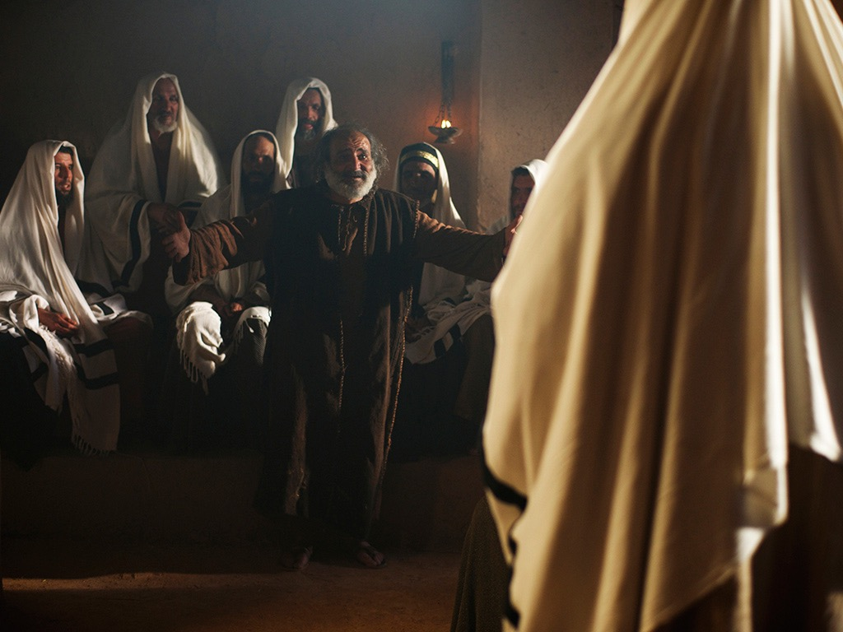

马可 1:21-28; 路加 4:31-37
耶稣解脱了一个污鬼附身的人

Slide 55
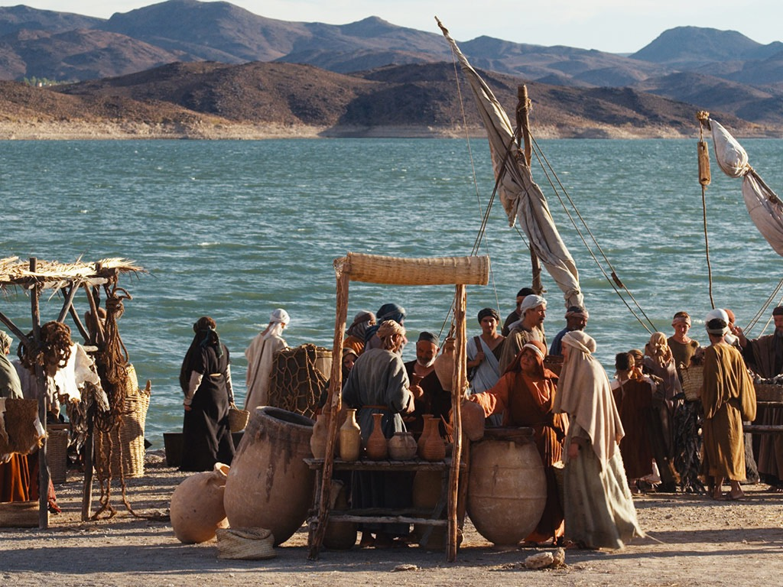

Slide 56
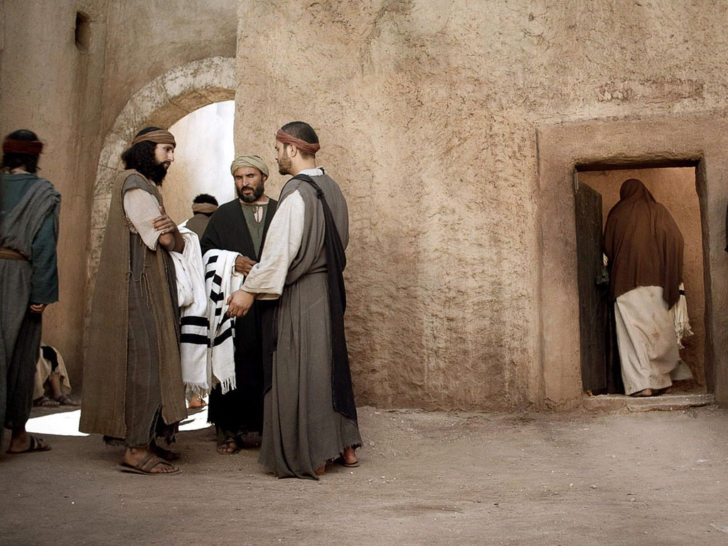

Slide 57
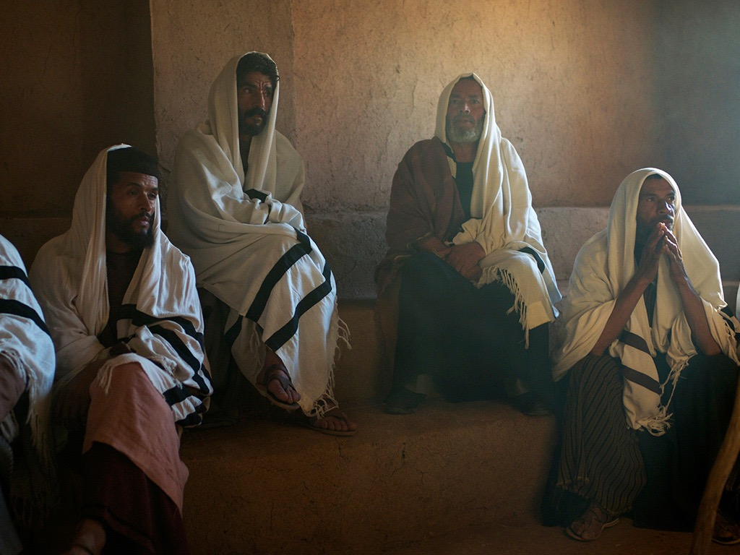

Slide 58
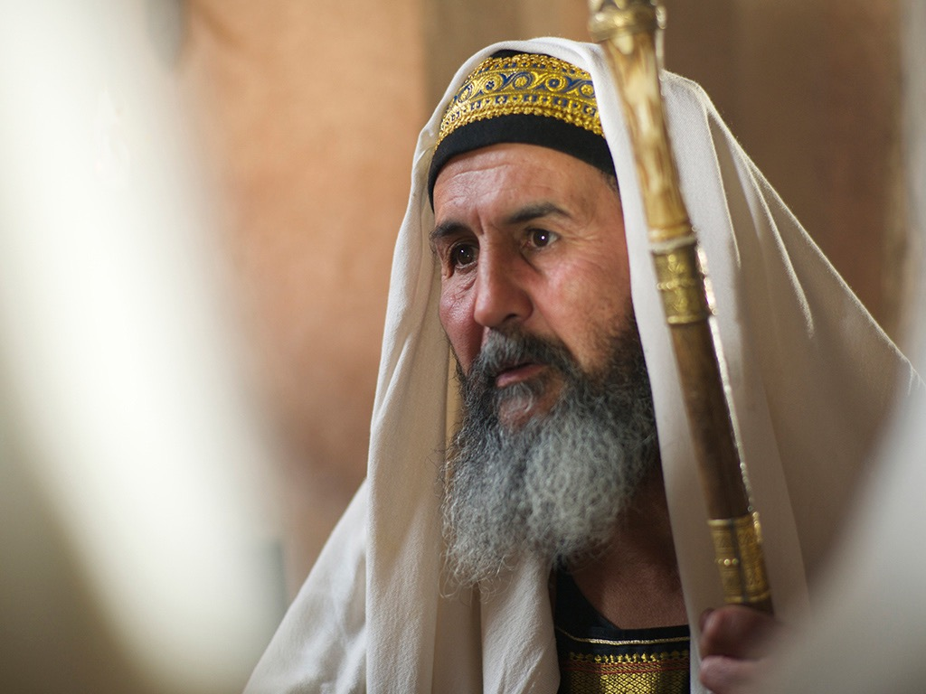

Slide 59
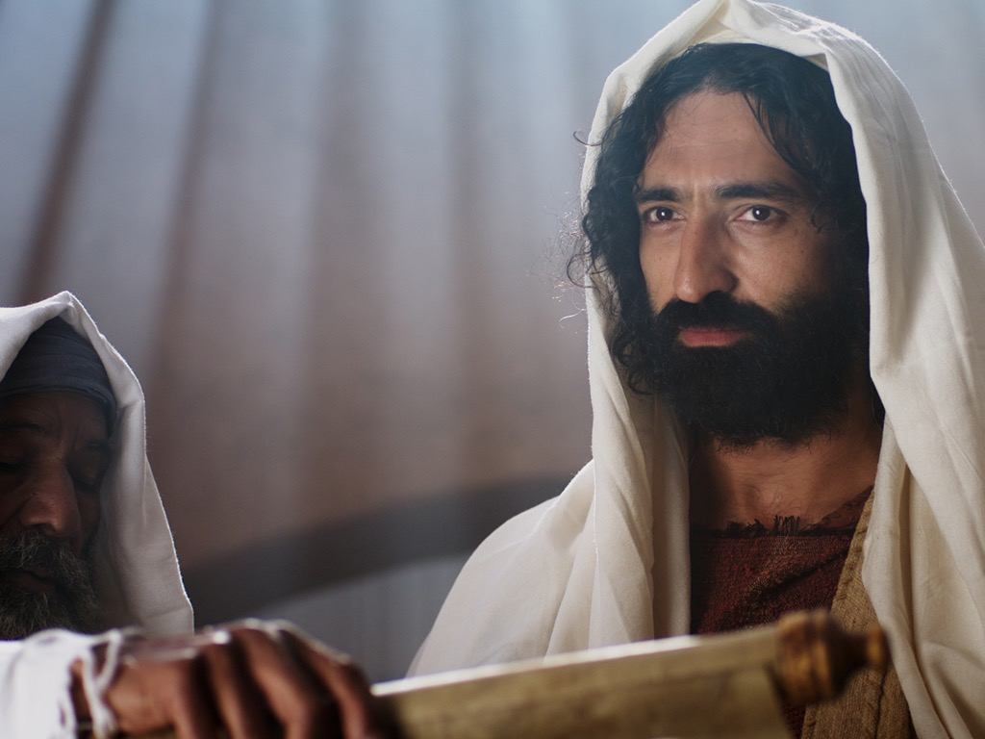

Slide 60
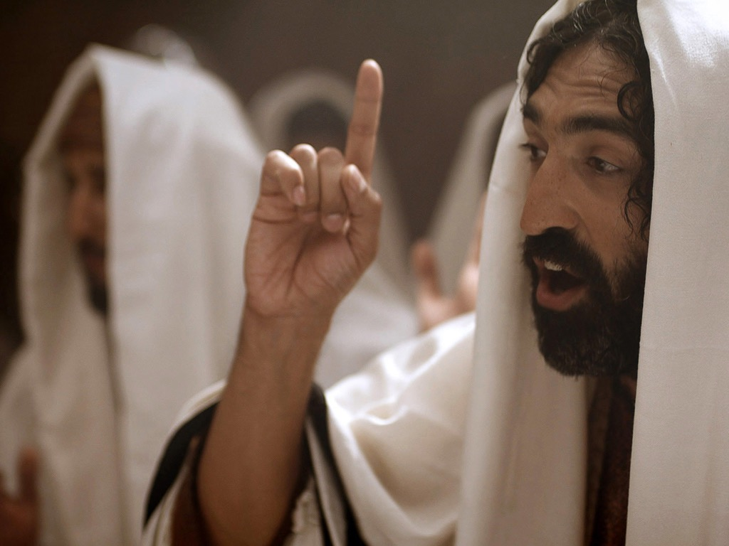

Slide 61
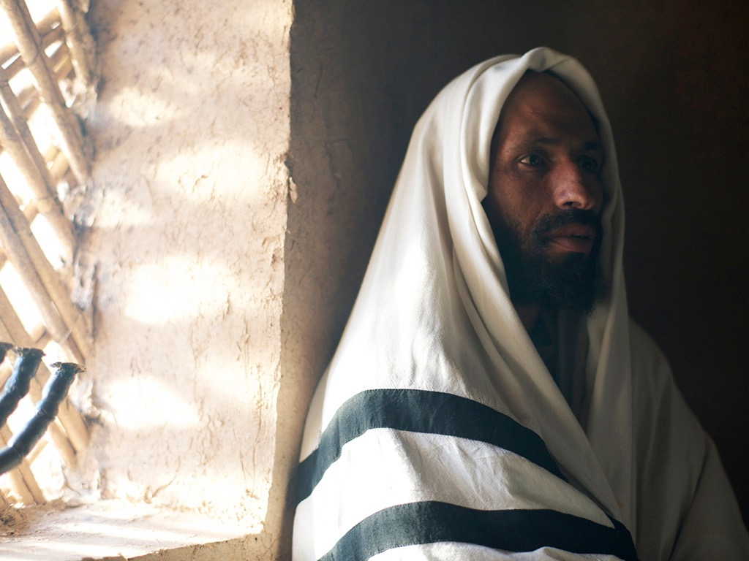

Slide 62
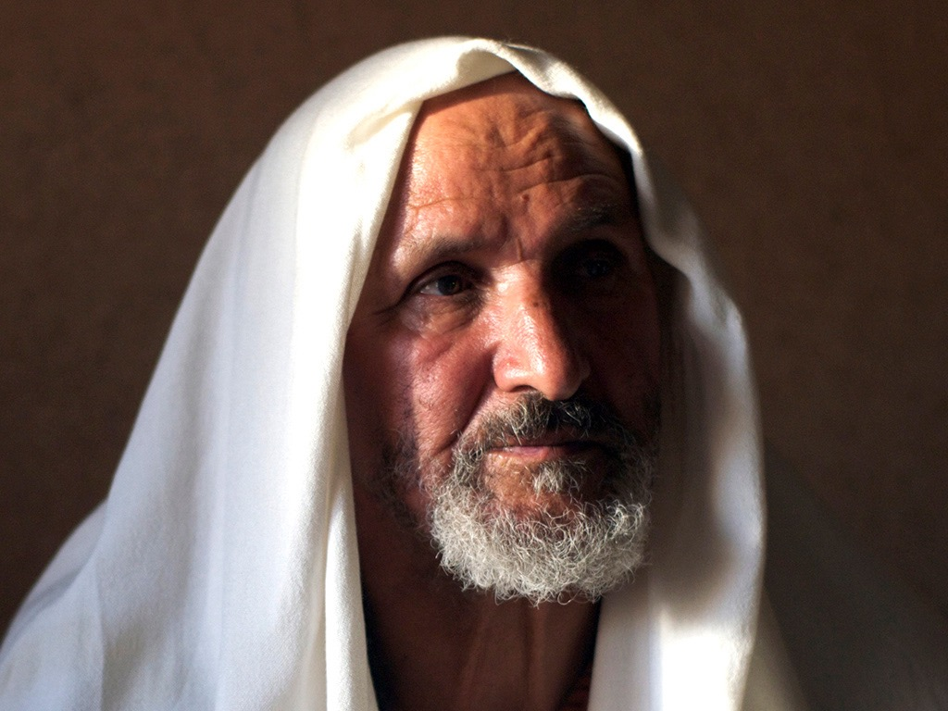

Slide 63
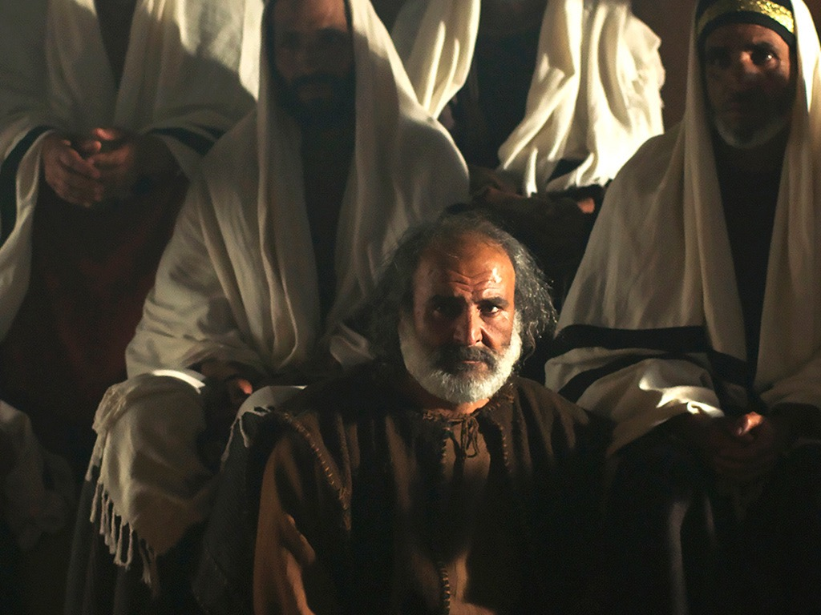

Slide 65


Slide 66
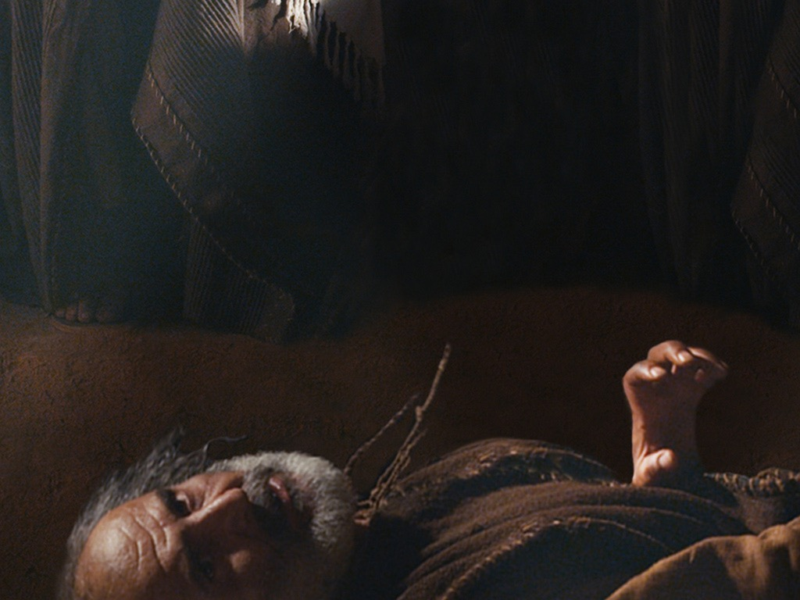

Slide 67
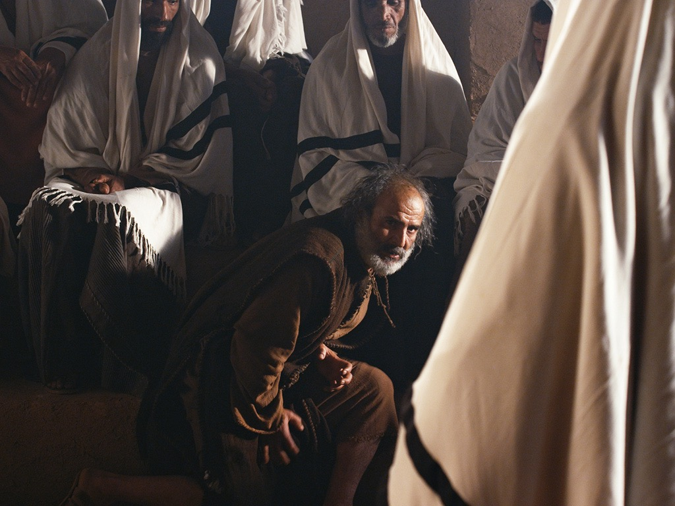

Slide 68
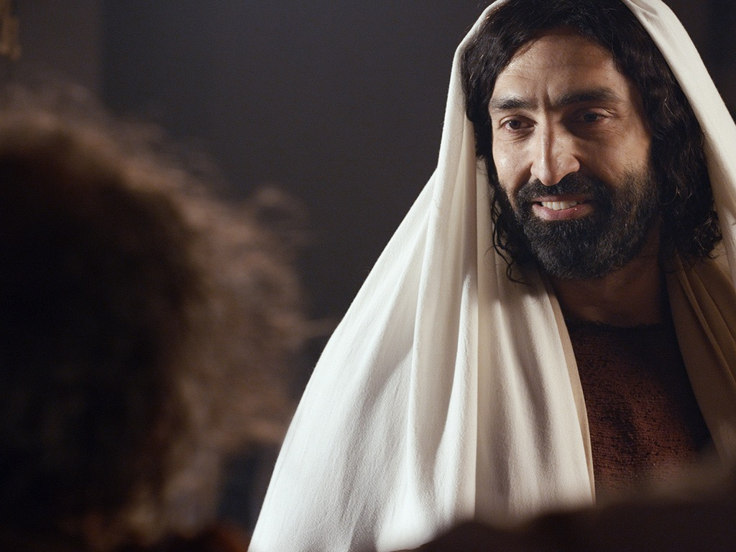

Slide 69
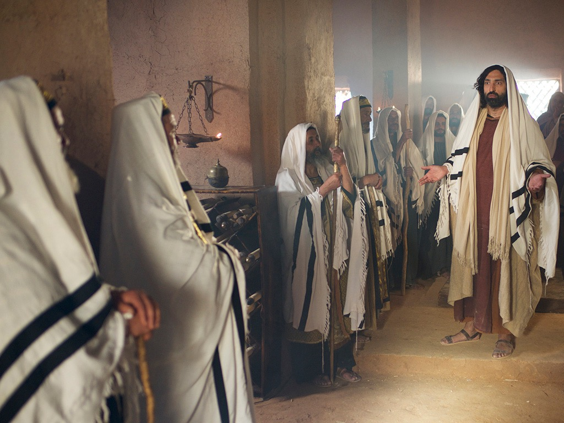

Slide 70
授权使用
马太福音
d
马可福音
o
路加福音
0
约翰福音
0
由Lumo Project出版独家资源，我们特此通知您我们不授权将这些图片发放给除freebibleimages.org客户以外的任何人。
所有图片不授权用于视频制作、epublishing或者其他媒体。所有下载的图片和文件不可通过除freebibleimages.org以外的其他网站传播，亦不可用于任何破坏基督信仰和福音的处境中。
o
图片仅供教育展示、博客和社交媒体使用；所有用途均需注明出处
www.LumoProject.com
图片声明 BBM
© 版权所有
www.bigbookmedia.com

Slide 71
7. Christ's Authority Over Sickness
§ 43
马太 8:14-17; 马可 1:29-34; 路加 4:38-41
Christ heals Peter's mother-in-law and other ill and demon-possessed persons to demonstrate His authority over sickness as Messiah, once again preventing demons from testifying of His divine nature lest people reject Him because the witness came from demonic forces

Slide 72
弥赛亚的权柄与权势
马太福音8–10
75
神迹与门训
(8:1–9:34)
赐下权柄与门徒
(9:35–10:42)
到了晚上，有人带着许多被鬼附的来到耶稣跟前，他只用一句话就把鬼都赶出去，并且治好了一切有病的人。
这是要应验先知以赛亚的话，说：他代替我们的软弱，担当我们的疾病。(马太. 8:16-17; cf.赛. 53:4)
耶稣叫了十二个门徒来，给他们权柄，能赶逐污鬼，并医治各样的病症。
(马太10:1)

Slide 73
8. Christ's Authority to Preach
§ 44
马太 4:23-25; 马可 1:35-39; 路加 4:42044
Christ's continued healings and compulsion to preach the good news that God had honored His covenant promises by sending Him to Israel is evidence that God Himself had commissioned Him to preach with divine authority as Messiah, this being confirmed by an ever widening sphere of ministry

Slide 74
9. Christ's Authority Over Defilement
§ 45
马太 8:2-4; 马可 1:40-45; 路加 5:12-16
Christ's immediate healing of the leper whose situation was completely hopeless substantiates His authority as Messiah in order to encourage an investigation of His person and claims before the Sanhedrin as a result of the leper's presentation of his healing to the priest in Jerusalem

Slide 75
10. Christ's Authority to Forgive Sin
§ 46
马太 9:1-8; 马可 1:41-45; 路加 5:17-26
Through healing the paralytic Christ maintains that as Messiah and God He has the authority to forgive sin

Slide 76
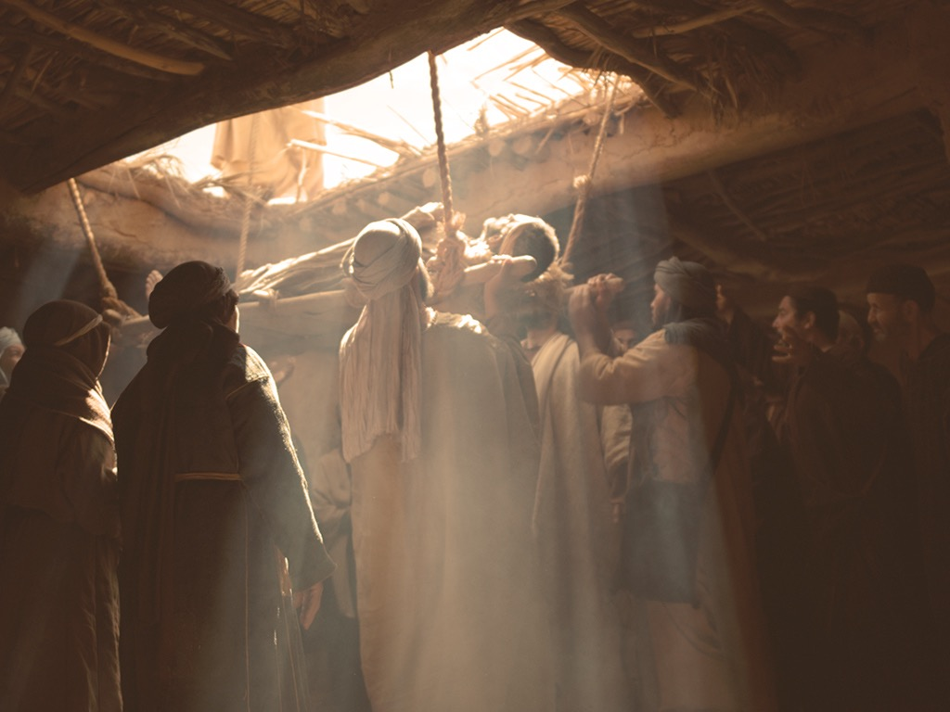
马可 2:2-12; 路加 5:17-26
耶稣原谅治愈瘫子

Slide 77
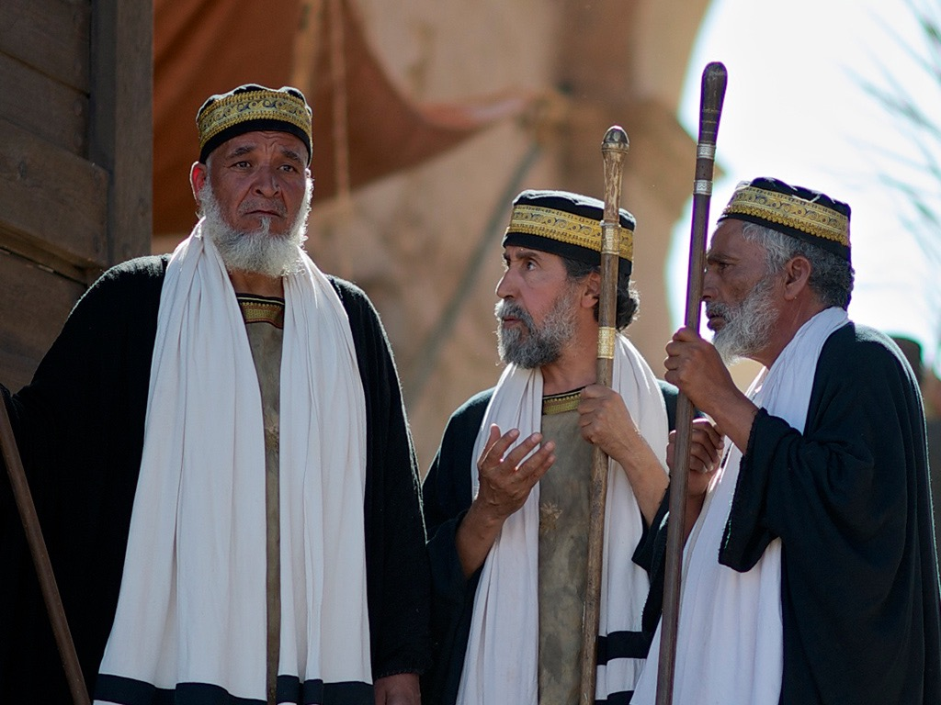

Slide 78
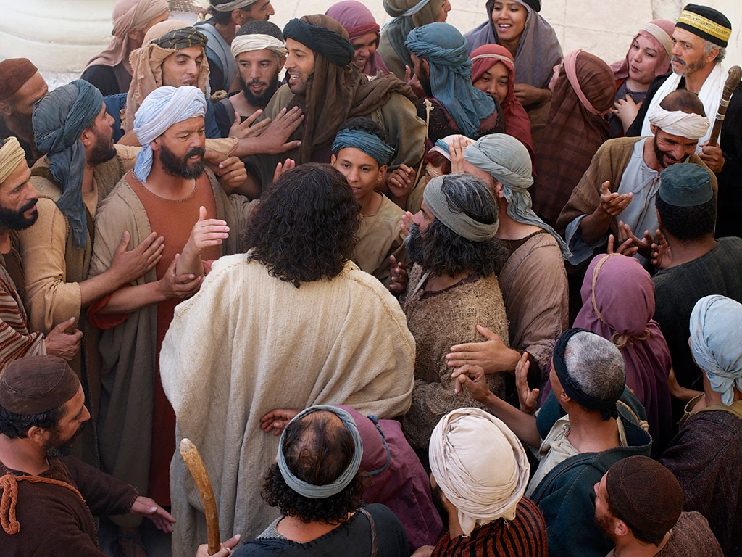

Slide 79
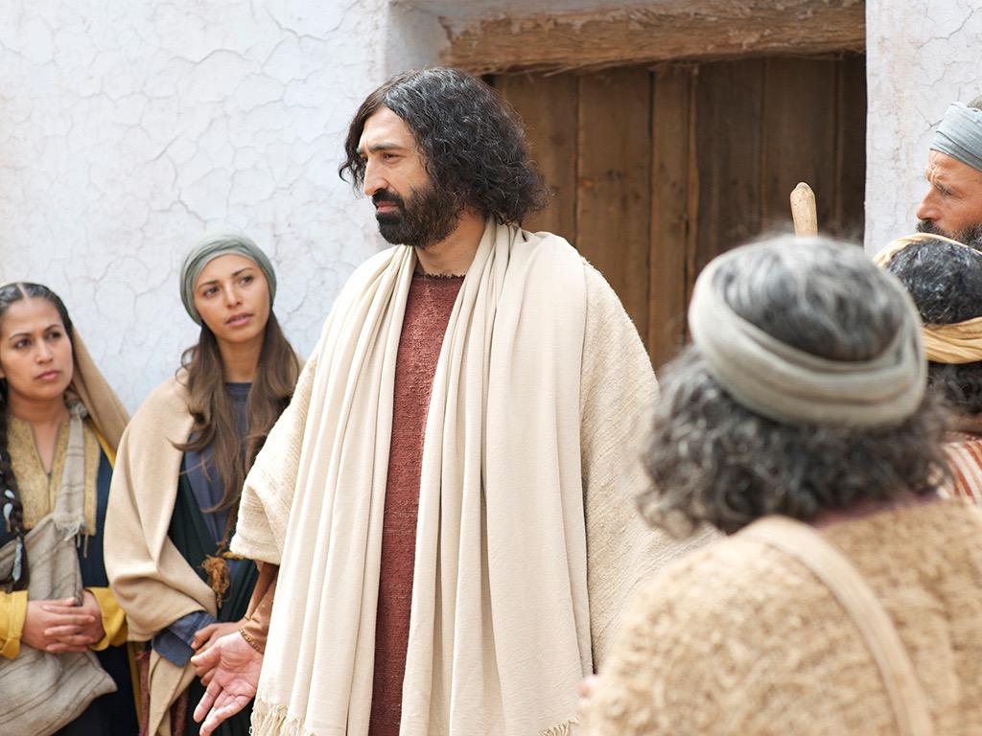

Slide 80
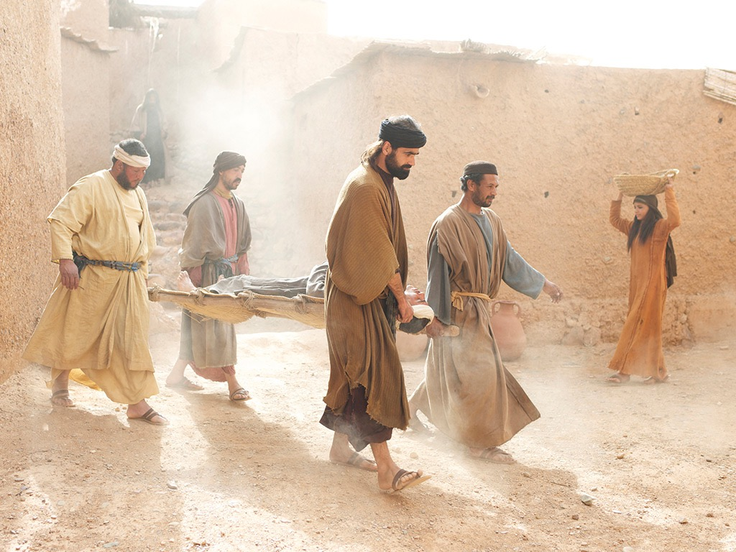

Slide 81
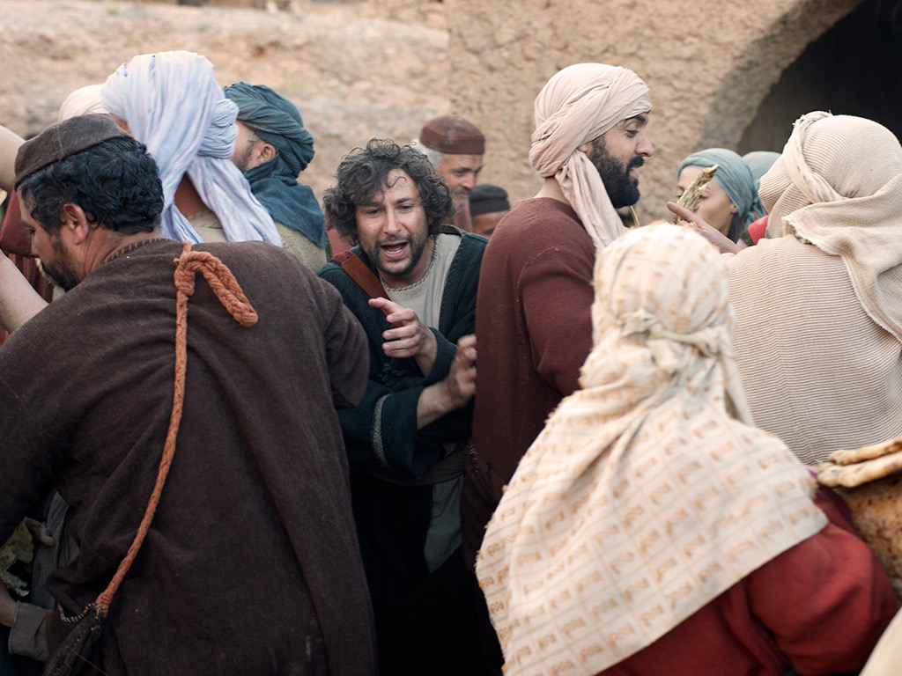

Slide 82
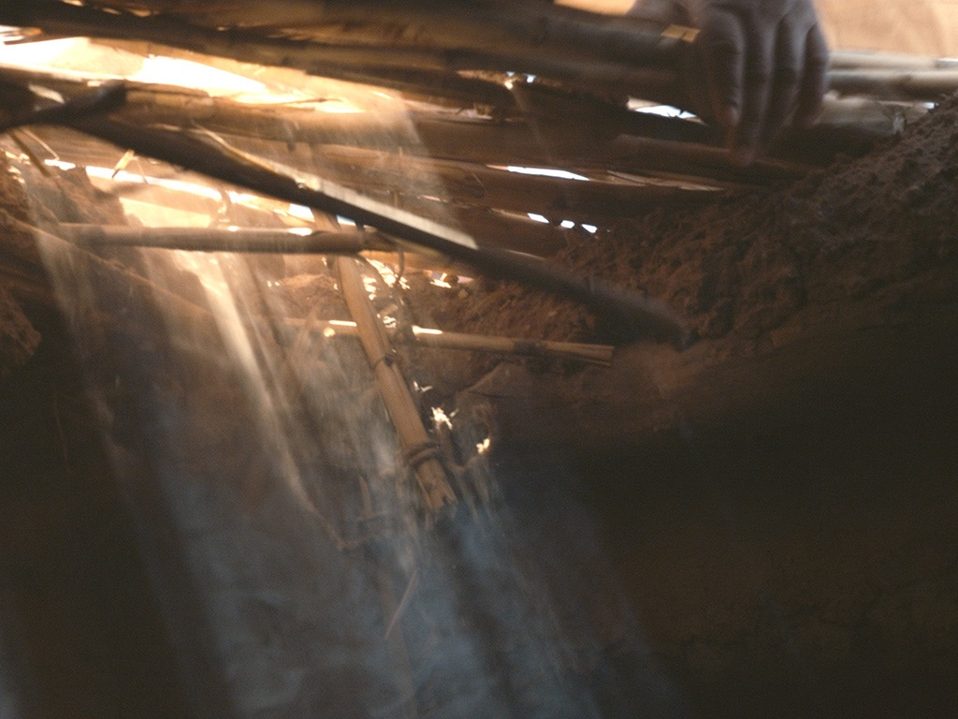

Slide 83
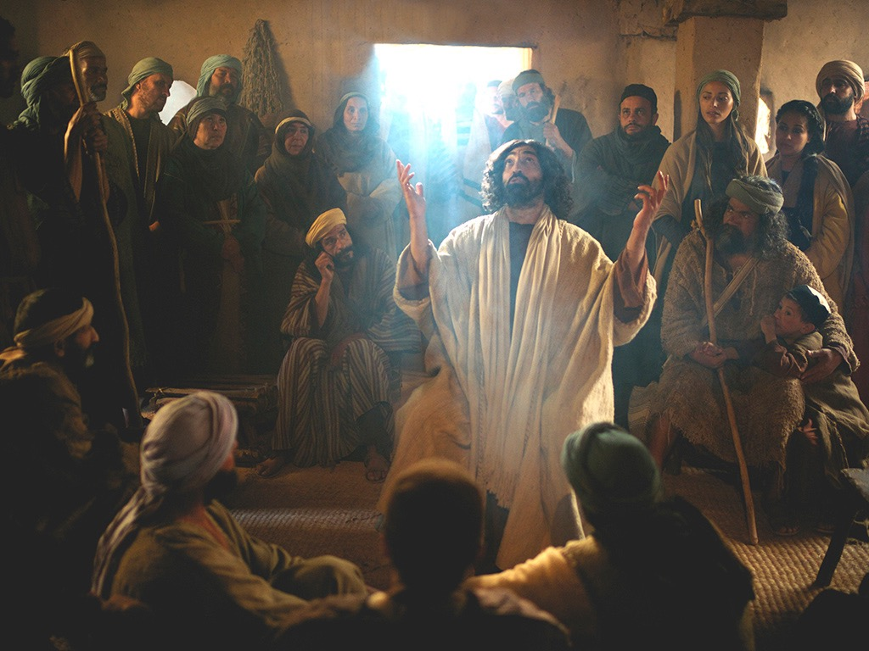

Slide 85
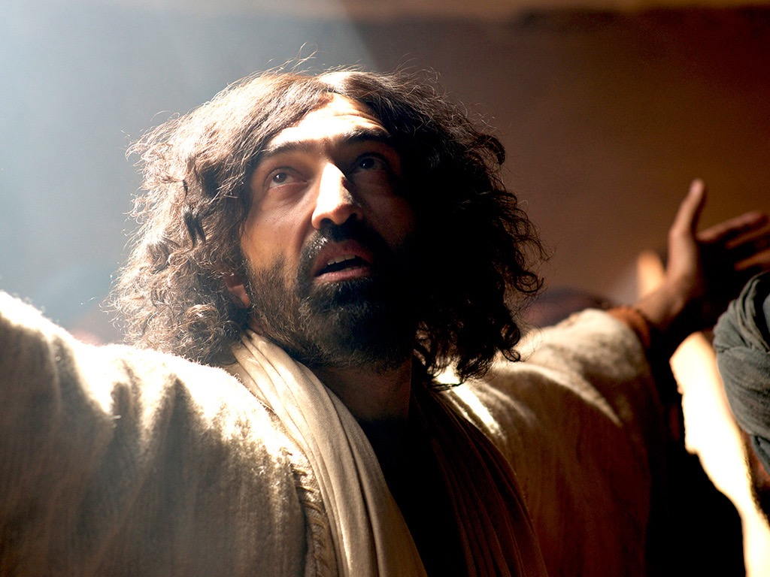

Slide 86
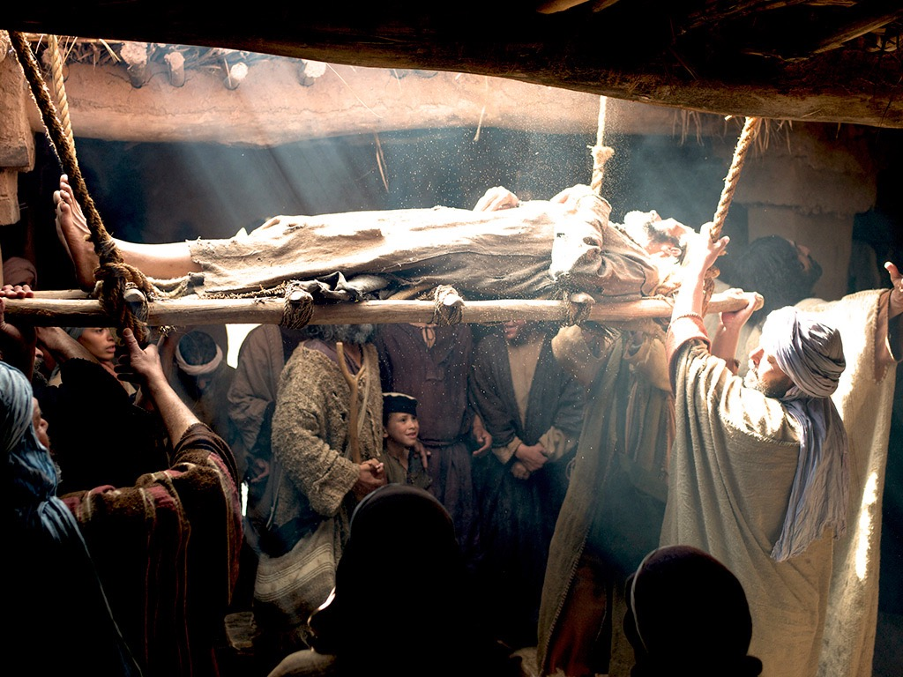

Slide 87
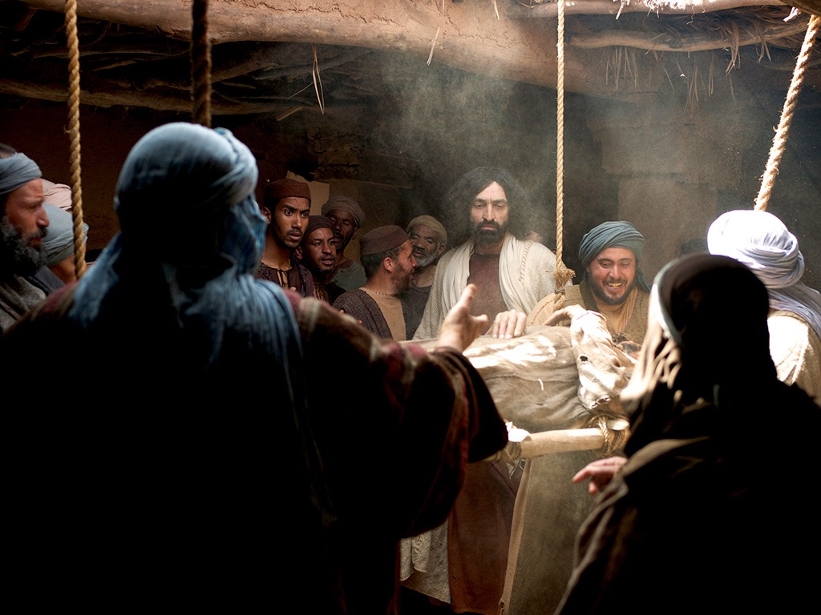

Slide 88
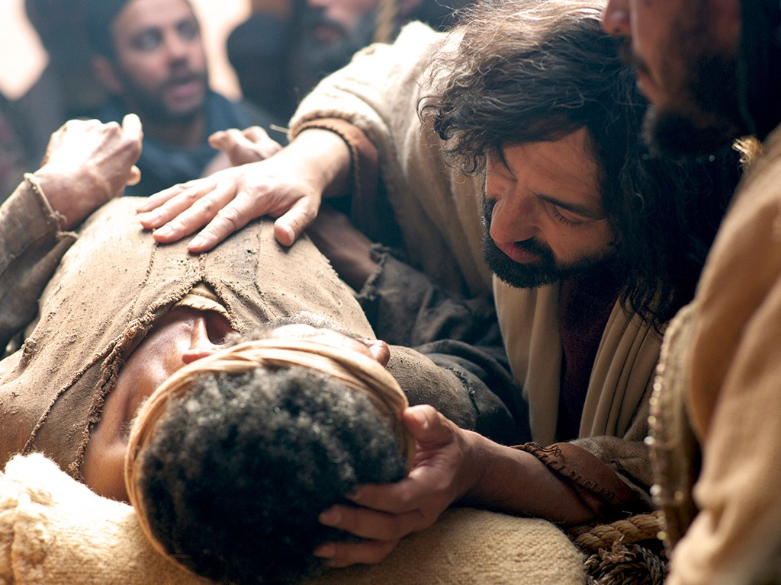

Slide 89
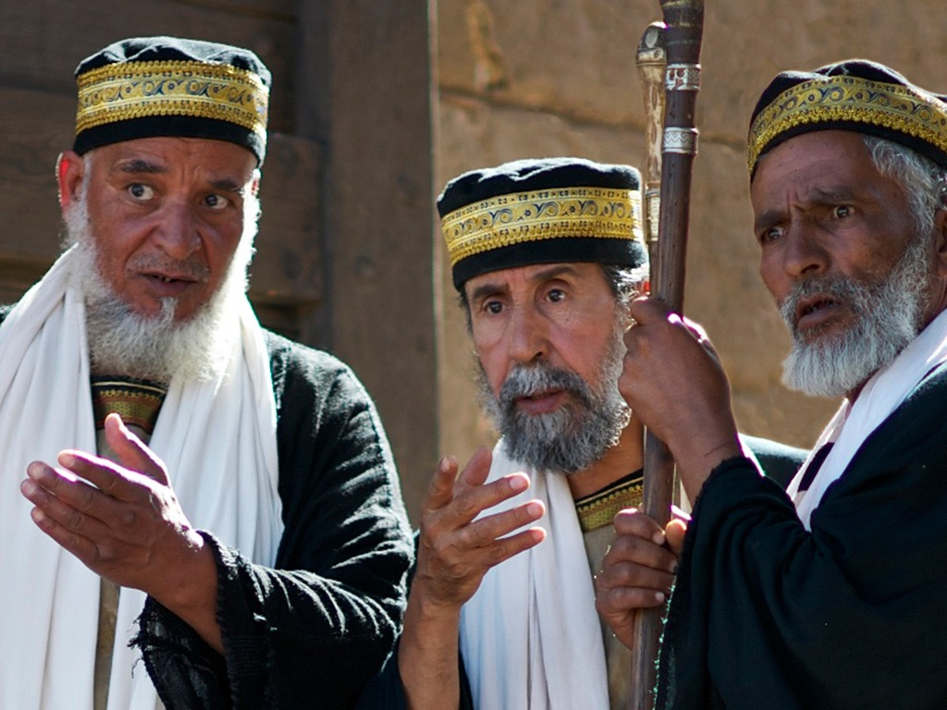

Slide 90
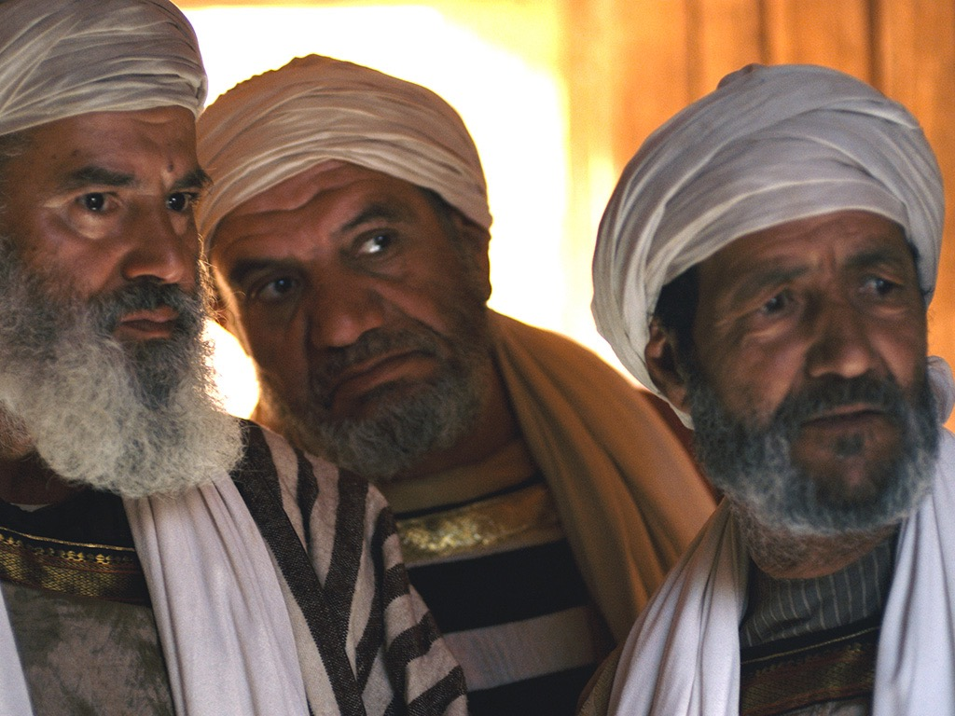

Slide 91
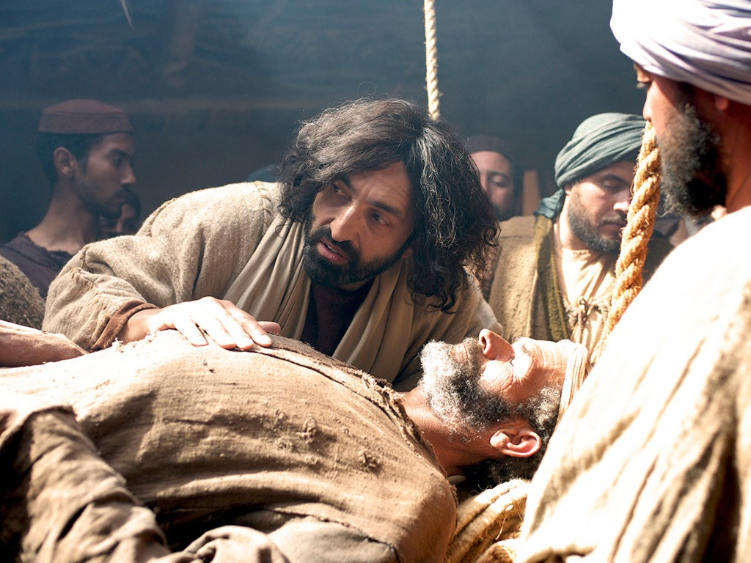

Slide 92
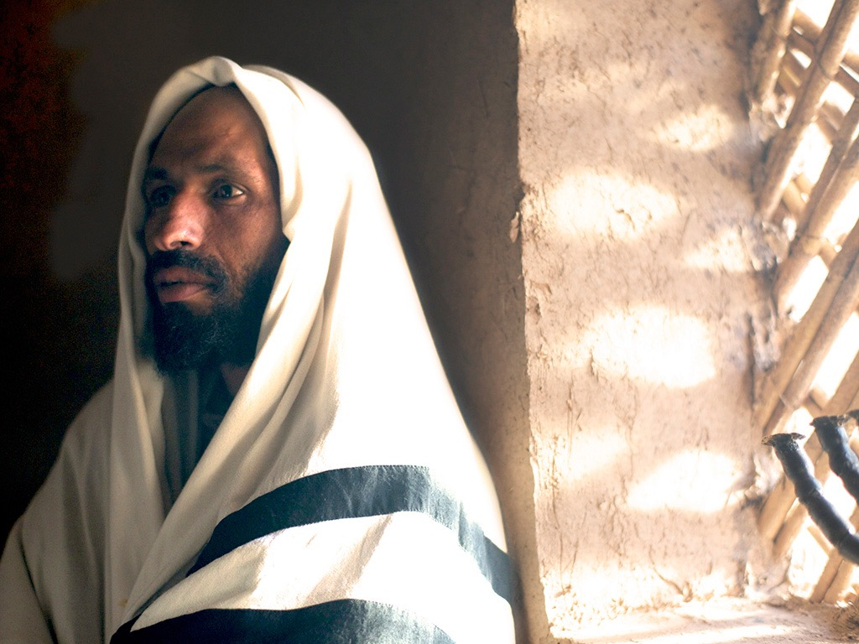

Slide 93
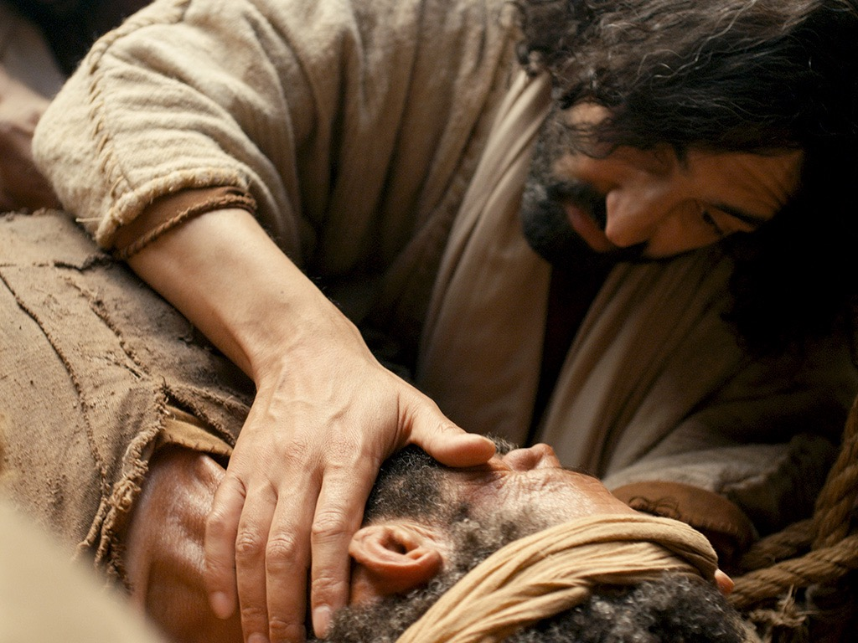

Slide 94
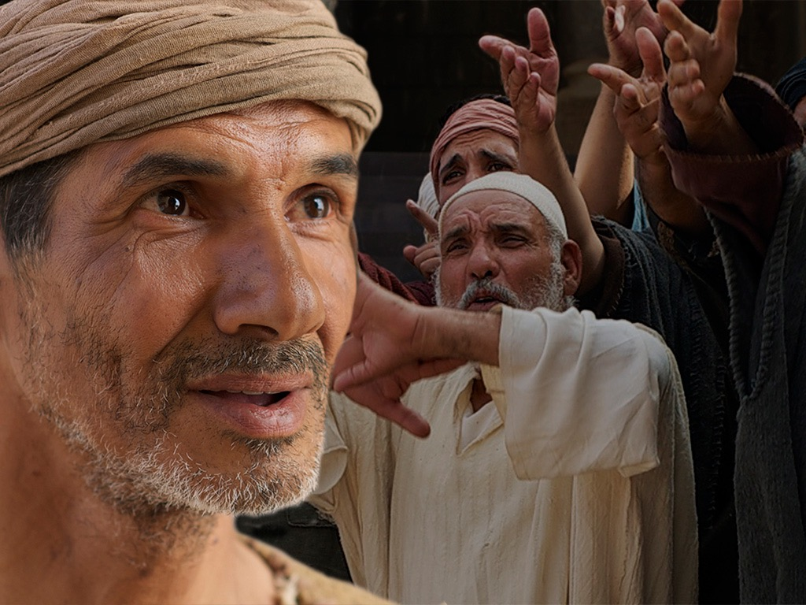

Slide 95
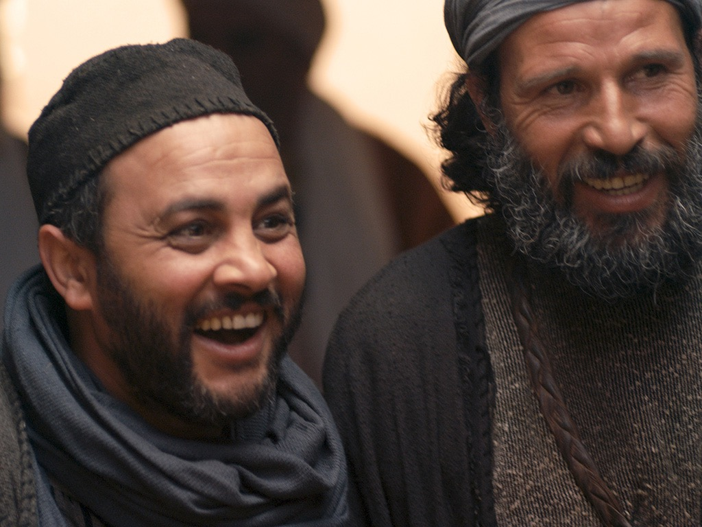

Slide 96
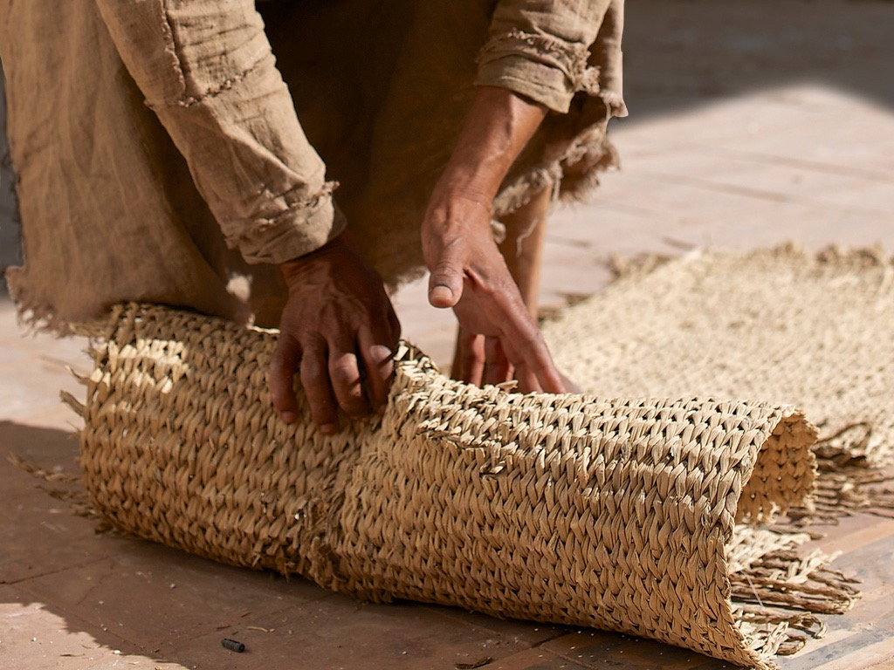

Slide 97
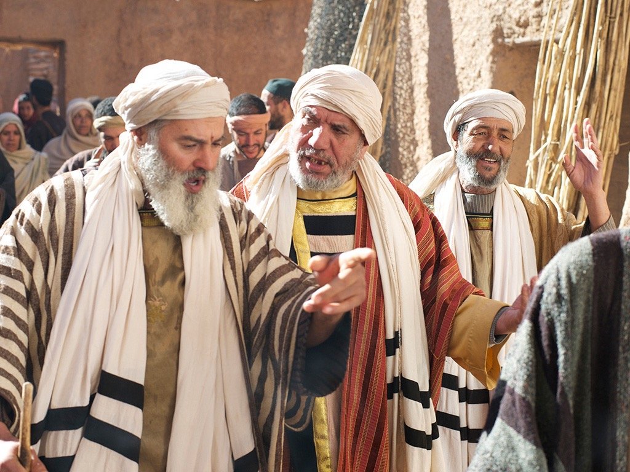

Slide 98
授权使用
马太福音
d
马可福音
o
路加福音
0
约翰福音
0
由Lumo Project出版独家资源，我们特此通知您我们不授权将这些图片发放给除freebibleimages.org客户以外的任何人。
所有图片不授权用于视频制作、epublishing或者其他媒体。所有下载的图片和文件不可通过除freebibleimages.org以外的其他网站传播，亦不可用于任何破坏基督信仰和福音的处境中。
o
图片仅供教育展示、博客和社交媒体使用；所有用途均需注明出处
www.LumoProject.com
图片声明 BBM
© 版权所有
www.bigbookmedia.com

Slide 99
11. Christ's Authority Over Men
§ 47
马太 9:9-13; 马可 2:13-17; 路加 5:27-32
The calling of 马太 from his tax-collector's booth demonstrates Jesus' Messianic authority over men and His acceptance of repentant sinners who, although rejected by society, were made righteous by faith in His person

Slide 100
12. Christ's Authority Over Tradition
§ 48
马太 9:14-17; 马可 2:18-22; 路加 5:33-39
In reply to a question why His disciples do not fast Christ declares His authority as Messiah over tradition by commencing a new system incompatible with the Pharisaical system

Slide 101
13. Christ's Authority Over the Sabbath
§§ 49-51
In two incidents of Sabbath healings and one defending the rights of His disciples Christ declares Himself as sovereign over the Sabbath institution due to His prerogatives as Israel's Messiah and demonstrates God's perspective of Sabbath work

Slide 102
a. Through the Healing of the Paralytic
§ 49
约翰 5:1-47
Christ heals the paralytic in order to verify His authority over the Sabbath as Messiah (Son of Man) and deity (Son of God), co-equal with the Father and the One on whom the Father had conferred His authority

Slide 103
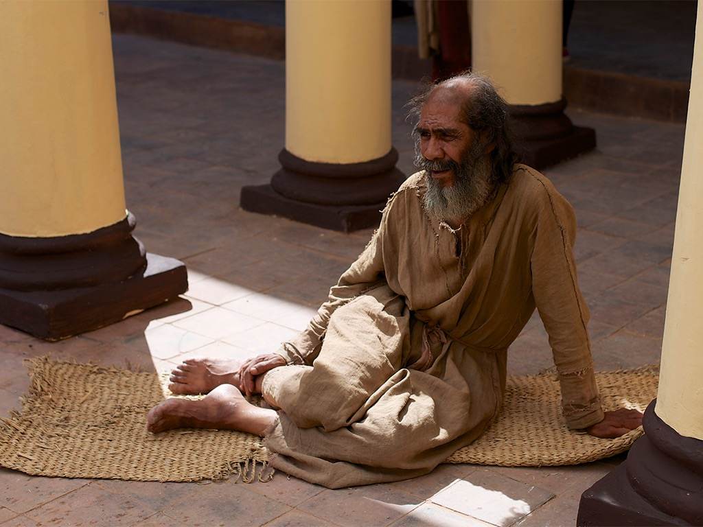
Free
Bible
images
约翰 5:1-30
JESUS AND THE LAME MAN
AT THE POOL OF BETHESDA

Slide 104


Slide 105


Slide 106


Slide 108


Slide 109


Slide 110


Slide 111


Slide 112


Slide 113


Slide 114


Slide 115


Slide 116


Slide 117


Slide 118


Slide 119


Slide 120


Slide 121
授权使用
马太福音
d
马可福音
o
路加福音
0
约翰福音
0
由Lumo Project出版独家资源，我们特此通知您我们不授权将这些图片发放给除freebibleimages.org客户以外的任何人。
所有图片不授权用于视频制作、epublishing或者其他媒体。所有下载的图片和文件不可通过除freebibleimages.org以外的其他网站传播，亦不可用于任何破坏基督信仰和福音的处境中。
o
图片仅供教育展示、博客和社交媒体使用；所有用途均需注明出处
www.LumoProject.com
图片声明 BBM
© 版权所有
www.bigbookmedia.com

Slide 122

约翰福音中七个神迹的重要性
119
神迹 | 关於永生的教导 | 应用
1.于迦拿变水为酒(2:1-11)* | 永生的喜乐 | 如果他可以变水为酒, 他一定可以改变我
2.于迦百农医治大臣的儿子 (4:46-54)* | 永生的情形 (信心) | 他的关怀永远环绕我
3.于耶路撒冷毕士大池子旁医治病了三十八年的人(5:1-18)* | 得着能力过永生 | 他的权柄永无极限
4.于加利利海边喂饱5,000人 (6:16-21) | 永生的粮食 | 耶稣能满足我们深深的需要
5.行走于加利利海的海面上 (6:5-14) | 永生的引导 | 耶稣是生命里风暴的主
6.于耶路撒冷医治生来瞎眼的 (9:1-7)* | 永生的真光 | 耶稣提供我们身心灵属灵的远见
7.于伯大尼叫拉撒路从死里复活 (11:1-45)* | 永生战胜死亡 | 耶稣掌控生死
Charles Ryrie, Ryrie Study Bible, 1618 (column 2); Mahlon Friesen, First Baptist Church of Yucaipa, CA (column 3).
* The asterisks indicate signs unique to 约翰's gospel.

Slide 123
b. Through the Controversy Over Grain
§ 50
马太 21:1-8; 马可 2:23-28; 路加 6:1-5
Christ defends His disciples' right to pick grain on the Sabbath through Old Testament Sabbath exceptions of necessity and worship in order to prove His authority over the institution and to demonstrate His deity since Israel's salvation depended upon faith in His person as Son of God

Slide 124
c. Through Healing the Man With the Withered Hand
§ 51
马太 12:9-14; 马可 3:1-6; 路加 6:6-11
Though the Pharisees seek to trick Christ into breaking the Sabbath, Christ demonstrates His authority over the day by healing a man's withered hand as an act of mercy in order to reveal the Pharisees' hypocrisy and to model the legitimacy of doing good on the Sabbath

Slide 125
14. Christ's Authority to Heal
§ 52
马太 12:15-21; 马可 3:7-12
Christ demonstrates authority to heal not only Jews but Gentiles as well, thus showing that as Messiah His ministry was one of compassion, gentleness and mercy to Gentiles in fulfillment of Isaiah 42:1-4

Slide 126
15. Commissioning of the Twelve
§ 53
马可 3:13-19; 路加 6:12-16
Following a night in prayer, Christ chooses from among the disciples twelve apostles to act as His authoritative representatives in His work

Slide 127
16. Christ's Authority to Interpret the Law
§§ 54-56
马太 5:1-7:29; 路加 6:17-42
In response to the crowds' interest regarding the nature of righteousness necessary to enter the kingdom Christ preaches the Sermon on the Mount to describe the holiness of God through teaching the characteristics of the kingdom's subjects, His relationship to the Law, and instruction to those who would enter the kingdom in order to discredit Pharisaic righteousness and to offer Himself as the sole basis for kingdom entrance

Slide 128

山上宝训
(马太福音介绍5–7)
请参阅NT讲道中1133张幻灯片的21 PPT演示

Slide 129


山上宝训
(马太福音5–7)
有史以来
最好的
宝训
Notes:
你可能已经注意到我的系列被称为“有史以来最好的布道”。也许你以为我完全失去了谦卑的感觉 - 但实际上，我在马太福音5-7中提到了基督的信息，这就是所谓的“山上的宝训”。

Slide 130

八福山(马太福音 5–7)
Notes:
如果您前往以色列，您今天可以访问这个实际的位置。这是一个美丽的环境。

Slide 131


八福山(马太福音 5–7)
Notes:
以色列称它为“八福山”，尽管这只描述了这篇布道的前12个经文。 •同样，纪念这个活动的小教堂被称为“八福圣堂”。

Slide 132

天上人间(马太福音 5–7)
Notes:
但是，耶稣在这三章中实际上说了些什么？

Slide 133

宣道的目的(马太福音 5–7)
如何得救?
得救的理论?
Notes:
但是，耶稣在这三章中实际上说了些什么？

Slide 134

当耶稣是君王时…
(马太福音 5–7)
如果基督果真是你生命中的王，你的生活会是什么样子呢?
Notes:
所有这些东西都支持讲道的主要教导，它显示了耶稣是我们生命中的王者时的生活。

Slide 135
回归本源(马太福音 5:21-48)
"你
听
人
说
过
…"
6议题:
"但
我
告
诉
你
…"
谋杀
通奸
离婚
誓言
复仇
敌人
上帝
的意念
法利赛的教导
外在的纯洁不会
进入王国(20)
Notes:
在这里，我们看到“耶稣拒绝了法利赛人的传统（21-48节）......耶稣说了六次，”你听说有人说过。 ......但我告诉你们“（5：21-22,27-28,31-32,33-34,38-39,43-44）。这些话清楚地表明，耶稣提出了（a）守律法的法利赛人和教师正在向人们说什么话，而相反的，（b）上帝真正的律法意图是什么，这说明他的言论（第20节）法利赛义不足以进入即将来临王国“（(Barbieri, BKC, 2:30).

Slide 136
a. The Subjects of the Kingdom
§ 54
马太 5:1-16; 路加 6:17-26
Those who would enter Messiah's kingdom must evidence a righteousness surpassing Pharisaical observances to demonstrate a Godly character and influence befitting the righteous kingdom Christ offered

Slide 137

"我告诉你们，你们的义若不胜过经学家和法利赛人的
义，就必不能进天国。"
(5:20 CNV).
Notes:
This spelled out His statement (v. 20) that Pharisaic righteousness is not enough to gain entrance into the coming kingdom" (Barbieri, BKC, 2:30).

Slide 138
(1) Introduction
马太 5:1-2; 路加 6:17-19
Christ describes the characteristics and influence of a righteous man that His hearers might know the type of person who would enter the kingdom

Slide 139
(2) The subjects
马太 5:3-16; 路加 6:20-26
Christ describes the characteristics and influence of a righteous man that His hearers might know the type of person who would enter the kingdom

Slide 140
(a) Their character
马太 5:3-12; 路加 6:20-26
The Beatitudes describe the characteristics of the righteous person and the basis of blessing in one's life that the hearers might know the 马可s of a righteous person and experience a happy life resulting from holiness

Slide 141

How to Be Happy in the Beatitudes
Notes:
Published on Apr 7, 2015
We all want to be happy. The question is, “How do we make that happen?” Explore a nonconventional path to true happiness.
Time elapsed is 2:26
https://www.youtube.com/watch?v=wxWCspyE7lg
Accessed 24 Jan 2016

Slide 142

The Revelation of the King (Matt 1–10)
His
Person
(Matt 1–4)
His Principles
(Matt 5–7)
His
Power
(Matt 8–10)
Warren W. Wiersbe, Be Loyal: Following the King of Kings, 15
Notes:
Matt 5–7 gives His principles—the Sermon on the Mount shows the lifestyle that his subjects should show.
• Matt 8–10 reveals His power—the authority of King Jesus over nature, sickness, demons, and actually everything!

Slide 143

Are Beatitudes LAWS on how you get into the kingdom (eternal life)?
Notes:
The purpose of the Sermon on the Mount has been debated. What are these chapters about?

Slide 144


Purpose of the Sermon (马太 5–7)
A way to be saved?
A charter for world peace?
A model for the millennium?
An ethic for believers now?
Notes:
For these 20 Sundays we're digging into this most significant sermon ever. But what was Jesus actually saying in these three chapters?

Slide 145
当耶稣是君王时…
(马太福音 5–7)
如果基督果真是你生命中的王，你的生活会是什么样子呢?
Notes:
所有这些东西都支持讲道的主要教导，它显示了耶稣是我们生命中的王者时的生活。

Slide 146
Beatitudes
POOR IN SPIRIT
MOURN
MEEK
HUNGER & THIRST FOR RIGHTEOUSNESS
MERCIFUL
PURE OF HEART
PEACEMAKERS
PERSECUTED
Notes:
Each first statement has these traits:
It shows a condition in which God blesses—when God adds a special measure of his grace so that we are better off than before.
That condition is an undesirable state—something people typically avoid.
Each first statement relates to character traits—something people typically also do not seek. Instead, we seek money, happiness, health, influence or power and so-called success.
"The qualities Jesus mentioned in this list, 'the poor in spirit,' 'those who mourn,' 'the meek,' etc., obviously could not be products of Pharisaic righteousness. The Pharisees were concerned primarily with external qualities, but the qualities Jesus mentioned are internal. These come only when one is properly related to God through faith, when one places his complete trust in God" (Louis A. Barbieri, Jr., "马太," in BKC, 2:29).

Slide 147

Beatitudes
Notes:
Each second statement also is parallel with one another in some ways:
Each second statement is the way God blesses us in a way parallel to the first statement—but it is upside down in nature—not what you'd expect!

Slide 148
…for they…
…for theirs is the kingdom of heaven
will be comforted
will inherit the earth
will be filled
will be shown mercy
will see God
will be called sons of God
…for theirs is the kingdom of heaven
Notes:
It is also something we typically do not seek—
However, this condition is what we really need!
In fact, it's also what we really want.

Slide 149

Results of believing in Christ (1-11)
What to do about these results (12)
Notes:
With that introduction, today we'll see the benefits or results of believing in Christ, followed by what to do about these results.
So how can you get blessed in life? It is found by faith or trust in God. In other words…

Slide 150

How can you get blessed in life?
Website
Notes:
How can we sum up the way to be blessed in 5:1-12?

Slide 151

Believer attitudes bring blessing
(Main Idea).
Notes:
God rewards us not for our actions but first in our attitudes that produce good deeds.

Slide 152
当耶稣是君王时…
(马太福音 5–7)
如果基督果真是你生命中的王，你的生活会是什么样子呢?
Notes:
所有这些东西都支持讲道的主要教导，它显示了耶稣是我们生命中的王者时的生活。

Slide 153

I. You get blessed by believing (5:1-11)!
Notes:
Those who trust Christ as King experience many rewards.

Slide 154

II. Be glad to suffer for Christ (5:12)!
Notes:
Rejoice over being persecuted.

Slide 155
(b) Their influence
马太 5:13-16
The influence of a righteous person creates a thirst for God in others by revealing God's righteousness, exposing sin and attracting them to the Lord

Slide 156

How can we bless others?
Salt & Light

Slide 157

Direct others to God.
Main Idea

Slide 158

Direct others to God.
Main Idea
Notes:
Influence people to follow God (MI restated).
Impact others for good (MI restated).
Show people God (MI restated).

Slide 159

I. Help people hunger for God (13).
Subtitle
Notes:
Like salt, help people hunger for God (5:13).

Slide 160

II. Lead people to God so they'll praise him (5:14-16).
Subtitle
Notes:
Like light, lead people to God so they’ll praise him (5:14-16).

Slide 161

Be involved…
"Both metaphors of salt and light raise important questions about Christian involvement in society regarding all forms of separatism or withdrawal. We are not called to control secular power structures; neither are we promised that we can Christianize the legislation and values of the world. But we must remain active preservative agents, indeed irritants, in calling the world to heed God's standards. We dare not form isolated Christian enclaves to which the world pays no attention."
Craig Blomberg, 马太, NAC (Nashville: Broadman, 1992), 103

Slide 162
b. The Relation of the King to the Law
§ 55
马太 5:17-7:6; 路加 6:27-42
As fulfiller of the law Christ rejects the Pharisaic interpretations and practices of the law that the disciples might know the proper type of righteousness necessary to enter the kingdom

Slide 163
(1) The Fulfiller
马太 5:17-20
Christ declares Himself as the fulfiller of all that the law and prophets required and denies that Pharisaic righteousness has any saving value since the Pharisees misconstrued the law's original intent

Slide 164
(2) Rejection of traditional interpretation of the law
马太 5:21-48
Christ provides six illustrations how the Pharisees misconstrued the real intent of the law in their interpretations which did not fulfill the righteousness demanded by the law to instruct why Pharisaic righteousness is not able to bring one into the kingdom and to teach that the second table of the law demanding proper conduct towards others should also be followed

Slide 165
(a) Murder
马太 5:21-26
One surpassing Pharisaic righteousness will not only preserve life but will avoid the anger, hatred and unreconciled relationships which eventually lead to murder

Slide 166

How can you sustain great relationships?

Slide 167

I. Watch your anger (21-22).

Slide 168

II. Watch your worship (23-24).

Slide 169

III. Watch your money (25-26).
Notes:
The one hurt for not resolving a financial relationship is you

Slide 170
(b) Adultery
马太 5:27-30
One surpassing Pharisaic righteousness will not only be faithful to his spouse but avoid the lustful desires which cause adultery and will remove the causes of lust in his life

Slide 171
(c) Divorce
马太 5:31-32
One surpassing Pharisaic righteousness will not only never divorce his wife without legal documentation but will never divorce his wife at all lest this cause her and her future husband to both commit adultery when she remarries

Slide 172

How can you defend marriage?
• 2 ways
Notes:
We know that God has a high view of marriage, but how can you defend marriage?
So what's the first way that you can defend marriage?

Slide 173

I. Don't let marriage be devalued (Matt 5:31).
Notes:
Don't let it be devalued, but now we see one of the most important ways to preserve it in the next verse…

Slide 174

II. Defend marriage against adultery (Matt 5:32).
Notes:
The way to preserve the marital union is by keeping sex within marriage.

Slide 175
(d) Oaths
马太 5:33-37
One surpassing Pharisaic righteousness will not only take oaths when affirming something which could be taken in more than one way but will have trustworthy speech at all times so oath-taking becomes unnecessary

Slide 176
(e) Retaliation
马太 5:38-42
One surpassing Pharisaic righteousness will not demand his right for retaliation but give up such rights as a characteristic of righteousness and godliness

Slide 177
(f) Love
马太 5: 43-48; 路加 6:27-30, 32-36
One surpassing Pharisaic righteousness will not only love his neighbor who will repay favors but will love his enemy as well who will never repay favors

Slide 178

Enemies: The How and Why
How to treat your enemy (43-44)
Why treat your enemy like that (45-48)
Notes:
Today we’ll see how to treat your enemy and then why you should treat this person that way.

Slide 179

I. Love and pray for your enemy (5:43-44).
Notes:
In verses 43-44, Jesus said to love and pray for that enemy of yours! But why bless your enemy? What could be the reason for blessing your enemy like that? Why would you follow such a counterintuitive practice to actually treat your enemy with a blessing? This is because…

Slide 180

II. Blessing your enemy shows Christ's higher law (5:45-48).
Notes:
Loving and praying for that rival shows God’s doing his good work in you.

Slide 181
(3) Rejection of the Pharisaic practices of the law
马太 6:1-7:6; 路加 6:37-42
Christ provides six illustrations how the Pharisees misconstrued the real intent of the law in their practices which did not fulfill the righteousness demanded by the law to instruct why Pharisaic righteousness is not able to bring one into the kingdom since their hypocritical practices were directed man-ward for a reputation of piety rather than God-ward in true righteousness

Slide 182
并行结构（马太福音6）
捐献
(1-4)
祷告
(5-15)
禁食
(16-18)
伪君子(2)
伪君子(5)
伪君子(16)
公开出示(1-2)
公开出示(5)
公开出示(16)
人类的奖励(2)
人类的奖励(5)
人类的奖励(16)
秘密(4)
秘密(6)
秘密(18)
天父看得见(4)
天父看得见(6, 8)
天父看得见(18)
Notes:
“在所有三个法利赛义的例子 - 施舍（1-4节），祈祷（5-15节）和禁食（16-18节） - 耶稣说到伪君子（第2节， 5,16），公开炫耀（1-2,5,16），当他们的行为在人类面前完成时，他们已得到应有的赏赐（第2,5,16节），秘密行的事件（第4节，第6节，18），当天父看到或‘知道’他的行为是秘密完成时，他会得到赏赐（第4，6，8，18节）“
(Barbieri, BKC, 2:33).

Slide 183
给予正义的奖励(马太福音 6:1–7:6)
这不能
做…
另 6 项议题:
这能做…
给予
祷告
禁食
投资
信托
批判
法 利 赛
的 推 行
纯 洁 的
实 践
“当心！不要公开你的善行，让别人钦佩你，因为你会失去你在天上的天父所要给你的报酬" (6:1 NLT)
Notes:
•与法利赛人的虚伪教义相反......
•耶稣以自己的人生榜样作为自己谦卑的教导。
•在马太福音7：1-7：6中，耶稣讲述了生活中的六个领域：给予，祷告，禁食，投资，信任（不担心）和谦卑（不是判断）。
•这些领域中的每一个都表明，宗教领袖们仅仅以7：1的形式警告他们只为公开展示做好他们的工作。

Slide 184
(a) Almsgiving
马太 6:1-4
The Pharisaical practice of public almsgiving is repudiated for being performed to demonstrate piety rather than to demonstrate the love of God by meeting a need

Slide 185
(b) Prayer
马太 6:5-15
The Pharisaical practice of public prayer for human approval is repudiated for being performed to demonstrate piety and private prayer is encouraged which includes worship, supplication for God's work and personal needs, confession, prayer for protection and a forgiving spirit

Slide 186
(c) Fasting
马太 6:16-18
The Pharisaical practice of public fasting is repudiated for being performed to demonstrate piety rather than done privately before God to receive reward only from Him

Slide 187
(d) Attitude toward wealth
马太 6:19-24
The Pharisaical practice of accumulating wealth as a sign of God's approval is repudiated for being only temporary and making eternal investments is encouraged since they last into eternity and cannot be lost

Slide 188
(e) Lack of faith
马太 6:25-34
The Pharisaical practice of lack of faith demonstrated in trusting accumulated money is repudiated by an encouragement not to worry about food and clothing at all but to trust in God's daily provisions as one seeks the kingdom's arrival

Slide 189
(f) Judging
马太 7:1-6; 路加 6:37-42
The Pharisaical practice of setting themselves up as judges and as the standard of judgment is repudiated for being performed by claiming knowledge of the motive behind the action whereas God's righteousness demanded that one not judge until his own life has been purified

Slide 190
c. Instruction to Those Who Would Enter the Kingdom
§ 56
马太 7:7-29
Christ knew that, in spite of the Pharisees' rejection, some would receive His teaching and would want to know how to enter the kingdom so He instructs those who desire to enter the kingdom in some pertinent areas

Slide 191
(1) Prayer
马太 7:7-11
Persistent prayer will be answered because of God's nature as a Father whose responsibility it is to make sure His children's needs are met, not because of the endless repetitions characteristic of the Pharisees

Slide 192
(2) True righteousness
马太 7:12; 路加 6:31, 43-45
Treating others as one desires to be treated himself demonstrates true righteousness

Slide 193
(3) The way of access
马太 7:13-14
The invitation to receive Christ and enter the kingdom is given by declaring that He alone is the true, narrow way of access, not the false, broad way of the Pharisees which ultimately ended in exclusion from the kingdom and destruction

Slide 194
(4) Warning to false teachers
马太 7:15-23
The Pharisees are false prophets demonstrated by their unrighteous lifestyles and will be judged because, while outwardly they fulfilled the requirements of the law, inwardly they lacked the relationship with the King which was the requisite for entrance into the kingdom

Slide 195
(5) The two foundations
马太 7:24-8:1; 路加 6:46-49
Another invitation to reject Pharisaism and accept Christ is given in a contrast between one who accepts the King's word and trusts His person and one who rejects His words and person, thus revealing that the destiny of those who hear Christ's words would be determined by their response to His message

Slide 196
17. Recognition of Christ's Authority in Capernaum
§ 57
马太 8:5-13; 路加 7:1-10
Christ's authority over sickness is demonstrated in healing the centurion's servant at a distance merely by His spoken word, thus illustrating the extension of the message of salvation to Gentiles in response to Israel's rejection

Slide 197
弥赛亚的权柄与权势
马太福音8–10
75
神迹与门训
(8:1–9:34)
赐下权柄与门徒
(9:35–10:42)
到了晚上，有人带着许多被鬼附的来到耶稣跟前，他只用一句话就把鬼都赶出去，并且治好了一切有病的人。
这是要应验先知以赛亚的话，说：他代替我们的软弱，担当我们的疾病。(马太. 8:16-17; cf.赛. 53:4)
耶稣叫了十二个门徒来，给他们权柄，能赶逐污鬼，并医治各样的病症。
(马太10:1)

Slide 198
18. Recognition of Christ's Authority in Nain
§ 58
路加 7:11-17
Christ proves His authority over death in the restoration of life to the son of a widow in Nain, bearing additional testimony to His Messianic identity

Slide 199
19. Witness of the Twelve
§ 59
马太 9:35-11:1; 马可 6:6b-13; 路加 9:1-6
Christ delegates His Messianic authority by sending out the twelve apostles with authority over demons, sickness and disease and a commission to preach that the kingdom is near

Slide 200
弥赛亚的权柄与权势
马太福音8–10
75
神迹与门训
(8:1–9:34)
赐下权柄与门徒
(9:35–10:42)
到了晚上，有人带着许多被鬼附的来到耶稣跟前，他只用一句话就把鬼都赶出去，并且治好了一切有病的人。
这是要应验先知以赛亚的话，说：他代替我们的软弱，担当我们的疾病。(马太. 8:16-17; cf.赛. 53:4)
耶稣叫了十二个门徒来，给他们权柄，能赶逐污鬼，并医治各样的病症。
(马太10:1)

Slide 201

马太 10
Commissioning
12
Disciples
Adapted from a Class Presentation by No Pum for
Dr. Rick Griffith • Singapore Bible College • BibleStudyDownloads.org

Slide 202
Outline
I. Theme of the Book
II. Context of the Passage
III. An Exposition of the Passage
IV. Homiletical Conclusion

Slide 203
I. Themes of the Book
A. Jesus in 马太
B. The Kingship of Jesus
in 马太 10

Slide 204

Jesus in 马太
The Hope of Israel,
long-awaited Messiah
Blessing for Gentile alike
The legitimate King & Ruler
Craig L. Blomberg. pp. 202

Slide 205
The Kingship of Jesus in 马太 10
Jesus
?
Matt 10:1,
“…give them
authority to…”
authority
command
The right to control or command, authority,
absolute power, warrant.
power exercised by rulers or others in
high position by virtue of their office,
ruling power, official power.
The right to control
absolute power
power exercised by rulers
high position
Bible background commentary : New Testament . InterVarsity Press: Downers Grove, Ill.Keener, C. S., & InterVarsity Press.
1993. The IVP
BibleWorks 6

Slide 206
II. Context of the passage
The Bridge
Division of the Passage
The Immediate Context
of the Passage

Slide 207


The Bridge (Matt. 9:36-10:4)
The harvest
is
plentiful
But the workers are few
Craig L. Blomberg. Jesus and the Gospel: Additional Teaching of Jesus, pp. 285

Slide 208
The Immediate Context of the
Passage
9:36: But when he saw the multitudes, he was moved with compassion for them, because they were distressed and scattered, as sheep not having a shepherd.
9:37: Then saith he unto his disciples, The harvest indeed is plenteous, but the laborers are few.
9:38: Pray ye therefore the Lord of the harvest, that he send forth laborers into his harvest.
10:1 And he called unto him his twelve disciples, and gave them authority over unclean spirits, to cast them out, and to heal all manner of disease and all manner of sickness. (ASV)

Slide 209
An Immediate Context of the Passage
9:36
But when he saw the multitudes, he was moved with compassion
for them because they were distressed and scattered, as sheep
not having a shepherd.
Then saith he unto his disciples,
The harvest indeed is plenteous, but the laborers are few.
9:37
Pray ye therefore the Lord of the harvest,
that he send forth laborers into his harvest.
9:38
Chapter Ten
10:1
And he called unto him his twelve disciples, and gave them
authority over unclean spirits, to cast them out, and to
heal all manner of disease and all manner of sickness. (ASV)

Slide 210
Division of the Passage:10:5-42
Context:9:36-10:4
vv. 5-16
vv. 17-42
Introductions
For
Ministry
During
Jesus
Life’s time
Looking ahead for coming persecution,
circumstances
after His death
&
Resurrection
Craig L. Blomberg. Jesus and the Gospel: Additional Teaching of Jesus, pp. 285

Slide 211
III. An Exposition of the passage
The Previous Call of Disciples
The re-gathering of disciples for urgent needs
Comparing between Synoptic
Definite Target Group
Instructions regarding with the future
Principles
Message

Slide 212

The Previous Call of Disciples: Matt. 4:19-22
Disciples have been chosen earlier. Matt. 4:19-22.
“Jesus called them, and immediately they left the boat and their father and follow him” (vs. 21b-22. ).

Slide 213

The re-gathering of disciples for urgent needs (Matt. 10:1-4).
Now the name of the twelve
apostles are listed
The first, Simon, who is called Peter, and Andrew his brother;
James the son of Zebedee, and 约翰 his brother;
Philip, and Bartholomew;
Thomas, and 马太 the publican;
James the son of Alphaeus, and Thaddaeus;
Simon the Cananaean, zealot, and Judas Iscariot, who also betrayed him.

Slide 214
Comparison between the Synoptic
马太 10
“…the harvest indeed is
plenteous, but the laborers are few…
And He called unto him his twelve disciples, and gave them authority…
These twelve Jesus sent forth, and charged them,…”
马可 6:7ff
“…And he calleth
Unto him the
twelve, and began
to send them forth
by two and two
and he gave them
authority over the
unclean spirits;…
and he charged them
that they…”
路加 10
“Now after these
things the Lord
appointed
seventy others,
and sent them
two and two…
The harvest indeed is plenteous, but the laborers are few:
Go your ways; behold, I send you forth…”

Slide 215
Definite Target Group
马太 10:6
Go
rather to
the lost sheep
of Israel
You will not finish going
through the cities of Israel (vv. 23)

Slide 216




Instructions regarding with the future
马太 10:17-42
1) 17-25
The prospect of future
hostility: Persecution
2) 26-31
The proper reaction to
hostility is:
“to fear God”
3) 32-42
Personal Choice:
Acknowledge Jesus or
Reject Jesus
Craig L. Blomberg. Jesus and the Gospel: Additional Teaching of Jesus, pp. 286

Slide 217

Principle
Jesus never guaranteed disciples (or us)
that there would not be hardship, difficulties,
problems, and persecution etc. in their ministry, rather
B
U
T
You will be…
“…but the Spirit of your Father speaking through you”
vv. 20(NIV)

Slide 218
Message: Matt. 10:5-42
As you go, preach this message:
“The kingdom of God is near” (vs. 7)
Kingdom of God means
The component of a kingdom
1. the act of ruling
kingship, royal power, royal rule
kingdom
the royal reign of God
(usually rendered ‘kingdom of God)
2. territory ruled by a king, kingdom
Country
King
People
Be prepared! The reign and
ruling power of God is
near because the King
(Jesus) is coming now.
BibleWorks 6

Slide 219
Homiletical
Conclusion

Slide 220

How could Jesus use the men He had chosen?
Because!
>None of them occupied prominent place in the Synagogue.
But
They all were
in their Master’s hands
Who can make them sharp
&
mould them better
>They did not belong to the Levitical priesthood.
>Probably having no professional training.
>None of them could have been considered wealthy
except probably sons of Zebedee.
>They were raised in the poor section of the country around Galilee and probably only have Synagogue school.
>Some of them were member of zealot (robbers and troublemakers)
Robert E. Coleman. The Master Plan of Evangelism. Pp. 22-23

Slide 221



Personal Response
“...I besought Him to give me
some work to do for Him, as an
outlet for love and gratitude;
some self-denying service,
no matter what it might be,
however trying or however
trivial; something with which
He would be pleased, and that
I might do for Him who had done
so much for me...”
A Retrospect, The Call to Serve ( Overseas Missionary
Fellowship), n.d. Chapter 45, pp. 300
“…He was uneducated,
unordained, unconnected
(with a mission society),
and uncouth. And if that
was not enough, he was
short (Maria was tall), and he wore Chinese clothes.”
Ruth A. Tucker. From Jerusalem to
Irian Jaya. pp. 191
(A letter from Miss. Aldersey to Maria’s uncle)
“…
Finally J. Hudson Taylor is known as the founder of China Inland Mission.

Slide 222

How about me or you?
I Love to Tell the Story
1. I love to tell the story
of unseen things above
Of Jesus and His glory,
Of Jesus and His love
I love to tell the story,
because I know ‘tis true;
It satisfies my longings
as nothing else can do.
I love to tell the story,
‘twill be my theme in glory.
To tell the old, old story,
of Jesus and His Love.

Slide 223

2. I love to tell the story,
‘tis pleasant to repeat.
What seems, each time I tell it,
more wonderfully sweet.
I love to tell the story,
for some had never heard.
The message of Salvation,
from God’s own holy Word.
I love to tell the story,
‘twill be my theme in glory.
To tell the old, old story,
of Jesus and His Love.

Slide 224
Black

Slide 225


基督生命链接地址 BibleStudyDownloads.org
免费获得该讲解!
圣经学习下载
Notes:
Bible Geograhpy (bg)

