Slide 1
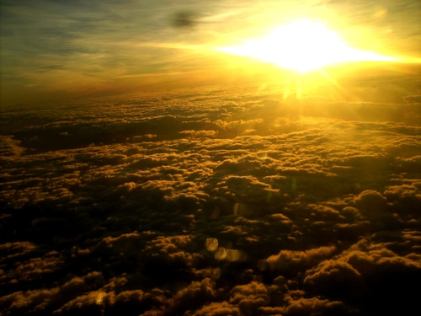
未来基督在耶稣撒冷掌权
以赛亚书 2:1-5; 4:2-6
基督论
Dr. Rick Griffith • 博士 • 新加坡神学院 • BibleStudyDownloads.org

Slide 2
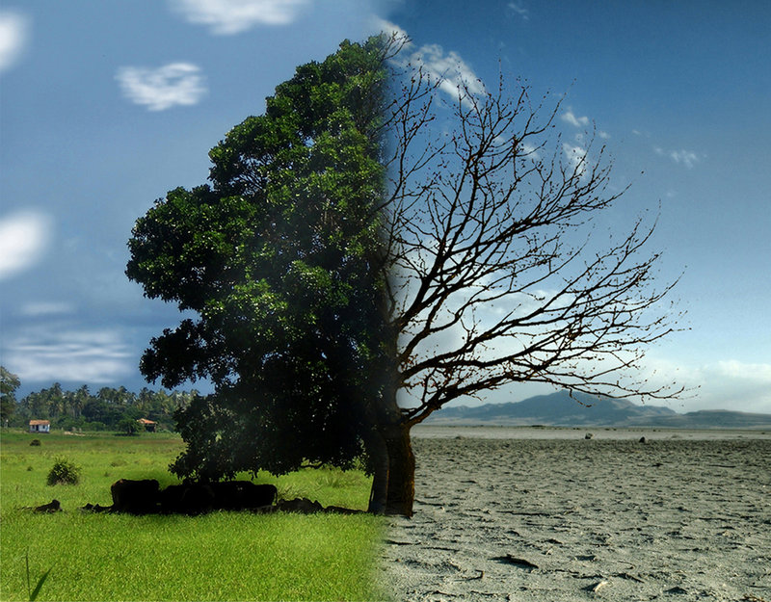
What in the world is happening?
Good
Bad
Notes:
Not too many people today feel that the world is getting better. Most say it is getting worse.
Financially the currencies are no longer backed by gold.
The family has fallen apart in most, if not all, countries.
Ethnic and religious conflicts abound.

Slide 3
What in the world is happening?
Do you have hope it will get better?
Good
Bad
Notes:
Do you think the next US president will turn the tide?
Do you think Singapore will be less crowded in the future?
Do you feel Singapore will become more affordable?
Have you ever heard a sermon on what the world will be life after Jesus returns?

Slide 4
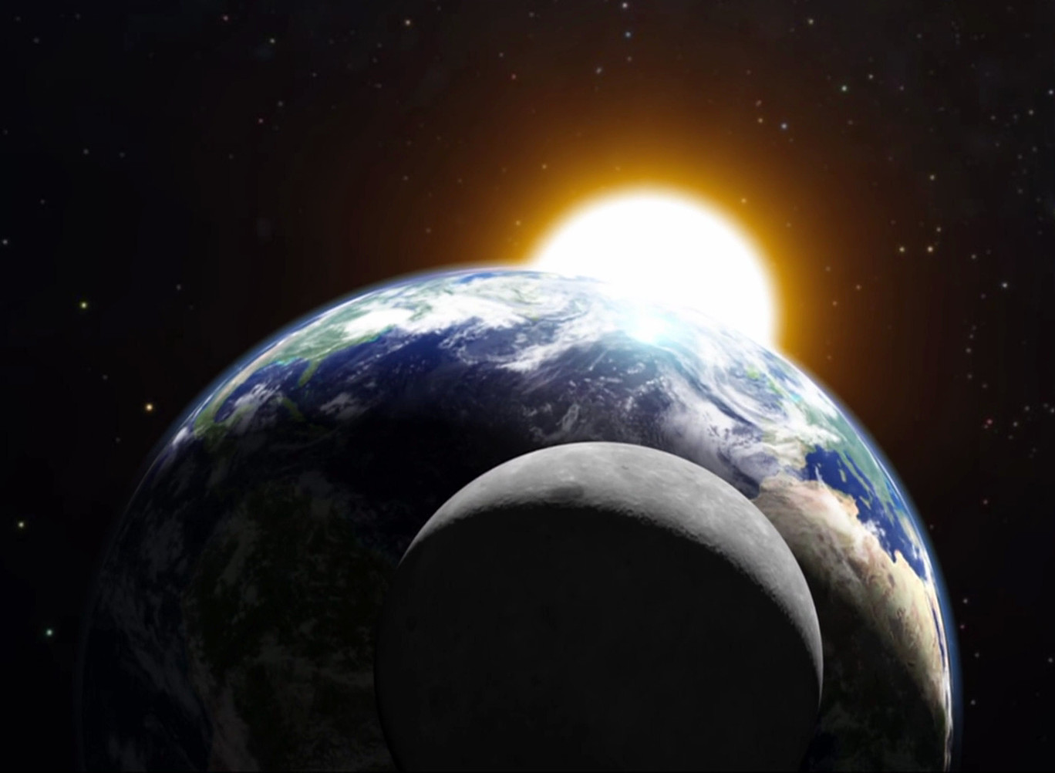
What will it be like when Christ rules this world?

Slide 5
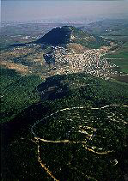
Life in Isaiah's Day
(735 BC)

Slide 6
亚述威胁
亚述膨胀
尼尼微
地中海
亚兰
以色列
犹太
波斯湾
埃及

Slide 7

以赛亚六十五年的先知部
(公元前 745 至 680)
结束以色列的国王
比加
何细亚
犹太的国王
乌西雅
约坦
亚哈斯
希西家

Slide 8
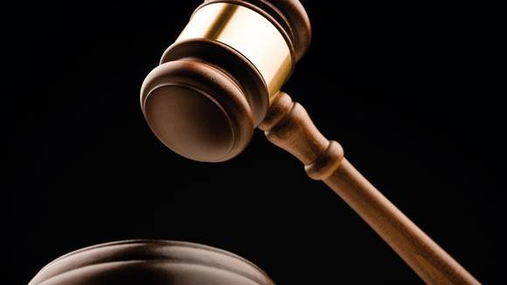
Isaiah 1
When God Takes His People to Court
Dr. Rick Griffith, Crossroads International Church, Singapore
www.biblestudydownloads.com

Slide 9
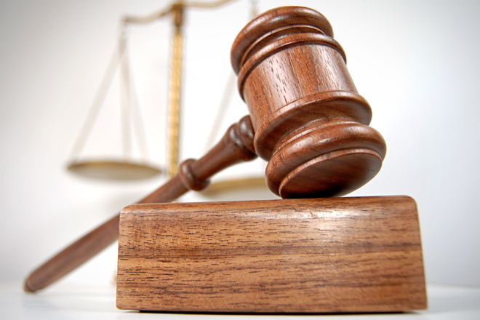
Court Procedure
Charge
Evidence
Verdict

Slide 10
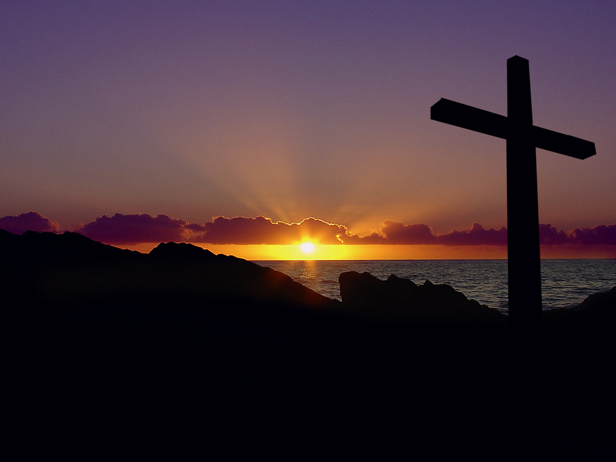
Isaiah 1 Main Idea
When rituals replace relationship, repent for restoration.
Notes:
Turn to God instead of religion—so don't be religious, be restored!
This comes through a change of mind (repentance) followed by the fruits of repentance (justice)

Slide 11
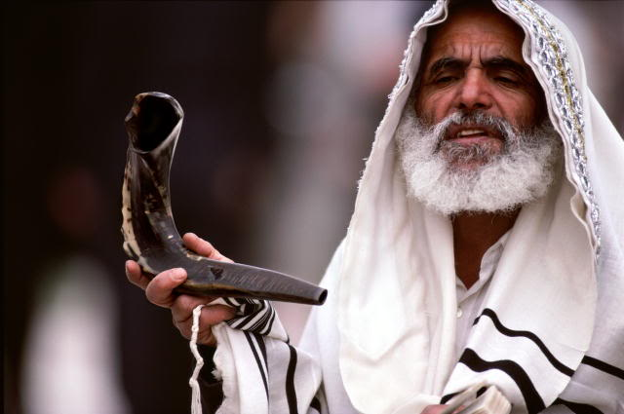
Two Key Texts:
以赛亚书 2:1-5
以赛亚书 4:2-6

Slide 12

I. Jesus will bring worldwide truth and peace (2:1-5).
Notes:
Christ will give us all God's values that will finally help us get along.

Slide 13
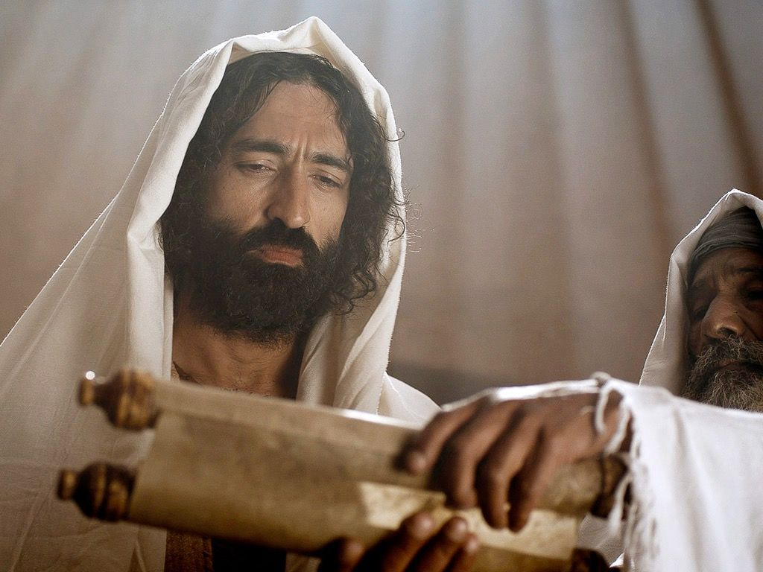
Christ will teach all people from Temple Mount (2:1-3)

Slide 14
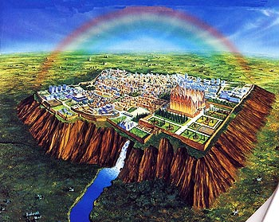
"In the last days,
the mountain of the LORD's house
will be the highest of all—
the most important place on earth.
It will be raised above the other hills,
and people from all over the world will stream there to worship"
(Isa. 2:2 NLT).

Slide 15

上帝的灵和荣光因以色列人的罪而离开所罗门的圣殿（结8-10章，11：23）
盆
祭司殿
祭坛
基路伯
约柜
蜡烛
波阿斯
至圣所
陈设饼桌
香坛
外院
圣所
储藏室
雅斤
铜海
以色列院

Slide 16

所罗门的圣殿
盆
以西结8:4
祭司殿
祭坛
基路伯
约柜
蜡烛
波阿斯
至圣所
陈设饼桌
外院
香坛
圣所
储藏室
雅斤
铜海
以色列院

Slide 17
所罗门的圣殿
盆
以西结8:4
祭司殿
祭坛
基路伯
约柜
蜡烛
波阿斯
至圣所
陈设饼桌
外院
香坛
圣所
储藏室
雅斤
铜海
以色列院

Slide 18
所罗门的圣殿
盆
以西结8:4
祭司殿
祭坛
基路伯
约柜
蜡烛
波阿斯
至圣所
陈设饼桌
外院
香坛
圣所
储藏室
雅斤
铜海
以色列院

Slide 19

The Glory Leaving
502
Ezekiel 11:23

Slide 20


The Glory Returns
502
656
Ezekiel

Slide 21
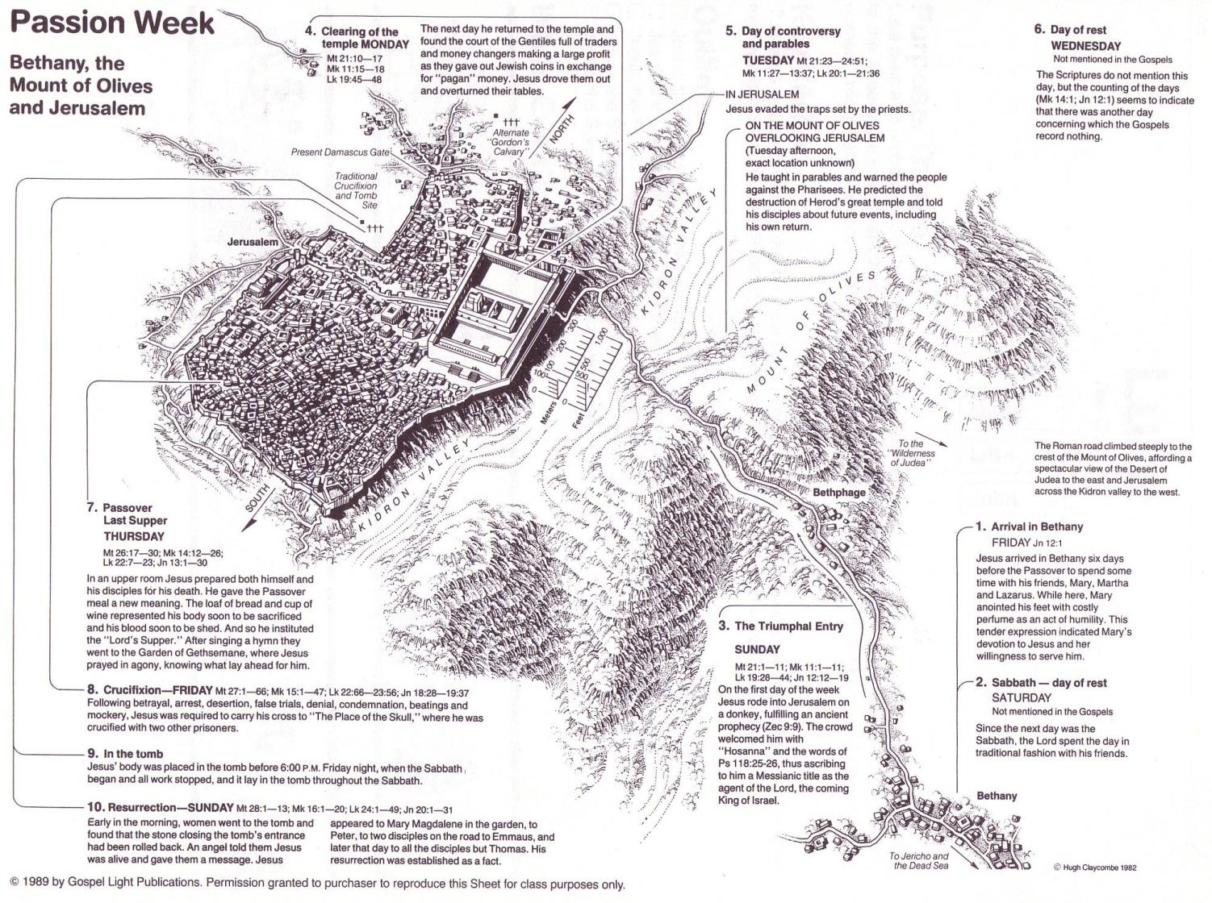
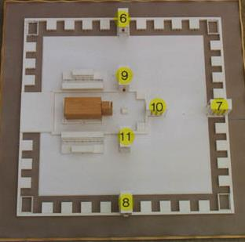
今日的圣山不足以建以西结书里所提的圣殿
www.pauljab.net/temple/ TemplePictures.html

Slide 22
谁抄袭谁?
(以赛亚书 2:2) 末后的日子, 耶和华殿的山必坚立, 超乎诸山, 高举过于万岭。万民都要流归这山。
(弥迦书 4:1) 末后的日子, 耶和华殿的山必坚立, 超乎诸山, 高举过于万岭。万民都要流归这山。

Slide 23
谁抄袭谁?
(以赛亚书 2:3) 必有许多国的民前往, 说,来吧, 我们登耶和华的山。奔雅各神的殿。主必将他的道教训我们, 我们也要行他的路。因为训诲必出于锡安, 耶和华的言语, 必出于耶路撒冷。
(弥迦书 4:2) 必有许多国的民前往, 说, 来吧, 我们登耶和华的山, 奔雅各神的殿。主必将他的道教训我们, 我们也要行他的路。因为训诲必出于锡安, 耶和华的言语必出于耶路撒冷。

Slide 24
谁抄袭谁?
(以赛亚书 2:4) 他必在列国中施行审判, 为许多国民断定是非。他们要将刀打成犁头, 把枪打成镰刀。这国不举刀攻击那国, 他们也不再学习山事。
(弥迦书 4:3) 他必在多国的民中施行审判, 为远方强盛的国断定是非。他们要将刀打成犁头, 把枪打成镰刀。这国不举刀攻击那国, 他们也不再学习山事。

Slide 25

千年耶路撒冷
106
“训诲必出于锡安, 耶和华的言语, 必出于耶路撒冷。”
- 以赛亚书 2:3

Slide 26
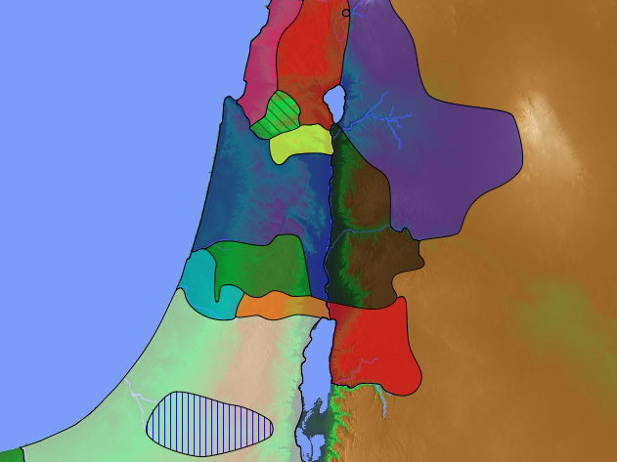
48 Levitical Cities
171a
6 Cities of Refuge

Slide 27

The Teacher

Slide 28
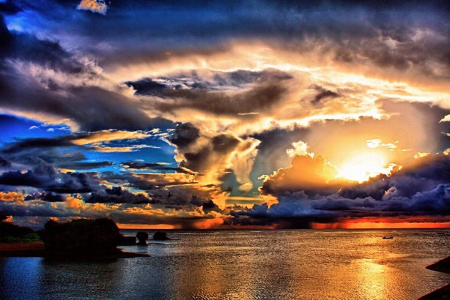
Christ will bring worldwide peace (2:4)
"He will judge between the nations and will settle disputes for many peoples" (4a).
Notes:
Christ will judge between countries at the worldwide court (2:4a).
What kind of disputes will Jesus settle among the nations (2:4a)? All arguments!
I think this means that the nations are going to stop arguing with each other as they have done for millennia.

Slide 29
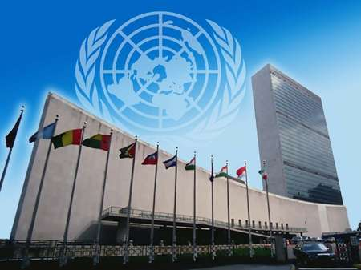
United Nations Building, New York

Slide 30
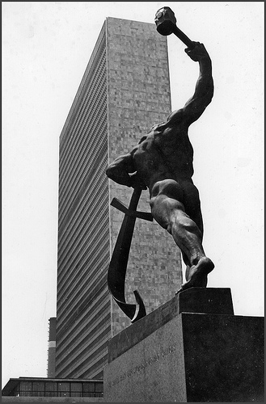
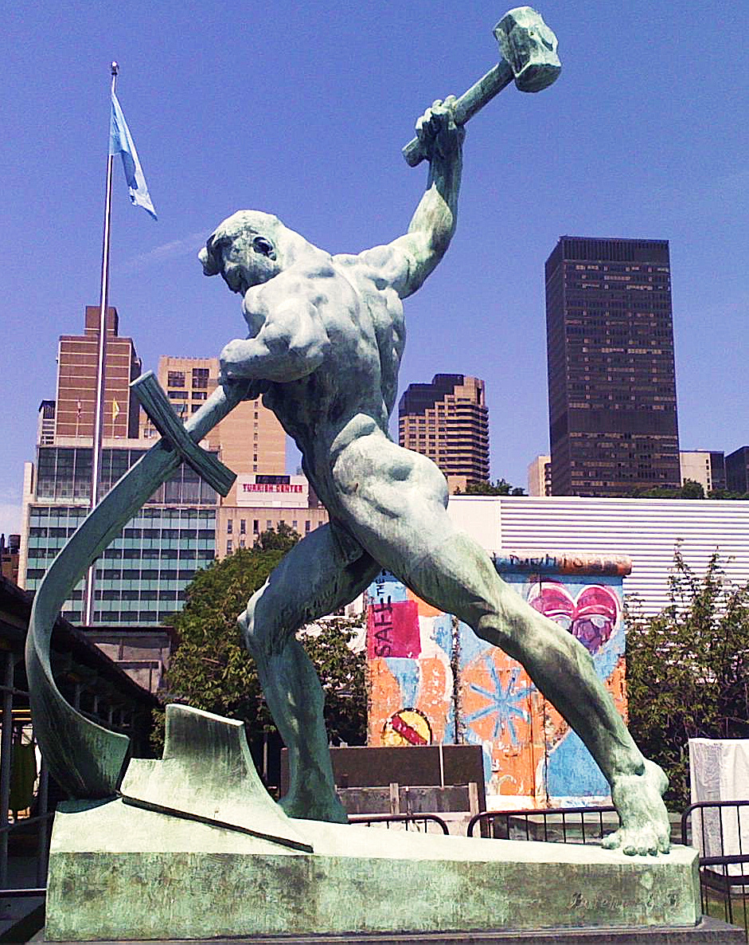
United Nations Building (New York)
Notes:
"Let Us Beat Swords into Plowshares
But first...
What is a plowshare?!
A plowshare is part of a plow. It is the leading edge that cuts
into the earth when turning over the dirt.
Let Us Beat Swords into Plowshares was sculpted
by Yevgeny Vuchetich. It was donated to the UN by the USSR in 1959.
The sculpture stands in the garden of the UN Headquarters."
https://sites.google.com/site/cdaunexploration/let-us-beat-swords-into-plowshares
Accessed 8 July 2015

Slide 31
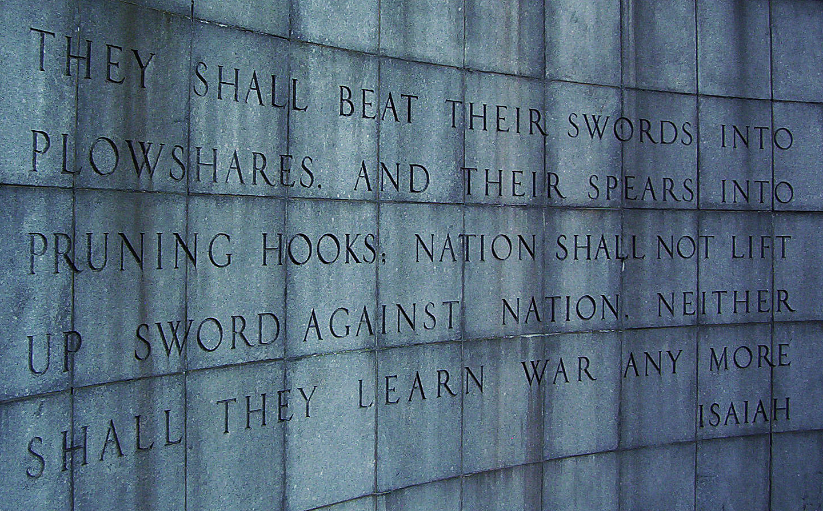
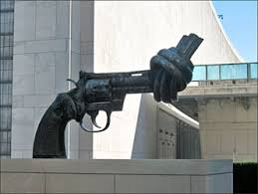
United Nations Building, New York

Slide 32
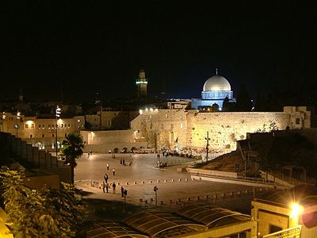
"The LORD has sworn to Jerusalem by his own strength: 'I will never again hand you over to your enemies. Never again will foreign warriors come and take away your grain and new wine'"
(Isa. 62:8 NLT).

Slide 33
I. Jesus will bring worldwide truth and peace (2:1-5).
Notes:
Christ will give us all God's values that will finally help us get along.

Slide 34
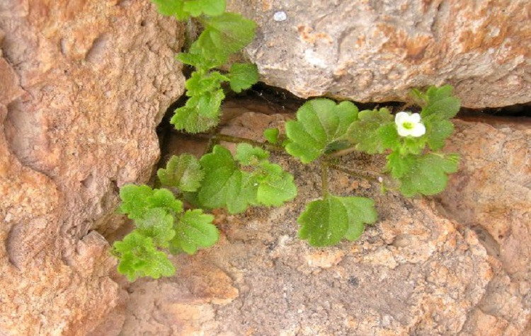
II. Jesus will bring worldwide prosperity, holiness and protection (4:2-6).
Notes:
Christ will give us all God's values that will finally help us get along.

Slide 35

"In that day the Branch of the LORD will be beautiful and glorious, and the fruit of the land will be the pride and glory of the survivors in Israel" (4:2 NIV).

Slide 36
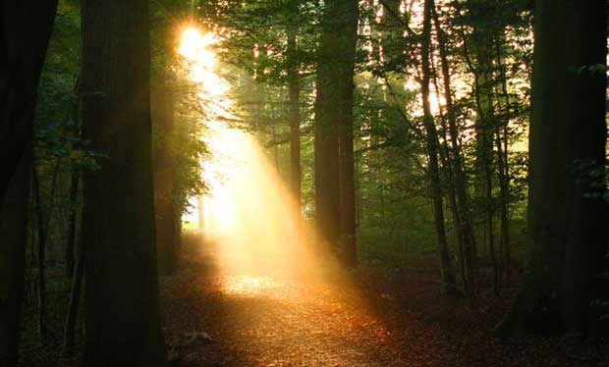
The Branch
"The prophet looked beyond the 'day of the Lord' to that time when the kingdom will be established on earth. 'Branch of the Lord' is a messianic title for Jesus Christ, who came as a 'shoot' from the seeming dead stump of David's dynasty (11:1; 53:2; see Jer. 23:5; 33:15; Zech. 3:8; 6:12). God will cleanse His people (Isa. 4:4; see Zech. 12:10–13:1), restore the fruitfulness of the land, and dwell with them as He did when He led them through the wilderness (Isa. 4:5–6; Ex. 13:21–22). Not just the temple, but every dwelling will be blessed by the presence of the Lord! Unlike in Isaiah's day, 'in that day' the people will be holy (set apart), and the land will be beautiful and glorious"
(Warren W. Wiersbe, Be Comforted: Feeling Secure in the Arms of God, 33).
Notes:
"The prophet looked beyond the 'day of the Lord' to that time when the kingdom will be established on earth. 'Branch of the Lord' is a messianic title for Jesus Christ, who came as a 'shoot' from the seeming dead stump of David's dynasty (11:1; 53:2; see Jer. 23:5; 33:15; Zech. 3:8; 6:12). God will cleanse His people (Isa. 4:4; see Zech. 12:10–13:1), restore the fruitfulness of the land, and dwell with them as He did when He led them through the wilderness (Isa. 4:5–6; Ex. 13:21–22). Not just the temple, but every dwelling will be blessed by the presence of the Lord! Unlike in Isaiah's day, 'in that day' the people will be holy (set apart), and the land will be beautiful and glorious" (Warren W. Wiersbe, Be Comforted: Feeling Secure in the Arms of God, 33).

Slide 37

"In that day the Branch of the LORD will be beautiful and glorious, and the fruit of the land will be the pride and glory of the survivors in Israel"
(4:2 NIV).

Slide 38
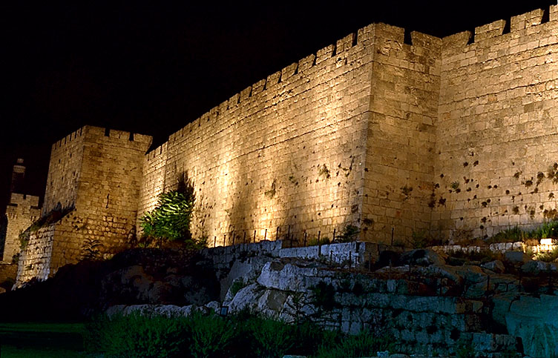
"O Jerusalem, I have posted watchmen on your walls; they will pray day and night, continually.
Take no rest, all you who pray to the LORD. ⁷Give the LORD no rest until he completes his work, until he makes Jerusalem the pride of the earth" (Isa. 62:6-7 NLT).

Slide 39

Christ will make holy Jerusalem's remnant in mortal bodies (4:3-4).

Slide 40
磨难之前千禧年前论
欢天喜地
第二次降临
大白王座
教会时代
磨难
千年时代
哈米吉多顿战役
歌革和玛各战役

Slide 41
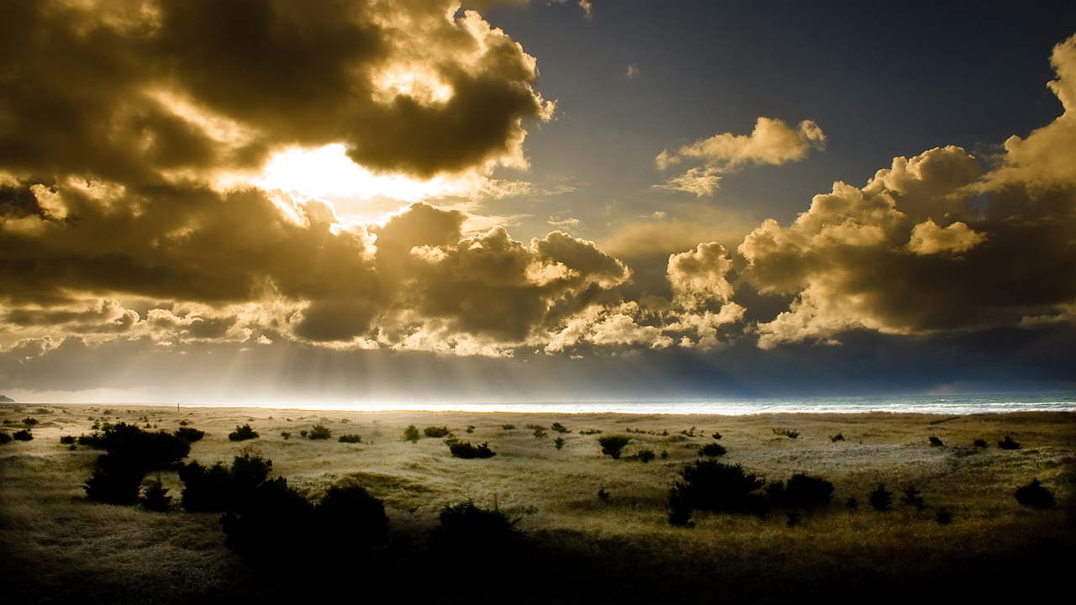
Christ will protect Jerusalem's citizens from the sun and rain (4:5-6).

Slide 42
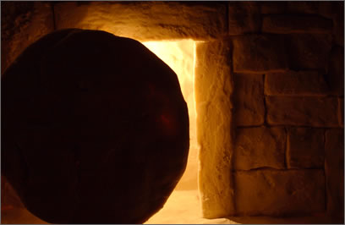
Main Idea of Isaiah 2:1-5; 4:2-6
Jesus will bring worldwide truth, peace, prosperity, holiness and protection

Slide 43
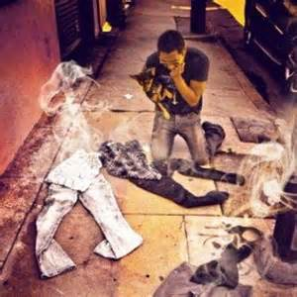
Main Idea

Slide 44
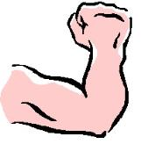
启 示 录 20:4-6 简图
^{4b} 他们都复活了、与基督一同作王一千年。
^{4a} 我又看见几个宝座、也有坐在上面的、并有审判的权柄赐给他们．我又看见那些因为给耶稣作见证、并为 神之道被斩者的灵魂、和那没有拜过兽与兽像、也没有在额上和手上受过他印记之人的灵魂…
1000 年
^{5b} 这是头一次的复活。 ^{6a} 在头一次复活有分的、有福了、圣洁了．第二次的死在他们身上没有权柄…
^{6b} 他们必作 神和基督的祭司、并要与基督一同作王千一年。
^{5a} 其余的死人还没有复活、直等那一千年完了。 .

Slide 45
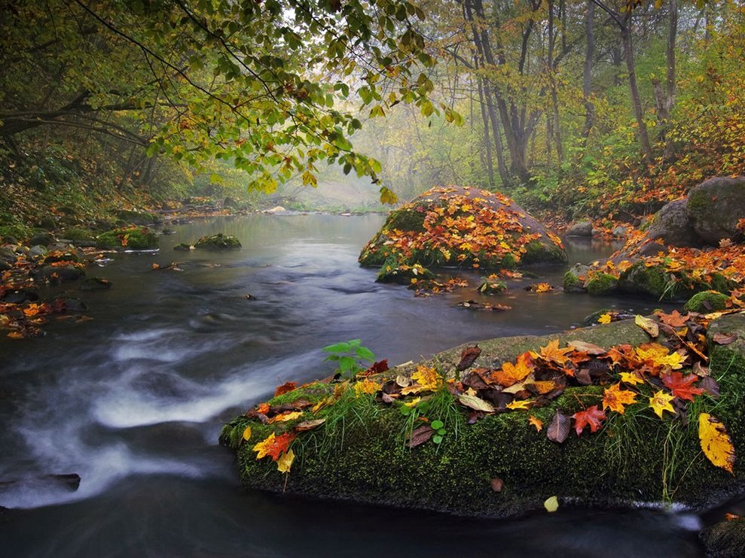
千禧年的目的
424
审判天使

Slide 46
“你们不知道圣徒要审判世界吗？既然世界要由你们来审判，难道你们不配审判这些最小的事吗？ 你们不知道我们要审判天使吗？何况今生的事呢？”
(林前 6:2-3 CNVS)

Slide 47
千禧年的目的
424
审判天使
掌管天下
恢复洪水前时代的世界 （以赛亚书65：20里的长寿）

Slide 48
令人难以置信的长寿命!
[新国际版本] 以赛亚书 65:20 “其中 (在耶路撒冷)必没有数日夭亡的婴孩，也没有寿数不满的老者。因为百岁死的仍算孩童，有百岁死的罪人算被咒诅。”

Slide 49
千禧年的目的
424
审判天使
掌管天下
恢复洪水前时代的世界 （以赛亚书65：20里的长寿）
显示人心的败坏

Slide 50
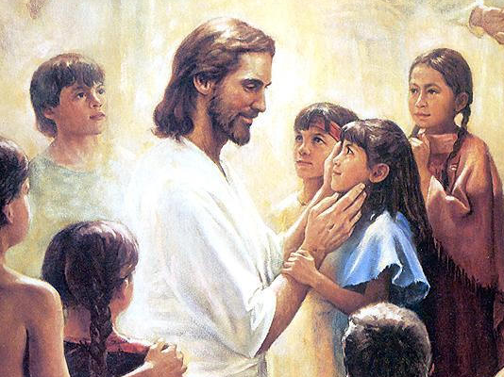
Christ will have a Spirit-led and righteous rule (11:1-5)
Christ will have a Spirit-led and righteous rule (Isa. 11:1-5)

Slide 51
千禧年的目的
424
审判天使
掌管天下
恢复洪水前时代的世界 （以赛亚书65：20里的长寿）
显示人心的败坏
履行亚伯拉罕之约

Slide 52


Abraham
亚伯拉罕
Heroes of the Faith
Notes:
In Genesis 12 the account switches directions from discussing all peoples to zeroing in on one man and his family—the man Abraham.

Slide 53
三个基本要素
7
创世记 12
耶和华对亚伯兰说：
“你要离开本地、本族、
父家，到我指示你的地方去。
1
土地
“我必使你成为大国，
赐福给你;
我必使你的名为大,
你也必使别人得福。
后裔
2
亚伯拉罕
呼召
给你祝福的，我必赐福给他,
咒诅你的，我必咒诅他；
地上的万族，都必因你得福。”
地 – 裔 – 福
3
祝福
Handbook pg. 19-24
14
2

Slide 54

应许之地
531e
叙利亚
黎巴嫩
以色列
约旦
India
埃及
创世记 15:18
就在那时候，耶和华与亚伯兰立约说：“我已经把这地赐给你的后裔了，就是从埃及河直到幼发拉底河之地 ”(新译本)
Notes:
God’s promised land stretched northeard from the small wadi of Egypt south in the Sinai to the large Euphrates River in the far north—a HUGE piece of real estate! When today’s boundaries are placed over this land we can see the struggle modern Israel has to claim land from Egypt, Lebanon, Syria and possibly even Jordan on the other side of the Jordan River.

Slide 55
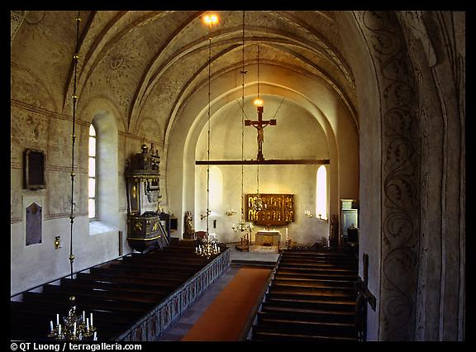
无条件契约的各层面
21
亚伯拉罕之约
巴勒斯坦之约
大卫之约
新约
土地 | 后裔 | 祝福
物质的 | 政治的 | 属灵的
申 30 | 撒下 7 | 耶 31

Slide 56
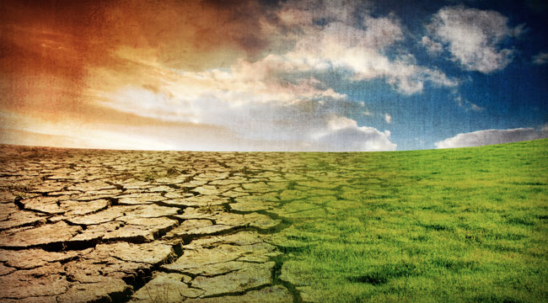
关键字
452
343
判断
救恩
以赛亚
Notes:
In contrast to humanism, God says that he will judge the world, but then renew it—or restore it.

Slide 57
关键
452
343
Restoration
以赛亚

Slide 58

465
应许与大卫所立的约
⁶ 因为有一个婴孩为我们而生，有一个儿子赐给我们；
政权必担在他的肩头上；
他的名必称为“奇妙的策士、全能的 神、永恒的父、和平的君”。
⁷ 他的政权与平安必无穷无尽地增加，
他在大卫的宝座上治理他的国，
以公平和公义使国坚立稳固，
从现在直到永远。
万军之耶和华的热心必成全这事。 (赛 9:6-7)

Slide 59
Since Jesus will reign, you should serve him now so your can rule with him later (以赛亚书 2:5)!

Slide 60

Jesus Shall Reign
CCLI Song #11026168
© 2010 Resolved Music
CIC CCLI Licence # 277507
Notes:
http://www.lyricsondemand.com/miscellaneouslyrics/christianlyrics/jesusshallreignwhereerthesunlyrics.html

Slide 61
Jesus Shall Reign
Jesus shall reign where'er the sun
Doth his successive journeys run
His Kingdom stretch from shore to shore,
Till moons shall wax and wane no more.
To Him shall endless prayer be made.
And princes throng to crown His head,
His name like sweet perfume shall rise
With every morning sacrifice.
Notes:
http://www.lyricsondemand.com/miscellaneouslyrics/christianlyrics/jesusshallreignwhereerthesunlyrics.html

Slide 62
Jesus Shall Reign
People and realms of every tongue
Dwell on His love with sweetest song;
And infant voices shall proclaim
Their early blessings on His name.
Blessings abound where'er He reigns:
The prisoner leaps to lose his chains,
The weary find eternal rest,
And all the sons of want are blest.
Notes:
http://www.lyricsondemand.com/miscellaneouslyrics/christianlyrics/jesusshallreignwhereerthesunlyrics.html

Slide 63
Jesus Shall Reign
Where He displays His healing power
Death and the curse are known no more;
In Him the tribes of Adam boast
More blessings than their father lost.
Let every creature rise and bring
Peculiar honors to our King;
Angels descend with songs again,
And earth repeat the loud Amen.
Notes:
http://www.lyricsondemand.com/miscellaneouslyrics/christianlyrics/jesusshallreignwhereerthesunlyrics.html

Slide 64
Black

Slide 65


Christology link at BibleStudyDownloads.org
Get this presentation for free!
Notes:
Creation (cr)

