Slide 1
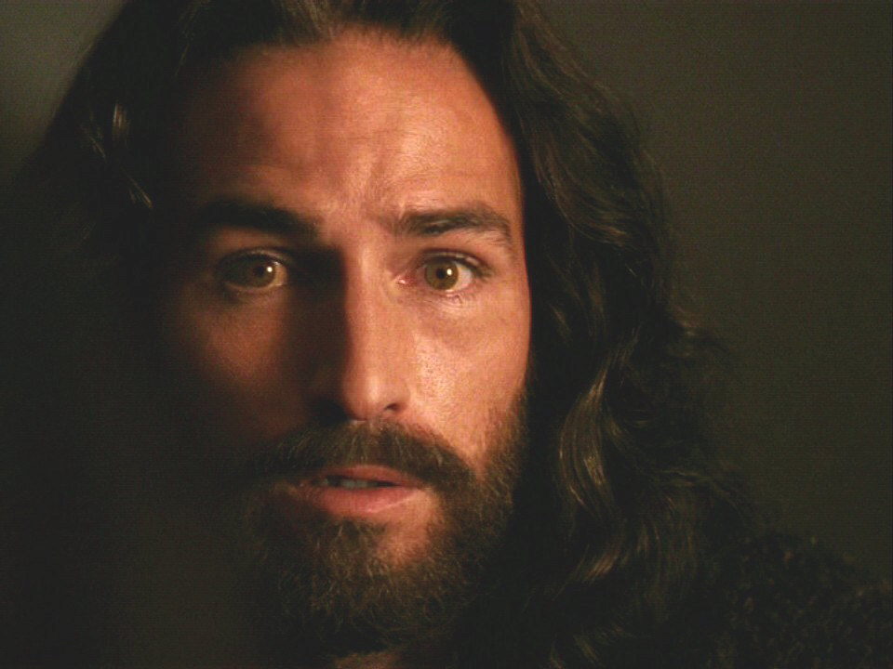
The Resurrection of Jesus Christ
John 20
Christology: The Person & Work of Jesus
Dr. Rick Griffith • 博士 • 新加坡神学院 • BibleStudyDownloads.org

Slide 2
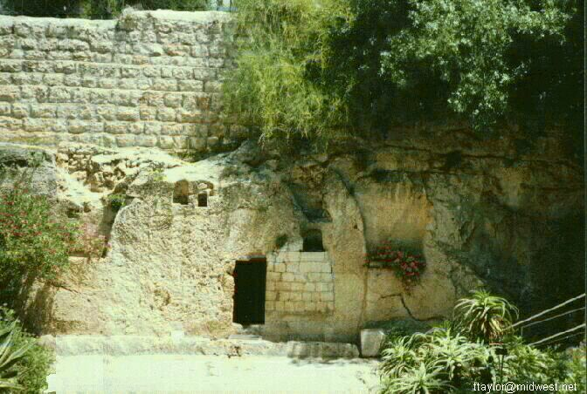
Why is it important for Jesus to be alive?
Notes:
2

Slide 3
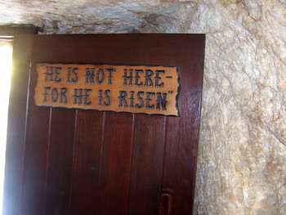
We live because He lives!

Slide 4
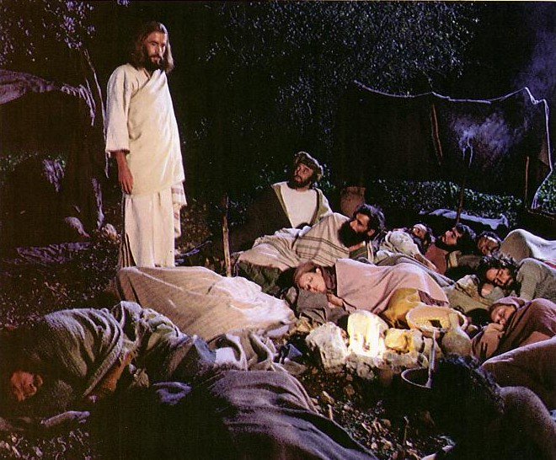
Jesus controlled His own arrest (John 18:1-11).

Slide 5
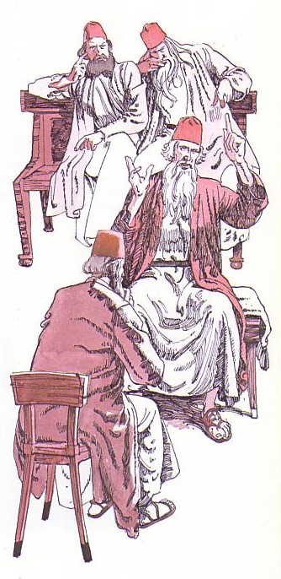
Jesus' illegal trials proved Him innocent (18:12-19:16a).

Slide 6
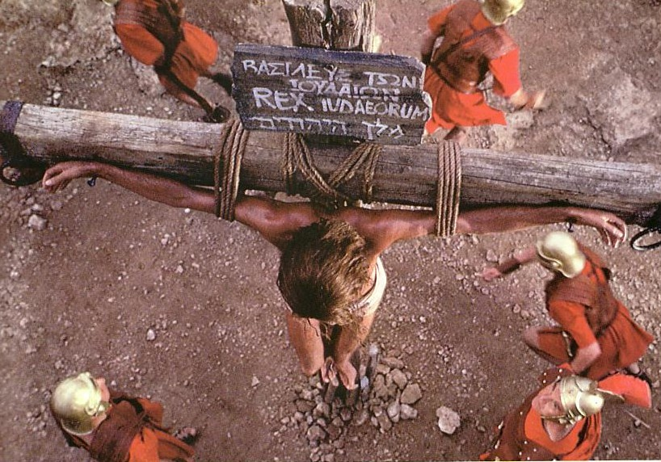
Jesus' death paid for our sin (19:16b-42)

Slide 7
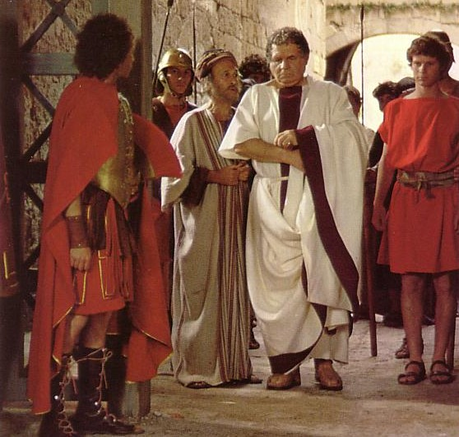
“Make the tomb secure!”

Slide 8
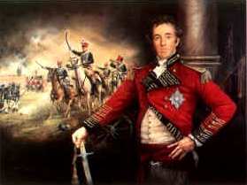
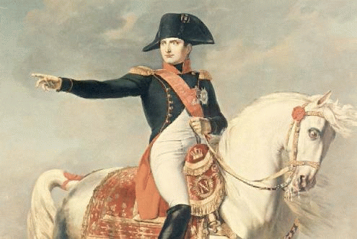
Battle News
Wellington defeated
Napoleon at Waterloo
Jesus defeated
Satan at Calvary
Notes:
8
8

Slide 9
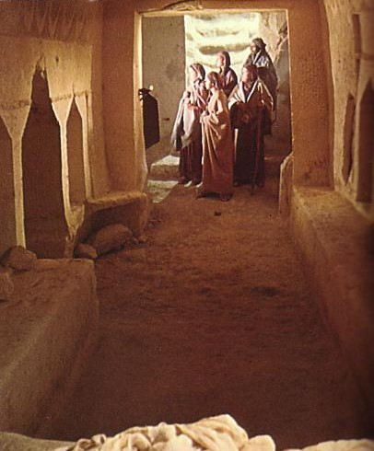
John's Key Idea:
Jesus' resurrection meets each of us at our point of need (John 20).

Slide 10
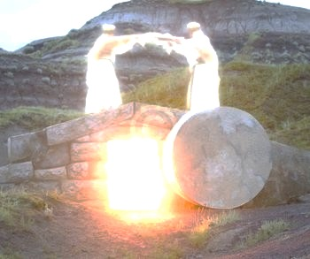
I. The empty tomb shows us that Christ is alive today (20:1-9).

Slide 11
“The Gospel of John” ® Movie
John 20:1-9
Notes:
11

Slide 12
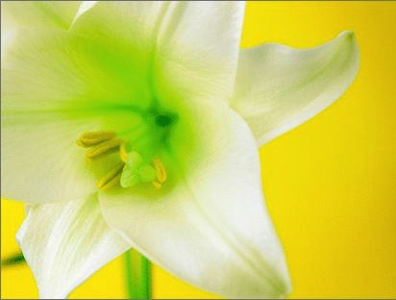
Three Initial Witnesses
Mary (1-2)
John (3-5)
Peter (6-9)

Slide 13
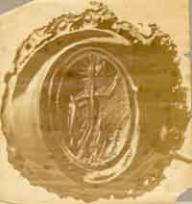
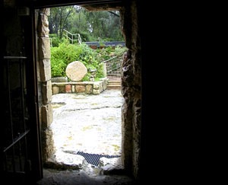
From Inside the Tomb Looking Out
The Roman seal prevented tampering
Notes:
13
13

Slide 14
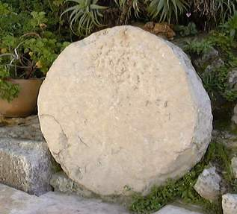
The stone was rolled away…
Notes:
14
14

Slide 15
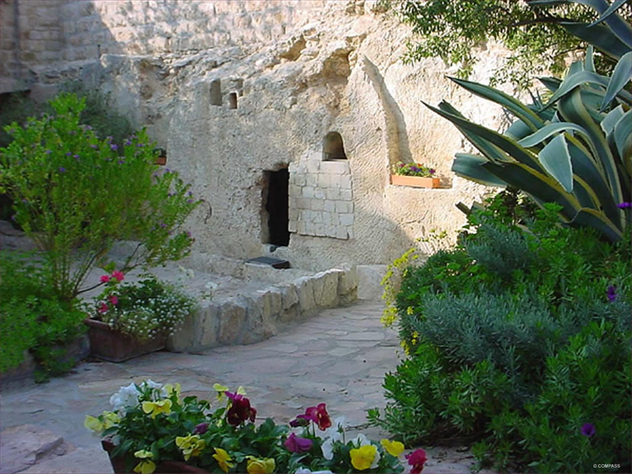
The Garden Tomb
Notes:
15
15

Slide 16
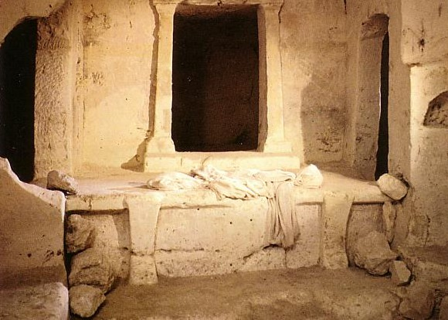
空坟墓证明了!
Notes:
Nothing short of a genuine miracle would have convinced all eleven disciples to preach his resurrection for a lifetime and then die as martyrs.

Slide 17
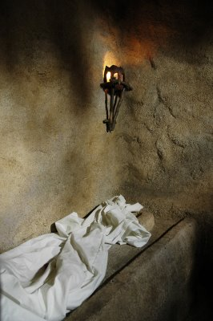
“Seeing” in 20:5-8
John “looked” v. 5
John “saw” v. 8
“peeped”
“perceived”
Peter “saw” v. 6
“beheld attentively”
Notes:
17
17

Slide 18
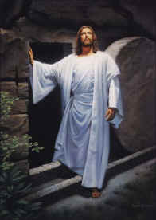
II. Christ's resurrection meets you at your need (20:10-29)
Comforts the despairing Mary (10-18)
Notes:
18
18

Slide 19
“The Gospel of John” ® Movie
John 20:10-18
Notes:
19

Slide 20
II. Christ's resurrection meets you at your need (20:10-29)
Comforts the despairing Mary (10-18)
Encourages the discouraged disciples (19-23)
Notes:
20
20

Slide 21
“The Gospel of John” ® Movie
John 20:19-23
Notes:
21

Slide 22
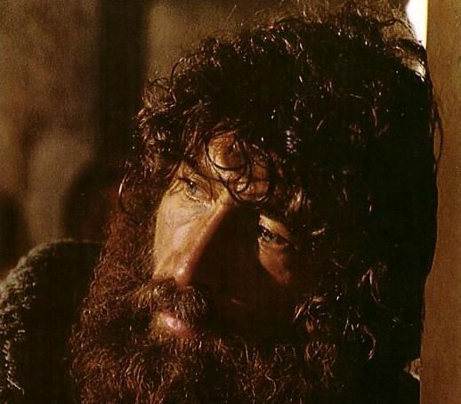
甚麽使灰心丧气的彼得回头?

Slide 23
II. Christ's resurrection meets you at your need (20:10-29)
Comforts the despairing Mary (10-18)
Encourages the discouraged disciples (19-23)
Gives proof to the doubting Thomas (24-29)
Notes:
23
23

Slide 24
“The Gospel of John” ® Movie
John 20:24-29
Notes:
24

Slide 25
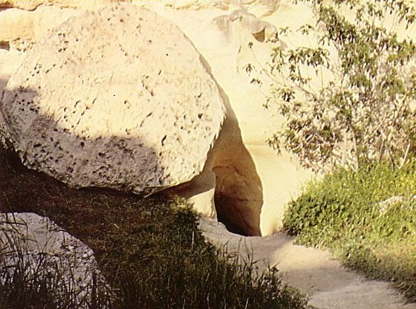
我们怎样解释空坟墓?
他根本没有死?
耶稣有力气自己离开?
门徒把尸体带走?
Notes:
我们每个人都必须解释为什么耶稣的身体在第三天失踪。
如果说他从来没有死，那是荒谬的，因为罗马人是死刑执行者的专家。
理论上说那凉爽的墓墓使基督更新到他足够克服他在十字架上的伤，及能够移动那1.5吨的磐石也是荒谬的。
门徒们根本都没想到耶稣会复活。
Each of us must explain why the body of Jesus was missing on the third day.
To say he never died is preposterous as the Romans were expert executioners.
The theory that the cool tomb refreshed Christ enough to overcome his crucifixion and move the 1.5 ton stone is also ridiculous.
The disciples were the ones LEAST expecting a resurrection, so they are not potential candidates.

Slide 26
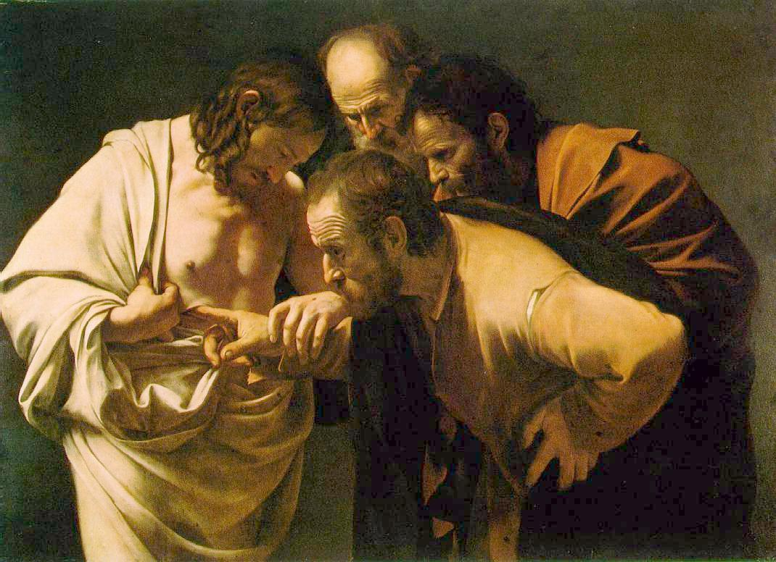
Why did John write about Jesus' miracles?
III. All of Christ's miracles are to bring us to faith in Him (20:30-31)
These [signs] are written so that you may believe that Jesus is the Christ, the Son of God, and that by believing you may have life in his name (John 20:31).

Slide 27
“The Gospel of John” ® Movie
John 20:30-31
Notes:
27

Slide 28
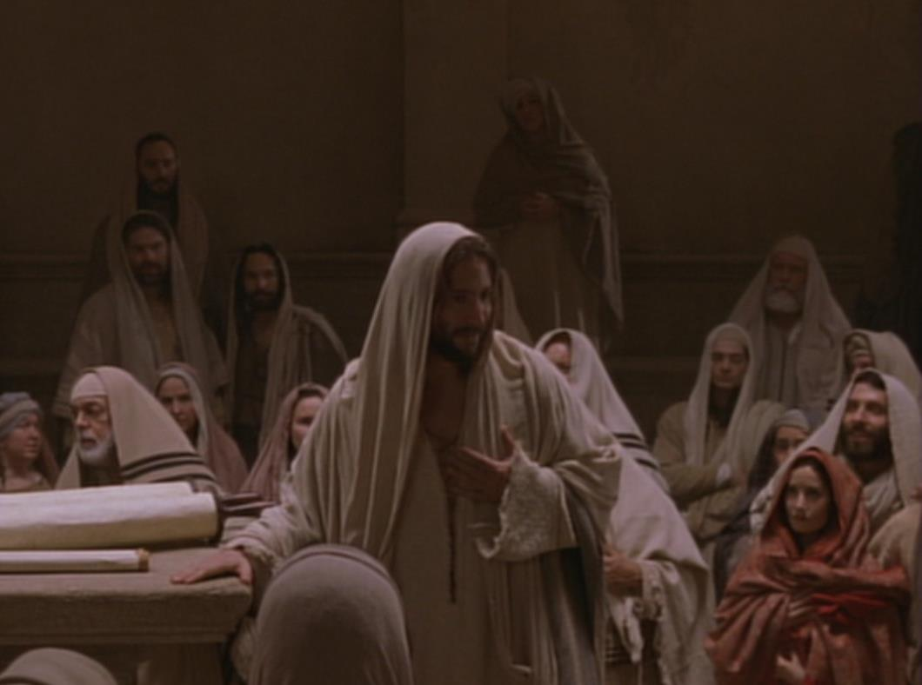
钥字 相信
约翰福音
107
钥节
“耶稣在门徒面前、另外行了许多神迹、没有记在这书上。但記這些事、要叫你們信耶穌是基督、是神的兒子．並且叫你們信了他、就可以因他的名得生命。” (20:30-31).

Slide 29
约翰福音20:31不同版本差异之处
110
福音性的
“…但記這些事、要叫你們信耶穌是基督、是神的兒子．並且叫你們信了他、就可以因他的名得生命。”
教导性的
“…但記這些事、要叫你們继续信耶穌是基督、是神的兒子．並且叫你們信了他、就可以因他的名得生命。”
希腊原文
i-na pisteu,shte
37 手写本
很多但後期的手抄本
希腊原文
i-na pisteu,hte
p⁶⁶ & a* 很少但早期的手抄本
Notes:
Most of the manuscripts have the little sigma (= English “s”) that makes the verb for believe in an undefined sense. However, a few early MSS lack this sigma, which turns it into a present tense.

Slide 30
但耶稣的复活证明他是神,能赐我们永生(约20)

Slide 31
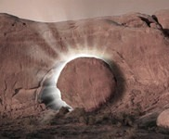
Trust the Living Savior to Meet Your Need Today!
Despair
Comfort
Discouraged
Encouraged
Doubt
Proof
Notes:
31
31

Slide 32
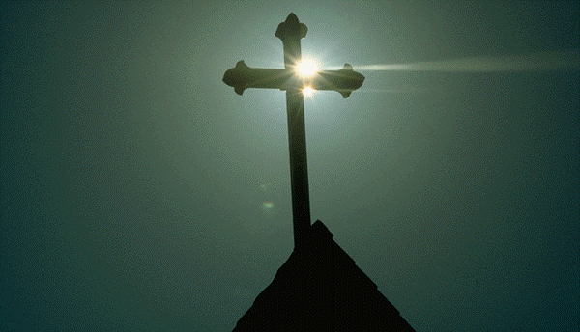
耶稣受难日为何是美好的?
耶稣掌控自己的被捕
耶稣受无理的指控,证明他是无辜的
耶稣的死为我们代付赎价
耶稣的复活证明他能赐永生

Slide 33
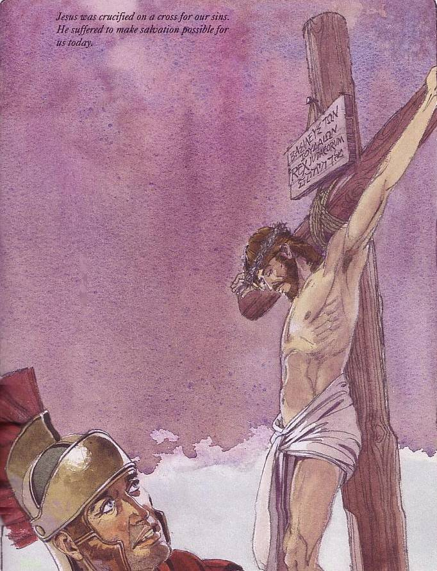
耶稣受难日是美好的,因为当日耶稣基督为我们代付赎价

Slide 34
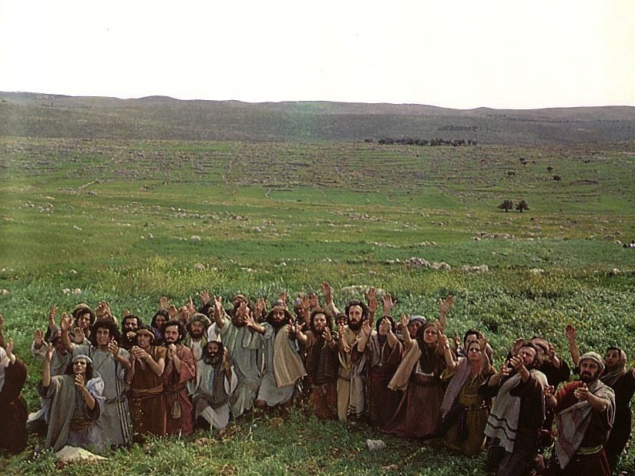
Jesus ascended to the Father
This means he is alive now!

Slide 35
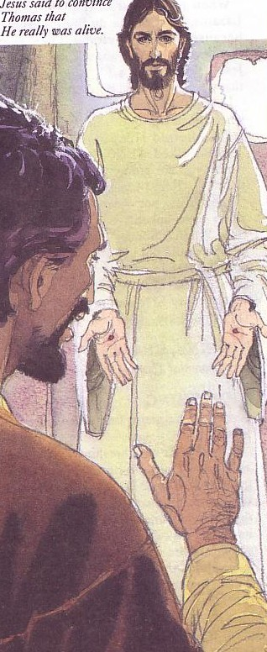
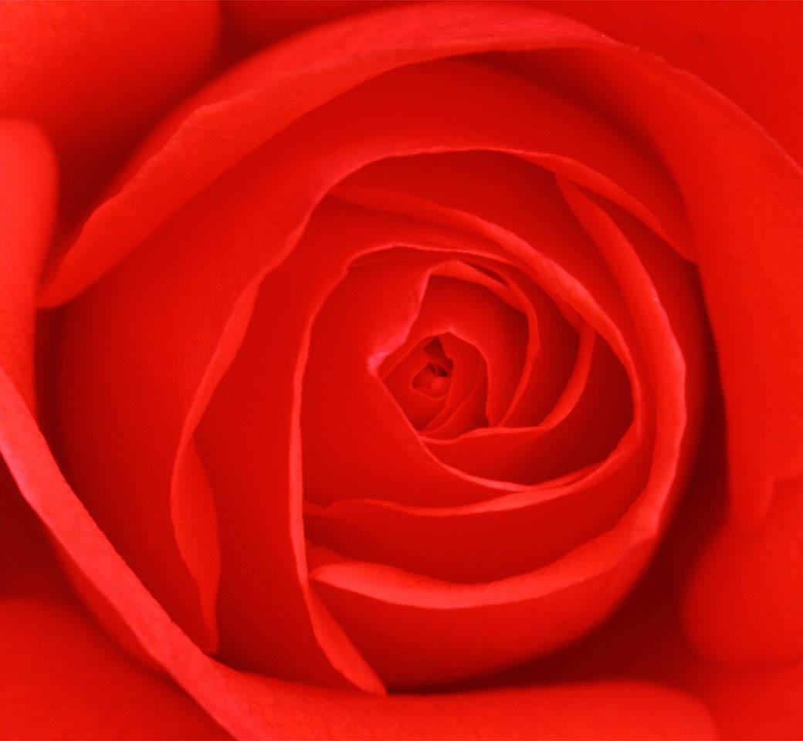
Jesus rose to give you new life!
耶稣复活给你新生!
Notes:
In his nearly 600 page paperback that supposedly tells us the “truth” of Christianity, Brown NEVER EVEN ONCE mentions the resurrection of Christ. This is the CHIEF teaching of Christianity--that Christ proved his claims by coming back from the dead.

Slide 36
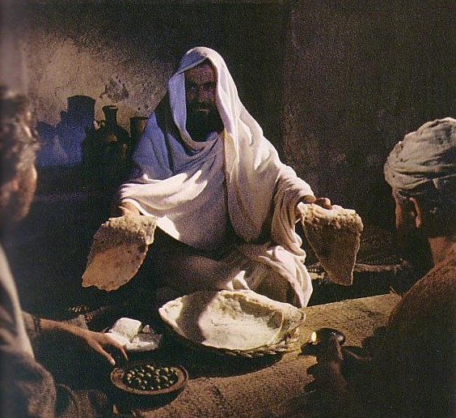
你如何能认识他?
承认你是罪人
相信耶稣为你而死
你忏悔并要从罪中回转
Notes:
This means Jesus is alive today. This also means you can know him personally. It’s as simple as A-B-C. Let’s bow our heads and if you wish to come into this new relationship with Christ, please pray to him now, acknowledging these three things to him.

Slide 37
Black
Notes:
37
37

Slide 38
Christology link at BibleStudyDownloads.org
Get this presentation for free!
Notes:
Creation (cr)

