Slide 1
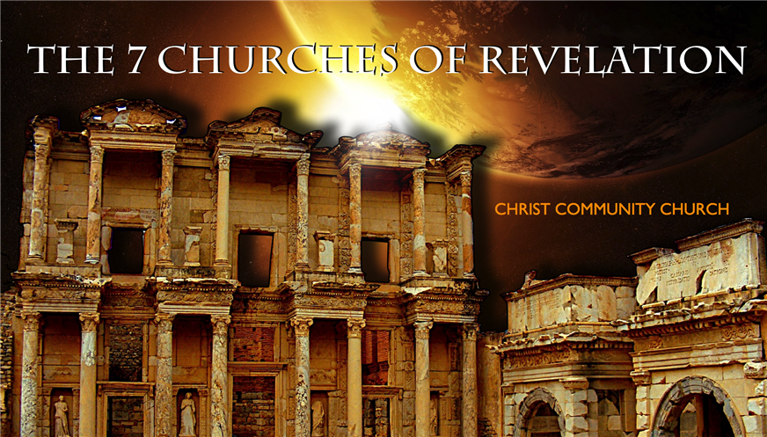
Revelation
耶稣
救恩论：上帝的救赎计划
The Writing Ministry of Jesus
Dr. Rick Griffith • 博士 • 新加坡神学院 • BibleStudyDownloads.org
Notes:
Slide 173

Slide 2
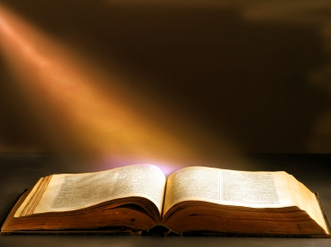
启示录 1

Slide 3
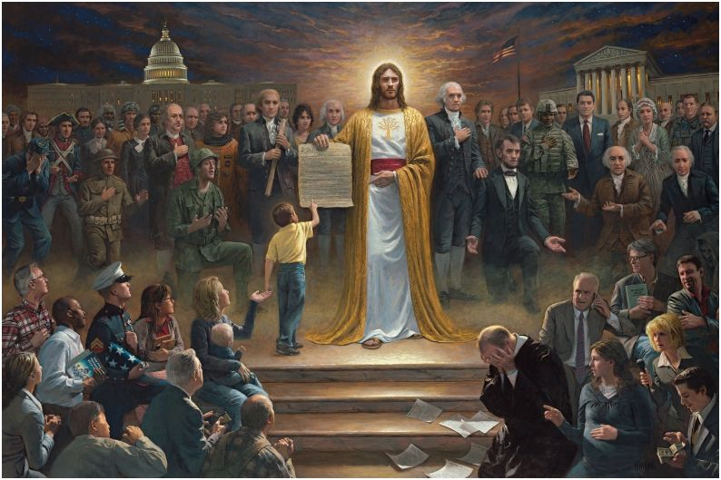
One Nation Under God
By Jon McNaughton (2012)
http://jonmcnaughton.com/content/ZoomDetailPages/OneNationUnderGod.html
Notes:
http://jonmcnaughton.com/content/ZoomDetailPages/OneNationUnderGod.html
Interview with the Artist: http://jonmcnaughton.com/content/ZoomDetailPages/OneNationInterview.html

Slide 4
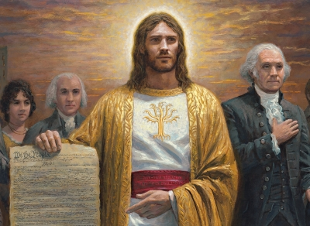
Jesus Christ, the Most Controversial Person
http://jonmcnaughton.com/content/ZoomDetailPages/OneNationUnderGod.html
Notes:
http://jonmcnaughton.com/content/ZoomDetailPages/OneNationUnderGod.html
Interview with the Artist: http://jonmcnaughton.com/content/ZoomDetailPages/OneNationInterview.html

Slide 5
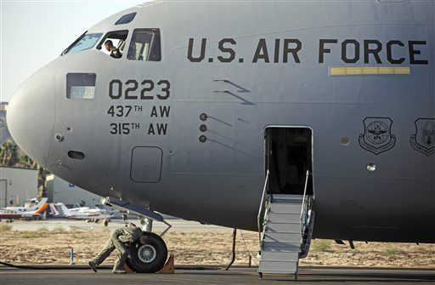
"God" Now Optional in US Air Force Oath
The full oath:
"We will not lie, steal or cheat nor tolerate among us anyone who does. Furthermore, I resolve to do my duty and live honorably,
so help me God."
Notes:
(Newser 25 Oct 2013) – An oath of honor uttered by Air Force cadets might be a little less godly from here on out. The service says cadets now have the option to skip the last phrase, "So help me God," reports the Air Force Times. The move comes in response to a group pushing for separation of church and state in the military, but it might not be enough to ward off a lawsuit. The Military Religious Freedom Foundation wanted the phrase cut entirely—the Air Force chose to keep it, but make it optional.
The full oath: "We will not lie, steal or cheat nor tolerate among us anyone who does. Furthermore, I resolve to do my duty and live honorably, so help me God." The founder of the MRFF calls it unconstitutional, though he wouldn't object if cadets continued to say the phrase even if it were stripped from the official oath. "They can swear so help me God, so help me Allah, so help me Spider-Man. But when you have it there, that is a noxious violation of separation of church and state."

Slide 6
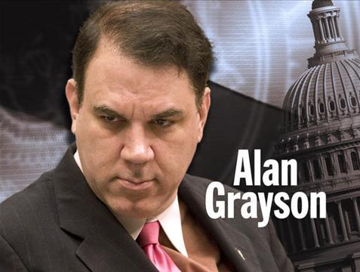
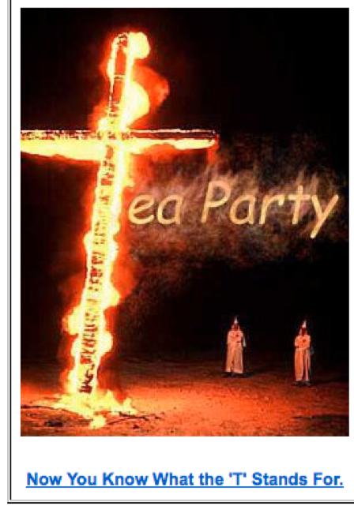
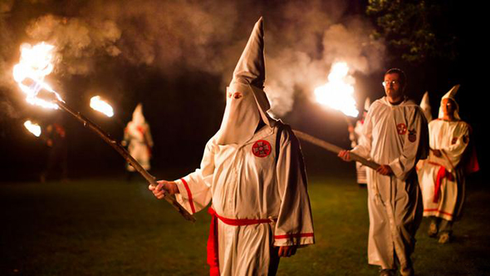
Sinking to new lows…

Slide 7
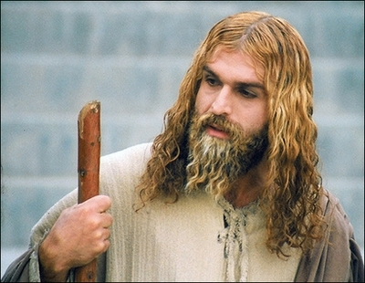
伊朗穆斯林在演耶稣基督（2008年4月29日）
Notes:
http://latimesblogs.latimes.com/babylonbeyond/2008/04/iran-an-iranian.html
IRAN: A Muslim actor as Jesus Christ
Comments (19)
(13)
(0)
April 29, 2008 | 3:00 am
He is an Iranian Muslim who looks so much like a Hollywood or Renaissance image of Jesus Christ that the faithful sometimes make the sign of the cross when they see him.
Ahmad Soleimani-Nia has been playing Jesus for seven years, keeping his hair long and lightly dyed, his beard knotty and vibrant.
He is the star of "Jesus, the Spirit of God," a new film from Iran that depicts the man Christians believe to be the messiah and son of God as a tormented Judean prophet heralding the coming of Muhammad, the founder of the Muslim faith. Nia's Jesus is at once serene, devout, driven and passionate.
In real life, if there is a real life after a spiritual and artistic odyssey that is still not over, Nia lives in Tehran. He was once a soldier in the Iranian army and then a welder for — the irony is interesting in this Jesus story — his nation's Atomic Energy Agency, which the Bush administration accuses of pursuing nuclear weapons.
That may unsettle some American neo-cons, but perhaps not as much as the film itself, which suggests that Jesus wasn't crucified and never rose from the dead.
Check out the rest of the story in today's Los Angeles Times.
— Jeffrey Fleishman in Tehran
Photo: Ahmad Soleimani-Nia as Jesus. Credit: minbar.tatar.ru/rus/Messiah.htm

Slide 8
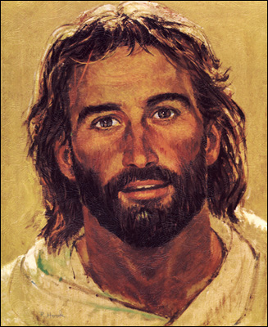
耶稣在80年代的形象是合适的

Slide 9
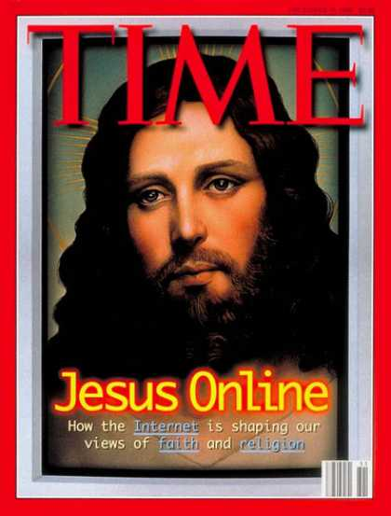
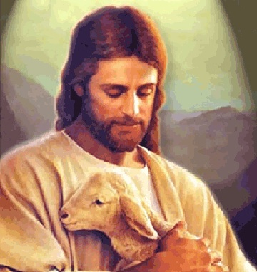
但是，耶稣后来变得懦弱

Slide 10
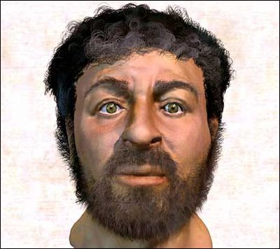
或耶稣成为一个穴居人
Notes:
This depiction of Christ was determined by collecting samples of first-century Jewish facial bone structures to provide a composite “average” man for that time.

Slide 11
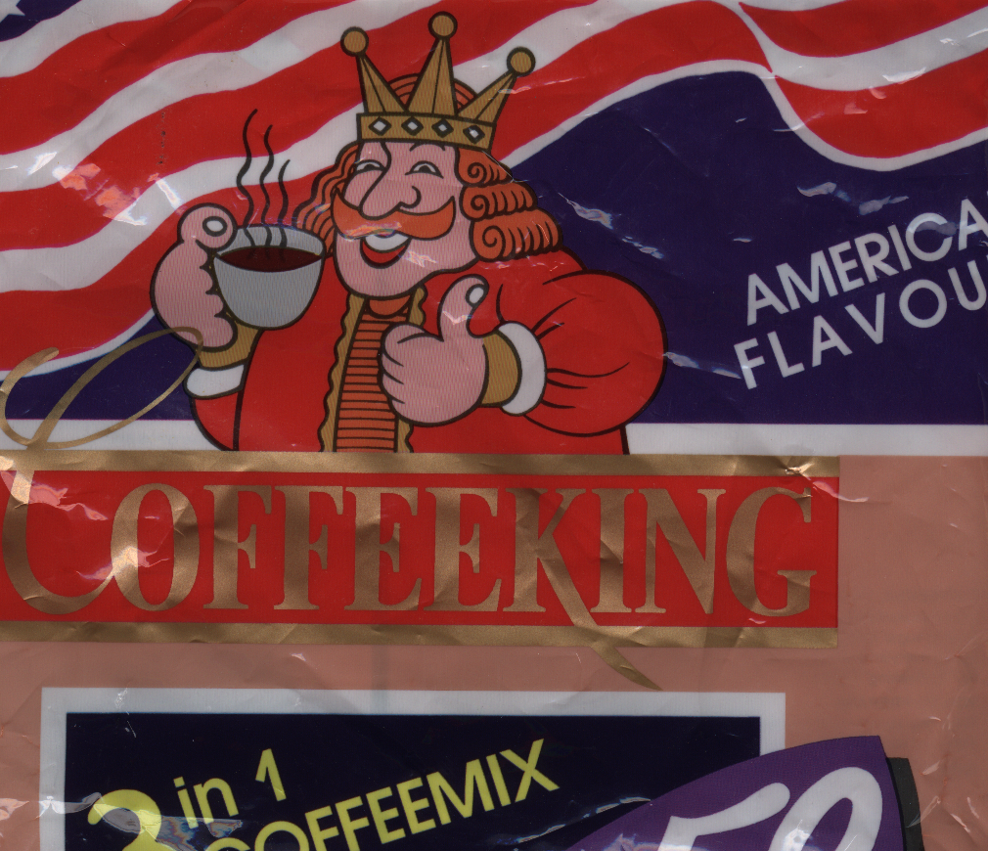
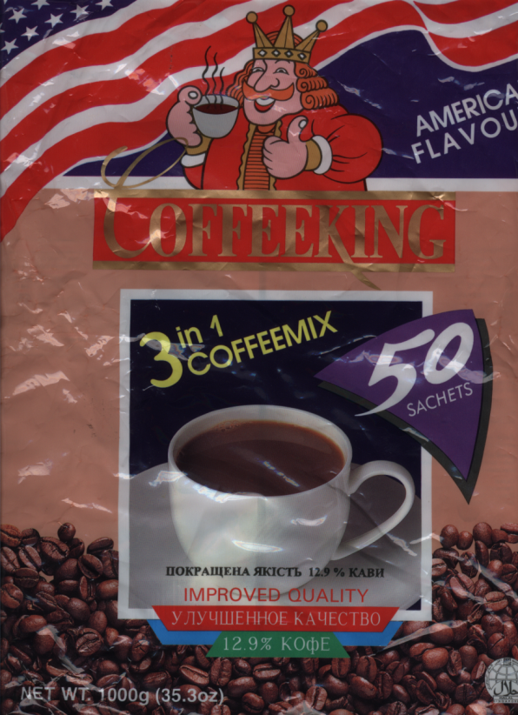
启示录
基督的胜利
Notes:
My favourite instant coffee is the “American Flavour” Coffee King brand. Interestingly, each packet shows a king drinking coffee. Since America was established in rebellion to the King of England and the USA has never had a king, one wonders who this king is on the package! Nevertheless, it does raise the issue of who really rules the world. The book of Revelation is quite clear on this question as it removes all doubt in showing that Christ is the Ultimate Victor and Sovereign over all creation.

Slide 12
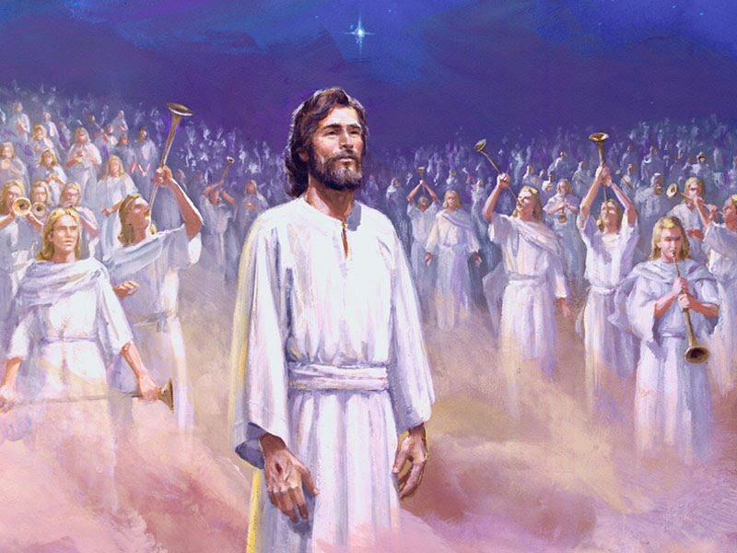
谁是真正的国王？
基督的胜利

Slide 13
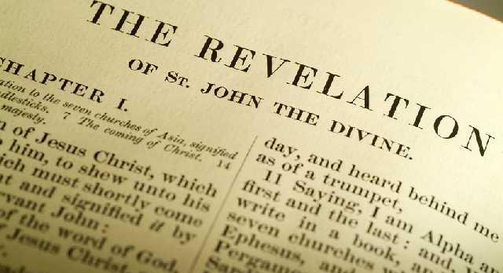
这是什么标题？
启示录s?
启示录

Slide 14
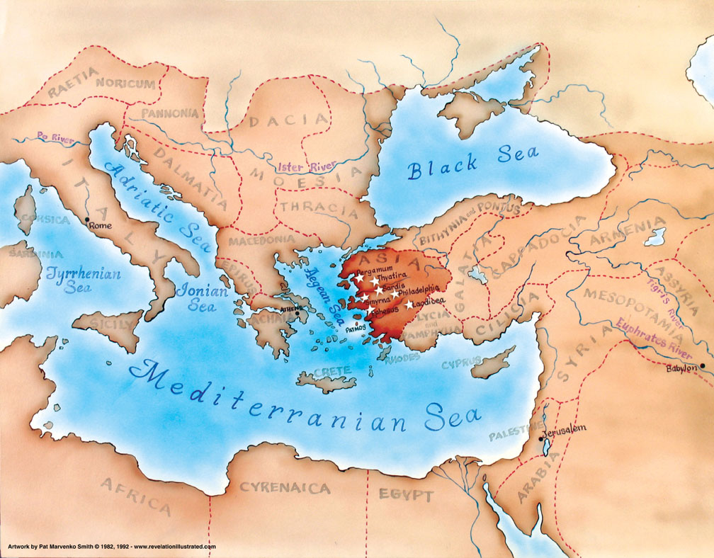
小亚细亚 公元95年
321

Slide 15
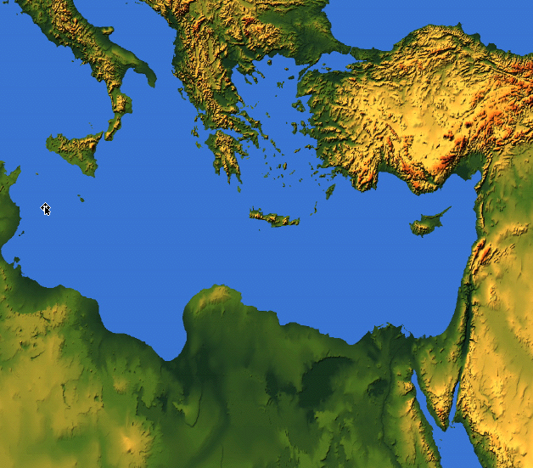
约翰看见了什么？
亚洲的教会
罗马
外部的迫害
来自罗马
(1:9; 2:9-10; 3:10)
教会 内部挣扎
(2:4, 14-15, 21-24;
3:1, 15-17)

Slide 16
我们为什么应当知道耶稣统治这个世界?
318
为何读《启示录》?
为何敬拜耶稣?
为何需要清楚认识耶稣?

Slide 17
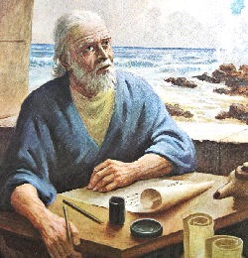
I. 阅读并谨守耶稣统管万有（拥有主权），这个启示带来祝福(1:1-3).
343

Slide 18
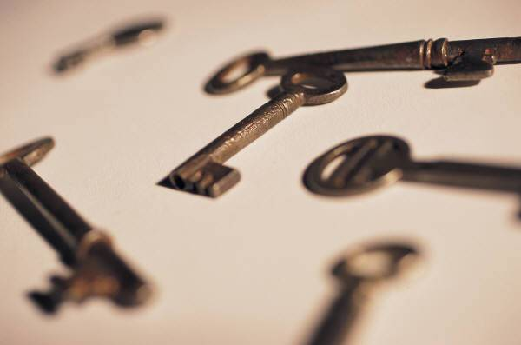
启示录的关键
320
Points E, F, J, M
上帝
“耶稣基督的启示，就是神赐给他以示他的仆人的事情，必须尽快进行。他派遣他的使者，将他的仆人约翰，见证了上帝的话和对耶稣基督的见证，甚至说，他看到的所有“（1:1-2）。
天使
约翰
关键词：胜利
关键句：“写，因此，你所看到的，什么是现在，以后会发生什么”（1:19）
读者
(耶和华的仆人)

Slide 19
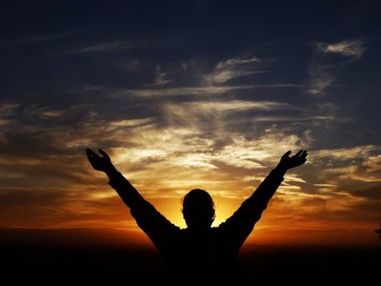
特征
322
这是《圣经》中唯一的书，明确应许读此书会带来特别的祝福 (1:3).
"读这书上预言的人， 和那些听见这预言并且遵守书中记载的人， 都是有福的！ 因为时候近了。" (1:3 CNV)

Slide 20
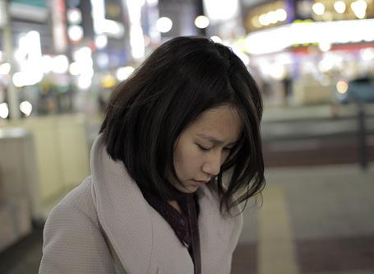
我们总是往下看…

Slide 21
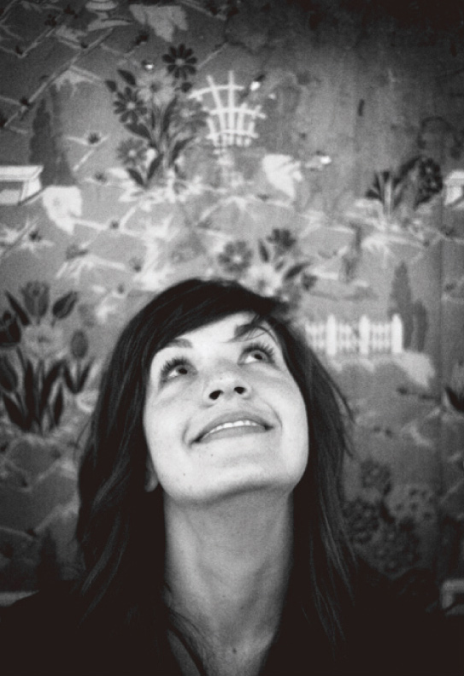
…为什么应当往上看，为什么在我困难、挣扎的时候应该敬拜耶稣?

Slide 22
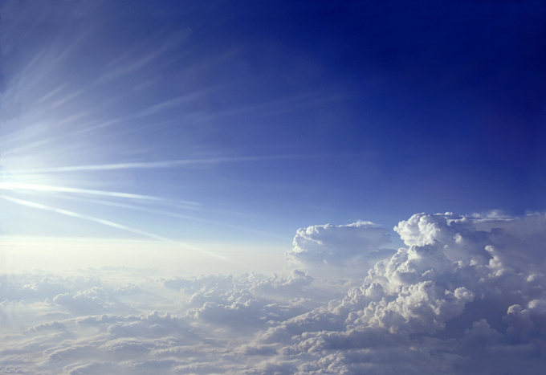
II. 我们应该敬拜三一神，因为耶稣很快就要回来 (1:4-8).

Slide 23
“愿恩惠平安归于你们，从昔在，今在，
以后永在的神"
圣父
启示录. 1:4-6
是
不是
i不是
神
是
是
圣子
圣灵
“从耶稣基督…"
“…从祂宝座前面的七灵"
不是
H. Wayne House, Charts of Christian Theology and Doctrine, 45

Slide 24
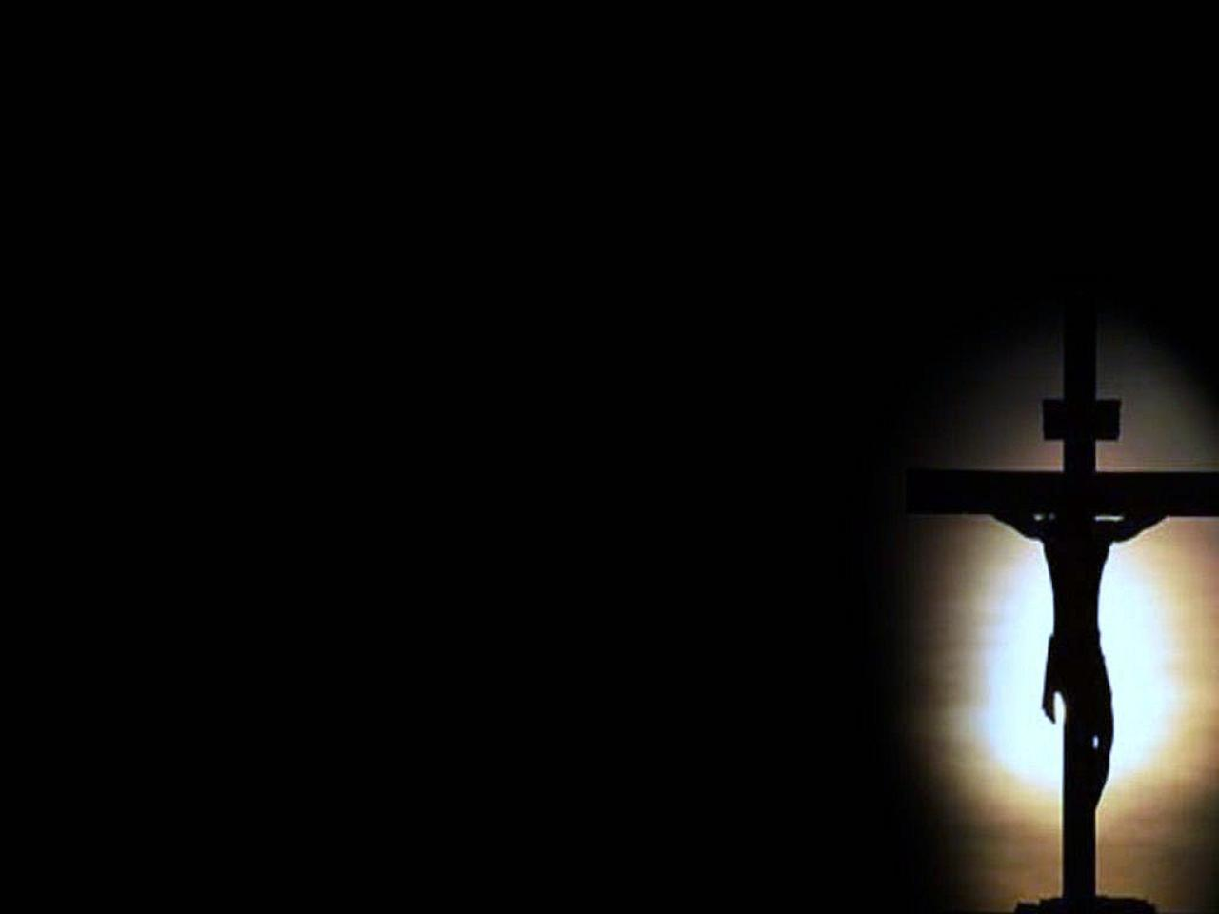
基督的救赎 (1:5b-6)
" 死人中首先复生的、 地上众君王的统治者耶稣基督临到你们。 他爱我们， 用自己的血把我们从我们的罪中释放出来， 6 又使我们成为国度， 作他父 神的祭司。 愿荣耀权能都归给他， 直到永永远远。 阿们。"

Slide 25

"看哪， 他驾着云降临， 每一个人都要看见他，
连那些刺过他的人也要看见他，
地上的万族都要因他哀号。
这是必定的， 阿们。"
《启示录》 1:7 NLT
参见《 撒迦利亚书》 12:10

Slide 26
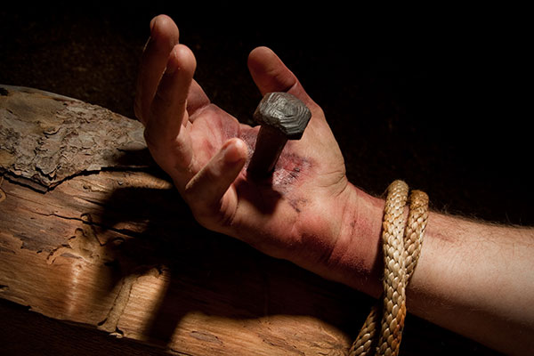
以色列的悔改
““我必把那恩慈与恳求的灵倾注在大卫家和耶路撒冷居民的身上。 他们必仰望我， 就是他们所刺的； 他们要为他哀哭， 好像丧独生子； 他们必为他悲痛， 好像丧长子”
(撒加利亚书 12:10 NLT).

Slide 27
"看哪， 他驾着云降临， 每一个人都要看见他，
连那些刺过他的人也要看见他，
地上的万族都要因他哀号。
这是必定的， 阿们。"
《启示录》 1:7 NLT
参见《 撒迦利亚书》 12:10

Slide 28

" 主 神说： “我是阿拉法， 我是俄梅格； 我是今在、 昔在、 以后要来， 全能的 神"
(1:8 CNV).
iii

Slide 29
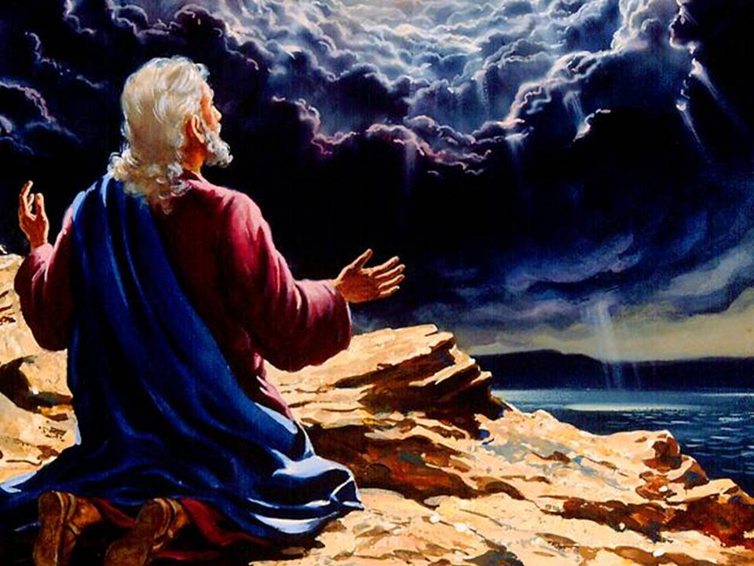
为什么要清楚认识耶稣?
343
Notes:
"Tradition says that it was Domitian who sent John to the Isle of Patmos, a Roman penal colony off the coast of Asia Minor. This being the location of John's exile, perhaps it is not surprising that the word sea is found twenty-six times in his book" (Warren Wiersbe, Bible Exposition Commentary)

Slide 30
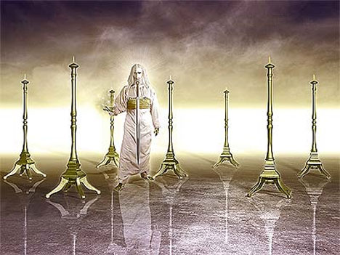
III. 荣耀的基督必能解决你的问题 (1:9-20).
343

Slide 31
约翰看见了什么？
亚洲的教会
321
罗马
拔摩海岛
" 我约翰， 就是你们的弟兄， 在耶稣里跟你们一同分享患难、 国度和忍耐的， 为了 神的道和耶稣的见证， 曾经在那名叫拔摩的海岛上。"
(Rev. 1:9 NLT)
Notes:
Two factors will help us understand the historical situation in AD 95 with these churches scattered throughout the Empire:
External persecution against the churches is noted in 1:9 [click] that began in Rome and spread by imperial edict
Internal compromise within most churches is rebuked in chapters 2-3: division, false teaching, sinful living, self-centered luxurious lifestyles, etc.
What evidence of internal compromise and eternal persecution do you see in your own experience today? How can you relate?

Slide 32
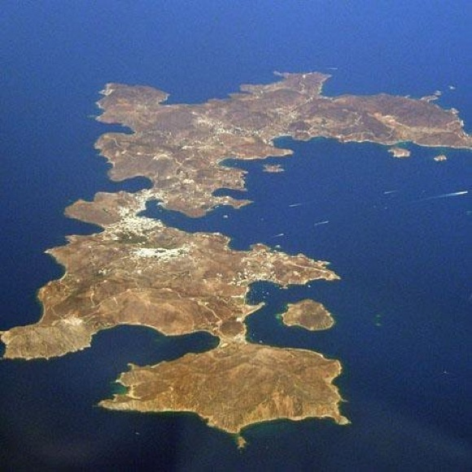
拔摩岛
Notes:
"The small island of Patmos is about 7.5 miles (12 km) long from north to south and at its widest is 6 miles (10 km) from east to west. It is the northernmost island of the Dodecanese. With an area of 13 square miles (35 sq. km) and a circumference of 25 miles (37 km), the volcanic island presents a largely rocky and treeless landscape" (http://www.bibleplaces.com/patmos.htm).

Slide 33
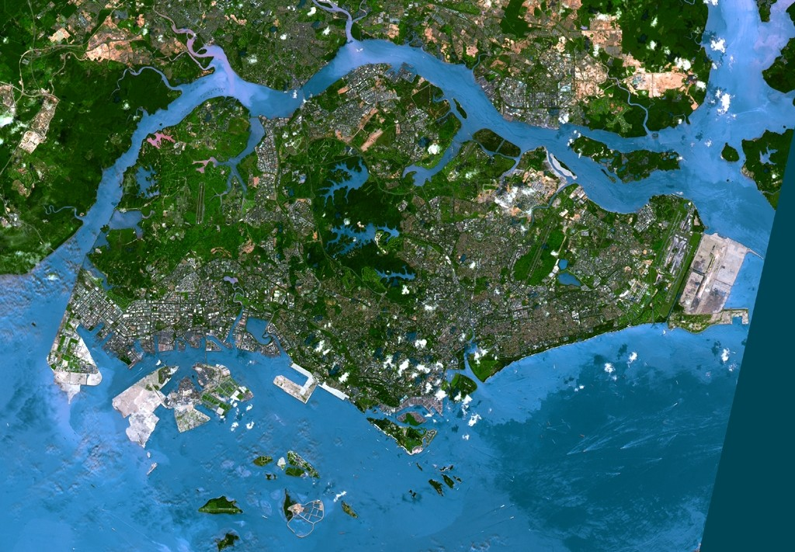
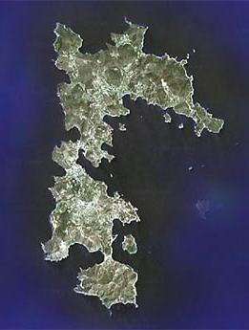
卫星图片：比较新加坡和拔摩岛
拔摩岛

Slide 34
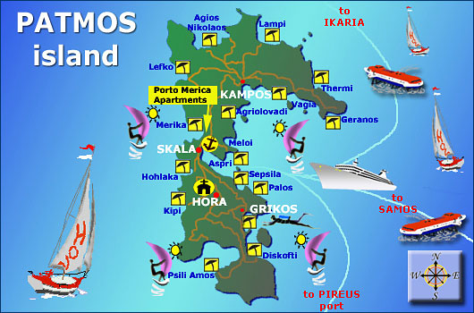
拔摩岛的旅行者们
拔摩岛

Slide 35
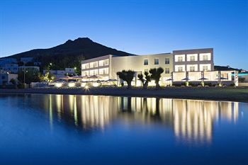
拔摩岛豪华旅馆

Slide 36
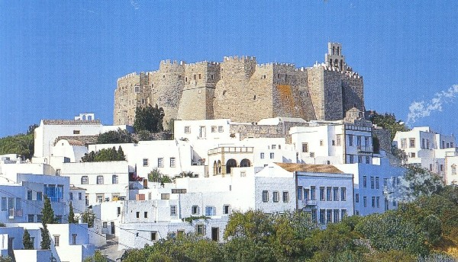
拔摩岛的圣约翰修道院
Notes:
"The most imposing building on the island is the Monastery of St. John the Theologian. Constructed by Christodoulos in 1088, the monastery is located in the town of Chora overlooking the harbor. With walls 50 feet (15 m) high, it was built like a fortress because of the threat from pirates. The monastery was built on top of the remains of a 4th century AD church and an earlier temple of Artemis. An inscription that mentions the temple of Artemis is displayed in the monastery's museum" (http://www.bibleplaces.com/patmos.htm).

Slide 37
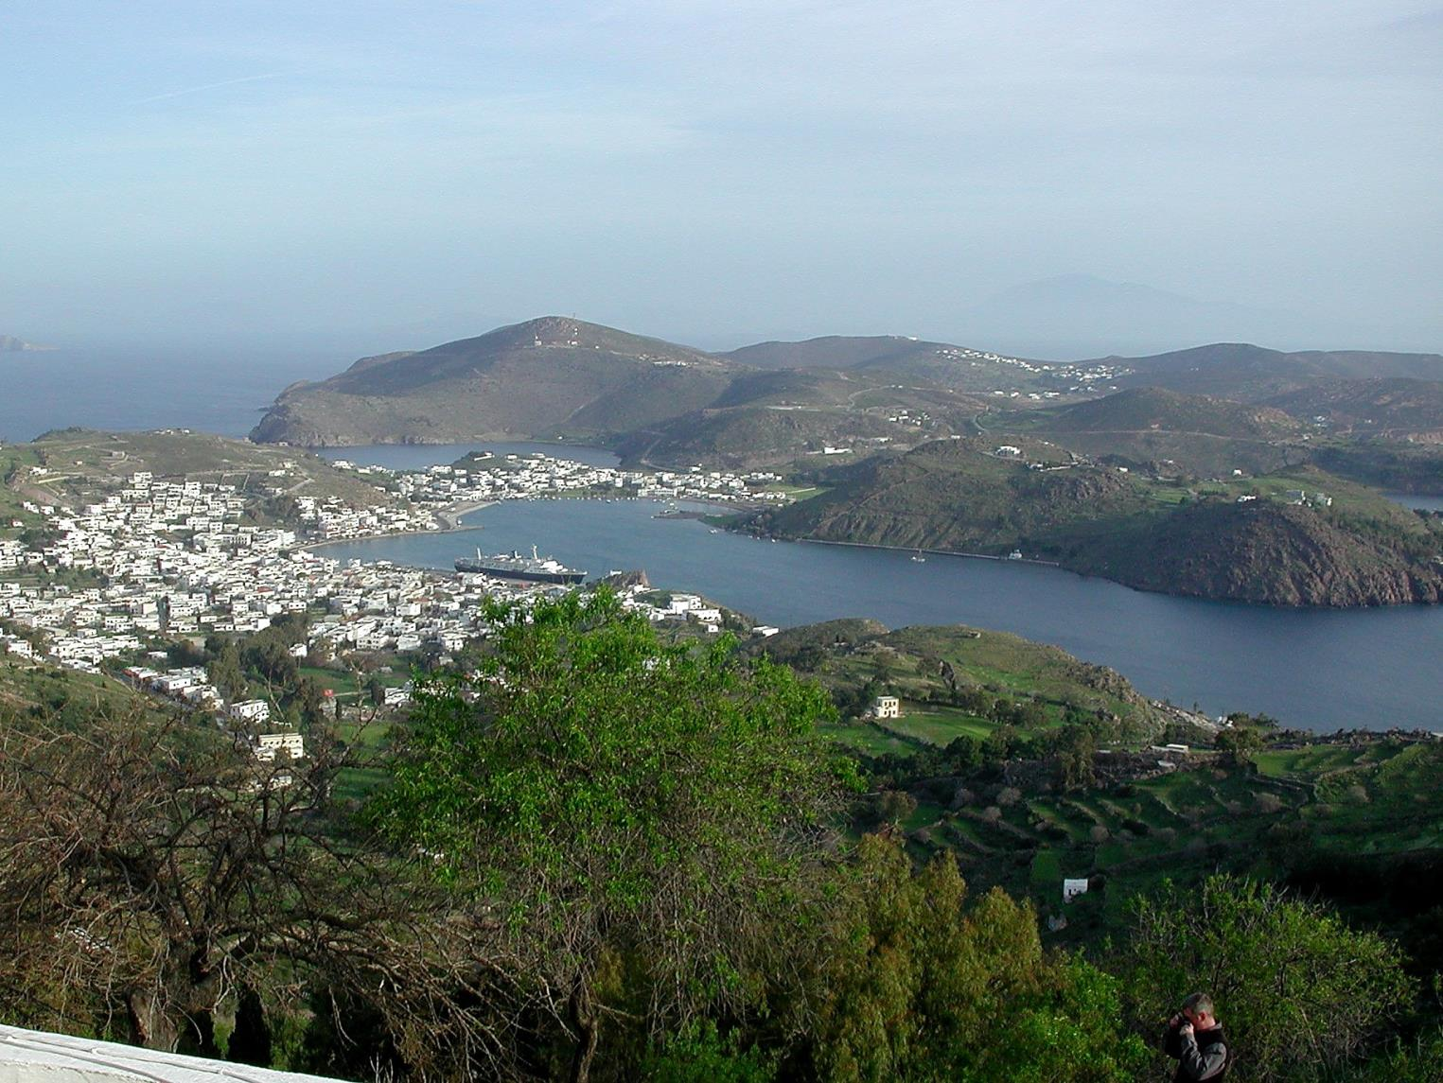
约翰从上看下来

Slide 38
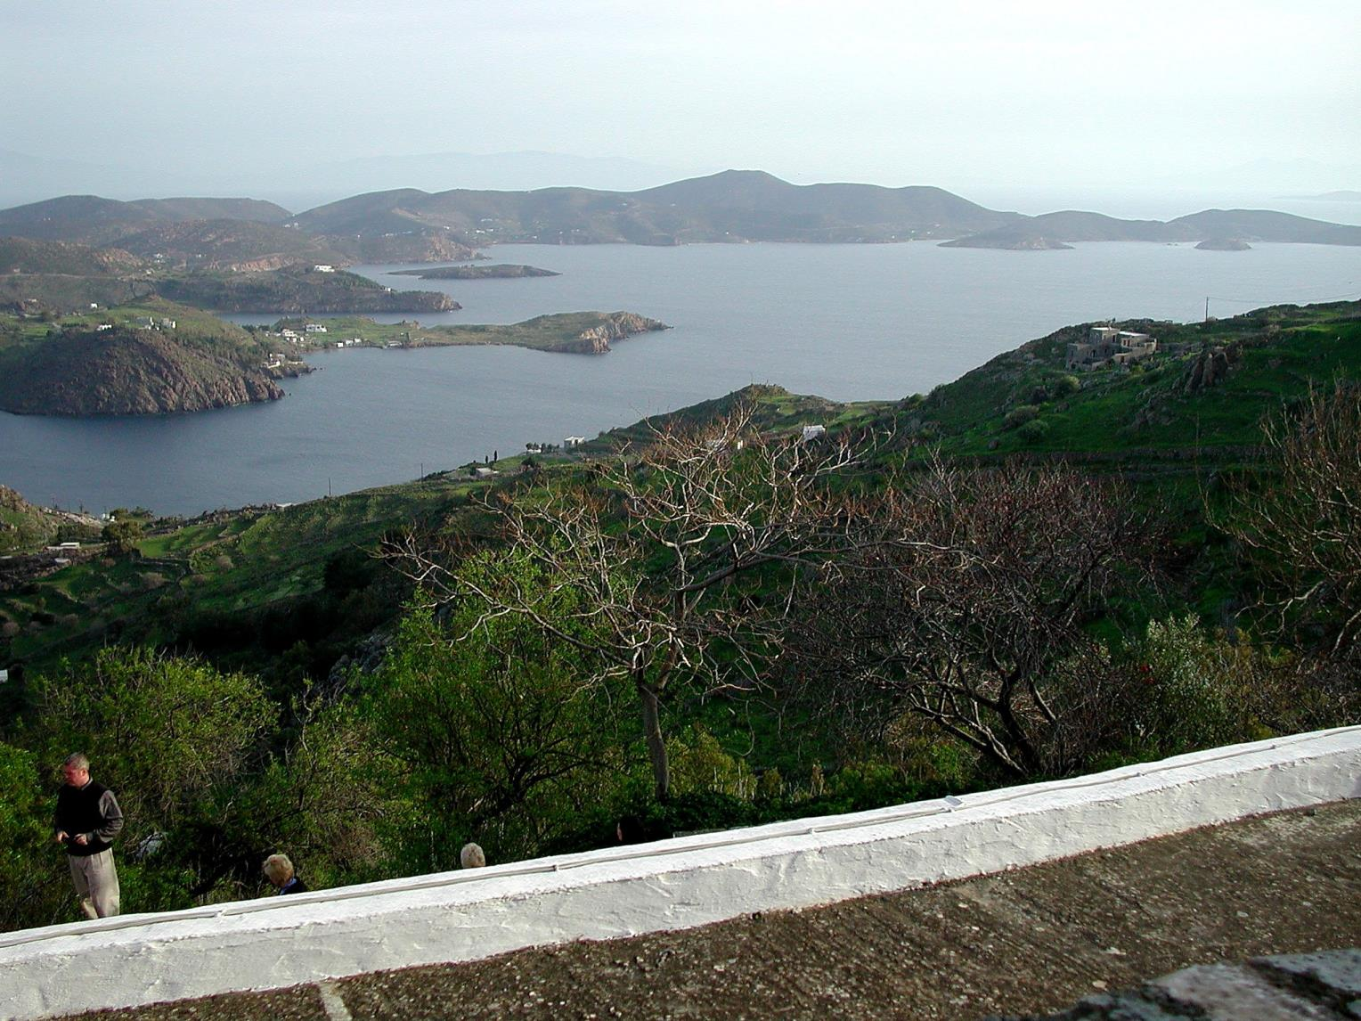
约翰自上而观

Slide 39
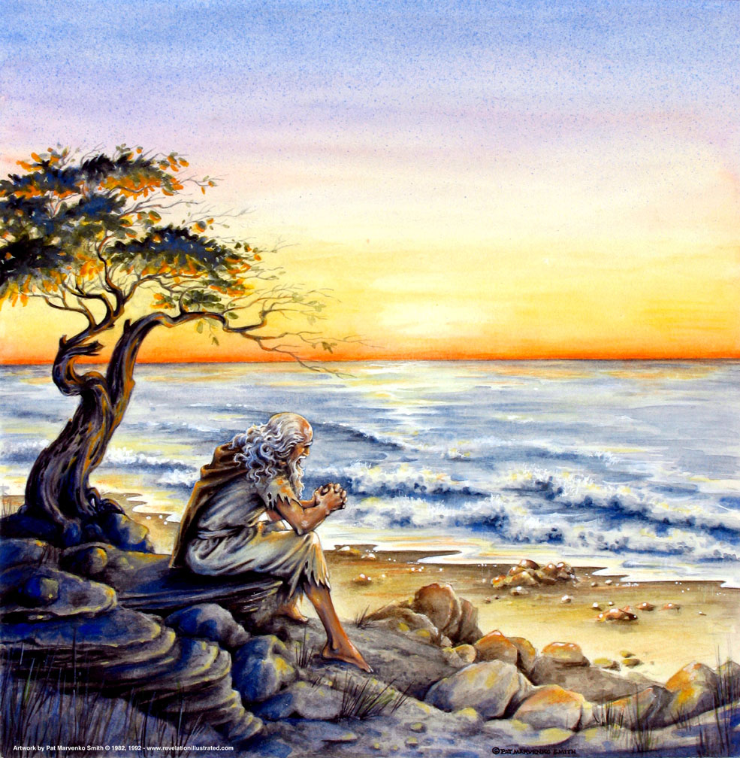
“…在一个主日…"
(1:10)
319
星期天?
神的日子（“Day of the LORD”）?

Slide 40
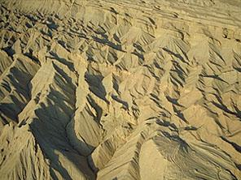
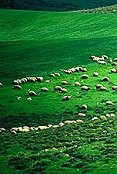
OTS 638-639
上帝的日子
审判
+
祝福
磨难
千年
创世记 6-19
创世记 20
7 年
1000 年

Slide 41
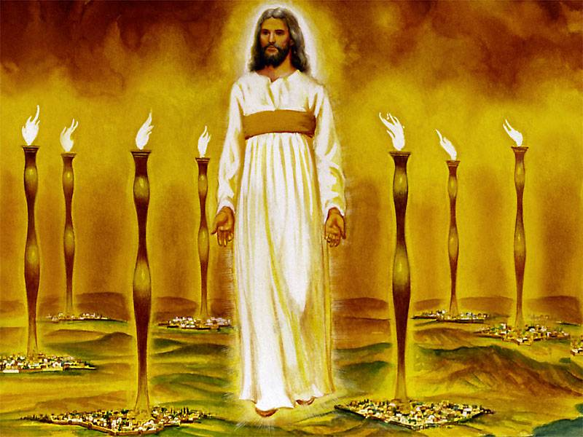
基 督 在 燈 台 中 (启 示 录 1 章 )
343
Notes:
“Christ’s garments are those of a Judge-King, One with honor and authority. The white hair symbolizes His eternality, “the Ancient of Days” (Dan. 7:9, 13, 22). His eyes see all (Rev. 19:12; Heb. 4:12), enabling Him to judge righteously. His feet of burning brass also suggest judgment, since the brazen altar was the place where the fire consumed the sin offering. The Lord had come to judge the churches, and He would also judge the evil world system. The “sound of many waters” (Rev. 1:15) makes me think of Niagara Falls! Perhaps two ideas are suggested here: (1) Christ gathers together all the “streams of revelation” and is the Father’s “last Word” to man (Heb. 1:1–3); (2) He speaks with power and authority and must be heard. The sword from His mouth certainly represents the living Word of God (Heb. 4:12; Eph. 6:17). He fights His enemies by using His Word (Rev. 2:16; 19:19–21)” (Wiersbe).

Slide 42
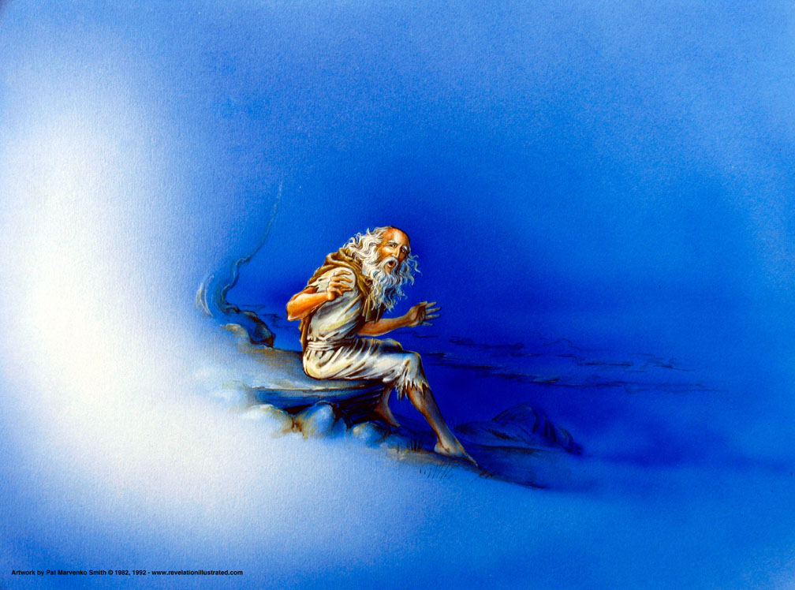
"有一个主日，我在灵里，听见在我后边有一个大声音，好像号筒的响声"
(1:10 CNV).

Slide 43
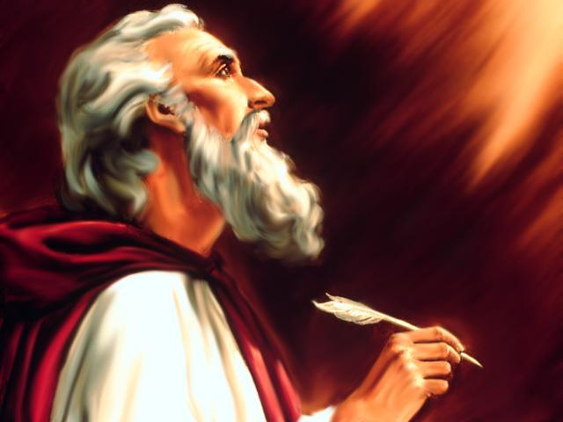

“我看见…"
(1:12)
1:12
1:17
4:1
5:1
5:2
5:6
5:11
6:1
6:2
6:5
6:8
6:9
6:12
7:1
7:2
7:9
8:2
8:13
9:1
9:17
10:1
10:5
13:1
13:2
13:11
14:1
14:6
14:14
15:1
15:2
15:5
16:13
17:3
17:6
18:1
19:11
19:17
19:19
20:1
20:4
20:11
20:12
21:1
21:2
21:22
p. 322
Point B
这个短语在《启示录》中用了45次!
ei=don

Slide 44


现在…完成主的形象描述…
启示给
使徒约翰
关于主耶稣基督
的启示录
启示录 1:12-18 (和合本)
马太
马可
¹²我转过身来，要看是谁发声与我说话。既转过来，就看见七个金灯台。
¹³灯台中间有一位好像人子，身穿长衣，直垂到脚，胸间束着金带。
¹⁴他的头与发皆白，如白羊毛、如雪，眼目如同火焰，
¹⁵脚好像在炉中锻炼光明的铜，声音如同众水的声音。
¹⁶他右手拿着七星，从他口中出来一把两刃的利剑，面貌如同烈日放光。
¹⁷ 我一看见，就仆倒在他脚前，像死了一样。他用右手按着我说：“不要惧怕！我是首先的，我是末后的，
路加
约翰
¹⁸又是那存活的；我曾死过，现在又活了，直活到永永远远，并且拿着死亡和阴间的钥匙。
©2006 TBBMI
28
10

Slide 45
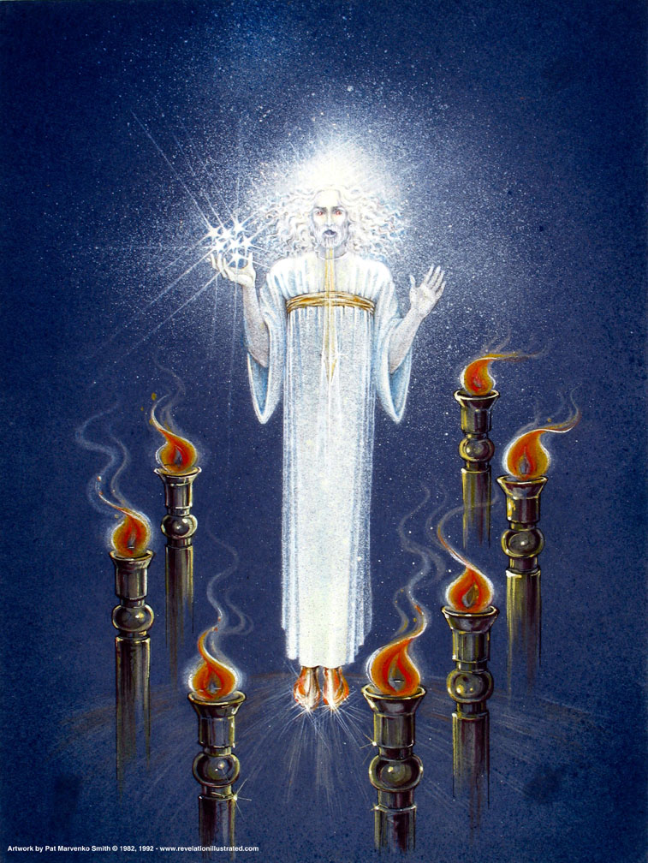
Christ Among the Lamp Stands
(1:12-16)
Notes:
"Christ's garments are those of a Judge-King, One with honor and authority. The white hair symbolizes His eternality, "the Ancient of Days" (Dan. 7:9, 13, 22). His eyes see all (Rev. 19:12; Heb. 4:12), enabling Him to judge righteously. His feet of burning brass also suggest judgment, since the brazen altar was the place where the fire consumed the sin offering. The Lord had come to judge the churches, and He would also judge the evil world system" (Wiersbe).

Slide 46
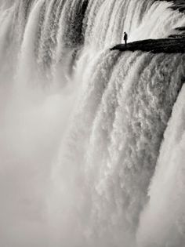
“…众水的声音"
(1:15)
Notes:
"The "sound of many waters" (Rev. 1:15) makes me think of Niagara Falls! Perhaps two ideas are suggested here: (1) Christ gathers together all the "streams of revelation" and is the Father's "last Word" to man (Heb. 1:1–3); (2) He speaks with power and authority and must be heard." (Wiersbe).

Slide 47
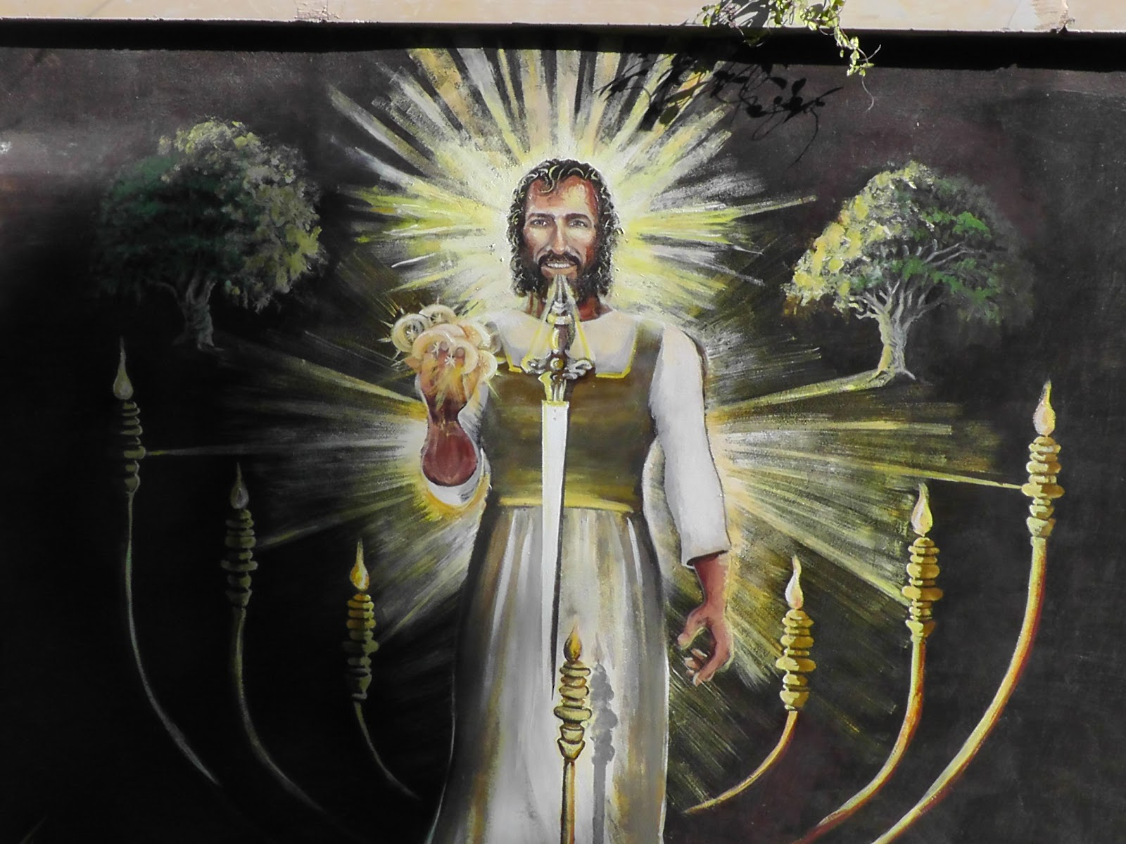
“口中的利剑"
(1:16)
Notes:
"The sword from His mouth certainly represents the living Word of God (Heb. 4:12; Eph. 6:17). He fights His enemies by using His Word (Rev. 2:16; 19:19–21)" (Wiersbe).

Slide 48
旧约与启示录1：12-16形容耶稣的相似之处
343
启 1:12-16 | 结 1:24-28 | 但 10:5-6 | 但 7:9-10 | 但 7:13-14
人子 | 仿佛人的形状 | 一人 |  | 人子
长衣 |  | 细麻衣
金带 |  | 精金带
白发 |  |  | 白发
眼目如火焰 | 火 | 眼目如火把 | 火
脚如铜 | 光耀的精金 | 光明的铜
声音如众水 | 象大水的声音 | 大众的声音
手拿着星
面貌如烈日 | 光辉 | 面貌如闪电
Vern Poythress at www.frame-poythress.org

Slide 49
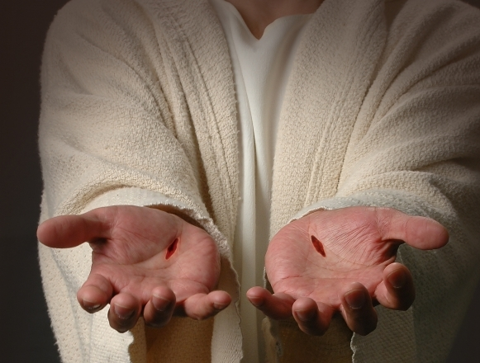
"我看见了他， 就仆倒在他脚前， 像死了一样。 他用右手按着我， 说： “不要怕！ 我是首先的， 我是末后的， 18 又是永活的； 我曾经死过， 看哪， 现在又活着， 直活到永永远远， 并且拿着死亡和阴间的钥匙。"
(1:17-18 NLT)
343

Slide 50
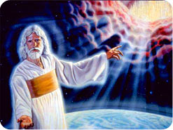
原则 #4
四个说明的原则
启 示 录 启发概要
19 所 以 你 要 把 所 看 见 的 ， 和 现 在 的 事 ， 并 将 来 必 成 的 事 ， 都 写 出 来 。启 示 录 1:17-19
看到
将
会发生

Slide 51
启示录
基督的主权在未来的胜利
主权是属于基督 |  |  | 主权在教会 | 主权在末日的事件
第 1 章 |  |  | 第 2–3 章 | 第 4–22 章
“你看到什么” (1:19a) |  |  | “现在是什么” (1:19b) | “以后会发生什么” (1:19c)
过去 |  |  | 现在 | 未来
基督揭露 |  |  | 教会揭露 | 完成揭露
上帝在地上 |  |  | 上帝的使者 在地上 | 从地狱在地上到天堂地上
审判官 |  |  | 任务 | 判决和奖励
主题 1:1-3 | 敬拜三位一体神 1:4-8 | 荣耀耶稣基督 1:9- 20 | 小亚细亚七教会: 以弗所、士每拿、别迦摩、推雅推喇、撒狄、非拉铁非、 老底嘉 | 苦难 4:1– 19:10 | 第二次来 19:11-21 | 千禧年 20 | 永恒的状态 21:1–22:5 | 终结的迫切性 22:6-21
A.D. 95
318

Slide 52

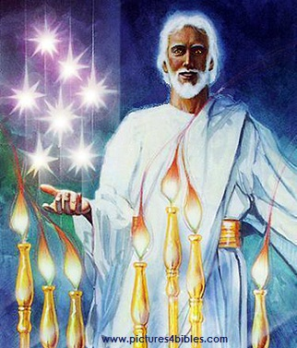
七星和七个灯台指什么 (1:20 NLT)?
你所看见在我右手中的七星和七个金灯台的奥祕就是这样： 七星是七个教会的使者， 七灯台是七个教会。”

Slide 53
约翰看见了什么？
亚洲的教会
罗马
外部的迫害
来自罗马
(1:9; 2:9-10; 3:10)
教会 内部挣扎
(2:4, 14-15, 21-24;
3:1, 15-17)
耶稣基督掌管万有，这些启示帮助小亚细亚的七个教会认识到，基督会帮助他们克服并胜过内在的妥协和外在的逼迫

Slide 54
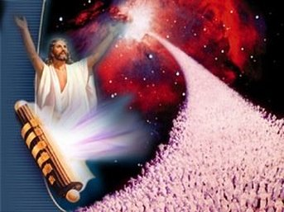
耶稣统治世界，拥有绝对主权!
祂当然能解决你的小问题.
大的观念

Slide 55
我们为什么应当知道耶稣对这个世界拥有绝对主权?
318
为何读《启示录》?
  你会得到祝福!
为何敬拜耶稣?
  祂要再来!
为什么要清楚认识耶稣?
  祂解决你的问题!

Slide 56

你眼中的耶稣？

Slide 57

总结陈述
343
上帝通过约翰展示了耶稣基督的主权在未来最终的胜利，以鼓励信徒在内有妥协和外有抵挡的境况中坚忍下去。

Slide 58
全能的
耶稣基督

Slide 60


基督论 • BibleStudyDownloads.org
免费获得该讲解!
圣经学习下载
Notes:
Jesus (Christology) link

