Slide 1
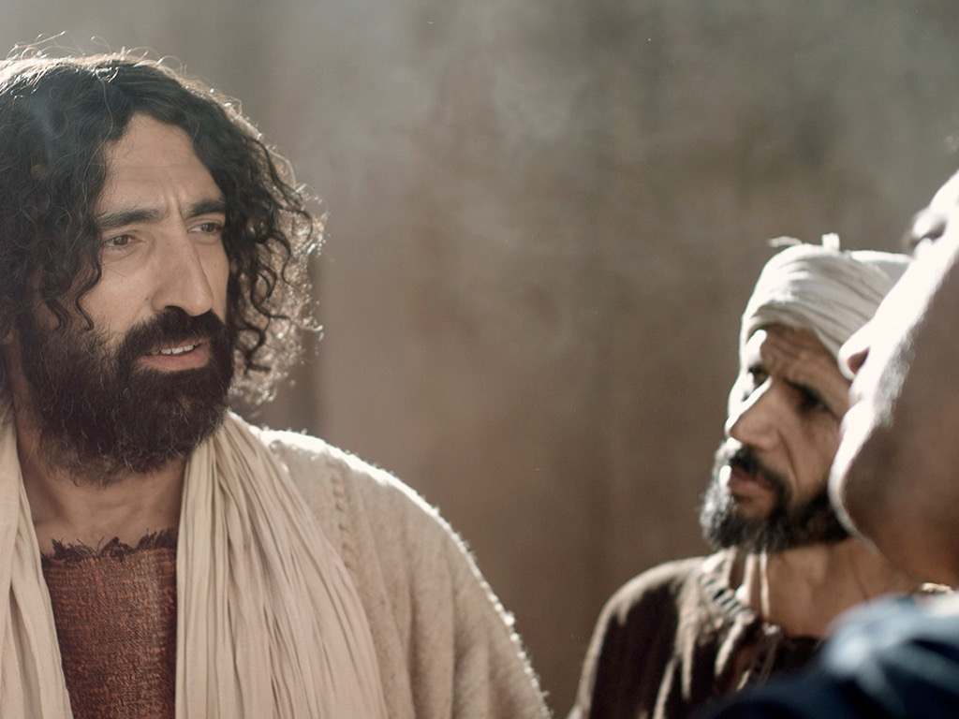
马太 15–28
Dr. Rick Griffith • 博士 • 新加坡神学院 • BibleStudyDownloads.org

Slide 2
Slides on
马太 15

Slide 3
Slides on
马太 16

Slide 4
16:13–20:34
大綱
73
IV. (11:1–16:12) 基督喻言祂将被拒絕為彌賽亞，並最终死在十
字架上。而祂一直教導將有新的國度再降臨，福音要傳给外邦人。
V. (16:13–20:34) 耶稣在離世前，把祂的權柄托付给祂的門徒將福音遍傳。

Slide 5
Slides on
马太 17

Slide 6
Slides on
马太 18

Slide 7
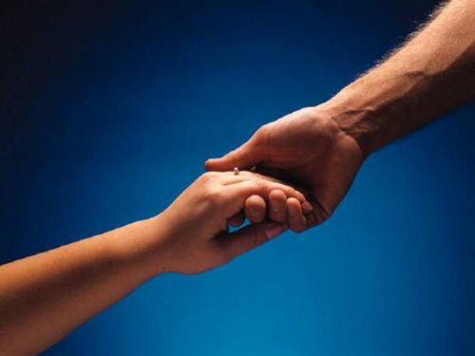

如何修复关系
马太福音 18:15-20
Dr. Rick Griffith • 博士 • 新加坡神学院 • www.BibleStudyDownloads.org
10 December 2006
6 March 2011

Slide 8
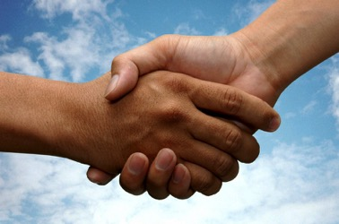
I. (15-17) 教会正确的与犯罪的信徒徒重建关系的方法是尽量不公开。
  (15) 个人的罪只局限于那些直接参与者因此容易重建犯罪的人。
  16) 经过私底下的沟通如对罪不愿悔改的情况下你可多带一两个人一同处理以便重建罪人。
  (17上)经过一小组人的沟通与重建如对罪还是不愿悔改的情况下可让全教会知道以制止继续犯罪。
  (17下) 不愿悔改的罪人让教会知道后的后果既是对待罪人如同非信徒（这包括取消会籍）。

Slide 9
II. (18-20) 教会有权柄恢复信徒或选择逐出犯罪的信徒的原因是实行上帝的权柄。
(18-19) 教会代天父恢复或者试图恢复犯罪的会友
1. （18）教会判决的依据乃是神早已订立的
2. （19）教会领袖的决定乃是执行神的旨意
B. (20) 教会在耶稣的面前恢复或者试图恢复犯罪的会友

Slide 10

释经思想:教会应该恢复或将犯罪信徒逐出教会的原因是实行上帝的权柄。
  (15-17) 教会应正确的与犯罪的信徒徒重建关系的方法是尽量不公开。
  (18-20)教会有权柄重建信徒或选择逐出犯罪的信徒的原因是实行上帝的权柄。

Slide 11
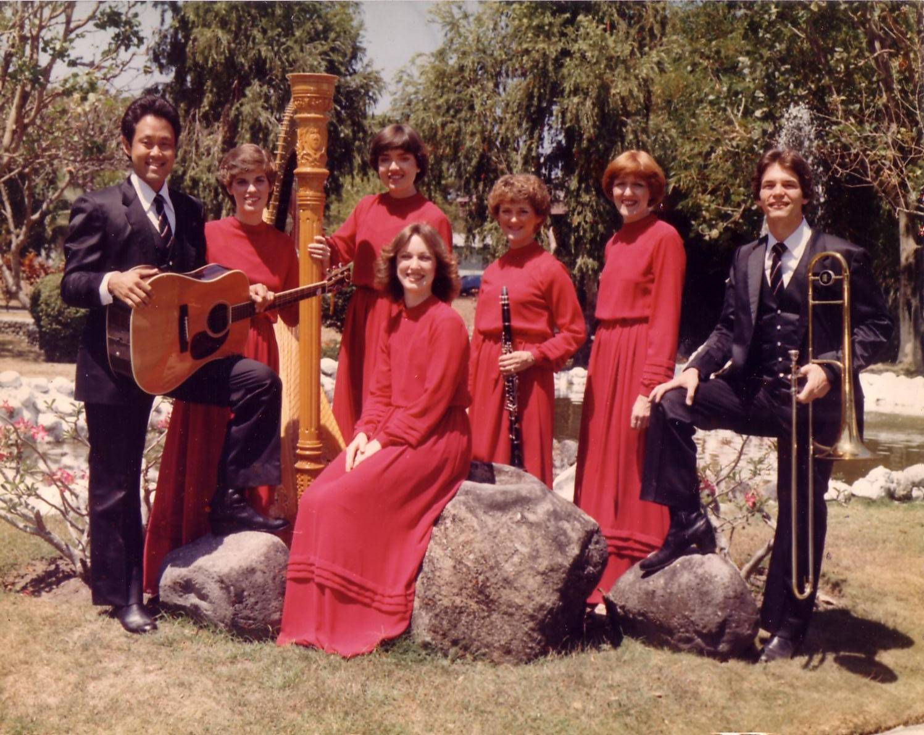
十字路团(1981-83)
Notes:
Some 30 years ago I sang on a music team of seven musicians called Crossroads. If you can’t tell, I am the guy who is not Japanese.

Slide 12
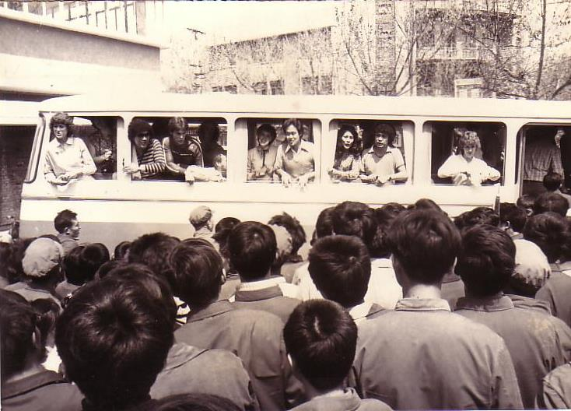
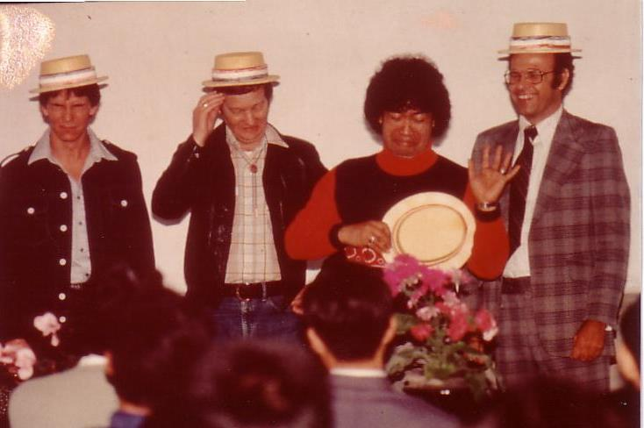
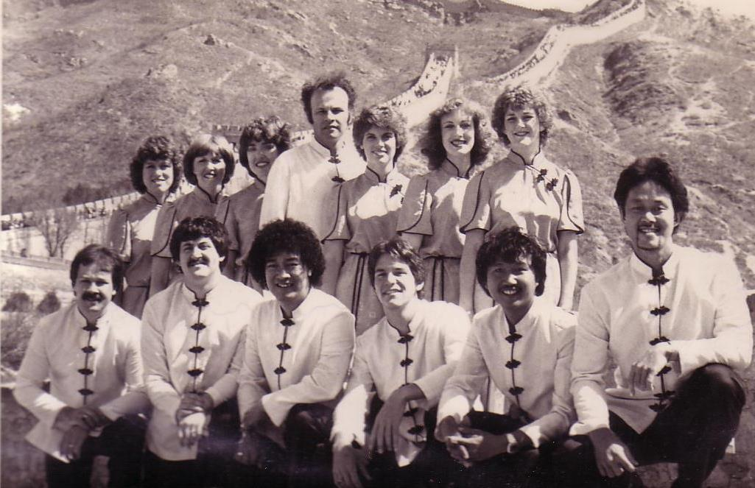
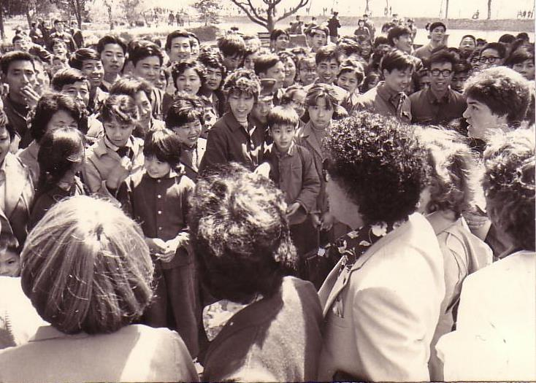
中国， 1981
Notes:
We shared the gospel in China and eleven other countries and—praise God—we reached over 600 people per concert!

Slide 13
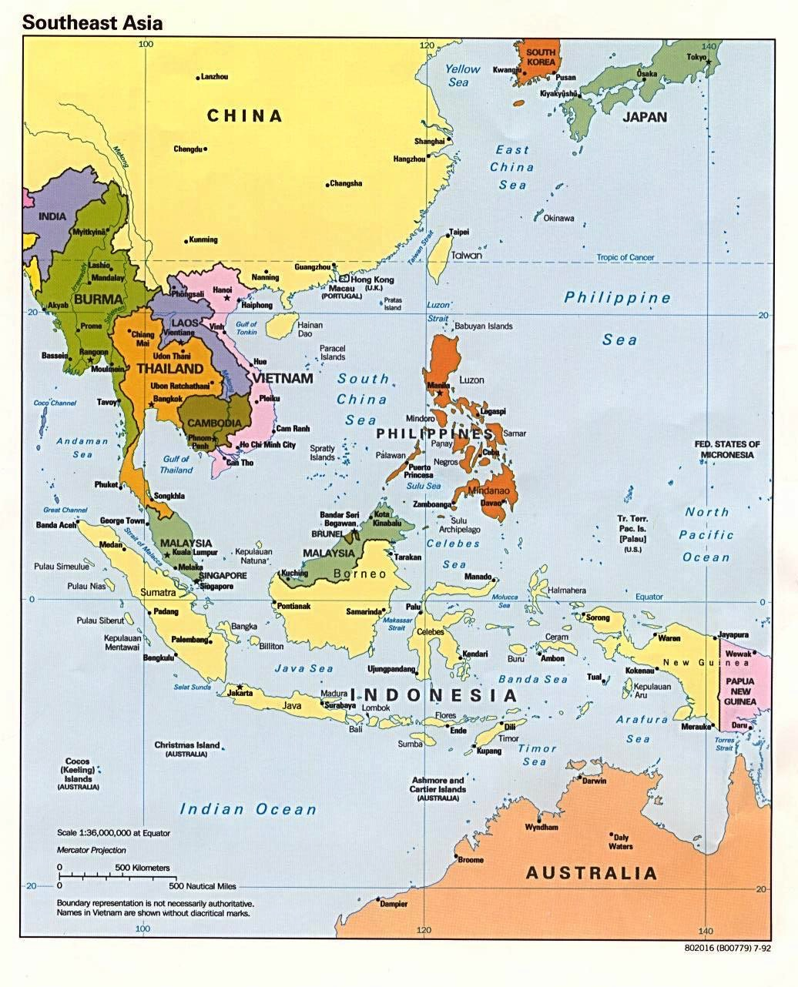
十字路事工
韩国
中国
日本
香港
台湾
澳门
泰国
菲利宾
马来西亚
新加坡
印度尼西亚
Notes:
The Crossroads team shared the gospel in 11 Asian nations and saw over 10,000 people indicate decisions to trust Christ! Again I was amazed at God's grace!

Slide 14
Black
Notes:
If you know anything about spiritual warfare, it is that the enemy of our souls concentrates his efforts on believers who are having an impact for Christ.
In our team, the opposition came from within—relationships that were a challenge. On that team was one particular woman named Kay. She was a godly woman but in terms of preferences, styles, and the like we didn’t see eye-to-eye at all. In fact, many times she felt that I just a "mister-know-it-all." (And of, course she was right as I did know it all.) She didn’t like my mannerisms, my clothes, or my insights in our group Bible studies. She avoided being around me and it seemed that I could do nothing right! She saw me as really arrogant.
So what do you do when you are forced into a working relationship with someone who just plain does not like you? I found that I couldn’t really avoid Kay. After all, every day we had four hours of music practice with the team. I had to sing in harmony with her—literally! But discord often reigned. Then we had a concert to give and had to work together.

Slide 15

Relational Pillars
信徒的
人际关系支柱
Notes:
God ministered to me then through two texts in Matthew that became "relational pillars" that I want to share with you today. These texts literally changed my life.

Slide 16
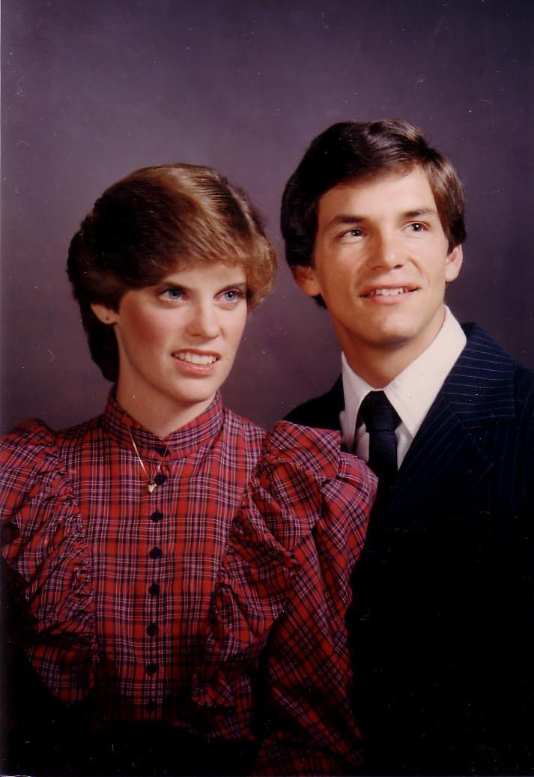
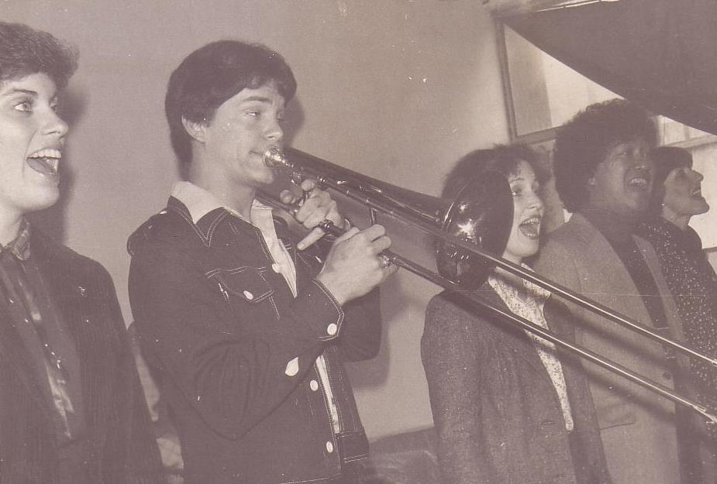
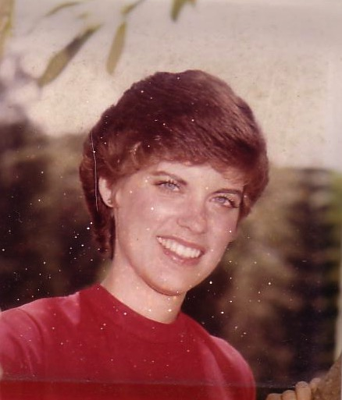
恋爱, 1982
Notes:
They enabled Kay and me to reconcile our differences—so much so that three years after our initial differences Kay actually said "yes" to marrying me!

Slide 17
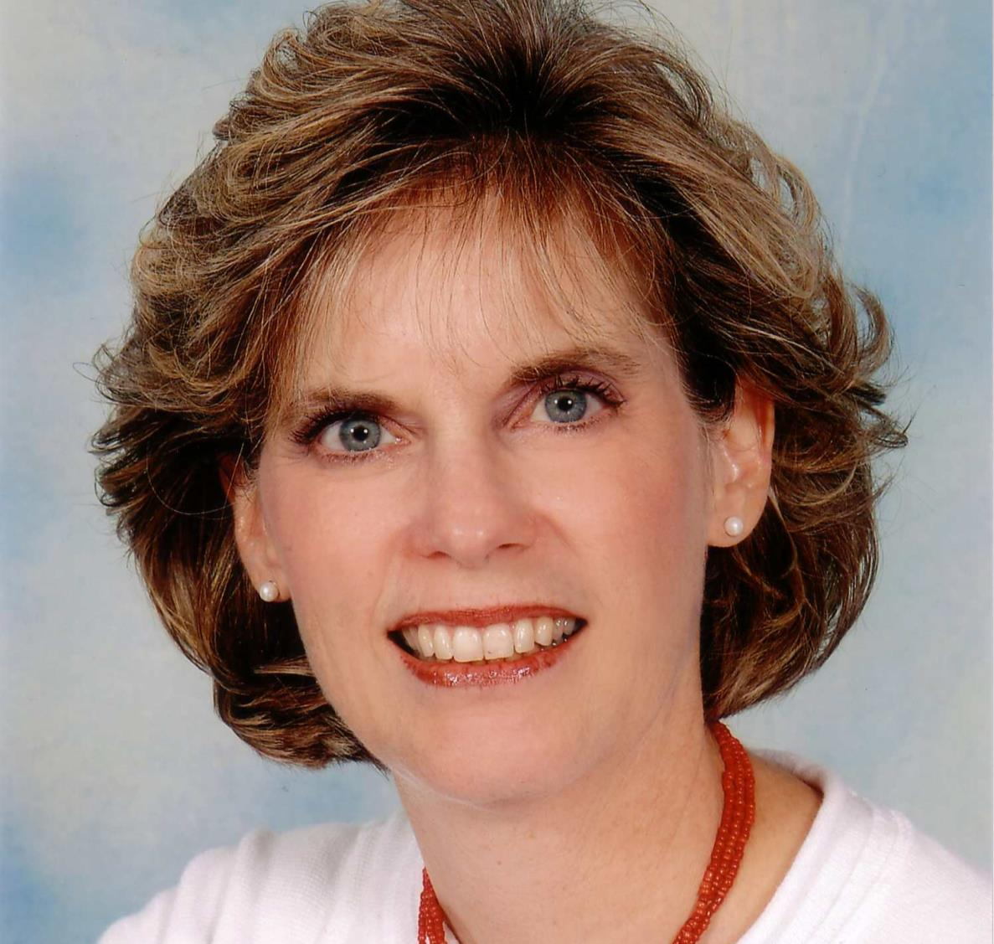
Susan Kay Griffith
Notes:
Yes, Kay is her middle name. Her full name is now Susan Kay Griffith.

Slide 18

Matthew's Relational Pillars
马太福音的人际关系支柱
5:23-24
你是:
冒犯别人者
问题:
一般情况
Notes:
Have you ever had a problem with another believer? (If you say “no,” then I wonder which planet you have been living on!) Are you in fellowship with every Christian that you know now—your family members, your work colleagues, your neighbors and friends? If you’re not in harmony, what should you do?

Slide 19


马太福音 5:23-24
Notes:
If you hurt the other person, Matthew 5 tells you what to do.
Let’s read it.
God places the responsibility to reconcile on you if you are the offender.

Slide 20
马太福音 5:23-24
"所以你在祭坛上献礼物的时候，若想起弟兄向你怀怨，就把礼物留在坛前，先去同弟兄和好，然后来献礼物。"
?
Notes:
The last I checked, believers weren’t offering up sacrifices at the altar. So what does the "altar" refer to today?

Slide 21
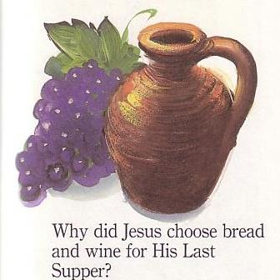
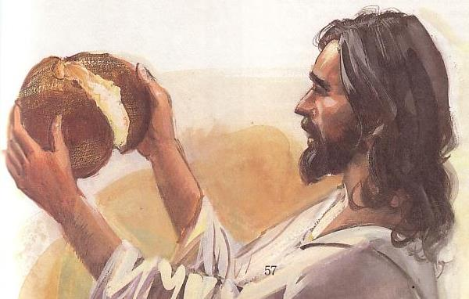
主餐
Notes:
At the very least, it refers to the Lord’s table—a sign of our fellowship & unity.

Slide 22
Matthew's Relational Pillars
马太福音的人际关系支柱
5:23-24
18:15-17
你是:
冒犯别人者
被冒犯者
问题:
一般情况
罪
Notes:
However, in some situations, you are the offended. The other person is guilty of sin. Every church eventually encounters problems with believers living in sin. In these cases a loving body will restore them to God’s holiness.

Slide 23


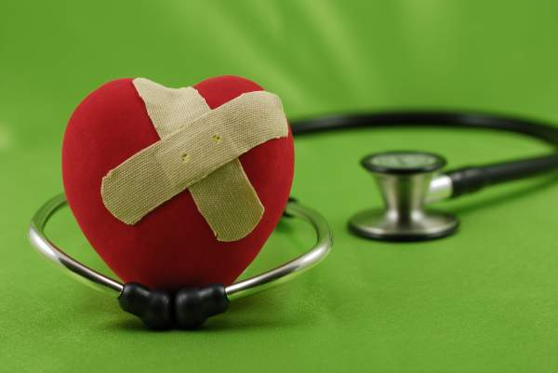
如何正确地挽回犯罪的基督徒?
我们今天第一个问题 (15-17节)
Notes:
So how do we restore sinning Christians properly? (This issue is addressed in your sermon outline.) When someone goes astray from God’s will, what process do we use to bring that person back?

Slide 24
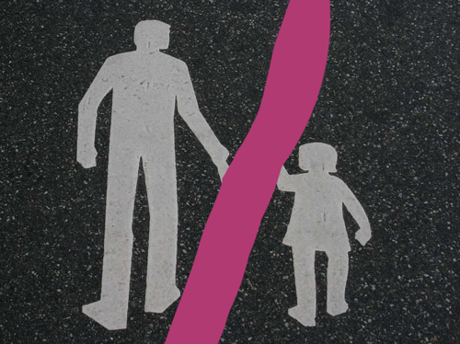

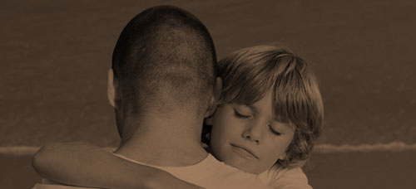
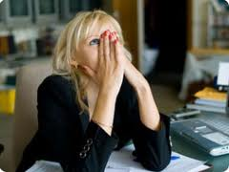
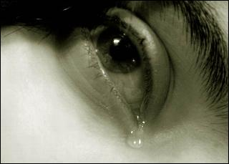
其他关系
Notes:
This doesn’t just refer to marriage, nor to serious sins—it's any kind of sin that can hurt any relationship among believers.

Slide 25
Black
Notes:
Why I am talking about resolving relational problems now?
I just know that issues surface in every relationship, including ours. At some point, I am going to offend you and you will offend me. So what should we do?

Slide 26
马太福音第18节
的价值
1
一
一个
小孩
(1-9)
一只
羊
(10-14)
一个
罪人
(15-20)
一个
欠债者
(21-35)
Notes:
So our key text today is Matthew 18. The context of Matthew 18 is the value of one—
• one child (1-9), one sheep (10-14), one sinner (15-20), one debtor (21-35).
• At the heart of this chapter is verses 15-20…

Slide 27
马太福音18:15-20
所以你在祭坛上献礼物的时候，若想起弟兄向你怀怨，就把礼物留在坛前，先去同弟兄和好，然后来献礼物。 倘若你的弟兄得罪你，你就去趁着只有他和你在一处的时候，指出他的错来。他若听你，你便得了你的弟兄。他若不听，你就另外带一两个人同去，要凭两三个人的口作见证，句句都可定准。若是不听他们，就告诉教会。若是不听教会，就看他像外邦人和税吏一样。我实在告诉你们，凡你们在地上所捆绑的，在天上也要捆绑。凡你们在地上所释放的，在天上也要释放。我又告诉你们，若是你们中间有两个人在地上，同心合意地求什么事，我在天上的父，必为他们成全。因为无论在哪里，有两三个人奉我的名聚会，那里就有我在他们中间。
如何挽回
15-17
为何挽回
18-20
Notes:
In Matthew 18:15-20 Jesus provides God’s plan for loving church discipline. Let’s read it together [read 15-20.] This text has two main teachings on restoring Christians in sin.
• Verses 15-17 give how to restore them and…
• Verses 18-20 give why to restore them.
Let’s first see how to restore relationships. God’s way to restore believers in sin is to…

Slide 28

The Point of Verses 15-17
1. 尽量在
私底下
进行
(15-17)
Notes:
God’s strategy to bring sinning Christians back is to involve as few people as you can.

Slide 29
我们的目标：
挽回！
Notes:
The desired end is restoration, not punishment or excommunication.
The goal of discipline is behavior change to bring the wayward one back. Unfortunately, too many churches "excommunicate" to punish rather than restore).
Restoration is God’s goal for a wandering saint in the sheep image of verses 10-14.
Restoration is the explicit teaching of this text in verse 15b.
Restoration is the goal of church discipline in other passages like Galatians 6:1.

Slide 30


Restore People in Sin
挽回犯罪的人
"弟兄们，若有人偶然被过犯所胜，你们属灵的人，就当用温柔的心，把他挽回过来。又当自己小心， 恐怕也被引诱。" (加 6:1）

Slide 31
神挽回的
四个步骤：
4
3
2
1
…逐步向更多人透露
Notes:
God’s restoring process has four steps that progressively tell more and more people about the sin (15-17).

Slide 32

挽回的第一步：
你亲自向他说
M
M
M
M
M
M
M
M
M
M
M
M
M
M
M
M
S
M
M
M
M
M
M
M
M
M
M
M
S = Sinner 犯罪的人
M = Member 会友
Notes:
What’s our human tendency here?
• It is to tell others about the problem instead of the one involved.
• God commands us to keep the issue as private as possible.

Slide 33
Matthew's Relational Pillars
马太福音的人际关系支柱
5:23-24
18:15-17
你是:
冒犯别人者
被冒犯者
问题:
一般情况
罪
Notes:
This differs from Matthew 5 in that you’re not an offender, but the offended.
• Note also that in Matthew 5 sin may not be in the picture, but Matthew 18 deals specifically with a believer living in sin. This does not refer simply to differences of opinion on debatable matters.

Slide 34
Matthew's Relational Pillars
马太福音的人际关系支柱
5:23-24
18:15-17
你是:
冒犯别人者
被冒犯者
问题:
一般情况
罪
主动者:
你！
你!
Notes:
Earlier we saw from Matthew 5:23-24 that God places the responsibility to reconcile on you if you are the offender. Now whose job is it to initiate if you are the offended?
• Yes, again it is your responsibility again! You say, "That’s not fair! Why is it my job in both situations? Whether I am the offender or the offended I still have to make the first move?" Well, if relationships are not resolved between believers, it has to be through the fault of both—as both have the command of God to resolve it!

Slide 35
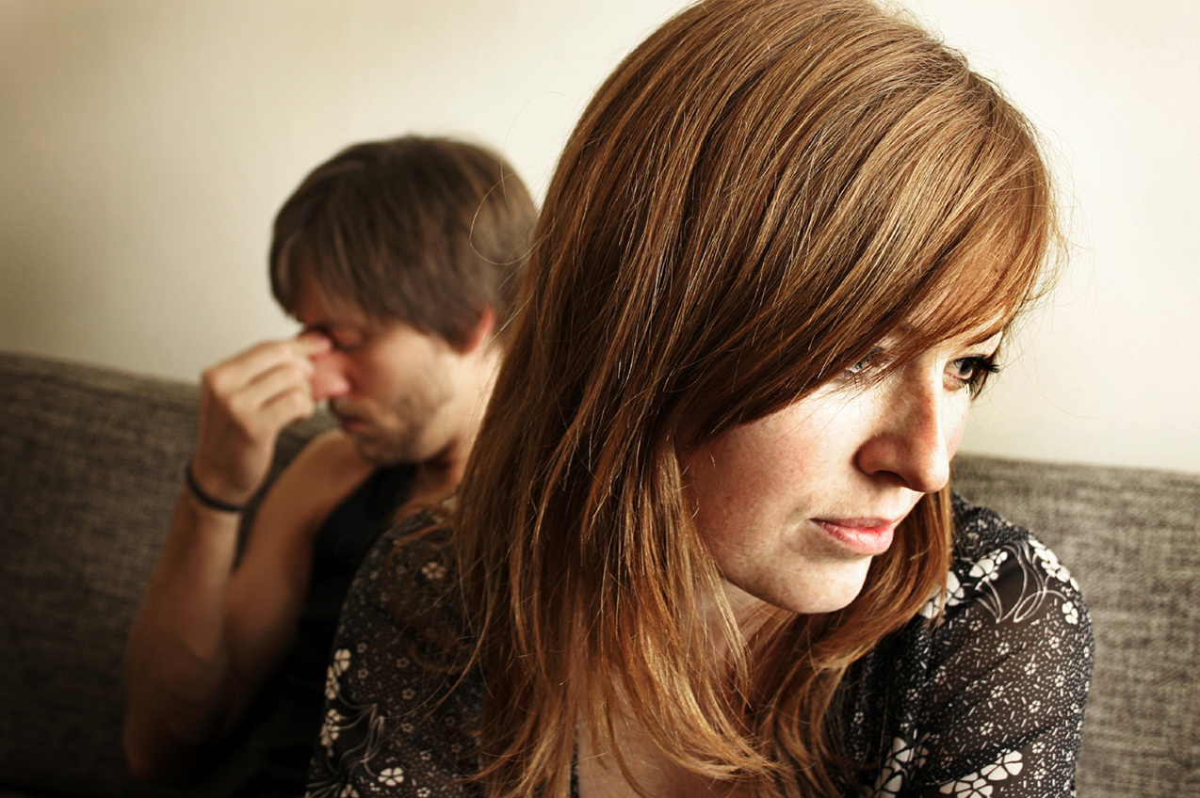
亲自去
不是:
电邮
短信
书信
电话
Notes:
While letter writing was very popular in the time of Christ, our Lord specifically says to deal with these sensitive matters face-to-face. Today this means confrontation should never be handled via email, SMS, letter, or phone calls. It also prohibits the cowardice of anonymous communication.

Slide 36
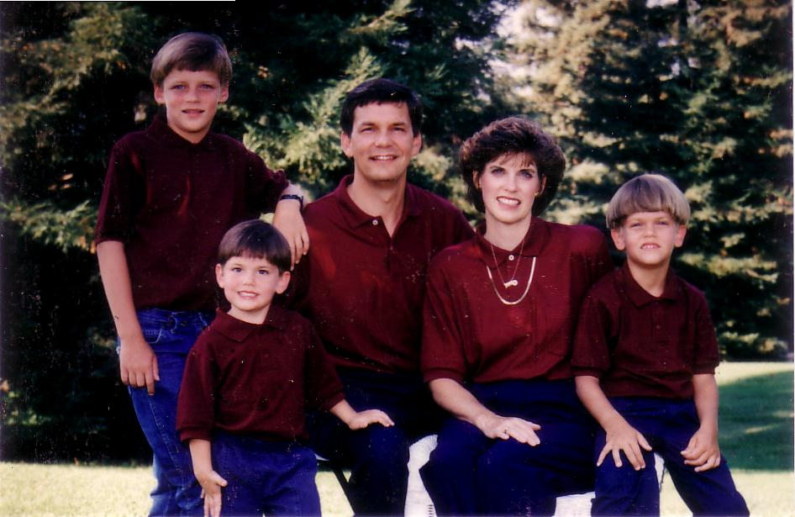
1996
Notes:
Our family has tried to do this since our three sons were young—not to let them do the "Mom! Dad! So-and-so did such-and-such to me!" We just told him, "Matthew 18, bud. If you can’t solve it, we’ll be step 2…" They rarely came back to us!

Slide 37
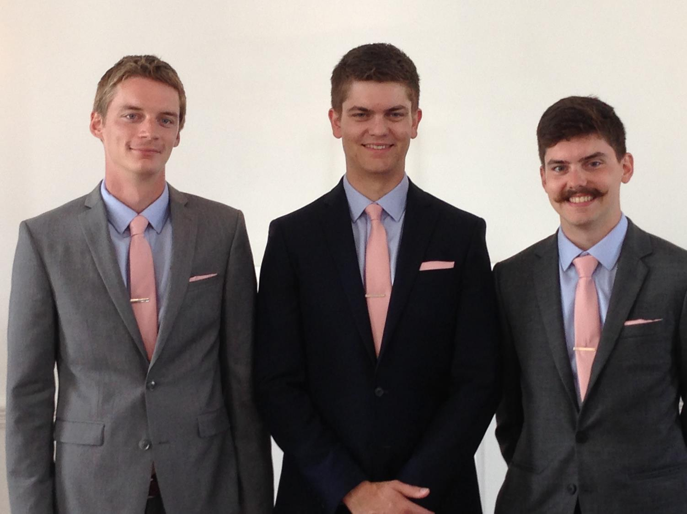
兄弟们…
Notes:
Now that they are older, they solve the problems among themselves without our intervention. Some friends were amazed that Kurt and Stephen moved to the US for college and decided to stay as roommates—for 7 years until they married!

Slide 38

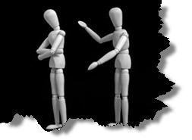
为何不面对面交锋?
无知
怀疑
失败
害怕
藉口
不纯
缺乏交际
Notes:
However, most of the time believers don’t keep issues private—or we don’t address them at all. Why do you think don’t we confront others? Tell the person next to you why! (Small groups for 1 min.) Why not?
• ignorance of what God commands here?
• doubt that it will work?
• failure of past confrontations that didn’t work?
• fear that we might look bad?
• excuses that we can’t get together?
• impurity in our own life?
• unsocial in that we just don’t care enough to risk it?

Slide 39
挽回的第一步：
你亲自向他说
M
M
M
M
M
M
M
M
M
M
M
M
M
M
M
M
S
M
M
M
M
M
M
M
M
M
M
M
S = Sinner 犯罪的人
M = Member 会友
Notes:
So… you should talk to the person by yourself—even though our tendency is to tell others instead. But what if the offender does not repent? We need step 2 where we…

Slide 40
挽回的第二步：
带一两个人同去
M
M
M
M
M
M
M
M
M
M
M
M
M
M
M
M
S
M
M
M
M
M
M
M
M
M
M
M
S = Sinner 犯罪的人
M = Member 会友
Notes:
Take one or two others along (16).

Slide 41

第二步骤的问题
应该带谁去？
为什么一两个人？
Notes:
Who should these 1-2 others be? These persons should be individuals whom the offender respects as they will best help restore him/her. They should not go instead of the offended believer, but along with this person.
• Why take 1-2 others along?

Slide 42
申命记 19:15
人无论犯什么罪，作什么恶，不可凭一个人的口作见证，总要凭两三个人的口作见证才可定案 。
Notes:
The OT law prohibited conviction of crimes based on only one person’s testimony (read Deut. 19:15). The NT teaching is the same, protecting the offender from an easily offended or lying accuser.
What if the offender still does not repent? Go to step 3…

Slide 43
挽回的第三步：
告知教会全体
M
M
M
M
M
M
M
M
M
M
M
M
M
M
M
M
S
M
M
M
M
M
M
M
M
M
M
M
S = Sinner 犯罪的人
M = Member 会友
Notes:
The church leadership certainly must be involved at this point before the matter is brought to the congregation. They also must see the issue isn’t just a difference of opinion between two parties; the biblical basis for the offender living in sin must be clearly shown with specific passages.

Slide 44
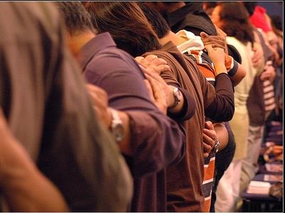
为什么要告知教会全体？
Notes:
Bringing the matter to the entire church is vital, since without it the sinning person will be able to find fellowship in other smaller groups within the larger church who do not know of his/her sin. Such gossip situations inevitably bring disunity, which lead to factions that can split the body.
What, then, should the entire church do once discipline has been determined? Step 4…

Slide 45
挽回的第四步：
看他作外邦人
M
M
M
M
M
M
M
M
M
M
M
M
M
M
M
M
S
M
M
M
M
M
M
M
M
M
M
M
S = Sinner 犯罪的人
M = Member 会友
S

Slide 46

Sins Worthy of Discipline
管教却不可
逐出教会！
Notes:
Sometimes this step has been misinterpreted to mean "excommunication" where the errant person is never contacted again.

Slide 47

Sins Worthy of Discipline
如何执行管教
不要称他/她作基督徒
向他/她传福音
不要让他/她领圣餐
取消他/她的教会会籍
不让他/她在教会里事奉
非信徒
要把犯淫乱的人"交给撒但 "（林前5:5）
不可与他/她吃饭（林前5:11）
禁止他/她参加教会？
更差
Notes:
But Jesus said to "treat him as you would a pagan or a tax collector." Jesus treated pagans with love and kindness, but he didn’t ask them to evangelize the lost as part of his team. You shouldn’t be ugly or ungodly, but…
• Don’t refer to him/her as a Christian. (ILL: I have done this with my former brother-in-law who divorced my sister to marry another woman.)
• Evangelize this person.
• Don’t let him/her take the Lord’s Supper.
• Remove the person from membership.
• Remove this person from church roles (ILL: My friend Paula was asked to leave her church kitchen ministry once her adultery was discovered.)
But in other ways it is more serious than how we treat unbelievers:
• "Deliver over to Satan" one in sex sin (1 Cor. 5:5). Years ago a friend named John left his wife and two small boys for another woman. My church disciplined him, but an elder kept up with him to restore him. After five years, he showed up at church—but he looked 20 years older!
• Don’t eat with him/her (1 Cor. 5:11).
• Should we prohibit the person from attending church? Some say they, like unbelievers, should be welcomed in services without taking the Lord’s Supper; but in most discipline cases this is not even an issue as few disciplined believers seek to return to the assembly until repentant.

Slide 48
The Point of Verses 15-17
1. 尽量在
私底下
进行
(15-17)
Notes:
So that’s God’s 4-step process—to keep the matter as private as possible.

Slide 49
神挽回的
四个步骤：
4
3
2
1
…逐步向更多人透露
Notes:
This is the intent in each of the four steps with the goal of restoration.

Slide 50
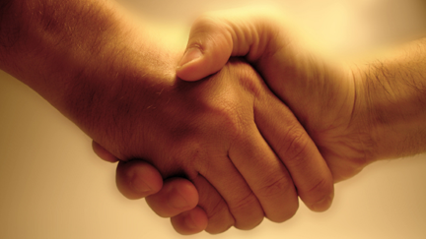
第二个问题的答案在第18-20节：
为何要正确地挽回犯罪跌倒的基督徒？
Notes:
But why must we do all this? What right do we have to discipline our members? Why must we restore sinning Christians properly? Because…

Slide 51

第18-20节的重点：
II.教会的行动
是神权柄的延伸！
Notes:
God’s right to judge is actually delegated to us!

Slide 52
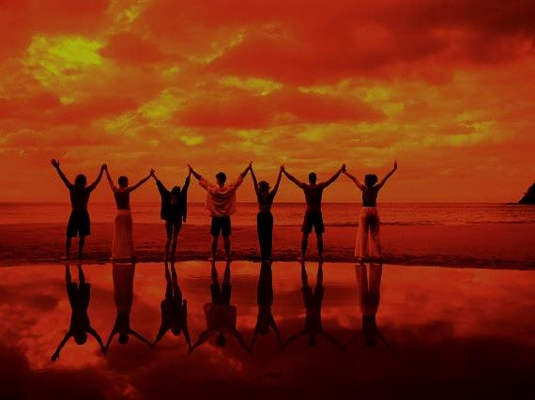
为何要执行处分?
当我们尝试挽回…
我们代父
执行
(18-19)
Notes:
We act in the place of the Father when we seek to restore someone (18-19).

Slide 53
A Better Translation…
NAU 是更好的翻译
NIV "我实在告诉你，你们在地上捆绑的，在天上也将被捆绑
你们在地上释放的，在天上也被或已经被释放。"
NAU “我实在告诉你，你们在地上捆绑的，在天上已经被捆绑；你们在地上释放的，在天上已经被释放。
Notes:
新国际版和新美国标准版
Too often today’s churches act as if they have no authority under God, and yet "binding" here refers to disciplining (a guilty verdict) while "loosing" refers to releasing from discipline (an innocent verdict).

Slide 54

马太18:19
"我又告诉你们，若是你们中间有两个人在地上，同心合意地求什么事，我在天上的父，必为他们成全。 "
（和合本）
Notes:
We should trust that our prayerful judgments are God’s will.

Slide 55
诗篇 82:1,6
(给以色列的统治者／神明)
"我曾说过："你们都是神，是至高者的儿子。… 但你却仍然像人一样死亡…"
Notes:
Ps. 82:6 has a similar idea where Israel’s rulers are called "gods" in that they rule others.
Why should we trust this process in discipline situations? Verse 20 says that…
08.41

Slide 56
为何要执行处分?
当我们尝试挽回…
我们代父
执行
(18-19)
我们在基督
面前并以他的权柄执行
(20)
Notes:
When we seek to restore someone, we act in the presence and authority of Christ (20).

Slide 57
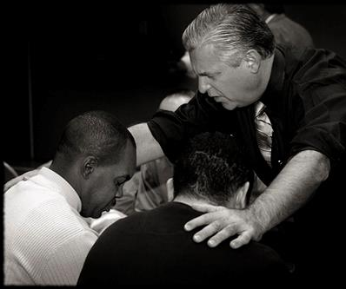
太18:20
"因为无论在哪里，有两三个人奉我的名聚会，那里就有我在他们中间 。"
（和合本）
Notes:
The "two or three" refers to the witnesses whose testimony enacted discipline (v. 16).
The point of Christ being "in their midst" is that local church discipline acts with the presence and authority of Christ Himself.

Slide 58
我们为何要合宜地挽回犯了罪的基督徒呢？
Notes:
So how can we sum up this passage in one sentence? I’d say it this way…

Slide 59
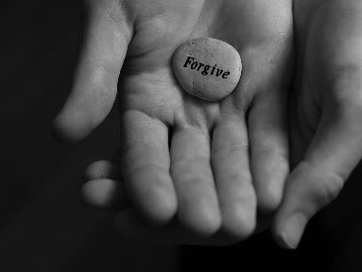
中心意思:
我们必须正确地挽回犯罪的会友因为我们代表上帝行动
Notes:
When sheep stray, we shepherd them back as loving hands of God’s grace.

Slide 60
Matthew's Relational Pillars
马太福音人际关系支柱
5:23-24
18:15-17
你是:
冒犯别人者
被冒犯者
问题:
一般情况
罪
主动者:
你!
你!
Notes:
God expects each of us to take the initiative—

Slide 61
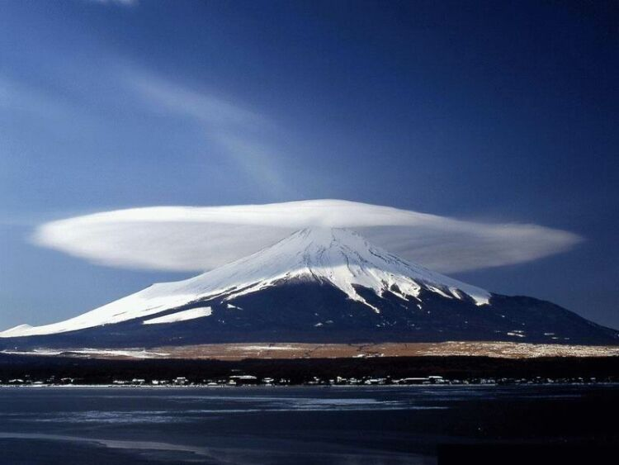
总原则
"可能的话，总要尽你们的所能与人和睦"
罗马书 12:18
Notes:
—and to do so as far as possible, as Romans 12:18 says [read]. This verse is a great encouragement to do all we can even if others are not responsive.

Slide 62
Matthew's Relational Pillars
马太福音的人际关系支柱
5:23-24
18:15-17
总原则: 罗马书 12:18
你是:
冒犯别人者
被冒犯者
问题:
一般情况
罪
主动者:
你！
你!
Notes:
This verse is a great overall principle in relationships.

Slide 63
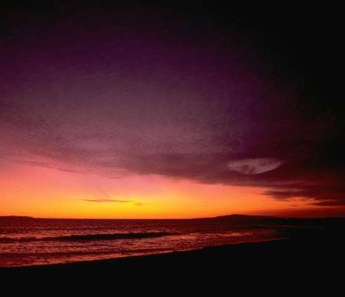
Make us one 3/3
主啊 让我们合而为一
让我们合而为一
圣灵啊 让我们合而为一
愿你爱涌流
让世界知道
我们在你的里面合而为一
Notes:
God desires us to truly live out the chorus "Make Us One, Lord"

Slide 64
上帝在对你说什么？
a. 教会肢体
M
M
M
M
M
M
M
M
M
M
M
M
b. 你自己的生活
M
M
M
M
S
M
M
M
M
M
M
M
M
c. 帮助他人
M
M
M
Notes:
Matthew 18 relates to us in at least three ways:
• To be in this assembly you must submit to its authority under God. This means that we will lovingly seek to restore you should you fall.
• Is there sin in you worthy of discipline? Clean it up now to avoid pain for us all!
• Do you know anyone who needs a private confrontation? Romans 12:18 encourages you to do everything possible to be at peace with all people, so do it!

Slide 65
Slides on
马太 19

Slide 66
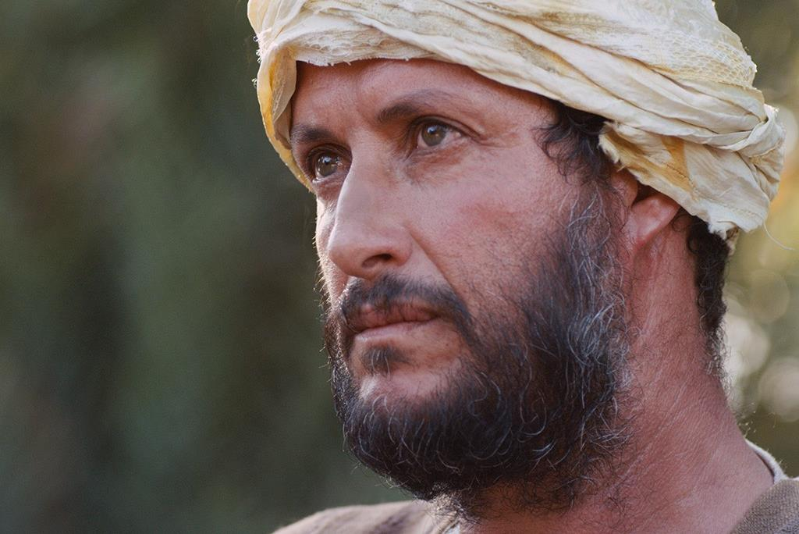

Free
Bible
images
富有的青年向耶稣问问题
马太 19:16-30; 马可 10:17-31; 路加 18:18-30

Slide 67


Slide 68


Slide 69


Slide 70


Slide 71


Slide 72


Slide 73


Slide 74


Slide 75


Slide 76


Slide 77

授权使用
马太福音
d
马可福音
o
路加福音
0
约翰福音
0
由Lumo Project出版独家资源，我们特此通知您我们不授权将这些图片发放给除freebibleimages.org客户以外的任何人。
所有图片不授权用于视频制作、epublishing或者其他媒体。所有下载的图片和文件不可通过除freebibleimages.org以外的其他网站传播，亦不可用于任何破坏基督信仰和福音的处境中。
o
图片仅供教育展示、博客和社交媒体使用；所有用途均需注明出处
www.LumoProject.com
图片声明 BBM
© 版权所有
www.bigbookmedia.com

Slide 78
Slides on
马太 20

Slide 79
Slides on
马太 21

Slide 80
21–27 章
大綱
73
IV. (11:1–16:12) 基督喻言祂将被拒絕為彌賽亞，並最终死在十
字架上。而祂一直教導将有新的國度再降臨，福音要傳给外邦人。
V. (16:13–20:34) 耶稣在離世前，把祂的權柄托付给祂的門徒将福音遍傳。
VI. (21–27章) 耶除穌降世，被拒绝為以色列君王，並代死被钉在十架上。而祂的國度延後是為了讓更多人得救。

Slide 81
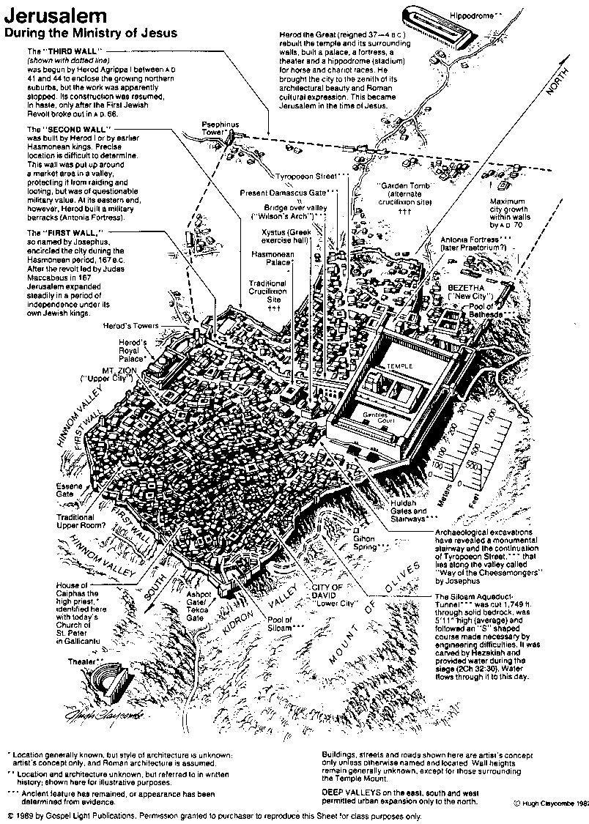
耶穌傳道時期的
耶路撒冷
80

Slide 82


马太 21:1-11
马可 11:1-11
路加 19:28-44
约翰 12:12-19
免费
圣经
图片
复活节的故事
凯旋进
圣城(棕枝全日)

Slide 83


Slide 84


Slide 85


Slide 86


Slide 87


Slide 88


Slide 89


Slide 90


Slide 91


Slide 93


Slide 94


Slide 95


Slide 96


Slide 97


Slide 98


Slide 99


Slide 100


Slide 101


Slide 102

Free Bible Images
授权使用
免费
圣经
图片
图片中的文字

Slide 103
授权使用
马太福音
d
马可福音
o
路加福音
0
约翰福音
0
由Lumo Project出版独家资源，我们特此通知您我们不授权将这些图片发放给除freebibleimages.org客户以外的任何人。
所有图片不授权用于视频制作、epublishing或者其他媒体。所有下载的图片和文件不可通过除freebibleimages.org以外的其他网站传播，亦不可用于任何破坏基督信仰和福音的处境中。
o
图片仅供教育展示、博客和社交媒体使用；所有用途均需注明出处
www.LumoProject.com
图片声明 BBM
© 版权所有
www.bigbookmedia.com

Slide 104

马太 21:12-17
马可 11:15-19
路加 19:45-48
约翰 2:13-24
复活节的故事
洁净圣殿
免费
圣经
图片

Slide 105


Slide 106


Slide 107


Slide 108


Slide 109


Slide 111


Slide 112


Slide 113


Slide 114


Slide 115


Slide 116


Slide 117


Slide 118


Slide 119


Slide 120


Slide 121
Free Bible Images
授权使用
免费
圣经
图片
图片中的文字

Slide 122


Palm Sunday
圣枝
主日
Notes:
棕榈星期天是一个有趣的名字，不是吗？

Slide 123


Palm Sunday
Notes:
我们知道，今天回想起当他在耶稣生命最后一周时进入耶路撒冷，群众以棕榈树枝向耶稣挥手致意。然而，重点并不是树掌，而是耶稣的手掌将在几天后会在十字架上伸出。

Slide 124

从圣枝到十架
Notes:
树掌不过是十字架的前奏。

Slide 125



凯旋进圣城
马太 21:9
Notes:
Even the alternate name—Triumphant Entry—is also perplexing.

Slide 126

凯旋进圣城
Notes:
True, Jesus rode into Jesus and the crowds cheered his arrival.

Slide 127


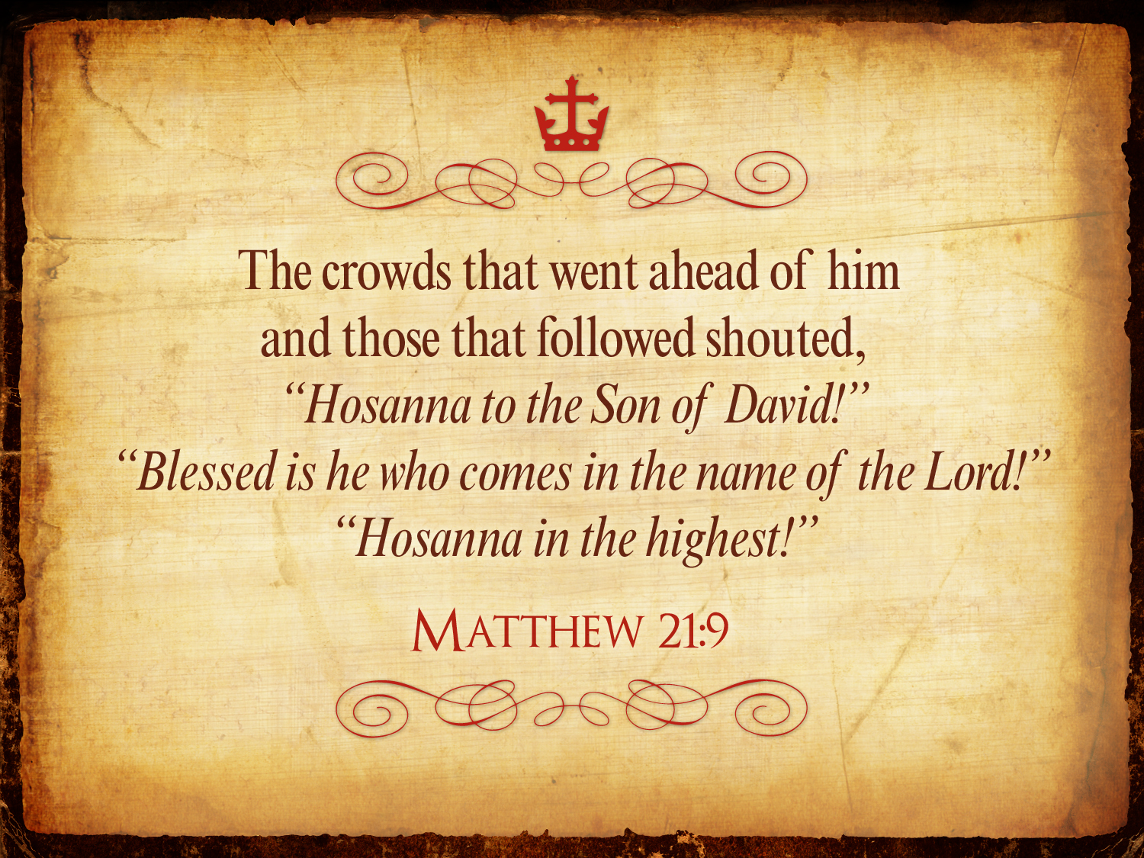
Triumphant Entry
Matthew 21:9
前 行 後 随 的 众 人 喊 着 说 ：
和 散 那
（ 原 有 求 救 的 意 思 ， 在 此 是 称 颂 的 话 ）
归 於 大 卫 的 子 孙 ！
奉 主 名 来 的 是 应 当 称 颂 的 ！
高 高 在 上 和 散 那 ！
马太21:9
Notes:
Matthew 21:9 says the crowds that went ahead of him and those that followed shouted, “Hosanna to the Song of David!” “Blessed is he who comes in the name of the Lord!” “Hosanna in the highest!”

Slide 128

从圣枝到双掌
Notes:
通常情况下，一个国王骑马进入城市，作为他的敌人的胜利者，而那个星期五将在星期五耶稣的死亡达到高潮，我们称之为耶稣受难日。

Slide 129

耶稣受难日为何是美好的？
Notes:
But that name is equally puzzling. Why is Good Friday called “good”?
Our leader died on that day, so it seems strange to call the day “good.” No other religion refers to the death of their leader as “good.”
We believe that his death was good. How was that?

Slide 130

基督的死怎么比
任何牺牲都好？

Slide 131
Slides on
马太 22

Slide 132

受难周
星期一
星期二
115
星期三
星期五
星期四
星期日
Fri
星期六
星期六
星期日

Slide 133
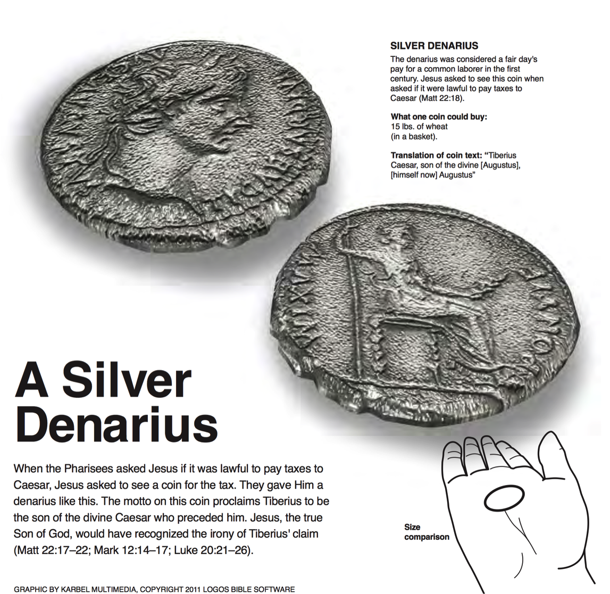
一枚银币
銀幣
在一世纪的时代，一枚银币被认为是一个普通劳动者的平日工资。当被问及向凯撒缴纳税款是否合法时，耶稣要求看这枚硬币 (马太22:18).
一枚硬币可以购买什么：
15磅小麦（在篮子里）
硬币文本的翻译： “神圣的奥古斯都之子提比略恺撒，[他本人]奥古斯都”
当法利赛人问耶稣是否可以向凯撒纳税时，耶稣要求看到一枚钱币。他们给了他一个像这样的银币。这枚硬币的座右铭宣称提比略是在他之前的神圣凯撒的儿子。耶稣，上帝的真正儿子，带出了提比略的要求的讽刺(马太22:17-22; 马可12:14-17; 路加 20:21-26).
Logos Bible Software

Slide 134
Slides on
马太 23

Slide 135
Slides on
马太 24

Slide 136
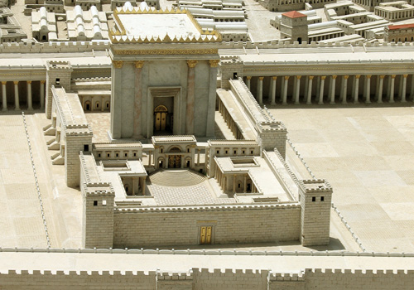
門徒: 多麼雄偉的聖殿! (24:1)
耶稣: “將來在這 裡没有一塊石頭 留在石頭上，不被 拆毁了 。” (24:2)
門徒: 何時? 有甚麼跡象? (24:3)

Slide 137
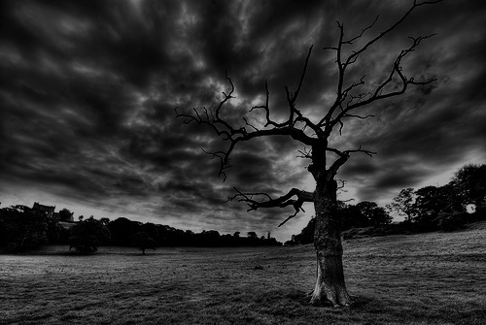
橄欖山的教導(太24–25)
78
Adapted from Mark L. Bailey, DTS class notes, 1986
第二次的再来(27-31):
天上的徵兆 (29-30)
人子的再来 (27, 30)
飛鳥的食物(28)
選民的拯救 (31)
憎惡的蒼凉
(15-20)
假基督與假先知
(23-26)
末世的徵兆
(4-8)
大災難
(9-14, 21-22)
列国的裁判
绵羊
山羊
與啟示錄相關性的經文
12:7-12
13:14
12:8-17
8:1–19:10
(太. 25:31-46)
6:1–8:5
19:11-21

Slide 138
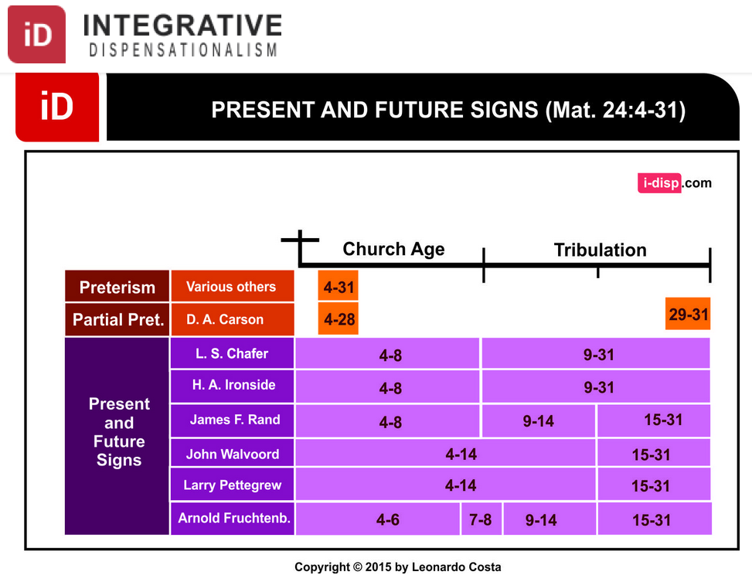
Dispensational Views on Matthew 24
综合
时代主义
目前和未来的迹象 （马太24：4-31）
教会时代
苦难
末世预言
实现论
其他
局部实现论
现在和
将来的年代
Notes:
莱昂纳多科斯塔，“马太福音24：4-31在时代论中实现”，综合解放主义网站
http://i-disp.com/the-fulfillment-of-matthew-244-31-in-dispensational-tradition/ accessed 24 July 2015

Slide 139
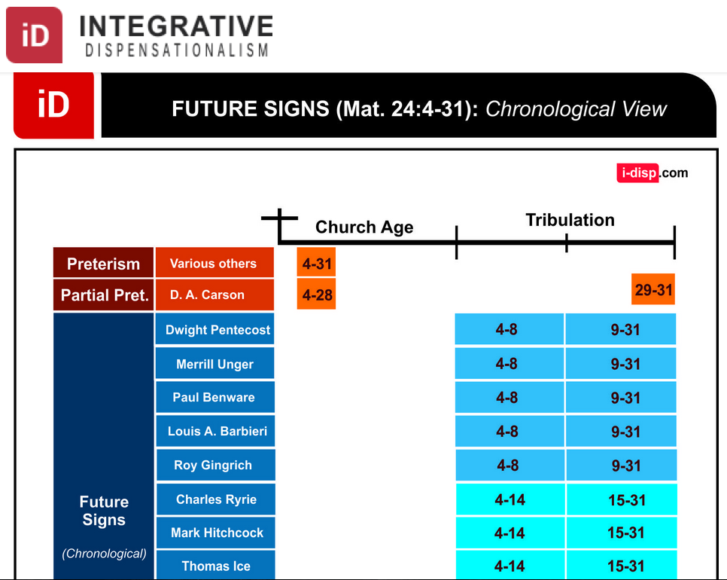
Dispensational Views on Matthew 24
综合
时代主义
未来的迹象 （马太24：4-31）按时间顺序
教会时代
苦难
末世预言
实现论
其他
局部实现论
未来的年代
Notes:
莱昂纳多科斯塔，“马太福音24：4-31在时代论中实现”，综合解放主义网站
http://i-disp.com/the-fulfillment-of-matthew-244-31-in-dispensational-tradition/ accessed 24 July 2015

Slide 140
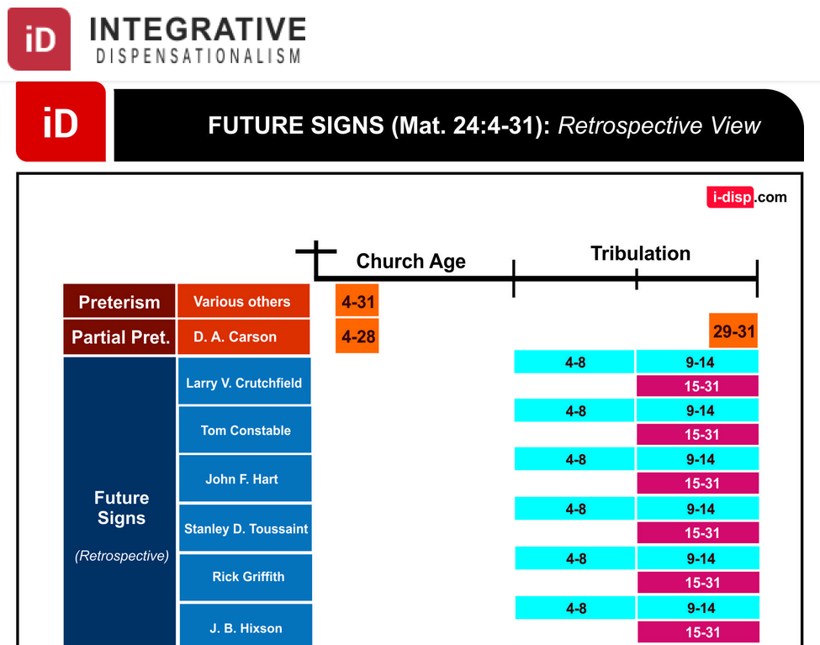
Dispensational Views on Matthew 24
综合
时代主义
未来的迹象 （马太24：4-31）回顾性观点
教会时代
苦难
末世预言
实现论
其他
局部实现论
未来的年代
(回顾性观点)
Notes:
莱昂纳多科斯塔，“马太福音24：4-31在时代论中实现”，综合解放主义网站
http://i-disp.com/the-fulfillment-of-matthew-244-31-in-dispensational-tradition/ accessed 24 July 2015

Slide 141
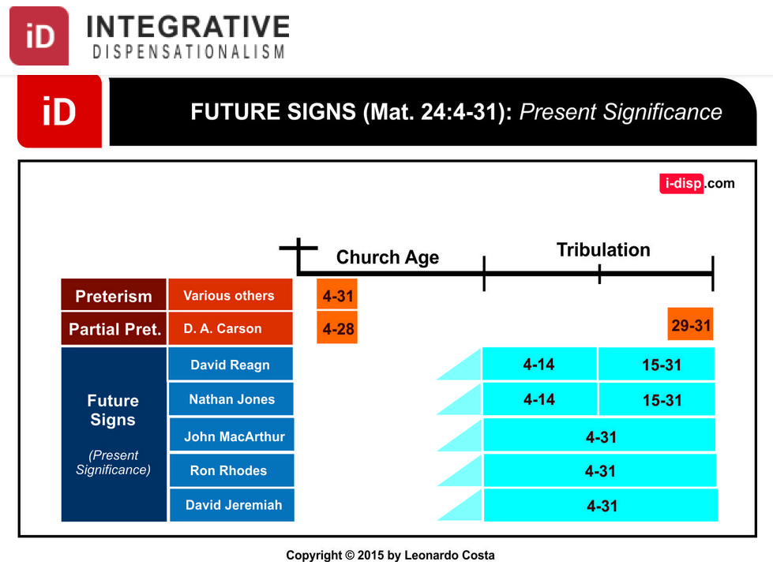
Dispensational Views on Matthew 24
综合
时代主义
未来的迹象 （马太24：4-31）目前的意义
教会时代
苦难
末世预言
实现论
其他
局部实现论
未来的年代
(目前的意义)
Notes:
莱昂纳多科斯塔，“马太福音24：4-31在时代论中实现”，综合解放主义网站
http://i-disp.com/the-fulfillment-of-matthew-244-31-in-dispensational-tradition/ accessed 24 July 2015

Slide 142
Slides on
马太 25

Slide 143
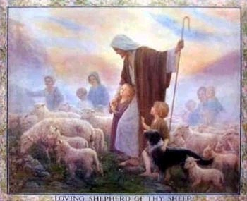
审判列国
(绵羊与山羊)
160
CNV 马太 25:31 "当人子在他的荣耀里，带着所有的使者降临的时候，他要坐在荣耀的宝座上。 32 万族要聚集在他面前，他要把他们彼此分开，好象牧羊人把绵羊和山羊分开一样： 33 把绵羊放在右边，山羊放在左边。 34 那时，王要对右边的说：‘蒙我父赐福的，来承受创世以来为你们预备好的国吧。"

Slide 144
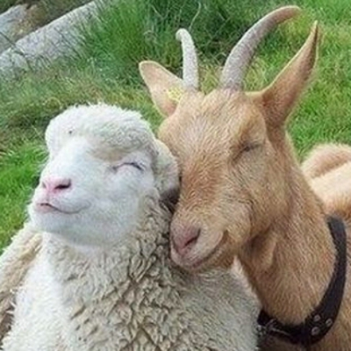
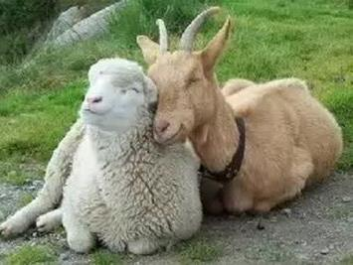
綿羊和山羊不是一樣嗎？

Slide 145
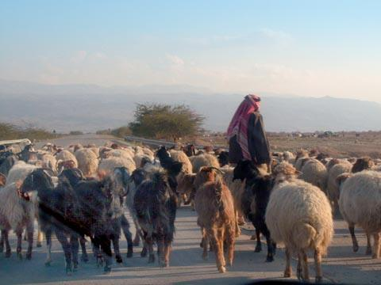
列國的審判
當人子在他榮耀裏、同著眾天使降臨的時候，
要坐在他榮耀的寶座上。
萬民都要聚集在他面前。他要把他們別出來，
好像牧羊的分別綿羊山羊一般
(馬太25:31-32)

Slide 146

活着的外邦人的审判
³¹ "当人子在他的荣耀里，带着所有的使者降临的时候，他要坐在荣耀的宝座上。
³² 万族要聚集在他面前，他要把他们彼此分开，好象牧羊人把绵羊和山羊分开一样： ³³ 把绵羊放在右边，山羊放在左边。 ³⁴ 那时，王要对右边的说：‘蒙我父赐福的，来承受创世以来为你们预备好的国吧。“
(马太 25:31-34 CNV).

Slide 147
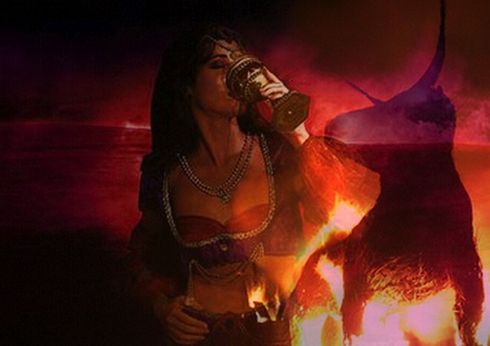
活着的外邦人的审判
⁴¹ "王也要对左边的说：‘你们这被咒诅的，离开我，到为魔鬼和他的使者所预备的永火里去
吧！ ⁴² 因为我饿了，你们没有给我吃；我渴
了，你们没有给我喝；
⁴³ 我作旅客，你们没有接待我；我赤身露体，你们没有给我衣服
穿；我病了，我在监里，你们没有看顾我。’ ⁴⁴ 他们就回答：‘主
啊，我们甚么时候见你饿了、渴了、作旅客、赤身露体、病了，或在监里，却没有服事你呢？’ ⁴⁵ 王要回答他们：‘我实在告诉你们，这些事你们既然没有作在一个最小的身上，就是没有作在我的身上了。’ ⁴⁶ 他们要进入永远的刑罚，义人却要进入永生。"
(马太 25:41-46 CNV).

Slide 148
橄榄山论语概述
Chinese Simplified
English
橄榄山话语概述
27
耶路撒冷
第一次被陷
586 B.C.
耶路撒冷
第二次被陷
A.D 70
被提
帖前
4:14-17
耶路撒冷
第三次被陷
圣徒第二次再来
太 23:39; 24:30
以色列
教会时代
灾难
千禧年
大灾难
但 9:27
太 24:15
以色列被分散
路 21:24
归回应许之地
外邦国的审判
太 25:31-46
606 B.C.
外邦人的时代 路 21:24
取自撒冷。可班
启示录表 (1979), 48

Slide 149
大綱結語
73
IV. (11:1–16:12) 基督作為彌賽亞在最终被钉十架時被拒绝，所
以耶稣介绍了在他最终被接纳前，兩次降臨之間的時期，以及他在向外邦人的事工中向人接受神的國的延遲。
V. (16:13–20:34) 基督預備他的門徒了解他的位格和計劃，使他們可以在他受死後代表他彌賽亞的主權。
VI. (21–27章) 基督正式的講說，他作為以色列的王在他為代贖而被钉十架時被拒绝，顯示為甚麼神的國被延遲直到他再来。

Slide 150
Slides on
马太 26

Slide 151
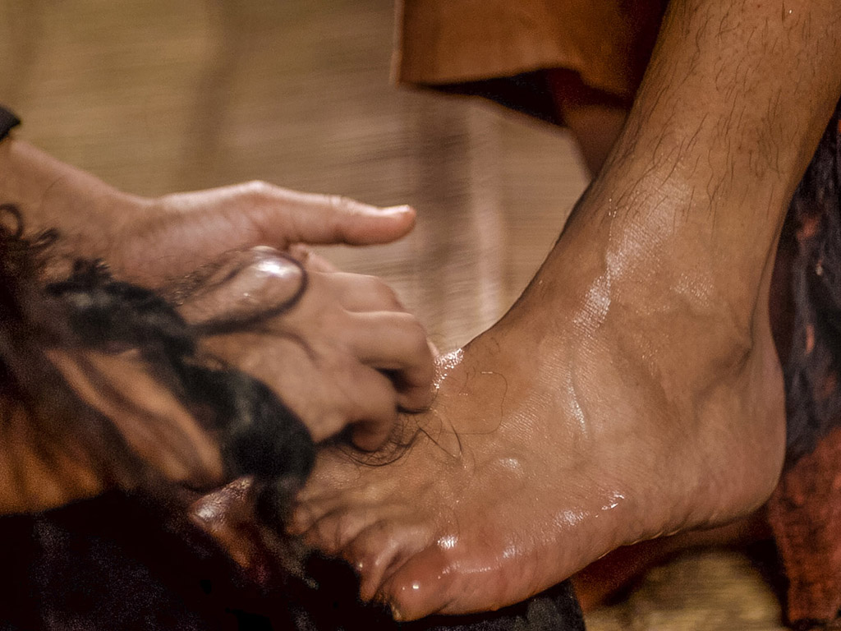
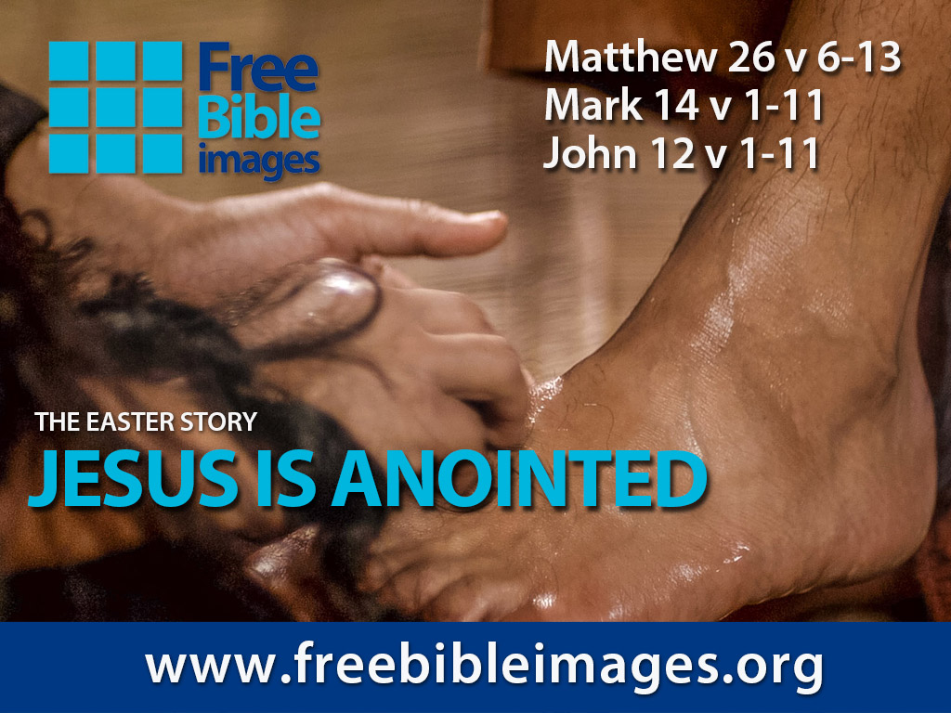
破碎和溢出
免费
圣经
图片
马太 26:6-13
马可 14:1-11
约翰 12:1-11
演出者： Steve Green
耶稣是受膏者

Slide 152
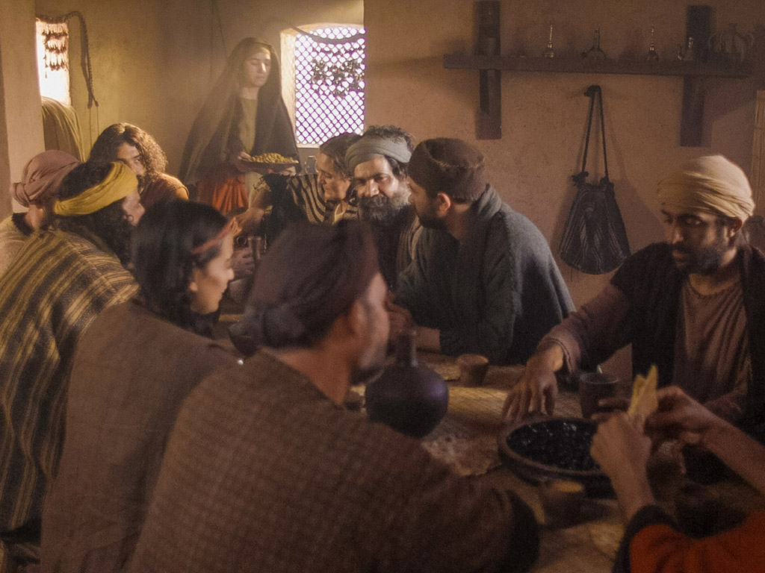
Notes:
Music background 1 of 2

Slide 153

Notes:
Music background 1 of 2

Slide 154

有一天，一位平凡的村女，被她对主热爱的
推动力

Slide 155
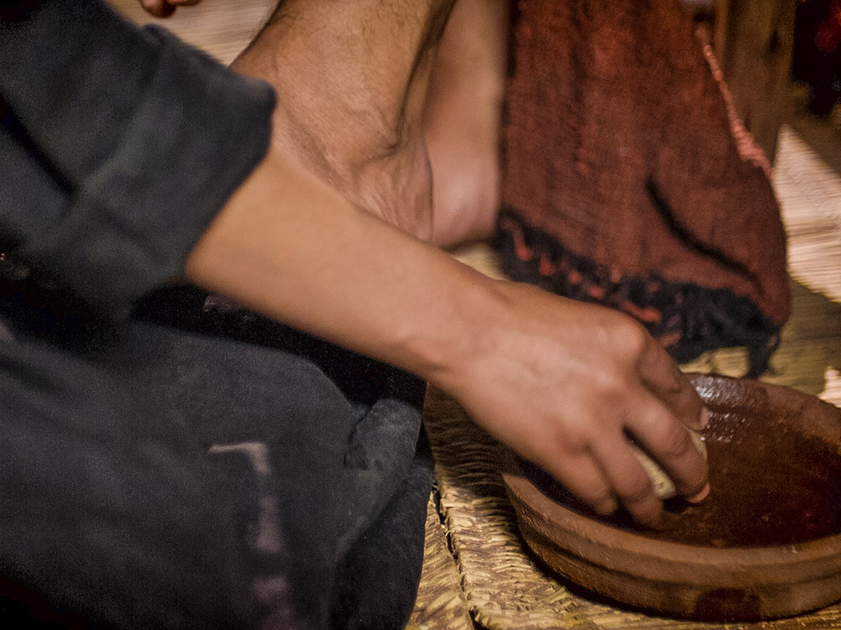
不顾众人嘲笑地肆意倾倒出一瓶价值不菲的精华

Slide 156
一旦它被打破并洒出香气弥漫了整个房间。就像一个囚犯从他的镣铐释放一样，像幽灵被坟墓中释放出来

Slide 157

耶稣，为了爱你，破碎而洒落
生命中最宝贵的财富，沉溺于你

Slide 158

破碎并洒出，倒在你的脚下
在甜蜜的放弃中，让我被洒出来用完于你

Slide 159

主啊，你是上帝宝贵的宝贝，祂是祂所爱的，祂自己完美的儿子
被差遣到这世间来向我展示天父的爱，只为了爱而实行

Slide 160

你是完美，圣洁的，但你自愿地放弃了自己尊荣的身份
你为了赦免我的罪犯而不惜代价，你已经耗尽并为我浪费了

Slide 161

破碎和洒落都为了爱我，耶稣 - 上帝最珍贵的宝藏就在我身上

Slide 162

破碎，洒出，倒在我的脚下。
主啊，为了我，你放弃所有尊荣，洒出了，为我而燃尽了

Slide 163

在甜蜜的放弃中，让我被洒出并用尽你

Slide 164

图片声明 Big Book Media
© 版权所有.
授权使用
BIG BOOK MEDIA

Slide 165
Free Bible Images
授权使用
免费
圣经
图片
图片中的文字

Slide 166

免费
圣经
图片
马太 26:17-35
马可 14:12-31
路加 22:7-38
约翰 13:18-38
复活节的故事
主的晚餐

Slide 167


Slide 168


Slide 169


Slide 170


Slide 171


Slide 172


Slide 173


Slide 174


Slide 176


Slide 177


Slide 178


Slide 179


Slide 180


Slide 181


Slide 182
Free Bible Images
授权使用
免费
圣经
图片
图片中的文字

Slide 183


免费
圣经
图片
马太 26:69-75
马可 14:66-72
路加 22:54-62
约翰 18:15-27
复活节的故事
彼得不认耶稣

Slide 184


Slide 185


Slide 186


Slide 187


Slide 188


Slide 189


Slide 190


Slide 191


Slide 192


Slide 194
图片声明 Big Book Media
© 版权所有.
授权使用
BIG BOOK MEDIA

Slide 195
Free Bible Images
授权使用
免费
圣经
图片
图片中的文字

Slide 196

带有雪花石膏罐子的妇女是抹大拉的马利亜吗？
不.路加福音没有提他的名,但在其它福音中清楚记说是伯大尼的马利亜

Slide 197

约翰福音12章事件
64
656
不信的摘要
12:37-50
死亡的预表
12:21-36
光荣的进入
12:12-20
伯大尼的受膏
12:1-11

Slide 198

路 7:36-50
耶稣和那有罪的女人

Slide 199

耶稣的恩膏
所有四个福音书记载的共同点：
女子的突然访问
耶稣的头和/或脚被受膏
用她的头发擦他的脚
弟子/犹大对浪费的投诉
耶稣对门徒的斥责
在一个名男人叫西门的家
雪花石膏瓶 （除了约翰书)
Notes:
耶稣的恩膏
共同所有四个福音书的记载：
由女子未宣布拜访
受膏耶稣的头和/或脚
擦他脚用她的头发
浪费投诉
弟子/犹大
门徒耶稣斥责
在一个名叫西门的男人的家
玉瓶（除了约翰）

Slide 200

耶稣的两个恩膏
路加7:36-50
早期的事工
哭泣
对于崇拜，女人的罪
得赦免(路加7:48)
由无名妓女在法利赛人
西门的家里(路加7:40)
约翰12:1-11
马太26:6-13; 马可14:3-9
在受难周
没有哭泣的记载
对于安葬，女人不需要有宽恕
由玛丽，拉撒路的姐姐，在长大麻疯的西门家里(马太26:6;马可14:3)

Slide 201

免费
圣经
图片
马太 26:36-56
马可 14:32-52
路加 22:39-53
约翰 18:1-12
复活节的故事
耶稣在客西马尼
祷告

Slide 202


Slide 203


Slide 204


Slide 205


Slide 206


Slide 208


Slide 209


Slide 210


Slide 211


Slide 212


Slide 213


Slide 214


Slide 215


Slide 216


Slide 217


Slide 218


Slide 219


Slide 220


Slide 221


Slide 222
Free Bible Images
授权使用
免费
圣经
图片
图片中的文字

Slide 223
授权使用
马太福音
d
马可福音
o
路加福音
0
约翰福音
0
由Lumo Project出版独家资源，我们特此通知您我们不授权将这些图片发放给除freebibleimages.org客户以外的任何人。
所有图片不授权用于视频制作、epublishing或者其他媒体。所有下载的图片和文件不可通过除freebibleimages.org以外的其他网站传播，亦不可用于任何破坏基督信仰和福音的处境中。
o
图片仅供教育展示、博客和社交媒体使用；所有用途均需注明出处
www.LumoProject.com
图片声明 BBM
© 版权所有
www.bigbookmedia.com

Slide 224

免费
圣经
图片
马太 26:57-67
马可 14:53-65
路加 22:66-71
约翰 18:15-27
复活节的故事
耶稣在公议会面前

Slide 225


Slide 226


Slide 227


Slide 229


Slide 230


Slide 231


Slide 232


Slide 233
Free Bible Images
授权使用
免费
圣经
图片
图片中的文字

Slide 234
授权使用
马太福音
d
马可福音
o
路加福音
0
约翰福音
0
由Lumo Project出版独家资源，我们特此通知您我们不授权将这些图片发放给除freebibleimages.org客户以外的任何人。
所有图片不授权用于视频制作、epublishing或者其他媒体。所有下载的图片和文件不可通过除freebibleimages.org以外的其他网站传播，亦不可用于任何破坏基督信仰和福音的处境中。
o
图片仅供教育展示、博客和社交媒体使用；所有用途均需注明出处
www.LumoProject.com
图片声明 BBM
© 版权所有
www.bigbookmedia.com

Slide 235
Slides on
马太 27

Slide 236

免费
圣经
图片
马太 27:27-37
马可 15:16-25
路加 23:26-34
约翰 19:16-27
复活节的故事
耶稣被钉十字架

Slide 237


Slide 238


Slide 239


Slide 240


Slide 241


Slide 242


Slide 243


Slide 244


Slide 245


Slide 246


Slide 247


Slide 248


Slide 249


Slide 250


Slide 251


Slide 252


Slide 253
Free Bible Images
授权使用
免费
圣经
图片
图片中的文字

Slide 254
授权使用
马太福音
d
马可福音
o
路加福音
0
约翰福音
0
由Lumo Project出版独家资源，我们特此通知您我们不授权将这些图片发放给除freebibleimages.org客户以外的任何人。
所有图片不授权用于视频制作、epublishing或者其他媒体。所有下载的图片和文件不可通过除freebibleimages.org以外的其他网站传播，亦不可用于任何破坏基督信仰和福音的处境中。
o
图片仅供教育展示、博客和社交媒体使用；所有用途均需注明出处
www.LumoProject.com
图片声明 BBM
© 版权所有
www.bigbookmedia.com

Slide 255

免费
圣经
图片
马太 27:38-66
马可 15:25-47
路加 23:35-56
约翰 19:28-42
复活节的故事
耶稣死在十字架上

Slide 256


Slide 257


Slide 258


Slide 259


Slide 260


Slide 261


Slide 262


Slide 264


Slide 265


Slide 267


Slide 268


Slide 269


Slide 270


Slide 271


Slide 272


Slide 273


Slide 274
Free Bible Images
授权使用
免费
圣经
图片
图片中的文字

Slide 275
授权使用
马太福音
d
马可福音
o
路加福音
0
约翰福音
0
由Lumo Project出版独家资源，我们特此通知您我们不授权将这些图片发放给除freebibleimages.org客户以外的任何人。
所有图片不授权用于视频制作、epublishing或者其他媒体。所有下载的图片和文件不可通过除freebibleimages.org以外的其他网站传播，亦不可用于任何破坏基督信仰和福音的处境中。
o
图片仅供教育展示、博客和社交媒体使用；所有用途均需注明出处
www.LumoProject.com
图片声明 BBM
© 版权所有
www.bigbookmedia.com

Slide 276

殿 裏 的 幔 子

Slide 277

殿 裏 的 幔 子 從 上 到 下 裂 開 為 二 (27:51)

Slide 278
Slides on
马太 28

Slide 279
大綱結語
73
IV. (11:1–16:12) 基督作為彌賽亞在最终被钉十架時被拒绝，所
以耶稣介绍了在他最终被接纳前，兩次降臨之間的時期，以及他在向外邦人的事工中向人接受神的國的延遲。
V. (16:13–20:34) 基督預備他的門徒了解他的位格和計劃，使他們可以在他受死後代表他彌賽亞的主權。
VI. (21–27章) 基督正式的講說，他作為以色列的王在他為代贖而被钉十架時被拒绝，顯示為甚麼神的國被延遲直到他再来。

Slide 280

马太 28:1-15
马可 16:1-20
路加 24:1-47
约翰 20:1-29
免费
圣经
图片
复活及的故事
耶稣复活了

Slide 281


Slide 283


Slide 284


Slide 285


Slide 286


Slide 287


Slide 288


Slide 289


Slide 290


Slide 291


Slide 292


Slide 293


Slide 294


Slide 295


Slide 296


Slide 297


Slide 298


Slide 299
Free Bible Images
授权使用
免费
圣经
图片
图片中的文字

Slide 300
授权使用
马太福音
d
马可福音
o
路加福音
0
约翰福音
0
由Lumo Project出版独家资源，我们特此通知您我们不授权将这些图片发放给除freebibleimages.org客户以外的任何人。
所有图片不授权用于视频制作、epublishing或者其他媒体。所有下载的图片和文件不可通过除freebibleimages.org以外的其他网站传播，亦不可用于任何破坏基督信仰和福音的处境中。
o
图片仅供教育展示、博客和社交媒体使用；所有用途均需注明出处
www.LumoProject.com
图片声明 BBM
© 版权所有
www.bigbookmedia.com

Slide 301


賄賂兵丁 (28:12)

Slide 302

馬太福音28:18-20
耶穌進前來，對他們說：
「天上地下所有的權柄都賜給我了。所以，你們要去，使萬民作我的門徒，奉父、子、聖靈的名給他們施洗（或譯：給他們施洗，歸於父、子、聖靈的名）。 凡我所吩咐你們的，都教訓他們遵守，我就常與你們同在，直到世界的末了。」

Slide 303

既然耶稣是王，那么信徒
就会与他统治！

Slide 304


信徒会统治地球
(启示. 5:10).
“使他們 成為我們神的國度 和祭司；
他們 將要在地上做王。“

Slide 305

启 示 录 20:4-6 简图
^{4b} 他们都复活了、与基督一同作王一千年。
^{4a} 我又看见几个宝座、也有坐在上面的、并有审判的权柄赐给他们．我又看见那些因为给耶稣作见证、并为 神之道被斩者的灵魂、和那没有拜过兽与兽像、也没有在额上和手上受过他印记之人的灵魂…
1000 年
^{5b} 这是头一次的复活。 ^{6a} 在头一次复活有分的、有福了、圣洁了．第二次的死在他们身上没有权柄…
^{6b} 他们必作 神和基督的祭司、并要与基督一同作王千一年。
^{5a} 其余的死人还没有复活、直等那一千年完了。 .

Slide 306

既然耶稣满足了所有成为
以色列王的条件，代表着我们
会与他统治！
要旨

Slide 307


你现在信任这位君王吗？
在我们祈祷，“主啊，你的国度降临”之前，我们必须愿意祈祷，“让我的王国离我而去。”

Slide 308

你会在此站立吗？

Slide 309

耶稣既是羔羊也是狮子
耶稣基督
神的羔羊
犹太的狮子

Slide 310

“我相信你为我的死。”

Slide 311

你准备好与他一同统治了吗？

Slide 312

现在就决定忠诚

Slide 313


四福音 • BibleStudyDownloads.org
免费获得该讲解!
圣经学习下载
Notes:
GO Gospels link

Slide 314
Black

