Slide 1
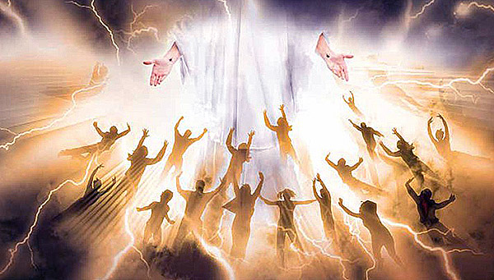
你为主再次降临而预备好了吗?
帖撒羅尼迦前書 4:13-18
Dr. Rick Griffith • Crossroads International Church Singapore
CICFamily.com • BibleStudyDownloads.org

Slide 2
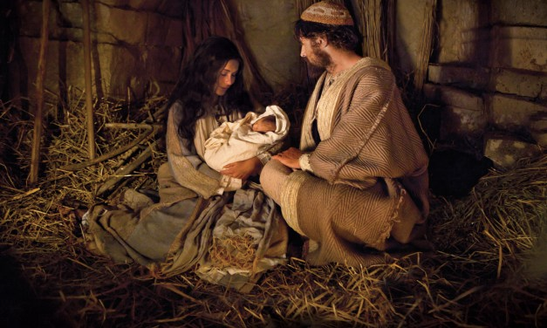
基督首次降临
Notes:
This past month over Christmas we have focused upon the first coming of our Savior in Bethlehem.

Slide 3
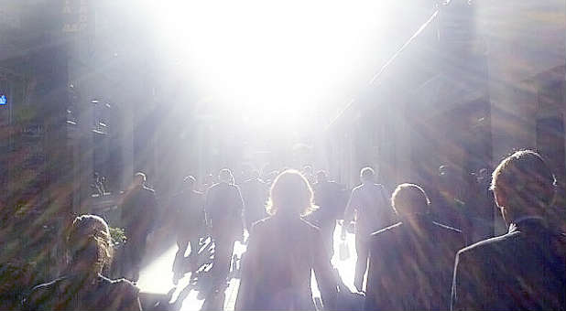
你为他再次降临而预备好了吗?
Notes:
But my title today is "Are You Ready For the Lord's Return?"

Slide 4
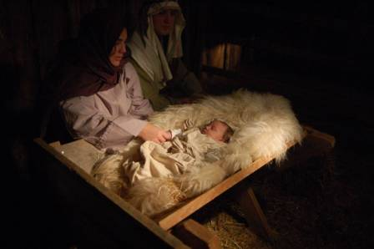
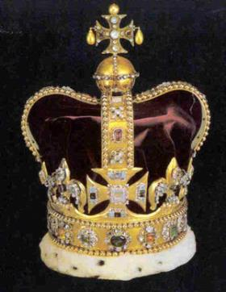
基督的两个缺憾
420
第一次来 | （教会时代） | 第二次来临
放在马槽 |  | 地政山
来作为羔羊 |  | 正值主
卑微和贫穷 |  | 豪华和强大
死，为他的敌人 |  | 他的敌人死亡
受魔鬼的试探 |  | 撒旦的陷阱中无底洞
住在一个不义的世界 |  | 信息世界，在义
死亡罪和再次上涨 |  | 指导和统治
露丝和拉里·穆迪，引圣经全景由特里·霍尔，, 117
Notes:
The Book of Revelation helps complete our picture of Jesus by not only seeing him in the left column, but the right as well.

Slide 5
无千禧年观
339e
主再来
基督属灵的管制
大灾难
撒旦被捆绑
教会时代
永恒的国度
审判
Notes:
The Amil view does not view the book of Revelation in chronological order. It puts chapter 20 BEFORE chapter 19 as it sees the Rev 20 millennium as the present church age that is followed by Christ’s return in Rev 19.

Slide 6
后千禧年观
339e
主再来
福音的黄金
时代
大灾难
撒旦被捆绑
教会时代
永恒的国度
审判
Notes:
Like the Amil view, the Postmil view also does not view the book of Revelation in chronological order. It puts chapter 20 BEFORE chapter 19 as it sees the Rev 20 millennium as the present church age that is followed by Christ’s return in Rev 19. However, it has even more difficulties as it sees the judgments of Rev 6-18 during a millennium that supposedly gets better and better, while these chapters show the world getting progressingly worse.

Slide 7
"大灾难之前"被提
433
升天
主再来
signs
磨难
千禧年
教会时代 (no signs)
永远的国度
7 年
1000 年
撒旦受捆绑
圣徒统治
千禧年
千禧年
启 示 录 6–18
19
20
21–22
Notes:
In my thinking, the Premil view is the most logical and biblical as it sees the chapters as a straightforward chronology. It also does not see the binding of Satan as simply applying to nations but to all people who comprise these nations.
NS-Rev Pres 27 for Rev 20-22 slide 48
FU Pres 24 for 1 Thess 4:13-18 slide 7
NP for 1 Thess 4:13-18 slide 7

Slide 8

末世论
eschatos
+
ology
"最后的"
"研究"
= 对最后事情对研究 (未来)
Notes:
But first let's define three terms: eschatology, the Rapture, and the Revelation.

Slide 9
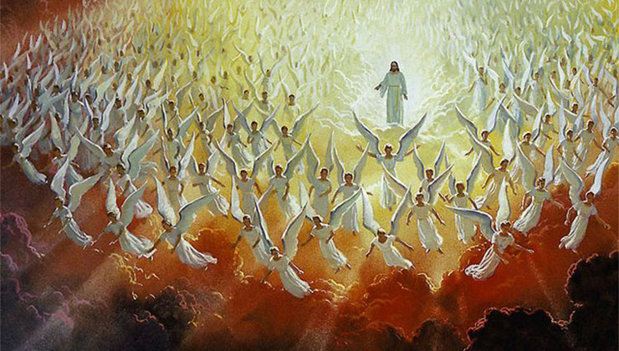
他再临的两个阶段
Notes:
Within that study an important doctrine is Christ’s Second Coming, but allow me to clarify what I mean by Christ's Second Coming. I am really using this as an umbrella term that encompasses two events separated by seven years: the Rapture that is followed by the Revelation.

Slide 10
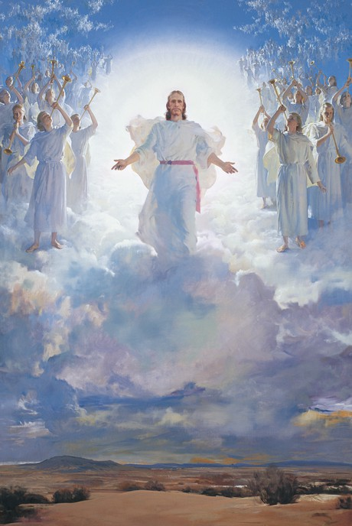
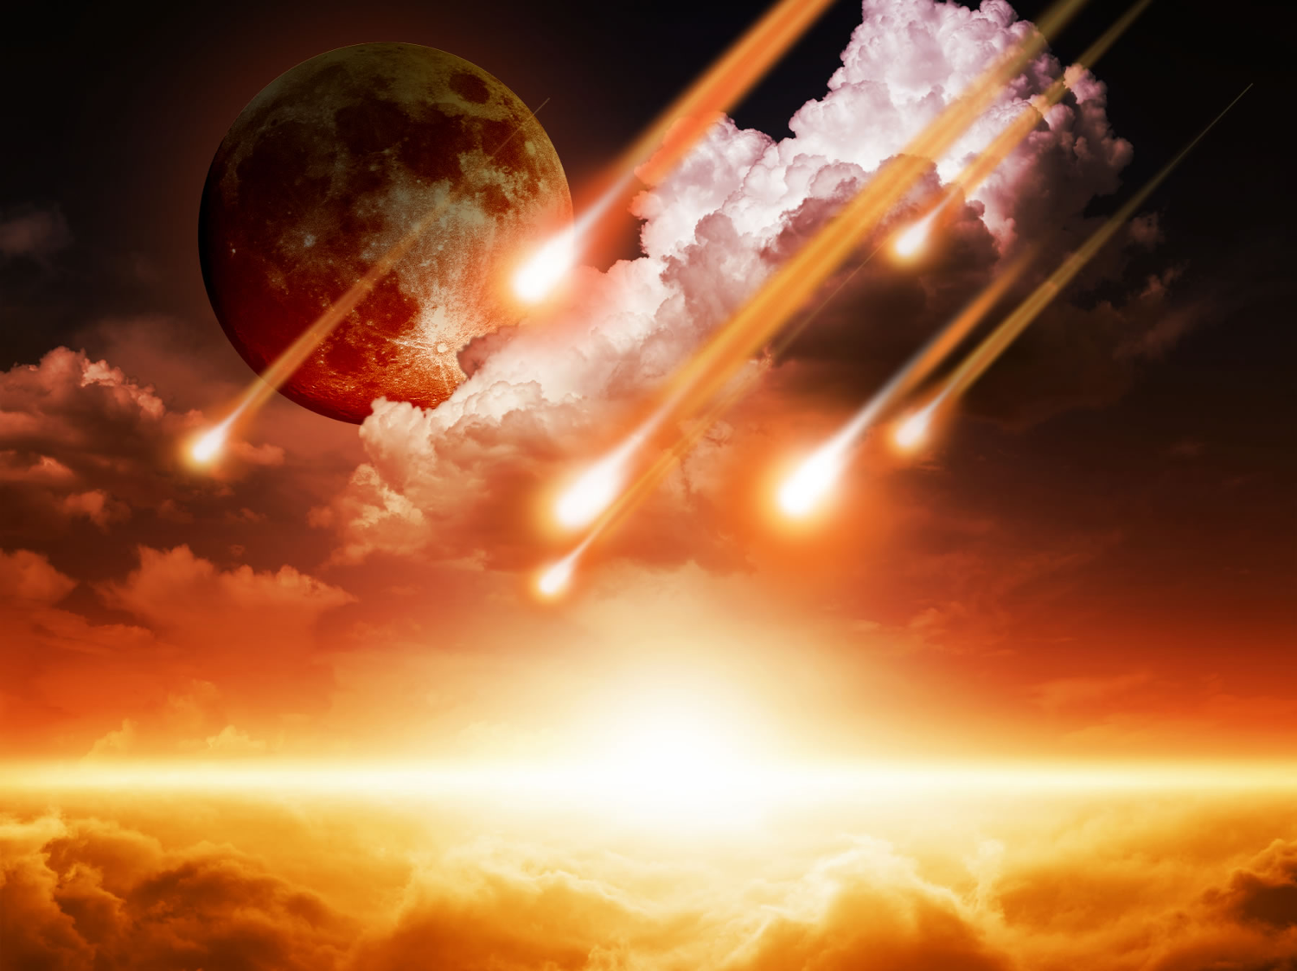
他再临的两个阶段
字面意思
基督
未来
”降临"
被提
启示
Notes:
The Rapture (the coming of Christ for His own in the air to take the church from the earth prior to the Great Tribulation) differs from the Revelation (the coming of Christ with His own to judge unbelievers upon the earth after the Great Tribulation).
• Both events are literal returns. Never does the Scripture refer to these events as only allegorical returns for in both instances Christ actually will return to the earth.
• Both events find Christ as their central figure. Although humanity is involved in both, Christ Himself is at the forefront.
• Both events are still future. They are yet to be seen on God's prophetic calendar.
• Both events are sometimes referred to by the same word (e.g., "coming" refers to the Rapture in 1 Thessalonians 4:15 and the Revelation in Matthew 24:27).

Slide 11
前千禧年主义
208
339e
第二次
再来
=二次
来临
大灾难
千禧年
教会年轮
永恒国度
7 年
1000年
5 个被提观念 全是 前千禧年论
审判

Slide 12
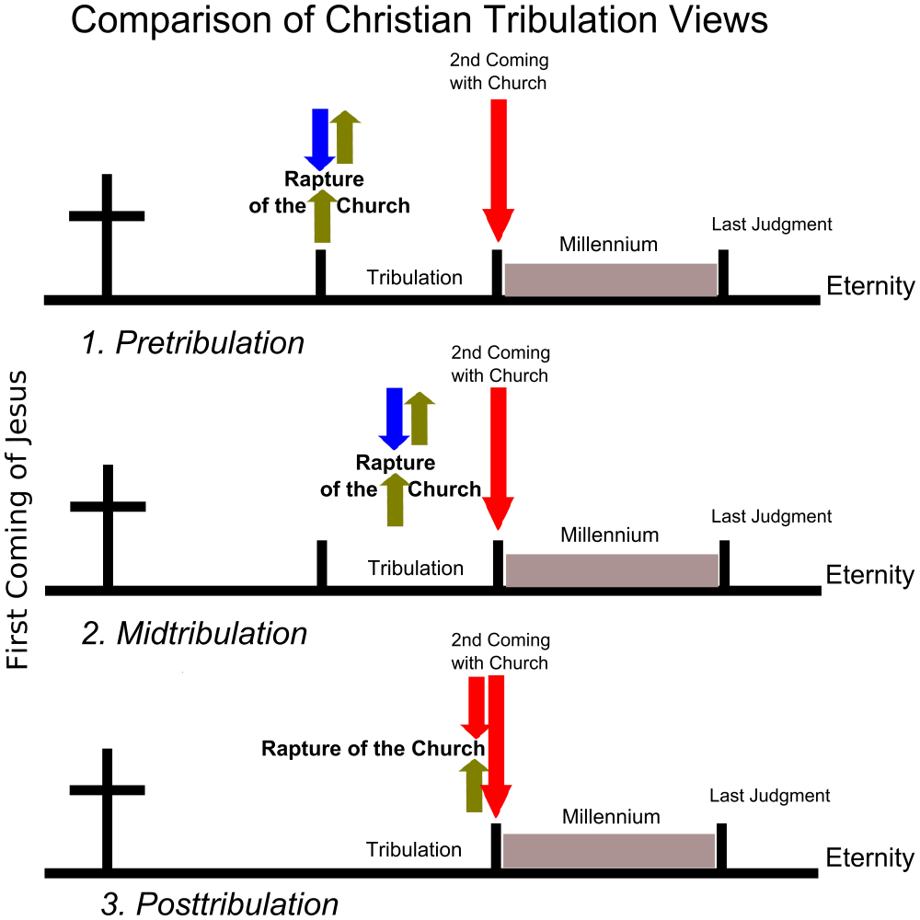
主要的大灾难观点
与教会一起第二次降临
教会被提
千禧年
最后的审判
大灾难
永生
1. 大灾难之前
与教会一起第二次降临
教会被提
耶稣首次降临
最后的审判
千禧年
大灾难
永生
2.大灾难之中
与教会一起第二次降临
教会被提
千禧年
最后的审判
大灾难
永生
3.大灾难之后

Slide 13
“磨难前” - 升天
208
主再来
升天
磨难
千禧年
教会时代
永远的国度
7 年
1000 年
千禧年

Slide 14
基督第二次降临的阶段
210
 | 被提 | 启示录
1 | 灾前(启3:10) | 灾后(启19:11-21)
2 | 救世主将乘祥云 (帖前4:16) | 救世主将降世, 他将脚踏橄榄山 (撒14:4)
3 | 为了圣徒而来 (约14:1-2; 帖前 4:15-17) | 和圣徒同道而来 (太25:31; 帖前3:13; 启19:14)
4 | 圣徒 (死的和活的) 从地上被提到云里，在空中与主相遇，和主永远同在(帖前4:16-17) | 活着的圣徒们将留在地上（而不是被提）被引入太平盛世 (徒15:16; 启5:10; cf. 太6:10; 太24)
5 | 带来安逸与希望 (帖前4:18) | 带来恐惧与审判 (太24:27-31; 路21:20-28; 启6:15-17)

Slide 15
基督第二次降临的阶段
210
 | 被提 | 启示录
6 | 奥秘的真理只有在新约的时代显露 (哥前15:51) | 是旧约中预言的重点 ，但在新约中被阐明(耶30:7; 撒14:1-3; 太24:30; 歌3:4)
7 | 教会圣徒们的身体被荣耀(哥前 15:51-58; 腓3:20-21) 以及被带上天上七年(帖前4:17) | 在灾难中的圣徒的身体会被保留肉身，在千禧年于世上继续存活 (太25:31-34)
8 | 随时到来, 不需要任何迹象 (帖前 4:16) | 并非随时到来，而是在天上和地上有非凡的前兆 (太24:29-31; 路21:25-28; 徒2:19-21; 启1:7; 启6-19)
9 | 主要的目的是将圣徒从这个世界转移 (帖前1:10) | 主要目的是审判非信徒 (太25:31-46)

Slide 16
基督第二次降临的阶段
210
 | 被提 | 启示录
10 | 只有信徒能无形地秘密地见到基督，因为上帝给反基督者一个生发错误的心 (帖后2:11) | 可见的而且公开的因为“每个人都能看见他”(启1:7)
11 | 实现对教会的承诺,在此，犹太教徒与非犹太教徒的区别将不复存在 (帖前4:15; cf.约14:1-3;弗2:11-16) | 实现在旧约中与以色列的契约(创12:1-3; 诗89; 赛11:11-14; cf. 罗11:26-27)
12 | 恶魔开始增加 (帖后2:1-12) | 恶魔被压制 (帖后1:7; 诗37:9-10)
13 | 教会被移除 (帖前4:13-18) | 撒旦被移除 (启20:1-3)

Slide 17
基督第二次降临的阶段
210
 | 被提 | 启示录
14 | 基督呈现为教会以及一切的领袖(弗1:10, 22; 4:15; 西1:18; 2:10) | 基督被证明是以色列的弥赛亚 (撒14:3-4; cf. 徒1:6 和 11)
15 | 耶稣对信徒的审判台 (哥后5:10; 哥前3:13) | 以色列和非犹太教徒的审判 (结20:34-38; 太25; 撒14:4; cf. 第160页)
16 | 主即将到来 (腓4:5) | 王国即将到来 (太24:14)
17 | 大自然随后被毁 (启6–16) | 大自然随后被重建 (罗8:19-22; 赛11:6-9; 35:9; 65:25)

Slide 18
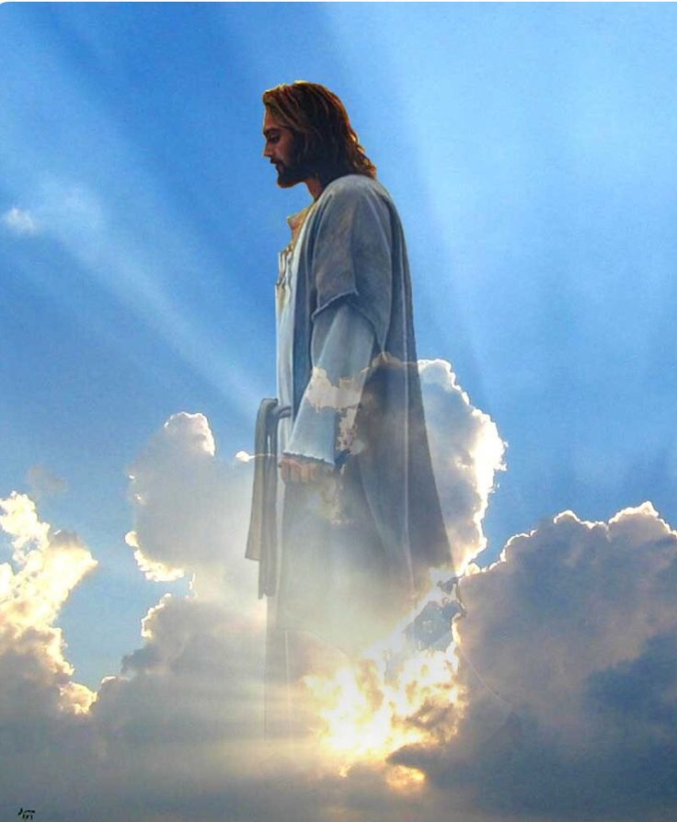
被提升天
Notes:
Today we will focus on the first stage: The Rapture.

Slide 19
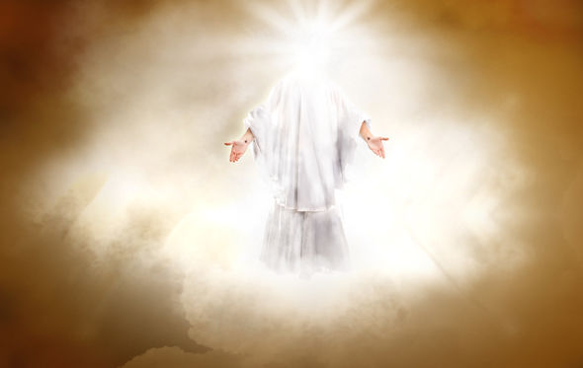
为什么我们要对被提充满期盼?
Notes:
So are you looking to Christ’s return at the Rapture?
What reasons can we give to anticipate Jesus coming back?

Slide 20
他再临的两个阶段
被提
启示
Notes:
The Rapture (the coming of Christ for His own in the air to take the church from the earth prior to the Great Tribulation) differs from the Revelation (the coming of Christ with His own to judge unbelievers upon the earth after the Great Tribulation).
• Both events are literal returns. Never does the Scripture refer to these events as only allegorical returns for in both instances Christ actually will return to the earth.
• Both events find Christ as their central figure. Although humanity is involved in both, Christ Himself is at the forefront.
• Both events are still future. They are yet to be seen on God's prophetic calendar.
• Both events are sometimes referred to by the same word (e.g., "coming" refers to the Rapture in 1 Thessalonians 4:15 and the Revelation in Matthew 24:27).

Slide 21
为什么我们应该对被提充满期盼?
帖撒罗尼迦前书 4:13-18
3个原因
Notes:
Paul gave them three reasons to have hope in the Lord’s return. So today we’ll see these three reasons to look forward to the Lord’s return at the Rapture.

Slide 22

I. 被提使我们在悲痛中 充满希望
(帖前 4:13-14).
Notes:
Knowing the destiny of Christians at death helps us to control our grief.

Slide 23
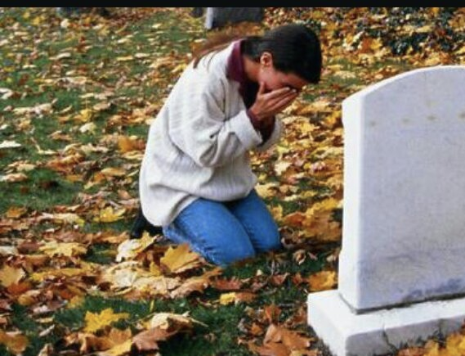
“现在，亲爱的弟兄姐妹, 我想要你们知道那些去世的信徒的命运...”
(帖前4:13a NLT).

Slide 24
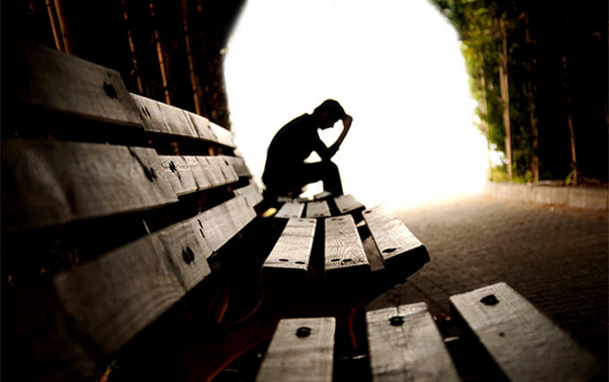
知道已经去世的信徒的未来命运 (4:13a).
Notes:
Many people think that eschatology is unimportant.
This is seen in what some say about the time of the Rapture: I'm not pretrib, midtrib, or posttrib. I am pantrib, because it will all pan out in the end!

Slide 25
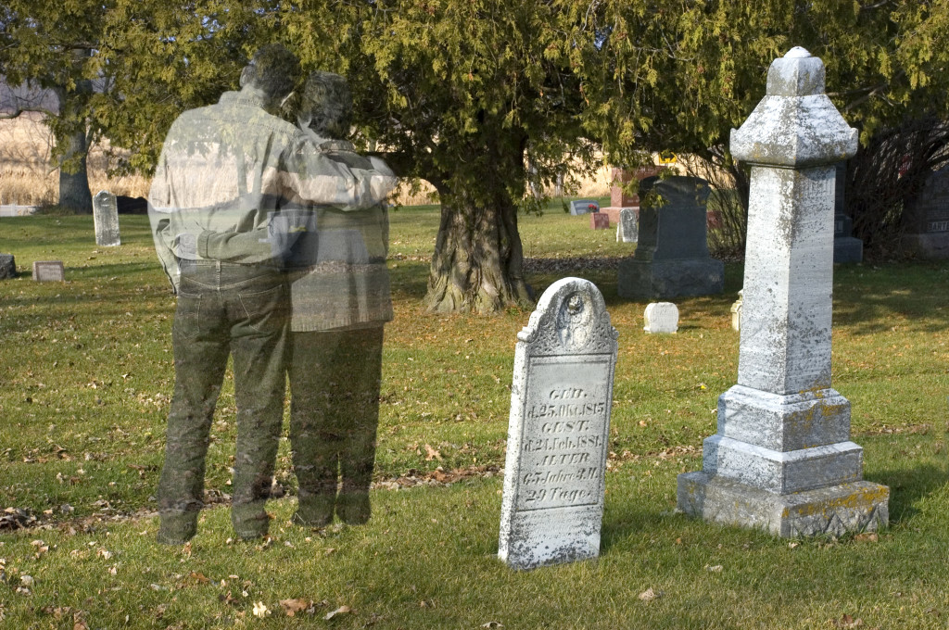
悲痛是艰难的
Notes:
Text

Slide 26

“悲痛是我们为爱所付的代价”
伊丽莎白女王II
Notes:
Why is it so important that we know about future things such as the destiny of believers? Paul saw eschatology as vital because it affects our hope. It's important because…

Slide 27

被告知已去世信徒的命运将防止我们无望的悲痛 (帖前4:13b).

Slide 28
"现在，亲爱的弟兄姐妹, 我想要你们知道那些去世的信徒的命运， 因此你们不会象那些没有指望的人那样悲痛。"
(4:13 NLT).

Slide 29
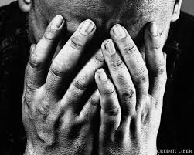
基督徒应该为一个信徒的死亡而悲痛吗?

Slide 30
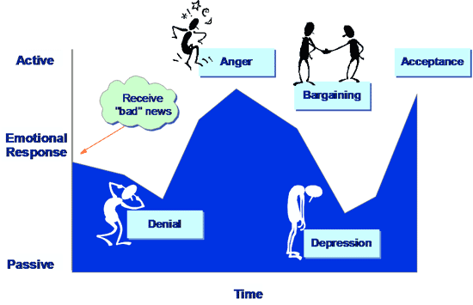
悲痛的五个阶段
主动的
生气
接受
收到“坏” 消息
讨价还价
情绪反应
否认
抑郁
被动的
Time

Slide 31
"现在，亲爱的弟兄姐妹, 我想要你们知道那些去世的信徒的命运， 因此你们不会象那些没有指望的人那样悲痛。"
(4:13 NLT).

Slide 32

被提升天
Notes:
Why did Paul say these things though? What problem was he addressing in the church?
Paul had already taught the believers about the Rapture when he was with them personally. He told them that when Christ comes all who have trusted Him will be removed from the earth.
Apparently the Thessalonians were confused regarding the destiny of believers who have died before the Rapture.
—Perhaps some thought these would miss the Rapture and have to wait until the Great White Throne Judgment.
—Perhaps some wondered whether they would be saved at all.

Slide 33
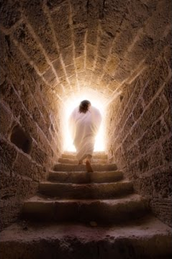
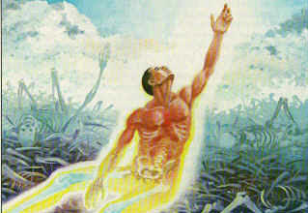
基督的复活保证了信徒的复活
(帖前4:14).

Slide 34
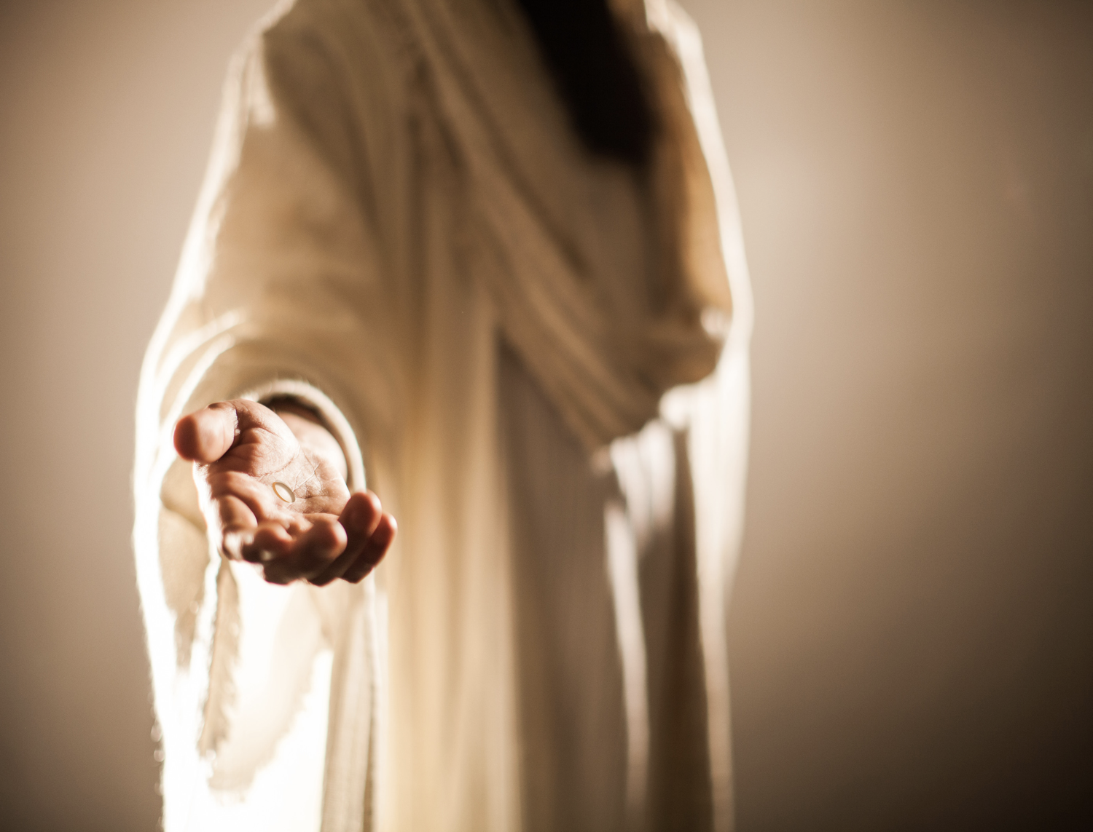
”我们若信耶稣死而复活了，我们也相信当耶稣再来当时候，上帝也会把死去当信徒和耶稣一同带来“ (帖前4:14 NLT).s
Notes:
The "if" here (in the NASB & KJV) is better translated "since" (as in the NIV & NLT) because of the Greek construction.
1) Therefore, it really means "since we believe that Christ died…"
2) Paul had no doubt regarding the validity of the resurrection.

Slide 35
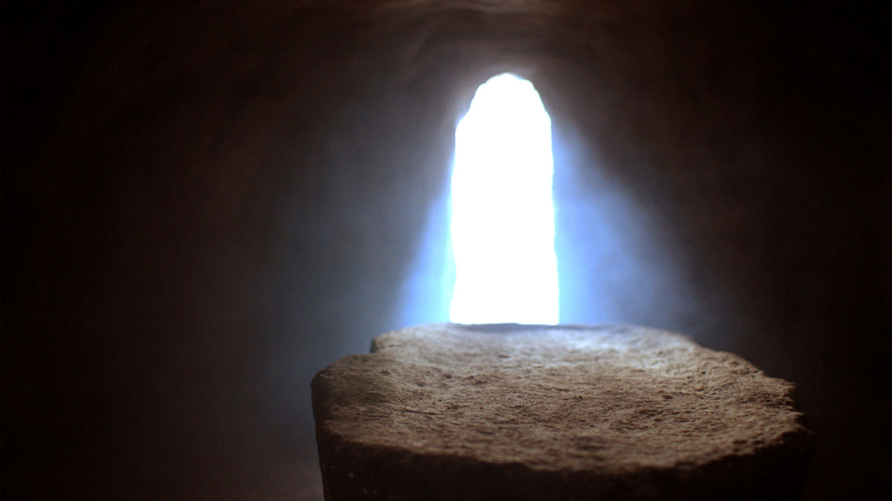
暗示
Notes:
This historical basis provides assurance that the bodies of all Christians also will be raised (4:14b).
Paul declared that both Christ's resurrection and our resurrection stand or fall together.
This is taught in 1 Corinthians 15:12-20.

Slide 36
I. 被提使我们在悲伤中 充满希望
(帖前 4:13-14).
Notes:
Knowing the destiny of Christians at death helps us to control our grief.

Slide 37
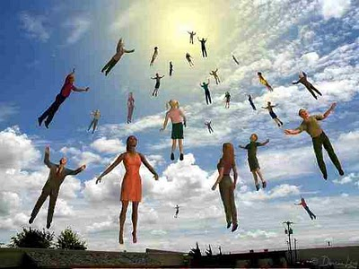
II. 已经死去的基督徒将在那些活着的基督徒之前和耶稣在空中相遇。 (4:15-17).
Notes:
We who are alive when the Rapture comes will be taken up only after the dead in Christ.
Now the living moving faster than the dead—but then the dead will move faster than the living!

Slide 38
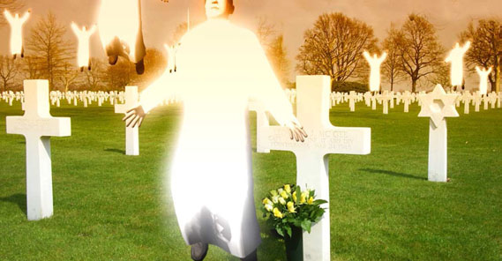
“我们照着主的话直接和你们说:我们这些还活着的人不能在那些已经死去的人之前先遇见主耶稣”
(帖前4:15 NLT).
Notes:
1. Notice how the verse expresses that this great truth wasn't something that Paul made up. It was Christ's own promise.
Perhaps this was an unrecorded statement of Christ (cf. Acts 20:35).
Maybe Paul received this word by direct revelation.
In either case, there was no need to worry since the dead will have a prominent place in the Rapture because they will rise even before the living.
2. Notice that Paul included himself among the living group and evidently expected to be living when Christ returned.
Here we see more evidence for a pre-tribulation Rapture.
According to Paul, the next event on God's timetable was the return of Christ since it could happen at any moment.

Slide 39
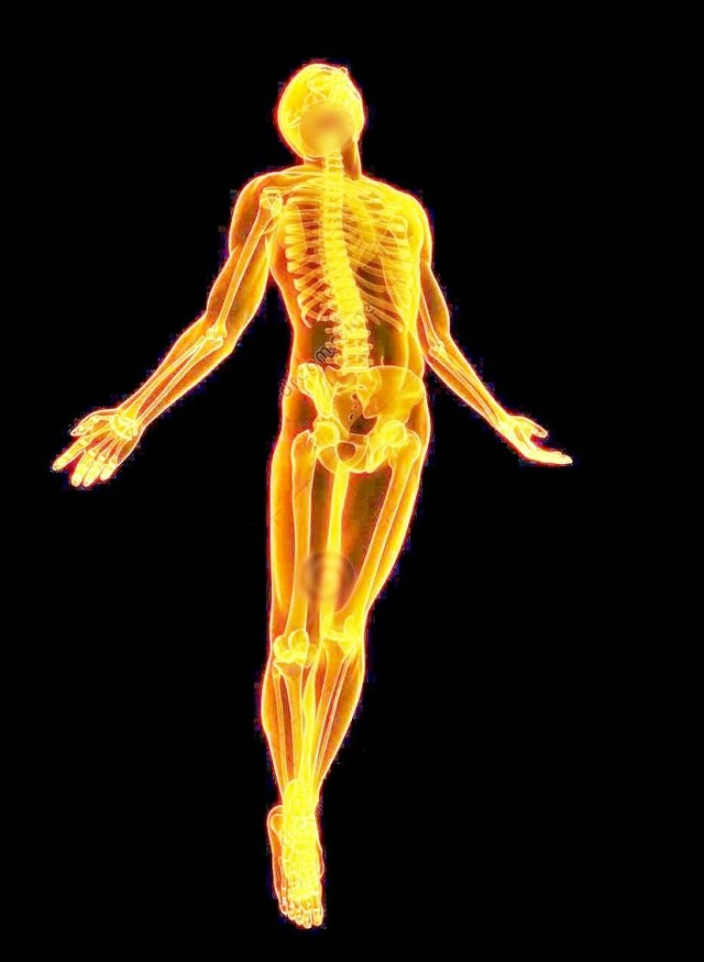
未来的某天有
4 个奇异的事件
将在没有预兆
的情况下发生
(帖前4:16-17)
Notes:
These four events will happen in the following order, each event beginning with the letter "R" (cf. Ryrie)…

Slide 40
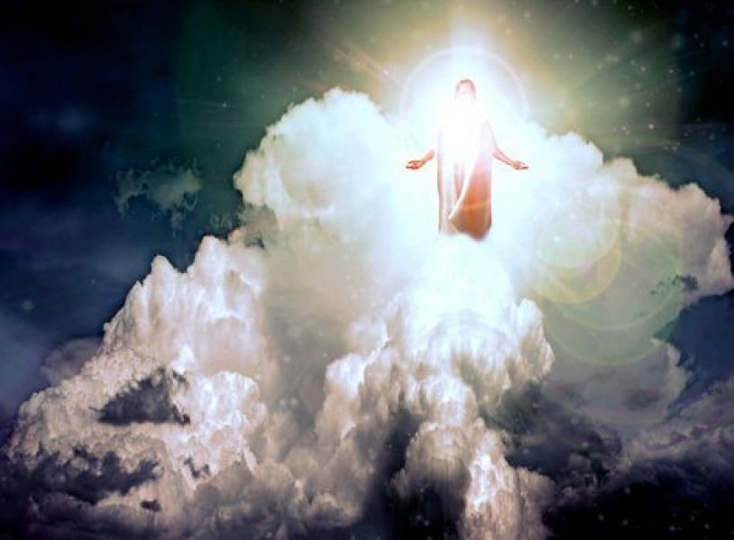
再来
“主必亲自从天降临，有命令的呼喊, 有天使长的声音, 又有神的号吹响”
(帖前4:16a NLT)。
Notes:
Where is Christ right now? In heaven seated at the right side of the Father.
Christ Himself (not an angel) will return for the church.
His return will be accompanied by three things:

Slide 41
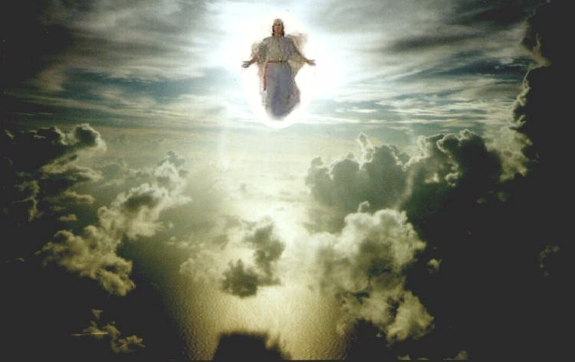
基督命令的呼喊
Notes:
Is this from Christ or an angel or Michael the archangel? The text isn't clear, but I like to think that it's from Christ.
The word for "loud command" or "shout" is "used of the cry of the charioteer to his horses or the hunter to his hounds; it is the shout of the ship's master to the rowers, or of the commander to his soldiers" (Morris).
What is the command? "Rise!" "Come forth!" "It's time!" ????
The word carries with it a ring of authority and urgency.

Slide 42
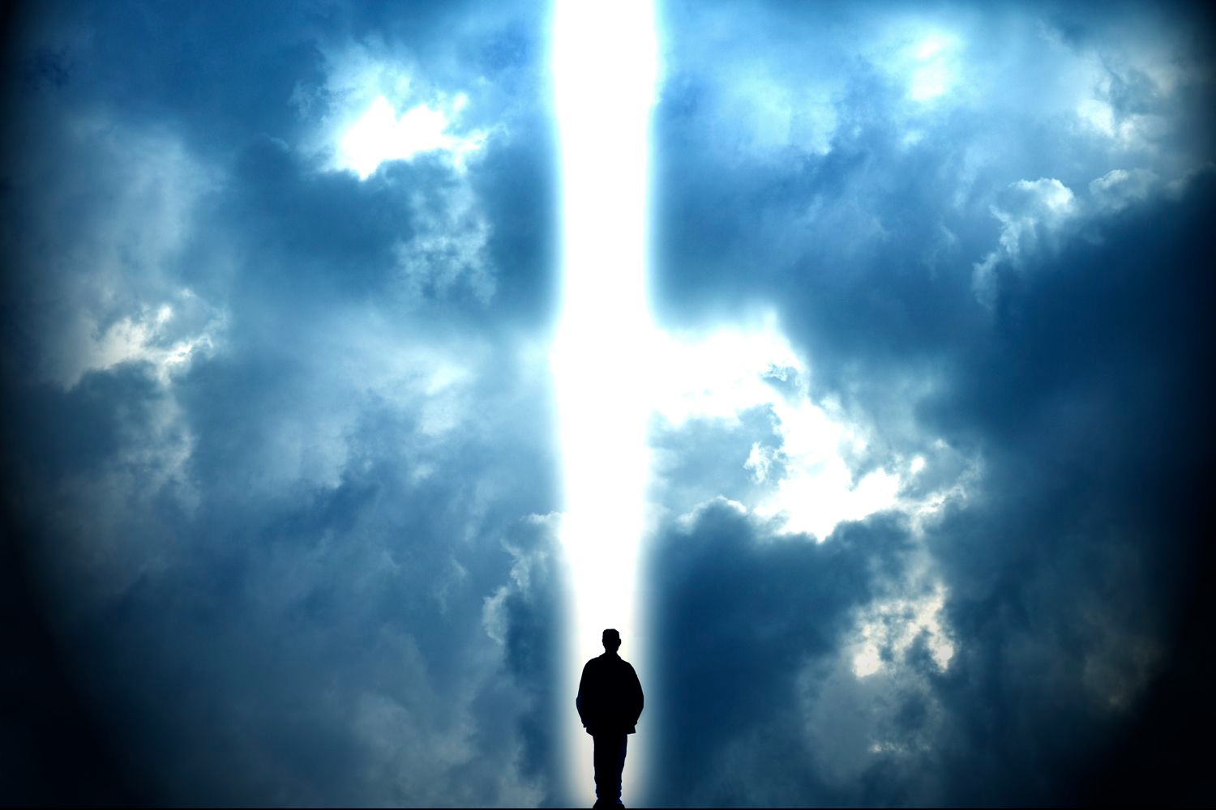
天使长的声音
Notes:
The Jews listed seven chief angels, but which one is the archangel?
The identity of this angel is somewhat unclear since Michael is the only angel in Scripture specifically referred to as an archangel, but here the word appears without a definite article.
"Voice" also lacks the word "the" in the Greek.
However, a definite article is not necessary to be definite so this is probably Michael.

Slide 43
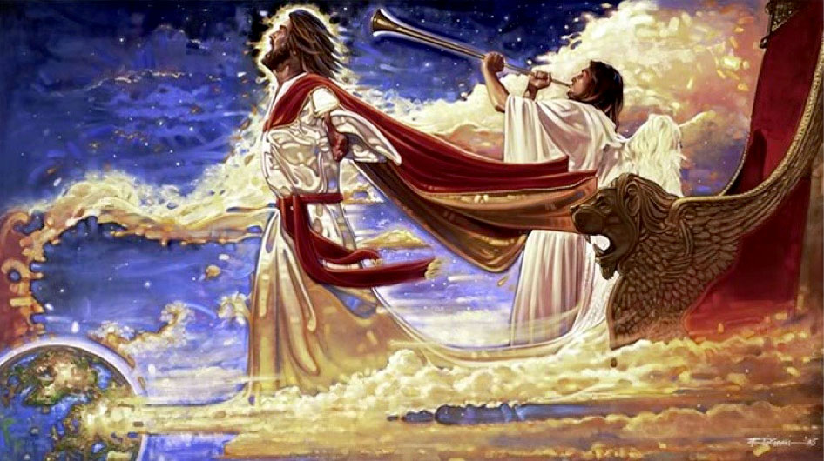
上帝的号吹响
Notes:
Trumpets are associated with God's activity in the Bible:
-Ex 19:16 has a trumpet at Mt. Sinai
-Isa 27:13 uses the trumpet to signal the return to the land from Assyria
-Joel 2:1 mentions the trumpet sounding in judgment
-Matt 24:31 has a trumpet sound when Christ returns after the Tribulation
Through the use of the trumpet God calls attention to this event as a majestic, dramatic, spectacular one worthy of Christ who is King of kings and Lord of lords.

Slide 44
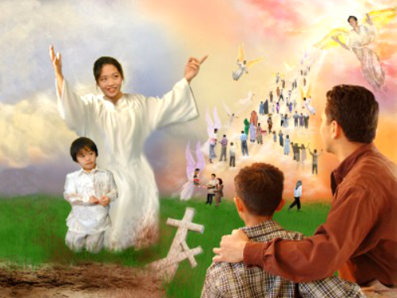
复活
“首先，死去的基督徒会从坟墓中复活”
(帖前4:16b NLT)。
Notes:
Christians who have died during the church age will rise first.
The designation "in Christ" refers only to those who have died since Christ's death and resurrection in the Church Age.
So those who have died as Christians will be rejoined with their spirits which have already been with Christ.

Slide 45

“在基督里死去的人要先复活”
(帖前 4:16b)
Notes:
But what happens to the bodies of these who have died? Are they changed? (RAPTURE transformation of the body= farmer's wife in elevator).
For sure! Read 1 Corinthians 15:50-55.
Exactly how these bodies are reassembled and resurrected is not stated.

Slide 46

被提
“然后，我们这些活着的人必和他们一同被提到云里，在空中与主相遇。”
(帖前4:17a NLT).
“被提”—不是 “消失"

Slide 47
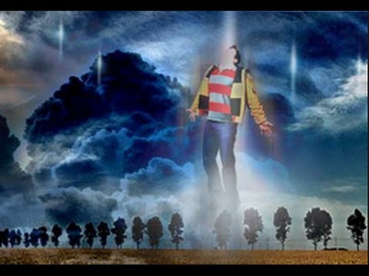

被提
源自 rapturo, “提起”(拉丁语)
Notes:
Text

Slide 48


Slide 49

以诺与神同行, 神将他取去, 他就不在世了。 (创世纪 5:24)
Notes:
Text

Slide 50
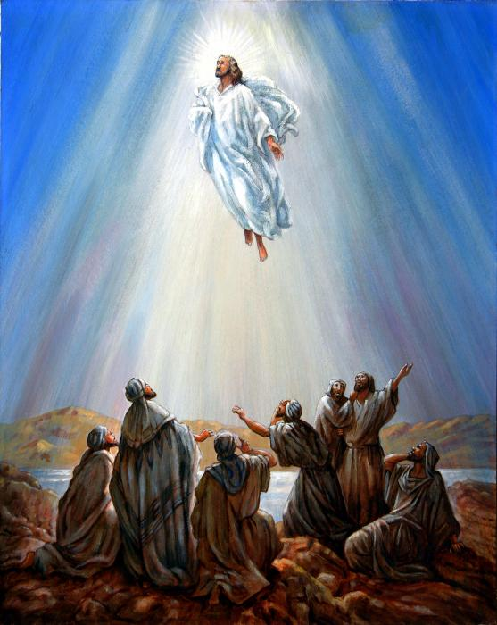
基督
升天
Notes:
Text

Slide 51
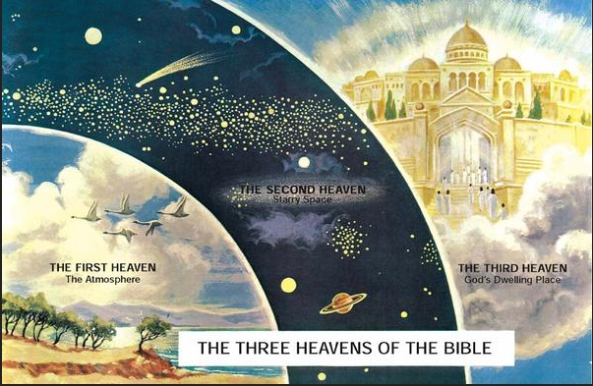
“我被提到第三层天”
(林后12:2 NLT)
  第二层天
  繁星闪耀的宇宙空间
  第一层天
  大气层
  第三层天
  上帝第处所
  圣经里的三层天
Notes:
Paul already had a private "Rapture" to the “third heaven” in 2 Corinthians 12:2, 4

Slide 52
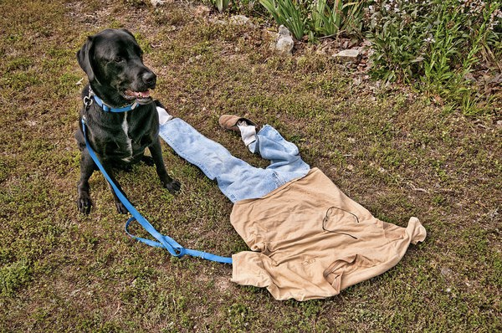
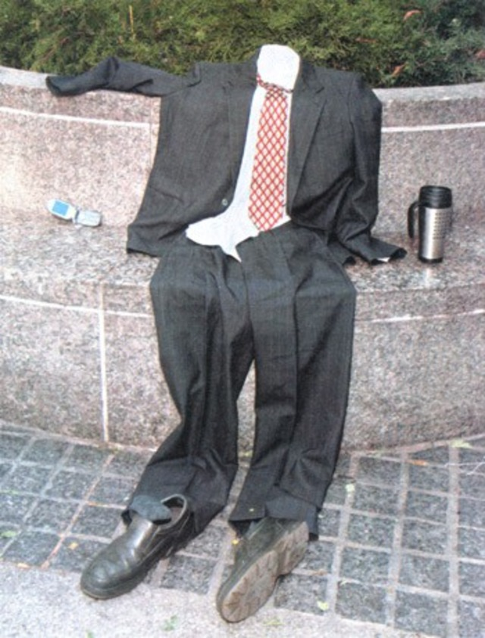
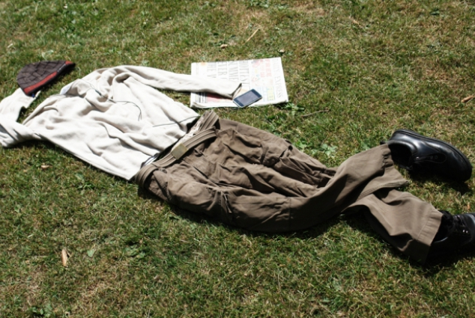
被提的嘈杂声
Notes:
Text

Slide 53
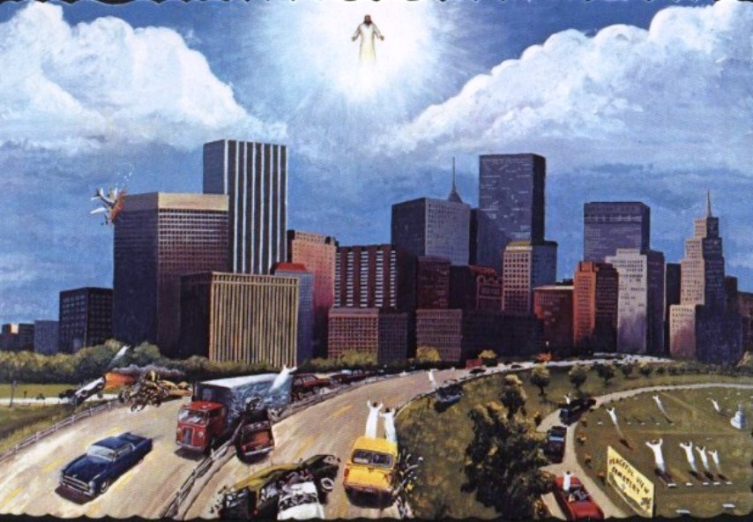
被提的嘈杂声
Notes:
Text

Slide 54
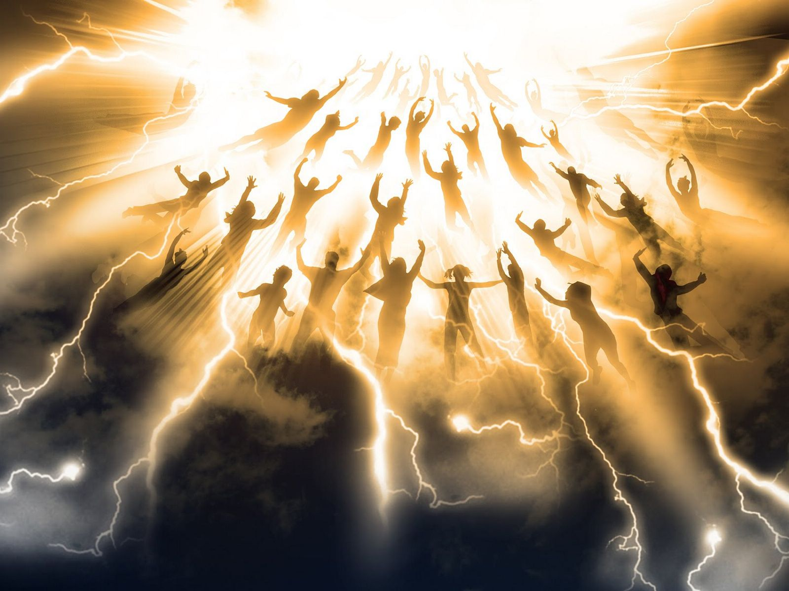
翻译

Slide 55
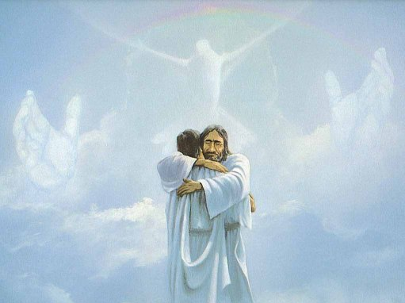
重聚
“我们会和主永远在一起”
(帖前4:17b NLT).

Slide 56

我们会与他在云中相见

Slide 57
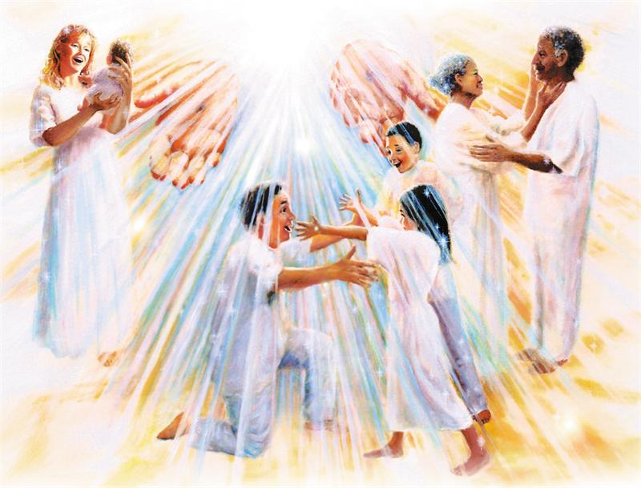
III. 基督的再来帮助我们鼓励彼此
(帖前4:18)。
Notes:
The word for "comfort" (or "encourage") here literally means to "come alongside to help (Read Charles Swindoll, Contagious Christianity, 46-47).
We're also guaranteed escape from the coming wrath of the Tribulation, which is something to be encouraged about! (A post-tribulation rapture would be no comfort to anyone!)

Slide 58
为什么我们要对被提充满期盼?
Notes:
So are you looking to Christ’s return at the Rapture?
What reasons can we give to anticipate Jesus coming back?

Slide 59
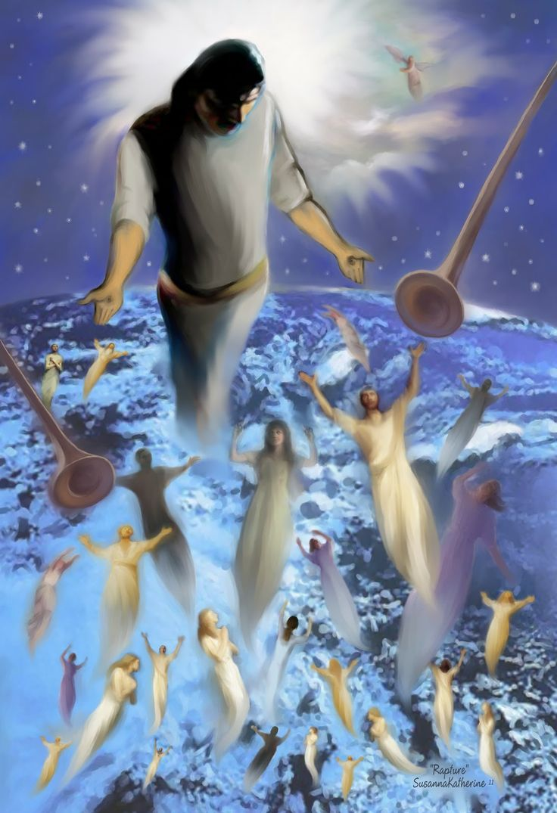
中心思想
被提给我们希望
和鼓舞
知道他将
为你而来。
Notes:
Restatement

Slide 60

”我还有时间..."
Notes:
Restatement

Slide 61
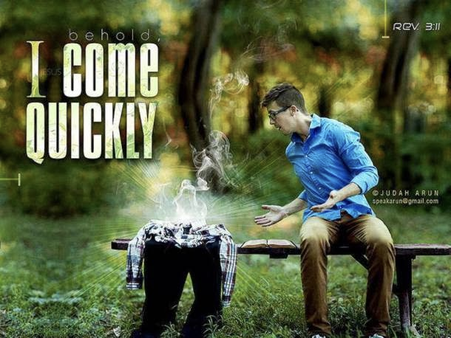
看哪,
我必
快来！
启 3:11
Notes:
Text

Slide 62

帖撒罗尼迦前书5:2
“像夜间的贼一样来到"

Slide 63
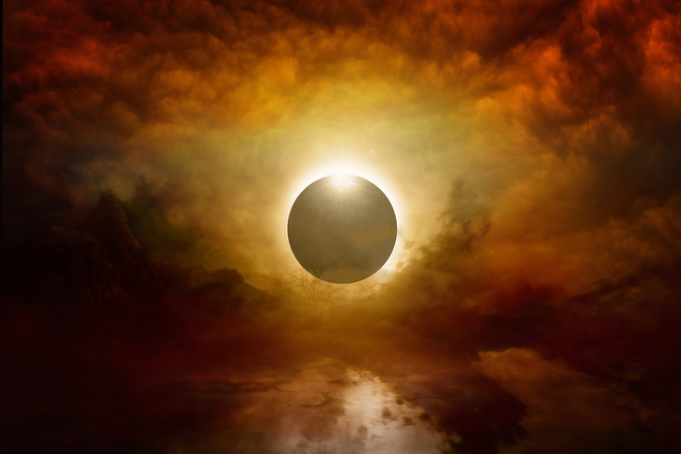
如何生活?
Charles R. Swindoll, Contagious Christiantiy, 47
Notes:
Text

Slide 64
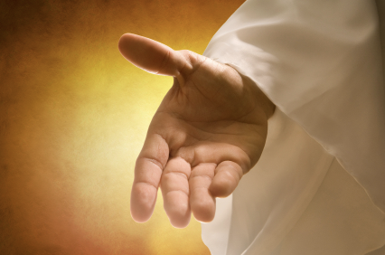
确认你已经得着神白白赐给你的救恩。 (提多书2:11 NLT).
“因为神救众人
的恩典
已经向世人
显明。"
Charles R. Swindoll, Contagious Christiantiy, 47

Slide 65
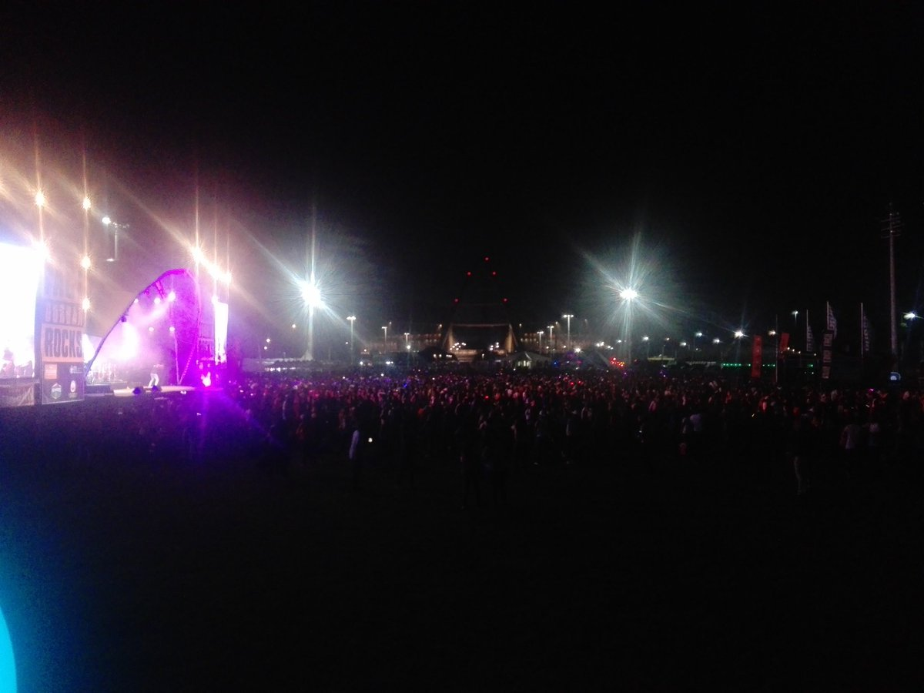
继续抵制腐败生活的诱惑
(提多书2:12a NLT)。
“我们被教导从不敬虔和罪中之乐中转回。"
Charles R. Swindoll, Contagious Christiantiy, 47

Slide 66

过明智和敬虔的生活
(提多书2:12b-13 NLT).
“我们应该在这邪恶的世界过自律、公义、敬畏上帝的生活，怀着美好的盼望等候耶稣基督—我们伟大的上帝和救主的
荣耀显现。"
Charles R. Swindoll, Contagious Christiantiy, 47

Slide 67

忠心敬虔的人要和耶稣一同作王
Notes:
Text

Slide 68
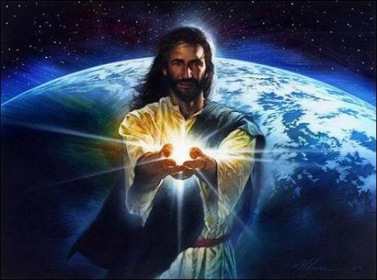
Black

Slide 69
Black

Slide 70


末世论 • BibleStudyDownloads.org
免费获得该讲解!
圣经学习下载
Notes:
The explanation for free!
Future (Eschatology) link address

