Slide 1
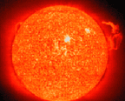
地狱
The Subject I'd Rather Not Teach
163
末世论
Dr. Rick Griffith • 博士 • 新加坡神学院 • BibleStudyDownloads.org

Slide 2

你的看法是…
162
天堂?
与
地狱?

Slide 3
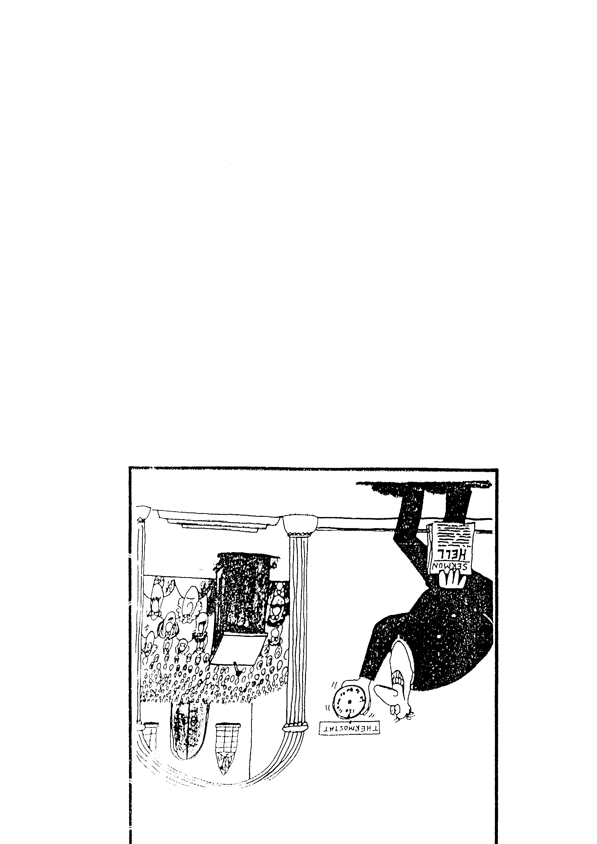
Sermon
恒温器
THERMOSTAT
信息:
地狱

Slide 4
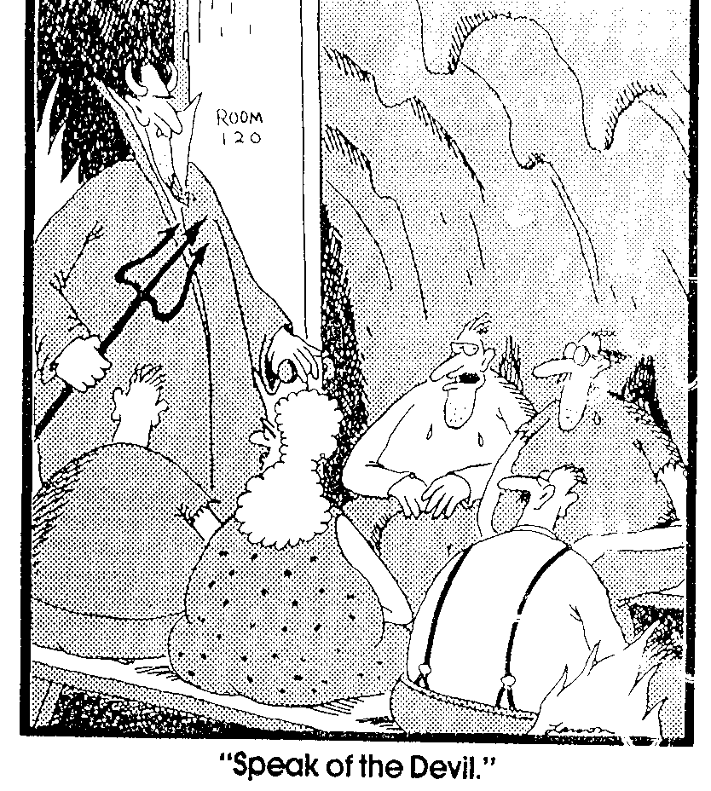
“说曹操，曹操就到"
房间
120

Slide 5
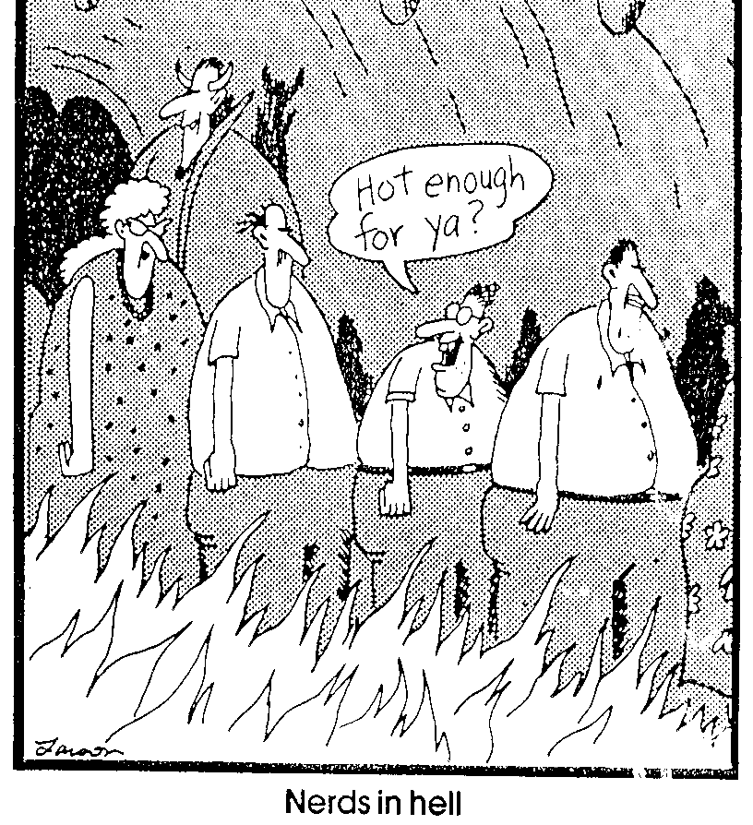
书呆子到地狱
热度适合你吗?

Slide 6

壳牌

Slide 7
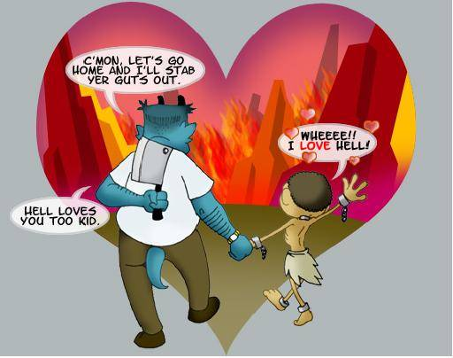
Some even love hell?
来吧！我们一起回家，让我把你的肠胃给
挖出来！
太好了！！我爱地狱！
小子，地狱也爱你。

Slide 8
地狱: 如果这是真的怎么办?
Notes:
tomstyle.com/ archive/hell.jpg

Slide 9
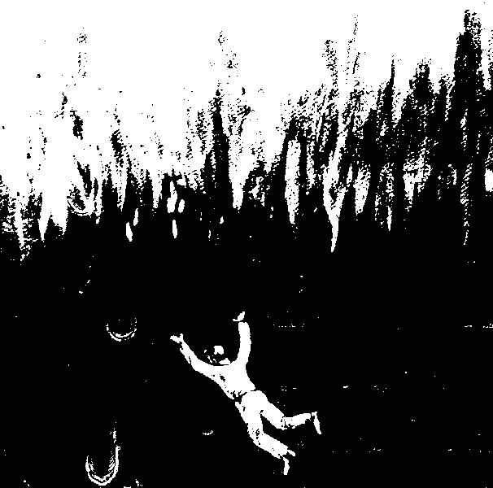

“凡是名字没有记在生命册上的，他就被抛在火湖里。”
(启示录 20:15 CNV)

Slide 10
进 攻 地 狱
52
普世性
毁灭性
炼狱

Slide 11
普 世 性
52
pt. a
这是什么?
引据论证
反驳

Slide 12


近代
普世论
“LOVE WINS 爱必胜”
这本书讲述关于天堂、地狱和
曾经活着的每个人的命运。
作 者：
Notes:
http://www.cbn.com/cbnnews/us/2011/april/love-wins-pastor-caught-off-guard-by-controversy/
'Love Wins' Pastor Caught Off Guard by Controversy
By Crystal Woodall CBN News Internet Producer
Sunday, April 10, 2011
Print 35 Comment(s)
Ad Feedback
Evangelical megachurch pastor Rob Bell says he was caught off guard by the condemnation his new book has received from leaders in the Christian community.
Standing before an audience of about 1,600 at Nashville's Belmont University, Bell said the last several weeks had been the "most painful" of his life.
"It has taken me to a place of profound brokenness," said Bell, who pastors the 10,000-member Mars Hill Bible Church in Grand Rapids, Mich.
Love Wins: Heaven, Hell, and the Fate of Every Person Who Ever Lived, released March 29, challenges the traditional Christian belief that few will enter Heaven.
"Will only a few select people make it into Heaven and will billions of people burn forever in Hell?" Bell asks in a promotional video of his book, recently released by publisher HarperOne. "And if that's the case, how do you become one of the few?" Watch the video here.
Bell insists it was never his intent to stir controversy, but to bring focus back to a message he suggests has got lost in dogma -- the love of God.
"I kept meeting religious people who were incredibly dogmatic about heaven and hell when you die but didn't seem to care about the fact that 8 million people will go to bed hungry tonight," Bell explained.
Bell denies charges that his book promotes a universalist theology - the belief that everyone, regardless of belief, will be saved by God.
"No, if by universalist we mean there's a giant cosmic arm that swoops everybody in at some point whether you want to be there or not," he told The Christian Post.
"That violates the laws of love and love is about freedom," he explained. "It's about choice; it's about do you want to be there? Because that's what would make it heaven."
According to the Associated Press, Bell says hell is something freely chosen that already exists on earth.
"Apparently this is a pastor who has written a book who has grown uncomfortable contending for the faith," CBN chaplain and Regent University theology professor Joel Palser said. "He is no longer able to defend what the Bible says and has endeavored to make that more palatable to modern culture."
"It may be trendy and it might sell a lot of books, but in fact Jesus speaks very clearly about heaven and hell," Palser added.

Slide 13
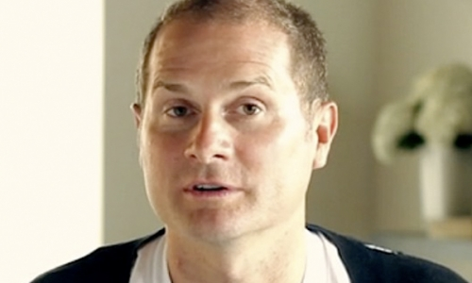
Grand Rapids Mars Hill 圣经教会拥有10,000个会众, 其中三千人在该书出版后离开了该教会, 后来Bell也离开前往加利福尼亚经营一个 “信心改变谈话秀” 的节目。
Notes:
http://www.cbn.com/cbnnews/us/2011/april/love-wins-pastor-caught-off-guard-by-controversy/
'Love Wins' Pastor Caught Off Guard by Controversy
By Crystal Woodall CBN News Internet Producer
Sunday, April 10, 2011
Print 35 Comment(s)
Ad Feedback
Evangelical megachurch pastor Rob Bell says he was caught off guard by the condemnation his new book has received from leaders in the Christian community.
Standing before an audience of about 1,600 at Nashville's Belmont University, Bell said the last several weeks had been the "most painful" of his life.
"It has taken me to a place of profound brokenness," said Bell, who pastors the 10,000-member Mars Hill Bible Church in Grand Rapids, Mich.
Love Wins: Heaven, Hell, and the Fate of Every Person Who Ever Lived, released March 29, challenges the traditional Christian belief that few will enter Heaven.
"Will only a few select people make it into Heaven and will billions of people burn forever in Hell?" Bell asks in a promotional video of his book, recently released by publisher HarperOne. "And if that's the case, how do you become one of the few?" Watch the video here.
Bell insists it was never his intent to stir controversy, but to bring focus back to a message he suggests has got lost in dogma -- the love of God.
"I kept meeting religious people who were incredibly dogmatic about heaven and hell when you die but didn't seem to care about the fact that 8 million people will go to bed hungry tonight," Bell explained.
Bell denies charges that his book promotes a universalist theology - the belief that everyone, regardless of belief, will be saved by God.
"No, if by universalist we mean there's a giant cosmic arm that swoops everybody in at some point whether you want to be there or not," he told The Christian Post.
"That violates the laws of love and love is about freedom," he explained. "It's about choice; it's about do you want to be there? Because that's what would make it heaven."
According to the Associated Press, Bell says hell is something freely chosen that already exists on earth.
"Apparently this is a pastor who has written a book who has grown uncomfortable contending for the faith," CBN chaplain and Regent University theology professor Joel Palser said. "He is no longer able to defend what the Bible says and has endeavored to make that more palatable to modern culture."
"It may be trendy and it might sell a lot of books, but in fact Jesus speaks very clearly about heaven and hell," Palser added.

Slide 14
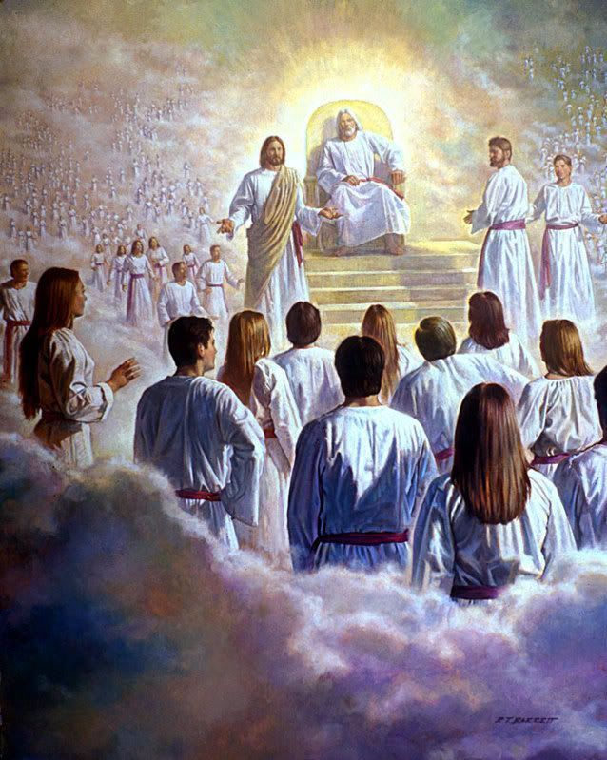
“我又看见一个白色的大宝座…”
(启示录20:11)

Slide 15
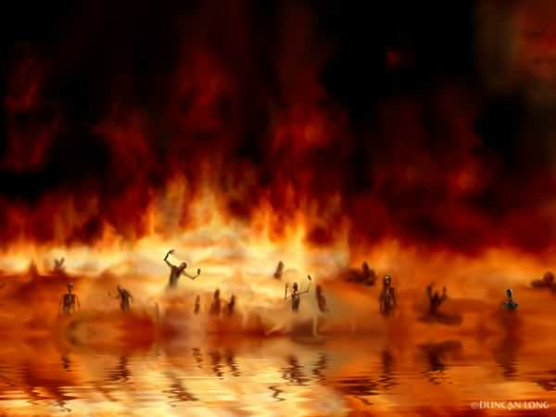
火湖
(启示录 20:14-15)

Slide 16
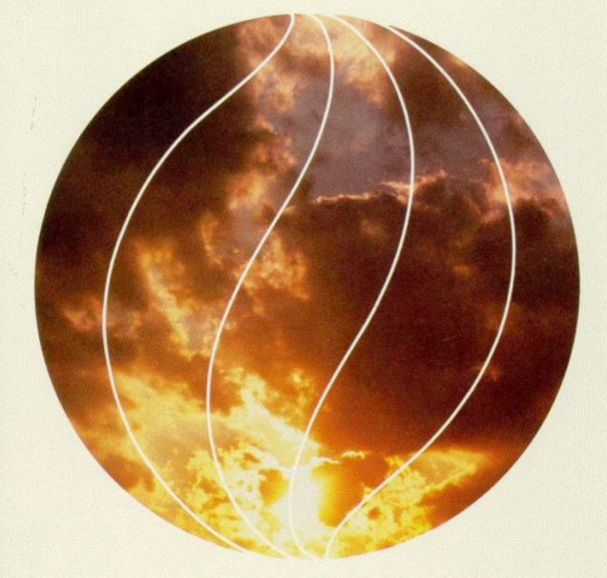
毁 灭 性
52
这是什么?
引据论证
反驳

Slide 17

持毁灭论的团体
52
第七日基督再临会
耶和华见证人
一些 “福音派教徒"?

Slide 18

持毁灭论者的辩论
52
反驳
上帝太仁慈了所以不会送人入永远的地狱
上帝是完全公义和圣洁的
“破坏”
意指毁灭
“破坏”
意指肉身死亡

Slide 19
英国教会报告,
1996年1月
“地狱是我们用来描述终极无乐世界的象征手法。可怕的恶魔是发明家和中世纪史学家想象出来的."
Bishop John Taylor
报告的作者们中的一位

Slide 20

炼 狱
52
pt. b
这是什么?

Slide 21
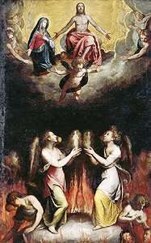
关于炼狱的论证
52
pt. b
“没有天堂那么美好，但是也没有地狱那么糟糕”
马加比后书

Slide 22
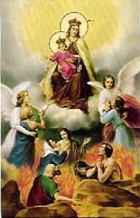
关于炼狱的反驳
52
pt. b
靠做工得救
伪经／次经
没有第二次机会

Slide 23
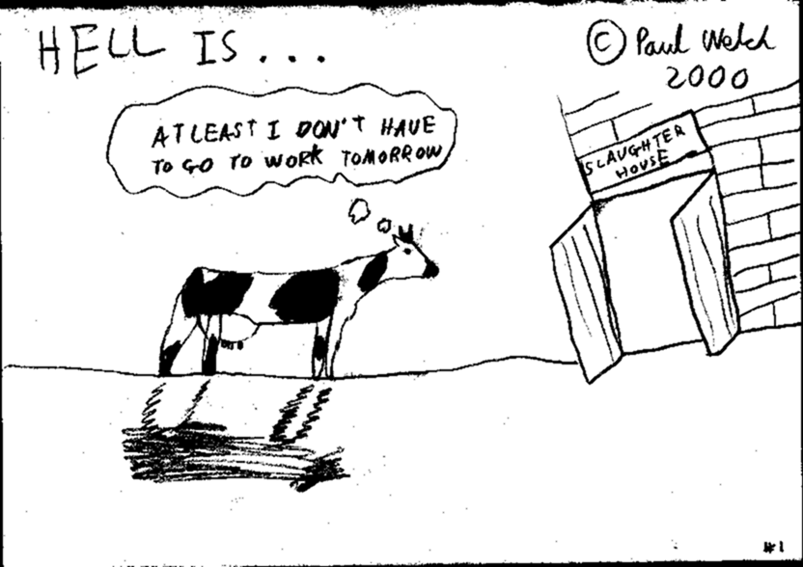
炼狱?
或是歼灭?
地狱
是
至少我明天不用做工。。。
屠宰场

Slide 24

为什么要研读和教导有关地狱的课题?
171

Slide 25
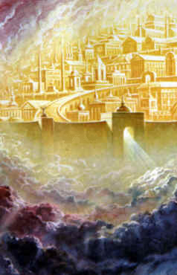

有什么不同?
53
pt. 2
恩典
怜悯
…是上帝给我们所
不
配得的
…是上帝
不 给
我们所
应
承受的

Slide 26
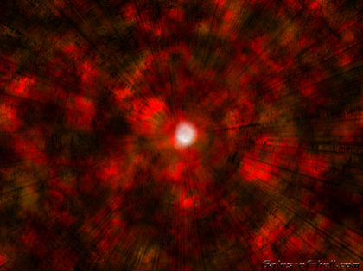
地狱在哪里?

Slide 27

Gates of Hell
地狱之门
171

Slide 28
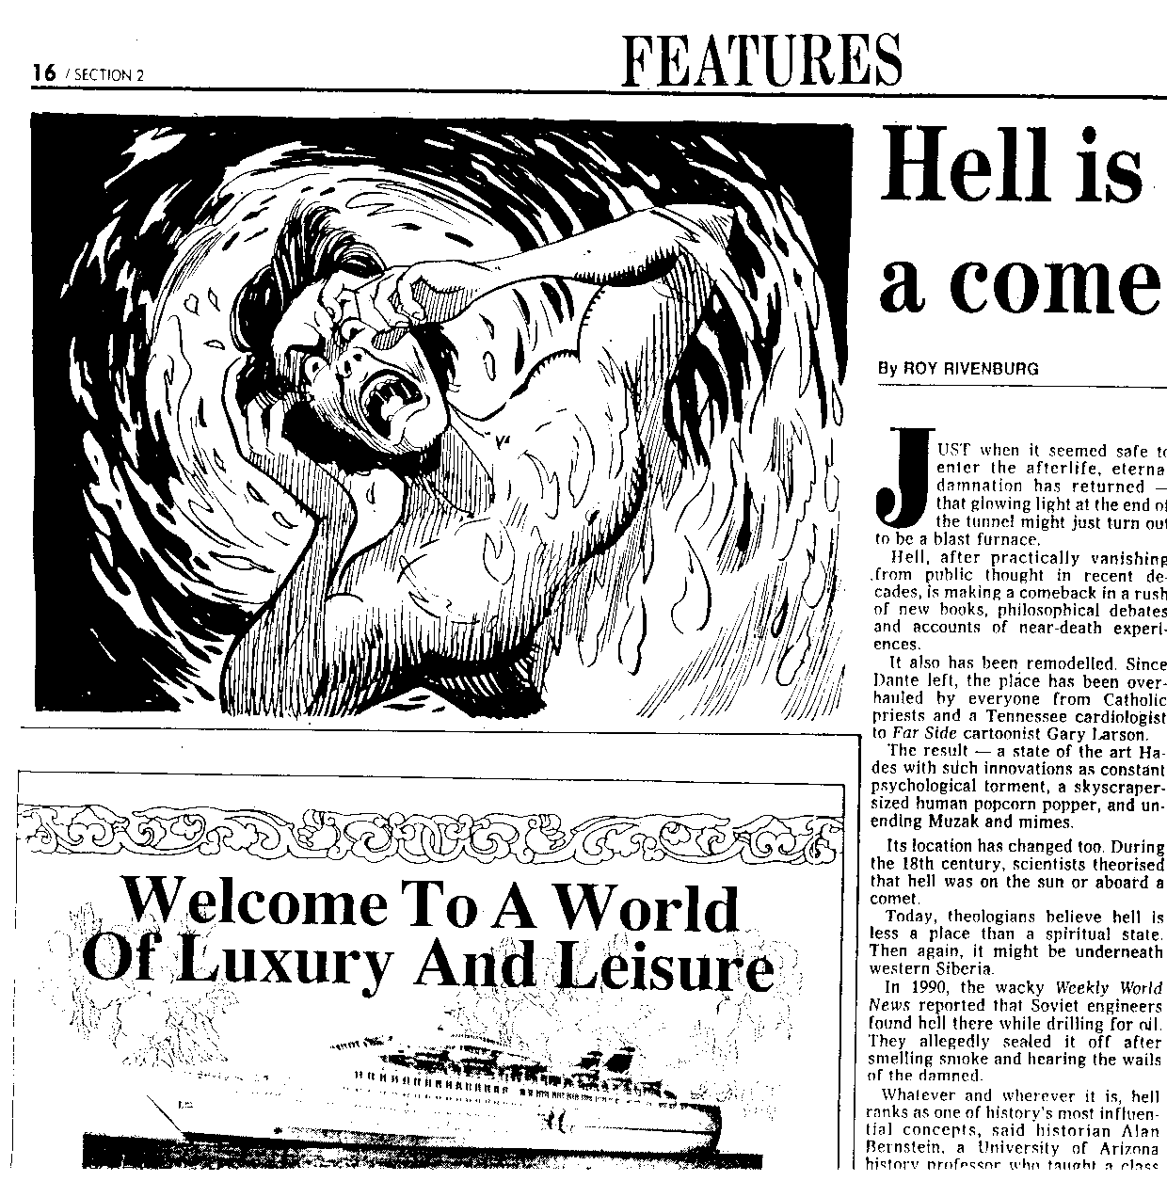
地狱卷土从来
Monday January 24, 1994 THE STAR
星期一，一月二十四日
“它（地狱）的确存在，但并不是一个地方， 就像数码。它们是真实的，可是没人知道它们在哪里。” 拜欧拉大学心理学系教授J.P. Moreland, 也是著作不朽: 死亡的另一边的和着者说到。
Notes:
Monday January 24, 1994 THE STAR
(Malaysia)

Slide 29
地狱是怎样的?
171
永恒 （太 25:46; 帖后 1:8-9; 歌前 1:18; 4:3; 希 2:3)
虫是不死的 (可 9:47-48)
完全与上帝隔离
(帖后 1:9)
外面黑暗 (太 8:12; 25:30; 彼后 2:17; 犹 13; 以诺书 102:8; 所罗门的诗篇 14:9)
不灭的火 (太 5:22; 18:8-9; 25:41; 可 9:47-48; 路 16:24; 雅各 3:6; 犹 7; 启 20:14-15; 出 3:1-6; 希腊神论书 4:40-44)

Slide 30
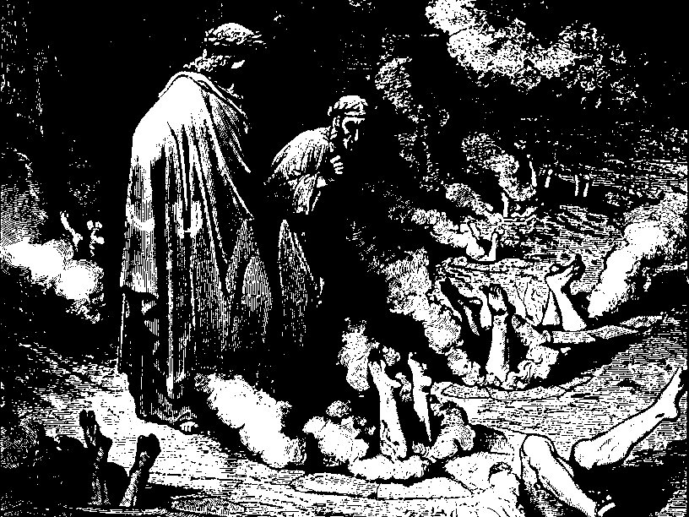
传统的看法
Notes:
Paul Lee Tan, 194

Slide 31
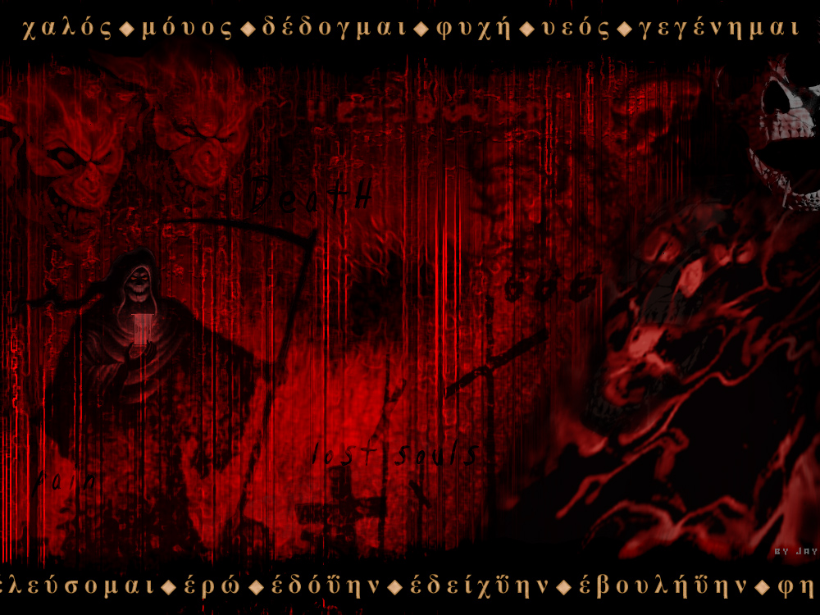
那里没有老板！
172
Point c
Notes:
http://plaza.ufl.edu/bigjay/Vision%20of%20Hell.jpg

Slide 32

地狱的火是比喻性还是真实的?
172
Point e

Slide 33
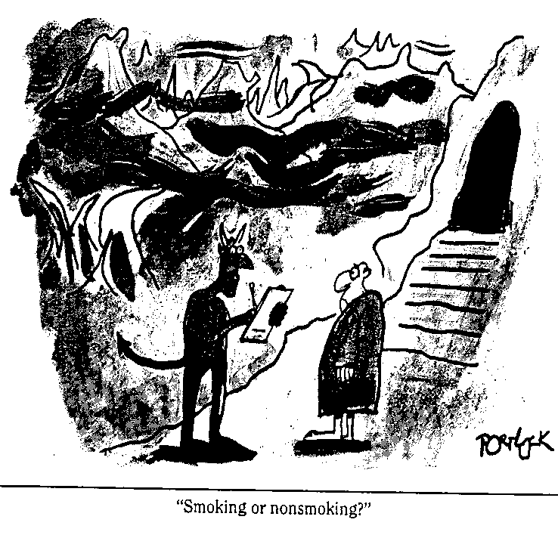
地狱有不同程度的惩罚?
172
Point f
“吸烟或是不吸烟?"

Slide 34
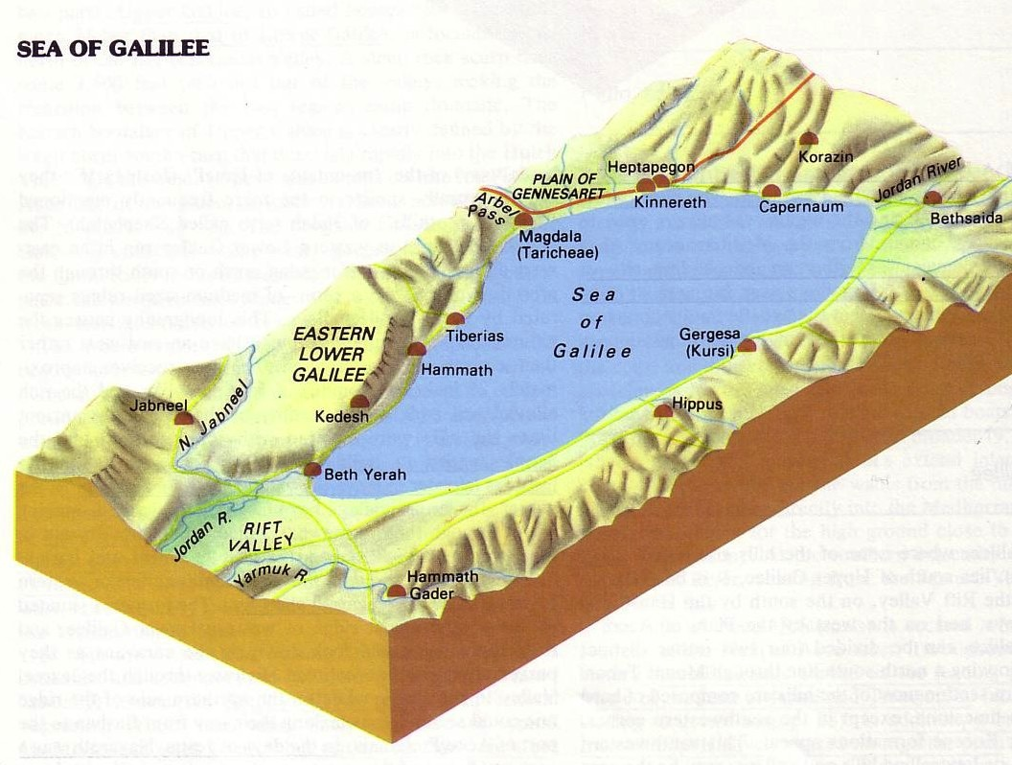

三城地区
172
Point f
那时，耶稣开始责备那些他曾在那里行过许多神迹的城，因为它们不肯悔改：
“哥拉逊啊，你有祸了！伯赛大啊，你有祸了！在你们那里行过的神迹，如果行在推罗和西顿，它们早已披麻蒙灰悔改了。 但我告诉你们，在审判的日子，推罗和西顿所受的，比你们还轻呢。
迦百农啊！你会被高举到天上吗？你必降到阴间。在你那里行过的神迹，如果行在所多玛，那城还会存留到今天。 24 但我告诉你们，在审判的日子，所多玛那地方所受的，比你还轻呢。”
马太福音11:20-24

Slide 35

地狱间最痛苦的是记忆
172
Point i

Slide 36
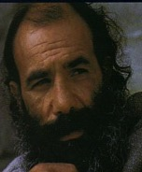
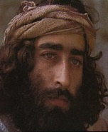
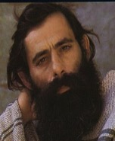
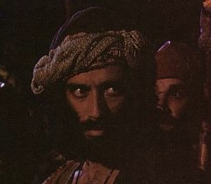
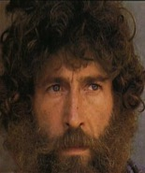
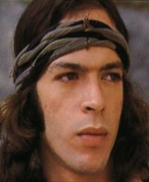
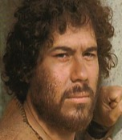
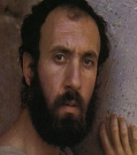
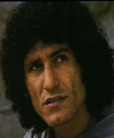
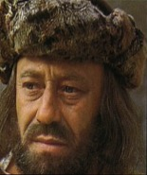
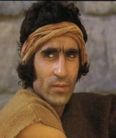
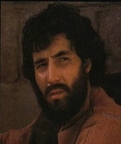





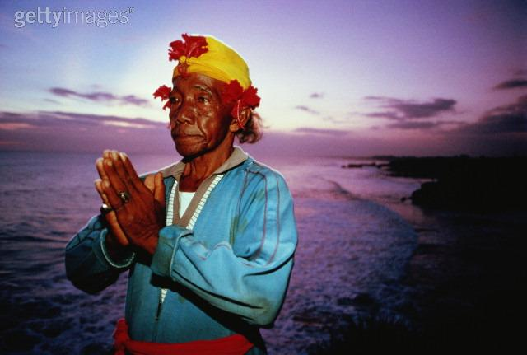
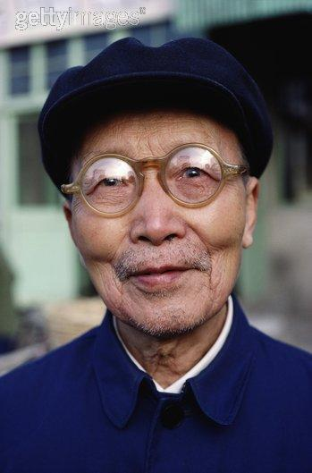





谁会下地狱?
那些 拒绝 耶稣 的人
James
Thaddeus
John
Peter
Andrew
Judas
Bartholomew
James bar Alphaeus
Thomas
Matthew
Simon the Zealot
Philip

Slide 37

神的愤怒 (罗马书1:18-20)
151
真实 (18a)
原因 (18b-20a)
后果(20b)

Slide 38

罗 1:20
161
无限的神
超然的神
其实自从创世以來，神那看不见的事，就如他永恆的大能和神性，都是看得见的，就是从他所造的万物中可以领悟，叫人沒有办法推诿。(新译本).

Slide 39

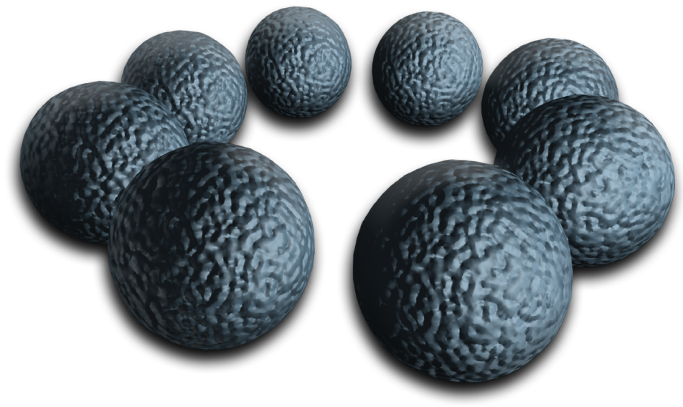
151
为何神对外邦人生气 (1:21-32)
忽视神(21-23)
神任凭他们
污秽(24)
拜偶像(25)
神任凭他们
同性恋(26-27)
神任凭他们
堕落 (28-32)

Slide 40
我们相信这将？
441
传统
圣经
人住 - 老板与魔鬼

Slide 41
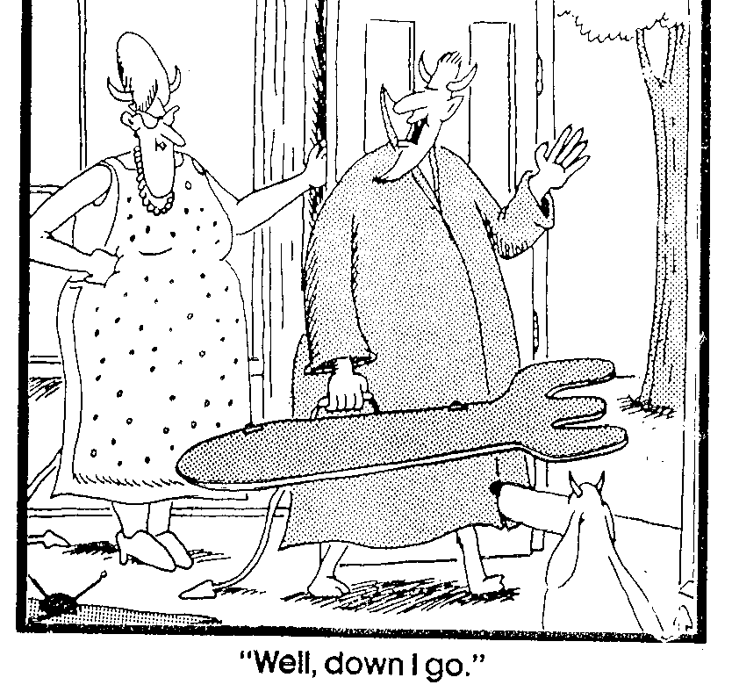
“好，我下去了."

Slide 42
我们相信这将？
441
传统
圣经
人住 - 老板与魔鬼
男子是孤独的
（路加福音13:28）
“至少我的朋友
将在那里“
是的，但你不会看到他们（路加福音13:28）
机构遭受轻微不适
机构遭受来自燃烧含硫量和消费蠕虫（马可福音9:47-48;启示录21:8）

Slide 43
我们相信这将？
441
传统
圣经
撒旦是地狱中的所有
与那些折磨折磨撒旦
（启示录20:10）
固体地球的地方
湖（启20:10）
只有人民受苦
太魔（彼得后书2:4）
撒旦与音叉规则
撒旦扔进地狱统治没有徽记（启示录20:10）

Slide 44
Black

Slide 45


末世论 • BibleStudyDownloads.org
免费获得该讲解!
圣经学习下载
Notes:
The explanation for free!
Future (Eschatology) link address

