Slide 1
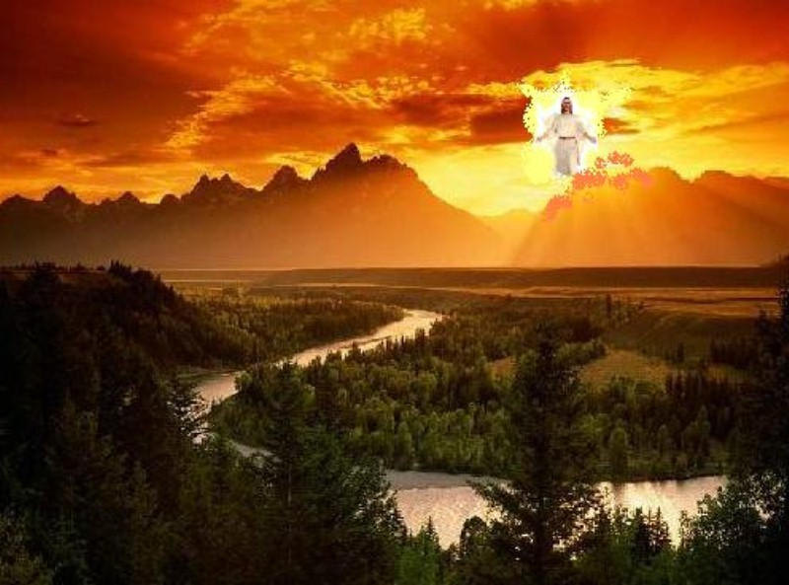
身体 和 基督台
末世论
Dr. Rick Griffith • 博士 • 新加坡神学院 • BibleStudyDownloads.org

Slide 2
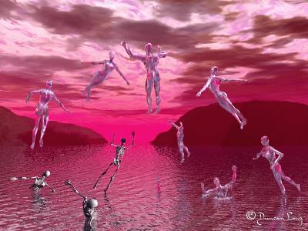
被提

Slide 3
复活和判断
439
R = 4 组复活
J = 7判断组
欢天喜地
第二次降临
R
2R
R
大白
宝座
J
4J
2J
教会时代
苦难
千年
战役
大决战
战役
歌革和玛

Slide 4

基督的审判台前
439
奖赏由基督的信徒
(林后. 5:10)
在着迷
(贴前. 4:17)
奖励的奖励或损失
（未得救）

Slide 5

“在一瞬间，我们也要改变。”
哥林多前书 15:51-52

Slide 6

新身体的三个比喻:
• 植物 (15:36-38)
• 动物 (15:39)
• 无生命的物体 (15:40-41)

Slide 7
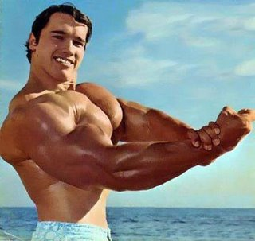
复活的身体

Slide 8

我们会与他在云中相见
(贴前4:17)

Slide 9
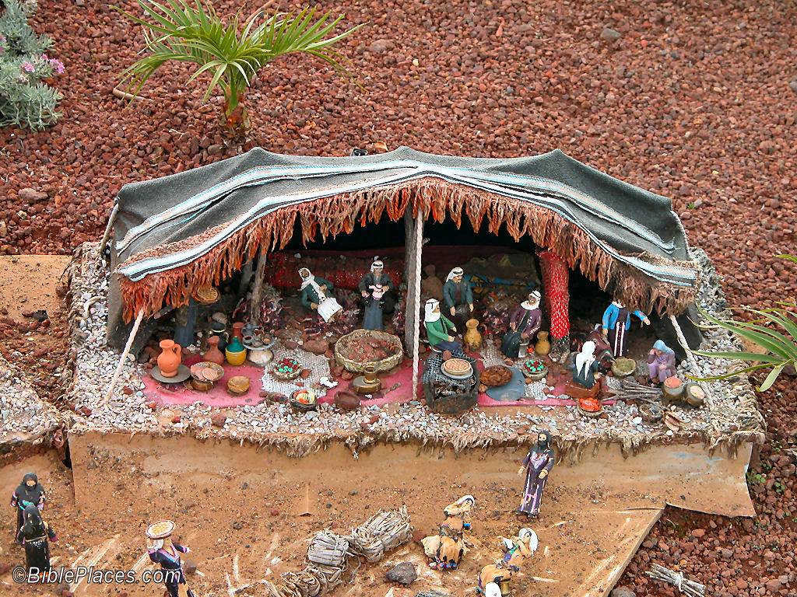
我们在地上的帐棚拆毁了
(林后. 5:1)

Slide 10
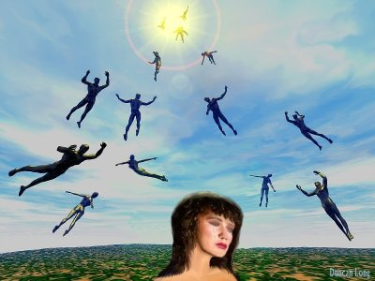
全新的身体

Slide 11
基督的审判台
这是为定救恩的审判？
还是为了奖励信徒？

Slide 12
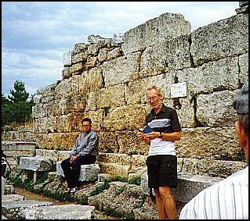
审判台（Bema）任存在
Notes:
12

Slide 13
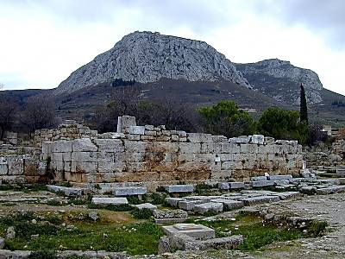
审判台和阿克罗科林斯在后
Notes:
13

Slide 14
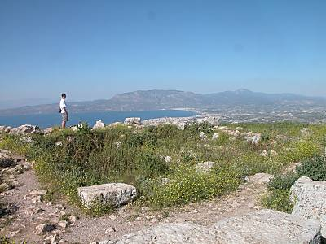
阿克罗科林斯的风景
Notes:
14

Slide 15
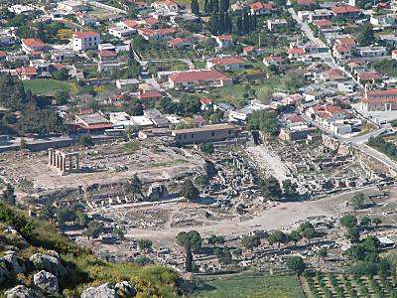
主城之下
Notes:
15

Slide 16
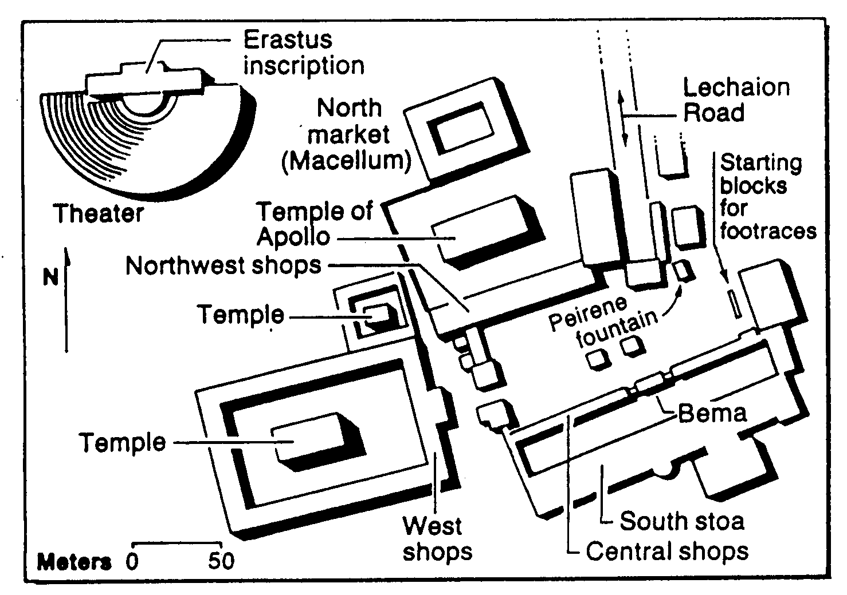
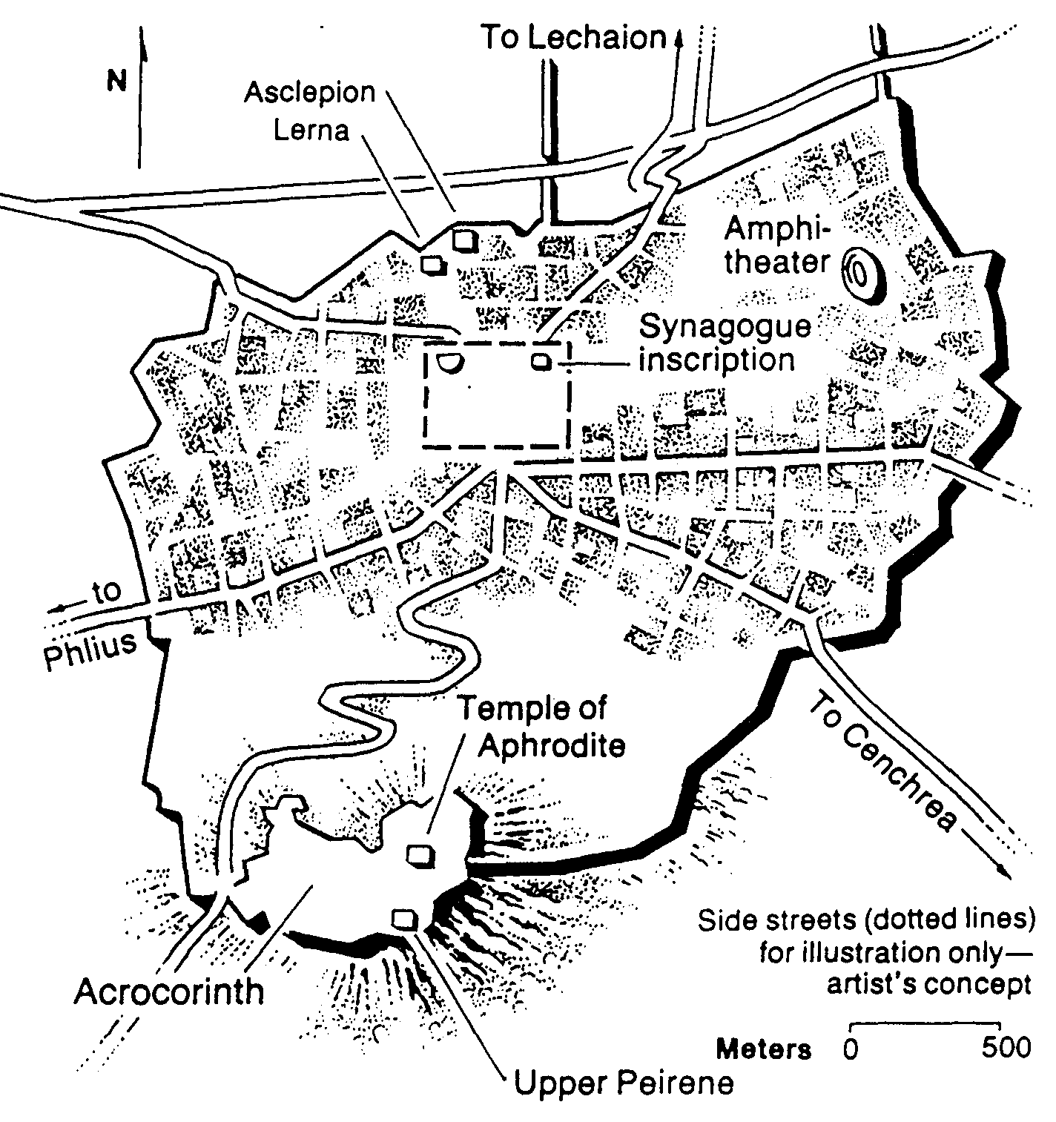
哥林多的市集
Bible Visual Resource Book, 235

Slide 17
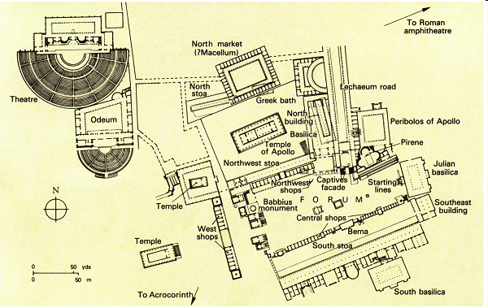
在哥林多的公堂
“迦利奥任亚该亚省长的时候，犹太人一致起来攻击保罗，把他带到审判台前” (使徒行18:12 CSBT)
告状
哥林多前 6
公堂
保罗被带
到审判台前
使徒行 18:12

Slide 18
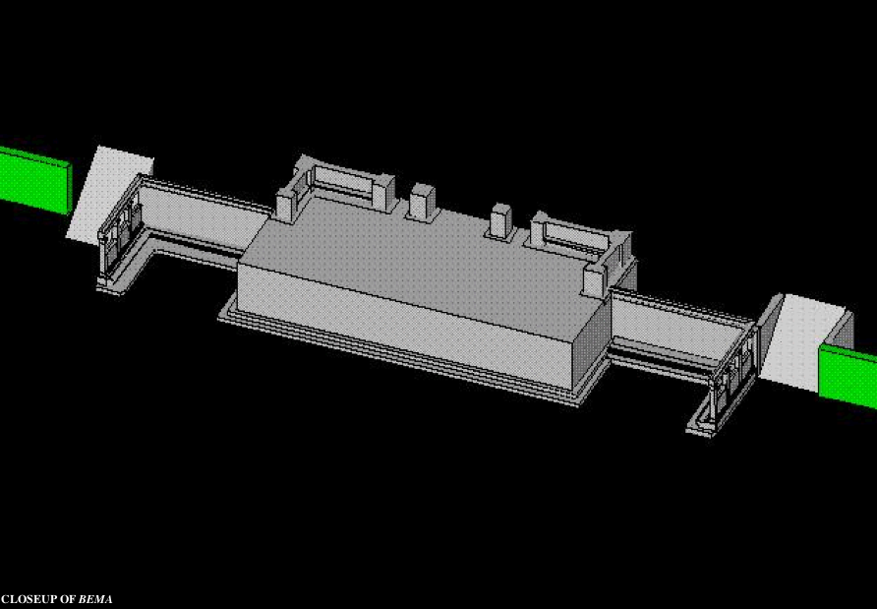
靠近审判台
“所以， 无论是住在身内，离开身外，我们立了志向，要得主的喜悦。因为我们众人必要在基督的审判台前显露出来，叫各人按着本身所行的， 或善或恶受抱” (哥林多后 5:9-10 CUVS).
Notes:
18
http://corinth.sas.upenn.edu/schola.html

Slide 19
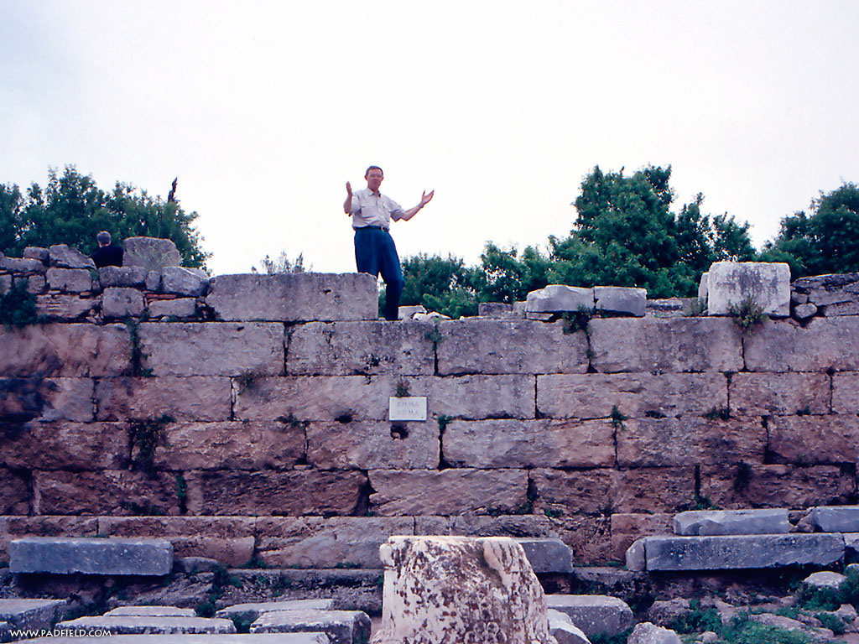
法官或演讲者站在审判台之上
Notes:
19

Slide 20
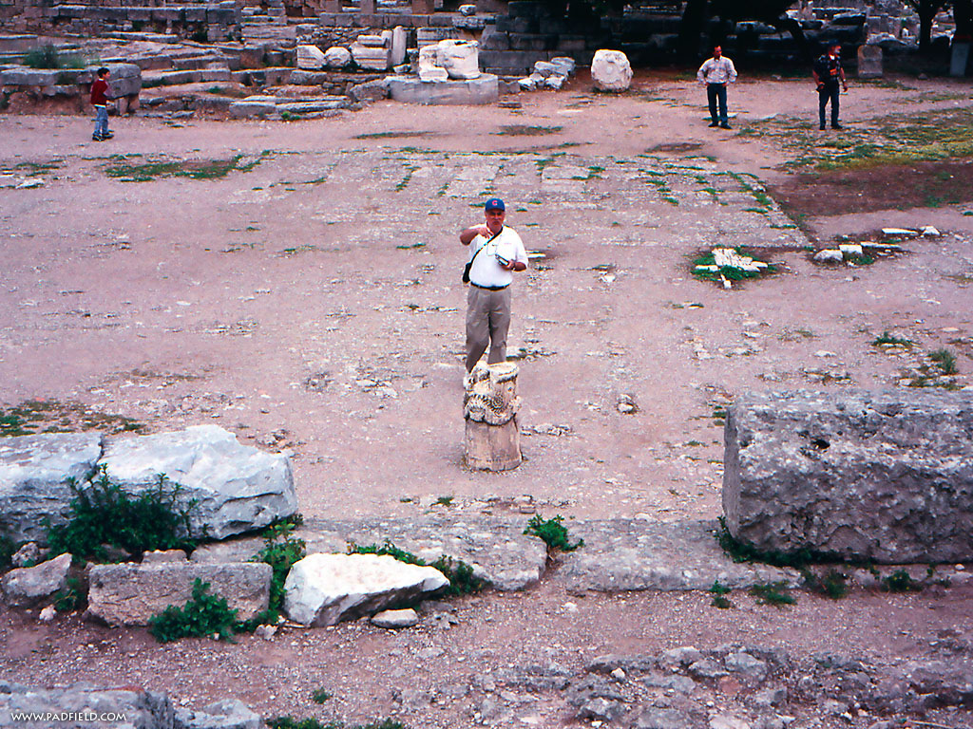
站在审判台前受审或受奖赏
Notes:
20

Slide 21
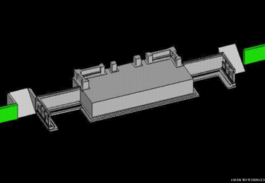
审判台的奖赏
75
“在雅典古希腊竞赛中, 旧的竞技场都有个升降台，是主席或竞技赛裁判坐的地方. 从这里，他会奖赏所有的参赛者； 从这里，他会奖赏所有的冠军。 这叫做 ‘读经台’ or '奖赏之位.' 它从不以审判台而用."
L. Sale-Harrison, Judgment Seat of Christ, 8
cited by Pentecost, Things to Come, 220
真的吗?
Notes:
21
21

Slide 22
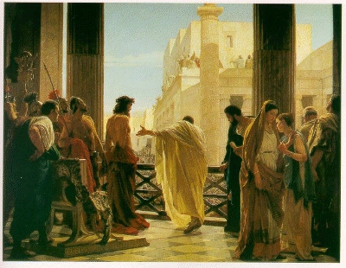
审判台是耶稣 被带到彼拉多 前的地方
Notes:
22
Bema is Used of Jesus Before Pilate

Slide 23
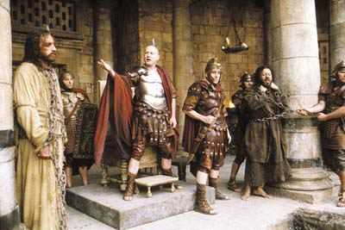
Jesus Before Pilate
Notes:
23

Slide 24
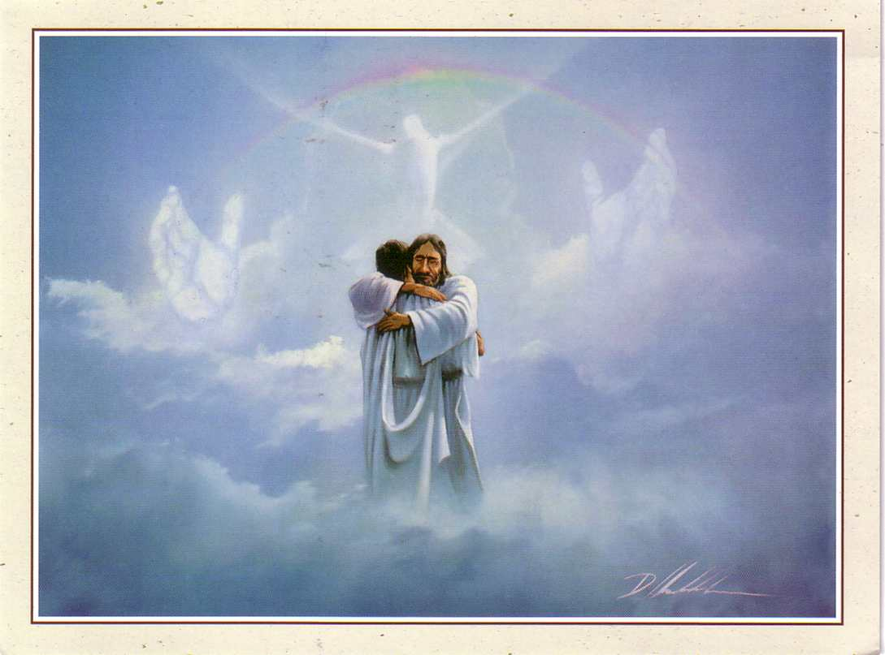
审判台是个赐奖赏的平台
76

Slide 25
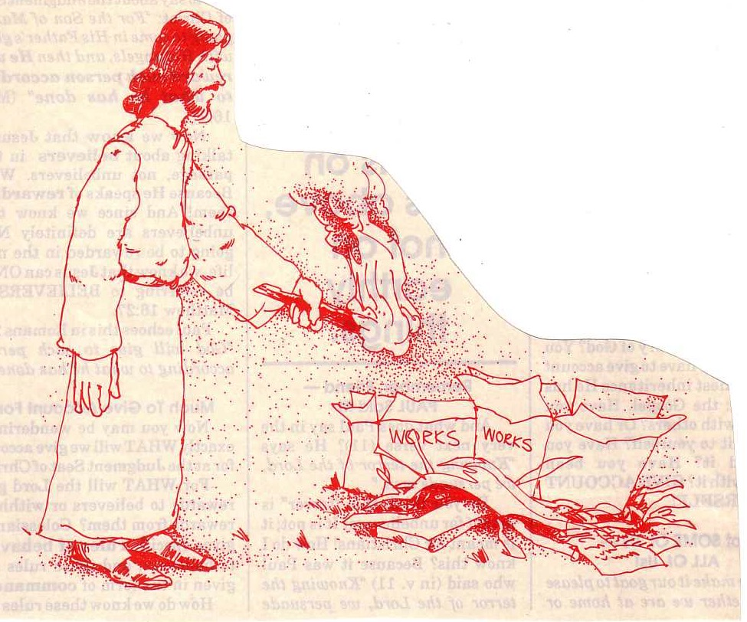
“… 那火要考验各人的工程是怎样的”
(林前3:13)
76
Notes:
25

Slide 26

有些爱跑步

Slide 27
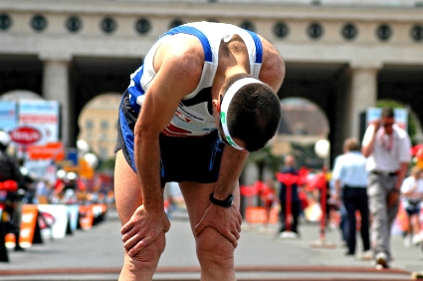
有些放弃

Slide 28

基督徒生命是个赛程

Slide 29

有些跑得好，但是…

Slide 30
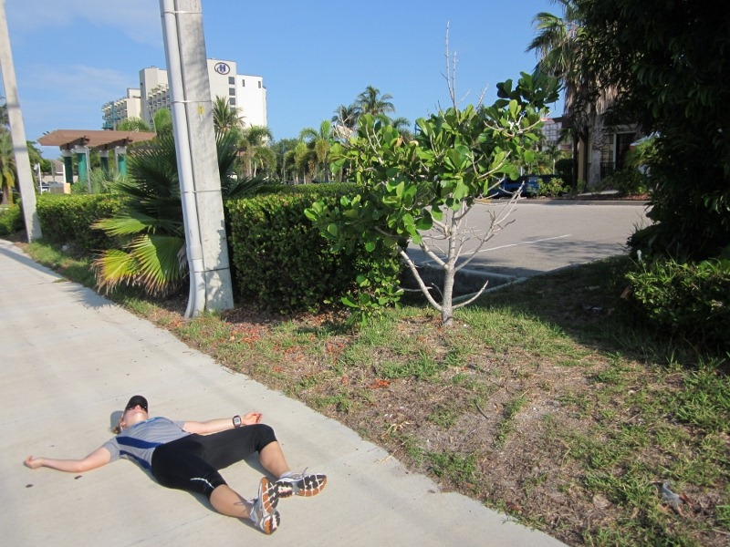
有些放弃了基督徒赛程

Slide 31

你会和基督奔跑多久?

Slide 32

”他们曾在这里."
• 离婚
• 大学疑惑
• 同居
• 分居

Slide 33
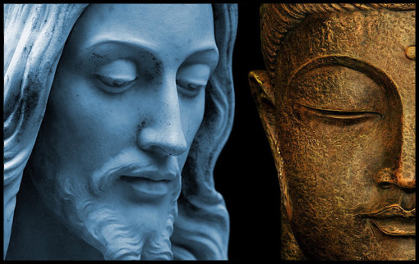
回返的新加坡人
Notes:
The last major study of new believers in Singapore in the 1980s shows that one third of Buddhists who become Christians then return to Buddhism (Keith Hinton, Growing Churches, Singapore-Style).

Slide 34
你呢?
NTS 266t
无神论者?
祖先崇拜?
佛教徒?
自由思想者?
印度教教徒?
回教徒?
道教徒?
基督徒?
名义上的基督徒?
你之前的宗教信仰是什么?
什么会诱惑你回返?
Notes:
The Hebrew temptation to return to Judaism is real today for Christians as 30% of Singapore converts return to Buddhism!

Slide 35

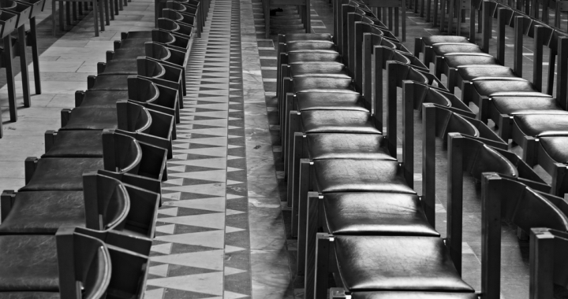
“他们曾在这里.”

Slide 36

继续奔跑
继续奔跑

Slide 37

为什么继续奔跑？

Slide 38

为什么继续奔跑？

Slide 39
真实的基督徒会在
死亡面前诚实坚守吗?
NTS
274i
Esch
78p
是
否
归正
参与者
亚米纽斯
叛教
不可能发生
叛教导致 失去奖赏
叛教导致 失去救恩
永生保障 但没有保证
永生保障
和保证
永生保障 和没有保证

Slide 40

无法完成的事情 (希伯来 6:4-6 CNV)
因为那些曾经蒙了光照，尝过属天的恩赐的滋味，与圣灵有分， ⁵ 并且尝过 神美善的道和来世的权能的人， ⁶ 如果偏离了正道，就不可能再使他们重新悔改了。因为他们亲自把 神的儿子再钉在十字架上，公然羞辱他。

Slide 41
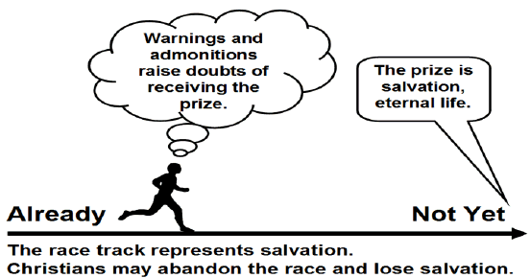
亚米纽斯观
希伯来书 6:4-8
Bob Deffinbaugh, "13. Dairy Queen or Steak and Ale (Hebrews 6:4-8)"
https://bible.org/seriespage/13-dairy-queen-or-steak-and-ale-hebrews-64-8
警告和告诫
会导致对接受奖赏的疑惑。
奖品是救恩, 永生.
已经
还没
赛程代表了救恩。
基督徒可能会遗弃赛程而失去救恩。
Notes:
The Arminian View
Summary: A Christian may turn away from his faith and thus may lose his salvation.
Main elements:
Those warned are genuine believers.
Future salvation is not assured (no eternal security).
The warning concerns eternal judgment (hell).
Positive aspects:
It appears to take the description of those warned at face value.
It appears to take the warnings literally.
Concerns:
It contradicts the doctrine of eternal security and raises doubt as to the certainty of one attaining salvation.
Bob Deffinbaugh, "13. Dairy Queen or Steak and Ale (Hebrews 6:4-8)"
https://bible.org/seriespage/13-dairy-queen-or-steak-and-ale-hebrews-64-8

Slide 42
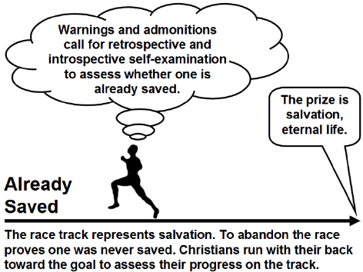
归正 (加尔文) 观
警告和告诫呼叫我们必须自我回顾，自我反思，评定自己是否已经得救。
奖品是救恩，永生
已经
得救
赛程代表救恩。遗弃赛程证明此人从没得救。
基督徒背对着目标跑着以评定自己在跑道上的进度。
Notes:
The Calvinistic View
Summary: If an apparent Christian apostatizes (falls away by denying the faith), then we know he was never really saved in the first place.
Main elements:
Those warned and disciplined are not true believers.
Only an unbeliever can apostatize or fall away from the faith.
The warning of eternal judgment is for unbelievers.
Positive aspects:
It is consistent with the doctrine of eternal security.
It means that a Christian can never lose his faith.
It takes the warning of judgment seriously (for unbelievers).
Difficulties:
Can those described in verses 4-5 really be unsaved?
The emphasis falls on unbelievers, rather than believers (to whom the author appears to have
consistently been speaking up to this point).
Does this view undermine the confidence and assurance of believers in their confession? Will true believers always be doubtful of their salvation?
Bob Deffinbaugh, "13. Dairy Queen or Steak and Ale (Hebrews 6:4-8)"
https://bible.org/seriespage/13-dairy-queen-or-steak-and-ale-hebrews-64-8

Slide 43
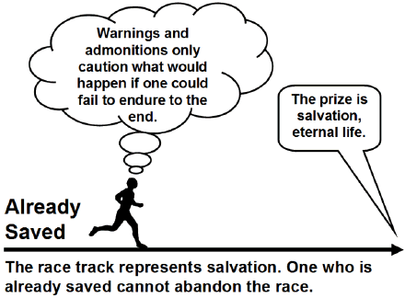
假设观
警告和告诫只能警惕如果没有坚守到最后的后果。
奖品是救恩，永生。
已经 得救
赛程代表救恩。 已经得救的人是无法抛弃赛程。
Notes:
The Hypothetical View
Summary: If a believer could apostatize, he would be eternally doomed (which will never happen), and thus there is no reason to continue to dwell on the ABC’s of the faith. This is the reason for moving from milk to meat.
Main elements:
It addresses believers hypothetically.
An apostate cannot be restored to salvation.
One should press on toward maturity.
Positive aspects:
It is consistent with the doctrine of eternal security.
It seeks to urge people on to maturity.
Difficulties:
It is only a theoretical view.
It doesn’t mean what the text appears to say.
It undermines the warnings.
It is an inferior motivation for growth.
Bob Deffinbaugh, "13. Dairy Queen or Steak and Ale (Hebrews 6:4-8)"
https://bible.org/seriespage/13-dairy-queen-or-steak-and-ale-hebrews-64-8

Slide 44
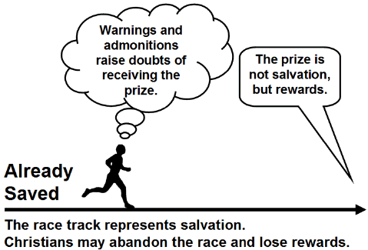
失去奖赏观
警告和告诫
会导致对接受奖赏的疑惑。
奖品不是救恩， 而是奖赏。
已经 得救
赛程代表救恩。
基督徒有可能会遗弃赛程而失去奖赏。
Notes:
The Loss of Rewards View
Summary: A Christian may fall away and thus lose future rewards, as well as encounter severe discipline in this life.
Main elements:
Those warned are viewed as genuine Christians.
Future salvation is assured for every true believer.
The warnings concern future rewards and earthly discipline.
Positive aspects:
The warnings apply to Christians (just as the exhortations do).
The warnings are taken seriously, as a very real possibility.
This view undergirds assurance and confidence in one’s confession.
Difficulties:
Is "earthly discipline" as severe as the description of the judgment on the one who falls away?
Is "earthly discipline" severe enough to match the description of judgment?
Bob Deffinbaugh, "13. Dairy Queen or Steak and Ale (Hebrews 6:4-8)"
https://bible.org/seriespage/13-dairy-queen-or-steak-and-ale-hebrews-64-8

Slide 45
失去生命观
(Dr. 里克 格里菲思持有的观点)
警告和告诫
劝诫与基督持之以恨，不让他们会面临
肉体死亡。
奖品不是救恩， 而是王国的遗产
已经
得救
赛程代表救恩。
基督徒有可能会遗弃赛程而失去生命。
Notes:
The Loss of Life View (This is my view as I do not find the other four views satisfactory)
Summary: A Christian may fall away and thus lose future rewards, as well as encounter severe discipline in this life TO THE POINT OF GOD TAKING THEIR LIFE.
Main elements:
Those warned are viewed as genuine Christians.
Future salvation is assured for every true believer.
The warnings concern future rewards and earthly discipline.
Positive aspects:
The warnings apply to Christians (just as the exhortations do).
The warnings are taken seriously, as a very real possibility.
This view undergirds assurance and confidence in one’s confession.
This takes the fire of Hebrews 10:27 in its normal sense of Jerusalem fires.
Difficulties:
This view seems to lack the deficiencies of the other views.

Slide 46

希伯来书
H

Slide 47
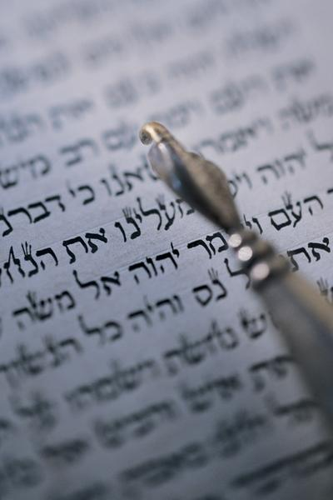
”我应该
回去吗?"
"因此，我们必须更加密切注意所听过的道理，免得我们随流失去。" (2:1 CNVS).
Notes:
No penalties are listed here, as in other warning passages (cf. 6:4-7; 10:26-31), but the penalties can’t include hell as the writer was among those who could "drift away" (2:1).

Slide 48
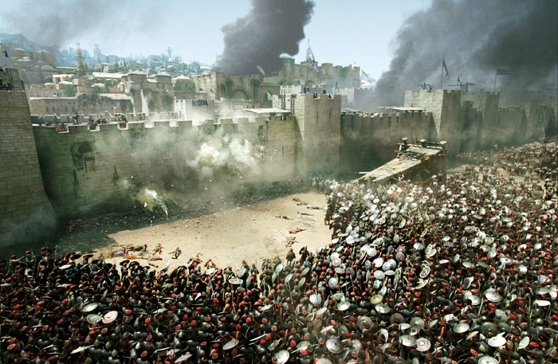
Antonia Fortress Leveled

Slide 49

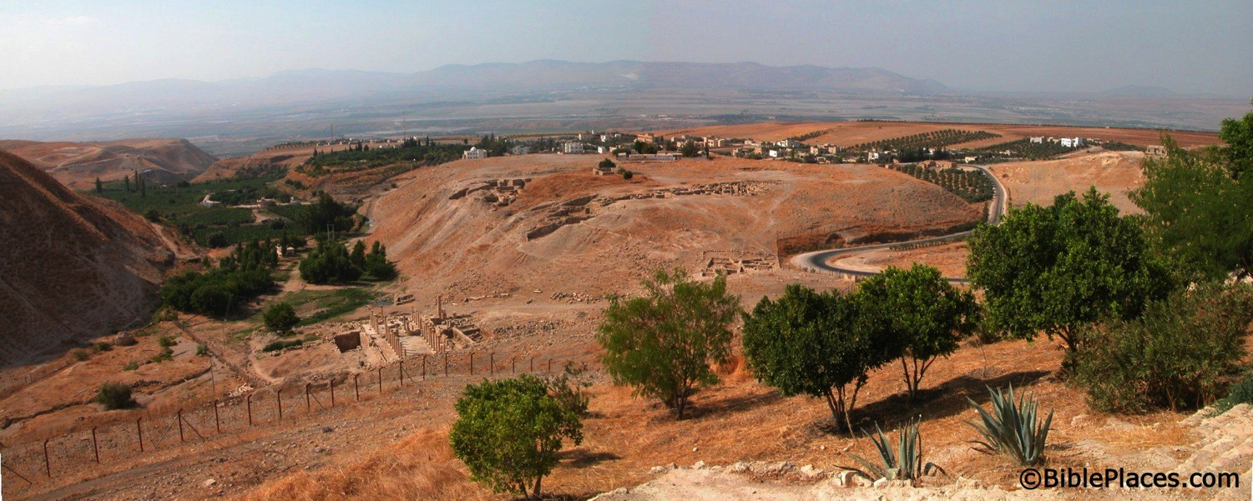
耶路撒冷的基督徒
遭受什么下场?
启发告诉信徒前往比尔拿寻求保护.
比尔拿
Jerusalem
Notes:
Todd Bolen: "Pella/Pehel is not mentioned explicitly in the Bible but it was prominent in biblical times. In the days of the judges, it led a rebellion against Egypt which was crushed by Pharaoh Seti I. In NT days, Pella was the site where Christians sought refuge during the Jewish Revolt against the Romans in 66-70 A.D. Eusebius records that the Jewish believers fled here in obedience to a revelation, which some correlate with Jesus' words in Matthew 24:16. This photo views the tell from the east. Several Byzantine churches have been excavated as well as a building believed to be a Late Bronze temple. The Jordan Rift and the mountains of Israel are visible in the background."

Slide 50

向前推进!
希伯来书的探讨

Slide 51

希伯来书的五个警告
258
纪律的警告 (2:1-4)
剥夺遗产的警告 (3:7-19)
死亡的警告 (6:4-8)
死亡的警告 (10:26-31)
不关心的警告(12:14-29)
Notes:
We have already seen three other warnings in this book…

Slide 52
烈 火
²⁶ 因 为 我 们 得 知 真 道 以 後 ， 若 故 意 犯 罪 ， 赎 罪 的 祭 就 再 没 有 了 ； 27 惟 有 战 惧 等 候 审 判 和 那 烧 灭 众 敌 人 的 烈 火 。
(希伯来书 10:26-27）
地狱的烈火?
不, 来之耶路撒冷的
烈火!

Slide 53
对一些警告性的经节的观点
266c
作者接着这些经文
向那一组的犹太人致词呢?
假信徒 | 前任信徒 | 世俗的信徒
那些不是真正的信徒。 | 没有看到和了解到 “基督是首位，尊贵与崇高” 而犯罪的基督徒。 | 没有看到和了解到 “基督是首位，尊贵与崇高” 而犯罪的基督徒。

Slide 54
对一些警告性的经节的观点
266c
他们被惩罚的性质是什么呢?
假信徒 | 前任信徒 | 世俗的信徒
没有得过拯救 | 失去了拯救 | 失去了赏赐

Slide 55
对一些警告性的经节的观点
266c
其结果是什么样的呢?
假信徒 | 前任信徒 | 世俗的信徒
地狱 | 地狱 | 神性的处罚

Slide 56
对一些警告性的经节的观点
266c
有那个神学看法相信以下的观点?
假信徒 | 前任信徒 | 世俗的信徒
改革中 | 亚米念 | 参与者

Slide 57
对一些警告性的经节的观点
266c
观点或论点的长处
假信徒 | 前任信徒 | 世俗的信徒
表明地狱的去向 | 表明地狱的去向 | 将得到“失去奖赏”的审判

Slide 58
对一些警告性的经节的观点
266c
观点或论点的短处
假信徒 | 前任信徒 | 世俗的信徒
连贯性的叙述读者为真诚的基督徒。 | “暂时性的保障”与新约神学教导里面关于“接着神的恩典得称为义”有冲突。 | 来10:26 指的是审判人而不是人的行为。

Slide 59
标签的问题
266c
我们一定要是其中之一…?
归正?
…或…
亚米纽斯?
很多还是会背离
失去救恩
弱点
永生保障
叛教的 现实
优点
参与者有双方的优点 但没有彼此的弱点

Slide 60
被提的牵连
78o

Slide 61
我们会与他在云中相见

Slide 62
Black

Slide 63
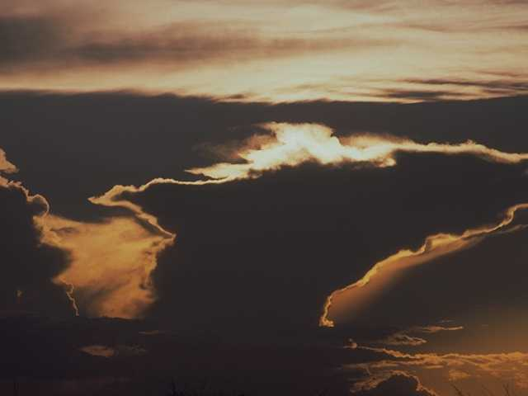
天空
将
展现…
Notes:
63

Slide 64
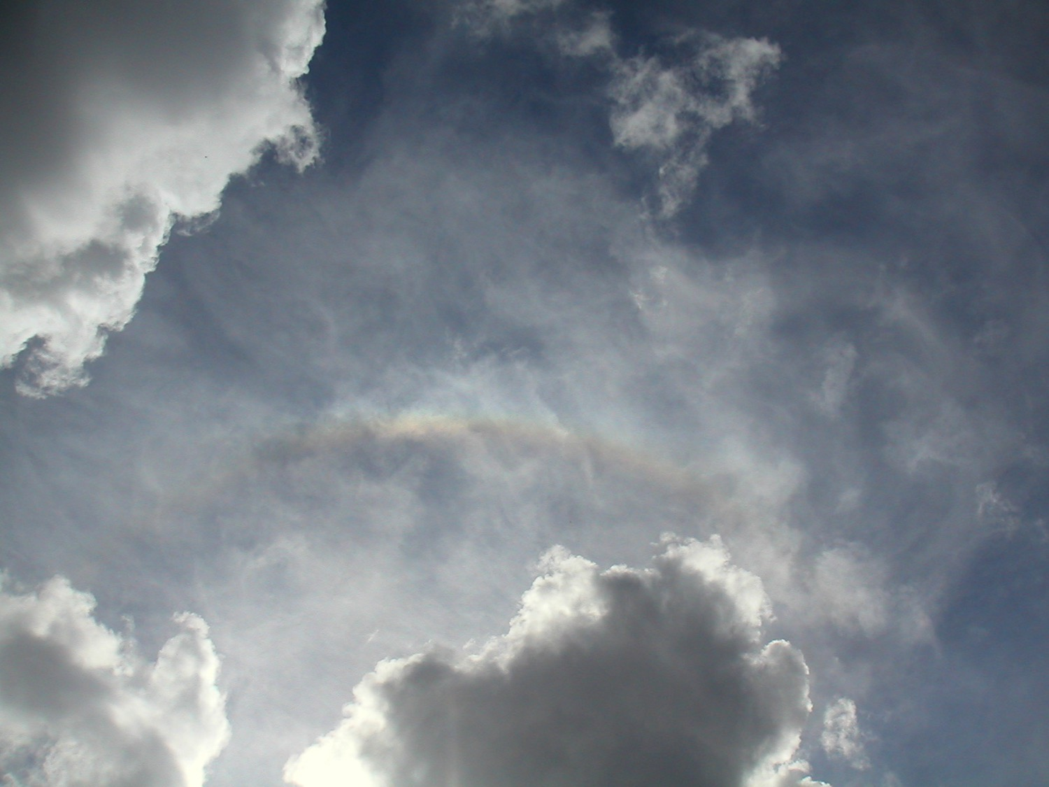
…准备他的入口
Notes:
64

Slide 65

星星
应为
他鼓掌
用
雷鸣般的
赞美

Slide 66
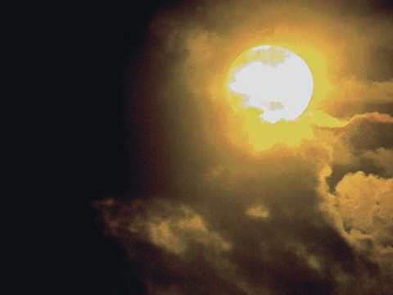
他眼中
的
甜美的
光芒
应加强
那些
等待
Notes:
66

Slide 67

我们应看他
然后面对面
Notes:
67

Slide 68
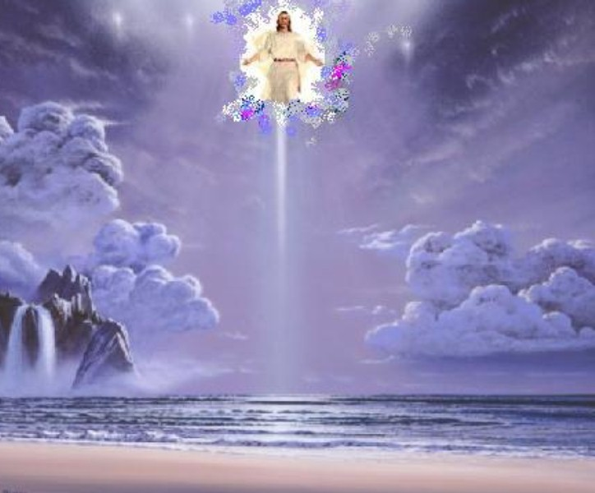
噢，我们应看他
是的，我们应看他
Notes:
68

Slide 69
…在所有的荣耀
面对面
Notes:
69

Slide 70

我们应看他
我们应看他
Notes:
70

Slide 71
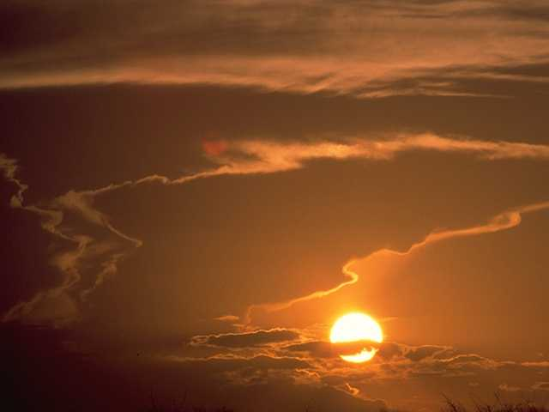
…面对我们的救主
和主的脸
Notes:
71

Slide 72
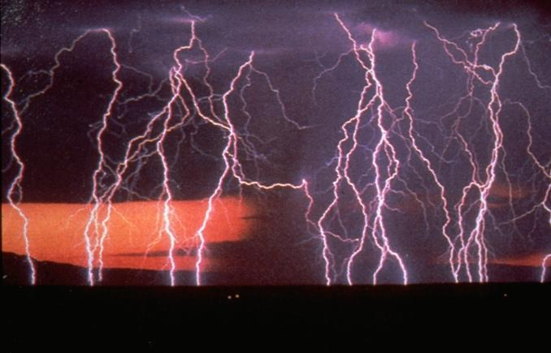
天使将吹响
他的到来的呐喊
Notes:
72

Slide 73
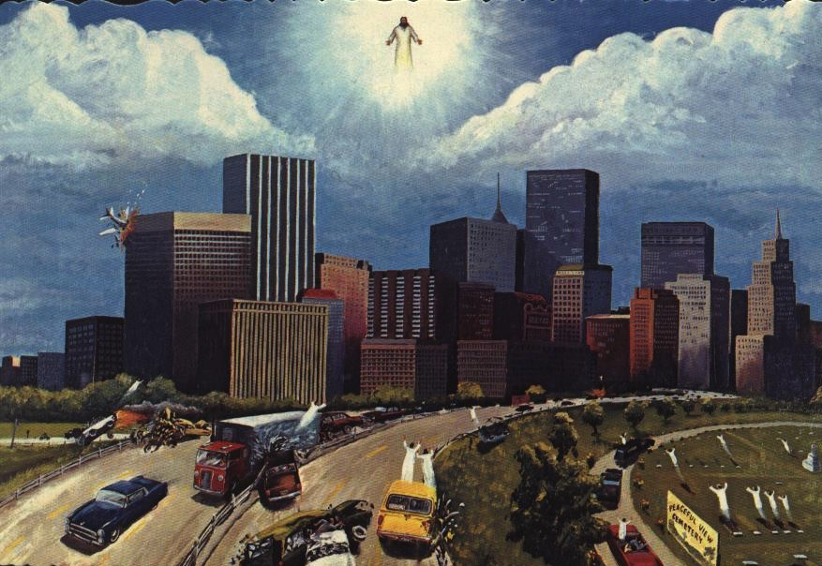
睡眠应从上升
他们沉睡的地方
Notes:
73

Slide 74
那些仍须
我们应在一瞬间改变了
Notes:
74

Slide 75

我们应看他
然后面对面
Notes:
75

Slide 76
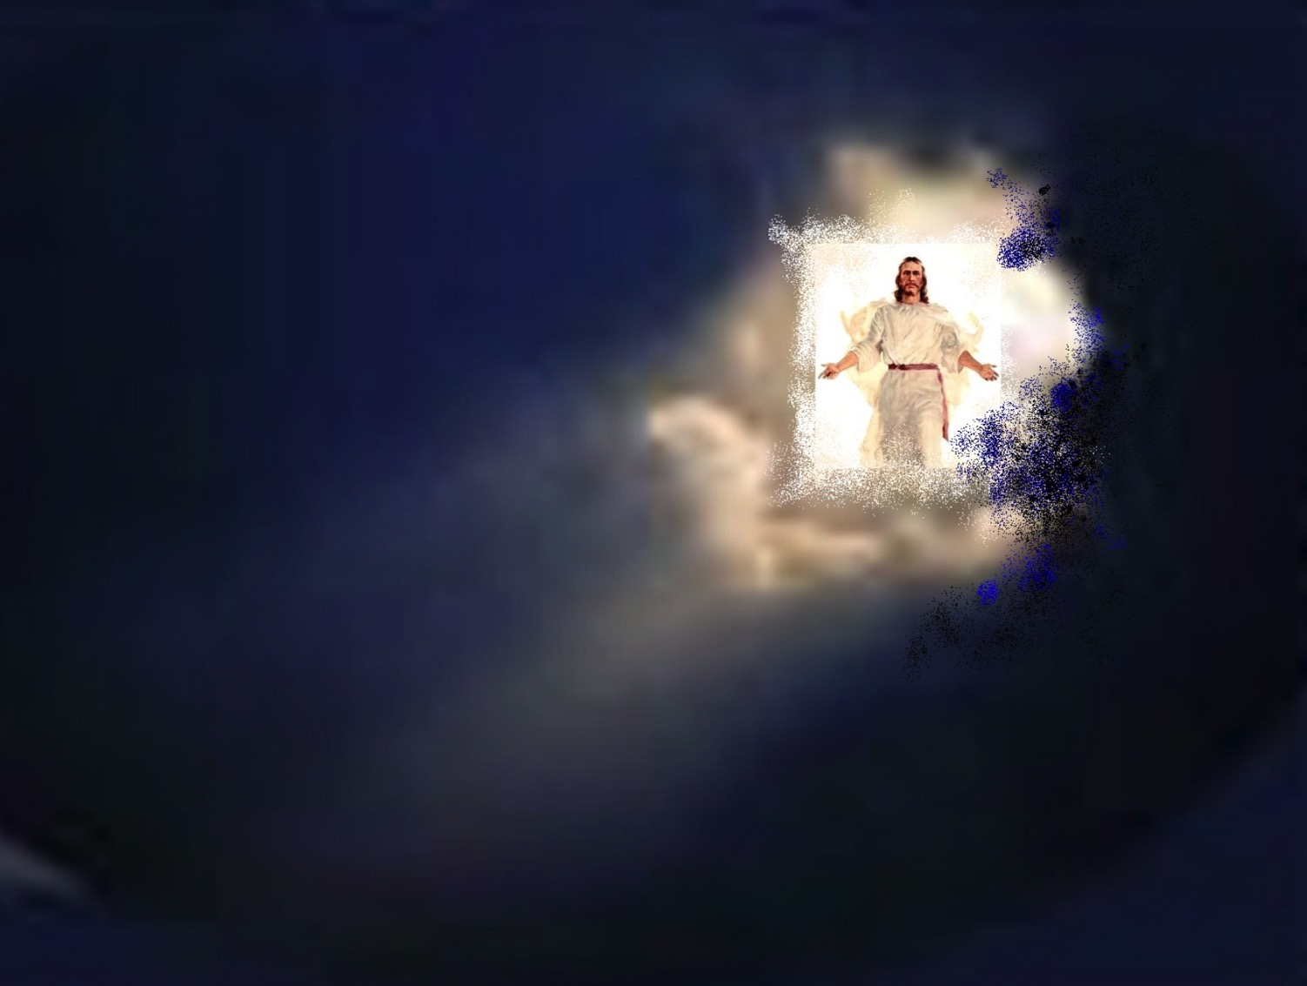
我们影看她
我们应看他
Notes:
76

Slide 77
…在所有的荣耀
面对面
Notes:
77

Slide 78
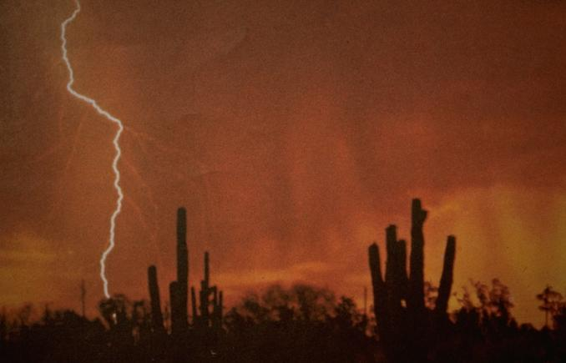
我们应看他
我们应看他
Notes:
78

Slide 79
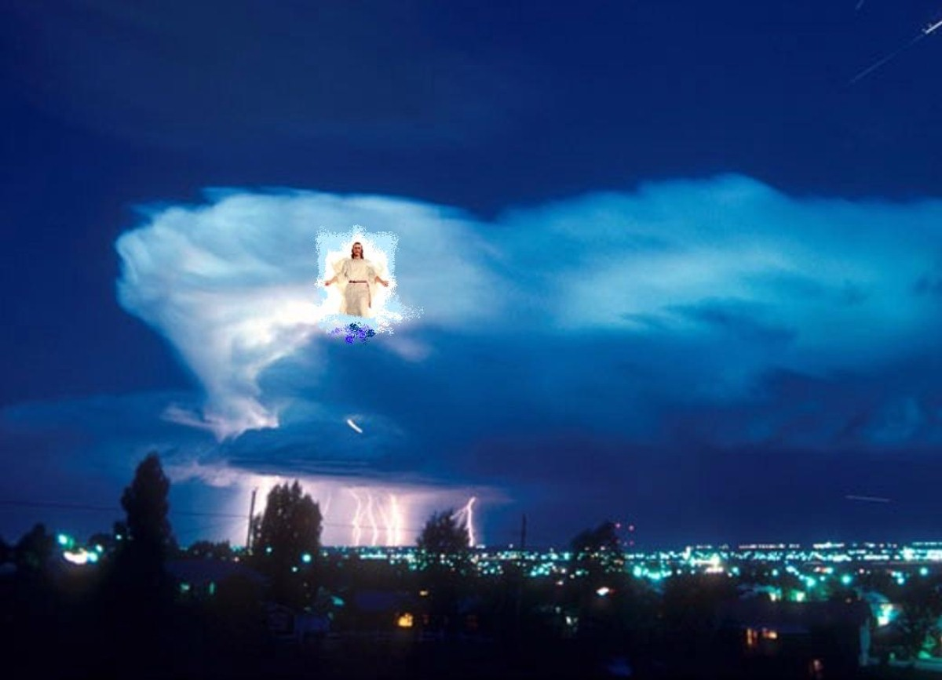
…面对我的救主
和主的脸
Notes:
79

Slide 80

我们应看他，
我们的救主和主!
Notes:
80

Slide 81
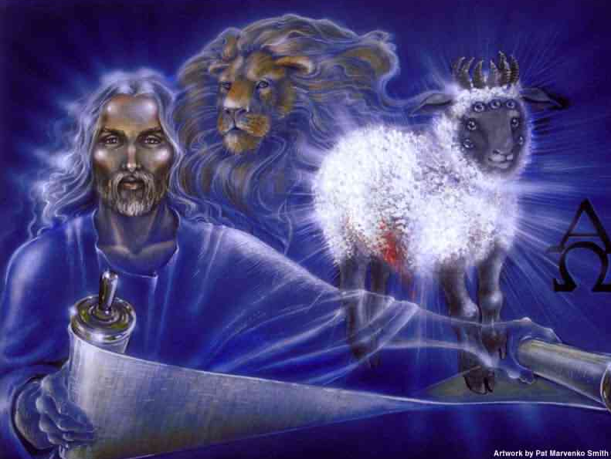
...我们的救主和主!
Notes:
81

Slide 82


末世论 • BibleStudyDownloads.org
免费获得该讲解!
圣经学习下载
Notes:
The explanation for free!
Future (Eschatology) link address

Slide 83
Black

