Slide 1
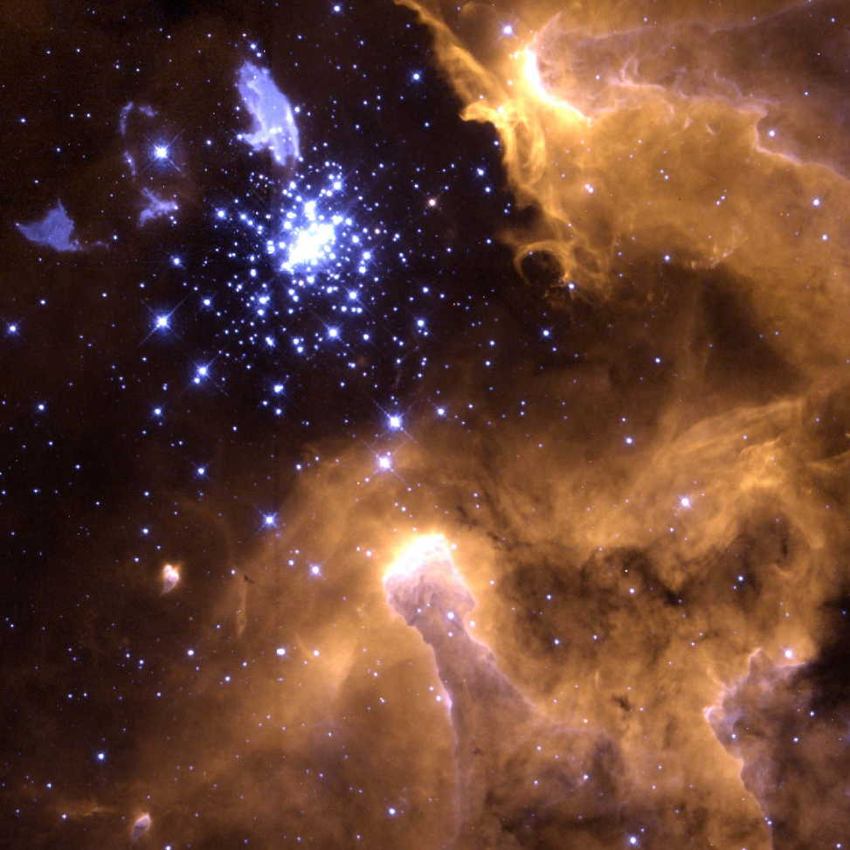
Outer Space
大爆炸： 大爆神话
Designed by Dr. Terry Mortenson
Dr. Rick Griffith • 博士 • 新加坡神学院 • BibleStudyDownloads.org

Slide 2
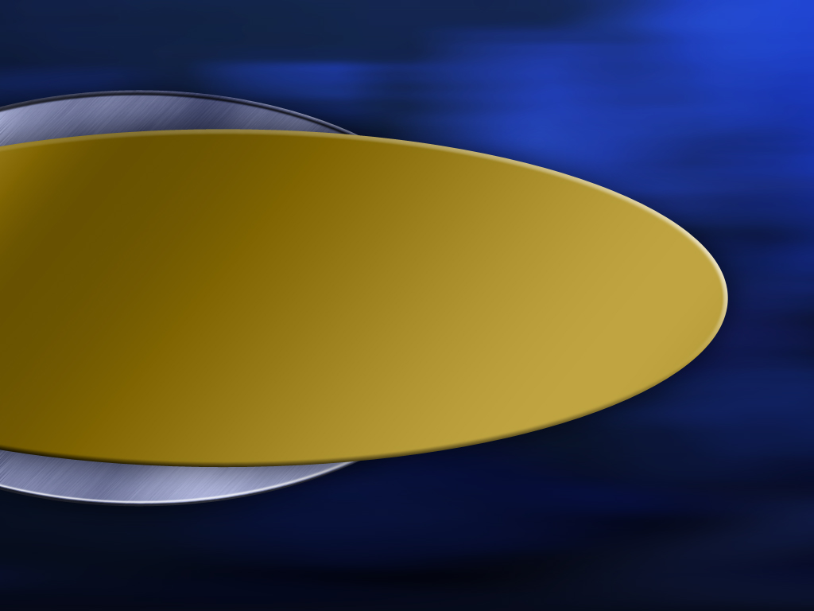

Template Suite 1-Title 01359
Terry Mortenson博士
大爆炸： 大爆神话
创世记答案机构

Slide 3
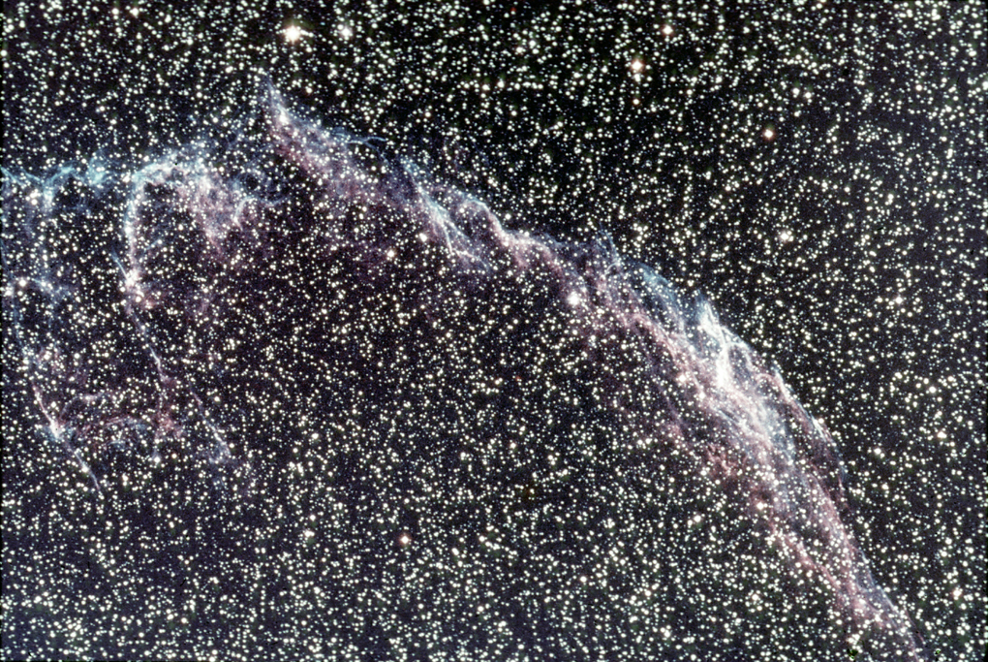
Beautiful heavens
Notes:
Source: my old creation lecture slides

Slide 4
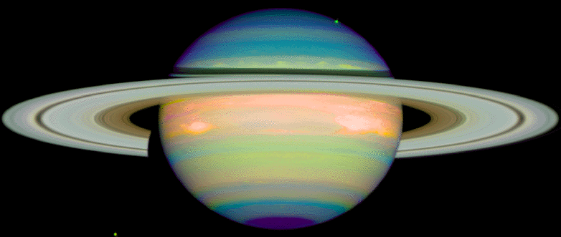
Saturn

Slide 5
Outer Space

Slide 6
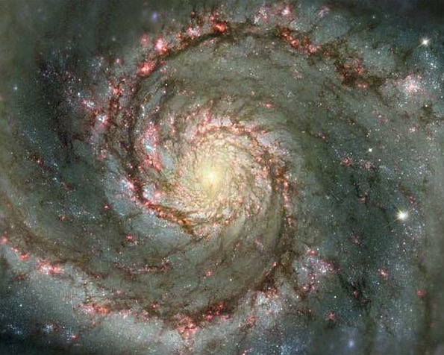
Spiral Galaxy

Slide 7
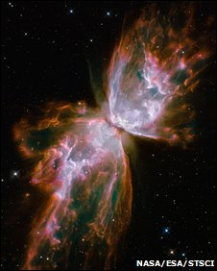
蝴蝶星云
美国航空航天局/欧洲空间局/
空间望远镜研究所
Notes:
http://news.bbc.co.uk/2/hi/science/nature/8246556.stm, accessed 10 Sept 2009

Slide 8
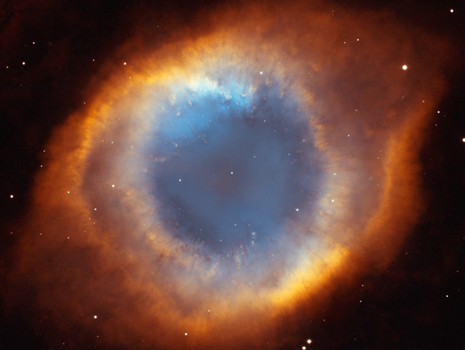
Helix nebula
螺旋星云
Notes:
Picture source: http://antwrp.gsfc.nasa.gov/apod/ap030510.html.

Slide 9
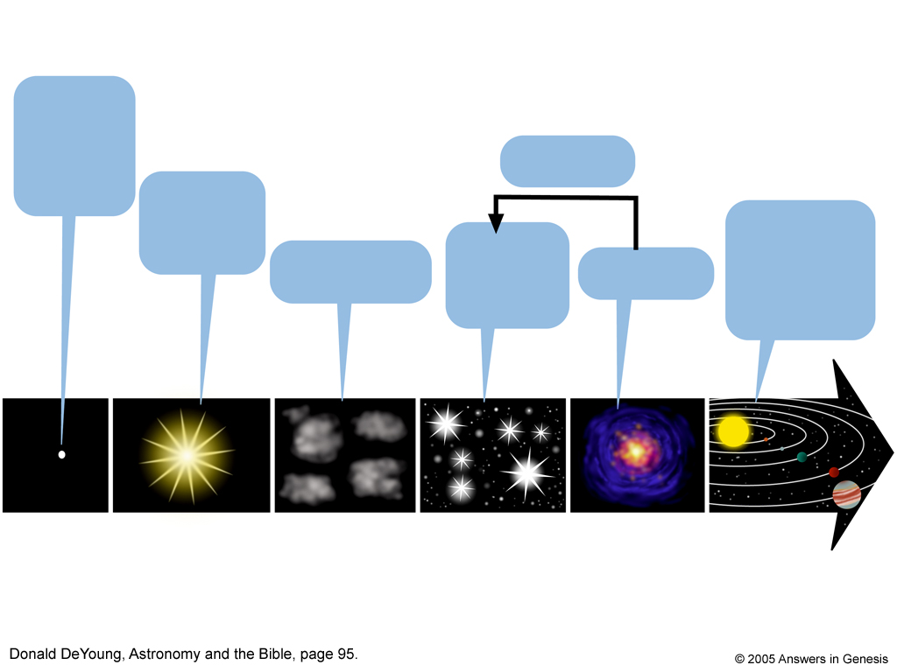
Big Bang Theory timeline
大爆炸理论
Big Bang Theory timeline
原始的物质能量“核”
回收
大爆炸150亿年前
太阳、行星、人类
50亿年前
恒星
100亿年前
氦和氢云
超新星
时间
多纳.德扬，Astrology and the Bible (天文学与圣经)，95页
© 2005年创世记答案机构
Notes:
“Among the surprises, Dr. Giavalisco said, is that the universe was copiously producing stars as early as a billion years of age. Some earlier surveys had suggested that star formation had started out slowly and then peaked until the universe was three billion to six billion years old. According to the GOODS results, however, star formation started out at a high rate and stayed that way until about seven billion years ago. Then the rate fell precipitously, perhaps because all the primordial hydrogen, the gas of which stars are made, had been used up or heated up too far to condense.”
GOODS stands for Great Observatories Origins Deep Survey, an analysis of two parts of the sky in both the north and south directions equal to the size of the moon and containing 50,000 galaxies.
<www.nytimes.com/2003/06/20/science/20GALA.html>, 20 June 2003

Slide 10

Operation vs Origin science
操作性科学
与
起源科学
Notes:
As a content template, this is best suited for standard content such as outlines, quotations, Scriptures, and maybe illustrations or photos. Presentation Team recommends 48–60 pt. font for headings and 28–40 pt. for body text. Because of eye flow and visual psychology, the top line may be a little closer than all other sides. This also contains a floating AiG logo that can be repositioned or removed as appropriate for the overhead’s content.

Slide 11
为操作性科学下定义
操作性科学
“科学方法”
在一个有控制的环境下使用能够观察得到、重复的实验，来发现在目前有形的宇宙中的再现的特性。

Slide 12
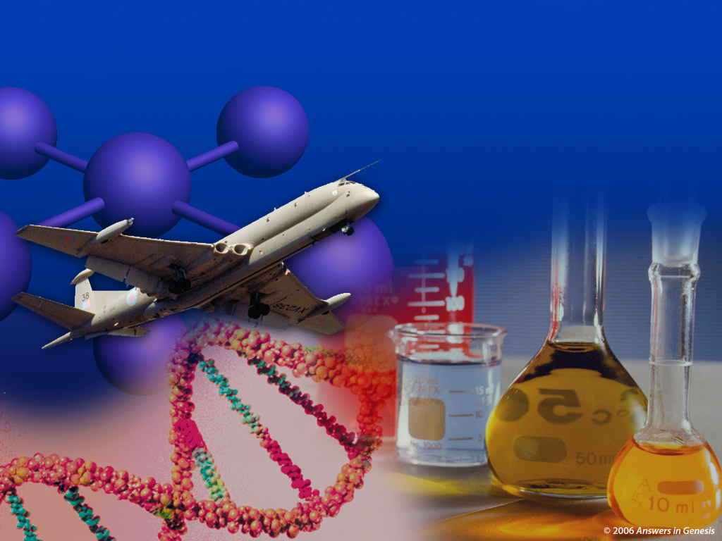
Observational Science 01160
实验性
科学

Slide 13
为起源科学下定义
起源科学
使用可靠的、目击者的见证 （若有）与间接证据确定一些过去、无法观察得到、单一的事件所产生的原因。
“法律-历史方法”

Slide 14

Historical Science painter 01159
历史
科学
© 2006年创世记答案机构

Slide 15
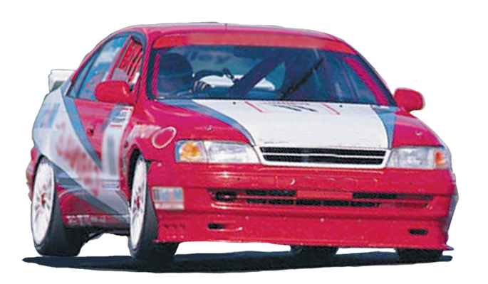
车—起源于操作
车技师
（操作性科学家）
汽车制造厂家
（起源科学家）

Slide 16
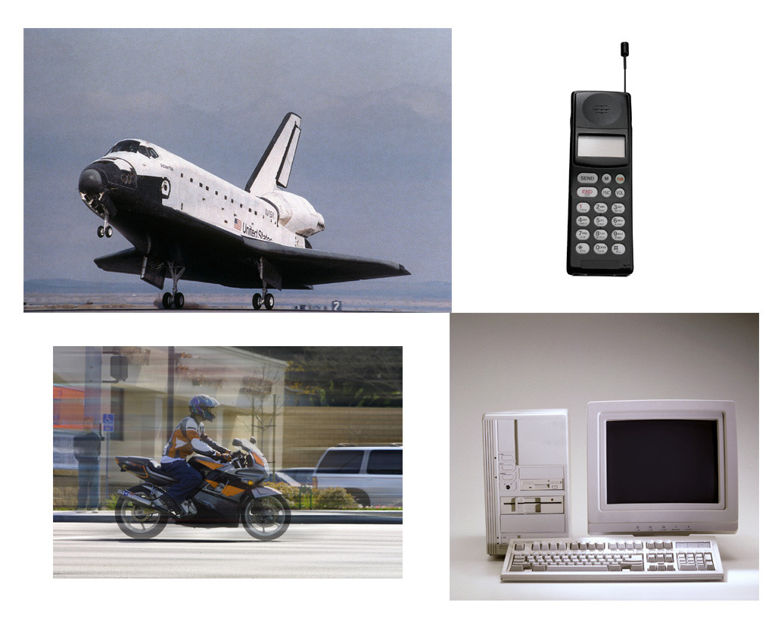
Products operation science

Slide 17
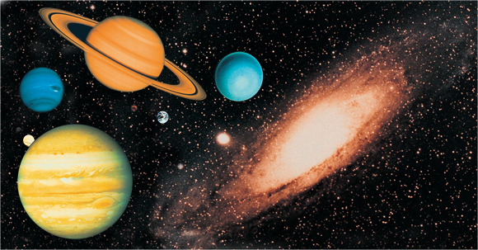
Operation/Origin science--stars
操作性科学
起源科学
行星与恒星

Slide 18
Assumptions Facts-Interpretations astronomy
自然假设
圣经假设
大爆炸与数亿年
有计划、年轻的宇宙

Slide 19

Origin of the Moon?
月球的起源？
创世记
答案机构
Notes:
As a content template, this is best suited for standard content such as outlines, quotations, Scriptures, and maybe illustrations or photos. Presentation Team recommends 48–60 pt. font for headings and 28–40 pt. for body text. Because of eye flow and visual psychology, the top line may be a little closer than all other sides. This also contains a floating AiG logo that can be repositioned or removed as appropriate for the overhead’s content.

Slide 20
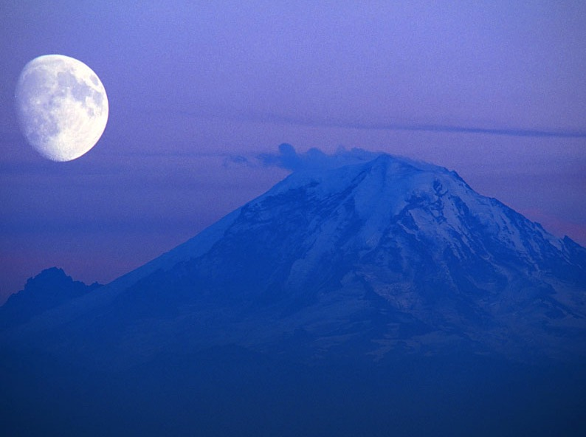
Moon Over Mt. Rainer
Notes:
Picture is from Windows Desktop options.

Slide 21
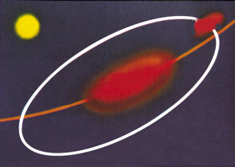
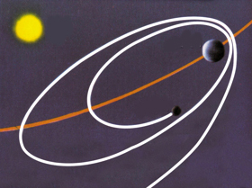
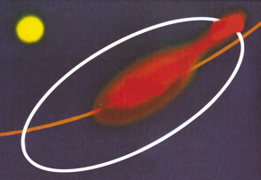
月球的理论
姐妹理论
妻子理论
太阳
月球
太阳
地球
地球
月球
女儿理论
太阳
月球
地球
Notes:
21
21
Source of pictures: Peter Adams, Moon, Mars and meteorites (London: British Geological Survey [formerly Institute of Geological Sciences], 1977), p. 28 The theories are explained below by Oard.
The dominant theory today:
According to Robert Roy Britt (Senior Science Writer for Space.com, on 15 Aug 2001 at http://www.space.com/scienceastronomy/solarsystem/moon_making_010815-1.html), the favored theory (because the others theories have such huge dynamical and geochemical problems) in 2003 is the single-impact daughter theory—an object the size of Mars slammed into the Earth. The moon was made in 1-100 years. The theory is based totally on computer models, which are based on naturaliistic assumptions. There is also the multiple-impact daughter theory. Another daughter theory that is gaining in popularity is that two large asteroid-type objects collided and eventually the earth and moon formed by accretion of the collision fragments.
The three theories explained by Mike Oard, TJ, 14:1 (2000), 6-7:
Fission (daughter) theory, invented by the astronomer George Darwin (son of Charles). He proposed that the earth spun so fast that a chunk broke off, with the Pacific Ocean as the probable scar (or a modification of the theory that had the earth molten at the time). But this theory is universally discarded today. First, the moon is too chemically different from the earth; second, the earth could never have spun fast enough to throw a moon into orbit; and third, the escaping moon would have been shattered while within the Roche Limit.
Capture (wife) theory — the moon was wandering through the solar system, and was captured by Earth’s gravity. But for one approaching body to enter into orbit around another, it would need to lose a lot of energy, which is why spacecraft sent to orbit other planets are designed with retro-rockets. Otherwise the approaching body would have been ‘slingshotted’ rather than captured, a phenomenon the Voyager probes exploited. Finally, even a successful capture would have resulted in an elongated comet-like orbit.
Condensation (or co-creation, sister) theory — earth and moon formed at about the same time from the same portion of the swarm of planetesimals which supposedly orbited the sun in the early phases of the evolution of the solar system. However, it’s unlikely that the gravitational attraction could have been strong enough, and it doesn’t account for the moon’s low iron content.

Slide 22
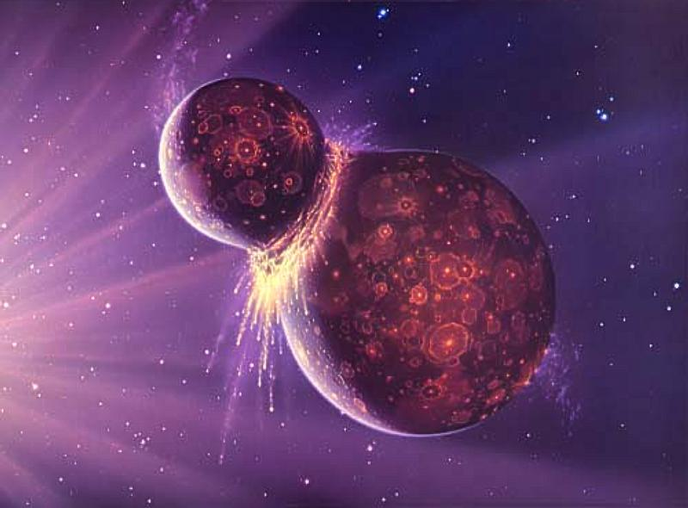
月球的理论：巨大撞击论
月球的起源？
巨大撞击论
Notes:
Mars-size object hit the earth about 4.45 billion years ago. The energy involved was 100 million times greater than the impact believed to have wiped out the dinosaurs. This early giant collision destroyed the incoming object, likely vaporized the upper layers of Earth's mantle, and ejected large amounts of debris into Earth orbit. Our Moon formed from this debris.
http://starchild.gsfc.nasa.gov/docs/StarChild/questions/question38.html, accessed 30 March 2009

Slide 23

Wright 2003—Dominant Moon theory
“事实上，月球起源的故事在细节上仍是轻薄的是。专家对于撞击发生于地球成长到目前的大小的之前或之后意见不一。 ”
凯伦·怀特，“Where did the Moon come from?” (月球从何来)，发现24：2 （2003年3月），63页。

Slide 24
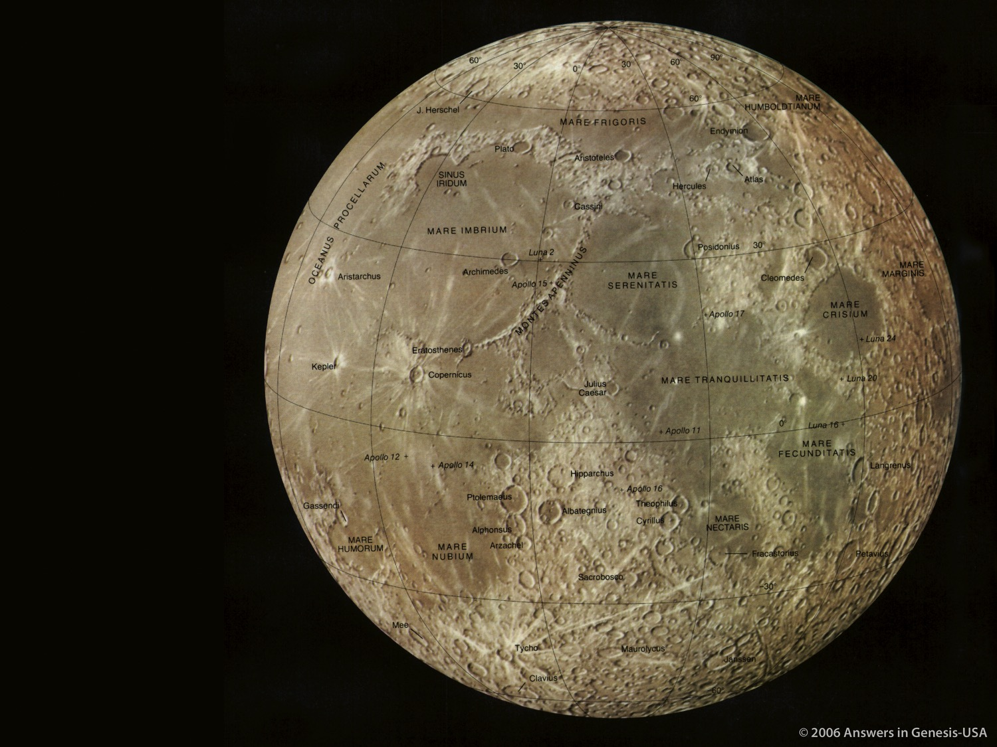
Moon—near side
月球
的正面
National Geographic Picture Atlas of Our Universe
（国家地理地图集图书之我们的宇宙）
© 2006年创世记答案机构—美国

Slide 25
月球与地球的不同
月球岩石里连一个水的分子也找不到。
月球缺乏地球所有的一个由铁组成的核。
凯伦·怀特，“Where did the Moon come from?” (月球从何来)，发现24：2 （2003年3月），63页。
Notes:
The article says (p. 63) that “Scientists recently estimated that hydrated minerals in Earth’s lower mantle could store about five times as much water as the oceans hold.” Water molecules can fit within the crystal lattices of minerals.
There is indirect evidence for a small molten lunar core, only about 2-3% of the moon’s mass, in contrast to the earth’s core, which is 32% of its mass. But there are still great uncertainties about the interiors of both the earth and the moon.

Slide 26
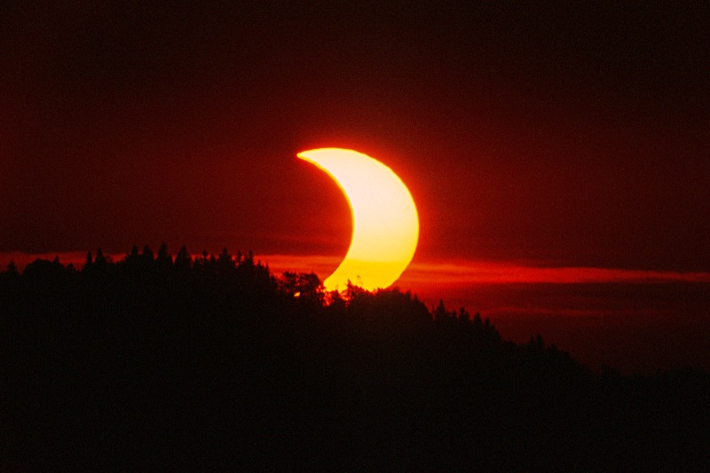
Solar eclipse partial
日食
Notes:
http://aida.astroinfo.org/nies/solar-eclipse-2003-05-31.jpg, downloaded 31 Jan 2005

Slide 27
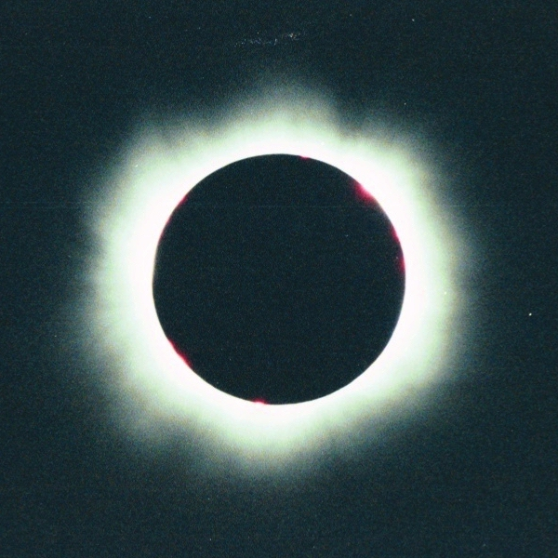
Solar eclipse full
Notes:
From http://members.bellatlantic.net/~vze2vrva/eclipse/hires/img013.jpg, downloaded 31 Jan 2005
The Sun is 400 times bigger than the Moon but the Sun is also 400 times farther from the Earth than the moon is.
Our Moon is unique in creating solar eclipses. Out of the 8 planets and 166 moons in the solar system, no other moon/planet relationship in the Solar System can produce such a perfect and total eclipse.

Slide 28
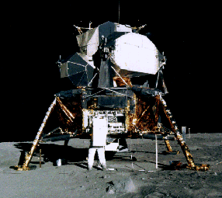
Armstrong and Lunar Module
Notes:
Neil Armstrong was the first man to walk on the moon: 21 July 1969. Apollo 11 trip.
Picture from http://en.wikipedia.org/wiki/Neil_Armstrong, accessed 21 Aug 2006

Slide 29
Origin of the Solar System
太阳系的起源？
Notes:
As a content template, this is best suited for standard content such as outlines, quotations, Scriptures, and maybe illustrations or photos. Presentation Team recommends 48–60 pt. font for headings and 28–40 pt. for body text. Because of eye flow and visual psychology, the top line may be a little closer than all other sides. This also contains a floating AiG logo that can be repositioned or removed as appropriate for the overhead’s content.

Slide 30
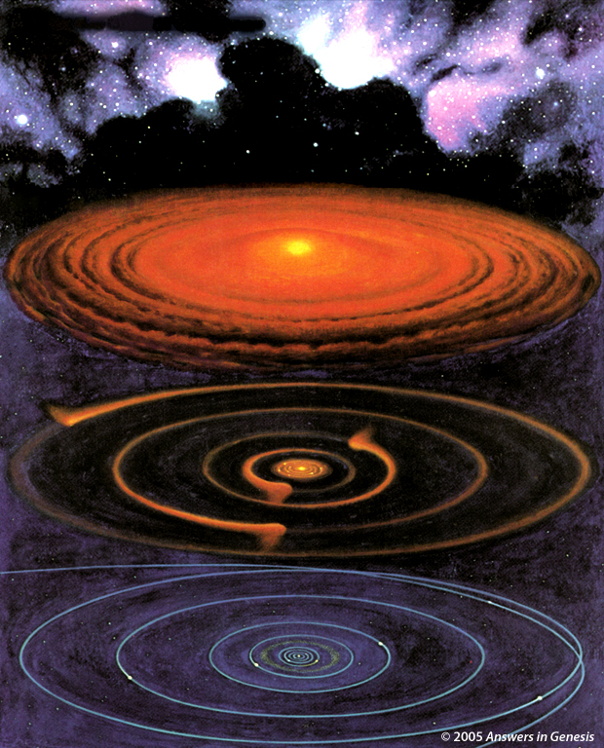
Evolving Solar System
约36亿年前
一千万年之后
二千万年之后
1.2亿年之后及至今天
© 2005年创世记答案机构
Notes:
Picture from Roy A. Gallant, National Geographic Picture Atlas of Our Universe (Wash. DC: National Geographic Society, 1986), p. 38. Similar to the diagram in Robert A. Wallace, Jack L. King and Gerald P. Sanders, Biology: the Science of Life (Glenview, IL: Scott, Foresman & Co., 1986), p. 426.

Slide 31
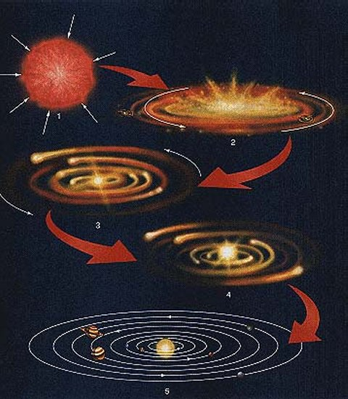
太阳系的诞生？
http://www.aerospaceweb.org （航空航天网站）
Notes:
http://www.aerospaceweb.org/question/astronomy/q0247.shtml, accessed 28 Feb 2008.

Slide 32
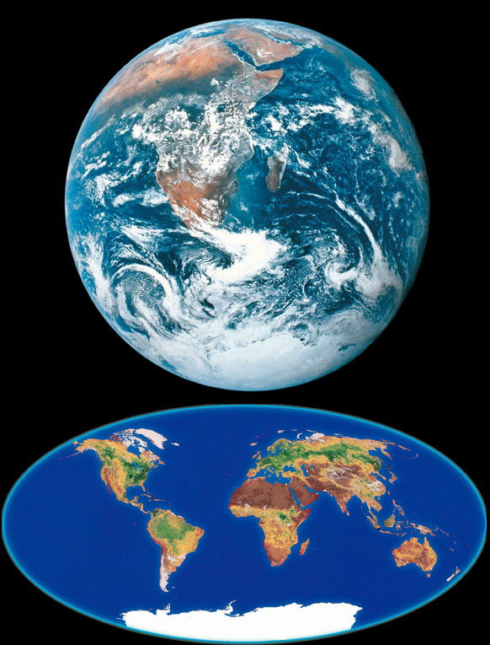
Earth with water
Notes:
Earth is 70% covered with water—the only place in the known universe where there is liquid water and we have it in abundance and it is absolutely essential for life as we know it. It has a near-perfect circular orbit around the sun and if it was 5% closer to the sun, its water would boil and turn to steam and if it was 1% farther away from the sun, the oceans would freeze.
Not only is the earth perfectly suited for life, it happens to be located in the best possible location in relation to the other heavenly bodies to enable people on earth to study the rest of the universe (see the DVD “The Privileged Planet”).
Regarding our knowledge of the inside of the earth:
“The world’s deepest excavation, a research project on Russia’s Kola Peninsula, has drilled only 7.5 miles into the crust, or less than 0.2 percent of the 3,959 miles to the Earth’s center. Learning about the deep interior from this hole is roughly comparable to learning about Alaska by driving from St. Petersburg, Florida, to Tampa. So geophysicists infer. Seismology, gravitational variation, high-pressure mineral experiments, and chemical analysis of rock samples and meteorites all provide clues. As with all circumstantial evidence, however, interpretations vary.” (bold added)
Source: Anonymous, “What Lies Beneath,” Discover (Aug. 2002), p. 35.

Slide 33
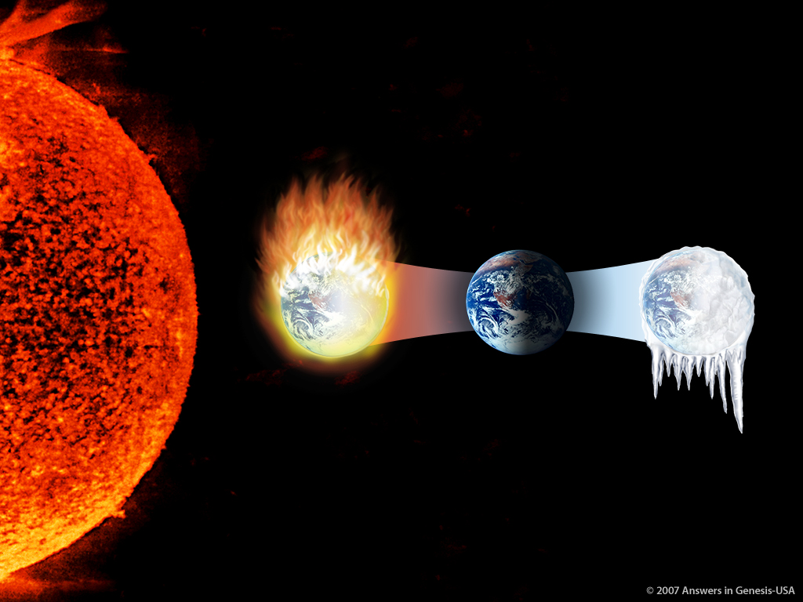
Earth Right Dist from Sun 01373
地球
远离
太阳
的距离恰恰好
太靠近：
燃烧起来
太远：
冻结
不按比例
© 2007年创世记答案机构—美国

Slide 34
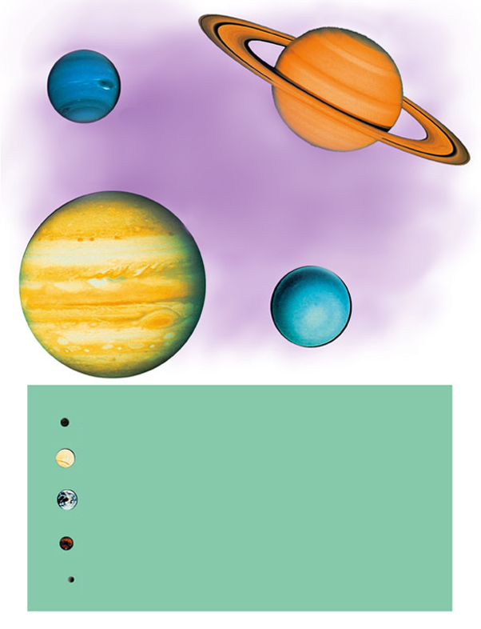
Different planets
海王星
土星
液体中心的气体
木星
天王星
水星
金星
固体
地球
火星
冥王星
Notes:
Pluto was demoted from being a planet in 2006, but there are scientists and other calling for a reverse of that decision by the IAU (Intern’l Astronomical Union).
In August 2005 scientists announced the discovery (first made in 2003) of a “10th planet” in our solar system, by 2008 it was named Eris, I think. It is 3 times farther from the sun than Pluto and 97 times farther from the sun than the earth with a very eliptical orbit (from 36-97 times from the sun than the earth is). It’s plane of orbit is 44 degrees off the ecliptic plane (Pluto is 17 percent off). It is believed to be dark, cold and as large or larger than Pluto. In 2006 (I think) Pluto was demoted from being a planet.

Slide 35
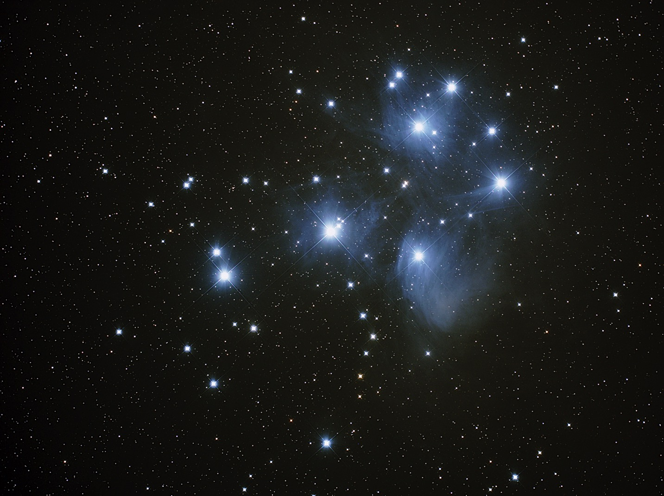
Inner planet composition
太阳
98% 氦和氢
水星
金星
地球
1% 氦和氢

Slide 36
行星有。。。
行星有：
不同轨道
不同自转速度
不同轴线的倾斜度
不同晕的数目或月球或两者
不同大气层

Slide 37
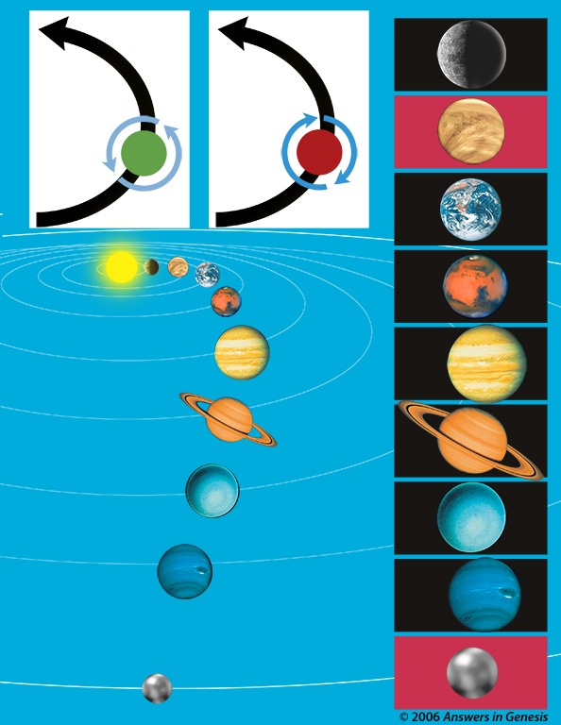
Planetary orbits
环绕着
太阳
环绕着
太阳
水星
行星
自转
行星
自转
金星
地球
火星
木星
土星
天王星
海王星
冥王星
© 2006年创世记答案机构

Slide 38
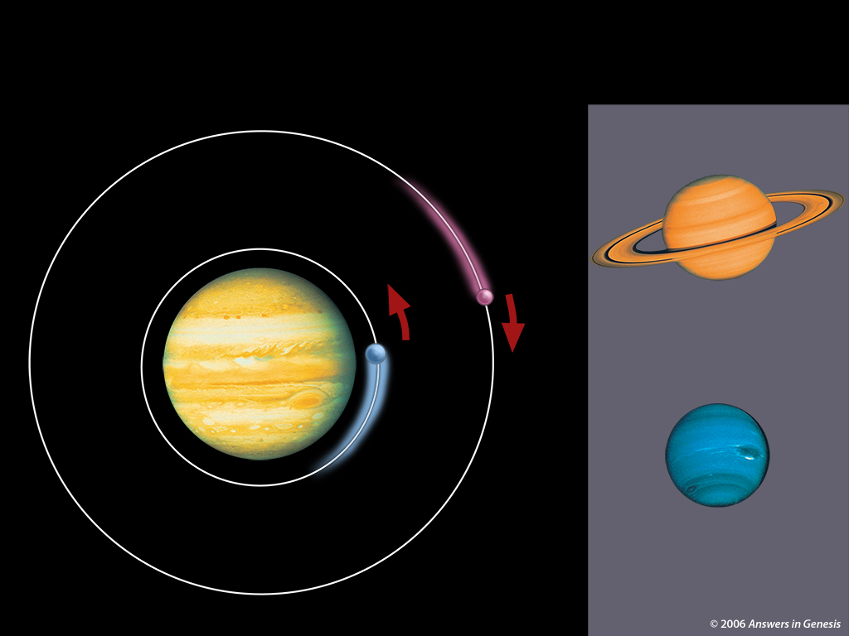
土星、天王星、木星 00336
月球的两个方向
月球轨道
木卫十一
土星
木星
木卫一
天王星
© 2006年创世记答案机构

Slide 39
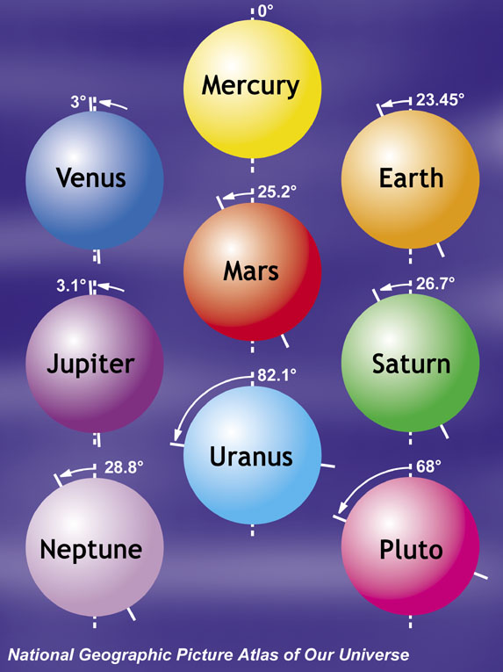
Tilts of axis
水星
金星
地球
火星
木星
土星
天王星
海王星
冥王星
（国家地理地图集图书之我们的宇宙）

Slide 40
Zeilik 1987—solar system #1
“我们的简略调查显示了太阳系的结构与含量 ，但是这不是终结。我们可以成功地诠释许多观察到的特征，譬如陨星的来源。然而,关于这些特征的起源，仍存留着大批的未解问题。这些未解的问题促使了假设性的答案（第七章）。
Michael Zeilik & Elske Smith, Introductory Astronomy & Astrophysics （天文学与天体物理学入门） Philadelphia: Saunders College Publ., 1987), 33页。
Notes:
This book was written for undergraduates with a background in math and physics.
Zeilik is from U. of New Mexico and Smith from Virginia Commonwealth U.

Slide 41
Zeilik 1987—solar system #2
“最基本的问题是太阳系起源的方式与缘故。为什么存有五个微小的类地行星和四个巨大的类木行星？。。。为什么行星的运行是靠近黄道平面正转？
太阳系的动量矩分布也是个谜底。。。。 行星供应了系统的97%的动量矩。为什么做为更大量的太阳不是主要的供应者？”
Zeilik （1987年），33页。

Slide 42
Zeilik 1987—solar system #3
“曾有原始的旋转速率吗？若有，为什么类地行星比类木行星旋转得更为缓慢？。。。为什么金星和土卫六（泰坦）和类木行星有如此稠密的大气层？什么形成了行星和卫星的地面？。。。为什么土星、木星和天王星的晕有那么大的分别？。。。彗星是如何形成的，并且外头存有多少个？
Zeilik （1987年），33页。

Slide 43
Zeilik 1987—solar system #4
“我们认为最基本的问题必须是由任何假设为我们的太阳系解释的模型解答。直到如此的模型的现成，我们只能够接受我们所看见的并试图解释在我们面前的谜语。”
Zeilik （1987年），33页。

Slide 44
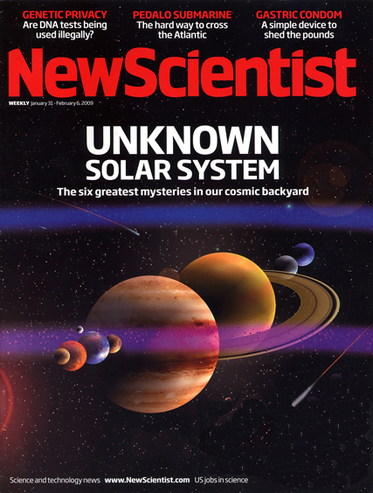
“未知的太阳系”
2009年1月31日

Slide 45
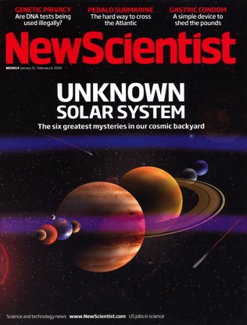
“6个持久的奥秘”
太阳系如何形成？
为什么在天上的太阳和月
球是同一个大小？
是否有个X星球？
彗星从哪里来？
太阳系是独一无二的吗？
它如何结束？
斯蒂芬·巴特斯, “不为人知的太阳系历史，” 新科学人201:2693 (2009年1月31日）, 29-35页。

Slide 46
Operation/Origin science--stars
操作性科学
起源科学

Slide 47
Template Suite 1-Content 01360
恒星与星系的起源？
Notes:
As a content template, this is best suited for standard content such as outlines, quotations, Scriptures, and maybe illustrations or photos. Presentation Team recommends 48–60 pt. font for headings and 28–40 pt. for body text. Because of eye flow and visual psychology, the top line may be a little closer than all other sides. This also contains a floating AiG logo that can be repositioned or removed as appropriate for the overhead’s content.

Slide 48
Weinberg 1985—stellar evolution #1
“最重要的遗物当中是我们在天空中看到的架构：许多恒星形成星团，星团和其他的自由恒星譬如我们的太阳形成为星系，而星系与其它的星系形成为一群的星系。”
史蒂文·温伯格，“起源，”科学230:4721 （1985年10月4日），16页。
Notes:
This is an article about the big bang and the origin of the universe.
Weinberg is a world-renown astrophysicist. At the time he was Prof. of Science, Dept. of Physics, Univ. of Texas, Austin.

Slide 49
Weinberg 1985—stellar evolution #2
“天体物理学的第二大失望是对于这些结构如何形成，我们没有一个清楚和详细的理解。我们甚至不知道是否是小的结构先形成，过后再合并成较大的结构，或者是否较大的结构先形成，然后分解成较小的。”
温伯格（1985年），16页。
Notes:
The first disappointment he mentioned was that after more than 20 years of discovering the remarkable properties of quasars, scientists “still have NO direct observational confirmation that the quasars actually are powered by black holes—it is just that no one can think of any equally plausible possibilities” (p. 15). Article in my file cabinet.

Slide 50
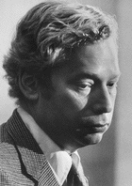
Weinberg 1985—stellar evolution #3
“有些困扰的方面是这些所有的恒星的年日与成份的估计基于它们内在所发生的精心的计算，但是我们所观察的仅有从他们地面所发射的光。”
温伯格（1985年），16页。
Notes:
Dr. Jason Lisle said in Nov. 2006 that this quote is still accurate with a caveat that they can observe neutrinos coming from the center of the sun and from the explosion of stars.
Dr. Weinberg (PhD Princeton, Nobel Prize in physics, 1979) is Professor and Director of the Theory Research Group at University of Texas, Austin.
Photo source: http://www.nobel.se/physics/laureates/1979/weinberg-autobio.html, downloaded 9 June 2004.

Slide 51
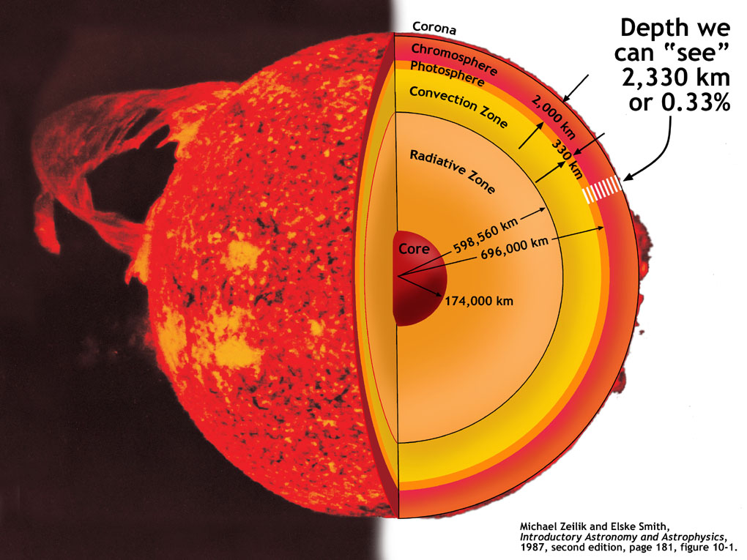
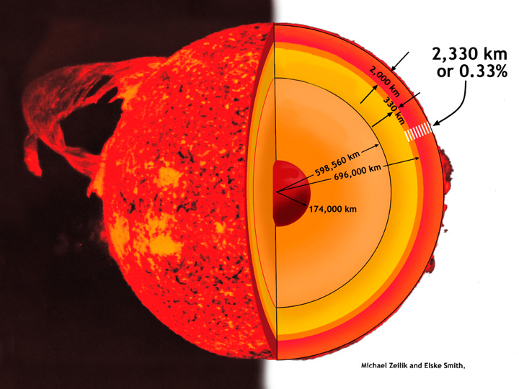
Sun--inside
光环带
我们可以“看”到的深度
色球
光球
对流层
辐射去
核
Michael Zeilik and Elske Smith,
Introductory Astronomy and Astrophysics （天文学与天体物理学入门） (1987年，第二版），181页，图10-1。
Notes:
51
Jason said that the boundaries of Convection Zone and outward layers are quite accurately known. The upper radiative zone is reasonably known, but from there inwardly it become more inference and estimate.

Slide 52
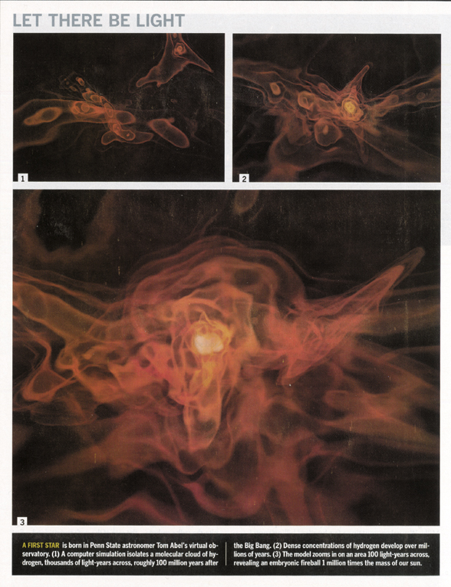
Simulation of star formation
要有光
“最初恒星在宾州，天文学家托姆·亚伯（Tom Abel）的虚拟天文台里诞生了。”
蒂姆· 福尔杰, “真正的大爆炸，”发现 (2002年12月），44页。

Slide 53
Chown 1998—stellar evolution #1
“宇宙大部分的质量是隐形的且没有人真正知道它是什么。。。。恒星的形成是笼罩着奥秘。大致上，恒星的形成是当气体云在引力之下瓦解。然而，若这云变成太热，气压会与引力的效应搏斗，并且阻止云瓦解。因此恒星的形成，气体云必须有它降温的方法。”
马库思·乔恩（天文学家），“神说要有光，”新科学人， ,1998年2月7日，28和29页。
Notes:
According to http://www.popularscience.co.uk/marcuschown/, Marcus Chown is an award-winning writer and broadcaster. He began his career as a radio astronomer at the California Institute of Technology in Pasadena. Now he is cosmology consultant of the British weekly science magazine New Scientist. Marcus's first popular science book was Afterglow of Creation, which in the UK is the most-read popular science book after Stephen Hawking's A Brief History of Time. Marcus chooses his words carefully. Marcus graduated from the University of London with a first-class degree in physics, and four years later he gained a Master of Science in astrophysics from the California Institute of Technology.

Slide 54
Chown 1998—stellar evolution #2
“听起来容易但却不。在今天的宇宙，这成就是由一大批分子的相撞并散发热气。然而，制作所有的分子，除了最简单的分子以外的必要原子—分子氢—必须在恒星里制作。这是一个鸡与蛋的情况。。。。”
乔恩（1998年），30页。

Slide 55
Chown 1998—stellar evolution #3
“[约翰]马瑟，[马里兰州的美国国家航空和太空管理局的戈达德太空飞行中心]，说：‘对于星系如何形成、最初恒星没有较早的恒星的协助下如何形成、星系如何进化、他们是否从小的单位集结或者是从大的单位分解，我们没有直接的证据。所有一切发生于宇宙的黑暗时期[假定大爆炸与最初恒星形成之间]。这直射向我们如何到此地步的问题的关键。’”
乔恩（1998年），30页。
Notes:
On Oct. 3, 2006, John Mather was named co-winner of the 2006 Nobel Peace Prize for physics (along with George Smoot, both Americans) for their contributions to the success of the Cosmic Background Explorer (COBE) satellite program launched by NASA in 1989. According to Reuters, “Their work took Big Bang theory, which contends the universe began 15 billion years ago as a tiny dot that exploded into today's huge system of stars and planets, out of the realm of mathematical equations and into the world of precise science.” Reuters reported that the Royal Swedish Academy of Sciences (which awards the Nobel prize of 10 million Swedish Crowns (about 1.37 million dollars) said, “the Big Bang scenario for the origin of the universe is the only scenario that predicts the kind of microwave background radiation measured by COBE.” http://today.reuters.com/news/articlenews.aspx?type=domesticNews&storyid=2006-10-03T144526Z_01_L03200407_RTRUKOC_0_US-NOBEL-PHYSICS.xml&src=rss&rpc=22
Of course that wasn’t too precise as evolutionists now say the universe is 13.4 billion years old.

Slide 56
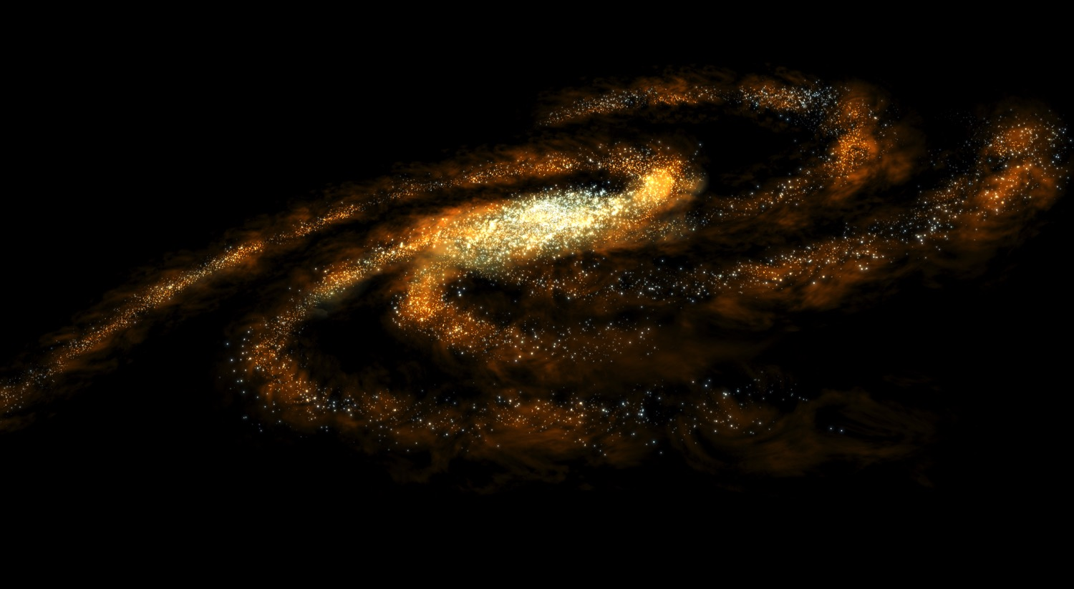
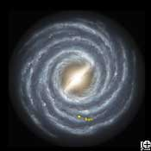
Milky Way galaxy
我们的银河星系
Notes:
http://solarsystem.nasa.gov/multimedia/gallery/MilkyWay.jpg, downloaded 7 Feb. 2005
In fact, it may be twice as big as we previously thought: http://www.abc.net.au/science/news/stories/s1435182.htm (article referred to in notes of previous slide) study referred to: J. Bland-Hawthorn, M. Vlaji, K. C. Freeman, and B. T. Draine, “NGC 300: An Extremely Faint, Outer Stellar Disk Observed to 10 Scale Lengths,” The Astrophysical Journal, 629:1:1 (10 Aug. 2005), p. 239-249.
And evidence published in August 2005 suggests that it is not a spiral galaxy but a bar-centered spiral: http://dsc.discovery.com/news/briefs/20050815/milkyway.html (picture and quote). “A survey of stars at the heart of the galaxy show that the Milky Way has a definitive bar feature, some 27,000 light years in length, that distinguishes it from pedestrian spiral galaxies. The survey, conducted using NASA's Spitzer Space Telescope, sampled light from an estimated 30 million stars in the plane of the galaxy in an effort to build a detailed portrait of the inner regions of the Milky Way.”
“The disk of the Milky Way galaxy is about 100,000 light years in diameter (one light year is about 9.5 x 1015 meters), but only about 1000 light years thick. Our Galaxy contains about 200 billion stars. Most of the stars are located in the disk of our galaxy, which is the site of most of the star formation because it contains lots of gas and dust. The halo, which is a spherical cloud surrounding the disk, contains only about 2% as many stars as the disk. It contains old and cool stars, since it has little gas and dust.”
http://imagine.gsfc.nasa.gov/docs/ask_astro/answers/980317b.html, answer given in 1998 by NASA.

Slide 57
Chiappini 2001--Milky Way origin
银河的起源？
“我们的星系是个高度进化的实体。。。。它是个优美的结构彰显着秩序和复杂性。。。。最终成品若视为起点尤其非凡：云雾状的一团气体。宇宙如何从如此简单的开始制作了银河是完全不清楚的。”
克里斯蒂娜·齐亚宾尼，“银河的形成与进化，”科学美国人，89期（2001年11/12月），506页。
Notes:
In fact, it may be twice as big as we previously thought:
And evidence published in August 2005 suggests that it is not a spiral galaxy but a bar spiral: http://dsc.discovery.com/news/briefs/20050815/milkyway.html.

Slide 58
Template Suite 1-Content 01360
宇宙的起源？
Notes:
As a content template, this is best suited for standard content such as outlines, quotations, Scriptures, and maybe illustrations or photos. Presentation Team recommends 48–60 pt. font for headings and 28–40 pt. for body text. Because of eye flow and visual psychology, the top line may be a little closer than all other sides. This also contains a floating AiG logo that can be repositioned or removed as appropriate for the overhead’s content.

Slide 59
Weinberg 1985—origin of universe—no idea
“你或许注意到，尽管这些有勇的话语，我却还没有解释宇宙的起源。原因当然是因为这是关于科学家仍然没有清楚理念的事件。。。。或许我们永远不会知道，比如我们或许永远无法知道自然界的终极规律。但是我不会指望这是如此。“
史蒂文·温伯格，“起源，”科学230:4721 （1985年10月4日），18页。
Notes:
This is in the last paragraph of the article.

Slide 60
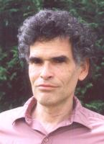
Lerner 2004—bucking big bang #1
“大爆炸论依靠日升月恒的假设性实体—我们从来没有观察到的事物。膨胀、暗物质以及暗能量最为显著。没有它们，天文学家所做出的观察与大爆炸论的预测之间将会有致命的矛盾。”
埃里克·雷诺, “批驳大爆炸理论，” 新科学人182:2448 (2004年5月22日），20页。来自10个国家的34位科学家的签字: www.cosmologystatement.org/。
Notes:
Article at: http://www.newscientist.com/article/mg18224482.900-bucking-the-big-bang.html, last accessed 2010 Feb 4.
As of 7 July 2009, the statement has been endorsed by 218 scientists and 187 independent researchers from over 50 countries and 105 other signers: www.cosmologystatement.org/
Picture from http://www.focusfusion.org/we.html. From this website we learn,
Eric J. Lerner is Executive Director of the Focus Fusion Society and President of Lawrenceville Plasma Physics in Lawrenceville, NJ. He is the author of The Big Bang Never Happened (Random House, 1991, and now in a Vintage paperback edition). He has been an independent researcher in plasma physics since 1979, and has become internationally known for his studies linking cosmic plasma phenomena and laboratory fusion devices, especially the dense plasma focus. He has developed original theories of quasars, large scale structure, the microwave background and the origin of light elements all based on the plasma cosmology approach, which is an alternative to the Big Bang theory. This work has been presented at international conferences and published in the Astrophysical Journal, Astrophysics and Space Sciences and other scientific journals.
In 1986, Lerner outlined a new theory of quasars that did not require black holes, describing quasars as a magnetic self-compression process similar to that occurring in the plasma focus. In effect, the plasmoid in the plasma focus is a tiny scale model of a quasar. In the course of this work, Lerner developed a quantitative theoretical model of the plasma focus which was consistent with all then-available data. The next year, he showed, in proposals to the Department of Energy, how this new theory indicated that the plasma focus could burn advanced fuels, especially hydrogen-boron, and developed the theoretical framework for describing the effect of differing filling gases on the plasma focus.
While the Department of Energy declined to fund this work, Lawrenceville Plasma Physics obtained small grants from NASA's Jet Propulsion Laboratory for space applications. In 1994, Lerner and colleagues at the University of Illinois successfully tested some of the predictions of his theory using a small plasma focus device there.
In 2001, Lerner and colleagues at Texas A&M University successfully achieved ion and electron energies equivalent to two billion degrees K, sufficient to fuse hydrogen-boron fuel. Two years later Lerner demonstrated that the high magnetic fields that can be produced in the plasma focus will greatly reduce the cooling of the plasma by x-rays form the electrons, and thus make achieving net energy production easier.
He is currently preparing for a new set of plasma focus experiments, including using hydrogen boron fuel, as well as continuing research in plasma cosmology.
In addition to research activity, Mr. Lerner has written widely on scientific and technological subjects, publishing over 600 articles in magazines such as IEEE Spectrum, Aerospace America, Discover and IBM Research.

Slide 61
Lerner 2004—bucking big bang #2
“在其他物理学领域里绝对不能接受对于新假设性的物件不停地依靠为一种弥合理论与观察之间的差距。它至少会提出关于潜在理论有效的重要问题。但是大爆炸论没有这些胡言因素无法留存。。。。”
雷诺（2004年），20页。
Notes:
Picture from http://www.focusfusion.org/we.html. From this website we learn,
Eric J. Lerner is Executive Director of the Focus Fusion Society and President of Lawrenceville Plasma Physics in Lawrenceville, NJ. He is the author of The Big Bang Never Happened, published in 1991 by Random House, and now in a Vintage paperback edition. He has been an independent researcher in plasma physics since 1979, and has become internationally known for his studies linking cosmic plasma phenomena and laboratory fusion devices, especially the dense plasma focus. He has developed original theories of quasars, large scale structure, the microwave background and the origin of light elements all based on the plasma cosmology approach, which is an alternative to the Big Bang theory. This work has been presented at international conferences and published in the Astrophysical Journal, Astrophysics and Space Sciences and other scientific journals.
In 1986, Lerner outlined a new theory of quasars that did not require black holes, describing quasars as a magnetic self-compression process similar to that occurring in the plasma focus. In effect, the plasmoid in the plasma focus is a tiny scale model of a quasar. In the course of this work, Lerner developed a quantitative theoretical model of the plasma focus which was consistent with all then-available data. The next year, he showed, in proposals to the Department of Energy, how this new theory indicated that the plasma focus could burn advanced fuels, especially hydrogen-boron, and developed the theoretical framework for describing the effect of differing filling gases on the plasma focus.
While the Department of Energy declined to fund this work, Lawrenceville Plasma Physics obtained small grants from NASA's Jet Propulsion Laboratory for space applications. In 1994, Lerner and colleagues at the University of Illinois successfully tested some of the predictions of his theory using a small plasma focus device there.
In 2001, Lerner and colleagues at Texas A&M University successfully achieved ion and electron energies equivalent to two billion degrees K, sufficient to fuse hydrogen-boron fuel. Two years later Lerner demonstrated that the high magnetic fields that can be produced in the plasma focus will greatly reduce the cooling of the plasma by x-rays form the electrons, and thus make achieving net energy production easier.
He is currently preparing for a new set of plasma focus experiments, including using hydrogen boron fuel, as well as continuing research in plasma cosmology.
In addition to research activity, Mr. Lerner has written widely on scientific and technological subjects, publishing over 600 articles in magazines such as IEEE Spectrum, Aerospace America, Discover and IBM Research.

Slide 62
Lerner 2004—bucking big bang #3
“更何况，大爆炸论可以夸的是没有定量预测随后被观测证实过。。。。然而大爆炸不止是了解宇宙的历史的唯一可供的框架。等离子体宇宙论与稳恒态模式两者假设一个没有始与终进化当中的宇宙。。。。”
雷诺（2004年），20页。
Notes:
Picture from http://www.focusfusion.org/we.html. From this website we learn,
Eric J. Lerner is Executive Director of the Focus Fusion Society and President of Lawrenceville Plasma Physics in Lawrenceville, NJ. He is the author of The Big Bang Never Happened, published in 1991 by Random House, and now in a Vintage paperback edition. He has been an independent researcher in plasma physics since 1979, and has become internationally known for his studies linking cosmic plasma phenomena and laboratory fusion devices, especially the dense plasma focus. He has developed original theories of quasars, large scale structure, the microwave background and the origin of light elements all based on the plasma cosmology approach, which is an alternative to the Big Bang theory. This work has been presented at international conferences and published in the Astrophysical Journal, Astrophysics and Space Sciences and other scientific journals.
In 1986, Lerner outlined a new theory of quasars that did not require black holes, describing quasars as a magnetic self-compression process similar to that occurring in the plasma focus. In effect, the plasmoid in the plasma focus is a tiny scale model of a quasar. In the course of this work, Lerner developed a quantitative theoretical model of the plasma focus which was consistent with all then-available data. The next year, he showed, in proposals to the Department of Energy, how this new theory indicated that the plasma focus could burn advanced fuels, especially hydrogen-boron, and developed the theoretical framework for describing the effect of differing filling gases on the plasma focus.
While the Department of Energy declined to fund this work, Lawrenceville Plasma Physics obtained small grants from NASA's Jet Propulsion Laboratory for space applications. In 1994, Lerner and colleagues at the University of Illinois successfully tested some of the predictions of his theory using a small plasma focus device there.
In 2001, Lerner and colleagues at Texas A&M University successfully achieved ion and electron energies equivalent to two billion degrees K, sufficient to fuse hydrogen-boron fuel. Two years later Lerner demonstrated that the high magnetic fields that can be produced in the plasma focus will greatly reduce the cooling of the plasma by x-rays form the electrons, and thus make achieving net energy production easier.
He is currently preparing for a new set of plasma focus experiments, including using hydrogen boron fuel, as well as continuing research in plasma cosmology.
In addition to research activity, Mr. Lerner has written widely on scientific and technological subjects, publishing over 600 articles in magazines such as IEEE Spectrum, Aerospace America, Discover and IBM Research.

Slide 63
Lerner 2004—bucking big bang #4
“大爆炸的支持者可能会反驳说这些理论不解释每一个的宇宙观察结果。但那是几乎不惊讶的，因为他们的研发因完全缺乏经费的资助被大大受到了阻碍。的确，这样的问题和可供替代的如今甚至不能进行自由地探讨与研究。”
雷诺（2004年），20页。
Notes:
Picture from http://www.focusfusion.org/we.html. From this website we learn,
Eric J. Lerner is Executive Director of the Focus Fusion Society and President of Lawrenceville Plasma Physics in Lawrenceville, NJ. He is the author of The Big Bang Never Happened, published in 1991 by Random House, and now in a Vintage paperback edition. He has been an independent researcher in plasma physics since 1979, and has become internationally known for his studies linking cosmic plasma phenomena and laboratory fusion devices, especially the dense plasma focus. He has developed original theories of quasars, large scale structure, the microwave background and the origin of light elements all based on the plasma cosmology approach, which is an alternative to the Big Bang theory. This work has been presented at international conferences and published in the Astrophysical Journal, Astrophysics and Space Sciences and other scientific journals.
In 1986, Lerner outlined a new theory of quasars that did not require black holes, describing quasars as a magnetic self-compression process similar to that occurring in the plasma focus. In effect, the plasmoid in the plasma focus is a tiny scale model of a quasar. In the course of this work, Lerner developed a quantitative theoretical model of the plasma focus which was consistent with all then-available data. The next year, he showed, in proposals to the Department of Energy, how this new theory indicated that the plasma focus could burn advanced fuels, especially hydrogen-boron, and developed the theoretical framework for describing the effect of differing filling gases on the plasma focus.
While the Department of Energy declined to fund this work, Lawrenceville Plasma Physics obtained small grants from NASA's Jet Propulsion Laboratory for space applications. In 1994, Lerner and colleagues at the University of Illinois successfully tested some of the predictions of his theory using a small plasma focus device there.
In 2001, Lerner and colleagues at Texas A&M University successfully achieved ion and electron energies equivalent to two billion degrees K, sufficient to fuse hydrogen-boron fuel. Two years later Lerner demonstrated that the high magnetic fields that can be produced in the plasma focus will greatly reduce the cooling of the plasma by x-rays form the electrons, and thus make achieving net energy production easier.
He is currently preparing for a new set of plasma focus experiments, including using hydrogen boron fuel, as well as continuing research in plasma cosmology.
In addition to research activity, Mr. Lerner has written widely on scientific and technological subjects, publishing over 600 articles in magazines such as IEEE Spectrum, Aerospace America, Discover and IBM Research.

Slide 64
Lerner 2004—bucking big bang #5
“在大多数的主流会议里缺乏的是公开交换主意。然而理查德·费曼（Richard Feynman)可以陈述“科学是一个怀疑的文化”，在今日的宇宙论怀疑和异议是不被容忍的，并且年轻的科学家学习的一个功课是，若他们对标准大爆炸模型没有任何负面的话就保持沉默。那些对大爆炸持有怀疑者惧怕若如此说将影响到他们的经费资助。”
雷诺（2004年），20页。
Notes:
Picture from http://www.focusfusion.org/we.html. From this website we learn,
Eric J. Lerner is Executive Director of the Focus Fusion Society and President of Lawrenceville Plasma Physics in Lawrenceville, NJ. He is the author of The Big Bang Never Happened, published in 1991 by Random House, and now in a Vintage paperback edition. He has been an independent researcher in plasma physics since 1979, and has become internationally known for his studies linking cosmic plasma phenomena and laboratory fusion devices, especially the dense plasma focus. He has developed original theories of quasars, large scale structure, the microwave background and the origin of light elements all based on the plasma cosmology approach, which is an alternative to the Big Bang theory. This work has been presented at international conferences and published in the Astrophysical Journal, Astrophysics and Space Sciences and other scientific journals.
In 1986, Lerner outlined a new theory of quasars that did not require black holes, describing quasars as a magnetic self-compression process similar to that occurring in the plasma focus. In effect, the plasmoid in the plasma focus is a tiny scale model of a quasar. In the course of this work, Lerner developed a quantitative theoretical model of the plasma focus which was consistent with all then-available data. The next year, he showed, in proposals to the Department of Energy, how this new theory indicated that the plasma focus could burn advanced fuels, especially hydrogen-boron, and developed the theoretical framework for describing the effect of differing filling gases on the plasma focus.
While the Department of Energy declined to fund this work, Lawrenceville Plasma Physics obtained small grants from NASA's Jet Propulsion Laboratory for space applications. In 1994, Lerner and colleagues at the University of Illinois successfully tested some of the predictions of his theory using a small plasma focus device there.
In 2001, Lerner and colleagues at Texas A&M University successfully achieved ion and electron energies equivalent to two billion degrees K, sufficient to fuse hydrogen-boron fuel. Two years later Lerner demonstrated that the high magnetic fields that can be produced in the plasma focus will greatly reduce the cooling of the plasma by x-rays form the electrons, and thus make achieving net energy production easier.
He is currently preparing for a new set of plasma focus experiments, including using hydrogen boron fuel, as well as continuing research in plasma cosmology.
In addition to research activity, Mr. Lerner has written widely on scientific and technological subjects, publishing over 600 articles in magazines such as IEEE Spectrum, Aerospace America, Discover and IBM Research.

Slide 65
Lerner 2004—bucking big bang #6
“今日，宇宙学的财政与实验的资源几乎全都投入于大爆炸的研究。资金只有来自少许的来源，并操纵他们的所有同行评审委员会是被大爆炸的资持者统治。因此，不管理论的科学有效性，大爆炸在领域内的统治渐渐自立。”
雷诺（2004年），20页。
Notes:
Picture from http://www.focusfusion.org/we.html. From this website we learn,
Eric J. Lerner is Executive Director of the Focus Fusion Society and President of Lawrenceville Plasma Physics in Lawrenceville, NJ. He is the author of The Big Bang Never Happened, published in 1991 by Random House, and now in a Vintage paperback edition. He has been an independent researcher in plasma physics since 1979, and has become internationally known for his studies linking cosmic plasma phenomena and laboratory fusion devices, especially the dense plasma focus. He has developed original theories of quasars, large scale structure, the microwave background and the origin of light elements all based on the plasma cosmology approach, which is an alternative to the Big Bang theory. This work has been presented at international conferences and published in the Astrophysical Journal, Astrophysics and Space Sciences and other scientific journals.
In 1986, Lerner outlined a new theory of quasars that did not require black holes, describing quasars as a magnetic self-compression process similar to that occurring in the plasma focus. In effect, the plasmoid in the plasma focus is a tiny scale model of a quasar. In the course of this work, Lerner developed a quantitative theoretical model of the plasma focus which was consistent with all then-available data. The next year, he showed, in proposals to the Department of Energy, how this new theory indicated that the plasma focus could burn advanced fuels, especially hydrogen-boron, and developed the theoretical framework for describing the effect of differing filling gases on the plasma focus.
While the Department of Energy declined to fund this work, Lawrenceville Plasma Physics obtained small grants from NASA's Jet Propulsion Laboratory for space applications. In 1994, Lerner and colleagues at the University of Illinois successfully tested some of the predictions of his theory using a small plasma focus device there.
In 2001, Lerner and colleagues at Texas A&M University successfully achieved ion and electron energies equivalent to two billion degrees K, sufficient to fuse hydrogen-boron fuel. Two years later Lerner demonstrated that the high magnetic fields that can be produced in the plasma focus will greatly reduce the cooling of the plasma by x-rays form the electrons, and thus make achieving net energy production easier.
He is currently preparing for a new set of plasma focus experiments, including using hydrogen boron fuel, as well as continuing research in plasma cosmology.
In addition to research activity, Mr. Lerner has written widely on scientific and technological subjects, publishing over 600 articles in magazines such as IEEE Spectrum, Aerospace America, Discover and IBM Research.

Slide 66
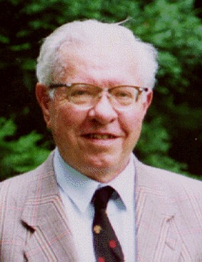
Hoyle, Fred 1995—science locked in paradigms
“今日科学被锁入范式。每条路被错误的信念受阻，并且倘若你今日尝试以一期的期刊出版任何文章，你将碰到一个范式，编辑者就会拒绝你的作品。”
弗雷德•霍伊爾爵士
霍根, “人物介绍：弗雷德•霍伊爾,” 科学美国人272:3 (1995年), 24-25页。
Notes:
Hoyle is a world-famous astrophysicist (expert on galaxies and quasars) at the Max Planck Institute in Germany.
Photo: http://www.pozsarko.hu/dla/futurologia/5_ora/56.jpg, accessed 22 Mar 2010.

Slide 67
Hoyle, Fred 1998—astronomers’ findings
“科学家，尤其属于最有名望的学院，固定地压制以及嘲笑与他们目前的理论与假设抵触的研究结果。。。。天文学家现在感觉被强迫必须使观察资料符合于理论而不是反之亦然。
弗雷德•霍伊爾爵士
霍尔顿•阿尔普，Seeing Red: Redshifts, Cosmology and Academic Science (Montreal, CAN: Apeiron, 1998)，12页。
Notes:
Hoyle is a world-famous astrophysicist (expert on galaxies and quasars) at the Max Planck Institute in Germany.
Photo: http://www.pozsarko.hu/dla/futurologia/5_ora/56.jpg, accessed 22 Mar 2010.

Slide 68
无理的大爆炸
起源 － 月球？
未知！
起源 － 太阳系？
未知！
起源 － 恒星与星系？
未知！
大爆炸？
不可想象的神话！
Notes:
“Figure 6. Galaxies tend to be grouped in concentric spherical shells around our home galaxy. The distance interval between shells is of the order of a million light years, but since several different intervals exist, the true picture is more complex than the idealization shown here.” D. Russell Humphreys, “Our galazy is the centre of the universe, ‘quantized’ red shifts show,” TJ 16:2 (2002), p. 98.

Slide 69
Template Suite 1-Content 01360
宇宙的岁数？

Slide 70
我的年龄多大？
若你不知道我是如何地存在，那么你是无法知道我什么时候开始存在。

Slide 71
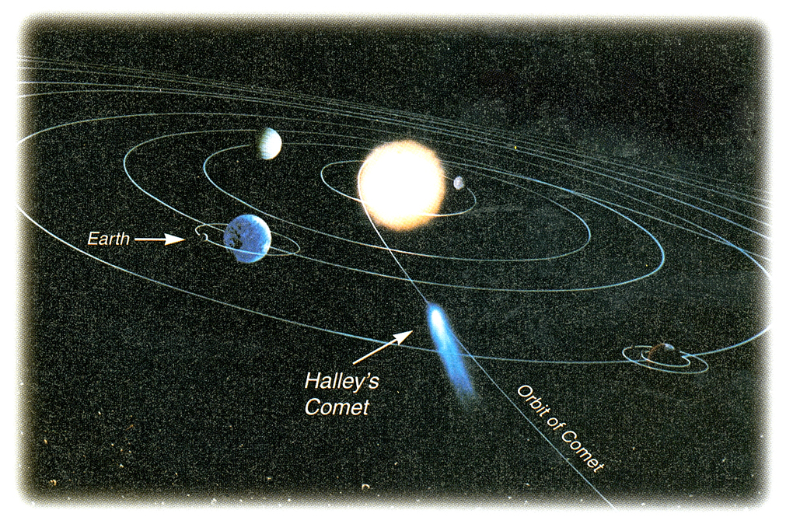
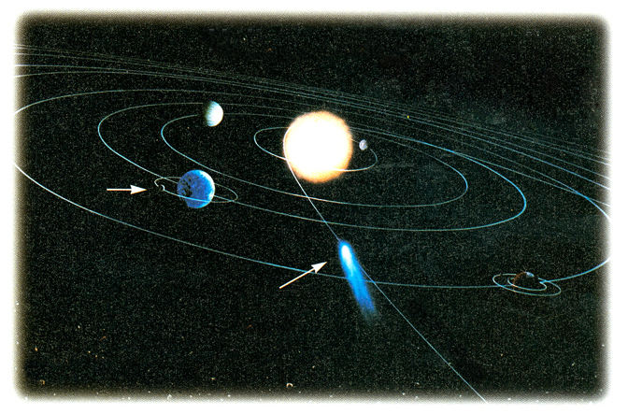
Short-period comets
Halley’s Comet
哈雷彗星
地球
哈雷彗星
彗星的轨道
One orbit: 76 years
一次环绕轨道运行：76年
Notes:
71
Evolutionary explanations for the persistence of short-period (< 200 years) comets in a 4.5 billion year old solar system:
1. Oort Cloud (past Pluto by 3 light years)—never observed, and how did they get knocked individually into orbits?
2. Kuiper Belt (outside the orbit of Neptune & beyond Pluto 30-50 AU from the Sun) KBOs (also called TNOs--Trans-Neptune Objects), are too large to too dense to be comet nuclei
Both theories have other problems too—see below. Long-period comets may have periods of 1000s of years
Oort Cloud (named after Dutch astronomer Jan Hendrik Oort [1900-92], who proposed the theory in 1950): the “cloud of comets” supposedly exists outside the solar system to a distance of up to 3 light-years. Passing stars, gas clouds or galactic tides supposedly knock comets into orbit around the sun.
Problems with Oort Cloud theory
no observational evidence of the cloud (“because they are so far away and so small” say evolutionists)
collisions would have destroyed most of the comets
about 100 times less comets are observed compared to prediction of the theory
Kuiper Belt (named after Dutch astronomer Gerald Kuiper [1905-73], father of modern planetary science, who proposed the theory in 1951)—now believed the main source of short-period comets.
Problems with the theory
billions of comet nuclei must be in the Belt but the known “Kuiper Belt Objects” (KBO—made up of frozen methane, ammonia and water) number only about 1000 as of 2007 (70,000 KBOs over 100 km in diameter are BELIEVED to be there).
KBO discovered so far are much larger than comets (so there has been no discovery of comets per se in the KB, so that some astronomers call them more objectively “Trans-Neptunian Objects”)
See Jonathan Sarfati, “Comets: Portents of doom or indicators of youth?,” Creation 25:3 (June-Aug. 2003), 37-40. Also, see http://www.answersingenesis.org/docs2002/0513_kuiper.asp and http://en.wikipedia.org/wiki/Kuiper_belt and http://www.ifa.hawaii.edu/~jewitt/kb.html

Slide 72
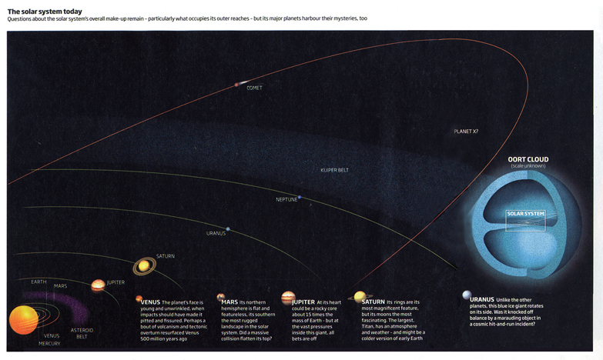
进化的解释
比例未知
奥尔特云
柯伊伯带
太阳系
海王星
太阳系
Notes:
Evolutionary explanations for the persistence of short-period (< 200 years) comets in a 4.5 billion year old solar system:
1. Oort Cloud (past Pluto’s orbit up to 3 light years)—never observed, and how did they get knocked individually into orbits?
2. Kuiper Belt (outside the orbit of Neptune & beyond Pluto 30-50 AU from the Sun) KBOs (also called TNOs--Trans-Neptune Objects), are too large and too dense to be comet nuclei
Both theories have other problems too—see below. Long-period comets may have periods of 1000s of years
Oort Cloud (named after Dutch astronomer Jan Hendrik Oort [1900-92], who proposed the theory in 1950): Passing stars, gas clouds or galactic tides supposedly knock comets into orbit around the sun.
Problems with Oort Cloud theory
no observational evidence of the cloud (“because they are so far away and so small” say evolutionists)
collisions would have destroyed most of the comets
about 100 times less comets are observed compared to prediction of the theory
Kuiper Belt (named after Dutch astronomer Gerald Kuiper [1905-73], father of modern planetary science, who proposed the theory in 1951)—now believed the main source of short-period comets.
Problems with the theory
billions of comet nuclei must be in the Belt but the known “Kuiper Belt Objects” (KBO—made up of frozen methane, ammonia and water) number only about 1000 as of 2007 (70,000 KBOs over 100 km in diameter are BELIEVED to be there).
KBO discovered so far are much larger than comets (so there has been no discovery of comets per se in the KB, so that some astronomers call them more objectively “Trans-Neptunian Objects”)
See Jonathan Sarfati, “Comets: Portents of doom or indicators of youth?,” Creation 25:3 (June-Aug. 2003), 37-40. Also, see http://www.answersingenesis.org/docs2002/0513_kuiper.asp and http://en.wikipedia.org/wiki/Kuiper_belt and http://www.ifa.hawaii.edu/~jewitt/kb.html
Diagram from Stephen Battersby, “Our Unknown Solar System,” New Scientist 201:2693 (31 Jan. 2009), p. 32-33.

Slide 73
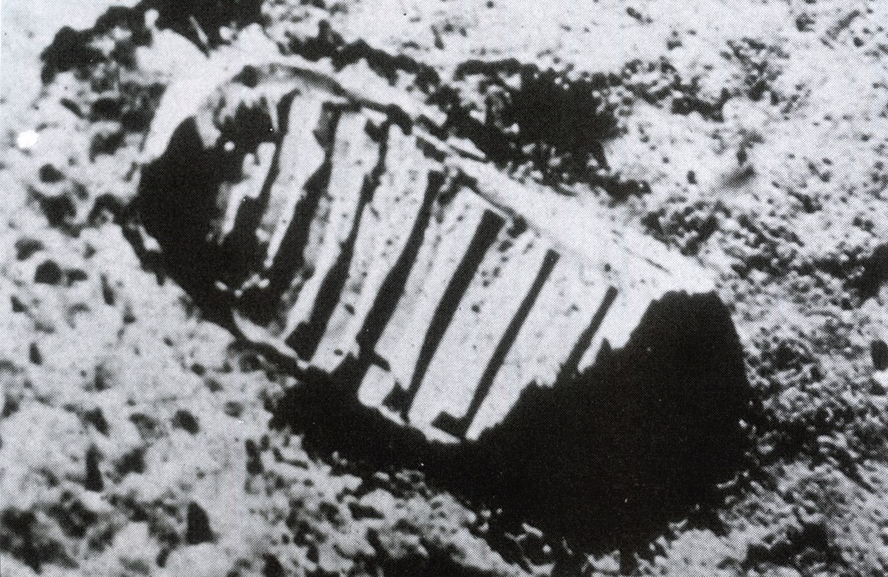
Moon dust argument
月尘论点 – 不好
www.AnswersInGenesis.org
Notes:
Photo Source: Richard Milton, The Facts of Life (London: Fourth Estate, 1992), photo collection after page 145.
On problems of moon-dust argument: http://www.answersingenesis.org/docs/1372.asp
(Creation Mag. Article)

Slide 74
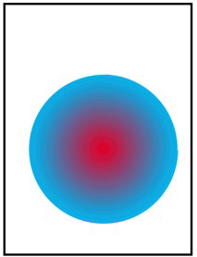
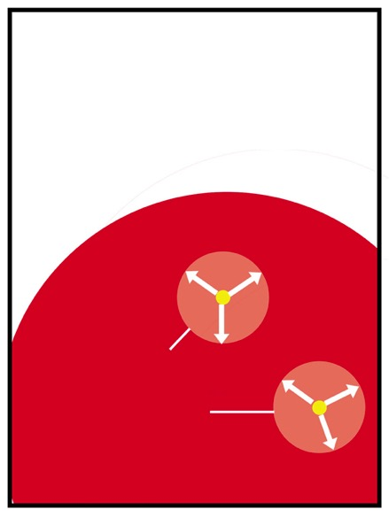
大爆炸拥护者拥有他们自己的光速时间的问题！
“视界问题”
‘大爆炸’膨胀
‘大爆炸’膨胀
A
A
B
B
光传播的最远的距离
1. 早期大爆炸断言，A点与B点以不同的温度开始。
2. 今日，A点与B点有同一个温度，然而却没有足够的时间使他们交换光/热度。
Notes:
In reply to a question on distant starlight, the first answer should be to show that the big bangers have their own problem with light travel time. This is called the horizon problem. That is, the different regions of space started off with widely different temperatures because of the fluctuations. But now, the Cosmic Background Radiation shows that all regions of space have almost exactly the same temperature. The only way this could occur naturalistically is if all the regions had been close enough to exchange radiation, with the net result that hot regions donate energy to cooler regions until they reach the same temperature.
But the problem for the big bangers is this—the different regions are at least 10 times more distant than the furthest distance light could have travelled, the ‘horizon’.
So if both sides have unanswered questions about the same sort of problem, it can’t be used as evidence against only one side.

Slide 75

AiG web site #1
创世记答案机构
相信·维护·宣告
“遥远的星光”
© 2007年创世记答案机构—美国

Slide 76
Template Suite 1-Content 01360
圣经说什么？
Notes:
As a content template, this is best suited for standard content such as outlines, quotations, Scriptures, and maybe illustrations or photos. Presentation Team recommends 48–60 pt. font for headings and 28–40 pt. for body text. Because of eye flow and visual psychology, the top line may be a little closer than all other sides. This also contains a floating AiG logo that can be repositioned or removed as appropriate for the overhead’s content.

Slide 77

Psalm 33:6, 8-9 NAS
诗篇33:6, 8-9
6. 诸天借着耶和华的话而造，
天上的万象借着他口中的气而成。
8. 愿全地都敬畏耶和华，
愿世上的居民都惧怕他。
9. 因为他说有，就有；
命立，就立。

Slide 78
Psalm 19:1-2 NAS
诗篇19:1-2
诸天述说神的荣耀，
穹苍传扬他的作为。
2. 天天发出言语，
夜夜传出知识。

Slide 79
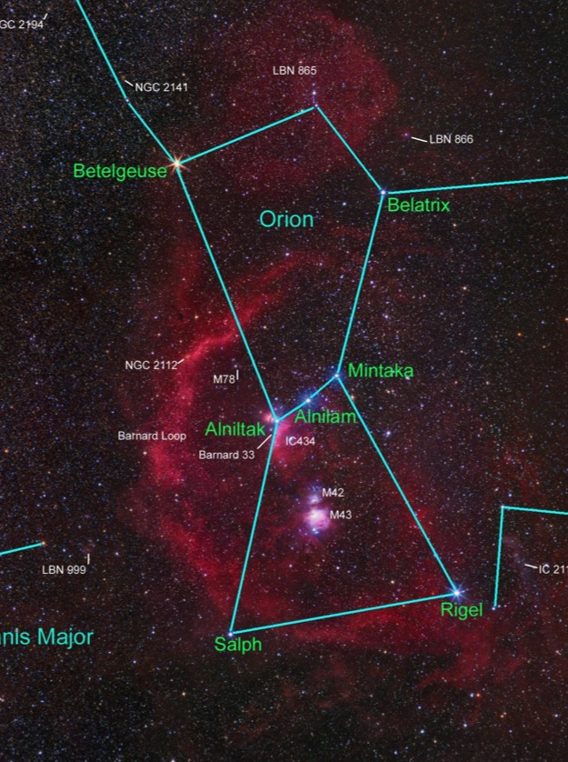
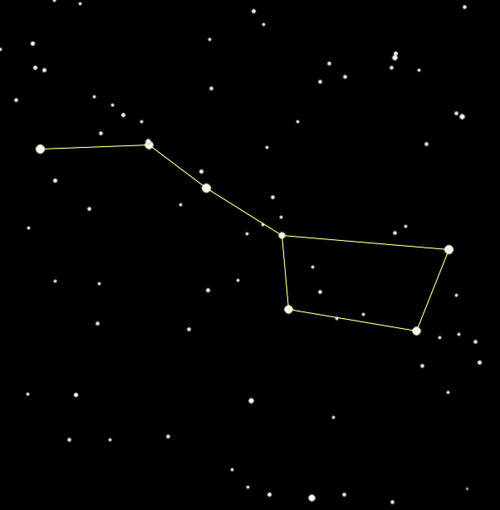
北斗七星与猎户座
北斗七星
猎户座
Notes:
Orion photo: http://www.astrosurf.com/sguisard/Pagim/Orion_constellation-HRVB-50mm.html, accessed 2 June 2008
Big Dipper photo: http://my.execpc.com/60/B3/culp/astronomy/Spring/Polar.html, accessed 2 June 2008

Slide 80
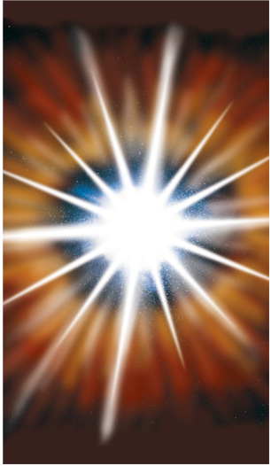
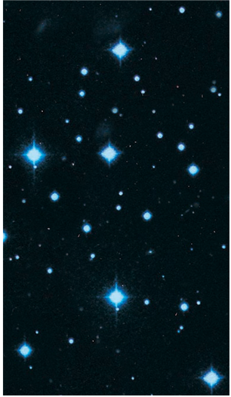






对比大爆炸与圣经的次序
大爆炸
恒星
太阳
熔地球
初始海洋
150亿年前
100亿年前
50亿年前
45亿年前
38亿年前
水遮盖地球
旱地与青草蔬菜
太阳、月球与恒星
第一至二天
第三天
第四天

Slide 81

Big Bang Time line
大爆炸未来的宇宙
大爆炸
亿万年
热寂
Big Bang Time line
圣经未来的宇宙
热寂
六天的
千万年
新天新地
永恒
创造
罪与死亡
创世记
彼后第3章
启示录
© 2005年创世记答案机构

Slide 82
Gen. 1:14-15 NAS
创世记1:14-15
(14) 神说：“在天上穹苍中，要有光体来分昼夜；这些光体要作为记号，定节令、日子和年岁； (15) 它们要在天上穹苍中发光，照耀地上！” 事就这样成了。
要有。。。第3、6、9、11、14、20、24、26节
事就这样成了。。。第3、7、9、11、15、24、30节
神看。。。是好的。。。 第4、10、12、18、21、25节

Slide 83
Gen. 1:16 NAS
创世记1:16
神造了两个大光体，大的管昼，小的管夜；又造了星星。
造 = asah （希伯来文）

Slide 84
Asah与Rahah以及诗147:7 新译本
Asah: 做、造
  从不意味着“出现”或“使看见”的意义。
Rahah: 出现
  创世记1:9 “使旱地露出来”
诗篇147:7-8
。。。用琴向我们的神歌颂。他以密云遮盖天空。。。

Slide 85
创1:16与诗136:7-9 新译本
创世记1:16
神造[et]了两个大光体，[et]大的管昼，[et]小的管夜[他][et] 又造了星星。
诗篇136:7-9
7. 那造成大光的。。。
8. [et] 太阳管白昼。。。
9. [et] 月亮和星星管黑夜
Notes:
LXX confirms the Hebrew in Gen. 1:16 and Ps. 136:8-9 by using the accusative forms of the definite articles and the nouns.

Slide 86
神几时造了它们？
若神没有在第四天造太阳、月亮和恒星，祂几时造它们？
第三节？
第一节？
Notes:
LXX confirms the Hebrew in Gen. 1:16 and Ps. 136:8-9 by using the accusative forms of the definite articles and the nouns.

Slide 87
结论—恒星是在第四天被造的
圣经清楚教导太阳、月亮与恒星全都是在第四天被造的。
Notes:
LXX confirms the Hebrew in Gen. 1:16 by using the accusative forms of the definite articles and the nouns.

Slide 88
Assumptions Facts-Interpretations astronomy
自然假设
圣经假设
x
不符合事实！
符合事实！
行星与恒星
大爆炸于数亿年
有计划、年轻的宇宙
x

Slide 89



Evolution Rings--animated
天进化
地质进化
全部都是基于自然哲学的假设。
神话！
生物进化
生命
地球
行星、恒星、星系
Notes:
Say that historically astronomical evolution and geological evolution laid the ground work for Darwin’s theory of biological evolution. Darwin used the same philosophical assumptions that the old-earth geologists and astronomers had used 50 years earlier to develop their theory of millions of years. 全所有都是基于自然哲学的假设。

Slide 90
AiG web site #1
创世记答案机构
相信·维护·宣告
© 2007年创世记答案机构—美国

Slide 91

创造论博物馆
辛辛那提，俄亥俄州

Slide 92


Stargazers Room
观星室

Slide 93

超自然的设计
“无神论是无意义的。当我望着太阳系，我看到地球和太阳的距离是完美的，吸取了适当的热气和光。这不是偶然的。”
艾萨克·牛顿爵士
“这美丽的太阳、行星以及彗星的系统只能出于一个有智慧的本体的策略与统治权。”
Notes:
Sources
Quote 1: Principia, Book III; cited in; Newton’s Philosophy of Nature: Selections from his writings, H.S. Thayer, ed. (New York: Hafner Library of Classics, 1953), p. 42.
Quote 2: A Short Scheme of the True Religion, manuscript quoted in Memoirs of the Life, Writings and Discoveries of Sir Isaac Newton by Sir David Brewster, (Edinburgh, 1850), cited in ibid, p. 65.

Slide 94

Eagle Nebula & Ps. 19:1 NAS/KJV
诸天述说神
的荣耀。。。
诗篇19:1
Notes:
Eagle Nebula
The tallest pillar (left) is about a light-year long from base to tip.
Source: http://grin.hq.nasa.gov/ABSTRACTS/GPN-2000-000987.html

Slide 95

History Book of the Universe 02022
宇宙的历史书
圣经
© 2005年创世记答案机构

Slide 96




科学者与圣经和8个妥协
大爆炸在数亿年前发生过。你得相信我！
大约6千年前，造太阳之前，我造了地球。你得相信我！
圣经

Slide 97
Black blank------------extras
终结

Slide 98

NewScientist-Brief History of Time
我们可以观察到的！
Notes:
Peter Coles, “Boomtime,” New Scientist (3 March 2007), p. 36. Coles is professor of astrophysics at the University of Nottingham, UK.

Slide 99
NewScientist-Brief History of Time
我们可以观察到的！
膨胀
“膨胀持续少过一毫秒，然而宇宙大部分的成长归功于它并且在微波背景辐射上留下了它的印记（嵌图）。”
Notes:
Peter Coles, “Boomtime,” New Scientist (3 March 2007), p. 36. Coles is professor of astrophysics at the University of Nottingham, UK.

Slide 100
Template Suite 1-Content 01360
星光谱线红移如何？
创世记
答案机构
Notes:
As a content template, this is best suited for standard content such as outlines, quotations, Scriptures, and maybe illustrations or photos. Presentation Team recommends 48–60 pt. font for headings and 28–40 pt. for body text. Because of eye flow and visual psychology, the top line may be a little closer than all other sides. This also contains a floating AiG logo that can be repositioned or removed as appropriate for the overhead’s content.

Slide 101



Redshift
实验室里的铁源
恒星
光
光束
准直器
准直器
光谱仪
光谱仪
波长
波长
红 橙 黄 绿 蓝 紫
红 橙 黄 绿 蓝 紫
红 橙 黄 绿 蓝 紫

Slide 102

036 Lightspectrum

Slide 103

Doppler effect

Slide 104
Redshift meaning #4-7
红移的定义？
宇宙的膨胀？
恒星与星系的内在本质？
光速缓慢？
恒星或星系的引力？
光线老化？
切向移动？
另一个诠释？

Slide 105

Galactic redshift shells
Notes:
“Figure 6. Galaxies tend to be grouped in concentric spherical shells around our home galaxy. The distance interval between shells is of the order of a million light years, but since several different intervals exist, the true picture is more complex than the idealization shown here.” D. Russell Humphreys, “Our galaxy is the centre of the universe, ‘quantized’ red shifts show,” TJ 16:2 (2002), p. 98.

Slide 106
Black

Slide 107


創造链接地址 BibleStudyDownloads.org
免费获得该讲解!
圣经学习下载
Notes:
The explanation for free!
Creation link address

