Slide 1


Template Suite 1-Title 01359
特里 莫特森 博士
恐龙:
你被洗脑了吗？
创世记答案机构
Designed by Dr. Terry Mortenson
Dr. Rick Griffith • 博士 • 新加坡神学院 • BibleStudyDownloads.org
Notes:
This template is intended for talk titles. Although it can be used for significant section titles, its “cover page” feel makes it best used once at the beginning of a presentation. Subtitle can be as its name suggests or the speaker's name. Presentation Team recommends title text size as 50–72 and subtitle size as 30–48 with optimal sizes already used in this example. This also contains a floating AiG logo that can be repositioned or removed as appropriate for the overhead's content.

Slide 2

AiG web site #1

Slide 3
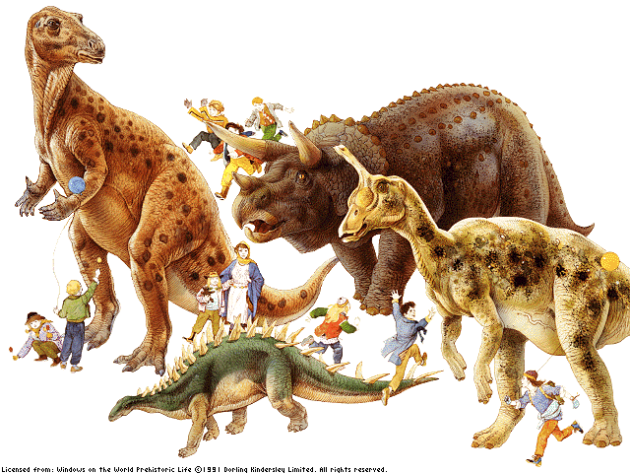
Dinosaurs are Fascinating
Notes:
Dinosaurs hold a greater degree of fascination for many people than any living animal. They were big, frightening and mysterious.

Slide 4
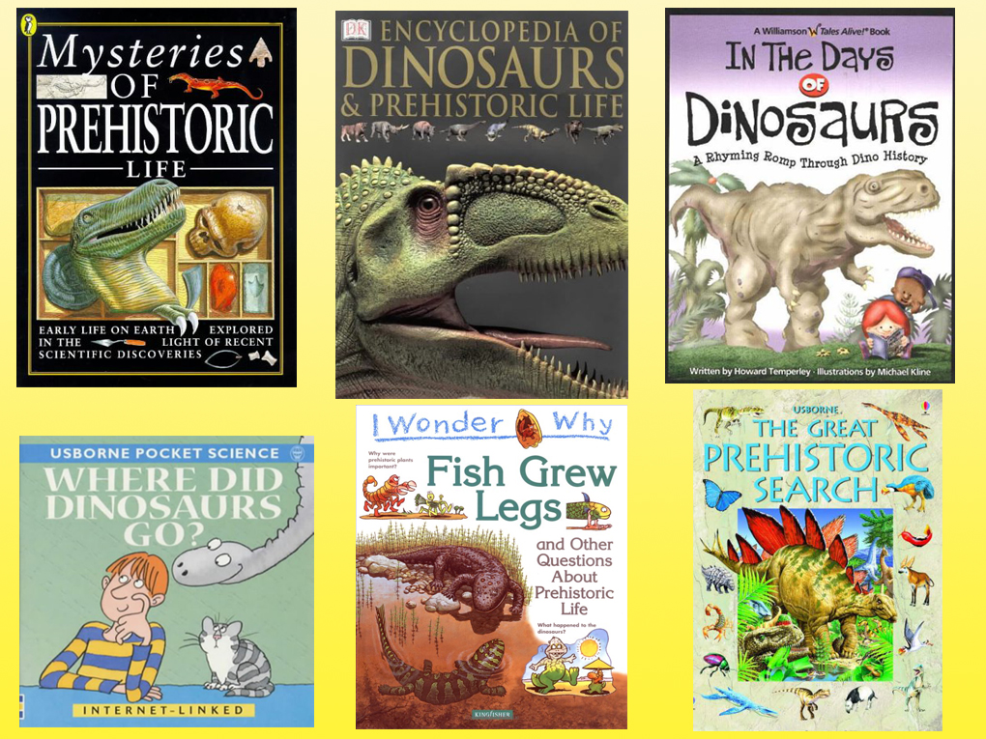
Dinosaurs & Kids - 1

Slide 5
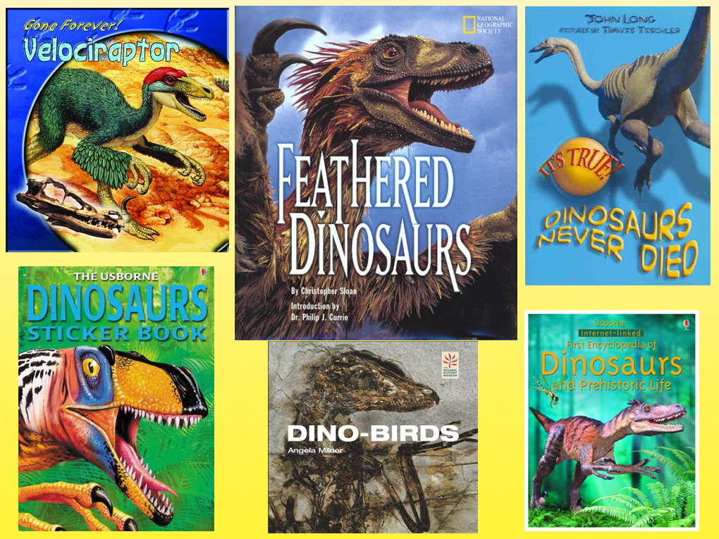
Dinosaurs & Kids - 2

Slide 6
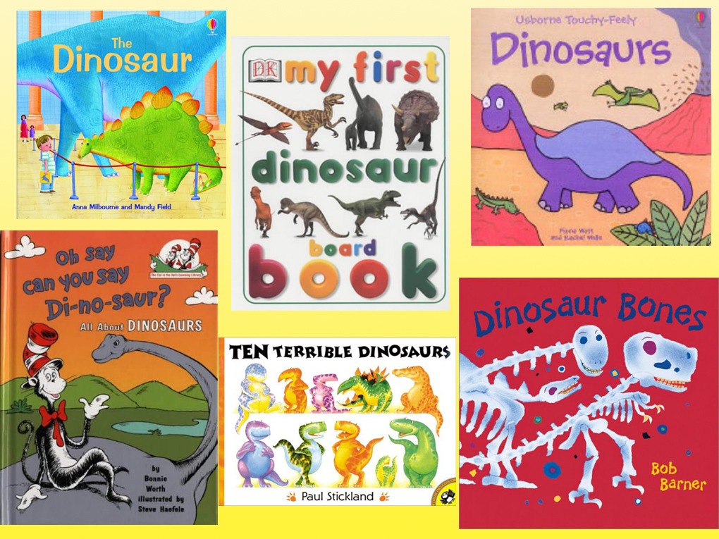
Dinosaurs & Kids - 3

Slide 7
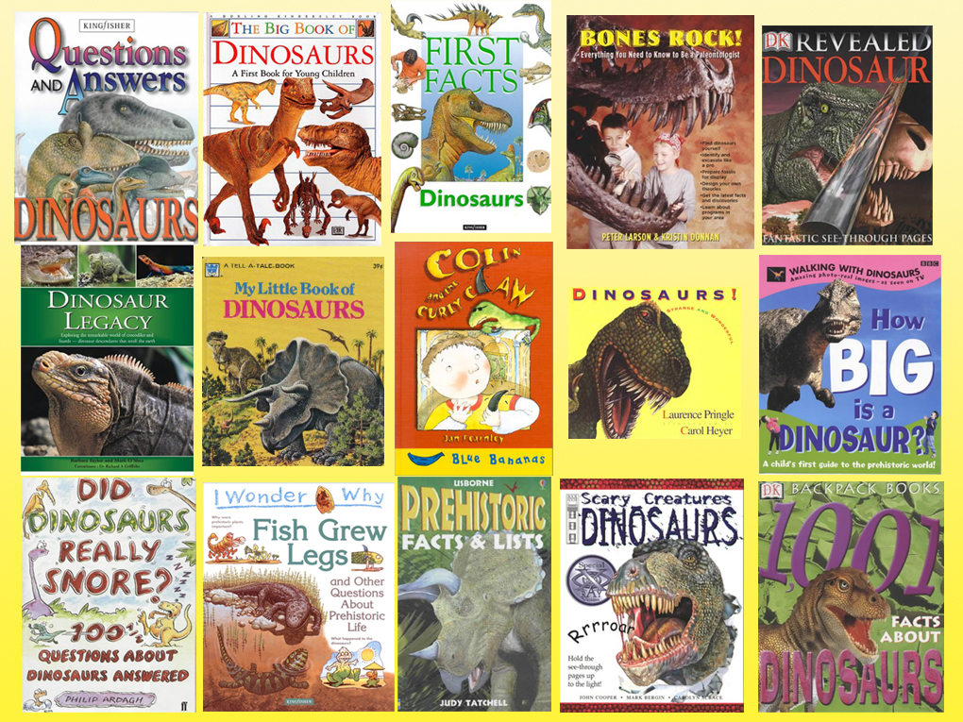
Dinosaurs & Kids - 4

Slide 8
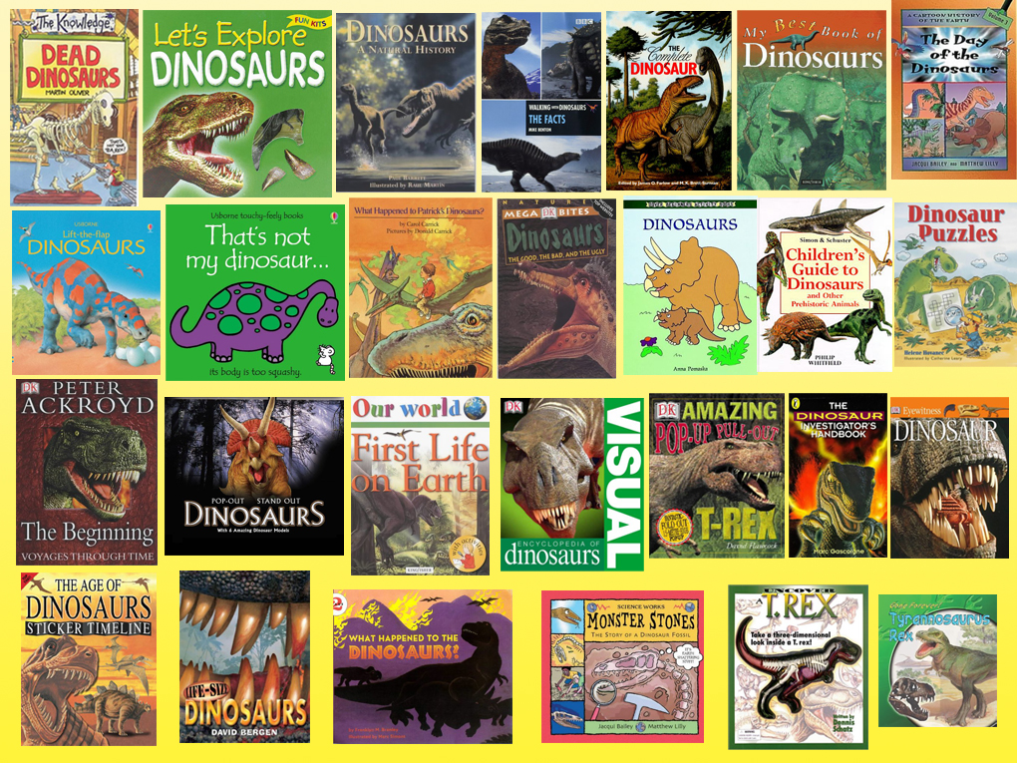
Dinosaurs & Kids - 5

Slide 9
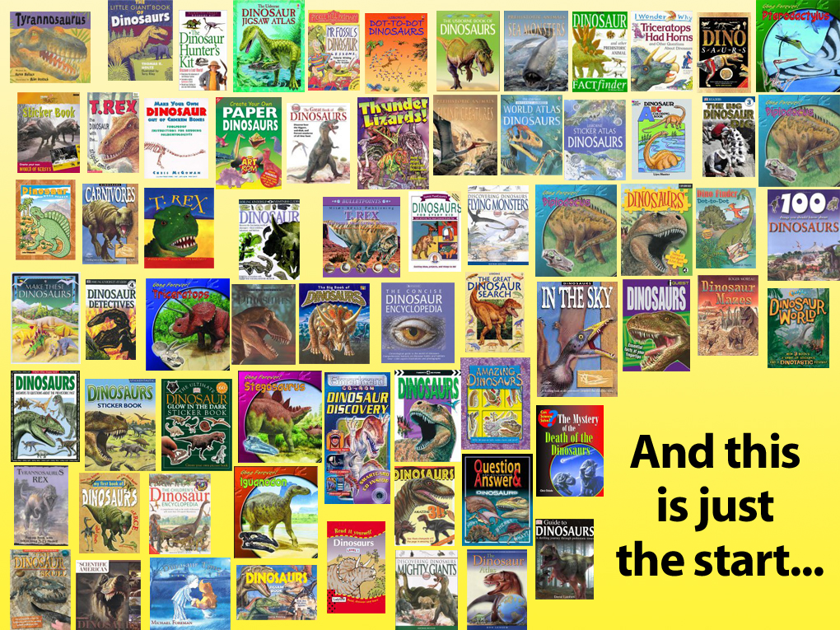
Dinosaurs & Kids - 6
这仅仅是个开始！

Slide 10
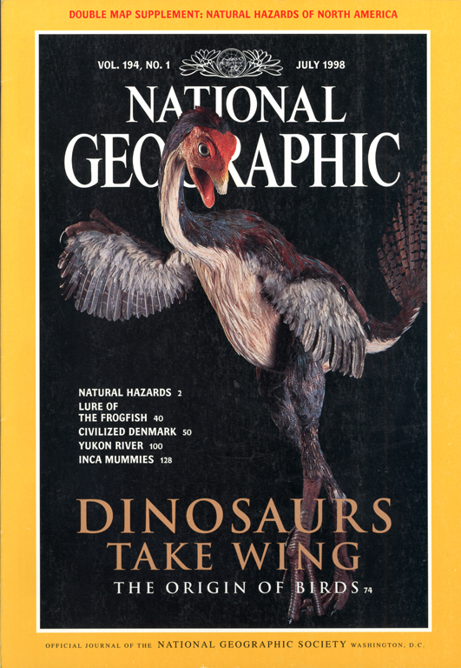
Triceratops
1998年7月
Triceratops

Slide 11
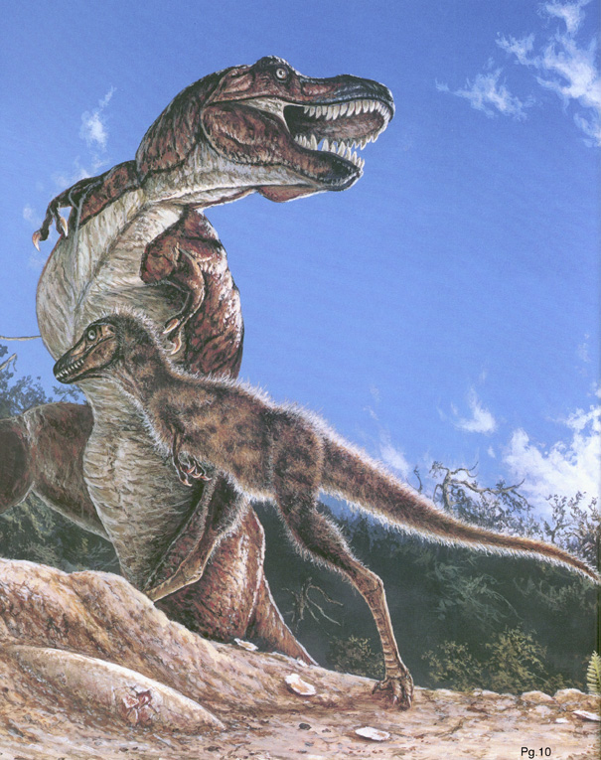
NG dino-bird –Feathers for T Rex picture
“霸王龙的羽毛?”
国家地理 1999年11月

Slide 12
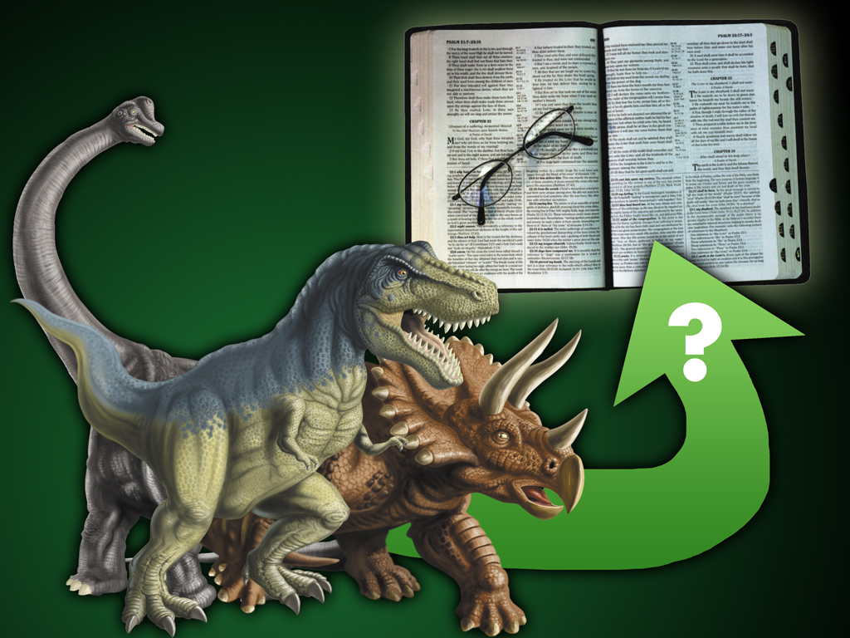
Fit Dino-How 00265
你该如何将恐龙融入圣经中？
你不该这么做！

Slide 13
Fit Dino-How 00265
你该如何将恐龙融入圣经中？

Slide 14
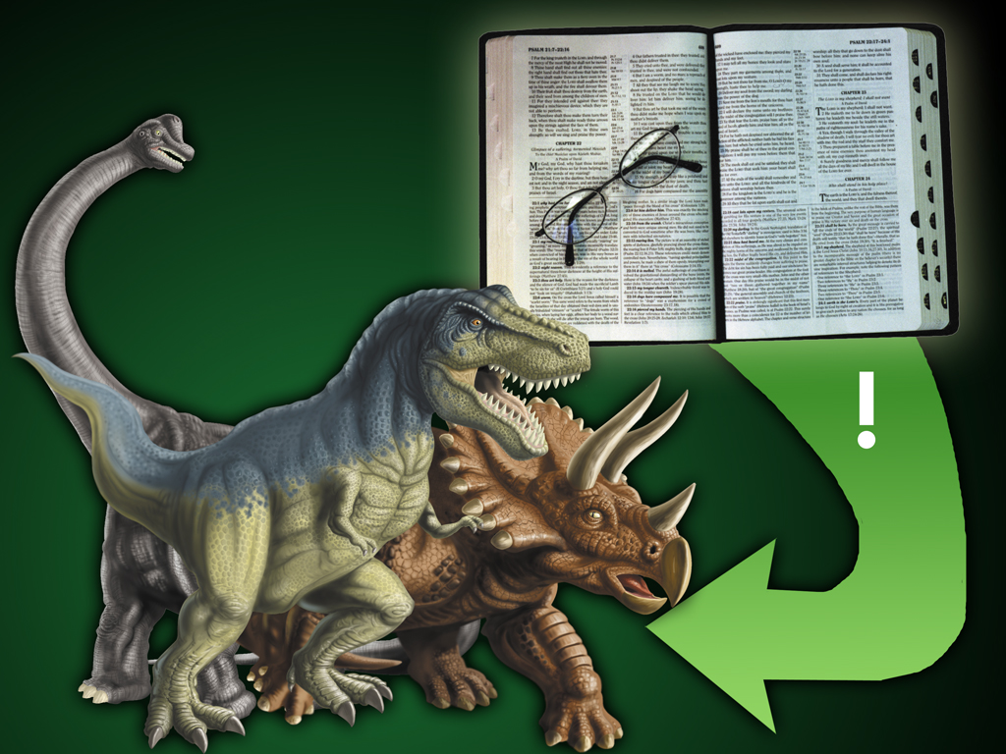
Dinos fit Bible 00617
该做的是使用圣经来解释恐龙!

Slide 15
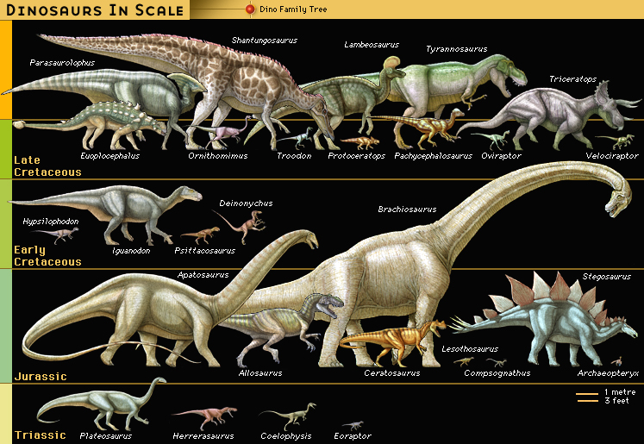
Dinosaur “Timeline”
恐龙的 “时间轴”
百万年
65
145
145
208
208
245
(大英百科全书, CD, 1999)
Notes:
Evolutionists believe that Herrerasourus was one of the first dinosaurs on earth (early Triassic, 240 million years ago). There are no known ancestors. He was about 10 feet long and a meat eater. He is classified as a theropod (lizard hipped). Lizard hipped dinosaurs are believed to have evolved into bird hipped dinos.
Also shown is Plateosaurus, the earliest large dinosaur (200 myo). Related to sauropods like Diplodocus. Many skeletons of this dinasaur were found Trossingen Germany were they appear to have been running in herds when they died by drowning. This large plant eater was about 26 feet long and could stand on its hind legs to reach leaves high in the trees. The front feet were hand like for grasping plants but could bend back so that they could also walk on all fours.
Atleast a 160 million years of evolution and NO transitional dinosaur fossils to show how any two could have evolved one into the other.

Slide 16
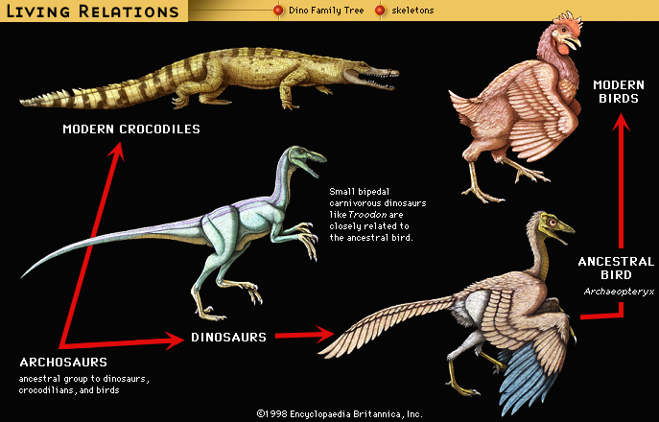
Living “Relatives” of Dinosaurs
LIVING RELATIONS
Dino Family Tree
Skeletons
MODERN BIRDS
MODERN CROCODILES
Small bipedal carnivorous dinosaurs like Troodon are closely related to the ancestral bird
ANCESTRAL BIRD
Arcaeopteryx
恐龙
ARCHOSAURS
Ancestral group to dinosaurs, crocodilians, and birds
(大英百科全书，CD，1999年)
Notes:
Archosaurs: The only picture of Archosaurs I could find on the web were artist's drawings of the skull. The UC Berkeley web site below under the icon “Fossil record” has a picture only of an artist's rendition of an “close relative” of Archosaurs. No picture of a fossil is shown.…That page says “Students of archosaur evolution are blessed with a wonderful fossil record for many groups of archosaurs, including some very bizarre extinct taxa.” We have to take it by faith that they have the majority of or whole skeleton of any of these creatures. Wikipedia.com tells us that living archosaurs are crocodiles and birds!
“Archosauria (the "ruling reptiles") is a major group of diapsids [see below], differentiated from the other diapsids by the presence of single openings in each side of the skull, in front of the eyes (antorbital fenestrae), among other characteristics.
This continues the tetrapod trend of the reduction of skull bones by the fusion of multiple bones and the opening of fenestrae in the skull. This helps to lighten the skull, provides more room for muscles and other tissues, and allows more skull flexibility (kinesis) when eating. Other typical archosaurian characteristics include another opening in the lower jaw (the mandibular fenestra), a high narrow skull with a pointed snout, teeth set in sockets (called thecodont tooth implantation), and a modified ankle joint.
The ancestral archosaurs probably originated some 250 million years or so ago, in the late Permian period. Their descendants (such as the dinosaurs) dominated the realm of the terrestrial vertebrates for a majority of the Mesozoic Era. Today, only the birds and crocodilians exist to provide a glimpse into the past glory of archosaurs.” http://www.ucmp.berkeley.edu/diapsids/archosauria.html, accessed 17 April 2007
“All members of the group called the Reptilia [including all dinosaurs], except for the anapsids (turtles and their ilk), and a few extinct groups, are diapsids. The main diagnostic physical character for a diapsid is the presence of two openings on each side of the skull; the upper and lower temporal openings. Even the birds are considered diapsids (and hence reptiles), because they are descended from certain dinosaurs (which are also diapsids), …” http://www.ucmp.berkeley.edu/diapsids/index.html, accessed 17 April 2007.

Slide 17

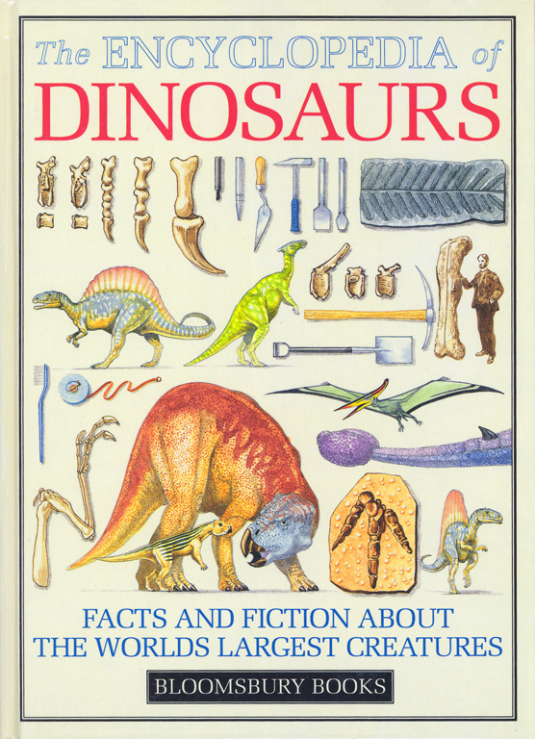
Encyclopedia of Dinosaurs—evolving reptiles
“不断进化的爬行动物”
“小蜥蜴类爬行动物进化从两栖类动物至少340万年前.”
“在头骨后面的眼睛可识别出
这些从早期进化后的不同种类的爬行动物群体.”
大卫·兰伯特，恐龙百科全书（伦敦的Bloomsbury出版社，1994年），16页，与英国自然历史博物馆联合刊登.
Notes:
In one sentence the explain the origin of reptiles.
In a second sentence, immediately following, they explain the origin of all other reptiles.

Slide 18
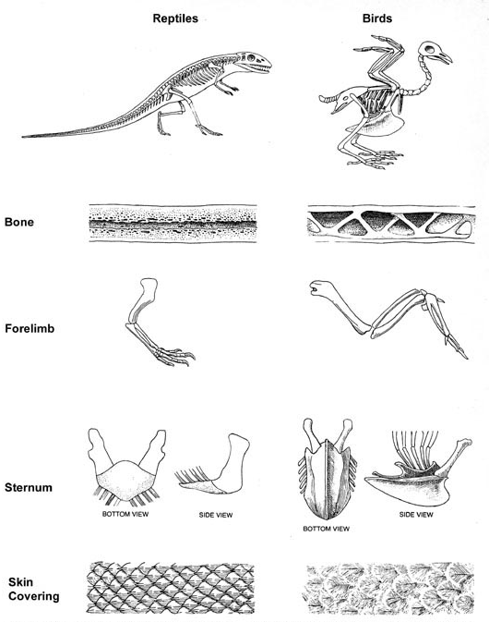
Lewontin 1978—reptiles to birds
爬行动物
鸟类
“鸟类从爬行动物类的进化过程可被视为是一个鸟类为了‘解决飞行问题’的一个适应的过程.”
骨
前肢
胸骨
理查德·列万廷，
“适应”美国科学（1978年9月），214页
底视图
侧面图
侧面图
底视图
皮层
Notes:
All bones are hollow (except the ossicle bones of the ear, which are solid).
But all animal bones are filled with marrow, whereas most of the bones in a bird are pneumatic—they have air-cavities many of which are part of the respiratory system. The air cavities also make the bones lighter aiding the bird in flight. The criss-cross structure in some bird bones has been copied by engineers to make “a Warren truss” used in bridges.

Slide 19
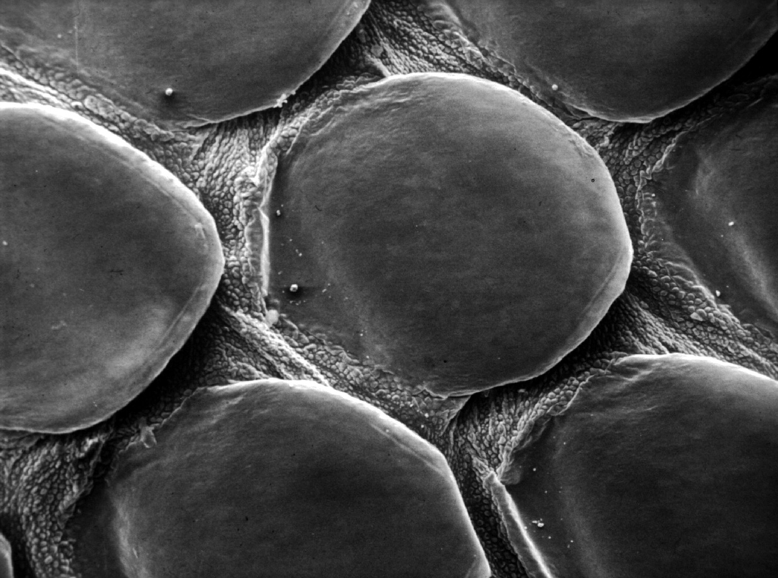
Menton--Reptile Scale
© David N. Menton 1998

Slide 20
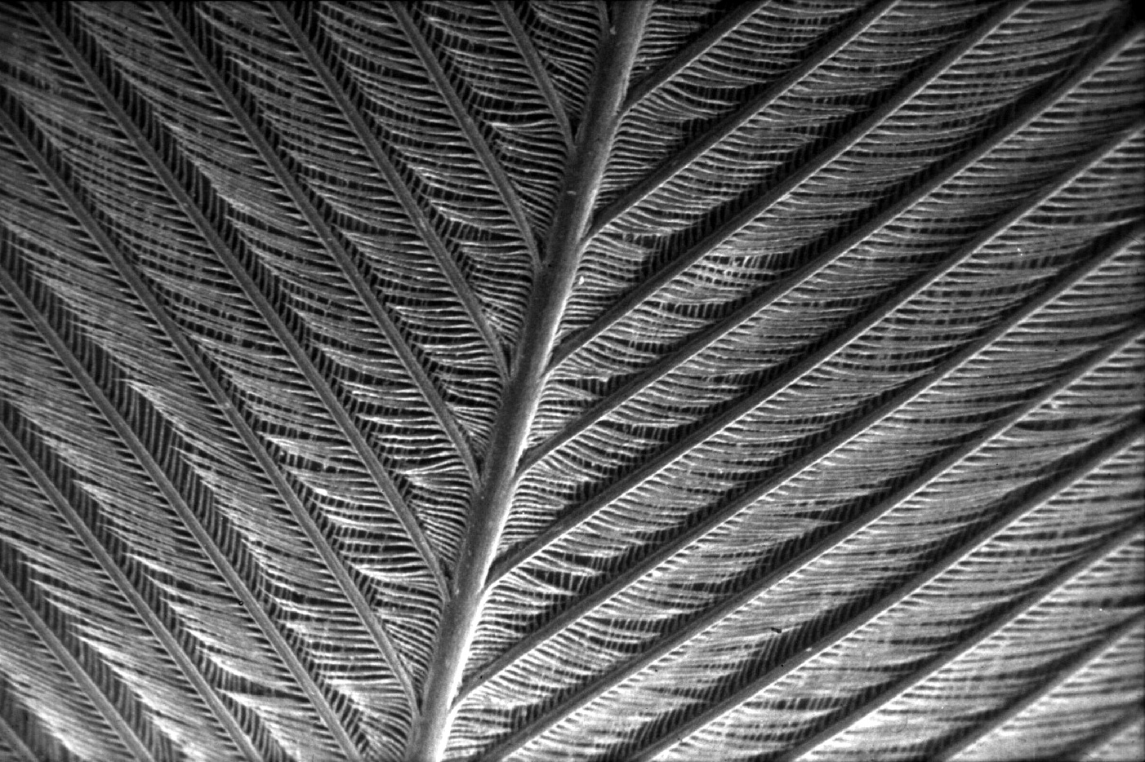
Menton--Bird Feather
© David N. Menton 1998

Slide 21
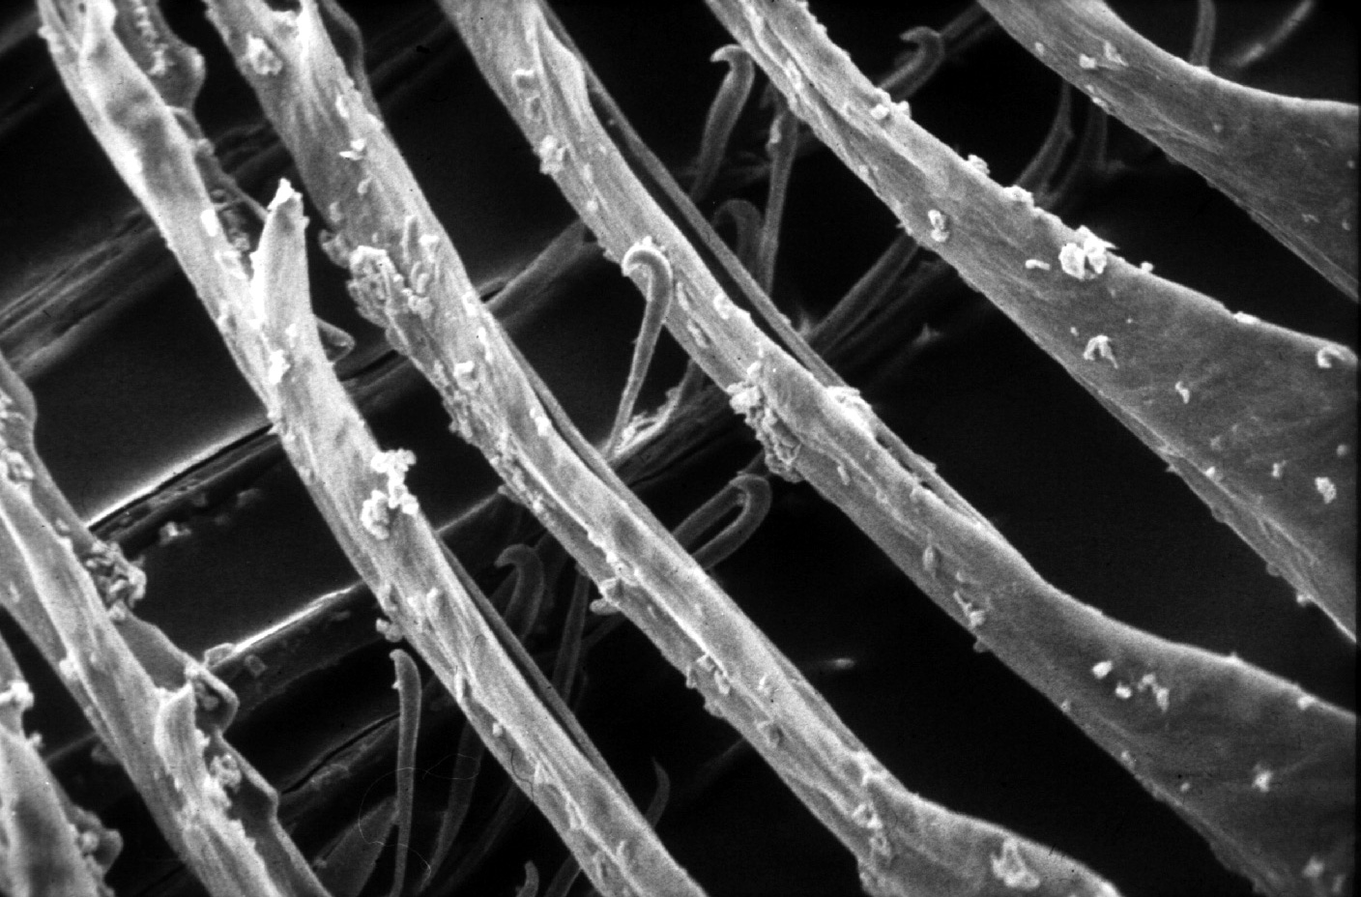
羽毛的近摄
Notes:
Picture: from Dr. David Menton

Slide 22
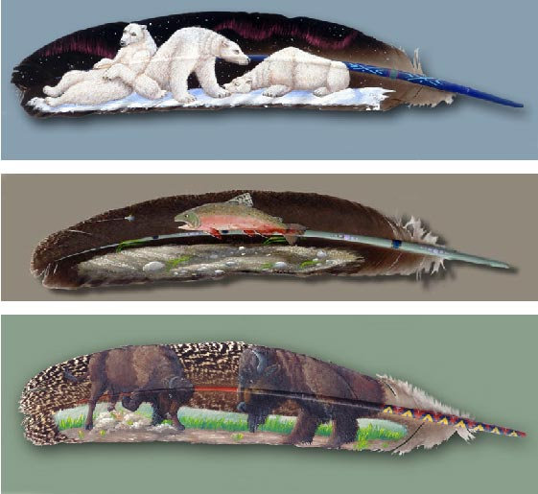
规律意外的形成?
Notes:
What evolutionist would think that the paintings on these feathers came about by time, chance and the laws of nature?
But the feather is infinitely more complex.
Artist unknown, sent to me by a friend

Slide 23
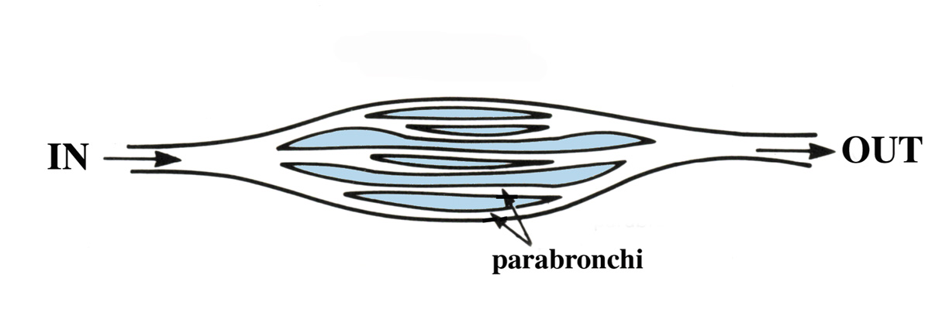
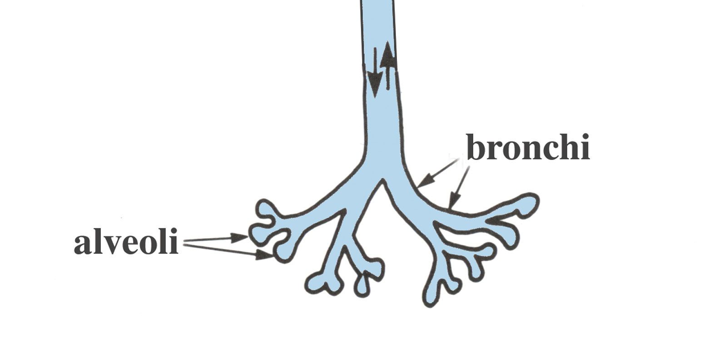
Bird vs reptile lungs
Bird lung
鸟类
的肺
进
出
段支气管
爬虫类动物的肺
支气管
肺泡
Notes:
Warm-blooded birds need about 20 times more oxygen than cold-blooded reptiles, and have a unique lung structure that allows for a high rate of gas exchange and high activity level.
Source: Michael Denton, Evolution: A Theory in Crisis, p. 210.
Denton says this: “This one-directional flow of air is maintained in breathing in and breathing out by a complex system of interconnected air sacs in the bird's body, which expand and contract in such a way as to ensure a continuous delivery of air through the parabronchi… The structure of the lung in birds, and the overall functioning of the respiratory system, are quite unique. No lung in any other vertebrate species in any way approaches the avian system. Moreover, in its essential details it is identical in birds.” (p.

Slide 24
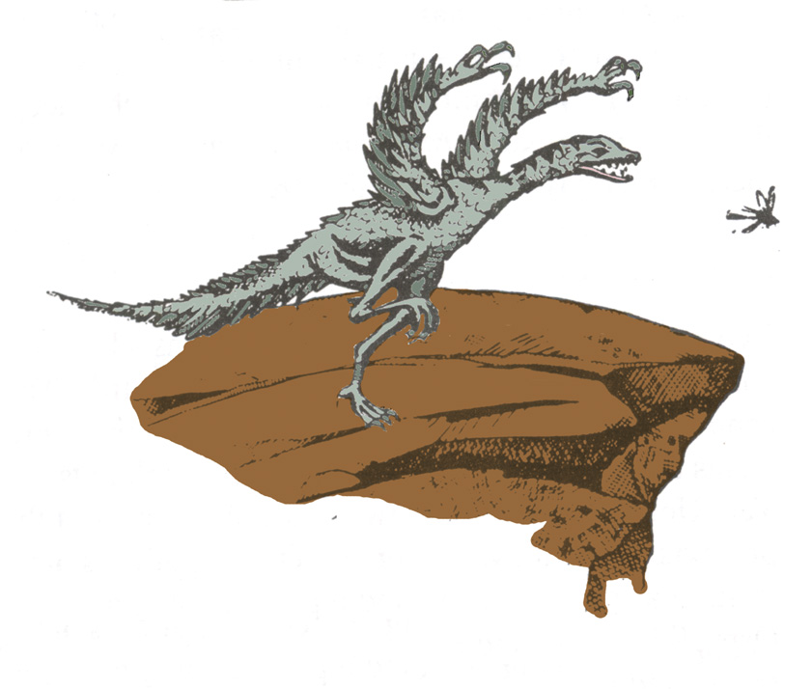
Reptile to Bird—up theory
从地面到空中的理论
Notes:
Source: Gary Parker, Creation: Facts of Life (Master Books), p. 152. This is the theory of the Dino-bird evolutionists.

Slide 25
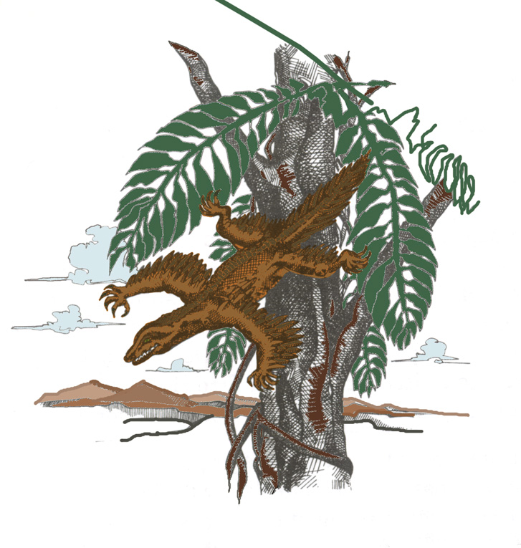
Reptile to Bird—down theory
从空中到地面的理论
Notes:
Source: Gary Parker, Creation: Facts of Life (Master Books), p. 152. This is the theory of Alan Feduccia, expert ornothologist. The proto-bird was a tree-dwelling lizard weighing a couple of pounds, which started as a glider and then evolved into a flyer. Both theories are reptile to bird.
Feduccia's reasons for rejecting the dino-bird ground-up theory (in favor of the tree-down reptile theory):
The time line is all wrong. These alleged dinosaurian ancestors of birds occur 25 million to 80 million years after Archaeopteryx, the earliest known bird.
By the time you get to dinosaurs, you are dealing with fairly large, earthbound creatures, which means they would have had to evolve flight from the ground up, rather than from the trees down. Evolving flight from the ground up is biophysically implausible.
Many of the features of birds and dinosaurs—the hands and teeth for example—don't match. The theropod dinosaur hand consists of the thumb and the next two fingers. The bird hand is made up of the middle three fingers. You can't just flip a switch to go from one type of hand to the other. Of course, it doesn't matter what line of evidence you come up with, you are automatically wrong if it is anything contrary to the dinosaurian origins of birds.
From Kathy A. Svitil, “Discover Dialogue: Ornithologist and Evolutionary Biologist Alan Feduccia, “Plucking Apart the Dino-Birds,” Discover, Vol. 24:2 (Feb. 2003), http://www.discover.com/feb_03/breakdialogue.html.

Slide 26
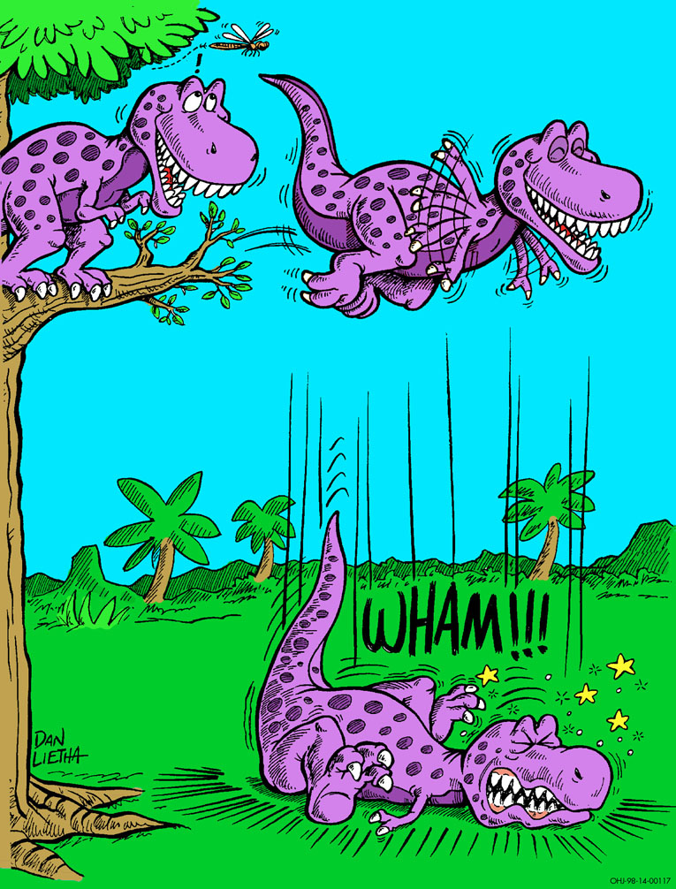
Dino learning to fly

Slide 27
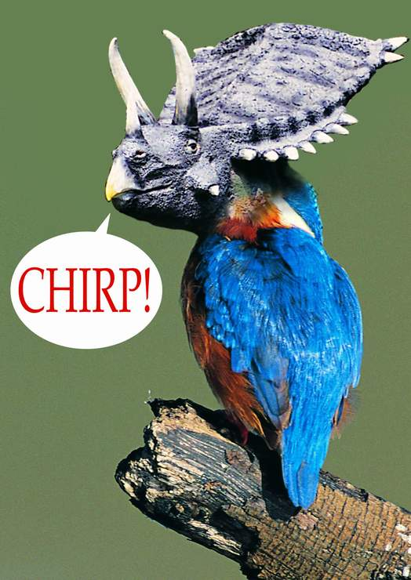
“保温”的理论
“事实上，反对所有的体温调节理论，最简单，最深刻的是：为什么羽毛吗？羽毛是极其复杂的结构和胚胎发育。“
（艾伦·费杜恰，鸟类的年龄，55页）
Brrrrr!
Tricerakeet

Slide 28
NG dino-bird fake 1999–Feathers for T Rex picture
1999
霸王龙的羽毛？
“新的鸟类化石在恐龙的进化中是个缺失的环节”。
克里斯托弗·P·斯隆，“霸王龙的羽毛”，“国家地理杂志，196:5（1999年11月），第98-107页。

Slide 29
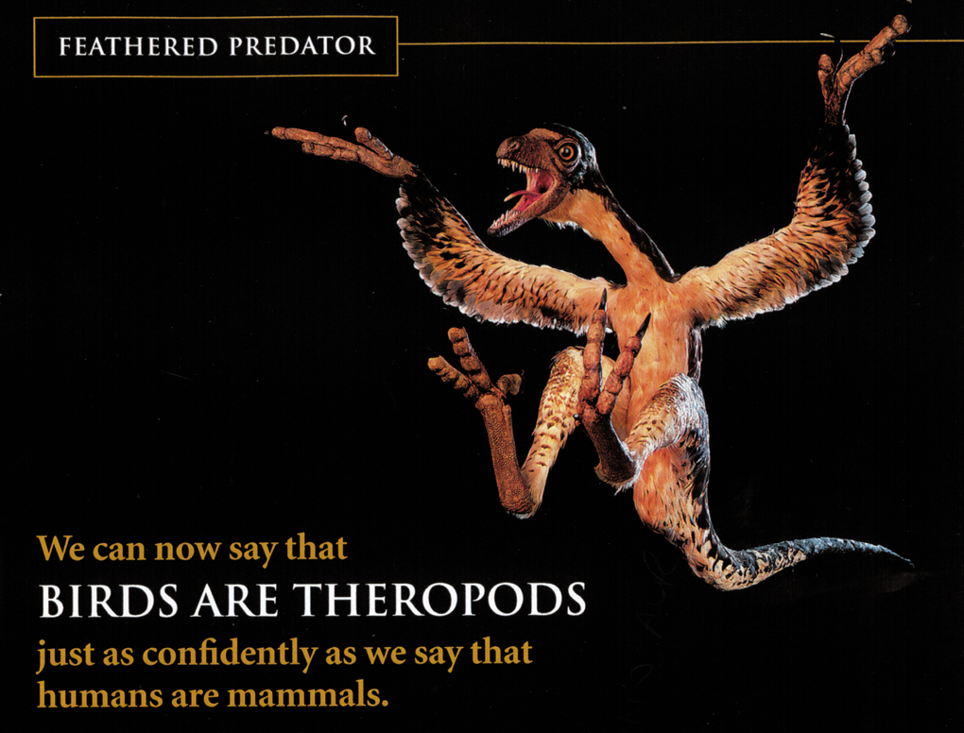
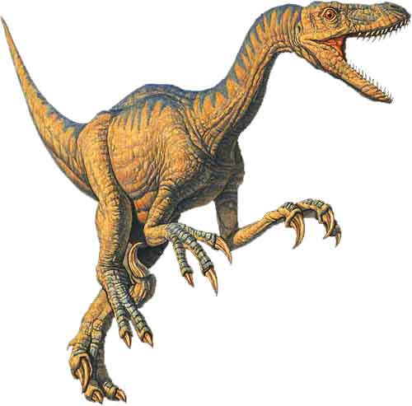
NG dino-bird fake 1999—picture Archaeoraptor
有羽毛的捕食者
Bird lung
骗局!
Archaeoraptor liaoningensis
我们现在可以说
鸟类是兽脚类恐龙
就像我们很有信心的说人类是哺乳动物
Notes:
Source: National Geographic, 196:5 (Nov. 1999), p. 105.
This picture in the article is not Archaeoraptor liaoningensis, but rather Sinorthosaurus millenii, which is another dino-bird discussed in the article very similar to Archaeoraptor L.
Therapod (velociraptor) picture: http://www.arizonaskiesmeteorites.com/Dinosaur_Fossils_For_Sale/T_rex_fossils_Tyrannosaurus_rex/Velociraptor/, accessed 1 may 2007

Slide 30
Feduccia 2003 on dino-bird fakes #1
发现（2003年2月）：
那其他有关长有羽毛恐龙的证据呢？
艾伦费杜恰：
当我们看到实际保存在标本上的羽毛时，我们需要仔细确定，我们是否在寻找不会飞却保留了羽毛而表面上像恐龙的鸟类，或其标本是否于恐龙有任何的关系。面对着假化石的存在，这是一个很难处理的问题。
Notes:
Ornithologist and evolutionary biologist at Univ. of N. Carolina in Chapel Hill.
Feduccia says that birds and dinosaurs evolved from some common reptile ancestor but that birds did not evolve from dinosaurs.
Based on his teams research, he said in 2005 that the surface patterns in supposed “dino-bird” fossils found in China are not primitive feathers but rather “bits of decomposed skin and supporting tissues that just happen to resemble feathers to a modest degree.”
See “Scientists Say No Evidence Exists That Therapod Dinosaurs Evolved Into Birds,” Science Daily, 10 Oct. 2005, http://www.sciencedaily.com/releases/2005/10/051010085411.htm, accessed 1 May 2007.

Slide 31
Feduccia 2003 on dino-bird fakes #2
发现: 到目前为止，只有一种身带羽毛的恐龙， Archaeoraptor, 已被公开承认是伪造的。 你认为还有其它的吗?
费杜恰：Archaeoraptor仅仅是冰山的一角。有许多的假化石的存在并给恐龙研究上蒙上了一层阴影。当你参观化石展时，分辨真假化石已成为及其困难的一件事。我听说有一个在中国东北地区辽宁省制造假化石的工厂。这工厂位置靠近近期发布发现所谓的有羽毛恐龙的所在地。

Slide 32
Purple blank
费杜恰继续说到:
“像自然学的学术刊物不要求标本进行验证，并在使用后立即还反中国，让人无法考证。他们可能是号称中奇迹般的发现或是缺失的环节，但这些东西都从来没有方法来验证”
史非特, 菲克史 2003年, 第 2b

Slide 33
Olson 1999 on NG dino-bird hoax
“有关有羽毛的恐龙和鸟类的兽脚类恐龙的起源正被热心的科学家，积极配合例如自然和国家地理，属于较为坦率的和充满偏见的劝诱改宗者的信念的编辑的情况下颁布。以真实和认真的科学衡量证据的方式已成为项目中的牺牲品，迅速地成为我们这个时代的最宏大的科学骗局之一 – 相等于古生物学的冷聚变。”
斯托斯奥尔森博士至给 “国家地理” 的公开信，1999年11月www.answersingenesis.org。
Notes:
Whole letter at www.answersingenesis.org/docs/4159.asp.
Olson is Curator of Birds at the National Museum of Natural History of the Smithsonian Institution.

Slide 34
爬行类动物到鸟类的进化?
羽毛的发育
改呼吸系统的进化
骨骼系统的进化 - 中空的骨头
消化系统的进化
神经系统的进化
鸟喙的形成
筑巢的技巧
学习飞行和导航
发声器官的发育和学习歌唱
恐龙和第一只飞鸟体积的缩小

Slide 35
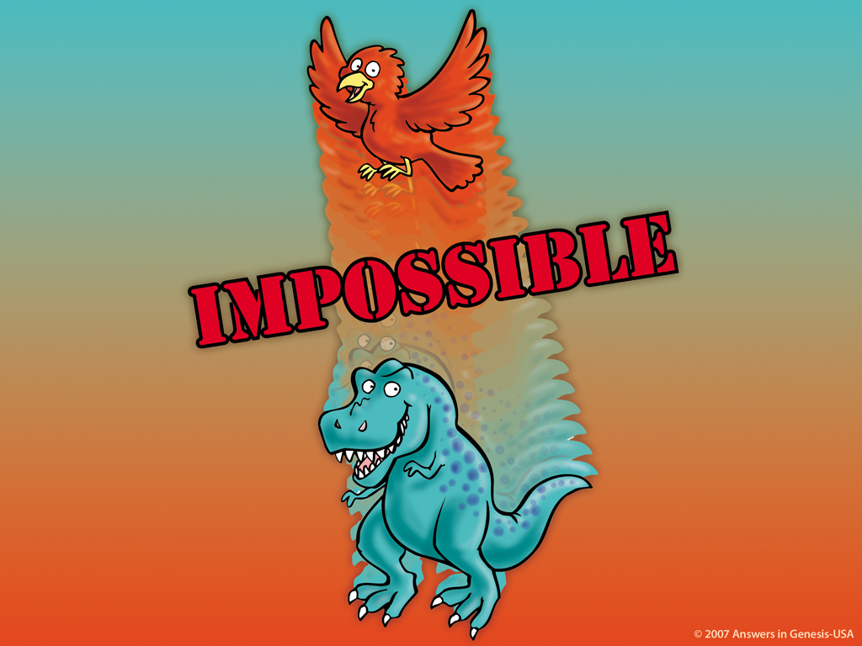
Dino to Bird Impossible 03052
不可能
Notes:
35

Slide 36

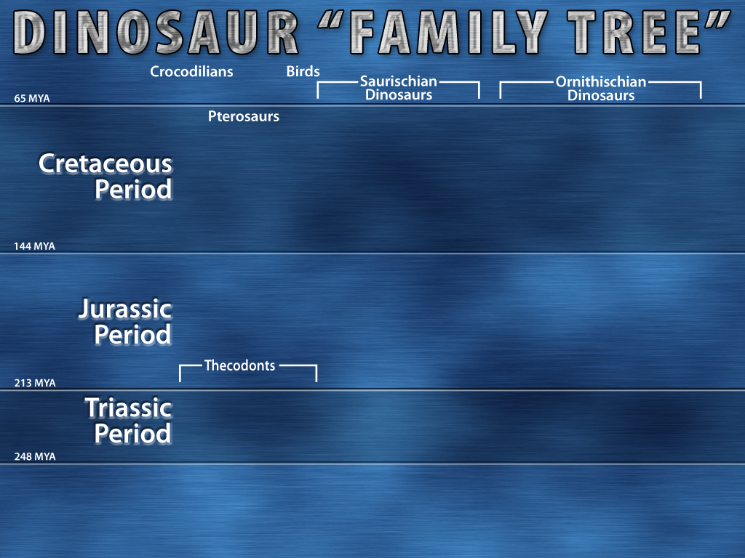
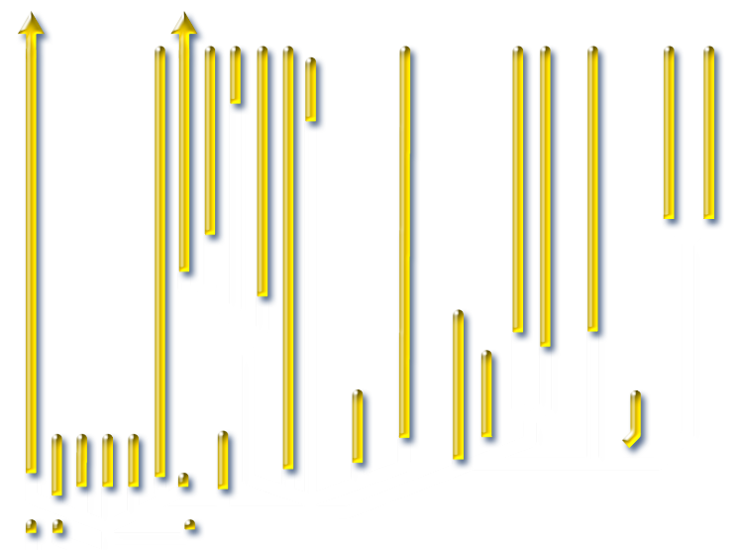
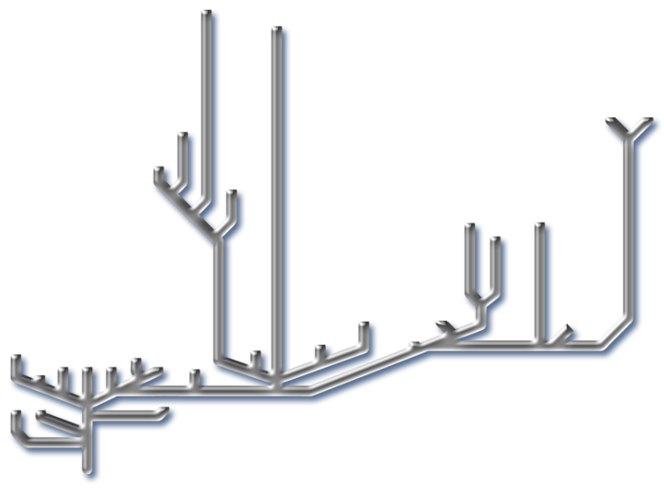
Dino Family Tree--animated
恐龙的“家谱"
鳄鱼
鸟
蜥臀目恐龙
鸟臀目恐龙
65 MYA
翼龙
白垩纪时期
144 MYA
侏罗纪时期
槽齿类
213 MYA
三叠纪时期
248 MYA
大卫兰伯特，恐龙百科全书“（伦敦的Bloomsbury，1990），26页
Ancestral
Anchosaurs
Notes:
“Thecodont ("socket-toothed" reptile), now considered an obsolete term, was formerly used to describe a diverse range of early archosaurs that first appeared in the Latest Permian and flourished until the end of the Triassic period. The group includes the ancestors of dinosaurs (including birds), and ancestors of pterosaurs, and crocodilians, as well as a number of extinct forms that did not give rise to any descendants. … Teeth were set in sockets in the jawbones; an archosaurian characteristic that was inherited by the dinosaurs. … All current vertebrate paleontology textbooks, (e.g. Michael Benton's Vertebrate Palaeontology (first ed. 1990, 2nd ed. 1997), follow the cladistic approach, and so the name Archosauria is used instead. This includes both the Thecodonts and all their descendants.” http://en.wikipedia.org/wiki/Thecodont, accessed 18 April 2008.

Slide 37
为什么恐龙最终走向灭亡呢？
“如Makovicky所说，正真的情况如是科学家本身也没真正明白［恐龙］发生了什么事。 所做的每个学术性假设都无法完整的提供解释。 恐龙的灭亡是逐步的还是突发的？由于缺乏数据，我们将无法给予相应的解释。”
米歇尔·凯勒，“想象恐龙的生活 菲尔德博物馆展示的目，”芝加哥论坛报“2007年3月28日，地铁部分，第1页。
Notes:
Peter Makovicky is curator of dinosaurs at the Chicago Field Museum.
http://www.topix.net/content/trb/1345906430078534802600492800613923403796. accessed 15 Aug. 2007.

Slide 38
Dinos fit Bible 00617
使用圣经来解释恐龙!

Slide 39





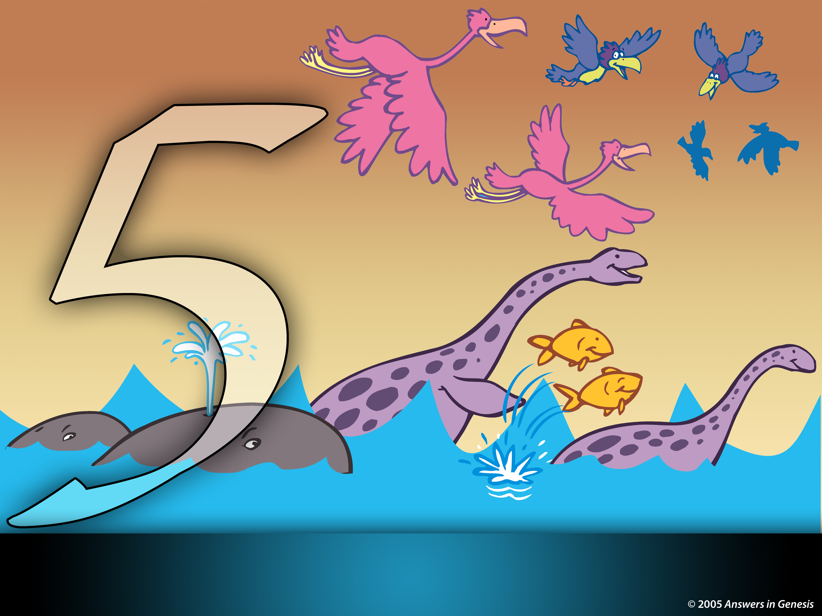
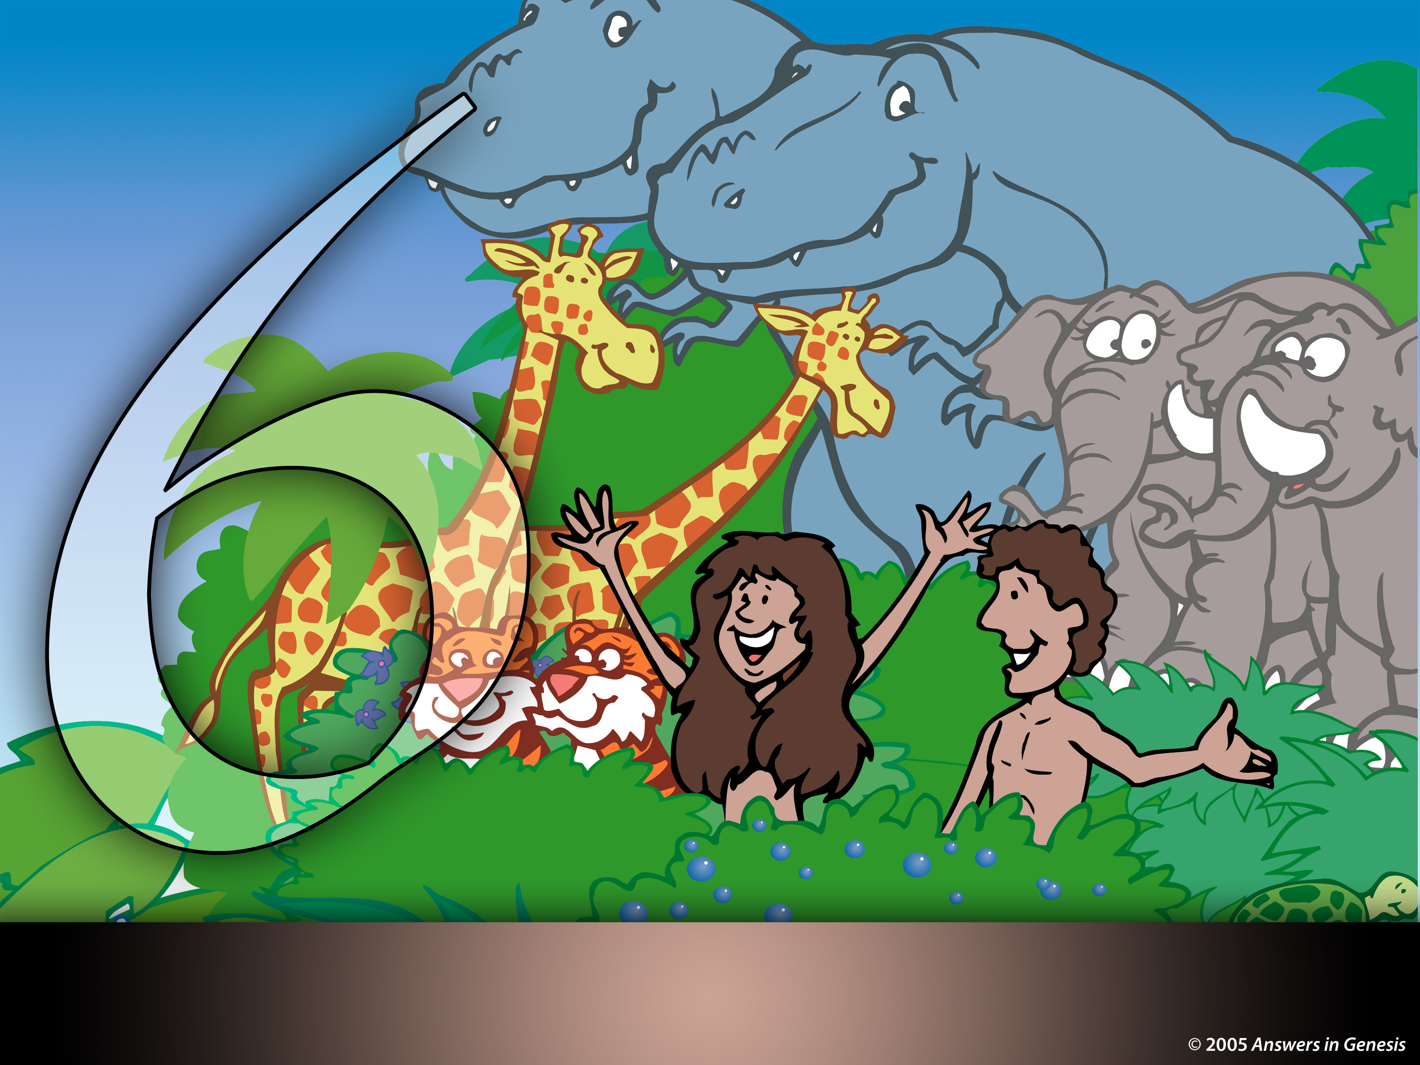
创世纪1章：神的创造
天
天
天
地球，空间，时间和光
宽阔的空间
日 土地和植物
天
天
天
太阳，月亮和星缩
飞行和海洋生物
陆地 动物和人类

Slide 40
创世纪1 = 真实的日子
1. Yom 在第5节的字面定义
2. Yom 的数值形容词
3. Yom 与“晚上” 和 “早晨”
4. Yom 在第14节的字面定义

Slide 41
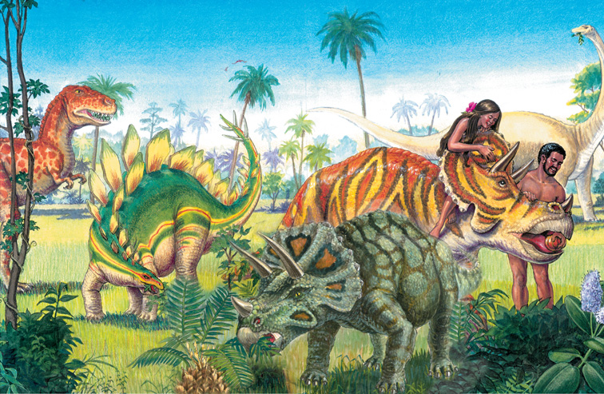
D of E – Adam & Eve in Garden w/dinos

Slide 42
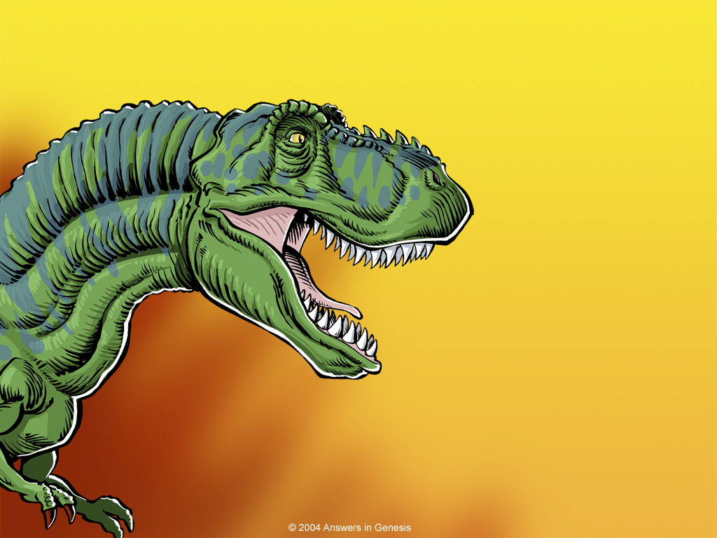
霸王龙
的牙齿有六英寸长!

Slide 43
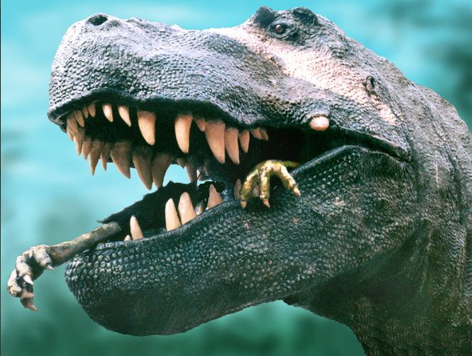
BD T rex eating feet
Notes:
Dino expert, Jack Horner (curator of paleontology at the Museum of the Rockies in Montana and technical adviser to Stephen Spielberg for the Jurassic Park films) argues that the monster's forelegs were too short, its eyes too small and its speed too slow to make it a hunter. On the other hand, like a vulture, a large part of its brain was dedicated to sensing smells and it could travel long distances. So, he concludes, it was a scavenger, not a violent predator. See http://www.msnbc.com/news/922540.asp#BODY

Slide 44
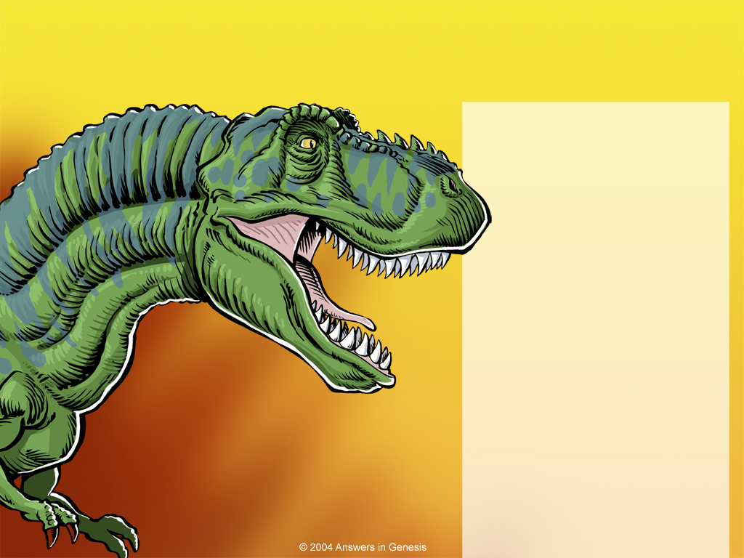
霸王龙
的牙齿有六英寸长!
这种恐龙最初将如何被描述？
食植物者
肉食者
清道夫
植物及肉食者

Slide 45

Gen. 1:29-30 NAS
创世纪 1:29-30
29. 神说，看哪，我将偏地上一切结种子的菜蔬，和一切树上所结有核的果子，全赐给你们做食物。
30. 至于地上的走兽，和空中的飞鸟并各样爬在地上有生命的物，我将青草赐给它们做食物，事就这样成了。

Slide 46

Fruit and Veggies 02245
“全赐给你们做食物”
创世纪 1:29-30
Notes:
Created: September 2005.

Slide 47
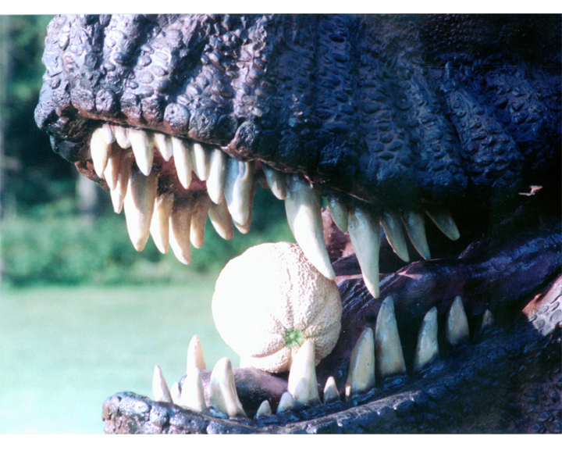
BD T rex w/melon

Slide 48
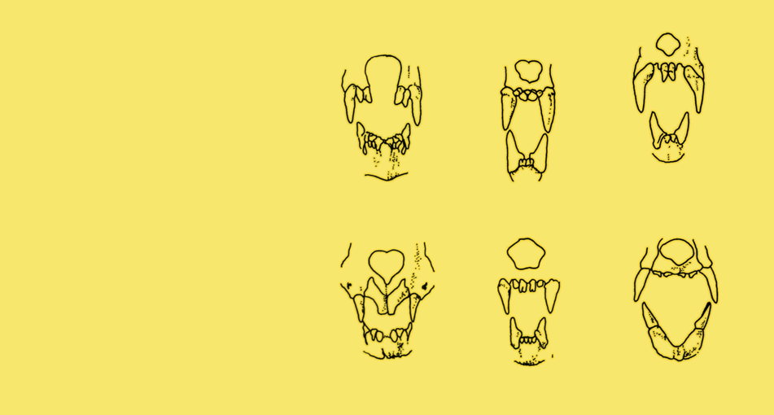
Various bat teeth
哪个蝙蝠牙齿吃小型哺乳动物?
血
鱼
水果
昆虫
花蜜和花粉
小型哺乳动物
创作，21:1（1998年12月-1999年2月），第30页
Notes:
B is the one that eats small animals
A—insects
C—fish
D—blood
E—fruit
F—nectar and pollen

Slide 49
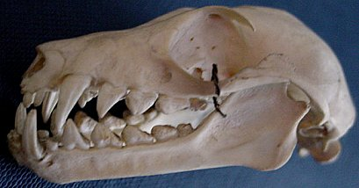
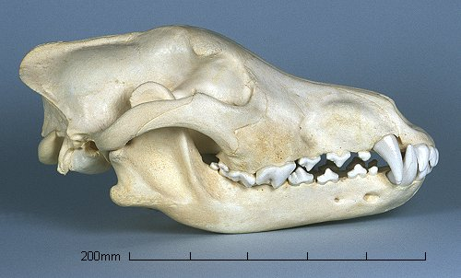
大牙齿就是肉食动物吗？
蝙蝠头骨
它吃水果
狼头骨
它吃肉
Notes:
Wolf: http://www.skullsite.co.uk/Wolf/wolf.htm, accessed 1 May 2007
Bat: http://www.hitchams.suffolk.sch.uk/skeletons/bat.htm, accessed 1 May 2007

Slide 50

Q762—bear's sharp teeth
“虽然所有熊的牙齿都能吃肉，它们的主要饮食还是植物。”
熊展示厅，塔龙加动物园（Taronga Zoo）
1999年7月，澳大利亚悉尼.
Notes:
Photo: http://www.sphoto.com/medium/panda_eating_3370_473.jpg, accessed 3 Nov 2007.

Slide 51
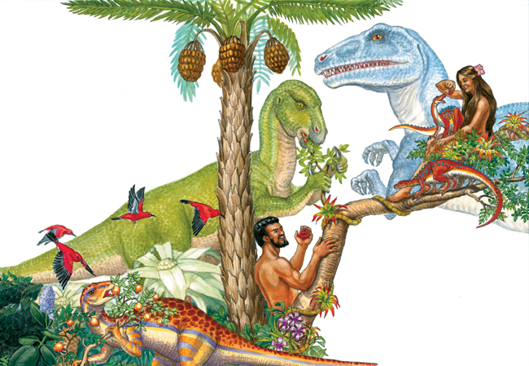
AE – dino eating fruit in Garden of Eden

Slide 52

Word Dino
为什么在圣经中找不到‘恐龙’这词？
1600
1700
1800
1900
2000

Slide 53

Word Dino
英王钦定本圣经被翻译到英文1611
1600
1700
1800
1900
2000

Slide 54
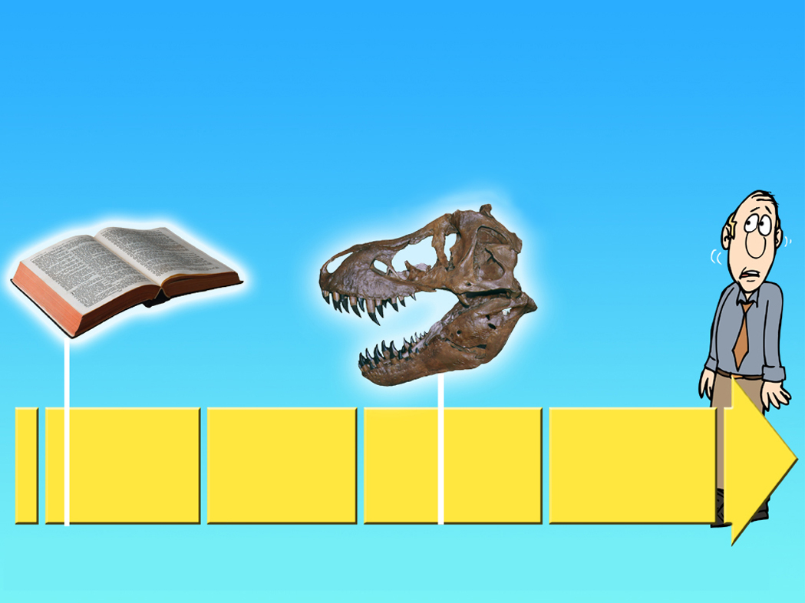
Word Dino
英王钦定本圣经被翻译到英文
1611
“恐龙”这词发明于1841
1600
1700
1800
1900
2000

Slide 55
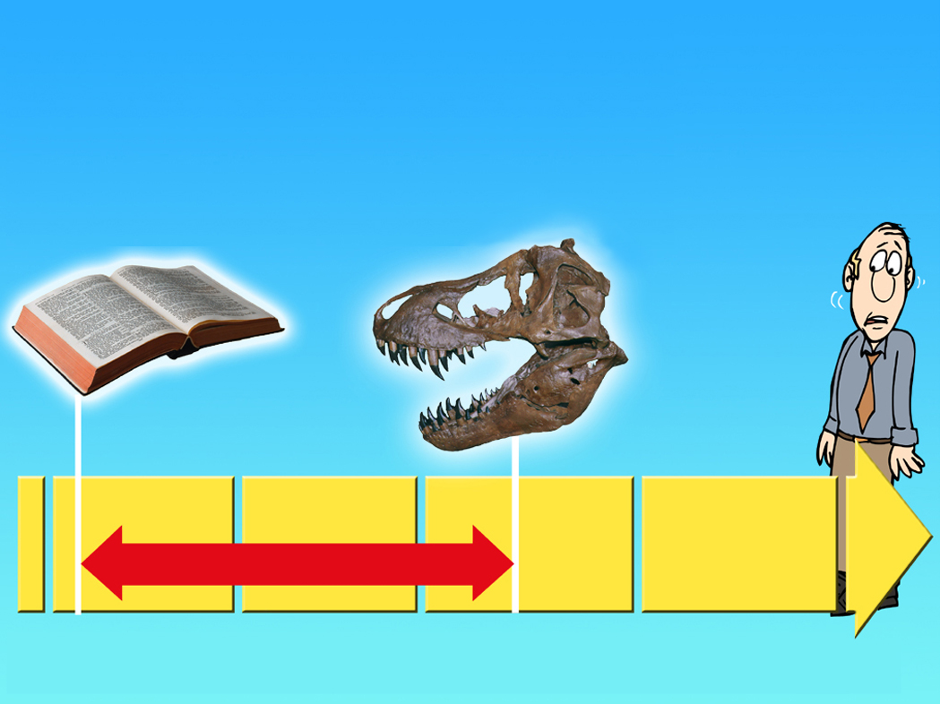
Word Dino
英王钦定本圣经被翻译到英文1611
“恐龙”这词发明于1841
230 年
1600
1700
1800
1900
2000

Slide 56
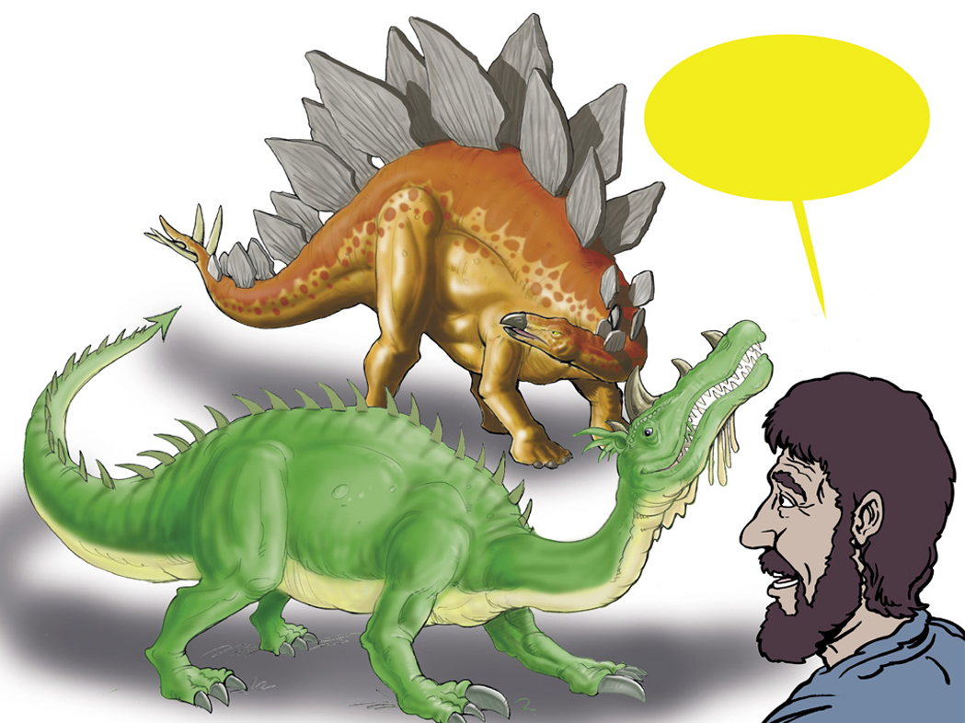
Dragon in Hebrew
希伯来文中的龙
“Tannin”
Notes:
Tannin is used of sea creatures (Isa. 27:1) and land animals (Ps. 91:13). It may be the equivalent of our “reptile” though the passages where it is used generally seem to refer to great and fearsome creatures.

Slide 57
Isaiah 27:1 NAS
以赛亚书 27:1
到 那 日 、 耶 和 華 必 用 他 剛 硬 有 力 的 大 刀 、 刑 罰 鱷 魚 、 就 是 那 快 行 的 蛇 、 刑 罰 鱷 魚 就 是 那 曲 行 的 蛇 ． 並 殺 海 中 的 大 魚 。
Notes:
“Dragon” is tannin in Hebrew.

Slide 58
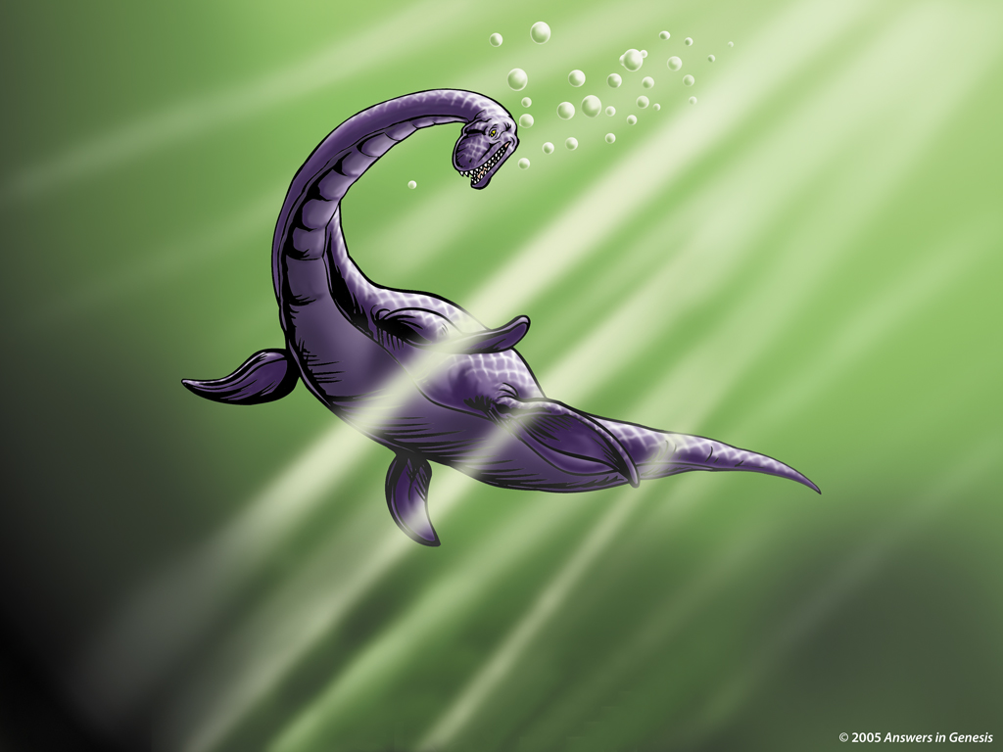

Plesiosaur 00350
蛇颈龙
Notes:
Revised: September 2005. The dinosaur's name is a separate element that can be individually animated.

Slide 59
Isaiah 30:6 NAS
以赛亚书 30:6
论 南 方 牲 畜 的 默 示 。 他 们 把 财 物 驮 在 驴 驹 的 脊 背 上 ， 将 宝 物 驮 在 骆 驼 的 肉 鞍 上 ， 经 过 艰 难 困 苦 之 地 ， 就 是 公 狮 ， 母 狮 ， 蝮 蛇 ， 火 焰 的 飞 龙 之 地 ， 往 那 不 利 于 他 们 的 民 那 里 去 。

Slide 60
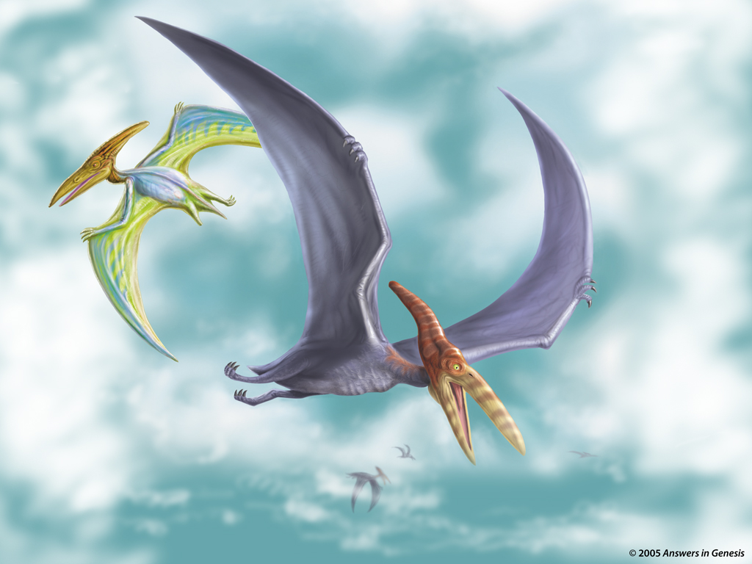
Two Pteranodons 02236
无齿翼龙
Notes:
Revised: September 2005. The dinosaur's name is a separate element that can be individually animated.
http://thescotsman.scotsman.com/index.cfm?id=1911852005 says that according to fossil evidence reported on in Sept. 2005 pterosaurs (the group that included pteranodons) could reach a size of 18m (60 ft) wingspans, the size of a medium-sized commercial plane, which was twice the size scientists previously thought.

Slide 61
Job 40:15-16 NIV
约伯记 40:15-16
你 且 观 看 河 馬 ． 我 造 你 也 造 他 ． 它 喫 草 與 牛 一 樣 。
他 的 氣 力 在 腰 間 、 能 力 在 肚 腹 的 筋 上 。
Notes:
Job 38 & 39 mention the horse, lion, eagle, deer, mountain goat, donkey, ox, ostrich and locust

Slide 62
Job 40:18-19 NIV
约伯记 40:18-19
18.他 的 骨 頭 好 像 銅 管 ． 他 的 肢 體 彷 彿 鐵 棍 。
19.他 在 神 所 造 的 物 中 為 首 …

Slide 63
Job 40:17 NIV
约伯记 40:17
他 搖 動 尾 巴 如
香 柏 樹 …
“可能是河马或大象.”
(国际版圣经)

Slide 64
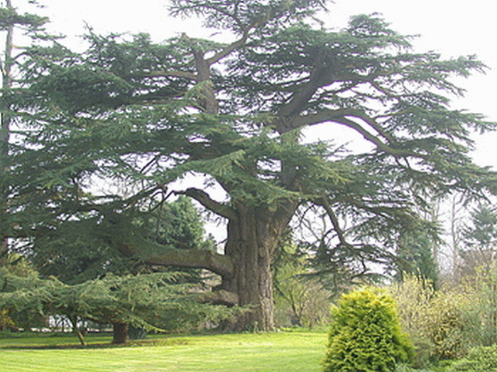
Cedars of Lebanon Cedrus libani
libani 雪松
Notes:
Cedar of Lebanon, Childrey, Oxfordshire
The cedar of Lebanon was first brought to Britain as seed by Arabic scholar, Dr Edward Pocock in 1638/ 39. He
planted this tree on his rectory lawn at Childrey in 1646 and it is believed to be the oldest cedar in Britain. The species soon became a familiar sight in the grounds of large estates as it was widely used by the 18th century landscape gardener Capability Brown.
Pic: www.treecouncil.org.uk/tws/ Great%20British%20Trees.htm (copyright unlikely to be a problem)

Slide 65




这“雪松”的尾巴适合哪个身体？

Slide 66
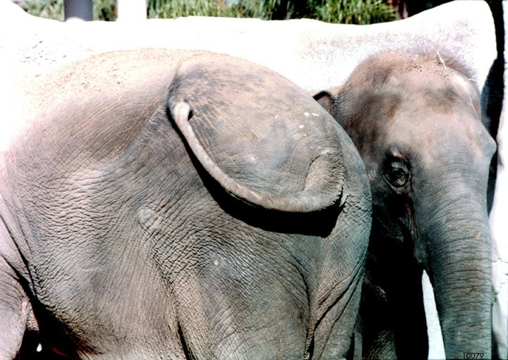
Elephant tail photo

Slide 67
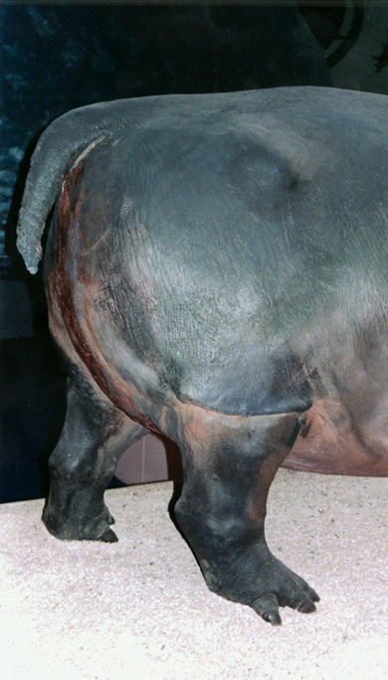
Hippo tail photo

Slide 68

Brachiosaur 00852
巨臂龙

Slide 69

恐龙发生了什么事？

Slide 70

Evolution Millions of Years + Creation 01133
｀
进化
数百万年
死亡
痛苦 疾病 流血
人的存在
神的创造
人的行为
罪
死亡
Notes:
70
Do these two views agree?
No, of course not. They are diametrically opposed to each other.

Slide 71
John 12:24 NAS
创世纪 3:14
耶 和 華 神 對 蛇 说 、 你 既 作 了 這 事 、 就 必 受 咒 詛 、 比 一 切 的 牲 畜 野 獸 更 甚 、 你 必 用 肚 子 行 走 、 終 身 喫 土 。
Notes:
The Bible only speaks of the first heaven and earth and the new ones. The gap theory would mean that there was a first, second and new—so three heavens and earths instead of only two.

Slide 72

Rom. 8:22 NAS—groaning creation 00792
我 們 知 道 一 切 受 造 之 物 、
一 同 歎 息 勞 苦 、 直 到 如 今 。
罗马书 8:22

Slide 73

Tyrannosaurus Eating
Notes:
Oh isn't this disgusting!
So nasty, even his mother didn't like him.

Slide 74

Cancer-Tumors-Arthritis
脑肿瘤
癌症
关节炎

Slide 75


A&E on bones animated
X

Slide 76

Pre-Flood violence
Notes:
Source: Gary Parker, Creation: Facts of Life (Master Books), p. 152.

Slide 77

D of E – animals entering Ark

Slide 78

Noah pushing dino in Ark

Slide 79

Noah's Ark w/football field & city block

Slide 80

人和恐龙是按照比例显示
彩光
甲板 1
45 英寸
甲板 2
75 英寸
甲板 3
450 英寸
坡道
Notes:
80

Slide 81


Small Dinosaurs
Notes:
Small dinos
Compsognathus was one of the smallest dinos (2.5 feet long and wighed only 6.5 pounds). Only two known specimens (found in Germany and France)

Slide 82

Dinosaurs Hatched From Eggs
Notes:
Protoceratops

Slide 83

Dinosaur growth pattern
迷惑龙 excelsus Growth
吨
被带上方舟
登陆
年龄 (年)
后格雷戈里米爱克生等，“恐龙增长模式和快速禽流感的增长率，” 自然412:6845（2001年7月26日），第431页，第 2图
Notes:
According to the article, the microscopic study of dinosaurs bones from most major dinosaurian clades showed that they all had similar growth patterns and all the large dinosaur kinds were like Apatosaurus above—very little growth in the first 5 years and then exponential growth in the next few years. “All dinosaurs great at rates more rapid than those of extant reptiles, but as a whole they did not show rates intermediate between reptiles and birds/mammals, nor values equivalent to the latter. Unexpectedly, our results show that growth in the Dinosauria was unique among major vertebrate groups…” (pp. 429-30).

Slide 84

Amazing Variety of Dinosaurs
惊人的各类恐龙
550属，1000余种
Notes:
A study published in 2009 by two leading paleontologists (see my WORD doc: Horner, Jack—Dinosaur species too many 2009) says due to the dramatic changes between juvenile and adult morphology, as many as 1/3 of the dinosaur species never existed. In Triceratops, for instance, the length, shape and direction of the horns and the shape of the frill changed significantly as the creatures grew.

Slide 85

Ceratopsia Chart
角龙亚目
一些例子
三角龙
牛角龙
Pentasaurus
纤角龙
准角龙
蒙大拿角龙
厚鼻龙
开角龙
始角龙
棘龙
尖角龙

Slide 86

Dog Variations 03045
不同的狗类
Notes:
“DNA mutation explains huge variety in dog sizes: study”, April 5, 2007
A single genetic mutation explains why dogs vary in size from the miniature Chihuahua to massive mastiffs, a range unmatched by any other mammal, according to a study released Thursday.
Researchers have long puzzled over the tremendous variation in size seen in canine breeds, particularly since the species diversified over a relatively short period of time from an evolutionary standpoint.
The new study suggests the riddle can be explained by a combination of a genetic accident that created a small dog and ten thousand years of selective dog-breeding that ensured the rapid dissemination of this particular piece of doggy DNA.
The researchers believe the discovery of the DNA mutation could also help explain why humans vary so much in size.
"The study is a major milestone in canine genetics. We have precisely located the major gene that produces our miniature breeds," said study co-author Paul Jones, a genetics researcher at Mars Inc, the US confectionery and pet food giant which supplied DNA samples used in the study.
All told, an international team of researchers examined the DNA of more than 3,000 dogs from 143 breeds ranging from pocket-sized pooches such as the Chihuahua, Maltese, Pomeranian, pug and Pekinese to the huge Great Dane, St. Bernard and Irish Wolfhound.
They found that all dogs under 20 pounds (9 kilos), and virtually all of the small canines studied, carried minute genetic variations on the gene IGF-1 which codes for a protein hormone called insulin-like growth factor 1.
The IGF-1 gene's hormone helps humans and other mammals grow from birth to adolescence. In small dogs, one or more mutations in the DNA next to the gene suppresses its activity, keeping small dogs from growing larger, the researchers reported in the journal Science.
The investigators found the genetic fingerprint in breeds that are distantly related and found in distant regions, suggesting that this hiccup in doggy DNA probably occurred about 12,000 years ago.
"It's as ancient as small dogs," said Gordon Lark, a biologist at the University of Utah in Salt Lake City who worked on the project.
"Dogs are derived from wolves. Since this is found in all small dogs, it either got into dogs when they were first domesticated or it was a small wolf that dogs descended from."
Over time, and under the management of humans, the species saw a rapid diversification into a multitude of domestic dog breeds. The researchers believe there was a bias toward breeding small dogs because they were easier to maintain in the crowded confines of developing cities and villages, and more easily transportable during trade and migration.
The findings have implications far beyond the canine world, the authors said. "By learning how genes control body size in dogs, we are apt to learn something about how skeletal body size is genetically programmed in humans," said Elaine Ostrander, a senior author of the study and chief of cancer genetics at the National Human Genome Research Institute (NHGRI), which is part of the National Institutes of Health.
"Nearly all of what we learn from studying body structure, behavior and disease susceptibility in dogs helps us understand some aspect of human health and biology."
Web page 2
Researchers at NHGRI led the study with help from colleagues at several US and UK institutions including Cornell University in New York, the University of California, Los Angeles, the University of Southern California in Los Angeles, and the Waltham Centre for Pet Nutrition in Leicestershire, England.
http://news.yahoo.com/s/afp/20070405/sc_afp/ussciencedogs2&printer=1;_ylt=AgwSKUvh, accessed 16 April 2007
Copyright © 2007 Agence France Presse. All rights reserved. The information contained in the AFP News report may not be published, broadcast, rewritten or redistributed without the prior written authority of Agence France Presse.
Original research in:
Nathan B. Sutter, et al, “A Single IGF1 Allele Is a Major Determinant of Small Size in Dogs,” Science, Vol. 316 (6 April 2007, pp. 112-115.

Slide 87

50 Dino Kinds 00725
只有
大约
50
恐龙
“种类"

Slide 88

Flood wave, volcano, dino GDM

Slide 89

Billions of Dead Things 00058
数十亿死亡的东西
埋在岩石层
安息水底
遍布全球

Slide 90

Paleontologists digging large dino fossil
Notes:
From Baumgardner slide—Dinosaur National Monument photo

Slide 91

Dino skin fossil
恐龙皮肤化石
Notes:
Fossilized skin of dinosaur 'Minmi', Queensland. (Photo by Lorraine Walker)
Creation 24:3 (June 2002), p. 7.

Slide 92

Template Suite 1-Special 01361
它们何时灭绝？
Notes:
This is for special needs such as section titles, special messages, very short quotations, and such. This is best suited for center-aligned text. Reposition your frame to be center-center when needed. Presentation Team recommends around 48 pt. Myriad Pro Bold for use on this template. This also contains a floating AiG logo that can be repositioned or removed as appropriate for the overhead's content.

Slide 93

Wollemi Pine
活化石
Wollemi 松
“1亿5千万年前灭年绝”
1994年再次被发现还存活着
Notes:
Supposedly went extinct 150 million years ago (Jurassic period—age of Dinosaurs) but found alive and healthy in 1994 in Wollemi National Park 200 km (125 mi) northwest of Sydney, Australia, and virtually identical to the fossil form found about 100 km (62 miles) away. Soon they will growing in gardens all over the world.
Wollemi pines are now well known to have the capacity to re-sprout after a catastrophe. New trunks can grow from old roots that may be 1000s of years old.
See Andrew Snelling's ICR Impact article, No. 394 (April 2006), at www.ICR.org.
Photo from Ken Ham 27 Mar 2008

Slide 94

Schweitzer 1993—T-Rex blood cells
“新鲜”霸王龙骨骼?
“看起来就有如一块新鲜的骨骼.
当然我无法相信。我对实验室技术人员说：“骨头，毕竟，有6500万年的历史。血细胞哪有可能能活那么久吗?'”
1993
--玛丽·施魏策尔
弗吉尼亚莫雷尔，“恐龙DNA：寻找和炒作，” 科学261（1993年7月9日），第160页。
Notes:
1993 Schweitzer-- grad student at Montana St. Univ. Museum of the Rockies, discovery--early 1992.
2005 Schweitzer --professor at U of N. Carolina, Chapel Hill.
David DeWitt explains: “Conventional wisdom held that proteins and DNA could not survive for millions of years. Indeed, an upper limit to the preservation of a stable protein such as collagen was presumed to be about 2.7 million years at 0°C, 180,000 years at 10°C, and only 15,000 years at 20°C.(1) Thus, there was much skepticism that what Schweitzer found was really dinosaur soft tissue when it was initially reported. Secular scientists were hesitant to believe that such tissue and proteins could persist for more than 65 million years.”
(1): Nielsen-Marsh, C., Biomolecules in fossil remains: A multidisciplinary approach to endurance, The Biochemist June 2002 pages 12–14, http://www.biochemist.org/bio/02403/0012/024030012.pdf. Quoted from DeWitt's article: http://www.answersingenesis.org/articles/2007/04/13/t-rex-big-chicken#fnList_1_5, “Tyrannosaurus rex: a big chicken?”, 13 April 2007.
Picture from http://www.meas.ncsu.edu/faculty/schweitzer/schweitzer.htm, downloaded 29 March 2005.

Slide 95

Schweitzer 2005—T-Rex soft tissue #1, Q1018
寻获霸王龙的软组织
组织片段（左）是“柔性和弹性，并拉伸时（箭头），返回到其原来的形状”。骨区域（右）显示秀纤维字符，“通常不会在化石骨中看到”。
玛丽·施魏策尔，等，“霸王龙的软组织管和细胞的保存”科学杂志307:5717（2005年3月25日），第1952至1955页。
2005
Notes:
By 2005 Schweitzer was professor at U of N. Carolina, Chapel Hill.

Slide 96

Schweitzer 2005—T-Rex soft tissue #1, Q1019
暴龙软组织提出了诱人的前景
来自:
玛丽·施魏策尔
“溶解的霸王龙骨骼取得了灵活，分支血管（左），其中含有一些细胞样结构（右）。”
伊丽莎白 潘睨施，“暴龙软组织提出了诱人的前景，”科学307：5718（2005年3月25日），第1852至1853页。
Notes:
This research has been further confirmed by Schweitzer and her colleagues by studying hadrosaur bones that show evidence of having been buried rapidly in a deep deposit of sandstone in the Judith River formation in Montana. See summary of the May 2009 Science article in “Proteins, Soft Tissue from 80 Million-Year-Old Hadrosaur Add Weight to Theory that Molecules Preserve Over Time,” http://www.physorg.com/news160320581.html, 30 April 2009, accessed 3 Aug. 2009

Slide 97

Chinese Dragon
几乎每一种文化都有龙的传说。
加拿大儿童博物馆
Notes:
Dragons do not look like any living animal, but they do look remarkably similar to dinosaurs.

Slide 98

Flag Wales
威尔士的旗标

Slide 99

‘Yarru’— 昆士兰北部
由原住民艺术家绘制
Notes:
The animal had swallowed a girl. Yarru is said to have lived in waterholes.
The drawing was made by an Aborigine tribal artist who had very little formal education and drew the picture based on the verbal description in the tribal stories. None of the Aborigines of the tribal knew about plesiosaurs or what they looked like, on the basis of others teaching them or showing them pictures of fossils.
Creation magazine 21:1 (Dec. 1998-Feb. 1999), pp. 24-27.
Source of the information: Dennis Fields, former missionary to the Kuku Yalanji people in the rainforest region of far north Queensland.

Slide 100

Carlisle Cathedral engraving
贝尔主教（卒于1496年）坟墓上的黄铜板，在英国卡莱尔大教堂的地板
Notes:
Also has leaves and hunting dogs engraved on the brass plate.

Slide 101
Q 606 Barnes—rock art
“在天然桥国家纪念碑有一个岩石雕刻，有着于恐龙惊人的相似度，有着一条长长的尾巴和脖子，小脑袋等，尤其是雷龙”
弗兰·巴恩斯（权威西南地区的岩石艺术）“在石头上的消息”创造无中生有 19:2版，第23页

Slide 102

Petroglyph – sauropod single frame
刻在岩石上的文字
Notes:
Natural Bridges National Monument is a located about 50 miles (80 km) northwest of the Four Corners boundary of southeast Utah, at the junction of White Canyon and Armstrong Canyon, part of the Colorado River drainage. It features the second and fourth largest natural bridges in the world, carved from the white Permian sandstone of the Cedar Mesa Formation.

Slide 103

Petroglyph - rubbing

Slide 104


900年前的恐龙
吴哥寺，柬埔寨
12世纪的高棉文明遗址
Notes:
12th century bas-relief picture of a dinosaur in the ruins of Angkor outside of Siem Reap, Cambodia. The ruins of Angkor Thom have purposely not been restored, though other ruins of thise ancient Khmer kingdom (9th--12th century) have been restored. The original edifices of Angkor Thom were constructed during the latter end of the kingdom. The most significant of the buildings of Angkor Thom is the great temple-monastery of Ta Prohm.
On the side of the west entrance to the temple are stone carvings of various common animals—pigs, monkeys, water buffaloes, roosters, snakes—and what appears to be a dinosaur! There are no mythological figures among them, so one can reasonably conclude that these figures depict the animals that were commonly seen by the ancient Khmer people in the twelfth century. Some have question the authenticity of the relief.
http://www.answersingenesis.org/docs2007/0115angkor.asp for pictures and info.
Inset photo and info: http://www.unexplainedearth.com/angkor.php, accessed 15 Sept 2007,
Further documentation of the authenticity of this from a different investigator is here: http://www.bible.ca/tracks/tracks-cambodia.htm, accessed 11 Aug. 2008

Slide 105

Wollemi Pine
活化石
Wollemi 松
"The discovery of the Wollemi Pine is the equivalent of finding a small dinosaur still alive on earth"
Professor Carrick Chambers
Royal Botanical Gardens, Sydney, 1994
“1亿5千万年前灭年绝”
1994年再次被发现还存活着
Notes:
Supposedly went extinct 150 million years ago (Jurassic period—age of Dinosaurs) but found alive and healthy in 1994 in Wollemi National Park 200 km (125 mi) northwest of Sydney, Australia, and virtually identical to the fossil form found about 100 km (62 miles) away. Soon they will growing in gardens all over the world.
Wollemi pines are now well known to have the capacity to re-sprout after a catastrophe. New trunks can grow from old roots that may be 1000s of years old.
See Andrew Snelling's ICR Impact article, No. 394 (April 2006), at www.ICR.org.
Photo from Ken Ham 27 Mar 2008

Slide 106

War of the World 1 00041
圣经在这属于科学的时代是不可信的。
圣经
圣经

Slide 107

War of the World 2 00042
世界
进化
年龄测定方法
猿男人
数百万年
圣经
没有全球性的洪水

Slide 108
Dinosaurs & Kids - 6
而这仅仅是开始！

Slide 109

侏罗纪公园
Notes:
http://www.dinosoria.com/diapo_jurassic/images/jurassic_park019(1)_jpg.jpg

Slide 110





Turning “Jews” into “Greeks” 02027
将上教堂的孩子变成持有怀疑态度的人
相信圣经
进化论
世俗
媒体和
教育
Notes:
110
After book sales and before final statements:
“Parents and grandparents, Your kids and grandkids are being indoctrinate with evolution and millions of years a whole lot more than you were when you were in school. Can they stand strong in their faith in the face of this relentless challenge? Do you care? If you walk out of here and say “That was a nice message, I believe Genesis” but don't get any resources for your kids and grandkids and make sure that they believe Genesis and know how to defend their faith, then you don't care enough. And when they crumble under the intellectual pressure, you will be partly responsible for not equipping them with answers.

Slide 111







Fish Emblem Battle-Progression 01588
的战斗
为您
汽车保险杠的
Notes:
Each of these emblems are independent elements that can be individually animated.

Slide 112


Bumper stickers: Darwin and Christianity
给中立的“基督徒”
Notes:
Top bumper sticker: http://bumperstickers.cafepress.com/item/christiandarwin-fish-sticker-rectangular/36975131, accessed 17 Sept 2009.
Bottom sticker: http://bumperstickers.cafepress.com/item/there-is-no-controversy-bumper-sticker/34003364.
This is a store that sells bumper stickers and t-shirts.

Slide 113

War of the World 3 00043
我想了解教会在这方面能做点什么！
圣经
圣经

Slide 114

War of the World 4 00044
教会
相信耶稣
圣经
圣经

Slide 115

AiG web site #1
www.ScienceAndApologetics.org

Slide 116

创新博物馆
俄亥俄州辛辛那提市

Slide 117

主堂

Slide 118

恐龙坛

Slide 119

Dino Missionary Lizards!
恐龙 …
传教的蜥蜴！

Slide 120

Gospel Message
福音的信息
死亡
罪

Slide 121
Dinos fit Bible 00617
使用圣经来解释恐龙!
无夏季前的死亡
千百年来
恐龙和人在第6天
原本都是素食主义者
诺亚的洪水化石

Slide 122

Cross With roots
创世纪
Notes:
Revised: November 2003.

Slide 123
Black blank------------extras
终

Slide 124

Template Suite 1-Special 01361
它们为什么会灭绝？
Notes:
This is for special needs such as section titles, special messages, very short quotations, and such. This is best suited for center-aligned text. Reposition your frame to be center-center when needed. Presentation Team recommends around 48 pt. Myriad Pro Bold for use on this template. This also contains a floating AiG logo that can be repositioned or removed as appropriate for the overhead's content.

Slide 125
可能的灭亡原因
人类过渡的捕猎
人类摧毁了它们的栖息地
人类带入的疾病
在洪水后的世界气候快速变化。
但它们未必已灭绝 – 还记得腔棘鱼

Slide 126

在完全发育后，体积还比一只鸡小
2009: “在北美最小的恐龙”
Notes:
At full growth, smaller than a chicken.
Given a separate species name, though it may be a juvenile of larger dinosaur.
“Tiniest Dinosaur in North America Found,” 22 Oct 2009, http://news.nationalgeographic.com/news/2009/10/091021-tiniest-dinosaur-north-america-picture.html, accessed 22 Oct 2009.

Slide 127
Black blank------------extras
终结

Slide 128


創造链接地址 BibleStudyDownloads.org
免费获得该讲解!
圣经学习下载
Notes:
The explanation for free!
Creation link address

