Slide 1
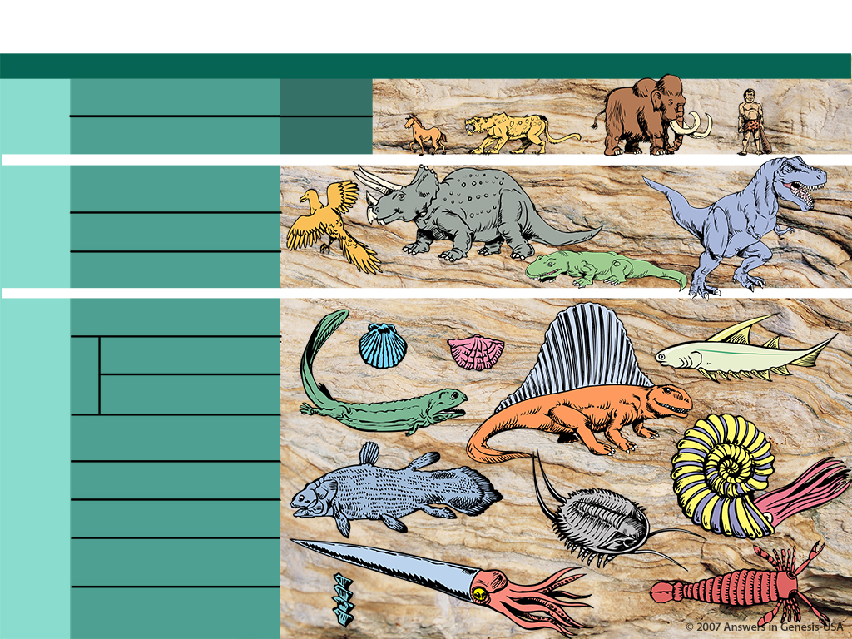
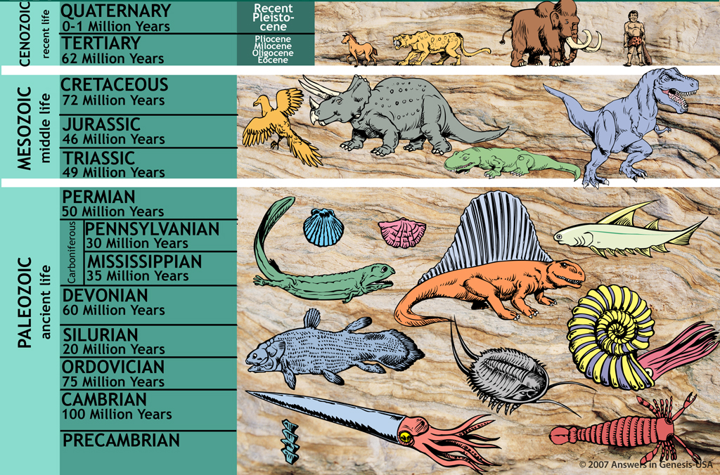
地质时间尺度
地质时间尺度
时代 时期 时代 一连串的生活
1.9—3.8亿年：
从单细胞到人类
新生代
（近代的生活）
第四纪 （0至一百万年）
更新世
第三纪 （62百万年）
上新世
中新世
渐新世
始新世
中生代
（中代的生活）
早白垩世 （72百万年）
侏罗纪 （46百万年）
数百万年:
这个理论从哪里来?
三叠纪 （49百万年）
古生
（古代的生活）
二叠纪 （50百万年）
宾夕法尼亚纪 （50百万年）
石炭系
密西西比纪 （35百万年）
泥盆系 （60百万年）
按照进化论
志留纪 （20百万年）
奥陶系 （75百万年）
寒武纪 （100百万年）
Designed by Dr. Terry Mortenson
Dr. Rick Griffith • 博士 • 新加坡神学院 • BibleStudyDownloads.org
寒武纪前

Slide 2


Template Suite 1-Title 01359
Dr. Terry Mortenson
苔莉莫滕松博士
数百万年:
这个理论从哪里来?
创世记答案机构

Slide 3

AiG web site #1
相信真理。 辩护真理。 传扬真理。

Slide 4
地质时间尺度
地质时间尺度
时代 时期 时代 一连串的生活
1.9—3.8亿年：
从单细胞到人类
新生代
（近代的生活）
第四纪 （0至一百万年）
更新世
第三纪 （62百万年）
上新世
中新世
渐新世
始新世
中生代
（中代的生活）
早白垩世 （72百万年）
侏罗纪 （46百万年）
三叠纪 （49百万年）
古生
（古代的生活）
二叠纪 （50百万年）
宾夕法尼亚纪 （50百万年）
石炭系
密西西比纪 （35百万年）
泥盆系 （60百万年）
志留纪 （20百万年）
按照进化论
奥陶系 （75百万年）
寒武纪 （100百万年）
寒武纪前

Slide 5

2 Corinthians 10:4-5 NAS
2 哥林多后书 10:4-5
4 因为我们争战所用的兵器不是属肉体的，而是有属神的能力，可以拆毁堡垒——拆毁各样的心思，
5 拆毁所有为抵挡神的知识而树立起来的高墙；又虏获各样的心意，达到属基督的顺从；

Slide 6
Col. 2:8 NAS
歌罗西书 2:8
你们要当心，免得有人用哲学和虚空的妄言把你们掳去；那些是出于人的传统，出于世界的原则，而不是出于基督。

Slide 7

Operation vs Origin science
操作科学
vs
起源科学
Notes:
As a content template, this is best suited for standard content such as outlines, quotations, Scriptures, and maybe illustrations or photos. Presentation Team recommends 48–60 pt. font for headings and 28–40 pt. for body text. Because of eye flow and visual psychology, the top line may be a little closer than all other sides. This also contains a floating AiG logo that can be repositioned or removed as appropriate for the overhead's content.

Slide 8
Operation science defined
操作科学
“科学方法”
在受控环境中运用能观察的，可重复的实验来发现经在目前的物理宇宙常性的行为模式。

Slide 9

Observational Science 01160
实验科学

Slide 10
Origin science defined
起源科学
使用可靠目击者的证词（如果可得到），证据和旁证，以确定过去一些不可观察，一次性事件的原因。
“法定-历史方法”

Slide 11

Historical Science painter 01159
历史性
科学

Slide 12

Car—origin vs operation
汽车修理工
(操作科学)
汽车制造商
(起源科学家)

Slide 13
New Theories of earth history
1770-1830
地球史的新理论

Slide 14
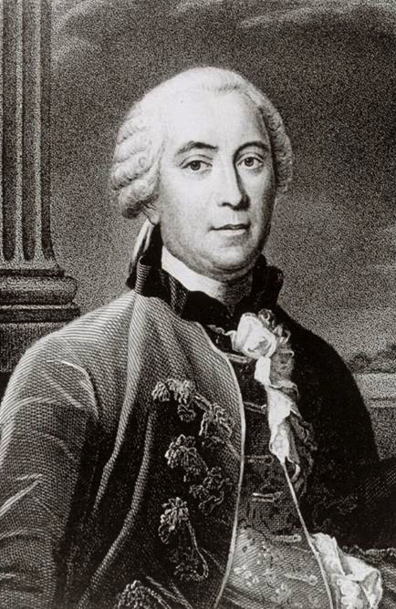

Purple blank
布冯
(1707-1788)
博物家
自然的时代
(1778)
Notes:
Source: Ian Taylor
Wide-ranging scientist with writings in mathematics, zoology, botany, astronomy and physics
Based on cooling experiments with various metal balls he estimated that the earth was about 75,000 years old. But based on his limited knowledge of sedimentary rocks he estimated as long as 3 million years for the formation of the earth (the latter figure was only in his manuscript—the published version of the book had the lower number). Though he attempted to say that his seven epochs of earth history could be seven figurative days of creation, his views were not even acceptable to the Catholic authorities in France, who forced him to recant in writing everything in his works that contradicted the Biblical account of creation.
He believed that a comet slammed into the sun breaking off material that became the planets. Part of the early earth broke off to become our moon. He believed in spontaneous generation of the first forms of life.
Comparing a metal ball to the earth to estimate age is like comparing bananas to alligators. Both are long and narrow. A banana reaches its full size in about 3**** months and since the alligator is about 25**** times longer than a banana it must take 12.5**** years for the alligator to reach full size. In fact, it takes ******

Slide 15
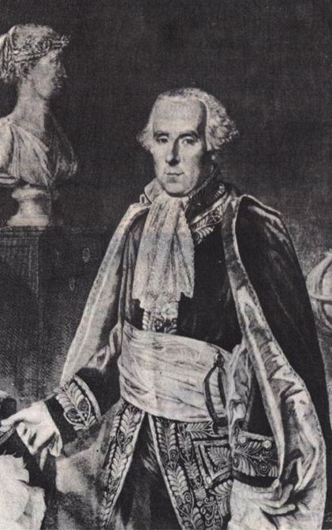
Purple blank
皮埃尔 拉普拉斯
(1749-1827)
天文学家
曝光宇宙的系统(1796)
Notes:
Source: The Historical Perspective (Milton Keynes: Open University Press, 1973), p. 51.

Slide 16
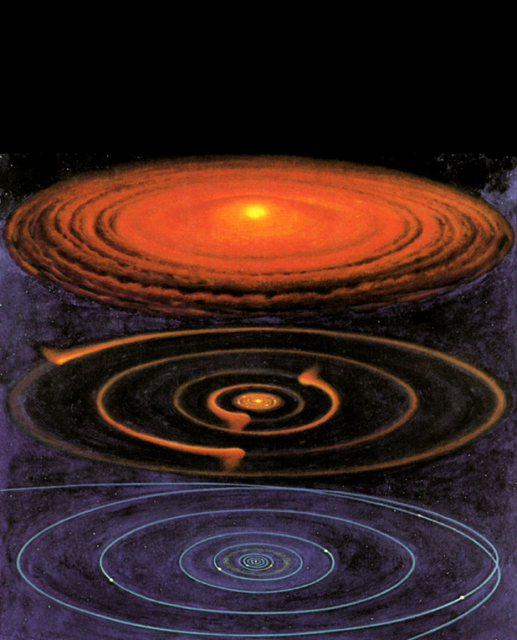
Nebular hypothesis
星云臆测
Notes:
Picture from Roy A. Gallant, National Geographic Picture Atlas of Our Universe (Wash. DC: National Geographic Society, 1986), p. 38. Similar to the diagram in Robert A. Wallace, Jack L. King and Gerald P. Sanders, Biology: the Science of Life (Glenview, IL: Scott, Foresman & Co., 1986), p. 426.

Slide 17
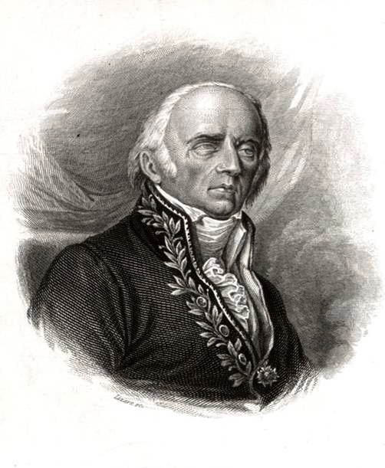
Purple blank
吉恩·拉马克
(1744-1829)
博物家
动物学哲学 (1809)
Notes:
Source: Ian Taylor

Slide 18
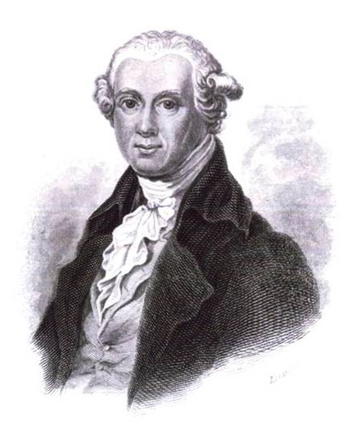
Purple blank
亚伯拉罕·沃纳 (1749-1817)
矿物学教授
各种岩石的短分类和说明
(1786)
Notes:
Source: Ian Taylor
Werner was very kind and helpful to his students but extremely dogmatic about this speculative theory of the earth. As such he had an enormous impact on his students, who swallowed his theory.
This book, based on very little observation, presented his theory of the earth of a slowly receding global ocean over a million years to explain the strata.

Slide 19
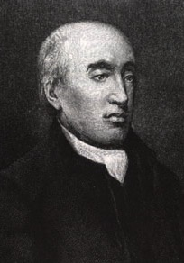
Purple blank
詹姆斯·赫顿(1726-1797)
医生，
农学家，地质学家
地球理论
(1788, 1795)
Notes:
Source: unknown
Hutton's theory written in incomprehensible English was “translated” by John Playfair (mathematician at Univ. of Edinburgh) in Illustrations of the Huttonian Theory of the Earth (Edinburgh, 1802)

Slide 20
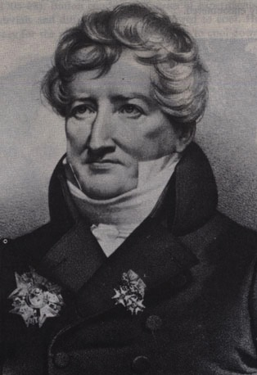
Purple blank
乔治 居维叶 (1769-1832)
比较解剖学家，
古生物学家
地球理论
(1812)
Notes:
Source: The Historical Perspective (Milton Keynes: Open University Press, 1973), p. 68.
He believed multiple local or regional catastrophes. All the animals were not killed in these events and creatures migrated in after the events to repopulate the flooded areas.

Slide 21
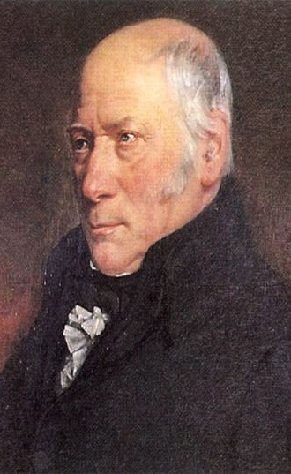
Purple blank
威廉·史密斯(1769-1839)
引流工程师，
测量师，地质学家
“英语地层学之父”
Notes:
Source: The Age of the Earth (London: Institute of Geological Sciences), p. 8. He was very involved in road work and discovered fossils on the way. He compared fossils from different places to estimate their age based on the rock layer.

Slide 22
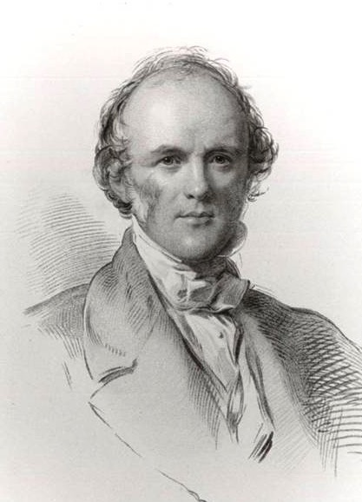
Purple blank
查尔斯·莱尔(1797-1875)
律师，
地质学家
地质学原理
(三卷, 1830-33)
Notes:
He invented the theory of uniformitarianism that taught the age of the earth by assuming that the present erosion rate has always been the same in the past.
Source: Ian Taylor

Slide 23

Old-earth theories (1778-1833)
旧地球理论 (1778-1833)
布冯:
拉普拉斯:
拉马克:
沃纳:
赫顿:
居维叶:
史密斯:
莱尔:
冷却地球，75,000岁
星云臆测，长年龄
生物的进化，长年龄
后退海洋，1亿年
均变，没有开始
灾异，长年龄
化石日期岩，长年龄
均变，长年龄
Notes:
Buffon's private notes indicate that he thought the earth was actually about a million years old, but he never published this as the Catholic Church already felt his 75,000 year estimate to be in conflict with Scripture.

Slide 24
Early 19C views of earth history new
地球史19世纪初观点
灾异观点 (居维叶, 史密斯 等)
SB
C
C
C
C
P
(亿等年)
均变观点 (赫顿, 莱尔 等)
SB?
P
(亿等年)
圣经／保守传统观点 (圣经地质学家)
SCW
F
P
(这一点起6000年)
Notes:
SB = 超自然的开始
C = 特大洪水
P = 现在
SCW = 超自然创造周
F = 诺亚的大洪水

Slide 25
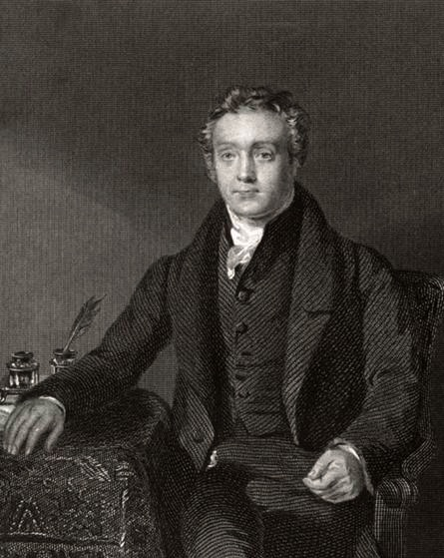
Purple blank
托马斯·查默斯(1780-1847)
长老会牧师
和博物学家
间隙理论
Notes:
Source: Ian Taylor

Slide 26
Purple blank
乔治·斯坦利 法贝尔
(1773-1854)
圣公会神学家
日代理论

Slide 27
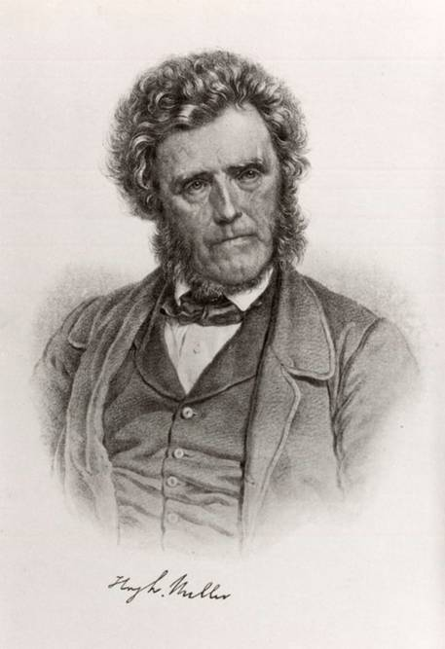
Purple blank
休·米勒 (1802-1856)
地质学家
间隙理论
后来 日代理论
Notes:
Just before his death by suicide, he switched to the Day-Age Theory
Source: Ian Taylor

Slide 28
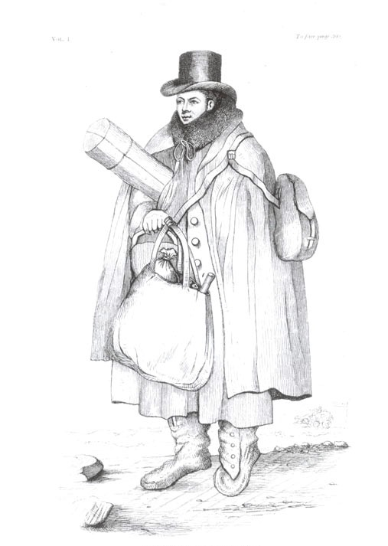
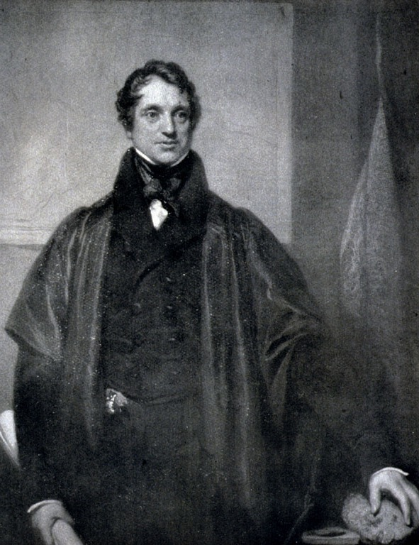
Purple blank
威廉·巴克兰(1784-1856)
亚当·塞奇威克(1785-1873)
全球, 地质有限的洪水
Notes:
Source: Ian Taylor

Slide 29
Purple blank
约翰·弗莱明
(1785-1857)
长老会牧师
和 动物学家
安宁的洪水
Notes:
Fleming published his idea in a journal article in 1826. He said the Bible describes a tranquil flood that didn't displace the plants or even the soil and therefore would have left no geological evidence. Lyell exploited Flemings argument to say the same, especially noting that the dove found an “olive branch” (the Bible says “olive leaf”).

Slide 30
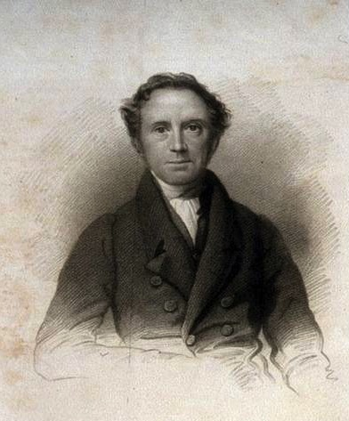
Purple blank
约翰·派伊·史密斯 (1774-1851)
公理
神学家
当地创造
和 当地洪水
Notes:
He saw these events only depicted as in Mesopotamia
Source: my slide

Slide 31
Purple blank
自由派
神学家
创世纪1–11 is 神话.
Notes:
This was held at bay somewhat due to the Great Awakening

Slide 32
Genesis & Geology: 19C #1
19世纪初：旧地球地质折中
1810－ 间隙理论 (查默斯)
1820－ 日代理论 (法贝尔)
安宁洪水理论 (弗莱明)
1830s－ 当地洪水理论 (派伊 史密斯)
创世纪是神话 (自由派)

Slide 33
Genesis & Geology: 19C #2
早期 1800年: 对圣经忠诚
1820-50 年轻地球创世
(“圣经 地质学家”)
Notes:
About 30 of these YEC geologists and clergy (some both) defended the Bible against both the catastrophists and uniformitarian defenders.

Slide 34
辩论的真正本质
哲学与宗教

Slide 35
Deism & Atheism
神
神
宇宙
宇宙
宇宙
自然神论
无神论
基督教
Notes:
35
Grudem, Systematic Theology (1994), p 268.

Slide 36
旧地球神学 (1778-1833)
旧地球神学
布冯:
拉普拉斯:
拉马克:
沃纳:
赫顿:
居维叶:
史密斯:
莱尔:
自然神论者或含糊有神论者
开放性无神论者
自然神论者或无神论者
自然神论者或无神论者
自然神论者或无神论者
自然神论者或含糊有神论者
自然神论者或含糊有神论者
自然神论者或一神论
Notes:
Every one of these men had a bias. And many Christians who were influenced by these writers became semi-deists in their thinking about the world.

Slide 37
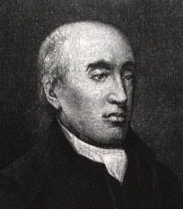
Hutton 1795—past history
“我们的地球的历史需要能以现在能看见的用来说明......我们不能用地球没显明自然的力量，也不能进行任何行径，除了那些我们以晓得的原则。”
詹姆斯·赫顿， 报价 阿瑟·霍姆斯, Principles of Physical Geology (UK: Thomas Nelson & Sons Ltd., 1965), pp. 43–44.
Notes:
Hutton therefore ruled out any eyewitness account from God.
Original source of last part of quote is James Hutton, Theory of the Earth (Edinburgh: William Creech, 1795), Vol. 2, p 547. I could not find the first part of the quote in vol. 1 or vol. 2. I also didn't find the quote in Hutton's 1788 article.

Slide 38
Hutton 1795—no global floods
“但一般洪水应该不能在地球的理论之内;因为，很明显的，地球的目的是保持蔬菜和动物的生活，而不是销毁。”
詹姆斯·赫顿, 地球的理论 (Edinburgh: William Creech, 1795), vol. 1, p. 273.
Notes:
Section IV, chapter 3, paragraph 6, in the on-line version of this book.
Chapter 3, section 3 in the book version
Quoted in A. Holmes, Principles of Physical Geology, (UK: Thomas Nelson & Sons Ltd., 1965), pp. 43–44.

Slide 39
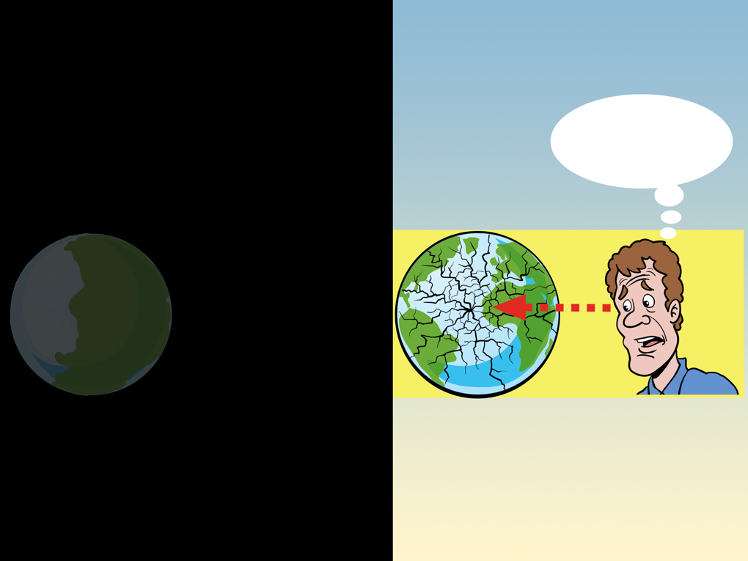
Present not key to past
现在不是过去的关键。
以前?
现在的世界
过去的世界

Slide 40
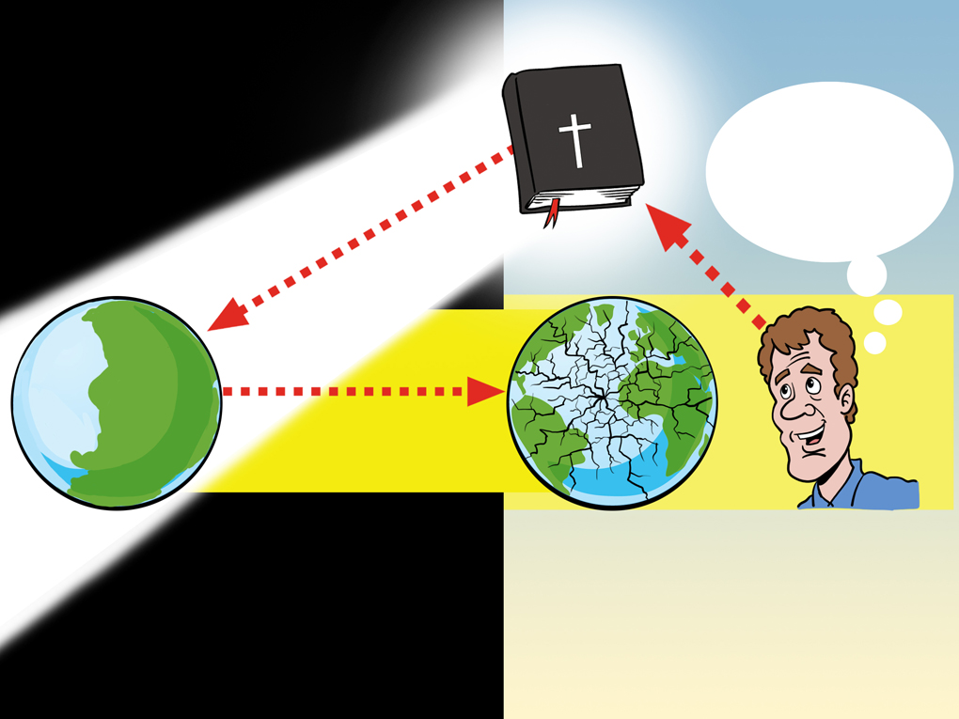
Revelation is key to past
万无一失全知目击者造物主100％的记事！
Holy Bible
以前和现在！
现在的世界
过去的世界
启示是了解过去和现在的关键！

Slide 41
Early 19C views of earth history new
19世纪初地球史的观念
灾异观点 (居维叶, 史密斯 等)
SB
C
C
C
C
P
(millions of years)
现在是过去的关键
均变观点 (赫顿, 莱尔 等)
SB?
P
(数百万年)
圣经／保守传统观点 (圣经地质学家)
SCW
F
P
过去是现在的关键
(ca. 6000 years)
Notes:
41
SB = 超自然的开始
C = 特大洪水
P = 现在
SCW = 超自然创造周
F = 诺亚的大洪水

Slide 42
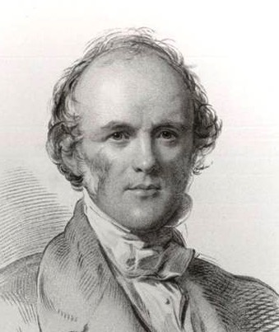
Lyell 1832—geology without Bible
“我一直都强烈欣赏一个优秀的作家和熟练的地质学家的观察力，尤其是当他说到‘为了启示以及科学，和各类的真理，物理的地质部分因该以‘圣经没存在’ 的标准进行调查。”
查尔斯·莱尔, 报价 M.J.S. Rudwick, “Charles Lyell Speaks in the Lecture Theatre,” Brit. J. Hist. Sci., IX:2:32 (July 1976), p. 150.
Notes:
lecture at King's College London, 4 May 1832

Slide 43
自然哲学的定义
均变自然主意
自然或物质是所有存在
2. 一切都必定能被时间和遇合加上物质变化被自然规律影响解释
3. 地质变化的过程过去以来一直都以同样的速度，频率和功率。

Slide 44
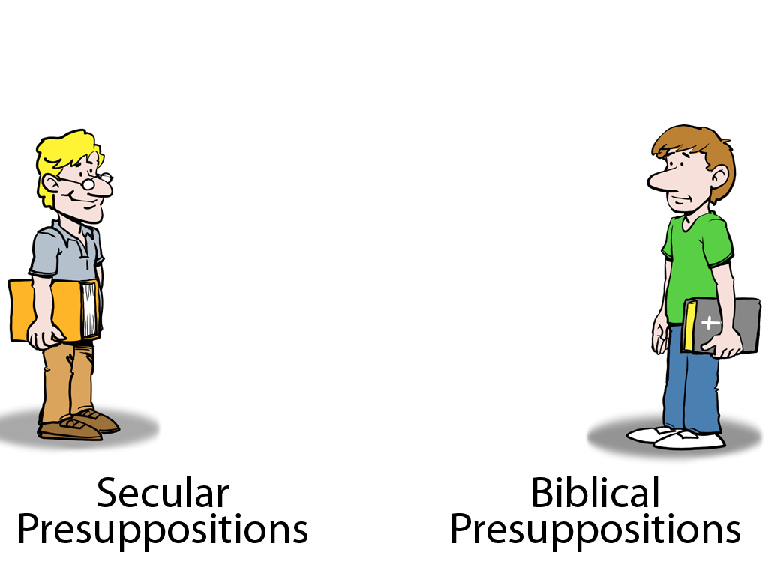
旧地球地质学家
基督徒
自然主义的假设
圣经的假设

Slide 45

中性点接地
Notes:
45

Slide 46

但是他还是从自然主义的假设看待事情！
中性点接地
Notes:
46

Slide 47
Operation vs Origin science
操作科学
vs
起源科学
Notes:
As a content template, this is best suited for standard content such as outlines, quotations, Scriptures, and maybe illustrations or photos. Presentation Team recommends 48–60 pt. font for headings and 28–40 pt. for body text. Because of eye flow and visual psychology, the top line may be a little closer than all other sides. This also contains a floating AiG logo that can be repositioned or removed as appropriate for the overhead's content.

Slide 48
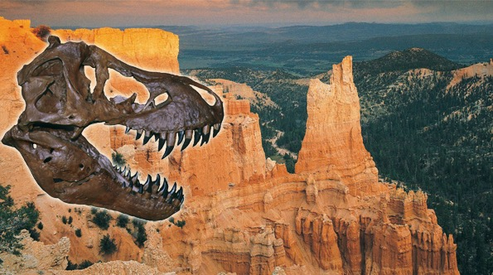
Assumptions Facts-Interpretations astronomy
自然主义的假设
圣经的假设
这是世界观
的斗争
古老地球
没有全球性的洪水
年幼地球
全球性大洪水

Slide 49
I Tim. 6:20-21 NAS
提摩太前书 6:20-21
提 摩 太 阿 ， 你 要 保 守 所 托 付 你 的 ， 躲 避 世 俗 的 虚 谈 和 那 敌 真 道 、 似 是 而 非 的 学 问 。
已 经 有 人 自 称 有 这 学 问 ， 就 偏 离 了 真 道 。 愿 恩 惠 常 与 你 们 同 在 ！
Notes:
“Science” (from the Latin, scientia, meaning knowledge) is the Greek, gnosis, meaning knowledge.

Slide 50

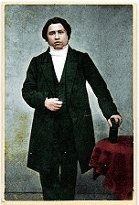
Spurgeon 1855—old-earth (gap) #1
“有任何人能告诉我起初是如何开始吗？几年前，我们以为这个世界的开始是当亚当临到;”
吉翁, “拣选” (1855), The New Park Street Pulpit (Pasadena, TX: Pilgrim Publ. 1990), vol. 1, p. 318.
Notes:
This is at the beginning of his point that divine election is eternal.
Charles Haddon Spurgeon (1834-92) was 21 years old at this time.
http://www.spurgeon.org/sermons/0041.htm, p. 10.
Sermon was preached on 2 Sept. 1855.

Slide 51
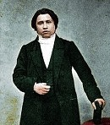
Spurgeon 1855—old-earth (gap) #1
“但我们发现这事发生千百年之前，神在准备混沌物质让它适合居留人类，把放置各个种族的生物；它的死必留下神的手艺和神奇的技能的痕迹 —— 这些都发生在他创造人类之前。”
吉翁, “拣选” (1855), The New Park Street Pulpit (Pasadena, TX: Pilgrim Publ. 1990), vol. 1, p. 318.
Notes:
By 1845 all the commentaries were arguing for the Gap theory or the Day-Age theory.
This is at the beginning of his point that divine election is eternal.
http://www.spurgeon.org/sermons/0041.htm, p. 10.
Sermon was preached on 2 Sept. 1855.

Slide 52
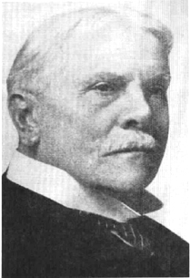
CI Scofield
斯科菲尔德参考圣经
（1909）
间隙理论
“第一个创造性的行为是指无日期的过去，并给出了所有的地质年龄的范围。”
斯科菲尔德
(1843-1921)
Notes:
That statement is all Scofield said about the gap (1917 edition). No argument, nothing. Just a bald assertion. The 1967 edition said at v. 1, “Scripture gives no data for determining how long ago the universe was created.” At v. 2, it gives two weak statements for the gap theory.
The man -- http://www.higherpraise.com/preachers/images/scofield.jpg
Scofield Reference Bible (revised in 1967 and still in print) has been used by tens of millions of Christians worldwide, many of whom act as if Scofield's notes are as inspired as the Biblical text.

Slide 53
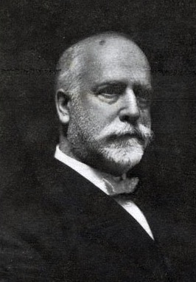
RA Torrey
鲁本·阿册·托里, 遍.,
基本原理
(12 册., 1910)
旧龄地球意见
鲁本 阿册 托里(1856-1928)
Notes:
6 of 90 articles dealt with Genesis and science. 2 clearly rejected evolution as unbiblical. 2 opposed atheistic evolution and human evolution, but didn't clearly reject theistic evolution of animals and plants. 3 of the 6 clearly accepted millions of years and none of the other 3 clearly affirmed the Bible's teaching on the age of the creation.
R. A. (Reuben Archer) Torrey (1856-1928) was an American evangelist, pastor, educator, and writer. Held evangelistic meetings around the world; called by D.L. Moody to head the Bible Institute of the Chicago Evangelization Society (now Moody Bible Institute); Dean of Bible Institute of Los Angeles (BIOLA); pastorates included Chicago Avenue Church (now Moody Memorial Church) and Church of the Open Door, Los Angeles. Wrote more than forty books.
In 1909 Lyman and Milton Stewart, two wealthy Presbyterian businessmen, financed the publication and mailing of 12 volumes of 68 articles, collectively called The Fundamentals. They were written by some of the leading godly Bible-believing pastors and scholars of the day (from Amer., Can., UK, Germany and from Anglican, Presbyt., Method., Baptist and non-denom. --several were editors of Scofield Bible) and edited by Dr. R.A. Torrey. These articles defended the Christian faith against the onslaught of rationalism and liberal theology invading the churches.
3,000,000 individual volumes of The Fundamentals were sent free of charge to pastors, missionaries, Sunday School superintendents and other Christian workers throughout the English-speaking world. All but a few of the articles were republished in 4 volumes in 1917.
64 of the 68 articles are great defenses of orthodox Christian doctrines. But the 4 articles dealing with science were all compromised with millions of years.
Picture: http://www.freewebs.com/ratorrey/Torrey%202.jpg

Slide 54
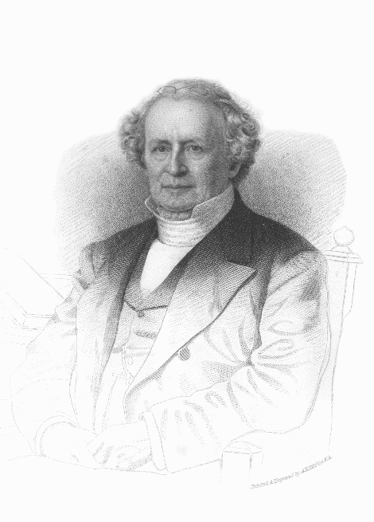
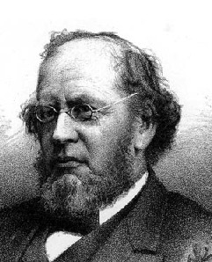
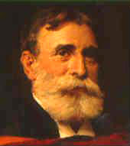
Presbyterian slippery slide
普林斯顿神学院
查尔斯·霍奇 (1779- 1878)
旧地球
霍奇 (1823-1886)
有神进化论??
沃菲尔德 (1851-1921)
有神进化论?
Notes:
C. Hodge (1797-1878)—initially favored gap theory, then by 1860 day-age, but was adamantly opposed to Darwinism, but not theistic evolution
In his 25-page chapter on the doctrine of creation (1871, vol. 1, pp. 550–574), Hodge mentions 6 verses from Genesis, but he discusses none of the Biblical verses relevant to determining the length of the Creation days or the age of the earth. In a couple of sentences he mentions the young-earth view and the gap theory, but no arguments against those views. Rather he has several pages defending the day-age view (mostly by a lengthy quote by an OEC geologist [Dana], but without using any Scripture from Genesis!
A.A. Hodge toyed with belief in evolution, open to gap or day-age but not sure if Gen. 1-11 was history
B.B. Warfield (1851-1921) open to theistic evolution, but not of man, but not sure
Based on Joseph Pipa & David Hall, Did God Create in Six Days? (Taylor, SC: Southern Presbyterian Press, 1999), pp 5-15.

Slide 55
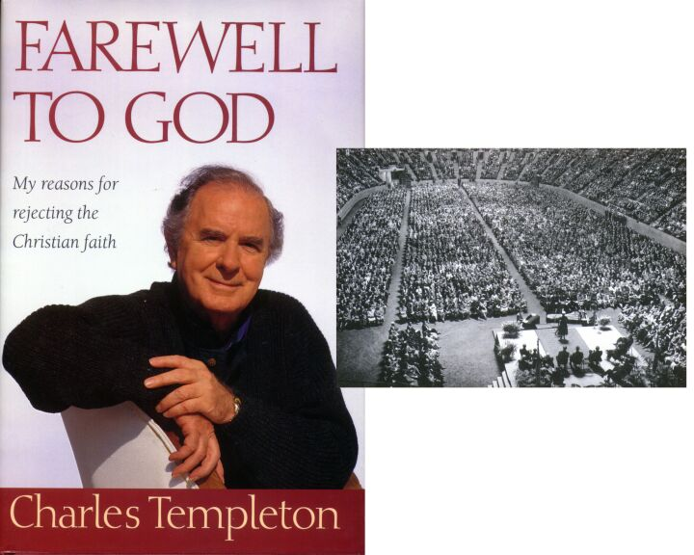
Farewell to God
查尔斯·邓普顿
1915-2001
Notes:
Started and pastored a church in Toronto
1945—became VP of Youth for Christ
1946—designated “best used of God” by Nat. Assoc. of Evang.
During these years growing doubts about Gen. 1-11 because of accepting millions of years and evolution
1948—began studies at Princeton seminary, which only increased his doubts about the authority of Scripture, the historical accuracy of Genesis and the deity of Christ.
After Princeton he continued preaching with the National Council of Churches. He had increasing health problems, esp. chest pains. A doctor said there was nothing physically wrong with him and suggested that the symptoms were the result of his inner conflict about doubting Scripture even as he preached it to others.
1957—left the ministry to become a secular journalist and author
2001—died as an atheist after suffering from Alzheimer's disease.

Slide 56
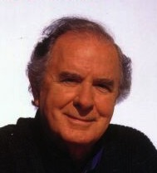
Q 815 Templeton
“我相信没有既拥有
人类的属性又是至上的存在 — 也没有圣经所描写的神—而是生命是永恒的进化力量的结果经过数百万年达到目前的瞬时状态。”
查尔斯·邓普顿, Farewell to God (Toronto: McClelland & Stewart, 1996), p. 232.

Slide 57
Presbyterian slippery slide
普林斯顿神学院
查尔斯·霍奇 (1779- 1878)
旧地球
霍奇 (1823-1886)
有神进化论??
沃菲尔德 (1851-1921)
有神进化论?
查尔斯·邓普顿 (～1940)
背教者

Slide 58
Q872 Waltke 2001
“七天创造论可能对严格的历史记录造成困难。当代科学家几乎一致驳回一个星期内创造的可能性；我们也不能草率驳回地球科学的证据。”
Bruce K. Waltke, Genesis (Grand Rapids: Zondervan, 2001), p. 77.
Notes:
As of 2003 his is Professor of OT at Reformed Theological Seminary in Orlando, FL. Before that he was at Dallas TS, Regent College and Westminster TS.

Slide 59
Cross Series 1

Slide 60

Cross Series 1
来信耶稣！
来到十字架前
领受救恩！

Slide 61

Cross Series 2
数百万年

Slide 62

Cross Series 6
它没有打中十字架！
启示录

Slide 63

Cross Series 7
启示录

Slide 64

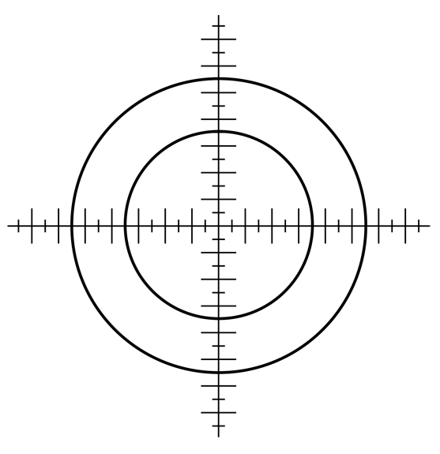
Cross Series 8
这只是小事罢了！
启示录
Notes:
基督徒常常认为攻击创世纪是外围项，不会影响信仰。
Too often Christians think that attacks against Genesis are peripheral matters that do not affect the cross.

Slide 65
Psalm 11:3 NAS
诗篇 11:3
根基若毁坏，
义人还能做甚麽呢？

Slide 66

Cross Series 9
龄测方法
进化
猿人
没有全球性的洪水
数百万年
启示录

Slide 67

Cross Series 11
没有打中
十字架！
直接
命中！
启
示
录

Slide 68
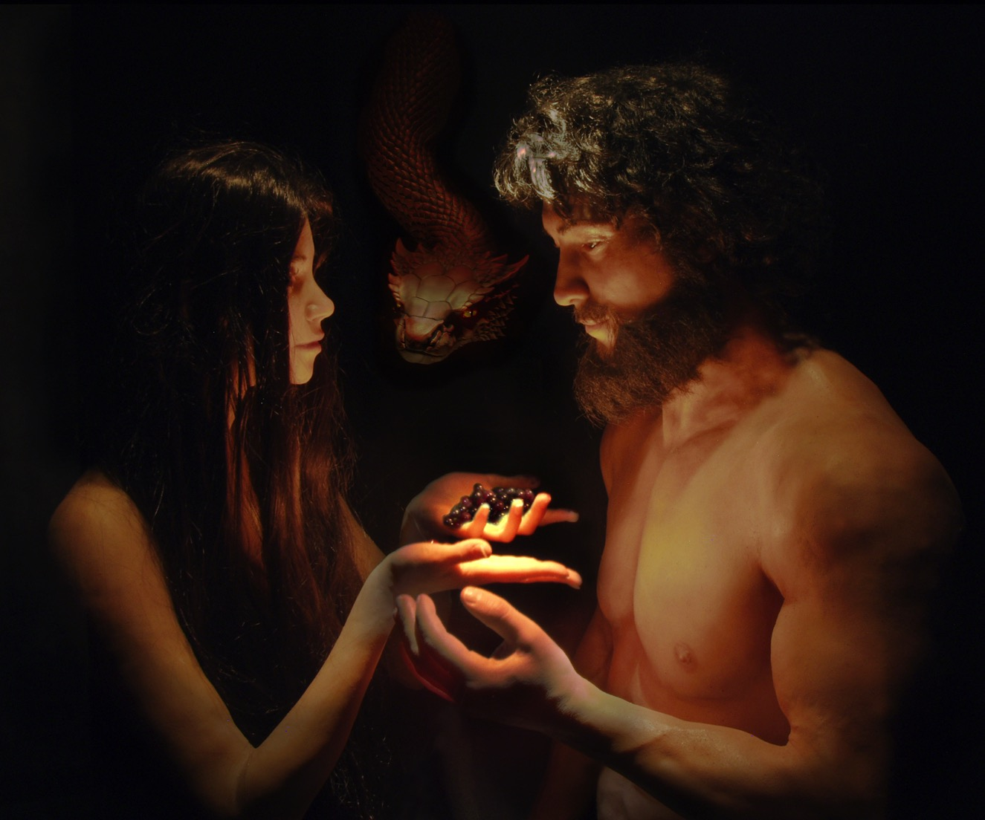
神有这么说 － NAS 博物馆
神有这么说？

Slide 69
神有这么说 － NAS 博物馆
你不必定死。

Slide 70

Cross Series 12
不信
启
示
录

Slide 71


Cross Series 10
进化
龄测方法
猿人
数百万年
启示录
没有全球性的洪水
Notes:
Layer the explosion stars and smoke that the “Genesis” can be put underneath them

Slide 72

02
创造
事工
启示录
02

Slide 73

04
进化
龄测方法
猿人
数百万年
没有全球性的洪水
创造
事公
启示录
04
Notes:
凭着带有圣经权威的答案毁灭这些假道
Destroy them by providing answers based on the authority of Scripture

Slide 74
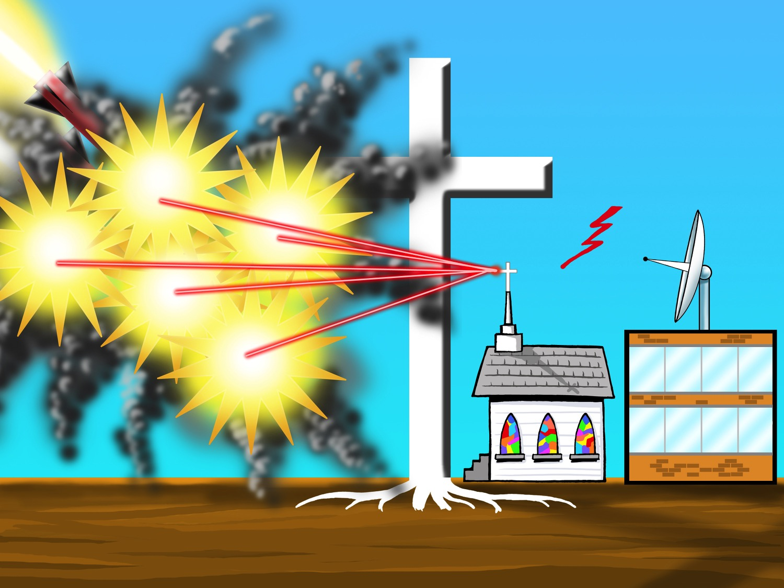
07
警告！
警告！
警告！
进化
龄测方法
猿人
数百万年
没有全球性的洪水
创造
事公
启示录
07
04
Notes:
现在他们能够毁灭每个争论，给大家一个答复，因为他们稳站在适当的基础上 — 圣经的权威。
Now they are able to demolish every argument, provide an answer to everyone, because they are standing on the proper foundation- the authority of Scripture

Slide 75

10
来信耶稣！
来到十字架前
领受救恩！
创造
事公
启示录
10
Notes:
现在教会有个适当的基础，帮助他人了解什么是罪，和耶稣为什么在十字架上被钉死；福音的信息不再被折中了。
Now the church has a proper foundation, help people understand what sin is and why Jesus died on the cross, the Gospel message is no longer compromised

Slide 76
2 Corinthians 10:4-5 NAS
歌林多后书 10:4-5
我 们 争 战 的 兵 器 本 不 是 属 血 气 的 ， 乃 是 在 神 面 前 有 能 力 ， 可 以 攻 破 坚 固 的 营 垒 ，
将 各 样 的 计 谋 ， 各 样 拦 阻 人 认 识 神 的 那 些 自 高 之 事 ， 一 概 攻 破 了 ， 又 将 人 所 有 的 心 意 夺 回 ， 使 他 都 顺 服 基 督 。

Slide 77
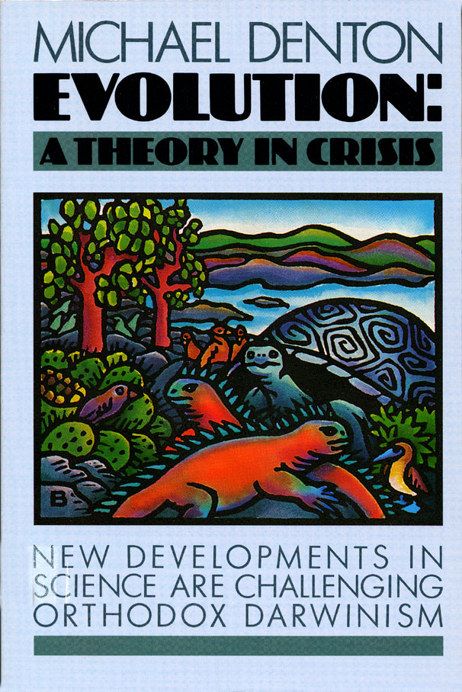
Purple blank
“也许20世纪的不可知和怀疑论最大的影响者是达尔文的自然理论。”
迈克尔·登顿, Evolution: A Theory in Crisis (London: Burnett Books, 1985), p. 358.
Notes:
Denton is medical doctor and PhD molecular biologist.
At the time of his book, he was an agnostic regarding the existence of God.

Slide 78
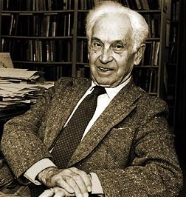
Purple blank
“这［达尔文的］革命开始是在一旦发现地球很明显是非常古老的，而不是被创造仅6000年前。这一发现是开始整个雪崩的雪球。”
恩斯特·迈尔, “The Nature of the Darwinian Revolution,” Science, vol. 176 (2 June 1972), 988.
Notes:
Mayr (1904-2005, died at age 100), Harvard zoologist
Picture from http://library.mcz.harvard.edu/history/images/mayr.jpg, accessed 19 Feb. 2004

Slide 79
Psalm 40:4 & Prov. 29:25 NAS
诗篇 40:4
那 倚 靠 耶 和 华 、 不 理 会 狂 傲 和 偏 向 虚 假 之 辈 的 ， 这 人 便 为 有 福 ！
Proverbs 29:25
惧 怕 人 的 ， 陷 入 网 罗 ； 惟 有 倚 靠 耶 和 华 的 ， 必 得 安 稳 。

Slide 80

Nailing Genesis 1-11 to church
创世纪
1-11
人类的观念
数百万年

Slide 81
Blank end
终

Slide 82


創造链接地址 BibleStudyDownloads.org
免费获得该讲解!
圣经学习下载
Notes:
The explanation for free!
Creation link address

