Slide 1
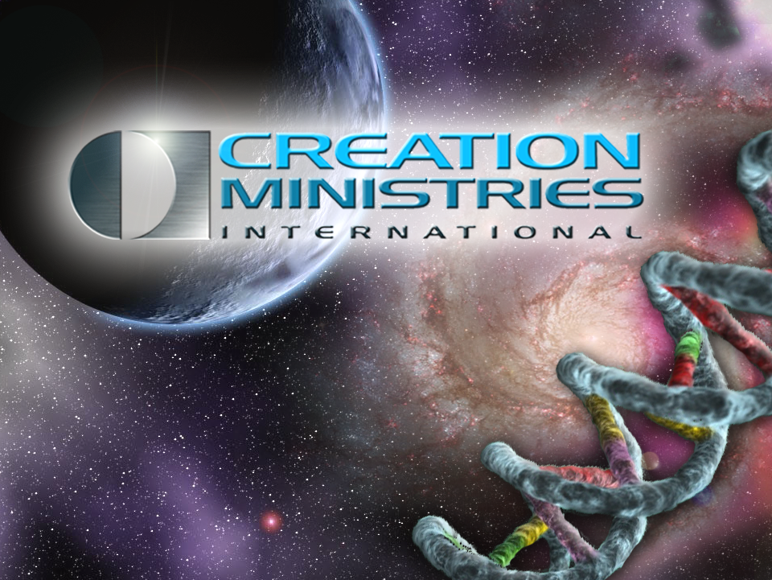
创造与福音︰关键的大图画
Dr Don Batten 唐‧巴滕博士B.Sc.Agr. (Hons I) PhD

Slide 2

万物从哪里来?
Where did everything come from?
只有两个选择︰
1. 神创造
2. 自我创造出来? (进化)
Notes:
There are only two options.
God created
Made itself (evolution)
That things have always been here is not an option because of the Law of Decay. If things had existed eternally in the past, the universe would have decayed to nothingness (no available energy) and we would not be here to talk about these things.

Slide 3

起初，神创造天地。
创世记 1:1
In the beginning God created the heavens and the earth. Genesis 1:1
Notes:
A most profound and sensible statement. And people of almost all cultures have agreed for millenia. But today there is a different view being promoted around the world.

Slide 4
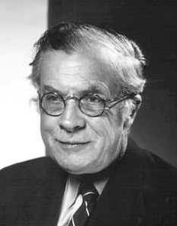
Evolution? 进化?
「在进化论的思考模式里，根本不需要或者容不下超自然这个解释。地球不是被创造出来；而是进化而来。」
“In the evolutionary pattern of thought there is no longer either need or room for the supernatural. The earth was not created: it evolved.”
联合国教科文组织首任主席
朱利安‧赫胥黎爵士 (Sir Julian Huxley)，《Essays of a Humanist》 [1964年]， Penguin Books出版，英国， 1969 年翻印，82–83页)

Slide 5
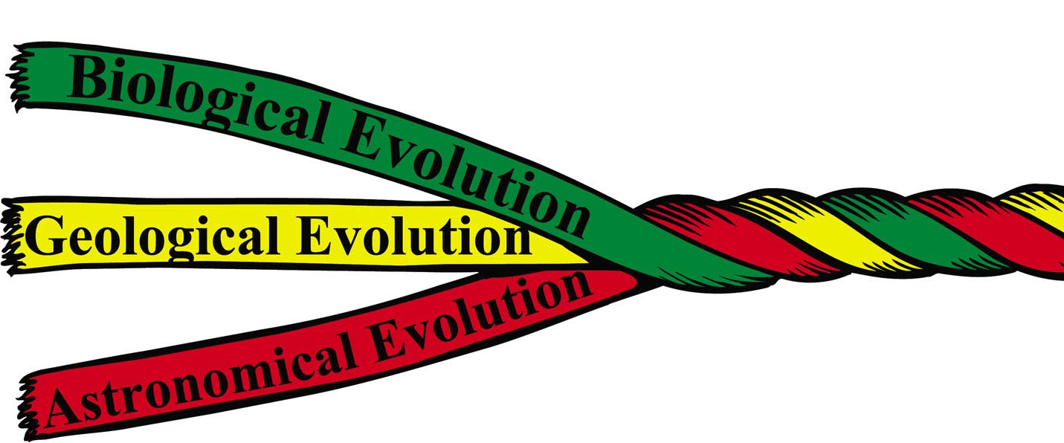
Evolution rope
「进化」?
生物进化
地质进化
天体进化
「宇宙」 进化
Notes:
The evolutionary way of thinking involves everything ‘creating itself’. No creator is needed or wanted. The universe, the earth and life all came into existence by purely natural processes in this way of thinking.
Dr John Hartnett will be talking about the origin of the universe. What about the origin of life?

Slide 6
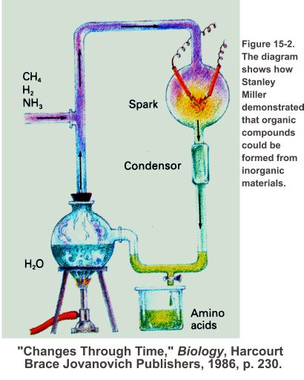
生命的起源?
输入
错误
不切实际的干扰
错误
输出
Notes:
This diagram is in just about every biology textbook. It shows an experiment done in the 1950s that supposedly demonstrated how life might have got started. However, this is very misleading. Wrong inputs (oxygen would have been present: boom!). Unrealistic interference to isolate and protect the products. And although they managed to get some amino acids, from which the proteins of life can be constructed, they were not the types of amino acids that would form proteins. For example, most amino acids can be in two forms that are mirror images of each other; like your right and left hands. Life’s proteins are only made from the left-handed forms whereas these sorts of experiments produce both left and right-handed amino acids. Life’s proteins could never form from these. But life is far more than getting the ingredients to make proteins.

Slide 7
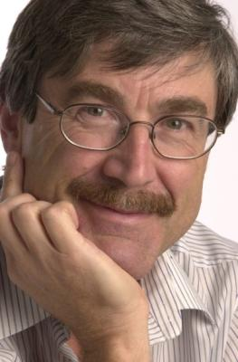
「大部份细胞的运作，最贴切不是用物质
(硬件)来形容，而是用资料或软件来形容。」
“Most of the workings of the cell are best described not in terms of material stuff—hardware—but as information, or software.”
天体生物学家保罗‧戴维斯教授
(Prof. Paul Davies) ,《卫报》,
2002年12月11日

Slide 8
「没脑袋的原子如何能自发地给自己写出一套软件来? 无人知道……」
“How did stupid atoms spontaneously write their own software …? Nobody
knows …”
保罗‧戴维斯教授 (Prof. Paul Davies)
《New Scientist》163 (2204):27–30
1999年9月18日

Slide 9
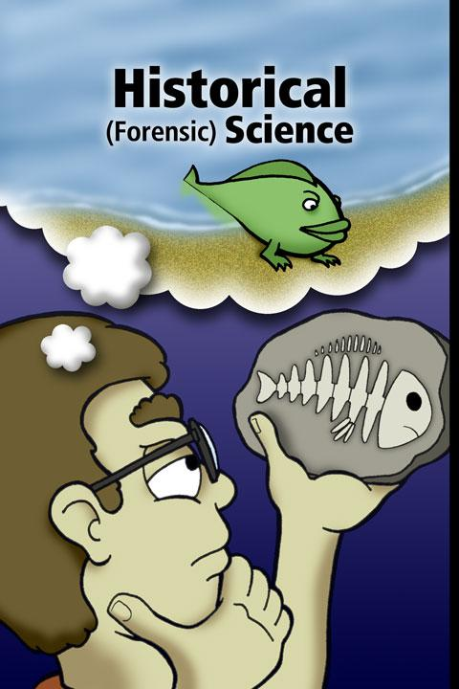
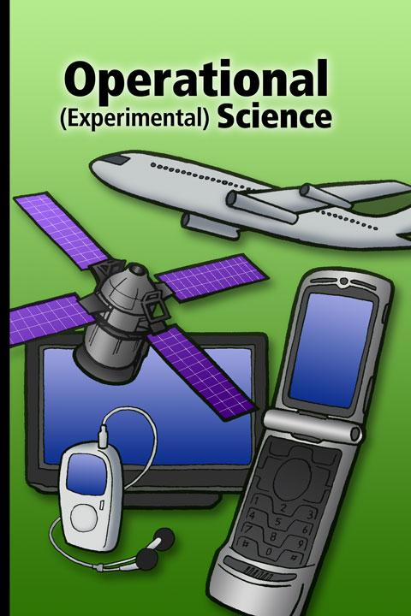
Historical & operational science
历史性(鉴证)科学
操作型(实验)科学
科学研究可重复的事；
历史研究不可重复的事
Notes:
Science studies the repeatable; history studies the unrepeatable.
Evolution is a claim about history; what happened in the past. Dating of rocks and fossils is historical science. The dates are not ‘facts’; they are interpretations that rely on many unprovable assumptions. You can‘t do experiments on the past. There is no ‘time machine’ to observe the past. The only way we can know what happened and when is by a reliable eye-witness, and we have that in the Bible (only God was there in the beginning).
Historical science contrasts with operational science, which involves learning how the world today operates. Here we can do experiments to test ideas. Operational science has brought us many, many benefits, but evolution has been an impediment to scientific progress (as well as causing social decay).

Slide 10
英格兰如何变成非基督教国家?
What changed England into a pagan nation?
「……我相信在英格兰，地质学和进化论把我们由基督教国家变成非基督教国家。」
“… I myself have little doubt that in England it was geology and the theory of evolution that changed us from a Christian to a pagan nation.”
—舍伍德‧泰勒(F. Sherwood Taylor), 「Geology changes the outlook」， 《Ideas and Beliefs of the Victorians》, Sylvan Press Ltd出版, 伦敦, 195页 ,1949年 (英国广播公司电台专题节目系列)
Notes:
—Taylor was Curator of the Museum of the History of Science, Oxford. Note the date: 1949! How much more so today!

Slide 11
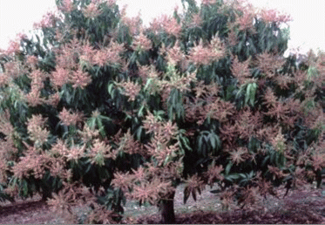
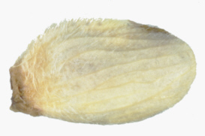
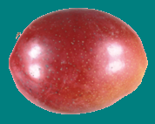
Origin of different kinds of life?
不同种类的生物起源?
神创造果树
… 果实含有所属品种的种子
长出果实
创世记 1:11,12
Notes:
So, where did different kinds of living things come from? The first life God created was fruit trees (day 3 of creation week). 10 times in Genesis 1 it says that God created different things “according to their kind”. Mango trees produce mango trees. Dog give birth to dogs. Cats, cats. Humans, humans. Chimps, chimps ….. No one has every observed anything different. It is the most established principle of biology. But evolution? One kind has changed into another over eons of time.

Slide 12
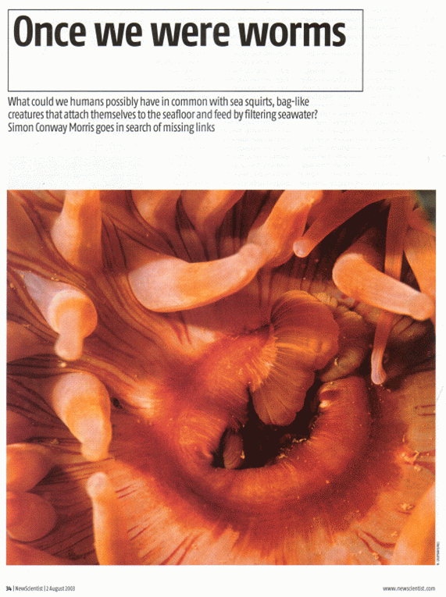
Once we were worms
—古生物学家
西蒙‧康韦‧莫里斯(Simon Conway Morris),
《New Scientist》179(2406):34ff, 2003年8月2日
Notes:
As this prominent British evolutionist claims: worms changed into people. Not that we have worms [parasitic, intestinal ones], but that we were once worms! (humour)

Slide 13
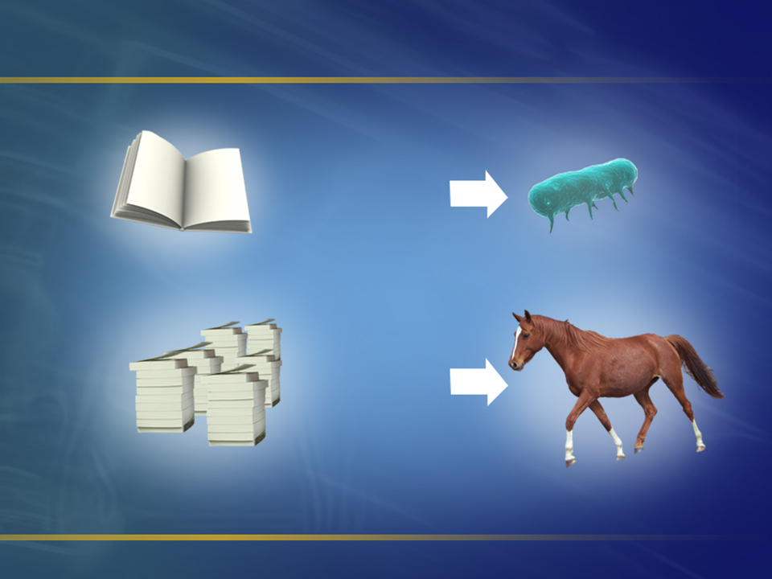
资料具体地识别生物
单细胞细菌的
遗传因子
马匹的遗传因子
(许多本书)
Notes:
Today we know why one kind cannot change into another kind. It has to do with the information on the DNA of living things. This information provides the specifications for how a living thing is to live and reproduce.
If we wrote out the information on the DNA of the simplest bacterium that can live, we would fill a book the size of a Bible. To change that microbe into a horse would need many more books of information (specifications) for how to make things horses have that bacteria don’t have, such as muscle, bone, nerves, etc.

Slide 14

1,000 books
人类的遗传因子所包含的资料，约有1,000本书的内容。
Notes:
So where does the 999 books of information come from to make a human from a microbe? Mutations supposedly created it. Mutations are copying mistakes when the DNA is passed from generation to generation. But copying mistakes would be expected to destroy information, not create it. We find that mutations are known by the destruction they cause. Here is an example of a mutation (TNR rooster).

Slide 15
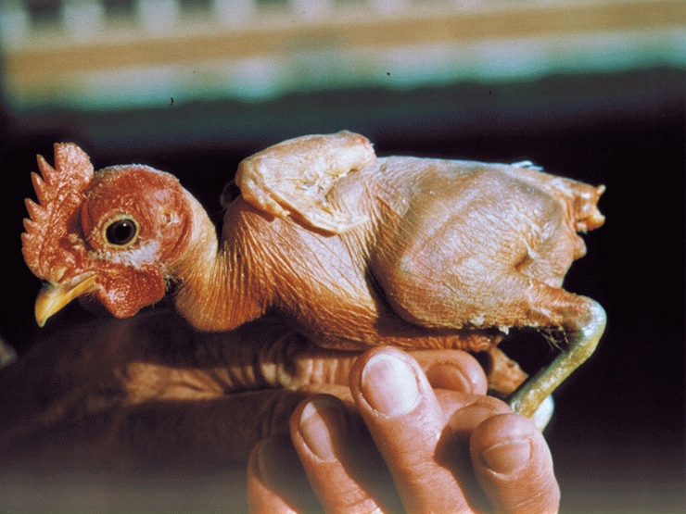
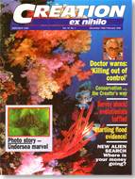
变种「裸鸡」
From:
Notes:
A mutation in the instructions for how to make feathers results in a rooster that cannot make feathers. Improved? You don’t have to pluck it to eat it, but the rooster will freeze in winter and ‘fry’ in summer.

Slide 16
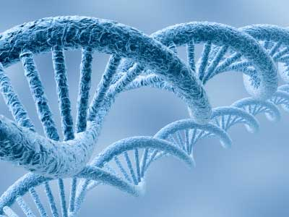
基因突变带来疾病!
逾 1,000种遗传病，例如︰
血友病 hemophilia
囊肿性纤维化 systic fibrosis
血色素沉着病 hemochromatosis
镰刀形细胞贫血症 sickle cell anemia
Notes:
Mutations cause disease!
Mutations can sometimes help survival but they never add the extra specifications needed to make evolution a viable scientific concept. The type of specifications or information needed is illustrated by the nano-scale machines being discovered daily in living things. [next slide]

Slide 17
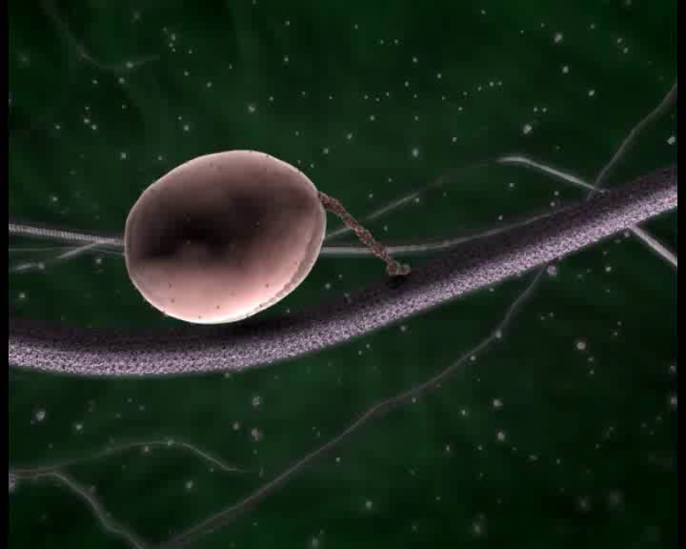
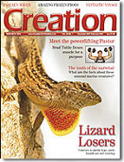
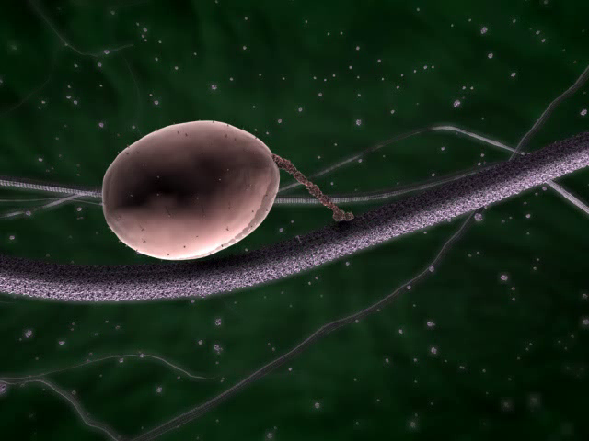
Kinesin animation
驱动蛋白如同细胞装卸工人/码头工人/海岸工人
Notes:
This is present in eukaryotes (organisms with a cell nucleus, etc.; not bacteria). 125,000 steps in a millimetre! These delivery machines walk along microtubules, a type of protein, which form a road network within cells. The bag contains proteins, which has an address label that determines where in the cell the kinesin takes it (different kinesins go to different destinations along the microtubules). The proteins are manufactured with address labels on them and then sorted into these parcels of proteins that are to go to the same destination. This is like the postman delivering parcels to the addresses on the packages. Kinesins are proteins a few hundred amino acids in size.
This shows incredible design skill, far beyond human ability! Cells are full of such incredible technology, and at a ‘nano’ scale. These discoveries speak of a super-Creator far above our ability.

Slide 18
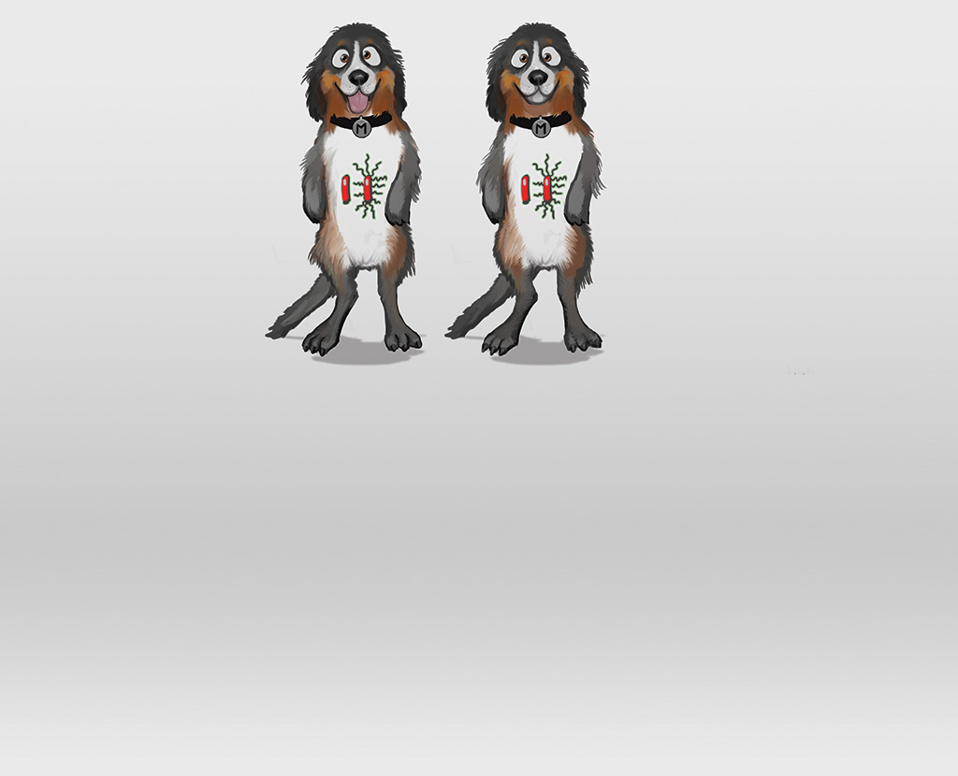
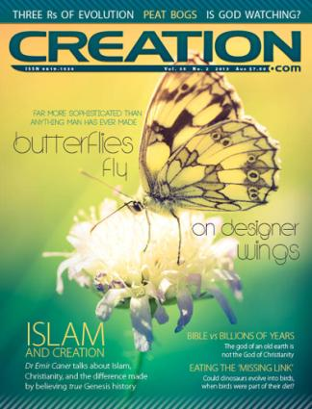
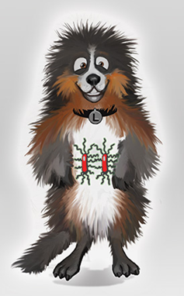


来自：
X
Notes:
What about natural selection, which is often demonstrated and then claimed to be an example of ‘evolution’?
This illustration shows that natural selection is not evolution. The red things represent genes for hair length (genes come in pairs). One ‘says’ make short hair; the other says make long hair. So a dog/wolf with such a pair of genes will have medium length hair. But if two short-hair genes get together in the offspring, it will have shorter hair. If two long-hair genes get together? Long hair!

Slide 19
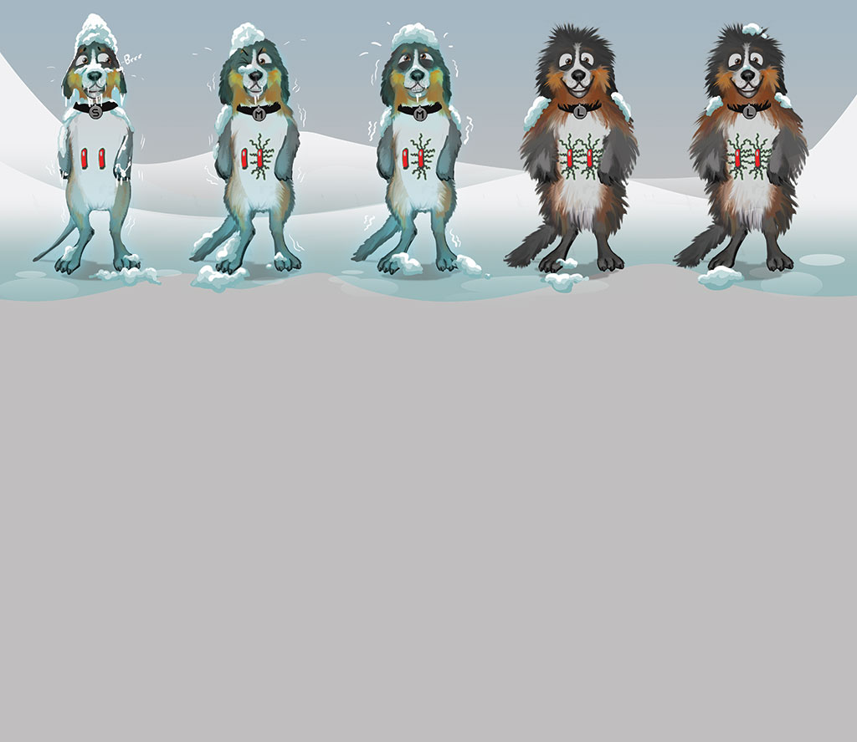




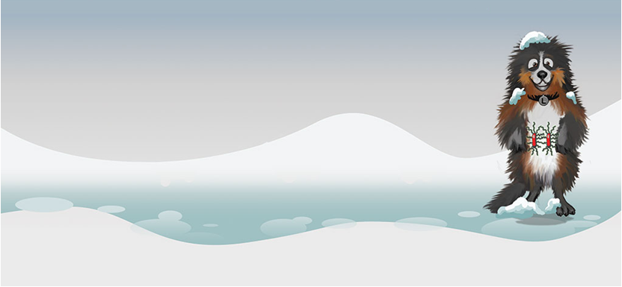
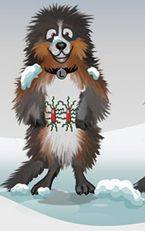
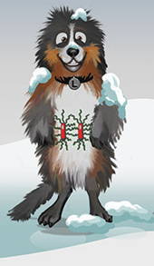
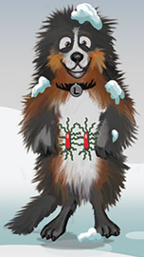

X
自然选择只能在现存的资料中作筛选!
Notes:
Natural selection only sorts existing information!
OK. During the ice age (after Noah’s Flood), wolves are breeding to repopulate the earth. With ones living in cold areas, which ones will be best able to survive the cold? OK, so the others get killed off and only long-haired ones remain to reproduce. What sort of babies can they have? Only long-haired ones! So the gene for short hair has been lost. That’s what natural selection does: it can only remove existing genetic information. It cannot create it.

Slide 20
基因突变和自然选择都不能
创造出需用的资料!
Neither mutations nor natural selection create the information needed!
进化是个不可能的过程!
Evolution is an impossible process!

Slide 21
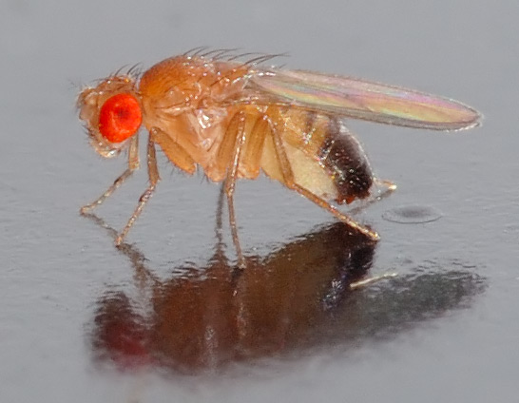
Experimental evidence?
Experiments showing organisms changed into fundamentally different kinds?
Experiments showing organisms with no significant change?
0 %
100 %
Notes:
Countless experiments have been done mutating animals and plants (e.g. the Drosophila fruit fly illustrated here) but nothing gives support to the claim that microbes could change into microbiologists by natural processes of mutation and selection (even intense artificial selection by humans).

Slide 22
Experimental evidence? 实验 证据?
Experiments showing organisms changed into fundamentally different kinds?
Experiments showing organisms with no significant change?
实验显示
有机生物彻底地
变成另一种类?
实验显示
有机生物没有
明显的改变?
0 %
100 %
Notes:
Countless experiments have been done mutating animals and plants (e.g. the Drosophila fruit fly illustrated here) but nothing gives support to the claim that microbes could change into microbiologists by natural processes of mutation and selection (even intense artificial selection by humans).

Slide 23
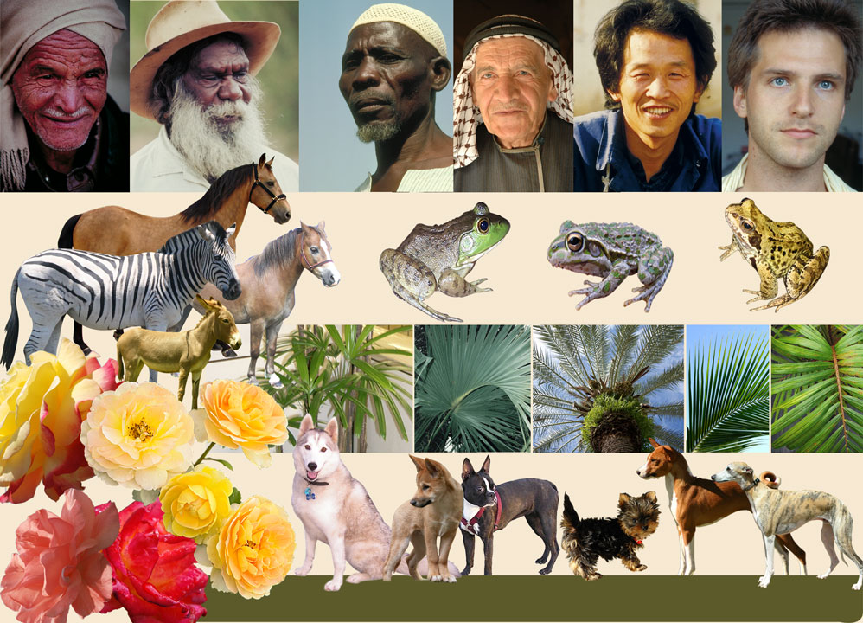
不同种类之间存着变异
Notes:
We see variety within the created kinds, but no evidence that one could transform into another, which is what evolution claims happened countless times.

Slide 24
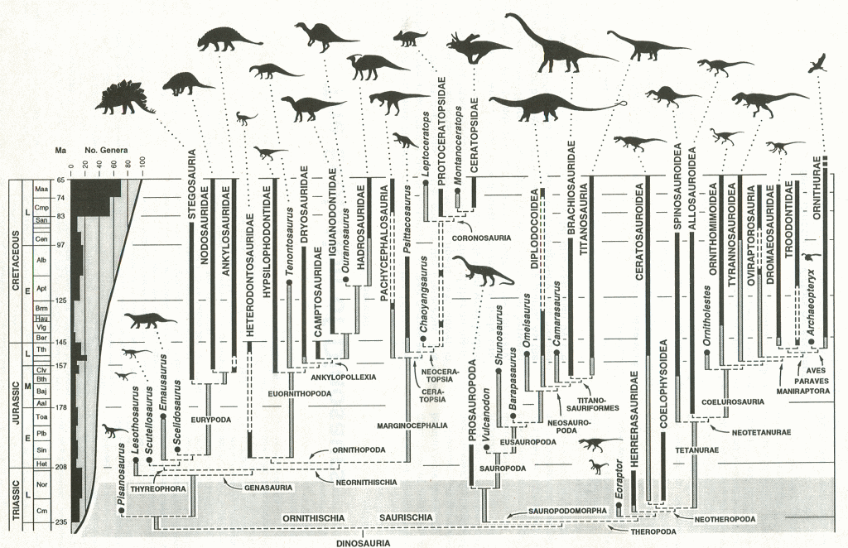
保罗‧塞里诺(Sereno, Paul C.), 「The evolution of dinosaurs」《Science》284:2137-2147, 1999年
Notes:
[Translation: don’t try and translate the terms on this diagram; this is not needed; only the title of the article: “The evolution of dinosaurs”]
Do the fossils show evolution of one kind into another?
This is the story of dinosaur evolution that illustrates that the fossils do not show evolution. The editors of Science journal, the world’s #2, asked Dr Paul Sereno to write a review of dinosaur evolution. This diagram shows the evolution of dinosaurs from a common ancestor (at the bottom). The different kinds of dinosaurs are at the top and we can see their fossil record in the dark black lines running down the page, down through the rock layers. The rest of the diagram is not based on fossil evidence at all. Let’s colour in the part of the diagram that is not based on fossils; that is, the imagination (in red and blue).
保罗‧塞里诺(Sereno, Paul C.), 「The evolution of dinosaurs」《Science》284:2137-2147, 1999年

Slide 25
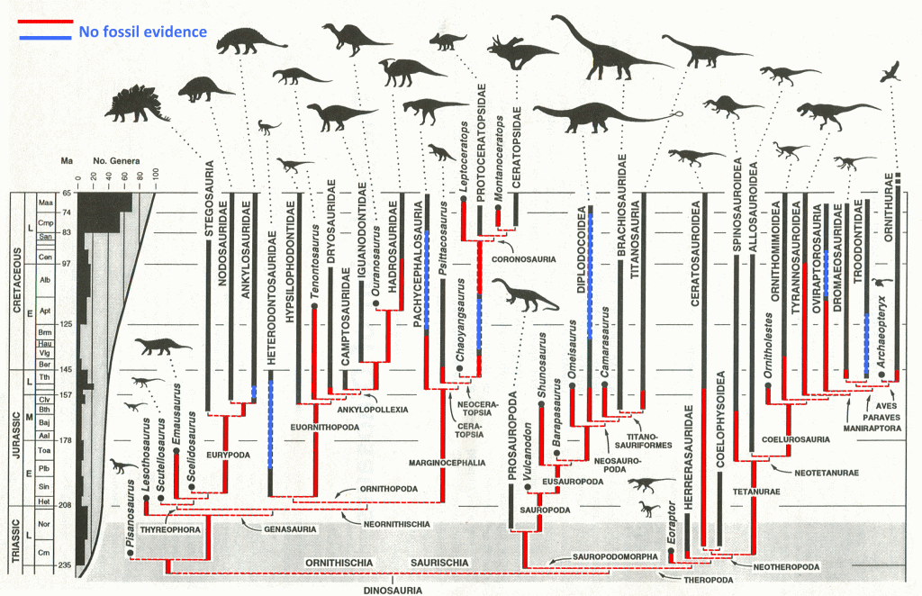
Dino family tree imagination (colour)
保罗‧塞里诺(Sereno, Paul C.), 「The evolution of dinosaurs」《Science》284:2137-2147, 1999年
Notes:
Now let’s erase the imaginary part of the diagram (the red and blue).

Slide 26
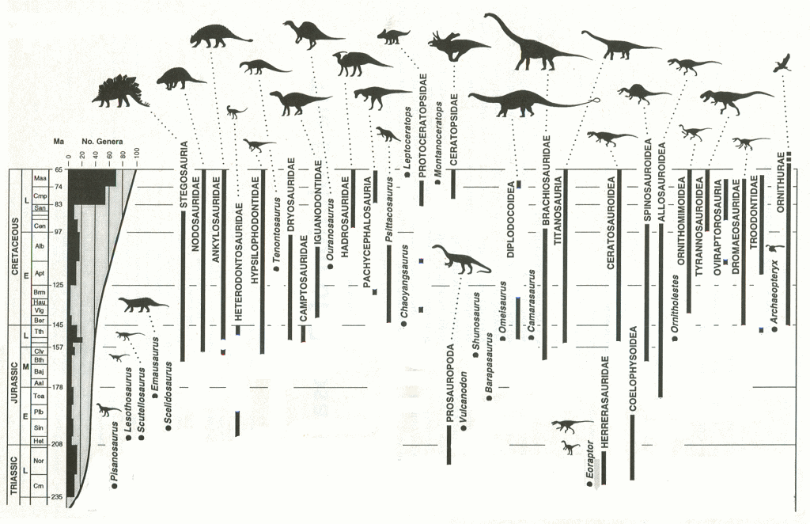
Dino family tree imagination erased
保罗‧塞里诺(Sereno, Paul C.), 「The evolution of dinosaurs」《Science》284:2137-2147, 1999年
Notes:
We don’t have a dinosaur family tree any more. In other words, evolution is not based on fossil evidence but imagination. The evolutionists cannot claim that there are not enough fossils to show the family tree because there are thousands of fossils of the different types of dinosaurs. There should be many thousands that show the family tree (evolution). They are not there because evolution did not happen.

Slide 27
God made us special!
Genesis 1:27
So God created man in His own image; in the image of God He created him; male and female He created them.
Notes:
The Bible says that God made us; Adam from the soil/dust. Eve from his rib.

Slide 28
神创造我们是独一无二的!
God made us special!
创世记 1:27
神就照着自己的形像造人，乃是照着祂的形像造男造女。
So God created man in His own image; in the image of God He created him; male and female He created them. Genesis 1:27
Notes:
The Bible says that God made us; Adam from the soil/dust. Eve from his rib.

Slide 29
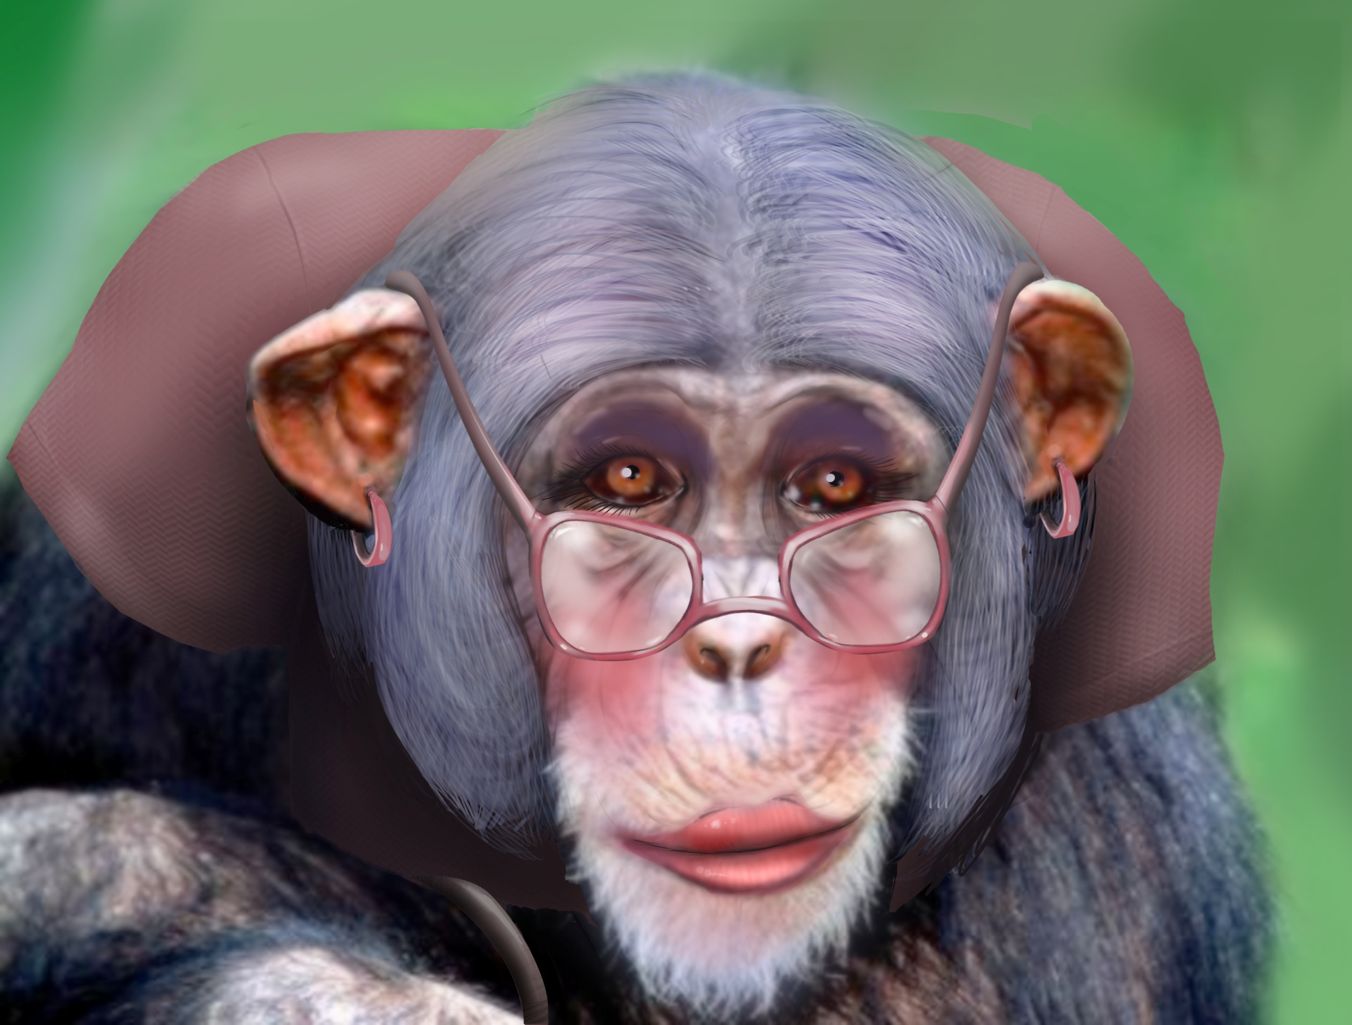
祖先?
Notes:
What is the evidence that we evolved from apes? Let me show you what goes on with this. But there is another story today [next slide].

Slide 30
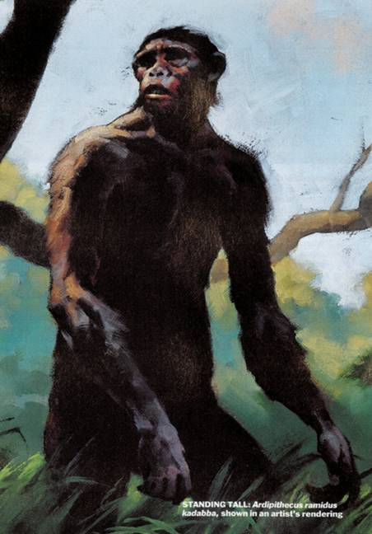
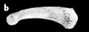
Apeman—TIME (23 July 2001) #1
标题: “Meet your newfound ancestor, a chimplike forest creature ….” (祖先新发现，貌似森林黑猩猩生物)
全凭一根脚趾骨!
《时代杂志》 (2001年7月23日), 54页
“Ardipithecus ramidus kadabba”
地猿始祖种
Notes:
This is an example of the story telling that passes as evolutionary science. Note that this was originally published in the world’s top science journal, “Nature”. Do you think that they would be publishing this if they had hard evidence that man was descended from an ape? And the idea that our DNA is only 1% different to a chimp is a myth; the difference is at least 25%. This huge difference is a huge problem for the evolutionary story, even making unrealistic assumptions in favour of it happening.
But why would anyone want to have an ape as their ancestor, not Adam?

Slide 31
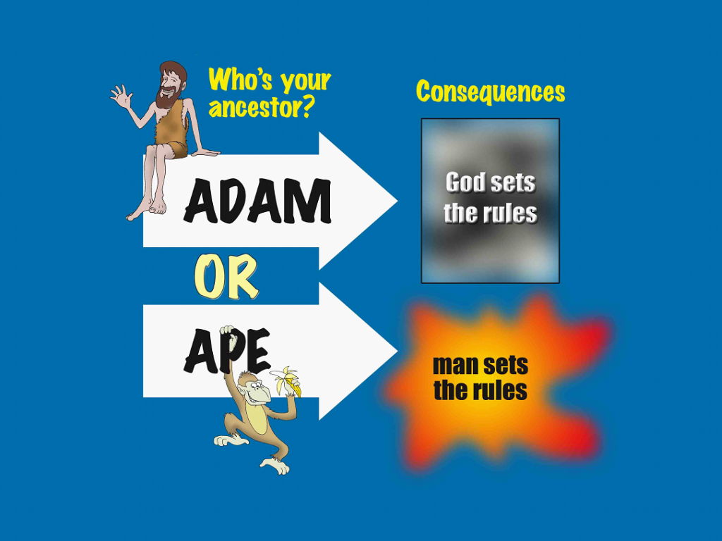
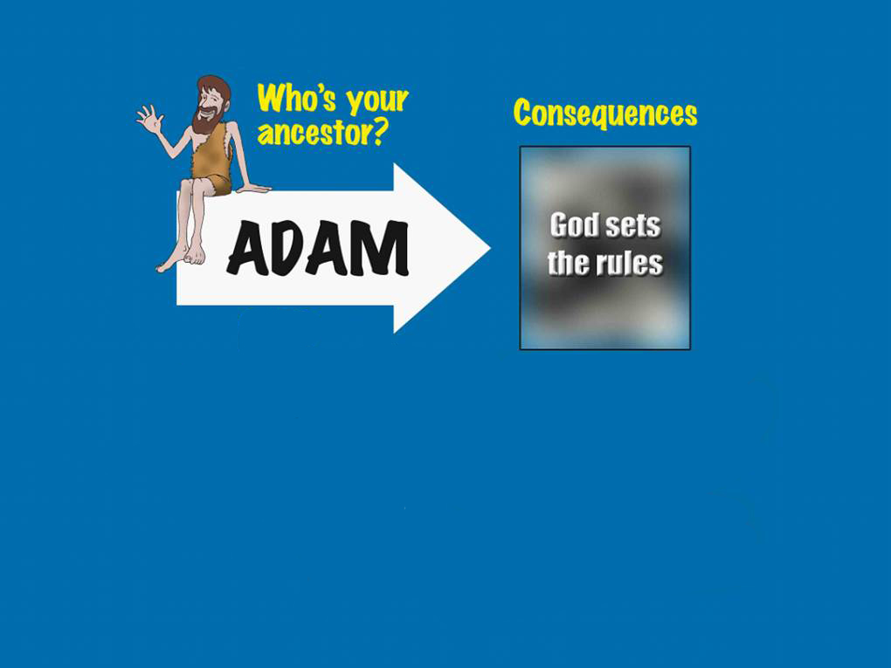
谁是你的
祖先?
结果
亚当
由神定
准则
Notes:
Who is your ancestor: consequences
Adam: God sets the rules
An ape: man sets the rules
If God made us (Adam is our ancestor like the Bible says) then He rules over us. If we are just a product of cosmic evolution, then no one rules over us and we can do whatever we can get away with. And that is at the core of the breakdown in social order in countries that previously based their thinking on the Bible. And sadly, at a time when evolution should be collapsing under the weight of evidence, we have some church leaders in the West telling people that they can accept evolution and its billions of years and add it to the Bible.

Slide 32
谁是你的
祖先?
结果
亚当
由神定
准则
人猿
由人定
准则
Notes:
If God made us (Adam is our ancestor like the Bible says) then He rules over us. If we are just a product of cosmic evolution, then no one rules over us and we can do whatever we can get away with. And that is at the core of the breakdown in social order in countries that previously based their thinking on the Bible. And sadly, at a time when evolution should be collapsing under the weight of evidence, we have some church leaders in the West telling people that they can accept evolution and its billions of years and add it to the Bible.

Slide 33
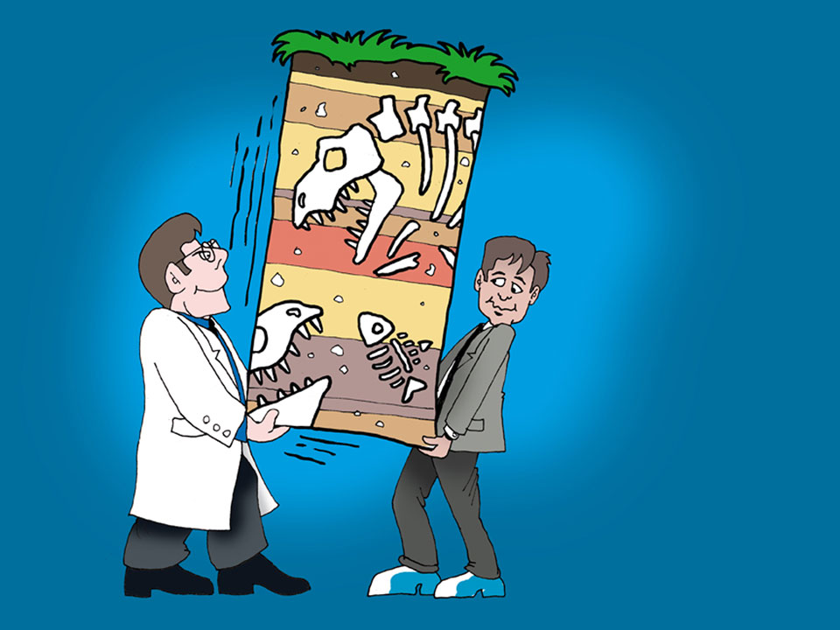
Geologic column
几百
万年
我会把年数加进
圣经去
Notes:
Most geologists tell us that the rocks under our feet are up to billions of years old. But this is historical science; not something open to experimental proof. Sadly, many Christians think that they have to find a way of adding these eons of time into the Bible. I tried to do that as a young Christian. At that time I mistakenly thought that historical science was a matter of facts, but it is story telling, not facts.

Slide 34
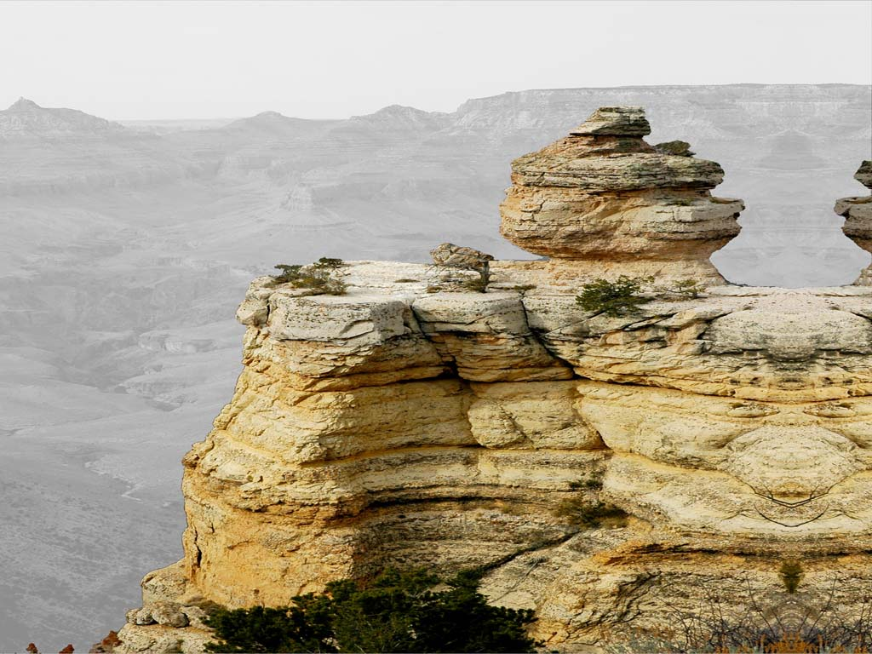

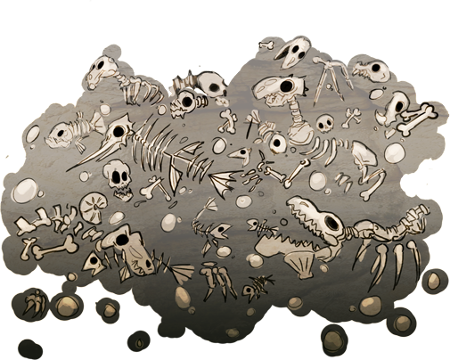
疼痛
死亡
杀戮
疾病
荆棘
几百
万年?
挣扎
苦难
灭绝
Notes:
Pain – death – killing – disease – thorns – struggle – suffering - extinction

Slide 35
创世记 1:31
神看着一切所造的都甚好。
Genesis 1:31
God saw all that he had made, and it was very good.
Notes:
NIV

Slide 36
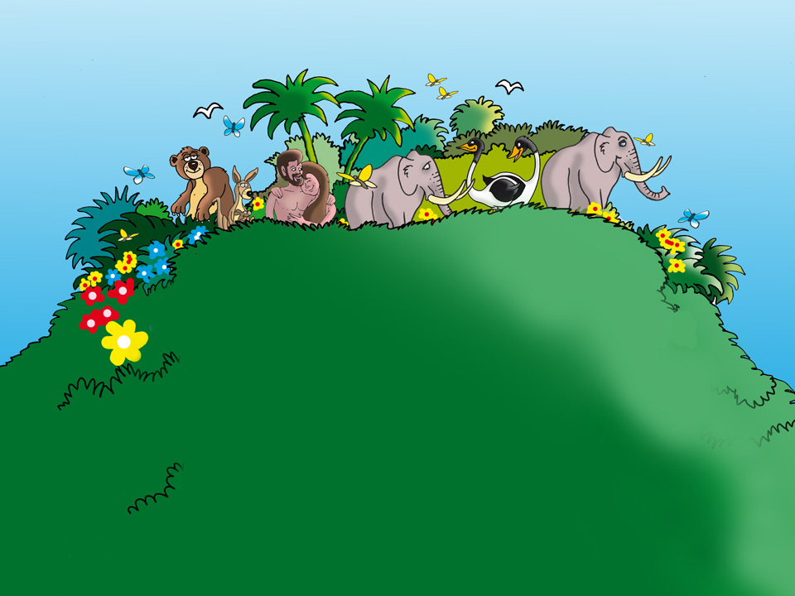
Garden of Eden
一切 ……都甚好? (创 1:31)
Notes:
All … very good?

Slide 37
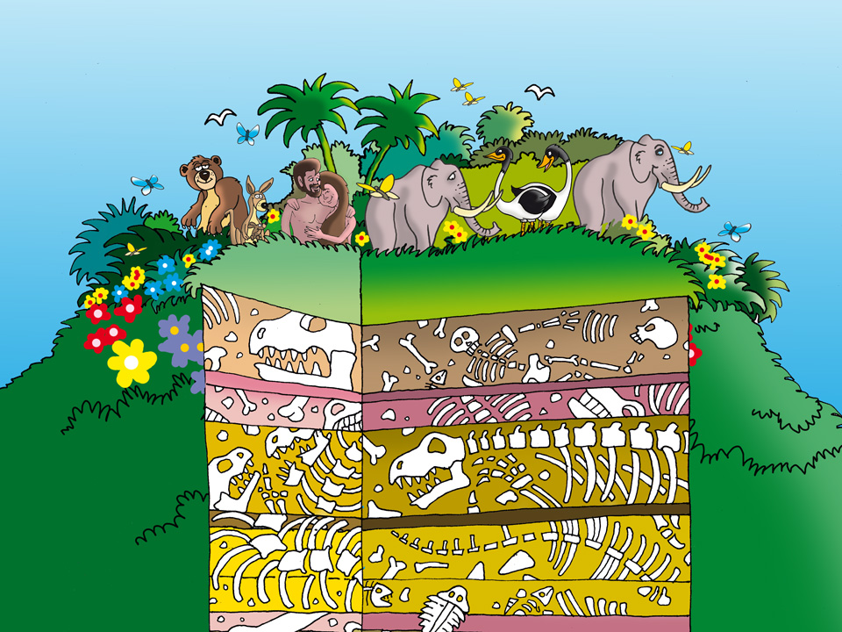
Eden on bones
一切 ……都甚好? (创 1:31)
死亡 Death
苦难 Suffering
疾病 Disease
Notes:
Adding millions of years to the Bible puts death and suffering before Adam sinned and brought death and suffering into God’s very good creation.

Slide 38




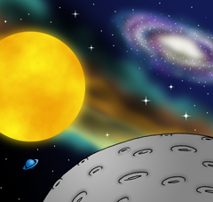


六日创造
第 1日
第 2日
第 3日
第 4日
第 5日
第 6日
Notes:
Six days of creation
This is the only view that does not damage the Bible’s clear teaching on the origin of death and suffering with sin. And this is foundational for the Gospel of Jesus Christ.

Slide 39
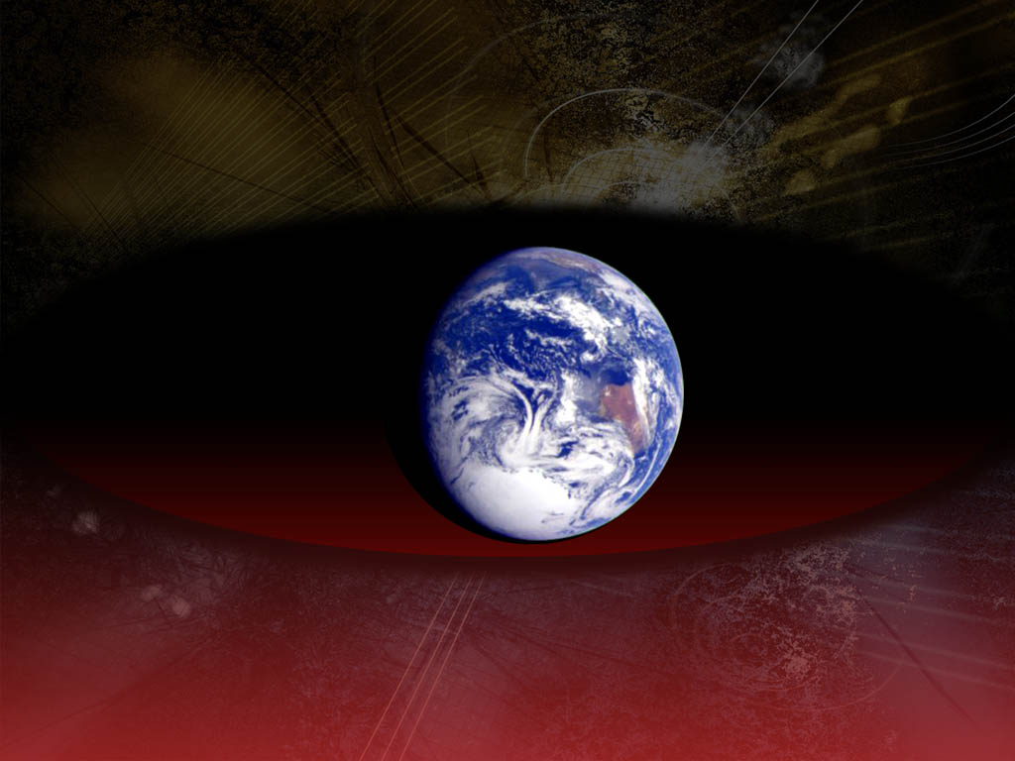

Romans 8:21,22
「但受造之物仍指望脱离
败坏的辖制……」 罗马书8:21
我们知道一切受造之物
一同叹息 劳苦，
直到如今。
罗马书 8:22
Notes:
Romans 8:22 We know that the whole creation groans and suffers as in the pains of childbirth until now.
Romans 8:21 The creation itself will be set free from its slavery to corruption.
God did not create it “groaning and suffering”; it became that way because of the rebellion of the first man, Adam.

Slide 40
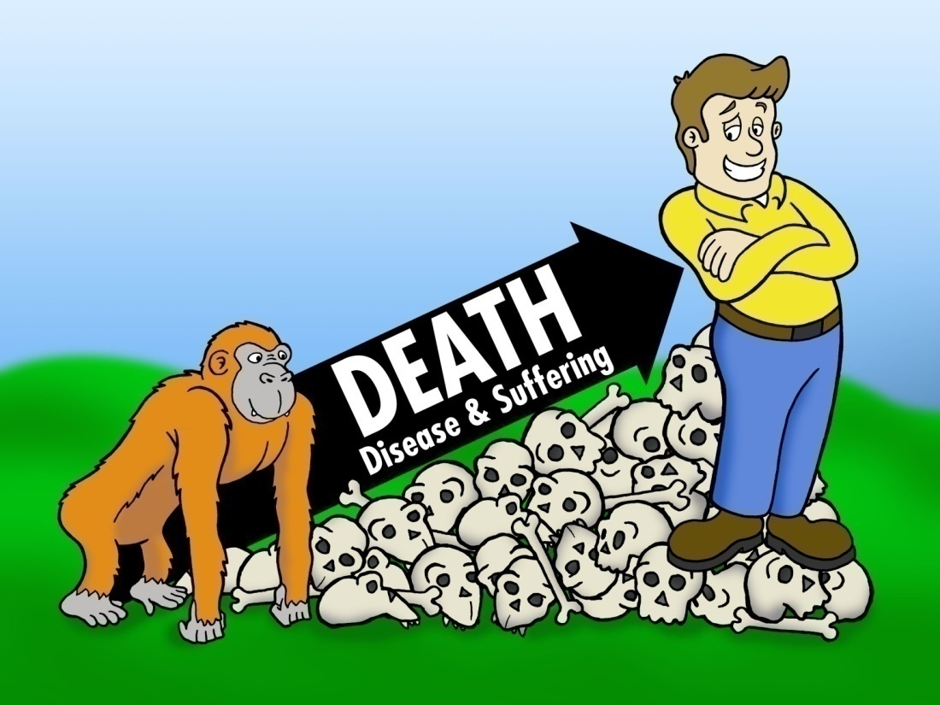
Death creation
进化的故事
死亡
疾病和苦难
Notes:
Evolutionary story vs real history
Evolution: death and suffering over millions of years brought man into existence.
Bible history: man’s actions brought death and suffering into God’s “very good” creation.
Evolution is really an alternative history of the world; a history that contradicts the Bible’s history, which is the basis of its message of salvation.

Slide 41
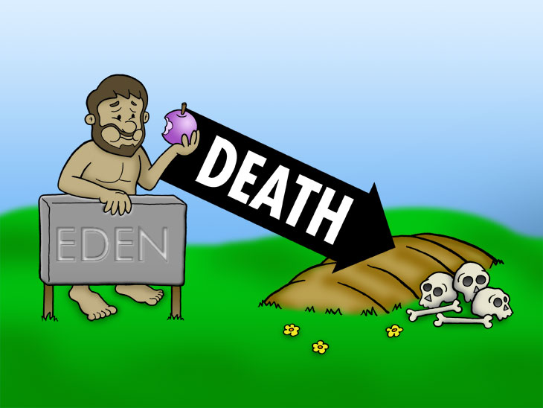
进化的故事
死亡
疾病和苦难
死亡
真实的历史
伊甸园
Notes:
Evolution: death and suffering over millions of years brought man into existence.
Bible history: man’s actions brought death and suffering into God’s “very good” creation.
Evolution is really an alternative history of the world; a history that contradicts the Bible’s history, which is the basis of its message of salvation.

Slide 42

哥林多前书15:21 –
「死既是因一人而来，死人复活也是因一人而来。」
1 Corinthians 15 Verse 21:
“For since death came through a man, the resurrection of the dead comes also through a man.”

Slide 43
哥林多前书15:22–
「在亚当里众人都死了，照样，
在基督里众人也都要复活。」
Verse 22
“For as in Adam all die, so also in Christ all will be made alive.”
Notes:
Death came through Adam. Life comes through Christ. 1 Corinthians 15:45 compares the first Adam with the last Adam. The last Adam (Jesus) came to undo what the first Adam did. All those who are only ‘in Adam’ die; those who are in Christ will live eternally. There will be a resurrection and new heavens and earth where there will be no more death and suffering.

Slide 44
第一个亚当
最后一个亚当
“The
FIRST
Adam”
“The
LAST
Adam”
林前15:45 1 Cor. 15:45
哪个亚当对福音来说是不必要呢?
Which Adam is non-essential to the Gospel?
Notes:
44

Slide 45
启示录21:4
「神要擦去他们一切的眼泪，不再有死亡，也不再有悲哀、哭号、疼痛……」
Revelation 21:4
“And God shall wipe away all tears from their eyes; and there shall be no more death, neither sorrow, nor crying, neither shall there be any more pain… ”
Notes:
In the future there will be a new heavens and earth and paradise will be restored where death will be no more. This is something to look forward to for those who are ‘in Christ’.

Slide 46
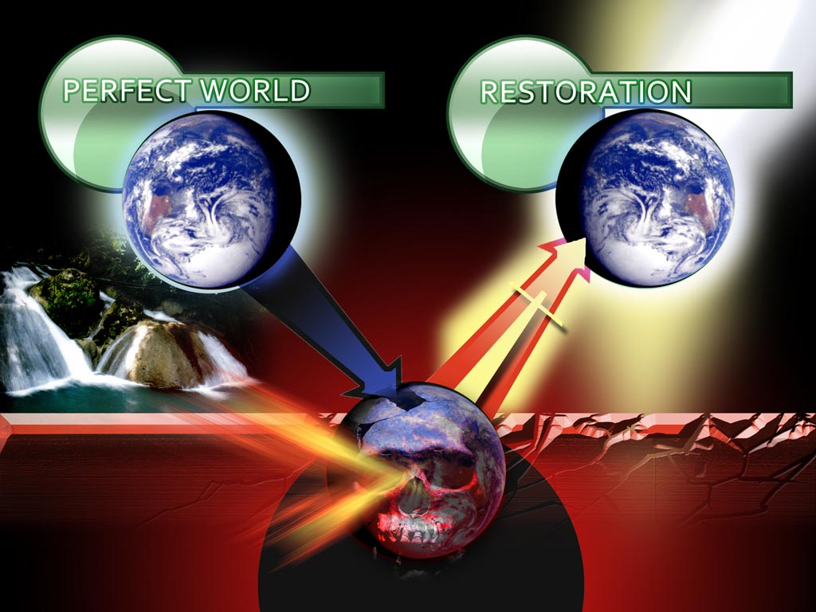
完美世界
复和
新天新地
入侵
死亡
疼痛
苦难
内心痛苦
Notes:
Perfect world, spoiled through sin, to be restored in the future (new heaven and earth).
New heavens and earth: 2 Peter 3:10-13 The ‘big picture’ from beginning to end. Accepting evolutionary ideas of death and suffering almost since the beginning, undoes the big picture from the Bible. It undermines the hope we have in Christ for the future, if you think about it!

Slide 47
约翰福音 10:10 (耶稣)
「盗贼来，无非要偷窃，杀害，毁坏；我来了，是要叫羊得生命，并且得的更丰盛。」
John 10:10 (Jesus)
“The thief comes only to steal and kill and destroy. I came that they may have life and have it abundantly.”

Slide 48
准备答案 彼得前书3:15
「有人问你们心中盼望的缘由，就要常作准备，以温柔敬畏的心回答各人。」
Be ready! I Peter 3:15
Always be prepared to give an answer to everyone who asks you to give the reason for the hope that you have.

