Slide 1
The Global Flood of Noah: a key to understanding history
(how the evidence from fossils & rocks affirms the Bible)
全球性挪亚大洪水︰
理解历史的关键
(化石与岩石的证据支持圣经)
唐‧巴滕博士(Dr Don Batten)
资深科学家
Creation Ministries International

Slide 2
彼得后书 3:3-6
……该知道在末世必有好讥诮的人随从自己的私欲出来讥诮说︰「主要降临的应许在那里呢?因为从列祖睡了以来，万物与起初创造的时候仍是一样。
…you must understand that in the last days scoffers will come, scoffing and following their own evil desires. They will say, “Where is this ‘coming’ he promised? Ever since our fathers died, everything goes on as it has since the beginning of creation.” …
Notes:
It’s interesting that the global Flood of Noah has been largely forgotten today. However, it was once the basis of thinking about the history of the earth. In my own experience, realizing the importance of the Flood was a key to me coming to a consistent understanding of the Bible’s ‘big picture’ from beginning to the end. When we just look at Genesis 1, we miss key elements of the Bible’s account that provides a basis for the later teaching about Jesus. The Flood in Genesis 6-9 is very important.

Slide 3
彼得后书 3:3-6
但他们故意忘记，从太古，凭神的命有了天，并从水而出，藉水而成的地。故此，当时的世界被水淹没就消灭了。
...But they deliberately forget that long ago by God’s word the heavens existed and the earth was formed out of water and by water. By these waters also the world of that time was deluged and destroyed.
Notes:
It’s interesting that the global Flood of Noah has been largely forgotten today. However, it was once the basis of thinking about the history of the earth. In my own experience, realizing the importance of the Flood was a key to me coming to a consistent understanding of the Bible’s ‘big picture’ from beginning to the end. When we just look at Genesis 1, we miss key elements of the Bible’s account that provides a basis for the later teaching about Jesus. The Flood in Genesis 6-9 is very important.

Slide 4

70,000,000年?
4,500年?
SECULAR HISTORY
圣经的历史
世俗化的历史
BIBLICAL HISTORY
Notes:
Secular history vs biblical history
There are different ways of looking at the same facts. The facts are the rocks and fossils that exist in the present. The stories we make up to explain how they came to be there are not facts, but interpretations. The world view or philosophical outlook that we bring affects the stories that we think up to explain the facts. No one is without a world-view, so no one is unbiased or neutral, in how we deal with the facts.

Slide 5

圣经
Notes:
Let’s look for a while at a world view based on the Bible. It tells us about events in history that would have a big affect on rocks and fossils. The first event of course was the creation week. But a later event would have re-shaped the earth in a major way: the Flood of Noah. And we can see the effects of this today.

Slide 6
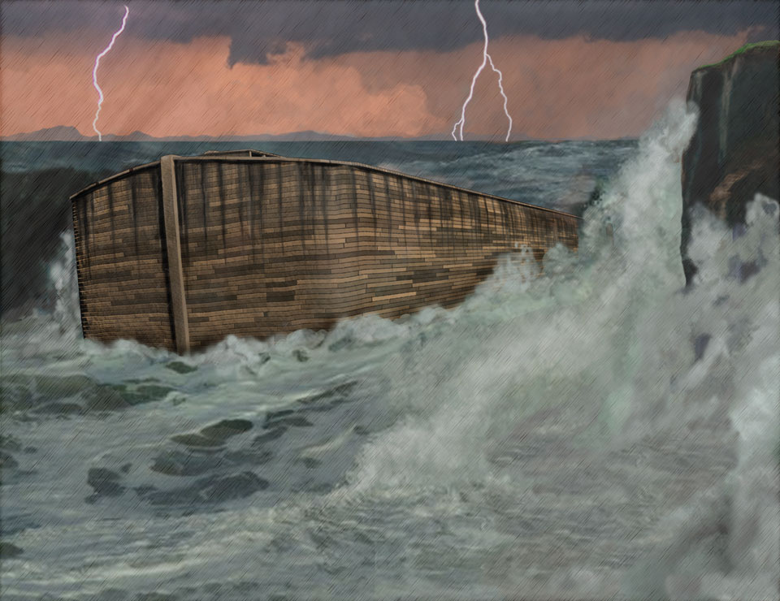
Noah’s Ark
洪水: 理解历史的关键
(创世记 6-8)
Notes:
The Flood: key to understanding history

Slide 7
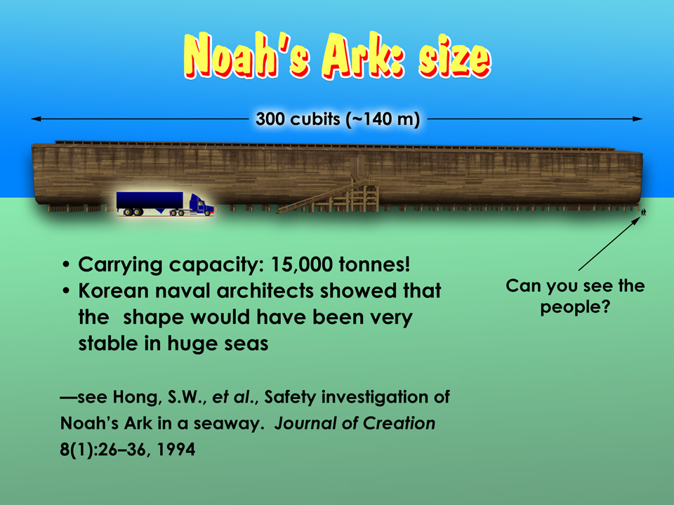
挪亚方舟的大小
300肘尺( 约140米)
载重︰15,000 吨
韩国海军工程师指出，其形状能在巨浪翻波的海面上保持稳定
你见到人们吗?
Notes:
Noah’s Ark size – huge!
Carrying capacity: 15,000 tonnes!
Korean naval architects showed that the shape would have been very stable in huge seas.
参考

Slide 8


挪亚大洪水的「解释」Noah’s Flood ‘explanation’
「 挪亚大洪水这场大灾难，一直都被视为许多岩石现象的解释，尤其是岩石中的化石。
“The great catastrophe of Noah’s Flood was long seen as the explanation for most of the phenomena of the rocks, especially the fossils they contain.”
—英国斯旺西大学(University College of Swansea)
地质学教授德里克‧阿格(Derek Ager) , 地质学大全《Planet Earth》, 185页, 1977年
Notes:
Today, Noah’s Flood is largely ignored. What happened?

Slide 9
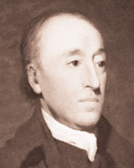
「现在是过去的钥匙」
「地球过去的历史一定由
目前仍在发生的事物所解释。」
“The past history of our globe must be explained by what can be seen to be happening now.”
詹姆斯‧赫顿(James Hutton 1726-97)的著作《Theory of the Earth》, 引述自霍姆斯(A. Holmes) 的《Principles of Physical Geology》, 1993年
Notes:
“The present is the key to the past”?
The rule was established that only things that we can see happening today can be used to explain the past. We don’t see any global flood happening today, so it in effect never happened!
A watershed in geological thinking. Popularized by Charles Lyell, a lawyer and mentor of Darwin. Note: this was not an observation but a philosophical position.

Slide 10
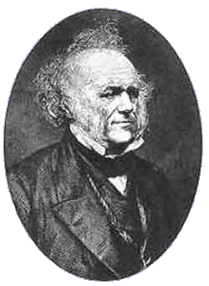
Uniformitarianism 2 - Lyell
著作: 《地质学原理》
藐视大灾难 (大洪水)
「均变论」(Uniformitarianism)
摆脱圣经的地质学
对达尔文造成深远影响
律师查尔斯‧莱尔
(Charles Lyell 1797–1875)
Notes:
Book: Principles of Geology
Lyell wrote to a friend that he wanted to “free science from Moses”. That is, he wanted to get rid of the Bible’s history, its influence. It was as if the Flood never occurred because it could not be seen to be happening today! All the rocks and fossils were to be interpreted as forming by processes seen operating today (not the Flood). The idea took root and the Bible’s account of the Flood was increasingly ignored. It was not the evidence, but the acceptance of a philosophical idea, that got rid of the Flood.
In response to the widespread acceptance of Lyell’s ideas, church leaders often retreated into saying the Noah’s Flood was a local flood, not world-wide.

Slide 11
Uniformitarianism 2 - Lyell
一场「本土性」大洪水?
The need of the Ark (emigrate?)
方舟的必要性 (迁徙?)
The need for animals on the Ark
动物在方舟的必要性
The need for birds on the Ark
雀鸟在方舟的必要性
The duration of the Flood
大洪水持续的时间
Notes:
Also the Bible’s description [next slide]:

Slide 12
Uniformitarianism 2 - Lyell
一場「本土性」大洪水?
The need of the Ark (emigrate?)
方舟的必要性 (遷徙?)
The need for animals on the Ark
動物在方舟的必要性
The need for birds on the Ark
雀鳥在方舟的必要性
The duration of the Flood
大洪水持續的時間
Notes:
Heading: A local flood?
Also the Bible’s description [next slide]:

Slide 13
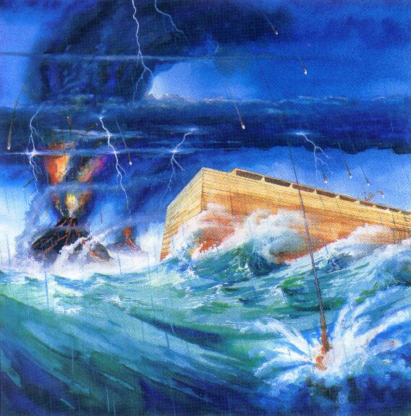
“All the high mountains … covered”
「天下的高山……淹没了」
创世记 7:19
「水势在地上极其浩大，天下的高山都淹没了」
They rose greatly on the earth, and all the high mountains under the entire heavens were covered”

Slide 14
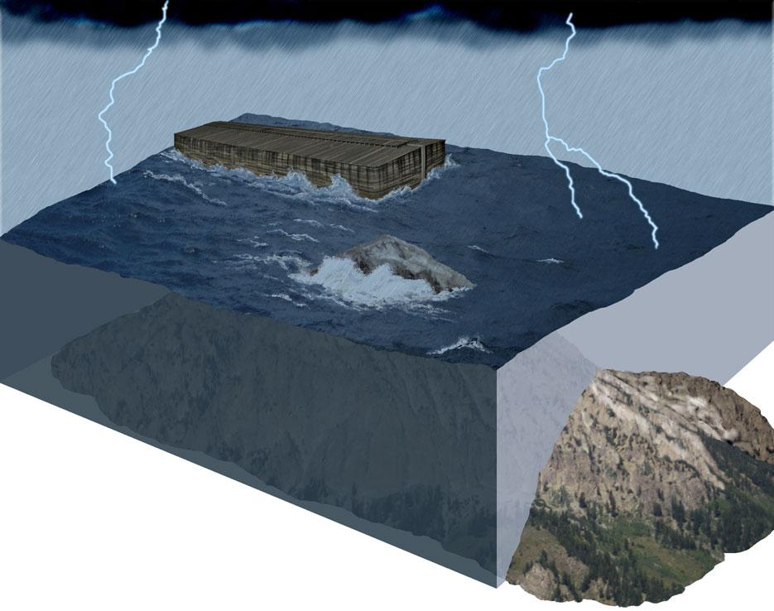
本地性大洪水?
Notes:
Local flood?
How could you have a local flood that covered all the high mountains locally?

Slide 15
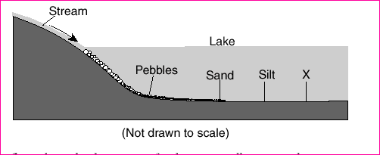
So how did they explain rocks and fossils without the Flood?
没有大洪水，如何解释岩石和化石的问题呢?
By the slow action of erosion and sedimentation over huge periods of time.
侵蚀和沉积作用以缓慢的速度，在漫长的时间里
进行
溪流
湖
卵石
砂粒
粉沙
不按比例
Notes:
Stream ---Pebbles---sand---silt deposited in a lake.
This is where the idea of huge periods of time came from: there were many kilometres depth of sediments around the world, so it must have taken a long time for such to build up at less than a mm per year rate of deposition! So this was the thinking.

Slide 16
Darwin on fossils of soft things:
达尔文对柔软有机体
变成化石的看法︰
「无一种全身柔软的有机体能得以保存。」
达尔文《物种起源》第10章
Notes:
Based on this slow formation of the rocks proposed by Hutton and Lyell, Darwin proposed that “No organism wholly soft could be preserved.” But this is not the case. Many fossils of soft-bodied creatures have been found, all around the world.

Slide 17
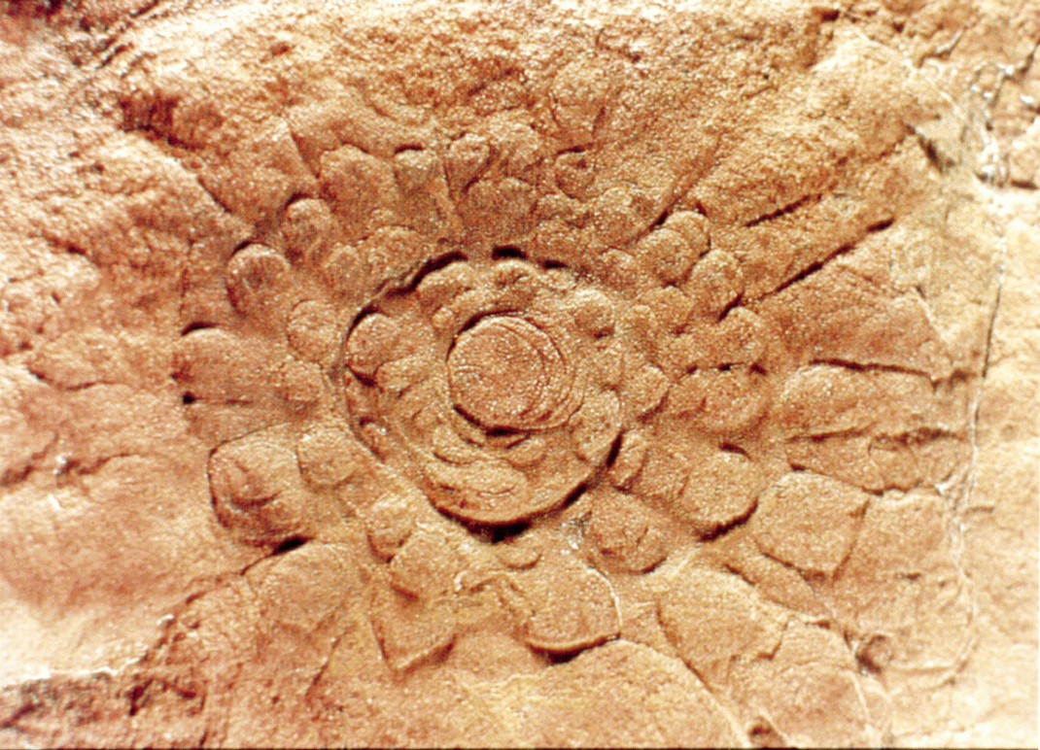
Fossil Jellyfish?
(《Creation》 杂志)
Notes:
Jellyfish fossil! Found by geologist Reg Sprigg, Flinders Ranges, South Australia. But there are many examples.

Slide 18
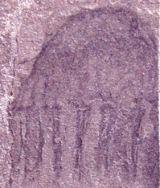
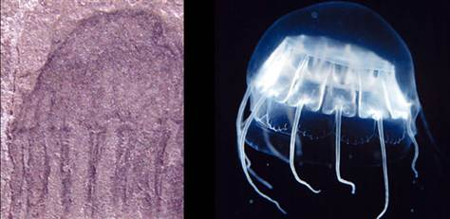

Cunina 品种
「寒武纪」水母化石 (美国犹他州)跟现代的Cunina 品种相似，
可谓「5亿年」不变!
《Creation》 30(4):21,2008年
Notes:
Here we see evidence of very rapid formation of the fossil. It also shows something else: when we look at fossils we find a huge number of them are just like living species today. So where is the evolution? The Bible says things were created to reproduce true to their created kinds and that is what we see, over and over. Note that in the claimed time frame for this, 500 million years, evolution supposes that a worm changed into you and me!
Cartwright, P., Halgedahl, S.L., et al., Exceptionally preserved jellyfishes from the Middle Cambrian, Public Library of Science ONE 2(10):e1121. doi:10.1371/journal.pone.0001121, October 2007.

Slide 19
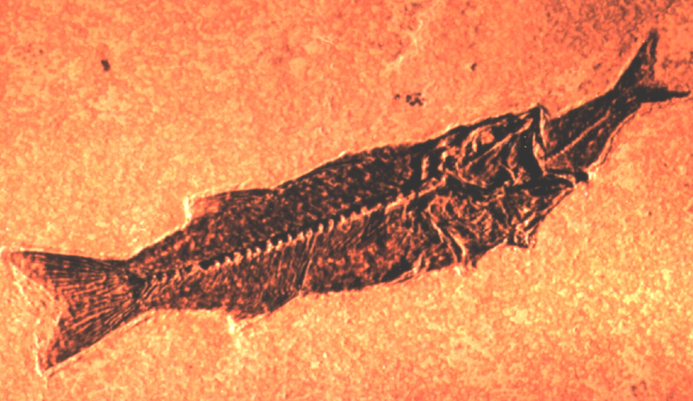
鱼儿在吃鱼: 快速埋藏!
Notes:
Heading: A fish eating another fish: rapid burial!
Even if it died of indigestion ( ☺ ), it would still need to be buried to be preserved.

Slide 20

Smiling fish

Slide 21

Tiddles 700 days
Notes:
Where would we get lots of mud from to create the fossils we see all around the world; fossils buried in rock layers that have been laid down by water?

Slide 22
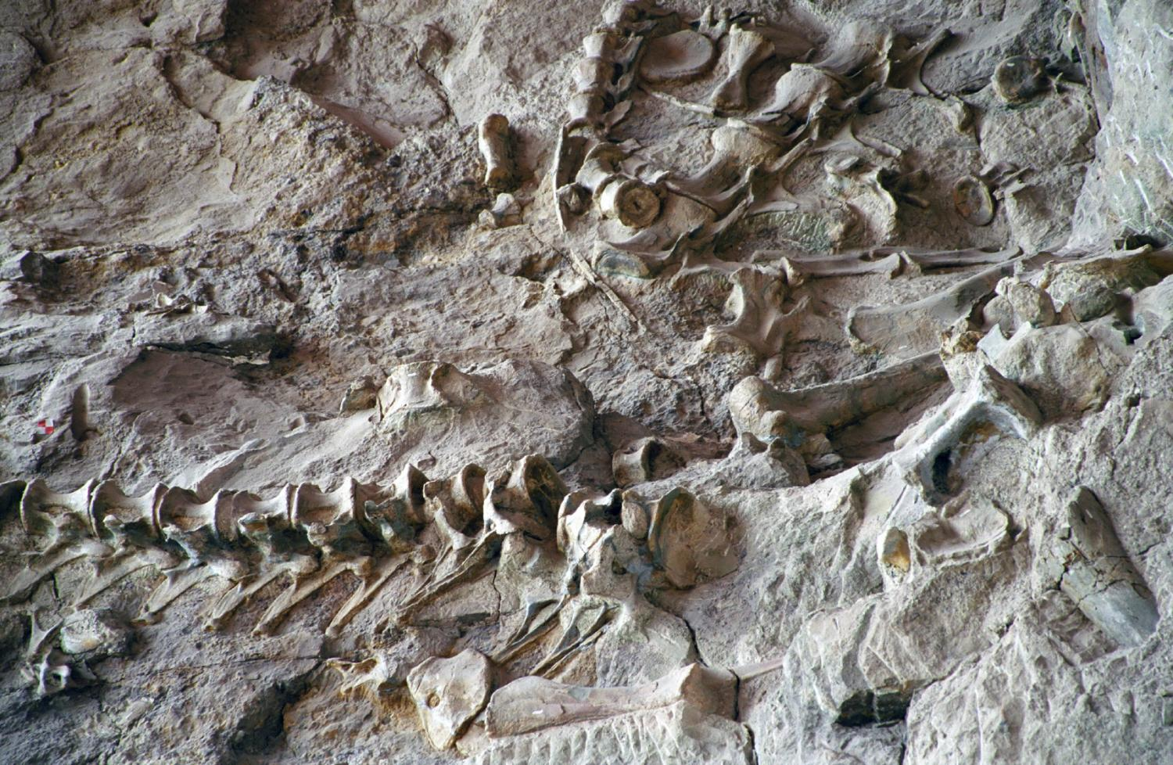
大规模埋葬的墓穴
犹他州恐龙国家纪念公园
Notes:
Heading: Dinosaur National Monument in Utah: Mass kill graveyards.
Thousands of dinosaur fossils mixed with marine fossils. We see all around the world – huge numbers of animals killed by large amounts of water and buried rapidly by large amounts of sediment. This is exactly what we’d expect to see if there was a worldwide flood.
If all the land was covered in water, tidal movement of the water would result in currents of over 100 km/hour. These currents would convert rock into mud in quick time. The result would be a huge mud-bath; a slurry of muddy water that would bury organisms and create fossils.

Slide 23
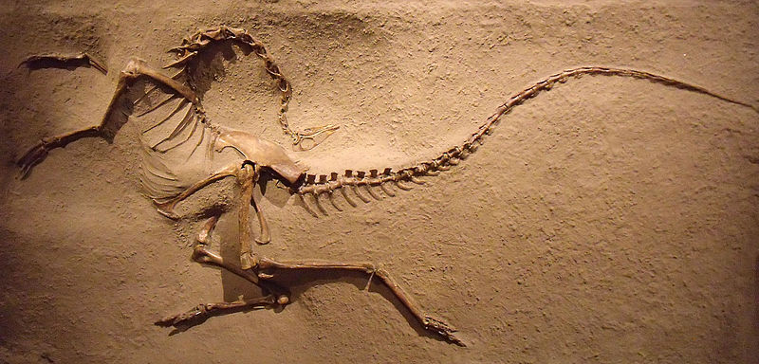
Evidence of drowning! 遇溺的证据!
Arched neck: due to drowning 颈部拱起: 由于遇溺所致
Dinosaur Provincial Park, Canada 加拿大省立恐龙公园
似鸵龙 Struthiomimus
Notes:
The arched neck of this dinosaur is fairly well established as being due to asphyxiation while floating in water. This is very, very common.
Dinosaur Provincial Park: 10,000 dinosaurs buried at once. How does this happen except in a flood like that of Noah?

Slide 24
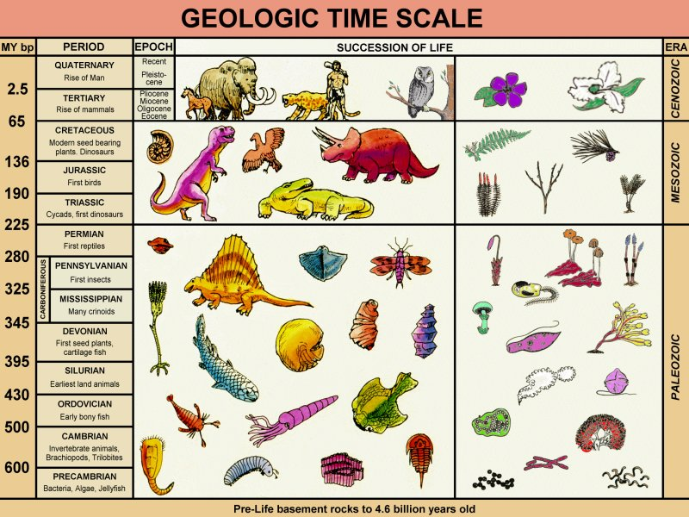
地质时间表
Notes:
Heading: geologic column
This is they typical way in which fossils and rocks are presented; as the geologic column. This is claimed to represent a history of life on earth over billions of years, but the Flood explains the fossils and rocks. And I believe it does it far better.

Slide 25
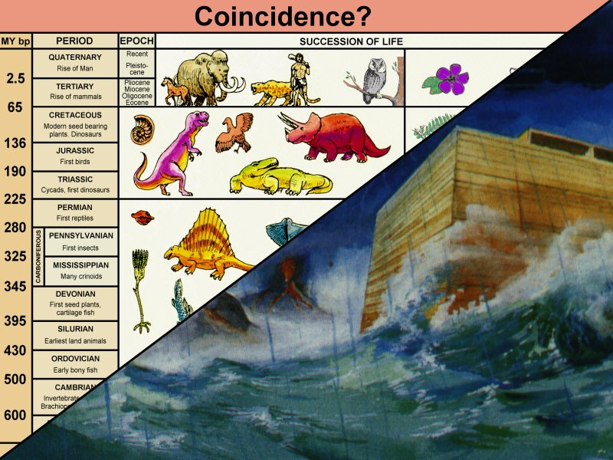
被大洪水淹没的次序
Notes:
“Order of burial during the Flood”
There is a progression in the fossils from bottom-dwelling sea creatures up to more and more land organisms. This would be the expected order from the sediment from a global flood progressively burying things. Rather than being a record of eons of time, it is evidence for Noah’s Flood.

Slide 26
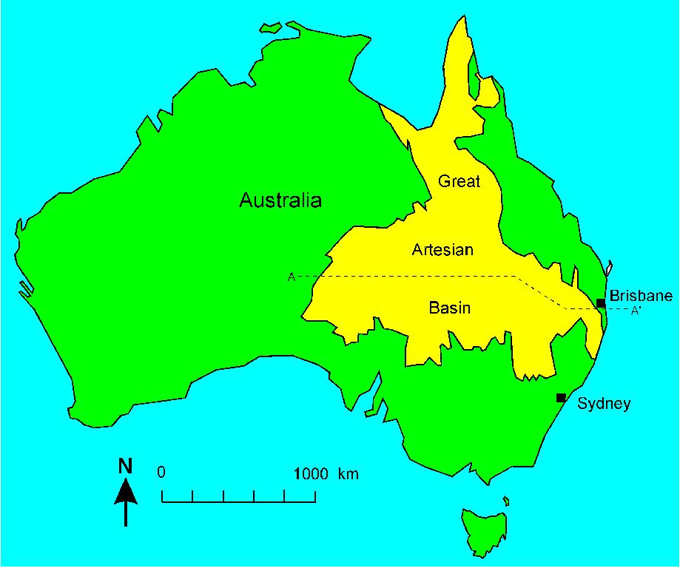
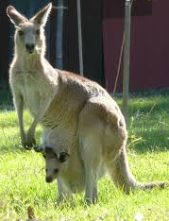
Great Artesian Basin
澳洲
布里斯班
大自流盆地
悉尼
Notes:
We find other evidence for Noah’s Flood in the rocks themselves We find huge areas and volumes of rock that was laid down under vast volumes of water.
Australia: Yellow area 2,500 km long x 2,000 km wide (over 2 million square km). Sandstone laid down under water. Indicates continent-wide flooding, not a local event.

Slide 27
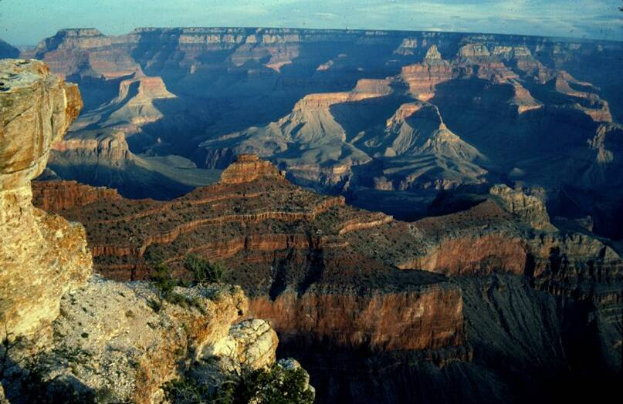
Large-scale sedimentary formations大规模的沉积岩组
Coconino Sandstone
Coconino 沙岩
Notes:
Coconino sandstone: 500,000 square km. 100 metres thick. ‘Cross-bedding’ in the stone shows fossilized sand-dunes. The sand-dunes were formed in deep, fast-flowing water. This shows that this whole rock layer was formed in a matter of days. Layer after layer in the Grand Canyon shows evidence of rapid formation, laid down under water.

Slide 28
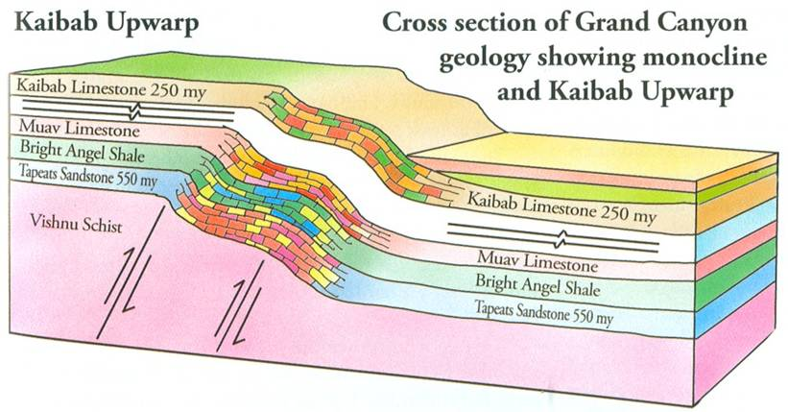
Soft sediment deformation
松软的沉积物扭曲变形
高原
大峡谷地质横切面
显示单斜褶皱结构
及Kaibab Upwarp高原
70 my
Notes:
(don’t translate the layer information; we don’t need such detail)
This is east of the Grand Canyon where the layers are all bent. The layers of the Grand Canyon are claimed to have been laid down over 300 million years and then the whole lot was bent a long time later. The last layers formed 250 million years ago’. The bending: 70 million years ago. But if that were so, the layers would all be hard rock when the bending occurred. So the rock should be cracked from the bending, but it is not. The evidence suggests that the layers were laid down in very quick succession (all in a short time) and that the bending occurred before the mud could become hardened stone. This is consistent with formation during the year of the Flood of Noah. This alone should be enough to overturn the millions of years story. But there’s more!

Slide 29
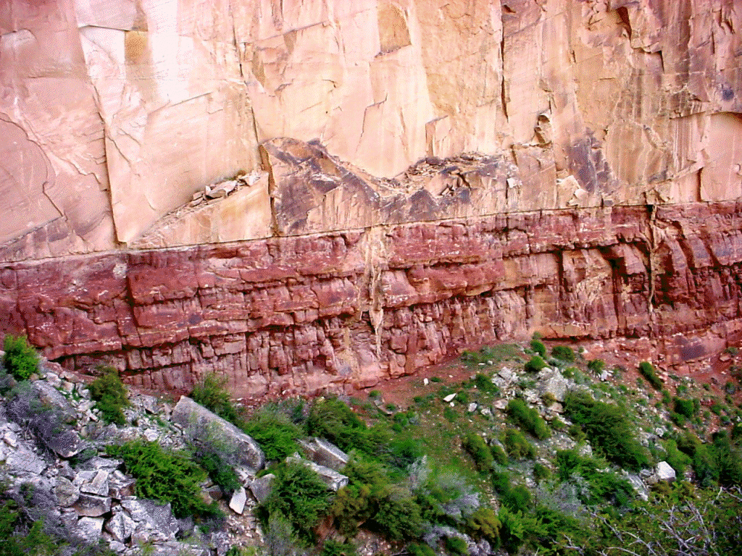
Coconino/Hermit contact
Coconino 沙岩
相隔1,200万年
Hermit页岩
岩层之间哪里有侵蚀的证据呢?
Notes:
The Coconino sandstone that we just talked about sits on top of a layer of shale rock. There is supposed to be a 12 million year gap between the two layers. Why? If we trace these two layers south from Grand Canyon, we find a thick layer of other rock inserted in between [next slide]:
Photo: John Hartnett (2003).

Slide 30
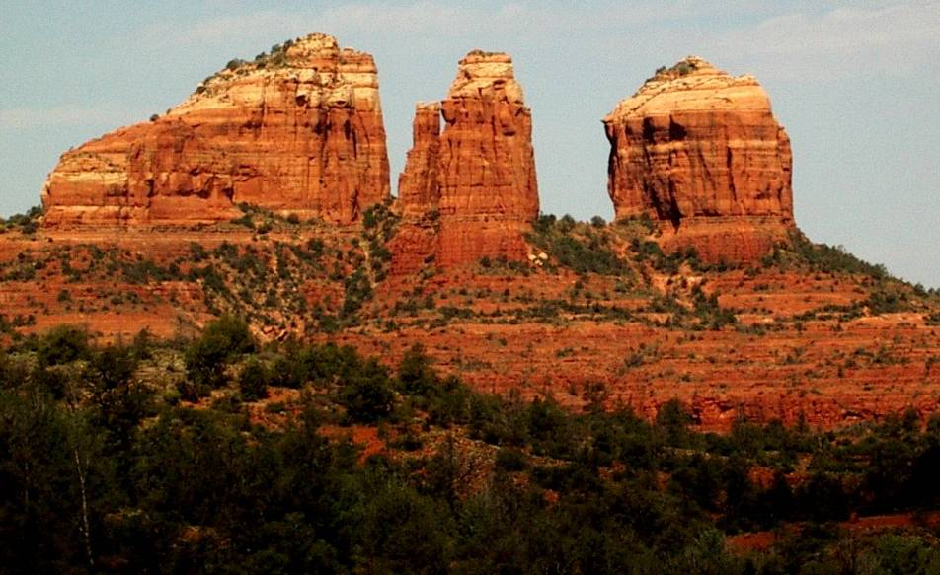
亚利桑那州︰位于Coconino砂岩组与Hermit页岩组之间的Schnebly Hill岩组
Coconino 砂岩
Schnebly Hill岩组
(砂岩)
Hermit 页岩
Notes:
Because of the false idea that such rock layers form slowly, a thin layer at a time, this means millions of years ‘must’ be in between the Coconino and the Hermit layers. However, there is no evidence of such time.
Near Sedona, eastern Arizona, USA (100 km south of Grand Canyon).

Slide 31
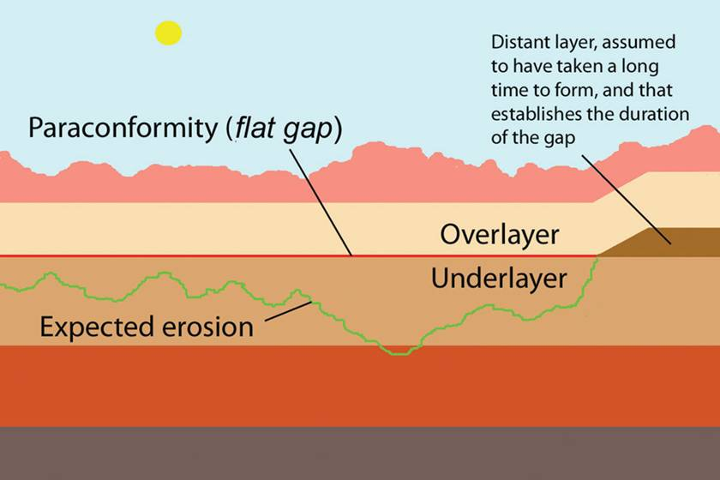
远古层，假设经过漫长的岁月才能形成，并能计算出间隙的时间有多长
平行而不整合的地质间隙 (平面间隙)
上层
下层
预期的侵蚀
Notes:
This diagram illustrates the problem. If a surface was exposed for millions of years, erosion would have occurred.
[I’m not sure if the Chinese here says what I want, but I think it does].

Slide 32
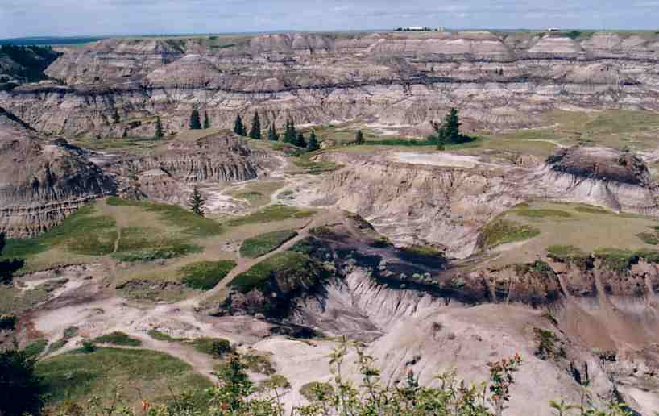
Land surfaces erode! 地面侵蚀!
Notes:
South Dakota, USA. Eroding at 25 mm per year, yet the erosion has supposedly been going on for more than 20 Ma (50 km of erosion??). The landform can change visibly from one thunderstorm, according to the Parks authority.

Slide 33
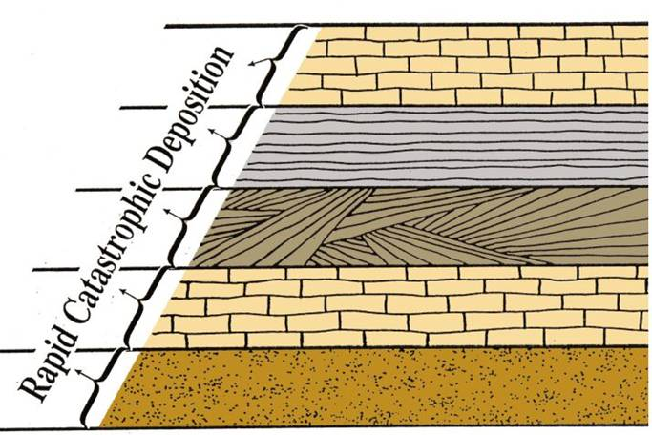
岩层快速形成 ─ 哪里显示时间?
灾难性快速沉积
时间过去
时间过去
时间过去
时间过去
但证据显示，岩层之间只有些微间断，甚至无间断
Notes:
Layers form rapidly — Where is all the time?
The evidence from the folding and within the layers and between the layers suggests that the layers formed quickly and that there was not much time between the layers.

Slide 34
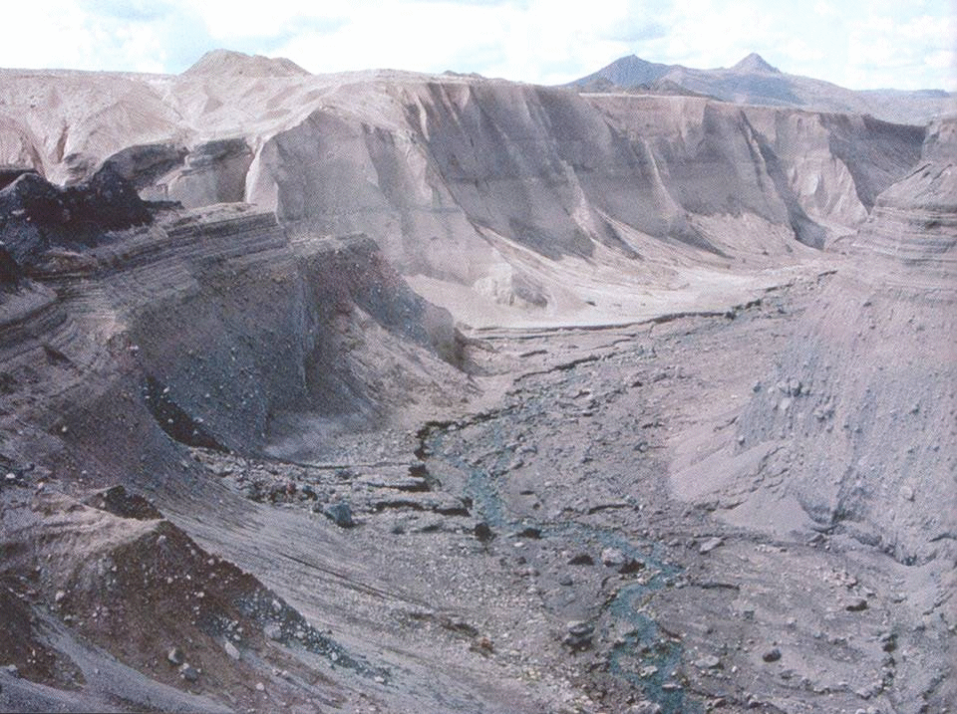
Mt St Helens: Little Grand Canyon2
「小型大峡谷」
Notes:
Near Mount Saint Helens volcano in the northwest of the USA.
Little Grand Canyon formed in a less than a day by mudflow on 19 March 1982. The creek is there because the valley was carved by a mudflow. The creek did not cause the valley to form by slow and gradual erosion over eons of time.
The Grand Canyon itself was carved by the retreating waters of Noah’s Flood.
[A note for Q&A if needed: a detailed study in Journal of Creation 24(3):106–116, December 2010 by Peter Scheele: A receding Flood scenario for the origin of the Grand Canyon]
[Steve Austin Book p. 76]

Slide 35
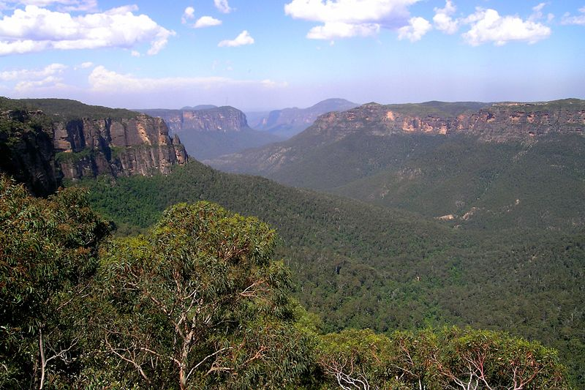
澳洲新南威尔士的蓝山
Notes:
If we think about the Flood, towards the end we have water covering all the land. As it begins to retreat from the land into the seas, it flows in a sheet manner (planar). This would erode surfaces fairly flat. This is the cause of plateaux in many places around the world. As the waters continued to retreat, the water would start to run in channels where ever a dip in the surface was present. Then that channel would rapidly erode to form valleys and canyons like we see carved into plateaux. We could think of the Grand Canyon, but this an example from Australia, in the Blue Mountains, west of Sydney.

Slide 36
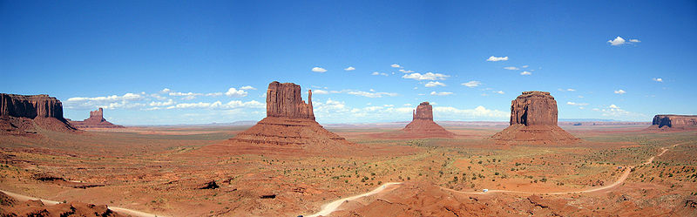
美国犹他州纪念碑峡谷Monument Valley, UT, USA
Notes:
Here is another really clear example from the USA.
People often ask, ‘Where did all the water come from?’ Let’s look at Google earth [next slide]

Slide 37
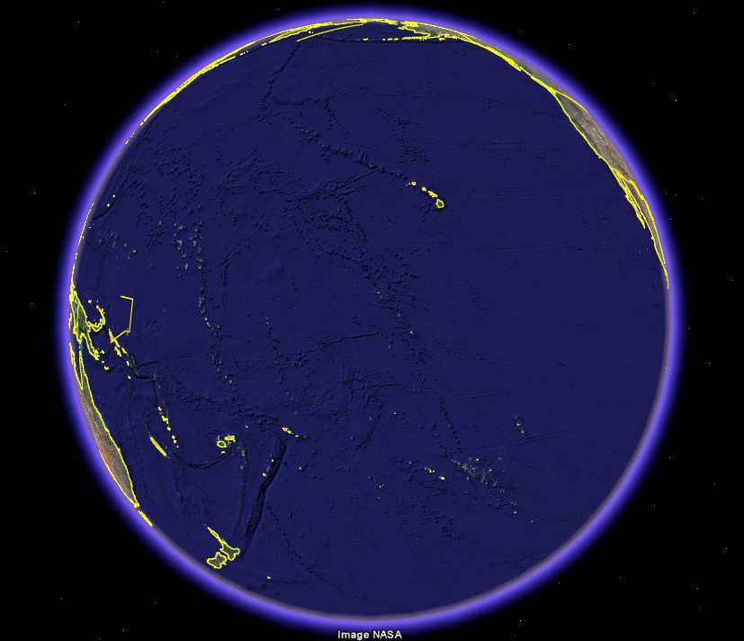
Where did the water come from (Pacific Ocean pic?
谷歌地球
太平洋

Slide 38
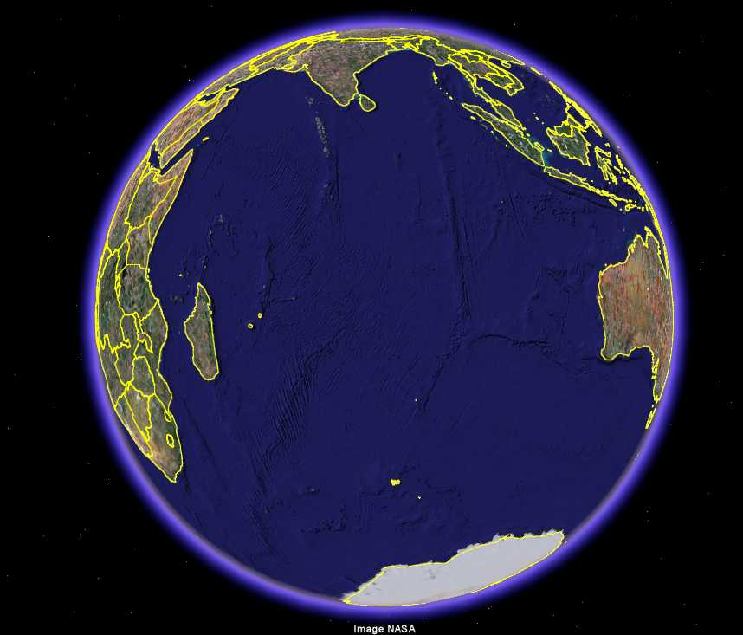
Where did the water come from (Pacific Ocean pic?
谷歌地球
印度洋
Notes:
There is plenty of water on earth for a global Flood.

Slide 39

World-wide flood stories
全球洪水故事
「洪水︰一个地球被水淹没或沉在水底的世界性灾难 ；这个观念几乎也在世界各地的传说中流传。」
“Deluge or Flood: A world cataclysm during which the earth was inundated or submerged by water: a concept found in almost every mythology in the world.”
—芬克及瓦格诺(Funk and Wagnalls), 《Dictionary of Folklore, Mythology and Legend》, 1950年
Notes:
Stories exist world-wide about a flood that destroyed the world, with many similarities to the biblical record given in Genesis 6-9.
These stories exist world-wide because all people are descendants of Noah’s family who survived the Flood on the Ark.

Slide 40
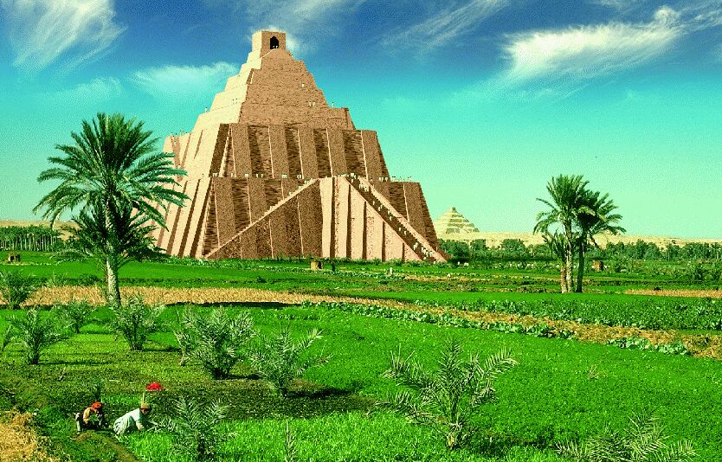
我们: 源自一个人类家庭!
语言? 13–23 个家庭。挪亚在巴别时有16个孙儿 。
全球人口增长︰由挪亚的家庭演变成今天的人口数目，每年的人口增幅 < 0.5%
Notes:
“We are one human family!”
DNA patterns are consistent with all people on earth coming from Noah’s family.

Slide 41
Race and genetics 种族及遗传
「但是，拿来解释人口表现型差异的基因，只属我们基因组的一小部分，再次肯定从遗传角度衍生『种族』的观念并不成立。」
“But the genes that explain the phenotypic differences between populations only represent a tiny part of our genome, confirming once again that the concept of ‘race’ from a genetic standpoint has been abolished.”
—法国国家科研中心(National Centre for Scientific Research)学者 Lluis Quintana-Murci, 2008年2月4日 http://www.physorg.com/news121369077.html
Notes:
We all have the same skin colour! Yes, it’s due to a pigment called melanin. If you have a lot of it you are black, not much you are white, and a moderate amount you are brown.

Slide 42

Family tree
我们的族谱
创 3:20;
使 17:26
亚当与夏娃
儿女们
创 5:4
创 9:17–19
挪亚与家庭
创 11:8–9
巴别塔
不同文化
Notes:
“Our family tree”
Acts 17:26 He made from one man every nation of mankind to live on all the face of the earth
Gen. 3:20 Eve … was the mother of all the living.

Slide 43


宇宙的
历史书
Notes:
“The history book of the universe!”

