Slide 1
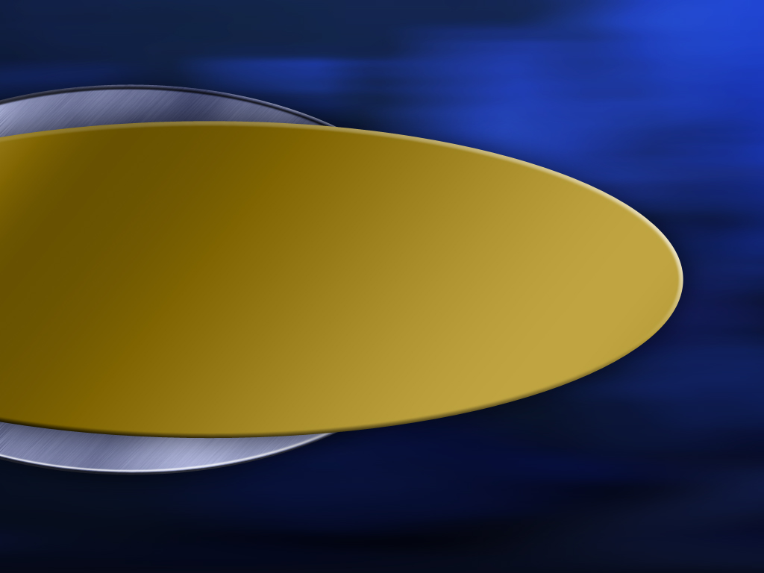

Title 2
Terry Mortenson博士
类人猿： 大幻影
创世记答案机构
Designed by Dr. Terry Mortenson
Dr. Rick Griffith • 博士 • 新加坡神学院 • BibleStudyDownloads.org

Slide 2

AiG web site #1
创世记答案机构
相信·维护·宣告
© 2007年创世记答案机构—美国

Slide 3
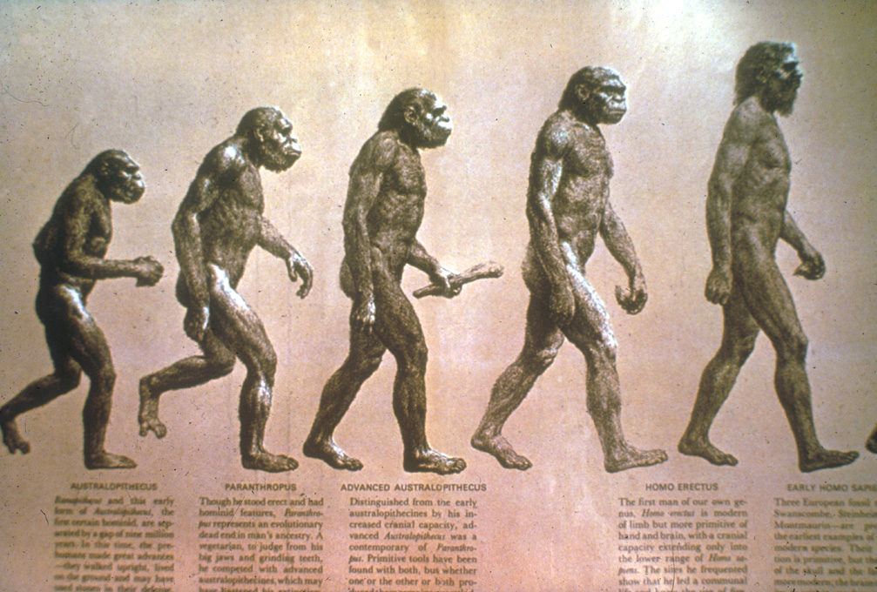
Evolution of man progression?
人类的进化论？

Slide 4
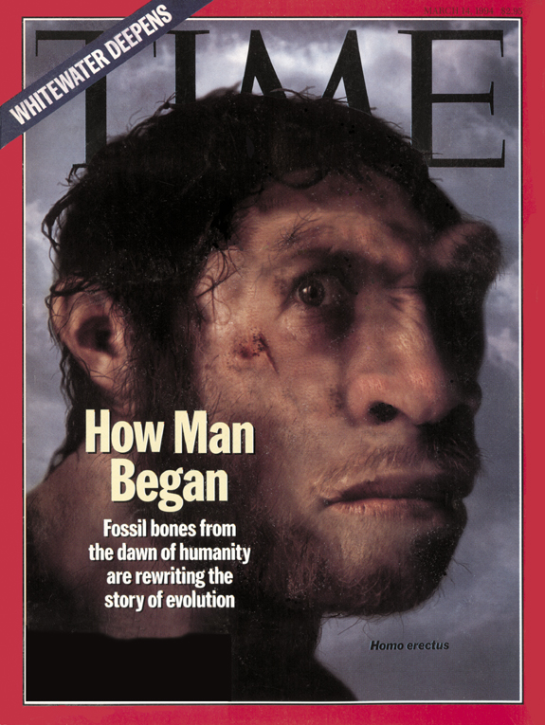
TIME cover, 14 March 1994
1994年
3月14日
How Man Began
Fossil bones from the dawn of humanity are rewriting the story of evolution

Slide 5
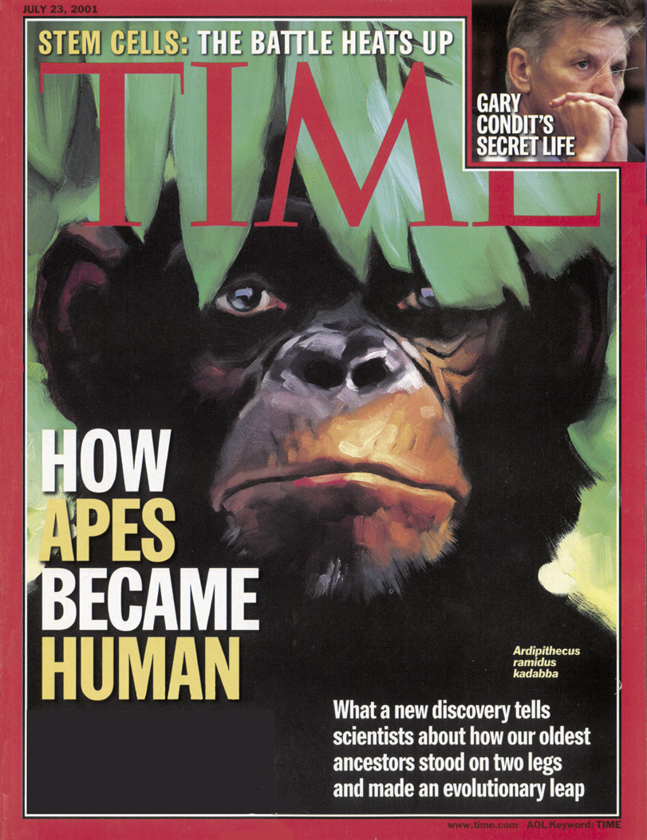
TIME cover, 23 July 2001
2001年
7月23日
HOW APES BECAME HUMAN
What a new discovery tells scientists about how our oldest ancestors stood on two legs and made an evolutionary leap

Slide 6
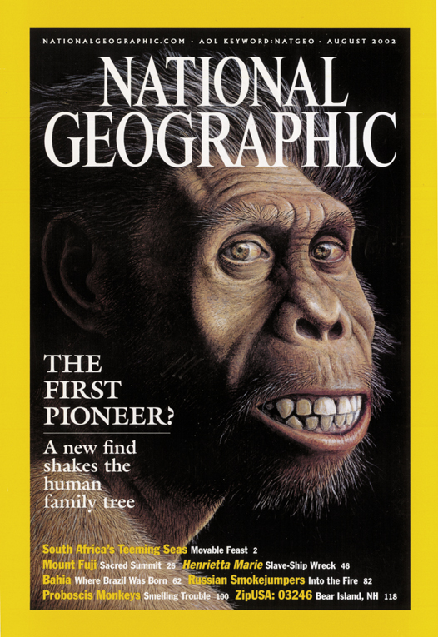
National Geographic cover, August 2002
2002年8月
THE FIRST PIONEER?
A new find shakes the human family tree

Slide 7
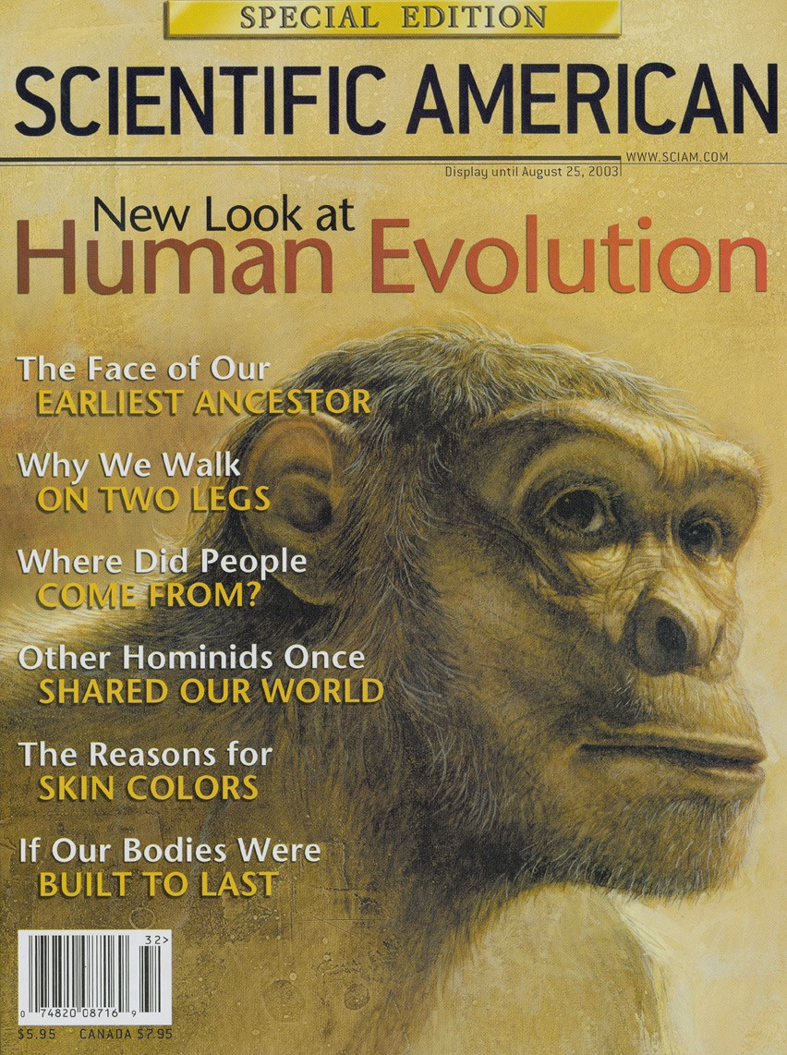
Scientific American cover, August 2003
2003年8月
The Face of Our Earliest Ancestor
Why We Walk on
Two Legs
Where Did People Come From?
Other Hominids Once Shared Our World
The Reasons for
Skin Colors
If Our Bodies Were Built to Last

Slide 8
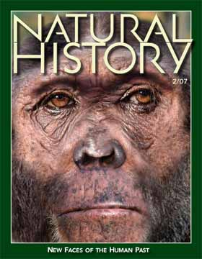
Natural History Feb 2007
2007年2月
人类历史的新面孔

Slide 9
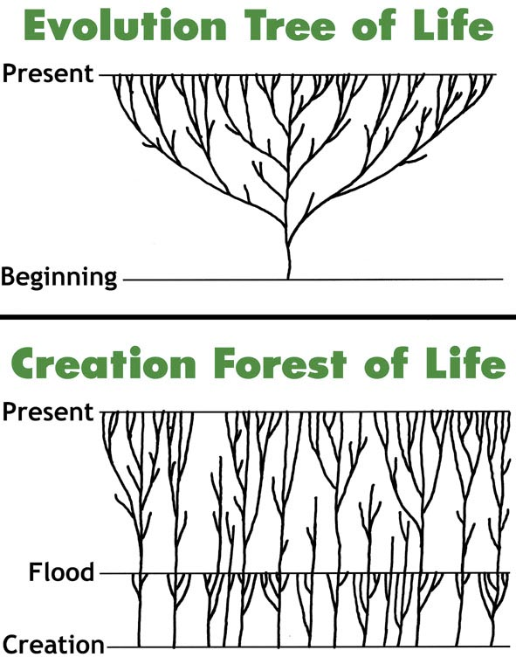
Evolution tree vs creation forest
生命树的进化论
现在
起初
生命的创造森林
现在
洪水
创造

Slide 10
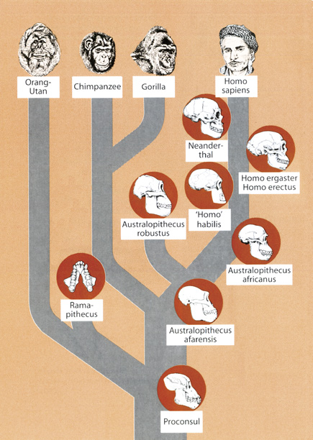
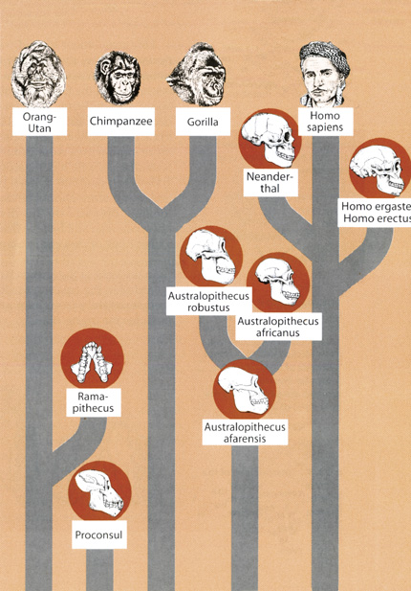
Evolution tree & creation forest
进化论树
创造森林
猩猩属
黑猩猩
大猩猩
智人
猩猩属
黑猩猩
大猩猩
智人
尼安德特人
尼安德特人
匠人
直立人
匠人
直立人
粗壮种南方古猿
能人
粗壮种南方古猿
非洲南方古猿
非洲南方古猿
腊玛古猿
腊玛古猿
阿法南方古猿
阿法南方古猿
原康修尔猿
原康修尔猿
Notes:
A hominid is any member of the biological family Hominidae (the "great apes"), including the extinct and extant humans, chimpanzees, gorillas, and orangutans. This classification has been revised several times in the last few decades. These various revisions have led to a varied use of the word "hominid": the original meaning of Hominidae referred only to the modern meaning of Hominina, i.e. only humans and their closest relatives. The meaning of the taxon changed gradually, leading to the modern meaning of "hominid," which includes all great apes.
The primatological term hominid is easily confused with a number of very similar words:
A hominoid or ape is a member of the superfamily Hominoidea: extant members are the lesser apes (gibbons) and great apes.
A hominid is a member of the family Hominidae: all of the great apes.
A hominine is a member of the subfamily Homininae: gorillas, chimpanzees, humans (excludes orangutans).
A hominin is a member of the tribe Hominini: chimpanzees and humans.
A hominan is a member of the sub-tribe Hominina: modern humans and their extinct relatives.
A human is a member of Homo sapiens. The word is sometimes also used to refer to any extinct member of the genus Homo or members from other hominan genera.
A humanoid is a vaguely human-shaped entity; the term is typically used in science fiction.
Certain morphological characteristics are still used conventionally to support the idea that hominid should only denote humans and human ancestors, namely bipedalism (walking on two feet) and large brains. These points of departure between human beings and the other great apes are important, but according to genetically based taxonomic classification, are not enough to divide us into separate families. Genetics, rather than morphology, is more widely accepted as the critical standard. Many scientists, including anthropologists, use the term to mean humans and their direct and near-direct bipedal ancestors.
Two charts from Reinhard Junker, Is Man Descended from Adam? (Biblical Creation Society, 2000, translated by Steven Robinson), p. 10-11.

Slide 11
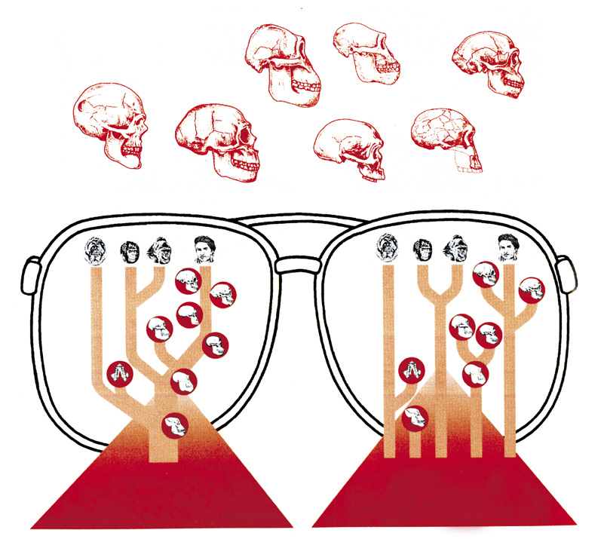
资料
哪一个观点最符合事实？
进化论树
创造森林

Slide 12

Australophithecus
南方古猿

Slide 13
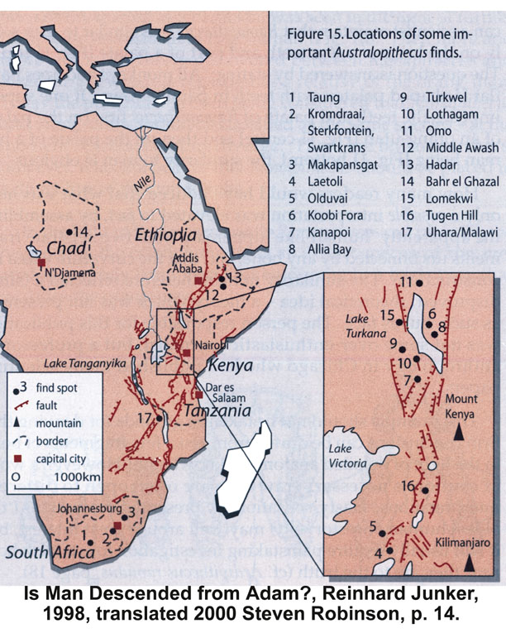
Australopithecines—Kenya map
Notes:
Most of the evidence for australopithecus has been found in east Africa, especially Kenya and Ethiopia

Slide 14
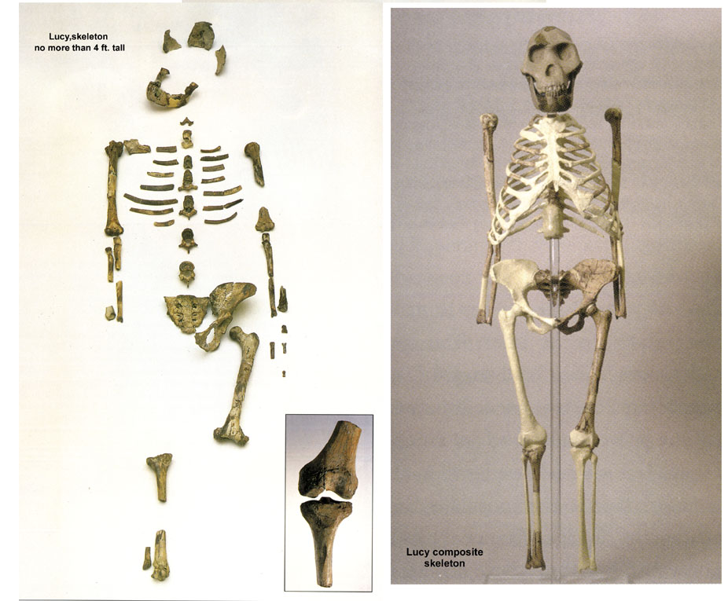
Lucy, partial and full
“露西”，埃塞俄比亚 (1974)
Notes:
100s of bone pieces representing 40% of body (Australophithecus afarensis) found by Donald Johanson in 1974 in Hadar Formation of Awash Valley in Ethiopia's Afar triangle by Donald Johanson. She's been dated at 3.2 million years old.
Johanson named her “Lucy” because as he came back into camp, the Beatles song “Lucy in the sky with diamonds” was playing.
Research has since shown that Lucy was male not female (David Menton's video: Lucy: She's no lady)
More australopithecines have been found and the evolutionist consensus is that they are transitional forms between chimps and humans. But the australopithecine fingers are long and curved like a chimpanzee and the wrist has a locking mechanism like chimpanzees that walk on their knuckles on all fours. The organ of balance is also very chimp-like in the australopithecines. Conclusions can be difficult to draw because these fossils are fragmentary and broken and must be reassembled.

Slide 15
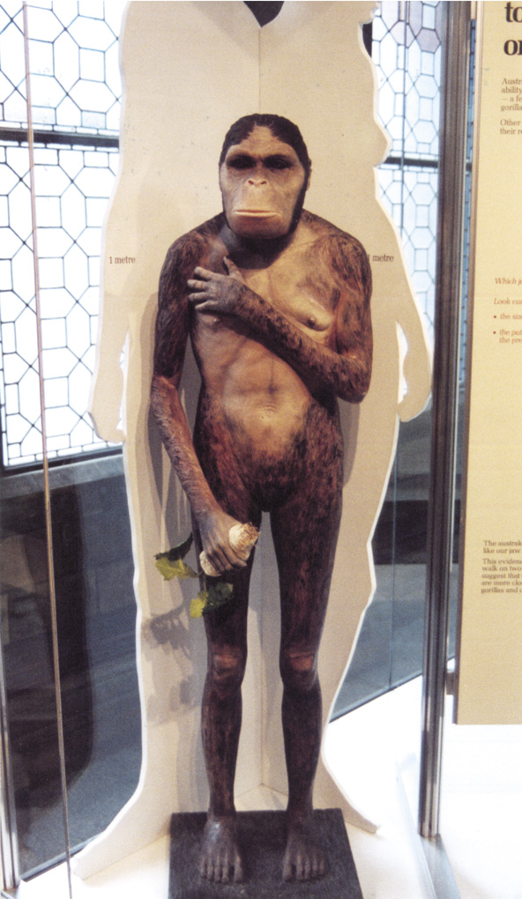
Lucy in the flesh--London
注意！
手与脚
挺直的姿势
脸部
真相
指背行走者，与侏儒黑猩猩或大猩猩相似
Notes:
PNAS (Proc. Nat. Acad. Sci), vol 104:16 (17 April 2007, pp. 6568-6572: research concludes that Lucy most closely resembles a gorilla or at least the robust australopithecines (no longer considered to be ancestral to man).
Photo by Ken Ham at Natural History Museum in London, 2009
The fossil evidence shows that Lucy (a specimen of Australopithecus afarensis) had very chimp-like body proportions (only 4 feet tall when upright) with long arms and short legs, wrists designed for knucklewalking, long curved hands and feet (with opposing big toes like in apes, not like in humans) for grasping trees, and hip/pelvic shape that indicates that she spent much time in trees, not walking like humans. See critique of the BBC's Walking with Cavemen, at <www.biblicalcreation.org> and the video by Dr. David Menton (anatomy professor), called “Lucy: She's no lady!” available from <www.answersingenesis.org>.

Slide 16
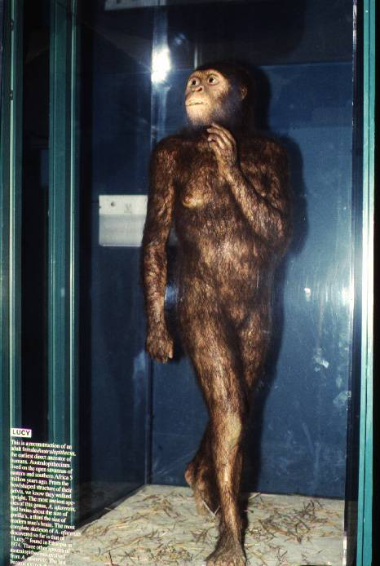
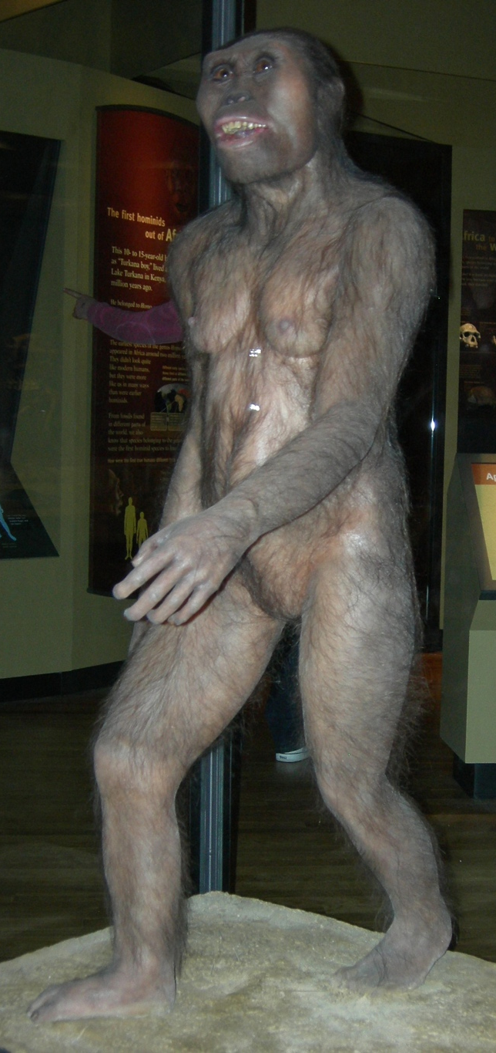
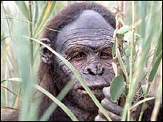
Lucy — London & St. Louis
BBC, 2006（英国广播公司）
芝加哥频道
圣路易斯动物园
伦敦自然历史博物馆
Notes:
London photo by Ken Ham from his visit to the Natural History Museum in 2009
St. Louis Zoo's “Living World” exhibit photo by David Menton (in his DVD, “Lucy: She's No Lady!”) taken in about 1995 (in the exhibit for at least 20 years from the very beginning in 1985)
Chicago Field Museum's model (in their “The Evolving Planet” permanent exhibition), photo by Carl Kerby in March 2006 (http://www.answersingenesis.org/docs2006/0313field_trip.asp, 13 Mar 2006, accessed 29 June 2011.
BBC photo: article reporting on Lucy's bones touring America. The caption under photo in the article: “Lucy's remains were found in 1974 in Hadar, Ethiopia.” See http://news.bbc.co.uk/1/hi/world/americas/6082990.stm, “Lucy's Ancient Bones to Tour US, 25 Oct. 2006.” She will be on loan from Ethiopia to the Houston Museum of natural Science in Texas for scientific study till 2013. Officials say that money from the tour will be used to improve museums across the country.

Slide 17

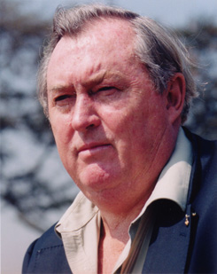
Purple blank
ew scientist
1981年: “现在我们可以说南方古猿的确是笔挺地行走。”.”
理查德·李基 （肯尼亚国家博物馆，董事） ，The Making of Mankind （智人的进化）, (New York: E. P. Dutton, 1981), p. 71.
Notes:
Picture from http://www.midland.edu/~events/davidson/leakey.html, downloaded 14 April 2005

Slide 18
Purple blank
但是1982年的时候。。。
“李基指出古生物学家不知道南方古猿到底是否笔挺地行走。他说，‘没人曾找到一具有关的骨骼和颅骨。’”
匿名，“李基对于人类的年数改变主意，”新科学人， 第93期（1982年3月）， 695页。

Slide 19
Purple blank
理查德·李基于上个星期五的英国科学研究所的夜间演说会在一群的优雅观众前说“‘我开始怀疑少过一年前我说的那番话。’他透露他最近在英国广播公司电视系列《智人的进化》所主张的传统的智慧，‘在几个关键的方面有可能是错误的’。”
匿名，“李基对于人类的年数改变主意，”新科学人， 第93期（1982年3月）， 695页。
Notes:
Note that his errors were broadcast on BBC for millions to hear, but his recantation was made before an elite audience at the Royal Institution and then quoted in a minor article in New Scientist. But judging from the article he didn't explicitly recant the error in his book [and no doubt in the BBC-TV series] about australopithecines walking upright.

Slide 20
Purple blank
“尤其是，他现在看人类最老的祖先为足足少了1500万至2000万的岁数 ，对比之前他在电视机前所主张的。李基说古生物学家归类猿人化石遗迹和人类的根基是误导性的，并且他希望看到全新归类的方式。
1982年
匿名，“李基对于人类的年数改变主意，”新科学人， 第93期（1982年3月）， 695页。

Slide 21
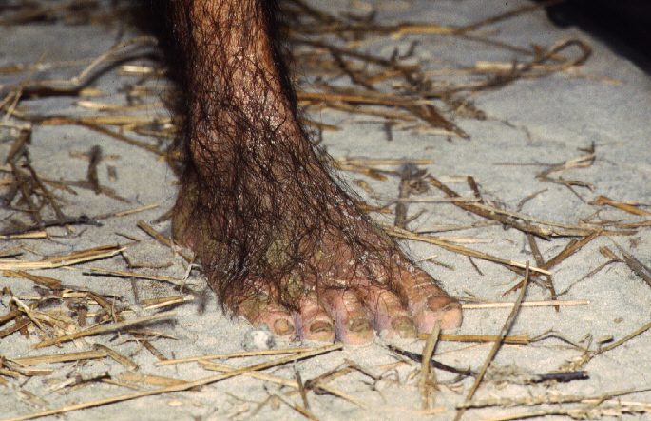
露西的“人”足
自然世界馆展览品，圣路易斯动物园
Notes:
“Living World” exhibit opened about 1985
Dave Menton's photo in about 1995

Slide 22
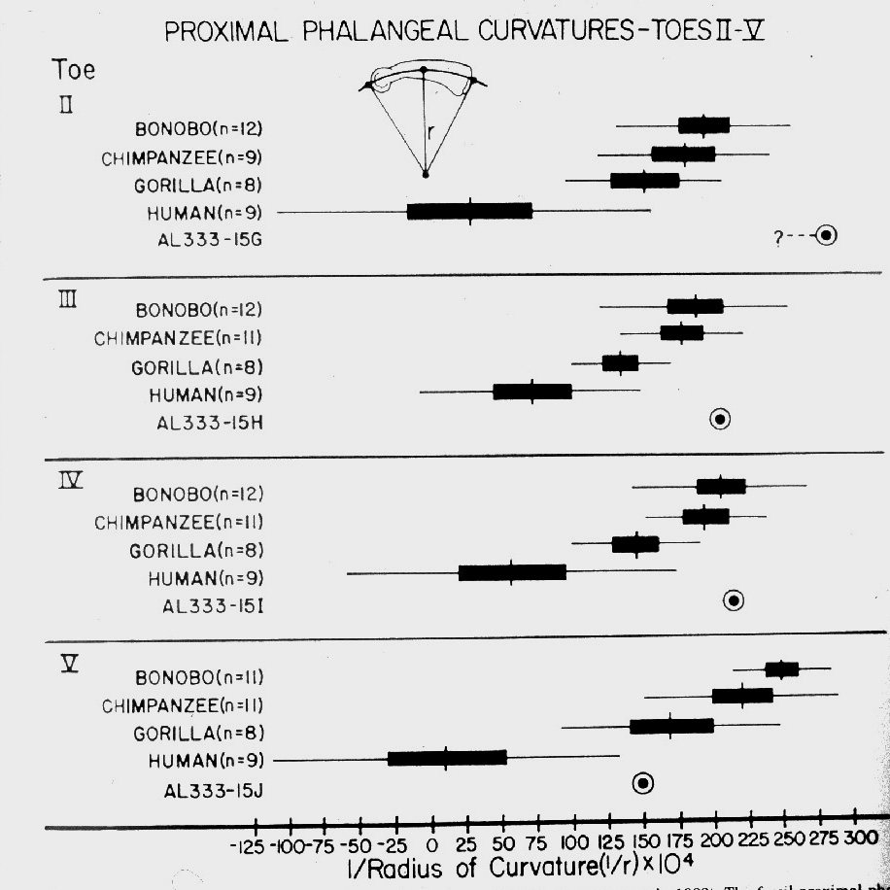
阿法南方古猿脚指头的弯曲
人类
古猿
1983年
J. Stern & R. Sussman, 1983, Am. J. Phys. Anthropology （美国人类体格学期刊） 60:279-212
Notes:
Curvature of the actual bones that make up the toes of these creatures. Australopithecus afarensis was clearly designed with hands and feet for life in the trees

Slide 23
露西的“人”足
非常
非科学
自然世界馆展览品，圣路易斯动物园
Notes:
Dave Menton: Only reason that evolutionists make Lucy's feet look so human is because they are totally convinced (in spite of the physical evidence) that Lucy's kind made the Laetoli footprints in Tanzania (which look perfectly human), hundreds of miles from the nearest australopithecine fossils that have been found.

Slide 24
Purple blank
“‘是时间承认我们所使用的系统对付具有时间量纲的事物来命名是不足够的。’。。。李基相信目前的各化石遗迹的困惑系统命名法正在使人‘转圈圈’。他确信‘若一个人从头开始并给予那些化石遗迹命新名，那人将提出一个与我们现在所看到的完全不一样的一幕。’”
匿名，“李基对于人类的年数改变主意，”新科学人， 第93期（1982年3月）， 695页。

Slide 25
Purple blank
关于南方古猿的文章在1986年开始：
“在肯尼亚所寻到的一头250万岁的颅骨在肯尼亚推翻了之前所有对早期人类进化的观念。
我们不再知道谁产生了谁—甚至可能连如何或我们几时开始存在我们都不知道。”
希普曼，(古生物学家，约翰·霍普金斯医学院），《人類里程樹難理解的分支》，发现杂志 （1986年9月），封面、89页。
Notes:
The skull was KNM-WT 17000 in the National Museums of Kenya. It has the robust characteristics of Australopithecus boisei.
A similar statement to what is on the magazine cover about this find is found on p. 89

Slide 26
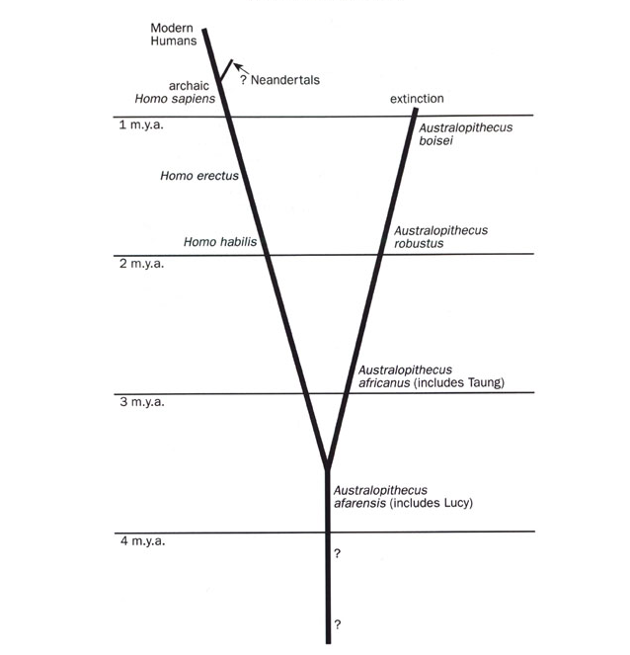
Human evolution chart 1979-86
人类进化论的理论 1979年-1986年
（Johanson与White之后）
现代人
古代智人
尼安德特人
绝种
鲍氏南方古猿
直立人
能人
粗壮种南方古猿
非洲南方古猿（包括汤恩）
阿法南方古猿
（包括露西）
Notes:
Taken from Marvin Lubenow, Bones of Contention (Grand Rapids: Baker, 1992), p. 54.

Slide 27
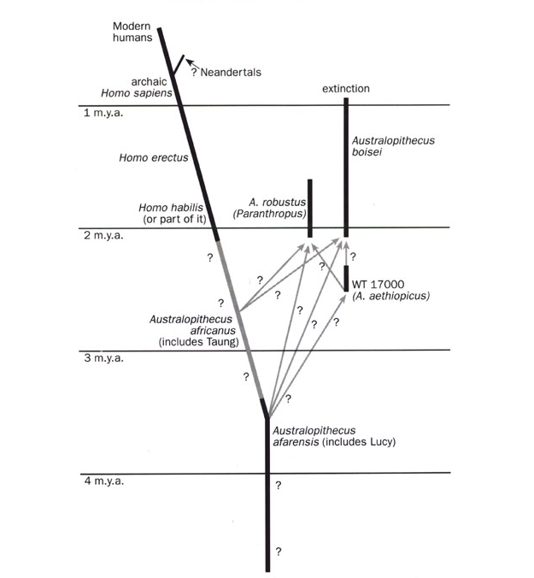
Human evolution chart post-1986
人类进化论的理论，后1986年
（Johanson与White之后）
现代人
尼安德特人
绝种
古代智人
鲍氏南方古猿
直立人
粗壮种
南方古猿
能人（或一部分）
埃塞俄比亚傍人
非洲南方古猿
（包括汤恩）
阿法南方古猿
（包括露西）
Notes:
Taken from Marvin Lubenow, Bones of Contention (Grand Rapids: Baker, 1992), p. 55.

Slide 28
Shipman 1986
文章的结尾：
“最重要的是庞大的工程需要进行。这是古生物学新的时代。 我们以为我们相当了解的事，却不然，。。。对于这新的颅骨，没有更好的论述可以支持所需的时间、工夫以及现场研究的费用。就如一场的地震，这新的颅骨把我们很好的组织构造化为一堆的尴尬、锋利的新假说。这的确是个科学进展的迹象。
希普曼（1986年），93页。

Slide 29
Template Suite 1-Content 01360
尼安德特人
Notes:
As a content template, this is best suited for standard content such as outlines, quotations, Scriptures, and maybe illustrations or photos. Presentation Team recommends 48–60 pt. font for headings and 28–40 pt. for body text. Because of eye flow and visual psychology, the top line may be a little closer than all other sides. This also contains a floating AiG logo that can be repositioned or removed as appropriate for the overhead's content.

Slide 30
Purple blank
斯科普斯进化论审判案美国田纳西州代顿镇, 1925年
“尼安德特人无疑比现代人更为原始以及在组织上更像类人猿。 ”
纽曼博士（Prof. Horatio H. Newman）
动物学家，芝加哥大学
“美国猴子案件”
(The World's Most Famous Court Trial, p. 278.)

Slide 31
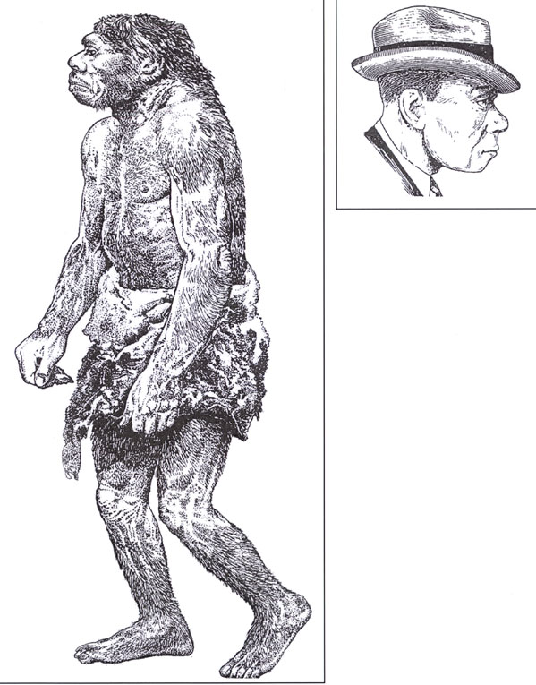
Neanderthals—then (1856) and now (1983)
1983年
1856年
Notes:
1856 is when the first Neanderthal was found in the Neander Valley near Dusseldorf, Germany. 490 Neanderthal skeletons have been found in Europe and western Asia as of 2006. Initially thought by scientists to be fully human, a man with rickets
1863 TH Huxley called it ancient human but not direct ancestor to modern man
1864 William King (Irish geologist) declared at meeting of BAAS that it was a different species and named it Homo neanderthalensis
1908 three RC priests excavated a nearly complete skeleton near La Chapelle-aux-Saints, France, and gave it to Marcellin Boule, anatomist at Museum d'Histoire Naturelle in Paris to declared it to be a hairy bestial creature with large brain but little intellect, which became the widely accepted view, even today.
The drawing was made by Zdenek Burian, according to Reinhard Junker, Is Man Descended from Adam? (Biblical Creation Society, 2000, translated by Steven Robinson), p. 7, from which the picture was taken. The right picture is from p. 8 of the same book and was done by Haviland in 1983. A similar contrast between the early ape-like and recent, modern-human-like (in a suitcoat and tie even) reconstructions is in Rick Gore, “Neandertals,” National Geographic 189:1 (Jan. 1996), pp. 32-33. The picture of the two in NG is taken from the Neanderthal Museum in Erkrath, Germany.

Slide 32
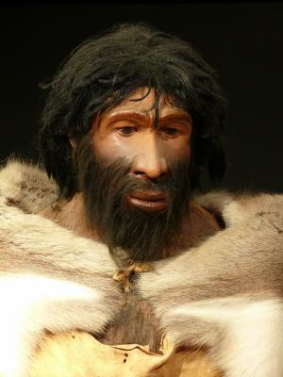
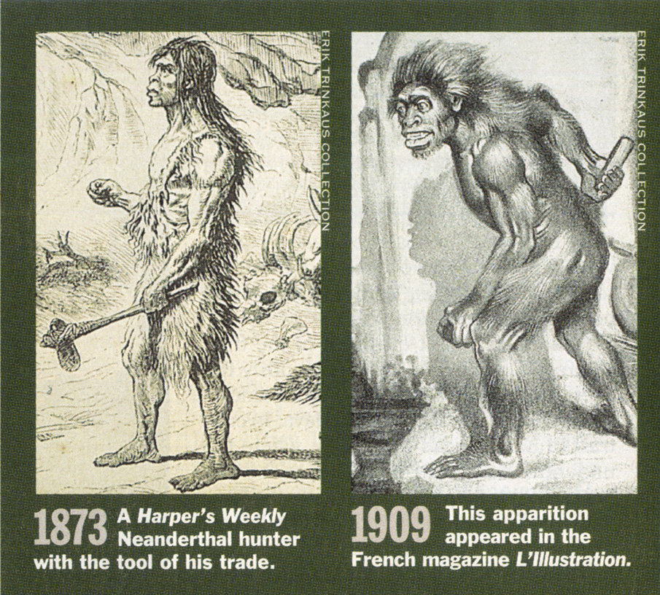
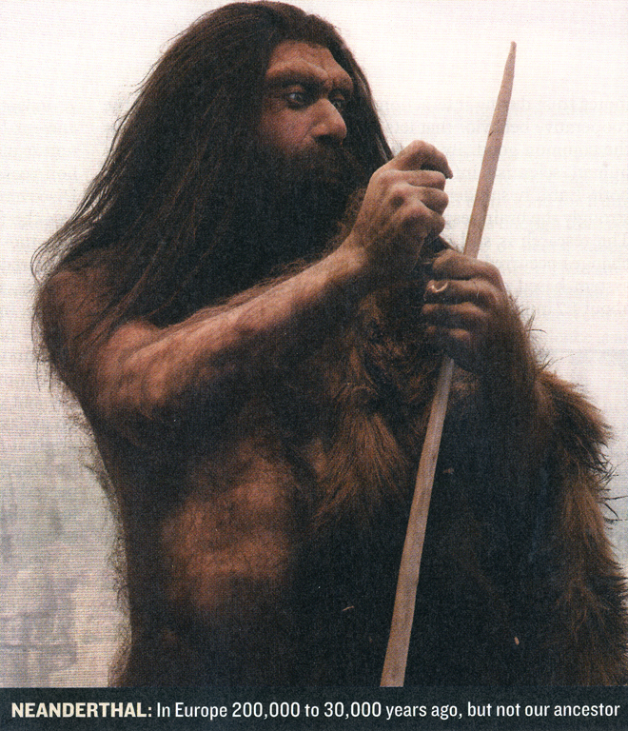
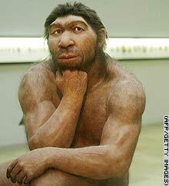
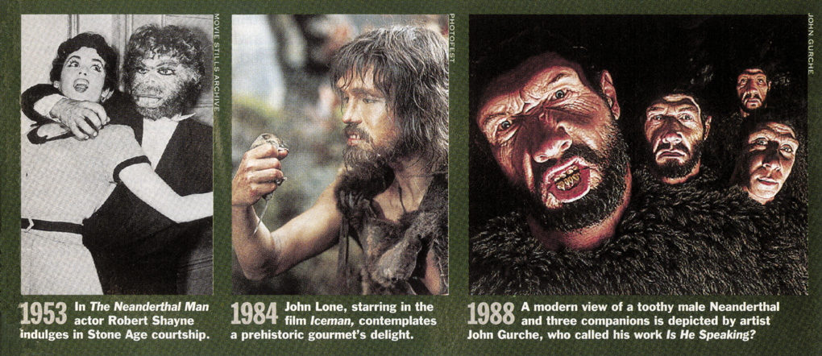
Neanderthal man—changing pictures: TIME magazine
尼安德特人的面貌变化
《时代周刊》，1994年3月
《新闻周刊》，
2007年3月
有线电视新闻网， 2006年
科学日报ScienceDaily.com 2008年8月
Notes:
From TIME, 14 March 1994, pp. 86-87.
CNN picture: http://www.cnn.com/2006/TECH/science/11/15/neanderthal.ap/index.html, “Neanderthal bone gives DNA clues,” 15 Nov. 2006.
The subtitle of the Newsweek picture said, “Neanderthal: In Europe 200,000 to 30,000 years ago, but not our ancestor.” Sharon Begley, “Beyond Stones and Bones,” Newsweek (19 Mar. 2007), p. 58.
Photo 2008: http://www.sciencedaily.com/releases/2008/08/080825203924.htm, accessed 26 Aug 2008. The article said that they made stone tools just as sophisticated as Homo sapiens made—overthrowing an evolutionist belief held to the contrary for over 60 years.

Slide 33
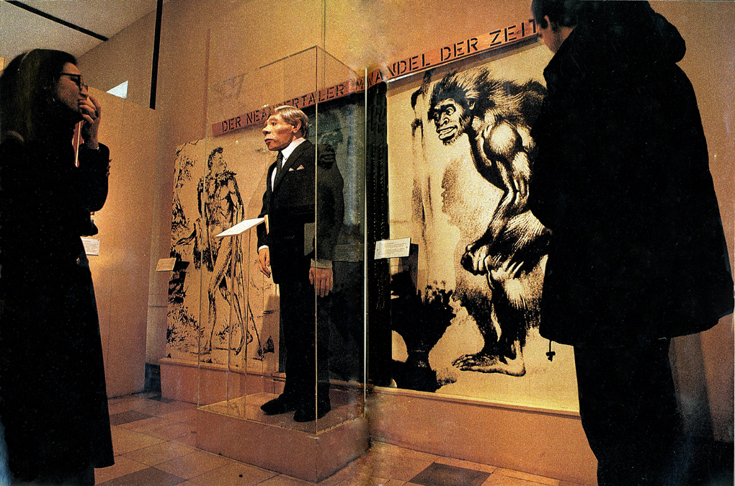
Neanderthals—German display
尼安德特博物馆，埃尔克拉特，德国
“从他似野兽的19世纪形象至另一个穿着西装的人，尼安德特人根据时代被归类。”
Notes:
Rick Gore, “Neandertals: the Dawn of Humans,” National Geographic, Vol. 189:1 (Jan 1996), pp. 32-33.
In the caption, Gore uses both spellings for this man.

Slide 34
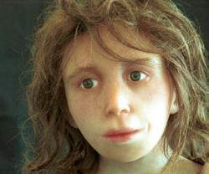
尼安德特人的孩童脸—2008年
她长得近似人类吗？
“重构尼安德特儿童的脸（图片：“人类学学会，苏黎世大学）”
Ewen Callaway, “经过三万年后，尼安德特人说话了，” www.newscientist.com （新科学人）, 2008年4月15日。
Notes:
Photo and caption: http://www.newscientist.com/channel/being-human/dn13672, accessed 17 April 2008

Slide 35
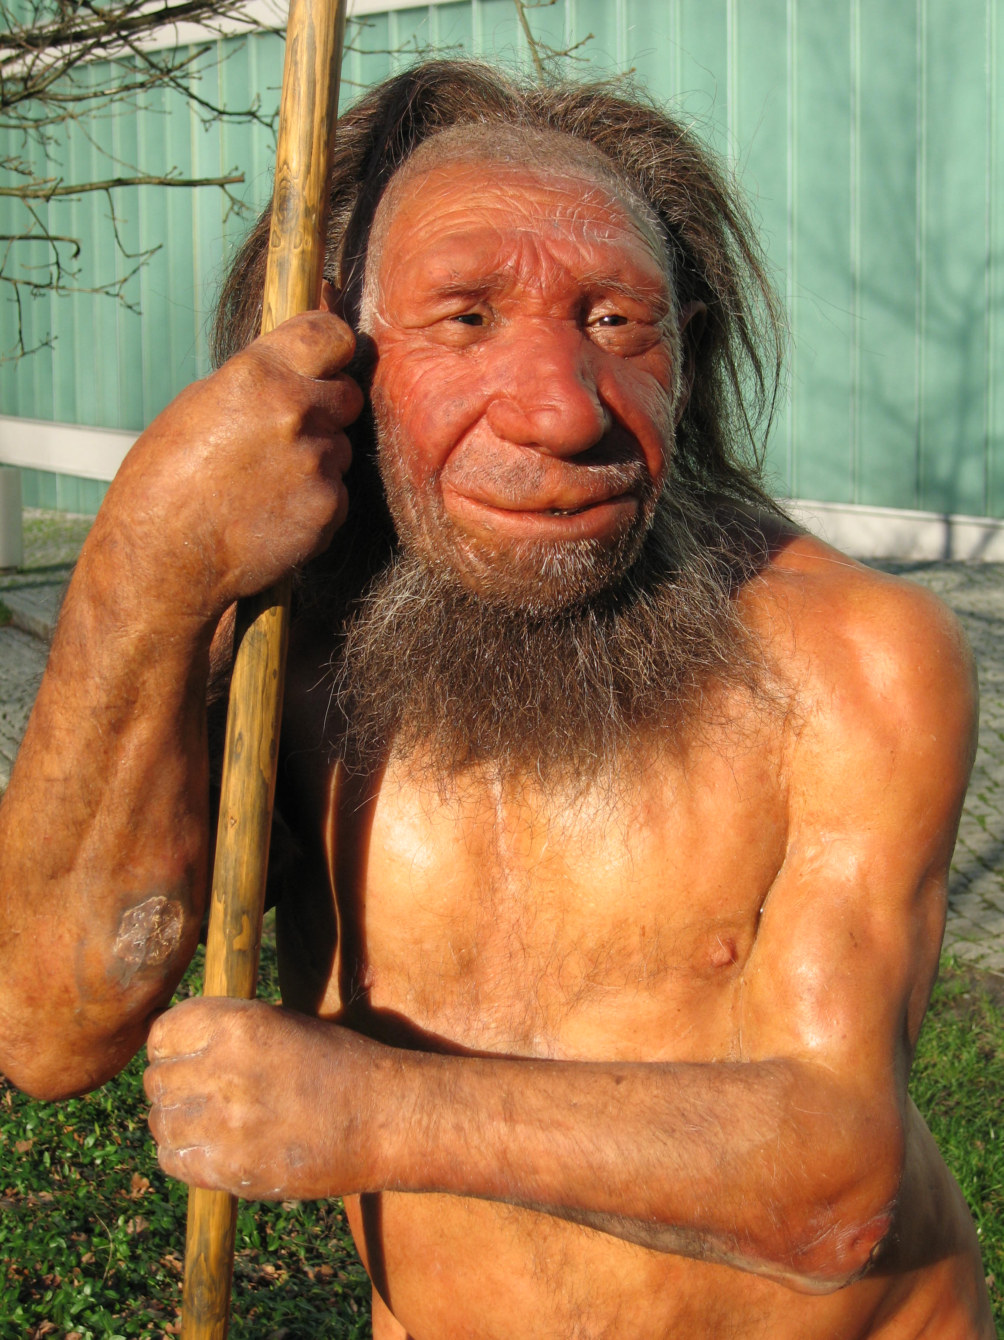
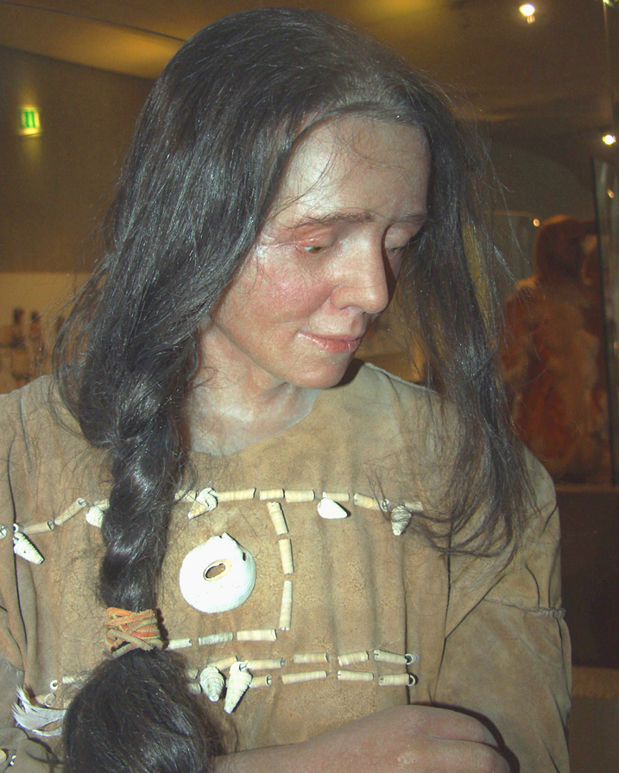
尼安德特人博物馆
2010年
Notes:
Top: http://commons.wikimedia.org/wiki/File:Neandertaler-im-Museum.jpg (public domain picture from Laura Strobl at AiG).
Left: http://commons.wikimedia.org/wiki/File:Neandertala_homo,_modelo_en_Neand-muzeo.jpg (see copyright on file in cabinet under Neander-homo NM 2010a).
Right: http://commons.wikimedia.org/wiki/File:Cro-Magnon-Frau-Neanderthal.jpg (public domain picture from Laura Strobl at AiG).. Museum calls the lady: Cro-Magnon Neanderthal

Slide 36
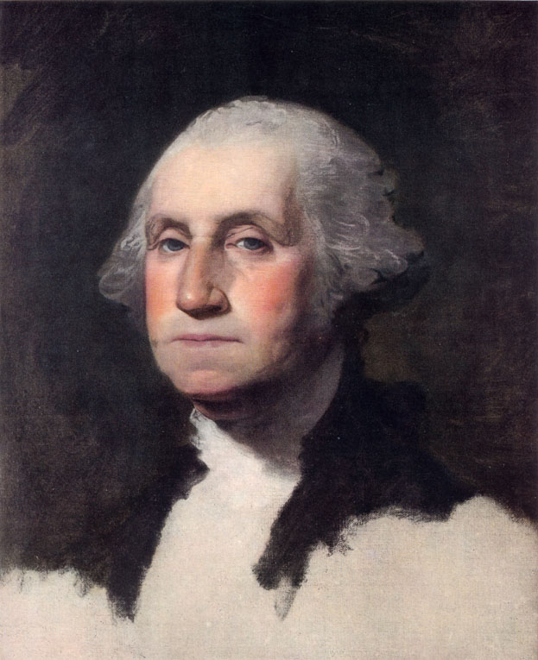
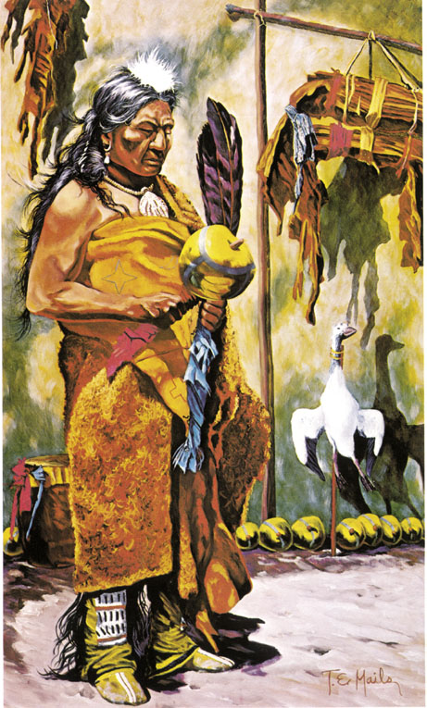
George Washington & Indian

Slide 37
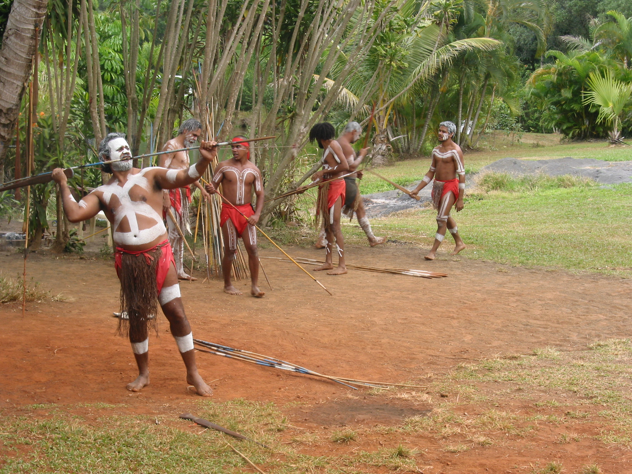
Aborigines - Photo

Slide 38
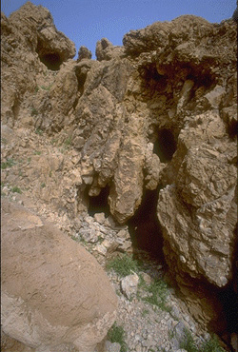
Dead Sea Scroll cave
埃赛尼派石洞，1947年死海古卷被发现的地点。
Notes:
Essenes didn't live in the caves but stored their manuscripts there.

Slide 39

Heb. 11:38 NAS
希伯来书11:38
。。。这世界不配有的人。他们飘流无定，在旷野、山岭、石洞和地穴栖身。
撒拉、雅各、拉撒路： 埋在石洞里
罗得、以利亚、大卫： 生活在石洞里

Slide 40

Osama bin Laden
奥沙马・本・拉登

Slide 41
尼安德特人—考古学
考古学的发现证明尼安德特人是100%人类
制作复杂的矛、真与石器
使用化妆品和贝壳类首饰
猎杀海豚和海豹
控制火的使用和用火煮食物
从兽皮建造棚屋
从熊股骨制作笛子
关心病危的以及举行礼仪埋葬死人
拥有舌骨（在声带里）与现代人“差不多相同”并且有使发生的基因FOXP2
Notes:
Source of info for above and below: http://www.creationontheweb.com/content/view/4750/, 14 Nov. 2006 article and Kate Wong “Twilight of the Neandertals,” Scientific American (Aug. 2009), pp. 32-37 (in my file cabinet)
CMI article: “Neandertal Genome like ours?” 1 June 2010, http://creation.com/neandertal-genome-like-ours? New genetic evidence confirms that Neandertal genome amazingly similar to modern man. Also, this article says the genomes are 99.5% the same and discusses the seashell jewelry: Jennifer Viegas, “Prehistoric Jewelry Reveals Neanderthal Fashion Sense,” 8 Jan 2010, http://news.discovery.com/archaeology/neanderthal-jewerly-fashion-seashells.html, accessed 22 May 2011. Mention of make-up and jewelry in Christopher Joyce, “Study: Neanderthals Wore Jewelry And Makeup,” 12 Jan 2010, http://www.npr.org/templates/story/story.php?storyId=122466430, accessed 22 May 2011.
CMI article: Neanderthal mitochondrial DNA (mtDNA) shows man is different species?
Considerable debate in the evolutionary community Issues such as postmortem contamination, small sample size, enormous mtDNA diversity in non-human primates, effects of population bottlenecks, and molecular clock inaccuracies render a solution impossible at this time. In 2006, U.S. and German scientists announced plans to reconstruct a draft of the Neanderthal genome over the next two years. But their interpretations of the data will depend on which areas are accurately sequenced and the worldview assumptions of the scientists.
Hyoid bone (has other functions than just speech, as it is found in non-talking animals)—see below for documentation. The larynx is made of cartilage (soft tissue) and has not been found fossilized (as of 2008).
language gene (FOXP2) in Neanderthals: http://www.foxnews.com/story/0,2933,303282,00.html, accessed 12 April 2008, research published 18 Oct. 2007.
Other information on Neanderthal in Marvin Lubenow, Bones of Contention, 2nd ed.
RE. Neanderthal bone flute see: http://www.greenwych.ca/fl-compl.htm and http://www.ukom.gov.si/eng/slovenia/background-information/neanderthal-flute/.
Arensburg, B., A. M. Tillier, et al. (1989). "A Middle Palaeolithic human hyoid bone." Nature 338(6218): pp. 758-60.
Abstract: “The origin of human language, and in particular the question of whether or not Neanderthal man was capable of language/speech, is of major interest to anthropologists but remains an area of great controversy. Despite palaeoneurological evidence to the contrary, many researchers hold to the view that Neanderthals were incapable of language/speech, basing their arguments largely on studies of laryngeal/basicranial morphology. Studies, however, have been hampered by the absence of unambiguous fossil evidence. We now report the discovery of a well-preserved human hyoid bone from Middle Palaeolithic layers of Kebara Cave, Mount Carmel, Israel, dating from about 60,000 years BP. The bone is almost identical in size and shape to the hyoid of present-day populations, suggesting that there has been little or no change in the visceral skeleton (including the hyoid, middle ear ossicles, and inferentially the larynx) during the past 60,000 years of human evolution. We conclude that the morphological basis for human speech capability appears to have been fully developed during the Middle Palaeolithic.”
From http://www.answersingenesis.org/articles/2008/04/19/news-to-note-04192008#three, April 19, 2008
Regarding McCarthy's computer simulation (based on fossil evidence) that Neanderthals could not make the modern English “e” sound, Washington University anthropologist Erik Trinkaus disputes the finding's significance: “Ultimately what is important is not the anatomy of the mouth but the neuronal control of it,” Trinkaus says, referencing Neanderthals' large brains.
Neanderthals also possessed the FOXP2 gene (the so-called “language gene”) that is unique in humans. Humans missing FOXP2 suffer from language and speech disorders.
Ultimately, it is impossible to reproduce with absolute accuracy what Neanderthals would have sounded like, and what vowels they could produce, from mere fossils.
Furthermore, even if Neanderthals were unable to produce a particular vowel, that may not be any more of a sign of communication breakdown than the inability of certain modern humans to pronounce the sounds of various foreign languages. For all we know, Neanderthals may have been able to produce many more sounds than modern humans can.

Slide 42
Template Suite 1-Content 01360
更多有问题的“缺环”
Notes:
As a content template, this is best suited for standard content such as outlines, quotations, Scriptures, and maybe illustrations or photos. Presentation Team recommends 48–60 pt. font for headings and 28–40 pt. for body text. Because of eye flow and visual psychology, the top line may be a little closer than all other sides. This also contains a floating AiG logo that can be repositioned or removed as appropriate for the overhead's content.

Slide 43
Purple blank
皮尔当人，1912年
证据：
一块下颌
两颗臼齿
一头颅骨
有把握的诠释：
“一个非常重要的发现。。。[1912年]12月18日。。。于宣布。。。大部分的古[500,000年]英国居民，或欧洲。。。 的一部分。。。所发现的遗迹无疑是并代表，。。。一个必定要当成提供我们一个联系的遥远祖先，猿，的人。”
伦敦新闻画报，1912年12月28日
Notes:
Over the next 40 years, more than 500 scientific essays were written about the fossils, according to TIME (http://www.time.com/time/specials/packages/article/0,28804,1931133_1931132_1931125,00.html, accessed 27 Oct 2009)

Slide 44
Purple blank
斯科普斯进化论审判案美国田纳西州代顿镇, 1925
“最古老的英国人遗迹称为皮尔当人骨头。”
纽曼博士（Prof. Horatio H. Newman）
动物学家，芝加哥大学
“美国猴子案件”
(The World's Most Famous Court Trial, p. 278.)
Notes:
This book is the transcript of the Scopes trial.

Slide 45
皮尔当人#2
1953年： 骗局揭穿
* 牙齿和颚骨—已死了50年的猩猩属
* 颅骨—人，C-14约有520-720年之久
* 牙齿被磨、骨头经过人工染色

Slide 46
Piltdown Man #3
1990年代： 有可能的肇事者
* 查尔斯·道森，发现者
* 德日进，法国耶稣会神父以及古生 物学家
* 在大英博物馆以及署名对大英科 学的最崇高的科学家专家
Notes:
Dawson died in 1916
Chardin—Catholic priest Teilhard (pronounced “tee-hard”) de Chardin died in 1955.

Slide 47
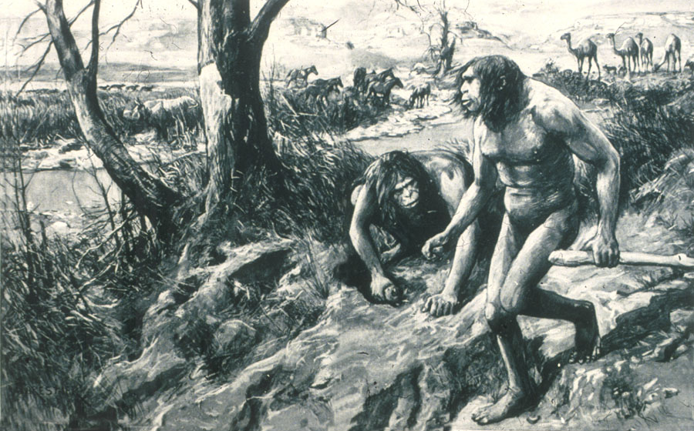
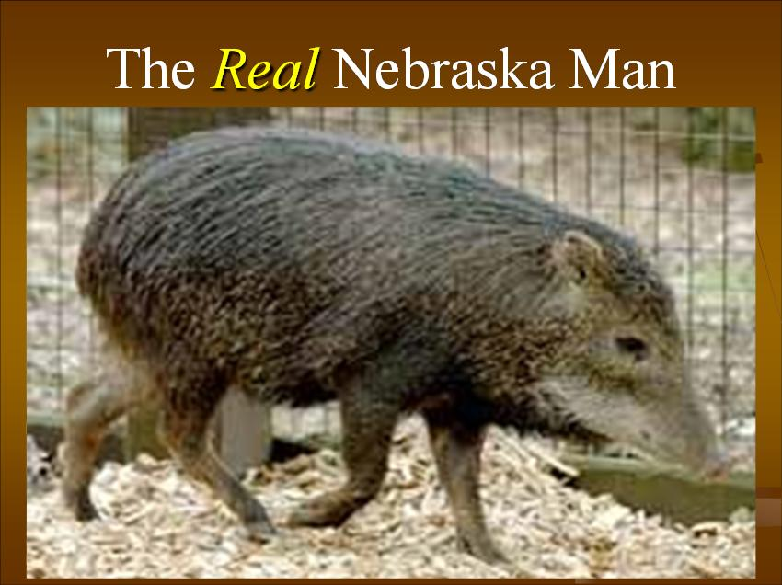
内布拉斯加人
内布拉斯加人
1922年: 有把握的诠释 – 类人猿
证据 – 单一牙齿
真正的内布拉斯加人
1927年： 重新诠释 – 已绝种的猪种类
Notes:
Source: Gary Parker, Creation: Facts of Life (Master Books), p. 152. or Ian Taylor, In the Minds of Men, 231-3.
source of original picture: *******************************
According to this well researched Muslim site http://www.harunyahya.com/refuted8.php#235a
Henry Fairfield Osborn named this tooth “Nebraska Man.” (Hesperophithecus haroldcookii, a form of Pithecanthropus erectus)
In 1927 other parts of skeleton were found and reinterpreted as a tooth from an extinct species of pig (in the genus Prosthennops): William K. Gregory, "Hesperopithecus Apparently Not An Ape Nor A Man," Science, vol. 66:1720 (16 Dec. 1927), pp. 579-581. (article in computer file in pdf form)

Slide 48
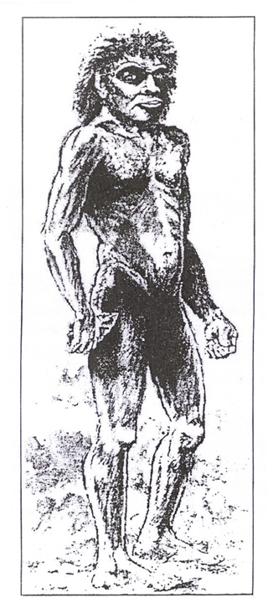
博克斯格羅夫
博克斯格羅夫人
(海德堡人)
证据 (1994-95年):
一个胫骨—明显是人
两颗牙齿—明显是人，但是发现不足以证明是从同一个个体
原始的石器—明显是人工品
身份？
100%人，后巴别
“300,000-400,000年”
Notes:
Source of picture and info: The Daily Mail (London), 20 June 1995, p. 15.
David Tyler summarizes the research at http://www.biblicalcreation.org.uk/origins_archaeology/bcs063.html:
Evidence found in quarry at Boxgrove, near Chicester in SW England, deposits classed as Middle Pleistocene (creationists would say this is probably post-flood)
Shin found May 1994
Two teeth found separately in late 1995, the first showing dental disease
Various dating methods were used giving dates ranging from 175,000 to 524,000 years. Finally narrowed the dates by using vole evolution data in northern Spain. There is considerable controversy whether this is the oldest European man or not.

Slide 49
非现存的人猿的总结
智人尼安德特人 — 人类的腊玛古猿 — 已绝种的猩猩种
道森始人（皮尔当人） — 骗局
西方古猿 (尼布拉斯加人) — 猪非洲南猿 — 一种的猿
南方粗猿 — 好像黑猩猩
能人 — 废物类，从不存在过？
直立人 — 一些进化论者：完全是人
猿人 (爪哇人，1890年代后）
中国猿人 (北京人，1920年至1930年代后）
没有明确的证据显示人是进化而成的！
Notes:
Homo Habilis—some evolutionists have argued that it is a mixture of australopithecine and Homo erectus fossils, so combining bones from two taxons into one taxon. Others have argued that it is just a variant of australopithecines.
Peking man evidence was all lost in 1941 during WW2. We only have plaster casts remaining

Slide 50
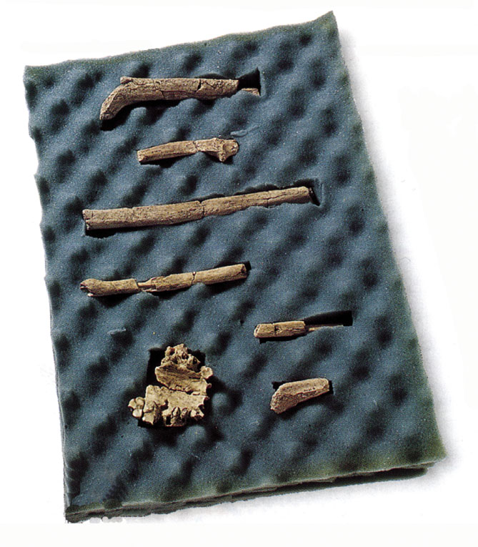
Purple blank
“要找到一个
能够很真实性地把
早期人类的
样子画出来
的人是困难的。
因此
国家地理的艺术部门举办了
新才华的搜寻。
被挑选的四位画家将领取有
二百万年日的女性
能人的化石[右]。
从这些点点滴滴的证据 ，他们必须素描一个—有骨架和肉身的形态—这些骨头属于的人。”
“Behind the Scenes,” 国家地理 (2000年3月）

Slide 51
Purple blank
“‘每位画家有
两个星期 的时间
拥有这些骨头，
过后这些骨头将转到下一个人,’ 协调人Kris Hannah说。
‘研究完全是由个人进行的。
因此他们的杰作
看起来很不一样。
画她的方法不止一个。’
古人类学家检阅了成果。对于四个成果的好奇，艺术部门邀请了这些画家根据顾问者的提供完成了画像。”

Slide 52
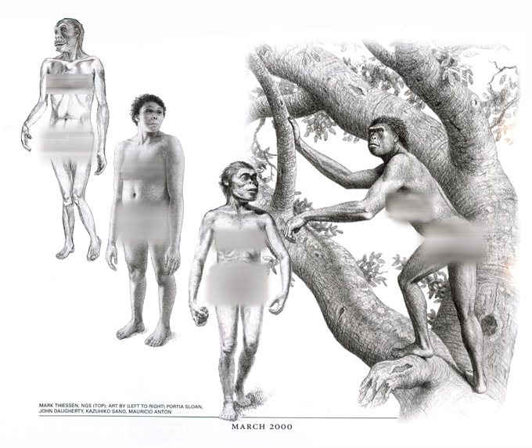
National Geographic—Behind the scences #1—four women

Slide 53
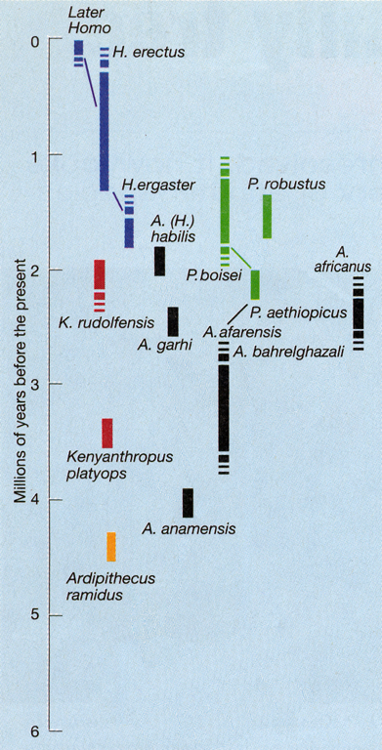
Purple blank
2001年
“直到数年后，我们种类的进化历史一向以为是相当的直截了当。。。。但是近来，混乱被撒在 人类进化论树里。。。。这混乱看起来似乎将更进一步提升。”
利伯曼（Daniel E. Lieberman）, “Another Face in our Family Tree,” 自然, 410期 (2001年3月22日), 420页。
Notes:
Lieberman is a professor in the Department of Anthropology, The George Washington University, in Wash. DC.

Slide 54
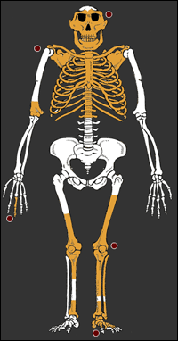
Lucy's baby—2006 deception
“露西的孩子，一个令人惊叹的
化石”
新人类
新猿
肩胛骨与颈椎—好像是大猩猩
内耳道—好像是非洲猿
长而弯曲的手指—好像是树栖猿
声带—好像黑猩猩
颅容量—好像黑猩猩
www.sciam.com （科学美国人）， 2006年9月20日
Notes:
Picture and details from http://www.sciam.com/article.cfm?chanID=sa003&articleID=00076C1D-62D1-1511-A2D183414B7F0000&pageNumber=1&catID=1, accessed 22 Sept 2006 and on file in computer (see BBC report on file too.
Found in 1999 in sandstone layer near Dikika, Ethiopia, about 4 km from where Lucy was dug up in 1973-74.
The scapulae (shoulder blades) were the first ever found for austropithecines.
The fossil evidence shows curved fingers, but the art work shows them straight like humans. And there doesn't appear to be any toe bones, but they are drawn like humans too, even though we know from other australopithecine bones that the toes are curved like apes too.

Slide 55
Lucy's baby—2006 deception
人猿
骗局
www.sciam.com （科学美国人）， 2006年9月20日
Notes:
Picture and details from http://www.sciam.com/article.cfm?chanID=sa003&articleID=00076C1D-62D1-1511-A2D183414B7F0000&pageNumber=1&catID=1, accessed 22 Sept 2006 and on file in computer (see BBC report on file too.
Found in 1999 in sandstone layer near Dikika, Ethiopia, about 4 km from where Lucy was dug up in 1973-74.
The scapulae (shoulder blades) were the first ever found for austropithecines.
The fossil evidence shows curved fingers, but the art work shows them straight like humans. And there doesn't appear to be any toe bones, but they are drawn like humans too, even though we know from other australopithecine bones that the toes are curved like apes too.

Slide 56
如何造人猿
1. 一些人骨 + 想象力 = 人猿
2. 一些猿（？）骨 + 想象力 = 人猿
3. 一些猿骨 + 一些人骨 + 想象力= 人猿
Notes:
A few human bones
A few ape bones
ape + human bones

Slide 57
Template Suite 1-Content 01360
圣经说什么？
Notes:
As a content template, this is best suited for standard content such as outlines, quotations, Scriptures, and maybe illustrations or photos. Presentation Team recommends 48–60 pt. font for headings and 28–40 pt. for body text. Because of eye flow and visual psychology, the top line may be a little closer than all other sides. This also contains a floating AiG logo that can be repositioned or removed as appropriate for the overhead's content.

Slide 58
人—超自然和独特
人的被造与其它生物比起来是
超自然
和
独特的。

Slide 59

Stott 1981—pre-Adamites 1
“似乎要亚当的历史性与至少一些（有神论）的进化论理论和解是完全可能的。事实上，许多圣经为根基的基督徒是相信这一点的，相信他们不是完全抵触的。
要断言第一对人是 因悖逆而犯罪的历史性是一件事；”
约翰·斯托得，引述于查普曼·柯林，The Case for Christianity (Grand Rapids: Eerdmans, 1981), 130页。
Notes:
Stott died in July 2011.

Slide 60
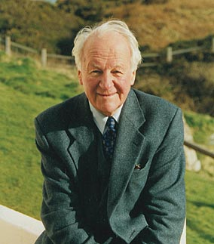
Stott 1981—pre-Adamites 1
“否认所有的进化并断言万事的创造的分类与独特，包括近似人类的生物和亚当的身体又是另外一件事。”
约翰·斯托得，引述于查普曼·柯林，The Case for Christianity (Grand Rapids: Eerdmans, 1981), 130页。
Notes:
Picture from http://www.cslewis.org/programs/cruise/2004/speakers.html, downloaded 15 April 2005

Slide 61
Stott 1981—pre-Adamites 2
“这个建议（因它不比这更多）对我不像是违背圣经因此当神以祂自己的形象造人的时候，祂所做的是在当时似乎生存着的‘原始人’的一个身上印出祂自己的形象。”
斯托得 (1981), 130页。

Slide 62
Stott 1981—pre-Adamites 2
“以一个非科学者踌躇着地说，”斯托得继续表明他倾向亚当之前原始人，在解剖学上与现代人是无法分辨的但没有上帝的形象的观念。
斯托得 (1981), 130页。

Slide 63
人—超自然和独特
人的被造与其它生物比起来是
超自然
和
独特的。

Slide 64
Gen. 1:27 NAS no ha'adam
创世记1:27
神照着自己的形象创造人；就是照着神的形象创造了他；他所创造的有男有女。
Notes:
All flesh is not the same flesh, but there is one flesh of men, and another flesh of beasts, and another flesh of birds, and another of fish.

Slide 65
1 Cor 15:39 NAS
哥林多前书15:39
而且各种身体也都不一样，人有人的身体， 兽有兽的身体，鸟有鸟的身体，鱼有鱼的身体。

Slide 66
Gen. 2:7 NAS
创世记2:7
耶和华 神用地上的尘土造成人形，把生气吹进他的鼻孔里，那人就成了有生命的活人。
Notes:
NAS, NIV, NKJV, HCSB: “living being”
KJV “living soul”

Slide 67
Genesis 2:7 diagrams NAS
圣经
人 + 神的气 = 活人
nephesh chayyah
(同看创1:20-2、24; 9:10)
哥林多前书15:45上
“第一个人亚当成了有生命的活人”
有神论进化论
X
活物 + 神的气 = 人
nephesh chayyah

Slide 68
Gen. 3:19 NAS
创世记3:19
你必汗流满面，才有饭吃，直到你归回地土, 因为你是从地土取出来的； 你既然是尘土，就要归回尘土。
Notes:
I've got news for your folks, when you die you are not going to become some sub-human living creature. You are literally going to become dust.

Slide 69
Gen. 2:22 NAS
创世记2:22
耶和华神用从那人身上所取的肋骨，造了一个女人，带她到那人面前。

Slide 70
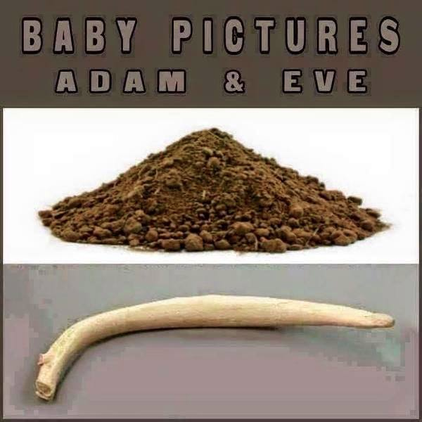
亚当和夏娃的婴孩照

Slide 71
Gen 3:20 & 1 Cor 15:45 NAS
创世记3:20
亚当给他的妻子起名叫夏娃，因为她是众生之母。
哥林多前书15:45
经上也是这样记着说：“第一个人亚当成了有生命的活人。。。
Notes:
The Bible only speaks of the first heaven and earth and the new ones. The gap theory would mean that there was a first, second and new—so three heavens and earths instead of only two.

Slide 72
Gen. 4
创世记4
该隐建造了一座城
六代以后 –
* 有些是居住帐棚、牧养牲畜的人
* 其他是有才华的音乐家、打造各种铜铁器具的匠人

Slide 73
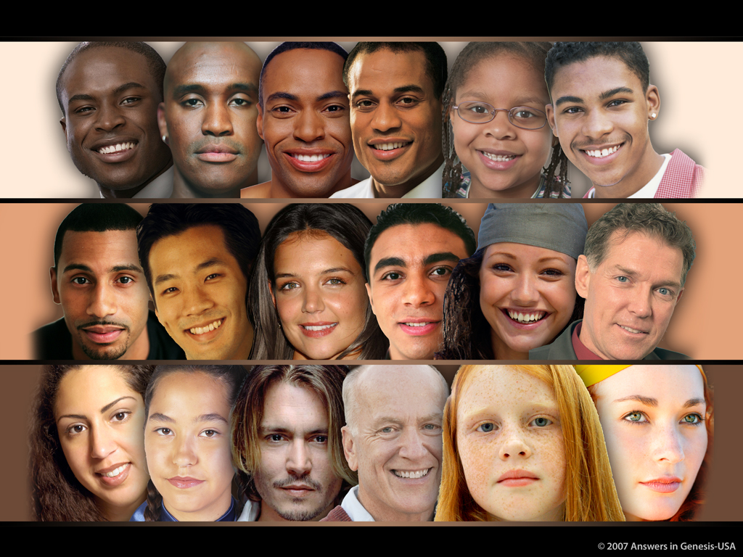
Skin Tones Line-up 03051
© 2007年创世记答案机构—美国

Slide 74
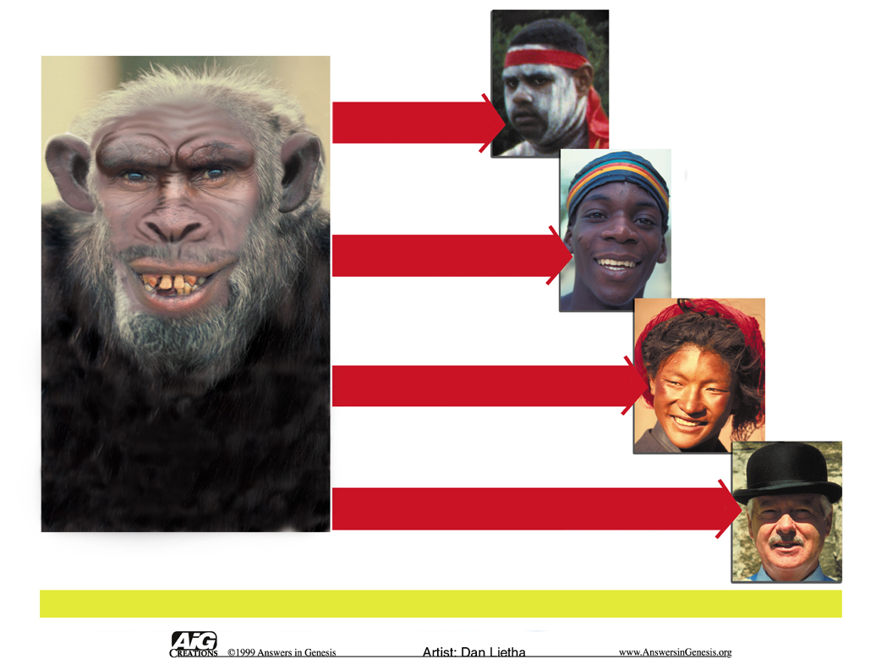
Races--Australoid to Caucasoid
澳大利亚种
黑种人
虚构
蒙古人种
的进化祖先
白种人
种族

Slide 75
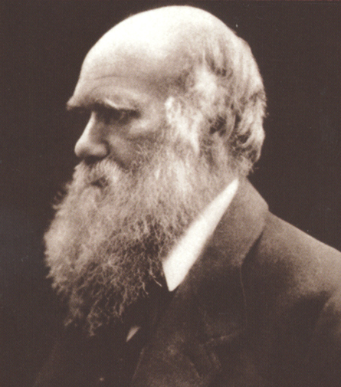
“不远的将来，文明的民族几乎一定要灭绝，取代世界上的野蛮民族与此同时,几种类人猿,。。。也无疑会被弄得精光。”
查尔斯·达尔文，The Descent of Man （人类的起源） (New York: A.L. Burt, 1874, 2nd ed.), 178页。

Slide 76
“人类与他最靠近的盟友的间隔将会更扩大， 因为这会在一个更文明化的状态中干涉于人类，甚至白种人以及一些的猿，比如低微的 狒狒，而不是现在的黑种人或澳大利亚人[土著人]与大猩猩之间。“
查尔斯·达尔文，The Descent of Man （人类的起源） (New York: A.L. Burt, 1874, 2nd ed.), 178页。

Slide 77
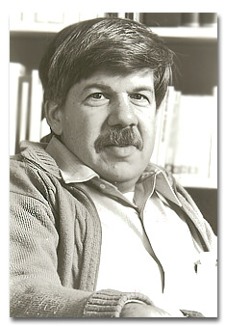
Purple blank
“1850年之前种族歧视的生物论证或许是普遍的，但是随着进化理论的接受而根据数量及和增加。”
史蒂芬·杰伊·古尔德, Ontogeny and Phylogeny （个体发生学与发展史） (Belknap-Harvard Press, 1977), 127-128页。
QC 674

Slide 78
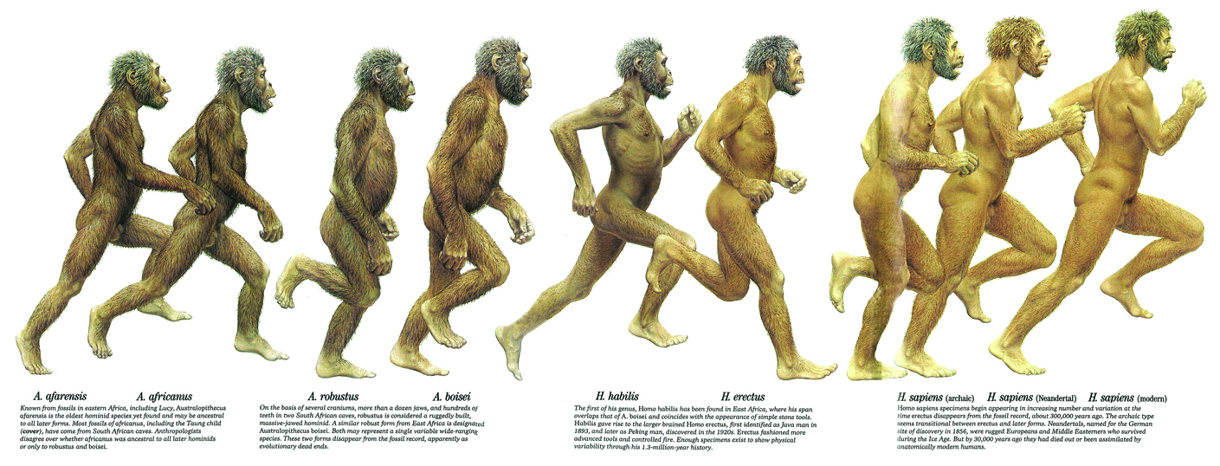

国家地理1985年
Time-Life书，1971年
Notes:
Top chart: Kenneth F. Weaver “The Search for our Ancestors,” National Geographic (Nov. 1985), pp. 574-577. Notice the feet, hands, arm length, subtly racist skin color.
Bottom chart: William Howells (Prof. of Anthrop., Harvard), Early Man (New York: Time-Life Books, 1971), pp. 41-45.

Slide 79

探索频道网站，2007年12月11日
Notes:
http://dsc.discovery.com/news/2007/12/11/human-evolution.html, article dated 11 Dec. 2007, accessed 27 July 2008
Notice the arm length and subtly racist skin color change.

Slide 80
Acts 17:24-26 NAS
使徒行传17:24、26
24. 创造宇宙和其中万有的 神，。。。26. 他从一个本源造出了万族来。。。

Slide 81

One Race 02279
一个“种族”
亚当与夏娃
哥林多前书15:45
创世记3:20
儿子与女儿
创世记5:4
挪亚与儿子
创世记9:17-19
在巴别塔的人
创世记11:8-9
使徒行传17:26
不同的人民/文化
© 2005年创世记答案机构
Notes:
81
Revised: September 2005.

Slide 82
Skin Tones Line-up 03051
© 2007年创世记答案机构—美国

Slide 83

男
女
AaBbCc x AaBbCc
在卵/精子里有可能存在的资料：
A
a
B
b
C
c
在后代里有可能存在的资料
人的肤色
AA BB CC
深 100%
aa bb cc
浅 100%
AA Bb CC
深 85%
Aa BB Cc
深 70%
Aa Bb Cc
穆拉托人 50%

Slide 84

亚当与夏娃
有许多样的基因
aabb
亚当与夏娃
aaBb
AaBb AaBb
AABb
并可以在一代里产生广泛的肤色！
AABB

Slide 85

Eye Shape Variations
眼形
变化
© 2006年创世记答案机构—美国

Slide 86

Notes:
2008: Mother is from Ghana, father from Germany, babies born in Berlin.
“Ryan came first, and everything was as usual, said the hospital's doctor, Birgit Weber. But when Leo [black baby] was born, I COULDN'T BELIEVE MY EYES.“ … “The doctor said she had been present at some 10,000 births over almost 20 years and had never seen anything quite like this, it has been reported.”
“Two in a Million: Twins Born - One Black, One White,” 17 July 2008, http://www.foxnews.com/story/0,2933,384862,00.html, accessed 18 July 2008.
Don't know if we have permission to use this picture in a product

Slide 87

Multi-color twins close-up
《大事件》
Multi-color twins close-up
Notes:
2006: Both parents have black fathers and white mothers
Lucy Laing, “Twin Sisters—One Black, One White—Turn Heads in England,” JET, vol. 109:12 (27 March 2006), p. 36.
AiG has permission to use this picture. It is used in the museum.

Slide 88

The Human family

Slide 89

Human variation since Noah
人类的变化
白种人
黑种人
蒙古人种
克罗马侬人
诺亚的家庭：
8个人
直立人
尼安德特人
亚当 + 夏娃
Notes:
From Reinhard Junker, Is Man Descended from Adam? (Biblical Creation Society, 2000, translated by Steven Robinson), p. 37.
Neanderthal, Homo erectus and Cro Magnon have the same range of brain size and the same inner ear structure (key for determining that they habitually walked upright) as modern man has. They buried their dead and did artwork like modern man does, too.
Good article (dated 2000) on Homo erectus being equal to modern man is: John Woodmorrape, “How different is the cranial-vault thickness of Homo erectus from modern man?”, <www.answersingenesis.org/home/area/magazines/tj/docs/v14n1_cranium.asp>

Slide 90

Map—post-flood dispersion
巴别的分散

Slide 91
资料
进化论树
创造森林

Slide 92
Template Suite 1-Content 01360
所以呢？

Slide 93

Purple blank
伦敦动物园代言人Polly Wills说：“在不同的环境里，与其他动物当中看着人的时候。。。较大公众人类耐不过是另一种的灵长类动物。”
Notes:
Picture and quote: Assoc. Press, “Crowds go ape over 'humans' zoo exhibit,” 26 Aug. 2005, http://www.msnbc.msn.com/id/9087023/, still on line as video clip and article on 2011 May 22.

Slide 94

Adam in Your Past 01127
上帝是权威
上帝定下规则
亚当
在你的过去
© 2004年创世记答案机构—美国

Slide 95

Ape in Your Past 01128
相对的
道德准则
猿
在你的过去
人定下规则
呜
呜呜
啊啊啊
© 2007年创世记答案机构—美国

Slide 96
American Atheists—no Adam, no redeemer
“没有亚当与夏娃表示无须一个救主。这也意旨圣经为一个明确、千真万确的真理是不可靠的。它是完全不可靠的，因为它是以一个神话开始，并且建基于这基础上。没有人的堕落的事件意旨无须救赎也无须一个救赎者。”
美国无神论者，“You KNOW it‘s a Myth: This Season, Celebrate REASON!” https://atheists.org, 无日期，2011年6月1日浏览）。
Notes:
https://atheists.org/atheism/Christmas

Slide 97



科学家与圣经—人猿与斯托得
我超自然地造了亚当和夏娃。你得相信我！
人类是从猿而进化的。你得相信我！
圣经
约翰·斯托得博士
© 2005年创世记答案机构

Slide 98


科学家与圣经—新分层
我超自然地造了亚当和夏娃。你得相信我！
人类是从猿而进化的。你得相信我！
I created Adam and Eve supernaturally. Take My Word for it!
圣经

Slide 99
AiG web site #1
创世记答案机构
相信·维护·宣告
© 2007年创世记答案机构—美国

Slide 100
Wood 2002—human evolution is illusion
“你能够到处找到的一个受欢迎的人类进化论的图像。。。左边有只猿。。。右边是个人。。。这两者之间是一系列越来越像人的轮廓。。。我们从猿至人的进展看起来流畅又整齐。这是多么诱人的图像甚至专家舍不得放弃它。 但是这是个幻觉。”
伯纳德·伍德（Bernard Wood） (美国乔治·华盛顿大学的人类起源学教授), “Who are we?” 新科学人， 2366 (2002年10月26日), 44页.

Slide 101
Evolution of man—progression: Illusion!
人类的进化论？
幻觉
骗局

Slide 102
Acts 17:30-31 NAS
使徒行传17 :30-31
30. 过去那无知的时代， 神不加以追究； 现在，他却吩咐各处的人都要悔改，
31. 因为他已经定好了日子，要借着他所立的人， 按公义审判天下，并且使他从死人中复活，给万人作一个可信的凭据。

Slide 103
Black blank------------extras
终结

