Slide 1








腐败
灾难
受造之物
混乱
历史的 七个C
完善
基督
十字架

Slide 2


Terry Mortenson 博士
历史的七个C
创世记答案机构
设计者 Terry Mortenson 博士
Rick Griffith 博士 • 新加坡神学院 • BibleStudyDownloads.org
所有文件免费可在BibleStudyDownloads.org下载

Slide 3
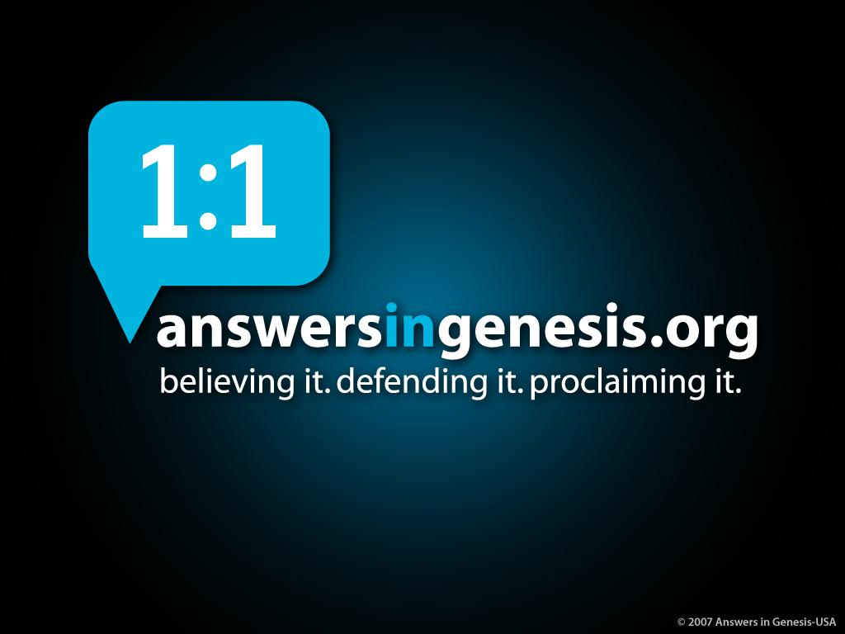
创世记答案机构
相信·维护·宣告

Slide 4

Psalm 11:3 NAS
‭‭诗篇‬ 11:3
“根基若毁坏，
义人还能做什么呢?”

Slide 5
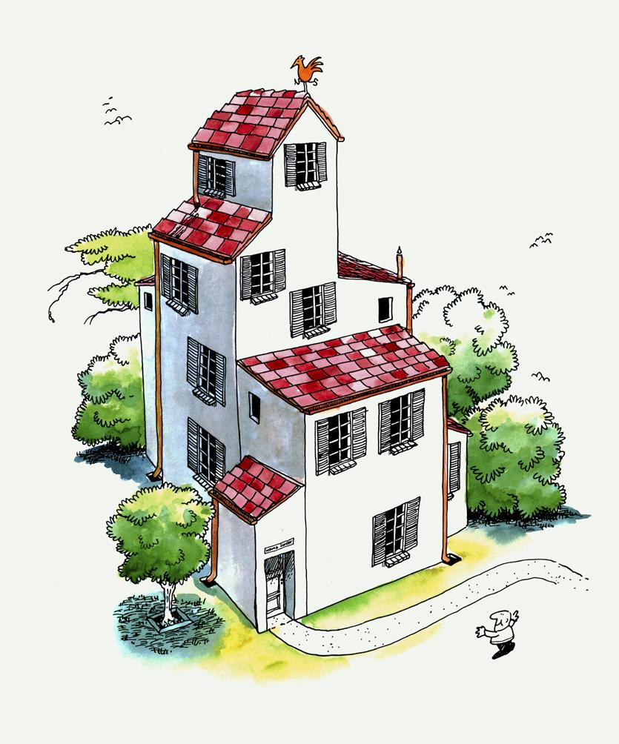
Typical House
Notes:
5

Slide 6
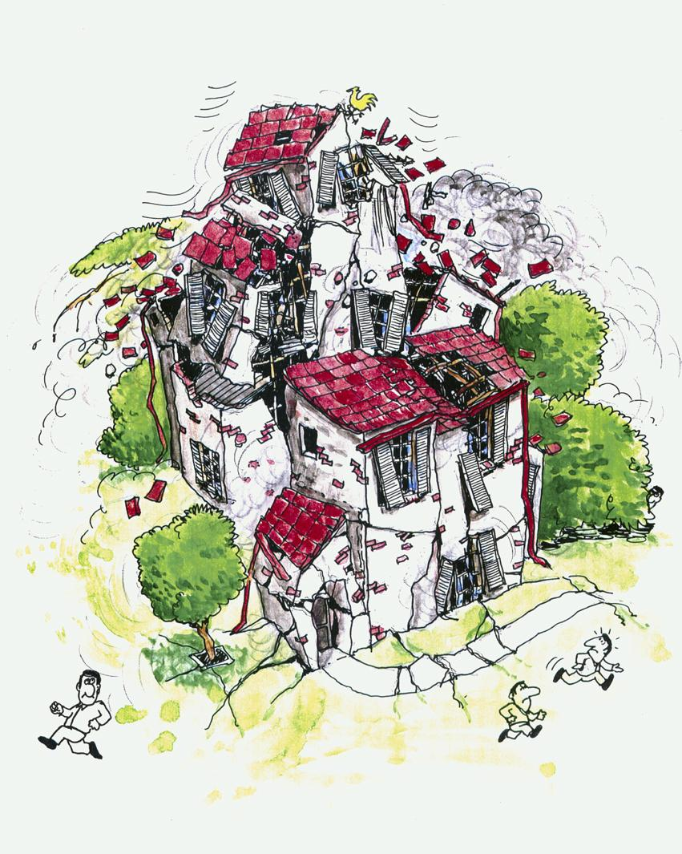
Typical House collapsed
Notes:
6

Slide 7
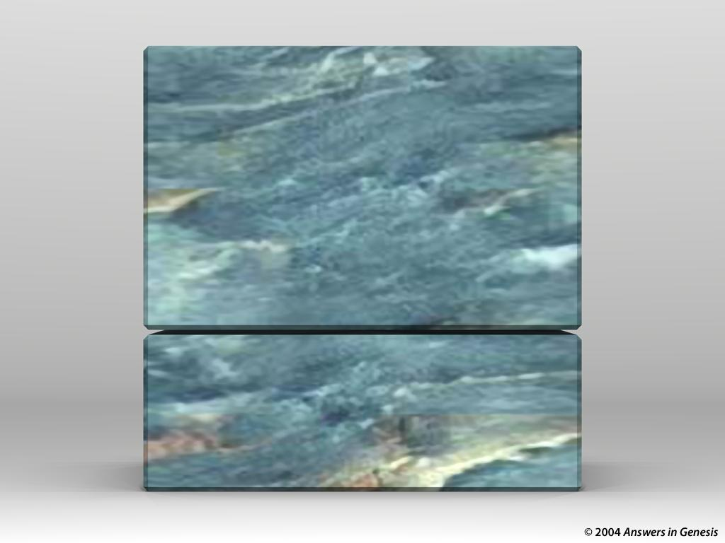
X
教义
创世纪
X

Slide 8
腐败
灾难
受造之物
混乱
历史的 七个C
完善
基督
十字架
Notes:
This is fully animated. The Scripture text frame is editable so you can insert a different version if you so desire.
In case you want to know. Each element is a TIFF image with alpha channels. This whole page totals 1.1 MB rather than 11+ MB that flat JPEGs would produce.

Slide 9
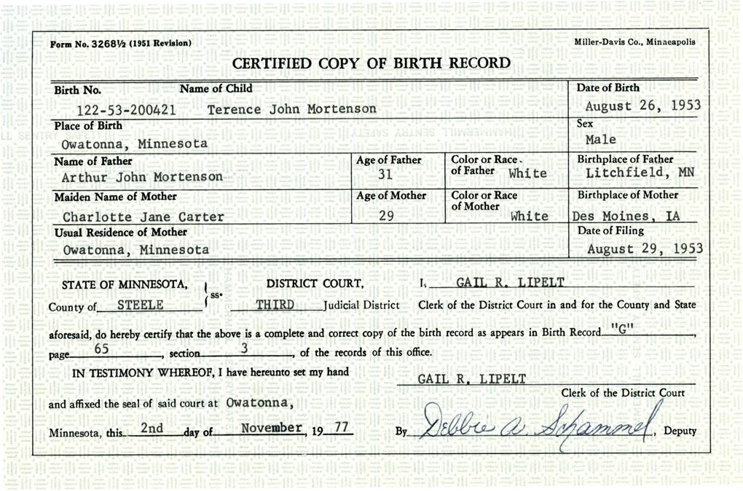
Terry 的出生证明

Slide 10
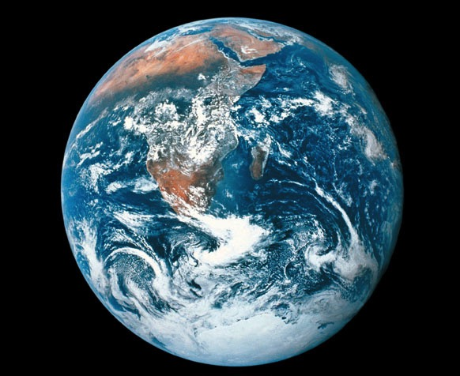
地球的年龄
神 (圣经):
6,000 年
进化论者:
地球: 4,500,000,000 年
宇宙 13,700,000,000 年

Slide 11




科学家和圣经
请听我说！地球是数十亿年。
请相信我! 我是在六天内创造的!
圣 经

Slide 12
Job 38:4 NAS
约伯记‬ 38:4
“我立大地根基的时候，你在哪里呢？ 你若有聪明，只管说吧！

Slide 13

D – Where you there?
2500万年前
你在那里吗？

Slide 14

Template Suite 1-Content 01360
我们为什么相信上帝比相信科学家更多呢？
Notes:
14
As a content template, this is best suited for standard content such as outlines, quotations, Scriptures, and maybe illustrations or photos. Presentation Team recommends 48–60 pt. font for headings and 28–40 pt. for body text. Because of eye flow and visual psychology, the top line may be a little closer than all other sides. This also contains a floating AiG logo that can be repositioned or removed as appropriate for the overhead's content.

Slide 15
Template Suite 1-Content 01360
神
--在一开始就在那里
--知道一切
--总是说实话
--永远不会犯错误
--爱我们
Notes:
15
As a content template, this is best suited for standard content such as outlines, quotations, Scriptures, and maybe illustrations or photos. Presentation Team recommends 48–60 pt. font for headings and 28–40 pt. for body text. Because of eye flow and visual psychology, the top line may be a little closer than all other sides. This also contains a floating AiG logo that can be repositioned or removed as appropriate for the overhead's content.

Slide 16
Template Suite 1-Content 01360
科学家
--在开始时不在那里
--不知道一切
--不一定说实话
--经常犯错
--不像神那样爱我们
Notes:
16
As a content template, this is best suited for standard content such as outlines, quotations, Scriptures, and maybe illustrations or photos. Presentation Team recommends 48–60 pt. font for headings and 28–40 pt. for body text. Because of eye flow and visual psychology, the top line may be a little closer than all other sides. This also contains a floating AiG logo that can be repositioned or removed as appropriate for the overhead's content.

Slide 17
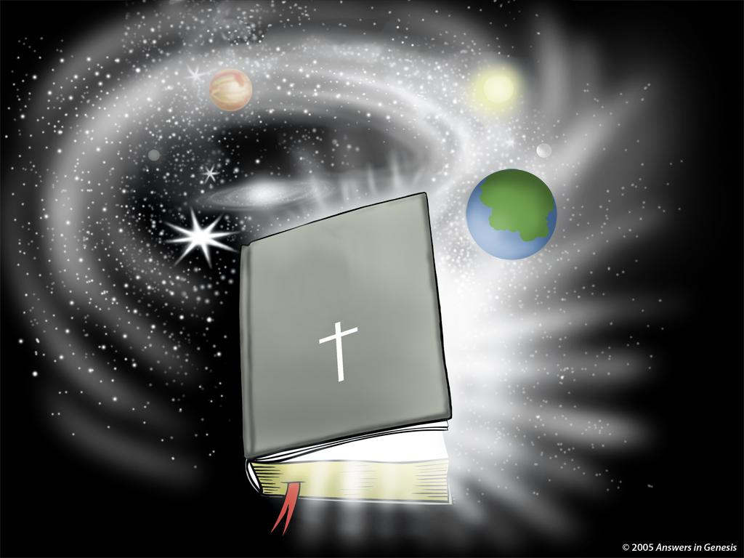
宇宙的历史书
圣经
Notes:
17

Slide 18
腐败
灾难
受造之物
混乱
历史的 七个C
完善
基督
十字架
Notes:
This is fully animated. The Scripture text frame is editable so you can insert a different version if you so desire.
In case you want to know. Each element is a TIFF image with alpha channels. This whole page totals 1.1 MB rather than 11+ MB that flat JPEGs would produce.

Slide 19





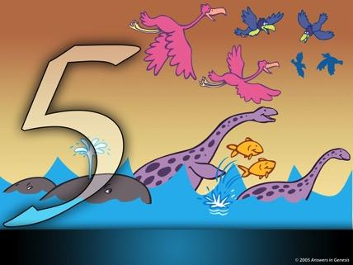

Days of Creation in Genesis One 00825—layered—NAS
创世纪第一章
创造之日
第一天
I
第二天
第三天
地球，土地，时间和光
空间
干旱的土地和植物
第四天
第五天
第六天
太阳, 月亮和星星
鸟类和鱼类
爬行的生物

Slide 20

Chicken or Egg?
谁先来
到这里?
是鸡还是鸡蛋？
Notes:
Kirby picture

Slide 21
Days of Creation in Genesis One 00825—layered—NAS
创世纪第一章
创造之日
第一天
I
第二天
第三天
地球，土地，时间和光
空间
干旱的土地和植物
第四天
第五天
第六天
太阳, 月亮和星星
鸟类和鱼类
爬行的生物

Slide 22
Gen. 1:21, 25 “kinds” NAS
‭‭创世记 1:21, 25
21. “神就造出大鱼和水中所滋生各样有生命的动物，各从其类；又造出各样飞鸟，各从其类。 神看着是好的。
25. 于是 神造出野兽，各从其类；牲畜，各从其类；地上一切昆虫，各从其类。 神看着是好的。

Slide 23
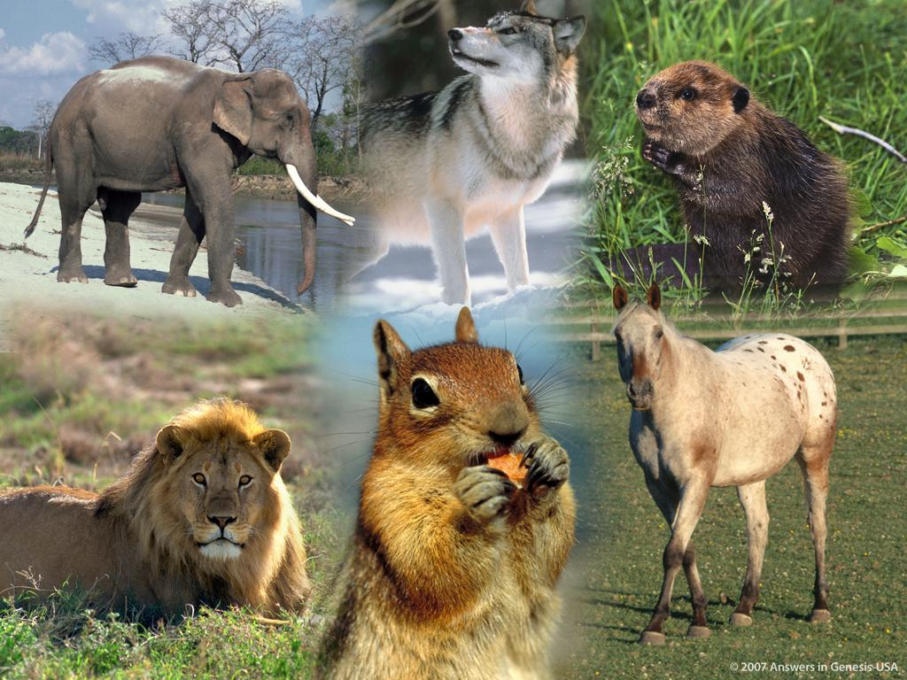

Slide 24
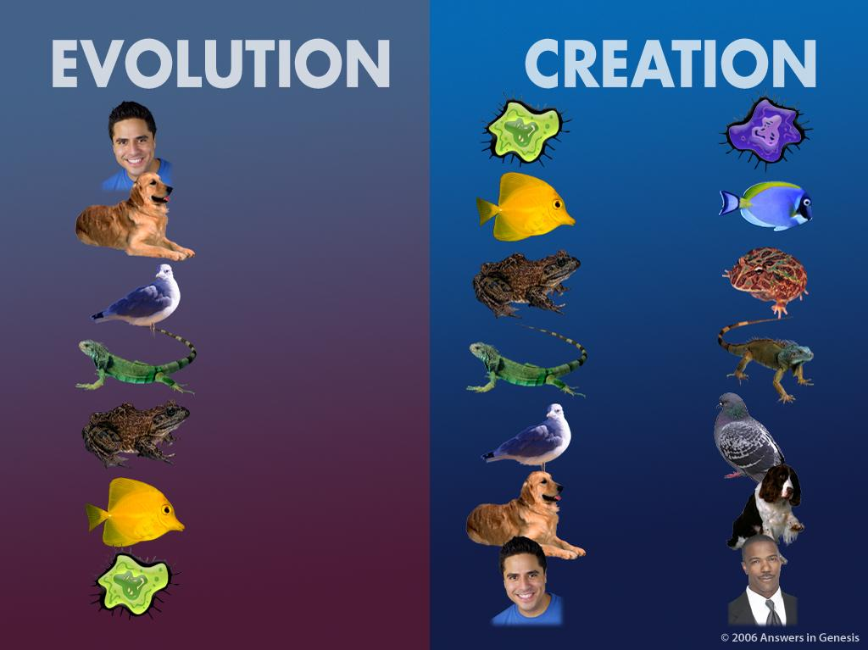
进化
受造之物
X
Notes:
NOTE: The word for creation is under the black panel so just move this panel aside to translate the word.

Slide 25
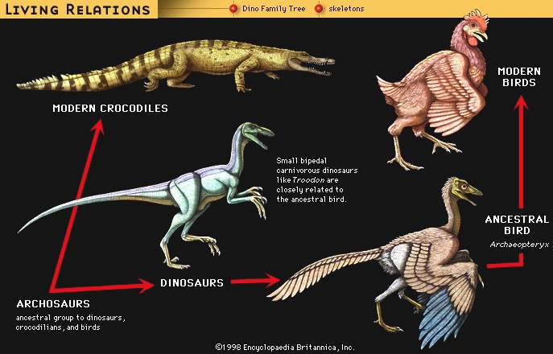
Living “Relatives” of Dinosaurs
X
生活关系
恐龙家谱
骨架
现代鸟类
现代鳄鱼
像特罗多顿这样的小型双足食肉恐龙与祖先的鸟类密切相关
祖鸟
始祖鸟
恐龙
初龙类
祖先分类为恐龙，鳄鱼和鸟类
(Encyclopaedia Britannica, CD, 1999)
Notes:
Cf. Presentations 4.16; 10.25
Archosaurs: The only picture of Archosaurs I could find on the web were artist's drawings of the skull. The UC Berkeley web site below under the icon “Fossil record” has a picture only of an artist's rendition of an “close relative” of Archosaurs. No picture of a fossil is shown.…That page says “Students of archosaur evolution are blessed with a wonderful fossil record for many groups of archosaurs, including some very bizarre extinct taxa.” We have to take it by faith that they have the majority of or whole skeleton of any of these creatures. Wikipedia.com tells us that living archosaurs are crocodiles and birds!
“Archosauria (the "ruling reptiles") is a major group of diapsids [see below], differentiated from the other diapsids by the presence of single openings in each side of the skull, in front of the eyes (antorbital fenestrae), among other characteristics.
This continues the tetrapod trend of the reduction of skull bones by the fusion of multiple bones and the opening of fenestrae in the skull. This helps to lighten the skull, provides more room for muscles and other tissues, and allows more skull flexibility (kinesis) when eating. Other typical archosaurian characteristics include another opening in the lower jaw (the mandibular fenestra), a high narrow skull with a pointed snout, teeth set in sockets (called thecodont tooth implantation), and a modified ankle joint.
The ancestral archosaurs probably originated some 250 million years or so ago, in the late Permian period. Their descendants (such as the dinosaurs) dominated the realm of the terrestrial vertebrates for a majority of the Mesozoic Era. Today, only the birds and crocodilians exist to provide a glimpse into the past glory of archosaurs.” http://www.ucmp.berkeley.edu/diapsids/archosauria.html, accessed 17 April 2007
“All members of the group called the Reptilia [including all dinosaurs], except for the anapsids (turtles and their ilk), and a few extinct groups, are diapsids. The main diagnostic physical character for a diapsid is the presence of two openings on each side of the skull; the upper and lower temporal openings. Even the birds are considered diapsids (and hence reptiles), because they are descended from certain dinosaurs (which are also diapsids), …” http://www.ucmp.berkeley.edu/diapsids/index.html, accessed 17 April 2007.

Slide 26
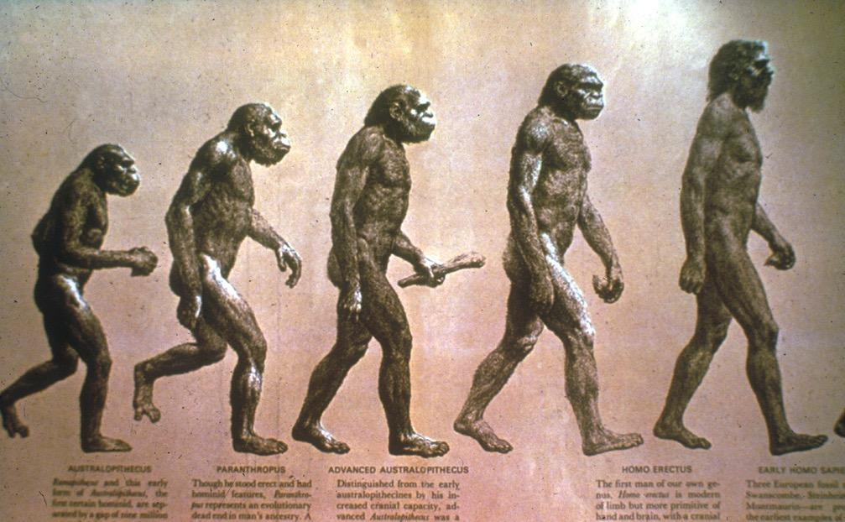
Evolution of man progression?
X
人类的进化?

Slide 27
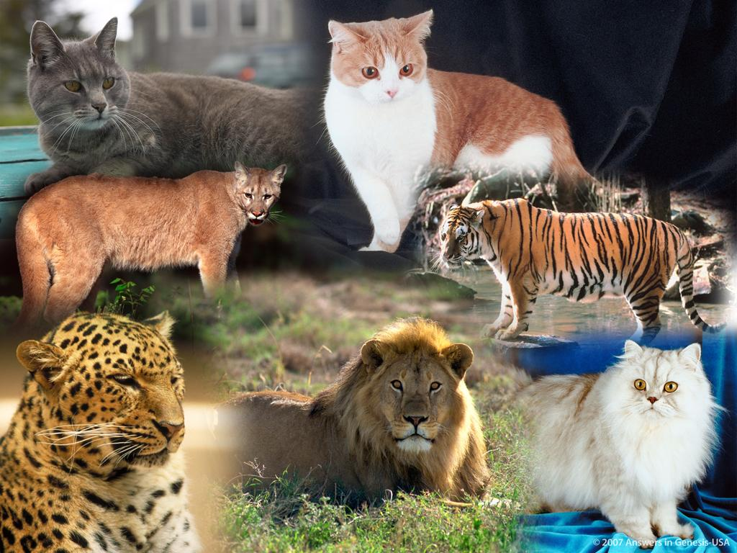
Notes:
27

Slide 28
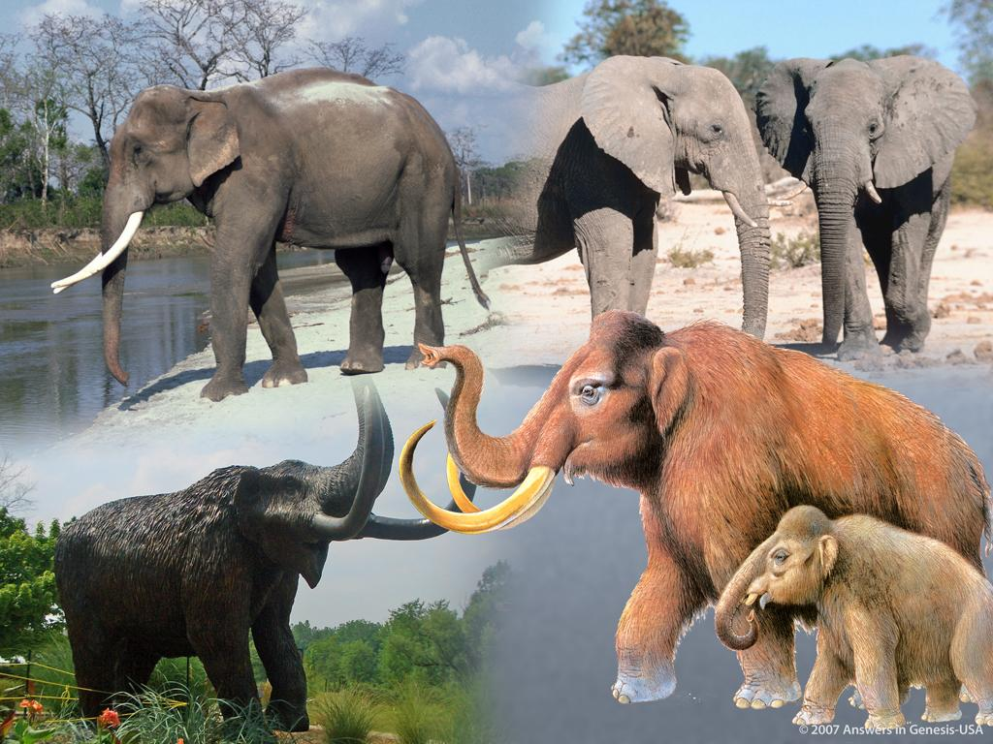
Notes:
28

Slide 29
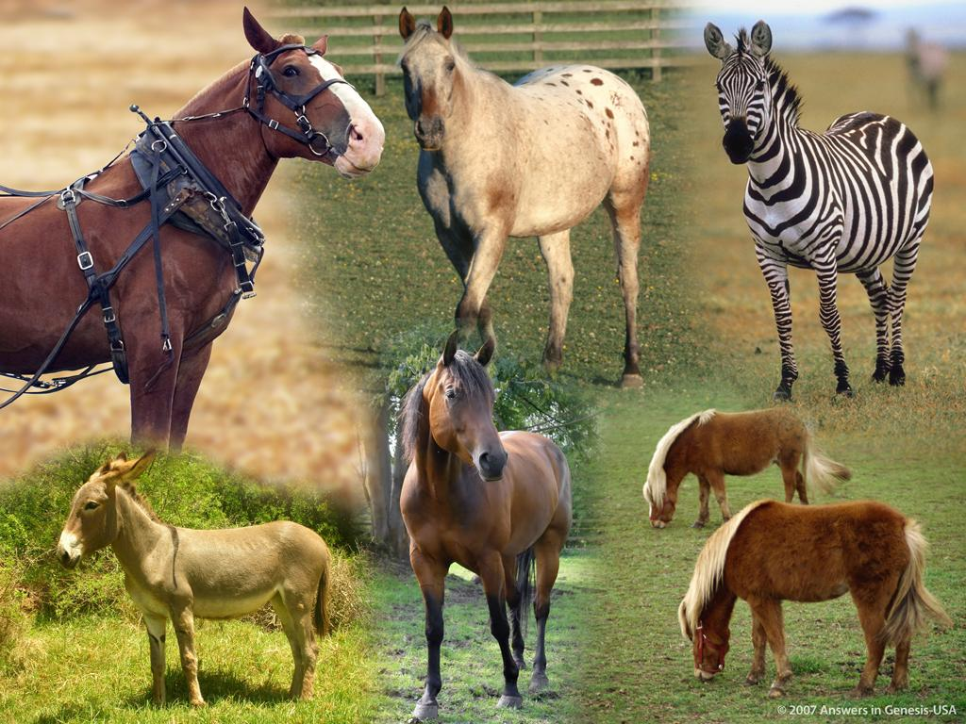
Notes:
29

Slide 30

Notes:
30

Slide 31
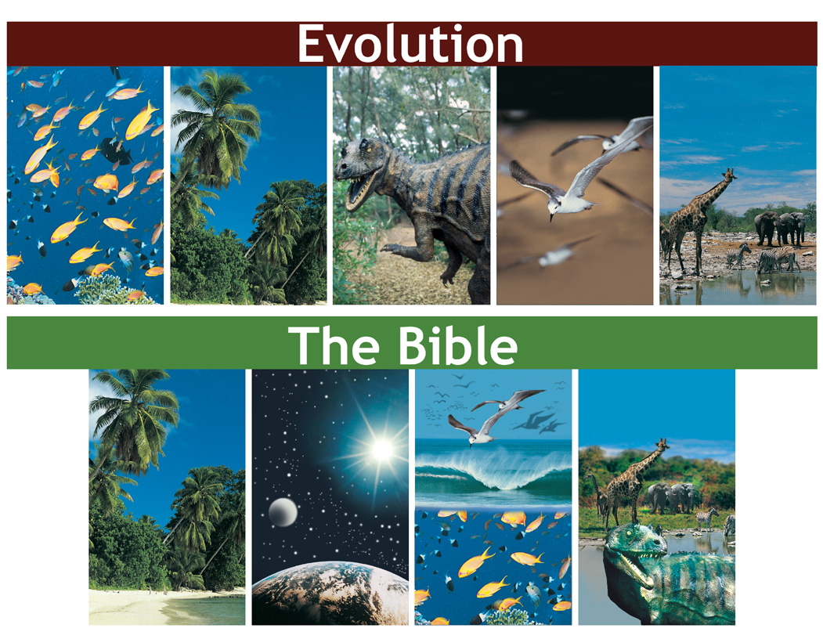
Evolution vs Bible timeline
演化
X
圣经

Slide 32
Genesis 1:1 NAS
创世记 1:5
“神称光为「昼」，称暗为「夜」。有晚上，有早晨，这是头一日。
Numbers the days: first, second, …
Modifies with “evening” & “morning”

Slide 33
Gen. 1:14 NAS
创世记 1:14
“神说：「天上要有光体，可以分昼夜，作记号，定节令、日子、年岁，”

Slide 34
Ex. 20:11 NAS
‭‭出埃及记‬ 20:11
“因为六日之内，耶和华造天、地、海，和其中的万物，第七日便安息，所以耶和华赐福与安息日，
定为圣日’’

Slide 35

创作第一天以来的时间
创造亚当前5天 = 5 天
亚当到亚伯拉罕 = ~ 2,000 年
亚伯拉罕到基督 = ~ 2,000 年
基督直到现在 = ~ 2,000 年
总数 = ~ 6,000 年
(创世记 1)
(创世记 5 & 11)
Notes:
This uses only the background from Template Suite 1. Nearly any content will work with this template. Presentation Team recommends keeping the main content at least half an inch from the edges. This also contains a floating AiG logo that can be repositioned or removed as appropriate for the overhead's content.

Slide 36
Gen. 1:31 NAS
创世记1:31
“神看着一切所造的都甚好。有晚上，有早晨，是第六日’’。

Slide 37
腐败
灾难
受造之物
混乱
历史的 七个C
完善
基督
十字架
Notes:
This is fully animated. The Scripture text frame is editable so you can insert a different version if you so desire.
In case you want to know. Each element is a TIFF image with alpha channels. This whole page totals 1.1 MB rather than 11+ MB that flat JPEGs would produce.

Slide 38

Perfection: Lion and lamb
生活在一个完美的世界
“神看着一切所造的都甚好。有晚上，有早晨，是第六日’’。 (创世记 1:31).
Notes:
38
38

Slide 39
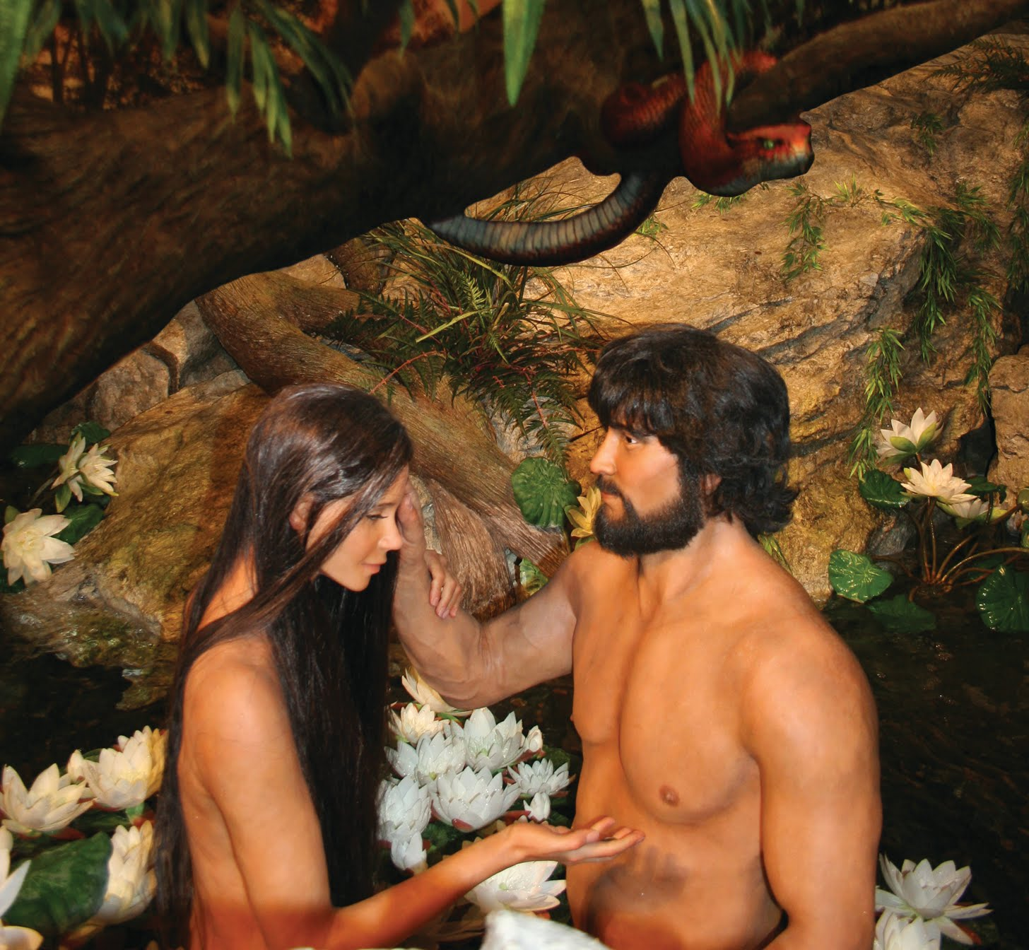
Adam & Eve with Serpent
Notes:
39

Slide 40
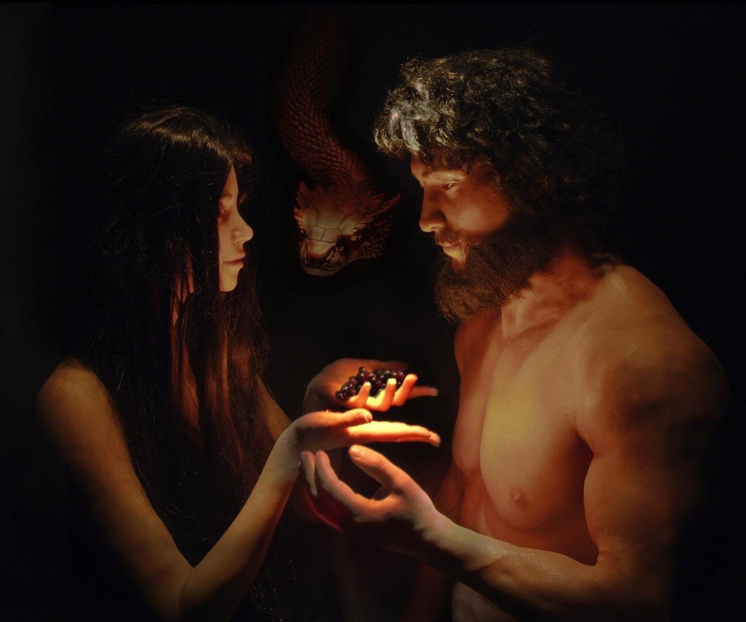

Slide 41
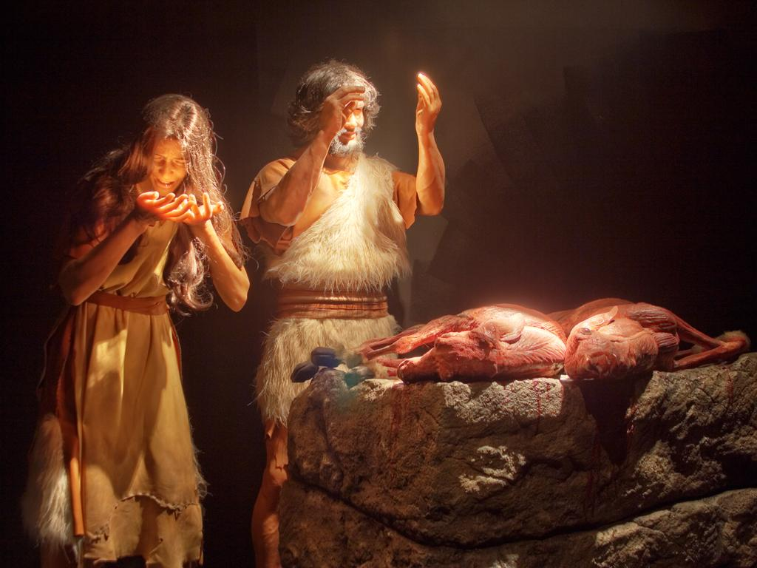
Adam & Eve—coats of skin
创世纪3:21
Notes:
41

Slide 42
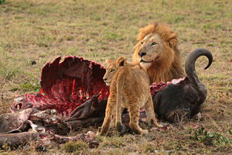
Notes:
42
http://en.wikipedia.org/wiki/Carnivore

Slide 43
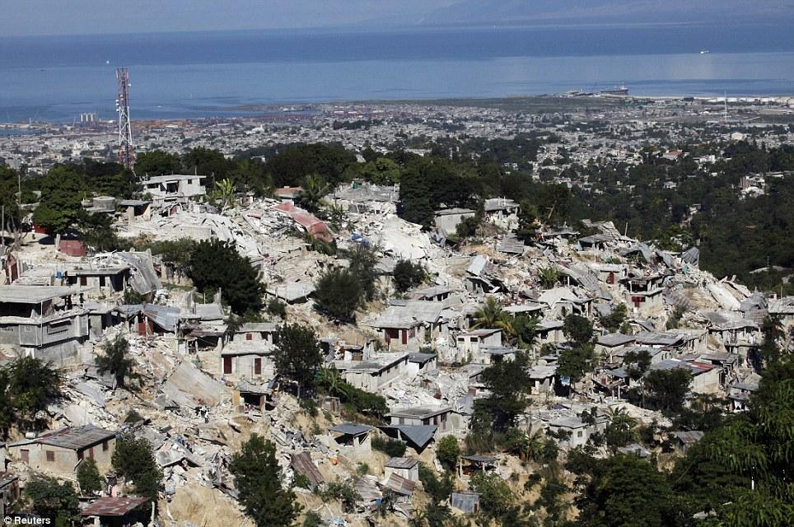
海地地震，2010年1月

Slide 44
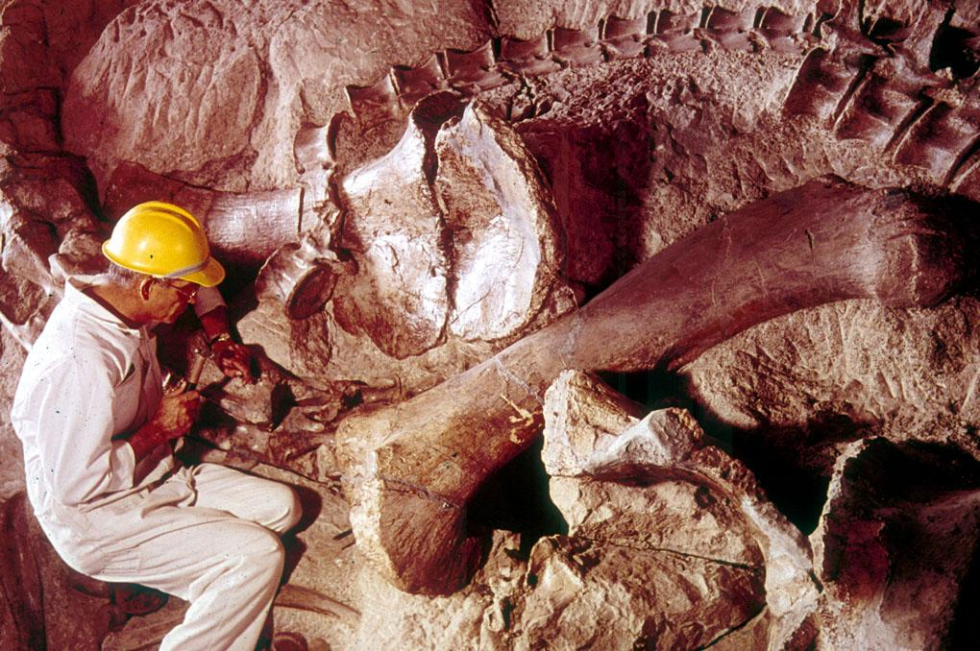
Fossil dinosaur with scientist
Notes:
44
Picture from Dinosaur National Monument (national park) in Utah & Colorado
Show my fossil shells

Slide 45

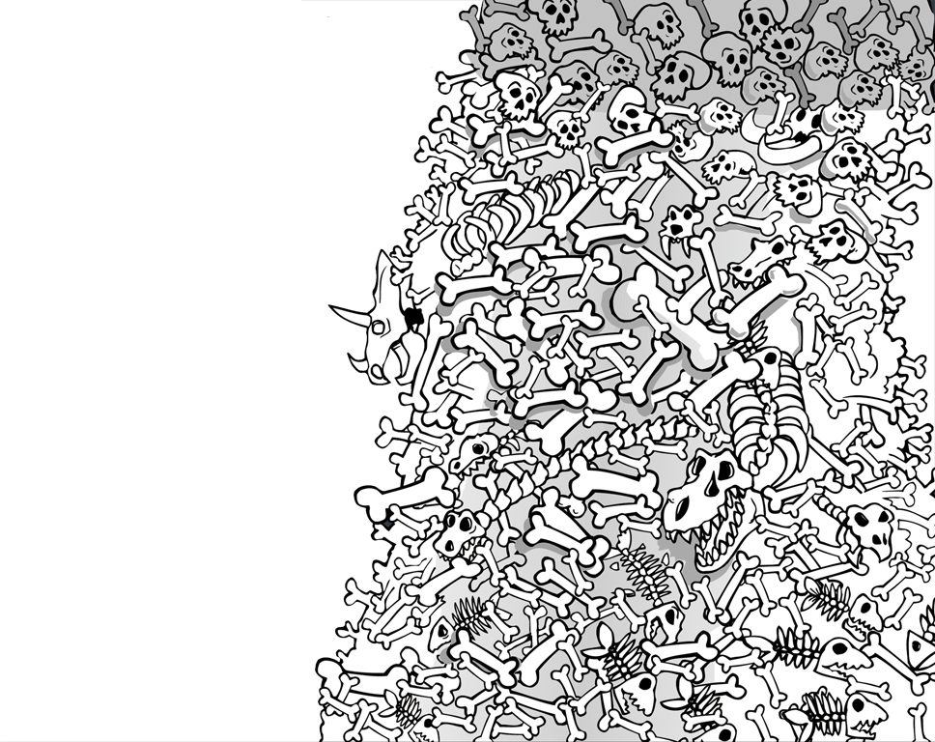
化石
记录
痛苦
死亡
搏杀
X
数百
万年
=
疾病
斗争
苦难
灭绝

Slide 46


Evolution Millions of Years + Creation 01133
进化百万年
死亡
苦难 疾病 血刃
人类的
存在
受造之物
人类的行为
罪
死亡
Notes:
46
Do these two views agree?
No, of course not. They are diametrically opposed to each other.

Slide 47
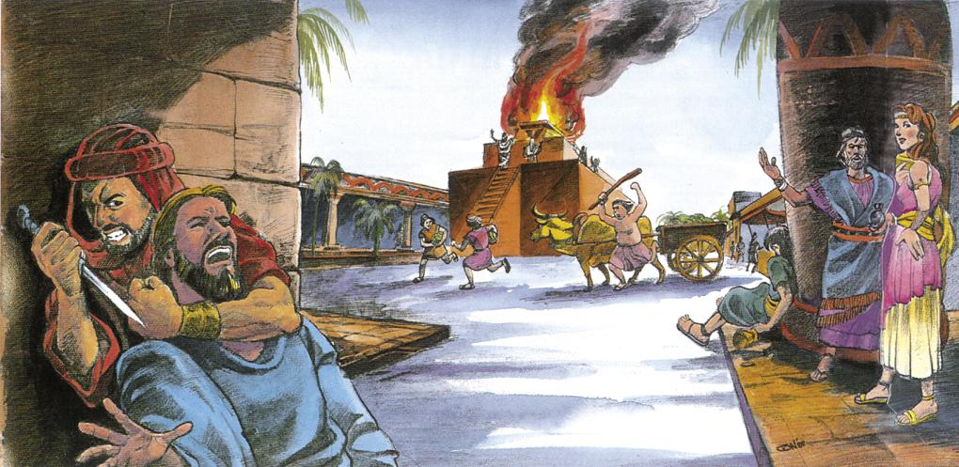
Pre-Flood violence
Notes:
47
Source: Gary Parker, Creation: Facts of Life (Master Books), p. 152.

Slide 48
腐败
灾难
受造之物
混乱
历史的 七个C
完善
基督
十字架

Slide 49

Template Suite 1-Content 01360
洪水的目的 是什么？
Notes:
49
What was the Flood going to destroy?

Slide 50
Gen. 6:7, 13 NAS
创世记 6:7, 13
7. “耶和华说：「我要将所造的人和走兽，并昆虫，以及空中的飞鸟，都从地上除灭，因为我造他们后悔了。.”
13. “神就对 挪亚 说：「凡有血气的人，他的尽头已经来到我面前；因为地上满了他们的强暴，我要把他们和地一并毁灭。”
Notes:
The underlined word is eretz, the same word translated earth in Gen. 1:1 and 2:1 and 2:4. Eretz is used 45 times in the Flood account in Gen. 6:5-9:17. The circled word is adamah, which in modern translations is rendered more accurately as “ground” or “land.” It is used only 9 times in the Flood account. In his rejection of the global Flood, OT scholar Dr. Walter Kaiser said in the Feb. 2006 John Ankerberg debates on creation that eretz is never used in the flood account, but that only adamah is used. He was seriously in error.

Slide 51

Template Suite 1-Content 01360
水从哪里来？
Notes:
As a content template, this is best suited for standard content such as outlines, quotations, Scriptures, and maybe illustrations or photos. Presentation Team recommends 48–60 pt. font for headings and 28–40 pt. for body text. Because of eye flow and visual psychology, the top line may be a little closer than all other sides. This also contains a floating AiG logo that can be repositioned or removed as appropriate for the overhead's content.

Slide 52
Gen. 7:11 NAS
创世记7:11
“当 挪亚 六百岁，二月十七日那一天，大渊的泉源都裂开了，天上的窗户也敞开了，
Notes:
Tsunamis caused by seaquakes can travel at speeds up to 500 mph for thousands of miles.

Slide 53
Template Suite 1-Content 01360
洪水有多汹涌?
Notes:
As a content template, this is best suited for standard content such as outlines, quotations, Scriptures, and maybe illustrations or photos. Presentation Team recommends 48–60 pt. font for headings and 28–40 pt. for body text. Because of eye flow and visual psychology, the top line may be a little closer than all other sides. This also contains a floating AiG logo that can be repositioned or removed as appropriate for the overhead's content.

Slide 54
Gen. 7:19-20 NAS
创世记7:19-20
19. “水势在地上极其浩大，天下的高山都淹没了。
20. 水势比山高过十五肘，山岭都淹没了。
Notes:
Where did all water go? Into late-flood ocean basins and underground reservoirs, as we have today. Present mountains were raised in the latter part of the flood (Ps. 104:6-9 is describing the flood, not the creation of dry land on Day 3, if you study the text carefully). There are marine fossils on the tops of all the high mountains which is part of the evidence that shows that they were once horizontal sediments under the sea that were hardened into stone and later broke and tilted in the process of mountain-building.

Slide 55
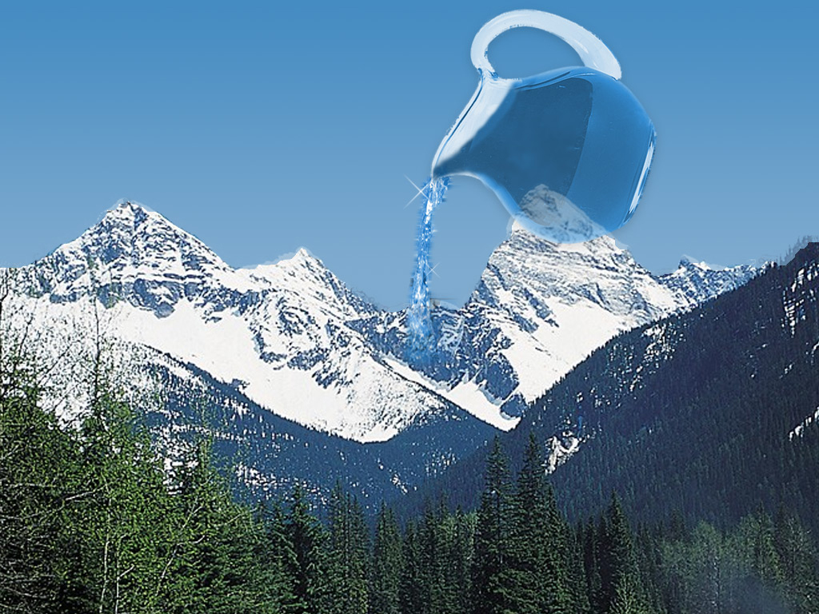
Water covering mountains
Notes:
55
Canadian Rockies, picture adapted from http://www.rocky-mountains-vacation.com/images/photogallery/03_yoho_nat_park_bc.jpg
If possible, have a child pour colored liquid from a pitcher over two different size large rocks in a clear glass pan to illustrate to kids how water seeks a level plane and only a global flood could cover all the mountains.
But explain that the present mountain ranges were produced as the waters of the Flood receded to produce new dry land and that creationists believe there are good reasons to think that the pre-flood mountains were not as high as our mountains today. Reasons would be evidence in Gen. 1 that there was only one land mass, possibly no rain before the flood and long ages of patriarchs, fossil evidence of global tropical/subtropical climate worldwide all suggest less extremes in climate which would imply less variations in topography.

Slide 56
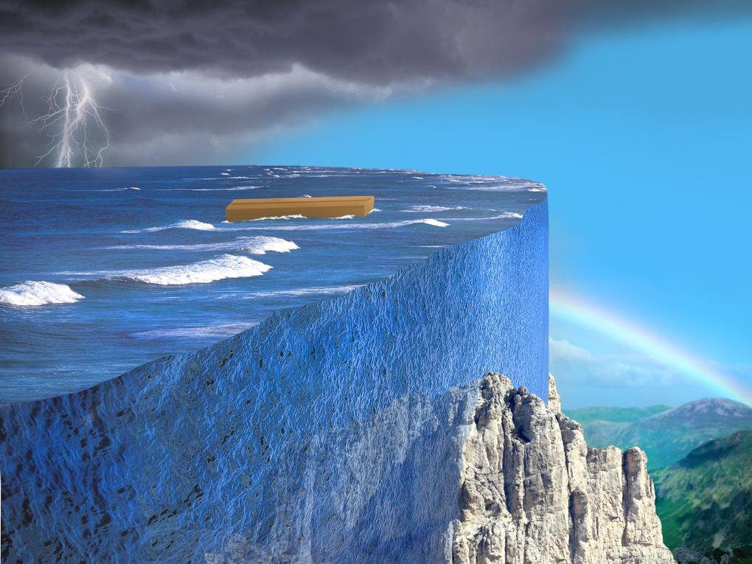
Local flood miracle wall
X
Notes:
56

Slide 57
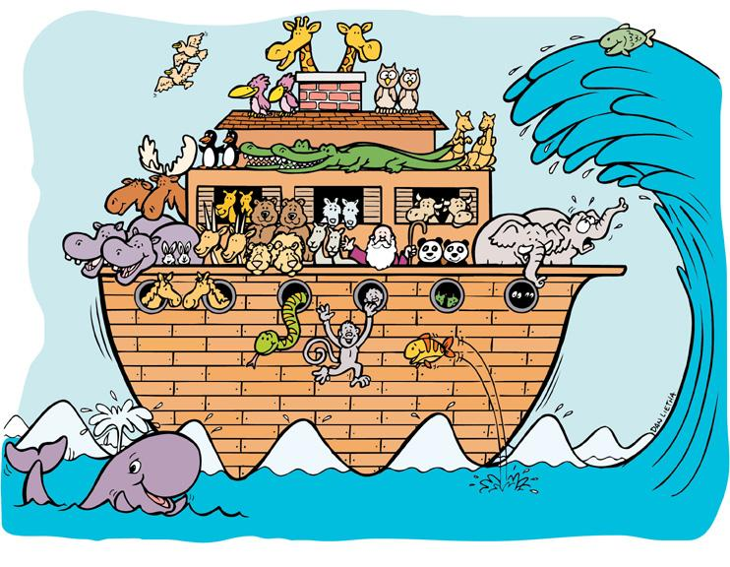
Noah's Ark (kids) & wave
X
Notes:
57

Slide 58
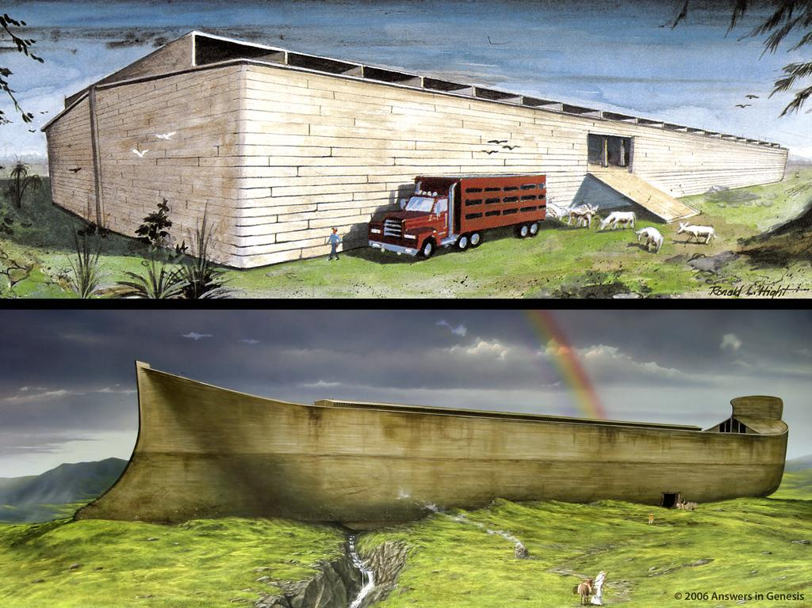
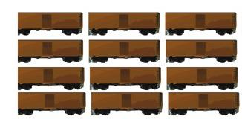
560
Notes:
58

Slide 59
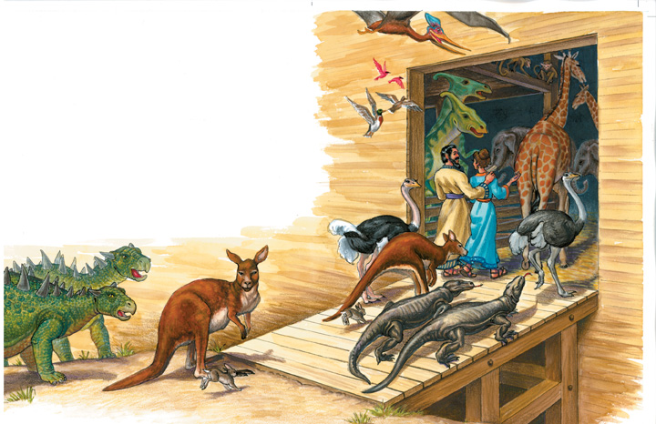
D of E – animals entering Ark
飞 鸟 各 从 其 类 ， 牲 畜 各 从 其 类 ， 地 上 的 昆 虫 各 从 其 类 ， 每 样 两 个 ， 要 到 你 那 里 ， 好 保 全 生 命
Notes:
59

Slide 60
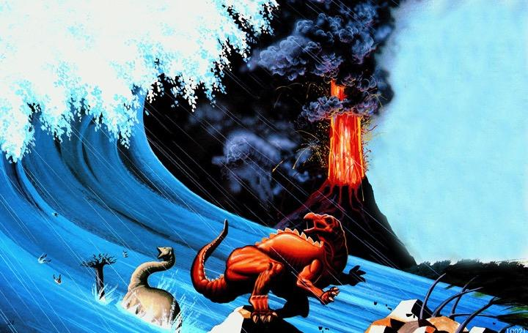
Dinosaurs in Flood
Notes:
60

Slide 61
数十亿死的东西
埋在岩石层
放下水
遍布全球

Slide 62
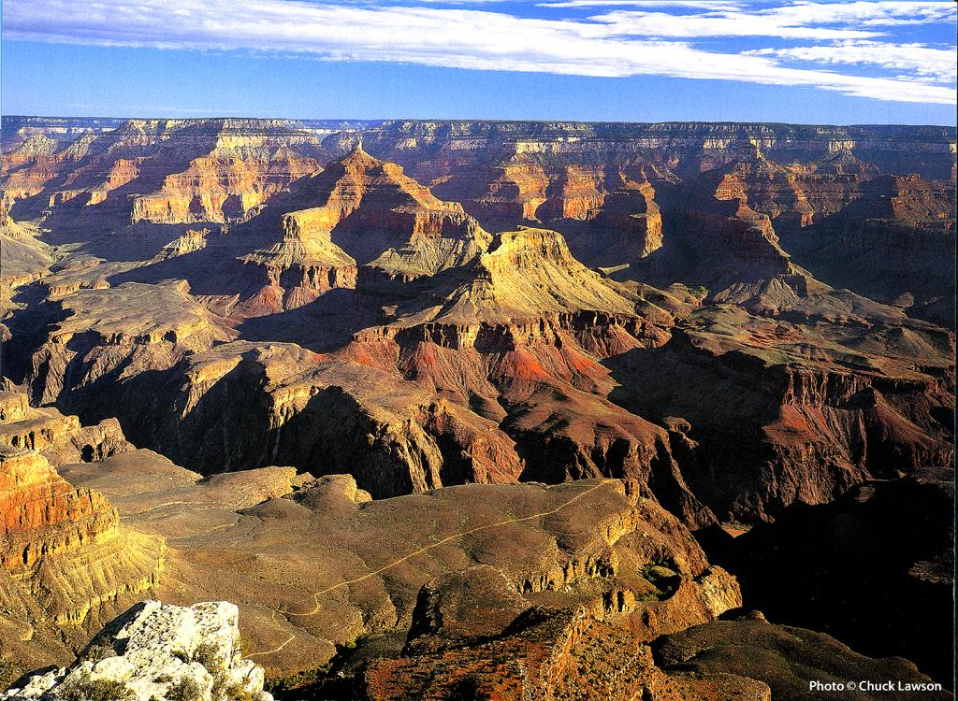
Grand canyon
大峡谷，美国
Notes:
62
Photo from “Grand Canyon 2004 Engagement Calendar” (August) produced by Smith-Southwestern, Inc., P.O. box 20100, Mesa, AZ 85277-100.

Slide 63
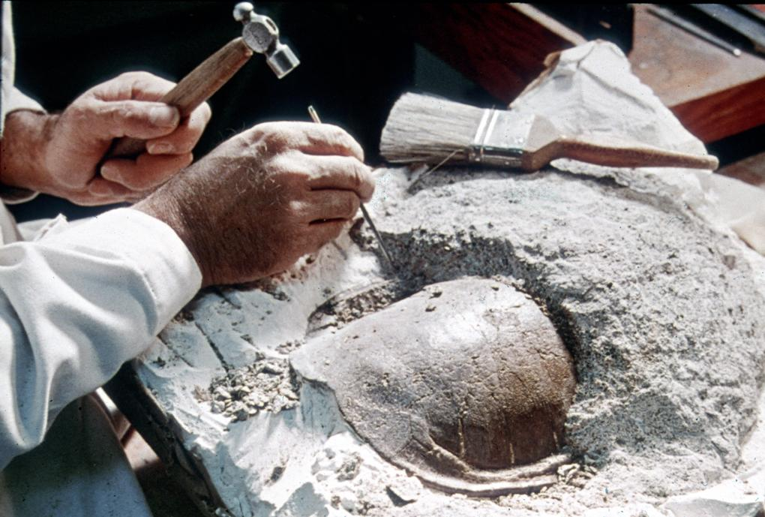
Fossil turtle
Notes:
63

Slide 64
Fossil dinosaur with scientist
Notes:
64
Picture from Dinosaur National Monument (national park) in Utah & Colorado
Show my fossil shells

Slide 65
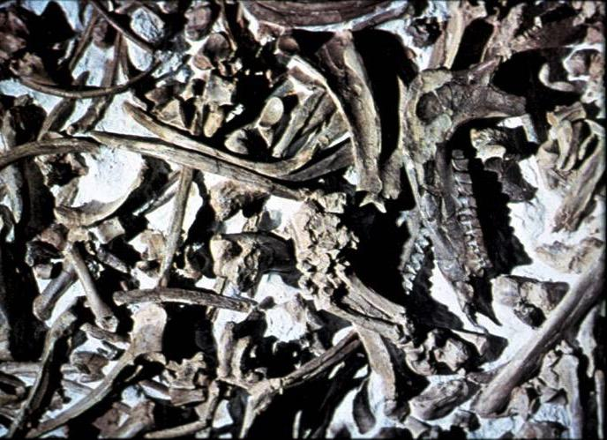
化石墓地
玛瑙斯普林斯，内布拉斯加州
Notes:
65
Source: The Genesis Flood, pp. 157-61. At Agate Springs are 1000s of fossils of rhinos, camels, giant boars and many other exotic animals all mixed together in the limestone stratum.

Slide 66

Earl the Cat Day 1
第1天
科学实验
进行中
不要碰！
在草地上的死猫

Slide 67

Earl Day 3
第3天
科学实验
进行中
不要碰！
在草地上臭了的死猫

Slide 68


Earl Day 9
第9天
科学实验
进行中
不要碰！
在草地上极臭的死猫

Slide 69


Earl Day 20
第20天
科学实验
进行中
不要碰！
EARL的一部分消失了

Slide 70


Earl Day 38
第38天
科学实验
进行中
不要碰！
EARL更多部分消失了

Slide 71


Earl Day 65
第65天
科学实验
进行中
不要碰！
EARL 消失了!!
EARL在哪里?

Slide 72

Fish fossilizing 1
Notes:
72

Slide 73
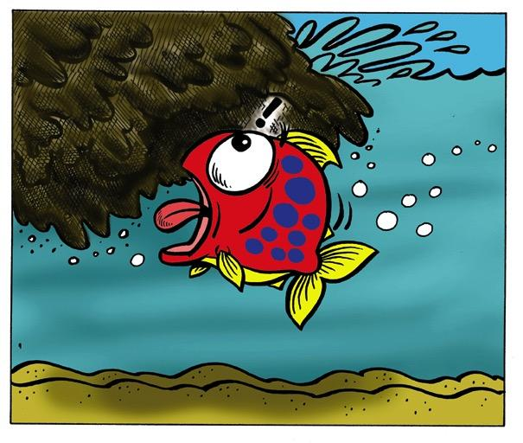
Fish fossilizing 2
Notes:
73

Slide 74
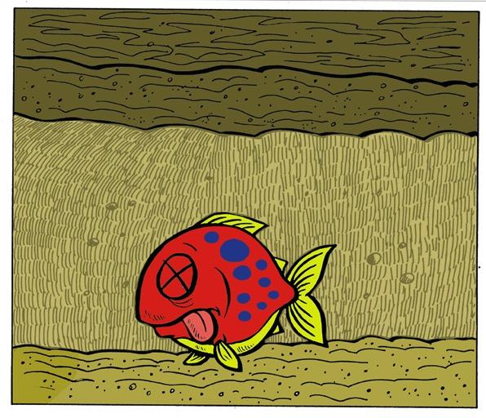
Fish fossilizing 3
Notes:
74

Slide 75
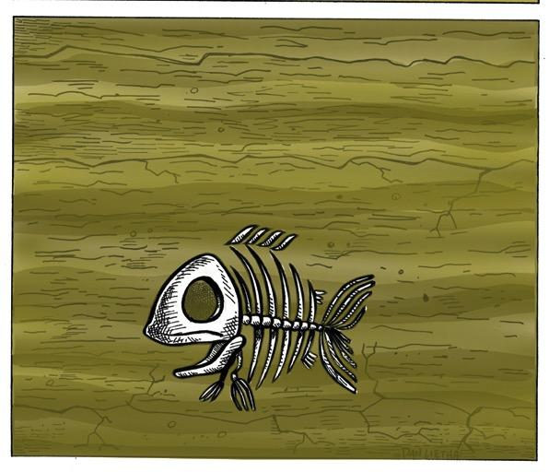
Fish fossilizing 4
Notes:
75

Slide 76
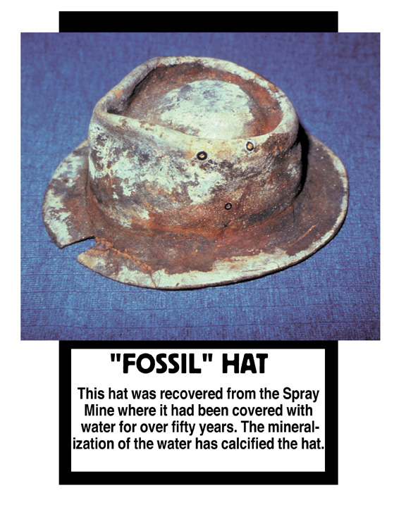
“化石”帽子
这顶帽子是从喷水井里被水覆盖了50多年的。水的矿化使帽子钙化。
Notes:
76

Slide 77
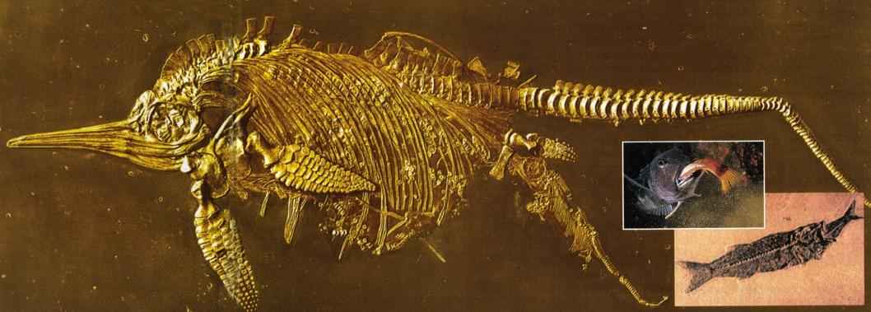
鱼龙生下小鱼
鱼在吃午餐
Notes:
77
Creation, Vol. 23, No. 1 (Dec. 2000-Feb 2001), pp. 10-11.

Slide 78
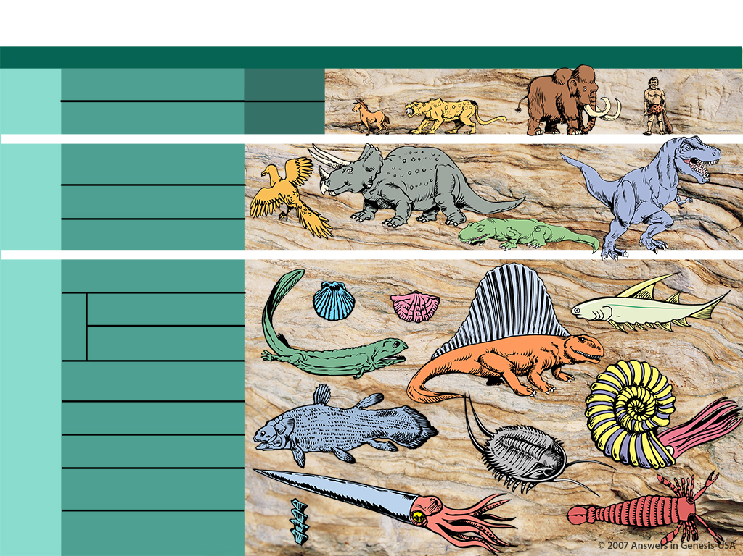
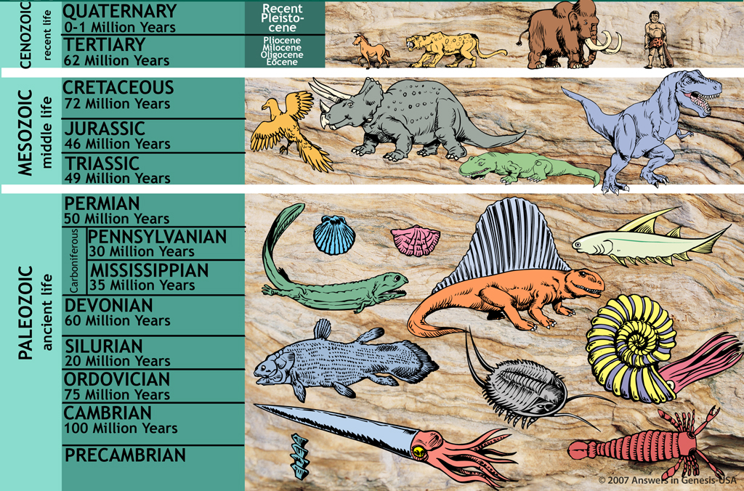
地质时间尺度
地质时间尺度
时代 时期 时代 一连串的生活
X
1.9—3.8亿年：
从单细胞到人类
新生代
（近代的生活）
第四纪 （0至一百万年）
更新世
第三纪 （62百万年）
上新世
中新世
渐新世
始新世
中生代
（中代的生活）
早白垩世 （72百万年）
侏罗纪 （46百万年）
三叠纪 （49百万年）
古生
（古代的生活）
二叠纪 （50百万年）
宾夕法尼亚纪 （50百万年）
石炭系
密西西比纪 （35百万年）
泥盆系 （60百万年）
志留纪 （20百万年）
按照进化论
奥陶系 （75百万年）
寒武纪 （100百万年）
寒武纪前
Notes:
The age of the earth is a huge debate today—how did we get this low in such a short time? By accident?!
_____________
Same slide at:
02-Noah's Flood-slide 4
06-Millions of Years-slide 4
10-Seven Cs-slide 79

Slide 79
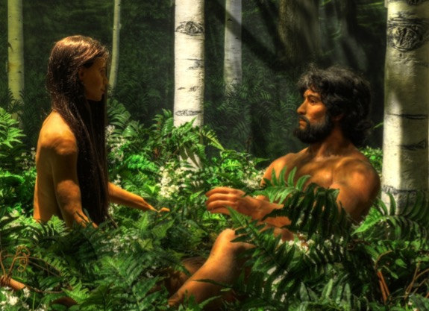
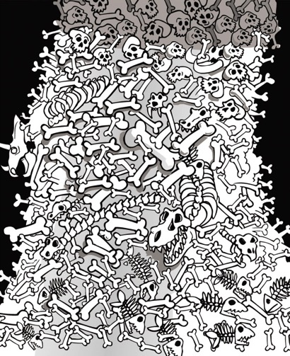
A&E on bones
痛苦
死亡
搏杀
疾病
斗争
苦难
灭绝
X
诺亚的洪水
几百万年
痛苦
死亡
搏杀
疾病
斗争
苦难
灭绝
Notes:
79
Some think the ravages of sin came BEFORE Adam and Eve. NO.
• The Bible says that their life was the foundation, then sin came after that, leading to Noah's Flood. I'd say YES to that.
• We have no support for the first view!

Slide 80
腐败
灾难
受造之物
混乱
历史的 七个C
完善
基督
十字架

Slide 81

Notes:
81

Slide 82

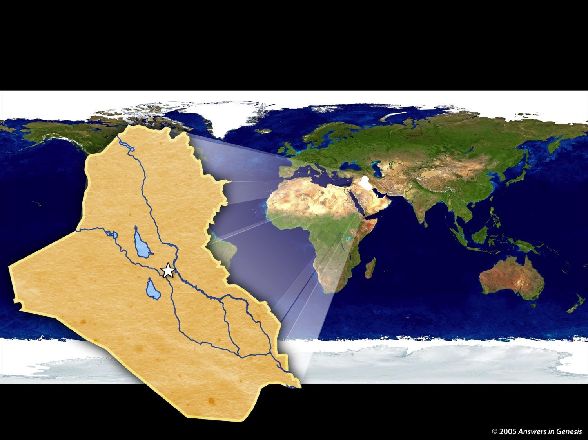
巴贝尔塔
伊拉克
巴贝尔塔
可能的位置
Notes:
82
82

Slide 83
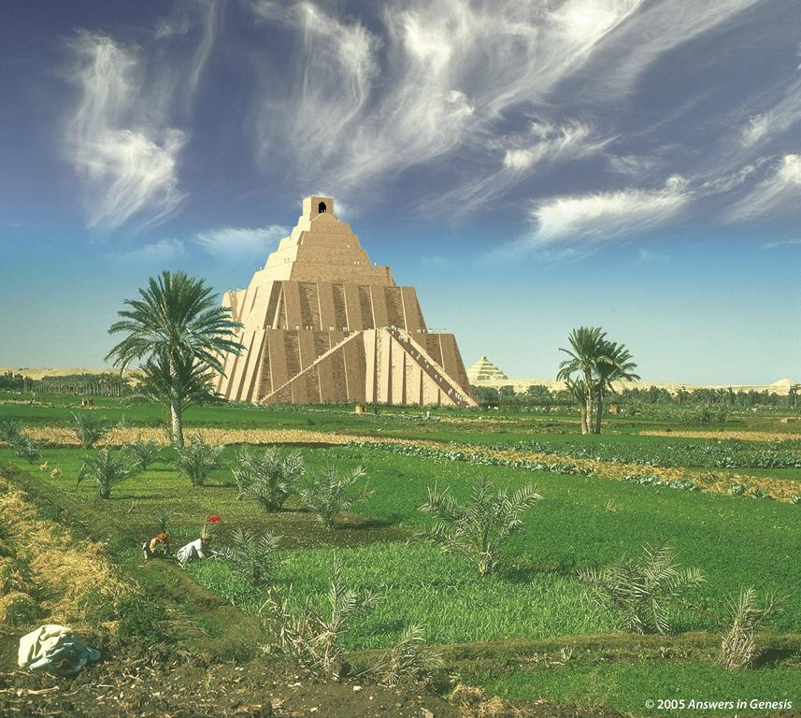
Notes:
Created: September 2005.

Slide 84
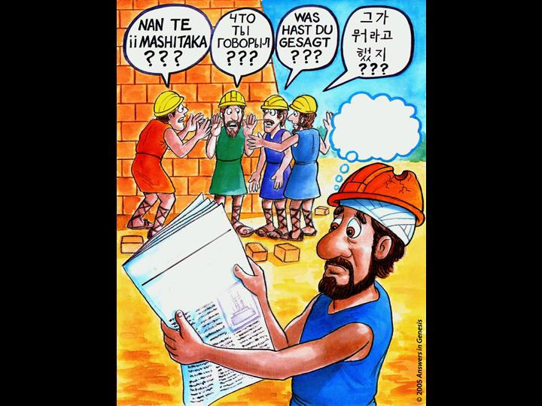
这个项目注定要失败!
BABEL DAILY
TOWER IN TROUBLE!
THE
LANGUAGE
NEEDED!
TRANSLATORS
Notes:
84
84
They lost their understanding of God, so God caused them to lose their understanding of each other.

Slide 85
Gen. 11:9 NAS
创世纪11：9
“因为耶和华在那里变乱天下人的言语，使众人分散在全地上，所以那城名叫 巴别 。’’
Notes:
The Bible only speaks of the first heaven and earth and the new ones. The gap theory would mean that there was a first, second and new—so three heavens and earths instead of only two.

Slide 86
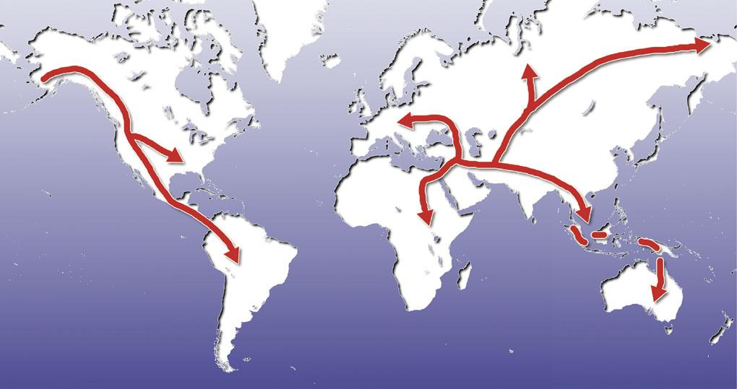
Map—post-flood dispersion
巴贝尔的分散

Slide 87
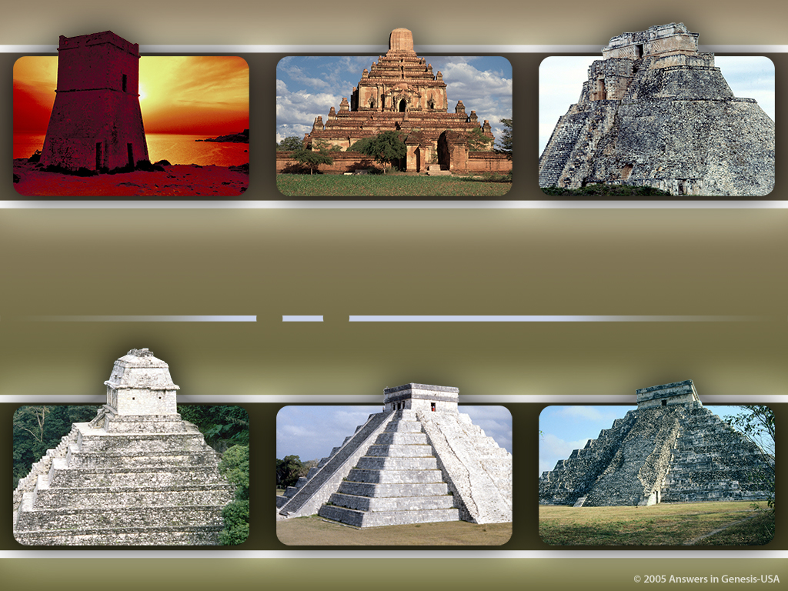
世界各地的
通灵塔
Notes:
Created: September 2005.

Slide 88

Races?
种族?

Slide 89
Evolution of man progression?
X
人类的进化?

Slide 90
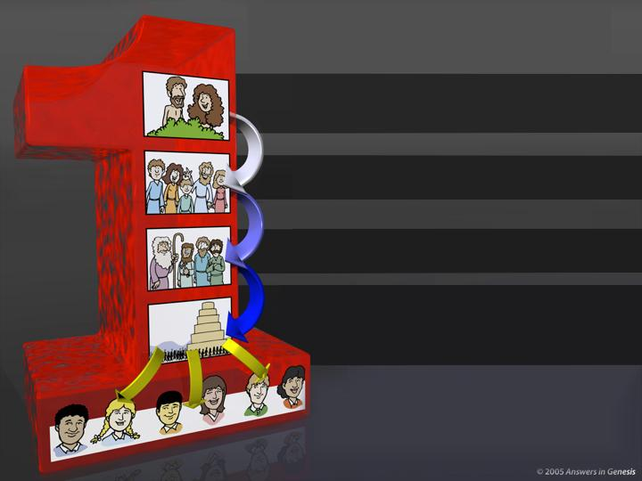
创世纪11：8-9
使徒行传17:26
一个 “种族”
亚当和夏娃
哥林多前书15:45
创世记3:20
儿女
创世记5：4
诺亚和众子
创世记9：17-19
巴贝尔塔的人们
创世纪11：8-9
使徒行传17:26
不同的人组/文化
Notes:
90
Revised: September 2005.

Slide 92
腐败
灾难
受造之物
混乱
历史的 七个C
完善
基督
十字架

Slide 93
Perfection: Lion and lamb
生活在一个完美的世界
“神看着一切所造的都甚好。有晚上，有早晨，是第六日’’。 (创世记 1:31).
Notes:
93
93

Slide 94
Notes:
94

Slide 95
Adam & Eve—coats of skin
创世记3:21
Notes:
95

Slide 96
Gen. 3:15 NAS
创世记3:15
“我又要叫你和女人彼此为仇； 你的后裔和女人的后裔也彼此为仇。 女人的后裔要伤你的头； 你要伤他的脚跟。’’

Slide 97
Isaiah 7:14 NAS
以赛亚书 7:14
“因此，主自己要给你们一个兆头，必有童女怀孕生子，给他起名叫 以马内利 。”
Notes:
The Hebrew word here is used in OT in Gen. 24:43, Ex. 2:8, Ps. 68:25, Prov. 30:19, Song 1:3 and 6:8 and refers there to a chaste unmarried maiden. There is no instance where the Hebrew word (almah) can be proved to designate a young woman who is not a virgin.

Slide 98
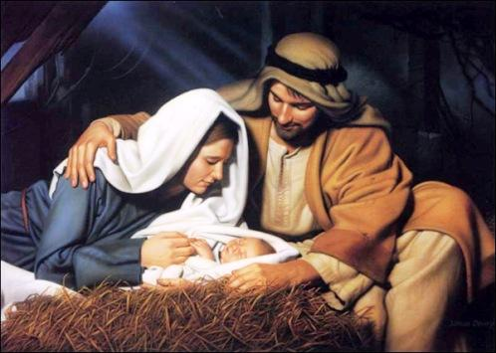
Birth of Jesus
Notes:
98
Mention that we celebrate his birth at Christmas
Picture: http://oneyearbible.blogs.com/photos/uncategorized/jesus_manger.jpg, accessed 1 Sept. 2006

Slide 99
Matt. 1:21 NAS
马太福音1:21
“她将要生一个儿子，你要给他起名叫耶稣，因他要将自己的百姓从罪恶里救出来。’’
Notes:
And Adam gave names to all cattle, and to the fowl of the air, and to every beast of the field; but for Adam there was not found an help meet for him.

Slide 100

基督
根据经文
为我们的
罪恶而死
Notes:
Created: September 2005.

Slide 101

Notes:
101
We celebrate the death and resurrection of Christ at Easter time.

Slide 102

Bozarth 1979 Q053TM--1
“基督教已经战斗，仍然在战斗，并且将把科学与进化的绝望对抗，因为进化彻底毁灭了，最终耶稣为人子的世俗生活被认为是必要的。”
G. Richard Bozarth, “The Meaning of Evolution,” American Atheist (Feb. 1978), p. 30.

Slide 103
Bozarth 1979 Q053TM--2
“消灭亚当和夏娃以及原罪，在瓦砾中，你会发现上帝儿子的遗憾（原文如此）。 带走他死亡的意义。 如果耶稣不是为我们的罪而死的救赎者，而这正是进化的意义，那么基督教就是一无是处！
G. Richard Bozarth, “The Meaning of Evolution,” American Atheist (Feb. 1978), p. 30.

Slide 104
腐败
灾难
受造之物
混乱
历史的 七个C
完善
基督
十字架

Slide 105


完美的世界
Notes:
105
Revised: September 2005.

Slide 106


完美的世界
入侵
死亡
疾病
疼痛
痛苦
情感
痛苦
Notes:
106
Revised: September 2005.

Slide 107


完美的世界
恢复
新天地
入侵
死亡
疾病
疼痛
痛苦
情感
痛苦
Notes:
107
Revised: September 2005.

Slide 108
Rev. 21:4 & 22:3a NAS
‭‭启示录 21:4
“神要擦去他们一切的眼泪；不再有死亡，也不再有悲哀、哭号、疼痛，因为以前的事都过去了。’’
启示录 22:3a
“以后再没有咒诅....

Slide 109
Rom. 8:21 NAS
罗马书8:21
“但受造之物仍然指望脱离败坏的辖制,得享 神儿女自由的荣耀。’’
Notes:
Rom. 8:23 uses the same Greek word to say that believers “wait eagerly” for the redemption of our bodies.

Slide 110
Matt. 24:37-39 NAS
马太福音24：37-39
37. “挪亚 的日子怎样，人子降临也要怎样。
38. “当洪水以前的日子，人照常吃喝嫁娶，直到 挪亚 进方舟的那日；
39. “不知不觉洪水来了，把他们全都冲去。人子降临也要这样。

Slide 111

Noah's Ark - Invitation
Notes:
111

Slide 112

“我就是门；凡从我进来的，必然得救，并且出入得草吃。” (‭‭约翰福音 10:9)
Notes:
112

Slide 113

Family Praying at Cross
Notes:
113

Slide 114

Big Bang Time line
宇宙的未来 - 根据大爆炸理论
X
宇宙
大爆炸
数十亿年
热和死亡
Big Bang Time line
Biblical Future of the Universe
Heat Destruction
6-Day
New
Heavens
Thousands of Years
Eternity
Creation
& Earth
Sin and Death
Genesis
2 Peter 3
Revelation
Notes:
Translators! Move the black box at the bottom and translate underneath it!

Slide 115
腐败
灾难
受造之物
混乱
历史的 七个C
完善
基督
十字架
Notes:
This is fully animated. The Scripture text frame is editable so you can insert a different version if you so desire.
In case you want to know. Each element is a TIFF image with alpha channels. This whole page totals 1.1 MB rather than 11+ MB that flat JPEGs would produce.

Slide 116
2 Corinthians 10:4-5 NAS
哥林多后书10：4-5
4. “我们争战的兵器本不是属血气的，乃是在 神面前有能力，可以攻破坚固的营垒，
5. 将各样的计谋，各样拦阻人认识 神的那些自高之事，一概攻破了，又将人所有的心意夺回，使他都顺服基督。’’

Slide 117
科学家和圣经
请听我说！地球是数十亿年。
请相信我! 我是在六天内创造的!
圣 经

Slide 118





Turning church kids into skeptics
把教会的孩子变成怀疑者
圣经的信徒
进化的人
世俗
媒体＆
教育
Notes:
118
After book sales and before final statements:
“Parents and grandparents, Your kids and grandkids are being indoctrinate with evolution and millions of years a whole lot more than you were when you were in school. Can they stand strong in their faith in the face of this relentless challenge? Do you care? If you walk out of here and say “That was a nice message, I believe Genesis” but don't get any resources for your kids and grandkids and make sure that they believe Genesis and know how to defend their faith, then you don't care enough. And when they crumble under the intellectual pressure, you will be partly responsible for not equipping them with answers.

Slide 119
I Peter 3:15 NAS
彼得前书3:15
“只要心里尊主基督为圣。有人问你们心中盼望的缘由，就要常作准备，以温柔、敬畏的心回答各人；’’

Slide 120
创世记答案机构
相信·维护·宣告
Notes:
120

Slide 121
腐败
灾难
受造之物
混乱
历史的 七个C
完善
基督
十字架

Slide 122
腐败
灾难
受造之物
混乱
历史
历史的 七个C
完善
基督
十字架

Slide 123
宇宙的史书
圣经
Notes:
123

Slide 124
D – Where you there?
2500万年前
你在那里吗？

Slide 125
科学家和圣经
请听我说！地球是数十亿年。
请相信我! 我是在六天内创造的!
圣 经

Slide 126
Black
Notes:
126

Slide 127

彩虹的承诺

Slide 128


Kids & the Book of Life
我找到了我的名字!
我的名字也在
那里！
我的也是！
我的也是！
在生命册里有你的名字吗？

Slide 129



人类的死亡年龄
神把人类的寿命缩短到平均70年
亚当
930 年
玛土撒拉
969 年
在洪水之前死亡
诺亚
950 年
闪
600 年
Lived & Died Before the Flood
亚伯拉罕
175 年
摩西
120 年
大卫王
70 年
Lived & Died After the Flood
"Before the Flood, when the world was much different than today, people sometimes lived almost one thousand years! But after the Flood, people's lives were much shorter. Today, few people live to be even 100 years old" (John Morris, Noah's Ark & the Ararat Adventure, page 10).
Notes:
From John Morris, Noah's Ark and the Ararat Adventure, p. 10.

Slide 130

Creatures buried with feet Up
不要担心我！我在方舟上!

Slide 131
Days of Creation in Genesis One 00825—layered—NAS
创世纪第一章
创造之日
第一天
I
第二天
第三天
地球，土地，时间和光
空间
干旱的土地和植物
第四天
第五天
第六天
太阳, 月亮和星星
鸟类和鱼类
爬行的生物

Slide 132
Black
Notes:
132

Slide 133


創造链接地址 BibleStudyDownloads.org
免费获得该讲解!
圣经学习下载
Notes:
The explanation for free!
Creation link address

