Slide 1
The Role of Women in the Church
Dr. Rick Griffith • Singapore Bible College • BibleStudyDownloads.org

Slide 2
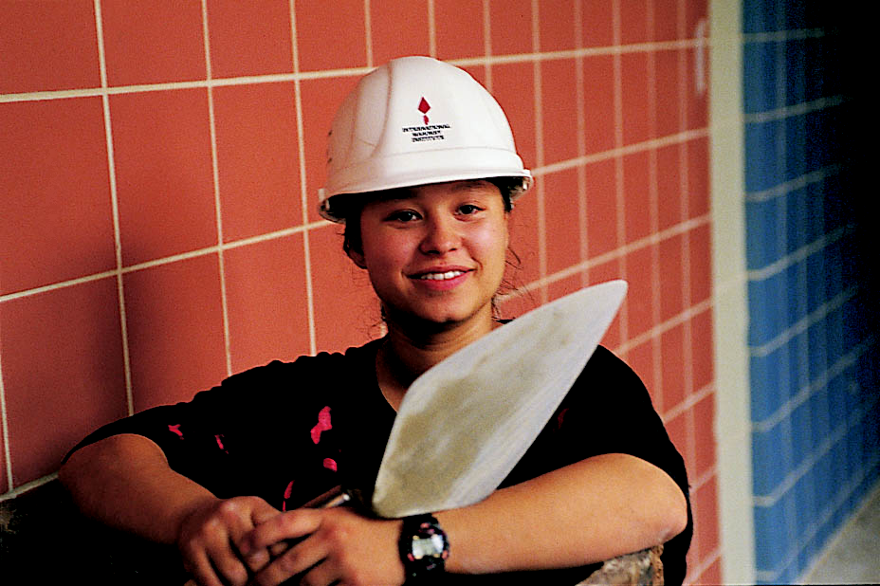
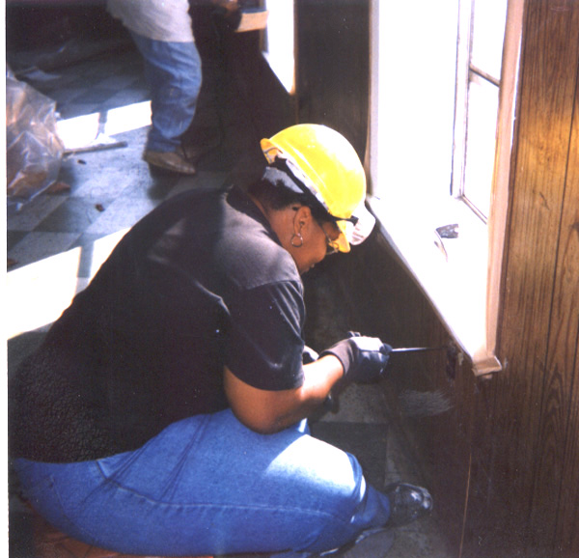
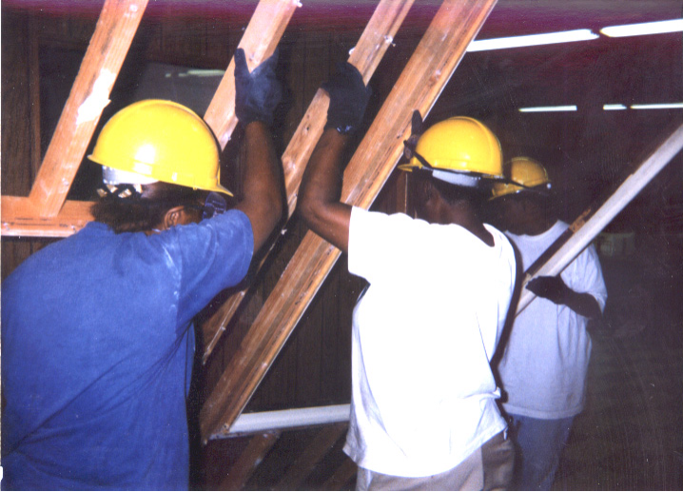
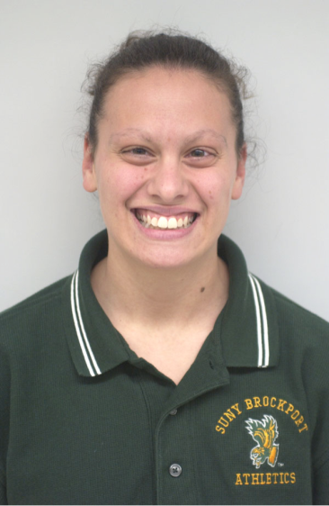
WOW
泥水匠
扩大女性的社会工作机会组织
Electrician 电工
木匠
教练
Notes:
www.work4women.org/multimedia/ photos.cfm

Slide 3
in the society
…there are more and more women leaders !

Slide 4
in the church
… we also have many women leaders!

Slide 5
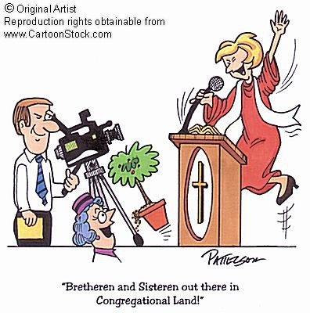

Slide 6
Do men and women have the same roles in the church?

Slide 7
两性人Androgyny
在哥林多及
新加坡
男人及女人在教会及社会是否有不同的角色？

Slide 8
天啊，语言的演变…
Mankind （人）
Humankind （人类）
空中小姐
空中服务员
过去（男女有别）
Fireman （消防员）
Fire Fighter （消防战士）
现在（中性词汇）
Policeman （警察）
Police Person （警员）
Boss
Bossette （上司）

Slide 9
女人该做什么呢？
161o
注意：以下三个经文的上下文都关于公众敬拜
看来林前11与林前14及提前2有矛盾
哥林多前书11 | 哥林多前书14 | 提摩太前书2
能公众祷告(5,13) |  | 公众祷告只有男人(8)
能公众讲道(5) | 不能说话(34) | 一定要安静(12c)
说话是可以的(含蓄的) | 说话是可耻的(35)
 |  | 不能教男人(12a)
 |  | 不许辖管男人(12b)
蒙着头是一般的(16) | 安静是一般的(33) | 男人祷告是一般的(8)
哪一个经文是一般的规律(普通)和哪一个是例外？
想知道如何解决这些矛盾，请看接下来的八面！

Slide 10
提摩太前书 2：12

Slide 11
我不准女人教导， 或辖制男人； 女人总要安静。
提摩太前书 2：12

Slide 12
1 Cor. 14:33-34

Slide 13
"As in all the congregations of the saints, ﻿ women should remain silent in the churches. They are not allowed to speak, but must be in submission, as the Law says."
1 Cor. 14:33-34 NIV

Slide 14
"My own conclusion… the Bible does not permit women to function in the role of pastor or elder within a church."
Wayne Grudem, Systematic Theology, Inter-Varsity Press, 937

Slide 15
彼此平等论
互相补足论
NT Wright
Ben Witherington III
Gordon Fee
Scot McKnight
Ruth A. Tucker
Walter C. Kaiser
Jim Wallis
Rachel Held Evans
Gilbert Bilezikian
J.I. Packer
Tim Keller
John F. MacArthur
C.S. Lewis
John Piper
John Wimber
Mark Driscoll
Elisabeth Elliot
Douglas Wilson
vs
15

Slide 16
共同基础
它不像童女怀孕，基督的神性，靠恩典得救般重要
我们能够在爱里异中求同
我们能在公众场合向别人学习神的话
16

Slide 17
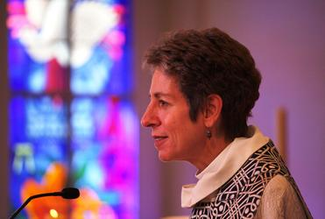
“超越政治的潘朵拉讲台”
17

Slide 18
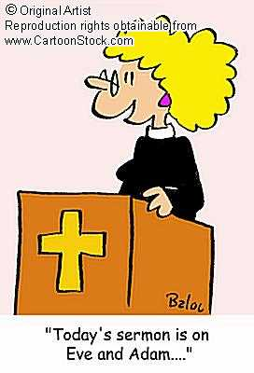
A look at two sides…
Women can and should take the key leadership role in the church
?
Women should not take the key leadership role in the church

Slide 19
Women can and should take the key leadership role in the church
Basis
Strengths
Weaknesses
Implications

Slide 20
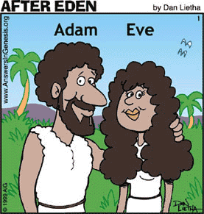
Women can and should take the key leadership role in the church
In the beginning ….
God created man and woman equal.
Genesis 1:27
Basis

Slide 21
Women can and should take the key leadership role in the church
God commanded ….
man and woman to rule over the earth.
Genesis 1:26
Basis

Slide 22
Women can and should take the key leadership role in the church
When man sinned ….
there was a change
in relationship,
but not in authority.
Genesis 3:16
Basis

Slide 23
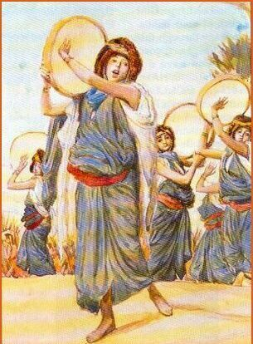
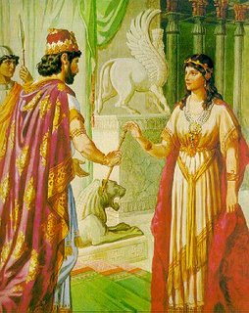
Women can and should take the key leadership role in the church
In the Old Testament…
there were
women leaders
(e.g., Miriam,
Deborah, Esther)
Basis

Slide 24
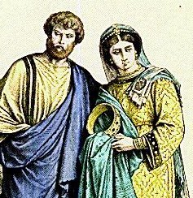
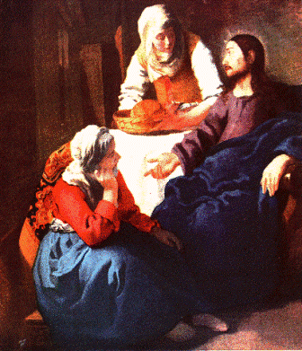
Women can and should take the key leadership role in the church
In the New Testament…
there are
women leaders
(e.g. Mary, Priscilla,
Junia)
Basis

Slide 25
Women can and should take the key leadership role in the church
Father – Jesus relationship …
= man – woman relationship.
Basis

Slide 26
Women can and should take the key leadership role in the church
Church can benefit from many gifted women.
+ women leaders show:
endurance
caring
intuition
Strengths

Slide 27
Women can and should take the key leadership role in the church
Paul opposed women's leadership in the church.
1 Corinthians 14:34-35
1 Timothy 2:11-14
They lacked biblical instruction?
Too emotional?
No public acceptance?
Weaknesses

Slide 28
Women can and should take the key leadership role in the church
Women can become :
Worship Leader
Pastor/Teacher
Elder
Deacon
Implications

Slide 29
Women should not take the key leadership role in the church
Basis
Strengths
Weaknesses
Implications

Slide 30
Women should not take the key leadership role in the church
In the beginning ….
God created Adam first, then Eve.
God created woman from man and for man
Genesis 2:18, 21 1 Tim. 2:13, 1 Cor. 11:8-9
Basis

Slide 31
Women should not take the key leadership role in the church
God commanded…
man and woman
to rule over the earth,
but it does not imply
that they have the same roles.
Genesis 1:26
Basis

Slide 32
Women should not take the key leadership role in the church
In the beginning…
women was deceived by Satan first, not man.
1 Timothy 2:14
Basis

Slide 33
提摩太前书 2:11-15
¹¹女人应该安静而完全顺服地学习。 ¹²我不准 女人教训男人，辖制男人； 女人总要安静。
¹³因为先造的是亚当，后造的夏娃。 ¹⁴不是亚当受了引诱，而是女人受了引诱，陷在过犯里面。¹⁵然而女人要是常常存着信心，爱心，圣洁自律，在她生育的事上必定得救。

Slide 34
Women should not take the key leadership role in the church
When man and woman sinned…
God asked
the man first
(assuming man
as the leader)
Genesis 3:9
Basis

Slide 35
Women should not take the key leadership role in the church
In the Old Testament…
women took
the main leadership role only for
special cases.
Basis

Slide 36
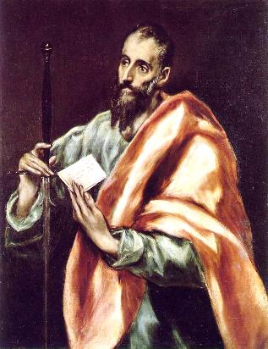
Women should not take the key leadership role in the church
In the New Testament…
Paul did not allow
women teachers in the congregational worship or women elders.
1 Corinthians 14:34-35
1 Timothy 2:11-15–3:2
Basis

Slide 37
Women should not take the key leadership role in the church
Another reason might be…
Woman can also be enticers or enticed to evil, but men can be equally enticed.
Isaiah 3:16 Acts 13:50
Basis

Slide 38
Women should not take the key leadership role in the church
… in a marriage
husband (man)
is the head
of the wife (woman).
Ephesians 5:22-23
Basis

Slide 39
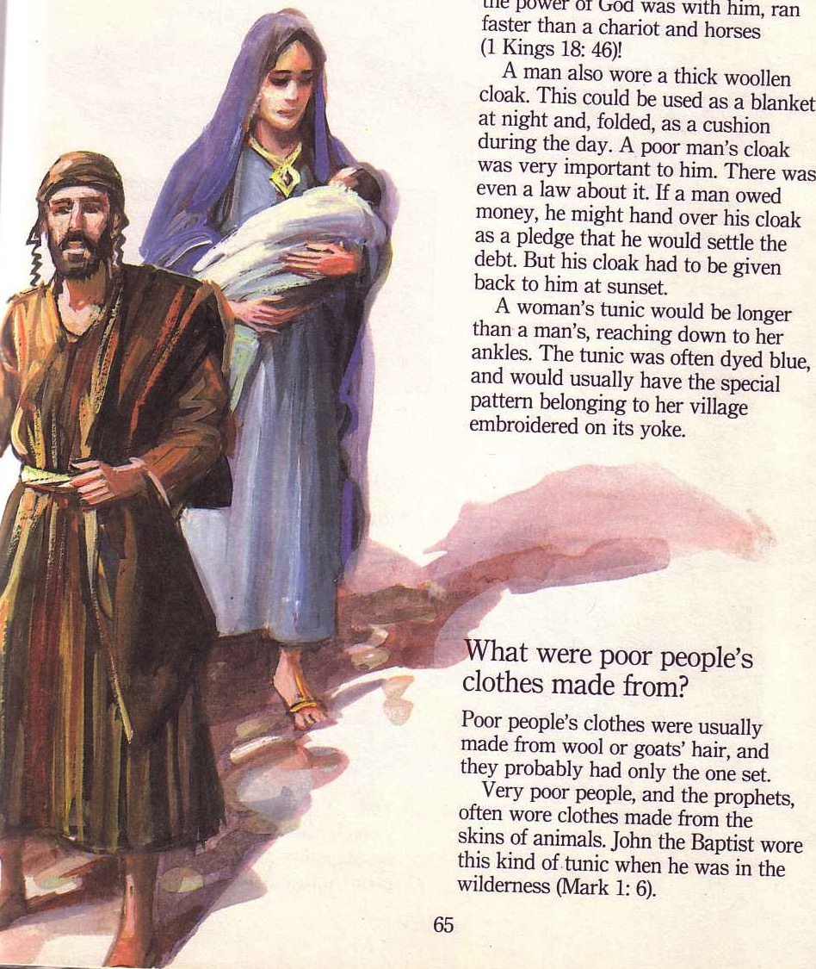
迈向中心思想…
男女是平等但有别的—因此教会里需要保留这些区别.
但是为何呢?
格林多前 11

Slide 40
抵制两性的区别会使权威蒙羞
为何强调两性的区别?

Slide 41
为何保持区别?
A. 在哥林多教会中---男人戴头巾而女人不戴。他们的权柄因而蒙羞 (11:3-6).

Slide 42
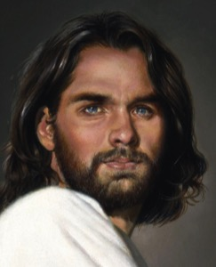
上帝的 权力 架构
上帝
基督
但是我愿意你们知道，基督是男人的头，男人是女人的头， 神是基督的头。 (林前 11:3 CNV)
丈夫
妻子

Slide 43
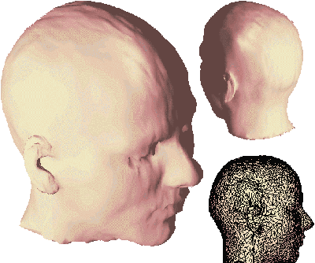
“头”意味着什么?
Notes:
43

Slide 44
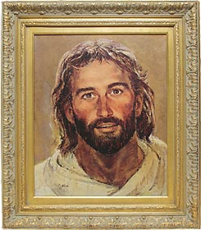
“头”意味着什么?
“源头"?
"权柄"?
Notes:
44

Slide 45
格林多前 11:5-6 CNV
⁵女人祷告或讲道的时候，如果不蒙着头，就是羞辱自己的头，因为这就好象剃了头发一样。 ⁶ 女人要不蒙着头，她就应当把头发剪了；如果女人以为剪发或剃头是羞耻的事，她就应当蒙着头。
Notes:
45

Slide 46
Flowing Hair
Notes:
46

Slide 47
Bald Hair
Notes:
47

Slide 48
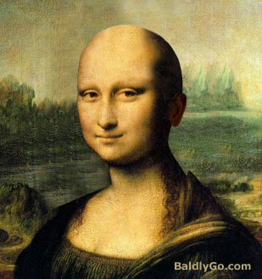
Bald Mona Lisa
Notes:
48

Slide 49
Women should not take the key leadership role in the church
Based on the practice in the Bible...
...women can support the leadership more effectively...
...and this is more accepted by the people
Strengths

Slide 50
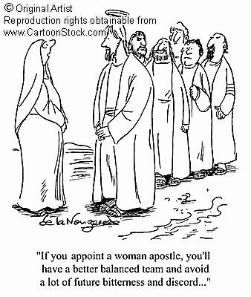
Women should not take the key leadership role in the church
It can have an imbalanced leadership
Weaknesses

Slide 51
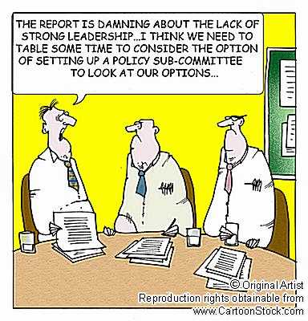
Women should not take the key leadership role in the church
The church lacks capable male leaders
Weaknesses

Slide 52
Women should not take the key leadership role in the church
Women shall not take initiative to be:
pastor
(esp. senior pastor!)
preacher
elder
worship leader
Implications

Slide 53
Women should not take the key leadership role in the church
For special cases:
women can take the key leadership role temporarily…
…while training capable male leaders
Implications

Slide 54
140
Women should not take the key leadership role in the church
"When there are simply no men to do the work… However, women must be cautioned against continuing in such work after there are trained men available for the job"
Charles Ryrie, The Role of Women in the Church, 80
Implications

Slide 55
Women should not take the key leadership role in the church
In church, the main leadership roles are assigned to men.
Supportive roles are delegated to women.
Implications

Slide 56
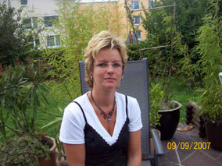
Quellendorf, Germany
Mr. Michaela Lindner
Mr. Norbert Lindner
Notes:
56
In 1998 a German town threw out their mayor [Read 1 Dec 98 Straits Times article].
• Michaela
• Norbert
The article pictures him with long hair and a dress, looking somewhat masculine and feminine at the same time. Later he had a so-called "sex change" operation.
They simply voted what we all know—there is no such thing as a sex change! God made us male or female. Sure, we can take some hormones and undergo surgeries to convincingly change outward features, but every cell of our bodies tells us our sex. For a real sex change, you need to change every second X or Y chromosome!

Slide 57
Conclusion
?
Leadership
in the
church …
?

Slide 58
Leadership in the church …
Conclusion
…is not to show who has more authority (men or women)
Each of you should look not only to your own interests, but also to the interests of others.
Philippians 2:3

Slide 59
Leadership in the church …
Conclusion
…should not destroy the church unity
Make every effort to keep the unity of the Spirit through the bond of peace
Ephesians 4:3

Slide 60
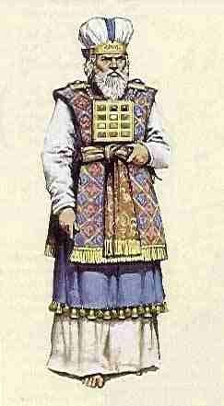
Leadership in the church …
Conclusion
…is not necessary to serve God
Whatever you do, work at it with all your heart, as working for the Lord, not for men.
Colossians 3:23

Slide 61
Application
What can women do in the church?
women's ministry children's ministry
administration youth ministry visitation church bulletin choir music cell-group mission-team counselling prayer meeting preparing teaching materials
… a lot !!!

Slide 62
This is what women should not do … ☺
"But I suffer not a woman to teach, nor to usurp authority over the man, but to be in silence"
1 Tim. 2:12 KJV 1769 ed.

Slide 63
There is neither Jew nor Greek,
slave nor free, male nor female,
for you are all one in Christ Jesus.
Galatians 3:28 NIV

Slide 64
Whatever role you have in the church,
we are to serve the LORD !!!

Slide 65
To GOD be the glory…

Slide 66
Adapted from:
William Siew Tran Thi Xuan Thuy Chumbeni Odyuo Elisabeth Chandra
The Role of Women in the Church

Slide 67
The Role of Women
Bibliography
Barclay, Oliver R. The Role Of Women: Leceister, England. IVP, 1984
Grudem, Wayne. Systematic Theology – An Introduction to Biblical Doctrine. IVP
Husbands, Mark and Timothy Larsen. Women, Ministry and the Gospel – Exploring New Paradigms. IVP, 2007
Jewett, Paul K. The Ordination of Women. Grand Rapids, Eerdmans, 1980
Ryrie, Charles C. The Role of Women in the Church. Chicago, Moody.

Slide 68
Black

Slide 69
教会论链接地址 BibleStudyDownloads.org
免费获得该讲解!
圣经学习下载
Notes:
CH Church (Ecclesiology)

