Slide 1


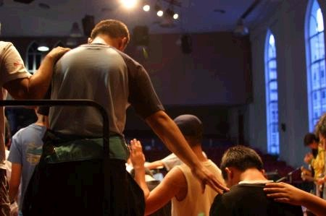
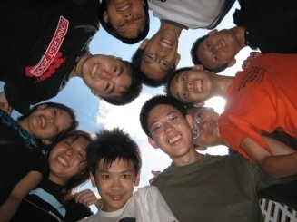


135
C
hurch
nity
U
Dr. Rick Griffith • 新加坡神学院 • BibleStudyDownloads.org

Slide 2
Church Unity
135
When should we not work together?

Slide 3
135
Church Separation

Slide 4

Church Unity
135
OVER WHAT SHOULD WE SEPARATE FROM BELIEVERS?
(In other words, which doctrines must believers agree upon to serve together?)

Slide 5


Which doctrines must believers agree upon to serve together?
135
Would you…
Join together with a Catholic church in opposing abortion?
Join together with a Catholic church in evangelism efforts?
Serve with charismatic churches in evangelism?

Slide 6
Are Denominations Wrong?
135
No—They're OK
Yes—Guard unity
Evangelical groups agree on basic theology
Some divide over minor doctrinal differences
Different languages is a good reason to worship separately
Personal ambition & pride can cause splits that form denominations

Slide 7
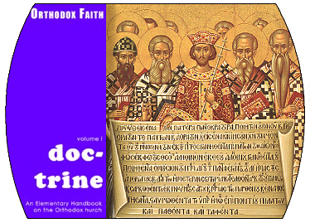


What is Unity in the Church?

Slide 8

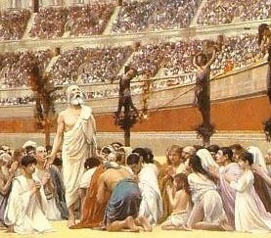
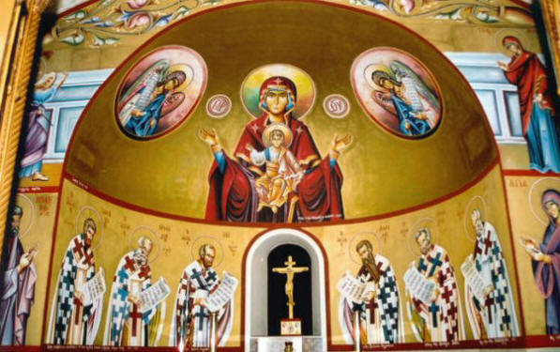
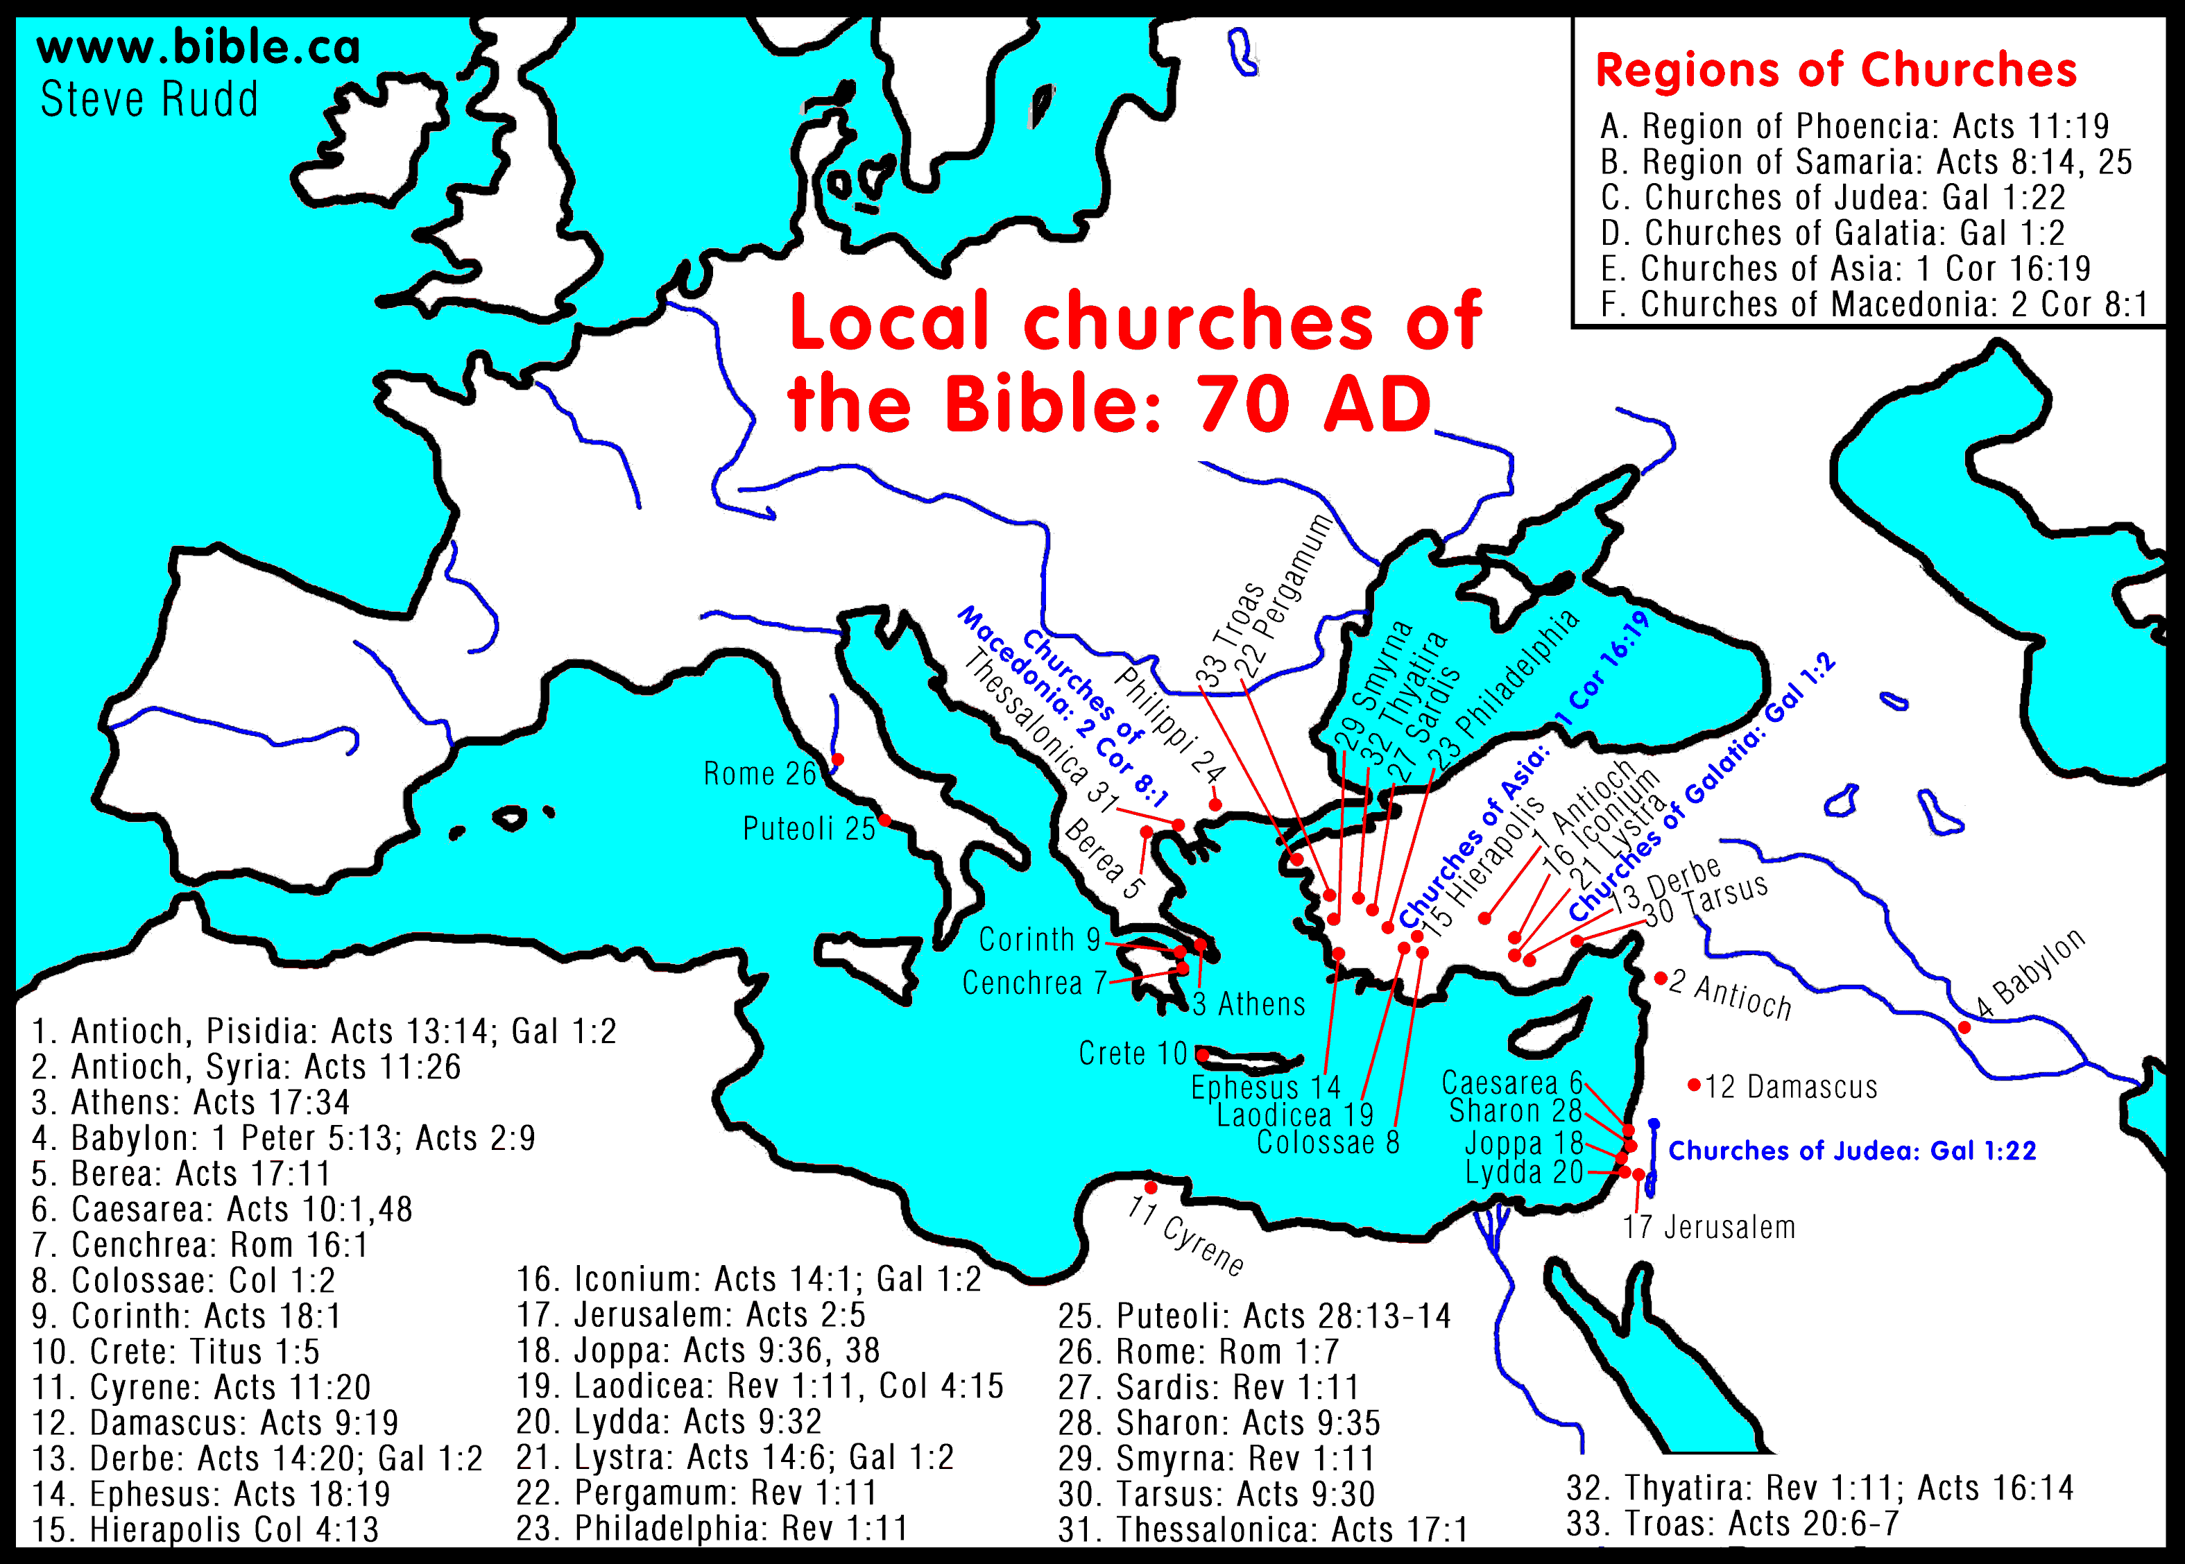
The Invisible/Universal Church
  Every person who has trusted in Jesus Christ as the Son of God.
  Visible to God only
  (2 Tim 2:19) —only God knows who.
  No exact boundary

Slide 9
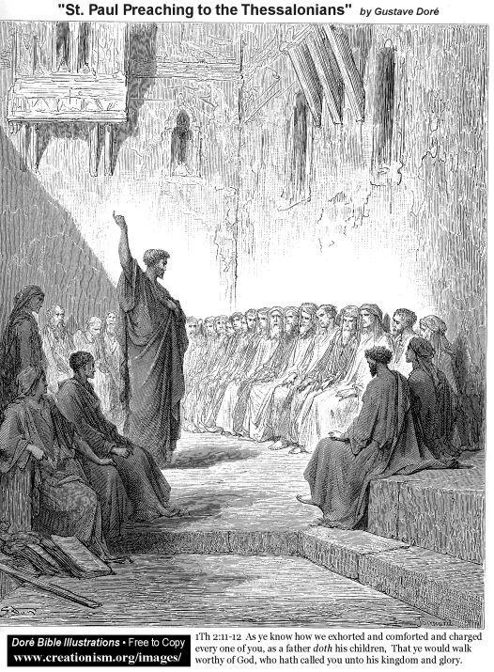
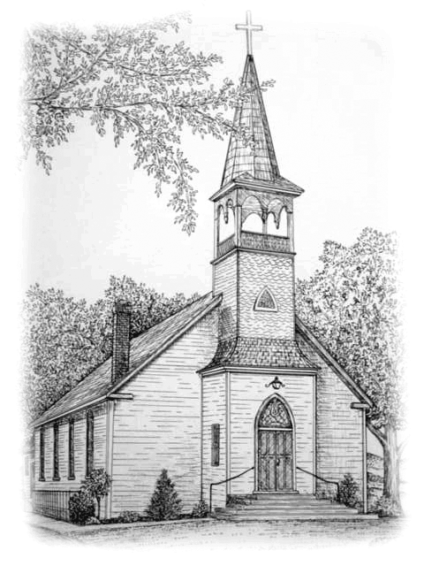
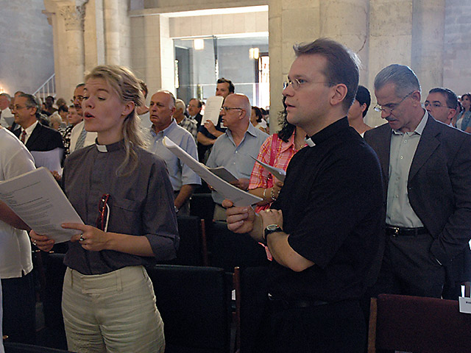
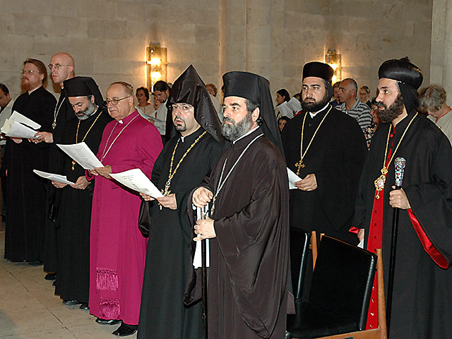
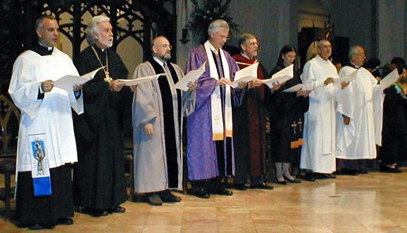
EARTHLY Visible/Local CHURCH
Manifestation of universal church
Visible to every Christian and even the world
Community based 1 Cor. 1:12 1 Thess.1:1 Philemon 1-2

Slide 10

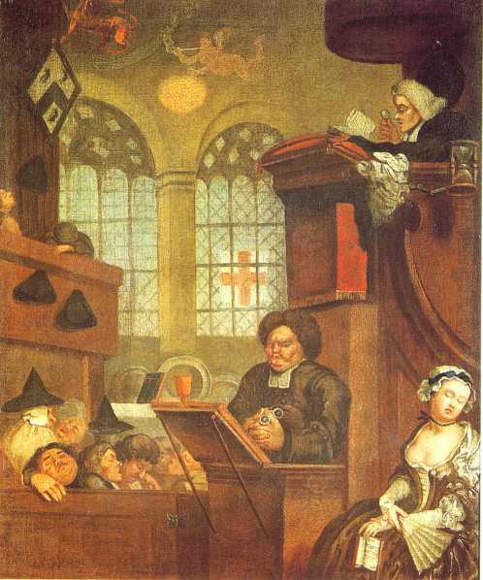

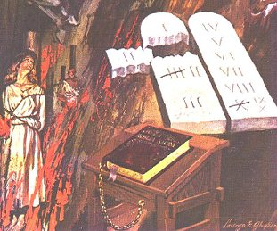
<<<True Churches
Fellowship of "True Christians"
Faithful to the word of God
The right use of the sacraments

Slide 11
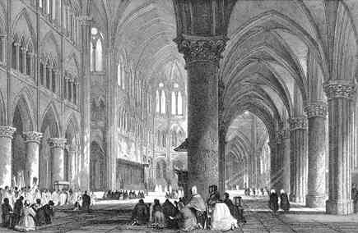
OTHER TRAITS OF THE LOCAL CHURCH (though less important)
Authorized ministry (Acts 14:23; 20:28)
Public worship (Heb. 10:25)
Suffering under the cross (Acts 14:22; 20:29)
Functioning system of discipline (Titus 1:13)
Active ministry of every member (Eph. 4:7-16)

Slide 12
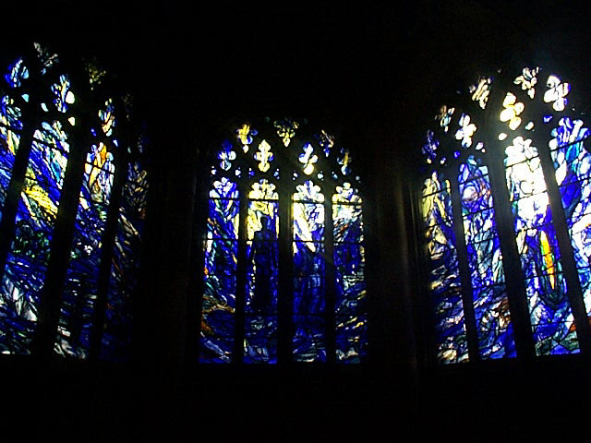
False Churches
…
JEHOVAH'S
WITNESSES…
…
MORMONS…

Slide 13
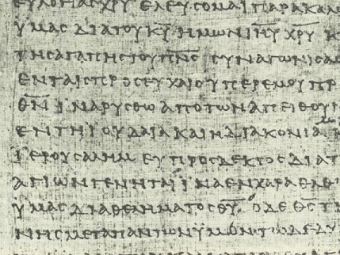
When should we separate?
136
What is meant by "separation"?
Biblical
Primary
Secondary

Slide 14
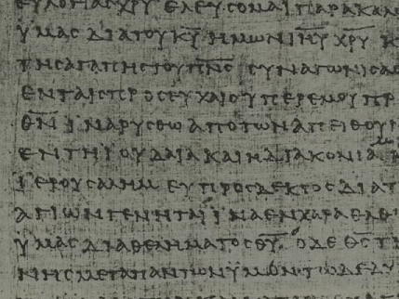
Biblical Separation
136
Biblical separation "is the separation of the church and its members from unbelief, apostasy, and compromise."
—Jeffrey Khoo, Biblical Separation
(Far Eastern Bible College Press, 1999), 11

Slide 15
Primary Separation
136
A believer who does not associate with other believers from another church due to a personal disagreement.

Slide 16
Primary Separation
Mr. Fen, a deacon of Hope church, was not in agreement with a church policy. He proposed a revision of the said policy but his proposal was rejected during a board meeting. As a result, he left the church and established another church.

Slide 17
Acts 15:36-41
A biblical illustration of primary separation was between Barnabas and Paul over John.
Barnabas wanted to take John while Paul did not.
Barnabas and Paul parted ways. Barnabas took John. Paul took Silas.

Slide 18
136
Secondary Separation
is separation between churches because of associations with other churches.
For example, Church A had been united with Church B in the past, but separates from Church B because Church B associates with Church C.

Slide 19
136
Primary separation:
"Should we separate from the wrong crowd?"
Secondary separation:
"Should we separate from those who run with the wrong crowd?"

Slide 20
Secondary Separation
Example 1
Separation between Fundamentalists with Bible-believing Christians or bodies that:
cooperate with Catholic, Eastern Orthodox, Liberal, Modernist, Pentecostal, and Charismatic teachers and churches
are involved with the World Council of Churches.

Slide 21
Secondary Separation
Example 2
Separation between the Fundamentalists with most Protestant churches that are neither Liberal nor Fundamental, and Para-Church organisations like Campus Crusade for Christ, Navigators, Varsity Christian Fellowship, Scripture Union, Operation Mobilisation, and Youth With a Mission.

Slide 22
Secondary Separation
Example 3
The Fundamentalists will not join the nation-wide gospel campaigns such as the Billy Graham Crusade and Luis Palau Crusade because in these events all churches are invited to participate in them, including Liberal and Roman Catholic churches.

Slide 23
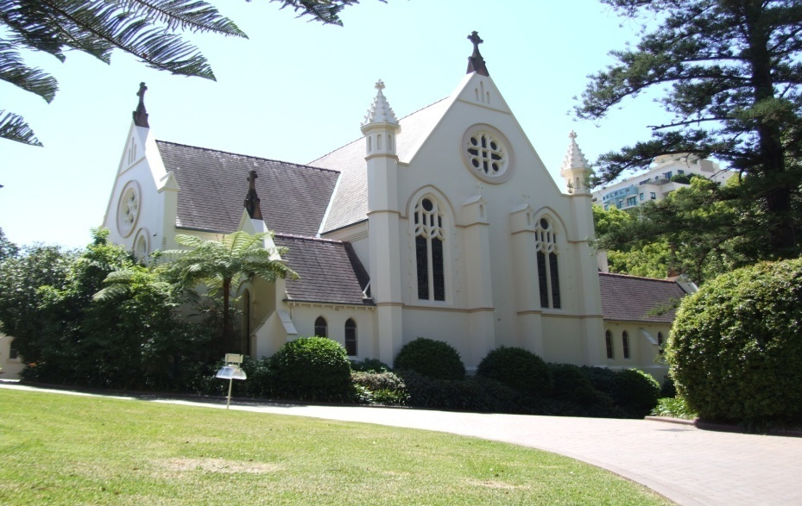
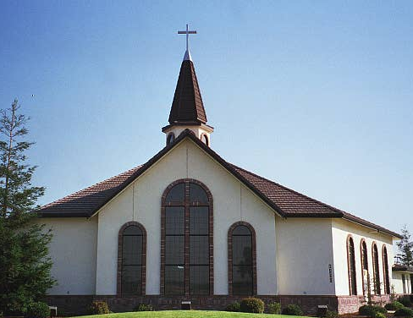
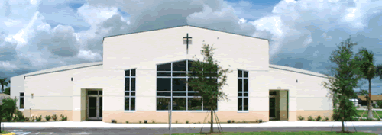
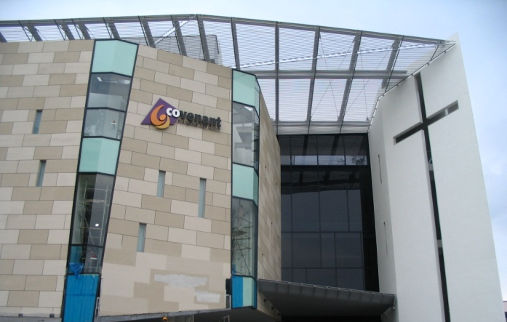
Secondary Separation
Example 4
Fundamental Bible Presbyterian Church
Presbyterian Church
Charismatic Church
Covenant EFC

Slide 24

平衡爱和真理
297
补充
“您所需要的只是爱...” (西皮四)
您同意这说法吗?为什么呢?
爱
真理
肉麻
平衡
严厉
爱
真理
爱
真理

Slide 25
136
Church Unity

Slide 26
Problem of disunity
Root Problems:
PRIDE
INSECURITY
The Church in Corinth Example

Slide 27
Problem of disunity
The Church in Corinth
  Call to Unity (1:10)
  Presenting Problem (1:11-12)
  Argument (1:13-17)
  Root Problem (1:18–2:5)
  Resolution (2:6-16)

Slide 28
The Biblical Call for Unity
John 10:16
"one flock, one shepherd"
John 17:23
"they may become perfectly one"

Slide 29
The Biblical Call for Unity
1 Cor. 1:10
"be united in the same mind and same judgment"
Phil. 2:2
"be of full accord and of one mind"

Slide 30
The Biblical Call for Unity
1 Cor. 10:1; 12:12-26
"one body"

Slide 31
NEW TESTAMENT TEACHING
UNITY—is grounded in the worship of one God (Eph. 4:1-6)
  Gathering of like-minded people confessing and worshipping the one God of the Bible.
  Common worship, even if they may come from different denominations with different emphasis.
  Example: SBC chapel service

Slide 32
…continued
UNITY—Based on the Lordship of Christ (1 Cor. 1:2)
  one Lord, one faith, one baptism, one God and Father of us all (Eph. 4:4-6)
  Enables us to identify our fellow Christians as brothers/sisters

Slide 33

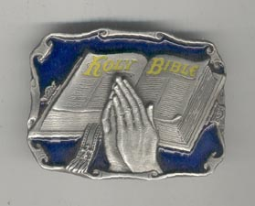
…continued
UNITY—is already given by the Holy Spirit to the regenerate.
Now we must keep this unity (Eph. 4:3).
Jesus' goal in His prayer was for His people to be one (John 17:21).

Slide 34
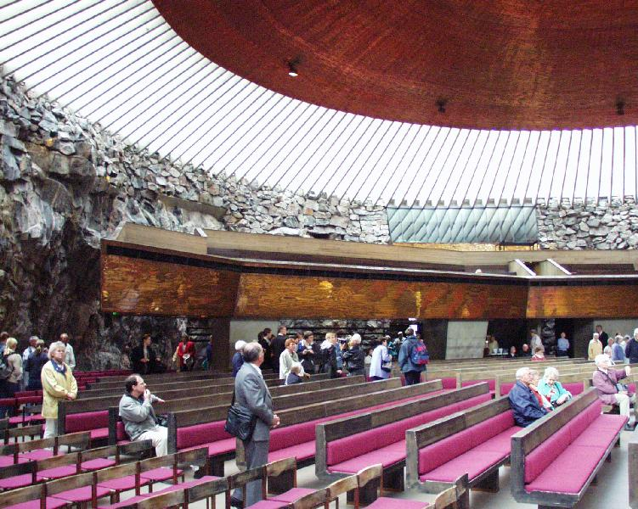
…continued
UNITY –does not imply uniformity as the church has a variety of ministries (1 Cor. 12:4-6)
  Viewpoints differ on issues of secondary importance (Rom. 14:1-15:11)
  Forms of worship vary (1 Cor. 14:26)
  Different denominations have different emphases

Slide 35

…continued
UNITY—can be a reality when
Philippians 2:2 is heeded and
believers are "one in spirit and purpose."
  Unity was a powerful testimony to the world (Acts 4:32-33) and the church tends to grow when the witness is united
  History has shown negative effects slip in when there are quarrels within a denomination or between churches even though each confesses to belong to the same God and Saviour

Slide 36
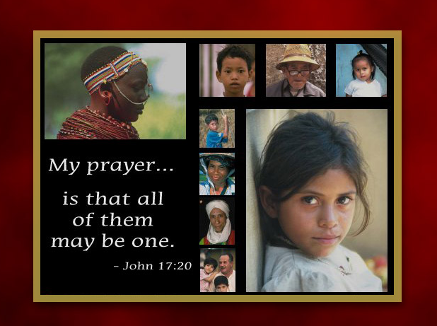
John 17:20

Slide 37
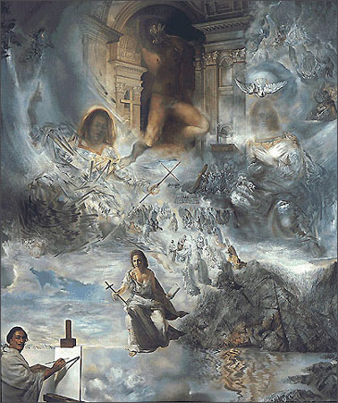

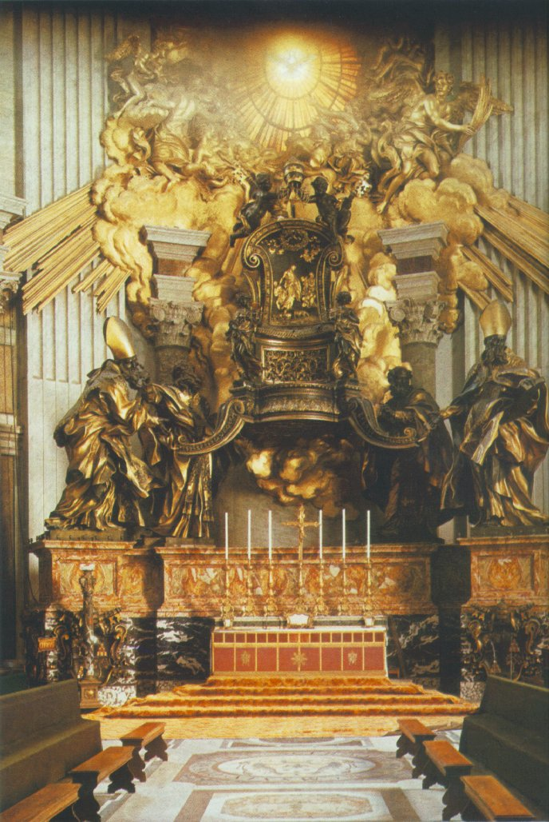
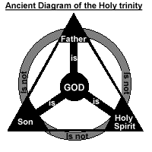



UNITY and DIVISION

Slide 38
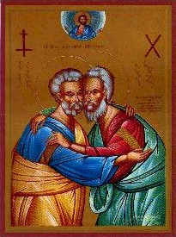
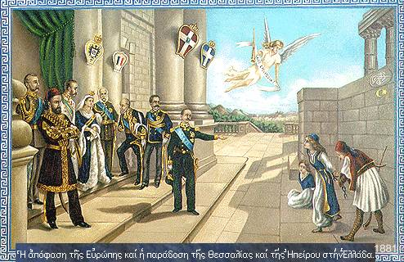
EARLY DAYS
1st century– Problems in Corinth
Church Fathers Era
  Doctrinal disagreements and schisms
  AD 1054 Eastern Church split away from the Western Church
Roman Catholic Era
  500 years
  Unhealthy form of unity
    Intimidation
    Ignorance
Reformation
  "Divided" the church into many denominations

Slide 39
PRESENT DAY >>>
20th century– Ecumenical Movement
  Discouraging results
  More bickering and infighting
The Real Problem:
  Not Intellect
  Affair of the heart:
    Pride
    Lust for Power
    Greed
    Intolerance
    Prejudice

Slide 40
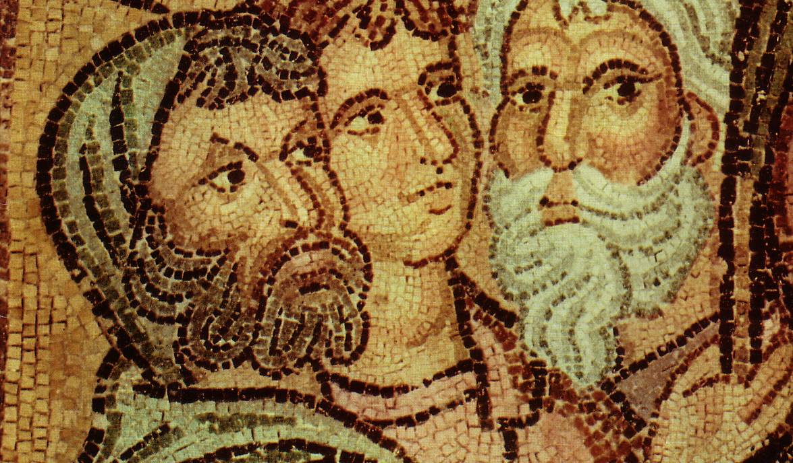
Parties at Corinth
Paul
Action
Party
P
A
P
Apollos
Yippee
Esquire
A
Y
E
Cephas
Triumph
Esquire
C
T
E
Savior
Dvlpmnt
Party
S
D
P

Slide 41

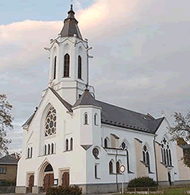
The Cause and Solution
The 1 Corinthians 1 Problem
  Division resulted from human ideas or personalities displacing Christ as the focus of the church's attention--the "I follow him" attitude.
The Way to Overcome Division
  1 Corinthians 1:10: Decide to agree with one another
      Choose to look for areas of agreement rather than dissent
  1 Corinthians 2:2: resolve to know nothing but Christ and Him crucified
      Keep your attention on the simple truth where all believers agree

Slide 42
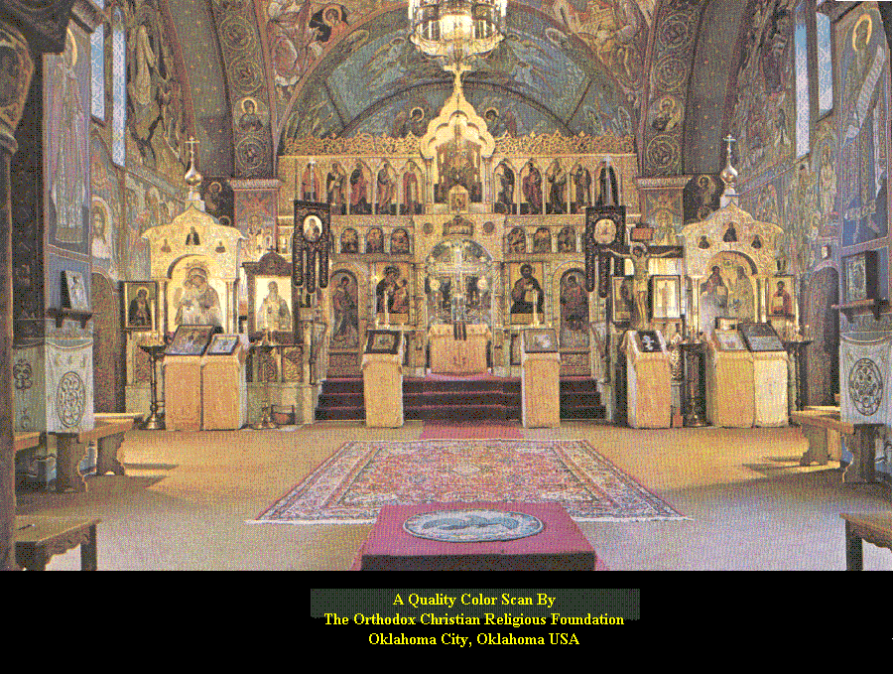
…continued
    1 Corinthians 2:4: Message and preaching not with wise and persuasive words but with a demonstration of the Spirit's power
      Let the Spirit of God lead us to:
        Love
        Grace
        Mercy
VALID REASONS to Separate
  Doctrine
  Conscience
  Practical Considerations

Slide 43
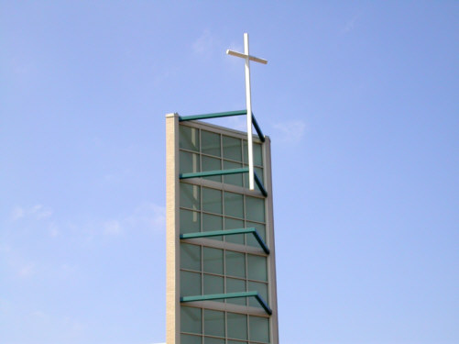
UT OMNES UNUM SINT
UBI CHRISTUS, IBI ECCLESIA
EXTRA CHRISTUS NULLA SALUS
SOLI DEO GLORIA!
That all of them may be one
One Christ, one Church
Outside Christ, no salvation
Only to the glory of God!

Slide 44


Reasons for Separation
UNEQUALLY YOKED
Giving up of control over one's activities and the loss of freedom to act in obedience to God.

Slide 45

林后 6:14-7:1 是什么意思?
"
136
"你们和不信的人不可共负一轭，义和不法有甚么相同呢？光明和黑暗怎能相通呢？ ¹⁵ 基督和彼列（“彼列”是撒但的别名）怎能和谐呢？信的和不信的有甚么联系呢？ ¹⁶ 神的殿和偶像怎能协调呢？我们就是永生 神的殿

Slide 46
林后 6:14-7:1 是什么意思?
"
136
"正如 神说：
“我要住在他们中间，
在他们中间来往；
我要作他们的 神，
他们要作我的子民。."
¹⁷所以，
“主说：你们要从他们中间出来，和他们分开，
不可触摸不洁净的东西，我就收纳你们。”
(林后 6:16-17)

Slide 47
林后 6:14-7:1 是什么意思?
"
136
"不可触摸不洁净的东西，我就收纳你们。”
¹⁸ “我要作你们的父亲，你们要作我的儿女。
这是全能的主说的。”
7 所以，亲爱的，我们有了这些应许，就应该洁净自己，除去身体和心灵上的一切污秽，存着敬畏 神的心，达到成圣的地步。"
(林后 6:17–7:1)

Slide 48
Separation Texts
136
Text
Issue?
Command?
2 Th 3:6-15
?
?
Rom 12:1-2
?
?
Rom 16:17
?
?
Eph 5:11
?
?
1 Th 5:21
?
?

Slide 49

Separation Texts
137
Text
Issue?
Command?
1 Tim 6:3-5
?
?
2 Tim 2:16-21
?
?
Titus 3:10
?
?
2 John 7-11
?
?
Jude 3
?
?

Slide 50
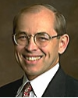
What does 2 Cor. 6:14-7:1 mean?
"
137
"The direct commands to separate from other people are always commands to separate from unbelievers, not from Christians with whom one disagrees… There are no direct New Testament commands to separate from Christians with whom one has doctrinal differences (unless those differences involve such serious heresies that the Christian faith itself is denied)."
Wayne Grudem, Systematic Theology, 877

Slide 51
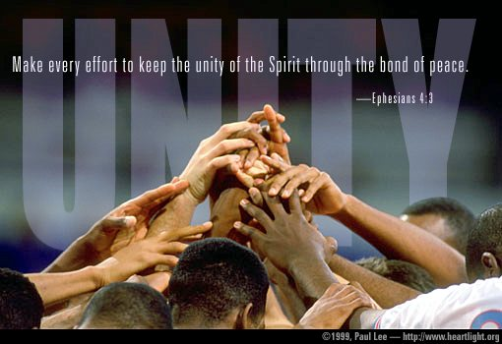
Eph 4:3
用 和 平 彼 此 联 络 ， 竭 力 保 守 圣 灵 所 赐 合 而 为 一 的 心。 以弗所书 4:3

Slide 52

Any questions?
Church Unity

Slide 53
Black

Slide 54


教会论链接地址 BibleStudyDownloads.org
免费获得该讲解!
圣经学习下载
Notes:
CH Church (Ecclesiology)

