Slide 1
Church Multiplication
132
Returning your Church
to its Primary Mission
Dr. Rick Griffith • Singapore Bible College • BibleStudyDownloads.org

Slide 2
Church Multiplication
132
Should church growth be the main goal of every church?

Slide 3
Coke

Slide 4
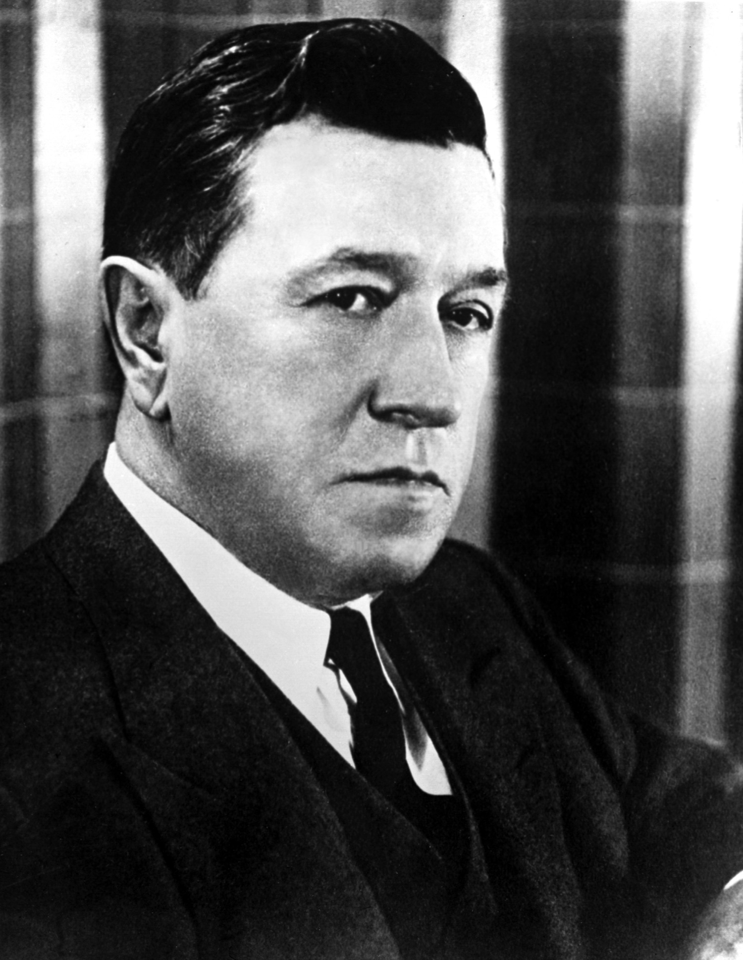
Robert Woodruff

Slide 5
Why is Coke worldwide?
Vision
Mission
Cooperation

Slide 6
OUR MISSION: Making Disciples
132
Matt. 28:18-20 "Then Jesus came to them and said, `All authority in heaven and earth has been given to me. ¹⁹Therefore go and make disciples of all nations, baptizing them in the name of the Father and of the Son and of the Holy Spirit, ²⁰and teaching them to obey everything I have commanded you. And surely I am with you always, to the very end of the age."

Slide 7
OUR MISSION: Making Disciples
132
Matt. 28:18-20 "Then Jesus came to them and said, `All authority in heaven and earth has been given to me. ¹⁹Therefore go and make disciples of all nations, baptizing them in the name of the Father and of the Son and of the Holy Spirit, ²⁰and teaching them to obey everything I have commanded you. And surely I am with you always, to the very end of the age."

Slide 8
What are the 3 parts of the Great Commission to make disciples?
132
1. Reach
2. Baptize
3. Teach

Slide 9
PRINCIPLES OF EVANGELISM
132
a) Evangelism is Active: It occurs from believers going to nonbelievers rather than simply waiting for them to ask (Mark 16:15).

Slide 10
PRINCIPLES OF EVANGELISM
132
b) Love for other Christians in a unified body is one of the most powerful ways to show the world that we are Christ's followers (John 13:34-35).

Slide 11
PRINCIPLES OF EVANGELISM
132
c) Share Christ in ever-increasing spheres of influence, starting at home in your own culture and working outwards (Acts 1:8).

Slide 12
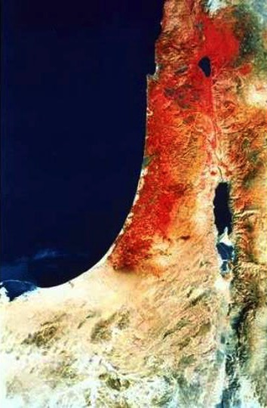
使徒 1:8 CUVS
“地极"
"但 圣 灵 降 临 在 你
们 身 上 ， 你 们 就 必
得 着 能 力 ， 并 要 在 耶 路 撒 冷 、 犹 太 全
地 ， 和 撒 玛 利 亚 ，
直 到 地 极 ， 作 我 的
见 证."
撒玛利亚
耶路撒冷
犹太

Slide 13
OUR VISION:
Making Disciples
locally, regionally and globally
The Prophecy: Acts 1:8
"But you will receive power when the Holy Spirit comes on you; and you will be my witnesses in Jerusalem, and in all Judea and Samaria, and to the ends of the earth."

Slide 14
OUR VISION:
Making Disciples
locally, regionally and globally
The Prophecy: Acts 1:8
"But you will receive power when the Holy Spirit comes on you; and you will be my witnesses in Jerusalem, and in all Judea and Samaria, and to the ends of the earth."

Slide 15
The
"Acts 1:8"
Target
LOCAL
(Jerusalem)
REGIONAL
(Judea & Samaria)
GLOBAL
(Uttermost)

Slide 16
The Fulfillment:
Book of Acts
1. LOCALLY, The church began existence in Jerusalem (1-7)
2. REGIONALLY, The church expanded into Judea & Samaria (8-12)
3. GLOBALLY, The church extended to the ends of the earth (13-28)

Slide 17
Spheres of Influence
100
FAMILY - RELATIVES
Relatives
In summary, a Christian's oikos or personal sphere of influence includes his family, friends, and associates in his neighborhood, work, and recreational activities. This personal sphere of influence is to be a primary target of a believer's personal evangelistic outreach.
Members of clubs, associations, other organizations a person belongs to, people met on a casual or regular basis
Immediate family
NEIGHBORS
AVOCATIONAL CONTACTS
PRIMARY SPHERE
Neighborhood or subdivision
Other close friends
Next-door neighbors
Close associates, clients
Other people with a similar occupation
SECONDARY SPHERE
Ronald D. Runyon, "Principles & Methods of Household Evangelism," Bib Sac 142 (Jan-Mar 1985), 67
VOCATIONAL CONTACTS

Slide 18
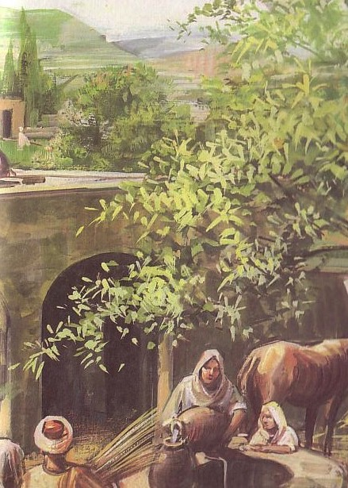
Household Applications
100
Share how Christ transformed your life
Pray for your oikos
Proclaim the Word
Use varied methods
Ronald D. Runyon, "Principles & Methods of Household Evangelism," BibSac 142 (Jan-Mar 1985), 64-74

Slide 19
Vary Your Method!
100
Prepared people need a simple presentation
EVANGELISM
Ronald D. Runyon, "Principles & Methods of Household Evangelism," BibSac 142 (Jan-Mar 1985), 64-74

Slide 20
Vary Your Method!
100
Prepared people need a simple presentation
Secular people need repeated exposures
Ronald D. Runyon, "Principles & Methods of Household Evangelism," BibSac 142 (Jan-Mar 1985), 64-74

Slide 21
Vary Your Method!
100
Prepared people need a simple presentation
Secular people need repeated exposures
Those in life transitions are especially open
Ronald D. Runyon, "Principles & Methods of Household Evangelism," BibSac 142 (Jan-Mar 1985), 64-74

Slide 22
PRINCIPLES OF EVANGELISM
132
d) Be non-discriminating to reach all people—Jews and Gentiles, rich and poor, male and female, etc. (Acts 11:19-21).

Slide 23
PRINCIPLES OF EVANGELISM
132
e) God and angels don't evangelize: People can't believe without a human messenger sent to share this good news with them (Rom. 10:14-15).

Slide 24
Use your Home for Evangelism
132
Share how your life was transformed
Pray for your oikos
Proclaim the Word
Use varied methods
Use your home
Ronald D. Runyon, "Principles & Methods of Household Evangelism," BibSac 142 (Jan-Mar 1985), 64-74

Slide 25
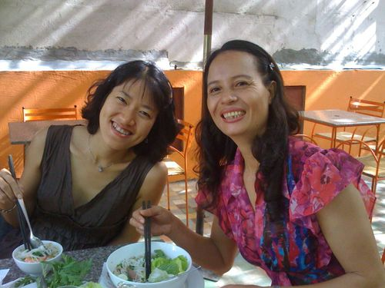
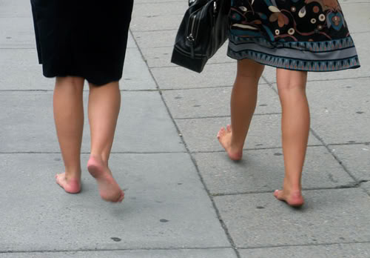
Home Evangelism: Individual Activities
132

Slide 26
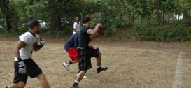
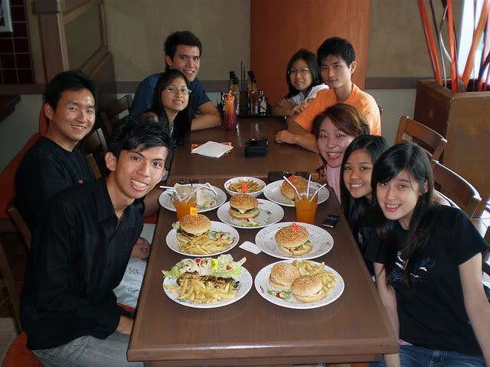
Home Evangelism: Group Activities
132

Slide 27
PRINCIPLES OF EVANGELISM
132
f) Evangelism essentially involves reconciling enemies (God and man) to the extent that people become new people altogether (2 Cor. 5:17-21).

Slide 28
PRINCIPLES OF EVANGELISM
132
g) True faith is contagious and becomes well known in areas where the evangelist doesn't even live (1 Thess. 1:8).

Slide 29
PRINCIPLES OF EVANGELISM
132
h) All believers are responsible to share their faith, despite their gift (2 Tim. 4:5).

Slide 30
PRINCIPLES OF EVANGELISM
132
i) We should always live in defense of our faith (1 Pet. 3:15).

Slide 31
PRINCIPLES OF EVANGELISM
132
j) Evangelism is not trying to convince a God who is reluctant to save but rather to join with God who wants all to repent (2 Pet. 3:9).

Slide 32
PRINCIPLES OF EVANGELISM
132
Mark the preceding principle that is most needed in your life and ministry.
What will you do about it?
Now share this with your neighbor.

Slide 33
OUR COOPERATION
Christians & churches
teaming together
make disciples

Slide 34
A Practical Strategy for Evangelism
133
1. Unreached Groups in My Area
2. Plan to Reach These Groups

Slide 35
Black

Slide 36
教会论链接地址 BibleStudyDownloads.org
免费获得该讲解!
圣经学习下载
Notes:
CH Church (Ecclesiology)

