Slide 1

Baptism
Dr. Rick Griffith • 博士 • 新加坡神学院 • BibleStudyDownloads.org
Notes:
But is baptism really that important? Why be baptized?

Slide 2
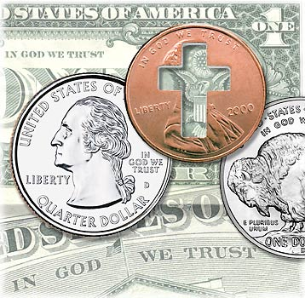
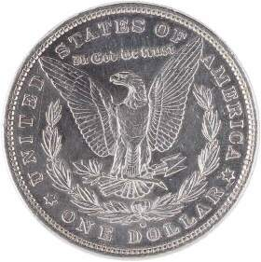
Do you trust in God?
Notes:
For over 200 years America has unashamedly declared trust in God. Since the 1950s by law each currency and coin must say on it, "In God We Trust."

Slide 3
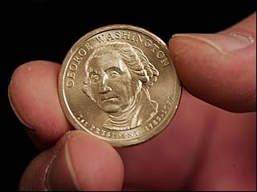
Do we trust in God?
Notes:
But do we really trust in God? (Click) I found it interesting that in 2008 the news broke that our new dollar coin produced the previous month actually doesn't have this phrase on the front or the back. Some have said that it doesn't appear on the coin at all.

Slide 4
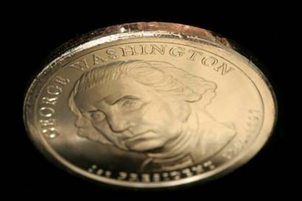
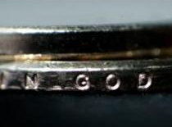
Does your trust in God embarrass you?
Notes:
But the phrase does appear--only it's on the side--at least on most of the 300 million coins minted! The news broke that an unknown amount of coins were missing the phrase totally. Interestingly, these coins are more valuable and at first sold for $600 on eBay. Now that we know there's as many as 100,000 of them, the price has dropped to $50. It seems that we are too embarrassed about Christ to put this phrase on the front or back anymore.

Slide 5

A Cause for Shame?
"Who, me? Well, no, I'm not actually a Christian…"
Notes:
That reminds me of some Christians. Ask them if they are believers and they want to know why you want to know! Worse yet, they won't admit that they trust in Christ.

Slide 6
Paul Had No Shame
¹⁶I am not ashamed of the gospel,
because it is the power of God for the salvation of everyone who believes: first for the Jew, then for the Gentile.
¹⁷For in the gospel a righteousness from God is revealed, a righteousness that is by faith from first to last, just as it is written: "The righteous will live by faith."
Notes:
Not Paul though! Paul wrote a great statement of his trust in Christ in Romans 1. Would you turn there with me in your Bibles to Romans 1:16? Paul wrote (click)…

Slide 7
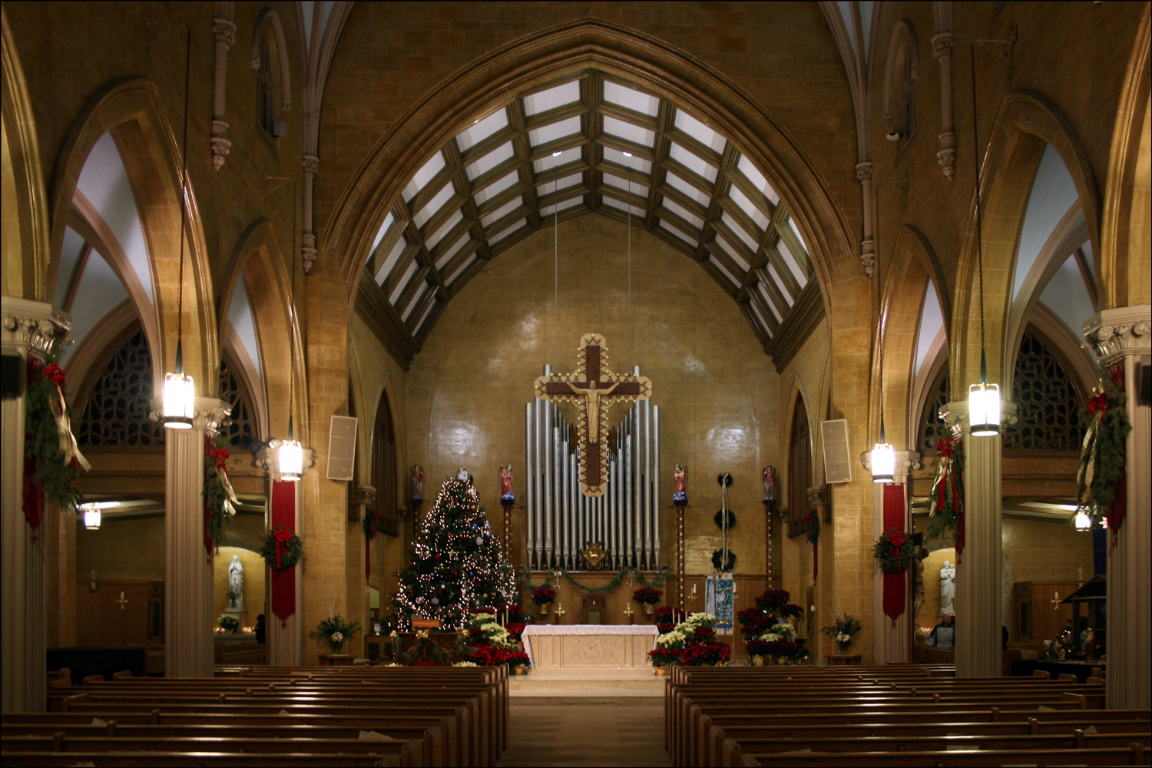
Defining Terms:
104
Sacrament: ritual as a means of grace
Ordinance: practice ordained by Christ
Foot washing

Slide 8
Christian Ordinances
104
Lord's Supper
Baptism
Seven Questions
Notes:
At CIC we unashamedly believe in Christ. We show this in two ordinances or practices instituted by Christ. They are called ordinances because Christ ordered or commanded them. We have spoken a fair amount about the Lord's Supper each first Sunday of the month, but so far we haven't addressed baptism (click).
Today I'm departing from my normal practice of giving an exposition of a single text of Scripture (click). Rather, we will look at many texts that answer seven basic questions about baptism.

Slide 9
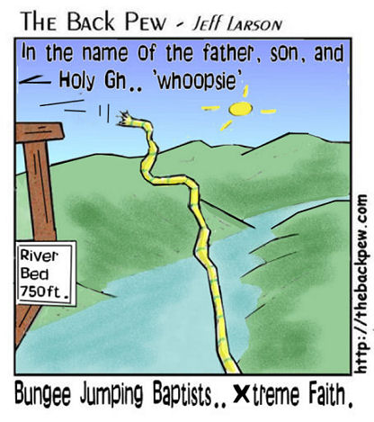
Extreme Faith
In the name of the Father, Son, and the Holy Gh… 'whoopsie'
River Bed 750 ft.
Bungee Jumping Baptists… Xtreme faith
Notes:
Hopefully answering these seven questions will take the fear out of being baptized since some of you haven't yet been baptized!

Slide 10
Ask your neighbor…
Have you been baptized?
Why or why not?
Notes:
To get you thinking about this, I want you to turn to the person next to you and ask two questions: Have you been baptized and why or why not? Take a minute to do this…

Slide 11
































SBC Faculty Members
Lutheran
Infant Sprinkling
Baptist
Anglican
Presbyterian
Believer's Immersion
Bible-Presbyterian
Brethren
Methodist
Independent
Notes:
In 2008 I prefaced my teaching on baptism by telling where I have served since 1991--at Singapore Bible College. At SBC we had:
31 faculty
7 countries
8 denominations
Sprinkling, pouring, immersion (least practiced)
Harmony, love, unity amidst diversity
ICS is a similar story!
By June 2010, of the 31 faculty in 2007, 14 had left and been replaced.
By March 2012, we still had 31 faculty, but 17 of the 31 in 2007 were replaced.
By February 2014, of our 31 faculty, only 11 of these remained as 20 were replaced.

Slide 12
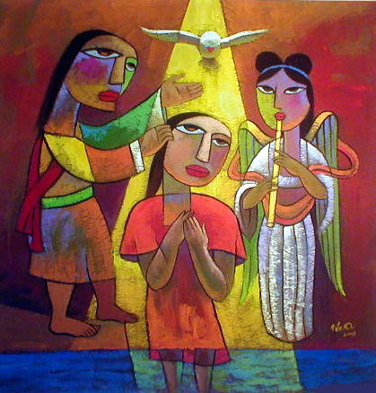
What is Baptism?
Notes:
Let's begin our search of the NT teaching on baptism by asking this simple question: What is baptism?

Slide 13
受洗的意义:
140
Identification
旧约: 没有这样的作法
二约之间 : 外邦人受洗后被视为犹太人。
约翰 : 不悔改的人受洗之后变成为悔改的人。
教会: 不信者受洗之后变成为信徒。
Notes:
Idsntification:鉴定

Slide 14

How is Christian Baptism Unique?
Notes:
If all baptisms have the idea of identification, then how is Christian baptism unique?

Slide 15

二约之间的洗礼
140
关于改信者 (外邦人离开他们异教的生活并参与以色列人的圣洁的生活)
自已受浸
特别是为妇女们，因为她们不能受割礼

Slide 16
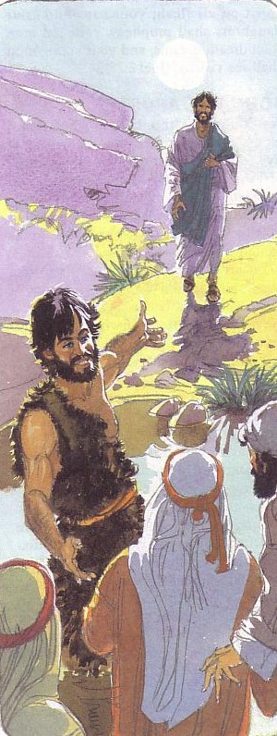
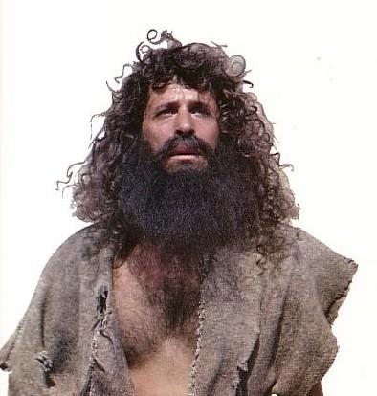
施洗约翰
140
约翰成为浸水礼的代理人
悔改

Slide 17

总结初代教会的洗礼与之前的洗礼
142
对照 (先前与新约/基督徒的对比) | 比较 (共同点)
没有公式与”父与子与圣灵的对比” | 在宗教的小区显示和确定
自我受浸与别人为我们受洗 | 在基督徒中实行
受割礼的先决条件与没有任何要求 | 受浸礼有二种的例子(主前一世纪)
犹太教/约翰和基督教的对比 | 在这二个实例中是很普遍
受浸与很多的方式的对比(二世纪) | 使用水

Slide 18
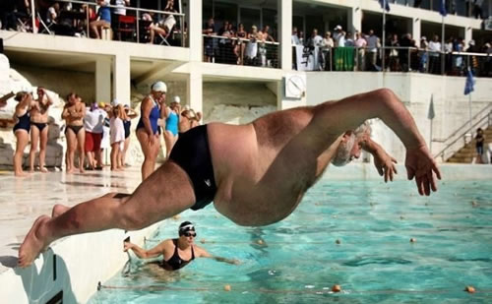
Why Be Baptized?
Notes:
But is baptism really that important? Why be baptized?

Slide 19
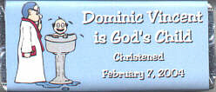
Is baptism needed for salvation?
Dominic Vincent is God's Child
Christened
7 February 2004
"…whoever believes in Him has eternal life"
(John 3:16)
Absolutely not!
Notes:
Some say it is needed for salvation--do you agree? For many parents, there is a feeling of uneasiness until their baby is baptized. They feel that if the baby died without being baptized, the baby would go to hell!

Slide 20
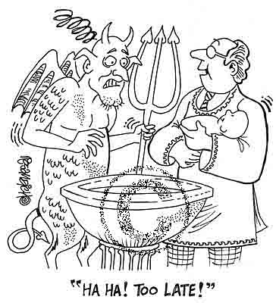
Is baptism needed for salvation?
"HА HА! TOO LATE!"
Notes:
Since the NT says nothing about baptizing a baby to save him, it's a false hope that baptizing a baby will make Satan fear. In fact, the devil wants us to think that anything but faith in Christ will save us from sin.

Slide 21
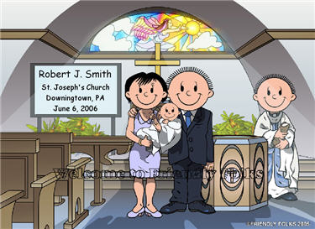
We celebrate each baby's birth
Robert J. Smith
St. Joseph's Church
Downingtown, PA
6 June 2006
Notes:
Now it's good and right to celebrate the birth of every baby…

Slide 22
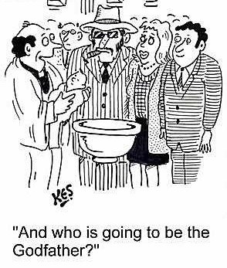
Infant baptism is actually a child & parent dedication
"And who is going to be the Godfather?"
Notes:
But actually, infant baptism is more of a commitment of the parents to raise the baby in the fear of God. In churches where I have been a part, since we don't see biblical support to baptize infants, we typically pray for the baby and the parents in a short dedication ceremony.

Slide 23

Why Be Baptized?
Baptism fulfills the command of Christ
Matthew 28:19-20
Notes:
So if baptism doesn't save us, then what value does it have? Let's look at some reason to be baptized…

Slide 24
The Great Commission
106
Matthew 28:18-20
¹⁸Then Jesus came to them and said, "All authority in heaven and on earth has been given to me. ¹⁹Therefore go and make disciples of all nations, baptizing them in the name of…, ²⁰and teaching them to obey everything I have commanded you. And surely I am with you always, to the very end of the age."
Notes:
Christ has all authority but he extends some of it to us as people under his authority. It may appear that there are four commands here, but "make disciples" is the only command here. This happens by us also obeying the three participles: going, baptizing, and teaching.

Slide 25
Why Be Baptized?
Baptism shows that you want to live under God's authority like Jesus showed when he was baptized.

Slide 26
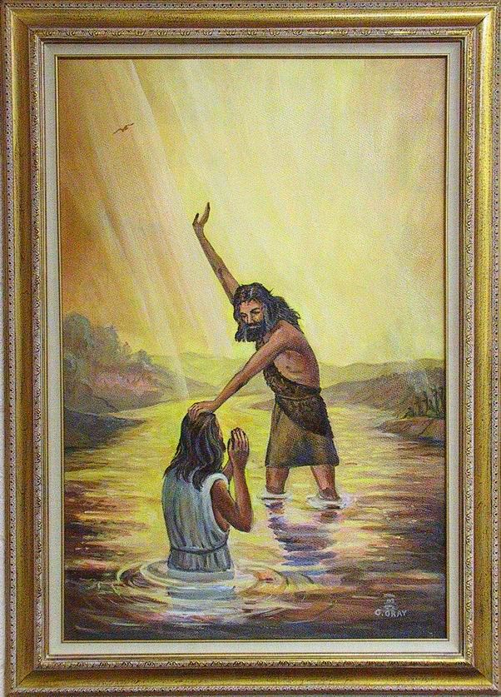
Christ was baptized by John

Slide 27
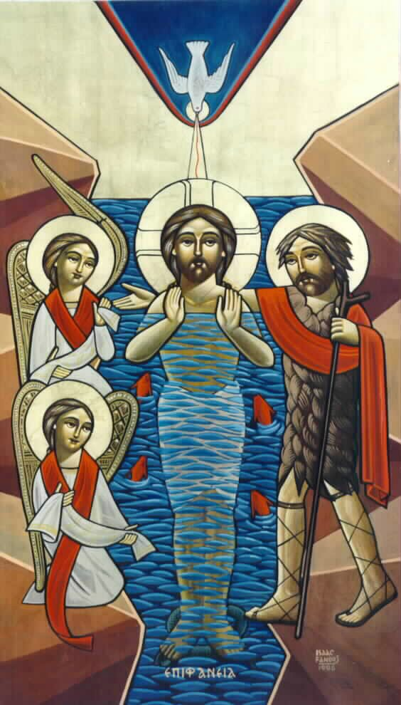
"To fulfill all righteousness"

Slide 28
Why Be Baptized?
Baptism is a sign that God has saved you from your sin (Rom. 6:1-2)

Slide 29
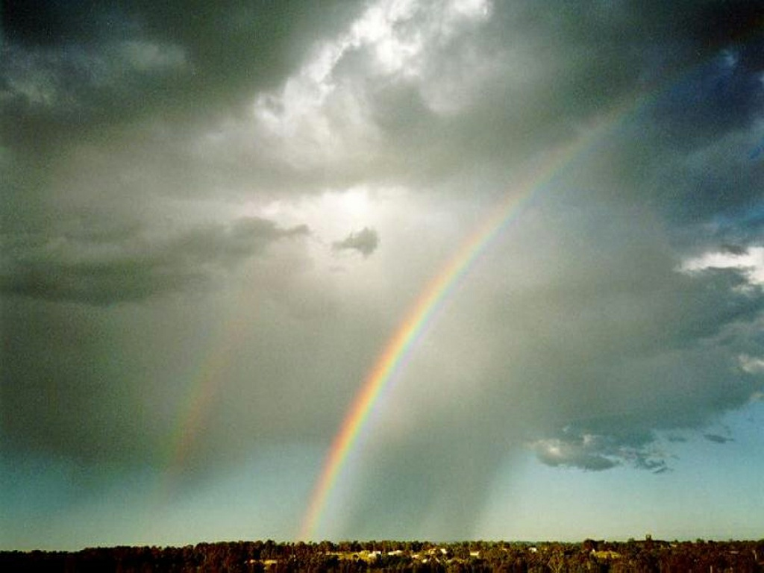
The Rainbow

Slide 30


… This cup is the
NEW COVENANT in my blood, which is POURED OUT for you.
The cup (not baptism) is the new covenant sign
LUKE 22:20

Slide 31
Symbolism
107
Why Be Baptized?
Baptism symbolizes the death, burial, and resurrection of Christ Jesus, and identifies you with Christ (Rom. 6:3-7)

Slide 32
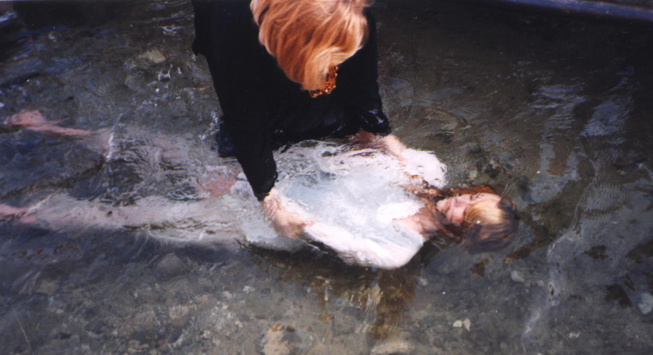
Romans 6:3
Don't you know that all of us who were baptized into Christ Jesus were baptized into his death? (Rom. 6:3)

Slide 33
New Life
Why Be Baptized?
Baptism portrays your new life or rebirth given through the Holy Spirit (Romans 6:4)

Slide 34
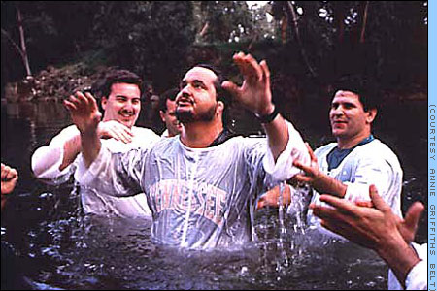
New Life picture

Slide 35
Why Be Baptized?
Baptism symbolizes the washing away and cleansing of a life of sin, into the purity of holiness acceptable to God
(Acts 2:38).

Slide 36

"Because of…"
"Repent and be baptized, every one of you, in the name of Jesus Christ [because of] the forgiveness of your sins."
Acts 2:38

Slide 37
Pouring
Why Be Baptized?
Baptism incorporates you into the body of the church (Gal. 3:26-29; Eph. 2:11-22)
Notes:
A person who gets baptized becomes an official member of the church where he or she is baptized.

Slide 38
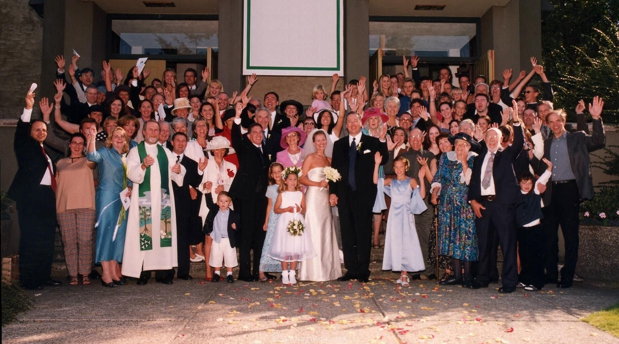
Church Family
Galatians 3:26-29
You are all sons of God through faith in Christ Jesus, for all of you who were baptized into Christ have clothed yourselves with Christ. There is neither Jew nor Greek, slave nor free, male nor female, for you are all one in Christ Jesus. If you belong to Christ, then you are Abraham's seed, and heirs according to the promise.

Slide 39
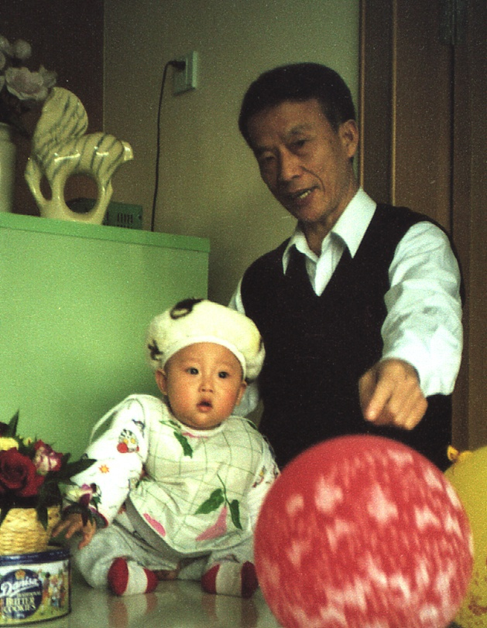
WHO should be baptized?

Slide 40
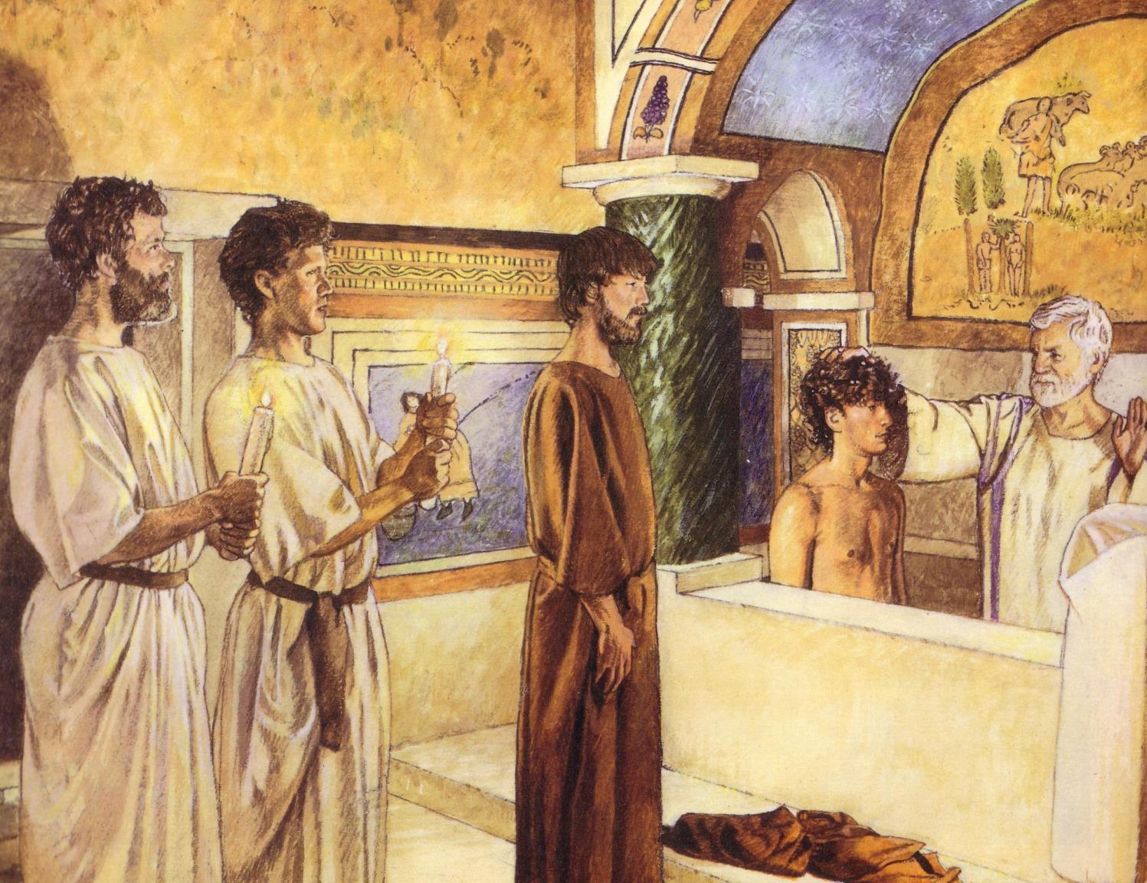
第一世纪教会的受洗礼
140
受洗礼只为相信者，
且只用浸水礼

Slide 41

Recipients
Theoretically, all people should be saved and baptized
Practically, baptism is open to all who earnestly repent of their sins and who, having believed in Christ, seek to follow him

Slide 42
Recipients
Naturally, this includes repentant adults. But…

Slide 43
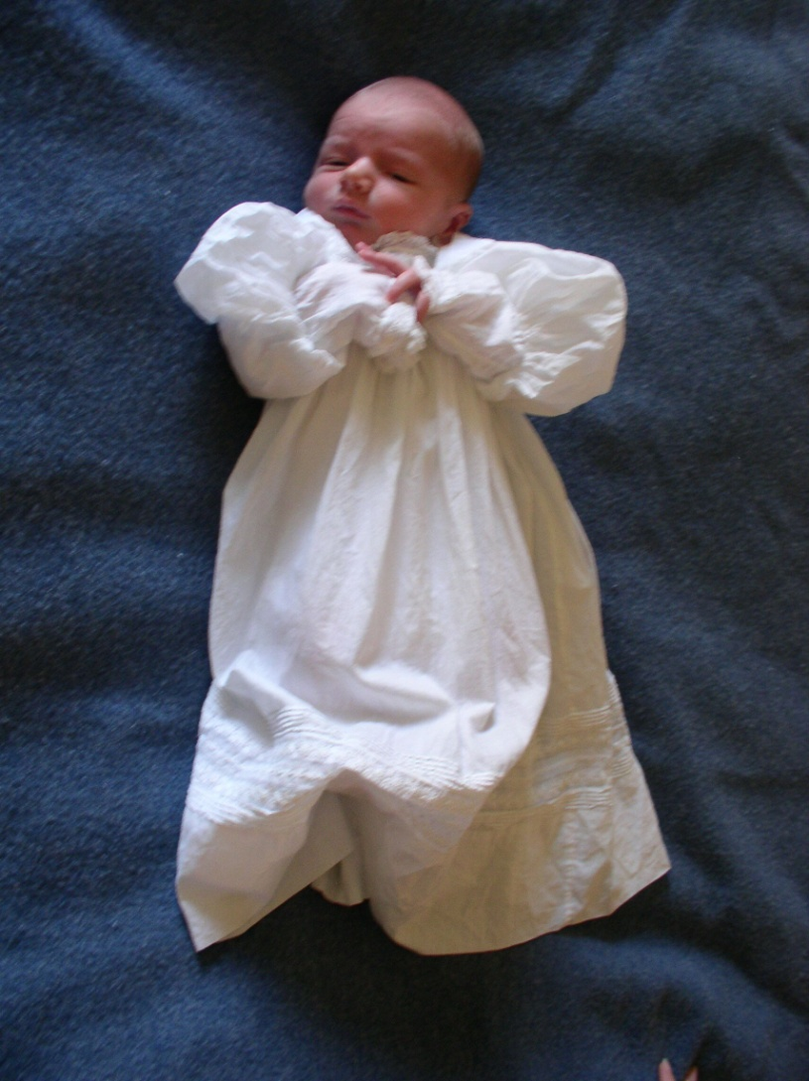
What About the Children?
(Paedobaptism)

Slide 44
"Believed…then Baptized" in Acts
105
Peter: "Repent…3000 baptized" (2:38, 41)
Samaritans "believed…baptized" (8:12)
Eunuch "believed…baptized" (8:36-38)
Paul believed…baptized (9:18)
Cornelius "believed…baptized" (10:47)
Jailer "believed…baptized" (16:14-15, 33)
Crispus "believed…baptized" (18:8)
John's disciples "believed…baptized" (19:5)

Slide 45
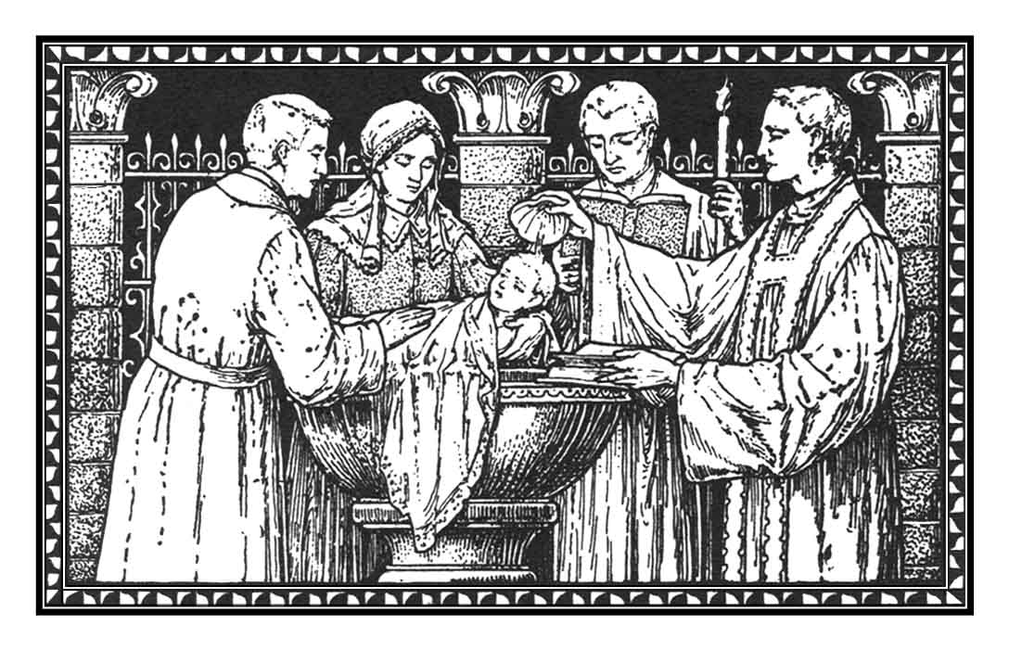
Recipients
(Paedobaptism)
The baptism of infants is recorded no earlier than the 3rd century A.D.

Slide 46
Recipients
(Paedobaptism)
Proponents claim that the "household baptisms" mentioned in Scripture included infants

Slide 47
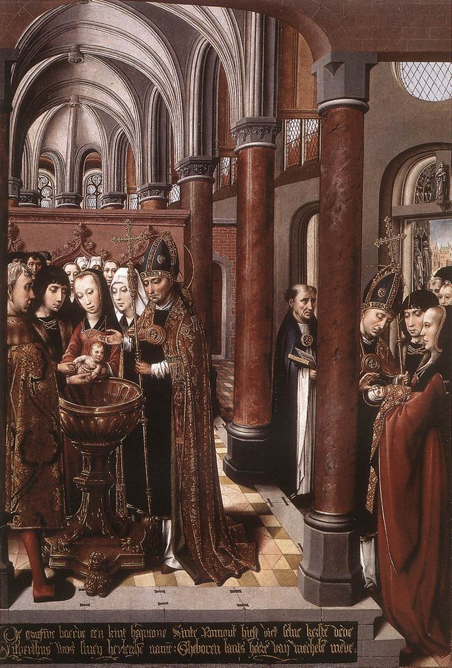
Recipients
(Paedobaptism)
Catholics believe that baptism itself is "the means of grace which brings regeneration. Baptism is the first step of the way of salvation."¹
¹Dorman, A Faith For All Seasons: Historic Christian Beliefs, 317.

Slide 48
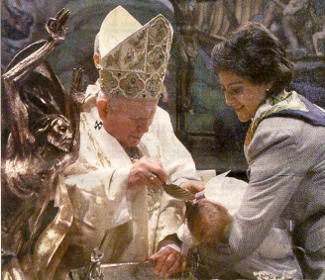
Recipients
(Paedobaptism)
If baptism saves, then it is better to baptize a human as soon as possible!

Slide 49
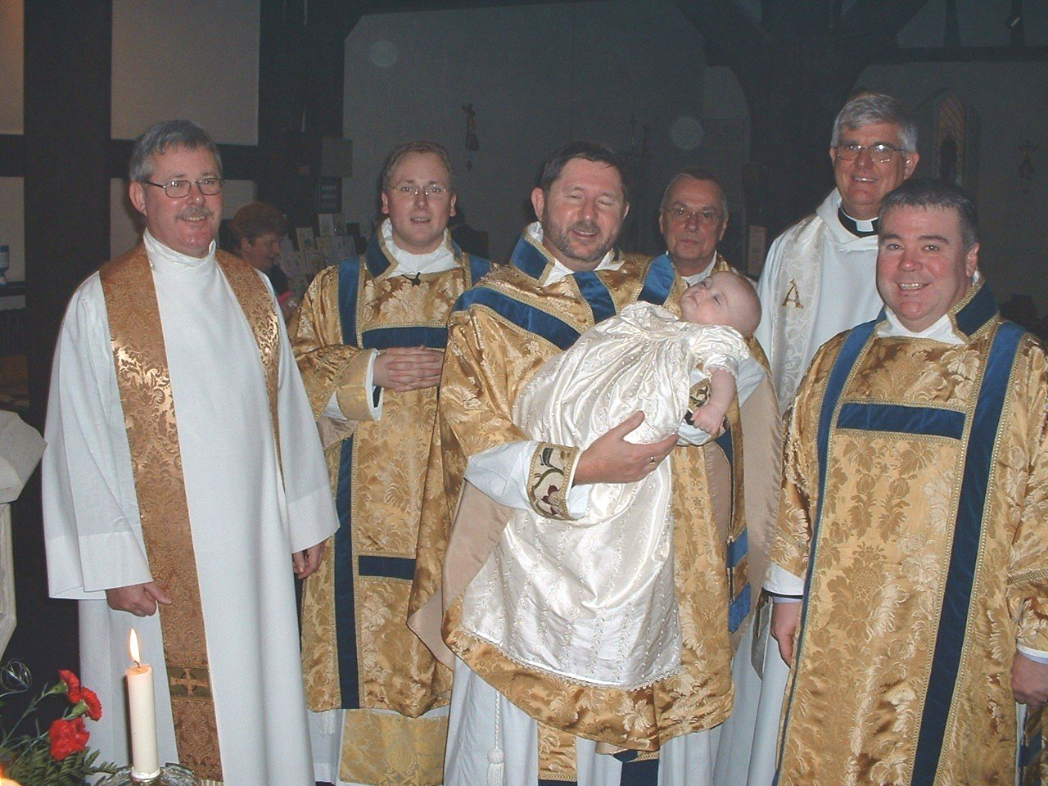
Recipients
Luther felt that faith was necessary for baptism, but he believed that the faith of parents and the church to be sufficient for the infant.

Slide 50
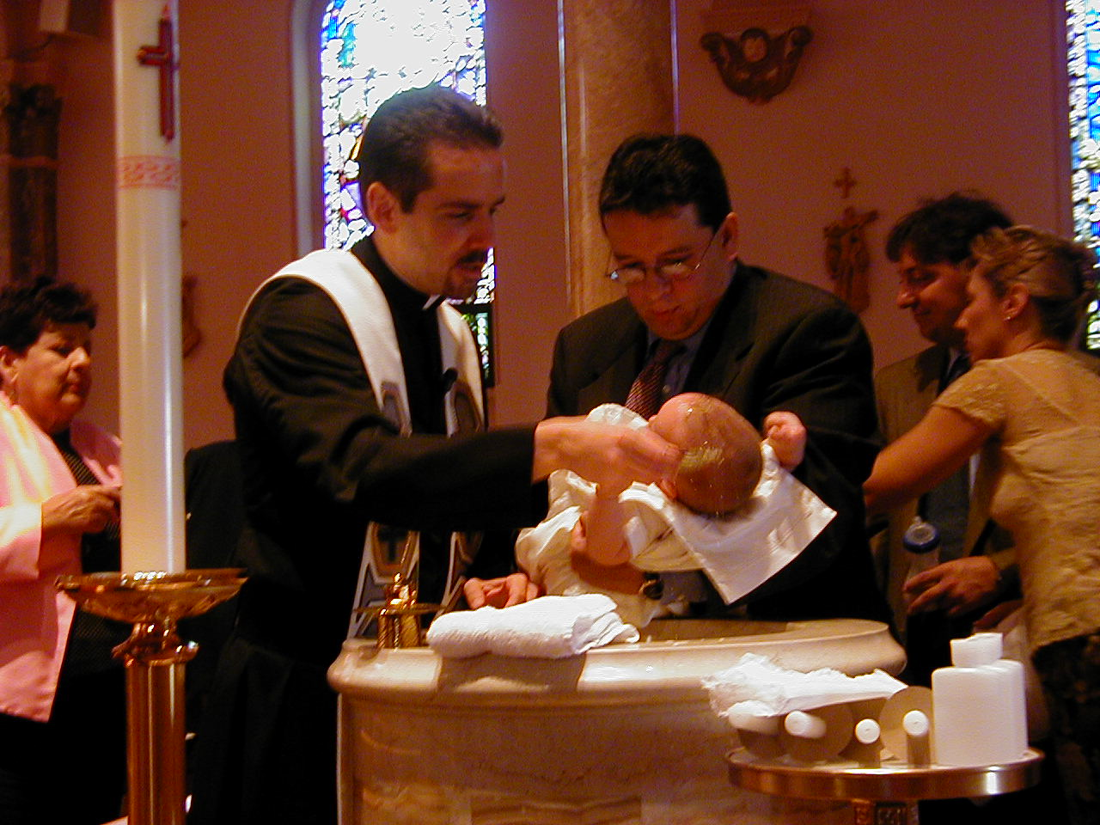
Recipients
Two additional points:
Paedobaptism is said to show that God loved and chose his children before they chose Him (John 15:16)

Slide 51
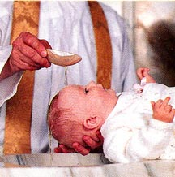
Recipients
Two additional points:
Infant baptism advocates believe Col. 2:11-12 says that baptism is a sign of the new covenant that corresponds to circumcision in the Old Testament.
Jews were circumcised at 8 days old, sooo….

Slide 52
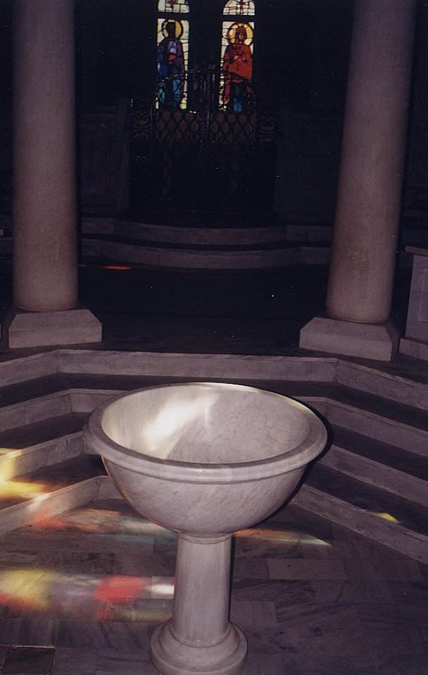
Recipients should not be infants because…
116
Circumcision doesn't parallel baptism
Males
All
Physical life
Spiritual life
Any age
Conscious faith
8th day of life
Right after belief
NT parallel = heart circumcision
New covenant sign = Lord's supper

Slide 53
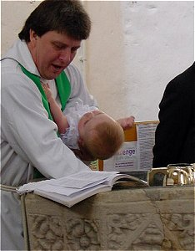
Recipients should not be infants because…
Baptism testifies to what has already taken place in the life of the believer

Slide 54
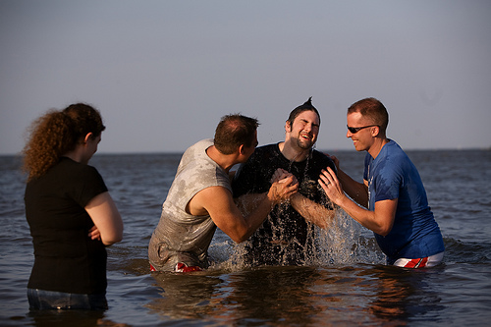
Why is immersion the proper mode?

Slide 55
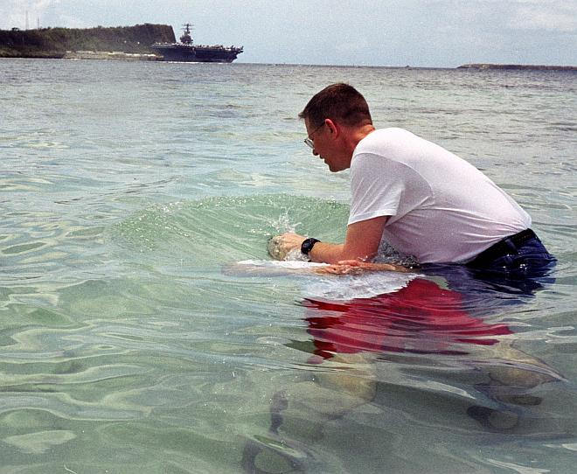
What does "baptize" mean?
141
语言学: bapti,zw
的意思是 “浸，浸泡，洗，下落，湿透，淹没…浸泡” (BAGD 131c)

Slide 56
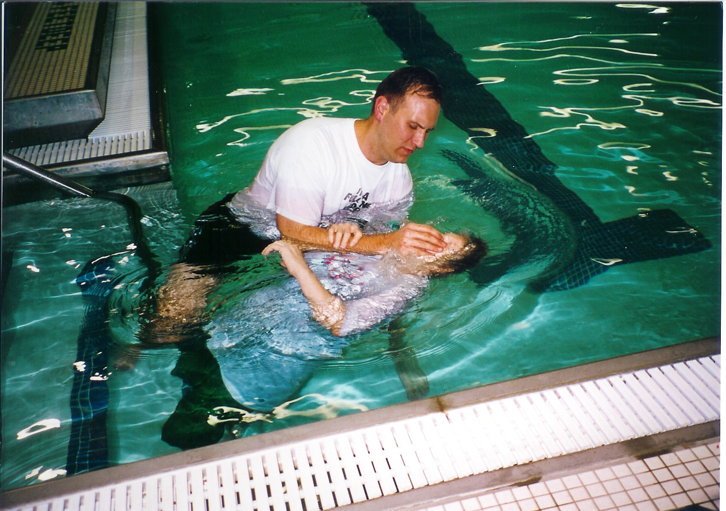
YMCA Pool
The place is not so significant…

Slide 57
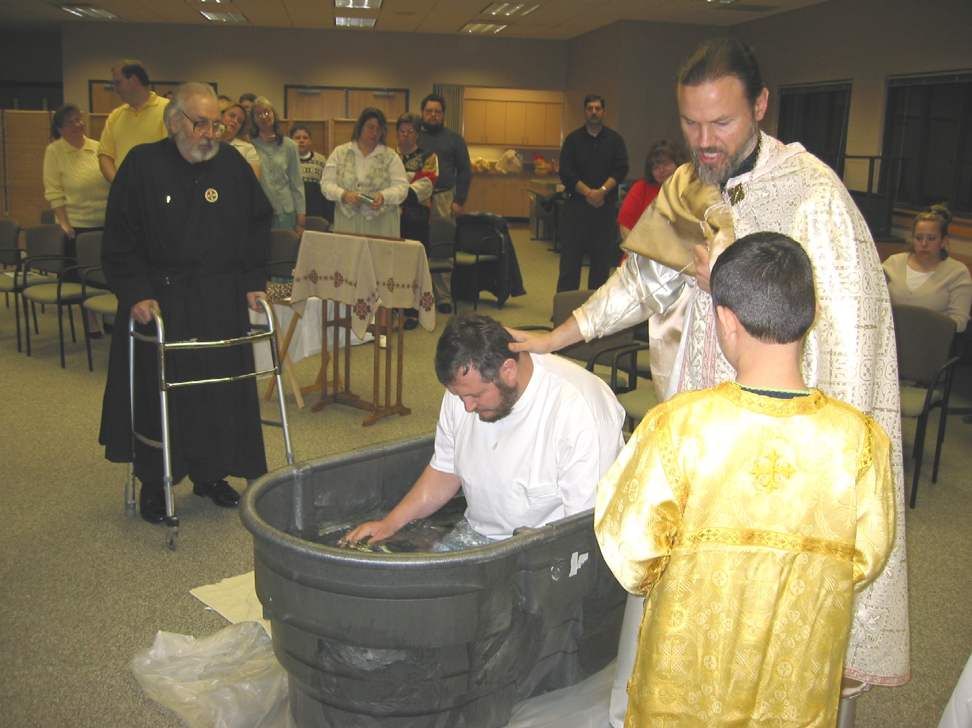
Immersion doesn't take a baptistery

Slide 58
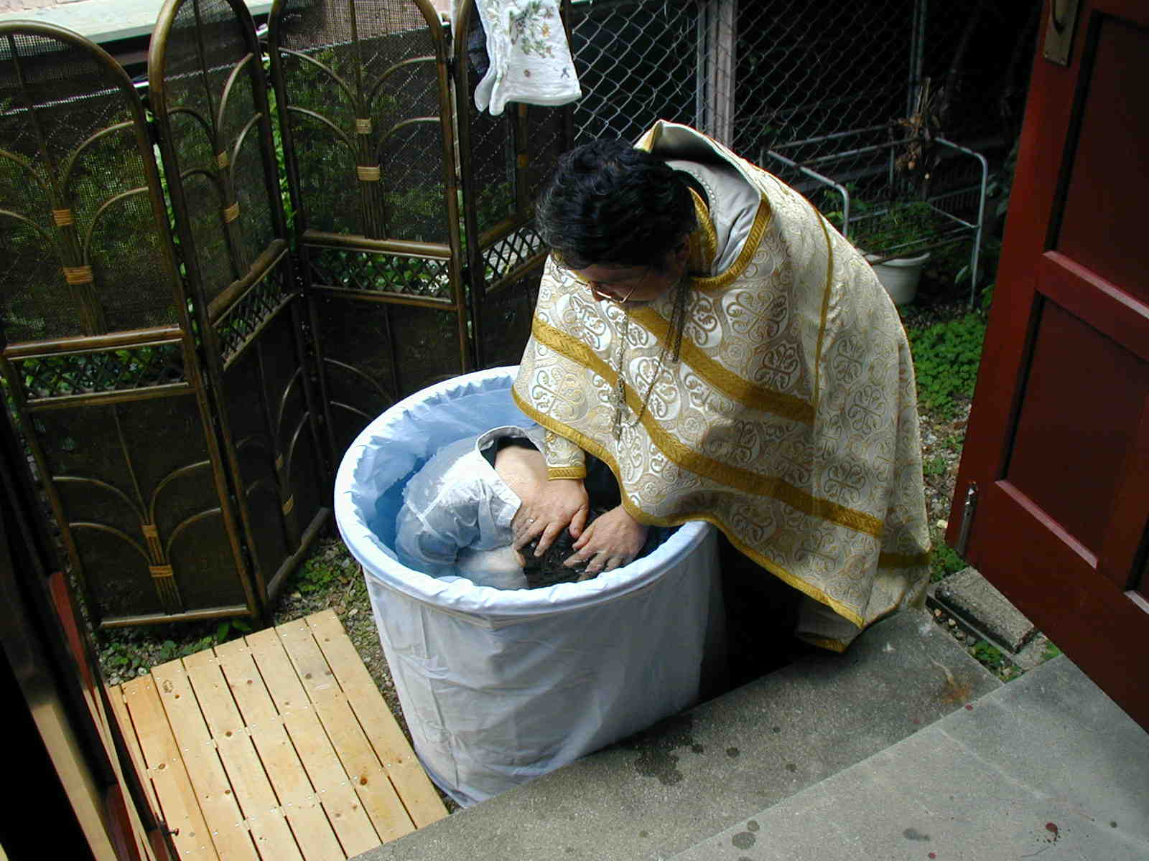
Japanese Orthodox
If they can do it, you can too!

Slide 59
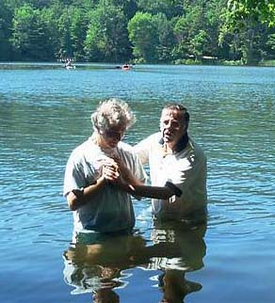
Greek
113
has separate words for:
• sprinkling
• pouring &
• immersion
Only the Greek word for immersion is ever used for baptism in the Bible.

Slide 60
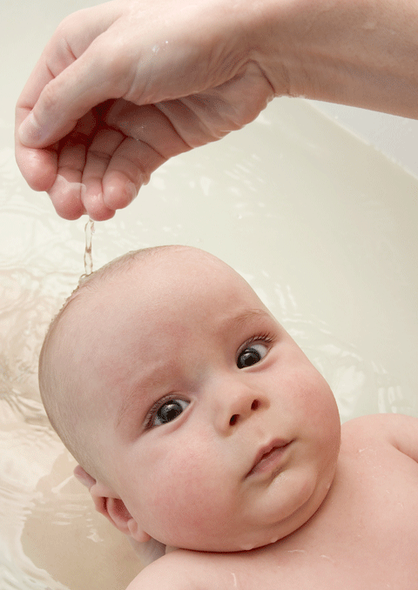
In Other Words…
There are other Greek words which mean other than immersion.
Louo means "to wash" or "to bathe."
Nipto means "to wash the extremities," as in the washing of hands or feet.
Rantizo means "to sprinkle."
Keo means "to pour."
The Greek was fully able to indicate which "mode" of baptism the church was to practice.
Philip D. Sanders, "How We Got the Bible" course, p. 140
Notes:
Philip D. Sanders, "How We Got the Bible" course (Maranatha Baptist Bible College pdf "Conference on Baptist Fundamentalism"), p. 140. www.mbbc.edu/download/PresidentOffice/ Fundamental%2005%20Notes.pdf

Slide 61
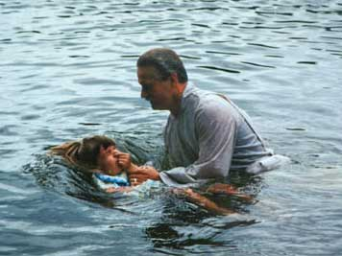
"Baptize" is a Transliteration
Translate bapti,zw = "immerse"
Transliterate bapti,zw = "baptize"
Bapti,zw
Notes:
When Luther and the Reformers translated the Greek NT into the common language they had came across the Greek word for "immerse." Rather than translating it, they transliterated it into the new word "baptize."

Slide 62
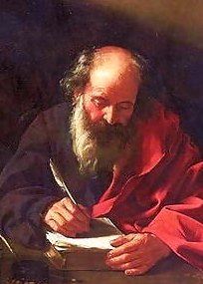
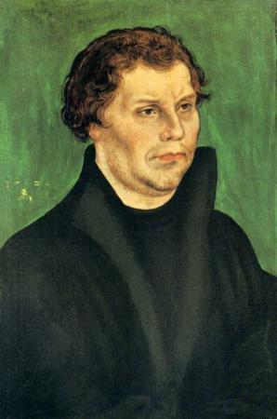
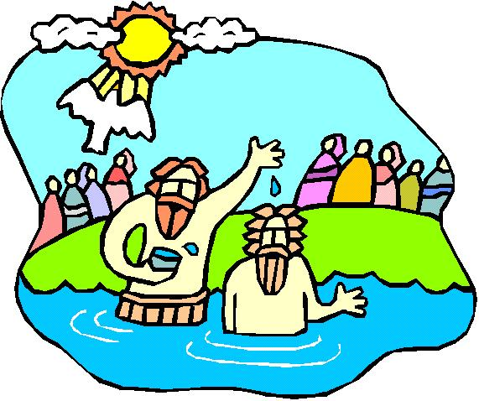
Inventing a Term
Bapti,zw
Jerome
400s
Luther
1500s
translate
transliterate
English:
immerse
baptize
Latin:
immergo
baptizo
German:
tauchen
taufen
Other translations
Notes:
The practice of transliterating baptizo did not begin with Luther, though. It started in the 4th century with Jerome's translation of the NT from Greek into Latin. Jerome could have translated baptizo into the Latin word for "immerse" (immergo). However, he didn't see churches around him immersing, but sprinkling, It would have been mistranslating the Bible for him to mistranslate baptizo as "sprinkle" or "pour," so instead he transliterated the word as "baptize" (baptizo). This became the pattern of subsequent translations in the Romantic languages (languages based in Latin from Rome, such as Italian, French, Romanian, etc.).
A thousand plus years later, Luther found himself in a similar situation. Luther could have translated baptizo into lower (common) German and rendered it "immerse" (tauchen). However, he also didn't see churches around him immersing, and unwilling to part with his Catholic background, he chose instead to render the Greek term into the more generic word for "baptize" (taufen). This became the pattern of subsequent translations not only into German but into Germanic languages such as English.

Slide 63
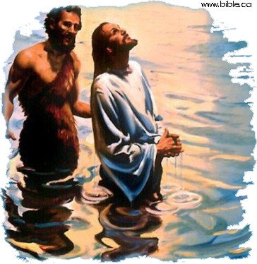
Mode of Baptism: Immersion
The verb "to baptize" means "to immerse"!
Immersion was the only mode of baptism in the New Testament.
Immersion continued as the regular mode until the 13th century!

Slide 64
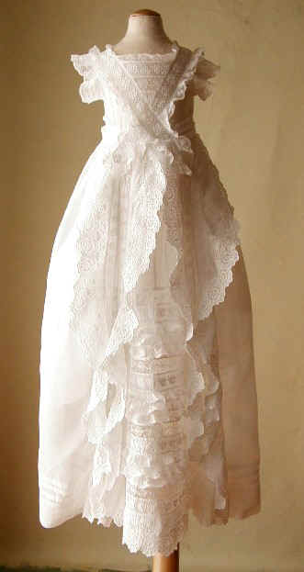
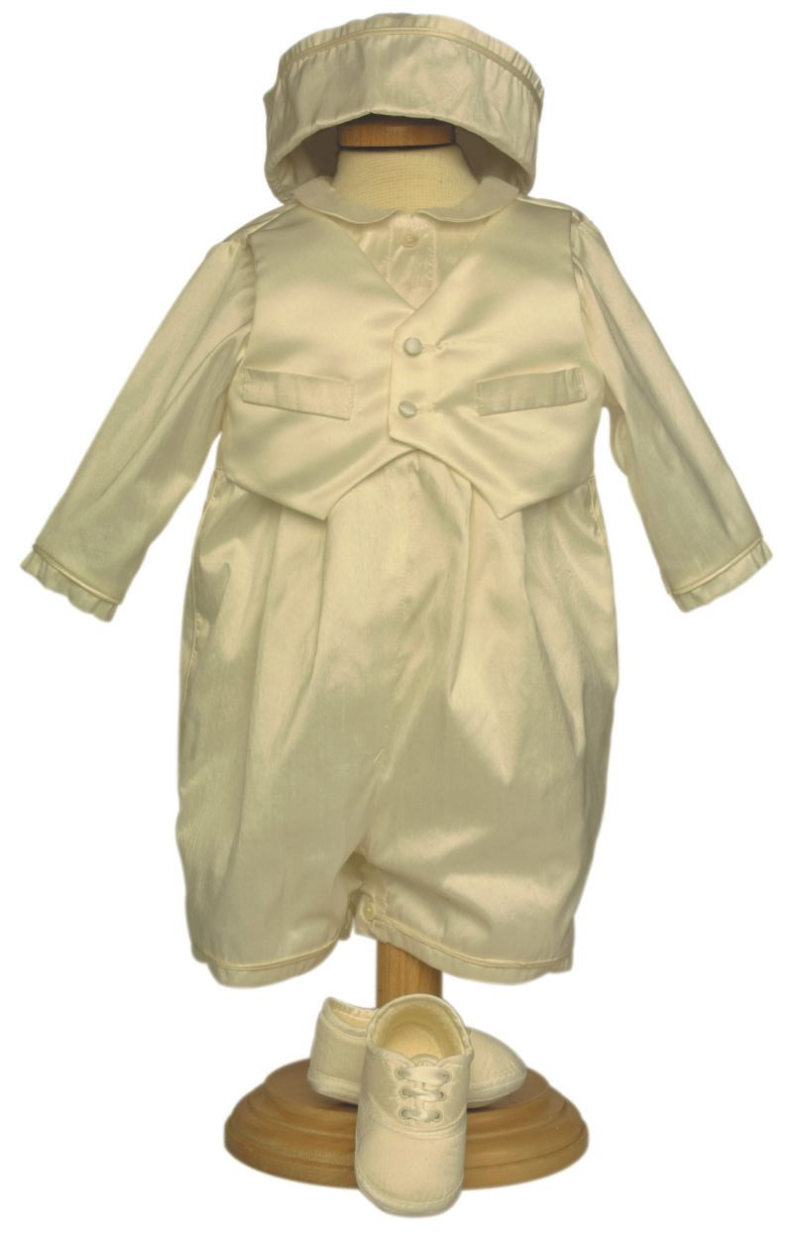
What about the clothes?

Slide 65
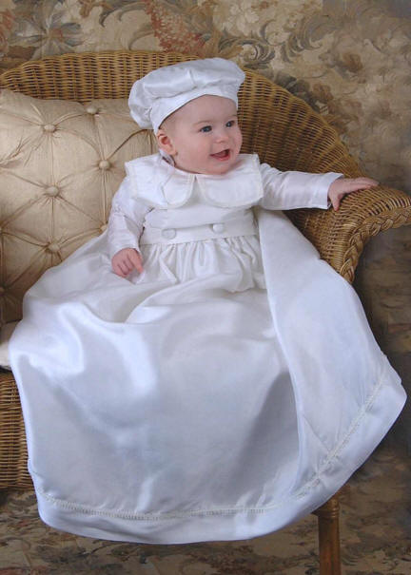
Do you want to dip this baby in water?

Slide 66
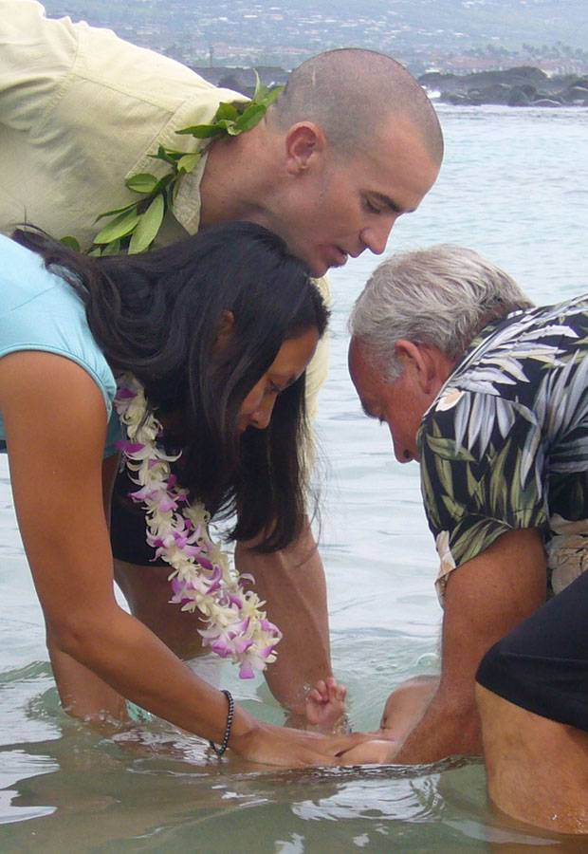
Infant Immersion!

Slide 67
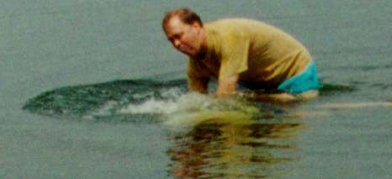
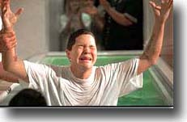
Immersion best signifies…
106
identification with Christ's death and resurrection (Rom. 6:3-5; Col. 2:12)
in order that, just as Christ was raised from the dead through the glory of the Father, we too may live a new life.
Romans 6:4 We were therefore buried with him through baptism into death

Slide 68

浸礼最好的说明…
141
  证明与主同死同复活 (罗 6:3-5; 西 2:12)
  服从基督的权柄 (太 28:18-20)
"All authority in heaven and earth has been given to me… therefore go and make disciples…baptizing…"

Slide 69

Immersion best signifies…
106
identification with Christ's death and resurrection (Rom. 6:3-5; Col. 2:12)
subjection to Christ's authority (Matt. 28:18-20)
obedience and a good conscience before God (1 Pet. 3:21)

Slide 70
受洗的意义
?
141
?
?

Slide 71
When was sprinkling invented?
The first recorded case of sprinkling was in
AD 257 to someone on a sick-bed. It was then an exception to the rule and brought about fierce opposition from the whole church.
Not until AD 757 did the church accept sprinkling in such sick-bed cases of necessity.
It wasn't until AD 1311, when the Catholic council of Ravenna, declared that sprinkling was an acceptable substitute for immersion and from that time forward sprinkling replaced immersion in the Roman Catholic church.
www.bible.ca/ cath-overview-false-teaching.htm
Notes:
www.bible.ca/ cath-overview-false-teaching.htm

Slide 72

Mode of Baptism
Sprinkling
Some believe it represents the sprinkling of the blood of Christ

Slide 73
Sprinkling?
Exodus 24:6-8
Moses took half of the blood and put it in bowls, and the other half he sprinkled on the altar… Moses then took the blood, sprinkled it on the people and said, "This is the blood of the covenant that the LORD has made with you in accordance with all these words."
107
Ezekiel 36:24-27
"'For I will take you [Israel] out of the nations; I will gather you from all the countries and bring you back into your own land. I will sprinkle clean water on you, and you will be clean; I will cleanse you from all your impurities and from all your idols. I will give you a new heart and put a new spirit in you; I will remove from you your heart of stone and give you a heart of flesh. And I will put my Spirit in you and move you to follow my decrees and be careful to keep my laws.
Numbers 8:7
To purify them, do this: Sprinkle the water of cleansing on them; then have them shave their whole bodies and wash their clothes, and so purify themselves.
Hebrews 9:13-14
The blood of goats and bulls and the ashes of a heifer sprinkled on those who are ceremonially unclean sanctify them so that they are outwardly clean. How much more, then, will the blood of Christ, who through the eternal Spirit offered himself unblemished to God, cleanse our consciences from acts that lead to death, so that we may serve the living God!
Exod. 24:6-8?
Num. 8:7?
Ezek. 36:24-26?
Heb. 9:13-14?
Heb. 10:22?
NIV Hebrews 10:22
Let us draw near to God with a sincere heart in full assurance of faith, having our hearts sprinkled to cleanse us from a guilty conscience and having our bodies washed with pure water.

Slide 74

Modes of Baptism:
Pouring
Some believe it portrays the outpouring of the Holy Spirit on the believer

Slide 75

Pouring?
NIV 1 Corinthians 6:11 And that is what some of you were. But you were washed, you were sanctified, you were justified in the name of the Lord Jesus Christ and by the Spirit of our God.
107
NIV Hebrews 10:22
Let us draw near to God with a sincere heart in full assurance of faith, having our hearts sprinkled to cleanse us from a guilty conscience and having our bodies washed with pure water.
1 Cor. 6:11?
Eph. 5:26?
Heb. 9:10?
Heb. 10:22?
Tit. 3:5?
NIV Ephesians 5:26
to make her holy, cleansing her by the washing with water through the word
NIV Hebrews 9:10
They are only a matter of food and drink and various ceremonial washings-- external regulations applying until the time of the new order.
NIV Titus 3:5
He saved us, not because of righteous things we had done, but because of his mercy. He saved us through the washing of rebirth and renewal by the Holy Spirit.

Slide 76

But does "washing" mean "pouring"?
Modes of Baptism: Sprinkling and Pouring
But does "washing" mean "pouring"?
Zwingli and most of the Reformers agreed that the central sign was washing, not death and resurrection. Pouring then became the norm.

Slide 77

Pouring

Slide 78

When it rains, it pours!

Slide 79
Was immersion possible?
Modes of Baptism: Sprinkling and Pouring
Did the apostles baptize 3000 at the Temple at Pentecost by immersion?
120 disciples each baptize 100 persons
an hour = 12,000 baptized
12 disciples each baptize 100 persons
an hour = 1200 baptized/hour for 3 hours
Notes:
One wonders if he could have sprinkled or poured upon that many either, but the text does not say Peter did the baptising. If one could immerse 100 people per hour (a distinct possibility), the 120 disciples there (Acts 1:15) could have immersed 12,000 in a single hour! Even if only the 12 baptized it would take less than three hours to baptise the 3000 (12 x 100 = 1200/hour).

Slide 80
Baptism at Philippi (Acts 16)
Modes of Baptism: Sprinkling and Pouring
"Did the bleeding Paul and Silas troop through the streets with the Philippian jailer and his family, when they already had water nearby to pour on them?"

Slide 81

Philippian Jailor (Acts 16)
Notes:
The jailor was sitting quietly one evening...

Slide 82

Fear seized him…
Notes:
Until suddenly there was an earthquake! Fear seized him…

Slide 83

Attempted suicide
Notes:
He thought that Paul and Silas had escaped, so he sought to kill himself

Slide 84

Joyful Jailor
Notes:
But Paul told him, "Believe in the Lord Jesus Christ and you will be saved—you and your entire household!" (Acts 16:16). So he trusted Christ and was filled with joy.

Slide 85

Pouring
Notes:
Then he was baptized. The artist wanted to please all, so he has him being baptized by pouring

Slide 86

Immersing the jailow
Notes:
Or immersion!

Slide 87

Why is immersion the proper mode?
115
"plenty of water" (John 3:23)
"coming up out of the water" (Mark 1:10)
"went down into the water"
(Acts 8:38)

Slide 88

Rememberthe Ethiopian eunuch
(Acts 8:26-40)?

Slide 89

How did Philip baptize the Ethiopian eunuch?
As they traveled along the road, they came to some water and the eunuch said, "Look, here is water. Why shouldn't I be baptized?" (Acts 8:36)

Slide 90

洗礼的必要条件
要接受三年的教导
在星期天洗礼的过程
  星期四: 沐浴
  星期五: 禁食
  星期六: 按手赶鬼
  星期日晚上: 通宵教导
  星期天: 祷告，抹油，问三个问题，裸体洗礼(先是小孩，男人，女人)
戴维 F的著作，”洗礼的小区”(2003年1月至3月):3-12

Slide 91

The First Church Building
At Dura-Europos on the Euphrates River
AD 240
Had a small room set apart as a baptistry!
David F. Wright, "The Baptismal Community," Bib Sac 160 (Jan-Mar 2003): 5
Notes:
http://commons.wikimedia.org/wiki/Image:DuraEuropos-Church.jpg

Slide 92

Avoiding Baptism
Onlookers were amazed when it took escape artist Dave only 15 minutes to escape from his baptism.
Notes:
Don't try to think that this small room in the church for baptism meant they didn't think it important! Why do we try to escape baptism?

Slide 93

对不受洗的态度
把他当作非基督徒来看待
不主动寻求受洗
在领圣餐前，离开教会(就是无法领圣餐)
戴维 F的著作，”洗礼的小区”(2003年1月至3月):3-12

Slide 94
第一世纪教会的受洗礼
140
受洗礼只为相信者，
且只用浸水礼

Slide 95

Why not immerse?
There is little reason to be baptized in any other manner but by immersion
Exceptions include physical, logistic, and economic considerations

Slide 96

If I have been sprinkled before, should I now be immersed?
Let's see how Paul helped 12 previously immersed disciples of John the Baptist in Acts 19:1-7…

Slide 97

If I have been sprinkled before, should I now be immersed?
Acts 19:1-7 (NLT): While Apollos was in Corinth, Paul traveled through the interior regions until he reached Ephesus, on the coast, where he found several believers. ²“Did you receive the Holy Spirit when you believed?” he asked them. “No,” they replied, “we haven’t even heard that there is a Holy Spirit.”
³“Then what baptism did you experience?” he asked. And they replied, “The baptism of John.”

Slide 98
If I have been sprinkled before, should I now be immersed?
⁴Paul said, “John’s baptism called for repentance from sin. But John himself told the people to believe in the one who would come later, meaning Jesus.”
⁵As soon as they heard this, they were baptized in the name of the Lord Jesus. ⁶Then when Paul laid his hands on them, the Holy Spirit came on them, and they spoke in other tongues and prophesied. ⁷There were about twelve men in all.

Slide 99

My Infant Baptism

Slide 100

The Main Idea
Every Christian should show his or her love for Christ through immersion

Slide 101

Who will follow Christ's example in baptism?

Slide 102

Simon Peter's Enthusiasm
"Jesus answered, 'Unless I wash you, you have no part with me.'
'Then, Lord,' Simon Peter replied, 'not just my feet but my hands and my head as well!'" (John 13:8b-9)

Slide 103

Don't Be Deprived of the Full Experience!

Slide 104

关于洗礼的问题?
受洗是否必需在守圣餐之前的吗?
婴儿的点水礼是否等同于受洗礼?
成人的点水礼是否等同于受洗礼?
不是根据圣经的教会是否需要去行浸水礼?

Slide 105
Black

Slide 106


教会论链接地址 BibleStudyDownloads.org
免费获得该讲解!
圣经学习下载
Notes:
CH Church (Ecclesiology)

