Slide 1
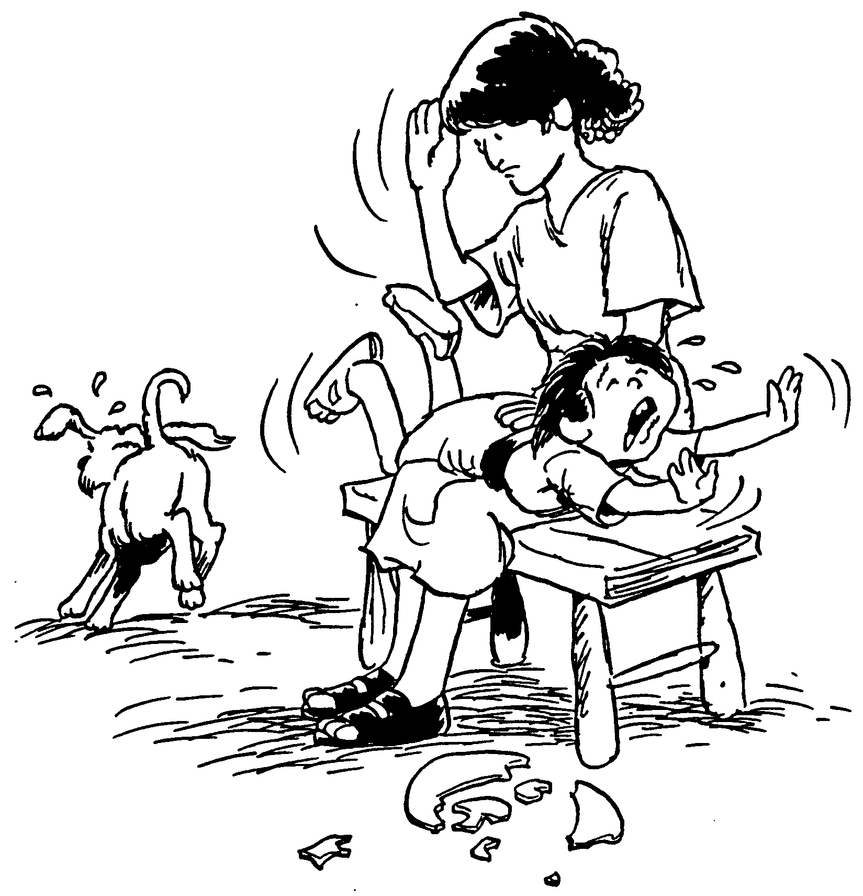
Church Discipline
Dr. Rick Griffith • Singapore Bible College • BibleStudyDownloads.org

Slide 2

God's Priority:
HOLINESS

Slide 3

Do you have a PLAN for church DISCIPLINE?

Slide 4
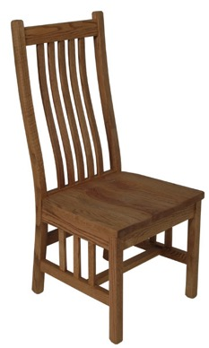
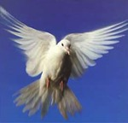

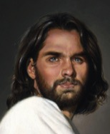
不同类型的人
属肉体的基督徒
(3:1)
自我
自我
自我
非基督徒 (2:14)
基督徒(2:15)

Slide 5
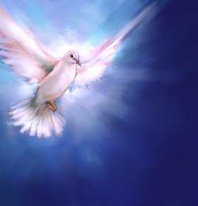
我们要如何维持教会的纯洁?

Slide 6
Issues to Discuss
95
What is church discipline?
Why don't we often do it?
What results when we fail to do it?
How do we discipline believers?
Why is discipline important?
What sins are worthy of discipline?

Slide 7
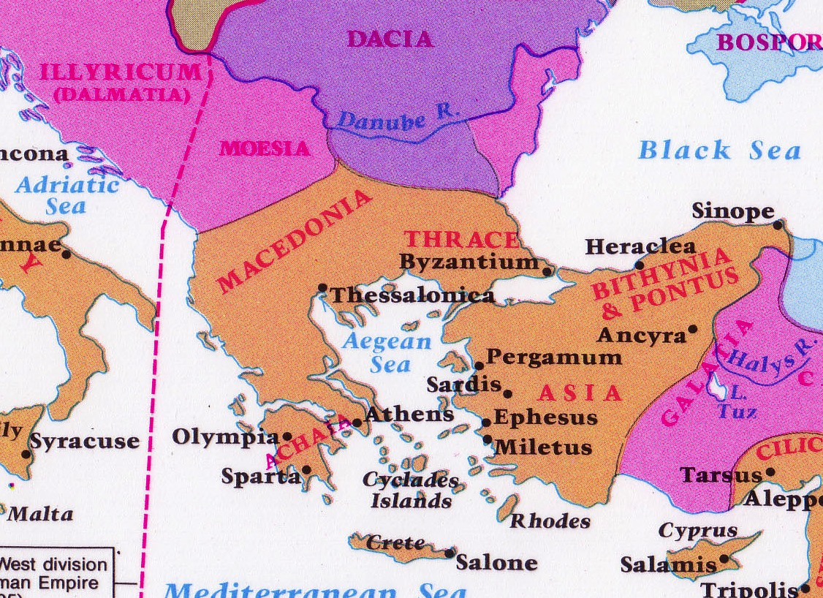
格林多: 淫乱的十字路口
142
格林多
Notes:
The route from Italy long required the treacherous sailing around the Corinthian Peninsula in order to arrive in the Aegean area to reach the heartland of Greek culture and trade.

Slide 8



哥林多地峡
161a
7 公里
格林多
格林多卫城Acrocorinth
爱芙罗黛蒂圣殿Aphrodite
Notes:
However, in the years before Christ, an ingenious business of ship transport developed. Sailors would disembark on one side of the Isthmus of Corinth, the ships would be put on logs and specialized crews rolled them on land the entire seven kilometers to the other side. This gave the sailors a few days off, so they visited nearby Corinth and then met their ship a few days later on the other side of the isthmus.

Slide 9
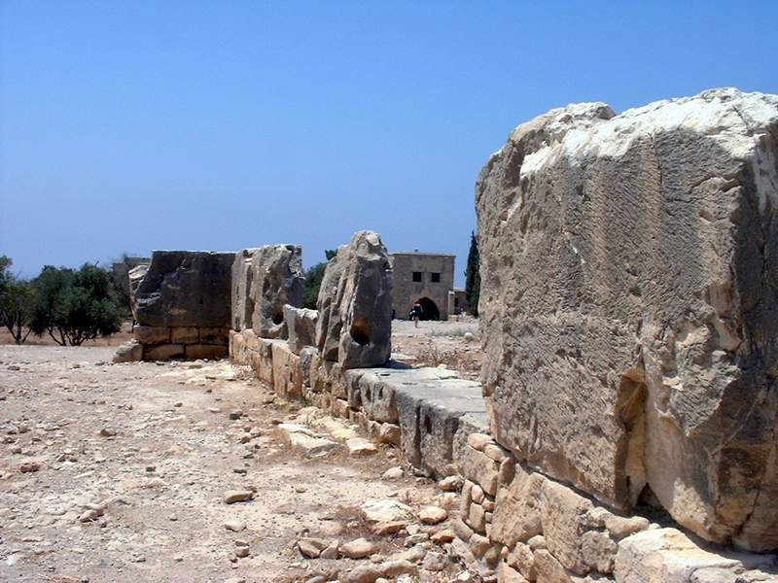
爱芙罗黛蒂圣殿
Notes:
Sex with a temple priestess of Aphrodite was a so-called union with the goddess.

Slide 10
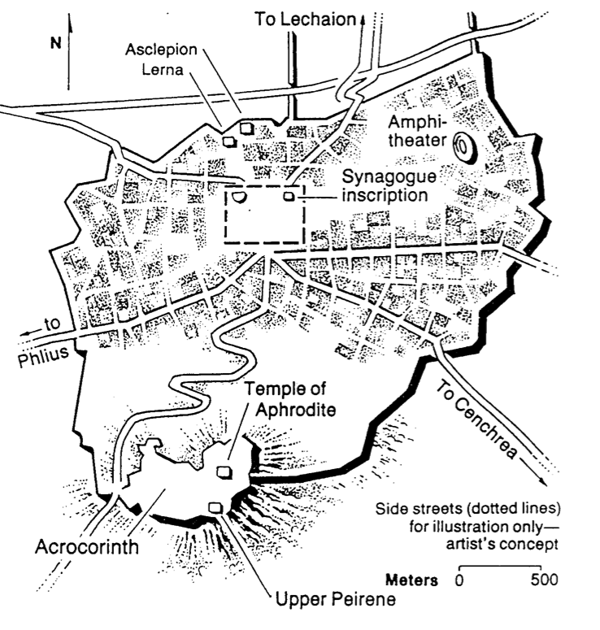
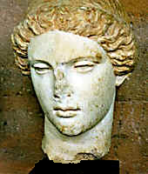
爱芙罗黛蒂圣殿
希腊爱情女神
Notes:
She was the goddess of love, so sailors who visited Corinth had a few days of "liberty" with her priestesses to alleviate the boredom of a generally calm life at sea.

Slide 11
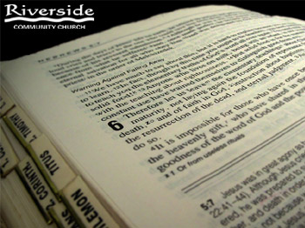
What is Church Discipline?
95-96
96
What it is…

Slide 12

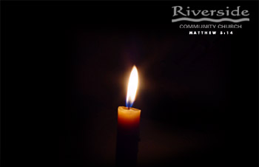
Restore People in Sin
挽回犯罪的人
“弟兄们，若有人偶然被过犯所胜，你们属灵的人，就当用温柔的心，把他挽回过来。又当自己小心，恐怕也被引诱。” (加 6:1）

Slide 13
I. 含泪开除生活在罪中的会友 (5:1-2).
关心，
所以管教!
对圣徒的
严厉管教

Slide 14

Our Goal:
Our Goal:
Restoration!

Slide 15

He heals the brokenhearted

Slide 16
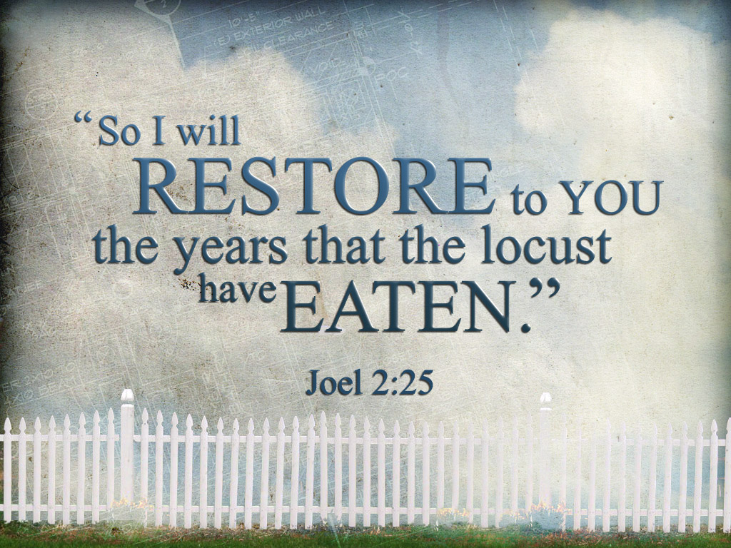
I will restore what the locust has eaten

Slide 17

Healed to Heal Others

Slide 18
What is Church Discipline?
95-96
96
What it is…
What it is not…
Excommunication
Public Humiliation
"Holier Than Thou"
"Heresy Hunts"

Slide 19
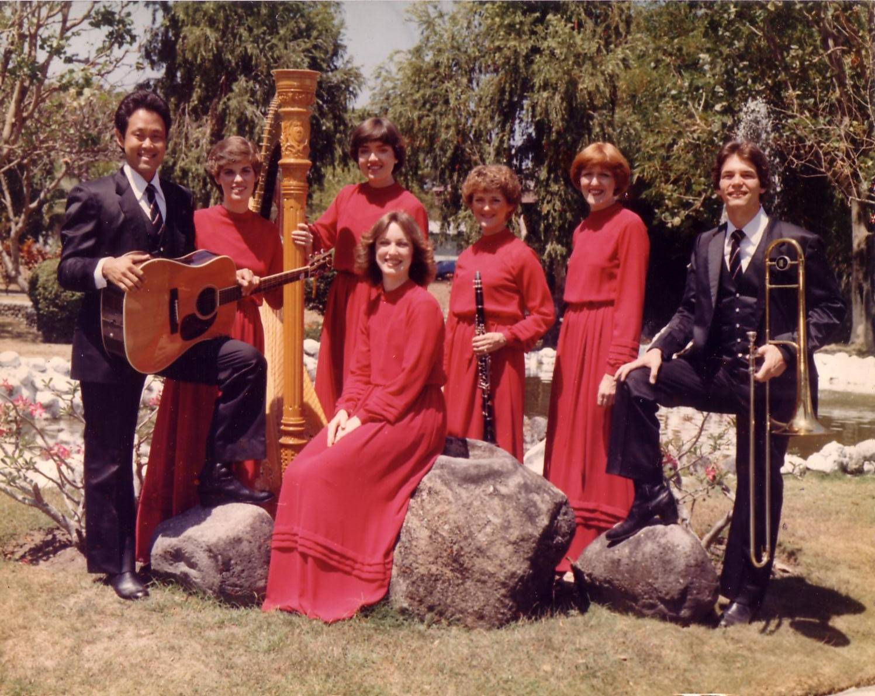
十字路乐团(1981-83)
Notes:
After college it seemed the natural thing to do to join Campus Crusade staff in the Philippines on a seven-member music team.

Slide 20
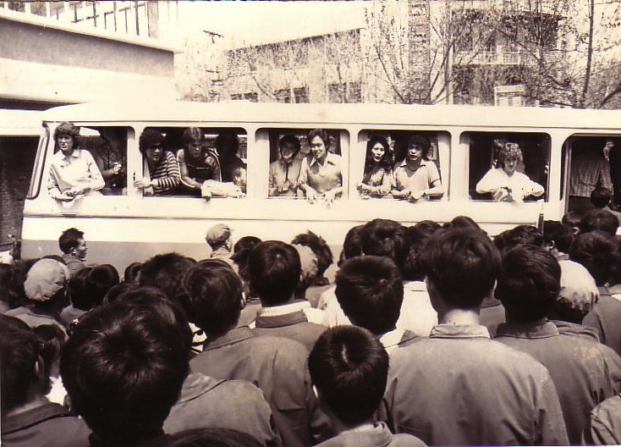
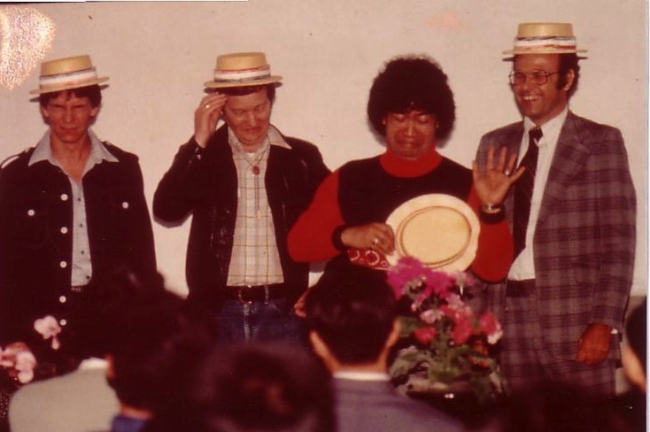
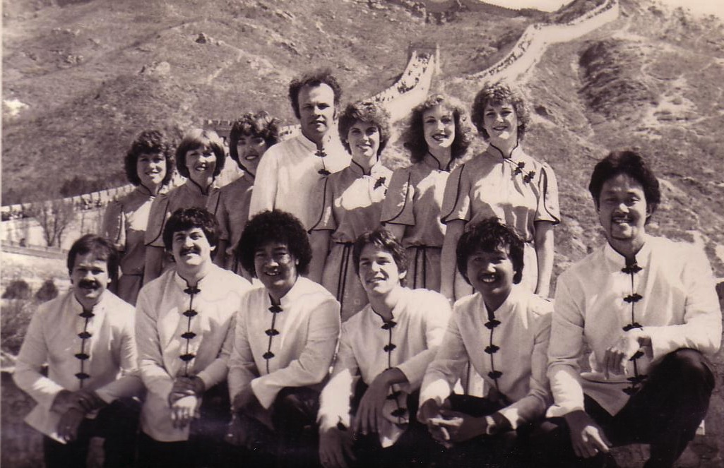
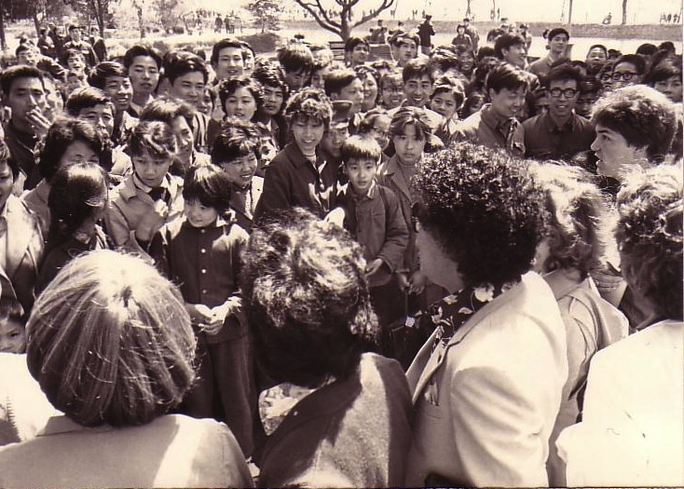
中国, 1981
Notes:
Our first tour to China we were celebrities as the first Christian musical team to visit the New China. We sang in music conservatories, parks, and even from the bus! God began to open my eyes to the needs of East Asia…

Slide 21
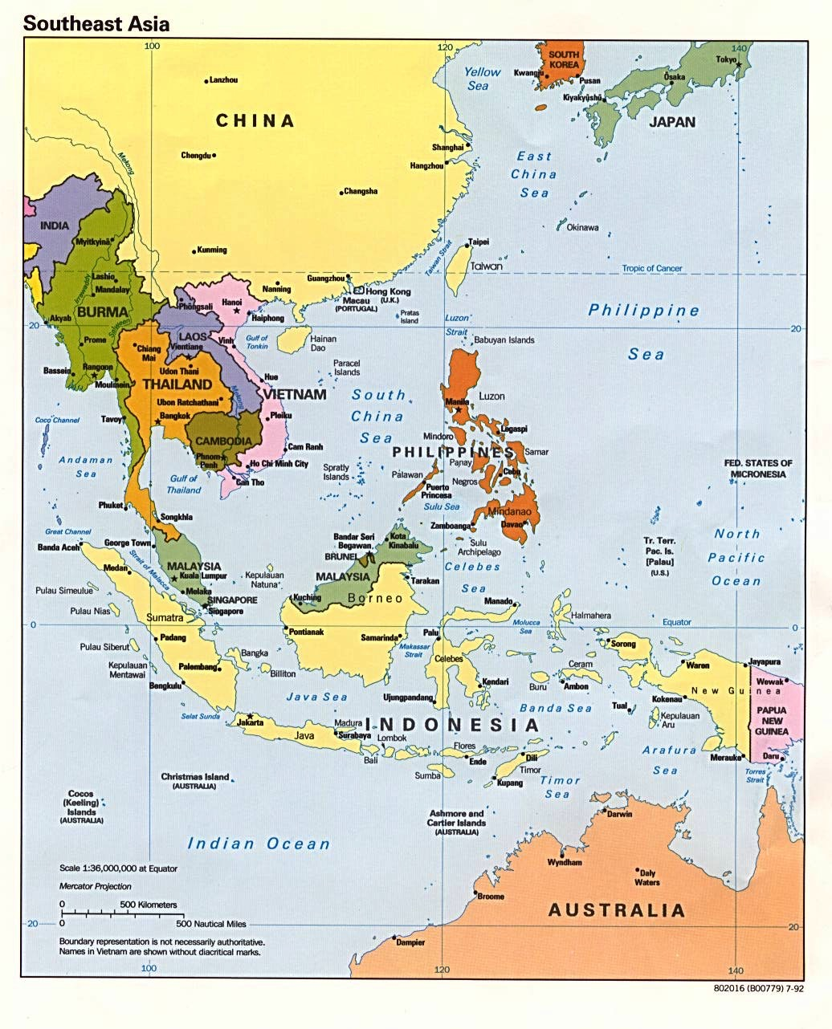
十字路口音乐事工
韩国
中国
日本
香港
台湾
澳门
泰国
菲律宾
马来西亚
新加坡
印尼
Notes:
The Crossroads team shared the gospel in 11 Asian nations and saw over 10,000 people indicate decisions to trust Christ! Again I was amazed at God's grace!

Slide 22

Relational Pillars
Relational Pillars
for all of your ministry relationships

Slide 23

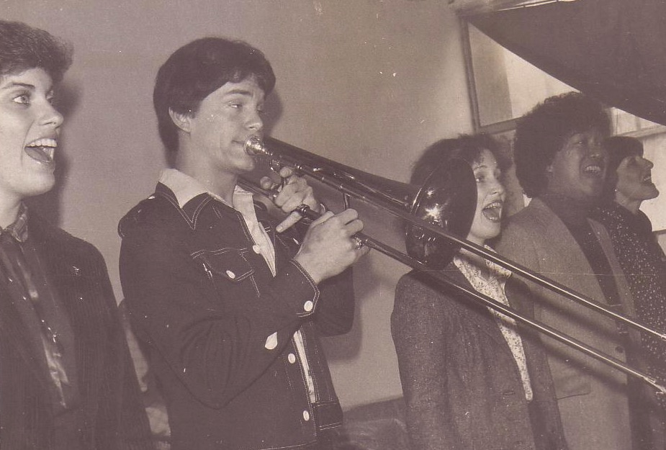
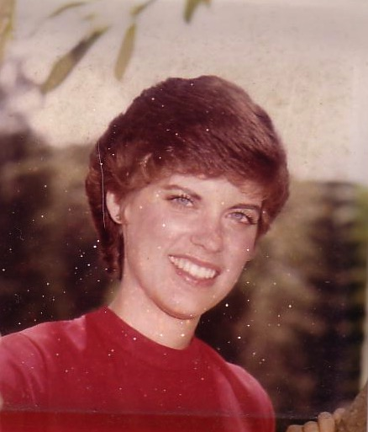
苏姗和我, 1982
Notes:
God also began to open my eyes to the woman singing next to me! She initially despised me but after a year or so she saw the light. That's our engagement picture. In 1983 we returned to the USA..

Slide 24
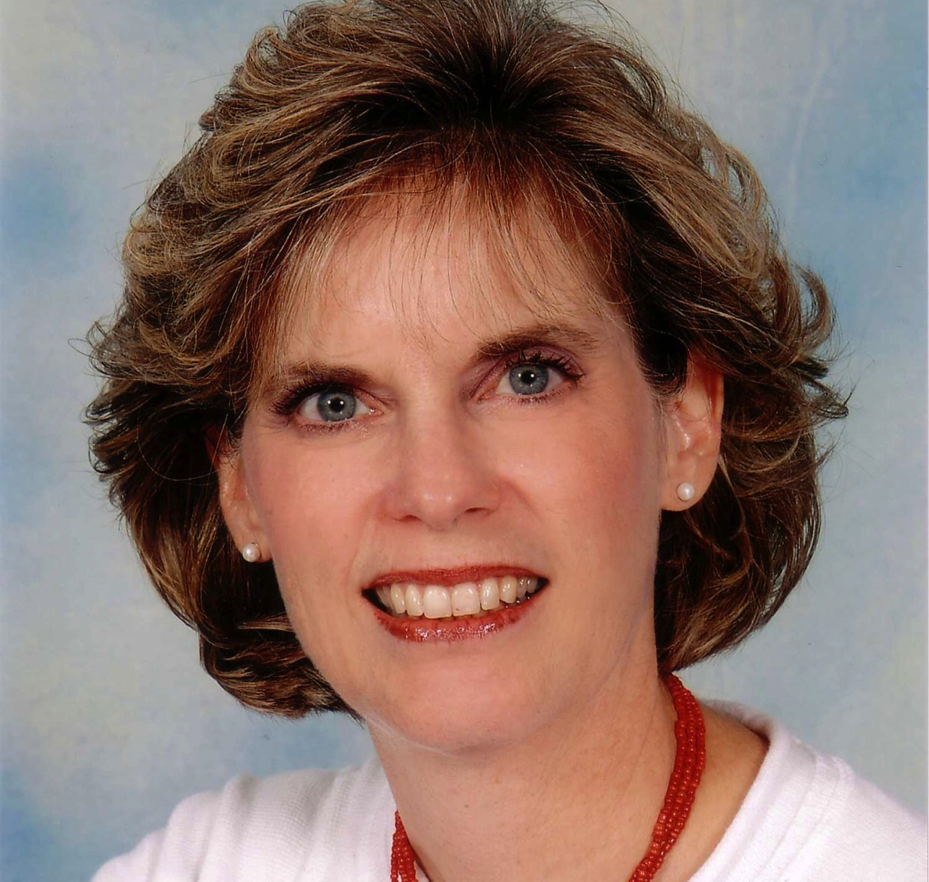
Susan Kay Griffith

Slide 25

Matthew's Relational Pillars
马太福音的人际关系支柱
5:23-24
你是:
冒犯别人者
问题:
一般情况
Notes:
Have you ever had a problem with another believer? (If you say “no,” then I wonder which planet you have been living on!) Are you in fellowship with every Christian that you know now—your family members, your work colleagues, your neighbors and friends? If you're not in harmony, what should you do?

Slide 26


马太福音 5:23-24

Slide 27
马太福音 5:23-24
“所以你在祭坛上献礼物的时候，若想起弟兄向你怀怨，就把礼物留在坛前，先去同弟兄和好，然后来献礼物。”
?

Slide 28
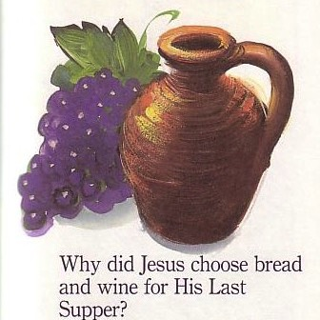
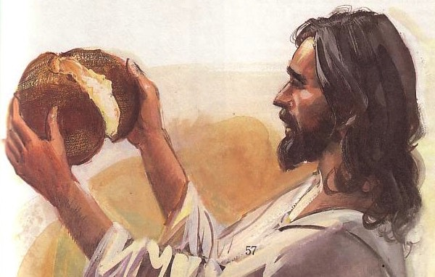
The Lord's Supper

Slide 29
四个方向
(Adapted from David Watson, I Believe in the Holy Spirit)
143
看... | 逾越节 犹太人 | 主圣餐 基督徒
向外 | 整個家庭參與(出12:3-4，16) | 团契合一(林前11:17-22, 10:16-17)
往后 | 從埃及拯救出來(出12:31-42) | 从罪中拯救出来(林前11:23-25)
向前 | 等候弥赛亚的时代(结45:2-10) | 期盼耶稣再来(林前11:26，可14:25)
向內 | 洁净房子的酵与不洁(出12:8，15) | 捡查自已的罪行(林前11:27-32，cf。5:6-8)

Slide 30
Matthew's Relational Pillars
马太福音的人际关系支柱
5:23-24
18:15-17
你是:
冒犯别人者
被冒犯者
问题:
一般情况
罪

Slide 31

B. Reasons Churches Fail to Discipline
96
Ignorance
Doubt
Failure
Fear
Excuses
Impurity
Unsocial
Leaders divided

Slide 32
What's Your Personal Experience?
Share when you have seen church discipline succeed to restore a person. What was done right?
Or share a story when the process was done poorly and the person wasn't restored. What did you learn from it?

Slide 33
Results of Failing to Discipline
96
Lack of Purity
Lack of Power
Lack of Progress
Lack of Unity

Slide 34
Issues to Discuss
97
What is church discipline?
Why don't we often do it?
What results when we fail to do it?
How do we discipline believers?

Slide 35
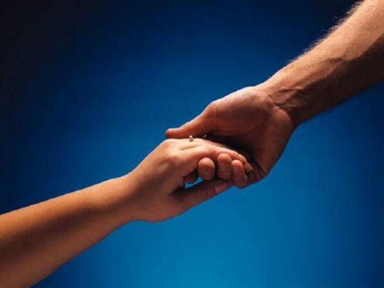

如何恢复关系
马太福音 18:15-20
释经大纲
10 December 2006
6 March 2011

Slide 36
马太福音18:15-20
所以你在祭坛上献礼物的时候，若想起弟兄向你怀怨，就把礼物留在坛前，先去同弟兄和好，然后来献礼物。 倘若你的弟兄得罪你，你就去趁着只有他和你在一处的时候，指出他的错来。他若听你，你便得了你的弟兄。他若不听，你就另外带一两个人同去，要凭两三个人的口作见证，句句都可定准。若是不听他们，就告诉教会。若是不听教会，就看他像外邦人和税吏一样。我实在告诉你们，凡你们在地上所捆绑的，在天上也要捆绑。凡你们在地上所释放的，在天上也要释放。我又告诉你们，若是你们中间有两个人在地上，同心合意地求什么事，我在天上的父，必为他们成全。因为无论在哪里，有两三个人奉我的名聚会，那里就有我在他们中间。
如何挽回
15-17
为何挽回
18-20
Notes:
two main teachings on restoring Christians in sin

Slide 37


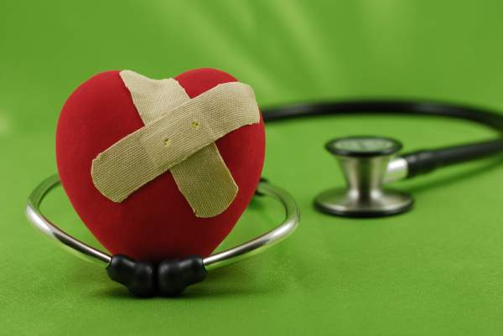
我们应如何 正确的恢复犯罪的基督徒?
我们今天的第一个问题...
(介绍重点一 15-17节)
Notes:
Fill in your bulletin outline

Slide 38
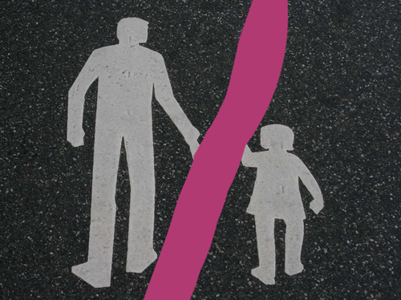
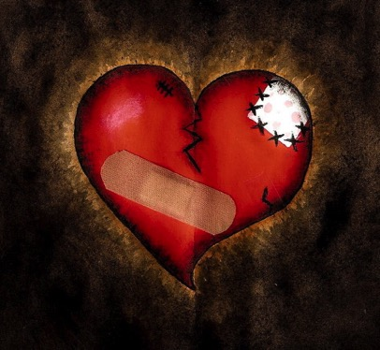
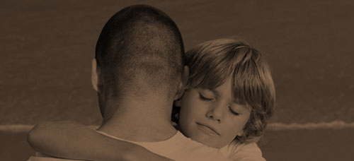
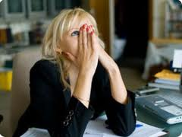
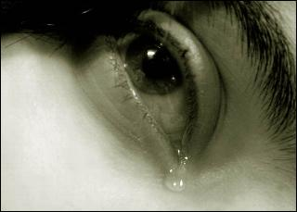
Other Relationships
Notes:
What to do with Christmas?

Slide 39
马太福音第18节
的价值
1
一
一个
小孩
(1-9)
一只
羊
(10-14)
一个
罪人
(15-20)
一个
欠债者
(21-35)
Notes:
Context: The value of one child (1-9), one sheep (10-14), one sinner (15-20), one debtor (21-35).
15-20 at the heart (advance slide to read)

Slide 40
神挽回的
四个步骤：
4
3
2
1
…逐步向更多人透露

Slide 41

The Point of Verses 15-17
I.神教导我们挽回一位
犯罪跌倒
的基督徒
的方法是
尽量私底下
进行
(15-17)

Slide 42

挽回的第一步：
你亲自向他说
M
M
M
M
M
M
M
M
M
M
M
M
M
M
M
M
S
M
M
M
M
M
M
M
M
M
M
M
S = Sinner 犯罪的人
M = Member 会友

Slide 43
Matthew's Relational Pillars
马太福音的人际关系支柱
5:23-24
18:15-17
你是:
冒犯别人者
被冒犯者
问题:
一般情况
罪

Slide 44
Matthew's Relational Pillars
马太福音的人际关系支柱
5:23-24
18:15-17
你是:
冒犯别人者
被冒犯者
问题:
一般情况
罪
主动者:
你！
你!

Slide 45
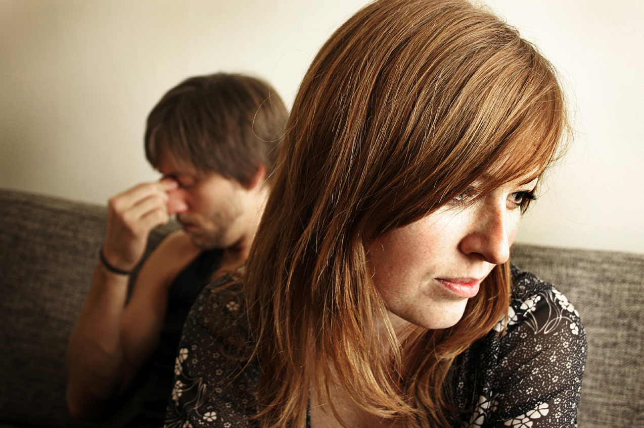
亲自去
不是:
电邮
短信
书信
电话

Slide 46
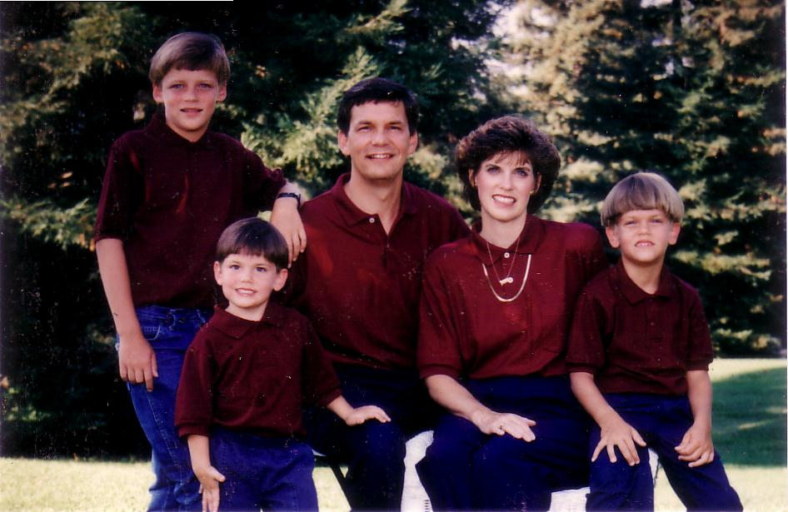
1996
Notes:
We have lived briefly in the USA the past 12 years.

Slide 47
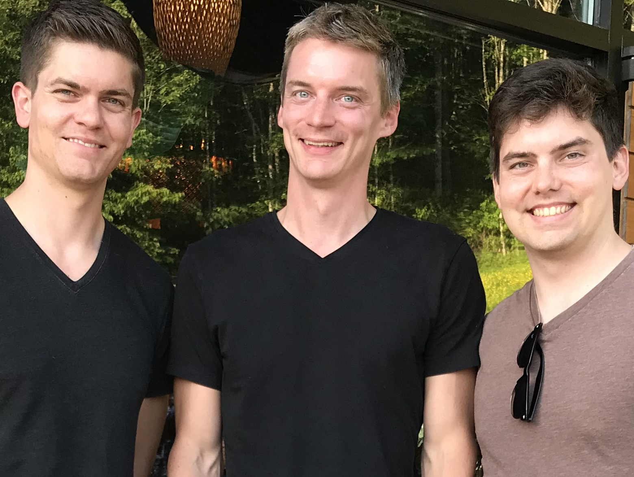
兄弟…

Slide 48
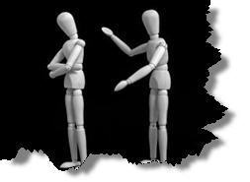
为何不面对面交锋?
无知
怀疑
失败
害怕
藉口
不纯
缺乏交际

Slide 49
挽回的第一步：
你亲自向他说
M
M
M
M
M
M
M
M
M
M
M
M
M
M
M
M
S
M
M
M
M
M
M
M
M
M
M
M
S = Sinner 犯罪的人
M = Member 会友

Slide 50
挽回的第二步：
带一两个人同去
M
M
M
M
M
M
M
M
M
M
M
M
M
M
M
M
S
M
M
M
M
M
M
M
M
M
M
M
S = Sinner 犯罪的人
M = Member 会友

Slide 51

第二步骤的问题
应该带谁去？
为什么一两个人？

Slide 52
民数记 19:15
`rb")D" ~Wqïy" ~ydIÞ[e-hv'(l{v. yPiî-l[;
Aa± ~ydIª[e ynEåv. ŸyPiä-l[; aj'_x/y<¥ rv<åa] aj.xeÞ-lk'B. taJ'êx;-lk'l.W '!wO['-lk'l. vyaiªB. dx'øa, d[e' •~Wqy"-al{)

Slide 53
民数记 19:15
人无论犯什么罪，作什么恶，不可凭一个人的口作见证，总要凭两三个人的口作见证才可定案 。

Slide 54
挽回的第三步：
告知教会全体
M
M
M
M
M
M
M
M
M
M
M
M
M
M
M
M
S
M
M
M
M
M
M
M
M
M
M
M
S = Sinner 犯罪的人
M = Member 会友

Slide 55
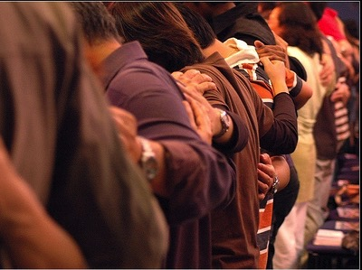
为什么要告知教会全体？

Slide 56
挽回的第四步：
看他作外邦人
M
M
M
M
M
M
M
M
M
M
M
M
M
M
M
M
S
M
M
M
M
M
M
M
M
M
M
M
S = Sinner 犯罪的人
M = Member 会友
S

Slide 57

Sins Worthy of Discipline
管教却不可
逐出教会！

Slide 58
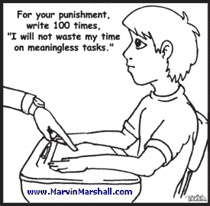
But how should we discipline?
For your punishment, write 100 times, "I will not waste my time on meaningless tasks."

Slide 59

如何对待受管教中的信徒
别把他／她当成一个信徒对待。
传福音给这个人。
别让他领受圣餐。
删除他／她的会友籍。
除去他／他在教会的职务。
非信徒
把犯淫乱奸淫的 “交给撒旦”
(林前五5).
不可与他／她一起吃饭 (林前五11).
不准他／她到教会参加崇拜?
更糟的

Slide 60
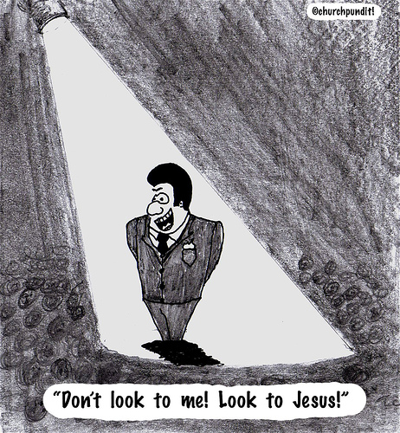
是否与不道德的人 相交 取决于他们是否是基督徒
(5:9-13).
“不要看我! 瞩目看耶稣!"

Slide 61

A. 我们 可以 和生活在罪中不信的人相交 (5:9-10).
but...
B. 我们 不可以 与不道德的基督徒相交 (5:11).

Slide 62
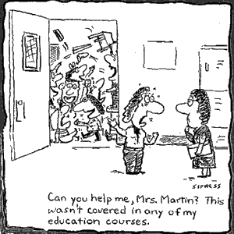
Discipline is needed in many arenas
Can you help me, Mrs. Martin? This wasn't covered in any of my education courses.

Slide 63
Issues to Discuss
98
What is church discipline?
Why don't we often do it?
What results when we fail to do it?
How do we discipline believers?
Why is discipline important?

Slide 64
Reasons for Discipline
98-99
The Church Extends God's Authority (Matt. 18:18-20)
It Benefits the Offender
It Benefits the Church Body
It Benefits the Individual Believers Not Living in Sin
It Benefits the Authority Structures of the Body
Points 2-5 adapted from Ted Kitchens, Aftershock: What to Do When Leaders
(and Others) Fail You (Portland, Oregon: Multnomah, 1992)

Slide 65
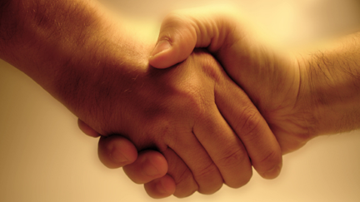
Matthew 18:18-20 answers this question:
Why do we restore sinning Christians properly?
98

Slide 66

The Point of Verses 18-20
99
The local church acts as an extension of the authority of God Himself!

Slide 67
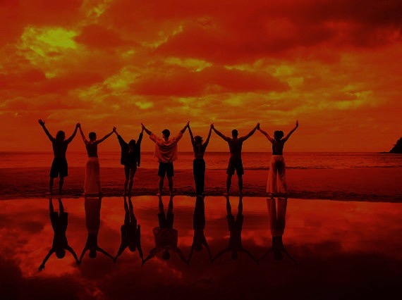
Why discipline?
When we seek to restore someone…
99
We act in the place
of the Father
(18-19)

Slide 68
A Better Translation…
NAU is a Better Translation…
99
NIV "I tell you the truth, whatever you bind on earth
will be {or have been} bound in heaven, and whatever you loose on earth will be {or have been} loosed in heaven."
NAU "Truly I say to you, whatever you bind on earth shall have been bound in heaven; and whatever you loose on earth shall have been loosed in heaven."

Slide 69

Matthew 18:19
99
"Again, I tell you that if two of you on earth agree about anything you ask for, it will be done for you by my Father in heaven" (NIV).

Slide 70
Psalm 82:1, 6
(to Israel's rulers/gods)
"I said, 'You are "gods"; you are all sons of the Most High… but you will die like men…"

Slide 71
Why discipline?
When we seek to restore someone…
99
We act in the place
of the Father
(18-19)
We act in the presence & authority of Christ
(20)

Slide 72
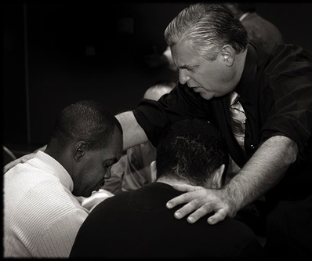
Matthew 18:20
99
"For where
two or three come together in my name, there I am with them" (NIV).

Slide 73
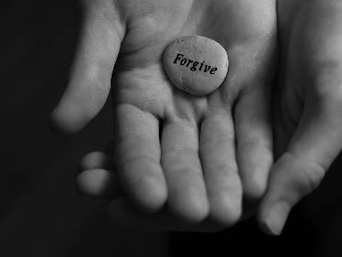
Main Idea:
99
We must restore sinning members properly since we act on God's behalf

Slide 74
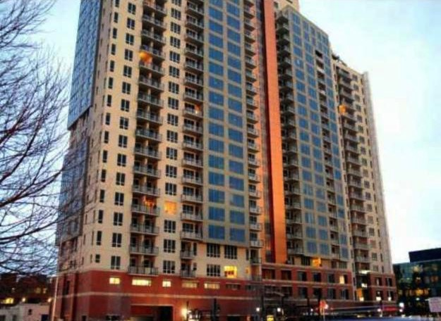
II. 纪律的管教会使犯错的人和教会 受益 (5:3-8)
"By wisdom a house is built and through understanding it is established"
(Prov. 24:3)

Slide 75
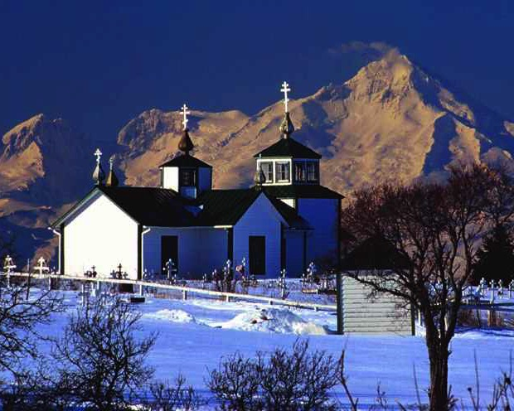
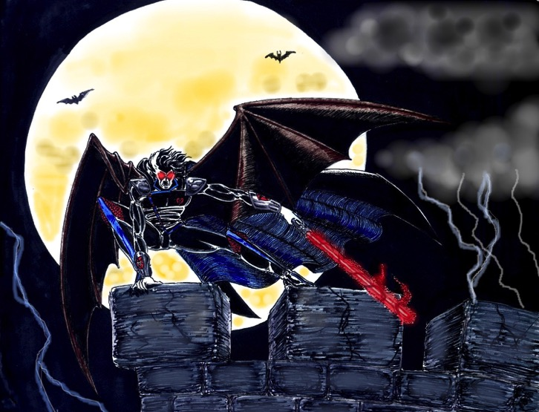
A. 纪律的管教就是将犯错的信徒交给撒旦的权势
(5:3-5)
"…交给
撒旦"

Slide 76

B. 惩戒维护
教会的
圣洁(5:6-8)

Slide 77
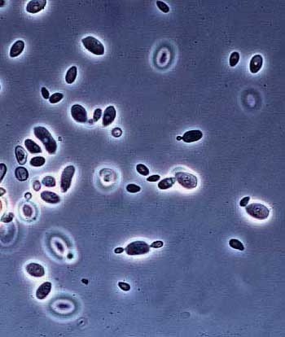
酵母

Slide 78
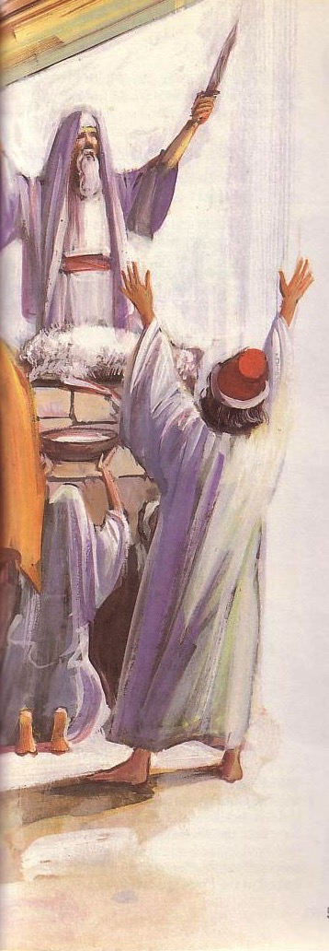
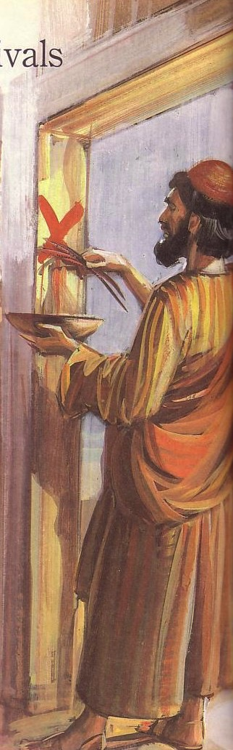
逾越节在过去
重要的含义
(出埃及记12)

Slide 79

逾越节
节日
利未记第23章
1 尼散月
2 以珥月
3 西湾月
4 搭模斯月
5 埃波月
6 以禄月
7 提斯利月
8 马西班月
9 基斯流月
10 提别月
11 细罢特月
12 亚达月
记念出埃及的日子
基督我们的救赎主

Slide 80

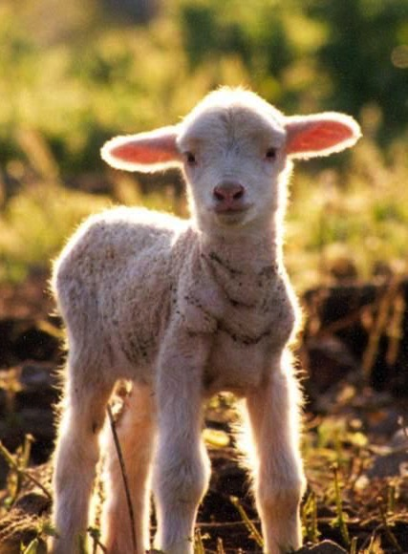
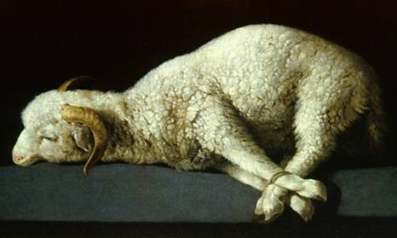
逾越节的羔羊

Slide 81

"除去所有的酵!"

Slide 82





除酵节
128, 137
Notes:
www.stephenwilliamson.com/ Hobbies/bakin.htm (Yeast bloom)

Slide 83
Issues to Discuss
99
What is church discipline?
Why don't we often do it?
What results when we fail to do it?
How do we discipline believers?
Why is discipline important?
What sins are worthy of discipline?

Slide 84

哪一些罪行足以得到教会的惩戒?
林前5:11
淫乱
贪婪
拜偶像
诽谤
醉酒
勒索
s
其他的经文:
分裂 (多 3:10)
懒惰 (贴后 3:6)

Slide 85

Sins Worthy of Discipline
99-100
Private offenses that violate Christian love
Divisions that hinder Christian unity
Moral deviations that break Christian law
Teaching doctrines that reject essential Christian truth
Adapted from Ted Kitchens, "Perimeters of Corrective Church Discipline,"
BibSac 148 (April-June 1991): 211-212

Slide 86
我们要如何维持教会的纯洁?

Slide 87
Living in a "toss away age"
Cartons
Carpets
Cars
Creatures made in God's image?

Slide 88

林前5：经文的重点
驱逐 不知悔改的信徒 以捍卫教会的纯正
Guard church by expelling unrepentant believers

Slide 89
Matthew's Relational Pillars
马太福音的人际关系支柱
5:23-24
18:15-17
你是:
冒犯别人者
被冒犯者
问题:
一般情况
罪
主动者:
你！
你!

Slide 90

The Overall Principle
"If possible, as far as it depends on you, be at peace with all men"
Romans 12:18

Slide 91
Matthew's Relational Pillars
马太福音的人际关系支柱
5:23-24
18:15-17
The Overall Principle: Romans 12:18
你是:
冒犯别人者
被冒犯者
问题:
一般情况
罪
主动者:
你！
你!

Slide 92

Make us one 3/3
Make us one, Lord,
make us one,
Holy Spirit, make us one.
Let Your love flow
so the world will know
we are one in You.

Slide 93
“自我” 主义
在现今的社会，你观擦到哪一些“以自我为中心 ” 的例子？
你认为如何能够在教会里宁可显明圣经的教导 : “以别人为中心”？
Notes:
93

Slide 94

雅各书 5章:19-20节
¹⁹我的弟兄们，你们中间若有失迷真道的，有人使他回转，
²⁰这人该知道：叫一个罪人从迷路上转回便是救一个灵魂不死，并且遮盖许多的罪。
Notes:
94

Slide 95



谁是 “失迷者”？
plana,w （主动词）：失迷, 偏离, 转向歧途; （被动词）：误入歧途， 被误导，被欺骗。
“失迷者” 是指基督徒因为失迷真道而从行为中，主动 （不是被动）地拒绝神的旨意。
Notes:
95

Slide 96
“失迷者”是指基督教：
“我的弟兄们，你们。。。”
若一个人还没有体验过真道,他是不可能会 “失迷真道的”.
Notes:
96

Slide 97

神的“鞭打”
“5你们又忘了那劝你们如同劝儿子的话，说：我儿，你不可轻看主的管教，被他责备的时候也不可灰心；6因为主所爱的，他必管教，又鞭打凡所收纳的儿子。7你们所忍受的，是神管教你们，待你们如同待儿子。焉有儿子不被父亲管教的呢？ 8管教原是众子所共受的，你们若不受管教，就是私子，不是儿子了。”
（希伯来书12章:5-8节)
Notes:
97

Slide 98

滥用圣餐的饼和酒
新标点合合本 哥林多前书 11章:30节 [在主的圣餐馋僗]
“因此，在你们中间有好些软弱的与患病的，死（原文作睡）的也不少。”
Notes:
98

Slide 99

有一些罪是至於死的罪
“人若看见弟兄犯了不至於死的罪，就当为他祈求，神必将生命赐给他；有至於死的罪，我不说当为这罪祈求。”
(约翰一书 5章:16节 新标点合合本 ).
Notes:
99

Slide 100
我如何在生命中
实际地应用这段经文
谁需要我的帮助与建立？
我应当如何去行？
Notes:
100

Slide 101
What's God Saying to You?
a. The Church Body
M
M
M
M
M
M
M
M
M
M
M
M
b. Your Own Life
M
M
M
M
S
M
M
M
M
M
M
M
M
c. Helping Others
M
M
M

Slide 102

I've Been Through a Fire
I've been through a fire
that has deepened my desire
to know the living God,
more and more.
It hasn't been much fun
but the work that it has done
in my life has made it worth the hurt

Slide 103

I've Been Through a Fire 2 of 3
You see, sometimes we need the hard times
to bring us to our knees.
Otherwise, we do as we please
and never heed Him.

Slide 104

I've Been Through a Fire 3 of 3
But He always knows what's best
and it's when we're in the test
that we really come to know God
as He is

Slide 105

要如何保持教会的纯洁?
a. 从 你自己的生活 开始。
b. 协助支持 教会的领袖。
c. 多多关心 他人 的需要。

Slide 106

Tough Questions
101

Slide 107

1. What about non-members?
101

Slide 108

2. Should we still remove them publicly if they request their membership withdrawn?
101

Slide 109

3. Should we pursue disciplined members to another church?
101
"Do unto others what you would have others do to you"

Slide 110
Black

Slide 111


教会论链接地址 BibleStudyDownloads.org
免费获得该讲解!
圣经学习下载
Notes:
CH Church (Ecclesiology)

